Slide 1









LUNG CANCER
Tuesday, December 5, 2023

Slide 2
Welcome
Steven Frommeyer
Executive Director, Global Ambassador Strategies - Oncology
MJH Life Sciences™

Slide 3



Thank You to Our Supporters:

Slide 4
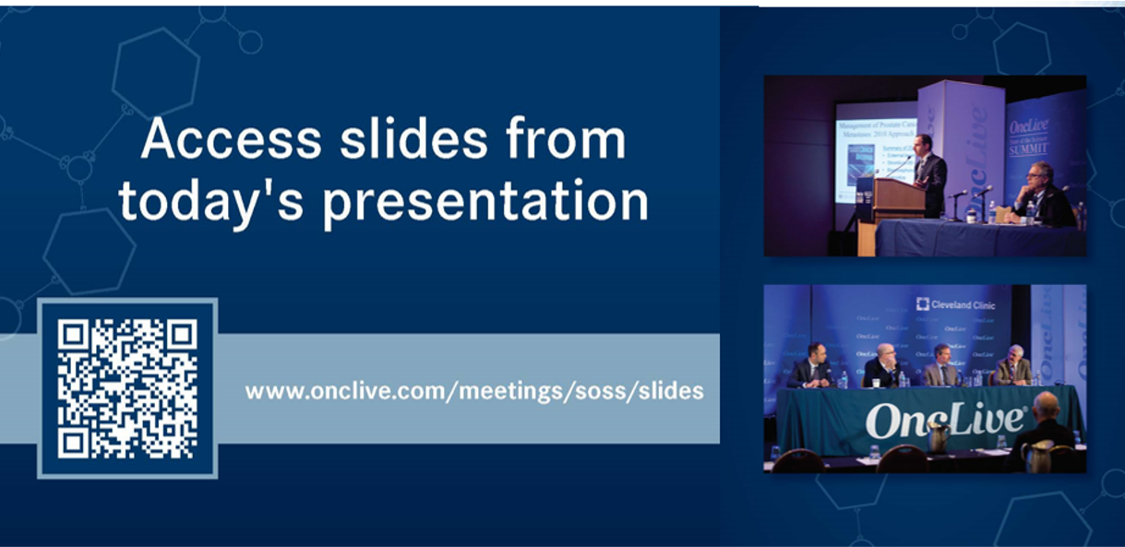

Slide 5


Slide 6
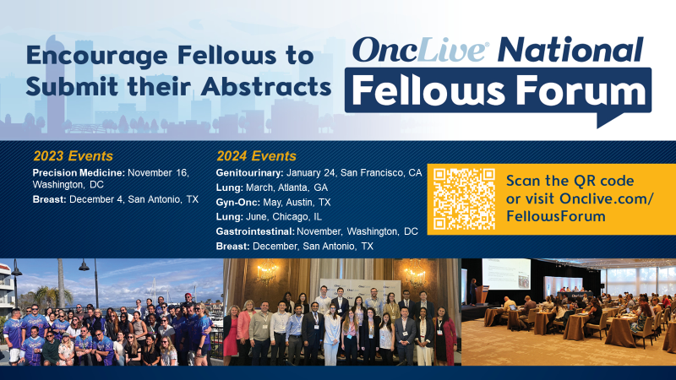
2023 Events
Precision Medicine: November 16,
Washington, DC
Breast: December 4, San Antonio, TX
2024 Events
Genitourinary: January 24, San Francisco, CA
Lung: March, Atlanta, GA
Gyn-Onc: May, Austin, TX
Lung: June, Chicago, IL
Gastrointestinal: November, Washington, DC
Breast: December, San Antonio, TX

Slide 7


Slide 8
Program Chair
Dr. Ranee Wenham, MD
Director of Head and Neck Medical Oncology
Solid Tumor Section Head at the University of Maryland Greenebaum Comprehensive Cancer Center
University of Maryland
Baltimore, MD
​

Slide 9
LUNG CANCER
Tuesday, December 5, 2023

Slide 10
Evolving Role of Immunotherapy in NSCLC – metastatic disease
Ranee Mehra, MD
Professor of Medicine
University of Maryland
Greenebaum Comprehensive Cancer Center
Baltimore, MD

Slide 11
Disclosures
Research funds – Merck
Consulting – Janssen, Coherus

Slide 12
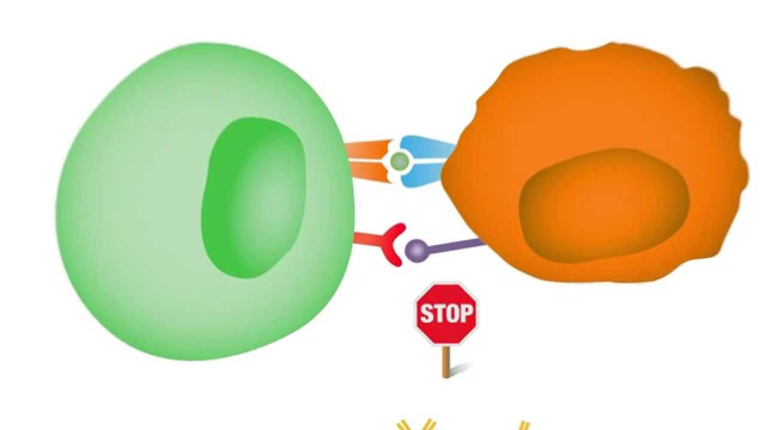
Rationale for Immunotherapy Cancer
Immune system plays a crucial role in surveillance and eradication of malignancy
Several steps are required for the immune system to effective attack tumor cells
  Tumor recognition → Tumor antigen presentation to T cell → T cell activation → Tumor cell destruction
“Immune Checkpoints” protect against excessive inflammation & auto-immunity
Cancers can utilize these “checkpoints” to evade destruction by the immune system

Slide 13
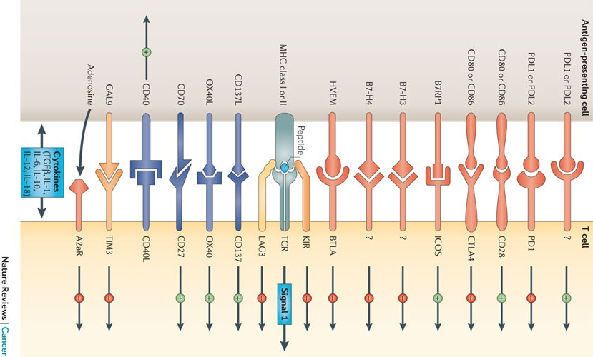
Numerous T-cell “Checkpoints”
Pardoll, D. Nature Rev Cancer. 2012

Slide 14
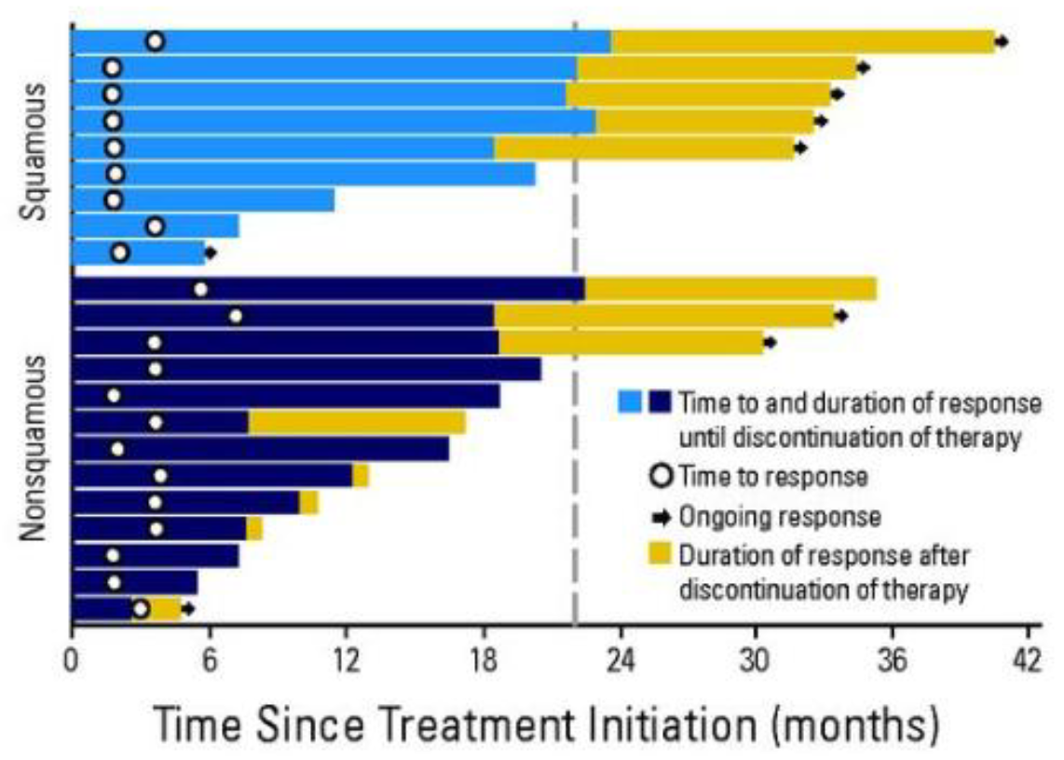
Immunotherapy in NSCLC
Phase I study: Nivolumab in previously treated, advanced NSCLC
Durable responses noted in both squamous & nonsquamous histologies
Subset of patients continued to have durable responses even after therapy was discontinued
Gettinger et al. J Clin Oncol 2015.

Slide 15
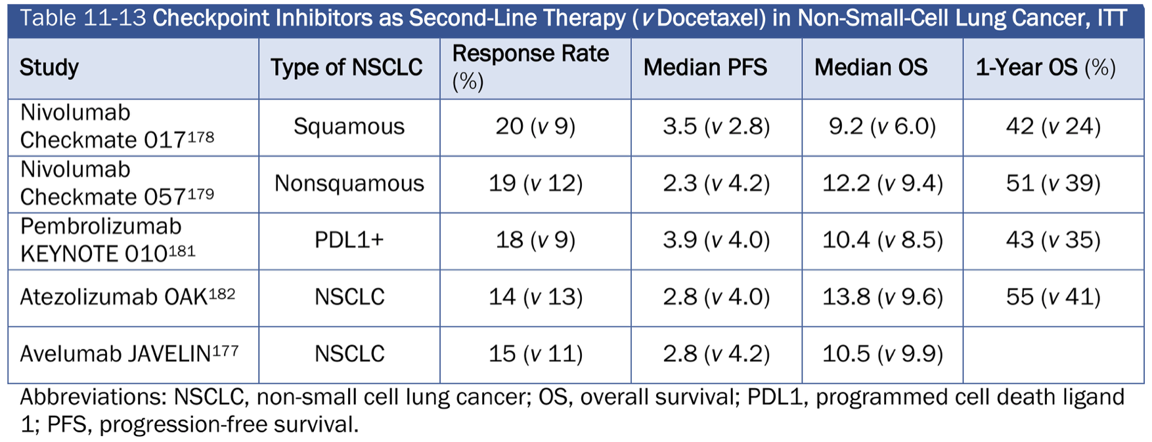
Brahmer et al. N Engl J Med 2015.
Borghaei et al. N Engl J Med 2015.
Herbst et al. Lancet 2016.
Rittmeyer et al. Lancet 2017.
Barlesi et al. Lancet 2018.
ASCO-SEP.
NEGATIVE STUDY

Slide 16
Front line treatment
  Molecular testing
  Biomarkers
  IO only approaches versus IO+chemotherapy
  Which agents?

Slide 17
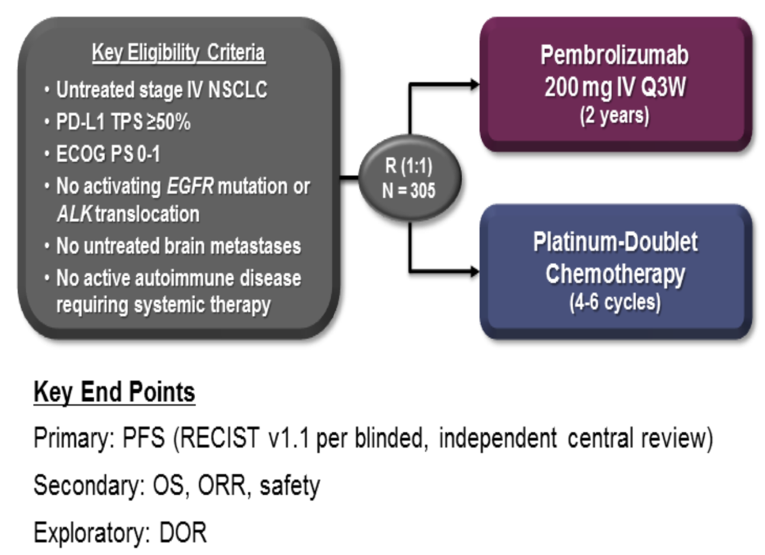
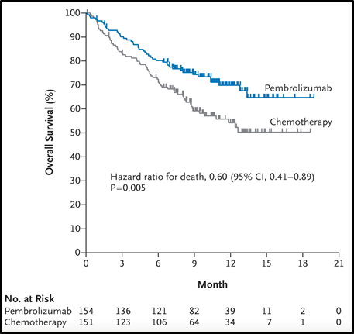
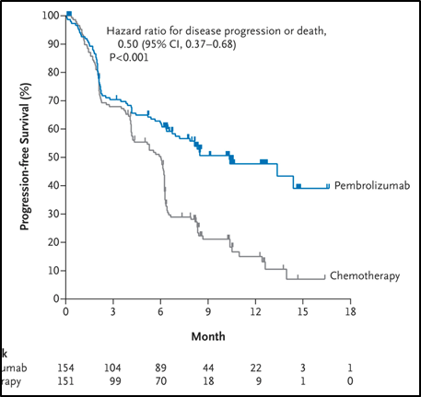
KEYNOTE 024
Pembrolizumab associated with:
↑ PFS (10.3 vs 6.0 months, HR 0.5, 95% CI 0.37-0.68)
↑ ORR (45% vs 28%)
↑ OS at 6 months (80.2% vs 72.4%, HR 0.60)
↓ Incidence serious treatment-related adverse events (27% vs 53%)
5 year follow-up: median OS 26.3 vs 13.4 months, HR 0.62, 95% CI 0.48-0.81)
*Crossover allowed
Reck et al. N Engl J Med 2016.

Slide 18
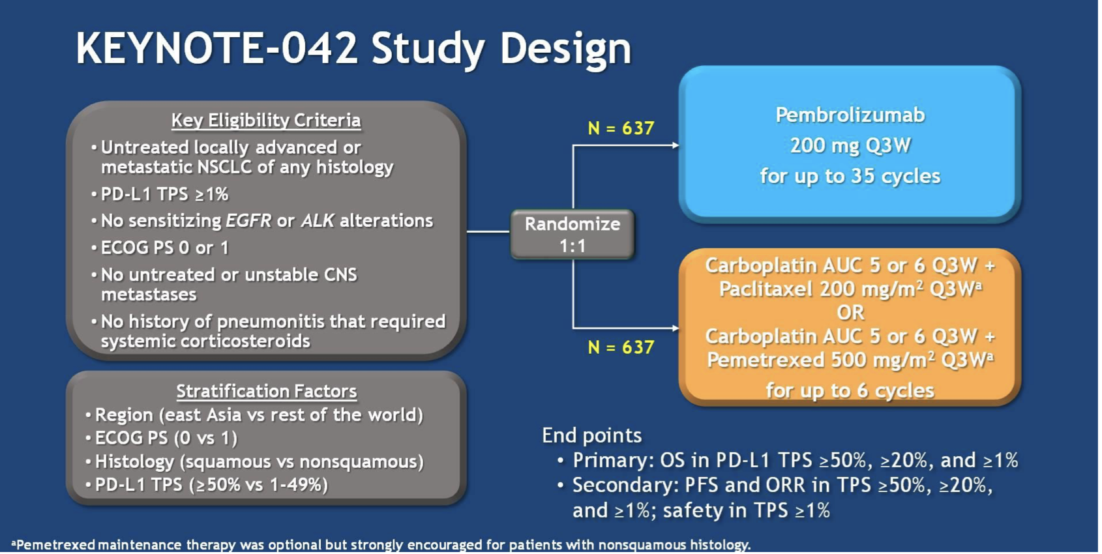
KEYNOTE 042
Mok et al. Lancet 2019.
Lopes et al. ASCO abstract 2018.

Slide 19
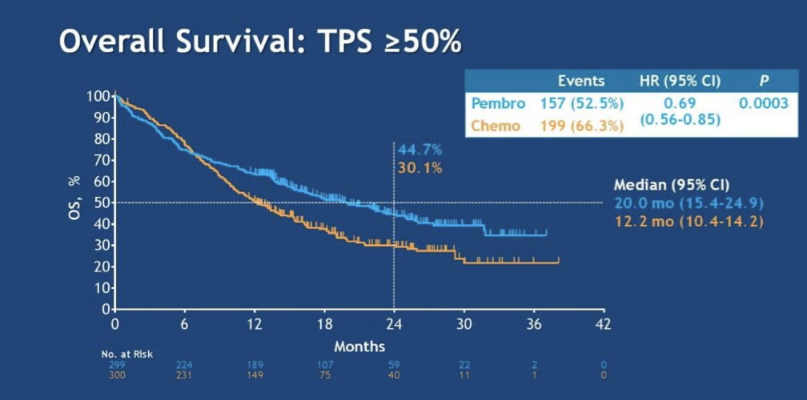
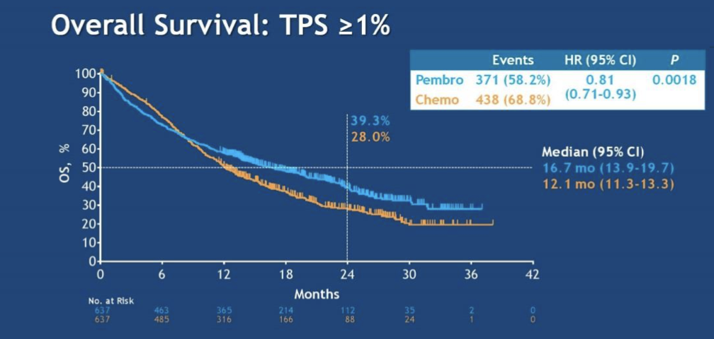
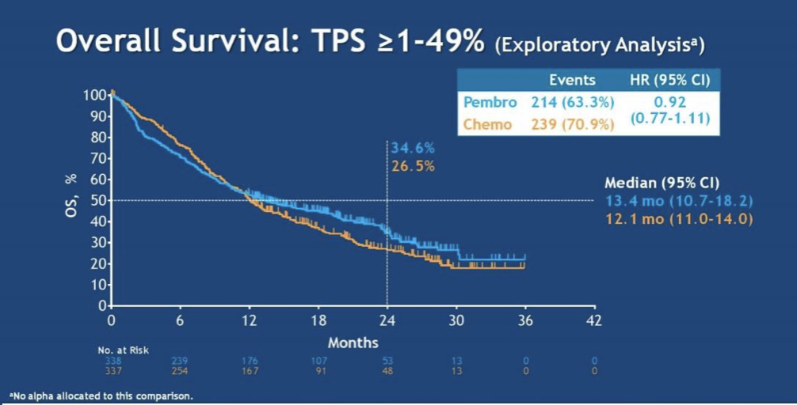
KEYNOTE 042
OS benefit seen in all planned PD-L1 subgroups (≥50%, ≥20%, ≥1%)
Exploratory analysis for PD-L1 1-49%:
No significant difference in OS
Lopes et al. ASCO abstract 2018.

Slide 20
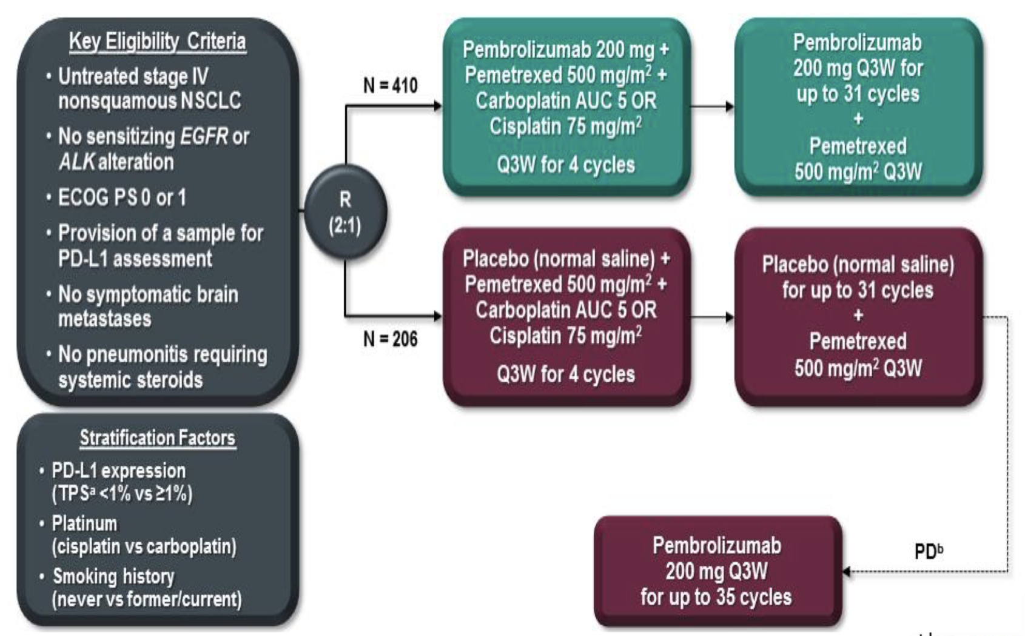
KEYNOTE 189
Gandhi et al. N Engl J Med 2018.

Slide 21
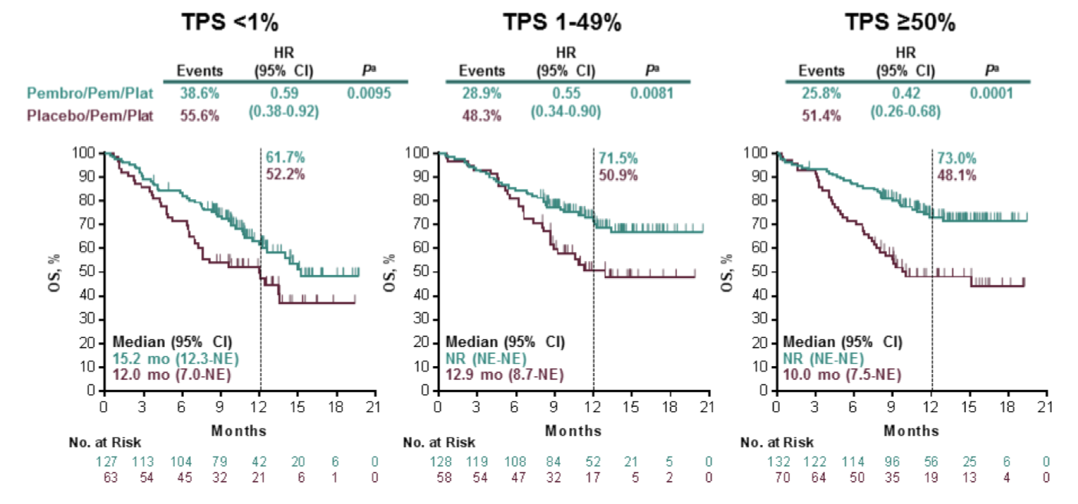
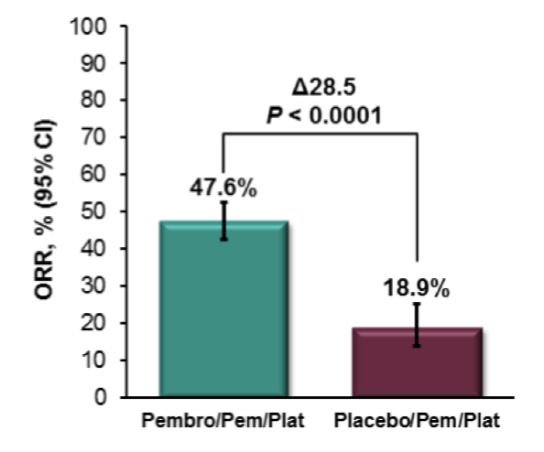
KEYNOTE 189
↑ 12 month OS in ITT population with pembrolizumab (69% vs 49%, HR 0.49, 95% CI 0.38-0.64)
Survival benefit noted in all PD-L1 expression subgroups
Similar rate of severe adverse events
Updated analysis: 2 year OS 46% with ICI vs 27% with chemo
Gandhi et al. N Engl J Med 2018.
Rodríguez-Abreu et al. Ann Oncol 2021.

Slide 22
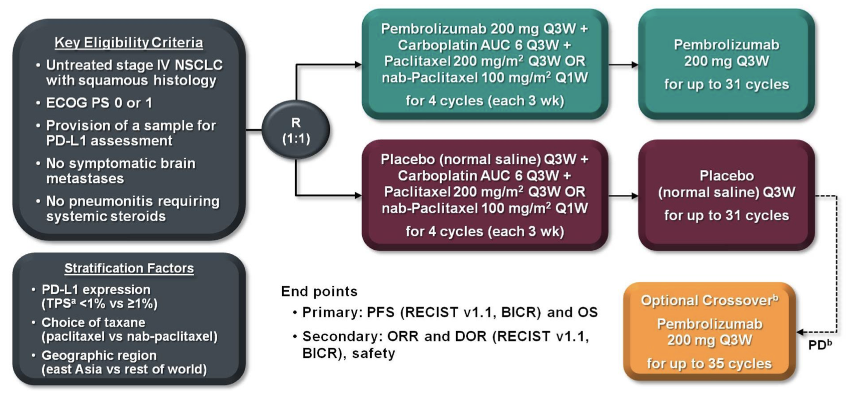
KEYNOTE 407
Paz-Ares et al. N Engl J Med 2018.

Slide 23
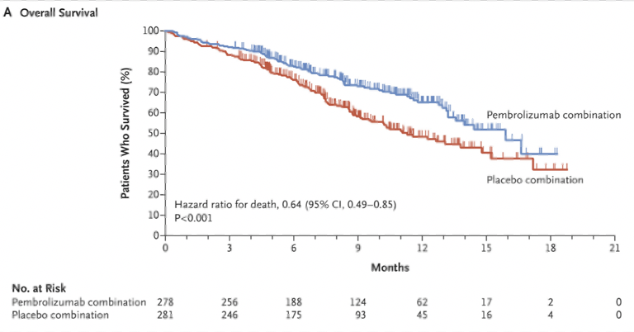
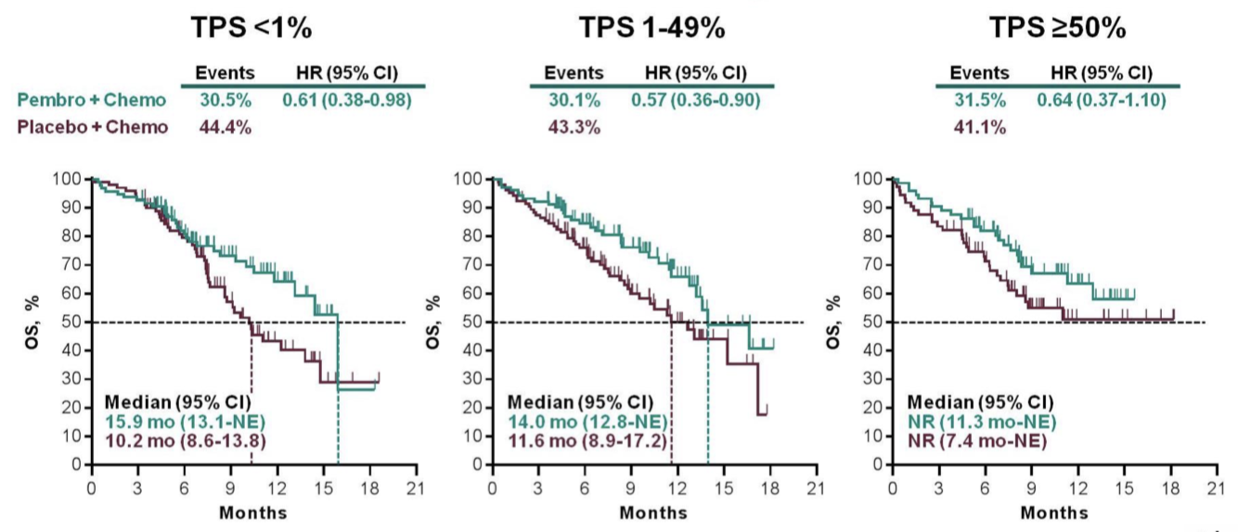
KEYNOTE 407
559 advanced squamous NSCLC patients enrolled
Pembrolizumab associated with:
  ↑ OS (15.9 vs 11.3 months, HR 0.64, 95% CI 0.49-0.85)
  ↑ PFS (6.4 vs 4.8 months, HR 0.56, 95% CI 0.45-0.70)
  ↑ ORR (58% vs 38%)
Paz-Ares et al. ASCO 2018.
Paz Ares et al. N Engl J Med 2018.

Slide 24
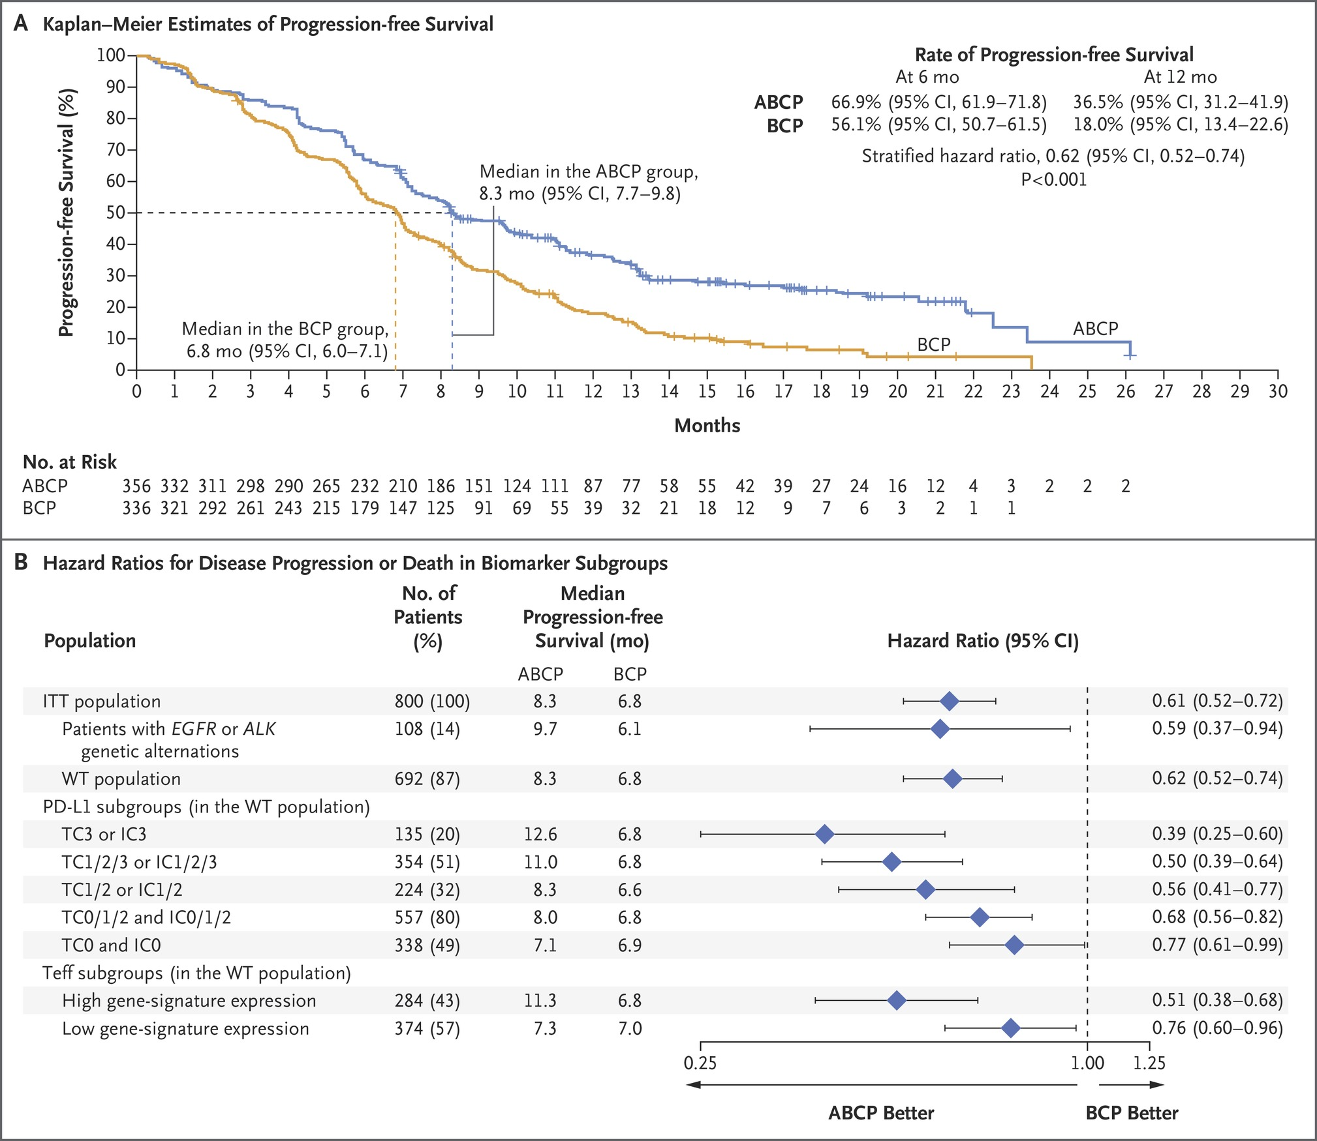

IMPower150
Socinski MA et al. N Engl J Med 2018;378:2288-2301
Notes:
Figure 2 Investigator-Assessed Progression-free Survival in the ABCP Group and the BCP Group. Panel A shows the Kaplan–Meier estimates of progression-free survival among the patients in the WT population. Panel B shows the hazard ratios (with 95% confidence intervals) for investigator-assessed progression-free survival in biomarker subgroups. Stratified hazard ratios are given for the ITT population (all enrolled patients, including those with EGFR or ALK genetic alterations), the WT population, and the Teff-high WT population; unstratified hazard ratios are given for the patients with EGFR or ALK genetic alterations, all programmed death ligand 1 (PD-L1) subgroups, and the subgroup of patients with low Teff gene-signature expression. The PD-L1 subgroups comprised 692 patients, and the Teff subgroups 658 patients; PD-L1 status and Teff gene-signature expression were evaluated among the patients in the WT population. PD-L1 status was determined by immunohistochemical analysis: TC3 or IC3 indicates PD-L1 expression on at least 50% of tumor cells or at least 10% of tumor-infiltrating immune cells (high PD-L1 expression); TC1/2/3 or IC1/2/3, PD-L1 expression on at least 1% of tumor cells or tumor-infiltrating immune cells (PD-L1–positive); TC1/2 or IC1/2, PD-L1 expression on at least 1% of tumor cells or tumor-infiltrating immune cells and less than 50% of tumor cells or less than 10% of tumor-infiltrating immune cells (low PD-L1 expression); TC0/1/2 and IC0/1/2, PD-L1 expression on less than 50% of tumor cells and less than 10% of tumor-infiltrating immune cells (low or negative PD-L1 expression); and TC0 and IC0, PD-L1 expression on less than 1% of tumor cells and tumor-infiltrating immune cells (PD-L1–negative). Patients with a sensitizing EGFR mutation or ALK translocation were included in the study if they had had disease progression or the occurrence of unacceptable side effects with at least one approved targeted therapy. The date of data cutoff was September 15, 2017.

Slide 25
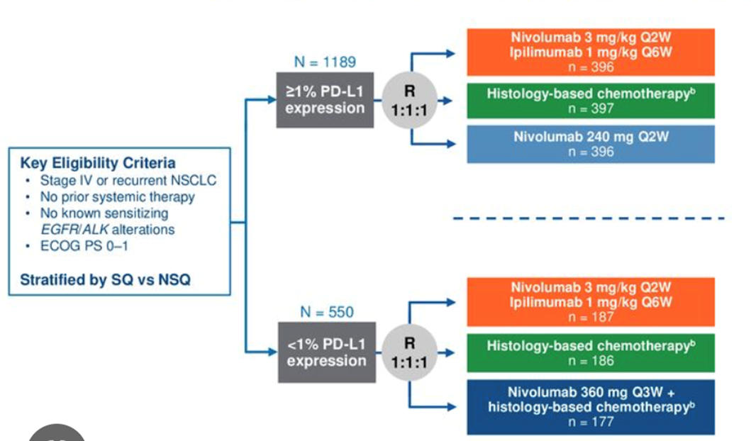

Checkmate 227: Dual checkpoint blockade
Primary Endpoints:
OS with nivolumab/ipilimumab versus chemotherapy in PD-L1 positive population
PFS with nivolumab/ipilimumab versus chemotherapy in high TMB population
Hellman et al. N Engl J Med 2018.
Hellman et al. N Engl J Med 2019.

Slide 26
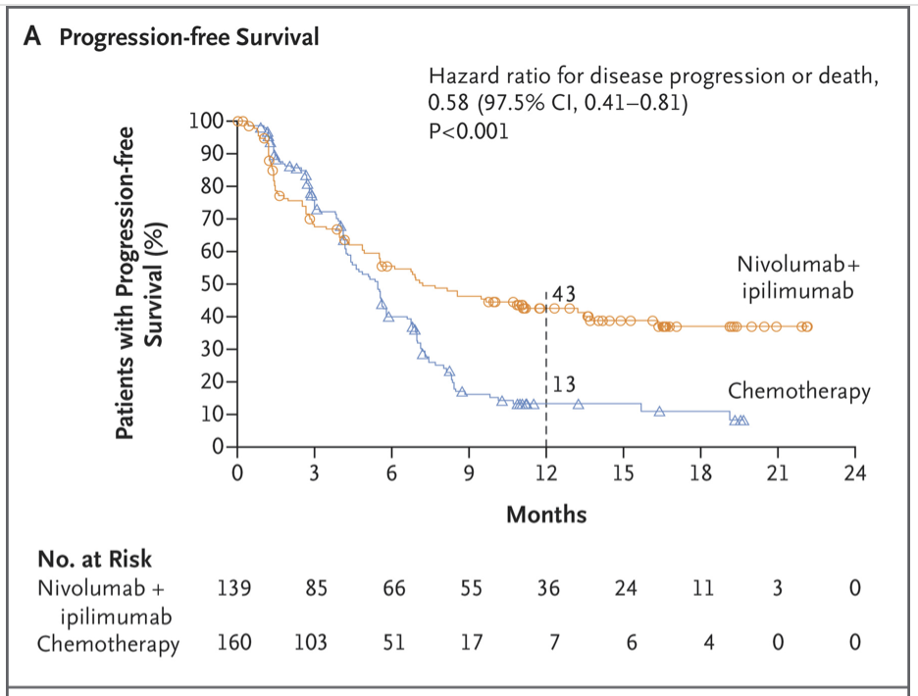
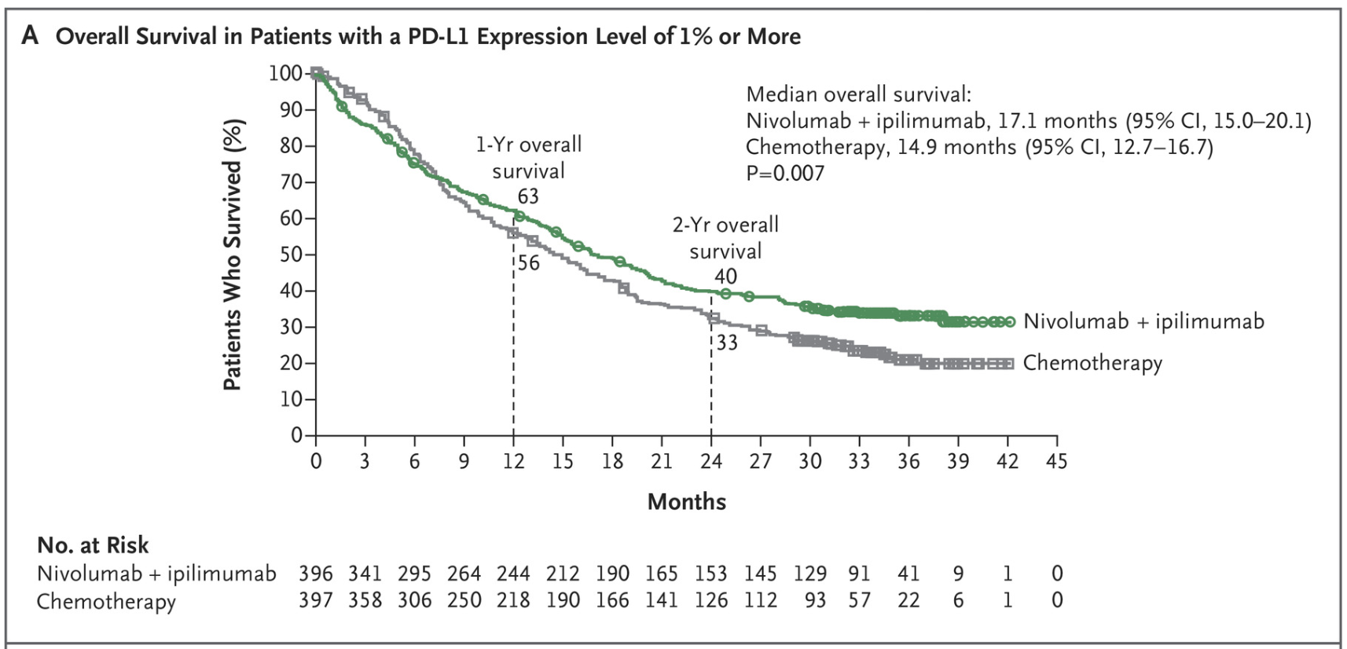
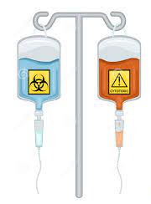
Checkmate 227
Nivolumab/Ipilimumab (compared to
chemotherapy) associated with:
↑ PFS in high TMB population
↑ OS in PD-L1 positive patients
(17.1 vs 14.9 months, HR 0.79)
↑ ORR (35.9% vs 30%)
↑ mDOR (23.2 vs. 6.2 months)
OS benefit also noted in PD-L1 negative
patients(17.2 vs 12.2 months, HR 0.62),
although this analysis was exploratory
Hellman et al. N Engl J Med 2018.
Hellman et al. N Engl J Med 2019.

Slide 27
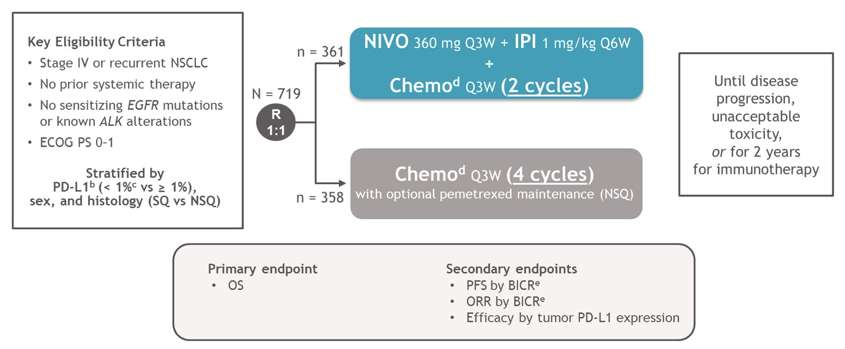
Checkmate 9LA
Reck et al. ASCO abstract 2020.
Paz-Ares et al. Lancet Oncol 2021.

Slide 28
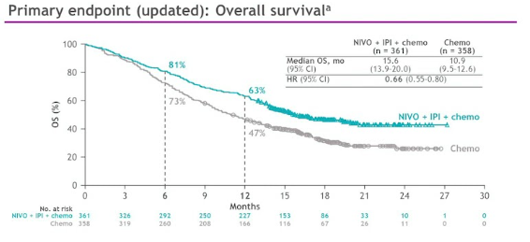
Checkmate 9LA
Nivolumab/Ipilimumab/chemotherapy associated with:
↑ median OS (15.6 vs 10.9 months, HR 0.66, 95% CI 0.55-0.80)
↑ PFS (6.8 vs 5.0 months; HR 0.70, 95% CI 0.57-0.86)
↑ ORR (38% vs 25%)
Reck et al. ASCO abstract 2020.
Paz-Ares et al. Lancet Oncol 2021.

Slide 29
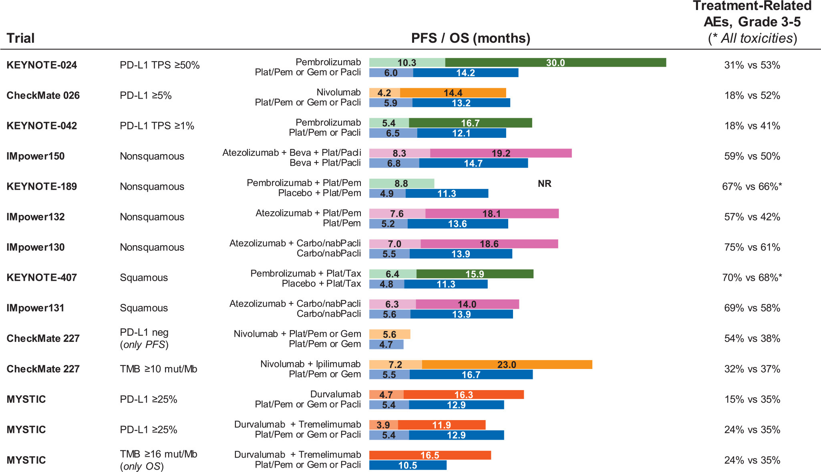

Figure 1
First line studies for metastatic NSCLC
Copyright © 2019 THE AUTHORS Terms and Conditions
Annals of Oncology 2019 30884-896DOI: (10.1093/annonc/mdz109)
Notes:
A summary of phase 3 trials for previously untreated advanced/metastatic NSCLC. AEs, adverse events; Beva, bevacizumab; Carbo, carboplatin; Gem, gemcitabine; Mb, megabase; NR, not reached; nabPacli, nab-paclitaxel; Pacli, paclitaxel; PD-L1, programmed death ligand 1; Pem, pemetrexed; PFS, progression-free survival; Plat, platinum; OS, overall survival; TMB, tumor mutation burden; TPS, tumor proportion score; Tax, taxane.

Slide 30
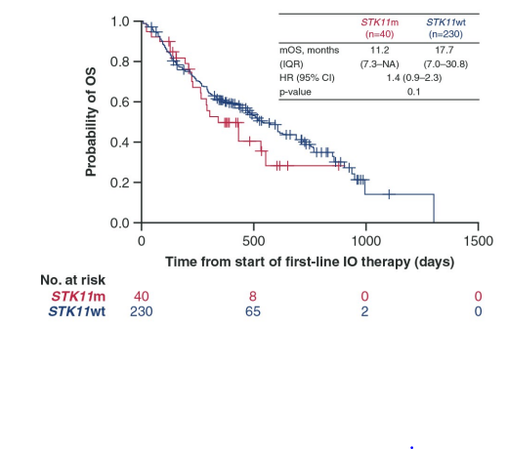
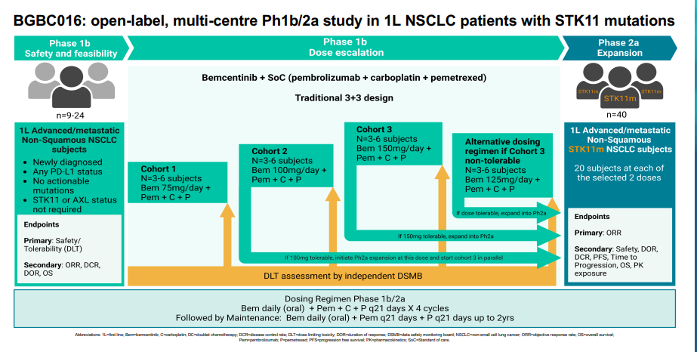
STK11
Shire et al. PLOS ONE 2020

Slide 31
Conclusions
First line treatment options for NSCLC should consider PDL1 biomarker and molecular testing
Decisions regarding IO versus chemotherapy plus IO based treatments will depend on toxicity profiles of each regimen and biomarkers for patient selection
  PDL1> 50 – Pembrolizumab monotherapy
  PDL1 >1 consider Chemo+IO or Ipilumumab/nivolumab
Prospective trials will need to determine the prognostic impact of STK11 mutations in more depth and identify possible therapeutic targets in this population.

Slide 32
LUNG CANCER
Tuesday, December 5, 2023

Slide 33

EGFR-mutated NSCLC:
Adjuvant to Metastatic
Katherine Scilla, MD, FACP
Assistant Professor of Medicine
University of Maryland School of Medicine
Baltimore, Maryland

Slide 34
Outline
Resected EGFR-mutated NSCLC
  ADAURA - Adjuvant osimertinib
1L advanced EGFR-mutated NSCLC
  FLAURA - Osimertinib
  FLAURA2 - Osimertinib +/- platinum-pemetrexed chemotherapy
  MARIPOSA - Amivantamab + Lazertinib
2L+ advanced EGFR-mutated NSCLC
  MARIPOSA2- Amivantamab + Lazertinib
  HERTHENA-Lung01- Patritumab deruxtecan

Slide 35
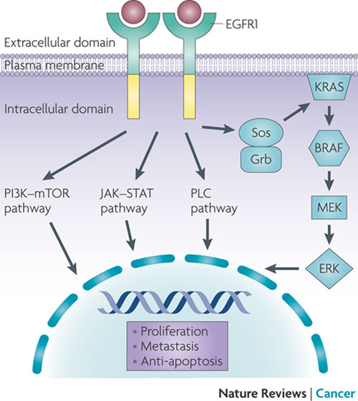
EGFR-mutated NSCLC
EGFR is a transmembrane tyrosine kinase receptor
EGFR mutations are present in ~15% of lung adenocarcinoma in US
Exon 19 deletion or exon 21 L858R mutations
Leads to constitutive activation of EGFR tyrosine kinase and phosphorylation of downstream pathways
→ uncontrolled cell growth & proliferation
Waltham et al. Nature Cancer Reviews 2009.

Slide 36
Osimertinib
3rd generation EGFR tyrosine kinase inhibitor (TKI)
Developed to overcome T790M-mediated acquired resistance to 1st and 2nd generation EGFR TKIs
Irreversible inhibitor selective for both EGFR-sensitizing & T790M-resistance mutations, with little inhibitory activity for wild-type EGFR

Slide 37
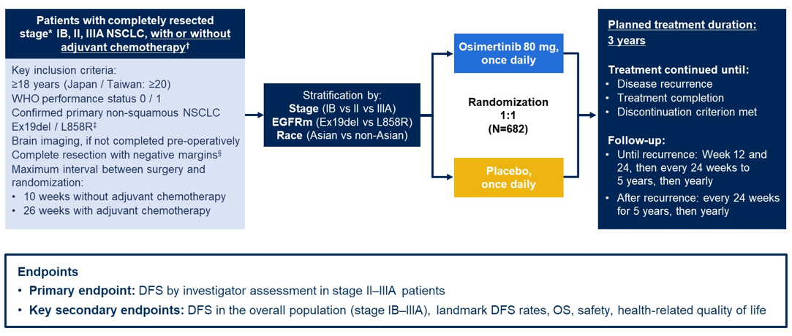
ADAURA- Adjuvant Osimertinib
Herbst et al. ASCO 2023.

Slide 38
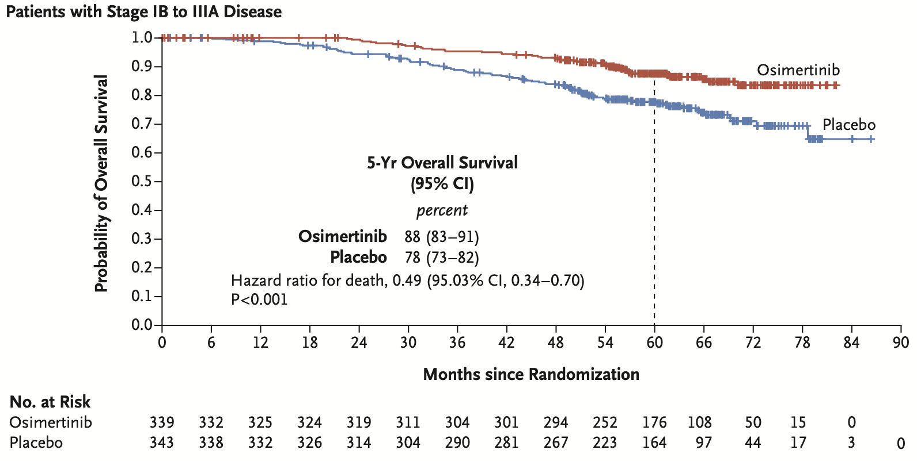
ADAURA
OS in stage IB-IIIA disease
Tsuboi et al. N Engl J Med 2023.

Slide 39
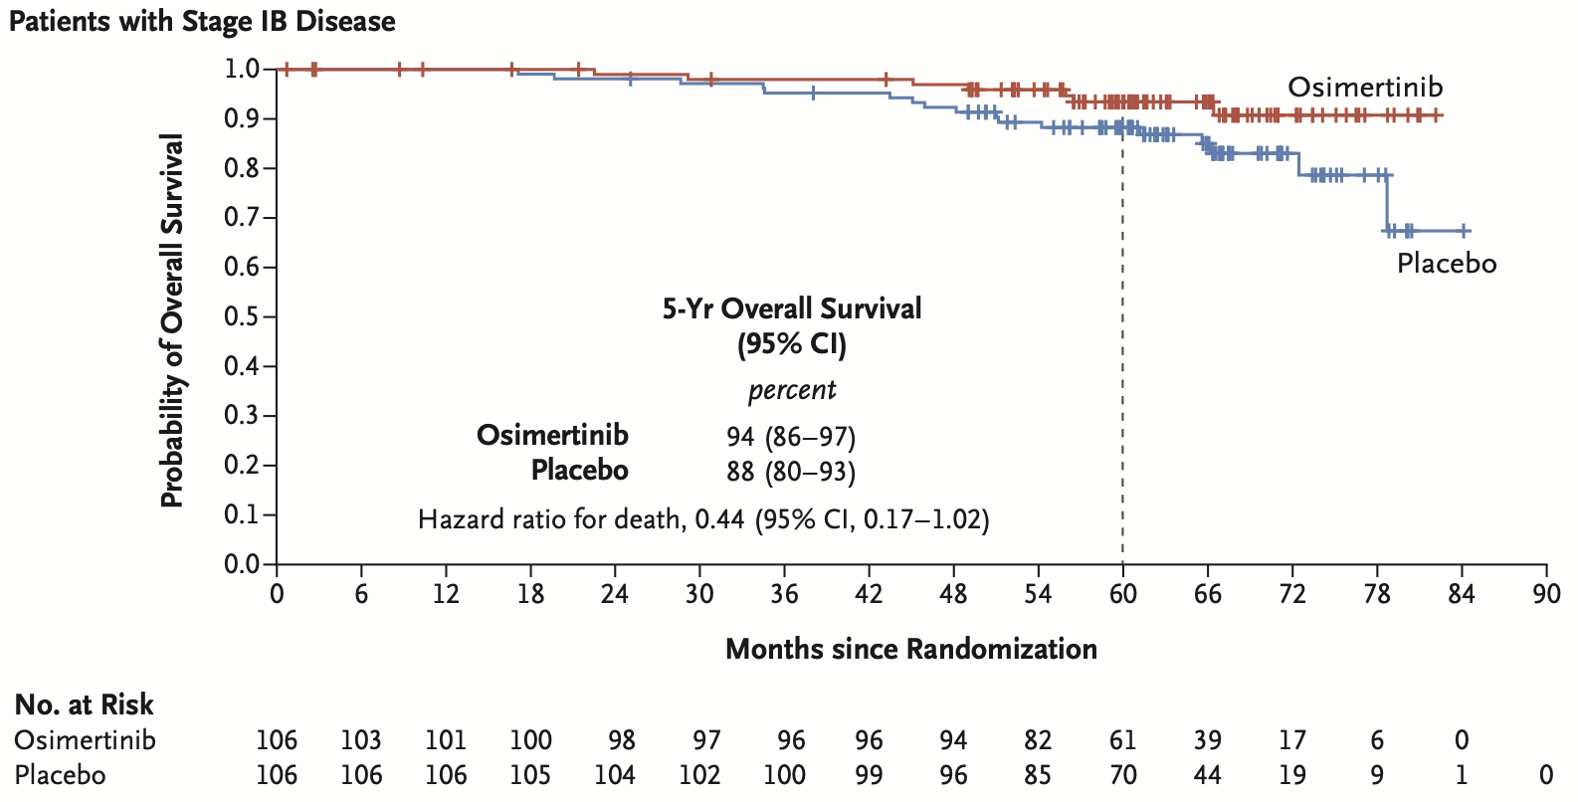
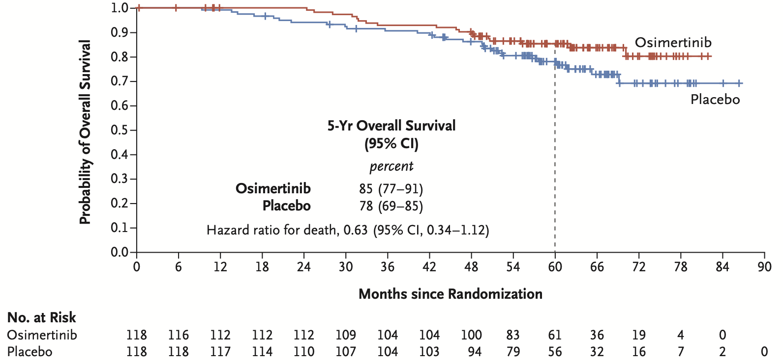
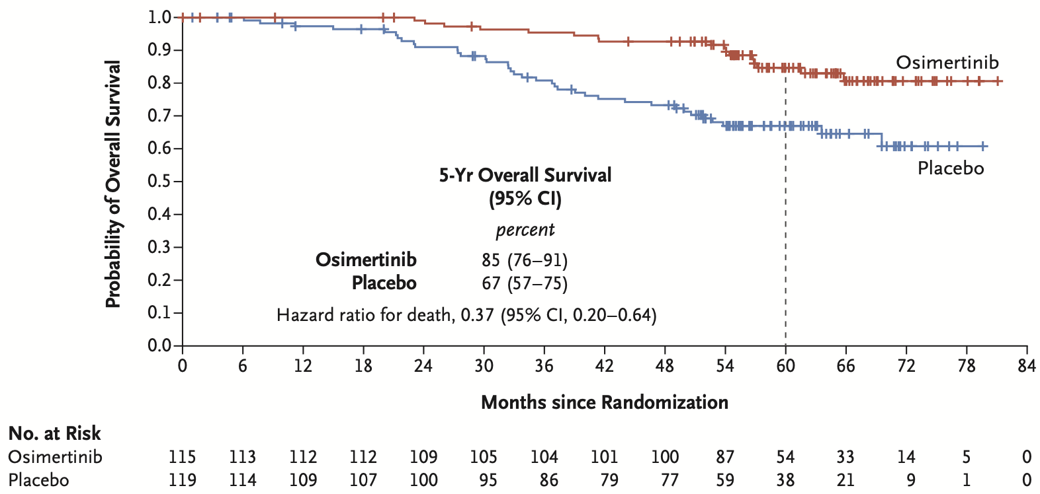
Stage IB
OS benefit of adjuvant osimertinib seen in all
stages of disease
Stage II
Stage IIIA
Tsuboi et al. N Engl J Med 2023.

Slide 40
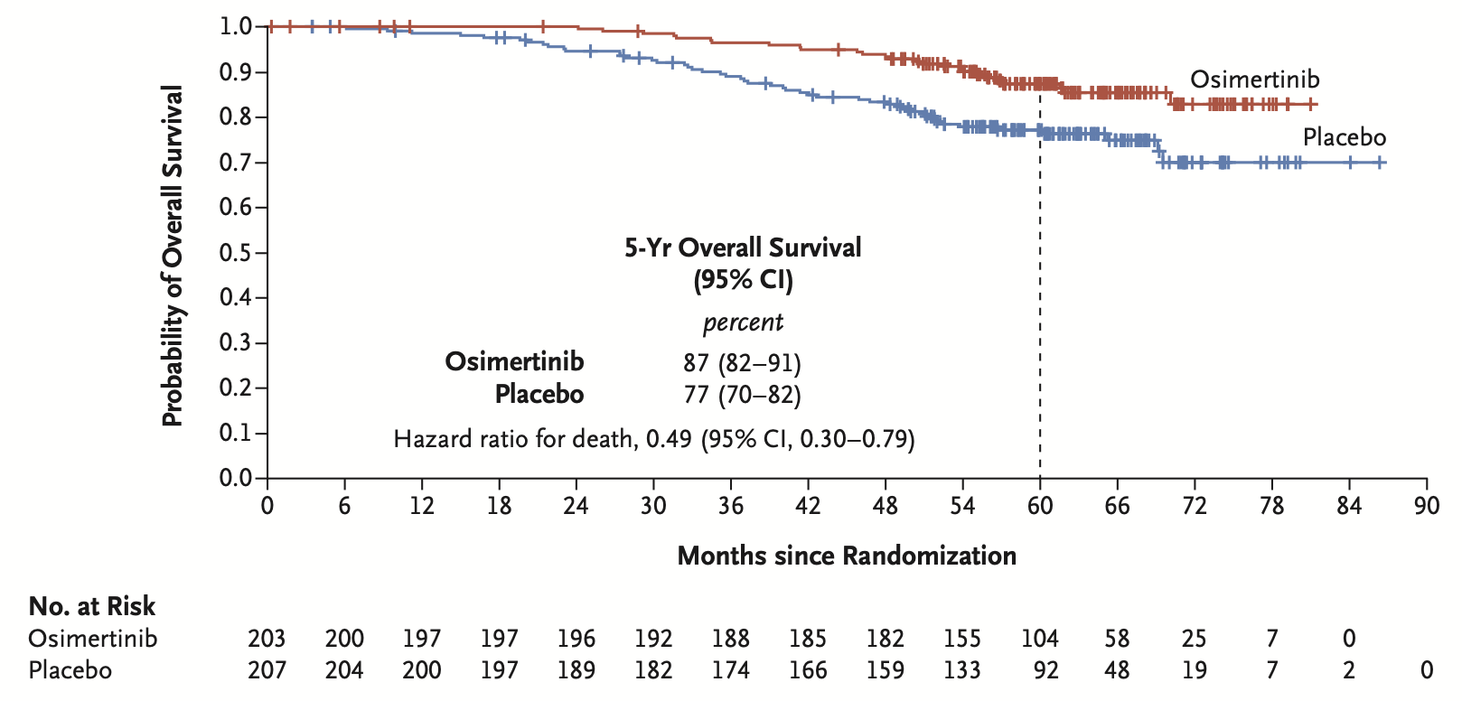
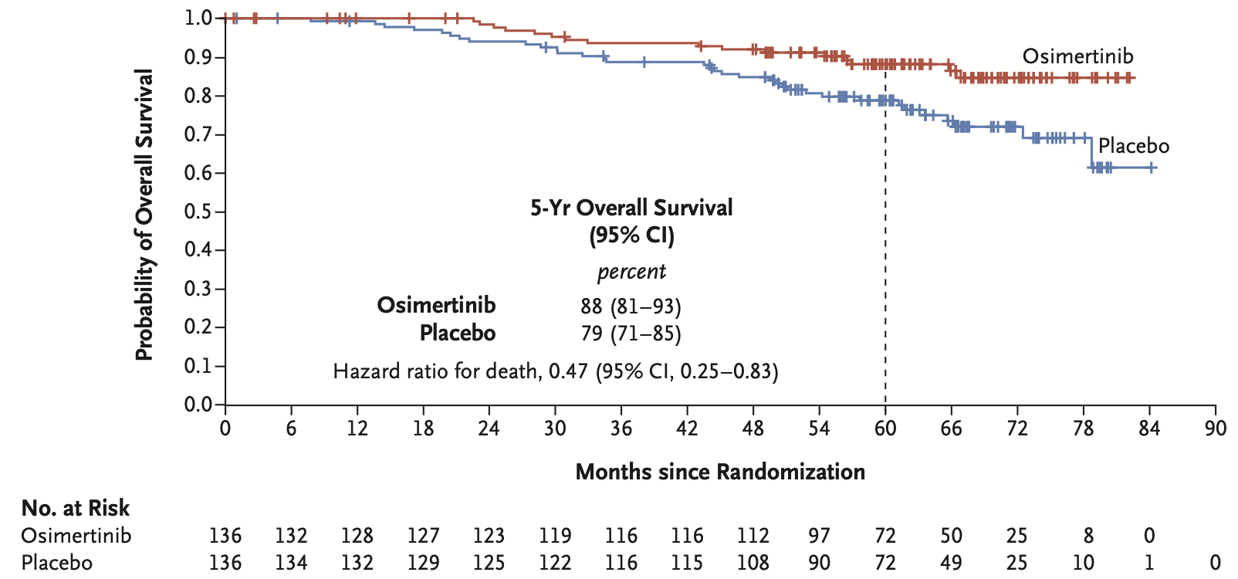
OS benefit regardless of adjuvant chemotherapy
Adjuvant chemotherapy
No adjuvant chemotherapy
Tsuboi et al. N Engl J Med 2023.

Slide 41
ADAURA
Osimertinib was FDA approved in December 2020 as adjuvant therapy
for patients with resected EGFR-mutated NSCLC
Toxicity $≥$ grade 3 | Osimertinib (%) | Placebo (%)
Diarrhea | 2 | <1
Paronychia | 1 | 0
Dry skin | <1 | 0
Stomatitis | 1 | 0
Decreased appetite | 1 | 0
Tsuboi et al. N Engl J Med 2023.

Slide 42
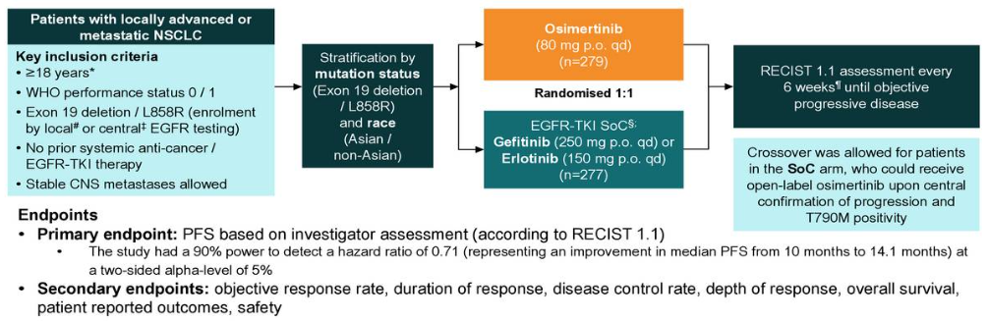
FLAURA
Ramalingam et al. ESMO 2017.

Slide 43
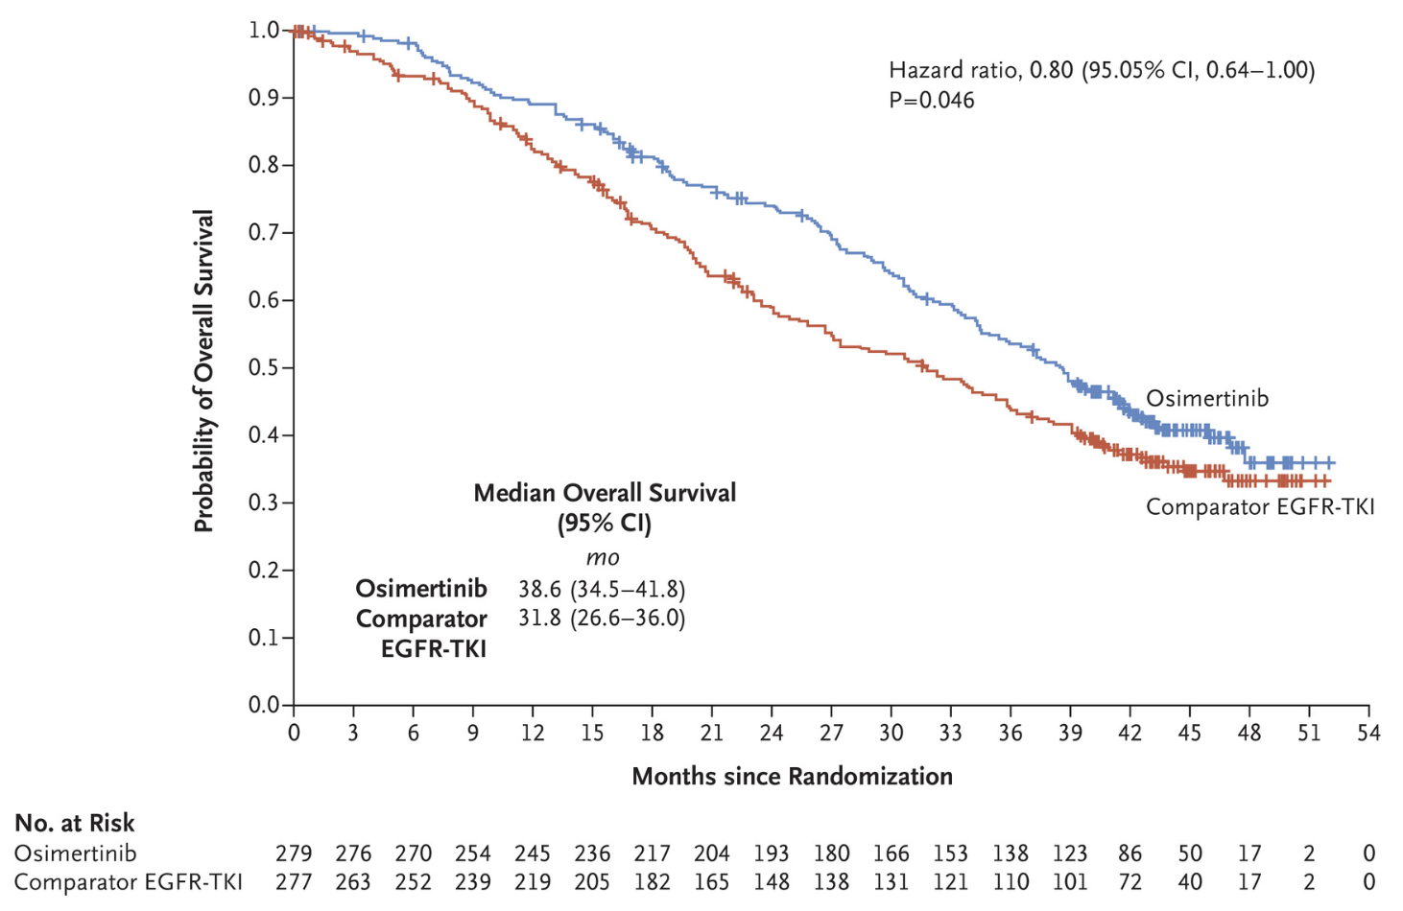
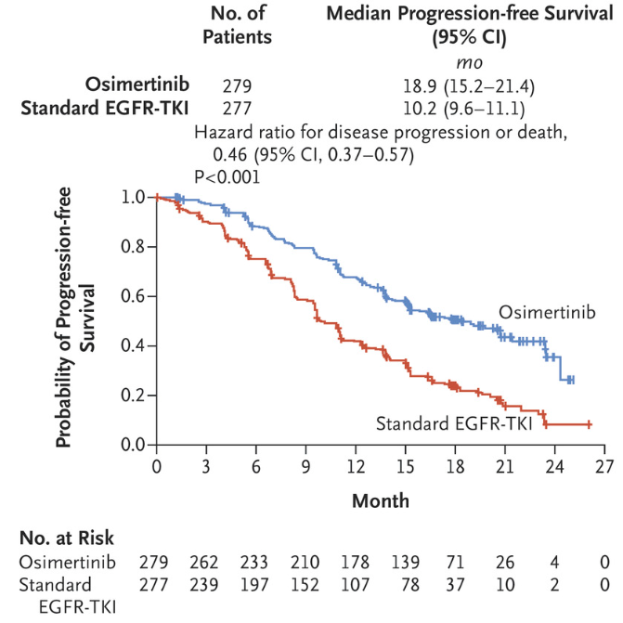
FLAURA- PFS & OS
Soria et al. N Engl J Med 2018.
Ramalingam et al. N Engl J Med 2020.

Slide 44
FLAURA- Safety
  Most common adverse events (osimertinib vs 1st generation EGFR TKI):
  Acneiform rash (58% vs 78%)
  Diarrhea (58% vs 57%)
  Dry skin (36% in both groups)
  Osimertinib associated with lower rates of grade 3 of higher adverse events
Osimertinib was FDA approved in April 2018 for 1L advanced EGFR-mutated NSCLC
Soria et al. N Engl J Med 2018.

Slide 45
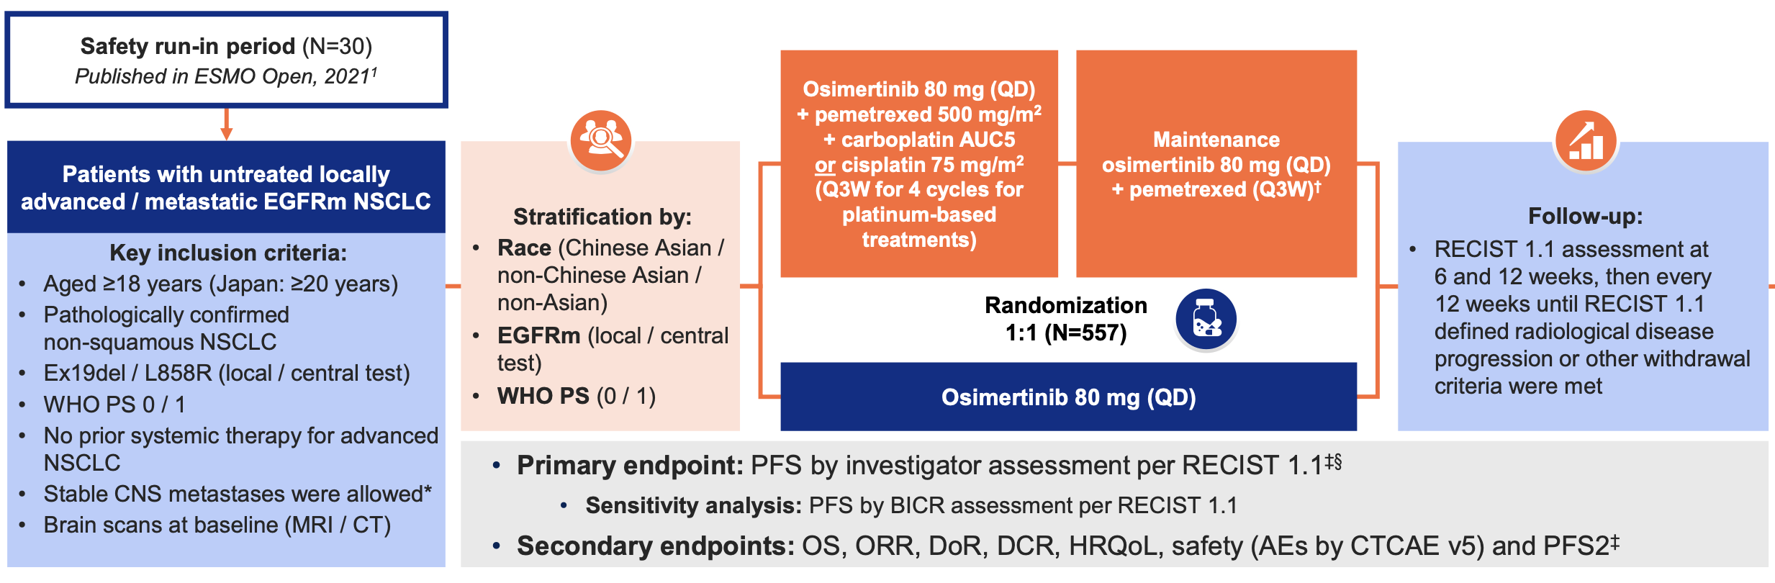
FLAURA2
Janne et al. WCLC 2023.

Slide 46
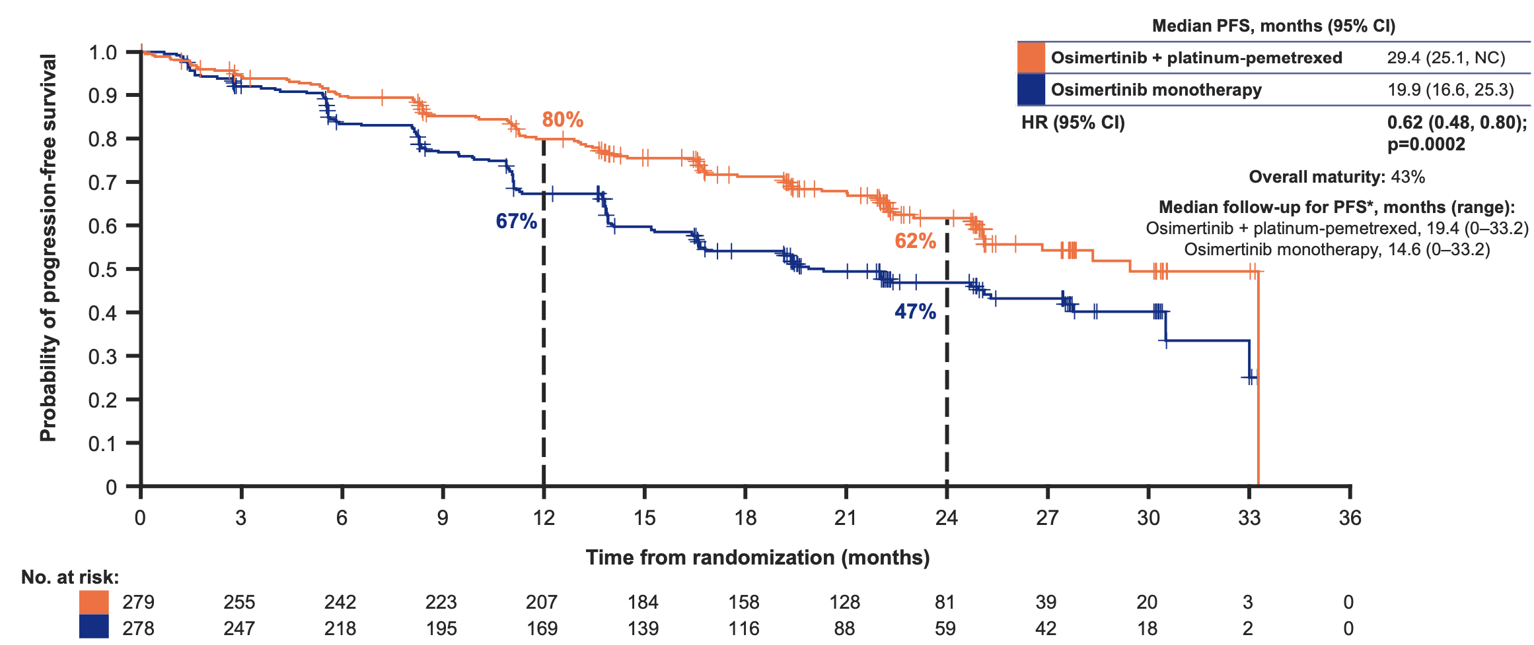
FLAURA2- PFS
Median PFS improved by 9.5m with osimertinib + chemotherapy vs osimertinib monotherapy
Janne et al. WCLC 2023.

Slide 47
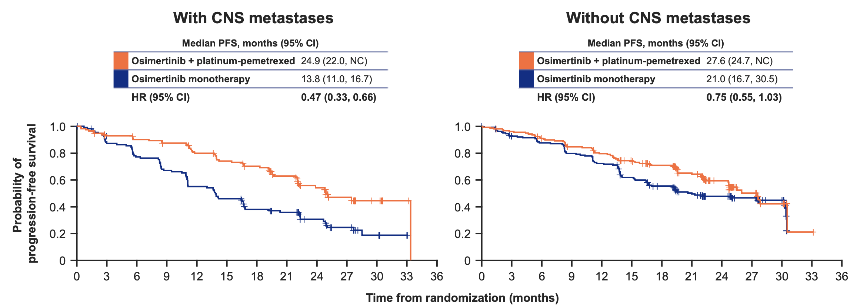
FLAURA2- PFS with & without baseline CNS metastases
Janne et al. WCLC 2023.

Slide 48
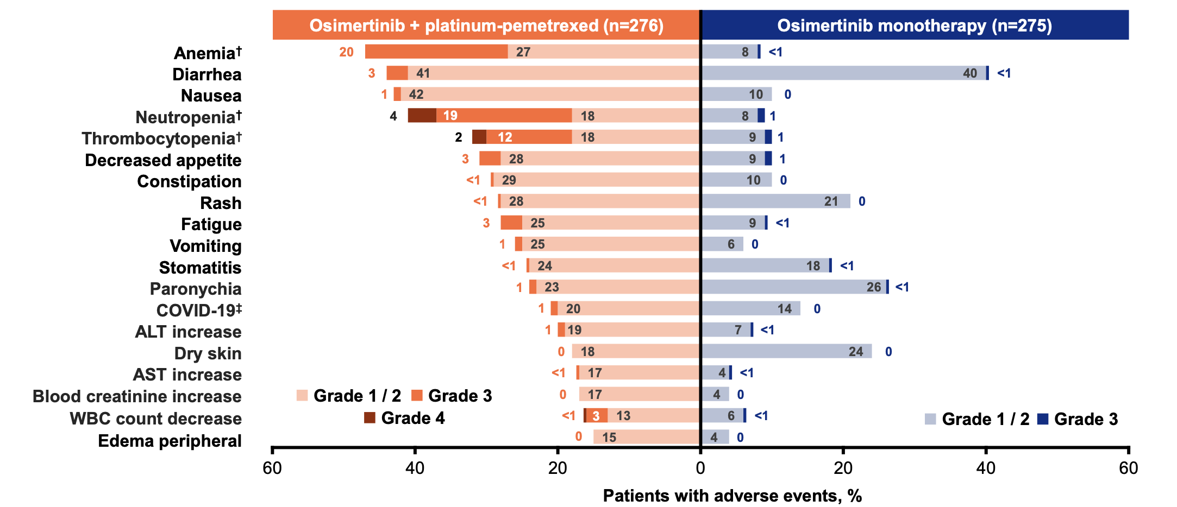
FLAURA2- Safety
Common adverse events ($≥15\%$ of patients)
Higher rates of hematologic AEs with osimertinib + chemotherapy
Janne et al. WCLC 2023.

Slide 49
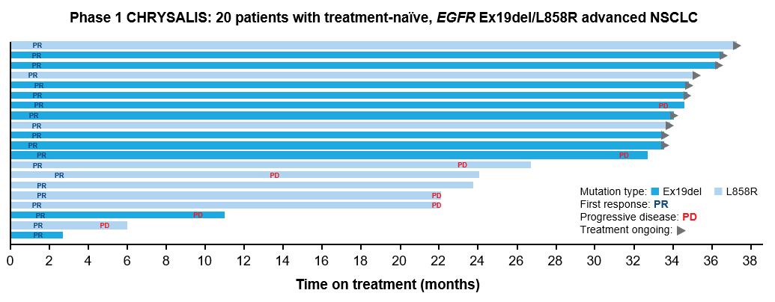
Amivantamab & Lazertinib
Amivantamab - EGFR-MET Bispecific antibody with immune cell-directing activity
Lazertinib- Highly selective, CNS penetrant, 3rd generation EGFR TKI
Cho et al. WCLC 2022.

Slide 50
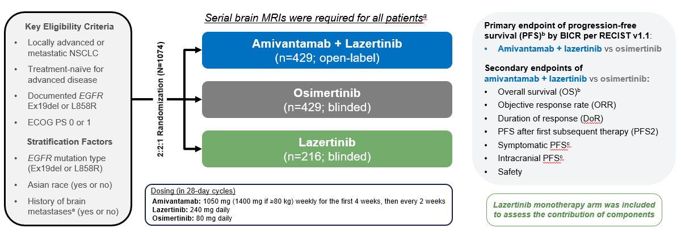
MARIPOSA
Cho et al. ESMO 2023.

Slide 51
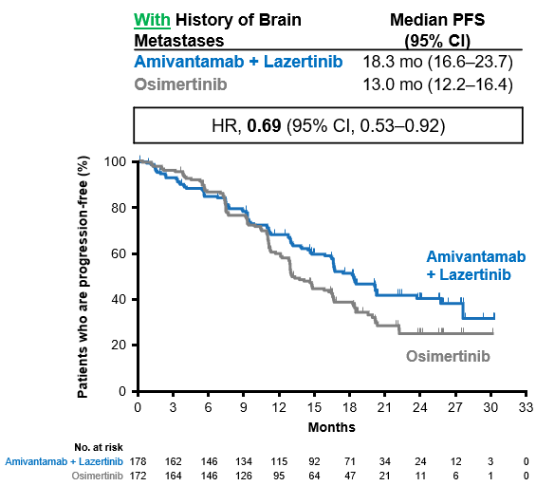
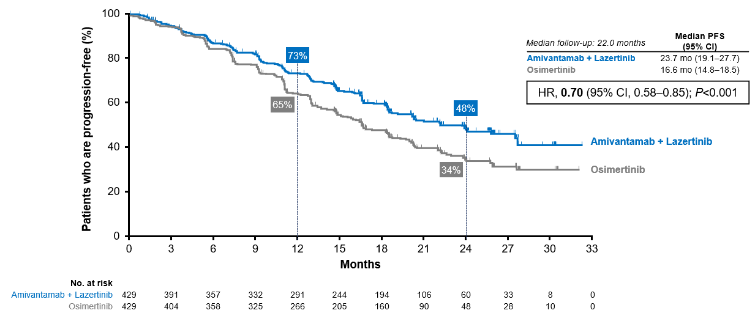
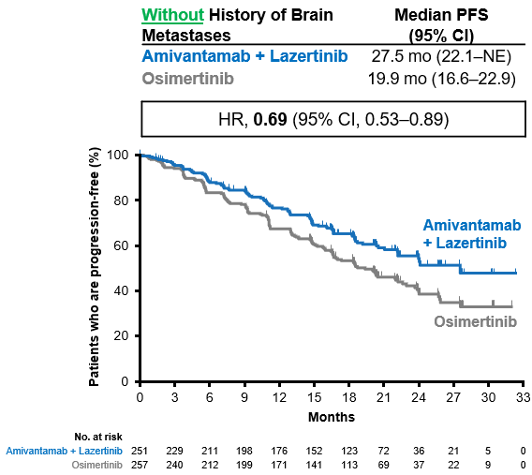
MARIPOSA- PFS
Overall population
Cho et al. ESMO 2023.
Notes:
Amivantamab + lazertinib reduced the risk of progression or death by 30% and improved median PFS by 7.1 months

Slide 52
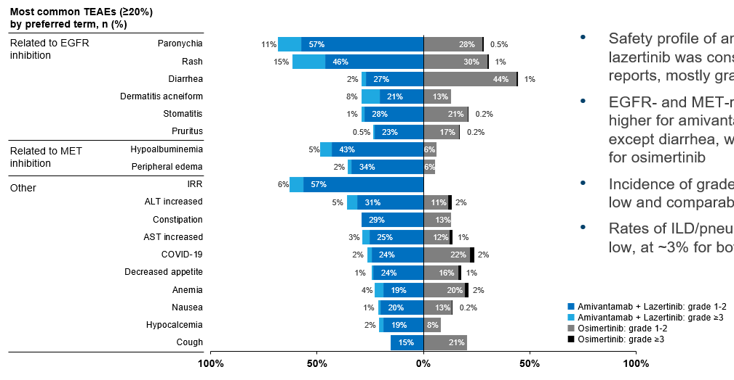

MARIPOSA- Safety
Amivantamab + lazertinib associated with:
  higher rates of EGFR- and MET-related AEs (except diarrhea)
  higher rates of VTE
*Prophylactic anticoagulation is now recommended for 1st 4 months of amivantamab + lazertinib treatment
Cho et al. ESMO 2023.

Slide 53


FLAURA2 & MARIPOSA-
OS (immature)
FLAURA2
MARIPOSA
Planchard et al. N Engl J Med 2023.
Cho et al. ESMO 2023.

Slide 54

Resistance after 1L osimertinib
Importance of repeat next generation sequencing testing (tissue, ctDNA) at time of disease progression
Despite broad molecular profiling, most patients do not have a targetable resistance mechanism
Leonetti et al. Br J Cancer 2019.

Slide 55

MARIPOSA-2
Passaro et al. ESMO 2023.
Notes:
Phase III, global randomized controlled trial

Slide 56



MARIPOSA-2
ORR
PFS
Passaro et al. ESMO 2023.
Notes:
At a median follow-up of 8.7 months, amivantamab-chemotherapy and amivantamab-lazertinib-chemotherapy
reduced the risk of progression or death by 52% and 56%, respectively

Slide 57

HERTHENA-Lung01
Patritumab deruxtecan (HER3-DXd)- HER3-directed ADC
  HER3-DXd in EGFR-mutated NSCLC progressed on prior EGFR TKI and platinum-based chemotherapy
  HER3-DXd 5.6 mg/kg (n=225)
    - ORR 29.8%, mPFS 5.5m
  Nonirradiated CNS metastasis at baseline (n=30)
    - CNS ORR 33.3%
Yu et al. J Clin Oncol 2023.

Slide 58


Chemotherapy + IO after EGFR TKI
Checkmate 722
KEYNOTE 789
Addition of immunotherapy to chemotherapy in patients with EGFR-mutated NSCLC after progression on EGFR TKI has failed to demonstrate a clinically meaningful PFS benefit
Mok et al. ESMO Asia 2022.
Yang et al. ASCO 2023.
Notes:
Phase III, global randomized controlled trial

Slide 59
Conclusions
Osimertinib is FDA approved as adjuvant therapy for resected EGFR-mutated NSCLC and for treatment-naïve advanced EGFR-mutated NSCLC
Novel approaches (osimertinib + chemotherapy; amivantamab + lazertinib) have demonstrated improved PFS compared to osimertinib monotherapy, but are associated with increased toxicity as well as need for increased clinic visits and IV infusions
Overall survival data from these trials and better risk stratification tools are needed to help determine the most appropriate therapy for advanced EGFR-mutated patients
Notes:
Are there certain patient subsets that derive greater benefit from FLAURA2 and MARIPOSA regimen?
Patients with brain metastases
Higher burden of disease

Slide 60
LUNG CANCER
Tuesday, December 5, 2023

Slide 61
Management of early-stage NSCLC
Sam Rosner, MD
Assistant Professor of Medicine
University of Maryland
Greenebaum Comprehensive Cancer Center
Baltimore, MD

Slide 62
Disclosures
No relevant disclosures

Slide 63



Survival after curative resection
Figure: Three year overall survival rates by stage and cancer type
Figure: Overall survival by clinical stage according to the proposed eighth edition groupings using SEER database
Goldstraw et al. JTO 2016
National Cancer Center 2014

Slide 64

Perioperative chemotherapy for NSCLC
Adjuvant cisplatin-based chemotherapy with modest benefit (5.4% survival over 5 years)
Neoadjuvant chemotherapy offers similar survival benefit at 5 years (5%)
Figure: KM curves of the effect of preoperative chemotherapy on time to survival
Pignon et al. JCO 2008
NSCLC-MCG. Lancet. 2014

Slide 65



Early stage EGFR mutant NSCLC
ADAURA Trial
Tsuboi et al. NEJM 2023

Slide 66




Early stage ALK altered NSCLC
Solomon et al. ESMO 2023

Slide 67

Skoulidis et al. Nature Rev Cancer 2019

Slide 68


Neoadjuvant vs. Adjuvant Immune checkpoint blockade
Figure: KM curves evaluating EFS between perioperative vs. post-operative pembrolizumab in resectable melanoma
Figure: Comparison of neoadjuvant and adjuvant ICB-based therapies
Sanber K, Rosner S, et al. BioDrugs. 2023
Patel S, Othus M, et al. NEJM 2023

Slide 69




Neoadjuvant chemoimmunotherapy trials
AEGEAN
CheckMate-816
Keynote-671
Checkmate 77T
Provencio Pulla et al. ESMO 2023
Heymach et al. NEJM. 2023
Spicer et al. ESMO 2023
Cascone et al. ESMO 2023

Slide 70
Phase III Perioperative Trials
Trial Name | N for treatment arm | Stages Included | Number of pre-operative cycles | Resection Rate for Treatment Arms | Post-operative treatment | pCR rate | EFS | OS | Key notes
CheckMate-816 | 179 | IB (>4cm)-IIIA | 3 | 83.2% | None | 24% | 57% @ 3 yrs, HR 0.68 | 78% @ 3 yrs, HR 0.62 | 7th AJCC edition Only neoadjuvant
Keynote-671 | 397 | II-IIIB (N2) | 4 | 82.1% | 1 year | 18.1% | 54.3% @ 3 yrs, HR 0.59 | 71.3% @ 3 yrs, HR 0.72* | Cisplatin only EGFR/ALK testing not required
CheckMate-77T | 229 | IIA (>4cm)-IIIB(N2) | 4 | 78% | 1 year | 25.3% | 70% at 18 mos, HR 0.58 | NR | ~30% multistation N2
AEGEAN | 400 | II-IIIB(N2) | 4 | 81% | 1 year | 17.2% | 63.3% @ 2 yrs, HR 0.68 | NR | Excluded T4 for invasion, planned pneumonectomy, EGFR/ALK enrolled but excluded from IIT analysis
NEO-TORCH | 202 | IIIA/IIIB (stage II not presented) | 3 | 82.2% | 1 year | 24.8% | 64.7% at 2 yrs, HR 0.40 | 81.2% at 2 yrs, HR 0.62 | 1 cycle of post-op chemoIO 78% SCC 66% PDL1+
*reached statistical significance

Slide 71




Emerging biomarkers
Provencio et al. ASCO 2022
Provencio et al. ESMO 2023
Awad et al. ESMO 2023

Slide 72



So what are we left with…
+ pCR/MPR
- pCR/MPR

Slide 73
So what are we left with…
More treatment?
~20% not getting surgery
Important biomarkers
# cycles
Who needs more ICB?
+ pCR/MPR
More of the same?
- pCR/MPR

Slide 74

So what are we left with…
More treatment?
~20% not getting surgery
Important biomarkers
# cycles
Who needs more ICB?
+ pCR/MPR
More of the same?
EGFR/ALK
PD-L1
ROS1/RET/NTRK?
- pCR/MPR
Solomon et al. ESMO 2023

Slide 75



So what are we left with…
More treatment?
~20% not getting surgery
Important biomarkers
# cycles
Who needs more ICB?
+ pCR/MPR
More of the same?
EGFR/ALK
PD-L1
ROS1/RET/NTRK?
- pCR/MPR
Qui et al. ASCO 2022

Slide 76

So what are we left with…
More treatment?
~20% not getting surgery
Important biomarkers
# cycles
Who needs more ICB?
+ pCR/MPR
More of the same?
EGFR/ALK
PD-L1
ROS1/RET/NTRK?
- pCR/MPR
Rosner et al. ASCO 2023

Slide 77

So what are we left with…
More treatment?
~20% not getting surgery
Important biomarkers
# cycles
Who needs more ICB?
+ pCR/MPR
More of the same?
EGFR/ALK
PD-L1
ROS1/RET/NTRK?
- pCR/MPR
Provencio et al. ESMO 2023

Slide 78


So what are we left with…
More treatment?
~20% not getting surgery
Important biomarkers
# cycles
Who needs more ICB?
+ pCR/MPR
~15%
More of the same?
EGFR/ALK
PD-L1
ROS1/RET/NTRK?
- pCR/MPR
Wakelee et al. ASCO 2023
Provencio et al. ESMO 2023

Slide 79



So what are we left with…
More treatment?
~20% not getting surgery
Important biomarkers
# cycles
Who needs more ICB?
+ pCR/MPR
~15%
More of the same?
EGFR/ALK
PD-L1
ROS1/RET/NTRK?
- pCR/MPR
Wakelee et al. ASCO 2023
Heymach et al. NEJM 2023

Slide 80

So what are we left with…
More treatment?
~20% not getting surgery
Important biomarkers
# cycles
Who needs more ICB?
+ pCR/MPR
~15%
More of the same?
EGFR/ALK
PD-L1
ROS1/RET/NTRK?
- pCR/MPR

Slide 81
Active Questions
Should perioperative approaches be more personalized (similar to the metastatic setting)?
Who needs post-operative ICB?
How should we escalate therapy for patients without pCR/MPR?
Who should go straight to surgery?

Slide 82

Questions?
Samuel.rosner@som.umaryland.edu

Slide 83
LUNG CANCER
Tuesday, December 5, 2023

Slide 84
Treatment Crossroads: Which ALK inhibitor do you choose and why?
Ranee Mehra, MD
Professor of Medicine
University of Maryland
Greenebaum Comprehensive Cancer Center
Baltimore, MD

Slide 85
Disclosures
Research funds – Merck
Consulting – Janssen, Coherus

Slide 86

EML4-ALK fusion
Chr 2p
Soda et al. Nature 448, 561-566 (2 August 2007)

Slide 87
Clinicopathologic features of EML4-ALK mutant lung cancer.
141 patients screened (selected population)
  18 (13%) were ALK mutant
  31 (22%) were EGFR mutant,
  92 (65%) were wild-type (WT) for both
  ALK:
    Majority adenocarcinoma, signet ring cell type
    Resistant to EGFR TKIs
    Younger
    Never/light smokers
Shaw et al. ASCO 2009 #11021

Slide 88

NCCN Guidelines

Slide 89



Analysis of Brigatinib 1L use
Camidge et al. ASCO 2023 #9078

Slide 90

ALEX Trial
Crizotinib versus Alectinib
-- 303 patients
-- 38-40% with CNS metastases
-- median progression-free survival with alectinib NR(95% CI, 17.7 months to not
estimable), as compared with 11.1 months (95% CI, 9.1 to 13.1) with crizotinib

Slide 91



Updated results - Alex
Camidge et al. JTO 2019
Zhang et al. Lung Cancer
Volume 158, August 2021, Pages 126-136

Slide 92

Phase 2 trial of lorlatinibstudy

Slide 93


Lorlatinib efficacy - pretreatedstudy
All tumor
Baseline CNS disease
CNS Dz
Without baseline CNS mets
Felip et al. Ann of Onc 2021

Slide 94




Phase 3 Crown study
Shaw AT et al. N Engl J Med 2020;383:2018-2029
Notes:
Figure 2 Efficacy Outcomes in the Intention-to-Treat Population. Panel A shows Kaplan–Meier estimates of progression-free survival, according to blinded independent central review (BICR) in the intention-to-treat population. Progression-free survival was significantly longer with lorlatinib than crizotinib; the median progression-free survival with lorlatinib was not reached. Tick marks on the survival curves indicate censoring of data. NR denotes not reached. Panel B shows Kaplan–Meier estimates of time to intracranial progression, as assessed by BICR, in the intention-to-treat population. Time to intracranial progression was defined as the time from randomization to the first objective progression of central nervous system (CNS) disease (either new brain metastases or progression of existing brain metastases). Panel C shows the cumulative incidence of CNS progression as the first event, as assessed by BICR in the intention-to-treat population. Cumulative-incidence probabilities were calculated with the use of a competing-risks approach, with values adjusted for the competing risks of non-CNS progression and death (Fig. S3 in the Supplementary Appendix). Panel D shows Kaplan–Meier curves of overall survival.

Slide 95

Results
 | Lorlatinib | Crizotinib | Odds Ratio
ORR | 113 (76%) | 85 (58%) | 2.25
CNS response | 25 (66%) | 8 (20%) | 8.41
DOR | NE | 11 mo
Shaw AT et al. N Engl J Med 2020;383:2018-2029
Notes:
Table 2 Objective Response in the Intention-to-Treat Population and among Patients with Brain Metastases at Baseline.

Slide 96



Intracranial activity on the CROWN study
3 yr follow up – crizotinib versus lorlatinib
Time to intracranial progression
Concomitant RT
Bauer et al. ASCO 2023 #9063

Slide 97

Decision factors for 1st line treatment
Alectinib versus brigatinib versus lorlatinib
Toxicity profiles
Baseline CNS disease and CNS activity
Sequencing options for therapy
Agent | CNS response | ORR | Intracranial DOR | PFS | Toxicity
Alectinib | 81%; 59% | 83% | 17.3 mo | 34.8 mo | GI, ALT/AST increase
Brigatinib | 78% | 71% | 12 mo – 78% | 24 mo | Pulmonary, GI, AST/ALT
Lorlatinib | 66%, 82% | 76% | 12 mo – 96% | 12 mo – 80% | Hyperlipidemia, cognitive, edema
Mok et al. Ann Oncol 2020

Slide 98
ALINA: efficacy and safety
of adjuvant alectinib versus chemotherapy in patients
with early-stage ALK+ NSCLC
Benjamin J. Solomon¹, Jin Seok Ahn², Rafal Dziadziuszko³, Fabrice Barlesi⁴,
Makoto Nishio⁵, Dae Ho Lee⁶, Jong-Seok Lee⁷, Wenzhao Zhong⁸, Hidehito Horinouchi⁹, Weimin Mao¹⁰, Maximilian Hochmair¹¹, Filippo de Marinis¹²,
Maria Rita Migliorino¹³, Igor Bondarenko¹⁴, Tania Ochi Lohmann¹⁵, Tingting Xu¹⁶, Andres Cardona¹⁷, Walter Bordogna¹⁸, Thorsten Ruf¹⁹, Yi-Long Wu⁸
¹Peter MacCallum Cancer Centre, Melbourne, Australia; ²Samsung Medical Center, Seoul, Republic of Korea; ³Medical University of Gdansk, Gdańsk, Poland; ⁴International Center for Thoracic Cancers (CICT), France; Paris Saclay University, Faculty of Medicine, France; ⁵Cancer Institute Hospital, Japanese Foundation for Cancer Research, Koto, Tokyo, Japan; ⁶Asan Medical Center, Seoul, Republic of Korea; ⁷Division of Hematology and Medical Oncology, Department of Internal Medicine, Seoul National University Bundang Hospital, Seongnam, Republic of Korea; ⁸Guangdong Lung Cancer Institute, Guangdong Provincial People’s Hospital, Guangdong, China; ⁹Department of Thoracic Oncology, National Cancer Center Hospital, Chuo City, Tokyo, Japan; ¹⁰Institute of Basic Medicine and Cancer, Chinese Academy of Sciences, Zhejiang, China; ¹¹Department of Respiratory & Critical Care Medicine,
Karl-Landsteiner-Institute of Lung Research & Pulmonary Oncology, Clinic Floridsdorf; ¹²Thoracic Oncology Division, European Institute of Oncology,
Via Giuseppe Ripamonti, Milan, Italy; ¹³Pneumo-Oncology Unit, San Camillo Forlanini Hospital, Rome, Italy; ¹⁴Dnipropetrovsk Medical Academy, Dnipro, Ukraine; ¹⁵PD Oncology, F. Hoffmann-La Roche Ltd, Basel, Switzerland; ¹⁶Department of Clinical Science, Roche (China) Shanghai, China; ¹⁷Data and Statistical Sciences, F. Hoffmann-La Roche Ltd, Switzerland; ¹⁸Product Development Medical Affairs, F. Hoffmann-La Roche Ltd, Basel, Switzerland;
¹⁹PD Safety Risk Management, F. Hoffmann-La Roche Ltd, Basel, Switzerland

Slide 99
ALINA study design*
Resected Stage IB (≥4cm)–IIIA ALK+ NSCLC
per UICC/AJCC 7th edition
Other key eligibility criteria:
ECOG PS 0–1
Eligible to receive platinum-based chemotherapy
Adequate end-organ function
No prior systemic cancer therapy
Stratification factors:
Stage: IB (≥ 4cm) vs II vs IIIA
Race: Asian vs non-Asian
Alectinib
600 mg BID
2 years
Recurrence
Further treatments at investigator’s choice and survival
follow-up
R
1:1
Platinum-based chemotherapy†
Q3W; 4 cycles
Recurrence
N=257
Primary endpoint
  DFS per investigator,‡ tested hierarchically:
        Stage II–IIIA → ITT (Stage IB–IIIA)
Other endpoints
  CNS disease-free survival
  OS
  Safety
Disease assessments (including brain MRI)§ were conducted: at baseline, every 12 weeks for year 1–2, every
24 weeks for year 3–5, then annually
Data cut-off: 26 June 2023; CNS, central nervous system; DFS, disease-free survival; ITT, intention to treat
*Superiority trial; †Cisplatin + pemetrexed, cisplatin + vinorelbine or cisplatin + gemcitabine; cisplatin could be switched to carboplatin in case of intolerability; ‡DFS defined as the time from randomisation to the first documented recurrence of disease or new primary NSCLC as determined by the investigator, or death from any cause, whichever occurs first; §Assessment by CT scan where MRI not available; NCT03456076

Slide 100
Patient demographics and baseline characteristics (ITT)
Characteristic | Alectinib (n=130) | Chemotherapy (n=127)
Median age <65 / ≥65 years, % | 54 years 79 / 21 | 57 years 73 / 27
Sex: female / male, % | 58 / 42 | 46 / 54
Smoking status: never / former / current, % | 65 / 32 / 4 | 55 / 43 / 2
Race: Asian / non-Asian, % | 55 / 45 | 56 / 44
ECOG PS: 0 / 1, % | 55 / 45 | 51 / 49
Stage at diagnosis*: IB / II / IIIA, % | 11 / 36 / 53 | 9 / 35 / 55
Nodal status: N0 / N1 / N2, % | 16 / 35 / 49 | 14 / 34 / 52
Histology: squamous / non-squamous, % | 5 / 95 | 2 / 98
Surgical procedure: Lobectomy / Other‡, % | 97 / 3 | 92 / 8
Data cut-off: 26 June 2023
*Per UICC/AJCC 7th edition; ‡Pneumonectomy (alectinib arm, 2%; chemotherapy arm, 3%), bilobectomy (2%; 4%), sleeve lobectomy (0; 1%)

Slide 101
Disease-free survival: stage II–IIIA*
100
93.8%
 | Alectinib (N=116) | Chemotherapy (N=115)
Patients with event Death Recurrence | 14 (12%) 0 14 | 45 (39%) 1 44
Median DFS, months (95% CI) | Not reached | 44.4 (27.8, NE)
DFS HR (95% CI) | 0.24 (0.13, 0.45) p†<0.0001
88.3%
80
Alectinib
63.0%
60
53.3%
Disease-free survival (%)
Chemotherapy
40
20
0
0
6
12
18
24
30
36
42
48
54
Time (months)
No. at risk
Alectinib
116
111
111
107
67
49
35
21
10
3
Chemo
115
102
88
79
48
35
23
17
10
2
Median survival follow up: alectinib, 27.9 months; chemotherapy, 27.8 months
Data cut-off: 26 June 2023; Time from last patient in to data cut off was ~18 months
*Per UICC/AJCC 7th edition; †Stratified log rank; DFS defined as the time from randomisation to the first documented recurrence of disease or new primary NSCLC as determined by the investigator, or death from any cause, whichever occurs first

Slide 102
Disease-free survival: ITT (stage IB–IIIA)*
100
93.6%
 | Alectinib (N=130) | Chemotherapy (N=127)
Patients with event Death Recurrence | 15 (12%) 0 15 | 50 (39%) 1 49
Median DFS, months (95% CI) | Not reached | 41.3 (28.5, NE)
DFS HR (95% CI) | 0.24 (0.13, 0.43) p†<0.0001
88.7%
80
Alectinib
63.7%
60
54.0%
Disease-free survival (%)
Chemotherapy
40
20
0
At the data cutoff date, OS data were immature with only 6 (2.3%) OS events reported‡
0
6
12
18
24
30
36
42
48
54
Time (months)
No. at risk
Alectinib
130
123
123
118
74
55
39
22
10
3
Chemo
127
112
98
89
55
41
27
18
11
2
Median survival follow up: alectinib, 27.8 months; chemotherapy, 28.4 months
Data cut-off: 26 June 2023; Time from last patient in to data cut off was ~18 months
*Per UICC/AJCC 7th edition; †Stratified log rank; ‡2 events in the alectinib arm, 4 events in the chemo arm; one additional patient in the chemo arm died but was censored due to incomplete date of death recorded. DFS defined as the time from randomisation to the first documented recurrence of disease or new primary NSCLC as determined by the investigator, or death from any cause, whichever occurs first

Slide 103
Disease-free survival subgroup analysis (ITT)
Subgroup
No. of events / patients
DFS HR (95% CI)
All patients
65 / 257
0.24 (0.14–0.43)
Age
<65
≥65
43 / 196
22 / 61
0.26 (0.13–0.52)
0.24 (0.08–0.71)
Sex
Male
Female
35 / 123
30 / 134
0.26 (0.11–0.60)
0.22 (0.10–0.50)
Race
Asian
Non-Asian
31 / 143
34 / 114
0.36 (0.17–0.79)
0.16 (0.06–0.38)
ECOG PS at baseline
0
1
32 / 137
33 / 120
0.20 (0.09–0.46)
0.31 (0.14–0.69)
Tobacco use history
Never
Current
Previous
37 / 154
0 / 8
28 / 95
0.27 (0.13–0.55)
NE
0.22 (0.08–0.57)
Stage*
Stage IB
Stage II
Stage IIIA
6 / 26
22 / 92
37 / 139
0.21 (0.02–1.84)
0.24 (0.09–0.65)
0.25 (0.12–0.53)
Regional lymph node status
N0
N1
N2
11 / 39
20 / 88
34 / 130
0.19 (0.04–0.88)
0.34 (0.13–0.89)
0.21 (0.09–0.47)
0.1
0.3
1.0
3.0
Alectinib better
Chemotherapy better
Data cut-off: 26 June 2023
Arrows indicate lower bound of the CI<0.1; *Per UICC/AJCC 7th edition

Slide 104
Disease-free survival by stage*
Stage IB
100
Alectinib
2-year DFS rate, % (95% CI) | Stage IB (n=26) | Stage II (n=92) | Stage IIIA (n=139)
Alectinib | 92.3 (77.8, 100.0) | 95.6 (89.5, 100.0) | 92.7 (86.4, 98.9)
Chemotherapy | 71.6 (44.2, 99.0) | 66.3 (51.7, 81.0) | 60.7 (47.9, 73.5)
HR† (95% CI) | 0.21 (0.02, 1.84) | 0.24 (0.09, 0.65) | 0.25 (0.12, 0.53)
80
60
Disease-free survival (%)
40
20
Chemotherapy
0
0
6
12
18
24
30
36
42
48
54
No. at risk
Time (months)
Alectinib
Chemo
14
12
12
10
12
10
11
10
7
7
6
6
4
4
1
1
NE
1
NE
NE
Stage II
100
Stage IIIA
100
80
Alectinib
80
Alectinib
60
60
Disease-free survival (%)
Chemotherapy
Disease-free survival (%)
40
40
Chemotherapy
20
20
0
0
6
12
18
24
30
36
42
48
54
0
0
6
12
18
24
30
36
42
48
54
No. at risk
Time (months)
No. at risk
Time (months)
Alectinib
Chemo
47
45
44
41
44
35
43
32
28
21
22
17
15
9
11
8
4
5
1
NE
Alectinib
Chemo
69
70
67
61
67
53
64
47
39
27
27
18
20
14
10
9
6
5
2
2
Data cut-off: 26 June 2023
*Per UICC/AJCC 7th edition; †Unstratified analysis

Slide 105
CNS disease-free survival in the ITT population
98.4%
95.5%
 | Alectinib (N=130) | Chemotherapy (N=127)
Patients with event Death Brain recurrence | 5 1 4 | 18 4 14
CNS-DFS HR* (95% CI) | 0.22 (0.08, 0.58)
100
Alectinib
80
85.8%
Chemotherapy
79.7%
60
CNS disease-free survival (%)
40
20
0
0
6
12
18
24
30
36
42
48
54
Time (months)
No. at risk
Alectinib
130
124
124
118
74
55
39
22
10
3
Chemo
127
113
98
90
57
43
27
18
11
2
Median survival follow up: alectinib, 27.8 months; chemotherapy, 28.4 months
Data cut-off: 26 June 2023
*Stratified analysis with race and stage as stratification factors
CNS-DFS defined as time from randomisation to the first documented recurrence of disease in the CNS or death from any cause

Slide 106
Sites of disease recurrence (ITT)
No disease recurrence
(n=115)
No disease recurrence
(n=77)
Site(s) of distant recurrence* | Alectinib (n=130) | Chemotherapy (n=127)
Brain | 4 | 14
Bone | 1 | 8
Adrenal gland | 0 | 3
Lymph node | 0 | 2
Kidney | 0 | 1
Peritoneum | 0 | 1
Other | 1 | 0
Local/regional
+ distant (n=5)
New primary lung cancer (n=1)
Distant
(n=22)
Local/regional + distant (n=2)
Local/regional (n=22)
Local/regional (n=9)
Distant (n=3)
Alectinib
Chemotherapy†
Data cut-off: 26 June 2023; *At disease assessment where first recurrence detected; patients may have multiple sites of disease recurrence counted; †One patient died without a recurrence event reported

Slide 107
AEs occurring in ≥15% of patients
Adverse event
Alectinib
(N=128)
Chemotherapy (N=120)
Blood creatine phosphokinase increased
Constipation
Aspartate aminotransferase increase
Alanine aminotransferase increased
Blood bilirubin increased
COVID-19
Myalgia
Blood alkaline phosphatase increased
Anaemia
Asthenia
Nausea
Vomiting
Decreased appetite
Neutrophil count decreased
Neutropenia
White blood cell count increased
100%
80%
60%
40%
20%
0
20%
40%
60%
80%
100%
AE grade:
1/2
1/2
3/4
3/4
Data cut-off: 26 June 2023
Median treatment duration was 23.9 months in the alectinib arm and
2.1 months in the chemotherapy arm. No grade 5 events were observed

Slide 108

EML4-ALK variant and TP53 status
Parikh et al. ASCO 2023 #9029

Slide 109


Figure 1
ctDNA depicts resistance mechanisms in ALK inhibitor-treated lung adenocarcinoma
Hua et al. ESMO Open 2022 7DOI: (10.1016/j.esmoop.2021.100337)
ESMO Open 2022 7DOI: (10.1016/j.esmoop.2021.100337)
Copyright © 2021 Terms and Conditions
Notes:
(A) Number of ALK resistance mutation identified in samples from patients progressing on different ALK TKIs (B) Number of ALK resistance mutation identified in samples from patients progressing on different ALK TKIs.
ALK, anaplastic lymphoma kinase; TKI, tyrosine kinase inhibitor; WT, wild type.

Slide 110
Conclusions
Brigatinib, alectinib and lorlatinib are options for the 1st line treatment of metastatic ALK+ NSCLC
Resistance and response to therapy is associated with co-mutation status (TP53) and ALK variants. Patterns of resistance are influence by 1st line agent
Phase 3 data has shown a benefit in disease free survival with the use of adjuvant alectinib after surgical resection of ALK+ NSCLC

Slide 111
LUNG CANCER
Tuesday, December 5, 2023

Slide 112
KRAS Controversies: What’s the latest?
Sam Rosner, MD
Assistant Professor of Medicine
University of Maryland
Greenebaum Comprehensive Cancer Center
Baltimore, MD

Slide 113
Disclosures
No relevant disclosures

Slide 114


KRAS Oncogene
Figure courtesy of: Friedlaender et al. Canc Treatment Rev. 2020
Acker et al. Front. Oncol., 15 December 2021
Notes:
Rat sarcoma (RAS) is the most frequently mutated oncogene in human cancer (~32%) with Kirsten rat sarcoma (KRAS) being the most commonly mutated RAS isoform and a key clonal oncogenic driver. Overall, KRAS accounts for 85% of RAS mutations observed in human cancers.
KRAS encodes a membrane-bound GTPase, which is inactive when bound to GDP and active when bound to GTP. The cycling of RAS proteins to their
active GTP-bound state is promoted by a guanine nucleotide exchange factor (GEF). This active form of KRAS acts like a cellular switch that, when turned on by extracellular stimuli,
can activate downstream signaling pathways responsible for fundamental cell processes. Key effector pathways downstream of oncogenic KRAS including MAPK and AKT/PI3K pathways responsible for cell proliferation, cell cycle regulation, metabolic changes, cell survival, and cell differentiation.
Point mutations represent a common alteration in the KRAS gene that leads to a constitutively active GTP-bound state, thereby triggering downstream effector pathways.
KRAS mutations have been observed in up to 30% of patients with NSCLC and occur primarily (>95%) at codons 12 and 13. A large study found that the most common codon variants in the protein were mutations from amino acid glycine (Gly) to cysteine (Cys) (or G12C variants), which accounted for 40-45% of KRAS mutations, followed by mutations from amino acid Gly to valine (Val) G12V (21%) and mutations from amino acid G to aspartic acid (Asp) G12D (17%).

Slide 115




KRAS Characterization
Judd et al. Mol Cancer Ther. 2021

Slide 116


KRAS and response to ICB
Nakajima, E. ASCO 2022 annual conference
Negrao, et al. JITC. 2021

Slide 117



KRAS Immunomodulatory effects
Hamarsheh S et al. Nature Communications. 2020
Notes:
In addition to the metabolic effects mutant Kras signaling can exert on the tumor cell, the oncogene has several immunomodulatory effects as well. These include both pro-inflammatory signals and immuno-inhibitory. Mutant KRAS cells have also been associated with decreased major histocompatibility class I (MHC I) expression, upregulation of programmed cell death ligand 1 (PD-L1), and promotion of an immunosuppressive immune cell population in the tumor microenvironment (TME) via the induction of Tregs as well as recruitment, accumulation, and maintenance of myeloid-derived suppressor cells (MDSCs). Presence of certain co-mutations have also shown to effect the TME, specifically by effecting STING dependent INF-y production, through mutations in STK-11.

Slide 118


KRAS and Co-mutations
Figure: Associations of co-occuring genomic alterations with KRAS and OS from time stage of stage IV diagnosis (a) STK11, (b) KEAP1, (c) TP53
Arbour et al. Clin Cancer Res. 2018

Slide 119

Co-mutation status and response to ICB
Ricciuti et al. J Thorac Oncol. 2021.
Notes:
Now specifically looking at the relationship between these common co-mutations and response to ICB, we see certain trends. In this particular paper, they analyzed a cohort of 1261 patient, of which Kras mutations were identified in 536 patients. Looking at patient responses and survival after treatment with PD-(L)1 inhibition, we see reduced response rates for patients with STK11 co-mutations as well as triple mutation status. We also see less favorable PFS and OS data for patients with presence of either 1 or both of these mutations.

Slide 120

Co-mutation effects on TME
Ricciuti et al. J Thorac Oncol. 2021.
Notes:
Looking deeper within the TME of these co-mutatated patients researchers were able to characterize some trends that may shed light on these clinical findings. Performing cell-enrichment analysis they were able to see trends in certain immune cell concentrations within the TME of patients without STK11/KEAP1 co-mutations and with. Specifically they noted a decrease presence of inflammatory macrophages and CD8 t-cell infiltration in STK11+ co-mutated patients. They also performed immune-scoring (sum of B cells, T cells, and myeloid-derived cells) and TME scoring ((composite score of the immune score and stroma cell signatures) showing reduced level (correlating with “colder” TME) in patients with STK11 co-mutation. Similar patterns were noted in KRAS/KEAP1 co-mutated patients (not shown in the figure above).

Slide 121




KRAS G12c inhibition MOA
KRYSTAL-1 (adagrasib)
CODEBREAK 100 (sotorasib)
Guo, M. et al. Future Onc. 2023
Skoulidis et al. N Engl J Med. 2021
Janne et al. N Engl J Med 2022
Notes:
KRAS^{G12C} oncogenic signaling pathway. Adagrasib, from Mirati, is a covalent inhibitor of KRAS^{G12C} that stabilizes the inactive GDP-bound form of KRAS^{G12C}, preventing downstream oncogenic signaling activation. In addition Sotorasib (AMG 510) is a small molecule that specifically and irreversibly inhibits KRASG12C through a unique interaction with the P2 pocket, trapping KRASG12C in the inactive GDP-bound state.

Slide 122
Toxicity profile between KRAS G12c inhibitors
Event | Any Grade (%) |  | Grade ≥ 3 (%)
 | Adagrasib | Sotorasib | Adagrasib | Sotorasib
Any adverse event | 100 | 99 | 95 | 61
Treatment related adverse event | N/A | 70 | N/A | 21
Diarrhea | 71 | 32 | 1 | 4
Transaminitis | ~26-30 | ~15 | ~5 | ~6
Nausea | 70 | 19 | 4 | 0
Vomiting | 57 | 8 | 1 | 0
Fatigue | 60 | 11 | 7 | 0
Skoulidis et al. N Engl J Med. 2021
Janne et al. N Engl J Med 2022

Slide 123





Up and coming KRAS G12c inhibitors
Divarasib
JDQ443
ORR 57.1% at RP2D
ORR 53.4%
mDOR 11.9 ms
mPFS 13.1 ms
Sacher et al. NEJM 2023
Miguel et al. ASCO 2023

Slide 124






CodeBreak 200
Johnson, M. ESMO 2022
AJ de Langen et al. Lancet. 2023
Skoulidis et al. ASCO 2023

Slide 125




CodeBreak 101
1st Line DCR 100%
2nd Line DCR 85%
Clarke et al. WCLC 2023

Slide 126




Codebreak 100/101
Li et al. WCLC. 2022

Slide 127

Krystal-7
ORR 63%
KN024 45%
KN024 12 ms% ~50%
Garassino et al. ESMO 2023

Slide 128



Future molecular targets/combinations
TNO-155 (SHP2i)
NCT05578092
NCT05480865
NCT05074810
NCT05254184
Negrao et al. WCLC 2023
Hoffman et al. AACR 2021
Nagasaka et al Cancer Treatment Reviews Volume. 2021

Slide 129



Pan-RAS inhibitor: RMC-6236
ORR 38%
DCR 85%
Arbour et al. ESMO 2023

Slide 130
Conclusions
KRAS is a key and now targetable oncogene in NSCLC
Responses to therapy are heterogenous, with some correlation based on co-mutation status
First generation KRAS inhibitors have shown modest, but meaningful benefit, for previously treated patients with newer agents being studied, including pan-RAS inhibitors
Future questions remain regarding active targeted therapy combinations, safety with ICB, and role in the frontline setting

Slide 131
Questions?
Samuel.rosner@som.umaryland.edu

Slide 132
LUNG CANCER
Tuesday, December 5, 2023

Slide 133
Managing Small Cell Lung Cancer
Katherine Scilla, MD, FACP
Assistant Professor of Medicine
University of Maryland School of Medicine
Baltimore, Maryland

Slide 134

Small Cell Lung Cancer (SCLC)
Aggressive neuroendocrine tumor, clinically & pathologically distinct from non-small cell lung cancer
  Rapid doubling time, early development of metastases
~15% of all lung cancer diagnoses
Occurs almost exclusively in smokers
TNM staging system per AJCC and IASLC; can also be divided into limited stage (LS) and extensive stage (ES) disease
Highly responsive to chemotherapy and radiation, although majority of patients experience disease relapse
Govidan et al. J Clin Oncol 2006.
Stupp et al. Lung Cancer 2004.
Lung Cancer Foundation of America.

Slide 135



Chemoradiation in LS-SCLC
Concurrent preferred over sequential
Early RT preferred over late RT
Twice daily RT remains the standard
Concurrent chemoradiation with early delivery of RT is current standard of care
Takeda et al. J Clin Oncol 2002.
Murray et al. J Clin Oncol 1993.
Turrisi et al. N Engl J Med 1999.

Slide 136


ChemoIO in 1L ES-SCLC
IMpower 133: Updated OS analysis
carboplatin/etoposide/atezolizumab vs carboplatin/etoposide
CASPIAN: 3-year OS update
platinum/etoposide/durvalumab vs platinum/etoposide
Platinum-etoposide + PD-L1 inhibition is standard of care for 1L ES-SCLC
Horn et al. N Engl J Med 2018.
Liu et al. J Clin Oncol 2021.
Paz-Ares et al. Lancet 2019.
Paz Ares et al. ESMO Open 2022.

Slide 137

SCLC Expression Profiles
SCLC can be classified into 4 subtypes (SCLC-A, SCLC-N, SCLC-I, SCLC-P) based on the differential expression of 4 key transcription regulators (ASCL1, NEUROD1, YAP1 or POU2F3, respectively)
YAP1 expression is associated with an inflamed T-cell gene expression profile
  May represent a patient subset that benefit from immunotherapy
Rudin et al. Nat Rev Cancer 2019.
Owonikoko et al. J Thorac Oncol 2021.
Gay et al. Cancer Cell 2021.

Slide 138


Relapsed SCLC
Topotecan- Topoisomerase inhibitor
FDA approved for treatment of chemotherapy-sensitive small cell lung cancer after prior chemotherapy
Median survival- 26-35 weeks
O’Brien et al. J Clin Oncol 2006.
Eckardt et al. J Clin Oncol 2006.

Slide 139
Relapsed SCLC
Lurbinectedin- Selective inhibitor of oncogenic transcription
Phase II, single arm basket trial → 105 SCLC patients after prior chemotherapy
3.2mg/m2 IV q3 weeks until progression or unacceptable toxicity
ORR 35.2%
Most common grade 3/4 adverse events were hematologic
 | n | Median PFS, months (95%CI) | Median OS, months (95% CI)
All patients | 105 | 3.9 (2.6-4.6) | 9.3 (6.3-11.8)
Resistant (CTFI<90d) | 45 | 2.6 (1.3-3.9) | 5.0 (4.1-6.3)
Sensitive (CTFI$≥$90d) | 60 | 4.6 (3.0-6.5) | 11.9 (9.7-16.2)
Lurbinectedin was granted FDA accelerated approval in June 2020
Trigo et al. Lancet Oncol 2020.

Slide 140
Investigational Approaches

Slide 141

SWOG S1929
Phase II study of maintenance atezolizumab vs atezolizumab + talazoparib in patients with SLFN11 positive ES-SCLC
79% of evaluable tumor samples were positive for SLFN11
Maintenance atezolizumab + talazoparib demonstrated improved PFS compared to atezolizumab monotherapy
PFS 4.2 vs 2.8 months, HR 0.70 (80% CI 0.52-0.94)
OS data immature
Most common toxicities hematologic
Karim et al. ASCO 2023.

Slide 142

Delta-like ligand 3 (DLL3)
DLL3- Inhibitory notch ligand that is highly expressed on SCLC and minimally expressed in normal tissues
Tarlatamab
-Bi-specific T-cell engager (BiTE) immunotherapy
-Binds both DLL3 on SCLC cells and CD3 on T cells
-Leads to T cell-mediated cancer cell lysis
Paz Ares et al. ESMO 2023.

Slide 143

DeLL-phi-301
Phase II, open label study
Paz-Ares et al. ESMO 2023.

Slide 144

DeLL-phi-301
Tarlatamab 10mg (n=100):
ORR 40%, DCR 70%
Tarlatamab 100mg (n=88):
ORR 32%, DCR 63%
Of responders, DOR $≥$ 6 months was 59%
Responses noted regardless of DLL3 expression
Most common AEs:
  Cytokine release syndrome (mostly grade 1-2, occurred during cycle 1)
  Decreased appetite
  Pyrexia
3% of patients discontinued due to TRAEs
Phase III DeLL-phi-304 study evaluating tarlatamab 10mg dose vs SOC chemo is ongoing
Paz-Ares et al. ESMO 2023.
Ahn et al. N Engl J Med 2023.

Slide 145

B7-H3
B7-H3- Highly expressed in various tumor types and associated with disease progression and lower survival
Ifinatamab deruxtecan (I-DXd, DS-7300)
-Antibody-drug conjugate comprised of an anti-B7-H3 monoclonal antibody attached to a topoisomerase I inhibitor payload via a cleavable linker
Johnson et al. WCLC 2023.

Slide 146

DS7300-A-J101
Phase I/II study evaluating I-DXd in patients with advanced solid tumors, unselected for B7-H3 expression
  SCLC subset (n=22): ORR 52%, mDOR 5.9m, mPFS 5.6m, mOS 12.2m
  No apparent trend observed between B7-H3 level and clinical efficacy parameters in SCLC cohort
  Most common TEAEs: Nausea, fatigue, anemia
Johnson et al. WCLC 2023.

Slide 147


Novel approaches in LS-SCLC

Slide 148
Conclusions
Platinum/etoposide plus immunotherapy is standard of care for first line treatment of extensive stage small cell lung cancer.
Concurrent chemoradiation remains standard therapy for limited stage small cell lung cancer.
Further studies are ongoing evaluating novel agents for patients with relapsed/refractory disease.
There is need for further biomarker identification to help determine which patient subsets will benefit most from therapies.

