Slide 1









PROSTATE/RCC
Tuesday, August 1, 2023

Slide 2
Welcome
Darryl Forest
Executive Director, Global Ambassador Strategies, Oncology
MJH Life Sciences™

Slide 3



Thank You to Our Supporters:

Slide 4
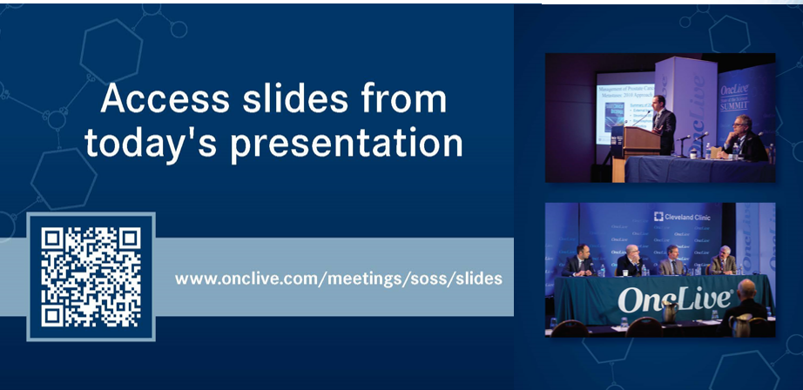

Slide 5


Slide 6


Slide 7
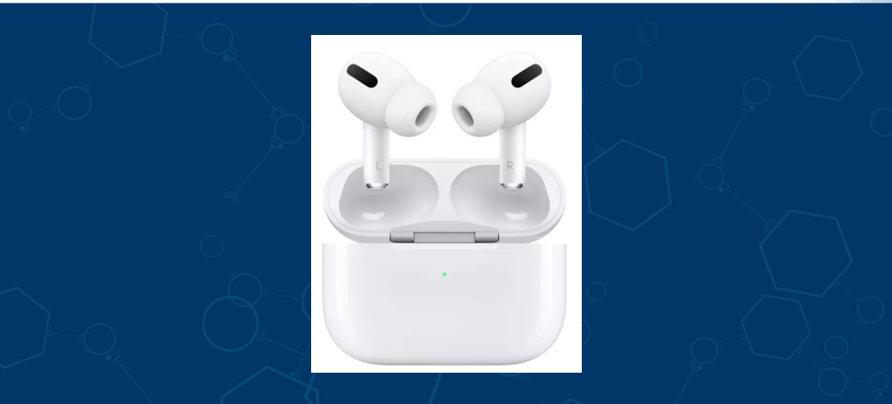

Slide 8
Program Chair
Ulka Vaishampayan, MD
Professor of Internal Medicine
Director of the Phase 1 Program
University of Michigan Health Rogel Cancer Center
Ann Arbor, MI

Slide 9
Management of Non-Metastatic CRPC (nmCRPC)
Clara Hwang, MD
Senior Staff Physician, Clinical Asst. Professor
Henry Ford Health, Wayne State University
Detroit, MI
Notes:
20 minutes

Slide 10
Background
Despite receiving optimal local therapy, patients with localized prostate cancer still experience disease recurrence.
With PSA monitoring, these recurrences are often diagnosed without radiographic evidence of disease
  recurrent non-metastatic prostate cancer
Natural history of non-metastatic prostate cancer is variable

Slide 11
Risk factors for progression to metastatic disease
  PSA doubling time <10 months after RP
  Gleason score 8 to 10 after RP
  interval to biochemical recurrence <18 months
  Gleason score 8 to 10 after RT
ADT recommended for patients with high-risk features
Prolonged ADT can lead to resistance with rising PSA in the absence of metastatic disease
→ non-metastatic castration prostate cancer

Slide 12
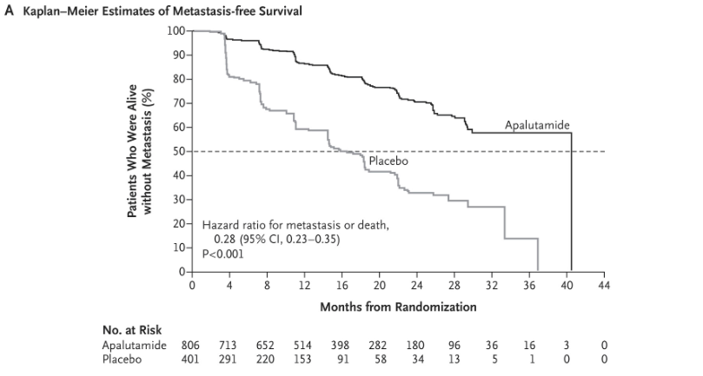
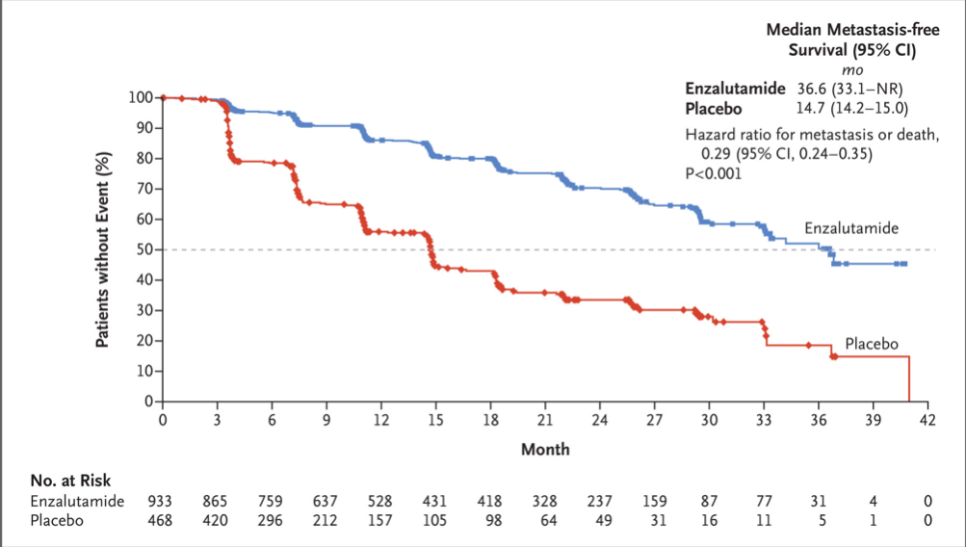
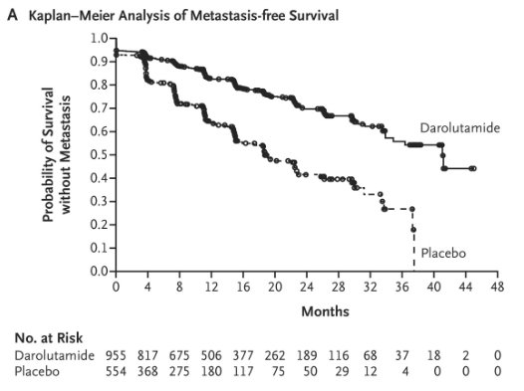
Apalutamide, darolutamide, enzalutamide all improve metastasis-free survival in nmCRPC
  SPARTAN (apalutamide) – NEJM April 12, 2018, approval February 2018
  PROSPER (enzalutamide) – NEJM June 28, 2018, approval July 2018
  ARAMIS (darolutamide) – NEJM March 28, 2019, approval July 2019

Slide 13
Inclusion criteria
PSA doubling time < 10 months despite castrate levels of testosterone
No evidence of metastasis with CT/bone scan
  Apalutamide and darolutamide studies allowed N1 patients
Novel PET imaging not utilized

Slide 14
Efficacy of AR antagonists in nmCRPC
 | SPARTAN | PROSPER | ARAMIS
N | 1207 | 1401 | 1509
mOS | 73.9 vs 59.9 mo (HR 0.78; P=0.016) | 67.0 v 56.3 mo HR 0.73; p=0.001 | NR v NR HR 0.69, p=0.003 3 yr OS 83% v 77%
MFS | 40.5 v 16.2 mo HR 0.28, p<0.001 | 36.6 v 14.7 mo HR 0.29; p<0.001 | 40.4 v 18.4mo HR, 0.41; P < .001
Time to PSA progression | 40.5 v 3.7 mo HR 0.07, p <0.0001 | 37.2 v 3.9 mo HR 0.07, p <0.001 | 33.2 v 7.3 mo HR 0.13, p<0.001
N Engl J Med 2018; 378:1408-1418 European Urology 2021; 79: 150-158
N Engl J Med 2018; 378:2465-2474
N Engl J Med 2020; 382:2197-2206
N Engl J Med 2019; 380:1235-1246t
N Engl J Med 2020; 383:1040-1049
Notes:
N Engl J Med 2018; 378:2465-2474 – original PROSPER report
N Engl J Med 2020; 382:2197-2206 – PROSPER update
N Engl J Med 2019; 380:1235-1246 – initial ARAMIS report
N Engl J Med 2020; 383:1040-1049 – ARAMIS update
N Engl J Med 2018; 378:1408-1418 – initial SPARTAN report
European Urology 2021; 79: 150-158 – SPARTAN update

Slide 15
AE profiles of AR antagonists in nmCRPC
All (gr 3-4) | SPARTAN | PROSPER | ARAMIS
Fatigue | 30.4 v 21.1% (0.9 v 0.3%) | 37 v 16% (4 v 1%) | 12.1 v 8.7% (0.4 v 0.9%)
Hypertension | 24.8 v 19.8% (14.3 v11.8%) | 17 v 6% (6 v 2%) | 6.6 v 5.2% (3.1 v 2.2%)
Rash | 23.8 v 19.8% (5.2 v 0.3%) | 4% v 3% | 2.9 v 0.9% 0.1 v 0%
Arthralgia | 15.9 v 7.5% (0 v 0%) | 13 v 8% (<1 v <1%) | 8.1 v 9.2% (0.3 v 0.4%)
Falls | 15.6 v 9.0% (1.7 v 0.8%) | 18 v 5% (2 v 1%) | 4.2 v 4.7% 0.8 0.7%
Fracture | 11.7 v 6.5 % (2.7 v 0.8%) | 2 v 2% | 4.2 v 3.6% (0.9 v 0.9%)
Cognitive disorder | 5.1 v 3.0% (0 v 0%) | 8 v 2% | 0.4 v 0.2% (0 v 0%)
Seizure | 0.2 v 0% (0 v 0%) | 1 v 1% | 0.2 v 0.2 % (0 v 0%)
Notes:
N Engl J Med 2018; 378:2465-2474 – original PROSPER report
N Engl J Med 2020; 382:2197-2206 – PROSPER update
N Engl J Med 2019; 380:1235-1246 – initial ARAMIS report
N Engl J Med 2020; 383:1040-1049 – ARAMIS update
N Engl J Med 2018; 378:1408-1418 – initial SPARTAN report
European Urology 2021; 79: 150-158 – SPARTAN update

Slide 16
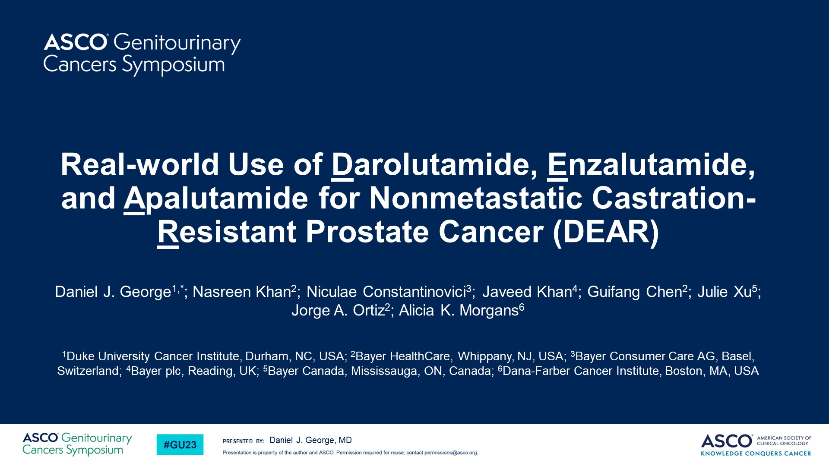
Real-world Use of Darolutamide, Enzalutamide, and Apalutamide for Nonmetastatic Castration-Resistant Prostate Cancer (DEAR)
Content of this presentation is the property of the author, licensed by ASCO. Permission required for reuse.

Slide 17
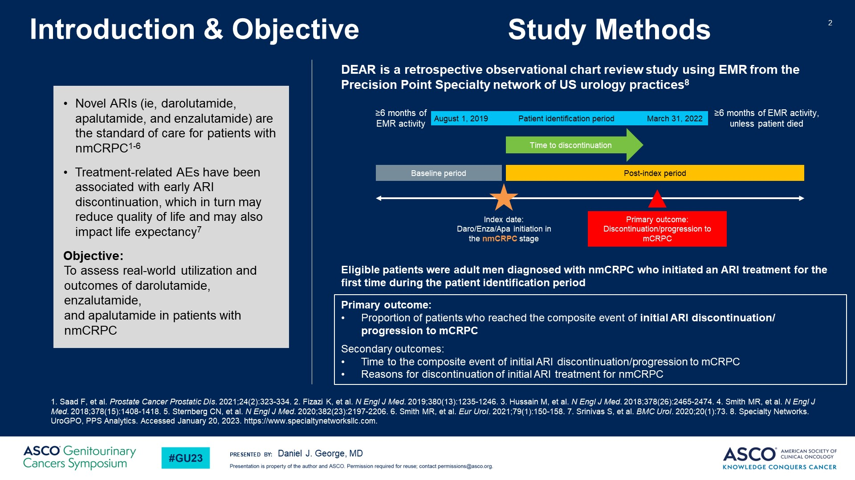
Introduction & Objective
Content of this presentation is the property of the author, licensed by ASCO. Permission required for reuse.

Slide 18
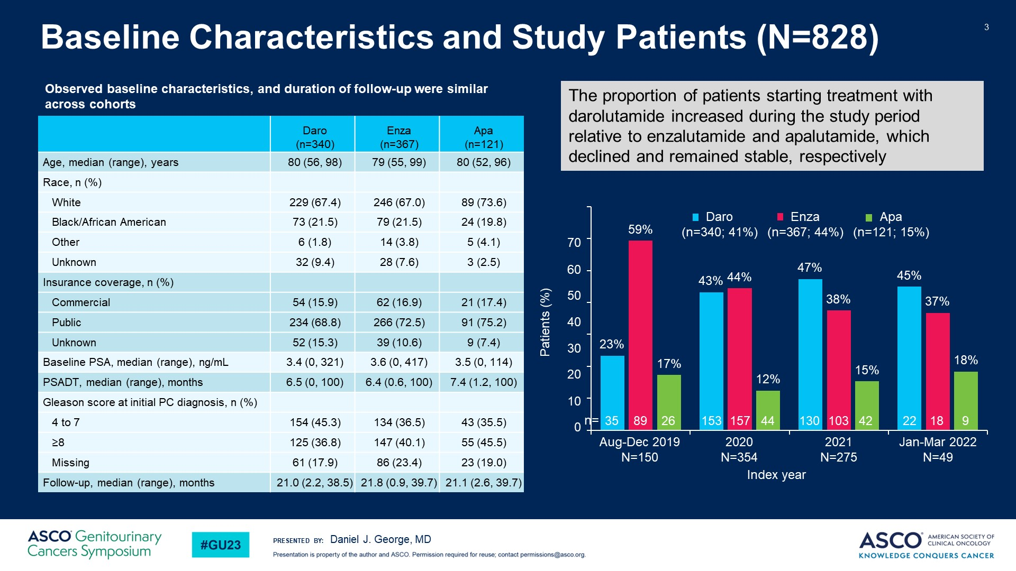
Baseline Characteristics and Study Patients (N=828)
Content of this presentation is the property of the author, licensed by ASCO. Permission required for reuse.

Slide 19
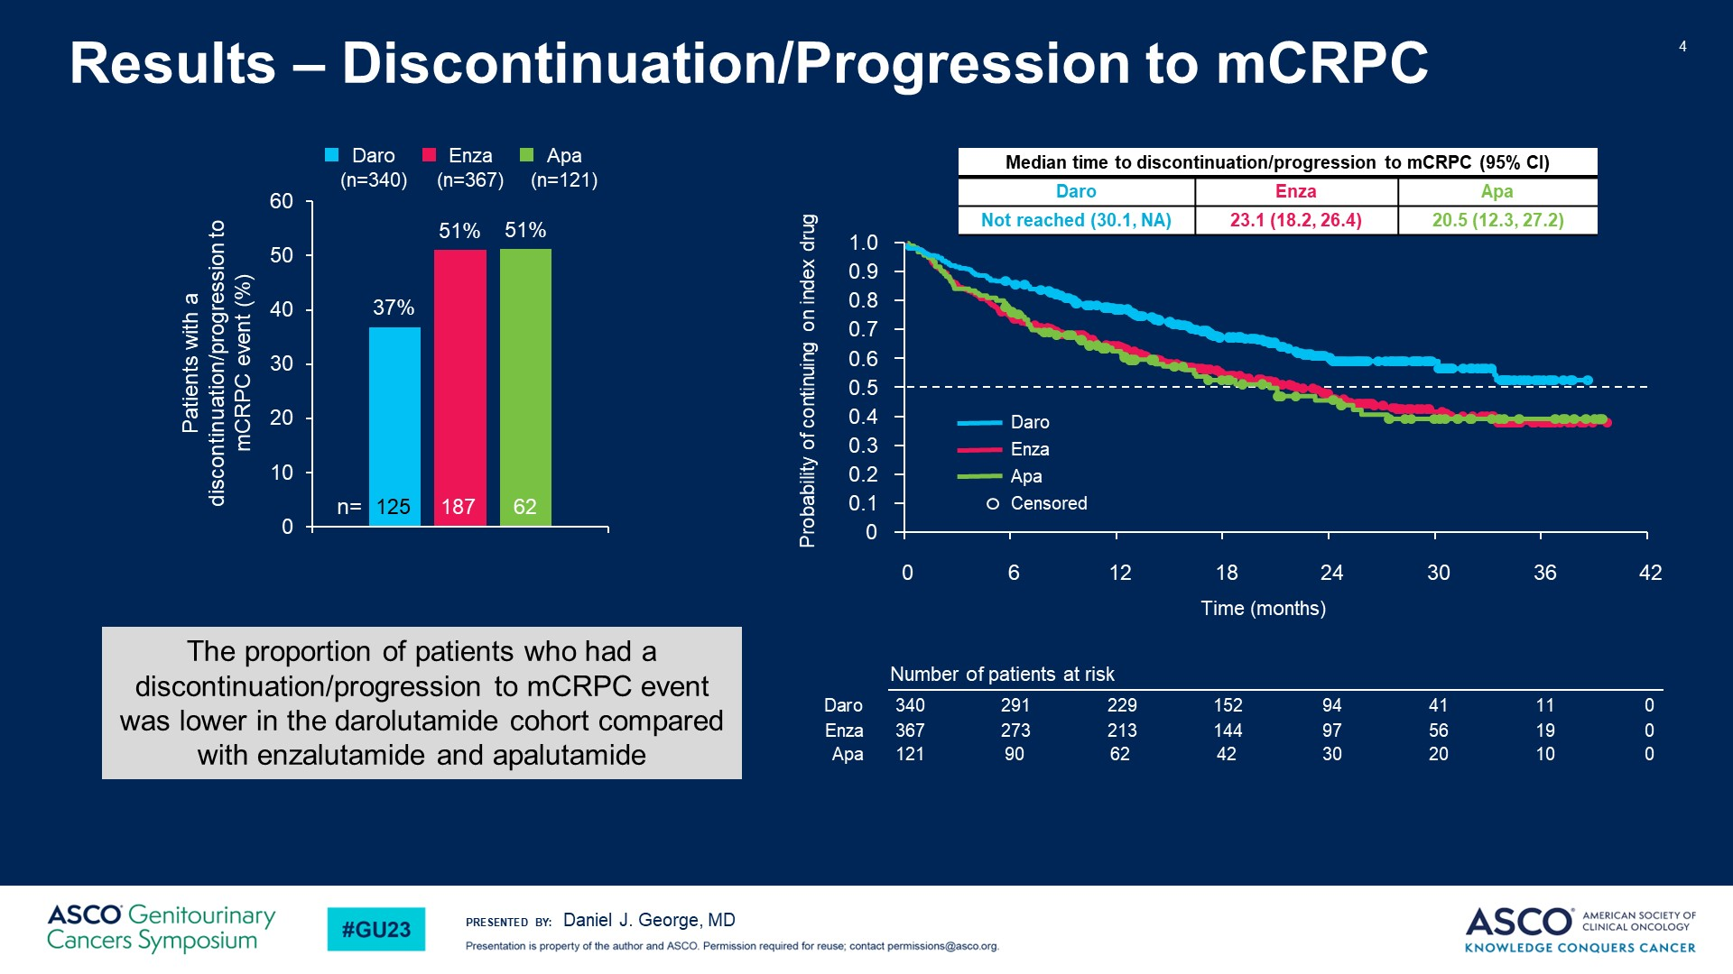
Slide 4
Content of this presentation is the property of the author, licensed by ASCO. Permission required for reuse.

Slide 20
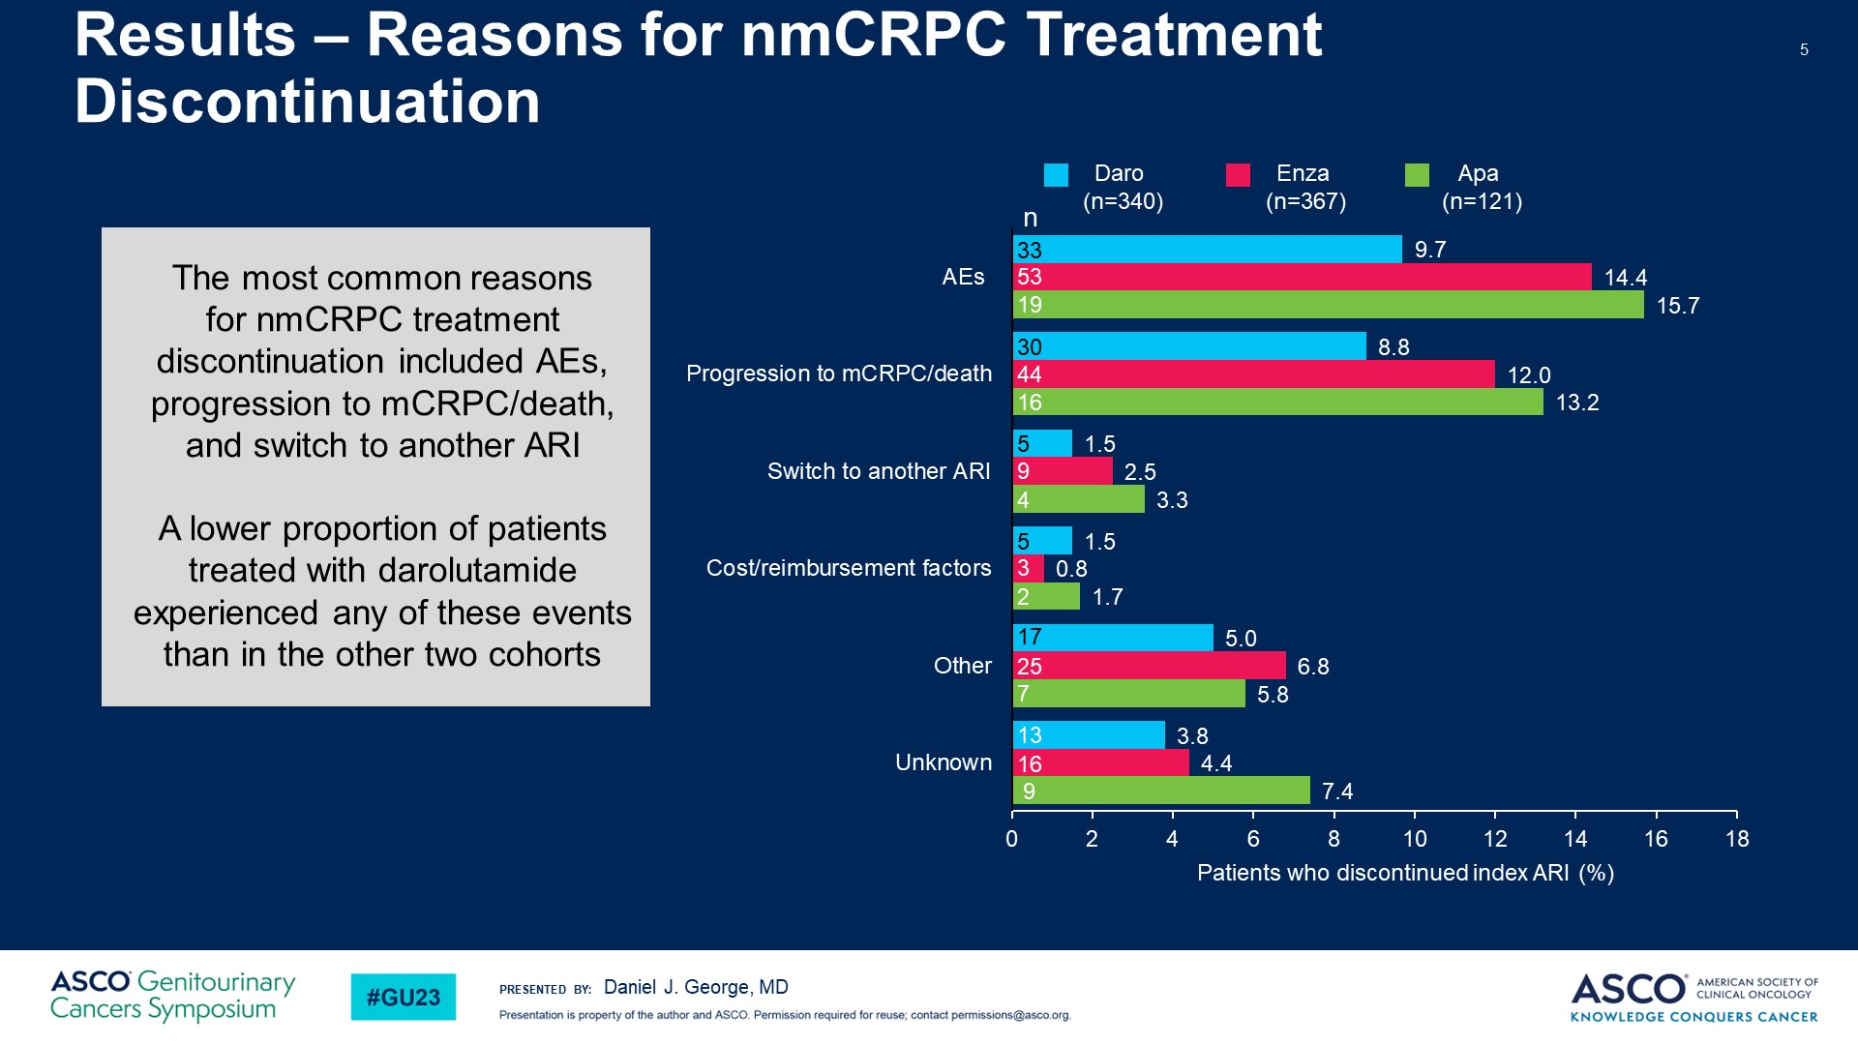
Slide 5
Content of this presentation is the property of the author, licensed by ASCO. Permission required for reuse.

Slide 21
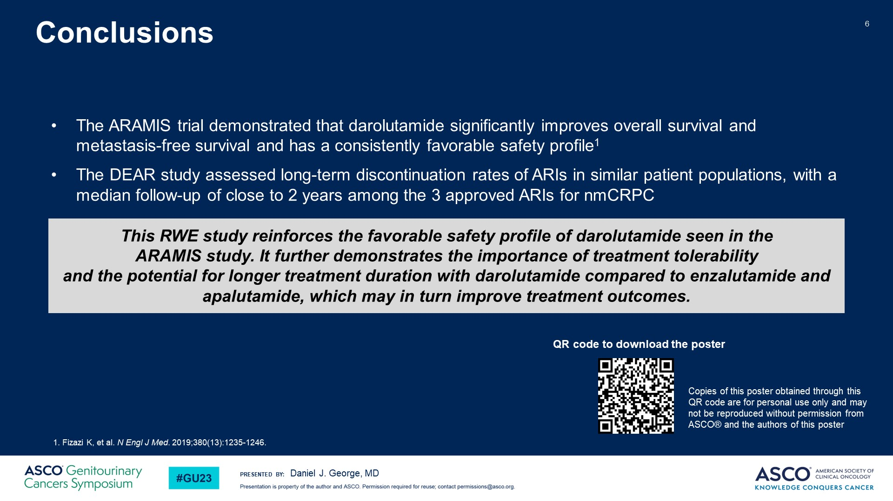
Slide 6
Content of this presentation is the property of the author, licensed by ASCO. Permission required for reuse.

Slide 22
Real-world Use of Darolutamide, Enzalutamide, and Apalutamide for Nonmetastatic Castration-Resistant Prostate Cancer (DEAR)
Content of this presentation is the property of the author, licensed by ASCO. Permission required for reuse.

Slide 23
Introduction & Objective
Content of this presentation is the property of the author, licensed by ASCO. Permission required for reuse.

Slide 24
Baseline Characteristics and Study Patients (N=828)
Content of this presentation is the property of the author, licensed by ASCO. Permission required for reuse.

Slide 25
Slide 4
Content of this presentation is the property of the author, licensed by ASCO. Permission required for reuse.

Slide 26
Slide 5
Content of this presentation is the property of the author, licensed by ASCO. Permission required for reuse.

Slide 27
Slide 6
Content of this presentation is the property of the author, licensed by ASCO. Permission required for reuse.

Slide 28
Risk factors for falls
Older age,
ECOG PS
Neuropathy
α-blocker use
development of arthralgia, or weight loss while on therapy
https://www.nature.com/articles/s41391-022-00592-9
Notes:
https://www.cancertherapyadvisor.com/clinicianpov/prostate-cancer-metastases-androgen-receptor-pathway-inhibitors-apalutamide-2/
SPARTAN update – 2023 ASCO GU post hoc analysis
https://ascopubs.org/doi/abs/10.1200/JCO.2023.41.6_suppl.157
Patients with adverse features more likely to progressed and go on to subsequent therapy; choice of therapy did not seem to impact efficacy outcomes (abi, enza, doce)

Slide 29
AE profiles
Fatigue
Bone loss/fractures
Hypertension
Rash
Hot flashes
Falls
Cognitive changes

Slide 30
Long-term safety and tolerability of darolutamide and duration of treatment in patients with nonmetastatic castration-resistant prostate cancer (nmCRPC) from the ARAMIS Rollover Study
Neal D. Shore,¹ Murilo de Almeida Luz,² Albertas Ulys,³ Jorge A. Ortiz,⁴ Shankar Srinivasan,⁴ Etah Kurland,⁴ Karim Fizazi⁵
¹Carolina Urologic Research Center/Genesis Care, Myrtle Beach, SC; ²Hospital Erasto Gaertner, Curitiba, PR, Brazil; ³Institute of Oncology, Vilnius University, Vilnius, Lithuania; ⁴Bayer HealthCare, Whippany, NJ; ⁵Institut Gustave Roussy, University of Paris-Saclay, Villejuif, France
Disclosures
The ARAMIS study was supported by Orion Corporation, Orion Pharma, and Bayer AG.

Slide 31
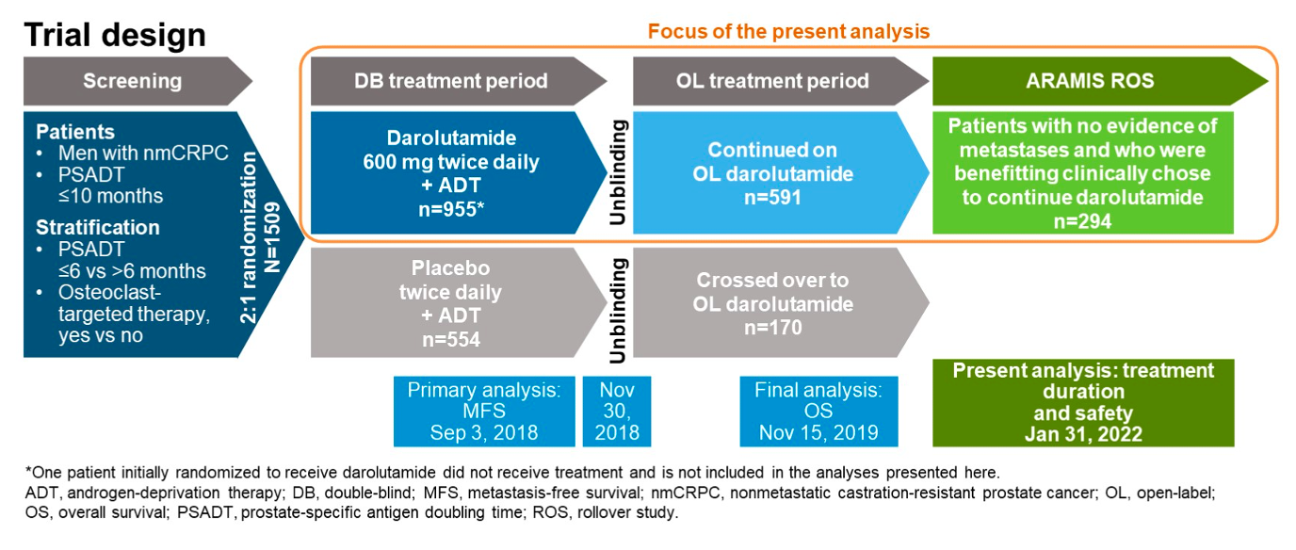
Open-label rollover study (NCT04464226) from the phase 3 ARAMIS trial

Slide 32
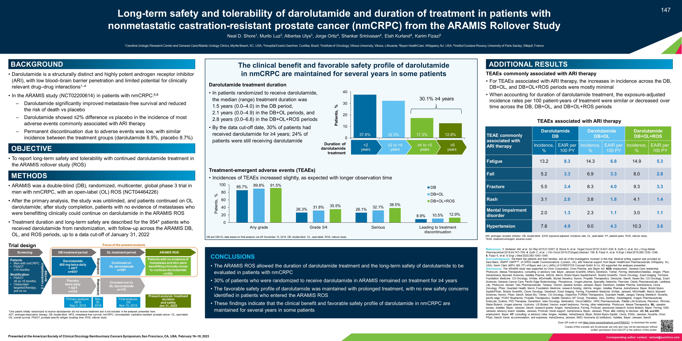
Darolutamide treatment duration
(ARAMIS DB+OL+ROS periods)
Treatment period | Median (range) duration of darolutamide treatment, years
DB | 1.5 (0.0-4.0)
DB+OL | 2.1 (0.0-4.9)
DB+OL+ROS | 2.8 (0.0-6.8)
24% of patients were still receiving darolutamide at the data cut-off

Slide 33
Treatment-emergent adverse events

Slide 34
TEAEs associated with AR inhibitor therapy
Exposure-adjusted incidence rates per 100 patient-years of treatment were similar or decreased over time across the DB, DB+OL, and DB+OL+ROS periods

Slide 35
Conclusions
~30% of patients who were randomized to receive darolutamide in ARAMIS remained on treatment for ≥4 years, suggesting long-term clinical benefit
The favorable safety profile of darolutamide was maintained with prolonged treatment, with minimal increase in TEAEs
  No new safety concerns were identified in patients who entered ARAMIS ROS

Slide 36
Thank you!
Clara Hwang, MD
chwang2@hfhs.org

Slide 37
Treating Metastatic Prostate Cancer
Joshi Alumkal, MD
Professor of Internal Medicine
GU Medical Oncology Section Head
University of Michigan Rogel Cancer Center
Ann Arbor, MI

Slide 38
Treating Metastatic Hormone-Naïve Prostate Cancer
Androgen deprivation therapy (ADT) alone was the standard of care
Recent phase III trials demonstrate improved OS with adding AR signaling inhibitors (ARSIs) (abiraterone, apalutamide, or enzalutamide) or docetaxel to ADT
Fizazi, et al NEJM 2017; Chi, et al NEJM 2019; Davis, et al NEJM 2019, Sweeney, et al 2015

Slide 39
Treating Metastatic Hormone-Naïve Prostate Cancer
Several of these trials helped to define patient subgroups
CHAARTED docetaxel trial
  High volume= visceral metastases and/or 4 or more bone mets, including one beyond the vertebral column and pelvis)
LATITUDE abiraterone trial
  High risk= 2 or more of the following: Gleason >8, visceral mets, 3 or more bone mets
The impact of adding the ARSI darolutamide to ADT was unknown as was the benefit of an ARSI + docetaxel
Sweeney, et al 2015; Fizazi, et al NEJM 2017

Slide 40
ARASENS Trial Demonstrates Improved Survival with the Addition of Darolutamide to ADT + Docetaxel
1:1 randomization to darolutamide vs. placebo
  Primary analysis included 1306 patients
All patients received ADT+ docetaxel
Well-tolerated with similar proportion of Grade 3 events (66.1 vs. 63.5%)
Smith, et al NEJM 2022; GU ASCO ‘23, Abstract 148

Slide 41
Post-hoc analysis by volume
  Volume definition from CHAARTED does not show an improvement with adding darolutamide in “low-volume”
  Disease status definition from LATITUDE does show a benefit in “low risk”
High volume
Low volume
High risk
Low risk
Hussain, et al Genitourinary Cancer 2023

Slide 42
PEACE-1 trial of ADT + docetaxel +/- abiraterone did not show a benefit of triple therapy in low-volume
Fizazi, et al Lancet 2022

Slide 43
Key Takeaways from Hormone-Naive Data
If you are using ADT+ docetaxel, we have 2 trials showing a benefit with adding an ARSI
Worth considering ADT/docetaxel + darolutamide or + abiraterone in fit men with high-volume/high-risk disease
Key question: Is docetaxel necessary, or is an ARSI + ADT sufficient for most patients?

Slide 44
Targeting Homologous Recombination DNA Repair (HRD) is a Promising New Treatment Approach in CRPC
PROFOUND trial
  Men with CRPC who had received at least 1 ARSI; prior docetaxel was allowed but not required
    Cohort A: BRCA1, BRCA2, ATM (n=245)
    Cohort B: 12 other pre-specified genes (n=142)
  1:1 with ARSI vs. olaparib
  Primary EP= rPFS (Cohort A); rPFS (Both cohorts); OS (Cohort A)
  Improved rPFS and OS in Cohort A and improved rPFS in Cohort A and B combined
  Olaparib approved for CRPC patients with prior ARSI with any Cohort A or B alteration
  Rucaparib also approved for CRPC patients with prior ARSI and docetaxel therapy with BRCA1/2 alterations
Cohort A
Cohorts A+B
De Bono, et al NEJM 2022; Hussain, et al NEJM 2022; Abida, et al JCO 2022
FoundationOne CDx

Slide 45
Niraparib + Abiraterone Demonstrates an rPFS Benefit in Patients with HRD Alterations
MAGNITUDE trial
  Men with CRPC who were abi-naïve randomized to niraparib + abi/pred vs. placebo + abi/pred
    Stratified by HRD status +: ATM, BRCA1, BRCA2 BRIP1, CDK12, CHEK2, FANCA, HDAC2, PALB2 (n=423) and - (n=247) patient cohorts
  Primary EP= rPFS in BRCA1/2 subgroup and the full HRD+ subgroup
  Improved rPFS in BRCA1/2 and full HRD groups
  HRD- cohort met futility endpoint
  OS not significant in BRCA1/2 subgroup
  FDA considering niraparib + abi/pred for HRD+ CRPC patients with gene alterations included in the study
rPFS BRCA1/2 subgroup
FoundationOne CDx
AmoyDx blood/tissue
Resolution plasma HRD
Local tumor testing
GU ASCO ’23, Abstract 170; Chi, et al JCO 2023; Chi, et al Annals Oncology 2023

Slide 46
Olaparib + Abiraterone Demonstrates an rPFS Benefit in Patients with BRCA1/2 Alterations
PROPEL trial
  Men with CRPC who were abi-naïve randomized to olaparib + abi/pred (n=399) vs. placebo + abi/pred (n=397)
    No stratification by HRD status (+ and - patient patients included)
    ~28% HRD+, ~70% HRD-
  Primary EP= rPFS
  Improved rPFS
    Subgroup analysis showed greatest benefit in patients with BRCA1/2 mutated tumors
      OS also improved in these patients
    Subgroup without BRCA1/2 mutations with significantly lower improvement in rPFS and no OS benefit
  FDA approved olaparib + abi/pred for BRCA1/2+ CRPC patients
HRD+ group
HRD- group
Clarke, et al NEJM Evidence 2022
FoundationOne CDx
FoundationOne Liquid CDx

Slide 47
Talozaparib + Enzalutamide Demonstrates an rPFS Benefit in Patients with HRD Alterations
TALAPRO-2 trial
  Men with CRPC who were enza-naïve randomized to talozaparib + enza (n=402) vs. placebo + enza (n=403)
    Stratified by HRD + (ATM, ATR, BRCA1, BRCA2, CDK12, CHEK2, FANCA, MLH1, MRE11A, NBN, PALB2, or RAD51C) and -/unknown patient cohorts
    ~21% were HRD+, ~51% HRD-, ~27% unknown
  Primary EP= rPFS in all comers
  Improved rPFS in all comers and HRD+ cohort
    Lesser benefit in HRD-/unknown cohort
  FDA approved talozaparib + enza for HRD+ CRPC patients with gene alterations included in the study
All comers
HRD+ group
FoundationOne CDx
FoundationOne Liquid CDx
Agarwal, et al Lancet 2023

Slide 48
Key Takeaways from PARP Inhibitor Data
All men with metastatic disease should undergo germline HRD testing per NCCN
Now that several PARP inhibitors are approved, all CRPC patients should undergo somatic tumor testing for HRD
Olaparib is approved for post-ARSI CRPC patients with HRD+
Rucaparib is approved for post-ARSI, docetaxel CRPC patients with BRCA1/2 alterations
Olaparib+ abi/pred is approved for CRPC patients with BRCA1/2 alterations
Talazoparib+ enza is approved for CRPC patients with HRD+
Await FDA verdict on niraparib + abi/pred in those with CRPC with HRD+
ARSIs are now given frontline + ADT
  The value of adding PARP inhibitors to an ARSI at time of castration/ARSI-resistance vs. switching to single agent PARP inhibitor in these patients is unclear

Slide 49
Advanced Prostate Cancer:
Novel Agents and Pathways
Zachery R. Reichert, MD, PhD
Clinical Associate Professor
University of Michigan
Ann Arbor, MI

Slide 50
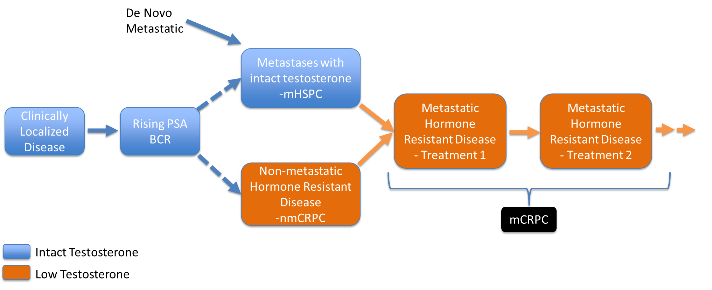
Scher Model (PCWG3)
Aggressive Variant
Cabazi/Carbo
(Doce/Carbo)
Docetaxel
Abiraterone
Cabazitaxel
Docetaxel
Enzalutamide
Radium
Sipuleucel-T
Scher et al JCO 2018

Slide 51
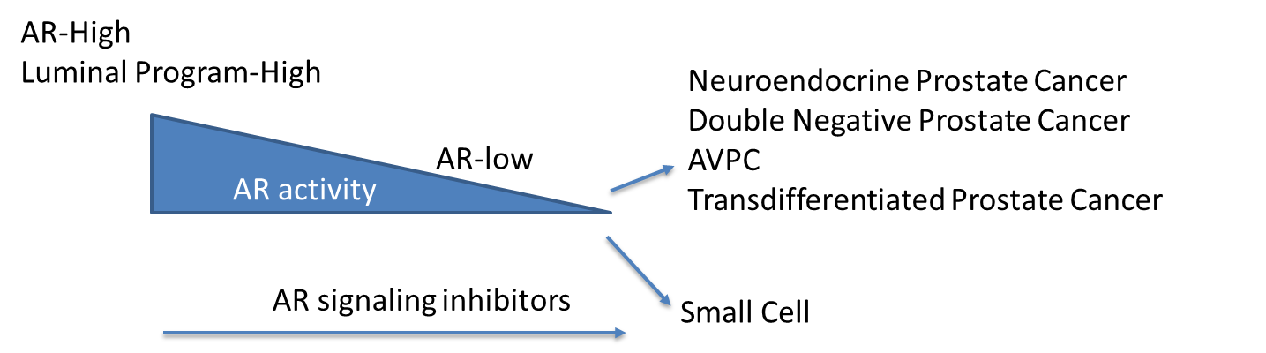
New World
Platinum Doublets?
Docetaxel
Abi, Apa, Daro, Enza
XRT (primary, mets)
Combinations
XRT (Oriole/Stomp)
Enza (ADT)
Abiraterone
Cabazitaxel
Docetaxel
Enzalutamide
Lu-PSMA
Olaparib, Talazoparib, Rucaparib
Radium
Sipuleucel-T
Pembrolizumab
Bipolar Testosterone
Combinations
Apa, Enza, Daro
Scher et al JCO 2018
Notes:
Besides rearranging where everything sites (typically to earlier and/or with combos) focus on one clinical class (stem-like) and one technologic improvement (actinium)

Slide 52
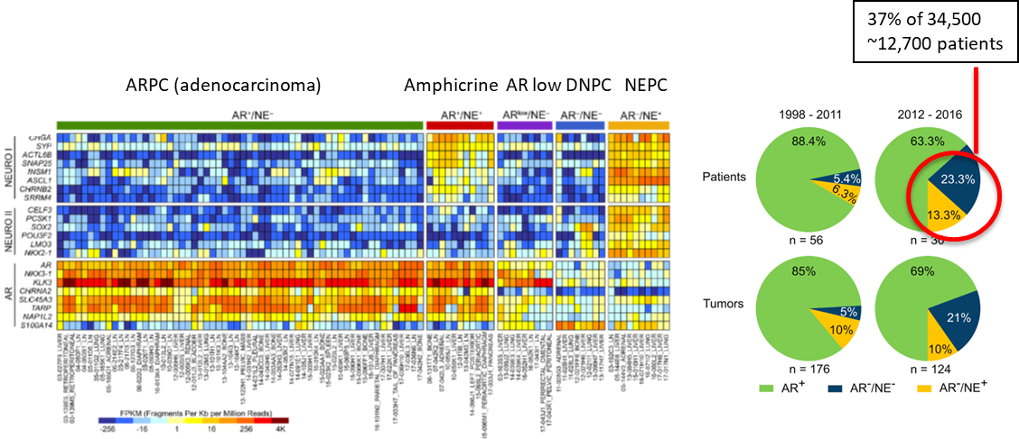
AR Pathway Loss Tumors are a Continuum and These Subsets are Increasing in Frequency
Rising Problem
Labrecque, et al JCI 2019; Bluemn, et al Cancer Cell 2017

Slide 53
Model of Therapy-Induced Lineage Plasticitiy
AR-High
Luminal Program-High
Neuroendocrine Prostate Cancer
Double Negative Prostate Cancer
AVPC
Transdifferentiated Prostate Cancer
AR activity
AR-low
AR signaling inhibitors
RB1/p53/PTEN loss, JAK/STAT signaling,
Epigenetic Reprogramming, DLL3 signaling
Nyquist, et al. Cell Rep. 2020
Labrecque, et al JCI 2019
Bluemn, et al Cancer Cell 2017
Ku, et al. Science 2017
Mu, et al. Science 2017

Slide 54
Selection of Studies Targeting Lineage Plastic Prostate Cancer
Epigenetic inhibitors (bromodomain)
JAK/STAT inhibition
Combination of immunotherapy agent
Bispecific antibodies (DLL3)
Notes:
DLL3 tarlatamab

Slide 55
Evolution of Radiopharmaceuticals
Radium
Lu-PSMA
What Next?
Notes:
Prior to radium, strontium, samarium

Slide 56
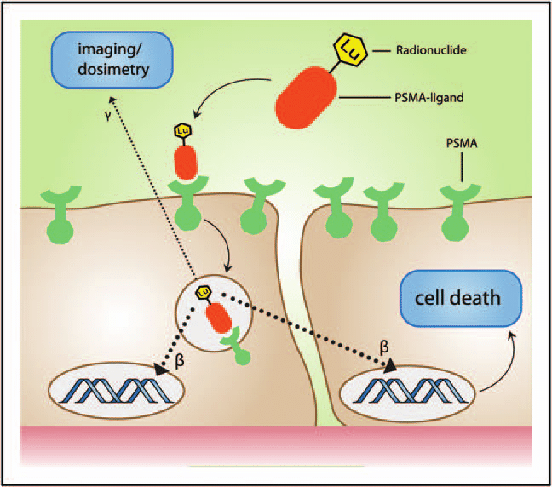
Radionuclides
Lu-PSMA
²²³Ra Replacing Ca
in Bone Matrix
Goldberg, UroToday 2019
Sartor et al, NEJM 2021

Slide 57
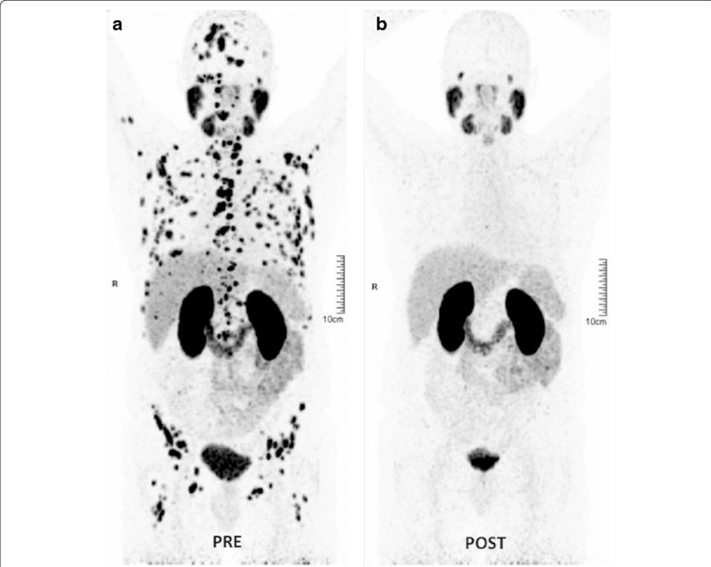
Garcia-Figueiras, Insights into Imaging 2019

Slide 58
Areas of Improvement
Different penetration, half-lives (Iodine, Actinium)
Combinations
Different ways to deliver it (antibody vs small molecule)
Targets beyond PSMA

Slide 59
Future of Prostate Cancer
Therapy is Exciting
Right Patient
Right Therapy
Right Time
Minimal Risk Profile

Slide 60
Question-and-Answer

Slide 61
Networking Reception
We will resume at 7:50pm

Slide 62
Front Line Management RCC
Sarah Yentz, MD
Clinical Assistant Professor
University of Michigan
Ann Arbor, MI

Slide 63
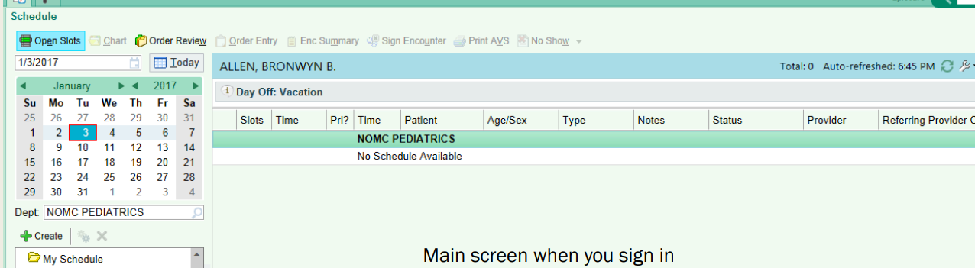
Front Line Metastatic RCC
60 yo p/w weight loss and anemia . CT AP showed a 10cm L sided kidney mass and lung nodules

Slide 64
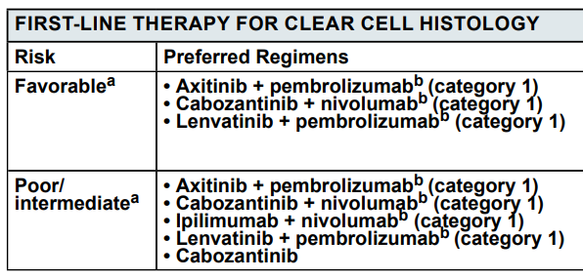


Slide 65
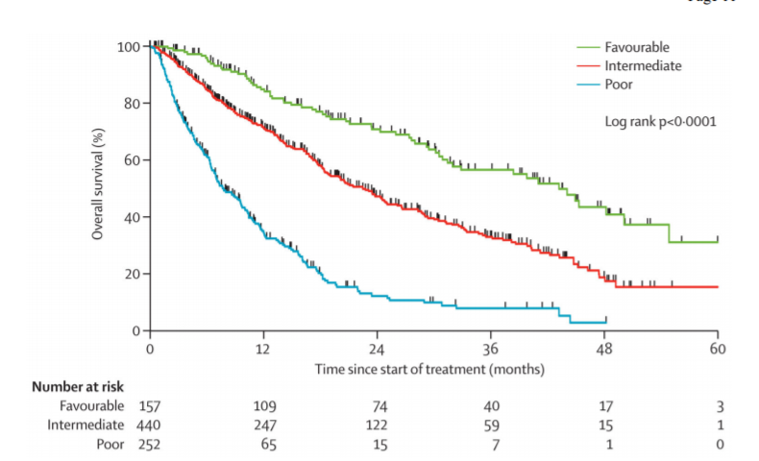
IMDC Prognostic Model- TKI era
IMDC Risk Criteria
<1 year from time of diagnosis to systemic therapy
Karnofsky Performance Status <80%
Hemoglobin <lower limit of normal
Corrected Calcium > upper limit of normal
Neutrophils >upper limit of normal
Platelets > upper limit of normal
80%
20%
Favorable= 0
Intermediate= 1-2
Poor= 3 or more
Notes:
Prognostic risk groups, not predictive- developed in the TKI only era
Data a bit more clear in the int/poor risk group and that makes up the majority of our pts so will start there
0- favorable, 1-2 intermediate, 3 or more poor
IMDC developed in ~650 pts, validated in 1000
International Metastatic RCC Database Consortium
2008-2011
Heng DY, Xie W, Regan MM, Harshman LC, Bjarnason GA, Vaishampayan UN, Mackenzie M, Wood L, Donskov F, Tan MH, Rha SY, Agarwal N, Kollmannsberger C, Rini BI, Choueiri TK. External validation and comparison with other models of the International Metastatic Renal-Cell Carcinoma Database Consortium prognostic model: a population-based study. Lancet Oncol. 2013 Feb;14(2):141-8. doi: 10.1016/S1470-2045(12)70559-4. Epub 2013 Jan 9. PMID: 23312463; PMCID: PMC4144042.

Slide 66
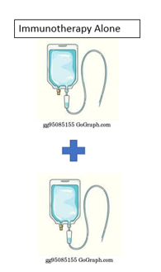
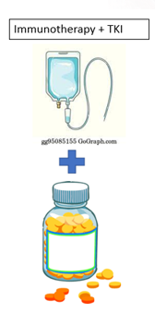
Checkmate 9ER
Cabo 40 + nivo
Keynote 426
Axitinib 5 BID + pembro
CLEAR Trial
Lenvatinib 20 + pembro
Checkmate 214
Ipi 1mg/kg + nivo 3mg/kg followed by nivo maintenance
All compared to Sunitinib- All Beat Sunitinib

Slide 67


How to Choose?
Durable Control Off Therapy
Response Rate
Efficacy
Toxicity
Short Term
Long Term

Slide 68
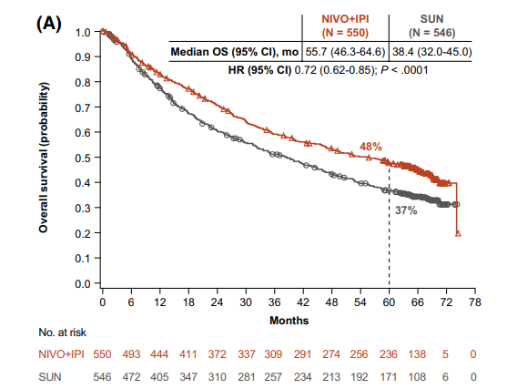
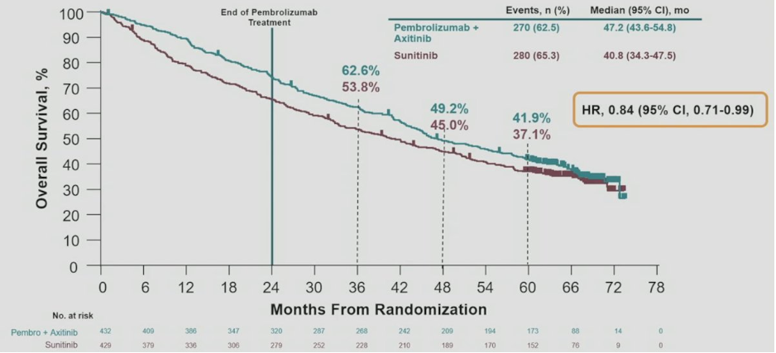
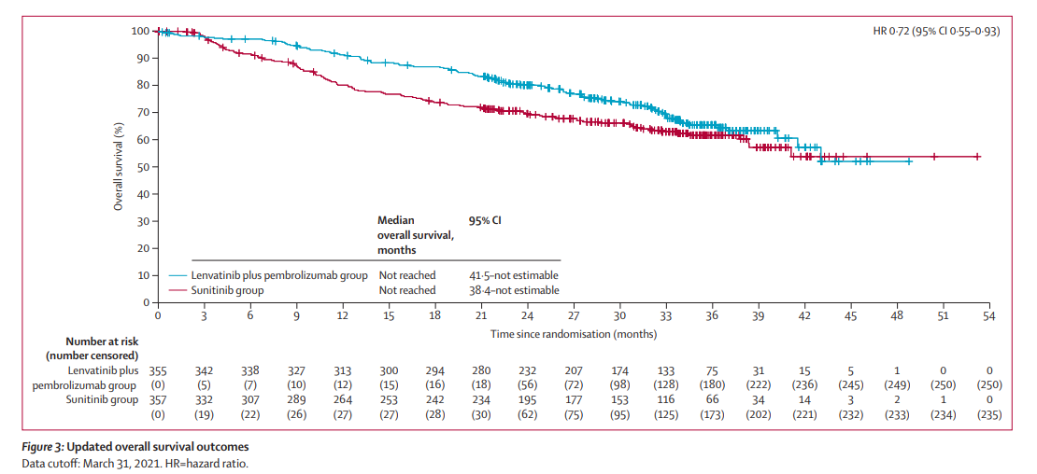
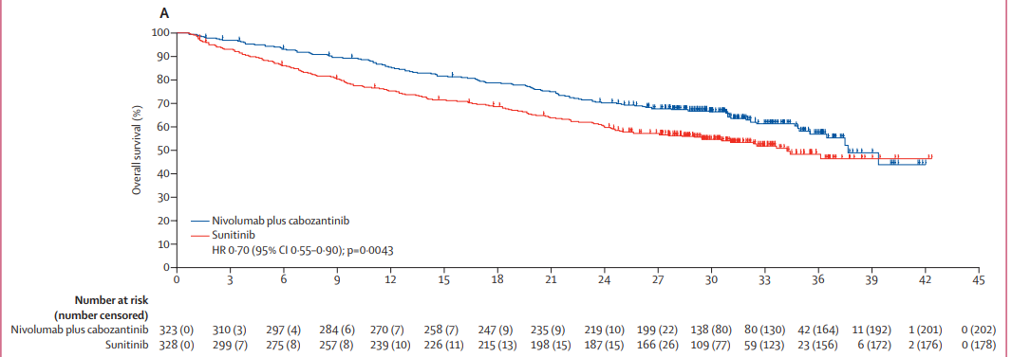
Ipi/Nivo
Axi/Pembro
Median OS= 47mo
Median OS= 55mo
Len/Pembro
Cabo/Nivo
Median OS= 49.5mo
Median OS= not reached
Notes:
Graphs are in all risk types
https://pubmed.ncbi.nlm.nih.gov/35383908/
https://dailynews.ascopubs.org/do/checkmate-9er-update-survival-better-first-line-nivolumab-cabozantinib-versus-sunitinib
https://www.urotoday.com/conference-highlights/asco-2023/asco-2023-kidney-cancer/144965-asco-2023-pembrolizumab-axitinib-versus-sunitinib-as-first-line-therapy-for-advanced-clear-cell-rcc-5-year-analysis-of-keynote-426.html

Slide 69
Durable Response off Therapy
At 42 mo, 18% of ipi/nivo pts are alive and treatment free
Ipi/Nivo
Axi/Pembro
Notes:
https://www.ncbi.nlm.nih.gov/pmc/articles/PMC9357269/

Slide 70
Response Rate
 | Ipi/Nivo | Axi/Pembro | Cabo/Nivo | Len/Pem
RR | 42% | 60% | 55% | 71%
CR | 10% | 11% | 12% | 17%
Progression | 19% | 12% | 6% | 5%
Notes:
https://www.sciencedirect.com/science/article/pii/S2059702920327642
https://www.onclive.com/view/long-term-keynote-426-data-continue-to-support-frontline-pembrolizumab-plus-axitinib-as-soc-for-advanced-ccrcc
https://dailynews.ascopubs.org/do/checkmate-9er-update-survival-better-first-line-nivolumab-cabozantinib-versus-sunitinib

Slide 71
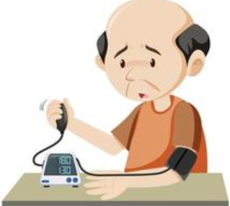
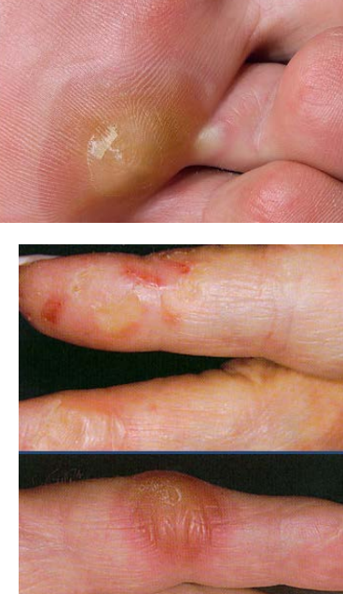
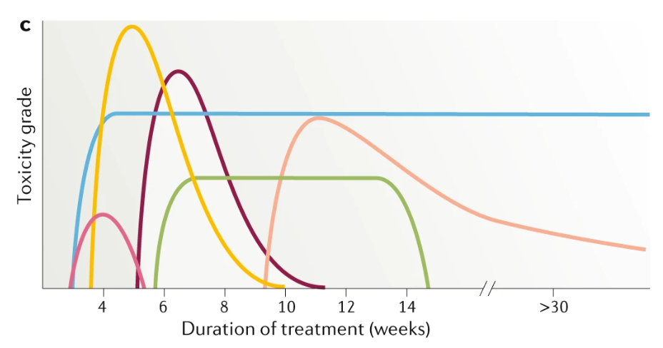

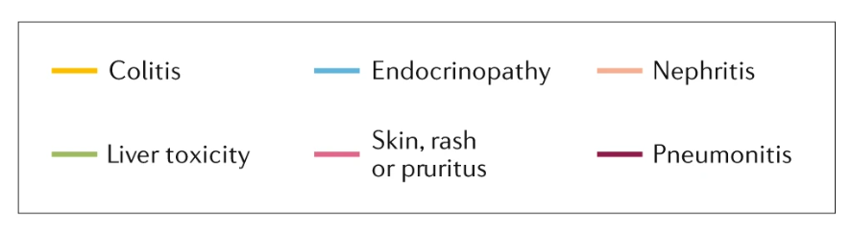
Toxicity
Higher chance of IRAEs w ipi/nivo
35% require prednisone vs ~20% w cabo/nivo
TKI
Notes:
Martins, F., Sofiya, L., Sykiotis, G.P. et al. Adverse effects of immune-checkpoint inhibitors: epidemiology, management and surveillance. Nat Rev Clin Oncol 16, 563–580 (2019). https://doi.org/10.1038/s41571-019-0218-0

Slide 72
Ipi/Nivo
Pro:
Potential for off treatment time
Preserves other options for progression
Avoids continued TKI toxicity
Less confusion re: which treatment is causing benefit/toxicity
Con:
Lower RR

Slide 73
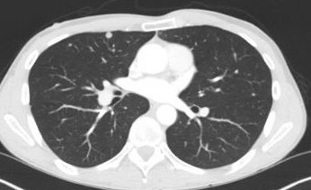
Case Presentation 1
44 y.o. with metastatic RCC. Presented with weight loss and anemia . CT AP showed a 10cm L sided kidney mass and sub-cm lung nodules. Underwent nephrectomy showing an 11cm clear cell RCC
CT 2 mo after diagnosis showed growth in lung nodules
Karnofsky PS >80%, hgb, platelet, neutrophil and calcium wnl

Slide 74
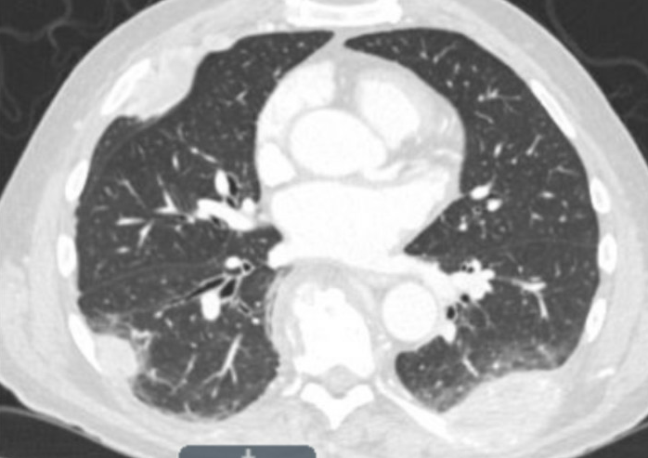
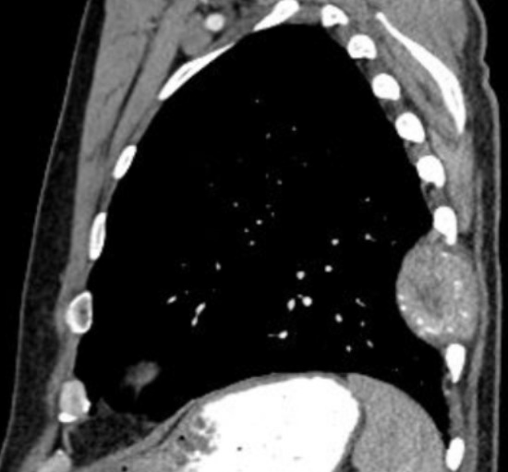
Case Presentation 2
61 yo had a nephrectomy for a pT3b clear cell RCC in 2020.
2021 develop back pain and R leg weakness.
CT CAP showed widespread lung mets, destructive lesions in T7, T8, T9 and L3 with the T8 lesion causing cortical breakthrough
Karnofsky PS <80%, hgb 10.4, plt, neutrophils and calcium normal

Slide 75
Translating Data to Clinical Practice
44 yo s/p nephrectomy now w/ small growing lung nodules
Low volume disease and Young→
  Willing to “roll the dice”
  Trading off chance of progressive disease w/ chance of long term durable control
  If he gets a CR he could come off therapy

Slide 76
Translating Data to Clinical Practice
61 yo s/p nephrectomy with widespread lung mets and bone mets w/ bone pain from mets
Symptomatic
  Not willing to “roll the dice”
  Need a response and can’t take chance he might be in the 20% primary progressor group

Slide 77
Favorable Risk
Different Type of Disease
May do well no matter what we do
Some may be less immunotherapy responsive
Do we need to treat at all?
Can we do oligomet treatment?
Is Ipi/nivo contraindicated?

Slide 78
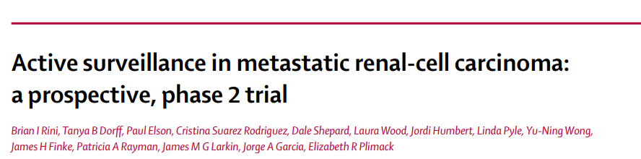
Favorable Risk: Watch and Wait
median time on surveillance = 14·9 months
Notes:
https://www.sciencedirect.com/science/article/pii/S1470204516301966?via%3Dihub 2016

Slide 79
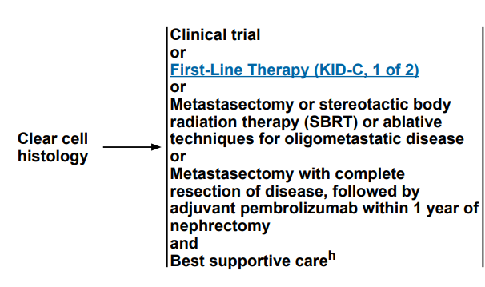
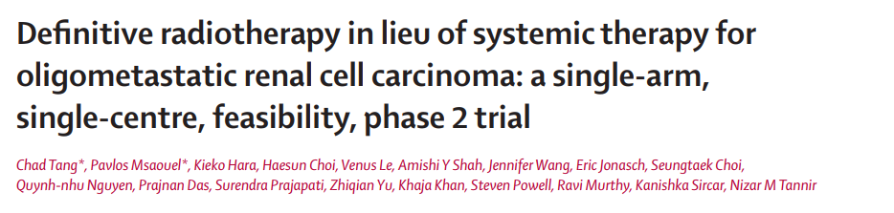
Oligometastatic Treatment
1-year systemic therapy-free survival probability of 82%

Slide 80
Ipi/Nivo in Favorable Risk?

Slide 81
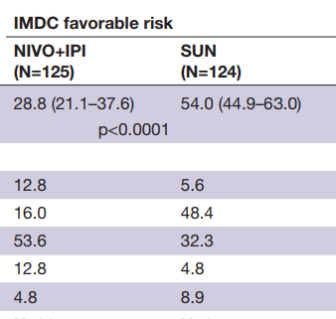
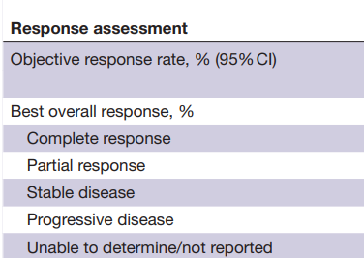
Ipi/Nivo: Favorable Risk
Notes:
https://www.ncbi.nlm.nih.gov/pmc/articles/PMC7359377/

Slide 82
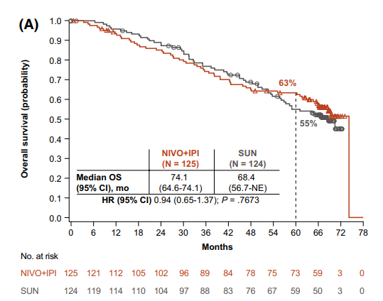
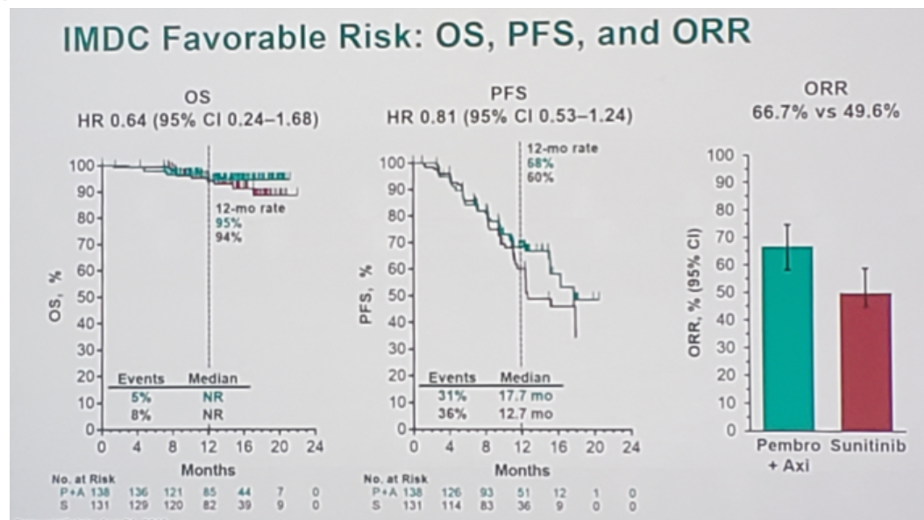
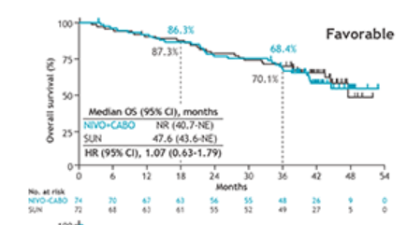
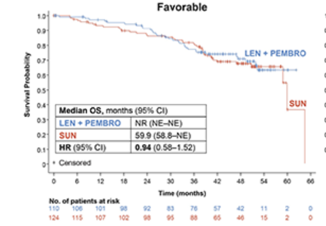
Overall Survival- Favorable Risk
Ipi/Nivo
Axi/Pembro
Cabo/Nivo
Len/Pembro

Slide 83
Overall Survival- Favorable Risk
Ipi/Nivo
19.5% were treatment-free at 42 mo

Slide 84
How do I treat?
Int/Poor Risk with Significant Symptoms
Favorable Risk
Int/Poor Risk
Depends
Ipi/Nivo
TKI/immunotherapy

Slide 85
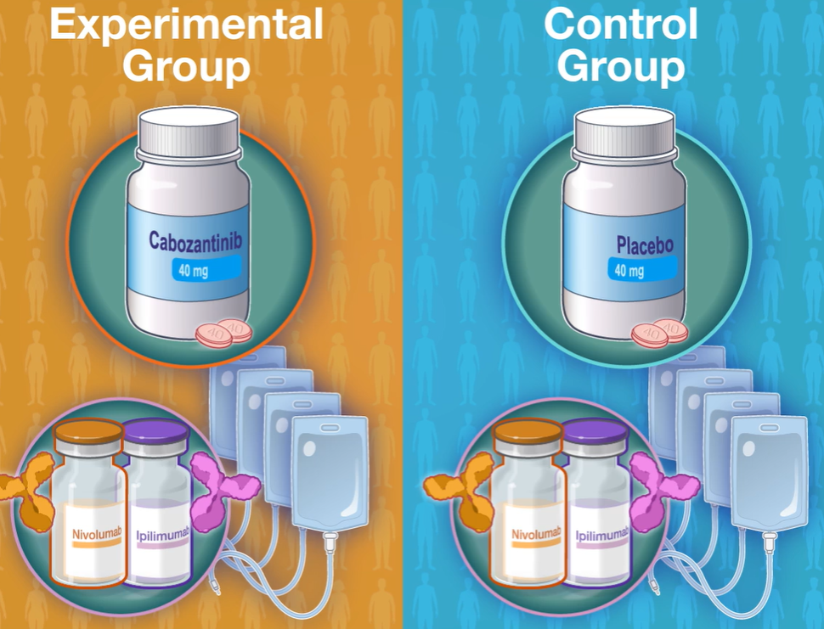
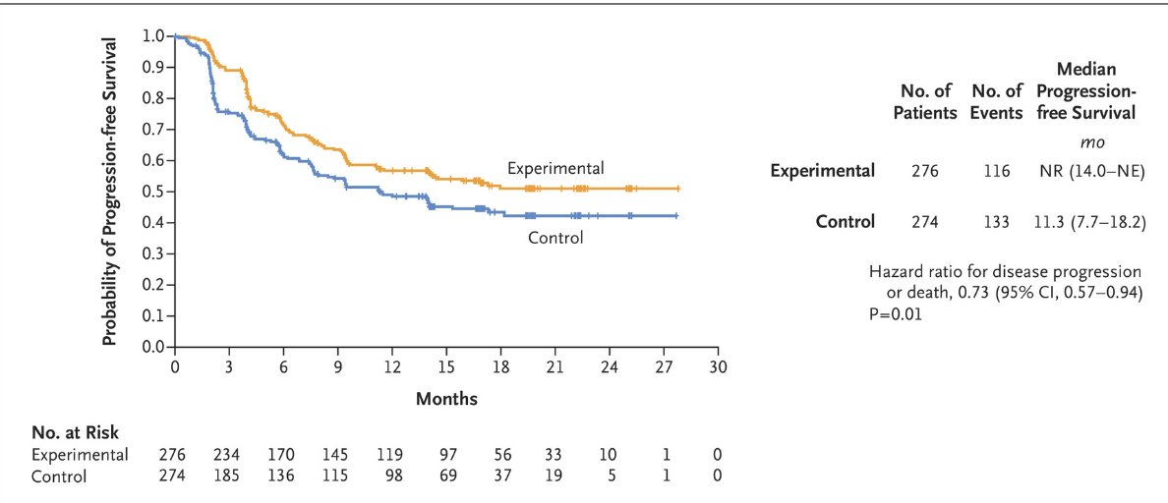
Cosmic 313
Int/Poor Risk
PFS

Slide 86
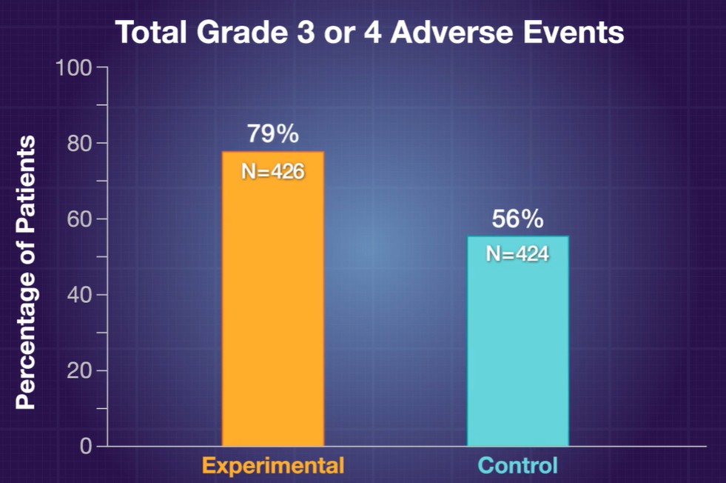
Cosmic 313
High Dose Prednisone
Ipi/Nivo/Cabo: 58%
Ipi/Nivo: 35%
Too early to know OS benefit
Given high toxicity, not ready for prime time yet

Slide 87
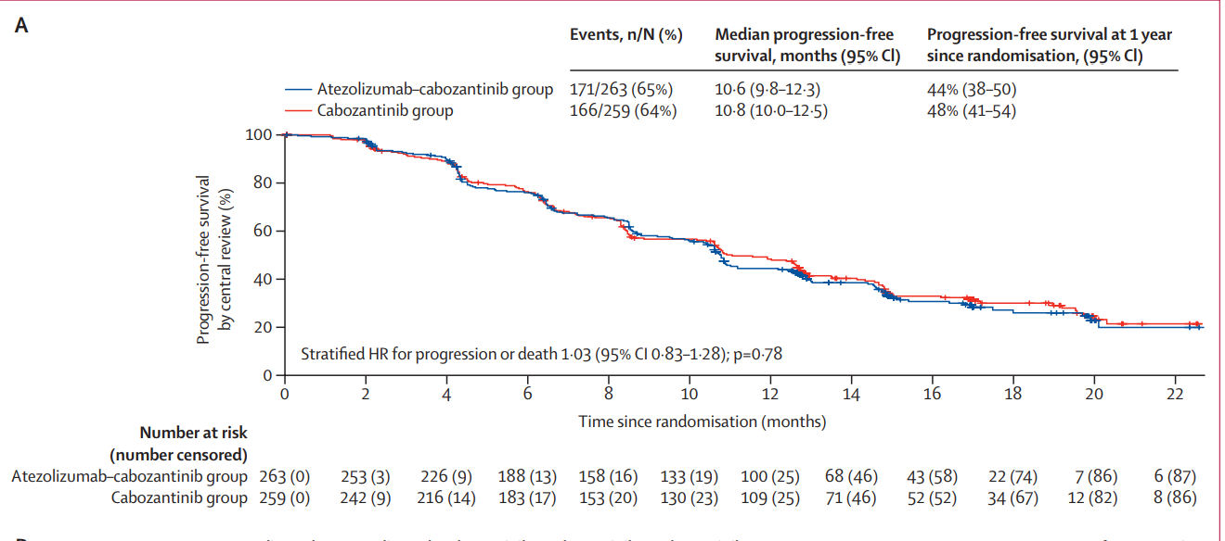
Contact-03
Progression either during or after immune checkpoint inhibitor therapy in the first-line (55%) or second-line (45%)
Cabozantinib 60mg
~250 pts
Cabozantinib 60mg
+ Atezolizumab
~80 pts
If progress on TKI/immuno, just switch to different TKI, don’t continue the immunotherapy
Notes:
1st line treatment: 31% ipi/nivo, 35% TKI, 14% axi/pembro
2nd line: 87% nivo

Slide 88
Summary
4 good front line options
  Differ in short term (RR) and long term (durable control off therapy) endpoints
Favorable risk requires asking additional questions
  Watch/wait, oligomet treatment, understand risk/benefit of ipi/nivo in these pts
Contact-03 indicates little benefit to continuing pd-1 drug after progression

Slide 89
Mitigating TKI-Based Toxicities in Patients with RCC
Shawna Kraft, PharmD, BCOP
Clinical Pharmacist Specialist
Rogel Cancer Center
Clinical Associate Professor
University of Michigan College of pharmacy
Ann Arbor, MI

Slide 90
Objectives
Discuss management of vascular endothelial growth factor (VEGF) inhibitor induced hypertension
Present alternative options for mucositis/stomatitis treatment
Review management of hand foot syndrome

Slide 91
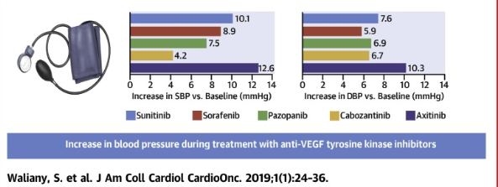
Affect on Blood Pressure
Onset within 6 weeks
Incidence
Axitinib 40.1%
Pazopanib 35.9%
Cabozantinib 32.9%
Sunitinib 21.6 %
Lenvatinib 45%
Tivozanib 45%
J Am Coll Cardiol CardioOnc. 2019;1(1):24-36; Fotivda [package insert]. AVEO Pharmaceuticals, Inc. Boston, MA 2021; Lenvima [package insert]. Eisai Inc. Nutley, NJ 2022

Slide 92
Hypertension definition
  ACC/AHA guidelines: ≥ 140/90 mm Hg
    Goal <130/80
  CTCAE v5.0
    Grade 1 SBP 120-139/ DBP 80-89
    Grade 2 SBP 140-159/ DBP 90-99
    Grade 3 SBP ≥160/ DBP ≥ 100
  VEGF Package Inserts
    Grade 3 or >150/100
ACC: America College of Cardiology
AHA: American Heart Assocation
CTCAE: common toxicity criteria for adverse effects
Hypertension. 2020;75((6)):1334–57; Trends Cardio Med 2020. 30(3):160-164; CTCAE v5.0

Slide 93
Management of VEGF inhibitor induced hypertension
Thiazide/thiazide like diuretics
ACE inhibitors
ARBs
Calcium channel blockers
  Dihydropyridines (e.g. amlodipine)
  Nondihydropyridines (e.g. diltiazem)
Betablockers
Central alpha-2 agonist (e.g. clonidine)
Direct vasodilators (e.g. hydralazine)
ACE: angiotensin converting enzyme
ARB:angiotensin receptor blocker
HypertensionVolume 71, Issue 6, June 2018; Pages e13-e115
J Am Coll Cardiol CardioOnc. 2019;1(1):24-36; J Am Heart Assoc. 2023;12:e028050

Slide 94
Management of VEGF inhibitor induced hypertension
Front Line: ACC/AHA
Thiazide/thiazide like diuretics
Potassium sparing diuretics (e.g. triamterene)
ACE inhibitors
ARBs
Calcium channel blockers (CCBs)
  Dihydropyridines (e.g. amlodipine)
VEGF inhibitor induced
Waliany 2019
  CCBs
  Potassium sparing diuretics
van Dorst 2023
  ACE inhibitors
  ARBs
  CCBs
  Improved survival benefit if VEGF inhibitor hypertension
    Median OS 45.4 versus 20.3 months, P=0.003
HypertensionVolume 71, Issue 6, June 2018; Pages e13-e115
J Am Coll Cardiol CardioOnc. 2019;1(1):24-36; J Am Heart Assoc. 2023;12:e028050
Notes:
Second study: Netherlands; BP increase more common in women(57 vs 44%); include HCC (37%) and RCC (28%) pts; only was able to compare CCBS and ACE/ARBS since numbers for others was too small
The hypothesised mechanism for CCBs increasing the risk of developing
cancer is through decreased influx of calcium inhibiting
apoptosis.

Slide 95
Management of Hypertension Summary
Blood pressure controlled prior to starting a VEGF inhibitor
Monitor daily for at least first 6 weeks
Treat if >150/100
Optimize current antihypertensive therapy first
Utilize CCBs, ACEi/ARBs first

Slide 96
Mucositis/Stomatitis Treatment
Etiology?
  VEGF receptors assist in maintaining buccal mucosa
Incidence ~30%
Cancer. 2020 Oct 1;126(19):4423-4431; Oncologist 2013, 18, e16–e17; Int. J. Mol. Sci. 2023, 24(9), 8188

Slide 97
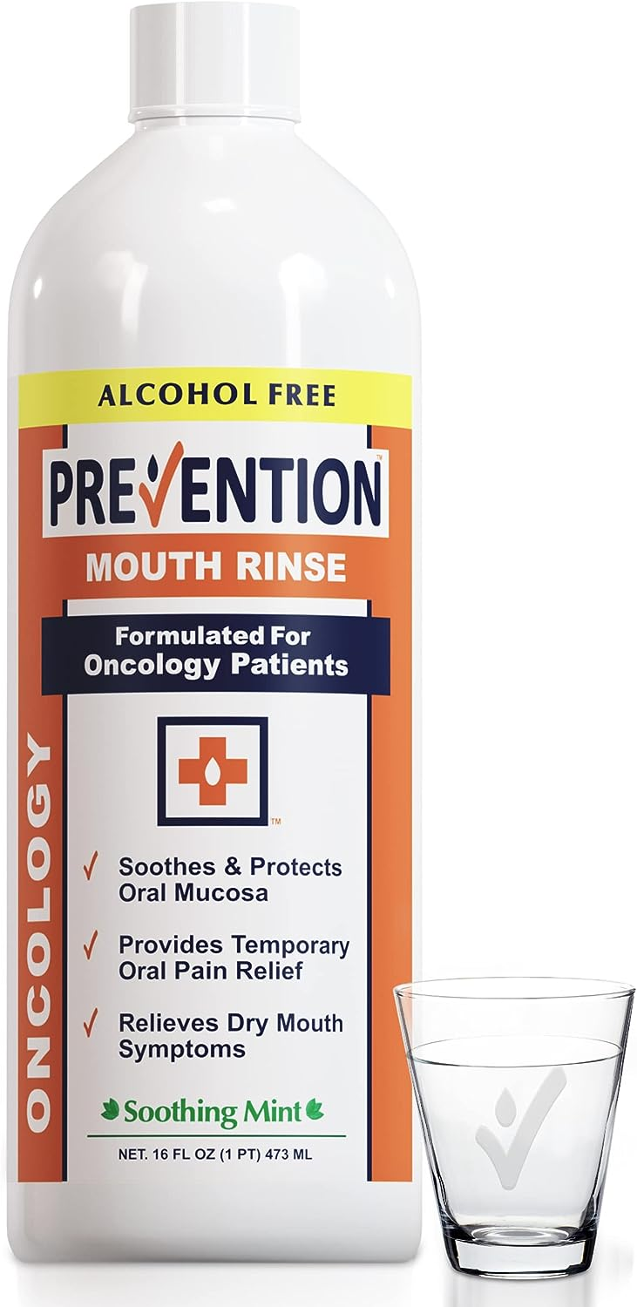
Mucositis/Stomatitis Treatment
Salt & soda mouth rinses
Prevention mouth rinse
  Active ingredient: glycerin
Gelclair
  Polyvinylpyrrolidone-sodium hyaluronate gel
Honey
Cancer. 2020 Oct 1;126(19):4423-4431

Slide 98
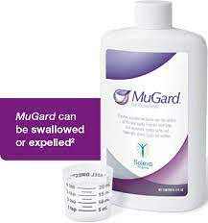
Mucositis/Stomatitis Treatment
Hurricaine spray
  Benzocaine 20%
Orajel
  Benzocaine 20%
MuGard
  Rx only
  Mucoadhesive hydrogel
Oralone
  Rx only
  Triamcinolone0.1% dental paste
Cancer. 2020 Oct 1;126(19):4423-4431

Slide 99

Hand Foot Syndrome
Etiology?
  Direct toxic effect/inhibition of target receptors in the skin
Incidence 30-40%
Invest New Drugs (2013) 31:787–797; image: https://ascopost.com/issues/december-15-2012/prevention-and-treatment-of-multikinase-inhibitor-induced-hand-foot-syndrome/

Slide 100
Hand Foot Syndrome Prevention/Management
Urea cream
  Prevention with sorafenib; 54.9% vs 71.4%, p<0.00001
Pyridoxine (Vitamin B6)
  >200 mg/day; prevention of all grades 69.6% vs 74.1%,p = 0.23
Diclofenac gel 1%
  Applied twice daily for prevention
  75% risk reduction in developing grade 2/3
Support Care Cancer. 2022 Nov;30(11):8655-8666; Journal of Clinical Oncology 2023 41:16_suppl, 12005-12005

Slide 101
Summary
Hypertension is an early side effect that can be managed with standard anti-hypertensives
In the setting of a lidocaine shortage, there are several over the counter options available
Urea remains an effective treatment of hand foot syndrome although newer options may also provide benefit
Education prior to treatment is key

Slide 102

Role of Nephrectomy in Advanced RCC
Ulka Vaishampayan
University of Michigan
Ann Arbor MI
GU Summit
Aug 1 2023

Slide 103
Key Objectives
Discuss the data of Nephrectomy with interferon and VEGF-TKI therapies
Real World Data and Contemporary Management of Advanced RCC
Clinical trials exploring the role of Nephrectomy in Advanced RCC

Slide 104


RCC cases and Survival by Stage

Slide 105


Phase III trials of CN in RCC in the interferon era
SWOG 8949 and EORTC trial
Flanigan R et al. N Engl J Med 2001 and Mickisch et al. Lancet 2001

Slide 106

Nephrectomy is NO Longer standard in mRCC
CARMENA: Study Design
Final analysis of multicenter, randomized, open-label noninferiority phase III trial
  Steering committee closed trial after second interim analysis (prespecified at 326 events) due to slow recruitment; second interim analysis deemed sufficient to meet trial objectives
Stratified by center, MSKCC risk group (intermediate vs high risk)
Adult patients with biopsy-confirmed clear-cell mRCC, ECOG PS 0-1, treated brain mets without recurrence 3 wks post treatment permitted, suitable candidate for nephrectomy, eligible for sunitinib, no prior systemic treatment
for kidney cancer
(N = 450)
Nephrectomy followed 3-6 wks later by
Sunitinib 50 mg QD* 4 wks on/2 wks off
(n = 226)
Follow-up for minimum of 2 yrs
Sunitinib 50 mg QD* 4 wks on/2 wks off
(n = 224)
*Dose reductions/interruptions allowed for managing AEs.
Primary endpoint: OS
  Trial designed to have 80% power with 1-sided α = 0.05 to show noninferiority with 576 patients enrolled (observed deaths, n = 456)
Secondary endpoints: PFS, ORR (RECIST v1.1), clinical benefit, treatment adherence, nephrectomy in sunitinib-only arm, postoperative morbidity and mortality, safety
Méjean A, et al. ASCO 2018. Abstract LBA3. Méjean A, et al. N Engl J Med. 2018;[Epub ahead of print].
Notes:
AE, adverse event; ECOG, Eastern Cooperative Oncology Group; mets, metastases; mRCC, metastatic renal cell carcinoma; MSKCC, Memorial Sloan Kettering Cancer Center; PS, performance status; RECIST, Response Evaluation Criteria in Solid Tumors.

Slide 107
CARMENA: Overall Survival
Sunitinib alone not inferior to nephrectomy → sunitinib (upper boundary of 95% CI ≤ 1.20)
mOS longer with sunitinib alone vs nephrectomy → sunitinib:
  MSKCC intermediate-risk: 23.4 vs 19.0 mos (HR: 0.92)
  MSKCC poor-risk: 13.3 vs 10.2 mos (HR: 0.86)
Overall Survival
100
mOS, Mos
Nephrectomy → sunitinib 13.9
Sunitinib alone 18.4
HR: 0.89 (95% CI: 0.71-1.10)
(non-inferiority ≤ 1.20)
90
80
70
64.4
60
50
55.2
Patients Who Were Alive (%)
42.6
40
29.1
30
35.0
20
25.9
10
0
0
12
24
36
48
60
72
84
96
Mos
Patients at Risk
Nephrectomy→
sunitinib
Sunitinib alone
226
224
110
128
61
76
40
44
19
26
11
8
4
3
1
1
0
0
Méjean A, et al. ASCO 2018. Abstract LBA3. Méjean A, et al. N Engl J Med. 2018;[Epub ahead of print].
Slide credit: clinicaloptions.com

Slide 108
CARMENA: PFS, Response, and
Clinical Benefit
Response | Nephrectomy → Sunitinib (n = 186) | Sunitinib (n = 213)
Best overall response, n (%) CR PR SD PD NE | n = 178 1 (0.6) 50 (28.1) 64 (36.0) 49 (27.5) 14 (7.9) | n = 208 0 62 (29.8) 97 (46.6) 40 (19.2) 9 (4.3)
ORR, % | 27.4 | 29.1
DCR,* % | 61.8 | 74.6
Clinical benefit,† n (%) | 68 (36.6)‡ | 102 (47.9)‡
PFS
100
Median PFS, Mos
Nephrectomy → sunitinib 7.2
Sunitinib alone 8.3
HR: 0.82 (95% CI: 0.67-1.00)
90
80
70
60
50
Patients Without an Event (%)
40
37.3
30
30.4
20
14.5
3.7
10
6.1
5.2
0
0
12
24
36
48
60
72
Mos
Patients at Risk
Nephrectomy→
sunitinib
Sunitinib alone
226
224
59
74
10
28
6
9
2
6
1
2
0
0
*Disease control defined as CR, PR, or SD. †Defined as disease control beyond 12 wks. ‡P = .02
Méjean A, et al. ASCO 2018. Abstract LBA3. Méjean A, et al. N Engl J Med. 2018;
Notes:
DCR, disease control rate; PD, progressive diseases; NE, not evaluable; SD, stable disease.

Slide 109
Conclusions
In final analysis of CARMENA, sunitinib alone not inferior to cytoreductive nephrectomy followed by sunitinib in patients with mRCC
  HR for death: 0.89 (95% CI: 0.71-1.10; noninferior if upper boundary ≤ 1.20)
  Median OS longer in sunitinib-alone arm for all patients and in intermediate-risk and poor-risk subgroups
Clinical benefit rate significantly higher in sunitinib-alone arm (47.9% vs 36.6% with nephrectomy followed by sunitinib; P = .02)
Nephrectomy should no longer be part of standard of care for patients with mRCC requiring medical treatment
SWOG study addressing role of nephrectomy in met RCC treated with immune therapy
Méjean A, et al. ASCO 2018. Abstract LBA3. Méjean A, et al. N Engl J Med. 2018
Notes:
mRCC, metastatic renal cell carcinoma.

Slide 110

SURTIME Trial: Bex A, et al. JAMA Oncol 2019

Slide 111

SURTIME RESULTS
28 week PFS rate 42% both arms
OS was double in the deferred arm (HR=0.57)
Median 15.1 months vs 32.4 months

Slide 112
ASCO Advance of the Year 2020
Refinement of Surgical Treatment of Cancer
Kidney Cancer: Surgical resection has traditionally been the primary treatment of many solid tumor cancers, including renal cell carcinoma. Results from two randomized controlled trials provided evidence for targeted therapy-based approaches that might eliminate the need for surgery in this type of cancer.

Slide 113
How do the RESULTS of CARMENA and SURTIME change standard of care?
The value of adding nephrectomy in the presence of metastatic disease is questionable in context of sunitinib therapy
However within the setting of immune therapy
will nephrectomy contribute to efficacy?

Slide 114
Value of Cytoreductive Nephrectomy: IMDC database
OS benefit of nephrectomy compared with no nephrectomy in mRCC patients treated with targeted therapies*,† – retrospective analysis
*Sunitinib (67%); sorafenib (20%); bevacizumab (4%); temsirolimus (3.6%); pazopanib (2.8%); other (2.6%)
3245 mRCC patients
†Sunitinib (79%); sorafenib (8.6%); bevacizumab (1.5%); temsirolimus (6.4%); pazopanib (2.8%); other (1.7%)
2569 (79%) patients
with nephrectomy
Excluded: 1587 (49%) patients with nephrectomy before metastases
676/1658 (41%)
No cytoreductive nephrectomy†
982/1658 (59%)
Cytoreductive nephrectomy*
Heng DY, et al. Eur Urol. 2014;66:704-710.

Slide 115
Retrospective IMDC database:
Cytoreductive Nephrectomy Has a Favorable Effect on OS
Median OS
+CN (N = 982) 20.6 months
−CN (N = 676) 9.5 months
HRª = 0.60 (95% CI, 0.52-0.69)
P<.0001
1.00
0.8
0.6
OS Probability
0.4
0.2
0
0
20
40
60
80
100
Time, months
CI, confidence interval; HR, hazard ratio.
ªAdjusted for IMDC criteria
Heng DY, et al. Eur Urol. 2014;66:704-710.

Slide 116
IMDC Prognostic Factors Predict Benefit from Cytoreductive Nephrectomy
Number of IMDC Factors | No Nephrectomy OS, months (n) | Nephrectomy OS, months (N) | P Value
0 | 92% of patients with nephrectomy; insufficient number to compare
1 | 22.5 (72) | 30.4 (178) | .002
2 | 10.2 (143) | 20.2 (253) | <.001
3 | 10.0 (113) | 15.9 (106) | <.001
4 | 5.4 (103) | 6.0 (67) | .166
5 | 3.6 (36) | 2.8 (14) | .504
6 | 75% of patients without nephrectomy; insufficient number to compare
Heng DY, et al. Eur Urol. 2014;66:704-710.

Slide 117

Rationale for Pre-Nephrectomy Anti-PD-1 Priming
Harshman Cancer J 2014
Ongoing but unsuccessful anti-tumor T cell response in the primary tumor, tumor microenvironment, and draining lymph nodes
Post-PD-1 blockade anti-tumor CD8 T cells may preferentially expand in these areas→traffic to distant sites as memory cells→eradicate micrometastases
Nephrectomy will remove the majority of these effector cells and cytokines potentially resulting in a less potent response
Campbell lab has shown significant decrease in circulating PD-1+ T cells after nephrectomy
Neoadjuvant immunotherapy in mouse models demonstrated significantly better survival and eradication rate of metastases as compared to surgery for primary and adjuvant immunotherapy [Liu J, et al Cancer Discov 2021]
Notes:
We believe presurgical priming is necessary
Rationale for neoadjuvant priming:
We know nivo can work in the metastatic setting, i.e., when there is tumor present; we do not know if it works when there is no or much less tumor present (micrometastatic)
Work out of the Drake Lab has shown the anti-PD-1 can expand the patient's endogenous tumor-specific PD-1 expressing cells to infiltrate the primary tumor and tumor-draining lymph nodes. Effector memory cells can traffic to distant sites, escape surgical removal, and potentially eradicate micrometastatic disease.
Nephrectomy removes the antigen, effector cells, and cytokines that drive PD-1 and PD-L1 expression
This is supported by Campbell Lab which has shown elevated levels of peripheral circulating PD-1 cells in patients with RCC pre surgery and significant decreases after nephrectomy (MacFarlane Cancer Immunol Research 2014).

Slide 118
Role of CN in the Checkpoint Inhibition Era
Deferring CN has increasing rationale to improve response to checkpoint inhibition due to:
-Development of immune responses against patient specific antigens/private mutations
- Higher mutation load
- Increased exposure to variety of mutations; antigen spread
- Higher possibility of immune response against multiple clones
- Due to Heterogeneity of renal primary tumors, the antigen cascade induced with the presence of the primary tumor is likely to be more comprehensive than the one induced post debulking.

Slide 119

EA8143: Phase III Perioperative PD-1 Blockade
Slide courtesy of Harshman L. et al.
Overall Survival
Clear cell RFS
Safety
Tolerability
Quality of Life
Primary endpoint: 13% absolute benefit in RFS
  84.9% power to increase from 55.8% → 68.8% at 5 yrs
Secondary endpoint OS: 5 yr OS: 78.7% to 87.3%; HR 0.77
Mandatory presurgical biopsy: diagnosis, correlative science
PI: Harshman
Notes:
PROSPER
In terms of details, we are targeting a higher risk popn of at least 7cm T2 or clinical node positive M0 patients
Will be randomized 1:1 to either nivo x 2 f/b surg f/b adjuvant therapy or to SOC nephrectomy f/b observation
Primary EP is to see an at least 13% benefit in RFS.
Also powered to detect an OS benefit and RFS benefit specifically in clear cell pts
Safety, tolerability, and QoL endpoints are critical in this generally otherwise healthy pt popn who could be cured with surgery alone
Accrue 264 pts/year for 2.9 years with 2.1 additional years of follow-up
Biopsy mandatory; recognize it is not SOC but the neoadjuvant approach but will ensure we don’t tx people who don’t have RCC and is a MAJOR opportunity for biomarker discovery..
CTEP mandated biopsy

Slide 120
Patients with synchronous primary and met RCC have worse clinical outcomes with either immune therapy or sunitinib therapy!
McDermott D, et al. IKCS 2018, Albiges L et al ESMO 2020 abstr 711P
Patient population | Ipi + Nivo | Sunitinib
Intermediate/Poor Risk | ORR 41.9%/ CR 10.2% Median OS 48 months | ORR 29.4%/ CR 1.3% Median OS 26 months
Sarcomatoid RCC | ORR 56.7%/ CR 18.3 % Median OS 31.2 months 30 month OS 53% | ORR 19.2%/ CR 0% Median OS 13.6 months 30 month OS 29%
Synchronous mRCC with primary | Primary ORR 34% DOR 20.5 months Med OS 26 months | Primary ORR 14.5% DOR 14.5 months Med OS 14 months
Treatment Free Survival | 31% free of therapy Median TFS 7.8 months | 12% free of therapy Median TFS 3.3 months

Slide 121

CN essential in setting of Immune therapy?
Immunotherapy Resistance Pathways:
Can they be eradicated with nephrectomy?
Lancet 2017 review
Syn NL, et al. Lancet Oncology 2017

Slide 122
Phase III Trial of Immunotherapy-based Combination Therapy with or without Cytoreductive Nephrectomy for Metastatic Renal Cell Carcinoma
(SWOG 1931/PROBE Trial)
Lead investigators:
Hyung Kim MD
Ulka Vaishampayan MD
Biostatisticians: Cathy Tangen and Eddie Mayerson
Patient Advocate: Peggy Zuckerman

Slide 123
SWOG 1931/PROBE Trial
Primary Endpoint: Overall Survival
RCC with Primary Tumor and Mets
Start on I-O based regimen
Any of the 5 FDA approved regimens are permitted
10-14 week scan for response assessment
Randomize patient if PR or SD
Continue systemic therapy
Nephrectomy followed by continued systemic immune therapy
CR in primary or Rapid symptomatic progression:
Not eligible for randomization

Slide 124
Primary Objective
To compare overall survival in participants with newly diagnosed metastatic renal cell carcinoma who are randomized to receive immune checkpoint inhibitor-based combination treatment plus cytoreductive nephrectomy versus immune checkpoint inhibitor-based combination treatment alone.

Slide 125
Secondary Objectives
To compare overall survival between arms in the subset who received their assigned protocol treatment.
To compare investigator assessed progression-free survival between arms.
To assess complications of nephrectomy and post-randomization drug toxicities.
To compare objective response rate in metastatic sites between the arms in participants with measurable metastatic disease.
To assess change in diameter of primary tumor at Week 12 disease assessment in participants who have received pre-randomization treatment.

Slide 126
Multidisciplinary Input is Critical!
Systemic Therapy First!
Risk profiling
Treatment sequence
Individualizing the therapeutic plan
Changing treatment course based on toxicities, responses, residual disease
Optimizing the therapy for every case!

Slide 127

Takes a Village to Treat Kidney Cancer!

Slide 128

All Clinical Trials Have a Common Goal!

Slide 129
Case 1 :Prostate cancer
Ulka Vaishampayan MD
University of Michigan
Ann Arbor MI

Slide 130
Question
70 year old man was diagnosed with locally advanced prostate cancer Gleason score of 4+5=9 and PSA -18. CT showed pelvic lymph nodes about 1.5 cm , otherwise normal. Bone scan revealed no e/o mets.

Slide 131
Case 1 continued
He was treated with RT and ADT. PSA nadir of 0.1 was achieved.
At 18 months patient had rising PSA of 30ng/ml and staging studies were done.
Bone scan reveals mets in spine and bilateral ribs.
Tissue genomic testing reveals BRCA 2 mutation, MSI stable and TMB of 4. No other genomic alterations /mutations noted.

Slide 132
Case 1 : Prostate Cancer
Comorbidities include well controlled congestive heart failure and diabetes mellitus. Ideal next step in therapy is:
A) Cabazitaxel
B) PSMA-Lu 177
C) Olaparib + abiraterone
D) Enzalutamide + talazoparib

Slide 133
Answer
Correct answer is D (Enzalutamide + Talazoparib)
Patient has BRCA2 mutation and PARP inhibitor based combinations such as abiraterone + Olaparib or enzalutamide + talazoparib have demonstrated benefit and are FDA approved currently.
Patients CHF presents a toxicity concern for use of abiraterone as fluid retention and exacerbation of hypertension are possible toxicities.
Cabazitaxel and PSMA-Lu 177 are FDA approved after taxane based chemo such as docetaxel.

Slide 134
Renal Cell Carcinoma
Case 1

Slide 135
History and Physical Exam
60 year old female who presented with abdominal pain and unexplained weight loss.
Performance status of 1.
PMHx: Diabetes, hypertension , history of 2 stents 5 years ago for coronary artery disease.
FHx: unremarkable
PE: Vitals normal, abdomen benign

Slide 136



Imaging : CT scan

Slide 137
Imaging
14cm left renal mass
Level I tumor thrombus
Multiple bilateral noncalcified pulmonary nodules (new compared to prior CT). Largest about 1.5 cm

Slide 138

Biopsy of renal mass
Clear cell renal cancer
Fuhrman grade 3

Slide 139
Question:
Initial therapy for this patient?
Cytoreductive Nephrectomy
Sunitinib
Ipilimumab and nivolumab
Pazopanib
Clinical Trial: S1931/PROBE trial

Slide 140
Renal Cell Carcinoma
Case 2

Slide 141
History and Physical Exam
72 year old female who presented with abdominal pain that resolved without intervention. Zubrod PS 0.
PMHx: htn, hyperlipidemia
FHx: unremarkable
PE: AF, VSS, abdomen benign

Slide 142


Imaging (MRI/CT)

Slide 143
Imaging
5cm left renal mass
2cm right adrenal mass

Slide 144

Biopsy
Clear cell RCC

Slide 145
Management Strategy for this Patient?
Surgery to render the patient in CR
Immune based Combination Regimen
Immune therapy followed by surgery

Slide 146
Question-and-Answer

Slide 147
Thank You to Our Supporters:

Slide 148

Concluding Remarks
Thank you for coming!
Please scan the QR code here to complete a brief survey about tonight's event.

