Slide 1

Hematologic Malignancies
April 23rd, 2024

Slide 2
Navigating BTK inhibitors in CLL: Updates from ASH 2023
Clark Cutrer, MD
Assistant Professor of Medicine, Division of Hematology/Oncology
University of Tennessee Medical Center
Knoxville, TN

Slide 3
Our case: Mr. Rock E. Topp
Mr. Topp is a 70 y/o M w/ HTN, T2DM and h/o TP53 mutated CLL. Diagnosed w/ WBC 60k in 2016. Observed for 3 years and then developed worsening anemia, thrombocytopenia. Treated with venetoclax/obinutuzumab and had remission that lasted 2.5 years. Upon relapse, treated with acalabruitinb. Counts improved and patient did well for ~18 months but now with worsening B symptoms, cytopenias and hepatosplenomegaly. No evidence of Richter’s transformation. What would you offer him for treatment?
FCR
Zanubrutinib
Pirtobrutinib
Single agent Rituximab

Slide 4
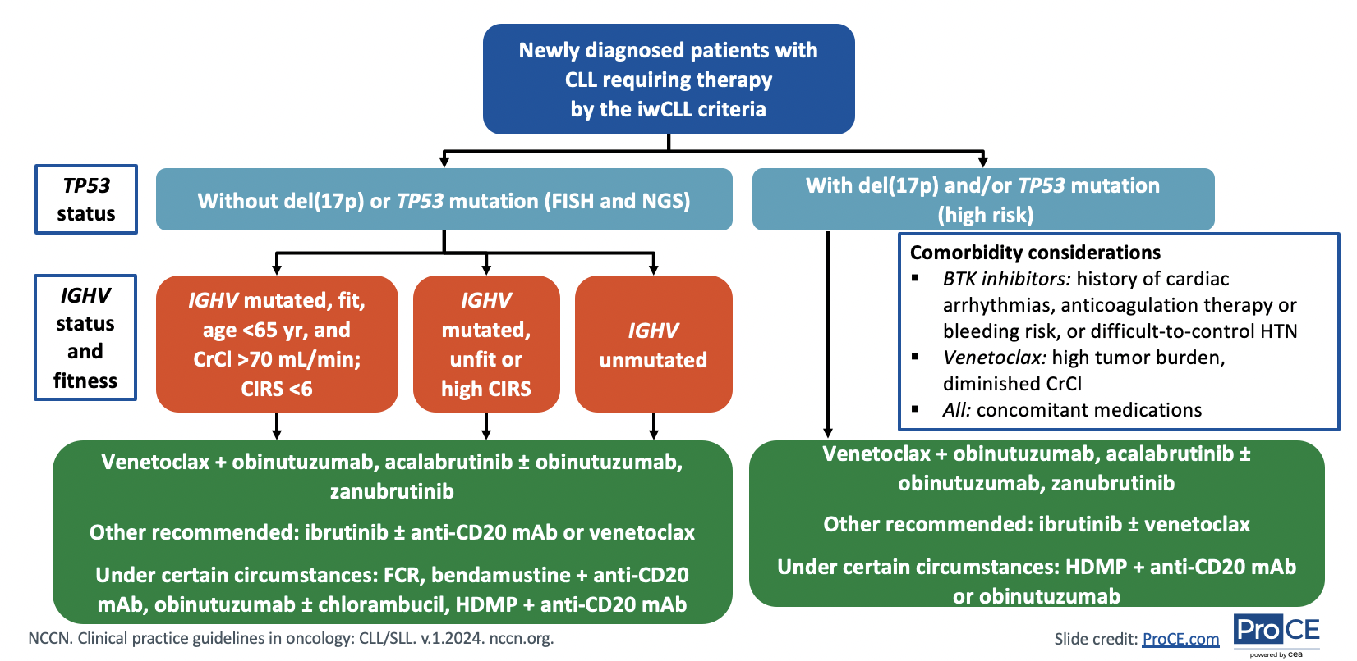
Overview of CLL/SLL treatment

Slide 5
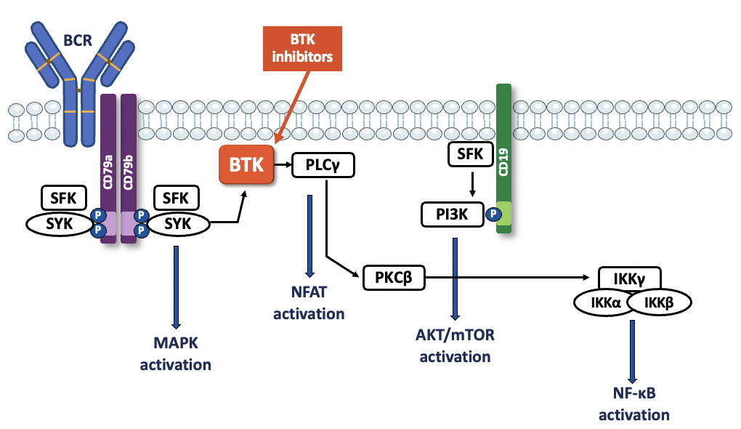

Overview of BTK Inhibition
B cell receptor (BCR) pathway plays a role in normal and malignant B cells in growth, survival and proliferation
Bruton tyrosine kinase (BTK) is an integral enzyme in this pathway and its inhibition leads to downstream effects on the survival and overall proliferation of malignant B cells
Young. Nat Rev Drug Discov. 2013;12:229.

Slide 6
BTK Inhibitors in CLL
Ibrutinib
Approved as frontline therapy (A041202, E1912 trials).
Also approved in relapsed/refractory setting (RESONATE)
Acalabrutinib
Approved as frontline therapy +/- Obinutuzumab (ELEVATE-TN)
Also approved in relapsed/refractory setting (ELEVATE-RR)
Non-inferior to ibrutinib but with fewer AEs
Zanubrutinib
Approved as frontline therapy (SEQUOIA)
Also approved in relapsed/refractory setting (ALPINE)
Superior to ibrutinib and with fewer AEs
1.Woyach. ASH 2021. Abstr 639. 2. Shanafelt. Blood. 2022;140:112. 3. Sharman. ASH 2023. Abstr 636. Sharman. Leukemia. 2022;36:1171. Sharman. Lancet. 2020;395:1278.
4. Ramakrishnan. ASH 2023. Abstr 1902. Tam. Lancet Oncol. 2022;23:1031. Kahl. SOHO 2022. Abstr CLL-137. 5. Byrd. JCO. 2021;39:3441. 6. Brown. ASH 2023. Abstr 202. 7. Byrd et al. NEJM 2015.

Slide 7
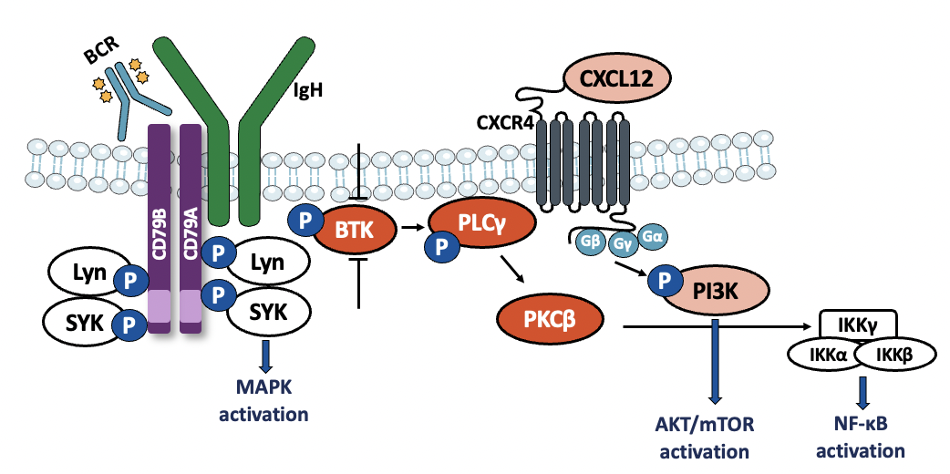
Non-covalent BTK inhibitors
Pirtobrutinib binds to BTK reversibly and independent of C481 residue unlike previously mentioned BTKs.
Allows for overcoming previous BTK resistance.
Lewis. J Pers Med. 2021;11:764.

Slide 8
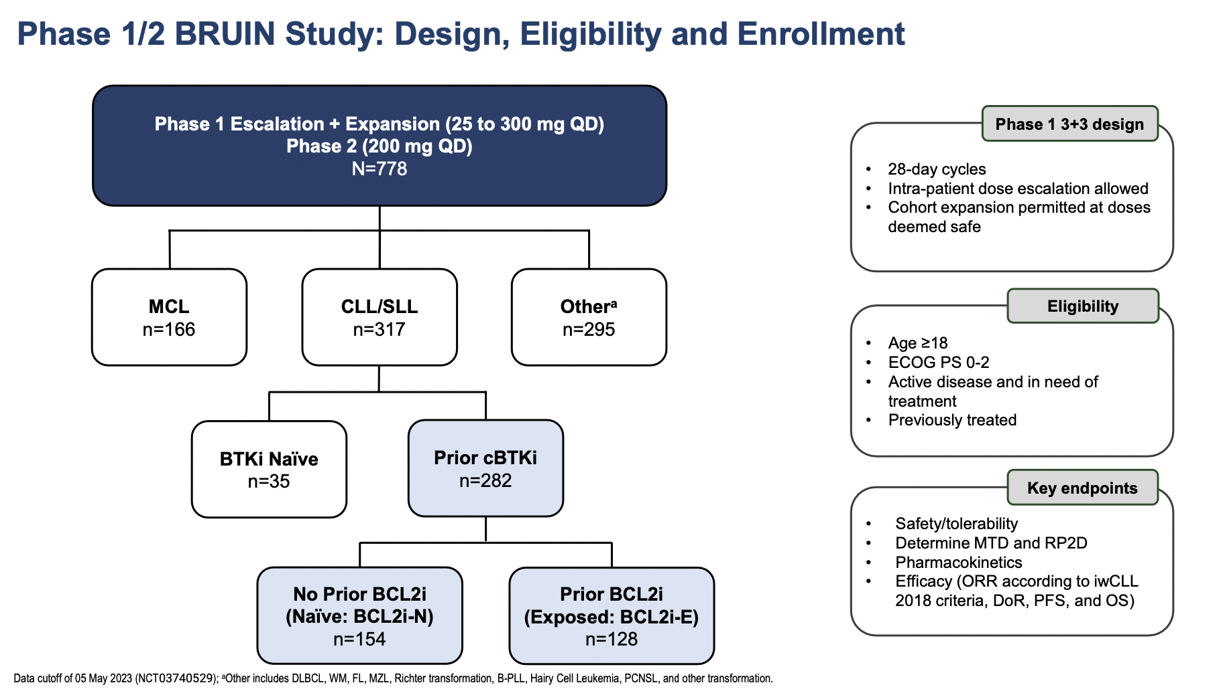
BRUIN study
Woyach, J. et al. ASH 2023. Abstract 325

Slide 9
Patients who had received prior BTKi
Median age 69
Majority had ECOG 0-1 (93%)
Average prior lines of therapy: 4
>75% progressed on previous BTKi (23% discontinued due to toxicity.
>80% had at least 1 high risk feature: nearly half (48%) were TP53 mutated.
Woyach, J. et al. ASH 2023. Abstract 325

Slide 10
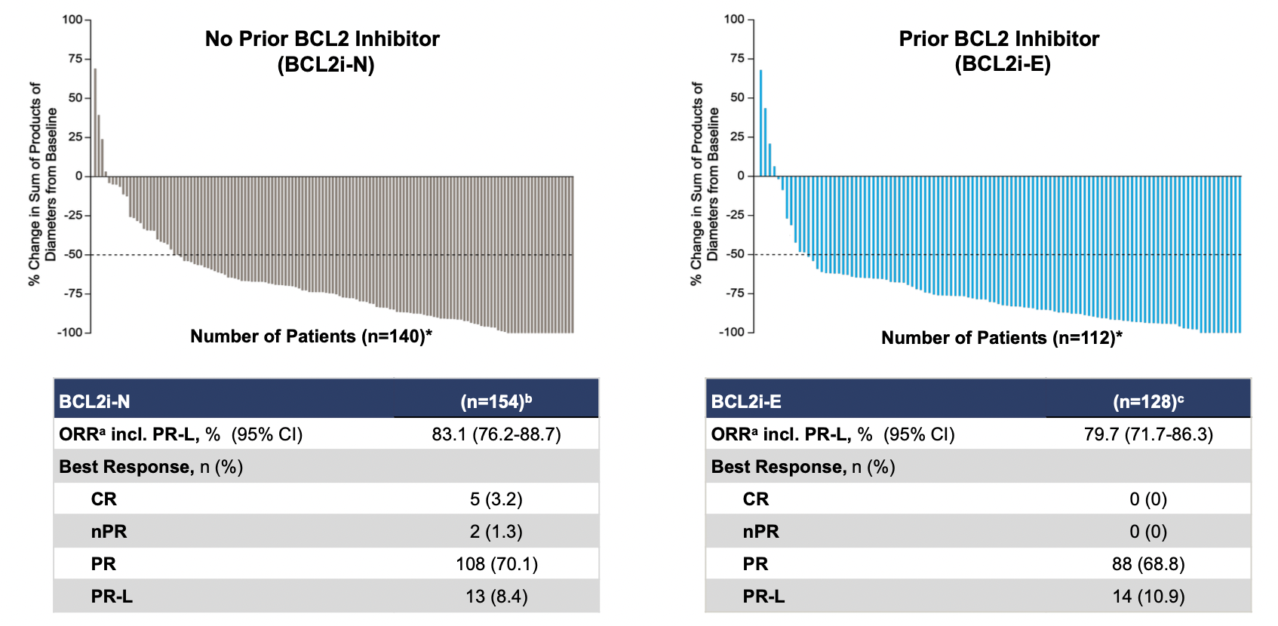
Efficacy of pirtobrutinib
Woyach, J. et al. ASH 2023. Abstract 325

Slide 11
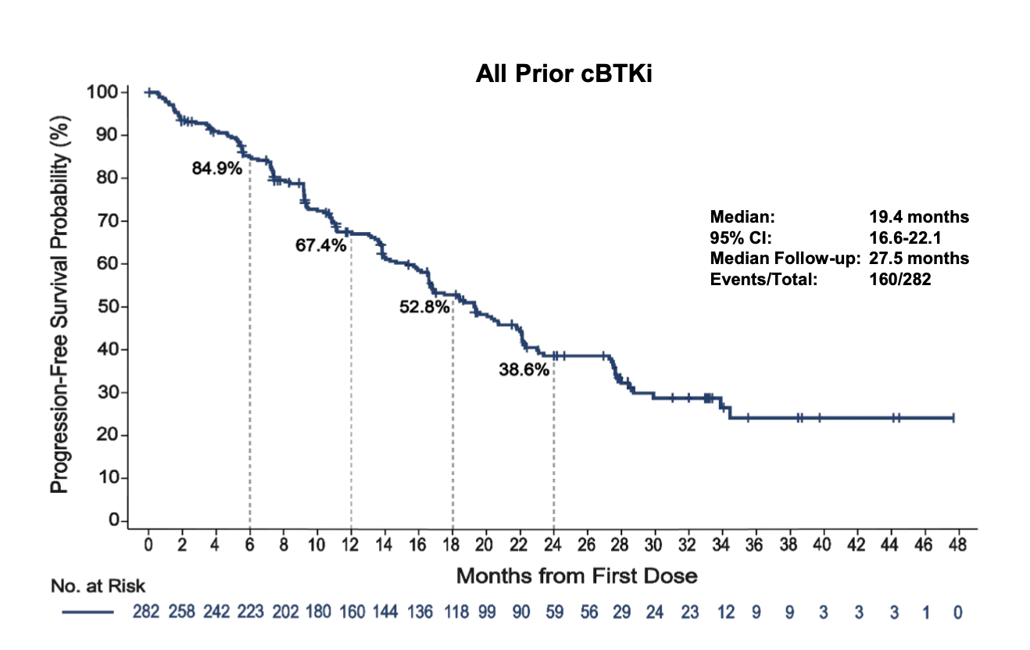
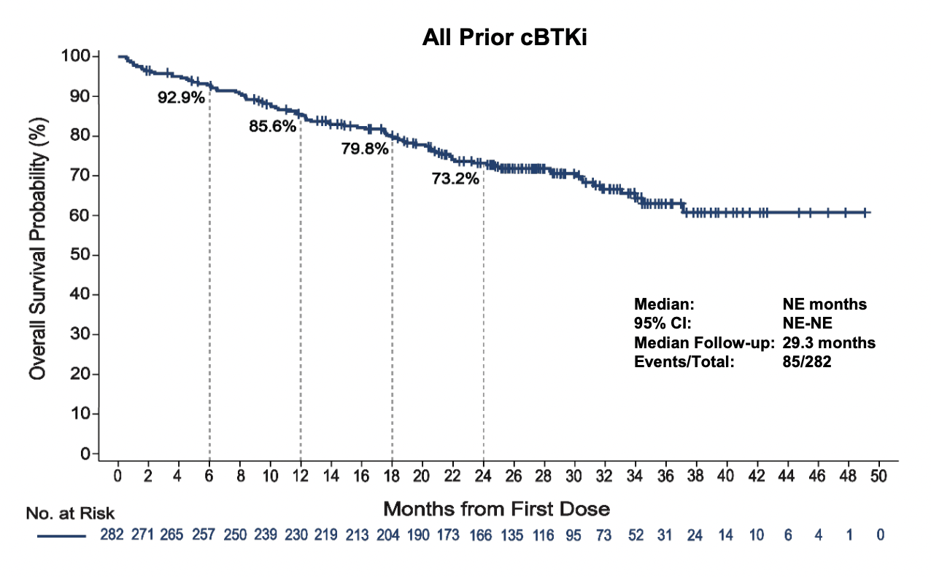
Progression free and overall survival: patients with prior BTKi
Woyach, J. et al. ASH 2023. Abstract 325

Slide 12
Treatment related adverse events
Neutropenia most common: 19% overall, 4.3% grade 3
Rate of infection: 13% overall, 4% grade 3
Bruising(19%)
Diarrhea (8%)
Rash (5%)
Fatigue (4%)
Woyach, J. et al. ASH 2023. Abstract 325

Slide 13
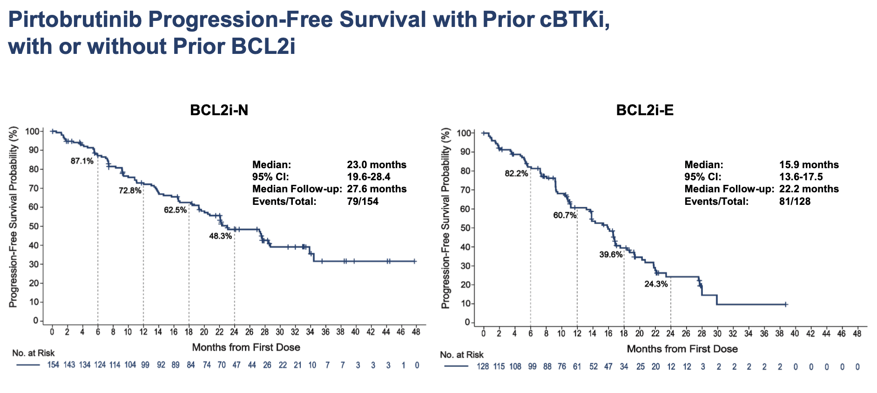
Progression free survival for BCL2i naïve and experienced patients
Woyach, J. et al. ASH 2023. Abstract 325

Slide 14
Takeaways from BRUIN study
Overall response rates ~80% regardless of prior BTKi exposure.
Median PFS 23 months in BCL2i naïve patients and 15 months in BCL2i exposed patients.
Most had 3+ lines of therapy – no significant change in efficacy.
Patients with high risk features (ie: TP53 mutation, del(11q), IGVH unmutated) responded well (ORR >80%).
Now FDA approved for CLL/SLL patients progressed on 2+ lines of therapy (including BTKi and BCL2i).

Slide 15
Back to our case: Mr. Rock E. Topp
Mr. Topp is a 70 y/o M w/ HTN, T2DM and h/o TP53 mutated CLL. Diagnosed w/ WBC 60k in 2016. Observed for 3 years and then developed worsening anemia, thrombocytopenia. Treated with venetoclax/obinutuzumab and had remission that lasted 2.5 years. Upon relapse, treated with acalabruitinb. Counts improved and patient did well for ~18 months but now with worsening B symptoms, cytopenias and hepatosplenomegaly. No evidence of Richter’s transformation. What would you offer him for treatment?
FCR
Zanubrutinib
Pirtobrutinib
Single agent Rituximab

Slide 16
Other updates from ASH23 on CLL/BTKi
3269 Fixed-Duration Pirtobrutinib Combined with Venetoclax ± Rituximab in Relapsed/Refractory Chronic Lymphocytic Leukemia: Updated Results, Including MRD Data, from the BRUIN Phase 1b Study
326 Genomic Evolution and Resistance during Pirtobrutinib Therapy in Covalent BTK-Inhibitor (cBTKi) Pre-Treated Chronic Lymphocytic Leukemia Patients: Updated Analysis from the BRUIN Study
4635 Combined Ibrutinib and Venetoclax for First-Line Treatment of Patients with Chronic Lymphocytic Leukemia (CLL): 5-Year Follow-up Data
631 Ibrutinib Plus Venetoclax with MRD-Directed Duration of Treatment Is Superior to FCR and Is a New Standard of Care for Previously Untreated CLL: Report of the Phase III UK NCRI FLAIR Study
1916 Association of Measurable Residual Disease with Progression-Free Survival in Patients with Chronic Lymphocytic Leukemia: A Systematic Review and Meta-Analysis in the Era of Novel Agents

Slide 17

Questions?

Slide 18
Hematologic Malignancies
April 23rd, 2024

Slide 19
Follicular Lymphoma
Current Practice and Future Opportunity
Radhakrishnan Ramchandren M.D.
Professor Hematology Oncology
Department of Medicine
University of Tennessee Knoxville
Phone # 865-279-1777
rramchandren@utmck.edu

Slide 20
Follicular Lymphoma
Composite lymphomas (12%)
Small lymphocytic (6%)
Follicular (22%)
Mantle cell (6%)
Peripheral T-cell (6%)
Marginal zone B-cell, MALT (5%)
Diffuse large B-cell (31%)
Other subtypes with a
frequency <2% (9%)
Marginal zone B-cell, nodal (1%)
Lymphoplasmacytic (1%)
Armitage et al. J Clin Oncol. 1998;16:2780–2795.
Notes:
.Accounts for 22 % of all NHL which is about 15000 new cases annually in the united states
Median age at diagnosis is 59 and

Slide 21
Follicular Lymphoma
Estimated 15000 new cases annually in USA
Median age at diagnosis 60
Incidence rising in western countries
Pathologically graded on a 1-3a,b scale
3% per year risk of transformation to more aggressive subtype with poor prognosis
Commonly presents with advanced stage disease
Treatment outcomes have improved with median survival ranging between 8-12 years
Follicular (22%)
Lymphoma
Armitage et al. J Clin Oncol. 1998;16:2780–2795.
Notes:
.Accounts for 22 % of all NHL which is about 15000 new cases annually in the united states
Median age at diagnosis is 59 and

Slide 22
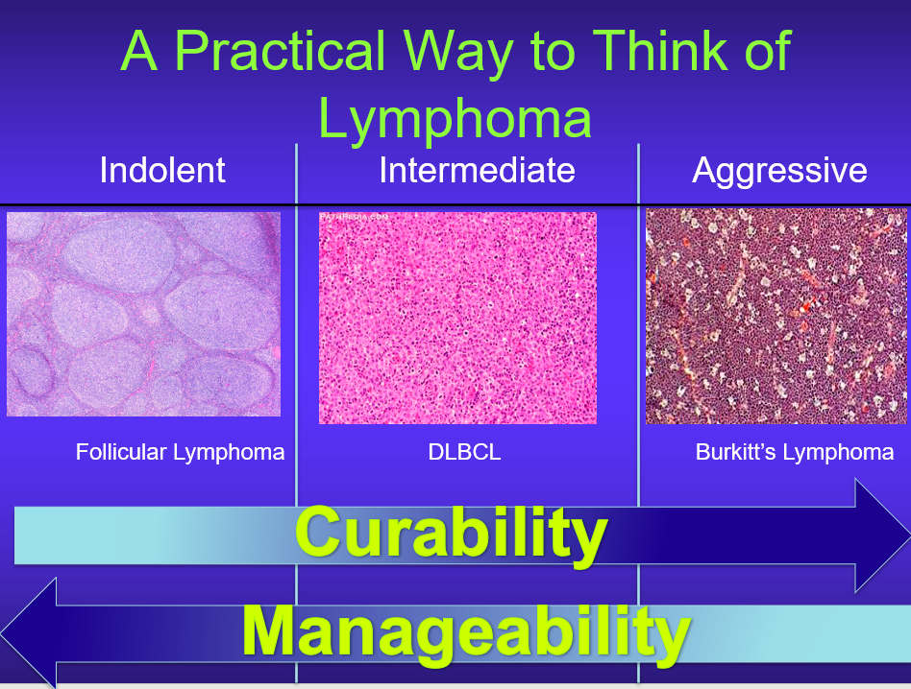
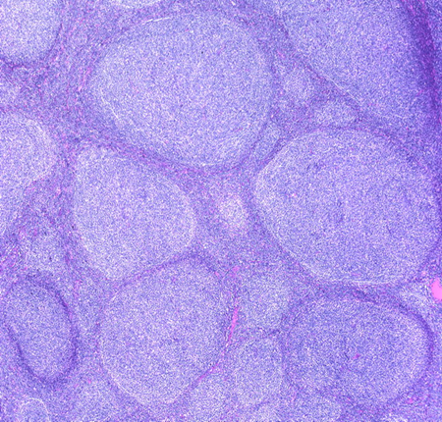
Outcomes for Patients With FL
1997-2007
1987-1996
1976-1986
1960-1975
Tan et al Blood Aug. 2013
Notes:
1334 patients median age at dx was 50!
The magnitudes of improvements in OS exceeded the gains in life expectancy and OS of the gen pop over the same periods

Slide 23
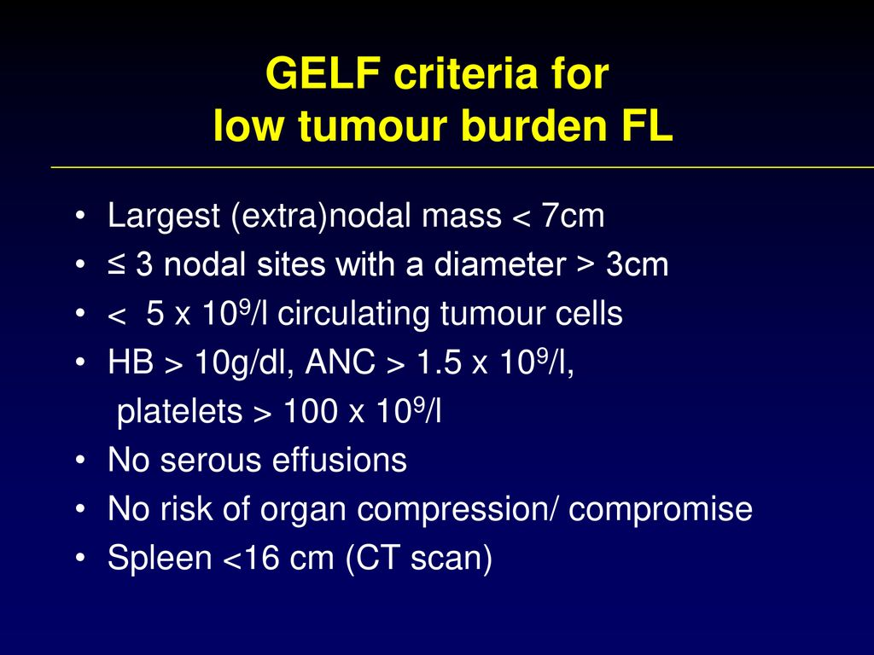
Current Management of FL
Treatment recommendations are based on 3 basic principles
  Patients with advanced stage disease are incurable
  Consequently, asymptomatic patients may not require early intervention (watch and wait) as the goals of therapy are to control the disease for as long as possible with minimal toxicity
  A proportion of early stage patients may be cured with RT alone
Brice et al JCO 1997

Slide 24
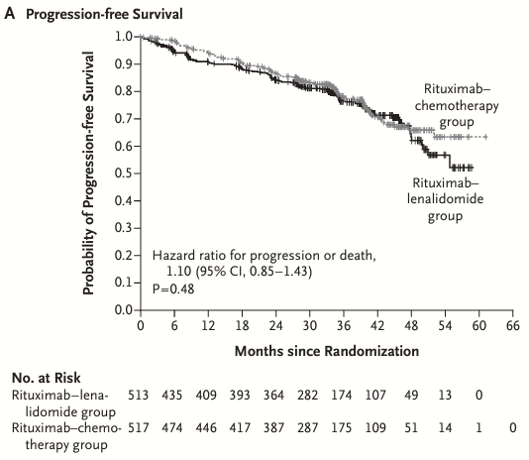
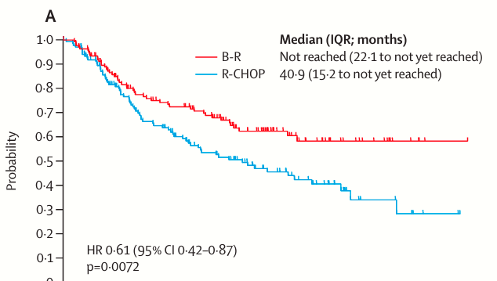
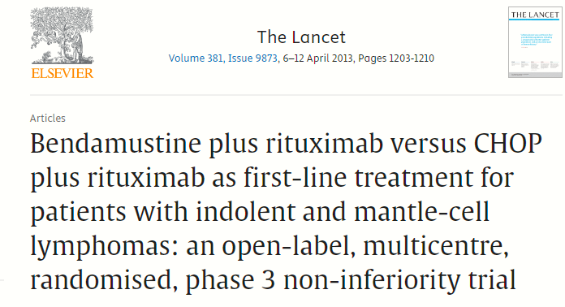
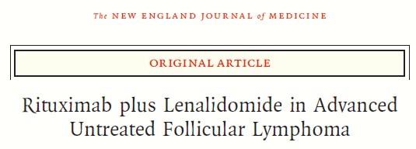
Frontline Therapy- Advanced Stage Disease
Several Choices are available and some have been compared in a randomized prospective fashion.
Rummel et al. Lancet 2013; 381: 1203–10
Morschhauser et al. NEJM 379;10 nejm.org September 6, 2018

Slide 25
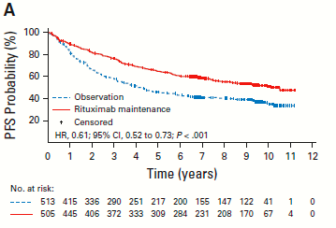
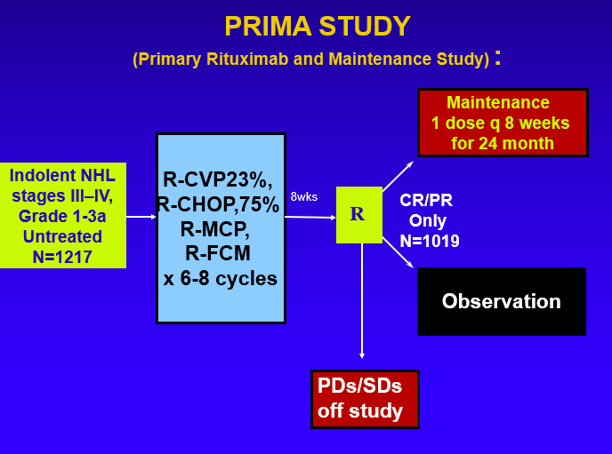
Some Practical Aspects of FL Management
Median PFS 4.1 vs 10.5 Yrs.
Maintenance Therapy
51%
35%
NO BR!
NO OS Difference
“There are lies, Damn lies and Statistics”
    --Mark Twain
Bachy et al JCO 2019
Notes:
Higher rates of PFS at 36 months (75 versus 58 percent); longer median PFS (10.5 versus 4 years)
●Higher percentage of patients in complete response or unconfirmed complete response at 24 months (72 versus 52 percent)
●Higher overall rate of severe (grade 3/4) adverse events (24 versus 17 percent)
●Higher rate of infections (39 versus 24 percent), the majority of which could be treated in the ambulatory setting
●Similar survival and quality of life ratings; 10-year OS 80 percent (HR 1.04; 95% CI 0.77-1.40)

Slide 26
Some Practical Aspects of FL Management
Post Treatment Surveillance
  Upon completion of therapy clinical and laboratory exams are recommended
  Studies demonstrating a survival benefit to CT imaging in follow up are listed below:
  Studies demonstrating NO survival benefit to follow up imaging are listed below
    Recommendations for initial evaluation, staging, and response assessment of Hodgkin and non-Hodgkin lymphoma: the Lugano classification Cheson et al JCO 2014.
    Surveillance imaging during first remission in follicular lymphoma does not impact overall survival. Goldman et al. Cancer 2021
    The impact of surveillance imaging after curative-intent radiotherapy for limited-stage follicular lymphoma. Urban et al Br J Haem. 2021
    Impact of imaging frequency on progression-free survival in Alliance trials enrolling patients with follicular lymphoma. Rutherford et al. Blood Adv 2024
There is No role for routine
PET imaging in Lymphoma
AND DOZENS MORE

Slide 27
Therapy For Relapsed Disease
The Presence of does not equal the need to treat even in relapsed FL.
Active Surveillance remains a valuable component of the treatment armamentarium.
However, responses to frontline therapy are variable and most patients will require therapy at some time for recurrence.
R squared can be used in the relapsed setting – particularly if not utilized frontline.
  295 FL patients R vs RR – Augment study
    ORR 78% with 34% CR with RR.
    Median PFS 39 vs 14 mos. with combination
    FN in 3% of patients no difference in thromboses.
Leonard et al JCO March 2019
Notes:
78Vs 53%
Cr rate 34 vs 18
36% of Rsq had Growth factors
70% used antiplt or AC in both arms

Slide 28
Therapy for Relapsed Disease
In addition to selecting alternative frontline therapy, there are several agents which have demonstrated meaningful activity in the relapsed setting.
Study/ Agent | N | CR/ORR % | Med FU/ PFS mos. | AE/Tox | Ref
Zuma-5 Axi-cel | 127 | 79/94 | 42/40 | Gr 3 CRS 7% Gr 3/4 ICANS 19% | Neelapu et al. Blood.2024 Jacobson et al. Lancet Oncol. 2022
ELARA Tisa-cel | 97 | 69/86 | 10/NR | Gr 3 CRS 0% Gr 3 ICANS 4% | Fowler et al. Nature Medicine Feb. 2022
Mosunetuzumab | 90 | 60/78 | 36/24 | Gr3 CRS 2.2% | ASH 2023 abst. 603. Schuster et al.
Tazemetostat | 99 45mut 54 WT | EZH2 Mutated 13/69 WT 9/35 | 36 13.8/11.1 | Gr 3 cytopenia 3% | Morschhauser et al. Lancet Oncol. 2020 November
Zanibrutinib | 33 | 18.2/36.4 | 34/10.4 | Gr 3 neutropenia 18.2% 1 pt w/ serious bleeding | Phillips et al. Blood advances June 2022
Notes:
Axi cel -- - only 51% met GELF
56% POD 24
Median DOR with PR 5 mos.
13 pts retreated with axi-cel – all 13 still w response
Tisa cel
45% had bridging therapy
Tazemetostat is approved by the US Food and Drug Administration (FDA) as a single agent for the treatment of patients with relapsed or refractory EZH2 mutation-positive FL who have received at least two prior systemic therapies [54]. To qualify for tazemetostat, FL tumor specimens should demonstrate one of the following EZH2 mutations: Y646, A682, or A692. Tazemetostat is also approved for patients with relapsed or refractory FL who have no satisfactory alternative treatment options.

Slide 29
Treatment of Relapsed FL
While response rates of CAR-T and Bispecific therapies are higher, not all patients are candidates for this therapy.
      Due to higher toxicity rates or for logistical reasons.
For these patients Tazemetostat and Zanibrutinib may provide therapeutic opportunities.
Efforts to increase response rates and minimize toxicities has led investigators to evaluate novel combinations with these agents.

Slide 30
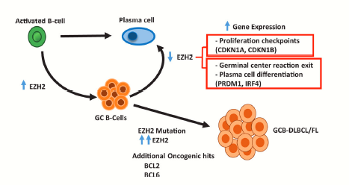
EZH2 AND Tazemetostat MOA
EZH2 is required for FL growth and survival, regardless of mutation status.
EZH2 helps to lock developing B cells in a state of uncontrolled growth
– Inhibition of EZH2 restores expression of genes involved in differentiation and cell cycle regulation, allowing malignant B cells to undergo apoptosis.
Tazemetostat is an oral, selective methyltransferase inhibitor of EZH2
– Based on pre-clinical data, it is believed that through the
inhibition of EZH2, tazemetostat reprograms cell
differentiation, reduces B-cell proliferation, promotes
antitumor immunity, and permits the expression of
tumor suppressor genes.
Gulati et al.Leuk Lymphoma. 2019 July 26
Notes:
Follicular lymphoma arises from germinal centre B cells. EZH2, a histone methyltransferase, is essential to the formation of the germinal centre, as the enzyme represses the transcription of genes that would otherwise limit B-cell proliferation and promote exit from the germinal centre.6 Gain-of-function mutations in the enzymatic domain of EZH2 are present in approximately 20% of patients with follicular lymphoma or diffuse large B-cell lymphoma derived from the germinal centre.7–9 Such activating mutations lead to the aberrant trimethylation of lysine 27 in histone 3 (H3K27me3),6,10,11 and the spread of H3K27me3 at target loci results in epigenetic silencing and maintenance of the germinal centre. This epigenetic silencing, in turn, allows B cells to proliferate and malignant clones to accumulate.10,12 EZH2 is also involved in tumour immune escape mechanisms, such as suppressing antigen presentation and preventing the trafficking of immune effector cells to the tumour microenvironment

Slide 31
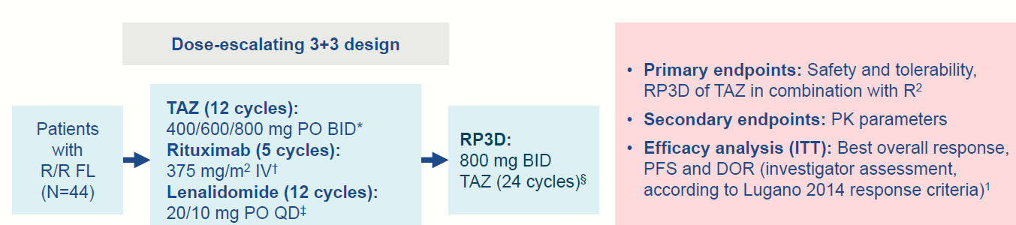
Tazemetostat Lenalidomide and Rituximab
SIMPLIFY-I
G
Phase Ib dose escalation study
Oral regimen after cycle 5 (R weeklyx4 then monthly)
Excluded prior Lenalidomide or EZH2 inhibitor therapy.
Salles et al ASH 2023 abst 3035

Slide 32
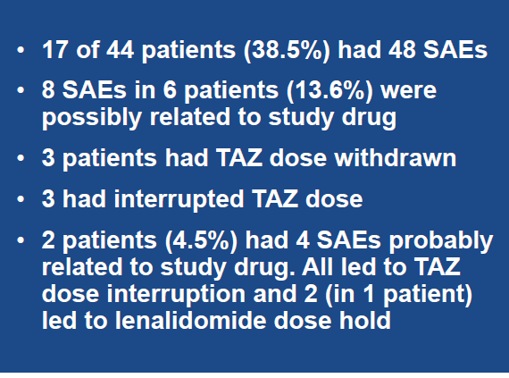
Tazemetostat Lenalidomide and Rituximab
Treatment was well tolerated
Grade 3 neutropenia in 41% and thrombocytopenia in 11%
No DLT’s and no new safety signals
RP3D was 800 mg BID for Tazemetostat
Salles et al ASH 2023 abst 3035
Notes:
G-CSF was not allowed prophylactically in
phase 1b, but 14 patients received G-CSF
as a secondary intervention after one occurrence
of neutropenia
The most common serious TEAE was
COVID-19 (9.1%)

Slide 33
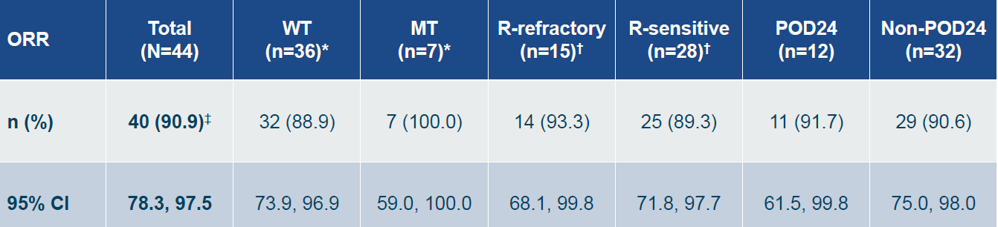
Efficacy
91% ORR with 55% CR.
No difference in MUT or WT EZH2
Dose dependent PFS with median PFS not reached at 22.5 mos.
Salles et al ASH 2023 abst 3035
Notes:
Phase III part of symphony 1 –randomized

Slide 34
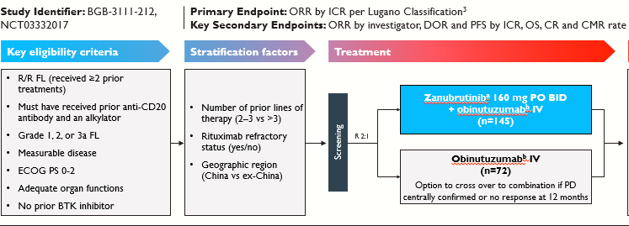
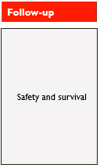
Zanibrutinib and Obinutuzumab
Zanibrutinib is a potent BTK inhibitor designed for improved BTK selectivity.
  Increased efficacy
  Reduced off target toxicity
Phase IB/2 trial evaluating ZO in 36 FL patients with ORR 72%.
Combining therapy with Obinutuzmab may improve efficacy with non overlapping toxicity in FL.
Phase II randomized study 2:1
Median 3 lines prior therapy
Median F/u was 20.2 months
Zinzani et al. JCO July 2023
Notes:
Aim to find a better partner than Bendamustine
Zanubrutinib was given orally at 160 mg twice a day until disease progression confirmed by ICR;
Obinutuzumab (1000 mg) was given in both arms on days 1, 8, and 15 of cycle 1, day 1 of cycles 2-6, and then every 8 weeks up to 20 doses maximum. Patients receiving Obinutuzumab remained on study treatment until disease progression confirmed by ICR or 30 months of treatment maximum, whichever occurs first.

Slide 35
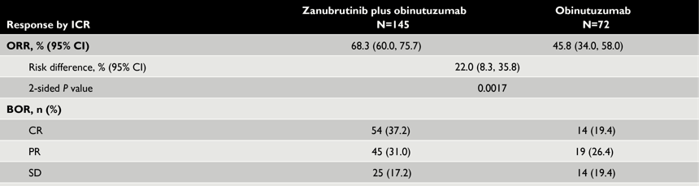
Zanibrutinib and Obinutuzumab
ORR 68% vs 46% with CR rate 37.2 vs 19.4%
  P val 0.0017 P val 0.0083
Subgroup analysis identifies no discrepant subtypes or populations.

Slide 36
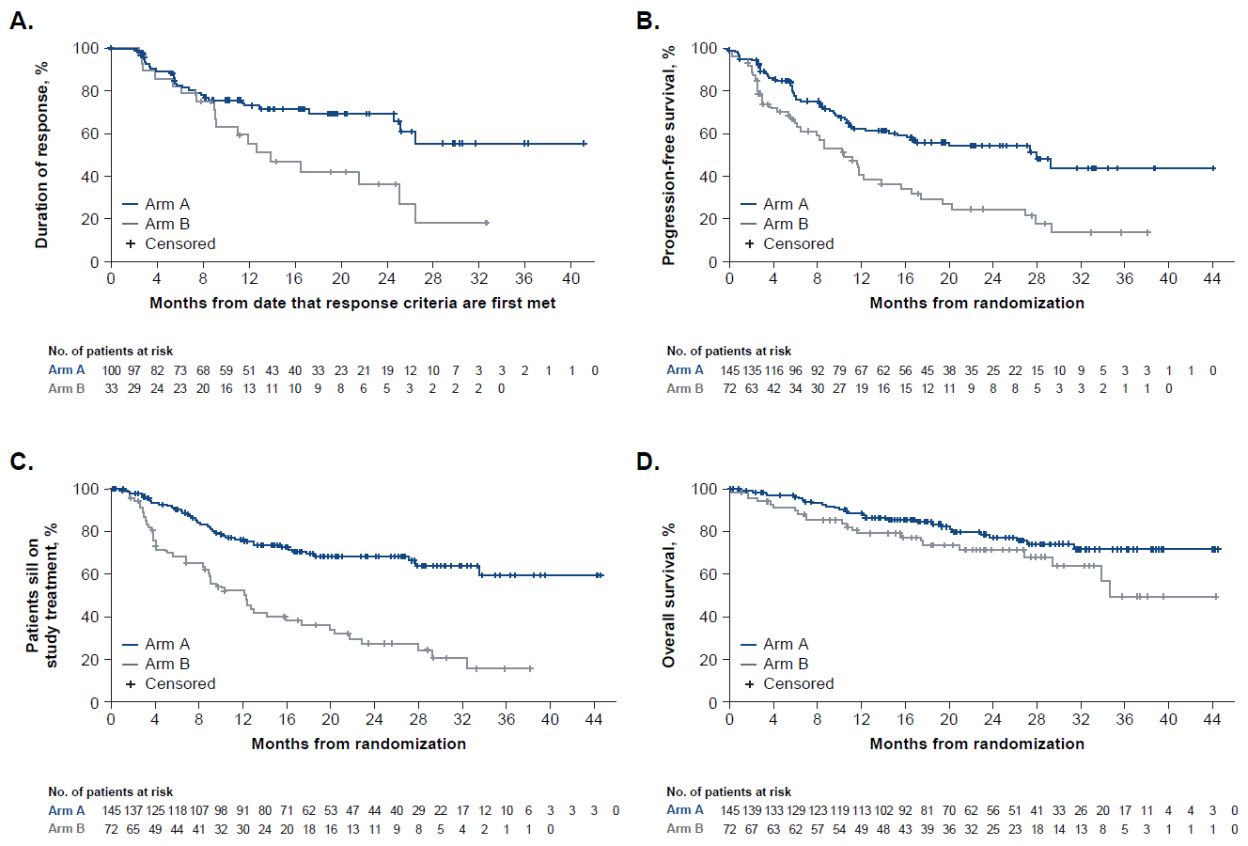
Zanibrutinib and Obinutuzumab
Median PFS ZO 28mos vs 10.4 mos. Obinutuzumab.
Patients who crossed over had median PFS of 7.6 mos.
OS at 24 mos. 77% vs 71% NSS

Slide 37
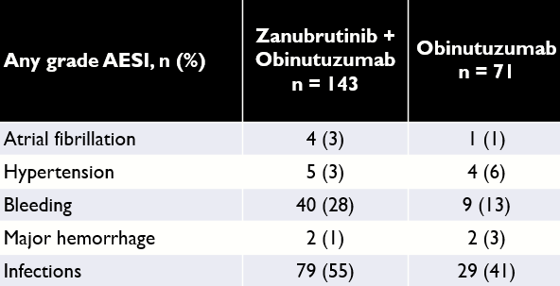
Zanibrutinib and Obinutuzumab
Overall treatment was well tolerated.
  Grade 3/4 neutropenia similar 24 vs 23 %
  20 vs 21% of patients received GCSF.
  IRR higher in Obin arm 10 vs 3%
Notes:
APPROVED March 2024 after 2 prior lines of therapy

Slide 38
Conclusions
Our understanding of the biology and natural history of FL have resulted in significant improvements in outcomes for patients.
Moreover, advances in drug development have improved PFS and OS in this disease. This is particularly true within the last decade due to the development of several novel agents with unique MOA.

Slide 39
Conclusions
Despite this watchful waiting remains the optimal and least toxic strategy for asymptomatic patients.
The development of several novel agents could and perhaps should provide clinicians the opportunity to strategically sequence therapies to improve outcomes further.
  The optimal sequence and duration is however remains unclear!?
Considerations of patient goals for treatment, comorbidities/therapeutic toxicities and cost may all play a role in decision making.

Slide 40
Conclusions
The agents discussed today are an incomplete window into potential combinations or additional novel therapies currently available or in development.
Future studies will be required to best understand these opportunities.
Lastly, given the expanding therapeutic landscape the time to develop and advance non chemotherapy based frontline regimens has never been closer to actuality.

Slide 41
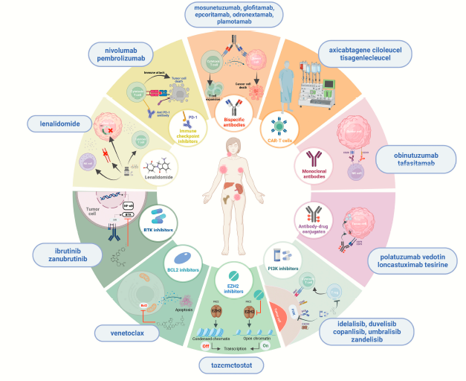
Notes:
CD 47 Magrolimab et al.

Slide 42
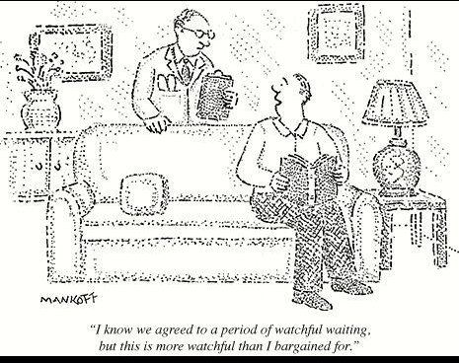
Thank You!
Questions?

Slide 43
Hematologic Malignancies
April 23rd, 2024

Slide 44
Updates in Myeloid Malignancy:
Acute Myeloid Leukemia
Stephen A Strickland, MD, MSCI
Director of Acute Leukemia / Myeloid Malignancy Program
SCRI @ TriStar Centennial
Nashville, TN

Slide 45
Acute Myeloid Leukemia
Frontline FLT3 inhibitors
7+3 vs Azacitidine / Venetoclax
Aza / Venentoclax vs Aza / Ivosidenib
On the Horizon
  Menin Inhibitors
  Antibody / Antibody Drug Conjugates
  Cell Therapies

Slide 46
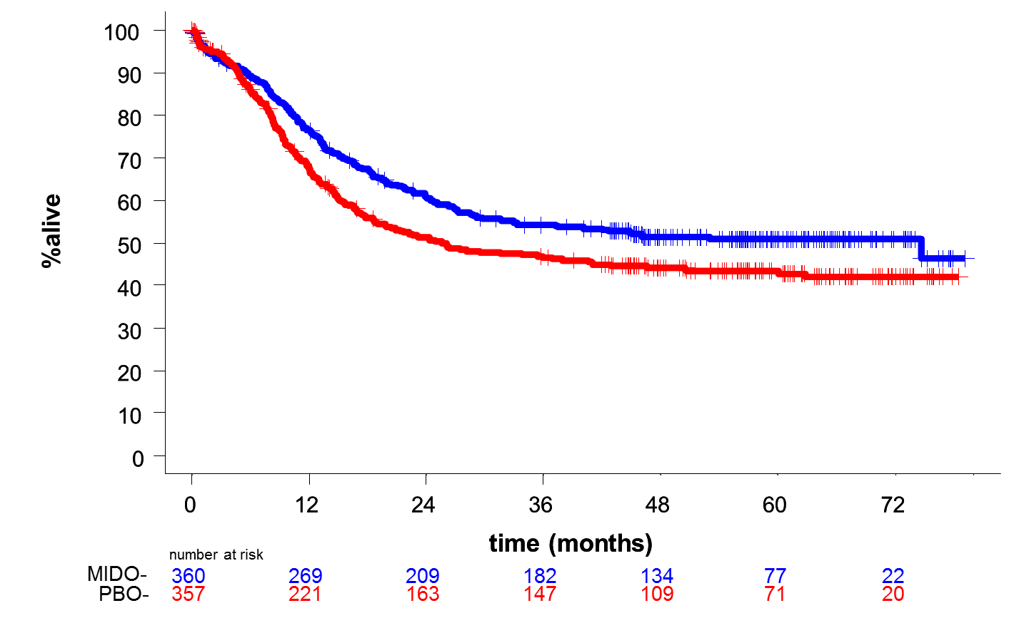
RATIFY
N= 717 pts
Similar
Tox Profile
CR Rate*
  Mido 59% Plac 54%
Allo SCT
  Mido 58% Plac 54%
Arm | 4-year Survival
MIDO | 51.4% (95%CI: 46, 57)
PBO | 44.2% (95%CI: 39, 50)
Hazard Ratio*: 0.77
1-sided log-rank p-value*: 0.0074
+ Censor
Median OS: Mido 74.7 (31.7-NE) Placebo 25.6 (18.6-42.9) mths
Stone, et al; ASH 2015

Slide 47
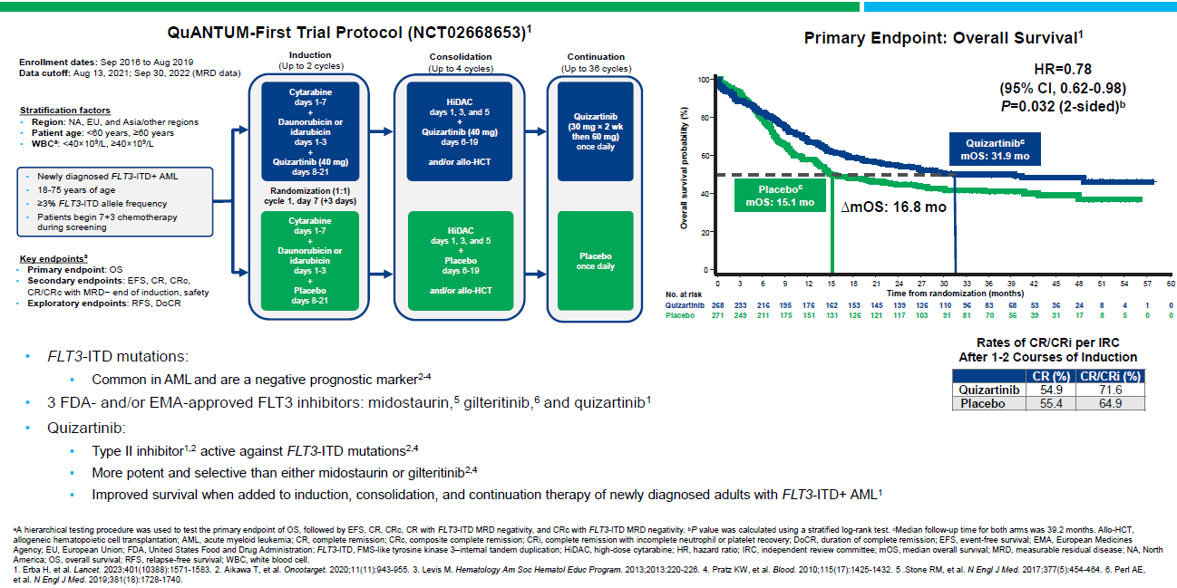
AML – Intensive Therapy
Perl et al. ASH 2023. Abstr 832

Slide 48
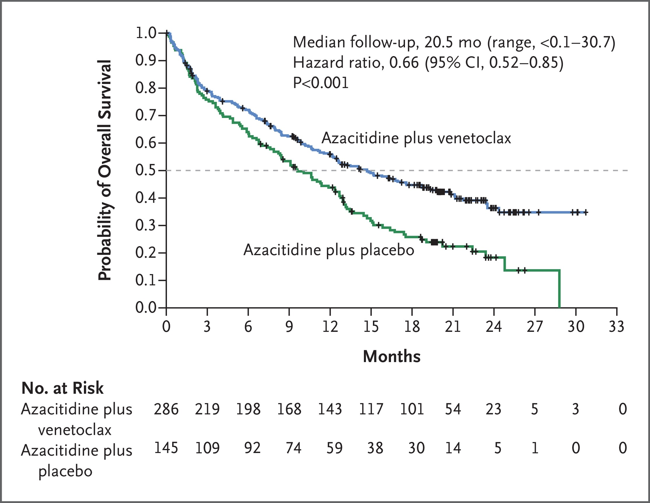

VIALE-A
DiNardo CD et al. N Engl J Med 2020;383:617-629
Notes:
Figure 2 Overall Survival. The distributions were estimated for each treatment group with the use of the Kaplan–Meier method and were compared with the log-rank test stratified according to age (18 to <75 years or ≥75 years) and cytogenetic risk (intermediate risk or poor risk). The hazard ratio for death was estimated with the use of the Cox proportional-hazards model with the same stratification factors used in the log-rank test. The data included are subject to a cutoff date of January 4, 2020. The dashed line indicates 50% overall survival probability, and the tick marks indicate censored data.

Slide 49
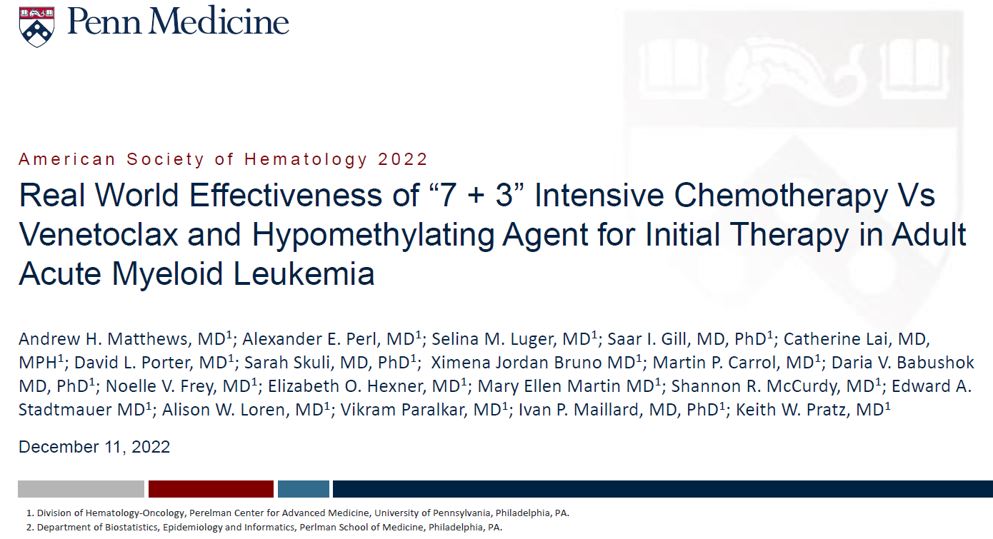

Slide 50
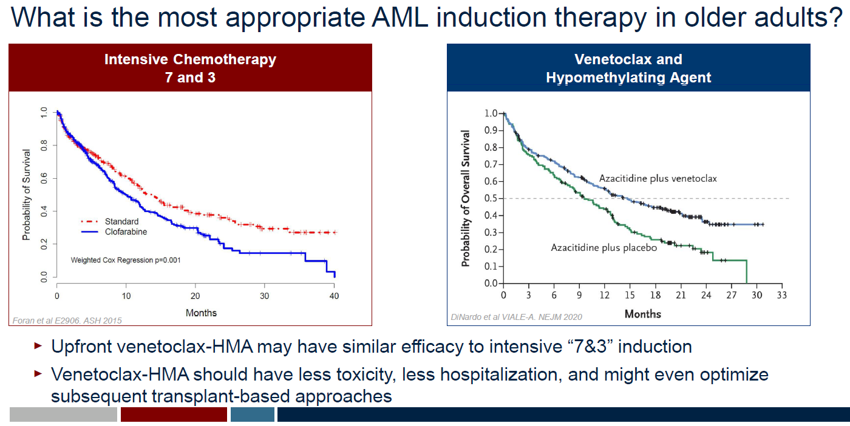

Slide 51
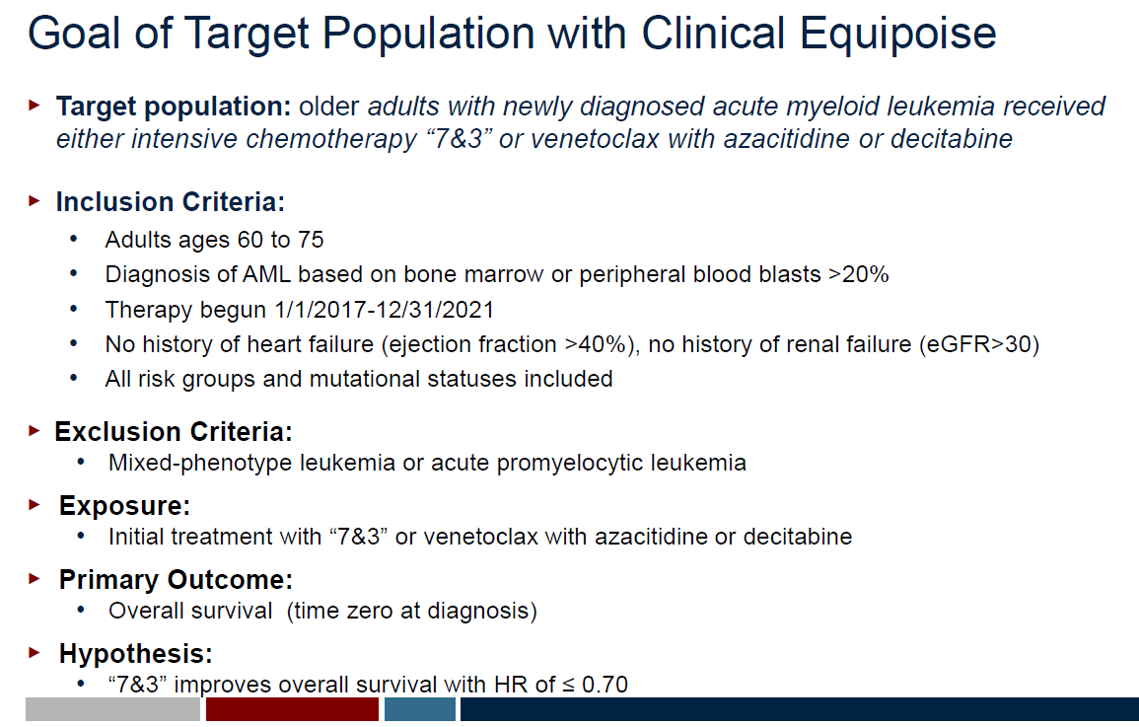

Slide 52
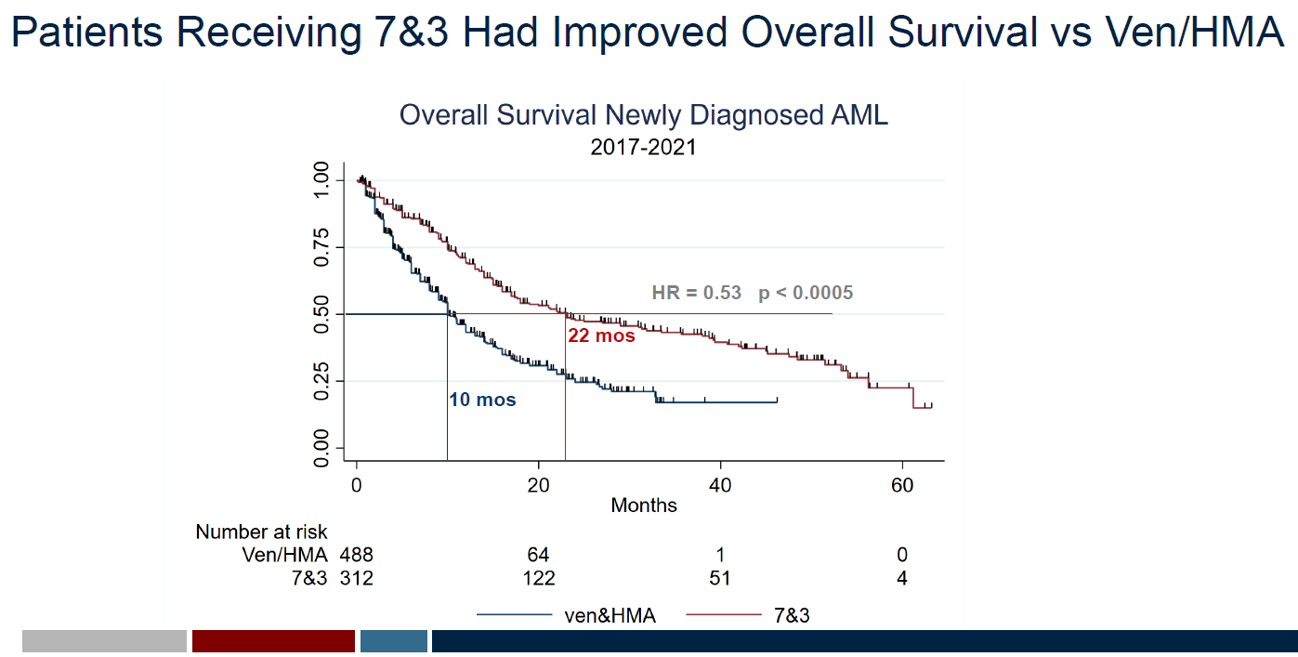

Slide 53
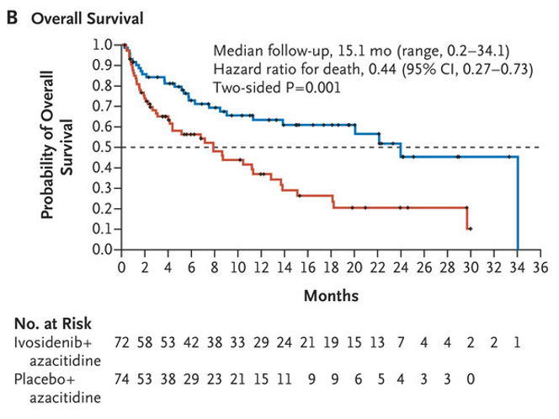
VIALE-A
AGILE
DiNardo CD et al. N Engl J Med 2020;383:617-629
Montesinos P et al. N Engl J Med 2022;386:1519-1531
Notes:
Figure 2 Overall Survival. The distributions were estimated for each treatment group with the use of the Kaplan–Meier method and were compared with the log-rank test stratified according to age (18 to <75 years or ≥75 years) and cytogenetic risk (intermediate risk or poor risk). The hazard ratio for death was estimated with the use of the Cox proportional-hazards model with the same stratification factors used in the log-rank test. The data included are subject to a cutoff date of January 4, 2020. The dashed line indicates 50% overall survival probability, and the tick marks indicate censored data.

Slide 54
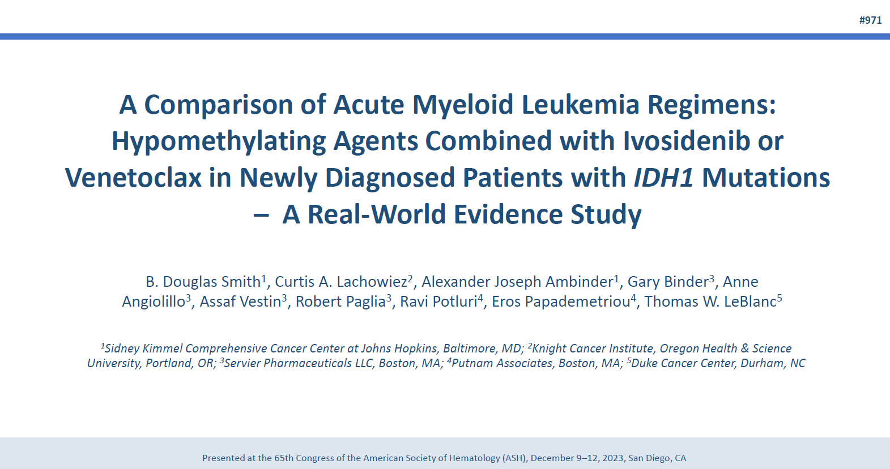
AML – Lower Intensity Therapy
Smith et al. ASH 2023. Abstr 971

Slide 55
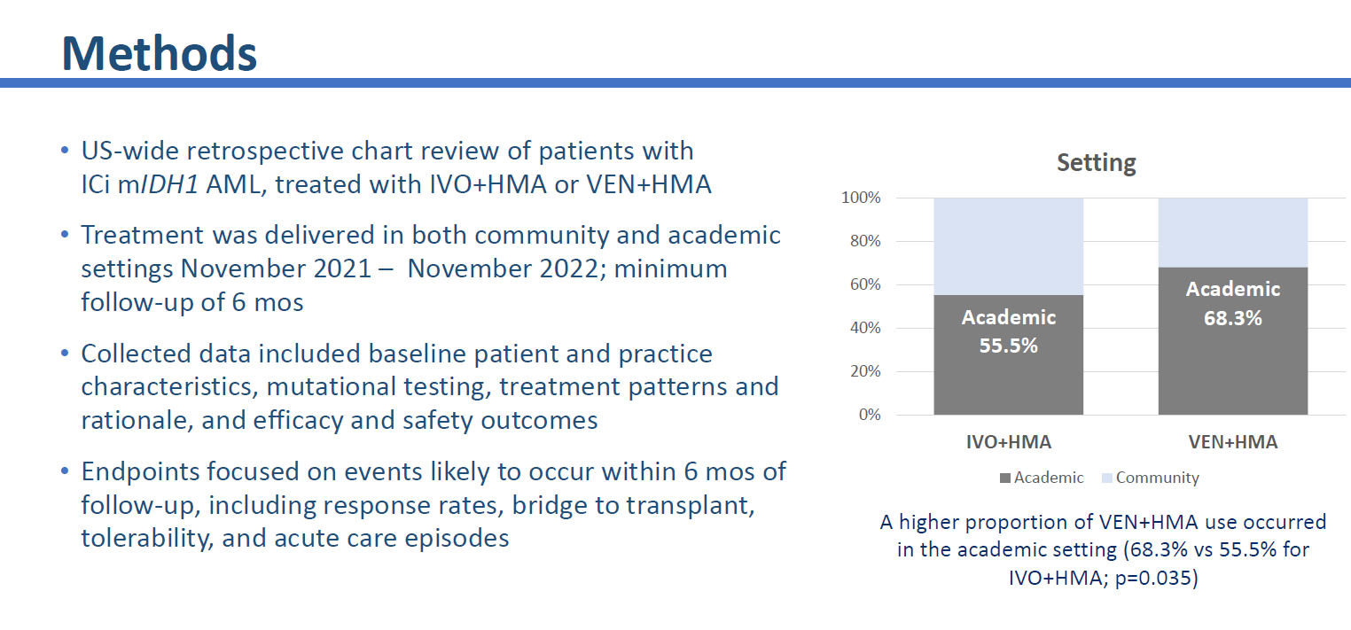
AML – Lower Intensity Therapy
Smith et al. ASH 2023. Abstr 971

Slide 56
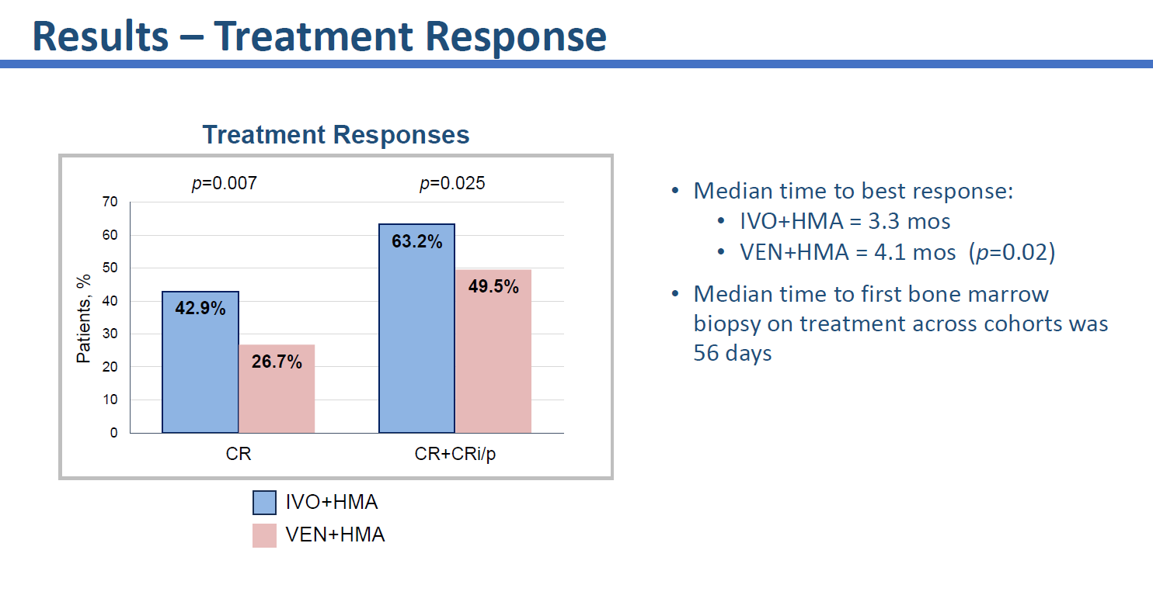
AML – Lower Intensity Therapy
Smith et al. ASH 2023. Abstr 971

Slide 57
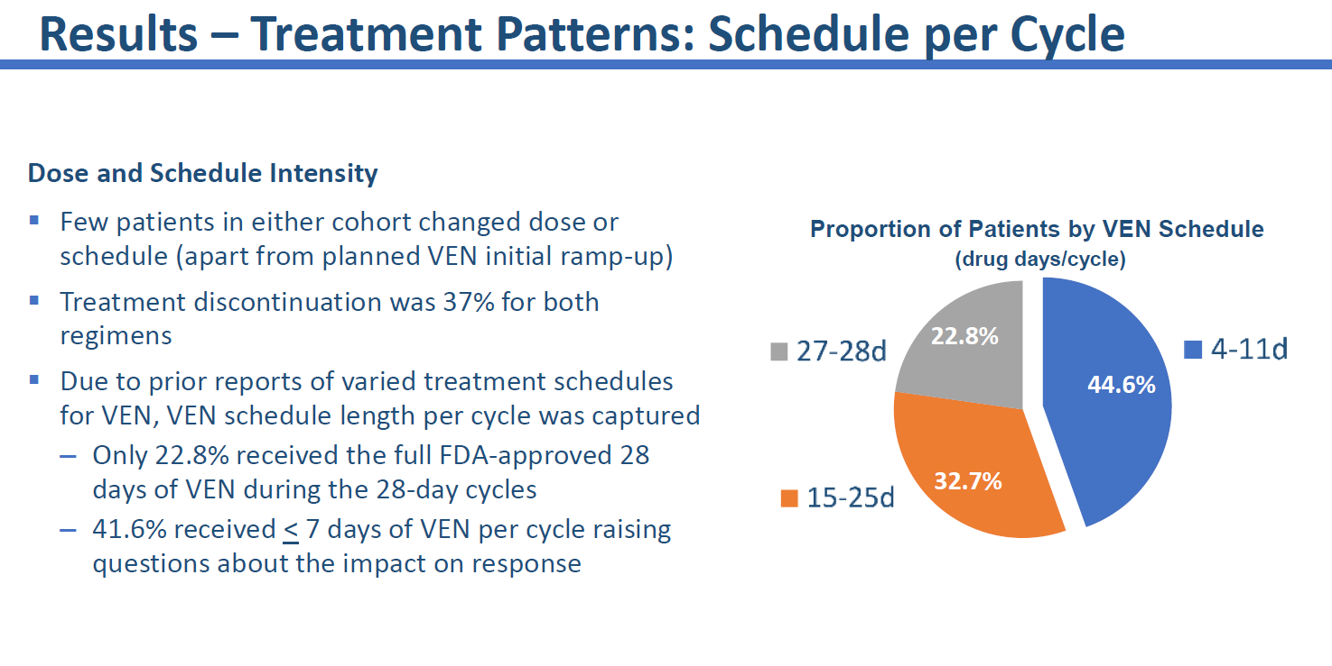
AML – Lower Intensity Therapy
Smith et al. ASH 2023. Abstr 971

Slide 58
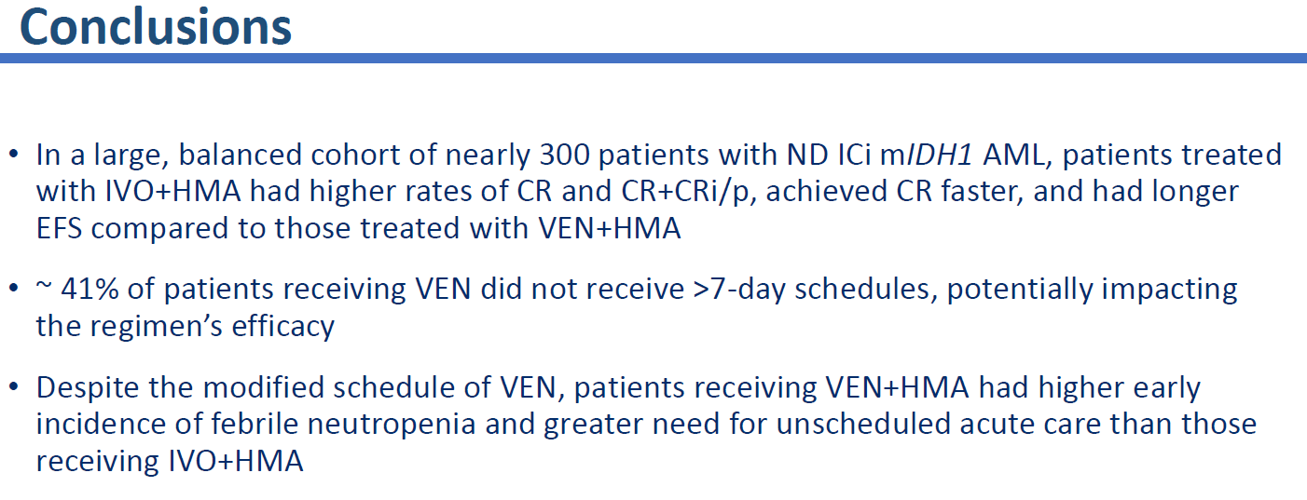
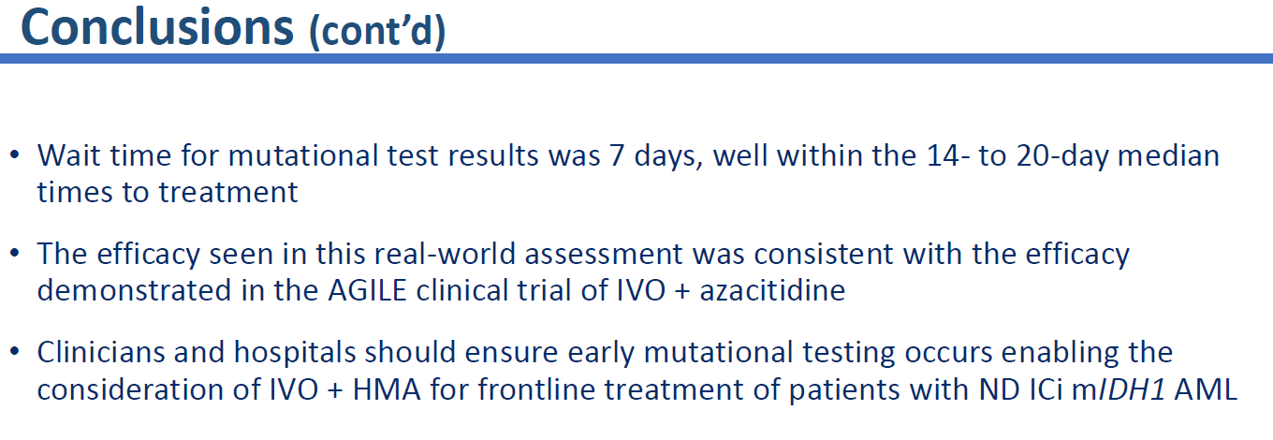
AML – Lower Intensity Therapy
Smith et al. ASH 2023. Abstr 971

Slide 59
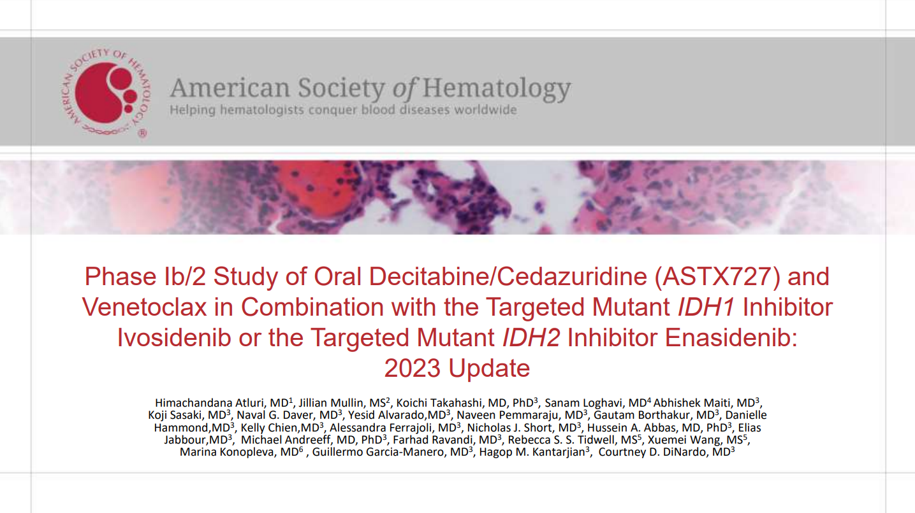
AML – Lower Intensity Therapy (Triplet)
Arluri et al. ASH 2023. Abstr 968

Slide 60
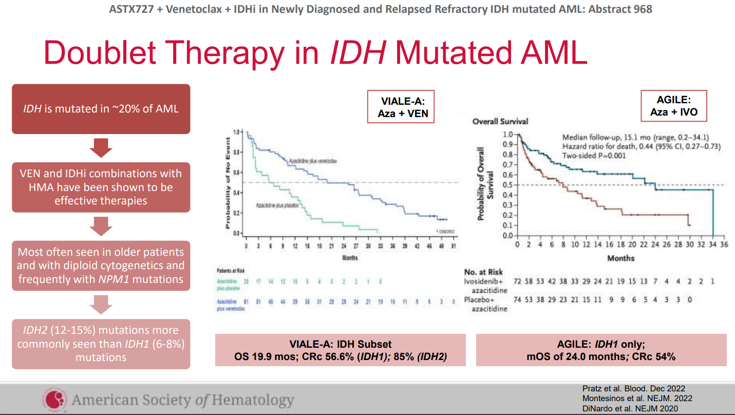
Pratz et al. Blood Dec 2022
Montesinos et al. NEJM 2022
DiNardo et al. NEJM 2020
Arluri et al. ASH 2023. Abstr 968

Slide 61
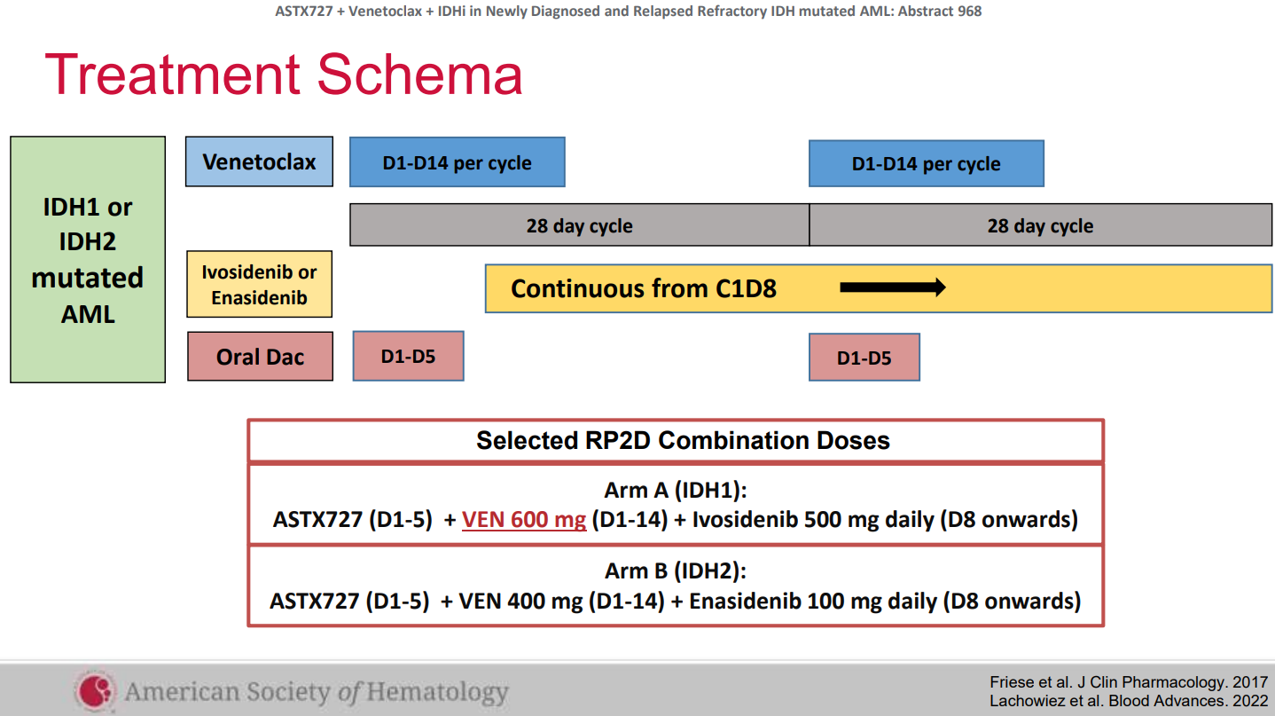
AML – Lower Intensity Therapy
Arluri et al. ASH 2023. Abstr 968

Slide 62
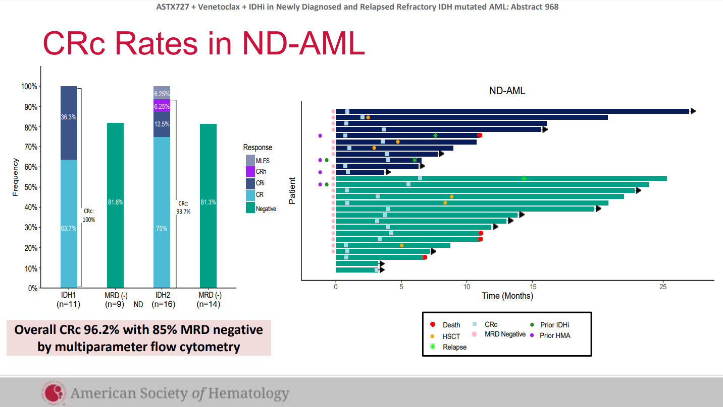
AML – Lower Intensity Therapy
IDH1
IDH2
Arluri et al. ASH 2023. Abstr 968

Slide 63
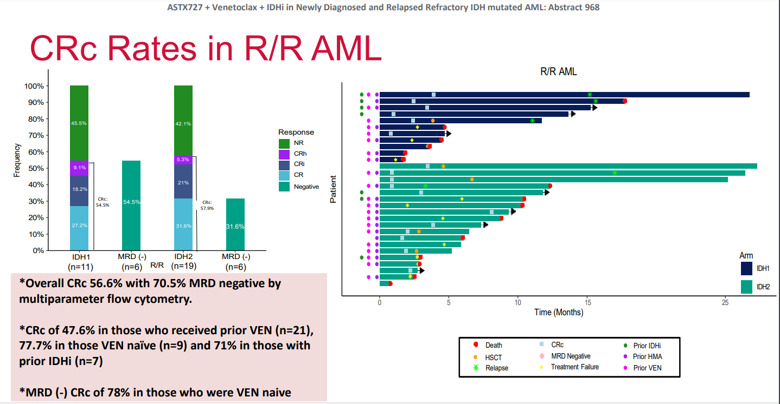
AML – Lower Intensity Therapy
Arluri et al. ASH 2023. Abstr 968

Slide 64
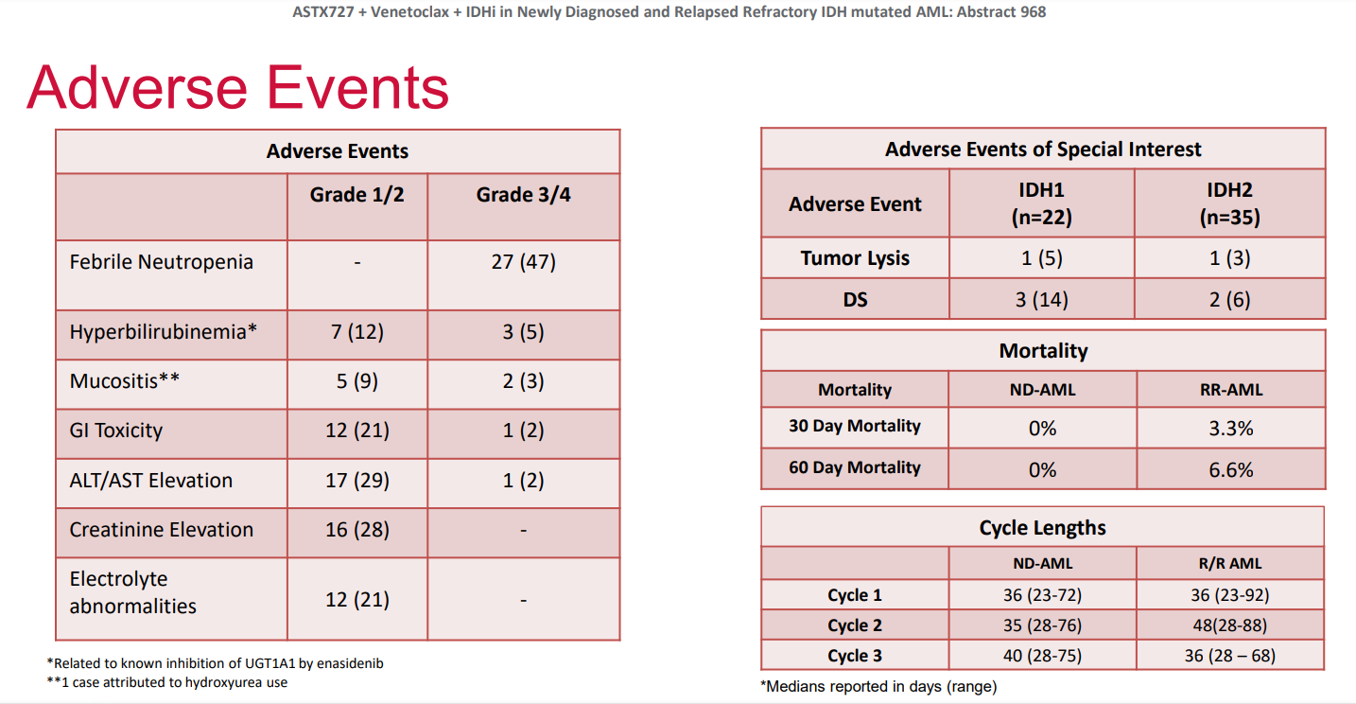
AML – Lower Intensity Therapy
CRc Rates:
96.2% (New Dx)
56.6% (R/R)
Arluri et al. ASH 2023. Abstr 968

Slide 65
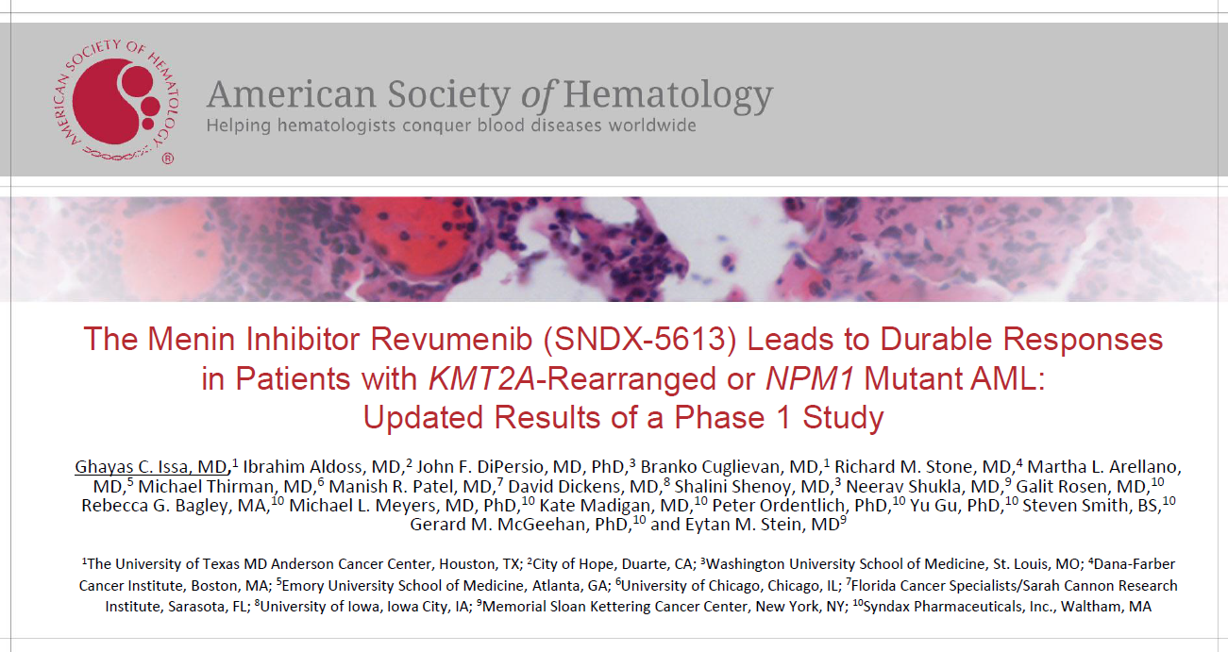
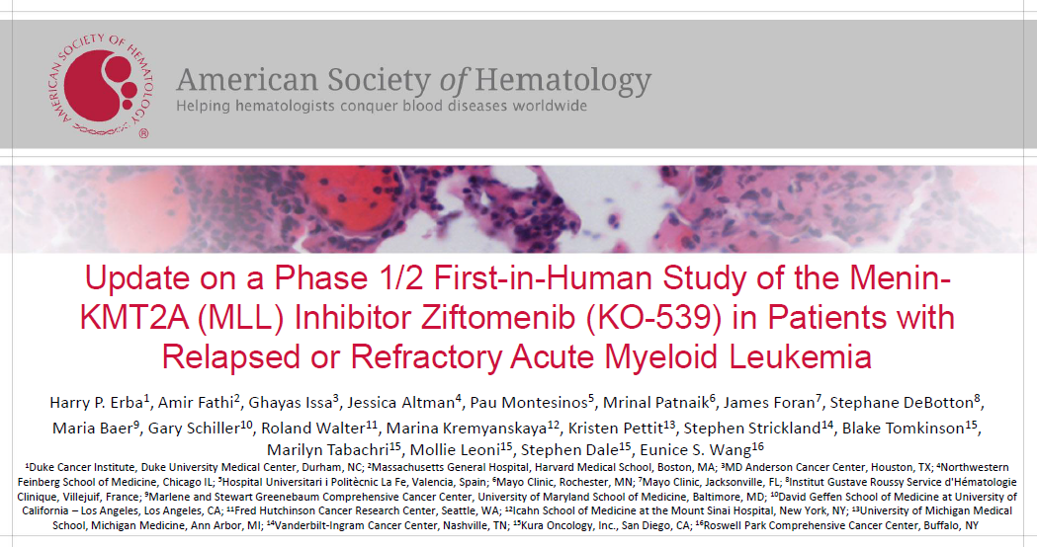
Menin Inhibitors
Disassembly of abnormal transcription complexes → Differentiation → Apoptosis
KMT2Ar + NPM1m → ~40% of AML

Slide 66


KMT2A-r
CR/CRh = 10 (27%)
MRD Negative 7/10 (70%)
NPM1-m
CR/CRh = 3 (27%)
MRD Negative 3/3 (100%)
KMT2A-r
CRc = 2
MRD Negative 2/0 (100%)
NPM1-m
CRc = 7
MRD Negative 3/7 (42.9%)

Slide 67

Jabbour et al. ASH 2023. Abstr 57

Slide 68

AML – Small Molecule Therapy
Jabbour et al. ASH 2023. Abstr 57

Slide 69

Jabbour et al. ASH 2023. Abstr 57

Slide 70

AML – Small Molecule Therapy
Aldoss et al. ASH 2023. LBA-5

Slide 71

AML – Small Molecule Therapy
Aldoss et al. ASH 2023. LBA-5

Slide 72

AML – Small Molecule Therapy
Median DoR: 6.4 mths
Proceeded to HSCT: 39%
Aldoss et al. ASH 2023. LBA-5

Slide 73

AML – Small Molecule Therapy
Aldoss et al. ASH 2023. LBA-5

Slide 74

AML – Small Molecule Therapy (Triplet)
Issa et al. ASH 2023. Abstr 58

Slide 75

AML – Small Molecule Therapy
Issa et al. ASH 2023. Abstr 58

Slide 76

AML – Small Molecule Therapy
Issa et al. ASH 2023. Abstr 58

Slide 77

AML – Small Molecule Therapy
Issa et al. ASH 2023. Abstr 58

Slide 78

Kura Oncology, Jan 2024

Slide 79

Kura Oncology

Slide 80

Kura Oncology, Jan 2024

Slide 81


New dx AML
7+3 + Zifto
R/R AML
Aza/Ven +Zifto
Kura Oncology, Jan 2024

Slide 82

CD123
Alkharabsheh. Biomedicines 2019

Slide 83

Aza/Ven + Tagraxofusp
Lane et al. Blood Adv 2024

Slide 84


Slide 85


CB-012 - Anti-CLL1 Allo CAR-T
Senti-202 - Anti-CD33/FLT3 Allo CAR-NK
Engineered to mitigate risk of GvHD and reduce T-cell exhaustion
Kaveri et al. AACR 2024; Abstr# 1333
-Caribou Biosciences

Slide 86
Summary
Frontline FLT3i w/ Induction
  Quizartinib (FLT3-ITD)
  Midostaurin (FLT3-TKD)
7+3 remains SOC for Fit Patients
Aza/Ven vs Aza/Ivo ?
Aza/Ven Triplets in development
Menin Inhibitors
  Single Agent MRD- remissions
  Menin + SOC Triplet
    Aza/Ven
    7+3
Immune Targets
  Anti-CD123
  Anti-CLL1
  Anti-CD33

Slide 87

Thank You
“HowDee!”

Slide 88
Hematologic Malignancies
April 23rd, 2024

Slide 89
Bispecifics in DLBCL
Farrukh T. Awan, MD
Professor of Internal Medicine
Director of Lymphoid Malignancies Program
Harold C. Simmons Comprehensive Cancer Center
University of Texas Southwestern Medical Center
Dallas, Texas

Slide 90
DISCLOSURES
Consultancy: Genentech, Astrazeneca, Abbvie, Janssen, Pharmacyclics, Gilead sciences, Kite pharma, Celgene, Karyopharm, MEI Pharma, Verastem, Incyte, Beigene, Johnson and Johnson, Dava Oncology, BMS, Merck, Cardinal Health, ADCT therapeutics, Epizyme, Caribou Biosciences, Cellecter Bisosciences, Loxo Oncology, Adaptive Biotechnologies, Genmab
Research funding from Pharmacyclics/Abbvie

Slide 91

Most Common Subtypes of Non-Hodgkin Lymphoma (NHL)
NHL accounts for 4% of all cancers in the US
Expected ~81,000 new diagnoses of NHL in 2023; more than 20,000 deaths
Highly heterogenous group of tumors affecting B lymphocytes
Subtypes and approximate percentages of all cases
  Diffuse large B-cell lymphoma (DLBCL) is most common, accounting for a third
  Follicular lymphoma (FL) = 20% to 22%
  Chronic lymphocytic leukemia/small lymphocytic leukemia (CLL/SLL) = 7%
  Marginal zone lymphoma (MZL) = 8%
  Mantle cell lymphoma (MCL) = 6%
American Cancer Society (ACS). Key statistics for non-Hodgkin lymphoma, 2023 (https://www.cancer.org/cancer/types/non-hodgkin-lymphoma/about/key-statistics.html). Accessed 9/1/23. Modified from Armitage JO, Weisenburger DD. J Clin Oncol. 1998;16:2780-2795.

Slide 92

Anti-CD20 Therapies: Fundamental Part of NHL Management
mOS = median overall survival; mPFS = median progression-free survival; OS = overall survival; PFS = progression-free survival.
Coiffier B, et al. N Engl J Med. 2002;346:235-242. Coiffier B, et al. Blood. 2010;116:2040-2045. Pescovitz MD. Am J Transplantation. 2006,6:859-866.

Slide 93

New and Emerging Bispecific Antibodies in Non-Hodgkin Lymphomas
Odronextamab is an investigational therapy for the management of NHL.
Ab = antibody; BsAb = bispecific Ab; Fc = crystallizable fragment; FL = follicular lymphoma; Fab = fragment antigen binding; IV = intravenous; LC = liquid chromatography; SC = subcutaneous.

Slide 94

Approved or Late-Stage Development Bispecifics: Administration Schedules
Odronextamab is an investigational therapy for the management of NHL.
González Barca E. Front Immunol. 2022;13:909008.

Slide 95

Treatment Landscape: DLBCL—The Relapsed/Refractory Setting
R-CHP-Pola is FDA-approved for DLBCL (not otherwise specified [NOS]) or high-grade B-cell lymphoma (HGBL).
allo = allogeneic; ASCT = autologous stem cell transplant; auto = autologous; R-CHP-Pola = rituximab, cyclophosphamide, doxorubicin, and prednisone plus polatuzumab vedotin. Ref = refractory; Rel = Relapsed; Tafa-Len = Tafasitamab plus lenalidomide; BR-Pola = Polatuzumab vedotin, bendamustine and rituximab; Lonca = Loncastuximab tesirine;

Slide 96

Epcoritamab in R/R LBCL: EPCORE NHL-1 LBCL Expansion Cohort
Step-up dosing protocol
Received FDA approval on May 19, 2023, for R/R DLBCL after 2 prior therapy lines
ICANS = Immune effector cell-associated neurotoxicity syndrome.
Thieblemont C, et al. J Clin Oncol. 2022;41:2238-2247.

Slide 97

Glofitamab Monotherapy at RP2D
Induces Durable Complete Responses
Received FDA approval on June 15, 2023, for R/R DLBCL after 2 prior therapy lines
Clinical cutoff date: March 14, 2022. *Time from the initial occurrence of a CR until PD or death due to any cause, whichever occurs first.
RP2D = recommended phase II doseCCOD = clinical cutoff date; CI = confidence interval; CRS = cytokine release syndrome; DoCR = duration of complete response; IRC = independent review committee; PD = progressive disease.
Dickinson M, et al. American Society of Clinical Oncology (ASCO) 2022; Abstract 7500. Dickinson M, et al. N Engl J Med. 2022;387:2220-2231.

Slide 98

Gloflitamab: Remission at 12-Month Post-EOT in Patients With CR at EOT
Hutchings M, et al. Presented at ASH 2022. Abstract 441

Slide 99

Glofitamab Update (Predictors of response)
Updated data from this pivotal phase 2 study of fixed-duration glofitamab monotherapy (NCT03075696)
In patients who had received prior CAR T-cell therapy (n = 52), complete response rates were 37%, which were similar to the complete response rate in the overall population (40%)
Median duration of complete response: 22.0 months in patients who had received prior CAR T-cell therapy and 26.9 months in the overall population
Baseline TMTV was predictive of progression-free survival
CAR = chimeric antigen receptor; TMTV = total metabolic tumor volume.
Hutchings M, et al. American Society of Hematology (ASH) 2023; Abstract 433 (https://ash.confex.com/ash/2023/webprogram/Paper173951.html). Accessed 1/5/2024.

Slide 100

Odronextamab Efficacy and Safety in R/R DLBCL:
ELM-2 Phase 2 Results
Pivotal phase 2 results presented at ASH 2023*
    R/R DLBCL after ≥2 prior LOT
    Median follow-up was 26.2 months
    Probability of CRs ongoing at 24 months was 48%
    Initial 1/20 step-up regimen revised to 0.7/4/20 to mitigate risk of CRS
Safety
  Most common AEs were CRS, anemia, pyrexia, neutropenia, and hypokalemia
  CRS was mostly low grade and further mitigated by revised step-up regimen
Odronextamab step-up regimen demonstrated clinical efficacy, durable CRs, and manageable safety profile; it also confirms the efficacy of odronextamab in hard-to-treat, highly aggressive R/R DLBCL.
Walewski J, et al. EHA 2023; Abstract P1115 (https://library.ehaweb.org/eha/2023/eha2023congress/385565/jan.walewski.odronextamab.in.patients.with.relapsed.refractory.diffuse.large.html?f=menu%3D16%2Abrowseby% 3D8%2Asortby%3D2%2Ace_id%3D2489% 2Aot_id%3D27893% 2Atrend%3D4016%2Amarker%3D4178). Accessed 1/5/2024. Ayyapan S, et al. Blood. 2023;142(suppl 1):436.

Slide 101

Mosunetuzumab, Pivotal Phase 2 in R/R FL
FL (N = 90) with >2 lines of therapy (including anti-CD20 and anthracycline based therapy)
ORR: 80% (95% CI: 70, 88), CR: 60%
Median follow-up of 14.9 months, estimated DOR = 22.8 months (95% CI: 10, NR)
DOR rate at 12 and 18 months was 62% and 57%, respectively
Side effects: CRS: 44%; ICANS 5% (any grade)
Phase 3 CELESTIMO trial (NCT04712097) is evaluating efficacy and safety of mosunetuzumab plus lenalidomide compared with rituximab plus lenalidomide in patients with follicular lymphoma
Budde LE, et al. Lancet Oncol. 2022;23(8):1055-1065. Bartlett LE, et al. Blood 2022;140 (suppl 1); Abstract 3573. NCT04712097 (https://clinicaltrials.gov/ct2/show/NCT04712097?term=NCT04712097). Accessed 9/1/23.

Slide 102

Efficacy Update in R/R FL After ≥2 Prior Therapies: 3-Year Follow-Up
*36-month DOR/DOCR data are not available as this analysis was conducted from the first response assessment; therefore, the landmark analysis is shorter for the duration outputs.
CI = confidence interval; DOCR = duration of complete response; DOR = duration of response; FL = follicular lymphoma; NR = not reached; OS = overall survival; PFS = progression-free survival; R/R = relapsed/refractory.
Schuster SJ, et al. ASH 2023; Abstract 603 (https://ash.confex.com/ash/2023/webprogram/Paper173692.html). Accessed 1/5/2024.

Slide 103

Odronextamab Efficacy and Safety in R/R FL:
ELM-2 Phase 2 Results
Pivotal phase 2 results presented at
ASH ’22 and EHA ‘23
  Grade 1-3a R/R FL after ≥ 2 prior LOT
  Median follow-up was 22.4 months
  Initial 1/20 step-up regimen revised to 0.7/4/20 to mitigate risk of CRS
Safety
  Most common AEs were CRS, neutropenia and pyrexia, and hypokalemia
  CRS was mostly low grade and further mitigated by revised step-up regimen (Gr 3 CRS observed in 1 patient)
Odronextamab step-up regimen showed clinical efficacy, durable CRs, and manageable safety profile; it also confirms the efficacy of odronextamab in hard-to-treat, highly aggressive R/R FL
*As of September 15, 2022
R/R = relapsed/refractory; FL = follicular lymphoma; LOT = lines of therapy; ORR = objective response rate;
CR = complete response; CRS = cytokine release syndrome. mDOCR = median duration of complete response
Taszner M, et al. Hemasphere. 2023;7(Suppl ):e214536e.

Slide 104

Odronextamab: ELM-2 Update in FL From ASH 2023
In a cohort of patients with R/R grade 1 to 3a FL from the phase 2 ELM-2 trial
140 patients treated with an initial step-up regimen of odronextamab followed by 80 mg weekly or 160 mg every 2 weeks, after a median follow-up of 26.6 months
  Median duration of CR of 21.7 months
  Median PFS: 20.7 months; median: OS not reached
Grade 3 CRS observed in a single patient (<1%; 1/140), while no grade 4 or grade 5 cases of CRS were reported; 1 case of low-grade ICANS was reported (<1%; 1/140)
Odronextamab is an investigational therapy for the management of NHL.
CR = complete response; ORR = overall response rate.
Novelli S, et al. Hematol Oncol. 2023;41:121-122. Villasboas JC, et al. Blood. 2023;142(suppl 1):3041.

Slide 105

CRS and ICANS: Bispecifics
Dickinson M, et al. N Engl J Med. 2022;387(24):2220-2231. Budde LE, et al. Lancet Oncol. 2022;23(8):1055-1065. Bannerji R, et al. Lancet Haematol. 2022;9(5):e327-e339. Thieblemont C, et al. J Clin Oncol. 2023;41(12):2238-2247.
Odronextamab is an investigational therapy for the management of NHL.

Slide 106
SUMMARY
Multiple clinical trials have been initiated with bispecific antibodies in NHL; Phase 3 clinical trials currently enrolling participants
Mosunetuzumab is now approved for patients with FL who have failed 2 or more lines of prior therapy (FDA approval 12/22/2022)
Epcoritamab and glofitamab are approved for patients with LBCL who have failed 2 or more lines of prior therapy (FDA approval 2023)
Odronextamab received FDA priority review acceptance (9/29/2023) for R/R DLBCL or R/R FL after 2 prior therapy lines
These off-the-shelf therapies have novel mechanistic features and unique safety and efficacy profiles

Slide 107
Hematologic Malignancies
April 23rd, 2024

Slide 108
Controversies in CAR-T Therapy
Jeremy Pantin, MD
Clinical Director, Adult Transplant and Cellular Therapy Program
Tristar BMT
Nashville, TN

Slide 109
Commercial CAR-T Indications and Cost
CAR-T | Adult Indication | ORR | CRR | 2023 Cost | Trial | Phase
tisagenlecleucel | Adult patients with relapsed or refractory (r/r) large B-cell lymphoma after two or more lines of systemic therapy | 53% | 39% | $427,048 | JULIET | 2 (n=93)
 | Adult patients with relapsed or refractory (r/r) follicular lymphoma (FL) after two or more lines of systemic therapy | 86.2% | 69.1% | $427,048 | ELARA | 2 (n=94)
axicabtagene ciloleucel | Adult patients with relapsed or refractory large B-cell lymphoma after two or more lines of systemic therapy | 82% | 54% | $424,000 | ZUMA-1 | 2 (n=92)
 | Adult patients with relapsed or refractory follicular lymphoma after two or more lines of systemic therapy | 89% | 78% | $424,000 | ZUMA-5 | 2 (n=40)
 | Adult patients with large B-cell lymphoma that is refractory to first-line chemoimmunotherapy or that relapses within 12 months of first-line chemoimmunotherapy | 83% vs. 50% SOC | 65% vs. 32% SOC | $424,000 | ZUMA-7 | 3 (n=359)
Am Soc Clin Oncol Educ Book 43, e397912(2023).

Slide 110
Commercial CAR-T Indications and Cost
CAR-T | Adult Indication | ORR | CRR | 2023 Cost | Trial | Phase
brexucabtagene autoleucel | Adult patients with relapsed/refractory mantle cell lymphoma | 93% | 67% | $424,000 | ZUMA-2 | 2 (n=60)
 | Adult patients with relapsed or refractory (r/r) B-cell precursor acute lymphoblastic leukemia |  | 56% | $424,000 | ZUMA-3 | 2 (n=55)
lisocabtagene maraleucel | Adult patients with relapsed or refractory large B-cell lymphoma after two or more lines of systemic therapy | 73% | 53% | $447,227 | TRANSCEND NHL 001 | 1 (n=269)
 | Adult patients with diffuse large B-cell lymphoma (DLBCL) not otherwise specified (including DLBCL arising from indolent lymphoma), high-grade B-cell lymphoma, primary mediastinal large B-cell lymphoma, and follicular lymphoma grade 3B |  | 66% vs. 39% SOC | $447,227 | TRANSFORM | 3 (n=184)
 | Adult patients with relapsed or refractory chronic lymphocytic leukemia (CLL) or small lymphocytic lymphoma (SLL) who have previously received at least 2 prior lines of therapy, including a BTK inhibitor and a BCL-2 inhibitor | 45% | 20% | ? | TRANSCEND CLL 004 | 1/2 (n=65)
Am Soc Clin Oncol Educ Book 43, e397912(2023).

Slide 111
Commercial CAR-T Indications and Cost
CAR-T | Adult Indication | ORR | CRR | 2023 Cost | Trial | Phase
idecabtagene vicleucel | Adult patients with relapsed or refractory multiple myeloma after four or more prior lines of therapy | 73% | 33% | $457,255 | KarMMa | 2 (n=128)
 | Adult patients with relapsed or refractory multiple myeloma after two or more prior lines of therapy, including an immunomodulatory agent (IMiD), a proteasome inhibitor (PI), and an anti-CD38 monoclonal antibody | 71% vs. 42% SOC | 39% vs. 5% SOC | ? | KarMMa-3 | 3 (n=254)
ciltacabtagene autoleucel | Adult patients with relapsed or refractory multiple myeloma after four or more prior lines of therapy | 97% | 67% | $465,000 | CARTITUDE-1 | 1b/2 (n=97)
 | Adult patients with relapsed or refractory multiple myeloma who have received at least one prior line of therapy, including a proteasome inhibitor (PI) and an immunomodulatory agent (IMiD), and who are refractory to lenalidomide | 84.6% vs. 67.3% SOC | 73.1% vs. 21.8% SOC 60.6% vs. 15.6% MRD^{neg} | ? | CARTITUDE-4 | 3 (n=211)
Am Soc Clin Oncol Educ Book 43, e397912(2023).

Slide 112
Accessibility
Despite the remarkable outcomes in clinical trials, there are barriers to access CAR T-cell therapies.
The acquisition cost of CAR T-cell is between $373,000 to $475,000 per infusion, excluding extra procedures and facility costs.
Access to CAR-T remains a challenge.
Insurance
Distance to center
Bridging therapy
30+ Day relocation proximal to center
Caregiver
No driving for 8 weeks

Slide 113

Hospital Reimbursement for CAR-T Under IPPS: Final FY 2024
Inpatient stays with CAR-T treatment are currently assigned to MS-DRG 018, which has a base reimbursement rate of $247,939.
Hospitals currently receive additional payments for three products with NTAP status: Tecartus, Abecma, and Carvykti; however, the NTAP is limited to a maximum of 65% of the product cost. NTAP payments will expire in FY 2024.

Slide 114

Equity
One survey of 15 institutions found that the average wait time for anti-BCMA CART was six months, and only 25% of patients ended up getting to CAR-T.
  J Clin Oncol. 2022;40(16_suppl):e20021.
Most patients who receive anti-BCMA CAR-T are white (79%). Only 6% of recipients are Black – despite the higher incidence of myeloma in the Black community – and they receive the treatment later in therapy than their white counterparts.
  JCO Oncol Pract. 2022;18(12):800-807.

Slide 115
Toxicity
Early: CRS, ICANS.
Movement and neurocognitive treatment-emergent adverse events with anti-BCMA CAR-T.
Late: Prolonged cytopenias, B-cell aplasia, hypogammaglobulinemia.
Secondary malignancies:
  Second primary malignancies (SPMs) were reported in 536 out of 12,394 (4.3%) adverse event reports following CAR T cell therapies in the FDA Adverse Event Reporting System. Blood blood.2024024166.
  Myeloid and T-cell neoplasms were disproportionately more frequently reported, warranting further follow-up.

Slide 116
Efficacy
Pts aged 18-75 years with LBCL who received CAR-T (between 2018-2021) or auto-HCT (between 2015-2021) while in a CR by PET or CT were compared using the data from the CIBMTR registry.
They identified 360 pts with LBCL who were in a CR before receiving CAR-T (n=79, tisa-cel 53%, axi-cel 46%, and liso-cel 1%) or auto-HCT (n=281).
In univariate analysis, treatment with CAR-T was associated with a higher rate of relapse at 2 years (48% vs. 27.8%; p < 0.001), a lower rate of 2-year PFS (47.8% vs. 66.2%; p < 0.001) and lower 2-year OS (65.6% vs. 78.9%; p=0.037).
There was no difference in rates of 2-year TRM (4.1% vs. 5.9%; p=0.673).
Similarly, patients with early (12 months) treatment failure (CAR-T =57 and auto-HCT=163), treatment with CAR-T was associated with a higher 2-year relapse rate (45.9% vs. 22.8%; p <0.001) and an inferior 2-year PFS (48.3% vs.70.9%.; p <0.001) compared to auto-HCT while there was no difference in 2-year OS or TRM.
In the multivariable analysis, treatment with CAR-T was associated with higher risk of relapse (HR 2.18; p < 0.0001) and an inferior PFS (HR 1.83; p=0.0011) compared to auto-HCT. There was no difference in the risk of TRM (HR 0.59; p=0.36) or OS (HR 1.44; p=0.12).

Slide 117

Shadman et al. ASH 2023 Abstract 781

Slide 118

Cost Effectiveness
Anti-CD19 CAR-T is approved in patients with relapsed or refractory (R/R) FL after ≥2 lines of therapy.
Calculated costs, discounted life years, quality-adjusted life years (QALYs), and the incremental cost-effectiveness ratio (ICER) of CAR T-cell vs SOC therapies with a willingness-to-pay threshold of $150 000 per QALY.
CAR T-cell therapy was associated with incremental clinical benefit of 1.50 QALYs, resulting in an ICER of $182 127 per QALY.
Potnis et al. Blood Adv. 2023 Mar 14; 7(5): 801–810.

Slide 119
Competing Therapies
Pirtobrutinib | Liso-cel
BRUIN open label single arm n=108 | TRANSCEND CLL 004 Phase 1/2 n=65
2 prior lines of therapy, including a BTK inhibitor and a BCL-2 inhibitor | 2 prior lines of therapy, including a BTK inhibitor and a BCL-2 inhibitor
ORR 72% | ORR 47%
CR 0% (all PR) | CR 18.4%
Median DOR 12.2 months | Median f/u 21.1 months, no CR progressed
$25,000 for 30 days ($300,000 p.a.) | $447,227

Slide 120
Future Directions
PERSEUS Trial N Engl J Med 2024;390:301-313
Phase 3 trial where 709 transplantation-eligible patients with newly diagnosed multiple myeloma were randomly assigned to receive either sc daratumumab with VRd induction and consolidation therapy and with lenalidomide maintenance therapy or VRd induction and consolidation therapy and lenalidomide maintenance therapy alone.
Progression-free survival at 48 months was 84.3% in the D-VRd group and 67.7% in the VRd group
Complete response or better was higher in the D-VRd group than in the VRd group (87.9% vs. 70.1%, P<0.001)
Cilta-cel approved for adult patients with relapsed or refractory multiple myeloma who have received at least one prior line of therapy, including a proteasome inhibitor (PI) and an immunomodulatory agent (IMiD), and who are refractory to lenalidomide
A Study of Daratumumab, Bortezomib, Lenalidomide and Dexamethasone (DVRd) Followed by Ciltacabtagene Autoleucel Versus Daratumumab, Bortezomib, Lenalidomide and Dexamethasone (DVRd) Followed by Autologous Stem Cell Transplant (ASCT) in Participants With Newly Diagnosed Multiple Myeloma (CARTITUDE-6)

Slide 121
Summary
CAR-T therapy has shown high response rates.
Widespread availability and accessibility remain a challenge.
Improved safety with newer constructs are needed.
Cost effectiveness is controversial due to uncertain clinical evidence.
Head-to-head comparisons with newer agents are unavailable.

Slide 122
Hematologic Malignancies
April 23rd, 2024

Slide 123
Practice Changing Updates in Myeloma
Minoo Battiwalla, MD, MS
Director, Outcomes Research
Sarah Cannon Transplant and Cell Therapy
Nashville, TN
No relevant conflicts of interest

Slide 124
Practice Changing Updates in Myeloma
Quads to the front line in TE NDMM
CAR-T in earlier line setting

Slide 125
Therapeutic landscape in 2023
←1L 2L 3L 4L 5L
ND MM
Transplant eligible
Transplant ineligible
Triplet induction
(Quad for HR)
Dara/Len/Dex
[MAIA]
Auto HCT
Maint
Anti BCMA CAR-T [Cilta-cel/Ide-cel]
Anti BCMA BiTE [Teclistamab,
Elranatamab]
Anti GPRC5d BiTE [Talquetamab]

Slide 126
Quads to the front line for all patients with transplant eligible MM

Slide 127
Phase 2 GRIFFIN Trial
Induction: Cycles 1-4
Consolidation: Cycles 5-6^{c}
Maintenance: Cycles 7-32
Primary endpoint:
sCR rate
(after consolidation)
Key eligibility criteria
Transplant-preferred NDMM
18-70 years of age
ECOG PS score 0-2
CrCl ≥30 mL/minª
Stratification factors
ISS disease stage (I, II, or III)
CrCl (30-50 or
>50 mL/min)
D-RVd
D: 16 mg/kg IV Days 1, 8, 15
R: 25 mg PO Days 1-14
V: 1.3 mg/m² SC Days 1, 4, 8, 11
d: 20 mg PO Days 1, 2, 8, 9, 15, 16
Transplant
D-RVd
D: 16 mg/kg IV Day 1
R: 25 mg PO Days 1-14
V: 1.3 mg/m² SC Days 1, 4, 8, 11
d: 20 mg PO Days 1, 2, 8, 9, 15, 16
D-R
D: 16 mg/kg IV Day 1 Q4W or Q8W^{d}
R: 10 mg PO Days 1-21 Cycles 7-9;
15 mg PO Days 1-21 Cycles 10+
1:1 randomization
RVd
R: 25 mg PO Days 1-14
V: 1.3 mg/m² SC Days 1, 4, 8, 11
d: 20 mg PO Days 1, 2, 8, 9, 15, 16
RVd
R: 25 mg PO Days 1-14
V: 1.3 mg/m² SC Days 1, 4, 8, 11
d: 20 mg PO Days 1, 2, 8, 9, 15, 16
R
R: 10 mg PO Days 1-21 Cycles 7-9;
15 mg PO Days 1-21 Cycles 10+
21-day cycles
21-day cycles
28-day cycles
Median age ~60; ISS3 14%, High risk 15%
Sborov D, et al. IMS Annual Meeting 2022.

Slide 128

GRIFFIN Final Analysis: Response Rates
Voorhees PM, et al. Lancet Haematol. 2023;10:e825-837.

Slide 129



GRIFFIN Final Analysis: PFS and OS
Progression-Free Survival
Overall Survival
Voorhees PM, et al. Lancet Haematol. 2023;10:e825-837.

Slide 130


Slide 131

Phase 3 PERSEUS Trial
Sonneveld P, et al. N Eng J Med. 2023;

Slide 132


PERSEUS: PFS in Transplant-Eligible NDMM
Phase 3 PERSEUS Trial: Efficacy
Sonneveld P, et al. N Eng J Med. 2023;

Slide 133

PERSEUS: Overall and Sustained MRD-Negativity Rates
Sonneveld P, et al. N Eng J Med. 2023; DOI: 10.1056/NEJMoa2312054

Slide 134


PERSEUS: Outcomes and Subgroup Analysis
PERSEUS: Who benefits? Safety Considerations
*
*
Sonneveld P, et al. N Eng J Med. 2023;

Slide 135

Phase 3 IsKia Trial: Study Design
Gay F, et al. Blood. 2023; 142(Supple 1):LBA4.

Slide 136
IsKia Trial: Post-Consolidation MRD Negativity
Response rates after consolidation:
>VGPR was 94% in both arms
≥CR 74% vs 72% for IsaKRd vs KRd
sCR 64% vs 67% for IsaKRd vs KRd
OR 2.29, p<0.001
Gay F, et al. Blood. 2023; 142(Supple 1):LBA4.
Gay F, et al. Blood. 2023; 142(Supple 1):LBA-4.

Slide 137


IsKia Trial: MRD Negativity Post-Consolidation
The addition of isatuximab to KRd induction and consolidation
- significantly increased MRD negativity rates in every treatment phase as compared to KRd
- no new safety concerns
- benefit was retained in HiR pts.
Gay F, et al. Blood. 2023; 142(Supple 1):LBA-4.

Slide 138
CAR-T cells in an earlier line setting

Slide 139

Earlier use of CAR-T cells
Effective in Len refractory [PFS ~ 12 months] and triple class ref [ PFS ~3-5 months]
Patients are lost to attrition with each line of therapy
Use of T cells in earlier setting, when less exhausted
One time infusion- no maint
Yong, et al. 2016

Slide 140



Phase 3 CARTITUDE-4: Cilta-cel Versus Standard of Care (PVd or DPd) in Lenalidomide-Refractory Multiple Myeloma w 1-3 prior LOT
CARTITUDE-1

Slide 141

Notes:
FDA officials raised concerns that 14% of patients who were randomly assigned to receive cilta-cel died in the first 10 months compared with 12% of patients who were treated with the investigator’s choice of standard-of-care (SOC) therapy. In data presented at the meeting, the overall survival (OS) Kaplan-Meier curves showed a hazard pattern crossing at around 11 months, with lower OS in the cilta-cel group compared with the SOC group before 11 months. Because of this, the FDA raised concerns about whether the hazard ratio data can be interpreted.
May never fully understand the reasons for the higher rates of early deaths observed in CARTITUDE-4- more delays during clinical trials or COVID-19 pandemic

Slide 142


Slide 143

Early deaths: in first 10 months
14% in ITT arm vs 12% in SOC
Due to Progression/Death Prior to Cilta-cel Infusion in Cilta-cel Arm
Notes:
FDA officials raised concerns that 14% of patients who were randomly assigned to receive cilta-cel died in the first 10 months compared with 12% of patients who were treated with the investigator’s choice of standard-of-care (SOC) therapy. In data presented at the meeting, the overall survival (OS) Kaplan-Meier curves showed a hazard pattern crossing at around 11 months, with lower OS in the cilta-cel group compared with the SOC group before 11 months. Because of this, the FDA raised concerns about whether the hazard ratio data can be interpreted.
May never fully understand the reasons for the higher rates of early deaths observed in CARTITUDE-4- more delays during clinical trials or COVID-19 pandemic

Slide 144
Cilta-cel significantly prolonged PFS vs SOC (HR, 0.26; P<0.0001)
12-month PFS rate 76% in cilta-cel vs 49% in SoC
PFS benefit was seen across all subgroups
ORR: 85% vs 67%CR / sCR = 73% vs 22%
MRD negativity = 61% vs 16%
ORR in the cilta-cel as-treated group was 99%, with 86% ≥CR and 72% MRD negative (10-5)
CAR-T–specific AEs were manageable Lower incidence and severity of CRS, ICANS, MNT, and some cytopenias were observed in CARTITUDE-4 vs CARTITUDE-1, suggesting improved tolerability of cilta-cel when used earlier in treatment
US FDA Approval
April 5, 2024
The treatment of adult patients with relapsed or refractory multiple myeloma who have received at least 1 prior line of therapy, including a proteasome inhibitor and an immunomodulatory agent, and are refractory to lenalidomide

Slide 145

Primary endpoint
• PFSbyIRC
Key secondary endpoints
• ORRbyIRC • OS
Other secondary endpoints
• CRR by IRC, MRD, PROs • Safety
Notes:
In the open-label, multicenter KarMMa trial (NCT03361748), investigators compared ide-cel with standard of care regimens for the treatment of adults with relapsed/refractory multiple myeloma after 2 to 4 prior lines of therapy including a PI, an IMID, and daratumumab (Darzalex).² All patients included in the trial were refractory to the last line of therapy and were randomized to receive a single infusion of ide-cel or investigator choice of 5 standard therapies.

Slide 146


Slide 147

Notes:
numerically higher proportion of early deaths in the ide-cel arm was driven by patients who never received ide-cel, and most of the early deaths that occurred were due to disease progression.

Slide 148



Slide 149

US FDA Approval
April 5, 2024
Triple class exposed after at least 2 prior LOT

Slide 150
Therapeutic landscape in 2024
←1L 2L 3L 4L 5L
Anti BCMA BiTE [Teclistamab,Elranatamab]
Anti GPRC5d BiTE [Talquetamab]
Megizdomide
[ELREXFIO]
ND MM
Transplant eligible
Transplant ineligible
Quad induction
(for all)
Dara/Len/Dex
[MAIA]
Auto HCT
Consolidation
Maint
Cilta-cel
[CARVYKTI]
Ide-cel
[ABECMA]

Slide 151
Change in landscape
One year ago…[TE]
INDUCTION: Triplet for SR, quad for HR
Auto HCT: after ~ 4 cycles in VGPR for TE
CONSOLIDATION: Uncommon
MAINT: Len based, + PI for HR
5L: CAR-T or BiTE
2024 [TE]
INDUCTION: Quad for SR and HR
Auto HCT: after ~ 4 cycles in VGPR for TE
CONSOLIDATION: Emphasized if not in CR
MAINT: Len based, + PI for HR
2L: Cilta-cel [CARVYKTI]
3L: Ide-cel [ABECMA]
5L: BiTE

Slide 152


Thank you!
Minoo Battiwalla MD, MS
Director, Outcomes Research |
Sarah Cannon Transplant and Cell Therapy Network
@DrBattiwalla
M: 301-742-7782

