Slide 1
Hematologic Malignancies
April 23rd, 2024

Slide 2
Welcome
Albert Tierney
VP of Sales, OncLive
MJH Life Sciences™

Slide 3


Thank You to Our Supporters:

Slide 4
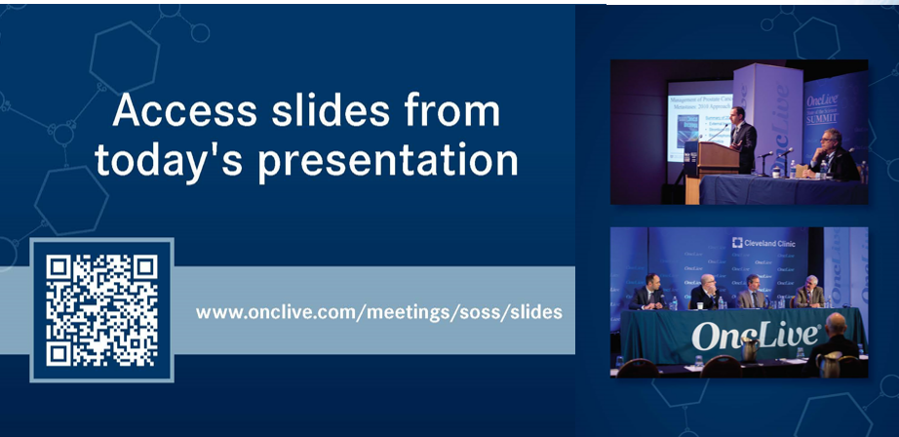

Slide 5


Slide 6
2024 Events
Lung: June, Chicago, IL
Pan Tumor: October, Miami, FL
Gastrointestinal: November, Washington, DC
Breast: December, San Antonio, TX

Slide 7



Slide 8
Program Chair
Martha Arellano, MD
Professor of Hematology and Oncology
Associate Director, Hematology Division
Program Director, Hematology/Medical Oncology Fellowship
Winship Cancer Institute of Emory University
Atlanta, Georgia

Slide 9
Hematologic Malignancies
April 23rd, 2024

Slide 10

Management of Myelofibrosis (MF): Where we are in 2024
Anthony Hunter, MD
Assistant Professor
Winship Cancer Institute of Emory University
Atlanta, GA

Slide 11
Disclosures
Consulting/Honoraria: GSK, Cogent Biosciences, PharmaEssentia, Blueprint Medicines, Sobi
Research support: Incyte, Cogent Biosciences, Ascentage Pharma, Blueprint Medicines, Syntrix Biosystems, Novartis, PharmaEssentia

Slide 12
Learning Objectives
Review the basics of myelofibrosis (MF) pathobiology and standard treatment approaches
Discuss the impact of cytopenias in MF
Review data supporting the novel JAKi, momelotinib, and its role in cytopenic MF
Examine emerging agents under investigation

Slide 13
Myelofibrosis Overview
Myelofibrosis Overview
Classical myeloproliferative neoplasm, Philadelphia chromosome negative
Clonal hematopoietic stem cell disorder characterized by marrow fibrosis, myeloproliferation, aberrant inflammatory cytokine signaling
Propensity for leukemic transformation and vascular complications
Extramedullary Hematopoiesis
Constitutional Symptoms
Cytopenias

Slide 14
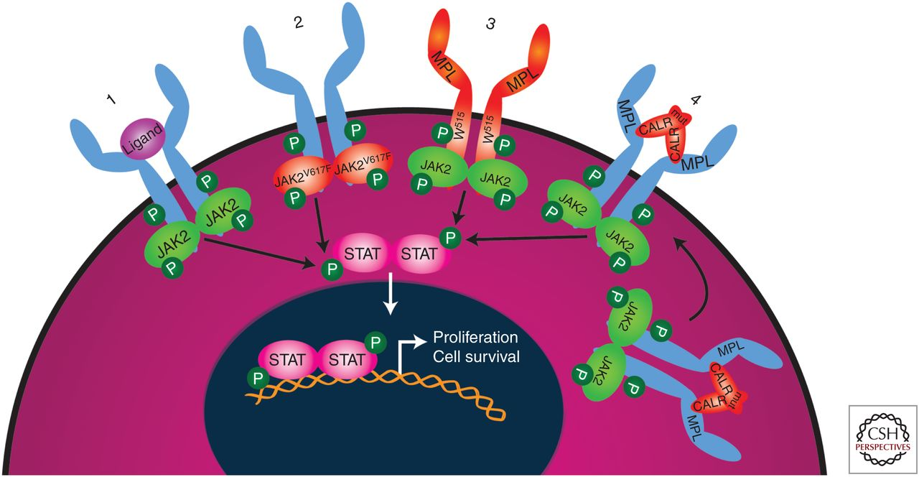
Activated JAK-STAT Signaling is Central to MF Pathogenesis
Marneth AE, Mullally A. Cold Spring Harb Perspect Med. 2020 Feb 3;10(2):a034876
Notes:
The mutation results in a valine to phenylalanine substitution at position 617 (V617F) in the JH2 domain of the protein, negating the otherwise repressive function of this domain on kinase activity (Chen and Mullally 2014).
JAK2 discovered in 2005
MPL 2006
CALR 2013
Results in multiple effects in hematopoiesis as well as inflammatory cytokine signaling (aberrant inflammatory cytokine signaling)

Slide 15
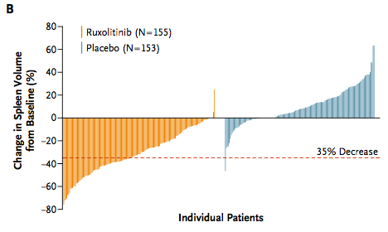
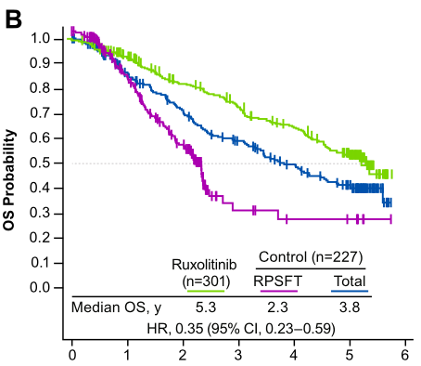
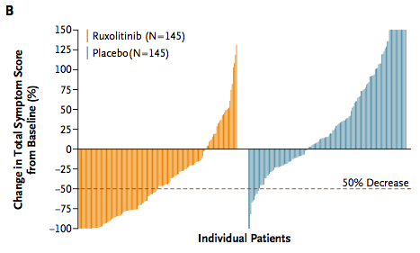
Ruxolitinib: The Standard of Care in Symptomatic, Higher-risk Myelofibrosis
Verstovsek S, et al. N Engl J Med 2012; 366(9):799-807.
Harrison C, et al. N Engl J Med 2012; 366(9): 787-98.
Verstovsek S, et al. Journal of Hematology & Oncology 2017; 10(1):156
Notes:
Approved in 2011…DOSING BASED ON PLT COUNT
Explain SVR35 and TSS50 here….SVR was primary, TSS secondary
COMFORT 1: vs. placebo (n=309) COMFORT2: vs. BAT (n=219 total)….dose 15mg if plts 100-200, 20mg if plts >200
COMFORT 1: SVR (42% vs 0.7%) and 2ndary TSS (45.9 vs. 5.3%) at week 24
COMFORT2: SVR35 in 28% vs. 0% at wk 48 (32% at wk 24); no specific TSS50
Both included: PMF/post-ET/post-PV, spleen >5cm, IPSS: int-2 or higher, PLTS >100!!!
Earlier treatment has been shown to improve response/outcomes (and lower risk disease, smaller spleen, lower TSS, lack of TD, higher plt count (proliferative vs. cytopenic MF)
-earlier treatment and lower-risk disease in several papers, including JUMP
-1 paper, higher response rate with VAF>50%
OS just over 5 years in pooled comfort data
rank-preserving structural failure time (RPSFT)- to account for crossover to tx arm (~70% of patients between the 2 studies)
Spleen responses correlate with survival
OS in several real world cohorts
-ERNEST (1010 European patients): OS benefit compared to hydrea (6.7 vs. 5.1 years, bigger separation with PS-matching)), including MV analysis
Lack of clear disease modifying capacity: capacity: no real marrow responses or decrease in fibrosis, no clear decrease in progression to AML, clonal evolution is seen (up to 36%), Some decrease in JAK2 CAF in comfort 1, occasional long-term patients with molecular remissions. Possibly OS improvements in long-term follow up, but may be more related to improvements in spleen (spleen response correlates with OS), inflammation, nutrition, etc (e.g. inc body weight and albumin)
-From MPN inflammation review paper: This is also important because JAK2 inhibition, as a therapeutic
modality for MPNs, does not greatly or reliably reduce the malignant clonal burden or extent of bone marrow fibrosis
Mutations: ASXL1, EZH2, DNMT3A have all been shown to correlate with time to discontinuation (replace IDH1/2 with DNMT3A for spleen response and OS), as has number of mutations
-RAS mutations and associated with Rux resistance and dec. OS (multiple studies)
-new mutations (clonal evolution also predictive of inferior OS);

Slide 16
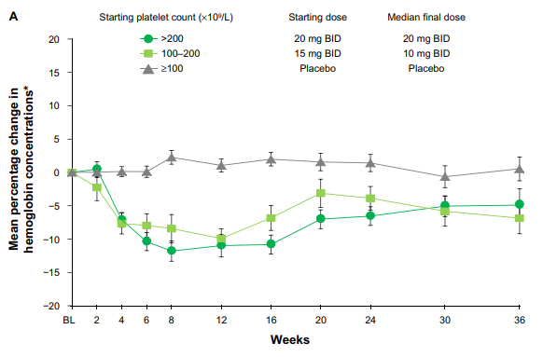
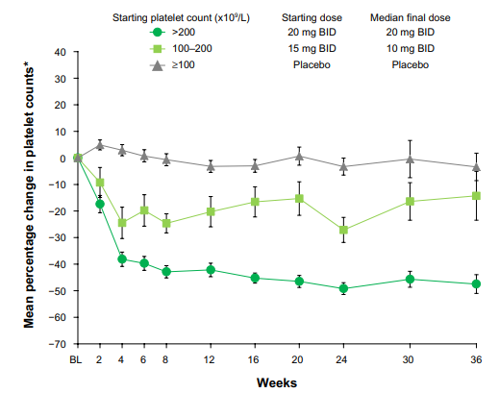
Cytopenias Complicate JAKi Treatment
In real-world cohorts, median duration of therapy is 11-18 months, with up to 1/3 of patients discontinuing due to cytopenias.
Survival after ruxolitinib discontinuation is poor (11-14 months)
  Treatment-emergent anemia does not impact survival.
Verstovsek S, et al. Onco Targets Ther. 2013; 7:13-21. Verstovsek S, et al. N Engl J Med 2012; 366(9):799-807. Palandri F, et al. Cancer 2020; 126(6):1243-1252. Kuykendal A, et al. Ann Hematol 2018; 97(3):435-441. Newberry K, et al. Blood 2017; 130(9):1125-1131. Al-Ali HK, et al. haematologica 2016; 101(9):1065-73. Gupta V, et al. haematologica 2016; 101(12):e482-484. Mascarenhas, et al. J Med Econ 2020; 23(7):721-727
Notes:
Drug-related cytopenias
Reason for discontinuation in up to a third of patients
Treatment-related anemia does not impact survival
Dose dependent. Both pleateau by 8-12 weeks, plt then stable, hgb some recovery
Important to monitor for cyotpenias, especially in first 12 weeks.
**Treat throught cytopenias, particularly anemia

Slide 17
Chifotides H, et al. Cancers (Basel). 2023 Jun 24;15(13):3331

Slide 18
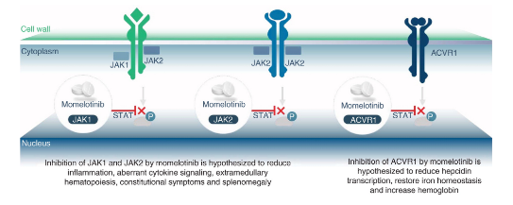
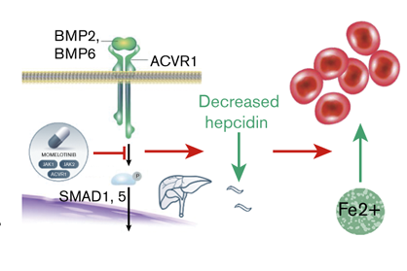
Momelotinib: Novel JAKi with Potential Anemia Benefits
Verstovsek S, et al. Future Oncol. 2021;17(12):1449-1458.
Oh ST, et al. Blood Adv. 2020 Sep 22;4(18):4282-4291
Notes:
Preclinical and clinical translational studies have demonstrated that MMB’s ability to improve anemia and transfusion dependency is linked to suppression of ACVR1/ALK2-mediated hepcidin production, which leads to increased serum iron availability and stimulation of erythropoiesis [26, 27]. Importantly, elevated hepcidin is significantly associated with shortened OS in patients with MF [28].
*Activin A receptor, type 1/ activin receptor like kinase 2
“ IRON RESTRICTED HEMATOPOIESIS”
The complex and interrelated drivers of anemia in MF include marrow fibrosis fundamental to the disease, anemia of chronic inflammation, and splenic sequestration of red blood cells (RBCs). In addition, anemia can be exacerbated by specific MF treatments, including the JAK inhibitors ruxolitinib and fedratinib.^{8,9}
Anemia of chronic inflammation is a complex iron distribution disorder mediated by elevated levels of hepcidin associated with shortened erythrocyte lifespan and restricted erythropoiesis through direct and indirect effects of cytokines.¹⁰ Hepcidin is a hepatic iron-regulatory hormone that reduces duodenal iron absorption and increases iron sequestration in monocytes and macrophages. Elevated serum hepcidin reduces iron availability and restricts erythropoiesis. Inflammation greatly increases synthesis of hepcidin through activation of the JAK2-STAT signaling pathway, a fundamental driver of MF. Aberrant cytokine-driven signaling via activin receptor type 1 (ACVR1), a member of the transforming growth factor-β superfamily of receptors that controls iron storage, also upregulates hepcidin production. Thus, anemia of inflammation is associated with substantially elevated circulating hepcidin levels and perturbed iron homeostasis, which is characterized by a decreased availability of iron for erythropoiesis and iron-restricted anemia.
Like severe anemia itself, elevated hepcidin has been associated with reduced survival in MF patients. These patients have significantly higher circulating hepcidin relative to healthy controls, which correlates with the need for RBC transfusions and shortened life expectancy.¹¹
Therapies that can adequately ameliorate anemia in MF are lacking. There are no available interventions to lower elevated hepcidin levels or directly address the iron-restricted anemia of chronic inflammation, 1 of the major drivers of anemia in MF. Consequently, there is a significant unmet medical need in moderate and severely anemic MF patients, especially in those who are transfusion dependent.
In contrast to the myelosuppressive effects of other approved and investigational JAK inhibitors, momelotinib (MMB) therapy elicited a range of anemia benefits in phase 1/2 clinical trials of MF. The benefits included high rates of durable conversion from transfusion dependence to independence in MF patients.¹² These initially unanticipated clinical data were later supported by increased rates of TI, decreased transfusion requirements, and fewer adverse events (AEs) of anemia in the MMB arms of the 2 phase 3 SIMPLIFY studies of MMB vs ruxolitinib and best-available therapy controls.^{13,14} These findings suggested that MMB exerted a differentiated but, at that stage, incompletely defined proerythropoietic pharmacology. Further investigation into the mechanism of anemia benefit revealed MMB to be a potent and selective inhibitor of JAK1 and JAK2, as well as of ACVR1. Preclinical studies in a hepatoma cell line and a rodent anemia of chronic disease (ACD) model demonstrated that MMB inhibited the interleukin-6 (IL-6)–JAK/STAT inflammatory pathway and uniquely inhibited the BMP6-ACVR1/SMAD1/5/8 iron-sensing pathway. Both pathways stimulate hepcidin production.¹⁵ Consequently, MMB treatment elicited decreased liver Hamp (which encodes hepcidin) messenger RNA expression, reduced serum hepcidin, and increased serum iron, resulting in increased hemoglobin and RBC production in ACD rats but not in normal controls. These preclinical findings suggested that MMB optimally and uniquely inhibits both pathways, thereby suppressing hepcidin production. Therefore, MMB is able to more adequately resolve the iron-restricted anemia typical of MF than is JAK-STAT inhibition alone.
11.Pardanani A . Associations and prognostic interactions between circulating levels of hepcidin, ferritin and inflammatory cytokines in primary myelofibrosis. Am J Hematol. 2013;88(4):312-316.
15.AsshoffM Momelotinib inhibits ACVR1/ALK2, decreases hepcidin production, and ameliorates anemia of chronic disease in rodents
. Blood. 2017;129(13):1823-1830
.

Slide 19
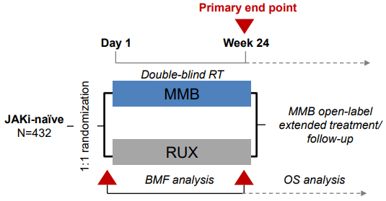
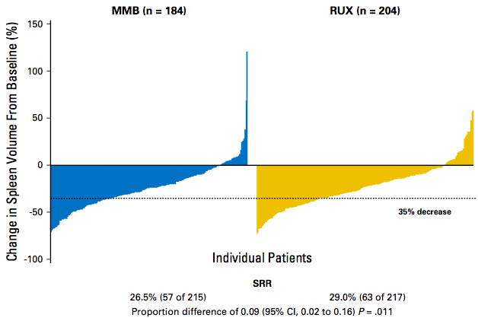
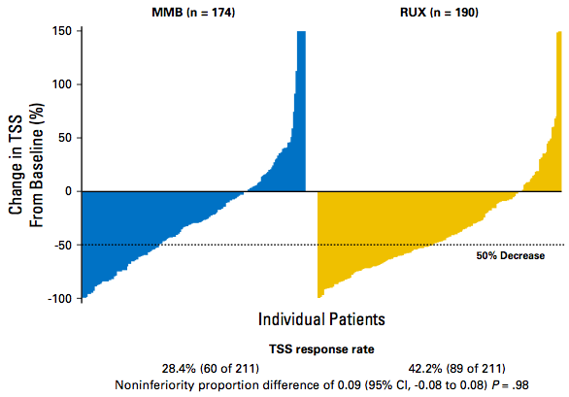
Momelotinib Demonstrates Comparable Spleen Response to Ruxolitinib in SIMPLIFY-1
Mesa RA, et al. J Clin Oncol 2017; 35(34):3844-3850.
Oh S, et al. Abstract 337. ASH Annual Meeting, 2022.
Notes:
Simplify 1: randomized phase 3 study; JAKi naïve int-2/high-risk or symptomatic int-1 (sx spleno/hepato/hgb<10)…spleen >5cm…PLTS >50
- randomized 1:1 to 24 weeks of Momelotinib (200mg daily) vs. Rux (20mg BID, modified as per label). …..RUX crossed over to open-label MOM after 24 weeks.
-Primary endpoint of SVR35 at WK24 (non-inferiority): 26.5% vs. 29% (NON-INFERIOR, p= 0.01)
-2nd: TSS50 at WK24: 28.4 vs. 42.2%, non-inferiority was not met (was inferior).
Lower rates of tcp (18.7 vs 29) and anemia (13.6 vs. 38.0), but increased peripheral neuropathy (~10 vs 5%) in momelotinib group and increased number of patients who had to d/c treatment due to AEs (13.1 vs. 5.6%)

Slide 20
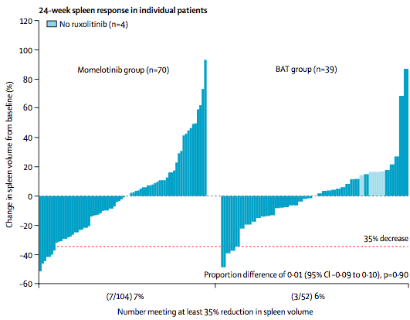
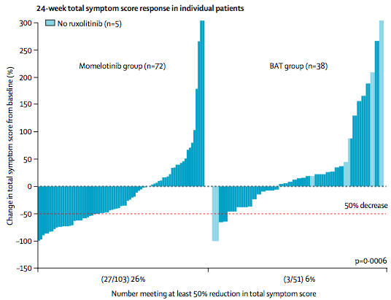
SIMPLIFY-2: Momelotinib in Ruxolitinib Treated Myelofibrosis
Momelotinib 200 mg QD
(n = 104)
Ruxolitinib ≥28 days with RBC transfusion requirement or dose adjustment for Grade ≥3 hematologic toxicity
Best Available Therapy
(n = 52)
Harrison CN, et al. Lancet Haematol 2018; 5(20):e73-e81
Notes:
Simplify 2: randomized phase 3 (2:1 MOM 200mg qday vs. BAT, including RUX[given in 89%]), open label study of MF patients with prior Rux treatment of at least 28 days who either 1) required RBC tx’s on rux or 2) required dose reductions to <20mg BD and had anemia or Gr3 thrombocytopenia or bleeding with rux. int-2 or high or symptomatic int-1 …… w/ spleen >5cm….NO LOWER PLT THRESHOLD….NO WASHOUT
Primary: SVR35 wk 23: 7% vs. 6% no difference/not superior;
2ndary: TSS50 wk 24: 26% vs. 6%
TI at wk 24: 43 vs. 21%
Increased d/c due to AE (21%, not well reported in BAT) and peripheral neuropathy

Slide 21
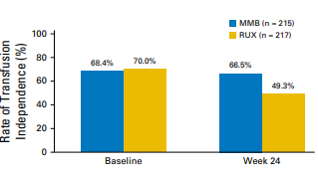
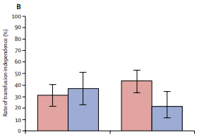
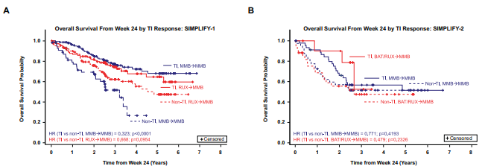
Anemia Benefit Observed in SIMPLIFY-1 and 2
Oh ST, et al. Blood Adv. 2020 Sep 22;4(18):4282-4291
Mesa RA, et al. J Clin Oncol 2017; 35(34):3844-3850.
Harrison CN, et al. Lancet Haematol 2018; 5(20):e73-e81
Notes:
Simplify 1 and 2 both showed that TI at baseline correlated with OS
-simplify 1 multivariat: TI status, IPSS, WBC
Simplify 2 multivariate: TI status, hgb, WBC, spleen volume
TI responders were defined as patients who did not receive a red blood cell transfusion and whose Hgb remained ≥8 g/dL within the 12 weeks immediately prior to week 24.
-Improved OS in Simplify 1 for MMB treatd patients (trend for RUX>MMB patients)
-TREND for OS in simplify 2
Anemia response/OS benefit also showedin retrospective cohort from Mayo (patients on P1 or P2 trials)
From Oh phase 2 TD study: 41 TD patients (prior RU allowed; TD as 4units/8wks)…..TI achieved in 41% at 24 weeks. CORRELATIVEs;decreased hepcidin, improved iron parameters/hematopoisis….also reduced STAT3 signaling.
Int2/high risk needing therapy or int-1 risk with splenomegaly

Slide 22
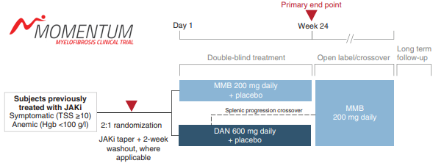
Momelotinib Approved 9/15/2023 for MF Patients with Anemia
Int-1 or higher risk
Splenomegaly >5cm
Platelets >25
Endpoints:
  Primary: TSS50
  Secondary: anemia and spleen responses
Verstovsek S, et al. Future Oncol. 2021;17(12):1449-1458.
Notes:
Randomized, double blind, phas3 study.
2:1: momelotinib (200mg daily) vs. danazol (300mg BID)…open label MMB for all pts on study after 24 weeks
N=195 (130 MMB, 65 danazol)
-PTs: Int-1 or higher w/ at least 90 days of prior JAKi (or 28d if 4units PRBCs/8 weeks, or grade ¾ anemia/tcp/bleeding….NO REQUIRED RESISTANCE/INTOLERANCE. Symptomatic (TSS>10), anemic (hgb <10), splenomegaly (>5cm)
-14d JAKi washout
-PLTS> 25

Slide 23
Momelotinib Demonstrates Improvement Across Endpoints
Verstovsek S, et al. Lancet. 2023 Jan 28;401(10373):269-280.
Gerds AT, et al. Lancet Haematol. 2023 Jul 27:S2352-3026(23)00174-6
Notes:
Superior TSS (0.009)
Non-inferior TI (0.006)
Superior SVR25 and SVR35 (0.0
-14% were TI at baseline, 50% were TD (4 units n 8 weeks).
Primary (superiority): TSS50 at wk 24: 25 vs. 9%, superior
Secondary:
TI at WK 24; non-inf (no PRBC and hgb >8 in last 12 weeks of the 24wk period): 31 vs. 20% (non-inferior, 0.006; not quite suprerior (0.08): TI rates from b/l to wk 24 increased by 18% vs. 5%......TI in non-TI patients 27% vs. 15%
SVR25 (superiority) at wk 24: 40 vs 6%
SVR35 at wk23: 23 vs 3%001, 0.0006)
EXTENSION : 93 MMB pts, with 66 completing 48 wks. 41 danazol pts with 28 completing 48wks
-data was in evaluable pts at 48 weeks (compared to initial repot with ITT at 24 weeks)
TI responses at WK 24 were durable, most sustained
Among patients without wk 24 TI, rates of patints achieving TI by 48 weeks was
-10/48 (21%) initial MMB
-10/24 (42%) initial danazol

Slide 24
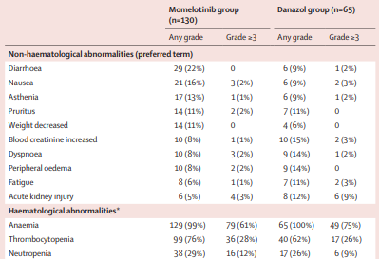
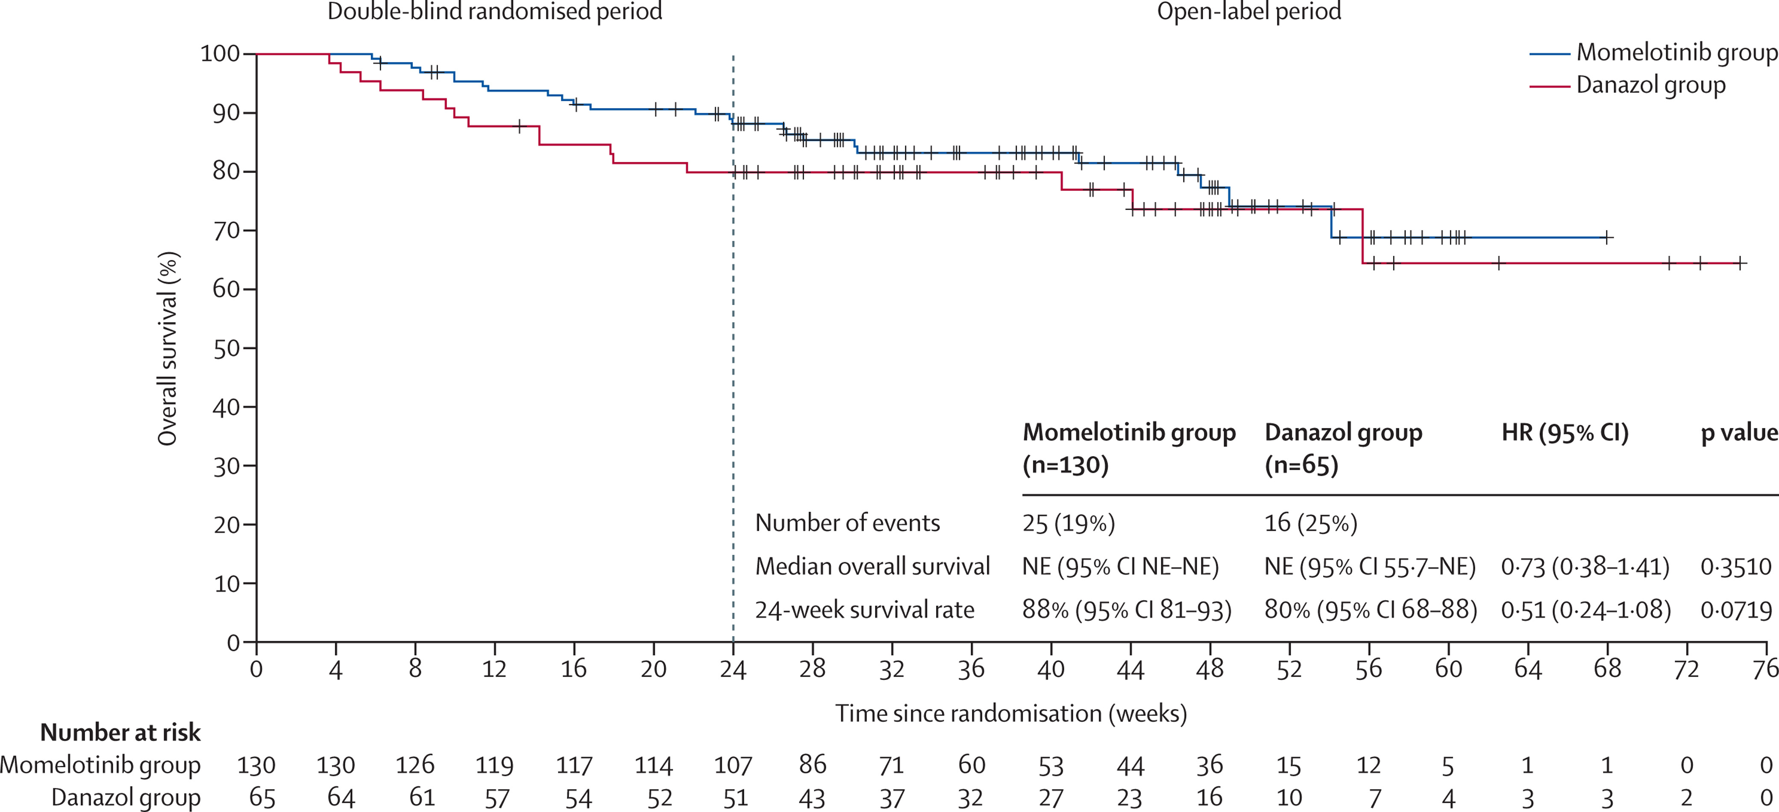
Momelotinib Demonstrates Acceptable Safety Profile and Trend Toward Improved OS
Verstovsek S, et al. Lancet. 2023 Jan 28;401(10373):269-280.
Gerds AT, et al. Lancet Haematol. 2023 Jul 27:S2352-3026(23)00174-6
Notes:
Actually improved OS at 24 weeks when factor out the COVID-19 deaths
AE leading to d/c: 18% vs. 23%

Slide 25
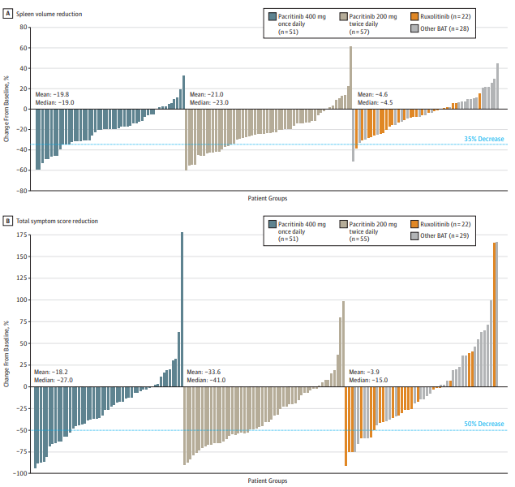

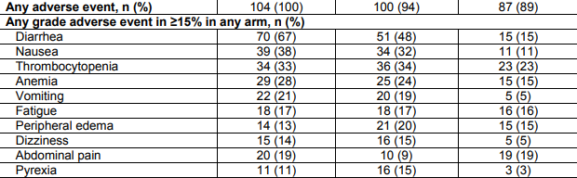
Pacritinib: A JAKi with Unique Activity and Safety in Thrombocytopenic MF
Kinase Activity: JAK2 >> JAK1, FLT3, IRAK1, CSF1R
Mascarenhas et al. JAMA Oncol 2018; 4(5):652-659.
Mesa RA, et al. Lancet Haematol 2017; 4(5):e225-e236.
Gerds AT, et al. Blood Adv. 2020; 4(22):5825-5835
Notes:
Thrombocytopenic patients: about 18% at diagnosis (a PMF only cohort) or 6% at diagnosis in another full cohort…..associated with poor OS (a Mayo cohort, a large retro MDACC with <50, DIPSS+)….also correlates with anemi, higher TSS……limits dosing of prior JAKi (RUX and FED both excluded < 50, lower doses of RUX, which are less effective, etc). Either altogether or leads to lots of dose reductions
Approved 3/1/22; Dose 200mg BID…..clinical hold during development for OS, bleeding and CV events, ultimately lifted after review
***Diarrhea, early on then improves
More selective toward JAK2 than JAK1 with activity against, FLT3, IRAK1, CSF1R
Demonstrated safety in pts with b/l anemia/thrombocytopenia in early studies. *trial data demonstrating safety in tcp patients, but not necessarily improvements in tcp
Approved based on persist 1, persist 2 and pac023…..PACIFICA ongoing: phase 3 RCT of PAC vs. physicians choice, int-high risk, MF with plts <50k, no or limited prior JAKi use (<90days)….ongoing
PERSIST1: Frontline vs. BAT (no exclusion for plts): improved SVR, no difference in TSS (NO data shown in slide)
PESRIST2: Front or 2nd line vs. BAT with plts <100. (PICTURED)
PACO23: phase2 dose finding study confirmed 200mg BID
Persist 1: randomized (2:1), phase 3 study; JAKi naive int/high-risk MF & spleen >5cm; pacritinib (400 daily) vs. BAT (no JAK2 inhibitors; mostly HU; No exclusion for plt or hgb levels.
-n= 327 (220 pac, 107 BAT); 78% completed 24 weeks. Median 15.6 months for PAC….84% of BAT crossed over to PAC
1: SVR3: 19 vs. 5%; endpoint met;
2: no difference in TSS50 at wk 24: 19% vs. 10%, but improved at wk 48 (15% vs. 0%), also improved at wk 24 in evaluable population
-25% of TD patients became TI
Allele reduction (15% vs. 7.9% reduction)
Persist 2: (terminated early due to FDA hold, about 23 weeks median tx) Randomized phase 3 of 1:1:1 pacritinib 400 daily: 200mg BID: BAT (rux allowed) in patients with int/high risk MF w/ spleen >5cm and Pac plts of <100; prior JAKi treatment allowed (not required, about ½ had prior rux); n=311 (104, 107, 100)
BAT: 45% got Rux (mostly 5mgBID), 19% HU, 13% pred, 19% observed
COPRIMARY ENDPOINTS (wk 24):
-SVR35: 18% vs. 3% for combined arms (22% for 200mgBID); significant for both PAC arms vs. BAT (only 1 RUX pt got SVR35), 6% and 13% of patients on PAC with prior RUX had SVR
-TSS 50: 25% combined arms vs. 14% (p=0.08) (though 32% BID dosing which was significant vs. BAT)
-OS: no benefit, but trend for BID.. Limited by the hold
-IWG-hgb response criteria (for baseline <10, 2g improvement): 13% vs. 25% (200mg BID) vs. 12%
***no drop in SVR35 (22% overall vs. 29%) or TSS50 (32% vs. 23%) if plts < 50; also similar for incidence of hematologic AEs
Tx discontinuation due to AE: 14% vs. 9% vs. 4%
ASCO2023 landmark analysis of persist 2: SVR35 correlated with OS in PAC arm but not BAT
PAC023: phase 2 dose-finding study (in patients intolerant/resistant to rux): confirmed 200mg BID dose (better than 100mgqd and 100mg BID); SVR 9.3% (17% with plts <50), TSS50 (7.4%)
FDA hold in 2016 due to concern for interim OS results, bleeding and CV events; final review of data from multiple trials led to removal of this hold by FDA in 2017

Slide 26
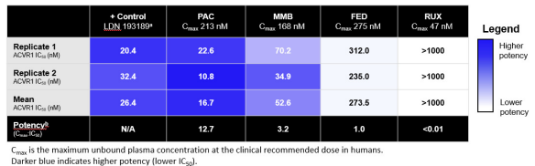
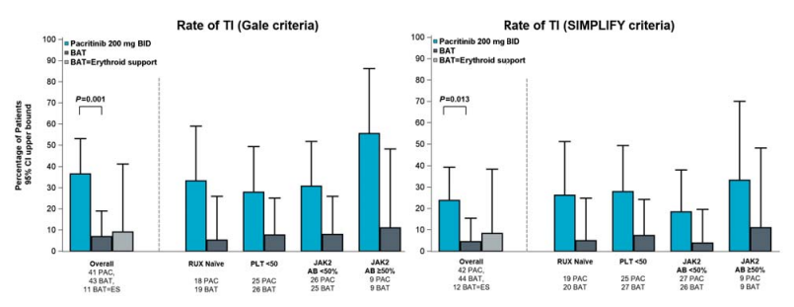
Pacritinib Potently Inhibits ACVR1 and Improves Anemia
Oh ST, et al. Blood Adv. 2023; 7(19):5835-5842
Notes:
Potency based on ratio of IC50 (half maximal inhibitory concentration) to Cmax (thee maximum plasma concentration at the clinically recommended dose)
Also lower IC50
→ Also demonstrated SMAD reduction and dec. in Hepcidin
TI rates for patients on PESRIST-2 who were no TI at baseline
GALE: 37 vs. 7%
SIMIPLIFY: 24% vs. 4.5%
TI was defined using both the Gale criteria (absence of RBC transfusions over any 12-week interval) and criteria similar to that employed in the SIMPLIFY studies (absence of RBC transfusions and no hemoglobin <8 over any 12-wek interval
JAK2 AB = allele burden

Slide 27
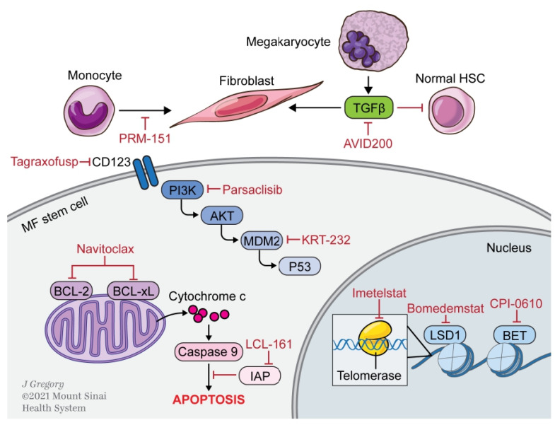
Emerging Targets in Myelofibrosis
TP-3543 (PIM Kinase)
Aurora Kinase inhibitors
Selinexor
PXS-5505 (LOX inhibitor)
ALK2/ACVR1 (INCB00928)
Tremblay D, Mascarenhas J. Cells. 2021 Apr 27;10(5):1034

Slide 28
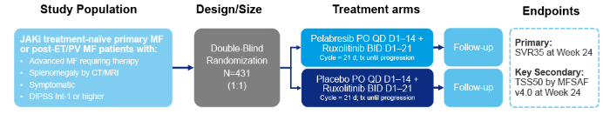
MANIFEST-2: The BET Inhibitor Pelabrasib Improves Spleen Responses in JAKi Naïve MF
% change in spleen volume from baseline
 | Pelabresib + ruxolitinib (N=214) | Placebo + ruxolitinib (N=216) | p-value
SVR35 at Week 24 | 65.9% | 35.2%
Difference† (95% CI) | 30.4 (21.6, 39.3) |  | <0.001
Rampal RK, et al. ASH Annual Meeting, 2023. Abstract 628

Slide 29
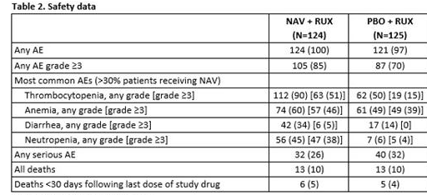
TRANSFORM-1: Navitoclax Improves Spleen Responses in JAKi Naïve MF
Pemmaraju N, et al. Blood (2023) 142 (Supplement 1): 620.

Slide 30
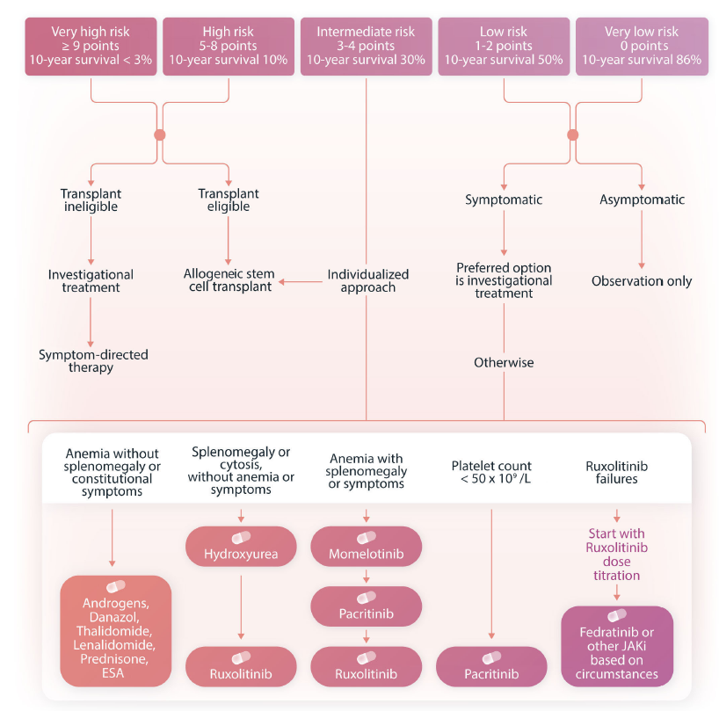
Current Risk-Adapted Treatment Approach In Myelofibrosis
Tefferi A, et al. Haematologica. 2023;108:2919-2932.
Notes:
Rux: Jak1/2
FED: JAK2 >JAK1, FLT3, BRD4, TYK2
PAC: JAK2 no jak1, IRAK1, FLT3, CSF1R
MMB: JAK1/2, ACVR1

Slide 31
Hematologic Malignancies
April 23rd, 2024

Slide 32
A Case of Myelofibrosis and Inflammatory Bowel Disease
Michael J. Hochman, MD
Assistant Professor
Winship Cancer Institute of Emory University
Atlanta, GA

Slide 33
Patient Presentation
A Case of Myelofibrosis

Slide 34
Patient Presentation
Mr. MPN is a 65 year-old man with myelofibrosis on ruxolitinib and history of inflammatory bowel disease presenting with lightheadedness.
Increased dyspnea on exertion and generalized weakness two months ago.
Decreased dose of ruxolitinib to see if this improved symptoms, but they persisted.
Electrocardiogram unremarkable.

Slide 35
Patient Presentation
Subsequently got up to use restroom and had presyncopal symptoms.
Nearly lost balance and fell.
Outpatient labs show drop in hemoglobin from 9s to 6.6 g/dL.
Patient admitted for further evaluation and urgently transfused packed red blood cells.

Slide 36
Past Medical History
Primarily Myelofibrosis
Noted to have moderate splenomegaly in 2010
Blood counts unremarkable, patient observed
Progressive splenomegaly prompted bone marrow in 2016
Marrow markedly hypocellular with osteosclerosis and areas of patchy fibrosis; normal male karyotype
Found to have JAK2 V617F mutation, plus smaller clones with ASXL1 and EZH2
Started on ruxolitinib in 2021 for early satiety and weight loss with great symptomatic improvement

Slide 37
Past Medical History
Ulcerative Colitis
Diagnosed in early 2000s
Unable to tolerate multiple immunosuppressive therapies due to infusion reactions or other side effects
Remained on oral 6-mercaptopurine (6-MP) with good disease control for years

Slide 38
Physical Exam
General: Well-appearing, in no acute distress.
HEENT: Normocephalic, anicteric sclera.
Cardiovascular: Normal rate, regular rhythm, no lower extremity edema.
Pulmonary: Respirations even and unlabored.
Abdominal: Grossly distended with protuberant splenomegaly approximately 10 cm below left costal margin.
Skin: Warm and dry without rash.
Neurologic: No gross focal deficits.

Slide 39
Physical Exam
General: Well-appearing, in no acute distress.
HEENT: Normocephalic, anicteric sclera.
Cardiovascular: Normal rate, regular rhythm, no lower extremity edema.
Pulmonary: Respirations even and unlabored.
Abdominal: Grossly distended with protuberant splenomegaly approximately 10 cm below left costal margin.
Skin: Warm and dry without rash.
Neurologic: No gross focal deficits.

Slide 40
Labs
Prior to Presentation
9.2
5.7
91
29.5

Slide 41
Labs
Prior to Presentation
9.2
5.7
91
29.5

Slide 42
Labs
Prior to Presentation
At Presentation
9.2
6.1
5.7
91
2.7
53
29.5
19.7

Slide 43
Labs
Prior to Presentation
At Presentation
9.2
6.1
5.7
91
2.7
53
29.5
19.7
Abs Retic Ct 62,000
Abs Neut Ct 2370
2% Other Cells
EPO 142 (H)
Iron and vitamin studies unremarkable

Slide 44
Work-Up and Evaluation
Serial bone marrow biopsies inadequate given cortical bone with osteosclerosis and crush artifact
Peripheral blood next generation sequencing shows ongoing mutations in JAK2 (V617F), ASXL1, EZH2, and a new TP53 mutation (R248Q, VAF 3%)
Asked to stop 6-MP for his IBD
Patient started on erythropoietin stimulating agent without clear response
Subsequently started on momelotinib 200 mg daily

Slide 45
Hemoglobin Trend on Momelotinib

Slide 46
Clinical Course
Patient had symptomatic improvement in early satiety and fatigue with weight gain and decreased splenomegaly to about 8 cm below LCM on momelotinib
He remained off IBD therapy including 6-MP
He was admitted for allogeneic stem cell transplantation from a matched unrelated donor

Slide 47
Questions to Dr. Hunter
What is your first line treatment for a patient with myelofibrosis presenting with moderate to severe anemia?
How do you decide between available JAK inhibitor therapies in patients who have disease progression on ruxolitinib?
Which mutations are considered high-risk in primary myelofibrosis?
What is the significance of the TP53 mutation in this case?

Slide 48
Hematologic Malignancies
April 23rd, 2024

Slide 49
Emerging Treatment Standards for MDS
Nikolaos Papadantonakis MD, M.Sc, PhD
Assistant Professor of Hematology and Medical Oncology,
Winship Cancer Institute of Emory University,
Atlanta, GA

Slide 50
Disclosures
Honoraria from Agios Pharmaceuticals and CTI Biopharma.
Advisory board for Agios Pharmaceuticals and CTI Biopharma.
Research Support (paid to the institution) from Gilead, ONO PHARMA USA, and Abbvie.

Slide 51
Anemia in Lower Risk MDS
Myelodysplastic Syndromes / Neoplasms (MDS) is a heterogenous group of myeloid neoplasms more commonly diagnosed in elderly patients. The incidence in US is estimated to be 21,000 cases / year.
Most new MDS cases fall into lower risk [defined as International Prognostic Score System (IPSS): up to intermediate 1 or Revised-IPSS ≤ 3.5]. Anemia is the main cytopenia that afflicts patients.
Anemia can impact patients in multiple ways, including fatigue and poor of quality of life.
Carraway, H.E.; Saygin, C. Hematology Am Soc Hematol Educ Program 2020, 2020, 426–433

Slide 52
MDS and Erythropoietin Stimulating Agents
Erythropoietin Stimulating Agents (ESA) have been the cornerstone of MDS-related anemia management. However, patients with high Erythropoietin (EPO) levels or heavy transfusion burden have low chances of response.
ESA responses are reported to range from 30-60%. MDS patients with Ring Sideroblasts (RS) have lower response rates to ESA.
ESA median duration of response has been reported to be ~ 18 - 24 months.
Park, S. et al. J Clin Oncol 2017, 35, 1591–1597
Platzbecker, U. et al. Leukemia 2017, 31, 1944–1950

Slide 53
MDS and Ineffective Erythropoiesis
Hallmark of MDS is ineffective erythropoiesis through multiple mechanisms
Including the TGF-B superfamily of ligands signaling through SMAD 2/3.
Luspatercept was engineered by fusing modified Activin receptor type IIb (ActRIIB) to the Fc domain of human IgG. It can decrease signaling through SMAD 2/3; the precise mechanisms of action remain an area of investigation.
Luspatercept is administered every three weeks. Dosing is increased step-wise depending on response.
Mies, A, et al. Curr Hematol Malig Rep 2016, 11, 416–424
Kubasch, A.S, et al. Blood Adv 2021, 5, 1565–1575

Slide 54
MEDALIST Trial - Updates
MEDALIST phase 3 placebo-controlled trial led to the initial approval of Luspatercept in patients with MDS with RS. Trial enrolled adult patients with MDS with RS with R-IPSS score up to intermediate risk, who were transfusion dependent (≥ 2 units of pRBC per 8 weeks), refractory to ESA, or with EPO level more than 200.
Fifty-one percent of patients (n:153) in the Luspatercept arm were transfusion-independent for at least 12 weeks during weeks 1-24. Thirty-one patients on Luspatercept arm became transfusion independent for at least 1 year.
No new progression to Acute Myeloid Leukemia or High Risk MDS was reported in most recent update in ASH 2023.
Fenaux, P, et al. New England Journal of Medicine 2020, 382, 140–151
Santini, V, et al. Blood (2023) 142 (Supplement 1): 915

Slide 55
COMMANDS Trial - Design
International phase III trial that enrolled adult, transfusion dependent non-del(5q) MDS patients with R-IPSS up to intermediate risk, EPO level < 500 U/L, without prior exposure to ESA, Luspatercept, Lenalidomide or hypomethylating agents.
Patients were randomized to Epoetin-alfa weekly (step-up dosing to a maximum dose of 1,050 IU/Kg) or Luspatercept ( step-up dosing to maximum of 1.75 mg/kg) every 3 weeks.
Primary endpoint: Transfusion independence for at least 12 weeks with a concurrent mean Hgb increase of at least 1·5 g/dL during weeks 1–24.
Platzbecker, U, et al. Lancet 2023, 402, 373–385
Lancet 2023 Jul 29;402(10399):373-385.

Slide 56
COMMANDS- Demographic and disease Characteristics
 | Luspatercept (n:178) | Epoetin-alfa (n:178)
Age (mean) | 74 | 75
Male | 60% | 51%
R-IPSS (low) | 71% | 74%
R-IPSS (intermediate) | 19% | 16%
EPO up to 200 U/L | 79% | 79%
+ Ring Sideroblasts | 73% | 73%
+ SF3B1 | 63% | 58%
Hgb <8 gr/dl | 60% | 60%
Platzbecker, U, et al. Lancet 2023, 402, 373–385
Lancet 2023 Jul 29;402(10399):373-385.

Slide 57
COMMANDS Trial- Outcomes (I)
 | Luspatercept | Epoetin-alfa
Primary Endpoint (PE) | 60 % | 34%
Median duration of treatment | 51 weeks | 37 weeks
+ Ring Sideroblasts achieving PE | 65% | 29%
- Ring Sideroblasts achieving PE | 47% | 50%
SF3B1 mutation present achieving PE | 70% | 32%
SF3B1 mutation absent achieving PE | 44% | 36%
Median duration of RBC transfusion independence ≥ 12 weeks (weeks) | 128 | 89
Garcia-Manero,G, et al. Blood (2023) 142 (Supplement 1): 193
Platzbecker, U, et al. Lancet 2023, 402, 373–385
Lancet 2023 Jul 29;402(10399):373-385.

Slide 58
COMMANDS Trial- Outcomes (II)
The overwhelming majority of patients enrolled in COMMANDS trial had mutations in at least one gene.
In the intention to treat population and in those patients with RS + Luspatercept demonstrated responses over ESA in a range of mutational burden and across different subgroups of Molecular International Prognostic System (IPSS-M).
Komrokji, R, et al. Blood (2023) 142 (Supplement 1): 4591
Platzbecker, U, et al. Lancet 2023, 402, 373–385
Lancet 2023 Jul 29;402(10399):373-385.

Slide 59
COMMANDS- Toxicities
Adverse Events (any Grade) | Luspatercept | Epoetin-alfa
Asthenia | 13.7% | 16.2%
Diarrhea | 17.6% | 14%
Kidney toxicity | 8.8% | 6.7%
HTN | 15.9% | 9.5%
Injection site reactions | 6.6% | 2.2%
On treatment deaths | 8.2% | 7.2%
Post treatment deaths | 13.2% | 13.4%
Garcia-Manero,G, et al. Blood (2023) 142 (Supplement 1): 193
Lancet 2023 Jul 29;402(10399):373-385.

Slide 60
Imetelstat
Imetelstat is a telomerase inhibitor that has been tested in a variety of myeloid neoplasms.
In the context of MDS, it was tested in a randomized phase 3 clinical trial against placebo (IMerge). One hundred seventy-eight patients with non-del(5q) MDS who were transfusion dependent, ESA refractory or relapsed, ESA ineligible (high EPO) were enrolled. Patients were randomized to Imetelstat infusion or placebo every four weeks.
Six percent of patients had prior exposure to Luspatercept. Sixty two percent of all patients were RS+.
Primary endpoint was transfusion independence for 8 consecutive weeks.
Platzbecker, U, et al. Lancet 2023, 6736, 1–12
Lancet 2023 Jul 29;402(10399):373-385.

Slide 61
IMerge– Demographic and disease Characteristics
 | Imetelstat (n:118) | Placebo (n:60)
Age (mean) | 72 | 73
Male | 60% | 67%
R-IPSS (low) | 74% | 77%
R-IPSS (intermediate) | 17% | 13%
EPO >500 U/L | 22% | 37%
pRBC units / 8 weeks (range) | 6 (6-8) | 6 (5-8.5)
Platzbecker, U, et al. Lancet 2023, 6736, 1–12
Lancet 2023 Jul 29;402(10399):373-385.

Slide 62
IMerge - Outcomes
 | Imetelstat | Placebo
Primary endpoint (PE) | 40% | 9%
RS + PE | 45% | 19%
RS - PE | 32% | 9%
Transfusion independence ≥ 24 weeks | 28% | 3%
Platzbecker, U, et al. Lancet 2023, 6736, 1–12
Lancet 2023 Jul 29;402(10399):373-385.

Slide 63
IMerge- Toxicities
 | Imetelstat |  | Placebo
Adverse events | Any Grade | Grade 3/4 | Any Grade | Grade 3/4
Thrombocytopenia | 75% | 62% | 10% | 8%
Neutropenia | 74% | 68% | 7% | 3%
Asthenia | 19% | - | 14% | -
Diarrhea | 12% | 1% | 5% | -
ALT increase | 12% | 3% | 7% | 3%
49% in the Imetelstat arm vs 7% in placebo arm had dose reductions.
16% in the Imetelstat arm vs none in placebo arm discontinued treatment secondary to adverse events.
Platzbecker, U, et al. Lancet 2023, 6736, 1–12
Lancet 2023 Jul 29;402(10399):373-385.

Slide 64
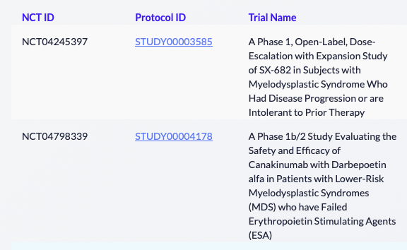
MDS Trials at Winship Cancer Institute
Winship MDS webpage
https://winshipcancer.emory.edu/patient-care/cancer-types/myelodysplastic-syndromes.html
Lancet 2023 Jul 29;402(10399):373-385.

Slide 65
Questions?
Lancet 2023 Jul 29;402(10399):373-385.

Slide 66
Hematologic Malignancies
April 23rd, 2024

Slide 67
BTK Inhibition in Mantle Cell Lymphoma (MCL) and Chronic Lymphocytic Leukemia (CLL): Key Updates
Jean Koff, MD, MSc
Associate Professor
Winship Cancer Institute of Emory University
Atlanta, GA

Slide 68
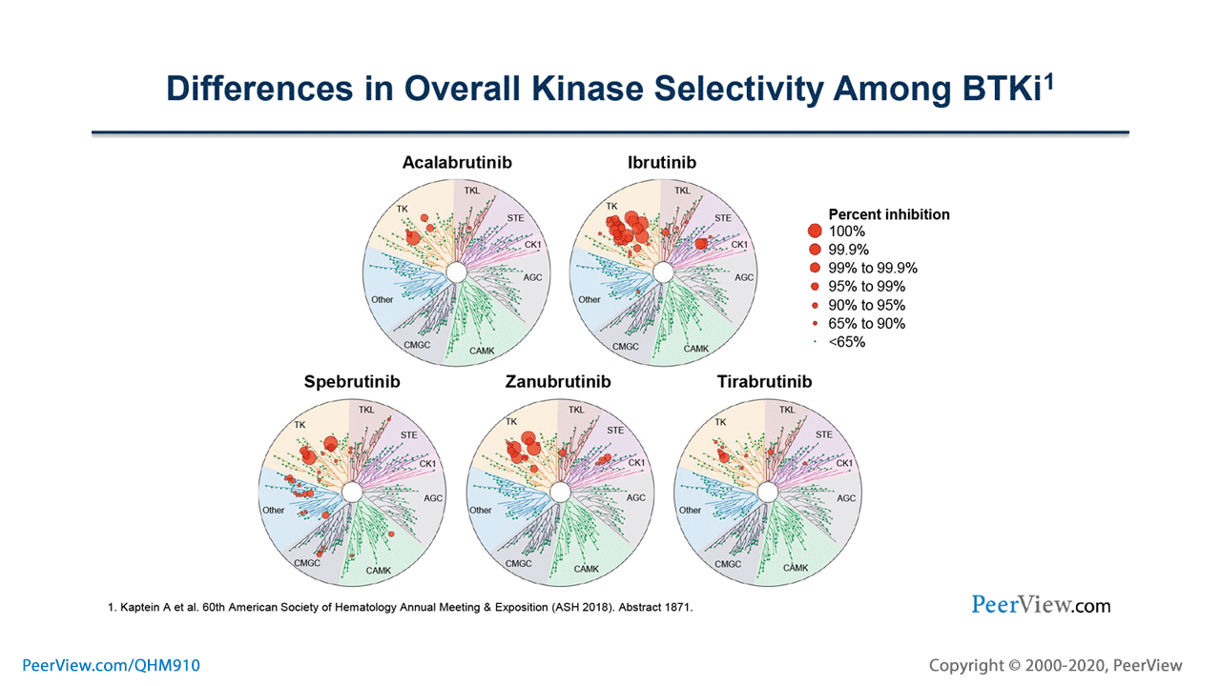
Covalent BTK inhibitors (cBTKi) are a cornerstone in management of MCL & CLL:
Agent​ | Indication(s)​ | Dosing​
Ibrutinib Irreversible​ | CLL, WM (and cGVHD)​ | 420 mg PO daily​
 | MCL, MZL​ | 560 mg PO daily​
Acalabrutinib Irreversible​ | CLL, MCL​ | 100 mg PO BID (q12H)​
Zanubrutinib Irreversible ​ | CLL, MCL, WM, MZL, FL​ | 160 mg PO BID or​ 320 mg PO daily​
All bind to C481
Mechanisms of resistance: C481S mutation & PLCγ2 mutations
Kaptein A, et al. Blood. 2018; 132(S1):1871
Notes:
he required postmarketing trials did not verify the clinical benefit of ibrutinib for these indications.
Based on biochemical binding kinetics, ibrutinib and zanubrutinib were the most potent BTK inhibitors differences were lost (in part) in cellular assays, particularly in hWB.
Differences in overall kinase selectivity were observed among the BTK inhibitors. acalabrutinib and tirabrutinib had the highest kinase selectivity.
Cysteine 481

Slide 69
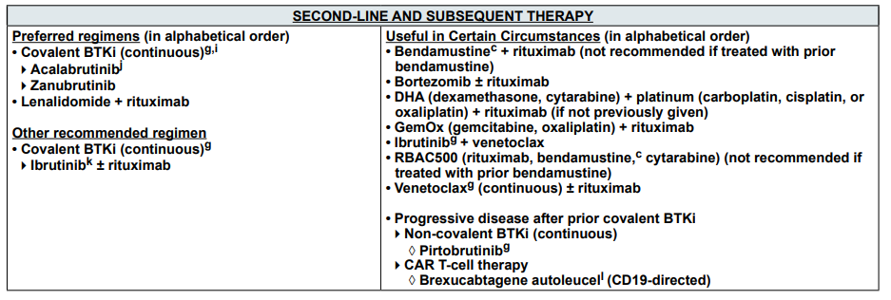
cBTKi are a cornerstone in management of MCL
NCCN Guidelines for B-Cell Lymphomas, version 1.2024

Slide 70
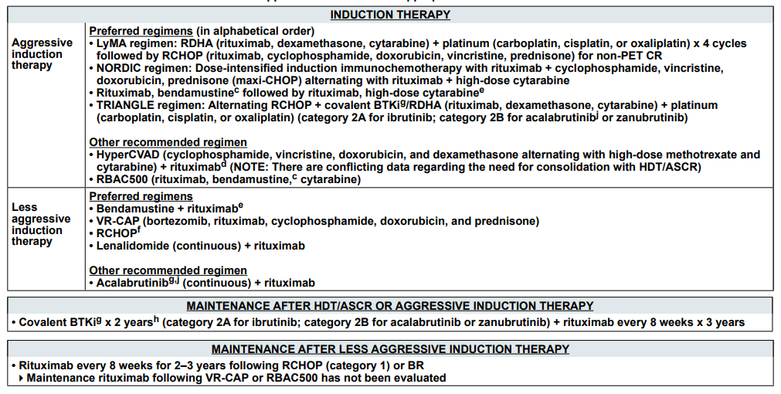
cBTKi are a cornerstone in management of MCL
NCCN Guidelines for B-Cell Lymphomas, version 1.2024

Slide 71
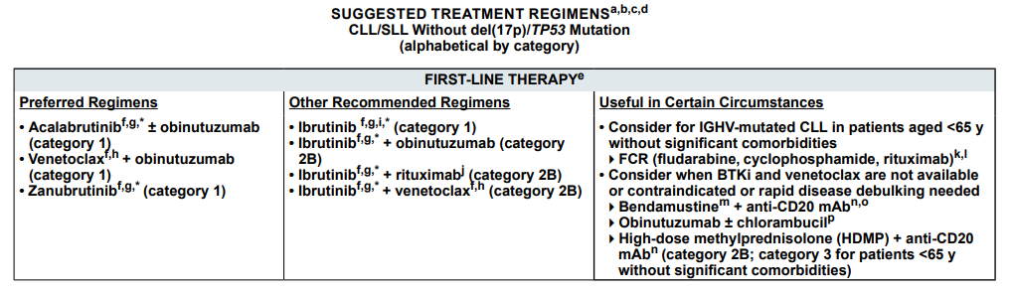
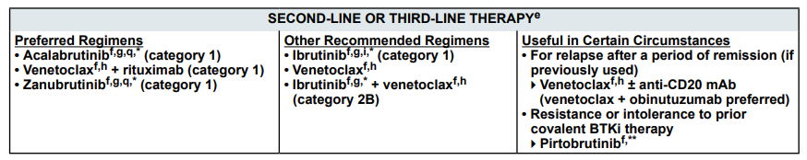
cBTKi are a cornerstone in management of CLL
NCCN Guidelines for Chronic Lymphocytic Leukemia/Small Lymphocytic Lymphoma, version 3.2024
Notes:
he required postmarketing trials did not verify the clinical benefit of ibrutinib for these indications.

Slide 72
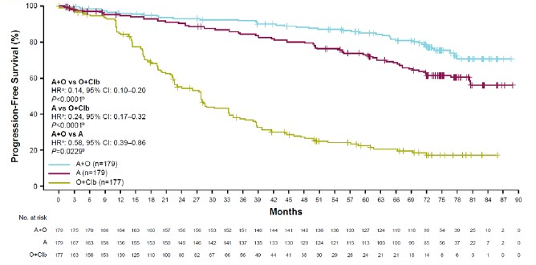
cBTKi are a cornerstone in management of CLL
ELEVATE-TN = randomized, open-label, phase 3 trial of frontline treatment with acalabrutinib ± O vs O-chlorambucil in CLL/SLL (age ≥ 65 or < 65 w/ comorbidities)
Sharman JP et al. Blood. 2023; 142(S1):636.
Notes:
The durable PFS benefits with zanubrutinib were observed across major subgroups, including multiple sensitivity analyses. The overall safety/tolerability profiles were consistent with previous reports for both treatments. The cardiac safety profile remained favorable for zanubrutinib compared with ibrutinib, with no new safety signals emerging with longer follow-up. With over 3 years of treatment, zanubrutinib continues to be a more efficacious and better tolerated treatment than ibrutinib for patients with R/R CLL/SLL.

Slide 73
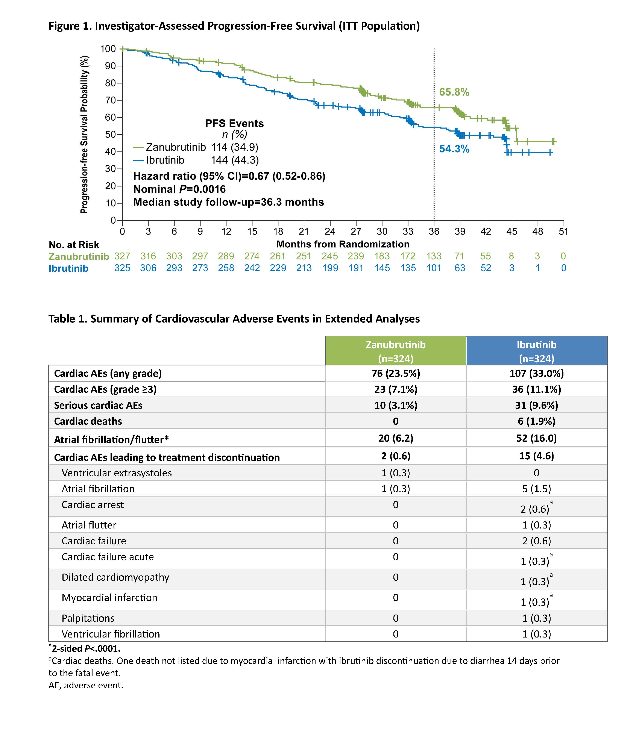
cBTKi are a cornerstone in management of CLL
ALPINE = randomized phase 3 trial of zanubrutinib vs. ibrutinib in R/R CLL/SLL
Brown JR et al. Blood. 2023; 142(S1):202.
Notes:
The durable PFS benefits with zanubrutinib were observed across major subgroups, including multiple sensitivity analyses. The overall safety/tolerability profiles were consistent with previous reports for both treatments. The cardiac safety profile remained favorable for zanubrutinib compared with ibrutinib, with no new safety signals emerging with longer follow-up. With over 3 years of treatment, zanubrutinib continues to be a more efficacious and better tolerated treatment than ibrutinib for patients with R/R CLL/SLL.

Slide 74
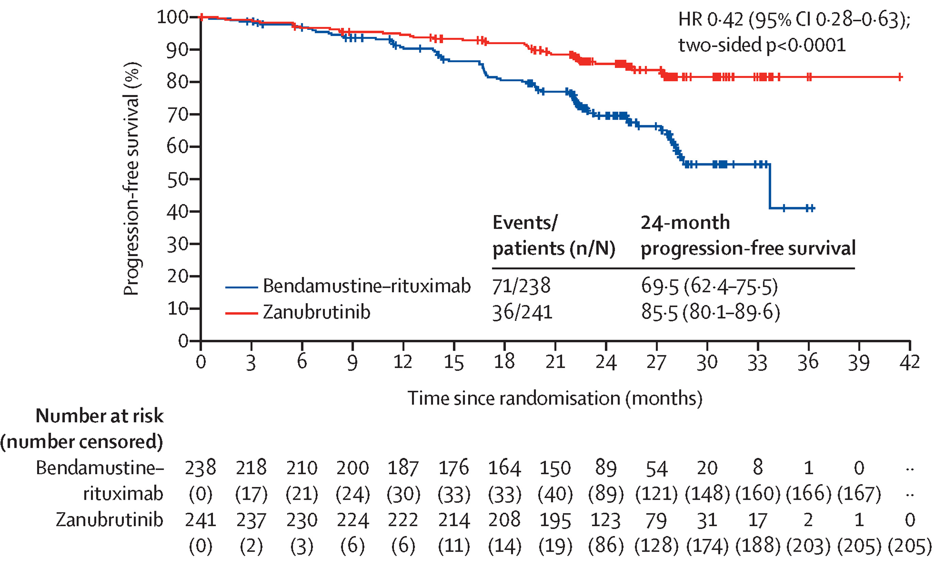
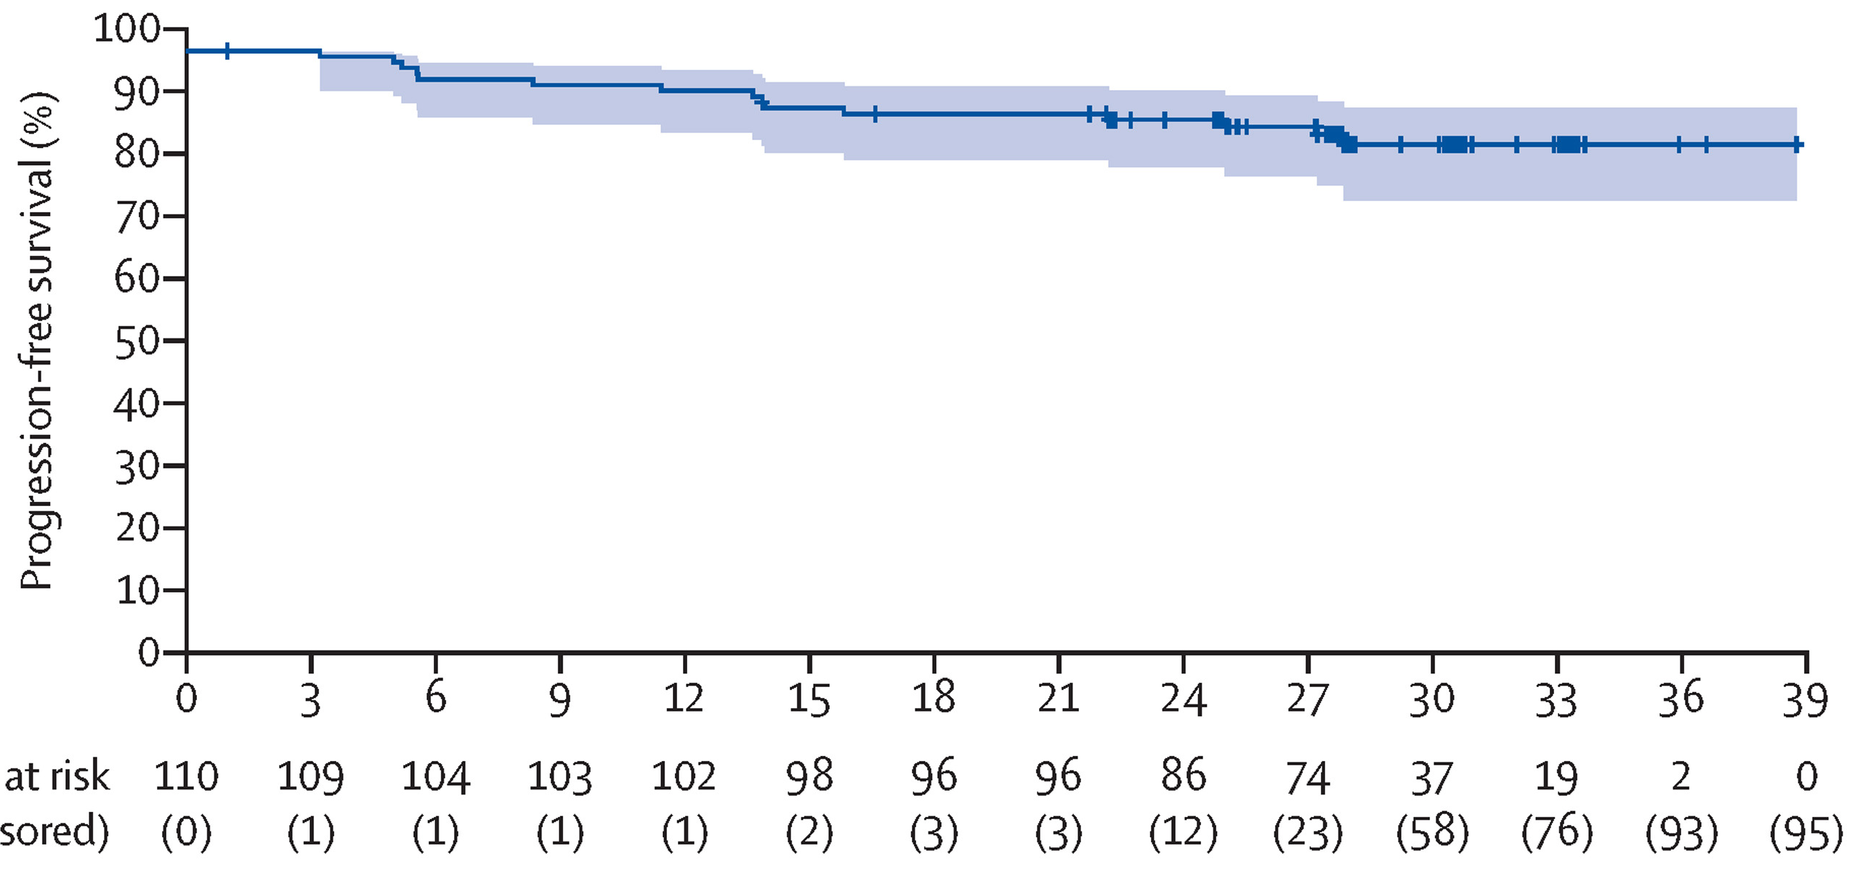
\
cBTKi are a cornerstone in management of CLL
SEQUOIA = Randomized, open-label, phase 3 trial of frontline treatment with zanubrutinib vs BR in in CLL/SLL (age ≥ 65 or < 65 w/ comorbidities)
* Patients with del17p (n = 111) were assigned to zanubrutinib in a separate arm
Tam, et al, Lancet Onc, 2022

Slide 75
What about MCL and CLL following cBTKi discontinuation?

Slide 76
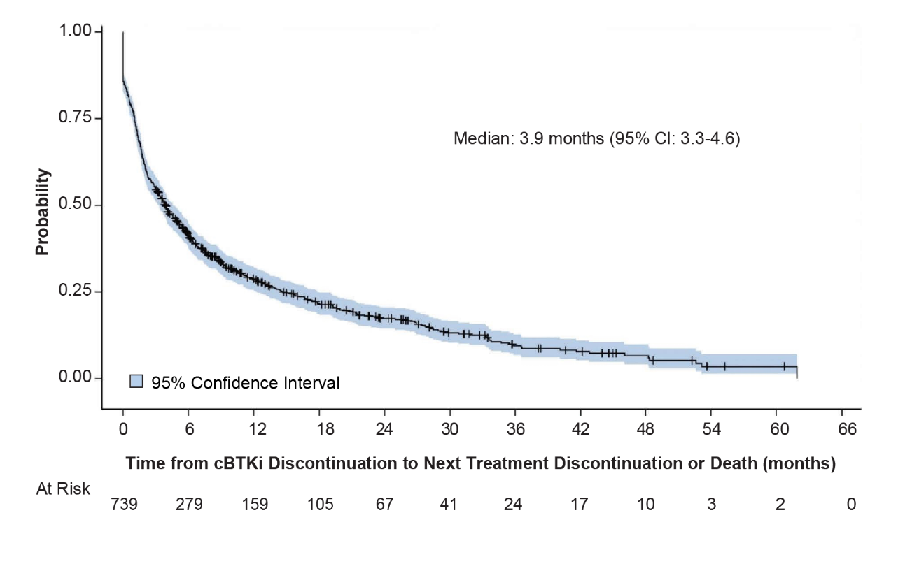
What about MCL following cBTKi discontinuation?
Time from cBTKi Discontinuation to Subsequent Treatment Failure or Death²
Outcomes are poor in MCL following cBTKi discontinuation.¹
¹Owen C et al. Curr Oncol. 2019; 2026(2):e233-e240.
²Hess et al. Adv. Hematol. 2022; 22:8262787.

Slide 77
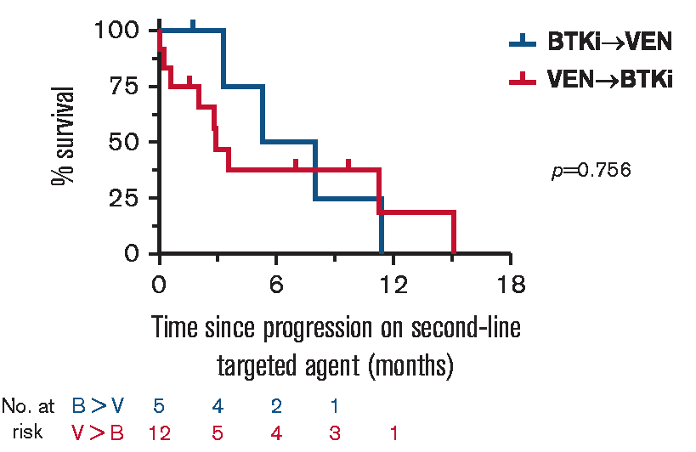
What about CLL following cBTKi discontinuation?
Prognosis of “double-exposed” CLL patients appears to be poor.
  I.e., prior treatment with cBTKi and BCL2i
  In double-refractory patients (n=17),¹ mOS = 3.6 months
  In double-exposed patients (n=65),² time from discontinuation of 2nd therapy to subsequent treatment failure or death = 11.4 months
1
¹Lew TE, et al. Blood Advances. 2021; 5(20):4054-4058.
²Thompson MC, et al. Blood. 2022; 138 S1:2628.

Slide 78
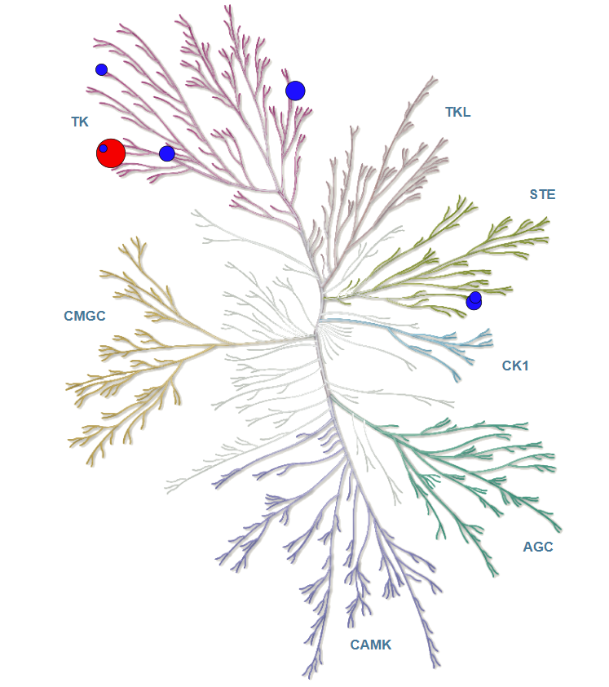
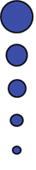
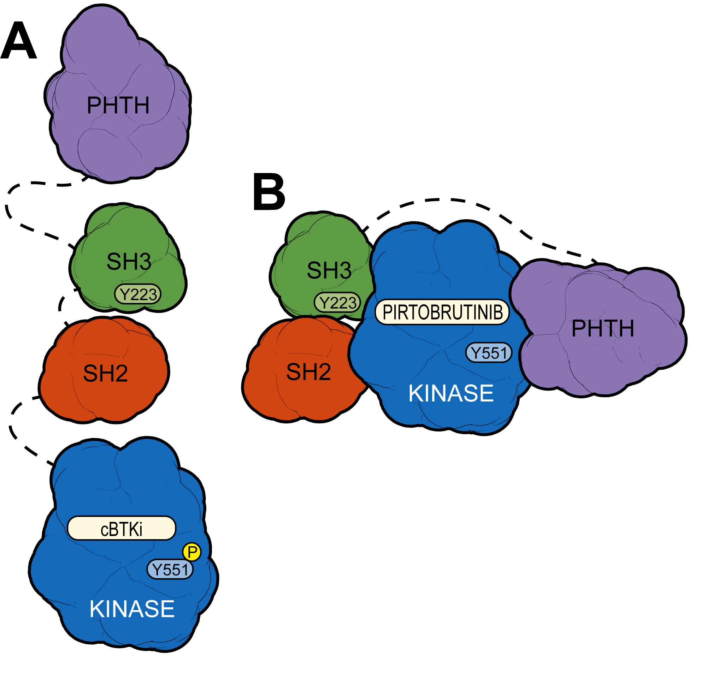
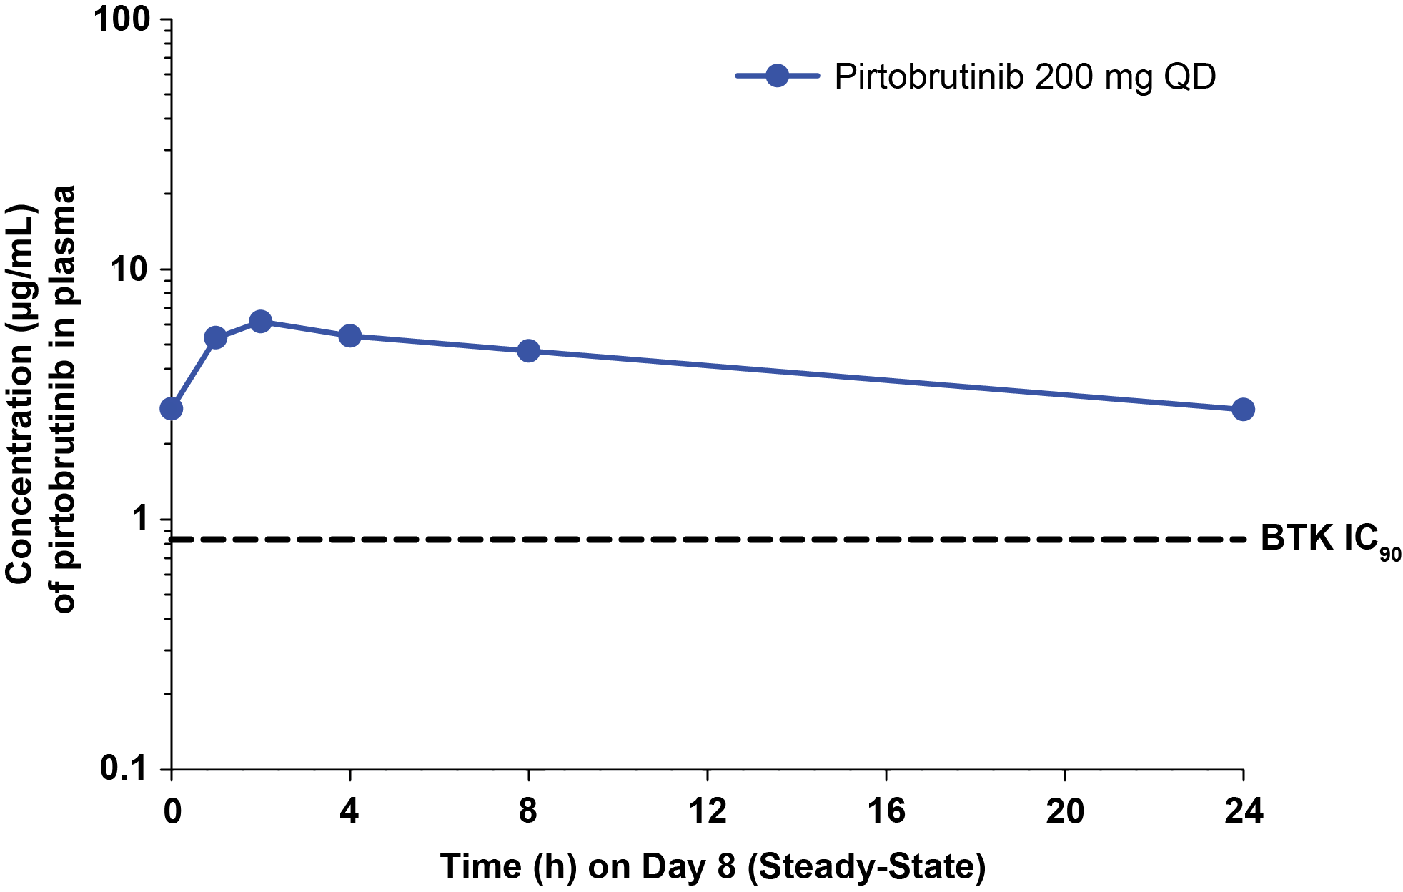
Pirtobrutinib is a Highly Selective, Non-Covalent (Reversible) BTK Inhibitor
Highly selective for BTK^{1,6}
Plasma exposures exceeded BTK IC₉₀
throughout dosing interval
Pirtobrutinib may stabilize/maintain BTK in a closed inactive conformation³
IC₅₀ <10 nM
10 nM < IC₅₀ <50 nM
50 nM < IC₅₀ <100 nM
100 nM < IC₅₀ <200 nM
200 nM < IC₅₀ <500 nM
BTK
Inhibits both WT and C481-mutant BTK with equal low nM potency³
Steady state plasma exposure corresponding to 96% BTK target inhibition and a half-life of about 20 hours³
Binding blocks access to upstream kinases and phosphorylation of Y551,​ inhibiting scaffolding interactions that support kinase-independent BTK signaling³
¹Mato et al. Lancet 2021; 397: 892–901. ²Brandhuber et al. Clin Lymphoma Myeloma Leuk 2018; 18(Suppl.1):S216. ³Gomez et al. Blood. 2023; 142(1):62-72.
Slide courtesy of Jonathon Cohen.
Notes:
Tyrosine 551

Slide 79
Phase 1/2 BRUIN Study of Pirtobrutinib
Phase 1 3+3 design
Phase 1 Escalation + Expansion (25 to 300 mg QD)
Phase 2 (200 mg QD)
N=778
28-day cycles
Intra-patient dose escalation allowed
Cohort expansion permitted at doses deemed safe
Eligibility
Age ≥18
ECOG 0-2
Active disease and in need of treatment
Previously treated
CLL/SLL
n=317
MCL
n=166
Other
n=295
Key endpoints
Safety/tolerability
Determine MTD and RP2D
Pharmacokinetics
Efficacy (ORR according to Lugano criteria, DoR, PFS, and OS)

Slide 80
Phase 1/2 BRUIN Study of Pirtobrutinib
Phase 1 3+3 design
28-day cycles
Intra-patient dose escalation allowed
Cohort expansion permitted at doses deemed safe
Phase 1 Escalation + Expansion (25 to 300 mg QD)
Phase 2 (200 mg QD)
N=778
Eligibility
Age ≥18
ECOG 0-2
Active disease and in need of treatment
Previously treated
CLL/SLL
n=317
MCL
n=166
Other
n=295
Key endpoints
Safety/tolerability
Determine MTD and RP2D
Pharmacokinetics
Efficacy (ORR according to Lugano criteria, DoR, PFS, and OS)
Prior cBTKi
n=152
cBTKi Naïve
n=14

Slide 81
Baseline Characteristics of Patients with MCL
Characteristics | Prior cBTKi n=152 | cBTKi Naïve n=14
Median age, years (range) | 70 (46-88) | 67 (60-86)
Male, n (%) | 120 (79) | 10 (71)
Histology, n (%)
Classic/leukemic | 120 (79) | 11 (79)
Pleomorphic/Blastoid | 32 (21) | 3 (21)
ECOG PS, n (%)
0 | 93 (61) | 5 (36)
1 | 56 (37) | 8 (57)
2 | 3 (2) | 1 (7)
sMIPI score, n (%)
Low risk (0-3) | 30 (20) | 3 (21)
Intermediate risk (4-5) | 79 (52) | 5 (36)
High risk (6-11) | 43 (28) | 6 (43)
Bulky Lymphadenopathy (cm), n (%)
<5 | 94 (62) | 8 (57)
≥5 | 36 (24) | 5 (36)
No Measurable Lymph Node | 22 (15) | 1 (7)
Bone marrow involvement, n (%)
Yes | 81 (53) | 4 (29)
No | 71 (47) | 10 (71)
Median number of prior lines of systemic therapy, n (range) | 3 (1-9) | 2 (1-3)
Characteristics | Prior cBTKi n=152 | cBTKi Naïve n=14
Prior therapy, n (%)
BTK inhibitor | 152 (100) | 0 (0)
Anti-CD20 antibody | 147 (97) | 14 (100)
Chemotherapy | 137 (90) | 14 (100)
Immunomodulator | 26 (17) | 1 (7)
Stem cell transplant | 33 (22) | 7 (50)
Autologous | 30 (20) | 7 (50)
Allogeneic | 7 (5) | 0 (0)
BCL2 inhibitor | 24 (16) | 0 (0)
CAR-T | 13 (9) | 0 (0)
PI3K inhibitor | 6 (4) | 1 (7)
Reason discontinued any prior BTKiª, n (%)
Progressive disease | 128 (84) | -
Toxicity / Other | 21 (14) | -
Unknown | 3 (2) | -
TP53 Mutation status, n (%)
Yes | 30 (20) | 3 (21)
No | 30 (20) | 4 (29)
Missing | 92 (61) | 7 (50)
Ki-67 index, n (%)
<30% | 18 (12) | 2 (14)
≥30% | 45 (30) | 6 (43)
Missing | 89 (59) | 6 (43)
Cohen JB et al. Blood. 2023; 142(S1):981. Slide provided courtesy of Dr. Cohen.

Slide 82
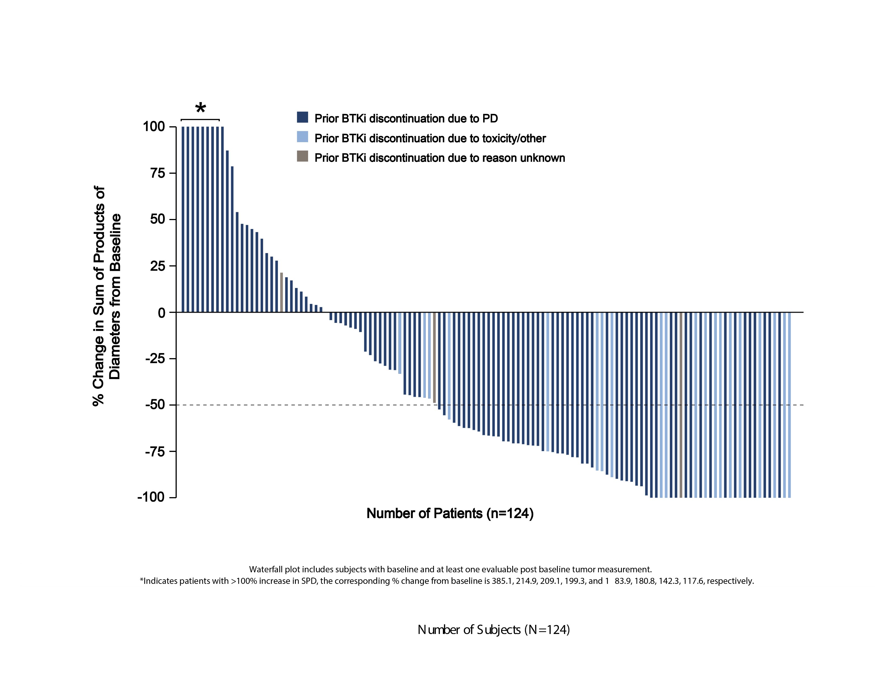

Pirtobrutinib Efficacy in Patients with MCL who Received Prior cBTKi
Prior cBTKi | n=152
ORR, % (95% CI) | 49.3 (41.1-57.6)
Best Response, n (%)
CR | 24 (15.8)
PR | 51 (33.6)
Median Time to First Response =1.8 months (range: 0.8-13.8)
Number of Patients (n=124)
Cohen JB et al. Blood. 2023; 142(S1):981.
Slide provided courtesy of Dr. Cohen.
Notes:
High ORRs were observed in pts who had PD on a prior cBTKi, and in pts with high-risk disease features including blastoid/pleomorphic variants, elevated Ki-67 index, and TP53 mutations.

Slide 83
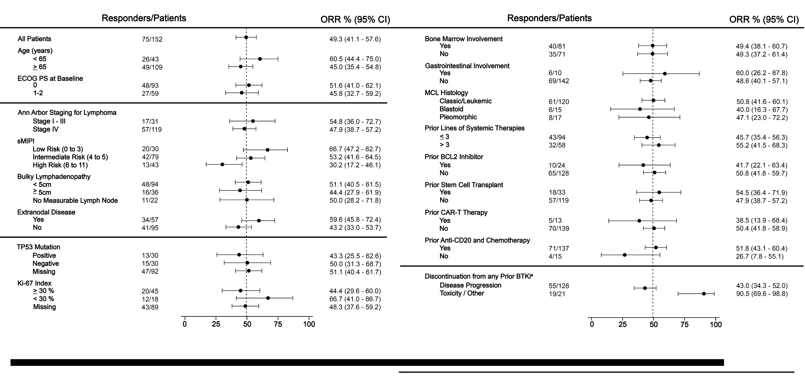
Overall Response Rate in Prior cBTKi Patients with MCL, Including High-Risk Subgroups
Cohen JB et al. Blood. 2023; 142(S1):981.
Slide provided courtesy of Dr. Cohen.

Slide 84
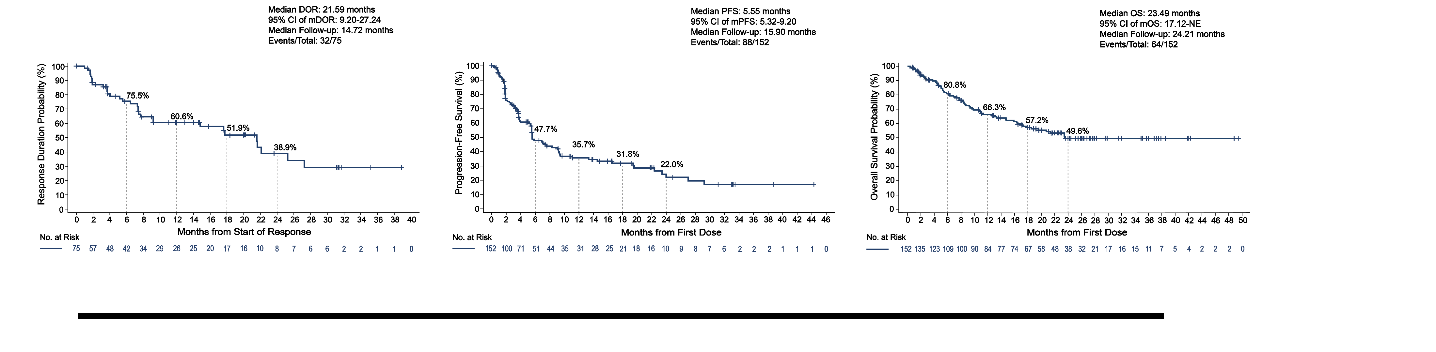
Pirtobrutinib Outcomes in Prior cBTKi Patients with MCL
Progression-Free Survival
Median PFS: 95% CI: Median Follow-up: Events/Total: | 5.6 months 5.3-9.2 15.9 months 88/152
Duration of Response
Median DoR: 95% CI: Median Follow-up: Events/Total: | 21.6 months 9.2-27.2 14.7 months 32/75
Overall Survival
Median OS: 95% CI: Median Follow-up: Events/Total: | 23.5 months 17.1-NE 24.2 months 64/152
Cohen JB et al. Blood. 2023; 142(S1):981. Slide provided courtesy of Dr. Cohen.

Slide 85
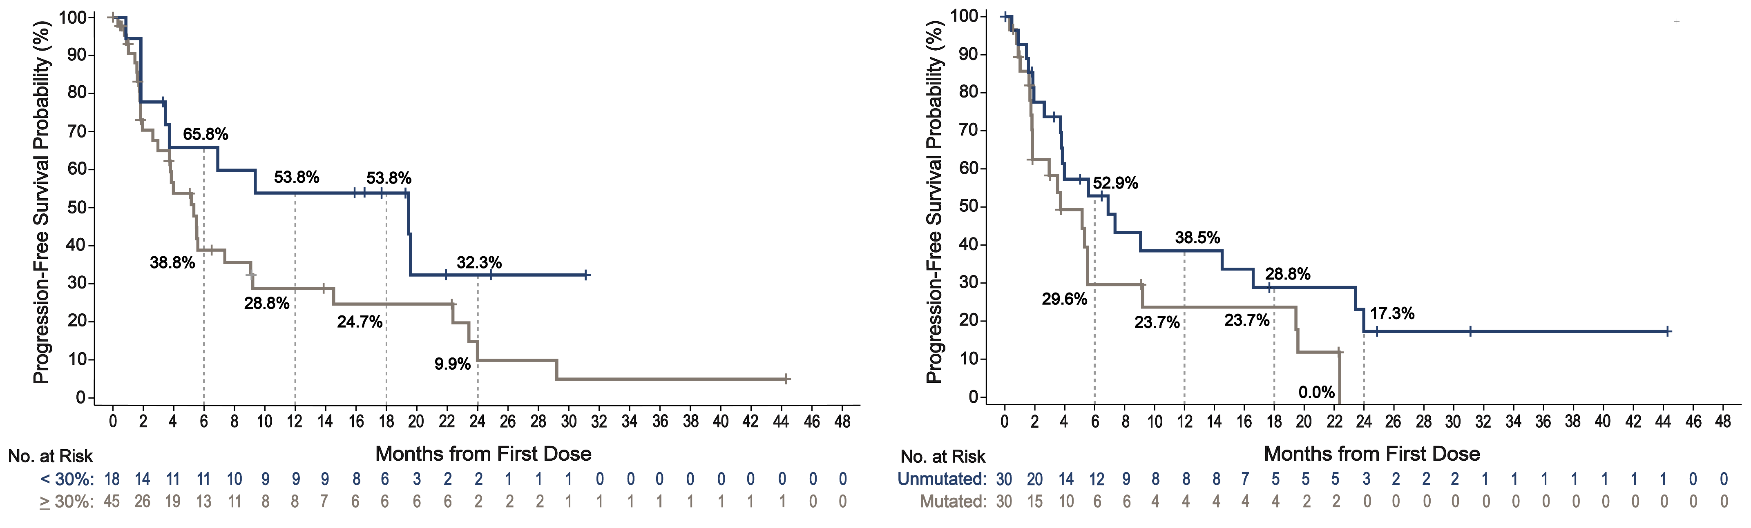
Pirtobrutinib Outcomes in Prior cBTKi Patients with MCL by High-Risk Subgroups
Ki-67 index
TP53 status
 | < 30% | > 30%
Median PFS, mos 95% CI: Events/Total: | 19.5 3.5-NE 10/18 | 5.3 3.0-9.1 31/45
 | Unmutated | Mutated
Median PFS, mos 95% CI: Events/Total: | 6.9 3.7-16.6 19/30 | 3.7 1.8-5.5 21/30
 | Median DoR (95% CI) | Median OS (95% CI)
Ki-67
< 30% | 17.7 (1.9-N.E.) | N.E. (9.4-N.E)
≥ 30% | 21.6 (5.6-27.2) | 23.4 (13.1-N.E.)
 | Median DoR (95% CI) | Median OS (95% CI)
TP53
Unmutated | 14.8 (1.9-N.E.) | N.E (10.7-N.E.)
Mutated | 17.6 (1.7-N.E.) | 15.9 (7.8-N.E)
Cohen JB et al. Blood. 2023; 142(S1):981. Slide provided courtesy of Dr. Cohen.

Slide 86
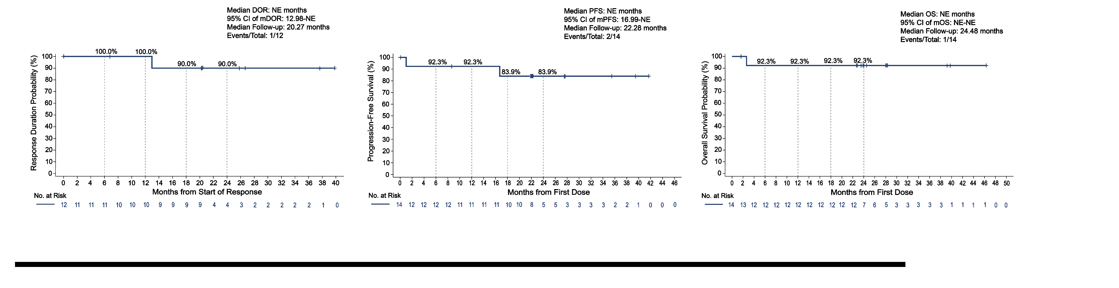
Pirtobrutinib Outcomes in cBTKi Naïve Patients with MCL
cBTKi Naive Cohort:
ORR = 85.7%
  6 CR (42.9%) and 6 PR (42.9%)
Progression-Free Survival
Duration of Response
Overall Survival
Cohen JB et al. Blood. 2023; 142(S1):981. Slide provided courtesy of Dr. Cohen.
Notes:
Median DoR, PFS, OS NE

Slide 87
Pirtobrutinib Safety Profile in MCL Patients
 | Treatment-Emergent AEs in Patients with MCL (n=166)
 | All Cause AEs, (≥15%), % |  | Treatment-Related AEs, %
Adverse Event | Any Grade | Grade ≥3 | Any Grade | Grade ≥3
Fatigue | 31.9 | 3.0 | 21.1 | 2.4
Diarrhea | 22.3 | 0.0 | 12.7 | 0.0
Dyspnea | 17.5 | 1.2 | 9.0 | 0.6
Anemia | 16.9 | 7.8 | 7.2 | 2.4
Platelet Count Decreased | 15.1 | 7.8 | 7.8 | 3.0
AEs of Interest | Any Grade | Grade ≥3 | Any Grade | Grade ≥3
Infections | 42.8 | 19.9 | 15.7 | 3.6
Bruising | 16.3 | 0.0 | 11.4 | 0.0
Rash | 14.5 | 0.6 | 9.0 | 0.0
Arthralgia | 9.0 | 1.2 | 2.4 | 0.0
Hemorrhage | 10.2 | 2.4 | 4.2 | 0.6
Hypertension | 4.2 | 0.6 | 1.8 | 0.0
Atrial Fibrillation/Flutter | 3.6 | 1.8 | 0.6 | 0.0
  Median time on treatment was 5.5 months.
  Discontinuations due to TRAEs in 3% (n=5); dose reductions due to TRAEs in 5% (n=8)
Cohen JB et al. Blood. 2023; 142(S1):981. Slide provided courtesy of Dr. Cohen.

Slide 88
Key BTKi updates in MCL
cBTKi are now recommended as part of frontline therapy and maintenance in MCL patients suitable for aggressive induction
With longer follow-up, pirtobrutinib continues to demonstrate clinically meaningful efficacy in a variety of R/R MCL subgroups, including patients with:
  Prior cBTKi treatment
  High-risk molecular features (e.g., Ki-67 and TP53)
  BTKi-naïve MCL
Pirtobrutinib is well tolerated with low rates of discontinuation due to drug-related toxicity.
Pirtobrutinib represents a new standard of care for patients who received a prior cBTKi.
A randomized, global phase 3 trial comparing pirtobrutinib with investigator’s choice of cBTKi is ongoing in relapsed BTKi-naïve MCL (BRUIN MCL-321; NCT04662255),
Notes:
(Median DoR was 21.6 months)

Slide 89
Phase 1/2 BRUIN Study of Pirtobrutinib
Phase 1 3+3 design
Phase 1 Escalation + Expansion (25 to 300 mg QD)
Phase 2 (200 mg QD)
N=778
28-day cycles
Intra-patient dose escalation allowed
Cohort expansion permitted at doses deemed safe
Eligibility
Age ≥18
ECOG 0-2
Active disease and in need of treatment
Previously treated
CLL/SLL
n=317
MCL
n=166
Other
n=295
Prior cBTKi
n=282
cBTKi Naïve
n=35
Key endpoints
Safety/tolerability
Determine MTD and RP2D
Pharmacokinetics
Efficacy (ORR according to Lugano criteria, DoR, PFS, and OS)
Prior BCL2i
n=128
BCL2i Naïve
n=154

Slide 90
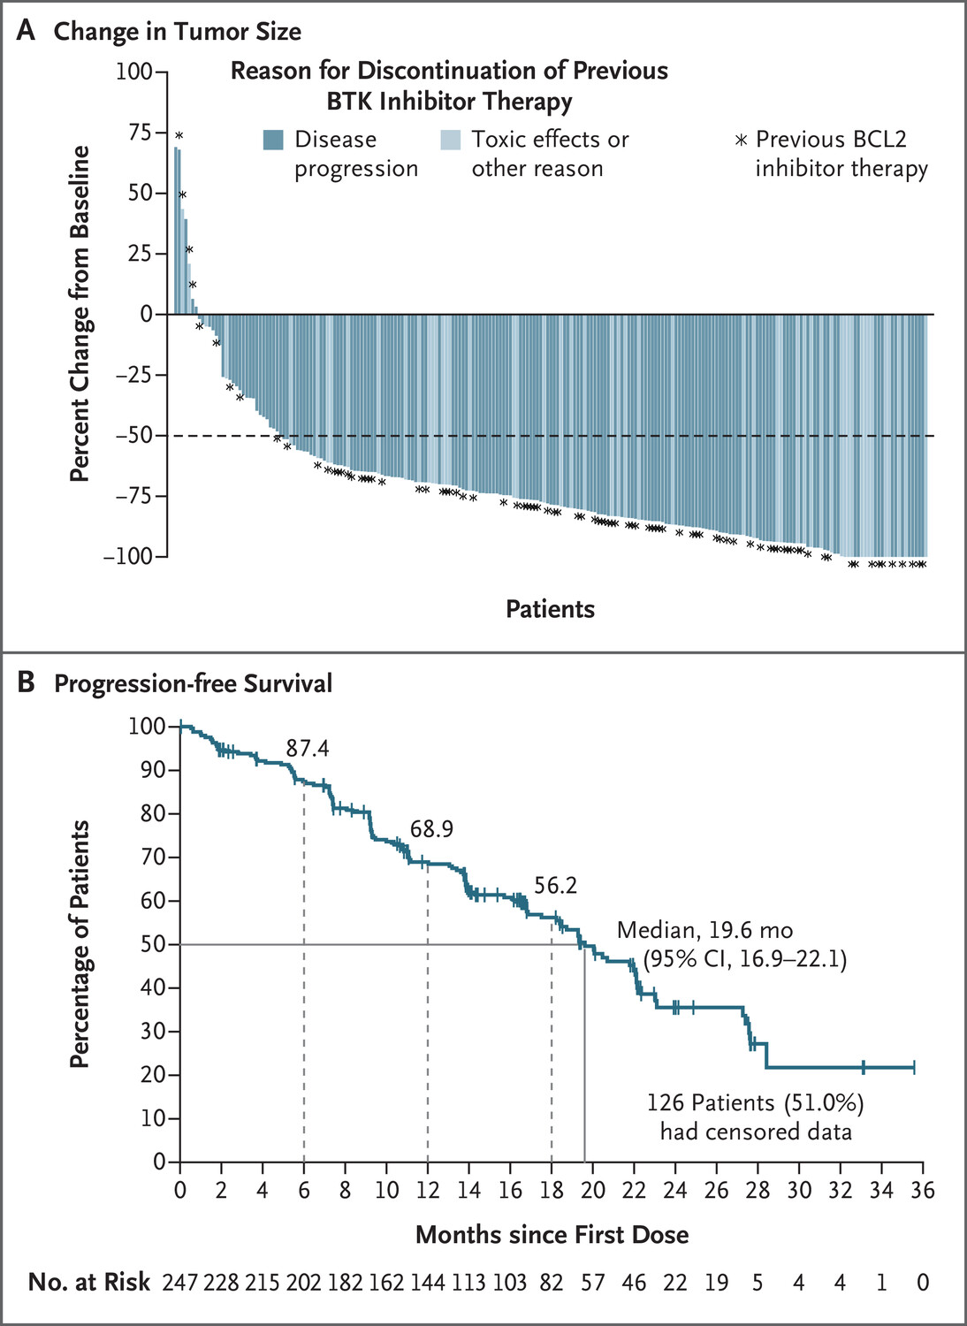
Pirtobrutinib after cBTKi in CLL
Mato AR et al. N Eng J Med. 2023; 389(1):33-44.
Notes:
317 patients with CLL or SLL received pirtobrutinib, including 247 who had previously received a BTK inhibitor. overall response to pirtobrutinib was 73.3% (95% confidence interval [CI], 67.3 to 78.7), and the percentage was 82.2% (95% CI, 76.8 to 86.7) when partial response with lymphocytosis was included. The median progression-free survival was 19.6 months
pirtobrutinib showed efficacy in patients with heavily pretreated CLL or SLL who had received a covalent BTK inhibitor. The most common adverse events were infections, bleeding, and neutropenia

Slide 91


ORR in cBTKi-exposed = 82%
  BCL2-N: 83.1%, BCL2-E: 79.7%
mDOR = 18.4 mos
  BCL2-N: 24.9 mo, BCL2-E: 14.8 mo
24-mo OS = 73.2%
  BCL2-N: 83.1%, BCL2-E: 60.6%
Similar AE profile across subgroups
  Most frequent: fatigue (36.9%), diarrhea (28.4%), cough (27.3%), contusion (26.2%)
  Grade ≥3 TEAEs: HTN (4.3%) and a-fib/flutter (1.8%)
  Grade 3 neutropenia- BCL2-N: 21.4%, BCL2-E: 36.7%
BCL2i-Naïve
PFS= 48.3% at 24 mo
BCL2i-Exposed
PFS= 24.3% at 24 mo
Woyach JA et al. Blood. 2023; 142(S1):325.
Notes:
BCL2i-N pts were exposed to fewer prior therapies than BCL2i-E pts (median prior therapies 3 and 5, respectively), including anti-CD20 antibody (83% and 97%), chemotherapy (74% and 89%), PI3K inhibitor (11% and 42%), CAR-T cell therapy (1% and 12%), and hematopoietic cell transplantation (1% and 6%). With a median follow up of 29.3 months, the median OS was not estimable for all cBTKi pre-treated pts
Though Grade ≥3 neutropenia/neutrophil count decreased was higher in BCL2i-E pts (36.7% and 21.4%), this may have been attributed to the higher frequency of baseline neutropenia in BCL2i-E pts (27.3% and 11.0%). In total, 7 (2.5%; 4 BCL2i-N, 3 BCL2i-E) pts had treatment-related AE leading to pirtobrutinib discontinuation.
Longer PFS was observed in BCL2i-N pts than BCL2i-E pts, likely due to the more heavily pretreated status of the BCL2i-E population which can be associated with poorer prognosis. Pirtobrutinib was well-tolerated with low-rates of discontinuation due to drug-related toxicity among both BTKi-N and BTKi-E pts.

Slide 92

Targeted NGS of PBMCs in CLL patients who progressed on pirto at baseline and within 4 months of PD
Baseline mutations in BTK (53%), TP53 (48%), SF3B1 (35%), ATM (23%), NOTCH1 (20%), XPO1 (16%), PLCG2 (14%), BCL2 (9%)
  42 patients with BTK C481 mutations → 55% completely cleared with pirto
69% (59/86) of patients acquired ≥1 mutation at PD.
  45 patients with non-BTK
  38 patients with BTK
Brown JR et al. Blood. 2023; 142(S1):326.
Notes:
In 46 pts, 64 BTK mutations were detected at baseline and included C481S (n=45), C481F/R/Y (n=11), T474I/F/S (n=6), A428D (n=1), D149G (n=1). Among 42 pts with C481, BTK C481 VAF decrease or complete clearance was observed at PD in the majority of pts (86%, 36/42, complete clearance = 55%, 23/42)
In 38 (44%) pts, 52 acquired BTK mutations were detected and most commonly included gatekeeper mutations (T474I/F/S/L/Y, n=25 in 22 pts), kinase-impaired (L528W, n=14 in 14 pts), C481S/R/Y (n=6 in 4 pts) and others proximal to the ATP-binding pocket (n=7 in 5 pts), including D539A/G/H (n=3 in 1 pt), V416L (n=2 in 2 pts), Y545N (n=1) and A428D . A total of 83 non-BTK acquired mutations were observed at PD in 45 pts (52%), including 14 TP53 mutations in 12 pts (14%), 6 PLCG2 mutations in 6 pts (7%), 6 PIK3CA mutations in 6 pts (7%) and 3 BCL2 mutations in 3 pts (3%).
Despite this cohort representing the first relapsing CLL patients from BRUIN and presenting with frequent baseline BTK mutations, response to pirtobrutinib was high, with an ORR of 83%, and substantial clearance of BTK C481 clones. At progression, the majority of pts (56%) either acquired non-BTK mutations or did not acquire any resistance mutations in this targeted panel, suggesting alternative resistance mechanisms. A smaller group of patients (44%) displayed emergence of non-C481 clones, particularly gatekeeper T474 and kinase-impaired L528W mutations. Whether similar patterns of resistance would manifest if pirtobrutinib was utilized in earlier lines of therapy or prior to cBTKi treatment remains uncertain.

Slide 93



Compared R/R CLL patients previously treated with cBTKi but not venetoclax: BRUIN (n=146) vs. Ven monotherapy (n=91)
Patient-level data from pirto cohort re-weighted to match the ven cohort using method of moments approach
  Adjusted for age, IGHV mutation status, TP53 aberrancy, del(17p), del(11q); # of prior therapy lines, and reason for prior cBTKi discontinuation
ORR 80% (pirto) vs 65% (ven).
PFS and OS similar between the 2 groups
Lower rates of cytopenias and febrile neutropenia in pirto group.
MAJOR CAVEATS:
  Ven monotherapy rather than with CD20
  Limited follow-up in ven trial (median 14 months)
  Not a randomized trial
Al-Sawaf O et al. HemaSphere. 2023; 7(S3):1113-1114.

Slide 94
Key BTKi updates in CLL
With longer follow-up, pirtobrutinib continues to demonstrate clinically meaningful efficacy in R/R CLL, including patients with:
  Prior cBTKi treatment ± BCL2i treatment
  C481 mutations in BTK
Pirtobrutinib is well tolerated with low rates of discontinuation due to drug-related toxicity.
Pirtobrutinib represents a new standard of care for patients who received a prior cBTKi.
A randomized, global phase 3 trial comparing pirtobrutinib with ibrutinib is ongoing in CLL/SLL (BRUIN CLL-314; NCT05254743).
Notes:
To help answer the question of whether pirto may outperform cBTKi,….

Slide 95
Questions?

Slide 96
Hematologic Malignancies
April 23rd, 2024

Slide 97
Bispecific Antibodies in DLBCL
Jason T. Romancik, MD
Assistant Professor
Winship Cancer Institute of Emory University
Atlanta, GA

Slide 98

DLBCL Background
Most common subtype of non-Hodgkin lymphoma
Majority of patients cured with modern therapies regardless of disease stage
Prognosis poor for those with relapsed disease
Sehn LH, Salles G. Diffuse Large B-Cell Lymphoma. N Engl J Med. 2021;384(9):842-858. doi:10.1056/NEJMra2027612

Slide 99
Treatment algorithm for R/R DLBCL
Time to relapse after 1L treatment
(e.g., R-CHOP, R-pola-CHP, R-EPOCH)
≤ 1 year (~75% of pts)
> 1 year (~25% of pts)
Eligible for CAR-T
Eligible for auto transplant
No (~30%)
No (~50%)
Yes (~70%)
2L or 3L+ treatment options:
Clinical trial
Bispecific antibody
(e.g., glofitamab, epcoritamab)
Loncastuximab tesirine
BR-polatuzumab
Tafasitamab + lenalidomide
Chemo, XRT
Best supportive care
Yes (~50%)
2L CAR-T
(axi-cel or liso-cel)
2L salvage chemo +/- auto transplant
Long-term remission: 30-40%
Long-term remission: 40-50%
Projected cure:
~20% all 2L DLBCL
Projected cure:
~5% all 2L DLBCL
Adapted from: Jason Westin, Laurie H. Sehn; CAR T cells as a second-line therapy for large B-cell lymphoma: a paradigm shift?. Blood 2022; 139 (18): 2737–2746. doi: https://doi.org/10.1182/blood.2022015789

Slide 100

Bispecific Antibodies
Bispecific abs bind and redirect cytotoxic activity of T-cells to malignant cells
“Off-the-shelf”, immediately available for use
Major adverse effects:
  Cytokine release syndrome
  Neurologic toxicity
  Hypogammglobulinemia
  Infection
Figure from: Singh A, Dees S, Grewal IS. Overcoming the challenges associated with CD3+ T-cell redirection in cancer. Br J Cancer. 2021;124(6):1037-1048. doi:10.1038/s41416-020-01225-5

Slide 101


Dosing and administration
Glofitamab
Epcoritamab
24hr hospital obs

Slide 102
Dosing and administration considerations
Easier to administer in the community
No REMS or FACT required
No apheresis, cell processing
Tocilizumab availability
Healthcare provider training
In-hospital monitoring
Afterhours plan

Slide 103
Bispecific monotherapy efficacy in R/R DLBCL
 | Glofitamab | Epcoritamab | Odronextamab
Median Age, yr (range) | 66 (21-90) | 64 (20-83) | 66 (24-88)
# Prior therapies | 3 (2-7) | 3 (2-11) | 2 (2-8)
ORR (CR) | 52% (39%) | 63% (39%) | 49% (31%)
Median PFS | 4.9 mo | 4.4 mo | 4.4 mo
Median OS | 11.5 mo | 18.5 mo | -
Dickinson MJ, et al. N Engl J Med. 2022;387(24):2220-2231.
Thieblemont C, et al. J Clin Oncol. 2023;41(12):2238-2247.
Bannerji R, et al. Lancet Haematol. 2022;9(5):e327-e339.

Slide 104


Duration of Response
Glofitamab
Epcoritamab
Dickinson MJ, NEJM 2022; 387:2220-2231
Thieblemont C, J Clin Oncol 2023; 41(12):2238-2247

Slide 105
Bispecific monotherapy safety
 | Glofitamab | Epcoritamab | Odronextamab
CRS (All), % | 63 | 50 | 53
CRS (≥ Grade 3), % | 4 | 3 | 1
ICANS (All), % | 8 | 6 | 3
ICANS (≥ Grade 3), % | 3 | 1 | 1
Infection (≥ Grade 3), % | 15 | 15 | 23

Slide 106


Treatment sequencing considerations
Bispecific after prior CAR-T
CAR-T survival after prior bispecific
ORR 92% (CR 46%)
1-yr PFS 37%
Crochet G, et al, ASH 2022

Slide 107

Real World Data
43 patients from 20 centers in Turkey
ORR 37% (CR 21%)
Median PFS 3.3 mo
Median DoR 6 months
Median OS 8.8 mo
Birtas Atesoglu E, Gulbas Z, Uzay A, et al. Glofitamab in relapsed/refractory diffuse large B-cell lymphoma: Real-world data. Hematol Oncol. 2023;41(4):663-673. doi:10.1002/hon.3174

Slide 108
What’s next for bispecific Abs in DLBCL?
1st Line DLBCL | Phase 3 Epcoritamab + R-CHOP vs R-CHOP (NCT05578976) Phase 3 Glofitamab + R-pola-CHP vs. R-pola-CHP (NCT06047080) Epcoritamab + R-mini-CVP in unfit/frail patients (NCT06045247) Glofitamab + Polatuzumab in unfit/frail patients (NCT05798156)
Pre-transplant salvage therapy | Epcoritamab + R-GDP → AutoHSCT or CAR-T (NCT05852717)
Peri-CAR T | SWOG 2114: Mosunetuzumab, polatuzumab, or combo for patients with PR after CAR-T Pola + obin + glofit as a peri-CAR-T treatment strategy (NCT06071871) Epcor vs. observations in patients not in CR after CAR-T (NCT06238648) Axi-cel and glofitamab as second line therapy for R/R DLBCL (NCT06213311)
Combination therapy for relapsed disease | Epcoritamab containing combinations for relapsed B-cell NHL (NCT04663347) Loncastuximab containing combinations for relapsed DLBCL (LOTIS-7; NCT04970901) Glofitamab + GemOx (NCT04408638)
Many more studies in MCL, FL, MZL
Trispecific antibodies in development

Slide 109
Take home message
Some patients have excellent responses to bispecific ab monotherapy, but there is much room for improvement
Bispecifics in earlier lines of therapy and in combination are appealing
Bispecifics easier to administer than CAR-T, but careful consideration of side effect management is required

Slide 110
Thank you!

Slide 111
Hematologic Malignancies
April 23rd, 2024

Slide 112
Updates in AML
Martha Arellano, MD
Professor of Hematology and Oncology
Associate Director, Hematology Division
Program Director, Hematology/Medical Oncology Fellowship
Winship Cancer Institute of Emory University
Atlanta, Georgia

Slide 113
Objectives
Menin pathway as a target in leukemia
Menin inhibitors with efficacy data
Menin-targeted agents in the pipeline/ongoing trials

Slide 114
Introduction
KMT2A rearrangements occur in up to 10-15% of acute leukemias and portend poor prognosis.
NPM1 mutations occur in up to 30% of AML cases, and co-mutations can alter the favorable prognosis of NPM1-mutated AML.
Nup98 rearrangements occur in approximately 4-5% of patients with AML and carry a dismal prognosis.
Hollink IHIM, Van den Heuvel-Eibrink MA, Arentsen-Peters JM. Blood (2011) 118 (13): 3645–3656.

Slide 115



Menin
Leukemia
Nup98
Differentiation/apoptosis
Nup98
Menin inhibitor
Kuhn M, Armstrong S. Cancer Cell 2015; 27(4):431-3, Thomas X. Oncol Ther 2024; 12: 57-72
Heikamp EB, Henrich JA, Perner F, et al. Blood 2022 139(6): 894-906.

Slide 116
Revumenib (SNDX-5613) Monotherapy in Patients with R/R KMT2Ar Acute Leukemia: Topline Efficacy and Safety Results from Augment-101
Phase 2 Study
Inclusion: Age ≥30 days with R/R KMT2Ar ALL/MPAL or AML.
163 mg (95 mg/m² if < 40 kg) q12h with a strong CYP3A4 inhibitor po on 28-day cycles, until toxicity or less than MLFS after C4.
Primary objectives: safety and tolerability, CR+CRh rate.
MLFS = morphologic leukemia-free state
Aldoss I, Issa GC, Thirman M, et al. 2023. Late Breaking Abstract-5
Issa GC, Aldoss I, DiPersio J, et al. Nature 2023. 615, 920-2
Notes:
Planned interim analysis of pooled adult and pediatric pts with KMT2Ar acute leukemia.
Cohort C (NPM1^{mut} AML) is ongoing.

Slide 117
Revumenib in R/R KMT2Ar Acute Leukemia, Augment-101 Phase 2 Results
Parameter | Efficacy population (n=57) | Safety population (N=94)
Median age, y (range) | 34 (1.3-75) | 37 (1.3-75)
Adult/Pediatric | 44/13 | 71/23
Female/Male | 33/24 | 56/38
ALL, n (%) | 7 (12.3) | 14 (14.9)
AML, n (%) | 49 (86) | 78 (83)
MPAL, n (%) | 1 (1.8) | 2 (2)
# prior lines of therapy, median (range) | 2 (1-11) | 2 (1-11)
Prior venetoclax, n (%) | 41 (71.9) | 61 (64.9)
Prior HSCT, n (%) | 26 (45.6) | 47 (50)
Aldoss I, Issa GC, Thirman M, et al. 2023. Late Breaking Abstract-5

Slide 118
Revumenib in R/R KMT2Ar Acute Leukemia, Augment-101 Phase 2 Results
Response | Pooled efficacy (n=57) | AML efficacy (n=49)
ORR, n (%) | 36 (63.2) | 32 (65.3)
Best response, n (%)
CR | 10 (17.5) | 9 (18.4)
CRh/CRi/CRp | 3/1/11 (26.3) | 3/1/9 (26.5)
CRc | 25 (43.9) | 22 (44.9)
MLFS | 10 (17.5) | 10 (20.4)
PR | 1 (1.8) | 12 (24.5)
MRD-negative CRc, n (%) | 15/22 (68.2) | 13/19 (68.4)
CR, complete remission; CRc, composite complete remission; CRi, CR with incomplete count recovery; CRh CR with partial hematologic recovery;
CRp, CR with incomplete platelet recovery; MLFS, morphologic leukemia free state; MRD, measurable residual disease
Aldoss I, Issa GC, Thirman M, et al. 2023. Late Breaking Abstract-5

Slide 119
Revumenib in R/R KMT2Ar Acute Leukemia, Augment-101 Phase 2 Results
Safety | Safety population (n=94)
Any grade TRAE, n (%) | 77 (81.9)
Any grade TRAE in > 20% patients, n (%)
Nausea | 26 (27.7)
Differentiation syndrome | 25 (26.6)
QTc prolongation | 22 (23.4)
Grade > 3 TRAE, n (%) | 51 (54.3)
Febrile neutropenia | 13 (13.8)
Differentiation syndrome | 15 (16)
QTc prolongation | 13 (13.8)
Cytopenias, n (%) | 42 instances (44.7)
TRAE leading to discontinuation | 6 (6.4)
CR, complete remission; CRc, composite complete remission; CRi, CR with incomplete count recovery; CRh CR with partial hematologic recovery; CRp, CR with incomplete platelet recovery; MLFS, morphologic leukemia free state; MRD, measurable residual disease
Aldoss I, Issa GC, Thirman M, et al. 2023. Late Breaking Abstract-5

Slide 120
Summary
Revumenib led to high remission rates in R/R KMT2Ar acute leukemias, with acceptable safety profile.
NPM1^{mut} AML cohort is still accruing.

Slide 121
Phase 1 Study of the Menin-KMT2A (MLL1) Inhibitor JNJ-75276617 in Adults with R/R AML Harboring KMT2A or NPM1 Alterations
Preliminary safety, efficacy, PD data presented
N= 58 (56 with R/R AML, 2 with R/R ALL), 33 with KMT2A and 25 with NPM1 alterations
Median age 63 (range 19-83)
Median prior lines of therapy 2 (range 1-7), 10 with prior allogeneic HSCT
PD = pharmacodynamic
Elias Jabbour, Emma Searle, Maher Abdul-Hay, et al. 2023. Session 616. Oral poster 57

Slide 122
Phase 1 Study of the Menin-KMT2A (MLL1) Inhibitor JNJ-75276617 in Adults with R/R AML Harboring KMT2A or NPM1 Alterations
Safety | Population N = 58
Any grade TRAE, n (%) | 30 (52%)
Differentiation syndrome | 15 (16)
Grade > 3 TRAEs, n, (%) | 17 (29%)
Neutropenia | 6 (10)
Differentiation syndrome (DS) | 3 (5%)
Anemia/Thrombocytopenia | 4 (7%) each
AST/ALT increase | 2 (3%) each
DLT observed | 5 (9%), 2 were DS
Elias Jabbour, Emma Searle, Maher Abdul-Hay, et al. 2023. Session 616. Oral poster 57

Slide 123

Phase 1 of JNJ-75276617 in Adult Patients with R/R AML with KMT2A or NPM1 Alterations,
Efficacy
7/20 (35%) of patients in the highest dose levels with ≥3 pts, achieved CR/CRh/CRi (3/1/3).
JNJ-75276617 shows early response and acceptable safety profile.
Dose escalation is ongoing.
Elias Jabbour, Emma Searle, Maher Abdul-Hay, et al. 2023. Session 616. Oral poster 57

Slide 124
Menin Inhibitors as Single Agents and Combinations
Newly diagnosed AML | R/R AML
NCT 05886049, Rev + 7+3 induction and Ara-C consol. | NCT 05326516 (augment-102), Rev + chemo, AML/ALL/MPAL
NCT06284486, Rev + Venetoclax for AML in MRD+ CR | NCT05360160, Rev + ASTX727, AML/MPAL (myeloid)
NCT06313437, Rev + 7+3 + Midostaurin | NCT06222580, Rev + Gilteritinb
NCT05453903, JNJ-75276617 + Aza/Ven, or 7+3 | JNJ-75276617 + Ven, or Aza, or AZA/Ven
 | NCT05153330, BMF-219, AML/ALL,DLBCL,MM,CLL/SLL
 | NCT04067336, Ziftomenib
 | NCT04811560, JNJ-75276617, Acute leukemias
 | NCT04988555, DSP-5336

Slide 125
SUMMARY
Menin inhibitors are showing safety and efficacy in treatment of relapsed/refractory acute leukemia harboring KMT2A rearrangements, NPM1 mutations and NUP98 rearrangements.
Five agents currently in trials as single agents and combinations, including co-targeting with FLT3 inhibitors

Slide 126
Hematologic Malignancies
April 23rd, 2024

Slide 127
CAR-T Cell Therapy for RRMM
Nisha S. Joseph, MD
Associate Professor
Department of Hematology and Medical Oncology
Winship Cancer Institute, Emory University

Slide 128
FDA approved CAR-T in RRMM
Ide-cel (Abecma)
Approved Mar 2021
Anti-BCMA
> 4 PLOT
Cilta-cel (Carvytki)
Approved Feb 2022
Anti-BCMA
> 4 PLOT
Now approved >2 prior lines of therapy

Slide 129


Idecabtagene Vicleucel (Ide-cel):
FDA Approved March 2021
Baseline Characteristics | N=128
Median age | 61 years
Target dose | 300-450 million
Median Prior Lines | 6
Triple Class Refractory | 84%
Penta Refractory | 26%
Bridging Therapy | 88%
Overall response rate: 73%
CR rate: 33%
MRD negativity: 26%
Survival Outcomes
Median PFS | 8.8 months
Median PFS in CR | 20.2 months
Median OS | 19.4 months
Munshi et al. NEJM 2021;384(8):705-716
Notes:
Excellent response rates (including MRD negative) and PFS, but no plateau in PFS;
Overall response rate: 73%, CR rate: 33%, MRD negativity: 26%
CR rate: 33%

Slide 130
KarMMa: Safety
​ | N = 128
AEs of Interest^{[a]}, N (%)​ | Any Grade​ | Grade ≥ 3​
Hematologic
Neutropenia | 117 (91) | 114 (89)
Anemia | 90 (70) | 78 (61)
Thrombocytopenia | 82 (64) | 67 (52)
Leukopenia | 54 (42) | 50 (39)
Lymphopenia | 36 (28) | 35 (27)
Non-Hematologic
Infection | 90 (70) | 34 (27)
Secondary primary malignancy | 9 (7) | 3 (2)
HLH/MAS | 4 (3) | 2 (2)
​ | N = 128
AEs of Interest^{[a]}, N (%) | Any Grade​ | Grade ≥ 3​
Cytokine release syndrome | 107 (84) | 7 (5)
Median onset (range), d | 1 (1 – 12)
Median duration (range), d | 5 (1 – 63)
Neurotoxicity | 23 (18) | 4 (3)
Median onset (range), d | 2 (1 – 10)
Median duration (range), d | 3 (1 – 26)
4 treatment related deaths (1 bronchopulmonary aspergillosis, 1 gastrointestinal hemorrhage, 1 cytokine release syndrome, 1 CMV pneumonia)^{[b]}
a. Anderson LD, et al. J Clin Oncol. 2021;39:8016; b. Munshi NC, et al. N Engl J Med. 2021;384:705-716.

Slide 131

KarMMa-3: Phase 3 Study of Ide-cel vs Standard Therapy in RRMM
Key inclusion criteria:
2 – 4 prior lines including PI, IMiD, and daratumumab
Refractory to last therapy
N = 254 randomized, 225 infused*
Ide-cel
Per KarMMa-1 protocol
Primary Endpoint: PFS
Key Secondary Endpoints: ORR, DOR, MRD, OS, safety
R
2:1
N = 140
N = 132 randomized, 126 received
Investigator’s choice standard regimen
DPd, DVd, Ixa-Rd, Kd, or EPd
Standard protocol until progression
*5 did not undergo leukapheresis, 24 did not receive ide-cel (including 4 deaths and 3 manufacturing failures).
Rodriguez-Otero P, et al. N Engl J Med. 2023;388:1002-1014.

Slide 132
KarMMa-3: Patient Characteristics
Baseline Characteristics | Ide-cel N = 254 | Standard Reg N = 132
Median age (range), y | 63 (30 – 81) | 63 (42 – 83)
Male, N (%) | 156 (61) | 79 (60)
Race, N (%) Asian Black White Other | 7 (3) 18 (7) 172 (68) 3 (1) | 5 (4) 18 (14) 78 (59) 4 (3)
ECOG PS, N (%) 0 1 2 | 120 (47) 133 (52) 1 (<1) | 66 (50) 62 (47) 4 (3)
R-ISS stage, N (%) I II III | 50 (20) 150 (59) 31 (12) | 26 (20) 82 (62) 14 (11)
Baseline Characteristics | Ide-cel N = 254 | Standard Reg N = 132
High risk cytogenetics, N (%) del17p, t(4;14), t(14;16) | 107 (42) | 61 (46)
Extramedullary, N (%) | 61 (24) | 32 (24)
Median prior lines (range) | 3 (2 – 4) | 3 (2 – 4)
Prior ASCT, N (%) | 214 (84) | 114 (86)
Refractory status, N (%) IMiD PI Daratumumab Double-refractory Triple-refractory Penta-refractory | 224 (88) 189 (74) 242 (95) 169 (67) 164 (65) 15 (6) | 124 (94) 95 (72) 123 (93) 91 (69) 89 (67) 5 (4)
Rodriguez-Otero P, et al. N Engl J Med. 2023;388:1002-1014.

Slide 133


KarMMa-3: Results
Ide-cel vs SOC in RRMM → CAR-T in earlier lines?
SOC options: DPD, DVD, IRD, Kd, EPD
2-4 prior lines
Rodriguez-Otero et al, NEJM 2023
Notes:
386 patients, 2-4 prior lines, phase 3 international trial
66% TCR disease, 95% Dara refractor
Median FU 18.6 months, mPFS 13.3 versus 4.4
ORR 71% v 42%
SOC options: DPD, DVD, IRD, Cd, EPD

Slide 134
KarMMa-3: Safety
​ | Ide-cel N = 250 |  | Standard Regimen N = 126
AEs of Interest, N (%)​ | Any Grade​ | Grade ≥ 3​ | Any Grade​ | Grade ≥ 3​
Hematologic
Neutropenia | 195 (78) | 189 (76) | 55 (44) | 50 (40)
Anemia | 165 (66) | 127 (51) | 45 (36) | 23 (18)
Thrombocytopenia | 136 (54) | 106 (42) | 36 (29) | 22 (17)
Lymphopenia | 73 (29) | 70 (28) | 25 (20) | 23 (18)
Leukopenia | 72 (29) | 71 (28) | 15 (12) | 11 (9)
Non-hematologic
Infection | 146 (58) | 71 (28)* | 68 (54) | 26 (20)^{ⴕ}
Hypophosphatemia | 78 (31) | 50 (20) | 10 (8) | 3 (2)
CRS | 197 (88) | 11 (5) | - | -
​ | Ide-cel N = 225
AEs of Interest, N (%)​ | Any Grade​ | Grade ≥ 3​
CRS | 197 (88) | 11 (5)
Median onset (range), d | 1 (1 – 14)
Median duration (range), d | 3.5 (1 – 51)
Neurotoxicity | 34 (15) | 7 (3)
Median onset (range), d | 3 (1 – 317)
Median duration (range), d | 2 (1 – 37)
2 (1%) CRS-related deaths in the ide-cel arm
18 infection-related deaths, 5% in each arm
*Included 11 (4%) grade 5 infections. ^{ⴕ}Included 3 (2%) grade 5 infections.
Rodriguez-Otero P, et al. N Engl J Med. 2023;388:1002-1014.

Slide 135
Real World Outcomes with Idecabtagene Vicleucel (Ide-cel) CAR-T cell Therapy for Relapsed/Refractory Multiple Myeloma
Surbhi Sidana¹; Nausheen Ahmed²; Othman Akhtar^{3,4}; Michael Heim³, Ruta Brazauskas³; Doris Hansen⁵; Christopher Ferreri⁶; Ciara Freeman⁵; Aimaz Afrough⁷; Larry Anderson⁷; Binod Dhakal⁴; Devender Dhanda⁸; Lohit Gowda⁹; Hamza Hashmi¹⁰; Melanie Harrison⁸; Amani Kitali⁸; Heather Landau¹¹; Sayeef Mirza⁹; Jinalbel Patel³; Pallavi Patwardhan⁸; Muzaffar Qazilbash ¹² ;Saad Usmani¹¹; Krina Patel¹²; Taiga Nishihori⁵; Siddhartha Ganguly¹³; Marcelo C. Pasquini^{3,4}
Affiliations: 1. Stanford University; 2.Kansas University Medical Center; 3.CIBMTR; 4.Medical College of Wisconsin; 5. Moffitt Cancer Center; 6. Levine Cancer Institute; 7.University of Texas Southwestern; 8. Bristol Myers Squibb; 9. Yale Cancer Center; 10. Medical University of South Carolina; 11. Memorial Sloan Kettering Cancer Center; 12. MD Anderson Cancer Center; 13. Houston Methodist Hospital.
On behalf of the CIBMTR® Plasma Cell Disorder Working Committee; CIBMTR® is a research collaboration between National Marrow Donor Program®/Be The Match® and Medical College of Wisconsin.
This was research collaboration between BMS and CIBMTR

Slide 136
Baseline Characteristics and Treatment History
N=821 | N (%) or Median (Range)
Median age, years | 66 years (29-90)
Age > 70 years | 251 (31%)
Sex, female | 334 (41%)
Race, White Race, Black | 652 (79%) 120 (15%)
Ethnicity, Hispanic | 55 (7%)
ECOG Performance Status 0-1 | 728 (89%)
Clinically significant co-morbidity | 631 (77%)
ISS Stage (N=420) Stage I Stage II Stage III | 210 (50%) 142 (34%) 68 (16%)
Bone marrow plasma cells > 50% | 71/508 (14%)
Non-secretory disease | 17 (2%)
High-risk cytogenetics | 196/727 (27%)
High-risk cytogenetics including 1q | 381/727 (52%)
Extramedullary disease | 85/488 (17%)
Plasma cell leukemia | 13 (1.6%)
N=821 | N (%) or Median (Range)
Prior lines of therapy | 7 (4-21)
Triple class exposed | 776 (97%)
Penta class exposed | 490 (60%)
Prior BCMA Therapy Prior ADC (Belantamab) Prior CAR-T Prior bispecific | 150 (18%) 116 (14%) 36 (4%) 3 (0.4%)
Bridging therapy | 442/799 (54%)
Lymphodepletion Chemotherapy Fludarabine/Cyclophosphamide Bendamustine Cyclophosphamide + Other Cyclophosphamide Other/unknown | 741 (90%) 51 (6%) 18 (2%) 8 (1%) 3 (0.3%)
CAR-T cell dose in million cells | 409 (307-460)
CAR-T cell dose > 400 million | 475 (58%)
High-risk cytogenetics include del17p, t(4;14) and t(14;16)

Slide 137
Response Rates
 | ORR | CR rate
Age > 70 years < 70 years | 77% 70% | 27% 23%
Cytogenetic Risk High risk Standard risk | 70% 74% | 25% 26%
ISS stage Stage I Stage II Stage III | 81% 70% 62% | 36% 31% 13%
ECOG PS 0-1 2 or more | 72% 60% | 26% 9.5%
Lymphodepletion Therapy Flu/Cy Bendamustine Others | 74% 43% 72% | 26% 10% 25%
Prior BCMA therapy No Prior BCMA therapy Prior BCMA therapy | 74% 58% | 26% 16%
ORR: 73%
> VGPR rate: 56%
Response data available in 810 patients.

Slide 138


Survival Outcomes after Ide-cel
Progression-free Survival
Overall Survival
Median PFS: 9 months
Median OS not reached
1 year estimate: 67%
*Total cohort included 821 patients; one patient was not included in the overall survival analysis due to missing survival status.
Progression data was only available in 801 patients

Slide 139


Sub-group Analysis: Cytogenetic Risk
Progression-free Survival
Overall Survival
High-risk cytogenetics include del17p, t(4;14) and t(14;16)

Slide 140
Safety
N=821 | N (%) or Median
CRS, Any grade Grade ≥ 3 | 657 (80%) 24 (3%)
CRS Grades 1 2 3 4 5 Not reported | 470 (57%) 155 (19%) 9 (1%) 11 (1%) 4 (0.5%) 8 (1%)
Time to CRS onset, median | 2 days (1-26)
Time to resolution of CRS | 3 days
ICANS, Any grade Grade ≥ 3 | 231 (28%) 39 (5%)
ICANS Grades 1 2 3 4 5 Not reported | 104 (13%) 43 (5%) 26 (3%) 12 (1.5%) 1 (0.1%) 45 (5.5%)
Time to ICANS onset | 3 days (1-33)
Time to resolution of ICANS | 4 days (1-61)
N=821 | N (%) or Median
IEC-HS/HLH | 9 (1%)
Tumor Lysis Syndrome | 8 (1%)
Clinically significant infections Bacterial Fungal Viral Not Specified | 367 (45%) 189 (23%) 20 (2%) 215 (26%) 78 (10%)
Prolonged cytopenia Neutropenia Thrombocytopenia | 228 (28%) 92 (11%) 197 (24%)
Second primary malignancies Myeloid neoplasms/acute leukemia | 33 (4%) 8 (1%)
No cases of any T cell malignancies
Prolonged Cytopenias: Defined as non-recovery of counts by day 30 to the following threshold among alive patients
Neutrophil recovery: Neutrophil count recovery is defined as achieving a neutrophil count of >500/µL for 3 consecutive days and the first day is the recovery day
Platelet recovery: Platelets of 20,000/µL without platelet transfusion in the last 7 days
Time to resolution of CRS, ICANS only reported in patients where these events resolved.

Slide 141
Ide-cel in MM: Real World Evidence and Trial Data
 | CIBMTR N=821 | KarMMa¹ N=128 | US RWE² N=159
CRS - Any grade Grade 3 or higher | 80% 3% | 84% 5% | 82% 3%
ICANS– Any grade Grade 3 or higher | 28% 5% | 18% 3% | 18% 6%
Overall response rate | 73% | 73% | 84%
Very good partial response rate | 56% | 52% | 62%
Complete response rate | 25% | 33% | 42%
Progression free survival, median | 9.0 months | 8.8 months | 8.5 months
Median follow-up | 11.6 months | 13.3 months | 6.1 months
US RWE: United States MM Consortium Real-World Evidence²
1. Munshi et al. NEJM 2021;384(8):705-716 ; 2. Hansen, Sidana et al. JCO 2023 DOI: 10.1200/JCO.22.01365.

Slide 142


CARTITUDE-1: Results
mDOR = 33.9 mo (95% CI, 25.5-NE)
mPFS = 34.9 mo (95% CI, 25.2-N#)
mOS NR; 3yr OS 62%
Lin et al, ASCO 2023

Slide 143

Dhakal et al, ASCO 2023
Notes:
N=419

Slide 144

Dhakal et al, ASCO 2023
Notes:
Met primary endpoint – SS improvemt in PFS

Slide 145

Dhakal et al, ASCO 2023

Slide 146

Dhakal et al, ASCO 2023
Notes:
Movement and neurocog

Slide 147
New Clinical Indication
On April 4th, 2024 the FDA Oncologic Drugs Advisory Committee (ODAC) approved both Idecel and Ciltacel for use in TCE RRMM after two prior lines of therapy

Slide 148
Clinical Questions Moving Forward
Use of CAR-T in earlier lines
Use of CAR-T in alternative settings (NDMM, post-ASCT, with maintenance)
CAR-T cell therapy in development with alternative targets

