Slide 1
HEMATOLOGIC MALIGNANCIES
January 11th, 2024

Slide 2
Welcome
Bonnie Labdi, PharmD, BCOP
Executive Director, Global Ambassador Strategies, Oncology
MJH Life Sciences™

Slide 3



Thank You to Our Supporters:

Slide 4
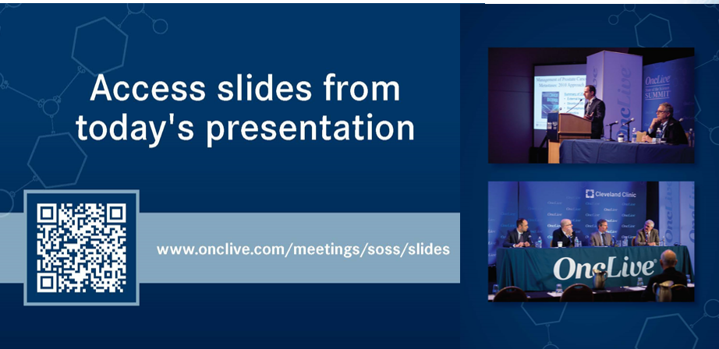

Slide 5


Slide 6
2023 Events
Precision Medicine: November 16,
Washington, DC
Breast: December 4, San Antonio, TX
2024 Events
Genitourinary: January 24, San Francisco, CA
Lung: March, Atlanta, GA
Gyn-Onc: May, Austin, TX
Lung: June, Chicago, IL
Gastrointestinal: November, Washington, DC
Breast: December, San Antonio, TX

Slide 7


Slide 8
Program Chair
Mikkael Sekeres, MD
Professor of Medicine,
Chief, Division of Hematology
Sylvester Comprehensive Cancer Center, part of UHealth–University of Miami Health System
Miami, FL

Slide 9
HEMATOLOGIC MALIGNANCIES
January 11th, 2024

Slide 10
The Role of JAK Inhibitors in Myelofibrosis
Terrence Bradley, MD
Assistant Professor of Medicine
SCCC, University of Miami MSOM
Miami, Florida

Slide 11
Disclosures
Advisory: Gilead, Novartis, Sobi, MorphoSys, Servier
Consulting: Novartis, MorphoSys

Slide 12
Myleofibrosis: Background
MF is an MPN characterized by marrow failure, splenomegaly, and significant constitutional symptoms
Can be both a primary process and secondary process (post-PV and post-ET)
Characterized by dysregulated JAK-mediated signaling, leading to clonal proliferation and abnormal inflammatory cytokine production
Impacts nearly 25,000 patients annually in the US

Slide 13
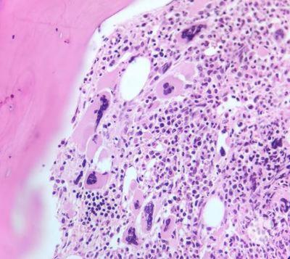
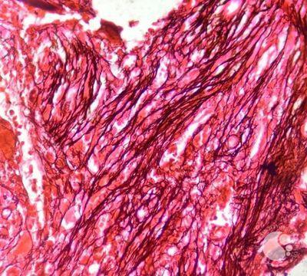
Myleofibrosis: Background
ASH Image Bank
Notes:
Paratrabecular megakaryocyte clustering
G3 reticulin fibrosis

Slide 14
JAKi Approval Timeline
2011
Ruxolitinib
(JAK1&JAK2)
2019
Fedratinib
(JAK1, JAK2, FLT3, BRD4)
2022
Pacritinib
(JAK1, JAK2, IRAK4, ACVR1)
2023
Momelotnib
(JAK1, JAK2, ACVR1)
Notes:
Ruxolitinib: Int/High Risk MF
Fedratinib: Int/High Risk MF
Pacritinib: Int/High Risk MF with thrombocytopenia (<50k) – TN or prior JAKi
Momelotinib: Int/High Risk MF with anemia - TN or prior JAKi

Slide 15
NCCN
NCCN v1.2024
Notes:
Key points on this slide – if thrombocytopenia – pacritinib or MOM

Slide 16
NCCN
NCCN v1.2024
Notes:
Momelotinib application is broad – treatment naïve in anemia or anemia which develops on prior JAKi

Slide 17
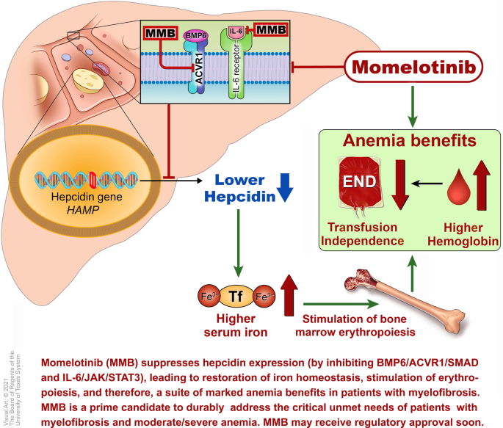
Momelotinib
First-in-class inhibitor of JAK1, JAK2, ACVR1 (activin A receptor type 1)
Approved 9/2023
Notes:
Inhibition of ACVR1 – decreases hepcidin – more iron available for erythropoiesis – improvement in anemia

Slide 18
SIMPLIFY-2
P3 randomized, open-label, multicenter study of patients with MF previously treated with JAK inhibitor therapy
Included patients with suboptimal response or toxicity to ruxolitinib
Patients had to have palpable splenomegaly, with transfusion dependence (pRBC) on rux, or required rux dose reduction for cytopenias
DIPSS Int-1, Int-2, or High
2:1 randomization to momelotinib 200mg qD plus placebo vs BAT (~90% receiving ruxolitinib)
After 24 weeks, crossover permitted from BAT
Primary endpoint: TSS50 at 24 weeks
Harrison et al, Lancet 2018
Notes:
BACKGROUND – SIMPLIFY1 came first – non-inferiority RUX vs MOM in TN MF – met non-inferiority on SVR but not on TSS50
Thus SIMPLIFY2 – MOM vs BAT in previously treated patients

Slide 19
SIMPLIFY-2
156 patients enrolled on study
  MOM: 104 patients, BAT: 52 patients
BAT was ruxolitinib in ~90% of patients
More patients randomized to MOM had Hgb<8g/dL (26% v 12%)
Harrison et al, Lancet 2018

Slide 20
SIMPLIFY-2: SVR
SVR by MRI/CT:
- 7% with MOM
- 6% with BAT
Not statistically significant (p=0.9)
TSS50 26% MOM v 6% BAT
Transfusion Independence at W24: 43% MOM vs 21% BAT
24-week spleen response in individual patients
120 No ruxolitinib (n=4)
100
Momelotinib group (n=70)
80
60
BAT group (n=39)
40
20
0
–20
35% decrease
–40
–60
Proportion difference of 0·01 (95% Cl –0·09 to 0·10), p=0·90
(7/104) 7%
(3/52) 6%
Number meeting at least 35% reduction in spleen volume
Harrison et al, Lancet 2018
Notes:
KEY – secondary endpoints of TSS and RBC TI were contingent on type 1 error control on primary endpoint – as it was not statistically significant in non-inferiority, secondary endpoints were reported on superiority

Slide 21
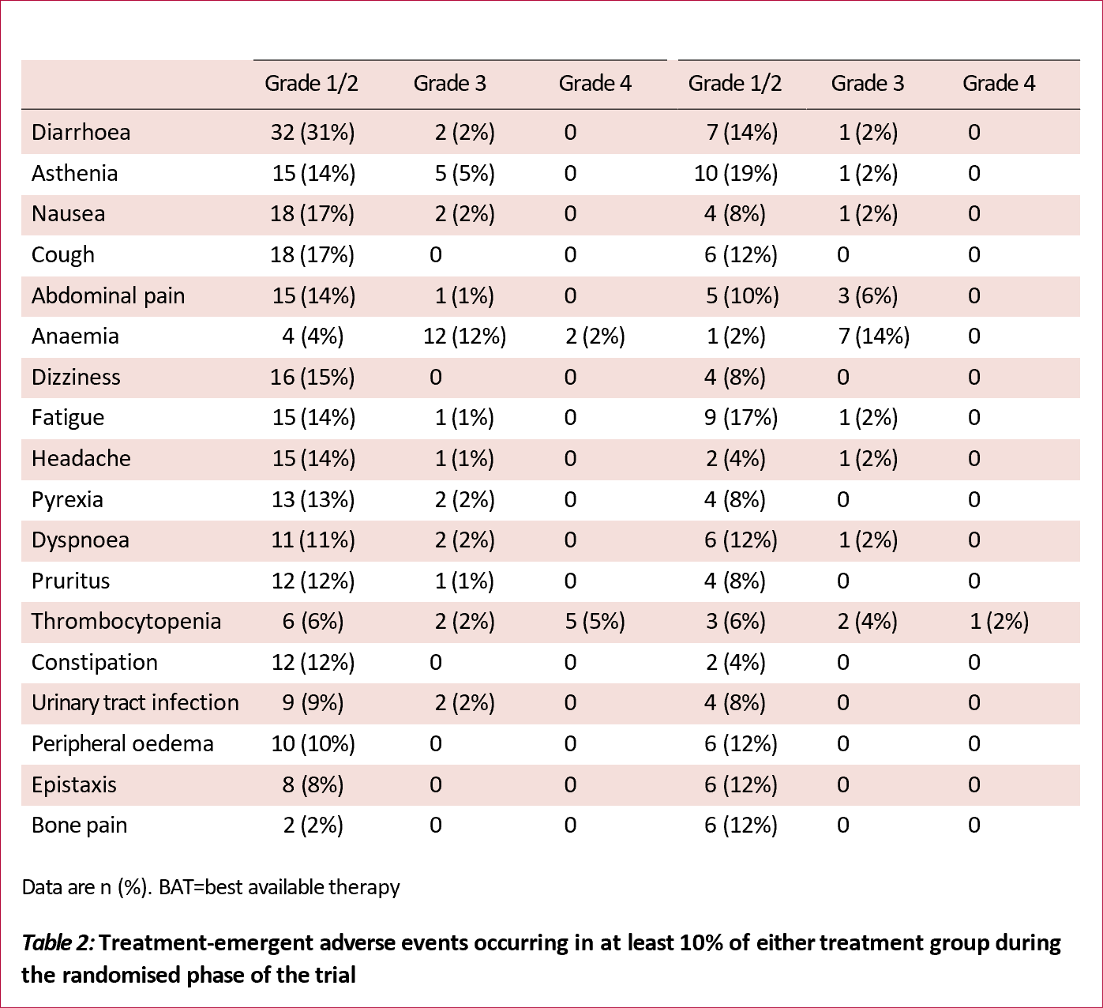
SIMPLIFY-2: AEs
Momelotinib
Ruxolitinib
Harrison et al, Lancet 2018
Notes:
However, superiority of momelotinib in providing additional spleen volume reductions of at least 35% immediately following ruxolitinib treatment without washout was not achieved in SIMPLIFY-2, necessitating a third, redesigned phase 3 study to fully understand the clinical profile of momelotinib in myelofibrosis.

Slide 22
MOMENTUM
P3, randomized, double-blinded, multicenter study of patients with MF and symptomatic anemia (Hgb<10g/dL)
2:1 randomization to receive momelotinib 200mg daily (+placebo) vs danazol 300mg BID (+placebo)
Patients were stratified by TSS (<22 vs ≥22), spleen size (<12cm vs ≥12cm), and blood transfusion 8 weeks prior to randomization (0 vs 1-4u vs ≥5u)
Primary endpoint: SVR35 at week 24
Secondary endpoints: TSS50 week 24, RBC transfusion, RBC transfusion independence at week 24
Vervostek et al, Lancet 2023
Notes:
Momentum: P3 study planned as SIMPLIFY 2 DID NOT meet its primary endpoint

Slide 23
MOMENTUM
195 patients were enrolled and received tx
- MOM: 130 pts, Danazol: 65 pts
- 72% MOM vs 58% danazol pts completed tx period
All pts on study received prior rux; mean duration of JAKi was 2.6 yrs
Vervostek et al, Lancet 2023

Slide 24
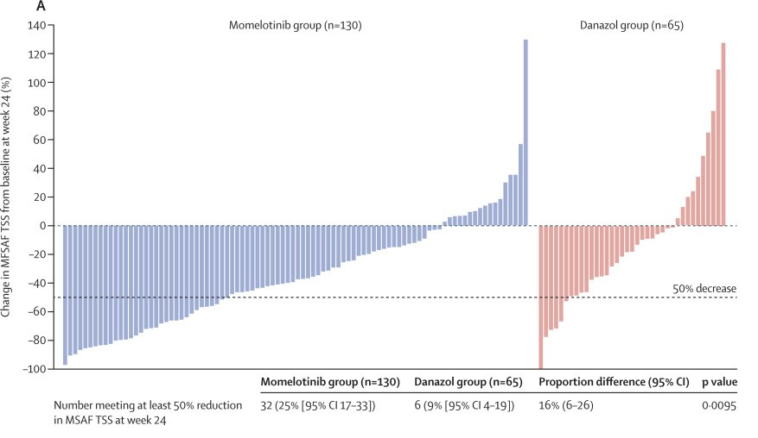
MOMENTUM: TSS50
Vervostek et al, Lancet 2023

Slide 25
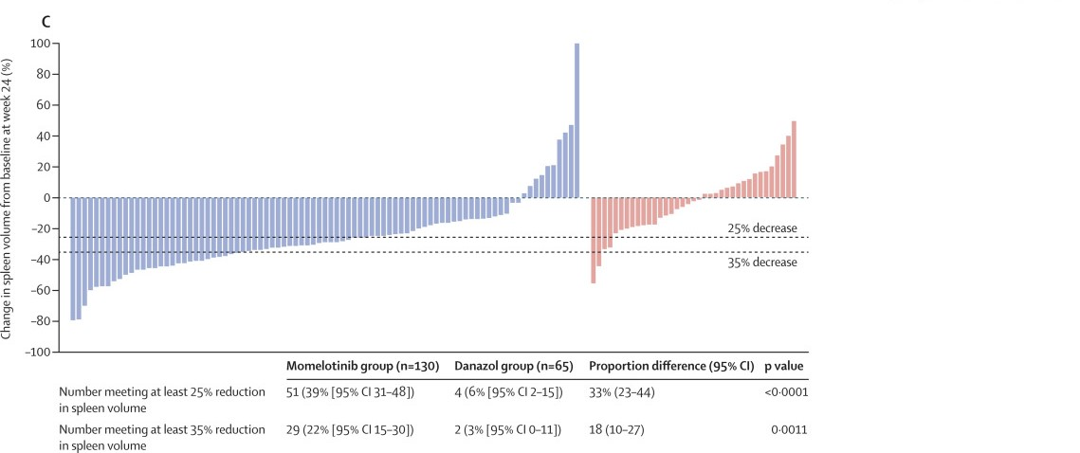
MOMENTUM: SVR
Vervostek et al, Lancet 2023

Slide 26
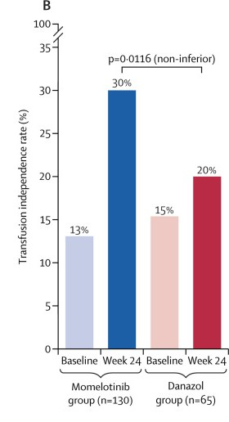
MOMENTUM: RBC TI
Vervostek et al, Lancet 2023
TI at week 24 was achieved by 30% on momelotinib vs 20% on danazol (p=0.12)
For pts with baseline Hgb≥8: TI 39% vs 19%
For pts with baseline Hgb<8: TI 27% vs 13%
For those not achieving TI at week 24, pts receiving MOM required less pRBC transfusions during treatment
Notes:
Rate defined by not requiring transfusion in 12 weeks

Slide 27
Momelotinib
In September 2023, the FDA approved momelotinib for the treatment of intermediate- or high-risk MF, including primary or secondary MF, in adults with anemia.
Broad approval – can consider in treatment-naïve or refractory/intolerant populations

Slide 28
Myelofibrosis: The Future?
CONSTELLATION: P3, randomized study of pelabresib+rux vs placebo+rux in treatment naïve
- DIPPS Int1 or higher; splenomegaly, TSS>10
- Primary: SVR35 w24 66% vs 35% (p=<0.0001)
- Secondary: Absolute TSS change from baseline w24 -15.99 vs - 14.01(p=0.0524)
- Presented at ASH 2023 (Rampal et al.)
TRANSORM-1: P3, randomized study of navitoclax+rux vs placebo+rux in treatment-naiive
- DIPSS Int2 or higher; splenomegaly; MF-related sx
- Primary: SVR35 w24 79% vs 40% (p<0.0001)
- Secondary: Absolute TSS change from baseline w 24 -9.7 vs -11.1 (p=0.2852)
- Presented at ASH 2023 (Pemmaraju et al.)
Notes:
BOTH have superior SVR
Navitoclax included higher risk by DIPSS
Palebresib may make absolute change in TSS with longer follow up

Slide 29
Thank You!
tbradley@Miami.edu

Slide 30



MDS | Patient
79 yo woman with worsening fatigue:
“Feels like my legs are encased in cement.”
Now uses a to park close to the casino entrance.
PMH: HTN, CAD, smoking
@MikkaelSekeres

Slide 31
MDS | Patient
Laboratory Results:
WBC 4500/uL with ANC 1600, no blasts
Hgb 7.8 g/dL with MCV of 102
Platelet count 174,000/uL
Reticulocyte ct 0.4%
Epo level is 80 mIU/ml
A bone marrow biopsy shows hypercellularity (70%), dyserythropoiesis and 25% ring sideroblasts, and she is diagnosed with MDS-LB-SF3B1 (2% blasts).
Cytogenetics: normal; NGS with SF3B1 (VAF 26%)
@MikkaelSekeres

Slide 32
MDS | Patient
Laboratory Results:
WBC 4500/uL with ANC 1600, no blasts
Hgb 7.8 g/dL with MCV of 102
Platelet count 174,000/uL
Reticulocyte ct 0.4%
Epo level is 80 mIU/ml
A bone marrow biopsy shows hypercellularity (70%), dyserythropoiesis and 25% ring sideroblasts, and she is diagnosed with MDS-LB-SF3B1 (2% blasts).
Cytogenetics: normal; NGS with SF3B1 (VAF 26%)
1.5
0
1
Total IPSS-R Score = 2.5 (Low)
@MikkaelSekeres

Slide 33
MDS | Patient
Laboratory Results:
WBC 4500/uL with ANC 1600, no blasts
Hgb 7.8 g/dL with MCV of 102
Platelet count 174,000/uL
Reticulocyte ct 0.4%
Epo level is 80 mIU/ml
A bone marrow biopsy shows hypercellularity (70%), dyserythropoiesis and 25% ring sideroblasts, and she is diagnosed with MDS-LB-SF3B1 (2% blasts).
Cytogenetics: normal; NGS with SF3B1 (VAF 26%)
Total IPSS-M Score = -0.82 (Low)
@MikkaelSekeres

Slide 34
MDS | Patient
How would you treat her?
Watchful waiting
ESA (epo, darbe)
Luspatercept
Lenalidomide
Azacitidine
Decitabine (or oral DEC/Ced)
BMT
@MikkaelSekeres

Slide 35
MDS | Patient
Treated with darbepoietin 500mcg q3w x 10 months with increase in hgb from 7.8 g/dl to 9.4 g/dl.
Hgb then slips to 7.6 g/dl.
Repeat bone marrow essentially unchanged, but cytogenetics (previously Nl) show Del (5q).
@MikkaelSekeres

Slide 36
MDS | Patient
How would you treat her?
Watchful waiting
ESA (epo, darbe)
Luspatercept
Lenalidomide
Azacitidine
Decitabine (or oral DEC/Ced)
BMT
@MikkaelSekeres

Slide 37
MDS | Patient
On LEN, Hgb improves to 11.7 g/dl x 22 months. Then, over the next few months changes in Laboratory Results:
WBC 1800/uL with ANC 950, no blasts
Hgb 7.8 g/dL with MCV of 106
Platelet count 24,000/uL
A bone marrow biopsy shows hypercellularity (80%), trilineage dyspoiesis, and she is diagnosed with MDS-MLD-RS (2% blasts).
Cytogenetics: Del (5q); NGS with SF3B1, ASXL1
@MikkaelSekeres

Slide 38
MDS | Patient
How would you treat her?
Watchful waiting
ESA (epo, darbe)
Luspatercept
Lenalidomide
Azacitidine
Decitabine (or oral DEC/Ced)
BMT
@MikkaelSekeres

Slide 39
MDS | Patient
Treated with 3-day AZA, has improvement in Plts to 147k and Hgb to 10.4 g/dL, lasting 15 months. But then has these Laboratory Results:
WBC 2100/uL with ANC 450, no blasts
Hgb 7.9 g/dL with MCV of 106
Platelet count 21,000/uL
A bone marrow biopsy shows hypercellularity (80%), trilineage dyspoiesis, but now with MDS-EB2 (12% blasts). Cytogenetics: Del (5q); NGS with SF3B1, ASXL1, TP53
@MikkaelSekeres

Slide 40
MDS | Patient
How would you treat her?
Watchful waiting
ESA (epo, darbe)
Luspatercept
Lenalidomide
Azacitidine
Decitabine (or oral DEC/Ced)
BMT
@MikkaelSekeres

Slide 41
HEMATOLOGIC MALIGNANCIES
January 11th, 2024

Slide 42
How do you manage patients with myelodysplastic syndromes (MDS)?
Namrata S. Chandhok, M.D.
Assistant Professor of Clinical Medicine
University of Miami/ Sylvester Comprehensive Cancer Center
Miami, Florida

Slide 43
Roadmap
MDS Classification → Prognostic Scoring → Treatment
- Recent Updates
WHO v. ICC
IPSS-R v. IPSS-M
Lower Risk MDS
Higher Risk MDS

Slide 44
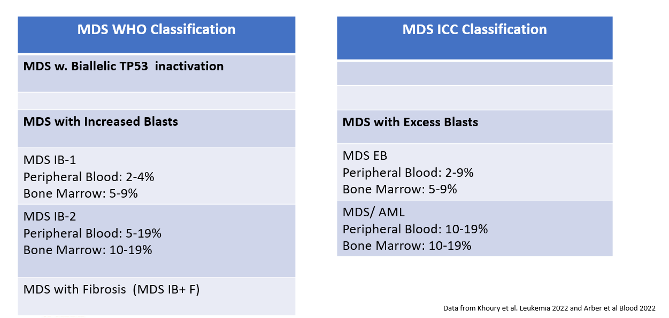
MDS Classification Systems

Slide 45
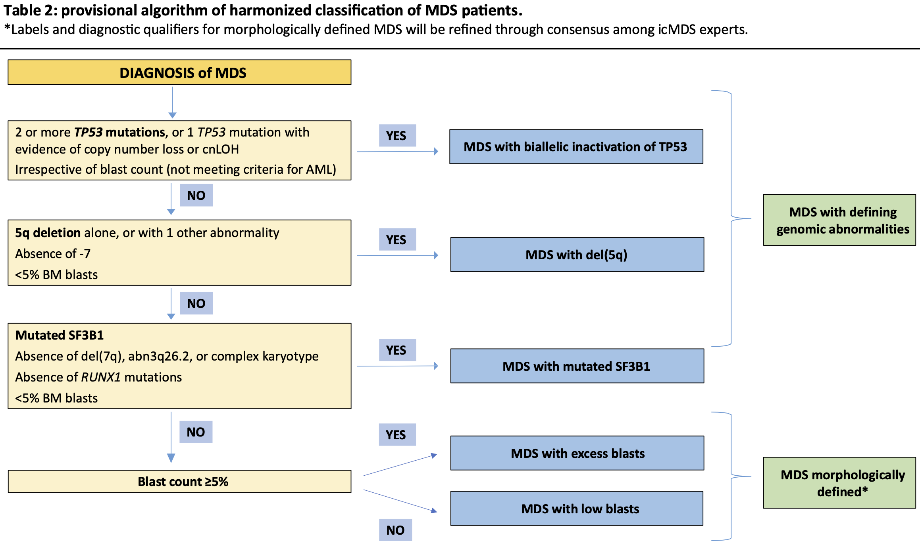
ASH 2023: Data-Driven Harmonization of 2022 Who and ICC Classifications of Myelodysplastic Syndromes/
Neoplasms (MDS): A Study By the International Consortium for MDS (icMDS)
Lanino et al. ASH 2023 Poster 998
Notes:
https://ash.confex.com/ash/2023/webprogram/Paper186580.html
Retrospective international cohorts of patients with a diagnosis of MDS (n=7017) and AML (n=1002) according to WHO 2016 criteria. A modified Delphi Process consensus approach is currently ongoing among icMDS experts to finalize a harmonized MDS classification scheme
inclusion of gene mutations and chromosomal abnormalities in the 2022 WHO and ICC Classifications of MDS has enhanced diagnostic precision and is expected to improve clinical decision-making process. Although these two systems share similarities, clinically relevant discrepancies still exist and potentially cause inconsistency in their adoption in a clinical setting.

Slide 46
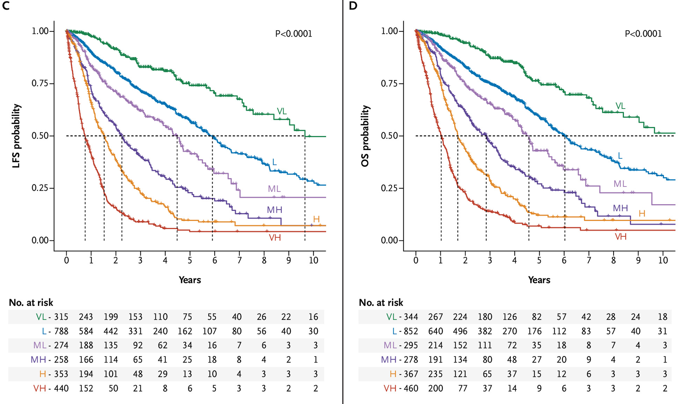
Prognostic Scoring: Use of IPSS-M
Notes:
RESULTS
6 categories – VL with excellent OS. 31 genes included.
Multivariable analysis identified TP53 multihit, FLT3 mutations, and MLLPTD as top genetic predictors of adverse outcomes.
Conversely, SF3B1 mutations were associated with favorable outcomes, but this was modulated by patterns of comutation.
Using hematologic parameters, cytogenetic abnormalities, and somatic mutations of 31 genes, the IPSS-M resulted in a unique risk score for individual patients.
We further derived six IPSS-M risk categories with prognostic differences. Compared with the IPSS-R, the IPSS-M improved prognostic discrimination across all clinical end points and restratified 46% of patients. The IPSS-M was applicable in primary and secondary/therapy-related MDS.

Slide 47
IPSS-R v. IPSS-M
Many presentations over the past 2-3 years!
Reclassification/ reorganization of trial data
Ex: ASCERTAIN Trial (ASTX 727-02)→ Discussed in Treatment, Presentation 4619
Ex: Imerge Trial → Discussed in treatment, Presentation 194
Notes:
ASCERTAIN- Reclassification from IPSS to IPSS-R or IPSS-M upgraded multiple subjects from a LR to a HR category, describing the ASCERTAIN patient population as a majority higher risk population with worse prognosis than previously assumed based on the IPSS. The efficacy as measured by the CR rates did not change when the LR and HR categories were defined by the different risk stratification systems. In contrast, the c-index improves with migration from IPSS to IPSS-R to IPSS-M, indicating an increased discriminatory ability of IPSS-M score in comparison to IPSS and IPSS-R, to predict patient outcomes.

Slide 48
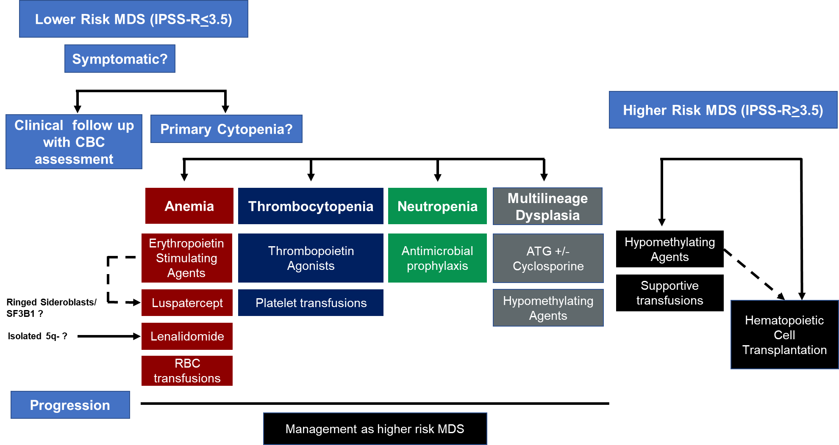
Current Treatment Algorithm
Chandhok and Sekeres, Wintrobes Hematology, 15th Edition

Slide 49
Lower Risk MDS

Slide 50
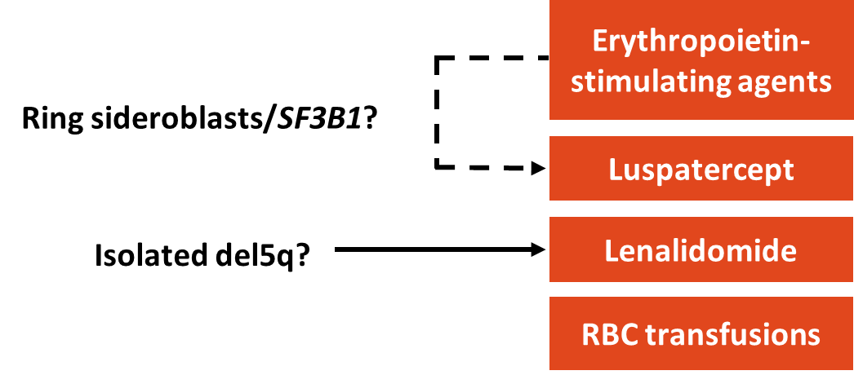
Label Expansion in the FDA Label in 2023
Imetelstat ?

Slide 51
Luspatercept
FDA Approval in 2023: “Treatment of anemia without prior erythropoiesis stimulating agent (ESA) use in adult patients with very low– to intermediate-risk myelodysplastic syndrome (MDS) who may require regular red blood cell (RBC) transfusions.”
ASH 2023 (Oral) : Efficacy and safety of luspatercept versus epoetin alfa
in erythropoiesis-stimulating agent-naive patients with transfusion-dependent lower-risk myelodysplastic syndromes: full analysis of the COMMANDS trial (Garcia-Manero et al. ASH 2023)
Notes:
Luspatercept an erythrocyte maturation agent that improves anemia by affecting late-stage erythropoiesis and is most effective in in adult patients with LR-MDS with ring sideroblasts (MDS-RS) or with myelodysplastic/myeloproliferative neoplasm with ring sideroblasts and thrombocytosis (MDS/MPN-RS-T) ¹⁷.
Recombinant fusion protein→ Binds TGF beta→ reduce SMAD2/3 signaling→ pathway regulates cellular growth. Initial approval in 2020 with a label expansion in 2023

Slide 52
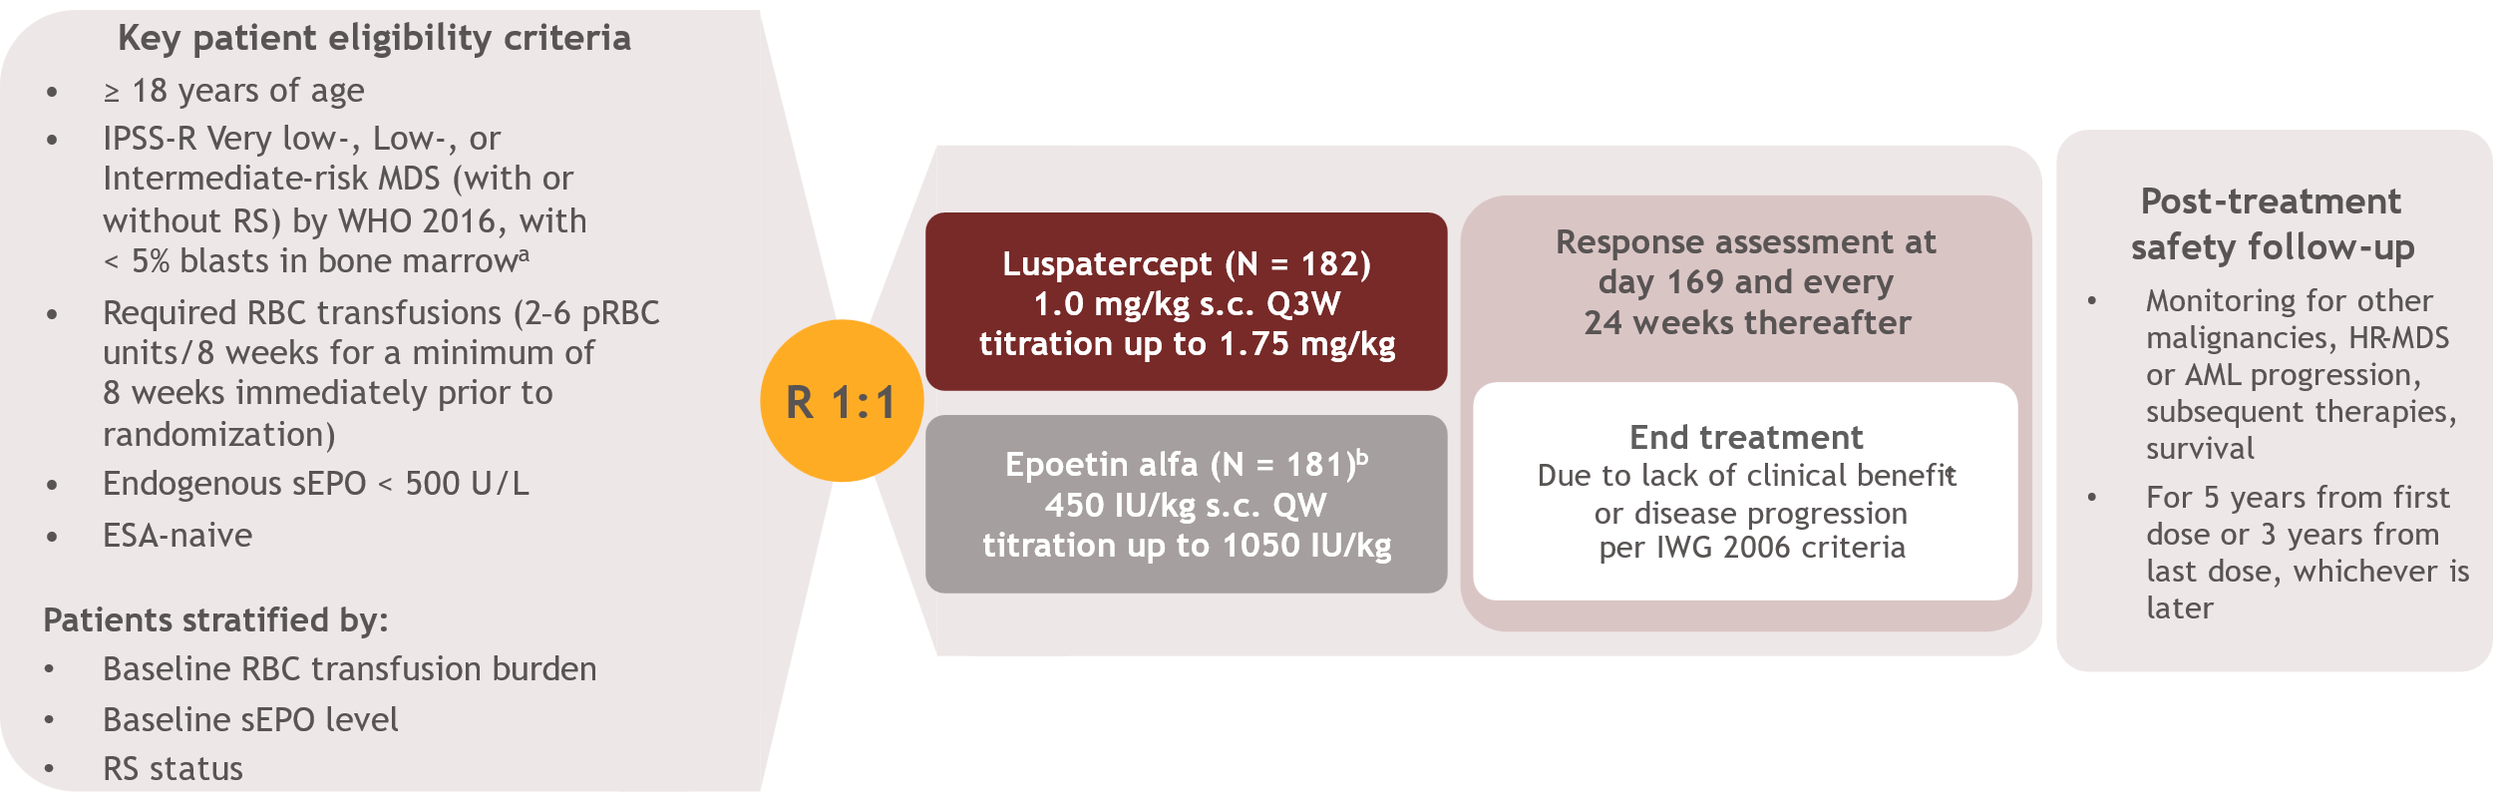
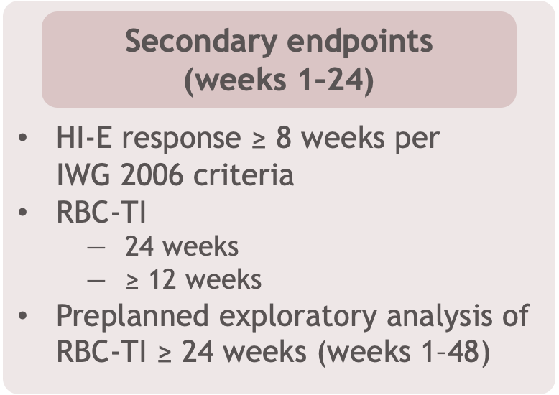

Garcia Manero, ASH 2023, Abstract 193

Slide 53
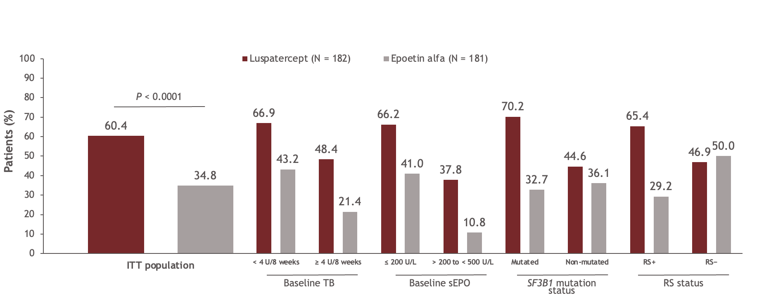
Luspatercept:
COMMANDS: Primary Endpoint (RBC-TI >12w +Hb increase 1.5g/dL)
Garcia Manero, ASH 2023, Abstract 193
Notes:
The primary endpoint was achieved by 110 (60.4%) patients in the luspatercept arm versus 63 (34.8%) patients in the epoetin alfa arm (P < 0.0001)
Subgroup analysis of the primary endpoint showed greater response rates with luspatercept regardless of baseline TB, sEPO category, or SF3B1 mutation status
The response rates for the primary endpoint in this full analysis are similar to those reported for the interim analysis
In the preplanned interim analysis, 86/147 (58.5%) of patients treated with luspatercept and 48/154 (31.2%) of patients treated with epoetin alfa achieved the primary endpoint

Slide 54
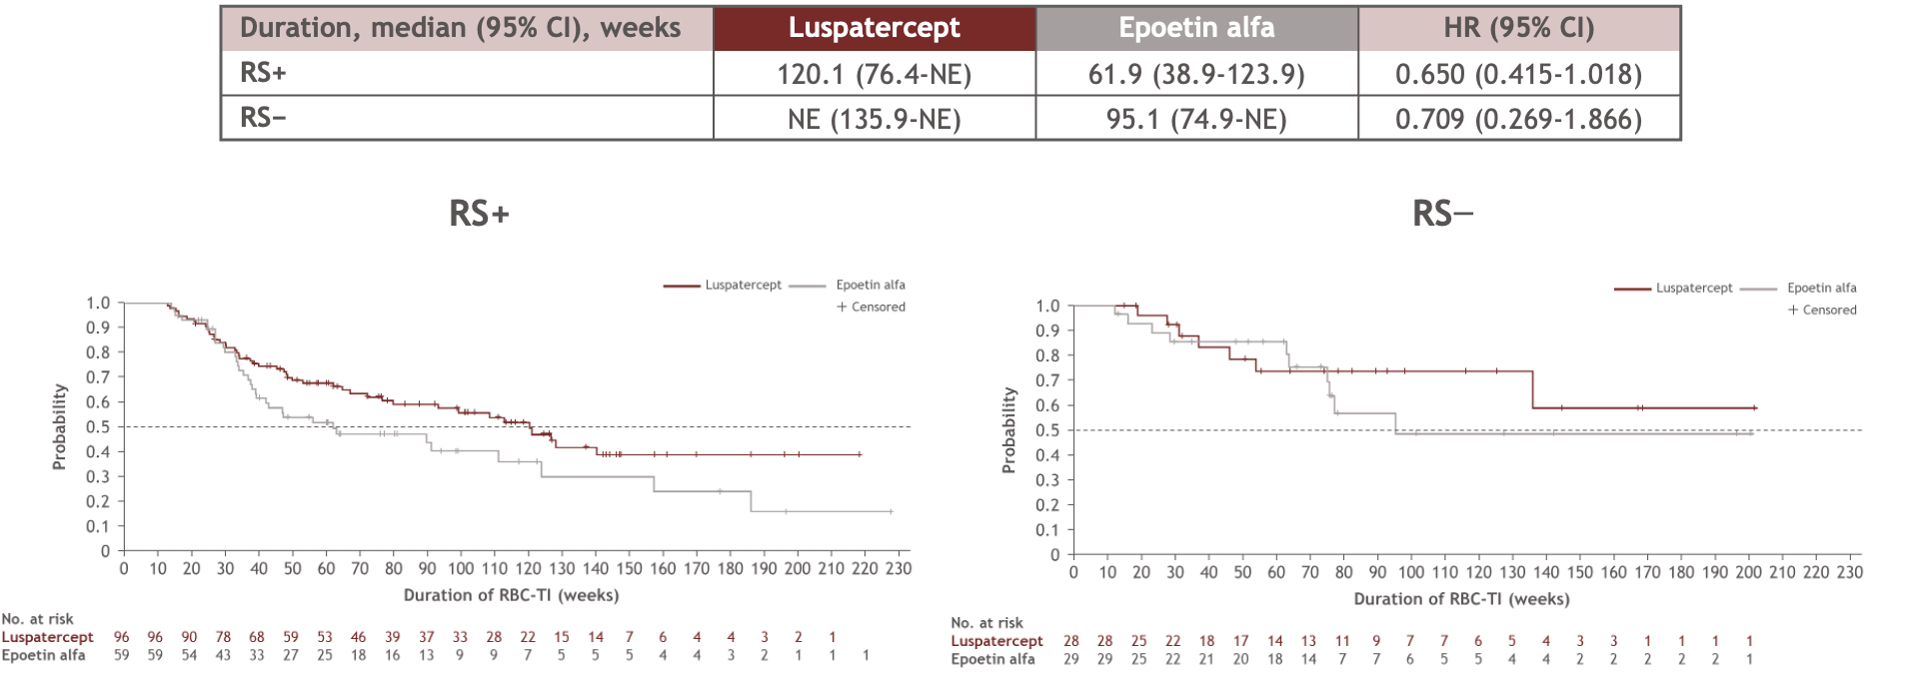
COMMANDS: Duration of RBC-TI ≥ 12 weeks by RS subgroups
(week 1–EOT)
Garcia Manero, ASH 2023, Abstract 193
Notes:
NOT SHOWN
As of September 28, 2023, the duration of RBC-TI for ≥ 12 weeks (from week 1 until EOT) was longer with luspatercept (126.6 weeks) than with epoetin alfa (89.7 weeks), similar to the preplanned interim analysis
In the preplanned interim analysis, the duration of RBC-TI for ≥ 12 weeks (from week 1 until EOT) was 126.6 weeks with luspatercept and 77.0 weeks with epoetin alfa
The median duration of RBC-TI ≥ 12 weeks in RS+ and RS− patients was longer in the luspatercept arm than in the epoetin alfa arm, similar to the preplanned interim analysis
Analysis of erythroid precursors in the bone marrow has shown that they continue to increase beyond 24 weeks of treatment with luspatercept (compared with baseline)
There is a gradual and sustained increase of both reticulocytes and Hb from baseline to week 24 and week 48

Slide 55
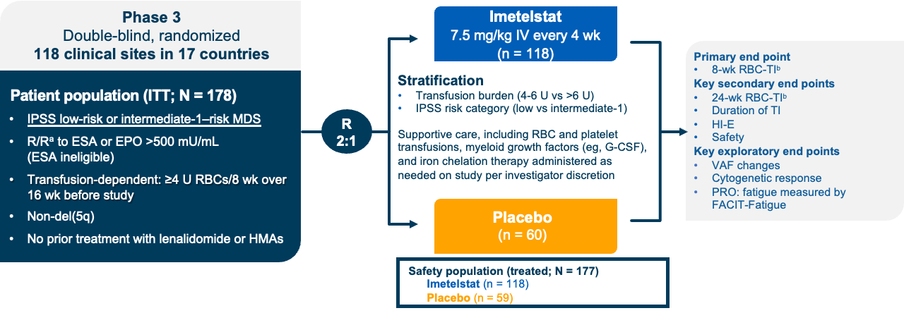
Imtelstat: IMerge Phase III Trial
Komrokji, ASH 2023, Abstract 194
Notes:
Imetelstat is a first-in-class telomerase inhibitor. Possible MOA→ could have selective pressure on the clonal cells within patients with MDS, leading to the killing of the MDS clone and the recovery of the count in those patients

Slide 56
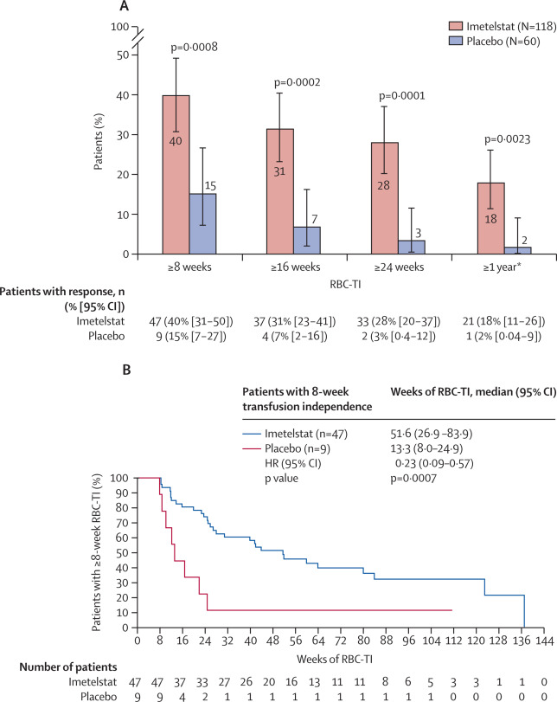
Platzbecker et al. Lancet December 2023
Komrokji, ASH 2023, Abstract 194
Notes:
https://www.thelancet.com/journals/lancet/article/PIIS0140-6736(23)01724-5/fulltext
178 patients enrolled and randomly assigned
The primary endpoint of RBC-TI for at least 8 weeks → 40% v. 15% in the placebo group
RBC-TI was sustained
45% (v. 19%) with RBC-TI in RS+
32% (v. 9%) in RS-
without ring sideroblasts in the imetelstat group versus seven (19%) of 37 patients with ring sideroblasts (rate difference 26%, 5·9 to 42·2) and two (9%) of 23 patients without ring sideroblasts (rate difference 23%, –1·3 to 40·6) in the placebo group (appendix p 15). When evaluated on the basis of previous RBC transfusion burden, RBC-TI for at least 8 weeks occurred more frequently in the imetelstat group: 28 (45%) of 62 patients with 4–6 units over 8 weeks and 19 (34%) of 56 patients with more than 6 units over 8 weeks had RBC-TI for at least 8 weeks, compared with seven (21%) of 33 patients with 4–6 units over 8 weeks (rate difference 24%, 1·9 to 41·4) and two (7%) of 27 patients with more than 6 units over 8 weeks (rate difference 27%, 4·7 to 41·8) in the placebo group (appendix p 15). A greater proportion of patients with an IPSS scoring of low risk (32 [40%] of 80 in the imetelstat group vs eight [21%] of 39 in the placebo group; rate difference 19%, 95% CI −0·1 to 35·2) and intermediate-1 risk (15 [40%] of 38 vs one [5%] of 21; rate difference 35%, 8·8 to 52·4) had RBC-TI for at least 8 weeks in the imetelstat group versus the placebo group (appendix p 15).

Slide 57
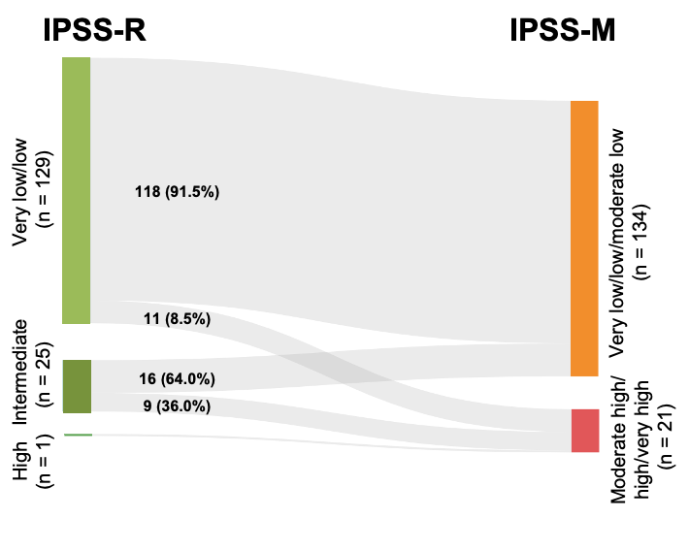
IMerge Trial: Patient Reclassification
IPSS – IPSS-R
14% 13%
Low/ Int.1 Very Low/ Low/ Intermediate
Classified to higher risk disease in IPSS-M
Komrokji, ASH 2023, Abstract 194
Notes:
They then analysed by IPSS/ IPSS-R and IPSS-M, with imtel doing better than placebo in all subgroups including those that were upstaged to higher IPSS-M

Slide 58
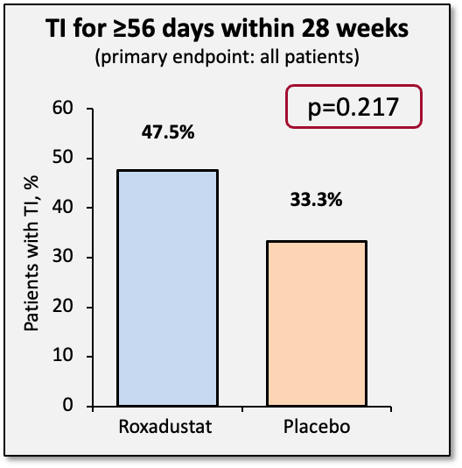
Honorable Mention: Matterhorn Trial
Final Reporting for Randomized, Placebo-controlled, Phase III Trial Enrolling Patients With LR-MDS With Low RBC Transfusion Burden
% (95% CI) | Roxadustat (n=80) | Placebo (n=57) | Roxadustat vs placebo
TI for ≥56 days within 28 weeks | 47.5% (36.2–59.0) | 33.3% (21.4–47.1) | OR: 1.582 (0.761–3.290) p=0.217
Primary endpoint outcomes did not meet statistical significance at 28 weeks
Notes:
Roxadostat: HIF prolyl-hydroxylase inhibitor that increases endogenous production of erythropoietin and stimulates production of RBC
This study was stopped early since it did not meet its endpoint, but what is interesting is that it did have efficacy in patients who has a higher transfusion dependence, suggesting that this agent could have efficacy with better patient selection/ without enrichment of those with a very low transfusion burden.

Slide 59
Higher Risk MDS

Slide 60
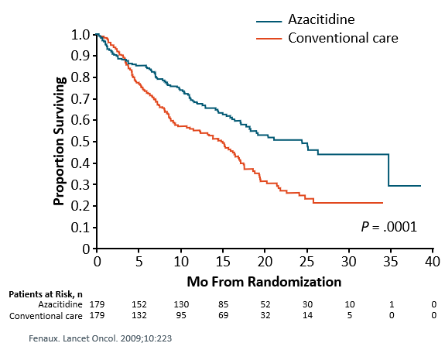
Higher Risk MDS
We are desperately waiting for new agents!
HMAs still win
Phase III AZA-001 study (N = 358)
  Subset analysis in patients >75 yr of age (n = 87; ~1/4 of randomized patients)
2-yr OS superior with azacitidine (P = .0003)
  Azacitidine: 55%
  Conventional care: 15%
No significant difference in the rate of bleeding or infections

Slide 61
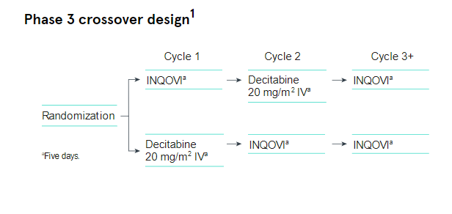
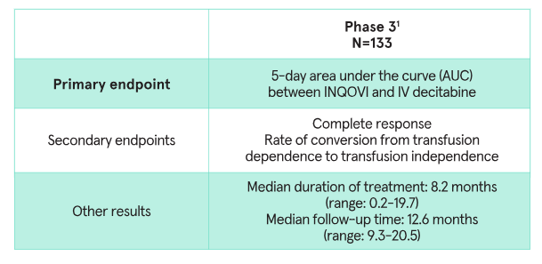
https://www.inqovi.com/hcp/inqovi-efficacy-and-safety
Notes:
2020: FDA approved an oral combination of decitabine and cedazuridine (INQOVI, Astex Pharmaceuticals, Inc.) for adult patients with myelodysplastic syndromes (MDS) including the following:
previously treated and untreated, de novo and secondary MDS with the following French-American-British subtypes (refractory anemia, refractory anemia with ringed sideroblasts, refractory anemia with excess blasts, and chronic myelomonocytic leukemia [CMML]) and
intermediate-1, intermediate-2, and high-risk International Prognostic Scoring System groups.

Slide 62
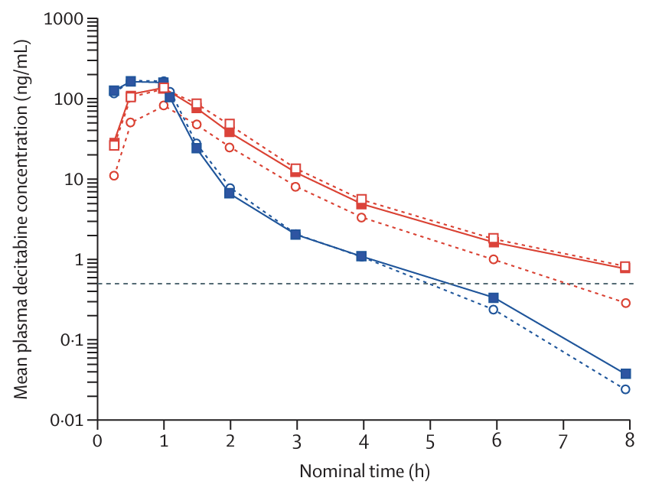
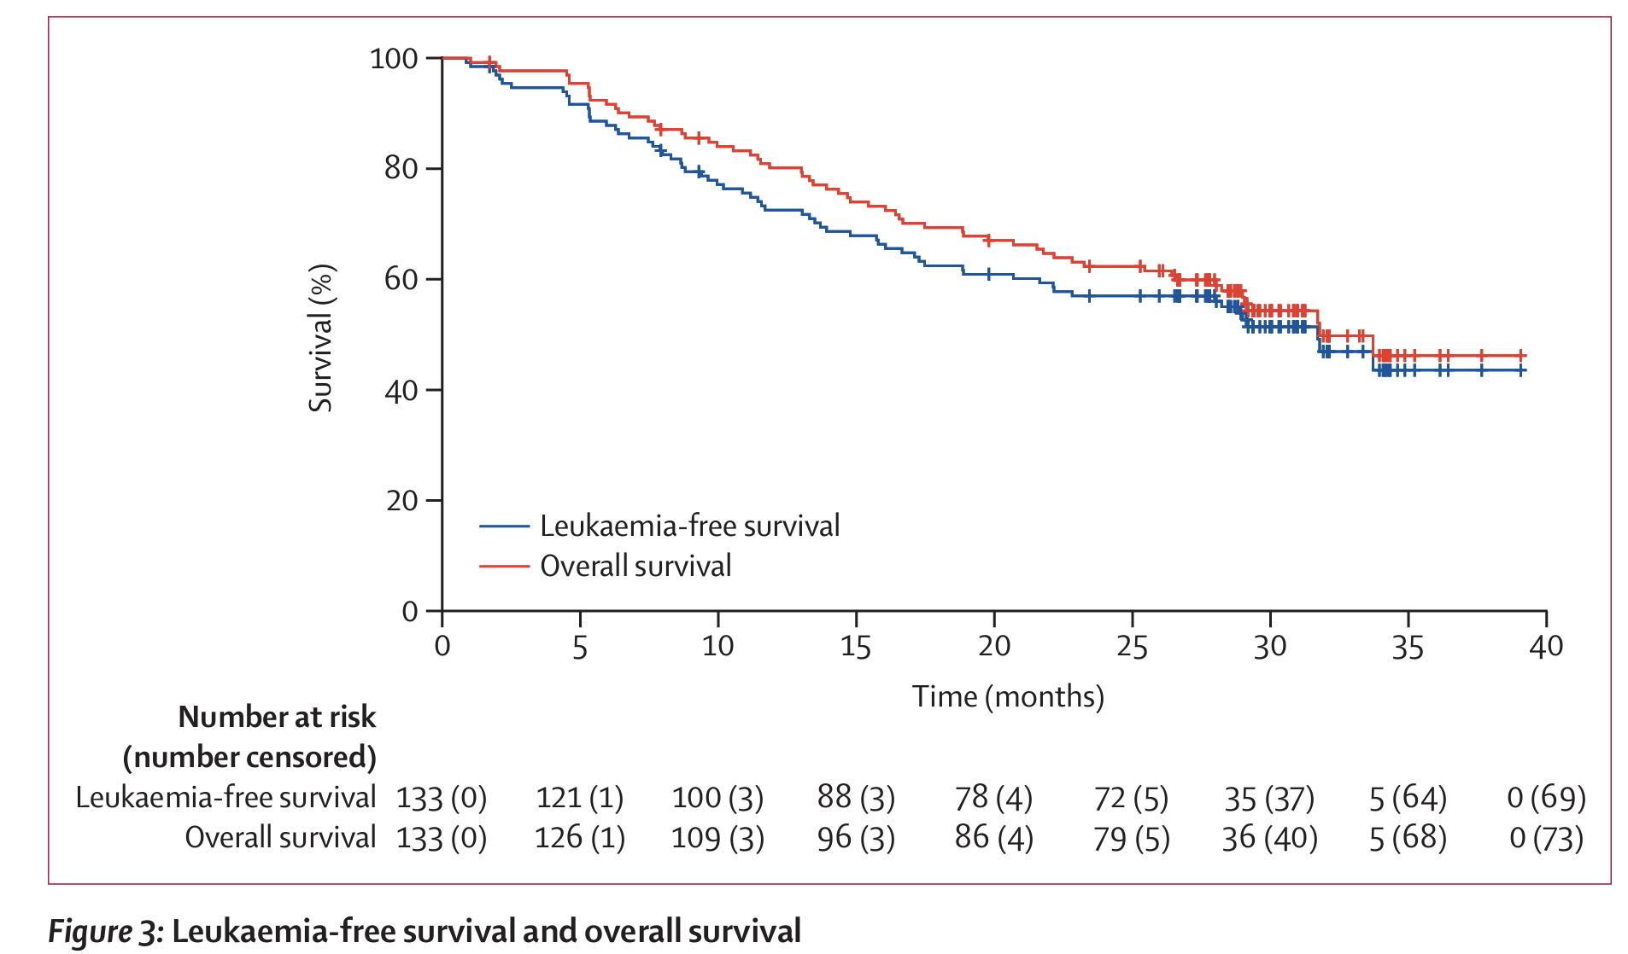
Ascertain Trial: Oral Decitabine- Cedazuridine
Garcia Manero et al. Lancet Haem. January 2024
Notes:
Oral decitabine–cedazuridine emulates the pharmacokinetics and pharmacodynamics of intravenous decitabine and appears to have similar clinical activity, potentially reducing the adverse effects of parenteral therapy (eg, effects of intravenous or subcutaneous administration, effects of intravenous devices, infection, and pain) and resource use, and eliminating some of the clinic visits needed for intravenous administration, particularly for individuals who maintain a response for more than 6 months.

Slide 63
Ongoing work and Questions
Novel Agents
Therapy sequencing? And how?
Combination studies: HMA backbone, or other?

Slide 64
Thank you for your attention!

Slide 65
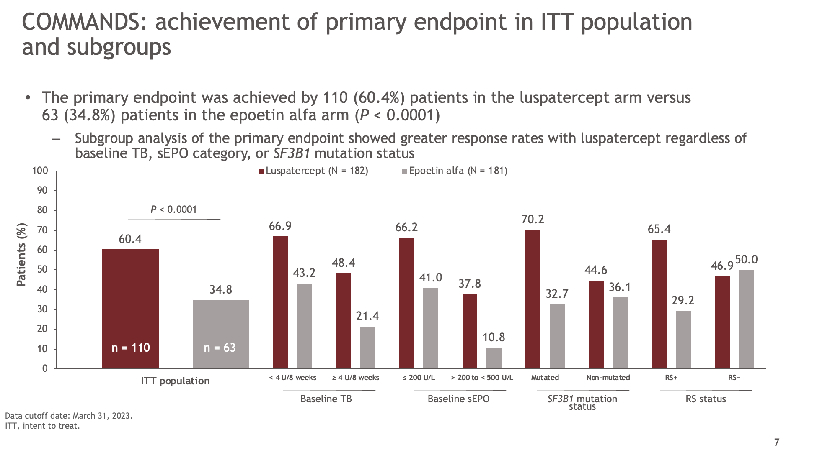
Notes:
A total of 356 patients were included in the preplanned interim analysis of the COMMANDS study, whereas the full analysis includes a total of 363 patients
The proportion of RS− patients in the full analysis did not change compared with the preplanned interim analysis
There are now 99 RS− patients included in this full analysis (97 RS− patients were included in the interim analysis)
Overall, baseline characteristics were well balanced between the 2 treatment arms, similar to the preplanned interim analysis previously presented at ASCO 2023
The response rates for the primary endpoint in this full analysis are similar to those reported for the interim analysis
In the preplanned interim analysis, 86/147 (58.5%) of patients treated with luspatercept and 48/154 (31.2%) of patients treated with epoetin alfa achieved the primary endpoint

Slide 66
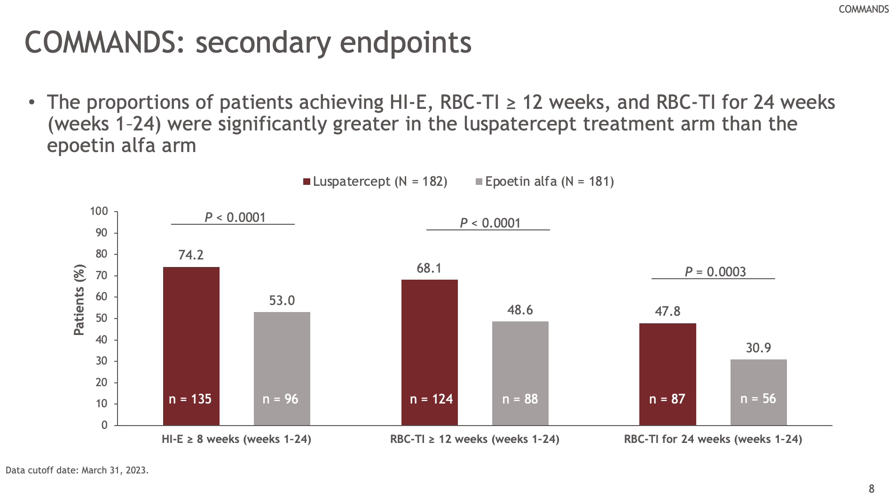
Notes:
Similar to the preplanned interim analysis, the response rates of the analyzed secondary endpoints (weeks 1–24) were significantly greater in the luspatercept arm versus the epoetin alfa arm

Slide 67
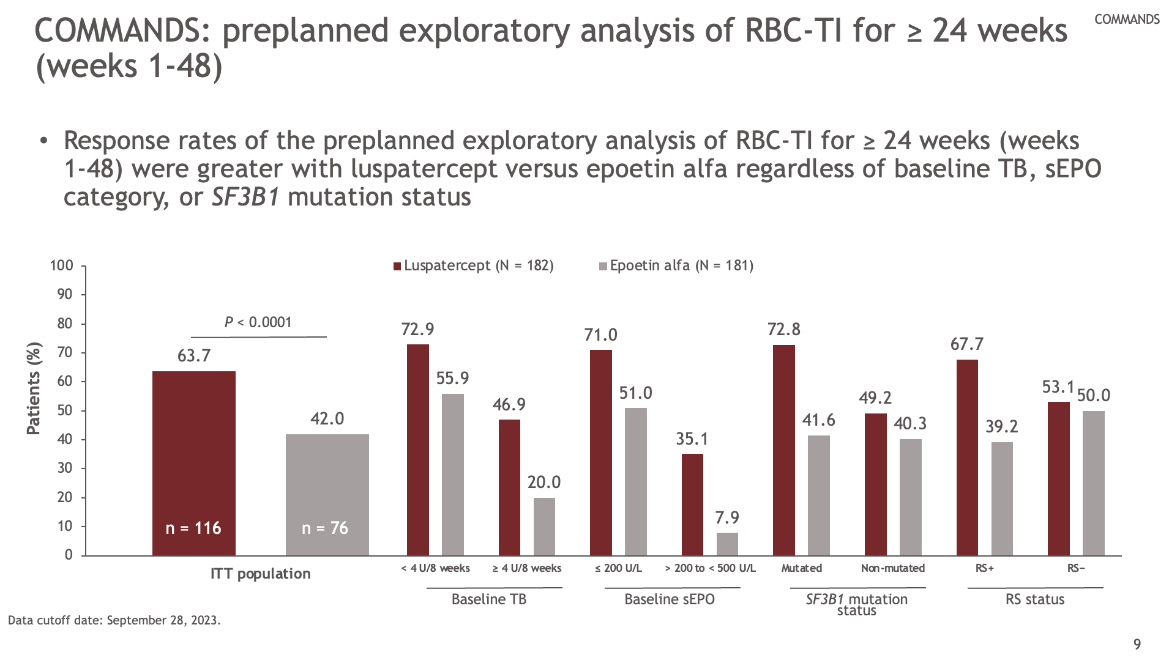
Notes:
Response rates in RS+ patients were also greater with luspatercept than with epoetin alfa (67.7% vs 39.2%) and were comparable in RS− patients (53.1% vs 50.0%)

Slide 68
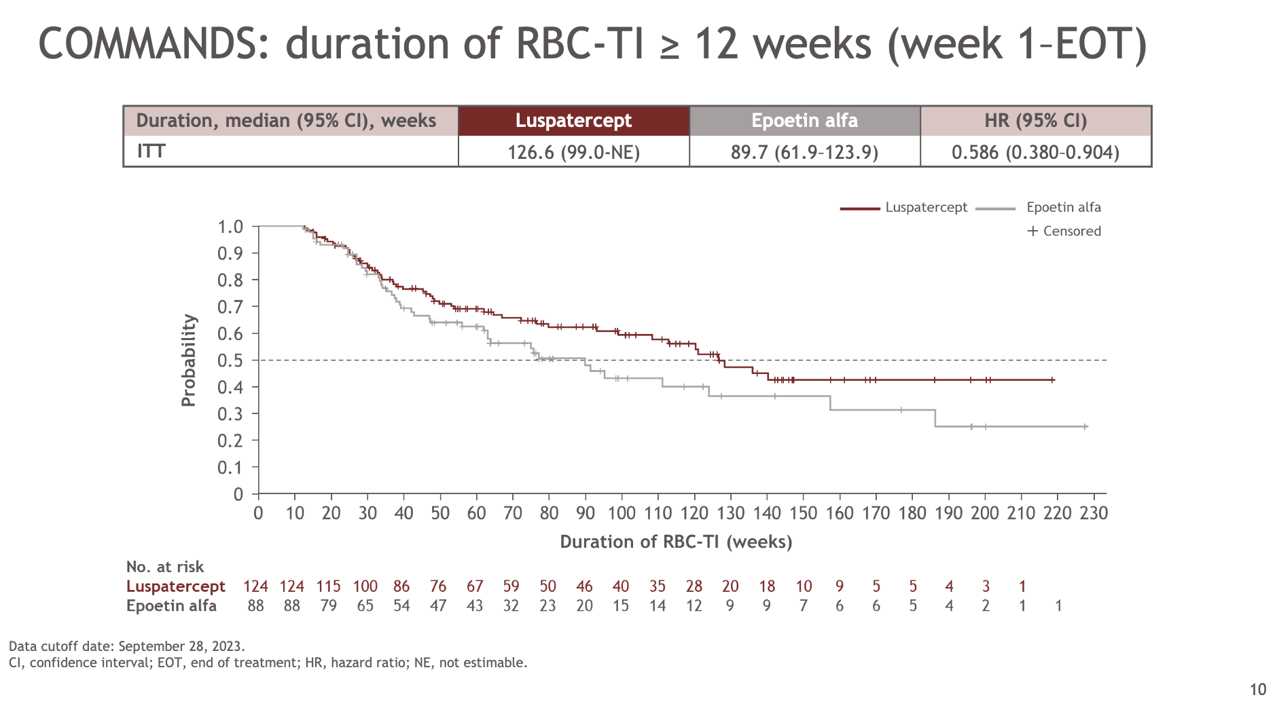
Notes:
As of September 28, 2023, the duration of RBC-TI for ≥ 12 weeks (from week 1 until EOT) was longer with luspatercept (126.6 weeks) than with epoetin alfa (89.7 weeks), similar to the preplanned interim analysis
In the preplanned interim analysis, the duration of RBC-TI for ≥ 12 weeks (from week 1 until EOT) was 126.6 weeks with luspatercept and 77.0 weeks with epoetin alfa

Slide 69
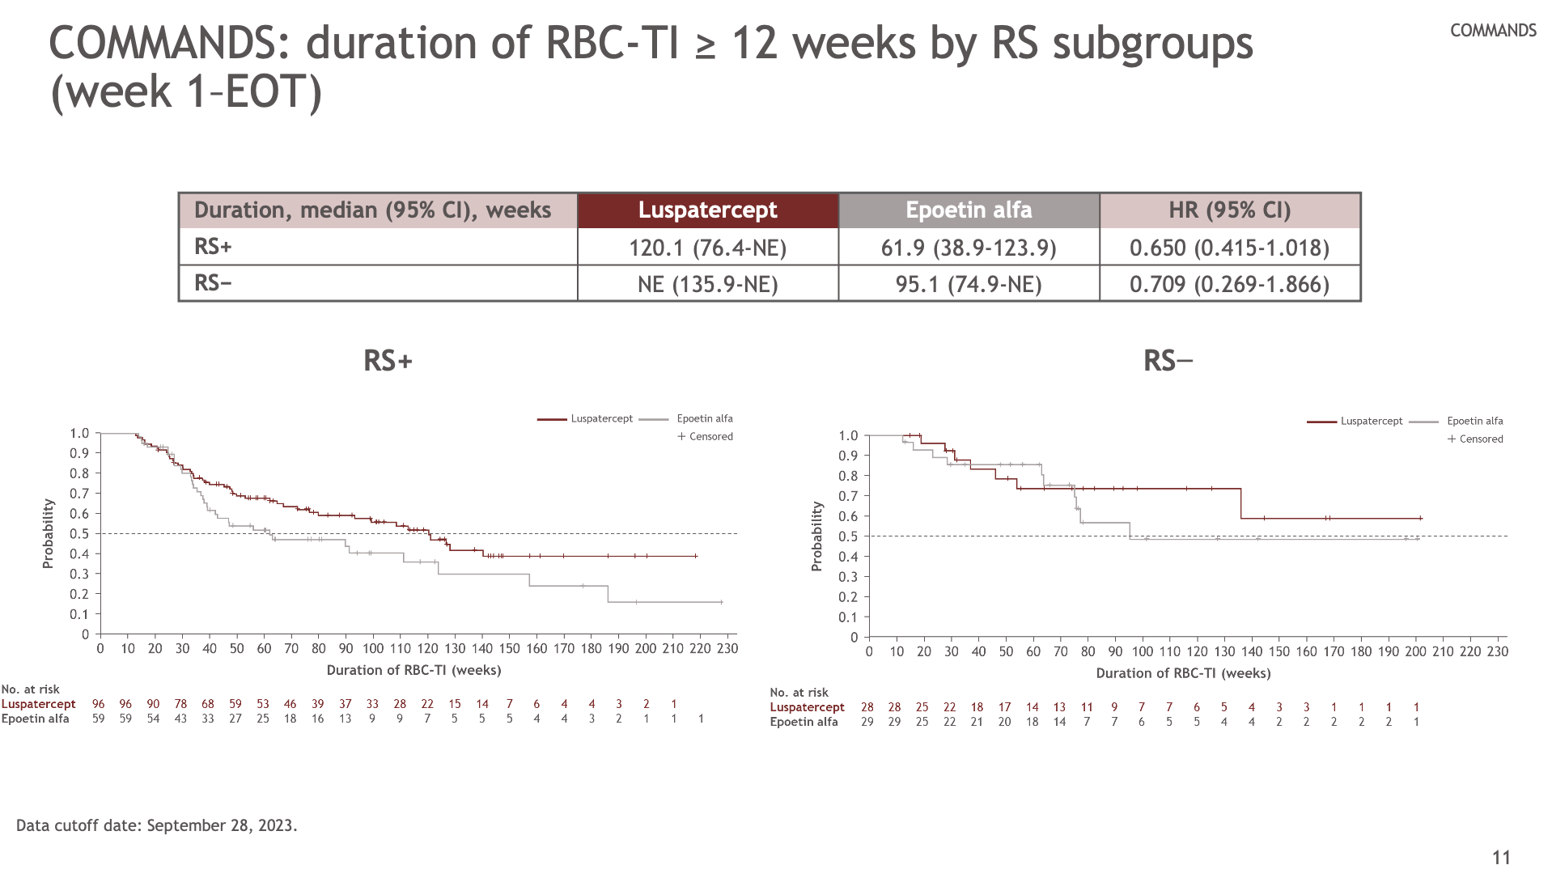
Notes:
The median duration of RBC-TI ≥ 12 weeks in RS+ and RS− patients was longer in the luspatercept arm than in the epoetin alfa arm, similar to the preplanned interim analysis
Analysis of erythroid precursors in the bone marrow has shown that they continue to increase beyond 24 weeks of treatment with luspatercept (compared with baseline)
There is a gradual and sustained increase of both reticulocytes and Hb from baseline to week 24 and week 48

Slide 70
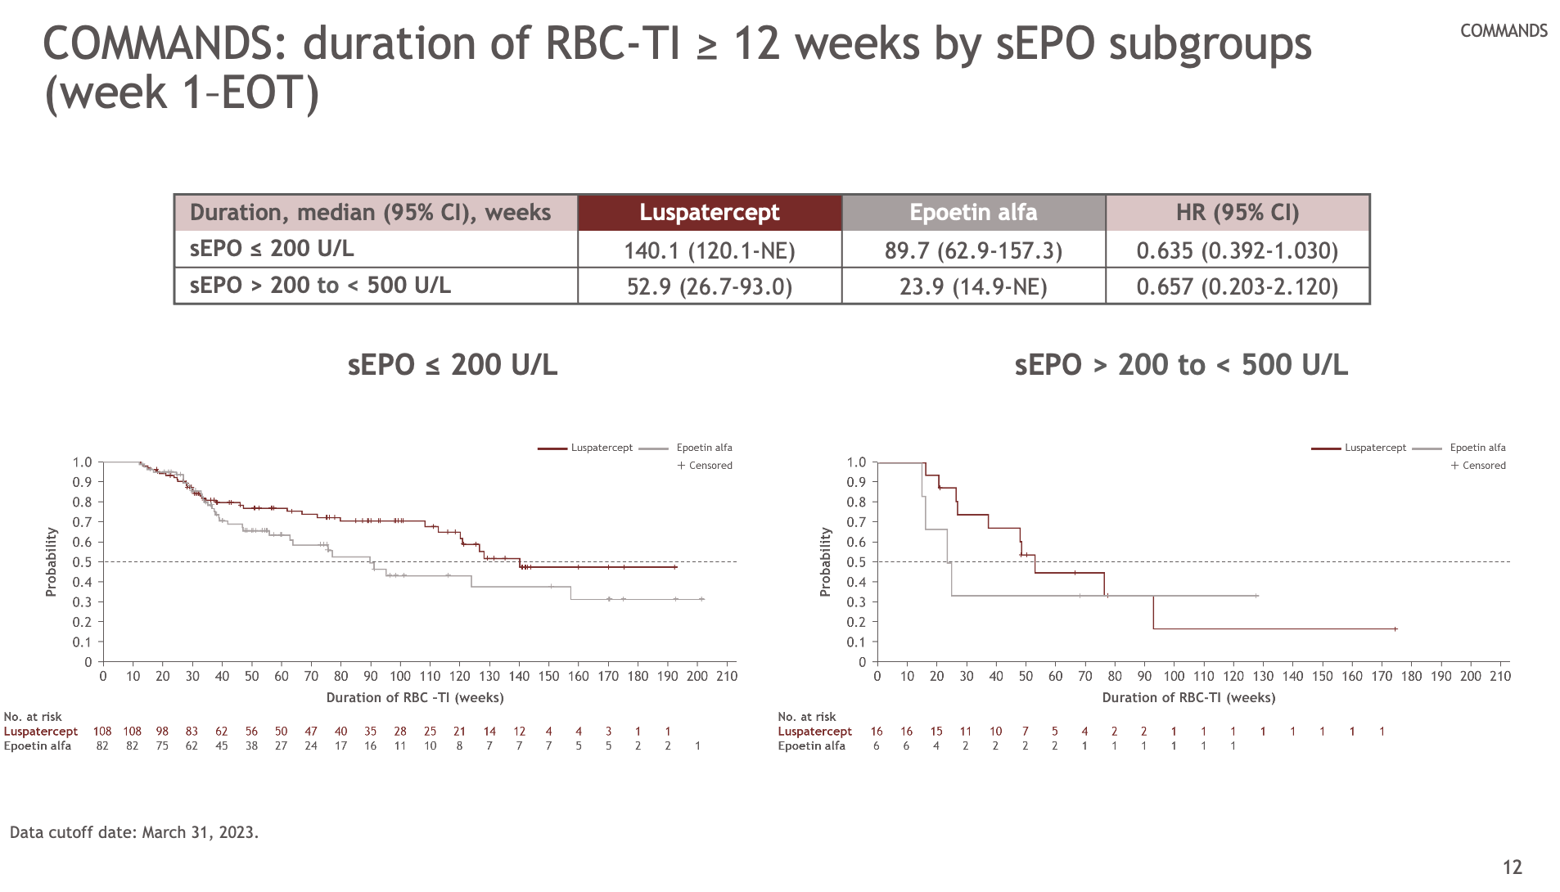
Notes:
Similar to the preplanned interim analysis, the duration of RBC-TI ≥ 12 weeks by sEPO subgroups was longer with luspatercept than with epoetin alfa

Slide 71
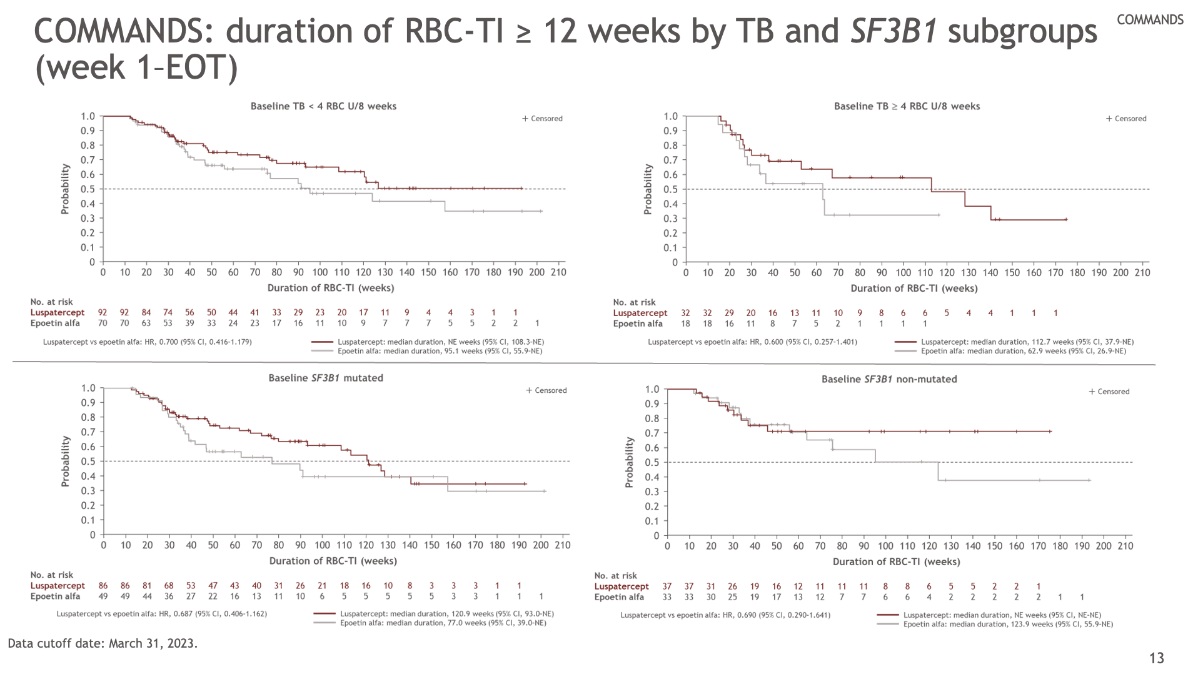
Notes:
The duration of RBC-TI ≥ 12 weeks by TB subgroups and SF3B1 mutation status was longer with luspatercept than with epoetin alfa in the full analysis, similar to the preplanned interim analysis

Slide 72
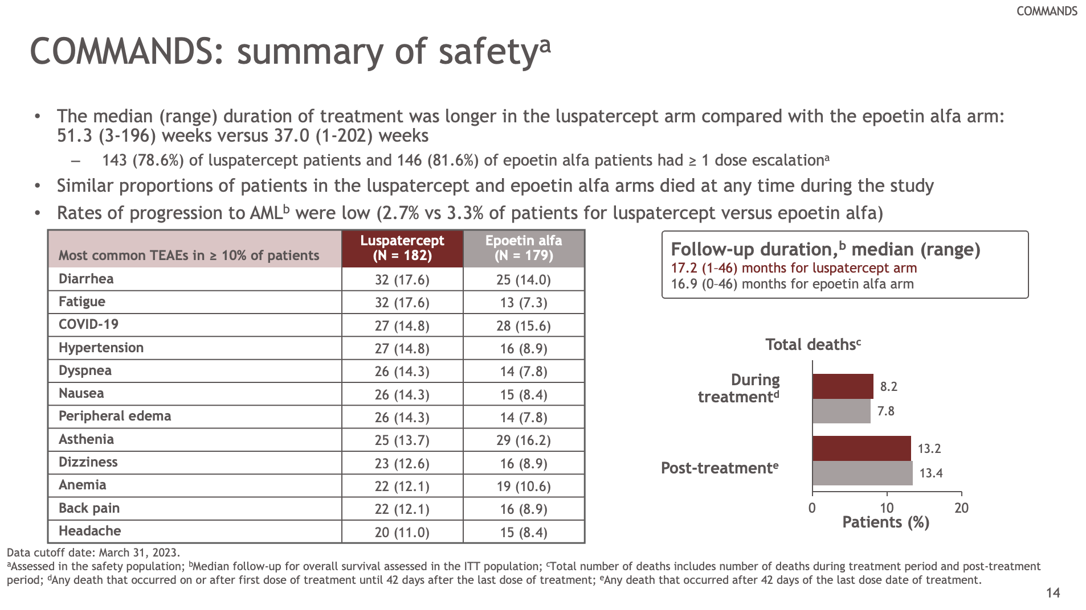
Notes:
Full analysis of the safety data did not reveal any new safety concerns or differences and the results were comparable to those at the interim analysis presented previously at ASCO 2023

Slide 73
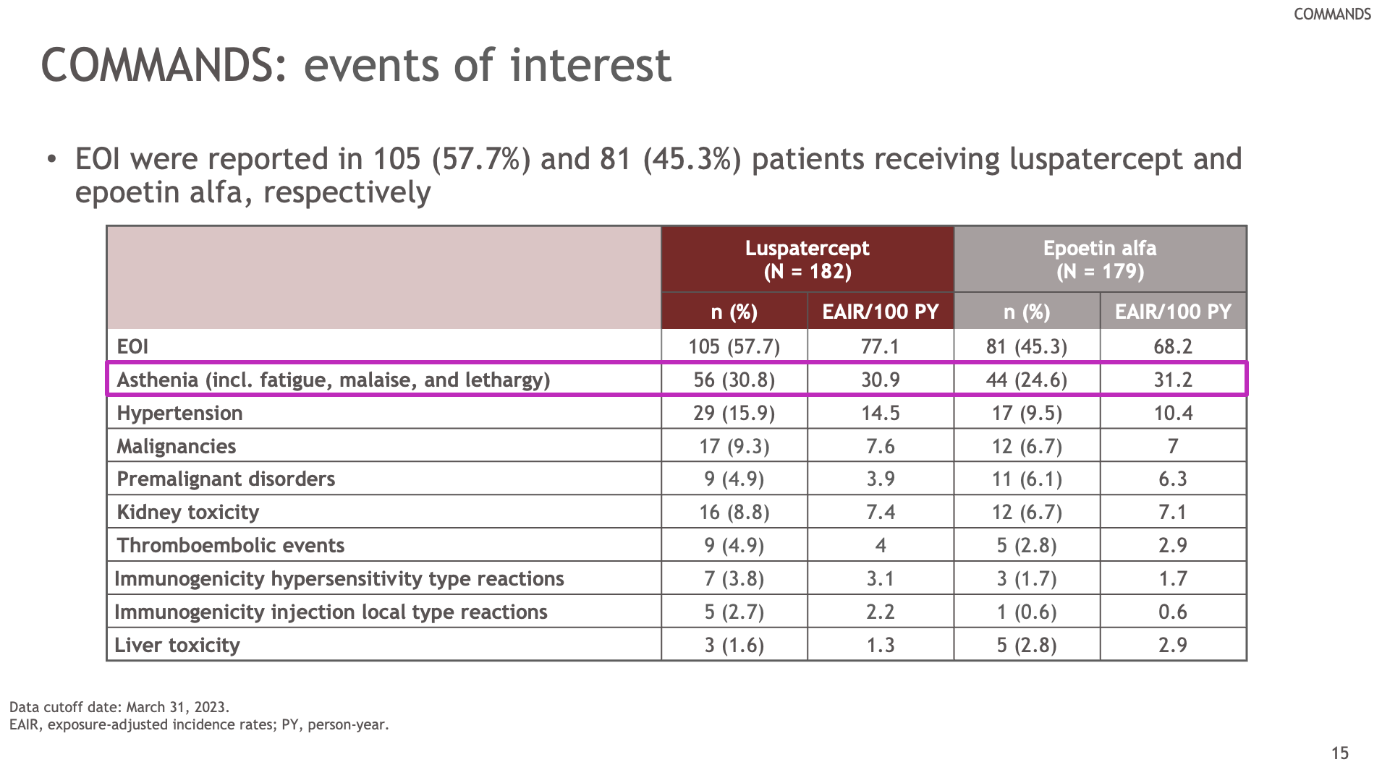
Notes:
Reported rates of asthenia are higher in the luspatercept arm compared with the epoetin alfa arm
However, after adjusting for exposure (which is ~ 1.5 times longer in the luspatercept treatment arm), asthenia rates are comparable between the 2 treatment arms (30.9 per 100 PY vs 31.2 per 100 PY)

Slide 74
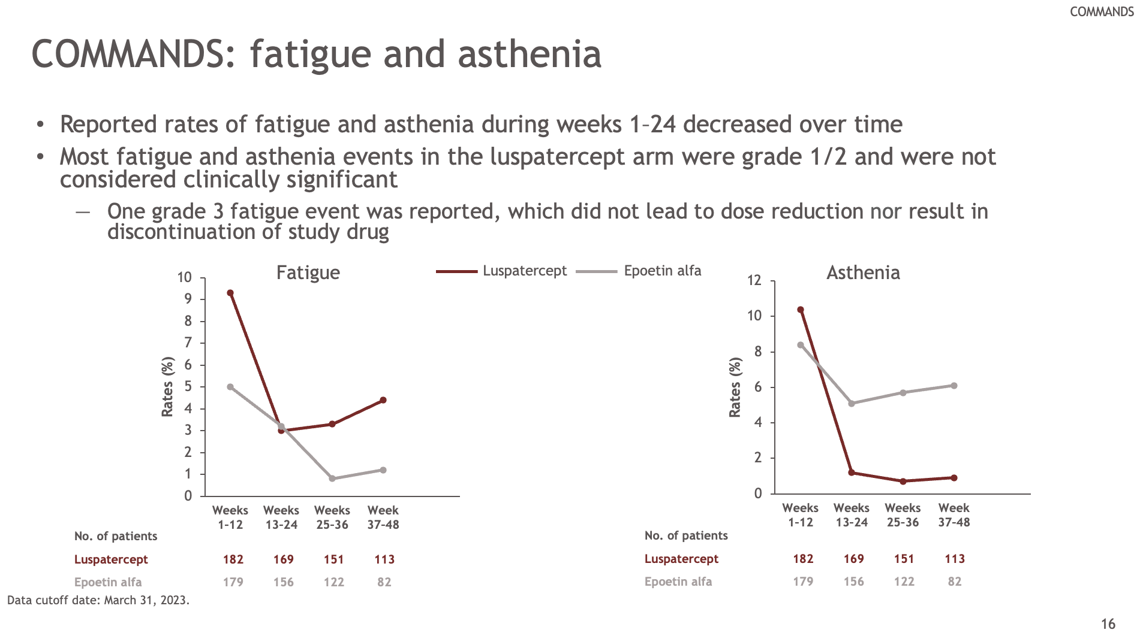

Slide 75
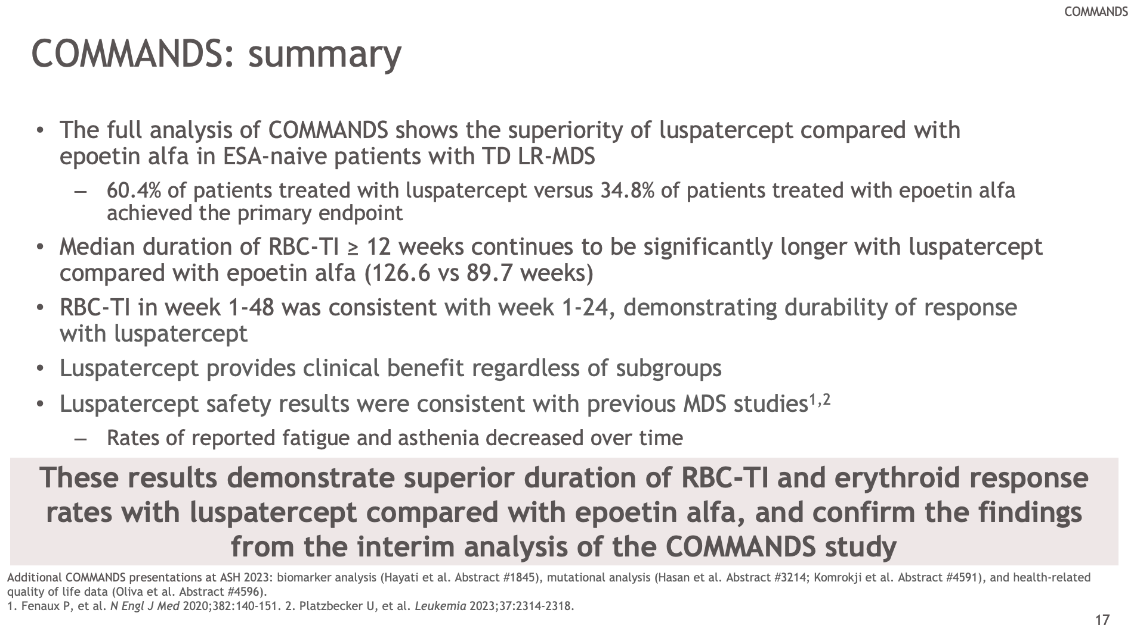

Slide 76
https://ash.confex.com/ash/2023/webprogram/Paper186863.html

Slide 77
ASH 2023
COMMANDS: Efficacy and Safety of Luspatercept Versus Epoetin Alfa in ESA-Naive Patients with Transfusion-Dependent (TD) LR-MDS; (193) Guillermo Garcia-Manero
Long-Term Evaluation of Luspatercept in ESA-Intolerant/Refractory Patients (pts) with LR-MDS in the Phase 3 MEDALIST Study; (915) Valeria Santini
Efficacy and Safety of Roxadustat for Treatment of Anemia in Patients withLR-MDS with Low Red Blood Cell (RBC) Transfusion Burden: Results of Phase III Matterhorn Study; (195) Moshe Mittelman
Durable Clinical Benefit with Ker-050 Treatment: Findings from an ongoing Phase2 study in participants with LR-MDS; (196) María Díez-Campelo
Efficacy of Imetelstat in Achieving RBC Transfusion Independence Across Different Risk Subgroups in Patients with LR-MDS R/R to ESAs in IMerge Phase 3 Study; (194) Uwe Platzbecker
Olutasidenib Alone or in Combination with Azacitidine Induces Durable Complete Remissions in Patients with mIDH1MDS; (1872) Jorges Cortes
Molecular MRD Clearance Is Associated with Improved Clinical Outcomes in Patients with HR-MDS: An Exploratory Analysis of Stimulus-MDS1 in Patients Receiving Sabatolimab or Placebo + HMA; (3236) Amer Zeidan
Update of a Phase II Trial of Guadecitabine in HR-MDS and CMML Under the IWG 2023 Criteria; (1877) Samuel Urrutia
Efficacy and Safety of Venetoclax in Combination with Azacitidine for the Treatment of Patients with Treatment-Naive, HR-MDS; (319) Jacqueline Garcia
Venetoclax (VEN) Improves Response Rates but Not Survival in Patients with CMML Treated with HMA: A Multicenter, Propensity Score Analysis; (321) Douglas Tremblay
Oral Decitabine/Cedazuridine with Venetoclax in HR-MDS or CMML: Analysis by Different Response Criteria; (3228) Alex Bataller
Molecular Taxonomy of MDS and Its Clinical Implications; (997) Elsa Bernard
Data-Driven Harmonization of 2022 Who and ICC Classifications of MDS: A Study By the International Consortium for MDS (icMDS); (998) Matteo Della Porta
Reclassification of Ascertain (ASTX727-02) MDS Patients: Outcomes Including Clinical Response, Overall Survival (OS), and Leukemia Free Survival (LFS) Based on IPSS-R and IPSS-M Scoring Systems; (4619) Guillermo Garcia-Manero
Validation of the Composite Complete Response (cCR) Definitions in the IWG 2023 Criteria in Patients (Pts) with HR-MDS Treated with HMAs – a Large, Multicenter, Retrospective Analysis from the Validate Database; (324) Jan Bewersdorf
Real-World Treatment Patterns Among Patients with MDS Initiating Oral Decitabine and Cedazuridine or Intravenous/Subcutaneous HMA; (548) Amer Zeidan

Slide 78
HEMATOLOGIC MALIGNANCIES
January 11th, 2024

Slide 79
Year in Review: 2023 Updates in CLL
Alvaro Alencar
Lymphoma Section – Div of Hematology
University of Miami Sylvester Comprensive Cancer Center
Miami, FL
January 11, 2024

Slide 80
ASH 2023 Updates
Indefinite vs finite therapy
  BTKi
  Combo – BCL2i + anti-CD20 (or BTKi)
Treatment post cBTKi and BCL2i failures
  ncBTKi
  BTK degrader
  CAR-T

Slide 81
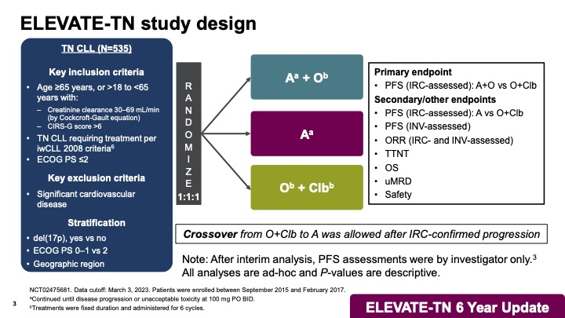
ASH 2023 abstr 636

Slide 82
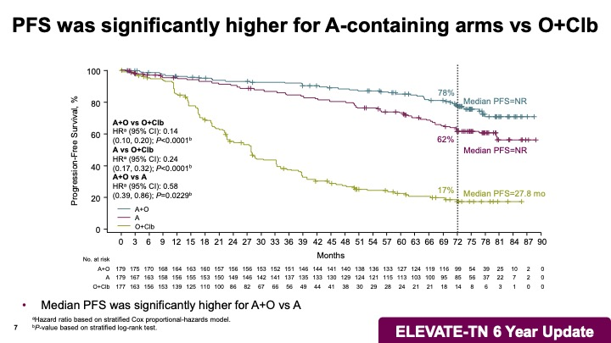
ASH 2023 abstr 636

Slide 83
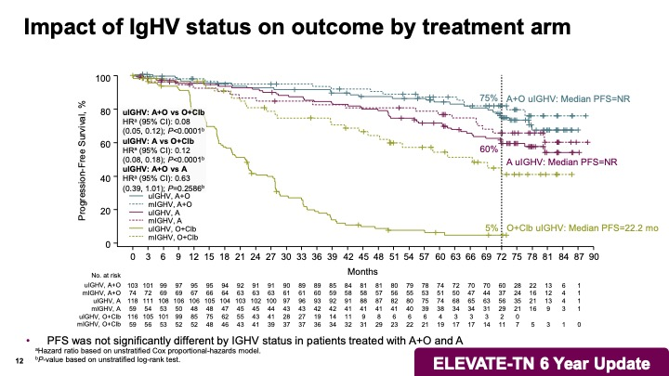
ASH 2023 abstr 636

Slide 84
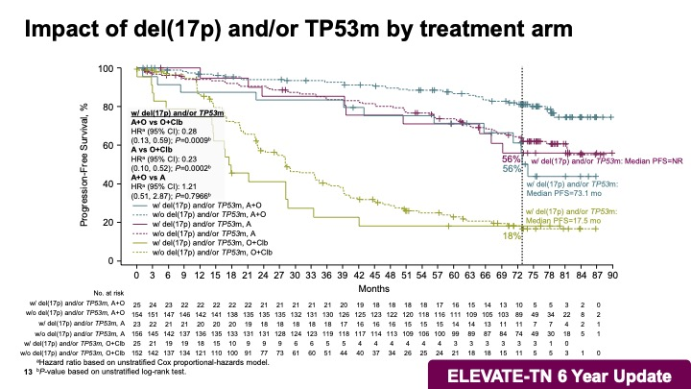
ASH 2023 abstr 636

Slide 85
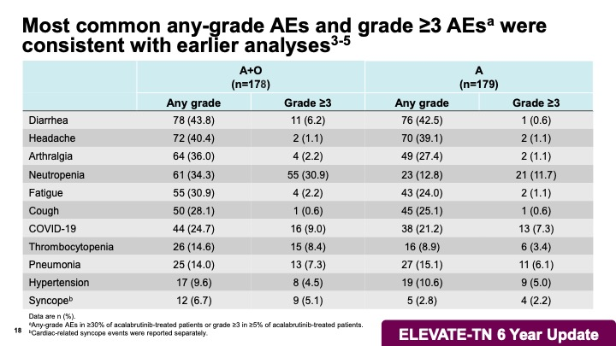
ASH 2023 abstr 636

Slide 86
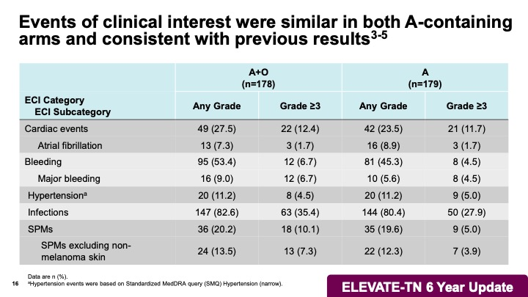
ASH 2023 abstr 636

Slide 87
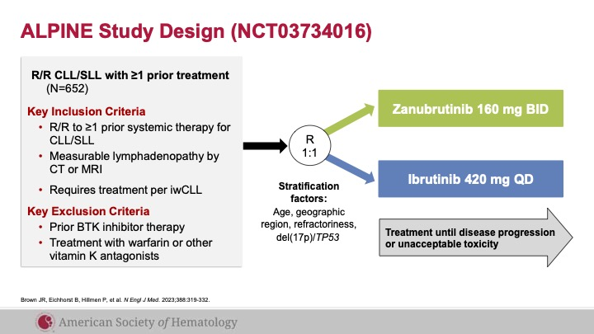
ASH 2023 abstr 202

Slide 88
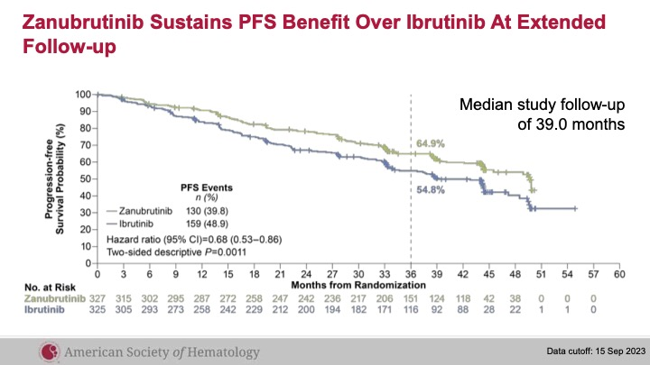
ASH 2023 abstr 202

Slide 89
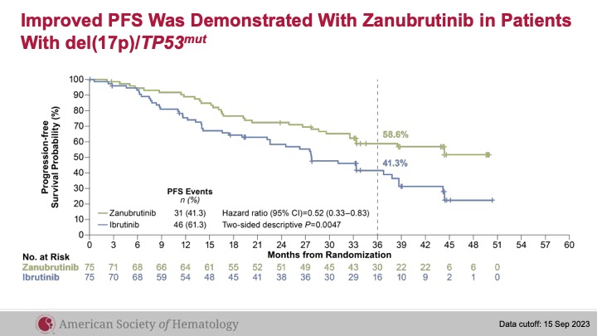
ASH 2023 abstr 202

Slide 90
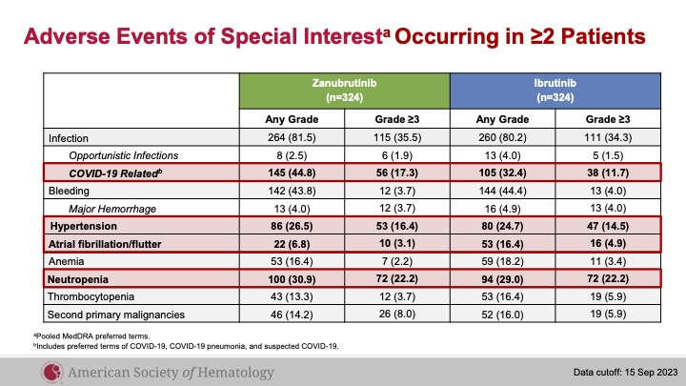
ASH 2023 abstr 202

Slide 91
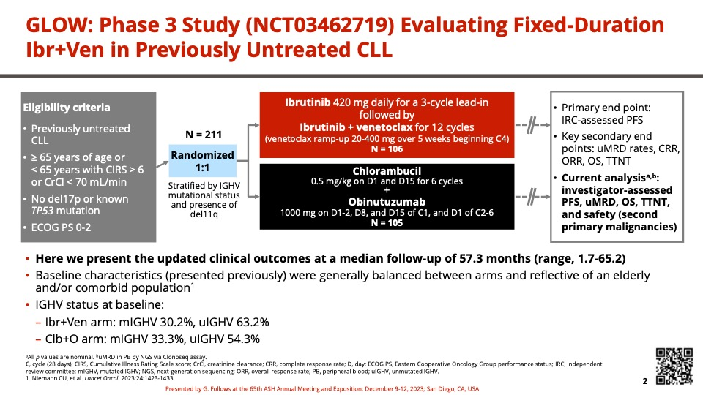
ASH 2023 abstr 634

Slide 92
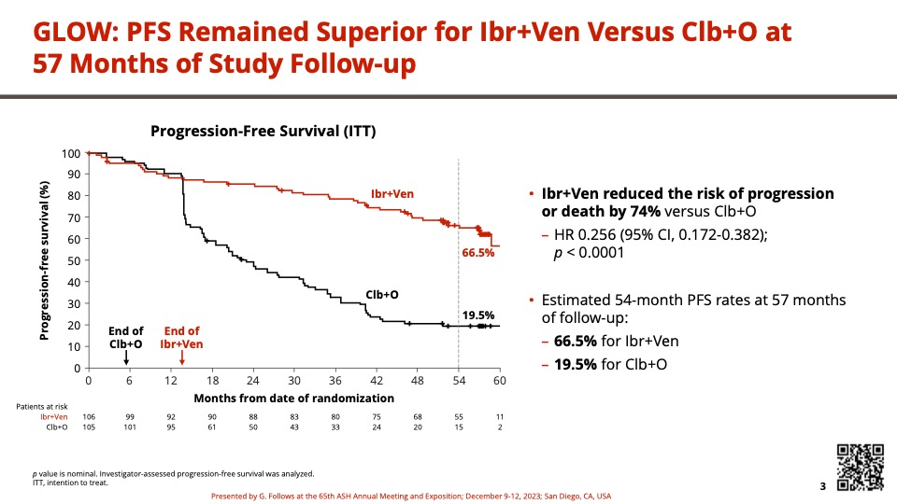
ASH 2023 abstr 634

Slide 93
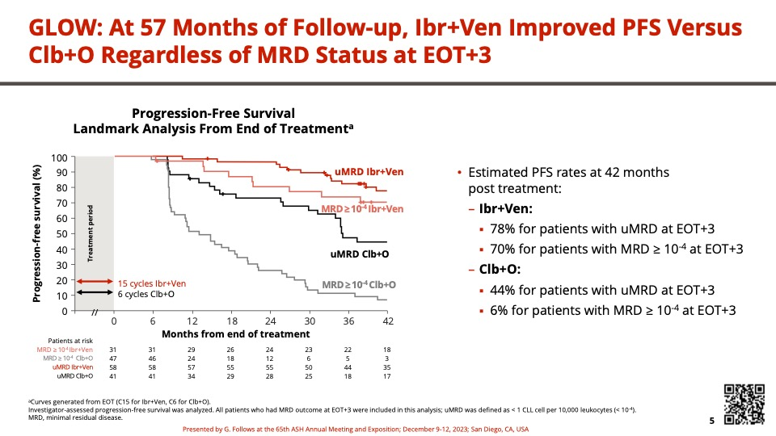
ASH 2023 abstr 634

Slide 94

ASH 2023 abstr 631

Slide 95

ASH 2023 abstr 631

Slide 96

ASH 2023 abstr 631

Slide 97

ASH 2023 abstr 631

Slide 98

ASH 2023 abstr 631

Slide 99

ASH 2023 abstr 631

Slide 100

ASH 2023 abstr 631

Slide 101

ASH 2023 abstr 633

Slide 102

ASH 2023 abstr 633

Slide 103

ASH 2023 abstr 633

Slide 104
Pirtobrutinib
Highly selective, non-covalent BTKi
  WT and mutant C481 BTK
  Stabilizes BTK in closed inactive conformation
  Long half-life
Mato et al, Lancet 2021; 397: 892–901; Brandhuber et al. Clin Lymphoma Myeloma Leuk 2018; 18(Suppl.1):S216; Gomez et al. Blood.2023; 142(1):62-72.

Slide 105
BRUIN
ASH 2023 abstr 325

Slide 106
Pirtobrutinib – longer f/u previous cBTKi/BCL2i
ASH 2023 abstr 325

Slide 107
Pirtobrutinib – longer f/u previous cBTKi/BCL2i
ASH 2023 abstr 325

Slide 108
Pirtobrutinib – longer f/u previous cBTKi/BCL2i
ASH 2023 abstr 325

Slide 109
Pirtobrutinib – longer f/u previous cBTKi/BCL2i
ASH 2023 abstr 325

Slide 110
Pirtobrutinib – longer f/u previous cBTKi/BCL2i
ASH 2023 abstr 325

Slide 111
Pirtobrutinib – RT
ASH 2023 abstr 1737

Slide 112
Pirtobrutinib – RT
ASH 2023 abstr 1737

Slide 113
Pirtobrutinib – RT
ASH 2023 abstr 1737

Slide 114


BTK degrader – NX-5948
ASH 2023 abstr 4473

Slide 115

CAR-T cell therapy – Liso-cel
ASH 2023 abstr 330

Slide 116

CAR-T cell therapy – Liso-cel
ASH 2023 abstr 330

Slide 117

CAR-T cell therapy – Liso-cel
ASH 2023 abstr 330

Slide 118
Summary
cBTKi continue to present excellent activity in 1L
Combination cBTKi/BCL2i active, well tolerated
ncBTKi active, well tolerated even in highly refractory patients
Future promising options

Slide 119
THANKS!
aalencar@med.miami.edu

Slide 120
HEMATOLOGIC MALIGNANCIES
January 11th, 2024

Slide 121
Year in Review: 2023 Updates in DLBCL
Juan P. Alderuccio, MD
Associate Professor of Medicine
Division of Hematology
Sylvester Comprehensive Cancer Center
Miami, FL

Slide 122
Disclosures
Advisory board: ADC Therapeutics, Genentech, AbbVie, and Regeneron
Research funding: Genmab, ADC Therapeutics, and BeiGene

Slide 123
Untreated DLBCL

Slide 124




Slide 125

Subgroup analysis for progression-free survival

Slide 126


Palmer A et al NEJM 2023
Notes:
Preclinical studies implicating CD79b dependent vulnerability of ABC DLBCLs

Slide 127


Slide 128



Notes:
Genomic alterations of patients with distinct genetic subtypes. Mutational status of 18 genes of the simplified 20-gene algorithm, 3 gene re-arrangements by FISH analysis, cell of origin classification by RNA-seq analysis, and MYC/BCL2 double expression status by immunohistochemistry are shown

Slide 129
Relapsed/refractory DLBCL

Slide 130




Slide 131

CD20xCD3 T-cell Engaging Bispecific Antibody
Falchi L et al. Blood 2023

Slide 132


Slide 133

Mosunetuzumab
Budde L et al. JCO 2021

Slide 134



Mosunetuzumab with Polatuzumab
mPFS: 11.4 months
mOS: 23.3 months
Budde L et al. Nat Med 2023

Slide 135

Glofitamab
Dickinson MJ et al. NEJM 2022

Slide 136


Epcoritamab
Thieblemont C et al. JCO 2022

Slide 137

Median DOR: 12 months
Median PFS: 4.4 months

Slide 138

Odronexamab
Bannergi R et al. Lancet Haematol 2022

Slide 139

Trispecific antibodies. PIT565
PIT565 is an investigational IgG-like tri-specific, CD19xCD3xCD2-targeting antibody, leading to redirected T-cell cytotoxicity toward CD19-positive malignant B cells
Mazza I. et al ASH 2023

Slide 140
Safety and efficacy of bispecifics in DLBCL
 | CRS | CRS ≥3 | ICANS | ORR | CR% | PFS
Mosunetuzumab | 26.1% | 2.3% | 2.2% | 42% | 24% | 12-month PFS 22.6%
Glofitamab | 63% | 4% | 8% | 52% | 39% | 12-month PFS 37%
Epcoritamab | 49.7% | 2.5% | 6.4%* | 63.1% | 38.9% | 6-month PFS 43.9%
Odronextamab | 61% | 7% | 12% | 39% | 24% | median PFS 11.5 months
* A fatal event

Slide 141
Investigator Initiated studies at Sylvester Comprehensive Cancer Center
Epcoritamab with loncastuximab tesirine in second line DLBCL
Pola-R-CHP with high-dose methotrexate and zanubrutinib in secondary CNS lymphoma

Slide 142
How I treat DLBCL in 2024 (January)
Newly diagnosed
IPI ≥2 and ABC: Pola-R-CHP
GC
Transformed
IPI <2
Relapsed/refractory
Refractory/relapsed within 1 year: CAR T-cell (axi-cel/liso-cel)
Relapsed >1 year: R-ICE +/- ASCT
Third line:
CAR T-cell
Epcoritamab
Glofitamab
Loncastuximab
BR-polatuzumab
Tafasitamab/lenalidomide
R-CHOP

Slide 143
HEMATOLOGIC MALIGNANCIES
January 11th, 2024

Slide 144

Venous Thromboembolism:
Some Highlights from ASH
Gerald A Soff MD
Chief, Classical Hematology Service
University of Miami /Sylvester Comprehensive Cancer Center
Email: gas199@miami.edu

Slide 145
Disclosures
Research Support (Past 5 years):
  Amgen
  Janssen Scientific Affairs
  Sobi/Dova Pharmaceuticals
  Anthos Therapeutics
Advisory Boards (Past 5 years)
  Janssen Scientific Affairs
  Sobi/Dova Pharmaceuticals
  Sanofi
  Novartis
  Agios Pharmaceuticals.

Slide 146
1. Ongoing Efforts to Develop Optimal Risk Assessment Model for Cancer Associated Thrombosis.
It is well known that many cancer patients are at very high risk of developing a VTE.
Not all are at equal risk.
Can we identify patients at very high risk, where prophylactic anticoagulation is warranted? (Balance risk:benefit with cost, convenience).
Two studies with rivaroxaban and apixaban have studied and validated this approach with Khorana Score of 2 or greater.
  Khorana et al, NEJM, 2019 (rivaroxaban)
  Carrier, et al, NEJM, 2019 (apixaban)
Recent study with enoxaparin showed similar benefit in high-risk patients.
  Alexander et al JAMA Oncol. 2023. doi:10.1001/jamaoncol.2023.3634.

Slide 147
Predictive Model for Chemotherapy-Associated VTE
Patient Characteristic | Risk Score
Site of Cancer
Very high risk (stomach, pancreas) | 2
High risk (lung, lymphoma, gynecologic, bladder, testis) | 1
Prechemotherapy platelet count > 350K/mcL | 1
Hemoglobin < 10 g/dL or use of red cell growth factors | 1
Prechemotherapy leukocyte count more than 11K/mcL | 1
BMI 35 kg/m2 or more | 1
Khorana AA et al. Blood. 111:4902-4907, 2008.
Khorana AA & Connolly GC. JCO. 27:4839-4847, 2009

Slide 148

Rates of VTE According To Scores From The Risk Model In The Derivation And Validation Cohorts
Possible role in identifying population where primary anticoagulation prophylaxis is appropriate.
Khorana, A. A. et al. Blood 2008;111:4902-4907

Slide 149

Risk Prediction Scores for Venous Thromboembolism in Cancer Patients
Some incorporate biomarkers or molecular profiles that may improve prediction capability, but at trade-off that the additional information will not be routinely available.
The goal is to identify high-risk patients for whom prophylactic anticoagulation may be warranted.
  Van Es et al, Haematologica. 2017 Sep; 102(9): 1494–1501., doi: 10.3324/haematol.2017.169060

Slide 150
Development and External Validation of a Lymphoma-Specific Venous Thromboembolism Risk Assessment Model.
(Shengling Ma et al. MD Anderson, ASH 2023)
10,313 lymphoma patients were randomly divided into an 80% derivation cohort and a 20% internal validation cohort.
At 6 months, overall VTE incidence were 5.75% - 8.24%.
The variables in the final RAM included
  lymphoma type (4 groups ranging from very-low to very-high risk),
  body mass index,
  indwelling catheter
  cytotoxic vs. targeted therapy
  history of VTE, recent hospitalization
  paralysis/immobilization

Slide 151

Rate of VTE:
High-risk 12-15%
Low-risk, 5-7%

Slide 152
Demonstrated ability to discriminate by about two-fold from low to high risk of VTE.
Much of the score reflects “known” risks.
Will this be sufficient to lead to implementation of prophylactic anticoagulation?

Slide 153
“The biggest question in the field, then, is not which risk-based approach or which anticoagulant is the best for primary prevention.
Rather, it is this: what is stopping patients with cancer from being offered thromboprophylaxis in the first place?
There are currently more RCT data to support outpatient thromboprophylaxis than inpatient prophylaxis in patients with cancer.”
  Khorana, JAMA Oncology Published online September 21, 2023

Slide 154
2. Why is elevated WBC Associated With Increased Risk of Venous Thromboembolism.
  In Khorana Score, elevated pre-chemotherapy white cell count (>11.0 K/mcL) is associated with increased risk of cancer associated thrombosis.

Slide 155


Neutrophil Extracellular Trap
Image by Soff
https://www.the-scientist.com/features/why-immune-cells-extrude-webs-of-dna-and-protein-66459

Slide 156
Neutrophil Extracellular Trap
Externalization of chromatin by neutrophils.
Net-like structures composed of DNA scaffolds coated with histones.
Have role in immobilizing pathogens in vivo.
“Neutrophil extracellular traps promote vessel occlusion by providing a scaffold for platelets, red blood cells, and procoagulant molecules, and neutrophil extracellular trap components enhance coagulation through both the intrinsic and extrinsic pathways.”
  Thålin et al. Arterioscler Thromb Vasc Biol. 2019;39:1724–1738.

Slide 157
DNA Liquid Biopsies for Cancer-Associated Venous Thromboembolism Prediction. (Justin Jee et al, ASH 2023)
Circulating tumor (ct)DNA may be thrombogenic due to its association with neutrophil extracellular traps.
Jee et al studied the association of of circulating tumor (ctDNA) and cell-free
(cfDNA) levels and related variables for predicting VTE.
cfDNA concentration was associated with VTE risk in all cancer types.
ctDNA association with VTE risk in non-small cell lung, breast, pancreatic, prostate, and less represented cancers as well as melanoma but not in bladder, hepatobiliary, or colorectal cancer.

Slide 158

ctDNA and cfDNA are independent biomarkers for cancer associated thrombosis.
    Jee, J. et al ASH 2023

Slide 159
3. Anticoagulation in Antiphospholipid Antibody Syndrome

Slide 160
3. Question of DOAC versus Warfarin in APS
“In thrombotic APS, VKAs are the preferred therapy for secondary thrombosis prevention.
“However, when APS is not diagnosed on initial presentation and patients are initiated on a DOAC, subsequent identification of aPL requires a decision of continuing DOAC or transitioning to warfarin for long-term anticoagulation.”
Anne Hubben and Keith R. McCrae, ASH 2023.

Slide 161
RCT Studies of DOAC versus Warfarin in APS
Trial | Author | Patient Selection | N | Triple Positive (%) | Findings
TRAPS | Pengo | Triple-positive APS | 120 (59 rivaroxaban) | 100 | Thromboembolic events DOAC: 7 (12%) (4 ischemic stroke and 3 MI) infarction), VKA: 0 events MB: 7% DOAC vs 3% VKA
EUDRA | Ordi-Ros | APS | 190 (95 rivaroxaban) | 60.5 | Recurrent VTE DOAC: 11.6%. VKA (6.3%) , RR 1.83 Stroke DOAC: 9.5%. VKA (0%) Bleeding: No difference
ASTRO-APS | Woller | APS, protocol modifcation to exclude prior ATE | 48 (23 apixaban) | 30.4 | Terminated prematurely 6 strokes DOAC vs 0 events VKA MB: 0 DOAC vs 1 VKA
Anne Hubben and Keith R. McCrae, ASH 2023

Slide 162
RCT with DOAC (rivaroxaban or apixaban) versus warfarin failed to show noninferiority.
TRAPS: Terminated prematurely after an excess of events (4 ischemic strokes, 3 myocardial infarctions) in the rivaroxaban group versus none with warfarin. (N=59 rivaroxaban).
OrdiRos, Rivaroxaban was associated with nearly twice the incidence of recurrent thrombosis as warfarin, with stroke again more common in rivaroxaban-treated patients. (N= 95 rivaroxaban)
ASTRO-APS: Apixaban versus warfarin. Terminated prematurely.
6 ischemic strokes in apixaban-treated patients compared with none with warfarin. (N=23 apixaban)
Anne Hubben and Keith R. McCrae, ASH 2023

Slide 163
“Based on trial data, regulatory agencies in the US and Europe changed the labeling of DOACs to advise against their use in patients with APS, especially triple-positive.”
“The 2019 European Society of Cardiology and 2020 American Society of Hematology guidelines similarly recommend against DOAC in APS patients.”
“However, other societal guidelines, including those of the British Society for Haematology, EULAR, and the International Society on Thrombosis and Hemostasis, offer a conditional approach.”
“While recommending warfarin as the first-choice agent, collectively the guidelines suggest that DOACs may be considered in individuals
  (1) without high-risk APS features such as triple positivity, arterial thrombosis, small vessel thrombosis, organ involvement, or heart valve disease;
  (2) already stable on a DOAC;
  (3) unwilling to undergo INR monitoring;
  (4) with <60% time in therapeutic range with VKA; or
  (5) with contraindications to VKA.”
  Anne Hubben and Keith R. McCrae, ASH 2023

Slide 164
Should We Screen for Antiphospholipid Antibody Before Initiation of Anticoagulation With a DOAC in “New” Patient with Unprovoked Venous Thromboembolism?
Assays must be repeated and confirmed after 12 weeks for confirmed diagnosis.
Impractical to screen for APS at initiation of anticoagulation for all new unprovoked venous thromboembolism.
Some “hints” of APS would be associated elevated aPTT or moderate thrombocytopenia at presentation. Reasonable to screen in those cases.
Otherwise, this remains an ongoing question/challenge.

Slide 165

Thank You!

Slide 166
HEMATOLOGIC MALIGNANCIES
January 11th, 2024

Slide 167
Hematology and Pregnancy
Diana Byrnes, MD MPH
Assistant Professor
University of Miami/Sylvester Comprehensive Cancer Center
Miami, FL
Notes:
I will be focusing my talk on non-malignant hematologic issues in pregnancy

Slide 168
Disclosures
Research funding: Anthos Therapeutics
Advisory Board: Sanofi
Not relevant to this presentation

Slide 169
Outline
Iron deficiency in pregnancy
ITP in pregnancy
Notes:
I chose to focus on these two topics because these are very common referrals that we receive from our colleagues in OB

Slide 170

Anemia during pregnancy
Important risk factor for fetal and maternal morbidity
Affects almost 40% of pregnancies according to WHO
Iron deficiency anemia (IDA) is the most common cause for anemia of pregnancy Globally
  High demand of maternal-fetal iron transfer
  Aggravated by decreased maternal iron reserves
Notes:
Global health problem

Slide 171


Educational Session: Identifying and treating iron deficiency anemia in pregnancy
Adam K. Lewkowitz,Methodius G. Tuuli, Identifying and treating iron deficiency anemia in pregnancy, Hematology Am Soc Hematol Educ Program, 2023,
Copyright © 2024 American Society of Hematology
Notes:
Figure Legend:

Slide 172
Iron deficiency anemia in pregnancy- Present Issues in management
ACOG does not recommend treating iron deficiency without anemia during pregnancy
Serum iron or ferritin are not routinely performed for anemic pregnant patients
Different thresholds of ferritin to dx IDA
Iron repletion therapy is often initiated without confirming the diagnosis for most patients.
Optimal route of iron repletion remains uncertain
Iron deficiency anemia has been associated with increased rates of cesarean delivery, postpartum depression, and perinatal blood transfusion
Notes:
WHO ferritin <15
ACOG ferritin <30
Iron deficiency anemia is also associated with increased risk of low birth weight, preterm birth, and small-for-gestational-age neonates
Fetal-neonatal iron deficiency has been linked to neurological impairments in infants that may persist into adulthood

Slide 173
Iron deficiency anemia in pregnancy
Oral iron is the current standard for treating IDA during pregnancy in the US
Ferrous sulfate is the most prescribed oral iron
  Causes several GI SE
QOD dosing has been shown to avoid hepcidin suppression, thereby increasing effectiveness of oral iron supplementation while likely reducing medication adverse effects→ Still not the recommended dosing in the US.
IV iron is usually administered in the second or third trimesters
No safety data for first-trimester use
All IV iron products currently on the market have similar safety and efficacy
Notes:
Many providers give oral iron three times a day

Slide 174

Iron deficiency anemia in pregnancy
Some data to suggest that IV iron may be superior to oral iron in rapidly correcting anemia and iron deficiency.
Urgent need for a study testing the clinical effectiveness, safety, and cost-effectiveness of IV iron on clinically relevant maternal and neonatal outcomes
IVIDA2 trial: Ongoing multicenter, placebo-controlled, double blind, RC trial comparing IV ferric derisomaltose to oral ferrous sulfate (1-3 times daily)→ Results to come!

Slide 175

Adam K. Lewkowitz,Methodius G. Tuuli, Identifying and treating iron deficiency anemia in pregnancy, Hematology Am Soc Hematol Educ Program, 2023,

Slide 176
Study: “Correction of Anemia with Intravenous Iron Mitigates Adverse Maternal Outcomes in Pregnancy”
Cohort Study of pregnant adult women who received at ≥ 1 IV iron infusion
  Iron sucrose (IS), low molecular weight iron dextran (LMWID), or ferric carboxymaltose (FCM)
1⁰ outcome: Maternal and neonatal outcomes, stratified by severity of IDA
Secondary outcomes: incidence of pregnancy morbidity by anemia severity, type of IV iron preparation used, and total iron dose received
Ashley E Benson et. al.; Correction of Anemia with Intravenous Iron Mitigates Adverse Maternal Outcomes in Pregnancy. Blood 2023; 142 (Supplement 1): 3747. doi: https://doi.org/10.1182/blood-2023-178359
Notes:
IDA defined by the WHO criteria as non-anemic (Hgb >11 g/dL, mild (Hgb 10 to 10.9 g/dL), moderate (Hgb 7 to 9.9 g/dL), or severe (Hgb < 7 g/dL)

Slide 177

Study: “Correction of Anemia with Intravenous Iron Mitigates Adverse Maternal Outcomes in Pregnancy”
Most patients received LMWID (80.9%)
IV iron well tolerated; ~1% did not complete infusion due to reaction
More maternal composite morbidity in those who were anemic vs those who were not anemic
Neonatal composite morbidity did not differ by anemia status
Notes:
17.8% received IS
1.5% FCM
Of patients with reaction, none required epinephrine or ED

Slide 178

“Correction of Anemia with Intravenous Iron Mitigates Adverse Maternal Outcomes in Pregnancy”
Anemia is associated with higher rates of maternal composite morbidity, regardless of severity
Anemia on admission was less likely in those who received LMWID vs. IS
Total iron dose received was lower in those who received IS
IV iron therapy was safe and effective and decreased incidence of anemia on admission to L&D
Ashley E Benson et. al.; Correction of Anemia with Intravenous Iron Mitigates Adverse Maternal Outcomes in Pregnancy. Blood 2023; 142 (Supplement 1): 3747. doi: https://doi.org/10.1182/blood-2023-178359
Notes:
More patients with moderate anemia at presentation to L&D got IS during pregnancy
Mean total Iron dose in iron sucrose group: 561mg vs 979mg in LMID group
More maternal composite morbidity in those who were anemic vs those who were not anemic

Slide 179
ITP in Pregnancy
Prevalence of 1 in 1000-10,000 pregnancies
3% of all causes of thrombocytopenia in pregnancy
1st line treatment options in pregnant ITP patients includes corticosteroids and intravenous immunoglobulin (IVIG)
Previous studies reported that the response rate of pregnant ITP patients to corticosteroids was less than 40% and to IVIG was 38-56%
Lower response compared nonpregnant ITP patients.
Second-line treatment options are extremely limited in pregnancy
Notes:
most common cause of thrombocytopenia in the first and early second trimesters

Slide 180
Study: “De Novo ITP diagnosed during pregnancy; outcome for the mothers and the neonates and prospective comparative study with chronic ITP pregnancy women”
Prospective multicentric study in France to evaluate the outcome of patients with ITP diagnosed during pregnancy (de novo)
Determine incidence of neonatal ITP (NITP)
Compare outcomes to a cohort of patients with chronic ITP in pregnancy
Stephanie Guillet et.al.; De Novo ITP Diagnosed during Pregnancy : Outcome for the Mothers and the Neonates and Prospective Comparative Study with Chronic ITP Pregnant Women. Blood 2023; 142 (Supplement 1): 802. doi: https://doi.org/10.1182/blood-2023-182050
Notes:
Stephanie Guillet, Valentine Loustau, Emmanuelle Boutin, Odile souchaud-Debouverie, Nathalie Costedoat-Chalumeau, Manuel Cliquennois, Anne-Sophie Morin, Louis Terriou, Agathe Masseau, Thibault Comont, Bertrand Lioger, Jean-Christophe Lega, Matthieu Mahevas, Marc Michel, Florence Canoui-poitrine, Bertrand Godeau; De Novo ITP Diagnosed during Pregnancy : Outcome for the Mothers and the Neonates and Prospective Comparative Study with Chronic ITP Pregnant Women. Blood 2023; 142 (Supplement 1): 802. doi: https://doi.org/10.1182/blood-2023-182050

Slide 181
“De Novo ITP diagnosed during pregnancy; outcome for the mothers and the neonates and prospective comparative study with chronic ITP pregnancy women”
Patients followed during pregnancy and 6 months after delivery.
De novo ITP was defined by a normal platelet count before pregnancy and a nadir < 50x10 ⁹/L during pregnancy without any other clinical or biological abnormalities & no sign of pregnancy-specific causes of thrombocytopenia
Compared ITP outcomes; episodes of bleeding events, severe thrombocytopenia (<30x10⁹/L), and ITP treatment modification
Obstetric complications and NITP incidences in both groups
Stephanie Guillet, et.al.; De Novo ITP Diagnosed during Pregnancy : Outcome for the Mothers and the Neonates and Prospective Comparative Study with Chronic ITP Pregnant Women. Blood 2023; 142 (Supplement 1): 802. doi: https://doi.org/10.1182/blood-2023-182050
Notes:
This study was an oral presentation investigating acutely diagnosed ITP in pregnancy to women with chronic ITP.
NITP: neonatal ITP

Slide 182
“De Novo ITP diagnosed during pregnancy; outcome for the mothers and the neonates and prospective comparative study with chronic ITP pregnancy women”
34 “ de novo” ITP women diagnosed during pregnancy were included and compared with 61 chronic ITP pregnant women
De novo ITP pregnant women experienced severe thrombocytopenia in 50% [35.5-91.9], bleeding events in 41.2% [26.8-59.4] including 11.8% [4.6%-28.4%] severe bleeding events, and ITP therapeutic interventions in 76.5% [61.4-88.9]
Episodes of severe thrombocytopenia and bleeding events including severe bleeding event were similarly observed in “ de novo” and “ chronic” groups
Stephanie Guillet, et.al.; De Novo ITP Diagnosed during Pregnancy : Outcome for the Mothers and the Neonates and Prospective Comparative Study with Chronic ITP Pregnant Women. Blood 2023; 142 (Supplement 1): 802. doi: https://doi.org/10.1182/blood-2023-182050

Slide 183
De Novo ITP diagnosed during pregnancy; outcome for the mothers and the neonates and prospective comparative study with chronic ITP pregnancy women
CITP pregnant women underwent less ITP therapeutic interventions 50.8% [39.1-63.8], p=0.039.
Obstetrical complications including preterm delivery, postpartum hemorrhage and cesarean delivery rates were similar in both groups (data not shown).
NITP <50x10 ⁹/L was observed in 6/31 (19.3%) neonates of women with de novo ITP and was similar to those observed in neonates of chronic ITP women 9/53 (17%).
Notes:
Median follow-up of 6 months [5-7] after delivery, de novo ITP remained active for 25/34 women (73.5%)

Slide 184
De Novo ITP diagnosed during pregnancy; outcome for the mothers and the neonates and prospective comparative study with chronic ITP pregnancy women
Conclusions:
  Severity of de novo ITP diagnosed during pregnancy and the risk of NITP are closely similar to those observed in chronic ITP pregnant women
  Pregnancy outcome in de novo ITP similar to that of chronic ITP
  Non-fatal severe bleeding events occur in around 10% of patients.
  De novo ITP remains active 6 months after delivery in a large majority of patients
Stephanie Guillet, et.al.; De Novo ITP Diagnosed during Pregnancy : Outcome for the Mothers and the Neonates and Prospective Comparative Study with Chronic ITP Pregnant Women. Blood 2023; 142 (Supplement 1): 802. doi: https://doi.org/10.1182/blood-2023-182050
Notes:
NITP: neonatal ITP

Slide 185
Study: “The Combination of Intravenous Immunoglobulin (IVIG) and Low Does Recombinant Human Thrombopoietin (rhTPO) for the Management of Corticosteroid/IVIG Monotherapy-Resistant Immune Thrombocytopenia in Pregnancy”
Monocenter, single-arm, open-label study to investigate the efficacy and safety of low-dose rhTPO plus IVIg in pregnant corticosteroid/IVIg monotherapy-resistant ITP patients
Recombinant human thrombopoietin (rhTPO) is a full-length and glycosylated thrombopoietin (TPO)
In theory, cannot cross the placenta due to large molecular weight
Advantage over the two TPO mimetics (impact to the fetus?)
Yun He, et.al.; The Combination of Intravenous Immunoglobulin (IVIG) and Low Does Recombinant Human Thrombopoietin (rhTPO) for the Management of Corticosteroid/IVIG Monotherapy-Resistant Immune Thrombocytopenia in Pregnancy. Blood 2023; 142 (Supplement 1): 1213. doi: https://doi.org/10.1182/blood-2023-185453
Notes:
Noteworthy study because it was an interventional study in high risk patients with refractory ITP- a very difficult population of patients to treat
combination of IVIg and TPO mimetics: IVIg could reduce platelet destruction, whereas TPO mimetics could increase platelet production.
molecular weight of 90 000 Daltons

Slide 186
Methods
Inclusion criteria:
  Diagnosis of primary ITP before or onset in first pregnancy
  Adult pregnant women ≥ 18 years of age
  Patients with bleeding manifestations and/or have a platelet count < 30 × 10^9/L
  Failed to respond to initial treatment

Slide 187
Intervention:
rhTPO initial dose: 150 U/kg subQ QD for 28 days and IVIg 400 mg/kg per day for 5 days
Platelets 30-50K
Combination repeated
platelet counts exceeded 100 × 10^9/L.
Treatment discontinued
Platelet count 50-100 × 10^9/L
Maintenance therapy:150 U/kg per day
If did not achieve a count of 30 × 10^9/L within 4 weeks
Treatment was discontinued

Slide 188
Results
Small study of only 19 patients
Median age: 34 years old (20 - 42 y/o)
Median platelet count before treatment: 13×10^9/L (range 1-30×10^9/L).
The four-week response rate was 63.2% (12/19), and the median response time was 7.5 days (range 5 to 35 days).
There were no treatment-related adverse reactions.
Low-dose rhTPO plus IVIg in pregnant corticosteroid/IVIg monotherapy-resistant ITP patients is effective and safe
Notes:
In the paper abstract response criteria was not elucidated, and mean platelet count with treatment not shown

Slide 189
Summary
Iron deficiency anemia
  Known benefits of treating IDA in pregnancy, however several discrepancies in diagnosis and management
  Optimal route of iron repletion remains uncertain
  Ongoing large randomized placebo-controlled trials will help answer these questions
  IV iron is safe and effective
  LMWID more effective in repleting iron and correcting anemia compared to IS
ITP
  First line treatment options limited to primarily steroids and IVIG. Second line treatments are very limited
  Pregnancy outcomes in de novo ITP similar to that of chronic ITP
  Severe thrombocytopenia and bleeding events similar in de novo vs chronic ITP
  New therapies are being investigated in pregnancy with promising results in regard to efficacy and maternal/fetal safety

Slide 190
THANK YOU
QUESTIONS?

