Slide 1
LUNG CANCER
July 18th, 2024

Slide 2
Welcome
Mike DiGrazia
National Accounts Manager
OncLive | MJH Life Sciences

Slide 3


Thank You to Our Supporters!

Slide 4
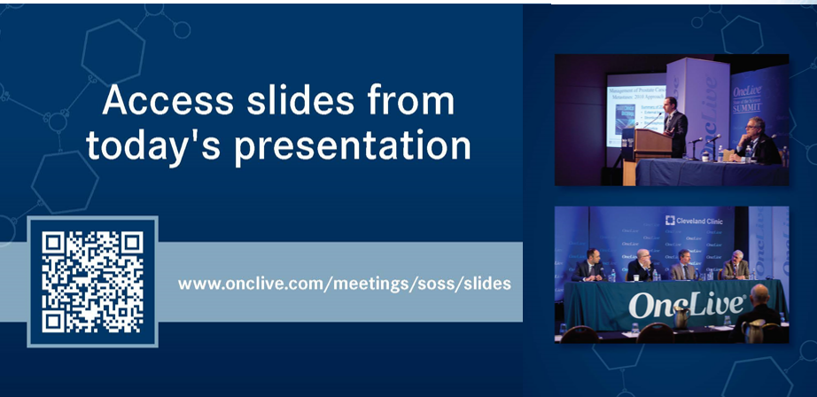

Slide 5


Slide 6


Slide 7


Slide 8
Program Chair
Isabel Preeshagul, DO, MBS
Assistant Attending Physician
Memorial Sloane Kettering Cancer Center

Slide 9
Treatment of Early–Stage Lung Cancers:
Better for Patients …Harder for Oncologists
Mark G Kris, MD Thoracic Oncology Service
Memorial Sloan Kettering Cancer Center
Professor of Medicine
Weill Cornell Medical College
New York, NY USA

Slide 10
Treatment of Early–Stage Lung Cancers
Financial Disclosures
Consultant/Lecturer: AstraZeneca, Bristol Myers Squibb, Daiichi Sankyo, Sanofi
Additional Disclosure
I was born a medical oncologist, but was raised by thoracic surgeons

Slide 11
Treatment of Early–Stage Lung Cancers
Introduction
Cure as the goal of care
Potential of precision medicine to facilitate cures
Durvalumab after chemoradiation – compelling 5 yr data
Adjuvant osimertinib, alectinib, atezolizumab, pembrolizumab
Neoadjuvant and adjuvant strategies on the horizon
Re-imagine the care of all patients with early-stage lung cancers

Slide 12
Bending the disease free and progression free survival curves (cure curves) in lung cancers
Stage IV
EGFR-mutant Lung cancers
Stage I-III
Adenocarcinomas and Squamous Lung cancers
Hellmann JAMA Oncology 2015

Slide 13
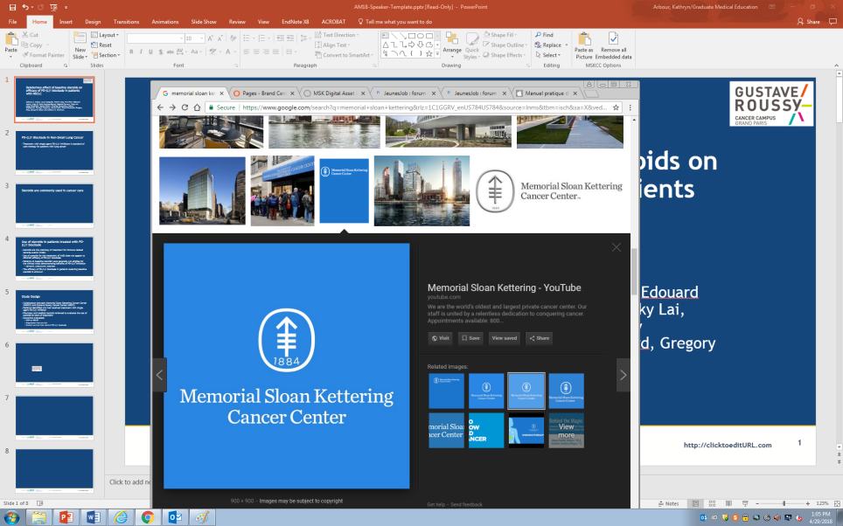
Paths forward to cure: combining systemic therapies with surgery and radiation
Metastases the nemesis. Eradicating/preventing metastases the priority
Few local failures with surgery or radiation. Statistically hard to prove improvement. Is this changing with targeted and immunotherapies?
More modalities…more toxicity. Efficacy must be improved. Equivalence in 3 vs 2 trials a failure
Only 92% 5 year survival for our lowest stage (<1 cm), all persons with lung cancer are candidates for additional therapies
Mark G Kris, MD

Slide 14


Components of Care for the Therapy for Lung Cancers: Consider Them All in Each Patient
Angiogenesis
Clinical Trials
Immunotherapy
Targeted Rx
Surgery
Radiation
Chemotherapy
Mark G Kris, MD

Slide 15
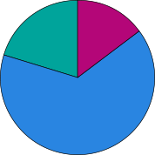
USA Lung Cancers by the Numbers – 2024
86,000 patients annually make
locally advanced lung cancers the 4th most common cancer
35,000
Localized, Resectable,
Surgery Possible
151,000
Metastatic
51,000
Localized, Unresectable,
Radiation Possible
Disease Extent at Diagnosis
Mark G Kris, MD

Slide 16
The Phase III PACIFIC Trial
Durvalumab 10 mg/kg
PLATINUM-BASED Chemotherapy-RT
IV every 2 weeks for up to 12 months
(n=476)
1–42 days
Randomization 2:1
Patients without progression
No Additional Treatment
≥2 cycles of CT
overlapping with RT
IV every 2 weeks for up to 12 months
(n=237)
Study enrolled patients with unresectable, Stage III NSCLC who had an ECOG PS of 0 or 1
Patients provided archived tumour tissue samples (if available)*
Efficacy and safety measured from randomization (day 1 of study drug initiation)
Patients were enrolled regardless of PD-L1 status or EGFR/ALK mutation status
Antonia N Engl J Med 2017;377:1919-29

Slide 17


Who Decides Resectability and Operability?
Thoracic
Surgeon
INTERNIST
Thoracic
Surgeon
RESECTABILITY
Thoracic
Surgeon
OPERABILITY
Multidisciplinary
Team
CARDIOLOGIST
PULMONOLOGIST

Slide 18
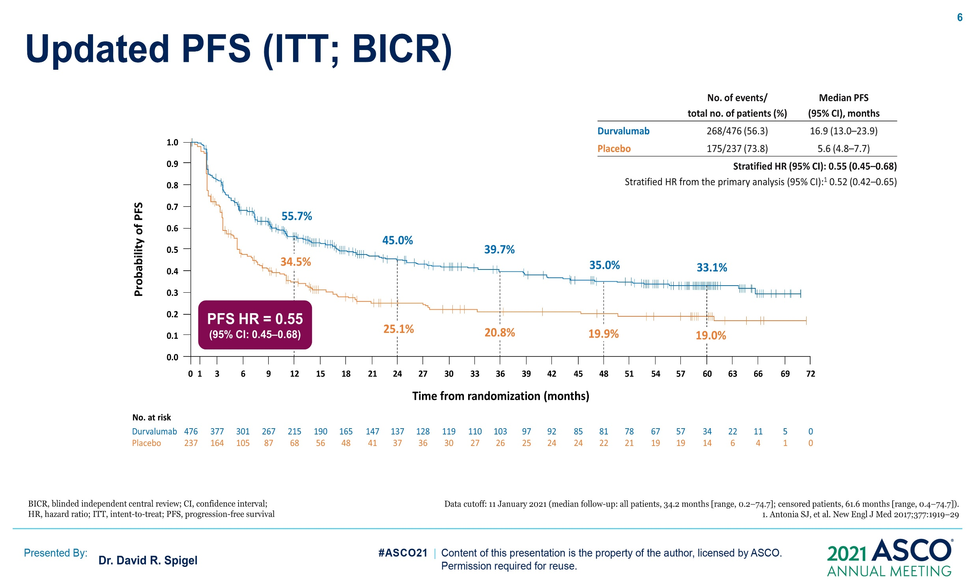
Updated PFS (ITT; BICR)
PACIFIC: 14% Improvement in 5 Year Progression Free Survival with Durvalumab
33%
19%
Content of this presentation is the property of the author, licensed by ASCO. Permission required for reuse.

Slide 19
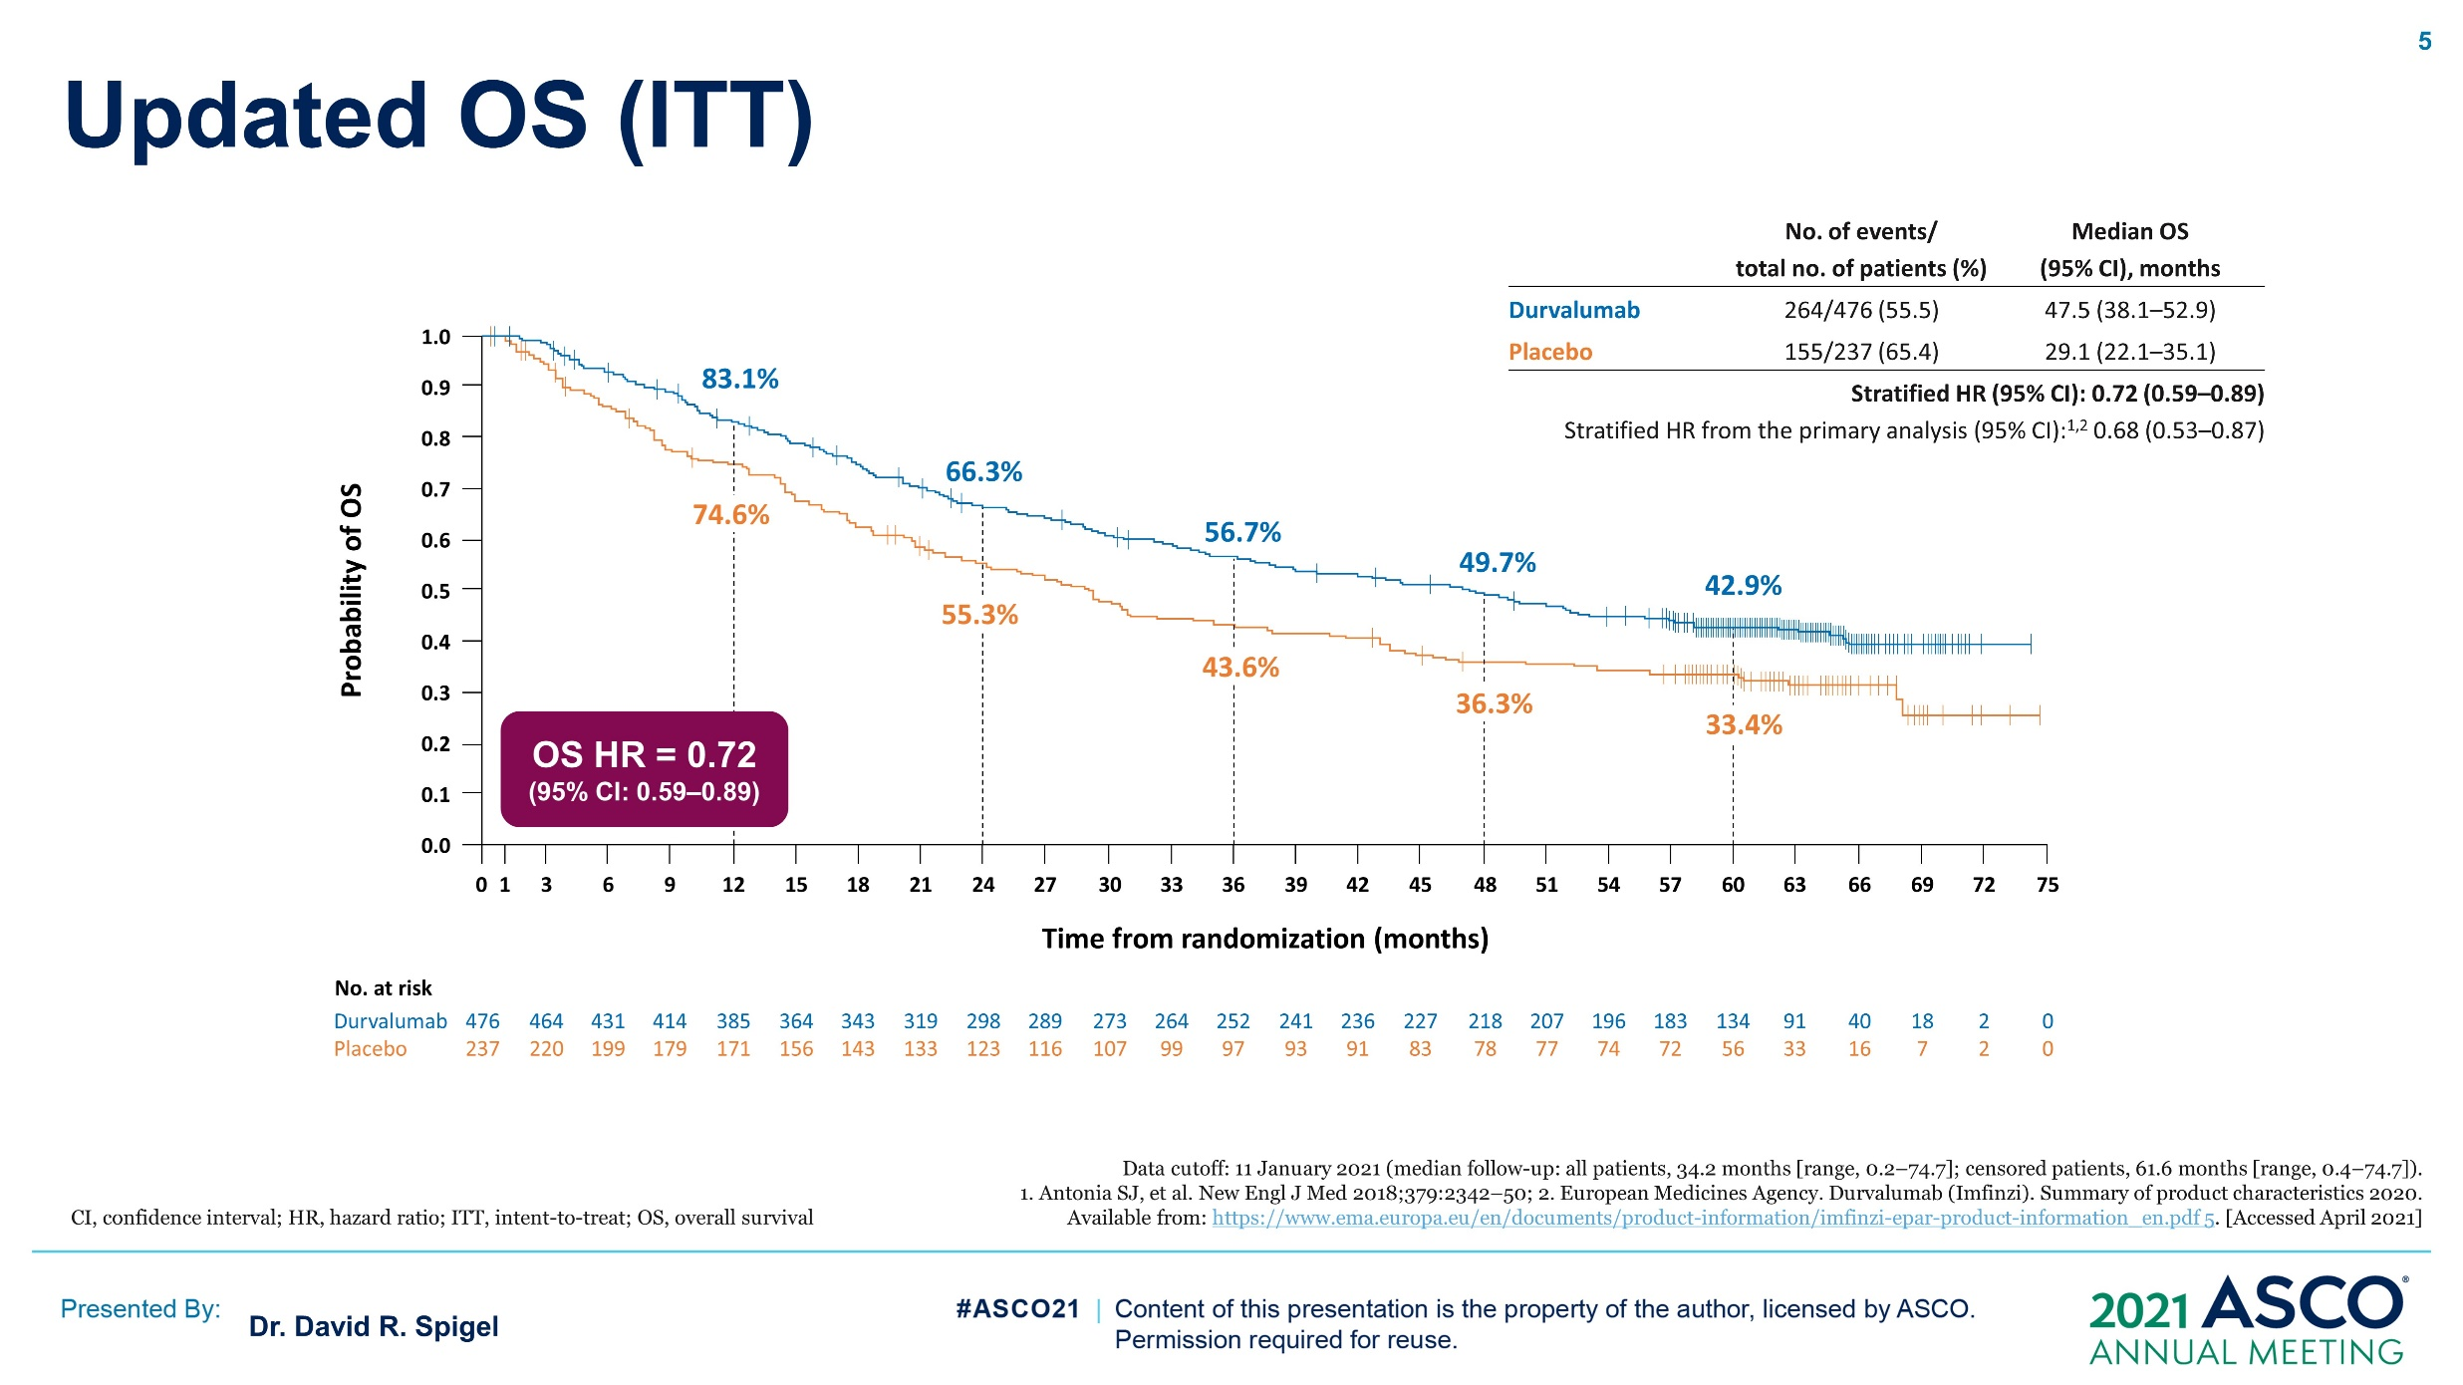
Updated OS (ITT)
PACIFIC: 10% Improvement in 5 Year Overall Survival with Durvalumab
PACIFIC: Updated 5 Year Overall Survival
1.6 year Median Improvement with Durvalumab
43%
33%

Slide 20
PACIFIC: UPDATED OS AND PFS IN PRE-SPECIFIED SUBGROUPS
 |  | OS
 |  | # events / # patients (%) | HR and 95% CI
All patients |  | 396/713 (55.5)
Sex | Male Female | 290/500 (58.0) 106/213 (49.8)
Age at randomisation | <65 years ≥65 years | 195/391 (49.9) 201/322 (62.4)
Smoking status | Smoker Non-smoker | 361/649 (55.6) 35/64 (54.7)
NSCLC disease stage | Stage IIIA Stage IIIB | 216/377 (57.3) 170/319 (53.3)
Tumour histologic type | Squamous All other | 192/326 (58.9) 204/387 (52.7)
Prior definitive CT | Cisplatin Carboplatin | 203/395 (51.4) 179/301 (59.5)
Best response to prior therapy | Complete response Partial response Stable disease | 8/16 (50.0) 177/349 (50.7) 203/338 (60.1)
EGFR mutation | Positive Negative Unknown | 24/43 (55.8) 261/482 (54.1) 111/188 (59.0)
PFS (BICR)
# events / # patients (%) | HR and 95% CI
440/713 (61.7)
313/500 (62.6) 127/213 (59.6)
235/391 (60.1) 205/322 (63.7)
401/649 (61.8) 39/64 (60.9)
223/377 (59.2) 208/319 (65.2)
212/326 (65.0) 228/387 (58.9)
238/395 (60.3) 189/301 (62.8)
9/16 (56.3) 211/349 (60.5) 214/338 (63.3)
32/43 (74.4) 290/482 (60.2) 118/188 (62.8)
NA*
NA*
Durvalumab better
Placebo better
Durvalumab better
Placebo better
*Hazard ratio and 95% CI not calculated if the subgroup has less than 20 events.
Data cutoff: 20 March 2020. BICR, blinded independent central review; CI, confidence interval; CT, chemotherapy; EGFR, epidermal growth factor receptor; HR, hazard ratio; ITT, intent-to-treat; NA, not applicable; OS, overall survival; PFS, progression-free survival.

Slide 21
UPDATED OS AND PFS IN PD-L1 SUBGROUPS
 |  | OS
 |  | # events / # patients (%) | HR and 95% CI
All patients |  | 396/713 (55.5)
PD-L1 status (pre-specified) | ≥25% <25% Unknown | 76/159 (47.8) 164/292 (56.2) 156/262 (59.5)
PD-L1 status (post-hoc) | 1–<25% ≥1% <1% | 75/144 (52.1) 151/303 (49.8) 89/148 (60.1)
PFS (BICR)
# events / # patients (%) | HR and 95% CI
440/713 (61.7)
92/159 (57.9) 181/292 (62.0) 167/262 (63.7)
85/144 (59.0) 177/303 (58.4) 96/148 (64.9)
Durvalumab better
Placebo better
Durvalumab better
Placebo better
Important facts regarding PD-L1 status:
  PD-L1 testing was not required and 37% of all randomised patients had unknown PD-L1 status
  PD-L1 status was determined from tumour tissue obtained pre-CRT (getting a sample post-CRT medically not feasible)
  PD-L1 expression-level cutoff of 1% was part of an unplanned post-hoc analysis requested by the EMA
*Hazard ratio and 95% CI not calculated if the subgroup has less than 20 events.
Data cutoff: 20 March 2020. BICR, blinded independent central review; CRT, chemoradiotherapy; CI, confidence interval; CR, complete response; EMA, European Medicines Agency; HR, hazard ratio; OS, overall survival; PD-L1, programmed death-ligand 1; PFS, progression-free survival.

Slide 22
There are no “Good Prognosis” Lung Cancers
8th Edition |  |  | 5 Year Survival | 5 Year Survival
T Stage (all N0M0) | Primary Size (cm) | N (%) | Clinical Stage | Pathological Stage
T1a | 0.1-1 | 785 (8) | 92% | 92%
T1b | 1.1-2 | 3157 (31) | 83% | 86%
T1c | 2.1-3 | 2469 (24) | 76% | 81%
T2a | 3.1-4 | 1944 (19) | 67% | 74%
T2b | 4.1-5 | 612 (6) | 60% | 65%
T3 | 5.1-7 | 814 (8) | 52% | 57%
T4 | >7 | 403 (4) | 38% | 47%
Rami-Porta J Thorac Oncol 2015

Slide 23
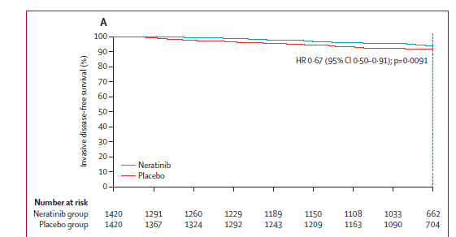
Where we need to be for adjuvant therapy for lung cancers
1 year of adjuvant neratinib vs placebo in HER2-amplified breast cancers after chemo and 1 year of trastuzumab
Median 2 year invasive disease-free survival
94% with Neratinib
92% with Placebo
Chan Lancet Oncol 2016

Slide 24
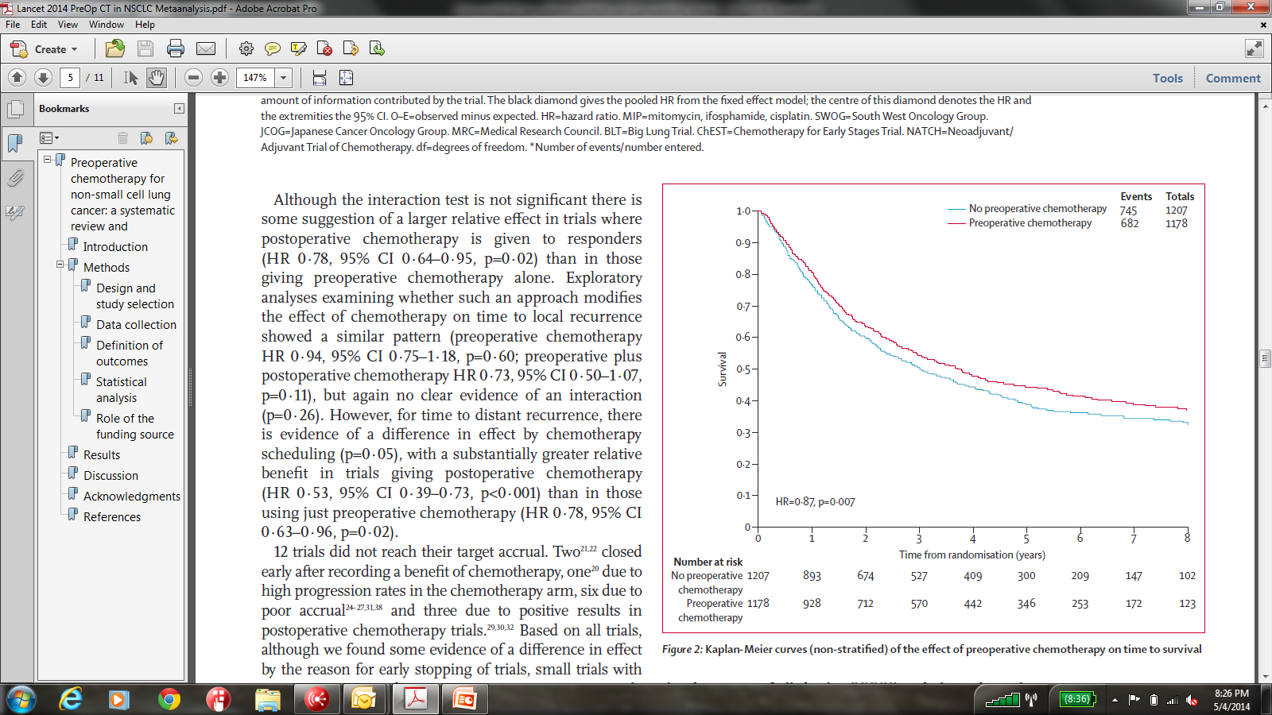
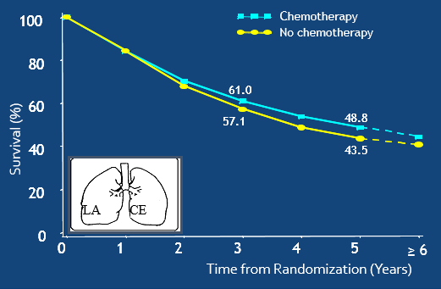
Meta-analyses: both neoadjuvant and adjuvant cisplatin-based therapies improve 5 yr survival by 5%
Neoadjuvant
Adjuvant
5% survival advantage at 5 years
HR = 0.89, P < 0.005
NSCLC Meta-Analysis Group Lancet Oncology 2014
Pignon J Clin Oncol 2006

Slide 25
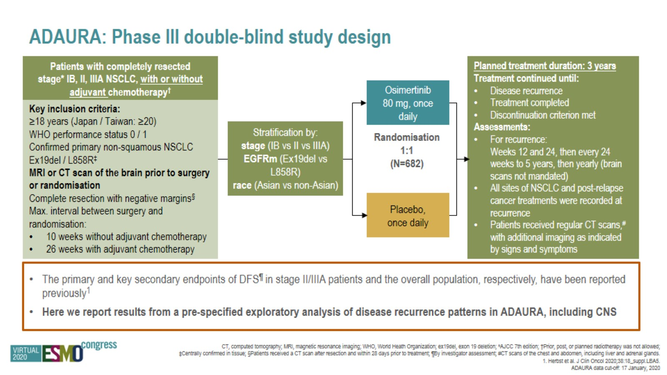

Slide 26
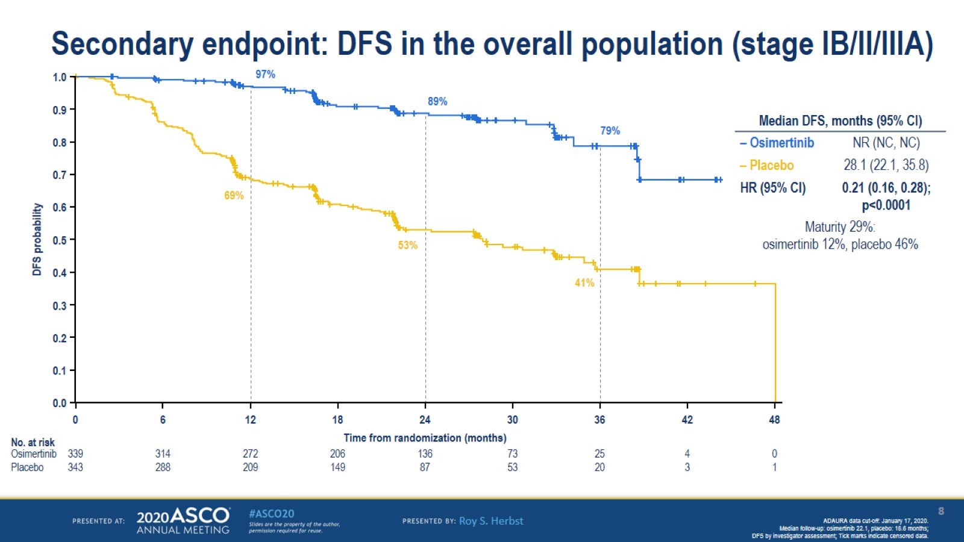
Disease Free Survival with Osimertinib: 36% Improvement at 2 Years
Notes:
The curve of Osimertinib continue the give the same benefit., only placebo arm did better with more fitter patients )stage IB)

Slide 27
Phase III Adjuvant Trials of Immune Checkpoint Inhibitors
 | ANVIL Fully Enrolled | BR.31 Fully Enrolled | IMPower 010 FDA Approved | PEARLS FDA Approved
Agent | Nivolumab | Durvalumab | Atezolizumab | Pembrolizumab
Duration of PD-1/PDL1 | 1 year | 1 year | 1 year | 1 year
Patients | 714 | 1360 | 1280 | 1177
Disease-Free Survival Primary Endpoint | Not Reported | Not Met Press Release | HR 0.81 P=0.04 | HR 0.76 P=0.0014
Overall Survival |  |  | HR 1.07 | HR 0.87 P=0.17

Slide 28
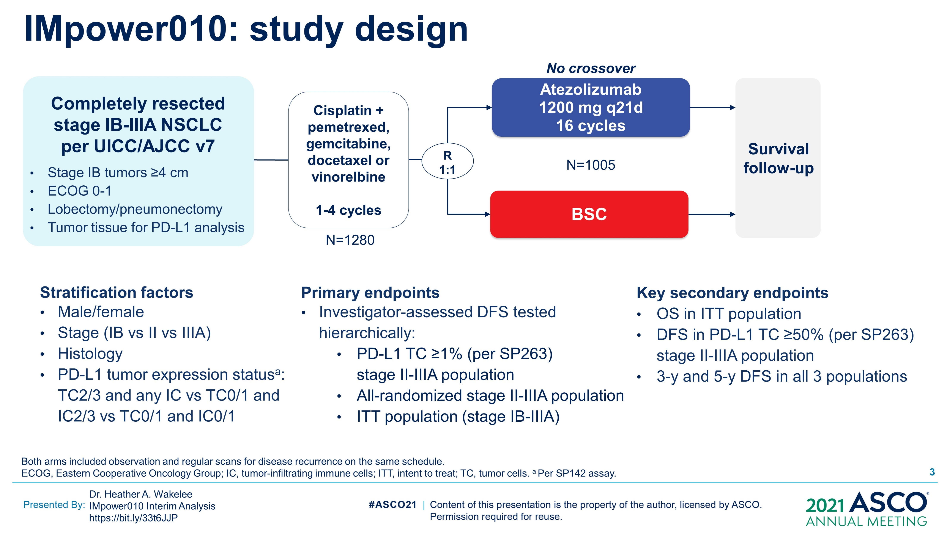
IMpower010: study design
Content of this presentation is the property of the author, licensed by ASCO. Permission required for reuse.

Slide 29
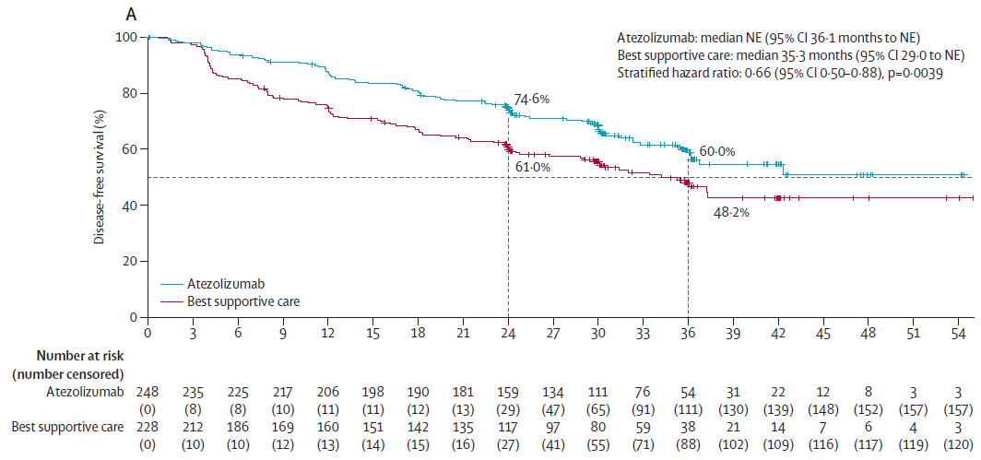
Disease-free survival in the atezolizumab and best supportive care groups: stages II-IIIA
Felip, Lancet, 2021

Slide 30
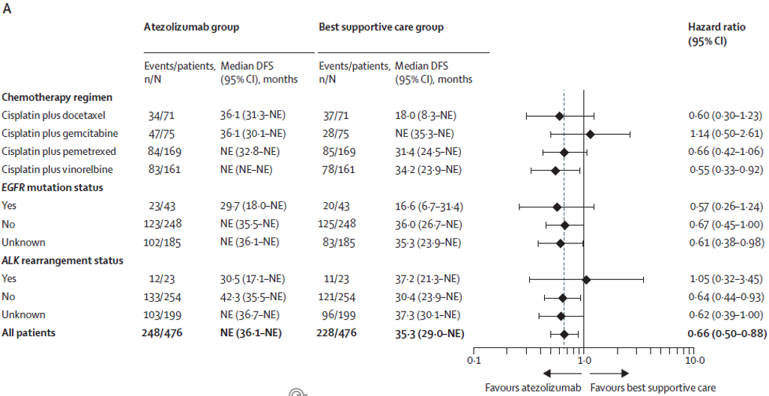
Disease-free survival in the atezolizumab and best supportive care groups
Felip, Lancet 2021

Slide 31
PEARLS/KEYNOTE-091 Study Design
Randomized, Triple-Blind, Phase 3 Trial
Eligibility for Registration
Confirmed stage IB (T ≥4 cm), II, or IIIA NSCLC per AJCC v7
Complete surgical resection with negative margins (R0)
Provision of tumor tissue for
PD-L1 testing
Eligibility for Randomization
No evidence of disease
ECOG PS 0 or 1
Adjuvant chemotherapy
  Considered for stage IB
  (T ≥4 cm) disease
  Strongly recommended for stage II and IIIA disease
  Limited to ≤4 cycles
Pembrolizumab 200 mg Q3W
for ≤18 administrations (~1 yr)
PD-L1 testing
done centrally using
PD-L1 IHC
22C3 pharmDx
R
1:1
Placebo Q3W
for ≤18 administrations (~1 yr)
Stratification Factors
Disease stage (IB vs II vs IIIA)
PD-L1 TPS (<1% vs 1-49% vs ≥50%)
Receipt of adjuvant chemotherapy (yes vs no)
Geographic region (Asia vs Eastern Europe vs
Western Europe vs rest of world)
Dual Primary End Points
DFS in the overall population
DFS in the PD-L1 TPS ≥50%
population
Secondary End Points
DFS in the PD-L1 TPS ≥1% population
OS in the overall, PD-L1 TPS ≥50%, and
PD-L1 TPS ≥1% populations
Lung cancer-specific survival in the
overall population
Safety
ClinicalTrials.gov number, NCT02504372.

Slide 32
Treatment Disposition, Overall Population
1955 participants registered
1177 randomly allocated and included in ITT population
Pembrolizumab
590 allocated
580 treated (median, 17 doses)
Placebo
587 allocated
581 treated (median, 18 doses)
Median (range) Follow-upª:
35.6 mo (16.5-68.0)
300 completed treatment
280 discontinued treatment
131 AE
18 investigator decision
3 lost to follow-up
5 other malignancy
46 participant decision
72 PD
5 other reason
381 completed treatment
200 discontinued treatment
28 AE
13 investigator decision
0 lost to follow-up
8 other malignancy
21 participant decision
127 PD
3 other reason
ª Defined as time from randomization to the data cutoff date of September 20, 2021.

Slide 33
DFS, Overall Population
 | Pts w/ Event | Median, mo (95% CI)
Pembrolizumab | 35.9% | 53.6 (39.2-NR)
Placebo | 44.3% | 42.0 (31.3-NR)
18-mo rate
73.4%
64.3%
HR 0.76 (95% CI, 0.63-0.91)
P = 0.0014
Response assessed per RECIST v1.1 by investigator review.
Data cutoff date: September 20, 2021

Slide 34
OS, Overall Population
 | Pts w/ Event | Median, mo (95% CI)
Pembrolizumab | 16.6% | NR (NR-NR)
Placebo | 18.9% | NR (NR-NR)
18-mo rate
91.7%
91.3%
HR 0.87 (95% CI, 0.67-1.15)
P = 0.17
Data cutoff date: September 20, 2021

Slide 35
DFS in Key Subgroups, Overall Population
Response assessed per RECIST v1.1 by investigator review.
Data cutoff date: September 20, 2021

Slide 36
Factors Favoring Neoadjuvant Therapy
Attacks micrometastases at earliest time
Unprecedented (and unexpected) effectiveness of checkpoint inhibitors
Ability to assess sensitivity of agents used in adjuvant for the patient and part of drug development and research -persisters
Ability to assess sensitivity of agents during in induction. You can change the regimen …..
Resection specimen represents potentially deadly persistent disease
Complete and Major Path Responses early clinical endpoints
Better chemotherapy drug delivery and tolerability
Better compliance with subsequent therapies
Time to find unsuspected metastases and comorbidities before local therapy
Blumenthal J Thorac Oncol 2018

Slide 37
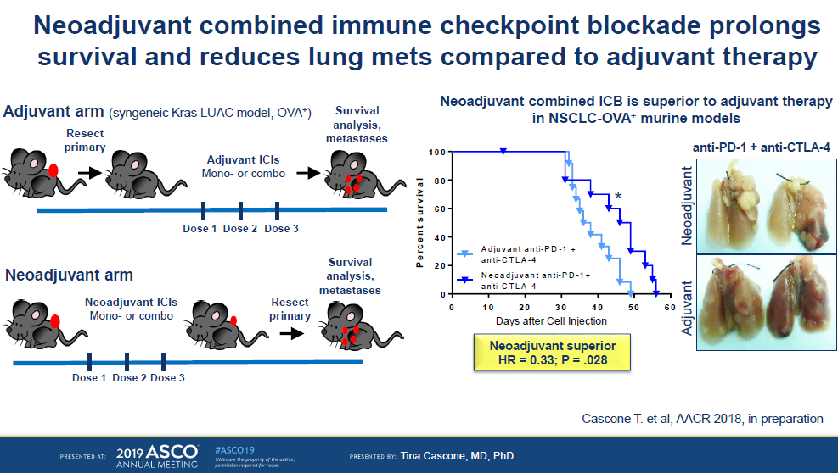

Slide 38
Factors Favoring Adjuvant Therapy
Precise staging
Resection specimen provides tissue for study
Proven approach for kinase inhibitors in oncogene-driven cancers
(Models: imatinib in GIST, osimertinib in EGFR-mutant lung cancers, alectinib with ALK fusion-driven cancers, 3 years standard and hints even longer better)

Slide 39
NATCH TRIAL (cTI-3/N0-1)
Assigned
Upfront Surgery Alone
210
Assigned
Neoadjuvant Chemotherapy
+ Surgery
199
Assigned
Surgery
+ Adjuvant Chemotherapy
210
Received Neoadjuvant Chemotherapy
193 (97%)
R0 Resection
189
R0 Resection
190
9%
9%
9%
R0 Resection
181
Received Adjuvant Chemotherapy
10 (pN2)
Received Adjuvant Chemotherapy
139 (66%)
Felip, J Clin Oncol, 2010

Slide 40
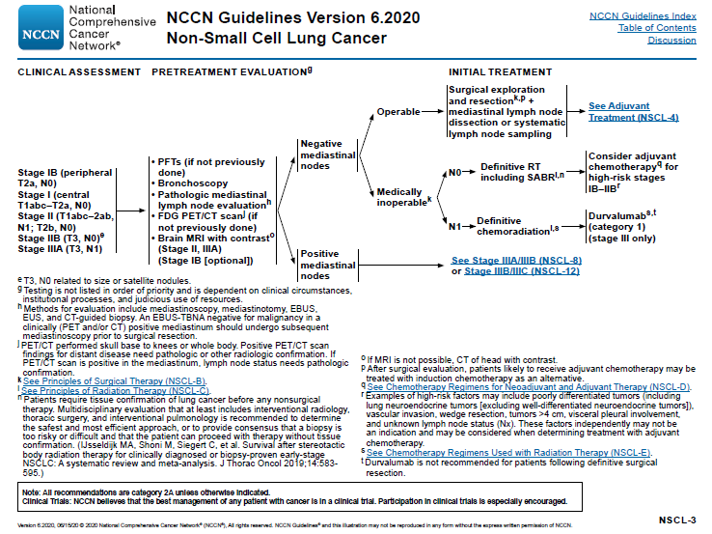

Slide 41
Phase II trials to determine pCR and MPR after neoadjuvant ICI or ICI plus chemotherapy in patients with resectable and operable stage I-III lung cancers
 | Author(s) | Agent(s) | MPR% (95% CI) | pCR% (95% CI)
Johns Hopkins University/Memorial Sloan Kettering N=21 | Forde and Chaft | Nivolumab | 43% (21 to 66) | 14% (4 to 34)
LCMC3 Lung Cancer Mutation Consortium - USA N=181 | Chaft | Atezolizumab | 21% (14 to 28) | 7% (2 to 12)
NEOSTAR MD Anderson N=44 | Cascone | Nivolumab plus Ipilimumab Nivolumab | 50% 24% | 38% 10%
NADIM Spanish Lung Cancer Group N=46 | Provencio | Nivolumab + Paclitaxel Carboplatin | 80% (64 to 91) | 75% (4 to 76)
Columbia University New York/MGH N=30 | Shu | Atezolizumab + Paclitaxel Carboplatin | 57% (36 to 76) | 33% (18 to 52)
Duke/Dartmouth/Mayo N=25 | Ready | Pembrolizumab | 28% (12 to 49) | 8% (1 to 26)
Kris, ASCOed, 2020

Slide 42
Phase III Neoadjuvant or Perioperative Trials of Immune Checkpoint Inhibitors plus Chemotherapy vs Chemotherapy – Approved - 2
 | Checkmate 816 Neoadjuvant Only | KEYNOTE 671 Perioperative
Agent | Nivolumab (NEJM 2022) | Pembrolizumab (NEJM 2023)
FDA Approval Date | 2022 | 2023
Patients | 642 | 786
Stages | IB-IIIA | IIB-IIIA
EFS better than chemo | HR 0.63 P=0.005 | HR 0.58 P<0.0001
spCR better than chemo | +22% (21 to 37%) | +14% (10 to 18%)
OS better than chemo | HR 0.57 P=0.008
Landmark EFS | 24 mo 64% | 24 mo 62%

Slide 43
Phase III Perioperative Trials of Immune Checkpoint Inhibitors plus Chemotherapy vs Chemotherapy – Reported - 5
 | NEOTORCH Perioperative | AEGEAN Perioperative | RATIONALE-315 Perioperative | CheckMate 77T Perioperative | NADIM-II Perioperative
Agent | Toripalimab | Durvalumab | Tislelizumab | Nivolumab | Nivolumab
Date Reported | 2024 (JAMA) | 2023 (NEJM) | 2023 | 2024 (NEJM) | 2023 (NEJM)
Patients | 404 | 800 | 453 | 461 | 86
Stages | III | IIA-IIIB | II-IIIA | IIA-IIIB | IIIA-IIIB
EFS better than chemo | HR 0.40 P<0.001 | HR 0.68 P=0.004 | HR 0.56 P= 0.0003 | HR 0.58 P<0.001 | HR 0.47
spCR better than chemo | +40% (32 to 48%) | +13% (8 to 18%) | +35% (28 to 42%) | +20% (14 to 24%) | +30% (13 to 45%)
OS better than chemo | HR 0.62 P=0.05 |  | HR 0.62 P=0.01 |  | HR 0.43
Landmark EFS | 24 mo 65% | 24 mo 63% | 24 mo 68% | 18 mo 70% | 24 mo 67%

Slide 44
Phase III Neoadjuvant Trial of Nivolumab + Ipilimumab vs Chemotherapy – Reported - 1
 | Checkmate 816 Neoadjuvant Only
Agents | Ipilimumab + Nivolumab
Reported | 2023
Patients | 215
Stages | IB-IIIA
EFS better than chemo
spCR better than chemo | +15%
OS better than chemo

Slide 45
Phase III Neoadjuvant Trials of Immune Checkpoint Inhibitors plus Chemotherapy vs Chemotherapy – Fully Enrolled – Not Reported - 1
 | IMPower 030 Perioperative
Agent | Atezolizumab
Patients | 302
Stages | II-IIIB
EFS better than chemo
spCR better than chemo
OS better than chemo

Slide 46
Neoadjuvant Study: Nivolumab+Chemotherapy vs Chemotherapy
Key Eligibility Criteria
Newly diagnosed, resectable, stage IB (≥ 4 cm)–IIIA NSCLC
(per TNM 7th edition)
ECOG performance status 0–1
No known sensitizing EGFR mutations or ALK alterations
Stratified by
Stage (IB–II vs IIIA),
PD-L1^{b} (≥ 1% vs < 1%^{c}), and sex
NIVO 360 mg Q3W
+
chemo^{d} Q3W (3 cycles)
N = 358
R
1:1
Surgery
(within 6 weeks
post-treatment)
Optional adjuvant chemo ± RT^{g}
Chemo^{e} Q3W (3 cycles)
Radiologic
restaging
Follow-up
Primary endpoints
pCR
EFS
Secondary endpoints
MPR
OS
Time to death or distant metastases
Exploratory endpoints
ORR
Predictive biomarkers (PD-L1, TMB, ctDNA^{h})

Slide 47
Primary endpoint: pCRª rate with neoadjuvant NIVO + chemo vs chemo
Primary endpoint: ITT (ypT0N0)^{b}
Patients with resection^{e} (ypT0N0)
OR = 13.94 (99% CI, 3.49–55.75)^{c}
P < 0.0001
30.5%
Difference^{c}
21.6%
3.2%
24.0%^{d}
n/N 43/141 4/126
Primary tumor only in ITT (ypT0)
25.7%
2.2%^{d}
2.8%
n/N 43/179 4/179
n/N 46/179 5/179
pCR rate in the exploratory NIVO + IPI arm (ITT) was 20.4% (95% CI, 13.4–29.0)
47
  ªPer BIPR; pCR: 0% residual viable tumor cells in both primary tumor (lung) and sampled lymph nodes; ^{b}ITT principle: patients who did not undergo surgery counted as non-responders for primary analysis;
  ^{c}Calculated by stratified Cochran–Mantel–Haenszel method; ^{d}pCR rates 95% CI: NIVO + chemo, 18.0–31.0; chemo, 0.6–5.6; ^{e}Patients who underwent definitive surgery with an evaluable pathology sample for BIPR.

Slide 48
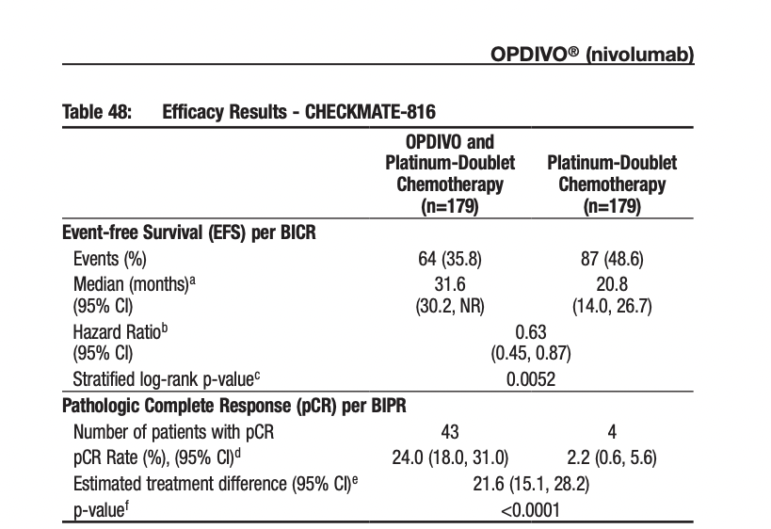
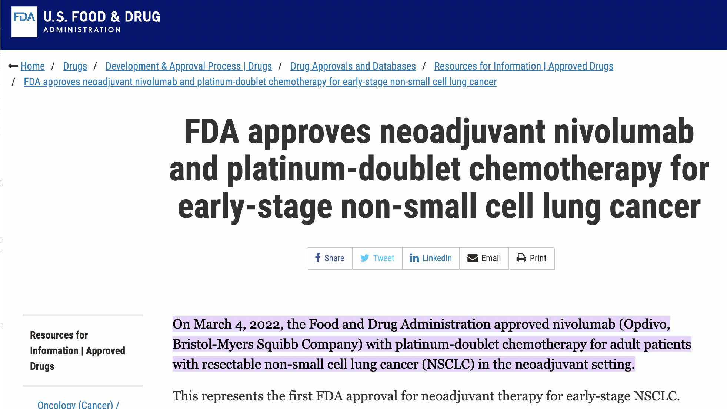
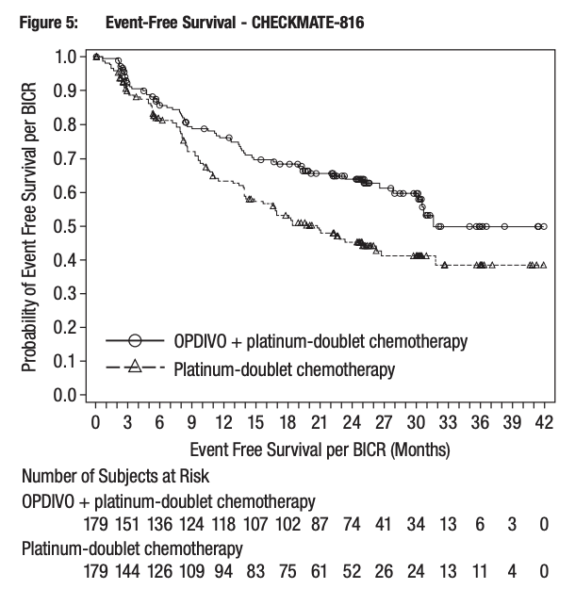
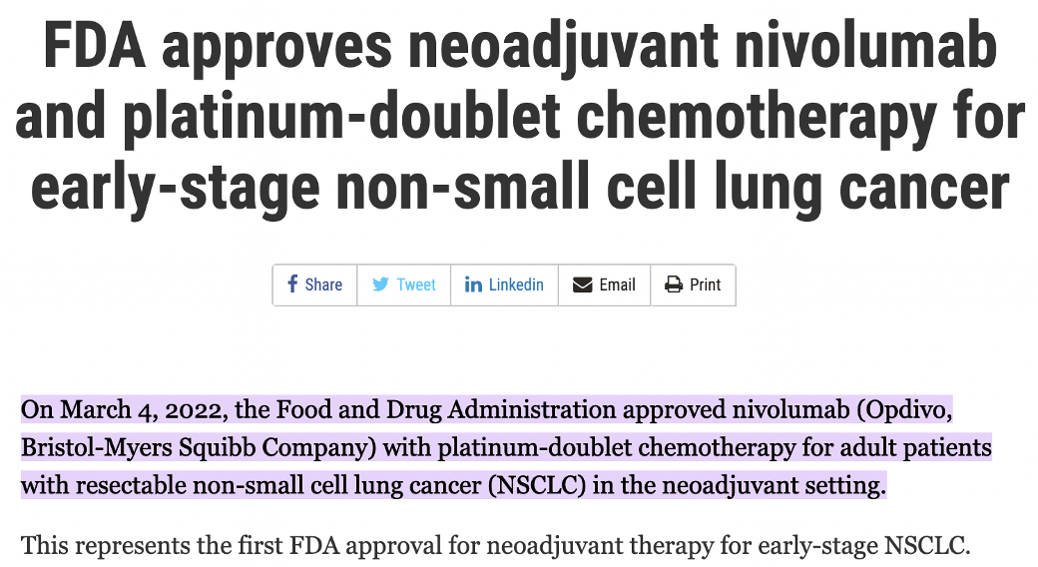
Neoadjuvant Nivolumab Approved for Early-Stage NSCLC
Nivolumab Prescribing Information 4 March 2022

Slide 49
Neoadjuvant Nivolumab Plus Chemotherapy
Approved by FDA 4 MAR 2022
14.3 Neoadjuvant Treatment of Resectable (Tumors ≥4 cm or Node Positive) Non-Small Cell Lung Cancer CHECKMATE-816 (NCT02998528) was a randomized, open label trial in patients with resectable NSCLC. The trial included patients with resectable, histologically confirmed Stage IB (≥4 cm), II, or IIIA NSCLC (per the 7th edition American Joint Committee on Cancer/Union for International Cancer Control (AJCC/UICC) staging criteria), ECOG performance status 0 or 1, and measurable disease (per RECIST version 1.1). Patients with unresectable or metastatic NSCLC, known EGFR mutations or ALK translocations, Grade 2 or greater peripheral neuropathy, active autoimmune disease, or medical conditions requiring systemic immunosuppression were excluded from the study
Nivolumab Prescribing Information 4 MAR 2022

Slide 50


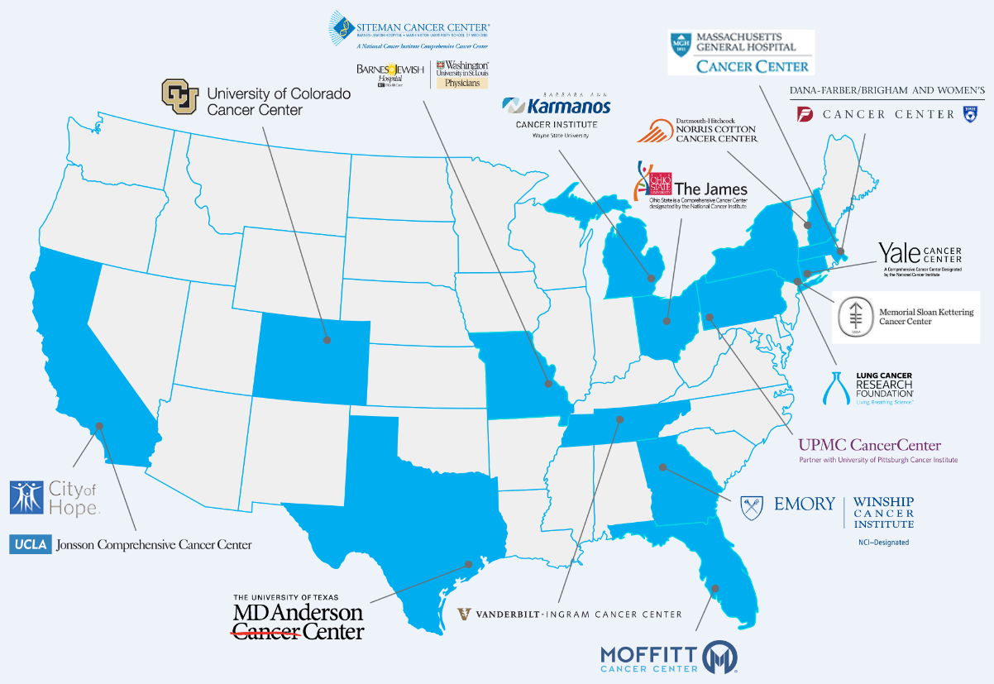

NTRK
HER2 Mutation
MET Mutation
BRAF V600E
MET Amp
RET
EGFR
Exon 20 EGFR
ROS1
KRAS G12C
HER2 Amp
ALK
Resectable I-IIIB (8th ed)
Enroll with local tissue genotyping or ctDNA
LCMC LEADER Neoadjuvant
Screening Trial:
NCT
LCMC4 Evaluation of Actionable Drivers
in Early Stage Lung Cancers
04712877
Genentech
ALK/NTRK/ROS1/RET/KRASG12C
Alectinib/Vemurafinib+/Entrectinib/Pralsetinib/Divarasib
NAUTIKA1 - NCT04302025
AstraZeneca
EGFR
Osimertinib + Chemotherapy
NeoADAURA - NCT04351555
MSKCC
HER2 Mutation
Trastuzumab Deruxtecan
MDACC
KRAS G12C
Sotorasib
JHMI
KRAS G12C
Adagrasib
(TBA)
Exon 20 EGFR
Complete and major pathologic response assessment
Percent viable cells in resection specimen
Correlates in persister cells
Adjuvant therapy – per protocol or investigator’s choice

Slide 51
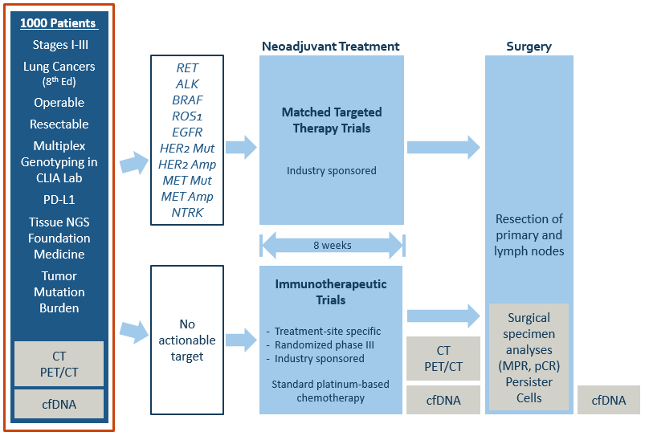
LCRF LEADER Neoadjuvant Screening Trial: LCMC4 Evaluation of Actionable Drivers in Early Stage Lung Cancers

Slide 52
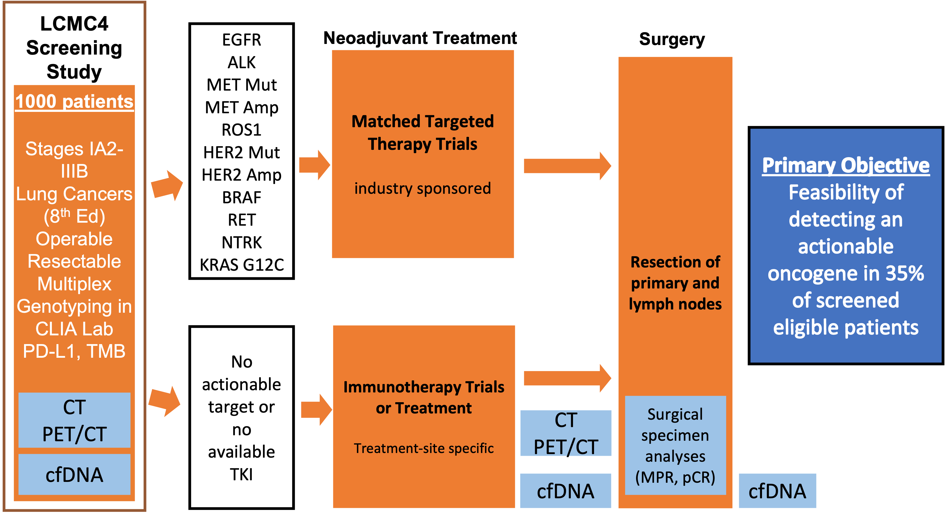
LCMC LEADER Neoadjuvant Screening Trial
Chaft, Proc ASCO 2024

Slide 53
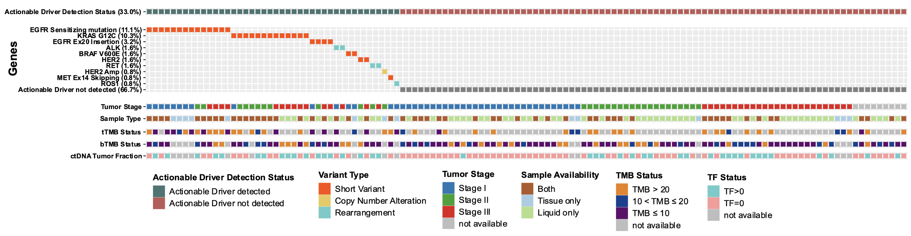
LCMC LEADER Neoadjuvant Screening Trial
Landscape of Actionable Alterations in Tissue and/or Liquid Samples (N=126)
Actionable oncogenes (33%, 42/126) were identified at a clinically meaningful rate, irrespective of stage (IA2-III) or smoking history
In patients with only a liquid biopsy (n=59) an actionable oncogene was found in 17%
In patients with tumor NGS testing (n=67) an actionable oncogene was found in 48%
In paired tissue and liquid with ctDNA TF > 0 (n=56) pairs, positive and negative predictive associations were 100%
Biomarker testing is essential as it may change therapy in nearly half of patients
Chaft, ASCO, 2024

Slide 54
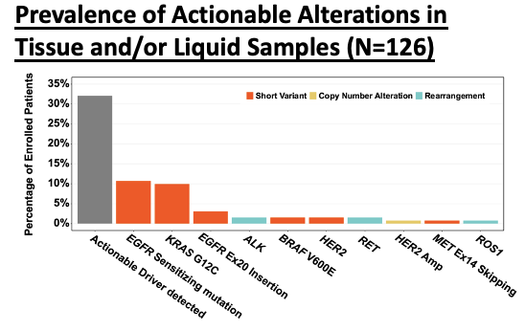
LCMC LEADER Neoadjuvant Screening Trial
Chaft, ASCO, 2024

Slide 55
Definitions of Resectable and Operable
Resectable: A complete resection (R0) can be achieved based on status today
Operable: The surgery required to achieve a complete resection can be performed with acceptable risk

Slide 56
How to Choose Between Surgery and Radiation for Fit Patients with Clinical Stage 3 Lung Cancers that are Operable and Resectable?
Primary Tumor Size – Amenable to Radiation?
Institutional Expertise and Resources
Institutional Experience with the Regimen
Patient Preference

Slide 57
What Percent of Patients with Clinical Stage II & III Lung Cancer Receive Adjuvant Chemotherapy? Less than Half…
Entered cIB-IIIB
181
Neoadjuvant Atezolizumab
Surgery
159
R0 Resection
137
Any Adjuvant Chemotherapy
55
% of all patients enrolled: 30%
% of patients with RO Resections: 40%
LCMC3 Neoadjuvant Atezolizumab
Chaft et al, Nat Med 2022

Slide 58
Local Recurrences Have Replaced Distant Recurrences in
Trials of Adjuvant Targeted Therapies in Lung Cancers
Adjuvant Osimertinib +/- Chemotherapy
Recurrences | 37
Local +/-Distant | 31 | 84%
Adjuvant Alectinib
Recurrences | 15
Local +/-Distant | 11 | 73%
Wu, NEJM, 2022
Wu, NEJM, 2024

Slide 59
Local Recurrences Have Replaced Distant Recurrences in Trials of Adjuvant Immunotherapies in Lung Cancers
Adjuvant Pembrolizumab + Chemotherapy (n=590)
Recurrences | 157
Local +/- Systemic | 89 | 57%
Adjuvant Atezolizumab + Chemotherapy (n=507)
DFS Events | 187
Local +/- Systemic
O’Brien, Lancet Onc, 2022
Felip, Lancet Onc, 2021

Slide 60
Treatment of Stages I-III Lung Cancers 2024
Adenocarcinoma
Squamous Cell Carcinoma
Operable
Resectable
Clinical
Stages I-IIIB
High Response Oncogenic Driver Detected
EGFR, ALK, RET, Ros1, NTRK
NGS
Testing
No Oncogenic Driver or Low Response(<50%) Oncogenic Driver Detected

Slide 61
Treatment of Stages I-III Lung Cancers
No or Low Response Oncogenic Driver Detected
Chemotherapy
Surgery
PORT Radiation
Therapy (N2)
Immune Checkpoint Inhibitor
Chemotherapy
Immune Checkpoint Inhibitor
Radiation Therapy
Surgery
Chemotherapy
PORT Radiation
Therapy (N2)
Immune Checkpoint Inhibitor
~1 Year

Slide 62
Treatment of Stages I-III Lung Cancers
No or Low Response Oncogenic Driver Detected
Chemotherapy
Surgery
PORT Radiation
Therapy (N2)
Immune Checkpoint Inhibitor
Chemotherapy
Immune Checkpoint Inhibitor
Radiation Therapy
Surgery
Chemotherapy
PORT Radiation
Therapy (N2)
Immune Checkpoint Inhibitor
~1 Year

Slide 63
Treatment of Stages I-III Lung Cancers
High Response Oncogenic Driver Detected
Targeted Therapy
Chemotherapy
Surgery
PORT Radiation Therapy (N2)
Targeted Therapy
Chemotherapy
Targeted Therapy
Radiation Therapy
Chemotherapy
Surgery
PORT Radiation Therapy (N2)
Targeted Therapy
Surgery
Chemotherapy
PORT Radiation Therapy (N2)
Targeted Therapy
~3 Years

Slide 64
Treatment of Stages I-III Lung Cancers
High Response Oncogenic Driver Detected
Targeted Therapy
Surgery
PORT Radiation Therapy (N2)
Targeted Therapy
Chemotherapy
Chemotherapy
Targeted Therapy
Radiation Therapy
Chemotherapy
Surgery
PORT Radiation Therapy (N2)
Targeted Therapy
Surgery
Chemotherapy
PORT Radiation Therapy (N2)
Targeted Therapy
~3 Years

Slide 65
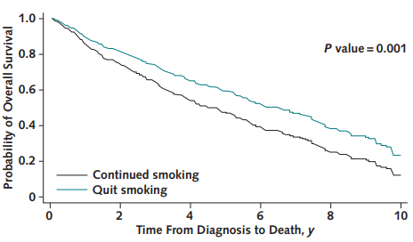
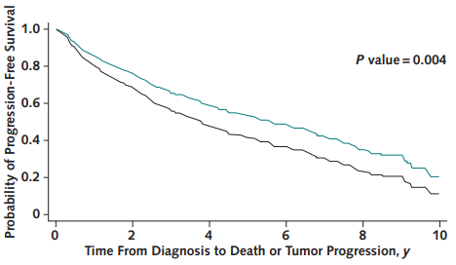
Effect of quitting smoking postdiagnosis on overall and progression-free survival:
stage I-III lung Cancers
14% Better
5 Yr Survival
10% Better
5 yr Progression-Free
Survival
Sheikh, Ann Intern Med 2021

Slide 66
Treatment of Early–Stage Lung Cancers
Take Home Messages
Targeted agents and checkpoint inhibitors have revolutionized therapy for locally advanced lung cancers
The goal of care is cure. The risk-benefit analysis in early stage cancers is different than when caring for patients with extra-thoracic metastases
All members of the multimodality team need to promote and support the overall regimen and not just individual components
The time is now for NGS testing of all lung tumors at diagnosis
Achieving optimal results requires even closer attention to the selection, sequence, timing, and sequential or concomitant use of all available therapies

Slide 67
LUNG CANCER
July 18th, 2024

Slide 68
Discussion / Debate
Neoadjuvant VS Adjuvant Therapies

Slide 69
Networking Reception
We will return at 7:50 pm.

Slide 70
ROS1 and NRG1 in NSCLC
(I still haven’t found what I’m looking for …)
Paul K. Paik, MD
Clinical Director, Thoracic Oncology Service
Memorial Sloan-Kettering Cancer Center

Slide 71
Overview
ROS1 fusion NSCLC
  Brief background
  Focus on NVL-520/ARROS-1 as newest trial candidate
NRG1 fusion NSCLC
  Brief background
  Focus on zenocutuzumab as potential future therapy

Slide 72
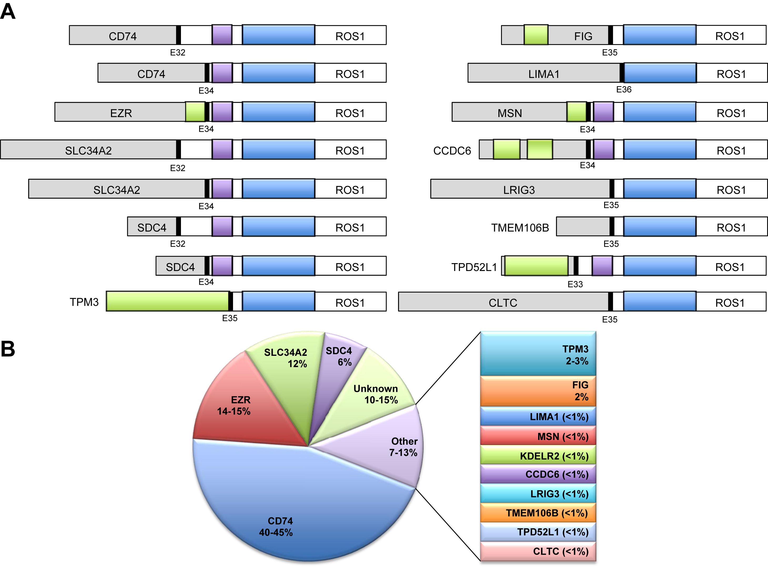
ROS1 overview
Lin et al. JTO 2017

Slide 73
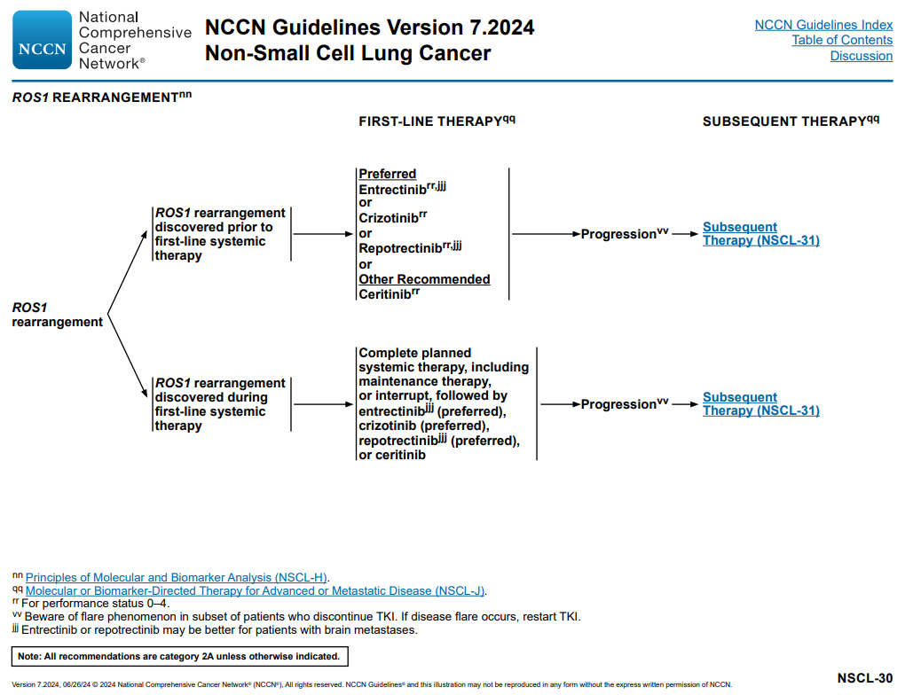
ROS1 therapy recommendations

Slide 74
ROS1 trials as of 2024
Drug | Target | Line | NCT # | N | ORR | PFS
Crizotinib¹ | ROS1 | 1-3 | NCT00585195 (PROFILE 1001) | 50 | 72% | 19.2 months PFS (14.4,NR) 18.3 months DOR (12.7,NR)
Lorlatinib² | ROS1 | 1 | NCT01970865 | 13 | 61.5% (31.6,86.1) | 21 months (4.2,26.7)
 |  | >1 | NCT01970865 | 34 | 26.5% (12.9, 44.4) | 8.5 months (4.4, 18.0)
Brigatinib⁵ | ROS1 | 2 | NA | 19 | 26.3% (9.1-51.2) | 7.3 months (1.3-9.3)
Certinib³ | ROS1 | 1 | - | 30 | 67% (48-81) | 19.3 months (1, 37)
Entrectinib⁴ | ROS1 | 1 | NCT02097810 (STARTRK-1) NCT02568267 (STARTRK-2) EudraCT 2012-000148-88 (ALK) | 53 | 77.4% (63.8,87.7) | 19.0 months PFS (12.2,36.6) 24.6 months DOR (11.4,34.8)
Repotrectinib⁶ | ROS1 | 1 | NCT03093116 (TRIDENT-1) | 56 | 79% (68,88) | 35.7 months PFS (27.4,NR) 34.1 months (25.6, NR)
1. Shaw et al. NEJM 2014; 2.Ou et al. IASLC WCLC 2018; 3. Lim et al. JCO 2017; 4. Drilon et al. Lancet Oncol 2019; 5. Daga et al. ASCO 2021; 6. Drilon et al. NEJM 2024

Slide 75
ROS1 TKIs: visual efficacy map
n=56
Repotrectinib
n=19
Brigatinib

Slide 76
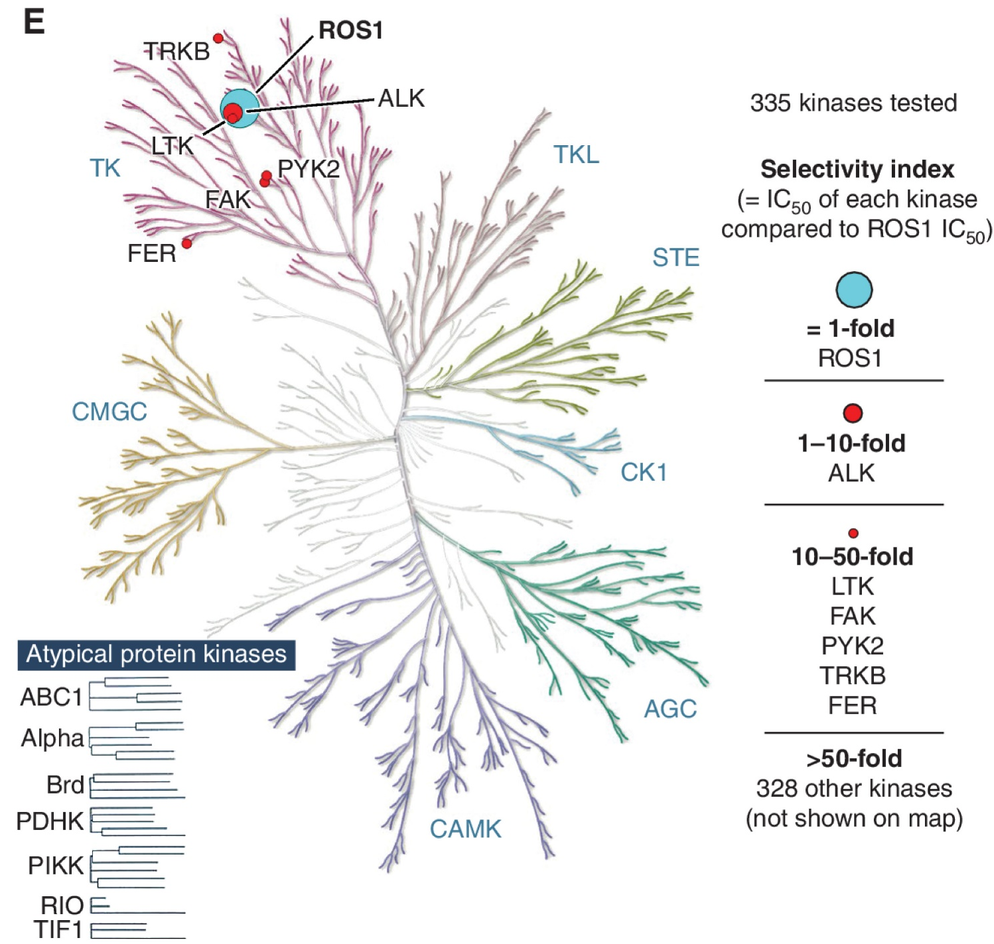

NVL-520: G2032R selective, CNS-penetrant TKI
Drilon et al., Cancer Discovery 2023

Slide 77
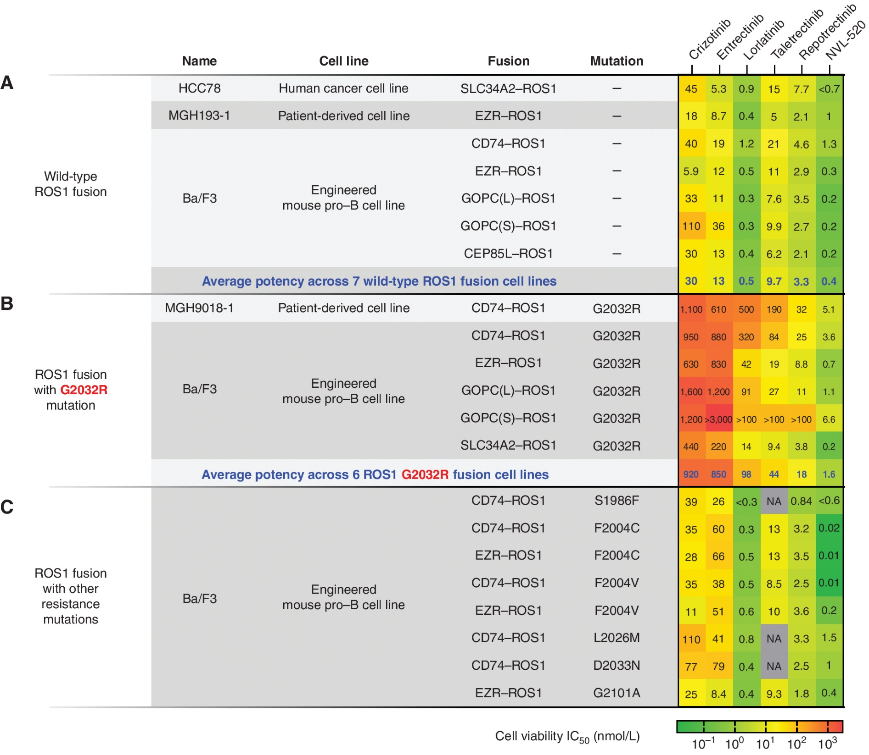
NVL-520 ROS1 mutation selectivity
Drilon et al., Cancer Discovery 2023

Slide 78
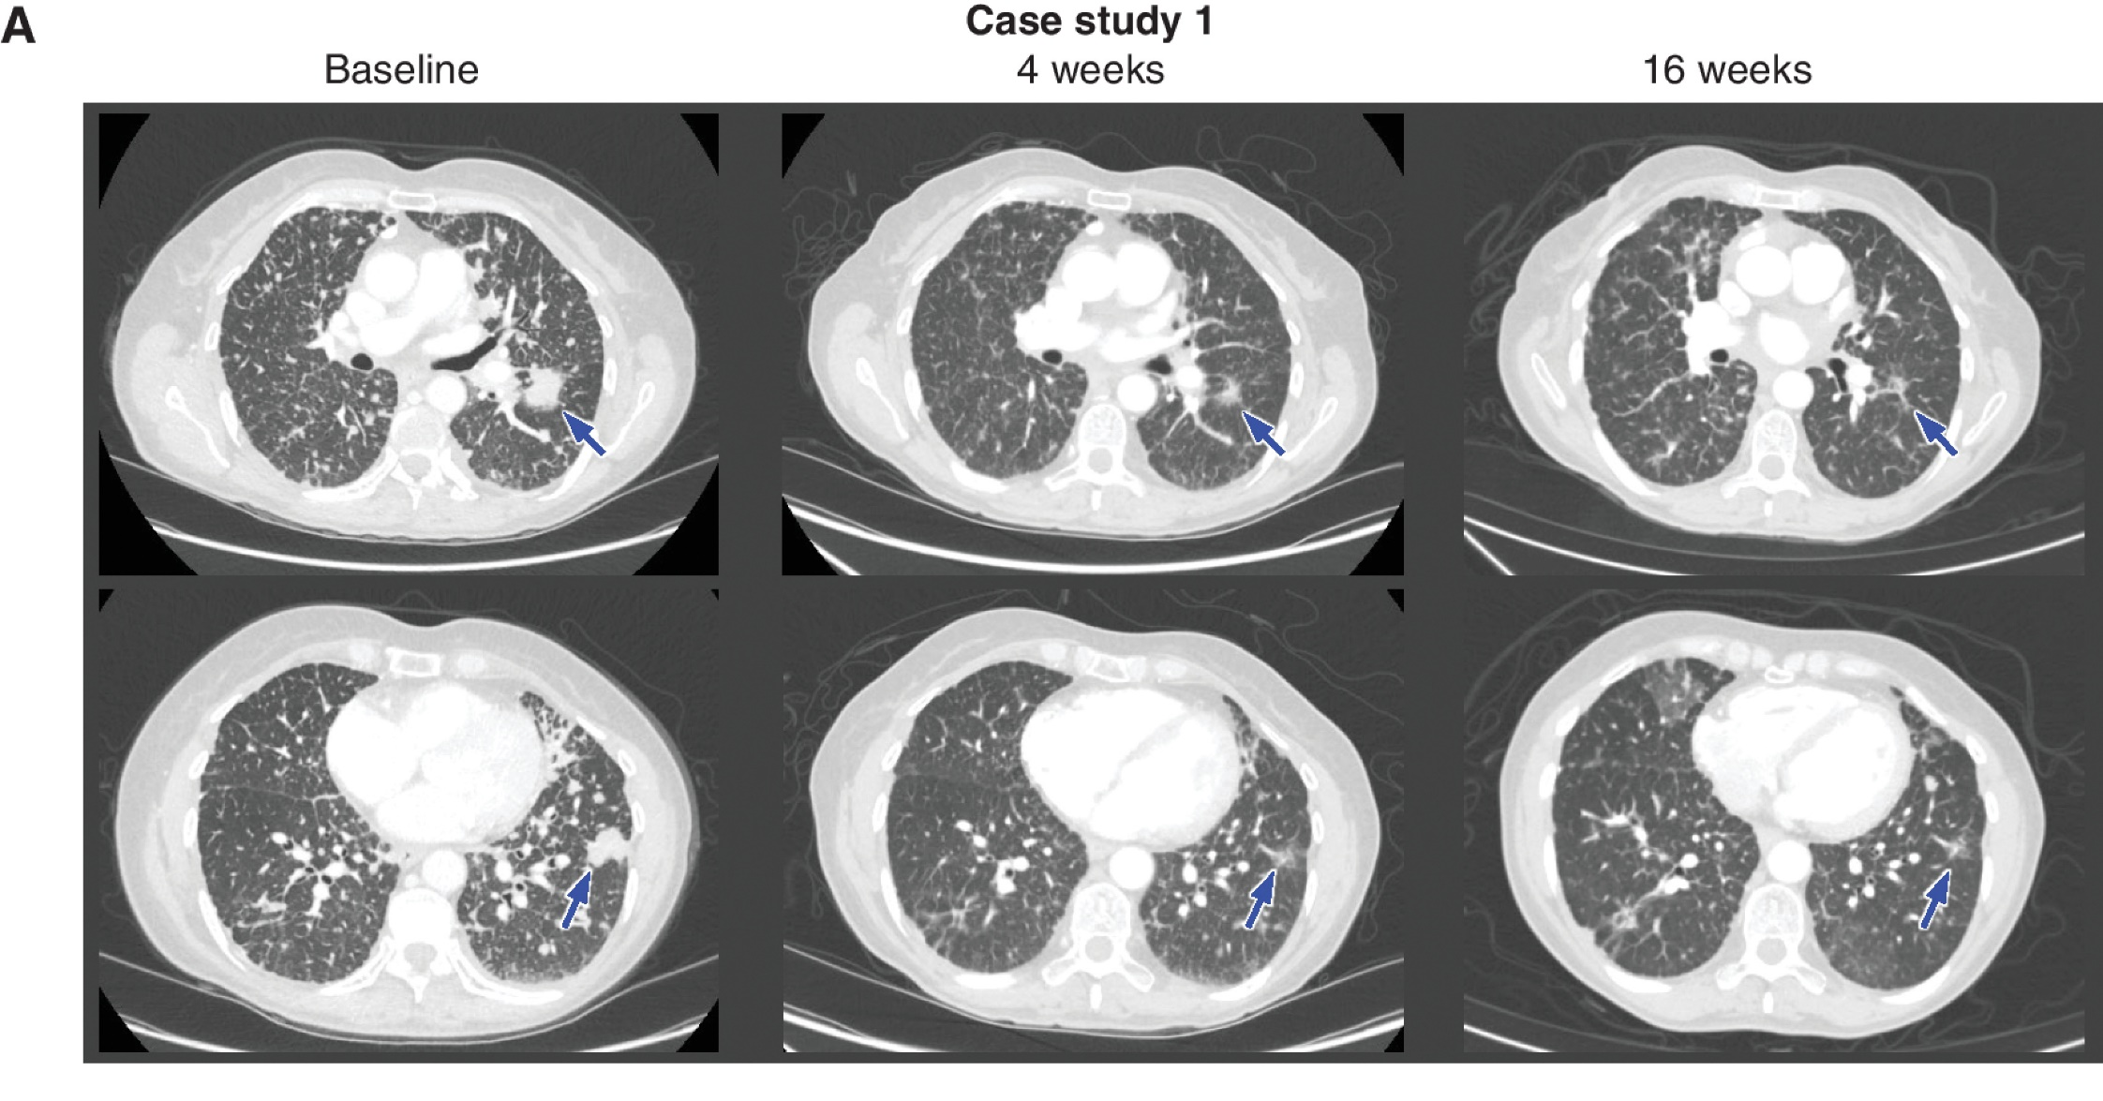
ARROS-1 example 1
CD74-ROS1 G2032R+
Prior crizotinib, lorlatinib, chemotherapy
NVL-520 25->75mg qd
Drilon et al., Cancer Discovery 2023

Slide 79
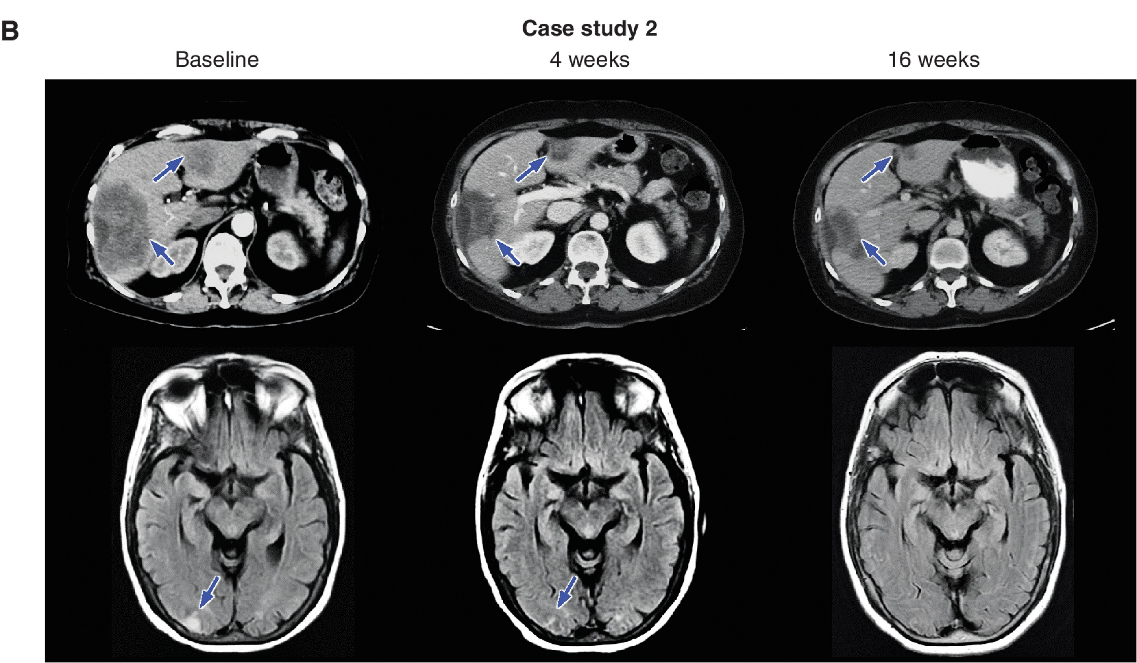
ARROS-1 example 2
EZR-ROS1 G2032R mutation
Prior entrectinib, repotrectinib, chemotherapy
NVL-520 50mg->75mg
Drilon et al., Cancer Discovery 2023

Slide 80
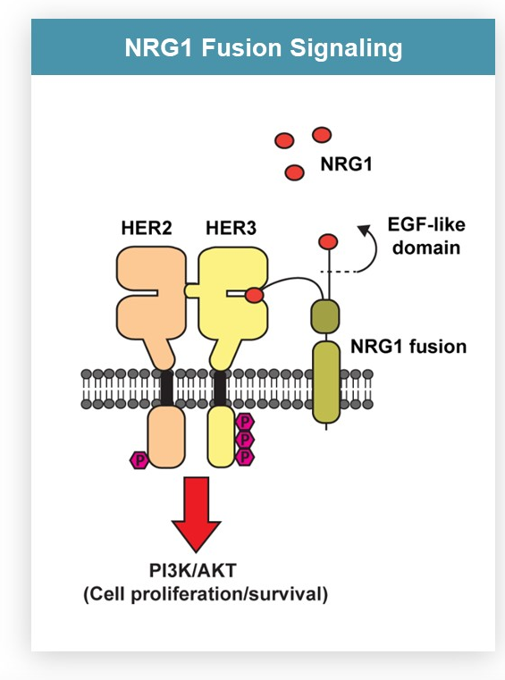
NRG1 fusions
Rare, though actionable fusion events across many cancer types
Structurally encodes an EGF-like domain that can bind o HER3
HER-pathway inhibitors have been a focus of clinical development as a result
Zenocutuzumab FDA fast track designation 2023, priority review 2024

Slide 81
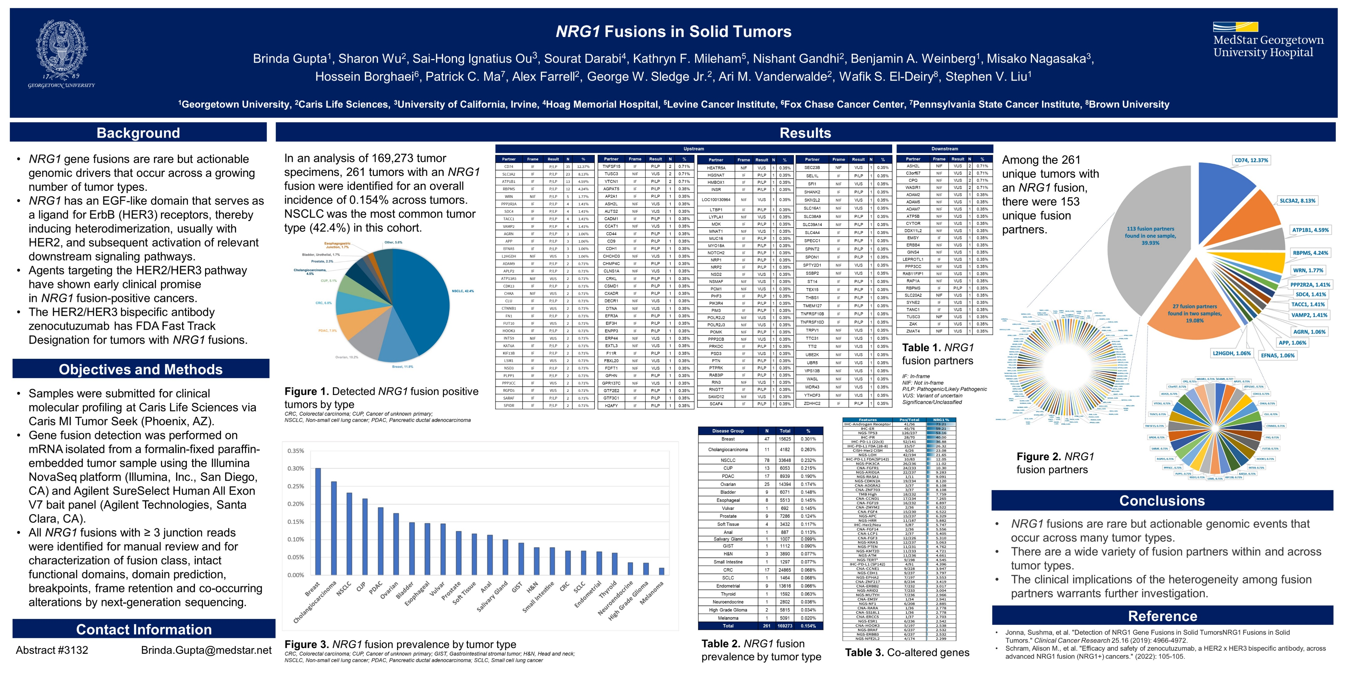
NRG1 fusion landscape
Gupta et al. ASCO 2023

Slide 82
NRG1 fusion partners are many and varied
Gupta et al. ASCO 2023

Slide 83
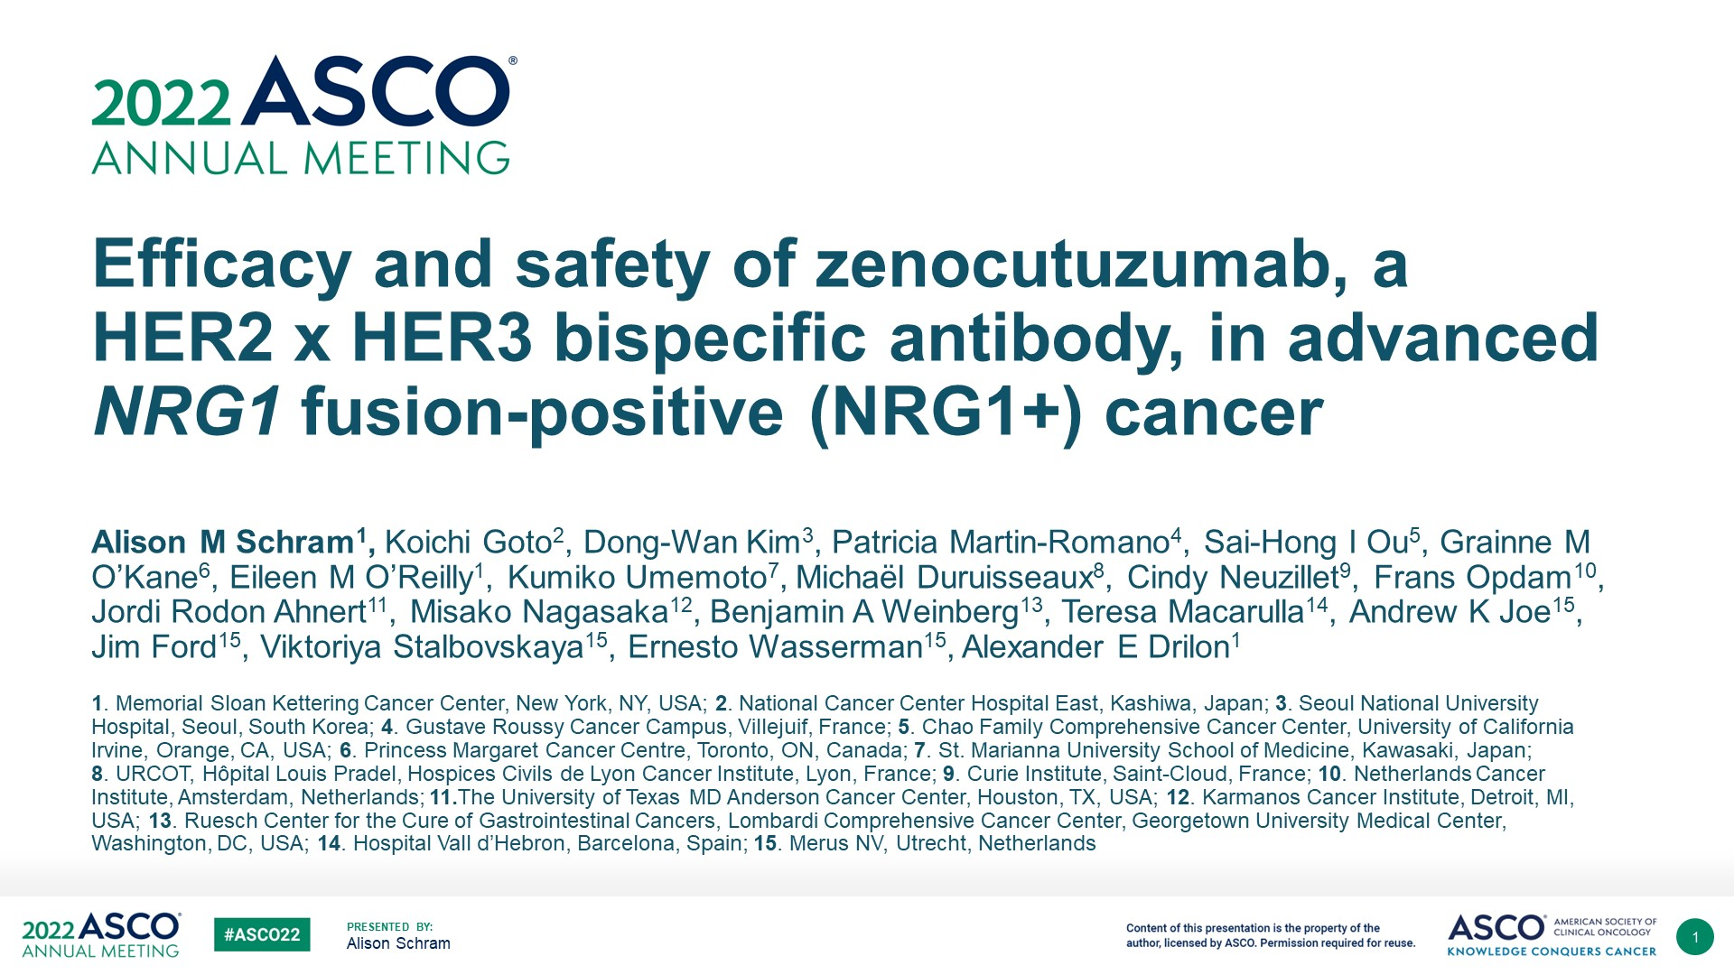

Slide 84
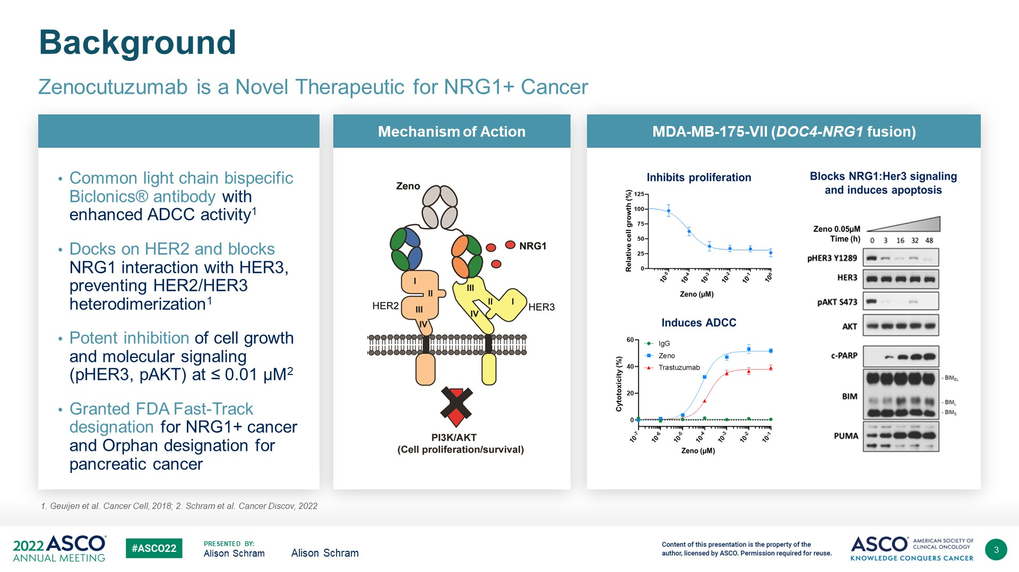
Zenocutuzumab
Schram et al. ASCO 2022

Slide 85
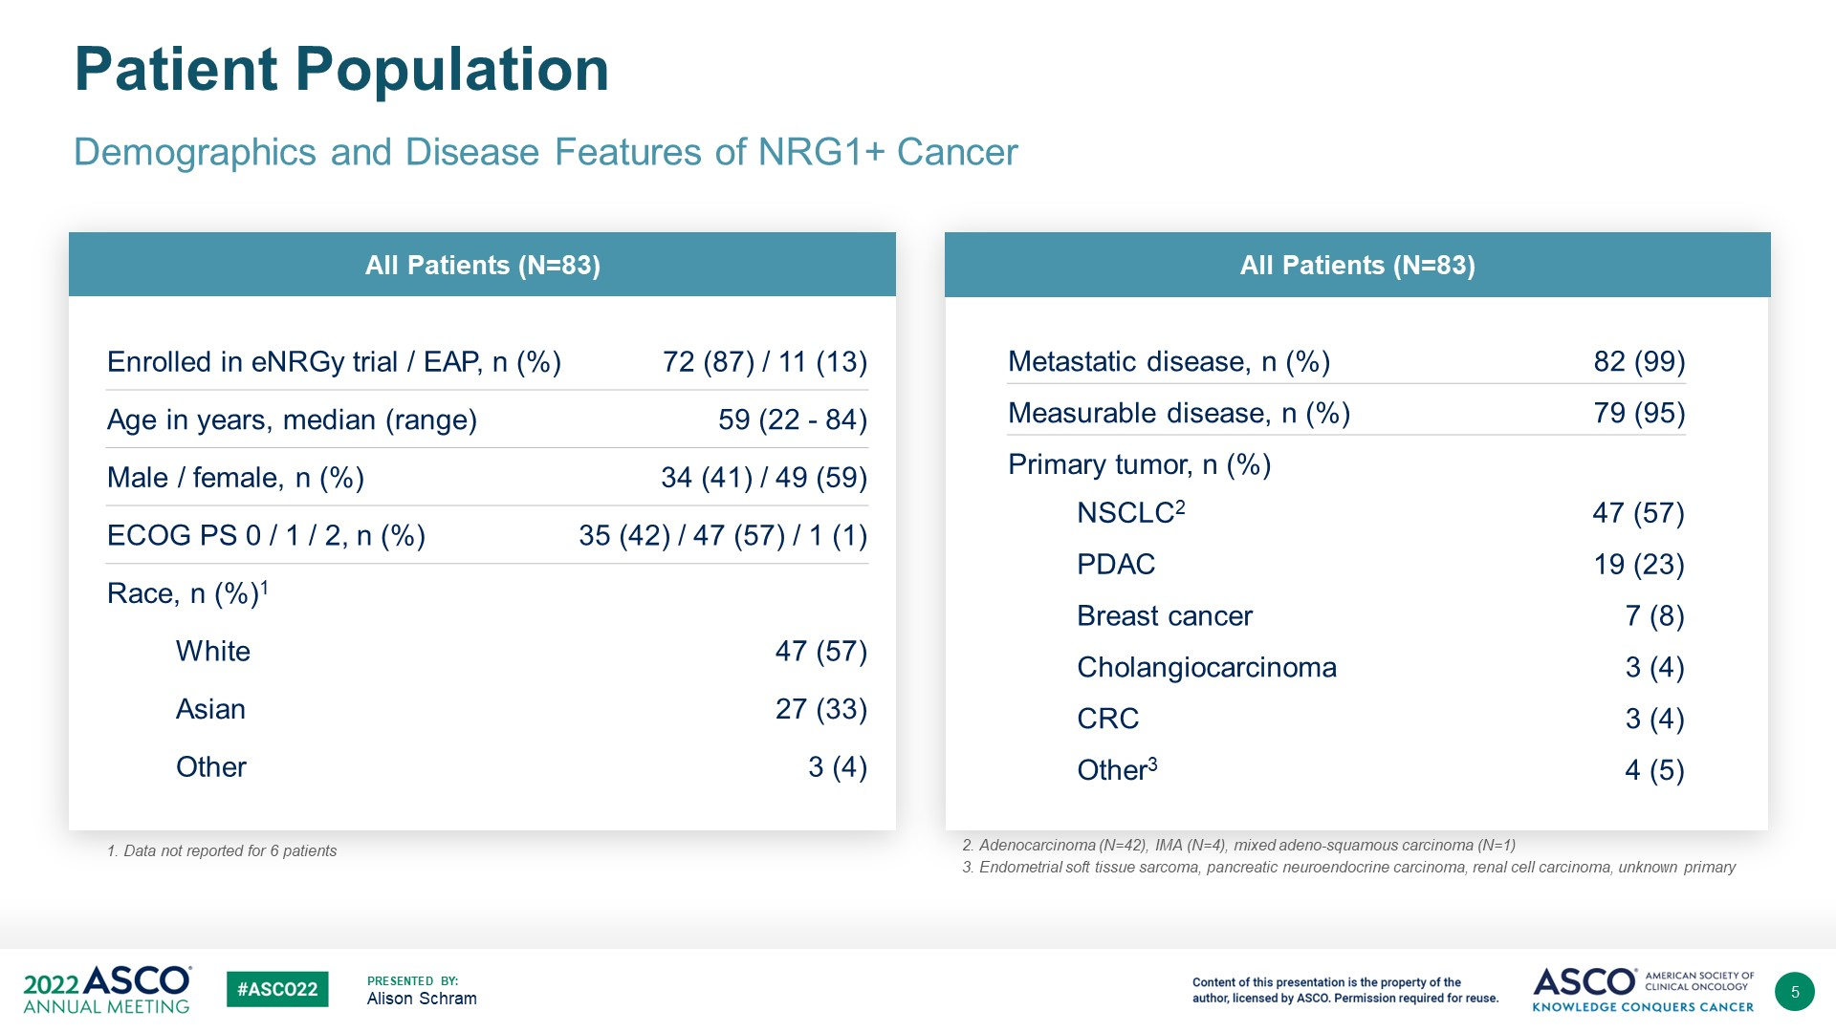
Patient characteristics
Schram et al. ASCO 2022

Slide 86
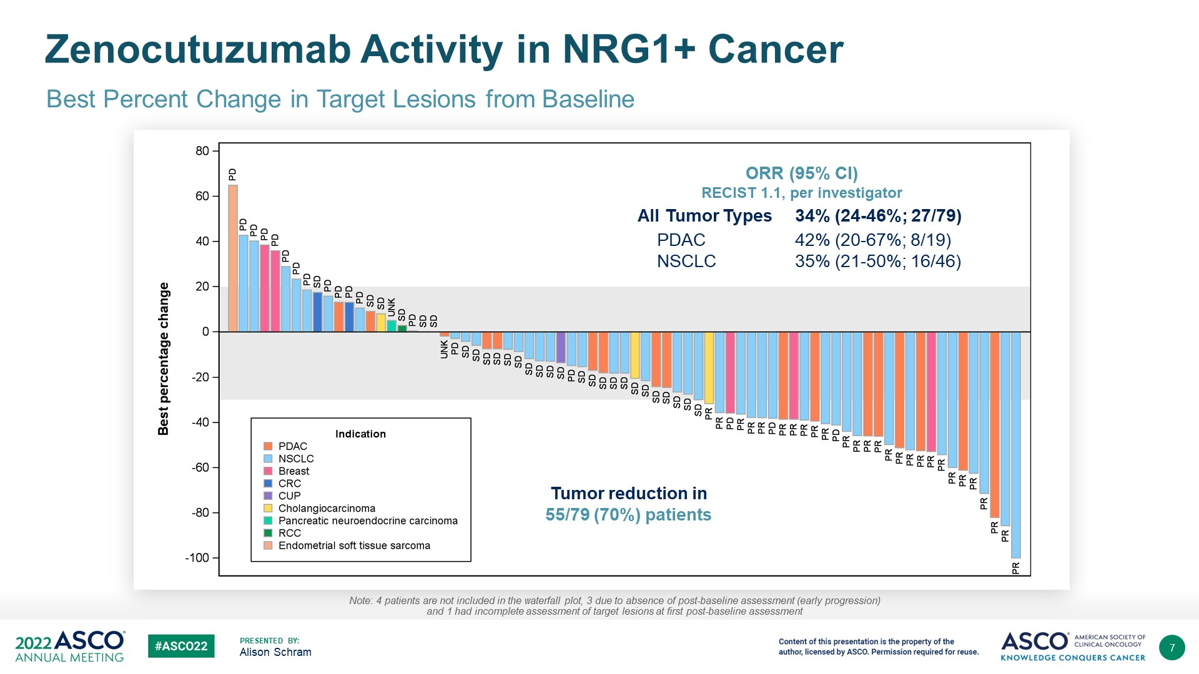
Radiographic response- ORR 35%
Schram et al. ASCO 2022

Slide 87
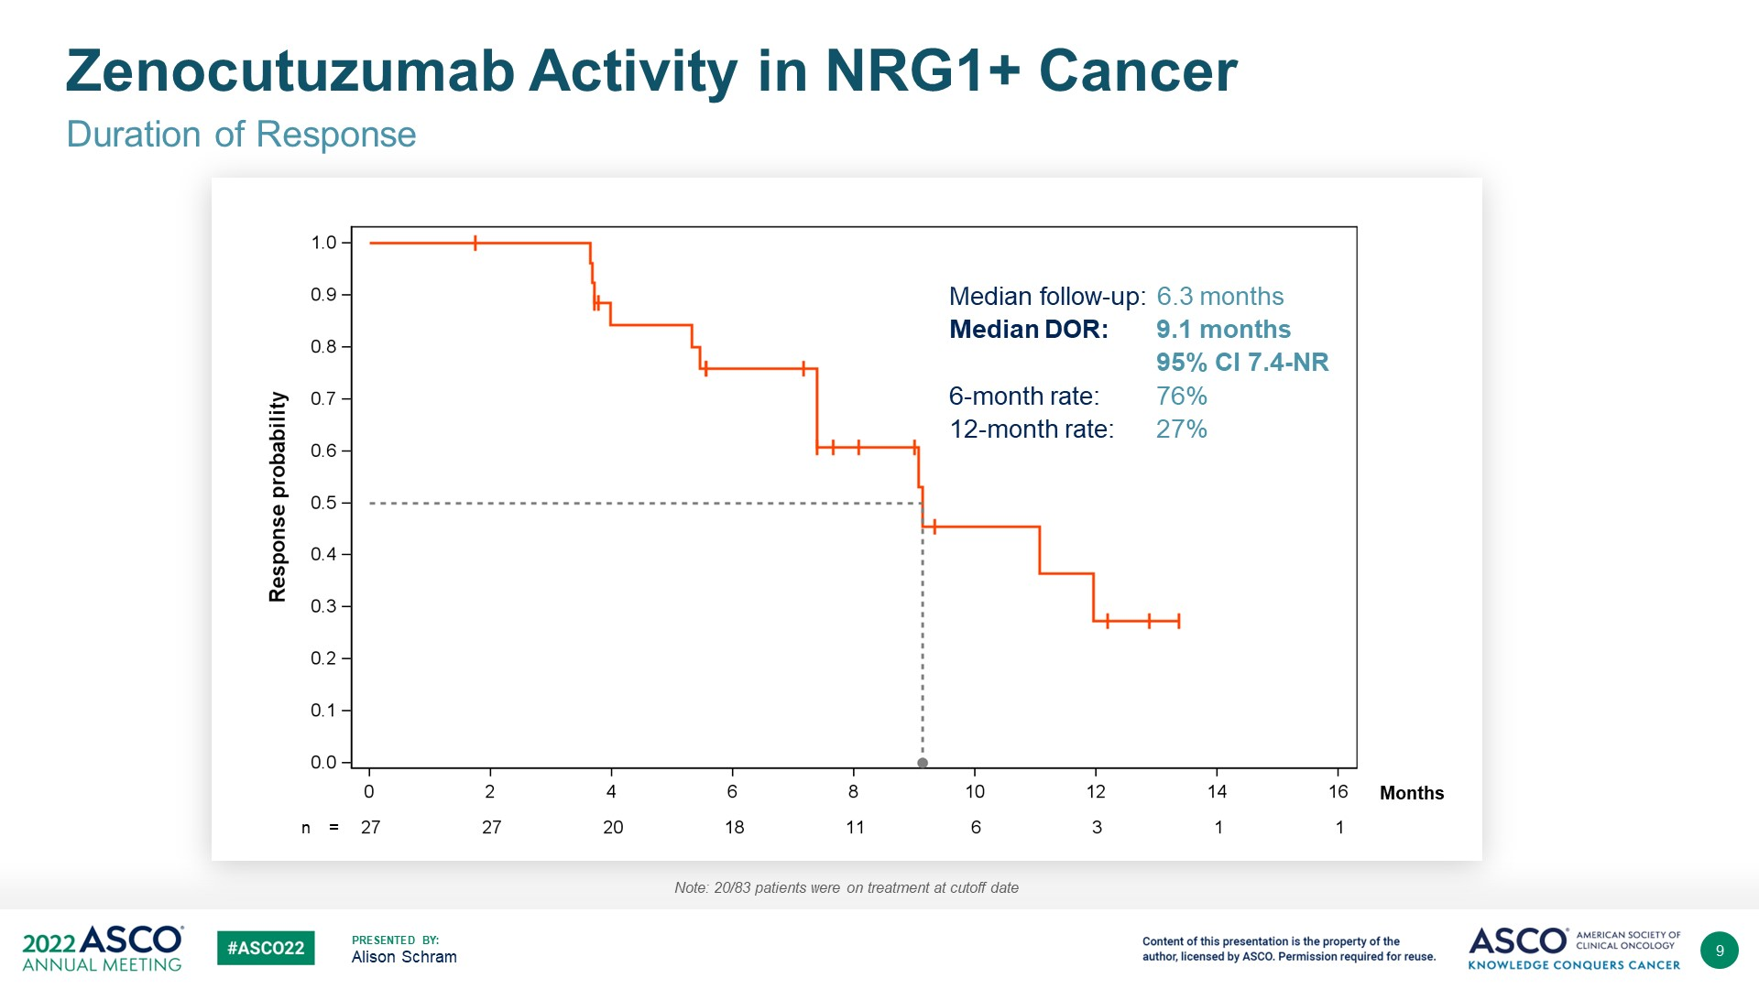
Duration of response
Schram et al. ASCO 2022

Slide 88
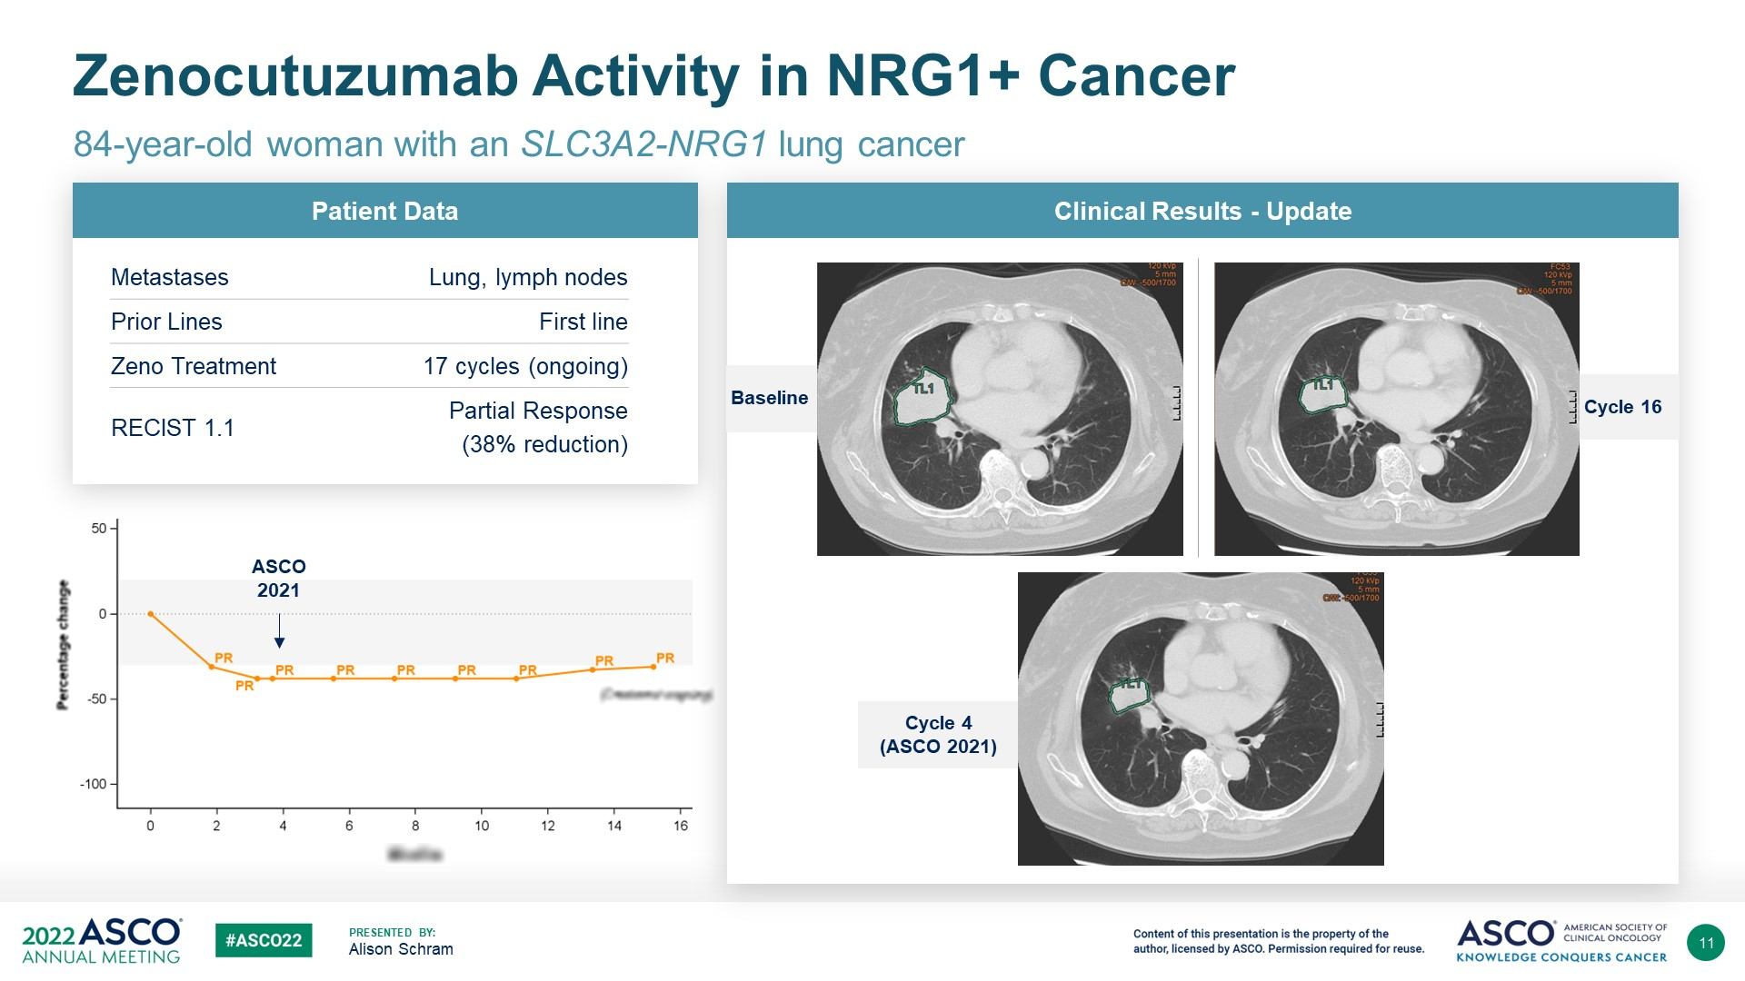
Case example
Schram et al. ASCO 2022

Slide 89
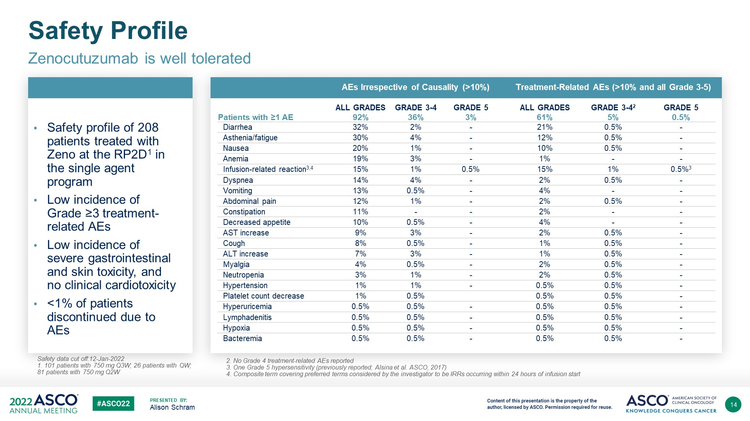
Safety: GI-related
Schram et al. ASCO 2022

Slide 90
Thank you!

Slide 91
LUNG CANCER
July 18th, 2024

Slide 92
ADCs in Lung Cancer
Alissa Cooper, MD
Assistant Attending, L1
Memorial Sloan Kettering Cancer Center
New York, NY

Slide 93
HERTHENA-Lung01: HER3-DXd
Patritumab Deruxtecan (HER3-DXd) in EGFR-Mutated NSCLC Following EGFR TKI and Platinum-Based Chemotherapy: HERTHENA-Lung01
Helena A. Yu,¹ Yasushi Goto,² Hidetoshi Hayashi,³ Enriqueta Felip,⁴ James Chih-Hsin Yang,⁵ Martin Reck,⁶ Kiyotaka Yoh,⁷ Se-Hoon Lee,⁸ Luis Paz-Ares,⁹ Benjamin Besse,¹⁰ Paolo Bironzo,¹¹ Dong-Wan Kim,¹²
Melissa L. Johnson,¹³ Yi-Long Wu,¹⁴ Qian Dong,¹⁵ Pang-Dian Fan,¹⁵ Pomy Shrestha,¹⁵
David W. Sternberg,¹⁵ Dalila Sellami,¹⁵ Pasi A. Jänne¹⁶
¹Department of Medicine, Medical Oncology, Memorial Sloan Kettering Cancer Center, New York, NY, USA; ²National Cancer Center Hospital, Tokyo, Japan; ³Kindai University, Osaka, Japan; ⁴Vall d’Hebron University Hospital and Vall d’Hebron Institute of Oncology, Barcelona, Spain; ⁵National Taiwan University Hospital, Taipei City, Taiwan; ⁶Department of Thoracic Oncology, Airway Research Center North, German Center for Lung Research, LungenClinic Grosshansdorf, Grosshansdorf, Germany; ⁷National Cancer Center Hospital East, Kashiwa, Japan; ⁸Division of Hematology-Oncology, Department of Medicine, Samsung Medical Center, Sungkyunkwan University School of Medicine, and Department of Health Sciences and Technology, Samsung Advanced Institute for Health Sciences & Technology, Sungkyunkwan University, Seoul, Republic of Korea; ⁹Hospital Universitario 12 de Octubre, Spanish National Cancer Research Center, Universidad Complutense and CIBERONC, Madrid, Spain; ¹⁰Université Paris-Saclay, Gustave Roussy, Villejuif, France; ¹¹Department of Oncology, University of Torino, Torino, Italy; ¹²Department of Internal Medicine, Seoul National University College of Medicine and Seoul National University Hospital, Seoul, Republic of Korea; ¹³Tennessee Oncology, Sarah Cannon Research Institute, Nashville, TN, USA; ¹⁴Guangdong Lung Cancer Institute, Guangdong Provincial People’s Hospital, Southern Medical University, Guangzhou, China; ¹⁵Daiichi Sankyo, Inc, Basking Ridge, NJ, USA; ¹⁶Dana-Farber Cancer Institute, Boston, MA, USA
Presented at WCLC 2023

Slide 94
HERTHENA-Lung01 Study Designsign¹
HER3-DXd IV Q3W
Fixed dose
5.6 mg/kg
Enrollment continued
(N=225)^{b}
Patient population
Advanced EGFR-mutated NSCLC
Progression on most recent systemic therapy
Prior EGFR TKI and prior platinum-based chemotherapy (amended protocol required prior osimertinib)
Inactive or previously treated asymptomatic brain metastases allowed
Pretreatment tumor tissue required​ª
5.6 mg/kg
Primary endpoint
cORR by BICR​
Key secondary endpoint
DOR by BICR
February 18, 2021
February 18, 2022
R
1:1
Decision point
A benefit-risk assessment of phase 1 data supported the closure of the uptitration arm
Uptitration
C1D1: 3.2 mg/kg
C2D1: 4.8 mg/kg
C3D1 and later cycles: 6.4 mg/kg
Enrollment discontinued (N=50)^{c}
January 18, 2021
September 16, 2021
Data cutoff: 21 Nov 2022^{d}
Data are presented for the 5.6-mg/kg fixed-dose arm
Median study follow-up, 13.1 (range, 9.0-21.6) months
Median treatment duration, 5.5 (range, 0.7-18.2) months
28 patients (12.4%) are ongoing with study treatment
Presented by: Helena A. Yu, WCLC 2023

Slide 95
Patient Characteristics
Baseline characteristics |  | HER3-DXd 5.6 mg/kg​ (N=225)
Age, median (range), years |  | 64 (37-82)
Female, n (%) |  | 132 (59)
Asian, n (%) |  | 105 (47)
Time since initial NSCLC diagnosis, median (range), months |  | 41.0 (9.1-224.7)
Sum of target lesion diameters at baseline (BICR), median (range), mm​ |  | 68 (11-248)
History of CNS metastasis, n (%) |  | 115 (51)
Brain metastasis at baseline (BICR), n (%) |  | 72 (32)
EGFR-activating mutations, n (%)^{b} | Ex19del | 142 (63)
 | L858R | 82 (36)
No. of prior lines of systemic therapy (locally advanced/metastatic) | Median (range) | 3 (1-11)^{c}
 | 2 prior lines, n (%) | 58 (26)
 | >2 prior lines, n (%) | 165 (73)
Prior cancer regimens, n (%) | Prior EGFR TKI therapy​ | 225 (100)
 | Prior third-generation EGFR TKI | 209 (93)
 | Prior platinum-based chemotherapy | 225 (100)
Presented by: Helena A. Yu, WCLC 2023

Slide 96
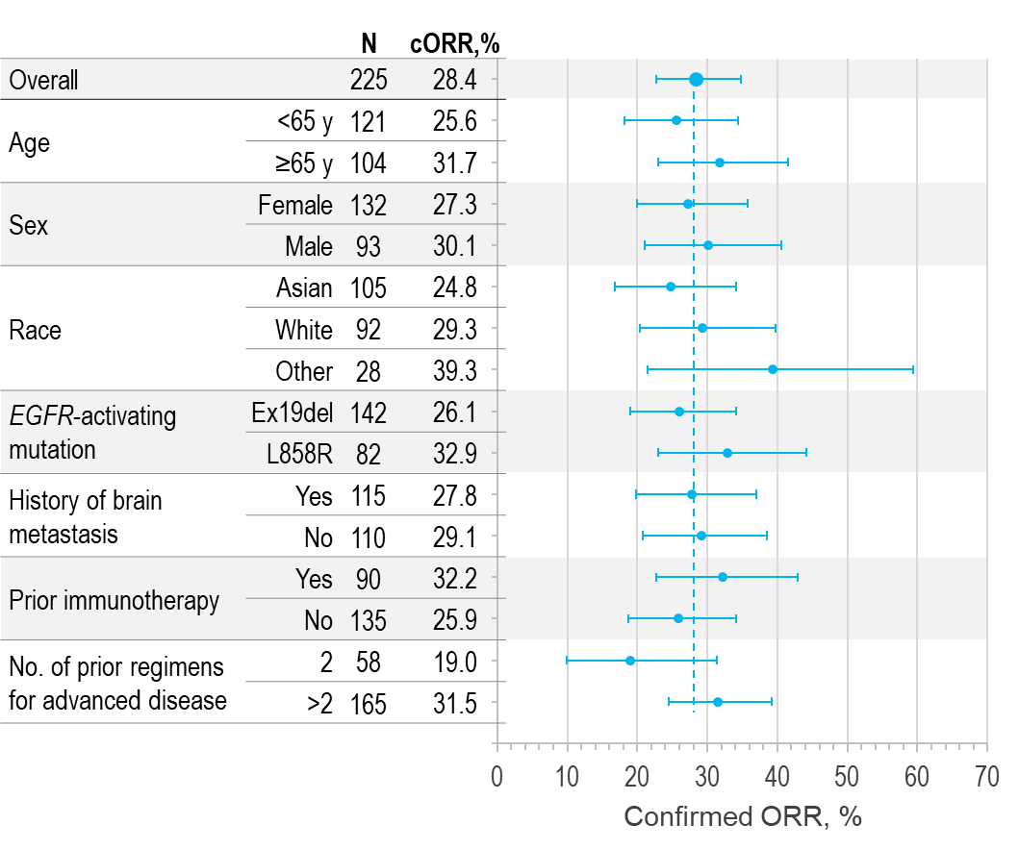
Clinical Efficacy
Confirmed responses and survival |  | Prior EGFR TKI (any) and PBC (N=225) | Subset with prior 3G EGFR TKI and PBC (n=209)
cORR​ (95% CI), % |  | 28.4 (22.6-34.8) | 28.2 (22.2-34.9)
Best overall response (BICR), n (%) | CR | 1 (0.4) | 1 (0.5)
 | PR | 63 (28.0) | 58 (27.8)
 | SD​ª | 102 (45.3) | 93 (44.5)
 | PD | 43 (19.1) | 41 (19.6)
 | NE^{​b} | 16 (7.1) | 16 (7.7)
DCR (95% CI), % |  | 73.8 (67.5-79.4) | 72.7 (66.2-78.6)
DOR, median (95% CI), mo |  | 6.0 (4.4-7.2) | 6.4 (4.4-7.2)
PFS, median (95% CI), mo |  | 5.5 (5.1-5.9) | 5.5 (5.1-6.4)
OS, median (95% CI), mo |  | 11.8 (11.2-12.6) | 11.8 (10.9-12.6)
cORR by Patient and Disease Characteristics at Study Entry
    Efficacy snapshot (6 months additional follow up):
    3 PRs confirmed, cORR 29.8% (95% CI, 23.9%-36.2%)
Presented by: Helena A. Yu, WCLC 2023
96

Slide 97
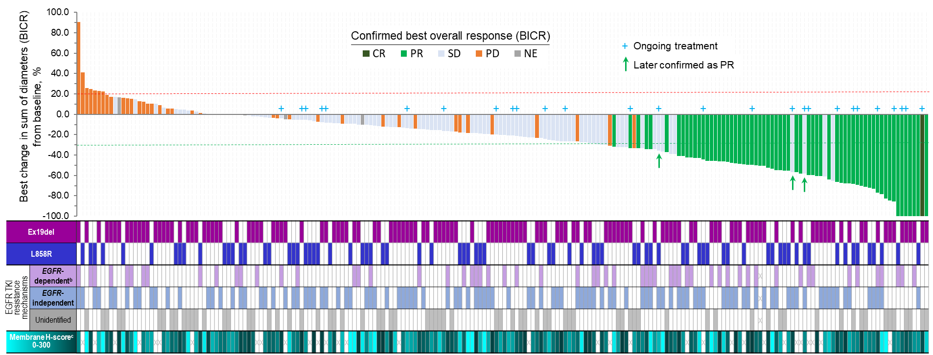
Tumor Reduction Across Diverse Mechanisms of EGFR TKI Resistance and Pretreatment Tumor HER3 Membrane Expression Levels
Tumor Reduction Across Diverse Mechanisms of EGFR TKI Resistance and
Pretreatment Tumor HER3 Membrane Expression Levels
HER3-DXd 5.6 mg/kg (N=225)ª
Presented by: Helena A. Yu, WCLC 2023
97

Slide 98
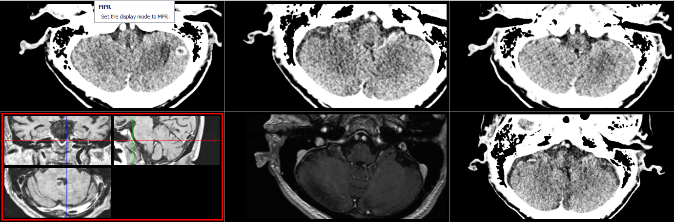
Intracranial Responses (by CNS BICR) Observed With HER3-DXd
Intracranial Efficacy of HER3-DXd in Patients With Brain Metastases at Baseline
Intracranial response by CNS BICR per CNS RECIST | Patients with brain metastasis at baseline and no prior radiotherapy (N=30)ª
Confirmed ORR (95% CI), % | 33.3 (17.3-52.8)
CR, n (%) | 9 (30.0)​^{b}
PR, n (%) | 1 (3.3)
SD, n (%)^{c} | 13 (43.3)
PD, n (%) | 4 (13.3)
NE, n (%) | 3 (10.0)
DOR, median (95% CI), mo | 8.4 (5.8-NE)
Complete CNS Response in 1 of 7 Patients With a Measurable CNS BICR Target Lesion
Screening
T1: LD, 11 mm
Week 6
T1: LD, 0 mm
Contrast enhanced CT scans
Presented by: Helena A. Yu, WCLC 2023
98

Slide 99
The Safety Profile of HER3-DXd Was Manageable and Tolerable
Most Common TEAEs Occurring in ≥15% of Patients (N=225)^{d}
Safety summary | HER3-DXd 5.6 mg/kg (N=225)
Any TEAE, n (%) | 224 (99.6)
Associated with treatment discontinuation​ª | 16 (7.1)
Associated with treatment dose reduction | 48 (21.3)
Associated with treatment dose interruption | 91 (40.4)
Associated with death​^{b} | 24 (10.7)
Grade ≥3 TEAE, n (%) | 146 (64.9)
Treatment-related TEAE, n (%) | 215 (95.6)
Associated with death​^{c} | 4 (1.8)
Grade ≥3 | 102 (45.3)
Serious TEAE | 34 (15.1)
Adjudicated interstitial lung disease, n (%) [All were adjudicated as treatment-related] | 12 (5.3)
Grade 1 | 1 (0.4)
Grade 2 | 8 (3.6)
Grade 3 | 2 (0.9)
Grade 4 | 0
Grade 5 | 1 (0.4)
66%
^{e}
44%
42%
^{e}
36%
34%
^{e}
33%
31%
27%
27%
^{e}
26%
25%
19%
19%
17%
17%
16%
^{e}
16%
Median treatment duration: 5.5 (range, 0.7-18.2) months.
    Any hematologic toxicities typically occurred early in treatment, were transient, and were not associated with clinical sequelae
Presented by: Helena A. Yu, WCLC 2023

Slide 100
Interpretations and Conclusions
HER3-DXd is an option for pts with EGFR-mutant NSCLC that has progressed on EGFR TKI and chemo given its activity across mechanisms of resistance and HER3 expression, though activity does appear modest overall
Adverse event profile characterized by cytopenias, fatigue, rare ILD, similar to unconjugated chemotherapies

Slide 101
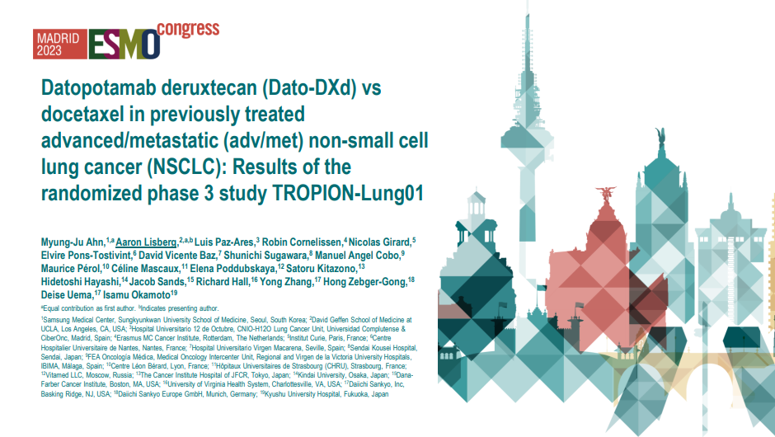

Slide 102
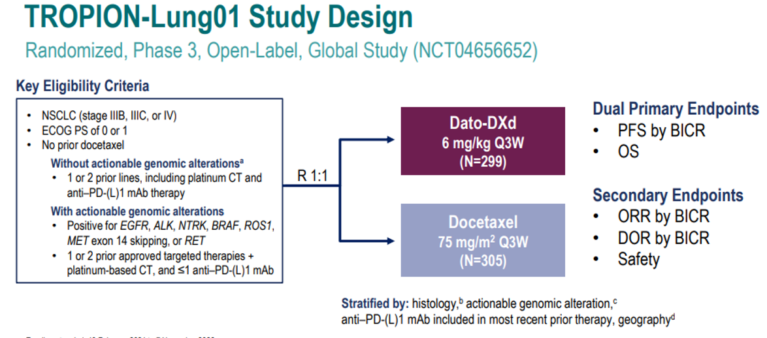
Lisberg et al, ESMO 2023

Slide 103
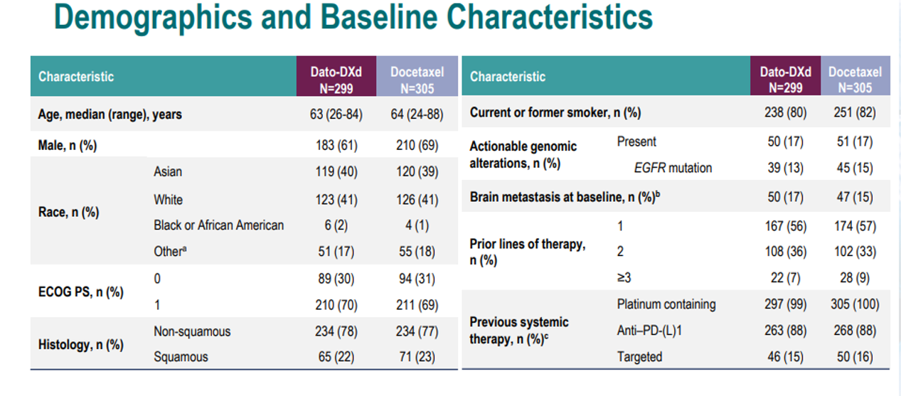
Lisberg et al, ESMO 2023

Slide 104
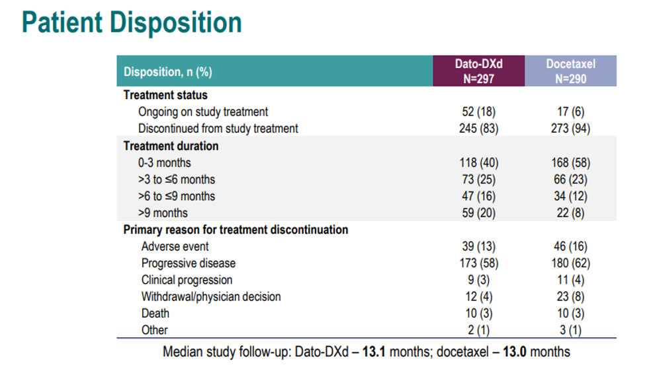
Lisberg et al, ESMO 2023

Slide 105
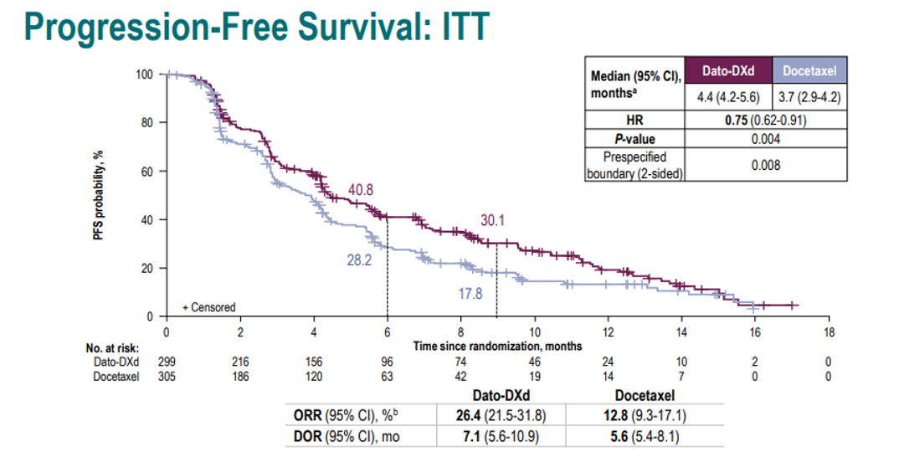
Lisberg et al, ESMO 2023

Slide 106
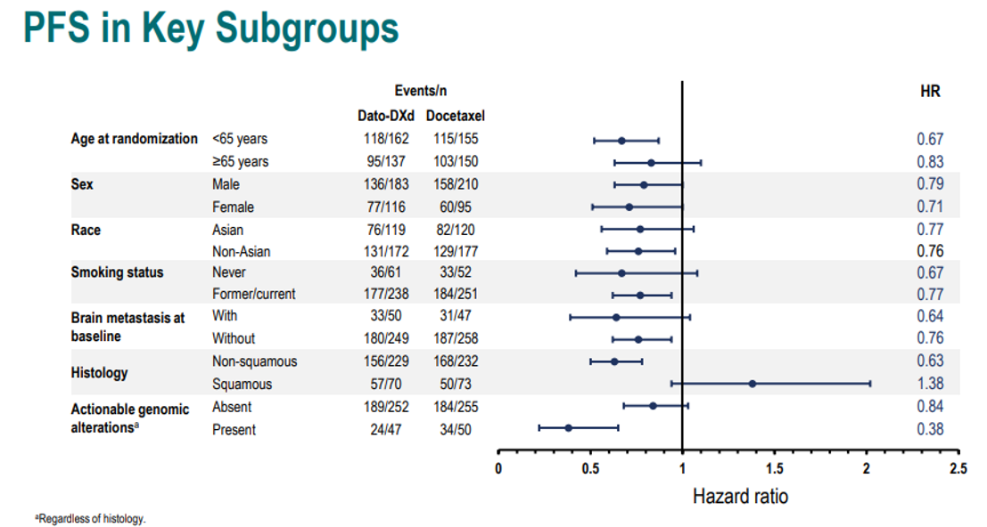
Lisberg et al, ESMO 2023

Slide 107

Lisberg et al, ESMO 2023

Slide 108

Lisberg et al, ESMO 2023

Slide 109

Lisberg et al, ESMO 2023

Slide 110

Lisberg et al, ESMO 2023

Slide 111

Lisberg et al, ESMO 2023

Slide 112
Interpretation and conclusions
2L treatment in unselected NSCLC sorely needs improvement
Better biomarkers (beyond histology) are needed to understand in which patients we might expect an enhanced benefit/risk ratio
Use in the clinic will require robust education amongst clinicians, nurses, and patients regarding expected toxicities and their management

Slide 113


Slide 114

TROPION-Lung05 study design
Lisberg et al, ASCO 2024

Slide 115

Methods of analysis
Lisberg et al, ASCO 2024

Slide 116

Demographics and clinical characteristics
Lisberg et al, ASCO 2024

Slide 117

Patient disposition
Lisberg et al, ASCO 2024

Slide 118

Systemic efficacy
Lisberg et al, ASCO 2024

Slide 119

PFS by brain mets status
Lisberg et al, ASCO 2024

Slide 120

Intracranial efficacy
Lisberg et al, ASCO 2024

Slide 121

Safety summary
Lisberg et al, ASCO 2024

Slide 122
Interpretations and conclusions
This study aims to answer a salient question and concludes Dato-DXd does have IC control in patients with brain mets at baseline, similar to results reported for other ADCs
PFS of Dato-DXd nearly identical amongst pts with and without brain mets, making it a reasonable option in oncogene-driven cancer

Slide 123

Slide 1
Content of this presentation is the property of the author, licensed by ASCO. Permission required for reuse.

Slide 124

Slide 3
Camidge et al, ASCO 2024
Notes:
In non sq arm – cMET int or high scores – 25% with 3+ or 50% with 3+
In sq – pts had to have 75% with at least 1+ staining
Only non sq EGFR wt met criteria for expansion

Slide 125

Slide 4
Camidge et al, ASCO 2024

Slide 126

Slide 5
Camidge et al, ASCO 2024

Slide 127

Slide 6
Camidge et al, ASCO 2024

Slide 128

Slide 7
Camidge et al, ASCO 2024

Slide 129

Slide 8
Camidge et al, ASCO 2024

Slide 130

Slide 9
Camidge et al, ASCO 2024

Slide 131

Slide 10
Camidge et al, ASCO 2024

Slide 132

Slide 11
Camidge et al, ASCO 2024

Slide 133
Interpretation and conclusions
Interpretation and conclusions
Teliso-V is a reasonable strategy in patients who meet the criteria for the dose expansion cohort
Even in highly selected patient population, there is room for improvement for both efficacy and tolerability

Slide 134
Overall conclusions
Overall conclusions
In general, ADCs remain challenging to implement in clinical practice due to heterogeneity in clinical and pathologic factors
  Reliance on target tissue expression varies by ADC
  Tissue target expression itself varies intra- and inter-tumor, as well as temporally and spatially
It is essential to continue to define optimal patient selection for these therapies to enhance therapeutic window
As we gain experience with these agents, we will need to learn further strategies to make them more tolerable for patients

Slide 135
LUNG CANCER
July 18th, 2024

Slide 136
KRAS mutant NSCLC: Current Controversies and New Opportunities
Kathryn C. Arbour, MD
Assistant Attending
Memorial Sloan Kettering Cancer Center
New York, NY

Slide 137


KRAS Mutation Landscape in NSCLC
Adapted from Choudhury et al. Clin Can Res. 2023
Arbour et al. Clin Can Res. 2018

Slide 138

Biology of KRAS Signaling
RAS proteins link upstream receptors at the cell surface to downstream pathways
  Proliferation
  Migration
  Survival
  Metabolism
KRAS signaling alters the TME leading to immunosuppressive environment
Huang et al. Signal Transduction and Targeted Therapy. 2021.

Slide 139


Heterogeneity of KRAS mutant NSCLC
TP53, STK11, and KEAP1 co-mutations are common in KRASmut NSCLC
STK11 and KEAP1 have been associated with poor outcomes
KEAP1+/- STK11 associated with poor outcomes with 1L chemo-IO
Arbour et al. Clin Cancer Res. 2017; Elkrief et al. Oncologist. 2017

Slide 140


KRAS G12C Inhibitors
G12C Inhibitor
Sotorasib
Adagrasib
Divarasib
Olomorasib
Fulzerasib
Glecirasib
Opnurasib
MK-1084
RMC-6291*
And More!
*active state inhibitor
Adapted from Kim et al. Cell. 2020

Slide 141



Early Results of KRAS G12C Inhibitors
Adagrasib (n=112) :
ORR 43%
mPFS 6.5 mos
Sotorasib (n=124):
ORR 37%
mPFS 6.8 mos
Divarasib (n=58):
ORR 53%
mPFS 13.7 mos
Skoulidis et al. NEJM. 2021; Janne et al. NEJM 2023; Sacher et al. NEJM. 2023

Slide 142

Sotorasib vs. Docetaxel

Slide 143


Sotorasib vs. Docetaxel
Codebreak 200 Controversies:
- Study amended to allow crossover potentially complicating OS analysis
- Impact of early drop out from docetaxel arm
- FDA cited challenges with BICR and potential early crossover from docetaxel to Sotorasib
Is 960mg the right dose?
Johannes de Langen et al. The Lancet. 2023

Slide 144

Adagrasib vs Docetaxel
Presented by Mok et al. Abstract LBA8509. ASCO 2024
Content of this presentation is the property of the author, licensed by ASCO. Permission required for reuse.

Slide 145


Adagrasib vs. Docetaxel
Presented by Mok et al. Abstract LBA8509. ASCO 2024

Slide 146
KRAS G12C Controversies
Should KRAS G12C inhibitors be used in the 2L setting? YES!
  Improved PFS compared to 2L chemotherapy
  Early pace of response to therapy
  Consideration of cost of therapy needs to include patient preference, broader financial toxicities of treatment
Best G12C Inhibitor for patients with CNS disease
  Prospective data of intracranial response in untreated CNS disease only available with Adagrasib
Toxicities of interest (e.g. hepatotoxicity) may be due to recent ICI exposure
  Higher rates of hepatotoxicity in patients treated with Sotorasib if ICI exposure <3 months
Moving beyond the 2L+ setting
  Prospective trials needed to explore use in perioperative setting
  Variety of combination strategies (chemo, ICI) in the 1L setting

Slide 147




Acquired Resistance to G12Ci
In 43 patients with paired liquid and/or tissue samples treated with G12Ci, subclonal secondary RAS alterations identified in ~1/3 of patients
Singhal et al. Nat Med. 2024, Awad et al. NEJM. 2020, Zhao et al. Nature. 2021

Slide 148

Future Directions: G12D and Beyond
G12C ON inhibitors
Rational combinations
  PD-1
  Anti-EGFR ab
  SHP2
  SOS1
Mutant specific inhibitors beyond KRAS G12C
Pan-RAS inhibitors
PROTACs
Novel IO approaches
  TIL
  TCRs
Compound | Target | Status
MRTX1133 | G12D | Clinical trial ongoing
RMC-9805 | G12D | Clinical trial ongoing
HRS-4642 | G12D | Clinical trial ongoing
TSN1611 | G12D | Clinical trial ongoing
LY3962673 | G12D | Preclinical
RMC-5127 | G12V | Preclinical
RMC-0708 | Q61H | Preclinical
Zhu et al. Molecular Cancer. 2022
7

Slide 149


Future Directions: Pan-RAS Inhibitors
G12C ON inhibitors
Rational combinations
Mutant specific inhibitors beyond KRAS G12C
Pan-RAS inhibitors
  RMC-6236
  BI-2865
  ERAS-4
  YL-17321
  JAB-23425
PROTACs
Novel IO approaches
  TIL
  TCRs
KRAS^{G12X} NSCLC: Best Response
Tumor Response (per RECIST 1.1)
Best overall response, n (%)
CR | 1 (3)
PR | 14 (35)
SD | 19 (48)
PD | 5 (13)
NE^{b} | 1 (3)
ORR, n (%) | 15 (38)
Confirmed, n | 12
DCR (CR+PR+SD), n (%) | 34 (85)
Evaluable for Efficacy (N = 40)ª
Best % Change from Baseline in Target Lesion
*Unconfirmed PR per RECIST 1.1.
ª Patients who received first dose of RMC-6236 at least 8 weeks prior to data extract date.
^{b}One subject withdrew from study without post-baseline scans.
Most common toxicities observed (n=111) include rash, nausea, vomiting, diarrhea, stomatitis, and fatigue
Presented by Kathryn C. Arbour at ESMO 2023, Data Extracted 12 Oct 2023.
7

Slide 150

KRAS in NSCLC: Key Takeaways
G12C inhibitors (adagrasib and sotorasib), are clinically meaningful for patients
Mechanisms of acquired resistance to G12Ci are complex
KRAS G12C inhibitors are just the beginning for RAS directed therapies
Singhal et al. Nat Med. 2024

Slide 151

ALK-Targeted Therapies
CROWN ASCO Update
Missak Haigentz, MD
Rutgers Cancer Institute
OncLive SOSS, July 18, 2024

Slide 152
Timeline of ALK Targeted Therapies
ALK rearrangements: 6% of lung adenocarcinomas
Identification of EML4-ALK fusion in NSCLC
Brigatinib, Ceritinib 1st line Alectinib 1st line
Brigatinib 1st line
Alectinib
Lorlatinib
Lorlatinib 1st line
Ceritinib
Crizotinib
Alectinib Adjuvant
2007
2011
2014
2015
2017
2018
2020
2021
2024
FDA Approval

Slide 153

Evolution of First- and Next-Generation <br />ALK Inhibitors for ALK+ NSCLC
Used with permission

Slide 154
ALK Therapies, 1L space
HEADLINES!!
1L ALK Targeted therapies
ALEX (Alectinib v. Crizotinib)
Peters, NEJM 2017; Mok, Ann Oncol 2020
ASCEND-4 (Ceritinib v. Crizotinib)
Soria, Lancet 2017
ALTA-1L (Brigatinib v. Crizotinib)
Camidge, NEJM 2018, J Thorac Oncol 2021
CROWN (Lorlatinib v. Crizotinib)
Shaw, NEJM 2020; Solomon, AACR 2022
Lorlatinib: 64% alive and without progression at 36 mo.
Solomon B et al. AACR 2022, abstract CT223
Alectinib: 5-year OS rate 62.5% with 34.9% still on study treatment
Mok T et al., Ann Oncol 2020

Slide 155

ALINA: Adjuvant Alectinib
Postoperative Alectinib x 2 years improved DFS over chemotherapy in resected early stage lung cancer
  Stages IB(T >4cm), II and III by AJCC 7th Ed
Demonstrating clear need for molecular testing of all NSCLC tumors, regardless of stage
Wu et al., NEJM 2024

Slide 156

CROWN ASCO 2024 Update
Solomon et al., ASCO 2024, LBA 8503

Slide 157

CROWN 5-year update (ASCO 2024)
5-year mPFS
NOT REACHED!
Solomon, ASCO 2024; J Clin Oncol 2024

Slide 158

Evaluating CROWN in the Context of ALK Treatment Landscape: Systemic Efficacy
Used with permission

Slide 159

Evaluating CROWN in the Context of ALK Treatment Landscape: Systemic Efficacy
Used with permission

Slide 160

Evaluating CROWN in the Context of ALK Treatment Landscape: CNS Efficacy
Used with permission

Slide 161
CROWN at 5 years, summary
mPFS not reached!
92% IC mPFS
Solidifies Lorlatinib in 1L ALK therapy space
Strongest level of efficacy for ALK based therapy to date
mPFS previously not achieved with targeted therapy in solid tumors

Slide 162

Reminder of the past
2002
Schiller, NEJM 2002
Only 4% 5-year OS, Unselected NSCLC

Slide 163

To a CROWNing Achievement
2024
ILLUSTRATION OF IMPORTANCE OF PRECISION MEDICINE
RIGHT DRUG FOR RIGHT PATIENT AT RIGHT TIME

Slide 164
LUNG CANCER
July 18th, 2024

Slide 165
Thank You to Our Supporters!

Slide 167


