Slide 1










BREAST CANCER
Monday, September 11, 2023

Slide 2
Welcome
Steven Frommeyer
Executive Director, Global Ambassador Strategies, Oncology
MJH Life Sciences

Slide 3


Thank You to Our Supporters:

Slide 4


Slide 5


Slide 6


Slide 7


Slide 8
Program Chair
Paul L. Baron, MD, FACS
Chief of Breast Surgery
Director of the Breast Cancer Program
Lenox Hill Hospital, Northwell Health
New York, NY

Slide 9
BREAST CANCER
Monday, September 11, 2023

Slide 10
Managing Early HER2+ Breast Cancer
Francisco J. Esteva, MD, PhD
Chief, Division of Hematology and Oncology
Lenox Hill Hospital
Northwell Health Cancer Institute

Slide 11
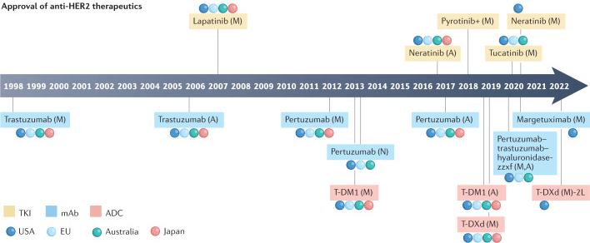
Swain SM, et al. Nat Rev Drug Discov. 2023; 22(2): 101–126

Slide 12
CASE Presentation
58 y/o female who presents with a right breast mass
Mammogram, US, MRI: 3 cm mass; enlarged LN (FNA +)
Breast biopsy: Poorly diff IDC, HER2+ (IHC 3+), ER-, PR-
PMHx: HTN
FHx: no h/o breast cancer
TREATMENT OPTIONS
  Definitive surgery
  Neoadjuvant HER2-Targeted therapy

Slide 13
Meta-analysis for Relationship Between pCR and EFS in Patients With HER2+ EBC
Association of pCR with better EFS was statistically significant in patients with HER2+ BC (HR 0.31; 95% PI: 0.21–0.50; n = 5,711)
Association of pCR with significantly improved OS was seen with HER2+ BC (HR: 0.13; 95% PI: 0.04–0.35, n = 1,654)
EFS
OS
100
100
90
90
80
80
70
70
60
60
Event-Free Survival (%)
50
50
Survival (%)
40
5-Yr EFS, % (95% PI)
40
5-Yr OS, % (95% PI)
30
30
20
With pCR 86 (74−94)
20
With pCR 95 (89−99)
10
Residual disease 63 (43−78)
10
Residual disease 76 (63−88)
0
0
0
1
2
3
4
5
6
7
8
9
0
1
2
3
4
5
6
7
8
9
Years
Years
Spring et al. Clin Cancer Res. 2020;26:2838
Notes:
BC, breast cancer; EBC, early breast cancer; EFS, event free survival; OS, overall survival; pCR, pathological complete response; PI, probability interval

Slide 14
Neoadjuvant Trastuzumab/Pertuzumab: Pivotal Studies
Open-Label Phase II NeoSphere Study: Neoadjuvant Trastuzumab/Pertuzumab¹
TH x 4 cycles
(n = 107)
S
U
R
G
E
RY
FEC Q3W x 3
Trastuzumab Q3W for 1 yr
Chemo-naive women with HER2+ EBC (operable or LA/inflammatory);
primary tumor >2 cm
(N = 417)
THP x 4 cycles
(n = 107)
FEC Q3W x 3
Trastuzumab Q3W for 1 yr
Primary endpoint: pCR in breast (ITT)
HP x 4 cycles
(n = 107)
Docetaxel Q3W x 4 → FEC Q3W x 3
Trastuzumab Q3W for 1 yr
TP x 4 cycles
(n = 96)
FEC Q3W x 3
Trastuzumab Q3W for 1 yr
Phase II TRYPHAENA Cardiac Safety Study: Dual HER2 Targeting ± Anthracycline Tx²
FEC + HP x 3 cycles →
THP x 3 cycles
Patients with operable, LA/inflammatory BC
(N = 225)
pCR assessed at surgery
FEC x 3 cycles →
THP x 3 cycles
Adjuvant tx to complete 1 yr of trastuzumab
Primary endpoint: Cardiac safety
TCHP x 6 cycles
1. Gianni. Lancet Oncol. 2012;13:25. 2. Schneeweiss. Ann Oncol. 2013;24:2278.
Notes:
BC, breast cancer; EBC, early breast cancer; FEC, 5-fluorouracil/epirubicin/cyclophosphamide; HP, trastuzumab/pertuzumab; ITT, intention-to-treat; LA, locally advanced; pCR, pathologic complete response; TCHP, docetaxel/carboplatin/trastuzumab/pertuzumab; TH, docetaxel/trastuzumab; THP, docetaxel/trastuzumab/pertuzumab; TP, docetaxel/pertuzumab; Tx treatment.

Slide 15
NeoSphere: Pathological Complete Response Rates
100
80
60
pCR (%)
45.8*
40
29.0
24.0‡
20
16.8†
P values vs TH:
*P = .0141
†P = .0198
‡P = .003
0
TH (n = 107)
THP (n = 107)
HP (n = 107)
TP (n = 96)
Gianni. Lancet Oncol. 2012;13:25.
Notes:
CT, chemotherapy; HP, trastuzumab/pertuzumab; ITT, intention-to-treat; pCR, pathologic complete response; TH, docetaxel/trastuzumab; THP, docetaxel/trastuzumab/pertuzumab; TP, docetaxel/pertuzumab.

Slide 16
TRYPHAENA: pCR (ypT0/is) by ER/PgR Status
100
ypT0/is and ER and PgR negative
ypT0/is and ER and/or PgR positive
79.4
83.8
65.0
80
48.6
50.0
46.2
60
pCR ± 95% CI (%)
40
20
0
FEC + HP x 3→THP x 3
(n = 73)
FEC x 3→THP x 3
(n = 75)
TCHP x 6
(n = 77)
Schneeweiss. Ann Oncol. 2013;24:2278.
Notes:
ER, estrogen receptor; FEC, fluorouracil/epirubicin/cyclophosphamide; HP, trastuzumab/pertuzumab; ITT, intention-to-treat; pCR, pathologic complete response; PgR, progesterone receptor; TCHP, docetaxel/carboplatin/trastuzumab/pertuzumab; THP, docetaxel/trastuzumab/pertuzumab.

Slide 17
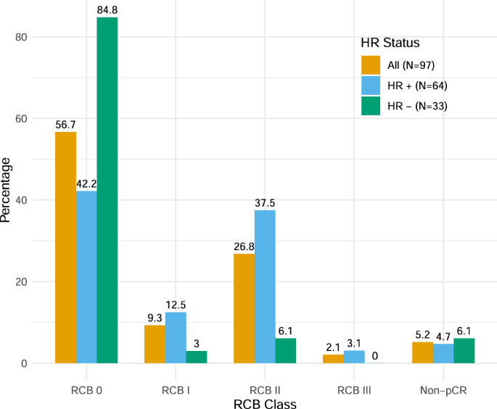
A prospective trial of treatment de-escalation following neoadjuvant paclitaxel/trastuzumab/pertuzumab in HER2-positive breast cancer
Stage II-III
HER2+
pCR: HP
THP
(Wkly Paclitaxel +HP)
RD: T-DM1
Surgery
(Consider ACx4 if significant residual dz)
Waks, A.G., Desai, N.V., Li, T. et al. npj Breast Cancer 2022; 8, 63

Slide 18
PHERGain: Tailoring Therapy Based on Early PET Response
Multicenter, randomized, open-label, noncomparative phase II trial
Stratified by HR status (+ vs -)
Group A
Women with newly diagnosed HER2+ invasive, operable stage I-IIIA EBC; tumor diameter ≥1.5 cm by MRI or ultrasound, with ≥1 breast PET-evaluable lesion
(N = 356)
TCHP x 4
PH (ET) x 12
TCHP x 2
(n = 71)
If pCR: PH (ET) x 10
Group B
If response:
PH (ET) x 6
Follow-up
Total body PET scan
Surgery
PH (ET) x 2
(N = 285)
If no pCR: TCHP x 6,
then PH (ET) x 4
If no response:
TCHP x 6
PH (ET) x 10
Patients with HR+ disease received ET concomitantly with PH.
Primary endpoints: pCR in PET responders (group B), 3-yr iDFS (group B)
Key secondary endpoints: pCR (groups A and B), 3-yr iDFS (group A), 3-yr DDFS (groups A and B),
3-yr EFS (groups A and B), 3-yr OS (groups A and B), safety
Cortes. ASCO 2023. Abstr LBA506. Pérez-García. Lancet Oncol. 2021;22:858.

Slide 19
PHERGain: 3-Yr iDFS in Group B (Primary Endpoint)
iDFS
3-Yr iDFS, n (%) | Group B (n = 267)
iDFS events Relapse Ipsilateral invasive BC recurrence Regional invasive BC recurrence Contralateral invasive BC Distant recurrence Nonrelated death without recurrence | 12 (4.5) 11 (4.1) 1 (0.4) 2 (0.8) 0 (0) 8 (3.0) 1 (0.4)
100
80
3-yr iDFS rate: 95.4%
(95% CI: 92.8-98%)
Events: 12/267
60
Invasive Disease-Free Survival
40
Treatment group B meets the second co-primary endpoint
With ≤15 patients with iDFS events (P <.001)
20
0
0
3
6
9
12
15
18
21
24
27
30
33
36
39
42
45
48
Time Since Surgery (Mo)
No. at Risk
267
264
263
262
261
259
256
251
251
249
249
245
232
62
31
11
6
Coprimary endpoint met given that ≤15 patients in group B had iDFS events at Yr 3
Cortes. ASCO 2023. Abstr LBA506. Reproduced with permission.

Slide 20
PHERGain: Efficacy (Key Secondary Endpoints)
3-Yr Outcomes, % (95% CI) | Group A | Group B | Group B Without CT
n | 63 | 267 | 86
iDFS* | 98.3 (95.1-100) | 95.4 (92.8-98.0) | 98.8 (96.3-100)
DDFS* | 98.3 (95.1-100) | 96.5 (94.3-98.8) | 100 (100-100)
n | 71 | 285 | 86
EFS† | 98.4 (95.3-100) | 93.5 (90.7-96.5) | 98.8 (96.6-100)
OS† | 98.4 (95.3-100) | 98.5 (97.1-100) | 100 (100-100)
*Defined from time of surgery. †Defined from randomization.
Cortes. ASCO 2023. Abstr LBA506.

Slide 21
KATHERINE: Trastuzumab Emtansine vs Trastuzumab as Adjuvant Therapy for HER2+ EBC
International, randomized, open-label phase III study
Stratified by clinical stage, HR status, single vs dual neoadjuvant HER2-targeted therapy, pathologic nodal status after neoadjuvant therapy
Patients with HER2+ EBC (cT1-4/N0-3/M0) who had residual invasive disease in breast or axillary nodes after neoadjuvant chemotherapy plus HER2-targeted therapy* at surgery
(N = 1486)
T-DM1† 3.6 mg/kg IV Q3W x 14 cycles
(n = 743)
Trastuzumab 6 mg/kg IV Q3W x 14 cycles
(n = 743)
Randomization occurred within 12 wk of surgery; radiotherapy and/or endocrine therapy given per local standards. *Minimum of 9 wk of taxane and trastuzumab. †Patients who d/c T-DM1 for toxicity allowed to switch to trastuzumab to complete 14 cycles.
Primary endpoint: IDFS
Secondary endpoints: distant recurrence-free survival, OS, safety
von Minckwitz, et al. NEJM. 2019;380:617.

Slide 22
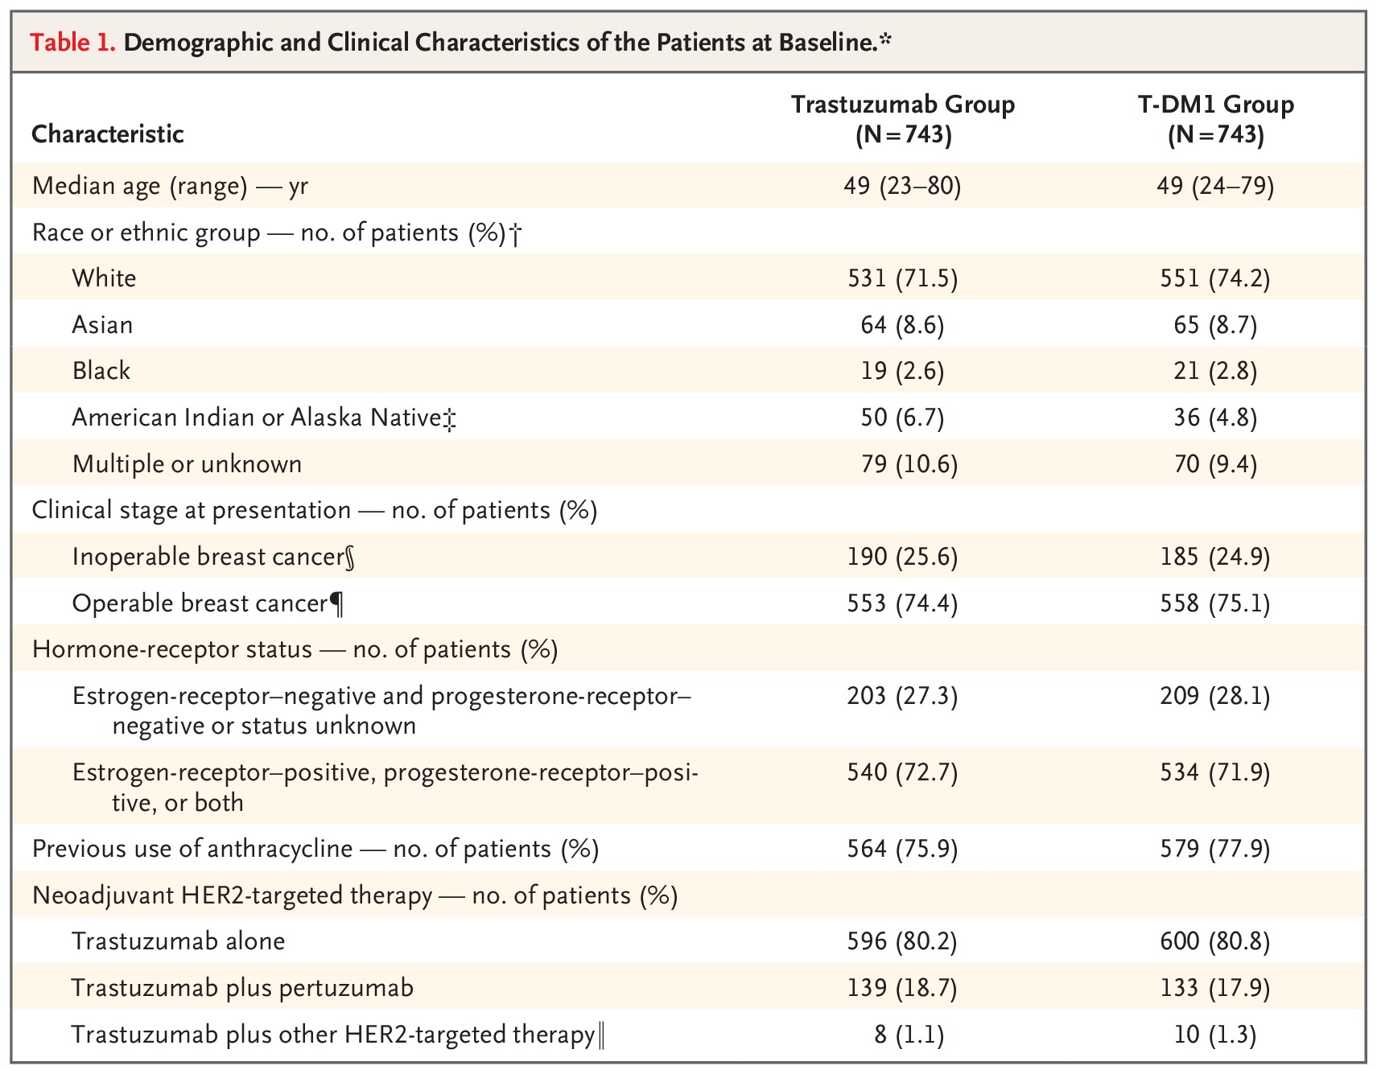
KATHERINE: Demographic and Clinical Characteristics
von Minckwitz G et al. N Engl J Med 2019; 380:617-628
Notes:
Table 1 Demographic and Clinical Characteristics of the Patients at Baseline.

Slide 23
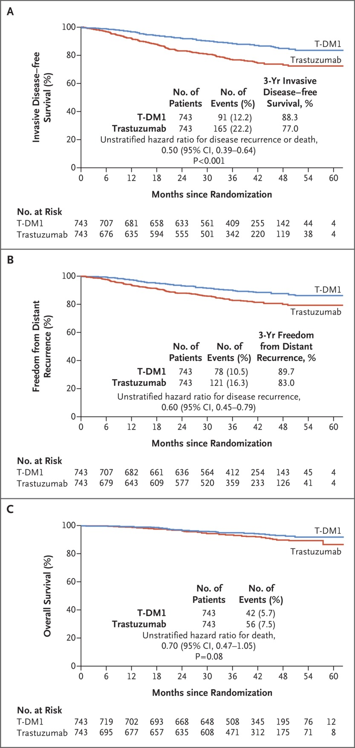
KATHERINE: Disease-Free Survival
von Minckwitz G et al. N Engl J Med 2019;380:617-628
Notes:
Figure 1 Kaplan–Meier Estimates of Survival in the Interim Analysis. Invasive disease–free survival (Panel A) was defined as the time from randomization until the date of the first occurrence of one of the following: recurrence of ipsilateral invasive breast tumor, recurrence of ipsilateral locoregional invasive breast cancer, contralateral invasive breast cancer, a distant disease recurrence, or death from any cause. Distant recurrence (Panel B) was defined as evidence of breast cancer in any anatomical site — other than ipsilateral invasive breast tumor or recurrence of locoregional invasive breast cancer — that was either histologically confirmed or clinically diagnosed as recurrent invasive breast cancer. No statistical adjustments were made for multiple comparisons. For overall survival (Panel C), the P value for the boundary for significance in this prespecified interim analysis was less than 0.000032, corresponding to a hazard ratio of less than 0.43. CI denotes confidence interval.

Slide 24
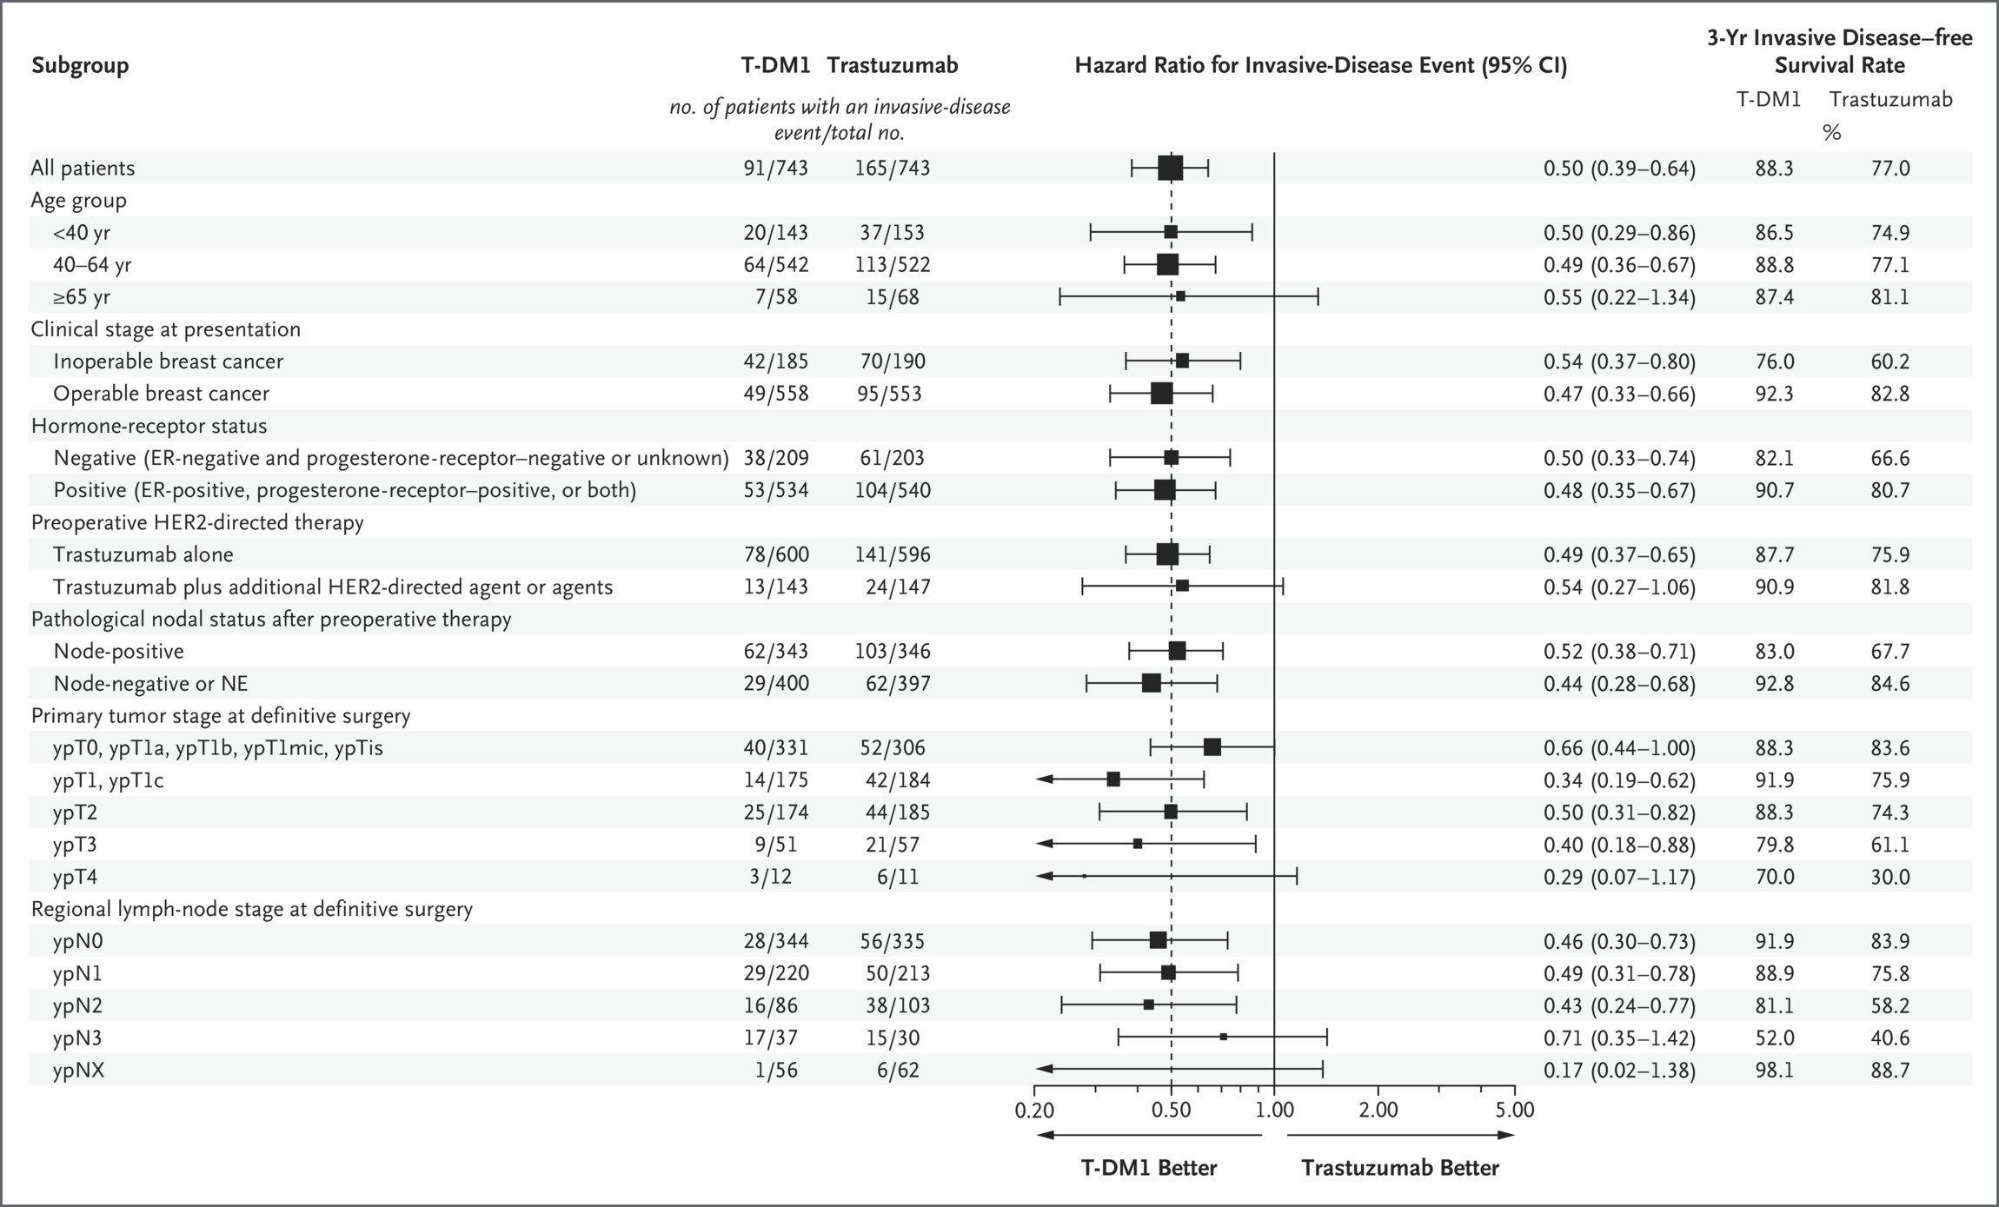
KATHERINE: Subgroup Analysis of Invasive DFS
von Minckwitz G et al. N Engl J Med 2019;380:617-628
Notes:
Figure 2 Subgroup Analysis of Invasive Disease–free Survival. Five patients with a ypT1 tumor stage had ypT1 disease without further subspecification. The ypT4 category includes all patients with ypT4 and one patient with ypTX. The size of the black squares corresponds to the number of patients. ER denotes estrogen receptor, and HER2 human epidermal growth factor receptor 2.

Slide 25
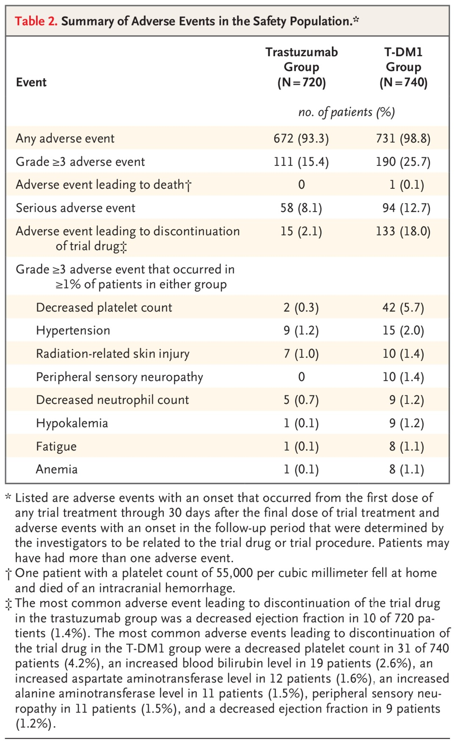
KATHERINE: Adverse Events
von Minckwitz G et al. N Engl J Med 2019;380:617-628
Notes:
Table 2 Summary of Adverse Events in the Safety Population.

Slide 26
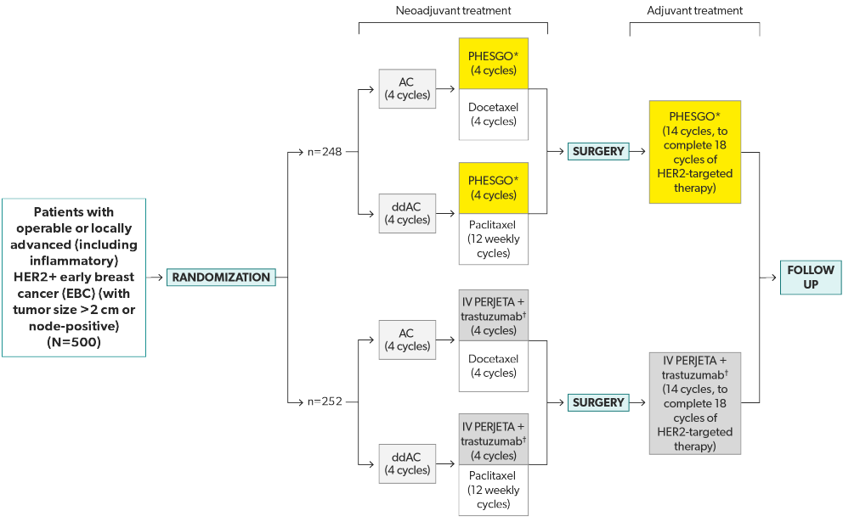
FeDeriCa Trial

Slide 27
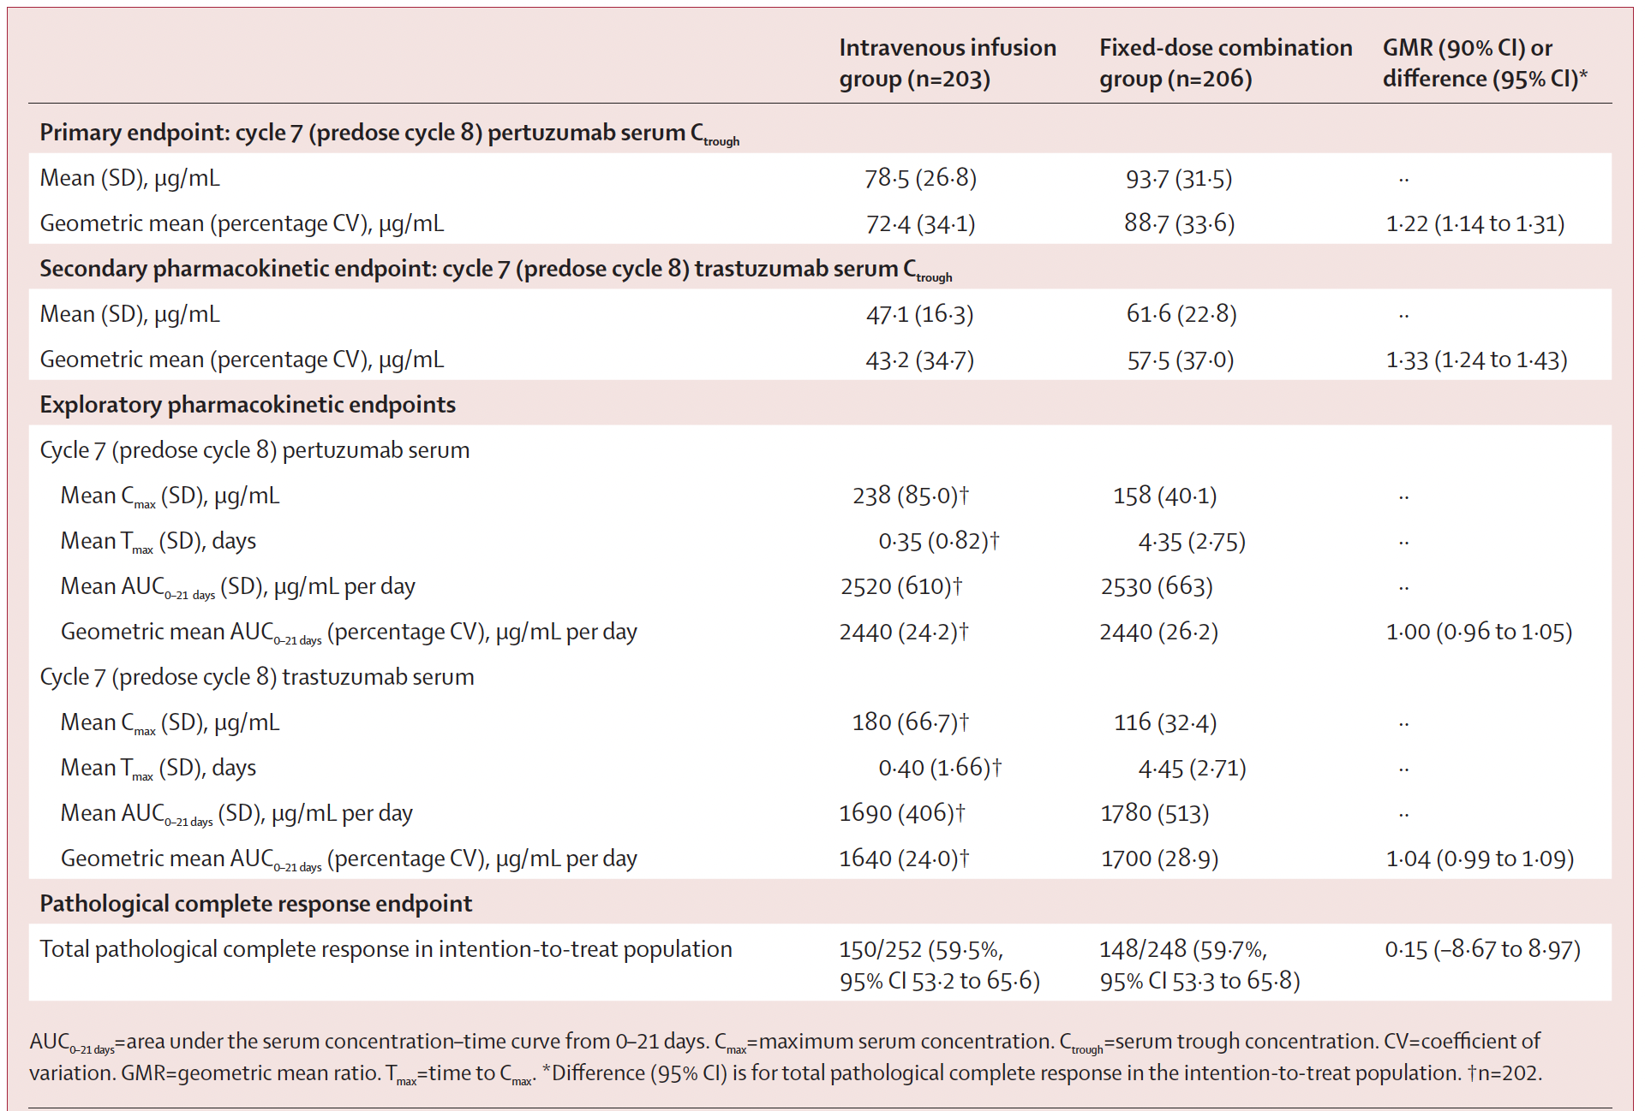
FeDeriCa: Pharmacokinetics and pCR
The fixed-dose combination of pertuzumab and trastuzumab for subcutaneous injection provides non-inferior cycle 7 pertuzumab serum C_{trough} concentrations to IV pertuzumab plus trastuzumab in the neoadjuvant setting
Tan AR, et al. Lancet Oncol 2021 2285-97

Slide 28
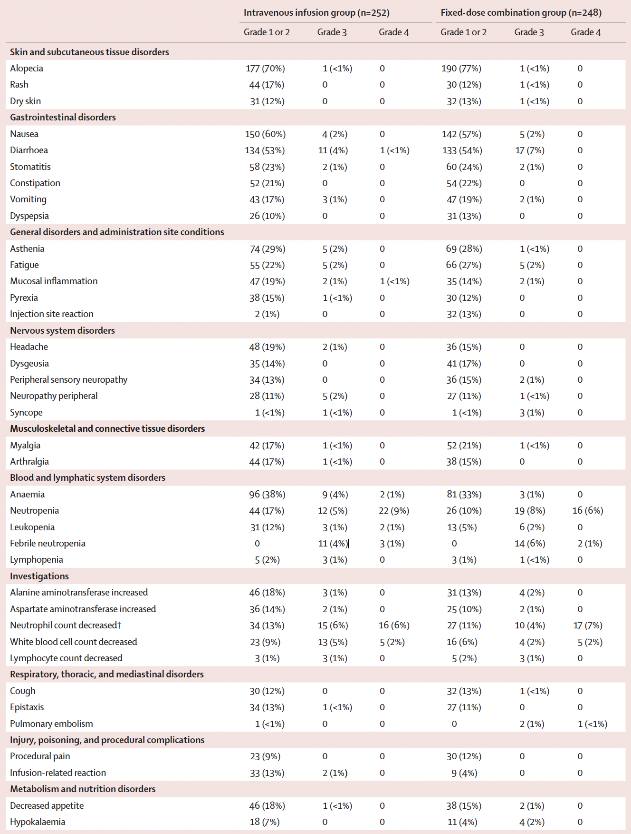
FeDeriCa: Adverse Events
Tan AR, et al. Lancet Oncol 2021 2285-97

Slide 29
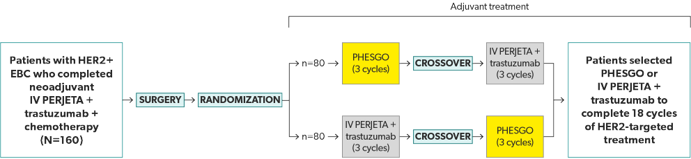
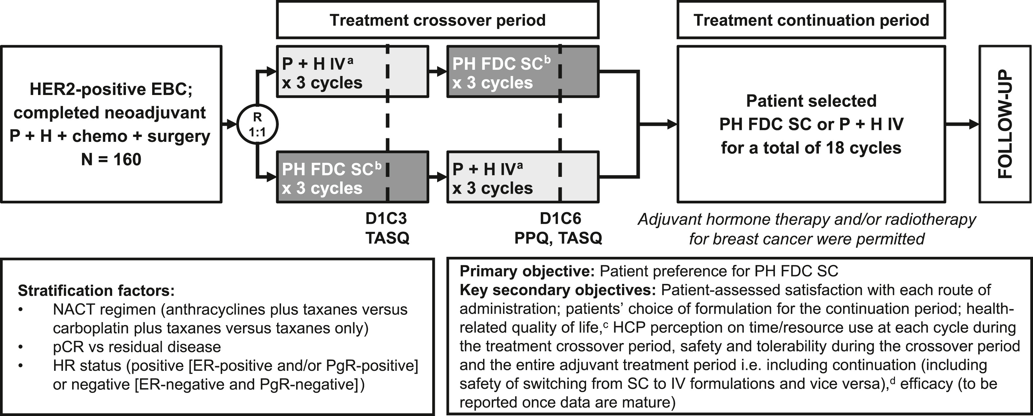
PHranceSCa trial design
O’Shaughnessy J, et al. Eur J Cancer 2021;152:223-232

Slide 30
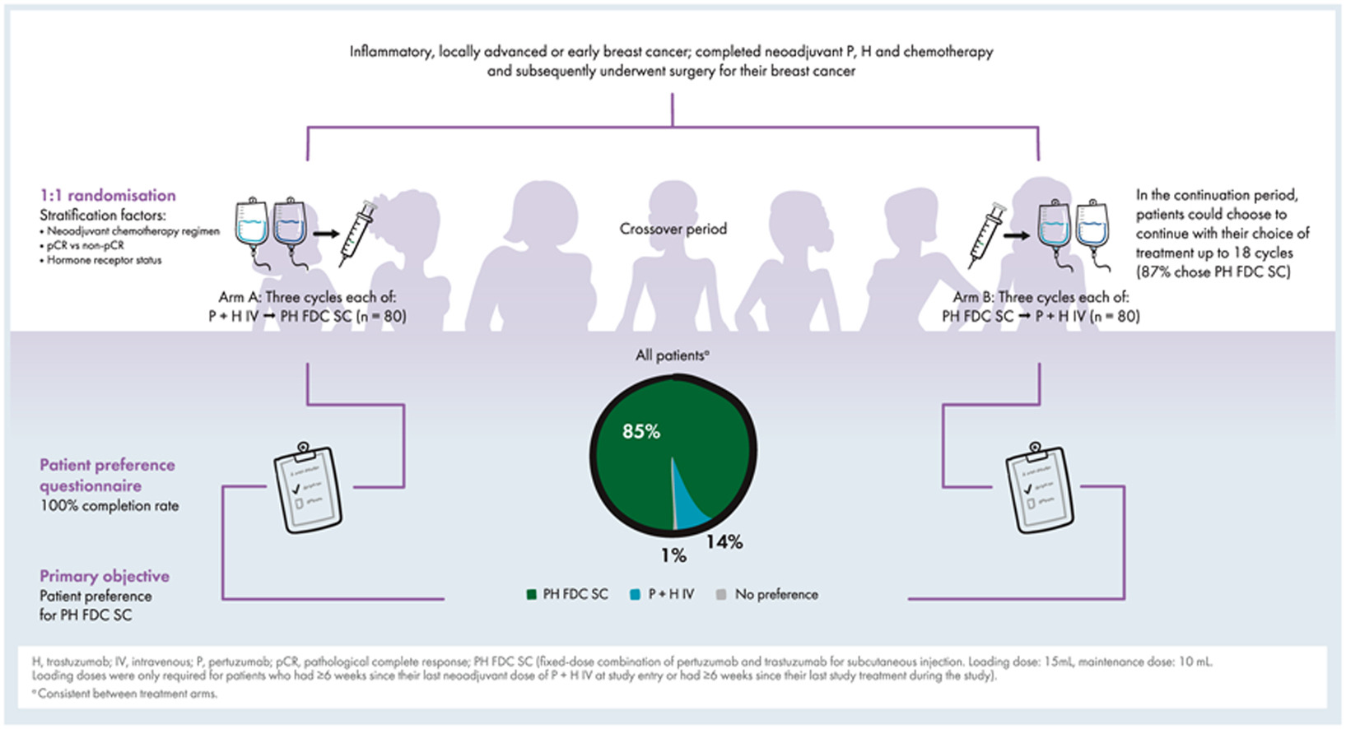

O’Shaughnessy J, et al. Eur J Cancer 2021;152:223-232

Slide 31
APHINITY: Study Design
International, randomized, double-blind, placebo-controlled phase III trial^{[1,2]}
Stratified by CT, nodal status, HR status, geographic region, protocol version (A vs B)
Wk 52
Patients with HER2+ EBC, no prior invasive BC or anticancer tx or radiotherapy; node-positive disease or node-negative disease with tumor > 1 cm or 0.5-1 cm with high-risk features*; BL LVEF ≥ 55%
(N = 4805)
Taxane Chemotherapy‡ +
Trastuzumab§ 6 mg/kg IV Q3W + Pertuzumab 420 mg IV Q3W†
(n = 2400)
Surgery
10-yr follow-up
Taxane Chemotherapy +
Trastuzumab§ 6 mg/kg IV Q3W + Placebo
(n = 2405)
*Patients with node-negative disease were no longer eligible following protocol amendment after 3655 patients were randomized. †Loading dose of 840 mg IV. Treatment started within 8 wks of surgery. ‡Standard anthracycline or nonanthracycline (TCH) regimens were allowed. Endocrine and/or radiotherapy could be started at end of adjuvant CT. §Loading dose of 8 mg/kg IV.
Primary endpoint: IDFS per modified STEEP definition^{[3]} (excludes second primary non-BC as event)
Secondary interim analysis: preplanned, time-driven OS analysis after 2.5 yrs; descriptive analysis of IDFS and cardiac safety
1. Piccart. SABCS 2019. Abstr GS1-04. 2. von Minchwitz. NEJM. 2017;377:122.
3. Hudis. J Clin Oncol. 2007;25:2127.

Slide 32
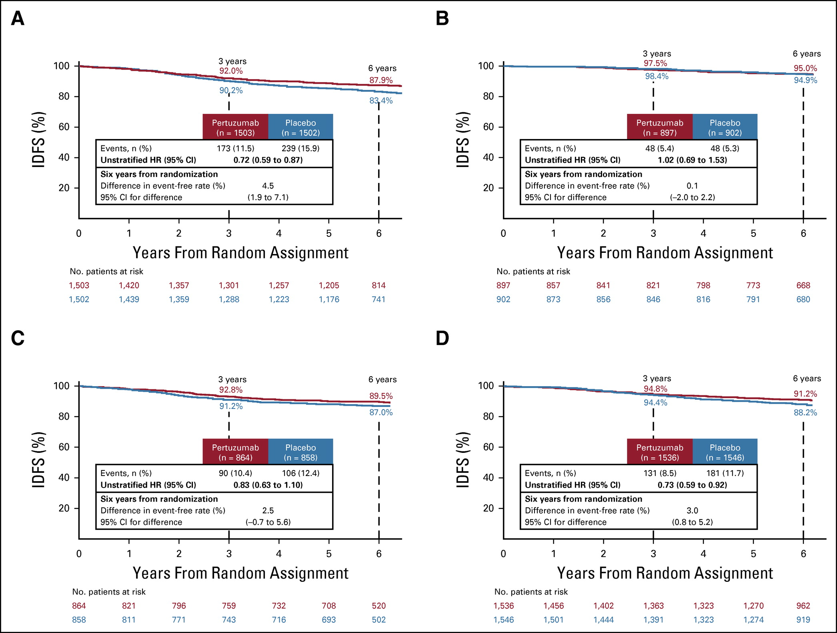
Aphinity: 6 year follow up
NODE+
NODE-
Piccart M, et al. J Clin Oncol 2021 391448-1457

Slide 33
APHINITY: Cardiac Safety
Characteristic, n (%) | Pertuzumab (n = 2364) | Placebo (n = 2405)
Primary cardiac event* | 18 (0.8) | 8 (0.3)
Cardiac death | 2 (.08) | 2 (0.08)
Secondary cardiac event† | 65 (2.7) | 68 (2.8)
At updated follow-up of 74.1 mos, 1 additional primary cardiac event in the pertuzumab arm and 1 additional patient in each arm had a secondary cardiac event
No new cardiac safety issues were identified
*Heart failure New York Heart Association class III or IV plus ejection fraction drop ≥ 10% from baseline and to < 50% or cardiac death. †Asymptomatic or mildly symptomatic (New York Heart Association class II) ejection fraction drop ≥ 10% from baseline and to < 50%.
Piccart. SABCS 2019. Abstr GS1-04.

Slide 34
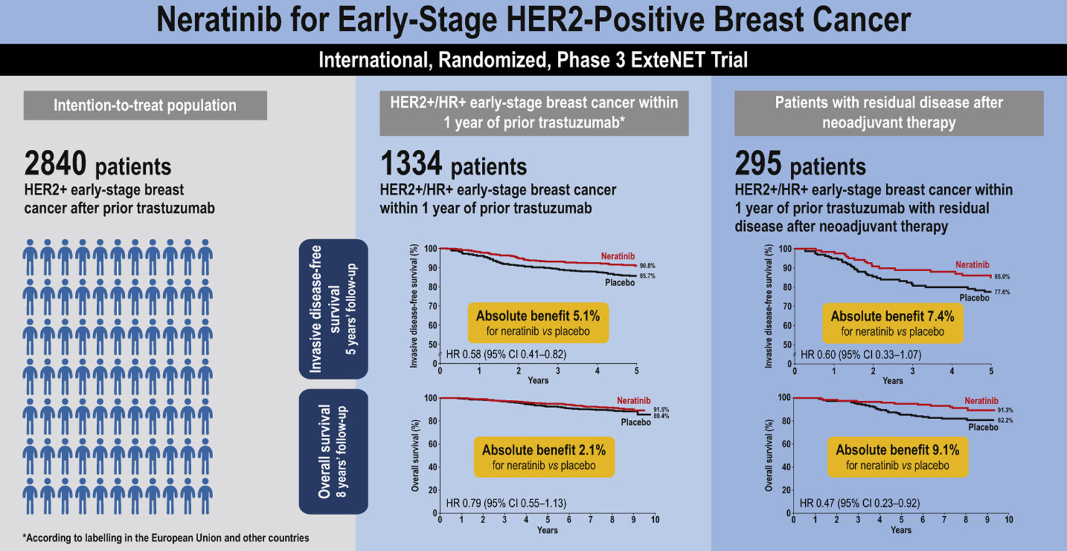
Chan A, et al. Clinical Breast Cancer 2021; 21 (1): 80-91.e7

Slide 35
Management of High-Risk HER2+ ESBC
NEOoadjuvant (Preferred)
  Chemotherapy backbone
    Docetaxel, Carbo vs. Weekly Paclitaxel (+/-Carbo)
  Trastuzumab and Pertuzumab (HP): IV vs. SQ
  Residual disease: T-DM1
ADJUVANT: TCHP or AC – THP
Extended Adjuvant: Neratinib
  Positive nodes
  HR+ (in combination with endocrine therapy)

Slide 36
BREAST CANCER
Monday, September 11, 2023

Slide 37
Updates in HER2+ Breast Cancer
Anna Komorowski, MD
Regional Medical Director, Hematology / Medical Oncology
Northwell Health Cancer Institute - Westchester
Assistant Professor of Medicine Zucker School of Medicine

Slide 38
No disclosures

Slide 39
Agenda
DESTINY- Breast02- SABCS 2022
PHERGain- ASCO 2023

Slide 40
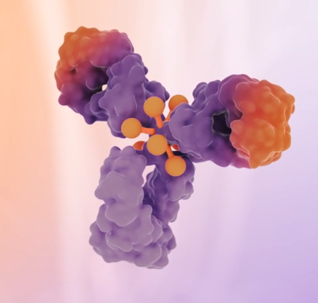
Trastuzumab Deruxtecan Antibody –Drug Conjugate
ADC with HER2 targeted antibody with a cleavable tetrapeptide-based linker and a topoisomerase I inhibitor
8 cytotoxic molecules payloads per antibody
Stable tumor-selective cleavable linker that is membrane permeable
Bystander antitumor effect
Ogitani Y, Cancer Sci 107:1039-1046, 2016

Slide 41
History of Treatments in HER2+ Metastatic Breast Cancer
EMILIA
2nd line
T-DM1 mPFS 9.6 m vs 6.4 m with lapatinib+ capecitabine
HR, 0.65 ( 95% CI, 0.55-0.77; P<0.001)
DESTINY- Breast 03
2nd line
T-DXd mPFS not reached vs 6.8 m with T-DM1
HR, 0.28 ( 95% CI, 0.22-0.37; P< 0.001)
DESTINY – Breast 01
3rd line
T-Dxd demonstrated activity in a post- TDM1 phase 2 single arm study with mPFS of over 19 months
Verma S et al NEJM 2012
Cortes J et al NEJM 2022
Saura C et al, ESMO 2021

Slide 42
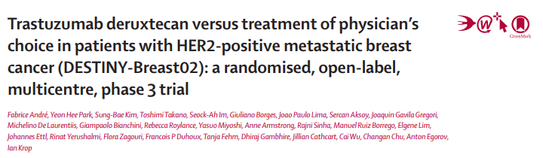
l
DESTINY-Breast02 is a confirmatory trial for DESTINY-Breast01
SABCS, 2022 Ian Krop
Lancet 2023; 401:1773-85, April 2023

Slide 43
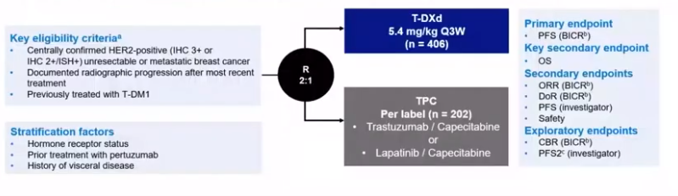
DESTINY- Breast02 Schema

Slide 44
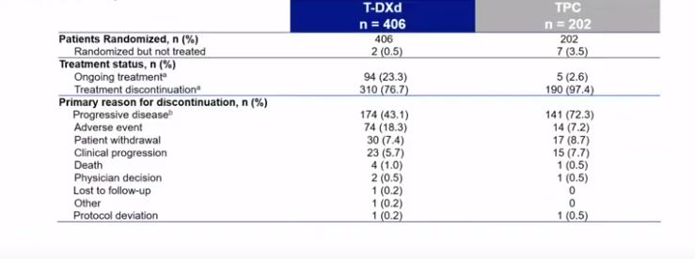
DESTINY-Breast02 Patients Disposition

Slide 45
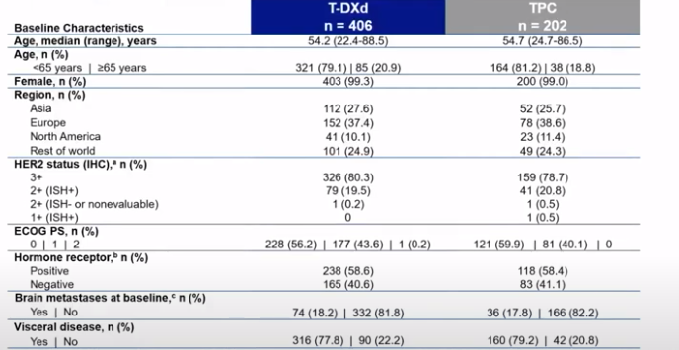
DESTINY-Breast02 Baseline Characteristics

Slide 46
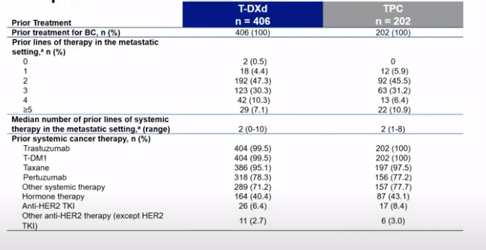
DESTINY-Breast02 Prior Therapies

Slide 47
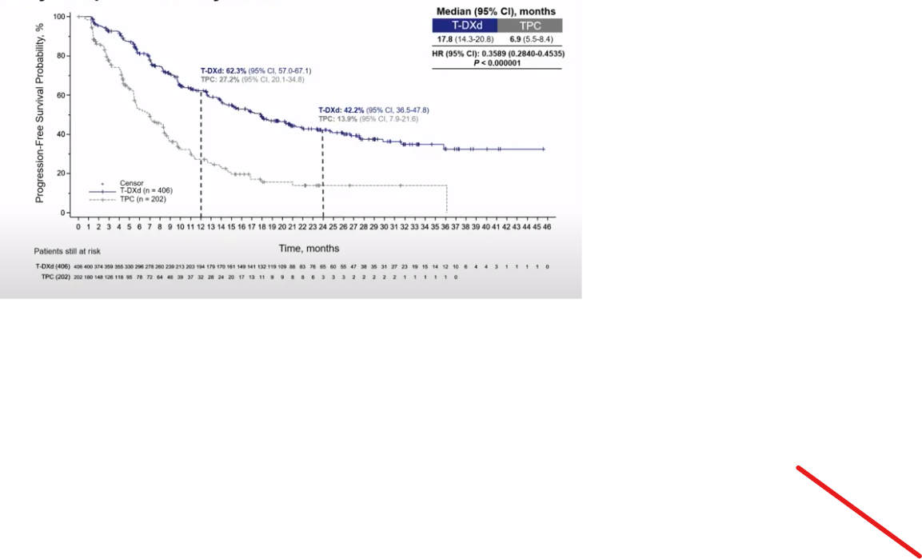
DESTINY-Breast02 - Primary Endpoints: PFS

Slide 48
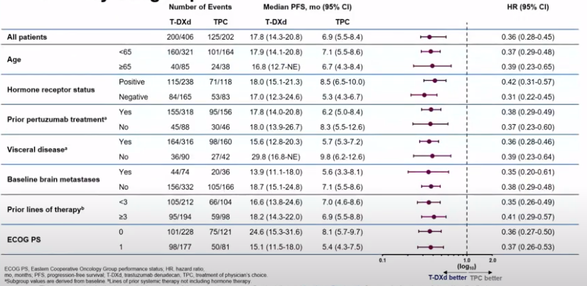
DESTINY-Breast02 in Key Subgroups

Slide 49
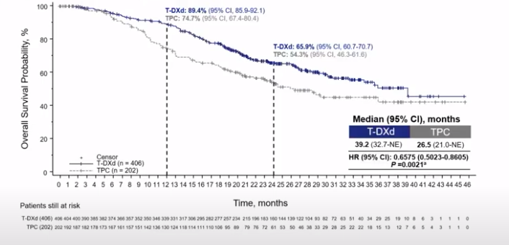
DESTINY-Breast02 Key Secondary Endpoint: OS

Slide 50
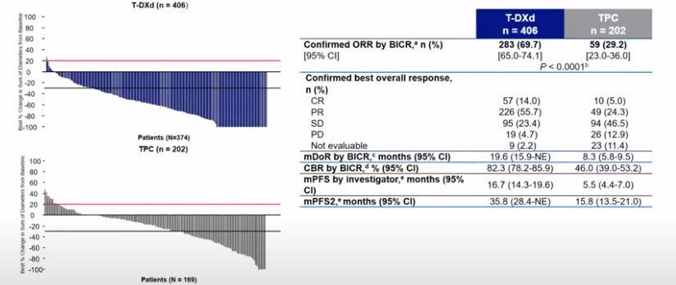
DESTINY-Breast02 Secondary and Exploratory Efficacy Endpoints

Slide 51
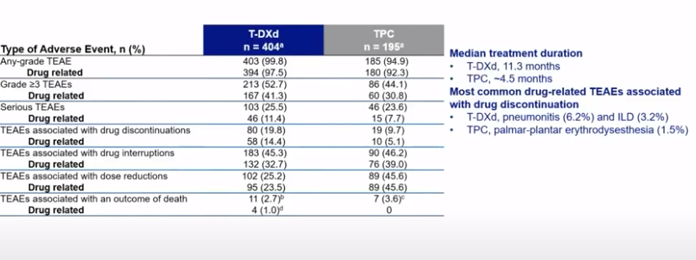
DESTINY-Breast02 Safety Summary

Slide 52
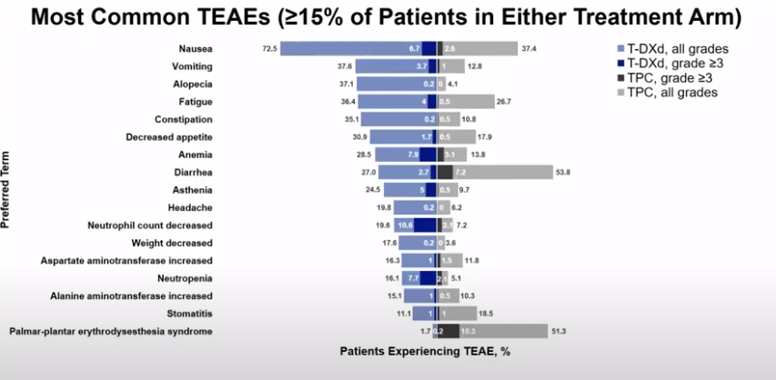
DESTINY-Breast02 Most Common TEAE

Slide 53
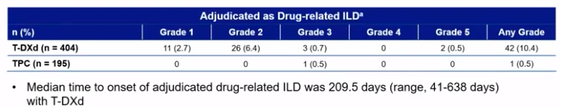
DESTINY-Breast02 - Adverse effects – ILD and LV dysfunction.

Slide 54
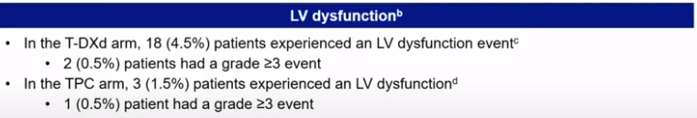
DESTINY-Breast02 Adverse effects – ILD and LV dysfunction.

Slide 55
Conclusions
In DESTINY- Breast02 , T-DXd demonstrated statistically significant and clinically meaningful improvement in PFS and OS vs TPC for patients with HER2+ mBC previously treated with T-DM1.
  mPFS results showed T-Dxd reduced the risk of progression or death compared with TPC ( mPFS of 17.8 and 6.9 months, respectively; HR, 0.3589; 95% CI, 0.284-0.4535; P< 0.000001)
  mOS results showed T-DXd reduced the risk of death compared with TPC ( mOS of 39.2. and 25.5 months, respectively; HR, 0.6575; 95% CI; 0.5023-0.8605; P=0.0021)

Slide 56
Conclusions
In DESTINY- Breast02 , T-DXd demonstrated statistically significant and clinically meaningful improvement in PFS and OS vs TPC for patients with HER2+ mBC previously treated with T-DM1.
  mPFS results showed T-Dxd reduced the risk of progression or death compared with TPC ( mPFS of 17.8 and 6.9 months, respectively; HR, 0.3589; 95% CI, 0.284-0.4535; P< 0.000001)
  mOS results showed T-DXd reduced the risk of death compared with TPC ( mOS of 39.2. and 25.5 months, respectively; HR, 0.6575; 95% CI; 0.5023-0.8605; P=0.0021)
The overall safety profile was consistent with the established safety of T-DXd, with no new safety signals observed
  Overall incidence of ILD for T-DXd in DESTINY-Breast02 was 10.4% ( grade 1/2 events, 9.25)
  Fewer grade 5 ILD events were observed in DESTINY- Breast02 ( 0.5%) compared with DESTINY- Breast01 ( 2.7%)
DESTINY-Breast02 confirms the favorable benefit/risk profile of T-DXd in patients with advanced HER2+ mBC, as previously demonstrated by DESTINY- Breast01

Slide 57
DESTINY-Breast02
First trial to show efficacy of one antibody conjugate after previous antibody.
How tumor become resistant to antibody
Restarting after grade 1 toxicity

Slide 58
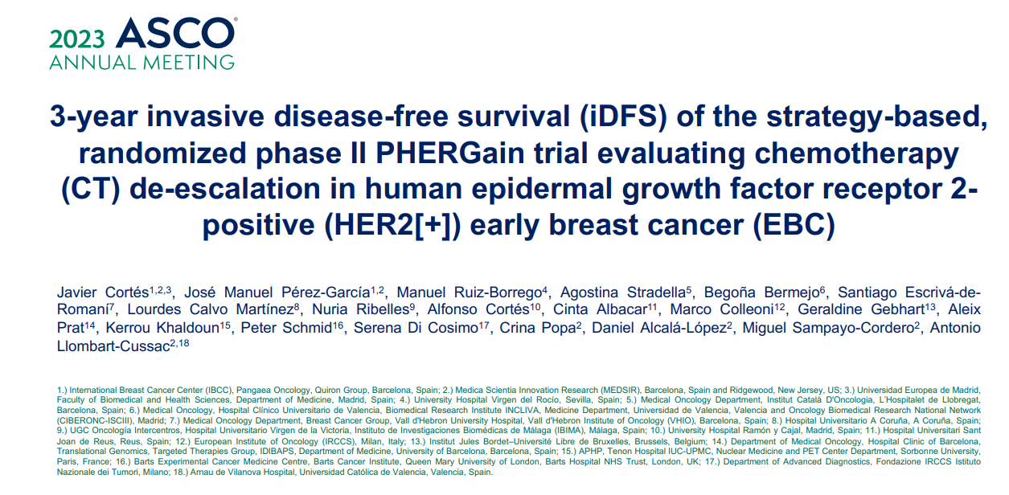

Slide 59
PHERGain Background
The introduction of HER2 directed therapies has dramatically improved the outcome of patients with HER2 positive EBC, leading to the investigation of different de-escalation strategies.
Early metabolic evaluation using FDG PET/CT helps to recognize patients with an increased probability of pathological complete response ( pCR)
PHERGain trial access the opportunity of CT de-escalation with the response adapted strategy in HER2 (+) EBC based on
  an early metabolic response by PET/CT to neoadjuvant trastuzumab plus pertuzumab
  the pathological response
Bueno Nuino C, et al ( 2022) Cancers, 14(3), 512
Pernas S, et al (2021). JCO Oncol Pract, 17(6), 320-330
Gebhart G, et al. (2013). J Nuc Med, 54:1862-8
Perez-Garcia, JM, et al. (2021). Lancet Oncol, 22(6), 858-871

Slide 60
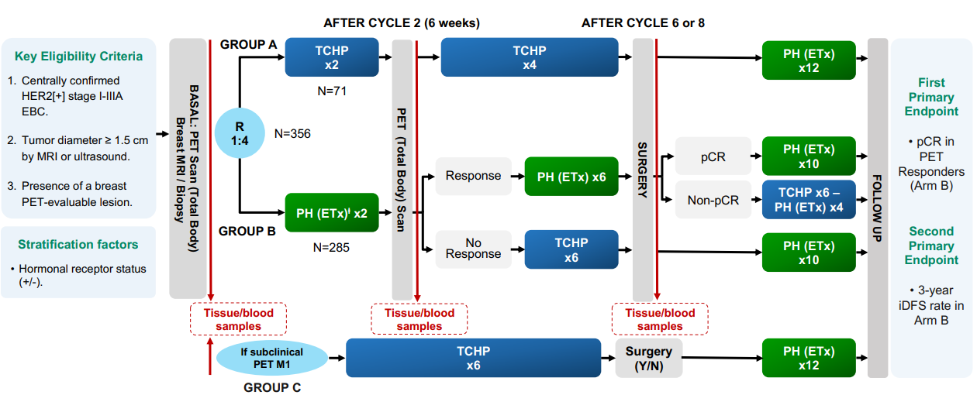
PHERGain Study Design: Adapted- Response Trial

Slide 61

PHERGain Study Design

Slide 62

PHERGain Study Design

Slide 63
Key Eligibility Criteria
Inclusion criteria
  stage I–IIIA invasive breast cancer
  tumor diameter > 1.5 cm by MRI or ultrasound
  at least 1 PET evaluable breast lesion (SUV max over 1.5 SUV mean liver +2 SD)
  centrally confirm HER2 positive breast cancer
  patient positive ER and PR status locally determined
Exclusion criteria
  previous chemotherapy, anti-HER2, radiotherapy or endocrine therapy for invasive breast cancer
  evidence of metastatic disease by routine classical assessment. Patient with subclinical M1 detected by PET will be included into group C

Slide 64
Study Endpoints
Primary endpoints
  pCR (ypT0/isN0) in PET responders ( Group B)
  3 –year iDFS rate in Group B
Secondary endpoints
  pCR in group A and group B
  pCR by PET response and other definitions of pCR
  breast conserving surgery
  tumor response by MRI
  optimal PET cut –off SUV max 4 pCR
  3-year iDFS in group A
  3-year DFS in group A and group B
  3-year OS in group A and group B
  long-term outcomes per group
  health-related quality of life
  toxicity

Slide 65
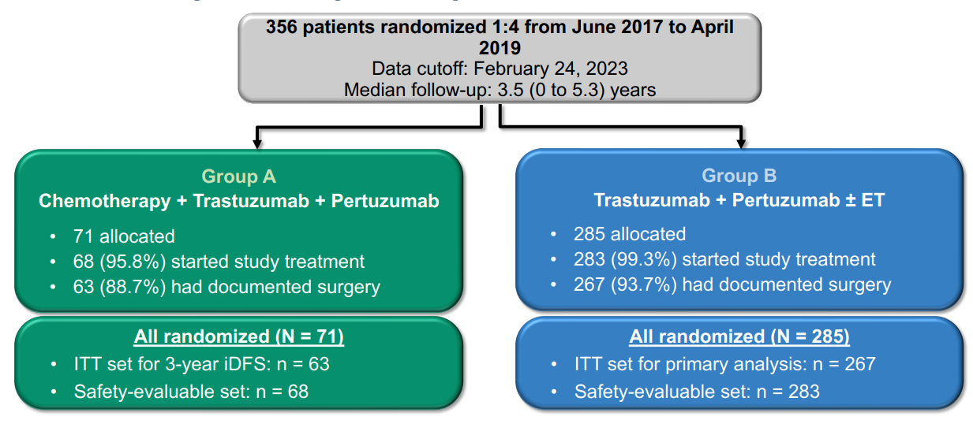
Summary of Analysis Population

Slide 66
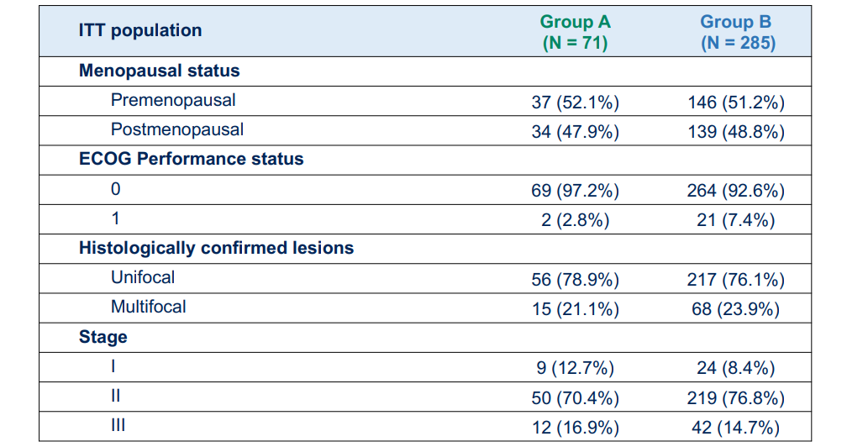
Baseline Characteristics

Slide 67
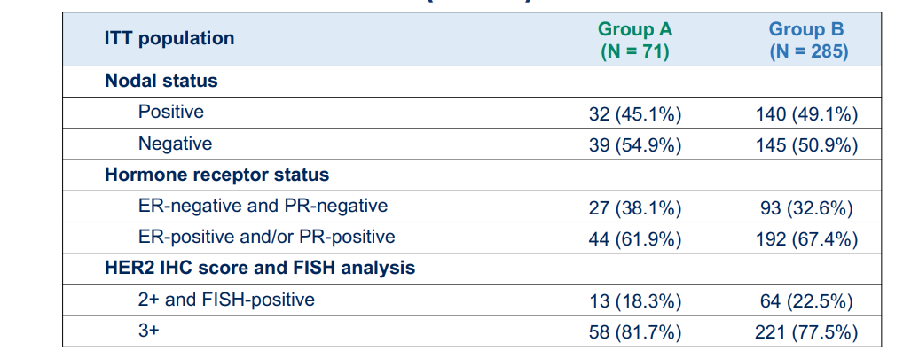
Baseline Characteristics

Slide 68
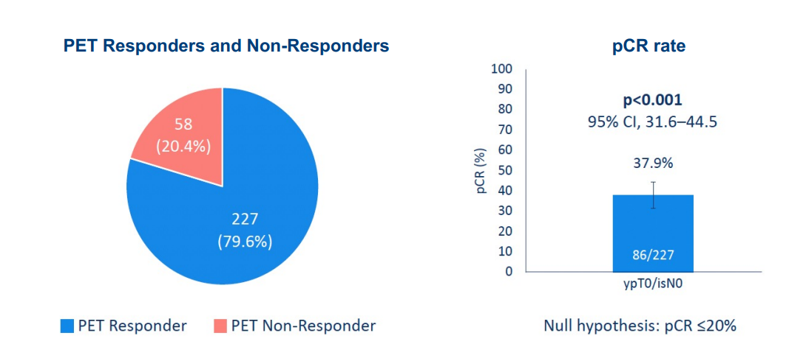
Primary Endpoint: PCR in FGD-PET responders and group B

Slide 69
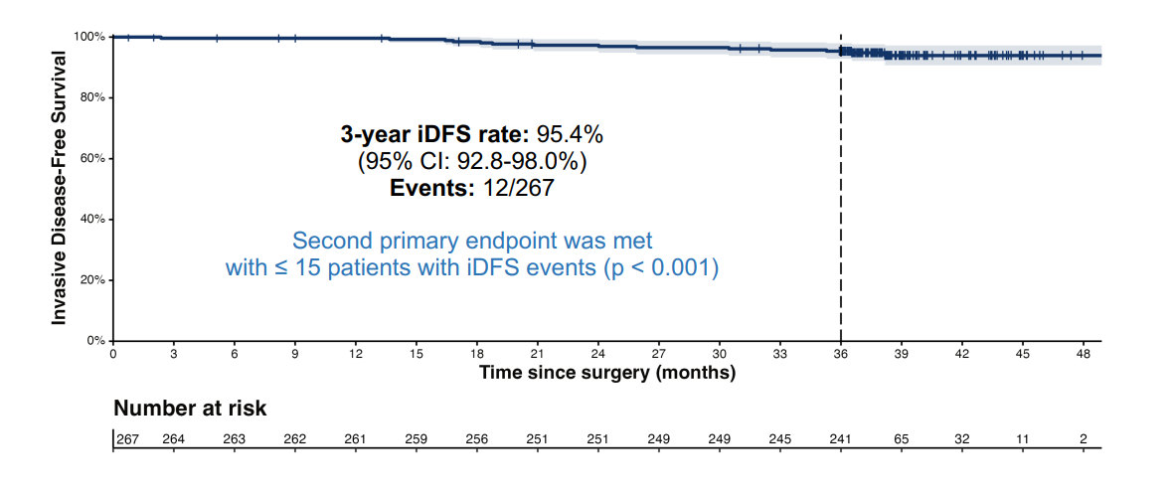
Primary Endpoint: 3-year iDFS in group B- ITT population

Slide 70
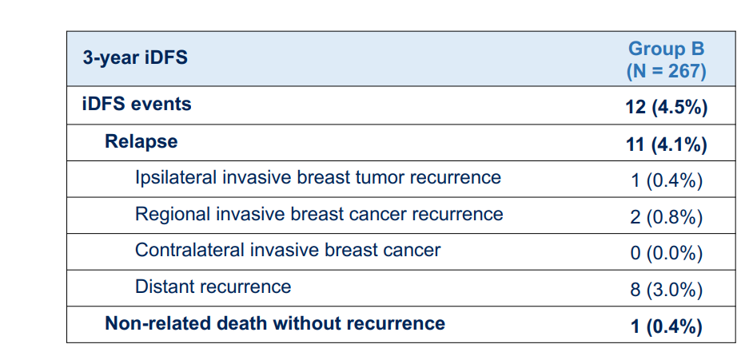
Primary Endpoint: 3-year iDFS in group B- ITT population

Slide 71
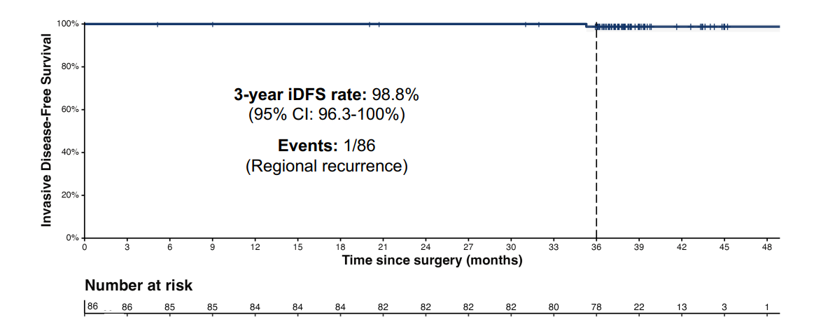
Subgroup analysis: 3 y iDFS without CT in PET
responders with pCR n=86

Slide 72
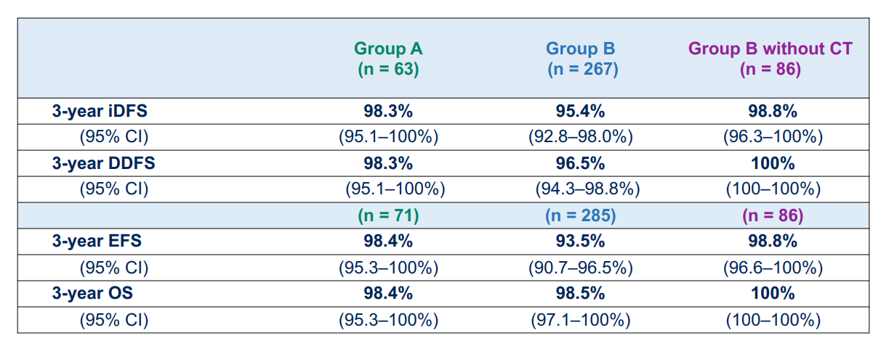
Efficacy Analysis :summary of other efficacy endpoints

Slide 73
Conclusions
The PHERGain study also meets the second primary endpoint with a 3-year DFS of 95.4% in patients in group B.
These results are in line with those reported using the combination of CT and HER2 targeted therapies for the same patient population.
No unexpected safety signals were identified.
Among CT-free patients treated with HP 3 years DFS was 98.8%.
This strategy identifies about 1 in 3 of HER2 positive EBC patients who can safely omit CT with significantly reduced toxicity.
Need longer follow up beyond 5 years

Slide 74
BREAST CANCER
Monday, September 11, 2023

Slide 75
Endocrine-Based Therapy in HR+/HER2- Breast Cancer
Francisco J. Esteva, MD, PhD
Chief, Division of Hematology and Oncology
Lenox Hill Hospital
Northwell Health Cancer Institute

Slide 76
Endocrine Therapy in HR+ Breast Cancer
EGFR
HER2
~ 30% of HR+ MBCs are de novo resistant to ET, with most developing acquired resistance
Mechanisms of resistance may include loss/alteration
of ER expression; overexpression/activation
of GF receptors; or activation of downstream signal transduction pathways
E
AI
Nonsteroidal AIs:
  Anastrozole
  Letrozole
  Steroidal AI:
  Exemestane
P
P
PI3K Inhibitors
Alpelisib
E
RAS
PI3K
ER
Downregulator
Fulvestrant
Raf
E
Akt
ER-α
mTOR Inhibitors
Everolimus
MEK
MAPK
mTOR
Selective ER modulators
Tamoxifen Toremifene
CDK4/6 Inhibitors
Palbociclib
Abemaciclib
Ribociclib
Cell cycle regulation
DNA replication
Cellular differentiation
Apoptosis
Angiogenesis
Cell
cycle
E
E
ER target gene transcription
ER-α
ER-α
Transcription
silencing
Brufsky. Oncologist. 2018;23:528. AlFakeeh. Curr Oncol. 2018;25:S18.

Slide 77
Targeting CDK4/6 in HR+, HER2- Metastatic BC: Rationale
G₀
Cyclin B-CDK1
Mitogenic pathways, including estrogen signaling, stimulate cyclin D production
Binding of cyclin D activates CDK4/6, an important player in driving cell cycle progression in ER+ BC
Selectively inhibiting CDK4/6 causes cell cycle arrest in G1 phase, resulting in reduced cell viability and tumor shrinking
Estradiol
AI
M
G₂
ER
Fulvestrant
Cyclin A-CDK1
Cyclin D-CDK4
Cyclin D-CDK6
G₁
R point
S
Palbociclib
Ribociclib
Abemaciclib
Cyclin A-CDK2
Cyclin E-CDK2
Because cyclin D–CDK4/6 activation occurs downstream of estrogen signaling,
ET + CDK4/6 inhibitor combination therapy has synergistic antitumor activity against HR+ BC

Slide 78
PALOMA-2
PALOMA-3
PALOMA-2: Study Design
Multicenter, international, double-blind, randomized phase III trial
Primary endpoint: PFS by investigator*
Secondary endpoints: OS,* response, safety, biomarkers, patient-reported outcomes
Stratified by disease site (visceral vs nonvisceral),
disease-free interval (de novo metastatic; ≤ 12 mo vs > 12 mo),
prior neoadjuvant or adjuvant hormonal therapy (yes vs no)
Palbociclib 125 mg QD (3 wk on, 1 wk off)
+ Letrozole 2.5 mg QD
(n = 444)
Postmenopausal women with ER+/HER2- advanced breast cancer; no prior treatment for advanced disease; ECOG PS 0-2
(N = 666)
Placebo QD (3 wk on, 1 wk off)
+ Letrozole 2.5 mg QD
(n = 222)
  *PFS: Study powered to detect ~44% increase in median PFS from 9 mo (placebo) to 13 mo (palbociclib), assuming HR 0.69 favoring palbociclib
  (90% power to detect 1-sided α = 0.025).
  OS: Assuming median OS 34-46 mo (placebo), 390 events needed to detect HR ≤0.74 (80% power to detect 1-sided α = 0.025).
Finn. ASCO 2022. Abstr LBA1003.

Slide 79
MONALEESA-7
PALOMA 2: PFS and OS
Outcome | Palbociclib + Letrozole (n = 444) | Placebo + Letrozole (n = 222) | HR (95% CI); P Value
Investigator-assessed Number of events, n (%) Median PFS, mos (95% CI) | 194 (44) 24.8 (22.1-NR) | 137 (62) 14.7 (12.9-17.1) | 0.58 (0.46-0.72); < .000001
Blinded independent central review Number of events, n (%) Median PFS, mos (95% CI) | 152 (34) 30.5 (27.4-NR) | 96 (43) 19.3 (16.4-30.6) | 0.65 (0.51-0.84); .0005
Outcome | Palbociclib + Letrozole (n = 444) | Placebo + Letrozole (n = 222) | HR (95% CI)
Planned ITT Analysis* Median OS in ITT population, mo (95% CI) | 53.9 (49.8-60.8) | 51.2 (43.7-58.9) | 0.956 (0.777-1.777); P = .3378
Finn R, et al. ASCO 2016. Abstract 507
Finn. ASCO 2022. Abstr LBA1003

Slide 80

PALOMA-3: Phase III Study Design
Stratified by visceral metastases (yes/no), sensitivity to previous endocrine therapy, menopausal status
Palbociclib 125 mg QD
3 wks on/1 wk off +
Fulvestrant 500 mg IM Q4W
(n = 347)
Pts with HR+/HER2- MBC; PD after endocrine therapy;
≤ 1 chemotherapy regimen for advanced BC
(N = 521)
Tx to PD, toxicity, or study withdrawal
Placebo 3 wks on/1 wk off +
Fulvestrant 500 mg IM Q4W
(n = 174)
Primary endpoint: investigator-assessed PFS
Secondary endpoints: ORR, CBR (CR, PR, or SD for ≥ 24 wks), OS, pt-reported outcomes, safety
Cristofanilli M, et al. SABCS 2015. Abstract P4-13-01.

Slide 81
MONALEESA-7
PALOMA-3: PFS in Overall Population and Specific Pt Subgroups
Median follow-up: 8.9 mos
Median PFS, Mos (95% CI) | Palbociclib + Fulvestrant (n = 345) | Placebo + Fulvestrant (n = 172) | HR (95% CI) | P Value
ITT population | 9.5 (9.2-11.0) | 4.6 (3.5-5.6) | 0.45 (0.36-0.59) | < .0001
Pre-/perimenopausal pts | 9.5 (7.4-NE) | 5.6 (1.8-7.6) | 0.50 (0.29-0.87) | .0065
Postmenopausal women | 9.9 (8.5-11.0) | 3.9 (3.5-5.5) | 0.45 (0.34-0.59) | < .0001
No earlier systemic therapy for metastatic disease | 9.5 (7.4-NE) | 5.4 (2.1-10.9) | 0.55 (0.32-0.92) | .0214
Disease responsive to earlier endocrine therapy | 10.2 (9.4-11.2) | 4.2 (3.5-5.6) | 0.42 (0.32-0.56) | < .0001
AIs as most recent therapy | 9.5 (9.2-11.0) | 3.7 (3.4-5.5) | 0.42 (0.31-0.56) | < .0001
Cristofanilli M, et al. SABCS 2015. Abstract P4-13-01.

Slide 82
Ribociclib Trials in HR+/HER2- MBC
Trial Name | Phase | Objective | Patients | Treatment
MONALEESA-2 | Phase 3 | Evaluate ribociclib + letrozole vs. placebo + letrozole | 668 | Ribociclib + letrozole showed significantly improved progression-free survival (PFS) and overall survival (OS) compared to placebo + letrozole.
MONALEESA-3 | Phase 3 | Compare ribociclib + fulvestrant vs. placebo + fulvestrant | 726 | Ribociclib + fulvestrant showed significantly improved PFS and OS compared to placebo + fulvestrant.
MONALEESA-7 | Phase 3 | Assess ribociclib + endocrine therapy vs. endocrine therapy alone in premenopausal women | 672 | Ribociclib + endocrine therapy demonstrated improved PFS and OS in premenopausal patients.
RIGHT CHOICE | Phase 2 | Evaluate ribociclib + endocrine therapy ± goserelin vs. chemotherapy in premenopausal and perimenopausal women | 222 | Ribociclib + endocrine therapy showed superior PFS compared to chemotherapy. Goserelin improved outcomes in premenopausal patients.

Slide 83
PALOMA-2
PALOMA-3
MONALEESA-7: Study Design
International, double-blind, randomized phase III trial^{[1,2]}
Stratified by liver/lung mets (yes vs no), prior CT for advanced disease (yes vs no), ET (tamoxifen + goserelin vs NSAI + goserelin)
Ribociclib 600 mg PO QD on Days 1-21 +
Goserelin 3.6 mg SC on Day 1 +
NSAI or Tamoxifen* PO QD on 28-day cycles
(n = 335)
Pre/perimenopausal women with HR+/HER2- advanced breast cancer; ECOG PS ≤ 1;
≤ 1 line of prior CT for advanced disease; no prior ET for advanced disease and no prior CDK4/6 inhibitor; (neo)adjuvant ET permitted
(N = 672)
Placebo PO QD on Days 1-21 +
Goserelin 3.6 mg SC on Day 1 +
NSAI or Tamoxifen* PO QD on 28-day cycles
(n = 337)
Primary endpoint: PFS
  Median PFS: 23.8 vs 13.0 mos (HR: 0.55;
  95% CI: 0.44-0.69; P < .0001)^{[3]}
Key secondary endpoint: OS
Other secondary endpoints: OS by ET, time to subsequent CT, PFS during second-line tx
*ET based on prior (neo)adjuvant or investigator/patient preference. NSAI either letrozole 2.5 mg or anastrozole 1 mg; tamoxifen at 20 mg.
1. Hurvitz. ASCO 2019. Abstr LBA1008. 2. Im SA, et al. N Engl J Med 2019; 381:307-316. 3. Tripathy. Lancet Oncol. 2018;19:904.

Slide 84
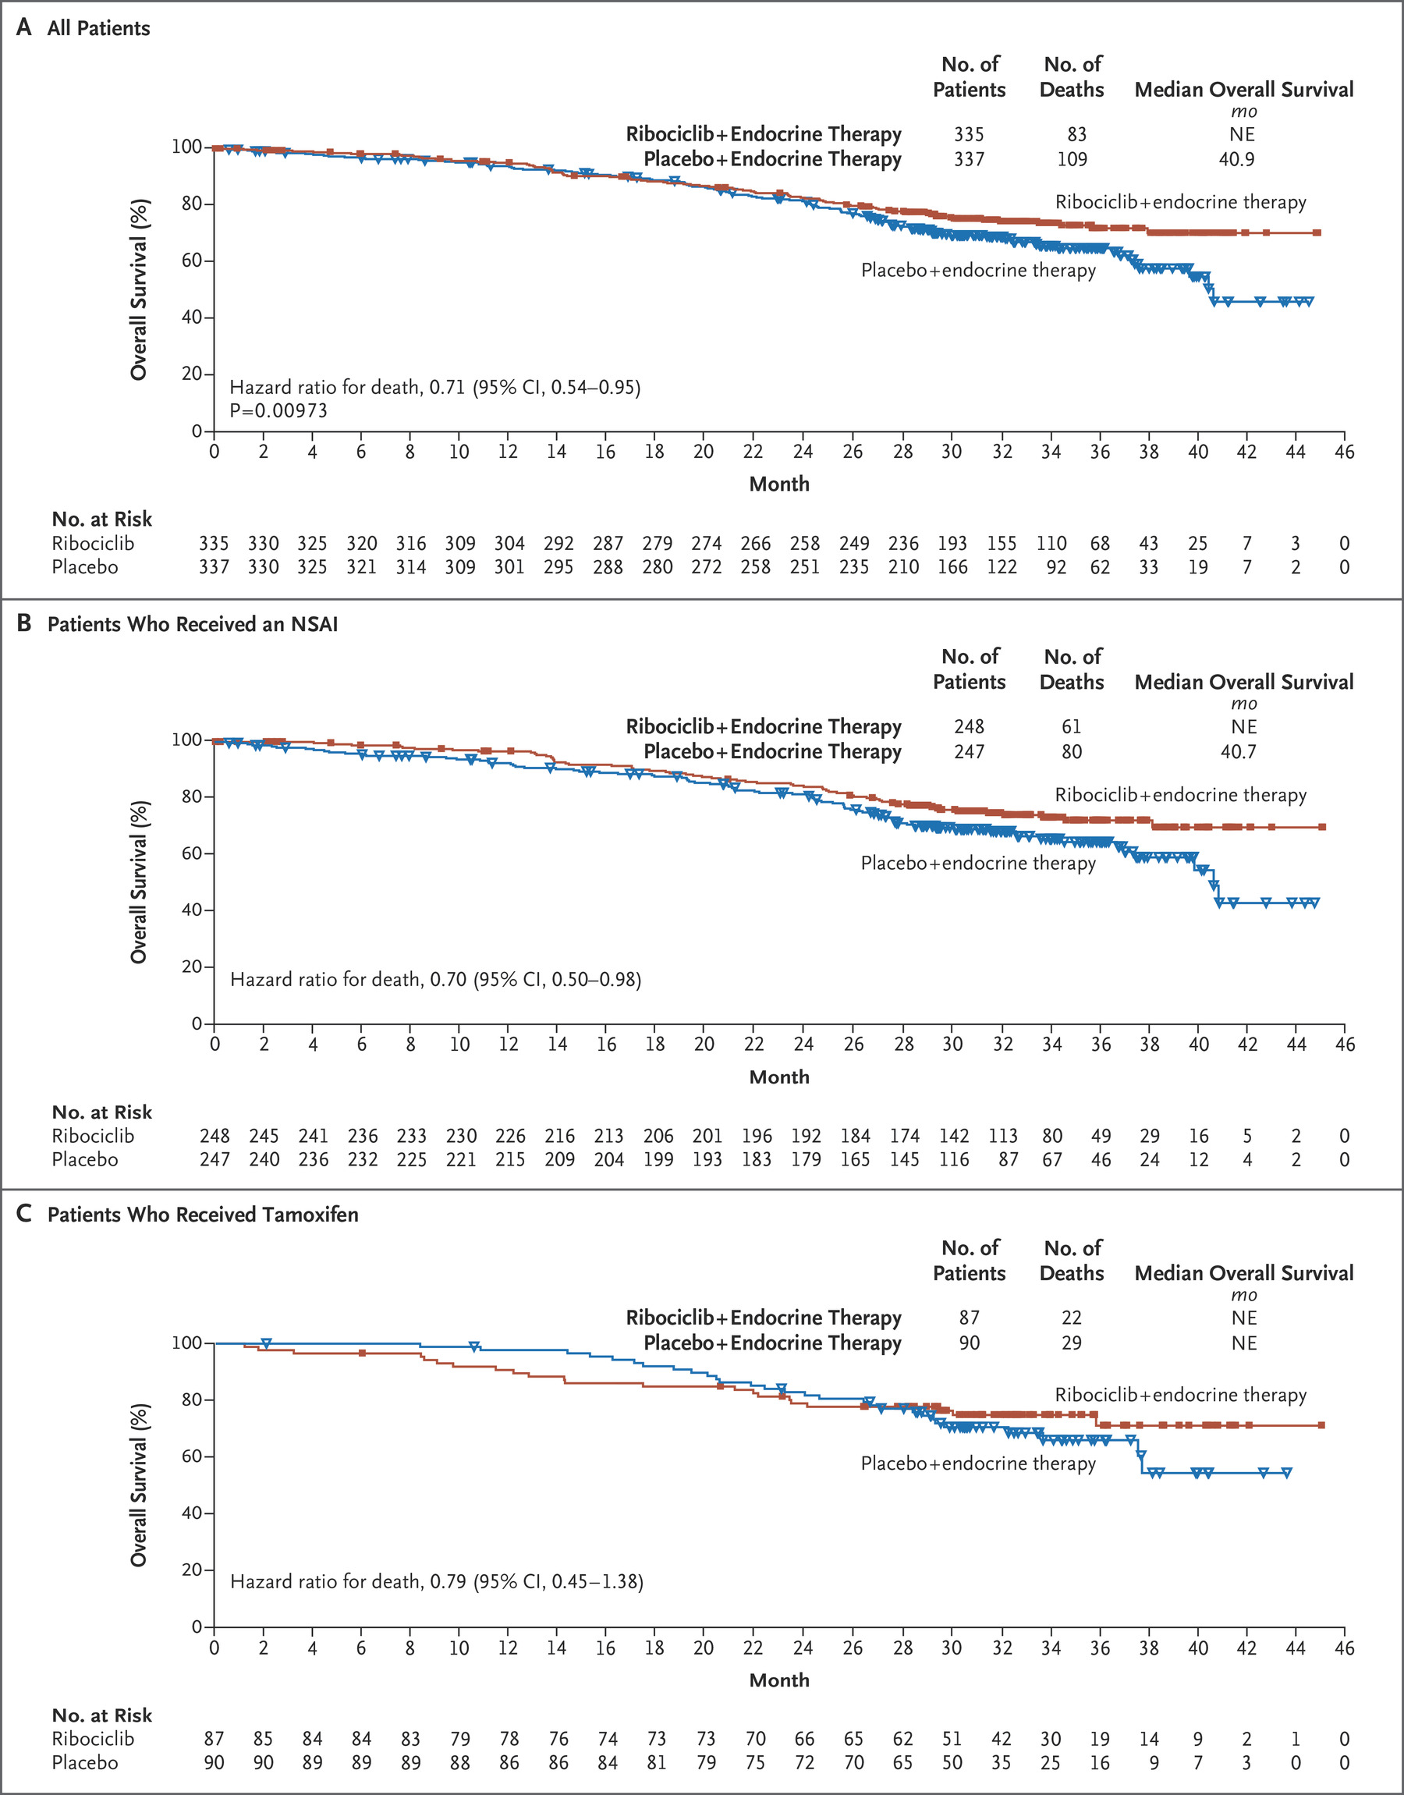
MONALEESA-7: Overall Survival
Im SA, et al. N Engl J Med 2019; 381:307-316

Slide 85
Is There a Role for CDK4/6 Inhibition in
Early-Stage HR+ Disease?
Risk of First Recurrence After Primary Treatment
PENELOPE-B
Palbociclib
After neoadjuvant,
high risk
0.25
Stage
I
II
III
0.20
monarchE
Abemaciclib
High-risk CPR factors, Ki67
0.15
Estimated Annual Hazard Rate
PALLAS
Palbociclib
Stage II, III
0.10
0.05
NATALEE
Ribociclib
Stage II, III
0
0
2
4
6
8
10
Follow-up Time After Primary Diagnosis of Breast Cancer (Yr)
Cheng. Cancer Epidemiol Biomarkers Prev. 2012;21:800.
Notes:
HR, hormone receptor.

Slide 86
monarchE: Adjuvant Abemaciclib + ET in
High-Risk, Node-Positive, HR+/HER2- EBC
International, randomized, open-label phase III trial
Primary endpoint: iDFS
Key secondary endpoints: iDFS in Ki-67 high (≥20%) population, DRFS, OS, safety, PROs, PK
Stratified by prior CT,
menopausal status, region
ITT Population (Cohorts 1 + 2)
Women or men with high-risk, node-positive, HR+/HER2- EBC; prior (neo)adjuvant CT permitted; pre- or postmenopausal;
no distant metastasis;
≤16 mo from surgery to randomization; ≤12 wk of ET
after last non-ET
(N = 5637)
Cohort 1 (91% of patients)
≥4 positive ALNs or 1-3 positive ALNs plus histologic grade 3 and/or tumor ≥5 cm
Abemaciclib 150 mg BID up to 2 yr +
ET per standard of care of physician’s choice for 5-10 yr as clinically indicated
(n = 2808)
Cohort 2 (9% of patients)
1-3 positive ALNs, Ki-67 ≥20% per central testing, grade 1-2, tumor size <5 cm
ET per standard of care of physician’s choice for 5-10 yr as clinically indicated
(n = 2829)
Johnston. Lancet Oncol. 2023;24:77.
Notes:
ALN, axillary lymph node; CT, chemotherapy; DRFS, distant relapse–free survival; EBC, early breast cancer; ET, endocrine therapy; HR, hormone receptor; iDFS, invasive disease–free survival; ITT, intention-to-treat; OS, overall survival; PK, pharmacokinetics; PRO, patient-reported outcome.

Slide 87
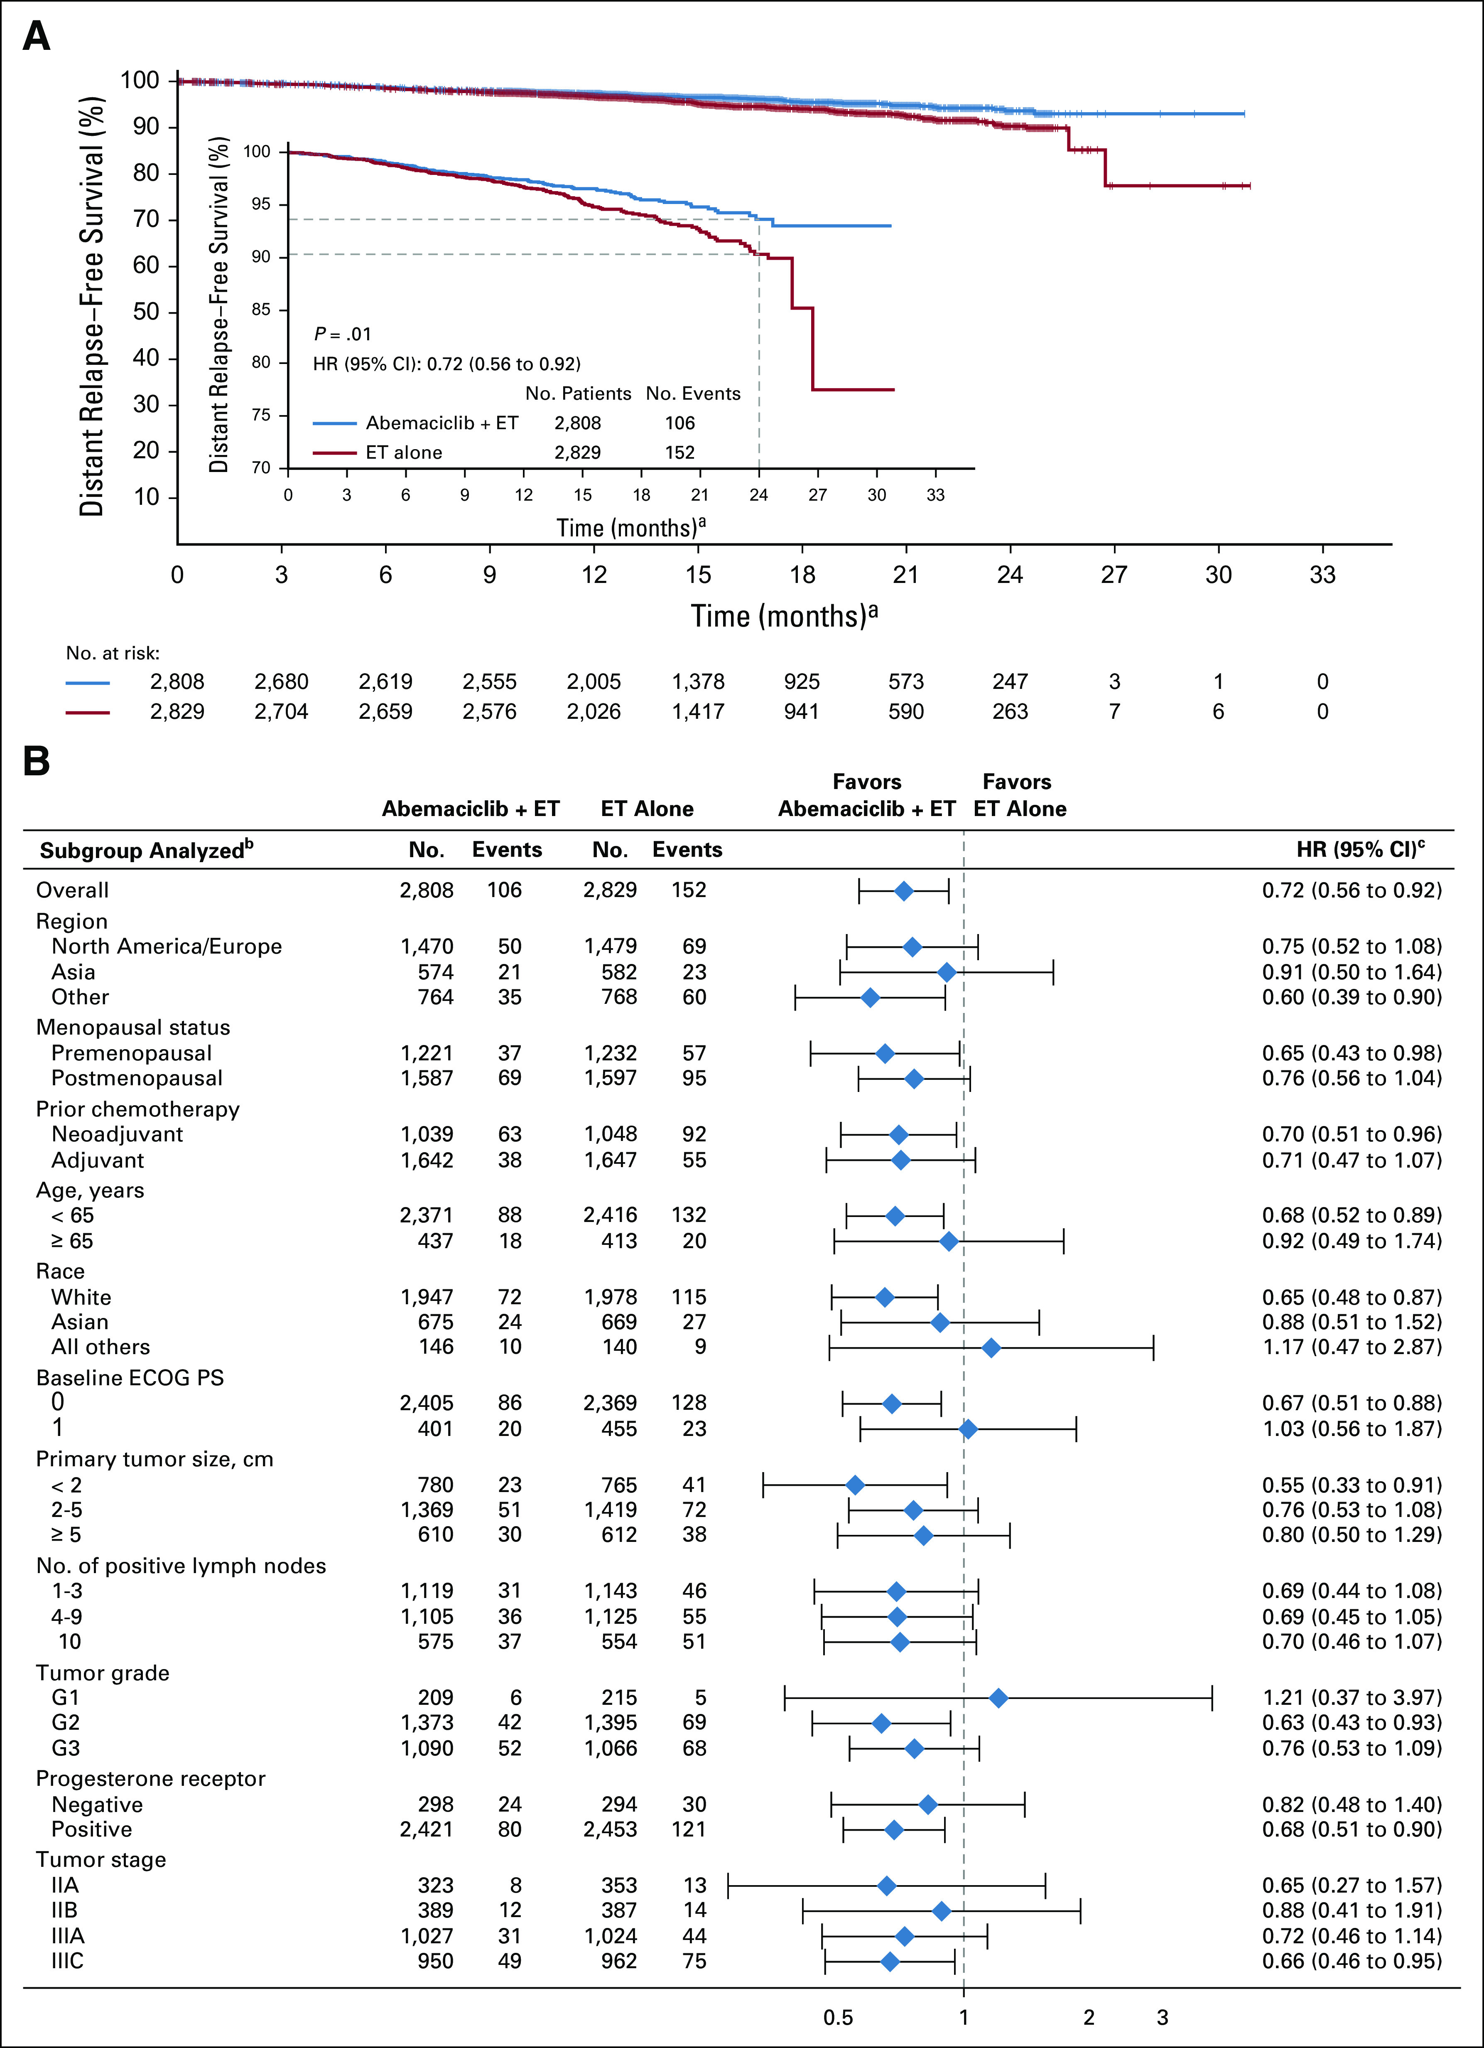
MonarchE: Distant RFS in ITT Population
Johnston. JCO. 2020;38:3987. O’Shaughnessy. ESMO 2021. Abstr VP8-2021. Johnston. Lancet Oncol. 2023;24:77.
Notes:
ET, endocrine therapy; iDFS, invasive disease–free survival; ITT, intention-to-treat; LN, lymph node.

Slide 88
monarchE: Outcomes by Ki-67 Status in Cohort 1
Abemaciclib treatment effects similar in Ki-67‒high and Ki-67‒low groups within cohort 1
iDFS by Ki-67 Status
Outcome in Cohort 1* | Ki-67 High |  | Ki-67 Low
 | Abema + ET (n = 1017) | ET (n = 986) | Abema + ET (n = 946) | ET (n = 968)
iDFS
Events, n | 147 | 224 | 91 | 141
HR (95% CI) | 0.618 (0.501-0.762) |  | 0.624 (0.478-0.814)
DRFS
Events, n | 126 | 193 | 74 | 119
HR (95% CI) | 0.612 (0.488-0.767) |  | 0.613 (0.458-0.821)
OS
Events, n | 68 | 88 | 39 | 50
HR (95% CI) | 0.733 (0.533-1.007) |  | 0.772 (0.506-1.175)
100
95
94.4%
92.8%
91.6%
90
91.6%
88.8%
iDFS (%)
87.7%
85
86.3%
Cohort 1 Ki-67 High
86.9%
83.6%
80
Abemaciclib + ET
ET alone
80.3%
82.4%
Cohort 1 Ki-67 Low
75
Abemaciclib + ET
ET alone
74.7%
70
Abemaciclib Duration
0
6
12
18
24
30
36
42
48
54
60
Mo
*Ki-67 missing in 1203 (23.5%) patients.
Johnston. Lancet Oncol. 2023;24:77. Johnston. SABCS 2022. Abstr GS1-09.
Notes:
DRFS, distant relapse-free survival; ET, endocrine therapy; iDFS, invasive disease–free survival; OS, overall survival.

Slide 89
NATALEE: Adjuvant Ribociclib + ET in HR+/HER2- EBC
International, randomized, open-label phase III trial
Pre/postmenopausal women and men with HR+/HER2-, stage II (either N0 with grade 2/3 and/or Ki67 ≥20% or N1), or stage III EBC; prior (neo)adjuvant CT permitted
(N = 5101)
Ribociclib 400 mg PO QD
for 3 wk on/1 wk off x 3 yr +
ET* for 60 mo
ET* for 60 mo
*Treatment may begin up to 1 yr before study treatment start date. Premenopausal women and men will also receive goserelin 3.6 mg/28 days.
Primary endpoint: iDFS (STEEP criteria)
Key secondary endpoints: recurrence-free survival, dDFS, OS, PROs, PK, safety
Slamon. ASCO 2023. Abstr LBA500. Slamon. ASCO 2019. Abstr TPS597. NCT03701334.
Notes:
DFS, disease-free survival; EBC, early breast cancer; ET, endocrine therapy; HR, hormone receptor; RIBO, ribociclib; STEEP, Standardized Definitions for Efficacy End Points.

Slide 90
NATALEE: Second Interim Efficacy Analysis of iDFS (Primary Endpoint)
iDFS Outcome | Ribociclib + NSAI (n = 2549) | NSAI Alone (n = 2552)
Events, n (%) | 189 (7.4) | 237 (9.3)
3-yr rate, % | 90.4 | 87.1
HR (95% CI) | 0.748 (0.618-0.906; P = .0014)
Median follow-up for iDFS: 27.7 mo.
NATALEE met its primary endpoint, with ribociclib + NSAI significantly improving iDFS vs NSAI alone
  P value of .0014 met protocol-defined stopping boundary for superior efficacy
  (1-sided P <.0128)
iDFS improvement generally consistent across prespecified patient subgroups
With ribociclib + NSAI vs NSAI alone:
  Absolute iDFS benefit at 3 yr: 3.3%
  Risk of invasive disease decreased by 25.2%
Ongoing patients to continue receiving tx, with follow-up to continue
Slamon. ASCO 2023. Abstr LBA500.

Slide 91
CDK4/6 Inhibitor Trials in Early Breast Cancer
Parameter* | monarchE^{1,2} | PALLAS^{3,4} | PENELOPE-B⁵ | NATALEE^{6,7}
N | 5637 | 5761 | 1250 | 5101
CDK inhibitor | Abemaciclib | Palbociclib | Palbociclib | Ribociclib
Eligibility | Cohort 1: ≥N2 or ≥N1 and G3 or T3 Cohort 2: N1 and Ki-67 ≥20% | Anatomic stage II or III (59% N2 or N1 and G3 or T3) | CPS-EG 3 or 2 with ypN+ | Stage II-III
CDKi duration, mo | 24 | 24 | 12 | 36
Follow-up, mo | 42 | 31 | 42.8 | 27.7
iDFS, % (abs diff) | 85.8 vs 79.4 (6.4) | 84.2 vs 84.5 (-.3) | 73.0 vs 72.4 (0.6) | 90.4 vs 87.1 (3.3)
*Cross-trial comparisons have significant limitations due to differences in study design and populations.
1. Johnston. JCO. 2020;38:3987. 2. Tolaney. ASCO 2022. Abstr 527.
3. Mayer. Lancet Oncol. 2021;22:212. 4. Gnant. JCO. 2022;40:282.
5. Loibl. JCO. 2021;39:1518. 6. Slamon. ASCO 2019. Abstr TPS597.
7. Slamon. ASCO 2023. Abstr LBA500.
Notes:
abs diff, absolute difference; AE, adverse event; CDKi, CDK inhibitor; CPS-EG, clinical-pathologic stage—estrogen/grade; DRFS, distant recurrence-free survival; iDFS, invasive disease–free survival; NR, not reported.

Slide 92
Key AEs With CDK4/6 Inhibitors: Management
Diarrhea
Abemaciclib
Palbociclib
Ribociclib
Hepatobiliary Toxicity
Abemaciclib
Ribociclib
QT Prolongation
Ribociclib
Neutropenia
Abemaciclib
Palbociclib
Ribociclib
VTE
Abemaciclib
ILD/
Pneumonitis
Abemaciclib
Palbociclib
Ribociclib
Antidiarrheal therapy
Increase oral hydration
Notify HCP
LFTs before starting tx, Q2W x 2 mo, then:
Abemaciclib, as indicated
Ribociclib, at start of cycle x 4 cycles
ECG before cycle 1, Day 14 of cycle 1, start of cycle 2, then as indicated
Electrolytes at start of cycle x 6 cycles, then as indicated
CBC before starting tx, then:
Abemaciclib, Q2W x 2 mo, QM x 2 mo, then as indicated
Palbociclib, Days 1 and 15 of cycles 1-2, then as indicated
Ribociclib, Q2W x 2 cycles, start of next 4 cycles, then as indicated
Monitor for signs
and symptoms of thrombosis or pulmonary embolism
Monitor for pulmonary symptoms indicative of ILD or pneumonitis
(eg, hypoxia, cough, dyspnea)
Abemaciclib PI. Palbociclib PI. Ribociclib PI.
Notes:
CBC, complete blood count; HCP, healthcare professional; ILD, interstitial lung disease; LFT, liver function test; tx, treatment; VTE, venous thromboembolism

Slide 93
Summary and Conclusions
CDK4/6 inhibitors are one of the most important advances in the treatment of patients with HR+/HER2- breast cancer
METASTATIC DISEASE
  Palbociclib, Ribociclib and Abemaciclib are effective in the first-line or second-line in metastatic breast cancer
  Ribociclib improved overall survival in combination with AI or fulvestrant in the metastatic setting, both in postmenopausal and premenopausal women
  Abemaciclib is effective in combination with endocrine therapy and as a single agent in metastatic breast cancer
ADJUVANT
  Abemaciclib is FDA approved for patients with early-stage breast cancer at high risk of recurrence, for 2 years
  Ribociclib showed efficacy in the early-stage setting - indication under review

Slide 94
BREAST CANCER
Monday, September 11, 2023

Slide 95
Imaging Options to Evaluate Response to Neoadjuvant Therapy
Lisa F. Baron, MD, FACR
Chief Division of Breast Imaging
Northwell Health – Lenox Hill Hospital
New York, New York

Slide 96
Learning Objectives
ACR appropriateness Criteria Monitoring Response to Neoadjuvant Systemic Therapy for Breast cancer.
Review of treatment imaging findings and predictors of tumor response

Slide 97
Neoadjuvant Therapy, Current Use
Downstage tumors
  Allow for surgical resection in previous large inoperable tumors
  Provide opportunity for breast-conserving surgery
  Decrease adenopathy and allow for sentinel lymph node biopsy (goal of reducing risk of lymphedema)
Predict treatment response
  Prognostic factor for disease recurrence
  Predictor of overall survival
  Provide in vivo response and timely alteration to therapy
Response depends on tumor subtype
5 % show disease progression
https://www.ncbi.nlm.nih.gov/pmc/articles/PMC8303777

Slide 98
How to Monitor The Response to Neoadjuvant
Physical Exam
Imaging
  Ultrasound
  Mammography
  MRI
  (PET)
When to Image?
Baseline within 4 weeks before treatment
Interval images as needed
Prior to surgical management
**Need to have imaging or clinical disease to follow for response

Slide 99

Monitoring Response – Clinical Exam
Clinical exam
  Monitor palpable disease
  Difficult to reproduce
  Clinical exam over- and underestimates response (bias)
  A significant percentage of patients who attain a clinical response have residual disease at surgical resection
  Accuracy 50-65%

Slide 100
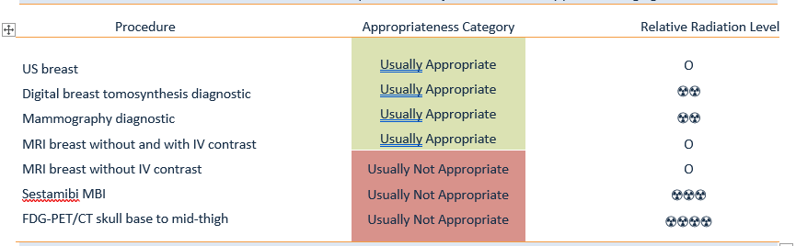
ACR appropriateness Criteria Monitoring Response to Neoadjuvant Systemic Therapy for Breast cancer.
Reference: Expert Panel on Breast Imaging, Hayward JH, Linden OE, et al. ACR Appropriateness Criteria® Monitoring Response to Neoadjuvant Systemic Therapy for Breast Cancer: 2022 Update. J Am Coll Radiol. 2023;20(5S):S125-S145. doi:10.1016/j.jacr.2023.02.016

Slide 101
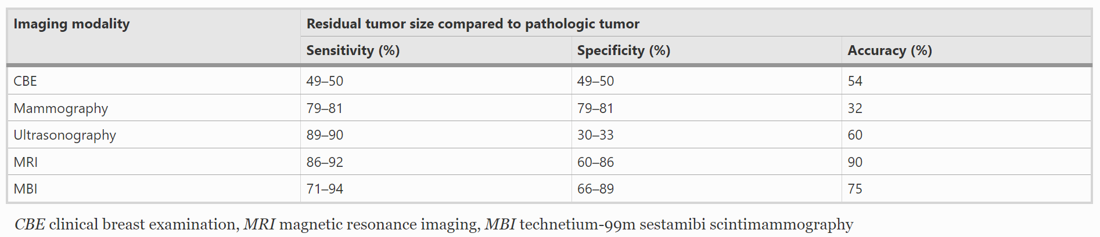
Comparison of Modalities
Reference: Dialani V, Chadashvili T, Slanetz PJ. Role of imaging in neoadjuvant therapy for breast cancer. Ann Surg Oncol. 2015;22(5):1416-1424. doi:10.1245/s10434-015-4403-9

Slide 102
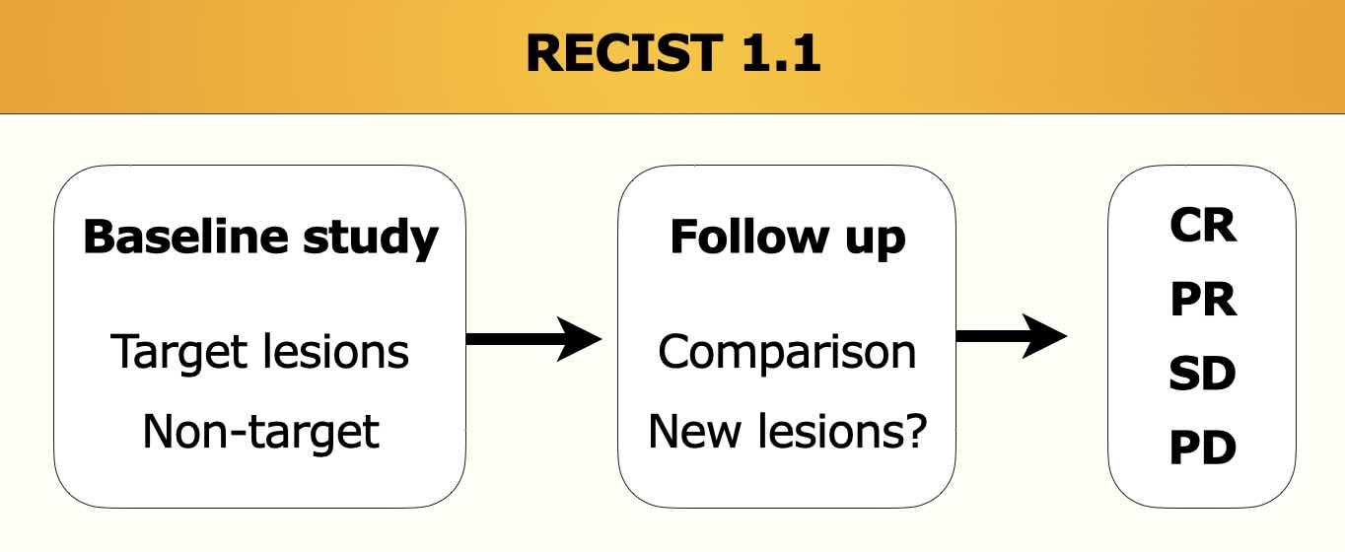
Standardizing Measurements
Response Evaluation Criteria In Solid Tumors
CR=Complete, PR = Partial, SD = Stable, PD = Progressive
https://radiologyassistant.nl/more/recist-1-1/recist-1-1-1

Slide 103
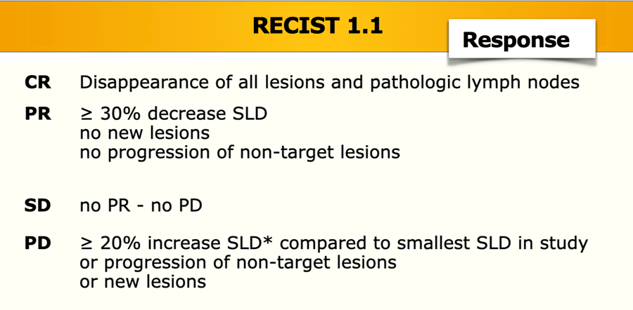
Monitory Response RECIST Terminology
Response Evaluation Criteria In Solid Tumors
Clinical Response
Partial Response
Stable Disease
Progression Disease
Reference: Reig, Beatriu, et al. “Breast MRI for evaluation of response to Neoadjuvant therapy.” RadioGraphics. 2021;41(3):665–679. https://doi.org/10.1148/rg.2021200134

Slide 104
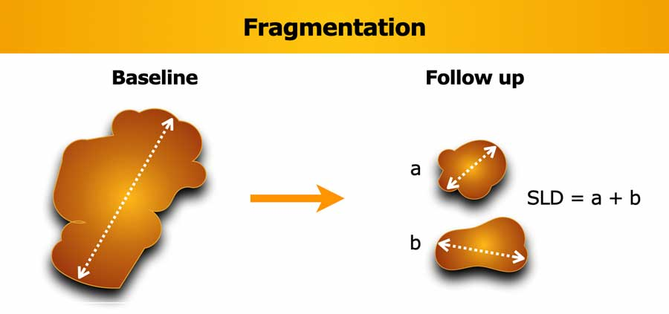

Slide 105
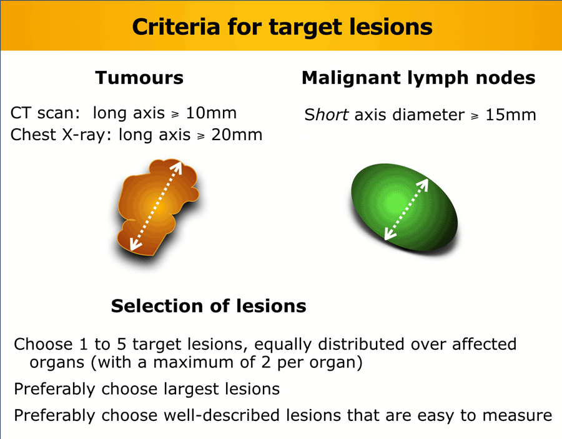
LN <1 cm considered normal

Slide 106
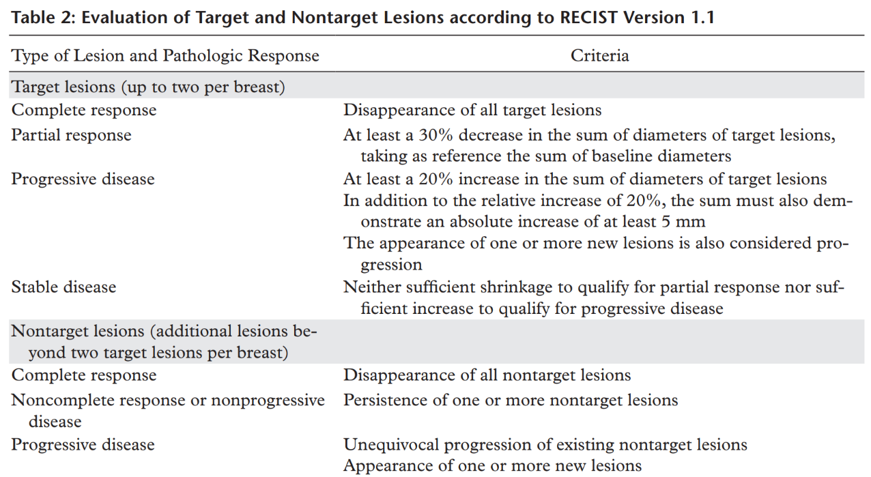
Monitory Response RECIST Terminology
Response Evaluation Criteria In Solid Tumors
Reference: Reig, Beatriu, et al. “Breast MRI for evaluation of response to Neoadjuvant therapy.” RadioGraphics. 2021;41(3):665–679. https://doi.org/10.1148/rg.2021200134

Slide 107
RECIST Measurement Techniques
Longest diameter
Diameters in 3 orthogonal dimensions
Functional tumor volume (determined by enhancement thresholds)
  More accurate in predicting tumor response
  Can help predict recurrence-free survival
Reference: Reig, Beatriu, et al. “Breast MRI for evaluation of response to Neoadjuvant therapy.” RadioGraphics. 2021;41(3):665–679. https://doi.org/10.1148/rg.2021200134

Slide 108
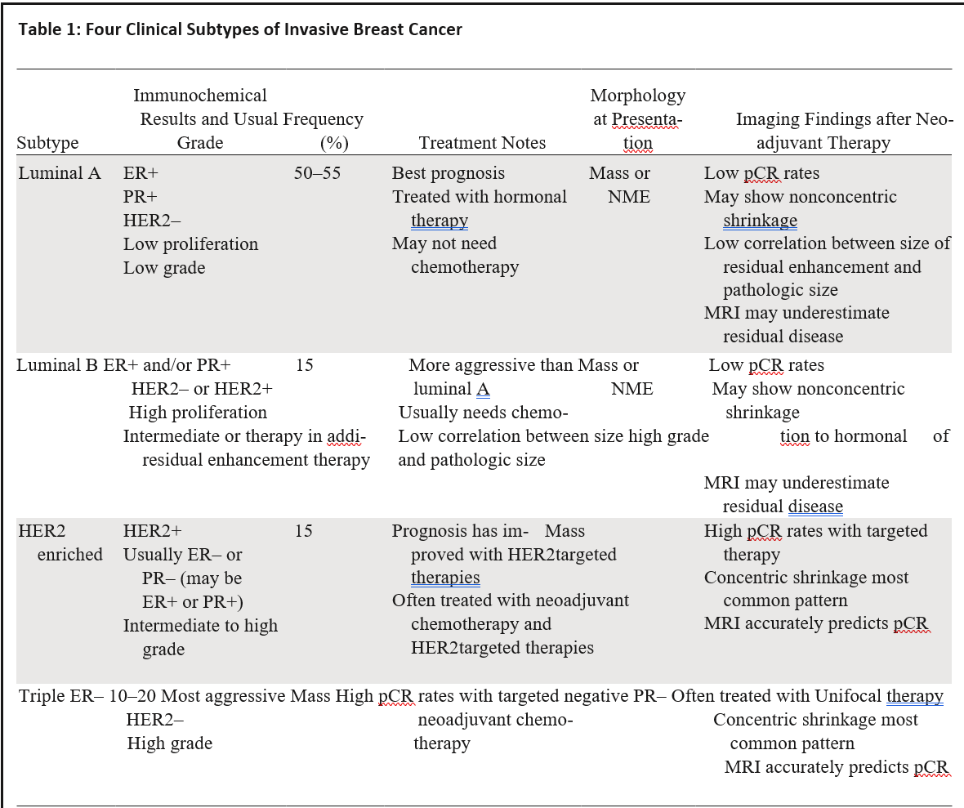
Not All Tumors Behave the Same
Luminal A
Low pCR
Nonconcentric shrinkage
Luminal B
Low pCR, but higher than Lum A
HER2
Triple negative
Low correlation between residual enhancement and path
MRI underestimates disease
Nonconcentric enhancement
MRI underestimates disease
High pCR
Concentric shrinkage
MRI accurately predictive
High pCR
MRI accurately predicts
Concentric shrinkage
Reference: Reig, Beatriu, et al. “Breast MRI for evaluation of response to Neoadjuvant therapy.” RadioGraphics. 2021;41(3):665–679. https://doi.org/10.1148/rg.2021200134

Slide 109
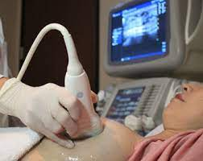
Monitoring Response – Ultrasound
Advantages
  Can measure tumor size pre- and post NAT
  Quick, easy to schedule
Limitations
  Over and underestimation of disease
    Post-treatment fibrosis may develop at the tumor bed resulting in persistent appearance of mass even when no tumor is present
  Unable to assess non-mass lesions
  Unable to assess distortion
  Unable to assess calcifications
  Unable to consistently visualize vascularity
  Sensitivity/specificity predictor of pCR (60%/78%)

Slide 110
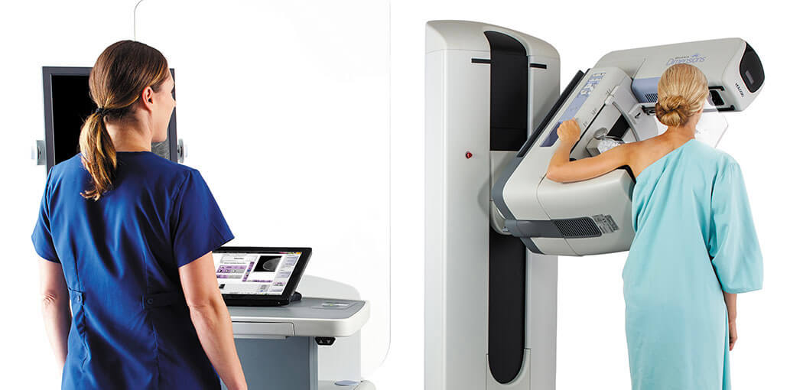
Monitoring Response – Mammography
Advantages
  Can measure tumor size pre- and post NAT
  Quick, easy to schedule
Limitations
  Over and underestimation of disease
    Post-treatment fibrosis may develop at the tumor bed resulting in persistent appearance of mass/asymmetry
  Residual disease can be difficult to detect, especially in dense breast
  Presence of residual calcifications might not correlate to residual disease at pathology
  Mammography is not functional imaging

Slide 111


Assessing Response Using MRI and CEM
Functional Imaging
Both MRI and CEM exploit imaging the neovascularity in tumors
Changes in vascularity can be captured with MRI and CEM
Madu CO, Wang S, Madu CO, Lu Y. Angiogenesis in Breast Cancer Progression, Diagnosis, and Treatment. J Cancer. 2020;11(15):4474-4494. Published 2020 May 18. doi:10.7150/jca.44313

Slide 112

Monitoring Response Functional Imaging – MRI
Advantages
  Functional imaging
  Can measure tumor size pre- and post NAT
Limitations
  Can overestimate residual disease
    Fibrosis or treatment change
    Necrotic tumors
    Residual benign masses
  Can underestimate residual disease
    Tumors with nonmass morphology
    Tumors with nonconcentric shrinkage
    Anticoagulant therapy
    Late-enhancing foci

Slide 113

11/2022
08/2023 (post neoadjuvant)

Slide 114

Monitoring Response With Functional Imaging
Using CEM Mammography when Unable to Have MRI
Contrast Mammography = Adds Contrast to Exam
Low and High kV and subtraction 3D mammogram

Slide 115
Case Study: Patient unable to have MRI
What are Other Options?
54 yo newly diagnosed left breast cancer (proven 2 sites). Lymph nodes normal (outside facility). Patient unable to have MRI due to claustrophobia. CEM ordered​ prior to chemotherapy.

Slide 116

54 yo newly diagnosed left breast cancer (2 site). Unable to have MRI. CEM ordered
poorly differentiated invasive ductal carcinoma,
ER >90%, PR 45%, HER-2 3+

Slide 117

2 areas of cancer confirmed. Also noted suspicious lymph node (not previously documented). CEM allowed restaging
CEM

Slide 118


Targeted Left Axillary Ultrasound Done
Patient restaged
BX = Metastatic Breast Cancer

Slide 119

Case Study
6409289

Slide 120



Monitoring Response With Mammo
Pre- and Post-Neoadjuvant
11/2022 vs 8/2023
Some reduction in calcs, mass no longer seen

Slide 121


Monitoring Response With Ultrasound
Reduce size of mass and LN (no follow up us mass available)

Slide 122
Monitoring Response with MRI Pre- and Post
After neo complete imaging response except lymph node
11/2022 vs 8/2023
Rt mass no longer seen. Residual lymph nodes

Slide 123

Breast conservation surgery
Complete imaging response does not always equate to no more tumor
Final Diagnosis:
1 Right sentinel lymph node #1, excision: One lymph node with metastatic carcinoma (14 mm) with focal extranodal extension (2 mm) and focal fibrosis (1/1).
2 Right sentinel lymph node #2, excision:
- One lymph node, negative for tumor (0/1).
3 Right breast lumpectomy 6 oclock:
Few scattered residual foci of microinvasive carcinoma identified, within 1 mm of inked posterior margin.
Extensive ductal carcinoma in situ, high-grade, solid type (36 mm), associated with calcifications
Lymphatic invasion identified.
Biopsy site and tumor bed identified.
5 Right breast inferior margin clip, excision:
- Fibrofatty breast with microscopic focus of atypical ductal hyperplasia, fibroadenomatoid change and benign calcifications, negative for tumor.
MRI often underestimates residual disease in Luminal A/B disease

Slide 124
Case Study:
36 yo presents with left breast pain and mass
Assessing Response with Imaging
ER +, PR-, Her2-

Slide 125


Slide 126


36 yo left breast mass and pain 3/6/2023

Slide 127

36 yo left axillary adenopathy

Slide 128

PET scan shows extensive left disease and adenopathy. Thigh enhancement is related to prior fat injections (cosmetic)

Slide 129


36 yo left breast mass and pain 3/6/2023

Slide 130


Pre and post neoadjuvant chemo
3/6/2023 vs 8/18/2023
Difficult to assess if there was improvement using only mammo

Slide 131

Pre and post neoadjuvant chemo
3/6/2023 vs 8/18/2023
Imaging of posterior lesions can be challenging
Lymph nodes improved

Slide 132

Ultrasound demonstrates improved imaging of the index mass
Pre and post neoadjuvant chemo
3/6/2023 vs 8/18/2023

Slide 133

Ultrasound demonstrates improved imaging of the index lymph node
Pre and post neoadjuvant chemo
3/6/2023 vs 8/18/2023

Slide 134



3/23/2023 vs 5/19/2023 vs 8/10/2023

Slide 135

Post Surgical

Slide 136

Summary

Slide 137

Summary

Slide 138

Summary

Slide 139
References
Expert Panel on Breast Imaging, Hayward JH, Linden OE, et al. ACR Appropriateness Criteria® Monitoring Response to Neoadjuvant Systemic Therapy for Breast Cancer: 2022 Update. J Am Coll Radiol. 2023;20(5S):S125-S145. doi:10.1016/j.jacr.2023.02.016
Madu CO, Wang S, Madu CO, Lu Y. Angiogenesis in Breast Cancer Progression, Diagnosis, and Treatment. J Cancer. 2020;11(15):4474-4494. Published 2020 May 18. doi:10.7150/jca.44313
Dialani V, Chadashvili T, Slanetz PJ. Role of imaging in neoadjuvant therapy for breast cancer. Ann Surg Oncol. 2015;22(5):1416-1424. doi:10.1245/s10434-015-4403-9
Reig, Beatriu, et al. “Breast MRI for evaluation of response to Neoadjuvant therapy.” RadioGraphics. 2021;41(3):665–679. https://doi.org/10.1148/rg.2021200134

Slide 140
BREAST CANCER
Monday, September 11, 2023

Slide 141
Impact of Neoadjuvant Therapy (NAT) on Breast Surgery
Paul L. Baron, MD, FACS
Chief, Breast Surgery
Director of Breast Cancer Program
Lenox Hill Hospital/Northwell Health

Slide 142
Case Study
42 yo f presented with new palpable right breast and axillary metastases. Biopsy positive for poorly diff IDC. ER pos 75%, PR pos 90%, HER2 pos. Also has met to right axillary node confirmed on biopsy.
PMH: negative
FH: negative
PE:
  Right breast-palpable 2cm at 4:00
  Right axilla-2cm node
Imaging incl PET

Slide 143

Case study

Slide 144

Palpable right mass and enlarged LN

Slide 145

Hypermetabolic right breast mass and LN

Slide 146

11/2022 vs 2/2023 (complete imaging response) s/p NAT with TCHP

Slide 147
Case Study
Surgery: Right localized lumpectomy, sentinel node biopsy/targeted axillary node biopsy, followed by axillary dissection for positive targeted node on frozen section

Slide 148


Four months postop

Slide 149
Case Study
Pathology: Few scattered foci of microinvasive ca, extensive DCIS, lymphatic invasion, clear margins. Targeted node removal positive on frozen section and underwent lymph node dissection. Only 1/18 nodes positive.
RCB (Residual Cancer Burden)-II (2.5)
Now on COMPASSHER2 Trial (COMprehensive Use of Pathologic Response ASSessment to Optimize Therapy in HER-2 Positive Breast Cancer): Double-Blind Phase III Randomized Trial of T-DM1 and Placebo vs T-DM1 and Tucatinib.
Completed XRT

Slide 150
Outline
Rationale and candidates for NAT
RCB Score
Time to surgery
Axillary management
Can some patients eliminate surgery?
Impact of exercise on pCR

Slide 151
Benefits of Preop Systemic Therapy
(NCCN Guidelines Version 4.2023)
Facilitates Breast Conservation
Can render inoperable tumors operable
Treatment response provides important prognostic information at an individual patient level, particularly in patients with TNBC or HER2-positive breast cancer
Identifies patients with residual disease at higher risk for relapse to allow for the addition of supplemental adjuvant regimens, particularly in patients with TNBC or HER2-positive breast cancer

Slide 152
Benefits of Preop Systemic Therapy
(NCCN Guidelines Version 4.2023)
Allows time for genetic testing
Allows time to plan breast reconstruction in patients electing mastectomy
Allows time for delayed decision-making for definitive surgery

Slide 153
Opportunities of Preop Systemic Therapy
(NCCN Guidelines Version 4.2023)
May allow SLN alone if initial cN+ becomes cN0 after NAT
May provide an opportunity to modify systemic treatment if no preoperative therapy response or progression of disease
May allow for more limited radiation fields in patients with cN+ who become cN0/pN0 after NAT
Provides excellent research platform to test novel therapies and predictive biomarkers.
Caution: possible overtreatment with systemic therapy if clinical stage is overestimated

Slide 154
Candidates for Preop Systemic Therapy
(NCCN Guidelines Version 4.2023)
Patients with Inoperable breast cancer
  IBC or cT4 tumors
  Bulky or matted cN2 axillary nodes; cN3 nodal disease
In select patients with operable cancer:
  HER2-positive and TNBC, if >cT2 or >cN1
  Large primary tumor relative to breast size in patient who prefers breast conservation.
  cN+ disease likely to become cN0 with NAT
  Consider for cT1c, cN0 HER2-positive and TNBC
  Patients in whom definitive surgery may be delayed.

Slide 155
NAT and Breast Surgery
Pathologic complete response (pCR) after NAC have better prognosis
  NSABP B-18 randomized 1523 patients to either NAC vs adjuvant chemo: while OS and DFS similar, those with pCR had better OS and DFS than those with residual disease.
Recent studies have showed that those with residual disease following NAT benefit from continued therapy
  CREATE-X Trial shows benefit to oral Capecitabine in patients with residual disease after NAT for Triple Negative Cancers (improved 5 year DFS 67.6% to 74.1% with Capecitabine)
  KATHERINE Trial shows benefit to T-DM1 in patients with residual disease after NAT for Her-2 positive tumors (improved 3 year DFS 77% with Herceptin to 88.3% with T-DM1)

Slide 156
Residual Cancer Burden (RCB Score)
Derived from final pathology
Components: Tumor bed size, residual viable cellularity (%), number and size of residual nodal metastases
Continuous score from 0 (pCR) to about 4 (almost no response to NAT)
  Higher the score=more cancer left
Performs equally as well as post-NAC AJCC Stage for predicting recurrence and survival
Symmans WF, Peintinger F, Hatzis C, et al. J Clin Oncol. 2007; 25: 4414-4422.

Slide 157

Residual Cancer Burden Calculator (RCB Score)*
*http://www3.mdanderson.org/app/medcalc/index.cfm?pagename=jsconvert3

Slide 158


Slide 159


Slide 160
RCB after NAT by Long-Term Outcomes
Pooled analysis of studies from 12 institutes and trials across Europe and US
Obtained RCB results and clinical and pathologic data from 5161 patients with Stage I-III breast cancer treated by NAC followed by surgery.
Conclusion: RCB score was independently prognostic in all cancer subtypes
Yau C, Osdoit M, van der Noordaa M, et al. Lancet Oncol 2022; 23: 149-60.

Slide 161

Event-free Survival & Distant Relapse-free Survival by RCB
Yau C, Osdoit M, van der Noordaa M, et al. Lancet Oncol 2022; 23: 149-60.

Slide 162
Time to Surgery (TTS)
General consensus to proceed with surgery about 4-6 weeks following completion of NAT.
Earlier studies have showed higher complication rates if Time to Surgery less than 28 days
In theory, longer the TTS, the higher the chance of local recurrence of breast cancer

Slide 163
Time to Surgery (TTS)
Retrospective review of 463 patients treated between 2011-2017
Nonmetastatic breast cancer
TTS calculated as time between last cytotoxic chemotherapy dose to date of surgery
Groups:
  < 4 weeks
  > 4 weeks and < 6 weeks
  > 6 weeks
Sutton TL et al. J Surg Oncol. 2020 Dec; 122(8): 1761-1769.

Slide 164


Slide 165


Slide 166

Results: Effect of TTS on RCB Score
Median RCB Score by TTS

Slide 167
Time to Surgery Conclusions
In breast cancer patients receiving NAT, TTS greater than 4 weeks adversely affects RFS, and TTS greater than 6 weeks adversely affects survival
Effect seems to be mediated by time-dependent regrowth in treated primaries and nodal basins (RCB score)
  Hypothesized to allow time for reseeding /regrowth of distant metastases.
Sutton TL et al. J Surg Oncol. 2020 Dec; 122(8): 1761-1769.

Slide 168
Sentinel Nodes following NAT
ACOSOG Z1071 trial: patients with clinically positive nodes (cN1, cN2) prior to NAT.
Following NAT, all patients underwent both sentinel node biopsy (SLN) and axillary node dissection (ALND). Encouraged both blue dye and radiolabeled colloid
756 patients enrolled
A sentinel node could not be identified in 46 (7.1%)
In 39 patients, cancer not found in SLNs but was found in nodes obtained with ALND resulting in FNR of 12.6%
Boughey JC, Suman VJ, Mittendorf EA, et al. JAMA 2013; 310(14): 1455-1461.

Slide 169



Slide 170

Targeted Axillary Dissection(TAD) after NAT
Study to determine if TAD removing the clipped node in N1 or N2 improves the FNR in SLN biopsy
Prospective study of 208 patients with biopsy-confirmed nodal metastases with clip placed in the sampled node.
Patients undergoing SLN and ALND, FNR was 10.1%
Adding the clipped node reduced FNR to 1.4% (p=0.03)
Clipped node not retrieved as SLN in 23% (31 of 134), including 6 with negative SLNs but metastases in the clipped node.
Caudle AS, Yang WT, Krishnamurthy S, et al. JCO 2016; 34: 1072-1078.

Slide 171
Nodal Recurrence following NAT is Rare
Evaluate nodal recurrence in consecutive cohort of patients with cN1 breast cancer patients treated with NAC followed by neg SLN.
Patients did NOT have nodes clipped at time of nodal biopsy so retrieval of the biopsied node could not be verified
Based on prior data, if 3 or more SLNs retrieved, then low FNR.
Barrio AV, Montagna G, Mamtani A, et al. JAMA Oncol 2021; 7(12): 1851-1855.

Slide 172

Finding: At median followup of 40 months, there was one axillary nodal recurrence synchronous with local recurrence in patient who refused XRT.
Barrio AV, Montagna G, Mamtani A, et al. JAMA Oncol 2021; 7(12): 1851-1855.

Slide 173
Eliminate Surgery for Invasive Breast Cancer in Exceptional Responders to NAT?
Prospective, multicenter single-arm, phase 2 trial in 7 centers
T1 or T2, N0 or N1, and HER-2 positive or Triple negative IDC
Clinically positive nodes biopsied and clip placed prior to NAT
Kuerer HM, Smith BD, Krishnamurthy S, et al. Lancet Oncol 2022; 23: 1517-24.

Slide 174
Eliminate Surgery for Invasive Breast Cancer in Exceptional Responders to NAT?
Following NAT, tumor bed rebiopsied with a minimum of 12 vacumn- assisted core biopsies with a 9G needle targeting previously biopsied clip:
  If no residual cancer, patient’s did not have breast surgery and underwent XRT
  If residual cancer, underwent standard breast surgery and XRT
  If no residual cancer but node positive prior to NAT, eligible for no breast surgery if targeted axillary dissection and no residual disease found
Kuerer HM, Smith BD, Krishnamurthy S, et al. Lancet Oncol 2022; 23: 1517-24.

Slide 175

Finding: At median follow-up of 26.4 months, there were no ipsilateral breast tumor recurrences in the 31 patients with pCR on core biopsy
Kuerer HM, Smith BD, Krishnamurthy S, et al. Lancet Oncol 2022; 23: 1517-24.

Slide 176
Impact of Exercise and Nutrition on Chemotherapy Completion and pCR with NAT
Randomized trial of an exercise and nutrition intervention on relative dose intensity (RDI) and pathologic complete response (pCR)
173 patients with stage I-III breast cancer randomized to usual care vs home-based exercise and nutrition intervention with counseling sessions
Sanft T, Harrigan M, McGowan C, et al. JCO. 2023 (online)

Slide 177
Effect of Intervention vs Usual Care in NAT (N=72)
Variable | Intervention | Usual Care | P
Overall | N=40 | N=32
-RDI continuous, mean | 92% | 89.3% | 0.34
-Dose reductions, skip, delays, No. (%) | 20 (50) | 19 (63) | 0.43
-pCR, No. (%) | 21 (53) | 9 (28) | 0.037
HR + and HER 2- | N=10 | N=12
-pCR, No. (%) | 3 (30) | 0 (0) | 0.08
TNBC | N=16 | N=10
-pCR, No. (%) | 11 (69) | 3 (30) | 0.05
HER2+ | N=14 | N=10
-pCR, No. (%) | 7 (50) | 6 (60) | 0.63

Slide 178
Summary
NAT can impact surgical decision making
Residual cancer burden correlates with long term recurrence rate
Once NAT completed, patient should undergo surgery 4 weeks from day of last chemotherapy dose.
Patients with cN1 or cN2 disease prior to NAT should have their node clipped prior to surgery to minimize FNR and avoid axillary dissection
In the future, select patients may be able to avoid surgery following NAT
Exercise and nutrition intervention seem to increase rate of pCR

Slide 179
BREAST CANCER
Monday, September 11, 2023

Slide 180
Radiation considerations for elderly breast cancer patients
Wesley Talcott, MD MBA
Radiation Oncologist
Northwell
New Hyde Park, NY

Slide 181
Disclosures: None

Slide 182
Treatment de-escalation is appealing in elderly patients
Radiation omission is an acceptable method of de-escalation in certain circumstances
Notes:
Treatment de-escalation is appealing in elderly patients. In this population, visits may be more burdensome, comorbidity may make toxicity less tolerable, and there are far more potential competing causes of death versus younger patients.

Slide 183


Two large trials have assessed safety of RT omission in elderly pts with invasive disease
Notes:
What do we know

Slide 184
Helping the elderly navigate early-stage breast cancer
 | CALGB 9343 | PRIME II
Age | ≥70 | ≥65
Invasive size | ≤2 cm | ≤3 cm
HR status | + | +
Margins | - | -
Nodes | pN0, cN0 + pNX | pN0
Endocrine tx | 5yrs required | 5yrs required
Radiation tx | Whole breast 45Gy/25fx + 14Gy/8fx boost | Whole breast 40-50Gy/15-25fx +/- 10-15 Gy boost
LVI + high grade | ---- | Either, but not both
Notes:
Breast cancer is a major source or mortality in patients older than 70 years of age. 30-40% of new cases of invasived udctal carcinoma appear in this cohort as well as 50% of all breast cancer related deaths. Mortality rate rises with increasing age reaching 1% in women aged over 80 years. Over the age of 85, there is a 13x increase in breast cancer mortality rate as compared to younger patients- these are truly patients dying OF breast cancer, not with breast cancer. Treatment omission or delay may be contributing to this worse progrnosis. (Breast Care, 2022, 17(1) 71-80). Marinopoulis et al.)

Slide 185


Two large trials have assessed safety of RT omission in elderly pts with invasive disease
Hughes KS et al. J Clin Oncol. 2013 Jul 1;31(19):2382-7;
Kunkler IH et al. N Engl J Med. 2023 Feb 16;388(7):585-594

Slide 186


DCIS with favorable risk features have a recurrence rate of ~1% per year
McCormick B et al. J Clin Oncol. 2015 Mar 1;33(7):709-15
Notes:
RTOG 9804 , ECOG (Solin et al, JCO, 2015) and Harvard data (Wong et al, JCO, 2006)
Retrospective studies suggest risk of reccurnece in higher risk DCIS s/p lumpectomy is ~2% per year
Confirm tamoxifen here

Slide 187

The NCCN supports om

Slide 188


Slide 189
We may not be tailoring our treatment recommendations as well as we could…
Physiologic age may vary dramatically from chronologic age
We may be too quick to omit treatment in chronologically “older” patients
Newer treatment options and techniques allow for more palatable, tailored treatment

Slide 190



Slide 191
At the national level, approach to elderly patients is not rational
We are anchored to a dichotomization at age 70

Slide 192




Barrier: Cognitive biases
  Leading image result for “Woman/man in her/his 60s” vs “in her/his 70s”
60s
70s
Google image/Stock photography
Notes:
These biases continue to be discovered. We’ve recently been working to highlight clinically significant age-cuttoff bias in oncologic care, whereby physicians dichotomize patients into bins of old vs young by age in their 60s vs in their 70s. The first hit from a google image search (at least as of the time this slide was created) shows you how this perception of age may be ingrained in our culture. While there may be truth to the assumption that someone in their 60s is more spry and youthful than someone in their 70s, this is unlikely to be the case for an individ
Another bias that seems particularly relevant
We as humans are flawed machines when it comes to plan review

Slide 193
Projected rate of adjuvant therapy recommendation by age at diagnosis
Rate of adjuvant therapy recommendation (%)
100
50
0
Pattern of adjuvant therapy allocation without use of an age cutoff heuristic
Pattern of adjuvant therapy allocation indicating use of an age cutoff heuristic
60
70
80
Age at diagnosis (years)

Slide 194


Slide 195

We do not appear to be factoring in age rationally in our decision making

Slide 196

We do not appear to be factoring in age rationally in our decision making
Talcott WJ et al. IJROBP. 2023 Jul 15;116(4):747-756

Slide 197
De-escalation in certain patients does not affect overall survival
We can and should tailor treatment to older patients
Especially for elderly patients, radiation therapy is not one-size-fits-all
Treatment can now be deescalated in a number of ways with data from prospective trials
  Smaller treatment volume
  Shorter courses

Slide 198
We do not appear to be factoring in age rationally in our decision making
Partial breast
  UK IMPORT LOW
    40 Gy in 15 fx partial breast RT had equal LR and DR vs whole breast
5 fraction regimens
  FAST
  FAST FORWARD
Accelerated Partial Breast Irradiation (APBI)
  RAPID
    Identical LR
    Lower acute toxicity with partial breast
    Higher late toxicity with partial breast
  NSABP B-39/RTOG 0413 (similar findings)
  Florence trial
Simultaneous integrated boost
Genomic testing
Notes:
90% of recurrences occur very close ot the tumor bed. Partial breast (Breast Care, 2022, 17(1) 71-80). Marinopoulis et al.)

Slide 199



Can we treat less breast tissue

Slide 200

IMPORT LOW
Coles et al. Lancet 2017;390:1048-690
Notes:
90% of recurrences occur very close ot the tumor bed. Partial breast (Breast Care, 2022, 17(1) 71-80). Marinopoulis et al.), and also that toxicity is a function of total breast treated

Slide 201

IMPORT LOW
Coles et al. Lancet 2017;390:1048-690
Notes:
90% of recurrences occur very close ot the tumor bed. Partial breast (Breast Care, 2022, 17(1) 71-80). Marinopoulis et al.), and also that toxicity is a function of total breast treated

Slide 202


IMPORT LOW
Notes:
Treatment should be individualized to the patient

Slide 203

IMPORT LOW
Notes:
Toxicity***

Slide 204

IMPORT LOW
Notes:
Lower cumulative rate of adverse events Main AEs breast shrinkage and induration

Slide 205
Can we treat in fewer fractions

Slide 206

FAST FORWARD

Slide 207
FAST FORWARD
Vs 40 Gy in 15 fx hypofractionation, 5 fx ultra fractionation had:
  No difference in overall toxicity rate (10.6% vs 12.2%, p=0.2)
  No difference in breast distortion, breast shrinkage, breast induration at resection cavity, telangiectasia, or breast or chest wall discomfort
  Higher rate of breast induration outside tumor bed (0.8% vs 1.6%, p=0.013) and breast or chest wall edema (1.5% vs 2.4%, p=0.032)
    Both absolute difference <1.0%

Slide 208
Can we treat with BOTH smaller volumes and fewer sessions: APBI

Slide 209
APBI
APBI: RAPID trial
Notes:
APBI (38·5 Gy in ten fractions delivered twice per day over 5–8 days)vs whole breast irradiation (42·5 Gy in 16 fractions once per day over 21 days, or 50 Gy in 25 fractions once per day over 35 days)

Slide 210

APBI: RAPID trial
IBTR over time
No difference in IBTR
Less acute toxicity in the APBI arm
More late toxicity in the APBI arm
  Higher rates of “fair or poor” cosmesis (30% vs 18% at 5 years)

Slide 211
APBI: Florence trial

Slide 212

APBI: Florence trial
3D tangents
IMRT

Slide 213

APBI: Florence trial
Notes:
Toxicity

Slide 214


98% without G2+ AE, 100% without G2+ LE

Slide 215

100% good/excellent physician reported cosmesis
99.2% patient reported

Slide 216

APBI Summary
ASTRO PBI Guidelines 2023 Update (in draft)

Slide 217
Can we more efficiently deliver boost radiation
Simultaneous integrated boost

Slide 218




Slide 219

Vicini et al. ASTRO 2022 Abstract

Slide 220

Can we more efficiently identify candidates for omission of radiation
DCISionRT (Prelude Dx)

Slide 221
Can we treat with fewer fractions
Conclusions
De-escalation is appropriate to ease toxicity and tx burden in elderly patients
De-escalation may include decrease in volume of breast treated and/or decrease in total treatment sessions
Physiologic age rather than chronologic age should be factored into decisions around RT omission or other forms of de-escalation
Multidisciplinary review and discussion with a radiation oncologist is warranted to allow for informed decision making
Notes:
In patients with higher-risk features who do not meet the criteria for RT omission (TN, marg+, no hormones, large tumors) we should consider that life expectancy can still be quite significant even in those with advanced age, and that adjuvant RT should at least be offered in all but the lowest performers, given low fx number options and low toxicity rates. The data shows we are not rationally allocating care in these pts…
Considering that life expectancy of breast cancer healthy women aged 70 and 80 is 15.8 and 8.8 years, respectively (28), comorbidities definition, social-economical frailties evaluation, and geriatric assessment should become routine practice when considering any treatment omission (4). Furthermore, in clinical practice RT is often omitted in this subgroup of patients due to concerns on QoL worsening. However, elderly patients desire to be informed and to share therapeutic decisions with physician (29). Therefore, it is essential to provide exhaustive information on RT pros and cons and to consider that RT is not the only treatment which can affect QoL. For example, endocrine therapy side effects and increased risk of local recurrence with the need of salvage mastectomy after RT omission, should be properly discussed with women because they can seriously affect long term QoL. Radiotherapy in elderly patients with breast cancer: a literature review of acute and late toxicity - PMC (nih.gov)

