Slide 1

@OncLiveSOSS • #OncLiveIPC
Leukemia/Lymphoma • Tuesday, December 19, 2023

Slide 2
Welcome
Bridget Waddell
Executive Director of Global Ambassador Strategies, Oncology
MJH Life Sciences™

Slide 3


Thank You to Our Supporters:

Slide 4


Slide 5
2023 Events
Precision Medicine: November 16,
Washington, DC
Breast: December 4, San Antonio, TX
2024 Events
Genitourinary: January 24, San Francisco, CA
Lung: March, Atlanta, GA
Gyn-Onc: May, Austin, TX
Lung: June, Chicago, IL
Gastrointestinal: November, Washington, DC
Breast: December, San Antonio, TX

Slide 6
Housekeeping Items
There is a Q&A box on the bottom of your screen. Please type your first and last name, including your institution so we know who is in attendance.
Please also use the Q&A box to ask a question. Questions will be addressed at the end of the program.
On the bottom of your screen, you will see “save a slide” and “take a slide note”. These slides will be sent directly to you one week following the event.
There will be a drawing for two $150 gift cards at the end of the program to those who pre-registered and attended.
There will be an opportunity to win $50 GrubHub Gift Card to those pre-registered US healthcare providers who attend until the end of the program and fill out our post event survey. The survey will be emailed the day after the program. To qualify for the Grubhub Gift Card, please answer each question and be thorough in your responses. Your feedback will help improve our virtual events and provide valuable insights to our faculty.

Slide 7
Program Chair
Catherine C. Coombs, MD
Associate Clinical Professor
University of California Irvine
Orange, CA

Slide 8

Acute Myeloid Leukemia: Updated Classification & New Approvals in 2023
Joshua Zeidner, MD
Associate Professor of Medicine
Chief, Leukemia Research
Director, Clinical Cancer Research, Commercial Integration
Associate Chief of Research, Hematology
University of North Carolina, Lineberger Comprehensive Cancer Center
@LeukDocJZ

Slide 9
Disclosures
Consultancy: AbbVie, Foghorn, Gilead, Novartis, Sellas, Servier, Sumitomo Dainippon
Honoraria (Advisory Boards): AbbVie, Bristol Myers Squibb, Daiichi Sankyo, Gilead, Immunogen, Servier, Shattuck Labs
Grants/Research Funding: AbbVie, Arog, Astex, Jazz, Gilead, Loxo, Merck, Newave, Shattuck Labs, Stemline, Sumitomo Dainippon Pharma, Takeda

Slide 10
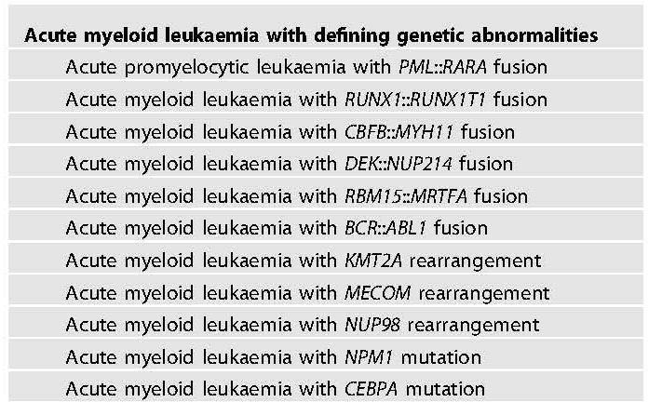
Diagnostic Classification of AML in 2023
AML traditionally defined as >20% myeloblasts in PB or BM
Evolution of Dx classification-> increasingly incorporating genomic factors
2022 WHO and ICC recognize the subjectivity of blast %
  MDS/AML- 10-19% blasts in ICC
WHO Classification (irrespective of blast %) ICC/ELN Criteria- >10% blasts
Khoury, Leukemia 2022; Arber, Blood 2022; Dohner, Blood 2022

Slide 11
Evolving Criteria of AML with Myelodysplasia
Secondary AML: therapy-related AML (t-AML) or AML from preexisting myeloid neoplasm
AML-MRC: WHO-defined subgroup in 2008 & refined in 2016
  AML from preexisting MDS/CMML
  AML with specific MDS-related cytogenetic abnormalities
  AML with multilineage dysplasia
    >50% dysplasia in >2 lineages in diagnostic BM Bx
    No NPM1 or biallelic CEBPA mutation
25-30% of newly dx AML pts classified as AML-MRC
Poor outcomes with conventional therapy
Arber, Blood 2016

Slide 12
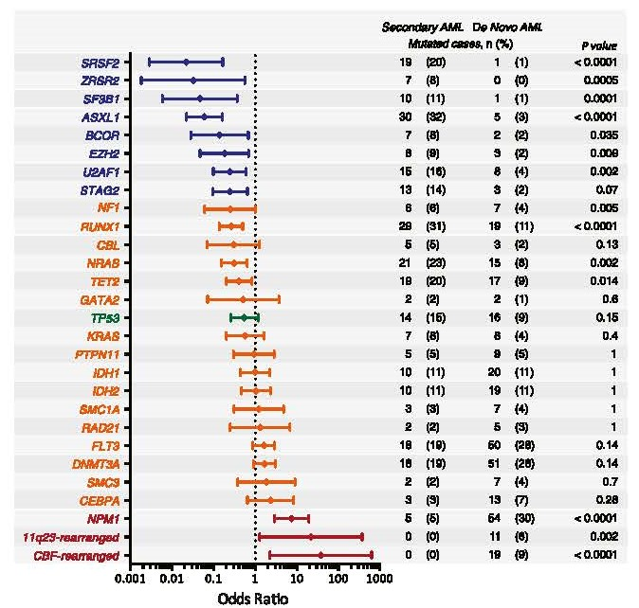
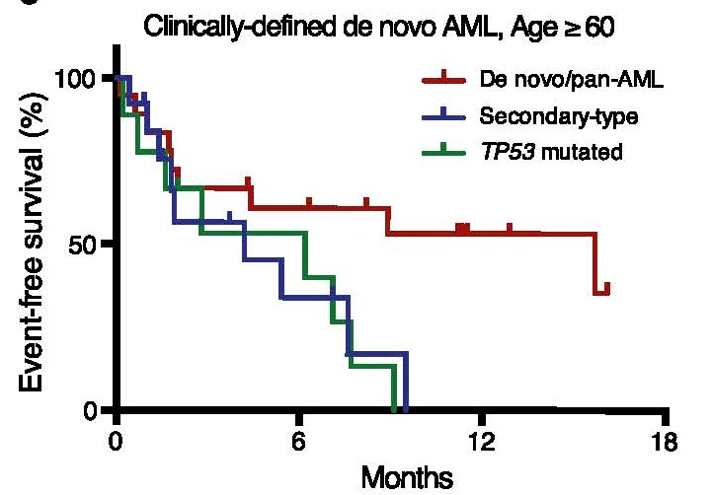
Mutations Highly Specific for Secondary AML
Lindsley, Blood 2015

Slide 13
Updated AML-MR Classification in 2022
Diagnostic Entity | International Consensus Classification (ICC) 2022 | World Health Organization (WHO) 2022
Multilineage dysplasia | Not included | Not included
Therapy-related AML | Qualifier only | Not included
Preexisting MDS or MDS/MPN | Qualifier only | Included in AML-MR
AML with MDS-related cytogenetics | AML w/ MDS-related cytogenetics Complex, del(5q)/t(5q)/add(5q), -7/del(7q), +8, del(12p)/t(12p)/add(12p), i(17q), -17/add(17p) or del(17p), del(20q), idic(X)(q13) | AML-MR Complex, del(5q)/t(5q), -7/del(7q)/t(7q), del(11q), del(12p)/t(12p), -13/del(13q), i(17q), del(17p)/t(17p), idic(X)(q13)
AML with MDS-Related Mutations | AML w/ MDS-Related Gene Mutations ASXL1, BCOR, EZH2, RUNX1, SF3B1, SRSF2, STAG2, U2AF1, ZRSR2 | AML-MR ASXL1, BCOR, EZH2, SF3B1, SRSF2, STAG2, U2AF1, ZRSR2
Khoury, Leukemia 2022; Arber, Blood 2022

Slide 14
MR Mutations Associated with Worse Outcomes
>60 years from ALFA-1200
- n= 509
- 48% had AML-MR
RWD newly Dx AML from Taiwan
- n=1213
- 33% had AML-MR
Gardin, Blood Adv 2020; Tsai, Blood Cancer J 2023

Slide 15
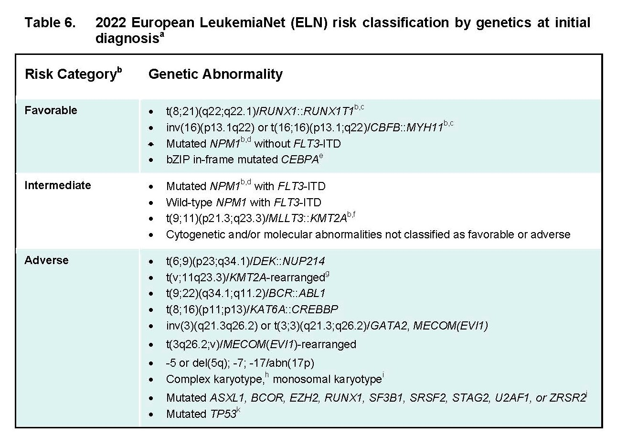
ELN Genomic and Risk Classification of AML
Dohner, Blood 2022

Slide 16
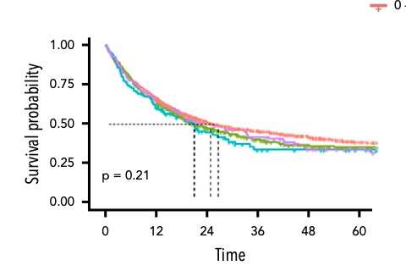
Can you Wait for Diagnostic Testing in AML?
Retrospective database from international AML Registry (n=2,263)
 | Time from Diagnosis to Treatment
 | 0–5 Days (n = 1547) | 6–10 Days (n = 447) | 11–15 Days (n = 106) | > 15 Days (n = 163)
CR/CRi | 79% | 76% | 72% | 77%
Early Mortality | 4% | 5% | 4% | 5%
Clinical outcomes are similar in all four subgroups including younger and older patients
Waiting for full diagnostic testing is feasible for most newly diagnosed AML cases
Rollig, Blood 2020

Slide 17
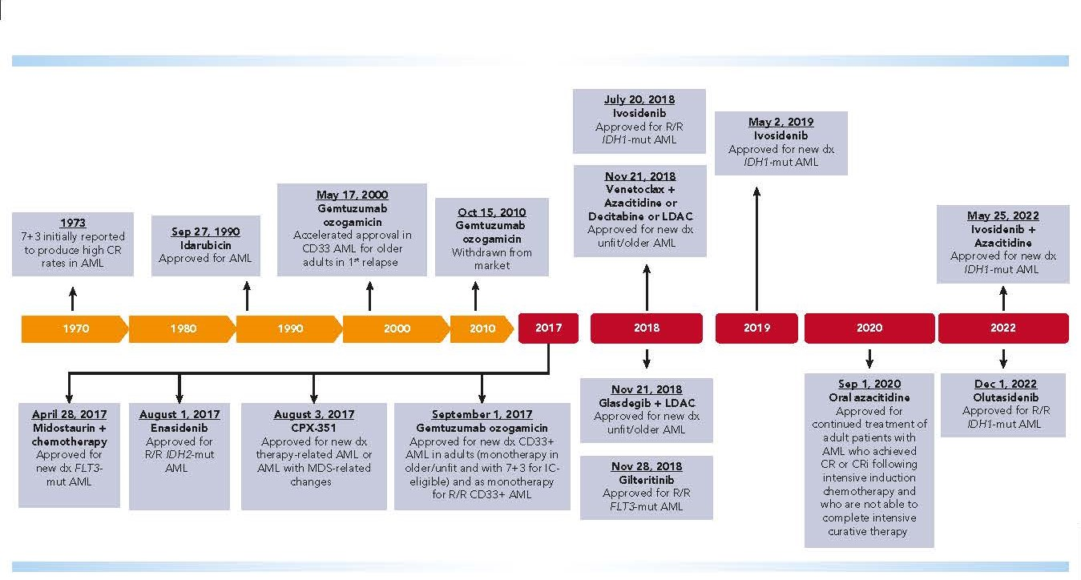
Treatment Landscape of AML in 2023
July 20, 2023
Quizartinib + 7+3
Approved for newly Dx AML w/ FLT3-ITD
2023
El Chaer, Blood 2023

Slide 18
Frontline Management of AML
Age is most significant factor when assessing for fitness for 1L Tx
Younger AML (<60 years)
  Induction therapy remains SOC- Tx regimen specific to genomic profile & risk group
  Exceptions include poor ECOG PS, prior anthracyclines, TP53 mutations
Older AML (60-75 years)
  Most controversial area in AML-> Individualized Tx
  Treatment landscape is shifting to less intensive therapies
Elderly AML (>75 years)
  Not intensive chemo candidates or BMT candidates (very few exceptions)
  Aza/Ven- paradigm shift as SOC (some exceptions- still mini-intensive)

Slide 19
FLT3 mutations: A New Era of Targeted Tx Approaches
FLT3-ITD mutation (~25% of newly Dx AML)
    Most common FLT3 mutation-> constitutive activation of FLT3
    Presentation: Younger pts, proliferative disease, monocytic phenotypes, most commonly w/ normal karyotype
    Relapse can be rapid
    Intermediate or Adverse-risk-> Should be referred for alloBMT
FLT3-TKD mutation (~5% of newly Dx AML)
    Most common = D835 mutation
    Neutral prognostically
    Heterogeneous subgroup, can also be associated w/ FLT3-ITD mutation

Slide 20
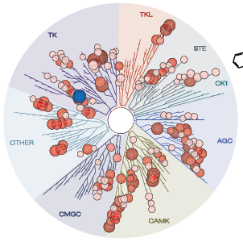
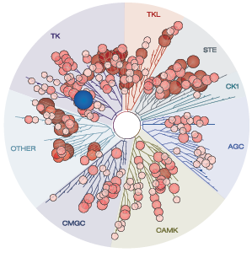
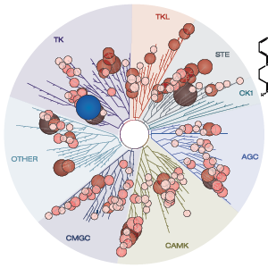
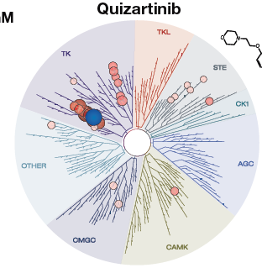
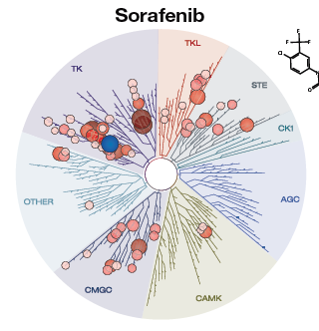
FLT3 inhibitors
Type 1- active against TKD and ITD
Type 2- active only against ITD
Midostaurin
Gilteritinib
Crenolanib
Quizartinib
Sorafenib
Aikawa, Cancer Res 2018; Daver, Leukemia 2019

Slide 21
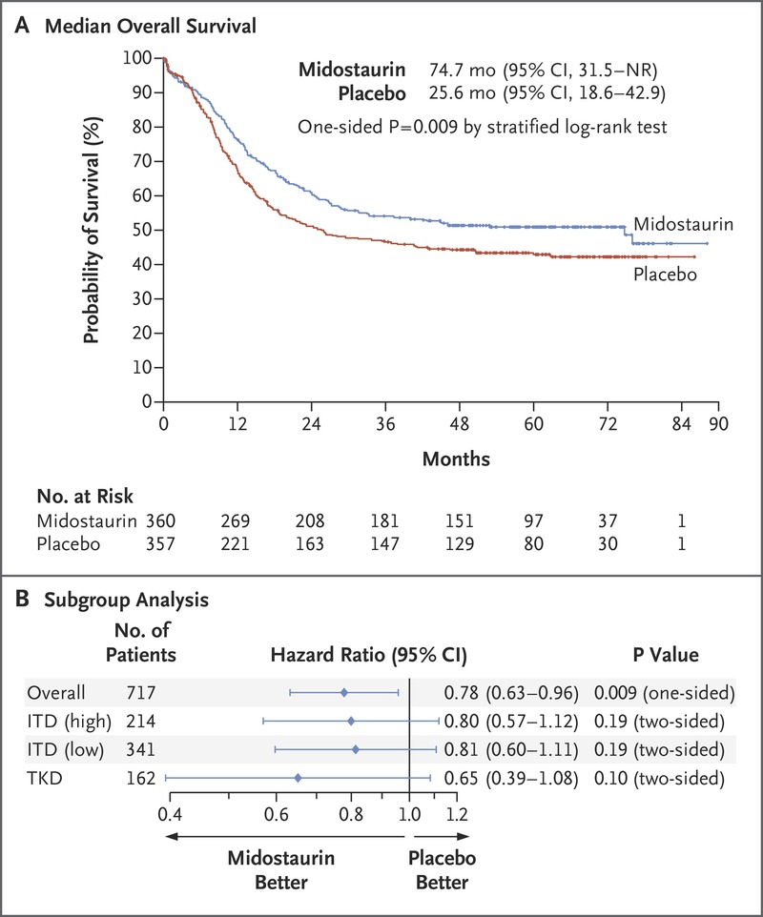
7+3 + Midostaurin (RATIFY)
 | 7+3 + Midostaurin (n=360) | 7+3 + Placebo (n=357)
Median OS | 74.7 months | 25.6 months
CR | 58.9% | 53.5%
Median EFS | 8.2 months | 3.0 months
Newly Dx AML w/ FLT3 mutation
18-60 years
7+3 + Midostaurin
N=360
N=717
N=357
7+3 + Placebo
23% of pts enrolled had FLT3-TKD mutation
7+3 + Midostaurin led to new SOC for newly Dx AML with FLT3 mutation in 2017
Stone, N Engl J Med 2017

Slide 22
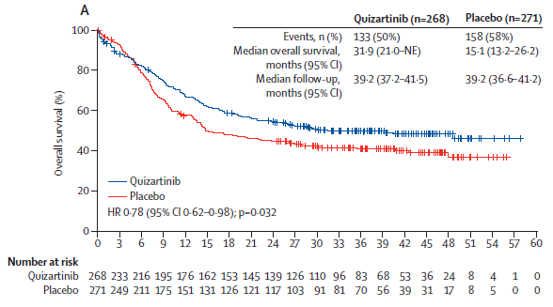
7+3 + Quizartinib (QUANTUM-First)
 | 7+3 + Quizartinib N=268 | 7+3 + Placebo N=271
Median OS | 31.9 months | 15.1 months
CR + CRi | 71.6% | 64.9%
Median duration of CR | 38.6 months | 12.4 months
Newly Dx AML w/ FLT3-ITD mut
18-75 years
7+3 + Quizartinib
N=268
N=539
N=271
7+3 + Placebo
Main AE = QTcF prolongation & myelosuppression
Quiz FDA-approved in combination with 7+3 in July, 2023 for Newly Dx FLT3-ITD mut AML
Erba, Lancet 2023

Slide 23
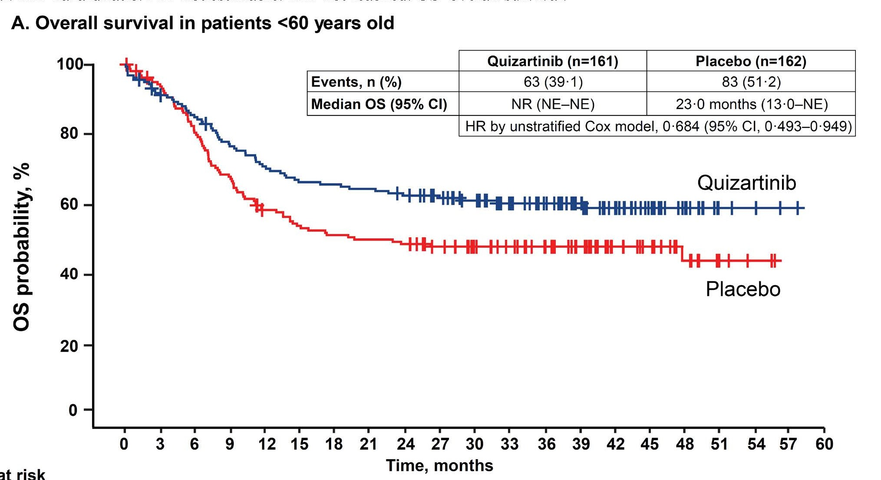
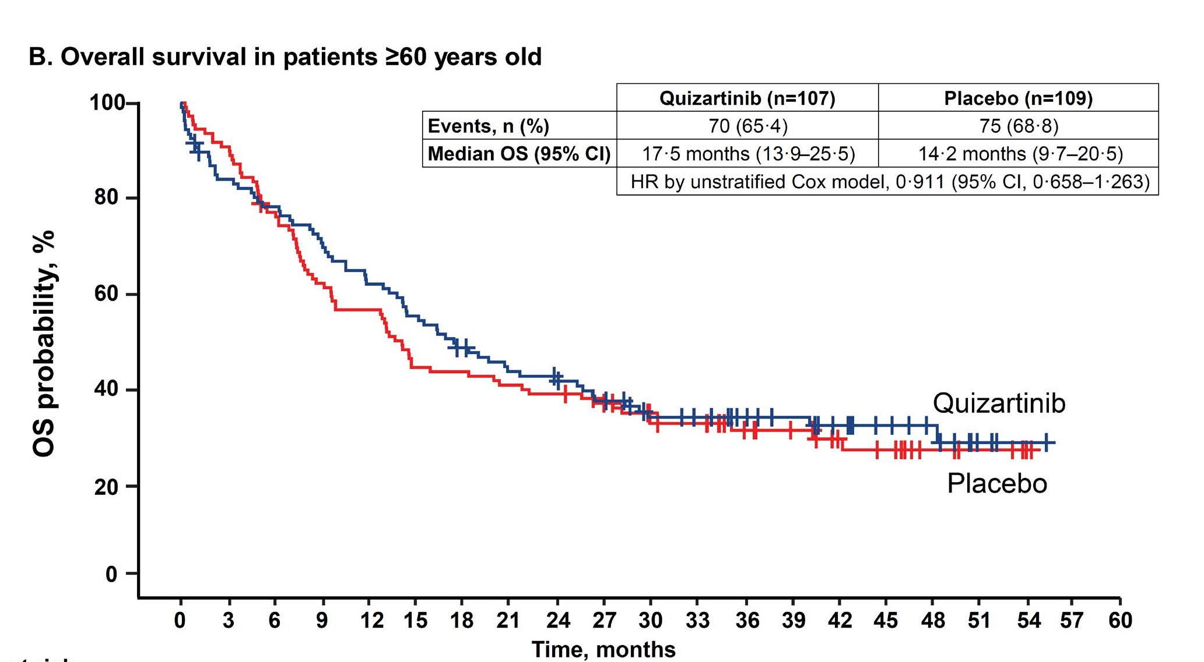
7+3 + Quizartinib OS Stratified by Age
Erba, Lancet 2023

Slide 24
Frontline Management of FLT3-Mut AML Summary
Critical to get molecular data prior to induction-> Rapid FLT3 assay
FLT3 inhibitors should be added to 7+3 induction for all FLT3 mutations
FLT3-TKD mutation-> 7+3 + Midostaurin should be used in pts <60-70 years
FLT3-ITD mutation-> 7+3 + Quizartinib (preferred) or 7+3 + Midostaurin
  7+3 + Quizartinib favorable outcomes compared w/ 7+3 + Midostaurin in FLT3-ITD Quizartinib should be used with caution in >60 years, those w/ cardiac comorbidities or prolonged QTcF
All FLT3-ITD mutated AML patients should be considered and prioritized for alloBMT given high relapse rates w/o alloBMT
  FLT3 inhibitors should be considered post-alloBMT for maintenance Tx
Dohner, Blood Adv 2022

Slide 25
Have Standards Been Challenged in Myelofibrosis?
Angela Fleischman MD PhD
Associate Professor
UC Irvine Health
Irvine, CA

Slide 26



Activated JAK/STAT signaling in MF
JAK2^{V617F}
CALR
MPL
CALR
P
P
P
P
P
P
JAK2^{V617F}
JAK2^{V617F}
JAK2
JAK2
JAK2
JAK2
P
P
P
P
P
P
Stat5
Stat5
Stat5
Stat5
Stat5
Stat5
P
P
P
P

Slide 27
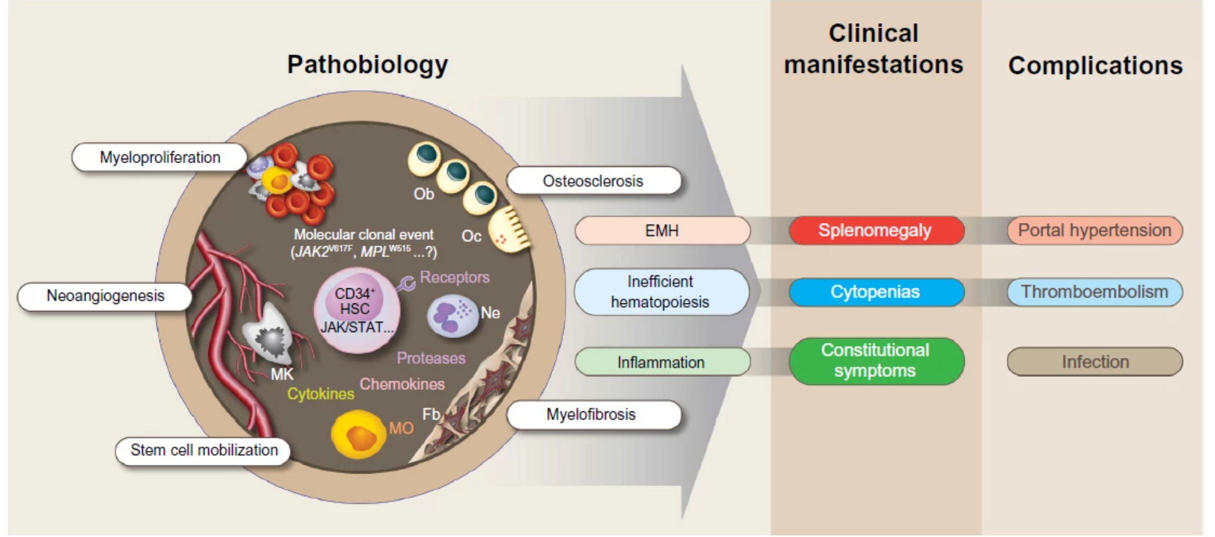
Clinical consequences of MF
From medqpillbox.com

Slide 28







Symptoms in MF
Constitutional
Symptoms
Cytopenias
Splenomegaly
Anemia
Fever
Abdominal
Pain
Night Sweats
Thrombocytopenia
Early Satiety
Fatigue

Slide 29


Not all MF is the same
Cytopenic
Low blood cell counts; increased circulating blasts
  Usually primary MF
  Less often present/lower
  More common (may precede JAK2)
  Poorer prognosis/higher risk of progression to AML
Myeloproliferative
  Normal to elevated blood cell counts
  Usually secondary MF
  More often present/higher
  Less common
  Better prognosis/lower risk of progression to AML

Slide 30



Current Treatment Goals in MF
Reduce Spleen Size
Improve Symptoms
Lessen anemia

Slide 31
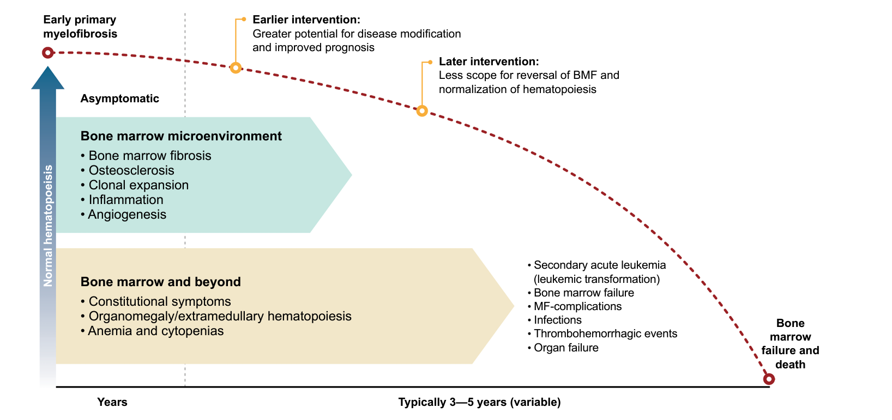
What is disease modification in MF?

Slide 32
Currently Approved JAK inhibitors
JAK Inhibitor | Targets/ MoA | Clinical Trials | Approved and Recommended Indications | Side Effects
Ruxolitinib^{[1]} | JAK1, JAK2 | COMFORT-I/II (phase 3) | FDA (Nov 2011): frontline for intermediate- and high-risk MF | Anemia, thrombocytopenia Nonmelanoma skin cancers Infections Hyperlipidemia
Fedratinib^{[2]} | JAK1, JAK2, JAK3/TYK2, FLT3 | JAKARTA/-2 (phase 3, 2) FREEDOM (phase 3b) | FDA (Aug 2019): frontline or second-line for intermediate-2 and high-risk MF | GI Low thiamine/ Wernicke encephalopathy Cytopenias
Pacritinib^{[3,4]} | JAK2, JAK3/TYK2 IRAK1, ACVR1 | PERSIST-1/2 (phase 3) | FDA (Feb 2022, accelerated): frontline for intermediate- and high-risk MF with PLT < 50 × 10⁹/L NCCN: frontline and second-line with any PLT count | GI Adverse cardiac events QT interval ↑ Hemorrhage
Momelotinib^{[5]} | JAK1, JAK2, ACVR1 | SIMPLIFY-1/2 (phase 3) MOMENTUM (phase 3) | FDA (Sept 2023): intermediate- and high-risk MF with anemia | GI Cytopenias
GI gastrointestinal, MoA, mechanism of action.
1. Ruxolitinib [PI]. Approved 2011. Revised January 2023; 2. Fedratinib [PI]. Approved 2019. Revised May 2023; 3. Pacritinib [PI]. Approved 2022. Revised August 2023; 4. NCCN Guidelines. Myeloproliferative neoplasms. Version 3.2023. Accessed November 20, 2023. https://www.nccn.org/professionals/physician_gls/pdf/mpn.pdf; 5. Momelotinib [PI]. Approved 2023.

Slide 33
Anemia of chronic inflammation: role of hepcidin
BMP2, BMP6
Serum iron
Hemoglobin
Erythropoiesis
ACVR1
Hepatocyte cellular membrane
P
SMAD1.5
Hepcidin

Slide 34
Defining Ruxolitinib “Failure” in Clinical Practice
Resistance, Intolerance, and Progression
No change in spleen length by palpation
No reduction in spleen-related symptoms
< 50% reduction in MPN-SAF score OR considered to remain unacceptable to patient
Secondary Resistance^{b}
Intolerance^{c}
Progression^{d}
Primary
Resistanceª
Loss of initial spleen response and return to baseline
Loss of initial
symptom response and return to baseline
Any unacceptable treatment-emergent toxicity
PLT < 35 × 10⁹/L
Doubling of RBC transfusion rate after 3 months and requiring 2 units at least every 8 weeks
Increase in blast % in bone marrow or peripheral blood to
≥ 10%
Increase in spleen length by 25% from baseline at initiation of therapy
a. Requires a minimum of 12 weeks on therapy at maximally tolerated dose or ≥ 20 mg/d; b. Preferably measured by MPN-SAF scores or responses not considered acceptable by patient; c. After any duration of therapy; d. After any duration of therapy
RBC, red blood cell.
McLornan DP, et al. Blood Adv. 2020;4:607-610.

Slide 35

JAK inhibitor combos on the horizon

Slide 36
Title of Presentation, Title Case
 | TRANSFORM-1: A Randomized, Double-Blind, Placebo-Controlled, Multicenter, International Phase 3 Study of Navitoclax in Combination With Ruxolitinib Versus Ruxolitinib Plus Placebo in Patients With Untreated Myelofibrosis
Naveen Pemmaraju¹, Adam J. Mead², Tim CP Somervaille³, James McCloskey⁴, Francesca Palandri⁵, Steffen Koschmieder⁶, David Lavie⁷, Brian Leber⁸, Su-Peng Yeh⁹, Maria Teresa Gomez Casares¹⁰, Emanuele Ammatuna¹¹, Ho-Jin Shin¹², Keita Kirito¹³, Eric Jourdan¹⁴, Timothy Devos¹⁵, Hun S. Chuah¹⁶, Atanas Radinoff¹⁷, Andrija Bogdanovic¹⁸, Rastislav Moskal¹⁹, Qi Jiang¹⁹, Avijeet S Chopra¹⁹, Elektra J Papadopoulos¹⁹, Jalaja Potluri¹⁹, Francesco Passamonti²⁰
¹Department of Leukemia, MD Anderson Cancer Center, Houston, TX, USA; ²Medical Research Council (MRC) Molecular Haematology Unit, MRC Weatherall Institute of Molecular Medicine, NIHR, Biomedical Research Centre, University of Oxford, Oxford, United Kingdom; Cancer and Haematology Centre, Churchill Hospital, Oxford University Hospitals NHS Foundation Trust, Oxford, United Kingdom; ³Cancer Research UK Manchester Institute, The University of Manchester and The Christie NHS Foundation Trust, Manchester, United Kingdom; ⁴Department of Leukemia, John Theurer Cancer Center at Hackensack Meridian Health, Hackensack, NJ, USA; ⁵Istituto di Ematologia "Seràgnoli", IRCCS Azienda Ospedaliero-Universitaria di Bologna, Italy; ⁶Department of Hematology, Oncology, Hemostaseology, and Stem Cell Transplantation, Faculty of Medicine, RWTH Aachen University, Aachen, Germany, and Center of Integrated Oncology Aachen Bonn Cologne Düsseldorf (CIO ABCD), Aachen, Germany; ⁷Hadassah Medical Center, Jerusalem, Israel; ⁸Division of Hematology, Juravinski Cancer Center, Hamilton, ON, Canada; ⁹China Medical University Hospital, Taichung, Taiwan; ¹⁰Hospital Universitario de Gran Canaria Dr. Negrín, Las Palmas de Gran Canaria, Spain; ¹¹Department of Hematology, University of Groningen, University Medical Center Groningen, Groningen, The Netherlands; ¹²Department of Hematology-Oncology, Pusan National University Hospital, Pusan National University School of Medicine, Busan, Korea; ¹³Department of Hematology and Oncology, University of Yamanashi, Japan; ¹⁴Hematologie Clinique, CHU de Nimes, Nimes; ¹⁵Department of Hematology, University Hospitals Leuven and Department of Microbiology and Immunology, Laboratory of Molecular Immunology (Rega Institute), KU Leuven, Leuven, Belgium; ¹⁶Department of Haematology, Royal Perth Hospital, Perth, Australia; ¹⁷Clinic of Haematology, St.Ivan Rilski University Multidisciplinary Hospital, Bulgaria; ¹⁸Clinic of Hematology, University Clinical Center of Serbia, and Faculty of Medicine, University of Belgrade, Serbia; ¹⁹AbbVie Inc., North Chicago, IL, USA; ²⁰Dipartimento di Oncologia ed Ematologia, Università degli Studi di Milano, Policlinico di Milano, Ospedale Maggiore, Fondazione I.R.C.C.S. Ca Granda, Milano, Italy.
ASH 2023; San Diego, USA

Slide 37
Introduction
  There is a substantial unmet need for therapies that alter disease trajectory, improve outcomes, and enhance survival in patients with MF¹
  JAKis, like ruxolitinib, are standard-of-care in MF, and have rates of SVR_{35W24} and SVR_{35W48} of 29–42% and 29%, respectively^{2,3}
  Although JAKis have demonstrated symptom improvement and spleen volume reduction in patients with MF, they provide limited benefit to the key outcomes mentioned above¹
Study objective: To evaluate the safety and efficacy of navitoclax plus ruxolitinib (NAV + RUX) compared with placebo plus ruxolitinib (PBO + RUX)
in JAK2i-naïve adults with MF
1. Pemmaraju N, et al. Cancer. 2022, 128; 2420–2432; 2. Verstovsek S, et al. N Engl J Med. 2012;366(9):799–807. 3. Mesa RA, et al. J Clin Oncol. 2017;35(34):3844–3850.
JAKi, Janus kinase inhibitor; MF, myelofibrosis; NAV, navitoclax; PBO, placebo; RUX, ruxolitinib; SVR_{35W24}, spleen volume reduction of ≥35% at Week 24; SVR_{35W48}, spleen volume reduction of ≥35% at Week 48.

Slide 38
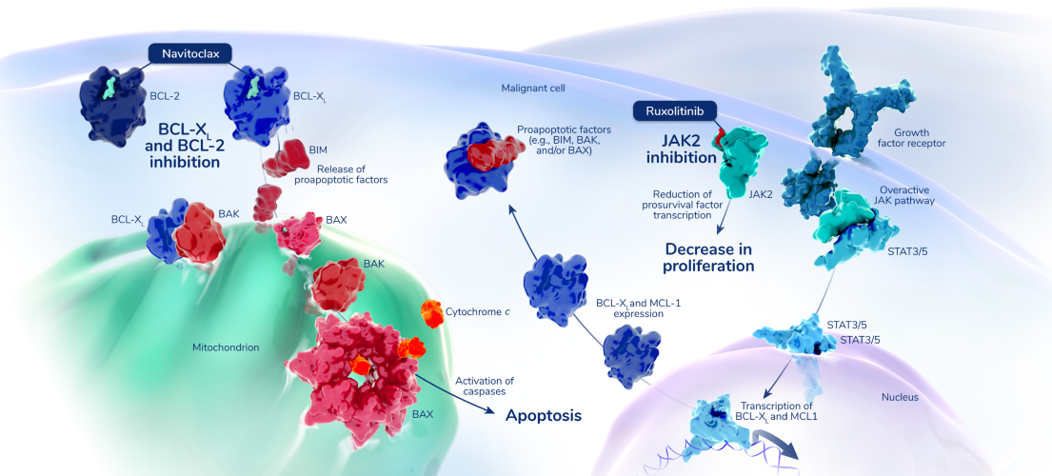
Rationale for Navitoclax in Myelofibrosis
Navitoclax is a novel, oral inhibitor of BCL-X_{L} and BCL-2, anti-apoptotic members of the
BCL-2 family¹
Preclinical studies suggest that JAK2 + BCL-2/BCL-X_{L} inhibition could overcome acquired resistance to single-agent JAKi treatment²
Navitoclax, in combination with ruxolitinib, demonstrated pronounced antitumor activity, including clinical responses in patients with MF who no longer benefited from ruxolitinib in the phase 2 REFINE trial (NCT03222609)³
1. Tse C, et al. Cancer Res. 2008;68(9):3421–3428; 2. Waibel M, et al. Cell Rep. 2013;5:1047–1059; 3. Harrison et al. J Clin Oncol. 2022;40:1671–1680.
BCL-X_{L}, B-cell lymphoma-extra large; BCL-2, B-cell lymphoma 2; JAK2, Janus kinase 2; JAKi, Janus kinase inhibitor; MF, myelofibrosis.

Slide 39
TRANSFORM-1 Is a Phase 3, Double-Blind, Multicenter Study (NCT04472598)
Inclusion criteria (N~230)
Aged ≥18 years with ECOG ≤2
Intermediate-2 or high-risk MF with measurable splenomegaly (as defined by the DIPSS+)
Evidence of MF-related symptoms
No prior JAKi treatment
Experimental arm
Ruxolitinib 15/20 mg BIDª
Navitoclax 100/200 mg QD^{b}
1:1 Randomization
Stratification factors:
Int-2 vs high-risk
PLT ≤200 × 10⁹/L vs >200 × 10⁹/L
Control arm
Ruxolitinib 15/20 mg twice dailyª
Placebo
Endpoints
Primary endpoint: SVR_{35W24} (assessed for superiority) as measured by MRI or CT scan, per IWG criteria
Secondary endpoints:
    Change in TSS^{c} from baseline at Week 24 as measured by MFSAF v4.0
    SVR₃₅ at any time
    Duration of SVR₃₅
    Anemia response per IWG criteria
Safety endpoints: AEs
ªPLT >200×10⁹/L: 20 mg BID, PLT 100 × 10⁹/L to 200 × 10⁹/L: 15 mg BID; ^{b}PLT >150 × 10⁹/L: 200 mg QD, PLT ≤150 × 10⁹/L: 100 mg QD and escalate to 200 mg after ≥7 days, if tolerable (platelets ≥75 x 10⁹/L). ^{c}TSS includes patient assessed fatigue, concentration, early satiety, inactivity, night sweats, itching, bone pain, abdominal discomfort, weight loss, and fevers. AEs, adverse events; BID, twice daily; CT, computed tomography; DIPSS+, Dynamic International Prognostic Scoring System Plus; ECOG, Eastern Cooperative Oncology Group; Int-2, intermediate-2; IWG, International Working Group, JAKi, Janus kinase inhibitor; MF, myelofibrosis; MFSAF, Myelofibrosis Symptom Assessment Form; MRI, magnetic resonance imaging; PLT, platelet; QD, once daily; SVR₃₅, spleen volume reduction of ≥35%; SVR_{35W24}, SVR of ≥35% at Week 24; TSS, total symptom score.

Slide 40
Demographics and Disease Characteristics Were Similar Between Groups
 | NAV + RUX (N=125) | PBO + RUX (N=127)
Age, median (range), years | 70 (42–87) | 69 (37–85)
Sex, male | 63 (50) | 81 (64)
Time from last MF diagnosis to study entry, median (range), months | 8 (0.3–181.6) | 6 (0.3–198.8)
Type of MF Primary Post-PV-MF or Post-ET-MF | 63 (50) 62 (50) | 72 (57) 55 (43)
Number of prior lines of therapy, median (range) | 1 (1–3) | 1 (1–4)
Spleen volume, median (range), cm³ | 1441 (419–8020) | 1639 (219–5664)
TSS score, median (range) | 21 (0.1–60.6) | 24 (6.7–61.6)
Transfusion dependent at BL | 5 (4) | 4 (3)
Calculated DIPSS+ risk at study entryª Intermediate-1 Intermediate-2 High | 8 (6) 104 (83) 13 (10) | 5 (4) 110 (87) 12 (9)
Driver mutations JAK2 V617F CALR MPL W515 | 81 (65) 22 (18) 14 (11) | 79 (62) 26 (20) 10 (8)
HMR mutations, n/N (%) | 57/120 (48) | 50/117 (43)
Data cutoff: 13 Apr 2023. Data are n (%) unless otherwise stated. ªDIPSS+ risk was calculated based on all available screening data.
BL, baseline; CALR, calreticulin; DIPSS+, Dynamic International Prognostic Scoring System Plus; ET, essential thrombocythemia; HMR, high molecular risk; JAK2, Janus kinase 2; MF, myelofibrosis; MPL, gene encoding the thrombopoietin receptor; NAV, navitoclax; PBO, placebo; PV, polycythemia vera; RUX, ruxolitinib.

Slide 41
Discontinuation of Study Treatment Was Similar Between Groups
  Of all enrolled patients, 83 (33%) discontinued study treatment (30% NAV + RUX vs 35% PBO + RUX)
    Most common primary reason in both arms was due to AEs (14% NAV + RUX and 11% PBO + RUX)
 | NAV + RUX (N=125) | PBO + RUX (N=127)
Discontinue study for any reason | 20 (16) | 23 (18)
Discontinue NAV/PBO treatment for any reason | 38 (30) | 45 (35)
Discontinue NAV/PBO treatmentª
AE | 18 (14) | 14 (11)
Physician decision | 6 (5) | 8 (6)
Withdrawal of consent | 6 (5) | 4 (3)
MF disease progression | 2 (2) | 10 (8)
Leukemia transformation | 3 (2) | 3 (2)
Disease relapse | 1 (1) | 2 (2)
Discontinued studyª
Death | 13 (10) | 13 (10)
Withdrawal of consent | 7 (6) | 10 (8)
Data are n (%) unless otherwise stated. ªPrimary reason for discontinuation.
AE, adverse event; MF, myelofibrosis; NAV, navitoclax; PBO, placebo; RUX, ruxolitinib.

Slide 42
NAV + RUX Led to an SVR_{35W24} Rate That Was Twice as High as PBO + RUX
  A significantly higher number of patients achieved SVR_{35W24} in NAV + RUX arm compared with PBO + RUX
  [79 (63.2%) vs 40 (31.5%); P<0.0001]
ªNumber of patients with available percent change in SVR_{35W24.}
ITT, intention-to-treat; NAV, navitoclax; PBO, placebo; RUX, ruxolitinib; SVR, spleen volume reduction; SVR_{35W24}, SVR of ≥35% at Week 24.

Slide 43
NAV + RUX Dose Utility Across 24-Week Period in SVR_{35W24} Responders and Nonresponders
  NAV and RUX average doses were higher in responders vs nonresponders
NAV
NAV + RUX
PBO + RUX
NAV
NAV + RUX
PBO + RUX
300
SVR_{35W24} Responders
40
300
SVR_{35W24} Nonresponders
40
30
30
200
200
Average NAV dose by week (mg)
20
20
Average RUX dose by week (mg)
Average NAV dose by week (mg)
Average RUX dose by week (mg)
100
100
10
10
0
0
0
0
0
5
10
15
20
25
0
5
10
15
20
25
Time (week)
Minimum RUX Dose Level (10 mg BID) for Efficacy
Time (week)
NAV and RUX average doses are calculated accounting for dose reductions and interruptions every week out to Week 24.
BID, twice daily; NAV, navitoclax; PBO, placebo; RUX, ruxolitinib; SVR_{35W24}, spleen volume reduction of ≥35% at Week 24.

Slide 44
AEs of Thrombocytopenia, Anemia, and Neutropenia Were Common But Manageable
 | NAV + RUX (N=124)ª N (%) |  | PBO + RUX (N=125)ª N (%)
Any AE | 124 (100) |  | 121 (97)
Any AE grade ≥3 | 105 (85) |  | 87 (70)
Most common AEs (>30% patients receiving NAV) Thrombocytopenia Anemia Neutropenia Diarrhea Bleeding/hemorrhagic events COVID-19 Contusion Abdominal pain Abdominal pain upper Bone pain | Any grade 112 (90) 74 (60) 56 (45) 42 (34) 30 (24) 26 (21) 13 (10) 11 (9) 9 (7) 9 (7) | Grade ≥3 63 (51) 57 (46) 47 (38) 6 (5) 2 (2) 1 (1) 0 1 (1) 1 (1) 0 | Any grade 62 (50) 61 (49) 7 (6) 17 (14) 27 (22) 23 (18) 7 (6) 8 (6) 10 (8) 6 (5) | Grade ≥3 19 (15) 49 (39) 5 (4) 0 7 (6) 7 (6) 0 1 (1) 1 (1) 0
Any serious AE | 32 (26) |  | 40 (32)
AEs leading to dose reduction Navitoclax/placebo Ruxolitinib | 101 (81) 112 (90) |  | 39 (31) 76 (61)
AE leading to dose interruption Navitoclax/placebo Ruxolitinib | 87 (70) 78 (63) |  | 44 (35) 41 (33)
All deaths Deaths ≤30 days following last dose of study drug | 13 (10) 6 (5) |  | 13 (10) 5 (4)
  Most commons AEs were thrombocytopenia, anemia, neutropenia, and diarrhea
  Most common serious AEs reported were
    COVID-19 pneumonia and pneumonia in 3 patients each with
    NAV + RUX and 2 each with PBO + RUX
  Dose reductions and interruptions were mostly due to thrombocytopenia, none were due to bleeding
ªAll AEs are presented as n (%).
AEs, adverse events, NAV, navitoclax; PBO, placebo; RUX, ruxolitinib.

Slide 45

TSS Responses Were Not Significantly Different Between Groups
  At Week 24, the mean change in TSS from baseline was -9.7 (95% CI: -11.8, -7.6) with NAV + RUX compared with -11.1 (95% CI: -13.2, -9.1) with PBO + RUX arm in ITT population (P=0.2852)
Change in TSS from baseline at Week 24 (ITT)ª
% patients with TSS≥-10 or TSS₅₀ reduction from baseline at Week 24^{c}
30
20
Worsening
39.2%
41.7%
10
0
-10
-10ª
Change in TSS from baseline at Week 24
-20
Improvement
n=47
n=45
n=54
n=50
-30
-40
-50
n=47
n=54
n=45
n=50
-60
NAV + RUX
(N^{d}=113)
PBO + RUX
(N^{d}=117)
NAV + RUX
(N^{d}=113)
PBO + RUX
(N^{d}=117)
-70
NAV + RUX (N^{b}=107)
PBO + RUX (N^{b}=107)
TSS improvement ≥-10
TSS₅₀
ªTSS was calculated based on reporting on the Myelofibrosis Symptom Assessment Form v4.0. A 10-point improvement (scale: 0–70) was estimated to be the level of change in TSS that patients would perceive to be meaningful improvement in MF-related symptoms; ^{b}Number of patients with available data for change in TSS at Week 24; ^{c}Error bars represent 95% CI. ^{d}Includes patients with baseline TSS ≥12 or at least 2 symptoms with a baseline symptom score ≥3 with TSS available at baseline and week 24. CI, confidence interval; ITT, intention-to-treat; NAV, navitoclax; RUX, ruxolitinib; TSS, total symptom score

Slide 46
Conclusions
This first randomized trial in JAKi-naïve MF with a NAV + RUX combination, which led to an SVR_{35W24} rate twice as high as PBO + RUX (P<0.0001), with similar symptom response despite a lower average dose of RUX
AEs of thrombocytopenia, anemia, and neutropenia were common but manageable with dose modification without any clinically significant sequelae
Preliminary data are encouraging, and additional evaluations are ongoing to assess additional outcomes of overall survival and responses in subgroups
AEs, adverse events; JAKi, janus kinase inhibitor; MF, myelofibrosis; NAV, navitoclax; PBO, placebo; RUX, ruxolitinib; SVR_{35W24}, spleen volume reduction of ≥35% at Week 24.

Slide 47
Pelabresib in combination with ruxolitinib for Janus kinase inhibitor treatment-naïve patients with myelofibrosis: results of the MANIFEST-2 randomized, double-blind, Phase 3 study
Raajit Rampal,¹ Sebastian Grosicki, Dominik Chraniuk, Elisabetta Abruzzese, Prithviraj Bose, Aaron T Gerds, Alessandro M Vannucchi, Francesca Palandri, Sung-Eun Lee, Vikas Gupta, Alessandro Lucchesi, Stephen Oh, Andrew T Kuykendall, Andrea Patriarca, Alberto Álvarez-Larrán, Ruben Mesa, Jean-Jacques Kiladjian, Moshe Talpaz, Morgan Harris, Sarah-Katharina Kays, Anna Maria Jegg, Qing Li, Barbara Brown, Claire Harrison*, John Mascarenhas*
*Both authors contributed equally
¹Leukemia Service, Memorial Sloan Kettering Cancer Center, New York, NY, USA
Rampal R, et al. ASH 2023. Oral 628

Slide 48
Study Design
Study population
Treatment arm
Primary endpoint
SVR35 at Week 24
JAKi-naïve patients with MF (N=430)
(primary or post-ET/PV)
Pelabresib
125 mg* PO QD Day 1–14
Ruxolitinib
+ Per label with a 5-mg BID lower starting dose†
Day 1–21
Key secondary endpoints
DIPSS Int-1 or higher
Splenomegaly (≥450 cm³) by CT/MRI
TSS ≥10 (≥3 for two symptoms, MFSAF v4.0)
Double-blind randomization
(1:1)
21-day cycles
TSS absolute change from baseline at Week 24
TSS50 at Week 24
Placebo PO QD Day 1–14
Ruxolitinib
+ Per label with a 5-mg BID lower starting dose†
Day 1–21
1:1 randomization stratified by:
Safety
AEs of all grades
and serious AEs
DIPSS risk category: Int-1 vs Int-2 vs high
Platelet count: >200 × 10⁹/L vs 100–200 × 10⁹/L
Spleen volume: ≥1800 cm³ vs <1800 cm³
AE, adverse event; BID, twice daily; CT, computed tomography; DIPSS, Dynamic International Prognostic Scoring System; ET, essential thrombocythemia; Int, intermediate; JAKi, Janus kinase inhibitor; MF, myelofibrosis; MFSAF, Myelofibrosis Symptom Assessment Form; MRI, magnetic resonance imagining; PO, orally; PV, polycythemia vera; QD, once daily; SVR35, ≥35% reduction in spleen volume; TSS, total symptom score;
TSS50, ≥50% reduction in total symptom score. *The starting dose for pelabresib was 125 mg QD and protocol-defined dose modifications based on AEs and treatment response allowed a dose range between 50 mg and 175 mg QD; †Ruxolitinib was started at 10 mg BID (baseline platelet count 100–200 × 10⁹/L) or 15 mg BID (baseline platelet count >200 × 10⁹/L) with a mandatory dose increase by 5 mg BID after one cycle and a maximum dose of 25 mg BID per label. Harrison CN, et al. Future Oncol. 2022;18(27):2987-29977.

Slide 49
Patient Demographics
Characteristic |  | Pelabresib + ruxolitinib (N=214) | Placebo + ruxolitinib (N=216)
Age — years | Median (min, max) | 66 (19, 84) 85 (39.7) / 129 (60.3) 160 (74.8) / 35 (16.4) / 2 (0.9) 1 (0.5) 15 (7.0) / 1 (0.5) 107 (50) 45 (21) 62 (29) 128 (59.8) 75 (35) 11 (5.1) 125 (67.2) 45 (24.2) 11 (5.9) 8 (4.3) 72 (38.7) 28 (13.1) 10.9 (5.8–18.0) 70 (32.7) 285 (99, 1303) 154 (72) 0.8 (1.18)† 35 (16) 107 (50) 97 (45.3) 10 (4.7) 0 1308.89 (200.24–7117.03) 26.6 (7.3–66.4) | 66 (26, 88)
Sex — n (%) | Female / male |  | 94 (43.5) / 122 (56.5)
 | White / Asian / Black |  | 163 (75.5) / 42 (19.4) / 0
Race — n (%) | American Indian or Alaska Native |  | 0
 | Not reported / Unknown |  | 11 (5.1) / 0
 | Primary myelofibrosis |  | 110 (50.9)
Myelofibrosis subtype — n (%) | Post-polycythemia vera myelofibrosis |  | 53 (24.5)
 | Post-essential thrombocytopenia myelofibrosis |  | 53 (24.5)
 | Intermediate-1 |  | 127 (58.8)
Dynamic International Prognostic Scoring System — n (%) | Intermediate-2 |  | 74 (34.3)
 | High-risk |  | 15 (6.9)
 | JAK2 V617F |  | 122 (64.6)
 | CALR |  | 50 (26.5)
Mutations — n (%)* | MPL Triple negative |  | 13 (6.9) 5 (2.6)
 | High-molecular risk mutations |  | 88 (46.6)
 | Missing |  | 27 (12.5)
Hemoglobin — g/dL | Median (range) |  | 11.0 (6.7–17.9)
 | ≤10 — n (%) |  | 76 (35.2)
Platelets — × 10⁹/L | Median (min, max) |  | 287 (66, 1084)
 | >200 × 10⁹/L — n (%) |  | 157 (72.7)
Peripheral blasts | Mean (SD) |  | 0.8 (1.25)‡
RBC transfusions — patient n (%) | Requiring RBC transfusion at baseline |  | 25 (12)
 | 0 |  | 109 (50.5)
ECOG performance status — n (%) | 1 ≥2 |  | 95 (44.0) 10 (4.6)
 | Missing |  | 2 (0.9)
Spleen volume (central read)§ | Median spleen volume (range) — cc |  | 1382.97 (277.87–5540.45)
Total symptom score¶ | Median total symptom score (range) |  | 24.7 (9.0–68.4)
Data cut off: August 31, 2023. CALR, calreticulin; ECOG, Eastern Cooperative Oncology Group; JAK, Janus kinase; max, maximum; min, minimum; MPL, MPL proto-oncogene, thrombopoietin receptor; RBC red blood cell; SD, standard deviation. *Results do not originate from a validated programming environment. †n=208. ‡n=207. §Randomization of patients was based on local read. ¶Patients with baseline TSS values of <10 have at least 2 individual symptoms score ≥ 3 at baseline.

Slide 50
Significantly greater response in patients treated with pelabresib + ruxolitinib vs placebo + ruxolitinib
Placebo + ruxolitinib (n=183*)
ITT population
% change in spleen volume from baseline
 |  | Placebo + ruxolitinib (N=216)
SVR35 at Week 24 |  | 35.2%
50
0
SVR35
Mean % change in spleen volume at Week 24† |  | -30.6 (n=183)
95% CI |  | -33.7, -27.5
35% redu
ction
-50
-100
Data cut off: August 31, 2023. CI, confidence interval; ITT, intent-to-treat; SVR35, ≥35% reduction in spleen volume. Spleen volume assessed by central read. *Waterfall plots represent patients who have baseline and Week 24 data. †Patients without Week 24 assessment are considered non-responders.

Slide 51
Significantly greater response in patients treated with pelabresib + ruxolitinib vs placebo + ruxolitinib
Pelabresib + ruxolitinib (n=171*)
Placebo + ruxolitinib (n=183*)
ITT population
% change in spleen volume from baseline
 | Pelabresib + ruxolitinib (N=214) | Placebo + ruxolitinib (N=216) | p-value
SVR35 at Week 24 | 65.9% | 35.2%
Difference† (95% CI) | 30.4 (21.6, 39.3) |  | <0.001
50
0
SVR35
35% reduction
Mean % change in spleen volume at Week 24‡ | -50.6 (n=171) | -30.6 (n=183)
95% CI | -53.2, -48 | -33.7, -27.5
-50
-100
Data cut off: August 31, 2023. CI, confidence interval; ITT, intent-to-treat; SVR35, ≥35% reduction in spleen volume. Spleen volume assessed by central read. *Waterfall plots represent patients who have baseline and Week 24 data. †Calculated by stratified Cochran–Mantel–Haenszel test; ‡Patients without Week 24 assessment are considered non-responders.

Slide 52
Strong numerical improvements for patients treated with pelabresib + ruxolitinib vs placebo + ruxolitinib
Pelabresib + ruxolitinib (n=175*)
Placebo + ruxolitinib (n=182*)
ITT population
Mean absolute change in TSS from baseline
20
 | Pelabresib + ruxolitinib (N=214) | Placebo + ruxolitinib (N=216) | p-value
TSS change† from baseline at Week 24 | -15.99 | -14.05
Mean difference‡ (95% CI) | -1.94 (-3.92, 0.04) |  | 0.0545
0
-20
-40
Absolute change in TSS is a continuous endpoint that estimates magnitude of symptom burden reduction with enhanced precision
-60
Data cut off: August 31, 2023. ANCOVA, analysis of covariance; CI, confidence interval; ITT, intent-to-treat; TSS, total symptom score. *Waterfall plots represent patients who have baseline and Week 24 data. †Change from baseline determined by ANCOVA model using Multiple Imputation. ‡Least square mean difference from ANCOVA model using baseline DIPSS, baseline platelet count and baseline spleen volume as factors, and
baseline TSS as covariate.
Rampal R, et al. ASH 2023. Oral 628

Slide 53
Numerically greater in patients treated with pelabresib + ruxolitinib vs placebo + ruxolitinib
Pelabresib + ruxolitinib (n=184*)
Placebo + ruxolitinib (n=193*)
ITT population
200
 | Pelabresib + ruxolitinib (N=214) | Placebo + ruxolitinib (N=216) | p-value
TSS50 at Week 24 | 52.3% | 46.3%
Difference† (95% CI) | 6.0 (-3.5, 15.5) |  | 0.216
% change in TSS from baseline
150
100
50
0
-50
TSS50
50% reduction
-100
Data cut off: August 31, 2023. CI, confidence interval; ITT, intent-to-treat; TSS, total symptom score; TSS50, ≥50% reduction in total symptom score. Patients are evaluable for TSS50 at Week 24 if they have had Week 24 TSS assessment by the data cutoff date or discontinued without Week 24 assessment at any time. *Waterfall plots represent patients who have baseline and Week 24 data. †Difference in treatment groups analyzed by
stratified Cochran–Mantel–Haenszel test (weighted 95% CI adjusted across strata).
Rampal R, et al. ASH 2023. Oral 628

Slide 54
Numerically greater in patients treated with pelabresib + ruxolitinib vs placebo + ruxolitinib with benefits balanced across all TSS domains
Pelabresib + ruxolitinib
Placebo + ruxolitinib
ITT population
 | Pelabresib + ruxolitinib (N=214) | Placebo + ruxolitinib (N=216) | p-value
TSS50 at Week 24 | 52.3% | 46.3%
Difference† (95% CI) | 6.0 (-3.5, 15.5) |  | 0.216
Fullness after eating
n= 178 191
Bone pain
163 162
Pain under left rib
171 176
Abdominal discomfort
182 191
Itching
Night sweats
Fatigue
Mean (SD) % change from baseline at Week 24
0
162
168
165
178
184
192
25
-31.05
-39.51
-35.20
-36.31
-38.55
-34.9
-47.46
-45.18
-43.19
-41.37
-50.45
50
-53.27
-56.48
-52.27
75
100
175
Data cut off: August 31, 2023. CI, confidence interval; ITT, intent-to-treat; TSS, total symptom score; TSS50, ≥50% reduction in total symptom score. Patients are evaluable for TSS50 at Week 24 if they have had Week 24 TSS assessment by the data cutoff date or discontinued without Week 24 assessment at any time. †Difference in treatment groups analyzed by stratified Cochran–Mantel–Haenszel test (weighted 95% CI adjusted across
strata).
Rampal R, et al. ASH 2023. Oral 628

Slide 55


Two-fold increase in patients achieving both SVR35 and TSS50 with pelabresib + ruxolitinib vs placebo + ruxolitinib
Pelabresib + ruxolitinib (N=214) Placebo + ruxolitinib (N=216)
SVR35 response:
141 patients (65.9%)
TSS50 response:
112 patients (52.3%)
SVR35 response:
76 patients (35.2%)
TSS50 response:
100 patients (46.3%)
Only SVR35: n=55 25.7%
Both
SVR35 and TSS50: n=86
40.2%
Only TSS50: n=26 12.1%
Only SVR35: n=36 16.7%
Both SVR35 and TSS50: n=40
18.5%
Only TSS50: n=60 27.8%
Data cut off: August 31, 2023. N, number of patients; SVR35, ≥35% reduction in spleen volume; TSS50, ≥50% reduction in total symptom score. Diagrams are not drawn to scale.

Slide 56
SVR35 response was consistently higher in pelabresib + ruxolitinib vs placebo + ruxolitinib across all predefined subgroups
Pelabresib + ruxolitinib (N=214)
Placebo + ruxolitinib (N=216)
Resp | Rate (%) | _{(95% CI) N*} Change from _{(95% CI)} baseline
93 DIPSS: Intermediate-1 risk | 72.7 | (64.9, 80.4) 113 15.44 (17.88, 13.0)
48 | 37.8 | (29.4, 46.2) 112 13.44 (15.76, 11.11)
41 DIPSS: Intermediate-2 risk | 54.7 | (43.4, 65.9) 55 17.53 (21.77, 13.29)
25 | 33.8 | (23.0, 44.6) 58 11.91 (14.83, 8.99)
7 DIPSS: High risk | 63.6 | (30.8, 89.1) 7 12.50 (24.21, 0.80)
3 | 20.0 | (4.3, 48.1) 12 16.96 (25.47, 8.46)
70 MF subtype: PMF | 65.4 | (56.4, 74.4) 88 15.79 (18.85, 12.73)
36 | 32.7 | (24.0, 41.5) 92 12.99 (15.40, 10.58)
35 MF subtype: PPV-MF | 77.8 | (65.6, 89.9) 39 18.88 (22.77, 14.99)
22 | 41.5 | (28.2, 54.8) 48 15.68 (19.88, 11.47)
36 MF subtype: PET-MF | 58.1 | (45.8, 70.3) 48 13.98 (18.12, 9.84)
18 | 34.0 | (21.2, 46.7) 42 10.75 (13.69, 7.82)
38 Baseline spleen volume: ≥1800 cm³ | 71.7 | (59.6, 83.8) 43 15.65 (19.04, 12.25)
19 | 32.2 | (20.3, 44.1) 48 16.13 (19.04, 13.22)
103 Baseline spleen volume: <1800 cm³ | 64.0 | (56.6, 71.4) 132 16.09 (18.63, 13.55)
57 | 36.3 | (28.8, 43.8) 134 12.13 (14.28, 9.98)
 | 10 | 20 | 30 | 40 | 50 | 60 | 70 | 80 | 90 | 100
SVR35 (%)
0 | 5 | 10 | 15 | 20 | 25 | 30
TSS improvement (absolute change)
0
Data cut off: August 31, 2023. CI, confidence interval; DIPSS, Dynamic International Prognostic Scoring System; MF, myelofibrosis; PET-MF, post-essential thrombocythemia myelofibrosis; PMF, primary myelofibrosis;
PPV-MF, post-polycythemia vera myelofibrosis; Resp, number of responders; SVR35, ≥35% reduction in spleen volume; TSS, total symptom score. *Number of patients with Week 24 observations.

Slide 57
SVR35 response was consistently higher in pelabresib + ruxolitinib combination vs placebo + ruxolitinib across hematologic subgroups
Pelabresib + ruxolitinib (N=214)
Placebo + ruxolitinib (N=216)
Resp | Rate (%) | (95% CI) N* ^{Change from} (95% CI) baseline
101 Baseline hemoglobin: >10 g/dL | 70.1 | (62.7, 77.6) 121 16.04 (18.37, 13.70)
48 | 34.3 | (26.4, 42.1) 121 13.57 (15.85, 11.30)
40 Baseline hemoglobin: ≤10 g/dL | 57.1 | (45.5, 68.7) 54 15.86 (20.21, 11.51)
28 | 36.8 | (26.0, 47.7) 61 12.40 (15.21, 9.60)
109 Baseline platelet count: >200 × 10⁹/L | 70.8 | (63.6, 78.0) 132 15.40 (17.67, 13.13)
63 | 40.1 | (32.5, 47.8) 138 13.42 (15.53, 11.31)
32 Baseline platelet count: 100–200 × 10⁹/L | 53.3 | (40.7, 66.0) 43 17.77 (22.68, 12.86)
13 | 22.0 | (11.5, 32.6) 44 12.44 (15.67, 9.22)
 | 10 | 20 | 30 | 40 | 50 | 60 | 70 | 80 | 90 | 100
SVR35 (%)
 | 5 | 10 | 15 | 20 | 25
TSS improvement (absolute change)
0
0
Data cut off: August 31, 2023. CI, confidence interval; Resp, number of responders; SVR35, ≥35% reduction in spleen volume; TSS, total symptom score. *Number of patients with Week 24 observations.

Slide 58
A numerically greater proportion of patients achieved hemoglobin response with pelabresib + ruxolitinib vs placebo + ruxolitinib
Pelabresib + ruxolitinib (N=214)
Placebo + ruxolitinib (N=216)
ITT population
115
 | Pelabresib + ruxolitinib (N=214) | Placebo + ruxolitinib (N=216)
Hemoglobin response* ≥1.5 g/dL mean increase (95% CI) | 9.3% (5.45, 13.25) | 5.6% (2.50, 8.61)
Patients requiring RBC transfusion during screening, n (%) | 35 (16.4) | 25 (11.6)
Patients requiring RBC transfusion during first 24 weeks of study treatment, n (%) | 66 (30.8) | 89 (41.2)
Mean of hemoglobin (g/L)
110
105
100
95
90
Number of patients
Pelabresib + ruxolitinib | 212 | 204 | 209 | 199 | 193 | 189 | 186 | 185 | 184
Placebo + ruxolitinib | 214 | 206 | 211 | 209 | 207 | 205 | 204 | 199 | 196
Preliminary Analyses from Data cut off: August 31, 2023. CI, confidence interval; RBC, red blood cell. *Hemoglobin response is defined as a ≥1.5 g/dL mean increase in hemoglobin from baseline in the absence of
transfusions during the previous 12 weeks. Baseline hemoglobin defined as the last assessment prior to or on Cycle 1 Day 1, regardless of blood transfusions. A similar effect was observed across DIPSS categories.

Slide 59
Improvement of reticulin fibrosis grade
in central read by Week 24
Pelabresib + ruxolitinib (n=104*) Placebo + ruxolitinib (n=99*)
Reduction of inflammatory cytokines by Week 24
Pelabresib + ruxolitinib (N=214)
Placebo + ruxolitinib (N=216)
Reduction in inflammatory cytokines
Increase in inflammatory cytokines
24.2%
improved
n | Mean reduction (95% CI)
161 | 33.1 (35.9, 30.2)
179 | 19.1 (22.1, 15.9)
141 | 35.5 (44.7, 24.8)
153 | 10.9 (23.7, -2.7)
139 | 8.8 (17.2, -0.5)
153 | -35.3 (-20.9, -51.3)
141 | 42.4 (46, 38.6)
151 | 23.6 (28.1, 18.9)
45.2%
unchanged
38.5%
improved
47.5%
unchanged
NFkB – set†
28.3%
worsened
16.3%
worsened
IL-6
IL-8
TNF alpha
 | Pelabresib + ruxolitinib | Placebo + ruxolitinib | Odds ratio
Worsened ≥1 grade (%) | 16.3 | 28.3 | 0.47 (0.23-0.92)
Improved ≥1 grade (%) | 38.5 | 24.2 | 2.09 (1.14-3.93)
60 | 40 | 20 | 0 | 20 | 40 | 60
Mean change from baseline (%)
Preliminary Analyses from Data cut off: August 31, 2023. IL-6, interleukin 6; IL-8, interleukin 8; NF𝜅B, Nuclear factor kappa-light-chain-enhancer of activated B cells; TNF, tumor necrosis factor. *n=203 evaluable patients
(baseline & C9D1). †NF𝜅B - set includes: B2M, CRP, CD40-L, HEPCIDIN, IL-6, IL-12p40, MIP-1 BETA, MPIF-1, RANTES, TNFR2, TNF alpha, VCAM-1.

Slide 60
The safety profile of the pelabresib + ruxolitinib combination was consistent with prior trials
Safety population*
TEAE, % |  |  | Pelabresib + ruxolitinib (N=212) |  | Placebo + ruxolitinib (N=214)
Any grade |  | 96.7 |  |  |  | 97.2
Grade ≥3 |  |  | 49.1 |  | 57.5
SAEs |  |  | 29.7 |  | 29.4
Associated with pelabresib or placebo discontinuation |  |  | 12.3 | 7.9
Associated with ruxolitinib discontinuation |  |  | 9.9 | 6.5
Associated with pelabresib or placebo dose reduction
Associated with ruxolitinib dose reduction Associated with pelabresib or placebo interruption
32.5
29
47.6
41.6
32.1
22.9
Associated with ruxolitinib interruption
Associated with death
23.1
16.4
2.4
2.8
100
50
0
50
100
Preliminary Analyses from Data cut off: August 31, 2023. TEAE, treatment-emergent adverse event; SAE, serious adverse event. *Safety population: received at least one dose of study drug. TEAEs are regardless of relationship to study drug. A TEAE for the double-blinded treatment period is defined as an adverse event that has a start date on or after the first dose of the pelabresib/placebo and before 30 days after the last dose of pelabresib/placebo or before the start of alternative (off-study) treatment for MF, whichever occurs first. MF, myelofibrosis.

Slide 61
Conclusions
Pelabresib in combination with ruxolitinib compared with placebo in combination with ruxolitinib in
JAK inhibitor treatment-naïve patients at Week 24:
  Significantly reduced splenomegaly (SVR35: 66% vs 35%; p<0.001)
  Demonstrated strong trends in reducing the mean absolute TSS (p=0.0545) and improving TSS50 response
  Doubled the percentage of patients with dual SVR35 / TSS50 response
Fewer anemia adverse events, higher rates of hemoglobin responses and less patients with transfusion requirement
The safety profile appeared generally comparable to the established safety profile of ruxolitinib with fewer grade ≥ 3 events
Pelabresib in combination with ruxolitinib showed reduction of pro-inflammatory cytokines, and improvement in bone marrow fibrosis and anemia response, addressing the four hallmarks of myelofibrosis
JAK, Janus kinase; SVR35, ≥35% reduction in spleen volume; TSS50, ≥50% reduction in total symptom score.
Rampal R, et al. ASH 2023. Oral 628

Slide 62
Where are we headed in MF?
Tailoring selection of JAK inhibitors to specific patient populations
Defining “disease modification”
JAK inhibitor combos
Novel non-JAK targets

Slide 63

Emerging Treatments in DLBCL
Swetha Kambhampati MD
Assistant Professor
City of Hope National Medical Center
Duarte, CA
@SwethaKamMD

Slide 64
Disclosures
Research Funding: Genentech, ADC-Therapeutics, Genmab
Advisory Board: Ipsen

Slide 65
Improving R-CHOP What has not worked
Phase III Trial | Subgroup | Outcome
GOYA¹ R-CHOP vs. G-CHOP (n = 1,418) | All | Negative
A50303² R-CHOP vs. R-EPOCH (n = 524) | All | Negative
PHOENIX³ R-CHOP ± Ibrutinib (N= 838) | Non-GC by Hans | Negative
ROBUST⁴ and E1412⁵ R-CHOP ± Lenalidomide (n = 570) (n = 349) | ABC by GEP | Negative
REMoDL⁶ R-CHOP ± Bortezomib (n = 1,128) | Stratified by GEP | Negative
R-CHOP 21 remains the standard of care for most patients with DLBCL
1. Sehn LH et al. J Hematol. Oncol. 2020;13(1):71. 2. Bartlett NL et al. J Clin Oncol. 2019;37(21):1790-1799. 3. Younes A et al. J Clin Oncol. 2019;37(15):1285-1295.4. Nowakowski GS et al. J Clin Oncol. 2021;39(12):1317-1328. 5. Nowakowski GS et al. J Clin Oncol. 2021;39(12):1329-1338. 6. Davies A et al. Lancet Oncol. 2019;20(5):649-662.
Notes:
Many attempts to improve R-CHOP have been tried including intensivation of chemoimmunotherapy, addition of maintenance treatment, use of new CD20 antibodies, or incorporation of novel agents. These trials are shown on these slide. Some of these trials such as PHOENIX and ROBUST have attempted the addition of targeted agents such as ibrutinib or lenalidomide to improve the outcomes of ABC subtype DLBCL given it’s worse prognosis. None of these studies however have demonstrated a meaningful improvement in long-term outcomes and RCHOP has remained the standard treatment for over 20 years.

Slide 66
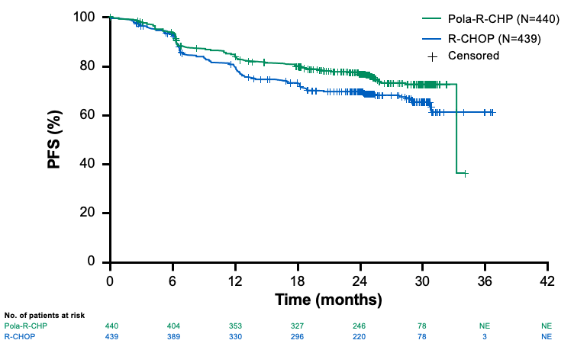
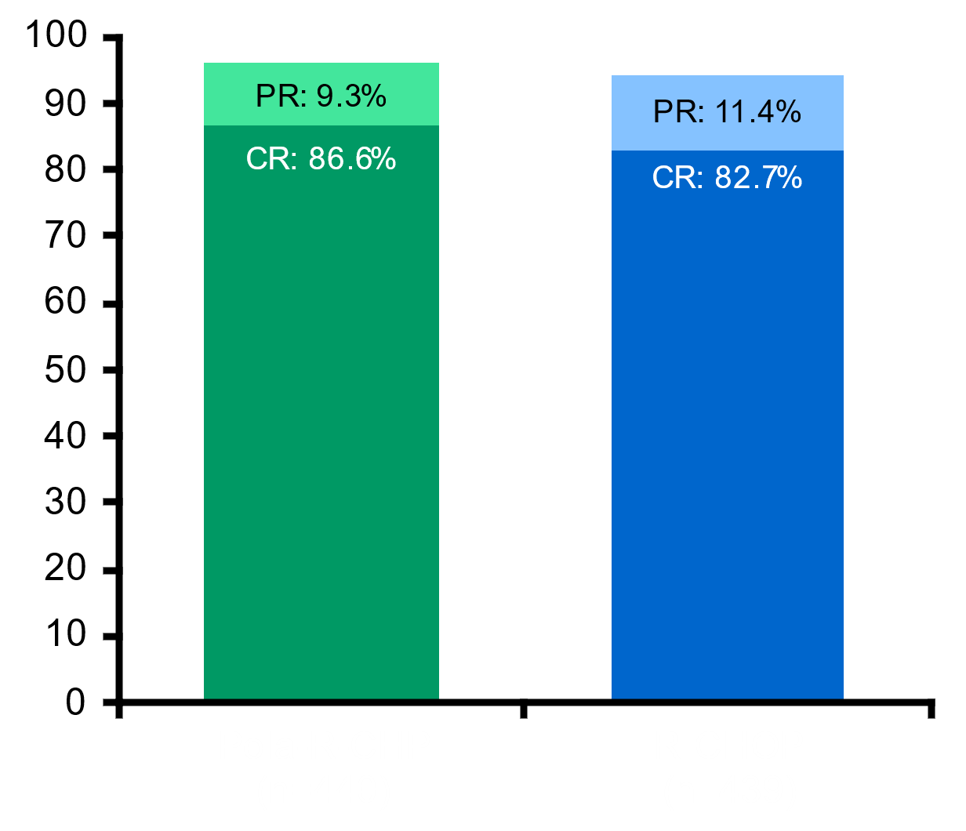
POLARIX: Pola-R-CHP improves PFS compared to R-CHOP
Pola-R-CHP demonstrated a 27% reduction in the relative risk of disease progression, relapse, or death versus R-CHOP
24-month PFS:
76.7% with Pola-R-CHP versus 70.2% with R-CHOP (∆=6.5%)
CR 86.6% vs 82.7%
At median follow-up of 28.2 months, no OS benefit
Pola-R-CHP FDA Approved in April 2023
Tilly et al. NEJM January 2022
Notes:
This changed however with the recent POLARIX study leading to the approval of Pola-R-CP in the frontline setting for DLBCL in April 2023. Polatuzumab vedotin is an ADC which targets CD79b that is ubiliquitously present on DLBCL cells and is then internalized and leads to microtubule disruption. It demonstrated initial efficacy in combination with BR in a phase II study leading to its approval
This led to the POLARIX study which is a phase 3 randomized double blinded study comparing Pola-R-CHP vs R-CHOP (replacement of vincristine with polatuzumab vedotine) in treatment naïve DLBCL and evaluating safety and efficacy. This is a randomized international placebo controlled trial where Polatuzumab vedotin or vincristine are given in double blinded manner. Main inclusion criteria were adults 18-80 , ECOG PS 0-2. IPI of 2-5. Randomization was by IPI score, bulky disease and by geographic region. 6 cycles of combination chemoimmunotherapy were given at 3 week intervals followed by 2 additional doses of rituximab
At the cut off date after a median follow-up of 28 months, a statistically significant improvement of progression free survival was observed with Pola-R-CHP vs R-CHOP HR 0.73 translating to 27% reduction in the relative risk of disease progression, relapse, or death vs R-CHOP. 24-month PFS, milestone analysis showed an absolute improvement of 6.5% from 76.7% in Pola arm to 70.2 % in control arm.
Based on these results, Pola-R-CHP was FDA approved for treatment naïve DLBCL in April 2023.
Response rates did not significantly differ between Pola-R-CHP or R-CHOP. Disease free survival indicated that patients who would achieve complete response with Pola-R-CHP were more likely to maintain remission compared to those who achieve CR with RCHOP
In this analysis, there was no difference in OS between treatment groups at 2 years with 88% of patients alive at 2 years

Slide 67
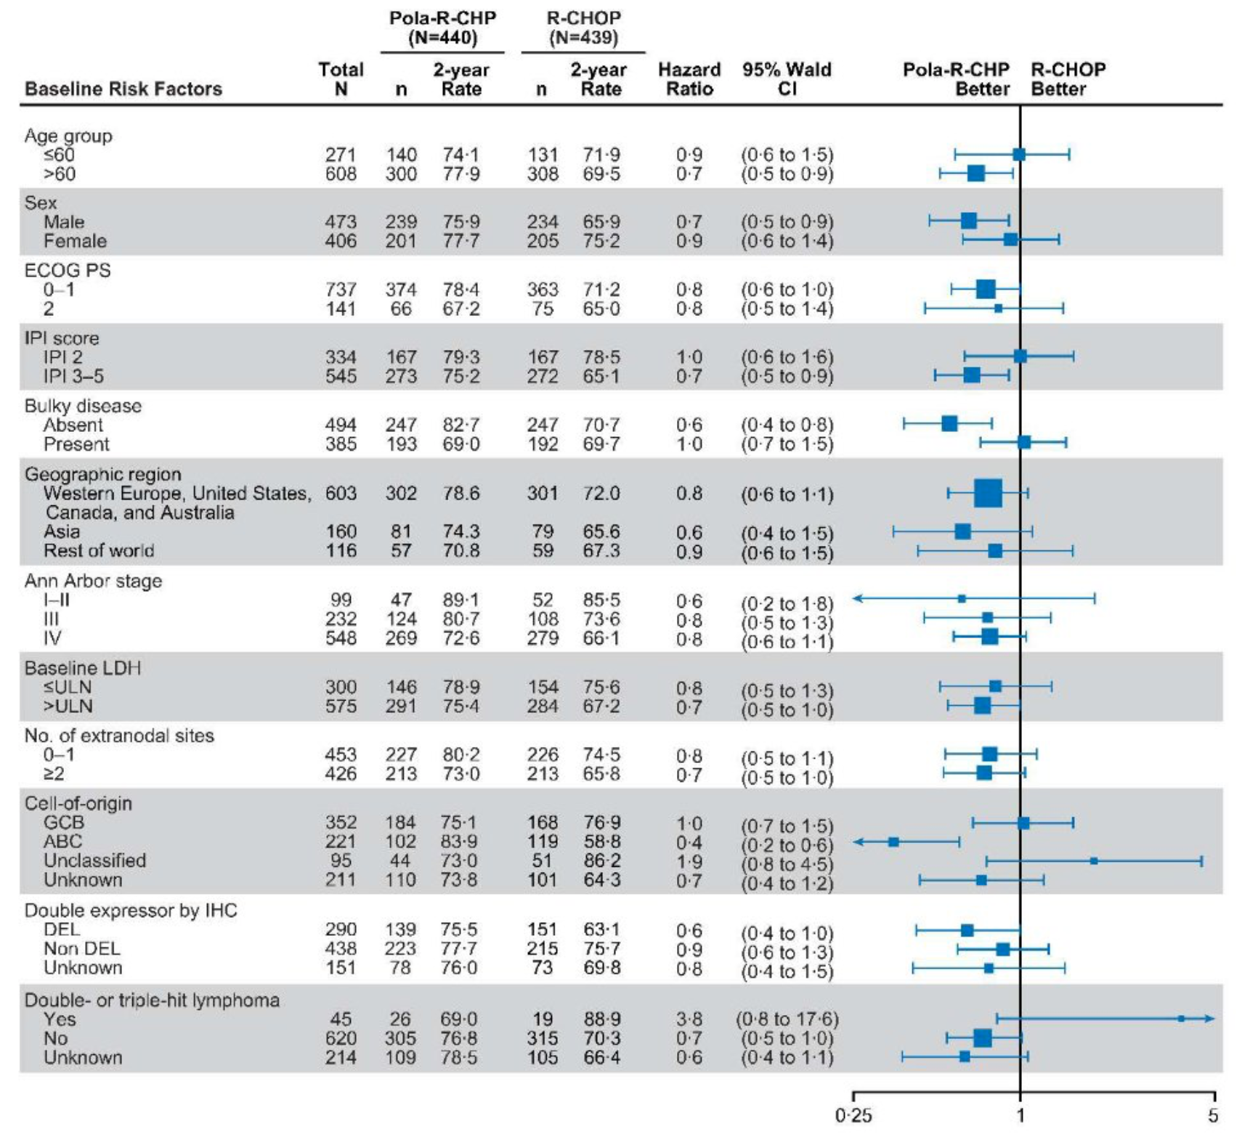
POLARIX Sub-group analysis
PFS Benefit in IPI 3-5, non-bulky disease, older male patients, and ABC subtype though study not powered for sub-group analysis
Tilly et al. NEJM January 2022
Tilly et al. NEJM January 2022
Notes:
An exploratory subgroup analysis was performed though the study was not powered for it and this study showed that there may be benefit in older patients, IPI 3-5, non-bulky, and ABC subtype. There was no clear benefit with pola-R-CHP in patients ≤60 years of age, patients with germinal-center B-cell-like subtype, patients with bulky disease, patients with lower IPI scores, and Patients with double hit or double expressor. This is hypothesis generating and there is no inherent biological explanation for why we see differences in outcomes between ABC and GCB subtype but this warrants additional study.

Slide 68
POLARIX Common Adverse Events
Pola-R-CHP
R-CHOP
Peripheral neuropathy*
Grade
Nausea
1
Diarrhea
2
Neutropenia
3
Anemia
4
Constipation
Fatigue
Alopecia
Decreased appetite
Pyrexia
Vomiting
Febrile neutropenia
Cough
Headache
Decreased weight
Asthenia
Dysgeusia
Tilly et al. NEJM January 2022
Notes:
The toxicity profile in pola-R-CHP vs R-CHOP is very similar including incidence of high grade AEs and serious AEs which speaks to the tolerability of the regimen.
Most frequent AEs in both arms: neuropathy, nausea, diarrhea, cytopenias, constipation, fatigue, alopecia, decreased appetite, pyrexia, vomiting, febrile neutropenia, cough, headache, decreased weight, asthenia, dysgeusia in that order

Slide 69
POLARIX: Pola-R-CHP vs R-CHOP
Pola-R-CHP significantly prolongs PFS compared with R-CHOP (HR 0.73) in patients with intermediate and high-risk previously untreated DLBCL
  24-month PFS: 76.7% with Pola-R-CHP versus 70.2% with R-CHOP
Benefit highest for patients age > 60, IPI 3-5, and ABC subtype? (study not powered for this)
No overall survival benefit yet
Safety profile of pola-R-CHP and R-CHOP comparable
Cost-effective analysis demonstrates that pola-RCHP is cost effective (ICER $84,308/QALY) if 5-year PFS is at least 66.1%
Strengths | Concerns
Enhanced PFS at 2-year follow-up No toxicity differences Higher risk patients appeared to disproportionately benefit Cost-effective if long-term outcomes are maintained | Small PFS difference (6%) at 2-year f/u Certain subsets (GCB, double hit) appear to not benefit Expensive Uncertain impact on outcome of salvage treatments No OS benefit at 2-year f/u
Tilly H et al. N Engl J Med. 2022;386(4):351-363.
Kambhampati et al. Blood. 2022
Notes:
How do we select between pola-R-CHP and R-CHOP for treatment naïve DLBCL and what are some pros/cons for both?
Strengths: enhanced PFS with median follow-up of more than 2 years, no toxicity difference, higher risk patients appeared to disproportionately benefit, appears to be cost-effective
Cons: relatively small PFS difference at 2-year follow-up, certain subsets (GCB, double hit) appear to not benefit, expensive, uncertain impact on outcome of salvage therapies, lack of OS benefit at 2-year follow-up
At this time standard frontline for DLBCL remains to be R-CHOP, but atleast in my practice I tend to favor use of pola-R-CHP for higher risk patients IPI 3-5 and those with DLBCL non-GCB subtype based on the exploratory subgroup analysis of POLARIX

Slide 70
The Next Generation of RCHOP + X Studies
frontMIND: R-CHOP + tafasitamab + lenalidomide vs R-CHOP
ESCALADE: R-CHOP + acalabrutinib vs R-CHOP
Pola-RCHP + glofitamab vs Pola-RCHP
R-CHOP + epcoritamab vs R-CHOP
R-miniCHOP + CC-486 vs R-miniCHOP
Zuma-23: R-chemotherapy x 2 -> Axi-cel vs R-chemotherapy
Notes:
ZUMA 23 is a global, phase 3, randomized controlled study of axicabtagene ciloleucel versus standard of care as first-line therapy in patients with high-risk large B-cell lymphoma, defined as IPI 4-5

Slide 71
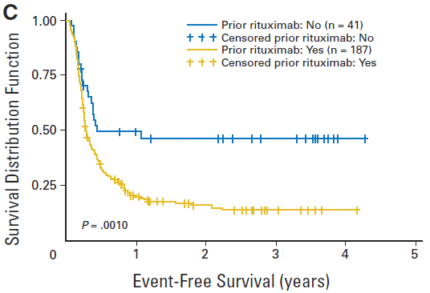
Relapsed/Refractory DLBCL
~1/3 of pts with aggressive B-NHL
Standard treatment is:
  Salvage/2L chemo-immunotherapy
  Autologous stem cell transplantation (ASCT) for chemosensitive pts
ASCT cures about half of pts
Primary refractory/early relapse after prior rituximab -> dismal outcomes
  2L salvage intent-to-transplant outcomes:
    ORR 46%
    3y EFS 20%
    3y OS 39%
CORAL
Gisselbrecht, et al. JCO 2010
Notes:
CORAL study evaluated salvage chemo and ASCT in patients with R/R DLBCL. However this study found that patients with early relapse and prior rituximab had poor outcomes with traditional salvage therapy plus ASCT approach with 3-EFS 20% and 3 year OS 39% representing a population that is high risk with need for novel treatment approaches

Slide 72
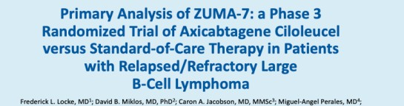
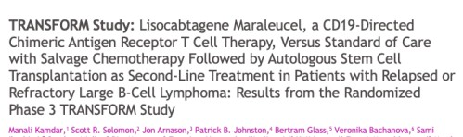
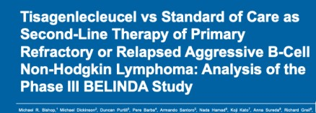
Three Randomized Trials of CAR T cell vs SOC in primary refractory/early relapse DLBCL
Positive study
Axi-cel approved second line
ZUMA 7¹
(N = 359)
Phase 3; axi-cel vs SOC
Clinical trials of CD19 CAR T cell therapies in 2L ≤ 12 months LBCL
Positive study
Liso-cel approved second-line
TRANSFORM² (N = 184)
Phase 3; liso-cel vs SOC
Negative study
Tisa-cel not approved second-line
BELINDA³
(N = 322)
Phase 3; tisa-cel vs SOC
1. Locke FL, et al. N Engl J Med. 2022;386:640-54. 2. Kamdar M, et al. Oral presentation at ASH 2021; abstract 91. 3. Bishop MR, et al. N Engl J Med. 2022;386:629-39.
Notes:
This high rates of efficacy of CAR T in third line or higher setting lead to three pivotal trials studying CAR T role in the second line setting in primary refractory/early relapse DLBCL patients, patients with historically poor prognosis after traditional salvage chemo followed by ASCT
All three studies compared CAR T cell therapy vs SOC salvage followed by ASCT in chemosensitive patients for patients with primary refractory or relapse within 12 months of completion of initial chemoimmunotherapy
ZUMA-7 evaluating Axi-cel, TRANSFORM evaluating liso--cel, BELINDA evaluating tisa-cel
There were slight differences in study design among all three studies, including no bridging chemotherapy allowed in ZUMA 7 but bridging chemo was allowed for other two
ZUMA 7 and TRANSFORM studies were both positive leading to recent FDA approvals in second line settings

Slide 73
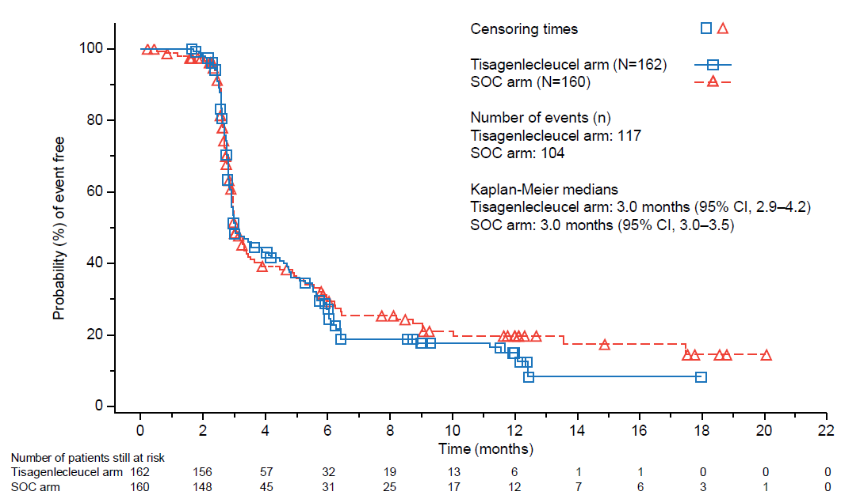
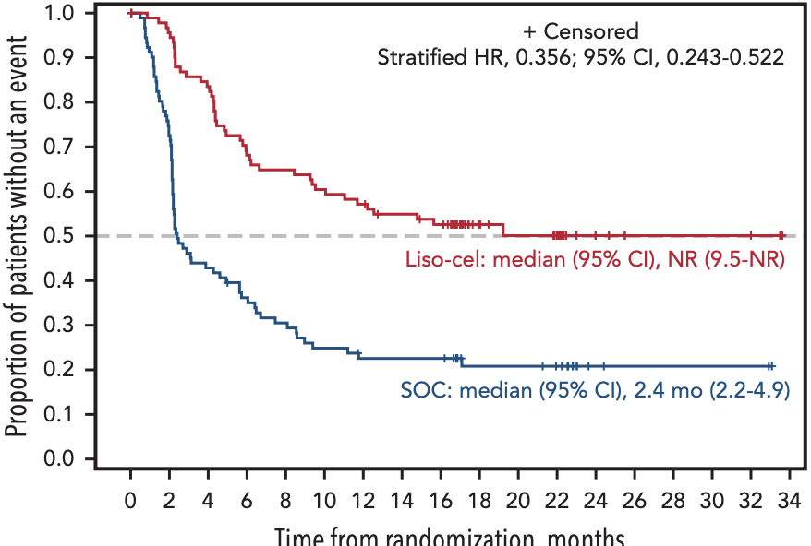
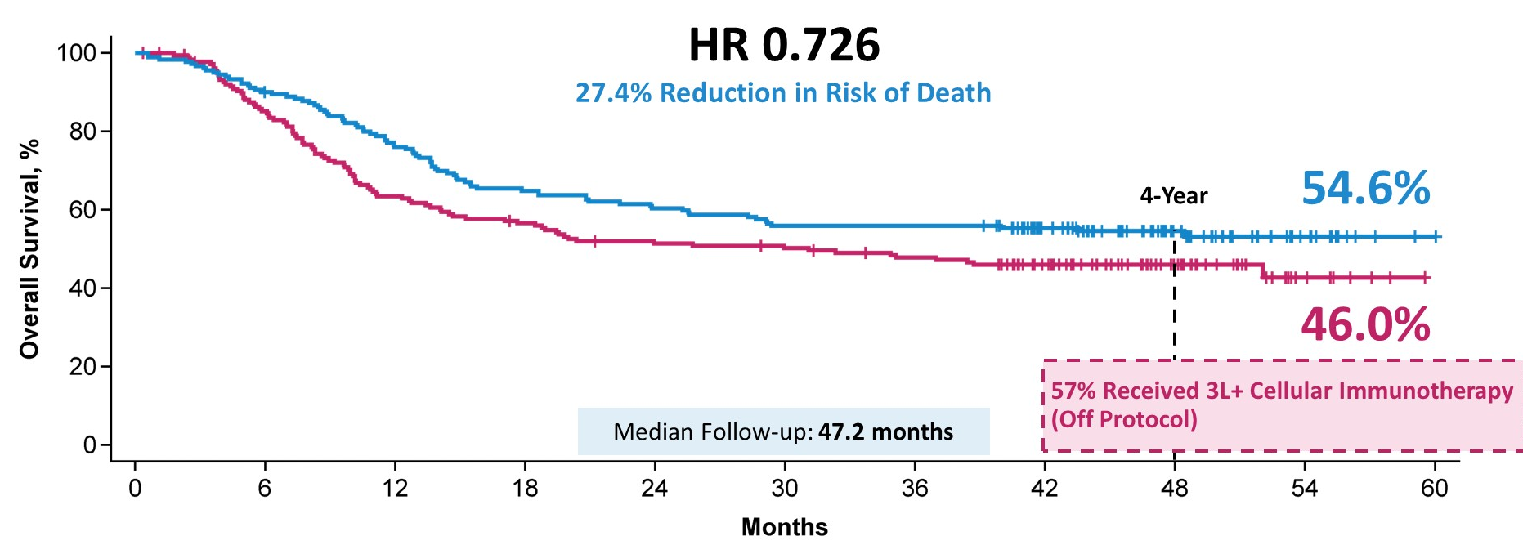
Primary Endpoint- Event-Free Survival
ZUMA 7
(Axi-cel)
TRANSFORM
(Liso-cel)
BELINDA
(Tisa-cel)
Median FU 47.2 months
Median FU 17.5 months
Median FU 10 months
HR 1.07 (95% CI, 0.82-1.40, p=0.69
Second-Line Axi-cel and Liso-cel FDA Approved in 2022
Locke, F et al, N Engl J Med. 2022 Feb 17;386(7):640-654., Westin et al NEJM 2023
Kamdar, M et al Lancet. 2022 Jun 18;399(10343):2294-2308.
Bishop,M et al N Engl J Med. 2022 Feb 17;386(7):629-639
Abramson JS et al Blood 2023 6;141(14):1675-1684
Notes:
The latest follow up of ZUMA 7 study with median FU 47.2 months presented at ASCO 2023 by Dr Westin shows a striking difference between second line Axi-cel vs SOC with 4 year OS in Axi-cel 54.6% vs 46% in SOC, demonstrating a statistical sig OS benefit of Axi-cel vs SOC in second line setting for primary refractory/early relapse DLBCL patients
At a follow up of 17.5 months, TRANSFORM study continue to show a difference in EFS of second line liso-cel vs SOC with median EFS NR in Liso-cel arm compared to 2.4 months in SOC.
BELINDA study at median FU of 10 months did not show any difference between second line Tisa-cel and SOC
Based on these pivotal randomized study results, in April and June 2022 FDA approved Axi-cel and Liso-cel respectively as second line therapy for primary refractory or early relapsed (within 12 months of first line chemoimmunotherapy) DLBCL in transplant-eligible patients

Slide 74
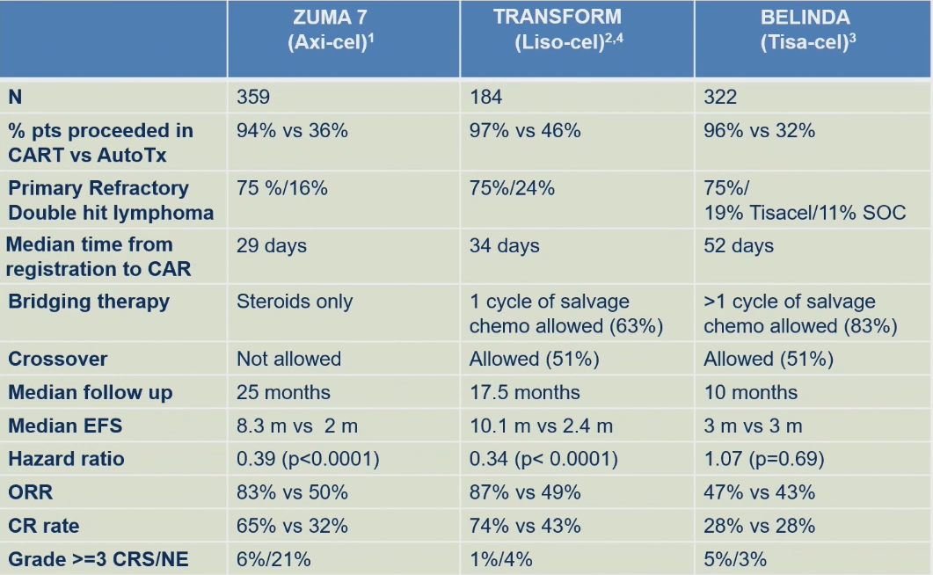
1.Locke, F et al, N Engl J Med. 2022 Feb 17;386(7):640-654. doi: 10.1056/NEJMoa2116133
2.Kamdar, M et al Lancet. 2022 Jun 18;399(10343):2294-2308. doi: 10.1016/S0140-6736(22)00662-6.
3.Bishop,M et al N Engl J Med. 2022 Feb 17;386(7):629-639. doi: 10.1056/NEJMoa2116596c
4.Abramson JS et al Blood 2023 6;141(14):1675-1684
Notes:
This table shows some important characteristics of all three pivotal studies. It is important to note that about 1/3 of patients in each study ultimately proceeded to auto HCT and median EFS in the autoHCT arm in each of the studies was only 2-3 months.
Some key differences in study design are highlighted as are some differences in grade 3 or higher CRS/neurotoxicity are highlighted here

Slide 75
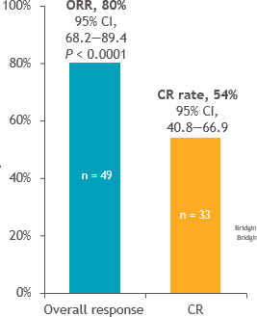
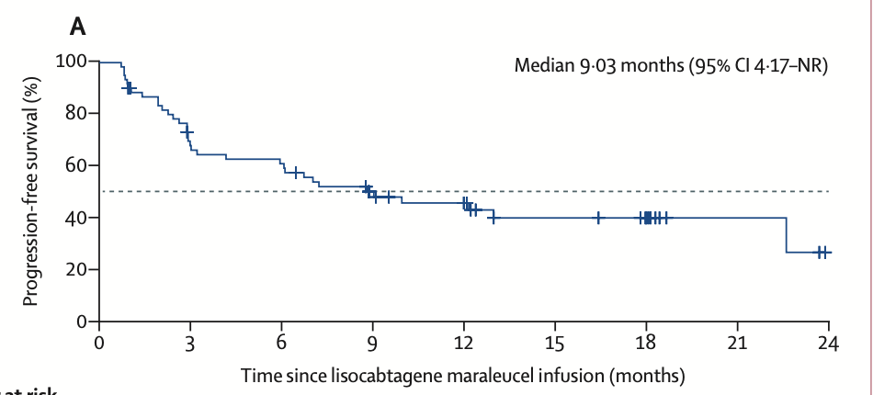
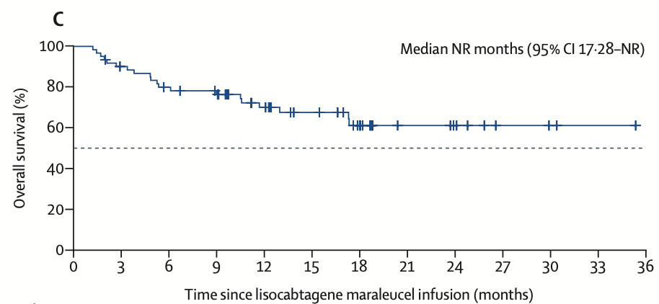
Not all patients are eligible for ASCT: PILOT study
Patient eligibility
Age ≥ 18 years
LBCL: DLBCL NOS (de novo; transformed from FL), HGBCL with rearrangements in MYC and BCL2 and/or BCL6 (double/triple hit), or FL3B
One prior line of therapy containing an anthracycline and a CD20-targeted agent
Not intended for HSCT by investigator and met ≥ 1 of the following TNI criteria: age ≥ 70 years, ECOG PS of 2, DLCO
≤ 60% (adjusted for sex-specific hemoglobin concentration), LVEF < 50%, CrCl < 60 mL/min (calculated using Cockcroft-Gault), and/or AST/ALT > 2 × ULN
Adequate organ functionª
Patients with secondary CNS lymphoma were allowed
RESULTS
Median follow up 12.3 months
Median PFS 9 months
Median DOR 12 mos
(22 mos in CR pts)
Median OS Not Reached
SAFETY
NO treatment related deaths
Most common >=Grade 3 treatment related AE’s – Neutropenia (48%), Thrombocytopenia (20%)
CRS (38% low grade; 1 grade 3 )
Neurological events (31% low grade, 3 grade 3)
Notes:
Phase 2 PILOT study evaluated the role of liso-cel in second line setting in transplant ineligible patients with criteria used to determine transplant ineligibility shown on this slide and these included age, poor performance status, renal dysfunction, transaminitis, EF < 50%.
54% were primary refractory, 21% had early relapse, and 25% had late relapse, 33% had double or triple hit lmphoma
ORR 80% and CR 54%. Median age 74, and 26% had ECOG 2
At a median follow-up of 13.0 months, median PFS was 9 months and median DOR was 12 months. Patients who did achieve CR had excellent DOR response at 21.6 months and excellent PFS of 22.6 months
OS looks promising at a follow-up of 17.6 months, median OS not reached for entire population and for those in CR
In 2022, the PILOT study lead to approval of Liso-cel in second line setting even for late relapse patients who are transplant ineligible.

Slide 76
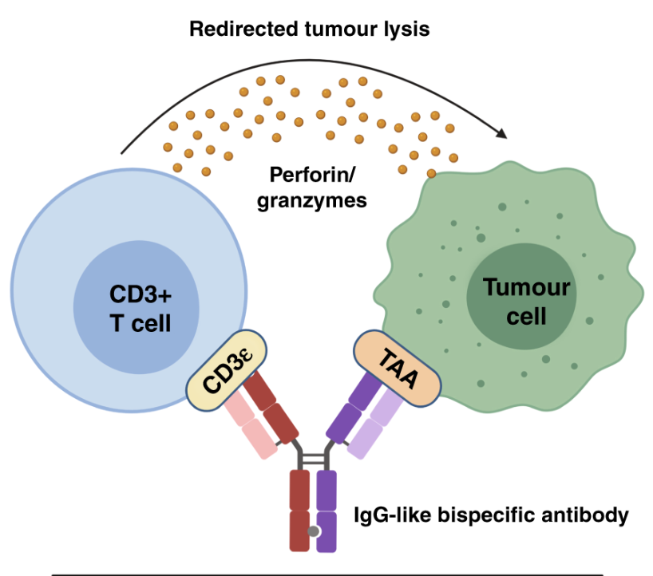
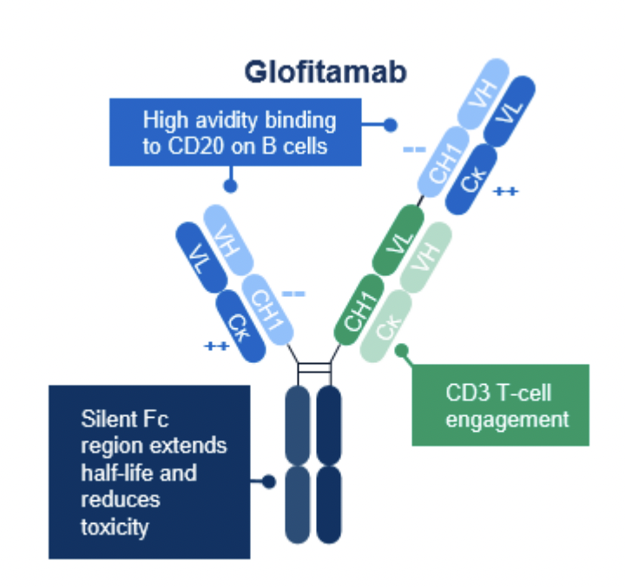
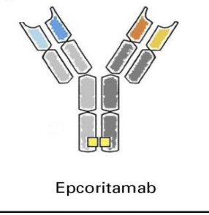
Bispecific Antibodies
IV infusion
Time-limited
FDA Approved
≥2 lines of treatment
FDA Approved in 2023
SC
Indefinite therapy
Notes:
Bispecific abs target CD3 on T cells and CD20 on B cells. All have FC modification which leads to prolonged half life, reduced crosslinking, and less ADCC. They can have alternate conformations such as glofitamab which has 2 CD20 binding sites and one CD3 binding site which confers specific structural properties
There are 2 Bispecifics recently FDA approved in R/R DLBCL after atleast 2 prior lines of therapy, Glofitamab and Epcoritamab was approved in June and May 2023 respectively.

Slide 77
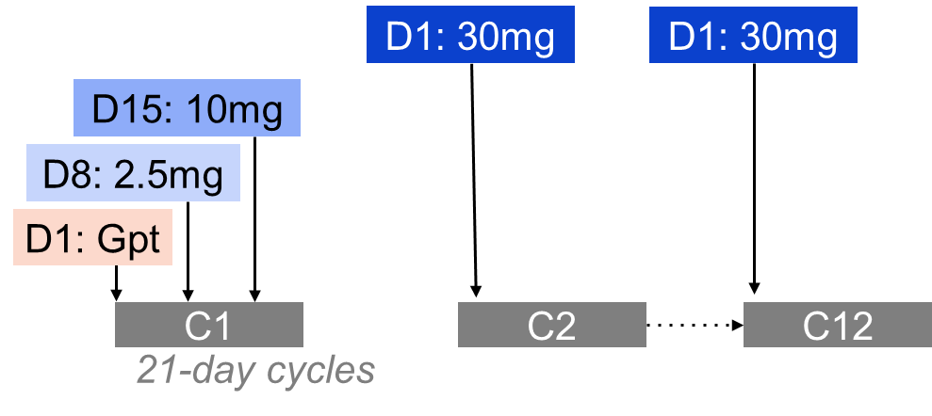
Glofitamab Pivotal Phase II Study overview
Pivotal Phase II study in patients with R/R LBCL and ≥2 prior therapies
Key inclusion criteria
Glofitamab IV administration
DLBCL NOS, HGBCL, trFL, or PMBCL
ECOG PS 0–1
≥2 prior therapies, including:
  Anti-CD20 antibody
  Anthracycline
  Fixed-duration treatment
Maximum 12 cycles
  CRS* mitigation:
Obinutuzumab pre-treatment
(1 x 1000mg)
C1 step-up dosing
Monitoring after first dose (2.5mg)
Endpoints
Landmark analyses
Primary: CR rate (as best response) by IRC†
Key secondary: ORR‡, DoR, DoCR‡, PFS, OS
PFS and OS post-hoc analysis were performed by response (landmark at C3, or EOT)
*By American Society for Transplantation and Cellular Therapy criteria.¹ †By PET-CT (Lugano criteria²). ‡By IRC and investigator. C, cycle; CRS, cytokine release syndrome; D, day; DLBCL NOS, diffuse large B-cell lymphoma not otherwise specified; DoCR, duration of complete response; DoR, duration of response; ECOG PS, Eastern Cooperative Oncology Group performance status; EOT, end-of-treatment; Gpt, Obinutuzumab; HGBCL, high-grade B-cell lymphoma; IRC, independent review committee;
IV, intravenous; ORR, overall response rate; OS, overall survival; PET-CT, positron emission tomography-computed tomography;
PFS, progression-free survival; PMBCL, primary mediastinal large B-cell lymphoma; trFL, transformed follicular lymphoma.
1. Lee DW, et al. Biol Blood Marrow Transplant 2019;25:625–38;
2. Cheson BD, et al. J Clin Oncol 2014;32:3059–68.
Hutchings, et al. ASH 2023.

Slide 78
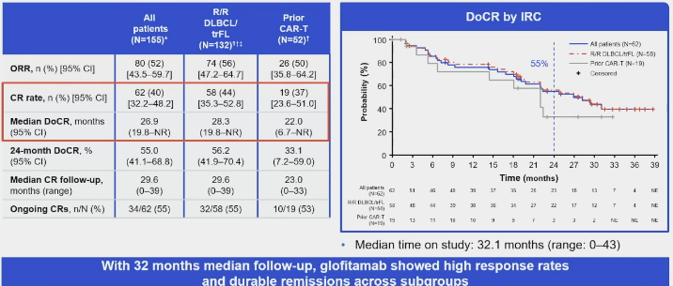
Complete Responses to Glofitamab were Durable
Hutchings, et al. ASH 2023.
Notes:
More than half (55%)of the patients with CR had 2 years of CR duration, but there are some drop-offs as you can see in the curve to the right
Patients with prior CAR T had similar duration of complete response curves as the general population

Slide 79
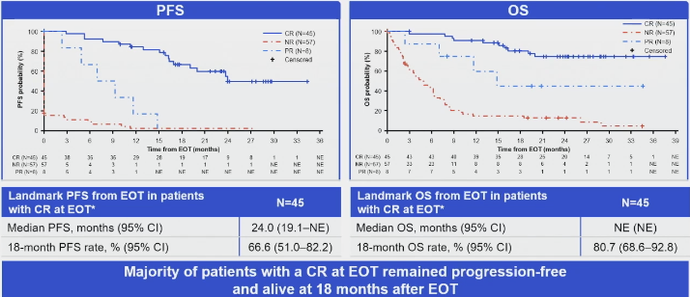
Landmark Analysis by Response at EOT
Hutchings, et al. ASH 2023.
Notes:
As we can see here, for majority of patients with CR at EOT remained progression-free and alive at 18 months after EOT
Those who had no response or PR of course had a much higher number of relapses with a much lower PFS and OS compared to those in CR
For patients in CR, median PFS was 2 years and median OS was not reached at this follow-up

Slide 80
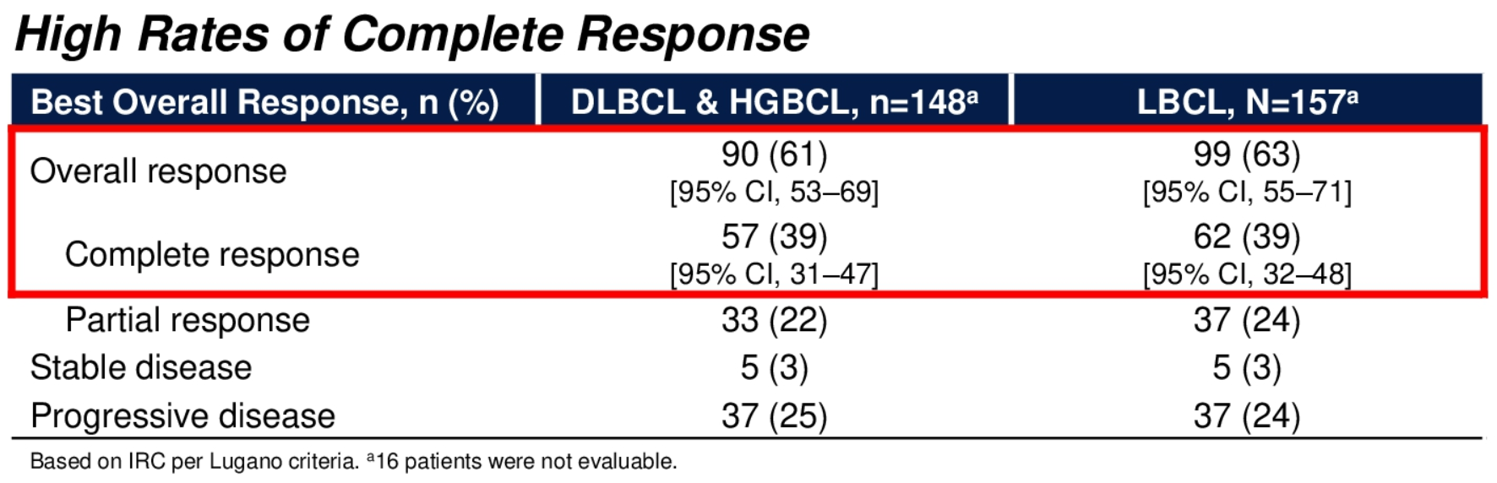
Epcoritamab is effective in R/R DLBCL
Karimi Y, et al. ASCO 2023.
Notes:
Here are the results from the pivotal EPCORE NHL-1 trial, with single agent epcor in R/R LBCL.
ORR 63% with CR 39%, PR 25% in DLBCL patients

Slide 81
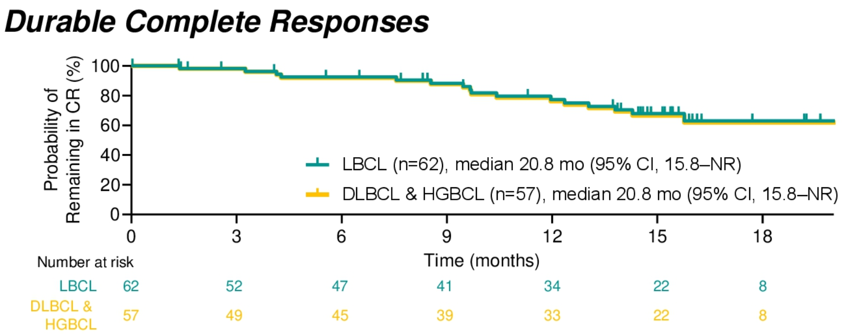
Median Duration of CR almost 2 years
Median DOR: 15.5 mo in all responders
Median DOCR: 20.8 mo among CR patients
Notes:
Notably patients who achieved CRs with the agent experienced durable responses. At median follow-up of 20 months, median duration of CR was 20.8 months in patients who achieved CR, and median DOR was 15.5 months in all responders.
Median OS was 18.5 months overall and median OS was not reached in patients who achieved CR.
At 12 months, an estimated 77% and 76% of complete responders, respectively, remained in CR; at 15 months, these rates were 68% and 67%, respectively.

Slide 82
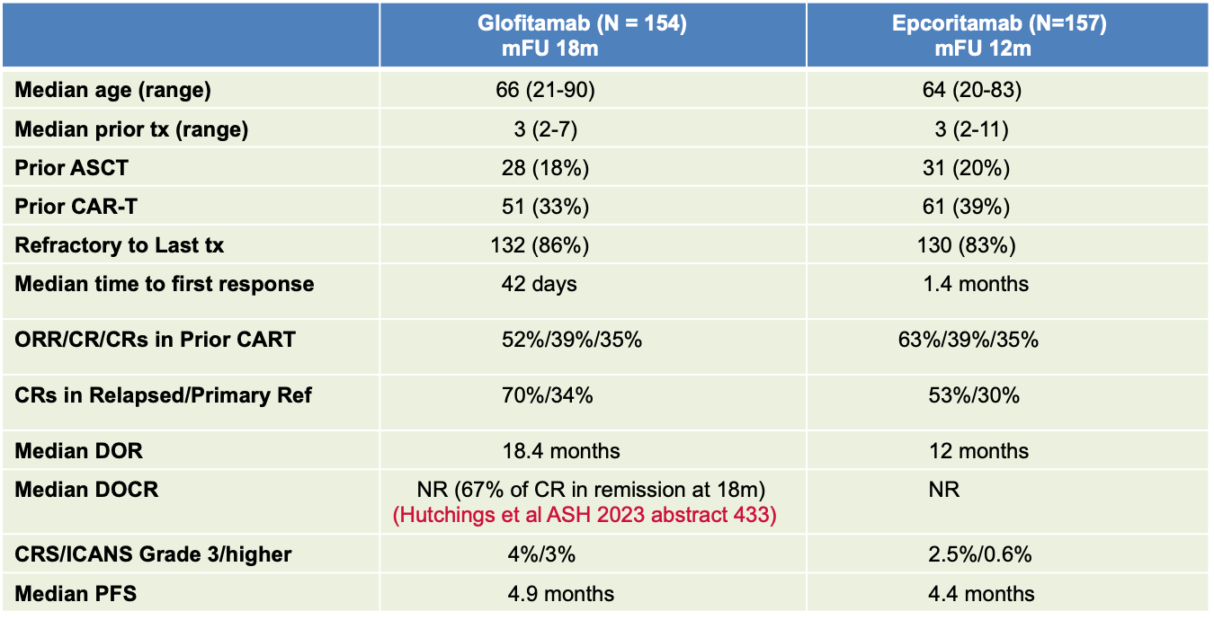
Glofitamab vs Epcoritamab
1. Dickinson et al. NEJM Dec 2022 2. Thieblemont et al JCO 2023
Notes:
This table compares some of the characteristics of both bispecifics based on data published from the pivotal phase1/2 studies for both bispecifics glofitamab and epcoritamab
As you can see baseline characteristics and responses rates are overall comparable with both bispecifics
Important to note that that responses in primary refractory group is sig lower than the refractory group
Durability of these responses remains to be seen with longer follow-up, with median PFS of 4.9 months and 4.4 months at this short follow-up

Slide 83
CD19 CAR T Cell Therapy vs CD20 Bispecifics
CAR-T therapy | Bispecific antibody therapy
Approved in second and third line setting | Approved in third line setting
Curative potential confirmed at 5 yr FU | Excellent efficacy but lacks longer term FU
Single Infusion- One and Done! | Repeated Infusions (12 cycles vs Indefinite)
Response irrespective of target antigen expression | Response dependent on target antigen expression
Established CNS efficacy | Unknown CNS efficacy
Prospective trials: Efficacy of Bisp after CART | Retrospective- Efficacy of CAR-T after Bisp
Inpatient and Outpatient | Mostly Outpatient
Need for Lymphodepleting Chemotherapy | No Lymphodepleting Chemotherapy but more Steroids
Specialized accredited centers | Community settings
Substantial upfront commitment/Manufacturing Time 3-4w | Less upfront commitment /Off-the shelf therapy
Higher risk of CRS/Neurotoxicity/Cytopenias | Lower risk of CRS/Neurotoxicity/Cytopenias
Notes:
How to sequence bispecifics and CAR T remains an important questiot.. This table here highlights some of the key differences of CD19 CAR T cell therapy and CD20 bispecific, highlighting advantages and disadvntages of each.
Some advantage of Car T over bsAb are, approved in second line….
Some advantages of bispecifics over CAR T therapy include that mostly outpatient, no LD therapy though more steroid use as pre-meds, can be given in community settings, off-the shelf, ……..

Slide 84
Summary of other approved third-line DLBCL therapies
Baseline Characteristics | GO29365 BR+Polatuzumab vedotin | L-MIND Tafasitamab+Lenalidomide | SADAL Selinexor | LOTIS-2 Loncastuximab tesirine
Primary refractory | Allowed | Excluded (19%) | Allowed | Allowed (20%)
Transformed DLBCL | Excluded | Allowed (9%) | Allowed (24%) | Allowed (20%)
Double-hit Double-expressor | 0% 42% | Excluded (n=2) Unknown | 4% 35% | 10% 14%
Median LOT (range) | 2 (1-7) | 2 (1-4, max 3) | 2 (2-3) | 3, 32% 4+ lines
Refractory to last tx | 80% | 44% | 72% (≥60 or 98d from last tx | 58%
ORR CR | 45% (best 62.5%) 50% (best 40%) | 48% 34% | 28% 12% | 48% 24%
DOR PFS OS | 12.6 mo 9.5 mo 12.4 mo | 21.7 mo (updated 43.9 mo) 12.1 mo 33.5 mo | 9.3 mo 2.6 mo 9.1 mo | 10.3 mo 4.9 mo 9.9 mo
Follow-up (mos) | 7.3 | 14.7 | 17.3 | 27
1. Caimi et al. Lancet 2021 2. Kalakonda et al. Lancet 2020 3. Salles et al. Lancet 2020 4. Sehn et al. JCO 2019
Notes:
Here is a table outlining other SOC approved therapies in the third line or later setting for DLBCL all based on phase 2 studies. Phaes 2 LOTIS-2 trial lead to Lonca’s approval in R/R DLBCL in April 2021. In the last 2 years there have been several other novel therapies approved for r/r DLBCL. Selinexor (selective inhibitor of XPO1) was approved in June 2020 for r/ DLBCL after at least 2 prior lines of therapies base on the SADAL study, tafasitamab (CD19-directed monoclonal Ab) + lenalidomide was approved in July 2020 for r/r DLBCL who are not eligible for auto-HCT based on the phase II L-mind study, Pola-BR was approved in June 2019 for r/r DLBCL after at least two prior therapies based on a phase 1b/II study comparing pola-BR with BR.
As we can see while these drugs have demonstrate efficacy in heavily pretreated patients, durability of responses are yet to be seen. We also need a better understanding of the outcomes of these therapies in the post CAR T setting, as these patients were heavily under-represented in the pivotal trials leading to their approvals
Other therapies in the third line setting or post CAR T setting include lenalidomide, PD-1 blockade, radiation, among others

Slide 85
Next Generation of Combination R/R DLBCL therapies
Mosun/Pola in R/R DLBCL (n=120)¹
  ORR 59.2%, CRR 45.9%
  Median duration of CR was not reached
  Median PFS 11.4 months, median OS 23.3 months (median f/u 23.9 mos)
  Safety: most common Grade 3 or higher AE neutropenia (25%) and fatigue (6.7%), any grade CRS 16.7%
Glofit/Pola in R/R DLBCL (n= 111)²
  ORR 78%, CR 56%
  In patients with a CR, 6 and 12 month DOCR rates were 89.2% and 73.1% respectively
  Safety: Grade 3/4 AEs were reported in 61.3% with neutropenia most common (29.7%)
Epcoritamab + Lenalidomide in R/R DLBCL EPCORE NHL-5 (n=26)³
  ORR 75%, CR 58%
  Safety: most common Gr3-4 TEAES were neutropenia (58%), anemia (15%), thrombocytopenia (15%), and febrile neutropenia (12%)
Budde et al ASH 2023
Hutchings et al ASH 2023
Mazza et al ASH 2023
Notes:
Mosun + Pola and Glofit + Pola have demonstrated high efficacy and durable response rates in R/R DLBCL in 2nd line or later setting, responses were also demonstrated in high risk subgroups including patients with prior CAR T
Mosun/Pola Glofit/Pola, and Epcor/Len are all phase 1b/2 study

Slide 86
DLBCL: New Treatment Options in Context
Newly diagnosed DLBCL (First-line R-CHOP, consider pola-R-CHP)
Response to salvage therapy
ASCT
Relapsed
Refractory to salvage therapy
ASCT intended
Relapsed
>12 months
Second-line CAR-T eligible:
Liso-cel
Third line options:
Chemoimmunotherapy
CAR-T (axi-cel, liso-cel, tisa-cel)
Bispecifics: Glofitamab, Epcoritamab
Loncastuximab tesirine-lpyl
Polatuzumab vedotin + BR
Tafasitamab-cxix + lenalidomide
Selinexor
Clinical trials
ASCT
Best supportive care
ASCT
ineligible
Second-line CAR-T ineligible:
Chemoimmunotherapy
Polatuzumab + BR*
Tafasitamab-cxix + lenalidomide
Relapsed/
Refractory/
Partial Response
CAR-T candidate
Relapsed
<12 months or primary refractory
Second-line CAR-T:
Axi-cel, liso-cel
Not a CAR-T candidate
Second-line options:
Chemoimmunotherapy
Tafasitamab-cxix + lenalidomide
*NCCN recommended but not an FDA approved option

Slide 87
Conclusions
DLBCL treatment landscape is changing
R-CHOP remains SOC but pola-R-CHP emerging option for high-risk patients (age > 60, IPI 3-5, and ABC subtype?) with similar safety profile
CAR T cells improve survival as second line therapy for primary refractory/early relapsed DLBCL
ASCT remains SOC for transplant-eligible patients with relapse >12 months of initial CIT
Post CAR T space is unmet need with multiple recently approved novel therapies: bispecifics, lonca-T, pola-BR, tafa-len, and selinexor
Bispecifics in single agent and combination are emerging as novel therapy option with high efficacy and low CRS/ICANS
Remaining question is how best to sequence these novel therapies

Slide 88
New Directions and Combination Studies in CLL
Catherine C. Coombs, MD
Associate Clinical Professor
University of California Irvine
Orange, CA

Slide 89
Conflict of Interest Statement
I have received honoraria/served as a consultant for AbbVie, Allogene, AstraZeneca, Beigene, Genentech, Janssen, LOXO/Lilly, MEI Pharma, Mingsight, Octapharma, TG Therapeutics, have served on speaker’s bureau for AbbVie, AstraZeneca, Beigene, Genentech, and have received research funding (paid to my institution) from AbbVie, LOXO/Lilly

Slide 90
BTK Inhibitors:
FDA Approvals and Current Status in CLL
Agent | Target |  | Status in CLL/SLL
Ibrutinib | BTK | Covalent | Approved
Acalabrutinib |  |  | Approved
Zanubrutinib |  |  | Approved – January 2023
Pirtobrutinib |  | Noncovalent | Approved – December 2023 Ongoing Phase 3 trials include BRUIN CLL-321, BRUIN CLL-322, BRUIN CLL-313, and BRUIN CLL-314
Nemtabrutinib |  |  | Phase 2 BELLWAVE-001 Phase 3 BELLWAVE-008

Slide 91
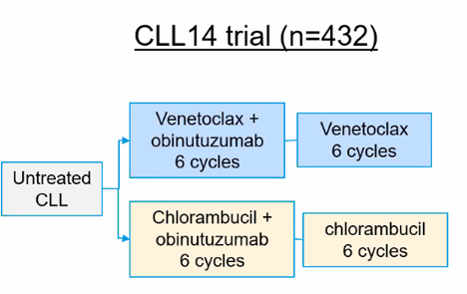
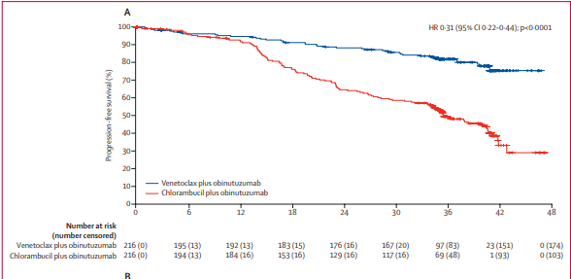
Venetoclax and obinutuzumab
Most progressions require ~1 year W+W prior to needing subsequent therapy
6-year updates from EHA 2023
Median PFS reached: 76.2 months
Median PFS for TP53 aberrant pts: 51.9 months
Median PFS for unmut IGHV pts: 64.8 months

Slide 92






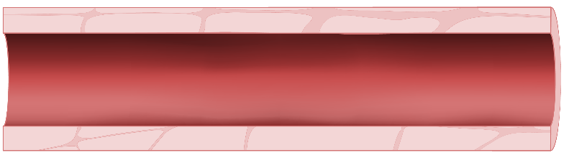
Evolving frontline options… does 1+1 = 3?
Lymph Node
Ibrutinib mobilizes
CLL cells out of protective lymphoid niches and inhibits proliferation
Ibrutinib accelerates
apoptotic cell killing by sensitizing CLL cells to BCL-2 inhibition
Stromal cell
Ibrutinib
Venetoclax
Ibrutinib
Eliminate
resting and dividing CLL cell subpopulations
Peripheral Blood
I+V eliminates
resting and dividing CLL cell subpopulations
Dividing CLL cells
Resting CLL cells
x
x
Apoptotic CLL cells
x
Dead CLL cells
x
x
1. Lu P et al. Blood Cancer J. 2021; 11:39; 2. Deng J et al. Leukemia. 2017; 31:2075-2084; 3. Herman ES et al. Clin Cancer Res. 2015; 21:4642-4651; 4. Burger JA et al. Leukemia. 2020;34:787-798; 5. Shanafelt T et al. N Engl J Med. 2019;381:432-443; 6. Cervantes-Gomez, F. et al. Clin. Cancer Res. 2015; 21:3705–3715; 7. Slinger E, et al. Blood. 2017; 130: 3018-3018; 8. Haselager MV, et al. Blood. 2020 ;136:2918-2926; 9. Slinger E et al. Leukemia. 2017 Dec;31(12):2601-2607.

Slide 93
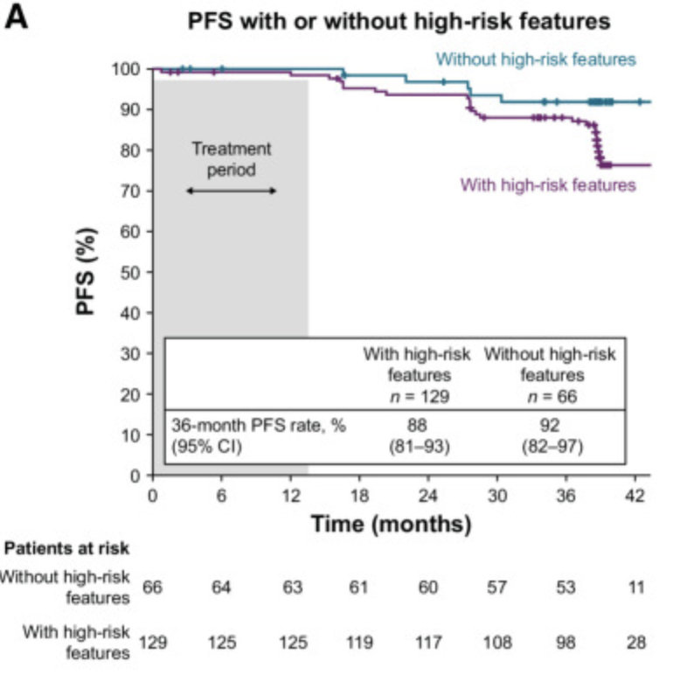
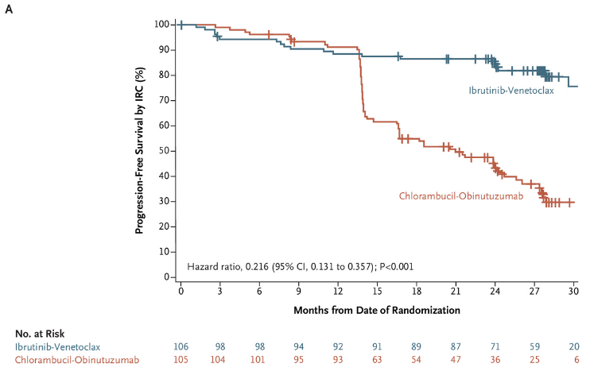
Ibrut+Ven studies
I+V is approved in Europe, many other countries but is not approved by US FDA
GLOW trial – I+V vs. chlorambucil+obi in older/unfit CLL
Kater et al. NEJM Evidence 2022
CAPTIVATE trial – pts <70
PFS curve is for fixed duration cohort
Allan et al CCR 2023

Slide 94
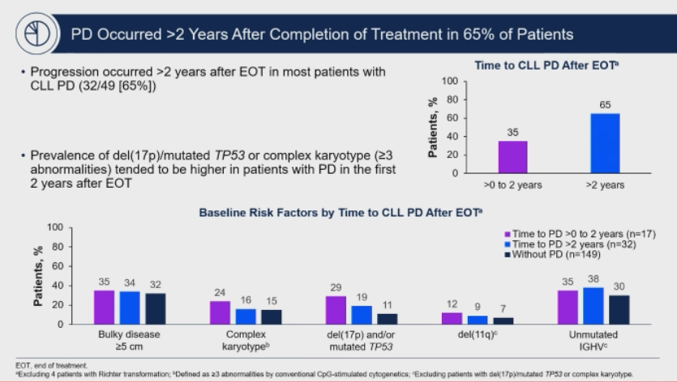
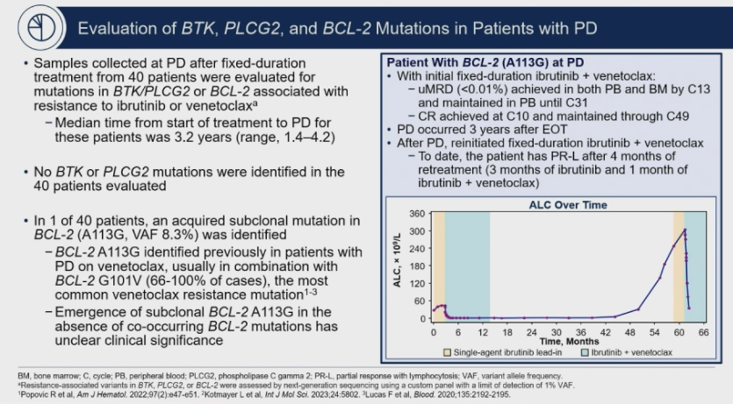
CAPTIVATE updates from ASH ’23: Retreatment

Slide 95
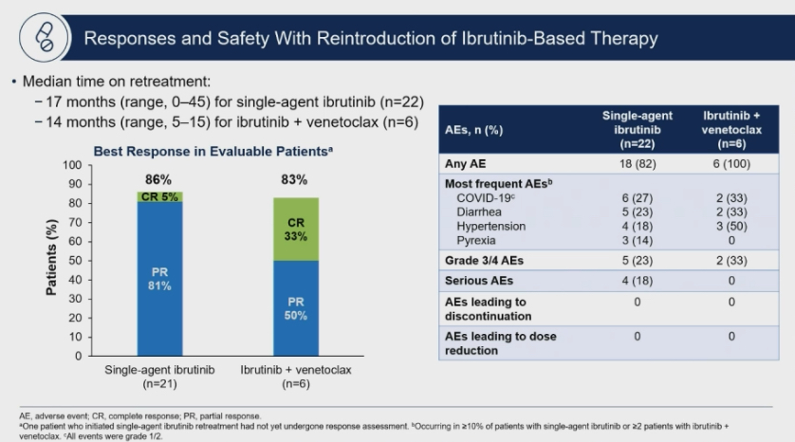
CAPTIVATE retreatments

Slide 96
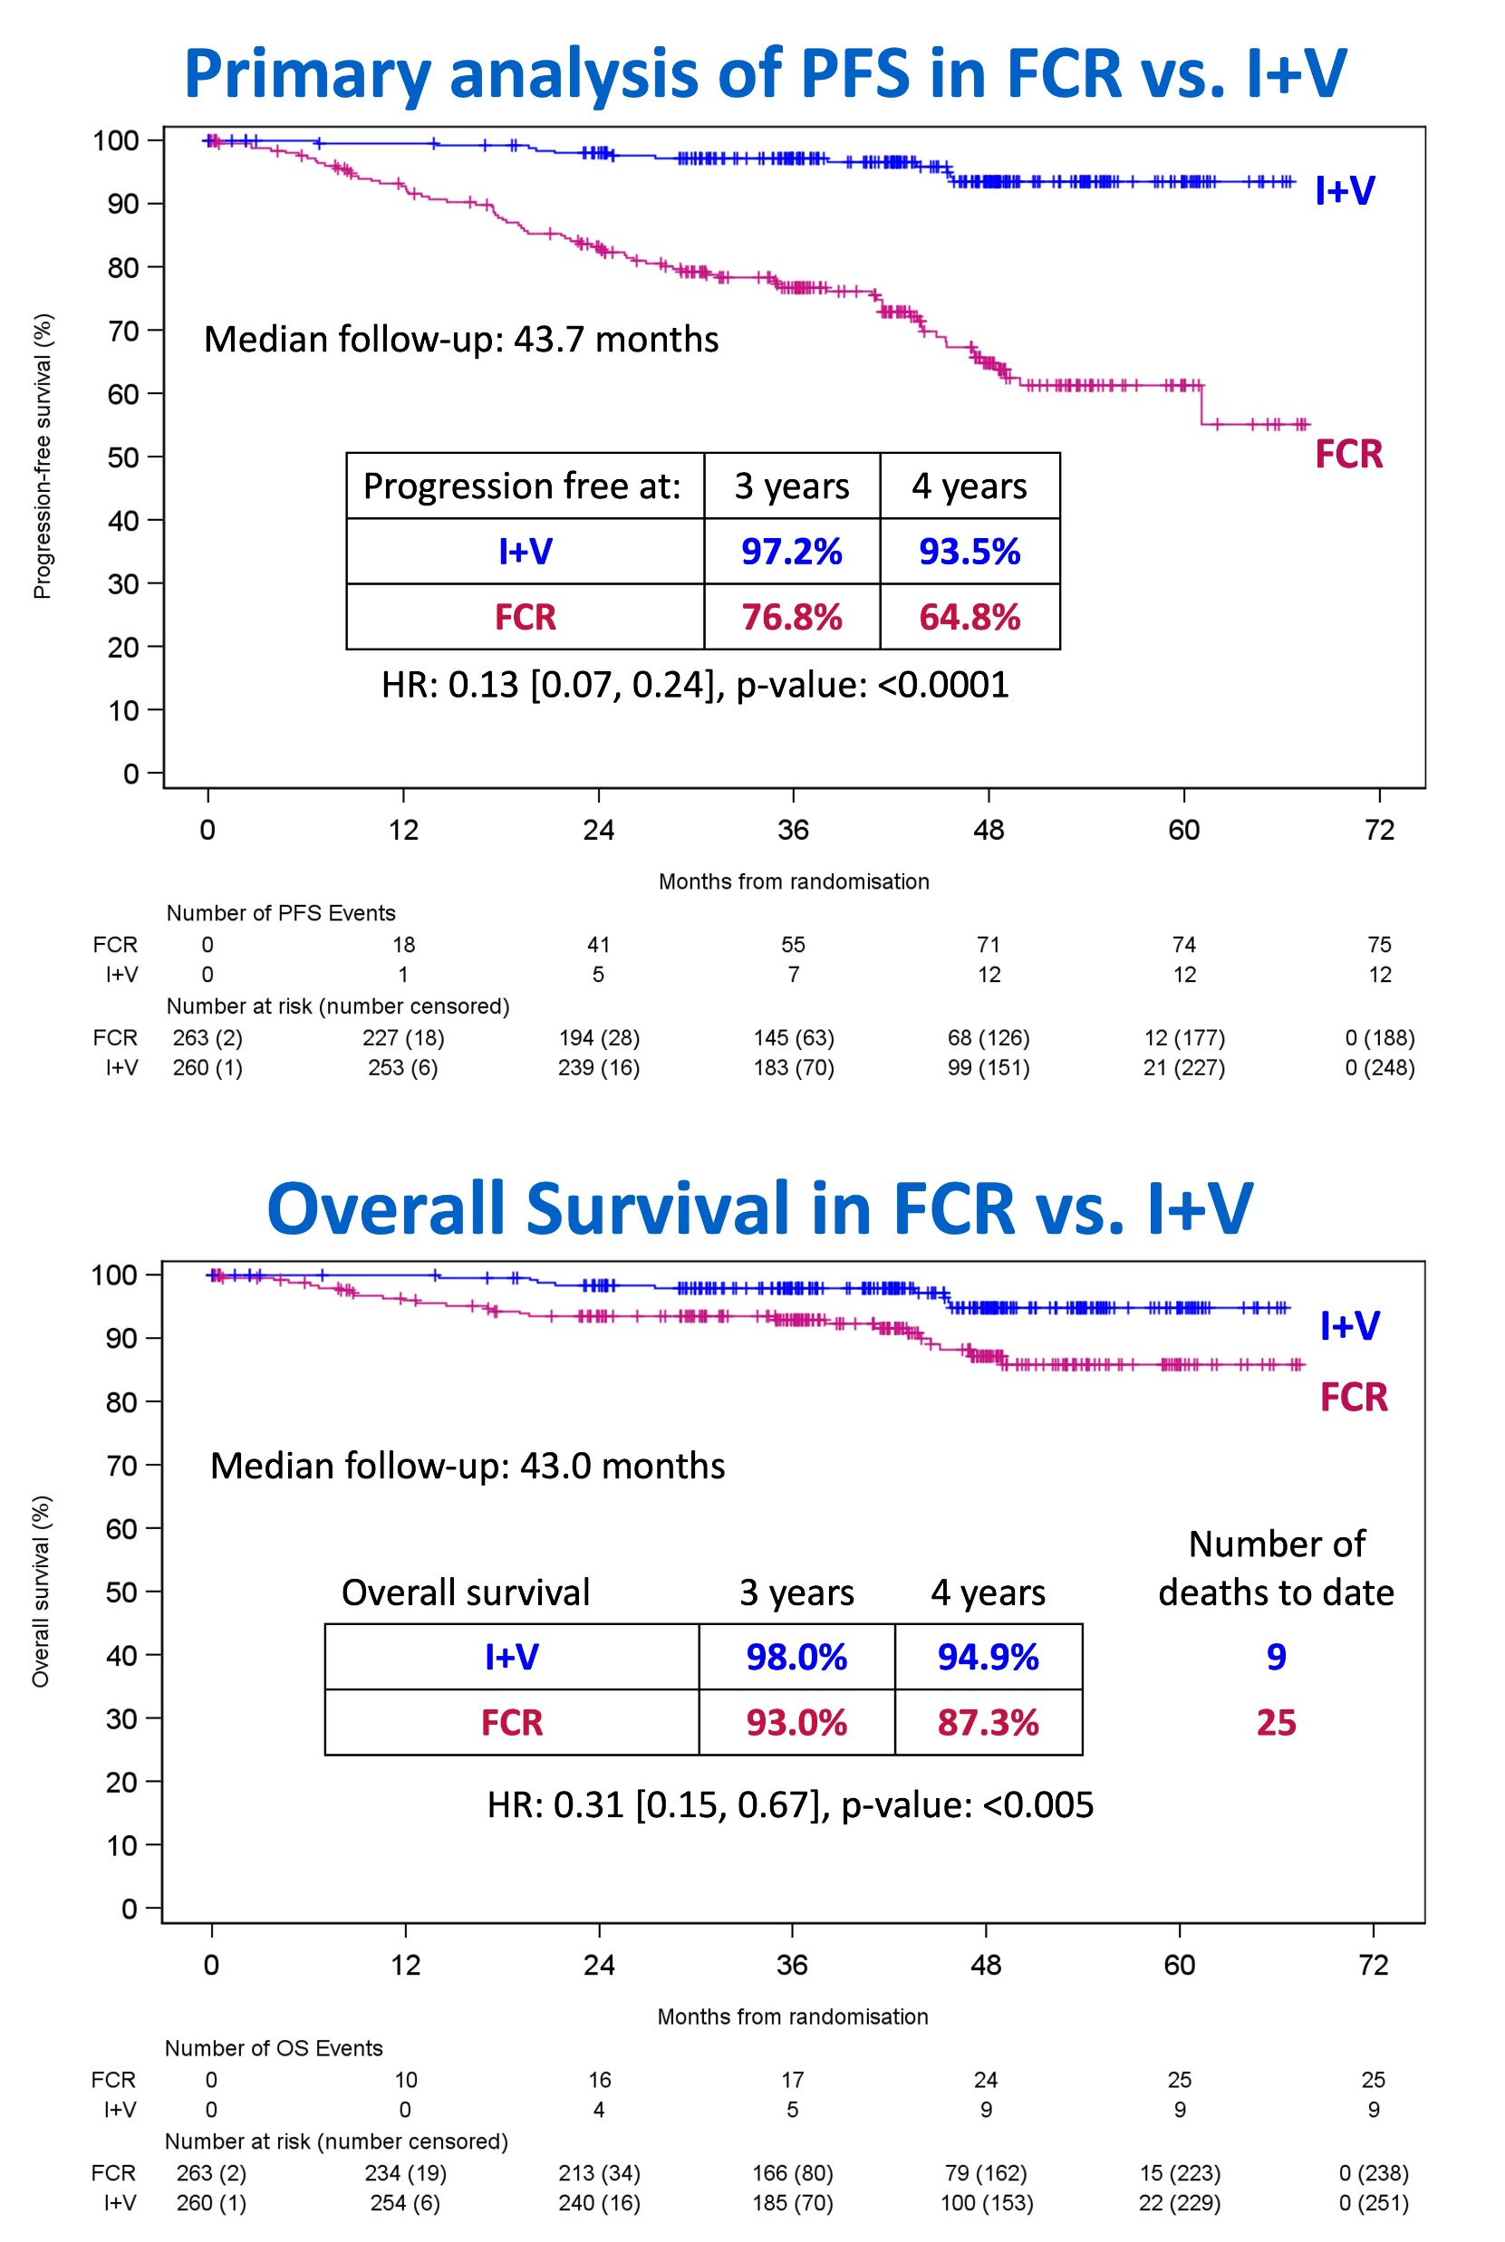

FLAIR trial

Slide 97


Ibrutinib is no longer a favored BTKi due to toxicity profile
Acalabrutinib has non-inferior efficacy to ibrutinib in high-risk relapsed population in ELEVATE-RR, but superior safety ⬇️afib/flutter, ⬇️HTN
Zanubrutinib has superior efficacy than ibrutinib in all-comer relapsed population in ALPINE, also superior safety ⬇️afib/flutter, but similar HTN

Slide 98
Ongoing Phase 3 AMPLIFY Trial
Arm A
Acalabrutinib (BID, D1-28, up to 14 cycles)
Venetoclax (cycles 3-14)
RANDOMIZE
Primary Endpoint: PFS per IRC
(Arm A vs Arm C)
Secondary Endpoints:
PFS per IRC
(Arm B vs Arm C)
PFS per investigators
(Arm A/B vs Arm C)
Adults with previously untreated CLL requiring treatment
No del(17p) or TP53 mutation
Arm B
Acalabrutinib (BID, D1-28, up to 14 cycles)
Venetoclax (cycles 3-14)
Obinutuzumab (cycles 2-7)
1:1:1
  Arm C
  FCR or BR (up to 6 cycles)
N=981
NCT03836261

Slide 99

MAJIC: An Ongoing Trial of Acalabrutinib + Venetoclax vs
Venetoclax + Obinutuzumab in Treatment-naïve CLL Patients
The MAJIC trial will compare venetoclax + acalabrutinib versus venetoclax + obinutuzumab in treatment-naïve CLL
This trial will allow for early discontinuation if patients have achieved undetectable MRD after 12 cycles of venetoclax
Ryan et al., Future Medicine. 2022

Slide 100

Zanubrutinib and sonrotoclax
Sonrotoclax (BGB-11417) is a BH3 mimetic that binds and inhibits BCL2 with potency >10x that of venetoclax in biochemical assays
Zanubrutinib and sonrotoclax demonstrates high ORR (100%) though with limited follow up
Zanubrutinib and sonrotoclax will be compared to venetoclax and obinutuzumab in a phase 3 trial (NCT06073821)

Slide 101


Zanubrutinib + sonrotoclax: ASH ’23

Slide 102

Pirtobrutinib Efficacy in All Patients with CLL/SLL who Received Prior cBTKi
Prior cBTKi | n=282^{b}
ORRª incl. PR-L, % (95% CI) | 81.6 (76.5-85.9)
Best Response, n (%)
CR | 5 (1.8)
nPR | 2 (0.7)
PR | 196 (69.5)
PR-L | 27 (9.6)
Number of Patients (n=252)
Data of patients with baseline and at least one evaluable post baseline tumor measurement. Data for 30 patients are not shown in the waterfall plot due to no measurable target lesions identified by CT at baseline, discontinuation prior to first response assessment, or lack of adequate imaging in follow-up. ªORR including PR-L is the number of patients with best response of PR-L or better divided by the total number of patients; 14 patients with a best response of not evaluable (NE) are included in the denominator.^{b}Post-cBTKi patients included a subgroup of 19 patients with one prior line of cBTKi-containing therapy and second line therapy of pirtobrutinib, who had an ORR including PR-L of 89.5% (95% CI: 66.9-98.7). Response status per iwCLL 2018 according to independent review committee assessment.

Slide 103

Pirtobrutinib Progression-Free Survival with Prior cBTKi with or without Prior BCL2i
BCL2i-N
Median: 95% CI: Median Follow-up: Events/Total: | 23.0 months 19.6-28.4 27.6 months 79/154
All Prior cBTKi
Median: 95% CI: Median Follow-up: Events/Total: | 19.4 months 16.6-22.1 27.5 months 160/282
BCL2i-E
Median: 95% CI: Median Follow-up: Events/Total: | 15.9 months 13.6-17.5 22.2 months 81/128

Slide 104


Pirtobrutinib resistance

Slide 105
Treatment Crossroads: Sequencing BTK Inhibitors in MCL
Nirav Shah, MD MS
Associate Professor of Medicine
Medical College of Wisconsin
Milwaukee, WI

Slide 106
Mantle cell lymphoma (MCL)
  Accounts for 6% of all cases of lymphoma
  Median age of presentation 60-70 years
  Male predominance (75-80%)
  Generally, presents with advanced disease (Stage III-IV)
  Follows a relapsing/remitting course
  Frontline regimens incorporate chemotherapy +/- autologous transplant followed by Rituximab maintenance
Skarbnik A, G.A., Mantle Cell Lymphoma: State of Art. Clinical Advances in Hematology & Oncology, 2015. 13(1): p. 44.

Slide 107
Relapsed MCL
BTK inhibitors are standard of care in patients without prior BTK exposure
Other options include CAR-T cell therapy, lenalidomide, Venetoclax based treatments
Question in 2023: Is there a best BTK inhibitor option?

Slide 108


Covalent BTK inhibitors
All irreversibly bind CYS481 in the BTK active site, inactivating the enzyme. Second generation BTKs more selective for BTK with potentially less off toxicity. Ibrutinib first BTK approved in Nov 2013
Owen, C., N.L et al. Current oncology (Toronto, Ont.), 2019. 26(2): p. e233-e240.
Kaptein A et al. 60th American Society of Hematology Meeting and Exposition (ASH 2018). Abstract 1871.

Slide 109
Comparing BTK inhibitors in MCL
 | Ibrutinib Wang NEJM 2013 N=111¹ | Acalabrutinib Wang Lancet 2018 N=124 | Zanabrutinib Song CCR 2020 N=86
FDA approval | Nov 2013 | Oct 2017 | Nov 2019
Median Prior Lines of Tx | 3 | 2 | 2
Median Age | 68 years | 68 years | 60.5 years
ORR% | 68% | 81% | 84 %
CR% | 21% | 40% | 68.6%
Median DOR | 17.5 months | 13.8 months | 19.5 months
Median PFS | 13.9 months | 12 mon rate: 67% | 22.1 months
Discontinued due to AE | 7% (n=8) | 6% (n=7) | 9.3% (n=8)
Grade≥3 AEs Neutropenia major hemorrhage atrial fibrillation | 16% 4.5% 4.5% | 10% 0.8% 0 | 19.8% 3.5% 0
1- Ibrutinib approval in MCL was voluntarily withdrawn in US market in April 2023

Slide 110


Acalabrutinib: ACE-LY-004 Trial
ORR=81%, CR rate=43%
Median PFS was 20 months
24-month PFS=49% in updated analysis
Safety: No cases of atrial fibrillation, most common AE were Grade 1-2 headache, diarrhea, fatigue, and myalgia.
Wang et al. Lancet 2018
Wang et al. Leukemia 2019

Slide 111

Zanubrutinib
Zanubrutinib in R/R MCL, long-term outcomes
N=86 patients
ORR 84%, CR 78%
2-year PFS=58%
3-year PFS 48%
Median DOR not-reached with median follow-up of 35.3 months
9.3% of patients discontinued due to AEs
No atrial fibrillation or flutter

Slide 112

Post-BTK Failure
Outcomes post covalent BTK progression
Author | N | Median prior lines of Rx | ORR to next Rx | Median PFS/DOR to next Rx | Median OS after next Rx | Comments
Cheah et al. Ann Oncol, 2017. | 42 | 2 26% >3 | 32% | 5.8 mo (DOR) | 8.4 mo (treated) | 10% prior HCT 52% Ki67>50% 32% pleomorphic/blastoid
Martin et al. Blood 2016 | 114 | 3 | 26% | 1.9 mo (PFS) | 5.8 mo (treated) | 21% prior HCT; 72% Ki67>30% 16% blastoid
Epperla et al. Hematol Oncol 2017 | 97 | 2; 28% >3 | 42% | 3.0 mo (DOR) | 5.0 mo (treated) | 50% prior HCT 38% Ki67>30% 16% blastoid
Wang et al. J Hematol Oncol 2017 | 58 | 4; 57% >3 | 29% 15%L; 27%LR; 35%L+other | 4.6 mo (DOR) | NR | Study of Len +/- other. Results better with Len+R or Len+other

Slide 113
NEXT GENERATION BTK INHIBITORS

Slide 114




Non-Covalent (Reversible) BTK Inhibitor: Pirtobrutinib
Highly selective for BTK¹⁻²
Pirtobrutinib may stabilize/maintain BTK in a closed inactive conformation¹¹
Plasma exposures exceeded BTK IC₉₀
throughout dosing interval
IC₅₀ <10 nM
10 nM < IC₅₀ <50 nM
50 nM < IC₅₀ <100 nM
100 nM < IC₅₀ <200 nM
200 nM < IC₅₀ <500 nM
BTK
In contrast to cBTKi (A), pirtobrutinib (B) appears to stabilize BTK in a closed, inactive conformation, blocking access to upstream kinases and phosphorylation of Y551,​ thus inhibiting scaffolding interactions that support kinase-independent BTK signaling³
Steady state plasma exposure corresponding to 96% BTK target inhibition
Different mechanism of action than covalent inhibitors
¹Mato et al, Lancet 2021. ²Brandhuber et al. Clin Lymphoma Myeloma Leuk 2018. ³Gomez et al. Blood.2023.
Notes:
Negin

Slide 115


Pirtobrutinib in MCL
These data led to FDA approval of Pirtobrutinib in R/R MCL after covalent BTKi in Jan 2023
Wang et al. JCO 2023
Shah NN et al. ASCO 2023

Slide 116


MCL Survival Curves (BTKi exposed)
Median duration of response was 21.6 months and median OS was not reached;
striking improvements from prior data for covalent BTK failures
Wang et al. JCO 2023
Shah NN et al. ASCO 2023

Slide 117

Safety Profile: 2023 Update
Low rates of traditional BTK toxicities such as atrial fibrillation, bleeding, HTN, hemorrhage, diarrhea.
Coombs et al. ASCO 2023 https://ascopubs.org/doi/abs/10.1200/JCO.2023.41.16_suppl.7513s et al. ASCO 2023

Slide 118

Covalent BTKi versus Non-Covalent BTKi
BRUIN-MCL 321 clinical trial
First head-to-head trial of BTK inhibitors in relapsed MCL.
Compares non-covalent BTK inhibitor pirtobrutinib to covalent BTK inhibitor in a 1:1 fashion (investigator choice of ibrutinib, acalabrutinib, or zanubrutinib)

Slide 119
Nemtabrutinib
Non-covalent BTK inhibitor currently under development.
Phase 1 clinical trial demonstrated a safe dose of 65 mg daily
Overall response rate in CLL patients was 75%
Limited data in NHL, only 12 efficacy evaluable patients reported with ORR of 42%, none of these patients had MCL
Further trials are indicated to determine the role of nemtabrutinib in MCL

Slide 120

BTK Degraders
A new class of BTK inhibiting agents that eliminates the BTK protein through proteosome degradation of the molecule leading to responses in B-cell malignancies.
Several agents under development
  BGB-16673: early data presented at ASH from phase 1
  NX-5948: phase 1 ongoing
  ABBV-101: phase 1 ongoing
NX-5948

Slide 121

Early Data BTK degraders
26 patient Phase 1 trial of BGB-16673 BTK degrader, dose escalation study across B-cell malignancies
18 response evaluable patients, 12 patients with a response (67%) including two patients with prior non-covalent BTKi exposure and 10 patients with covalent BTKi exposure
EARLY DATA!

Slide 122
BTK inhibitors in 2023
Covalent BTK inhibitors remain current standard of care for relapsed/refractory MCL, in US two options: acalabrutinib and zanubrutinib
For relapse or intolerance with covalent BTK inhibitors, Pirtobrutinib is a first-in-class non-covalent BTK inhibitor approved for treatment of R/R MCL
New non-covalent molecules and BTK degraders will expand the BTK universe and offer new options for relapsed disease.

Slide 123
Question-and-Answer

Slide 124
Concluding Remarks
Thank you for attending!

Slide 125
Thank You to Our Supporters:

