Slide 1










HEMATOLOGIC MALIGNANCIES
Wednesday, September 27, 2023

Slide 2
Welcome
Bonnie Labdi, PharmD, BCOP
Executive Director, Global Ambassador Strategies, Oncology
MJH Life Sciences™

Slide 3



Thank You to Our Supporters:

Slide 4
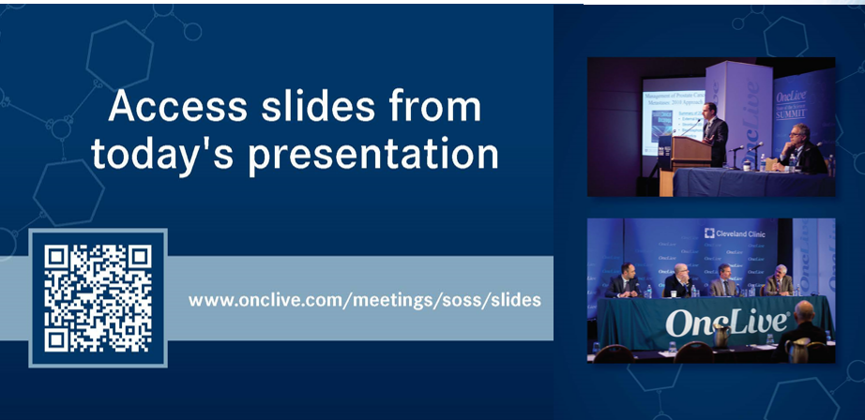

Slide 5
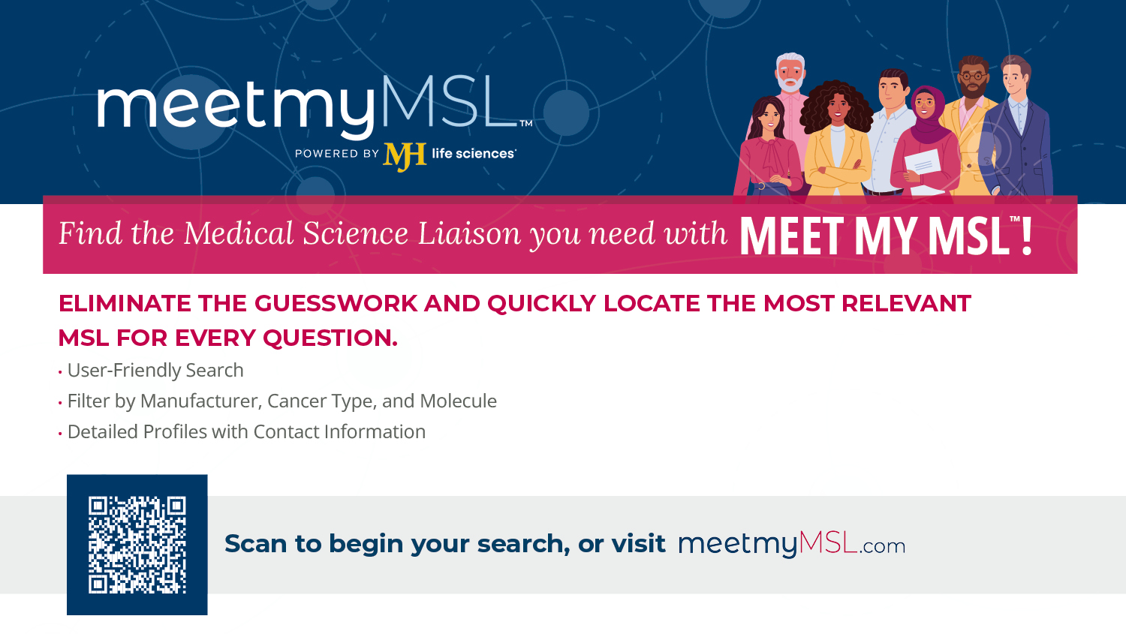

Slide 6


Slide 7
2023 Events
Precision Medicine: November 16,
Washington, DC
Breast: December 4, San Antonio, TX
2024 Events
Genitourinary: January 24, San Francisco, CA
Lung: March, Atlanta, GA
Gyn-Onc: May, Austin, TX
Lung: June, Chicago, IL
Gastrointestinal: November, Washington, DC
Breast: December, San Antonio, TX

Slide 8
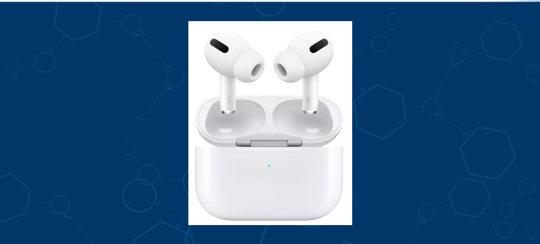

Slide 9
Program Chair
Ricardo D. Parrondo, MD
Assistant Professor of Medicine
Mayo Clinic Florida
Jacksonville, Florida

Slide 10
HEMATOLOGIC MALIGNANCIES
Wednesday, September 27, 2023

Slide 11
Current State of JAK Inhibitors for Myelofibrosis (MF)
Cándido E. Rivera, MD, FACP
Assistant Professor of Medicine
Department of Hematology/Oncology
Mayo Clinic Jacksonville FL

Slide 12
Objectives
JAK2 inhibitors landscape 2023
Myelofibrosis treatment algorithm 2023
SIMPLIFY-1 momelotinib clinical trial overview
SIMPLIFY-2 momelotinib clinical trial overview
MOMENTUM momelotinib clinical trial overview/highlights from ASH annual meeting presentation Dec 2022
Correlative study between JAK2 inhibitor treatment response and degree of bone marrow fibrosis/highlights from ASH annual meeting presentation
Dec 2022

Slide 13
Myelofibrosis (MF) is a myeloproliferative neoplasm characterized by anemia, extramedullary hematopoiesis,
splenomegaly, debilitating constitutional symptoms.
Approximately 90% of patients with MF harbor mutations in JAK2, CALR, or MPL leading to constitutive activation of Janus kinase (JAK)–signal transducers and activators of transcription signaling

Slide 14
Shortly after the discovery of the JAK2 mutation as a driving force in patients with myeloproliferative disorders, JAK2 inhibitors were developed for clinical use.
The 1st generation of JAK2 inhibitors such as ruxolitinib and fedratinib are very helpful in decreasing spleen size and ameliorating constitutional symptoms.
The newer generations of JAK2 inhibitors such as pacritinib and the now recently FDA approved momelotinib are also useful in improving anemia and thrombocytopenia.

Slide 15
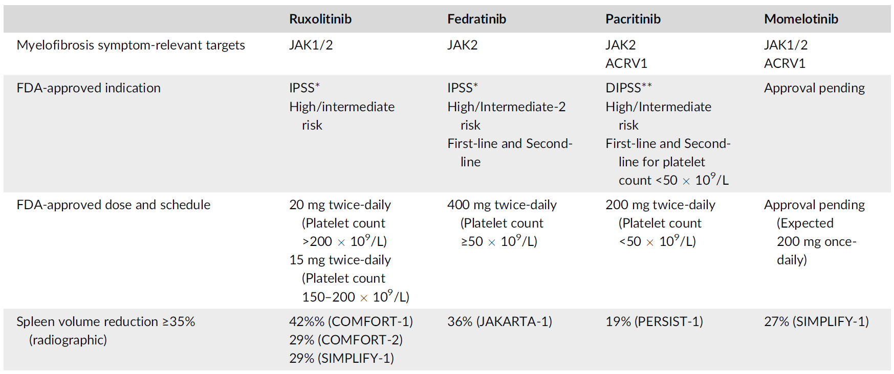
Efficacy and toxicity details of JAK2 inhibitors in JAK inhibitor-naïve patients with myelofibrosis
IPSS
High/Intermediate
Risk
First-line and Second-line for
anemia
200 mg daily
Modifed from Tefferi A Am J Hematol. 2023 May;98(5):801-821

Slide 16
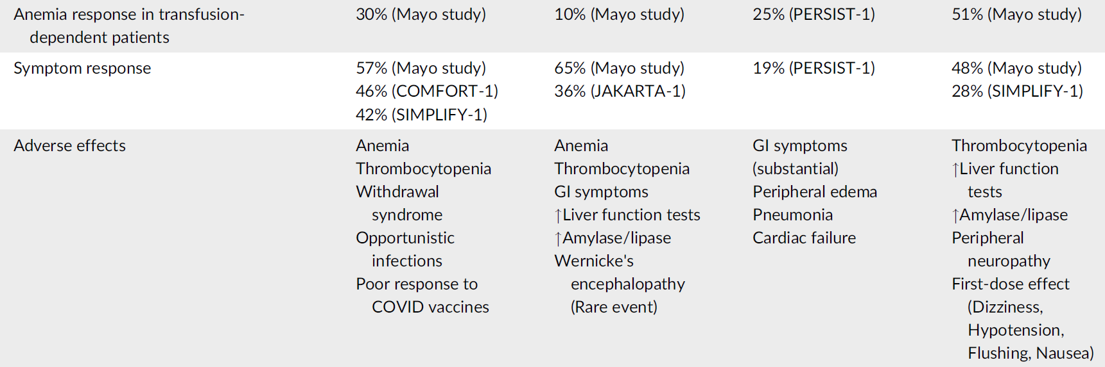
Efficacy and toxicity details of JAK2 inhibitors in JAK inhibitor-naïve patients with myelofibrosis
Tefferi A Am J Hematol. 2023 May;98(5):801-821

Slide 17
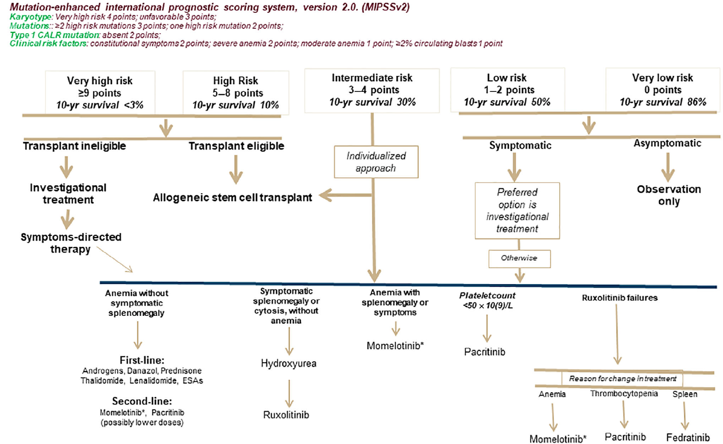
Risk-adapted treatment approach in primary myelofibrosis using the mutation-and karyotype-enhanced international prognostic
system, version 2.0.
http://www.mipss70score.it
Tefferi A, et.al. J Clin Oncol. 2018 Jun 10;36(17):1769-1770
Tefferi A Am J Hematol. 2023 May;98(5):801-821

Slide 18
Momelotinib mechanism of action
Momelotinib is an oral, small-molecule inhibitor of JAK1/2 with selectivity over other tyrosine and serine/threonine kinases

Slide 19
Hepcidin
Hepcidin is a key regulator of iron absorption.
In states in which the hepcidin level is abnormally high such as inflammation serum iron falls due to iron trapping within macrophages and liver cells and decreased gut iron absorption. This typically leads to anemia due to an inadequate amount of serum iron being available for erythropoiesis.

Slide 20
Momelotinib mechanism of action cont.
Momelotinib has also demonstrated inhibition of the bone morphogenic protein receptor kinase activin A receptor, type I (ACVR1)–mediated expression of hepcidin in the liver, thereby increasing iron availability for erythropoiesis

Slide 21
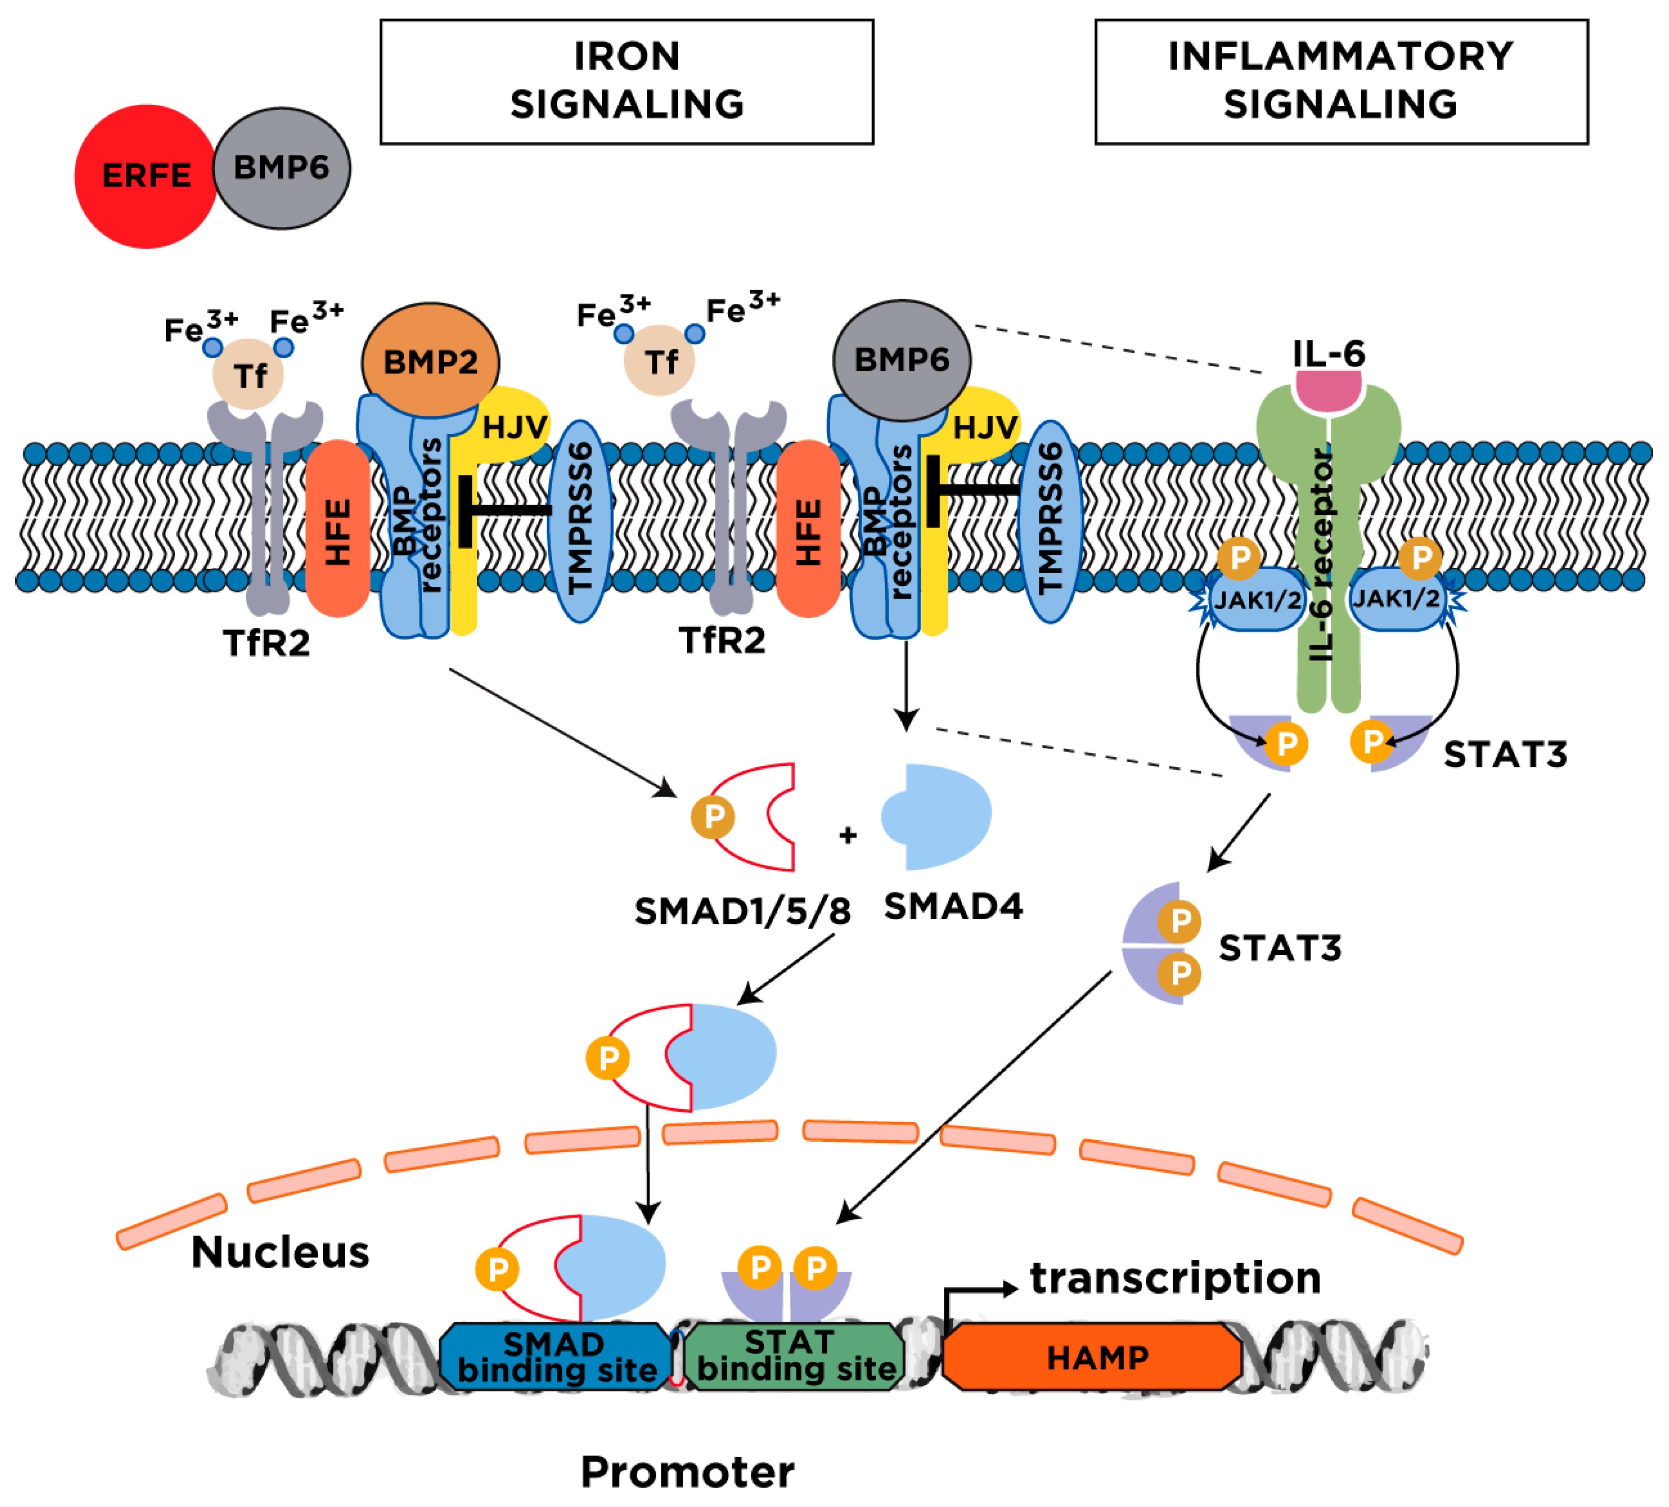
Mechanism of hepcidin regulation
Hepcidin transcription
Figure in Katsarou A Pharmaceuticals (Basel). 2018 Nov 21;11(4):127

Slide 22
Momelotinib blocks BMP receptor ACVR1 and inflammation signals downregulating hepcidin transcription
Hepcidin transcription
Modified figure from Katsarou A Pharmaceuticals (Basel). 2018 Nov 21;11(4):127

Slide 23
SIMPLIFY-1 study
Multicenter, randomized, double-blind phase 3 clinical trial in Jak-naïve patients with high risk or intermediate-2 risk or symptomatic intermediate-1 risk myelofibrosis.
A total of 432 patients were randomly assigned to receive 24 weeks of treatment with momelotinib 200 mg orally daily or ruxolitinib 20 mg orally twice a day after which all patients could receive open label momelotinib.
Mesa RA ,et.al. J Clin Oncol. 2017 Dec 1;35(34):3844-3850

Slide 24
SIMPLIFY-1 study
Primary endpoint was 35% or greater reduction in spleen volume at 24 weeks of therapy.
Secondary end points were rates of symptom response and effects on RBC transfusion requirements.
Mesa RA, et.al. J Clin Oncol. 2017 Dec 1;35(34):3844-3850

Slide 25
SIMPLIFY-1 study
A greater than 35% reduction in spleen volume at week 24 was achieved by similar proportion of patients in both treatment arms
Momelotinib 26.5% (non-inferior to ruxolitinib P=0.011)
Ruxolitinib 29.0%
Greater than 50% reduction in the total symptom score
Momelotinib 28.4% (inferior to ruxolitinib)
Ruxolitinib 42.2%
Mesa RA, et.al. J Clin Oncol. 2017 Dec 1;35(34):3844-3850

Slide 26
SIMPLIFY-2 study
SIMPLIFY-2 was a 2:1 randomized open-label phase 3 study testing momelotinib compared to best available therapy (BAT, which included ruxolitinib RUX in 88.5% of patients) in patients with myelofibrosis who experienced hematologic toxicity when previously treated with RUX (n = 156).
All 156 subjects received study treatment, and 40/52 (76.9%) of BAT/RUX-randomized patients
crossed over to MMB treatment at week 24. In both trials, the primary endpoint was spleen volume reduction (SVR) ≥ 35% from baseline at 24 weeks.
Secondary endpoints included total symptom score (TSS) response rate and red blood cell transfusion independence (TI) rate at 24 weeks and overall and leukemia-free survival (OS and LFS).
Harrison CN, et.al. Lancet Haematol. 2018 Feb;5(2):e73-e81.

Slide 27
SIMPLIFY-2 study
Additional symptom responses were observed with momelotinib treatment compared with best available therapy, which was ruxolitinib in 89% of patients. However,
Superiority of momelotinib in providing additional spleen volume reductions of at least 35% immediately following ruxolitinib treatment without washout was not achieved in SIMPLIFY-2, necessitating a third, redesigned phase 3 study to fully understand the clinical profile of momelotinib in myelofibrosis.
Harrison CN, et.al. Lancet Haematol. 2018 Feb;5(2):e73-e81.

Slide 28
MOMEMTUM study
MOMENTUM was designed to evaluate the safety and efficacy of momelotinib vs danazol for the treatment and reduction of key manifestations of myelofibrosis in an anemic, symptomatic, JAK inhibitor–experienced patient population. The MOMENTUM trial met all its primary and key secondary endpoints, demonstrating statistically significant response with respect to constitutional symptoms, splenic response, and transfusion independence in patients treated with momelotinib vs danazol. Results from the 24-week treatment period were recently reported
Mesa RA Journal of Clinical Oncology 2022 40:16 suppl 7002
Gerds AT Blood (2022) 140 (Supplement 1): 1514–1517
Gerds AT Lancet Haematol. 2023 Sep;10(9):e735-e746

Slide 29
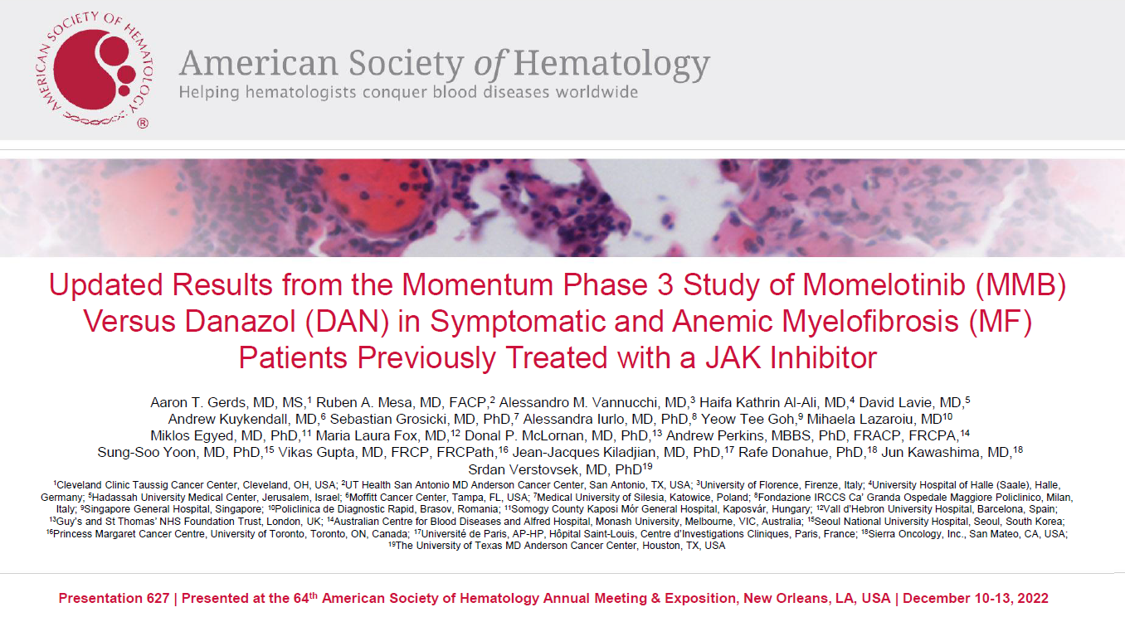
Presentation 627/ Presented at the 64th American Society of Hematology Annual Meeting and exposition
New Orleans, LA, USA/ December 10-13, 2022
Gerds AT Blood (2022) 140 (Supplement 1): 1514–1517

Slide 30
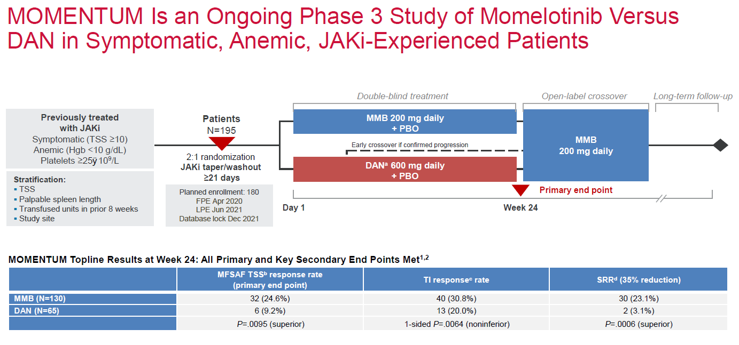
Presentation 627/ Presented at the 64th American Society of Hematology Annual Meeting and Exposition
New Orleans, LA, USA/ December 10-13, 2022
Gerds AT Blood (2022) 140 (Supplement 1): 1514–1517

Slide 31
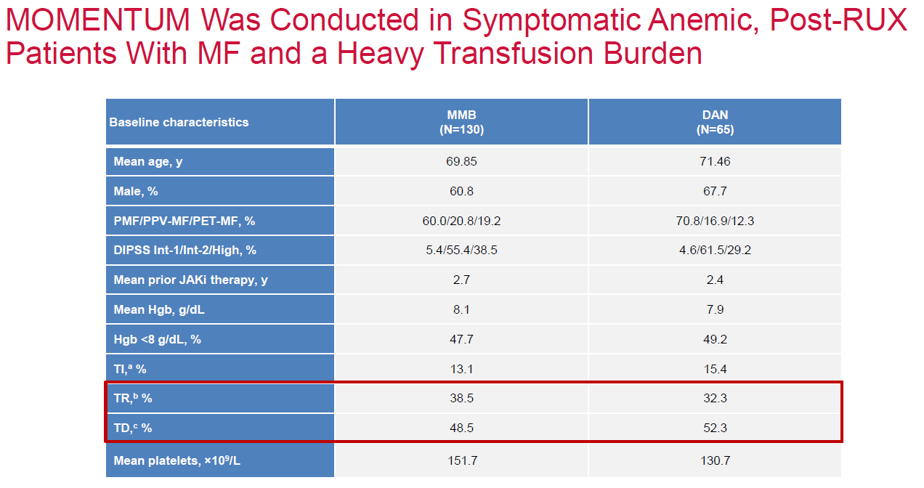
Presentation 627/ Presented at the 64th American Society of Hematology Annual Meeting and Exposition
New Orleans, LA, USA/ December 10-13, 2022
Gerds AT Blood (2022) 140 (Supplement 1): 1514–1517

Slide 32
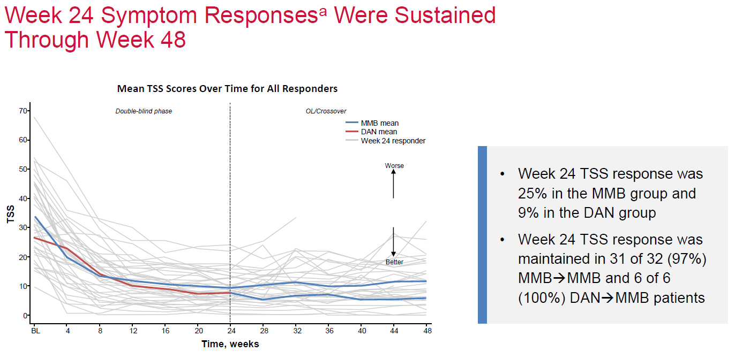
MOMEMTUM study
Presentation 627/ Presented at the 64th American Society of Hematology Annual Meeting and Exposition
New Orleans, LA, USA/ December 10-13, 2022
Gerds AT Blood (2022) 140 (Supplement 1): 1514–1517

Slide 33
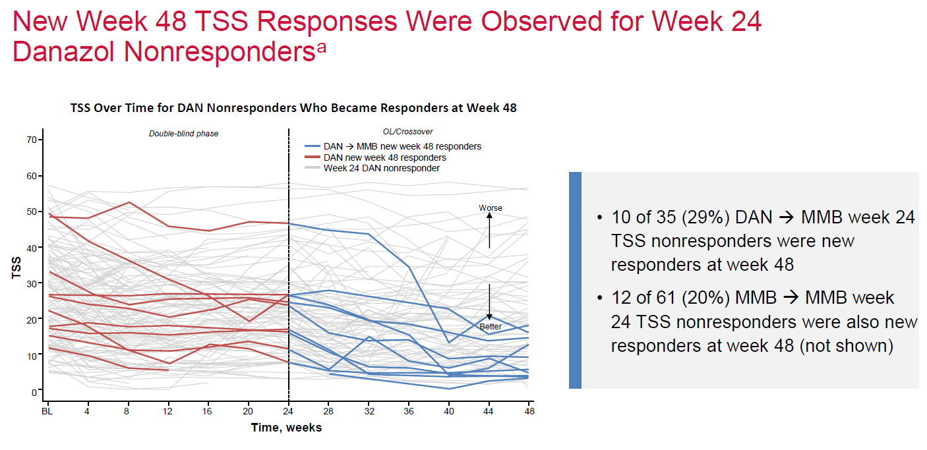
MOMEMTUM study
Presentation 627/ Presented at the 64th American Society of Hematology Annual Meeting and Exposition
New Orleans, LA, USA/ December 10-13, 2022
Gerds AT Blood (2022) 140 (Supplement 1): 1514–1517

Slide 34
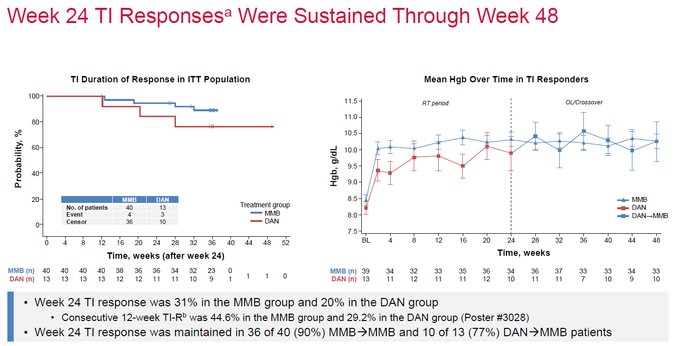
MOMEMTUM study
Presentation 627/ Presented at the 64th American Society of Hematology Annual Meeting and Exposition
New Orleans, LA, USA/ December 10-13, 2022
Gerds AT Blood (2022) 140 (Supplement 1): 1514–1517

Slide 35
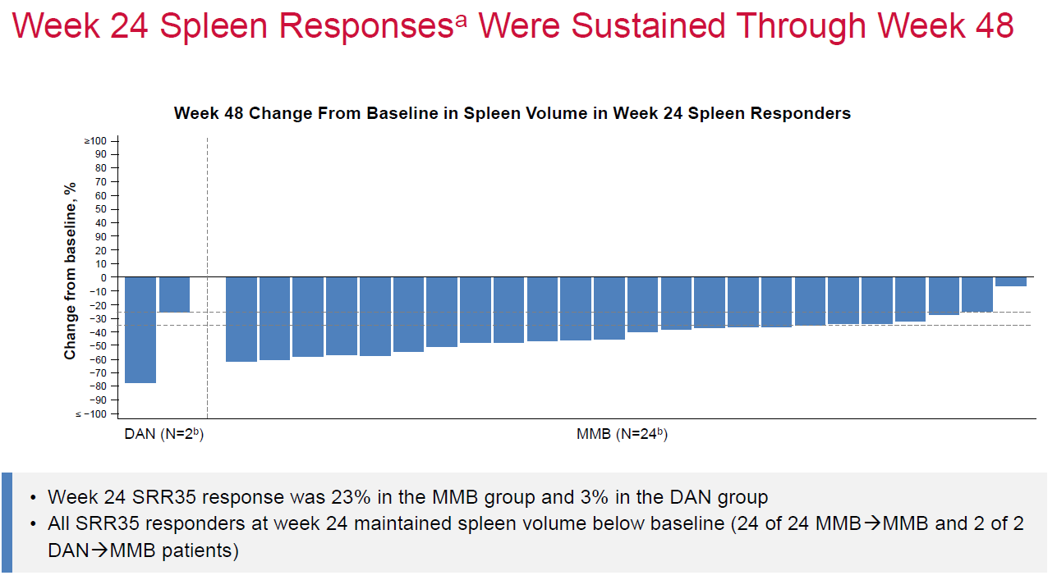
MOMEMTUM study
Presentation 627/ Presented at the 64th American Society of Hematology Annual Meeting and Exposition
New Orleans, LA, USA/ December 10-13, 2022
Gerds AT Blood (2022) 140 (Supplement 1): 1514–1517

Slide 36
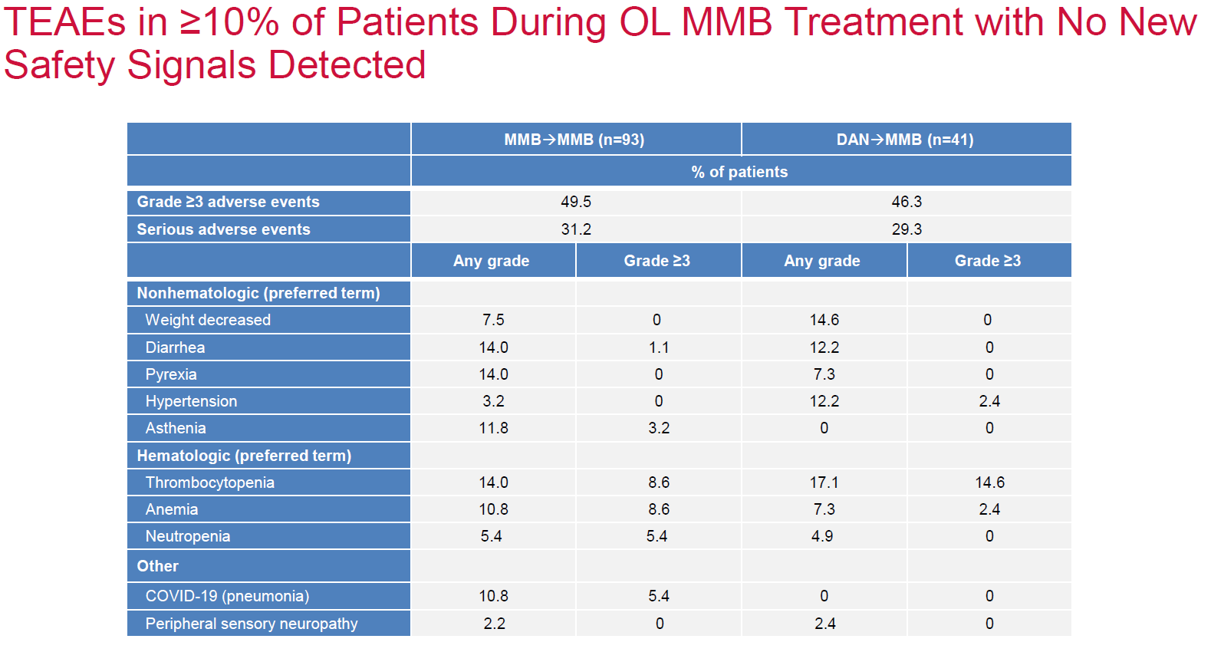
MOMEMTUM study
Presentation 627/ Presented at the 64th American Society of Hematology Annual Meeting and Exposition
New Orleans, LA, USA/ December 10-13, 2022
Gerds AT Blood (2022) 140 (Supplement 1): 1514–1517

Slide 37
Based on the SIMPLIFY-1 study and MOMENTUM study data Momelotinib (Ojjaara) was FDA approved on September 15, 2023 for the treatment of intermediate- or high-risk myelofibrosis, including primary myelofibrosis or secondary myelofibrosis (post–polycythemia vera and post–essential thrombocythemia), in adults with anemia

Slide 38
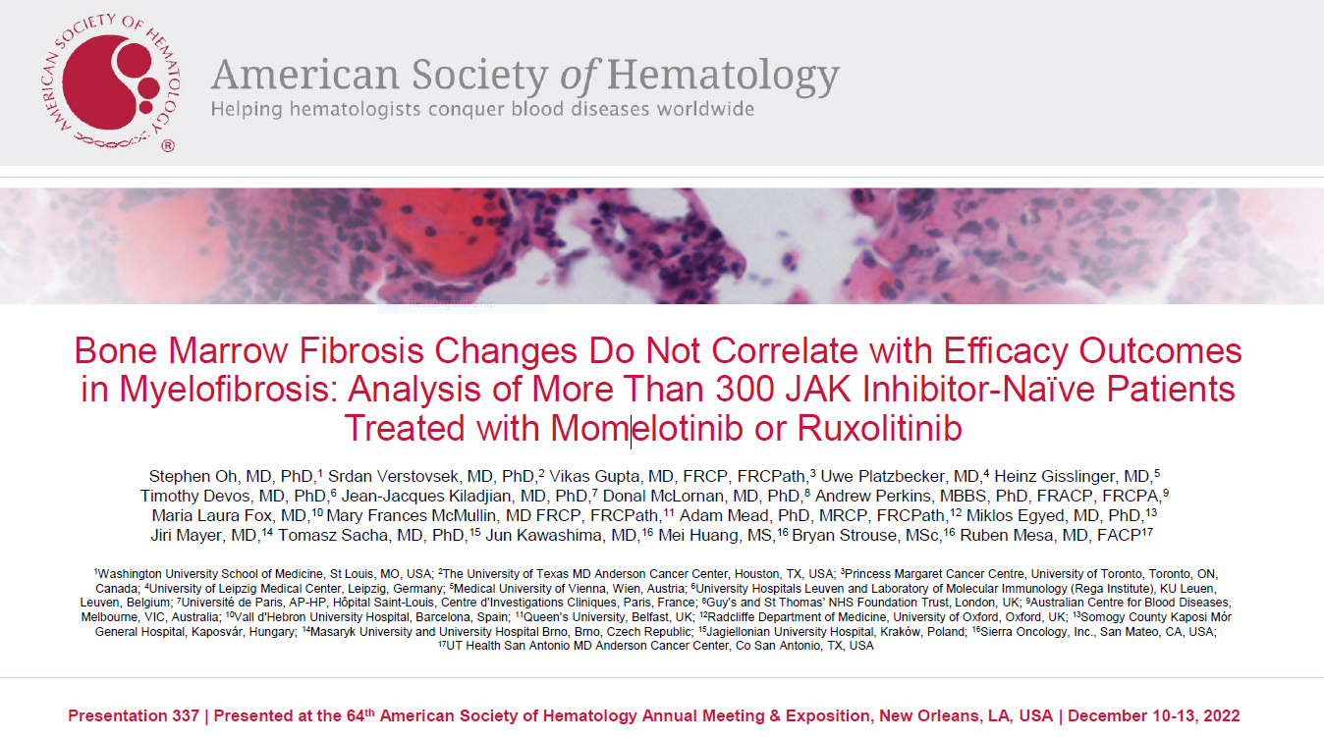
Oh S Blood (2022) 140 (Supplement 1): 821–823

Slide 39
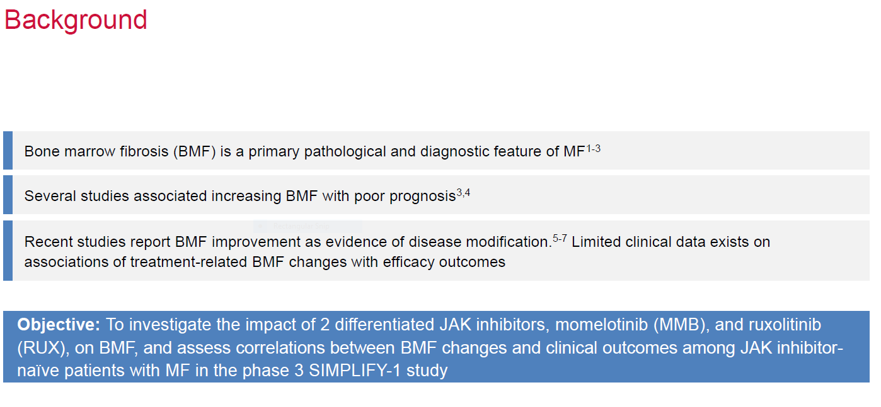
Bone marrow fibrosis changes correlation with treatment with momelotinib on ruxolitinib in JAK inhibitor naïve myelofibrosis patients
Presentation 337/ Presented at the 64th American Society of Hematology Annual Meeting and Exposition
New Orleans, LA, USA/ December 10-13, 2022
Oh S Blood (2022) 140 (Supplement 1): 821–823

Slide 40
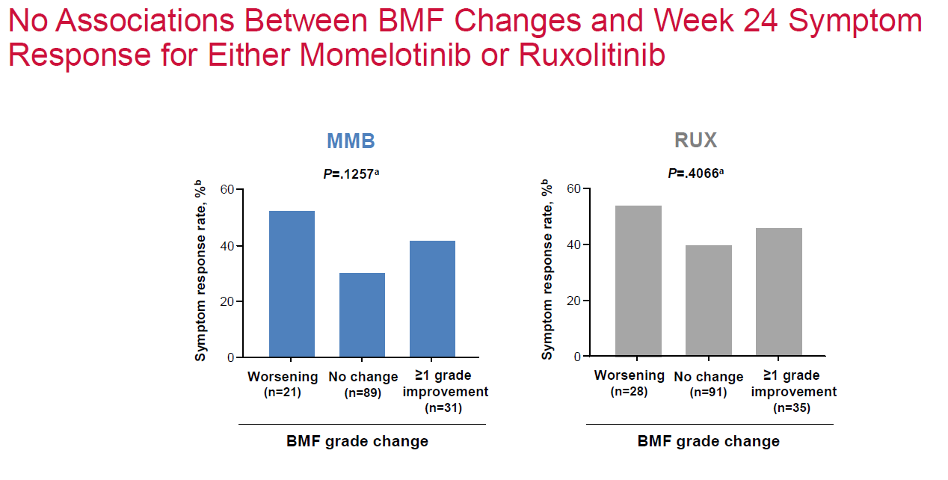
Bone marrow fibrosis changes correlation with treatment with momelotinib or ruxolitinib in JAK inhibitor naïve myelofibrosis patients
Presentation 337/ Presented at the 64th American Society of Hematology Annual Meeting and Exposition
New Orleans, LA, USA/ December 10-13, 2022
Oh S Blood (2022) 140 (Supplement 1): 821–823

Slide 41
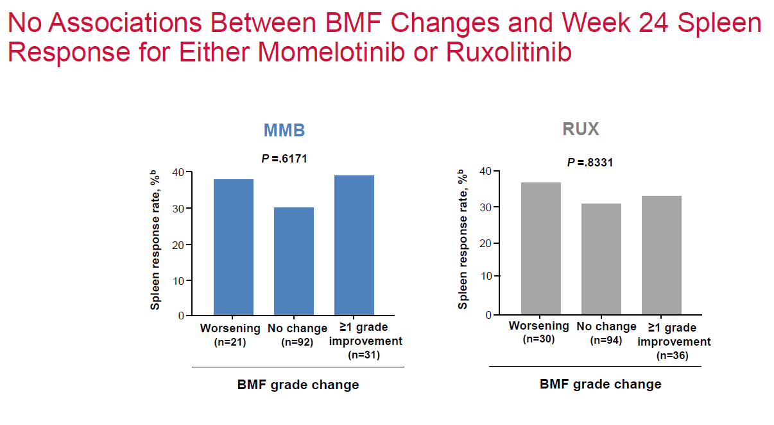
Bone marrow fibrosis changes correlation with treatment with momelotinib or ruxolitinib in JAK inhibitor naïve myelofibrosis patients
Presentation 337/ Presented at the 64th American Society of Hematology Annual Meeting and Exposition
New Orleans, LA, USA/ December 10-13, 2022
Oh S Blood (2022) 140 (Supplement 1): 821–823

Slide 42
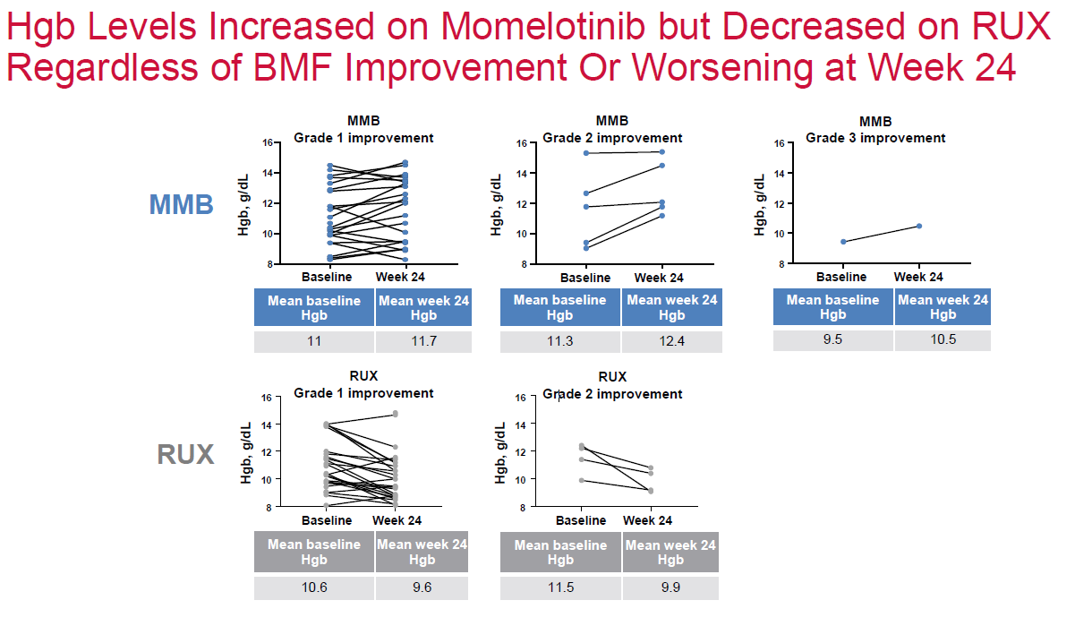
Bone marrow fibrosis changes correlation with treatment with momelotinib or ruxolitinib in JAK inhibitor naïve myelofibrosis patients
Presentation 337/ Presented at the 64th American Society of Hematology Annual Meeting and Exposition
New Orleans, LA, USA/ December 10-13, 2022
Oh S Blood (2022) 140 (Supplement 1): 821–823

Slide 43
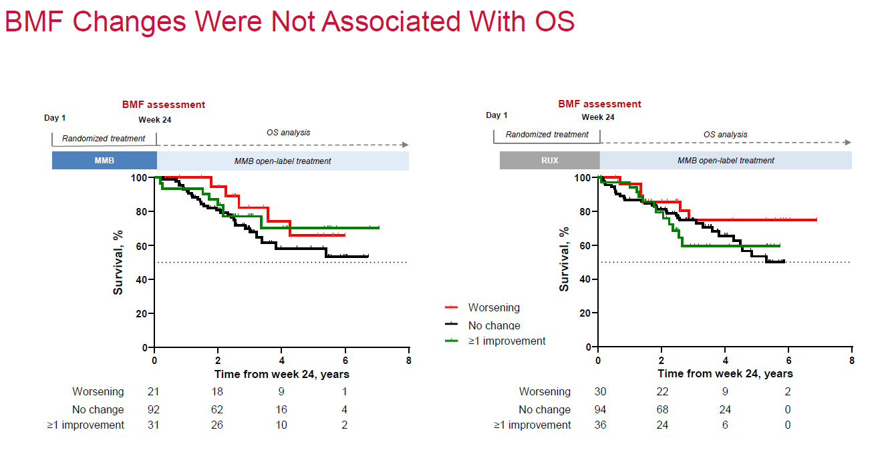
Bone marrow fibrosis changes correlation with treatment with momelotinib or ruxolitinib in JAK inhibitor naïve myelofibrosis patients
Presentation 337/ Presented at the 64th American Society of Hematology Annual Meeting and Exposition
New Orleans, LA, USA/ December 10-13, 2022
Oh S Blood (2022) 140 (Supplement 1): 821–823

Slide 44
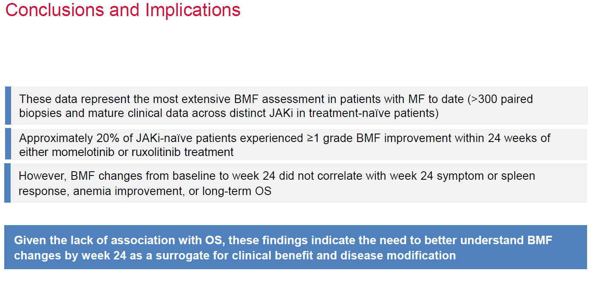
Bone marrow fibrosis changes correlation with treatment with momelotinib or ruxolitinib in JAK inhibitor naïve myelofibrosis patients
Presentation 337/ Presented at the 64th American Society of Hematology Annual Meeting and Exposition
New Orleans, LA, USA/ December 10-13, 2022
Oh S Blood (2022) 140 (Supplement 1): 821–823

Slide 45
Questions

Slide 46
HEMATOLOGIC MALIGNANCIES
Wednesday, September 27, 2023

Slide 47
Polycythemia vera update
Cándido E. Rivera, MD, FACP
Assistant Professor of Medicine
Department of Hematology/Oncology
Mayo Clinic Jacksonville FL

Slide 48
Objectives
Diagnosis and treatment algorithms in polycythemia vera
CYTO PV collaboratory study group highlights
PEGINVERA clinical trial overview
Low-PV study highlights ASH annual meeting 2022 abstract #627

Slide 49
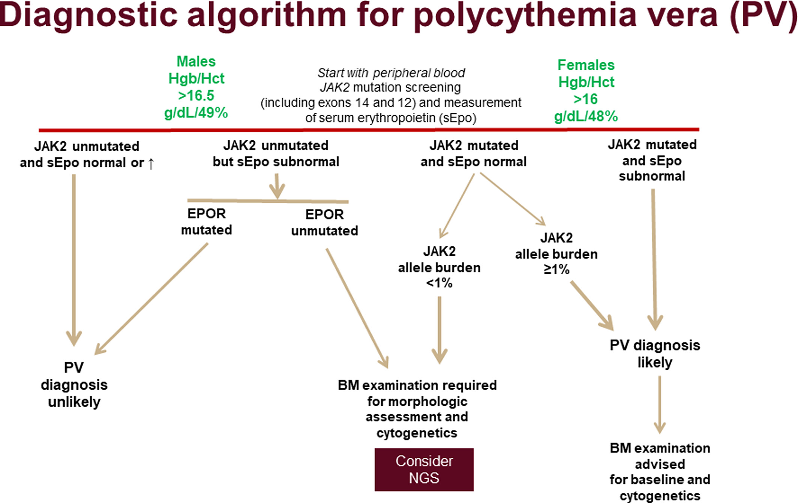
Tefferi A, Barbui T. Polycythemia vera: 2024 update on diagnosis, risk-stratification, and management. Am J Hematol. 2023 Sep;98(9):1465-1487

Slide 50
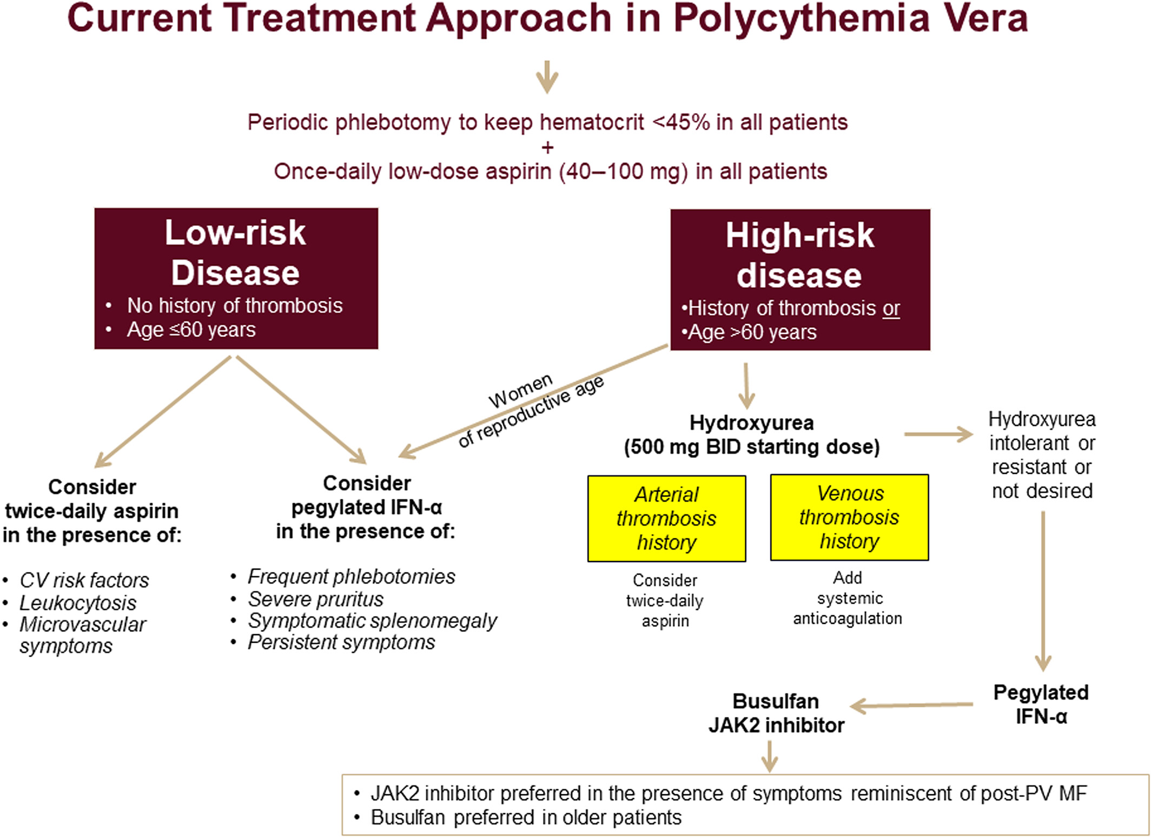
Tefferi A, Barbui T. Polycythemia vera: 2024 update on diagnosis, risk-stratification, and management. Am J Hematol. 2023 Sep;98(9):1465-1487

Slide 51
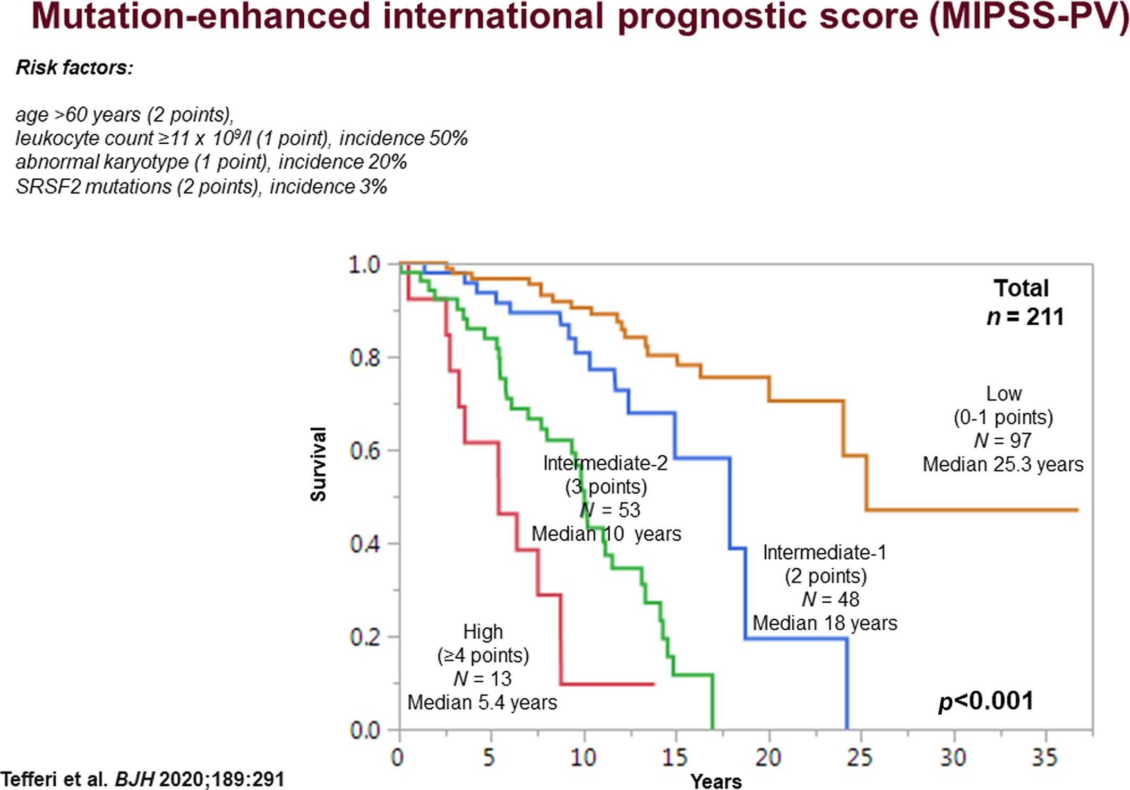
Tefferi A, Barbui T. Polycythemia vera: 2024 update on diagnosis, risk-stratification, and management. Am J Hematol. 2023 Sep;98(9):1465-1487

Slide 52
Cardiovascular events and intensity of treatment in polycythemia vera
CYTO-PV collaborative group study
Randomly assigned 362 adults with JAK2 positive polycythemia vera treated with phlebotomy, hydroxyurea or both
Intensive treatment with target hematocrit below 45% (low hematocrit group)
Less intensive treatment target hematocrit between 45-50% (high hematocrit group)
Marchioli R, et.al. N Engl J Med. 2013 Jan 3;368(1):22-33

Slide 53
Cardiovascular events and intensity of treatment in polycythemia vera
CYTO-PV collaborative group study
Primary endpoint
Time until death from cardiovascular causes or major thrombotic events (stroke, acute coronary syndrome, transient ischemia attack, pulmonary embolism, abdominal thrombosis, deep vein thrombosis, or peripheral arterial thrombosis)
Secondary endpoint
Total rate of cardiovascular events defined as the primary endpoint plus superficial vein thrombosis.
Marchioli R, et.al. N Engl J Med. 2013 Jan 3;368(1):22-33

Slide 54
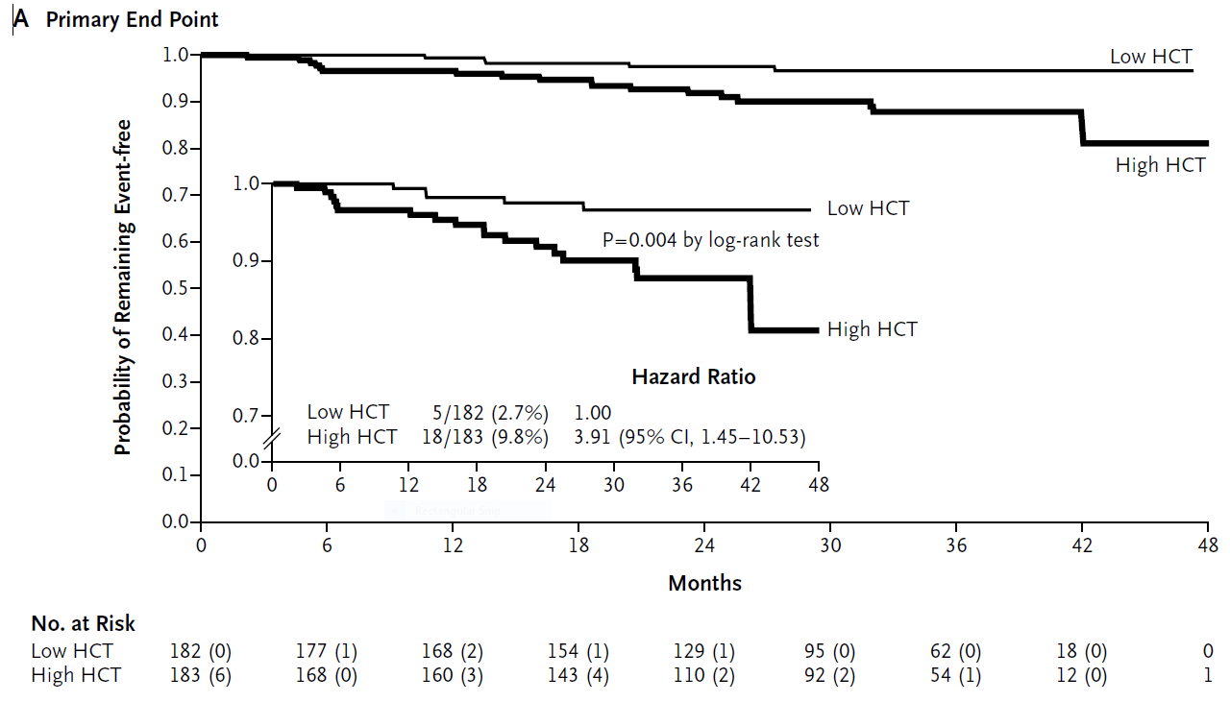
Cardiovascular events and intensity of treatment in polycythemia vera
Low hematocrit
5/182 ( 2.7%)
High hematocrit
18/183 ( 10.9%)
Hazard ratio 3.91%
Marchioli R, et.al. N Engl J Med. 2013 Jan 3;368(1):22-33

Slide 55
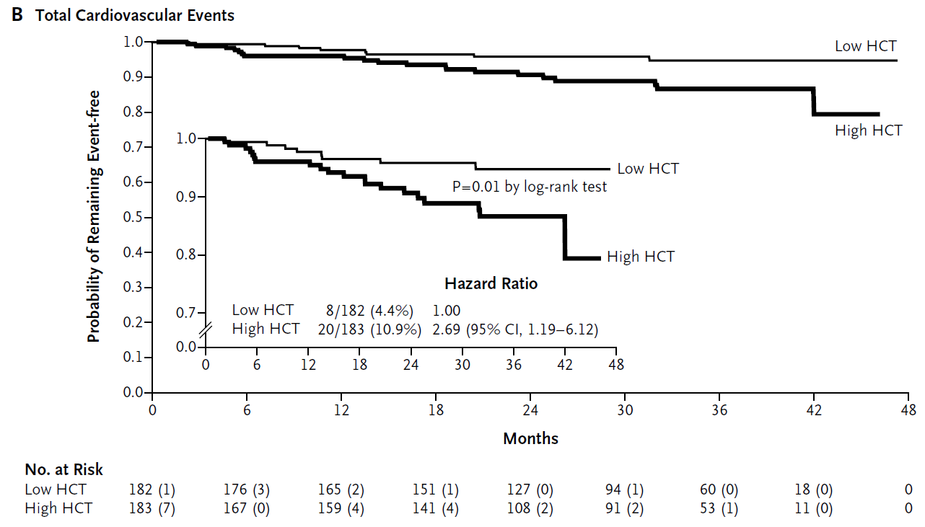
Cardiovascular events and intensity of treatment in polycythemia vera
Low hematocrit
8/182 ( 4.4%)
High hematocrit
20/183 ( 10.9%)
Hazard ratio 2.69%
Marchioli R, et.al. N Engl J Med. 2013 Jan 3;368(1):22-33

Slide 56
Cardiovascular events and intensity of treatment in polycythemia vera
CYTO-PV collaborative group study
Conclusion
Maintaining a hematocrit target of less than 45% was associated with a significantly lower rate of thrombotic complications without an increase in serious treatment complications
Marchioli R, et.al. N Engl J Med. 2013 Jan 3;368(1):22-33

Slide 57
Ropeginterferon alfa-2b
Ropeginterferon alfa-2b subcutaneous injection was FDA-approved on November 12, 2021 for polycythemia vera patients regardless of their treatment history based on the results of the PEGINVERA study
Gisslinger H et. Al. Blood. 2015 Oct 8;126(15):1762-9
Gisslinger H et. al. Blood (2018) 132 (Supplement 1): 3030

Slide 58
Ropeginterferon alfa-2b
Ropeginterferon alfa-2b is a monopegylated IFNα developed for treating myeloproliferative neoplasms.
In contrast to other pegylated IFNα compounds, ropeginterferon alfa-2b consists of a single positional isomer (N-terminal proline) resulting in an extended elimination half-life, enabling less frequent dosing (every other week, or monthly during maintenance therapy) and improved tolerability, supporting long-term patient compliance.

Slide 59
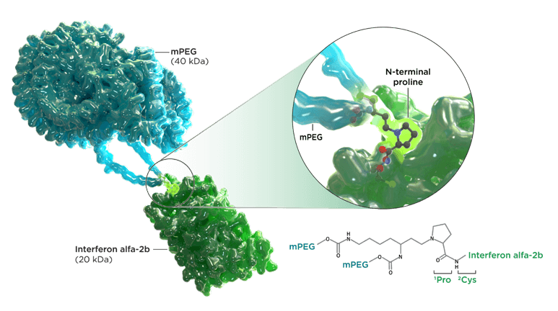
Ropeginterferon alfa-2b

Slide 60
PEGINVERA phase I/II study
Prospective, open label, multicenter study investigating the efficacy and safety of Ropeginterferon alfa-2b for long-term treatment in 51 adult patients with confirmed diagnosis of polycythemia vera regardless of prior cytoreductive therapy.
Ropeg subcutaneous injection was administered every 2 weeks for at least 1 year and patients who responded well were permitted to switch to every 4 week intervals dosing regimen.
Gisslinger H et. al. Blood (2018) 132 (Supplement 1): 3030

Slide 61
PEGINVERA phase I/II study
Median exposure to Ropeg was approximately 5.1 years (61 months; range: 0 to 87 months).
Patients were treated for a median of approximately 2 years (98.9 weeks; (Q1-Q3: 69.0 - 117.4 weeks) on the 2-weekly regimen
Patients were treated for a median of approximately 4 years (207.1 weeks; Q1-Q3: 158.6 - 242.0 weeks) on the 4-weekly regimen
Gisslinger H et. al. Blood (2018) 132 (Supplement 1): 3030

Slide 62
PEGINVERA phase I/II study
Complete hematological response for 27/42 (64.3%)
Partial response for 14/42 (33.3%) patients.
Patients required a median of 34 weeks (Q1-Q3: 10-96 weeks) treatment to achieve a complete hematological response
Patients required a median of 10 weeks (Q1-Q3: 10-20 weeks) to achieve any hematological response.
Switch from 2 to 4-week dosing regimen had no apparent effect on maintenance of response.
Gisslinger H et. al. Blood (2018) 132 (Supplement 1): 3030

Slide 63
PEGINVERA phase I/II study
Mild side effects, 296, occurred in 44 [86.3%] patients
Moderate side effects, 102, occurred in 34 [66.7%] patients
Severe side effects, 11, occurred in 10 [19.6%] patients
The most frequently reported ARs (frequency >20%) were arthralgia, influenza-like illness and fatigue.
Twelve serious treatment emergent adverse events (TEAE) reported by 8/51 patients (15.7%) were considered to be treatment related: 2 events of depression, 2 of positive anti-thyroid antibodies, and one each of acute stress disorder, increased antinuclear antibodies, arthralgia, atrial fibrillation, fatigue, influenza-like illness, pyrexia, and increased transaminases.
Gisslinger H et. al. Blood (2018) 132 (Supplement 1): 3030

Slide 64
PEGINVERA phase I/II study
Twenty-five patients completed the trial.
The majority of discontinuation due to TEAE (13/21 patients) occurred in the first year, when the recommended slow up-titration of Ropeg could not be applied because of the maximum-tolerated-dose design.
After the first year, only 8 additional patients discontinued because of TEAE.
Gisslinger H et. al. Blood (2018) 132 (Supplement 1): 3030

Slide 65
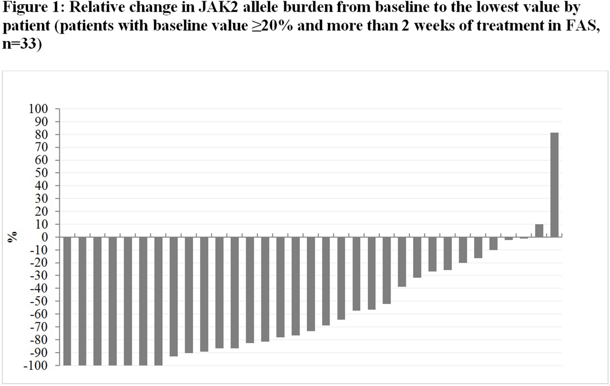
PEGINVERA phase I/II study
Gisslinger H et. al. Blood (2018) 132 (Supplement 1): 3030

Slide 66
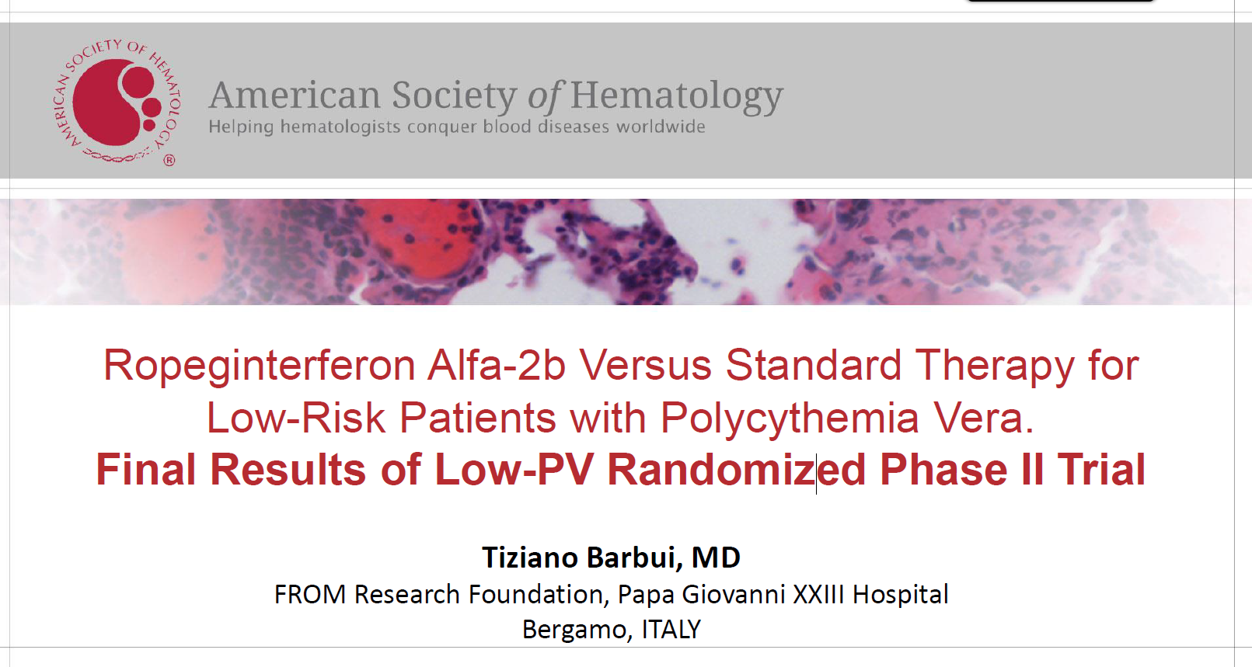
Low-PV Study
Presentation 634/ Presented at the 64th American Society of Hematology Annual Meeting and Exposition
New Orleans, LA, USA/ December 10-13, 2022
Barbui T Blood (2022) 140 (Supplement 1): 1797-1799

Slide 67
Guidelines recommend phlebotomy and aspirin as 1st line treatment in low-risk polycythemia vera
Phlebotomies can maintain the hematocrit values on target in only 20-30% of low-risk polycythemia vera patients
Phlebotomies may produce negative effect on several aspects of quality of life
With phlebotomy-only, thrombosis rate still remain elevated
Cytoreductive drugs can reduce the vascular complications in polycythemia vera
Barbui T Blood (2022) 140 (Supplement 1): 1797-1799

Slide 68
Low-PV study
A multicentre, open-label, two-arm, parallel-group, investigator-initiated, phase 2 randomized trial with a group-sequential adaptive design testing the safety – efficacy profile of Ropeg versus phlebotomy-only program in conventionally defined low risk polycythemia vera patients
Ropeg subcutaneous injection was administered every 2 weeks in a fixed dose of 100 mcg, on top of standard therapy.
Barbui T Blood (2022) 140 (Supplement 1): 1797-1799

Slide 69
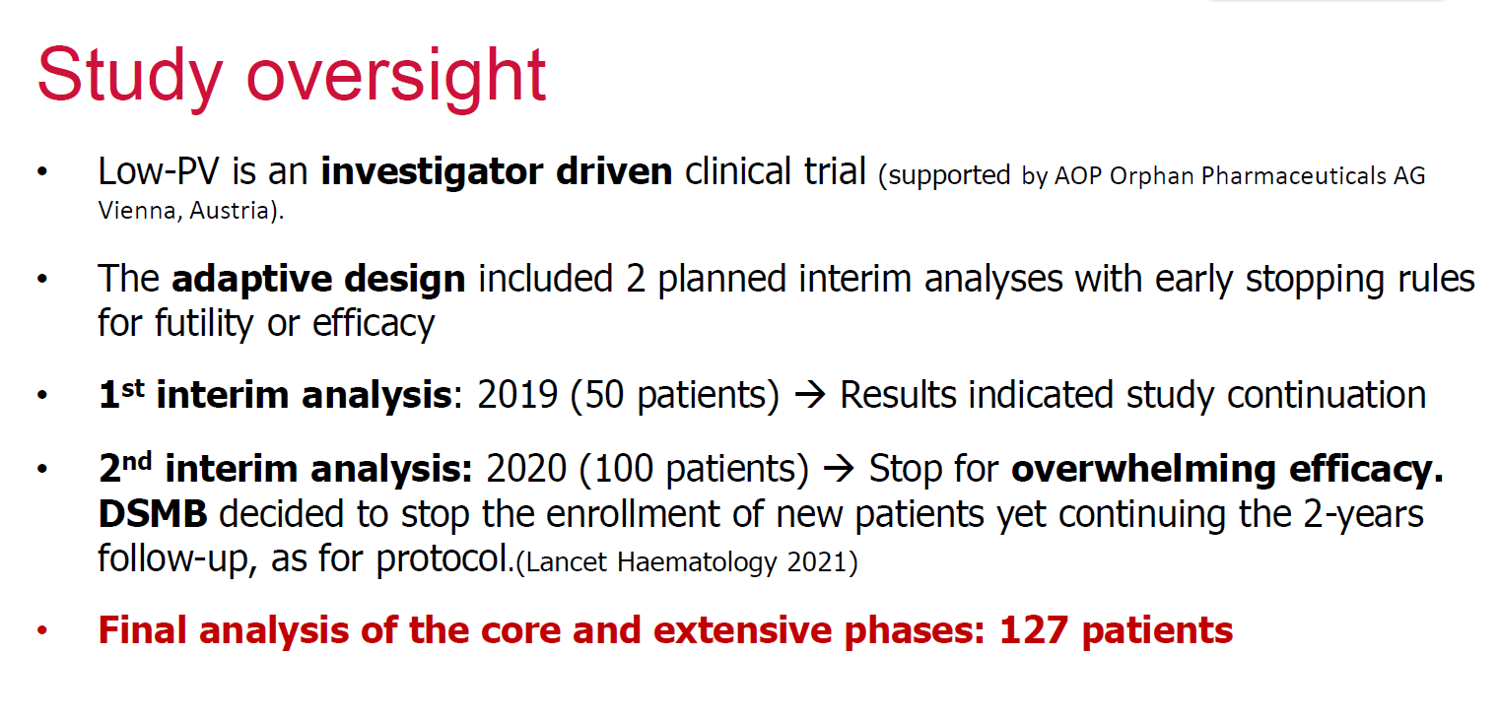
Low-PV Study
Barbui T, Lancet Haematol. 2021 Mar;8(3):e175-e184.
Barbui T Blood (2022) 140 (Supplement 1): 1797-1799

Slide 70
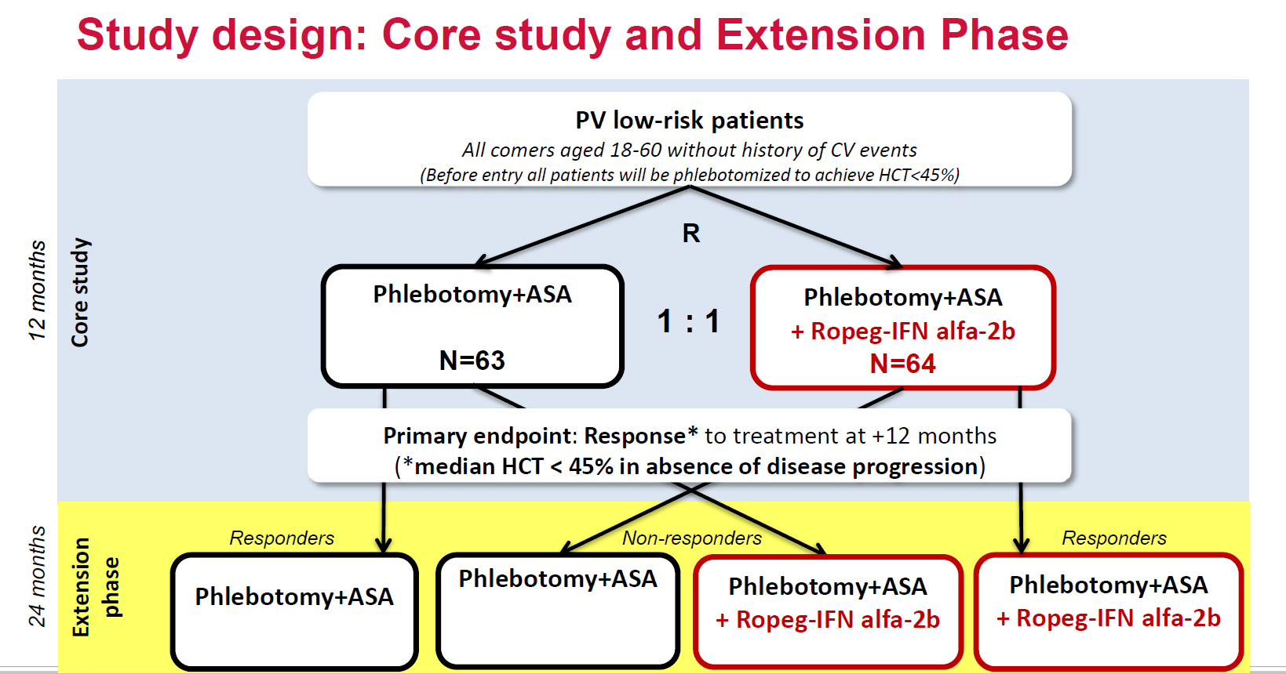
Low-PV Study
Presentation 634/ Presented at the 64th American Society of Hematology Annual Meeting and Exposition
New Orleans, LA, USA/ December 10-13, 2022
Barbui T Blood (2022) 140 (Supplement 1): 1797-1799

Slide 71
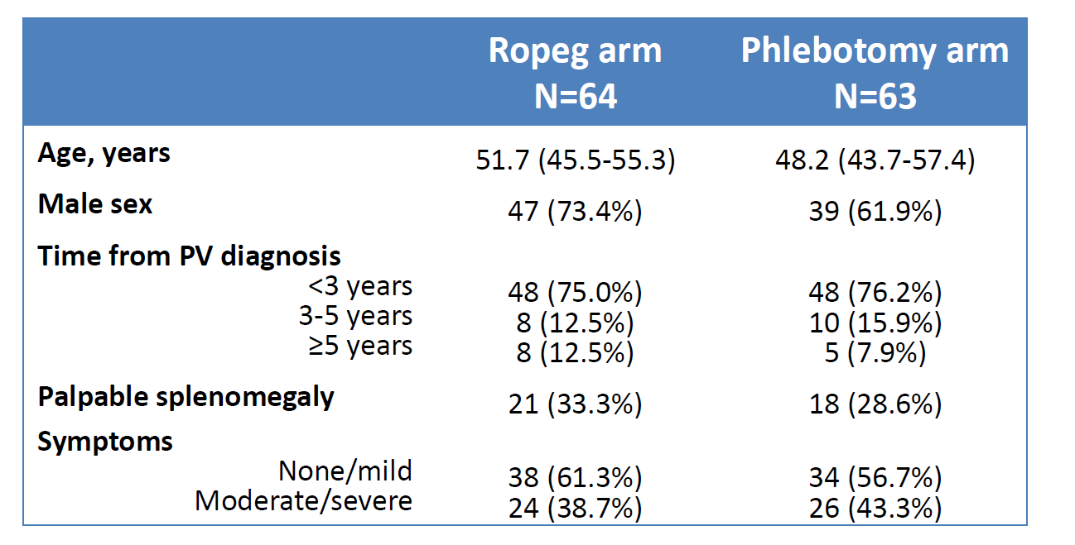
Low-PV Study
Presentation 634/ Presented at the 64th American Society of Hematology Annual Meeting and Exposition
New Orleans, LA, USA/ December 10-13, 2022
Barbui T Blood (2022) 140 (Supplement 1): 1797-1799

Slide 72
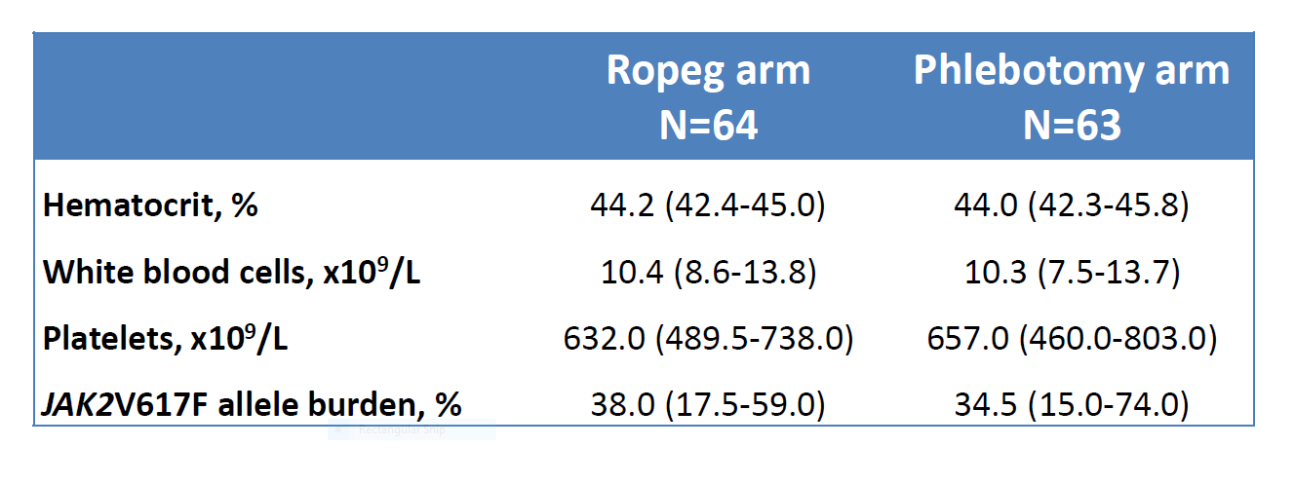
Low-PV Study
Presentation 634/ Presented at the 64th American Society of Hematology Annual Meeting and Exposition
New Orleans, LA, USA/ December 10-13, 2022
Barbui T Blood (2022) 140 (Supplement 1): 1797-1799

Slide 73
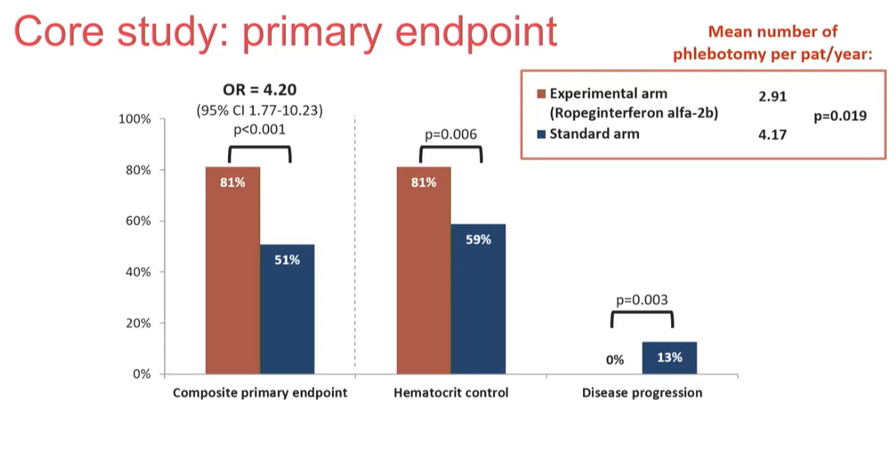
Low-PV Study
Presentation 634/ Presented at the 64th American Society of Hematology Annual Meeting and Exposition
New Orleans, LA, USA/ December 10-13, 2022
Barbui T Blood (2022) 140 (Supplement 1): 1797-1799

Slide 74
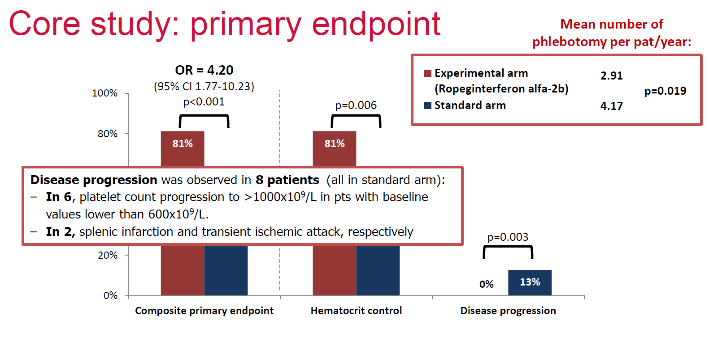
Low-PV Study
Presentation 634/ Presented at the 64th American Society of Hematology Annual Meeting and Exposition
New Orleans, LA, USA/ December 10-13, 2022
Barbui T Blood (2022) 140 (Supplement 1): 1797-1799

Slide 75
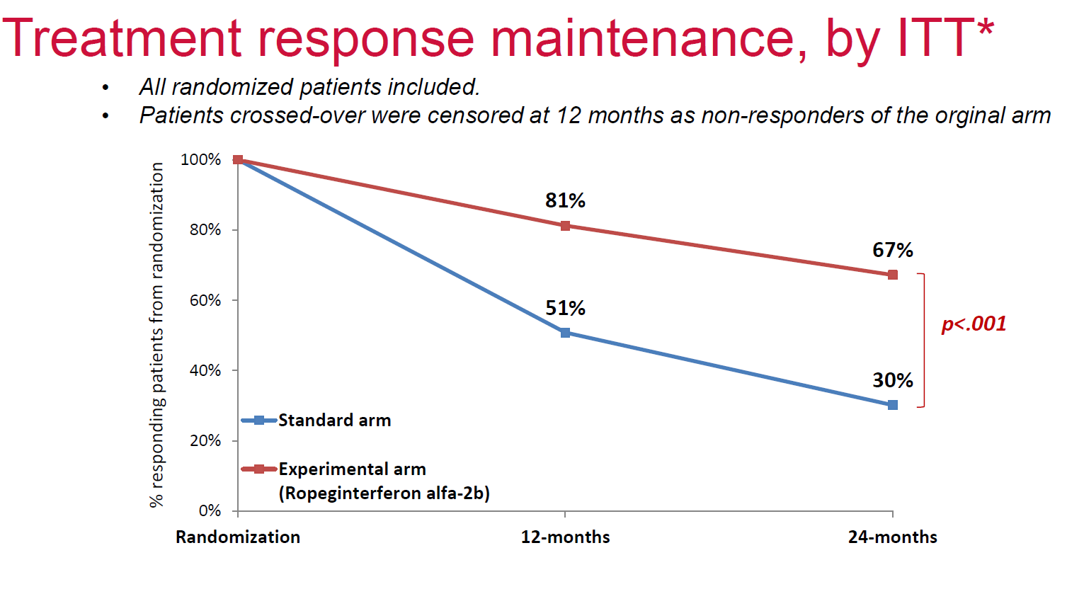
Low-PV Study
Presentation 634/ Presented at the 64th American Society of Hematology Annual Meeting and Exposition
New Orleans, LA, USA/ December 10-13, 2022
Barbui T Blood (2022) 140 (Supplement 1): 1797-1799

Slide 76
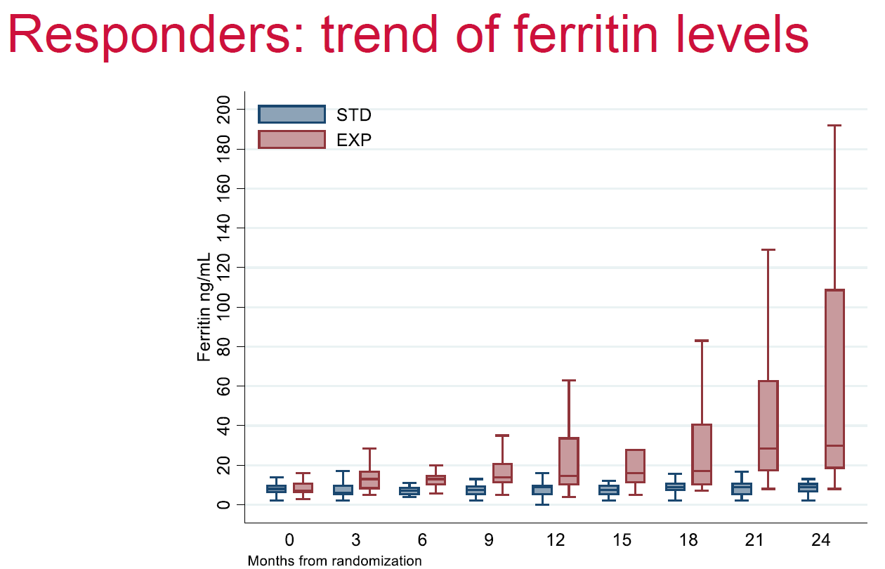
Low-PV Study
Presentation 634/ Presented at the 64th American Society of Hematology Annual Meeting and Exposition
New Orleans, LA, USA/ December 10-13, 2022
Barbui T Blood (2022) 140 (Supplement 1): 1797-1799

Slide 77
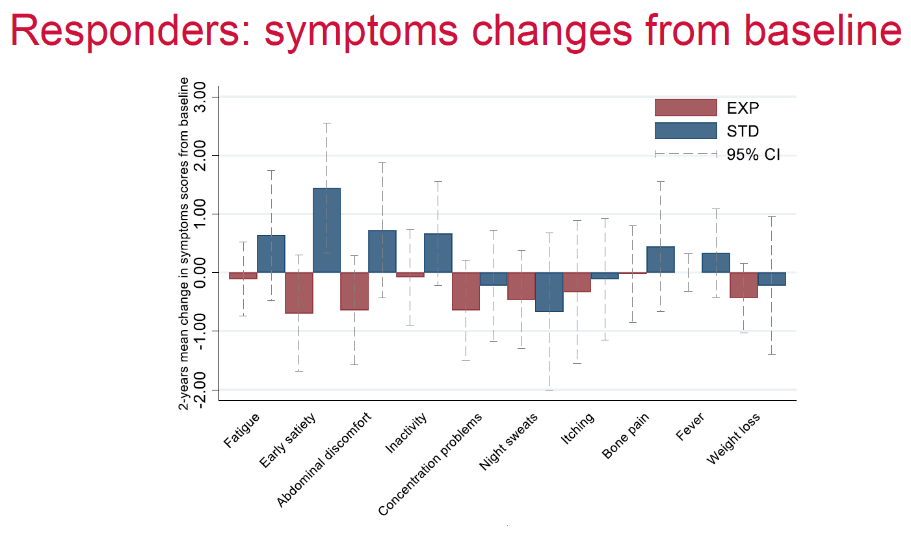
Low-PV Study
Presentation 634/ Presented at the 64th American Society of Hematology Annual Meeting and Exposition
New Orleans, LA, USA/ December 10-13, 2022
Barbui T Blood (2022) 140 (Supplement 1): 1797-1799

Slide 78
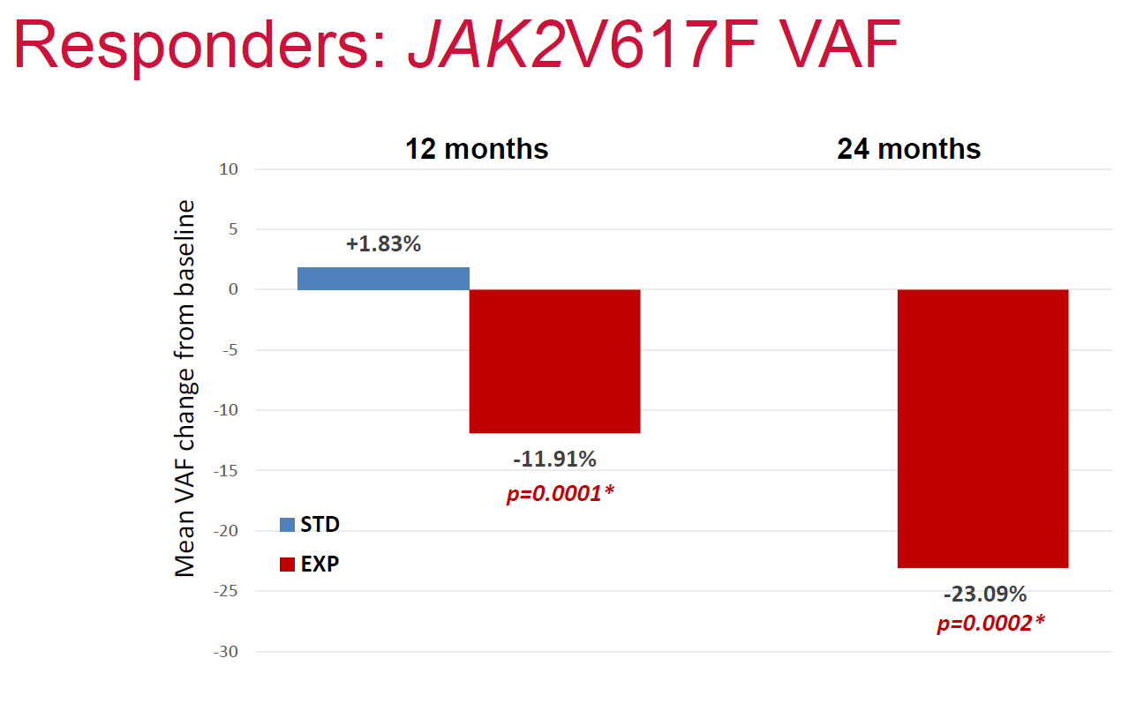
Low-PV Study
Presentation 634/ Presented at the 64th American Society of Hematology Annual Meeting and Exposition
New Orleans, LA, USA/ December 10-13, 2022
Barbui T Blood (2022) 140 (Supplement 1): 1797-1799

Slide 79
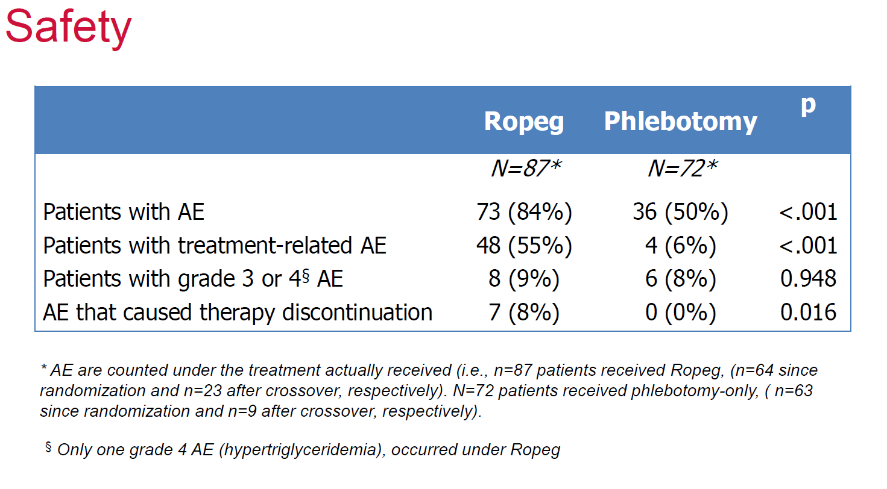
Low-PV Study
Presentation 634/ Presented at the 64th American Society of Hematology Annual Meeting and Exposition
New Orleans, LA, USA/ December 10-13, 2022
Barbui T Blood (2022) 140 (Supplement 1): 1797-1799

Slide 80
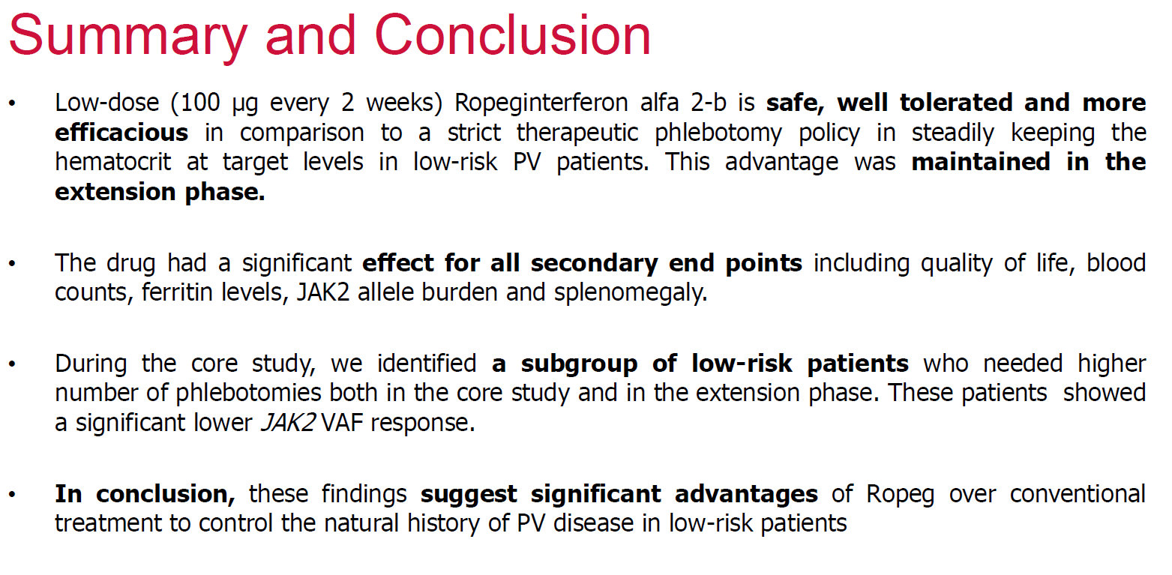
Low-PV Study
Presentation 634/ Presented at the 64th American Society of Hematology Annual Meeting and Exposition
New Orleans, LA, USA/ December 10-13, 2022
Barbui T Blood (2022) 140 (Supplement 1): 1797-1799

Slide 81
Final thoughts
Is it time to rethink our treatment strategies for low-risk polycythemia vera?
Therapeutic phlebotomies and hydroxyurea have proved efficacy in terms of thrombosis prevention but do not have disease modifying effects
Ropeg interferon is not only helpful in thrombosis prevention and symptom relief but signals on these clinical trials suggest that it may have disease modifying effects when started early in the course of the disease
Further studies will help to elucidate this question

Slide 82
HEMATOLOGIC MALIGNANCIES
Wednesday, September 27, 2023

Slide 83
Recent Approvals in DLBCL
Muhamad Alhaj Moustafa, MD, MS
Assistant Professor of Medicine
Mayo Clinic
Jacksonville, Florida

Slide 84
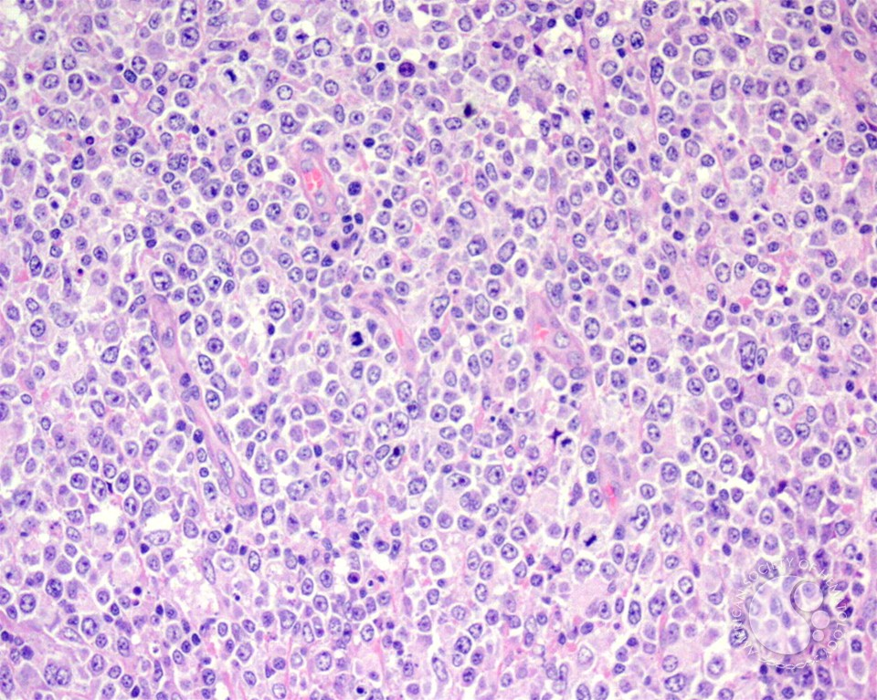
Diffuse Large B Cell Lymphoma
DLBCL accounts for 30% of adult NHL in The USA
Median age at diagnosis is 66 years
Male>female
SEER Cancer Stat Facts: DLBCL. National Cancer Institute. Bethesda, MD, https://seer.cancer.gov/statfacts/html/dlbcl.html
Epperla, N, Vaughn, JL, Othus, M, Hallack, A, Costa, LJ. Recent survival trends in diffuse large B-cell Lymphoma––Have we made any progress beyond rituximab? Cancer Med. 2020; 9: 5519– 5525. https://doi.org/10.1002/cam4.3237

Slide 85
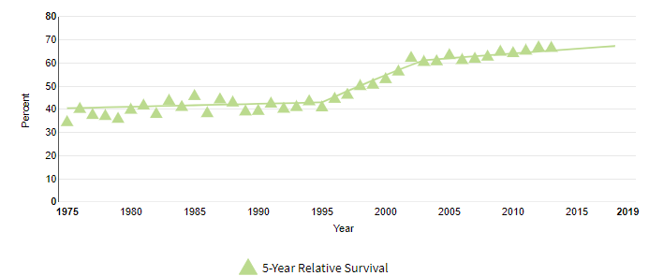
Diffuse Large B-cell lymphoma
Diffuse Large B Cell Lymphoma
Rituximab
SEER Cancer Stat Facts: Follicular Lymphoma. National Cancer Institute. Bethesda, MD, https://seer.cancer.gov/statfacts/html/follicular.html
Notes:
The overall survival of DLBCL has improved significantly over years from 40% 5 yrs OS in 1970s-80s to around 70% or more now. Click.
We can see the upward flick in the improvement of OS at the end of 1990s to around 2005. Click.
Which is related to the introduction of rituximab. Click.

Slide 86
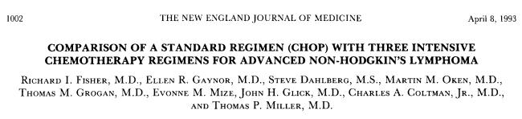
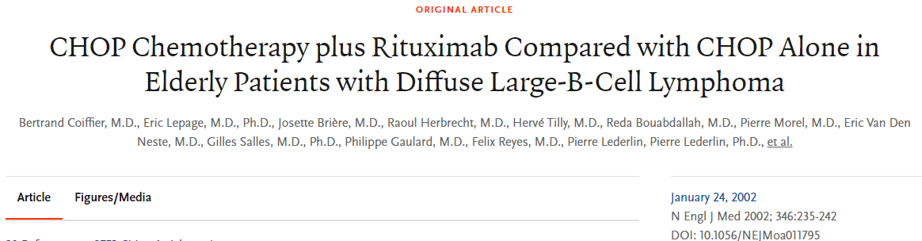
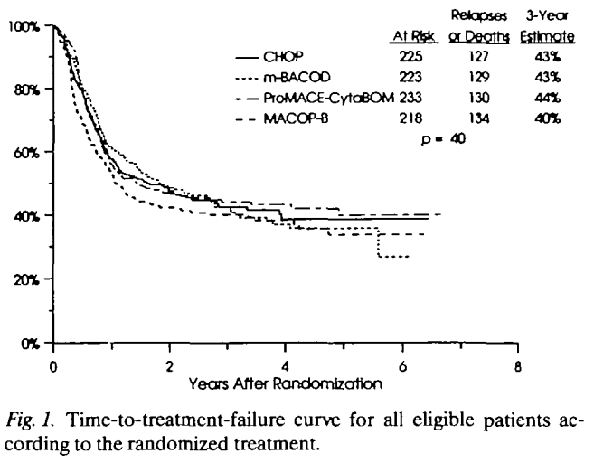
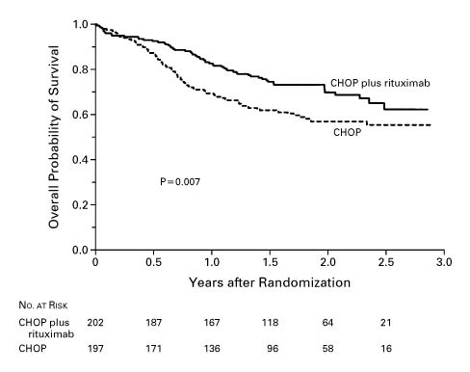
The story of R-CHOP
Newly Diagnosed DLCBL
1988
2002
CHOP became standard*
R-CHOP became standard
*Coltman CA, et al. Southwest Oncology Group studies in diffuse large cell lymphoma: a subset analysis. Cancer chemotherapy: challenges for the future. Tokyo, Japan: Excerpta Medica. 1988:194-202

Slide 87
DA-EPOCH-R
Alliance 50303
HR 1.09
p=0.65
O-CHOP
GOYA
HR 0.99
p=0.99
RCHOP + enzastaurin
ENGINE (DGM1+ genotype)
pending
(1) GELA
HR 0.96
p=0.749
RCHOP-14
RCHOP + acalabrutinib
(non-GCB and <65)
pending
(2) BNLI
HR 0.90
p=0.376
PHOENIX
(non-GCB by IHC)
HR = 0.99, p=0.96
*exploratory analysis suggests OS benefit in <60 subset
RCHOP+ ibrutinib
R-CHOP
Graveyard
LNH03-2B
(age <60/IPI 1)
HR 0.44
p=0.0071
R2CHOP (lenalidomide)
ROBUST
(ABC by Lymph2Cx)
2-year OS 79% vs. 80%
R-ABCVP
REMoDL-B
(COO by DASL)
HR 0.85, p=0.397
RCHOP+ bortezomib
RCHOP + ASCT
SWOG-9704
HR 1.24, p=0.32
*exploratory analysis suggests OS benefit in high-risk IPI
RCHOP + everolimus maintenance
RCHOP + enzastaurin maintenance
RCHOP+ lenalidomide maintenance
REMARC
HR 1.22
p=0.264
RCHOP+ R maintenance
(1) NHL13
HR 0.81, p=0.415
(2) ECOG4494
HR 1.28, P=0.48
(3) Hovon-Nordic
5-year OS 85% vs. 83%
PILLAR-2 (IPI 3-5)
HR 0.75, p=NS
PRELUDE (IPI 3-5)
HR 1.04, p=0.807
Adapted from Matt Cheung @MattCheungMD

Slide 88
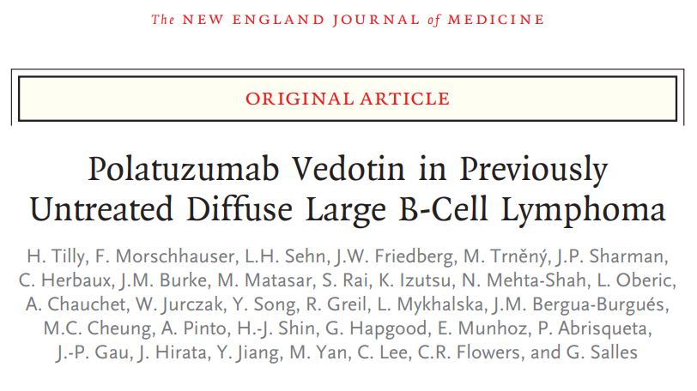
Polatuzumab R-CHP vs. R-CHOP (POLARIX study)
Phase III, randomized, double blinded, placebo-controlled, stratified (IPI, Bulky disease, and geographic region) trial
Tilly H, et al. Polatuzumab Vedotin in Previously Untreated Diffuse Large B-Cell Lymphoma. N Engl J Med. 2022 Jan 27;386(4):351-363. doi: 10.1056/NEJMoa2115304. Epub 2021 Dec 14. PMID: 34904799.

Slide 89
Pola R-CHP vs. R-CHOP (POLARIX study)
Polatuzumab R-CHP vs. R-CHOP (POLARIX study)
Median follow up time = 28.2 months
6.5% 2 years-PFS benefit in Pola-R-CHP (76.7% vs. 70.2%)
No OS benefit
Not included in the study: Transformed lymphoma, PMLBCL, >80 y.o
Tilly H, et al. Polatuzumab Vedotin in Previously Untreated Diffuse Large B-Cell Lymphoma. N Engl J Med. 2022 Jan 27;386(4):351-363. doi: 10.1056/NEJMoa2115304. Epub 2021 Dec 14. PMID: 34904799.

Slide 90
Polatuzumab R-CHP vs. R-CHOP (POLARIX study)
Overall similar profile with some increase in neutropenic fever
Tilly H, et al. Polatuzumab Vedotin in Previously Untreated Diffuse Large B-Cell Lymphoma. N Engl J Med. 2022 Jan 27;386(4):351-363. doi: 10.1056/NEJMoa2115304. Epub 2021 Dec 14. PMID: 34904799.

Slide 91
Therapeutic choices for DLBCL
First line
  R-CHOP / Pola-R-CHP
  DA-R-EPOCH (in certain situations)
Second line and beyond
  Transplant eligible (relapse >12 months):
    Chemoimmunotherapy → ASCT
  Transplant ineligible:
    Polatuzumab vedotin-piiq + bendamustine +rituximab
    Tafasitamab-cxix +lenalidomide
    Ibrutinib (non-GCB DLBCL)
  Relapsed within 12 months:
    Axicabtagene ciloleucel (CAR-T)
    Lisocabtagene maraleucel (CAR-T)
Third line and beyond
  Axicabtagene ciloleucel (CAR-T)
  Lisocabtagene maraleucel (CAR-T)
  Tisagenlecleucel (CAR-T)
  Loncastuximab tesirine-Ipyl
  Selinexor
  Epcoritamab-bysp
  glofitamab-gxbm

Slide 92
Novel treatments in R/R DLBCL
Drug | Type | Combination | Line of therapy | CR/ORR (%) | Trial | Approval date
Tafasitamab-cxix | CD19-directed cytolytic antibody (Naked antibody) | Lenalidomide | 2nd (ASCT ineligible) or Beyond | 40/57 | Phase II (L-MIND) | July 2020
Polatuzumab vedotin-piiq | CD79b-directed antibody (drug conjugate) | Bendamustine + Rituximab | 3nd (ASCT ineligible) or beyond | 40/45 | Phase Ib/II trial, randomized | June 2019
Loncastuximab tesirine-Ipyl | CD19-directed antibody (alkylating agent conjugate) | N/A | 3rd or beyond | 35/48 | Phase II trial, single arm (LOTIS-2) | April 2021
Selinexor | Nuclear export inhibitor | N/A | 3rd or beyond | 12/28 | phase 2b study (SADAL) | June 2020
Epcoritamab-bysp | CD20-CD3 bispecific antibody | N/A | 3rd or beyond | 39.6/61 | Phase II (EPCOR-NHL1) | May 2023
glofitamab-gxbm | CD20-CD3 bispecific antibody | N/A | 3rd or beyond | 39/52 | Phase II | June 2023
Duell J. et al. Long-term outcomes from the Phase II L-MIND study of tafasitamab (MOR208) plus lenalidomide in patients with relapsed or refractory diffuse large B-cell lymphoma. Haematologica 2021;106(9):2417-2426;
Sehn LH, et al. Polatuzumab Vedotin in Relapsed or Refractory Diffuse Large B-Cell Lymphoma. J Clin Oncol. 2020 Jan 10;38(2):155-165. doi: 10.1200/JCO.19.00172. Epub 2019 Nov 6. PMID: 31693429; PMCID: PMC7032881.
Goparaju K, et al. Loncastuximab tesirine for treatment of relapsed or refractory diffuse large B cell lymphoma. Expert Opin Biol Ther. 2021 Nov;21(11):1373-1381. doi: 10.1080/14712598.2021.1973998. Epub 2021 Sep 10. PMID: 34505550.
Kalakonda N, et al. Selinexor in patients with relapsed or refractory diffuse large B-cell lymphoma (SADAL): a single-arm, multinational, multicentre, open-label, phase 2 trial. Lancet Haematol. 2020 Jul;7(7):e511-e522. doi: 10.1016/S2352-3026(20)30120-4. PMID: 32589977.
Thieblemont C, et al. Epcoritamab, a Novel, Subcutaneous CD3xCD20 Bispecific T-Cell–Engaging Antibody, in Relapsed or Refractory Large B-Cell Lymphoma: Dose Expansion in a Phase I/II Trial. Journal of Clinical Oncology 2023 41:12, 2238-2247
Dickinson M, et al. Glofitamab for Relapsed or Refractory Diffuse Large B-Cell Lymphoma. N Engl J Med 2022; 387:2220-2231. DOI: 10.1056/NEJMoa2206913

Slide 93
Treatment algorithm for DLBCL
Newly diagnosed DLBCL
Chemo-immunotherapy (CIT)
Within 1 year
CAR-T
Relapse
> 1 year
Salvage + ASCT
Relapse
CAR-T
Relapse
?????
CAR-T

Slide 94
Relapse after CAR-T
Salvage treatment with novel agents is preferable to standard chemotherapy in patients with large B-cell lymphoma progressing after CAR-T therapy
Iacoboni et al
Iacoboni et al. Salvage Treatment with Novel Agents Is Preferable to Standard Chemotherapy in Patients with Large B-Cell Lymphoma Progressing after Chimeric Antigen Receptor T-Cell Therapy. Blood 2022; 140 (Supplement 1): 378–380.

Slide 95
Why is this important?
CD19 CAR-T → Relapse → Unclear treatment strategy
Poor outcomes

Slide 96
Methodology
Retrospective
Aggressive B-cell lymphoma relapsed after CD19 CAR-T
10 Spanish centers
Iacoboni et al. Salvage Treatment with Novel Agents Is Preferable to Standard Chemotherapy in Patients with Large B-Cell Lymphoma Progressing after Chimeric Antigen Receptor T-Cell Therapy. Blood 2022; 140 (Supplement 1): 378–380.

Slide 97
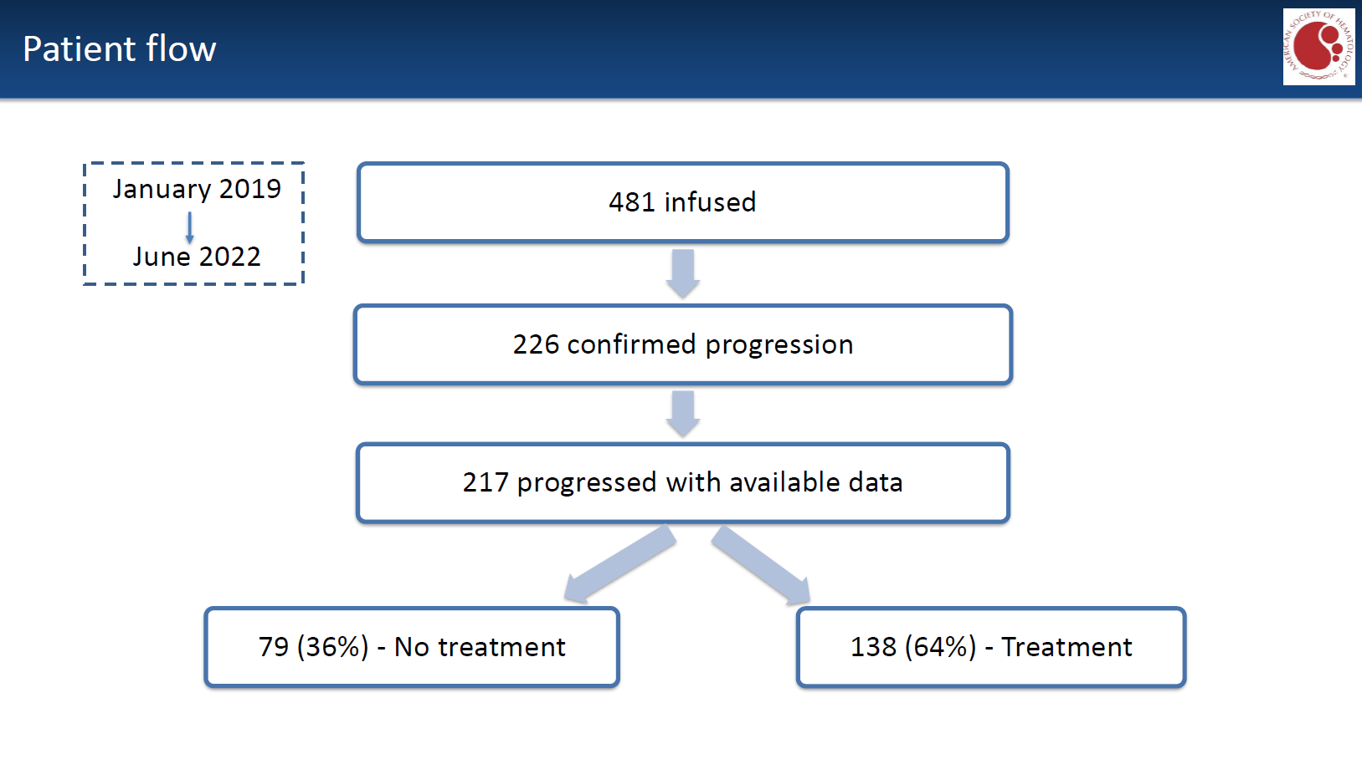
Iacoboni et al. Salvage Treatment with Novel Agents Is Preferable to Standard Chemotherapy in Patients with Large B-Cell Lymphoma Progressing after Chimeric Antigen Receptor T-Cell Therapy. Blood 2022; 140 (Supplement 1): 378–380.

Slide 98

Overall survival after CAR-T relapse
Relapse >=6 month
Treatment
No Treatment
Relapse =<2 months
Iacoboni et al. Salvage Treatment with Novel Agents Is Preferable to Standard Chemotherapy in Patients with Large B-Cell Lymphoma Progressing after Chimeric Antigen Receptor T-Cell Therapy. Blood 2022; 140 (Supplement 1): 378–380.

Slide 99

Iacoboni et al. Salvage Treatment with Novel Agents Is Preferable to Standard Chemotherapy in Patients with Large B-Cell Lymphoma Progressing after Chimeric Antigen Receptor T-Cell Therapy. Blood 2022; 140 (Supplement 1): 378–380.

Slide 100

Response rates by type of salvage treatment
Iacoboni et al. Salvage Treatment with Novel Agents Is Preferable to Standard Chemotherapy in Patients with Large B-Cell Lymphoma Progressing after Chimeric Antigen Receptor T-Cell Therapy. Blood 2022; 140 (Supplement 1): 378–380.

Slide 101

Bonus Results – Outcomes after allogeneic SCT
Iacoboni et al. Salvage Treatment with Novel Agents Is Preferable to Standard Chemotherapy in Patients with Large B-Cell Lymphoma Progressing after Chimeric Antigen Receptor T-Cell Therapy. Blood 2022; 140 (Supplement 1): 378–380.

Slide 102
Study Conclusions
POLA + BR and BITEs seemed to work better than traditional salvage chemotherapy
Consolidation with allogeneic transplant after salvage was a viable strategy

Slide 103
Bispecific T-cell engagers
Epocoritamab

Slide 104
Approved Bispecific Antibodies
Epcoritamab-bysp
R/R DLBCL
After >2 lines
FDA approval: 5/19/2023
EPCORE NHL-1 (NCT03625037): Open-label, multicenter, multi-cohort study, single arm
148 pts for efficacy outcome
ORR: 61%, CR: 38%
F/U was 9.8 months
SC injections

Slide 105
Epcoritamab-bysp
ICANS any grade: 6%
CRS any grade: 51%
 | DLBCL
Grade ≥ 3
CRS | 2.5%
ICANS | o.6%
Infections | 15%

Slide 106

Cycles: 28 days
Epcoritamab-bysp
Continuos treatment until progression
FDA package insert: https://www.accessdata.fda.gov/drugsatfda_docs/label/2023/761324s000lbl.pdf

Slide 107
Timing of CRS/Neurotoxicity
Epcoritamab-bysp
The median time to onset of CRS from the most recent administered Epcoritamab-bysp dose across all doses was 24 hours (range: 0 to 10 days).
The median time to onset after the first full 48 mg dose was 21 hours (range: 0 to 7 days).
CRS resolved in 98% of pts and the median duration was 2 days (range: 1 to 27 days).

Slide 108
Bispecific T-cell engagers
Glofitamab
Hutchings et al, ASH 2022
Dickenson et al, NEJM 2022

Slide 109
Approved Bispecific Antibodies
Glofitamab-gxbm
R/R DLBCL
After >2 lines
FDA approval: 6/16/2023
NP30179 (NCT03075696): Open-label, multicenter, multi-cohort study, single arm
132 pts for efficacy outcome
ORR: 56%, CR: 43%
F/U was 11.4 months
IV infusion
Hutchings et al, ASH 2022
Dickenson et al, NEJM 2022

Slide 110
Glofitamab-gxbm
ICANS any grade: 4.8%
CRS any grade: 70%
 | DLBCL
Grade ≥ 3
CRS | 4.2%
Neurotoxicity | 2.1%
Infections | 10%
Hutchings et al, ASH 2022
Dickenson et al, NEJM 2022

Slide 111

Cycles: 21 days
Glofitamab-gxbm
Continue Glofitamab-gxbm for a maximum of 12 cycles or until disease progression or unacceptable toxicity, whichever occurs first. (Limited therapy)

Slide 112
Glofitamab-gxbm vs. Epcoritamab-bysp
Glofitamab
Fixed duration (12 months)
IV infusion (4hrs)
Continuous treatment
Epcoritamab
SC
Cycle: 28 days
Cycle: 21 days
Pre-treatment Obintuzumab
*Both had low incidence of >= 3 grade CRS or ICANS
Also presented:
Efficacy in MCL (Phillips et al)
Efficacy/safety with R-CHOP in untreated DLBCL (Topp et al)

Slide 113
Conclusions
Many advances have happened over the last decade
Accelerated approvals with novel agents are changing the landscape for DLBCL treatment
Manipulation of the immune system is a hallmark for the future therapies along with drug conjugates and mutation-targeted therapies
More-effective less-toxic treatments are the ultimate goal (chemotherapy-free?)

Slide 114
Thank you
AlhajMoustafa.Muhamad@Mayo.edu
Twitter: @AlhajMoustafa
Notes:
Thank you and Happy to take any questions

Slide 115
HEMATOLOGIC MALIGNANCIES
Wednesday, September 27, 2023

Slide 116
Updates in Management of CLL
Ricardo D. Parrondo, MD
Assistant Professor of Medicine
Mayo Clinic Florida
Jacksonville, Florida

Slide 117


First Line Therapy for CLL
Treatment Naïve CLL
Ibrutinib + Venetoclax
Clinical Trial
BTKi*
BCL2i
Ibrutinib
Acalabrutinib +/- Obinutuzumab
Zanubrutinib
Venetoclax + Obinutuzumab
*Pts with del17p/p53 mut do better with continuous BTKi

Slide 118

Acalabrutinib vs. Chemoimmunotherapy (Chl +O)
Phase III ELEVATE-TN¹
Enrolled patients aged ≥65 years, or 18–65 years with comorbidities (Cumulative Illness Rating Scale Geriatric score >6, creatinine clearance 30–69 mL/min by Cockcroft-Gault)
Median 46.9 month follow-up²
N=177
N=179
N=179
 | Acalabrutinib | Acalabrutinib + O | O + Chlorambucil | P-value | Notes
mPFS | NR | NR | 27.8m | P < 0.0001 | In a post hoc analysis, prolonged PFS also was observed with acalabrutinib + O versus acalabrutinib (P = 0.0296) however, the study was not sufficiently powered for this comparison
mPFS in del17p/p53 mut | NR | NR | 17.5m | P < 0.0001
mPFS in unmutated IGHV | NR | NR | 22.2m | P <0.0001
48m PFS/OS Rate | 77.9%/87.6% | 87.0%/87.6% | 25.1%/88%
ORR | 89.9% | 96.1% | 82.5% | P sig
≥Gr3 A Fib/HTN | 1.1%/2.8% | 0.6%/3.4% | 0/3.6% |  | Chl + O arm had more frequent neutropenia, nausea, and infusion-related reactions relative to both acalabrutinib-containing arms.
¹Sharman JP, et al. Lancet 2020; 395:1278–91.
²Sharman JP, et al. Leukemia 2022; Online ahead of print.
¹Sharman JP, et al. Lancet 2020; 395:1278–91.
²Sharman JP, et al. Leukemia 2022; Online ahead of print.

Slide 119

Contribution of Obinutuzumab to Acalabrutinib Therapy in Patients with Treatment-Naive Chronic Lymphocytic Leukemia: Analysis of Survival Outcomes By Genomic Features
Investigators performed a pooled analysis of 2 clinical studies (ELEVATE-TN and CL-003) to compare PFS and OS for A+O vs A monotherapy in pts with TN CLL by prognostic factors within each genomic characteristic
376 pts (A+O, n=197; A monotherapy, n=179). Overall, 28 (14%) A+O and 24 (13%) A pts had del(17p)/TP53m, 112 (57%) and 118 (66%) had uIGHV, and 35 (18%) and 32 (18%) had CK
PFS and OS improved with A+O vs A in pts with uIGHV, mutated IGHV, no del(17p)/TP53m and no CK abnormality
PFS and OS did not improve with A+O vs A for pts with del(17p)/TP53m and CK
The benefit of adding O to A was not as evident in pts with del(17p)/TP53m or CK; however, the sample size was limited in these subgroups
Nonetheless, the benefit of adding O to A appears to be limited to patients without del(17p)/TP53m and CK
Davids MS, Sharman JP, Eyre TA, et al. Contribution of obinutuzumab to acalabrutinib therapy in patients with treatment-naive chronic lymphocytic leukemia: analysis of survival outcomes by genomic features [ASH abstract 1815]. Blood. 2022;140(Suppl 1).

Slide 120
Ibrutinib vs. Acalabrutinib: ELEVATE-RR¹
After a median follow-up of 40.9 months, acalabrutinib was determined to be noninferior to ibrutinib with a median PFS of 38.4 months in both arms (HR: 1.00; 95% CI, 0.79 to 1.27)
All-grade atrial fibrillation/atrial flutter incidence was significantly lower with acalabrutinib versus ibrutinib (9.4% v 16.0%; P=.02)
Grade 3 or higher infections (30.8% v 30.0%) and Richter transformation (3.8% v 4.9%) were comparable between groups
Median overall survival was not reached in either arm (hazard ratio, 0.82; 95% CI, 0.59 to 1.15), with 63 (23.5%) deaths with acalabrutinib and 73 (27.5%) with ibrutinib
Treatment discontinuations because of adverse events occurred in 14.7% of acalabrutinib-treated patients and 21.3% of ibrutinib-treated patients
Acalabrutinib demonstrated noninferior PFS with fewer cardiovascular adverse events
¹Byrd JC, et al. Journ Clin Oncol 2021; 39( 31): 3441-3452.

Slide 121

Ibrutinib vs. Acalabrutinib: Clonal Evolution
Clonal evolution data on paired samples (baseline and progression) is reported on patients with CLL progression on A (n=47) vs. I (n=30)
At progression, emergent BTK mutations were seen in 31 (66%) A versus 11 (37%) I pts (P=0.02)
Emergent PLCG2 mutations occurred in 3 (6%) A vs. 6 (20%) I pts (P=0.14)
BTK C481S, C481Y,and C481R mutations occurred at similar frequency in both groups
Patterns of mutation frequency, mutation VAF, and uncommon BTK variants varied with A versus I in this R/R CLL pt population
Resistance to covalent BTK inhibitors (ibrutinib, acalabrutinib, & zanubrutinib) is mainly driven by mutations at the BTK C481 amino acid residue impair drug binding and thereby restore the catalytic activity of BTK
In addition, activating mutations in phospholipase C gamma 2 (PLCγ2), a direct substrate of BTK, render malignant cells less reliant on BTK
Woyach, J.A., et al. V. (2023), Characterization of Mechanisms of Resistance in Previously Treated Chronic Lymphocytic Leukemia (CLL) From a Head-to-Head Trial of Acalabrutinib Versus Ibrutinib. Hematological Oncology, 41: 249-250.

Slide 122
Acalabrutinib vs. Zanubrutinib in RR CLL: MAIC
There is no head-to-head data of A vs. Z in CLL
Investigators used an unanchored MAIC (matching-adjusted indirect comparison) to compare the efficacy and safety of A vs Z using individual patient data (IPD) from ASCEND (A vs. IdR vs. BR in RR CLL) and published aggregate data from ALPINE (I vs. Z in RR CLL)
A IPD (n=149) from ASCEND were weighted to match Z (n=327) baseline data from ALPINE to adjust for prognostic factors
The MAIC hazard ratio (HR) for INV PFS is similar for A vs Z (HR 0.90, 95% CI 0.60–1.36). The risk of having grade ≥ 3 AE, atrial fibrillation, grade ≥ 3 AF/atrial flutter, grade ≥ 3 hemorrhage or an AE leading to discontinuation was similar with A vs Z
The risk of having a serious AE, hypertension (any grade and grade ≥ 3), any grade hemorrhage or an AE leading to dose reduction was lower with A vs Z
While this data suggest that A and Z have similar efficacy and A results in less serious AE, head-to-head data comparing A vs. Z is needed in CLL
Kittai, A et al. A matching-adjusted indirect comparison (MAIC) of the efficacy and safety of acalabrutinib (acala) versus zanubrutinib (zanu) in relapsed or refractory chronic lymphocytic leukemia (RR CLL). Journal of Clinical Oncology 2023 41:16_suppl, 7540-7540

Slide 123
 | Afib (All grade) | Afib (≥Grade 3) | HTN (All grade) | HTN (≥Grade 3)
Ibrutinib (Resonate 2) Barr, et al. Blood Advances, 2022. | 7% during year 7-8 | 6% | 25% | 12%
ELEVATE-RR ELEVATE-RR Byrd, et al. J Clin Oncol, 2021 | A: 9.0% I: 15.6% | A: 4.5% I: 3.4% | A: 8.6% I: 22% | A: 4.1% I: 8.7%
ALPINE Brown, et al. NEJM 2023 | Z: 4.5% I: 12.3% | Z: 1.9% I:3.7% | Z: 21.9% I: 19.8% | Z:14.8% I:11.1%
Pooled Data from Acalabrutinib in B-cell Malignancies Furman et al. Leukemia, 2021 | 4% | 1% | 8% | 3.5%
Pooled Data from Zanubrutinib in B-cell Malignancies Tam, et al. Blood Advances, 2022 | 3% | 1% | 12% | 5%
Acalabrutinib appears to have a lower rate of HTN compared to Zanubrutinib and Ibrutinib
Zanubrutinib appears to have a lower rate of atrial fibrillation compared to Acalabrutinib and Ibrutinib
This data can help guide choice of BTKi to use in patients with pre-existing cardiovascular comorbidities

Slide 124

Phase 1/2 BRUIN Study: Pirtobrutinib for RR CLL
Pirtobrutinib, a highly selective, non-covalent (reversible) BTKi, inhibits both wildtype and C481-mutant BTK
76 pts with CLL/SLL who had received a prior BTKi, median of 3 prior therapies (range 1-11), additional prior therapies included anti-CD20 antibody (89%), chemotherapy (80%), BCL2 inhibitor (44%), PI3K inhibitor (24%), CAR-T cell therapy (6%), and stem cell transplantation (2%)
High-risk features were frequent: del(17p) in 29% (58/197), mutated TP53 in 40% (91/230), and unmutated IGHV in 85% (188/220)
ORR by investigator assessment was 74% (95% CI, 68-79) amongst the 84% who received the RP2D of 200mg PO qd
At a median follow up time of 13.9 months, the median PFS was 19.4 months (95% CI, 16.6-22.3)
The most common TEAEs, regardless of attribution, were fatigue (26%, n=191), diarrhea (22%, n=160), and contusion (19%, n=138) ≥Grade 3 AEs were low; 1% (n=7) had Afib and 3% (n=20) had HTN
Mato A, et al. Efficacy of Pirtobrutinib in Covalent BTK-Inhibitor Pre-Treated Relapsed / Refractory CLL/SLL: Additional Patients and Extended Follow-up from the Phase 1/2 BRUIN Study
Blood (2022) 140 (Supplement 1): 2316–2320.

Slide 125

Phase II CAPTIVATE Study¹: Fixed Duration Ibrutinib Venetoclax
4-year follow-up: Pts aged ≤70 y (median=60) with previously untreated CLL/SLL received 3 cycles of I then 12 cycles of I+V (I 420 mg/d orally; V ramp-up to 400 mg/d orally)
N=159, 17% del17p, 56% uIGHV
At 4 y, PFS rate was 79% (95% CI 71‒84) and OS rate was 98% (95% CI 94–99). 4 y PFS rates were numerically lower in pts with uIGHV (73%) or del(17p) and/or TP53 mutation (63%), while OS rates remained consistently high
4 y PFS rates by MRD status 3 mo after stopping treatment (EOT+3) were significantly higher overall in pts with uMRD vs detectable MRD (dMRD) in PB (90% vs. 66%)
One fatal AE (0.6%) (sudden death) occurred during ibrutinib lead-in in CAPTIVATE study²
In Phase III GLOW study³ (I+V vs. O+Chl) patients were ≥65 yo with CIRS ≥6 and most patients had preexisting hypertension (66.8%) and/or metabolism disorders (57.8%)
There were seven (6.6%) treatment-emergent deaths in the ibrutinib-venetoclax arm, including four during ibrutinib lead-in in the GLOW study
Caution with I + V in elderly, frail pts with CV comorbidities more data to come from V +Z (SEQUOIA trial) and A+ V (MAJIC trial)
¹Barr PM, et al. Fixed-duration ibrutinib + venetoclax for first-line treatment of chronic lymphocytic leukemia (CLL)/small lymphocytic lymphoma (SLL): 4-y follow-up from the FD cohort of the phase 2 CAPTIVATE study.
J Clin Oncol 41, 2023 (suppl 16; abstr 7535).
2Tam, CS, et al. Fixed-duration ibrutinib plus venetoclax for first-line treatment of CLL: primary analysis of the CAPTIVATE FD cohort. Blood (2022) 139 (22): 3278–3289.
3 Kater AP, et al. Fixed-Duration Ibrutinib-Venetoclax in Patients with Chronic Lymphocytic Leukemia and Comorbidities. NEJM Evid 2022;1(7)

Slide 126
Questions?

Slide 127
HEMATOLOGIC MALIGNANCIES
Wednesday, September 27, 2023

Slide 128
Updates in Mantle Cell Lymphoma
Muhamad Alhaj Moustafa, MD, MS
Assistant Professor of Medicine
Mayo Clinic
Jacksonville, Florida

Slide 129

Mantle Cell Lymphoma
Recognized as a distinct NHL entity by REAL Classification in 1992
MCL accounts for 7% of NHL cases
Median age 60 years
Male > female
Majority of cases Stage III/IV
Monomorphic small to medium-sized lymphoid cells
Blood 2010;116:3724
Br J Cancer 2011;105: 1684

Slide 130



Mantle Cell Lymphoma
CD20
CD5
Aberrant cyclin D1 overexpression due to t(11;14)(q13;q32) is a molecular signature of MCL
Cyclin D1
Biopsy at Mayo Clinic

Slide 131
Clinical subtypes of MCL
 | Classical MCL | Leukemic MCL
Cellular origin | Naïve B cells | Ag-experienced B cells
Localization | LN and extranodal sites | PB, BM, and Spleen
SOX11 | (+) | (-)
Clinical course | Aggressive | Indolent
Prognosis | Poorer | Better

Slide 132
Biomarkers of poor prognosis
Ki-67 - >30%
TP53 mutations or deletion – 10-25% of MCL
SOX11- Aberrant expression blocks B cell differentiation. Differentiates classical MCL from leukemic MCL.

Slide 133
The story of R-CHOP
Newly Diagnosed MCL
Early stage (I/limited II)
Rare
Advanced stage (II/II/IV)
Most cases
ISRT
Indolent:
Leukemic non-nodal CLL-like with splenomegaly
GI or blood/ bone marrow involvement only
Low tumor burden
Ki-67 proliferation fraction <10%
Treatment
Observation if asymptomatic

Slide 134
The story of R-CHOP
Newly Diagnosed MCL
Advanced stage
Transplant eligible
Transplant ineligible
Chemoimmunotherapy
BTKi +/- rituximab
(off-label)
Chemoimmunotherapy +/- rituximab maintenance
HD chemotherapy + ASCT
Maintenance Rituximab x 3 years
Zoellner AK, et al. Long-term survival of patients with mantle cell lymphoma after autologous haematopoietic stem-cell transplantation in first remission: a post-hoc analysis of an open-label, multicentre, randomised, phase 3 trial. Lancet Haematol 2021;8:e648-e657.
Thieblemont C, et al. Chemotherapy with rituximab followed by high dose therapy and autologous stem cell transplantation in patients with mantle cell lymphoma. Cancer 2005;104:1434-1441.
Ritchie D, et al. The hyper-CVAD–rituximab chemotherapy programme followed by high-dose busulfan, melphalan and autologous stem cell transplantation produces excellent event-free survival in patients with previously untreated mantle cell lymphoma. Ann Hematol 2007;86:101-105.
van 't Veer MB, de Jong D, MacKenzie M, et al. High-dose Ara-C and beam with autograft rescue in R-CHOP responsive mantle cell lymphoma patients. Br J Haematol 2009;144:524-530.
Graf S, et al. Maintenance rituximab after autologous stem cell transplantation in patients with mantle cell lymphoma. Ann Oncol 2015;26:2323-2328.
Le Gouill S, et al. Rituximab after autologous stem-cell transplantation in mantle-cell lymphoma. N Engl J Med 2017;377:1250-1260.
Kluin-Nelemans HC, et al. Treatment of older patients with mantle cell lymphoma (MCL): Long-term follow-up of the randomized European MCL Elderly Trial. J Clin Oncol 2020;38:248-256.
Rummel MJ, et al. Two years rituximab maintenance vs. observation after first-line treatment with bendamustine plus rituximab (B-R) in patients with mantle cell lymphoma: First results of a prospective, randomized, multicenter phase II study (a subgroup study of the StiL NHL7-2008 MAINTAIN trial) [abstract]. J Clin Oncol 2016;34:Abstract 7503.

Slide 135
STiL Trial in indolent lymphomas
MCL
FL
BR vs. R-CHOP
PFS
WM
MZL
Lancet 2013;381:1203-10

Slide 136
Control (RCHOP) vs Cytarabine (RDHAP or RCHOP/HiDAC)
PFS
OS
Lancet 2016;388:565

Slide 137
RBx3→R-HiDAC in transplant eligible patients with MCL
23 pts eligible for ASCT
RBx3 + R-HiDACx3
CR – 96%
MRD negative – 93%
PFS – 96% at mFU of 13 M
Br J Hematol 2016;173:89

Slide 138
ASCT in Rituximab era
1254 patients from 25 institutions
Median F/U – 76 M
PFS (ASCT vs. No ASCT) - 75 M vs. 44 M (P<0.01)
OS (ASCT vs. No ASCT) – 147 M vs. 115 M (P-0.06)
JCO 2019;37:471

Slide 139
Maintenance Rituximab post-ASCT in MCL
Phase III clinical trial
N = 299 patients younger than 65
Rituximab 375 mg/m2 q2M x 3Y
Treatment scheme
RDHAP x 4 → ASCT → Maintenance Rituximab vs. no Rituximab
 | Rituximab | No Rituximab
4Y EFS | 79% | 61% | P<0.001
4Y PFS | 83% | 64% | P<0.001
4Y OS | 89% | 80% | P-0.04
Maintenance Rituximab after ASCT prolongs EFS, PFS, and OS
NEJM 2017;377:1250

Slide 140


What’s new in newly diagnosed MCL??
SHINE Study
Triangle Study
ASCT+ ibrutinib superior to ASCT alone
Phase III
Randomized
Transplant ineligible
BR + maintenance R + either ibrutinib or placebo
PFS 80.6 mon (Ibrutinib) vs. 52.9 mon (placebo)
Grade 3 / 4 AE: 81.5% vs. 77.3%
ASCT alone is NOT superior to ibrutinib
NEJM 2022; 386:2482-2494

Slide 141
Practice-changing?
Ibrutinib not approved in first line setting
Increased toxicities with BR + I (sequential better?) in ASCT ineligible?
Manuscript not published (Triangle)
Ongoing discussion

Slide 142
Therapeutic choices for R/R <C:
Second line and beyond
  BTKi (Acalabrutinib or Zanubrutinib)
  R2
  Venetoclax +/- Rituximab
  Bortezomib +/- Rituximab
  Chemotherapies (not used previously
Third line and beyond
  Brexucabtagene autoleucel (CAR-T) - (only given after chemoimmunotherapy and BTK inhibitor)
  Pirtobrutinib (Non-covalent BTKi)
Pirtobrutinib inhibits both wild type and C481S mutant BTK → effective in patients with intolerance or covalent BTKis refractory disease

Slide 143
BRUIN Study (Pirtubrutinib in R/R MCL)
Phase I/II
Monotherapy pirtobrutinib
90 pts
Prior use of BTKi: 100% (82% BTKi refractory)
ORR: 58%
CR: 20%
DOR =14.9 months
Cohen JB, et al. MCL-133 Pirtobrutinib, a Highly Selective, Non-Covalent (Reversible) BTK Inhibitor in Previously Treated Mantle Cell Lymphoma: Updated Results From the Phase 1/2 BRUIN Study. Clin Lymphoma Myeloma Leuk 2022;22 Suppl 2:S394-S395.
Wang M, et al. Efficacy of pirtobrutinib in covalent BTK-inhibitor pre-treated relapsed/ refractory mantle cell lymphoma: Additional patients and extended follow-up from the phase 1/2 BRUIN study [abstract]. Blood 2022;140:9368-9372

Slide 144
Treatment algorithm for MCL
Newly diagnosed MCL
Chemo-immunotherapy (CIT)
ASCT if eligible
Maintenance Rituximab
Observation vs. rituximab maintenance if ASCT ineligible
Relapse
CAR-T
Relapse
Covalent BTKi
Pirtubrutinib

Slide 145
Conclusions & Future directions
Many advances have happened over the last 5 years → median survival is likely improving
Accelerated approvals with novel therapies are changing the landscape for MCL treatment
Manipulation of the immune system is a hallmark for the future therapies including bispecific antibodies and cellular therapies

Slide 146
Thank you
AlhajMoustafa.Muhamad@Mayo.edu
Twitter: @AlhajMoustafa
Notes:
Thank you and Happy to take any questions

Slide 147
HEMATOLOGIC MALIGNANCIES
Wednesday, September 27, 2023

Slide 148
Updates in CAR-T for B-Cell Lymphoma
Hemant S. Murthy, MD
Associate Professor of Medicine
Mayo Clinic Comprehensive Cancer Center
Jacksonville, Florida

Slide 149
Current Indications for CAR-T in NHL
Diffuse large B-cell lymphoma
  3rd line and beyond
    Axicabtagene ciloleucel
    Lisocabtagene maraleucel
    Tisagenlecleucel
  2nd line
    Axicabtagene ciloleucel
    Lisocabtagene maraleucel
Mantle cell lymphoma
  Brexucabtagene auutoleucel
Follicular lymphoma
    Axicabtagene ciloleucel
    Tisagenlecleucel

Slide 150




How do we improve CAR-T
SAFETY
New Targets
Manufacturing
Accessibility

Slide 151

Improving Cost Effectiveness of CAR-T
Optimize Manufacturing
  Faster more efficient manufacturing
  Local Manufacturing of cellular therapy
Improve efficacy
  Earlier line of therapy
  Adjunct therapies to improve car-t efficacy
  Toxicity Prophylaxis Strategies

Slide 152
Toxicities of CAR-T therapy
Cytokine Release Syndrome | Immune effector cell-associated neurotoxicity syndrome (ICANS) | Other Toxicities
Most Common observed toxicity with CAR-T therapy | Second Most Common adverse event | CAR- related HLH/MAS
Symptoms range from low grade constitutional symptoms to Life threatening multiorgan dysfunction and rarely fulminant HLH | Symptoms range from confusion and disorientation to seizures, obtundation, cerebral edema | Cytopenias/ Coagulopathies B cell aplasia and Hypoammaglobinemia
Onset of CRS toxicity usually occurs within the first week after CAR-T-cell therapy, and typically peaks within 1–2 weeks of cell administration | Biphasic: first phase within 5 days of cellular infusion; second phase beyond 5 days. Delayed neurotoxicity during 3rd or 4th week in 10%. | Infection: Bacteremia, Salmonella, urinary tract infections, viral infections such as influenza, respiratory syncytial virus, and herpes zoster virus
 | Can occur independent or concurrent with CRS | Secondary malignancies

Slide 153

Preventing CAR-T toxicities- Cohort 6
Oluwole OO, et al 2021 TCT| Transplantation & Cellular Therapy Meetings of ASTCT and CIBMTR

Slide 154
Preventing CAR-T toxicities
Prophylactic Steroid Use (Dex 10mg daily (d0-d2))
  31/39 pts (79%) developed CRS managed with tocilizumab and/or therapeutic doses of corticosteroids
  No patients developed Grade 3 or higher CRS.
  The median time to onset of CRS was 5 days (range: 1 to 15 days) and the median duration of CRS was 4 days (range: 1 to 10 days)
  grade ≥3 NT rates did not change significantly but the incidence of NT within 72 hours from CAR-T cell infusion was lower
Efficacy of Axi-cel was not affected by steroid use
Median cumulative corticosteroid dose (including prophy dose) 6x less with prophylaxis than standard
Oluwole OO, et al 2021 TCT| Transplantation & Cellular Therapy Meetings of ASTCT and CIBMTR

Slide 155
Important cytokine mediators
IL-6
Macrophage activation
Glucose metabolism
Neuroendocrine system
Hyperthermia
IL-1
Produce IL-6
Induce acute phase proteins
Production of pro-inflammatory mediators
Recruitment of immune cells
Notes:
IL-6 is primarily produced by macrophages and other cells of the myeloid lineage and can function in an autocrine manner, promoting macrophage maturation and activation in combination with other inflammatory signals. IL-6R is primarily expressed by immune cells, including microglia, and by hepatocytes. IL-6 participates in the regulation of hyperthermia, glucose metabolism, the neuroendocrine system and appetite and macrophages.
IL-1 is also a pleiotropic cytokine with multiple functions43. It is produced predominantly by monocytes. The IL-1 receptor (IL-1R1) is ubiquitously expressed and responsible for transducing pro-inflammatory signalling. IL-1 can induce tissues to produce downstream pro-inflammatory cytokines, such as IL-6, as well as a range of chemokines that organize the maturation and recruitment of immune cells. In addition, IL-1 can activate the production of pro-inflammatory lipid mediators (such as prostaglandin E2, which can promote oedema44), induce acute phase proteins and signal to the hypothalamus to induce fever, as well as to the pituitary and adrenal glands, with direct and indirect effects on the circulatory system

Slide 156
Anakinra prophylaxis
CAR T cells activate tumor-associated macrophages resulting in increased secretions of IL-1 and IL-6
Anakinra- IL-1 receptor antagonist (IL-1Ra)
preclinical models showed anakinra ICANS without compromising anti-CD19 CAR-T efficacy.
Park JH et al Nature Medicine 29, 1710-1717 (2023)

Slide 157

Anakinra prophylaxis
31 treated pts (74% axi-cel, 13% brexu-cel, 4% tisagen)
All patients started SC anakinra at 100 mg Q12H
81% started anakinra on day 2 post CAR-T cell infusion and 19% started before day 2 for grade 1 CRS
Dosing was increased to 100 mg Q6H in 48% of patients for persistent CRS and grade 2 CRS
Median duration of anakinra administration was 11 days (10-27 days)
No patient stopped the drug due to side effects
ANAKINRA 100 mg SC BID start either on day 2 postinfusion or after two documented
fevers ≥38.5 °C, whichever occurred first, for a minimum of 10 d.

Slide 158

Anakinra prophylaxis
All-grade CRS occurred in 23 patients (74%).
  Most CRS events were grade 1 or 2, except for one grade 3 and one grade 4 events.
  Of the patients who received CD28-containing CARs n = 27 the all-grade and severe CRS rates were 78% and 7%
  The median time to CRS onset was 1 d (range: 1–8 d), and the median duration was 7 d (range: 1–15 d).
All-grade and severe ICANS rate was 22% and 11%; 0% for tisagen
  Median time to ICANS onset was 4.5 d (range: 3–11 d) after CAR T-cell infusion, and the median duration was 4 d
  16% patients received dexamethasone for the treatment of ICANS
  6% patients required transfer to intensive care for grade 3 ICANS
  The median steroid duration was 4 d
Park JH et al Nature Medicine 29, 1710-1717 (2023)

Slide 159
NGS/ Clonal Hematopoiesis and CAR-T toxicities
Rare missense variants in STXBP2 experienced toxicity (CRS and ICANS) after treatment with axi-cel and had higher levels of baseline IFNγ and peak levels of inflammatory cytokines
CH mutations, especially those associated with inflammation (DNMT3A, TET2, and ASXL1), are associated with severe-grade neurotoxicities
Post CAR-T- therapy related neoplasms
  TP53, GATA2, TET2, DNMT3A, WT1, CEBPA, PPM1D
Should this become SOC for predicting CAR-T outcomes/ toxicities?
Leick MB, et al. Am Soc Hematol 2022 (Abs 262)
Saini NT et al. Blood Cancer Discovery 2023 May 1;4(3):246.
Alkhateeb HB et al Blood Cancer Journal 2022 Jul 26;12(7):113

Slide 160
Manufacturing
Limitation of autologous CAR-T
  Manufacturing time
  Need for bridging therapy
  Disease progression between leukapheresis and manufacturing/
  Failure to respond, or relapse after an initial response.
Stem cell memory T cells
  Traditional CAR T-cell manufacturing requires extended culturing (≈10 days), → depletes naive and stem cell memory T cells (T_{SCM})
  T_{SCM} and potential for immune reconstitution →improved antitumor efficacy
  high frequency of naive and T_{SCM} cells in leukapheresis correlated with positive clinical outcomes

Slide 161

YTB323
CD19-directed CAR-T cell therapy with T-Charge manufacturing
<48 hrs for manufacturing
preserves T-cell stemness
After ≈24 hours of culture, cells were harvested, washed, and formulated (YTB323).

Slide 162



YTB323- CAR T-cell Efficacy in Early Clinical Development
Cancer Discov. 2023;13(9):1982-1997. doi:10.1158/2159-8290.CD-22-1276
Date of Download: 9/21/2023
Copyright © 2023 American Association for Cancer Research. All rights reserved.
Notes:
Figure Legend:
Efficacy of YTB323 in patients with r/r DLBCL. A, Swimmer plot of YTB323 efficacy in patients with r/r DLBCL. Nineteen patients with r/r DLBCL were infused with YTB323 and evaluable for efficacy. Three patients at DL1 and 12 at DL2 responded to YTB323. Five patients at DL2 had high lactate dehydrogenase (LDH) at baseline (rows 4, 6, 8, 13, and 15 from the top), 7 patients at DL2 had high LDH at screening (rows 2, 4, 6–8, 14, and 15 from the top), and 4 patients had elevated LDH at both baseline and screening (rows 4, 6, 8, and 15 from the top). At DL1, 2 patients had high LDH at baseline (rows 18 and 19 from the top), 2 patients had high LDH at screening (rows 17 and 19 from the top), and 1 patient had elevated LDH at both baseline and screening (row 19 from the top). Arrow denotes ongoing efficacy assessments. Gray bars represent screening prior to infusion; purple bars represent screening after infusion. The symbols at time 0 represent each patient's disease status at the time of YTB323 infusion. B, Complete response rate following YTB323 treatment. <sup>a</sup>Patients who were in CR prior to receiving YTB323 due to either a late effect of prior therapies or bridging chemotherapy. cCR, continuous CR indicates patients in CR before infusion of YTB323; DL, dose level; PD, progressive disease; SD, stable disease; UNK, unknown. Panel A reprinted from Blood, 138 (suppl 1), Flinn I, et al. A first-in-human study of YTB323, a novel, autologous CD19-directed CAR-T cell therapy manufactured using the novel T-charge TM platform, for the treatment of patients (pts) with relapsed/refractory (r/r) diffuse large B-cell lymphoma (DLBCL), 2021; Oral 740. Copyright © 2021 American Society of Hematology. Published by Elsevier Inc. All rights reserved (20).

Slide 163

YTB323- CAR T-cell Efficacy in Early Clinical Development
Cancer Discov. 2023;13(9):1982-1997. doi:10.1158/2159-8290.CD-22-1276
Date of Download: 9/21/2023
Copyright © 2023 American Association for Cancer Research. All rights reserved.
Notes:
Figure Legend:
Efficacy of YTB323 in patients with r/r DLBCL. A, Swimmer plot of YTB323 efficacy in patients with r/r DLBCL. Nineteen patients with r/r DLBCL were infused with YTB323 and evaluable for efficacy. Three patients at DL1 and 12 at DL2 responded to YTB323. Five patients at DL2 had high lactate dehydrogenase (LDH) at baseline (rows 4, 6, 8, 13, and 15 from the top), 7 patients at DL2 had high LDH at screening (rows 2, 4, 6–8, 14, and 15 from the top), and 4 patients had elevated LDH at both baseline and screening (rows 4, 6, 8, and 15 from the top). At DL1, 2 patients had high LDH at baseline (rows 18 and 19 from the top), 2 patients had high LDH at screening (rows 17 and 19 from the top), and 1 patient had elevated LDH at both baseline and screening (row 19 from the top). Arrow denotes ongoing efficacy assessments. Gray bars represent screening prior to infusion; purple bars represent screening after infusion. The symbols at time 0 represent each patient's disease status at the time of YTB323 infusion. B, Complete response rate following YTB323 treatment. <sup>a</sup>Patients who were in CR prior to receiving YTB323 due to either a late effect of prior therapies or bridging chemotherapy. cCR, continuous CR indicates patients in CR before infusion of YTB323; DL, dose level; PD, progressive disease; SD, stable disease; UNK, unknown. Panel A reprinted from Blood, 138 (suppl 1), Flinn I, et al. A first-in-human study of YTB323, a novel, autologous CD19-directed CAR-T cell therapy manufactured using the novel T-charge TM platform, for the treatment of patients (pts) with relapsed/refractory (r/r) diffuse large B-cell lymphoma (DLBCL), 2021; Oral 740. Copyright © 2021 American Society of Hematology. Published by Elsevier Inc. All rights reserved (20).

Slide 164

CAR-T for the elderly
Germal Lymphoma Alliance/ German SCT registry
356 pts total (140 patients age 65 years or older (median age 71 years, range 65–83) No significant differences in terms of gender, LBCL subset, pretreatment lines, PS, IPI, etc
  More Younger pts failed SCT
Toxicites: no difference in CRS, older adults w/ more ICANS
Non-relapse mortality (NRM) tended to be higher in the elderly group
  12-month cumulative NRM (9% vs 3% )
Dreger, P., Holtick, U., Subklewe, M. et al. Impact of age on outcome of CAR-T cell therapies for large B-cell lymphoma: the GLA/DRST experience. Bone Marrow Transplant 58, 229–232 (2023
Notes:
November 2018 and April 2021 356 patients received axi-cel (n = 173) or tisa-cel (n = 183) for standard-of-care (SOC) treatment of r/r LBCL. Of these, 140 patients were aged 65 years or older (median age 71 years, range 65–83), whereas the remainder was younger than 65 years (median 53 years, range 19–64). There were no significant differences between the two age cohorts in terms of gender, LBCL subset, pretreatment lines, performance status, LDH at lymphodepletion, International Prognostic Index, ZUMA-1 eligibility, and CAR product used. However, the younger group had a significantly shorter time from diagnosis to dosing, contained a significantly higher proportion of patients who had failed hematopoietic cell transplantation, and tended to have a smaller fraction of bridging respondersRegarding toxicities, older and younger patients did not differ in terms of duration of hospitalization and incidence of higher-grade cytokine release syndrome. However, patients aged ≥65 years had an almost doubled risk of higher-grade neurotoxicity, both with axi-cel and tisa-cel, even though this was not statistically significant (Supplementary Table S2). Furthermore, non-relapse mortality (NRM) tended to be higher in the elderly group: 12-month cumulative NRM incidence considering relapse/progression as competing risks was 9% (95% confidence interval (95% CI) 4–14%) in patients ≥65 years vs 3% (95% CI 1–5%) in patients <65 year

Slide 165

Real-world experience of CAR T-cell therapy in older patients with relapsed/refractory diffuse large B-cell lymphoma
100% Medicare fee-for-service claims database and analyzed outcomes
551 pts (aged ≥65 years) w/ DLBCL who received CAR T-cell therapy between 2018 and 2020.
PTs age ≥75 years w/ shorter EFS compared with pts age 65 to 69 and 70 to 74 years
No significant difference in OS (median 17 mos)
Dai Chihara et al., Blood, 2023,
Notes:
551 pts (aged ≥65 years) w/ DLBCL who received CAR T-cell therapy between 2018 and 2020.
100% Medicare fee-for-service claims database and analyzed outcomes
PTs age ≥75 years w/ shorter EFS compared with pts age 65 to 69 and 70 to 74 years
12-month EFS estimates of 34%, 43%, and 52%, respectively (P = .002)
No difference in OS (median 17 mos)

Slide 166
ALYCANTE trial
Open label Phase 2 trial for pts ineligible for auto-SCT
Axi-cel as a second-line therapy in 62 patients with R/R LBCL
Ineligible for ASCT based on a physician’s assessment and with at least one of the following criteria
  age ≥65 years
  HCT-CI score ≥3
  previous ASCT (as first-line consolidation).

Slide 167
Eligibility
Inclusion
ECOG performance status of 0, 1 or 2.
Adequate vascular access for leukapheresis (peripheral or central venous line).
Absolute neutrophil count ≥1.0 × 10⁹ l⁻¹.
Platelet count ≥75 × 10⁹ l⁻¹.
Absolute lymphocyte count ≥0.1 × 10⁹ l⁻¹ .
Creatinine clearance ≥40 ml min⁻¹.
Serum ALT/AST ≤ 2.5 × upper limit of normal.
Total bilirubin ≤26 μmol l⁻¹, except in patients with Gilbert’s syndrome.
Left ventricular ejection fraction ≥45%.
Oxygen saturation ≥92% on room air.
Exclusion
Receipt of more than one prior line of systemic therapy.
Previous CD19-targeted therapy.
Cardiac involvement.
Requirement for urgent therapy due to tumor mass effects such as bowel obstruction or blood vessel compression.
Clinically significant pleural effusion.
Known CNS disease.
History of cardiovascular disease in past 6 months.
History of autoimmune disease requiring systemic immunosuppression and/or DMARD within the last year.
History of idiopathic pulmonary fibrosis, organizing pneumonia, drug-induced pneumonitis, idiopathic pneumonitis or evidence of active pneumonitis on CT.
Active Hep B,C or HIV

Slide 168
ALYCANTE trial
Primary endpoint: Complete Metabolic Response
  3 month CMR 71%
Median Follow up 12 mos
  mPFS 12 months (range 2.1 – 17.9)
  mOS not reached
Toxicity
  CRS: 93% (Gr 3-4 CRS 8.1%)
  ICANS 51/6% (Gr 3-4 ICANS 14.5%)
  Most frequent infection: COVID-19 (24%) including 2 deaths
  Late cytopenia (beyond d30: 37%)
  No deaths from CRS/ICANS;
  Treatment Related Mortality: 9.7%

Slide 169
What about a new target different from CD19?

Slide 170

CC19/20 CAR-T
Phase 1 clinical trial Autologous naïve and memory T (T_{N/MEM}) cells engineered to express a bispecific anti-CD19/CD20 CAR (CART19/20) for patients with relapsed/refractory NHL
Ten patients were treated with 36–165 × 10⁶ CART19/20 cells
Larson SM et al. Cancer Discov. 2023 Mar 1;13(3):580-597

Slide 171


CC19/20 CAR-T
No ICANS, no CRS > gr1
90% ORR; 70% CR rate.
  One patient relapsed after 18 months in CR, but returned to CR after receiving a second dose of CART19/20 cells
Median PFS and OS not reached
17-month median follow-up
Larson SM et al. Cancer Discov. 2023 Mar 1;13(3):580-597

Slide 172
BAFF-R CAR-T
We manufactured a novel CAR-T cell therapy targeting B-cell activating factor receptor (BAFF-R), a key regulator of B-cell proliferation and maturation→ MC10029
Pre-clinical data completed
FDA granted an IND (June 21, 2023)
Phase I clinical trial anticipated to activate in December 2023
  Study will allow inclusion of prior CD19-guided CAR T-cell failures

Slide 173


MC10029 CAR-T elicited in vivo antitumor
effects against Nalm-6 (ALL) and CD19 negative tumors
Luo Y, et al, under review (Cancer Immunol Immunother)

Slide 174
Summary
Many Advances in CAR-T therapy for NHL including:
  Toxicity Prevention (Anakinra)
  New targets beyond CD19 (Bispecific CAR, BAFF-R)
  CAR-T Feasible for older adults
Strategies needed to further improve outcomes

Slide 175

Thank You!
Email: Murthy.Hemant@Mayo.edu
: @Hemant.murthy

Slide 176
HEMATOLOGIC MALIGNANCIES
Wednesday, September 27, 2023

Slide 177
Question-and-Answer

Slide 178
Thank You to Our Supporters:

Slide 179

Concluding Remarks
Thank you for coming!
Please scan the QR code here to complete a brief survey about tonight's event.

