Slide 1










BREAST CANCER
Thursday, August 10, 2023

Slide 2
Welcome
Bonnie Labdi, PharmD, BCOP
Executive Director, Global Ambassador Strategies, Oncology
MJH Life Sciences™

Slide 3


Thank You to Our Supporters:

Slide 4


Slide 5


Slide 6


Slide 7
Program Chair
Victoria Rizk, MD
Medical Oncologist
Tampa General Hospital Cancer Institute
Tampa, FL

Slide 8
BREAST CANCER
Thursday, August 10, 2023

Slide 9
Metastatic Breast Cancer(MBC):
Endocrine therapy
Jamie McKenzie, MD
Breast Medical Oncology
Tampa General Cancer Institute
Tampa, FL

Slide 10
CDK 4/6 Inhibitors in MBC
Development of CDK 4/6 inhibitors:
seminal advance in HR positive MBC in last decade
Usually paired with endocrine therapy backbone
Leads to cell cycle arrest
Multiple large RCT’s have shown benefit:
1st line and pre-treated settings in MBC
3 FDA approved for MBC:
palbociclib (2015), ribociclib (2017), abemaciclib (2017)
Notes:
Paloma 1: Phase II randomized 165 postmenopausal women to 1st line palbo + letrozole median PFS 20.2 v 10.2 months HR 0.488, p .0004. Approved February 2015.
Monaleesa 2: RCT 668 pts1st line ribo + letrozole. Approved march 2017.
Abema approved September 2017 in combination: Monarch2. RCT 669 pts abema + fulvestrant 2nd line.
Monarch1. Monotherapy single arm 132 pts with disease progression on/after endocrine therapy, taxane, 1-2 prior chemo in metastastic setting. ORR 19.7% median duration 8.6 mos.

Slide 11
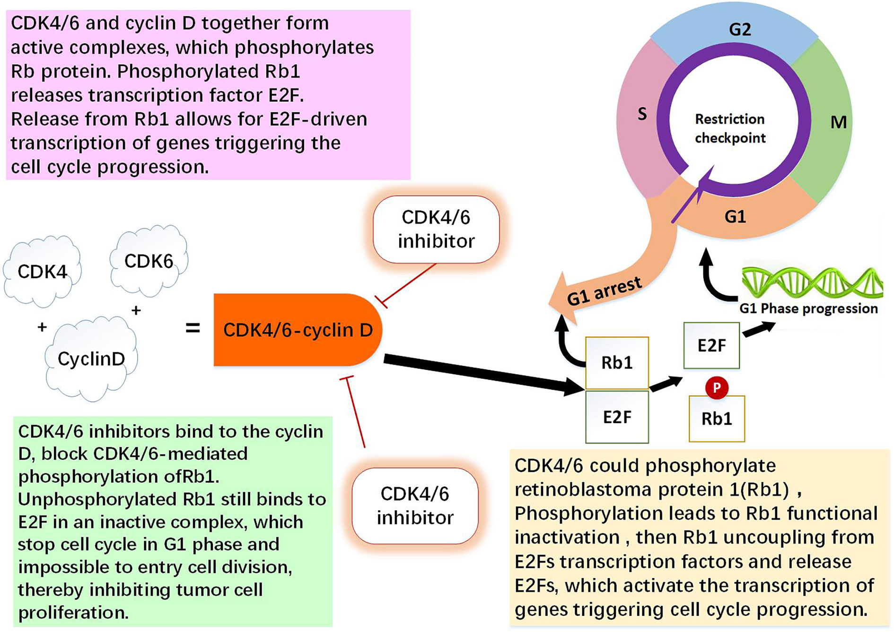
CDK 4/6 Inhibitors in MBC
Wang et al.
Front. Oncol. 11(2021):651431
Notes:
Cyclin-dependent kinases (CDKs) are serine/threonine kinases that play key roles in regulating cell cycle (1). CDK 4 and 6 mediate the cellular transition from G0/G1 (growth) phase to S phase during cell cycle: dysregulation of CDK 4/6, result in uncontrolled cell division. The main effect of CDK4/6 inhibitor is to bind with cyclin D specifically, block cell cycle transformation, and stop cell cycle in G1 phase, thereby inhibiting tumor cell proliferation

Slide 12
NCCN Guidelines 2023 HR(+) MBC preferred regimens
1st line therapy
AI + CDK 4/6 inhibitor^{b}
  AI + ribociclib (category 1)^{c}
  AI + abemaciclib
  AI + palbociclib
Fulvestrant + CDK 4/6 inhibitor
  Fulvestrant + ribociclib (category 1)^{e}
  Fulvestrant + abemaciclib (category 1)^{e}
  Fulvestrant + palbociclib
2nd & subsequent line therapy
Fulvestrant + CDK 4/6 inhibitor(any of 3) if not previously used^{f,g}
b-controversy of choice of CDK 4/6 inhibitor as no head to head comparisons and some differences in study populations in the phase III randomized trials.
c-in phase III RCT’s ribociclib + ET has shown OS benefit in 1st line setting
e-in phase III RCT’s fulvestrant + ribociclib or abemaciclib has shown OS benefit in 1st line setting
f-in phase III RCT’s fulvestrant + CDK 4/6 inhibitor has shown OS benefit in 2nd line setting
g-if there is disease progression on Palbociclib, there is limited phase II data to support use of 2nd line ribociclib
Notes:
b-b-controversy of choice of CDK 4/6 inhibitor as no head to head comparisons and some differences in study populations in the phase III randomized trials.
C-in Phase III RCT ribo _ ET has shown OS benefit in 1st line setting

Slide 13
Are CDK 4/6 Inhibitors the same or different?
All 3 with DFS benefit. 2 now with OS benefit in 1st line.
Palbociclib / Ribociclib – intermittent dosing: 3 weeks on, 1 week off
Abemaciclib:
  Continuous dosing
  Approved as monotherapy
  Crosses blood brain barrier.
  Highest CDK4: CKD6 inhibition ratio
  Approved in 2021 for adjuvant high risk node (+) HR (+)- Ribociclib to enter this space soon?
Notes:
Natalee Trial: phase III kisqali anatomic stage II/III regardless of nodal involvement, men and women, menopausal status. DFS primary endpoint. Dosing 400mg days 1-21 q 28 days v 600mg dosing.x 3 years. + AI +/- gosarelin. 5101 pts. 3 year IDFS 90.4% v 87.1%
Monarch E: 5637 pts high risk node positive pts. 2 year IDFS 92.2 v 87.7% 4 positive nodes or 1-3 nodes + tumor 5+cm, grade 3 or Ki67 >20%

Slide 14
CDK4/6 inhibitor side effects
 | Palbociclib | Ribociclib | Abemaciclib
Neutropenia | ++ | ++ | + | Febrile neutropenia <2%
Diarrhea |  | + | ++
Creatinine ↑ |  |  | + | No impact on GFR
LFT ↑ |  | + | +
QTc → |  | +
Pneumonitis | + | + | + | 1-2% risk

Slide 15
1st line HR(+) MBC
5 Phase III 1st line trials. 1°endpoint: PFS
Palbociclib
PALOMA-2. 666 ♀ postmenopausal. 2:1 Palbo/placebo + letrozole
Ribociclib
MONALEESA-2: 668 ♀ postmenopausal. 1:1 Ribo/placebo + letrozole
MONALEESA -3: 0-1 prior lines. 726 ♀ postmenopausal. 2:1 ribo/placebo + fulvestrant
MONALEESA-7: 0-1 prior lines. 672♀ pre/peri-menopausal. 1:1 Ribo/placebo + OS + tam/AI
Abemaciclib
MONARCH-3: 493 ♀ postmenopausal. 2:1 abema/placebo + letrozole or anastrozole
PALOMA = Palbociclib
MONALEESA = Ribociclib
MONARCH = Abemaciclib
Notes:
PALOMA = Palbociclib
MONALEESA – ribociclib
MONARCH - abemaciclib

Slide 16
CDK 4/6 studies - 1st line MBC
CDK 4/6 | PFS | OS
PALOMA-2 | 27.6 v 14.5 mos. HR 0.563 | 53.9 v 51.2 mos. HR 0.96(0.78-1.18)
MONALEESA-2 | 25.3 v 16 mos. HR 0.568 | 63.9 v 51.4 mos. HR 0.76 (0.63-0.93)
MONALEESA-3 (fulvestrant) | 33.6 v 19.2 mos. HR 0.55 | 67.7 v 51.8 mos. HR 0.67 (0.54-0.90)
MONALEESA-7 (pre/peri-menopausal) | 23.8 v 13 mos. HR 0.583 | 58.7 v 47.7 mos. HR 0.80(0.61-1.04)
MONARCH-3 | 28.2 v 14.8 mos. HR 0.54 | 67.1 v 54.5 mos. HR 0.75 (0.58-0.97) p value NS
PALOMA-2.
MONALEESA-2
MONALEESA-7
MONARCH-3: 493 ♀ postmenopausal. 2:1 abema/placebo
Notes:
Monaleesa 2: over 5 years median OS for first line postmenopausal pts with an AI at median follow up of 80 months.
Monaleesa 3: postmenopausal ribo + fulvestrant. Median follow up 71 months.
Monaleesa 7: pre/perimenopausal women. Median follow up of 54 months. Increased risk QT prolongation in arm receiving tamoxifen. Not indicated for use with tamoxifen.

Slide 17
MONALEESA - 7
1st trial of CDK4/6 inhibitor in pre/perimenopausal ♀ with HR+ advanced breast cancer
672 patients, randomized phase III, 1st line endocrine Rx (tam or AI).
1:1 randomization AI/Tam + goserelin +/- ribociclib
12/2014 – 8/2016 enrollment
May have received Neoadjuvant/adjuvant endocrine Rx
May have received up to 1 line chemotherapy in advanced setting

Slide 18
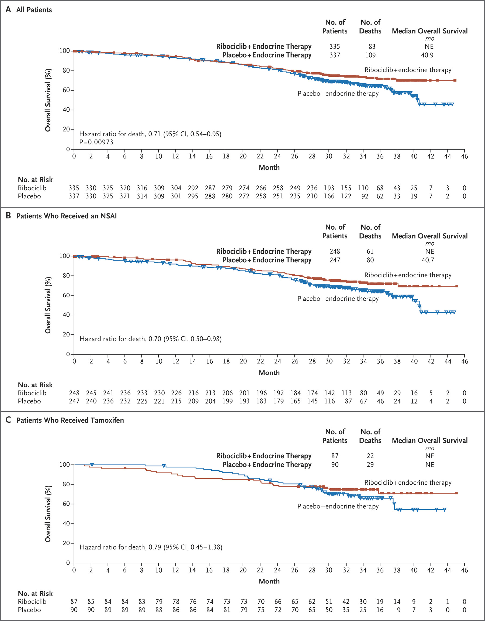
MONALEESA - 7
5/2018: Primary endpoint - PFS 23.8 months v 13.0 months HR 0.55 (0.44 v 0.69)
1st CDK 4/6 inhibitor trial to show statistically significant OS benefit. July 2019 NEJM.
Median OS not reached in protocol –specified final analysis.
Overall survival NR v 40.9 months HR 0.71 (0.54 – 0.95)
Im et al. NEJM 2019; 381:307-316

Slide 19
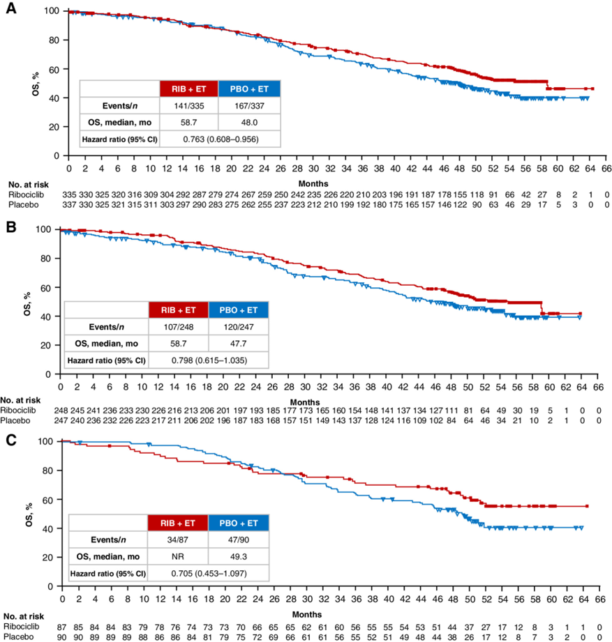
MONALEESA - 7
A- All patients
Median follow up now 53.5 mos.
Median OS: 58.7 mos. v 48.0 mos.
HR 0.76 (0.61 – 0.96)
B-Aromatase
inhibitor
C-Tamoxifen
Lu et al. Clin Cancer Res. 2022;28(5):851-859
Notes:
Median follow up 53.5 months. OS 58.7 months v 48.0 months

Slide 20
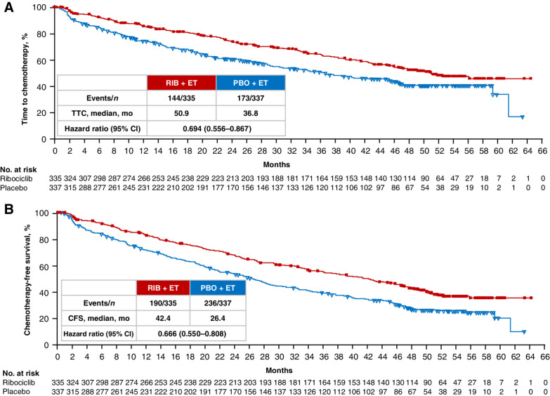
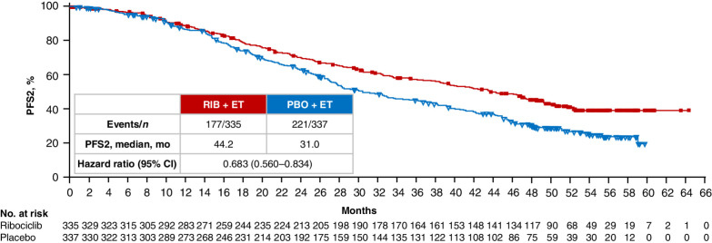
MONALEESA - 7
PFS2: disease progression on subsequent therapy
Time to subsequent chemotherapy
& chemo free survival
Lu et al. Clin Cancer Res. 2022;28(5):851-859

Slide 21
MONALEESA - 7
Improved OS in ♀ <40:
51.3 v 40.5 months
HR 0.65 (0.43-0.98)
4 yr OS 56.2 v 34.4 mos.
Delayed time to chemo:
50.9 v 36.0 months
HR 0.66(0.51-0.85)

Slide 22
MONALEESA - 7
SABCS 2022: Pooled analysis of post progression Rx after 1st line ribo +ET.
Monaleesa 2,3,7 all showed PFS and OS of Ribo + ET v ET alone.
Delayed time to chemo & PFS2 per ML-7.
PALOMA 3: similar or numerically shorter durations of next – line therapy after palbo & chemo most common 2nd line.
Outcomes of subsequent Rx strategies:
ET/CT/targeted therapy/other
Less frequent use of CT as next line Rx
Hamilton et al. SABCS 2022. Poster P4-01-42
Notes:
Poster P4-01-42 at SABCS 2022.
Pooled analysis of post progression treatments after 1st line ribo + ET in Monaleesa 2, 3, and 7. Paloma 3 reported similar or shorter durations of next line therapy after palbo. Chemo was most common next line Rx.

Slide 23
MONALEESA - 7
Duration of 1st line and 2nd line Rx longer for 1st line ribo v placebo.
Duration of 1st line Rx shortest for those who received 2nd line chemo
Duration of 1st line Rx longest for those who received 2nd line targeted therapy
Hamilton et al. SABCS 2022. Poster P4-01-42
Notes:
Poster P4-01-42 at SABCS 2022.
Pooled analysis of post progression treatments after 1st line ribo + ET in Monaleesa 2, 3, and 7. Paloma 3 reported similar or shorter durations of next line therapy after palbo. Chemo was most common next line Rx.

Slide 24
MONALEESA - 7
Longest median OS in those receiving 2nd line CDK4/6 inhibitor: 84 mos
ET: 59.9 mos.
Targeted therapy: 52.2 mos.
Chemotherapy: 37.4 mos.
Hamilton et al. SABCS 2022. Poster P4-01-42
Notes:
Decisions about subsequent therapy may depend on how well patients did on prior therapy. Findings confirm that 1st line ribociclib _+ ET may not render tumor more aggressive and does not worsen pt outcomes.
Trend towards improved outcomes of subsequent therapies after 1st line ribo + ET may suggest a post treatment effect of ribociclib that may explain OS benefit.

Slide 25
2nd line MBC
CDK 4/6 | PFS | OS
PALOMA-3 (palbo +fulvestrant) | 9.2 v 3.8 mos. HR 0.42 (0.32-0.56) | 34.9 v 28.0 mos. HR 0.81 (0.64-1.03)
MONALEESA-3 (ribo+fulvestrant) | 14.5 v 9.1 mos. HR 0.57 (0.44-0.74) | 40.2 v 32.5 mos. HR 0.73 (0.53-1.00)
MONARCH-2 (abema + fulvestrant) | 16.4 v 9.3 mos. HR 0.553 (0.45-0.68) | 46.7 v 37.3 mos. HR 0.757 (0.61-0.95)
PALOMA-2.
MONALEESA-2
MONALEESA-7
MONARCH-3: 493 ♀ postmenopausal. 2:1 abema/placebo
Notes:
OS based on protocol specified OS analysis.

Slide 26
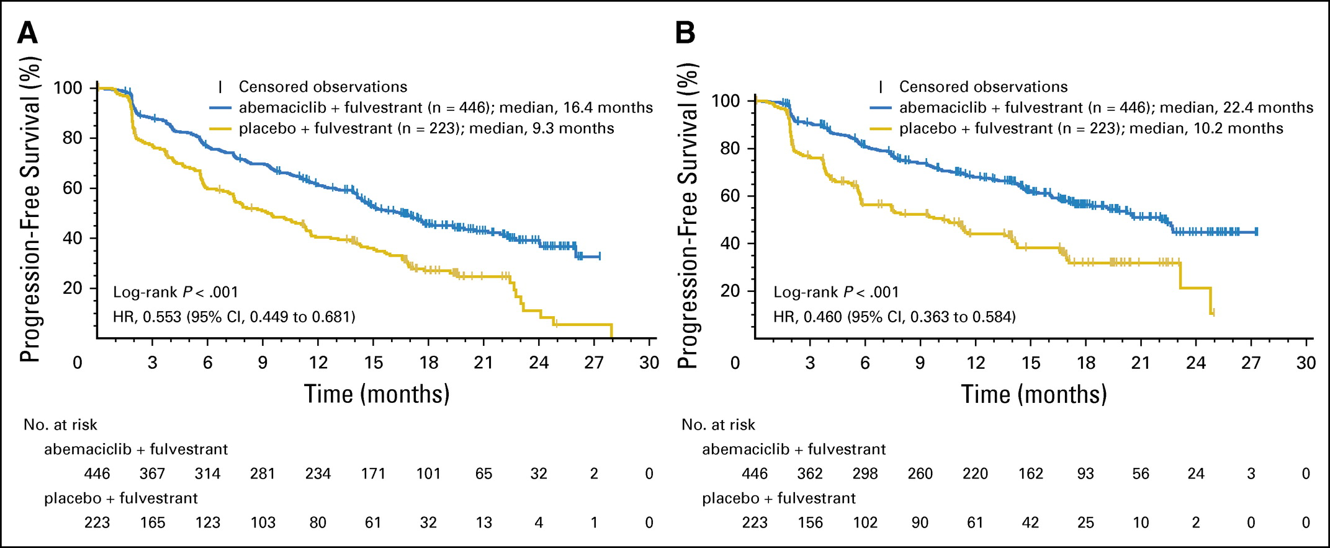
MONARCH 2
Phase III RCT 2nd line fulvestrant +/- abemaciclib. 8/2014- 12/2015
669 pre/peri/postmenopausal ♀. CDK 4/6 inhibitor naive
Progression on neoadjuvant/adjuvant ET, <12 months from completing adjuvant ET, or 1st line ET for MBC.
Randomized 2:1.
Primary endpoint: PFS - 16.4 v 9.3 months HR 0.553
Sledge et al. JCO 35(25) 2017
Notes:
Graph A is investigator assessed. Graph B is independent central review of intent to treat population.

Slide 27
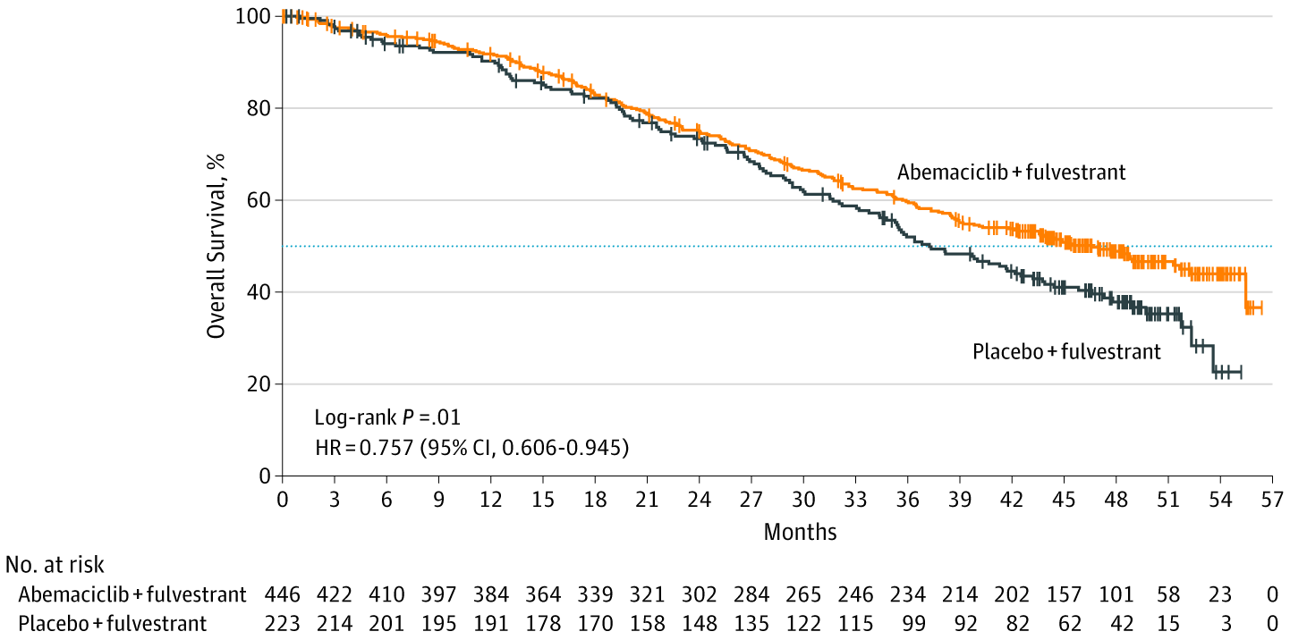
MONARCH 2
OS benefit update ESMO 2019.
Prespecified endpoint.
Median OS 46.7 mos v 37.3 mos.
HR 0.757 (0.606 – 0.945)
Sledge et al JAMA Oncology 2020; 6(1) 116-124

Slide 28
MONARCH 2
SABCS 2022 Update: final OS analysis
Median follow up 6.5 years.
Median OS 45.8 mos v 37.2 mos HR 0.784
Benefit maintained in groups w/ poor prognosis:
Visceral disease HR 0.643
Primary resistance to ET HR 0.634
Negative PR status HR 0.623
CFS= chemo free survival
3 yr CFS 42% v 29.3%
4 yr CFS 37% v 18.6%
5 yr CFS 32.4% v 14.7%

Slide 29
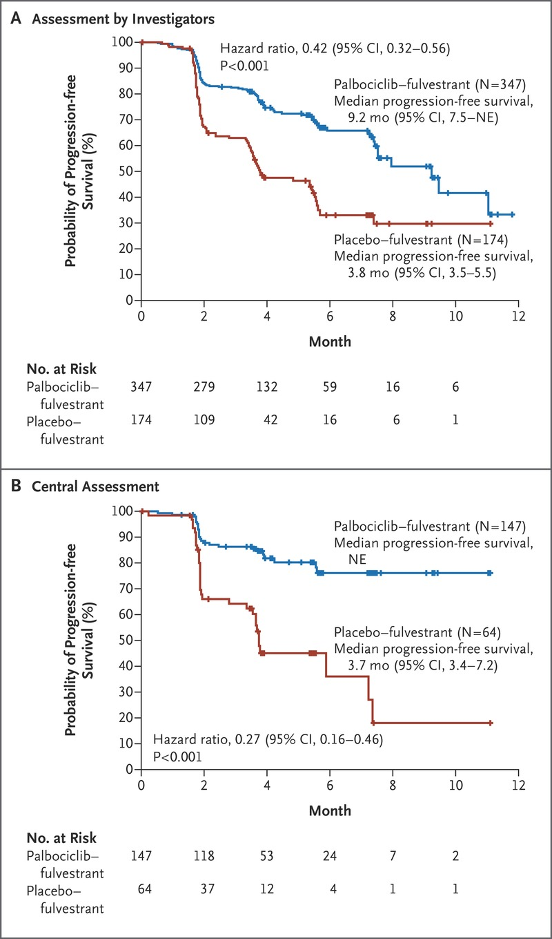
PALOMA – 3
Phase III RCT 521 pre/postmenopausal ♀
2nd line: progression/relapse during 1st line endocrine Rx
10/2013 - 8/2014
2:1 Fulvestrant (+ OS for premenopausal) +/- Palbociclib
PFS-primary endpoint
9.2 mos v 3.8 mos. HR 0.42
Turner et al NEJM 2015; 373: 209-219
Notes:
PFS: 9.2 months v 3.8 mos investigator assessment HR 0.42
PFS NE v 3.7 mos central assessment

Slide 30
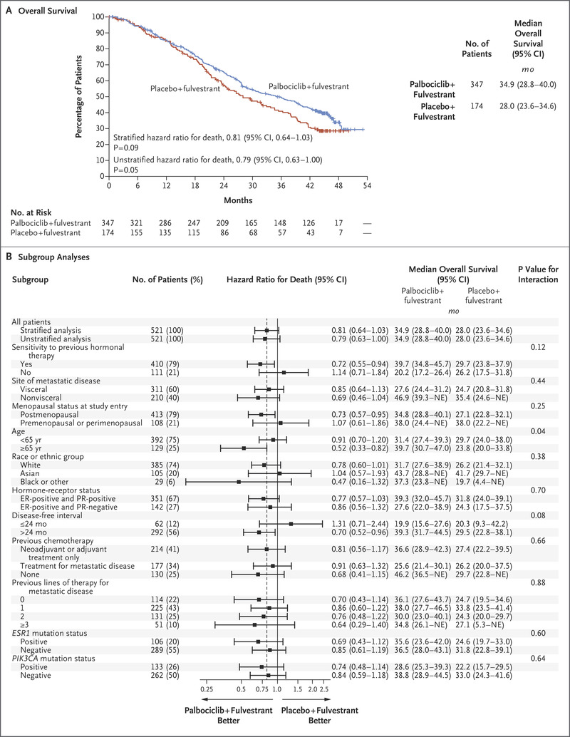
PALOMA – 3
OS update NEJM 2018
34.9 mos v 28.0 mos.
HR 0.81 (0.64-1.03)
Turner et al. NEJM 2018 379:1926-1936
Notes:
PFS: 9.5 months v 4.6 months HR 0.46 CI 0.36-0.59 P <0.0001

Slide 31
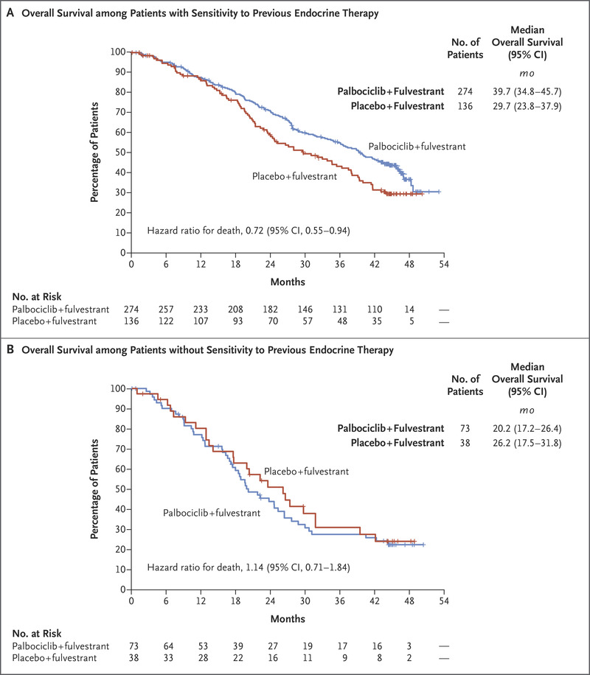
PALOMA – 3
OS benefit if sensitive to prior endocrine Rx:
39.7 mos v 29.7 mos.
HR 0.72 (0.55-0.94)
Turner et al. NEJM 2018 379:1926-1936
Notes:
PFS: 9.5 months v 4.6 months HR 0.46 CI 0.36-0.59 P <0.0001

Slide 32
Case Discussion
42yo premenopausal ♀
De Novo HR(+) MBC.
Liver metastases, abnormal LFT’s
RIGHT Choice
Phase II, 222 pts
1st line Ribo + ET vs combo chemo in aggressive HR (+) MBC
54.5% v 50.% visceral crisis
PFS: 24.0 v 12.3 mos.
HR 0.54 (0.36-0.79)
Notes:
RIGHT CHOICE: Phase II ribo + ET extended PFS v combo chemo in aggressive HR positive MBC. Aggressive disease: symptomatic visceral mets, rapid disease progression, impending visceral compromise, markedly symptomatic nonvisceral disease chemo choices docetaxel/capecibtaine, taxol/gemcitabine, or capecitabine/vinolrebine

Slide 33
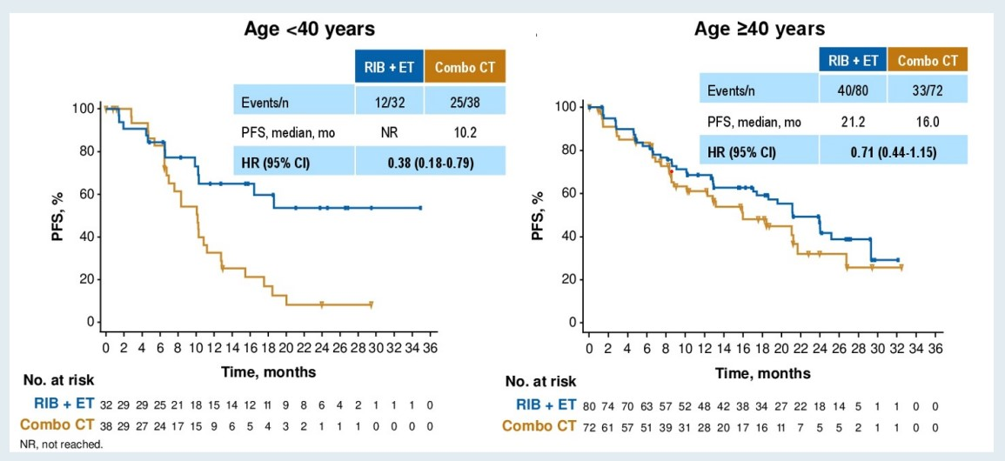
RIGHT CHOICE
Time to Rx failure:
  18.6 mos ribo v 8.5 mos chemo
RR 65.2% ribo v 60.0% chemo
Median time to response:
  4.9 ribo v 3.2 chemo
Age <40 v Age >40 PFS
El Saghir NS et al. ASCO 2023;Abstract 1063.
Notes:
RIGHT CHOICE: Phase II ribo + ET extended PFS v combo chemo in aggressive HR positive MBC. Aggressive disease: symptomatic visceral mets, rapid disease progression, impending visceral compromise, markedly symptomatic nonvisceral disease chemo choices docetaxel/capecibtaine, taxol/gemcitabine, or capecitabine/vinolrebine

Slide 34
Case Discussion
70yo postmenopausal ♀ experiences disease progression after 3 years on 1st line palbo/ET.
Is 2nd line CDK 4/6 inhibitor an option?
MAINTAIN trial:
120 pts progressed on 1st line CDK 4/6 inhibitor + ET
Phase II RCT 1:1 fulvestrant or exemestane + /- ribociclib
84% palbo, 11% ribo, 2% abema

Slide 35
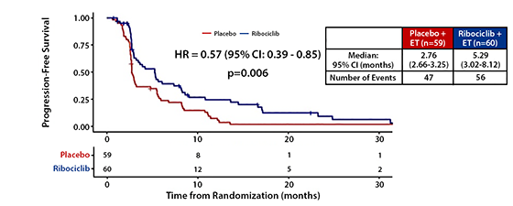
MAINTAIN trial
Primary endpoint: PFS
5.33 mos. v 2.76 mos.
HR 0.56 (0.37-0.83)
Kalinsky et al. JCO 40, 2022 (suppl 17; abstr LBA 1004)
Notes:
ASCO 2022

Slide 36
PACE trial
Palbo after CDK 4/6 inhibitor + AI.
220 patients
2:1:1 palbo + fulvestrant, fulvestrant, avelumab/palbo/fulvestrant.
90% palbo, 4.5% ribo, 4.1% abema
PFS 4.6 mos. v 4.8 mos. HR 1.11
Triplet PFS 8.1 mos.
OS 24.6 mos. V 27.5 mos. HR 1.02
Triplet OS 42.5 mos.
Mayer et al.SABCS 2022 Abstract GS3-06
Notes:
ASCO 2022

Slide 37
postMONARCH
Disease progression on prior CDK4/6 inhibitor + AI as initial 1st line MBC or adjuvant Rx
Phase III RCT
Abemaciclib 150mg PO BID or placebo + fulvestrant. 1:1
January 2022 start time -350 pts planned
Key endpoints: OS, PFS, RR, safety, PRO
Results TBD
Kalinsky et al. JCO 40, 2022 (suppl 16; TPS1117)
Notes:
ASCO 2022

Slide 38
Case Discussion
70yo postmenopausal ♀ denovo HR (+) MBC
Can 2nd line CDK 4/6 inhibitor work as well as 1st line?
SONIA trial
Randomized Phase III
1050 pre/postmenopausal ♀
1st line AI + CDK4/6=>fulvestrant
1st line AI->fulvestrant + CDK 4/6 inhibitor

Slide 39
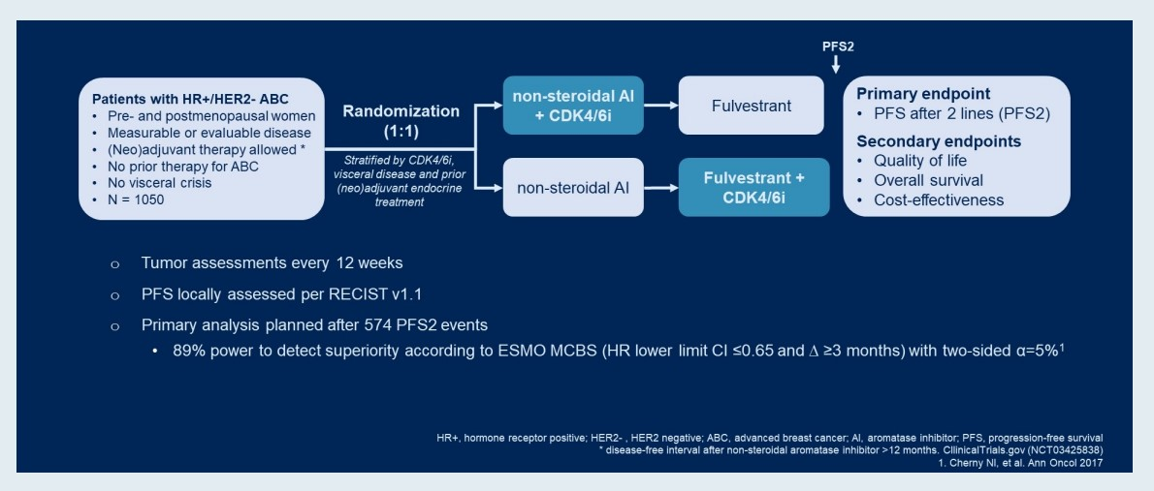
SONIA trial
Results TBD
Sonke G et al. ASCO 2023;Abstract 1000.
Notes:
ASCO 2022

Slide 40
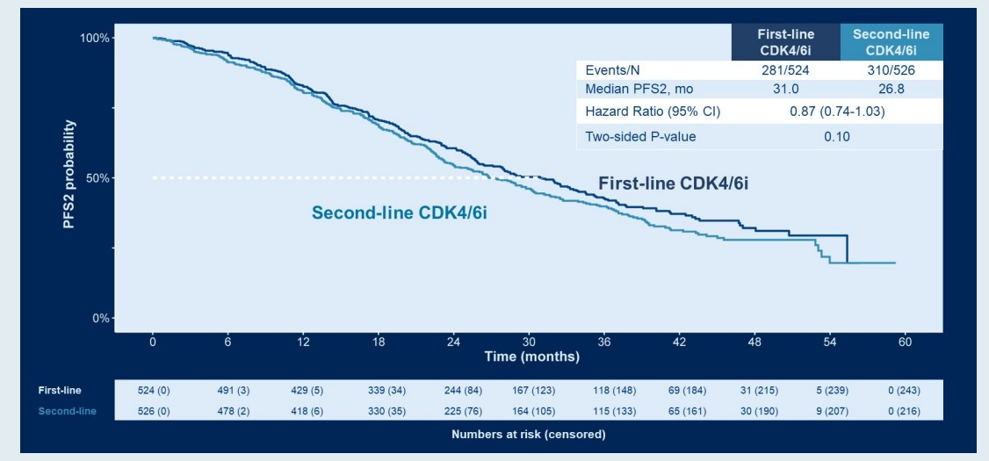
SONIA trial: PFS2
Sonke G et al. ASCO 2023;Abstract 1000.
Notes:
ASCO 2022

Slide 41
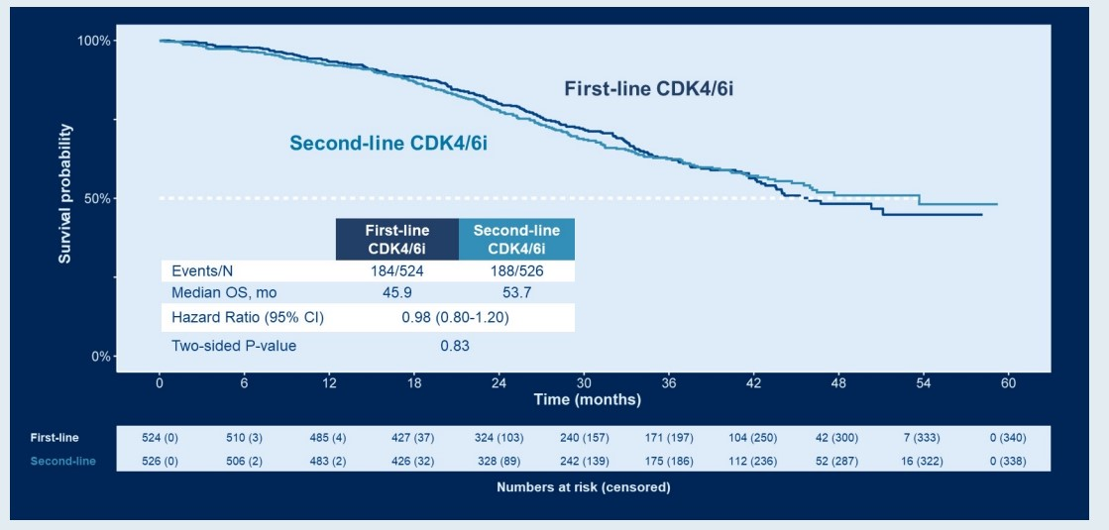
SONIA trial: OS
Sonke G et al. ASCO 2023;Abstract 1000.
Notes:
ASCO 2022

Slide 42










BREAST CANCER
Thursday, August 10, 2023

Slide 43

Beyond CDK4/6 Inhibitors in Breast Cancer
Aixa Soyano, MD
Assistant Member
Moffitt Cancer Center
Tampa, FL

Slide 44
Disclosures
Consulting for Novartis and Speaker for Eli Lilly
No CI related to this presentation

Slide 45
Capivasertib and fulvestrant for patients with aromatase inhibitor-resistant hormone receptor-positive/human epidermal growth factor receptor 2-negative advanced breast cancer: Results from the Phase III CAPItello-291 trial
San Antonio Breast Cancer Symposium®, December 6–10, 2022
Nicholas C Turner,¹ Mafalda Oliveira,² Sacha Howell,³ Florence Dalenc,⁴ Javier Cortes,⁵ Henry Gomez,⁶ Xichun Hu,⁷ Komal Jhaveri,⁸ Sibylle Loibl,⁹ Serafin Morales Murillo,¹⁰ Zbigniew Nowecki,¹¹ Meena Okera,¹² Yeon Hee Park,¹³ Masakazu Toi,¹⁴ Lyudmila Zhukova,¹⁵ Chris Yan,¹⁶ Gaia Schiavon,¹⁶ Andrew Foxley,¹⁶ and Hope S Rugo¹⁷
¹Institute of Cancer Research, Royal Marsden Hospital, London, UK; ²Medical Oncology Department, Vall d’Hebron University Hospital, Barcelona, Spain; ³The Christie NHS Foundation Trust, Manchester, UK; ⁴Institut Claudius Regaud, l'Institut Universitaire du Cancer de Toulouse Oncopole – IUCT Oncopole, Toulouse, France; ⁵International Breast Cancer Center (IBCC), Barcelona, Spain; ⁶Instituto Nacional de Enfermedades Neoplásicas (INEN), Departamento de Oncología Médica, Lima, Peru;⁷Shanghai Cancer Center, Fudan University, Shanghai, China; ⁸Memorial Sloan Kettering Cancer Center, New York, NY, USA; ⁹GBG Forschungs GmbH, Neu­Isenburg, Germany; ¹⁰Institut de Recerca Biomèdica, Barcelona, Spain; ¹¹The Maria Skłodowska Curie Memorial Cancer Center and Institute of Oncology, Warsaw, Poland; ¹²ICON Cancer Centre, Adelaide, Australia; ¹³Sungkyunkwan University School of Medicine, Samsung Medical Centre, Seoul, Republic of Korea;¹⁴Kyoto University Hospital, Kyoto, Japan; ¹⁵Loginov Moscow Clinical Scientific Center, Moscow, Russia; ¹⁶Oncology R&D, AstraZeneca, Cambridge, UK; ¹⁷University of California San Francisco Helen Diller Family Comprehensive Cancer Center, San Francisco, CA, USA

Slide 46


Background and overview of capivasertib
San Antonio Breast Cancer Symposium®, December 6–10, 2022
AKT pathway activation occurs in many HR+/HER2– ABC through alterations in PIK3CA, AKT1 and PTEN, but may also occur in cancers without those genetic alterations.^{1,2} AKT signalling is also implicated in the development of resistance to endocrine therapy²
Capivasertib is a potent, selective inhibitor of all three AKT isoforms (AKT1/2/3)
In the Phase II, placebo­controlled FAKTION trial³:
Receptor tyrosine kinase
E Estrogen
P P
E
RAS
PI3K
Capivasertib
PTEN
Raf
AKT
E
ER-α
TSC2
MEK
mTOR
The addition of capivasertib to fulvestrant significantly improved PFS and OS in postmenopausal women with AI­resistant HR+/HER2– ABC in the overall population, with a more pronounced benefit in pathway altered tumours
No patients had received prior CDK4/6 inhibitors
MAPK
Nucleus
Fulvestrant
E E
ER-α ER-α
Tumor cell survival, growth and proliferation
1. Millis et al. JAMA Oncol 2016;2:1565­1573; 2. Toss et al. Oncotarget. 2018;9:31606­31619; 3. Howell et al. Lancet Oncol 2022;23:851–64. ABC, advanced breast cancer.

Slide 47
CAPItello­291: Study overview
San Antonio Breast Cancer Symposium®, December 6–10, 2022
Phase III, randomized, double-blind, placebo-controlled study (NCT04305496)
Patients with HR+/HER2– ABC
Capivasertib
400 mg twice daily, 4 days on, 3 days off
Dual primary endpoints
PFS by investigator assessment
Overall
AKT pathway­altered tumors (≥1 qualifying PIK3CA, AKT1, or PTEN alteration)
Men and pre­/post­menopausal women
Recurrence while on or <12 months from end of adjuvant AI, or progression while on prior AI for ABC
≤2 lines of prior endocrine therapy for ABC
≤1 line of chemotherapy for ABC
Prior CDK4/6 inhibitors allowed (at least 51% required)
No prior SERD, mTOR inhibitor, PI3K inhibitor, or AKT inhibitor
HbA1c <8.0% (63.9 mmol/mol) and diabetes not requiring insulin allowed
FFPE tumor sample from the primary/recurrent cancer available for retrospective central molecular testing
Fulvestrant
500 mg: cycle 1, days 1 &
15; then every 4 weeks
Stratification factors:
Liver metastases (yes/no)
Prior CDK4/6 inhibitor (yes/no)
Region*
R1:1
(N=708)
Key secondary endpoints
Overall survival
Overall
AKT pathway­altered tumors
Objective response rate
Overall
AKT pathway­altered tumors
Placebo
Twice daily,
4 days on, 3 days off
Fulvestrant
500 mg: cycle 1, days 1 &
15; then every 4 weeks
HER2– was defined as IHC 0 or 1+, or IHC 2+/ISH–. *Region 1: United States, Canada, Western Europe, Australia, and Israel, Region 2: Latin America, Eastern Europe and Russia vs Region 3: Asia. ABC, advanced (locally advanced [inoperable] or metastatic) breast cancer.
Pre­ or peri­menopausal women also received a luteinizing hormone­releasing hormone agonist for the duration of the study treatment
Turner et al. San Antonio Breast Cancer Symposium (SABCS) 2022; December 6-10, 2022; San Antonio, TX. Presentation GS3-04. Turner et al. N Engl J Med. 2023;388(22):2058-2070.

Slide 48
Baseline and tumor characteristics
San Antonio Breast Cancer Symposium®, December 6–10, 2022
Overall population
AKT pathway-altered population
Characteristic
Capivasertib + fulvestrant (N=355)
Placebo + fulvestrant (N=353)
Capivasertib + fulvestrant (N=155)
Placebo + fulvestrant (N=134)
Median age; years | (range) |  | (range) |  | 59 (26–84) | 58 (26–90) | 58 (36–84) | 60 (34–90)
Female; n (%) |  |  |  |  | 352 (99.2) | 349 (98.9) | 153 (98.7) | 134 (100)
Post menopausal; | n | (%) |  |  | 287 (80.8) | 260 (73.7) | 130 (83.9) | 105 (78.4)
 | White |  |  |  | 201 (56.6) | 206 (58.4) | 75 (48.4) | 76 (56.7)
Race; n (%) | Asian Black or African American |  |  |  | 95 (26.8) 4 (1.1) | 94 (26.6) 4 (1.1) | 48 (31.0) 2 (1.3) | 35 (26.1) 1 (0.7)
 | Other |  |  |  | 55 (15.5) | 49 (13.9) | 30 (19.4) | 22 (16.4)
Metastatic sites; n (%) | Bone only Liver* |  |  |  | 51 (14.4) 156 (43.9) | 52 (14.7) 150 (42.5) | 25 (16.1) 70 (45.2) | 16 (11.9) 53 (39.6)
 | Visceral |  |  |  | 237 (66.8) | 241 (68.3) | 103 (66.5) | 98 (73.1)
 | ER+/PR+ |  |  |  | 255 (71.8) | 246 (69.7) | 116 (74.8) | 101 (75.4)
Hormone receptor status; n (%)† | ER+/PR­ |  |  |  | 94 (26.5) | 103 (29.2) | 35 (22.6) | 31 (23.1)
 | ER+/PR unknown |  |  |  | 5 (1.4) | 4 (1.1) | 4 (2.6) | 2 (1.5)
Endocrine resistance; Primary |  |  |  |  | 127 (35.8) | 135 (38.2) | 60 (38.7) | 55 (41.0)
n (%) Secondary |  |  |  |  | 228 (64.2) | 218 (61.8) | 95 (61.3) | 79 (59.0)

Slide 49
Prior treatments
San Antonio Breast Cancer Symposium®, December 6–10, 2022
Overall population
AKT pathway-altered population
Characteristic
Capivasertib + fulvestrant (N=355)
Placebo + fulvestrant (N=353)
Capivasertib + fulvestrant (N=155)
Placebo + fulvestrant (N=134)
Prior endocrine | 0 | 40 (11.3) | 54 (15.3) | 14 (9.0) | 20 (14.9)
therapy for ABC; | 1 | 286 (80.6) | 252 (71.4) | 130 (83.9) | 96 (71.6)
n (%) | 2 | 29 (8.2) | 47 (13.3) | 1 (7.1) | 18 (13.4)
Previous CDK4/6 inhibitor for ABC; n (%) |  | 245 (69.0) | 244 (69.1) | 113 (72.9) | 91 (67.9)
Previous | Adjuvant/neoadjuvant | 180 (50.7) | 170 (48.2) | 79 (51.0) | 67 (50.0)
chemotherapy; n (%) | ABC | 65 (18.3) | 64 (18.1) | 30 (19.4) | 23 (17.2)
Turner et al. San Antonio Breast Cancer Symposium (SABCS) 2022; December 6-10, 2022; San Antonio, TX. Presentation GS3-04. Turner et al. N Engl J Med. 2023;388(22):2058-2070.

Slide 50
AKT pathway alterations
San Antonio Breast Cancer Symposium®, December 6–10, 2022
Alteration; n (%)
Capivasertib + fulvestrant (N=355)
Placebo + fulvestrant (N=353)
Any AKT pathway alteration |  | 155 (43.7) | 134 (38.0)
 | Any | 116 (32.7) | 103 (29.2)
PIK3CA | PIK3CA only | 110 (31.0) | 92 (26.1)
 | PIK3CA and AKT1 | 2 (0.6) | 2 (0.6)
 | PIK3CA and PTEN | 4 (1.1) | 9 (2.5)
AKT1 only |  | 18 (5.1) | 15 (4.2)
PTEN only |  | 21 (5.9) | 16 (4.5)
Non-altered |  | 200 (56.3) | 219 (62.0)
AKT pathway alteration not detected |  | 142 (40.0) | 171 (48.4)
Unknown |  | 58 (16.3) | 48 (13.6)
No sample available |  | 10 (2.8) | 4 (1.1)
Preanalytical failure |  | 39 (11.0) | 34 (9.6)
Post analytical failure |  | 9 (2.5) | 10 (2.8)
AKT pathway alteration status was determined centrally using next­generation sequencing in tumor tissue with the FoundationOne®CDx assay (and Burning Rock assay in China)
Turner et al. San Antonio Breast Cancer Symposium (SABCS) 2022; December 6-10, 2022; San Antonio, TX. Presentation GS3-04. Turner et al. N Engl J Med. 2023;388(22):2058-2070.

Slide 51
Dual­primary endpoint: Investigator ­assessed PFS in the overall population
San Antonio Breast Cancer Symposium®, December 6–10, 2022
Capivasertib + fulvestrant (N=355)
258
Placebo + fulvestrant (N=353)
293
100
90
80
70
60
50
40
30
20
10
0
Progression­free survival (%)
PFS events
Median PFS (95% CI); months | 7.2 (5.5–7.4) | 3.6 (2.8–3.7)
Adjusted HR (95% CI): | 0.60 (0.51, 0.71); two­sided p­value <0.001
0 1 2 3 4 5 6 7 8 9 10 1 12 13 14 15 16 17 18 19 20 21 22 23 24 25 26
Time from randomization (months)
Number of patients at risk Capivasertib + fulvestrant
Placebo + fulvestrant
355 | 330 | 266 | 252 | 207 | 199 | 172 | 166 | 138 | 133 | 115 | 98 | 78 | 64 | 55 | 44 | 43 | 25 | 25 | 21 | 8 | 8 | 5 | 2 | 2 | 1 | 0
353 | 329 | 207 | 182 | 142 | 136 | 106 | 100 | 83 | 81 | 66 | 59 | 51 | 41 | 33 | 24 | 23 | 12 | 11 | 10 | 4 | 4 | 3 | 1 | 1 | 0 | 0
+ indicates a censored observation. HR was estimated using the Cox proportional hazard model stratified by the presence of liver metastases, prior use of CDK4/6 inhibitor, and geographic region.
Turner et al. San Antonio Breast Cancer Symposium (SABCS) 2022; December 6-10, 2022; San Antonio, TX. Presentation GS3-04. Turner et al. N Engl J Med. 2023;388(22):2058-2070.

Slide 52
Dual­primary endpoint: Investigator ­assessed PFS in the AKT pathway ­altered population
San Antonio Breast Cancer Symposium®, December 6–10, 2022
Capivasertib + fulvestrant (N=155)
Placebo + fulvestrant (N=134)
100
90
80
70
60
50
40
30
20
10
0
Progression­free survival (%)
PFS events
121
115
Median PFS (95% CI); months | 7.3 (5.5–9.0) | 3.1 (2.0–3.7)
Adjusted HR (95% CI): | 0.50 (0.38, 0.65); two­sided p­value <0.001
0 1 2 3 4 5 6 7 8 9 10 1 12 13 14 15 16 17 18 19 20 21 22 23 24 25 26
Time from randomization (months)
Number of patients at risk Capivasertib + fulvestrant
Placebo + fulvestrant
155 | 150 | 127 | 121 | 99 | 97 | 80 | 76 | 65 | 62 | 54 | 49 | 38 | 31 | 26 | 22 | 21 | 12 | 12 | 9 | 3 | 3 | 2 | 1 | 1 | 0 | 0
134 | 124 | 77 | 64 | 48 | 47 | 37 | 35 | 28 | 27 | 24 | 20 | 17 | 14 | 11 | 6 | 6 | 2 | 2 | 2 | 1 | 1 | 1 | 0 | 0 | 0 | 0
+ indicates a censored observation. HR was estimated using the Cox proportional hazard model stratified by the presence of liver metastases and prior use of CDK4/6 inhibitor.
Turner et al. San Antonio Breast Cancer Symposium (SABCS) 2022; December 6-10, 2022; San Antonio, TX. Presentation GS3-04. Turner et al. N Engl J Med. 2023;388(22):2058-2070.

Slide 53
Investigator­ assessed PFS by subgroup: Overall population
San Antonio Breast Cancer Symposium®, December 6–10, 2022
Number of patients
HR (95%CI)
All patients
708
0.60 (0.51, 0.71)
Age
<65 years
491
0.65 (0.53, 0.79)
≥65 years
217
0.65 (0.47, 0.90)
Asian
189
0.62 (0.44, 0.86)
Race
White
407
0.65 (0.52, 0.80)
Other
112
0.63 (0.42, 0.96)
1
395
0.60 (0.48, 0.75)
Region
2
136
0.77 (0.51, 1.16)
3
177
0.60 (0.42, 0.85)
Menopausal status (females only)
Pre/peri
154
0.86 (0.60, 1.20)
Post
547
0.59 (0.48, 0.71)
Liver metastases
Yes
306
0.61 (0.48, 0.78)
No
402
0.62 (0.49, 0.79)
Visceral metastases
Yes
478
0.69 (0.56, 0.84)
No
230
0.54 (0.39, 0.74)
Endocrine resistance
Primary
262
0.66 (0.50, 0.86)
Secondary
446
0.64 (0.51, 0.79)
Prior use of CDK4/6 inhibitors
Yes
496
0.62 (0.51, 0.75)
No
212
0.65 (0.47, 0.91)
Prior chemotherapy for ABC ^{Yes}
129
0.61 (0.41, 0.91)
No
579
0.65 (0.54, 0.78)
0.3 0.5
Favors capivasertib + fulvestrant
1.0
Hazard ratio (95% CI)
2.0
Favors placebo + fulvestrant
Region 1: United States, Canada, Western Europe, Australia, and Israel, Region 2: Latin America, Eastern Europe and Russia; Region 3: Asia. Primary and secondary resistance as per ESMO definition.
Turner et al. San Antonio Breast Cancer Symposium (SABCS) 2022; December 6-10, 2022; San Antonio, TX. Presentation GS3-04. Turner et al. N Engl J Med. 2023;388(22):2058-2070.

Slide 54
Overall survival at 28% maturity overall
San Antonio Breast Cancer Symposium®, December 6–10, 2022
Overall population
AKT pathway-altered population
100
90
80
70
60
50
40
30
20
10
0
Number of patients at risk
Capivasertib + fulvestrant
Placebo + fulvestrant
100
90
80
70
60
50
40
30
20
10
0
Overall survival (%)
Capivasertib + fulvestrant (N=355)
87
Placebo + fulvestrant (N=353)
108
Capivasertib + fulvestrant (N=155)
41
Placebo + fulvestrant (N=134)
46
OS events
OS events
HR (95% CI):
0.74 (0.56, 0.98)*
HR (95% CI): 0.69 (0.45, 1.05)*
0 2 4 6 8 10 12 14 16 18 20 22 24 26 28
Time from randomization (months)
0 2 4 6 8 10 12 14 16 18 20 22 24 26 28
Time from randomization (months)
355 | 343 | 327 | 318 | 306 | 295 | 258 | 198 | 144 | 95 | 63 | 33 | 9 | 2 | 0
353 | 334 | 316 | 301 | 283 | 274 | 237 | 181 | 134 | 90 | 59 | 30 | 11 | 0 | 0
155 | 153 | 144 | 139 | 131 | 125 | 111 | 83 | 60 | 45 | 30 | 14 | 3 | 1 | 0
134 | 127 | 122 | 112 | 101 | 99 | 87 | 62 | 46 | 31 | 22 | 13 | 3 | 0 | 0
*0.01% alpha penalty assigned to OS analyses of no detriment. Formal analysis not prespecified. HR was estimated using the Cox proportional hazard model stratified by the presence of liver metastases (overall
Turner et al. San Antonio Breast Cancer Symposium (SABCS) 2022; December 6-10, 2022; San Antonio, TX. Presentation GS3-04. Turner et al. N Engl J Med. 2023;388(22):2058-2070.

Slide 55
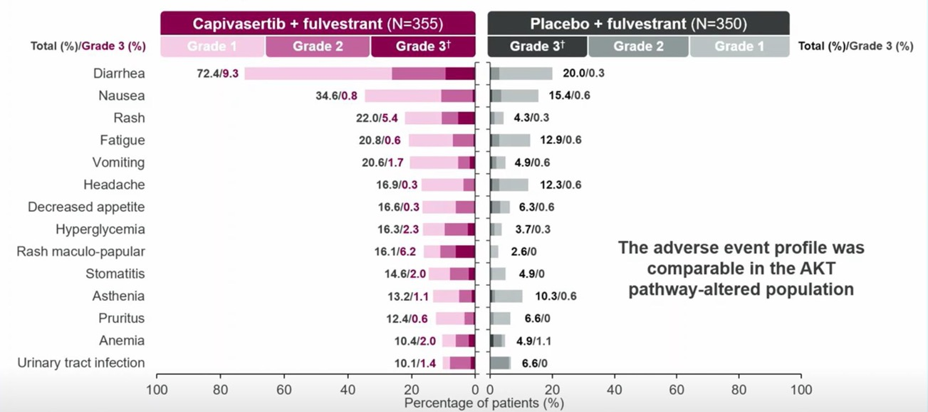
CAPItello-291
Adverse Events
AEs in > 10% of Patients
35% dose interruption; 20% dose reduction and discontinuation rate 13%; 9% due to capivasertib
Turner et al. San Antonio Breast Cancer Symposium (SABCS) 2022; December 6-10, 2022; San Antonio, TX. Presentation GS3-04. Turner et al. N Engl J Med. 2023;388(22):2058-2070.

Slide 56
CAPItello­291: Conclusions
San Antonio Breast Cancer Symposium®, December 6–10, 2022
Capivasertib plus fulvestrant provides a statistically significant and clinically meaningful improvement in PFS in the overall and the AKT pathway­altered population (dual primary)
Benefit from capivasertib was consistent across clinically relevant subgroups, including in:
  patients previously treated with a CDK4/6 inhibitor
  patients with liver metastases
Overall survival follow­up is ongoing
Capivasertib plus fulvestrant safety profile appears consistent with that previously reported, with a relatively low discontinuation rate due to adverse events
Capivasertib plus fulvestrant has the potential to be a future treatment option for patients with HR+ ABC who have progressed on an endocrine-based regimen
Turner et al. San Antonio Breast Cancer Symposium (SABCS) 2022; December 6-10, 2022; San Antonio, TX. Presentation GS3-04. Turner et al. N Engl J Med. 2023;388(22):2058-2070.

Slide 57


Slide 58
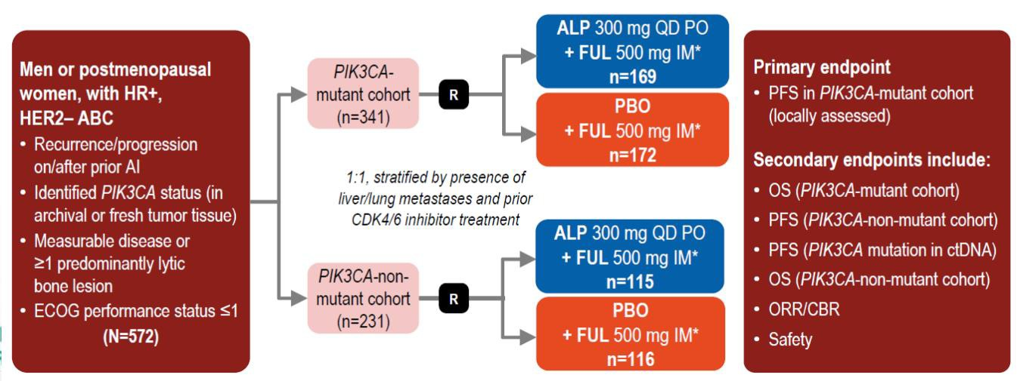
HR+ PIK3CA-Mutated Disease
Alpelisib (BYL-719) Is More ⍺-Specific
SOLAR-1 is a phase 3 randomized trial investigating the addition of alpelisib to fulvestrant in
PIK3CA-mutated HR+/HER2− BC
PIK3CA mutations were detected using an alternative tumour tissue-based companion
diagnostic PCR test for 11 mutations, including the most common hotspots
ALP, alpelisib; AI, aromatase inhibitor; CDK4/6, cyclin-dependent kinase 4/6; ctDNA, circulating tumor DNA; CBR, clinical benefit rate; ECOG, Eastern Cooperative Oncology Group; FUL, fulvestrant;
IM, intramuscular; ORR, objective response rate; OS, overall survival; PBO, placebo; PFS, progression-free survival; PO, oral; QD, once daily.
.André F, et al. N Engl J Med. 2019;380:1929-1940.

Slide 59
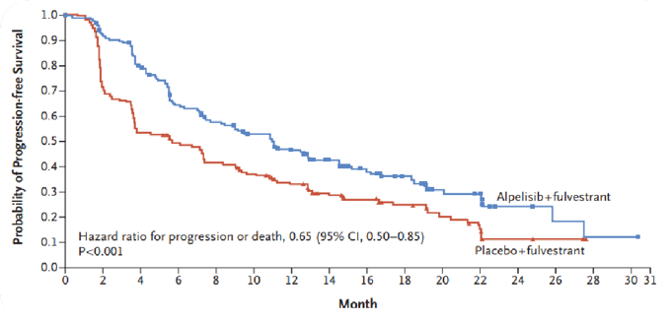
SOLAR-1 (Phase 3): Fulvestrant ± Alpelisib
(Progression on or after AI)
PIK3CA-mutated cohort, n = 341
∆ 5.6 months
Numerical improvement in median OS of 7.9 months in the mutated cohort^{[b]}
Discontinuation rate was 25% in FUL + ALP arm vs 4.2% in the FUL arm^{[a]}
Most common side effects (grade 3): hyperglycemia (36%), rash (10%), and diarrhea (7%)^{[a]}
6% had prior CDK4/6 inhibitor
Median PFS^{[a]}
11.0 months (ALP + FUL) vs 5.7 months (FUL)
HR = 0.65 (95% CI: 0.50, 0.85); P < .001
Andre F, et al. N Engl J Med. 2019;380:1929-1940. Andre F, et al. Ann Oncol. 2021;32:208-217

Slide 60
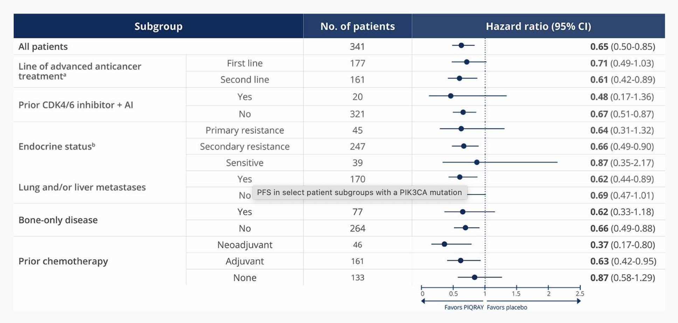
SOLAR-1 (Phase 3): Fulvestrant ± Alpelisib
Consistent PFS was seen across subgroups, including those with prior CDK4/6 inhibitor + AI or primary/secondary endocrine resistance

Slide 61
Alpelisib + ET (Fulvestrant vs Letrozole) in PIK3CA-Mutated ABC
BYLieve
BYLieve is a phase 2 trial assessing alpelisib + ET (fulvestrant or letrozole) in PIK3CA-mutated
HR+/HER2− ABC in the post-CDK4/6i setting
Patients who received CDK4/6i + AI as immediate prior
treatment (n = 112) Cohort A
Men or pre/ postmenopausal women
HR+/HER2− ABC with a PIK3CA mutation
Last line of prior therapy: CDK4/6i + ET, systemic chemotherapy or ET
ECOG PS ≤ 2
Measurable disease (per RECIST v1.1) or
≥ 1 predominantly lytic
bone lesion
Primary endpoint
Proportion of patients alive without PD at 6 months in each cohort
Alpelisib 300 mg QD + fulvestrant 500 mg
Patients who received CDK4/6i + fulvestrant as immediate prior treatment (n = 112)
Cohort B
Secondary endpoints
PFS
PFS2
ORR, CBR, DOR
OS
Safety
Alpelisib 300 mg QD + letrozole 2.5 mg
Patients who progression on/after AI and receive chemotherapy
as immediate prior treatment (n = 112)
Cohort C
Alpelisib 300 mg QD + fulvestrant 500 mg
Treatment crossover between cohorts not permitted
DOR, duration of response; ET, endocrine therapy; PD, progressive disease.
Rugo HS, et al. J Clin Oncol. 2020;38(15_Suppl):1006; Rugo et al Lancet 2021

Slide 62
Lessons Learned From SOLAR-1 and BYLieve Trials
 | SOLAR-1^{[a]} Fulvestrant + Alpelisib | BYLieve Cohort A^{[b]} Fulvestrant + Alpelisib | BYLieve Cohort B^{[c]} Letrozole + Alpelisib
Prior Rx in metastatic setting, % First line | 52 47 - | 70.1 16.5 1.6 | 52.4 44.4 1.6
Prior CDK4/6i, % | 5.3 | 100 | 100
Median PFS, months | 11.0 | 7.3 | 5.7
ORR, % (measurable disease) | 36 | 21 | 18
CBR, % (measurable disease) | 57 | 42 | 32
Decrease in best % change from baseline | 75.9 | 70.1 | 66.3
Median relative dose intensity, % | 82.7 | 89.9 | 87.6
AEs leading to discontinuation (≥ 1.5%), % | 25 | 20.5 | 14.3
Hyperglycemia | 6.3 | 1.6 | 0.8
Rash | 3.2 | 3.9 | 3.2
AE, adverse event; CBR, clinical benefit rate; ORR, overall response rate.
a. André F, et al. N Engl J Med. 2019;380:1929-1940; b. Rugo H, et al. Presented at: 2020 ASCO Annual Meeting; May 29 to May 31, 2020; Virtual. Abstract 1006; c. Rugo H, et al. Presented at: San Antonio Breast Cancer Symposium (SABCS) 2020; December 8-11, 2020; Virtual. Presentation PD2-07.

Slide 63
Selective Estrogen Receptor Down Regulators or Degraders (SERDs)

Slide 64
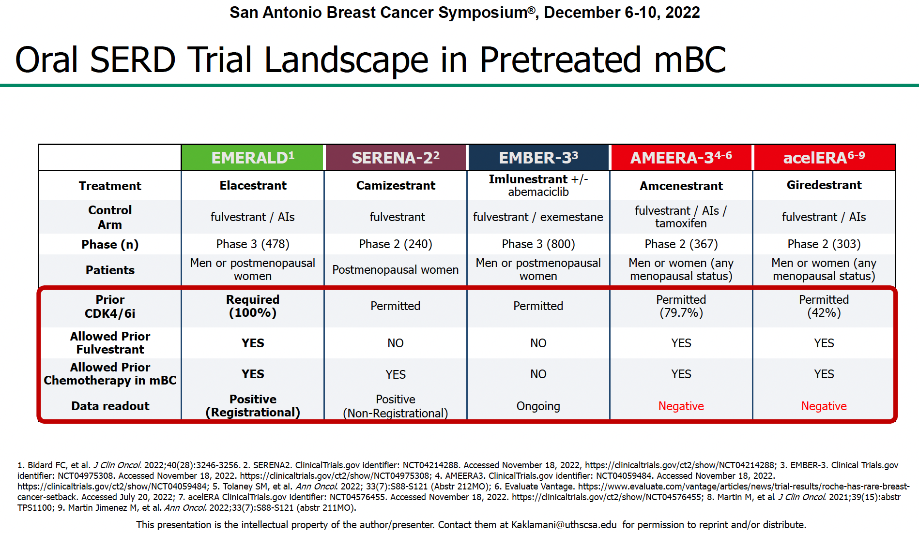

Slide 65
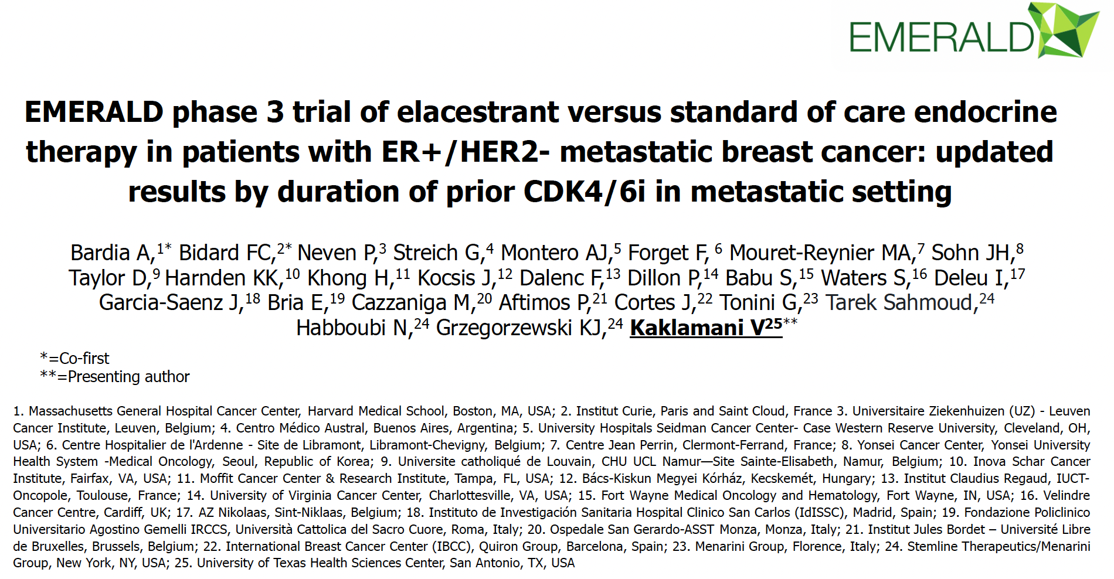

Slide 66
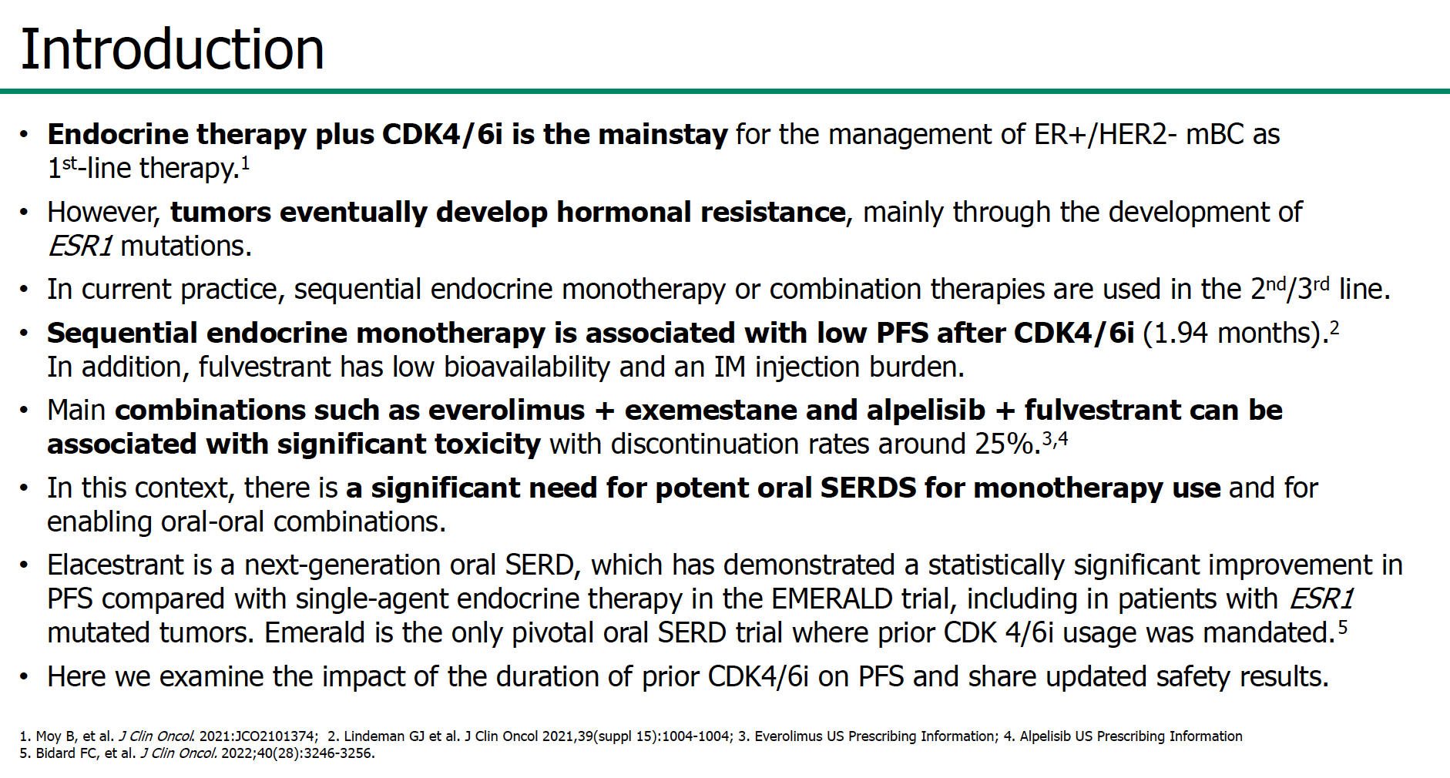

Slide 67
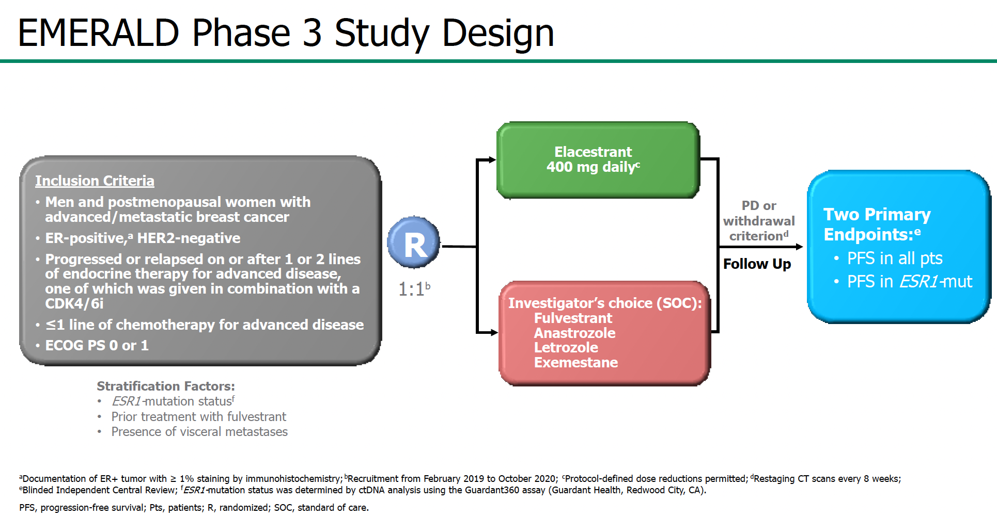

Slide 68
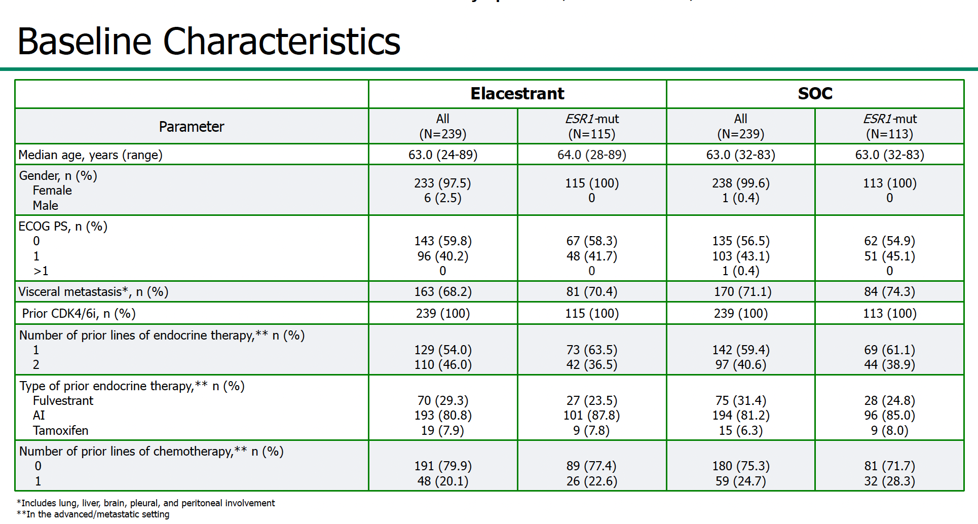

Slide 69
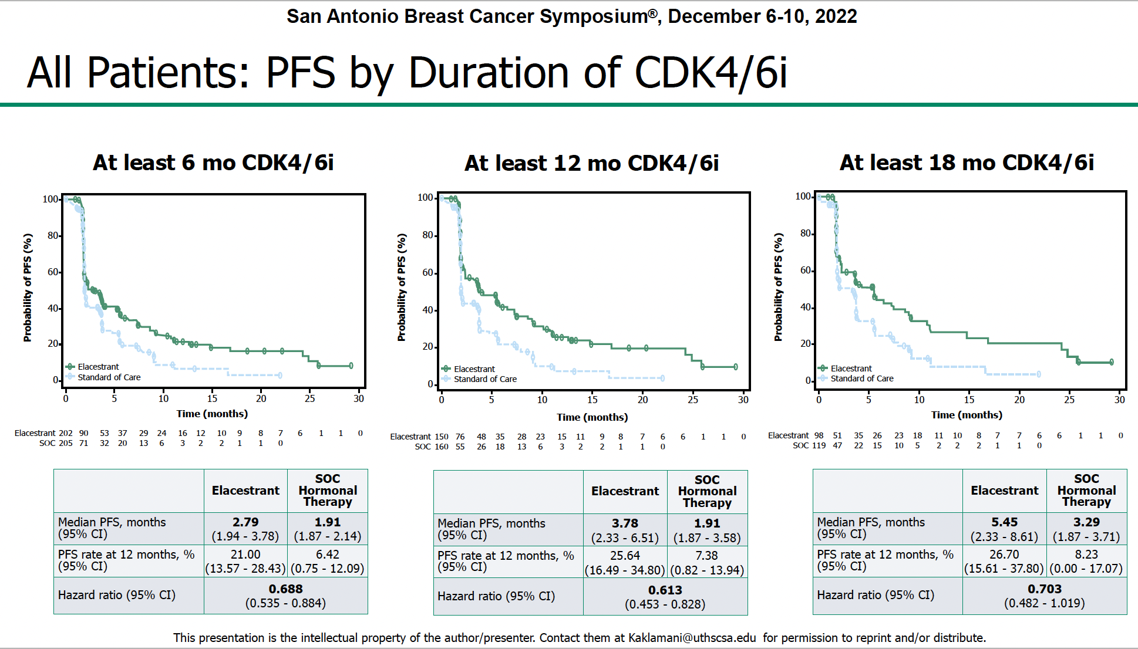

Slide 70
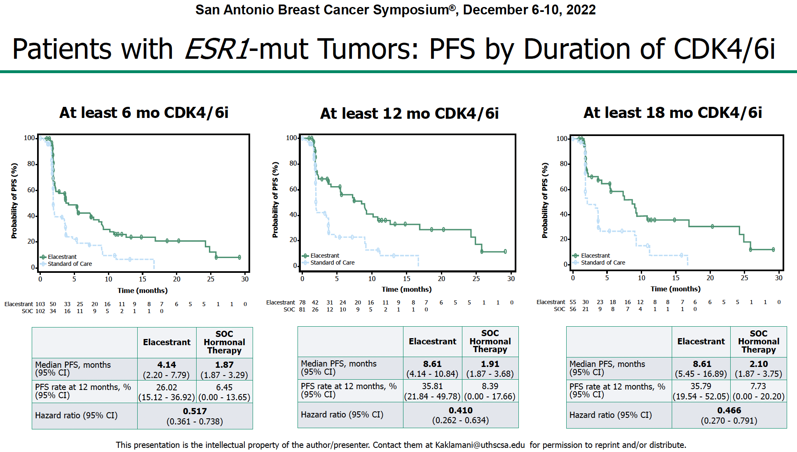

Slide 71
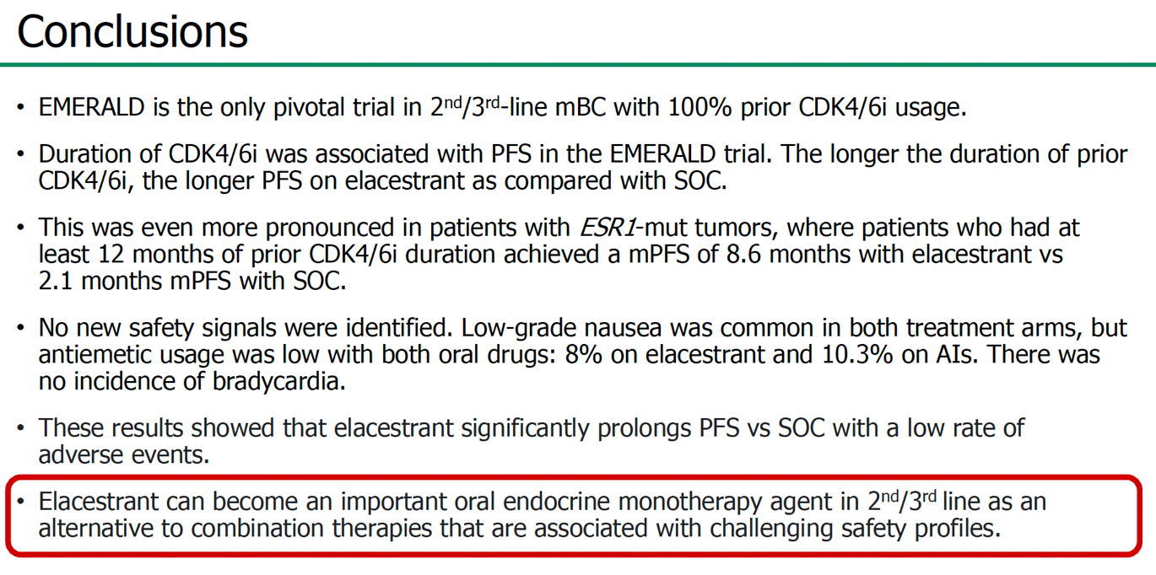

Slide 72
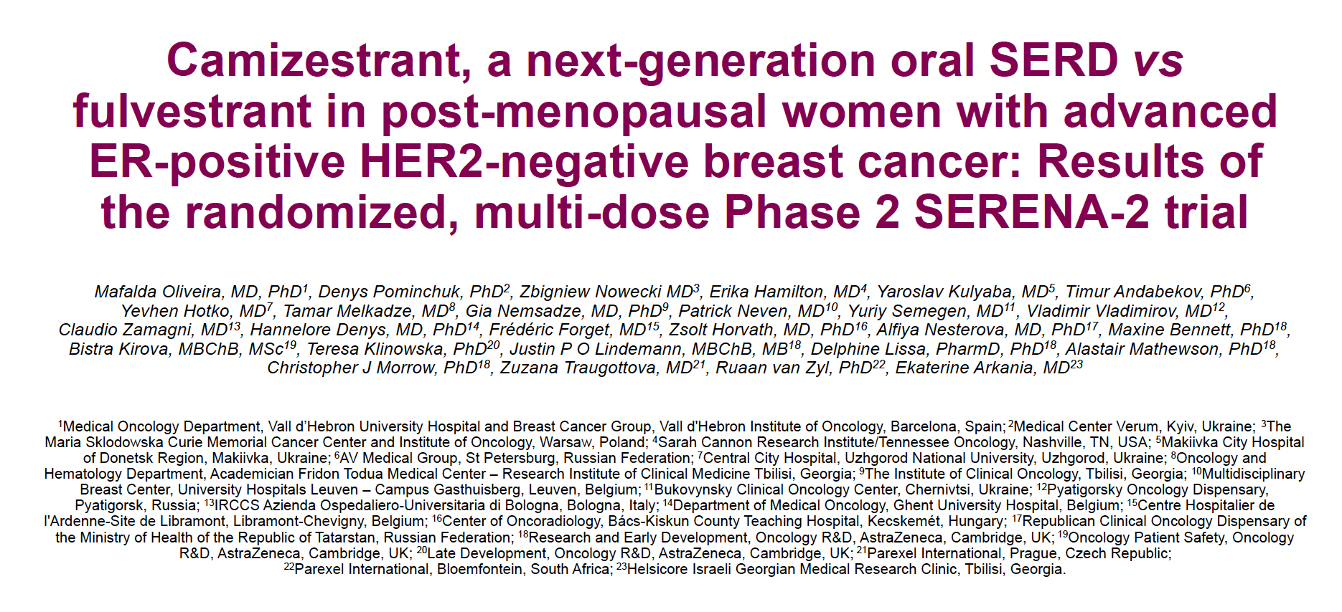

Slide 73
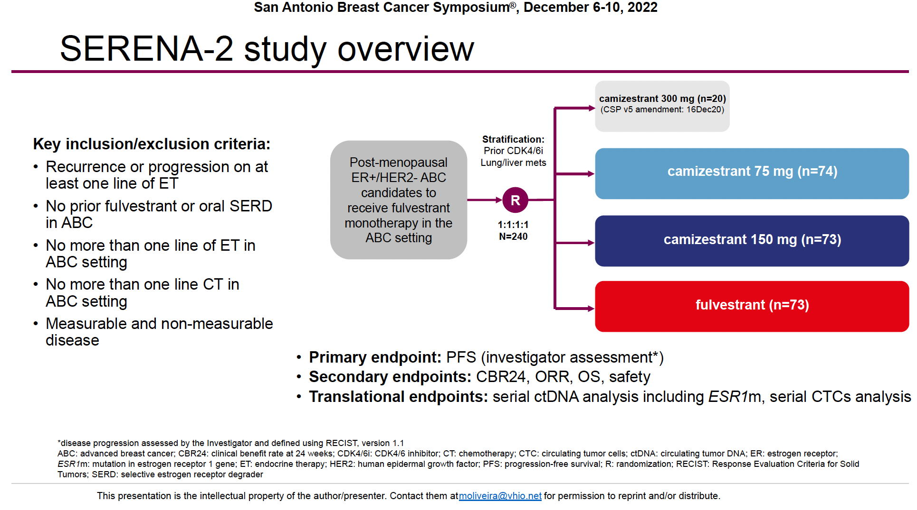
Camizestrant is a next generation oral SERD and pure ER antagonist

Slide 74
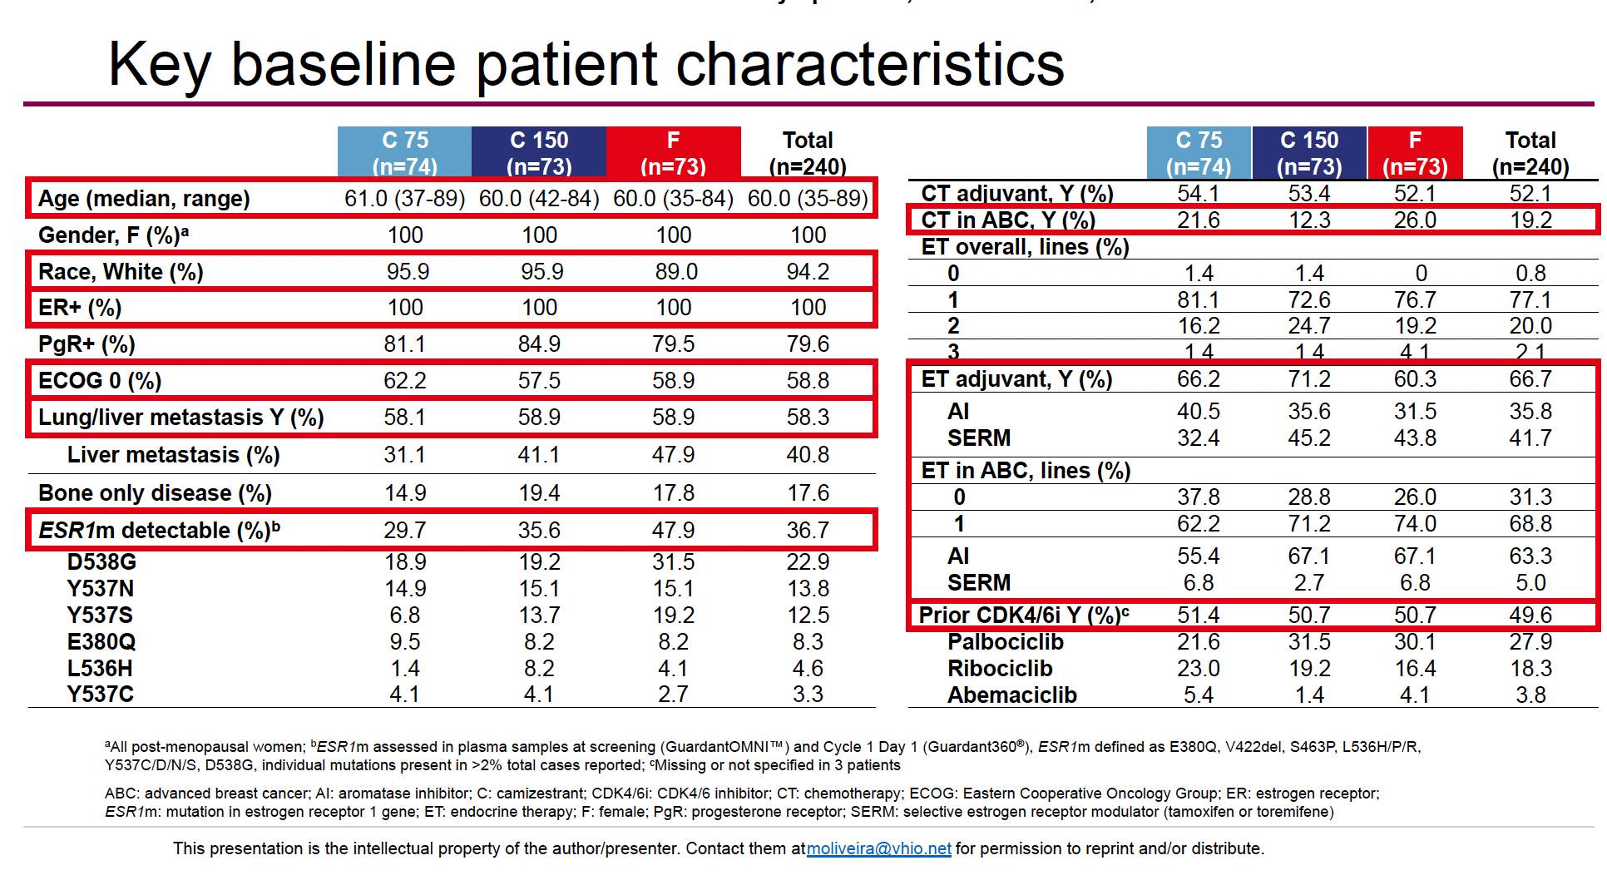

Slide 75
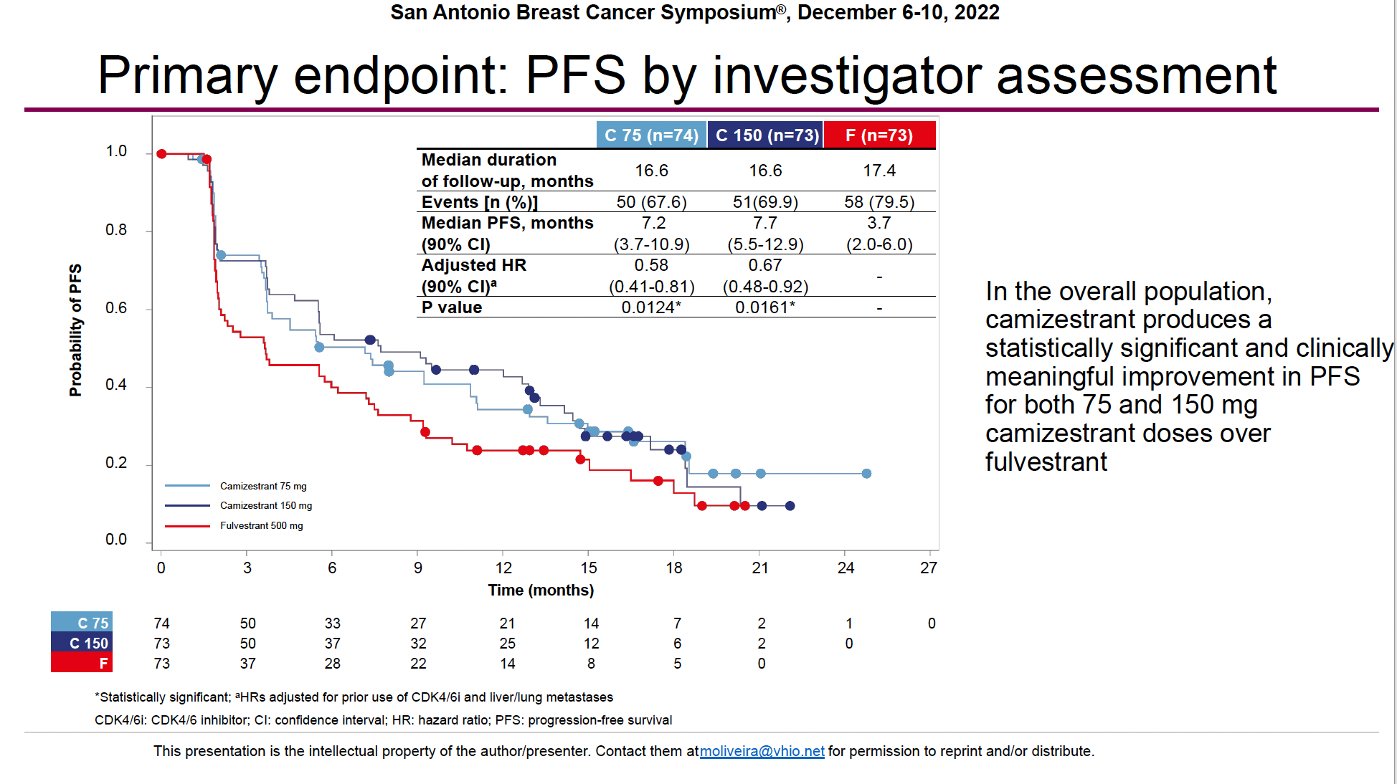

Slide 76
Improved PFS over Fulvestrant in patients previously treated with CDK4/6inh (n=75)
Also improved PFS in patients with lung or liver metastasis
Both doses produced a clinically significant improvement in PFS in patients with detectable ESR1m at baseline

Slide 77
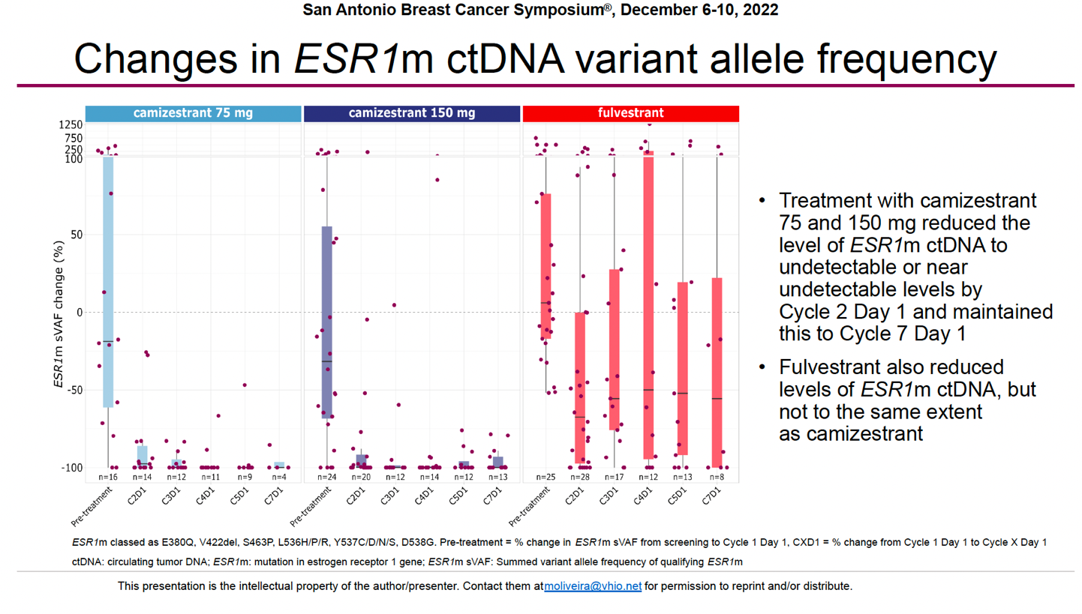

Slide 78
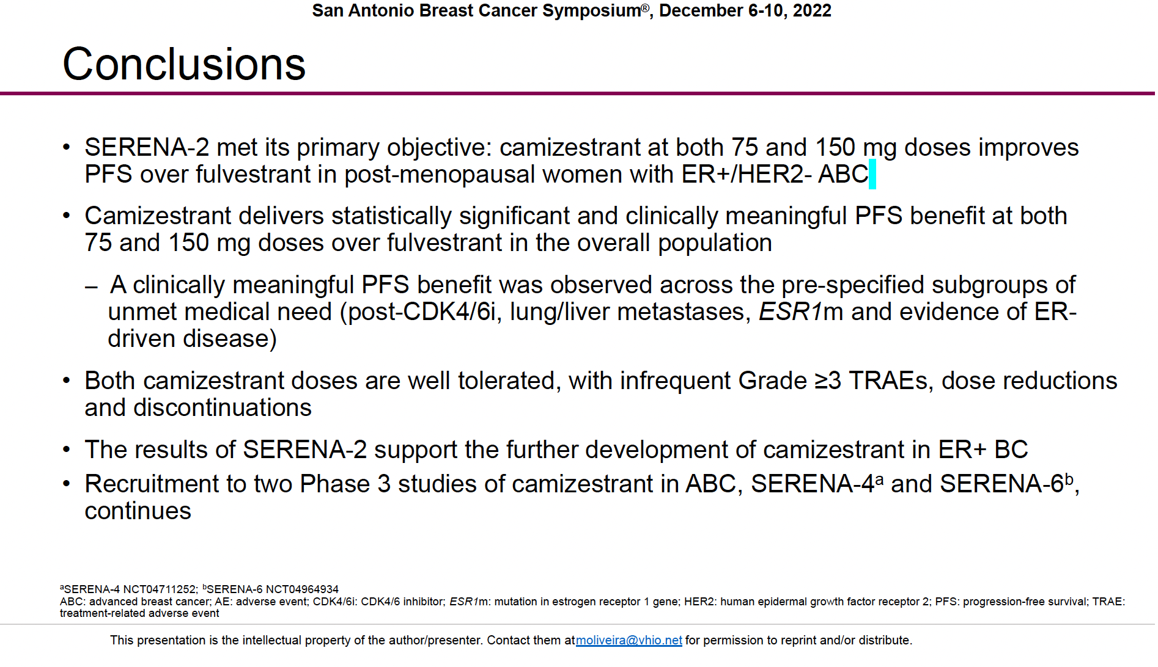

Slide 79
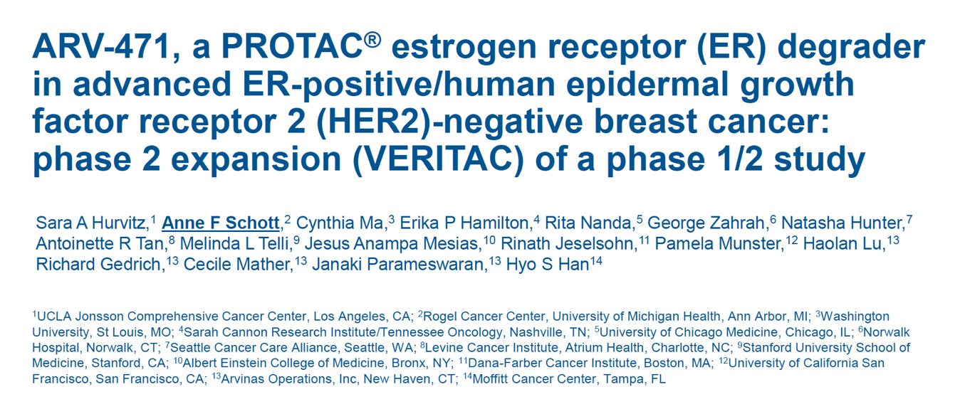

Slide 80
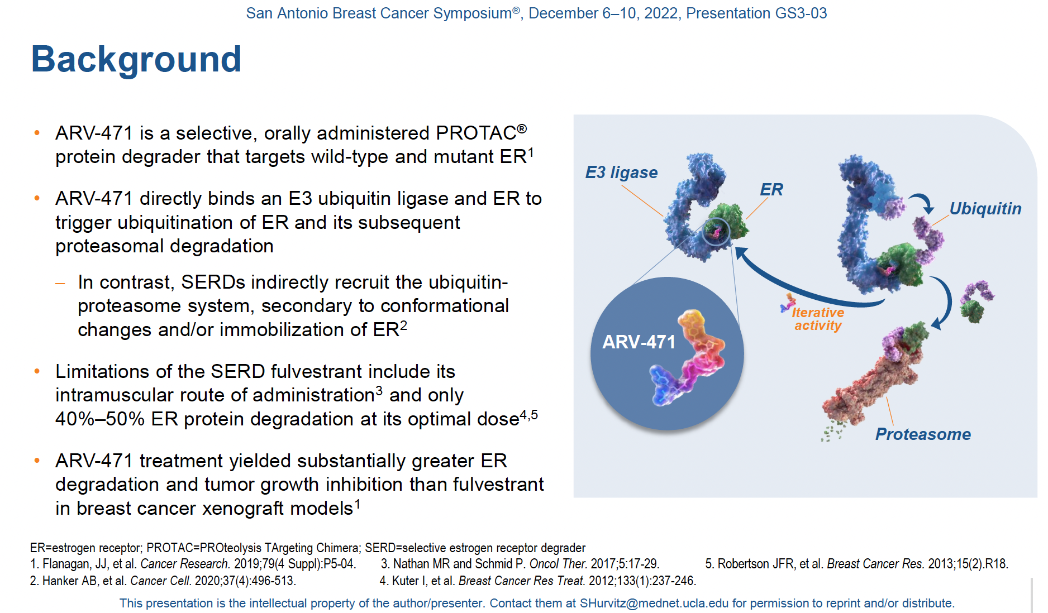

Slide 81
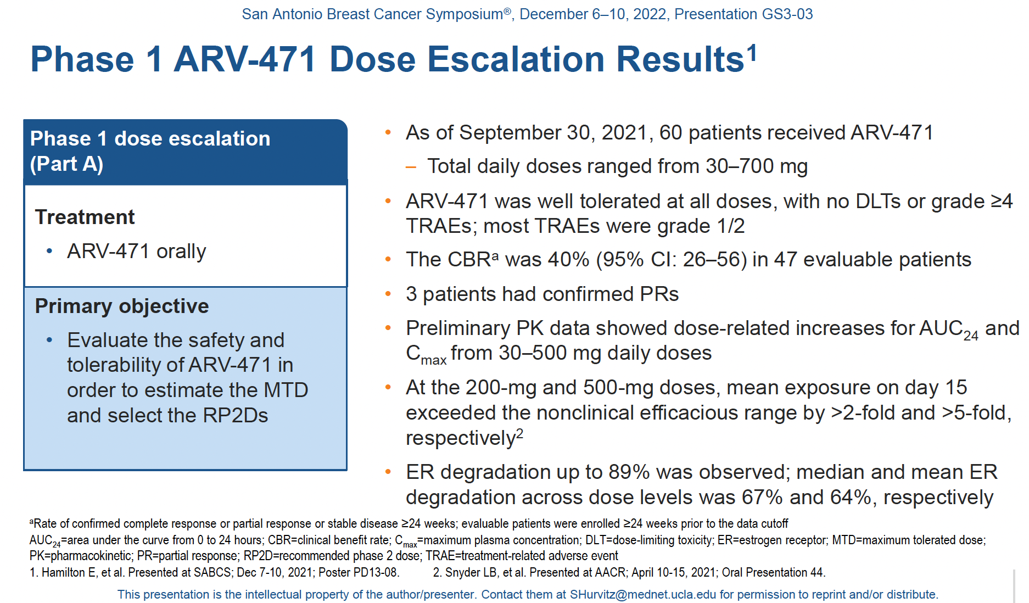

Slide 82
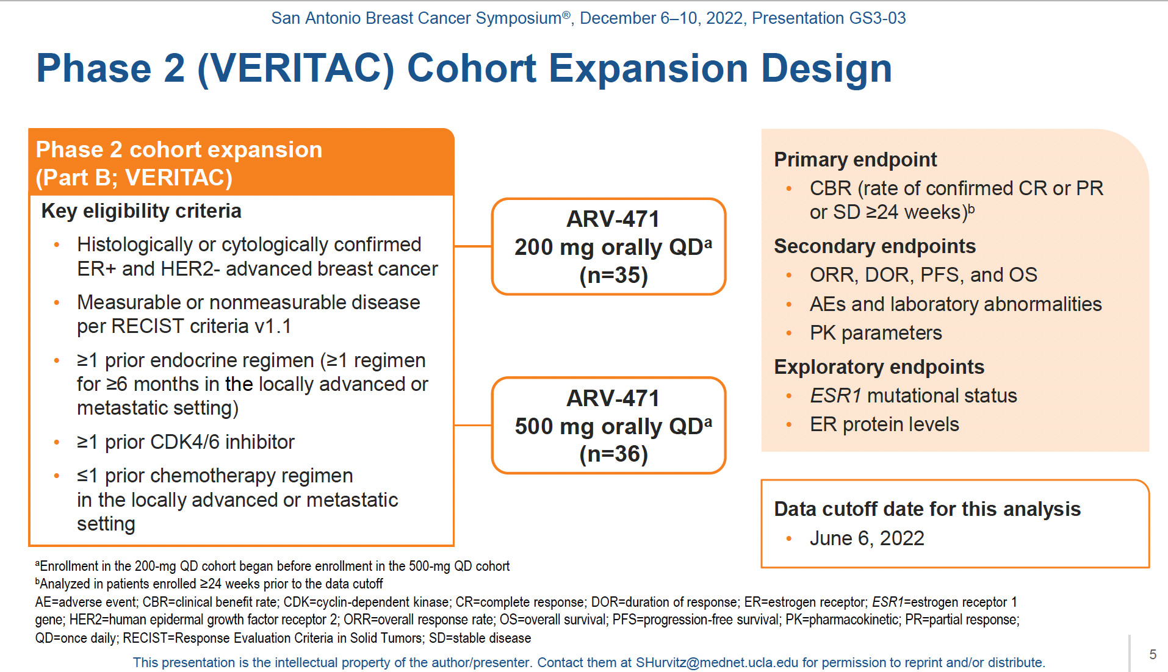

Slide 83
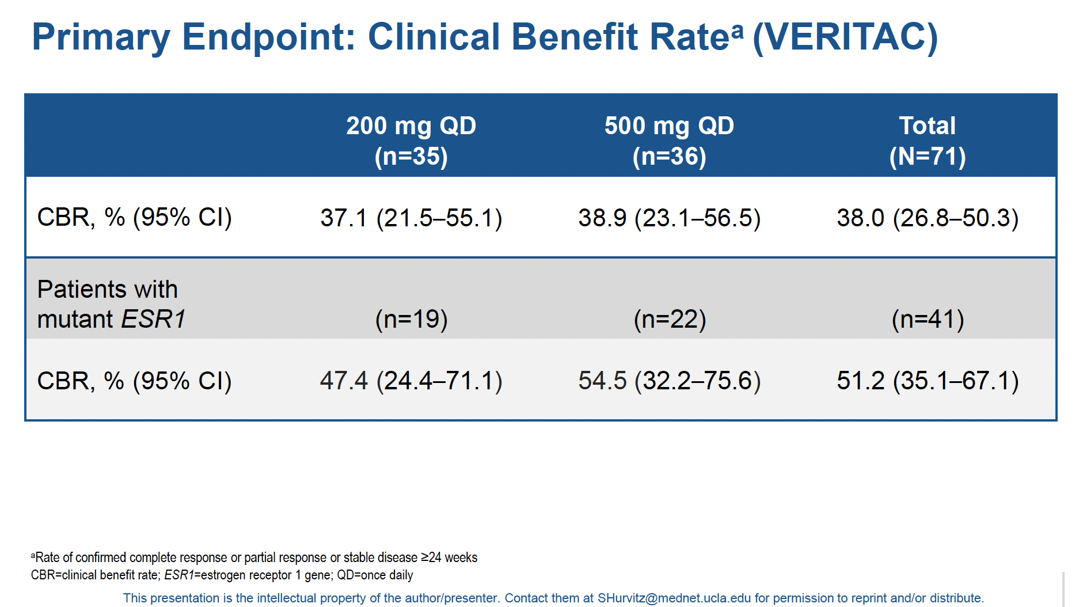

Slide 84
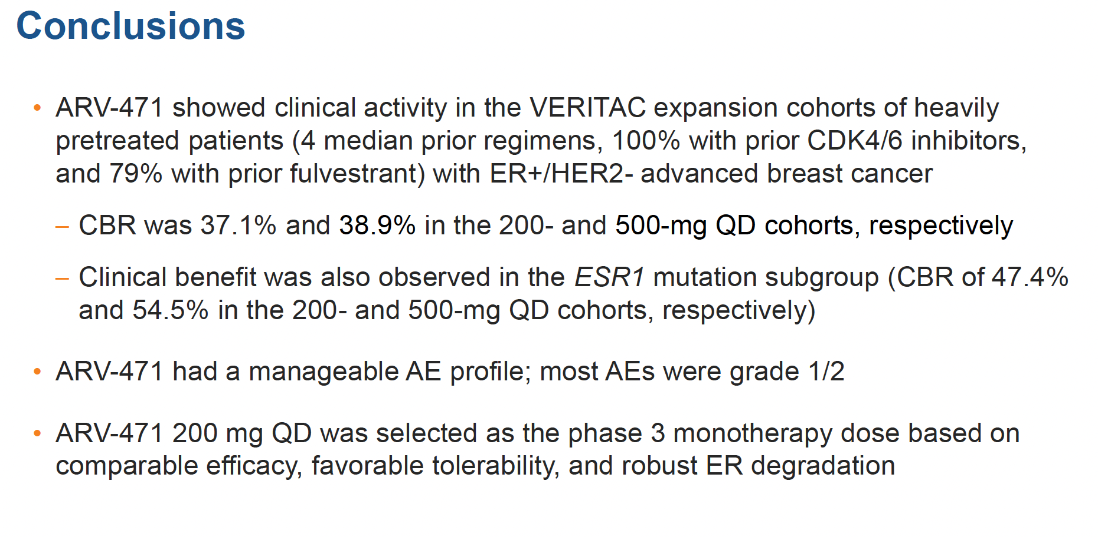

Slide 85
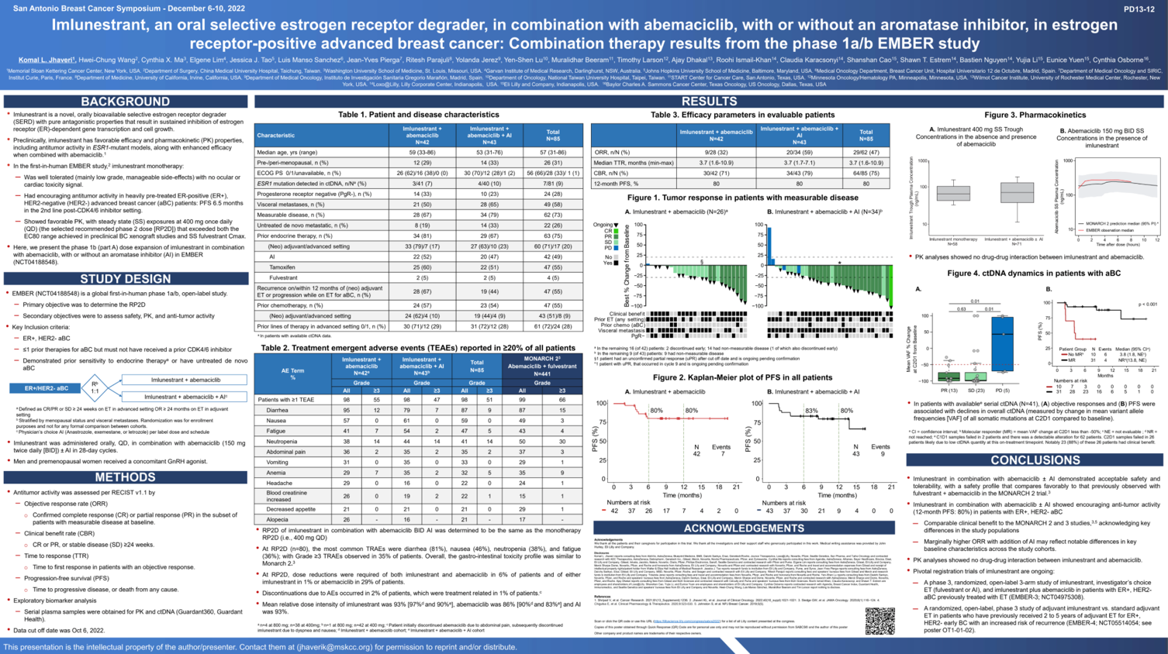

Slide 86
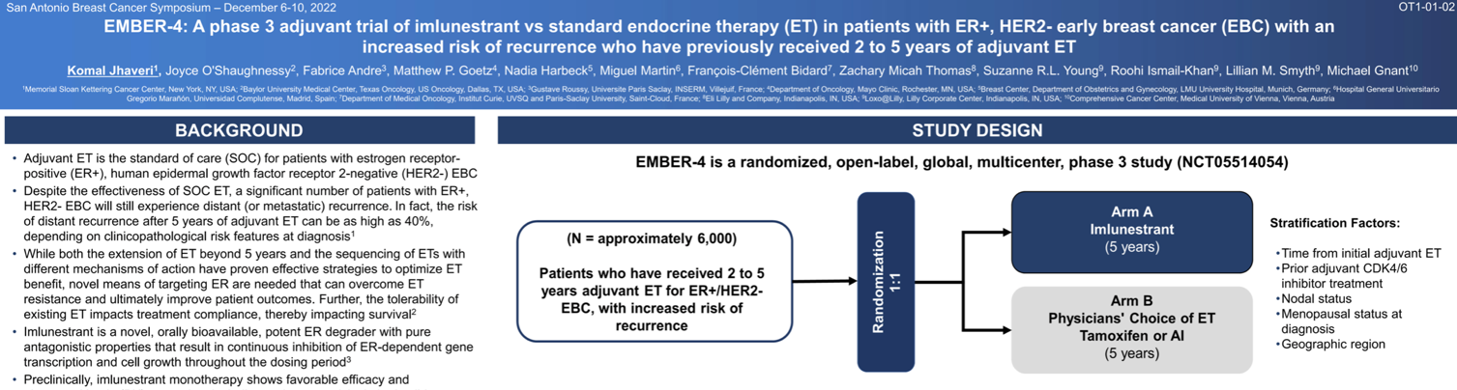

Slide 87
Questions?
Tropics-02
Emerald
ARV-471
Dr. Aixa Soyano
Aixa.Soyano@moffitt.org
Medical Oncologist
Breast Oncology Department

Slide 88
BREAST CANCER
Thursday, August 10, 2023

Slide 89
Question-and-Answer

Slide 90
Networking Reception
We will return at 7:45pm

Slide 91
BREAST CANCER
Thursday, August 10, 2023

Slide 92
Managing HER2+ Early Breast Cancer
Victoria Rizk, MD
Medical Oncologist
Tampa General Hospital Cancer Institute
Tampa, FL

Slide 93
Managing HER2+ Early Breast Cancer
cT1a-b N0
Upfront surgery
Adjuvant Paclitaxel IV weekly x 12 + Herceptin every 3 weeks
to complete 12 months
Neoadjuvant
Chemotherapy
AND
Herceptin + Perjeta*
every 3 weeks
x 4-6 cycles
Adjuvant TDM-1 every 3 weeks x 14 cycles
Residual Disease
cT1c-4 N0-1
Surgery
No Residual Disease
Adjuvant HP to complete 12 months
*Perjeta is usually added for tumors >2cm or node positive
Notes:
Patients with stage I or II HER2-positive cancers may also be appropriate candidates for neoadjuvant therapy if one or more of the following criteria apply:
●The patient desires breast-conserving surgery (BCS) but is not a candidate for BCS or is likely to have a suboptimal cosmetic outcome with BCS due to tumor location or size relative to the size of the patient's breast, and may be a better candidate if neoadjuvant therapy decreases the extent of the cancer.
●The patient has limited axillary nodal involvement by clinical assessment (cN1), for which axillary lymph node dissection would be standard surgical management, but could be a candidate for sentinel lymph node biopsy alone if converted to clinically node-negative (ycN0) with neoadjuvant therapy.
●Surgery must be postponed awaiting consultation with plastic surgery regarding breast reconstruction, results of genetic testing or resolution of an intercurrent illness, including pregnancy, and the patient and treating clinicians do not wish to delay initiation of treatment.
●Postoperative treatment with ado-trastuzumab emtansine (T-DM1) would be considered if the patient were found to have residual invasive disease in the breast or axillary nodes following NACT with single or dual HER2-targeted therapy. (See "Adjuvant systemic therapy for HER2-positive breast cancer", section on 'Patients who were treated with neoadjuvant therapy' and "Adjuvant systemic therapy for HER2-positive breast cancer", section on 'T-DM1'.)

Slide 94
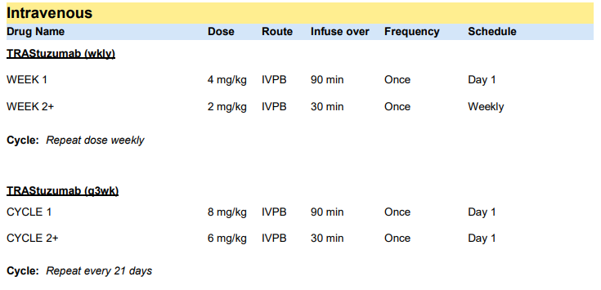

Slide 95
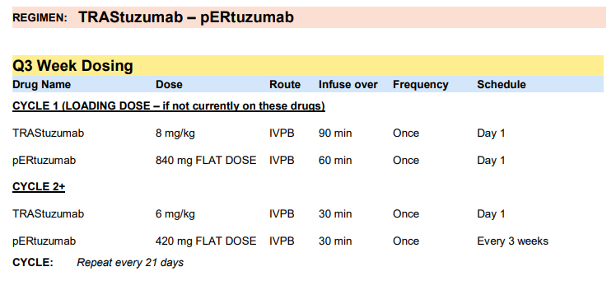

Slide 96
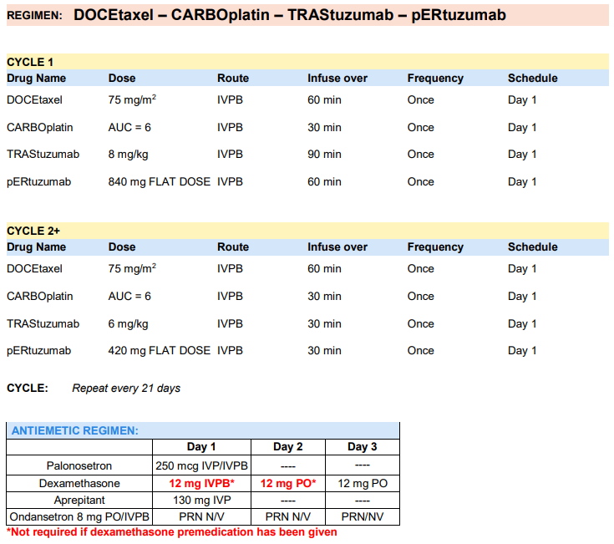

Slide 97
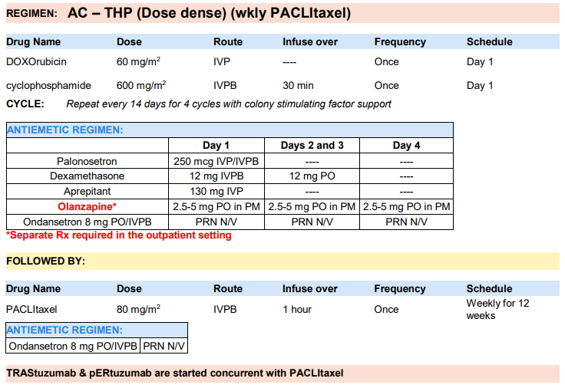

Slide 98
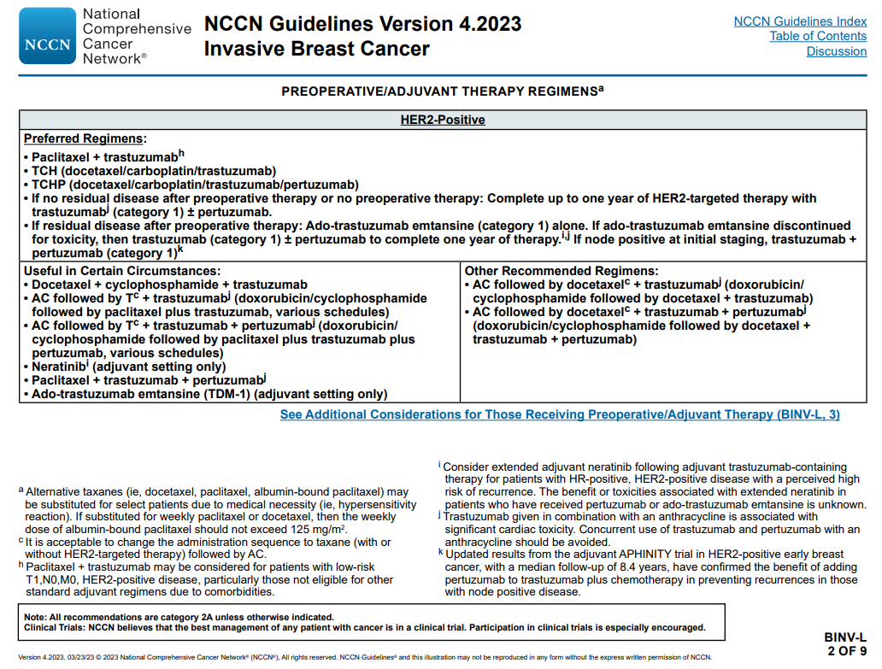

Slide 99
Managing HER2+ Early Breast Cancer
APHINITY (ESMO 22 plenary VP6-2022)
KATHERINE
PHranceSCa
FeDeriCa

Slide 100
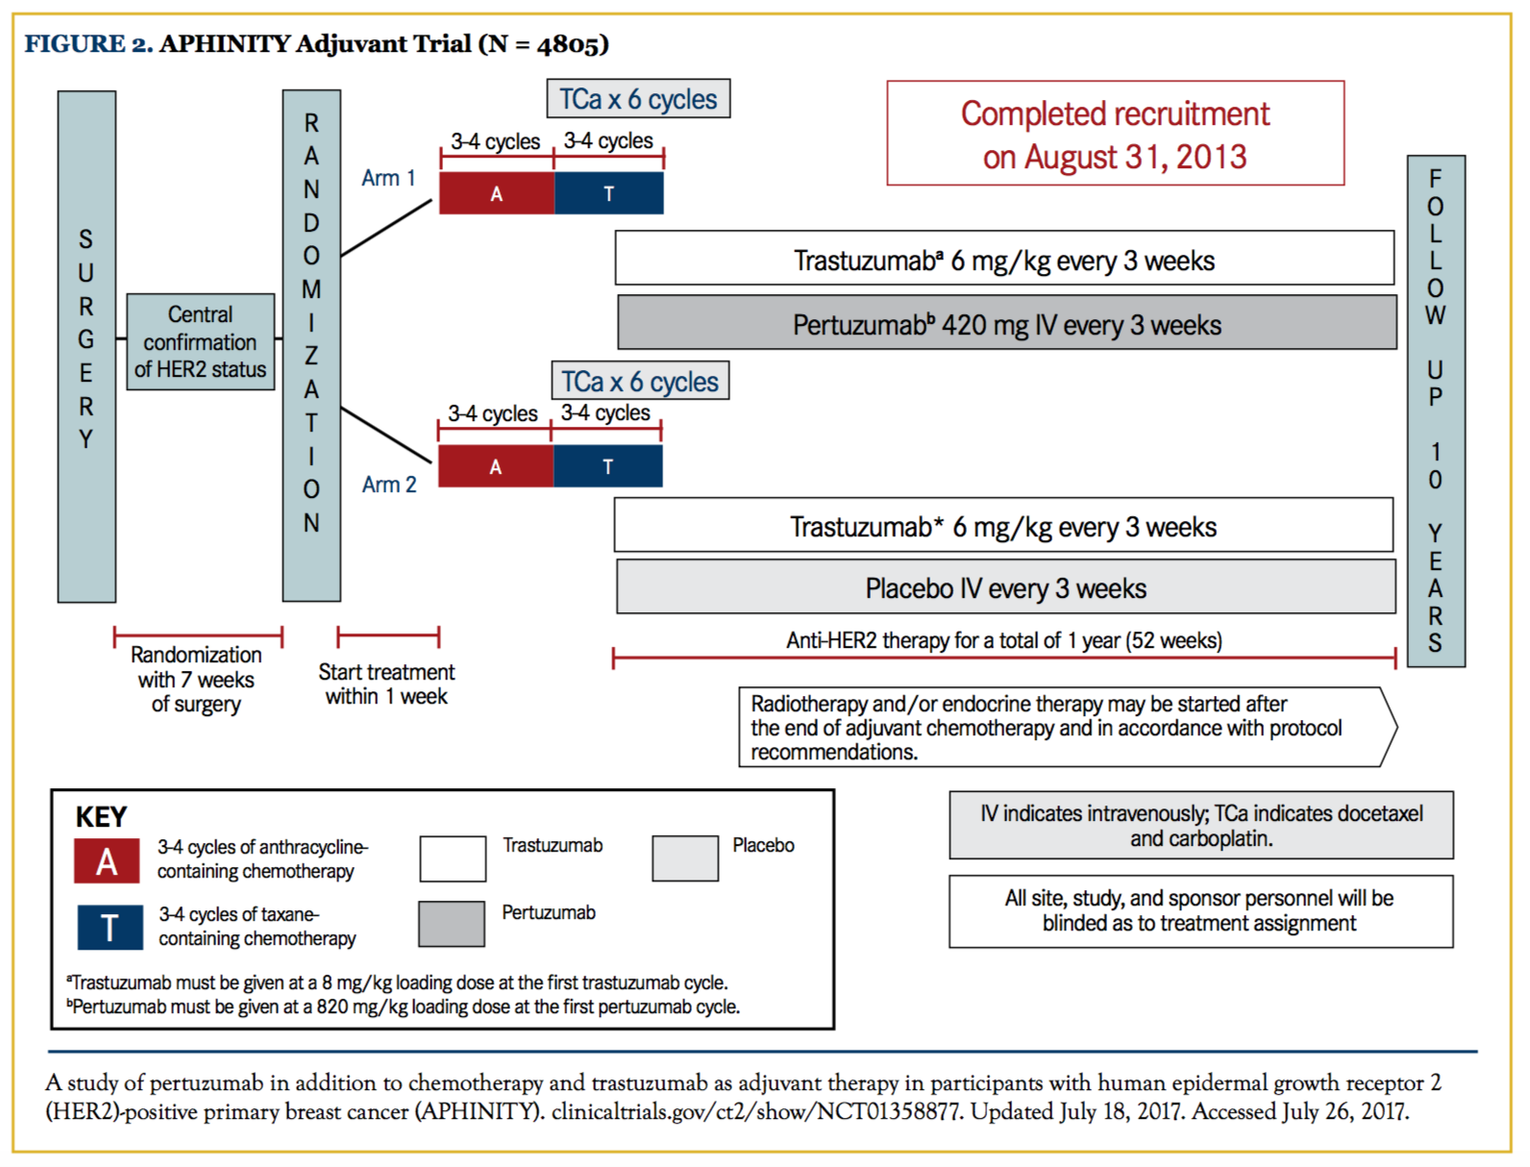
APHINITY TRIAL

Slide 101
APHINITY TRIAL
BACKGROUND
Randomized, phase III, double-blind trial, HER2+, operable breast cancer
2400 patients assigned to receive:
  Pertuzumab added to adjuvant Trastuzumab and chemotherapy
2405 patients assigned to receive:
  Placebo plus Trastuzumab and chemotherapy
INITIAL RESULTS
Primary analysis demonstrated adding PERTUZUMAB to TRASTUZUMAB plus chemotherapy statistically significantly improved invasive disease-free survival
Pre-specified analyses of overall survival did not reach statistical significance

Slide 102
APHINITY TRIAL
Pre-specified analysis of OS and updated descriptive analyses of IDFS
With 8.4 years of median follow-up fewer deaths were observed in the P group [168 (7.0%) vs 202 (8.4%)]. Statistical significance (p-value < 0.0060 required) was not reached.
8-year OS are 92.7% vs 92.0% (0.7% difference)
8-year IDFS are 88.4% vs 85.8% (2.6% difference)
Reduction in distant (6.2% vs 8.5%) and locoregional (1.3% vs 2.4%) breast cancer recurrence

Slide 103
APHINITY TRIAL
RESULTS
The node positive cohort continues to derive clear IDFS benefit from the addition of PERTUZUMAB
The benefit in terms of 8-year IDFS is 4.9% [86.1% vs 81.2%]
  In the node negative cohort, the IDFS hazard ratio is 1.01 with >92% of patients being event-free in both arms at 8 years
  IDFS benefit of PERTUZUMAB is seen in both the HR negative and HR positive cohorts
No new cardiac safety concerns emerged

Slide 104
APHINITY TRIAL
CONCLUSIONS
After 8.4 years of median follow-up, no statistically significant difference in OS was found
IDFS benefit of P in HER2+ early BC is maintained, with the benefit continuing in the Nþ cohort, regardless of HR status
HR status should not guide P treatment decisions
Continued follow up of patients is needed to determine possible survival benefit and long-term safety of adding adjuvant P to T
Final OS analysis is planned when 640 deaths have occurred

Slide 105
KATHERINE TRIAL
Multicenter, randomized, open-label, phase 3
HER2-positive early breast cancer and residual invasive cancer at surgery after completion of neoadjuvant chemotherapy plus HER2-targeted therapy
  Clinical tumor stage T1 to T4, nodal stage N0 to N3, and no evidence of metastasis M0
  Excluding clinical stage T1aN0 or T1bN0
Compared adjuvant T-DM1 vs trastuzumab
Notes:
Among patients with human epidermal growth factor receptor 2 (HER2)–positive early breast cancer who have received neoadjuvant chemotherapy plus HER2-targeted therapy and are then found to have residual invasive disease at surgery, the risk of disease recurrence or death is higher than the risk among patients with a pathological complete response. KATHERINE trial compared adjuvant T-DM1 with trastuzumab in patients who had HER2-positive early breast cancer and residual invasive cancer at surgery after completion of neoadjuvant chemotherapy plus HER2-targeted therapy.

Slide 106
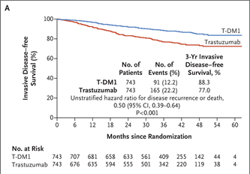
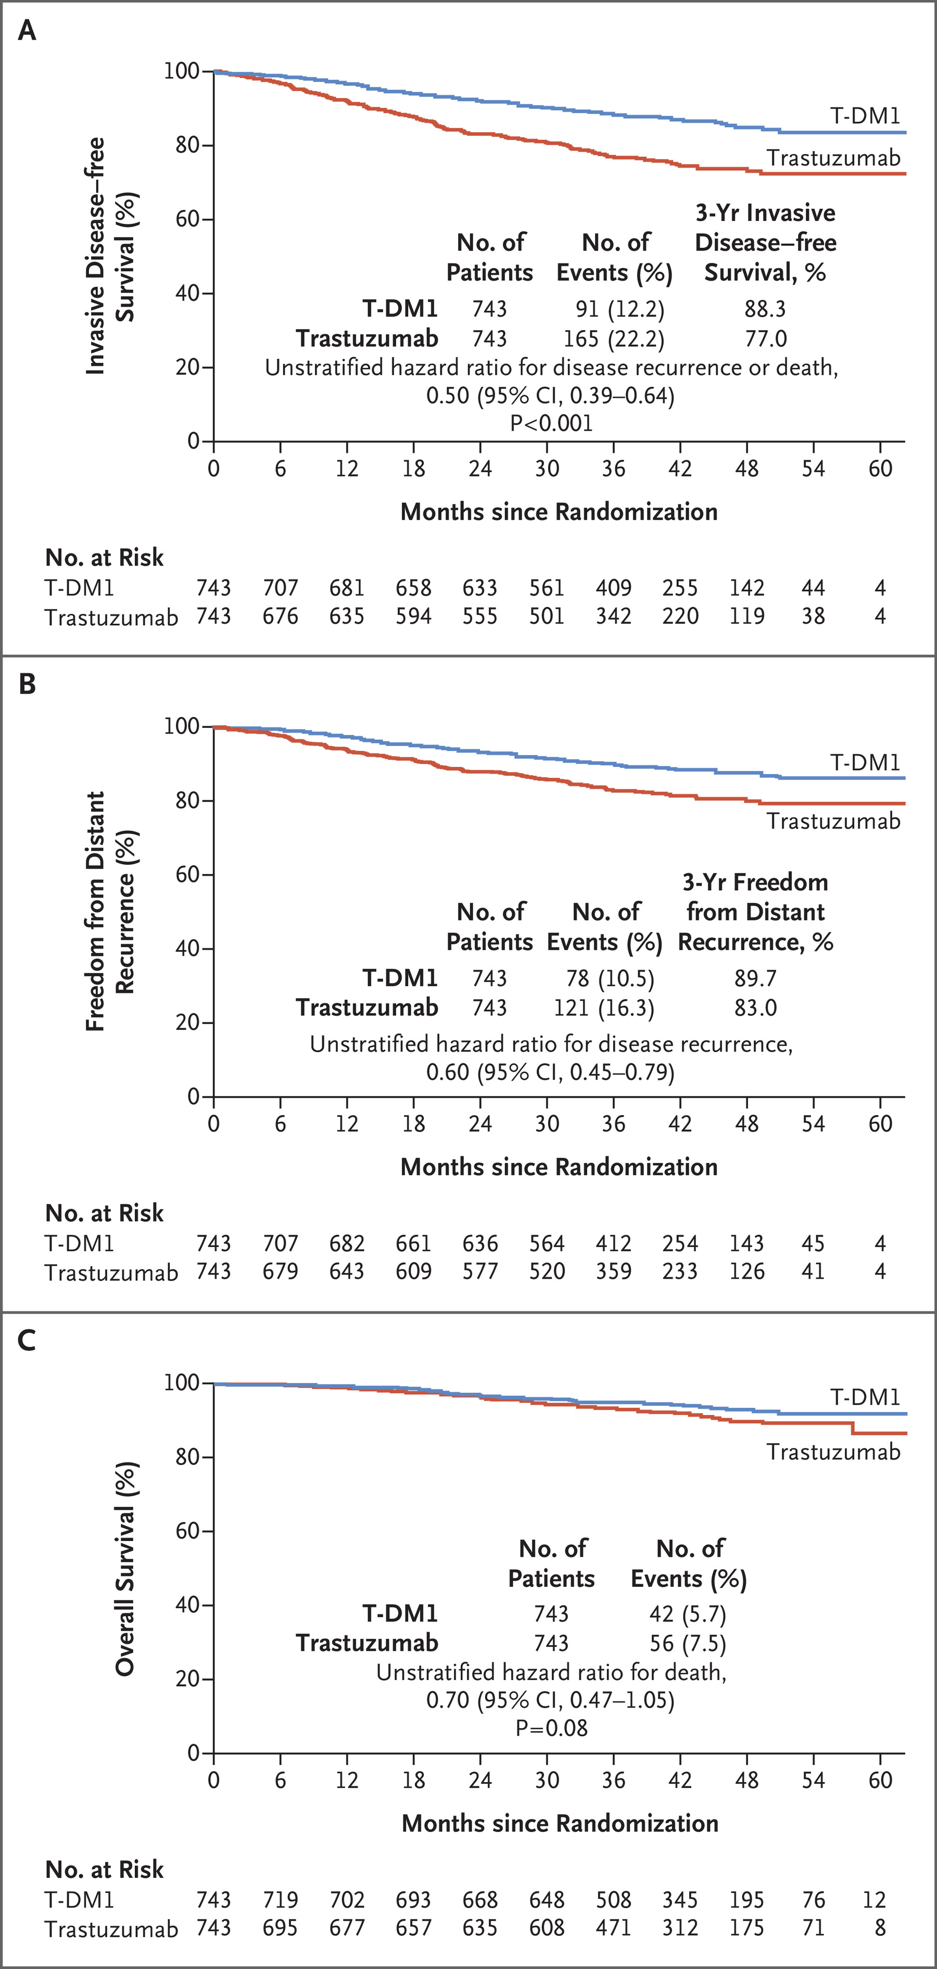
KATHERINE TRIAL
Notes:
Among patients with human epidermal growth factor receptor 2 (HER2)–positive early breast cancer who have received neoadjuvant chemotherapy plus HER2-targeted therapy and are then found to have residual invasive disease at surgery, the risk of disease recurrence or death is higher than the risk among patients with a pathological complete response. KATHERINE trial compared adjuvant T-DM1 with trastuzumab in patients who had HER2-positive early breast cancer and residual invasive cancer at surgery after completion of neoadjuvant chemotherapy plus HER2-targeted therapy.

Slide 107
KATHERINE TRIAL
Notes:
Among patients with human epidermal growth factor receptor 2 (HER2)–positive early breast cancer who have received neoadjuvant chemotherapy plus HER2-targeted therapy and are then found to have residual invasive disease at surgery, the risk of disease recurrence or death is higher than the risk among patients with a pathological complete response. KATHERINE trial compared adjuvant T-DM1 with trastuzumab in patients who had HER2-positive early breast cancer and residual invasive cancer at surgery after completion of neoadjuvant chemotherapy plus HER2-targeted therapy.

Slide 108
PHranceSCa TRIAL
Preference for the fixed-dose combination of pertuzumab and trastuzumab for subcutaneous injection in patients with HER2-positive early breast cancer
Background
  A subcutaneous fixed-dose combination of P + H may offer pts less invasive, faster administration vs intravenous P + H
  Open-label, randomised cross-over study evaluating pt preference and satisfaction with PH FDC SC vs PH IV.

Slide 109
PHranceSCa TRIAL
Methods:
Pts with HER2+ BC who completed neoadjuvant therapy with P + H + chemotherapy and had surgery are enrolled and 1:1 randomised
  Group A: 3 cycles of PH IV every 3 weeks then 3 cycles of PH FDC SC q3w
  Group B: 3 cycles of PH FDC SC q3w then 3 cycles of PH IV q3w.
Pts then choose PH FDC SC or PH IV to complete anti-HER2 therapy up to 18 cycles

Slide 110
PHranceSCa TRIAL
Results
  118 patients randomised (Group A, n ¼ 56; Group B, n ¼ 62). All were female; median age was 49 years. 42/51 pts (82%) who completed the cross-over therapy preferred PH SQ
  Main reasons for PH SQ preference
    “less time in clinic” (n ¼ 38)
    “more comfortable therapy administration” (n ¼ 22).
  46/51 (90%) pts were “very satisfied” or “satisfied” with PH FDC SC vs 34/51 (67%) with PH IV
  84% patients chose PH SQ to complete their therapy

Slide 111
PHranceSCa TRIAL
Results
  81/116 pts had 1 adverse event (AE), 1 had a serious AE (PH IV; pyrexia) and 5 had a Grade 3 AE (PH FDC SC, n ¼ 3: ejection fraction [EF] decrease, diarrhoea, device-related infection; PH IV, n ¼ 2: EF decrease, lymphopenia); there were no deaths and no AEs led to study discontinuation. 16/116 (13.8%) pts had diarrhoea, mainly low grade.
  Systemic administration-related reaction rates were 2/116 (1.7%) for PH FDC SC and 3/116 (2.6%) for PH IV. 21/116 (18.1%) pts had local injection site reactions; there were no local infusion-related reactions.

Slide 112
PHranceSCa TRIAL
Conclusions:
82% of pts preferred PH FDC Subcutaneous
PH FDC SC was generally well tolerated; the safety profile was consistent with PH IV and no new safety signals were seen

Slide 113
Antibody-Drug Conjugates (ADCs) in
HER2+ Metastatic Breast Cancer
Victoria Rizk, MD
Medical Oncologist
Tampa General Hospital Cancer Institute
Tampa, FL

Slide 114
Antibody-Drug Conjugates (ADCs) in HER2+ Breast Cancer
DESTINY-Breast02 (SABCS 22 abstr GS2-01)
DESTINY-Breast03 (SABCS 22 abstr GS2-02)
TROPiCS-02 (SABCS 22 GS1-11)

Slide 115
DESTINY-Breast 02 (SABCS 22 abstract GS2-01)
Trastuzumab deruxtecan (Enhertu) vs trastuzumab emtansine (T-DM1) for HER2+ MBC
Patients with HER2 positive unresectable and/or metastatic breast cancer previously treated with trastuzumab and a taxane
Enhertu demonstrated a statistically significant and clinically meaningful improvement in overall survival compared to T-DM1

Slide 116
DESTINY-Breast 02 (SABCS 22 abstr GS2-01)
Enhertu demonstrated a 64% reduction in the risk of disease progression or death in patients with HER2 positive unresectable and/or metastatic breast cancer previously treated with T-DM1 compared to physician’s choice of treatment (trastuzumab plus capecitabine or lapatinib plus capecitabine)
Most common grade 3 adverse events in the ENHERTU arm:
  Decreased neutrophil count (10.6%), anemia (7.9%), neutropenia (7.7%), nausea (6.7%) and asthenia (5.0%)
  ILD or pneumonitis (10.4%)
    Majority low grade (grade 1 or grade 2)

Slide 117
DESTINY-Breast03 (SABCS 22 Abstract GS2-02)
Global, head-to-head, randomized, open-label, pivotal phase 3 trial
Evaluating the efficacy and safety of ENHERTU (5.4 mg/kg) versus T-DM1 in patients with HER2 positive unresectable and/or metastatic breast cancer previously treated with trastuzumab and a taxane
Primary efficacy endpoint
  Progression free survival
Secondary endpoints
  Overall survival
  Objective response rate

Slide 118
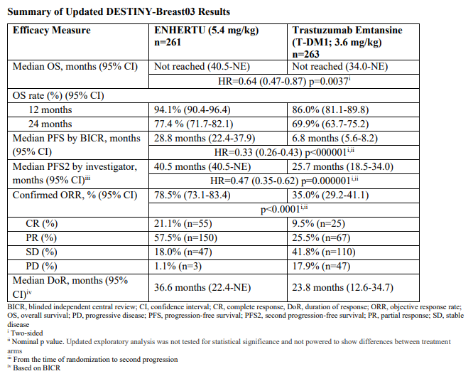
DESTINY-Breast03 (SABCS 22 Abstract GS2-02)

Slide 119
TROPiCS-02 (SABCS 22 GS1-11)
Randomized phase 3 study of sacituzumab govitecan (SG) versus treatment of physician’s choice in patients with HR+/HER2 negative advanced breast cancer
Background
  HR+/HER2– disease is the most common subtype of metastatic breast cancer
  Treatment includes sequential endocrine therapy combined with targeted agents followed by single-agent chemotherapy, with increasingly shorter durations of benefit
  SG is an anti–Trop-2 antibody-drug conjugate approved for metastatic triple-negative breast cancer with ≥2 prior therapies (≥1 for MBC)
  TROPiCS-02 is a phase 3 randomized study to confirm SG outcomes in HR+/HER2– advanced breast cancer

Slide 120
TROPiCS-02 (SABCS 22 GS1-11)
Results
272 vs 271 pts were randomized to receive SG vs TPC
Pt characteristics in the SG vs TPC arms were similar
  3 median prior chemotherapy regimens for MBC [range: 0-8]
  95% had visceral metastases
  86% had prior endocrine therapy for MBC for ≥6 mo
  60% and 38% received prior CDK4/6 inhibitors for ≤12 and > 12 mo, respectively

Slide 121
TROPiCS-02 (SABCS 22 GS1-11)
Results
SG vs TPC improved median PFS (5.5 vs 4.0 mo; HR, 0.66; 95% CI, 0.53-0.83; P= 0.0003)
  PFS rates at 6 and 12 mo were 46% vs 30% and 21% vs 7%, respectively
SG vs TPC showed a numeric but nonsignificant difference in OS (13.9 vs 12.3 mo; HR, 0.84; P= 0.143)
ORR (21% vs 14%) and clinical benefit rate (34% vs 22%) were higher with SG vs TPC
Median duration of response was 7.4 vs 5.6 months

Slide 122
TROPiCS-02 (SABCS 22 GS1-11)
Results
74% vs 60% of patients (SG vs TPC) had grade ≥3 treatment-emergent adverse events
  Neutropenia (51% vs 39%)
  Diarrhea (10% vs 1%)
1 treatment-related death in the SG arm; 0 in the TPC arm

Slide 123
TROPiCS-02 (SABCS 22 GS1-11)
Conclusions
  Sacituzumab Govitecan had a statistically significant, clinically meaningful PFS benefit over single-agent chemotherapy and a manageable safety profile in pts with heavily pre-treated HR+/HER2– endocrine-resistant, unresectable locally advanced or MBC

Slide 124
Questions?
THANK YOU!

Slide 125
BREAST CANCER
Thursday, August 10, 2023

Slide 126
Updates in Triple Negative Breast Cancer and Immunotherapy
Avan Armaghani, MD, FACP
Assistant Member
Department of Breast Oncology
Moffitt Cancer Center
August 10, 2023

Slide 127
Triple Negative Breast Cancer: Overview
Accounts for approximately 15% of all breast cancers diagnosed
Aggressive phenotype
Therapy options have expanded
  Chemotherapy
  Immunotherapy
  PARP-inhibitors
  Anti-body drugs conjugates (ADCs)
Notes:
Aggressive phenotype

Slide 128
Neoadjuvant Therapy
Immunotherapy + Chemotherapy new SOC Stage II-III TNBC
Can we de-escalate therapy?
Future Directions

Slide 129
Keynote-522
Neoadjuvant
Adjuvant
Key Eligibility Criteria
Age ≥18 years
Newly diagnosed TNBC of either T1c N1-2 or T2-4 N0-2
ECOG PS 0-1
Tissue sample for PD-L1 assessment
Carboplatin + Paclitaxel
Doxo/Epirubicin + Cyclophosphamide
S
U
R
G
E
R
Y
Pembrolizumab
200mg Q3W
Pembrolizumab 200mg Q3W
R
2:1
Placebo
Carboplatin + Paclitaxel
Doxo/Epirubicin + Cyclophosphamide
Placebo
Stratification Factors:
Nodal Status (+ vs -)
Tumor Size (T1/T2 vs T3/T4)
Carboplatin schedule
Primary Endpoints:
pCR (ypT0/Tis ypN0) in ITT
EFS in ITT
Schmid et al. NEJM 2020
Notes:
Original data presented in 2020 that
Stratification Factors:
Chemotherapy on study (taxane or gemcitabine-carboplatin)
PD-L1 tumor expression (CPS >/=1 or CPS </+1
Prior treatment with same class chemotherapy in the neoadjuvant or adjuvant setting (yes or no)
Patients who completed treatment for stage I, II or III breast cancer were eligible if at least 6 months had elapsed between completion of treatment with curative intent and the first documented local or distant disease recurrence.

Slide 130

KEYNOTE-522: Results EFS
84.5%
76.8%
Schmid et al. NEJM 2022
Notes:
Median follow-up 39.1mo

Slide 131

Schmid et al. NEJM 2022
Notes:
PD-L1 status did not predict pCR.
64.8% v 51.2%

Slide 132
Neoadjuvant Therapy
Immunotherapy + Chemotherapy new SOC Stage II-III TNBC
Can we de-escalate therapy?
Future Directions

Slide 133
NeoPACT
S
U
R
G
E
R
Y
Neoadjuvant (18 weeks)
Stage I-III TNBC
T >1cm or N+
ER/PR ≤10%
N = 120
Carboplatin (AUC 6) q21days x6 cycles
Adjuvant therapy at provider discretion
Docetaxel (75mg/m2) q21 days x6 cycles
Pembrolizumab 200mg q21days x6 cycles
Secondary Endpoints
RCB
EFS, OS, Safety
pCR = 60%
RCB 0+1 = 71%
Primary Endpoints:
pCR
Sharma et al. ASCO 2022 Abstract
Notes:
No adjuvant pembrolizumab per study protocol

Slide 134
Neoadjuvant Therapy
Immunotherapy + Chemotherapy new SOC Stage II-III TNBC
Can we de-escalate therapy?
Future Directions

Slide 135
Future Directions
NeoSTAR: Neoadjuvant Sacituzumab govitecan with or without pembrolizumab for TNBC
TBCRC 056: Preoperative niraparib (PARPi) and dostarlimab (anti-PD-1) for BRCA ½ or PALB2 deficient breast cancer
SWOG 2212 (SCARLET): NeoPACT v KEYNOTE-522 regimens
Notes:
Laura Spring

Slide 136
Metastatic TNBC (mTNBC):
Immunotherapy
Chemotherapy
PARP-Inhibitors
ADCs

Slide 137
Keynote-355
Key Eligibility Criteria
Age ≥18 years
Central determination of TNBC and PD-L1 expression
Previously untreated locally recurrent inoperable or metastatic TNBC
De novo metastasis or completion of treatment with curable intent ≥6 months prior to first disease recurrence
ECOG PS 0 or 1
No active CNS metastases
Pembrolizumab + chemotherapy*
n=566
R
2:1
Primary Endpoints: PFS, OS
PD-L1 CPS score ≥ 10
PD-L1 CPS ≥ 1
ITT Population
Placebo + chemotherapy*
n=281
*Chemotherapy: nanoparticle albumin-bound paclitaxel, paclitaxel, or gemcitabine-carboplatin
Cortes J et al. Lancet 2020
Notes:
Original data presented in 2020 that
Stratification Factors:
Chemotherapy on study (taxane or gemcitabine-carboplatin)
PD-L1 tumor expression (CPS >/=1 or CPS </+1
Prior treatment with same class chemotherapy in the neoadjuvant or adjuvant setting (yes or no)
Patients who completed treatment for stage I, II or III breast cancer were eligible if at least 6 months had elapsed between completion of treatment with curative intent and the first documented local or distant disease recurrence.

Slide 138


Cortes J et al. NEJM 2022
Cortes J et al. Lancet 2020
Notes:
Led to pembro accelerated approval in 2020.
CPS 10: median PFS 9.7 mos v 5.6 mos
CPS 10: median OS 23 mos v 16.1 mos. Median follow-up 44.1 months. Not stat significant in the CPS 1 group

Slide 139
Metastatic TNBC (mTNBC):
Expanded treatment options
Immunotherapy
Chemotherapy
PARP-Inhibitors
ADCs

Slide 140

Anti-body Drug Conjugates and mTNBC
Chau et al. Lancet. 2019
Notes:
monoclonal antibody tethered to a cytotoxic drug (known as the payload) via a chemical linker.

Slide 141

Sacituzumab-govetecan (trodelvy)
https://www.cancer.gov/news-events/cancer-currents-blog/2021/sacituzumab-govitecan-tnbc-regular-approval
Notes:
The payload of TRODELVY is SN-38, a topoisomerase 1 inhibitor that prevents repair of DNA damage and leads to apoptosis and cell death
Second line or later triple negative metastatic breast cancer
Trop-2 is a surface protein highly expressed by many cancers, including approximately 90% of TNBC tumors²*

Slide 142
ASCENT
Key Eligibility Criteria
≥2 chemotherapies for advanced disease
Central determination of TNBC and PD-L1 expression
Previously untreated locally recurrent inoperable or metastatic TNBC
De novo metastasis or completion of treatment with curable intent ≥6 months prior to first disease recurrence
ECOG PS 0 or 1
No active CNS metastases
Sacituzumab Govetecan (SG)
n=566
R
1:1
Primary Endpoints: PFS
Treatment Physicians Choice*
n=281
*eribulin, vinorelbine, gemcitabine or capecitabine
Bardia et al. NEJM 2021
Notes:
Original data presented in 2020 that
Stratification Factors:
Chemotherapy on study (taxane or gemcitabine-carboplatin)
PD-L1 tumor expression (CPS >/=1 or CPS </+1
Prior treatment with same class chemotherapy in the neoadjuvant or adjuvant setting (yes or no)
Patients who completed treatment for stage I, II or III breast cancer were eligible if at least 6 months had elapsed between completion of treatment with curative intent and the first documented local or distant disease recurrence.

Slide 143

Bardia et al. NEJM 2021

Slide 144

Overview of HER family
Hudis NEJM 2007
Notes:
The human epidermal growth factor receptor 2 (HER-2)/neu (c-erbB-2) gene is localized to chromosome 17q and encodes a transmembrane tyrosine kinase receptor protein that is a member of the epidermal growth factor receptor (EGFR) or HER family and regulate cell growth and survival.
HER1, HER2, HER3, HER4 (also called epidermal growth factor receptors ErbB-1,2,3,4)
Consists of: extracellular binding domain, transmembrane lipophilic segment and functional intracellular tyrosine kinase domain (except for HER3)
- the intracellular tyrosine kinase domain is activated by homo and heterodimerization that is induced by ligand binding.
- HER2 can adopt a fixed conformation resembling a ligand-activated state, permitting it to dimerize in the absence of a ligand.
- receptor overexpression or mutation can also induce dimerization.
- cleavage of the extracellular domain of HER2 leaves a signaling remnant p95 at the cell membrane
HER2 signaling promotes cell proliferation through the RAS-MAPK pathway and inhibits cell death through the PI3K-AKT-mTOR pathway
HER3 forms heterodimers with other RTKs (most notably HER2) to promote tumorigenesis and metastasis via downstream signaling
Higher HER3 expression found in metastatic breast cancer samples compared with primary breast tumor samples

Slide 145

Trastuzumab Deruxtecan
https://www.adcreview.com/trastuzumab-deruxtecan-drug-description/
Notes:
The antibody is a humanized anti-HER2 IgG1. The small molecule, DXd, is a topoisomerase I inhibitor attached to the antibody by a cleavable linker and is the payload

Slide 146
Destiny Breast-04
Key Eligibility Criteria
HER2 low mBC (IHC 1+ or IHC2+/ISH -)
HR+ ~89%, HR- ~11%
Received chemotherapy for metastatic disease or have had disease recurrence diruing or within 6 months after completing adjuvant chemotherapy
HR+ patients must have received at least one prior line of endocrine therapy
Trastuzumab Deruxtecan
(5.4mg/kg q3w)
R
2:1
Treatment Physicians Choice*
(capecitabine, eribulin, gemcitabine, paclitaxel or nab-paclitaxel)
Primary Endpoints: PFS in HR+ cohort
Secondary Endpoints: PFS all patients, OS HR+ and all patients
Modi et al. NEJM 2022

Slide 147

Modi et al. NEJM 2022
Notes:
HR+ cohort: PFS improved 10.1 mo from 5.4 mo
All patients: PFS 9.9 from 5.1

Slide 148

Modi et al. NEJM 2022
Notes:
HR+ cohort: OS 23.9 from 17.5 months
OS cohort: OS 23.4 from 16.8 mos

Slide 149

Patritumab Deruxtecan
HER3 overexpressed in 30-50% of breast cancers
  Associated with poor prognosis
Notes:
Three components:
Fully human anti-HER2 IgG1 mAb
Tetrapeptide based linker
Topoisomerase I inhibitor payload

Slide 150

Notes:
A previous phase I/II study that evaluated patritumab deruxtecan in patietns with heavily pretreated MBC demonstrated decreased tumor size irrespective of BC subtype and HER2 expression

Slide 151

ASCO 2023 Patritumab deruxtecan
Phase 2 study
Objective response rate (ORR) = 35%
Duration of Response (DoR) ≥ 6 months = 47.6%
Clinical benefit rate (CBR) = 43%
Erika P Hamilton et al. ASCO 2023 Meeting
Notes:
Presented data from Part A: activity and HER3 expression
Primary Objective: Objective response rate (ORR) and 6 month progression free survival (PFS) of single agent patritumab deruxtecan in patients with HER2 negative MBC
Secondary Objective:
Safety and tolerability in HER2 negative and HER2 positive MBC
Estimate the duration of response (DoR), PFS and clinical benefit rate (CBR) in patients with HER2 negative and HER2 positive MBC
1-2 prior regimens 40%
3 or more prior regimens 60%

Slide 152
Conclusions
HER3-DXd demonstrates durable activity in heavily pre-treated population of breast cancer patients
Manageable safety profile
  6.6% had treatment-related ILD events
Notes:
. 4.4% being grade 1 and grade 2. There was one grade 5 ILD event

Slide 153
mTNBC: Future Directions
Sacituzumab Govitecan versus TPC in patients with previously untreated metastatic TNBC (ASCENT-03)
Sacituzumab Govitecan + Pembrolizumab Versus TPC + Pembrolizumab in Patients With Previously Untreated, Locally Advanced Inoperable or Metastatic TNBC (ASCENT-04)
Datopotamab deruxtecan (Dato-DXD)
  TROPION-PanTumor01
  BEGONIA
Notes:
Dato-DXS: ADC humanized anti-TROP2 antibody covalently linked to a highly potent topoisomerase I inhibitor payload.
The Trop-2–targeting antibody-drug conjugate datopotamab deruxtecan shows promising activity in triple-negative breast cancer.
In the phase I TROPION-PanTumor01 trial, among 44 patients with previously treated advanced triple-negative breast cancer, responses were achieved in 34% of patients, rising to 52% for patients not previously exposed to a topoisomerase 1 inhibitor antibody-drug conjugate.
BEGNOIA: is an ongoing 2-part, open-label platform study, evaluating the safety and efficacy of durvalumab, an anti–PD-L1 antibody, combined with other novel therapies in 1L a/mTNBC one of those included Dato-DXd. Early data from BEGONIA arm 7 of durvalumab in combination with Dato-DXd were presented at ESMO Breast 2022 (n = 29) and showed promising responses.

Slide 154
Conclusions
Significant advancements in the treatment of TNBC
Chemotherapy + immunotherapy new SOC for stage II-III TNBC
Immunotherapy and ADCs provide additional therapy options for patients with mTNBC
Future directions
  De-escalating therapy in the neoadjuvant setting
  New ADCs
  Combination of Immunotherapy with ADCs

Slide 155
Thank you!
avan.armaghani@moffitt.org

Slide 156
BREAST CANCER
Thursday, August 10, 2023

Slide 157
Question-and-Answer

Slide 158
Thank You to Our Supporters:

Slide 159

Concluding Remarks
Thank you for coming!
Please scan the QR code here to complete a brief survey about tonight's event.

