Slide 1

@OncLiveSOSS • #OncLiveIPC
Gynecologic Cancers • Tuesday, July 30, 2024

Slide 2
Welcome
Steven Frommeyer
Executive Director of Global Ambassador Strategies, Oncology
MJH Life Sciences™

Slide 3

Thank You to Our Supporter:

Slide 4


Slide 5
2024 Events
Lung Cancer: July 24, Huntington Beach, CA
Transplant: October 16, St. Louis, MO
Pan Tumor: October 18, Miami, FL
Gastrointestinal: November, Washington, DC
Breast: December, San Antonio, TX

Slide 6
Housekeeping Items
There is a Q&A box on the bottom of your screen. Please type your first and last name, including your institution so we know who is in attendance.
Please also use the Q&A box to ask a question. Questions will be addressed at the end of the program.
On the bottom of your screen, you will see “save a slide” and “take a slide note”. These slides will be sent directly to you one week following the event.
There will be a drawing for two $150 Snappy gifts at the end of the program to those who pre-registered and attended.
There will be an opportunity to win $50 GrubHub Gift Card to those pre-registered US healthcare providers who attend until the end of the program and fill out our post event survey. The survey will be emailed the day after the program. To qualify for the Grubhub Gift Card, please answer each question and be thorough in your responses. Your feedback will help improve our virtual events and provide valuable insights to our faculty.

Slide 7
Program Chair
Ritu Salani, MD, MBA
Director, Division of Gynecologic Oncology
Professor, Department of Obstetrics and Gynecology
David Geffen School of Medicine
UCLA
Lost Angeles, CA

Slide 8
Key Highlights in Endometrial Cancer for 2024
Nancy Nguyen, MD
Assistant Professor
University California, Davis
Sacramento, CA

Slide 9
Advances in endometrial cancer
Current focus on new role for immunotherapy and targeted agents in advanced/recurrent disease
  Platinum based chemotherapy alone for advanced/recurrent disease, median OS < 3 years
  Improve frontline systemic treatment
  Incorporate new targeted therapy
Dostarlimab
Pembrolizumab
Durvulumab
2023-2024
TAP
GOG 177
2004
Carboplatin/Paclitaxel
GOG 209
2012
1961 Progestin
1st line systemic therapy
2nd + line systemic therapy
2019 2021
Dostarlimab GARNET
Pembrolizumab KEYNOTE 158
2022
Pembrolizumab +
Lenvatinib
KEYNOTE 775

Slide 10
Exciting Time for Endometrial Cancer
FDA drug approvals
July 13, 2023: Dostarlimab-gxly with chemotherapy and maintenance for dMMR and/or MSI-H advance/recurrent endometrial cancer
April 5, 2024: Accelerated approval for Fam-trastuzumab deruxtecan-nxki for HER2 IHC 3+ recurrent solid tumors
June 14, 2024: Durvalumab with chemotherapy followed by maintenance for advanced or recurrent dMMR endometrial cancer
June 17 2024: Pembrolizumab with chemotherapy followed by maintenance for advance/recurrent endometrial cancer (dMMR/MSI-H or pMMR)

Slide 11
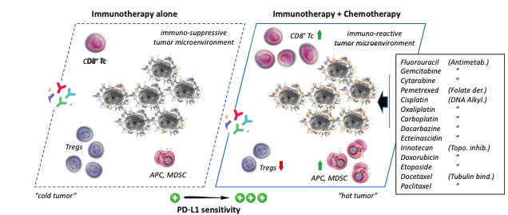
Why immunotherapy + chemotherapy?
Chemotherapy boosts antitumor immunity
Chemotherapy improves PD-L1 sensitivity and efficacy of PD-1/PD-L1 blockage
Adding IO to frontline chemotherapy
  GY018
  RUBY
  DUO-E

Slide 12
Front Line Immunotherapy in Endometrial Cancer

Slide 13
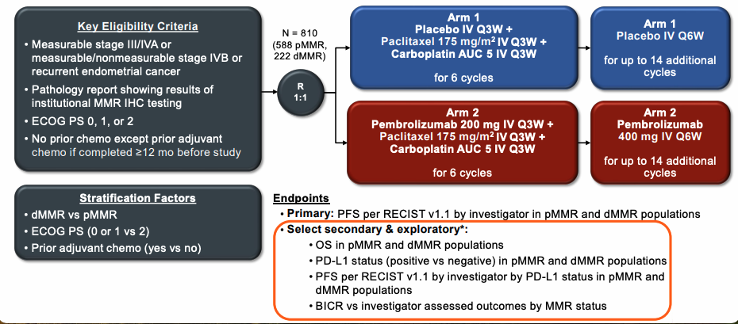
Phase III NRG-GY018: Chemotherapy + Pembrolizumab
Eskander R et al. NEJM 2023
Eskander R et al. SGO 2024
Notes:
I would personally just say the frontline, the figure needs to be bigger I think

Slide 14
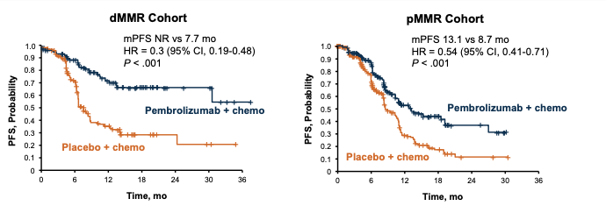
Pembrolizumab + chemotherapy improves PFS
PFS benefit in both dMMR and pMMR, most in dMMR which was not reached (2023)
OS at this time not available
Eskander R et al. NEJM 2023

Slide 15
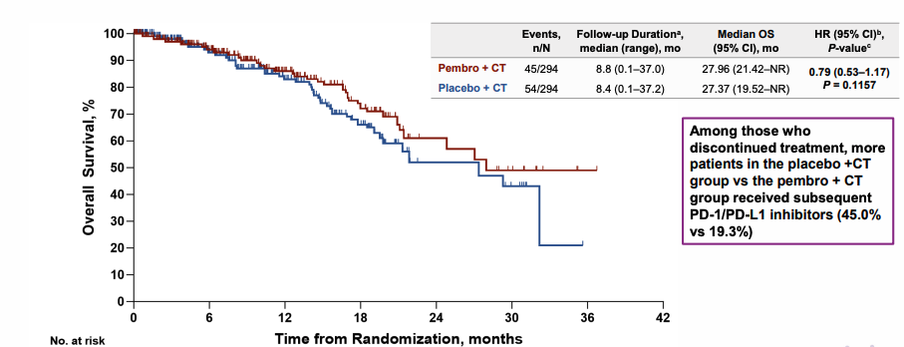
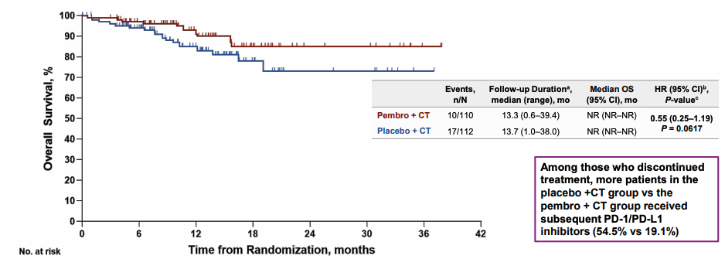
Overall survival update GY018
dMMR: Favorable trend in OS with Pembro + CT
OS Data Immature at IA (18% information fraction)
pMMR: Favorable trend in OS with Pembro + CT
OS Data immature at IA (27.2% information fraction)
Trend towards favorable benefit in pembrolizumab with chemotherapy in both dMMR and pMMR endometrial cancers
PFS improved regardless of PD-L1 status for both dMMR and pMMR
Current FDA approval for use of pembrolizumab + chemotherapy regardless of MMR status
Eskander R et al. SGO 2024

Slide 16
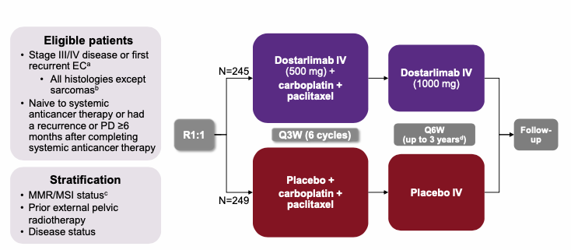
Phase III RUBY (Part 1): Chemotherapy + Dostarlimab
- Primary: PFS, OS
- Secondary: ORR, DOR, DCR, HRQOL/PRO
Mirza MR et al. N Engl J Med. 2023;388:2145-2158
Powell M et al. SGO 2024
Powell M. et al. Annals of Oncol, 2024

Slide 17
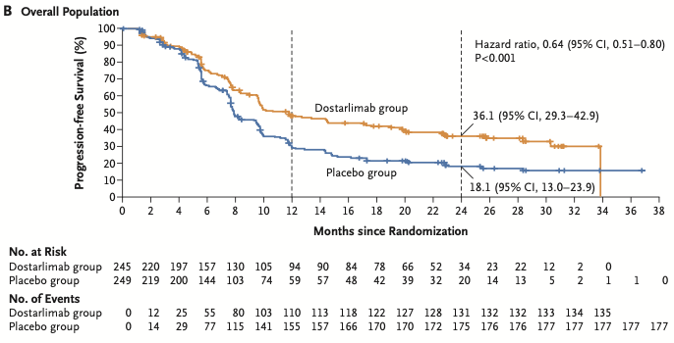
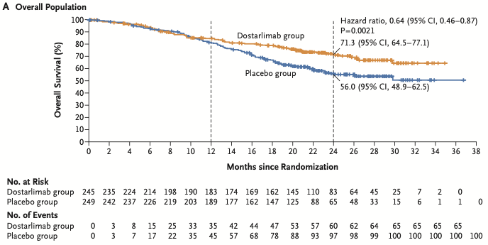
RUBY 2023: PFS and OS
Improved progression free survival
Trend towards improved OS
(33% maturity)
Mirza MR et al. N Engl J Med. 2023
Mirza MR et al. SGO, 2023
Notes:
- PFS

Slide 18
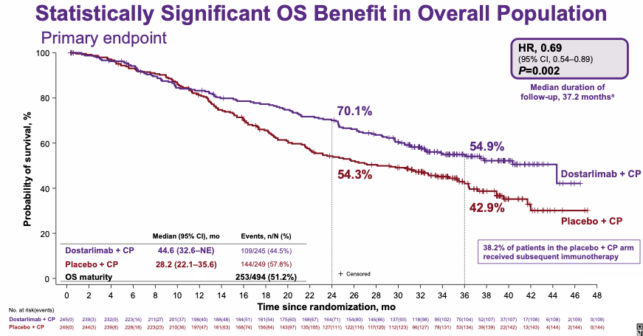
Update RUBY : Overall Survival
Powell M et al. SGO 2024
Powell M. et al. Annals of Oncol, 2024

Slide 19
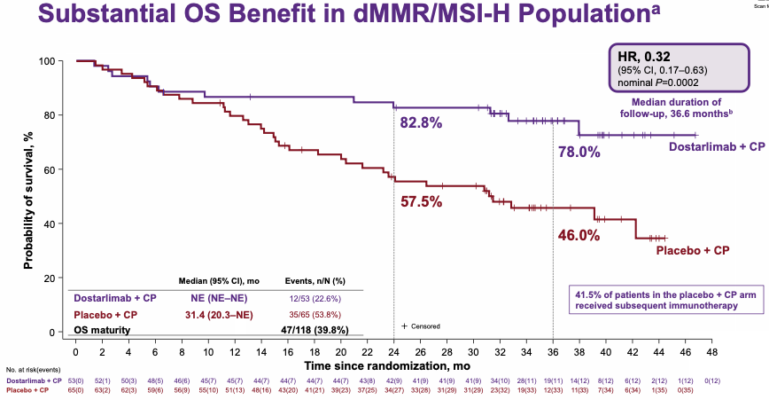
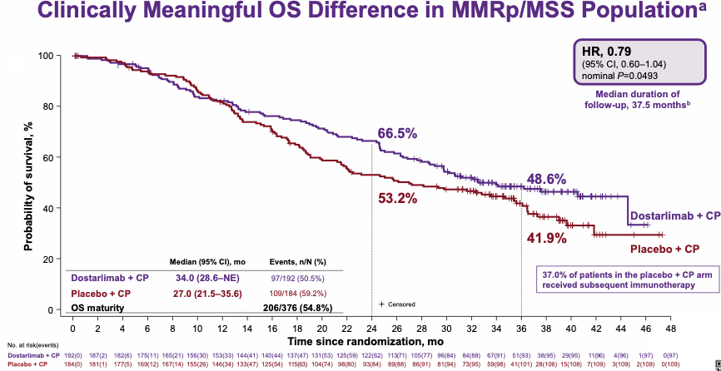
RUBY – Overall Survival
Improved OS in dMMR/MSI-H
Improved OS in pMMR/MSS
Improved OS regardless of MMR status, substantial survival benefit in dMMR subgroup (HR 0.32)
Current FDA approved for dMMR/MSI-H
Pending 2024 : FDA plans to conduct Priority Review to consider expanding for all (dMMR + pMMR)
Powell M et al. SGO 2024
Powell M. et al. Annals of Oncol, 2024

Slide 20
Other Agents

Slide 21
Frontline Immunotherapy + PARP inhibitor maintenance phase
IO+ chemotherapy, followed by IO maintenance improves outcomes in advance stage/recurrent endometrial cancer (GY018, RUBY)
PARP inhibitor added to IO in maintenance phase may potentiate anti-tumor immunity
Trials assessing IO + chemotherapy, followed by IO + PARP inhibitors:
  RUBY Part 2
  DUO-E
Westin SN et al. J Clin Oncol 2024;42:283–99

Slide 22
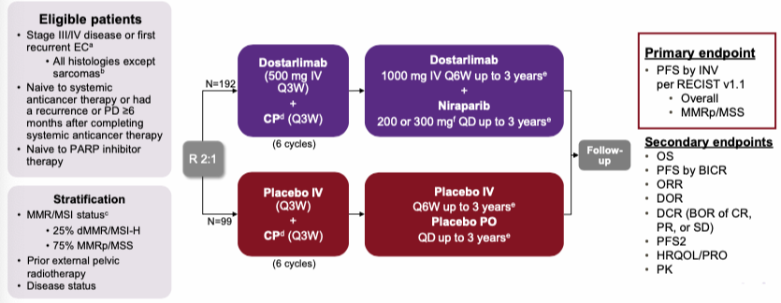
Immunotherapy + PARPi Maintenance
ENGOT/EN6-NSGO/GOG-3031/RUBY Part 2
Mirza RM. SGO 2024

Slide 23
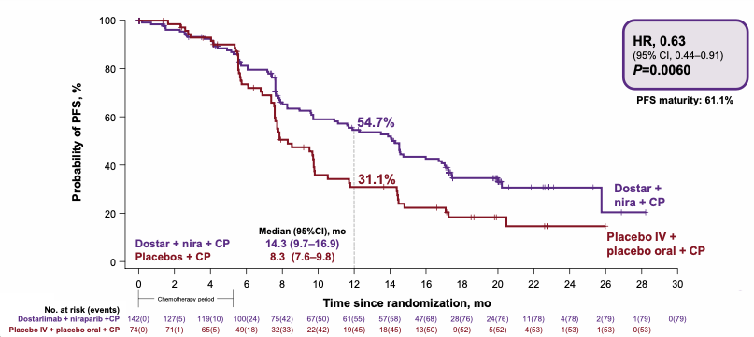
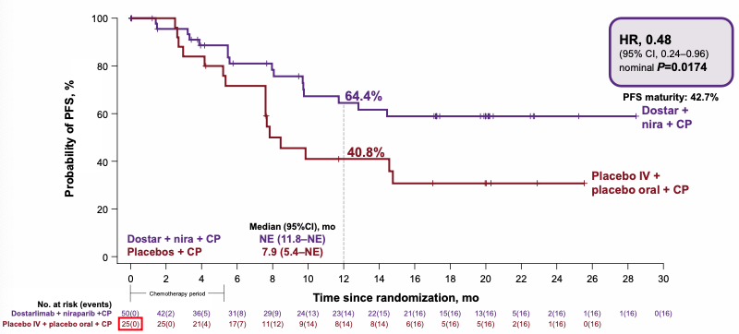
RUBY (Part 2): Dostarlimab + Niraparib Maintenance Phase
PFS benefit in MMRp/MSS
PFS benefit in MMRd/MSI-H
Met primary endpoint: clinically relevant PFS benefit in dMMR/MSI-H and pMMRp/MSS in Dostarlimab + Niraparib maintenance vs placebo
Unclear benefit of Dostarlimab + Niraparib vs Dostarlimab alone – missing 3rd arm
Mirza RM. SGO 2024

Slide 24
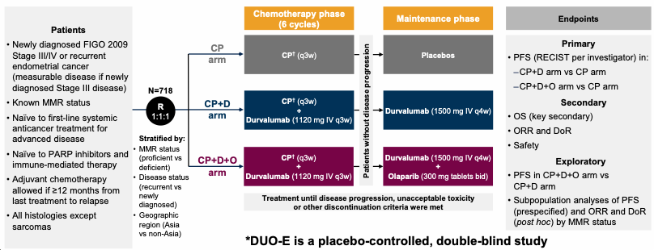
DUO-E/GOG-3041/ENGOT-EN10 trial
*
* Primary endpoint did not include PFS assessment of CP + D arm vs CP + D+ O arm
Chon HS. SGO 2024
Baurain JF. SGO 2024

Slide 25
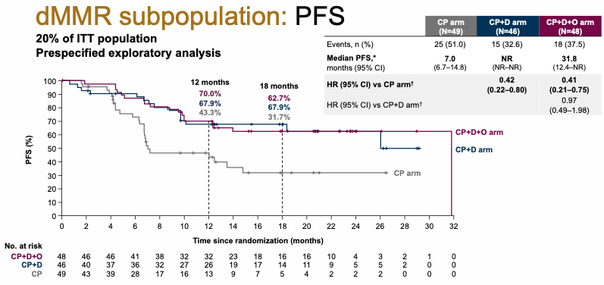
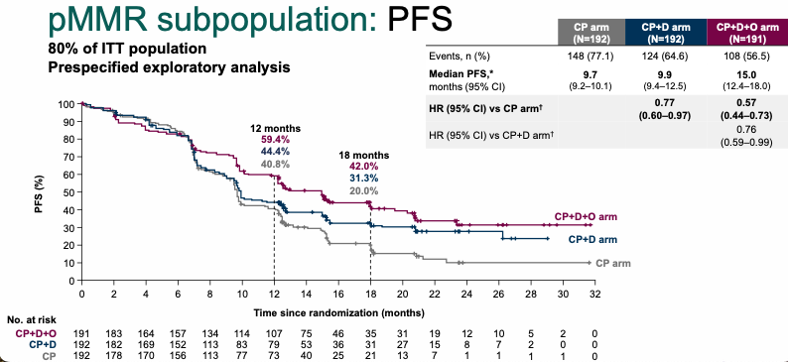
DUO-E
Key primary endpoint PFS met in ITT and MMR subgroups
dMMR population had most benefit in PFS in durvalumab + chemo cohort
pMMR population (80% of ITT) had most benefit in PFS in durvalumab + chemo + olaparib cohort
Chon HS. SGO 2024

Slide 26
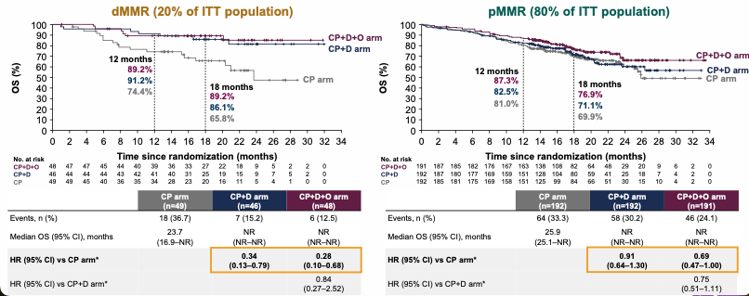
DUO-E Overall Survival by MMR status
Baurain JF. SGO 2024

Slide 27
DUO-E
Improved benefit in secondary endpoint (OS) in ITT
In dMMR , Durvalumab with chemotherapy showed consistent improve OS benefit vs chemotherapy alone
FDA approved Durvalumab + chemotherapy followed by Durvalumab maintenance for dMMR
More pronounced benefit to combination maintenance in pMMR group
Which patients? Biomarkers?

Slide 28
Leveraging targeted therapies in endometrial cancer
HER2 expressing endometrial cancers
XPO1 inhibitors: Selinexor

Slide 29
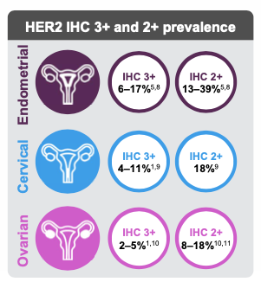
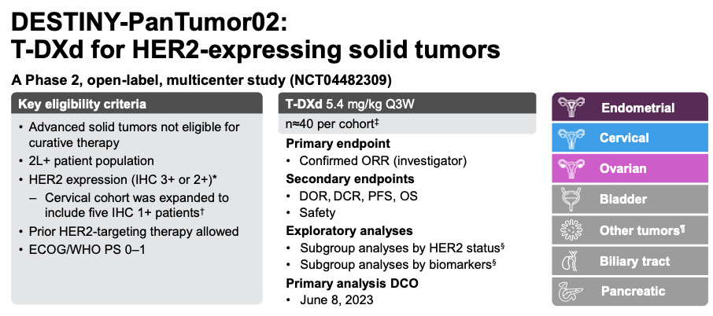
HER2 expressing endometrial cancer
FDA approved for HER2 IHC 3+ recurrent solid tumors after prior systemic chemotherapy
Makker et al. SGO 2024
Meric-Bernstam F et al. J Clin Oncol. 2024;42:47–58;

Slide 30
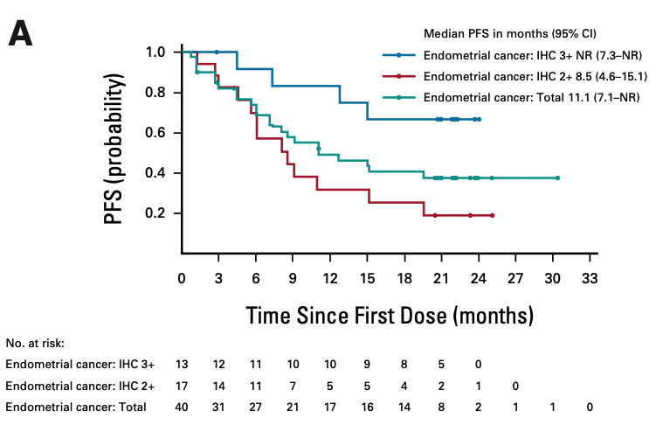
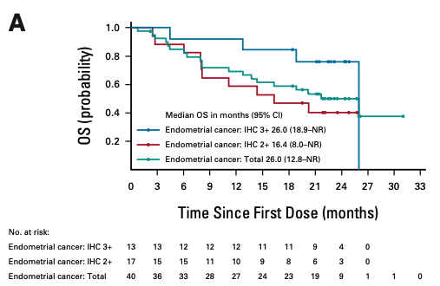
DESTINY-PanTumor02 – Endometrial
Clinically meaningful response rate, PFS, OS
Meric-Bernstam F et al. J Clin Oncol.

Slide 31
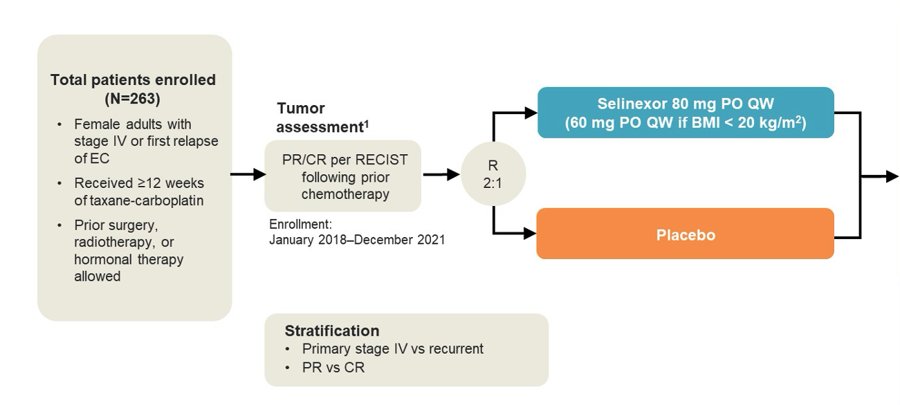
ENGOT-EN5/GOG-3055/SIENDO
Selinexor - novel oral maintenance therapy targeting TP53wt endometrial cancer
Prevents XPO1-mediated export of tumor suppressor genes, including p53wt
Primary: PFS
Secondary: PFS by BICR, OS, TPST, QOL
Predefined exploratory:
  Histologic subtype
  Molecular sub-classification
    TP53 status
    MMR status
    POLE
Makker V et al. ASCO 2024
Vergote et al. J Clin Oncol 2023

Slide 32
SIENDO
Selinexor maintenance did not show clinically meaningful PFS
Exploratory analysis showed promising PFS benefit in TP53wt subpopulation
 | Selinexor | Placebo | P-value | Hazard Ratio (95% CI)
mPFS in Overall (months) | 5.7 | 3.8 | .126 | 0.76 (0.54 to 1.08)
mPFS in TP53 wild-type (months) | 13.7 | 3.7 | .002 | 0.41 (0.23 to 0.72)
Vergote et al. J Clin Oncol 2023

Slide 33
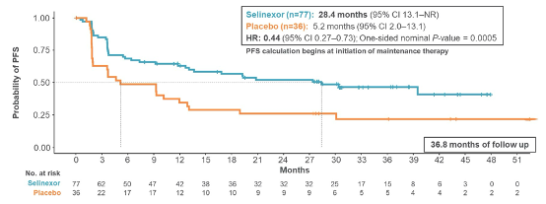
SIENDO sub-analysis: Long term mPFS in TP53wt Subgroup
TP53wt mPFS of 28.4 months with Selinexor vs 5.2 months months in placebo
  TP53wt/pMMR subgroup mPFS 39.5 months with Selinexor
  TP53wt/dMMR subgroup mPFS 13.1 months with Selinexor
Makker V et al. ASCO 2024

Slide 34
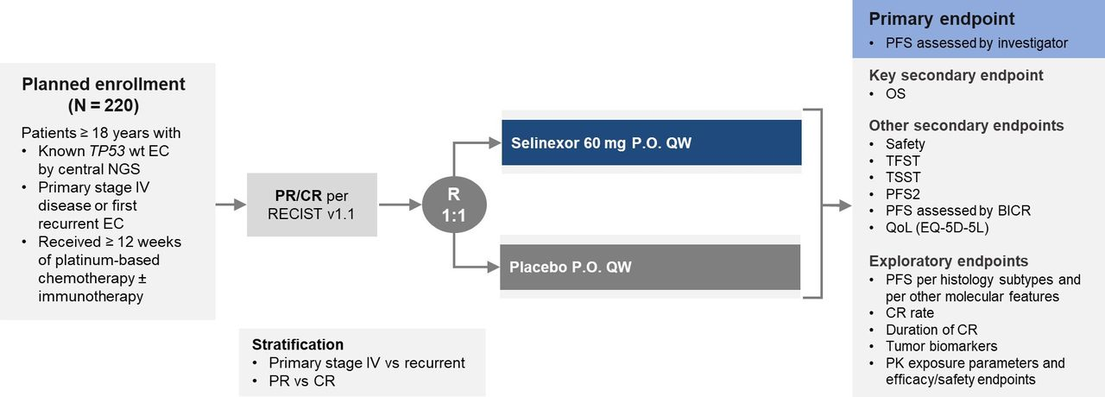
Next steps in Selinexor
ENGOT-EN20/GOG-3083/XPORT-EC-042: Selinexor maintenance after chemotherapy for p53wt in advance/recurrent endometrial cancer
Vergote et al, Int J Gynecol Cancer 2024

Slide 35
Conclusions
Immunotherapy with frontline chemotherapy in advance/recurrent endometrial cancer improves outcomes (PFS and OS) regardless of MMR status, with more pronounce benefit in dMMR group
The optimal maintenance therapy following upfront chemotherapy in advance/recurrent endometrial cancer is not yet clear
Advances in targeted therapy is promising for the future treatment of advance/recurrent endometrial cancers

Slide 36
Endometrial Cancer: A Case Study
Michael T. McHale, MD
Division Director, Gynecologic Oncology
University of California, San Diego
Moores Cancer Center

Slide 37
Agenda
Applying recent advances in the management endometrial cancer- “real world” experience
Historical perspective: how did we get here?
Frontline therapy: addition of a checkpoint inhibitor
Molecular classification: impact on therapy
Strategies for recurrent disease: navigating murky waters

Slide 38
CASE
64 y/o with post menopausal bleeding, EMBX confirms grade 2 endometroid adenocarcinoma
Robotic assisted hysterectomy, BSO, sentinel node mapping and biopsies
Path (stage IIIC1):
  55% myometrial invasion
  +LVSI
  +pelvic nodes
  Grade 2
ER PR +
MMR- proficient

Slide 39
What next?

Slide 40
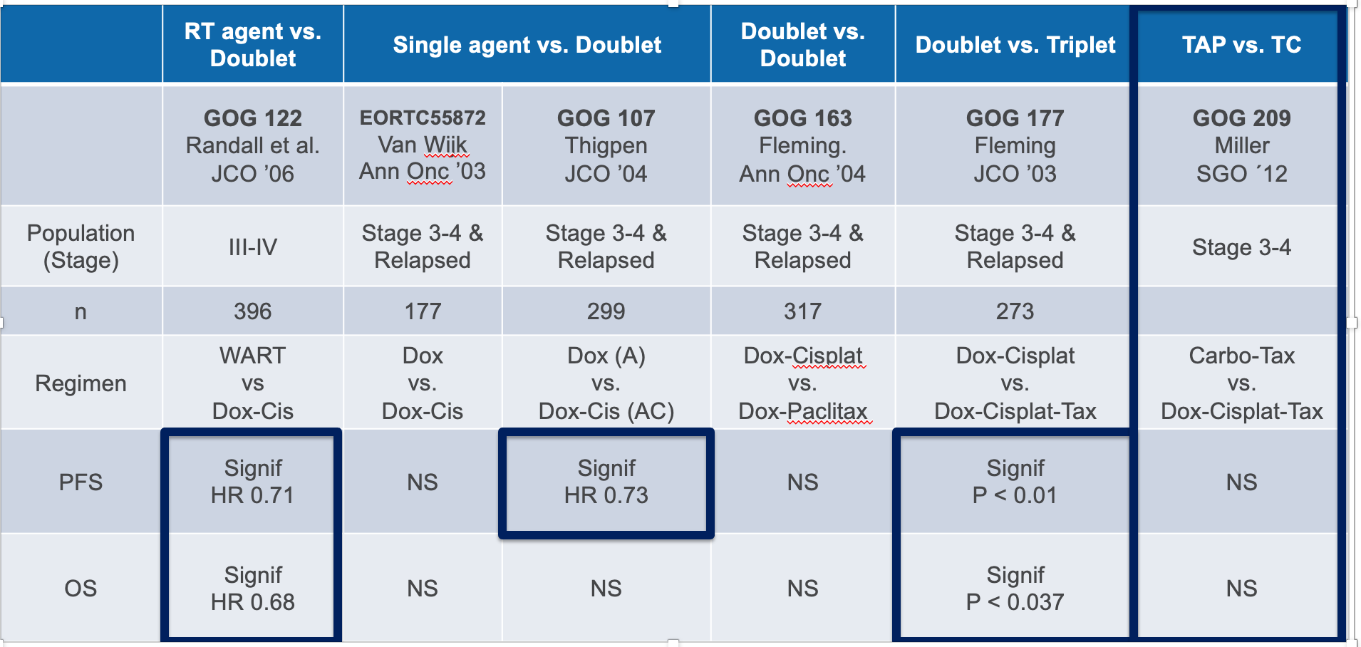
Historical Perspective: Treatment of advanced stage/recurrent Endometrial Cancer

Slide 41
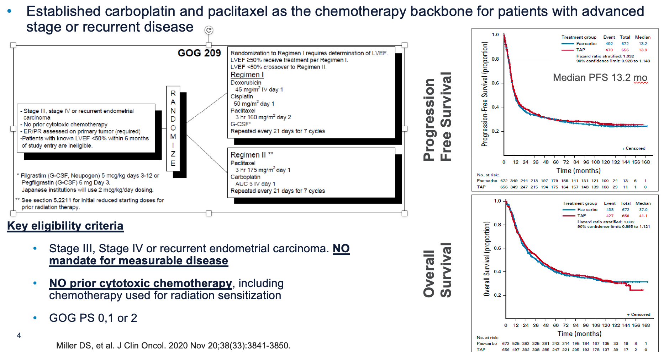
GOG 209

Slide 42
Changing Landscape

Slide 43
Molecular Classification
Molecular Classification
Emerging
May offer more consistent categorization and both prognostic and predictive information
2013 Cancer Genome Atlas (TCGA) characterized 370 endometrial cancers
  Identified 4 molecular subtypes
  Based on tumor cell genomic architecture with distinct prognostic outcomes
  Clinicopathologic features
  Provide framework for subclassifications, clinical trials and possibly treatment
Cancer Genome Atlas Research Network. Nature 2013;497:67

Slide 44
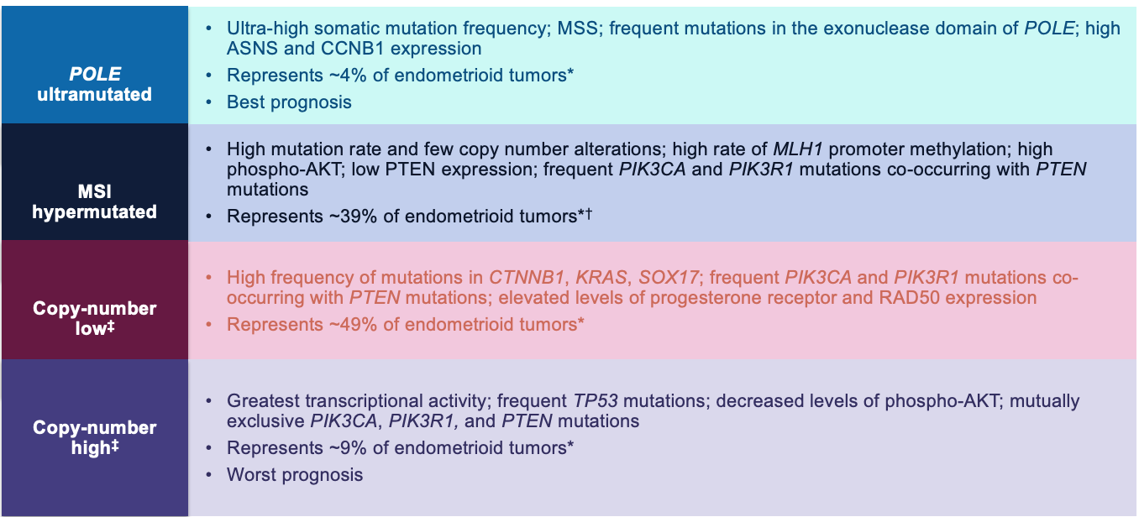
Endometrial Cancer: Molecular Subtypes
Clear IO
efficacy
? IO
Hormonal Tx?
? Role for IO
? Anti-Her2
? Other ADCs
? VEGF targets
? Role for IO
? Anti-Her2
? Other ADCs
? VEGF targets
G Getz et al. Nature 497, 67-73 (2013) doi:10.1038/nature12113

Slide 45
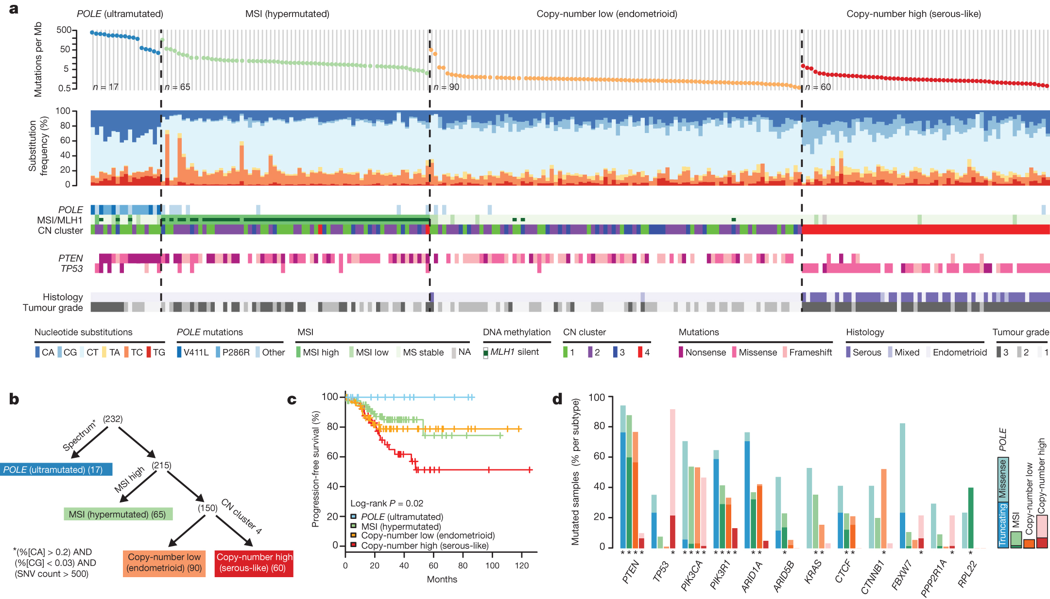
Disease Homogeneity to Molecular Granularity
Disease Homogeneity to Molecular Granularity
Immunologically Responsive
Immunologically Non-Responsive
G Getz et al. Nature 497, 67-73 (2013) doi:10.1038/nature12113

Slide 46


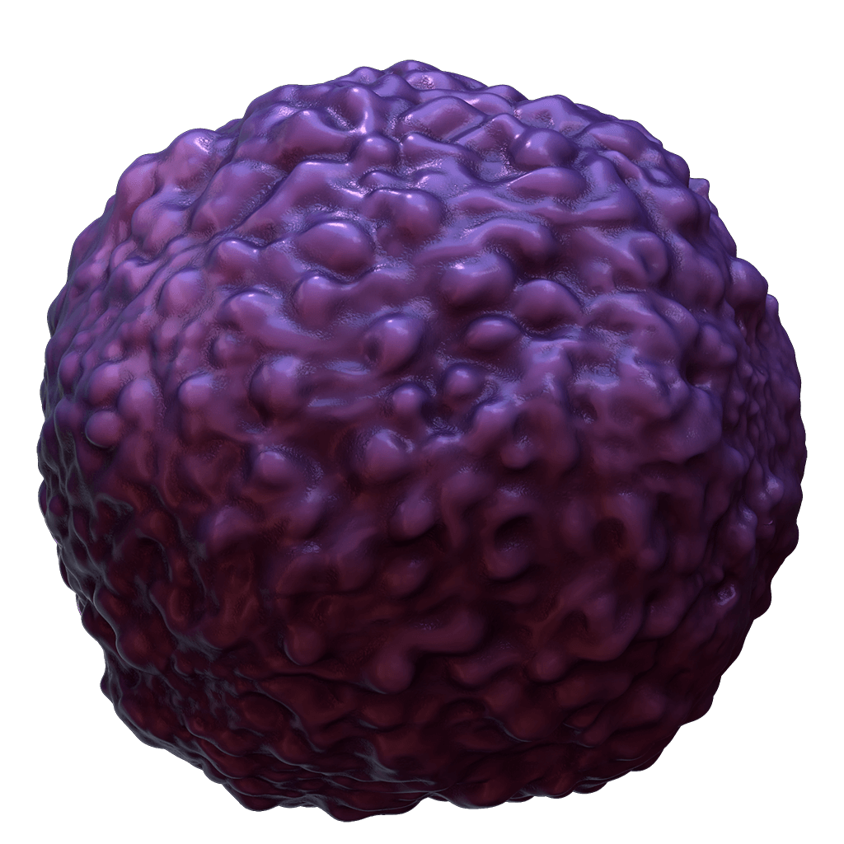

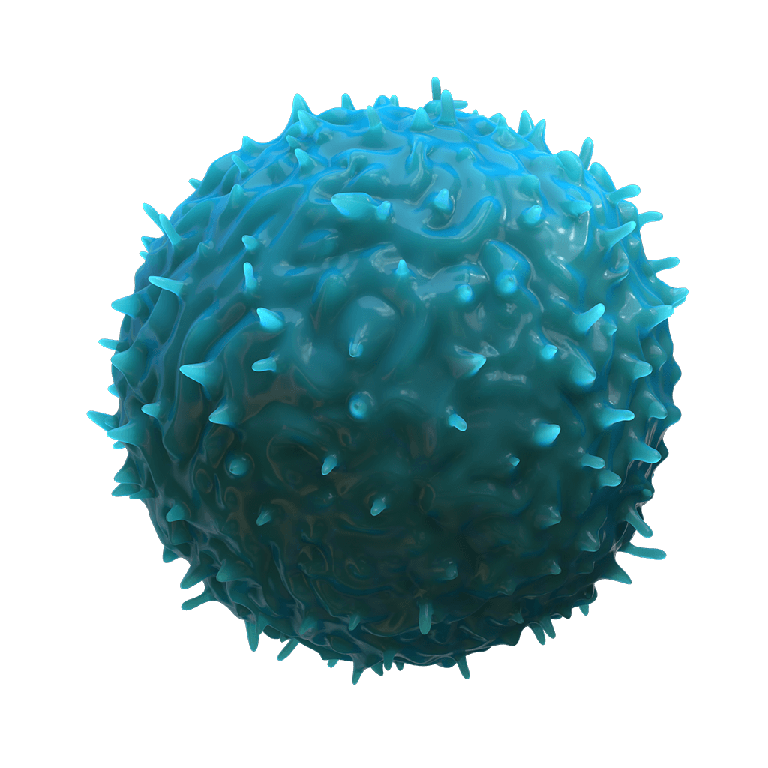

Rationale for Combinatorial Approach with Chemotherapy + IO
Tumor cell death
Immunogenic cell death
Reduction of tumor cells producing immunosuppressive mediators
MDSC
Anti-PD(L)1
MDSC
depletion
Treg
depletion
Increased expression of tumor antigens
Recognized and targeted by the immune system
Treg
Chemo
Homeostatic proliferation of T cells
1. Hato SV et al. Clin Cancer Res. 2014. 2. Chen Y et al. Am J Cancer Res. 2021. 3. Pfannenstiel T et al. Cell Immunol. 2010. 4. Sevko A et al. J Immunol. 2013.

Slide 47
RUBY
For over a decade, the standard of care for 1L treatment of primary advanced or recurrent EC was chemotherapy (CP); however, long-term outcomes were poor, with a median OS <3 years
Checkpoint plus chemotherapy
  Dostarlimab plus CP significantly improved PFS in the dMMR/MSI-H and overall populations with an early OS trend at the first interim analysis
Mirza et al. N Engl J Med 2023;388:2145

Slide 48
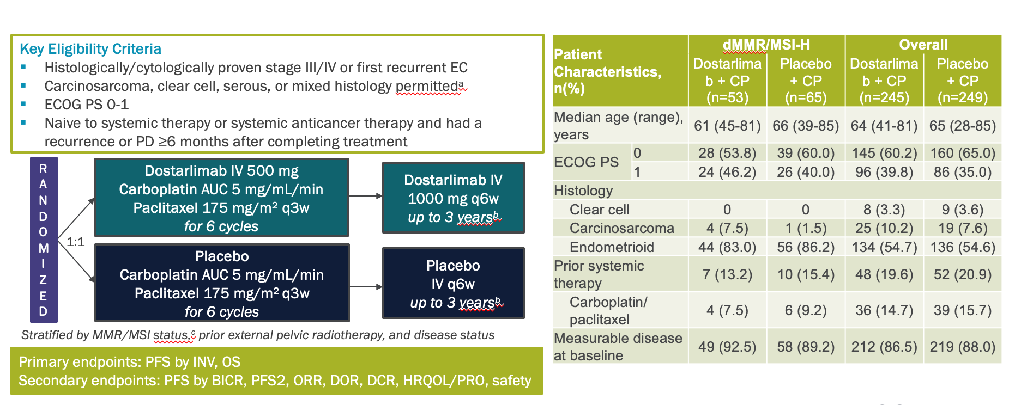
GOG-3031/RUBY: Phase 3 Trial of Dostarlimab + Chemo for Primary Advanced/Recurrent EC
Mirza et al. N Engl J Med 2023;388:2145

Slide 49
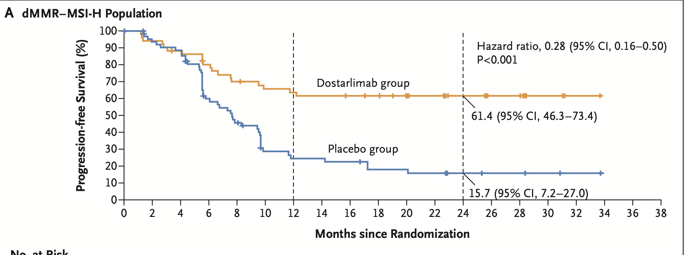
GOG-3031/RUBY: Phase 3 Trial of Dostarlimab + Chemo for Primary Advanced/Recurrent EC
Mirza et al. N Engl J Med 2023;388:2145

Slide 50
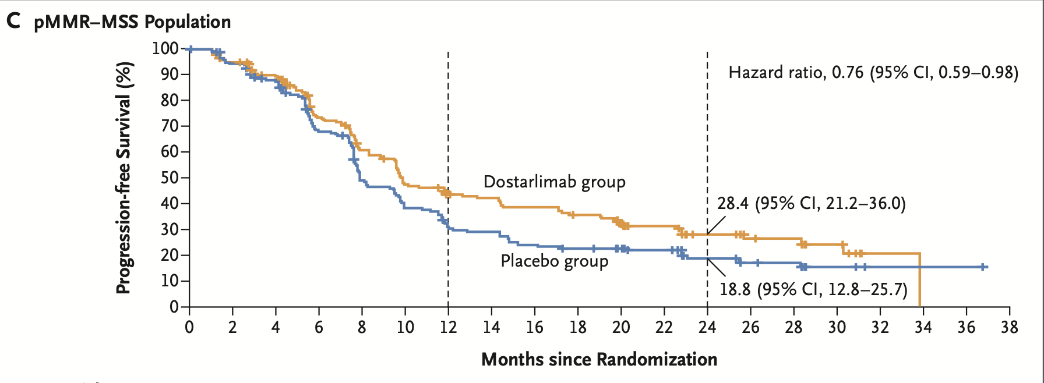
GOG-3031/RUBY: Phase 3 Trial of Dostarlimab + Chemo for Primary Advanced/Recurrent EC
Mirza et al. N Engl J Med 2023;388:2145

Slide 51
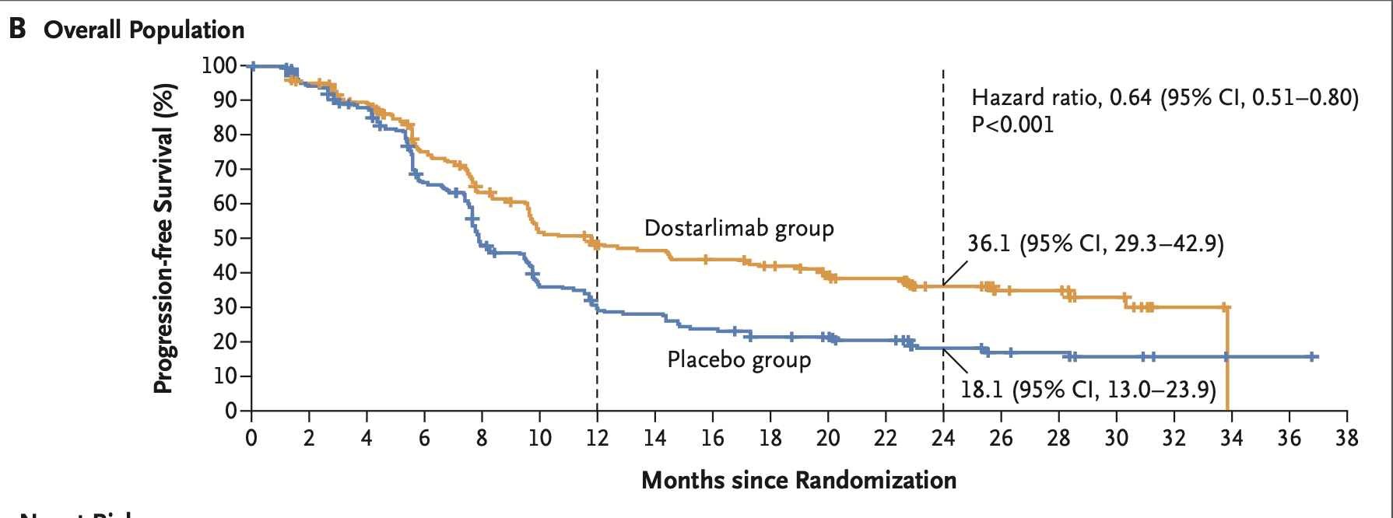
GOG-3031/RUBY: Phase 3 Trial of Dostarlimab + Chemo for Primary Advanced/Recurrent EC

Slide 52
Based on PFS at interim analysis 1
Dostarlimab approved as first immunotherapy plus chemotherapy combination for primary advanced or recurrent dMMR/MSI-H endometrial cancer

Slide 53
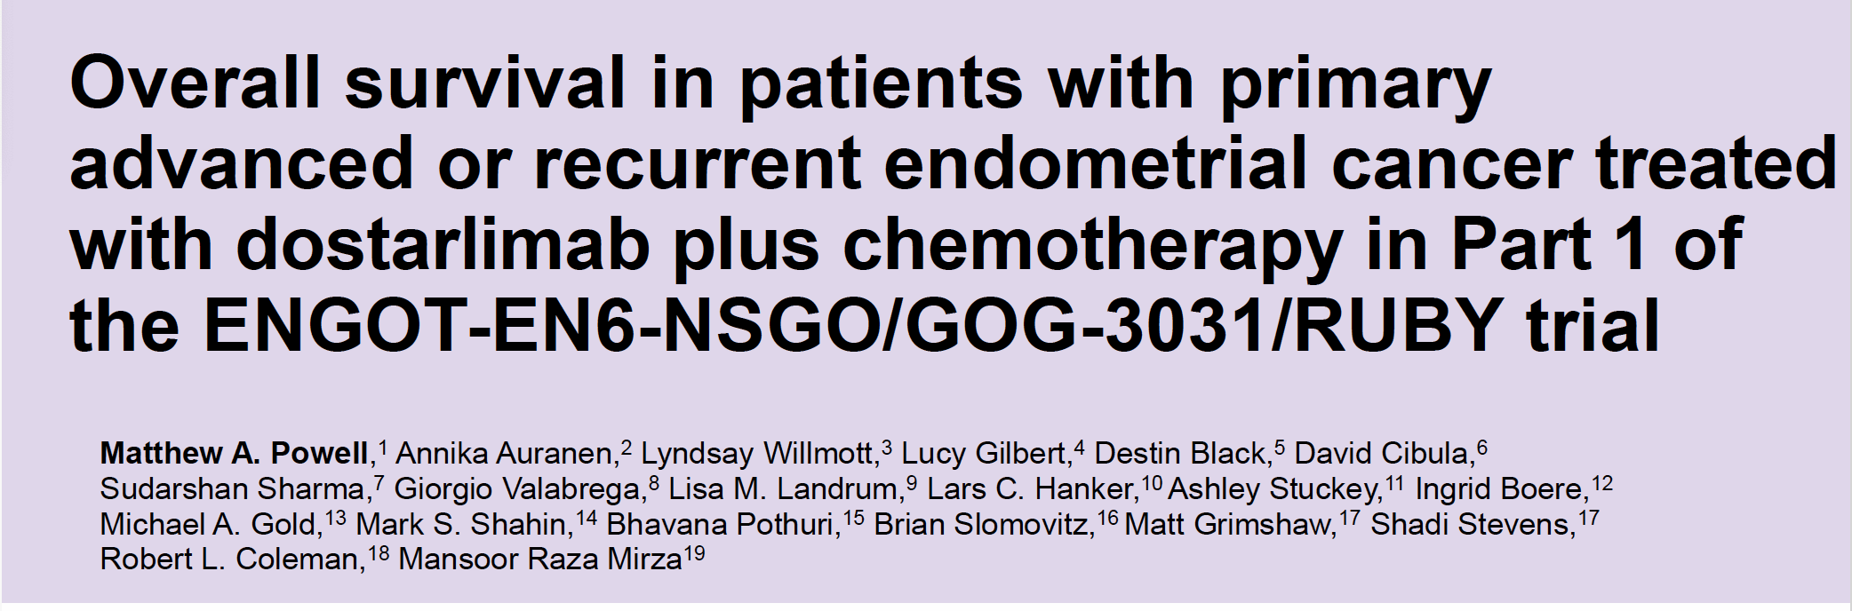
Powell et al. Annals of Oncol. 2024; 35(8):728

Slide 54
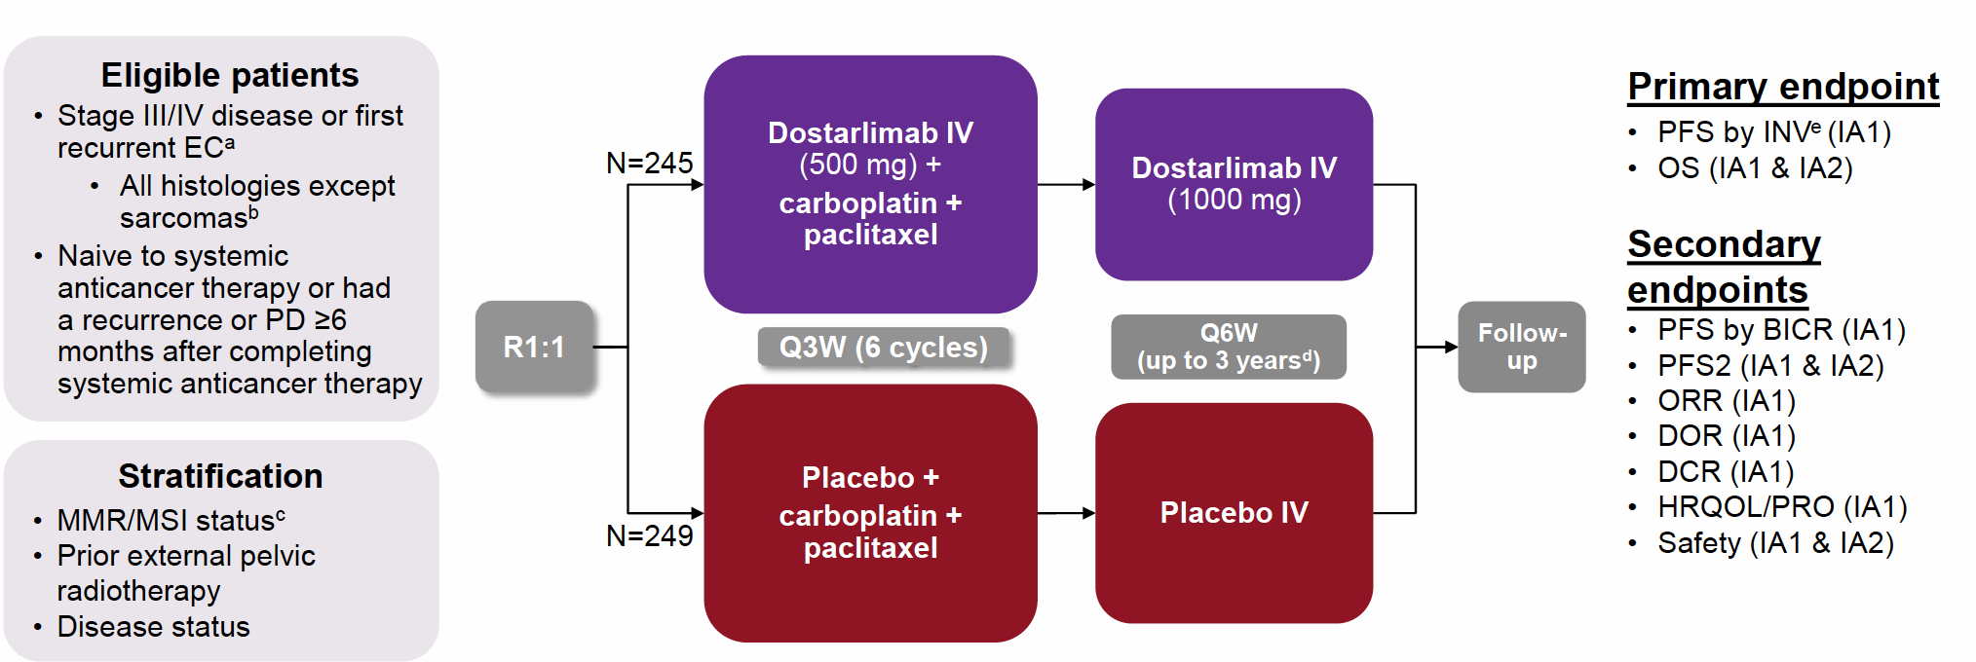
Schema

Slide 55
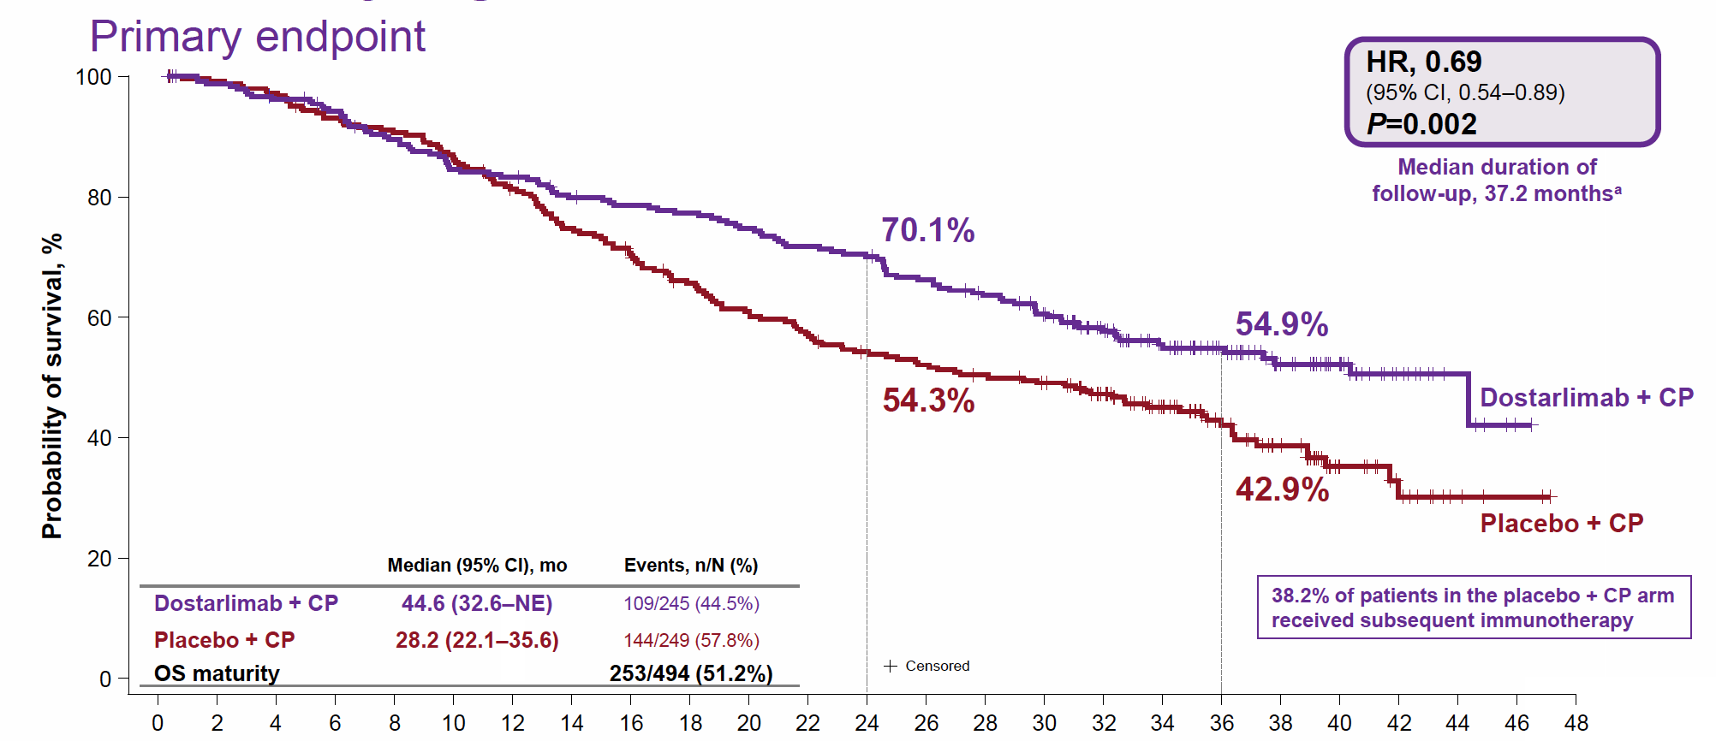
Statistically Significant OS Benefit in Overall Population
Powell et al. Annals of Oncol. 2024; 35(8):728

Slide 56
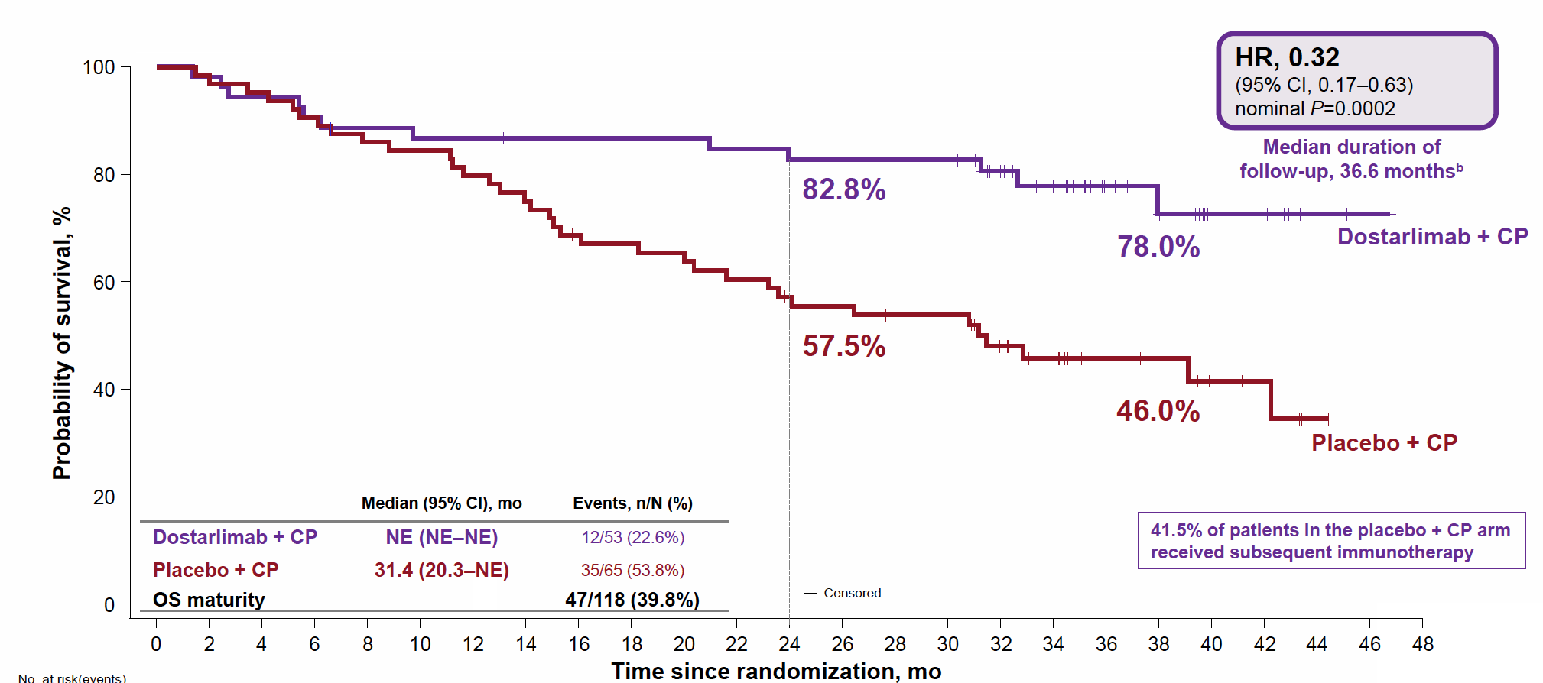
Substantial OS Benefit in dMMR/MSI-H Populationa
Powell et al. Annals of Oncol. 2024; 35(8):728

Slide 57
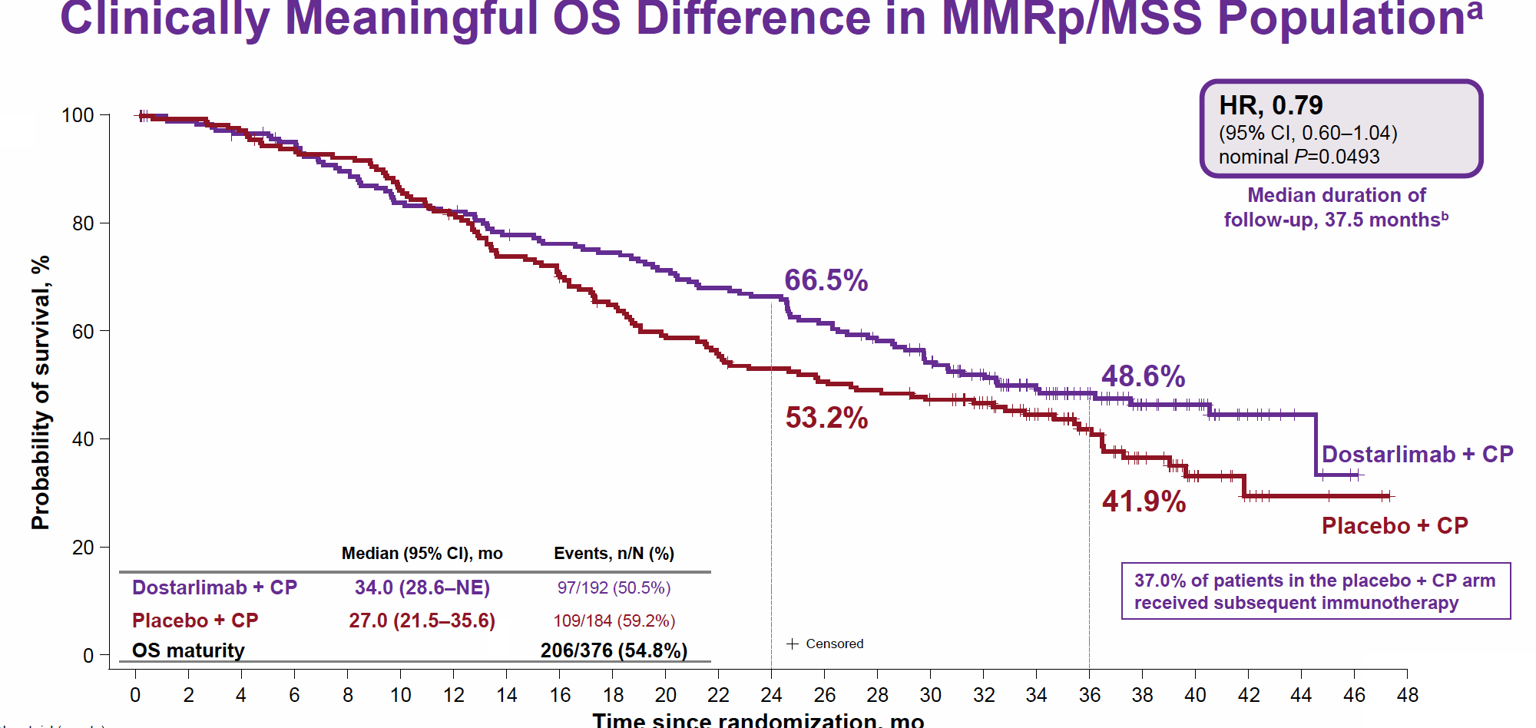

Slide 58
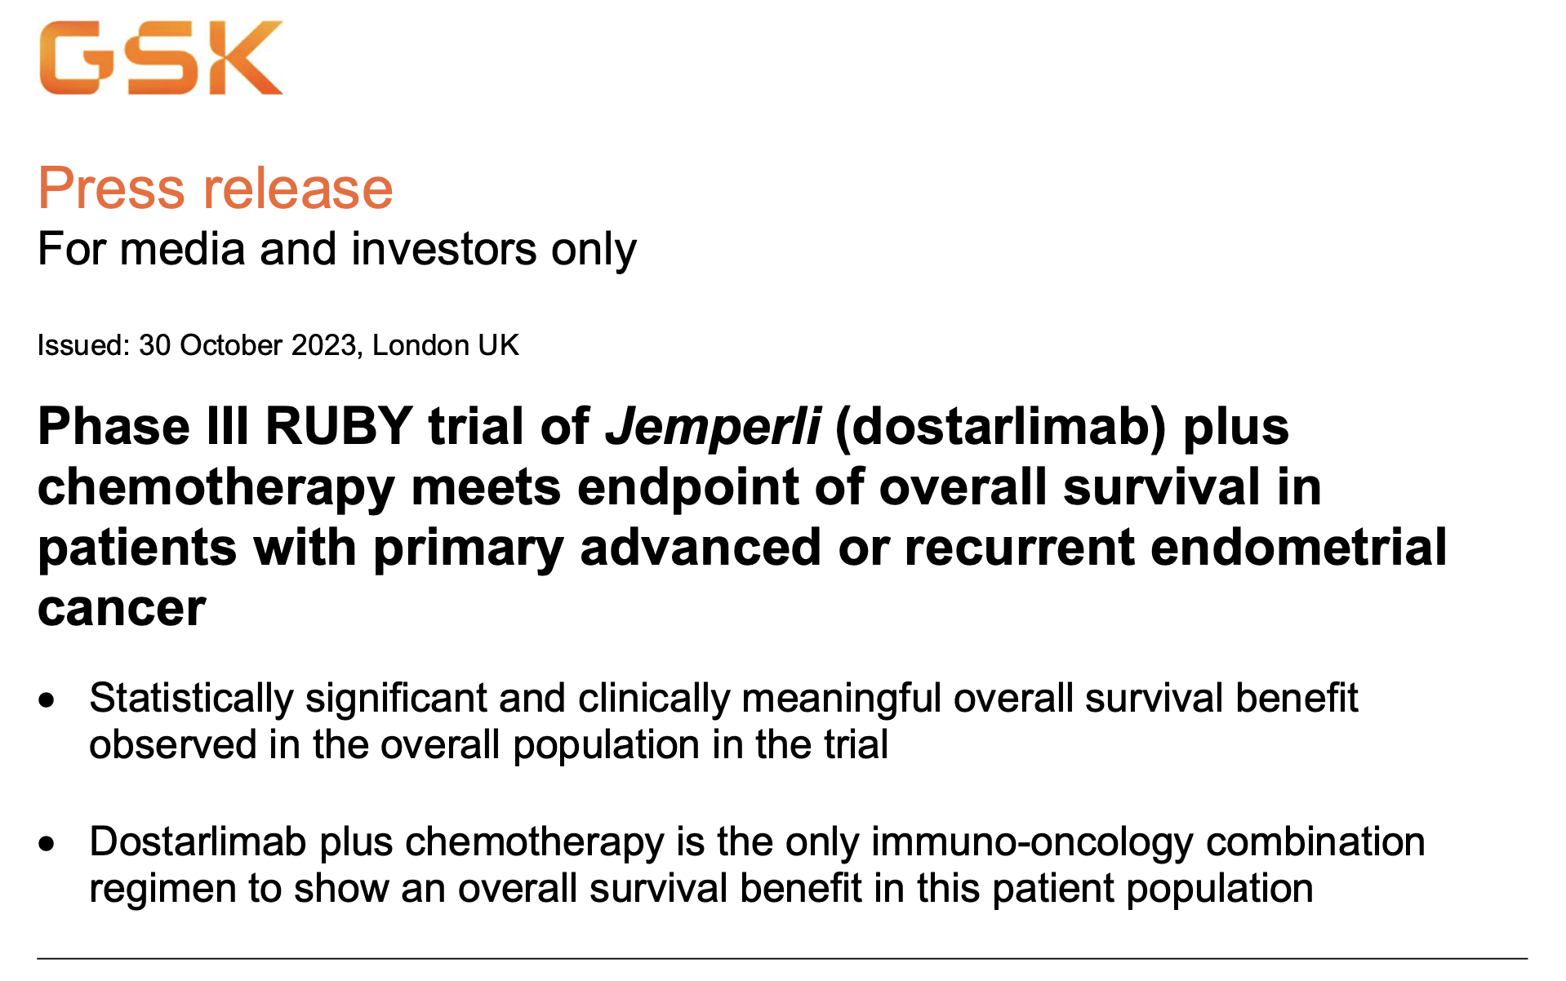

Slide 59
GOG-3031/RUBY: Molecular Classification Algorithm
In RUBY Part 1, molecular classification was performed for all participants with WES results – 400 of 494 patients
EC
(histological subtype independent)
POLε status
POLε pathogenic
POLε non-pathogenic
MMR status
dMMR
MMRp
p53 status
P53-mut
P53 WT
Integrated diagnosis | POLεmut (EDM) | dMMR (or MSI-H) | TP53 aberrant | NSMP
Prevalence in RUBY, % (n/N) | 1.25% (5/400) | 22.75% (91/400) | 22% (88/400) | 54% (216/400)
Diagnostic test | WES | Results of local (IHC, NGS, PCR) or central test (IHC) provided for RUBY at randomization | WES
Efficacy per molecular classification was an exploratory analysis.
dMMR, mismatch repair deficient; EC, endometrial cancer; EDM, exonuclease domain; IHC, immunohistochemistry; MMRp, mismatch repair proficient; MSI-H, microsatellite instability-high; mut, mutated; NGS, next generation sequencing; NSMP, no specific molecular profile; PCR, polymerase chain reaction; POLε, polymerase epsilon; TP53, tumor protein 53; WES, whole exome DNA sequencing; WT, wild type.
Mirza MR, et al. ESMO 2023.

Slide 60
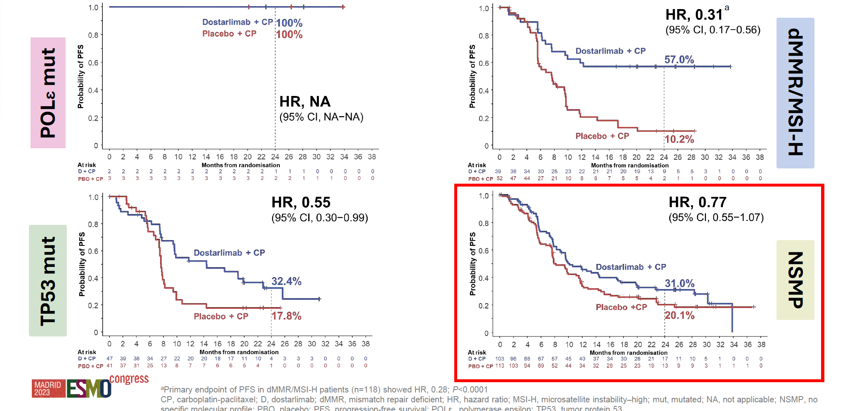
RUBY: PFS per Molecular Classification

Slide 61
NRG GY018: Phase 3 Trial of Pembrolizumab + Chemo for Measurable Stage 3 or 4a, Stage 4b, or Recurrent EC – Study Design and Patients
Key Eligibility Criteria
Measurable stage III/IVA or measurable/nonmeasurable stage IVB or recurrent EC
MMR IHC testing
ECOG PS 0-2
No prior Chemo except adjuvant Chemo if completed ≥12 mo before study
Patient Characteristics, n (%) |  | dMMR (n=225) |  | pMMR (n=588)
 |  | Pembro + CT (n=112) | Placebo + CT (n=113) | Pembro + CT (n=293) | Placebo + CT (n=295)
Median age (range), years |  | 67 (38-81) | 66 (37-85) | 66 (31-93) | 65 (29-90)
ECOG PS | 0 | 72 (64.3) | 73 (64.6) | 196 (66.9) | 198 (67.1)
 | 1 | 39 (34.8) | 35 (31.0) | 88 (30.0) | 88 (29.8)
 | 2 | 1 (0.9) | 5 (4.4) | 9 (3.1) | 9 (3.1)
Histology
Clear cell |  | 1 (0.9) | 0 | 17 (5.8) | 20 (6.8)
Endometrioid, G1 |  | 21 (18.8) | 35 (31.0) | 54 (18.4) | 46 (15.6)
Endometrioid, G2 |  | 52 (46.4) | 41 (36.3) | 51 (17.4) | 58 (19.7)
Endometrioid, G3 |  | 15 (13.4) | 16 (14.2) | 53 (18.1) | 42 (14.2)
Serous |  | 4 (3.6) | 1 (0.9) | 78 (26.6) | 72 (24.4)
No prior chemotherapy | No prior chemotherapy | 107 (95.5) | 105 (92.9) | 221 (75.4) | 218 (73.9)
RANDOMIZED
Pembrolizumab 200 mg IV q3w +
Paclitaxel 175 mg/m² IV q3w +
Carboplatin AUC 5 IV q3w
for 6 cycles
Pembrolizumab 400 mg IV q6w up to 14 additional cycles
1:1
Placebo IV q3w +
Paclitaxel 175 mg/m² IV q3w +
Carboplatin AUC 5 IV q3w
for 6 cycles
Placebo
IV q6w
up to 14 additional cycles
Stratified by MMR status (pMMR vs dMMR), ECOG status, and prior adjuvant Chemo
Primary endpoints: PFS per RECIST v1.1 by INV in pMMR and dMMR cohorts
Secondary endpoints: Safety, ORR/DOR, OS, PRO/QoL, concordance of MMR testing results
Data cutoff: December 16, 2022 for dMMR; December 6, 2022 for pMMR.
Eskander R, et al. SGO 2023. Abstract 264.

Slide 62
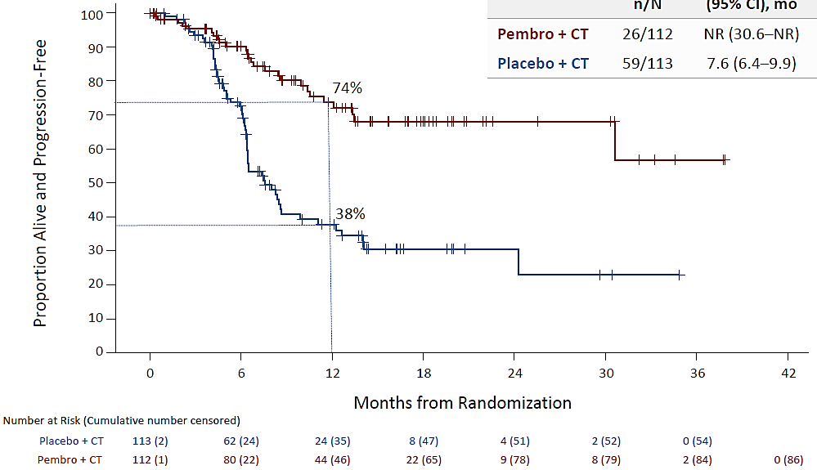
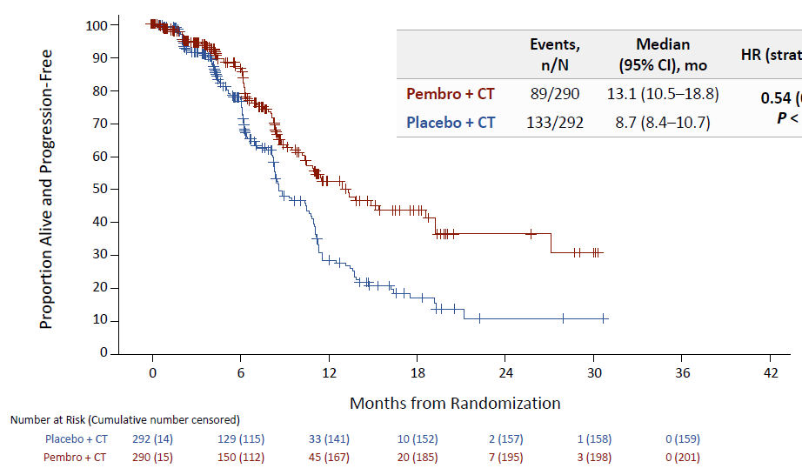
NRG GY018: Phase 3 Trial of Pembrolizumab + Chemo for Measurable Stage 3 or 4a, Stage 4b, or Recurrent EC – PFS
PFS per RECIST v1.1 in dMMR Population
PFS per RECIST v1.1 in pMMR Population
 | Events, n/N | Median (95% CI), mo | HR (stratified; 95% CI)
Pembro + CT | 26/112 | NR (30.6-NR) | 0.30 (0.19-0.48) P<0.00001
Placebo + CT | 59/113 | 7.6 (6.4-9.9)
 | Events, n/N | Median (95% CI), mo | HR (stratified; 95% CI)
Pembro + CT | 89/290 | 13.1 (10.5-18.8) | 0.54 (0.41-0.71) P<0.00001
Placebo + CT | 133/292 | 8.7 (8.4-10.7)
Median follow-up: 12 months for dMMR, 7.9 months for pMMR
Data cutoff: December 16, 2022 for dMMR; December 6, 2022 for pMMR.
Eskander R, et al. N Eng J Med. March 2023

Slide 63
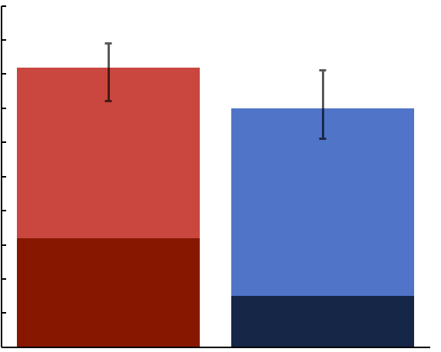
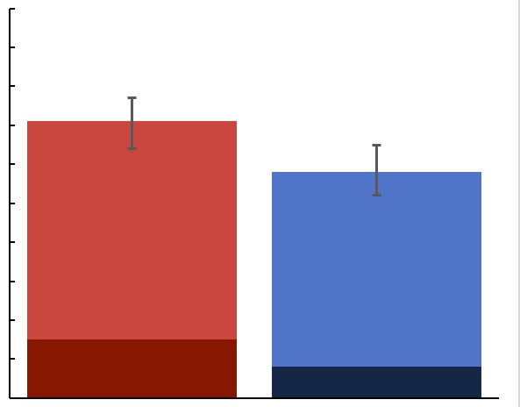
NRG GY018: ORR in dMMR and pMMR populations
dMMR
pMMR
100
100
82% (95% CI, 72%–89%)
90
71% (95% CI, 60%–80%)
90
80
80
71% (95% CI, 64%–77%)
70
70
58% (95% CI, 52%–65%)
ORR, %
60
PR: 50%
ORR, %
60
50
50
40
PR: 55%
40
PR: 56%
30
30
PR: 50%
20
20
CR: 32%
10
CR: 15%
10
CR: 15%
0
0
CR: 8%
Pembro + CP
N = 92
Placebo + CP
N = 92
Pembro + CP
N = 212
Placebo + CP
N = 234
Odds ratio for response with Pembro + CP: 1.83 (95% CI, 0.92‒3.66)
Odds ratio for response with Pembro + CP: 1.74 (95% CI, 1.18‒2.58)
Data cutoff: Aug 18, 2023
Eskander R, et al. ESMO 2023

Slide 64
NRG GY018: Duration of Response by MMR status (Patients with CR or PR)
dMMR
 | Events n/N | Median (95% CI), mo | HR (95% CI)
Placebo + CP | 43/65 | 6.2 (4.3–9.2) | 0.218 (0.13–0.37) P < 0.0001
Pembro + CP | 20/75 | 28.7 (20.2–NR)
pMMR
 | Events n/N | Median (95% CI), mo | HR (95% CI)
Placebo + CP | 92/136 | 6.2 (4.8–6.5) | 0.467 (0.34–0.64) P < 0.0001
Pembro + CP | 69/150 | 9.2 (7.1–14.7)
100
100
90
90
80
80
70
70
60
60
50
50
40
40
30
30
20
20
10
10
0
0
0
6
12
18
24
30
36
42
48
0
6
12
18
24
30
36
42
48
Months from First Best Response of PR/CR
Months from First Best Response of PR/CR
Number at risk (Cumulative number censored)
Number at risk (Cumulative number censored)
Placebo + CP
Pembro + CP
65 (2)
75 (2)
28 (9)
58 (8)
7 (18)
31 (29)
6 (18)
20 (37)
1 (21)
6 (50)
1 (21)
3 (52)
1 (21)
2 (53)
0 (22)
0 (55)
Placebo + CP
Pembro + CP
136 (5)
150 (6)
59 (21)
98 (26)
11 (34)
30 (54)
5 (39)
13 (69)
2 (42)
5 (76)
1 (43)
2 (79)
1 (43)
2 (79)
0 (44)
0 (81)
Data cutoff: Aug 18, 2023
Eskander R, et al. ESMO 2023

Slide 65
On June 17, 2024, the Food and Drug Administration approved pembrolizumab (Keytruda, Merck) with carboplatin and paclitaxel, followed by single-agent pembrolizumab, for adult patients with primary advanced or recurrent endometrial carcinoma.

Slide 66
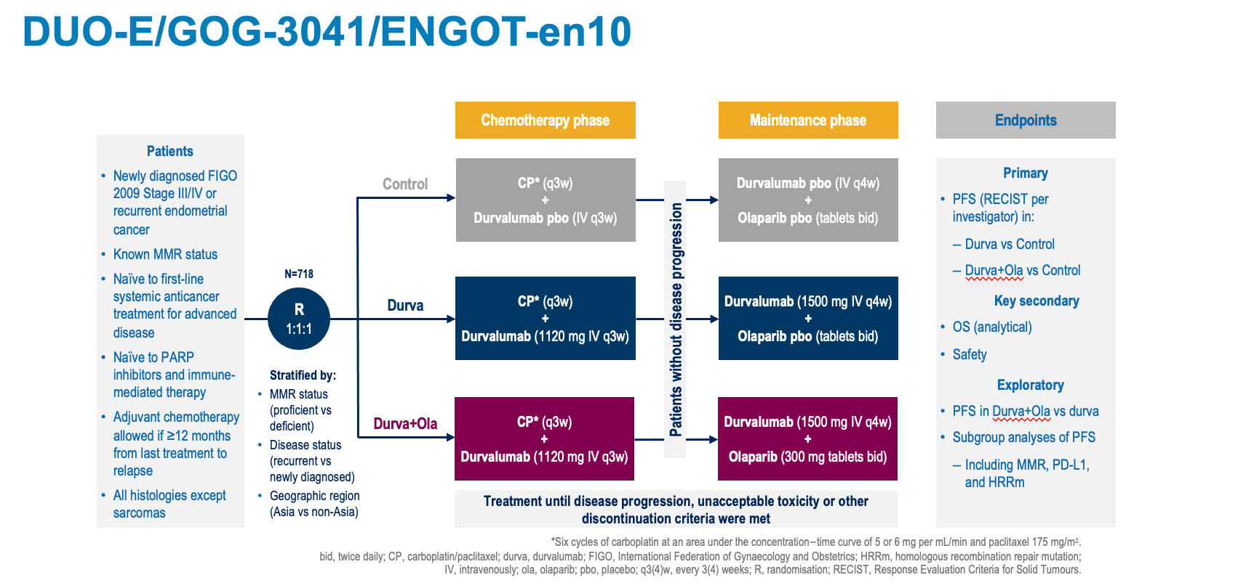
Westin, S et al. ESMO 2023

Slide 67
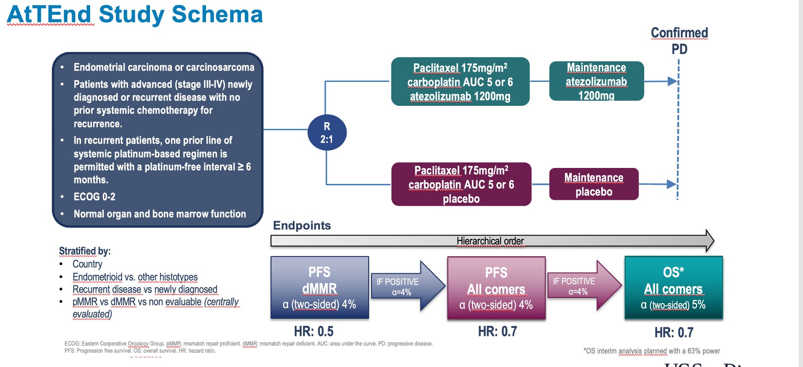

Slide 68
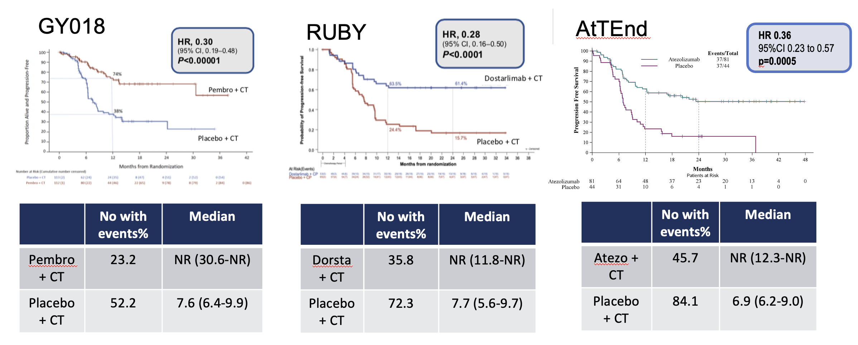
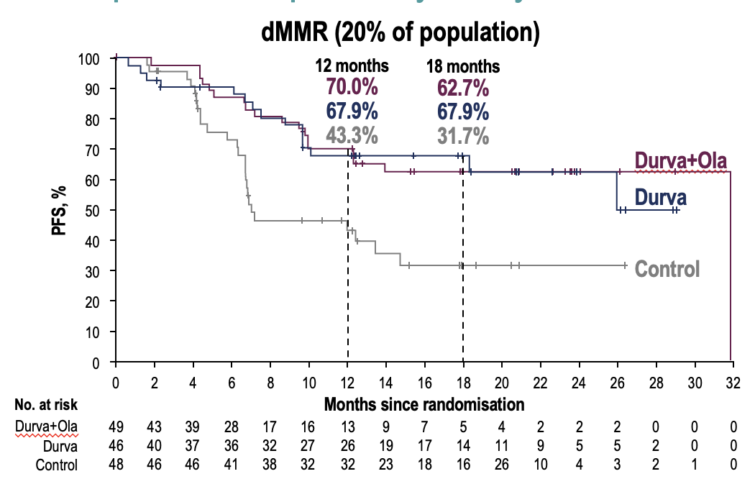
Benefit of IO + Chemo in the dMMR EC population
HR 0.42
95% CI 0.22-0.80
D + CT arm
DUO-E
 | No with events % | Median
Durva + CT | 32.6 | NR (NR-NR)
Durva + O + CT | 37.5 | 31.8 (12.4-NR)
Placebo + CT | 51 | 7.0 (6.7-14.8)
Slide courtesy of Dr. Eskander- Revised

Slide 69
Immune Checkpoint Inhibition + Chemotherapy has emerged as the new standard of care option in advanced stage or recurrent dMMR EC…

Slide 70


Benefit of IO + Chemo in the pMMR EC population
Only study powered to assess pMMR independently
HR 0.57
95% CI 0.44-0.73
D + O + CT arm
DUO-E
 | No with events % | Median
Durva + CT | 64.6 | 9.9 (9.4-12.5)
Durva + O + CT | 56.5 | 15 (12.4-18)
Placebo + CT | 77.1 | 9.7 (9.2-10.1)
Only trial with prespecified alpha allocated analysis in pMMR EC cohort as primary endpoint
Slide courtesy of Dr. Eskander. Revised

Slide 71
The 1L Data Conundrum..
 | GY018 | RUBY | AtTEnd | DUO-E | MITO END-3
Follow-up in months: | 20.6 months dMMR 15.8 months pMMR | 24.8 months dMMR 25.4 ITT | 26.2 months dMMR 28.3 months ITT | 20.6 months dMMR 15.8 months pMMR | 23.3 months dMMR 23.3 months pMMR
Measurable or evaluable Stage III/IV [%measurable] | Y | Y [87%] | Y | Y (85 vs 77% IN D VS D-O) | Y (100% measurable)
Non-measurable stage IVB | Y | Y | N | ? THINK YES | N
Carcinosarcoma | N | Y (capped at 10%) | Y (9.1%) | Y (7.3%) | N
Recurrent disease [III/IV] | Y | Y 47%[18/34] | Y 66%[5.5/27] | Y ( 52%)[6/42] | Y 48%
PS 0-1 | 97% | 100% | 98.7% | 100 | 100
PS2 | 3% | - | 1.3% | 0 | 0
PFI for recurrent disease MONTHS | ≥ 12 | ≥ 6 | ≥ 6 | ≥ 12 months. (HRRm: 11 vs 16% (D VS D-O) | ≥ 6
Slide courtesy of Dr. Matthew Powell (Revised and updated)

Slide 72
Recurrent Disease: Evolving Landscape

Slide 73

Recurrent
Stage IIIC1
Carbo/paclitaxel/pembro
IO maintenance stopped due to toxicity at 10 months
4 months: SOB, cough
CT chest, biopsy confirms progression

Slide 74
General Principles: Changing Landscape
Previous therapy
Length of time since prior therapy
Molecular features: if not previously assessed
  Her2
  ER/PR
  MMR
  TMB
  Aberrations in P53 or POLE (more investigational)
Recurrent disease while on maintenance IO or later

Slide 75
Management Strategy for Recurrent Disease
IO
No
yes
dMMR
pMMR
Trial
Hormone therapy
Molecular targets
Chemotherapy
IO post IO??
IO
Len/Pem

Slide 76
Single Agent IO in “non-biomarker” Selected Endometrial Cancer Populations
Response to single agent IO in pMMR or MSI-stable endometrial cancer has been modest
Study & Drug | Patient Population | Outcome
Keynote 28: Pembrolizumab (N=24) | Advanced stage or metastatic PD-L1 + endometrial cancer | ORR: 13%
PHAEDRA trial: Durvalumab (N=36 pMMR) | Advanced stage or metastatic endometrial cancer | ORR in pMMR: 3%
GARNET study: Dostarlimab (N=94) | Previously treated, recurrent advanced stage endometrial cancer | ORR in pMMR: 13.9%
Ph II Avelumab study (N= 16 pMMR) | Advanced stage or metastatic endometrial cancer | ORR: 6.25%
Ott PA et al. J Clin Oncol 2017
Antill PSK et al. J Clin Oncol 2019
Oaknin A et al. Gynecol Oncol 2019
Konstantinopoulos PA et al. J Clin Oncol 2019
Pothuri et al. SGO Annual Meeting 2021

Slide 77


Combinatorial IO approach: Lenvatinib + Pembrolizumab
Keynote 775 – IO naïve population

Slide 78

Combinatorial IO approach: Lenvatinib + Pembrolizumab Keynote 775 – IO naïve population
6.6v 3.8m
7.2 v 3.8

Slide 79

Combinatorial IO approach: Lenvatinib + Pembrolizumab
Keynote 775 – IO naïve population
Makker et al. N Eng J Med. 2022

Slide 81
Treatment Post IO: Multiple Unknowns
Limited data post IO
Clinical trial
If more than 6 months off all therapy: retreat ??? +/- IO
Single agent chemo: limited response rates
Hormonal therapy
IO after IO ??

Slide 82
Single Agent chemotherapy: RR 10-35%
  Doxorubicin
  Paclitaxel
  Pegylated liposomal doxorubicin
  Single agent+Bev (GOG 86P)

Slide 83
Revisiting Hormonal Therapy

Slide 84

Hormonal Therapy

Slide 85


Slide 86


Slide 87

Aromatase inhibitors + CDK4/6 inhibitors in EC
PALEO Study
Letrozole and Abemaciclib
Single Arm, phase II
Median PFS 9.1 months
Median duration of response 7.4 months
ORR 30%
Predictors of response: (CTNNB1/KRAS/CDKN2A mut)
Predictors no response(TP53mut)

Slide 88
IO after IO?

Slide 89


Slide 90


IO after IO: Endometrial cancer

Slide 91
Clinical Trials

Slide 92
Sacituzumab Tirumotecan (MK-2870) in Post Platinum and Post Immunotherapy Endometrial Cancer(MK-2870-005)
A Phase 3, Randomized, Active-controlled, Open-label, Multicenter Study to Compare the Efficacy and Safety of MK-2870 Monotherapy Versus Treatment of Physician's Choice in Participants With Endometrial Cancer Who Have Received Prior Platinum-based Chemotherapy and Immunotherapy (MK-2870-005/ENGOT-en23/GOG-3095)
FAETH : PIK3 and mTOR
Gilead Trop 2

Slide 93


Slide 95
New Data for PARP inhibitors in Ovarian Cancer
Lee-may Chen, MD
John A. Kerner Professor of Gynecologic Oncology
Division Chief
University of California, San Francisco

Slide 96
DISCLOSURES
I have no conflicts of interest

Slide 97
Objectives
To review current indication of prescribing PARP inhibitors in ovarian/tubal/peritoneal cancer
To describe updates in PARP inhibitor clinical trial outcomes

Slide 98
FDA approved PARP inhibitors
Olaparib: ovarian cancer, breast cancer, prostate cancer, pancreatic cancer
Rucaparib: ovarian cancer, prostate cancer
Niraparib: ovarian cancer, prostate cancer
Talazoparib: breast cancer, prostate cancer
Veliparib (orphan drug): lung cancer

Slide 99

PARP inhibitors in Ovarian Cancer

Slide 100

Maintenance after First-line Chemotherapy: SOLO-1
Maintenance olaparib in Stage III/IV high grade serous & endometrioid ovarian carcinoma with germline or somatic BRCA1/2 mutation
Median follow-up: 41 months
PFS at 3 years: 60% vs. 27%, HR 0.30 (95% CI, 0.23-0.41);
p < .001
Moore et al, N Engl J Med 2018

Slide 101

5-year follow-up of SOLO-1
Median follow-up
  Olaparib: 4.8 years
  Placebo: 5 years
Median treatment
  Olaparib: 24.6 months
  Placebo: 13.9 months
Median PFS at 5 years:
  Olaparib: 56 months
  Placebo: 13.8 months, HR 0.33 (95% CI 0.24-0.43)
Banerjee et al, Lancet Oncol 2021

Slide 102

Maintenance with bevacizumab
PAOLA1
Maintenance olaparib in Stage III/IV high grade ovarian carcinoma with bevacizumab through 15 months
Progression free survival: 22.1 mo vs. 16.6 mo, HR 0.59, 95% CI 0.49-0.72
  BRCA1/2: 37.2 mo.
  Non-BRCA HRD: 28.1 mo.
  HR-proficient: 16.9 mo.
Ray-Coquard et al, N Engl J Med 2019

Slide 103

Maintenance after Second-line Chemotherapy
SOLO-2
Maintenance olaparib in platinum-sensitive relapsed ovarian cancer with germline or somatic BRCA1/2 mutation
Progression-free survival by blinded review: 30.2 vs 5.5 mo., HR 0.25 (95% CI, 0.18-0.35); p < .0001
Pujade-Lauraine et al, Lancet Oncol 2017

Slide 104

Chemotherapy after SOLO-2
Frenel et al, Ann Oncol 2022

Slide 105

Chemotherapy versus PARP inhibitor
SOLO-3
Olaparib versus non-platinum in platinum-sensitive relapsed ovarian cancer with germline or somatic BRCA1/2 mutation
RR: 72.2% vs 51.4%, p = 0.002
Penson et al, J Clin Oncol 2020

Slide 106



Slide 107

Maintenance after First-line Chemotherapy
PRIMA
Maintenance niraparib in Stage III/IV high grade serous & endometrioid ovarian carcinoma
Progession-free survival: 21.9 mo versus 10.4 mo, HR 0.43, 95% CI 0.31-0.59
  BRCA1/2: 22.1 mo
  Non-BRCA HRD: 19.6 mo.
  HR-proficient: 8.1 mo
Gonzalez-Martin et al, N Engl J Med 2019

Slide 108

Dosing based on weight & platelets
NORA
Individualize starting dose for weight < 77kg & platelets < 150K
Median OS: 51.5mo vs 47.6mo, HR 0.86
Wu et al, Lancet 2024

Slide 109

Maintenance after Second-line Chemotherapy
NOVA
Maintenance niraparib in platinum-sensitive recurrent ovarian cancer
Progression-free survival:
  BRCA1/2: 21 vs 5.5mo, HR 0.27
  Non-BRCA HRD: 12.9 vs 3.8mo, HR 0.38
  HR-proficient: 9.3 vs 3.9mo, HR 0.45
Mirza et al, N Engl J Med 2016

Slide 110




Slide 111

Chemotherapy versus PARP inhibitor
ARIEL4
Platinum-resistant or partially sensitive relapsed ovarian cancer with BRCA1/2
PFS: 7.4 mo vs 5.7mo, HR 0.64, p = 0.001
Kristeleit et al, Lancet Oncol 2022

Slide 112
FDA Indications for PARP inhibitors
Agent | First Line | Second Line | Recurrence
Olaparib | gBRCA sBRCA | gBRCA sBRCA | None
Olaparib + bevacizumab | HRD positive | N/A | N/A
Niraparib | All | gBRCA | None
Rucaparib | None | gBRCA sBRCA | None

Slide 113

PARP inhibitor Rechallenge
OReO
BRCAmut & non-mutated cohorts randomized
One prior PARPi followed by chemotherapy
PFS:
  BRCAmut: 4.3mo vs 2.8mo, HR 0.57
  Non-mutated: 5.3 mo vs 2.8 mo, HR 0.43
Pujade-Lauraine et al, Ann Oncol 2023

Slide 114


Slide 115
The Future of PARP inhibitors
Biomarker selection
Combination therapies
Resistance mechanisms

Slide 116

Antibody Drug Conjugates
And Future Directions in
Ovarian Cancer
From Bench to Bedside
Gottfried E. Konecny M.D.
University of California Los Angeles

Slide 117


Identify Proteins on the Cell Surface which can be targeted with Monoclonal Antibodies

Slide 118


Antibody Drug Conjugates

Slide 119
Determinants of Success
ADC drug specific:

Slide 120

Determinants of Success
ADC drug specific:
Tumor selectivity
Tumor
Normal

Slide 121

Determinants of Success
ADC drug specific:
Tumor selectivity
Endocytosis

Slide 122

Determinants of Success
ADC drug specific:
Tumor selectivity
Endocytosis
Intracellular activation

Slide 123

Determinants of Success
ADC drug specific:
Tumor selectivity
Endocytosis
Intracellular activation
Bystander effects

Slide 124

Determinants of Success
ADC drug specific:
Tumor selectivity
Endocytosis
Intracellular activation
Bystander effects
Efficacy of payload
Payload
Drug A
Payload
Drug B

Slide 125

Determinants of Success
ADC drug specific:
Tumor selectivity
Endocytosis
Intracellular activation
Bystander effects
Efficacy of payload
Patient specific:
Target expression level
Prior treatments
Performance status
Folate receptor α expression: Negative (a), low (b), moderate (c), and high (d).

Slide 126

Approved ADCs in Clinic
Dumontet C et al. Nat Rev Drug Discov 22; 2023: 641-661

Slide 127

Common toxicities observed with select ADCs
Differentiated Safety Profiles Require Intentional Mitigation

Slide 128
Eye Toxicity a New Problem
Ocular Toxicity
Antibody–Drug Conjugate | Tumor Type | Antibody Target | Chemotherapy Payload | Findings
Brentuximab vedotin | HL, sALCL | CD30 | MMAE | Not reported¹
Belantamab mafodotin | Multiple myeloma | BCMA | MMAF | 72%-77% of patients reported microcyst-like epithelial changes²
Tisotumab vedotin | Cervical cancer | Tissue factor (TF) | MMAE | Ocular events: 60%, including conjunctival AEs 37%, dry eye 29%, corneal AEs 21% ³
Enfortumab vedotin | Urothelial cancer | Nectin-4 | MMAE | Ocular events: 40%, including dry eye, keratitis, blurred vision⁴
Trastuzumab deruxtecan | HER2+ breast cancer | HER2 | Topoisomerase I inhibitor | 11% of patients reported dry eye (G1/2)⁵
Trastuzumab emtansine | HER2+ breast cancer | HER2 | Maytansine/DM1 | Conjunctivitis, dry eye, blurred vision reported in <10% of patients (G1/2)⁶
Sacituzumab govitecan | TNBC Urothelial | TROP2 | Topoisomerase I inhibitor | Not reported⁷
Mirvetuximab soravtansine | Ovarian cancer | Folate receptor | DM4 | (N=464) Keratitis 32% (G1/2), 9% (G3) ⁸
1. Brentuximab vedotin PI, 2. Belantamab mafodotin PI. 3. Tisotumab vedotin PI. 4. Enfortumab vedotin PI. 5. Trastuzumab deruxtecan PI, DESTINY Breast01. 6. Trastuzumab emtansine PI. 7. Sacituzumab govitecan PI. 8. Mirvetuximab PI and Moore K NEJM 2023.

Slide 129

Mechanisms of ADC Toxicity

Slide 130

Management of Toxicities of ADCs
The cornea is composed of layers of epithelial cells in an avascular environment and a thick substratum.
Corneal epithelial cells originate from stem cells in the vascularized limbal region
LSCs migrate toward the central and outer region of the cornea while becoming more differentiated.
It is estimated that the half-life of human corneal epithelium is 3-5 days.
It takes about 20 days in humans to fully replace this epithelium.

Slide 131
MIRASOL: The First and Only Positive Phase 3 Study Vs Single-Agent Chemotherapy in FRα-Positive Platinum-Resistant Ovarian Cancer
MIRASOL was a global, multicenter, randomized, open-label confirmatory study evaluating the efficacy and safety of ELAHERE vs investigator’s choice chemotherapy in FRα-positive, platinum-resistant ovarian cancer
Patient population (N=453)
Key eligibility:
Platinum-resistant disease: PFI ≤6 months
FRα positive: ≥75% of tumor cells staining with ≥2+ intensity
ELAHERE (n=227)
(6 mg/kg AIBW q3w)
Primary endpoint:
PFS by investigator
1:1 Randomization
Investigator’s choice
chemotherapy (n=226)^{b}:
41% paclitaxel (n=92)
36% PLD (n=81)
23% topotecan (n=53)
Key secondary endpoints:
OS
ORR by investigator
PRO
Notes:
Speaker notes/guidance:
This slide must be presented.
Key Messages:
ELAHERE previously received accelerated approval based on the results of the single-arm study, SORAYA.¹ The primary endpoint of SORAYA was investigator-assessed overall response rate, and the key secondary end point was duration of response.²
The primary endpoint of the MIRASOL study was investigator-assessed progression-free survival. Key secondary analytic endpoints included overall survival, overall response, and participant-reported outcomes.³
MIRASOL was a phase 3 confirmatory study in which patients with FRα-positive platinum-resistant ovarian cancer experienced significant overall survival benefits when treated with ELAHERE vs investigator’s choice of chemotherapy.^{1,3}
References:
ELAHERE. Package insert. ImmunoGen, Inc.; 2024.
Matulonis UA, et al. J Clin Oncol. 2023;41(13):2436-2445.
Moore KN, et al. N Engl J Med. 2023;389(23):2162-2174.

Slide 132
ELAHERE Significantly Improved PFS vs Standard Single-Agent Chemotherapy
ELAHERE reduced risk of disease progression or death by 35% vs standard chemotherapy
Primary endpoint: Progression-free survival with ELAHERE vs standard chemotherapy (ITT population)¹
1.0
+ Censored
0.8
ELAHERE
5.6 months mPFS
(95% CI: 4.3, 5.9)
HR: 0.65 (95% CI: 0.52, 0.81)
P<0.0001^{b}
0.6
Progression-Free Survival Probability
0.4
Standard chemotherapy
4.0 months mPFS
(95% CI: 2.9, 4.5)
0.2
0.0
0
3
6
9
12
15
18
21
24
27
No. at Risk
Time (months)
ELAHERE
227
151
89
38
18
10
3
3
1
0
Standard chemo
226
98
48
19
5
3
2
1
0
0
Notes:
Speaker notes/guidance:
This slide must be presented.
Key Messages:
Risk of disease progression or patient death was reduced by 35% with ELAHERE compared with standard chemotherapy.¹
Mirvetuximab soravtansine-gynx (ELAHERE) is recommended by the NCCN Guidelines® for Ovarian Cancer as Category 2A preferred regimen for recurrence therapy in patients with folate receptor alpha–positive, platinum-resistant epithelial ovarian, fallopian tube, or primary peritoneal cancer.²
Reference:
ELAHERE. Package insert. ImmunoGen, Inc.; 2024
Referenced with permission from the NCCN Clinical Practice Guidelines in Oncology (NCCN Guidelines®) for Ovarian Cancer/Fallopian Tube Cancer/Primary Peritoneal Cancer V.1.2024. © National Comprehensive Cancer Network, Inc. 2024. All rights reserved. Accessed January 17, 2024. To view the most recent and complete version of the guideline, go online to NCCN.org. NCCN makes no warranties of any kind whatsoever regarding their content, use or application and disclaims any responsibility for their application or use in any way.

Slide 133
Ovarian Cancer
ELAHERE Significantly Improved OS vs Standard Single-Agent Chemotherapy
ELAHERE delivered longer median overall survival than standard chemotherapy
1.0
+ Censored
ELAHERE
16.5 months mOS
(95% CI: 14.5, 24.6)
0.8
HR: 0.67 (95% CI: 0.50, 0.88)
P=0.0046ª
0.6
Overall Survival Probability
0.4
Standard Chemotherapy
12.7 months mOS
(95% CI: 10.9, 14.4)
0.2
0.0
0
3
6
9
12
15
18
21
24
27
30
No. at Risk
Time (months)
ELAHERE
227
204
175
128
82
53
28
15
9
4
0
Standard chemo
226
185
157
107
68
39
18
9
5
2
0
Notes:
Speaker notes/guidance:
This slide must be presented.
Key Messages:
Patients receiving ELAHERE experienced longer median overall survival compared with those receiving standard chemotherapy.¹
Risk of death was reduced by 33% with ELAHERE vs standard chemotherapy.²
Reference:
ELAHERE. Package insert. ImmunoGen, Inc.; 2024.
Moore KN, et al. N Engl J Med. 2023;389(23):2162-2174.

Slide 134

ELAHERE Significantly Improved ORR vs Standard Single-Agent Chemotherapy
Notes:
Speaker notes/guidance:
This slide must be presented.
Upon presenting this slide, the speaker will have the option to review exploratory efficacy analyses (slides 63-69) using the corresponding “i” icon.
The speaker will then proceed to slide 21 to discuss safety data from the MIRASOL study.
Key Messages:
Patients treated with ELAHERE had higher response rates and a longer median duration of response compared with patients that received standard chemotherapy.¹
In the ELAHERE arm, 11 patients achieved a complete response, while no patients in the chemotherapy arm achieved a complete response.^{2,3}
Complete response was defined according to the Response Evaluation Criteria in Solid Tumors (RECIST), version 1.1.¹
Complete response for non-target lesion was defined as disappearance of all non-target lesions and normalization of tumor marker level if tumor marker at baseline is above the upper normal limit. All lymph nodes must be non-pathological in size (<10 mm short axis).⁴
Complete response for target lesion was defined as disappearance of all target lesions. All pathological lymph nodes (whether target or non-target) must have reduction in short axis to <10mm.⁴
References:
Moore KN, et al. N Engl J Med. 2023;389(23):2162-2174.
ELAHERE. Package insert. ImmunoGen, Inc.; 2024.
Data on file. ImmunoGen, Inc. Waltham, MA.
Moore KN, et al. Protocol. N Engl J Med. 2023;389(23):2162-2174.

Slide 135

Targeting HER2 in OC, EC and CC
Notes:
Speaker notes/guidance:
This slide must be presented.
Upon presenting this slide, the speaker will have the option to review exploratory efficacy analyses (slides 63-69) using the corresponding “i” icon.
The speaker will then proceed to slide 21 to discuss safety data from the MIRASOL study.
Key Messages:
Patients treated with ELAHERE had higher response rates and a longer median duration of response compared with patients that received standard chemotherapy.¹
In the ELAHERE arm, 11 patients achieved a complete response, while no patients in the chemotherapy arm achieved a complete response.^{2,3}
Complete response was defined according to the Response Evaluation Criteria in Solid Tumors (RECIST), version 1.1.¹
Complete response for non-target lesion was defined as disappearance of all non-target lesions and normalization of tumor marker level if tumor marker at baseline is above the upper normal limit. All lymph nodes must be non-pathological in size (<10 mm short axis).⁴
Complete response for target lesion was defined as disappearance of all target lesions. All pathological lymph nodes (whether target or non-target) must have reduction in short axis to <10mm.⁴
References:
Moore KN, et al. N Engl J Med. 2023;389(23):2162-2174.
ELAHERE. Package insert. ImmunoGen, Inc.; 2024.
Data on file. ImmunoGen, Inc. Waltham, MA.
Moore KN, et al. Protocol. N Engl J Med. 2023;389(23):2162-2174.

Slide 136

Targeting HER2 in OC, EC and CC
Notes:
Speaker notes/guidance:
This slide must be presented.
Upon presenting this slide, the speaker will have the option to review exploratory efficacy analyses (slides 63-69) using the corresponding “i” icon.
The speaker will then proceed to slide 21 to discuss safety data from the MIRASOL study.
Key Messages:
Patients treated with ELAHERE had higher response rates and a longer median duration of response compared with patients that received standard chemotherapy.¹
In the ELAHERE arm, 11 patients achieved a complete response, while no patients in the chemotherapy arm achieved a complete response.^{2,3}
Complete response was defined according to the Response Evaluation Criteria in Solid Tumors (RECIST), version 1.1.¹
Complete response for non-target lesion was defined as disappearance of all non-target lesions and normalization of tumor marker level if tumor marker at baseline is above the upper normal limit. All lymph nodes must be non-pathological in size (<10 mm short axis).⁴
Complete response for target lesion was defined as disappearance of all target lesions. All pathological lymph nodes (whether target or non-target) must have reduction in short axis to <10mm.⁴
References:
Moore KN, et al. N Engl J Med. 2023;389(23):2162-2174.
ELAHERE. Package insert. ImmunoGen, Inc.; 2024.
Data on file. ImmunoGen, Inc. Waltham, MA.
Moore KN, et al. Protocol. N Engl J Med. 2023;389(23):2162-2174.

Slide 137
Targeting FOLR1 in OC in 2024
Mirvetuximab Soravtansine | FRα | DM4 (MTi) | AbbVie/ ImmunoGen | FDA approved- PROC
Farletuzumab ecteribulin (MORAb-202) | FRα | Ecteribulin | Bristol-Myers Squibb | Phase II ongoing
Levultemab tazevibulin (STRO-002) | FRα | Hemasterlin | Sutro Biopharma | FDA Fast track, Phase III trial recruiting
Rinatabart Sesutecan (PRO1184) | FRα | Exatecan | Profound Bio | FDA fast track, Phase I/II ongoing
BAT8006 | FRα | NR | Bio-Thera Solutions | Phase I ongoing China Only
IMGN151 | FRα | DM21 | Immunogen | Phase I ongoing
AZD5335 | FRα | TOP1i | AstraZeneca | Phase I/II ongoing
LY4170156 | FRα | Exatecan | Eli Lilly and Company | Phase I ongoing
DB-1305 | Trop-2 | P1021 | DualityBio Inc. | FDA Fast Track
Sacituzimab govitecan | Trop-2 | SN-38 | Gilead Sciences | Phase II ongoing
TORL-1-23 | CLDN6 | MMAE | TORL Biotherapeutics | Phase I ongoing
Raludotatug deruxtecan | CDH6 | Deruxtecan | Daiichi Sankyo | Phase II/III ongoing
CUSP06 | CDH6 | Exatecan | OnCusp Therapeutics | Phase I ongoing
LY4101174 | Nectin-4 | Exatecan | Eli Lilly and Company | Phase I ongoing
TUB-040 | NaPi2b | Exatecan | Tubulis GmbH | FDA fast track Phase I/II ongoing
HS-20089 | B7-H4 | NR | Hansoh BioMedical R&D | Phase II ongoing China only
AZD8205 | B7-H4 | TOP1i | Aztrazeneca | Phase I/II ongoing

Slide 138
Rinatabart Sesutecan (PRO1184) Novel FOLR1 Targeting ADC with Topoisomerase Inhibitor Payload

Slide 139
Immunogen 151 - Novel FOLR1 Targeting ADC with DM21 Payload
B5327A: asymmetric bivalent biparatopic anti-FRα antibody targeting two independent epitopes of FRα
  2x binding events and payload delivery over conventional IgG1 inside cells
DM21-L-G: next generation potent maytansine-derived linker/payload
Greater stability and bystander activity than other DM platforms

Slide 140


Novel Biomarker and ADC Target
CLAUDIN 6
ADC targeting CLDN6 - Program at UCLA

Slide 141

Novel Biomarker and ADC Target
CLAUDIN 6
ADC targeting CLDN6 - Program at UCLA

Slide 142

Expression of Claudin 6 in Normal Tissues (GTEX)

Slide 143

Expression of HER2 in Normal Tissues (GTEX)

Slide 144


Pharmacology of TORL-1-23
TORL-1-23 is an ADC with a fully humanized IgG1 (TORL-1-23-MAB) linked to MMAE through a cathepsin hydrolysable dipeptide VC linker (vc-MMAE).
TORL-1-23 binds to CLDN6 with high affinity and specificity.
TORL-1-23 is being developed for the treatment of CLDN6 positive cancers
including ovarian, endometrial, and NSCLC.

Slide 145
TORL123-001 (TRIO-049)
Phase 1 Study Design
CLDN6+ Platinum Resistant Ovarian Cancer Expansion
Dose Level 1
Dose Level 2
First-in-human starting dose
(0.2 mg/kg q21d)
≥ Grade 2
Related AE
Recommended Phase 2 Dose
CDLN6+ Refractory NSCLC Expansion
Dose Level 1
Dose Level 2
Accelerated
Dose Titration
(1 patient per cohort)
Standard
“3 + 3” Dose Escalation
Dose Cohort | Dose (mg/kg)
1 | 0.2
2 | 0.4
3 | 0.8
4 | 1
5 | 1.3
6 | 1.7
7 | 2
8 | 2.4
9 | 3
10 | TBD
Other CLDN6+ Refractory Cancers Expansion
Dose Level 1
Dose Level 2
NCT05103683
Study Sponsor: TORL Biotherapeutics

Slide 146
The higher the CLDN6 positivity, the lower the likelihood that patients are FOLR1 positive
CLDN6+
FOLR1+
CLDN 6+ high (upper half of CLDN 6 mid/high) population appears to be distinct
Notes:
UpRi: https://www.sciencedirect.com/science/article/abs/pii/S009082582201294X

Slide 147

Tumor Response by RECIST 1.1
Dose Levels 0.2 to 4 mg/kg
Datacut 29SEP2023

Slide 148

Change in Tumor Size Over Time
Dose Levels 0.2 to 3 mg/kg
Datacut 14-Feb 2024
Notes:
image

Slide 149

EVOKE-01 Study Sacituzumab Govitecan Versus Docetaxel in NSCLC

Slide 150
Summary on ADCs in Ovarian Cancer
Mirvetuxiamb is first ADCs approved in ovarian cancer.
FOLR1 and HER2 testing required for MIRV and TDXd.
New adverse events are ocular and pulmonary toxicities.
Mitigation strategies minimize ocular toxicities.
Target expression in normal tissues determines toxicities.
Claudin 6 novel target with no expression in normal tissues.
At this point, the identification of clinically actionable biomarkers in the space of ADCs remains a top research priority.

Slide 151


ARTIFICIAL INTELLIGENCE IN ONCOLOGY
OncLive Virtual Event Tuesday 30 July 2024
Krishnansu S. Tewari, MD, FACOG, FACS, FRSM
Professor with Tenure
The Philip J. DiSaia MD Endowed Chair in Gynecologic Oncology University of California, Irvine

Slide 152


This Evening…
History of Robots!
Origins of Artificial Intelligence
AI in Clinical Oncology

Slide 153


Part the Third: AI Chatbot in Medicine

Slide 154




AI Chatbot for Medicine
Lee P, et al. N Engl J Med 2023;388:1233-9.

Slide 155


Generated Pretrained Transformer 4
Lee P, et al. N Engl J Med 2023;388:1233-9.

Slide 156


Medical Note Taking
Lee P, et al. N Engl J Med 2023;388:1233-9.

Slide 157


Strategies for computing in medicine:
Medical Consultation
Matching a patient’s clinical characteristics with a bank of “stored profiles” or “illness scripts”
*Key deficiencies due to lack of pathophysiological knowledge
Lee P, et al. N Engl J Med 2023;388:1233-9.

Slide 158




Healthcare Delivery Domain II: Clinical Operations
Operating Room
  Pre-operative Prediction Analytics to reduce cancellations and estimate mortality
  Using Operating Room Analytics in Real Time
    Build prediction of duration of a procedure into precise scheduling to allow coordination of multiple operating rooms being used simultaneously
Tackling Clinician Burnout
  Physicians spend >50% time updating EMRs
  Natural Language Processing turns clinician’s notes (unstructured data) into structured data required for EMR, documenting quality metrics, and filing appropriate CPT codes
Sahni NR & Carrus B. N Engl J Med 2023;389:348-58.

Slide 159


Healthcare Deliver Domain III: Quality & Safety
AI Sepsis Algorithm
EMR data in combination with BP and HR to predict sepsis in ICU
AI output links with clinical workflows to quickly alert hospital staff
8,000 lives saved over 5 years (2014-2019)
•
AI Clinical Deterioration in ICU Algorithm
  Mortality reduced in 21 hospitals
AI Algorithm to Assess Likelihood of Disenrollment & Sentiment Score
  Consumer Assessmentof Healthcare Providers & Systems (CAHPS)
  Medicare Advantage Plans
Nemati S, et al. Crit Care Med 2018;46:547-53. Escobaar GJ, et al. N Engl J Med 2020;383:1951-60.

Slide 160

Part the Fifth: Medical Statistics

Slide 161

Biostatistics
Randomization in clinical trials
Hypothesis testing
Likelihood-based inference
P values
Bayesian analysis
Decision theory

Slide 162

AI in Medical Statistics I:
Population Inference vs Prediction
Hippocrates: “It’s more important to know what sort of person has a disease than to know what sort of disease a person has.”
Human judgement necessary b/c different AI algorithms may present different conclusions when applying causal inference methods to biomedical data
Hunter DJ & Holmes C. N Engl J Med 2023;389:1211-9.

Slide 163


AI in Medical Statistics II:
Generalizability & Interpretation
AI algorithms automatically adapt their complexity to the task at hand – may lead to overfitting the data and overinterpretation of the generalizability & reproducibility of results
AI algorithms seek patterns in data that are not prespecified increasing the potential for false positive results
Hunter DJ & Holmes C. N Engl J Med 2023;389:1211-9.

Slide 164

AI in Medical Statistics III:
Stability & Statistical Guarantees
AI may affect medical science since most AI methods are designed outside of medicine and have evolved to improve performance in non-medical domains
Hunter DJ & Holmes C. N Engl J Med 2023;389:1211-9.

Slide 165

Part the Seventh: Molecular Medicine

Slide 166

AI in Molecular Medicine
Genomics
Transcriptomics
Epigenomics
Proteomics
Metabolomics
Gomes B, et al. N Engl J Med 2023;388:2456-65.

Slide 167


The Human Genome Project
1990s
  One incomplete monoploid genome
  10 years
  $Billions
2024
  Complete human genome
  5 hrs
  Several hundred $

Slide 168

Machine Learning
in Genomics
Variant Calling

Slide 169

Machine Learning in Transcriptomics
32-layer deep neural network with splice- outlier algorithm based on RNA sequencing of patient’s blood identified a splice-gain variant in KCTD7 leading to progressive myoclonus epilepsy
Mertes C, et al. Nat Commun 2021;12:529.

Slide 170

Machine Learning in Epigenomics
Traditional Bisulfide Conversion fractures DNA
Small chemical compounds reversibly attached to DNA or chromatin proteins
  DNA methylation & Histone Acetylation results in Chromatin Remodeling
    Spatial organization
    Capacity to interact with gene regulatory machinery

Slide 171

Machine Learning in Proteomics
Bidirectional, long short-term memory, deep- learning approach
  Prediction of spectra of candidate peptides via mass spectrometry
  Prediction of peptide retention time in liquid chromatography
  De novo peptide sequencing & protein identification
  Prediction of post-translational modification of protein sequence alone
  Prediction of protein function from peptide sequence
  Accurate assessment of protein structure
  Prediction of 11 different biomarkers of health in a panel of 17,000 persons with no major illnesses
Williams SA, et al. Nat Med 2019;25:1851-7.

Slide 172

Machine Learning in Metabolomics
Central application: Inborn Errors of Metabolism
  Dynamics of the protein complement, fatty acids, lipids, organic acids, amino acids, steroids, and carbohydrates
Multi-channel convolutional neural network identified mutations in the iron- binding site of metalloproteins closely associated with metabolic diseases
Koohi-Moghadam M, et al. Nature Machine Intelligence 2019;1:561-7.

Slide 173

Part the Eighth: Radiology

Slide 174


Radiology
Primary driver behind emergence of AI in medical imaging
  Desire for greater efficacy & efficiency in clinical care
Radiological imaging data grows at disproportionate rate when compared with number of available trained readers and decline in imaging reimbursements
  Forces health-care providers to compensate by increased productivity
  Dramatic increase in radiologists’ workloads
  1 image q3-4 sec over 8-hrs!
Radiology is ideal for AI integration
  Established digital work flow
  Universal standards for image storage
  Quantitative Interpretation NOT Qualitative
Hosny A, et al. Nat Rev Cancer 2018;18:500-10.

Slide 175

AI for Interpretation of Radiographic Images
Rajpurkar P & Lungren MP. N Engl J Med 2023;388:1981-90.

Slide 176

Part the Ninth: Pathology

Slide 177

Integration of AI Into Digital Pathology

Slide 178

Part the Tenth: Applications in Oncology

Slide 179

AI Will Revolutionize Cancer Care
Risk assessment
Biomarker identification
Pathologic diagnosis
Drug development
Dynamic modulation of drug dosing
Treatment response

Slide 180

High Through-Put Diagnosis & Treatment Efficacy

Slide 181


Further Reading…

Slide 182

Thank You!
@dr.tewari ktewari@uci.edu

Slide 183
Question-and-Answer

Slide 184
Concluding Remarks
Thank you for attending!

Slide 185
Thank You to Our Supporter:

