Slide 1
Gastrointestinal (GI) Cancers
June 18, 2024

Slide 2
OncLive State of the Science Summit:
Locoregional Therapies in HCC
Anjana A. Pillai, MD
Professor of Medicine and Surgery
Medical Director, Liver Tumor Program
University of Chicago Medicine

Slide 3
Disclosures
Medical advisory board: Genentech and AstraZeneca

Slide 4
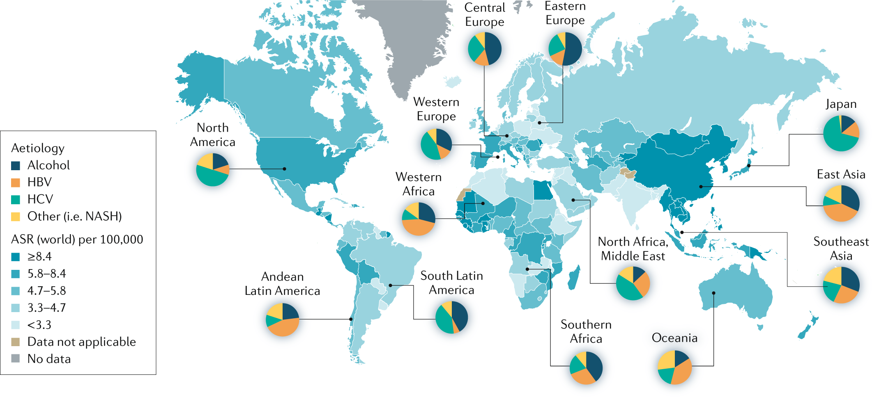
Etiology of HCC varies around the world
Llovet JM, et al. Nature Rev Dis Primers 2021

Slide 5
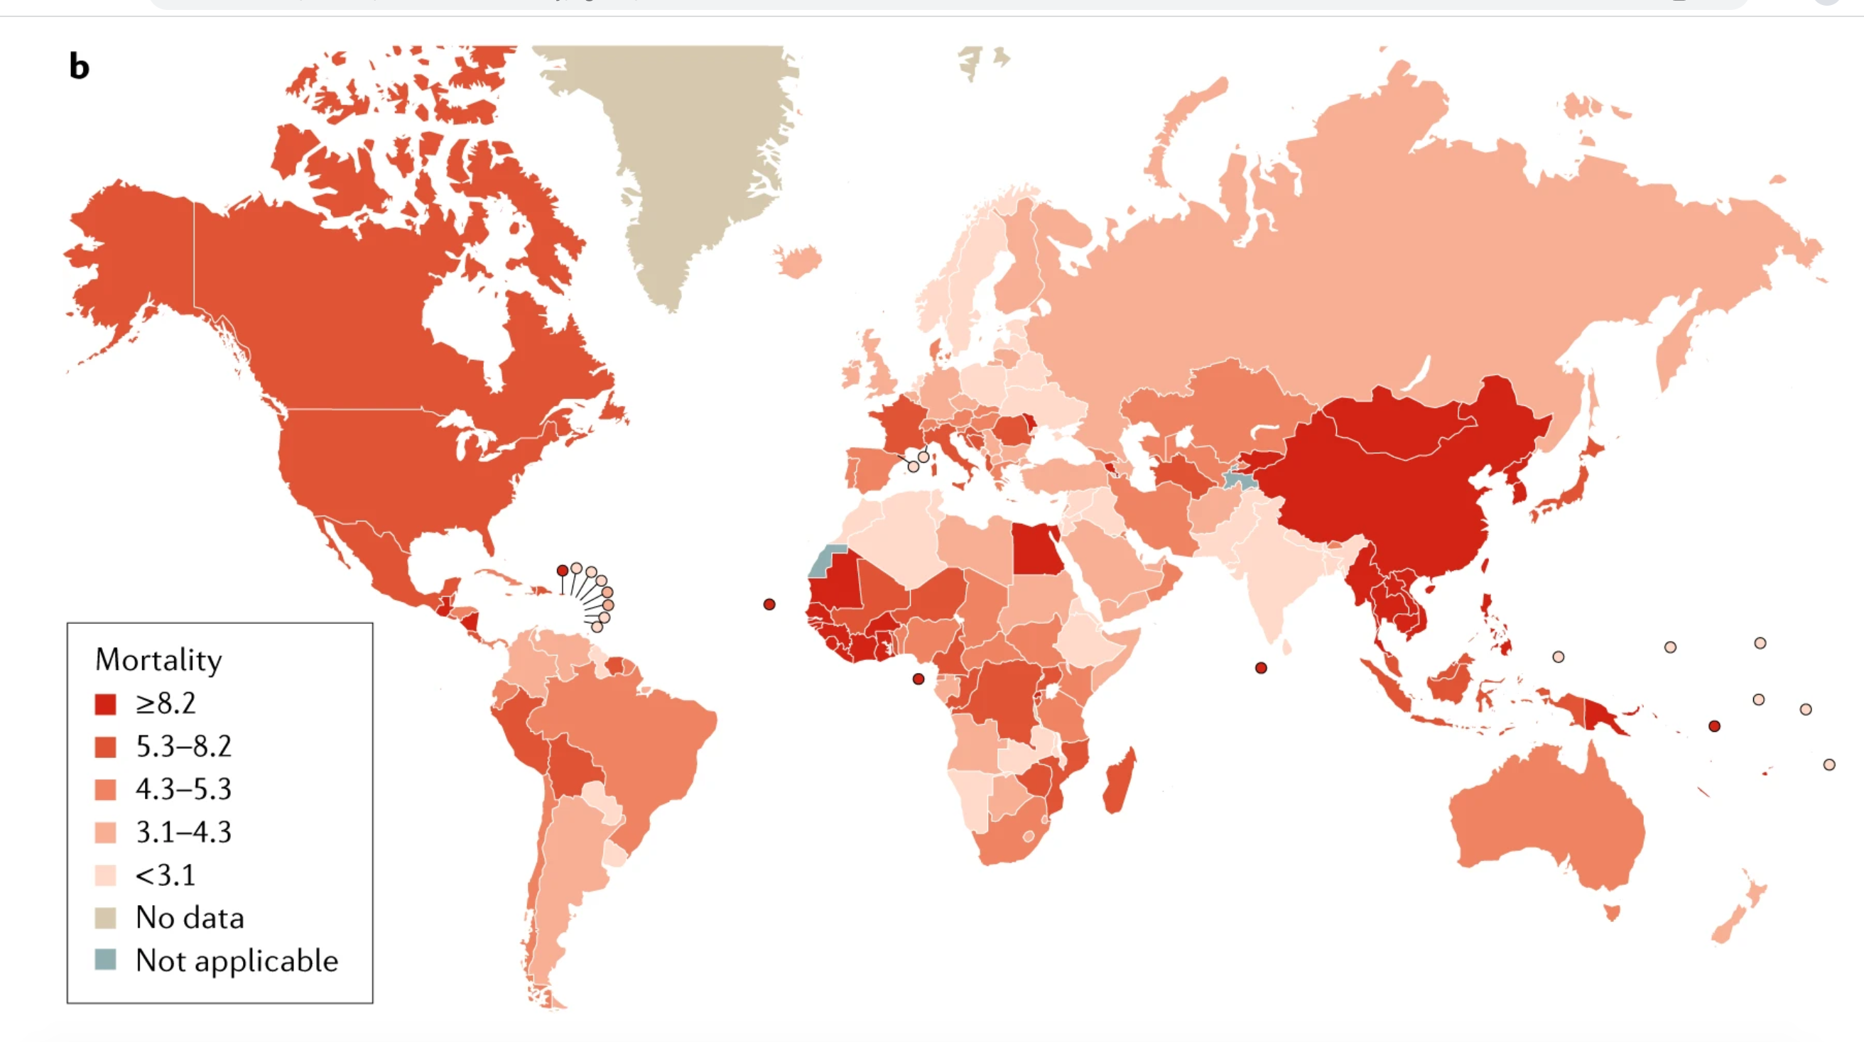
HCC related mortality is on the rise: 3rd leading cause of cancer-related death worldwide
Yang J, et al. Nat Rev Gastroenterol Hepatol 2019: 16, 589-604

Slide 6
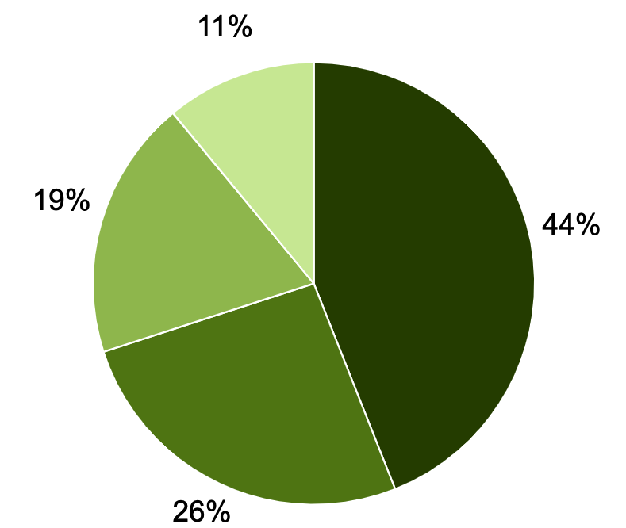
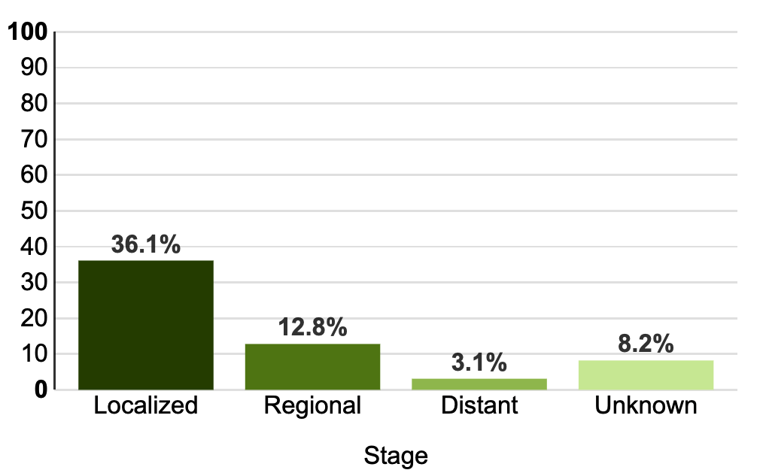
HCC is often diagnosed at later stages when treatment options are limited
% Alive at 5 years
Data from SEER 17, 2012-2018.
Slide courtesy of Dr. Nicole Rich

Slide 7
Patient Case
61 yo man with MASH cirrhosis presents to hepatology clinic for routine HCC screening. He underwent cross sectional imaging which showed:
  4.5 cm LIRADS-5 lesion in segment 6 of the liver and known splenomegaly. No extrahepatic mets. ECOG 0. CP A. His AFP is 200. Platelets 50K
What is the next best therapeutic option in locoregional therapy?

Slide 8
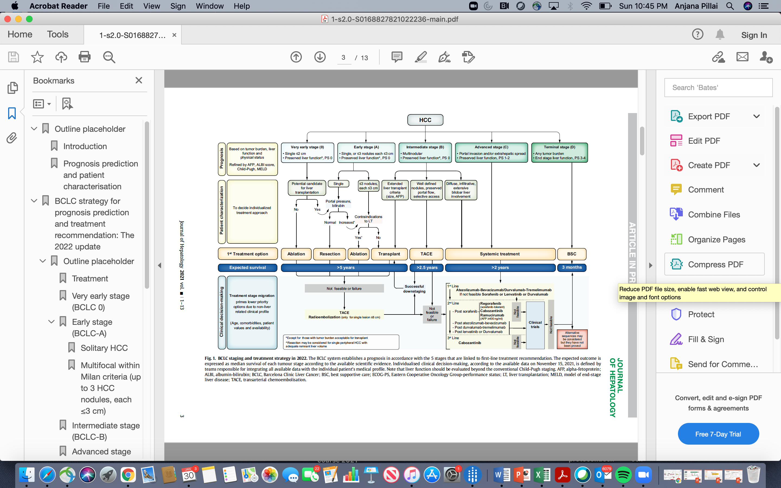
BCLC Algorithm for liver cancer treatment
Reig M, et al. Jl Hepatology 2022

Slide 9
Downstaging has acceptable outcomes. Multiple bridging therapies including systemic therapies are acceptable.
TARE
TARE
(PVT only)

Slide 10
Therapies available for HCC
Surgical
  *Resection
  *Transplant: Deceased or Living Donor
Locoregional Therapy
  Percutaneous ablation
  *Radiofrequency Ablation (RFA)
  * Microwave Ablation (MWA)
  Transarterial Chemoembolization (TACE) +/-Drug eluting beads (DEB)
  Yttrium-90 Microspheres: Radioembolization (TARE)
Systemic
    1st line – Atezo + Bev, Durva + Tremi, Sorafenib, Lenvatinib, Ipi+Nivo
    2nd line –Nivolumab, Regorafenib, Cabozantinimb, Pembrolizumab, Ramucirumab (AFP >400), Ipi +Nivo
    3rd line - Cabozantinib
Other
  Stereotactic body radiation therapy (SBRT)
  Histotripsy
* Potentially curative therapies

Slide 11
Therapies available for HCC
Surgical
  *Resection
  *Transplant: Deceased or Living Donor
Locoregional Therapy
  Percutaneous ablation
  *Radiofrequency Ablation (RFA)
  * Microwave Ablation (MWA)
  Transarterial Chemoembolization (TACE) +/-Drug eluting beads (DEB)
  Yttrium-90 Microspheres: Radioembolization (TARE)
Systemic
    1st line – Atezo + Bev, Durva + Tremi, Sorafenib, Lenvatinib, Ipi+Nivo
    2nd line –Nivolumab, Regorafenib, Cabozantinimb, Pembrolizumab, Ramucirumab (AFP >400), Ipi +Nivo
    3rd line - Cabozantinib
Other
  Stereotactic body radiation therapy (SBRT)
  Histotripsy
  “AASLD does not advise one locoregional therapy over another for bridging therapy. The choice of locoregional modality should be based on tumor size, location, and center expertise (Level 3, Weak Recommendation)
* Potentially curative therapies

Slide 12

Catheter Directed Therapies for HCC
TACE (Transarterial chemoembolization)
  Bland TACE
DEB-TACE
(Drug eluting beads)
Radiation Therapy
  Y90=SIRT=TARE
  Allows higher targeted dose to tumor when compared to external beam radiation and SBRT (120 Gy and upward)
  Sirspheres
  Theraspheres

Slide 13
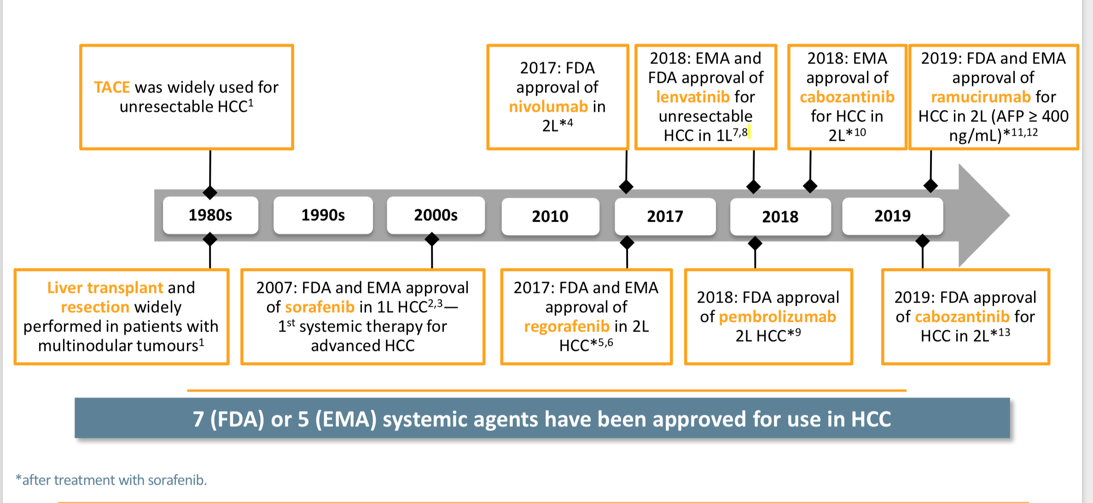
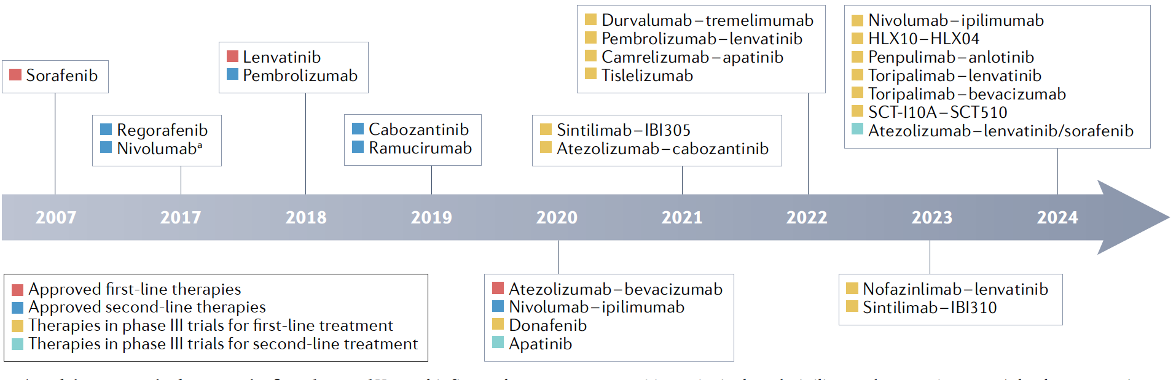
In the beginning there was only TACE...(for LRT)

Slide 14
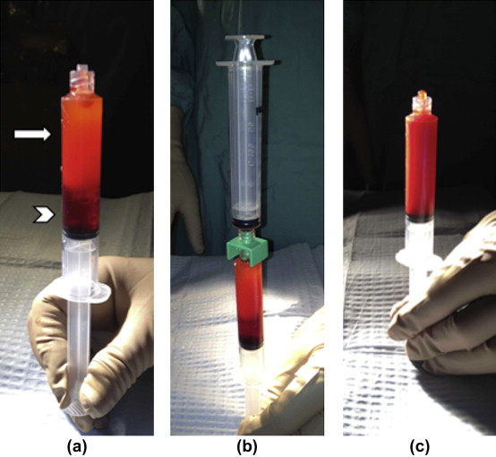
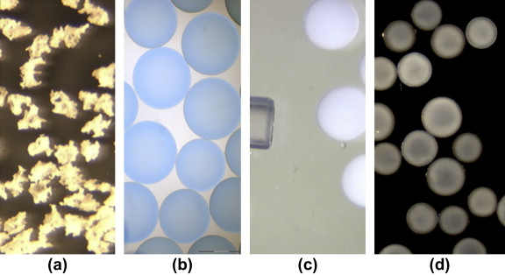
Transarterial Chemoembolization (TACE)
First performed in the early 1980’s
Targeted intra-arterial delivery of chemotherapy followed by an embolic agent
Most common regimen in the US:
    cisplatin 100 mg
    doxorubicin 50 mg
    mitomycin C 10 mg
Embolic agent
  Prevents drug washout
  Induce ischemic necrosis
+ Iodinated contrast and Lipiodol
hydrogel PVA
Gelfoam
PVA
Embospheres

Slide 15


Transarterial Chemoembolization (TACE)
HCC receives most of its blood supply from the hepatic artery (HA)
Injection into the HA spares most of the normal liver
Embolization of the HA prevents systemic absorption of chemotherapy agents and induces ischemic necrosis
Catheter placement for
chemoembolization
Tumor
Hepatic
artery
Liver
Portal vein
Llovet et al. Hepatology. 2003;37:429
Bruix et al. Gastroenterology. 2004;127(5):S179

Slide 16
Transarterial Chemoembolization (TACE)
Macroembolic effect
Arterial occlusion
  Risk of hepatic artery occlusion
Can cause pain, post-embolization syndrome
Can require hospitalization, narcotics, NSAIDs, antiemetics
Notes:
Leads to overexpression of hypoxia-inducible factor 1 alpha, vascular EGF

Slide 17
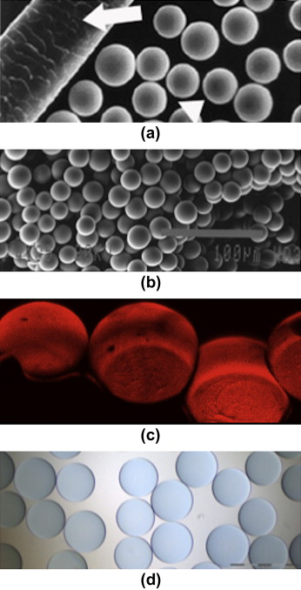
Transarterial Chemoembolization –Drug eluting beads (DEB-TACE)
Quadraspheres
LC Beads
Drug-eluting microspheres developed in 2005
Many advantages over standard TACE
Predictable dose administration
Sustained targeted drug delivery
Higher tumor retention of
doxorubicin
Much easier to use
No lipiodol
Well tolerated
Expanded patient population
Kritzinger J, et al., Hepatic embolotherapy in interventional oncology: Technology, techniques, and applications, Clinical Radiology (2012), http://dx.doi.org/10.1016/j.crad.2012.06.112

Slide 18
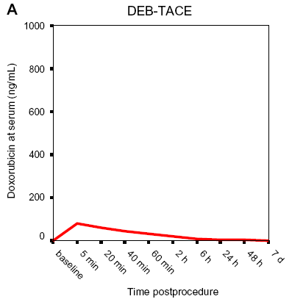
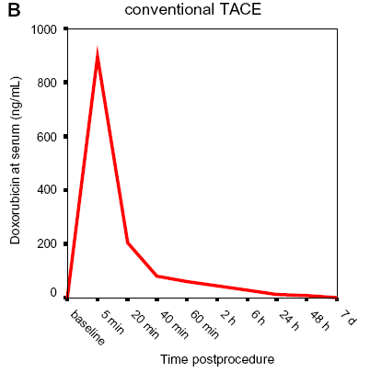
Transarterial Chemoembolization –Drug eluting beads (DEB-TACE)
Improvements over conventional TACE:
  Drug slowly released
  Decreased systemic toxicity
  Beads embedded with doxorubicin: dual purpose of drug delivery and emoblization
Standardization of DEBs: more predictable release of chemotherapy
Varela et al. J of Hepatology 2007; 46: 474-81
Lencioni R et al. Cardiovasc Intervent Radiol. 2012;35(5):980-85

Slide 19
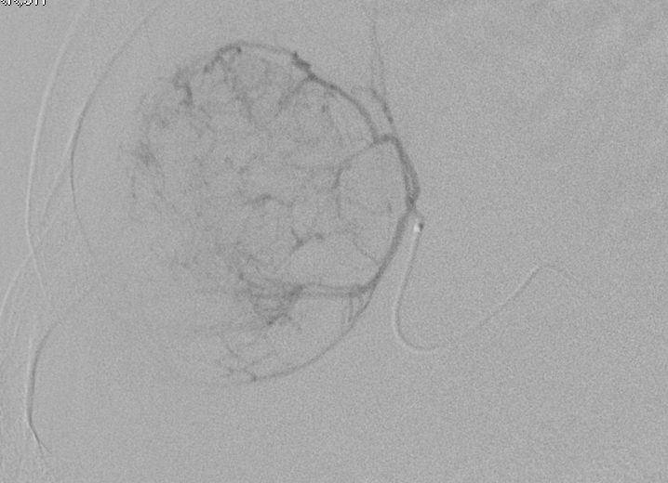
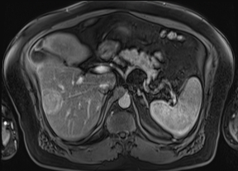
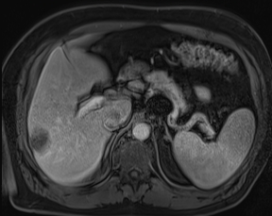
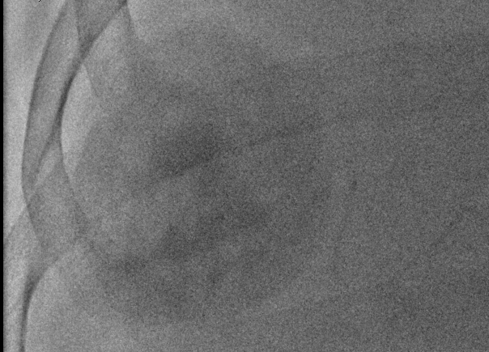
Treatment changes
Subselective Angiogram
Pre-treatment MRI
Tumor staining after treatment

Slide 20

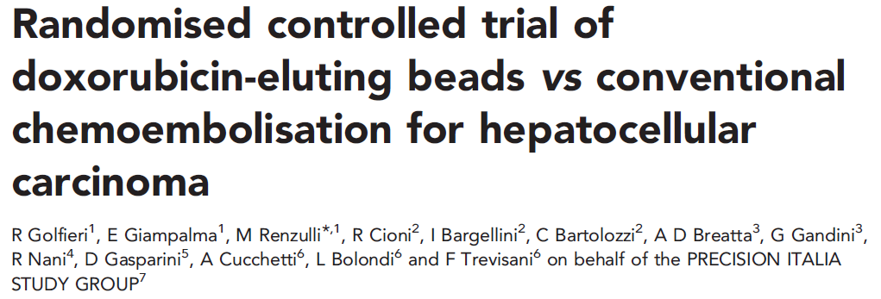
TACE vs. DEB-TACE for HCC
PRECISION Studies
PRECISION V (2009) and PRECISION ITALIA (2014)
  Two Multicenter Prospective RT comparing TACE and DEB-TACE
  Conclusions:
    PRECISION V – no statistical difference in response and local control (p = 0.11), however improved tolerability (p < 0.001) with DEB-TACE
    PRECISION ITALIA – equally effective and safe; less abdominal pain with DEB-TACE(p < 0.001)
TACE vs. DEB-TACE both work and use will depend on your institution and the operator

Slide 21
Catheter Directed Therapies for HCC
TACE (Transarterial chemoembolization)
  Bland TACE
DEB-TACE
(Drug eluting beads)
Radiation Therapy
  Y90=SIRT=TARE
  Allows higher targeted dose to tumor when compared to external beam radiation and SBRT (120 Gy and upward)
  Sirspheres
  Theraspheres

Slide 22
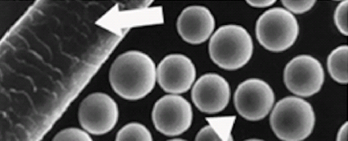
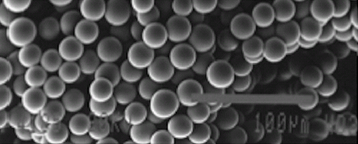
Y90 Manufacturers
TheraSphere®
SIR-Spheres®

Slide 23
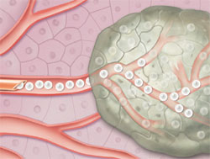
Radioembolization (TARE)
Two Y90 microsphere devices
  TheraSphere- glass
    20-30 um, higher specific activity
    and lower # spheres
  SIR-Spheres- resin
    Moderately embolic, 20-60 um, lower specific activity, and greater # of spheres
Delivery of higher radiation doses to smaller volumes for a potential greater tumoricidal effect and less damage to surrounding liver tissue

Slide 24
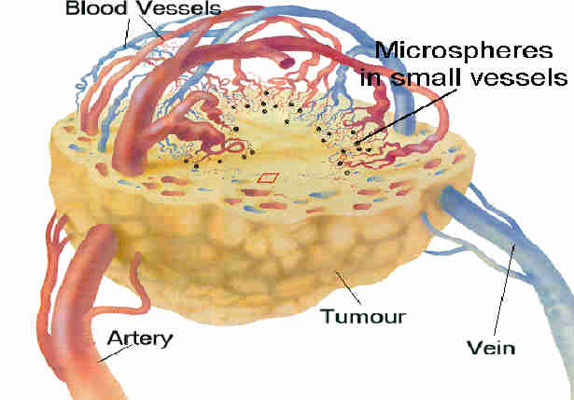
Radioembolization (TARE)
Microspheres, 25-30 microns, are
preferentially trapped in the tumor
capillary bed
Historically staging angiogram performed 7-10 days prior in Y90
Median time to response
  1.2 mo. (necrosis)
  6.6 mo (decrease size)
Areas of interest
  Downstaging
  Radiation lobectomy
  PVT
2.5 mm
Notes:
.

Slide 25
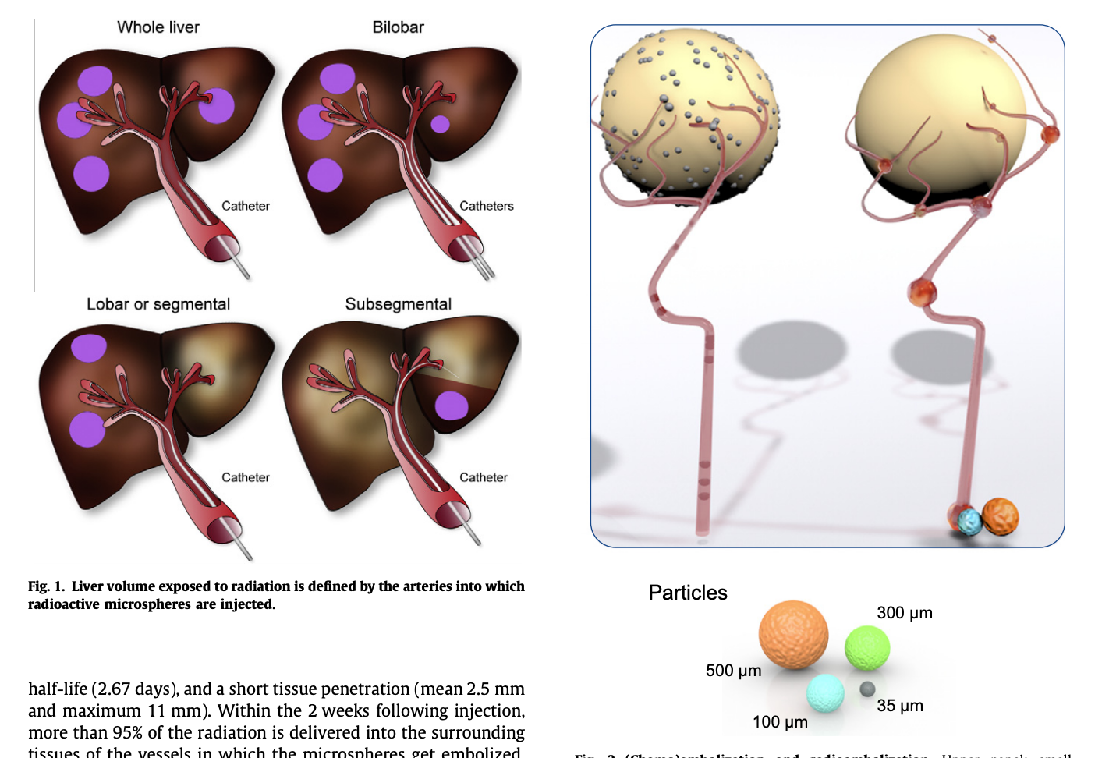
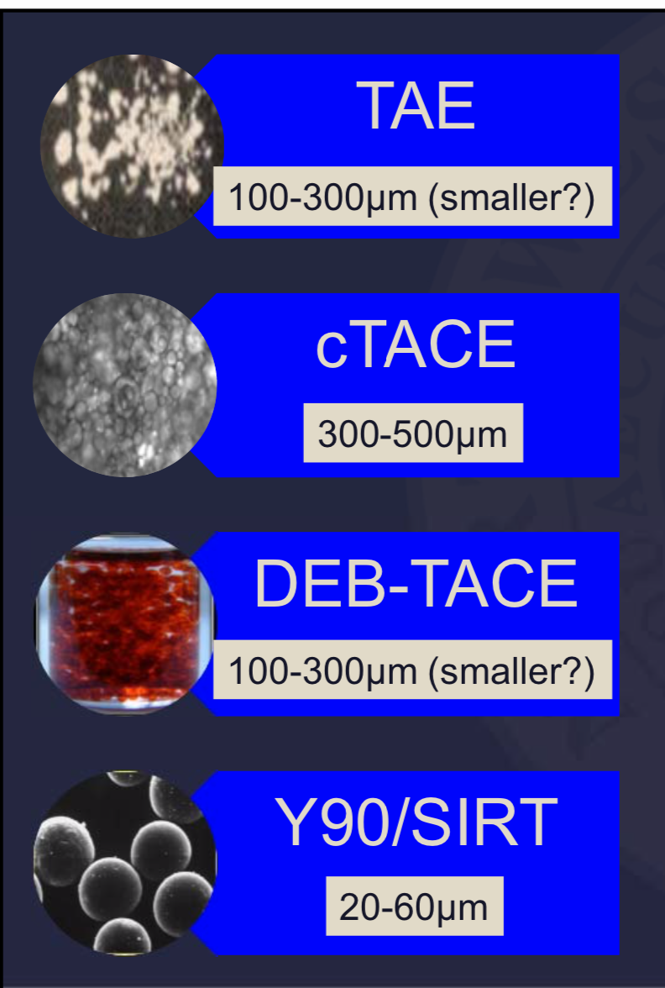

Slide 26
Chemoembolization
Compared to Chemoembolization
ischemia
Radioembolization
radiation
Source: Bilbao, JI.

Slide 27
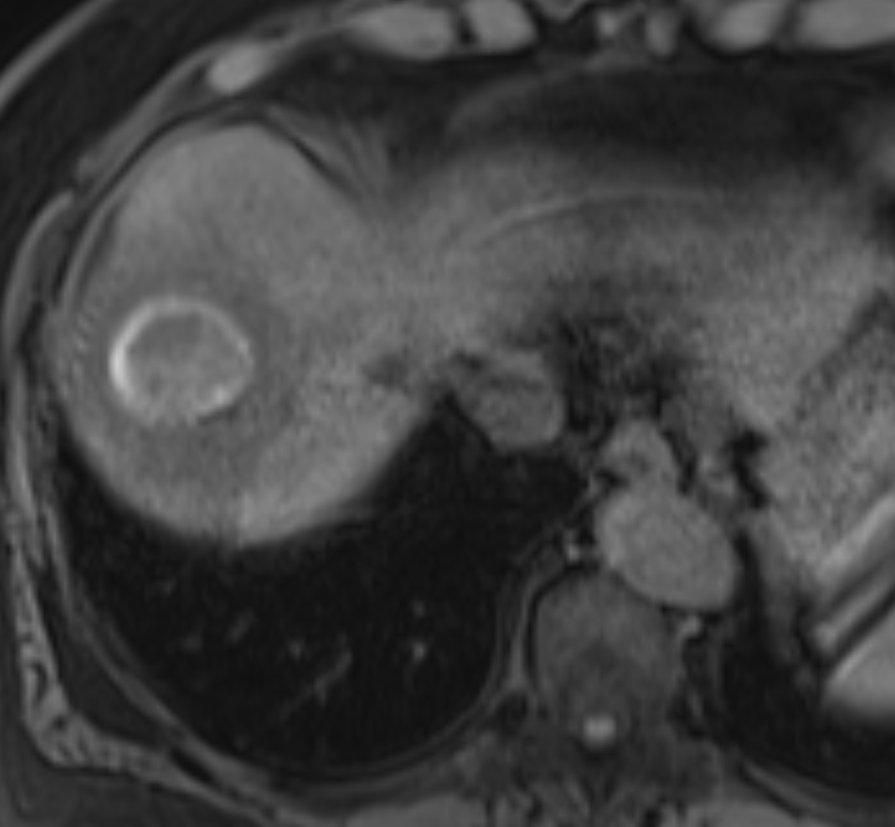
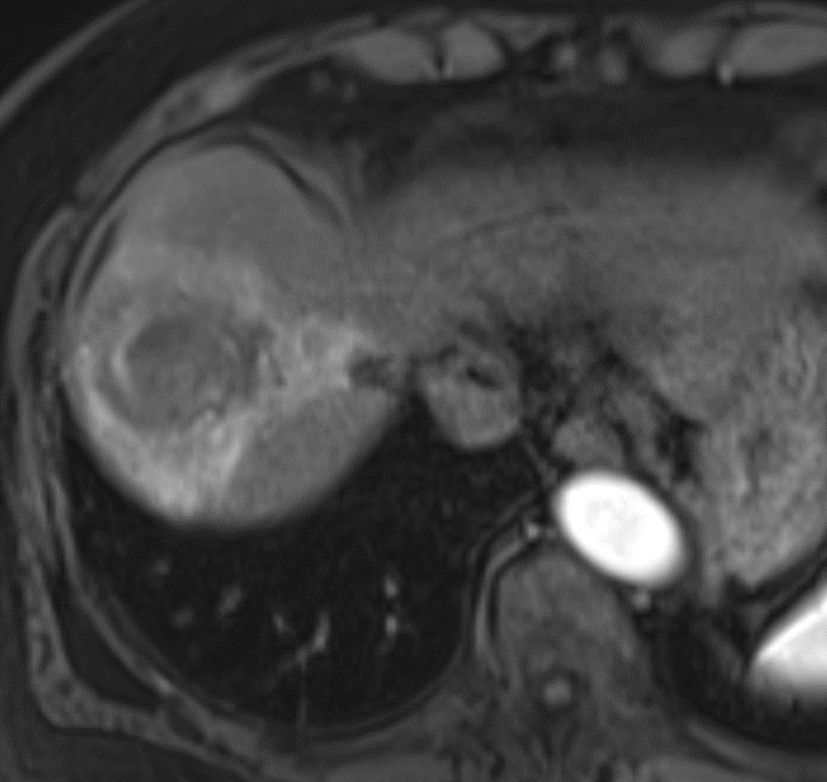
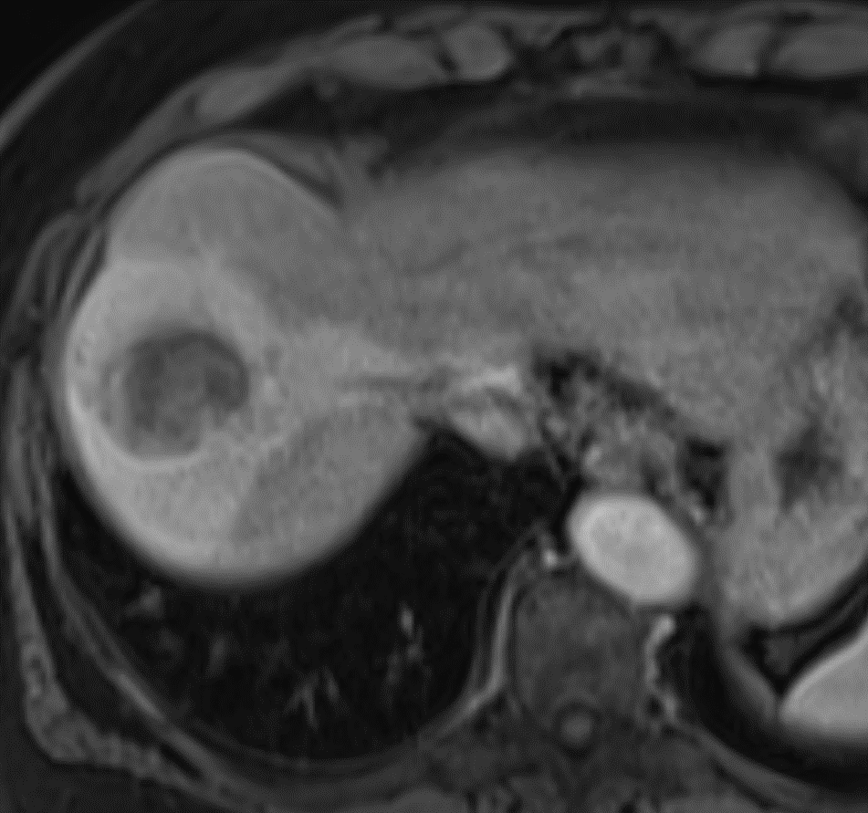
Treatment changes

Slide 28
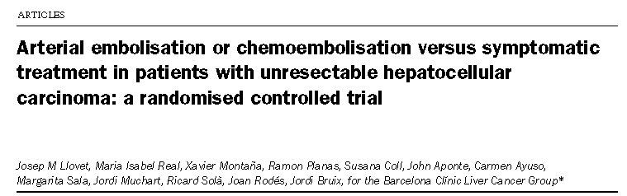
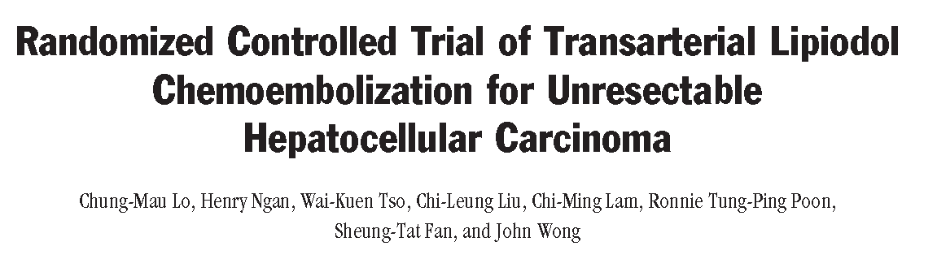
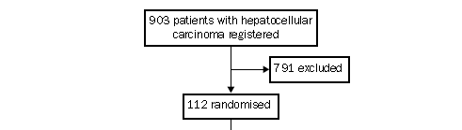
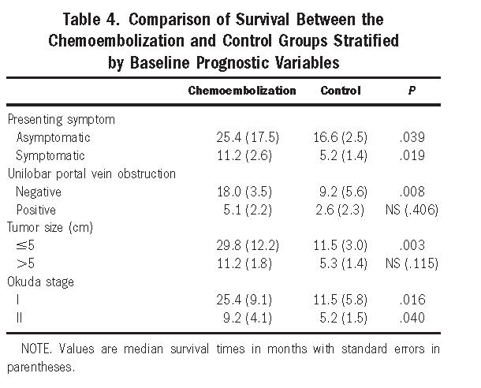
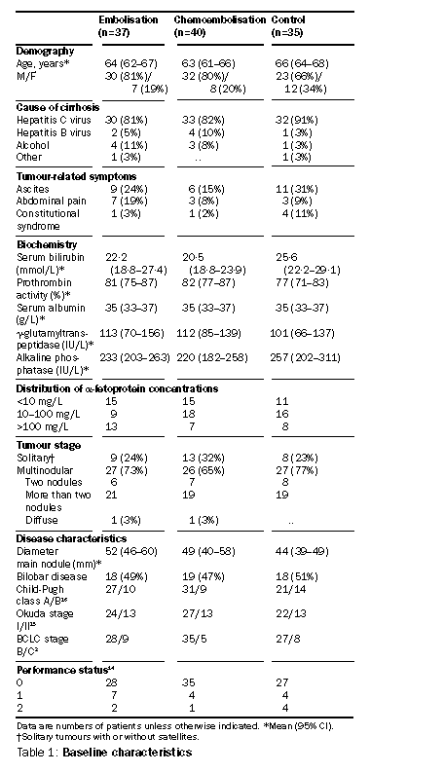
**N=40** **N=40**
Llovet et al. Lancet 2002;359:1734-39
Lo et al. Hepatology. 2002;35:1164-71
Slide courtesy of Dr. Salem

Slide 29
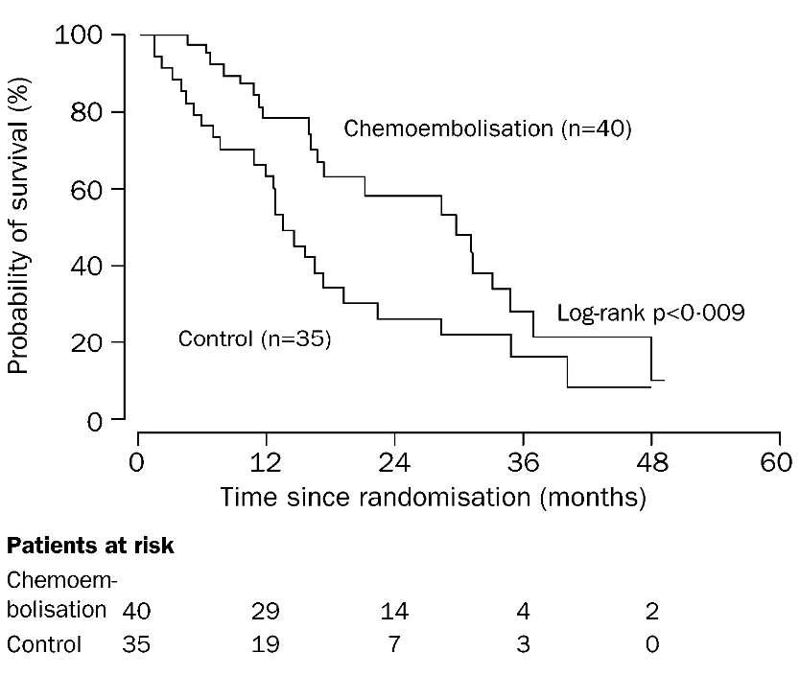
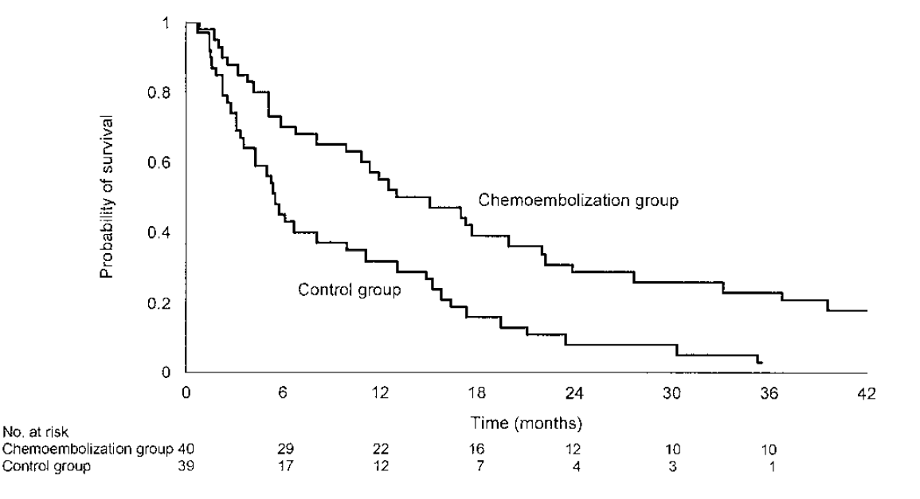
Llovet et al. Lancet, 2002
Lo et al. Hepatology. 2002;35:1164-71

Slide 30
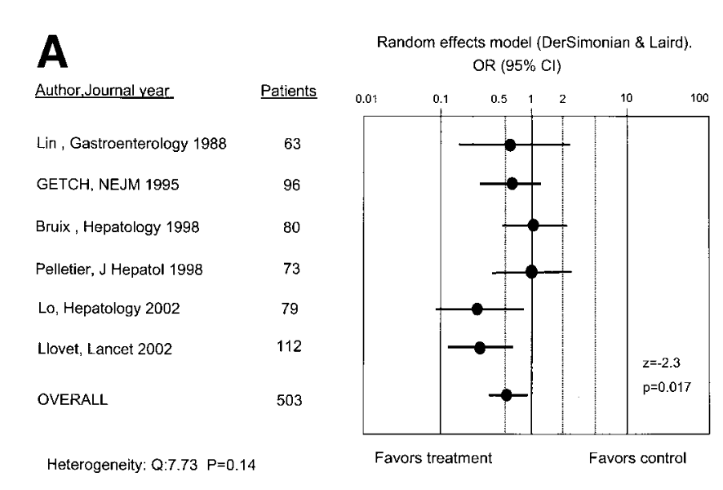
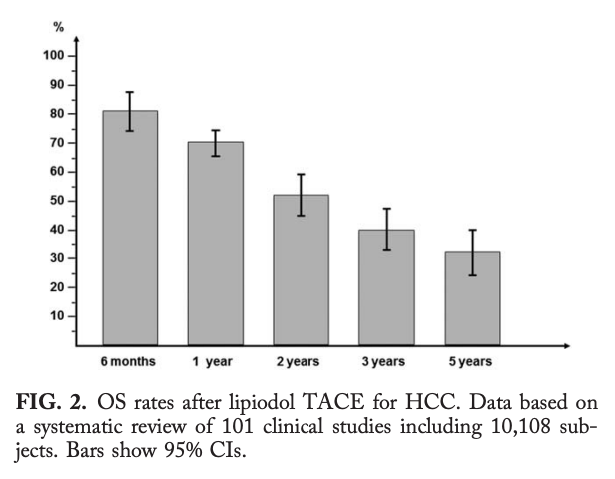
TACE outcomes: Meta-analysis
Llovett et al Hepatology 2003
Lencioni et al Hepatology 2016

Slide 31
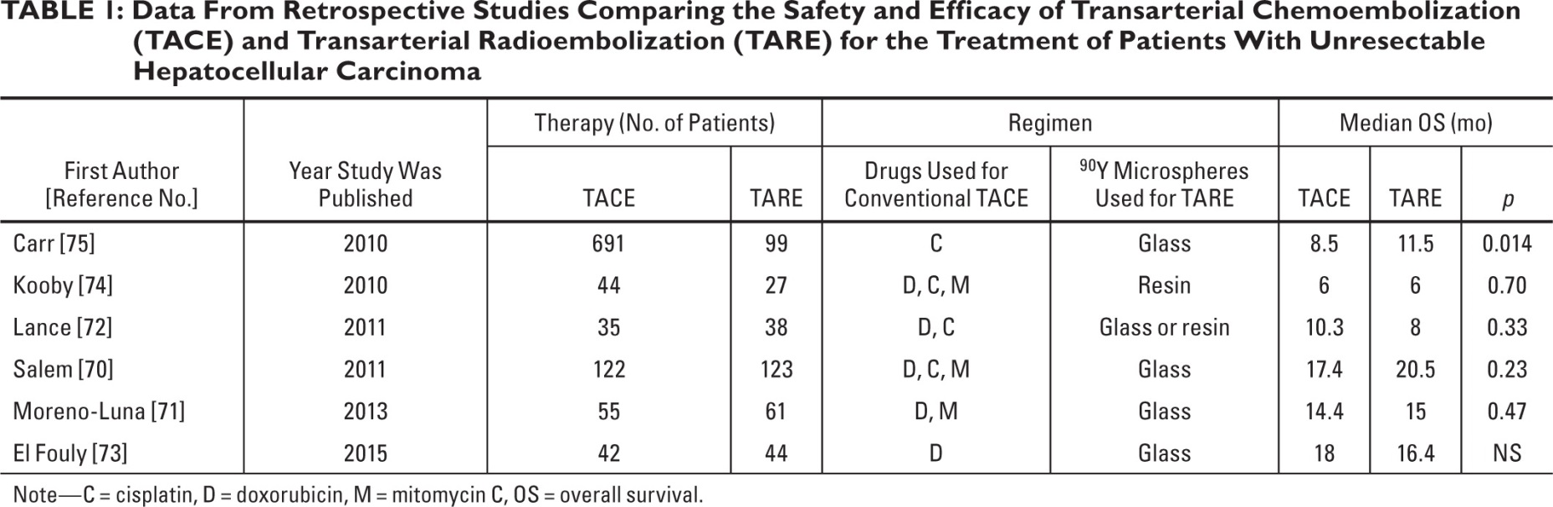
TACE vs TARE for HCC?
In most clinic scenarios the safety and efficacy of TACE and Y90 are equivalent
  Use of one in favor of the other often depends on regional/institutional bias and availability

Slide 32
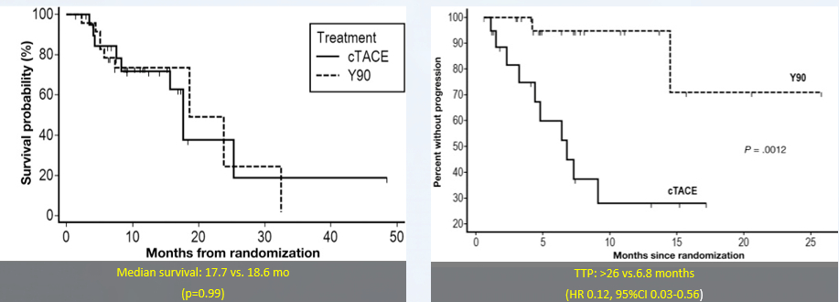
PREMIERE Phase II Trial: TACE vs TARE
Salem R et al Gastro 2016

Slide 33
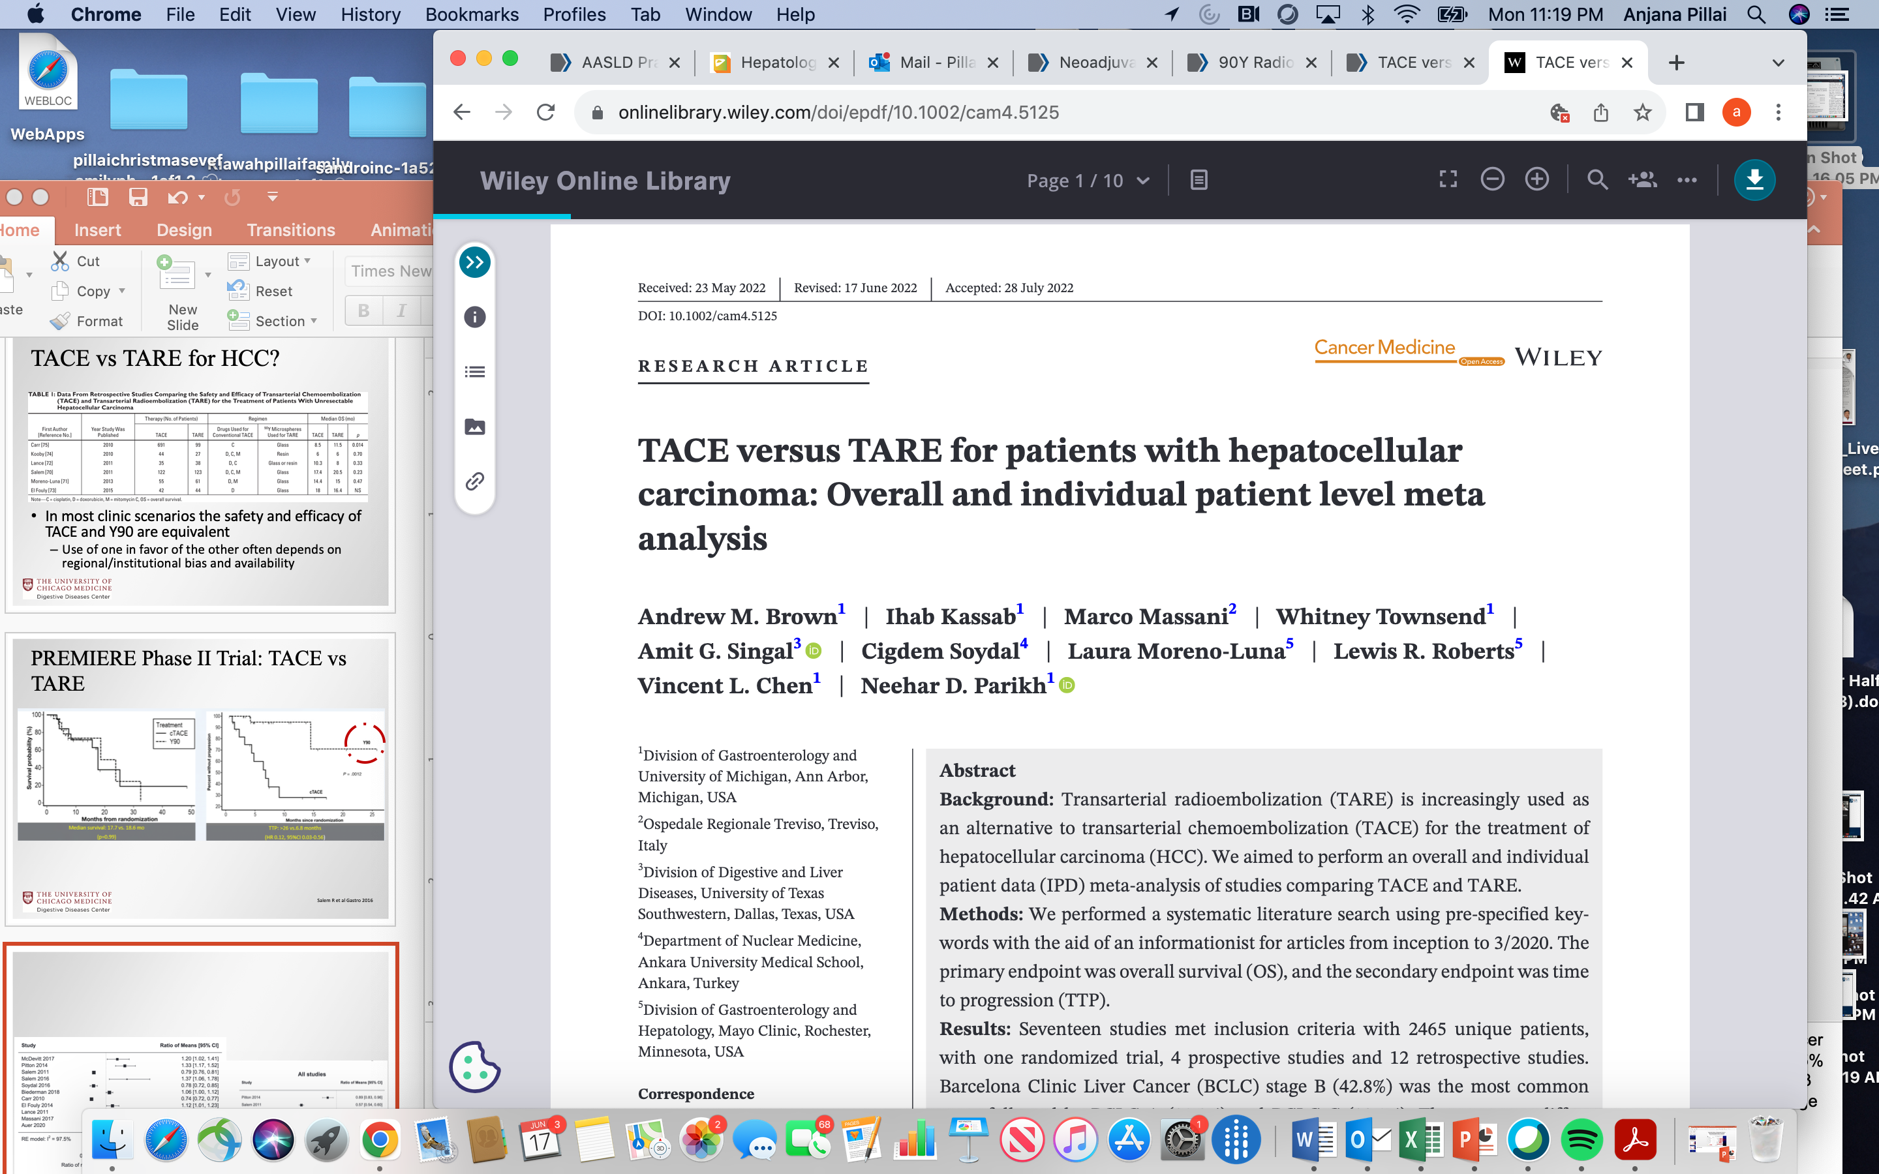
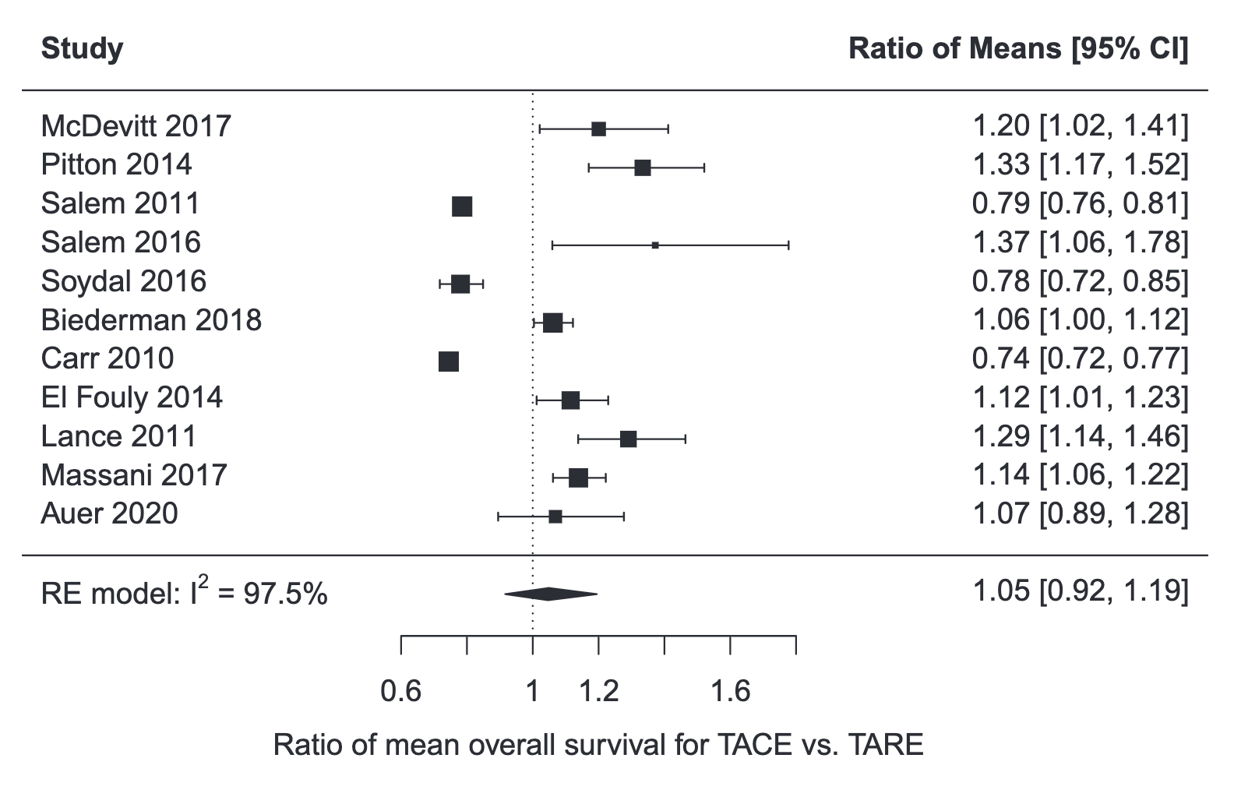
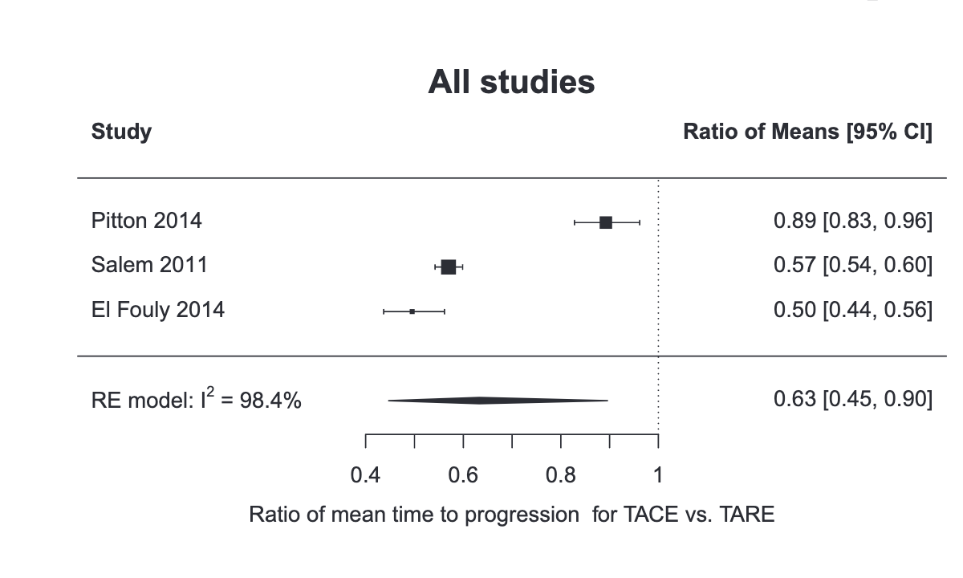
No difference in OS but TTP longer with TARE
2465 patients
N= 17 studies
Brown et al. Cancer Medicine 2022

Slide 34
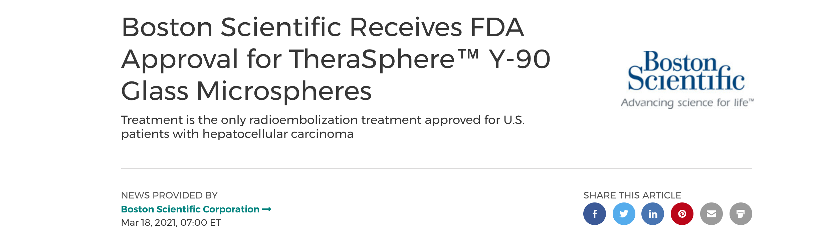
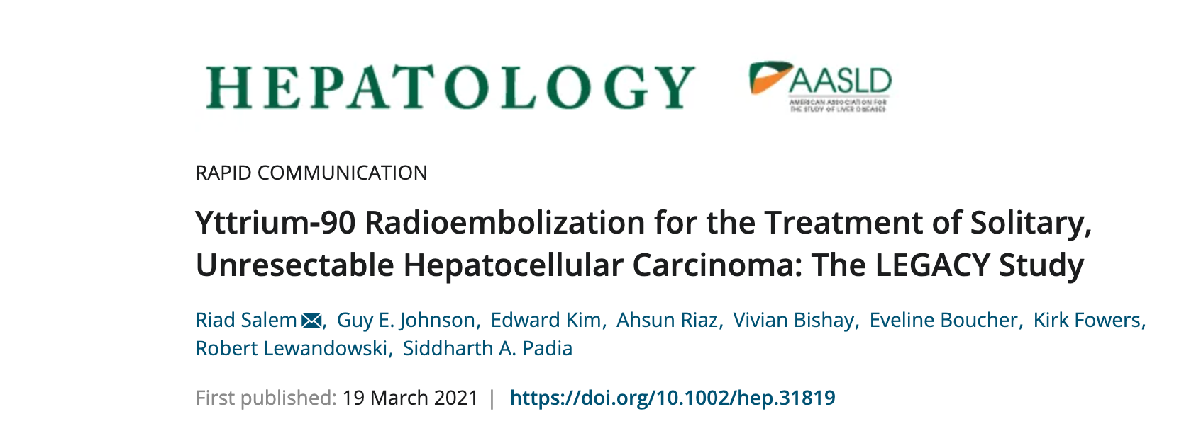
FDA approval of TARE for HCC

Slide 35
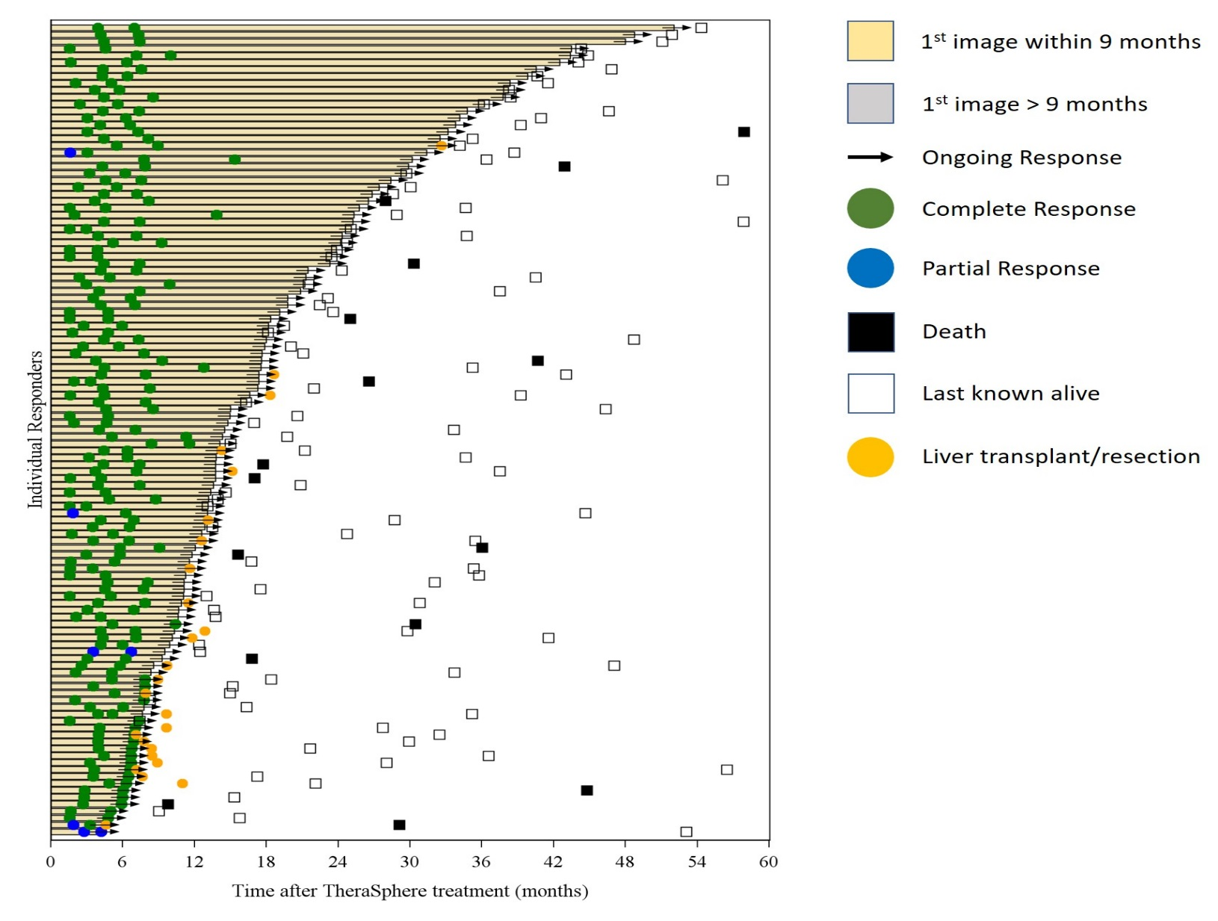
LEGACY Results
N= 162 patients
Median tumor size 2.7 cm
Median f/u: 29.9 mos
ORR: 88.3%
3-year OS: 86.6%
92.8% for neoadjuvant patients resected or transplanted
Salem et al. Hepatology 2021

Slide 36
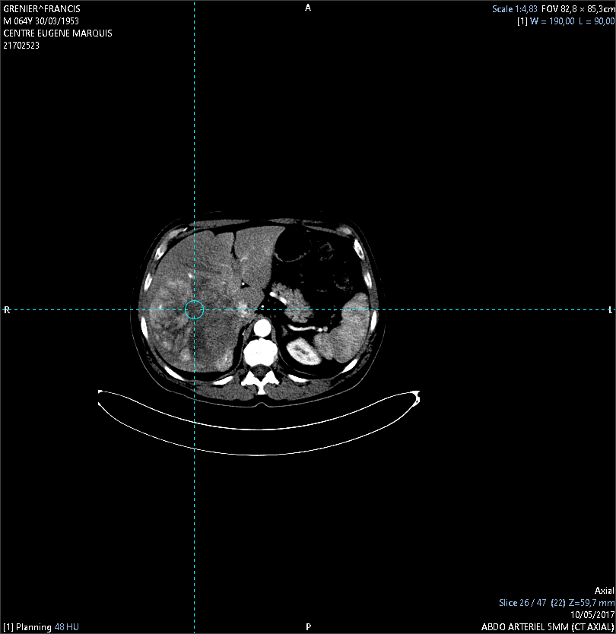
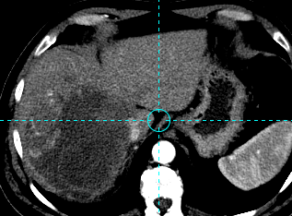
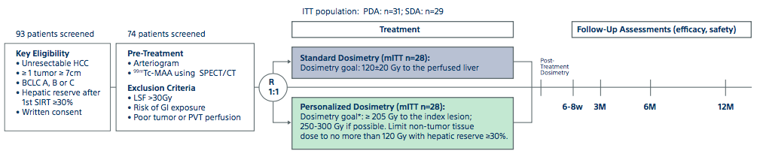
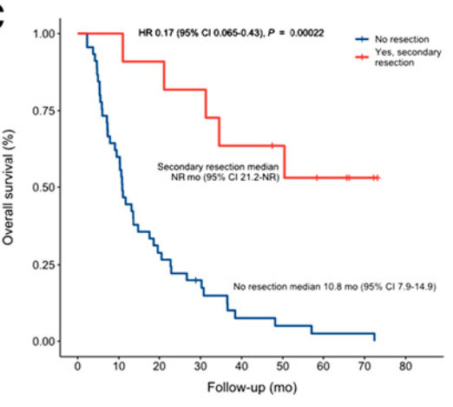
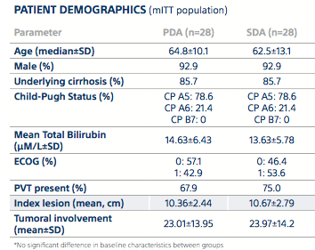
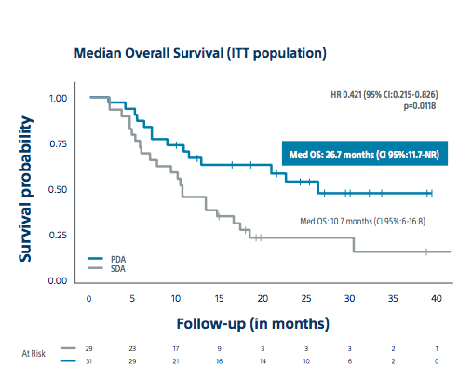
Y90: Personalization Matters
RCT Phase II; 4 centers
Sample Text
Secondary surgery rate = 35% in the PDA vs 3.5% in the SDA, p=0.0024 (8 patients with PVT)
Garin et al Lancet Gastroenterol Hepatol. 2022
Slide courtesy of Dr. Salem

Slide 37
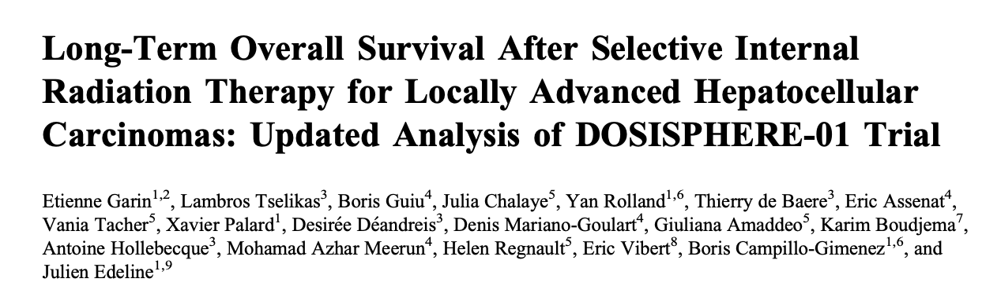


Slide 38

Dhont et al Radiology 2022

Slide 39


Decline in TACE
Significant increase in Y90
Kwong A et al. Clin Gastro Hep 2022

Slide 40
EMERALD-1: TACE and Durvalumab ± Bevacizumab for Unresectable HCC
Global, double-blind, placebo-controlled phase III trial
Primary endpoints: PFS for arm B vs arm C per BICR
Secondary endpoints: PFS for arm A vs arm C, OS, ORR, TTP, QoL, safety
Arm A:
Durvalumab* 1500 mg Q4W + TACE†
Durvalumab 1120 mg
+ B Placebo Q3W
Patients with untreated HCC not amenable to curative therapy;
Child-Pugh A-B7; without evidence of extrahepatic disease; Vp3 and Vp4 excluded; ECOG PS ≤1
(N = 616)
Arm B:
Durvalumab* 1500 mg Q4W + TACE†
Durvalumab 1120 mg +
Bevacizumab 15 mg/kg Q3W
Arm C:
D Placebo* Q4W + TACE†
D Placebo + B Placebo Q3W
Lencioni. ASCO GI 2023. Abstr LBA432.
Lencioni. ASCO GI 2023. Abstr LBA432.

Slide 41

EMERALD-1: PFS With Durvalumab/ Bev + TACE vs Placebo + TACE

Slide 42



Slide 43

EMERALD–1: Response and Safety

Slide 44



IO has changed the landscape of HCC-
TARE and immunomodulation
Y90 altered adaptive and innate immune response, including an increased frequency of activated CD3+ T cells and CD8+ subsets, regulatory T cells (Treg) and inflammatory (PD-L1+ and HLA-DR+) monocyte populations- peaking at 1 mo post treatment
Using ICIs within 1 mo post-Y90 could restore immune response and enhance long term memory
Rivoltini L et al. Gut 2023

Slide 45


OS 19.8 vs 9.5 mos
Advanced HCC –stage 3 or 4
Academic center
Hispanic/Black
Stage 4

Slide 46

Key TakeAways
Incidence and mortality of HCC is on the rise in the US and world-wide
There are multiple treatment options available for patients with HCC and personalization is key!
AASLD does not recommend one LRT over another - based on tumor size, location, and center expertise
Evidence for TARE as good as TACE but smaller numbers and TACE available globally
Effective multimodal and durable downstaging strategies (including immunotherapy) will be key in pushing the limits in the future
Notes:
Tumor differentiation and MVI important but not always available to biopsy
Look at screen shots on phone from Amit re biomarker development

Slide 47

apillai1@bsd.uchicago.edu
X@AnjanaPillaiMD

Slide 48
Gastrointestinal (GI) Cancers
June 18, 2024

Slide 49
How have systemic therapy standards evolved for hepatocellular carcinoma (HCC)?
Joseph W. Franses, MD-PhD
Assistant Professor of Medicine
Director of Translational GI Cancer Research
University of Chicago
joseph.franses@bsd.uchicago.edu

Slide 50
Disclosures
Paid consultant: Eisai, Foundation Medicine, Genentech, Guardant, Servier
Research funding (personal): NCI
Research funding (institutional): Abbvie, Genentech, Iterion Therapeutics, Omega Therapeutics

Slide 51
Outline
Background
Timeline through 2020 (IMbrave 150)
HIMALAYA
LEAP-002
CELESTIAL
COSMIC-312
CARES-310
CheckMate-9DW
Summary, conclusions

Slide 52

Epidemiology
Globocan database

Slide 53

Staging – Barcelona Clinic Liver Cancer (BCLC)
Reig et al, J Hepatol 2022

Slide 54
Systemic therapy landscape through 2020

Slide 55


IMbrave150: atezolizumab + bevacizumab
ORR
30%
11%
Grade 3+ AEs
 | Atezo-bev | Sorafenib
Any | 63% | 57%
Hypertension | 12% | 9%
Elevated AST | 5% | 3%
Proteinuria | 4% | 1%
PPE | 0% | 8%
Req. steroids | 9% | 0%
Finn et al, NEJM 2020. Cheng et al, J Hepatol 2022

Slide 56


HIMALAYA: durvalumab + tremelimumab
Grade 3+ AEs
ORR
20%
17%
5%
 | DT (STRIDE) | Sorafenib
Any | 51% | 52%
Elevated lipase | 6% | 3%
Elevated AST | 5% | 3%
Diarrhea | 4% | 4%
PPE | 0% | 9%
Req. steroids | 20% | 2%
Abou-Alfa et al, NEJM Evid 2022

Slide 57

LEAP-002: lenvatinib + pembrolizumab
Grade 3+ AEs
 | Len-Pem | Lenvatinib
Any | 55% | 57%
Hypertension | 17% | 17%
Proteinuria | 7% | 6%
Elevated LFTs | 6% | 4%
Diarrhea | 6% | 4%
PPE | 5% | 3%
ORR
26%
18%
Llovet et al, Lancet Oncol 2023

Slide 58

CELESTIAL: cabozantinib (after sorafenib)
Grade 3+ AEs
 | Cabo | Placebo
Any | 68% | 37%
PPE | 17% | 0%
Hypertension | 16% | 2%
Elevated LFTs | 11% | 6%
Diarrhea | 10% | 2%
Anorexia | 6% | 1%
ORR
4%
<1%
Abou-Alfa et al, NEJM 2018

Slide 59

COSMIC-312: cabozantinib + atezolizumab
Grade 3+ AEs
 | Cabo-Atezo | Sor | Cabo
Any | 64% | 46% | 60%
Elevated LFTs | 9% | 3% | 10%
Hypertension | 9% | 8% | 12%
PPE | 8% | 8% | 9%
Diarrhea | 4% | 2% | 6%
Anorexia | 2% | 2% | 5%
Req. steroids | 7%
ORR
12%
5%
Kelley et al, Lancet Oncol 2022

Slide 60




Why doesn’t co-targeting angiogenesis and PD1/PDL1 always work?
Kudo, Cancers 2020. Morita et al, BioRxiv 2023.

Slide 61

CARES-310: rivoceranib + camrelizumab
Grade 3+ AEs
 | rivo-cam | sor
Any | 71% | 48%
Hypertension | 37% | 15%
Proteinuria | 6% | 2%
Elevated AST | 13% | 3%
Diarrhea | 2% | 5%
PPE | 12% | 15%
Req. steroids | 16% | 0%
ORR
25%
6%
Qin et al, Lancet 2023

Slide 62

CheckMate-9DW: ipilimumab (3 mg/kg) + nivolumab (1 mg/kg)
Grade 3+ AEs
 | ipi-nivo | len/sor
Any | 41% | 42%
Hypertension | 0% | 12%
Proteinuria | 0% | 5%
Elevated AST | 6% | 1%
Diarrhea | 1% | 3%
PPE | 0% | 3%
Req. steroids | 29%
ORR
36%
13%
Galle et al, ASCO 2024 oral presentation

Slide 63
Four 1L IO combinations have positive ph3 data
 | Imbrave150 | HIMALAYA | CARES-310 | CheckMate-9DW
Regimen | atezolizumab + bevacizumab | durvalumab + tremelimumab | rivoceranib + camrelizumab | ipilimumab (3 mg/kg) + nivolumab (1 mg/kg)
Comparator | sorafenib | sorafenib | sorafenib | sorafenib or lenvatinib
mOS (months) | 19 (vs 13) | 16 (vs 13) | 22 (vs 15) | 24 (vs 20)
ORR (RECIST 1.1) | 30% | 20% | 34% | 36%
% HBV, % HCV | 49%, 21% | 31%, 28% | 76%, 8% | 34%, 27%
vP4 allowed | yes | no | no | no
Gr. 3+ PPE | 0% | 0% | 12% | 0%
Gr. 3+ GIB | 1% | 0.5% | 2% | 0%
Req. steroids | 9% | 20% | 17% | 29%
Secular drift: Modern TKI mOS is ~20 mo

Slide 64
Systemic therapy landscape through mid-2024
ipilimumab +
nivolumab
(Galle, ASCO 2024)
camrelizumab + rivoceranib
(Qin, Lancet 2023)
1st line
durvalumab +
tremelimumab
(Abou-Alfa, NEJM Evid 2020)
atezolizumab +
bevacizumab
(Finn, NEJM 2020)
sorafenib
(Llovet, NEJM 2008)
lenvatinib
(Kudo, Lancet 2018)
regorafenib
(Bruix, Lancet 2017)
cabozantinib
(Abou-Alfa, NEJM 2018)
ramucirumab
AFP > 400
(Zhu, Lancet 2019)
ipilimumab + nivolumab
(Yau, Ann Oncol 2019)
pembrolizumab
(Finn, JCO 2020)
>2nd line
post-sorafenib

Slide 65
Potentially pivotal trials are forthcoming
Adjuvant
IMbrave050: Atezolizumab-bevacizumab vs active surveillance (+ for RFS, Qin et al, Lancet 2023)
KEYNOTE-937: Pembrolizumab vs placebo
Checkmate-9DX: Nivolumab vs placebo
EMERALD-2: Durvalumab +/- bevacizumab, vs placebo
Intermediate
EMERALD-1: Durvalumab +/- bevacizumab, with TACE (+ for PFS)
EMERALD-3: Durvalumab-tremelimumab +/- Lenvatinib, with TACE
EMERALD-Y90: Durvalumab-bevacizumab + Y90
ROWAN: Durvalumab-tremelimumab + Y90
Advanced, 1L
IMbrave152: Atezolizumab-bevacizumab +/- tiragolumab (anti-TIGIT)
NRG-GI2312: 1L IO (IC) +/- SBRT for PV-invasive HCC
** planning phase

Slide 66
Conclusions
The systemic therapy landscape for HCC continues to evolve rapidly.
Immune checkpoint inhibitor regimens have improved outcomes for patients with well compensated cirrhosis and advanced HCC.
Adjuvant: Atezolizumab-bevacizumab *may* be considered in certain high-risk cohorts (OS data immature).
Localized: LRT +/- IO is likely going to become SOC for large burden / multifocal disease.
1L: Atezolizumab-bevacizumab or durvalumab-tremelimumab (or lenvatinib or sorafenib)
  Ipilimumab-nivolumab and rivoceranib-camrelizumab will likely be approved
  Better biomarkers of response are needed.
  No prospective data for CP B
2L+: No prospective data after 1L IO. Standard options include ipi-nivo, lenvatinib, sorafenib, cabo, rego, trials preferred (many novel targets/combinations under investigation).
  No prospective data for CP B

Slide 67
Acknowledgments
Patients and families
UChicago Section of Hematology-Oncology
UChicago Liver Tumor Program

Slide 68

Gastrointestinal Cancers
June 18th, 2024

Slide 69
Advanced Biliary Tract Cancers (BTCs) Updates
Chih-Yi “Andy” Liao, MD
Assistant Professor of Medicine
Interim Director, GI Oncology
University of Chicago
Chicago, IL

Slide 70
Disclosures
• I have the following financial relationships to disclose:
Consultant for: AstraZeneca, BluePrints Medicine, Cancer Experts Now, Exelixis, FirstThought, Genentech, Histosonics, Incyte, Ipsen, QED, Transthera, Boston Scientific
Speaker for: AstraZeneca, Incyte
• I will discuss non-approved, off-label and/or investigational use of therapies in my presentation

Slide 71
Advanced BTC Treatment Landscape
First Line
Second Line and Beyond
No Targetable
Alteration
FGFR2 Fusion
IDH1 Mutation
Gemcitabine + Cisplatin + Durvalumab
Pemigatinib
Ivosidenib
FOLFOX
Futibatinib
BRAF V600E Mutation
Gemcitabine + Cisplatin + Pembrolizumab
5-FU and Liposomal Irinotecan
Dabrafenib + Trametinib
HER2 Amplification
Trastuzumab Deruxtecan
MSI-High
Pembrolizumab
Trastuzumab + Pertuzumab

Slide 72

First-Line Systemic Therapy
Phase III TOPAZ-1 Trial: Gemcitabine/Cisplatin/Durvalumab
 | Gem/Cis Durva | Gem/Cis Placebo
OS | 12.8 mo | 11.5 mo
PFS | 7.2 mo | 5.7 mo
RR | 26.7% | 18.7%
DCR | 85.3% | 82.6%
OS 12.8 mo.
OS 11.5 mo.
Oh et al, NEJM Evid 2022

Slide 73
First-Line Systemic Therapy
Phase III TOPAZ-1 Trial: Gemcitabine/Cisplatin/Durvalumab
 | Gem/Cis Durva | Gem/Cis Placebo
OS | 12.8 mo | 11.5 mo
PFS | 7.2 mo | 5.7 mo
RR | 26.7% | 18.7%
DCR | 85.3% | 82.6%
24-month OS: 24.9%
24-month OS:
10.4%
Oh et al, NEJM Evid 2022

Slide 74
First-Line Systemic Therapy
Phase III TOPAZ-1 Trial: Gemcitabine/Cisplatin/Durvalumab
  PD-L1 status does not predict for benefit from Durvalumab
  Durvalumab benefits both Asian and non-Asian patients
  Durvalumab benefits patients with intrahepatic cholangiocarcinoma, extrahepatic cholangiocarcinoma, and gallbladder cancer
  Patients benefitted from addition of durvalumab, regardless of genomic alterations
Oh et al, NEJM Evid 2022

Slide 75

First-Line Systemic Therapy
Phase III KEYNOTE-966 Trial: Gemcitabine/Cisplatin/Pembrolizumab
 | Gem/Cis Pembro | Gem/Cis Placebo
OS | 12.7 mo | 10.9 mo
PFS | 6.5 mo | 5.6 mo
RR | 29% | 29%
DCR | 75% | 76%
OS 12.7 mo.
OS 10.9 mo.
Kelley et al, Lancet 2023

Slide 76
First-Line Systemic Therapy
Phase III KEYNOTE-966 Trial: Gemcitabine/Cisplatin/Pembrolizumab
 | Gem/Cis Pembro | Gem/Cis Placebo
OS | 12.7 mo | 10.9 mo
PFS | 6.5 mo | 5.6 mo
RR | 29% | 29%
DCR | 75% | 76%
24-month OS: 25%
24-month OS:
18%
Kelley et al, Lancet 2023

Slide 77

Second-Line and Beyond
Phase III ABC-06 Trial: FOLFOX
ORR: 5%
OS 6.2 mo
OS 5.3 mo
Lamarca et al, J Clin Oncol 2019

Slide 78

Second-Line and Beyond
Phase II NIFTY Trial: 5FU + Liposomal Irinotecan
OS 8.6 mo.
ORR: 14.8%
OS 5.5 mo.
Yoo et al, Lancet Oncol 2021

Slide 79

Targeted Therapy in BTC
Nakamura et al, Nature Genetics 2015

Slide 80
Targeted Therapy in BTC
Genomic Profiling Findings | Intrahepatic CCA | Extrahepatic CCA | Gallbladder Cancer
IDH1/2 Mutations | 20% | 3% | 0%
FGFR1-3 Fusions | 11% | 0% | 3%
HER2 Amplification | 3% | 11% | 16%
BRAF Mutations | 5% | 3% | 1%
KRAS Mutations | 22% | 42% | 11%
Javle et al, Cancer 2016

Slide 81

IDH1 Inhibitor: Ivosidenib
Phase III ClarIDHy Study
 | Ivosidenib | Placebo
PFS at 12 mo. | 22% | 0%
OS | 10.3 mo | 7.5 mo
ORR | 3% | 0%
DCR | 53% | 28%
HR = 0.37 (95% CI 0.25 – 0.54, p<0.0001)
PFS 2.7 mo.
PFS 1.4 mo.
Abou Alfa et al, Lancet Oncol 2020
Zhu et al, JAMA Oncol 2021

Slide 82

FGFR Inhibitor: Pemigatinib
Phase II FIGHT-202 Study
ORR | 37.0% (95% CI 26.5 – 45.4%)
DCR | 82.4%
PFS | 7.0 months
OS | 17.5 months
FGFR Translocation Cohort (n = 108)
Abou-Alfa et al, J Clin Oncol 2021

Slide 83

FGFR Inhibitor: Futibatinib
Phase II FOENIX-CCA2 Study
ORR | 42%
DCR | 85%
PFS | 9.0 months
OS | 21.7 months
Goyal , et al, NEJM 2023

Slide 84


FGFR Inhibitor: Futibatinib
Phase II FOENIX-CCA2 Study
Baseline
PR after 2 cycles
Efficacy in Patients Resistant to Other FGFR Inhibitors
Goyal , et al, NEJM 2023

Slide 85

Acquired Resistance to FGFR Inhibitors
Acquired Resistance Mutations
Gatekeeper Mutations at ATP Binding Pocket
Silverman, et al, Cancer Discovery 2021

Slide 86

Next-Gen FGFR Inhibitor: Lirafugratinib
Phase I/II ReFocus Study
Borad, et al, J Clin Oncol 2023

Slide 87

Next-Gen FGFR Inhibitor: Lirafugratinib
Phase I/II ReFocus Study
Borad, et al, J Clin Oncol 2023

Slide 88

Next-Gen FGFR Inhibitor: Lirafugratinib
Phase I/II ReFocus Study
Borad, et al, J Clin Oncol 2023

Slide 89

Next-Gen FGFR Inhibitor: Tinengotinib
Javle, et al, GI ASCO 2024

Slide 90

Next-Gen FGFR Inhibitor: Tinengotinib

Slide 91

BRAF V600E: Dabrafenib/Trametinib
Phase II ROAR Study
ORR | 51% (95% CI 36 – 67%)
DCR | 91%
DOR | 9 months
PFS | 9 months
OS | 14 months
Subbiah et al, Lancet Oncol 2020

Slide 92


KRAS G12C: Adagrasib
Phase I/II KRYSTAL-1 Study
Bekaii-Saab et al, J Clin Oncol 2023

Slide 93


Novel Strategies for KRAS Mutant BTC
NCT05564403
GNS561: PPT1 Inhibitor, Inhibits Autophagy

Slide 94

HER2+: Trastuzumab/Pertuzumab
Phase II MyPathway Study
ORR | 23% (95% CI 11 – 39%)
DCR | 51%
PFS | 4.0 months
OS | 10.9 months
Javle et al, Lancet Oncol 2021

Slide 95

HER2+: Trastuzumab Deruxtecan
Phase II HERB Study
 | HER2+ (n=22) | HER2 low (n=8)
ORR | 36.4% (95% CI 17 – 59%) | 12.5% (95% CI 0.3 – 53%)
DCR | 81.8% | 75.0%
PFS | 5.1 months | 3.5 months
OS | 7.1 months | 8.9 months
Ohba et al, J Clin Oncol Oncol 2022

Slide 96

HER2+: Trastuzumab Deruxtecan
Phase II DESTINY-PanTumor02
 | All Patients (n=41) | HER2 IHC 3+ (n=16) | HER2 IHC 2+ (n=14)
ORR | 22.0% | 56.3% | 0%
PFS | 4.6 mo | 7.4 mo | 4.2 mo
OS | 7.0 mo | 12.4 mo | 6.0 mo
HER2 IHC 3+ Patients
FDA-Approved for HER2 IHC3+ Solid Tumors
Meric-Bernstam et al, J Clin Oncol Oncol 2024

Slide 97


HER2+: Zanidatamab
Phase II HORIZON-BTC01 Study
N = 80
Trastuzumab
Binding Domain
Pertuzumab
Binding Domain
ORR 41%
DCR 69%
PFS 5.5 mo
Pant et al, J Clin Oncol 2023

Slide 98

HER2+: Trastuzumab/Tucatinib
Phase II SGNTUC-019 Study
ORR 46.7%
DCR 76.7%
PFS 5.5 mo
OS 15.5 mo
Nakamura et al, J Clin Oncol 2023

Slide 99

CTX009: DLL4/VEGF-A Bispecific Ab
Phase II Study Preliminary Results: CTX-009 + Paclitaxel
ORR 37.5%
PFS 9.4 mo
OS 12.5 mo
Oh et al, J Clin Oncol 2023

Slide 100

CTX009: DLL4/VEGF-A Bispecific Ab

Slide 101
Advanced BTC Treatment Landscape
First Line
Second Line and Beyond
Gemcitabine + Cisplatin + Durvalumab
No Targetable
Alteration
FGFR2 Fusion
MSI-High
BRAF V600E
Mutation
HER2 Amplification
Pemigatinib
Pembrolizumab
Trastuzumab Deruxtecan
FOLFOX
Dabrafenib + Trametinib
Futibatinib
IDH1 Mutation
Trastuzumab + Pertuzumab
5-FU + Liposomal Irinotecan
Ivosidenib
KRAS Mutation
Gemcitabine + Cisplatin + Pembrolizumab
Lirafugratinib
Adagrasib
NTRK Fusion
Trastuzumab + Tucatinib
CTX009 + Paclitaxel
Entrectinib
FOLFOX + Binimetinib
Tinengotinib
Zanidatamab
Larotrectinib
GNS561 + Trametinib

Slide 103
Applying Clinical Evidence in the Management of GI Malignancies
Chih-Yi “Andy” Liao, MD
Assistant Professor of Medicine
Interim Director, Gastrointestinal Oncology
Co-Director, Neuroendocrine Tumor Program
University of Chicago
Chicago, IL

Slide 104
Navigating Treatment Options in Intermediate and Advanced HCC

Slide 105

Polling Question
We would love your participation throughout
the entirety of the program!

Slide 106


On an annual basis how many patients do you see with newly diagnosed HCC?
ⓘ Start presenting to display the poll results on this slide.

Slide 107

Patient Case 1
34F with no PMH, incidentally found to have liver lesions and biopsy confirmed HCC. Imaging:
Bilobar disease, >5 lesions
Dominant lesion in R lobe: 6 cm
No extrahepatic disease

Slide 108
What would be your preferred choice of locoregional therapy for this patient?
ⓘ Start presenting to display the poll results on this slide.

Slide 109
Patient Case 1 (cont)
Patient received locoregional therapy with TARE

Slide 110
Discussion
How are you currently establishing the eligibility of patients for locoregional therapy?
What is the role of an interventional radiologist (IR) in initiating locoregional therapy?

Slide 111
Discussion
Describe the working relationship between IRs and MedOncs in your clinical setting when initiating and overseeing the treatment of patients with intermediate or advanced HCC.
  What influence do IRs have on treatment decisions? MedOncs?
  How is the final treatment selection typically determined?
  What other specialties may be involved in treatment selection?

Slide 112
Discussion
What criteria do you use to choose between TACE and TARE, and what factors influence your decision?
  Presence of multifocal disease, vascular invasion, or portal venous thrombosis influence your selection?
  Liver involvement and underlying liver function
  Patient QoL and cost

Slide 113


Patient Case 1 (cont)
Partial response to locoregional therapy…
Progressive disease in L hepatic lobe

Slide 114
What would be your preferred 1L treatment for this patient following locoregional therapy?
ⓘ Start presenting to display the poll results on this slide.

Slide 115
Patient Case 1 (cont)
Patient receives 1L systemic treatment with Atezolizumab + Bevacizumab

Slide 116
Discussion
How do you select patients for monotherapy vs combination therapy in the first-line setting?
How may your treatment approach differ if …
  Child-Pugh B7 liver function
  Child-Pugh C10 liver function
  Potential transplant candidate

Slide 117
Discussion
In which patients do you consider TKI vs IO based treatment approach?
How do you choose between TKI+IO vs. IO+IO regimens?
How do the available data influence your treatment decision?
  Toxicity profile?
  HCC etiology (viral vs. nonviral)?
  Portal vein thrombosis?

Slide 118

Patient Case 1 (cont)
Disease progression following 1L Atezolizumab/Bevacizumab

Slide 119
What would be your preferred 2L treatment for this patient?
ⓘ Start presenting to display the poll results on this slide.

Slide 120
Case Discussion
Patient receives 2L therapy with cabozantinib

Slide 121
Discussion
How do you select patients for therapy in the second-line setting?
How may your treatment approach differ if …
  Symptomatic and in need of rapid response
  Multiple cardiovascular comorbidities or high bleeding risk
  Child-Pugh B8 liver function
  Rapid progression on 1L atezolizumab/bevacizumab

Slide 122
Navigating Treatment Options in Advanced BTC

Slide 123
On an annual basis how many patients do you see with newly diagnosed BTC?
ⓘ Start presenting to display the poll results on this slide.

Slide 124
When do you conduct molecular testing in patients with advanced BTC?
ⓘ Start presenting to display the poll results on this slide.

Slide 125
What type of molecular testing do you perform?
ⓘ Start presenting to display the poll results on this slide.

Slide 126
Discussion: Molecular Testing in BTC
Do you typically assess HER2 status in patients with BTC?
When may you use liquid vs tissue-based testing?
Do testing results impact your 1L treatment selection? 2L treatment selection?

Slide 127


Patient Case 2
56F, previously healthy, presented with 20-30 lb weight loss and early satiety. Imaging showed:

Slide 128
Patient Case 2
Mediastinal lymph node biopsy showed moderately differentiated adenocarcinoma, IHC positive for CK7 and CA 19-9, negative for CK20, CDX2 and TTF1
NGS showed ERBB2 amplification, PIK3CA mutation, TMB 3.5 mut/Mb, MSS

Slide 129
What would be your preferred 1L treatment choice for this patient?
ⓘ Start presenting to display the poll results on this slide.

Slide 130
Patient Case 2 (cont)
Patient receives 1L treatment with Gemcitabine, Cisplatin, Durvalumab

Slide 131
Discussion Questions
What is your experience using TOPAZ-1 or KEYNOTE-966 treatment protocols in practice?
  How do trial data/results translate to the practice setting?
What percentage of patients receiving these treatment protocols experience disease progression?
  For patients who experience disease progression, how rapidly does this occur?

Slide 132
Discussion Questions
Do you typically continue gemcitabine in patients receiving the KEYNOTE-966 regimen?
  In which patients may you consider discontinuation of gemcitabine?
When using the TOPAZ-1 regimen is there a role for continuation of chemotherapy after 8 cycles?
  In which patient may this be most appropriate?

Slide 133


Patient Case 2 (cont)
After 6 months of Gemcitabine/Cisplatin/Durvalumab followed by 3 months of maintenance Durvalumab, restaging scans showed disease progression

Slide 134
What would be your preferred 2L treatment choice for this patient?
ⓘ Start presenting to display the poll results on this slide.

Slide 135
Case Discussion
How do you select patients for 2L therapy?
How may your treatment approach differ if …
  No actionable alterations
  FGFR2 fusion
  HER2 amplification
How may your approach differ in patients experiencing significant neuropathy symptoms secondary to chemotherapy?

Slide 136
Looking Ahead:
HER2-Targeted Therapies in BTC

Slide 137
Summary of Key Efficacy and Safety Data from HER2-Targeted Therapies in BTC
 | MyPathway¹ | HERIZON-BTC-01² | SGNTUC-019³ | DESTINY-PanTumor02⁴
Treatment | Pertuzumab + Trastuzumab | Zanidatamab | Tucatinib + trastuzumab | T-DXd
HER2+ Status | Overexpression defined as: IHC 3+ Amplification defined as: HER2/CEP17 ratio >2.0 or HER2 copy number >6.0 | Amplified defined as: Cohort 1 (IHC 2+ or 3+) Cohort 2 (IHC 0 or 1+) | Overexpression defined as: IHC 3+ Amplification defined as: HER2/CEP17 signal ratio ≥2.0 or gene copy number ≥6.0 or NGS amplification | HER2+ defined as: IHC 3+ IHC 2+ AND ISH+ OR ERBB2 gene copy number ≥6·0 by NGS
Efficacy
mOS, months (95% CI) | 10.9 | NA | 15.5 | 12.4
mPFS, months (95% CI) | 4.0 | 5.5 | 5.5 | 7.4
ORR, % | 23.0 | 41.3 | 46.7 | 56.3
CR, % | - | 1.3 | 3.3 | -
DCR, % | 51.0 | 68.8 | 76.7 | -
Safety
Grade ≥3 TRAEs, % | 11.2 | 18.8 | 60 | 40.8
1. Meric-Bernstam F, et al. ASCO 2021. Abstract 3004; 2. Pant S, et al. ASCO 2023. Abstract 4008; 3. Nakamura Y, et al. J Clin Oncol. 2023;41(36):5569; 4. Lee C, et al. Lancet Gastroenterol Hepatol. 2023;8(1):56:65; 5. Ohba A, et al. ASCO 2022. Abstract 4006; 6. Swed B, et al. ASCO Daily News. 2023.
https://dailynews.ascopubs.org/do/implementing-her2-directed-therapies-advanced-biliary-tract-cancers-practice-do-we

Slide 138
Discussion Questions
What are your thoughts on emerging data with HER2-directed therapies in BTC and recent approval of T-DXd?
What is the future role of HER2-directed agents in the treatment of HER2+ BTC?

Slide 139
Questions?

