Slide 1










GENITOURINARY CANCER
Thursday, September 21, 2023

Slide 2
Welcome
Steven Frommeyer
Executive Director, Global Ambassador Strategies, Oncology
MJH Life Sciences™

Slide 3


Thank You to Our Supporters:

Slide 4


Slide 5


Slide 6


Slide 7
2023 Events
Precision Medicine: November 16,
Washington, DC
Breast: December 4, San Antonio, TX
2024 Events
Genitourinary: January 24, San Francisco, CA
Lung: March, Atlanta, GA
Gyn-Onc: May, Austin, TX
Lung: June, Chicago, IL
Gastrointestinal: November, Washington, DC
Breast: December, San Antonio, TX

Slide 8


Slide 9
Program Chair
Vivek Narayan, MD, MSCE
Assistant Professor of Medicine
University of Pennsylvania, Abramson Cancer Center
Philadelphia, PA

Slide 10
GENITOURINARY CANCER
Thursday, September 21, 2023

Slide 11
PARP inhibitors in Prostate Cancer
Samuel Takvorian, MD MSHP
Assistant Professor of Medicine
University of Pennsylvania, Abramson Cancer Center
Philadelphia, PA

Slide 12
Outline
Regulatory landscape
Rationale & mechanism of action
Evidence: Progressive mCRPC (2L+)
Evidence: Frontline mCRPC (1L)
Toxicity and management
Conclusions

Slide 13
Regulatory approvals
2020
  Olaparib for HRR-mutated mCRPC post ARSI ^{[PROfound]}
  Rucaparib for BRCA-mutated mCRPC post ARSI and taxane ^{[TRITON2/3]}
2023
  Olaparib/abiraterone for BRCA-mutated mCRPC ^{[PROpel]}
  Niraparib/abiraterone for BRCA-mutated mCRPC ^{[MAGNITUDE]}
  Talozaparib/enzalutamide for HRR-mutated mCRPC ^{[TALAPRO2]}

Slide 14
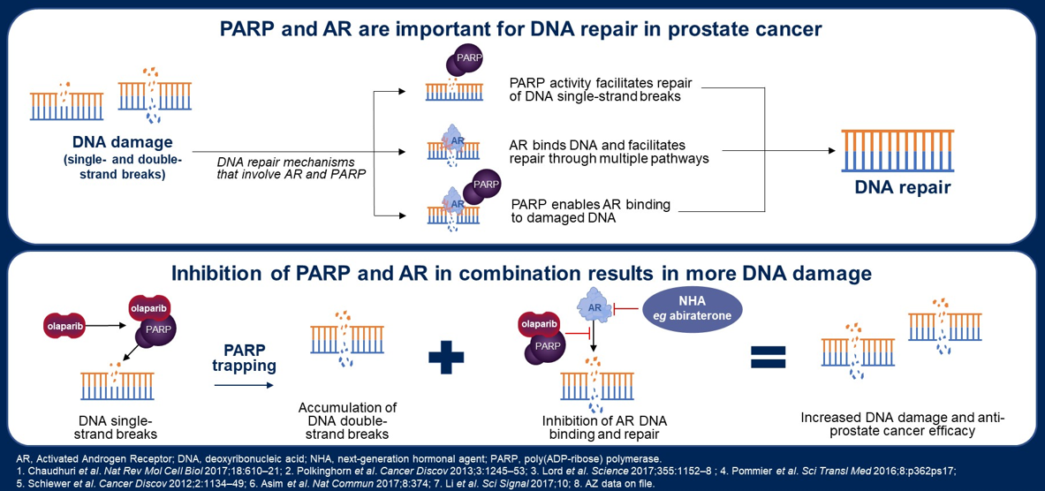
Rationale & mechanism of action
Adapted from: Clarke et al., ASCO GU 2023

Slide 15
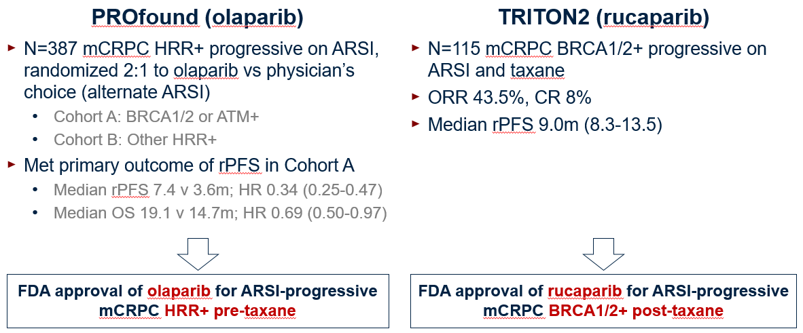
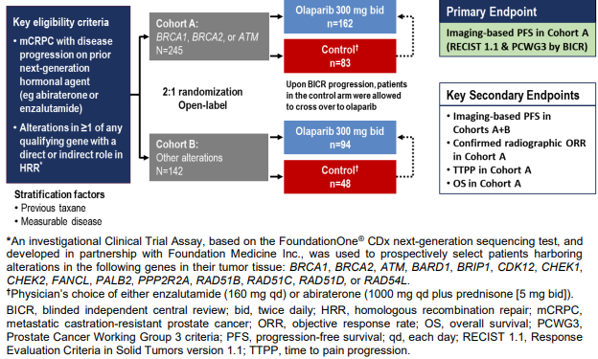
PARPi in progressive mCRPC
De Bono et al., NEJM 2020; Hussain et al., NEJM 2020; Abida et al., JCO 2020

Slide 16
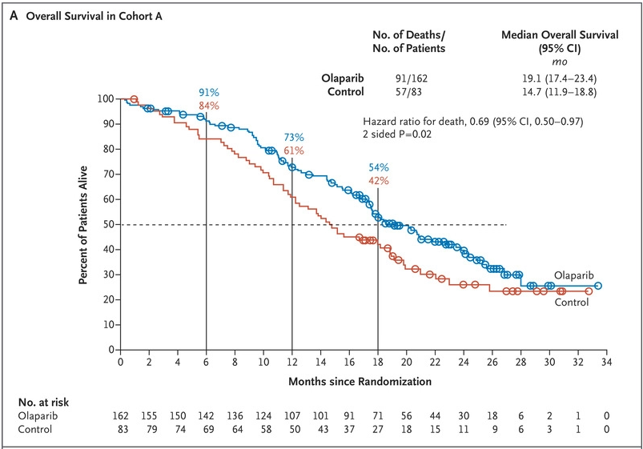
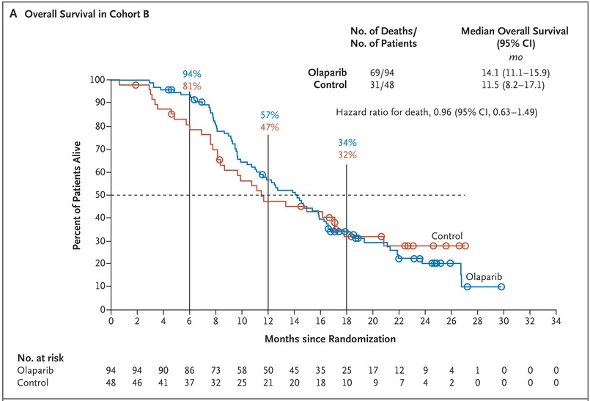
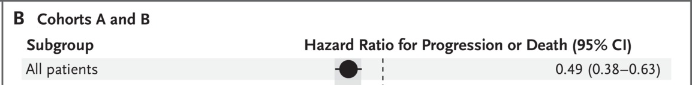
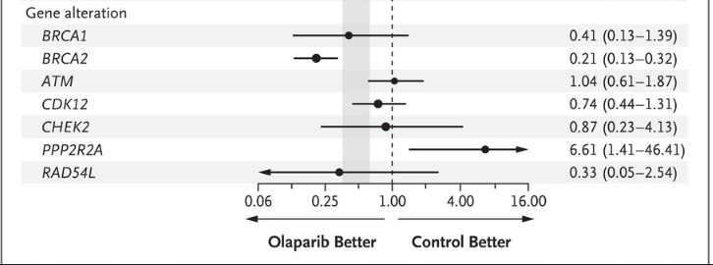
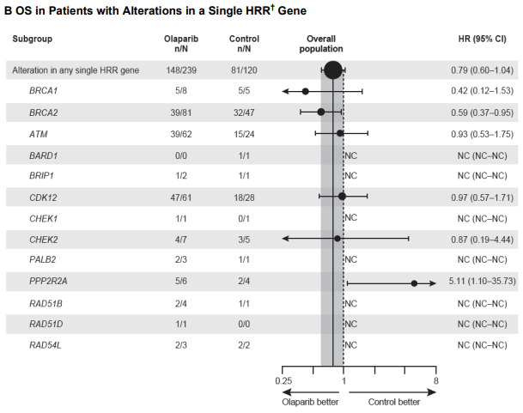
rPFS/OS benefit in PROfound driven by BRCA
Cohort A [BRCA1/2 or ATM]
Cohort B [Other HRR]
De Bono et al, NEJM 2020; Hussain et al, NEJM 2020

Slide 17
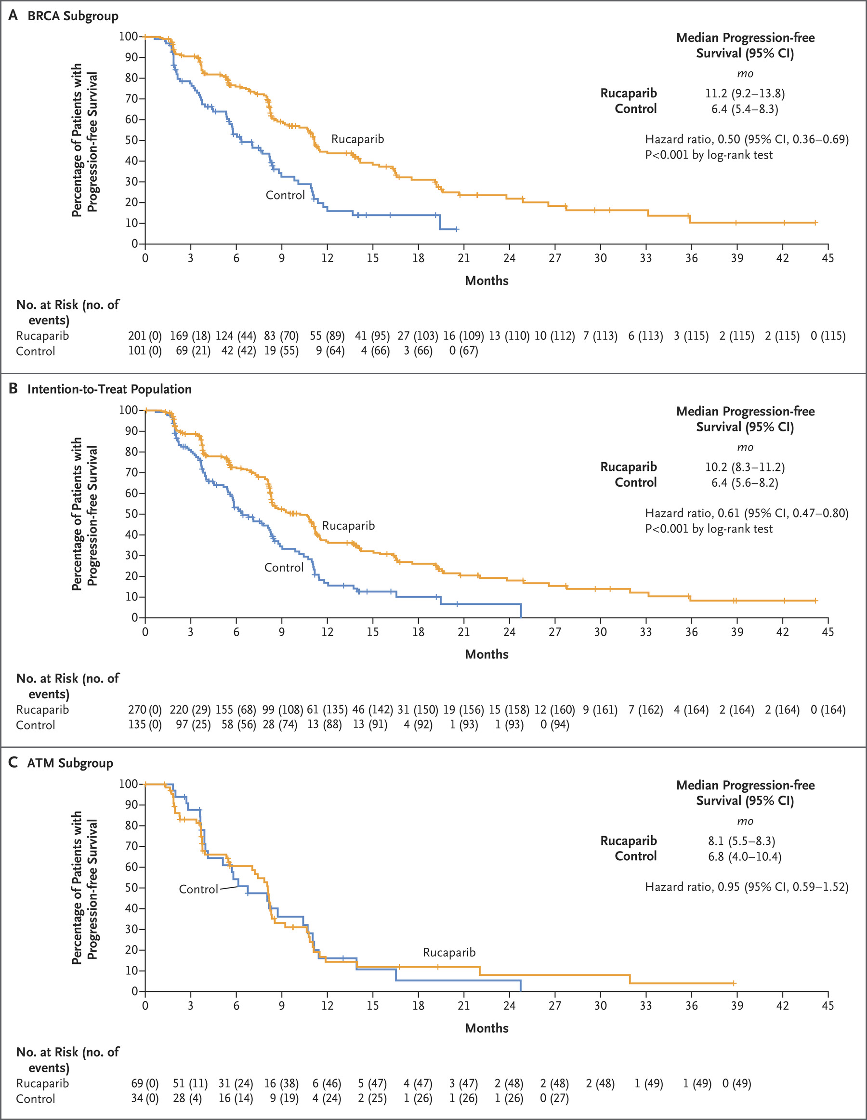
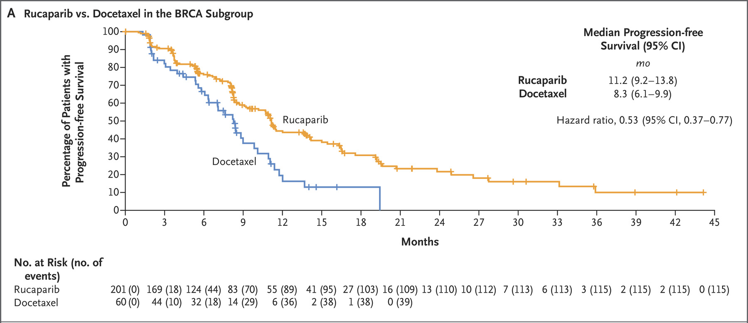
Similarly, rPFS benefit in TRITON3 driven by BRCA
N=405 chemo-naïve mCRPC BRCA1/2- or ATM-mutated progressive on ARSI
Randomized 2:1 rucaparib v physician’s choice (docetaxel or alternate ARSI)
Fizazi et al., NEJM 2023

Slide 18
PARPi/ARSI combinations in 1L mCRPC
Olaparib/abiraterone (PROpel)
Niraparib/abiraterone (MAGNITUDE)
Talozaparib/enzalutamide (TALAPRO2)

Slide 19
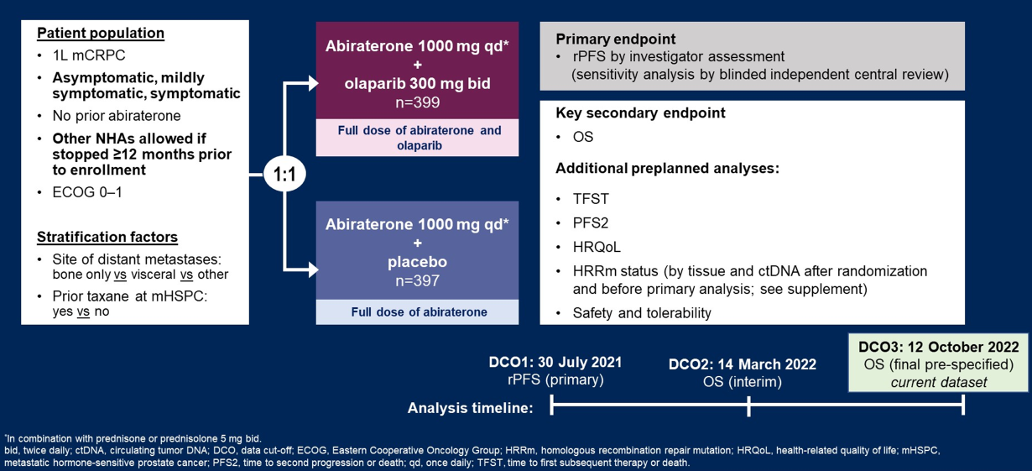
PROpel
Adapted from: Clarke et al., ASCO GU 2023

Slide 20
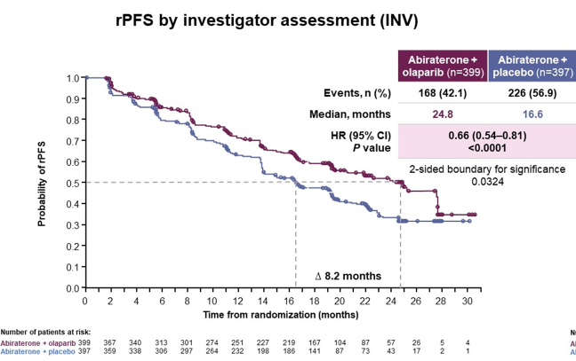
PROpel: rPFS
Adapted from: Clarke et al., ASCO GU 2023

Slide 21
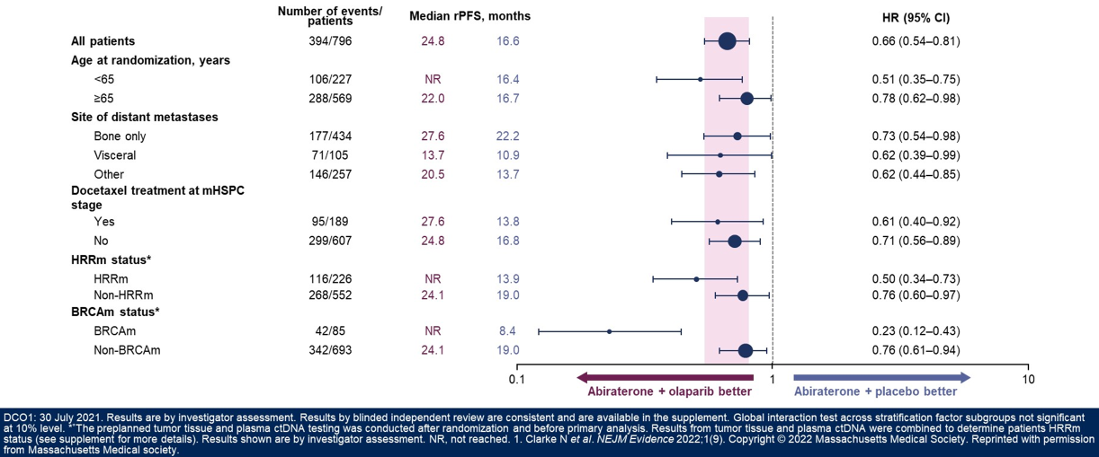
PROpel: rPFS (subgroups)
Adapted from: Clarke et al., ASCO GU 2023

Slide 22
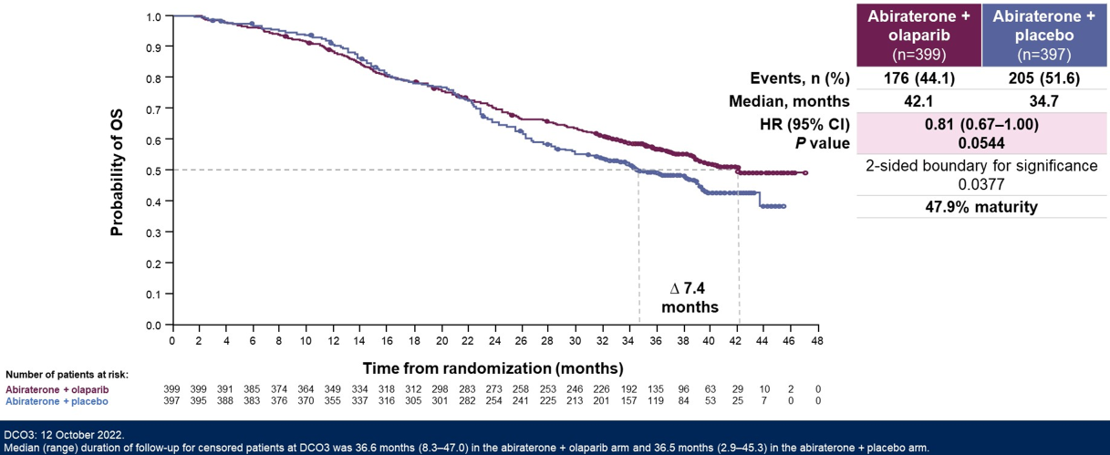
PROpel: OS
Adapted from: Clarke et al., ASCO GU 2023

Slide 23
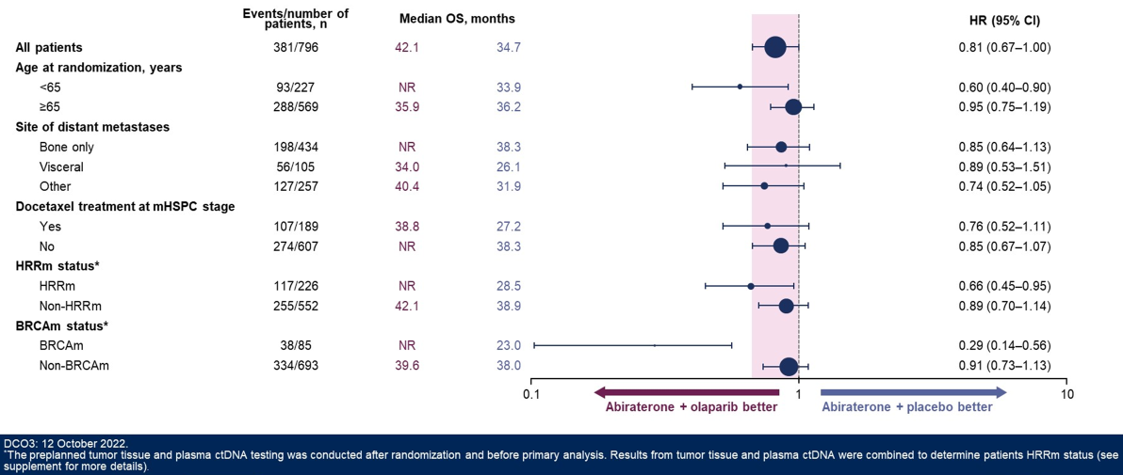
PROpel: OS (subgroups)
Adapted from: Clarke et al., ASCO GU 2023

Slide 24
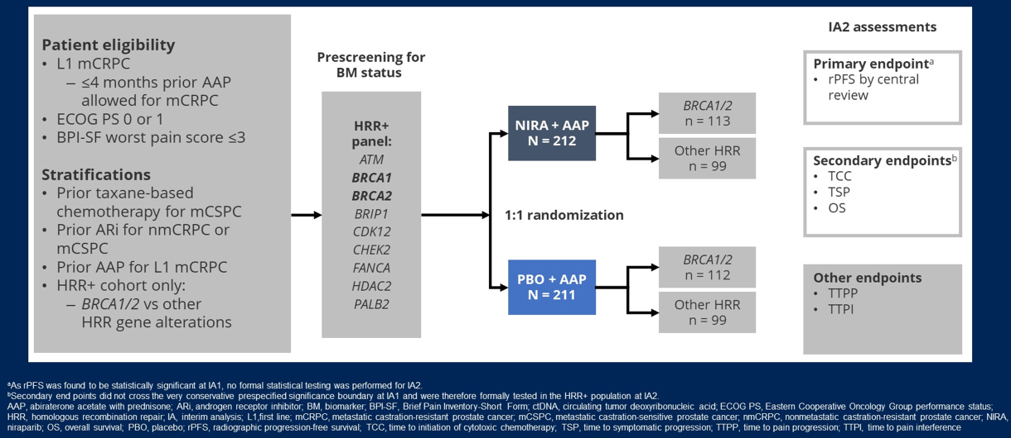
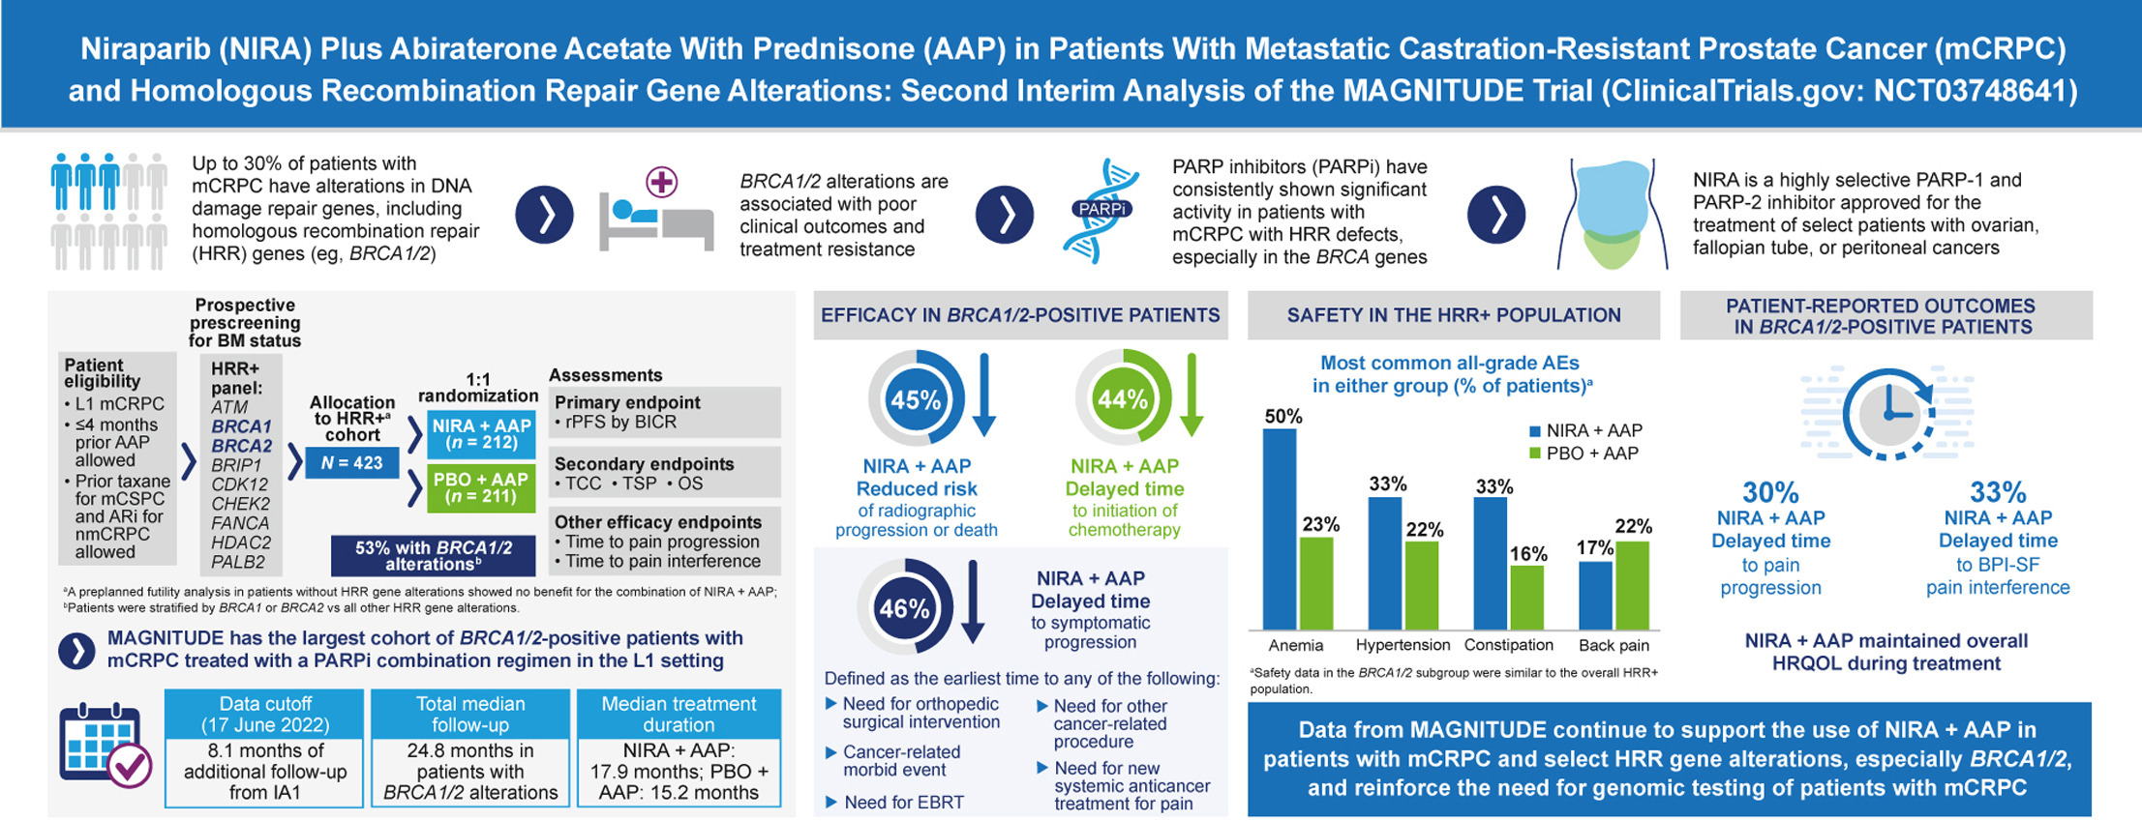
MAGNITUDE
Chi et al., Ann Oncol 2023

Slide 25
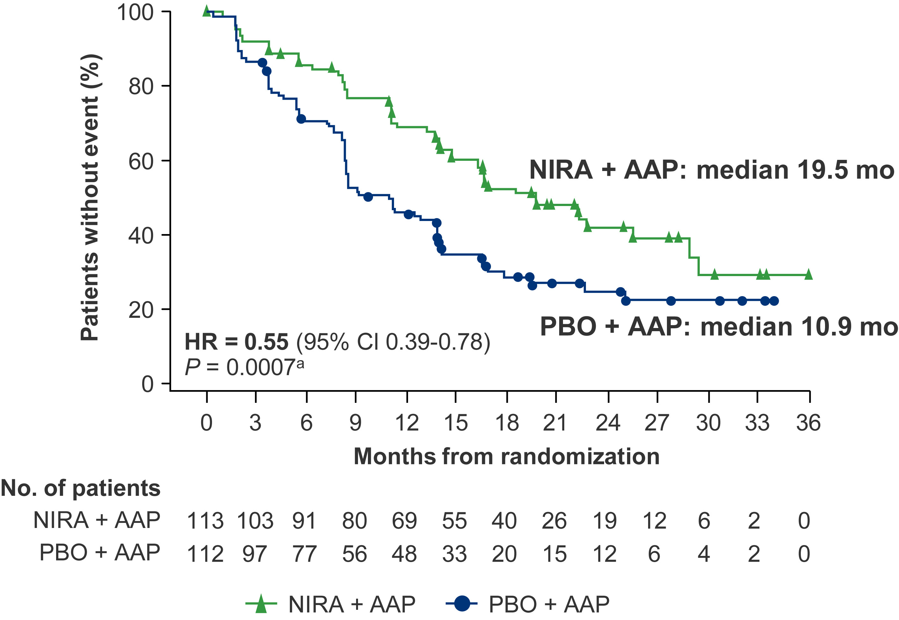
MAGNITUDE: rPFS in BRCA1/2 subgroup
Chi et al., Ann Oncol 2023

Slide 26
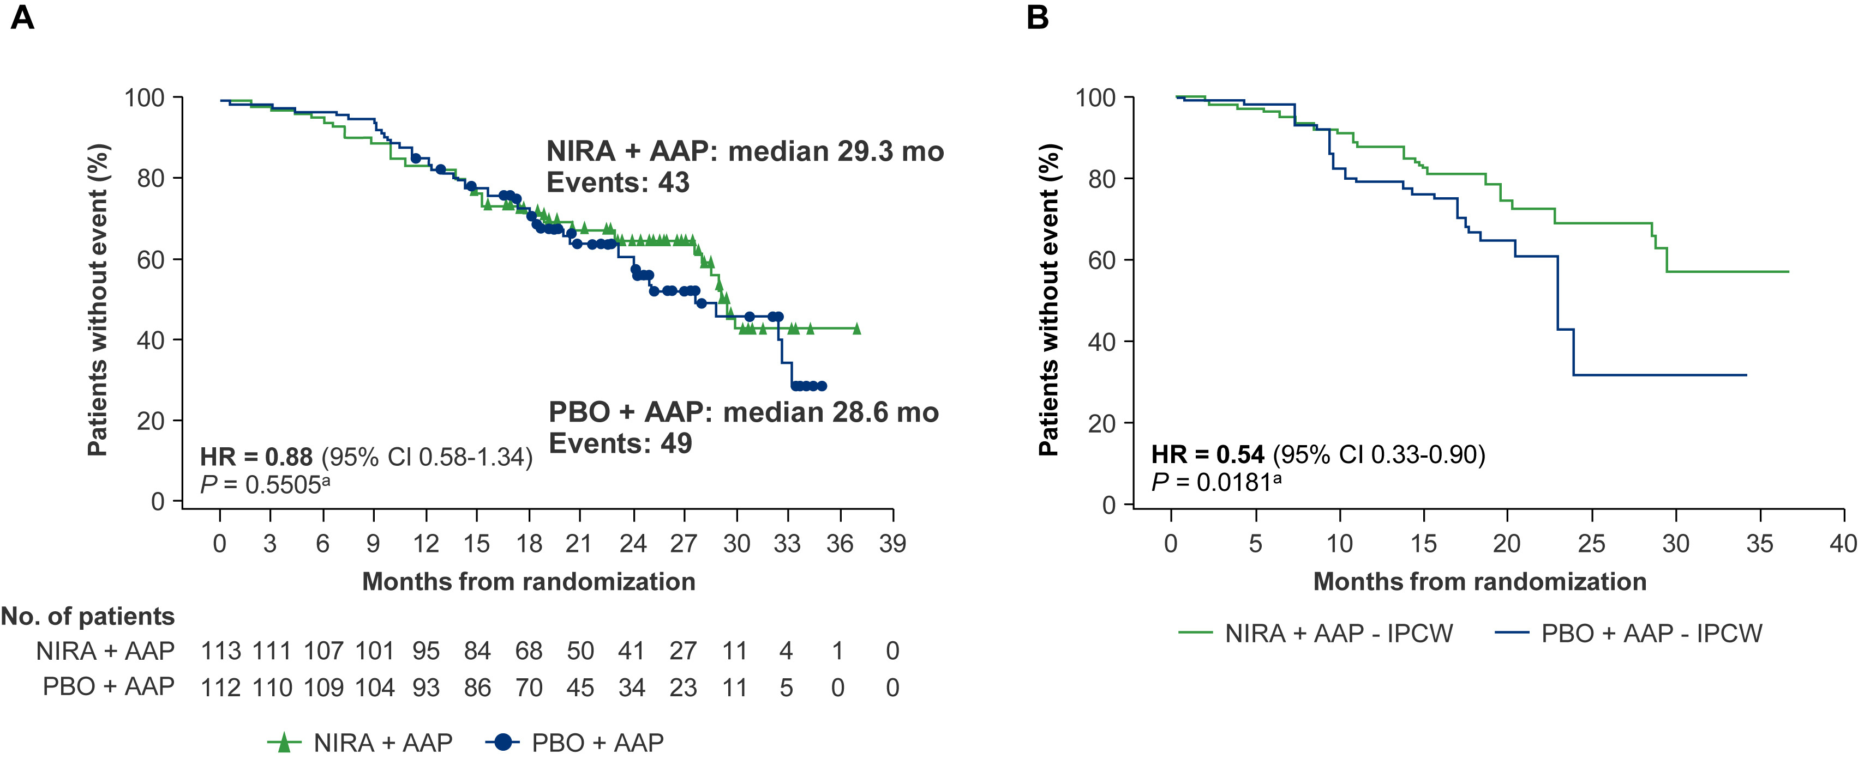
MAGNITUDE: OS in BRCA1/2 subgroup
Chi et al., Ann Oncol 2023

Slide 27
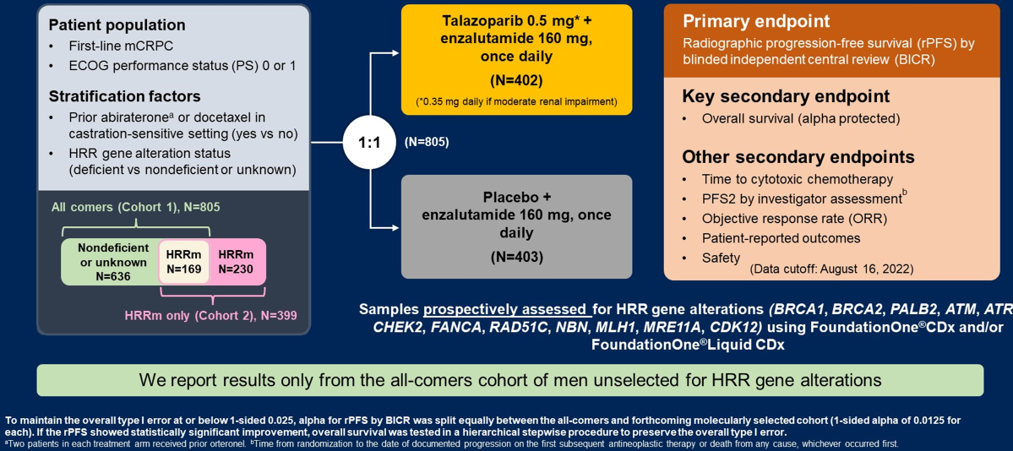
TALAPRO2
Adapted from: Agarwal et al., ASCO GU 2023

Slide 28
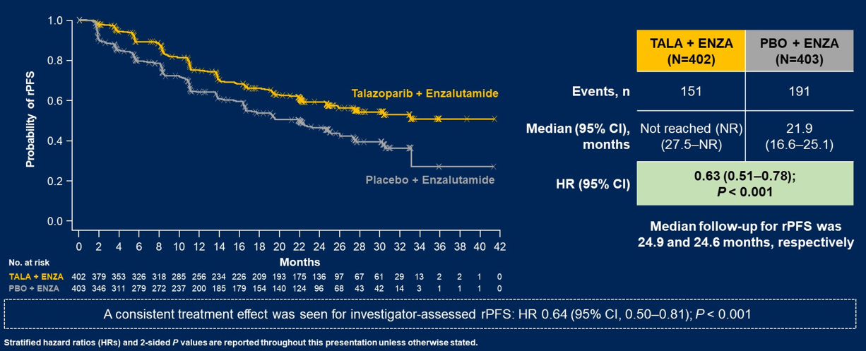
TALAPRO2: rPFS
Adapted from: Agarwal et al., ASCO GU 2023

Slide 29
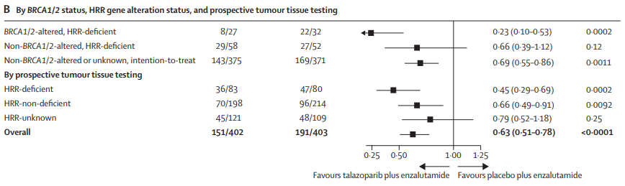
TALAPRO2: rPFS (subgroups)
Agarwal et al., Lancet 2023

Slide 30
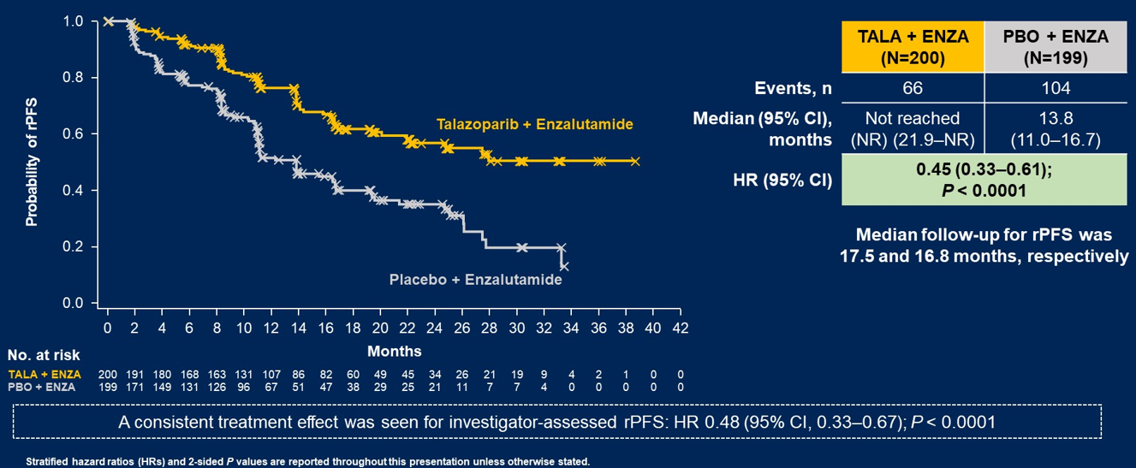
TALAPRO2: rPFS in HRRm cohort
Adapted from: Fizazi et al., ASCO 2023

Slide 31
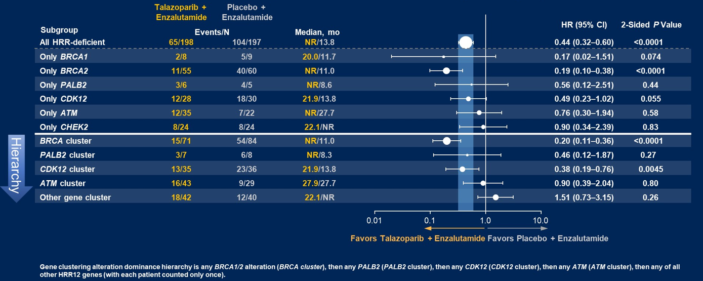
TALAPRO2: rPFS in HRRm cohort
Adapted from: Fizazi et al., ASCO 2023

Slide 32
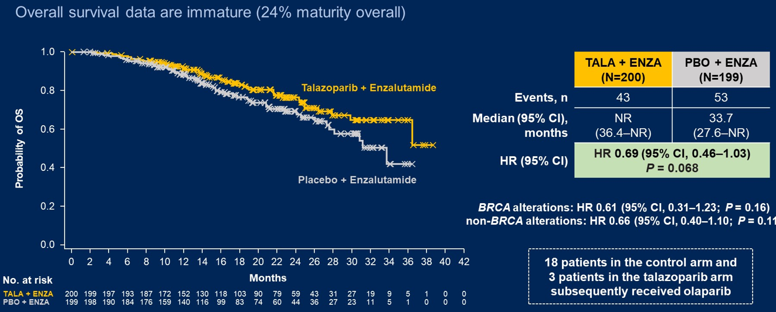
TALAPRO2: OS in HRRm cohort
Adapted from: Fizazi et al., ASCO 2023

Slide 33
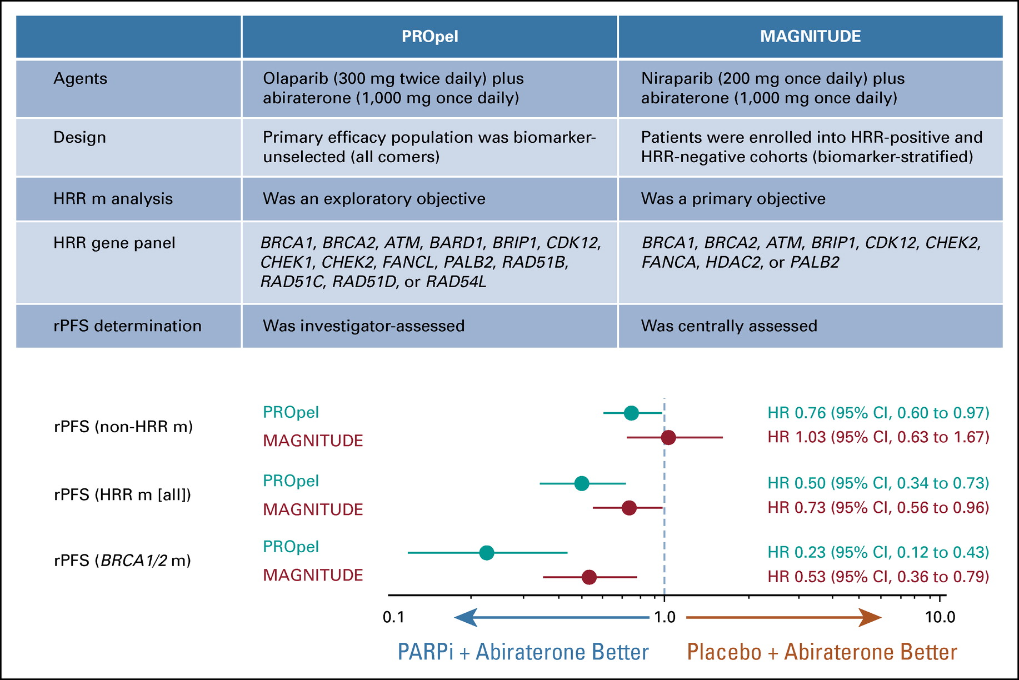
Summary
PARPi + ARSI better Placebo + ARSI better
TALAPRO2 talozaparib +/- enzalutamide
olaparib +/- abiraterone
  niraparib +/- abiraterone
Adapted from: Antonarakis et al., JCO 2023

Slide 34
Key toxicities
Hematologic (anemia, leukopenia, thrombocytopenia)
GI (decreased appetite, nausea, diarrhea, constipation)
Fatigue, asthenia
Rare: thrombosis/PE, pneumonitis, MDS/AML
 | PROpel | MAGNITUDE | TALAPRO2
Any AE grade≥3 | 55.8% | 72.2% | 71.9%
Anemia grade≥3 | 16.1% | 29.7% | 46.5%*
Dose interruption | 49% | 49.1% | 75.4%
Dose reduction | 22.6% | 20.3% | 56.0%
Discontinuation | 17.3% | 15.1% | 19.1%
*TALAPRO2: 49.0% had G1-2 anemia at baseline; G3-4 anemia median onset 3.3mo; 8.3% discontinued talazoparib due to anemia
Adapted from: Clarke et al., ASCO GU 2023; Agarwal et al., ASCO GU 2023; Chi et al., Ann Oncol 2023
Notes:
*49.0% had G1-2 anemia at baseline
G3-4 anemia: median time to onset 3.3mo, reported in 46.5% men, 8.3% discontinued talazoparib due to anemia

Slide 35
Conclusions
Consistently, BRCAm pts derive greatest benefit from PARPi+/-ARSI
Non-BRCA HRRm pts may derive intermediate benefit, though intragroup heterogeneity
Early germline/somatic testing is critical to identify populations most likely to benefit, to inform sequencing, and to identify trial opportunities

Slide 36
Conclusions
In BRCAm mCRPC without ARSI resistance:
  Level 1 evidence supports PARPi/ARSI combinations
  OS benefit for olaparib/abiraterone only (as of yet), other combinations with rPFS benefit
In BRCAm mCRPC progressive on ARSI +/- taxane:
  Level 1 evidence supports PARPi alone
  Role for PARPi/ARSI combinations uncertain

Slide 37
GENITOURINARY CANCER
Thursday, September 21, 2023

Slide 38
Case Discussion: PARP Inhibitors in Prostate Cancer
Vivek Narayan, MD MSCE
Assistant Professor of Medicine
University of Pennsylvania, Abramson Cancer Center
Philadelphia, PA

Slide 39

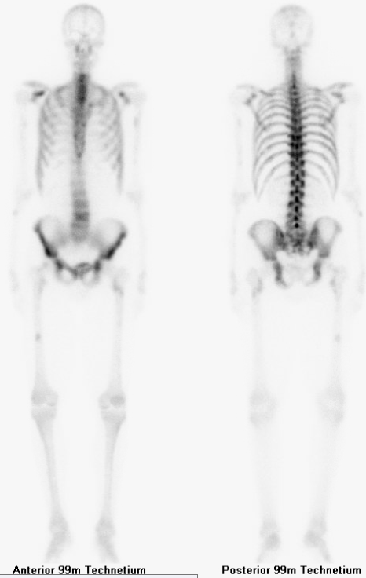
Case 1: PARPi in mCRPC post-ARPi (PROFOUND, TRITON3)
62 yo presented with de novo metastatic prostate cancer (bone and LN metastases)
Initiated ADT + abiraterone – progression to mCRPC following 10 months (rising PSA, new bone lesions, minimal pain)
Metastatic LN biopsy: pathogenic BRCA2 mutation (subsequent germline testing negative)
What is your recommended next-line treatment?
  A) Docetaxel
  B) PARP inhibitor (Olaparib, Rucaparib)
  C) Enzalutamide
  D) Other

Slide 40
Case 1 Modified: PARPi in mCRPC post-ARPi (PROFOUND, TRITON3)
62 yo presented with de novo metastatic prostate cancer (bone and LN metastases)
Initiated ADT + abiraterone – progression to mCRPC following 10 months (rising PSA, new bone lesions, minimal pain)
Germline ATM mutation
What is your recommended next-line treatment?
  A) Docetaxel
  B) PARP inhibitor (Olaparib)
  C) Enzalutamide
  D) Other

Slide 41

Case 2: PARPi in 1st Line mCRPC post-ADT (PROPEL)
67 yo with biochemical progression following prostatectomy and salvage RT.
Received intermittent ADT for ~2 years.
Now with rapidly rising PSA despite castrate testosterone. CT/bone scan imaging with new pelvic LN and low-burden bone metastases. (mCRPC)
Metastatic LN biopsy: pathogenic BRCA2 mutation (subsequent germline testing negative)
What is your recommended next-line treatment?
  A) Abiraterone alone (and use Olaparib later)
  B) Abiraterone + Olaparib
  C) Docetaxel
  D) Other

Slide 42
Case 2 Modified: PARPi in 1st Line mCRPC post-ADT (PROPEL, MAGNITUDE, TALAPRO2)
67 yo with biochemical progression following prostatectomy and salvage RT.
Received intermittent ADT for ~2 years.
Now with rapidly rising PSA despite castrate testosterone. CT/bone scan imaging with new pelvic LN and low-burden bone metastases. (mCRPC)
Metastatic LN biopsy: pathogenic BRCA2 mutation (subsequent germline testing negative). Hgb 9.8 g/dL
What is your recommended next-line treatment?
  A) Abiraterone alone (and use Olaparib later)
  B) Abiraterone + Olaparib
  C) Abiraterone + Niraparib
  D) Enzalutamide + Talazoparib

Slide 43

Case 3: PARPi in 1st Line mCRPC (post-ARPi for mCSPC)
67 yo with metastatic prostate cancer (germline BRCA2 mutation)
Receives ADT with abiraterone/prednisone (mCSPC)
16 months later: Rising PSA, but NO radiographic or symptomatic progression (mCRPC)
What is your recommended next-line treatment?
  A) Enzalutamide
  B) Enzalutamide + Talazoparib
  C) Continue abiraterone; Add Olaparib or Niraparib
  D) PARP inhibitor alone (Olaparib)
  E) Other

Slide 44
Case 3 Modified: PARPi in 1st Line mCRPC (post-ARPi for mCSPC)
67 yo with metastatic prostate cancer (germline BRCA2 mutation)
Receives ADT with abiraterone/prednisone (mCSPC)
16 months later: Rapidly rising PSA, radiographic progression, new bone pain (mCRPC)
What is your recommended next-line treatment?
  A) Enzalutamide
  B) Enzalutamide + Talazoparib
  C) Continue abiraterone; Add Olaparib or Niraparib
  D) PARP inhibitor alone (Olaparib)
  E) Other
How (if at all) would your recommendation change if patient received enzalutamide/apalutamide/darolutamide in the mCSPC setting?

Slide 45
GENITOURINARY CANCER
Thursday, September 21, 2023

Slide 46
Treatment strategies in metastatic urothelial cancer
Ronac Mamtani, MD MSCE
Assistant Professor of Medicine
Division of Hematology-Oncology
Penn Medicine Abramson Cancer Center
Philadelphia, PA
Notes:
Thank you Dr. Narayan and to the organizing committee . This is such an exciting time to be a bladder cancer oncologist.

Slide 47
Agenda
Therapeutic classes in mUC (then and now) – 5 min
Current treatment sequencing (by level of evidence) – 5 min
Insights from routine care (real-world evidence) – 5 min
New first-line treatment option (recent approval) – 5 min
Notes:
Over the next 20 minutes, we’ll discuss current therapeutic , the sequence in which they should be given based on pivotal clinical trials, how they are being in the real world, and finally, a new first-line treatment approach.

Slide 48
Therapeutic classes before 2016 (pre –IO)
Therapeutic class | First-line | Post-platinum PD
Platinum-chemotherapy (cisplatin or carboplatin) | Platinum-eligible
Single-agent cytotoxic chemotherapy |  | Taxane Pemetrexed Vinflunine
Chemotherapy
Notes:
Prior to 2016, platinum-based chemo, particularly, cisplatin-based chemo, was the only treatment to demonstrate a meaningful OS benefit. Following platinum chemotherapy, treatment options were limited to single agent chemotherapy with very limited benefit.

Slide 49
Therapeutic classes after 2016 (post-IO)
Therapeutic class | First-line | Maintenance Non-PD | Post-platinum PD | Post-IO
Platinum-chemotherapy* (cisplatin or carboplatin) | Platinum-eligible
Immunotherapy (IO) | Platinum-ineligible (pembrolizumab) | Avelumab* | Pembrolizumab* Nivolumab Avelumab
Antibody drug conjugate (ADC) | Enfortumab + Pembrolizumab |  | Enfortumab* Sacituzumab
FGFR inhibitor |  |  | Erdafitinib*
Immunotherapy
* Proven OS benefit in Phase 3 RCT
Antibody drug conjugate therapy
Gene targeted therapy
Gupta, ASCO, 2022
Notes:
Today, the treatment landscape has expanded substantially beyond chemotherapy, with three additional therapeutic classes including immunotherapy, antibody drug conjugate therapy, and gene targeted therapy. Within each class, I’ve listed specific therapies with proven overall survival benefits marked by an asterisk: the immune checkpoint inhibitors (avelumab* as maintenance therapy for those without disease progression after platinum; pembrolizumab as 2L therapy for those with disease progression after platinum), the antibody drug conjugates (EV for those who have previously received platinum-chemo and checkpoint blockade) and gene targeted therapy (erdafitinib in those who have received an immune checkpoint inhibitor).

Slide 50
Treatment sequence, by level of evidence, ‘23
Cisplatin-eligible
Enfortumab
Platinum-chemo
4-6 cycles
IO
Cisplatin-ineligible
PD vs no PD
Erdafitinib
(FGFR+)
(FGFR+)
Clinical factors
Sacituzumab
FDA approved, + level 1 evidence
FDA approved, - level 1 evidence
First-line
Maintenance or 2nd line
3rd line or beyond
Galsky, 12th European Multidisciplinary Congress on Urological Cancers (EMUC), 2020; Jun et al., JCMT, 2022
Notes:
New treatment options raise the question of optimal treatment selection– how do we maximize benefit while minimizing harm.
This figure, modified from Matt Galsky’s work, illustrates the optimal treatment sequence based on level 1 evidence from pivotal phase 3 clinical trials.
Green boxes indicate treatment decisions based on clinical factors such as platinum eligibility, presence or absence of disease progression, and presence or absence of biomarkers
Yellow boxes indicate FDA approved treatments, solid lines around the yellow boxes supported by level 1 evidence.

Slide 51
Strongest evidence for IO benefit is post-platinum
Cisplatin-eligible
Enfortumab
Platinum-chemo
4-6 cycles
IO
Pembrolizumab – PD
Avelumab – no PD
Cisplatin-ineligible
Erdafitinib
(FGFR+)
Clinical factors
Sacituzumab
FDA approved, + level 1 evidence
FDA approved, - level 1 evidence
First-line
Maintenance or 2nd line
3rd line or beyond
Notes:
I’d like to start immune checkpoint blockade - the strongest evidence for immunotherapy benefit is in the post-platinum chemotherapy setting.

Slide 52
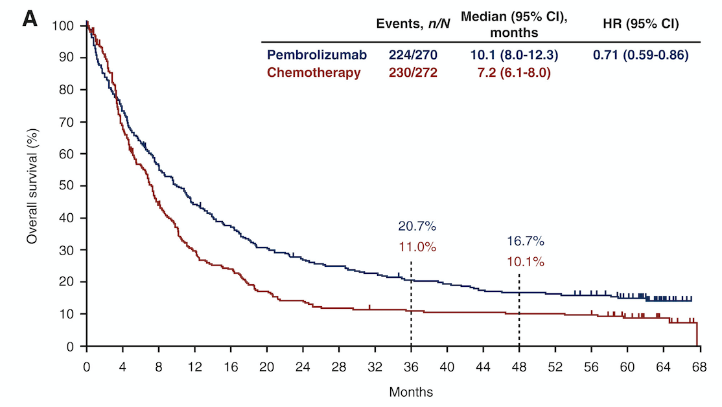
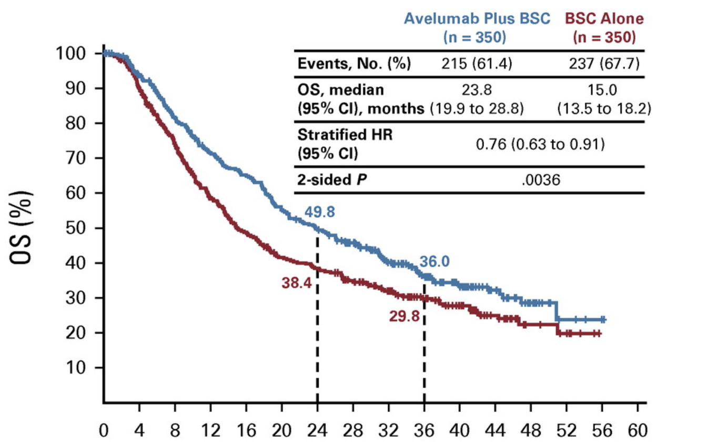
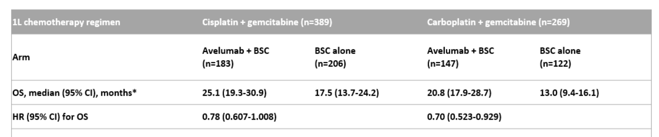
Strongest evidence for IO benefit is post-platinum
Post-platinum, PD
KEYNOTE 45: 5 y update
Post-platinum, no PD (maintenance)
JAVELIN 100: ≥2 y update
Balar et al, Annals of Oncology, March 2023
Powles et al., JCO, April 2023
Sridhar et al, ASCO GU, February 2023
Notes:
Two randomized clinical trials, keynote 45 on the left and javelin 100 on the right, have demonstrated meaninigful OS benefits for single agent immune checkpoint inhibitors in the post-platinum setting, regardless of PDL1 status. Pembrolizumab has demonstrated an OS benefit over single agent chemo in 2nd line if there is progression on platinum, as shown in the KM on the left, derived from 5-year update of KN45. And on the right, based on longer term update from Javelin, avelumab demonstrated OS benefit over BSC alone in the maintenance setting if no progression after platinum chemo. The magnitude of benefit was seen whether patients received carbo or cis as first line treatment. Maintenance ICI rather than ICI at progression is considered the preferred approach in NCCN.

Slide 53
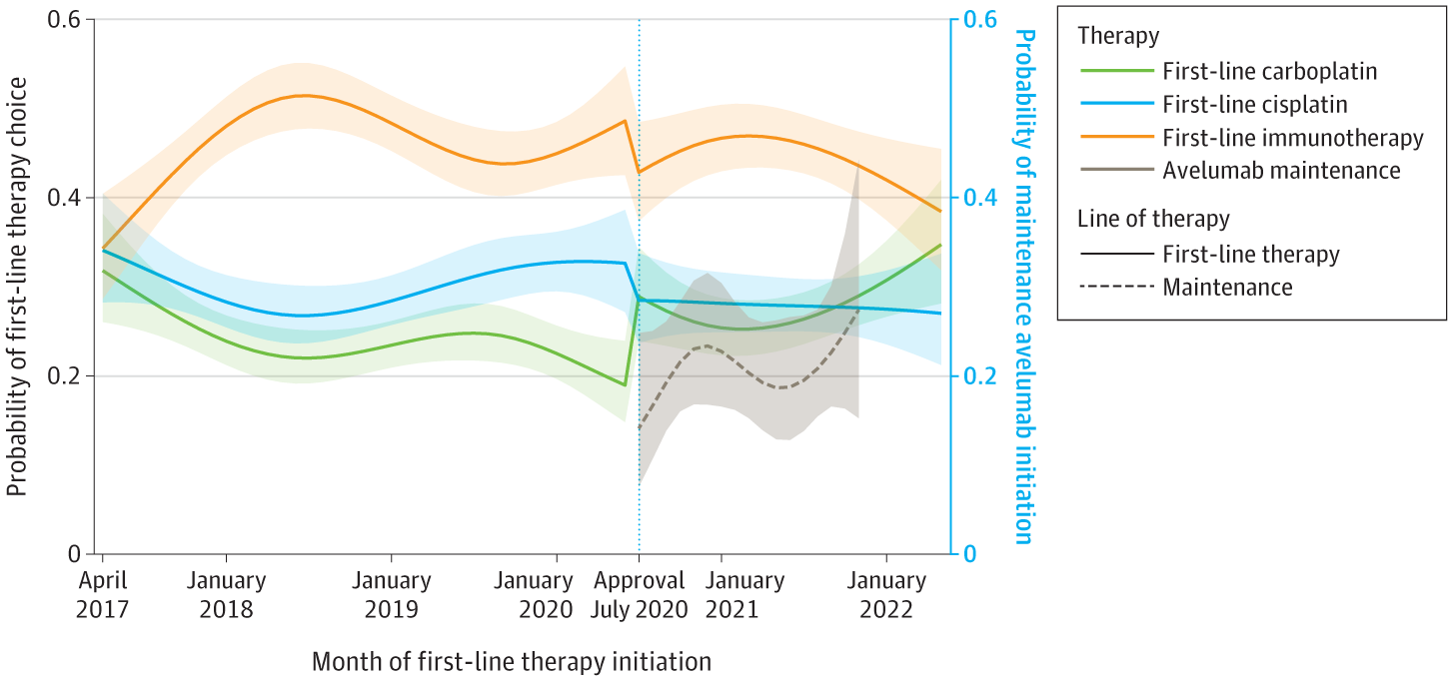
Real-world use: maintenance IO post-approval
~25% of maintenance eligible
received maintenance avelumab
Mamtani et al., JAMA Network Open, April 2023; GU ASCO, February 2023
Notes:
One of the focuses of our research program at Penn is to understand real-world utilization of new treatment indications. Here, using a nationwide oncology dataset, we examined the uptake of maintenance avelumab in routine care and found that in the 22 months after its approval, only 25% of patients eligible for maintenance avelumab it. Potential explainations may be limited clinician awareness of maintenance immunotherapy and/or patient preferences against long-term treatment after response to initial chemotherapy.

Slide 54
Platinum-chemo remains first-line SOC
Cisplatin-eligible
Enfortumab
Platinum-chemo
4-6 cycles
IO
Cisplatin-ineligible
Erdafitinib
(FGFR+)
Clinical factors
Sacituzumab
FDA approved, + level 1 evidence
FDA approved, - level 1 evidence
First-line
Maintenance or 2nd line
3rd line or beyond
Notes:
Despite the introduction of many novel agents, what has not changed is that 4-6 cycles of platinum-based chemotherapy remains the first-line standard approach for patients with metastatic urothelial cancer.

Slide 55
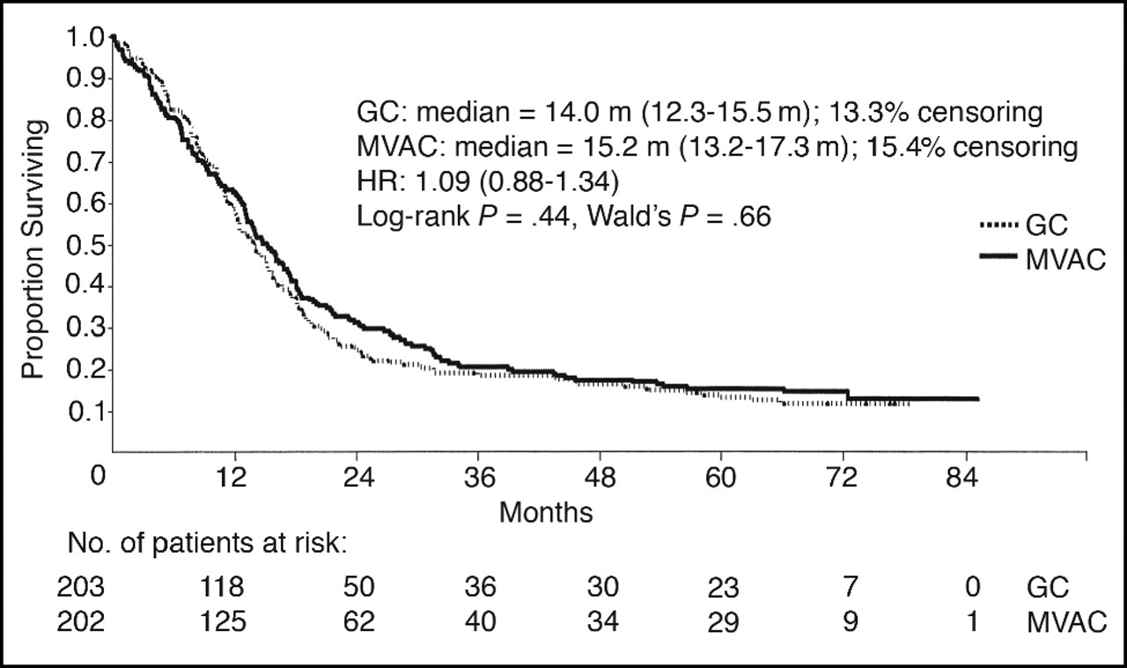
Platinum-chemo remains first-line SOC
1L cisplatin regimens
1L carboplatin regimens
= 8.1 m
= 9.3 m
Von der Maase et al, JCO, 2005
De Santis M et al, JCO, 2012
Notes:
Cisplatin-based chemotherapy was established in RCTs in the 1990s with MVAC, and subsequently the combination of gem cis was found to have similar outcomes as MVAC, shown here. Survival outcomes with carboplatin-chemo are inferior, shown in the KM on the right.

Slide 56
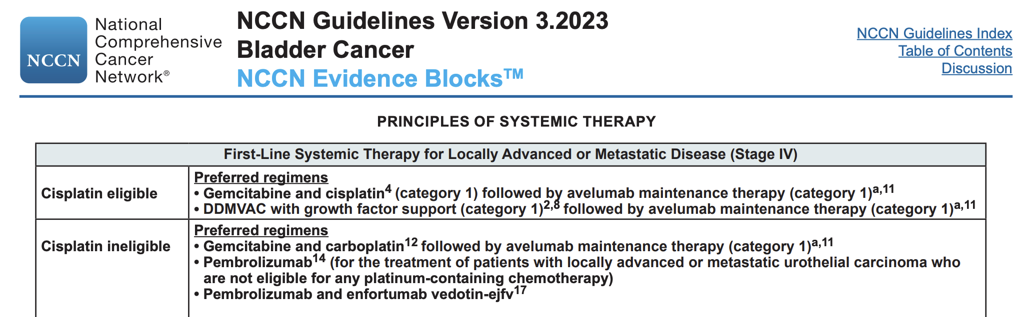
Platinum-chemo remains first-line SOC
Notes:
Based on these studies, Platinum-based chemotherapy is endorsed as an NCCN cat 1, shown here, with one important update which we’ll discuss soon.

Slide 57
Strategies to impact first-line SOC (beyond maintenance)
Cisplatin-eligible
Platinum-chemo
4-6 cycles
KN361 - Pembrolizumab |  | IM130 - Atezolizumab
mOS | HR | mOS | HR
17.0 | 0.86 (0.72-1.02) | 16.1 | 0.85 (0.73-1.0)
14.3 | Reference | 13.4 | Reference
15.6 | 0.92 (0.77-1.11) | 15.2 | 0.98 (0.82-1.16)
Cisplatin-ineligible
Chemo + IO
R
Chemo
IO
Powles, Lancet Onc, 2021
Bamias et al., ASCO GU 2023
First-line
Notes:
There have been several strategies tested to improve the 1L SOC, one such strategy is shown here, includes combining chemotherapy with checkpoint blockade or even single agent checkpoint blockade versus platinum chemotherapy. Here are results from two similarly designed phase III studies testing this approach, KN 361 ad IM 130. What we have learned from these studies, in contrast to other solid tumors, is that combination chemo-immunotherapy does not significantly improve OS relative to chemotherapy alone. What about immunotherapy alone versus chemotherapy, this was not formally statistically compared, in exploratory analyses you can see that this approach has not shown to improve OS and in fact within the first year of follow up had lower survival compared to chemo therapy alone.

Slide 58
Regulatory update: IO monotherapy is no longer an FDA approved 1L option for cis-ineligible mUC
Clinical factors
Cisplatin-eligible
FDA approved, + level 1 evidence
Platinum-chemo
4-6 cycles
FDA approved, - level 1 evidence
Cisplatin-ineligible
PDL1 +
Pembrolizumab
Atezolizumab
Pembro / Atezo are no longer FDA-approved 1L options
for cisplatin-ineligible mUC.
Platinum-ineligible
Pembrolizumab
Pembro monotherapy is an FDA-approved 1L option
for platinum-ineligible mUC
(category 2A, NCCN)
First-line
Notes:
I want to point out that as a result of these confirmatory studies and subsequent ODAC meetings, there have been several regulatory changes to the label indication of pembro and atezo, which time does not permit me to detail, but the net result is that today, immunotherapy monotherapy is no longer an FDA approved first line option for patients who are cisplatin ineligible and PDL1+, however pembrolizumab remains an option for those who are any platinum ineligible. This is a cat 2A NCCN recommendation.

Slide 59
Clinical trial update: CM 901 chemo/IO sub-study meets primary endpoint of OS and PFS
Cisplatin-eligible
Platinum-chemo
4-6 cycles
Cisplatin-ineligible
Chemo + IO
(Gem/Cis + Nivo)
‘Sub-study’ positive
R
Chemo
(Gem/Cis or
Gem/Carbo)
Primary study negative
IO
(Ipi/Nivo)
First-line
Notes:
Just when I mentioned that combination chemo-IO was a failed strategy, it was recently announced recently that the CM 901 sub study, shown in this schematic, compared the addition of nivolumab to standard gemcitabine and cisplatin with gemcitabine and cisplatin alone, met its primary endpoints of OS and PFS. Why is this study + and KN361 and IM130 negative, maybe cisplatin combines better with checkpoint blockade. We look forward to the actual results of this study to assess the magnitiude of benefit and how it relates to that observed with gem cis followed by maintenance avelumable and EV pembro

Slide 60
Treatment sequence, by level of evidence, ‘23
Cisplatin-eligible
Enfortumab
Platinum-chemo
4-6 cycles
IO
Cisplatin-ineligible
Erdafitinib
(FGFR+)
Clinical factors
Sacituzumab
FDA approved, + level 1 evidence
FDA approved, - level 1 evidence
First-line
Maintenance or 2nd line
3rd line or beyond
Notes:
I’d like to now turn our attention beyond immunotherapy.

Slide 61
Treatment options beyond IO
Cisplatin-eligible
Enfortumab
Platinum-chemo
4-6 cycles
IO
Cisplatin-ineligible
Erdafitinib
(FGFR+)
Clinical factors
FDA approved, + level 1 evidence
FDA approved, - level 1 evidence
First-line
Maintenance or 2nd line
3rd line or beyond
Notes:
Two treatment options supported by level 1 evidence , phase 3 data showing an overall survival benefit include enfortuamb , and erdafitinib

Slide 62
Erdafitinib - First gene targeted therapy in mUC
2019 FDA Accelerated Approval: Post-platinum, +FGFR3/2 alteration
Phase 2 BLC2001 (n=99)
Efficacy
ORR, % | 40 (all), 16 (+fusion)
CR, % | 4
PR, % | 36
mDOR, mo | 6
mPFS, mo | 5.5
mOS, mo | 11.3
Safety (grade ≥3 AEs in ≥5% of Patients) | (N=99)
Stomatitis | 10 (10)
Hyponatremia | 11 (11)
Asthenia | 7 (7)
Nail dystrophy | 6 (6)
Hand-foot syndrome | 5 (5)
Urinary tract infection | 5 (5)
Loriot Y, et al. N Engl J Med. 2019
Notes:
Erdafitinib is the first gene targeted therapy in mUC, it received AA for patients with FGFR altered mUC previously treated with platinum chemotherapy. This was based on a single arm study showing response rates of 40% and mOS of 11 months. Erda has a unique side effect profile, this has to do with inhibitiring FGFR3, adverse events include: hyperphosphatemia, nail and skin toxicity, and ocular side effects such as central serous retinopathy . These are reversible toxicities and early recognition is important.

Slide 63
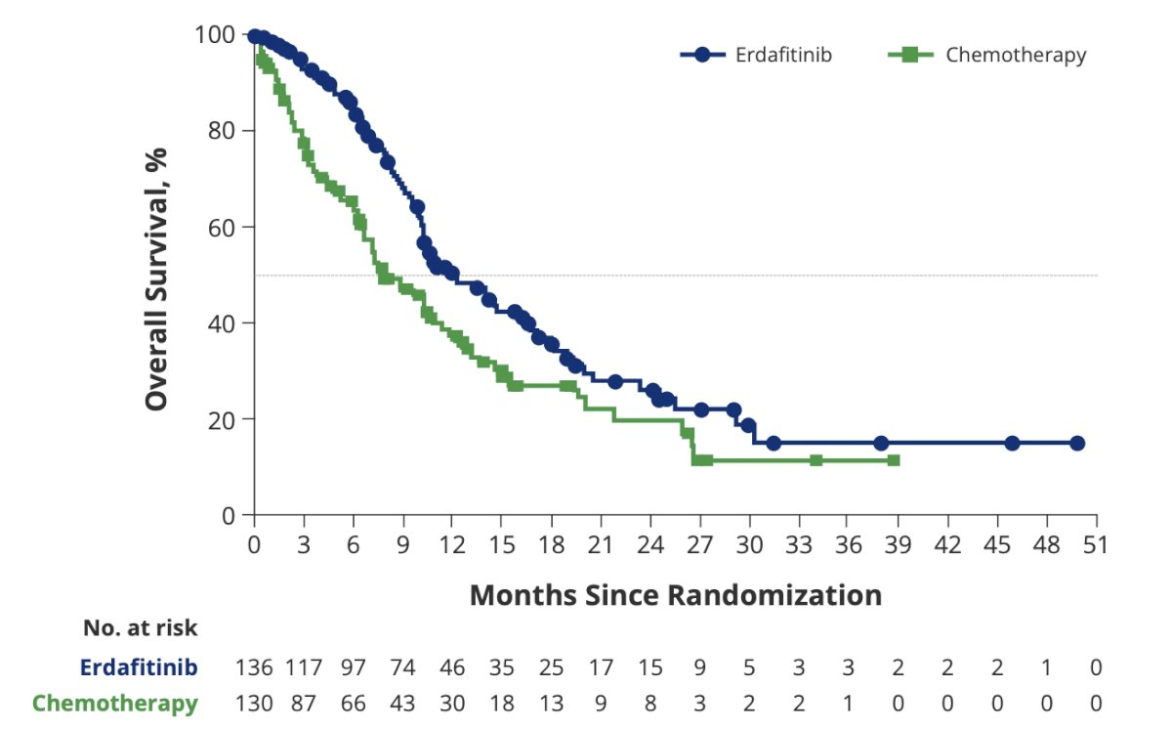
Where should FGFR inhibitors be integrated?
THOR: Phase 3 Trial of Erdafitinib
Post platinum, FGFR+
Primary endpoint: OS
Estimated primary completion date: 2024
Cisplatin-eligible
Platinum-chemo
4-6 cycles
IO
Cohort 1:
Prior IO
Erdafitinib vs chemo
Cisplatin-ineligible
Cohort 2:
No prior IO
Erdafitinib vs pembro
mOS: 12.1 vs 7.8 m
ORR: 45% vs 11%
Loriot et al, ASCO ‘23
Erdafitinib ?
(FGFR+)
First-line
Maintenance or 2nd line
3rd line or beyond
Notes:
A common question in practice is where to integrate erdafitinib in patients with an FGFR2/3 alteration – prior to immunotherapy or after immunotherapy? The THOR phase 3 study will try to help us to answer this question. Patients with prior IO are randomized to erdafitinib or single agent chemo. Patients without prior IO and patients are randomized to erdafitnib vs pembro. The results from cohort 1 were recently presented at ASCO, showing clear improvement in OS with erda vs chemo.

Slide 64
Where should FGFR inhibitors be integrated?
Cisplatin-eligible
Platinum-chemo
4-6 cycles
IO
Cisplatin-ineligible
Erdafitinib
(FGFR+)
Erdafitinib
(FGFR+)
First-line
Maintenance or 2nd line
3rd line or beyond
Notes:
Supporting the role of erdafitinib as SOC option for patients with FGFR altered mUC who have had prior immunotherapy,

Slide 65


Where should FGFR inhibitors be integrated?
Cisplatin-eligible
Platinum-chemo
4-6 cycles
IO
Cisplatin-ineligible
Erdafitinib
(FGFR+)
Erdafitinib
(FGFR+)
First-line
Maintenance or 2nd line
3rd line or beyond
Notes:
Will be interesting to see results from cohort 2, to determine its efficacy relative to IO, which will further inform sequencing decisions.

Slide 66
Where should FGFR inhibitors be integrated?
Median Survival 12.9 mos | Complete response 4.9% | Partial response 35.7% | EV 301
12.1 mos | 6.6% | 39.0% | THOR
10.9 mos | 5.3% | 22.1% | Trophy-U01
Cisplatin-eligible
Enfortumab
Platinum-chemo
4-6 cycles
IO
Cisplatin-ineligible
Erdafitinib
(FGFR+)
Erdafitinib
(FGFR+)
Sacituzumab
First-line
Maintenance or 2nd line
3rd line or beyond
Notes:
And more importantly, how we view sequencing of erdafitinib in relation to other available options, such as enfortumab, and Sacituzumab, may come down to the adverse event profiles in the absence of comparative data.

Slide 67
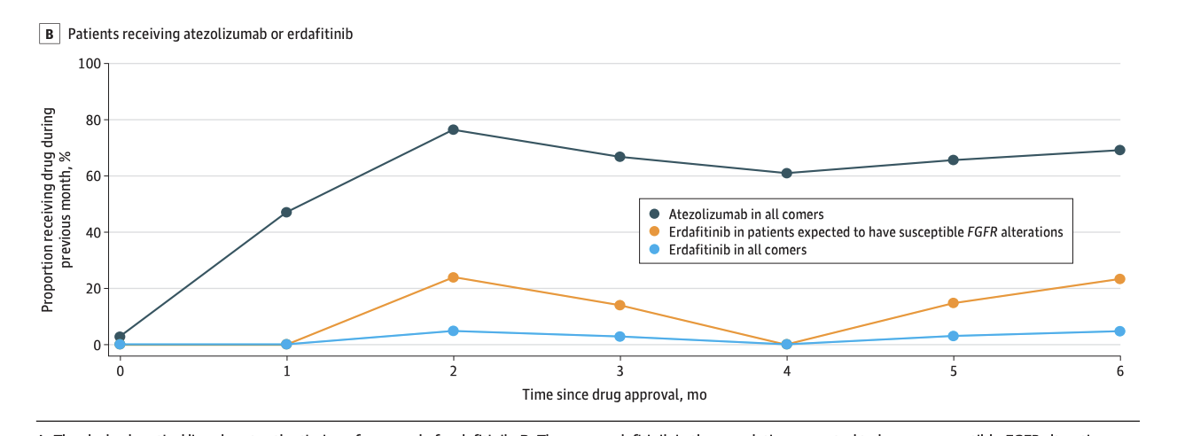
Real-world use: Erdafitinib post-approval
N=761 patients who received post-platinum therapy:
  n=343 (45.1%) had an FGFR test recorded; 71 (20%) were FGFR +
      n=30 (42.3%) with an FGFR alteration received erdafitinib
Nimgaonkar V, Hubbard RA, Carpenter EL, Mamtani R, JAMA Onc, 2022
Notes:
A few insights into the real-world use of erdafitinib. We recently described the update of erdafitinib in US patients with mUC, and what we found was surprising. First, only 45% had FGFR testing performed, highlighting the need for molecular testing in this population. Second, of those that had an alteration, less than half received drug, possibly due to limited clinical awareness, perceptions on toxicity, or lack of confirmatory trial.

Slide 68
Enfortumab Vedotin: Nectin-4 directed ADC
Cisplatin-eligible
Enfortumab
2019
Platinum-chemo
4-6 cycles
IO
(avelumab or pembro)
Cisplatin-ineligible
Erdafitinib
(FGFR+)
Enfortumab + Pembro
2023
Enfortumab
2021
IO
(pembro)
Platinum-ineligible
FDA approved, + level 1 evidence
3rd line or beyond
First-line
Maintenance or 2nd line
FDA approved, - level 1 evidence
Notes:
I’d like to end by walking you through the rapidly expanding indications of enfortumab vedotin, which is an antibody drug conjugate directed against nectin 4 with an MMAE chemo payload,

Slide 69
Enfortumab Vedotin: Rapidly expanding indications
INDICATION #1 (‘19) → Post-platinum and post-IO (“3L”)
  EV 201 (single-arm, cohort 1): ORR: 44%, CR: 12%
  EV 301 (RCT): mOS 12.88 EV vs 8.97 chemo; ORR: 40% EV vs 17% chemo
INDICATION #2 (‘21)→ Cis-ineligible, ≥1 prior therapies (“2L”)
  EV 201 (single-arm, cohort 2): ORR: 52%, CR: 20%, mOS: 14.7
Notes:
EV received an accelerated approval in 2019 for patients previously treated with platinum and CPB based on results from the single arm EV 201 cohort 1 study. This was converted to a regular approval based on results from the confirmatory phase 3 trial, EV 301, which demonstrated an overall survival benefit with EV vs dealers choice chemotherapy, reinforcing its as a SOC in the 3L setting.
This indication was expanded to patients who were cisplatlin ineligible and who received 1 or more prior therapies, ie, can be used for post-chemo or post-IO, in the 2L setting ,based on results from EV 201 cohort 2, showing response rates of approximately 50%.

Slide 70
Enfortumab Vedotin: Rapidly expanding indications
INDICATION #1 (‘19) → Post-platinum and post-IO (“3L”)
  EV 201 (single-arm, cohort 1): ORR: 44%, CR: 12%
  EV 301 (RCT): mOS 12.88 EV vs 8.97 chemo
INDICATION #2 (‘21)→ Cis-ineligible, ≥1 prior therapies (“2L”)
  EV 201 (single-arm, cohort 2): ORR: 52%, CR: 20%, mOS: 14.7
INDICATION #3 (‘23) → +Pembro, Cis-ineligible, 0 prior therapies (“1L”)
  EV 103 (multi-cohort: cohort A, cohort K):
Pooled efficacy (n=121)
ORR, % | 68% (58.7, 76.0)
CR, % | 12%
FDA Accelerated Approval
Notes:
EV has been explored even further in the 1L setting, in combination with pembrolizumab, and this has led to much enthusiasm, and yielded response rates of 68% , resulting in its third indication in cisplatin ineligible patients who are treatment naïve.

Slide 71
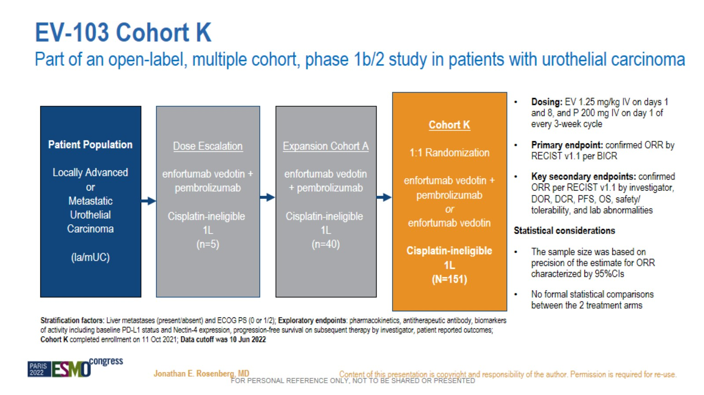
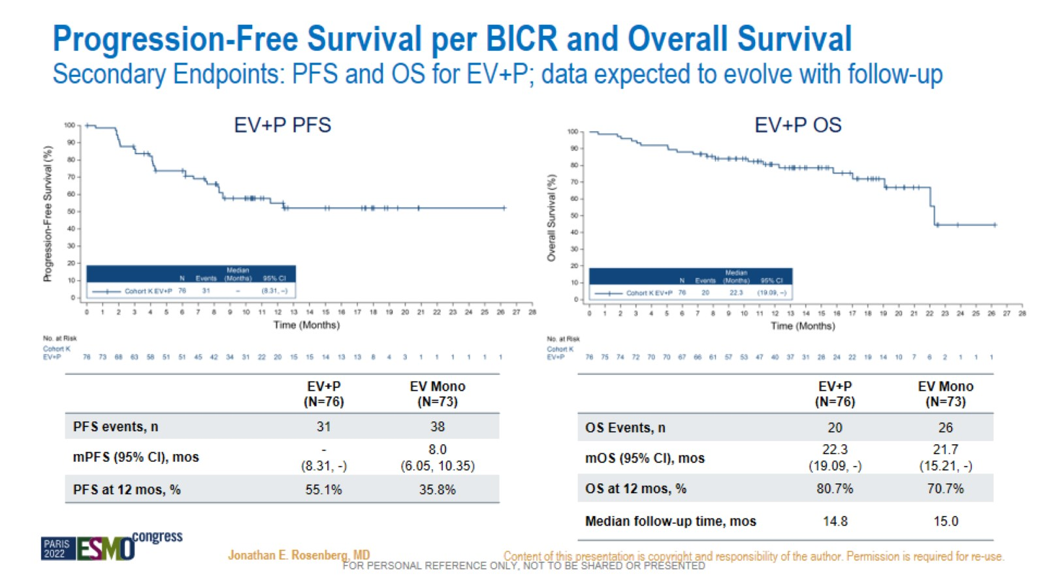
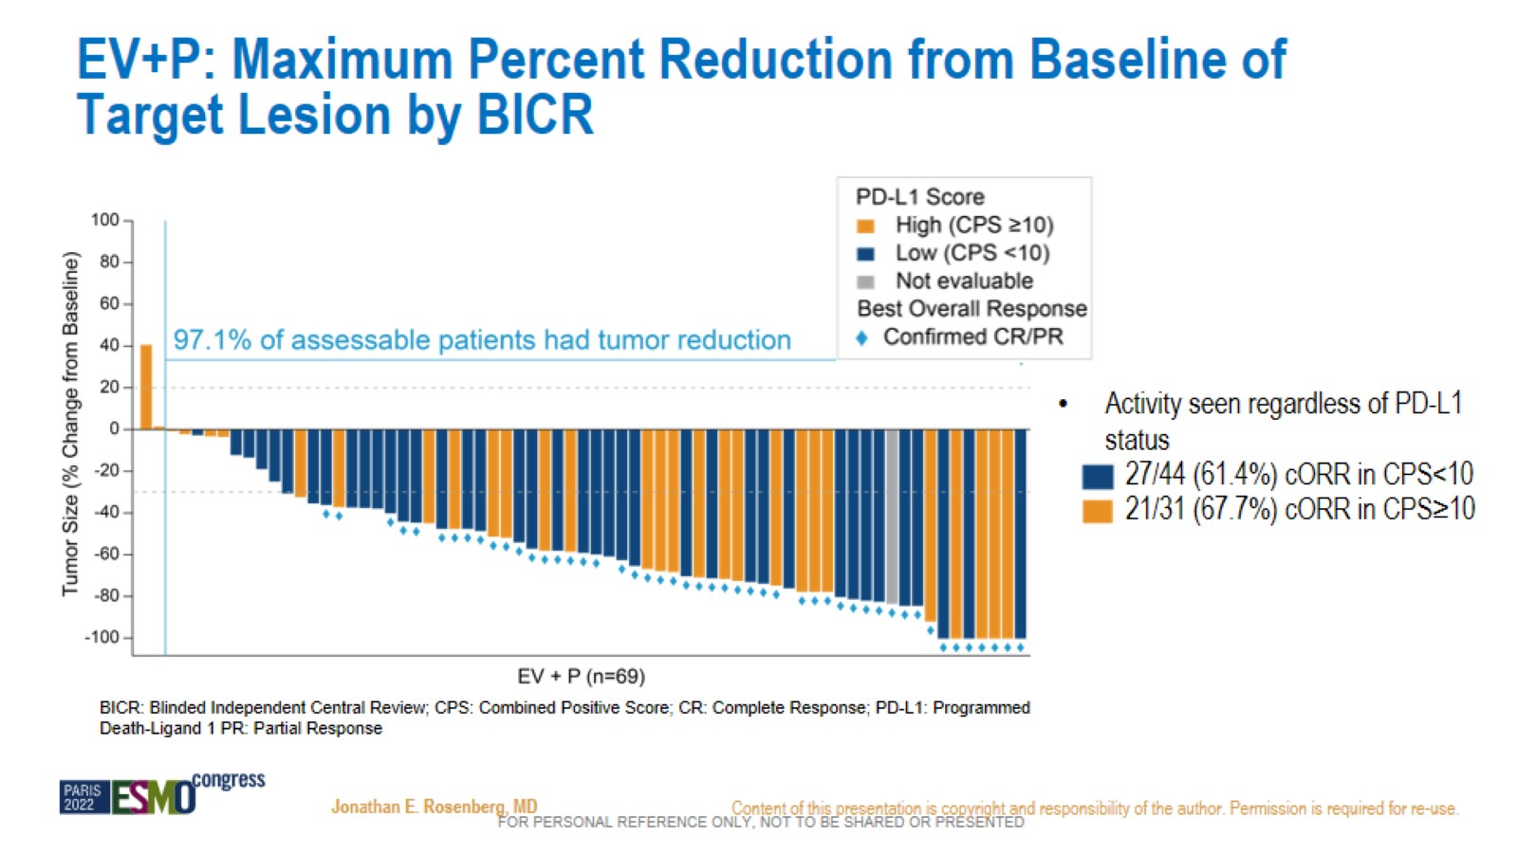
EV 103 cohort K EV + P: Efficacy
Most common reason for cis-ineligibility
in EV + P arm: renal impairment (63%)
Note: >80% were ECOG PS 0,1
Confirmed ORR: 64.5%
Median time to response: 2 mos.
Median DOR: not reached (>24 mos.)
Rosenberg et al, ESMO 2022
Notes:
This approval was largely based on results from EV 103, cohort K, in which cis ineligible treatment naïve patients were randomized to EV + Pembro vs EV monotherapy, notably response rates for EV + P was 64% and monotherapy with EV was 45%, with a median OS for EV-P of 22 months, which is truly unprecedented in this population.

Slide 72
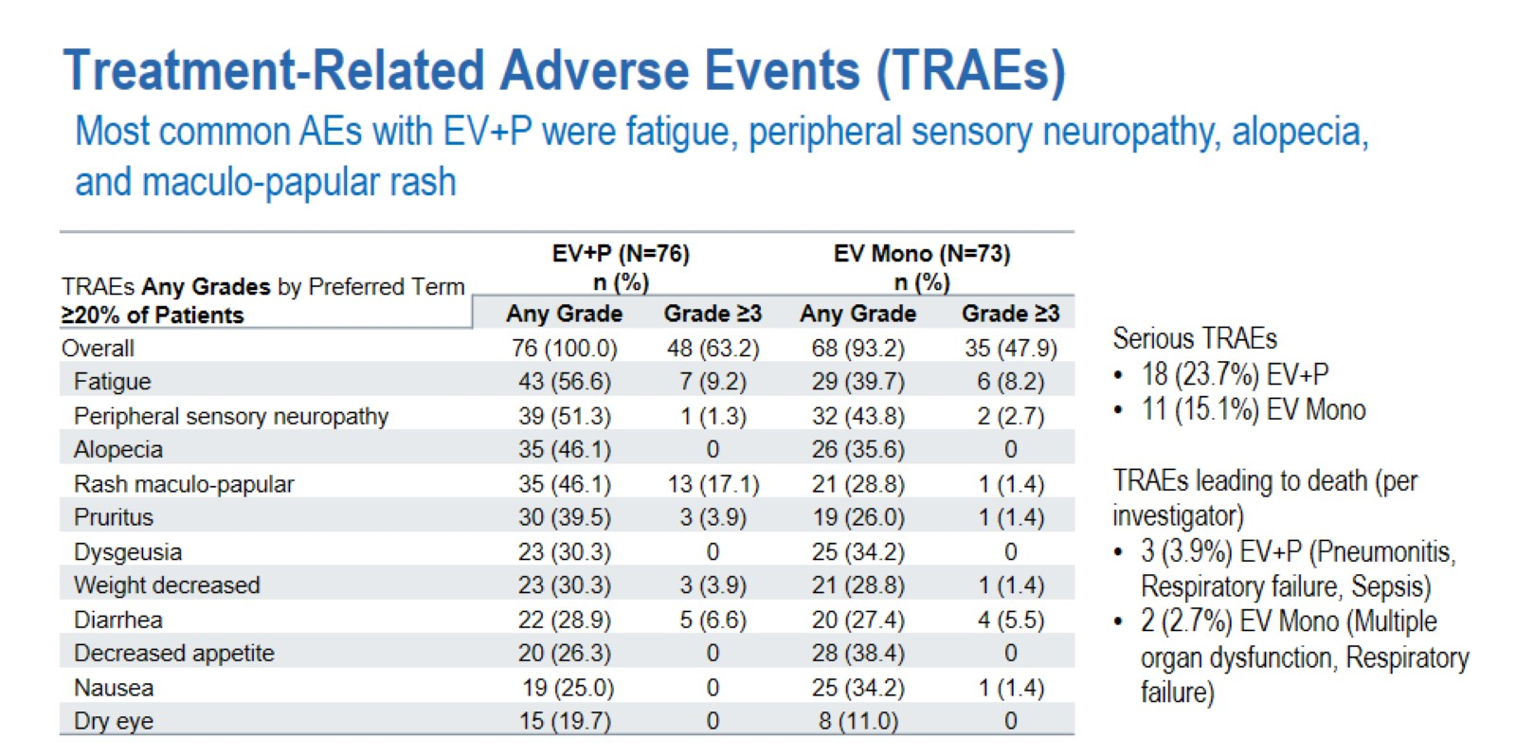
EV 103 cohort K EV + P: Safety
Rosenberg et al, ESMO 2022
Notes:
Safety is an important consideration with this combination given the potential for overlapping toxicity,
Most common AEs are shown here, including .

Slide 73
EV + P efficacy in context of current 1L SOC
GEM + CARBO OS
Gem/Carbo
Phase 3 KN 361 – gem/carbo arm (n=196)
ORR, % | 41.8%
mOS | 14.6 months
Phase 1b/2 EV 103 Cohort K – EV + P arm (n=77)
ORR, % | 64.5%
mOS | 22.3 months
Powles et al., Lancet Onc, 2021
Rosenberg et al., ESMO, 2022
Notes:
These results have led to much enthusiasm for this combination in the bladder cancer community, particularly when placed in context of the current 1L SOC, gemcitabine and carboplatin, with response rates of 40%, with mOS of 14 months, derived from a contemporary cohort - control arm of KN 361.

Slide 74
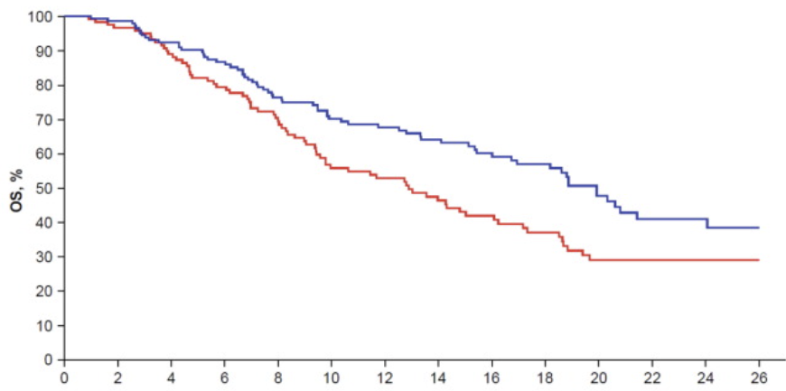
EV + P efficacy in context of current 1L SOC
GEM + CARBO → AVELUMAB OS
Gem/Carbo
Phase 3 JAVELIN 100 – gem/carbo arm (n=269)
mOS | 19.9 months
Phase 1b/2 EV 103 Cohort K – EV + P arm (n=77)
ORR, % | 64.5%
mOS | 22.3 months
Grivas et al, European Urology, 2023
Rosenberg et al., ESMO, 2022
Notes:
The outcomes of patients treated with EV P are as favorable as the outcomes of the subset of gem carbo patients who receive maintenance avelumab.

Slide 75
EV + P is a new 1L option for cis-ineligible mUC
Cisplatin-eligible
Platinum-chemo
4-6 cycles
IO
(avelumab or pembro)
Cisplatin-ineligible
Enfortumab + Pembro
IO
(pembro)
Platinum-ineligible
First-line
Maintenance or 2nd line
Notes:
EV + P is an exciting new treatment option for cis ineligible mUC

Slide 76
EV + P has potential to become the new 1L SOC…
Platinum-eligible
Enfortumab + Pembro
IO
(pembro)
Platinum-ineligible
First-line
Notes:
It has the potential to become the new 1 L SOC

Slide 77
…if EV 302 (confirmatory trial) is positive:
Enfortumab + Pembro
Endpoints
OS
PFS
Platinum-eligible
R
Gem with carbo or cis
(+/- maintenance IO)
Inclusion
mUC
PS: 0-2
Fit for cis or carbo
Adequate organ fx
Exclusion
Immune disease
Uncontrolled DM
Grade 2+ neuropathy
Opportunities:
Platinum-sparing 1L paradigm
Unprecedented response + duration
Treatment de-escalation
Challenges:
GC + Nivo?
Unique toxicity profile
Sequencing uncertainty
Notes:
Which randomizes patients to EV + P versus gem platinum is positive.
This combination presents several opportunities -

Slide 78
mUC Treatment Summary
Level 1 evidence supports single-agent IO as either second-line (pembro) or maintenance (avelumab) therapy post-platinum
Level 1 evidence supports 1L platinum-chemo if platinum-eligible
IO alone no longer an FDA approved SOC option for 1L platinum-eligible
IO + EV (FDA AA) is a new 1L option if cisplatin-ineligible, and has the potential to become the 1L SOC in the platinum-eligible
EV is FDA approved post-platinum & IO (3L); and post-platinum or IO (2L)
Erdafitinib (FDA AA) is an option post-IO (+FGFR2/3 alteration)
Sacituzumab (FDA AA) is an option post-platinum and IO

Slide 79
GENITOURINARY CANCER
Thursday, September 21, 2023

Slide 80
Urothelial Carcinoma Updates:
Case Presentations
Jason Shpilsky, MD
Penn Medicine Clinician
University of Pennsylvania
Philadelphia, PA

Slide 81
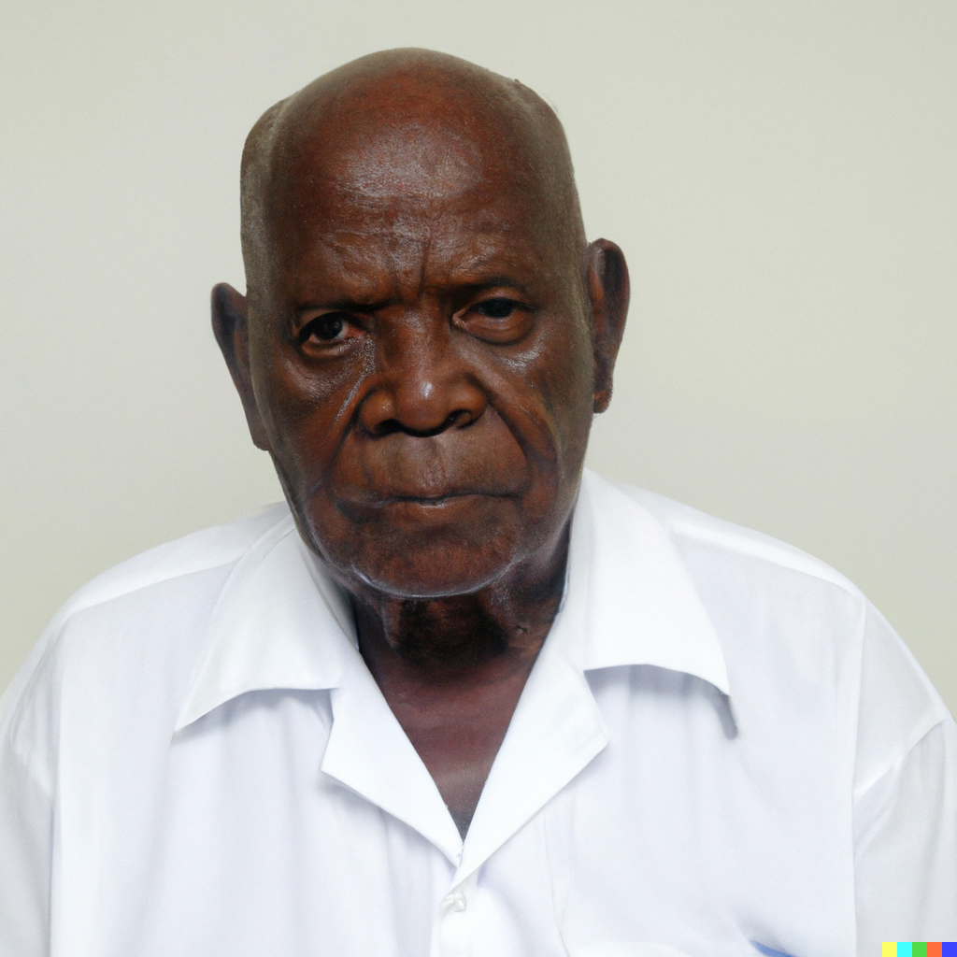
Case 1
MB is a 68yo man with cT3N0 MIBC of the bladder trigone
PMH: HTN, CKD (CrCl 50ml/min),
Social Hx: Former 35 pack-year smoker
ECOG: 1

Slide 82
Initial Options
Radical Cystectomy vs Trimodality Therapy
What makes someone a candidate for TMT?

Slide 83
Patient elects to consider RC
Neoadjuvant treatment?
How do you determine cisplatin eligibility?
If cisplatin ineligible, what options do we have now? Forthcoming?

Slide 84
Case 1
MB is a 68yo man with cT3N0 MIBC of the bladder trigone
He completes 3 cycles of ddMVAC with partial response. He undergoes RC with resultant ypT2N0, R0 resection.

Slide 85
Adjuvant Treatment
What adjuvant treatment options are available?
What patient population do you most strongly advocate for adjuvant treatment?
Are there any markers or clinical findings you use to prognosticate response?

Slide 86
Case 1
MB is a 68yo man with ypT2N0 MIBC after neoadjuvant MVAC.
He completes 1 year of adjuvant nivolumab therapy with manageable Grade 1 dermatitis.
2 years later, routine surveillance identifies metastatic deposit at the supraclavicular lymph node

Slide 87
Metastatic Recurrence
Are any treatments off the table if someone has received prior neoadjuvant chemotherapy and adjuvant immunotherapy?
What is your preferred approach in this setting?

Slide 88
Key Decision Points in Localized MIBC
RC vs TMT
Cis-eligible vs ineligible
Adjuvant immunotherapy

Slide 89

Case 2
ES is a 70yo woman presents with hematuria and new bladder mass
PMH: HTN, Hypothyroid
ECOG: 0

Slide 90
Case 2
CT Urogram
6x3x3cm bladder mass involving the right UVJ extending outside the bladder wall
Multiple enlarged retroperitoneal lymph nodes as well as a single enlarged para-aortic lymph node
M1a
N3
N1-2

Slide 91
Case 2
ES is a 70yo woman with cT3N3M1a (stage IVa) urothelial carcinoma
PMH: HTN, Hypothyroid
ECOG: 0

Slide 92
Metastatic Urothelial Carcinoma
What is the optimal initial treatment strategy for this patient (M1a disease)?
Is there a role for consolidative therapy? When?

Slide 93
Case 2
ES is a 70yo woman with cT3N3M1a (stage IVa) urothelial carcinoma
Completes 5 cycles of gem/cis with partial response before transition to maintenance avelumab

Slide 94
Metastatic Urothelial Carcinoma
If the patient were cisplatin ineligible, what options could you offer?
How has recent data, i.e. EV-103, changed standard of care?

Slide 95
Enfortumab Vedotin + Pembrolizumab
How should we counsel patients starting this combination? (PROs?)
Thoughts on uptake of this combination in the community

Slide 96
mUC Key Decision Points
Cis-eligible vs ineligible
How do we sequence chemotherapy vs immunotherapy vs combination immunotherapy/ADC?
Next-Generation Sequencing and targeted therapies

Slide 97
Final Thoughts

Slide 98
G E N I T O U R I N A R Y C A N C E R
Thursday, September 21, 2023

Slide 99
Evolving Strategies for Localized Muscle Invasive Bladder Cancer
Pooja Ghatalia, MD Assistant Professor
Fox Chase Cancer Center Philadelphia, PA

Slide 100
Standard of Care for Muscle Invasive Bladder Cancer
Neoadjuvant Cisplatin-Based
Regimen (Gemcitabine/Cisplatin OR ddMVAC)
Radical Cystectomy with
b/l pelvic LN dissection
5-Yr Survival
Alive
Dead Cystectomy^{43%}
57%
Dead 43%
NAC ➔
Alive
Cystectomy _{57%}
Galsky JCO 2011, Grossman NEJM 2003

Slide 101
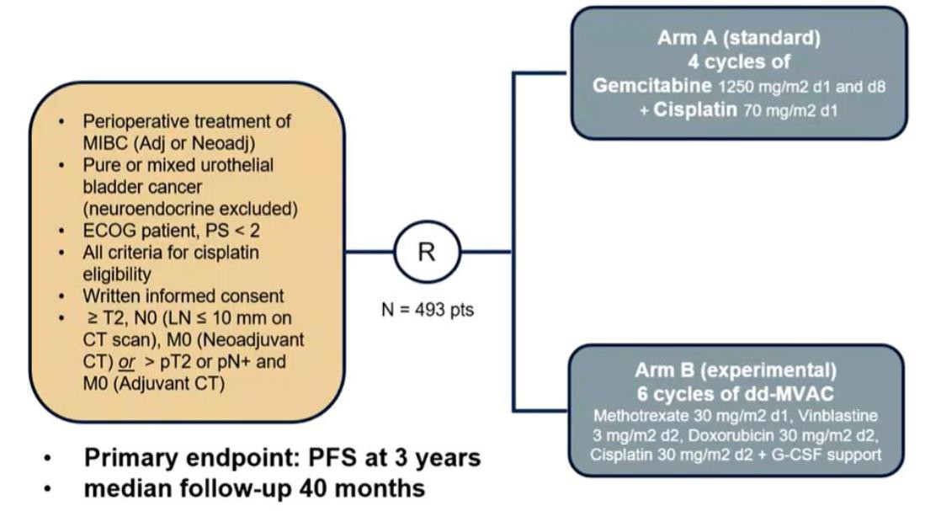
VESPER: Neoadj/adj MVAC vs gem/cis
Pfister et al. JCO 2022

Slide 102
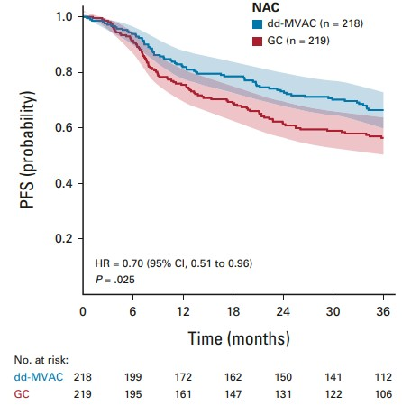
VESPER: Neoadj/adj MVAC vs gem/cis
3-yr PFS rate was 64% vs 56%
Pfister et al. JCO 2022

Slide 103
Standard of Care for Muscle Invasive Bladder Cancer
Neoadjuvant Cisplatin-Based
Regimen (Gemcitabine/Cisplatin OR ddMVAC)
Radical Cystectomy with
b/l pelvic LN dissection
approximately 30-50% cis-ineligible
renal dysfunction
Eastern Cooperative Oncology Group (ECOG) performance status (PS) ≥ 2
comorbidities such as cardiac dysfunction, neuropathy and hearing loss
Galsky JCO 2011, Dash Cancer 2006

Slide 104
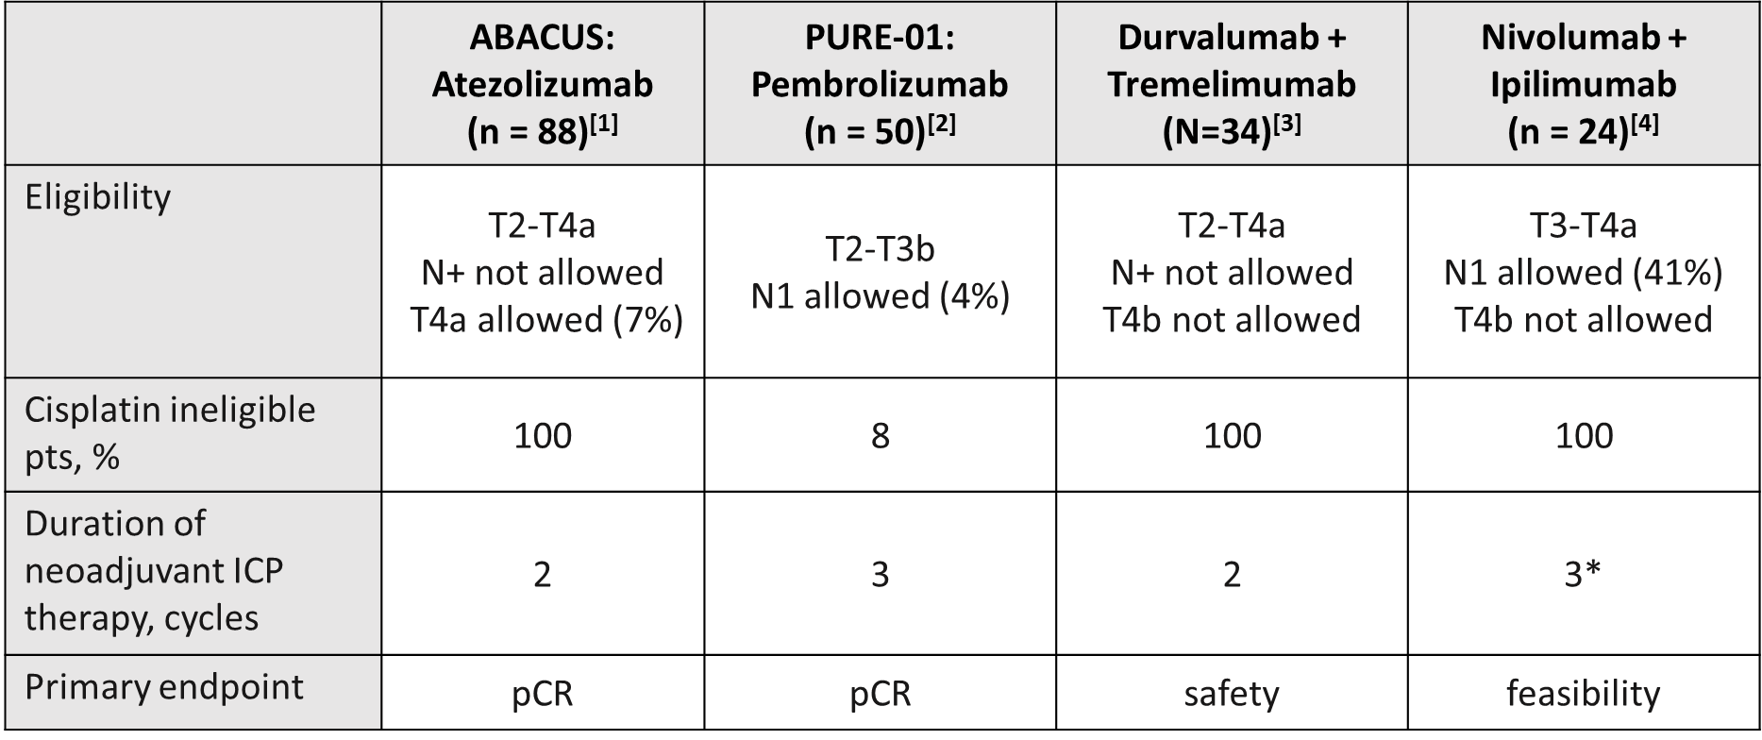
Phase I/II Trials of Neoadjuvant Checkpoint Inhibition in MIBC
1. Powles. ASCO 2018. Abstr 4506. 2. Necchi. J Clin Oncol. 2018;36:3353. 3. Gao. ASCO 2019. Abstr 4551. NCT02812420. 4. Van der Heijden.
ESMO 2019. Abstr 904PD. NCT03387761

Slide 105
Phase I/II Trials of Neoadjuvant Checkpoint Inhibition in MIBC
1. Powles. ASCO 2018. Abstr 4506. 2. Necchi. J Clin Oncol. 2018;36:3353. 3. Gao. ASCO 2019. Abstr 4551. NCT02812420. 4. Van der Heijden.
ESMO 2019. Abstr 904PD. NCT03387761

Slide 106
Substantial Heterogeneity in Baseline Clinical Stages Complicates Comparisons Across Neoadjuvant Trials
Pembrolizumab^{[1]} pCR: 37%
Atezolizumab^{[2]} pCR: 29%
Durvalumab + tremelimumab^{[3]} pCR: 43%
Ipilimumab + Nivolumab^{[4]} pCR: 46%
cN+ 4%
cT3-4aN0
27%
cT2N0 42%
cTanyN+
cT3- 4aN0
50%
cT1-2N0 50%
cT3N0 54%
42%
cT3-4aN0 58%
cT2N0
73%
1. Necchi. J Clin Oncol 2018;36:3353. 2. Powles. Nat Med 2019 3. Gao. ASCO 2019. Abstr 4551. 4. Van der Heijden. ESMO 2019. Abstr 904PD.

Slide 107
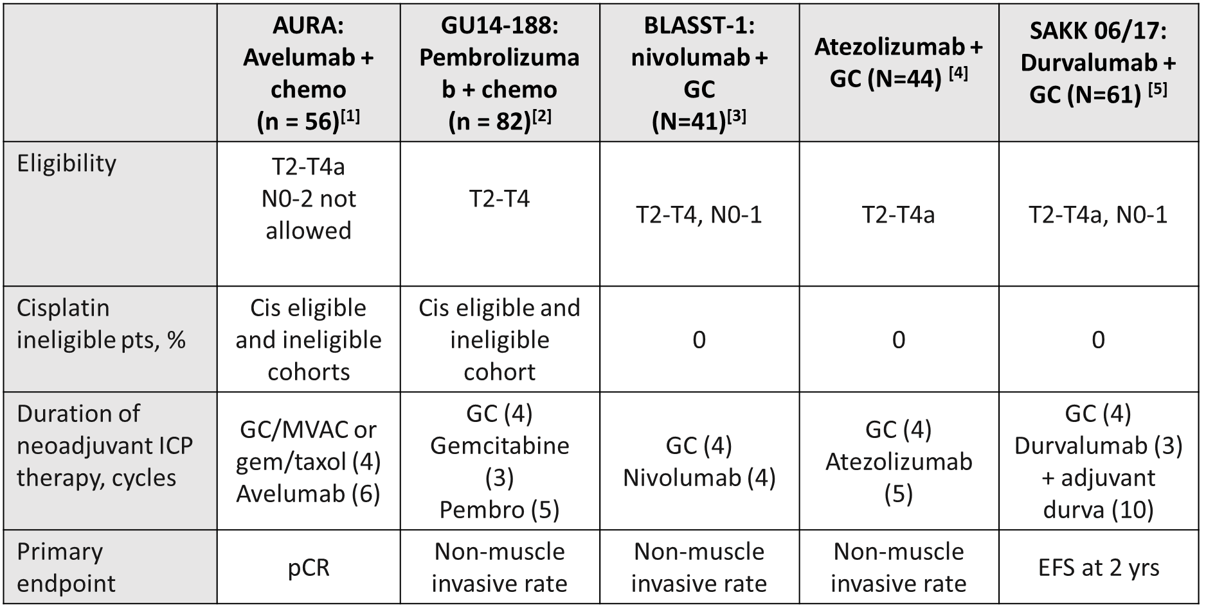
Phase I/II Trials of Neoadjuvant ICI/chemotherapy in MIBC
1. Chanza. ESMO 2021. 2. Brown. GU ASCO 2023 abst 448. 3. Gupta GU ASCO 2022. 4. Funt JCO 2022. 5. Cathomas JCO 2023

Slide 108
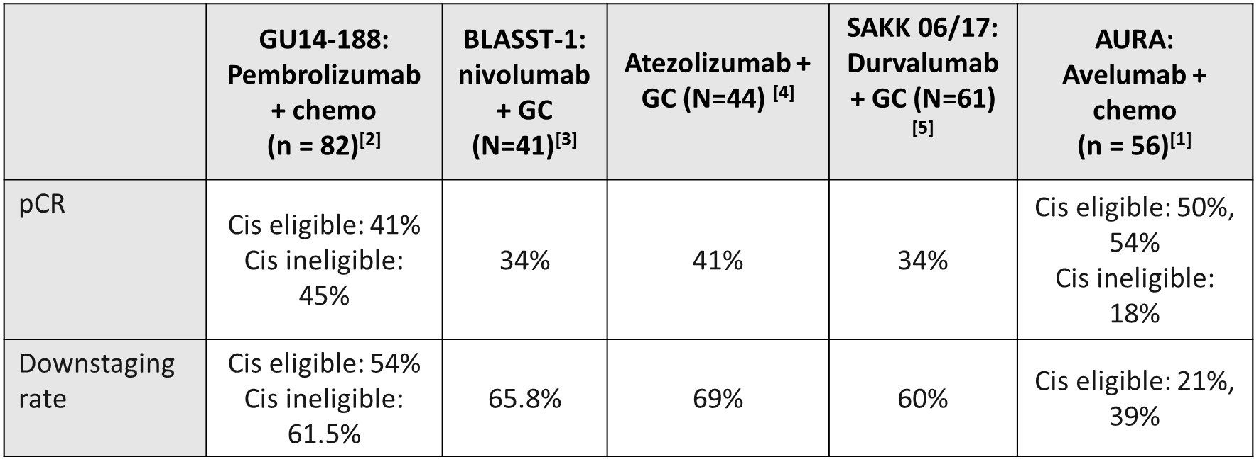
Phase I/II Trials of Neoadjuvant ICI/chemotherapy in MIBC
1. Chanza. ESMO 2021. 2. Brown. GU ASCO 2023 abst 448. 3. Gupta GU ASCO 2022. 4. Funt JCO 2022. 5. Cathomas JCO 2023

Slide 109
pCR Rate With IO Similar to
100
90
80
70
60
50
40
30
20
10
0
Cisplatin-Based NAC
Ipi/Nivo^{[6]} Durva/Tremi^{[7]} ddGC^{[2]} | Pembrolizumab^{[1]} ddMVAC^{[3]} | MVAC (SWOG 8710)^{[5]}
Atezolizumab^{[4]} Cystectomy (SWOG 8710)^{[5]}
pCR Rate (%)
0 10 20 30 40 50 60 70 80 90 100 110 120
130
N
1. Necchi. ASCO 2018. Abstr 4507. 2. Anari. Eur Urol Oncol. 2018;1:54. 3. Plimack. Eur Urol. JCO. 2014;32:1895.
4. Powles. Nat Med 2019. 5. Grossman. NEJM. 2003;349:859. 6. Gao. ASCO 2019. Abstr 4551. NCT02812420. 7. Van der Heijden. ESMO 2019. Abstr 904PD. NCT03387761

Slide 110
pCR Rate With IO or IO/chemo Similar to
Cisplatin-Based NAC
100
90
80
70
60
50
40
30
20
10
0
pCR Rate (%)
Atezo+GC
Avelumab+GC
Ipi/Nivo
Durva/Tremi
ddGC
Pembrolizumab
ddMVAC Nivo+GC
Pembro+GC
MVAC (SWOG 8710)
Atezolizumab Durva+GC
Cystectomy (SWOG 8710)
0 10 20 30 40 50 60 70 80 90 100 110 120
N
130
1. Necchi. ASCO 2018. Abstr 4507. 2. Anari. Eur Urol Oncol. 2018;1:54. 3. Plimack. Eur Urol. JCO. 2014;32:1895.
4. Powles. Nat Med 2019. 5. Grossman. NEJM. 2003;349:859. 6. Gao. ASCO 2019. Abstr 4551. NCT02812420. 7. Van der Heijden. ESMO 2019. Abstr 904PD. NCT03387761

Slide 111
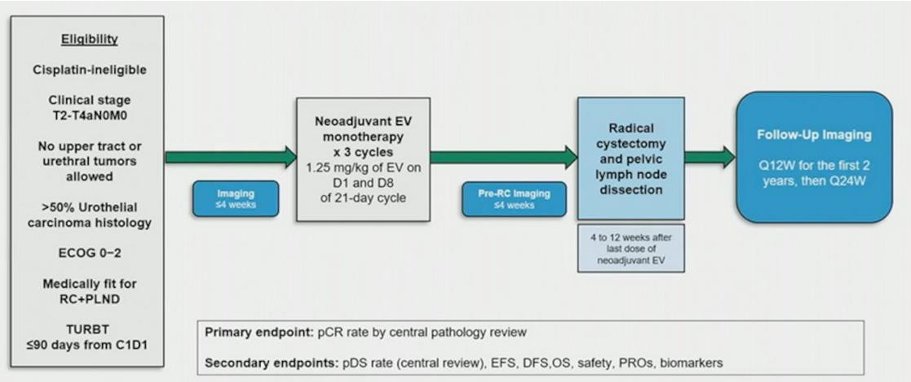
EV-103 cohort H

Slide 112
EV-103 cohort H
N =22
pCR 36.4%,
Downstaging rate 50%
Flaig ASCO 2023

Slide 113
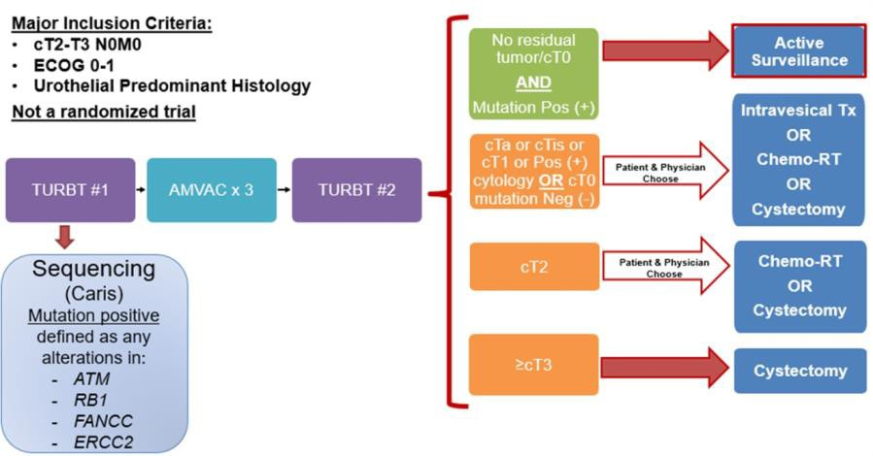
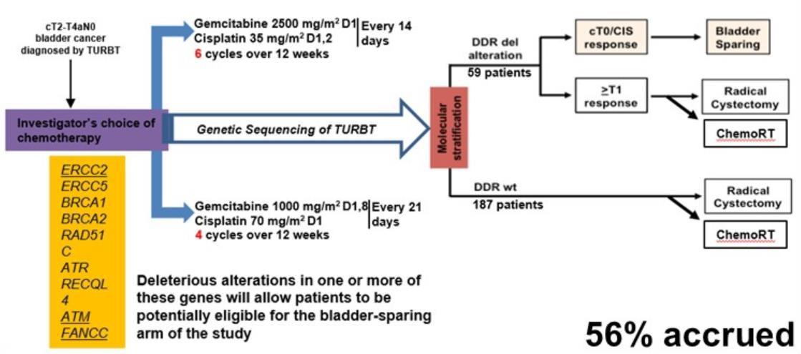
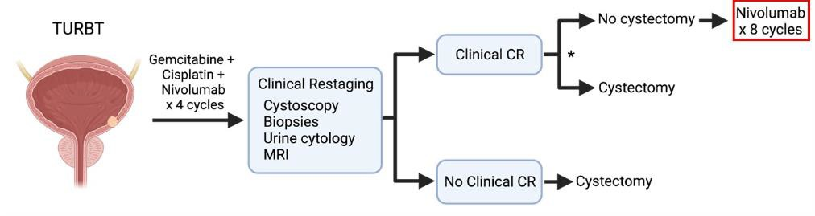
Bladder sparing trials
NCT03608216
RETAIN
HCRN GU16-257

Slide 114
Trimodality Therapy in MIBC
TMT is a valid option for bladder preservation in patients with MIBC
5-year DSS can approach 80- 85% in patients who are good candidates
Neoadjuvant chemotherapy prior to TMT is being explored
Recently immunotherapy before and in combination with RT is being explored
Zlotta. ASCO GU 2022. Abstr 433. Hall. Eur Urol. 2022;82:273.
James. NEJM. 2012;366:1477. Vashistha. Int J Radiat Oncol Biol Phys. 2017;97:1002.

Slide 115

Trimodality therapy with immune checkpoint inhibitors
Weickhardt ASCO 2020. Abstr 485, Balar ASCO 2021. Abstr 4504, Singh ASCO 2021, Joshi ASCO 2021. Abstr 398,
Vazquez-Estevez ASCO 2022. Abst 4588, Muro ASCO 2021 Abstr 4505

Slide 116

Adjuvant Therapy Ultimate Goal: Improve DFS, OS
1. Sternberg. Lancet Oncol. 2015;16:76. 2. ABC Meta-Analysis Collaborators Group. Eur Urol. 2022; 81:50.

Slide 117

Adjuvant IO Trials in High-Risk MIUC
High-risk MIUC: if received NAC ypT2-T4a/ypN+ or pT3-T4a/pN+
if not eligible for or declined adjuvant cisplatin-based chemotherapy
1. Bellmunt. Lancet Oncol. 2021;22:525. 2. Bajorin. NEJM. 2021; 384:2102. 3. NCT03244384.

Slide 118

IMvigor010 Adjuvant Atezolizumab vs Observation in High-Risk MIUC: DFS and OS
Bellmunt. Lancet Oncol 2021;22:525.

Slide 119

IMvigor010: Survival Outcomes With Atezolizumab vs Observation by Postsurgical ctDNA Status
owles. Nature. 2021;595:432.

Slide 120


ctDNA-Guided Adjuvant IO trials
PI: Tom Powles, MD. NCT04660344.

Slide 121

CheckMate 274: Adjuvant Nivolumab vs Placebo After Radical Surgery ±
Neoadjuvant CT in High-Risk MIUC
Bajorin. NEJM. 2021;384:2102. NCT02632409.

Slide 122


CheckMate 274: Disease-Free Survival
Bajorin NEJM 2021

Slide 123

ALLIANCE/AMBASSADOR: Adjuvant Pembrolizumab vs Observation in Muscle-Invasive or Locally Advanced UC
Apolo. ASCO GU 2019. Abstr TPS504. NCT03244384.

Slide 124
Conclusion
Neoadjuvant cisplatin-based chemotherapy remains current SOC for
cisplatin eligible patients with MIBC
Neoadjuvant IO and IO/chemotherapy combinations have been explored
Bladder preservation trials are ongoing and very attractive to patients
TMT is another promising approach for bladder preservation
While adjuvant nivolumab has become an FDA approved option for high risk MIBC post cystectomy, incorporation of ctDNA for treatment selection appears to be a promising approach

Slide 125
GENITOURINARY CANCER
Thursday, September 21, 2023

Slide 126
Question-and-Answer

Slide 127
Concluding Remarks
Thank you for attending!

Slide 128

Concluding Remarks
Thank you for coming!
Please scan the QR code here to complete a brief survey about tonight's event.

Slide 129
Thank You to Our Supporters:

