Slide 1










BREAST CANCER
Wednesday, June 14, 2023

Slide 2
Welcome
Albert Tierney
Senior Director of Sales, OncLive
MJH Life Sciences

Slide 3



Thank You to Our Supporters:

Slide 4


Slide 5
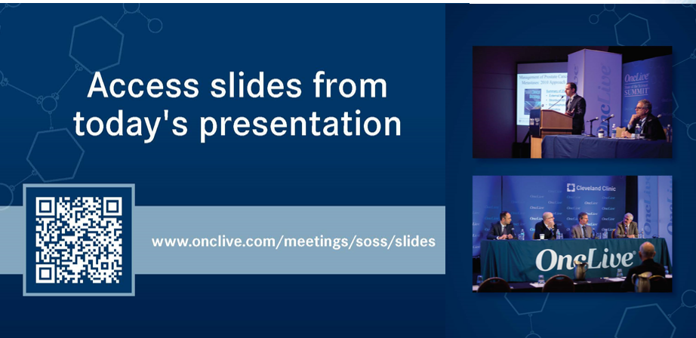

Slide 6


OncLive® is launching
a new app called
Meet MY MSL!
Visit https://cloud.email.onclive.com/referrals to be one of the first health care professionals to gain access to Meet My MSL
Meet My MSL has been created to provide oncologists the opportunity to initiate direct contact with the Medical Science Liaison (MSL) in their area of expertise. It has never been easier to meet, locate, and contact the MSL you need.
Find any MSL from any company for any tumor

Slide 7


Slide 8
Program Chair
Nancy U. Lin, MD
Associate Professor of Medicine
Director, Metastatic Breast Cancer Program
Dana-Farber Cancer Institute/Harvard Medical School
Boston, MA

Slide 9
Program Chair
Sarah Sammons, MD
Associate Director, Embrace MBC Program
Dana Farber Cancer Institute
Boston, MA

Slide 10









BREAST CANCER
Wednesday, June 14, 2023

Slide 11
CDK4/6 Inhibitors: Updates and Controversies
Sarah Sammons, M.D.
Associate Director, Embrace MBC Program
Dana Farber Cancer Institute
Boston, MA
Notes:
20 minutes

Slide 12
Disclosures
Research funding: Astra Zeneca, Abbvie, Bristol Myers Squibb, Eli Lilly, SEAGEN, Sermonix
Consulting: Foundation Medicine, Astra Zeneca, Daichii Sankyo, Eli Lilly, Incyclix, Merck, Pfizer, SEAGEN, Sermonix, Novartis

Slide 13
Objectives
Overall Survival Controversies in 1st Line CDK4/6i Use
Can CDK4/6i wait until 2nd line? SONIA
Updates in Adjuvant CDK4/6 inhibitors
Notes:
Adjuvant CDK 4/6 Trials: PALLAS, monarchE, NATALEE
Ribociclib: MONALEESA (SABCS 22 abstr P4-01-42), MONARCH 2
OS Updates

Slide 14
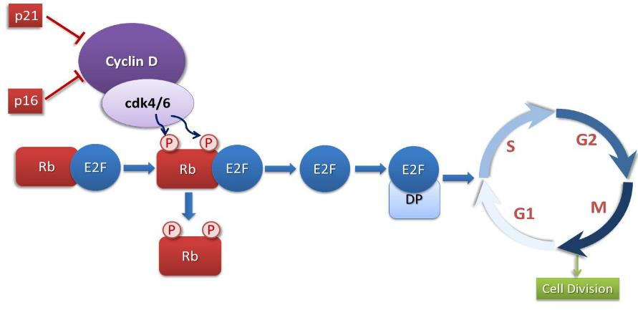
CDK 4/6 Inhibitor Rationale
CDK4 and 6 Regulate G1/S Cell Cycle Progression
ER+ breast cancer preferentially overexpresses cyclin D or has loss of p16, with subsequent loss of control of the cell cycle

Slide 15
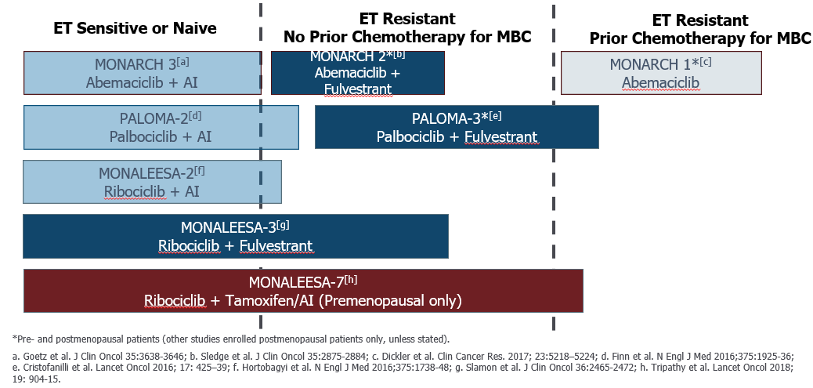
Overview Pivotal CDK4/6 Inhibitor Trials

Slide 16
PFS Pivotal First Line Trials Nearly Identical
 | PALOMA-2 | MONALEESA-2 | MONARCH-3
Phase | Phase 3 | Phase 3 | Phase 3
Line | 1st line | 1st line | 1st line
Endocrine tx | Letrozole | Letrozole | Letrozole or anastrozole
CDK4/i | Palbociclib | Ribociclib | Abemaciclib
Patients (n) | 666 | 668 | 493
PFS Hazard Ratio | 0.58 | 0.56 | 0.54
PFS (months) | 24.8 vs 14.5 | 25.3 vs 16 | 28.2 vs 14.8
*Different studies, different designs, different study populations, different subgroup definitions*
Finn NEJM 2016; Hortobagyi NEJM 2016; Goetz J Clin Oncol 2017; Finn, ASCO 2022; Hortobagyi NEJM 2022; Goetz ESMO 2022
Slide borrowed: Daniel Stover ASCO 2023

Slide 17
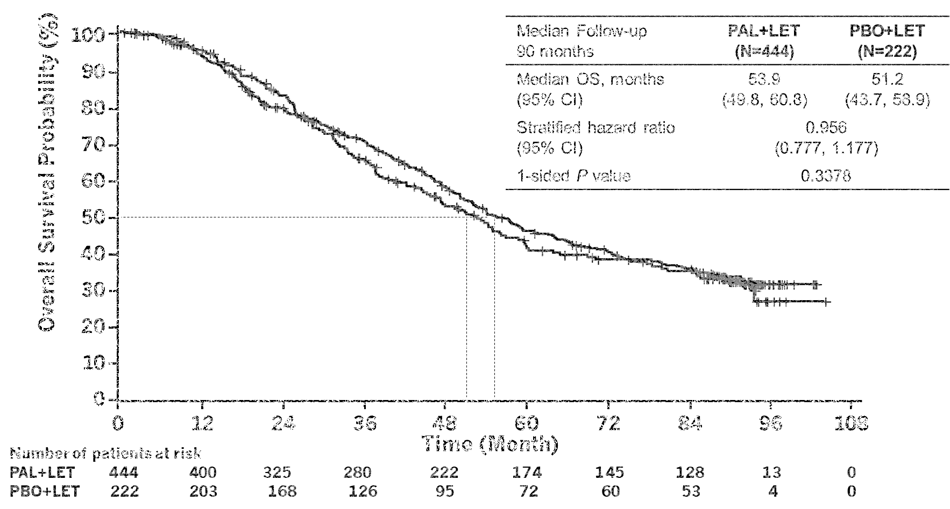
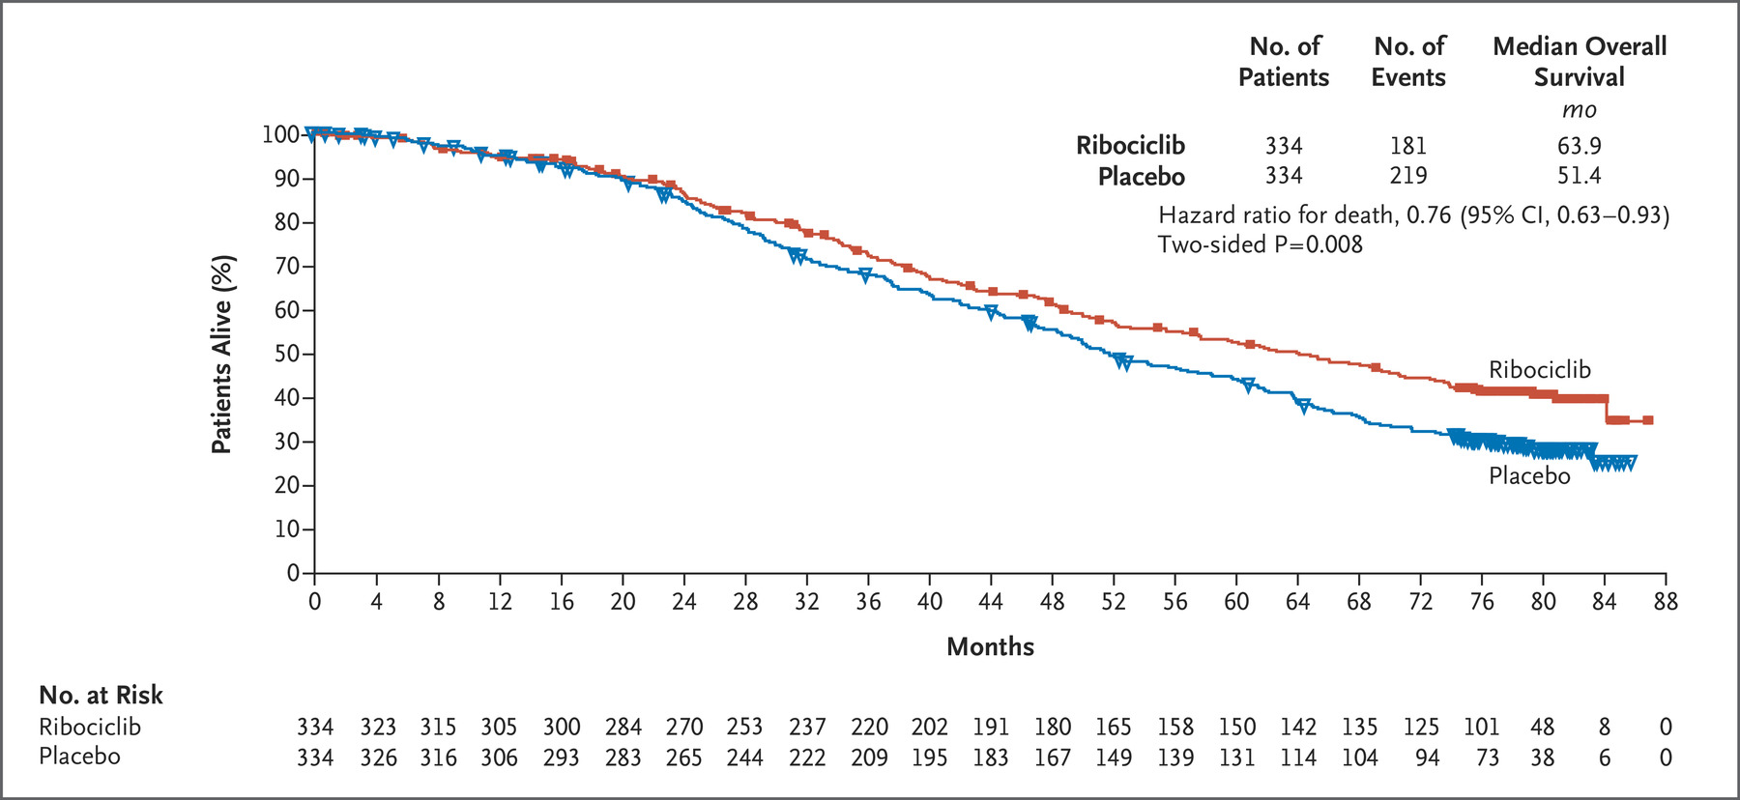
Previously Reported CDK4/6 OS Data
PALOMA 2- Overall Survival ITT
MONALEESA 2- Overall Survival ITT
Finn RS, et al. ASCO 2022.
Hortobagyi, ESMO 2021.

Slide 18
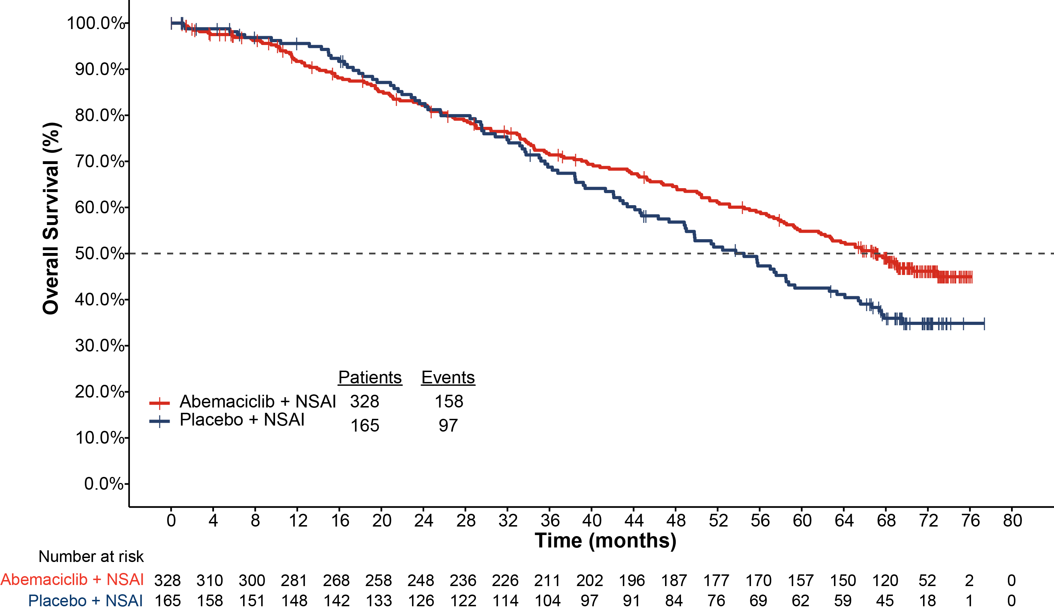
MONARCH 3: OS IA2 for the ITT Population
 | abemaciclib + NSAI | placebo + NSAI
Median OS, (months) | 67.1 | 54.5
HR (95% CI; P value) | 0.754 (0.584-0.974) p-value 0.0301*
Pre-planned OS IA2 Analysis Data cut: 02 Jul 2021
67.1 mo
54.5 mo
*p-value did not reach threshold for statistical significance at this interim
31.5% of patients in the control arm and 10.1% in the abemaciclib arm received a subsequent CDK4 & 6 inhibitor
At this interim analysis, statistical significance was not reached but data are maturing favorably (HR 0.754, 95% CI: 0.584-0.974)
and follow up continues. The observed difference in median OS was 12.6 months.
CDK; cyclin dependent kinase; CI, confidence interval; HR, hazard ratio; IA2, interim analysis 2; mo, months; ITT, intent to treat; NSAI, nonsteroidal aromatase inhibitor; OS, overall survival.
Goetz, ESMO 2022

Slide 19
Pt Populations 1st Line Trials
 | PALOMA-2 Palbociclib | MONALEESA-2 Ribociclib | MONARCH-3 Abemaciclib
De novo mBC | 38% | 34% | 40%
Disease-free interval
DFI ≤ 12 months DFI > 12 months DFI > 24 months | 22% 40% NR | 18%* NR 60% | NR
“No substantial differences in prior therapy, visceral disease, use of subsequent CDK4/6i in placebo arm, other variables”
*Novartis data on file
DFI, disease-free interval; mBC, metastatic breast cancer; NR, not reached.
Isaacs C. ASCO 2022.

Slide 20
Summary PFS/OS 1st Line Trials
 | PALOMA-2 | MONALEESA-2 | MONARCH-3
Phase | Phase 3 | Phase 3 | Phase 3
Line | 1st line | 1st line | 1st line
Endocrine tx | Letrozole | Letrozole | Letrozole or anastrozole
CDK4/i | Palbociclib | Ribociclib | Abemaciclib
Patients (n) | 666 | 668 | 493
PFS Hazard Ratio | 0.58 | 0.56 | 0.54
PFS (months) | 24.8 vs 14.5 | 25.3 vs 16 | 28.2 vs 14.8
OS Hazard Ratio | 0.96 | 0.76 | 0.75
OS (months) | 53.9 vs 51.2 NS | 63.9 vs 51.4 12.5m *sig | 67.1 vs 54.5 12.6m *trending
*Different studies, different designs, different study populations, different subgroup definitions*
Finn NEJM 2016; Hortobagyi NEJM 2016; Goetz J Clin Oncol 2017; Finn, ASCO 2022; Hortobagyi NEJM 2022; Goetz ESMO 2022
Slide borrowed: Daniel Stover ASCO 2023

Slide 21
Choosing First Line CDK4/6i
Abundant 1st Line Statistically Significant OS data for Ribociclib + ET in pre/postmenopausal women (NCCN preferred).
1st Line Abemaciclib same OS HR, final OS and still a consideration.
Palbociclib lack of OS in 1st or 2nd line. Trial design? Missing Data? Underpowered? Crossover? Data is what it is.
Patient preference, comorbidities and toxicity profiles must be considered!

Slide 22
Side Effect Profile of CDK 4/6i + ET
Palbociclib/Ribociclib
Abemaciclib
Diarrhea
Neutropenia
81
75
75
75
All Grades, %
All Grades, %
Nausea
Neutropenia
50
50
Nausea
Fatigue
35 to 45
Fatigue
41
Alopecia
40
40
30 to 35
Diarrhea
Alopecia
Anemia
Anemia
25
30
25
25 to 30
26
25
25
Ribociclib: risk of QTc prolongation (1.38%)*
Abemaciclib: 5% incidence of VTE
Courtesy of Martine Piccart, MD : compiled from the
reported toxicity data of the randomized trials
Thein KZ. Et al, JNCCN, 2019;doi.org/10.6004/jnccn.2018.7154
Slide Courtesy Danial Stover ASCO 2023

Slide 23
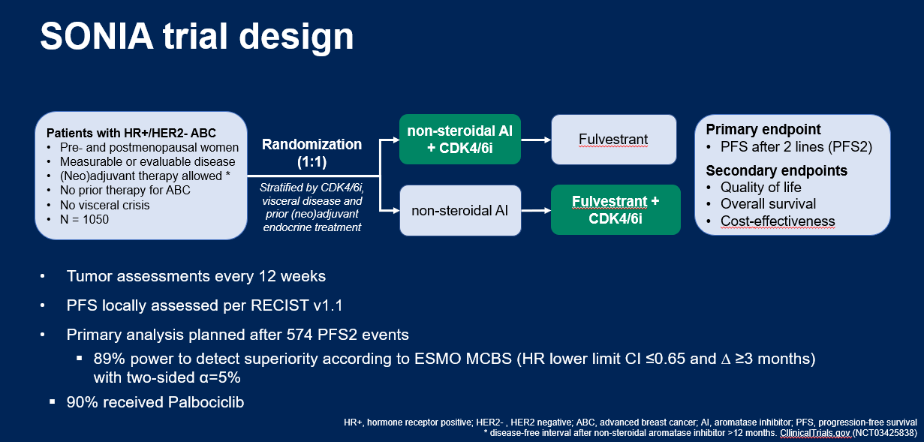
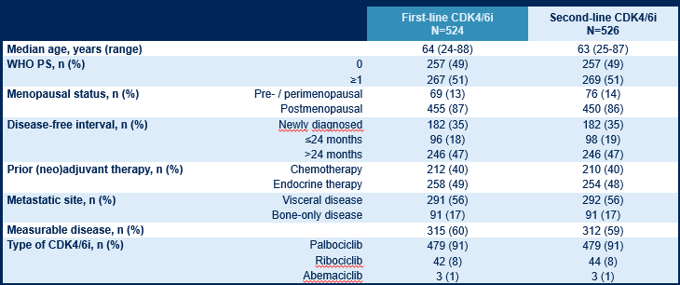
Can we hold off on CDK4/6i until 2nd Line?
91% Palbociclib
80% de novo or >24m
Interval (ET sensitive)
Sonke, ASCO 2023

Slide 24
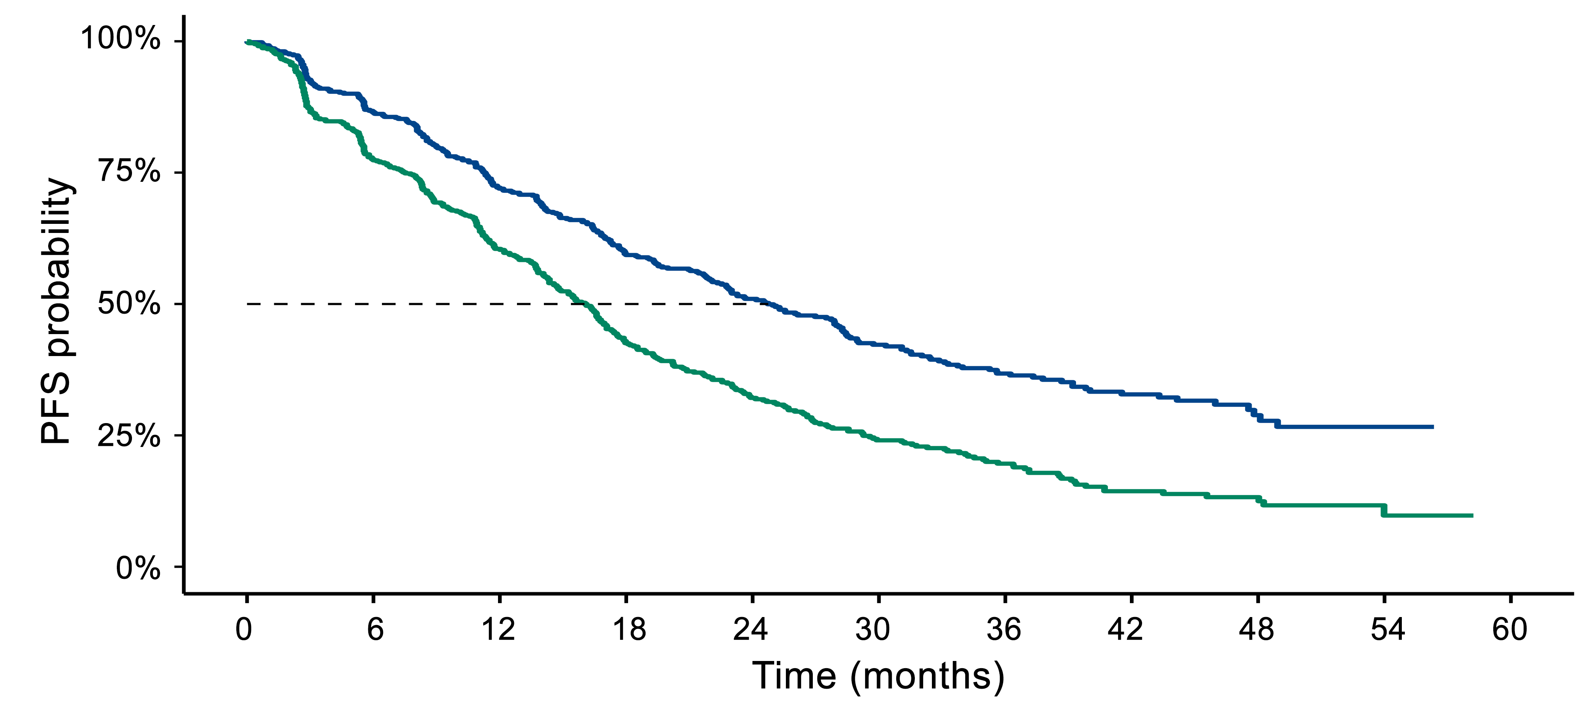
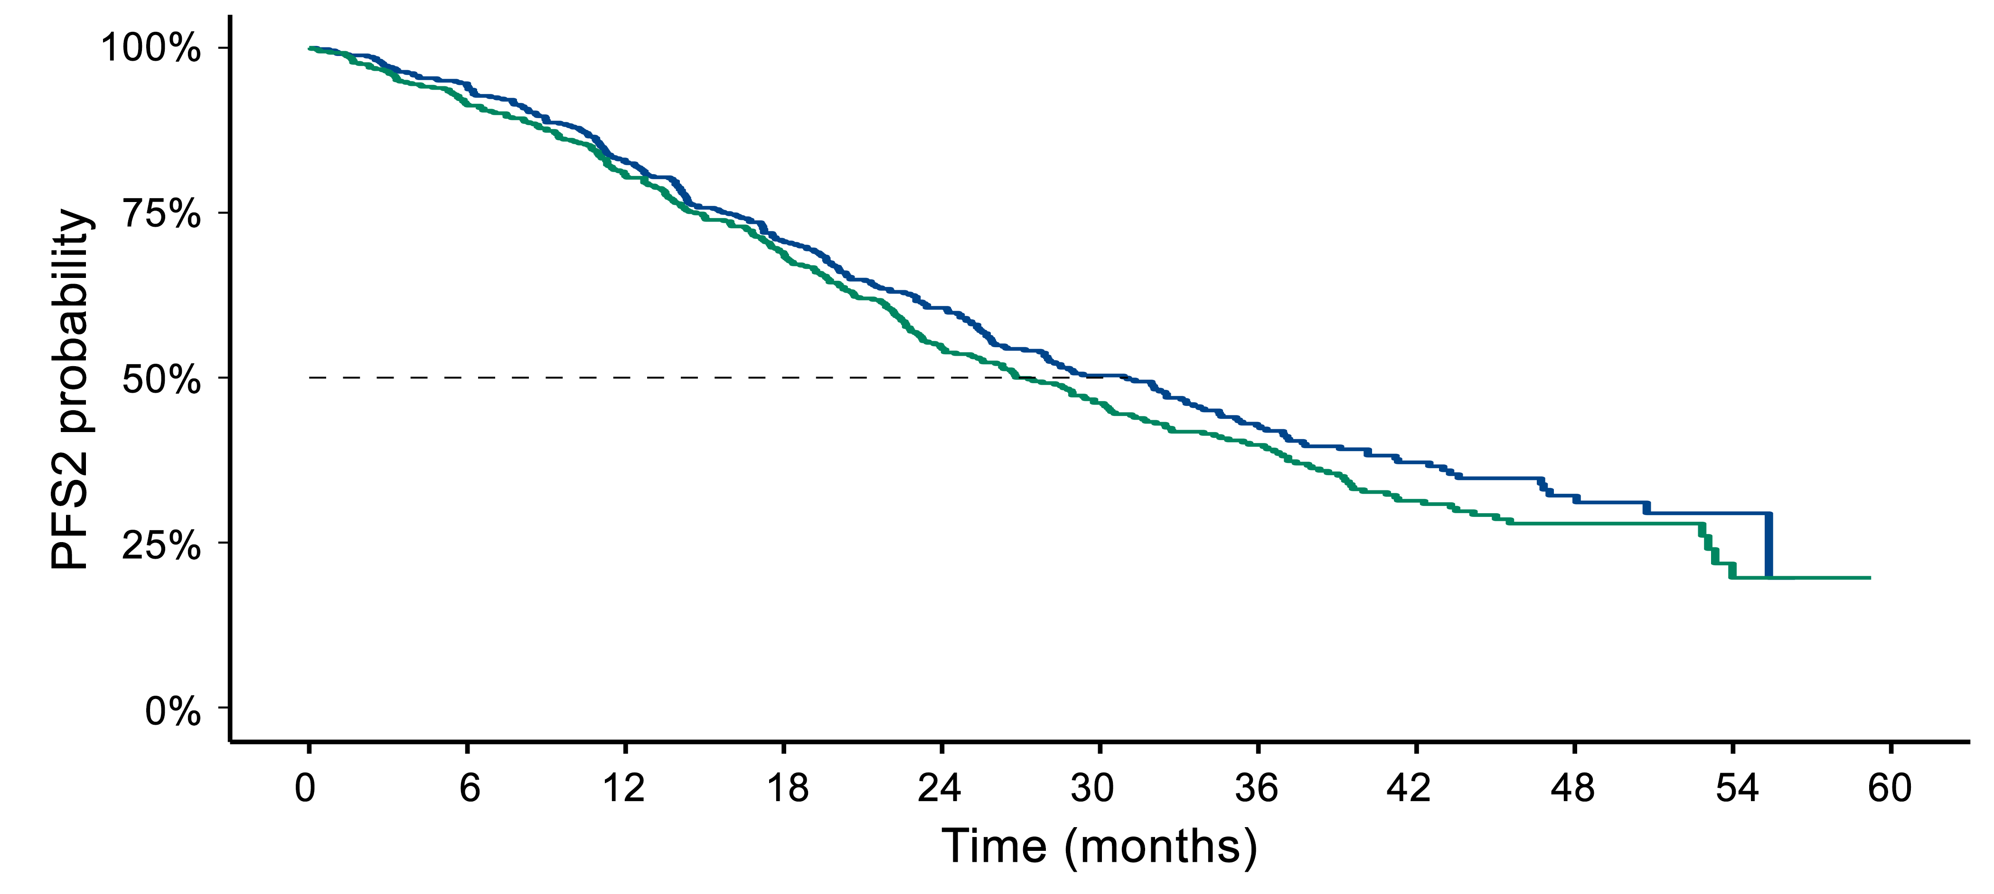
SONIA: 1st v 2nd CDK 4/6
PFS 1
PFS 2
Sonke, ASCO 2023
 | First-line CDK4/6i | Second-line CDK4/6i
Events/N | 281/524 | 310/526
Median PFS2, mo | 31.0 | 26.8
Hazard Ratio (95% CI) | 0.87 (0.74-1.03)
Two-sided P-value | 0.10
 | First-line CDK4/6i | Second-line CDK4/6i
Events/N | 310/524 | 407/526
Median PFS1, mo | 24.7 | 16.1
Hazard Ratio (95% CI) | 0.59 (0.51-0.69)
Two-sided P-value | <0.0001
First-line CDK4/6i
Second-line CDK4/6i
MONARCH 3 PFS2: 36.9 months versus 25.6 months
Sonke, ASCO 2023

Slide 25
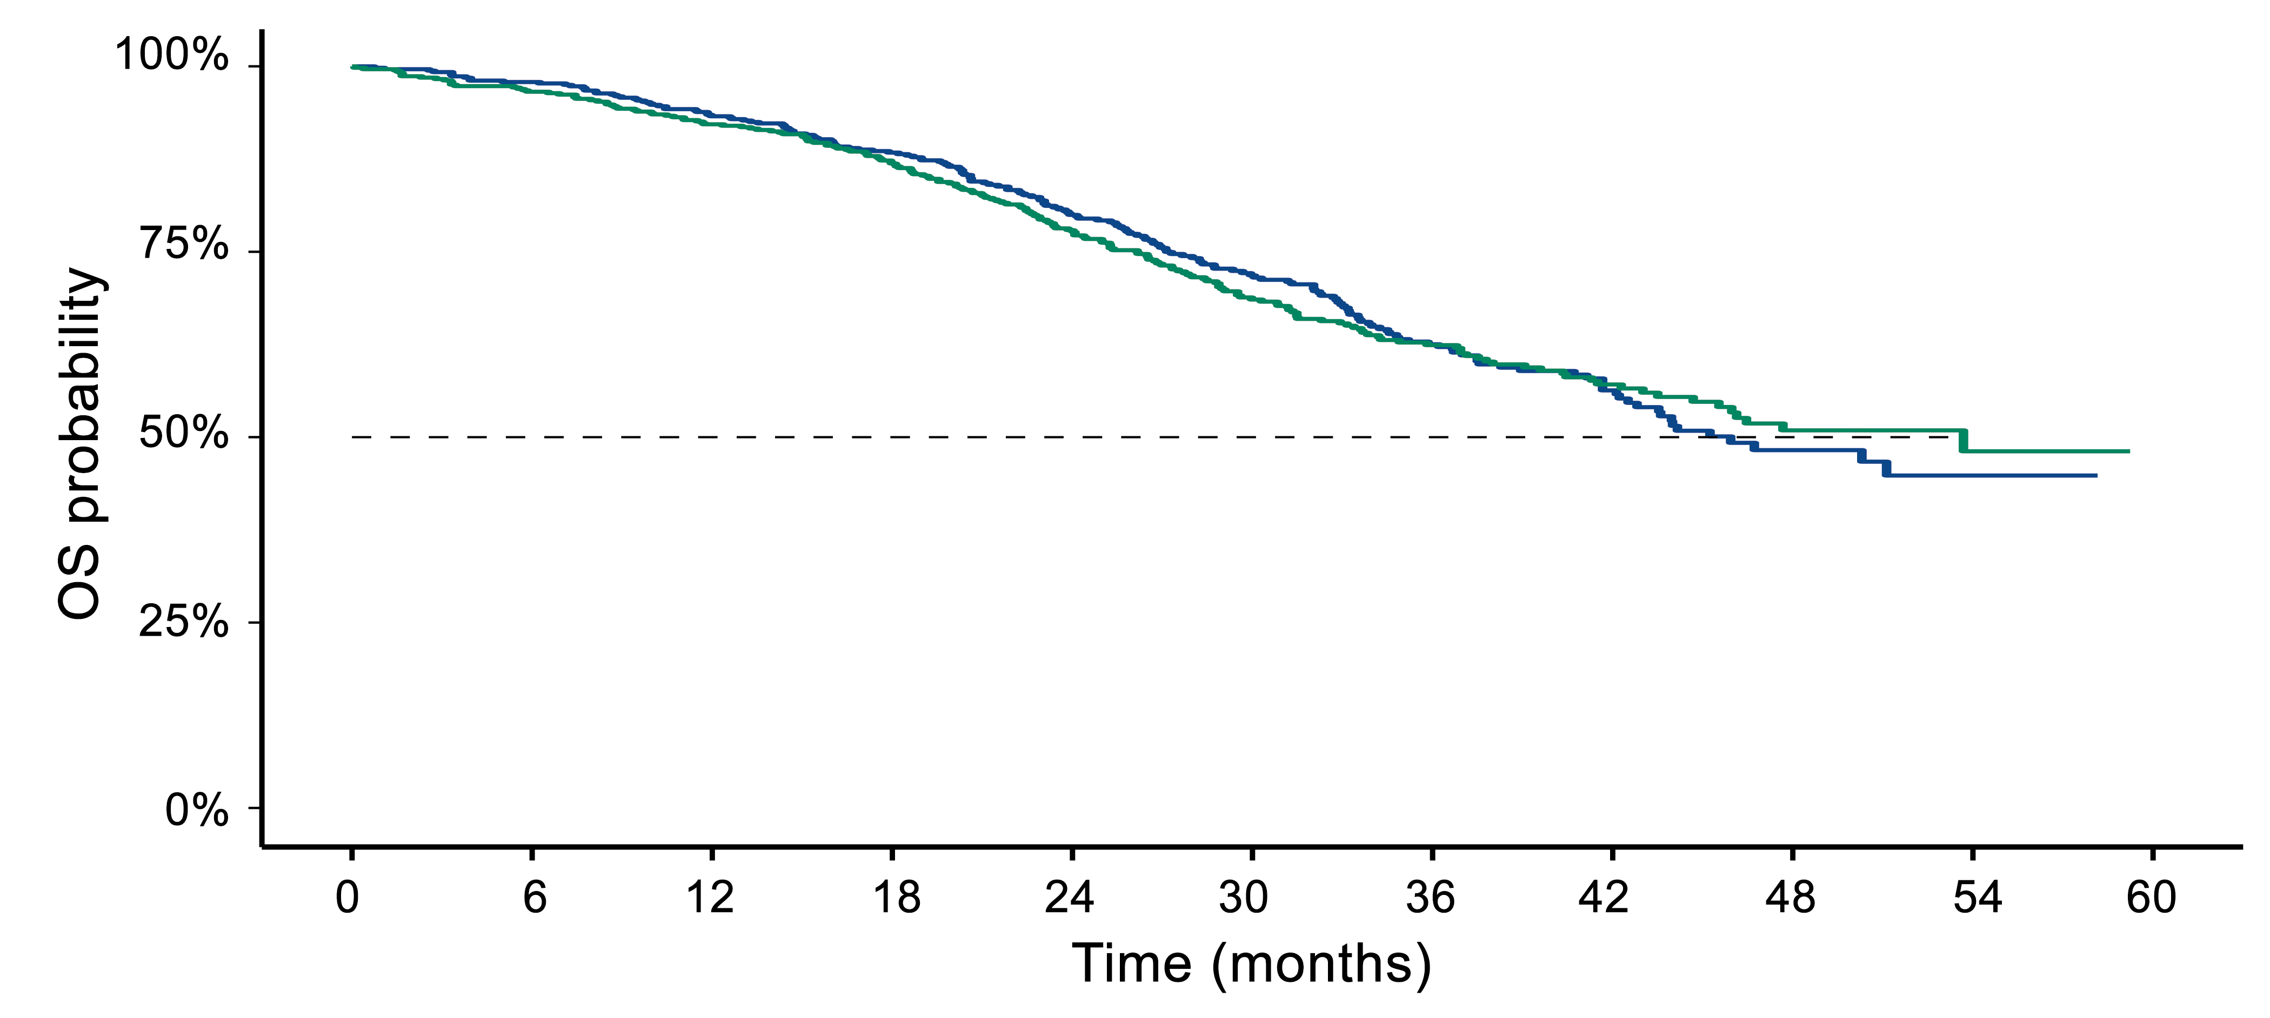
SONIA Overall Survival: 1st v 2nd CDK 4/6
 | First-line CDK4/6i | Second-line CDK4/6i
Events/N | 184/524 | 188/526
Median OS, mo | 45.9 | 53.7
Hazard Ratio (95% CI) | 0.98 (0.80-1.20)
Two-sided P-value | 0.83

Slide 26
Should 1st Line CDK4/6 Still Be Standard for Most Patients?
Yes
Palbociclib (predominant in SONIA) has not yield OS benefits in 1st or 2nd line settings.
Ribo and abemaciclib in 1st line with OS >60m
Fulvestrant no longer standard 2nd line therapy
Single agent aromatase inhibitor followed by Fulv/CDK4/6 option for some patients most concerned with toxicity, cost
In 2023, no biomarker/clinical feature teases out these pts

Slide 27
What about adjuvant CDK4/6 Inhibitors in Early-Stage HR+ BC?
 | 2 year iDFS rate |  | 3 year iDFS rate |  | Hazard ratio (95% CI) | P value | Significance reached vs placeboª
 | Treatment arm | Placebo arm | Treatment arm | Placebo arm
PALLAS¹ | 93.9% | 93.0% | 89.3% | 89.4% | 0.96 (0.81-1.14) | 0.65 | ✗
PENELOPE-B² | 88.3% | 84.0% | 81.2% | 77.7% | 0.93 (0.74-1.17) | 0.53 | ✗
MonarchE ^{3,b} | 92.7% | 90.0% | 88.8% | 83.4% | 0.70 (0.59-0.82) | <0.0001 | ✓
NATALEE | ASCO 2023 |  |  |  |  |  | Not yet reported
PAL
ABE
RIBO
Comparisons cannot be made in the absence of well-controlled, head-to-head studies.
\
1. Gnant M, et al. J Clin Oncol. 2022;40(3):282-293. 2. Loibl S, et al. J Clin Oncol. 2021;39(14):1518-1530. 3. Harbeck N, et al. Ann Oncol. 2021;32(12):1571-1581.
Notes:
NOTES: The first question my be repetitive as we may have already discussed this in the ASCO section.

Slide 28
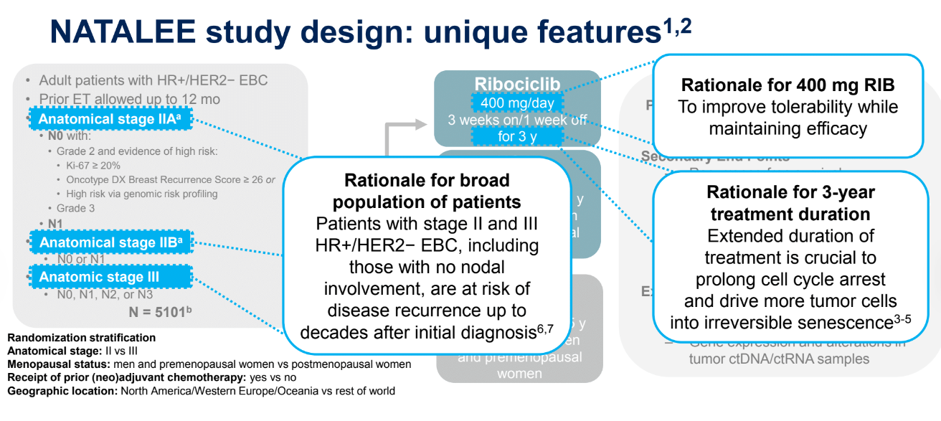
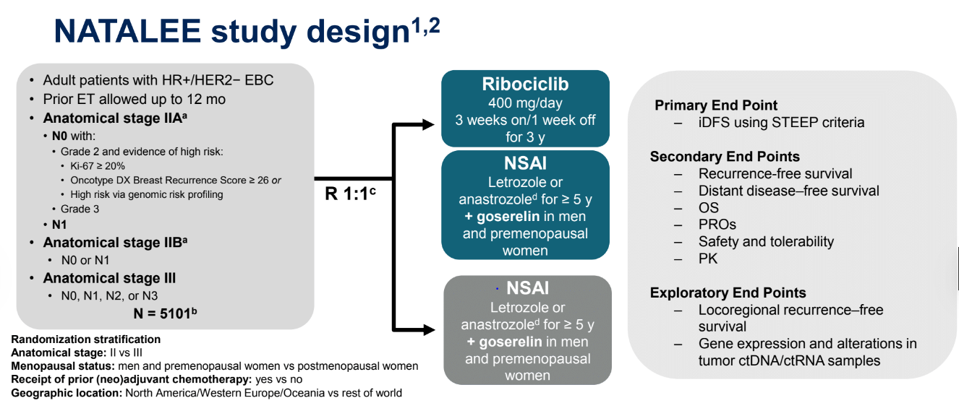
NATALEE: Adjuvant Ribociclib
Slamon, ASCO 2023

Slide 29
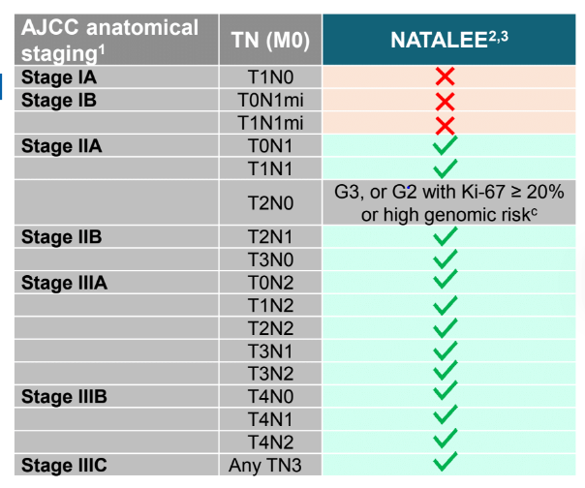
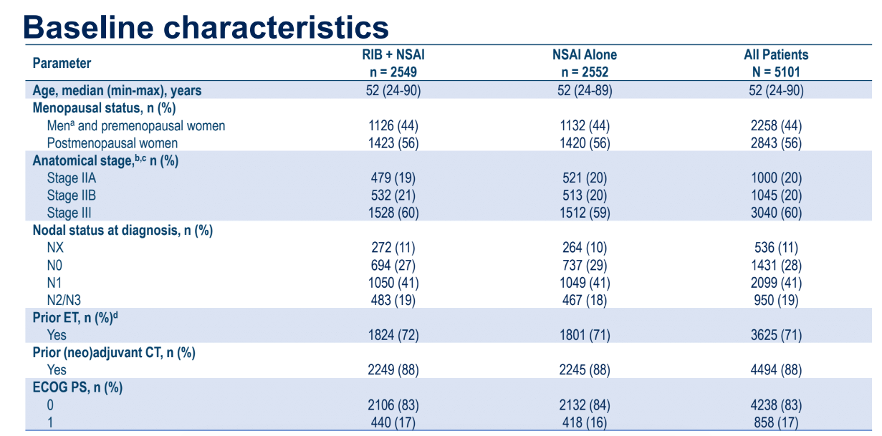
NATALEE, much broader inclusion
Slamon, ASCO 2023

Slide 30
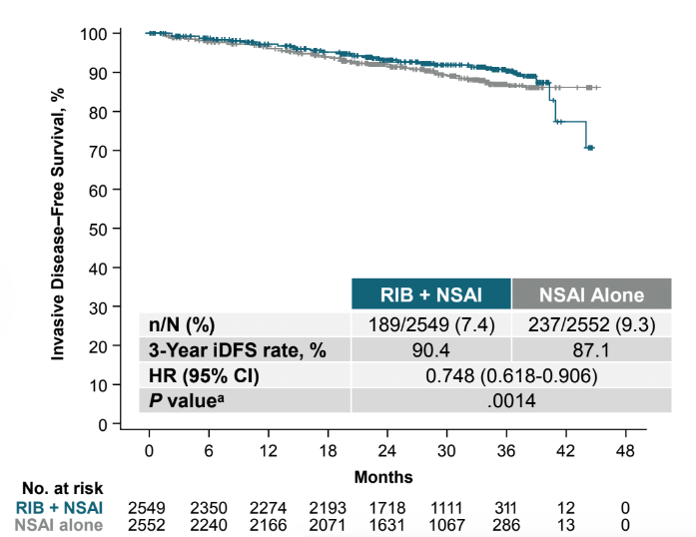
NATALEE 2nd Interim Efficacy Analysis
27.7m median f/u
Only 20% pts completed 3 yrs
3.3% iDFS benefit
Slamon, ASCO 2023
Notes:
Median follow-up foriDFSwas 27.7 months•Based on thePvalue of 0.0014, the IDMCconcluded that the results met the criteria todemonstrate statistically significant andclinically superior efficacy•AbsoluteiDFSbenefit with RIB + NSAI at 3years was 3.3%

Slide 31
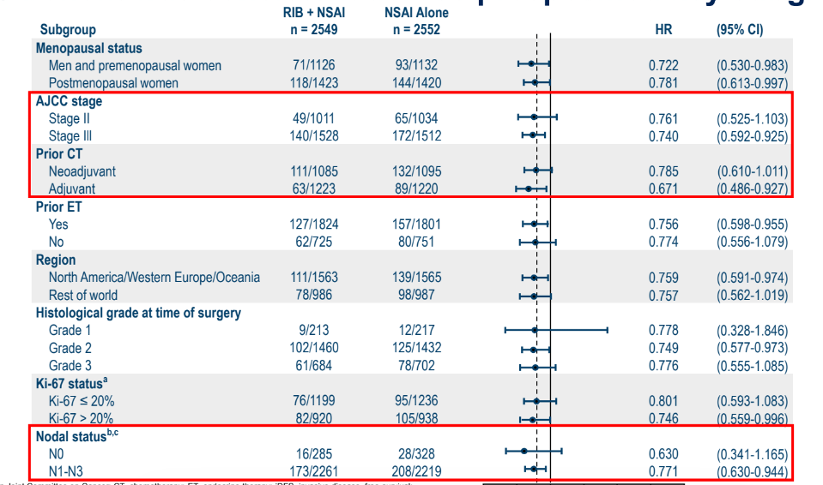
NATALEE Subgroup Analyses
AI/Ribo
AI
Slamon, ASCO 2023

Slide 32
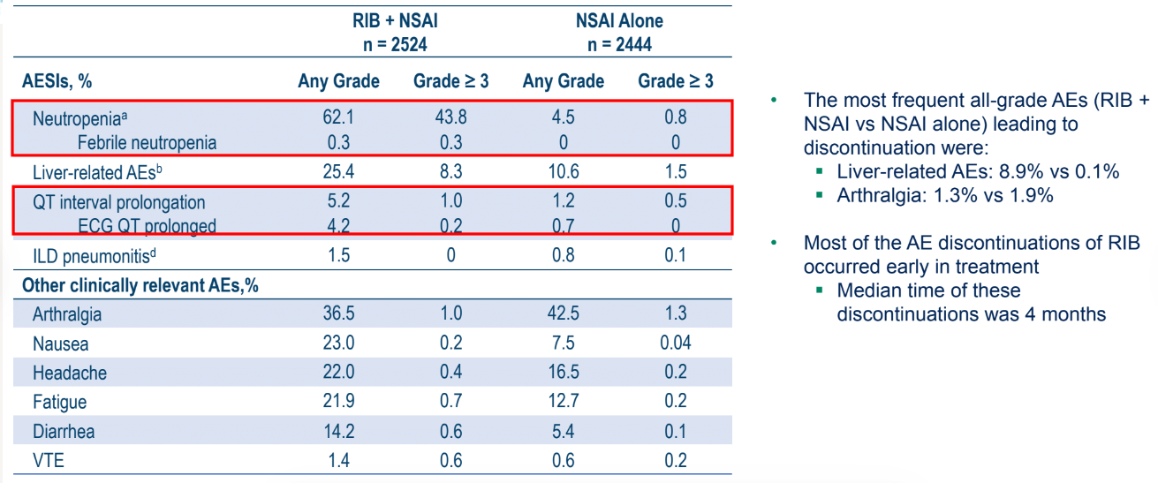
Adjuvant Ribociclib 400 mg Safety
Grade 3 LFTs:
AST/ALT: >5.0× – 20.0× ULN
Bilirubin: >3.0× ULN
Slamon, ASCO 2023

Slide 33
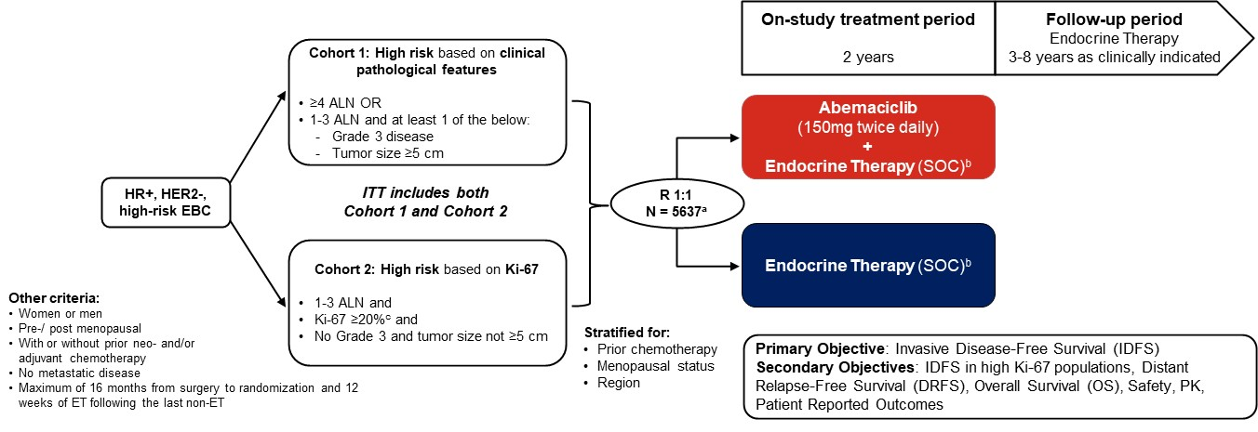
Adjuvant Abemaciclib FDA Approved in High-Risk HR+ BC
Cohort 1:
4+ LNs
T3 or G3, N1-3

Slide 34
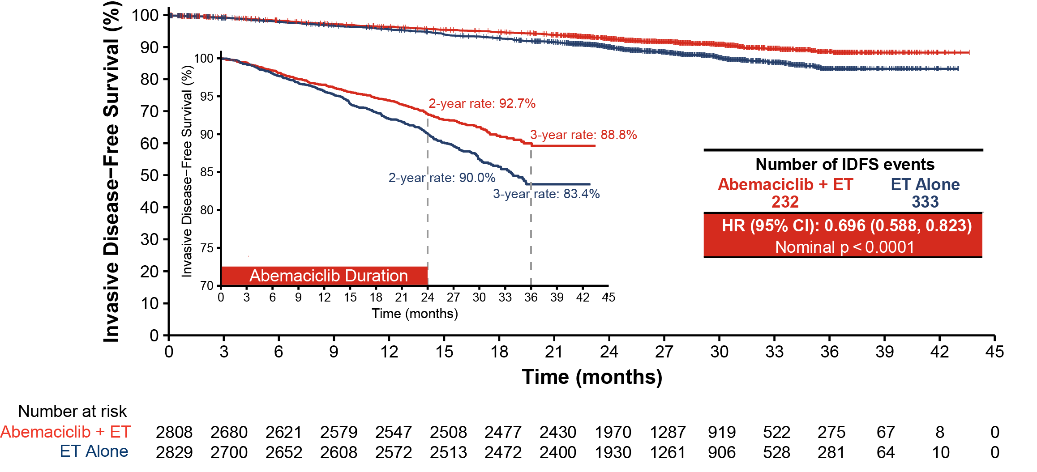
Abemaciclib 3-Year iDFS Benefit ITT
Harbeck, Annals Oncol 2021

Slide 35
Adjuvant CDK4/6 Inhibition
Adjuvant abemaciclib remains the only FDA approved adjuvant CDK4/6 inhibitor in high risk, node positive HR+, HER2- EBC
  Best evidence for COHORT 1: 4+ nodes, T3 or G3 N1-3
Adjuvant ribociclib for 3 years leads to statistically significant improvement in iDFS
  Await further follow-up to assess iDFS off CDK4/6 and understanding of optimal patient selection

Slide 36

THANK YOU
FOR JOINING!

Slide 37










BREAST CANCER
Wednesday, June 14, 2023

Slide 38
ER+/HER2- MBC:
Treatment Beyond CDK4/6 Inhibitors
Erica L. Mayer MD MPH
Dana-Farber Cancer Institute
June 2023
Boston, MA

Slide 39
CDK4/6 Inhibitors + Endocrine Therapy Improve PFS in the 1st/2nd line MBC Setting
Study/Arms | ¹Paloma 1 | ²Paloma 2 | ³Monaleesa 2 | ⁴Monarch 3 | ⁵Monaleesa 7 | ⁶Paloma 3 | ⁷Monarch 2 | ⁸Monaleesa 3
Phase | 2 | 3 | 3 | 3 | 3 | 3 | 3 | 3
CDK4/6i ET partner | Palbo AI | Palbo AI | Ribo AI | Abema AI | Ribo AI/Tam + OS | Palbo Fulvestrant | Abema Fulvestrant | Ribo Fulvestrant
N | 165 | 666 | 668 | 493 | 642 | 521 | 669 | 726
Median PFS (months) Placebo | 10.2 | 14.5 | 16 | 14.7 | 13.0 | 4.6 | 9.3 | 12.8
Median PFS (months) CDK 4/6i | 20.2 | 27.6 | 25.3 | 28.1 | 23.8 | 11.2 | 16.4 | 20.5
HR 95% CI | 0.48 0.31-0.74 | 0.56 0.46-0.69 | 0.54 0.41-0.69 | 0.55 0.44-0.69 | 0.55 0.44-0.69 | 0.50 0.40-0.62 | 0.553 0.45-0.68 | 0.593 0.480-0.732
P value | <0.01 | <0.01 | <0.01 | <0.01 | <0.01 | <0.01 | <0.01 | <0.01
¹Finn R, et al. Lancet Oncol. 2015; 16:25-35; ²Rugo H, et al, et al. SABCS. 2017; ³Hortobagyi GN, et al. ASCO; ⁴Goetz MP, et al. J Clin Oncol. 2017 Nov 10;35(32):3638-3646; ⁵Tripathy D, et al. Lancet Oncol. 2018 Jul;19(7):904-915. ⁶Turner NC, et al. N Engl J Med. 2015;373:209-219; ⁷Sledge GW, et al. JCO. 2017;35:2875-2884; ⁸Slamon DJ, et al. J Clin Oncol. 2018 Aug 20;36(24):2465-2472.
Notes:
CDK4/6 is the standard of care, consistent benefits across all CDK 1st and second lines

Slide 40
What are the best strategies after CDK4/6 inhibition?
Should we offer another CDK4/6 inhibitor?
What other pathways are active and targetable?
Can we monitor for development and mechanisms of resistance?
How do we put this together?

Slide 41
Phase II MAINTAIN: Addition of Ribociclib to ET After Progression on CDK4/6 Inhibitor + ET in HR+/HER2- MBC
Key Entry Criteria
Men or Women age > 18 yrs
ER and/or PR > 1%, HER2- MBC
Progression on ET + any CDK 4/6 inhibitor
< 1 line of chemotherapy for MBC
Measurable or non-measurable
PS 0 or 1
Postmenopausal
  GnRH agonist allowed if premenopausal
Stable brain metastases allowed
Primary Endpoint
Progression free survival
  Locally assessed per RECIST 1.1
Secondary Endpoints
Overall response rate
Clinical benefit rate
Safety
Tumor and Blood Markers, including circulating tumor DNA
Arm 1
Ribociclib + Switch Endocrine Therapy*
1:1
Arm 2
Placebo + Switch
Endocrine Therapy*
N=120
  Fulvestrant as endocrine therapy in pts with progression on a prior aromatase inhibitor for MBC and no prior fulvestrant; Protocol amended to allow exemestane as endocrine therapy if progression on prior fulvestrant (September 2018); Ribociclib 600 mg administered 3 weeks on/1 week off
Kalinsky K et al, JCO 2023

Slide 42
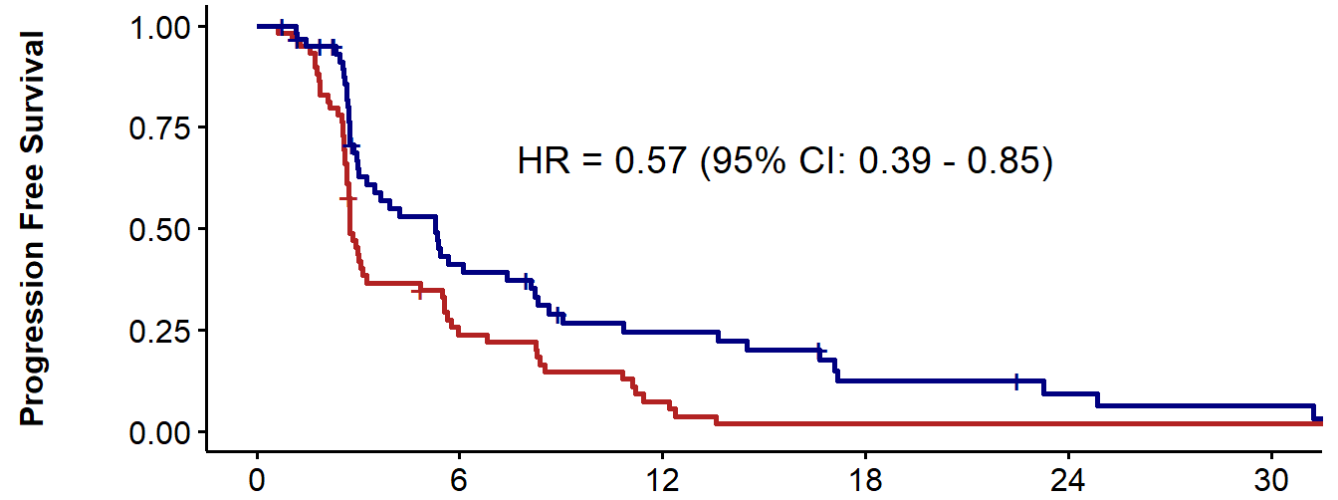

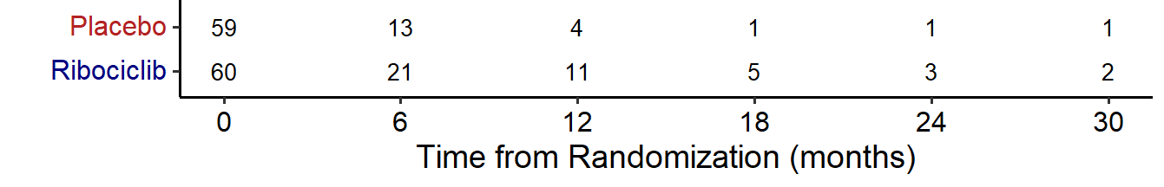
MAINTAIN: Primary Endpoint: Progression Free Survival (PFS)
 | Placebo + ET (n=59) | Ribociclib + ET (n=60)
Median: 95% CI (months) | 2.76 (2.66-3.25) | 5.29 (3.02-8.12)
HR=0.57 (95% CI: 0.39-0.95), p=0.006
87% prior palbocilcib
Kevin Kalinsky, MD, MS

Slide 43
PACE: Fulvestrant ± Palbociclib After Progression on CDK4/6i and ET in HR+/HER- MBC
Multicenter, randomized, open-label phase II study (data cutoff: July 2022)
Stratification by exposure to CT between CDK4/6 inhibition and trial entry
28-Day Cycles
Fulvestrant* + Palbociclib†
(n = 111)
Adults with HR+/HER2- MBC; progression on CDK4/6i and ET with ≥6 mo SD on prior tx; ≤2 prior lines of ET for MBC; no fulvestrant exposure;
≤1 prior CT for MBC
(N = 220)
Fulvestrant* + Palbociclib† + Avelumab‡
(n = 54)
2:1:1
Until PD
Fulvestrant*
(n = 55)
*Fulvestrant 500 mg IM on Days 1 and 15 of cycle 1, then monthly thereafter.
†Palbociclib 125 mg PO QD on Days 1-21 (lower starting dose to match prior tx could be considered). ‡Avelumab 10 mg/kg IV every 14 days.
Primary endpoint: RECIST-confirmed PFS
for fulvestrant + palbociclib vs fulvestrant
Secondary endpoints: PFS of fulvestrant + palbociclib + avelumab vs fulvestrant, ORR, safety, outcomes in predefined molecular subgroups
Mayer. SABCS 2022. Abstr GS3-06.
Notes:
CDK4/6i, CKD4/6 inhibitor; CT, chemotherapy; ET, endocrine therapy; HR, hormone receptor; MBC, metastatic breast cancer; ORR, overall response rate; PD, progressive disease; PFS, progression-free survival; RECIST, Response Evaluation Criteria in Solid Tumors; SD, stable disease; tx, treatment.

Slide 44
PACE: PFS (Primary Endpoint)
100
 | F + P (n = 111) | F + P + A (n = 54) | F (n = 55)
Events, n | 79 | 35 | 34
mPFS, mo (90% CI) | 4.6 (3.6-5.9) | 8.1 (3.2-10.7) | 4.8 (2.1-8.2)
HR vs F (90% CI) | 1.11 (0.74-1.66) P = .62 | 0.75 (0.47-1.20) P = .23 | --
6-mo PFS, % | 40.0 | 50.8 | 42.9
12-mo PFS, % | 13.1 | 35.6 | 17.5
80
60
PFS (%)
40
F + P + A
90% prior palbocilcib
20
F
F + P
0
0
2
4
6
8
10
12
14
16
18
Patients at Risk, n
F + P
F + P + A
F
Mo
111
54
55
73
38
31
48
25
20
32
20
14
28
20
12
16
15
9
7
12
4
5
10
3
4
9
3
4
7
3
Mayer. SABCS 2022. Abstr GS3-06. Reproduced with permission.
Notes:
A, avelumab; F, fulvestrant; P, palbociclib; PFS, progression-free survival.

Slide 45
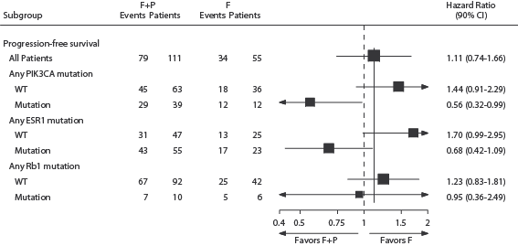
PACE: Exploratory Analysis of Baseline Mutation and Outcome

Slide 46

PALMIRA Study Design (NCT03809988)
Fulvestrant‡
500 mg IM, on day 1, 15, 29 and monthly thereafter
Letrozole‡
2.5 mg PO, once daily, continuously
Treatment until progressive disease,
unacceptable toxicity,
or
study withdrawal
Key Eligibility Criteria
Patients with HR[+]/HER2[‑] ABC*
PD on a 1L of palbociclib plus ET (AI or fulvestrant) after clinical benefit, or
PD on palbociclib–based adjuvant regimen after at least 12 months of treatment but no more than 12 months following completion
No other prior treatment for ABC
OR
N = 136
Palbociclib†
75/100/125 mg PO, once daily, 3 weeks on, 1 week off
R
2:1
N = 198
Fulvestrant‡
500 mg IM, on day 1, 15, 29 and monthly thereafter
Letrozole‡
2.5 mg PO, once daily, continuously
Stratification Factors
Prior ET (fulvestrant vs. AIs)
Site of disease (visceral vs. non-visceral)
N = 62
OR
1L: First–line; ABC: Advanced breast cancer; AI: Aromatase inhibitors; ET: Endocrine therapy; HER2[-]: Human Epidermal Growth Factor Receptor 2-negative; HR[+]: Hormone receptor-positive; IM: Intramuscular injection; PO: oral administration; PD: Progressive disease; R: Randomization.
*If pre-menopausal, ovarian function suppression method required.
†Palbociclib dose could be reduced until 75 mg. If a dose reduction below 75 mg is required, treatment must be discontinued.
‡Administration of endocrine therapy was chosen depending on the prior administered agent.
Dr. ANTONIO LLOMBART CUSSAC, MD PhD

Slide 47
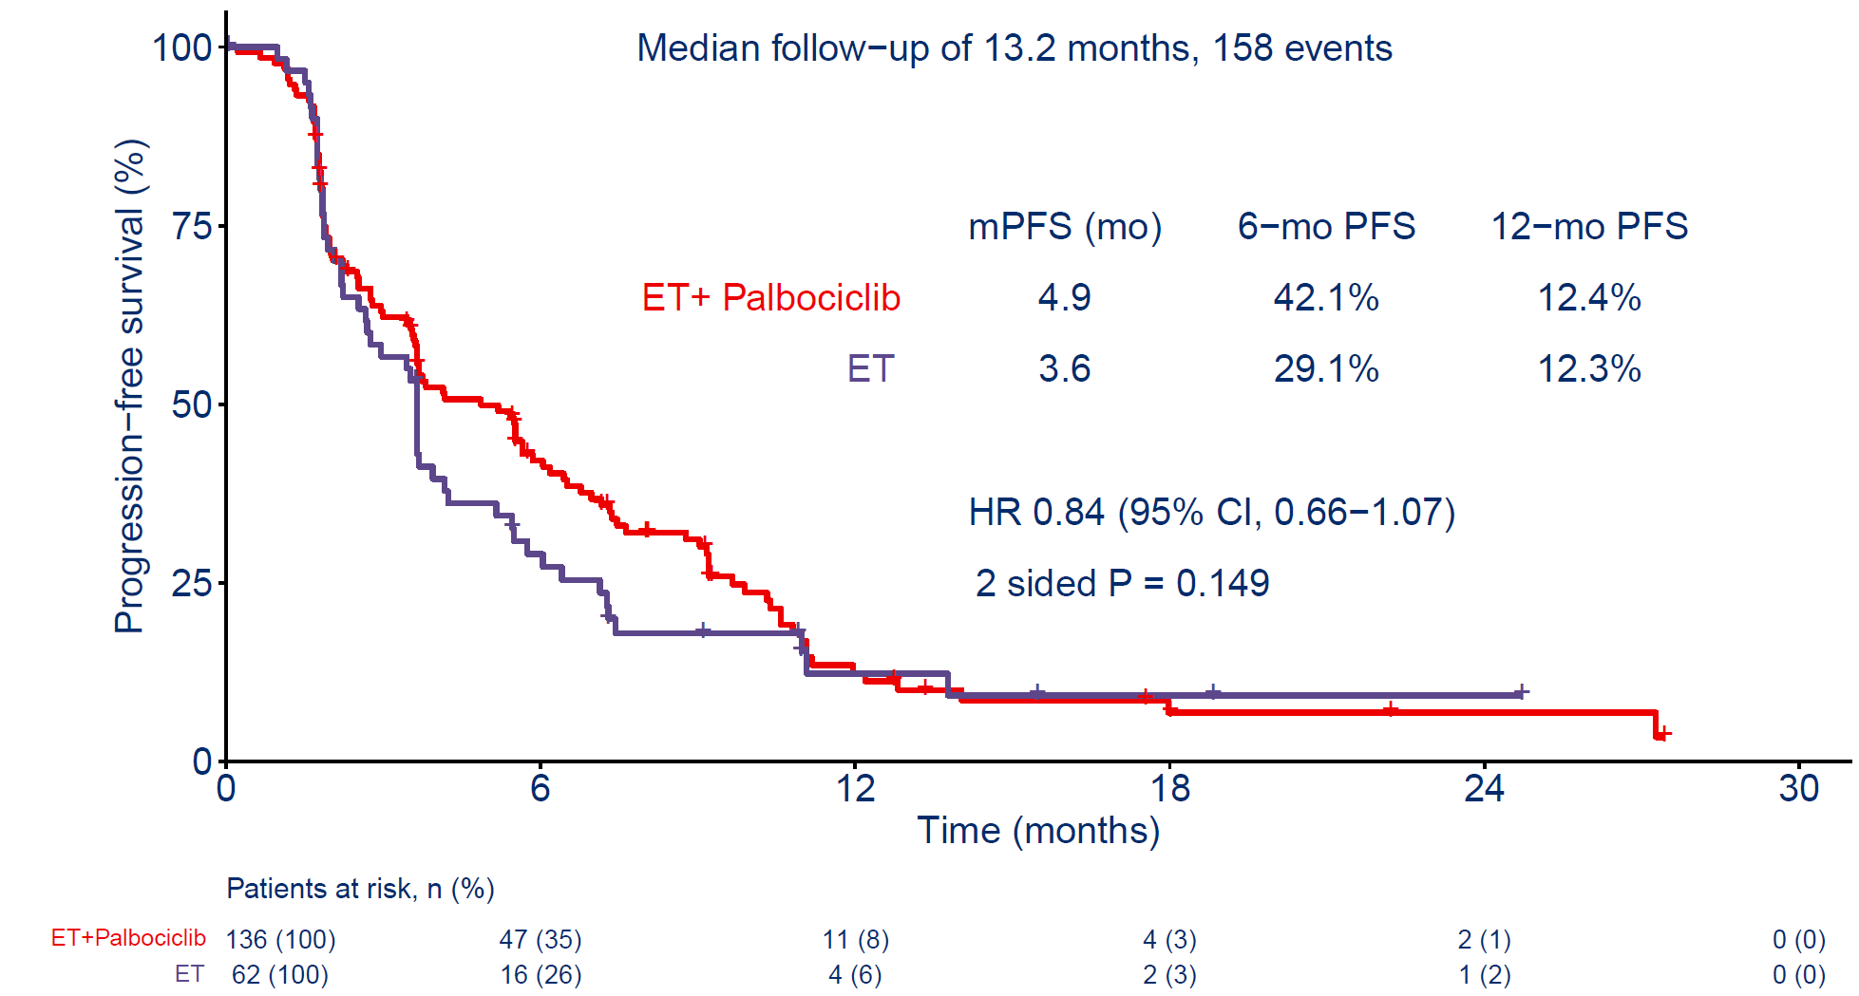
Primary Objective: Investigator-assessed PFS (ITT Population)
  CI: Confidence interval; HR: Hazard ratio; ITT: Intention to treat; mo: Months; mPFS: Median progression-free survival; PFS: Progression-free survival.
Dr. ANTONIO LLOMBART CUSSAC, MD PhD

Slide 48
How can we compare the CDK after CDK studies?
 | MAINTAIN | PACE | PALMIRA
Patients (n) | 120 | 166 | 198
1st line CDK4/6i | Palbociclib (84%) | Palbociclib (90%) | Palbociclib (100%)
% 1st line CDK4/6i >12mo | 67% | 75% | 86%
Endocrine therapy | Fulvestrant (83%) or exemestane | Fulvestrant (100%) | Fulvestrant (90%) or letrozole
'Continuation’ CDK4/6i | Ribociclib | Palbociclib | Palbociclib
PFS ET only | 2.8mo | 4.8mo | 3.6mo
PFS Fulv + CDK4/6i | 5.3mo | 4.6mo | 4.9mo
*Different studies, different designs, different study populations, different subgroup definitions*
Pending CDK4/6i→CDK4/6i studies:
PostMONARCH: Fulv +/- abema (n=350)
EMBER-3: ET vs. imlunestrant vs. imlunestrant/abema (n=860)
Daniel G. Stover, MD
Kalinsky JCO 2023; Mayer SABCS 2022; Llombart-Cussac ASCO 2023

Slide 49
What are the best strategies after CDK4/6 inhibition?
Should we offer another CDK4/6 inhibitor?
What other pathways are active and targetable?
Can we monitor for development and mechanisms of resistance?
How do we put this together?

Slide 50
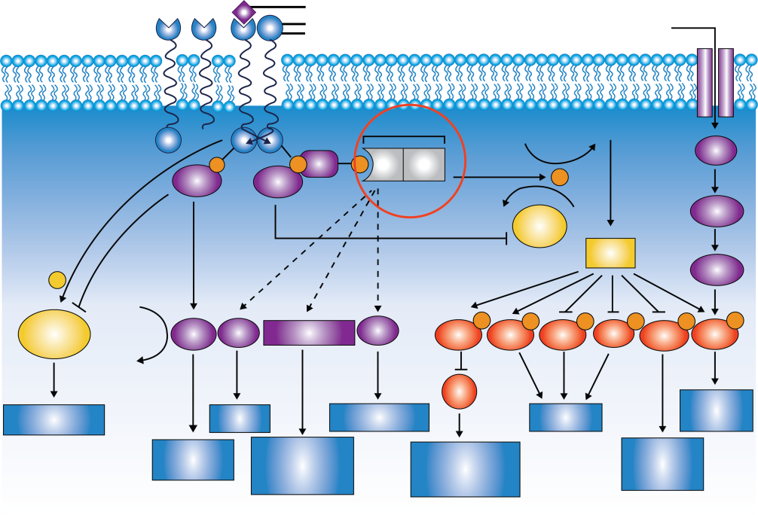
What about inhibition of the mTOR/PI3K/AKT Pathway?
PI3K/AKT/mTOR pathway is frequently altered in HR+ BC and has been implicated in resistance to endocrine therapies^{1,2}
≈40% of HR+ BC harbor a PIK3CA mutation, leading to hyperactivation
of the PI3K pathway³⁻⁵
PI3K signaling promotes estrogen-independent growth of ER+ BC cells, and this growth is inhibited by the addition of PI3K inhibitors to antiestrogens⁶⁻⁸
PI3K/AKT Pathway⁹
HER4
HER3
Growth factor
Glucose,
amino acids
EGFR
HER2
↓ATP
↑AMP
PI3K
PIP₂
PIP₃
P
p85
p110
PKA
P
Src
IRS
P
P
Grb2
PIP₂
PTEN
PIP₃
LKB1
AKT
AMPK
+
GDP
P
P
P
P
P
P
STAT
Ras
SGK
RAC1/CDC42
PKC
MDM2
NF-κB
FKHR
BAD
GSK3β
mTOR
GTP
p53
Growth
Translation
STAT signaling
Survival
Transformation
Apoptosis
MAPK/ERK
signaling
Cytoskeletal
rearrangement
Transformation
Cell cycle arrest
Apoptosis
DNA repair
Cell cycle
Glucose
metabolism
1. Miller TW et al. J Clin Oncol. 2011;29:4452-4461. 2. Bosch A et al. Sci Transl Med. 2015;7283ra51. 3. Mayer IA et al. Clin Cancer Res. 2017;23:26-34. 4. Loi S et al. Proc Natl Acad Sci. 2010;107:10208-10213. 5. Stemke-Hale K et al. Cancer Res. 2008;68:6084-6091. 6. Miller TW et al. JCI. 2010;120:2406-2413. 7. Crowder RJ et al. Cancer Res.
2009;69:3955-3962. 8. Miller TW et al. Cancer Discovery. 2011;1:338-351. 9. Hennessy BT et al. Nat Rev Drug Discov. 2005;4:988-1004.
Notes:
BC, breast cancer; ER, estrogen receptor; HR, hormone receptor.

Slide 51
SOLAR-1: Alpelisib + Fulvestrant vs Placebo + Fulvestrant in HR+/HER2- Advanced Breast Cancer^{1,2}
Randomized, Double-Blind, Placebo-Controlled Phase 3 Trial
Alpelisib 300 mg QD PO
+ fulvestrant 500 mg IMª
(n = 169)
PIK3CA-mutant cohort
(n = 341)
Men or postmenopausal women with HR+/HER2- advanced BC with recurrence or progression on/after prior AI
Measurable disease or ≥1 predominantly lytic bone lesion
ECOG PS 0/1
Stratification factors
Presence of liver/lung metastases
Prior CDK4/6i therapy
Placebo QD PO
+ fulvestrant 500 mg IMª
(n = 172)
N = 572
R
1:1
PIK3CA-nonmutant cohort
(n = 231)
Alpelisib 300 mg QD PO
+ fulvestrant 500 mg IMª
(n = 115)
Placebo QD PO
+ fulvestrant 500 mg IMª
(n = 116)
Primary endpoint: PFS (locally assessed) in all patients randomized to PIK3CA-mutant cohort
Secondary endpoints: OS in PIK3CA-mutant cohort; PFS in PIK3CA-nonmutant cohort (proof of concept);
PFS in ctDNA and ORR/CBR for both cohorts; safety for patients with ≥1 dose study drug
ª Fulvestrant given on days 1, 15 of 28 in cycle 1, then day 1 thereafter.
1. André F et al. New Engl J Med. 2019;380:1929. 2. Juric D et al. SABCS 2018. Abstract GS3-08.
Notes:
AI, aromatase inhibitor; BC, breast cancer; CBR, clinical benefit rate; CDK, cyclin-dependent kinase; ctDNA, circulating tumor DNA; ECOG, Eastern Cooperative Oncology Group; HR, hormone receptor; mets, metastases; PS, performance status.

Slide 52
SOLAR-1: Locally Assessed PFS in PIK3CA-Mutant Cohort (Primary Endpoint)¹
 | Alpelisib + Ful (n = 169) | Placebo + Ful (n = 172)
PFS Events, n (%) Progression Death Censored | 103 (60.9) 99 (58.6) 4 (2.4) 66 (39.1) | 129 (75.0) 120 (69.8) 9 (5.2) 43 (25.0)
Median PFS (95% CI) | 11.0 (7.5-14.5) | 5.7 (3.7-7.4)
Mutation status
from tissue
Similar results
with mutation status
from ctDNA
Only 6% of patients with prior CD4/6i exposure
HR (95% CI) = 0.65 (0.50-0.85); P = .00065
Data cutoff: June 12, 2018
Probability of PFS, %
Alpelisib + ful
Placebo + ful
Time, mo
No. at Risk
Alpelisib + ful
Placebo + ful
 | 169 | 158 | 145 | 141 | 123 | 113 | 97 | 95 | 85 | 82 | 75 | 71 | 62 | 54 | 50 | 43 | 39 | 32 | 30 | 27 | 17 | 16 | 14 | 5 | 5 | 4 | 3 | 3 | 1 | 1 | 1 | 0
 | 172 | 167 | 120 | 111 | 89 | 88 | 80 | 77 | 67 | 66 | 58 | 54 | 48 | 41 | 37 | 29 | 29 | 21 | 20 | 19 | 14 | 13 | 9 | 3 | 3 | 2 | 2 | 2 | 0 | 0 | 0 | 0
1. André F et al. New Engl J Med. 2019;380:1929.

Slide 53
BYLieve: Alpelisib + Fulvestrant in PIK3CA-Mutant HR+/HER2- aBC After CDK4/6i + AI (Cohort A)¹
International, Open-Label, Multicohort, Noncomparative Phase 2 Study
Cohort A: Prior CDK4/6i + AI
Alpelisib 300 mg PO QD + fulvestrant 500 mg IM^{b,c}
(n = 127)
Men and pre/postmenopausal women with PIK3CA-mutantª HR+/HER2- advanced BC
Immediate prior treatment CDK4/6i and ET, systemic CT, or ET
No prior PI3Ki
Measurable disease or ≥1 predominantly lytic bone lesion
ECOG PS ≤ 2
Planned
N = 340
Cohort B: Prior CDK4/6i + Fulvestrant
R
Alpelisib 300 mg PO QD + letrozole 2.5 mg PO QD^{c}
(minimum n = 112)
Cohort C: Prior AI Then CT or ET
Alpelisib 300 mg PO QD + fulvestrant 500 mg IM^{b,c}
(minimum n = 112)
Primary endpoint: proportion of each cohort alive without PD at 6 months (RECIST v1.1)
  Endpoint met if lower 95% CI >30%
Secondary endpoints (in each cohort): PFS, PFS2, ORR, CBR, DOR, OS, and safety
Notes:
AI, aromatase inhibitor; BC, breast cancer; CBR, clinical benefit rate; CDK4/6i, CKD4/6 inhibitor; CT, chemotherapy; DoR, duration of response; ECOG, Eastern Cooperative Oncology Group; ET, endocrine therapy; FULV, fulvestrant; HR, hormone receptor; PI3Ki, PI3K inhibitor; PS, performance status.

Slide 54
BYLieve: PI3K Inhibitors + Various Endocrine Partners
PFS Benefit in 2L Met Setting After Progression on CDK4/6i: ~5-7 Mo
 | BYLieve: PI3Ki + ET in HR+/HER2- BC With PIK3CA Mutation and PD on CDK4/6i
 | Cohort A¹ (n = 121) | Cohort B² (n = 115) | Cohort C³ (n = 126)
Cohort population | CDK4/6i + AI as immediate prior tx | CDK4/6i + fulvestrant as immediate prior tx | Chemo or ET as immediate prior tx
Endocrine partner | Fulvestrant | Letrozole | Fulvestrant
PI3Ki | Alpelisib | Alpelisib | Alpelisib
Median PFS, mo | 7.3 | 5.7 | 5.6
HR (PI3Ki vs control) | NA | NA | NA
1. Rugo. Lancet Oncol. 2021;22:489. 2. Rugo. SABCS 2021. PD2-07. 3. Rugo. SABCS 2021. Abstr PD13-05.

Slide 55
SOLAR-1: Adverse Events
AEs ≥20% in Either Arm, n (%) | Alpelisib + Fulvestrant (n = 284) |  |  | Placebo + Fulvestrant (n = 287)
 | All | Grade 3 | Grade 4 | All | Grade 3 | Grade 4
Any AE | 282 (99.3) | 183 (64.4) | 33 (11.6) | 264 (92.0) | 87 (30.3) | 15 (5.2)
Hyperglycemia | 181 (63.7) | 93 (32.7) | 11 (3.9) | 28 (9.8) | 1 (0.3) | 1 (0.3)
Diarrhea | 164 (57.7) | 19 (6.7) | 0 | 45 (15.7) | 1 (0.3) | 0
Nausea | 127 (44.7) | 7 (2.5) | 0 | 64 (22.3) | 1 (0.3) | 0
Decreased appetite | 101 (35.6) | 2 (0.7) | 0 | 30 (10.5) | 1 (0.3) | 0
Rashª | 101 (35.6) | 28 (9.9) | 0 | 17 (5.9) | 1 (0.3) | 0
Vomiting | 77 (27.1) | 2 (0.7) | 0 | 28 (9.8) | 1 (0.3) | 0
Decreased weight | 76 (26.8) | 11 (3.9) | 0 | 6 (2.1) | 0 | 0
Stomatitis | 70 (24.6) | 7 (2.5) | 0 | 18 (6.3) | 0 | 0
Fatigue | 69 (24.3) | 10 (3.5) | 0 | 49 (17.1) | 3 (1.0) | 0
Asthenia | 58 (20.4) | 5 (1.8) | 0 | 37 (12.9) | 0 | 0
25% of patients discontinued alpelisib: 18 patients (6.3%) for hyperglycemia, 9 patients (3.2%) for rash; no patients discontinued placebo due to either hyperglycemia or rash
Maculopapular rash, all grade (grade 3): 14.1% (8.8%) with alpelisib vs 1.7% (0.3%) with placebo
Safety similar in PIK3CA-mutant and PIK3CA-nonmutant cohorts
Notes:
AE, adverse event; FULV, fulvestrant.

Slide 56
Understanding and Modifying Toxicity Associated
With Alpelisib¹
For patients who received alpelisib + fulvestrant, antihistamine prophylaxis markedly reduced rash
  Of patients who received
  anti-rash prophylaxis
    69.8% received antihistamines
    Rash occurred in 26.7% with prophylaxis
    and 64.1% without
    Grade 3/4 reduced
    by 50%
Alpelisib + Fulvestrant
Prophylactic Anti-rash Medication
(n = 86)
Alpelisib + Fulvestrant
No Prophylactic Anti-rash Medication
(n = 198)
Grade 1/2
15%
Grade 1/2
15%
No Rash
36%
Grade 1/2
41%
Grade 3/4
12%
No Rash
36%
Grade 1/2
41%
Grade 3/4
12%
No Rash
73%
No Rash
73%
Grade 3/4
23%
Grade 3/4
23%
Notes:
FULV, fulvestrant.

Slide 57
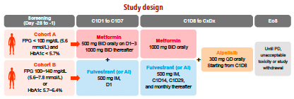
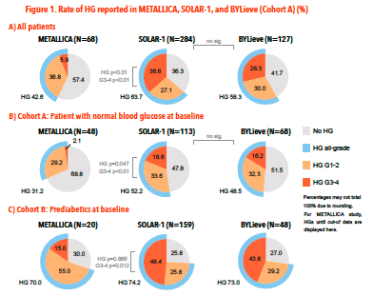
METALLICA Study:
Metformin prophylaxis to prevent hyperglycemia with alpelisib
Use of prophy metformin substantially reduced incidence of sevre hyperglycemia with alpelisib exposure
G3 hyperglycemia 5.9% (METALLICA) versus 36.6% (SOLAR-1)
Llombart-Cussac et al, SABCS 2022

Slide 58
CAPItello-291: Capivasertib + FULV vs Placebo + FULV in AI-Resistant, HR+/HER2- Advanced Breast Cancer
Capivasertib: investigational oral inhibitor of AKT1/2/3; in combination with fulvestrant, significantly prolonged PFS and OS in postmenopausal women with AI-resistant HR+/HER2- ABC
and no prior CDK4/6i in phase II FAKTION trial¹
CAPltello-291: international, randomized, double-blind phase III trial^{2,3}
Stratified by liver mets (yes vs no),
prior CDK4/6i (yes vs no), region
Men and pre/postmenopausal women with HR+/HER2- ABC; recurred on or <12 mo from end of adjuvant AI, or PD on prior AI for ABC; ≤2 lines of ET and ≤1 line of CT for ABC; no prior SERD, mTORi, PI3Ki, or AKTi; A1C <8.0% and diabetes not requiring insulin permitted; prior CDK4/6i permitted*; FFPE sample available from primary/recurrent tumor
(N = 708)
Dual primary endpoints: investigator-assessed PFS in overall population and in those with AKT pathway–altered tumors (≥1 qualifying PIK3CA, AKT1, or PTEN alteration)
Key secondary endpoints: OS and ORR in overall and AKT pathway–altered tumor populations
Capivasertib 400 mg PO BID
(4 days on, 3 days off) +
Fulvestrant 500 mg IV on D1,15 of cycle 1, then Q4W
(n = 355)
Placebo PO BID
(4 days on, 3 days off) +
Fulvestrant 500 mg IV on D1,15 of cycle 1, then Q4W
(n = 353)
*Required in ≥51%.
1. Howell. Lancet Oncol. 2022;23:851. 2. Turner. SABCS 2022. Abstr GS3-04. 3. NCT04305496.
Notes:
ABC, advanced breast cancer; AI, aromatase inhibitor; CDK4/6i, CKD4/6 inhibitor; CT, chemotherapy; ET, endocrine therapy; FFPE, formalin-fixed paraffin-embedded; HR, hormone receptor; ORR, overall response rate; OS, overall survival; PFS, progression-free survival; SERD, selective estrogen receptor degrader.

Slide 59
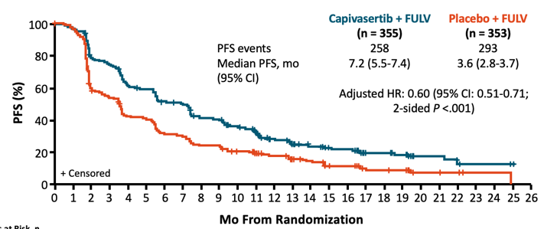
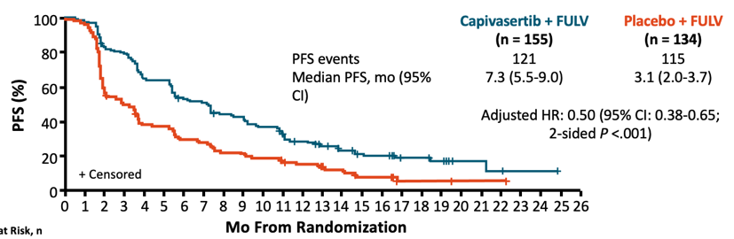
CAPItello-291: Investigator-Assessed PFS in
Overall Population and AKT-Pathway Altered
Study met dual primary endpoints, showing significantly prolonged PFS with capivasertib + FULV vs placebo + FULV in overall and AKT pathway–altered populations (41% AKT altered)
Exploratory analysis observed improved PFS in nonaltered subpopulation (HR: 0.70; 95% CI: 0.56-0.88)
ITT
AKT altered
Turner. SABCS 2022. Abstr GS3-04. Reproduced with permission.

Slide 60
CAPItello-291: AEs in >10% of Overall Population
Capivasertib + FULV (n = 355)
Placebo + FULV (n = 350)
All Grades (%)/Grade 3 (%)
Grade 1
Grade 2
Grade 3*
Grade 3*
Grade 2
Grade 1
Diarrhea
Nausea
Rash
Fatigue
Vomiting
Headache
Decreased appetite
Hyperglycemia
Maculopapular rash
Stomatitis
Asthenia
Pruritus
Anemia
Urinary tract infection
72.4/9.3
20.0/0.3
34.6/0.8
15.4/0.6
22.0/5.4
4.6/0.3
20.8/0.6
12.9/0.6
20.6/1.7
4.9/0.6
16.9/0.3
12.3/0.6
16.6/0.3
6.3/0.6
16.3/2.3
3.7/0.3
16.1/6.2
2.6/0
14.6/2.0
4.9/0
13.2/1.1
10.3/0.6
12.4/0.6
6.6/0
10.4/2.0
4.9/1.1
10.1/1.4
6.6/0
100
80
60
40
20
0
0
20
40
60
100
Patients (%)
*All events depicted were grade 3, except for 1 case of grade 4 hyperglycemia with capivasertib + FULV.
Turner. SABCS 2022. Abstr GS3-04. Reproduced with permission.
Notes:
AE, adverse event; FULV, fulvestrant.

Slide 61
What are the best strategies after CDK4/6 inhibition?
Should we offer another CDK4/6 inhibitor?
What other pathways are active and targetable?
Can we monitor for development and mechanisms of resistance?
How do we put this together?

Slide 62
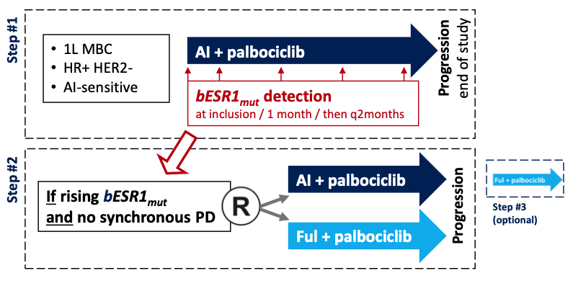
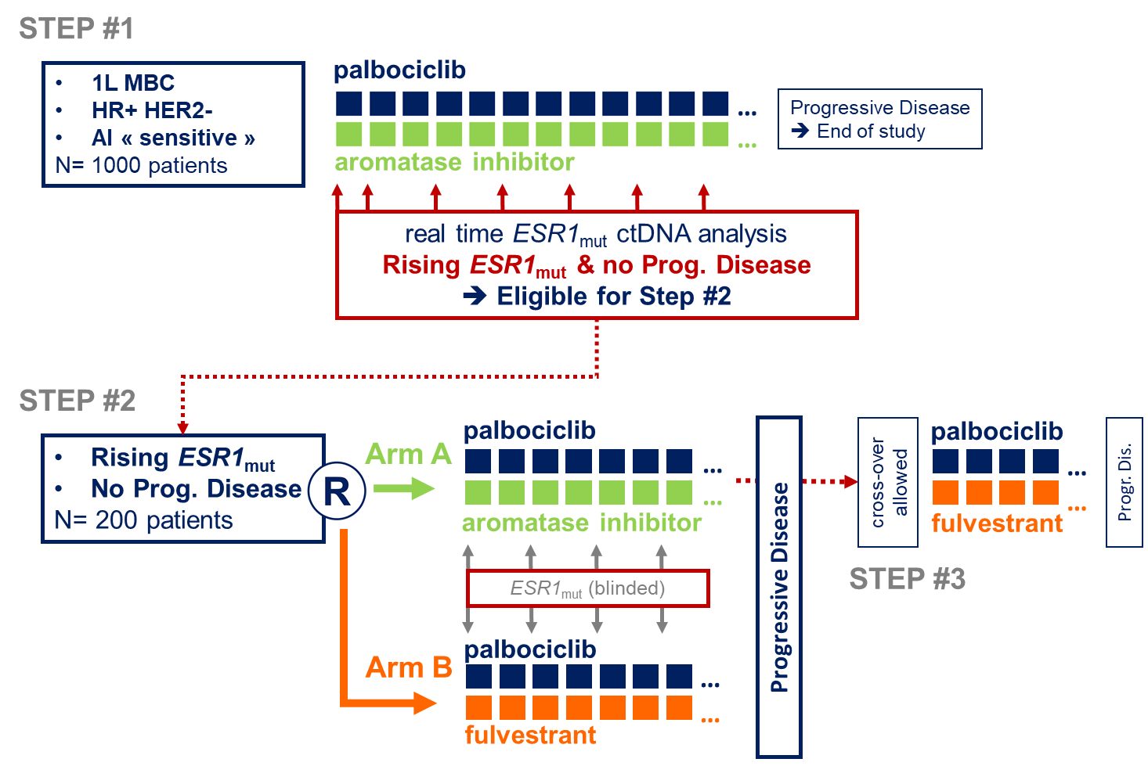
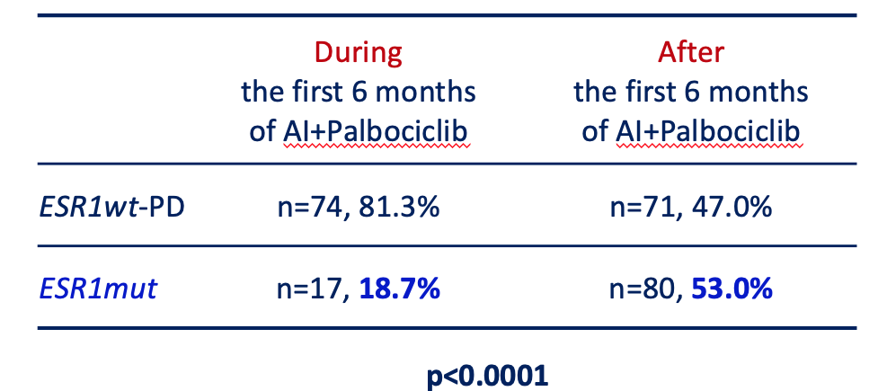
PADA-1: Evaluation of ESR1 Mutation during CDK4/6i and ET in ER+ MBC
Objective: To assess whether a change of the hormone therapy during ESR1mut emergence will benefit patients (n=1017)
Recent report on emergence of ESR1 mutations during therapy with CDK4/6 inhibitor and AI
ESR1 mutation is rare in those with early progression, but is a major mechanisms of resistance after 6 months
Bidard et al Lancet Oncol 2022
Notes:
This observation of mutation timing has been confirmed prospectively in the PADA-1 trial. This study will attempt to evaluate the benefit of a change in endocrine therapy due to detection of emergent mutations. A first report from this trial has shown a low frequency of ESR1 mutations at baseline, but enrichment after 6 months exposure to AI and CDK4/6, suggesting it is a major mechanism of resistance. This will be an important trial to follow to see if a change to fulvestrant will overcome this mutation.

Slide 63
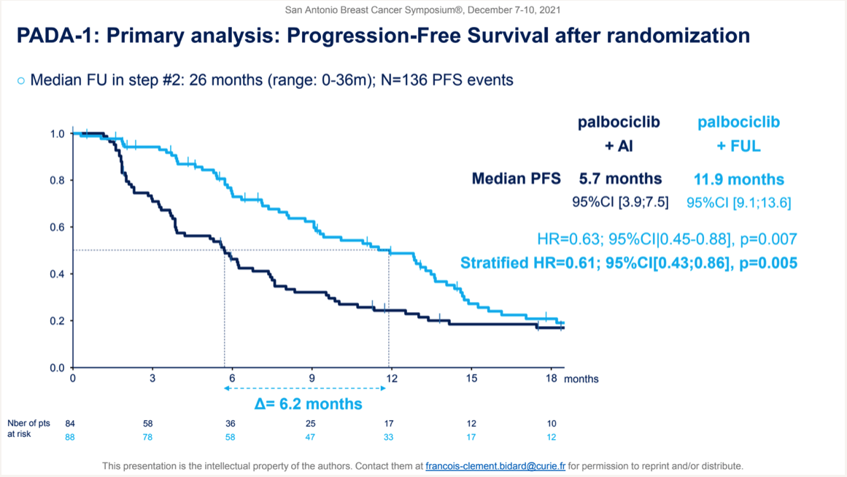
Updated Results: PFS2
FUL+PAL mPFS2: 29.4 mos, 95%CI [21.9;NR]
AI+PAL mPFS2: 14.0 mos, 95%CI [11.0;18.6]
PFS2 HR= 0.37 [0.24;0.56]
Await Overall Survival Data
Bidard et al, ASCO 2023

Slide 64
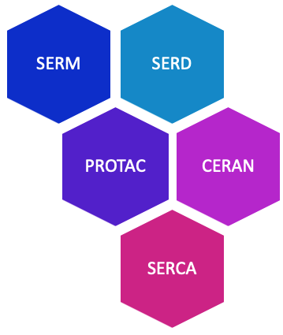
Novel endocrine therapies may address endocrine resistance in MBC
SERD : Mechanism of action
SERD
Estrogen
Competitive binding to ERα
Estrogen receptor α (EΡα)
ERα degradation
Estrogen response element ERE
Key advantages
Oral formulation
Higher potency
Activity in ESR1 mutant MBC
Activity in post-ET and CDK4/6i treated pts
5’
3’
5’
3’
©WebMD Global, LLC
Estrogen responsive gene
Transcription
ERα antagonism
Hernando et al, Int J Mol Sci 2021; slide adapted from Erika Hamilton

Slide 65
Novel Oral Endocrine Therapies: SERD, CERAN, PROTAC
Agent | Company | Disease setting | Select ongoing trials
ORAL SERDs
Elacestrant (RAD1901) | Radius Health | Advanced/Metastatic | EMERALD
Giredestrant (GDC-9545) | Genentech/Roche | Advanced/Metastatic | preservERA, acelERA, evERA
 |  | Neoadjuvant | coopERA
 |  | Adjuvant | lidERA
Camizestrant (AZD9833) | Astra Zeneca | Advanced/Metastatic | SERENA-1,-2,-4, -6
 |  | Neoadjuvant | SERENA-3
 |  | Adjuvant | CAMBRIA, CAMBRIA-2
Imlunestrant (LY3484356) | Eli Lilly | Advanced/Metastatic | EMBER
 |  | Neoadjuvant | EMBER-2
 |  | Adjuvant | EMBER-4
Other novel agents
ARV-471 | Arvinas | Advanced/Metastatic | NCT04072952
OP-1250 | Olema Oncology | Advanced/Metastatic | NCT04505826

Slide 66
EMERALD: Elacestrant vs Investigator’s Choice SoC ET in ER+/HER2- MBC
Randomized, open-label, active-controlled phase III trial
Stratified by mESR1 status (Y vs N), prior fulvestrant (Y vs N), presence of visceral metastases (Y vs N)
Elacestrant 400 mg QD
(n = 239)
Men and postmenopausal women with ER+/HER2- MBC; relapse/PD after 1-2 lines of ET (1 line with CDK4/6 inhibitor);
≤1 line of CT for advanced disease; ECOG PS 0/1
(N = 478)
Until progression, unacceptable toxicity, or withdrawal
SoC
(investigator’s choice of fulvestrant,
anastrozole, letrozole, exemestane)
(n = 239)
Coprimary endpoints: PFS in all patients, PFS in patients with ESR1 mutation, both by BICR
Key secondary endpoint: OS
Current analysis examined impact of prior CDK4/6i duration on PFS
Bidard. JCO. 2022;40:3246. Bardia. SABCS 2022. Abstr GS3-01.
Notes:
BICR, blinded independent central review; CDK4/6i, CDK4/6 inhibitor; CT, chemotherapy; ECOG, Eastern Cooperative Oncology Group; ER, estrogen receptor; ET, endocrine therapy; MBC, metastatic breast cancer; OS, overall survival; PFS, progression-free survival; PS, performance status; SoC, standard of care.

Slide 67
EMERALD: PFS With Elacestrant vs Physician Choice ET After Previous ET + CDK 4/6 Inhibitors
All Patients
Patients With Tumours Harboring mESR1
100
 | Elacestrant | Fulvestrant
N | 239 | 165
Event (%) | 144 (60.3) | 109 (66.1)
Median PFS, months (95% CI) | 2.79 (1.94-3.78) | 1.94 (1.87-2.10)
P value | 0.0049
Hazard ratio (95% CI) | 0.684 (0.521-0.897)
100
 | Elacestrant | Fulvestrant
N | 115 | 83
Event (%) | 62 (53.9) | 59 (71.1)
Median PFS, months (95% CI) | 3.78 (2.17-7.26) | 1.87 (1.84-2.10)
P value | 0.0005
Hazard ratio (95% CI) | 0.504 (0.341-0.741)
90
90
80
80
70
70
60
60
50
50
Probability of PFS (%)
Survival Probability (%)
40
40
30
30
20
+
20
+
10
+
Elacestrant
10
+
Elacestrant
0
Fulvestrant
0
Fulvestrant
0
1
2
3
4
5
6
7
8
9
10
11
12
13
14
15
16
17
18
19
20
21
22
23
24
25
0
1
2
3
4
5
6
7
8
9
10
11
12
13
14
15
16
17
18
19
20
21
22
23
24
25
Time (months)
Time (months)
Elacestrant is associated with a 30% reduction in the risk of progression or death in all patients with ER+/HER2- mBC
Elacestrant is associated with a 45% reduction in the risk of progression or death in patients harboring mESR1
Median PFS 2.8 months with elacestrant vs 1.9 months with SOC
Median PFS 3.8 months with elacestrant vs 1.9 months with SOC
Notes:
Exploratory Add to speaker notes. As this was additional analysis

Slide 68
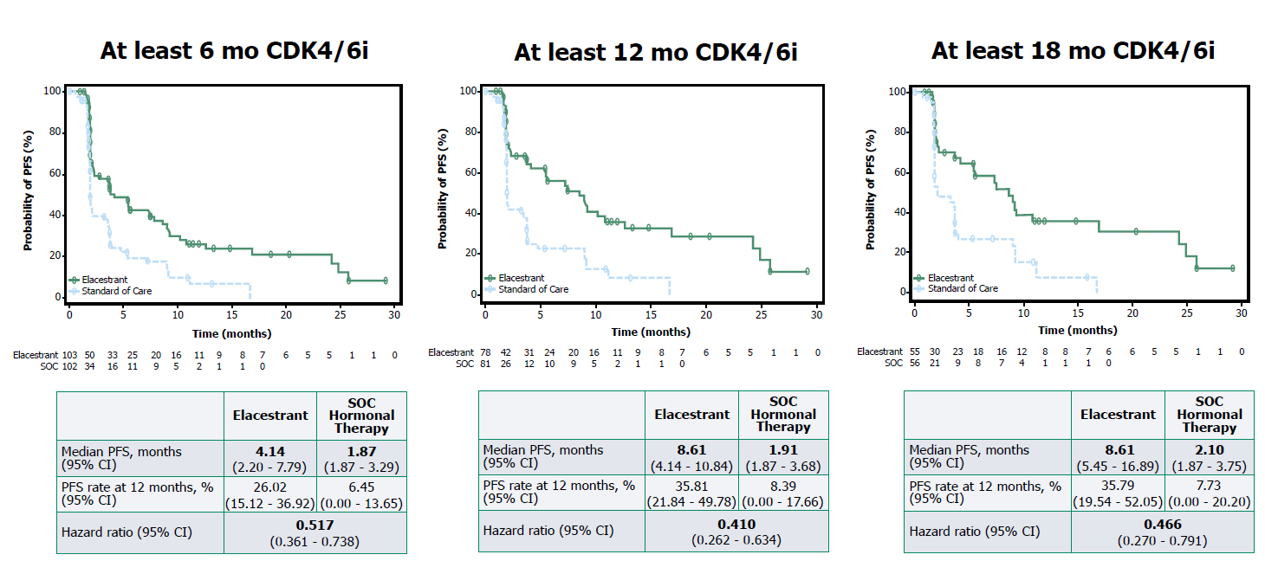
EMERALD (Phase 3): PFS in patients with ESR1-mutant tumors (by duration of prior CDK4/6i)
Bardia A, et al. SABCS 2022. Abstract GS3-01
Most common AE mild nausea; rare hyperlipidemia

Slide 69
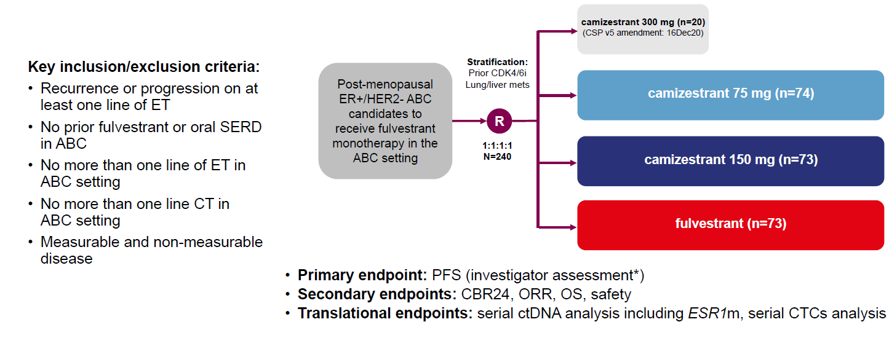
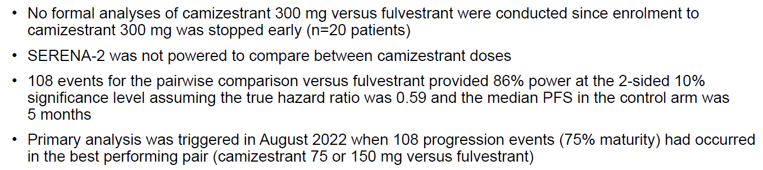
SERENA (Phase 2): Camizestrant vs fulvestrant in post-menopausal women with advanced ER+ HER2− BC
HR
GC
Oliveira M, et al. SABCS 2022. Abstract GS3-02

Slide 70
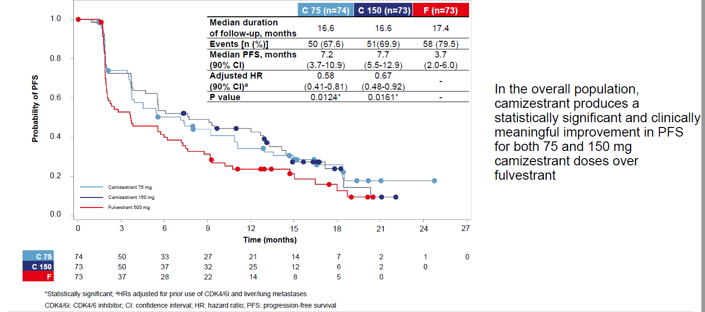
SERENA-2: Camizestrant vs fulvestrant in post-menopausal women with advanced ER+ HER2− BC
HR
GC
PFR (by investigator assessment; primary endpoint)
Oliveira M, et al. SABCS 2022. Abstract GS3-02

Slide 71
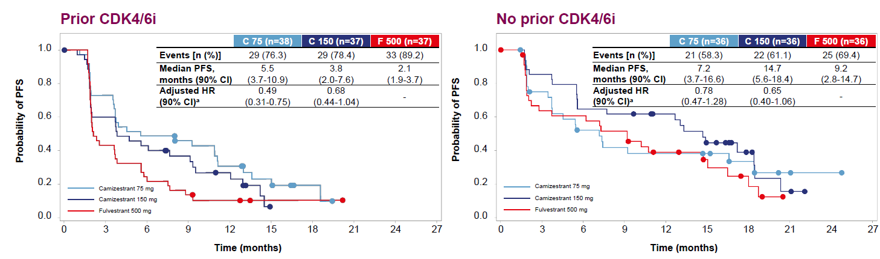
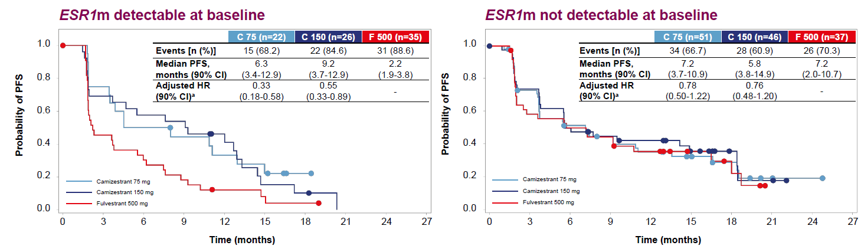
SERENA (Phase 2): PFS in patient subgroups
HR
GC
Oliveira M, et al. SABCS 2022. Abstract GS3-02

Slide 72
What are the best strategies after CDK4/6 inhibition?
Should we offer another CDK4/6 inhibitor?
What other pathways are active and targetable?
Can we monitor for development and mechanisms of resistance?
How do we put this together?

Slide 73
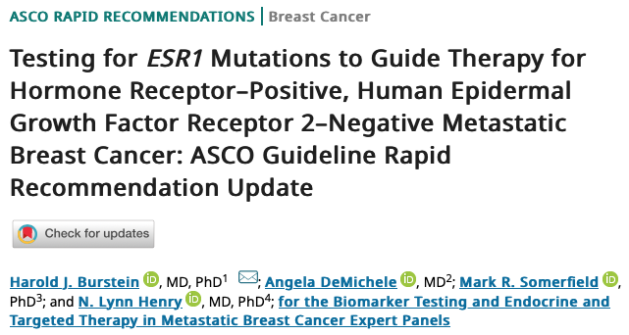
New ASCO Guidelines for ESR1 testing for ER+/HER2- MBC
“To aid in treatment selection, the Expert Panel recommends routine testing for emergence of ESR1 mutations at recurrence or progression on ET (given with or without CDK4/6 inhibitor) in patients with ER-positive, HER2-negative MBC.”
Burstein, DeMichele et al, JCO 2023

Slide 74

San Antonio Breast Cancer Symposium Dec 10-14, 2019
Precision Model of Tailored Therapy Post CDK4/6 Inhibition
Precision Model of Tailored Therapy Post CDK4/6 Inhibition
TUMOR GENOMIC PROFILING
OF RESISTANT METASTATIC TUMOR BIOPSY OR ctDNA
Patients with
metastatic ER+ breast cancer
progressing on CDK4/6 inhibitor
RB1
Loss
AURKA
Amplification
ERBB2
Activation
FGFR2
Activation
RAS
Activation
PI3K/AKT
Mutation
CCNE2
Amplification
ESR1 Mutation
AURKA Inhibitor
AURKA Inhibitor
HER2 Inhibitor
FGFR Inhibitor
ERK Inhibitor
PI3K/AKT Inhibitor
CHK1 Inhibitor
SERD
+/- CDK4/6i
AURKA
MAPK Pathway
PI3K/AKT/MTOR
CDK2/CCNE
ET
Adapted from Wander, Cohen, Gong et al. Biorxiv, Nov 2019
This presentation is the intellectual property of the author. Contact Erica_Mayer@DFCI.Harvard.edu for permission to reprint and/or distribute
Notes:
Lets examine further the possible agent selection and data supporting those drugs.

Slide 75
Approach to Therapy for HR+/HER2- MBC:
Move to Personalization
1L^{[1-4]}
2L^{[1]}
3L
4L/5L^{[1]}
4L+^{[1]}
AI + CDK4/6i
Fulvestrant
(+/- CDK4/6i)
Exemestane + everolimus^{[8]}
Taxane or capecitabine
Eribulin
Doxil
Vinorelbine
Gemcitabine
Carboplatin
Fulvestrant + CDK4/6i
Tamoxifen
BRCAm: olaparib or talazoparib^{[9,10]}
Exemestane + everolimus
Endocrine Therapy alone
ESR1m: SERD^{[6,7]}
PIK3CAm:
fulvestrant + alpelisib^{[5]}
Fulvestrant + Capi ^{[14]}
Sacituzumab govitecan
(IMMU-132)^{[13]}
ESR1m: SERD^{[6,7]}
Fulvestrant + Capi ^{[14]}
HER2 low: trastuzumab deruxtecan (DS8201a)^{[11]}
1. Cardoso. Ann Oncol. 2018;29:1634. 2. Abemaciclib PI. 3. Palbociclib PI. 4. Ribociclib PI. 5. Alpelisib PI. 6. Fribbens. JCO. 2016;34:2961. 7. Bardia. SABCS 2017. Abstr PD5-08. 8. Everolimus PI. 9. Olaparib PI. 10. Talazoparib PI. 11. Modi. JCO. 2020;38:1887. 12. Smyth. Cancer Discov. 2020;10:198. 13. Bardia. ASCO 2018. Abstr 1004. 14. Turner et al, SABCS 2022
Notes:
AI, aromatase inhibitor; HR, hormone receptor; MBC, metastatic breast cancer; SERD, selective estrogen receptor degrader.

Slide 76
Conclusions and Questions
The era of endocrine monotherapy for ER+ MBC is almost over.
  With rare exception, ET partner with targeted agent should be considered for all lines of therapy
Multiple options available after progression on CDK4/6 inhibitor.
  Is there an identifiable population for whom CDK after CDK is an acceptable choice? Which CDK4/6i?
  Who should get oral SERD?
  Who should get mTOR/PIK3CA/AKT inhibitor?
Exciting agents in development, including pathways inhibitors and oral SERDS.
  Tolerability and ability to combine may be key.
Can we identify resistance?
  Is early intervention better? Or just burning up agents without OS benefit?
  Economic burden of serial ctDNA, vs only at time of PD?

Slide 77
BREAST CANCER
Wednesday, June 14, 2023

Slide 78
Clinical case
Paolo Tarantino, MD
Advanced Research Fellow
Dana-Farber Cancer Institute, Harvard Medical School
Boston, MA

Slide 79

Clinical case (BG)
COMORBIDITIES
Panic attacks
Gestational diabetes mellitus
History of infertility
ALLERGIES: none
FAMILIAR HISTORY: none. Negative at genetic testing (multigene panel)
Never smoker.

Slide 80
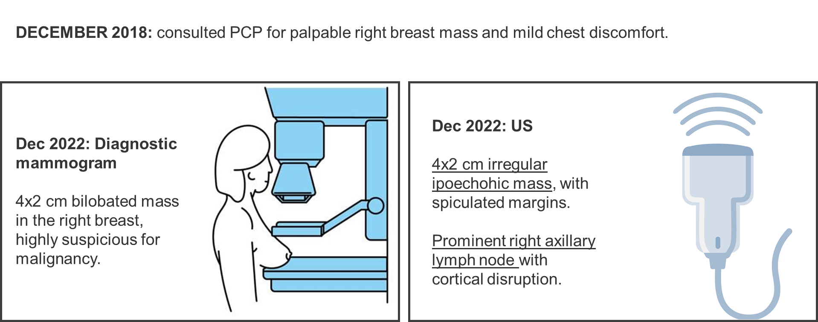
Breast Imaging

Slide 81
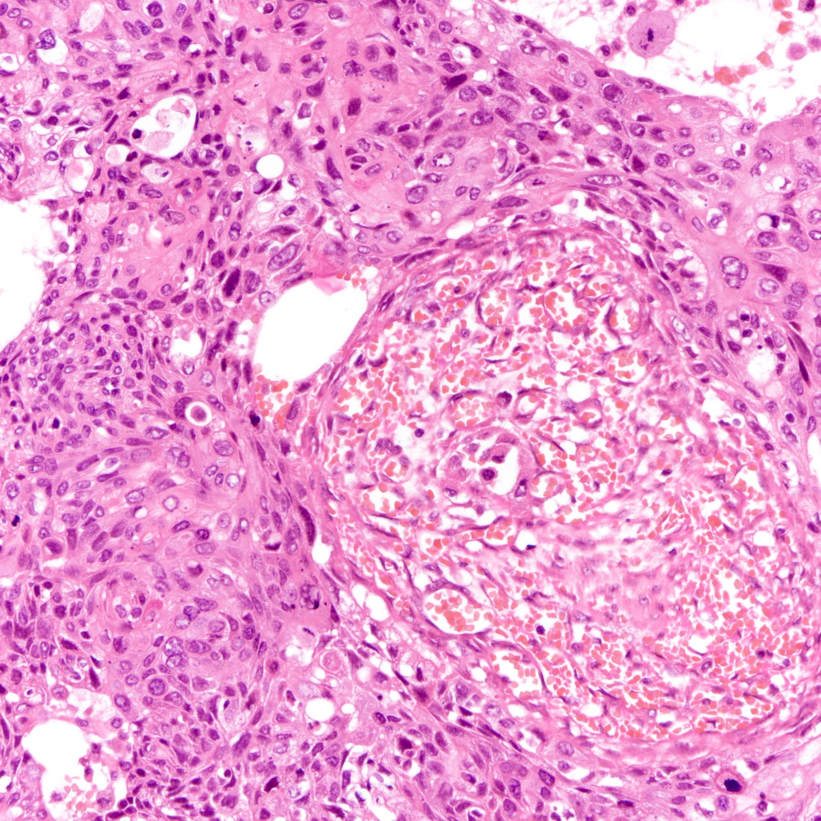
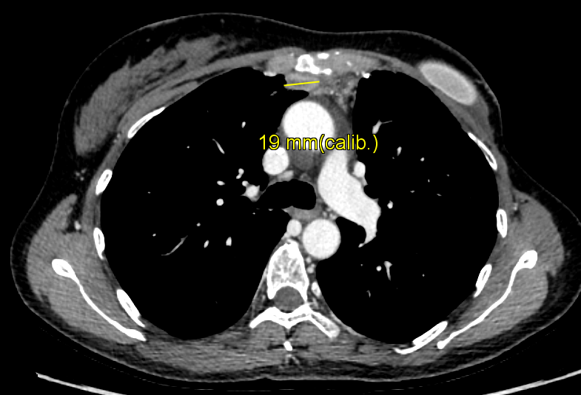

Histology and staging
Jan 2019 - Breast & axillary LN: Invasive Ductal Carcinoma, G2. ER: 95%, PR 30%, HER2 IHC 2+ (FISH-negative)
Jan 2019 - Staging total-body CT-scan: multiple, biopsy confirmed mediastinal pathologic lymph nodes, right kidney metastasis.

Slide 82
What first-line treatment would you recommend for a healthy, postmenopausal 54-year-old patient with de-novo HR+ MBC?
Tamoxifen
Aromatase inhibitor + CDK4/6 inhibitor
Fulvestrant + CDK4/6-inhibitor
Oral chemotherapy (e.g. capecitabine)
IV chemotherapy (e.g. paclitaxel)

Slide 83
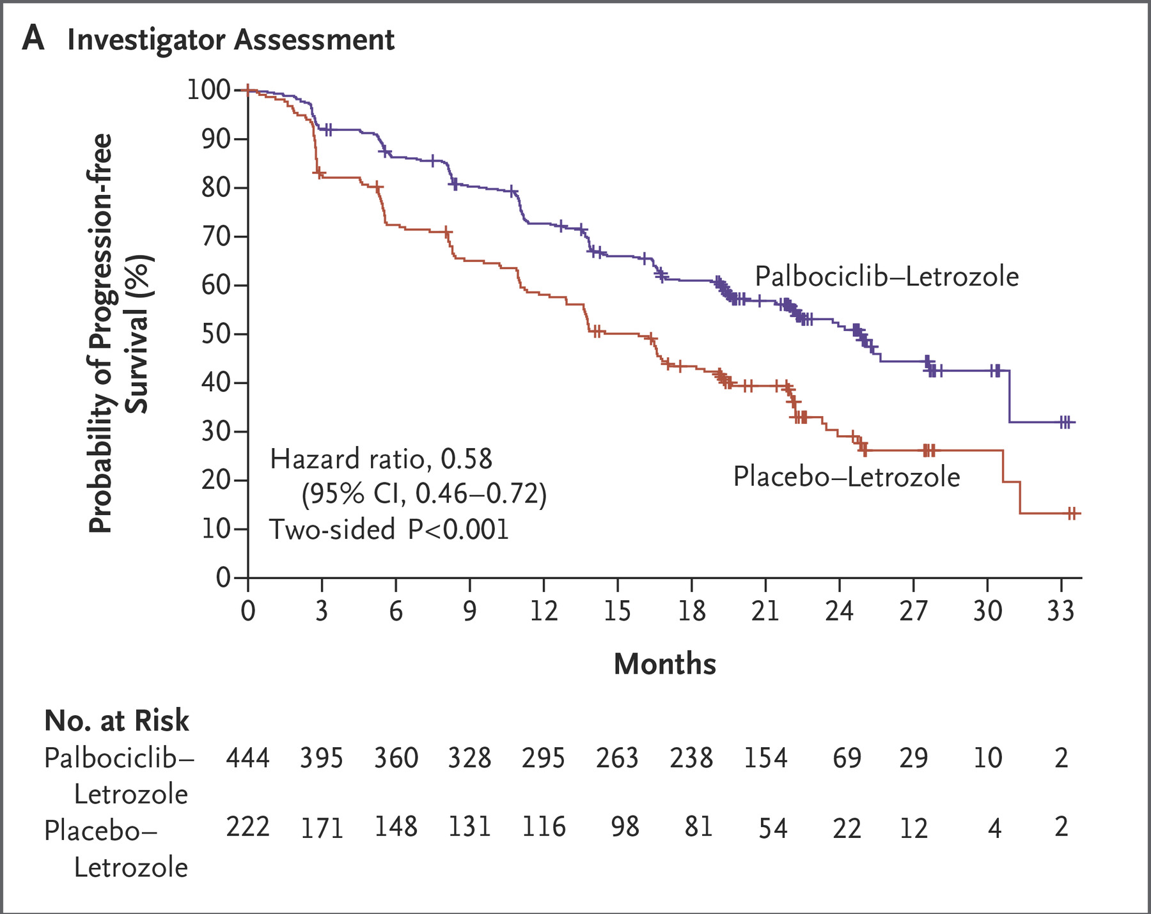
First line systemic treatment
Feb 2019 – starts letrozole + palbociclib
Combination well tolerated (G1 arthralgias, G1 fatigue, G2 neutropenia)
Finn R.S. et al. NEJM 2016

Slide 84
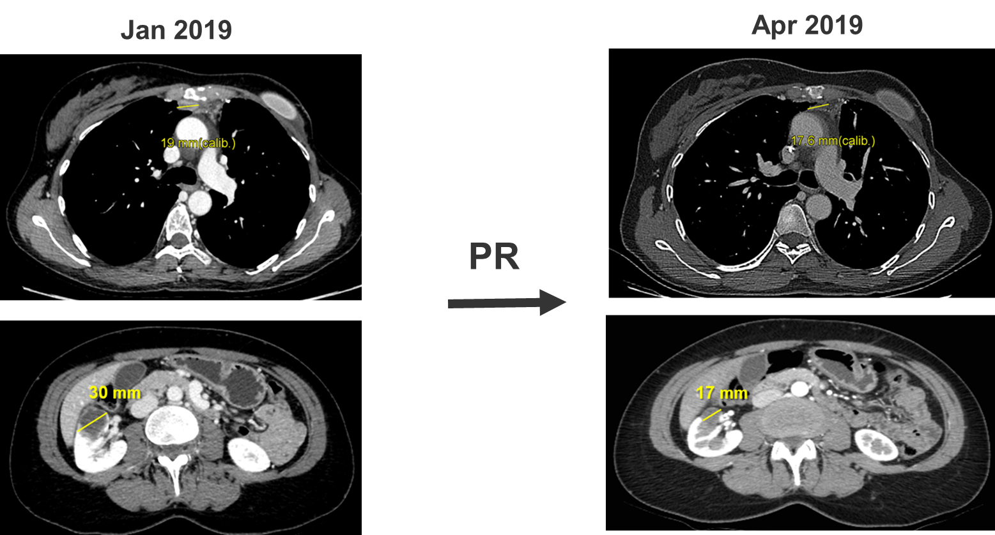
First restaging scan

Slide 85
First line systemic treatment
Apr 2019 – April 2023: maintained PR of kidney lesion and mediastinal LN, near CR of the breast mass and right axillary lymph nodes
May 2023 scans – dimensional increase of multiple mediastinal LN and kidney lesion, appearance of new left axillary lymph nodes (max 18 mm).
US-guided biopsy of left axillary lymph node: Invasive Ductal Carcinoma, G2. ER: 80%, PR 0%, HER2 IHC 0.
NGS testing: CCND1 amplification, ESR1 mutation (Y537S), MSS, TMB 1 mut/Mb
Patient remains asymptomatic, PS ECOG 0

Slide 86
What second-line treatment would you recommend for a postmenopausal patient progressing after 1L AI + Palbociclib (time to progression: ~4 years) with detection of an ESR1 mutation?
Fulvestrant
Fulvestrant + everolimus
Fulvestrant + different CDK4/6-inhibitor (ribo or abema)
Elacestrant
Capecitabine

Slide 87
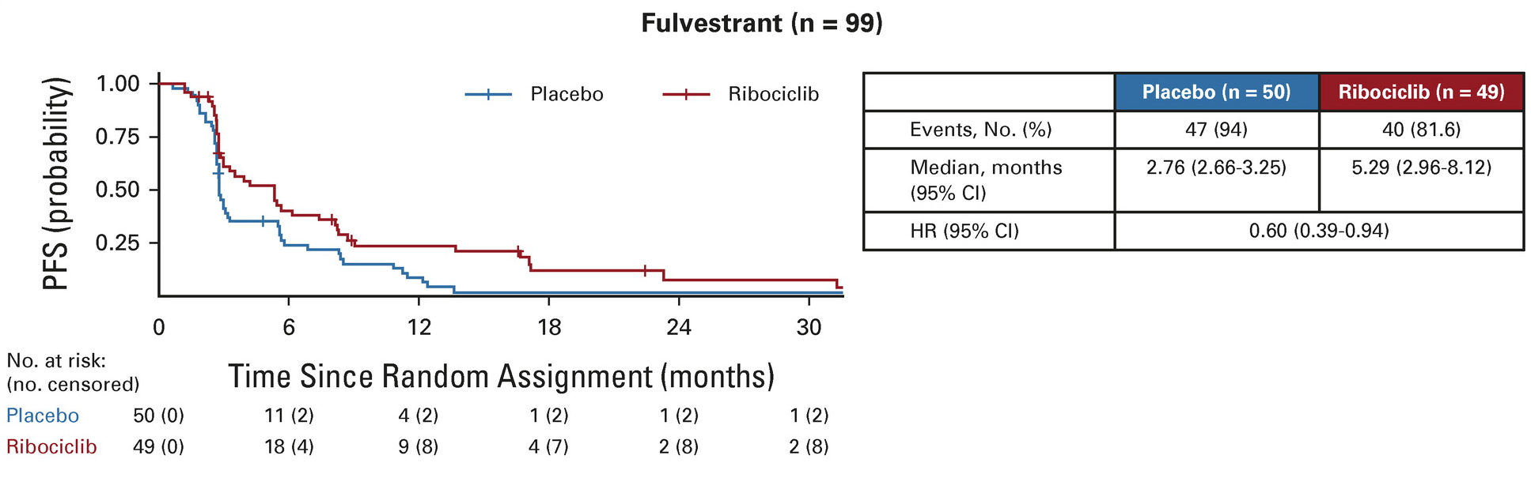
Fulvestrant +/- ribociclib (MAINTAIN phase 2 trial)
Kalinsky K. et al. JCO 2023

Slide 88
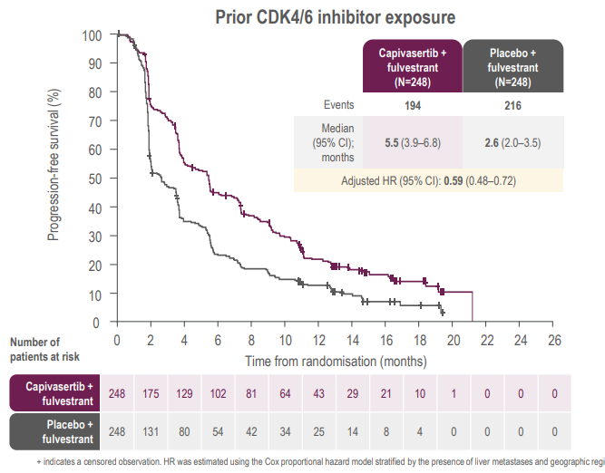
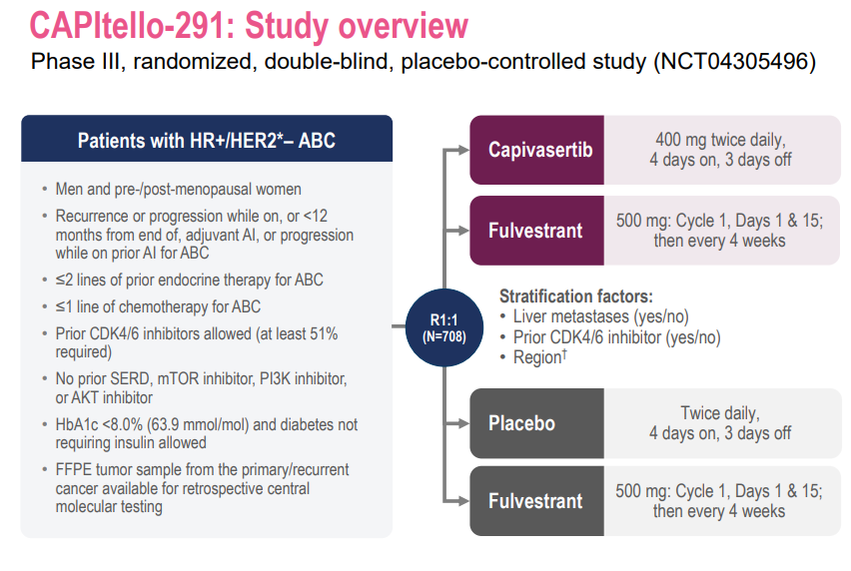
Fulvestrant +/- capivasertib (CAPItelo291 phase 3 trial)
Turner N. et al. ESMO Breast 2023

Slide 89
Elacestrant (EMERALD phase 3 trial)
PFS by Duration of CDK4/6i: ESR1 mutant
Bardia A. et al. SABCS 2022

Slide 90
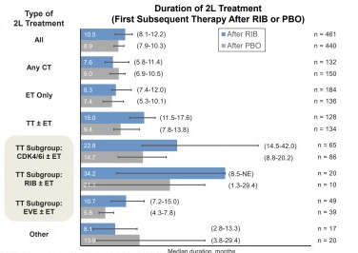
Pooled analysis of outcomes after ET+ribo (or placebo)
Hamilton E. et al. SABCS 2022

Slide 91
Thank you for your attention!

Slide 92
BREAST CANCER
Wednesday, June 14, 2023

Slide 93
Discussion / Q & A

Slide 94
Networking Reception
We will resume at 7:50 pm

Slide 95
BREAST CANCER
Wednesday, June 14, 2023

Slide 96
Treating CNS Metastases in Patients with Breast Cancer
Nancy U Lin, MD
Associate Professor of Medicine
Director, Metastatic Breast Cancer Program
Dana-Farber Cancer Institute/Harvard Medical School
Boston, MA

Slide 97
Brain Metastases are Common in Patients with MBC
  ~Half of patients with HER2+ MBC^{1,2}
  25-50% of patients with metastatic TNBC^{3,4}
  10-15% of patients with ER+ MBC⁴
¹Pestalozzi et al, Lancet Oncol 2013; ²Olson et al, Breast 2013; ³Lin et al, Cancer 2008; ⁴Kennecke et al, J Clin Oncol 2010

Slide 98


Survival after BCBM diagnosis is heavily dependent on tumor subtype
N=2,473 pts with breast cancer and brain mets
diagnosed 2006-2017 across 18 institutions in
3 countries
*Luminal B defined as ER+/HER2+
www.brainmetgpa.com
Sperduto et al, JCO 2020

Slide 99
Weighing Local Tx vs Systemic Tx
Favors Local Tx
-controlled extracranial dz
-symptomatic lesions
-dz amenable to SRS
-initial presentation
-low brain metastasis velocity
-less confidence in systemic tx
Favors Systemic Tx
-progressive systemic dz
-asymptomatic or minimally symptomatic lesions
-progression after prior RT
-dz not amenable to RT or concern for RT toxicity
-high brain metastasis velocity
-more confidence in systemic tx
-longer estimated life expectancy, if can delay need for WBRT

Slide 100
Brain Metastasis Velocity
BMV category | Definition
Low risk | <4 new brain mets since first SRS/year
Intermediate risk | 4-13 new brain mets since first SRS/year
High risk | > 13 new brain mets since SRS/year
Higher BMV associated with more likely need for salvage WBRT and shorter OS
Farris et al, IJROBP 2017

Slide 101


Slide 102
HER2CLIMB: Study Design
+
+
21-day cycle
Tucatinib
300 mg PO BID
Trastuzumab
6 mg/kg Q3W, loading dose 8 mg/kg C1D1
Capecitabine
1000 mg/m² PO BID Days 1-14
Key Eligibility Criteria
HER2+ metastatic breast cancer
Prior treatment with trastuzumab, pertuzumab, and T-DM1
ECOG performance status 0 or 1
Brain MRI at baseline
N=410
R*
(2:1)
+
+
21-day cycle
Placebo
Trastuzumab
6 mg/kg Q3W, loading dose 8 mg/kg C1D1
Capecitabine
1000 mg/m² PO BID Days 1-14
N=202
*Stratification factors: presence of brain metastases (yes/no), ECOG status (0 or 1), and region (US or Canada or rest of world)
https://clinicaltrials.gov/ct2/show/NCT02614794

Slide 103

HER2CLIMB: OS Benefit in Pts with BM
Median OS
12.5 → 21.6 months
9 month absolute gain in OS
HR 0.6 (0.44, 0.81), p<0.001
Lin et al, JAMA Oncol 2022

Slide 104

HER2CLIMB: OS Benefit in Pts with Active Brain Mets

Slide 105

HER2CLIMB: Prolongation of time to CNS PD or Death
Subgroup | Treatment | Events | HR (95% CI) | P value | Median CNS-PFS (95% CI)
Patients with active brain metastases | TUC+Tras+Cape | 69/118 | 0.339 (0.215, 0.536) | <0.00001 | 9.6 months (7.6, 11.1)
 | Pbo+Tras+Cape | 35/56 |  |  | 4.0 months (2.9, 5.6)
Patients with treated stable brain metastases | TUC+Tras+Cape | 25/80 | 0.406 (0.194, 0.850) | 0.01 | 13.9 months (9.7, 24.9)
Patients with treated stable brain metastases | Pbo+Tras+Cape | 13/37 |  |  | 5.6 months (3.0, –)
Lin et al, SABCS 2021/JAMA Onc 2022

Slide 106

BRIDGET Study
PI: Sarah Sammons/Carey Anders

Slide 107


PATRICIA: “High dose” trastuzumab + pertuzumab
Trastuzumab 6 mg/kg IV once weekly
Pertuzumab 840 mg loading dose then 420 mg IV 3W
Lin et al, J Clin Oncol 2021

Slide 108

KAMILLA: Phase IIIb T-DM1
398/2003 enrolled patients with BM at baseline
In the 126 patients with measurable BM
Best overall response (CNS and non-CNS) = 21.4%; clinical benefit rate = 42.9%
CNS response in:
  32.7% of patients who received RT ≥30 days before baseline
  49.3% of patients who did not receive brain radiotherapy
Montemurro et al, Ann Oncol 2020

Slide 109

DESTINY-Breast03: Pts with Treated, Stable BM
 | T-DXd | T-DM1
mPFS, mo (95% CI) | 15.0 (12.5-22.2) | 3.0 (2.8-5.8)
12-mo PFS rate, % (95% CI) | 72.0 (55.0-83.5) | 20.9 (8.7-36.6)
HR (95% CI) | 0.25 (0.13-0.45) | XX.X
100
80
T-DXd (n = 21)
60
40
20
0
-20
-40
-60
-80
-100
Best % Change in Sum of Diameters from Baseline
100
80
T-DM1 (n = 23)
60
40
20
0
-20
-40
-60
-80
-100
Hurvitz et al, SABCS 2021

Slide 110


CNS Activity of TDXd in Pts with Breast Cancer
Best CNS response
TUXEDO-1 trial
Bartsch et al, Nat Med 2022
DFCI/Duke/MDACCC series
Kabraji et al, Clin Ca Res 2022
DEBBRAH trial
Vaz Batista et al, Neuro Oncol 2023
ORR-IC = 73% in pts with
active BM
ORR-IC =44% in pts with
Active BM
ORR-IC =73%
(70% in pts with active BM)

Slide 111
Other Systemic Options for Pts with HER2+ BCBM
Trastuzumab + chemotherapy (platinum, Doxil, eribulin, irinotecan, etc)
Neratinib combinations (capecitabine or TDM1)
Clinical trials
  Trastuzumab + GDC 0084
  TDXD + ZN1041

Slide 112


Slide 113
Prospective Studies Evaluating Systemic Tx for BCBM
Intervention | Patient Population | CNS Response Rate
Abemaciclib | HR+/HER2-negative | 5.2%
Capecitabine | Breast cancer brain mets, any subtype | 18%
Temozolomide | Breast cancer brain mets | 0-4%
Irinotecan | Triple-negative, all comers | 7-12%
Platinum + bevacizumab | Breast cancer brain mets, any subtype | 63-77%

Slide 114

JPBO study of abemaciclib for CNS disease
N=58 HR+/HER2-negative BCBM
Median 2 prior ET and 2 prior chemo for MBC
CNS-ORR 5.2%
Intracranial CBR (CR+PR+SD ≥6 months) was 24%
Median OS 12.5 months
Intracranial
% Change from Baseline
Extracranial
Pre-surgical window cohort
Therapeutic levels in brain
CSF concentrations above IC50
% Change from Baseline
Tolaney et al, Clin Ca Res 2020

Slide 115

Elacestrant
In healthy post-menopausal women, elacestrant has been shown to penetrate the BBB in a dose-dependent manner
Two ongoing studies exploring elacestrant + abemaciclib for pts with ER+ breast cancer brain mets
NCT04791384, PI: Peter Kabos
NCT05386108, “ELECTRA”, sponsor, Stemline Therapeutics
Conlan et al, Eur J Drug Metab Pharmacokinet 2020

Slide 116

OP-1250
CERAN = Complete estrogen receptor antagonist
Blocks both AF1 and AF2 and also degrades ER
Active against wt and mutant ESR1
Robust penetration across an intact BBB
Hodges-Gallagher et al, AACR 2020

Slide 117

S2007: Sacituzumab for HER2-negative BM
 | CNS Tumor Mean Total SN-38 | CNS Tumor Mean Free [SN-38] | Fold change from IC-50
Breast cancer CNS metastases (N = 4) | 455nM (174-1160) | 73nM (15-198) | 150-fold
Glioblastoma multiforme (N = 6) | 270nM (93-687) | 46nM (20-90) | 40-fold
Tumor response in MDA-MB-468 intracranial xenografts.
SN-38 levels in a preoperative window trial of Sacituzumab
in patients with BCBM or GBM
Brenner et al, ESMO 2020
Brenner et al, SABCS 2020

Slide 118

DATO-BASE: Phase II Trial of DATO-DXd for Pts with HER2-neg CNS Metastases (Study planned)
PIs: Paolo Tarantino / Sarah Sammons

Slide 119
My personal “list” of regimens for ER+ or TN BM
ER+ TNBC
Clinical trial!!
ET + abemaciclib
ET + alpelisib
ET + everolimus
Capecitabine
Doxil
Carbo +/- gem
Chemo + bevacizumab
TDXD if HER2 low
Sacituzumab (on trial preferably)
Clinical trial!!
Capecitabine
Doxil
Carbo +/- gem
Chemo + bevacizumab
TDXd if HER2 low
Sacituzumab (on trial preferably)

Slide 120
Summary
Expanding systemic options for patients with breast cancer brain metastases
Multidisciplinary care and patient engagement in medical decision-making is key
Support of clinical trials critical to continued progress

Slide 121
BREAST CANCER
Wednesday, June 14, 2023

Slide 122
Recent advances in metastatic triple-negative breast cancer
Ana C. Garrido-Castro, MD
Assistant Professor of Medicine
Harvard Medical School
Dana-Farber Cancer Institute
Boston, MA

Slide 123
Disclosures
Research funding (to Institution): AstraZeneca, Daiichi-Sankyo, Merck, Gilead Sciences, Zenith Epigenetics, Bristol-Myers Squibb, Novartis
Travel/accommodations: Roche/Genentech

Slide 124
Biomarkers for treatment of mTNBC
Cortes J et al. Lancet. 2020;396(10265):1817-28; O’Shaughnessy J et al. Breast Cancer Res. 2020;22(1):114; Bonneville R et al. JCO Precis Oncol. 2017;PO.17.00073;
Barroso-Sousa R et al. Ann Oncol. 2020;31(3):387-94; Westphalen CB et al. npj Precis Oncol. 2021;5(1):69; Paratala BS et al. Nat Commun. 2018;9(1):4821.

Slide 125
Advanced TNBC
Immune checkpoint inhibition
PARP inhibition
Antibody drug conjugates

Slide 126
Immune checkpoint inhibition in mTNBC
KN355: Pembrolizumab plus chemotherapy
Cortes J et al. Lancet 2020.

Slide 127
KN355: Addition of pembrolizumab to chemotherapy improves survival in PD-L1+ mTNBC
Cortes J et al. Lancet. 2020;396(10265):1817-28; Rugo H et al. ESMO 2021; Cortes J et al. N Engl J Med. 2022;387:217-26.

Slide 128
KN355: Addition of pembrolizumab to chemotherapy improves survival in PD-L1+ mTNBC
Cortes J et al. Lancet. 2020;396(10265):1817-28; Rugo H et al. ESMO 2021; Cortes J et al. N Engl J Med. 2022;387:217-26.

Slide 129
PARP inhibitors in gBRCA-associated breast cancer
OlympiAD
EMBRACA
Robson M et al. N Engl J Med. 2017;377(6):523-33; Litton J et al. N Engl J Med. 2018;379:753-63.

Slide 130
PARP inhibitors in gBRCA-associated breast cancer
OlympiAD
EMBRACA
Robson M et al. N Engl J Med. 2017;377(6):523-33; Litton J et al. N Engl J Med. 2018;379:753-63.

Slide 131


PARP inhibitors in gBRCA-associated breast cancer
OlympiAD
OLAPARIB vs. Chemotherapy
Median PFS: 7.0 vs. 4.2 months; HR=0.58 (p<0.001)
Median OS: 19.3 vs. 17.1 months; HR=0.90 (p=0.513)
ORR: 59.9% vs. 28.8%
Median time to ≥10-pt decrease in QLQ-C30: NR vs. 15.3 months; HR 0.44 (p=0.004)
EMBRACA
TALAZOPARIB vs. Chemotherapy
Median PFS: 8.6 vs. 5.6 months; HR=0.54 (p<0.001)
Median OS: 19.3 vs. 19.5 months HR=0.85 (p=0.17)
ORR: 62.6% vs. 27.2%
Median time to deterioration of QOL: 26.3 vs. 6.7 months; HR 0.39 (95% CI, 0.26-0.56)
Robson M et al. N Engl J Med. 2017;377(6):523-33; Litton J et al. N Engl J Med. 2018;379:753-63.

Slide 132
TBCRC 048: Olaparib expanded
Benefit in gPALB2 and sBRCA1/2
Tung N et al. ASCO 2020; Tung N et al. J Clin Oncol. 2020;38(36):4274-82.

Slide 133
Antibody drug conjugates in breast cancer

Slide 134
Antibody drug conjugates in breast cancer

Slide 135

Antibody drug conjugates in breast cancer
Rinnerthaler G et al. Int. J. Mol. Sci. 2019;20(5):1115.

Slide 136
ASCENT: Sacituzumab govitecan (TROP2 ADC) for 2L+ mTNBC
NCT02574455
Modified from Bardia A et al. ESMO 2020.

Slide 137
ASCENT: Sacituzumab govitecan (TROP2 ADC) for 2L+ mTNBC
Bardia A et al. ESMO 2020; Bardia A et al. N Engl J Med. 2021;384(16):1529-41.

Slide 138
ASCENT: Benefit from sacituzumab govitecan regardless of TROP2 expression
H-Score ≥100:
80% of TNBC pts with evaluable samples
Bardia A et al. Ann Oncol 2021;32(9):P1148-56.

Slide 139
ASCENT-03: SG vs. TPC
1L PD-L1-negative mTNBC
ASCENT-04: SG/Pembrolizumab vs. TPC/Pembrolizumab
1L PD-L1 positive mTNBC
NCT05382299
NCT05382286

Slide 140
Saci-IO TNBC: SG/Pembro vs. SG 1L PD-L1-negative mTNBC
Saci-IO HR: SG/Pembro vs. SG HR+/HER2- MBC (0-1 prior chemo)
NCT04468061
NCT04448886

Slide 141
HER2-low breast cancer
Tarantino P et al. J Clin Oncol 2020;38(17):1951-62.

Slide 142
Trastuzumab deruxtecan (HER2 ADC) in heavily pretreated HER2-low MBC
Modi S et al. J Clin Oncol 2020;38(17):1887-96.

Slide 143
DESTINY-Breast04: T-DXd vs. TPC in HER2-low MBC
Modi S et al. ASCO 2022, Abstract LBA3; Modi S et al. N Engl J Med 2022;387(1):9-20.

Slide 144
DESTINY-Breast04: T-DXd improves PFS and OS in
HER2-low MBC
Modi S et al. ASCO 2022, Abstract LBA3;
Modi S et al. N Engl J Med 2022;387(1):9-20.

Slide 145
DESTINY-Breast04: Exploratory analysis in HR-negative/ HER2-low MBC
Modi S et al. ASCO 2022, Abstract LBA3; Modi S et al. N Engl J Med 2022;387(1):9-20.

Slide 146
DESTINY-Breast04: Confirmed ORR
Modi S et al. ASCO 2022, Abstract LBA3; Modi S et al. N Engl J Med 2022;387(1):9-20.

Slide 147
HER2-low is unstable
Slide courtesy of S. Tolaney: Tarantino P et al. Eur J Cancer. 2022;163:35-43; Miglietta F et al. NPJ Breast Cancer. 2021;7:137; Garrido-Castro AC et al. SABCS 2022.

Slide 148

HER2-low status: Biopsy considerations
Which timepoint and what type of biopsy should be used to define HER2-low status?
DB04 required “adequate archived or recent tumor-biopsy specimens”
  Excluded: FNA, other cytologic specimens, decalcified bone metastases
In DB04, T-DXd had consistent efficacy regardless of tumor sample characteristics
Practical Definition of HER2 Low
HER2 non-amplified tumor showing HER2-low expression on any prior sample in course of disease
Modified from slide courtesy of S. Tolaney. Miglietta F et al. NPJ Breast Cancer. 2021;7:137; Modi S et al. N Engl J Med. 2022;387:9; Prat A et al. SABCS 2022. Abstr HER2-18.

Slide 149
T-DXd biomarker analyses (DAISY)
Dieras V et al. SABCS 2021, Abstract PD8-02.

Slide 150
Future directions
Novel ADCs and targets
Combinatorial approaches
Sequencing ADCs
Understanding mechanisms of resistance

Slide 151

Novel ADCs and targets in mTNBC
Datopotamab
deruxtecan
(TROP2 ADC)
Patritumab
deruxtecan
(HER3 ADC)
Bardia A et al. SABCS 2022; Krop IE et al. ASCO 2022.

Slide 152

Novel ADCs and targets in mTNBC
ORR: 39.6%
Median PFS: 5.7 mo
Trastuzumab duocarmazine
(HER2 ADC)
Disitimab
vedotin
(HER2 ADC)
Ladiratuzumab
vedotin
(LIV1A ADC)
Banerjii U et al. Lancet Oncol 2019;20:1124–35; Wang J et al, ASCO 2021; Modi S et al. SABCS 2017; Tsai M et al. ESMO 2021.

Slide 153
TROPION-Breast02: Dato-DXd vs. TPC in
1L mTNBC not candidate for PD-(L)1 inhibitor
NCT05374512
Dent R et al. SABCS 2022. OT1-03-05.

Slide 154
BEGONIA: PD-L1 inhibitor and ADC combination in
1L mTNBC
NCT03742102
Schmid P et al. ASCO 2021; Schmid P et al. ESMO Breast 2022.

Slide 155
BEGONIA: Dato-DXd + Durvalumab in 1L mTNBC
Schmid P et al. SABCS 2022.

Slide 156
BEGONIA: T-DXd + Durvalumab in 1L mTNBC
Schmid P et al. SABCS 2022.

Slide 157
TBCRC 047: InCITe
NCT03971409
PI: H. Rugo

Slide 158
Mechanisms of resistance to ADCs
Modify payload
Modify target
Coates et al. Cancer Discov 2021; 11(10):2436-45.

Slide 159
Mechanisms of resistance to ADCs
Change in expression of target (HER2 IHC) from baseline to progression on T-DXd
Mosele F. et al. ESMO Breast 2022.

Slide 160
Treatment algorithm for metastatic TNBC

Slide 161
Thank you

Slide 162
BREAST CANCER
Wednesday, June 14, 2023

Slide 163
Recent Advances in HER2+ Metastatic Breast Cancer
Adrienne G. Waks, MD
Staff physician, Breast Medical Oncology
Dana-Farber Cancer Institute
Boston, MA

Slide 164
Outline
Second-line therapy options
  Trastuzumab deruxtecan
  HER2CLIMB regimen: tucatinib/capecitabine/H
Third-line and beyond
Future directions

Slide 165
Outline
Second-line therapy options
  Trastuzumab deruxtecan
  HER2CLIMB regimen: tucatinib/capecitabine/H
Third-line and beyond
Future directions

Slide 166
DESTINY-Breast03: First Randomized Phase 3 Study of T-DXd
An open-label, multicenter study (NCT03529110)
Patients (N = 524)
Unresectable or metastatic HER2-positiveª breast cancer that has been previously treated with trastuzumab and a taxane^{b}
Could have clinically stable, treated brain metastases^{c}
    ≥2 weeks between end of whole brain radiotherapy and study enrollment
Stratification factors
Hormone receptor status
Prior treatment with pertuzumab
History of visceral disease
Primary endpoint
PFS (BICR)
Key secondary endpoint
OS
Secondary endpoints
ORR (BICR and investigator)
DOR (BICR)
PFS (investigator)
Safety
T-DXd
5.4 mg/kg Q3W
(n = 261)^{d}
R
1:1
T-DM1
3.6 mg/kg Q3W
(n = 263)^{e}
At the time of data cutoff (May 21, 2021), 125 (48.6%) T-DXd patients and 214 (82.0%) T-DM1 patients had discontinued treatment
Median follow up was 15.9 months
BMs were measured at baseline by CT or MRI and lesions were monitored throughout the study
BICR, blinded independent central review; BM, brain metastasis; CT, computed tomography; DOR, duration of response; HER2, human epidermal growth factor receptor 2; IHC, immunohistochemistry; ISH, in situ hybridization; MRI, magnetic resonance imagining; ORR, objective response rate; OS, overall survival; PFS, progression-free survival; Q3W, every 3 weeks; R, randomization; T-DM1, trastuzumab emtansine; T-DXd, trastuzumab deruxtecan.
ªHER2 IHC3+ or IHC2+/ISH+ based on central confirmation. ^{b}Progression during or <6 months after completing adjuvant therapy involving trastuzumab and a taxane. ^{c}Prior to protocol amendment, patients with stable, untreated BM were eligible. ^{d}4 patients were randomly assigned but not treated. ^{e}2patients were randomly assigned but not treated.
Cortes, J et al. ESMO 2021
Notes:
59/82 subjects with BM at baseline consented prior to protocol amendment
Highlight brain mets related eligibility!

Slide 167
Baseline Characteristics and Prior Therapies
 | T-DXd n = 261 | T-DM1 n = 263
Age, median (range), years | 54.3 (27.9-83.1) | 54.2 (20.2-83.0)
Female, n (%) | 260 (99.6) | 262 (99.6)
Region, n (%) Europe Asia North America Rest of world | 54 (20.7) 149 (57.1) 17 (6.5) 41 (15.7) | 50 (19.0) 160 (60.8) 17 (6.5) 36 (13.7)
HER2 status (IHCª), n (%) 3+ 2+ (ISH amplified) 1+ | Not evaluable | 234 (89.7) 25 (9.6) 1 (0.4) | 1 (0.4) | 232 (88.2) 30 (11.4) 0 | 1 (0.4)
ECOG PS, n (%) 0 | 1 | 154 (59.0) | 106 (40.6) | 175 (66.5) | 87 (33.1)
Hormone receptor, n (%) Positive | Negative | 131 (50.2) | 130 (49.8) | 134 (51.0) | 129 (49.0)
History of BM, n (%) Yes | No | 62 (23.8) | 199 (76.2) | 52 (19.8) | 211 (80.2)
BM at baseline,^{b} n (%) Yes | No | 43 (16.5) | 218 (83.5) | 39 (14.8) | 224 (85.2)
Visceral disease, n (%) Yes | No | 184 (70.5) | 77 (29.5) | 185 (70.3) | 78 (29.7)
Prior treatment for mBC, n (%) | 240 (92.0) | 234 (89.0)
Prior lines of therapy in the metastatic setting,^{c} n (%) 0-1 | ≥2 | 132 (50.6) | 129 (49.4) | 126 (47.9) | 137 (52.1)
Prior cancer therapy,^{d} n (%) Trastuzumab Pertuzumab | 260 (99.6) 162 (62.1) | 262 (99.6) 158 (60.1)
BM, brain metastasis; ECOG PS, Eastern Cooperative Oncology Group performance status; HER2, human epidermal growth factor receptor 2; IHC, immunohistochemistry; ISH, in situ hybridization; BC, metastatic breast cancer; T-DM1, trastuzumab emtansine; T-DXd, trastuzumab deruxtecan.
ªHER2-status as evaluated by central laboratory. ^{b}Patients with BM at baseline compose the patient population described in all subsequent slides. ^{c}Includes patients with rapid progression as 1 line of treatment. Rapid progression defined as progression within 6 months of (neo)adjuvant therapy or 12 months if regimen contained pertuzumab. Line of therapy does not include endocrine therapy. ^{d}All patients received at least 1 prior cancer therapy. One patient who underwent prior T-DM1 treatment was enrolled in error in the T-DXd arm.
Cortes, J et al. ESMO 2021

Slide 168

Presented by Sara Hurvitz at SABCS 2022
Notes:
These PFS results were updated at SABCS 2022…mPFS for T-DXd has now been reached

Slide 169

Presented by Sara Hurvitz at SABCS 2022
Notes:
AND Significant OS benefit now seen

Slide 170
Pneumonitis with T-DXd (DB03)
Adjudicated as drug-related ILD/pneumonitisª, n (%)
n (%) | Grade 1 | Grade 2 | Grade 3 | Grade 4 | Grade 5 | Any Grade
T-DXd (n = 257) | 7 (2.7) | 18 (7.0) | 2 (0.8) | 0 | 0 | 27 (10.5)
T-DM1 (n = 261) | 4 (1.5) | 1 (0.4) | 0 | 0 | 0 | 5 (1.9)
There were no grade 4 or 5 adjudicated drug-related ILD/pneumonitis events observed with T-DXd
Median time to onset of pneumonitis: 5 months (range 1-23+ months)

Slide 171
Outline
Second-line therapy options
  Trastuzumab deruxtecan
  HER2CLIMB regimen: tucatinib/capecitabine/H
Third-line and beyond
Future directions

Slide 172

HER2CLIMB
*Stratification factors: presence of brain metastases (yes/no), ECOG performance status (0 or 1), and region (US or Canada or rest of world)
a HER2CLIMB met all primary and alpha-controlled secondary endpoints at the time of the primary analysis.
Notes:
Note – a more heavily pretreated pop than DESTINY Breast03 (all had H, P, TDM1)

Slide 173
HER2CLIMB results: tucatinib improves PFS and OStline
Median PFS
7.8 mo vs 5.6 mo
HR = 0.54; P < .001
Median OS
21.9 mo vs 17.4 mo
HR = 0.66; P = .005
1.0
0.8
0.6
0.4
0.2
0
1.0
0.8
0.6
0.4
0.2
0
76%
63%
Tucatinib combination
Tucatinib combination
62%
Median
Median
PFS, %
OS, %
46%
33%
△ 2.2 mo
Placebo combination
45%
Placebo combination
27%
12%
△ 4.5 mo
0 3 6 9 12 15 18 21 24 27 30 33 36
0 3 6 9 12 15 18 21 24 27 30 33 36
Time Since Randomization, mo
Time Since Randomization, mo
No. at Risk
Tuc + tras + cape
Pbo + tras + cape
320 235 152 96 40 29 15 10 8 4 2 1 0
No. at Risk
Tuc + tras + cape
Pbo + tras + cape
410 388 322 245 178 123 80 51 34 20 10 4 0
160 94 45 27 6 4 2 1 1 0 0 0 0
202 191 160 119 77 48 32 19 7 5 2 1 0
Murthy R et al NEJM 2020
Notes:
Original results published in NEJM 2020 (primary endpoint = PFS in first 480 pts enrolled)

Slide 174

HER2CLIMB: Patients with Brain Metastases
Lin NU et al, SABCS 2021
Notes:
(Pts with brain mets requiring immediate local tx were not eligible)

Slide 175

HER2CLIMB: OS for All Patients with Brain Metastases
OS benefit with tucatinib was improved with additional follow-up. Median OS was 9.1 months longer in the tucatinib arm compared with the control arm in all patients with brain metastases.
  Previously reported, median OS was 6.1 months longer in tucatinib arm compared with control arm in all patients with brain metastases (18.1 vs 12.0 months)⁴
Lin NU et al, SABCS 2021

Slide 176
How should we treat patients with HER2+ active brain metastases in the second line setting?
Both T-DXd and the HER2CLIMB regimen (tucatinib/capecitabine/trastuzumab) are reasonable options
For patients with intracranial-predominant disease and active CNS metastases (progressing after prior local tx, or not yet treated with local tx), HER2CLIMB regimen has a greater evidence basis
Selected other patients (eg history of significant ILD) may not be T-DXd candidates…otherwise, T-DXd is the default choice in second line

Slide 177

Tucatinib: Real-World Data
Flatiron Health MBC Database 2017-2022
154 pts with HER2+ MBC treated with tucatinib
69% had brain metastases prior to initiating tucatinib-based therapy
Caveat: data
Outcomes appear similar in this real-world dataset and HER2CLIMB trial data
Kaufman P et al SABCS 2022 P4-03-30

Slide 178
Outline
Second-line therapy options
  Trastuzumab deruxtecan
  HER2CLIMB regimen: tucatinib/capecitabine/H
Third-line and beyond
Future directions

Slide 179


Data-free zone
Notes:
Unfortunately, as of yet, there are no data to guide us here….

Slide 180

NERATINIB:
Low-molecular-weight, irreversible, pan-HER inhibitor (ErbB1,2,4)
Significant toxicity: 40% Grade 3-4 diarrhea (must use standing loperamide, at least during cycle 1; OR use a dose escalation strategy [CONTROL trial])
Neratinib
Burstein et al
JCO. 2010. 28:1301

Slide 181
NALA Trial: A Phase 3 Trial of Neratinib + Capecitabine vs Lapatinib + Capecitabine
Centrally Confirmed PFS
Overall Survival
1.0
1.0
Probability of OS
8.8 vs 6.6 mo
∆ 2.2 mo
P = .0003
Probability of OS
24 vs 22.2 mo
∆ 1.8 mo
P = NS
Restriction:
24 mo
Restriction:
48 mo
2.2 months
1.7 mo
No. at Risk
Time Since Randomization, mo
No. at Risk
Time Since Randomization, mo
Neratinib + cape | 307 | 183 | 113 | 69 | 54 | 35 | 20 | 13 | 9 | 7 | 3 | 2 | 2
Lapatinib + cape | 314 | 183 | 82 | 39 | 24 | 9 | 8 | 3 | 2 | 2 | 2 | 2 | 1
Neratinib + cape | 307 | 294 | 275 | 244 | 220 | 182 | 142 | 112 | 82 | 64 | 47 | 34 | 28 | 18 | 15 | 13 | 6 | 4 | 2 | 1
Lapatinib + cape | 314 | 303 | 273 | 240 | 208 | 170 | 132 | 107 | 84 | 67 | 47 | 36 | 27 | 22 | 17 | 12 | 8 | 4 | 3 | 1
1-y PFS: 29% vs 15%
ORR: 33% vs 27% (P = .1201)
Median DOR: 8.5 mo vs 5.6 mo (HR = 0.50, 95% CI, 0.33-0.74; P = .0004)

Slide 182


Margetuximab: A Novel HER2 mAB
With a Modified Fc Domain^{1,2}
Trastuzumab
Margetuximab^{1,2}
  Fab
  Binds HER2 with high specificity
  Disrupts signaling that drives cell proliferation and survival
Fab
Same specificity and affinity
Similarly disrupts signaling
  Fc
    Wild-type immunoglobulin G1 (IgG1) immune effector domains
    Binds and activates immune cells
Fc engineering:
Affinity for activating Fcγ RIIIA (CD16A)
Affinity for inhibitory Fcγ RIIB (CD32B)
1. Nordstrom JL et al. Breast Cancer Res. 2011;13:R123. 2. Stavenhagen JB et al. Cancer Res. 2007;67:8882-8890.

Slide 183
SOPHIA Trial: Primary endpoint (PFS)
Margetuximab + chemo vs trastuzumab + chemo
~3rd line
population
 | Margetuximab + Chemotherapy (n = 266) | Trastuzumab + Chemotherapy (n = 270)
No. of events | 130 | 135
Median PFS (95% CI) | 5.8 months (5.52-6.97) | 4.9 months (4.17-5.59)
 | HR by stratified Cox model, 0.76 (95% CI, 0.59-0.98) Stratified log-rank P = .033
PFS, %
24% Risk Reduction of
Disease Progression
∆ 0.9 mo
Margetuximab + chemotherapy
Trastuzumab + chemotherapy
Time Since Randomization, mo
Margetuximab | 266 | 174 | 94 | 45 | 21 | 8 | 6 | 4 | 2 | 0
Trastuzumab | 270 | 158 | 74 | 33 | 13 | 2 | 2 | 1 | 1 | 1 | 1
Notes:
No OS benefit

Slide 184

MonarcHER Trial (randomized phase II)
*Primary endpoint statistical design:
2-sided alpha 0.2
Andre F ESMO 2022
Andre F ESMO 2022

Slide 185

MonarcHER: PFS results
Tolaney SM Lancet Oncol 2020

Slide 186
Current Standard of Care for HER2+ MBC
First Line
Second Line
Third Line
Trastuzumab + pertuzumab + taxane
Trastuzumab deruxtecan
(T-DXd)
Tucatinib + Trastuzumab + Capecitabine
HER2CLIMB
-or-
CLEOPATRA
DB03
-or-
Trastuzumab deruxtecan
Tucatinib + Trastuzumab + Capecitabine
DB01
-or-
HER2CLIMB
Factors: extracranial dz burden,
intracranial dz burden,
co-morbidities, pt preference,
etc
Trastuzumab emtansine
(T-DM1)
EMILIA, TH3RESA
Activity post TDxd?
Slide courtesy of Nancy Lin

Slide 187
Late Line Options for HER2+ MBC: “Dealer’s Choice”
Fourth line +
**Many possible agents:
Vinorelbine
Eribulin
Gemcitabine
Doxil
Carboplatin
Etc.
Trastuzumab emtansine
(T-DM1)
Trastuzumab + chemo**
TH3RESA
Margetuximab + chemo
Trastuzumab + lapatinib
SOPHIA
EGF104900
Neratinib + capecitabine
Special consideration in HR+/HER2+:
Fulvestrant/abema/trastuzumab
NALA
*or tucatinib/cape/trastuzumab, or T-DXd if not already received
Slide courtesy of Nancy Lin

Slide 188
Outline
Second-line therapy options
  Trastuzumab deruxtecan
  HER2CLIMB regimen: tucatinib/capecitabine/H
Third-line and beyond
Future directions

Slide 189

DESTINY-Breast09: A Phase III Study of Trastuzumab Deruxtecan (T-DXd) with or without Pertuzumab versus THP in First-line HER2-positive Breast Cancer
Currently enrolling

Slide 190

HER2CLIMB-05: A Study of Tucatinib or Placebo With Trastuzumab and Pertuzumab for Metastatic HER2+ Breast Cancer
Currently enrolling

Slide 191
NRG BR004: First-line THP +/- atezolizumab
IDMC recommended stopping trial early in 2022 due to:
  Increased Grade 5 AEs in the atezolizumab arm (6 vs 0)
  (Slow enrollment)
Accrued 190 pts (of 600 planned pts)
PFS and OS will be analyzed in 2024
Geyer CE et al SABCS 2022

Slide 192
HER2CLIMB-02: Completed Accrual
Patient Population
Unresectable locally advanced/metastatic HER2+ breast cancer
with progression after trastuzumab and taxane
Patients with or without brain metastases
Tucatinib
(300 mg PO BID)
+ T-DM1
(3.6 mg/kg) q 21d
Primary Endpoints
PFS by Investigator Assessment per
RECIST v1.1
Key Secondary Endpoint
OS
ORR by Investigator Assessment per
RECIST v1.1
1:1
N=460
Placebo
(PO BID)
+ T-DM1
(3.6 mg/kg) q 21d
Completed enrollment

Slide 193
HER2CLIMB-04: A Single Arm, Open Label Phase 2 Study of Tucatinib in Combination with Trastuzumab Deruxtecan in Subjects with HER2+ MBC
N=70
• HER2+ MBC
• Previously treated with taxane + H
Tucatinib PO BID
+
Trastuzumab deruxtecan IV q3wks
Eligible pts:
Active brain metastases
Stable brain metastases
No brain metastases
Currently enrolling
Notes:
This is essentially a second line trial

Slide 194

KATE3: T-DM1 +/- atezolizumab in PD-L1+ HER2+ metastatic breast cancer
Currently enrolling

Slide 195
THANK YOU!

Slide 196
BREAST CANCER
Wednesday, June 14, 2023

Slide 197
Discussion / Q & A

Slide 198
Concluding Remarks
Thank you for coming!

Slide 199
Thank You to Our Supporters:

