Slide 1









BLADDER/RCC
Monday, August 14, 2023

Slide 2
Welcome
Shane Marchesani
OncLive Senior National Accounts Manager
MJH Life Sciences™

Slide 3




Thank You to Our Supporters:

Slide 4
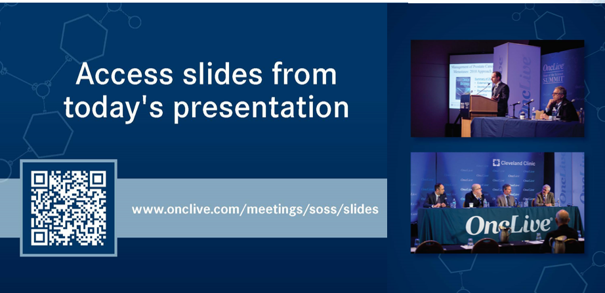

Slide 5
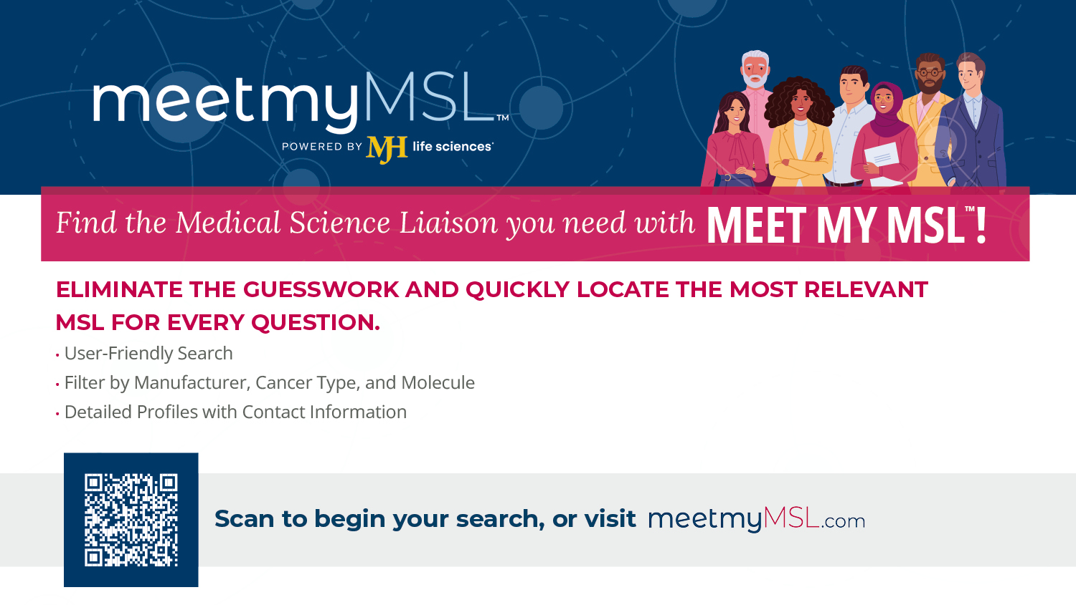

Slide 6


Slide 7


Slide 8
Program Chair
Hans Hammers, MD, PhD
Professor of Medicine
UT Southwestern Harold C. Simmons Comprehensive Cancer Center
Dallas, TX

Slide 9
BLADDER/RCC
Monday, August 14, 2023

Slide 10
Presentation Title
Waddah Arafat, MD
Assistant Professor of Medicine, Genitourinary Medical Oncology
University of Texas Southwestern
Director of Cancer Clinical Informatics
Simmons Comprehensive Cancer Center
Dallas, Texas

Slide 11
JAVELIN Bladder 100
(ASCO GU 23 abstr 508)

Slide 12
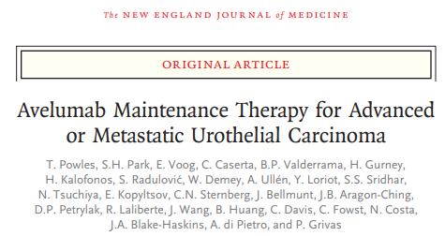
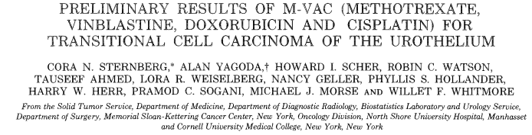
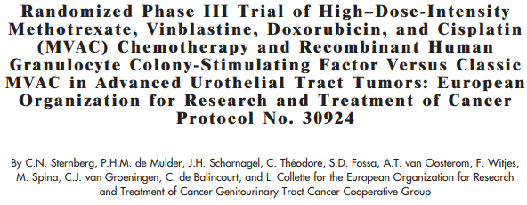
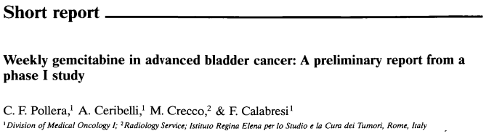
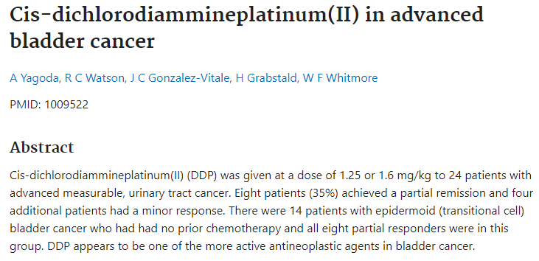
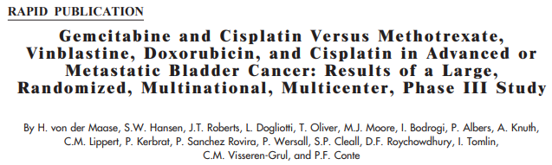
FDA approves Cisplatin in 1st line Bladder Cancer
FDA approves Cisplatin + Gemcitabine
FDA Acc approves Erdafitinib FGFR +
FDA Acc approves Enfortumab Vedotin
JAVELIN 100
1978
1985
1994
2001
2006
2019
2020
1976
2000
2016
2021
2023
IMvigor 210
IMvigor 211
FDA accelerated approval Atezolizumab in 2nd line
FDA Acc approves EV + Pembro
Atezo approval withdrawn for 2nd line
Nivo/Pembro/Avelumba/Durva 2017
Sacituzaumab
Govitecan 2021

Slide 13
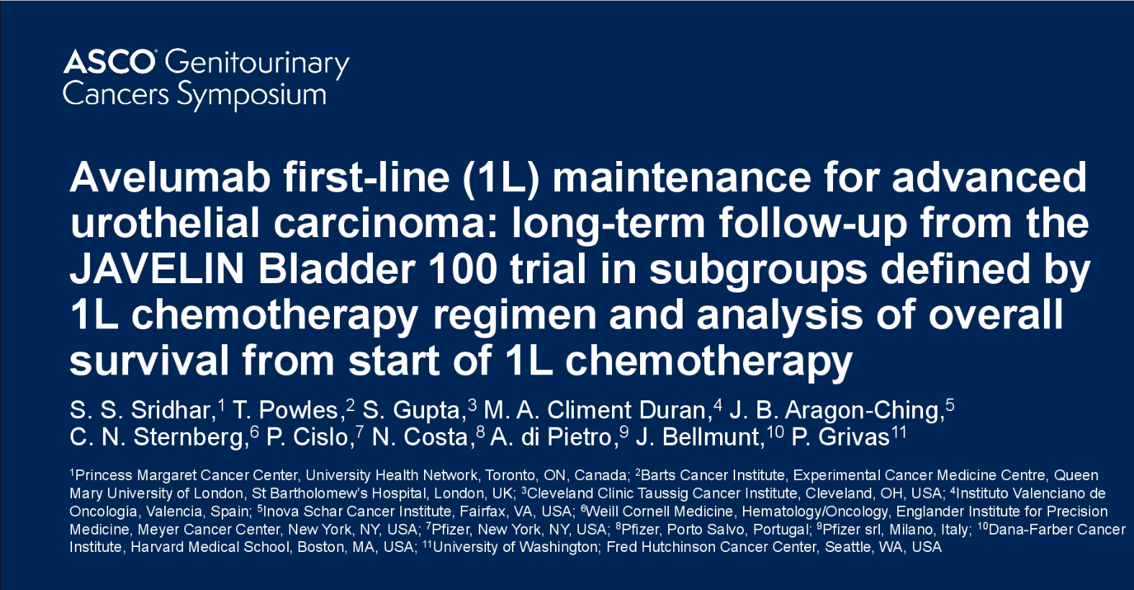
Meaning of Precision Oncology
Presented by Srikala Sridhar, GU ASCO 2023
Notes:
Dr. Arafat

Slide 14
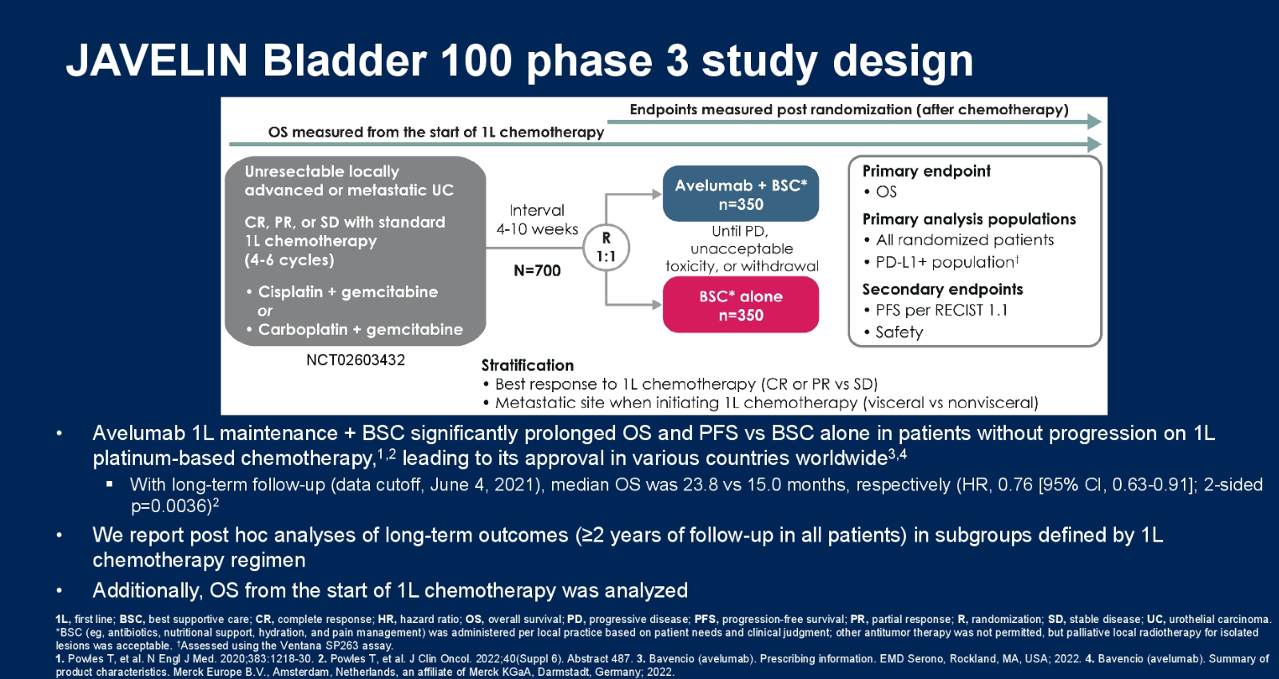
Presented by Srikala Sridhar, GU ASCO 2023

Slide 15
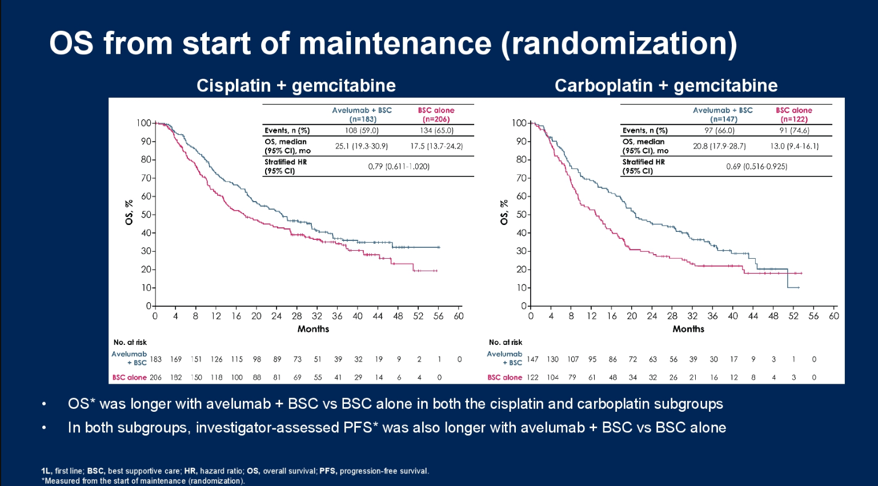
Presented by Srikala Sridhar, GU ASCO 2023

Slide 16
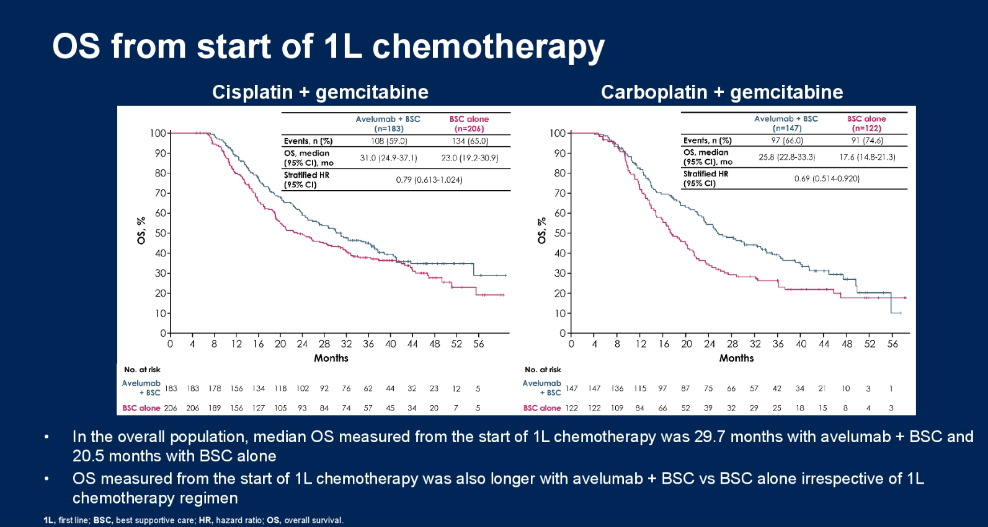
Presented by Srikala Sridhar, GU ASCO 2023

Slide 17
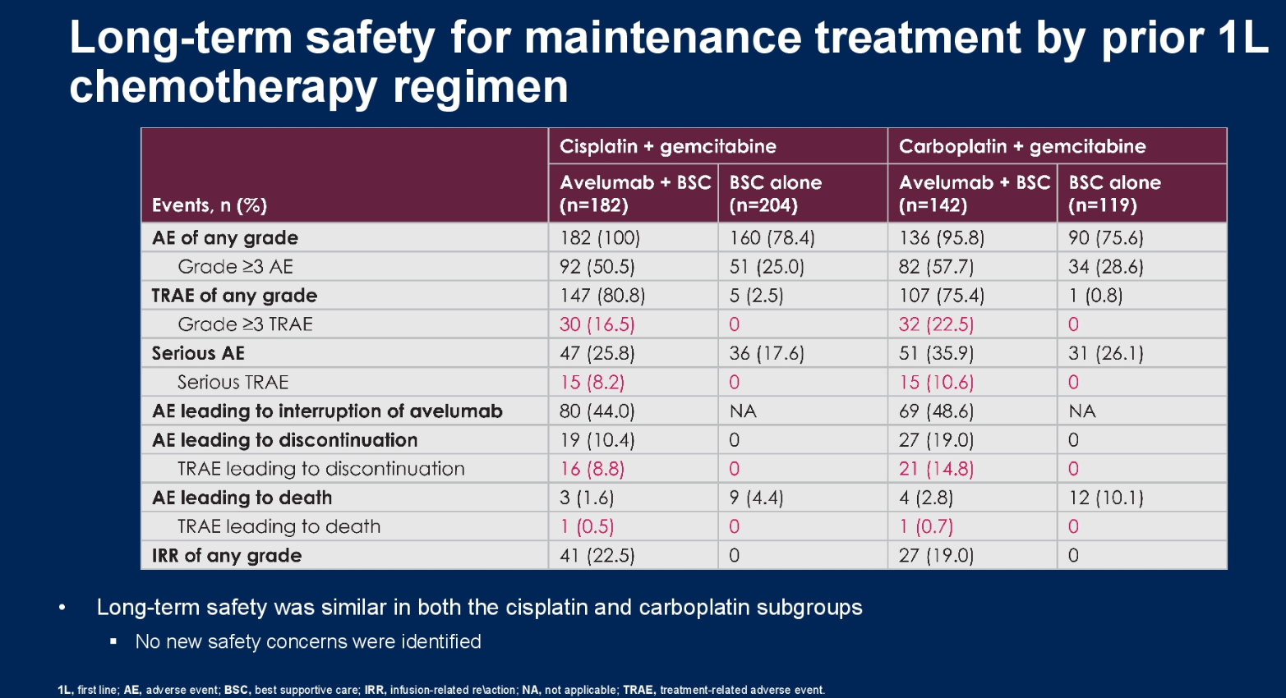
Presented by Srikala Sridhar, GU ASCO 2023

Slide 18
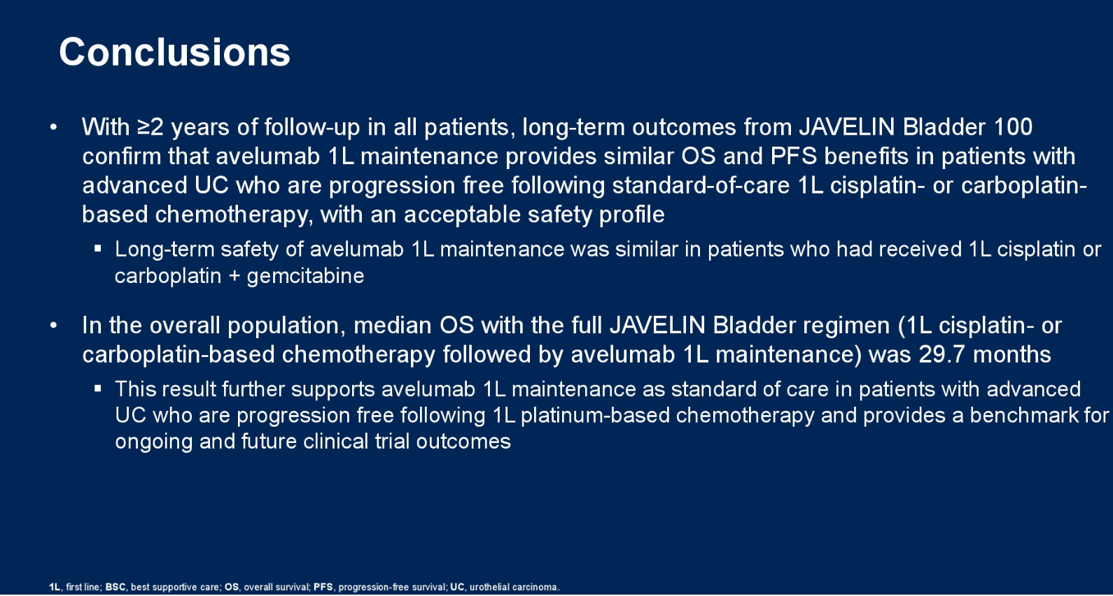
Presented by Srikala Sridhar, GU ASCO 2023

Slide 19
EV-103 Cohort A Long-term outcome (4 yrs)
(ASCO 2023 abst 4505)

Slide 20
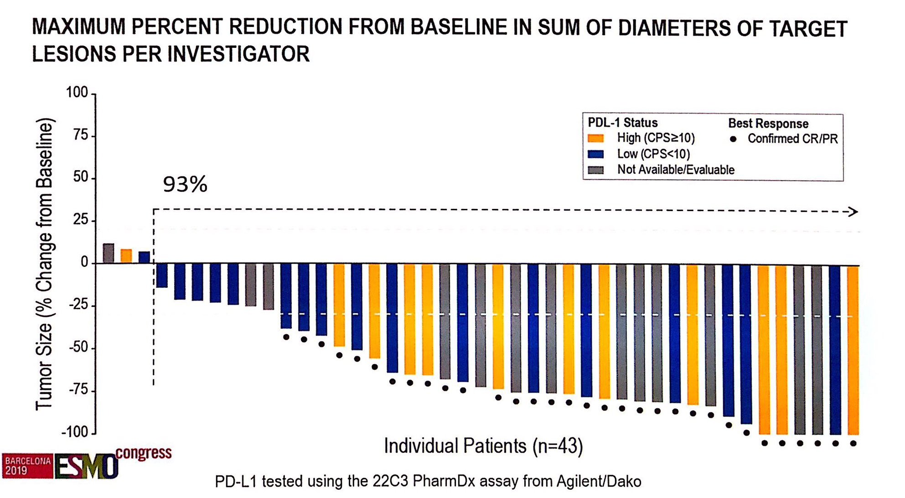
Presented by Christopher Hoimes ESMO 2019

Slide 21
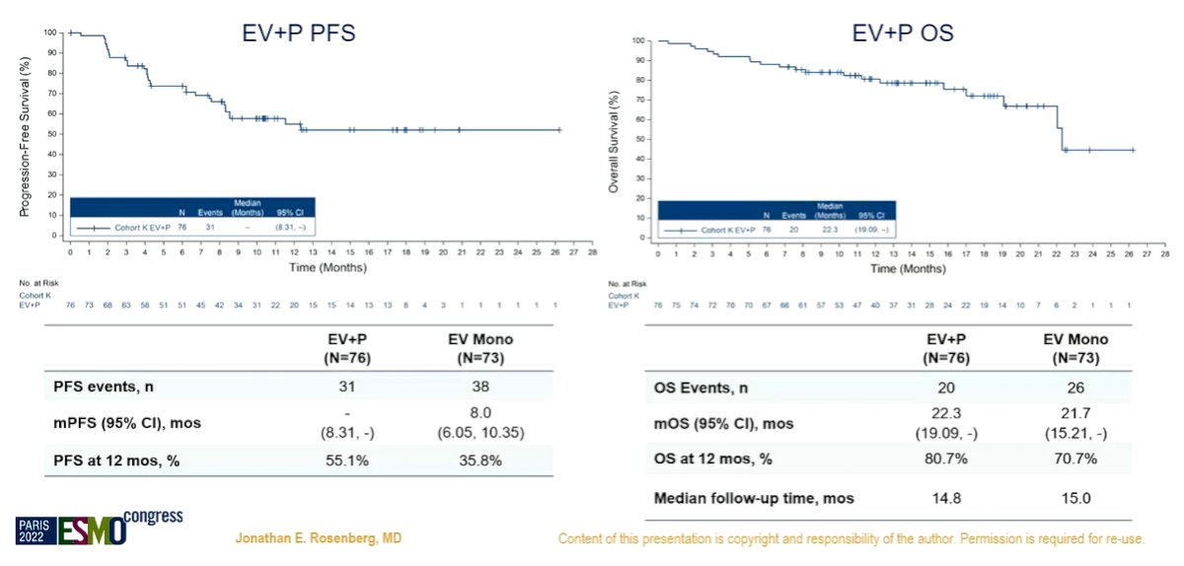
Presented by Jonathan Rosenberg ESMO 2022

Slide 22
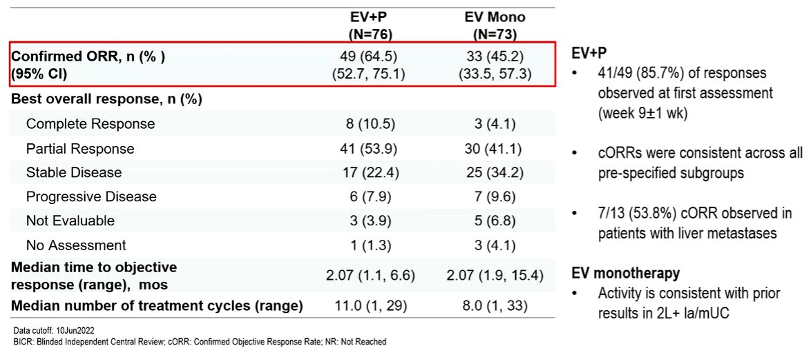
Presented by Jonathan Rosenberg ESMO 2022

Slide 23
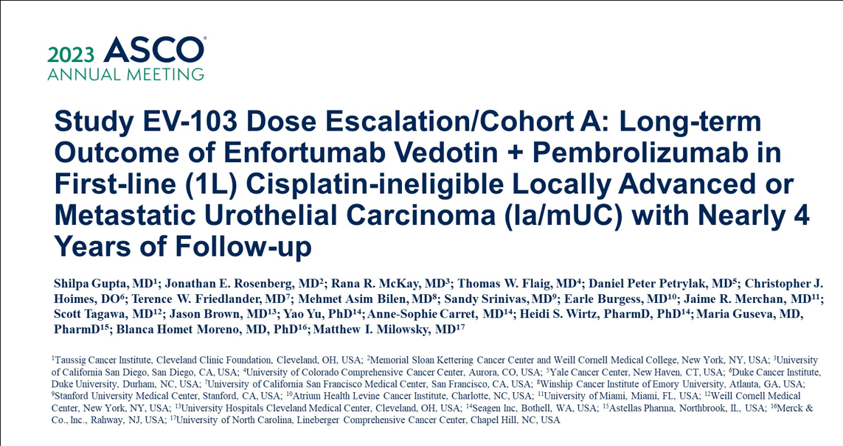
Presented by Shlipa Gupta ASCO 2023

Slide 24
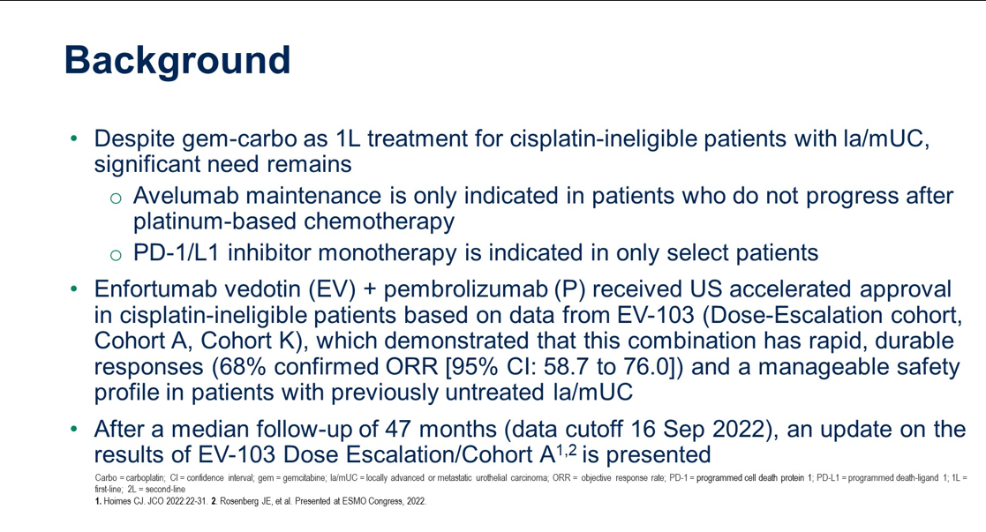
Presented by Shlipa Gupta ASCO 2023

Slide 25
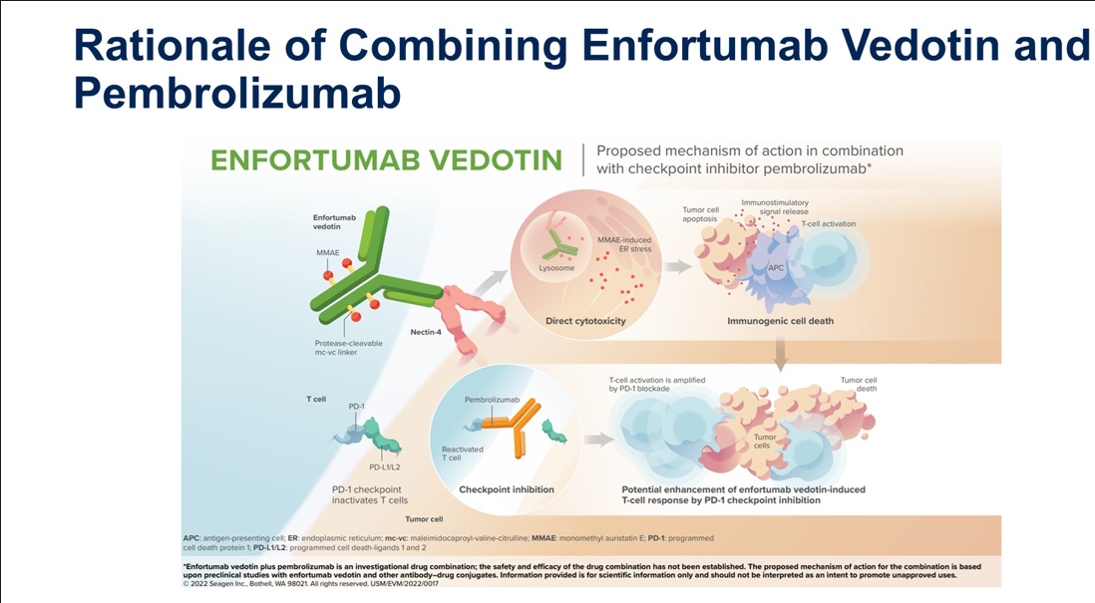
Presented by Shlipa Gupta ASCO 2023

Slide 26
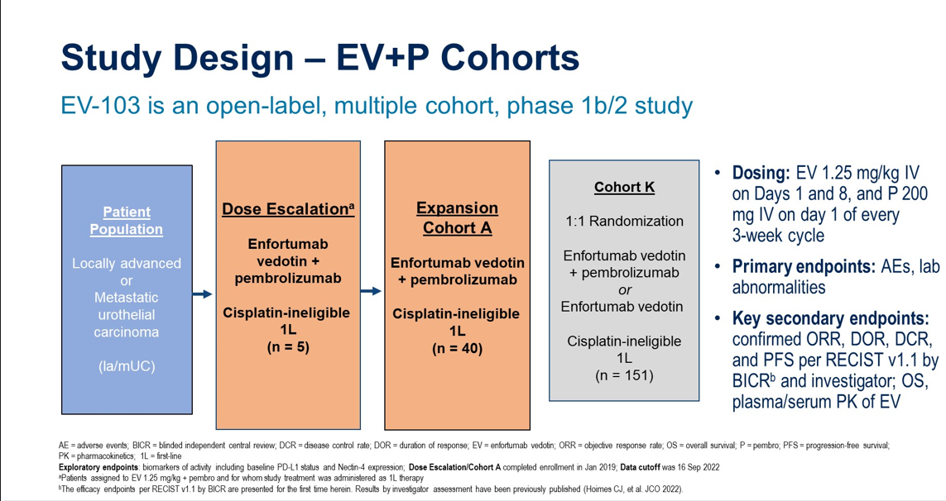
Presented by Shlipa Gupta ASCO 2023

Slide 27
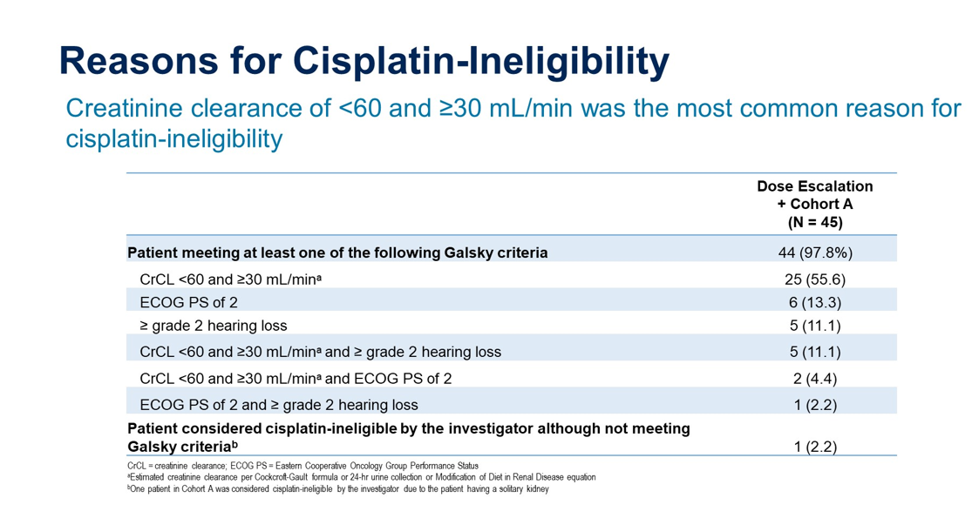
Presented by Shlipa Gupta ASCO 2023

Slide 28
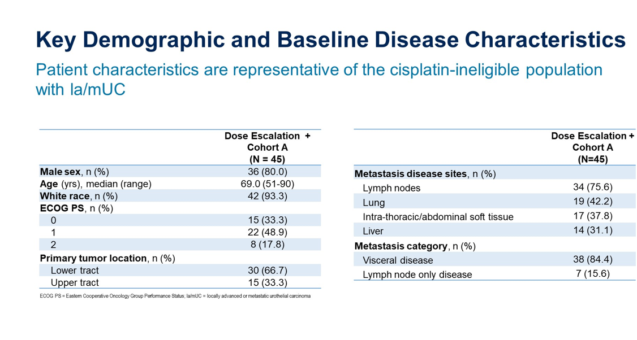
Presented by Shlipa Gupta ASCO 2023

Slide 29
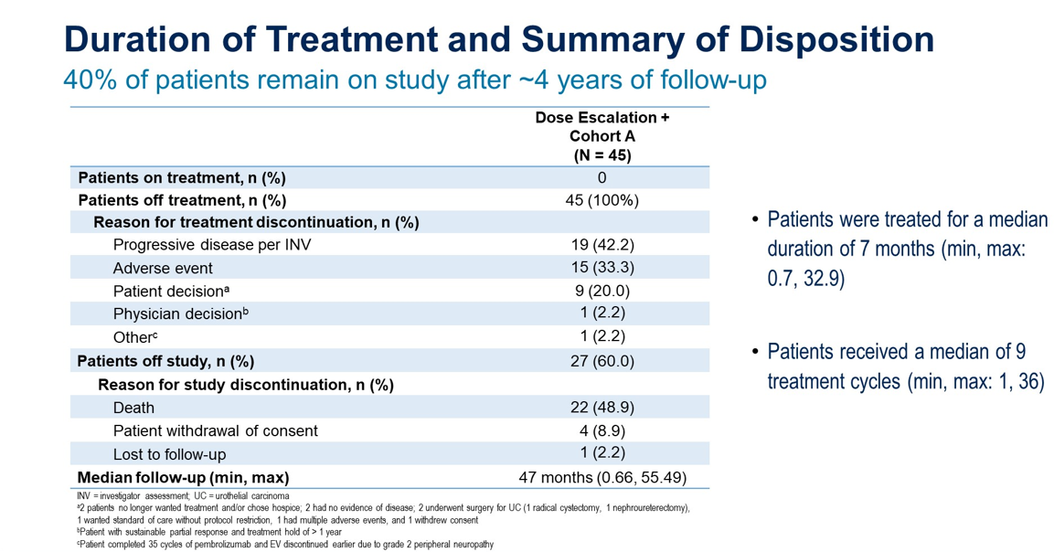
Presented by Shlipa Gupta ASCO 2023

Slide 30
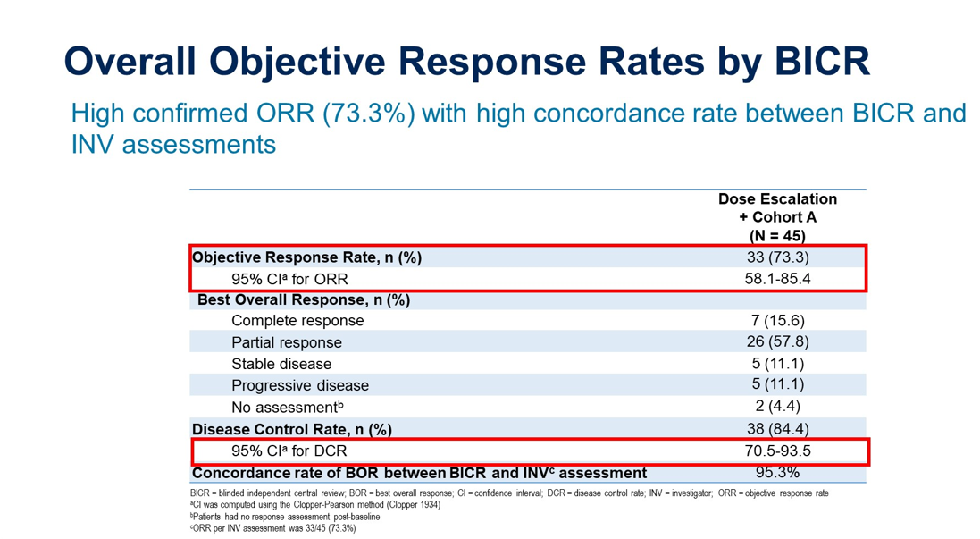

Slide 31
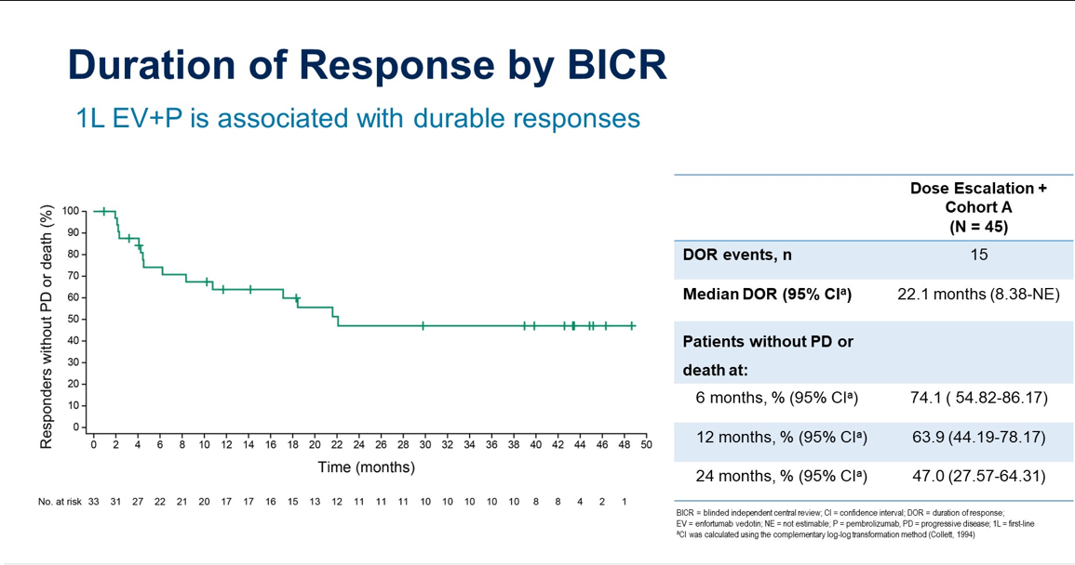
Presented by Shlipa Gupta ASCO 2023

Slide 32
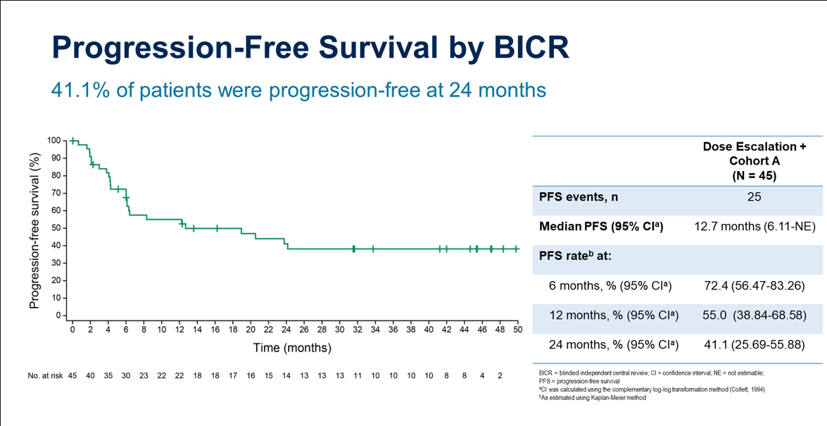
Presented by Shlipa Gupta ASCO 2023

Slide 33
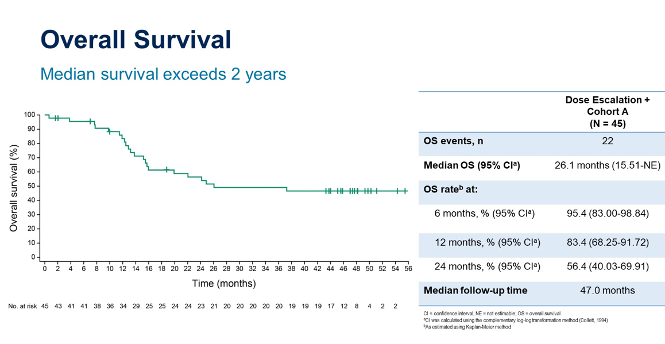
Presented by Shlipa Gupta ASCO 2023

Slide 34
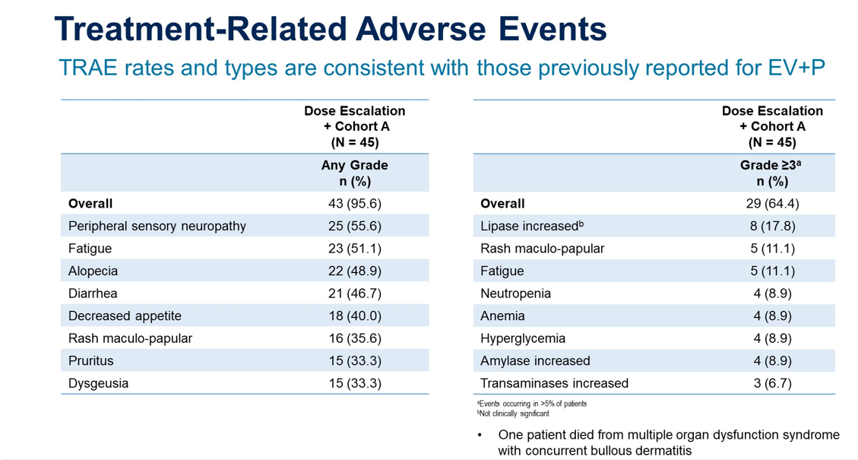
Presented by Shlipa Gupta ASCO 2023

Slide 35
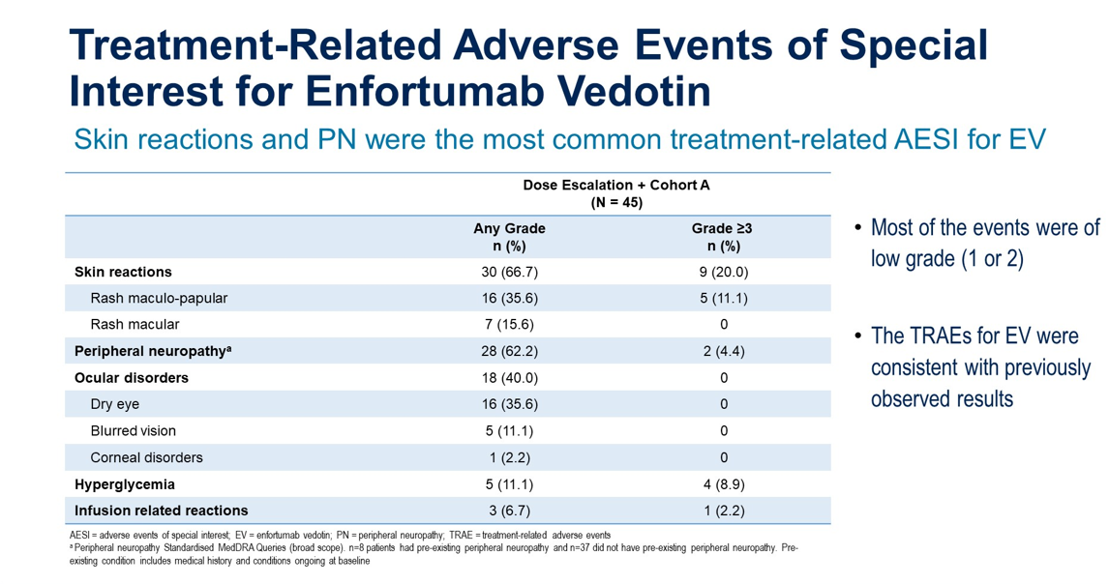
Presented by Shlipa Gupta ASCO 2023

Slide 36
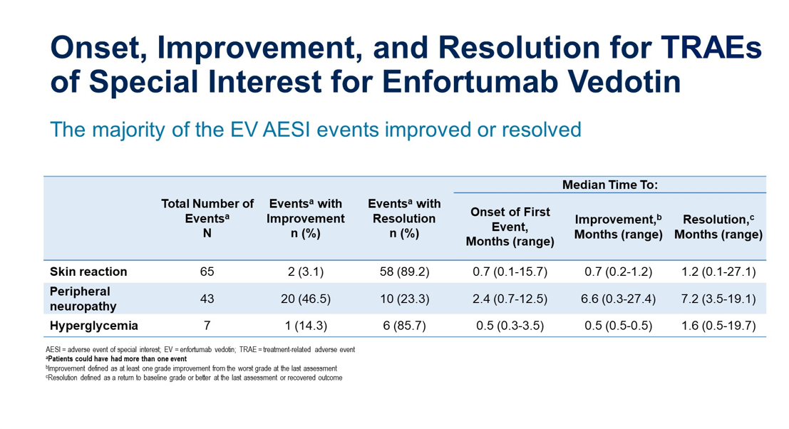
Presented by Shlipa Gupta ASCO 2023

Slide 37
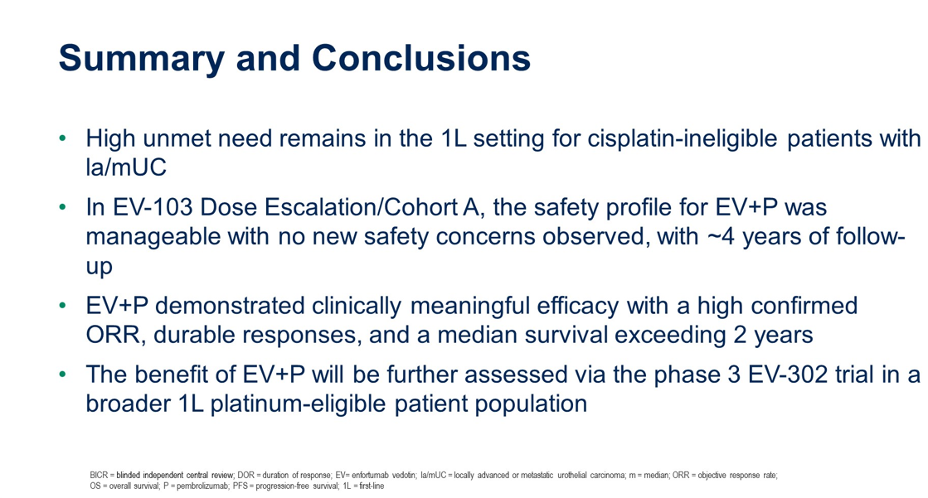
Presented by Shlipa Gupta ASCO 2023

Slide 38
Imvigor 130 OS final analysis
(ASCO 2023 abst 4503)

Slide 39
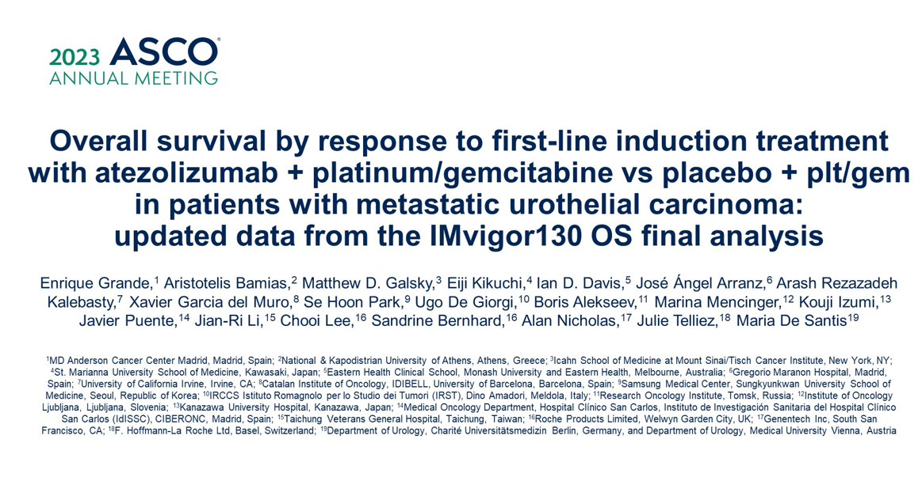
Presented by Enrique Grande ASCO 2023

Slide 40
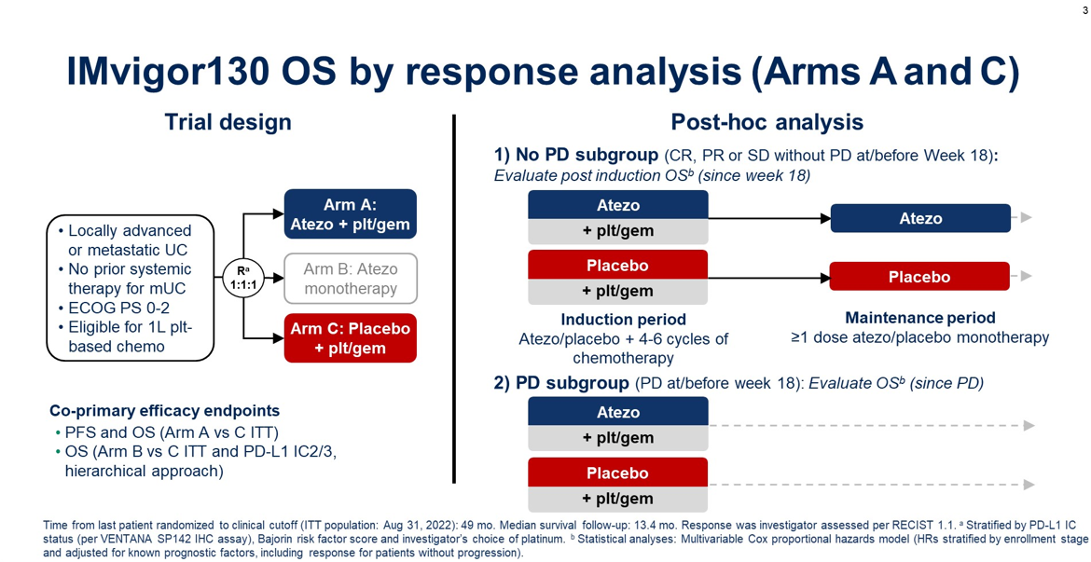
Presented by Enrique Grande ASCO 2023

Slide 41
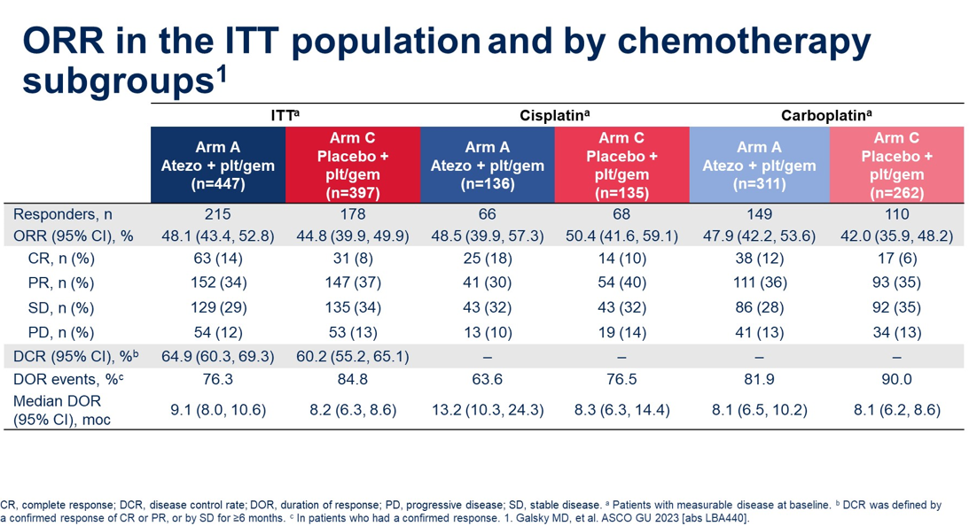
Presented by Enrique Grande ASCO 2023

Slide 42
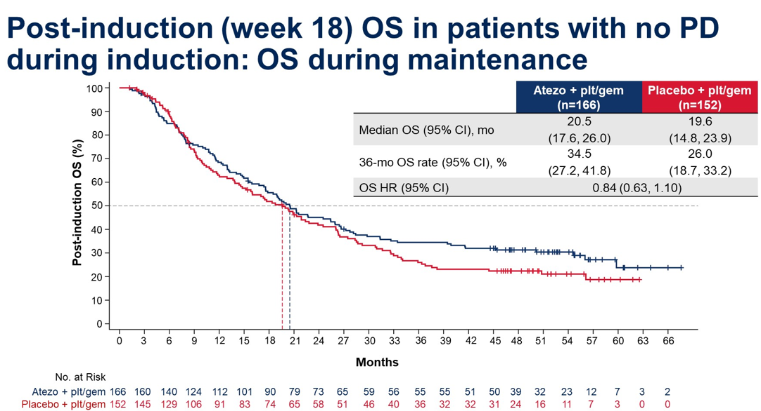
Presented by Enrique Grande ASCO 2023

Slide 43
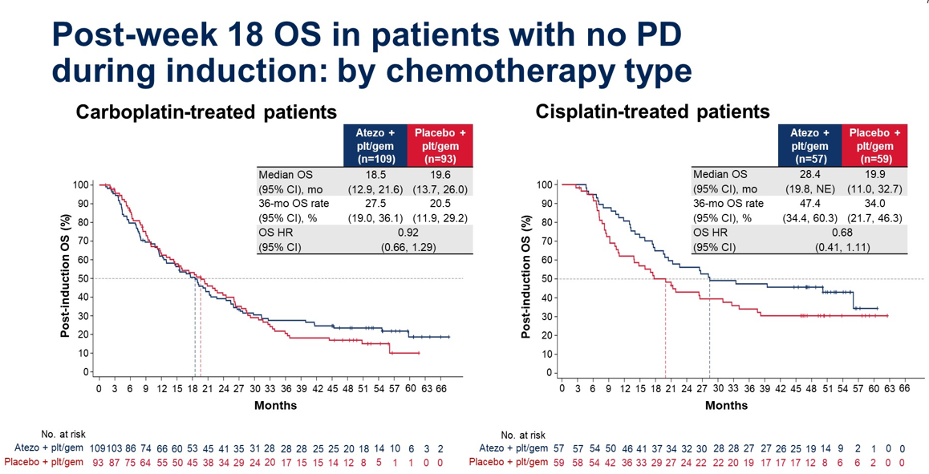
Presented by Enrique Grande ASCO 2023

Slide 44
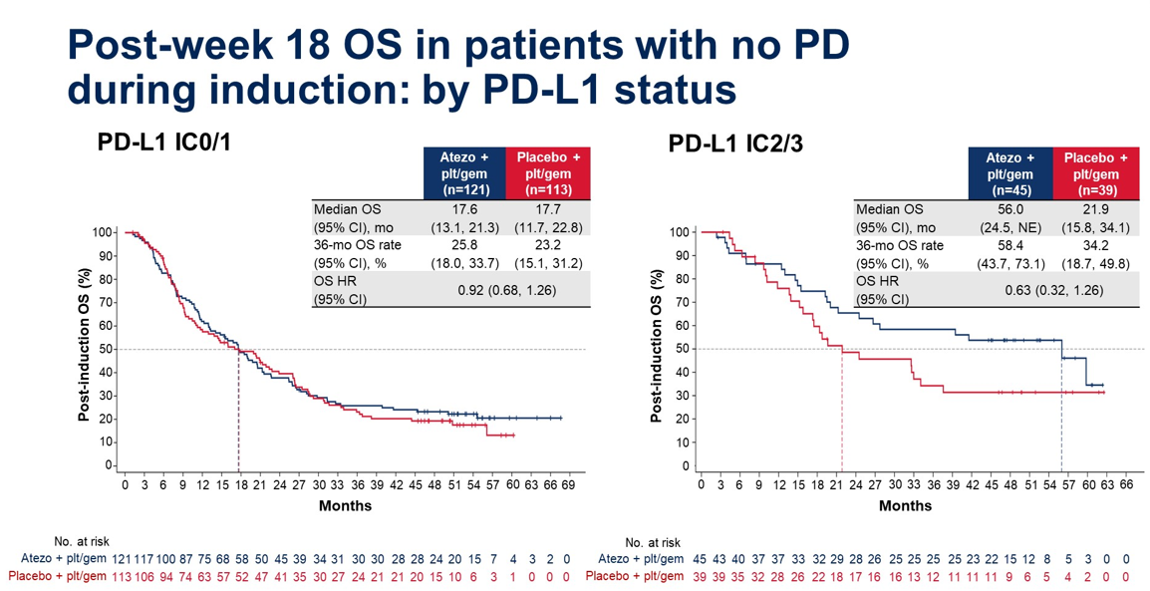
Presented by Enrique Grande ASCO 2023

Slide 45
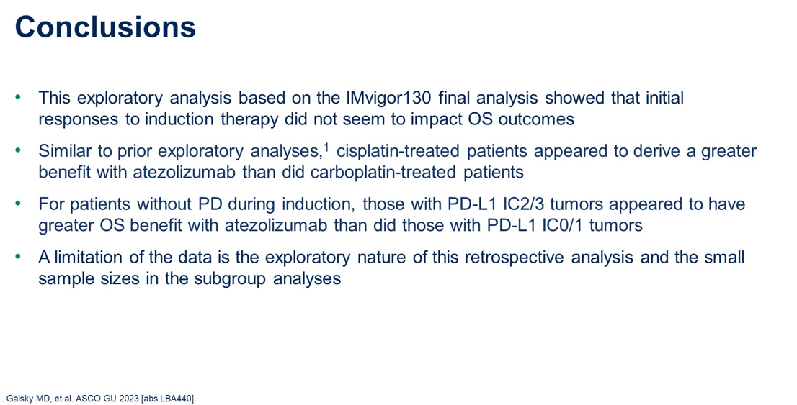
Presented by Enrique Grande ASCO 2023

Slide 46
Now what?

Slide 47
dd-MVAC x 4-6 cycles
Y
PS/Age/Comorbidities
N
Cisplatin + Gemcitabine
Maintenance Avelumab
Y
CISPLATIN-ELIGIBLE?
Carbplatin + Gemcitabine
N
Fit for Cytotoxic therapy?
Y
EV + Pmebro
FGFR+
Erdafitnib + Cerelimab
N
Single Agent IO

Slide 48
BLADDER/RCC
Monday, August 14, 2023

Slide 49
Sequencing strategies for treating relapsed/refractory urothelial carcinoma
Jue Wang, MD, FACP
Professor of Medicine
University of Texas Southwestern Medical Center
Dallas, Texas

Slide 50
Relapsed and Refractory Disease: The Journey
2014: Superficial bladder cancer T1 N0 M0
2017: MIBC. Bulky nodal disease with invasion to prostate
2017: ddMVAC x 4 with partial response.
2017: NCT02500121 "A Randomized, Double-Blinded, Phase II Study of Maintenance Pembrolizumab versus Placebo after First-line Chemotherapy in Patients with Metastatic Urothelial Cancer (GU14-182)".
2018: NCT02903914 A first-in-human phase 1 study of small molecule inhibitor of arginase, as monotherapy and in combination with an anti-PD-1 checkpoint inhibitor
2019: NCI-MATCH, arm J ( HER2 amp Trastuzumab, Pertuzumab) NCT02465060
2019: Gem/cis x 4 in 2019
Feb 2020: Enfortumab vedotin-ejfv
April 2021 to June 2021: Avelumab
July 2021-September 2021: Sacituzumab govitecan
2022: NCT04579224 A Phase III Randomized Trial of Eribulin With or Without Gemcitabine Versus Standard of Care (Physician's Choice) for Treatment of Metastatic Urothelial Carcinoma Refractory to, or Ineligible for, Anti PD1/PDL1 Therapy.
Aug 2022 Docetaxel
October 2022-2023 Phase I study

Slide 51
Outline
The challenges in the management of metastatic urothelial carcinoma
Emerging strategies for relapsed or refractory urothelial carcinoma
  Delay relapse/refractory disease through maintenance therapy
  Reduced the risk of relapse/refractory disease through frontline intensification
  Targeting tumor biology of relapse/refractory disease: Achilles' heel?
Summary and Conclusions

Slide 52
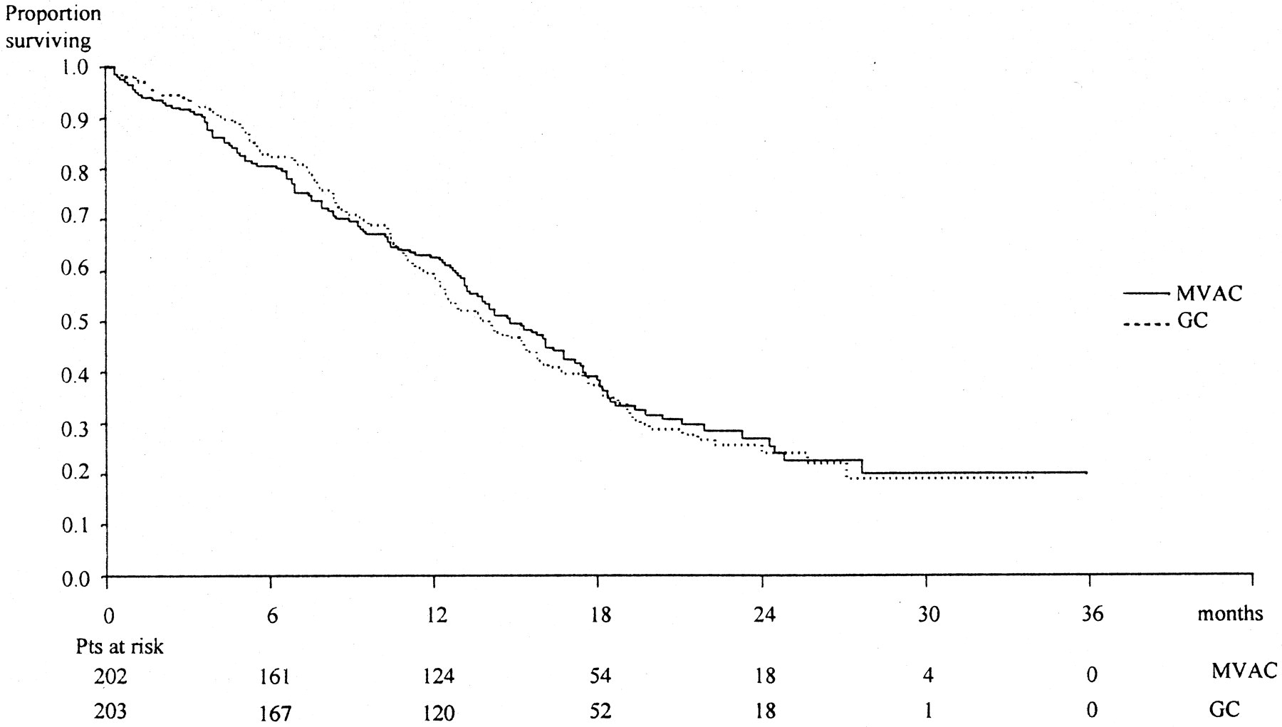
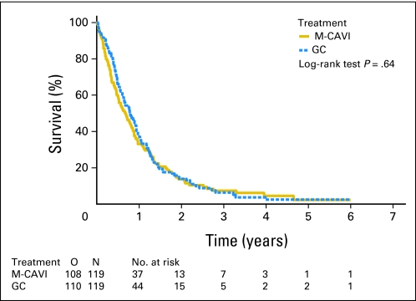
Chemotherapy responses are typically not durable
Objective responses or stable disease (SD) in approximately 65–75% of patients
Median approximately 6–8 months) and OS (median approximately 9–14 months)
J Clin Oncol. 2000 Sep;18(17):3068-77
J Clin Oncol. 2012;30(2):191-9.
Notes:
Clinical trial or systemic treatment as per patient’s co-morbid medical conditions:

Slide 53
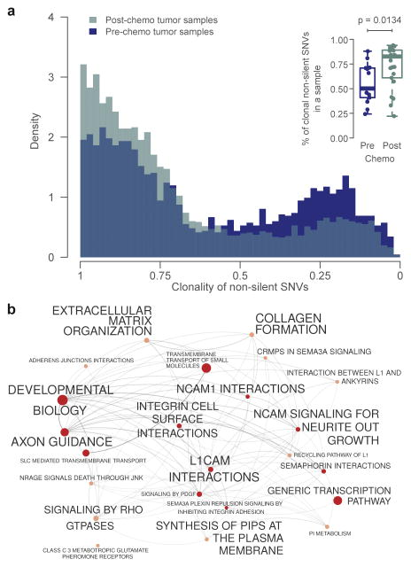
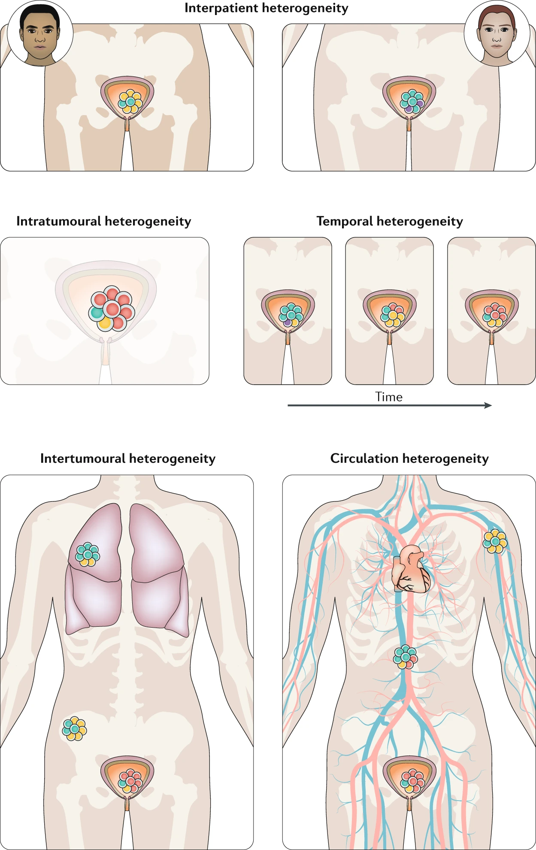
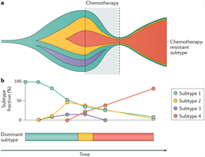
Chemotherapy-driven clonal evolution: intratumoural and intertumoural heterogeneity at the clinical, morphological, genomic, transcriptional and cellular levels
Nat Rev Urol. 2020;17(5):259-270
Nat Rev Urol 2020, 17, 259–270
Nat Genet. 2016;48(12):1490-1499.

Slide 54
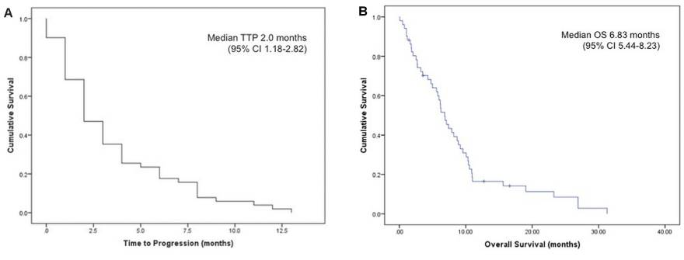
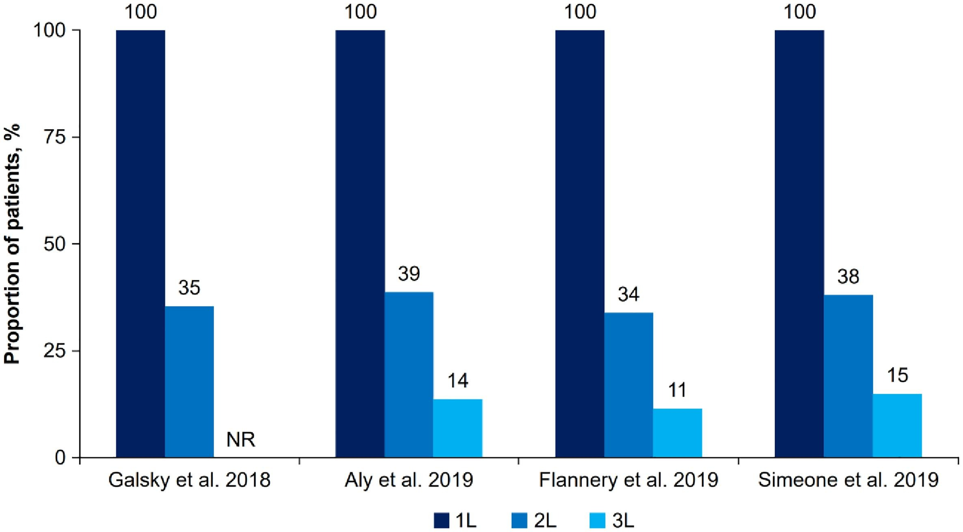
Treatment challenges in the management of relapsed or refractory Urothelial Carcinoma
Median time to progression (ttp) and overall survival (OS) were 2.0 and 6.83 months
Time to progression for patients with mUC who received second-line chemotherapy.
Overall survival for all patients with mUC who received more than 1 line of systemic therapy.
Curr Oncol. 2019;26(2):e260-e265.
Cancer Treat Rev. 2021 Jun;97:102187.

Slide 55
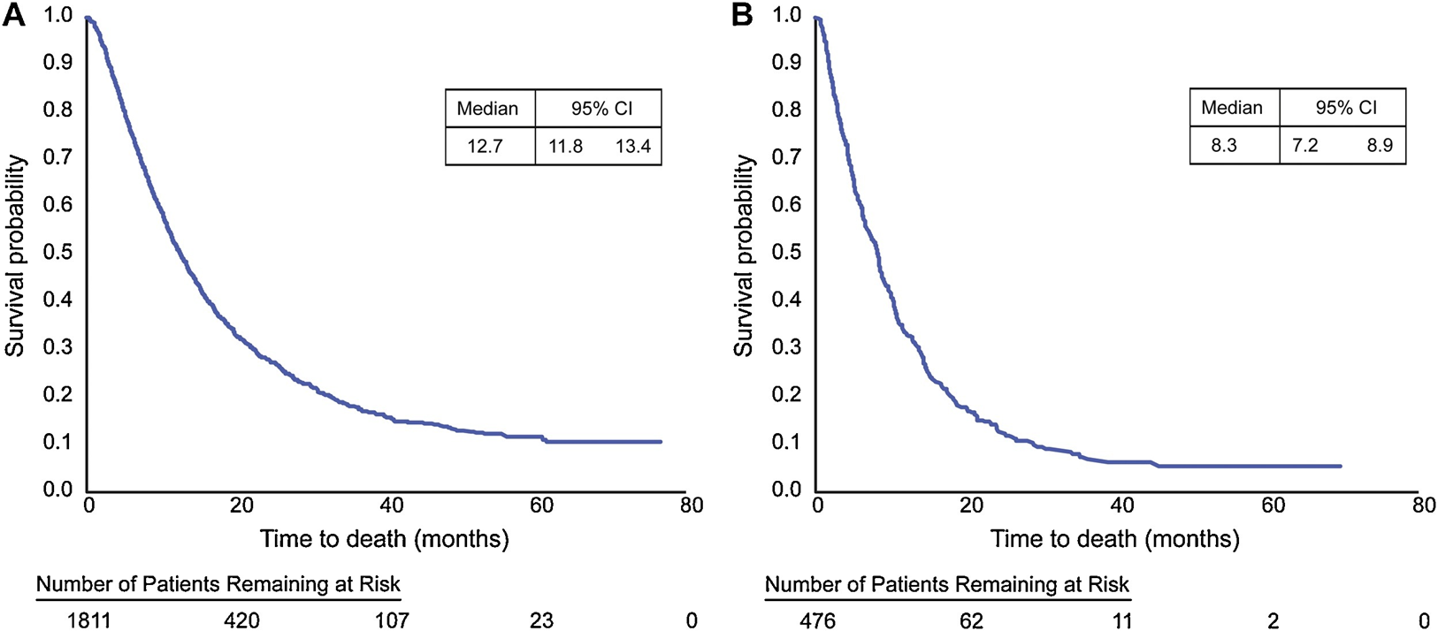
Overall survival in metastatic urothelial carcinoma: real-world data
Cancer Epidemiol. 2019;60:121-127.

Slide 56
Emerging strategies for relapsed or refractory UC
Switch maintenance: delay relapse/refractory disease
Frontline intensification: Reduced the risk of relapse/refractory disease
Targeting tumor biology of relapse/refractory disease: finding Achilles' Heel

Slide 57
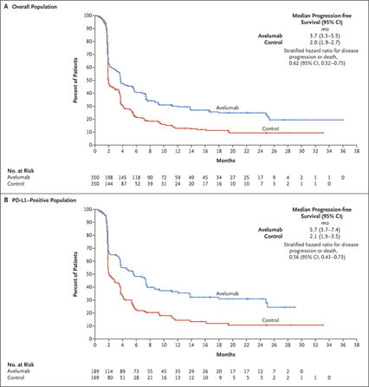
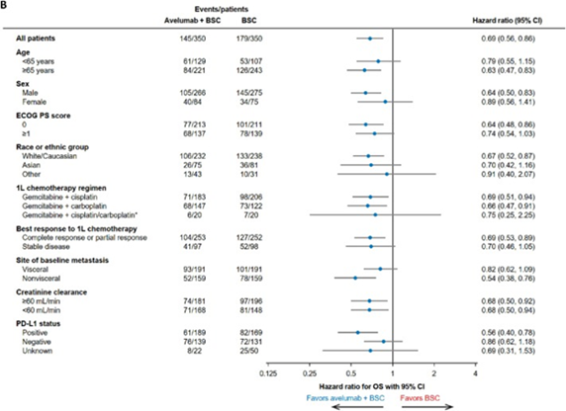
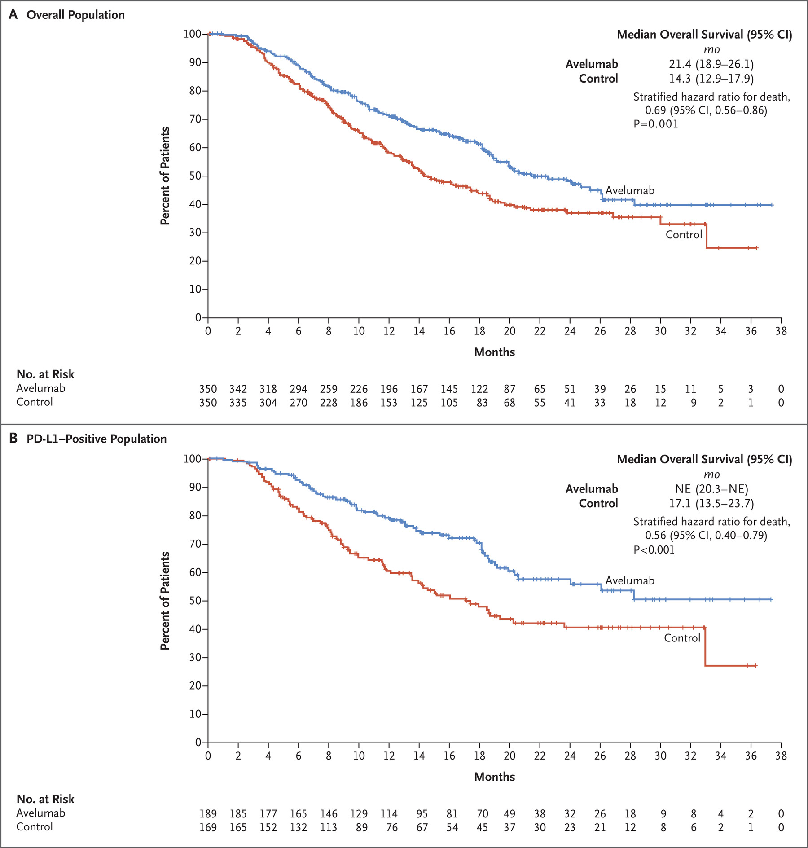
Maintenance avelumab plus best supportive care significantly prolonged overall survival
 | Switch maintenance median OS | BSC median OS (months )
Overall population | 29.7 | 20.5
cisplatin plus gemcitabine | 31.0 | 23.0
carboplatin plus gemcitabine | 25.8 | 17.6
N Engl J Med 2020; 383:1218-1230
2023 GU ASCO Abstract #508

Slide 58


Improve survival without compromising quality of life: Patient-reported Outcomes from JAVELIN Bladder 100
Eur Urol. 2023;83(4):320-328

Slide 59

Switch maintenance: leveraging synergy between chemotherapy and immunotherapy
Front line | Median OS from start first line therapy (m)
JAVENLIN Bladder 100 | 29.7
ICI follow platinum containing chemotherapy | 16-18
ICI monotherapy (Cisplatin-ineligible with PDL1+) | 12.3-18.5
AntiPD-L1 and anti-CTL-4 Ab | 15.1
Cancer Treat Rev. 2021 Jun;97:102187.

Slide 60
Emerging strategies for relapsed or refractory UC
Switch maintenance: Delay relapse/refractory disease
Frontline intensification: Reduced the risk of relapse/refractory disease
Targeting tumor biology of relapse/refractory disease: finding Achilles' Heel

Slide 61



Enfortumab Vedotin Plus Pembrolizumab in Previously Untreated Advanced UC in patients ineligible for cisplatin.
The confirmed objective response rate 73.3% with complete response rate of 15.6%.
The median DOR and were 25.6 months and median OS 26.1 months.
Waterfall plot of change from baseline
Change from baseline of the sum of diameters of target lesions
Swimmer plot of time to response and duration of response
(A) DOR, (B) PFS, and (C) OS
J Clin Oncol. 2023;41(1):22-31

Slide 62
Emerging strategies for relapsed or refractory UC
Switch maintenance: Delay relapse/refractory disease
Frontline intensification: Reduced the risk of relapse/refractory disease
Targeting tumor biology of relapse/refractory disease: finding Achilles' Heel

Slide 63


Pembrolizumab as Second-Line Therapy for Advanced UC
N Engl J Med 2017; 376:1015-1026

Slide 64



Enfortumab Vedotin Prolonged Survival in Previously Treated Advanced UC
N Engl J Med 2021; 384:1125-1135

Slide 65




Sacituzumab Govitecan in Patients With mUC Progressing After Platinum-Based Chemotherapy and Checkpoint Inhibitors
Kaplan-Meier analysis of (A) PFS, (B) OS, and (C) DOR. DOR, duration of response
J Clin Oncol. 2021;39(22):2474-2485.

Slide 66



Erdafitinib in patients with advanced or mUC with select FGFR alterations
45.9% of patients had at least 1 TRAE of grade 3 or 4.
Hyperphosphatemia (78.5% and 5.2%),
Diarrhea (54.8% and 3.0%),
Stomatitis (45.9% and 8.1%),
Dry mouth (38.5% and 0%),
Palmar-plantar erythrodysesthesia (30.4% and 9.6%),
Onycholysis (23.0% and 5.9%).
Journal of Clinical Oncology 41, no. 17_suppl (June 10, 2023) LBA4619-LBA4619.

Slide 67
Sequencing Therapies for Metastatic UC
Front-line systemic treatment or clinical-trials:
Cisplatin eligible: cisplatin-combinations and switch maintenance
Cisplatin ineligible:
  GCa-combinations and switch maintenance
  Pembrolizumab for any patient ineligible for platinum-based chemotherapy
  Atezolizumab for any patient whose tumor expresses PD-L1 or for any patient ineligible for platinum-based chemotherapy
  Enfortumab vedotin-ejfv with pembrolizumab
Subsequent-lines systemic treatment or clinical trials:
Primary refractory disease: Immune checkpoint inhibition
FGFR3 mutation or fusion: Erdafitinib
Enfortumab vedotin
Sacituzumab govitecan
Alternative chemotherapy regimens

Slide 68
Practical Considerations in optimal selecting and sequencing in relapse/refractory UC
Consider both host, the disease, and previous treatment factors
Maximize the exposure to all active agents
Consider clinical trials options
Geriatric assessment, frailty level, comorbidities
Quality of life, performance status, nutrition status, social supports
Previous goal and preference
Intrinsic disease characteristics, time of relapse, disease burden, and progress pace, genetic evolution, variant tumor histology.
Previous therapies, duration of response, toxicities

Slide 69
Conclusion and Summary
As new treatment options are rapidly introduced, and clinical decision-making becomes more complex.
Clinical studies will continue to refine the treatment approach of R/R UC with the goal of personalization of treatment with biomarkers.
Optimal management of R/R UC need to consider each individual patients' comorbidities, organ functions, biology of the recurrent disease, prior therapies, response and toxicities.

Slide 70
Patient Case
MLS 79 yo

Slide 71
Case presentation:
History of previously cured breast cancer in 1996
Treated for non-muscle invasive bladder cancer 2010 (Likely only TURBT, incomplete records) she stopped following up after 5 years of monitoring in 2015.
She presents to outside provider with urinary frequency treated as urinary tract infection starting 6/26/2022 but eventually referred to urology when she did not have improvement.
She underwent TURBT on 8/18/2022: Papillary urothelial carcinoma, high-grade with tumor invading into muscularis propria and lymphovascular invasion.
Needed left PCN.
OSH CT Abdomen/Pelvis 8/19/2022:
  Diffuse irregular wall thickening and enhancement of the bladder, asymmetric right posterior lateral bladder wall thickening with suspected invasion into the right superior lateral vagina.
  There was internal iliac and pelvic sidewall lymph node metastases measuring 1.5 cm. Additionally, she has a soft tissue nodule posterior to the right kidney (hematoma versus metastasis), low-density 2.6 x 1.9 cm cystic lesion in the right groin of indeterminate nature, right middle lobe pulmonary nodules.

Slide 72


Circumferential thickening of the bladder wall is presumably related to history of bladder neoplasm

Slide 73



- No definitive pelvic lymphadenopathy. Right internal iliac cystic lesion and right inguinal cystic lesion may correspond to the outside CT reported findings. These could represent small lymphatic malformations.
- Cystic/necrotic lymphadenopathy is felt to be less likely given that the primary tumor appears solid.

Slide 74



Slide 75





Slide 76
Next:
Before starting any treatment, she was admitted for sepsis due to pyelonephritis.
Carboplatin + Gemcitabone (Unresectable vs. Neoadjuvant?)
Restaging after 2 cycles:
  Circumferential bladder wall thickening with mild enhancement along the anterior left lateral walls. This may represent the patient's known bladder mass.
  Moderate to severe left hydroureteronephrosis to the distal left ureter just above the left ureterovesical junction. No distal ureteral calculus or discrete ureteral mass visible by CT. Bilateral nephrostomies remain in position.
  Unchanged 4.1 cm left adnexal cystic lesion.
  Atrophic right kidney.
  Unchanged small cystic lesions adjacent to the right internal iliac vessels and right inguinal location.
  11 mm left pericardiophrenic node, unchanged. No other adenopathy in the abdomen or pelvis.

Slide 77
Next:
To ED during C3 with Tmax 100.6 x2
To ED during C4 with Tmax 101
Completed 4 cycles of Gem + Carbo in late 1/2023.

Slide 78
Other discussions about treatment optisons?
Met RadOnc during chemotherapy:
  Is Trimodality therapy Feasible?
  What is bladder preservation rate?
  What is the distant metastases risk?
Met with Urology around C3-4
  Is she resectable?
  Thoughts about initial nodes?
  Thoughts about pulmonary nodules?

Slide 79
Surgery
A. Urinary bladder, uterus and cervix including anterior vaginal cuff, bilateral fallopian tubes and ovaries, radical cystectomy total abdominal hysterectomy and vaginectomy:
Extensive invasive urothelial carcinoma, micropapillary variant; see Interpretation
Patchy denuded surface with foreign body giant cell reaction, consistent with therapy effect
Carcinoma centered around the right ureteral orifice but involves the entire posterior and right bladder including the dome
Carcinoma involves anterior endocervix (direct extension versus lymphovascular spread), and involves uterine corpus and posterior endocervix (favor lymphovascular spread)
Surgical resection margins including vaginal cuff margins free of carcinoma
Pathologic stage ypT4aN0
B. Left pelvic lymph nodes, lymphadenectomy:
– 10 benign lymph nodes, negative for carcinoma (0/10)
– Tumor embolus in small para-nodal venous channel
C. Right pelvic lymph nodes, lymphadenectomy:
– 17 benign lymph nodes negative for carcinoma (0/17)
D. Left distal ureter, resection:
– Benign ureter segment
E. Right distal ureter, resection:
– Benign ureter segment

Slide 80
Next?
Offered Adjuvant Nivolumab (Checkmate-274)
Sudden deterioration right after start of Nivolumab
Prolonged admission for failure to thrive and hyponatremia possibly SIADH
Renal failure likely on background of preexisting CKD.
Patient elected to forgo additional treatment and enrolled on hospice.

Slide 81
BLADDER/RCC
Monday, August 14, 2023

Slide 82
Frontline Therapy for advanced RCC
Hans Hammers MD, PhD
Professor of Medicine
UT Southwestern
Dallas, TX

Slide 83




Advanced ccRCC: Variable Biology

Slide 84


Goal of Immunotherapy

Slide 85
1st Line Treatment Categories
IO/IO
PD1/CTLA4
(Nivo/IPI)
TKI/IO
Axi/PD1
Cabo/PD1
Len/PD1

Slide 86

IO/IO: Nivo/IPI
HR for OS in FAV subgroup, 0.94
ORR ITT (nivo/ipi vs sun): 41% vs 34% [CR, 11% vs 2%; PR, 31% vs 32%; SD, 30% vs 41%; PD, 22% vs 16%].
Motzer R, et al. ESMO 2021. Abstract 661P.
Notes:
Slide/Content Note:
After 4 years minimum follow-up, OS (HR; 95% CI) remained superior with NIVO+IPI vs SUN in ITT (0.69; 0.59 to 0.81) and I/P patients (0.65; 0.54 to 0.78).
HR for OS in FAV patients was 0.94

Slide 87

Powles T, et al. Gu Ca Symp. Abstract 543.
Notes:
Slide/Content Note:
Slide/Content Notes
ASCO GU 2022 updates
Real-world treatment outcomes of first-line axitinib plus pembrolizumab in patients with advanced renal cell carcinoma in the United States.
Abstract 314 Poster
Zakharia Y, et al.
Real-world experience (RWE) of safety and efficacy of 6-weekly pembrolizumab 400mg (pem6w) plus axitinib (axi) in patients (pts) with advanced renal cell carcinoma (aRCC).
Abstract 309 Poster
Ansel S, et al.

Slide 88

Progression-Free Survival in the ITT Population
Keynote 426: Axitinib/Pembrolizumab
Content of this presentation is the property of the author, licensed by ASCO. Permission required for reuse.

Slide 89

Overall Survival in the ITT Population
Keynote 426: Axitinib/Pembrolizumab
Content of this presentation is the property of the author, licensed by ASCO. Permission required for reuse.

Slide 90

Phase 3 CheckMate 9ER: Study Design
Choueiri T, et al. ESMO 2020. Presentation 696O. Choueiri T, et al. N Engl J Med. 2021;384:829-841.
Notes:
Slide/Content Notes
Background: Results from the phase 3 CheckMate 9ER trial evaluating the checkpoint inhibitor (CPI) nivolumab (N) plus the tyrosine kinase inhibitor (TKI) cabozantinib (C) v sunitinib (S) for first-line (1L) treatment of advanced clear cell renal cell carcinoma (aRCC) are reported. As monotherapies, N and C have demonstrated efficacy and a manageable safety profile in aRCC. C has immunomodulatory properties that may counteract tumor-induced immunosuppression, providing a rationale for combining N+C.
Methods: Patients (pts) were randomized 1:1 (stratified by IMDC risk score, tumor PD-L1 expression, region) to N 240 mg flat dose IV Q2W + C 40 mg PO QD v S 50 mg PO for 4 wk (6-wk cycles) until disease progression or unacceptable toxicity (max N treatment, 2 y). Primary endpoint: progression-free survival (PFS; a ¼ 0.05 final) by blinded independent central review (BICR). Secondary endpoints (hierarchical testing): overall survival (OS; a ¼ 0.011 first interim analysis), objective response rate (ORR; a ¼ 0.05 final) by BICR, and safety.
Results: A total of 651 pts (22.6% favorable risk, 57.6% intermediate risk, 19.7% poor risk; 24.9% PD-L1 _1%) were randomized to N+C (n ¼ 323) v S (n ¼ 328). With 18.1 mo median (10.6 mo minimum) study follow-up, all 3 efficacy endpoints were met. N+C significantly improved PFS (HR 0.51 [95% CI 0.41e0.64], P < 0.0001; median, 16.6 v 8.3 mo) and OS (HR 0.60 [98.89% CI 0.40e0.89]; P ¼ 0.0010; medians not reached) v S, and results were consistent across prespecified IMDC risk and PD-L1 subgroups. ORR (95% CI) was significantly higher with N+C v S (55.7% [50.1e61.2] v 27.1% [22.4e32.3]; P < 0.0001), and 8.0% v 4.6% of pts achieved complete response. Median duration of response was 20.2 v 11.5 mo for N+C v S. Any-grade TRAEs occurred in 96.6% v 93.1% of pts treated with N+C v S (60.6% v 50.9% grade _3). One treatment-related death occurred with N+C v 2 with S. TRAEs led to discontinuation of S in 8.8%, N or C in 15.3%, N+C in 3.1%, N only in 5.6%, and C only in 6.6% of pts.
Conclusions: N+C demonstrated superior PFS, OS, and ORR v S in 1L aRCC. The safety profile of this combination was manageable and consistent with the known single agent AE profiles of N and C. These results support N+C as a new CPI+TKI option for aRCC pts.
Clinical trial identification: NCT03141177.

Slide 91

CheckMate 9ER: PFS (BICR), ITT—Primary Endpoint
ASCO GU
2023
Median (range) follow-up, 44.0 (36.5-56.5) months
Database lock, May 27, 2022
Burotto M, et al. ASCO GU 2023. Abstract 603. Powles T, et al. GU Ca Symp 2022. Abstract 350.
Notes:
Slide/Content Notes
42% reduction in risk of disease progression
Progression-free survival and objective response were assessed by blinded independent central review
Benefits sustained with additional follow up (44 mo median follow up, ASCO GU 2023 Abstract 603)
________________________
GU Ca Symp 2022 Updates
https://meetings.asco.org/abstracts-presentations/205620
Results:
After 25.4 months minimum follow-up (median, 32.9 months) for OS in ITT pts, a total of 271 OS events occurred, and N+C continued to demonstrate OS improvement vs SUN (N = 323 vs 328; median 37.7 vs 34.3 months; HR 0.70 [95% CI 0.55–0.90]).
PFS (median 16.6 vs 8.3 months; HR 0.56 [95% CI 0.46–0.68]) and ORR (55.7% [95% CI 50.1–61.2] vs 28.4% [95% CI 23.5–33.6]) benefits were maintained with N+C vs SUN, and 12.4% (N+C) vs 5.2% (SUN) of pts had a complete response.
Median duration of response was 23.1 months with N+C vs 15.1 months with SUN. A higher percentage of pts experienced any reduction and ≥30% reduction from baseline with N+C vs SUN in target lesions at all organ sites assessed (Table). Among all treated pts, 97.2% (N+C; N = 320) vs 93.1% (SUN; N = 320) had a treatment-related adverse event (TRAE) of any grade (65.0% vs 54.1% had a grade ≥ 3 TRAE).
Conclusions:
N+C continued to provide survival improvement vs SUN among ITT pts in the final OS analysis, additionally PFS and ORR benefits with N+C were sustained with minimum 2-year follow-up. A higher proportion of pts experienced tumor shrinkage benefit with N+C vs SUN across all 4 organ sites assessed. No new safety signals emerged with extended follow-up in either arm. These results highlight N+C as a first-line treatment for pts with aRCC. Clinical trial information: NCT03141177.
References
1. Choueiri T, et al. N Engl J Med. 2021;384:829-841.

Slide 92

CheckMate 9ER: OS (ITT)—Secondary Endpoint
ASCO GU
2023
Median (range) follow-up, 44.0 (36.5-56.5) months
Database lock, May 27, 2022
Burotto M, et al. ASCO GU 2023. Abstract 603.
Notes:
Moderator/Discussion Note
Ask attendees reaction to this curve with longer follow up.
HR has remained stable w longer follow up

Slide 93

Phase 3 CLEAR Study: Frontline Lenvatinib + Pembrolizumab or Everolimus Versus Sunitinib
Subsequent therapies received (L+P / S), %: anti-VEGF, 30 vs 34; anti-PD-1/PD-L1, 8 vs 43; other, 7 vs 15.**
*Patients could receive a maximum of 35 pembrolizumab treatments. **Pts may have received > 1medication with a medication type. Other includes mTORi and CTLA4i, et al.
DOR, duration of response; HRQoL, Health-related quality of life; IRC, Independent Review Committee; MKSCC, Memorial Sloan Kettering Cancer Center; ORR, R, randomization.
Motzer R, et al. N Engl J Med. 2021;384(14):1289-1300. Voss M, et al. ASCO 2022. Abstract 4514.
Notes:
Slide/Content Note:
SUBSEQUENT THERAPY ANALYSIS ABSTRACT
Background: In the open-label, randomized, phase 3 CLEAR study, LEN + PEMBRO had significant PFS (primary endpoint) and OS (key secondary endpoint) benefits over SUN among pts with aRCC in the 1L setting (Motzer 2021, NEJM). We evaluated PFS on next-line therapy (“PFS2”) and explored the effect of subsequent anticancer therapy on OS in the LEN + PEMBRO and SUN treatment arms of CLEAR.Methods:PFS2 was defined as time from randomization to disease progression (as assessed by investigator) on next-line treatment or death from any cause (whichever occurred first). PFS2 was evaluated in all pts randomly assigned to LEN 20 mg orally QD + PEMBRO 200 mg IV Q3W (n=355) or SUN 50 mg orally QD (4 wks on/2 wks off) (n=357) using Kaplan-Meier estimates, and compared between treatment arms via a log-rank test stratified by geographic region and MSKCC prognostic groups. The HR and corresponding CI were estimated using the Cox regression model with Efron’s method for ties, using the same stratification factors. A post hoc analysis accounting for the effect of subsequent anticancer therapy on OS (time from randomization to death from any cause) in the LEN + PEMBRO and SUN arms using 2-stage estimation was conducted.Results:Among pts who received subsequent anticancer therapy in the LEN + PEMBRO (n=117 pts) and SUN (n=206 pts) arms (Table), median time to next-line therapy was 12.2 mos (range 1.45–37.36) and 6.4 mos (range 0.39–28.52), respectively. Median duration of first subsequent anticancer therapy was 5.2 mos (range 0.10–30.23) in the LEN + PEMBRO arm and 6.8 mos (range 0.03–30.72) in the SUN arm. Among all pts, PFS2 was longer with LEN + PEMBRO than with SUN (median not reached vs 28.7 mos; HR, 0.50; 95% CI 0.39–0.65; nominal P<0.0001); PFS2 rates at 24 and 36 mos are in the Table. The unadjusted OS HR for LEN + PEMBRO vs SUN (from the primary analysis [Motzer 2021, NEJM]) was 0.66 (95% CI 0.49–0.88); the HR for OS adjusted for subsequent therapy was 0.54 (bootstrap 95% CI 0.39–0.72).Conclusions: LEN + PEMBRO had a statistically significant and clinically meaningful benefit over SUN in the CLEAR study. These findings remained consistent after accounting for subsequent therapies, as evidenced by prolonged PFS2 and adjusted OS. Results further support LEN + PEMBRO as a standard of care in 1L aRCC. Clinical trial information: NCT02811861.

Slide 94

Continued PFS benefit of LEN+PEMBRO vs SUN with follow up extended by over 23 months
Content of this presentation is the property of the author, licensed by ASCO. Permission required for reuse.

Slide 95

Final OS analysis
Content of this presentation is the property of the author, licensed by ASCO. Permission required for reuse.

Slide 96

TKI Flavors: Lenvatinib
Alanine aminotransferase and /aspartate aminotransferase increase by arm (LEN + PEMBRO vs SUN):
9.7% vs 8.8% (Gr 3: 3.1% vs 1.8%) / 9.4% vs 8.8% (Gr 3: 2.6% vs 0.6%)
*AE of interest for PEMBRO.
Motzer R, et al. N Engl J Med. 2021;384(14):1289-1300.
Notes:
Slide/Content Notes
The safety profiles of lenvatinib plus pembrolizumab and lenvatinib plus everolimus were consistent with each drug’s known profile and manageable, as needed, through dose modifications
These results support lenvatinib plus pembrolizumab as a potential first-line treatment for patients with advanced RCC
Point out not about liver enzyme elevation w/ this regimen

Slide 97

TKI Flavors: Cabozantinib
Choueiri T, et al. ESMO 2020. Presentation 696O.
Notes:
Slide/Content Notes
Combination was generally well tolerated with a low rate of treatment-related discontinuations
Patients had significantly better quality of life with NIVO + CABO versus SUN
TRAE-related discontinuations
Both agents 6.6%
Nivolumab 9.7%
Cabozantinib 7.2%

Slide 98


Special Case: Favorable-Risk RCC
Motzer R, et al. Cancer. 2022;128(11):2085-2097.

Slide 99

Extreme Case for IO/IO

Slide 100
IO/IO vs IO/TKI
vs
PROS
Mature Follow Up
Durable Responses/Plateau
Unmatched QoL
Know what happened
PROS
High ORR
Longer PFS
Unclear when to stop therapy
Lower irAE rate (15%)
CONS
Higher irAE rate (30%)
Lower PFS/ Response Rate
Primary Progression ~20%
CONS
Immature Follow Up, long term benefit unclear
Unclear which component contributed
Masks heterogeneity in IO response
Lower QoL, chronic TKI toxicity
Hans Hammers @HHammersMD

Slide 101
vs
Triple Therapies (IO/IO/TKI)
(e.g. COSMIC313, MK-6482-012)
>> Best of both Worlds?

Slide 102
TRIPLETS
More = Better?
    Higher Response? PFS?
    OS?
2. Combinability / Toxicity?
    High Grade AEs? QoL?
    Affect Drug Exposure?

Slide 103

COSMIC 313
Toni Choueiri and Colleagues
ESMO 2022

Slide 104


COSMIC 313
@HHammersMD
Low ORR, LOW CR, no OS?

Slide 105


COSMIC 313
Toxicity Gets in the Way!!

Slide 106
Conclusions
Opportunity Individualize Therapy
Therapies come with different flavors, pros/cons
No Biomarkers yet
Combinations are coming

Slide 107
Thank you !
@HHammersMD

Slide 108

BLADDER/RCC
Monday, August 14, 2023

Slide 109
Emerging Treatment Regimens for
Advanced RCC
Qian [Janie] Qin, MD
Assistant Professor
Division of Hematology and Oncology
Department of Internal Medicine,
UT Southwestern Medical Center
Dallas, Texas

Slide 110


Background
2023 estimates:
New cases: 81,800; death: 14,890
Age: 6-8th decades of life
Gender: 2:1 (M/F)
SEER, Kidney, accessed Aug 2023

Slide 111

Chronology of FDA-approved, first-line therapies for advanced ccRCC
Qin et al, unpublished

Slide 112
Efficacy of Doublet Therapies
Trial | CheckMate 214 | Keynote 426 | Javelin Renal 101 | CheckMate 9ER | CLEAR
Experimental | Ipilimumab Nivolumab | Pembrolizumab Axitinib | Avelumab/ Axitinib | Nivolumab/ Cabozantinib | Pembrolizumab Lenvatinib
Comparator |  | Sunitinib
Risk Group | All | All | All | All | All
Outcomes
OS | + OS (55.7)* | + OS (47.2)* | OS immature* | + OS (49.5) | + OS (53.7)
PFS | +PFS (12.3, 0.86)* | +PFS (15.7, 0.69)* | +PFS (13.8, 0.62)* | +PFS (16.6, 0.58)* | + PFS (23.9, 0.47)*
ORR | 39% * | 61% | 53% | 56% | 71%
CR | 12% | 12% | 4% | 12% | 18%
Primary PD | 18% | 12% | 12% | 6% | 5%
FDA | Yes | Yes | Yes | Yes | Yes
Motzer et al Cancer 2022; Rini et al ASCO 2023; Choueiri et al 2020; Burrotto et al ASCOGU 2023; Choueiri et al Lancet Oncol 2023 and Motzer ASCO 2023

Slide 113

Overview
Triplet therapy
Targeting the HIF pathway
Novel IO/VEGFR-TKI, and mechanisms of action
Kase et al, Cancers, 2023

Slide 114

COSMIC-313: Phase III, cabozantinib + ipilimumab + nivolumab
Powles et al, ASCOGU 2023; Choueiri et al, NEJM 2023

Slide 115

PFS
(PITT, n=550)
The trial met its primary endpoint of superior PFS
NR v. 11.3, HR 0.73
95% CI 0.57 – 0.94; P=0.01
Powles et al, ASCOGU 2023; Choueiri et al, NEJM 2023

Slide 116
Trial | COSMIC-313
Experimental | Cabozantinib/Ipilimumab/Nivolumab
Comparator | Ipilimumab/nivolumab | Ipilimumab/nivolumab
Risk Group | Intermediate/ Poor
Outcomes
OS | Immature
PFS | +PFS (NR, 0.73)*
ORR | 43% | 36%
CR | 3% | 3%
Primary PD | 8% | 20%
FDA | No
CheckMate 214 | CheckMate 9ER
Ipilimumab Nivolumab | Nivolumab/ Cabozantinib
sunitinib | sunitinib
All | All
+ OS (55.7)* | + OS (49.5)
+PFS (12.3, 0.86)* | +PFS (16.6, 0.58)*
39% * | 56%
12% | 12%
18% | 6%
Yes | Yes
Powles et al, ASCO GU 2023 and Choueiri et al, NEJM 2023; Motzer et al Cancer 2022; ; Burrotto et al ASCOGU 2023
Qin, unpublished

Slide 117

Treatment Exposure/Discontinuation
Choueiri et al, ESMO 2022; Powles et al, ASCO GU 2023 and Choueiri et al, NEJM 2023

Slide 118

Summary of Adverse Events
Choueiri et al, ESMO 2022; Powles et al, ASCO GU 2023 and Choueiri et al, NEJM 2023

Slide 119

IMDC Poor Risk
IMDC Intermediate Risk
45%
36%
ORR
PFS
Intermediate risk responded better to triplet therapy
No major difference in drug exposure or rate of grade 3-5 TRAEs
Powles et al, ASCO GU 2023 and Choueiri et al, NEJM 2023

Slide 120

Ongoing Triplet Trials
Novel TKI/IO
+/-
novel agents in RCC
Fakey et al, ASCO Educational Book, 2023

Slide 121
Takeaways
Cabozantinib/ipilimumab/nivolumab met its primary endpoint of PFS benefit, however
  No increase in ORR or CR rate
  Could be related to suboptimal drug exposure
  OS remains immature
Other triplets on the horizon with novel TKI, IO, or novel mechanisms

Slide 122

Novel agents targeting the HIF pathway
Cardenas et al, Curr Oncol 2022

Slide 123



VHL syndrome associated RCC
LITESPARK(MK6482)-004
Significant response
ORR of 64%; DCR of 98%
92% (56/61) experienced reduction in target lesion size
Well tolerated
Grade 3 TRAE: 18%; no Grade 4/5 TRAE
Dose interruption: 21%; discontinuation: 3%
Most common grade 3 TRAE: anemia (10%), fatigue (5%)
Jonasch et al, NEJM 2021; Jonasch et al, ASCO2022; Srinivasan et al, ESMO2022;

Slide 124


LITESPARK (MK6482)-001
Phase I, belzutifan 120mg
→ Significantly pre-treated population (median 3 lines)
Grade 3
40%
Anemia
24%
Hypoxia
13%
Characteristic | ccRCC cohort (n=55)
Prior lines of tx
Median (range) | 3 (1-9)
lines (0 / 1 / 2 / >3) | 0%/ 15% /24% / 62%
Therapy type
VEGF/VEGFR | 91%
IO | 80%
investigational/other | 29%
mTOR inhibitor | 24%
Cytokine | 18%
IMDC (Fav/ interm & poor) | 24% / 76%
-Promising efficacy, with ORR 25%
Prior IO + VEGFR-TKI: 21%
Prior IO or VEGFR-TKI: 38%
-Median DoR NR (range 3.1+ to 28+)
-Notable AEs: anemia and hypoxia
Choueiri et al. Nat Med. 2021; Jonasch et al, ASCO 2022

Slide 125



LITESPARK (MK6482)-003
Phase II, belzutifan 120mg + Cabozantinib 60mg
→ Treatment naïve (Cohort 1) and < 2 lines (Cohort 2)
Cohort 1 (treatment naive)
Cohort 2 ( < 2 lines, prior IO +/- TKI)
ORR
Overall (n=35)
Favorable (n=21)
Inter/poor (n=14)
ORR
57%
62%
50%
28.8%
  (54%)
  (46%)
Choueiri et al. Nat Med. 2021; Jonasch et al, ASCO 2022; Choueiri et al, ESMO 2022

Slide 126

TRAEs (Cohort 1)

Slide 127



belzutifan 120mg v. everolimus 10mg
LITESPARK (MK6482)-005
LITESPARK (MK6482)-011
Phase III, < 2 lines, doublet
Phase III, < 3 lines, single agent
belzutifan 120mg +lenvatinib 20mg v. cabozantinib 60mg
LITESPARK (MK6482)-012
Phase III, treatment naïve, triplet
belzutifan/lenvatinib/pembrolizumab
quavonlimab/lenvatinib/pembrolizumab
lenvatinib + pembrolizumab
Motzer, KCRS2020, Trial in Progress and Their Significance

Slide 128



Tackling HIF resistance
ARO-HIF21001
Phase I
Aro-HIF2: synthetic dsRNAi, designed to silence HIF2a expression
Heavily pretreated (~70% > 3 lines) population
Overall tolerable (G1/2: 60%; G3: 30.8%)
  Most frequent AEs: anemia, hypoxia
Efficacy:
  Reduction in HIF2a mRNA by qPCR (9/9) and IHC (9/14)
  ORR: 8%; DCR: 39%
Validate that HIF2a can be targeted with RNAi
Brugarolas et al, ASCOGU 2022

Slide 129
Takeaways
Belzutifan represent a novel agent with high potential in ccRCC
Evaluation in both treatment naïve and pre-treated setting
  both as monotherapy and in combination
  promising efficacy
  well tolerated
Mechanism of resistance and novel HIF-pathway inhibitors in development

Slide 130


CAR-T Therapy
Normal
CAR-T
Disease
De Marco et al, Int J Mol Sci, 2023
***

Slide 131
Challenge in solid tumor
Trafficking to tumor
Penetrate layers of extracellular matrix
Hostile tumor microenvironment
Tumor-associated antigens
  Uniformly expressed in tumor at high levels
  Tumor-specific, not expressed in normal cells
***

Slide 132

ALLO-316 (anti-CD70 allogeneic CAR-T)
CD70
TRAVERSE
COLBALT-RCC
Phase I, ccRCC, post IO and TKI
Phase I, ccRCC, post IO and TKI
CTX130 (allogeneic CRISPR-cas9 gene-edited, anti-CD70 CAR-T)
30 %
100 %
First-in human CD70 CAR-T
N=14
ORR 8% DCR 77%
  1 CR, durable
Tolerable safety profile
  50% grade 1/2 CRS (no grade > 3)
  No neurotoxic syndrome, GVHD, HLH
Overall ORR: 17%; DCR: 89%
Pal et al, Society for Immunotherapy of Cancer’s 37th Annual Meeting, 2022
Srour et al, AACR 2023; Allogen Therapeutic Press release 2023; : https://www.mdanderson.org/newsroom/aacr--novel-allogeneic-car-t-cell-therapy-delivers-promising-early-results-patients-metastatic-clear-cell-renal-cell-carcinoma.h00-159617856.html

Slide 133

Active clinical trials with CAR-T enrolling RCC patients
Kim et a. Investig Clin Urol 2022

Slide 134
Takeaways
CAR-T therapy has changed the treatment landscape for hematological malignancies
Its utility in solid tumor faces unique challenges
RCC tumor-associated antigen and CAR-T therapy under investigation with overall tolerability and preliminary efficacy

Slide 135


Radioligand Therapy
CAIX: expressed in >90% of ccRCC; not expressed in normal tissue
ZIRCON
STARLITE
Phase III
CAIX-based PET/CT (89Zr-DFO-girentuximab)
Sensitivity: 85.5%, specificity: 87%
STARLITE 1 Trial
Phase Ib/II
ccRCC, treatment naïve, avid on 89Zr-girentuximab PET
177Lu girentuximab + cabozantinib + nivolumab
STARLITE 2 Trial
Phase II
ccRCC, progress on prior IO, avid on 89Zr-girentuximab PET
177Lu girentuximab + nivolumab
Feldman et al, ASCO 2022; Hasanov et al, ASCO GU 2023; Shuch et al ASCO 2023;

Slide 136
Additional therapies
Novel VEGFR-TKIs
  XL092 (STELLAR-001, STELLAR-002)
Antibody drug conjugates
  DS-6000a, AGS-16C3
Others (cell cycle inhibition, etc)
Notes:
DS-6000a: cadherin 6 directed ADC with three components
AGS-16C3F: ADC to ectonucleotide pyrophosphatase/phosphodiesterase 3
Palbociclib: cyclein dependent kinase 4/6 inhibitor
CBM-588: bifidogenic live bacterial product, contains Clostridium butyricum
Batiraxcept: recombinant fusion protein with region of AXL with IgG1Fc
TPST-1120: inhibits PPARalpha, a transcription factor that regulate FAO

Slide 137
Summary – emerging treatment regimens for advanced RCC
Double IO/IO and IO/TKI therapies now shape the treatment landscape of advanced RCC
However, CR remains low, primary PD remains a challenge, and most patients who respond will eventually progress
Novel therapies under development
  Triple therapy with novel agents
  HIF2 pathway inhibition
  CAR-T
  Radioligand therapy & others
Holds promise in expanding the arsenal of available therapies for advanced RCC

Slide 138
Acknowledgements
UTSW/ Harold C Simmons Comprehensive Cancer Center GU Oncology
Kevin Courtney Hans Hammers
Jim Brugarolas Waddah Arafat
Tian Zhang Suzanne Cole
Vitaly Margulis Jue Wang
Yair Lotan Ganesh Raj
Xiaosong Meng Solomon Woldu
Jeffrey Cadeddu Jeffrey Gahan
Jeffrey Gahan Claus Roehrborn
Aurelie Garant Raquib Hannan
Neil Desai Kenneth Goldberg
Daniel Yang Andrew Wang
Thanks to our patients who teach us every day

Slide 139
How would you treat advanced RCC?
Hans Hammers MD, PhD
Professor of Medicine
UT Southwestern
Dallas, TX

Slide 140

PATIENT CASE #1
48 yo previously healthy Caucasian journalist was diagnosed with a large renal mass after workup for hematuria.

Slide 141
Baseline Scans
Around 10 cm Left Renal Mass, tumor in renal vein, probably extending into vena cava
Bx revealed ccRCC, G3
Good PS

Slide 142
Baseline Scans
Multiple large (up to 12 cm) liver metastases,
Bx revealed ccRCC, G3
No metastatic disease in the chest
No significant lab abnormalities, LFTs normal

Slide 143
Would you perform cytoreductive nephrectomy?
  Yes
  No

Slide 144
What frontline therapy would you choose?
  VEGF/TKI inhibitor
  Immunotherapy plus VEGF/TKI inhibitor (IO-TKI)
  Immunotherapy plus Immunotherapy (IO-IO)

Slide 145
What would be your primary rationale for your choice of first-line therapy?
Survival data
Overall response rate
Complete response rate
Durability of response
Quality of life
Simplicity of management of irAEs
Comfort with management of AEs
Real-world data
Other

Slide 146
6 Week Scans

Slide 147

irAE: Nephritis
6 weeks
Creatinine mg/dl
N/I #1
N/I #2

Slide 148
What would your management strategy be given the nephritis the patient experienced once therapy was resumed?
  Continue therapy as planned
  Discontinue therapy
  Hold therapy and restart at same dose once nephritis was resolved
  Hold therapy and restart at a lower dose once nephritis was resolved

Slide 149
irAE: Nephritis
6 weeks
P100 bid
P60 qd
MP1000 bid
P30 qd
MP1500 bid
MP1500 bid
Creatinine mg/dl
100 qd
N/I #1
N/I #2

Slide 150
12 Week Scans
Surgical Consolidation 1 year later : No residual tumor in the liver

Slide 151

5 years later … no further therapy

Slide 152
PATIENT CASE #2
Grandma in Distress

Slide 153
66 yo Female presents to OSH in January of 2022 with worsening fatigue, respiratory symptoms self-transported by granddaughter to UTSW
1/15/2022 CTA chest: Widespread metastatic disease throughout the lungs, mediastinum, lymphadenopathy, and pericardial implants.
1/15/2022 CT abdomen and pelvis with: Large left renal mass (14.7 x 11.9 x 16.9 cm

Slide 154


Baseline Scans

Slide 155
1/19/2022 US guided biopsy of left kidney mass: Clear-cell renal cell carcinoma, grade 2, no sarcomatoid or rhabdoid features identified, no necrosis or lymphovascular invasion.
Oxygen requirements
Poor PS / delta MS. No brain mets
Anemia

Slide 156
Would you perform cytoreductive nephrectomy or radiation ?
  Yes
  No

Slide 157
What frontline therapy would you choose? And Why ?
  Nivolumab / Ipilimumab
  Axitinib / Pembrolizumab
  Cabozantinib / Nivolumab
  Lenvatinib Pembrolizumab

Slide 158
Started in-house on Lenvatinib with significant improvement in oxygen requirements
Started on pembrolizumab as outpatient

Slide 159


2 months F/U Scans

Slide 160


1 year F/U Scans

Slide 161
Spring 2023 developing significant bilateral joint and muscle aches
Stopped pembrolizumab
Started on Prednisone with prompt improvement
Diagnosed with irAR Polymyalgia Rheumatica
Held Pembrolizumab

Slide 162
Spring 2023 developing significant bilateral joint and muscle aches
Stopped pembrolizumab
Started on Prednisone with prompt improvement
Diagnosed with irAR Polymyalgia Rheumatica
Held Pembrolizumab

Slide 163
What would you do next?
  Stop pembrolizumab, continue Lenvatinib and prednsione
  Continue pembrolizumab and Lenvatinib and prednisone
  Stop both drugs, continue prednisone
  Stop Lenvatinib, if no progression then continue pembrolizumab with low dose prednisone

Slide 164
PATIENT CASE #3
Progression after adjuvant Rx

Slide 165
64 yo Male was diagnosed in March 2018 with 8.5 cm ccRCC, nucleolar grade 3 (pT3a, N0 MX), margins negative, no LVI identified, 20% necrosis identified, BAP 1 positive.
May 2018 C1D1 of atezolizumab versus placebo trial (atezo arm).
Flu-like symptoms with infusions
Oct 2018 final infusion of study drug
April 2019 MRI abdomen/pelvis: new and enlarging metastatic lesions including a 1.3 cm lymph node inferior to the surgical bed. Multiple serosal implants throughout the colon measuring up to 2.4 cm and a 2 cm implant in the right paracolic gutter.

Slide 166

Baseline Scans

Slide 167
What would you do next ?
  Nivolumab / Ipilimumab
  Axitinib / Pembrolizumab
  Surgery / Resection
  Radiation

Slide 168
Started on Nivolumab/Ipilimumab in May 2019
Completed induction therapy w/o significant irAE

Slide 169

4 months f/u Scans

Slide 170
Continued shrinkage and benefit
Completed 2 years of IO in 2021
March 2023: No evidence of enhancing metastatic disease

Slide 171
Questions ?

Slide 172
Thank you !
@HHammersMD

Slide 173
BLADDER/RCC
Monday, August 14, 2023

Slide 174
Question-and-Answer

Slide 175
Thank You to Our Supporters:

Slide 176

Concluding Remarks
Thank you for coming!
Please scan the QR code here to complete a brief survey about tonight's event.

