Slide 1
Genitourinary Cancers
Tuesday, August 27, 2024

Slide 2
Navigating Combination Regimens for Advanced Clear Cell RCC (ccRCC)
Adam Singer, MD, PhD
Health Sciences Clinical Instructor of Medicine
University of California, Los Angeles
Los Angeles, CA

Slide 3
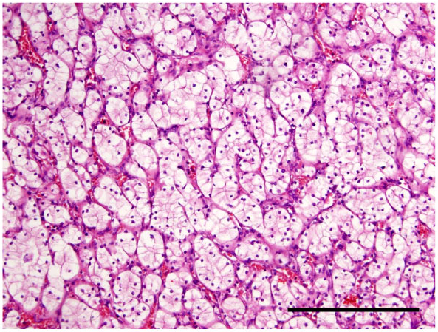
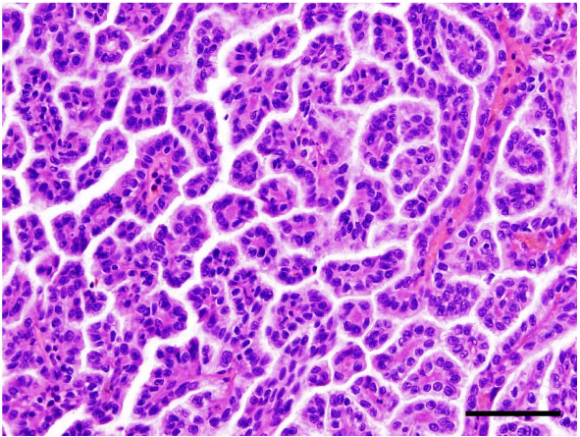
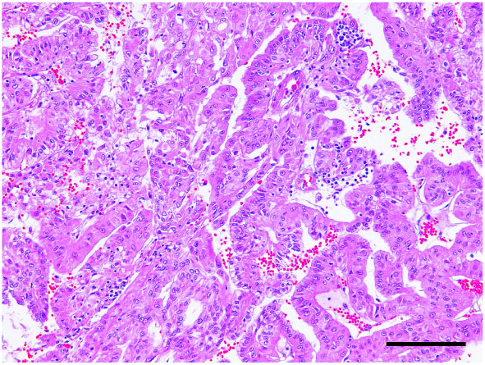
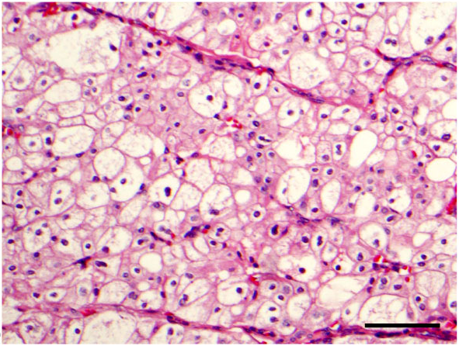
RCC Pathology
Histology | Incidence | Origin | Behavior | Molecular Alterations
Clear cell | 70-75% | Proximal tubule | Aggressive | VHL, PBRM1, BAP1
Papillary | 10-15% | Proximal tubule | Aggressive | MET
Chromophobe | 5% | Intercalated cells | Indolent | TP53, PTEN
Clear cell
Papillary
Papillary
Chromophobe
Zhang et al, Ann Urol Oncol 2018

Slide 4
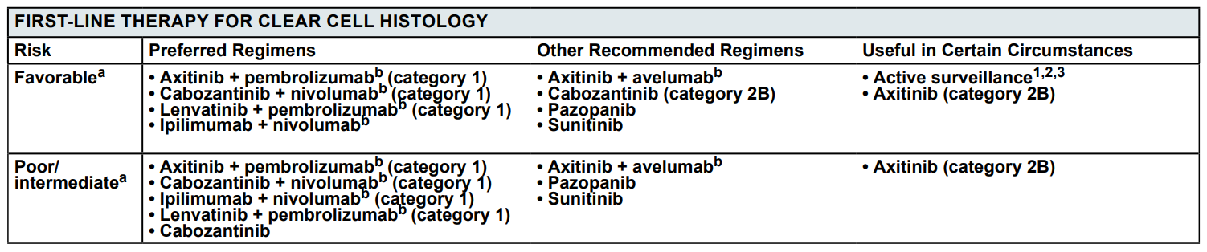
First-Line Therapy
Keynote-426
Checkmate-9ER
CLEAR
Checkmate-214

Slide 5
First-Line Trials
All four key first-line trials randomized a doublet vs. sunitinib monotherapy
4+ year data is now available for each trial

Slide 6
First-Line Trials
Keynote-426: axitinib + pembrolizumab
Checkmate-9ER: cabozantinib + nivolumab
CLEAR: lenvatinib + pembrolizumab
Checkmate-214: ipilimumab + nivolumab

Slide 7
First-Line Trials
Keynote-426: axitinib + pembrolizumab
Checkmate-9ER: cabozantinib + nivolumab
CLEAR: lenvatinib + pembrolizumab
Checkmate-214: ipilimumab + nivolumab

Slide 8
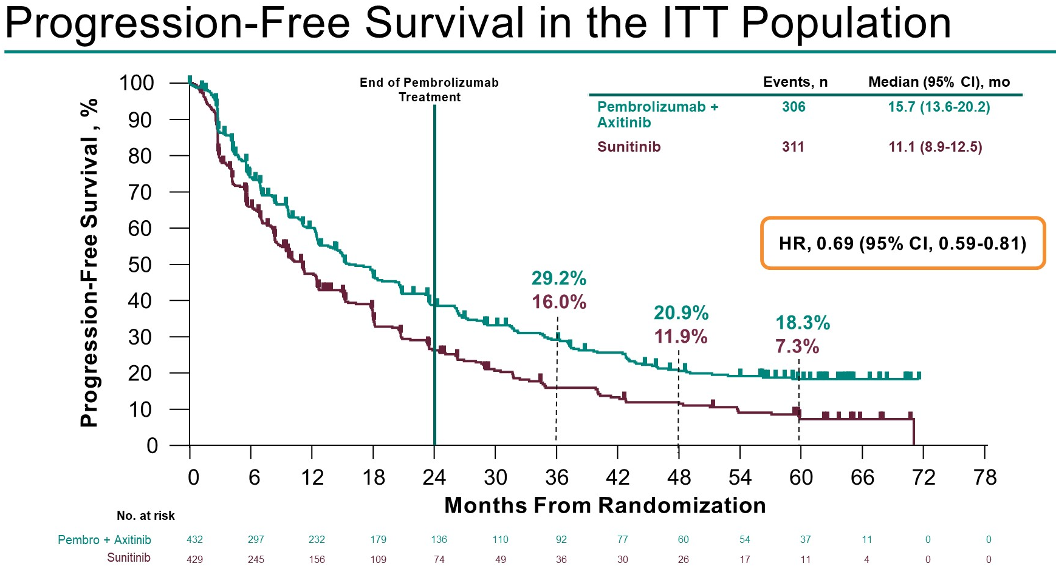
Keynote-426 – ITT population
Rini et al, ASCO 2023

Slide 9
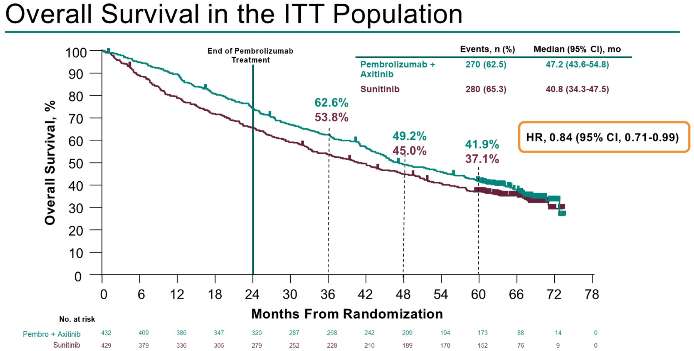
Keynote-426 – ITT population
Rini et al, ASCO 2023

Slide 10
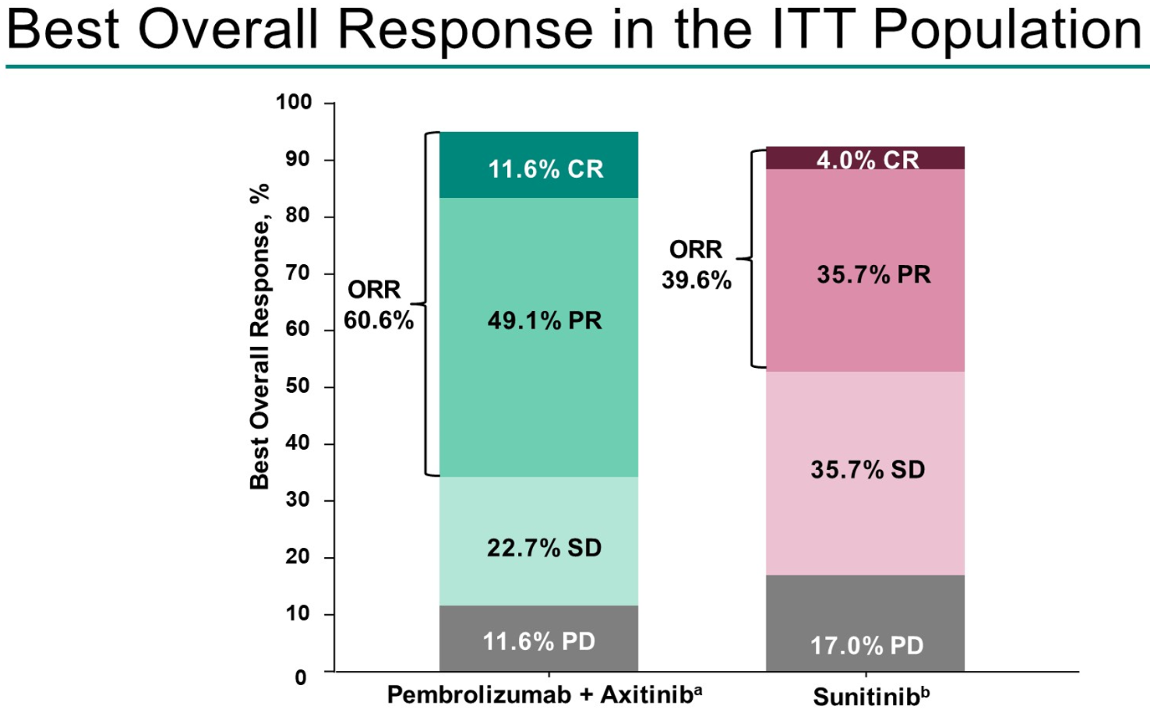
Keynote-426 – ITT population
Rini et al, ASCO 2023

Slide 11
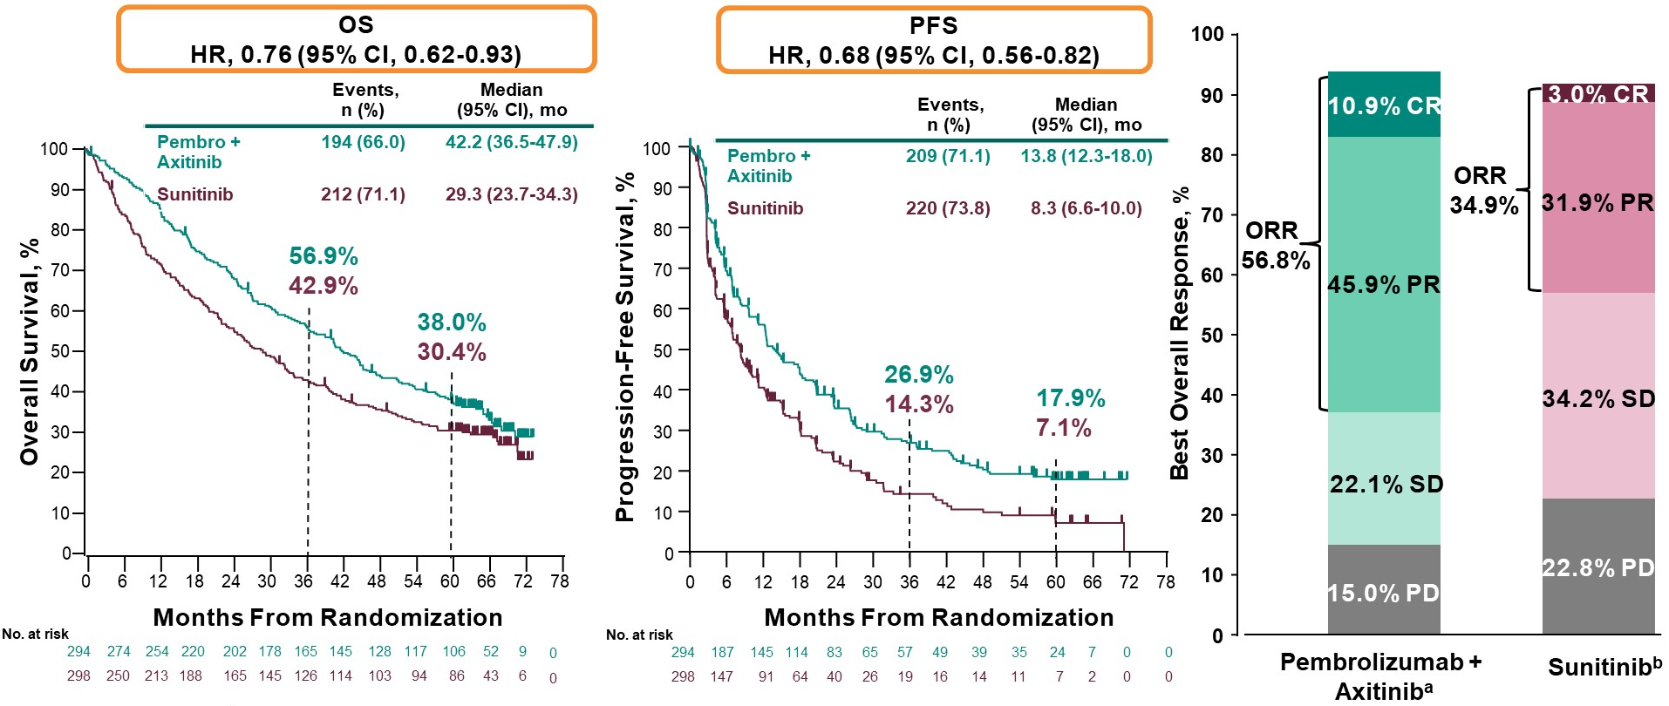
Keynote-426 – IMDC int/poor risk
Rini et al, ASCO 2023

Slide 12
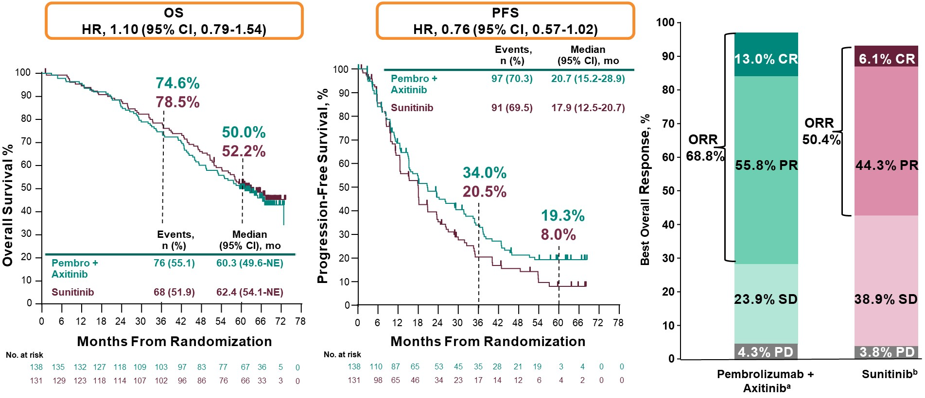
Keynote-426 – IMDC favorable risk
Rini et al, ASCO 2023

Slide 13
First-Line Trials
Keynote-426: axitinib + pembrolizumab
Checkmate-9ER: cabozantinib + nivolumab
CLEAR: lenvatinib + pembrolizumab
Checkmate-214: ipilimumab + nivolumab

Slide 14
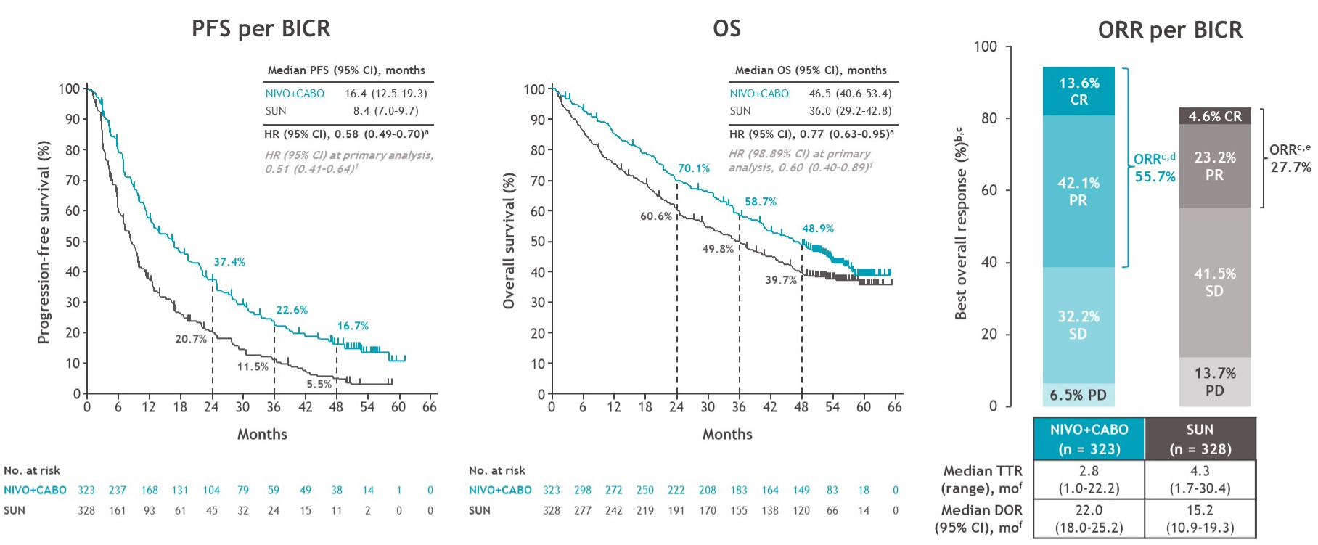
Checkmate-9ER – ITT population
Bourlon et al, GU ASCO 2024

Slide 15
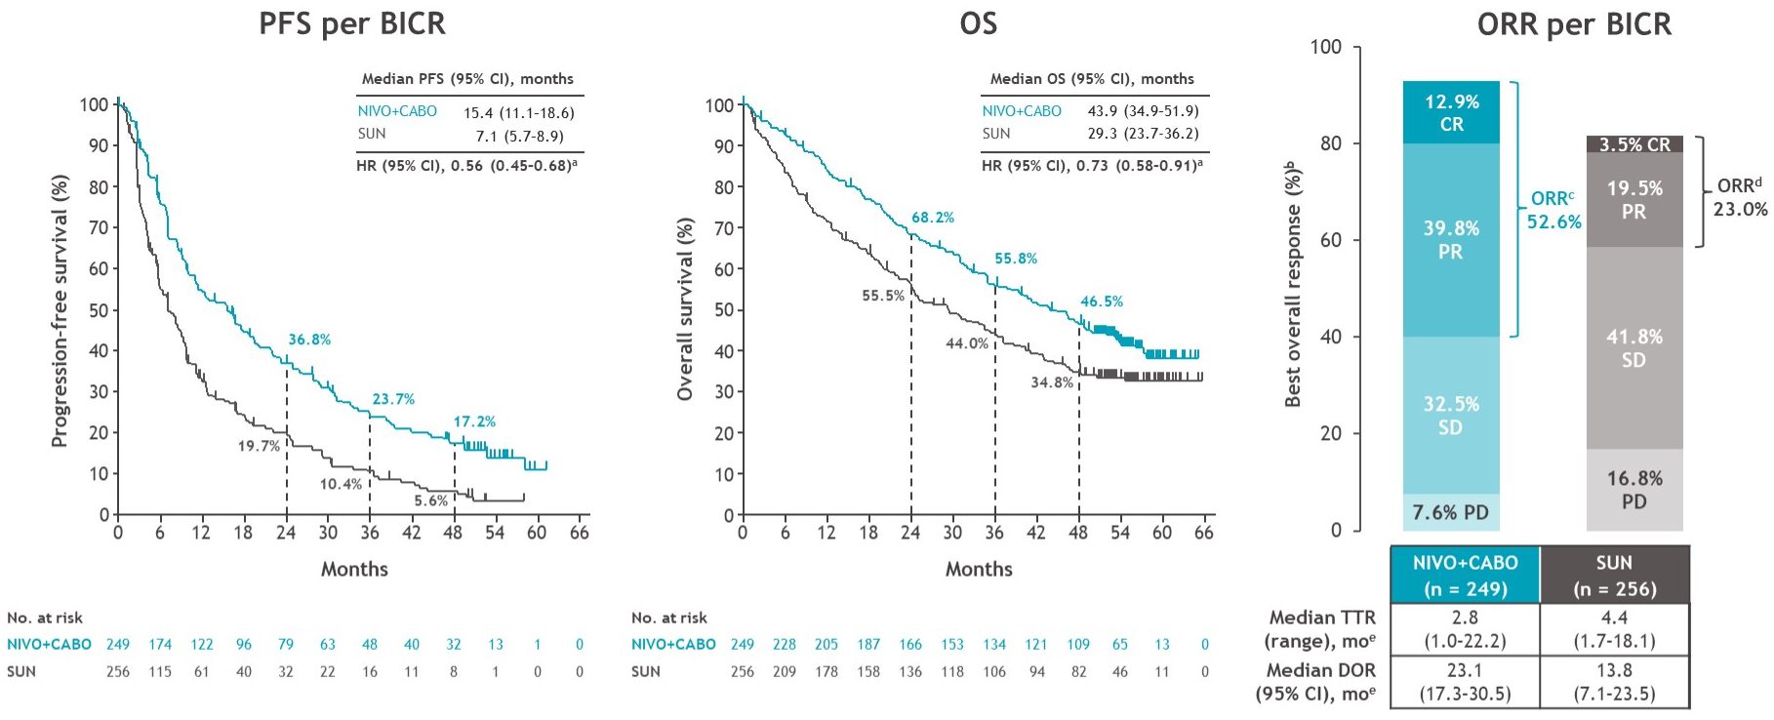
Checkmate-9ER – IMDC int/poor risk
Bourlon et al, GU ASCO 2024

Slide 16
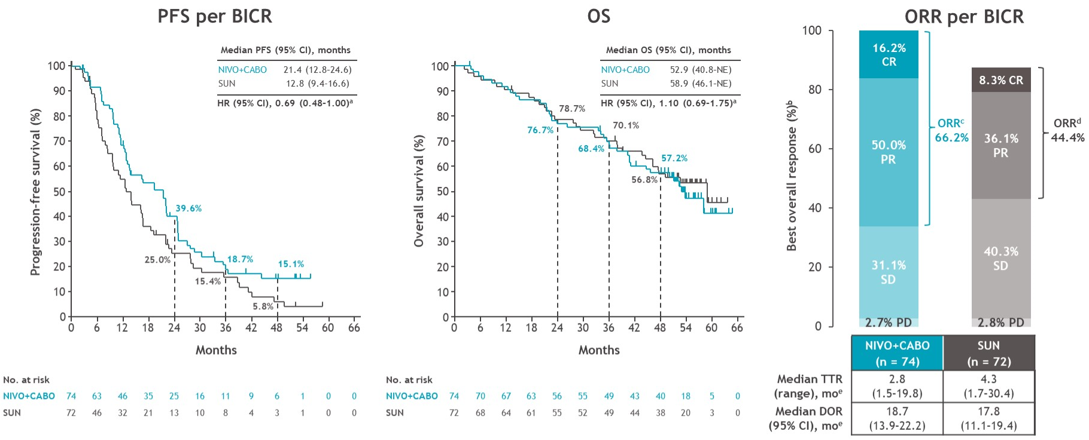
Checkmate-9ER – IMDC favorable risk
Bourlon et al, GU ASCO 2024

Slide 17
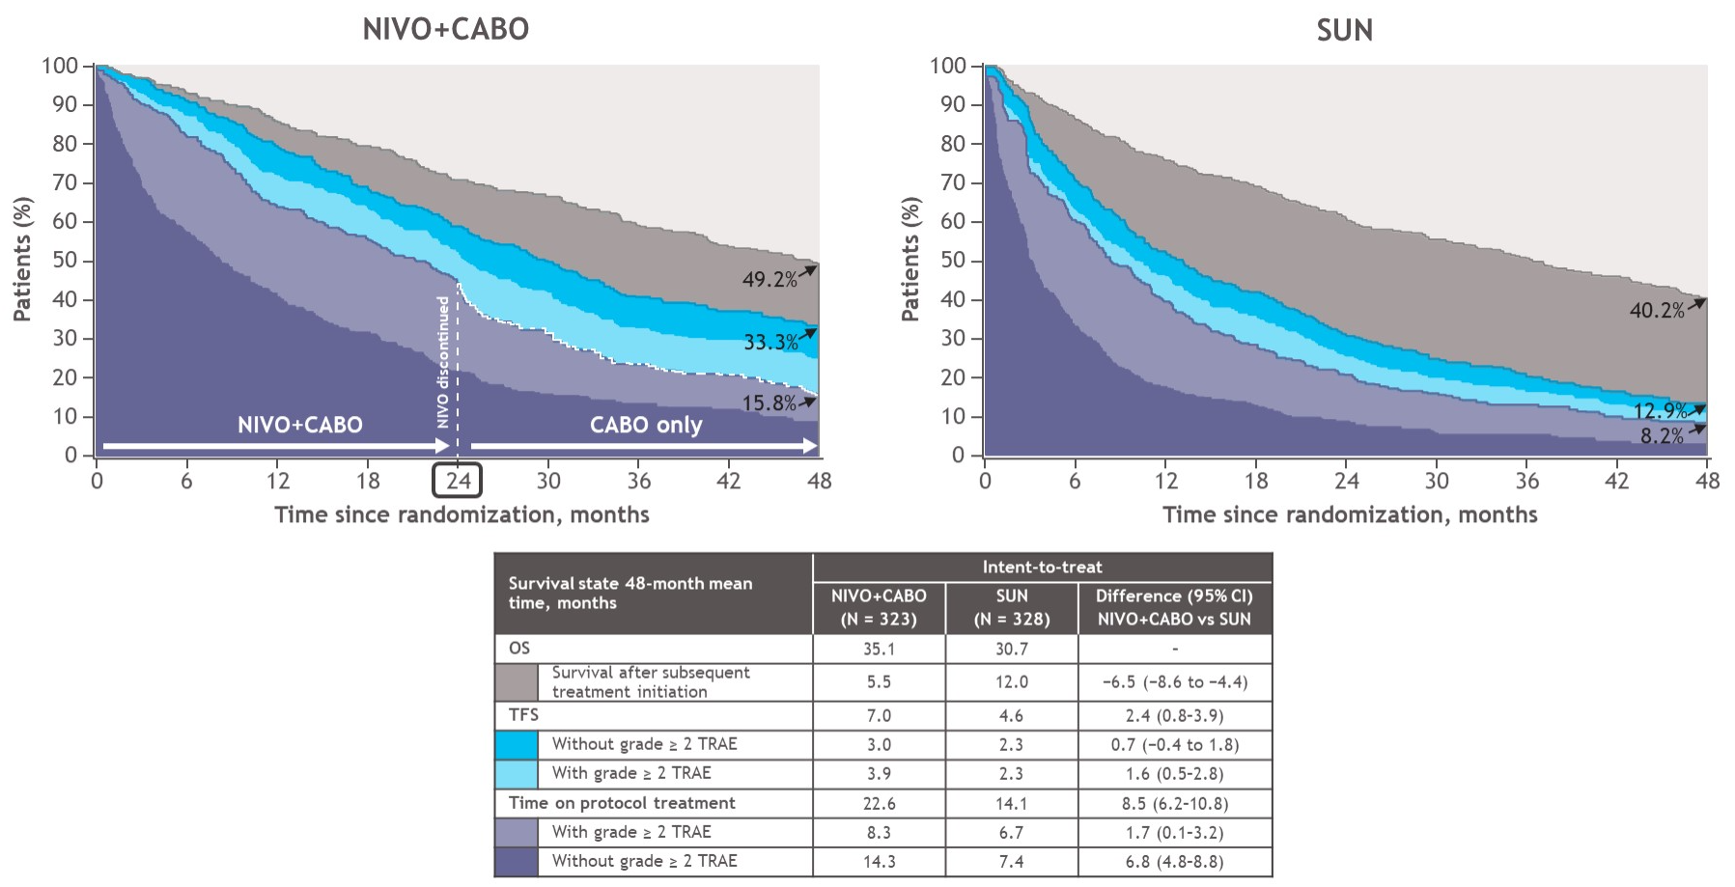
Checkmate-9ER – Treatment-Free Survival
Mantia et al, ASCO 2024

Slide 18
First-Line Trials
Keynote-426: axitinib + pembrolizumab
Checkmate-9ER: cabozantinib + nivolumab
CLEAR: lenvatinib + pembrolizumab
Checkmate-214: ipilimumab + nivolumab

Slide 19
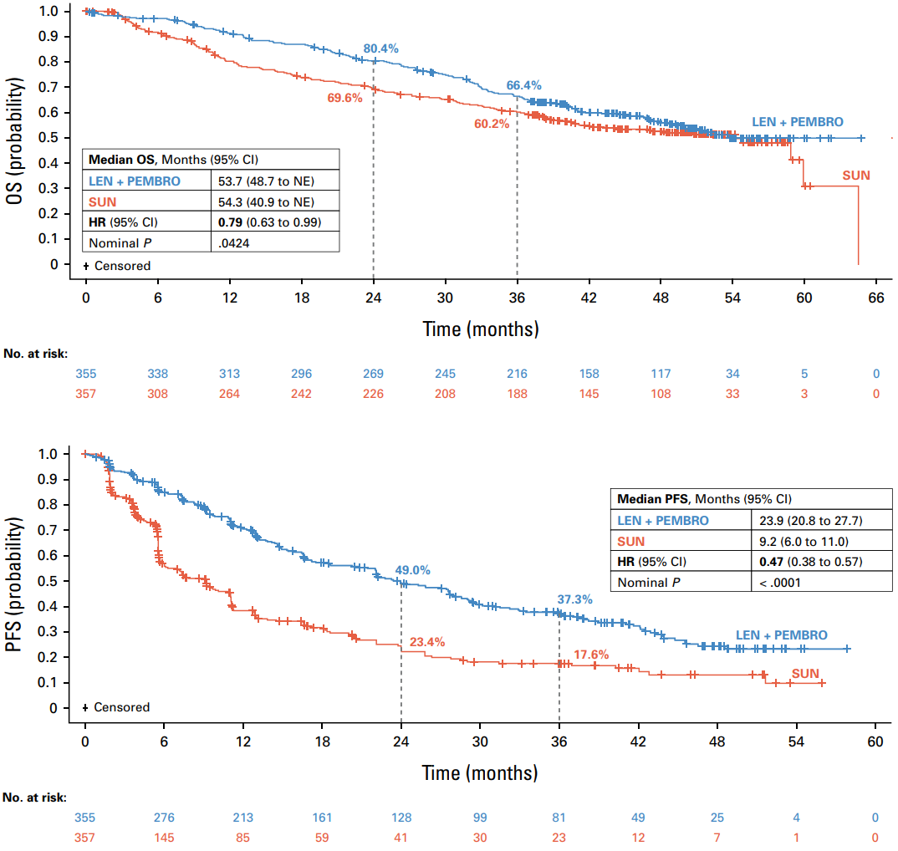
CLEAR – OS and PFS
Motzer et al, JCO 2024

Slide 20
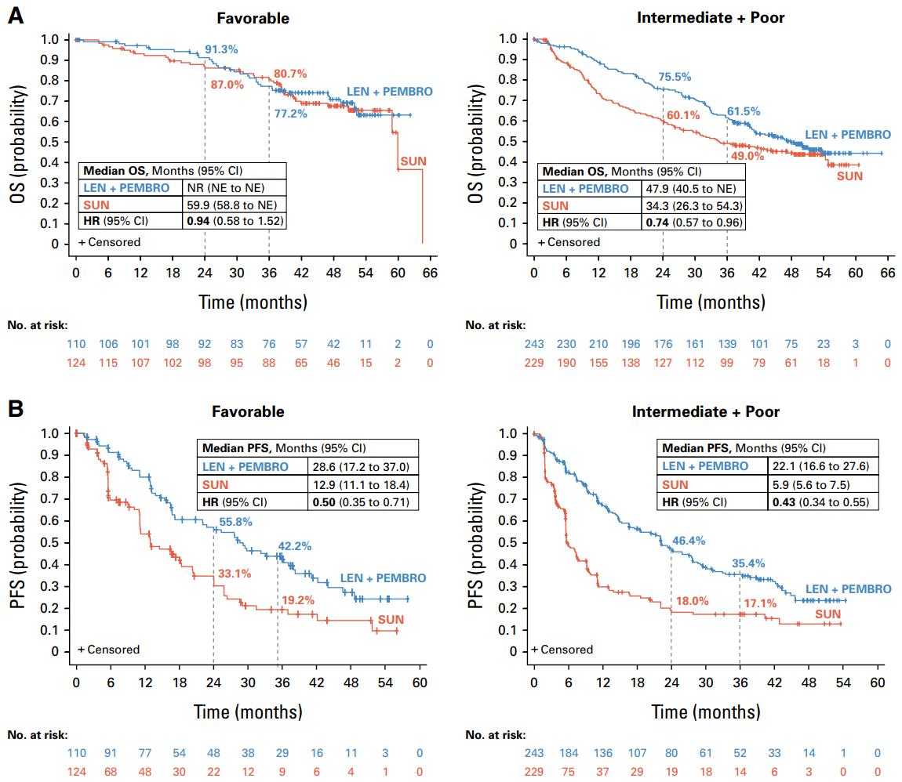
CLEAR – OS and PFS, by IMDC risk
Motzer et al, JCO 2024

Slide 21
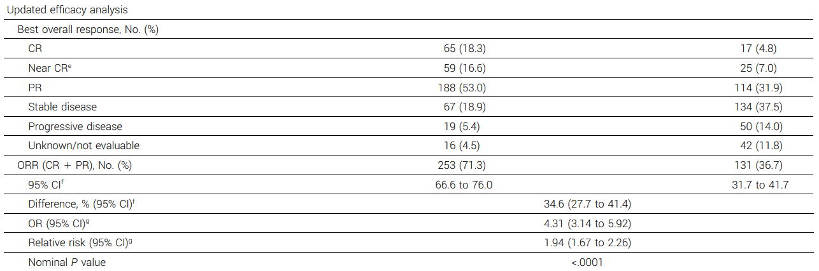
CLEAR – ORR
Lenvatinib + pembrolizumab
Sunitinib
Motzer et al, JCO 2024

Slide 22
First-Line Trials
Keynote-426: axitinib + pembrolizumab
Checkmate-9ER: cabozantinib + nivolumab
CLEAR: lenvatinib + pembrolizumab
Checkmate-214: ipilimumab + nivolumab

Slide 23
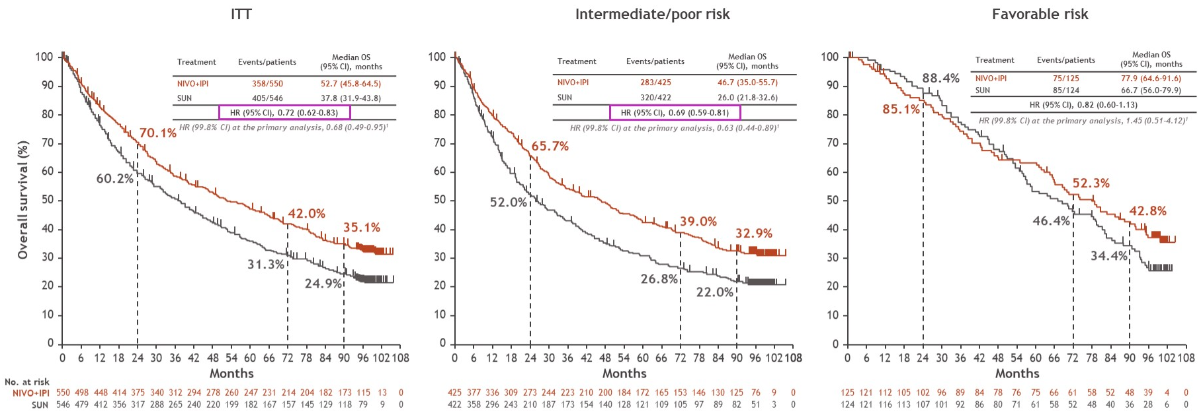
Checkmate-214 – OS
Tannir et al, GU ASCO 2024

Slide 24
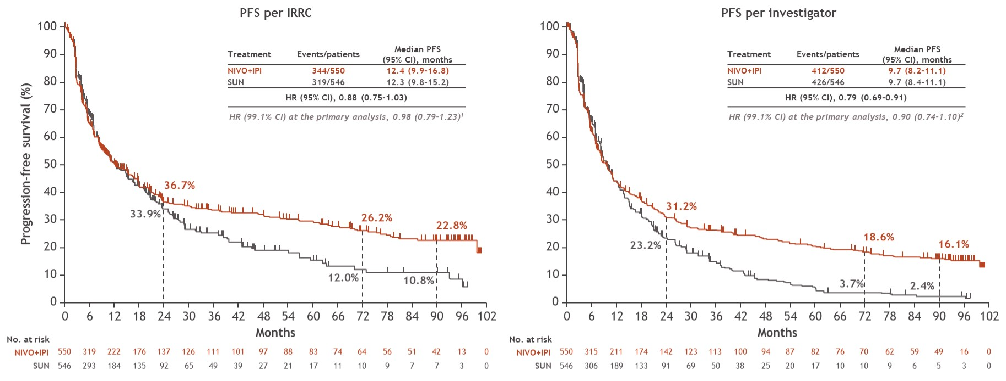
Checkmate-214 – PFS
Tannir et al, GU ASCO 2024

Slide 25
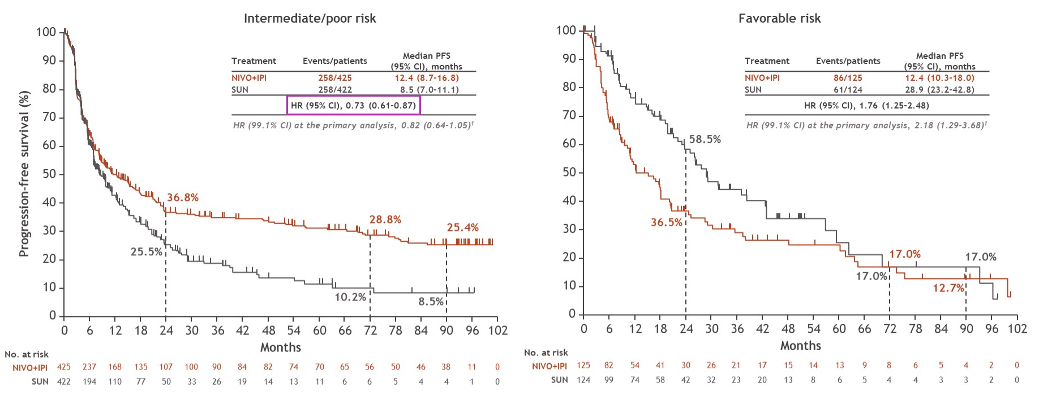
Checkmate-214 – PFS
Tannir et al, GU ASCO 2024

Slide 26
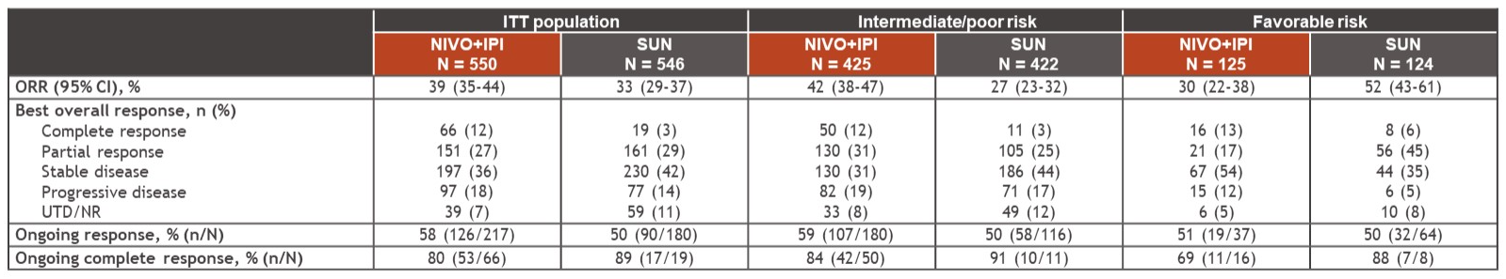
Checkmate-214 – ORR
Tannir et al, GU ASCO 2024

Slide 27
First-Line Trials
Study | Intervention | ORR | mPFS (mo) | mOS (mo)
Keynote-426 | Axitinib + pembrolizumab | 59% | 16 | 43-47
Checkmate-9ER | Cabozantinib + nivolumab | 56% | 16.4 | 46.5
CLEAR | Lenvatinib + pembrolizumab | 71% | 23.3 | 53.7
Checkmate-214 | Ipilimumab + nivolumab | 39% | 12.4 | 52.7

Slide 28
First-Line Trials – Takeaways
First-line doublets improve PFS and OS in ITT populations, but this is driven by the IMDC intermediate/poor risk subgroup
  PFS for ipi/nivo inferior to sunitinib in IMDC favorable risk disease
No first-line doublet improved OS over sunitinib in IMDC favorable risk disease
ORR is better with first-line doublets in all IMDC risk subgroups
  Except ipi/nivo: inferior to sunitinib in IMDC favorable risk disease
Ipi/nivo is a “gamble”
  Lower ORR and higher rate of primary progression
  But higher chance of long-term response

Slide 29
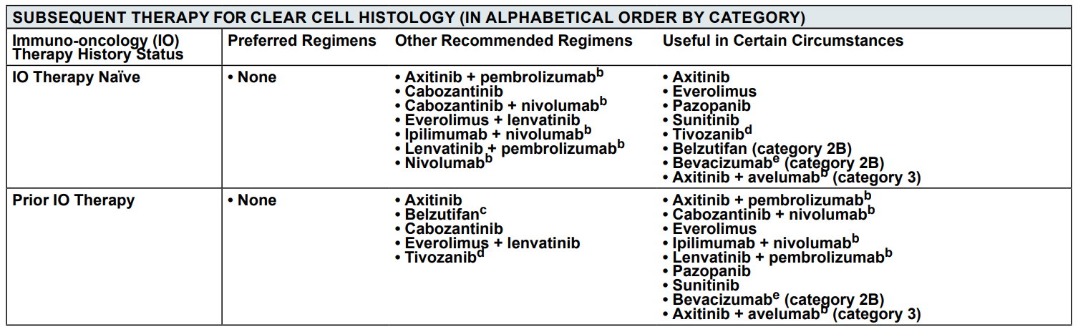
Subsequent Therapy

Slide 30
IO after IO?
CONTACT-03
  ccRCC or nccRCC
  Received IO in first- or second-line
  Randomized to cabozantinib + atezolizumab vs. cabozantinib alone
TiNivo-2
  RCC with a clear cell component
  Received IO in first- or second-line
  Randomized to tivozanib + nivolumab vs. tivozanib alone

Slide 31
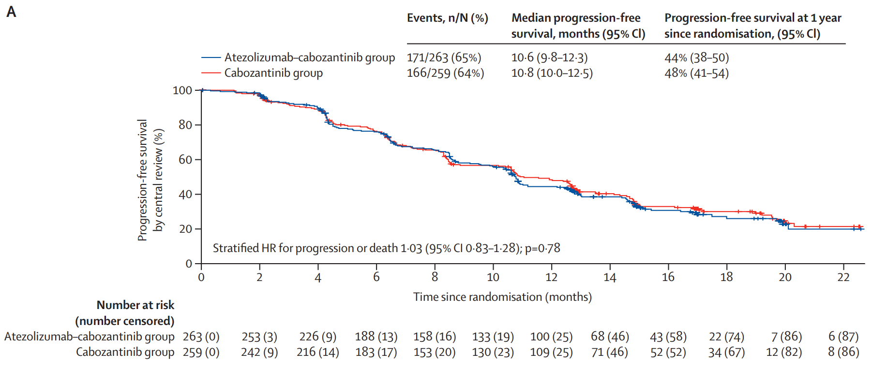
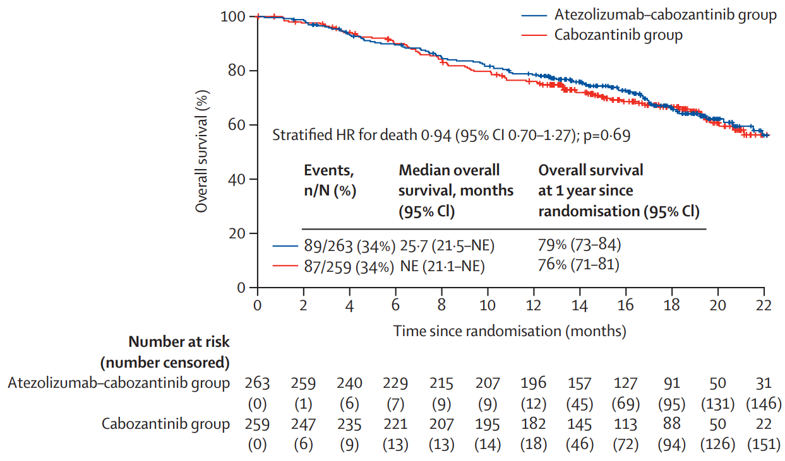
CONTACT-03
PFS
OS
Pal et al, Lancet 2023

Slide 32
TiNivo-2
Negative study per press release
Data will be presented at ESMO 2024

Slide 33
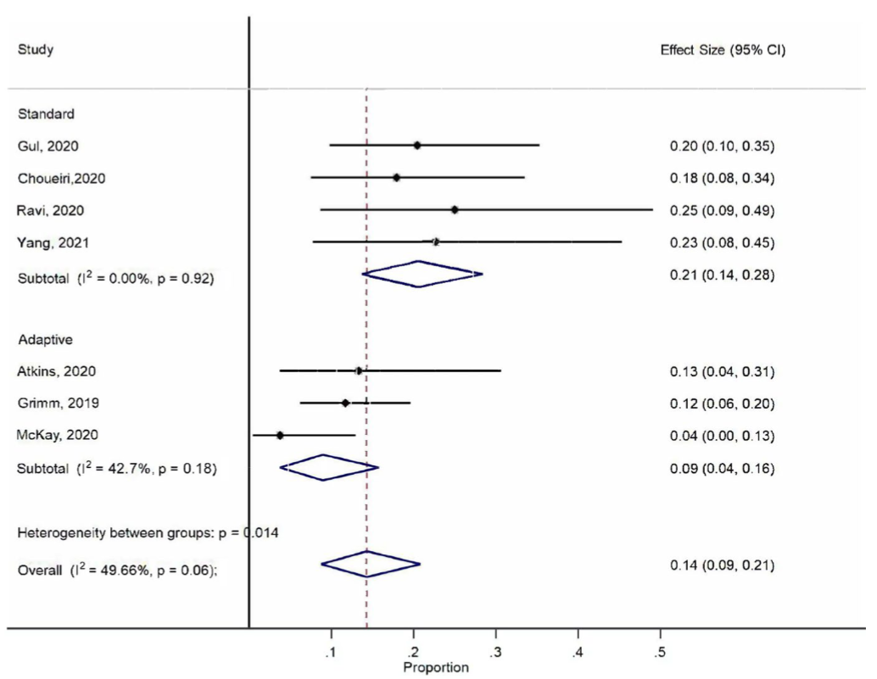
Ipilimumab + nivolumab after PD-1 failure
Pooled ORR 14%
Yang et al, Cancer Med 2022

Slide 34
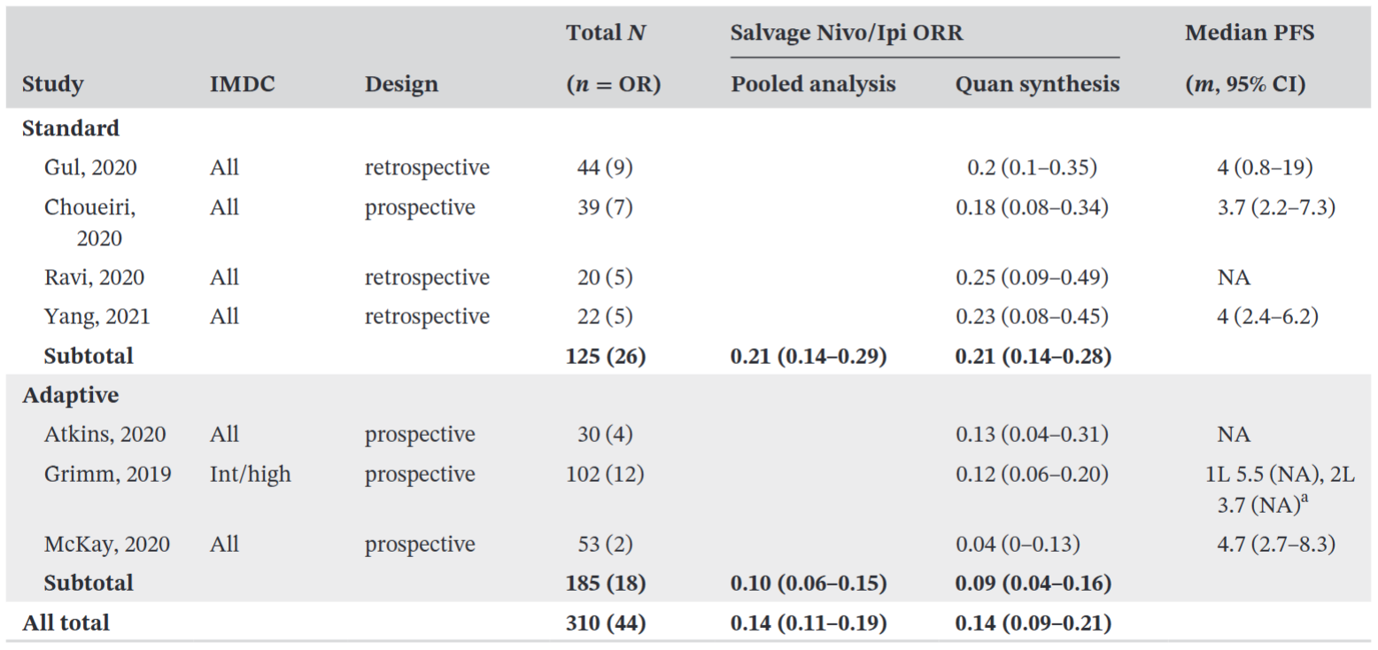
Ipilimumab + nivolumab after PD-1 failure
Yang et al, Cancer Med 2022

Slide 35
IO after IO?
PD-1 inhibitors: almost never
Ipilimumab: sometimes

Slide 36
VEGFR TKI side effects
Side effect | Lenvatinib | Cabozantinib | Axitinib | Tivozanib
Any | 100% | 100% | NR | 84%
Diarrhea | 71% | 74% | 55% | 35%
Nausea | 62% | 50% | 32% | 19%
Anorexia | 58% | 46% | 34% | 28%
Fatigue | 50% | 56% | 39% | 32%
Hypertension | 48% | 37% | 40% | 47%
Weight loss | 48% | 31% | 25% | 9%
Vomiting | 38% | 32% | 24% | 8%
Dysphonia | 37% | 20% | 31% | 24%
Hypothyroidism | 37% | 20% | 19% | 14%
Proteinuria | 31% | 12% | NR | NR
Stomatitis | 25% | 22% | 15% | 20%
Headache | 25% | 11% | NR | NR
Arthralgia | 25% | 11% | 15% | NR
Hand-foot syndrome | 15% | 42% | 27% | 16%
Common
side effects:
All grades
Motzer, Lancet Oncol 2016
Choueiri, NEJM 2015
Rini, Lancet 2011
Rini, Lancet Oncol 2020

Slide 37
VEGFR TKI side effects
Side effect | Lenvatinib | Cabozantinib | Axitinib | Tivozanib
Any | 79% | 68% | NR | 11%
Diarrhea | 12% | 11% | 11% | 2%
Nausea | 8% | 4% | 3% | 0%
Anorexia | 4% | 2% | 5% | 4%
Fatigue | 8% | 9% | 11% | 4%
Hypertension | 17% | 15% | 16% | 20%
Weight loss | 6% | 2% | 2% | 1%
Vomiting | 4% | 2% | 3% | 1%
Dysphonia | 0% | <1% | 0% | 1%
Hypothyroidism | 2% | 0% | <1% | 1%
Proteinuria | 19% | 2% | NR | NR
Stomatitis | 2% | 2% | 1% | 2%
Headache | 4% | <1% | NR | NR
Arthralgia | 0% | <1% | 1% | NR
Hand-foot syndrome | 0% | 8% | 5% | 1%
Common
side effects:
Grades 3-4
Motzer, Lancet Oncol 2016
Choueiri, NEJM 2015
Rini, Lancet 2011
Rini, Lancet Oncol 2020

Slide 38
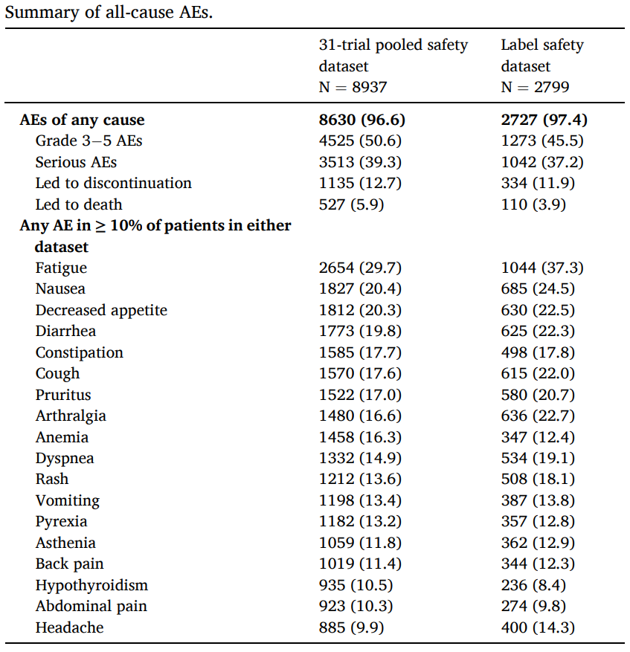
Side effects: pembrolizumab
Brahmer et al, Eur J Cancer 2024

Slide 39
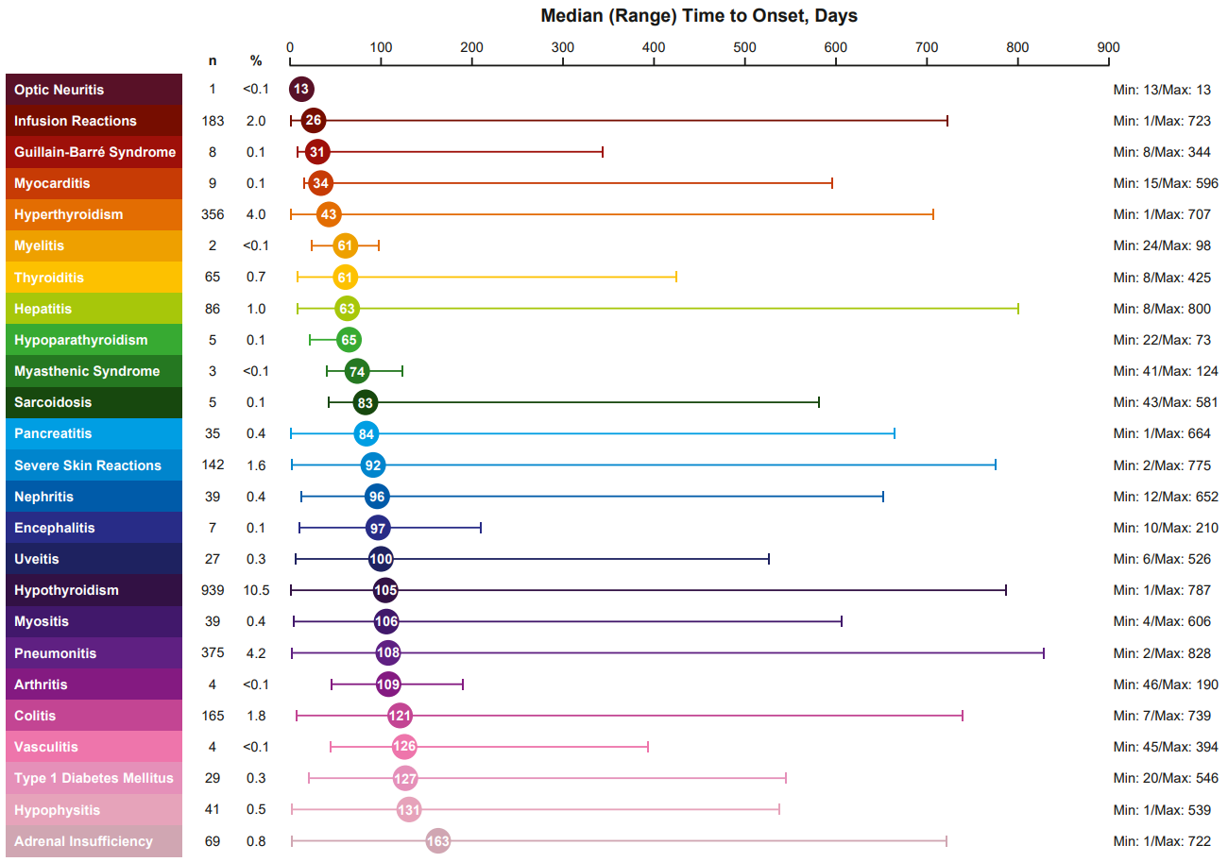
Side effects: pembrolizumab
Brahmer et al, Eur J Cancer 2024

Slide 40
Thank you
adsinger@mednet.ucla.edu

Slide 41
Genitourinary Cancers
Tuesday, August 27, 2024

Slide 42
​Current and Emerging Treatment Standards of
Advanced Non-Clear Cell RCC
Alexandra Drakaki, MD, PhD
Associate Professor of Hematology/Oncology and Urology
Medical Director of the Genitourinary Oncology Program
Leader of the Genitourinary Research Program
UCLA

Slide 43
Agenda
Types of Non clear cell Renal Cell Cancer
Current Therapies
Ongoing Trials
GU ASCO 2024 Updates

Slide 44
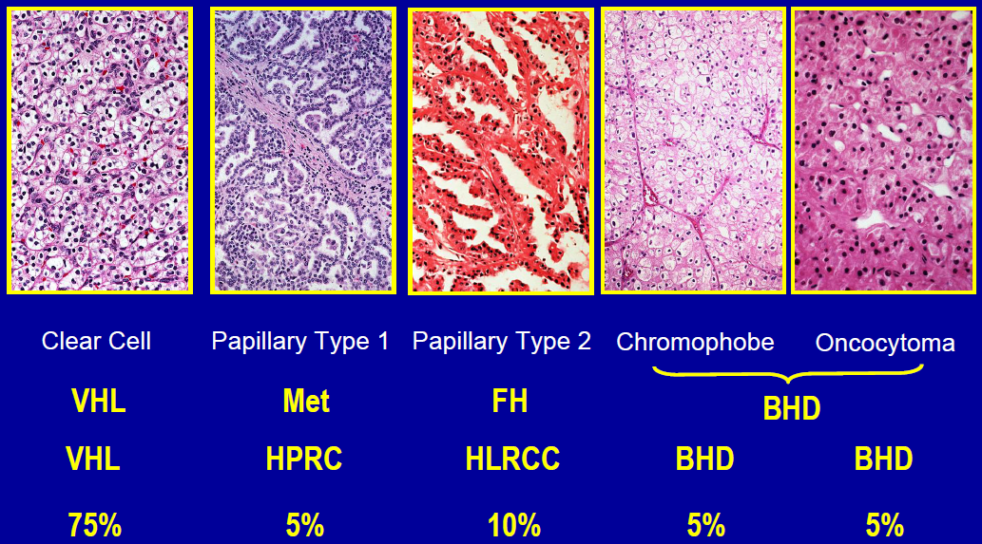
Kidney Cancer: A family of tumors (part A)

Slide 45
Kidney Cancer: A family of tumors (part B)
Collecting Duct
Kidney Medullary Carcinoma
Unclassified RCC
Translocation RCC
Kidney Cancer with Sarcomatoid Features

Slide 46
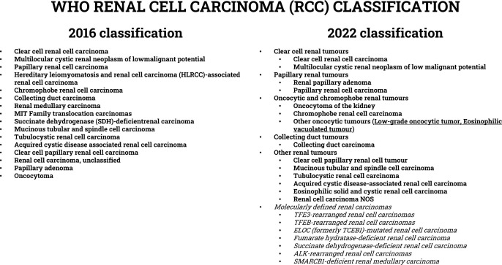

Slide 47


Treatment of Non Clear Cell Carcinoma
McDermott et al, JCO 2021

Slide 48
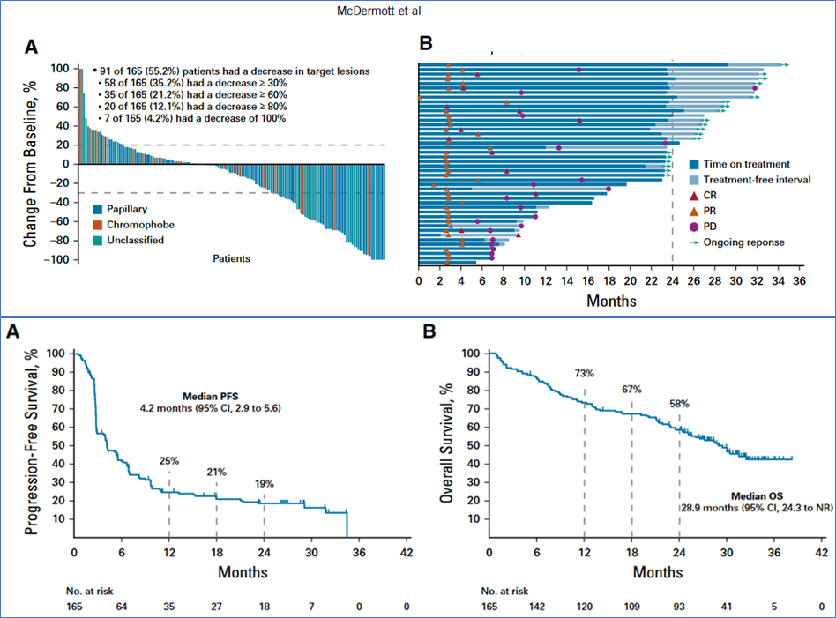
Pembrolizumab
Monotherapy

Slide 49
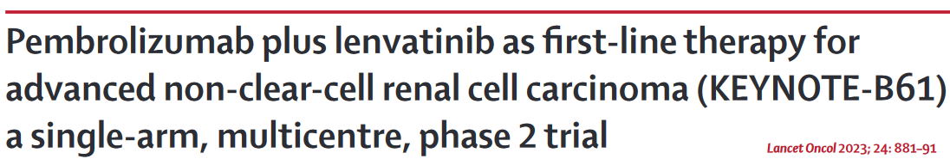

Treatment of Non Clear Cell Carcinoma

Slide 50
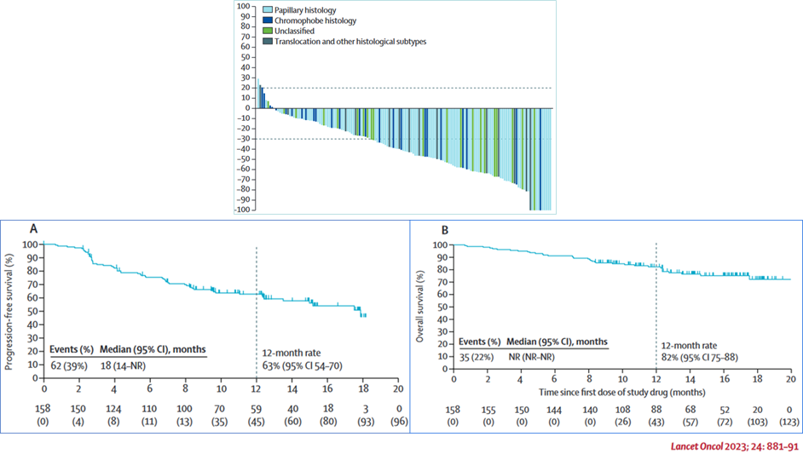
Pembrolizumab
Lenvatinib

Slide 51

Treatment of Non Clear Cell Carcinoma
Lee et al, JCO 2022

Slide 52
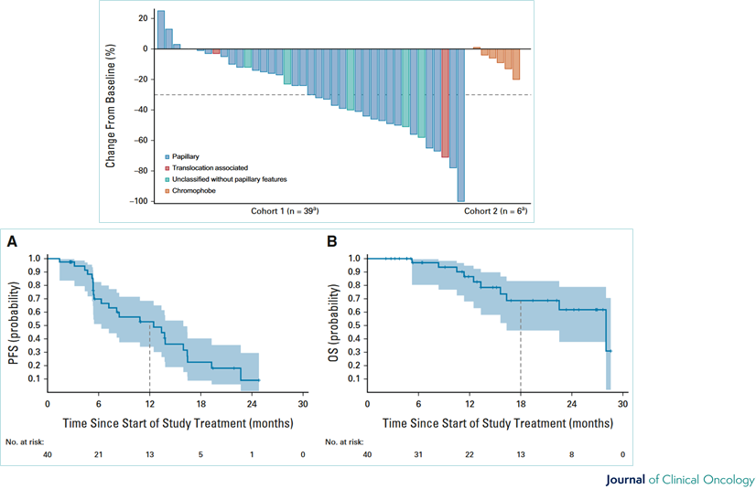
Nivolumab
Cabozantinib

Slide 53
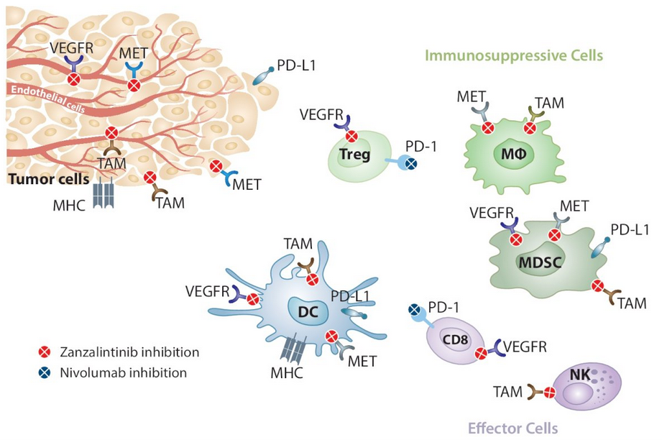
Zanzalintinib (XL092) plus nivolumab in non-clear cell renal cell carcinoma: The randomized phase 3 STELLAR-304 study
Zanzalintinib:
multi-targeted TKI of
VEGFR, MET, & TAM kinases
TYRO3, AXL, and MER

Slide 54
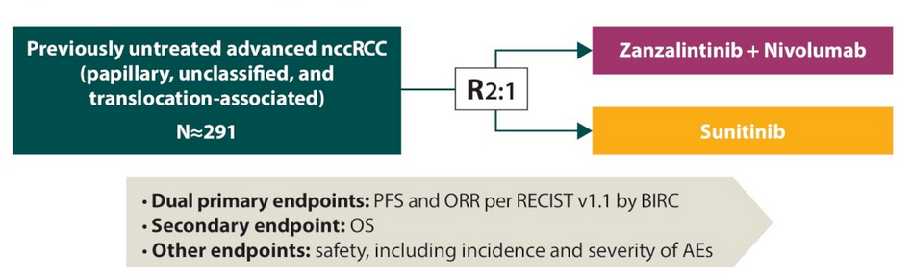
Zanzalintinib (XL092) plus nivolumab in non-clear cell renal cell carcinoma: The randomized phase 3 STELLAR-304 study

Slide 55
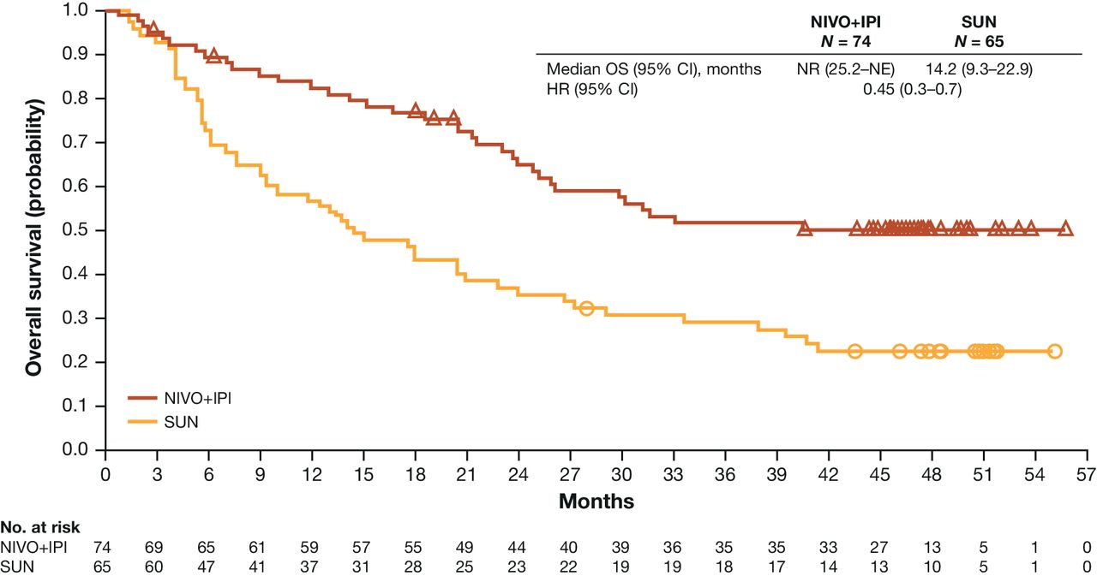
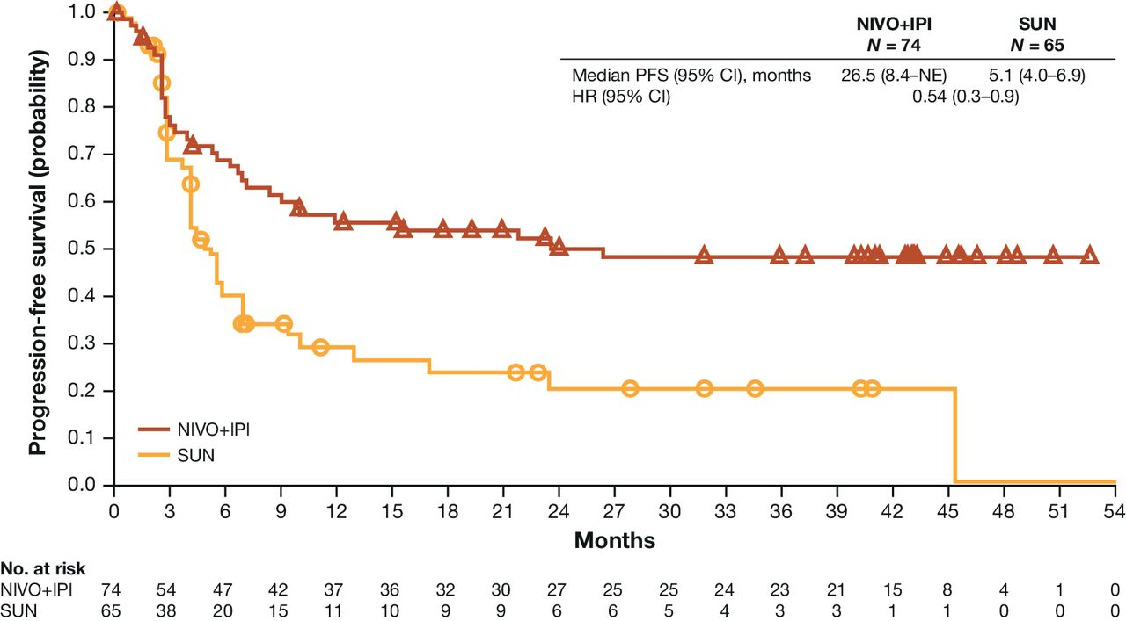
Efficacy and Safety of Nivolumab & Ipilimumab vs Sunitinib in First-line Sarcomatoid Renal Cell Carcinoma
Clin Cancer Res. 2021

Slide 56
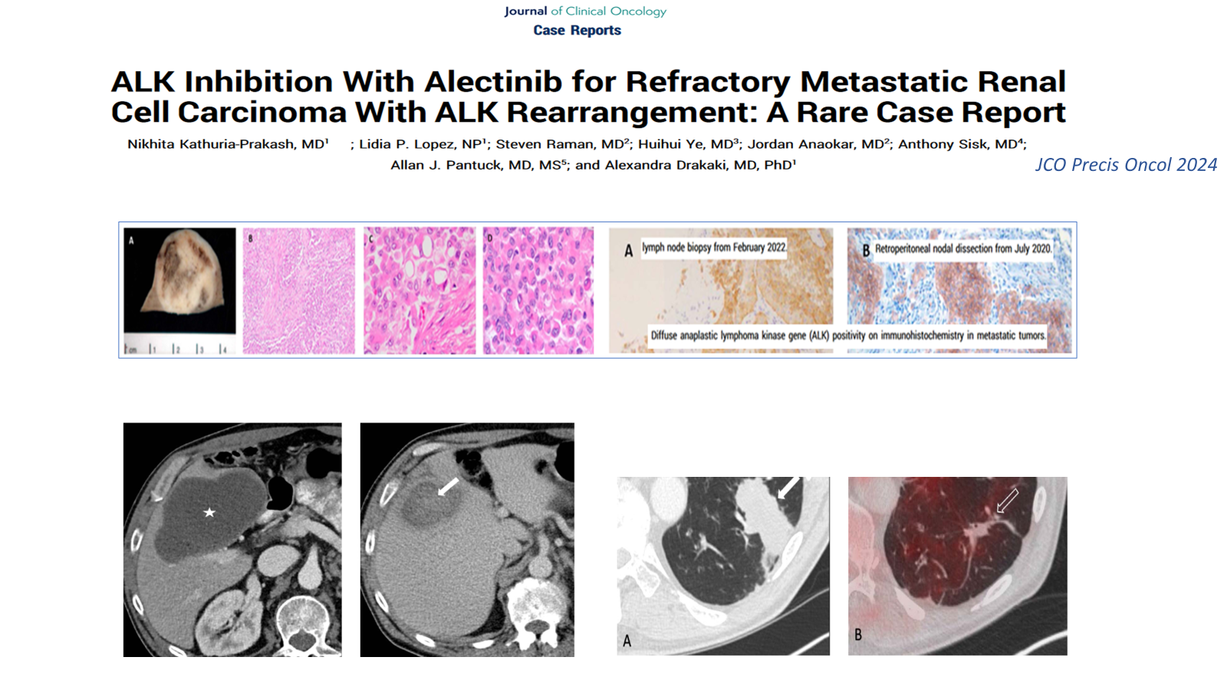

Slide 57
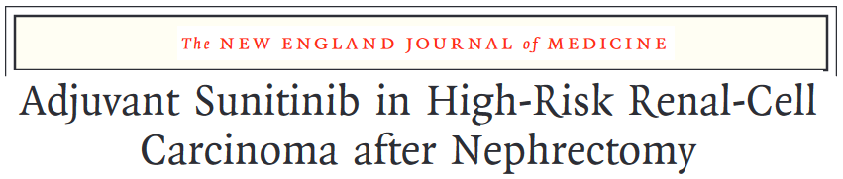
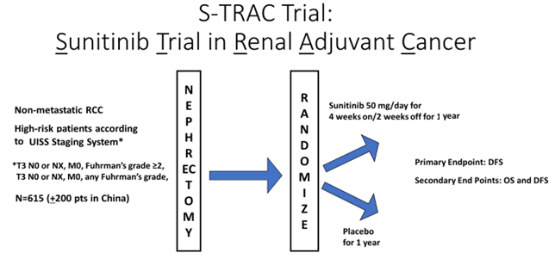
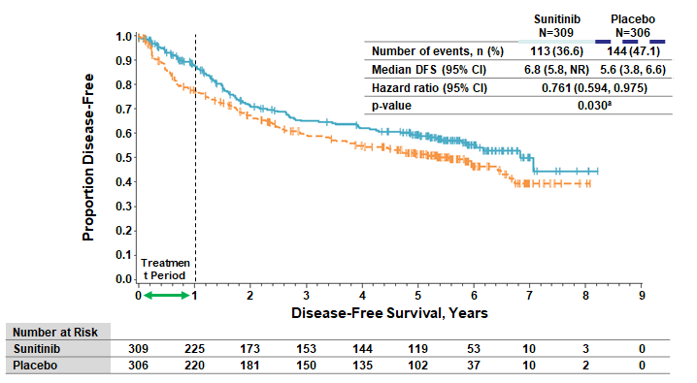
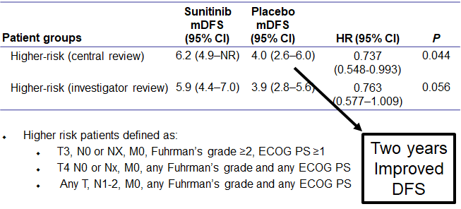
ADJUVANT
THERAPY
IN RCC
Ravaud et al NEJM 2016

Slide 58
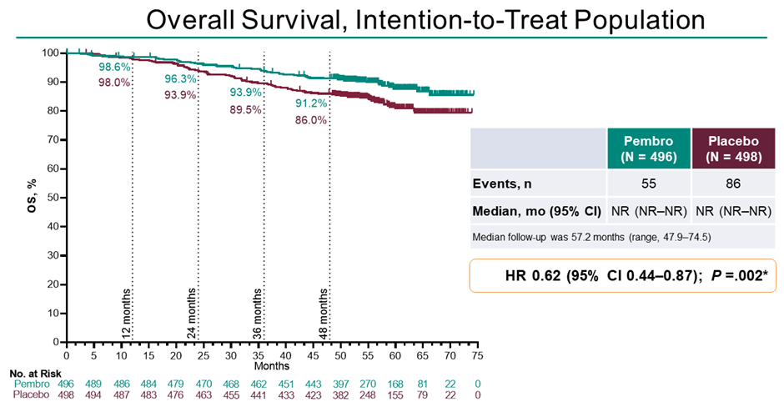
Overall Survival Results from Phase 3 Study of
Adjuvant Pembrolizumab vs Placebo for Clear Cell RCC
ADJUVANT
THERAPY
IN RCC
KEYNOTE 564 GU ASCO 2024

Slide 59

Overall Survival Results from Phase 3 Study of
Adjuvant Pembrolizumab vs Placebo for Clear Cell RCC
ADJUVANT
THERAPY
IN RCC
Thank You
Questions ???
KEYNOTE 564 GU ASCO 2024

Slide 60
Genitourinary Cancers
Tuesday, August 27, 2024

Slide 61
Recent Approvals and Advances in Metastatic Bladder Cancer
John K. Lee, M.D., Ph.D.
Associate Professor-in-Residence
University of California, Los Angeles
Los Angeles, CA

Slide 62
Disclosures
Equity/royalties, scientific advisory board: PromiCell Therapeutics
Consultant: Lyell Immunopharma
Sponsored research agreements: Bristol Myers Squibb, Sanofi, Immunomedics, Grey Wolf Therapeutics, NIO Biopharma
Speaker’s bureau: Mission Bio

Slide 63
Outline
The last year has been quite active for practice-changing developments in the treatment of metastatic urothelial cancer:
1. Enfortuman vedotin and pembrolizumab in untreated advanced urothelial cancer
2. Nivolumab plus gemcitabine-cisplatin in advanced urothelial carcinoma
3. Fam-trastuzumab deruxtecan-nxki for unresectable or metastatic HER2-positive solid tumors

Slide 64
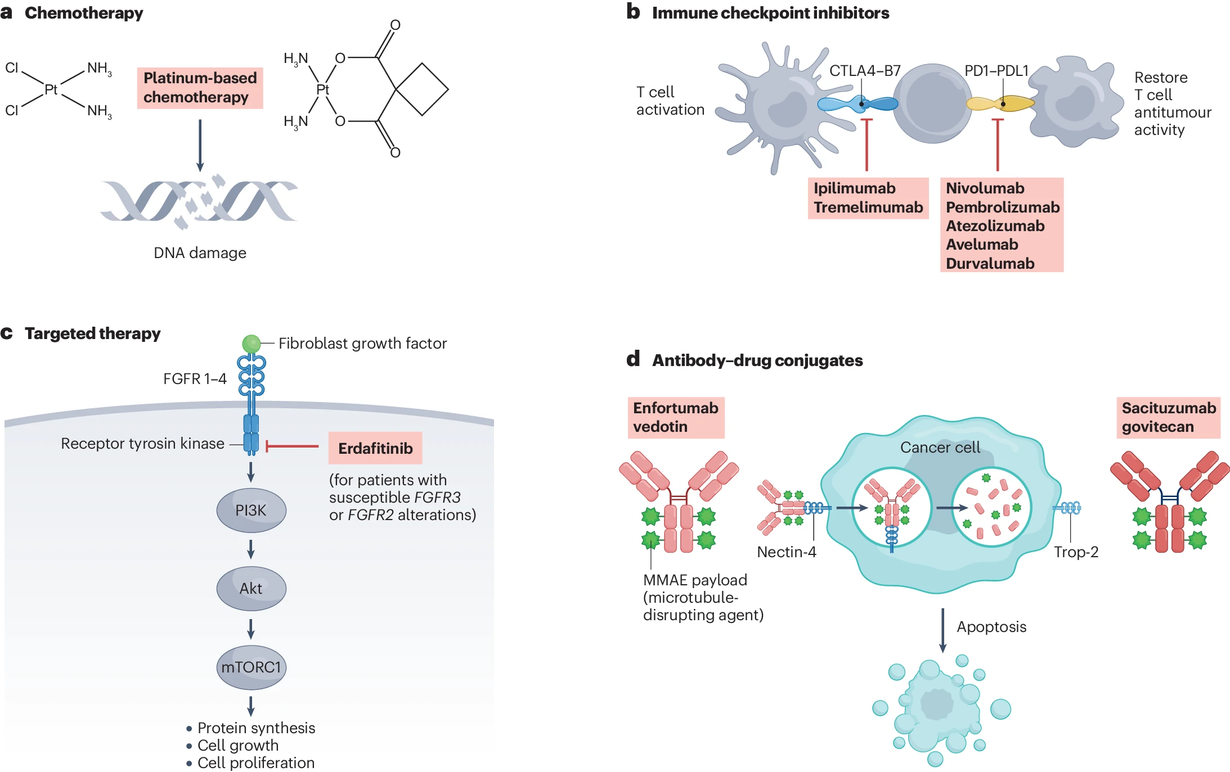
Drug classes for mUC treatment
Roviello G, et al. Nat Rev Urol, 2024.

Slide 66
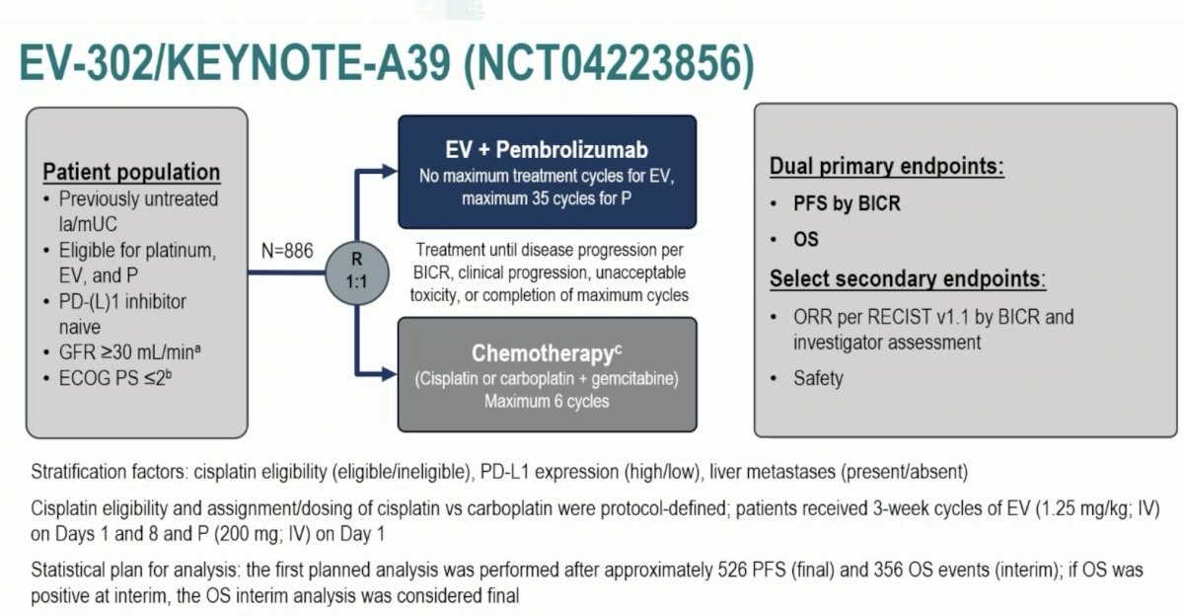
ESMO 2023.

Slide 67
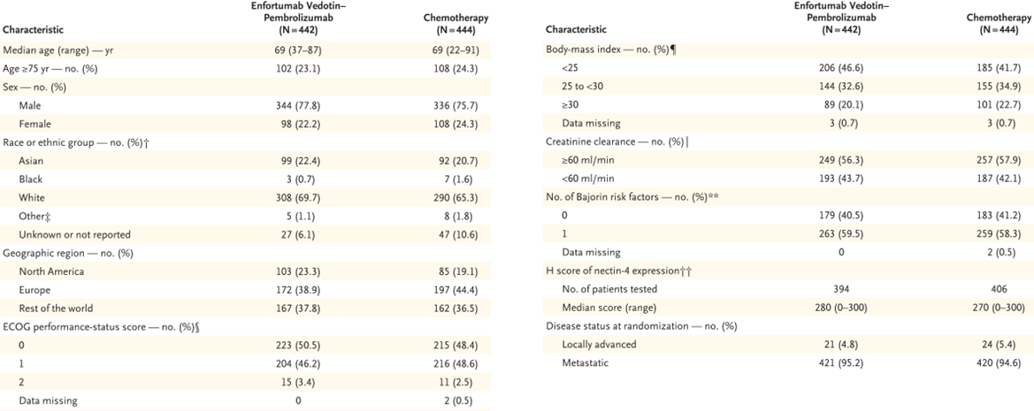
Patient demographics
Powles T, et al. NEJM, 2024.

Slide 68
Powles T, et al. NEJM, 2024.

Slide 69
EV-pembro improves PFS over chemotherapy
Powles T, et al. NEJM, 2024.

Slide 70
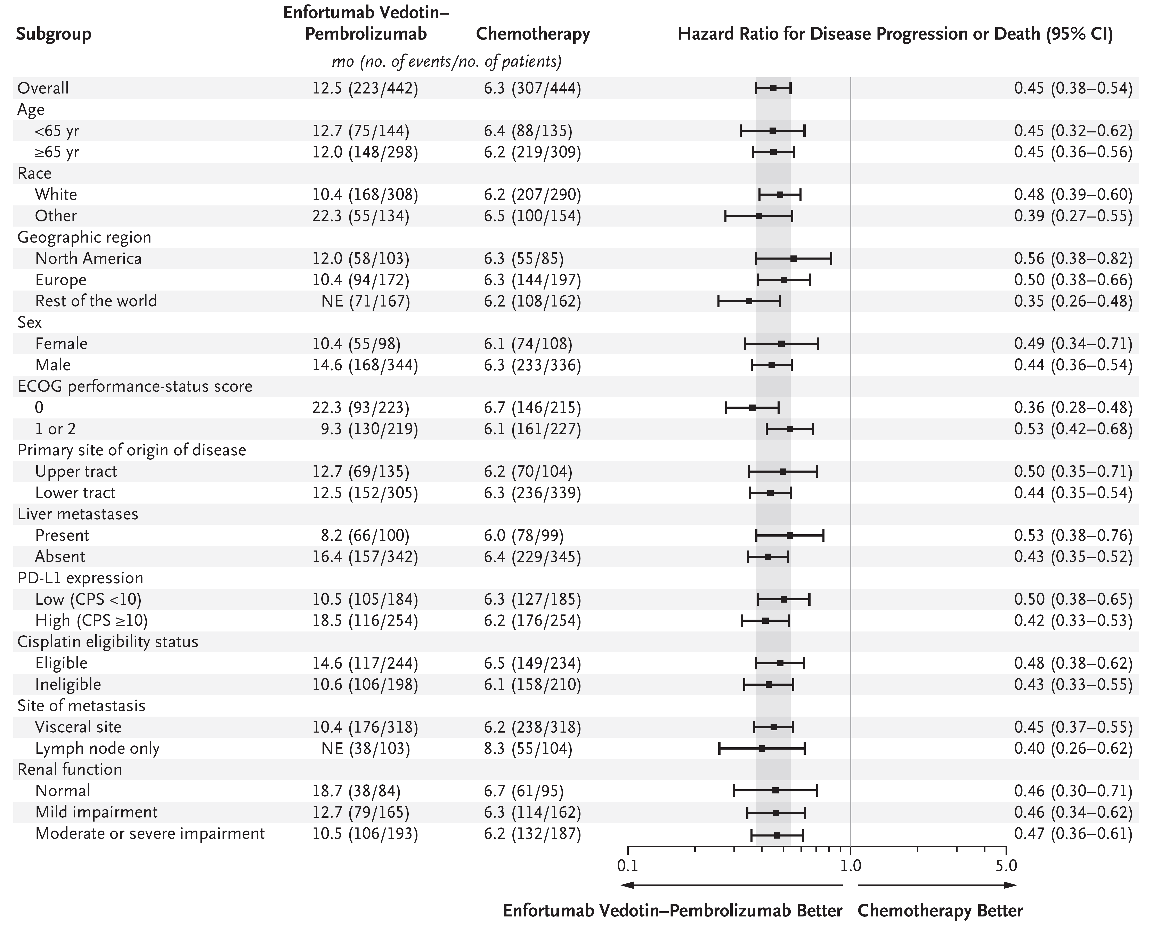
PFS benefit conserved across subgroups
Powles T, et al. NEJM, 2024.

Slide 71
EV-pembro improves OS over chemotherapy
Powles T, et al. NEJM, 2024.

Slide 72
OS benefit conserved across subgroups
Powles T, et al. NEJM, 2024.

Slide 73
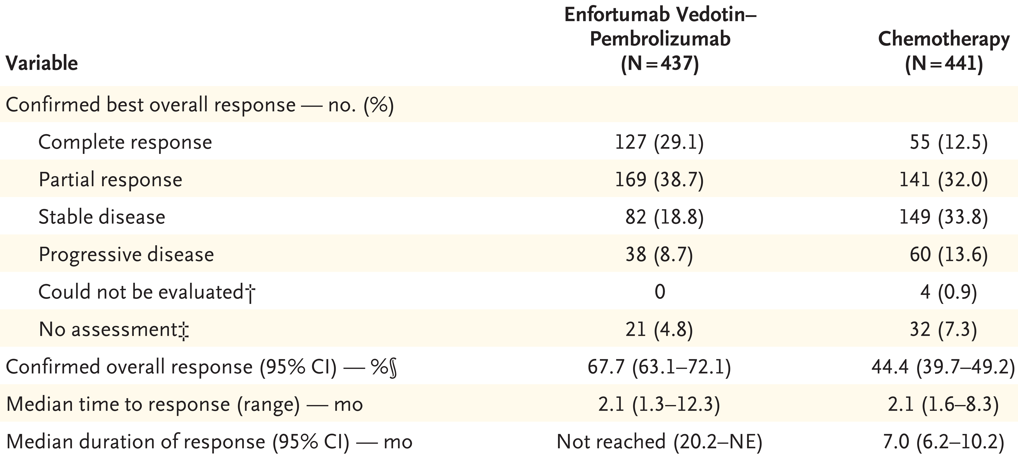
ORR and DoR
Powles T, et al. NEJM, 2024.

Slide 74
Treatment-related adverse events
Powles T, et al. NEJM, 2024.

Slide 76
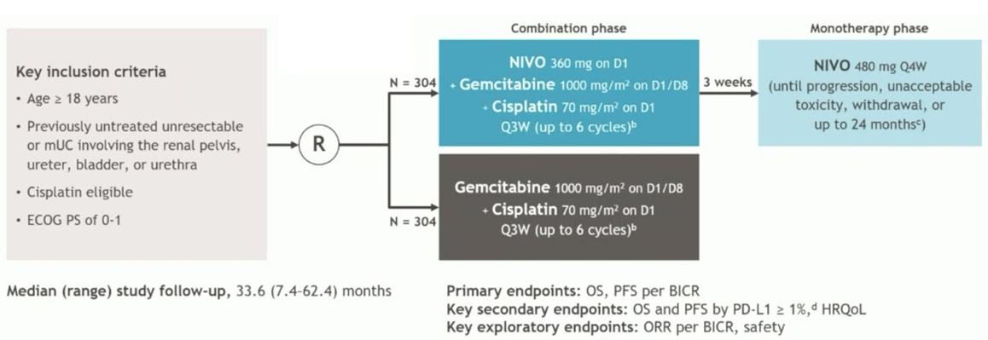
CheckMate 901 study design
ESMO 2023.

Slide 77

Patient demographics
van der Heijden MS, et al. NEJM, 2023.

Slide 78
van der Heijden MS, et al. NEJM, 2023.

Slide 79
Addition of nivolumab enhances OS and PFS over chemotherapy alone
van der Heijden MS, et al. NEJM, 2023.

Slide 80
Benefit across subgroups
van der Heijden MS, et al. NEJM, 2023.

Slide 81
ORR and DoR
van der Heijden MS, et al. NEJM, 2023.

Slide 82
Treatment-related adverse events
van der Heijden MS, et al. NEJM, 2023.

Slide 83





Slide 84


Slide 85

DESTINY-PanTumor02 study design
ASCO 2023.

Slide 86
Patient demographics
Meric-Bernstam F, et al. JCO, 2023.

Slide 87

ORR in HER2 IHC 3+ vs. IHC 2+ across tumor types
Meric-Bernstam F, et al. JCO, 2023.

Slide 88

Maximum change in tumor size and DoR
Meric-Bernstam F, et al. JCO, 2023.

Slide 89

Bladder cancer PFS and OS
Meric-Bernstam F, et al. JCO, 2023.

Slide 90
Adverse events
Meric-Bernstam F, et al. JCO, 2023.

Slide 91

Timeline of approved drugs for mUC
Roviello G, et al. Nat Rev Urol, 2024.

Slide 92

Current treatment landscape for mUC
Before
Current
Roviello G, et al. Nat Rev Urol, 2024.

Slide 93

Potential factors to consider with 1st line treatment of mUC
Guru Sonpavde, ASCO Daily News.

