Slide 1
Lung Cancers
Thursday, January 18th, 2024

Slide 2
Welcome
Steven Frommeyer
Executive Director, Global Ambassador Strategies, Oncology
MJH Life Sciences™

Slide 3




Thank You to Our Supporters:

Slide 4
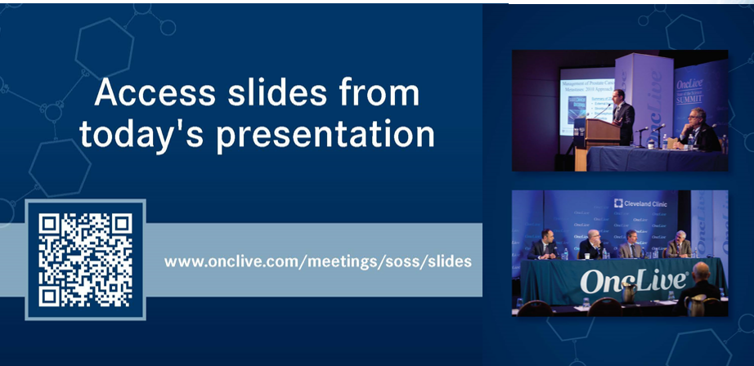

Slide 5


Slide 6
2023 Events
Precision Medicine: November 16,
Washington, DC
Breast: December 4, San Antonio, TX
2024 Events
Genitourinary: January 24, San Francisco, CA
Lung: March, Atlanta, GA
Gyn-Onc: May, Austin, TX
Lung: June, Chicago, IL
Gastrointestinal: November, Washington, DC
Breast: December, San Antonio, TX

Slide 7


Slide 8
Program Chair
Nisha Mohindra, MD MS
Associate Professor
Northwestern University
Chicago, IL

Slide 9
Lung Cancers
Thursday, January 18th, 2024

Slide 10
The Latest in Management of SCLC
Nisha Mohindra, MD MS
Associate Professor
Northwestern University
Chicago, IL

Slide 11
Agenda
Today, we will review:
Long-term data for first line chemo-IO in ES SCLC
Emerging biomarkers
Evolving therapies for SCLC in second line and beyond

Slide 12







IMpower133: Atezolizumab + Chemotherapy in ES-SCLC¹
Induction (4 x 21-day cycles)
Maintenance
Patient Population
ES-SCLC
ECOG PS 0 or 1
No prior systemic
treatment for ES-SCLC
Treated, asymptomatic brain metastases
N = 403
Atezolizumab 1,200 mg IV on d 1
+ carboplatin AUC 5 mg/mL/min IV on d 1
+ etoposide 100 mg/m² IV on d 1-3
Atezolizumab
Survival follow-up
1:1
R
Placebo
+ carboplatin AUC 5 mg/mL/min IV on d 1
+ etoposide 100 mg/m² IV on d 1-3
Placebo
Stratified by
Sex (male vs female)
ECOG PS (0 vs 1)
Brain metastases (yes vs no)
Coprimary endpoints: OS, investigator-assessed PFS
Key secondary endpoints: ORR, DOR, safety
1. Horn L et al. N Engl J Med. 2018;379:2220-2229.

Slide 13
IMpower133: Overall Survival
100
90
80
70
60
50
40
30
20
10
0
Atezo + CP/ET
Placebo + CP/ET (n = 202)
(n = 201)
Median OS, mo
12.3
10.3
(9.3-11.3)
(95% CI)
(10.8-15.8)
HR (95% CI)
0.76 (0.60-0.95)
.0154ª
P
OS, %
12-mo OS
51.9%
Median follow-up: 22.9 mo
18-mo OS
39.0%
34.0%
Atezolizumab + CP/ET
21.0%
Placebo + CP/ET
0 2 4 6 8 10 12 14 16 18 20 22 24 26 28 30 32
Time, mo
Liu SV, et al. J Clin Oncol 2021; 39:619-30

Slide 14
Where do sites of progression occur?
Measurable ES-SCLC (per RECIST version 1.1)
ECOG PS 0 or 1
No prior systemic treatment for ES-SCLC
Patients with treated asymptomatic brain metastases were eligible
Induction
Maintenance
Atezolizumab + carboplatin + etoposide Four 21-day cycles
Survival follow-up
Atezolizumab
Treat until PD or loss of clinical benefit
R 1:1
Placebo + carboplatin + etoposide
Four 21-day cycles
Placebo
Stratification
Sex (male vs female)
ECOG PS (0 vs 1)
Brain metastases (yes vs no)ª
N = 403
Primary endpoints
Overall survival
Investigator-assessed PFS
Exploratory analyses
Time to intra-cranial progression
Patterns of PD per RECIST 1.1^{b}
Time to intra-cranial progression was defined as the time from randomization to development of new lesions in the brain or receipt of therapeutic brain radiation without new brain lesions reported during the follow-up period
Higgins et al. ASTRO 2020. Abstract LBA3.

Slide 15
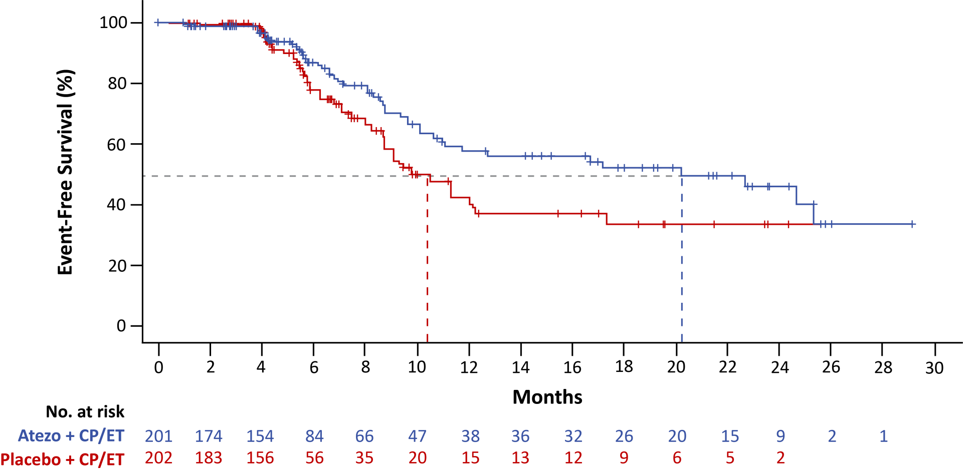
Time to Intra-cranial Progression (ITT Population)
 | Atezo + CP/ET (n = 201) | Placebo + CP/ET (n = 202)
Median time to intra-cranial progression (95% CI), mo | 20.2 (11.0, NE) | 10.5 (8.7, 17.3)
HR (95% CI) | 0.66 (0.44, 1.00) P = 0.046ª

Slide 16
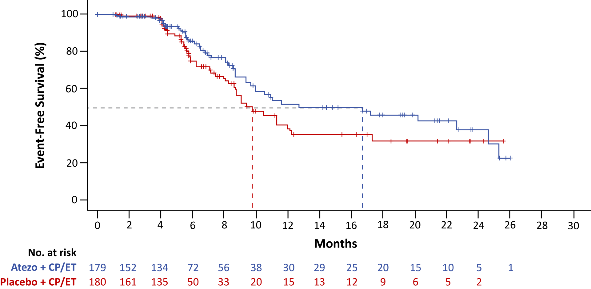
Time to Intra-cranial Progression in Patients Who Did Not Receive PCI
 | Atezo + CP/ET (n = 179) | Placebo + CP/ET (n = 180)
Median time to intra-cranial progression (95% CI), mo | 16.7 (10.0, 24.6) | 9.8 (8.6, 12.3)
HR (95% CI) | 0.72 (0.48, 1.09) P = 0.12ª

Slide 17
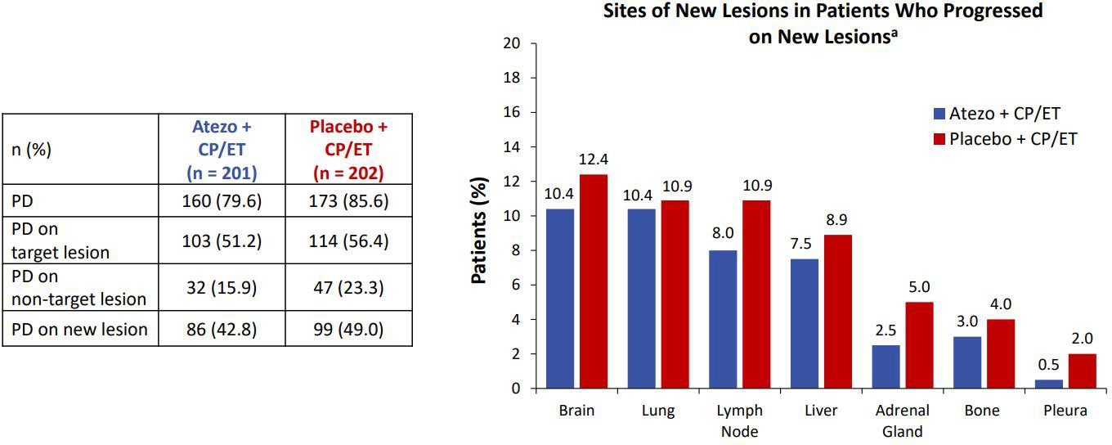
Sites of Progression: IMpower 133
n (%) | Atezo + CP/ET | Placebo + CP/ET
PD | 160 (79.6) | 173 (85.6)
PD on target lesion | 103 (51.2) | 114 (56.4)
PD on nontarget lesion | 32 (15.9) | 47 (23.3)
PD on new lesion | 86 (42.8) | 99 (49.0)
Patients, %
Dominant pattern of progression in both treatment arms was in initial sites of disease
Higgins et al. ASTRO 2020. Abstract LBA3.

Slide 18
5-year OS: Imbrella A Extension Study
IMbrella A is an open-label, non-randomised, multicentre extension and long-term observational study
Patients in the IMpower133 control arm were not eligible for enrollment in IMbrella A
Rollover from IMpower133 to IMbrella A for patients treated with atezolizumab in IMpower133 occurred between December 2019 and July 2020
We report a merged analysis from IMpower133 and IMbrella A with a CCOD of 16 March 2023
IMpower133 study IMbrella A extension study
IMbrella A (n=18)
Patients were eligible if they:
Atezolizumab
+ CP/ET (n=201)
Atezolizumab
LPLV: Jul 2020
Atezolizumab and/or survival follow-up
Primary PFS and OS analysis CCOD
Apr 2018¹
Updated OS
analysis CCOD Jan 2019²
Rollover^{b}
continued to receive atezolizumab at study closure, or
were in survival follow-up
R 1:1
Placebo
+ CP/ET (n=202)
Placebo LPLV: Nov 2019
Presented by S Liu, WCLC 2023
4.
https://ter.li/b12nvl

Slide 19
OS: Combined IMbrella + IMpower 133
Atezo + CP/ET (n=201)
Placebo + CP/ET (n=202)
OS rate (95% CI), % | IMpower133 and IMbrella A Atezo + CP/ET (n=201) | IMpower133 only Placebo + CP/ET (n=202)
1-year | 52% (45-59) | 39% (32-46)
2-year | 22% (16-28) | 16% (11-21)
3-year | 16% (11-21) | NEª
4-year | 13% (8-18) | NEª
5-year | 12% (7-17) | NEª
100
OS events, n (%)
159 (79.1)
169 (83.7)
80
Median OS (95% CI), months
12.3 (10.8, 15.8)
10.3 (9.3, 11.3)
Atezo + CP/ET median follow-up: 59.4 months (range, 0.0-72.6) Placebo + CP/ET median follow-up: 26.4 months (range, 0.0-34.4)
60
OS (%)
40
20
5-year OS, 12%
0
0 3 6 9 12 15 18 21 24 27 30 33 36 39 42 45 48 51 54 57 60 63 66 69 72 75
Months
No. at risk
Atezo + CP/ET | 201 182 159 121 93 81 61 48 38 33 30 | 30 28 26 17 15 15 14 14 12 11 10 8 | 7 | 2
Placebo + CP/ET | 202 186 160 114 74 55 39 34 25 11 3 | 2
Presented by S Liu, WCLC 2023
6.
https://ter.li/b12nvl

Slide 20
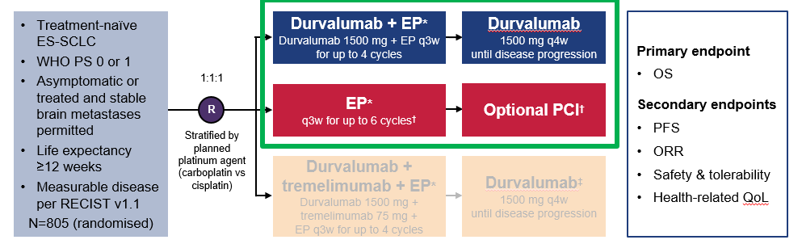
CASPIAN Study Design: Durvalumab+/-Tremelimumab+/- EP

Slide 21
CASPIAN: Overall Survival
Durva + EP
EP
1.0
Events, n/N (%)
mOS, mo (95% CI) HR (95% CI)
Nominal P value
221/268 (82.5)
12.9 (11.3-14.7)
248/269 (92.2)
10.5 (9.3-11.2)
0.8
OS, Proportion
0.71 (0.60-0.86)
.0003
0.6
52.8%
Median follow-up in censored patients: 39.4 mo (range, 0.1-47.5)
0.4
32.0%
39.3%
22.9%
17.6%
0.2
24.8%
Durva + EP
5.8%
13.9%
9 12 15 18 21 24 27 30 33 36 39 42 45 48 51
Time Since Randomization, mo
EP
0.
0
0
3
6
No. at Risk
Durva + EP | 268 | 244 | 214 | 177 | 140 | 109 | 85 | 70 | 60 | 54 | 50 | 46 | 39 | 25 | 13 | 3 | 0 | 0
EP | 269 | 243 | 212 | 156 | 104 | 82 | 64 | 51 | 36 | 24 | 19 | 17 | 13 | 10 | 3 | 0 | 0 | 0
Paz-Ares L, ESMO Open. 2022;7(2):100408.

Slide 22
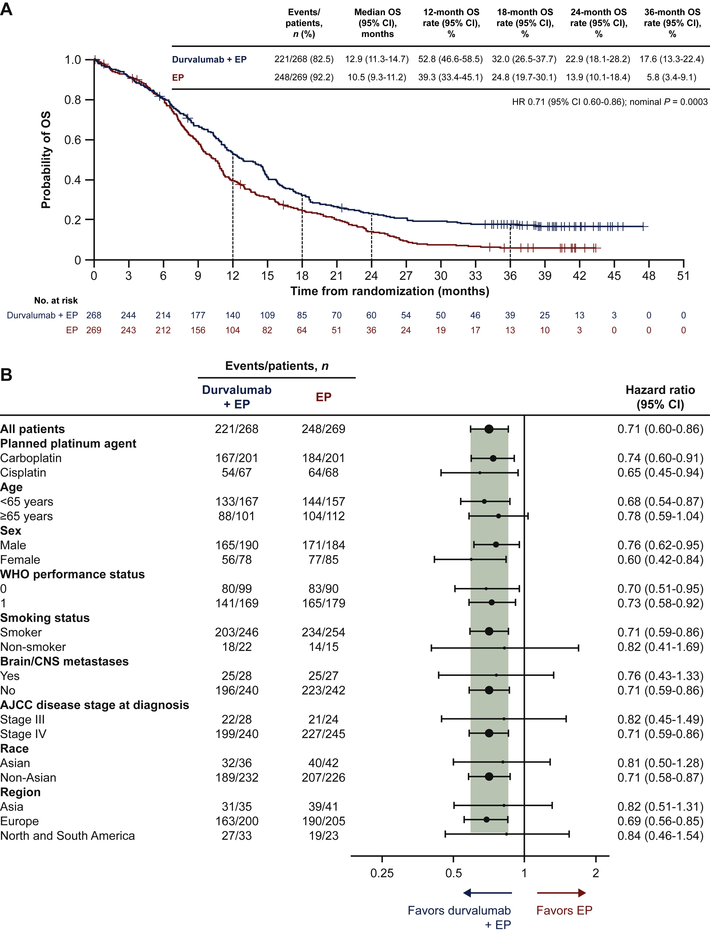
CASPIAN: 3-year OS update

Slide 23
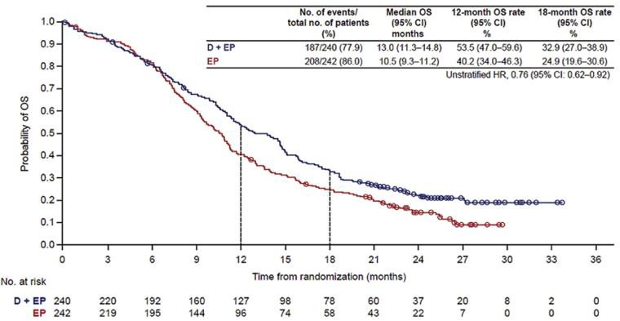
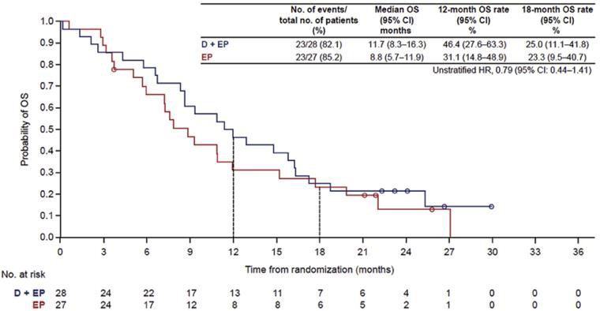
CASPIAN: Impact of Brain Metastases on Outcomes
OS benefit with D+ EP maintained regardless of presence of brain metastases at baseline
OS in Patients With Brain Metastases
OS in Patients Without Brain Metastases at Baseline
Chen Y et al. JTO Clin Res Rep. 2022;3:100330.

Slide 24
Emerging Subtypes in SCLC
Epigenetic and gene expression studies on preclinical models and on primary human tumors have resulted in molecular classification of four distinct SCLC subtypes based on relative expression of key transcription regulators.
  ASCL1 (achaete-scute homologue 1)
  NEUROD1 (neurogenic differentiation factor 1)
  POU2F3 (POU class 2 homeobox 3)
  YAP1* versus inflamed
Subtypes based on neuroendocrine (SCLC-A and SCLC-N), non-neuroendocrine (SCLC-P), and immune-infiltrated (SCLC-I) transcription signatures have been evaluated as biomarkers
neuroendocrine
Non-neuroendocrine
1. Rudin C et al, Nat Rev Cancer. 2019;19:289-297.
2. Gay C et al. Cancer Cell. 2021;39:346-60.e7.

Slide 25
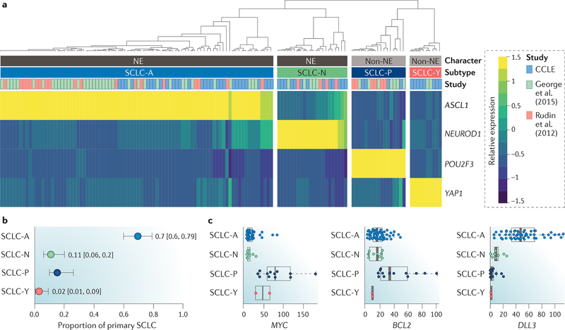
Molecular Subtypes
Rudin C et al, Nat Rev Cancer. 2019;19:289-297.

Slide 26
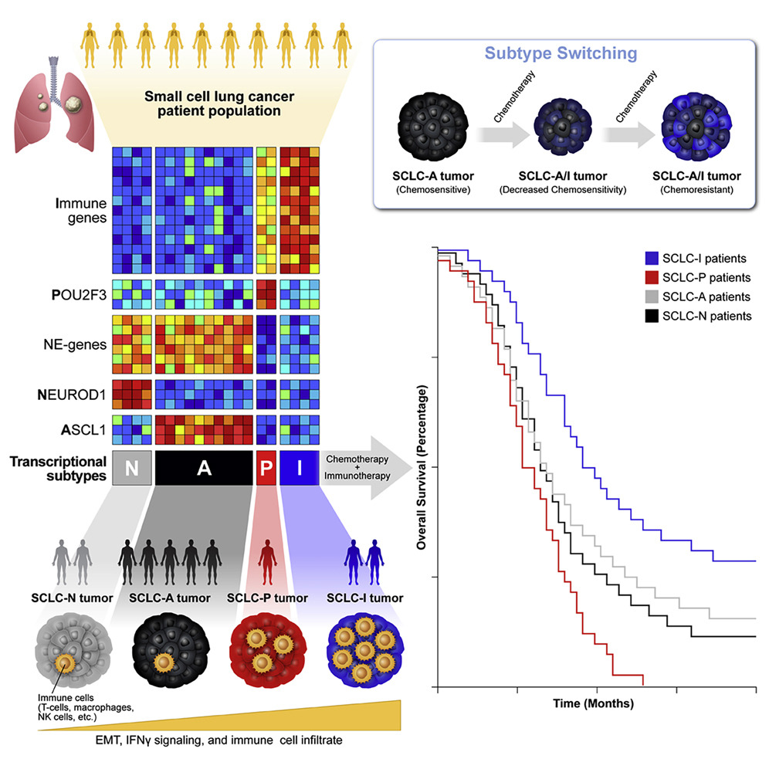
Plasticity (subtype switching on therapy)
Multiple subtypes in 1 tumor
SCLC- I Subtype:
  EMT and an inflamed phenotype
  high expression of genes related to HLAs, interferon-γ activation, and immune checkpoints
Gay CM et al. Cancer Cell. 2021;39:346-60.e7.

Slide 27
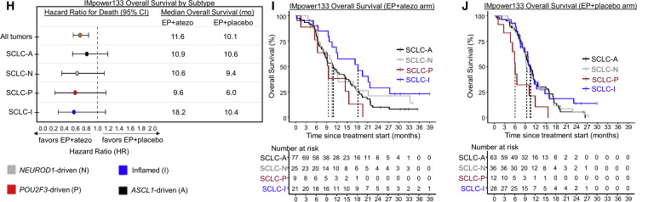
IMpower-133 OS by Subtype
Gay CM et al. Cancer Cell. 2021;39:346-60.e7.

Slide 28
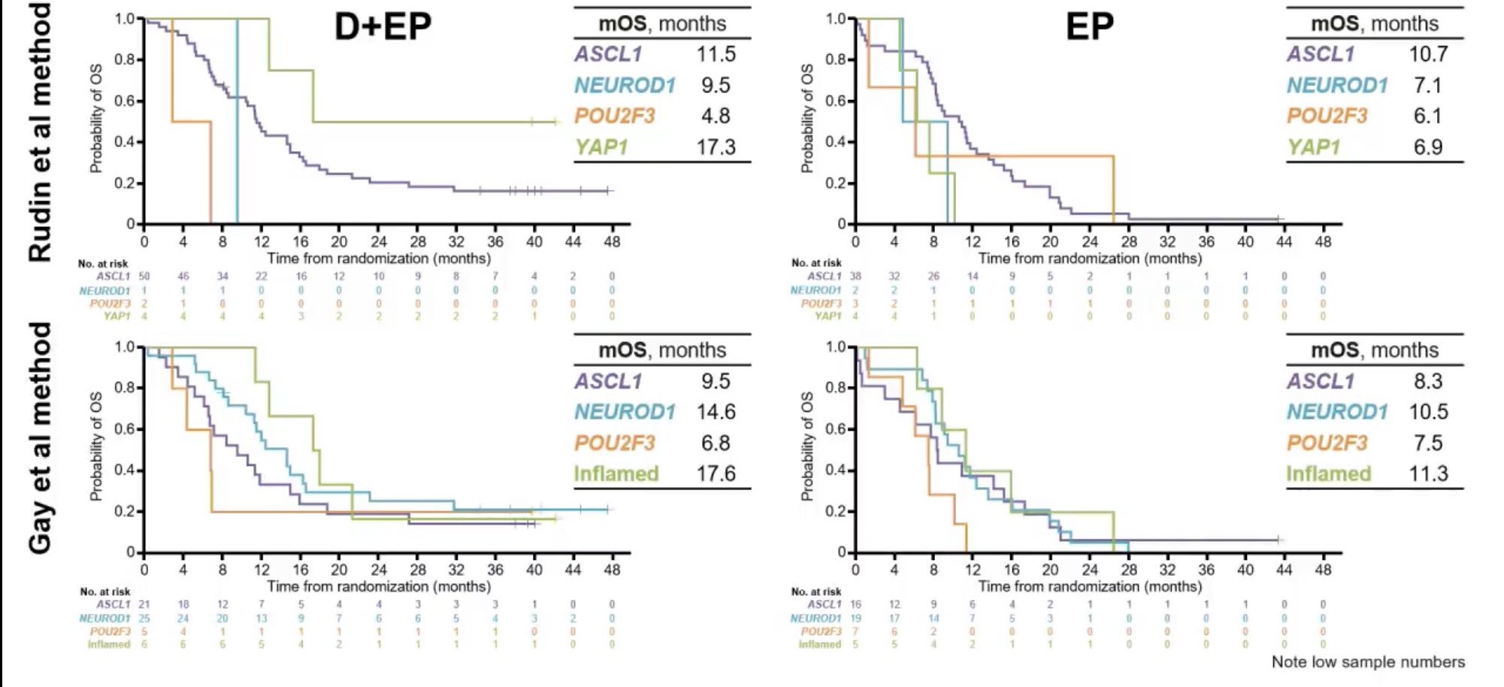
CASPIAN OS By Molecular Subtype
Xie M et al. AACR 2022. Abstract CT024.

Slide 29
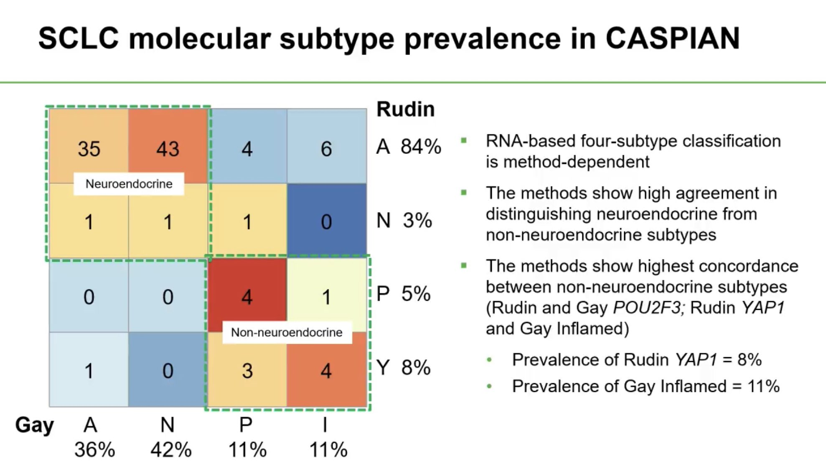
Xie M et al. AACR 2022. Abstract CT024.

Slide 30
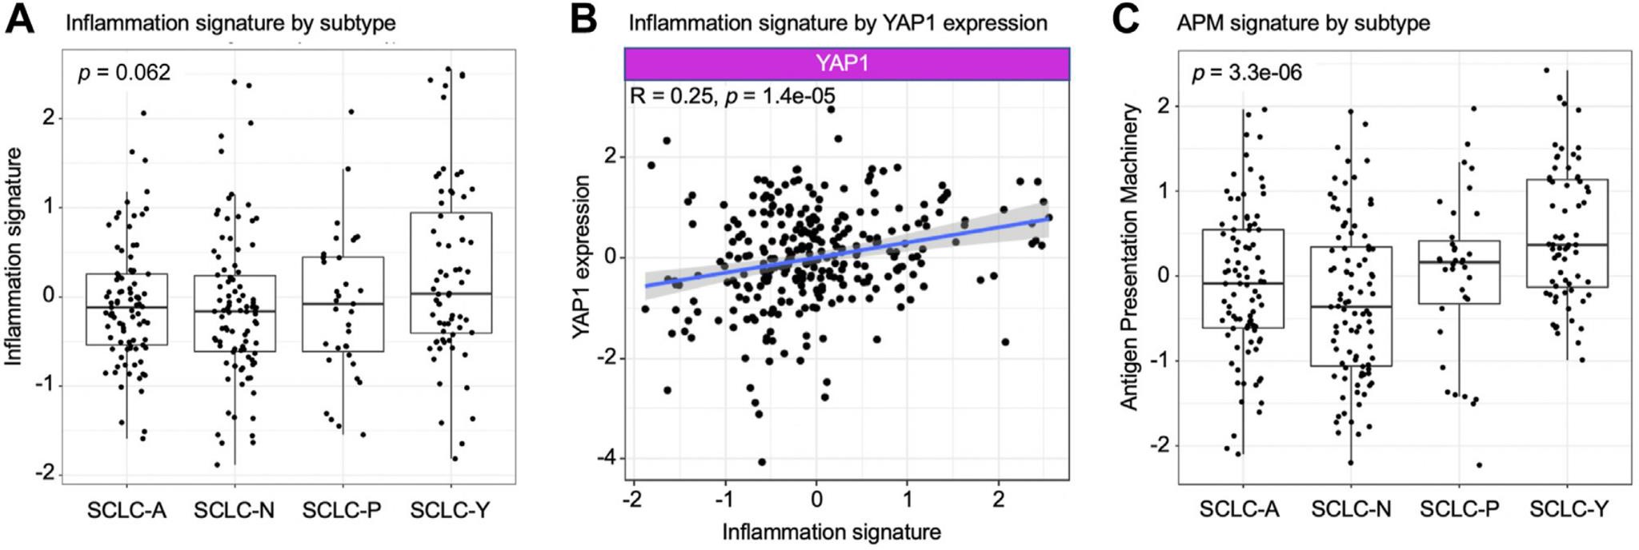
YAP-1 Correlates with immune signature
Analysis of gene expression profiling by RNA-seq of pretreatment SCLC tumor samples from CheckMate -032 revealed a trend toward higher levels of inflammation gene signature in SCLC-Y tumors at baseline vs other transcriptional subsets, but this did not reach statistical significance (P = .062)
YAP1 gene expression across the data set did significantly correlate with inflammation signature (R = 0.25, P = .00014)
Rudin CM et al. J Thorac Oncol. 2023;18:1222-1232.

Slide 31
What about second line treatment?

Slide 32
Platinum Rechallenge vs Topotecan
>90day CTI
100
Topotecan (2.7 mo; 90% CI, 2.3-3.2)
Combination chemotherapy (4.7 mo; 90% CI, 3.9-5.5)
HR = 0.57 (90% CI, 0.41-0.73)
Log-rank P = .0041
100
Topotecan
Combination chemotherapy
75
75
PFS, %
OS, %
50
50
25
25
0
0
0
2.5
5.0
Time, mo
7.5
10.0
0
10
20
Time, mo
30
40
No. at Risk (Censored)
Topotecan Combination chemotherapy
No. at Risk (Censored)
Topotecan Combination chemotherapy
81 (0) | 45 (0) | 15 (0) | 2 (0) | 1 (0)
81 (0) | 63 (0) | 7 (0) | 6 (2) | 0 (2)
79 (0) | 27 (0) | 15 (0) | 2 (2) | 1 (2)
77 (0) | 25 (0) | 0 (0) | 0 (4) | 0 (5)
Baize N et al. Lancet Oncol. 2020;21:1224-1233.

Slide 33
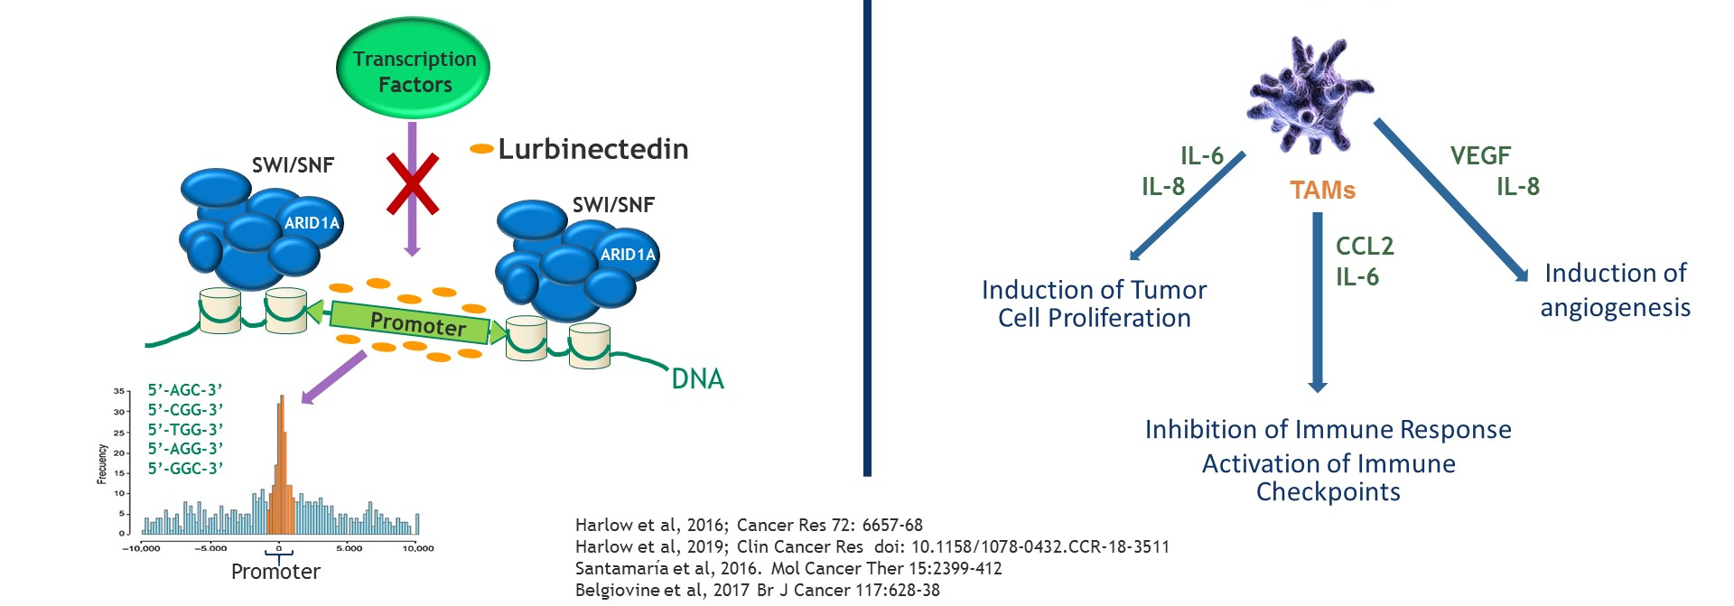

Lurbinectedin: Mechanism of Action
SCLC transcriptionally active disease
Lurbinectidin:
Binds to DNA promotors→
Selective inhibitor of oncogenic transcription
Inhibitor of transcription within macrophages
IL-6, IL-8, CCL2, VEGF
Paz-Ares, ASCO 2019
Trigo J, Lancet Oncology, May 2020
Notes:
Lurbinectedin in now FDA approved for SCLC after chemo
L is a selective inhibitor of transcription and is active in SCLC due to the transcription dependence of the disease
We now know there are molecular subtypes of disease that have differential expression of 4 key TF
L binds to regulatory areas in DNA promoters. Binding of drug prevents binding of TF leading to decreased transcription and eventual apoptosis
Transcription I can also occur within tumor micorenviron learning to dec T in MP and reduction of

Slide 34
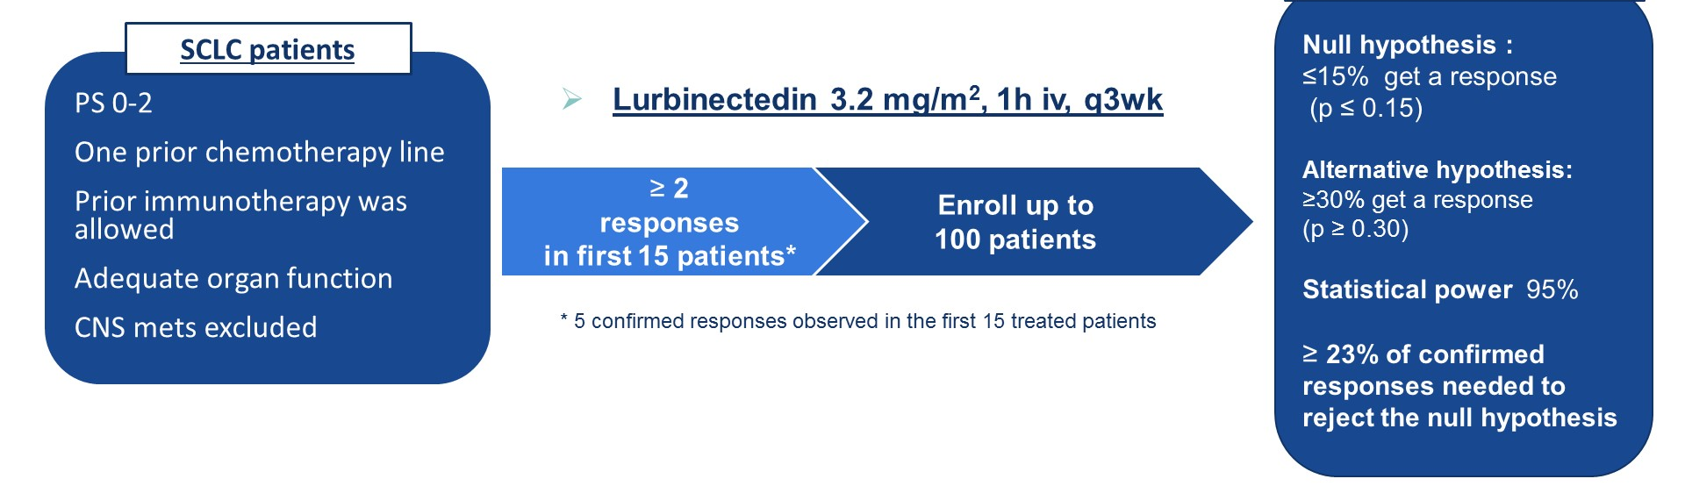
Phase II Basket trial of Single Agent Lurbinectedin
Primary end point: ORR

Slide 35
Lurbinectedin: Efficacy Data
 | All Patients (N = 105) | Chemotherapy-Free Interval <90 d (n = 45) | Chemotherapy-Free Interval ≥90 d (n = 60)
RECIST responses
Complete response | 0 | 0 | 0
Partial response, n (%) | 37 (35) | 10 (22) | 27 (45)
Stable disease, n (%)ª | 35 (33) | 13 (29) | 22 (37)
Progressive disease, n (%) | 28 (27) | 18 (40) | 10 (17)
Not evaluable, n (%)^{b} | 5 (5) | 4 (9) | 1 (2)
Overall response, % (95% CI) | 35.2 (26.2-45.2) | 22.2 (11.2-37.1) | 45.0 (32.1-58.4)
Disease control, % (95% CI)^{c} | 68.6 (58.8-77.3) | 51.1 (35.8-66.3) | 81.7 (69.6-90.5)
Duration of response
Disease progression, relapse, or death events in responding patients, n/N (%) | 29/37 (78) | 9/10 (90) | 20/27 (74)
Median duration of response, mo (range) | 5.3 (4.1-6.4) | 4.7 (2.6-5.6) | 6.2 (3.5-7.3)
Patients still responding at 6 mo, % (range) | 43.0 (25.6-60.5) | 11.7 (0.0-33.1) | 55.3 (34.5-76.0)
PFS
PFS events, n (%) | 90 (86) | 41 (91) | 49 (82)
Median PFS, mo (95% CI) | 3.5 (2.6-4.3) | 2.6 (1.3-3.9) | 4.6 (2.8-6.5)
4-mo PFS, % (95% CI) | 46.6 (36.7-56.5) | 29.1 (15.3-42.8) | 59.9 (47.1-72.7)
6-mo PFS, % (95% CI) | 32.9 (23.3-42.5) | 18.8 (6.8-30.9) | 43.5 (30.1-56.9)
OS
Deaths, n (%) | 66 (63) | 37 (82) | 29 (48)
Median OS, mo (95% CI) | 9.3 (6.3-11.8) | 5.0 (4.1-6.3) | 11.9 (9.7-16.2)
6-mo OS, % (95% CI) | 67.1 (57.6-76.7) | 45.8 (30.4-61.3) | 83.6 (73.7-93.5)
12-mo OS, % (95% CI) | 34.2 (23.2-45.1) | 15.9 (3.6-28.2) | 48.3 (32.5-64.1)
Trigo J et al. Lancet Oncol. 2020;21:645-654.

Slide 36
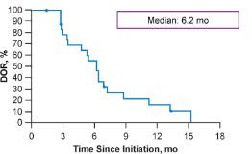
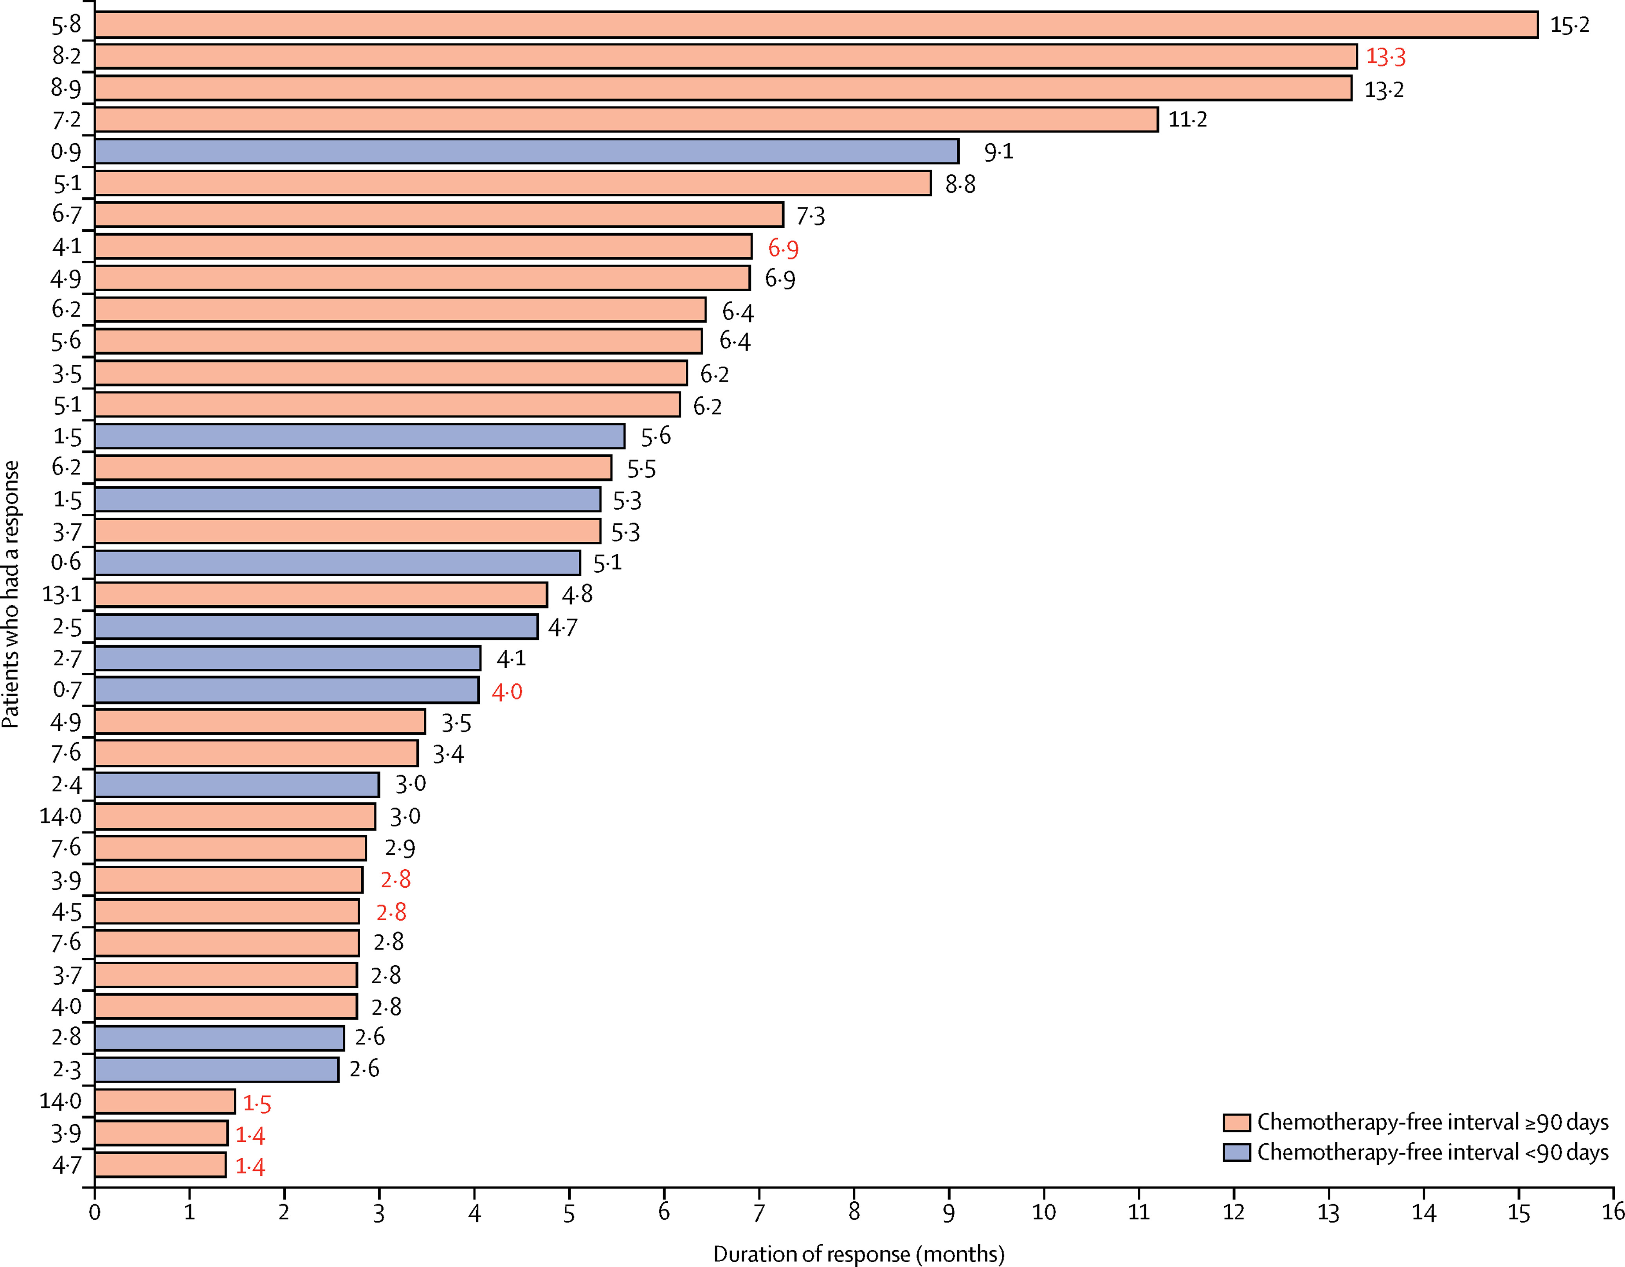
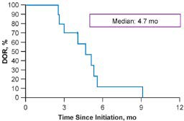
Lurbinectedin: Duration of Response by CTI

Slide 37
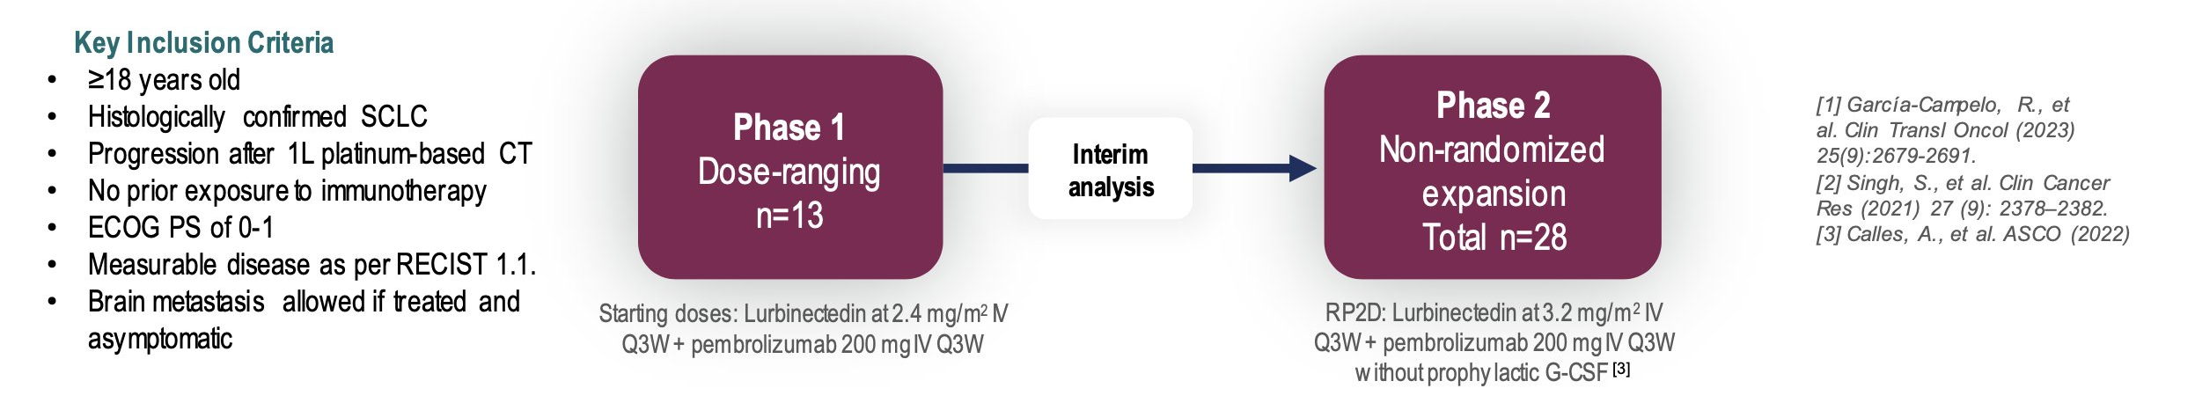
LUPER: PhaseI/II Lurbinectedin+pembrolizumab
Primary endpoint: ORR
Secondary Endpoint: DoR, PFS, OS, Safety
Calles A, ESMO 2023

Slide 38
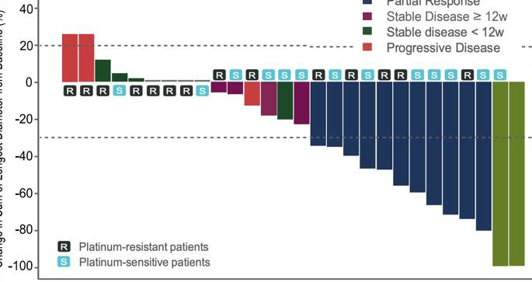

LUPER: Efficacy, ORR
Tumor Response, n (%) | Platinum-Free Interval <90 Days (n = 14) | Platinum-Free Interval ≥90 Days (n = 13) | Overall (N = 28)
BOR
CRª | 0 (0) | 1 (7.7) | 2 (7.1)
PR | 5 (35.7) | 6 (46.2) | 11 (39.3)
SD ≥12 weeks | 1 (7.1) | 3 (23.1) | 4 (14.3)
SD <12 weeks | 2 (14.3) | 2 (15.4) | 4 (14.3)
PD | 3 (21.4) | 0 | 3 (10.7)
NE | 3 (21.4) | 1 (7.7) | 4 (14.3)
ORR
Yesª | 5 (35.7) | 7 (53.9) | 13 (46.4)
No | 9 (64.3) | 6 (46.1) | 15 (53.6)
CBR
Yesª | 6 (42.9) | 10 (76.9) | 17 (60.7)
No | 8 (57.1) | 3 (23.1) | 11 (39.3)
Change in Sum of Longest Diameter From Baseline, %
Primary objective has been achieved with 46.4% confirmed response rate assessed by investigator (95% CI, 29.5-64.2; P < .001)
Sensitive
Calles Blanco A et al. ESMO 2023. Abstract 1989MO.
No. at Risk Resistant Sensitive
Time Since Treatment Initiation, mo
14
13
0
1
0
1
0
1
0
1
0
0

Slide 39
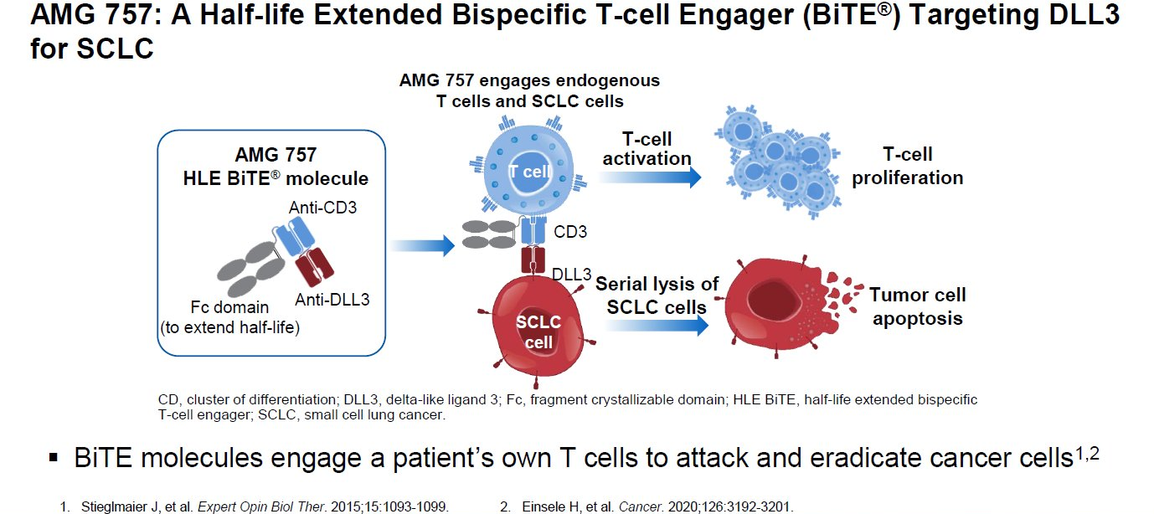
BiTE Therapy in SCLC

Slide 40
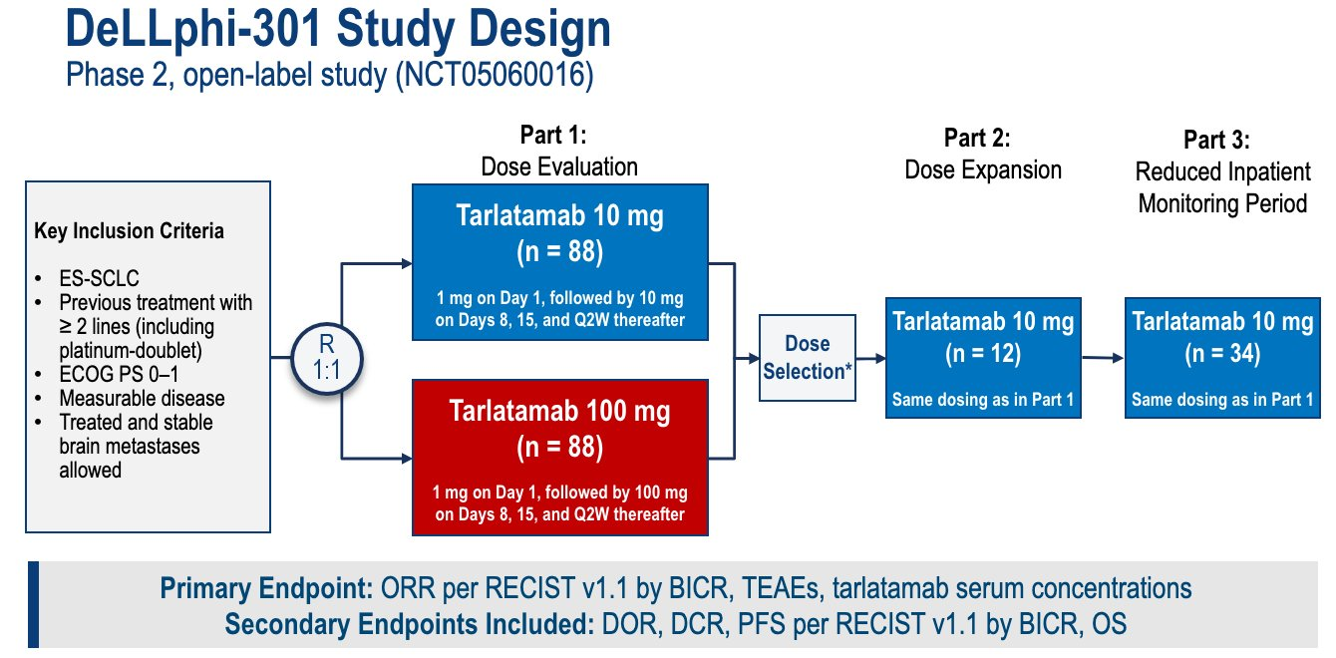

Slide 41
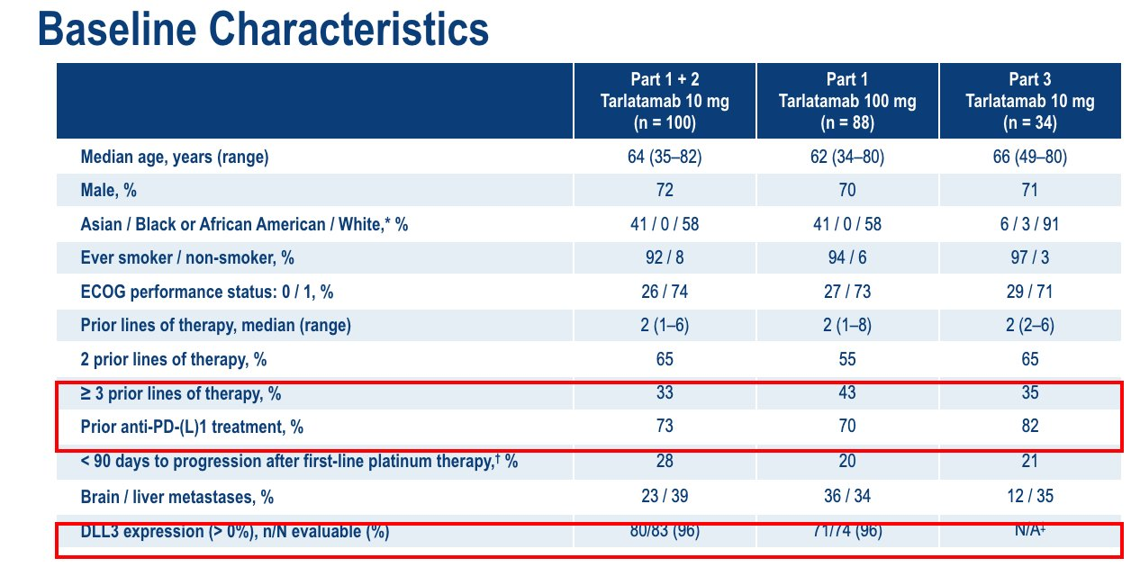

Slide 42
Tarlatamab Efficacy Data
Outcome | Tarlatamab 10 mg (n = 100) | Tarlatamab 100 mg (n = 88)
ORR, n (%) (97.5% CI) | 40 (40) (29-52) | 28 (32) (21-44)
CR | 1 (1) | 7 (8)
PR | 39 (39) | 21 (24)
SD | 30 (30) | 27 (31)
PD | 20 (20) | 13 (15)
NE/no post-baseline scan | 10 (10) | 20 (23)
Observed DOR ≥6 mo, n/N (%) | 23/40 (58) | 17/28 (61)
DCR, n (%) (95% CI) | 70 (70) (60-79) | 55 (63) (52-73)
Median PFS, mo (95% CI) | 4.9 (2.9-67) | 3.9 (2.6-4.4)
Median OS, mo (95% CI) | 14.3 (10.8-NE) | NE (12.4-NE)
Ahn M-J et al. N Engl J Med2023;389:2063-2075

Slide 43
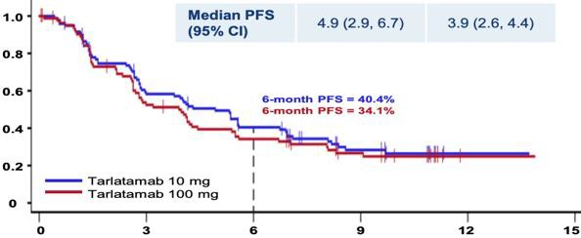
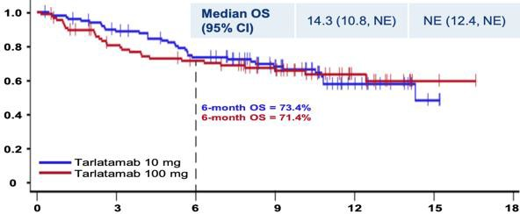
Efficacy Data
Progression Free Survival
Overall Survival

Slide 44
Safety Summary
Most common AE was CRS, which primarily occurred in cycle 1 and was mostly grade 1-2
Discontinuation of tarlatamab due to TRAEs was low (3%)
Safety was not altered with shorter inpatient monitoring (Part 3)
TEAEs, n (%) | Part 1 + 2 Tarlatamab 10 mg (n = 99) | Part 1 Tarlatamab 100 mg (n = 87) | Part 3 Tarlatamab 10 mg (n = 34) |  | Most Common TEAEs in ≥20% of Patients, n (%) | Part 1 + 2 Tarlatamab 10 mg (n = 99) | Part 1 Tarlatamab 100 mg (n = 87) | Part 3 Tarlatamab 10 mg (n = 34)
Any grade | 96 (97) | 87 (100) | 34 (100) |  | CRS | 49 (49) | 53 (61) | 19 (56)
 |  |  |  |  | Grade 1-2 | 49 (49) | 48 (55) | 18 (53)
 |  |  |  |  | Grade ≥3 | 0 | 5 (6) | 1 (3)
Grade ≥3
57 (58)
56 (64)
22 (65)
Related to tarlatamab, any grade
89 (90)
81 (93)
29 (85)
Grade ≥3
29 (29)
29 (33)
5 (15)
Decreased appetite
25 (25)
38 (44)
13 (38)
Fatal | 0 | 0 | 1 (3)
Leading to dose interruption/reduction | 14 (14) | 25 (29) | 3 (9)
Leading to discontinuation | 4 (4) | 3 (3) | 0
Pyrexia
38 (38)
29 (33)
8 (24)
Constipation
28 (28)
22 (25)
8 (24)
Anemia
26 (26)
22 (25)
9 (26)
Asthenia
20 (20)
21 (24)
10 (29)
Dysgeusia
24 (24)
12 (14)
14 (41)
Fatigue 21 1.
17 (20)
9 (26)
Paz-Ares L et al. ESMO 2023. Abstract LBA92. 2. Ahn M et al. N Engl J Med. 2023

Slide 45
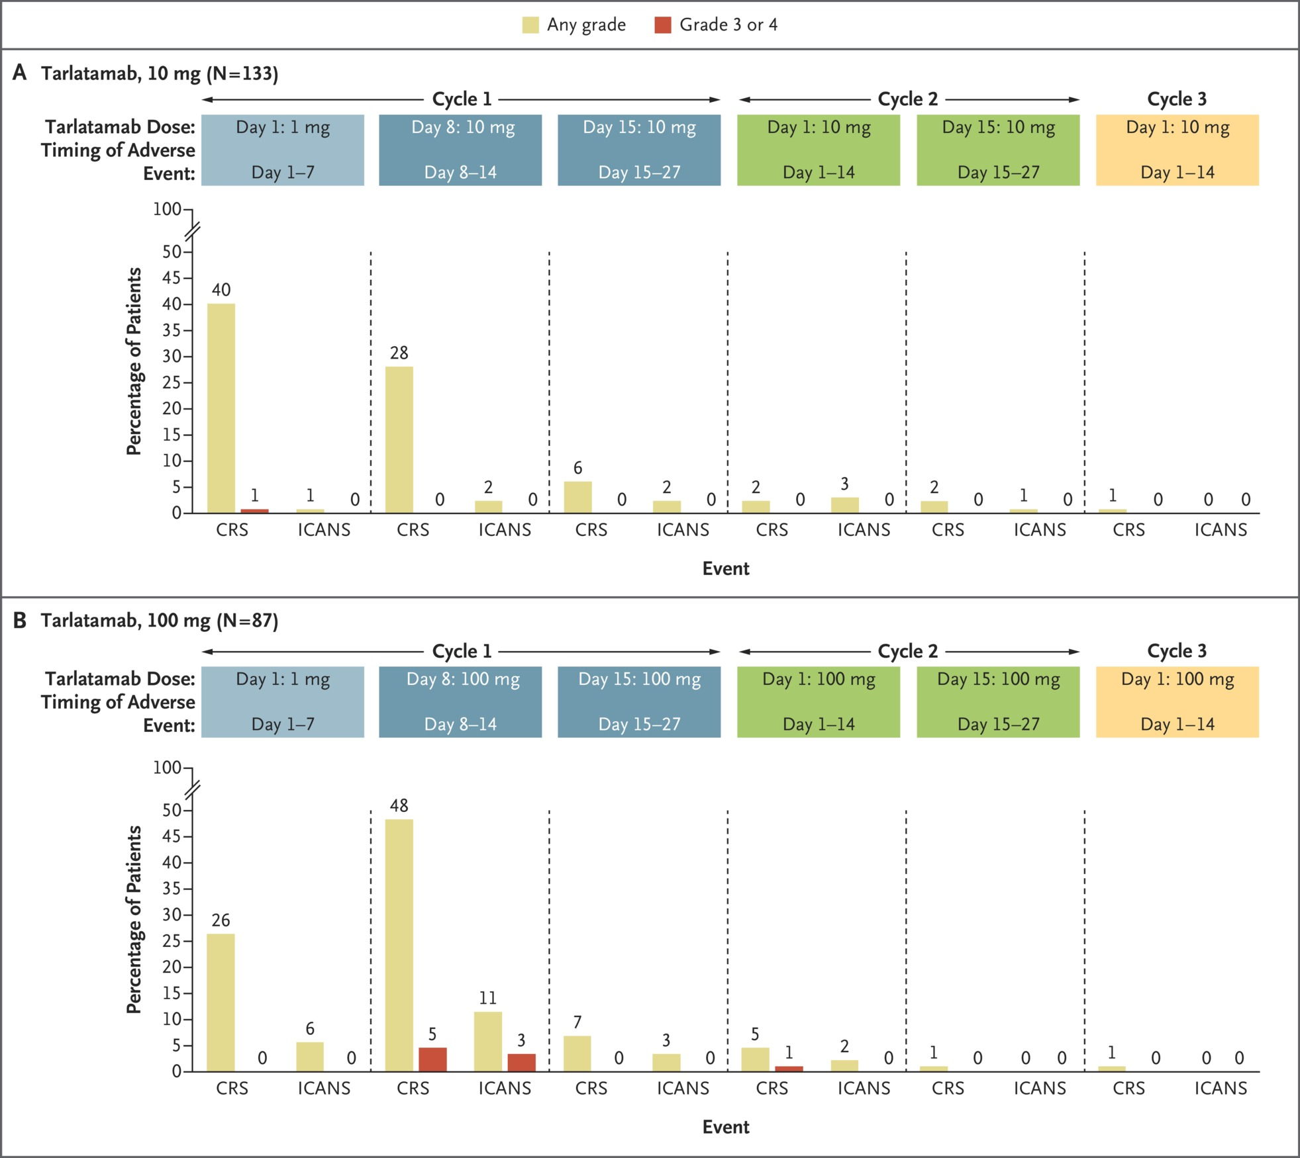

Slide 46
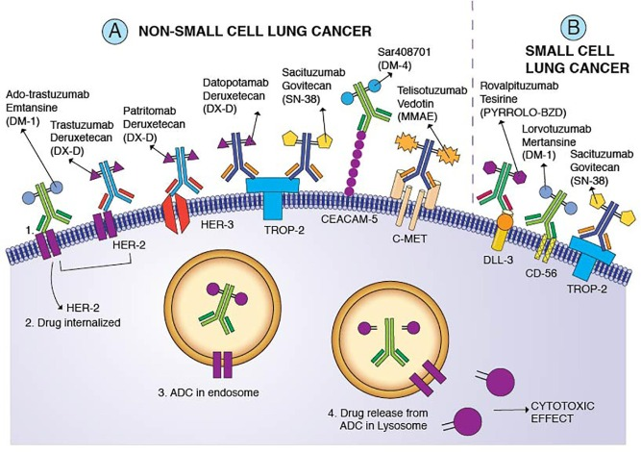
ADCs in SCLC
Desai A, Lung Cancer 2022

Slide 47
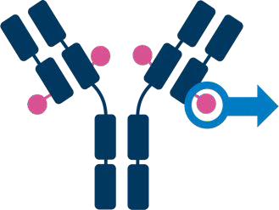
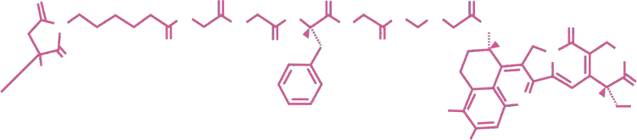
Ifinatamab-deruxetecan (I-DXd) in SCLC
Ifinatamab deruxtecan (I-DXd) is an ADC
A fully human anti–B7-H3 IgG1 mAb
  B7-H3 transmembrane immunoregulatory protein
  65% of SCLC have moderate-to-high expression of B7-H3)
A topoisomerase I inhibitor payload and an exatecan derivative via
A tetrapeptide-based cleavable linker
Humanized anti–B7-H3 IgG1 mAb
Deruxtecan⁴
O
H N
O
H N
O
H N
O
N
N H
N H
O
N H
H
O
O
O
O H
O
N
O
H
O
HO CH₃
H₃C
N
Cleavable tetrapeptide-based linker
F
Topoisomerase I inhibitor
payload (DXd)
Doi T et al. ESMO 2022. Abstract 453O.

Slide 48
Ifinatamab Deruxtecan (I-DXd; DS-7300) in Patients with Refractory SCLC: A Subgroup Analysis of a Phase 1/2 Study
Efficacy Population (≥4.8 mg/kg) | n = 21
Confirmed ORR, n (%, 95% CI) | 11 (52.4, 29.8-74.3)
Confirmed CR, n (%) | 1 (4.8)
Confirmed PR, n (%) | 10 (47.6)
Median TTR, mo (95% CI) | 1.2 (1.2-1.4)
Median DOR, mo (95% CI) | 5.9 (2.8-7.5)
Median PFS, mo (95% CI) | 5.6 (3.9-8.1)
Median OS, mo (95% CI) | 12.2 (6.4-NE)
Median follow-up, mo (95% CI) | 11.7 (4.6-12.9)
SCLC
100
Starting dose level
6.4 mg/kg
80
8.0 mg/kg
12.0 mg/kg
16.0 mg/kg
Best Change From Baseline, %
60
40
20
0
-20
-40
-60
-80
-100
Safety Population (All Doses) | n = 22
Number of prior systemic regimens, median (range) | 2 (1-7)
Platinum-based chemotherapy, n (%) | 22 (100)
Immunotherapy, n (%) | 18 (81.8)
Irinotecan or topotecan, n (%) | 5 (22.7)^{b}
Topotecan, n (%) | 3 (13.6)
Johnson M, WCLC 2023

Slide 49
Conclusion
Long-term follow up demonstrates 5-year OS in chemo+IO of 12%
Molecular subsets may help us understand disease
Emerging novel therapies show promise in SCLC (BiTE, ADCs))

Slide 50
Lung Cancers
Thursday, January 18th, 2024

Slide 51
Treatment Crossroad: Neoadjuvant and Adjuvant IO Therapy in NSCLC
Divya M. Gupta, MD
Assistant Professor of Medicine
Northwestern University
Chicago, IL

Slide 52
Background
Surgery remains the primary curative-intent treatment for eligible patients with early-stage NSCLC
Recent phase 3 trials have demonstrated the clinical benefit of immune checkpoint inhibitor (ICI) in the neoadjuvant and adjuvant resectable NSCLC setting
As a result, various ICI therapies have received approvals for use as a component of either neoadjuvant or adjuvant treatment regimens
Notes:
First Phase III trial looking at neoadjuvant immunotherapy

Slide 53
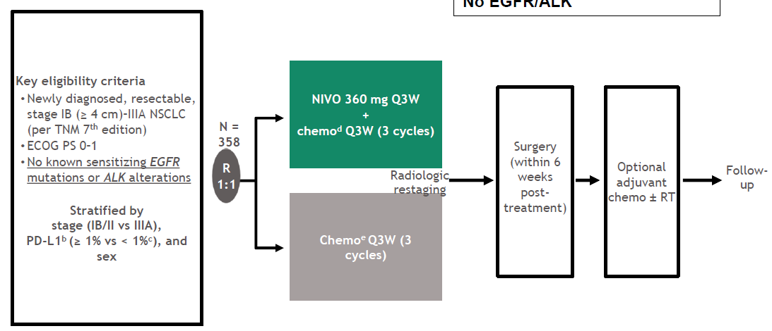
Neoadjuvant ICI - CheckMate 816
37% Stage IB/II, 63% Stage IIII
50% PD-L1 >1%; No EGFR/ALK
Spicer ASCO 2021 abstr: 8503, Forde NEJM
Notes:
First Phase III trial looking at neoadjuvant immunotherapy
No known EGFR mutations or ALK alterations

Slide 54
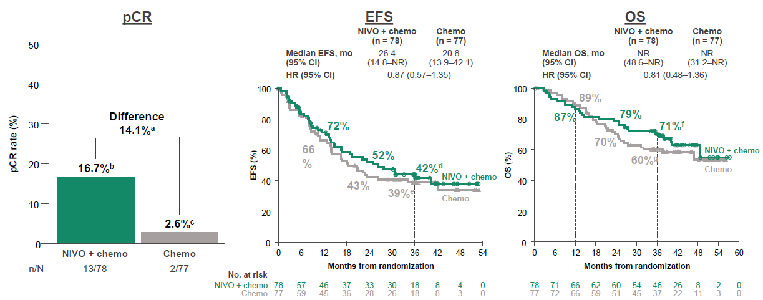
Efficacy outcomes in patients with tumor PD-L1 <1%
Provencio ESMO 2023
Notes:
Want to look at results stratified by PD-L1
In the PD-L1 <1% group, there is an improved path CR and while there are trend in improved EFS and OS, these are not statistically significant

Slide 55
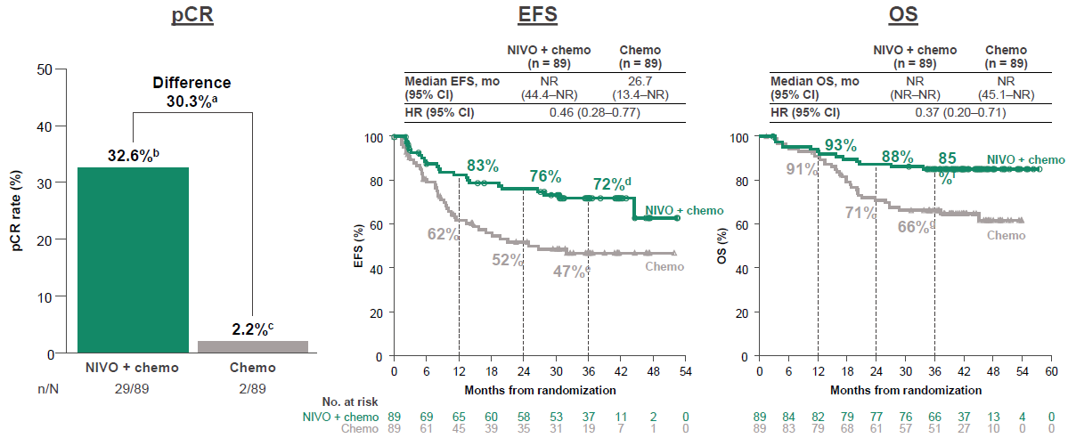
Efficacy outcomes in patients with tumor PD-L1 ≥1%
Provencio ESMO 2023
Notes:
On the other hand, in patients with a tumor PD-L1 expression level of 1% or greater, you can see a much greater event-free survival and OS benefit

Slide 56
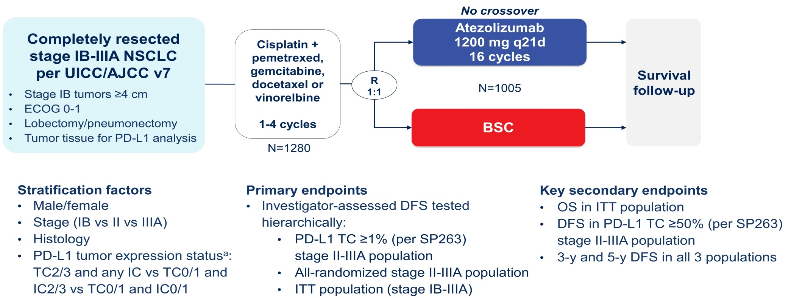
Adjuvant ICI - IMpower 010
55% PD-L1 >1%
15% had known driver mutation
WakeleeASCO 2021, abstr8500:IMpower010 Interim Analysis; FelipLancet 2021, FelipIASLC WCLC 2022
Notes:
There are a few adjuvant ICI trials, we’ll focus on just the IMpower 010 today, this was the first published phase III trial but Keynote 091 is the second one

Slide 57
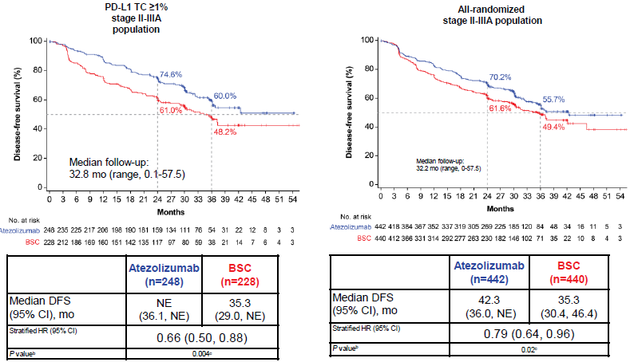
IMpower 010 DFS Results
Wakelee ASCO 2021 abstr8500; Felip Lancet 2021
Notes:
Importance of PD-L1 positivity in predicting response

Slide 58
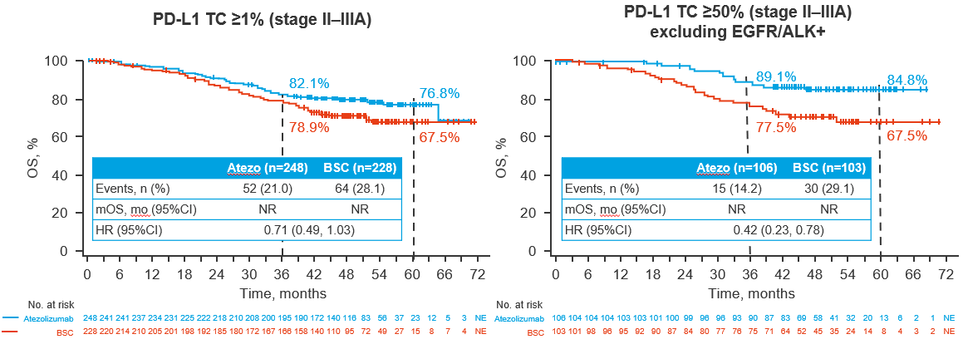
IMpower 010 Overall Survival (selected subsets)
FelipIASLC WCLC 2022 Presidential Plenary

Slide 59
Peri-operative ICI
Perioperative regimens could further improve long-term clinical outcomes by combining the benefits of neoadjuvant and adjuvant immunotherapy to prime anti-tumor immunity with neoadjuvant therapy, while the primary tumor and involved lymph nodes are present, and eradicate micro-metastases with adjuvant therapy
AEGEAN is a phase 3, randomized, double-blind, placebo-controlled study evaluating perioperative durvalumab + neoadjuvant chemotherapy in patients with resectable NSCLC

Slide 60
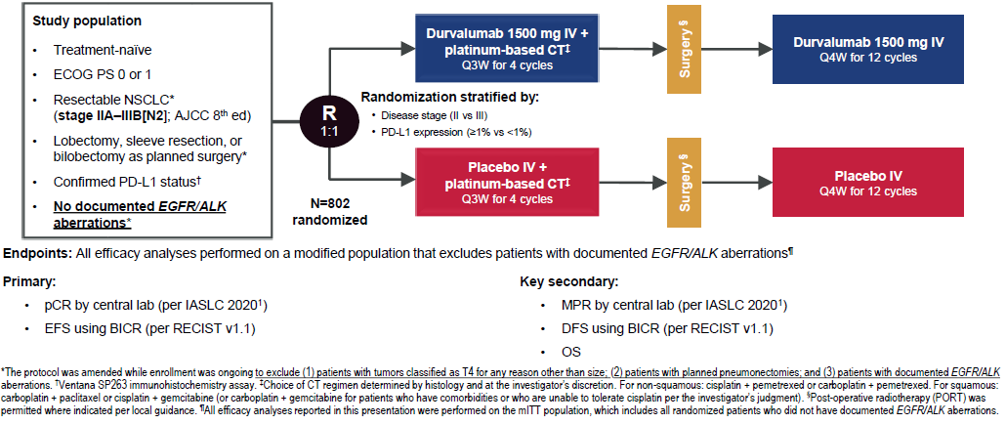
AEGEAN: Trial Design
~1/3 PD-L1 <1%, 1/3 PD-L1 1-49%, 1/3 PD-L1 ≥50%
~6% had known EGFR mutation
Heymach AACR 2023, NEJM 2023.

Slide 61
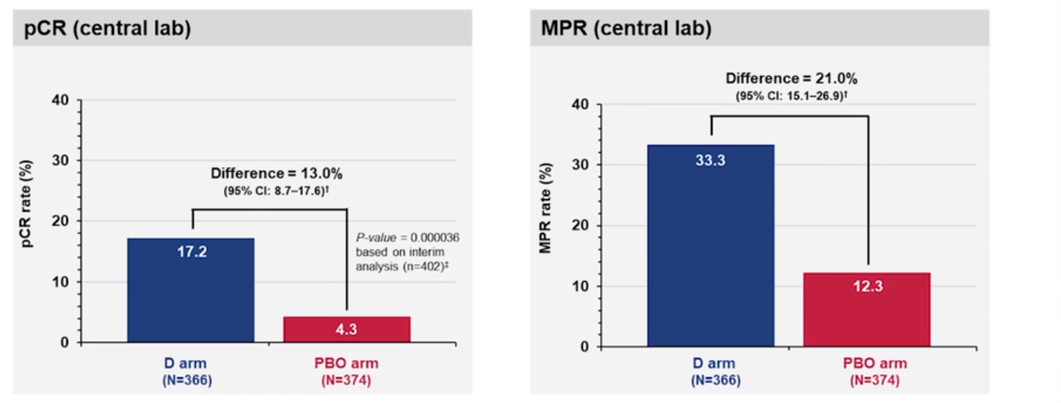
AEGEAN: Pathologic Response per IASLC 2020 Methodology (mITT)
Heymach AACR 2023, NEJM 2023

Slide 62
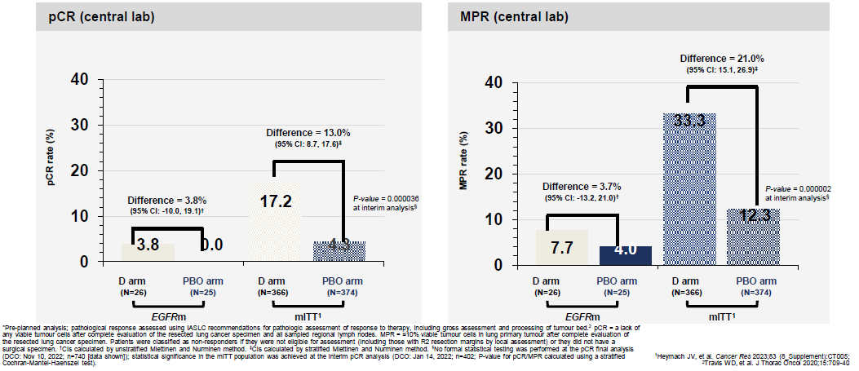
AEGEAN: Pathologic Response (EGFRm and mITT)
Harpole WCLC 2023 OA12.06, NEJM 2023
Notes:
Subgroup analysis in the EGFRm population showed a 3.8% pCR rate compared to 17.2% in the ITT population and a 7.7% MPR rate compared to 33% in the ITT population

Slide 63
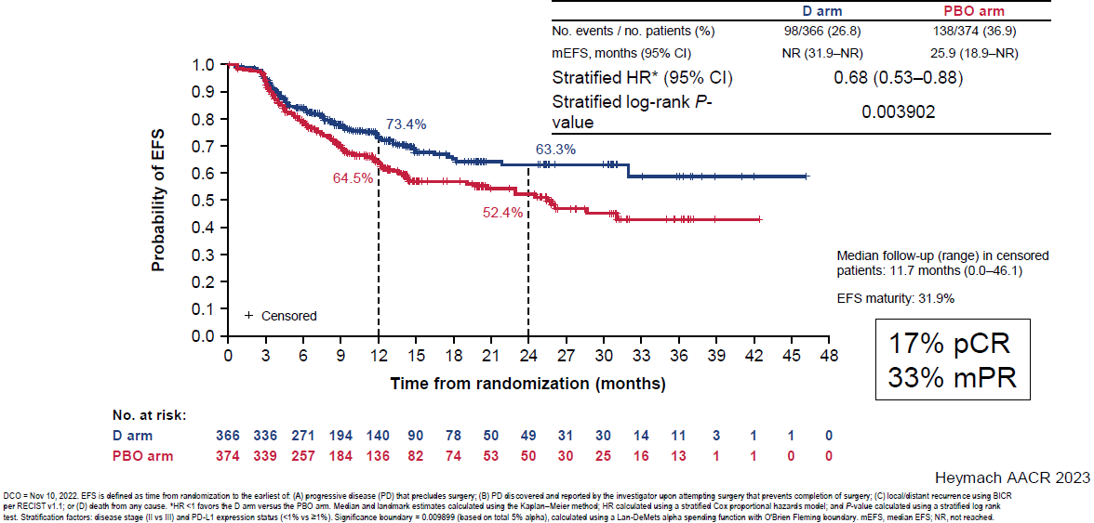
AEGEAN: EFS using RECIST v1.1 (mITT)
JV Heymach et al. N Engl J Med 2023;389:1672-1684.

Slide 64
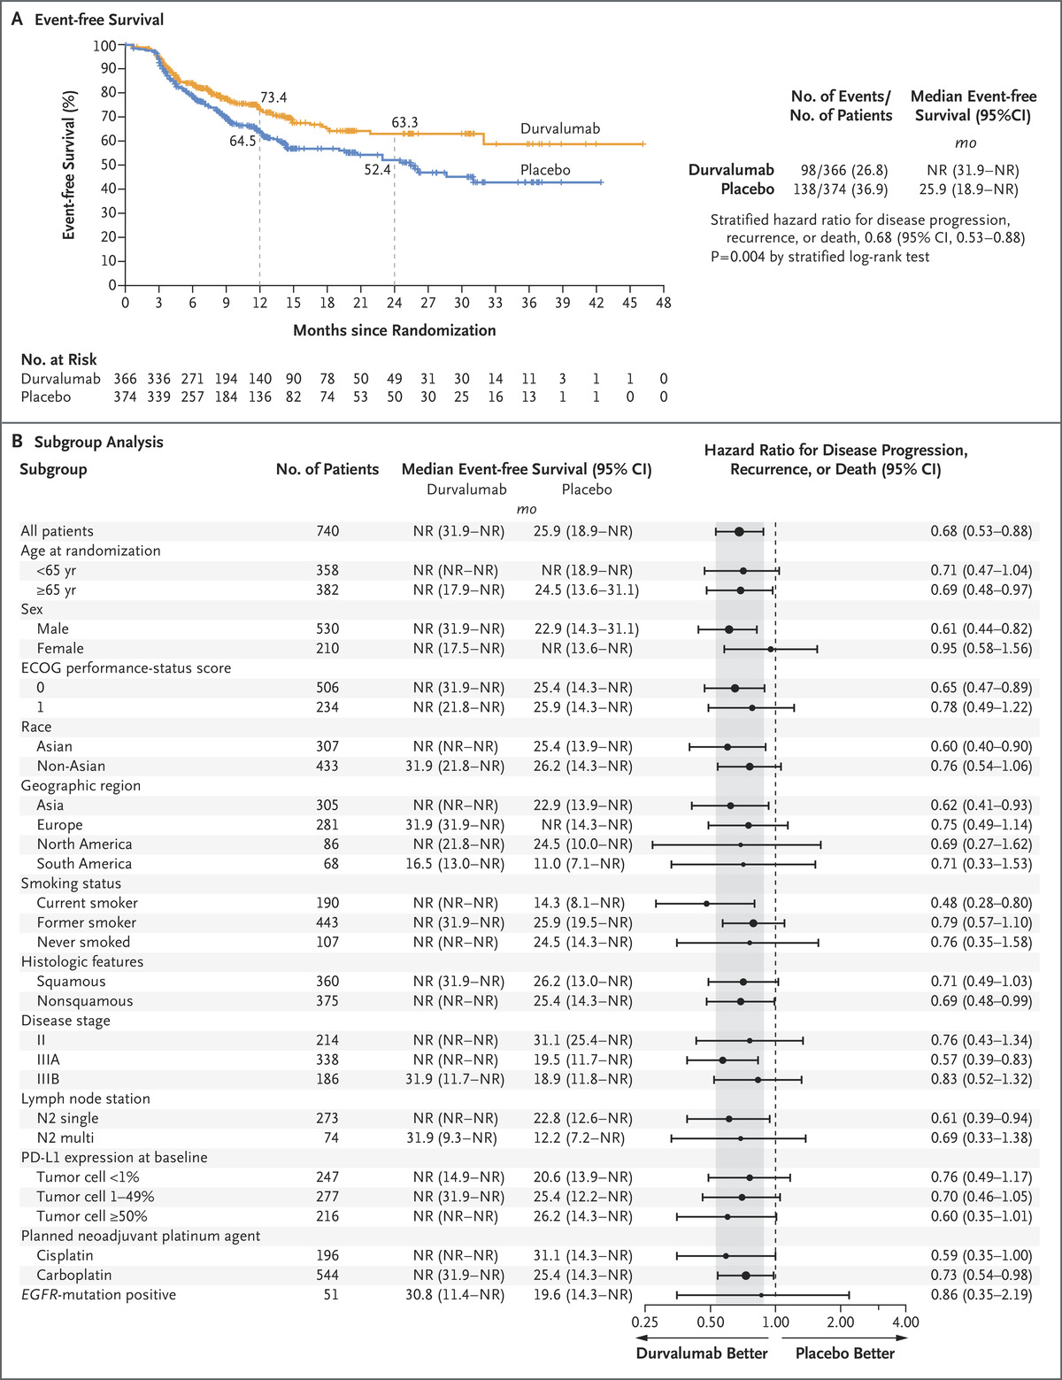
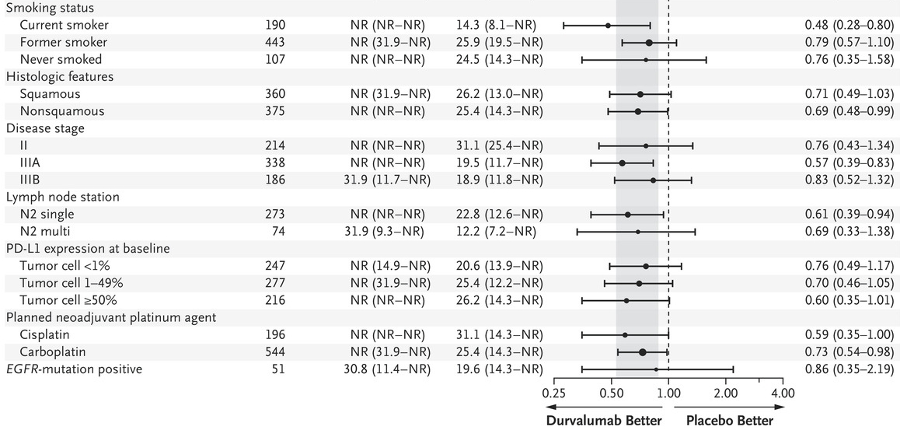
AEGEAN: EFS using RECIST v1.1 by subgroup (mITT)
JV Heymach et al. N Engl J Med 2023;389:1672-1684.
Notes:
Subgroup analysis with EGFR-mutation positive patients revealed EFS HR was 0.86 (95% CI, 0.35-2.19; vs mITT: stratified HR, 0.68; 95% CI, 0.53-0.88; P=0.003902).
Among patients with EGFRm R-NSCLC, there is no clear evidence of clinical benefit in the durvalumab versus placebo arm. However, these findings should be interpreted with caution due to the small number of patients and wide confidence intervals.

Slide 65
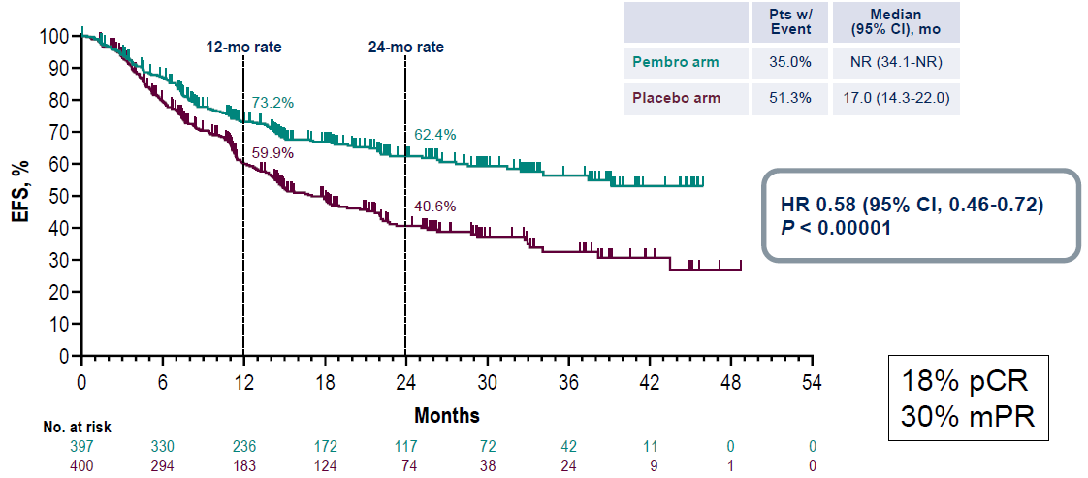
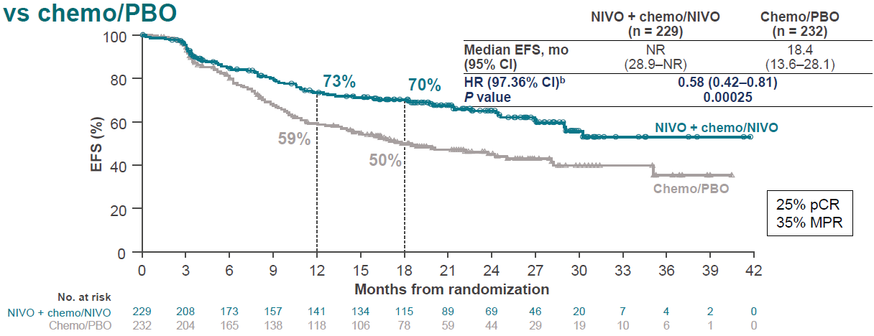
Other Perioperative ICI Trials
KN671 Perioperative Pembro - EFS
CM77T Perioperative Nivo - EFS
Subgroup EFS analyses for both studies revealed an increased relative benefit in the immunotherapy arm with increasing PD-L1 expression and in current/former smokers vs never smokers
Wakelee, ASCO 2023, NEJM 2023; Cascone ESMO 2023

Slide 66
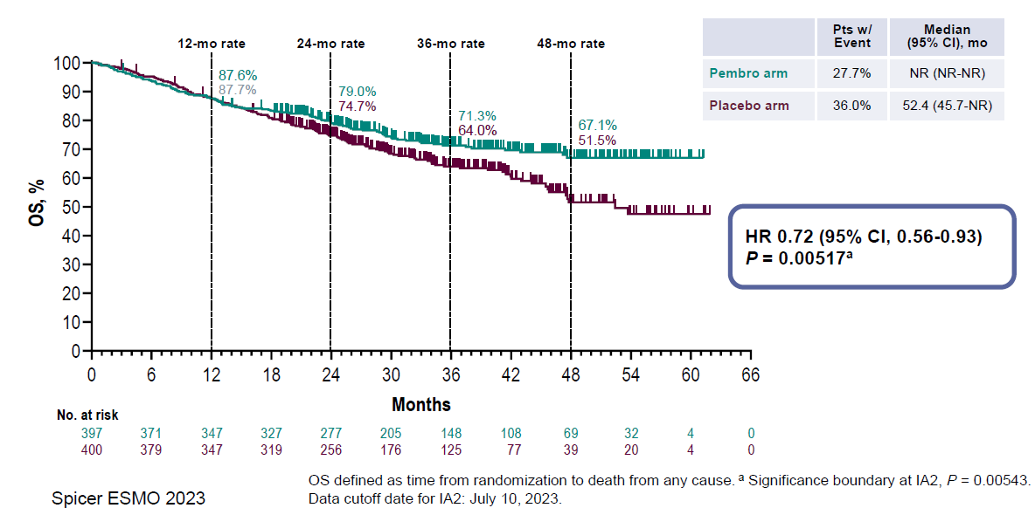
KN671 Overall Survival
Spicer ESMO 2023
Notes:
First trial showing OS benefit for peri-operative therapy

Slide 67
Conclusions
Findings from the AEGEAN trial and other recent trials (i.e., CM816, IMpower010, KN091, CM77T, and KN671) have confirmed the benefits of immunotherapy given as neoadjuvant treatment in combination with chemotherapy, as adjuvant treatment, or both
  AEGEAN is the first phase 3 study to describe the benefit of perioperative immunotherapy + neoadjuvant chemotherapy
Patient selection is critical and may be dependent on the following:
  Testing for PD-L1 levels, EGFR, ALK (and other drivers)
  Smoking status (possibly a surrogate marker for limited ICI benefit)
  Stage of disease (definite benefit for stage III)
  Contraindications to immunotherapy

Slide 68
Unanswered Questions
Which patients should get both neoadjuvant and adjuvant ICI vs neoadjuvant ICI alone?
  Could consider using pathologic response or MRD assays to guide adjuvant therapy
How do we expedite PD-L1/EGFR/ALK testing prior to surgery?
Can we avoid chemotherapy in certain patients with resectable NSCLC?

Slide 69
Navigating Immunotherapies in Advanced or mNSCLC
Young Kwang Chae
Northwestern University
1/18/2024

Slide 70
Contents
The current NSCLC IO guideline 2024
EMPOWER-Lung1
EMPOWER-Lung3
POSEIDON
CheckMate 227 (5-yr update)
PACIFIC (5-yr update)
EVOKE-2

Slide 71
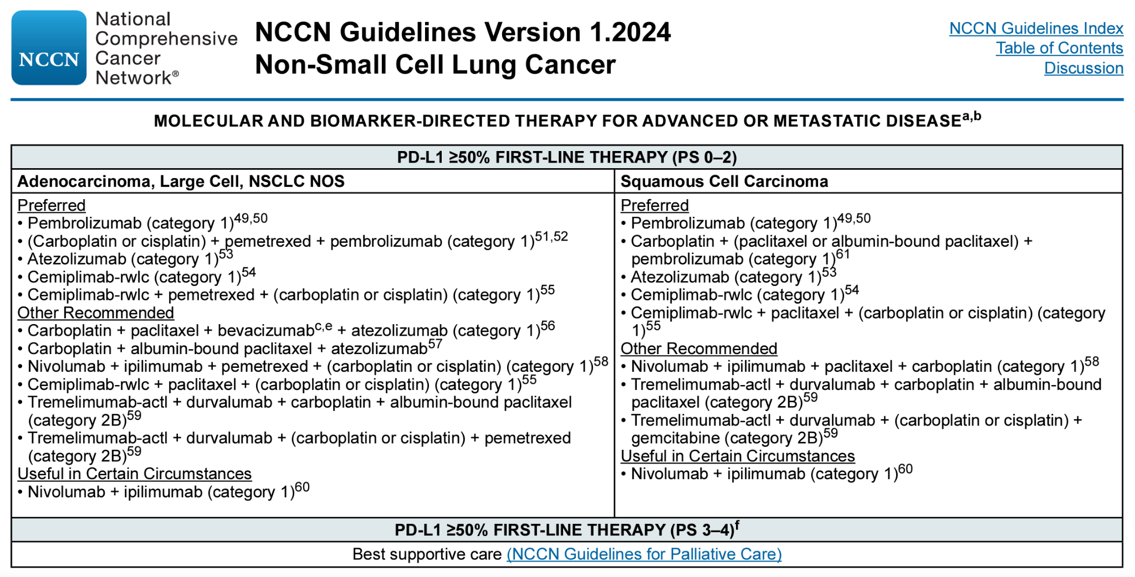

Slide 72
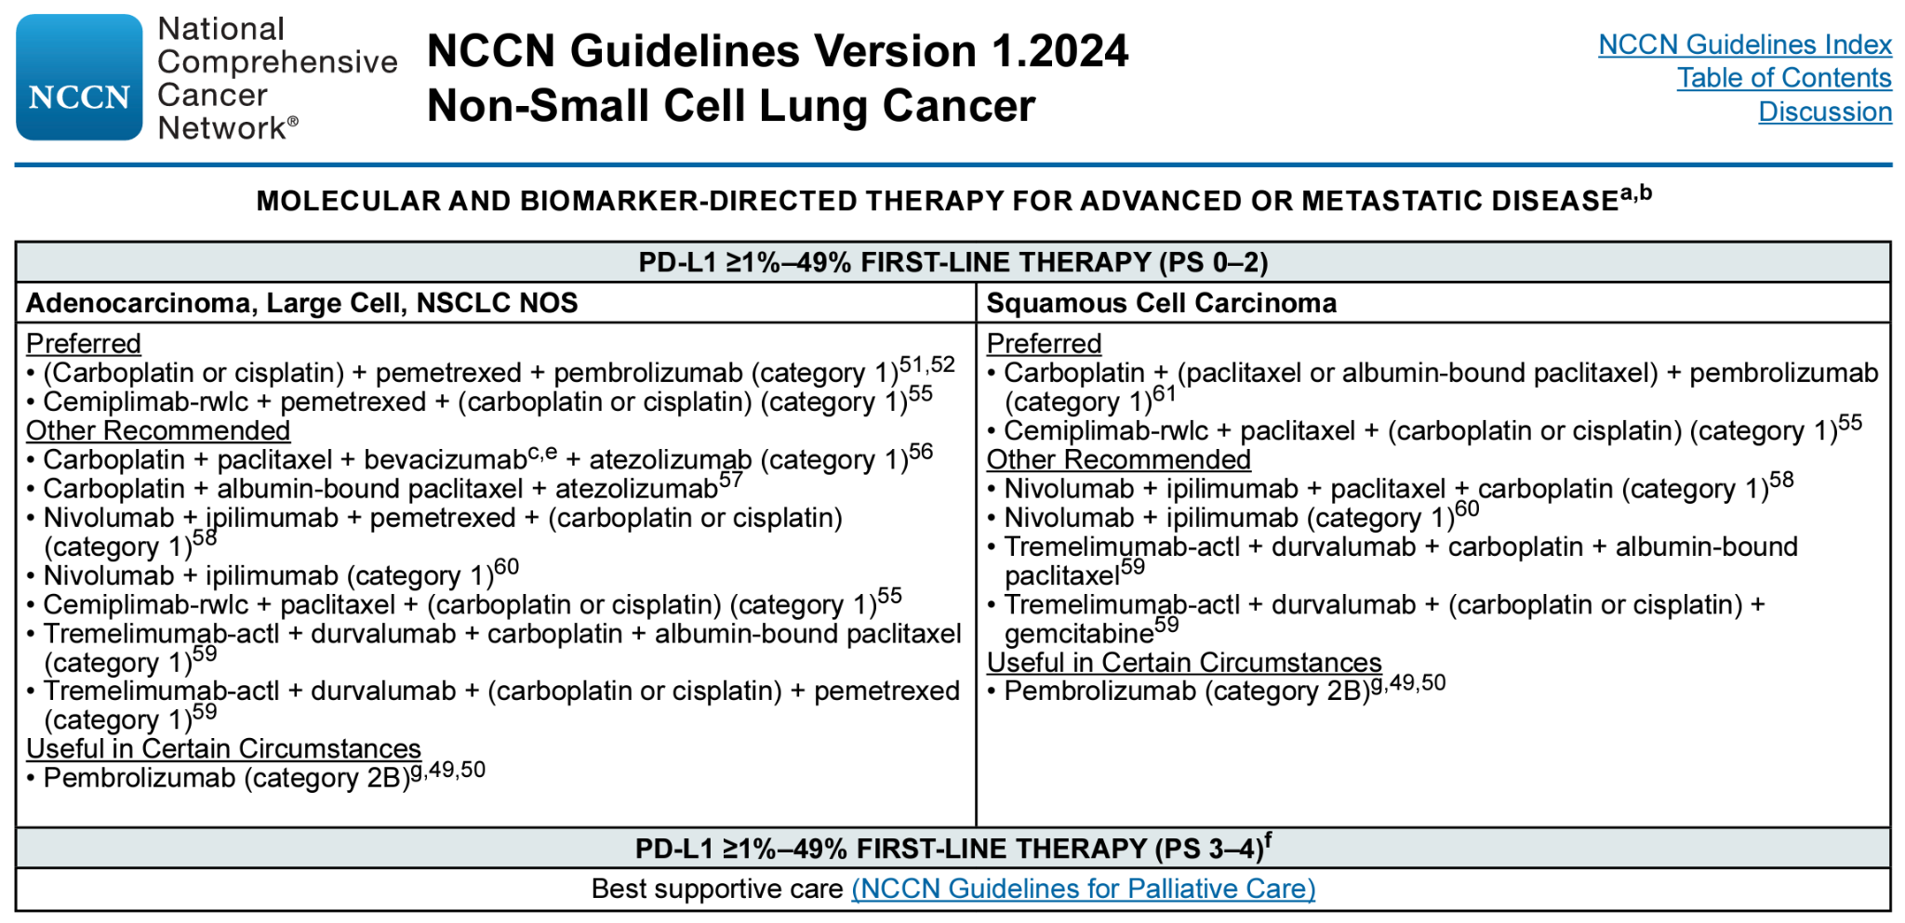

Slide 73
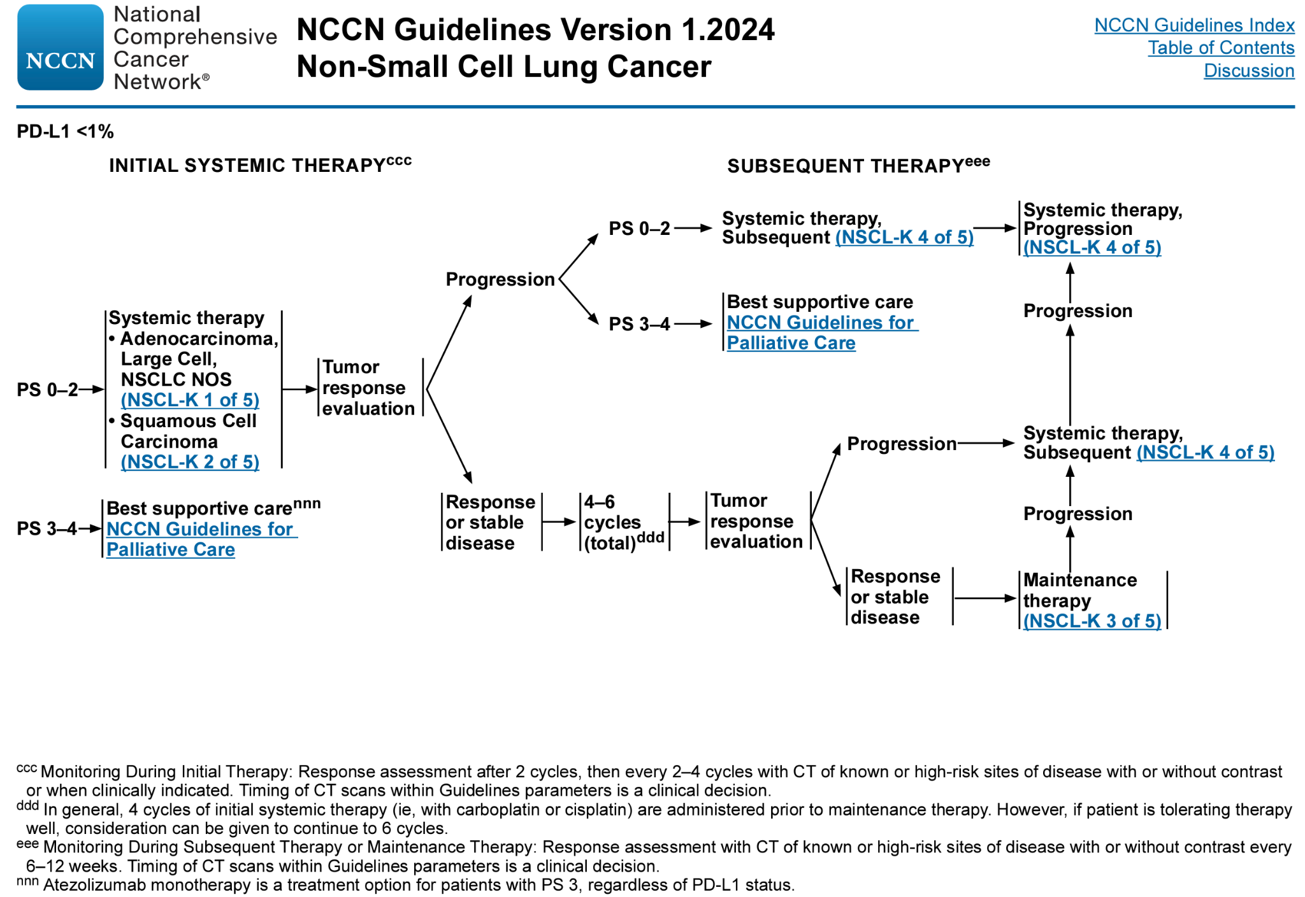

Slide 74
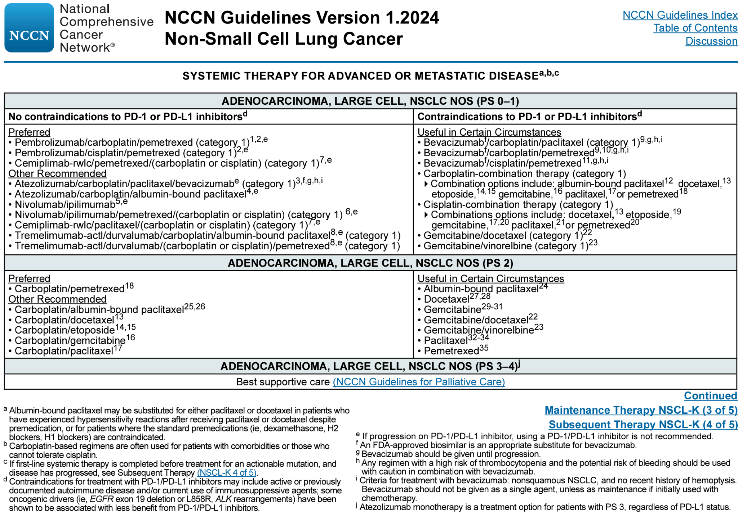

Slide 75
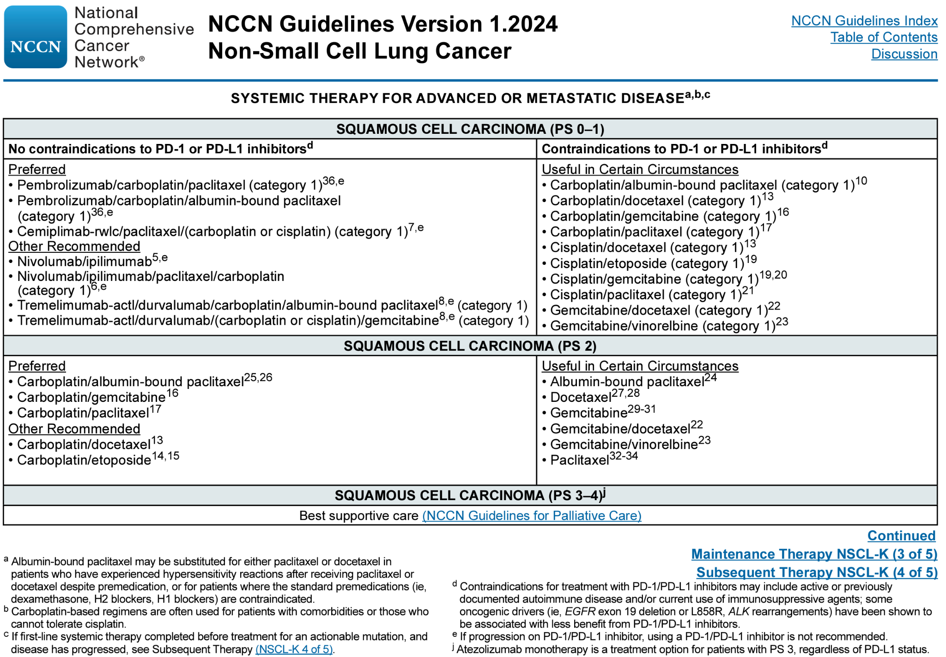

Slide 76

EMPOWER-Lung1

Slide 77
EMPOWER-Lung1
Cemiplimab: fully human hinge-stabilised IgG4(S228P) immune checkpoint inhibitor, targeting the PD-1 receptor
cemiplimab monotherapy was compared with that of investigator’s choice of platinum doublet chemotherapy in patients with newly diagnosed advanced NSCLC, with PD-L1 tumour expression of 50% or more and no EGFR mutations or ALK or ROS1 fusions.
  11 months follow-up: significantly improved overall survival, progression-free survival, and objective response rate compared with chemotherapy
Second-line continued cemiplimab + investigator’s choice of platinum-based doublet chemotherapy

Slide 78

EMPOWER-Lung1
565 patients had verified PD-L1 expression in at least 50% of tumour cells
284 (50%) patients were randomly assigned to cemiplimab and 281 (50%) to chemotherapy
median duration of follow-up from randomisation to data cutoff for the population with PD-L1 of at least 50% was 34.9 months for the cemiplimab group and 35.0 months for the chemotherapy group

Slide 79

Figure 1: Overall survival in patients with PD-L1 expression of at least 50%
OS HR 0.57
median overall survival:
cemiplimab group: 26.1 months
chemotherapy group: 13.3 months

Slide 80

PFS (HR 0.57)
cemiplimab group: 214 events (172 progressions and 42 deaths)
chemotherapy group: 236 events (180 progressions and 56 deaths).
Median PFS:
Cemiplimab: 8·1 months (95% CI 6.2–8.8)
Chemotherapy: 5·3 months (4.3–6.1)
Objective response rate
Cemiplimab: 46% (132 of 284 patients; 95% CI 41–53])
Chemotherapy: 21% (59 of 281; 16–26) (OR 3·264 [2·255–4·724]; p<0·0001)
Complete response:
Cemiplimab: 23 (8%) patients
Chemotherapy: 6 (2%)
Response Duration:
Cemiplimab: 23.6 months
Chemotherapy: 5.9 months
Figure 2: Progression-free survival in patients with PD-L1 expression of at least 50%

Slide 81

Figure 3: Cemiplimab versus chemotherapy efficacy by PD-L1 tumour expression
Cemiplimab group
99 patients had a PD-L1 expression of ≥90%
89 patients had a PD-L1 expression of >60% and <90%
96 patients had a PD-L1 expression of ≥50% and ≤60%
Chemotherapy group
95 patients had a PD-L1 expression of ≥90%
90 patients had PD-L1 expression of >60% and <90%
96 patients had a PD-L1 expression of ≥50% and ≤60%.

Slide 82


Slide 83


Slide 84
Results
At 35 months’ follow-up, cemiplimab monotherapy continued to provide meaningful survival benefit, compared with platinum-based doublet chemotherapy in patients with advanced NSCLC with PD-L1 expression of at least 50% and no EGFR, ALK, or ROS1 aberrations
  response to cemiplimab was further pronounced at 35-months follow-up than at 11 months
Approximately 50% increase in progression free survival and a substantial decrease in the risk for disease progression
A substantial increase in response rates and four-times longer response duration with cemiplimab compared with chemotherapy
Objective response rate after the addition of chemotherapy to continued cemiplimab was similar to that induced by cemiplimab as first-line therapy in these patients and greater than that induced by first-line chemotherapy in this study

Slide 85

EMPOWER-Lung3

Slide 86
EMPOWER-Lung 3
First-line cemiplimab in combination with investigator’s choice of platinum-doublet chemotherapy in patients with NSCLC with either squamous or non-squamous histology and any level of PD-L1 expression.

Slide 87

CONSORT diagram of EMPOWER-Lung 3
Between 17 June 2019 and 30 September 2020, 466 patients were enrolled and randomly assigned 2:1 to cemiplimab plus chemotherapy (n=312) and placebo plus chemotherapy (n=154) treatment arms.

Slide 88

Baseline characteristics were generally well balanced between both arms; 42.9% (n=200) of patients had squamous histology, 84.3% (n=393) of patients had an Eastern Cooperative Oncology Group performance status (ECOG PS) of 1, and 14.8% (n=69) of patients had locally advanced disease.

Slide 89


Slide 90


Slide 91

Tumor response data for the cemiplimab plus chemotherapy and placebo plus chemotherapy arms. a, Kaplan–Meier curves of DOR in all patients. The median DOR and corresponding two-sided 95% CI were estimated by the Kaplan–Meier method. b, Forest plots of objective response in pre-specified subgroups. Odds ratios and corresponding two-sided 95% CIs were calculated using the Cochran–Mantel–Haenszel method. c, ORR in correlation with baseline PD-L1 levels. ORR and the corresponding two-sided 95% CI were calculated using the Clopper–Pearson method. d, Tumor response in correlation with baseline PD-L1 levels. Median percent change in tumor size over time was calculated descriptively (LOCF). Cemi, cemiplimab; chemo, chemotherapy; LOCF, last observation carried forward; met, metastasis; PBO, plac

Slide 92


Slide 93
Results
Overall Survival (OS):
Median OS with cemiplimab + chemotherapy: 21.9 months.
Median OS with placebo + chemotherapy: 13.0 months.
Hazard Ratio (HR) = 0.71; P = 0.014.
65.7% alive at 12 months with cemiplimab ; 56.1% with placebo.
Progression-Free Survival (PFS):
Median PFS with cemiplimab + chemotherapy: 8.2 months.
Median PFS with placebo + chemotherapy: 5.0 months.
HR = 0.56; P < 0.0001.
Tumor Response
Objective Response Rate (ORR) with cemiplimab + chemotherapy: 43.3%.
ORR with placebo + chemotherapy: 22.7%.
Complete response (CR): 2.6% with cemiplimab, all partial response (PR) with placebo.
Median Duration of Response (DOR): 15.6 months with cemiplimab, 7.3 months with placebo.

Slide 94
Results
Patient-Reported Outcomes:
Improvement in overall change from baseline in global health status (GHS)/quality of life (QoL) with cemiplimab plus chemotherapy
Significant delay in onset of deterioration according to GHS/QoL scale
Significant overall improvement in pain symptoms with cemiplimab plus chemotherapy
Treatment-emergent adverse events (TEAEs):
Cemiplimab+ chemotherapy : 95.8%
Placebo + chemotherapy : 94.1%
Grade ≥3 TEAEs (anemia, neutropenia, etc):
Cemiplimab+ chemotherapy: 43.6%
Placebo + chemotherapy: 31.4%
TEAEs leading to discontinuation:
Cemiplimab+ chemotherapy: 5.1%
Placebo + chemotherapy: 2.6%
Immune-related adverse events (irAEs) occurred in 18.9% of patients treated with cemiplimab plus chemotherapy, with grade ≥3 irAEs occurring in 2.9% of patients

Slide 95

The open-label, phase III POSEIDON study evaluated tremelimumab plus durvalumab and chemotherapy (T + D + CT) and durvalumab plus chemotherapy (D + CT) versus chemotherapy alone (CT) in first-line metastatic non–small-cell lung cancer (mNSCLC).
Pts with EGFR/ALK wild-type mNSCLC were randomised 1:1:1 to 1L D (until progression) ± limited-course T (up to 5 doses) + platinum-based CT (up to 4 cycles); or CT (up to 6 cycles). Alpha-controlled endpoints were PFS and OS for D+CT vs CT and T+D+CT vs CT.

Slide 96

CONSORT diagram. Data cutoff date: March 12, 2021. aAmong these patients, one patient each randomly assigned to the T + D + CT arm and the D + CT arm did not receive immunotherapy and were included in the CT arm of the safety population; one patient randomly assigned to the T + D + CT arm received durvalumab and tremelimumab but not chemotherapy. bThe most common cause of treatment discontinuations classified as other was investigator's decision (39%). AE, adverse event; CT, chemotherapy; D, durvalumab; ITT, intention-to-treat; T, tremelimumab.

Slide 97

Baseline Patient Demographics and Disease Characteristics (ITT population)

Slide 98

Fig 2. (A) PFS and (B) OS (ITT) with D + CT versus CT. (C) PFS and (D) OS (ITT) with T + D + CT versus CT. Data cutoff date for PFS: July 24, 2019. Data cutoff date for OS: March 12, 2021. One patient died 1 day before random assignment and was censored at day 1. CT, chemotherapy; D, durvalumab; HR, hazard ratio; ITT, intention-to-treat; OS, overall survival; PFS, progression-free survival; T, tremelimumab.

Slide 99

OS in patient subgroups with (A) D + CT versus CT or (B) T + D + CT versus CT.

Slide 100

non-squamous
squamous
Fig 4. (A) PFS and (B) OS in patients with nonsquamous histology. (C) PFS and (D) OS in patients with squamous histology. Data cutoff date for PFS: July 24, 2019. Data cutoff date for OS: March 12, 2021. HRs and 95% CIs were calculated using an unstratified Cox proportional hazards model. CT, chemotherapy; D, durvalumab; HR, hazard ratio; OS, overall survival; PFS, progression-free survival; T, tremelimumab.
non-squamous
squamous

Slide 101

Duration of response with (A) T + D + CT versus CT and (B) D + CT versus CT.

Slide 102

POSEIDON Study
ESMO 22 abstract LBA59

Slide 103

Peters S et al. IASLC 2023 abstract 15-04

Slide 104


Slide 106
Results:
At an updated data cutoff (DCO) of 11 Mar 2022 (mFU 46.5 mo in censored pts), T+D+CT continued to show OS benefit vs CT (HR 0.75; 95% CI 0.63–0.88) with an estimated 25.0% of pts alive at 3 y vs 13.6%.
D+CT continued to numerically improve OS vs CT (HR 0.84; 95% CI 0.71–0.99; 3 y OS 20.7%).
Consistent with results at the earlier DCO, OS benefit appeared more pronounced with T+D+CT vs CT in pts with non-squamous histology.
A trend for OS benefit with T+D+CT vs CT continued to be observed in non-squamous subgroups with mutations (m) in STK11, KEAP1 or KRAS.
No new safety signals were identified based on collection of serious AEs during long-term FU.

Slide 107


Slide 108


Slide 109


Slide 110



Slide 111

The phase III PACIFIC trial compared durvalumab with placebo in patients with unresectable, stage III non–small-cell lung cancer and no disease progression after concurrent chemoradiotherapy.
Consolidation durvalumab was associated with significant improvements in the primary end points of overall survival (OS; stratified hazard ratio [HR], 0.68; 95% CI, 0.53 to 0.87; P = .00251) and progression-free survival (PFS [blinded independent central review; RECIST v1.1]; stratified HR, 0.52; 95% CI, 0.42 to 0.65; P < .0001), with manageable safety.

Slide 112

CONSORT diagram. Study data collected up to the DCO date of January 11, 2021. Patients who completed 12 months of study treatment are those for whom the electronic case report form showed that they had received the maximum number of cycles of study treatment. aInformed consent received. bFour patients did not receive their assigned study treatment because of neutropenia (n = 1), worsening chronic obstructive pulmonary disease (n = 1), and patient decision (n = 2). cNine patients (durvalumab, n = 4; placebo, n = 5) who terminated the study because of patient decision have subsequently died; one additional patient (placebo arm) with missing termination reason has subsequently died. AE, adverse event; DCO, data cutoff.

Slide 113

Updated (A) OS and (B) PFS (blinded independent central review) in the intent-to-treat population. The vertical dashed lines indicate yearly landmarks; the associated numerical values represent the OS and PFS rates at the landmark. OS was defined as time from random assignment until death from any cause. PFS was defined as time from random assignment to the date of the first documented event of tumor progression or death in the absence of disease progression. For PFS, patients who had not progressed or died at the time of the data cutoff were censored at the time of their last evaluable RECIST assessment; however, if the patient progressed or died after ≥ 2 missed visits, they were censored at the time of the latest evaluable RECIST assessment before the two missed visits. HR, hazard ratio; OS, overall survival; PFS, progression-free survival.

Slide 114

Updated TTDM (blinded independent central review) in the intent-to-treat population. The vertical dashed lines indicate yearly landmarks; the associated numerical values represent the TTDM rates at the landmark. TTDM was defined as time from random assignment until the first date of distant metastasis or death in the absence of distant metastasis. HR, hazard ratio; TTDM, time to death or distant metastasis.

Slide 115

Updated OS by prespecified and exploratory, post hoc subgroups.

Slide 116


PD-L1<1%
PD-L1>25%
PD-L1 unknown
PD-L1<25%
PD-L1 1-25%
PD-L1>1%

Slide 117


Slide 118


Slide 119


Slide 120


Slide 121


Slide 122


Slide 123


Slide 124


Slide 125


Slide 126


Slide 127


Slide 128
Lung Cancers
Thursday, January 18th, 2024

Slide 129
Discussion / Q&A

Slide 130
Networking Reception
We will return at 7:50 pm

Slide 131
Lung Cancers
Thursday, January 18th, 2024

Slide 132
Adjuvant to Metastatic:
Exploring Targeted Agents for mNSCLC
Jyoti D. Patel MD FASCO
Professor of Medicine
Director of Thoracic Oncology
Northwestern University
Chicago, IL

Slide 133
Disclosures:
Advisor: AbbVie, AnHeart, Astra Zeneca, Blueprint, Daiichi Sankyo, Genentech, Gilead, Guardant, Janssen, Sanofi, Takeda
Travel reimbursement: Daiichi Sankyo, Tempus

Slide 134
Outline
Oncogenic Drivers/Targetable NSCLC
EGFR
  Early stage disease
  Classical mutations
  Exon 20
ROS1, ALK, BRAF and others

Slide 135



Progress in Lung Cancer
Monolithic therapy: Chemo vs. BSC
Targeted therapy for a few patients
Personalized treatment for All
2020
mOS 22 mos
2010
mOS 12.6 mos
2000
mOS 7.9 mos
Schiller JH ,et al. N Engl J. Med. 2002;346(20):92-98
Patel, JD, et al. J Clin Onc. 2013; 31(34):4369-57
Gadgeel S, et al. J Clin Onc. 2020; 38(14);1505-1517

Slide 136

Targeted Therapy Options for Non-Squamous NSCLC
Thai AA et al. Lancet 2021 398: 535–54

Slide 137


ADAURA: Adjuvant Osimertinib

Slide 138

ADAURA: Adjuvant Osimertinib

Slide 139


ADAURA: Adjuvant Osimertinib

Slide 140

ADAURA: Adjuvant Osimertinib

Slide 141

ADAURA: Adjuvant Osimertinib

Slide 142
ADAURA: Adjuvant Osimertinib
Adjuvant osimertinib after resection in patients with stage II-IIIA EGFRm NSCLC is standard of care (maybe IB)
Patients with resected NSCLC need appropriate molecular testing
DFS benefit in ADAURA translated to deep OS benefit—OS HR 0.49!
Perhaps more benefit in EGFR del 19 > L858R exon 21
Intensification/de-intensification questions remain

Slide 143


Advanced EGFRm NSCLC
FLAURA – 1st line Osimertinib
Soria JC, et al. N Engl J Med. 2018;378:113-125.
Leoneti A, et al. British Journal of Cancer 2019;121:725-737

Slide 144


EGFRm NSCLC: Improving Outcomes
Chemo + Osi 1L
Janne PA, et al. IASLC WCLC 2023;PL03.13

Slide 145


EGFRm NSCLC: Improving Outcomes
Amivantamab + Osi 1L

Slide 146


Overall Survival - Immature
1L EGFR Intensification Strategies: Overall Survival is Immature
FLAURA2
MARIPOSA
Janne PA, et al. IASLC WCLC 2023;PL03.13
Chul Cho B, et al. ESMO 2023; abst LBA14
Janne PA, et al. IASLC WCLC 2023;PL03.13
Chul Cho B, et al. ESMO 2023; abst LBA14

Slide 147

2L EGFR: Post Progression on Osimertinib
Passaro, Ann Oncol, 2023

Slide 148


2L EGFR: Post Progression on Osimertinib
MARIPOSA 2 is the first positive randomized Ph3 study against chemotherapy with modest improvement in PFS and no OS data yet
Patient selection strategy is not clear
Need to balance the benefit with high cost and moderate toxicity profile
PFS by BICR
CNS PFS by BICR

Slide 149
What is optimal?...It depends
Medication administration
  How drugs are given influences which drugs are given
  Financial toxicity
  Time toxicity
  Drug toxicity
Shared Decision Making
What is the goal?
To increase survival? More days with loved ones, landmark events
To increase survival within a certain lifestyle? More time of a specific quality with freedom to ______

Slide 150

Different Subtypes of EGFR Mutations
Exon 19 deletion
Exon 20 Insertion
L858R
“Uncommon”
G719X, L861Q
Exon 19/L858R – 85% - erlotinib, gefitinib, afatinib, dacomitinib & osimertinib
G719X, L861Q, S768I – 8-10% - afatinib
Exon 20 - 5-7% - amivantimab (mobocertinib)

Slide 151

PAPILLON (Phase 3): Amivantamab + chemotherapy vs chemo as 1L treatment for EGFR exon 20 insertion-mutated advanced NSCLC
Amivantamab-chemotherapy
(n=153)
Characteristic, n (%) | Amivantamab- chemo (n=153) | Chemotherapy (n=155)
Median age, years (range) | 61 (27–86) | 62 (30–92)
Female | 85 (56) | 93 (60)
Race: Asian / White / Other | 97 (64) / 49 (32) / 5 (3) | 89 (59) / 60 (39) / 3 (2)
ECOG PS: 0 / 1 | 54 (35) / 99 (65) | 55 (35) / 100 (65)
History of smoking: yes / no | 65 (42) / 88 (58) | 64 (41) / 91 (59)
History of brain metastases: yes / no | 35 (23) / 118 (77) | 36 (23) / 119 (77)
Prior EGFR TKI use: yes / no | 1 (1) / 152 (99) | 3 (2) / 152 (98)
Histology: adenocarcinoma subtype / other | 151 (99) / 2 (1) | 153 (99) / 2 (1)
Key eligibility
Treatment-naïve,a locally advanced or metastatic NSCLC
Documented EGFR Exon 20 insertion mutations
ECOG PS 0 or 1
Optional crossover to 2nd-line amivantamab monotherapy^{e}
R
1:1
Chemotherapy
(n=155)
Dosing (in 21-day cycles)
Amivantamab: 1400 mg (1750 mg if ≥80 kg) for the first 4 weeks, then 1750 mg (2100 mg if ≥80 kg) Q3W starting at Week 7 (first day of cycle 3)
Chemotherapy on the first day of each cycle:
Carboplatin: AUC5 for the first 4 cycles
Pemetrexed: 500 mg/m² until disease progression
Primary endpoint:
PFS by BICR (confirmed; RECIST v1.1)
Secondary endpoints:
ORR
DOR
OS
PFS2
Stratification factors
Symptomatic PFS
Time to subsequent therapy
Safety
Stratification Factors
ECOG PS
History of brain metastases
Prior EGFR TKI use
Primary endpoint: PFS by BICR
PFS by BICR: Subgroup analysis
 | Median PFS (95% CI)
Amivantamab-chemo | 11.4 months (9.8, 13.7)
Chemotherapy | 6.7 months (5.6, 7.3)
HR, 0.395 (95% CI: 0.30, 0.53); P<0.0001
Patients who are progression free (%)
48%
Median follow-up: 14.9 months
13%
31%
3%
No. at risk
Amivantamab-
Chemotherapy
Chemotherapy
Months
153
155
135
131
105
74
74
41
50
14
33
4
15
2
3
1
0
0
Girard N, et al. ESMO 2023. Abstract LBA5.

Slide 152




PAPILLON (Phase 3): Amivantamab + chemotherapy vs chemotherapy as 1L treatment for EGFR exon 20 insertion-mutated advanced NSCLC
Tumor response: Amivantamab-chemotherapy
Tumor response: Chemotherapy
DOR by BICR
○ CR
○ PR
○ SD
○ PD
○ NE/Unknown
○ CR
○ PR
○ SD
○ PD
○ NE/Unknown
BICR-assessed response | Amivantamab-chemotherapy (n=153) | Chemotherapy (n=155)
Mean percent change of SOD | -53% | -34%
ORR | 73% (95% CI: 65, 80) | 47% (95% CI: 39, 56)
Odds ratio | 3.0 (95% CI: 1.8–4.8); P<0.0001
Best response, n (%)
Complete response | 6 (4) | 1 (1)
Partial response | 105 (69) | 71 (47)
Stable disease | 29 (19) | 62 (41)
Progressive disease | 4 (3) | 16 (11)
NE/Unknown | 8 (5) | 2 (1)
Median time to response | 6.7 wk (range, 5.1–72.5) | 11.4 wk (range, 5.1–60.2)
Most common AEs of any cause by preferred term (≥20%), n (%) | Amivantamab-chemotherapy (n=151) |  | Chemotherapy (n=155)
 | All grades | Grade ≥3 | All grades | Grade ≥3
Associated with EGFR inhibition
Paronychia | 85 (56) | 10 (7) | 0 | 0
Rash | 81 (54) | 17 (11) | 12 (8) | 0
Dermatitis acneiform | 47 (31) | 6 (4) | 5 (3) | 0
Stomatitis | 38 (25) | 2 (1) | 9 (6) | 0
Diarrhea | 31 (21) | 5 (3) | 20 (13) | 2 (1)
Associated with MET inhibition
Hypoalbuminemia | 62 (41) | 6 (4) | 15 (10) | 0
Peripheral edema | 45 (30) | 2 (1) | 16 (10) | 0
Interim OS
Convincing results in all aspects in this Phase 3 trial
A new Standard of Care
Toxicity as expected (EGFR & MET-related)
As of data cutoff, responses were ongoing in 49% (54/111) in patients with amivantamab-chemotherapy vs 17% (12/72) with chemotherapy
Girard N, et al. ESMO 2023. Abstract LBA5.

Slide 153
Other Targeted Therapies
ALK+ resected NSCLC
Repotrectinib in ROS1+ NSCLC

Slide 154
ALINA: Adjuvant alectinib vs chemotherapy among patients with early-stage ALK+ NSCLC (pre-specified interim DFS analysis)
Key eligibility
Stage IIIB/IV ALK+ NSCLC
No prior systemic treatment for metastatic disease
ECOG PS 0–1
Asymptomatic treated or untreated CNS metastases were permitted
≥1 extracranial measurable target lesion (RECIST v1.1) with no prior radiation required
Demographics and baseline characteristics (ITT)
Alectinib
600 mg BID
2 years
Recurrence
Further treatments at investigator’s choice
and survival follow-up
Characteristic | Alectinib (n=130) | Chemotherapy (n=127)
Median age, years <65 years, % ≥65 years, % | 54 79 21 | 57 73 27
Sex, %: female/male | 58/42 | 46/54
Smoking status, %, never/former/current | 65/31/4 | 55/43/2
Race, %, Asian/non-Asian | 55/45 | 56/44
ECOG PS, %, 0 / 1 | 55/45 | 51/49
Stage at diagnosis, %, IB/II/IIIA | 11/36/53 | 9/35/55
Nodal status, %, N0/N1/N2 | 16/35/49 | 14/34/52
Histology, %, squamous/ non-squamous | 5/95 | 2/98
Surgical procedure, % lobectomy/other | 97/3 | 92/8
R
1:1
Platinum-based chemotherapy
Q3W; 4 cycles
Disease assessments (including brain MRI) were conducted: at baseline, every 12 weeks for Year 1–2, every 24 weeks for Year 3–5, then annually
Stratification factors
Primary endpoint:
DFS per investigator, tested hierarchically:
  Stage II–IIIA → ITT (Stage IB–IIIA)
Secondary endpoints:
CNS disease-free survival
OS
Safety
Disease stage per UICC/AJCC 7th edition:
IB (≥4 cm) vs II vs IIIA
Race: Asian vs non-Asian
Solomon BJ, et al. ESMO 2023. Abstract LBA2.

Slide 155
ALINA: DFS overall and by CNS status
DFS: ITT population (Stage IB–IIIA)
CNS DFS: ITT population
100
93.6%
88.7%
98.4%
95.5%
Alectinib
Alectinib
100
Chemotherapy
80
85.8%
63.7%
80
79.7%
60
54.0%
DFS (%)
Chemotherapy
CNS DFS (%)
60
40
40
20
DFS data immature
20
0
0
6
12
18
24
30
36
42
48
54
0
0
6
12
18
24
30
36
42
48
54
No. at risk
Time (months)
No. at risk
Time (months)
Alectinib
130
123
123
118
74
55
39
22
10
3
Alectinib
130
124
124
118
74
55
39
22
10
3
Chemo
127
112
98
89
55
41
27
18
11
2
Chemo
127
113
98
90
57
43
27
18
11
2
Data cut-off: 26 June 2023. Median survival follow-up: alectinib, 27.8 months; chemotherapy, 28.4 months
Solomon BJ, et al. ESMO 2023. Abstract LBA2.

Slide 156

Repotrectinib in patients with ROS1+ NSCLC:
Phase 1 / 2 TRIDENT‑1 trial
Repotrectinib is a next‑generation ROS1 and TRK TKI
  Macrocyclic structure
  Designed to decrease potential of developing ROS1 resistance

Slide 157

Repotrectinib in ROS1+ NSCLC

Slide 158
ROS1+ TKIs
 | Crizotinib | Ceritinib | Entrectinib | Repotrectinib
n | 50 | 30 | 53 | 71
ORR (%) | 72 | 67 | 77 | 79
mPFS (mo) | 19.2 | 19.3 | 19.0 | 35.7
Common AEs | Visual impairment 82% Diarrhea 44% | Diarrhea 78% Nausea 59% Anorexia 56% | Dysgeusia 42% Dizziness 33% | Dizziness 62%

Slide 159
Conclusions
Conclusions
Molecular subtyping is an integral part of optimal therapy
There is rapid evolution in treatment paradigms for EGFRm NSCLC. Patient preference and share decision making will guide treatment selection
Early supportive care is required to ensure best outcomes

Slide 160
Lung Cancers
Thursday, January 18th, 2024

Slide 161
Advances in Surgical Approaches for Lung Cancer
Diego Avella, MD
Assistant Professor of Surgery
Northwestern University, Canning Thoracic Institute
Chicago, IL

Slide 162
Standard of Care and Recent Advances
Lobectomy has been the standard mode of surgery since 1960
More recently, sub-lobar resection has been demonstrated to produce equivalent results as compared to lobar resection for early stage lung cancer

Slide 163


JCOG0802. Lancet 2022
CALGB 140503. NEJM 2023

Slide 164
Significant Differences in Two Landmark Trials
What explains the differences in the survival between the Japanese and American trials?

Slide 165
Hypothesis
Different biology of the cancers in Asian and Caucasian populations
Technical aspects of the operation (margin, hilar and mediastinal LN dissection)
Different patient characteristics

Slide 166

Three Dimensional Reconstruction for Preoperative Planning

Slide 167
Lung Cancers
Thursday, January 18th, 2024

Slide 168
Updates in Radiation Approaches
Tarita Thomas, MD, PhD, MBA
Associate Professor, Radiation Oncology
Northwestern University
Chicago, IL

Slide 169
Outline
SBRT for central & ultracentral lung (UCLT) tumors
SBRT for oligoprogression
Re-irradiation in the lung
Altered fractionation for locally advanced, unresectable NSCLC
Fractionation for LS-SCLC

Slide 170

Anatomical Central Lung for SBRT
Central: tumor within 2cm in all directions around the PBT or immediately adjacent to mediastinal or pericardial pleura (PTV touching the mediastinal pleura)
Ultra-central: planning PTV touches or overlaps the central bronchial tree, esophagus, pulmonary vein, pulmonary artery

Slide 171

HILUS Trial: Phase II Prospective UCLT treated with SBRT
Ultracentral located ≤ 1cm from proximal bronchial tree
1ry endpoint: LC
2ndry endpoint: toxicity
Dose 7Gy x 8 prescribed 67% isodose
65 total patients recruited 2011-2016
  Group A: 39 pts tumors ≤ 1cm from main bronchi and trachea
  Group B: 26 pts all others
Lindberg et al, J Thoracic Onc 2021

Slide 172
HILUS Trial Results and Commentary
Results:
  2yr LC 83%
  34% Grade 3 to 5 toxicity (22 pts)
  15% Grade 5 toxicity (10 pts)
    txt related deaths: 8 bronchopulmonary hemorrhage, 1 fistula, 1 pneumonitis
  RF toxicity dose to combined main bronchi/ trachea and tumor distance to main bronchi
Heterogeneity in txt set-up & margins -> large treatment volumes
Contouring of critical organs at risk was not mandated -> significant hot spots in critical organs
Plan prescribed to 67% isodose line, 150% hotspots -> significant higher than prior studies for central/ UCLT
No forgiveness in plan for intra-fraction and inter-fraction motion
Lindberg et al, J Thoracic Onc 2021
Rosenberg et al, J Thoracic Onc, 2021
Notes:
G3-5 should be about 10% in other studies

Slide 173

HILUS Pooled Analysis of Risk Factors for Toxicity
65pt from HILUS trial with retrospective expansion cohort 165pt
Treated 56Gy in 8 fxn, Dmax 150% to lesions within 2cm of tracheobronchial tree
G3-4 toxicity: 15%; G5 13%, majority of fatal events 66% bronchopulm hemorrhage
MVA: max dose to mainstem bronchi or bronchus intermeidus, tracheobronchial compression were independent predictors of G5 toxicity
Safavi AH et al, Int J Rad Onc Bio Phys 2023
Lindberg et al, Int J Rad Onc Bio Phys 2023

Slide 174
SBRT for UCLT NSCLC: Safety & Efficacy Trial (SUNSET)
Multicenter Phase I prospective trial aimed to determine MTD using time-to-event continual reassessment methodology (TITE-CRM)
Eligibility: ECOG 0-2, T1-T3N0M0(≤ 6 cm)
MTD: dose of RT associated with ≤ 30% G3-5 toxicity within 2 years of txt
Starting Dose: 60Gy in 8 fxn; de-escal 60Gy in 10 or 15 if toxicity ≥30%
CT simulation with contrast
Hot spot limited to 120%
Giuliani ME et al, Int J Rad Onc Bio Phys 2023
2023 Multid Thoracic Cancers Symposium

Slide 175
SBRT for UCLT NSCLC: Safety & Efficacy Trial (SUNSET)
Accrued 30 patients between March 2018 to April 2021
Median FU 36.5 mo
Median age: 73yo; 56.7% female
76.7% T1, 20% T2, 3.3% T3
2 pt (6.7%) G3-5 adverse events: 1 pt G3 dyspnea, 1pt G5 pneumonia related to ILD
3 yr actuarial outcomes: OS 72.5%, PFS 66.1%, LC 89.6%
60Gy in 8 fractions with moderate hotspot has fav adverse event rate, excellent tumor control
Giuliani ME et al, Int J Rad Onc Bio Phys 2023
2023 Multid Thoracic Cancers Symposium

Slide 176
SBRT for UCLT Systematic Review & Meta-Analysis
International SRS Practice Guideline
PubMed and EMBASE database searches with 602 unique studies identified. 27 included with 1183 treated targets.
Dose fxn utilized: 50Gy/ 5, 60Gy/ 8, 60Gy/ 12
Pooled 1- & 2- year LC estimates: 92%, 89%
BED10 significant predictor of 1 yr LC
Yan et al, Lung Cancer 2023
Notes:
Stereotactic body radiotherapy for Ultra-Central lung Tumors: A systematic review and Meta-Analysis and International Stereotactic Radiosurgery Society practice guidelines

Slide 177

SBRT for UCLT Systematic Review & Meta-Analysis
International SRS Practice Guideline
G3-4 toxicity: 6%, most common pneumonitis
G5 toxicity: 4%, most common hemoptysis
Risk factors for fatal toxicity: anticoagulation, ILD, endobronchial tumor, concomitant targeted therapies
Consider limiting PBT Dmax <133-150Gy BED (EQD2 <80-90Gy)
  Dmax <150%
  Prescribe to higher isodose 80-85%
Yan et al, Lung Cancer 2023
Notes:
Stereotactic body radiotherapy for Ultra-Central lung Tumors: A systematic review and Meta-Analysis and International Stereotactic Radiosurgery Society practice guidelines

Slide 178

Oligoprogression
Patients with extensive metastatic disease on systemic therapy manifest primarily stable disease except for progression at a few sites
Tsai CJ et al, Lancet 2024
Notes:
SABR-COMET Phase II Randomized Trial Long Term Results
Patients with 1-5 metastasis, stratified number of metastasis 1-3 vs 4-5
Randomized 1:2 palliative standard of care (SOC) vs SABR + SOC
2012 to 2016: 99 patients accrued; Median FU 51 mo
5yr OS: 17.7% vs 42.3% p=0.006; 5yr PFS: not reached vs 17.3% p=0.001
No grade 2-5 adverse events
SABR COMET: breast/ lung/ colorectal/ prostate metastasis

Slide 179
CURB (consolidative use of radiotherapy to block oligoprogression) Trial
Phase II randomized controlled phase 2 study: SOC vs SOC +SBRT
Oligoprogression (≤5) in breast or NSCLC completing 1st line systemic therapy
Exclusion: lepto, re-RT to the same tumor location
Patients were stratified based on # oligoprogressive sites:
  1 vs 2-5; receptor or driver genetic alteration status
SBRT doses: 27-30Gy in 3 fxn; 30-50Gy in 5 fxn
Tsai CJ et al, Lancet 2024
Notes:
receptor or driver genetic alteration status: ER+/ER-, EGFR/ ALK or ROS alterations

Slide 180




CURB (consolidative use of radiotherapy to block oligoprogression) Trial
4x
2x
Tsai CJ et al, Lancet 2024
Notes:
receptor or driver genetic alteration status: ER+/ER-, EGFR/ ALK or ROS alterations

Slide 181
CURB Trial
Breast patients: > sites mets, > # triple neg, > # prior therapies, longer interval between dx of mets and enrollment -> more diverse biology
NSCLC majority did not have actionable driver mutations
Progression: breast patients were new met sites; NSCLC in pre-existing non-irradiated sites
Tsai CJ et al, Lancet 2024
Notes:
receptor or driver genetic alteration status: ER+/ER-, EGFR/ ALK or ROS alterations

Slide 182


ESTRO Consensus on Re-irradiation
Andratschke N et al, Lancet Oncology, 2022

Slide 183
Re-irradiation in the Thorax
Local relapse: ~ 1/3 of patients 2 years after radical RT
Rate of 2nd 1ry ca at 10 years: 14%
Consensus: if ≥ 75% of committee agreed
Cumulative dose constraints expressed as EQD2 – no consensus on dose to PBT
Consensus recommendations on RT planning
Definition of re-RT: type I reRT for local relapse with likely high degree of OAR overlap, type II reRT new NSCLC with little or no overlap but increase volume of lung irradiated (71% agreement)
Recommended at least 6mo between courses (73% agreement)
Rulach, R et al, Advances in Rad Onc, 2021
Notes:
receptor or driver genetic alteration status: ER+/ER-, EGFR/ ALK or ROS alterations

Slide 184

Re-irradiation in the Thorax
Rulach, R et al, Advances in Rad Onc, 2021
Notes:
receptor or driver genetic alteration status: ER+/ER-, EGFR/ ALK or ROS alterations

Slide 185

Altered Hypofractionated CRT followed by SABR Boost for locally advanced, unresectable NSCLC
Wu TC et al, JAMA 2024
Notes:
Single cohort open labeled RT dose escalation trial with concurrent chemotherapy.
SABR boost to residual, metabolically active dz (based on interim PET at fxn 9 or 10 w/o txt break)
-between 7-15 patients enrolled in each boost cohort. if none of the 1st 7 patients, 2 or fewer of the 1st 9 patients or 3 or fewer of the 1st 12 patients experienced DLTE during the risk assessment waiting period then the SABR boost would not proceed to the next level

Slide 186
Altered Hypofractionated CRT followed by SABR Boost for locally advanced, unresectable NSCLC
1ry objective: MTD (highest total dose in which <33% patients experienced DLTE within 90 day risk assessment period)
  DLTE: txt related G ≥ 3 pulmonary, upper GI, cardiac toxic effect; any nonheme txt related G ≥ 4
Majority of patients were unresectable stage III
  Patients accrued: 5/2011 to 5/2018 pre-PACIFIC/ pre-RTOG 0617
% of remaining FDG active tumor noted in 83.3% patients
21% patients had consolidation carb/paclitaxel
Median FU: 18.2 mo
Toxicity:
  Low dose cohort: 1 G3 bronchial stenosis; 1 G3 esophageal stenosis, no G4/5
  Intermediate dose cohort: no G ≥ 3
  High dose cohort: 2 G5 deaths
Study did not reach the MTD, all 3 dose-escalation cohorts were completed with limited DLTEs
Wu TC et al, JAMA 2024
Notes:
Single cohort open labeled RT dose escalation trial with concurrent chemotherapy.
SABR boost to residual, metabolically active dz (based on interim PET at fxn 9 or 10 w/o txt break)
-between 7-15 patients enrolled in each boost cohort. if none of the 1st 7 patients, 2 or fewer of the 1st 9 patients or 3 or fewer of the 1st 12 patients experienced DLTE during the risk assessment waiting period then the SABR boost would not proceed to the next level

Slide 187

Altered Hypofractionated CRT followed by SABR Boost for locally advanced, unresectable NSCLC
2yr OS 30%, 76%, 56% low, int, high dose cohort for boost
2yr LC 74%, 86%, 100%
PACIFIC trial had majority of failures at 2 years from intrathoracic failures
Backbone: SWOG S1933, DUART, LU004
Wu TC et al, JAMA 2024
Notes:
Single cohort open labeled RT dose escalation trial with concurrent chemotherapy.
SABR boost to residual, metabolically active dz (based on interim PET at fxn 9 or 10 w/o txt break)
-between 7-15 patients enrolled in each boost cohort. if none of the 1st 7 patients, 2 or fewer of the 1st 9 patients or 3 or fewer of the 1st 12 patients experienced DLTE during the risk assessment waiting period then the SABR boost would not proceed to the next level
Durvalumab Following Radiation Therapy in Patients With Stage 3 Unresectable NSCLC Ineligible for Chemotherapy (DUART)

Slide 188
CALGB 30610/ RTOG 0538 High Dose Once Daily
Thoracic RT in LC-SCLC
2 stage trial randomly assigned to 45Gy BID, 70Gy QD or 61.2Gy concomitant boost starting with 1st or 2nd cycle of 4 cycles chemo
  2nd stage 61.2Gy was d/c following interim toxicity analysis
1ry endpoint OS
Accrual: 3/2008 to 12/2019
313 pts in 45Gy BID; 325 pt in 70Gy QD
Median FU 4.7 years
OS not improved in QD p=0.594
Median survival: 28.5 mo BID; 30.1 mo QD; 5 year OS 29% vs 32%
Lindberg S et al, Int J Rad Onc Bio Phys 2023
Notes:
. Treatment was tolerable, and the frequency of severe adverse events, including esophageal and pulmonary toxicity, was similar on both arms.
Conclusion: Although 45-Gy twice-daily radiotherapy remains the standard of care, this study provides the most robust information available to help guide the choice of thoracic radiotherapy regimen for patients with limited-stage small-cell lung cancer.

Slide 189
Conclusions
SBRT for central & ultracentral lung (UCLT) tumors can be performed safely
SBRT for oligoprogression for NSCLC does provide benefit more studies are needed
Re-irradiation in the lung is being performed more frequently
Altered fractionation for locally advanced, unresectable NSCLC is being used as a backbone for future studies
LS-SCLC BID or QD are equivalent
Notes:
. Treatment was tolerable, and the frequency of severe adverse events, including esophageal and pulmonary toxicity, was similar on both arms.
Conclusion: Although 45-Gy twice-daily radiotherapy remains the standard of care, this study provides the most robust information available to help guide the choice of thoracic radiotherapy regimen for patients with limited-stage small-cell lung cancer.

Slide 190
Thank You!

Slide 191
Lung Cancers
Thursday, January 18th, 2024

Slide 192
Question-and-Answer

Slide 193
Thank You to Our Supporters:

Slide 194

Concluding Remarks
Thank you for coming!
Please scan the QR code here to complete a brief survey about tonight's event.

Slide 195
Concluding Remarks
Thank you for coming!
Please scan the QR code here to complete a brief survey about tonight's event.

Slide 196
Concluding Remarks
Thank you for coming!
Please scan the QR code here to complete a brief survey about tonight's event.

Slide 197
Lung Cancers
Thursday, January 18th, 2024

Slide 198
Lung Cancers
Thursday, January 18th, 2024

Slide 199
Lung Cancers
Thursday, January 18th, 2024

Slide 200
Lung Cancers
Thursday, January 18th, 2024

Slide 201
Lung Cancers
Thursday, January 18th, 2024

Slide 202
Lung Cancers
Thursday, January 18th, 2024

