Slide 1










BLADDER & RCC MALIGNANCIES
Tuesday, February 20, 2023

Slide 2
Welcome
Morgan Burum
Director of Sales, OncLive
MJH Life Sciences™

Slide 3




Thank You to Our Supporters:

Slide 4
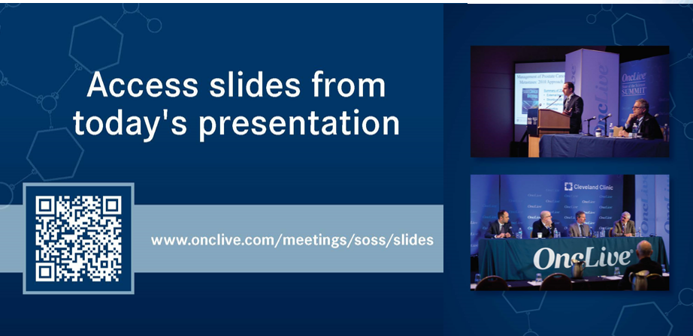

Slide 5


Slide 6
2023 Events
Precision Medicine: November 16,
Washington, DC
Breast: December 4, San Antonio, TX
2024 Events
Genitourinary: January 24, San Francisco, CA
Lung: March, Atlanta, GA
Gyn-Onc: May, Austin, TX
Lung: June, Chicago, IL
Gastrointestinal: November, Washington, DC
Breast: December, San Antonio, TX

Slide 7



Slide 8
Program Chair
Brad Somer, MD, MBA
Medical Oncology
West Cancer Center
Memphis, TN

Slide 9
BLADDER & RCC MALIGNANCIES
Tuesday, February 20, 2023

Slide 10
How Do We Select Frontline Therapy in mUC
Brad Somer, MD, MBA
Medical Oncology
West Cancer Center
Memphis, TN

Slide 11
Introduction
Key updates in front line metastatic urothelial carcinoma:
  JAVELIN 100
  EV-103
  CheckMate 901
  EV-302/KEYNOTE-A39
General approach

Slide 12
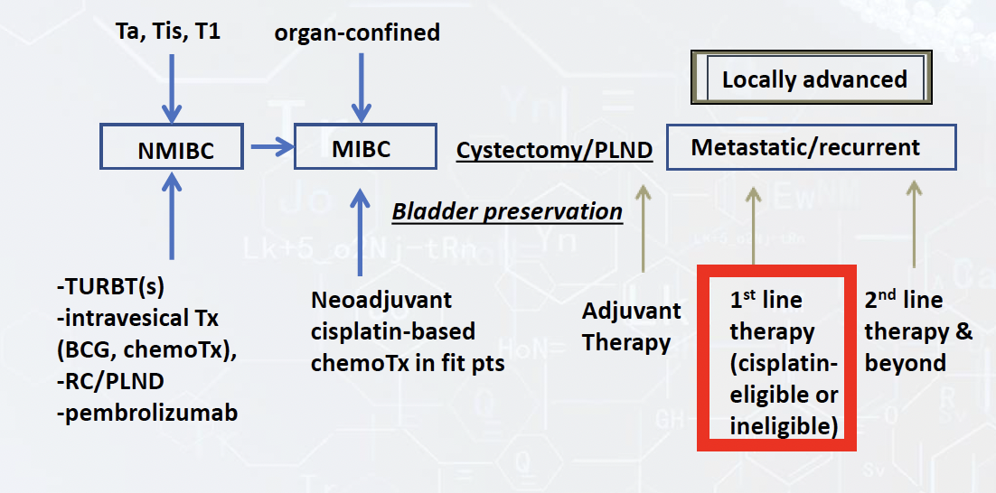

Slide 13
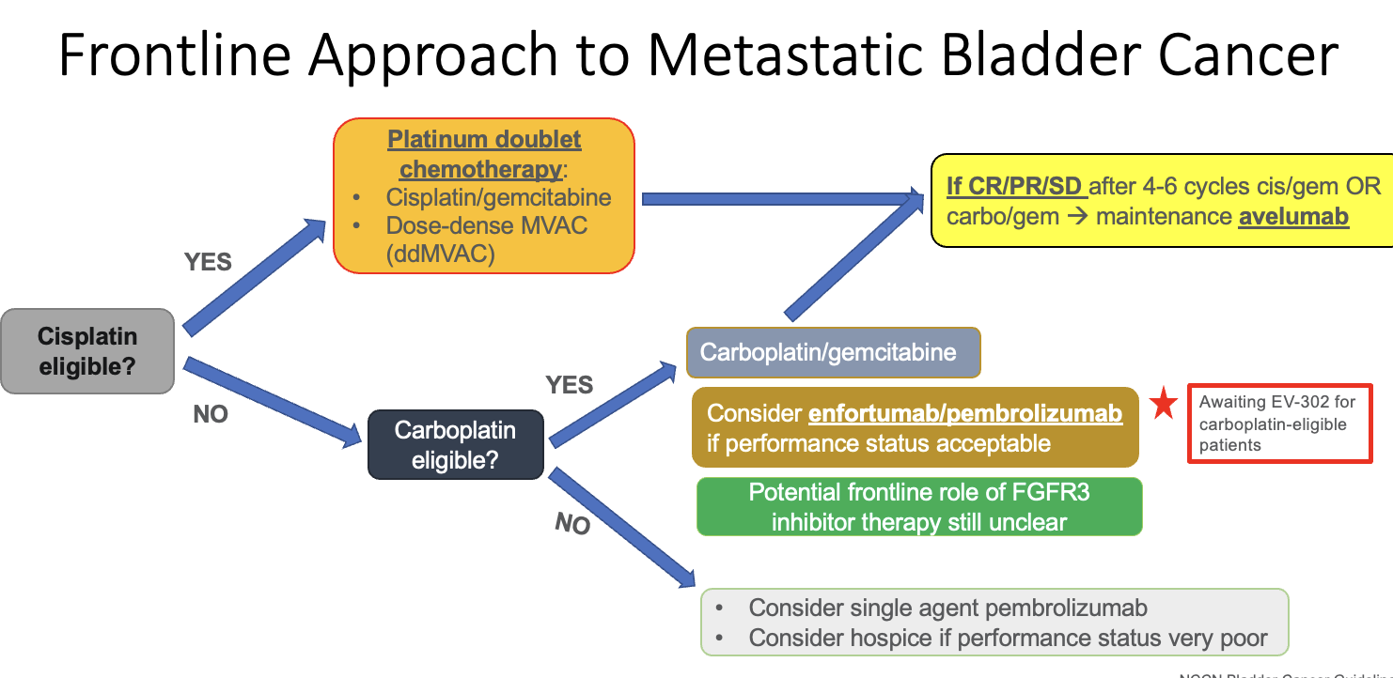

Slide 14
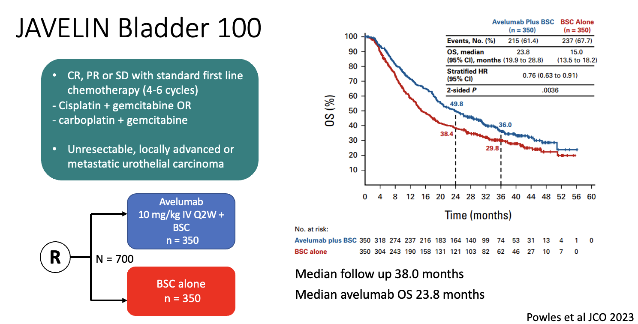

Slide 15
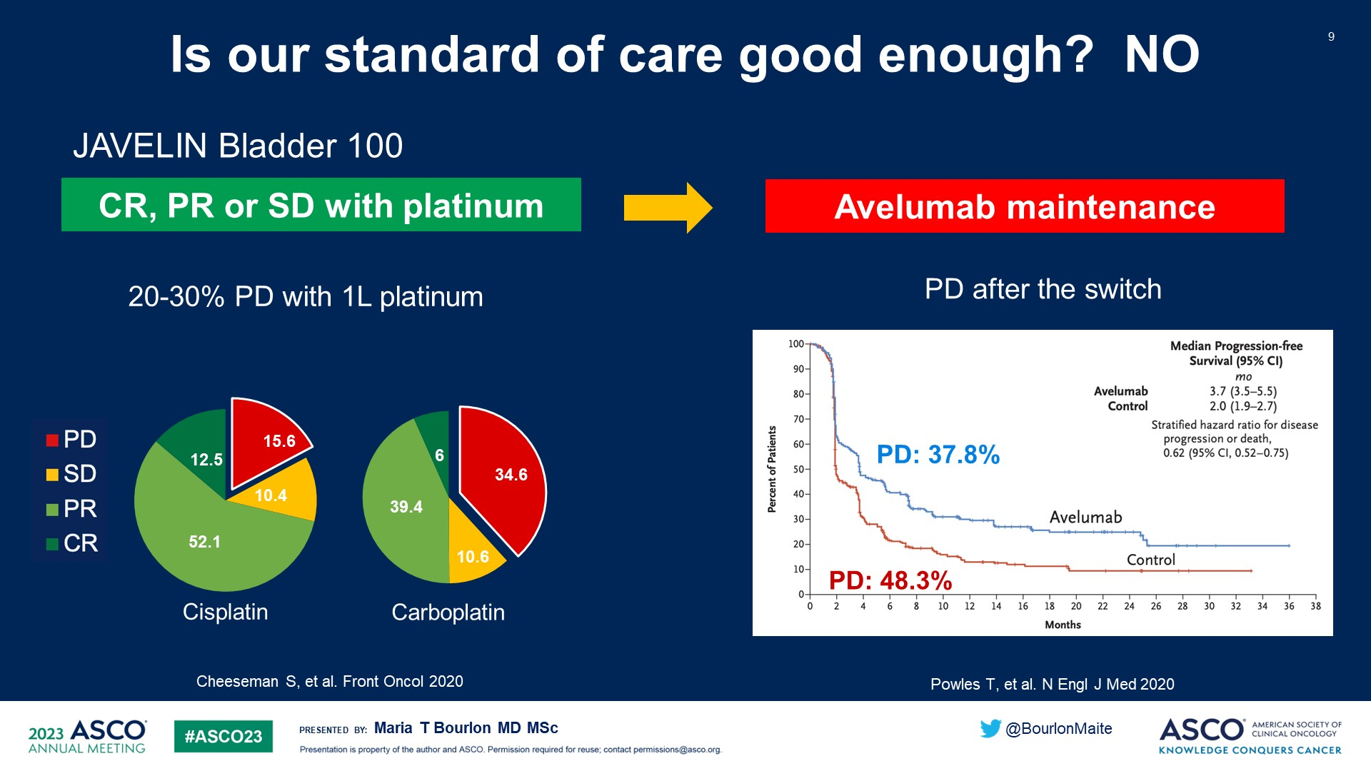
Is our standard of care good enough? NO
Content of this presentation is the property of the author, licensed by ASCO. Permission required for reuse.

Slide 16
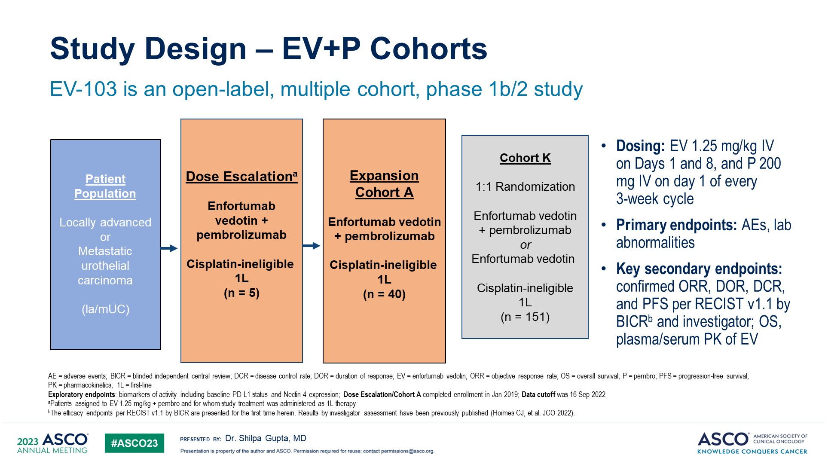
Study Design – EV+P Cohorts
For Cisplatin Ineligible
Gupta S et al, ASCO 2023

Slide 17
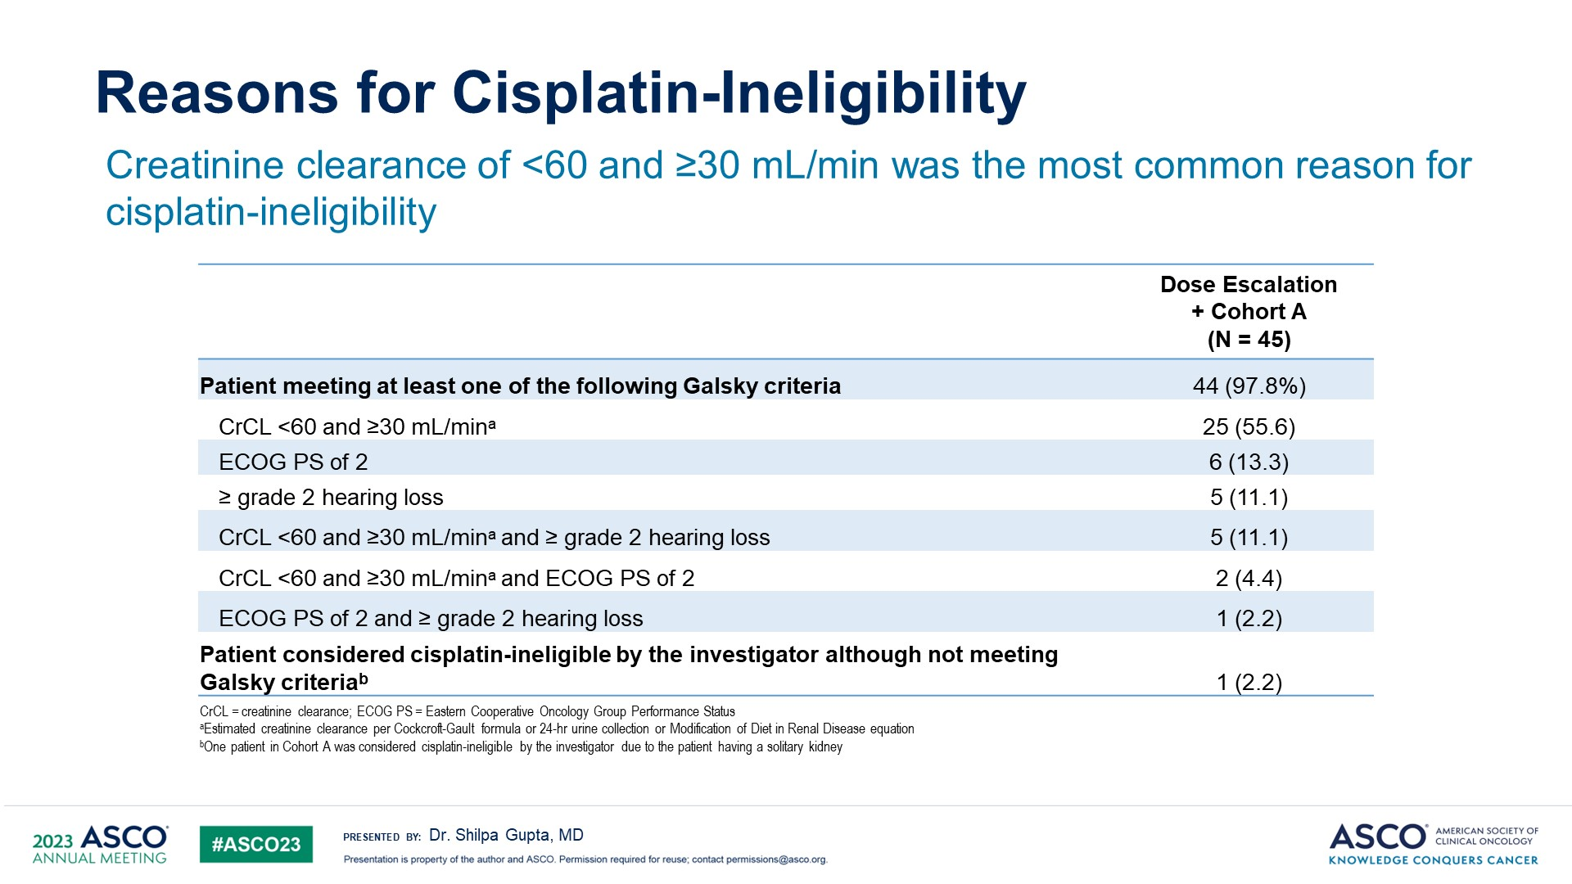
Reasons for Cisplatin-Ineligibility
Content of this presentation is the property of the author, licensed by ASCO. Permission required for reuse.

Slide 18
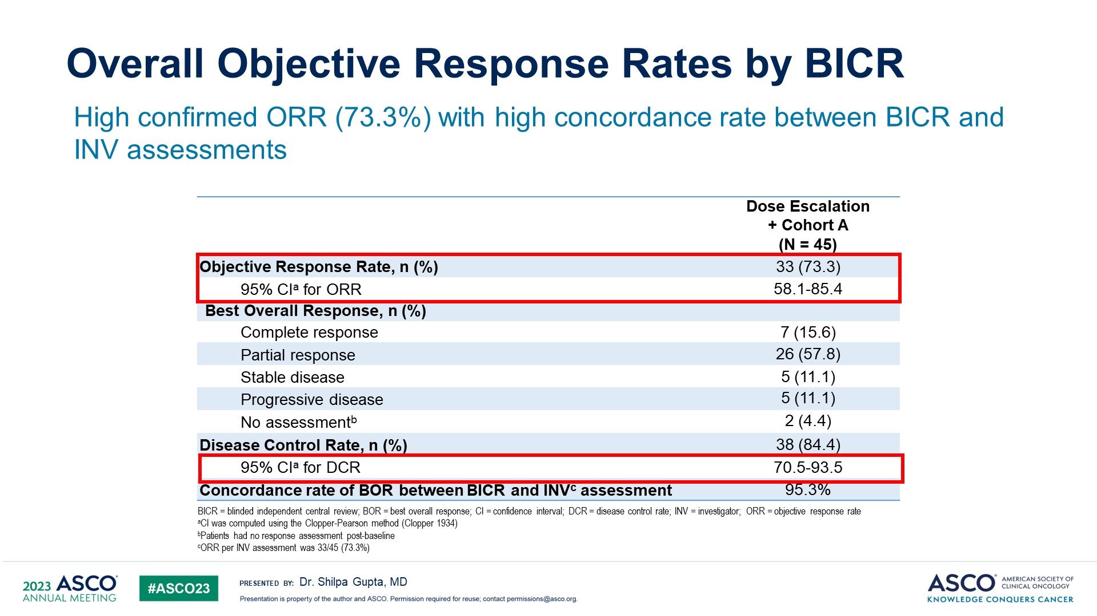
Overall Objective Response Rates by BICR
Content of this presentation is the property of the author, licensed by ASCO. Permission required for reuse.

Slide 19
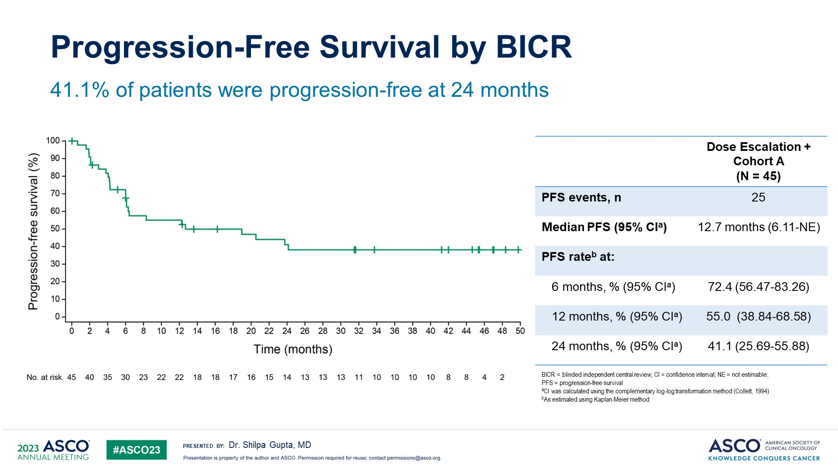
Progression-Free Survival by BICR
Content of this presentation is the property of the author, licensed by ASCO. Permission required for reuse.

Slide 20
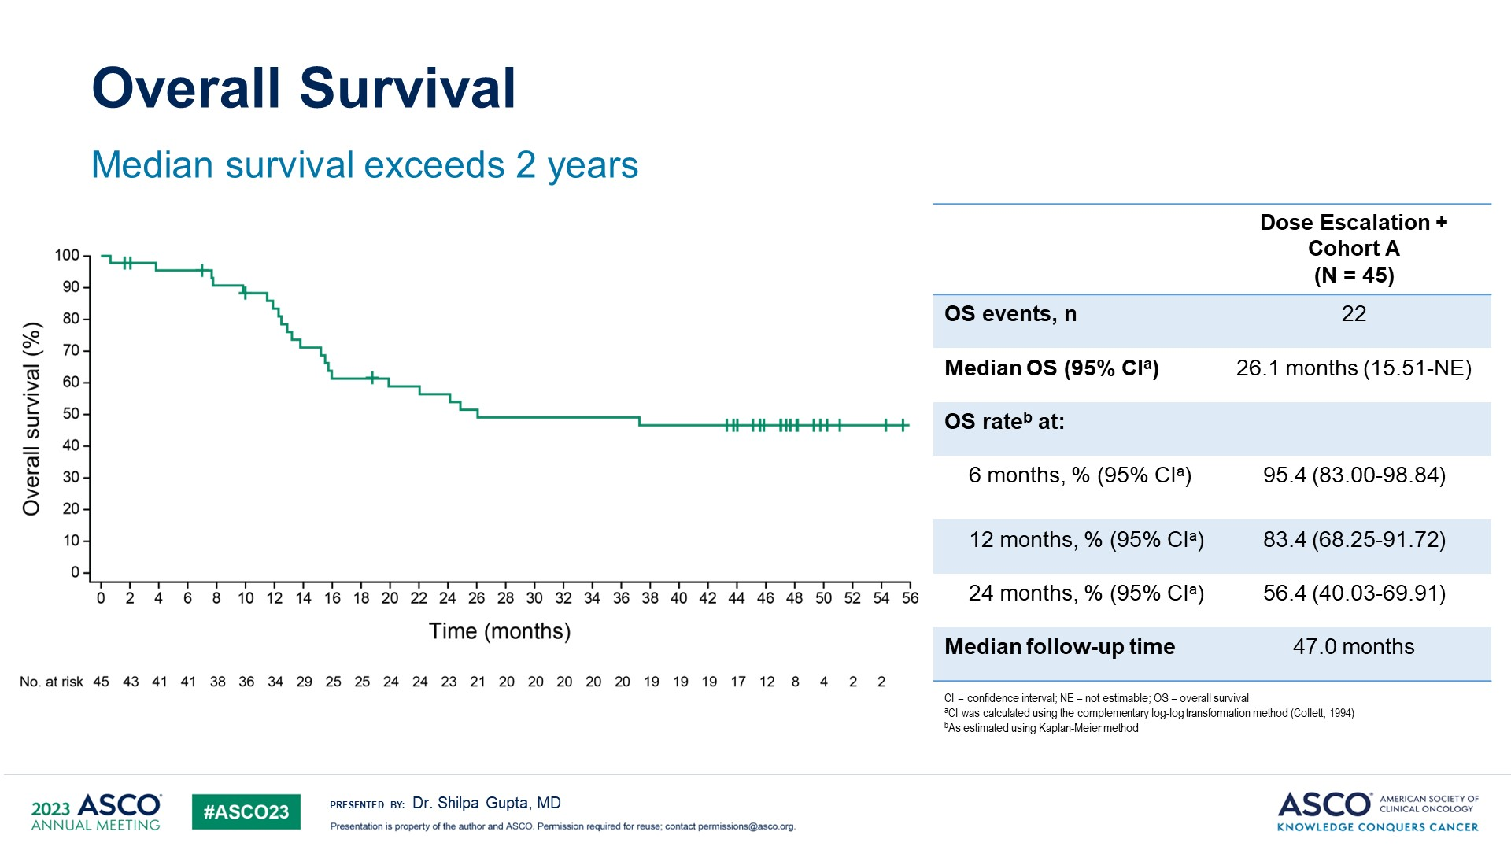
Overall Survival
Content of this presentation is the property of the author, licensed by ASCO. Permission required for reuse.

Slide 21
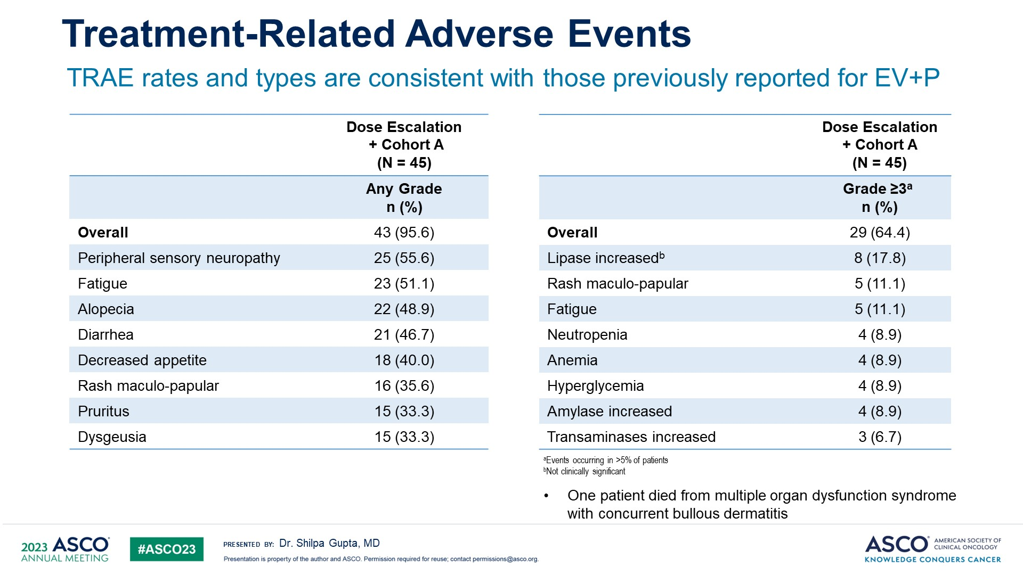
Treatment-Related Adverse Events
Content of this presentation is the property of the author, licensed by ASCO. Permission required for reuse.

Slide 22
On April 3, 2023, the Food and Drug Administration granted accelerated approval to enfortumab vedotin-ejfv (Padcev, Astellas Pharma) with pembrolizumab (Keytruda, Merck) for patients with locally advanced or metastatic urothelial carcinoma who are ineligible for cisplatin-containing chemotherapy.

Slide 23
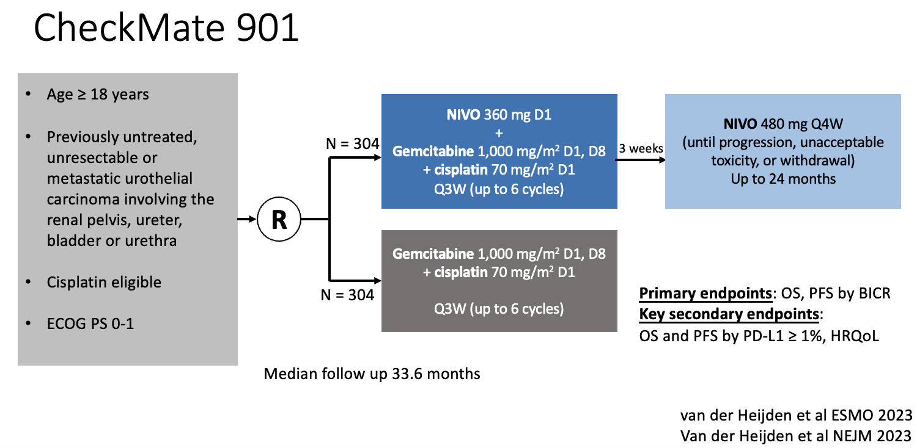

Slide 24
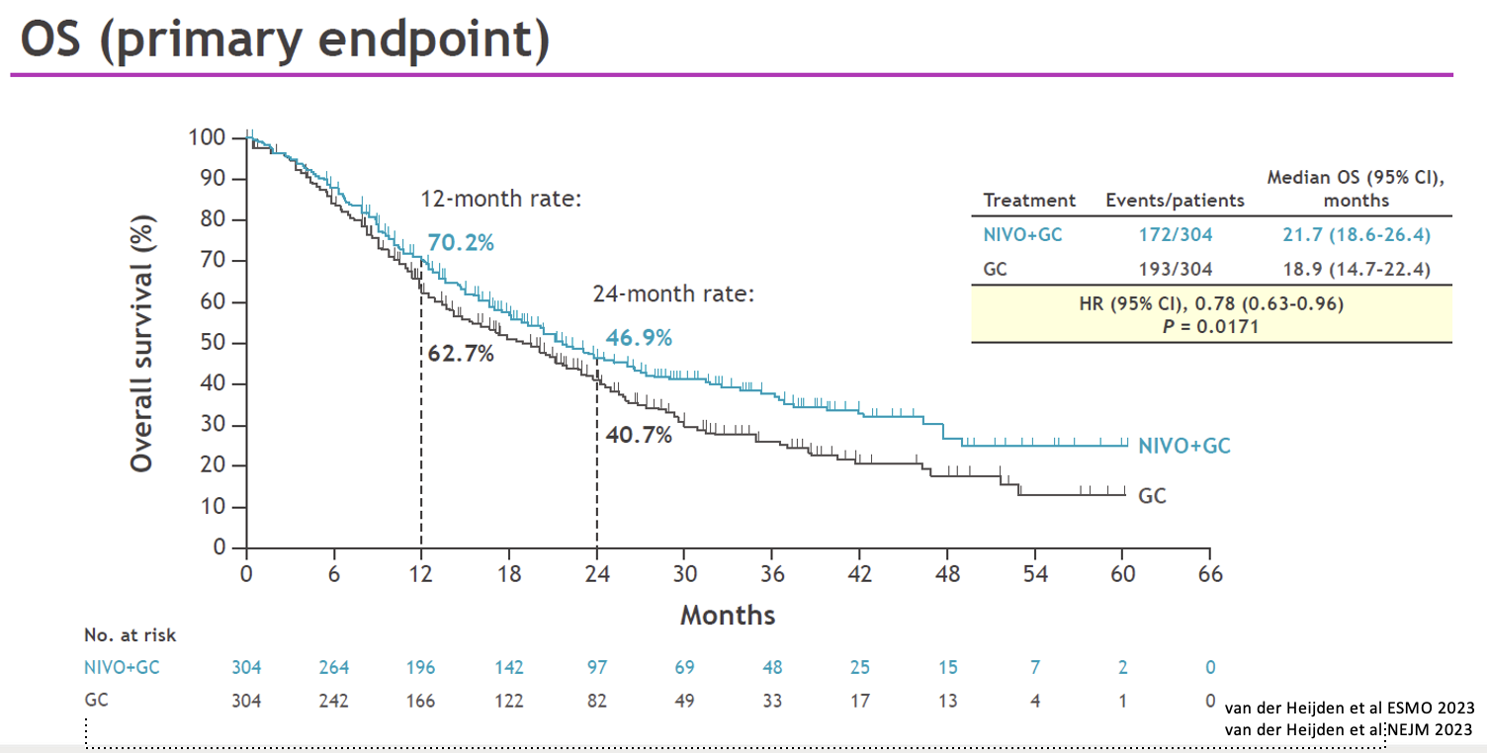

Slide 25
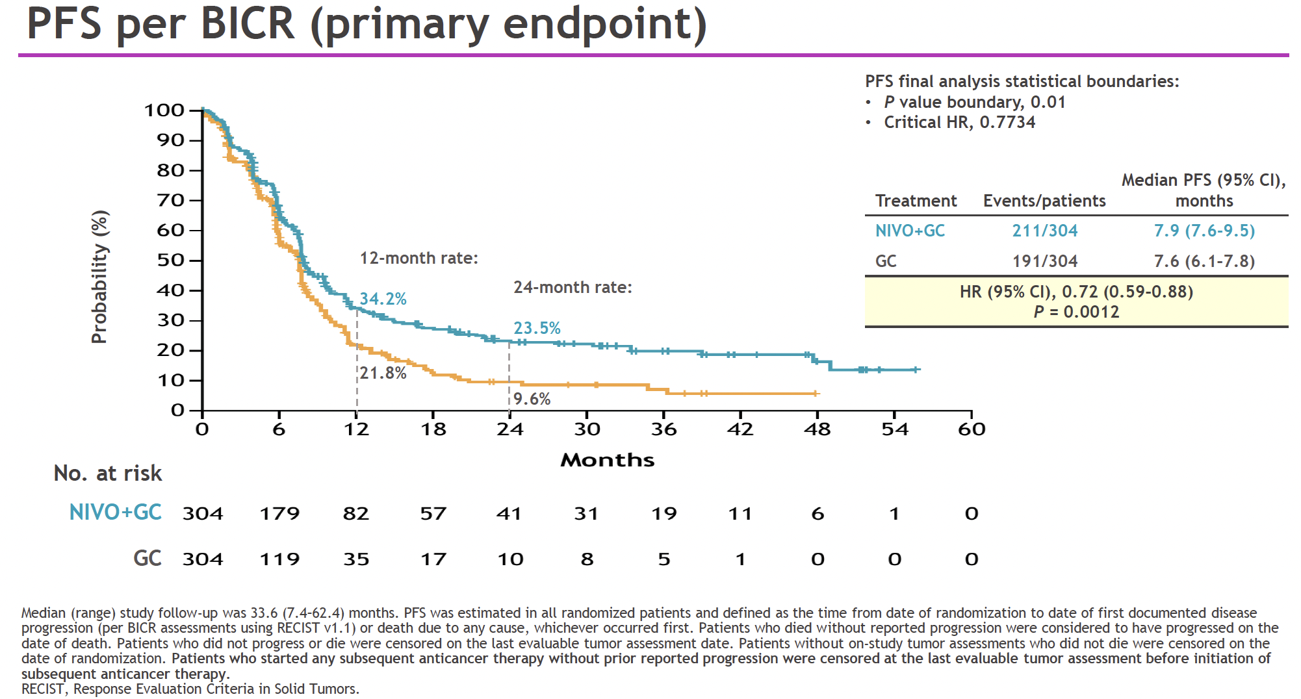


Slide 26
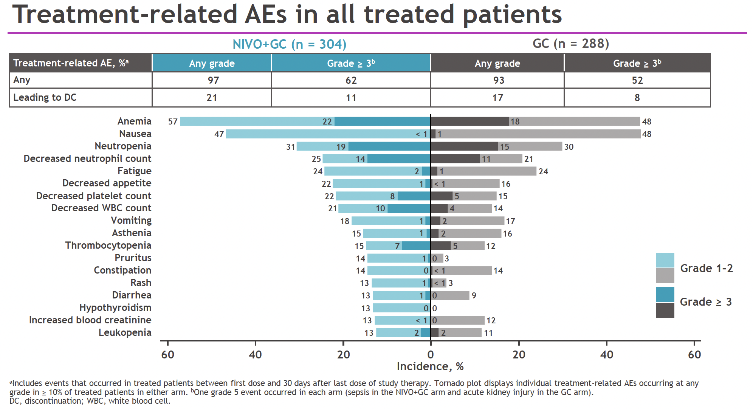

Slide 27
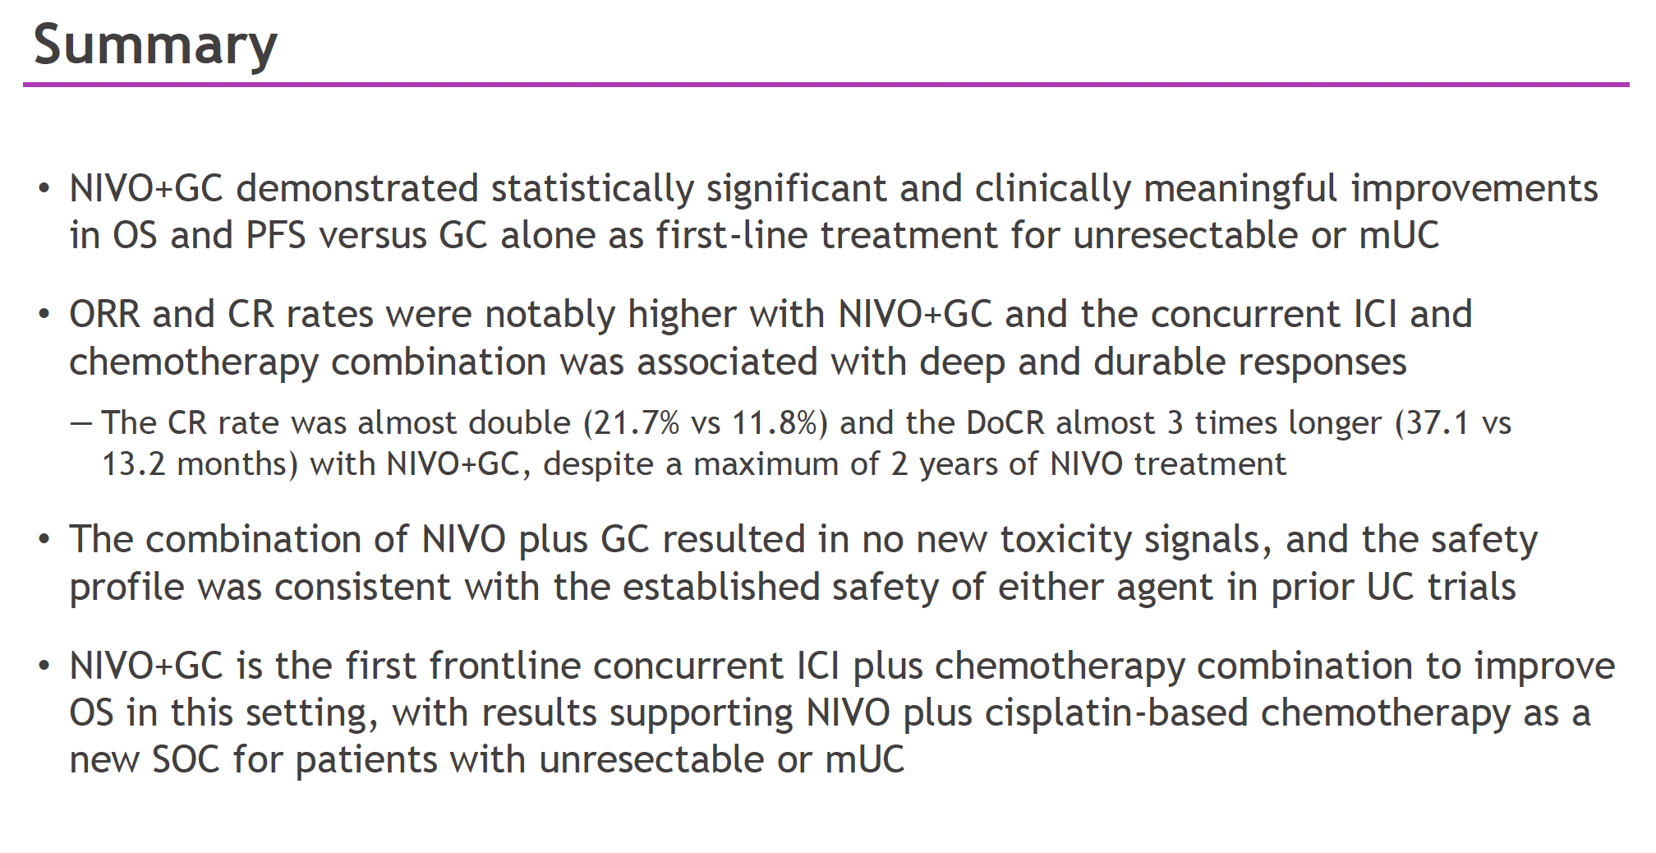

Slide 28
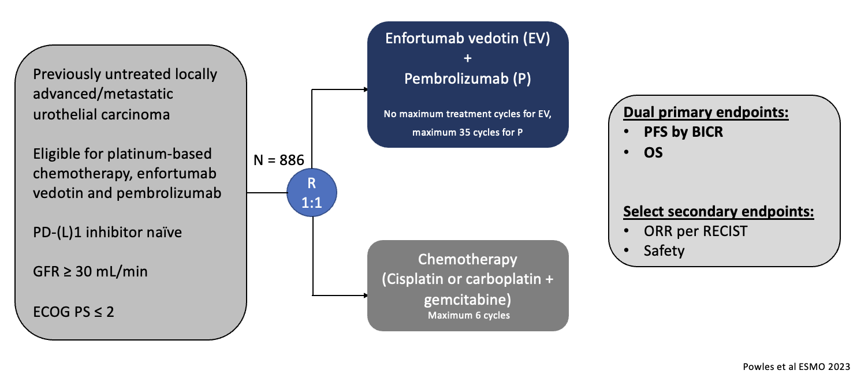
EV-302/KEYNOTE-A39

Slide 29
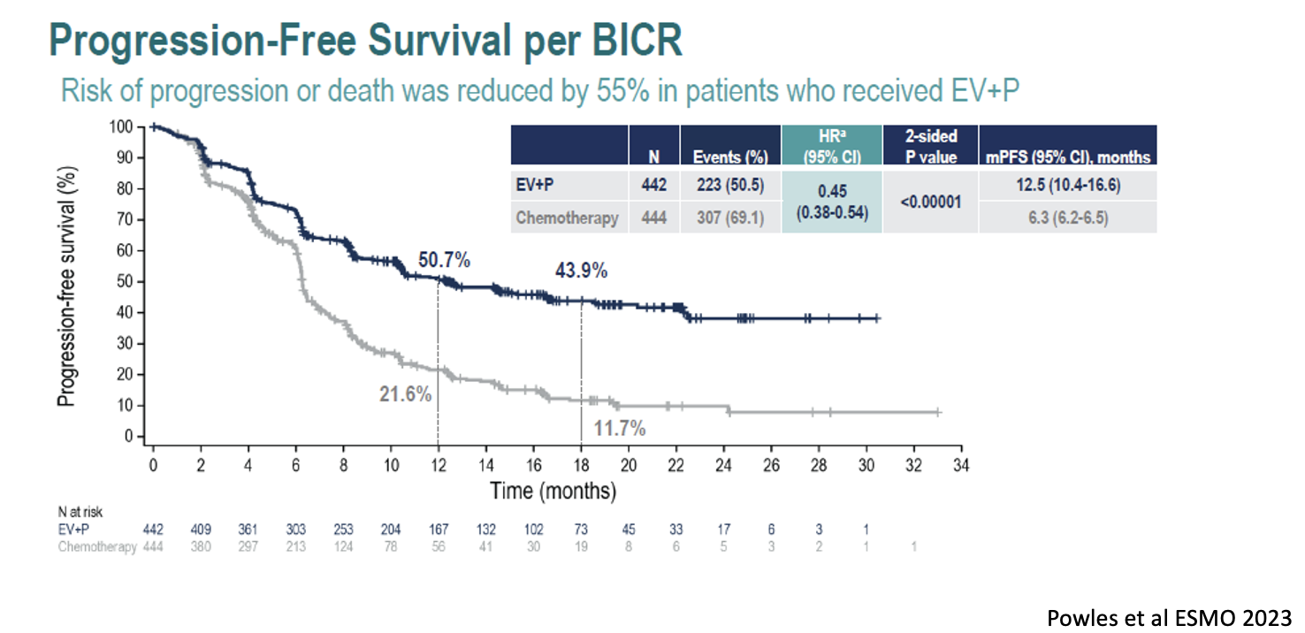

Slide 30
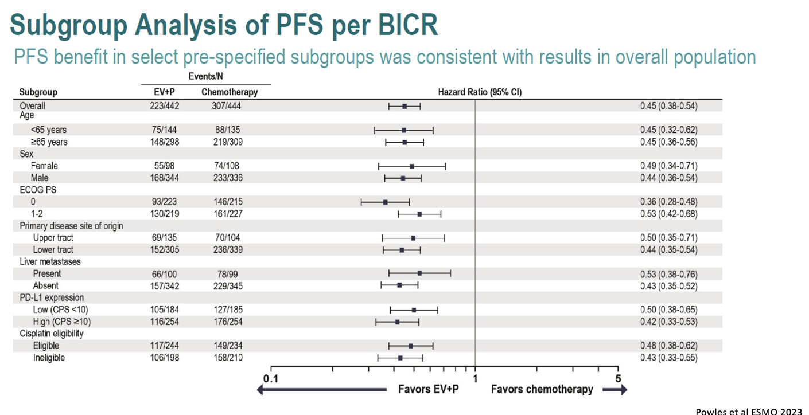

Slide 31
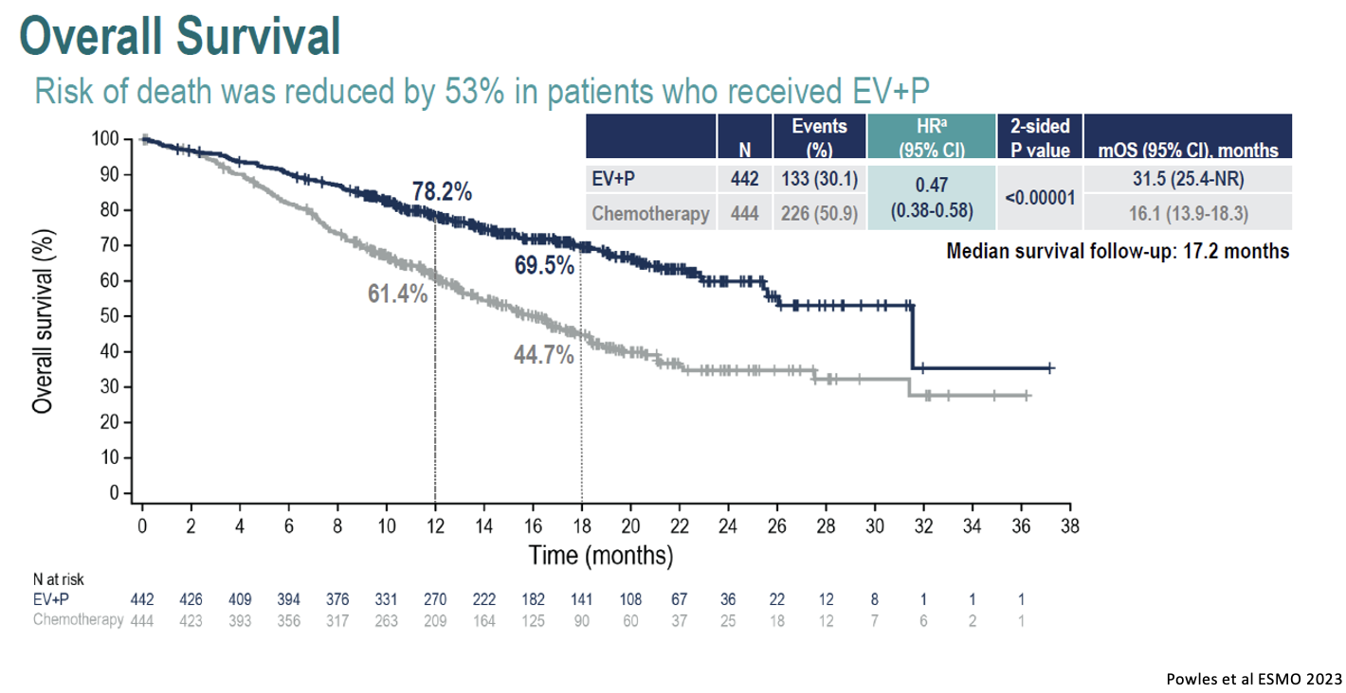

Slide 32
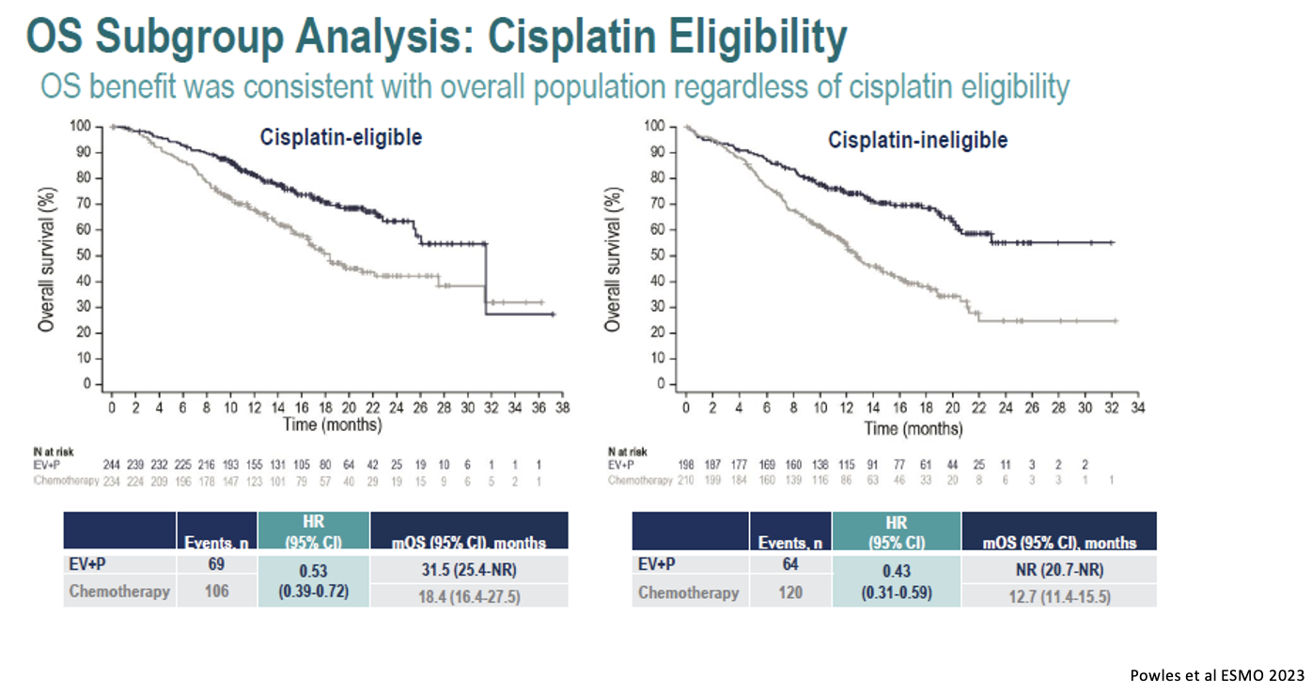

Slide 33
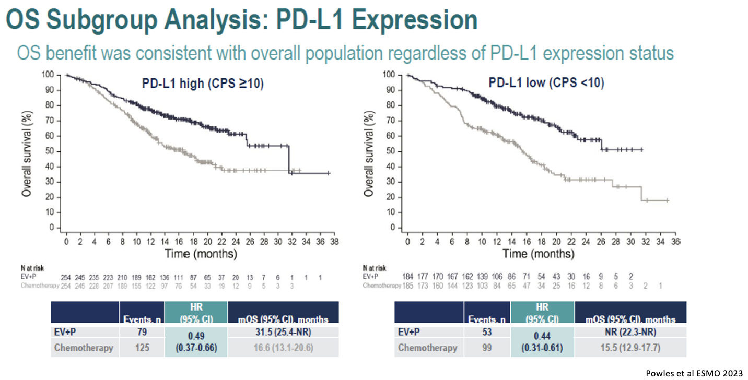

Slide 34
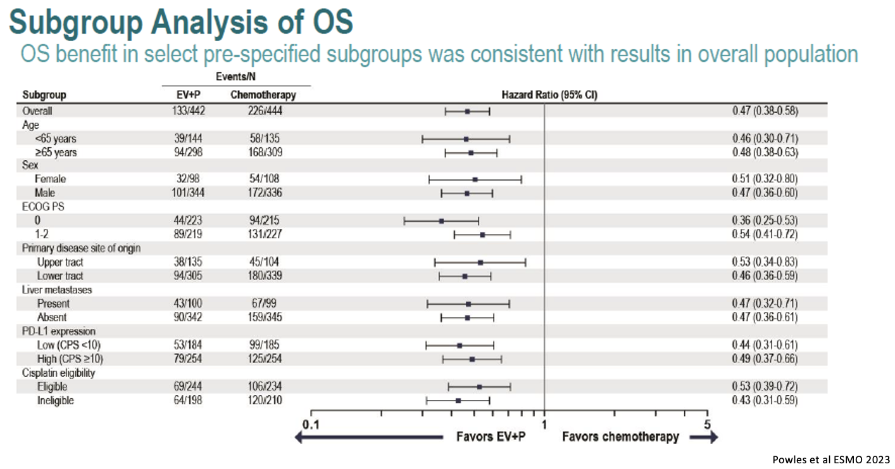

Slide 35
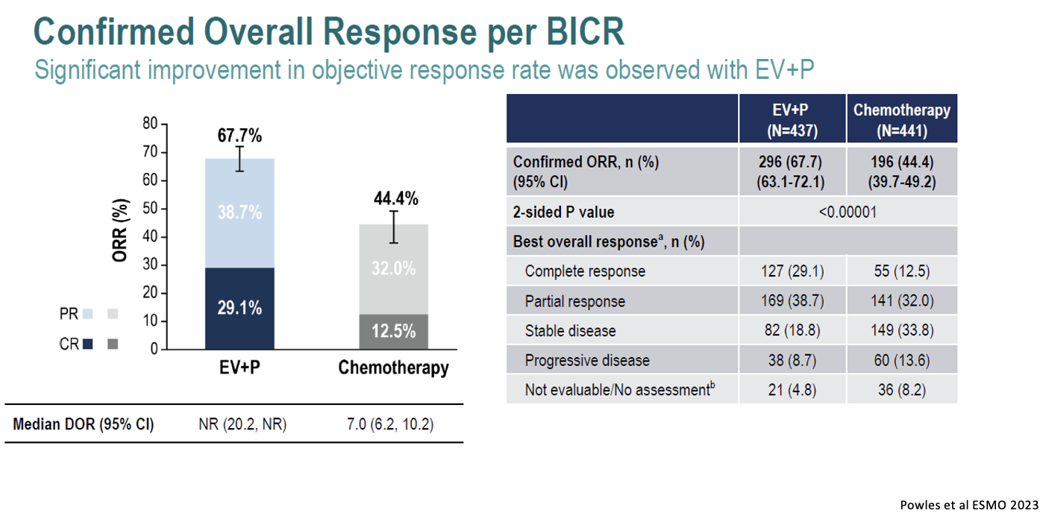

Slide 36
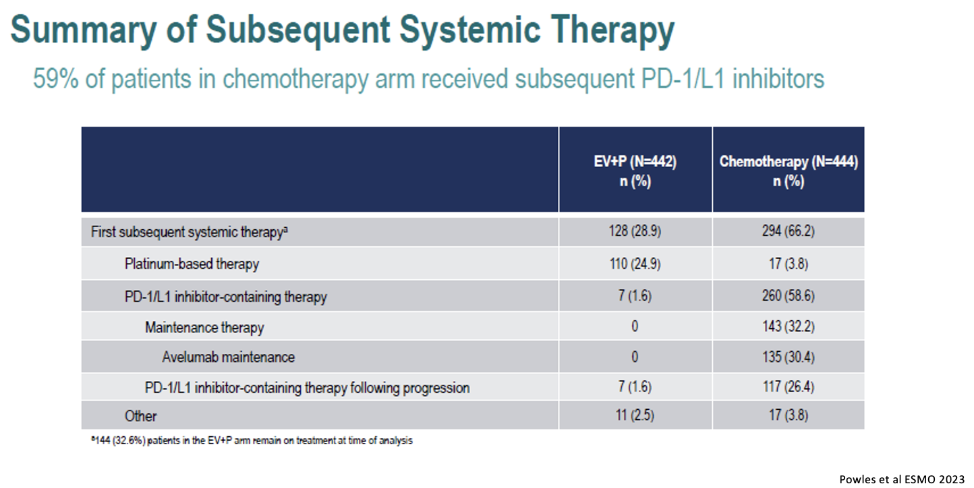

Slide 37
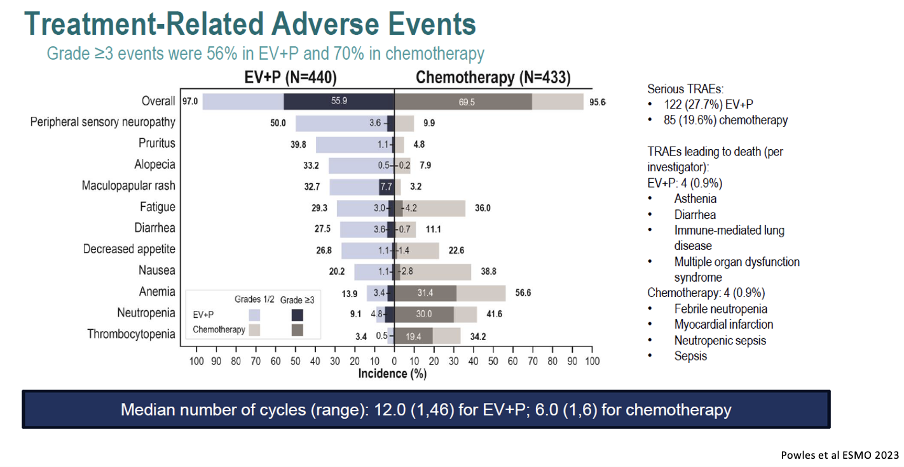

Slide 38
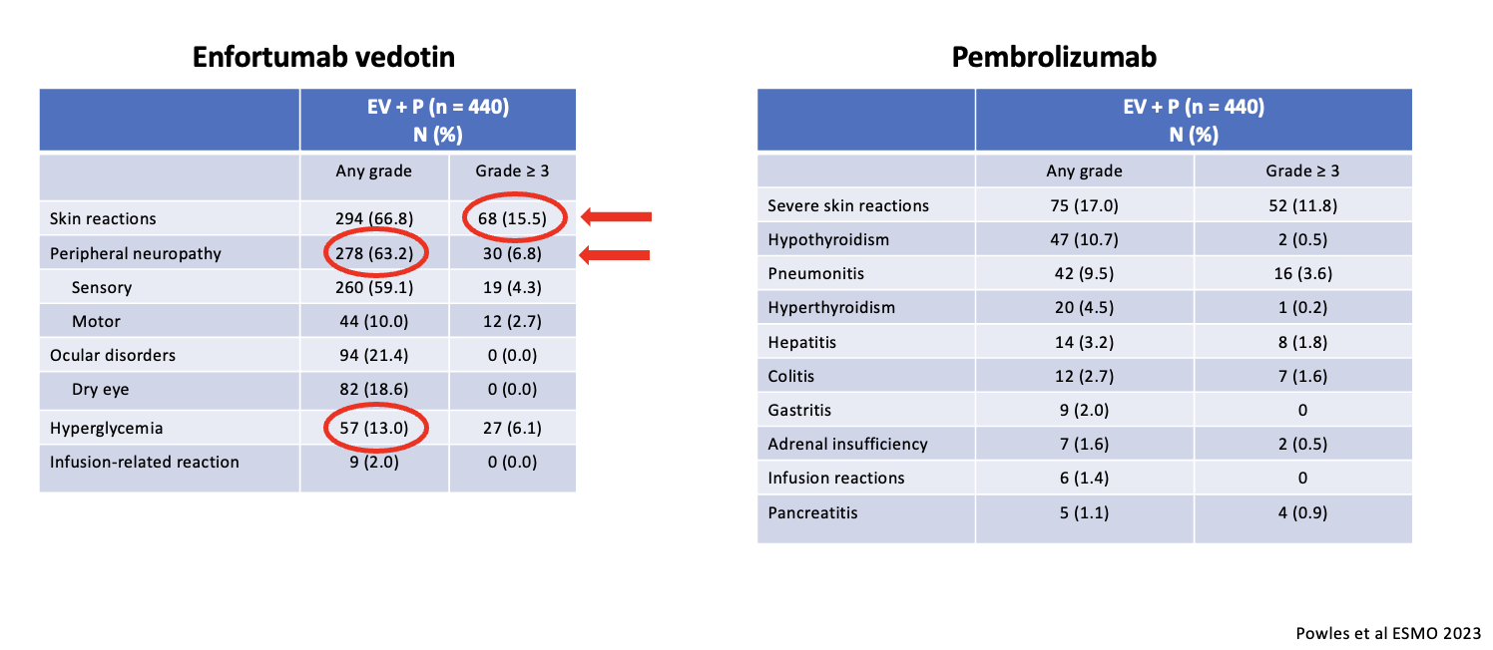
Treatment Emergent Adverse Events of Special Interest

Slide 39
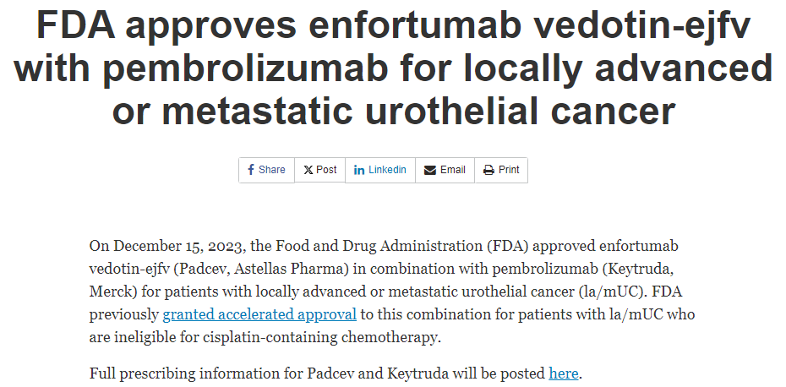

Slide 40
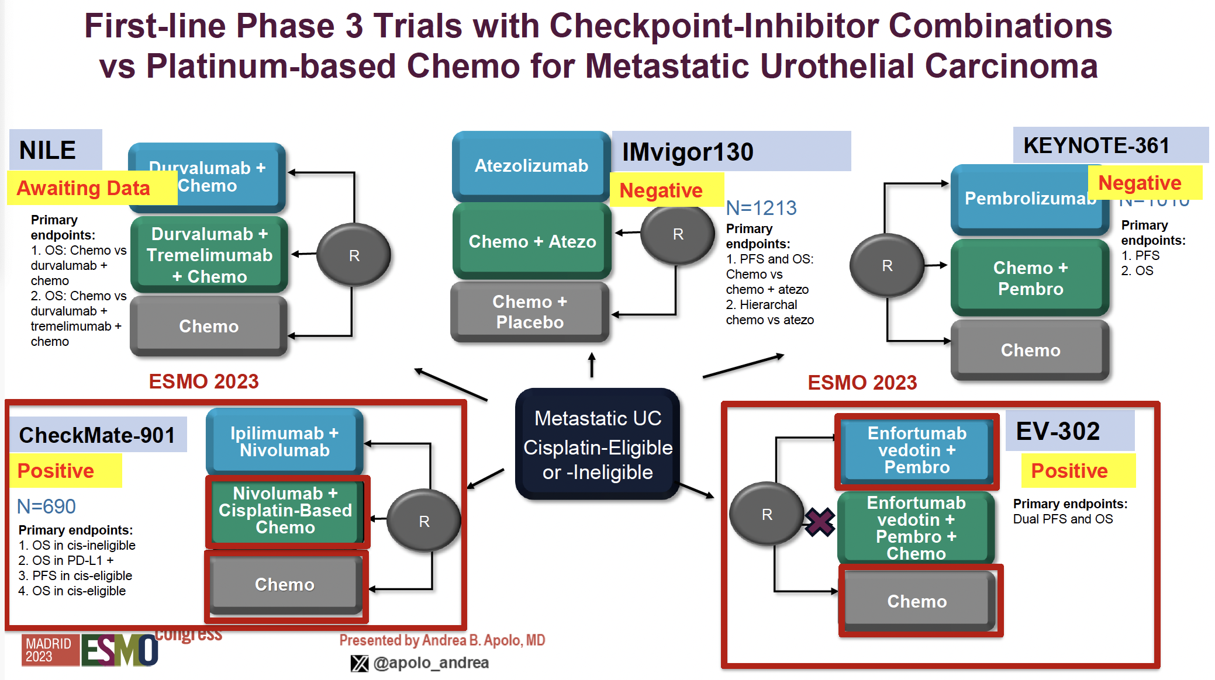

Slide 41
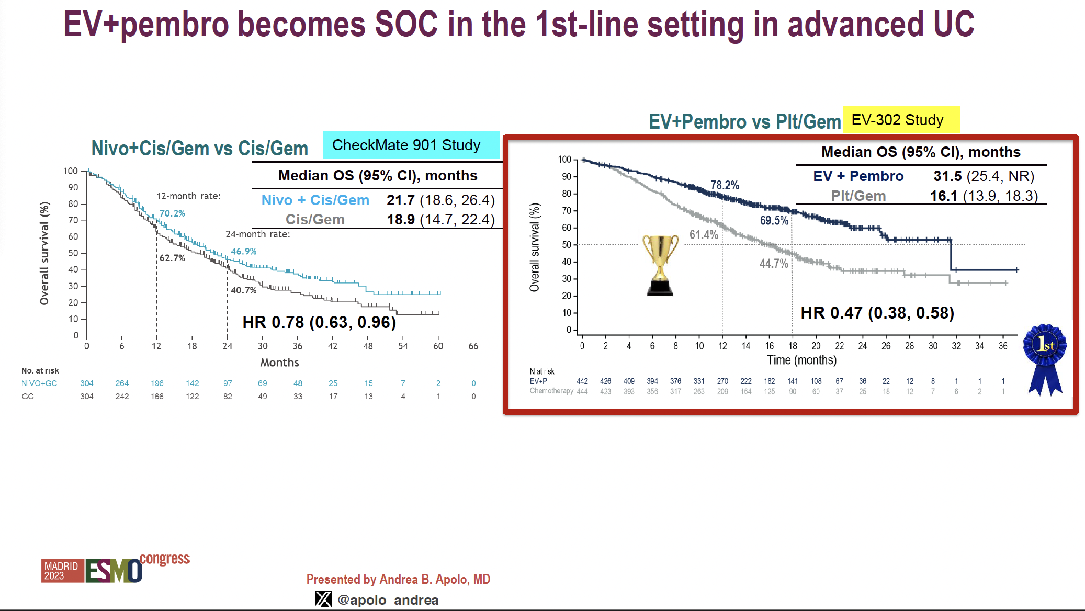

Slide 42
CONCLUSION
Two phase 3 trials in 1L mUC with improved OS:
  Nivo+Gem/Cis (CM-901) and EV + Pembro (EV-302)
Nivo+Gem/Cis is 1st chemo/IO combo to show OS benefit (mOS 21.7 months), however, the combination of EV+Pembro almost doubles mOS vs chemotherapy (mOS 31.5 months) => new SOC.
Questions that arise include:
  Can we dose escalate EV in EV + Pembro (eg. Start at 100mg/kg)?
  Biology/Biomarkers?
  What about in an earlier setting?
  Cost?
  What if had IO in adjuvant setting? Would you employ this in front line?
  The end of characterization of platinum eligibility and relevance of JAVELIN Bladder 100?
  What do you then use in next line therapy?

Slide 43
Refractory Bladder Cancer
Katy Beckermann, MD, PhD
Vanderbilt University Medical Center
02.20.24
@Katy_Beckermann
Thanks to @alantanmd for slides!

Slide 44
What do we do now?
Frontline paradigm is changing more patients will have adjuvant immunotherapy or frontline EV+pembro
Still some patients on treatment with frontline cytotoxic switch maintenance avelumab
  EV monotherapy in refractory setting
  For FGFR alterations data for erdafitinib
  SG monotherapy
  Will cytotoxic chemotherapy continue to play a role in refractory bladder
New Targets
  HER2 agents

Slide 45
EV-301 Open-Label Phase 3 Trial Design
Abstract 393
Enfortumab vedotin
(N=301)
1.25 mg/kg
on Days 1, 8, and 15
of each 28-day cycle
Key eligibility criteria:
Histologically/cytologically confirmed UC, including with squamous differentiation or mixed cell types
Radiographic progression or relapse during or after PD-1/L1 treatment for advanced UC
Prior platinum-containing regimen for advanced UC^{b}
ECOG PS 0 or 1
Primary endpoint: Overall survival
Secondary endpoints:
Progression-free survival
Disease control rate
Overall response rate
Safety
1:1 randomization
with stratificationª
Preselected Chemotherapy
(N=307)^{c}
Docetaxel 75 mg/m² or
Paclitaxel 175 mg/m² or
Vinflunine^{d} 320 mg/m²
on Day 1 of each
21-day cycle
Investigator-assessed per RECIST v1.1
ªStratification variables were ECOG performance status (0 or 1), regions of the world (United States, western Europe, or rest of world), liver metastasis (yes or no).
^{b}If used in the adjuvant/neoadjuvant setting, progression must be within 12 months of completion.
^{c}Investigator selected prior to randomization.
^{d}In countries where approved; overall proportion of patients receiving vinflunine capped at 35%.
Abbreviations: ECOG PS, Eastern Cooperative Oncology Group performance status; PD-1/L1, programmed cell death protein-1/programmed death-ligand 1; RECIST, Response Evaluation Criteria in Solid Tumors; UC, advanced urothelial carcinoma.

Slide 46
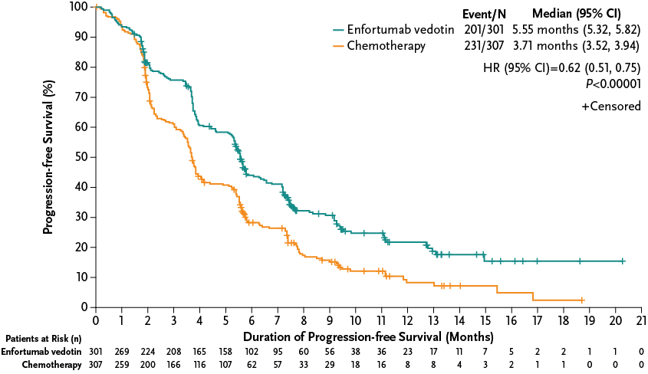
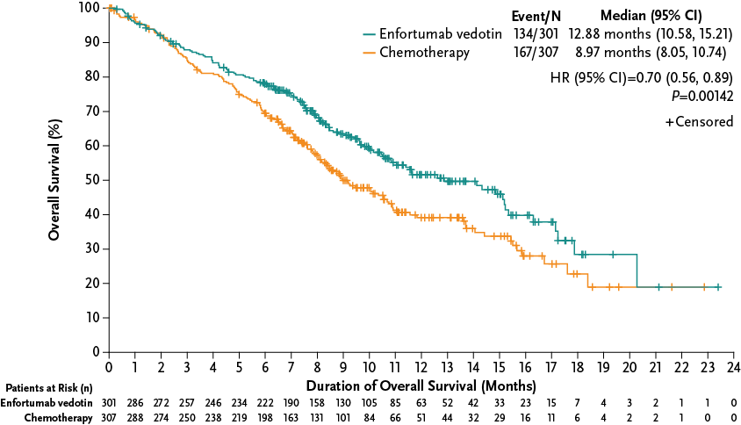
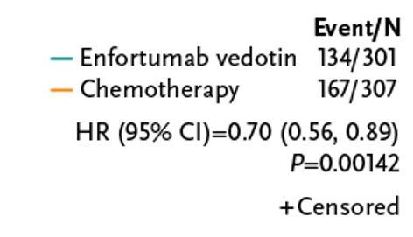
Improvement in PFS and OS by EV in refractory setting
OS Rate, % (95% CI) | Enfortumab vedotin N=301 | Chemotherapy N=307
6-month | 77.9 (72.74, 82.25) | 69.5 (63.85, 74.38)
12-month | 51.5 (44.63, 58.03) | 39.2 (32.60, 45.64)
Median PFS (95% CI)
5.55 months (5.32, 5.82)
3.71 months (3.52, 3.94)
Median OS (95% CI)
12.88 months (10.58, 15.21)
8.97 months (8.05, 10.74)
Data cut-off: July 15, 2020
Powles T et al. N Engl J Med 2021

Slide 47
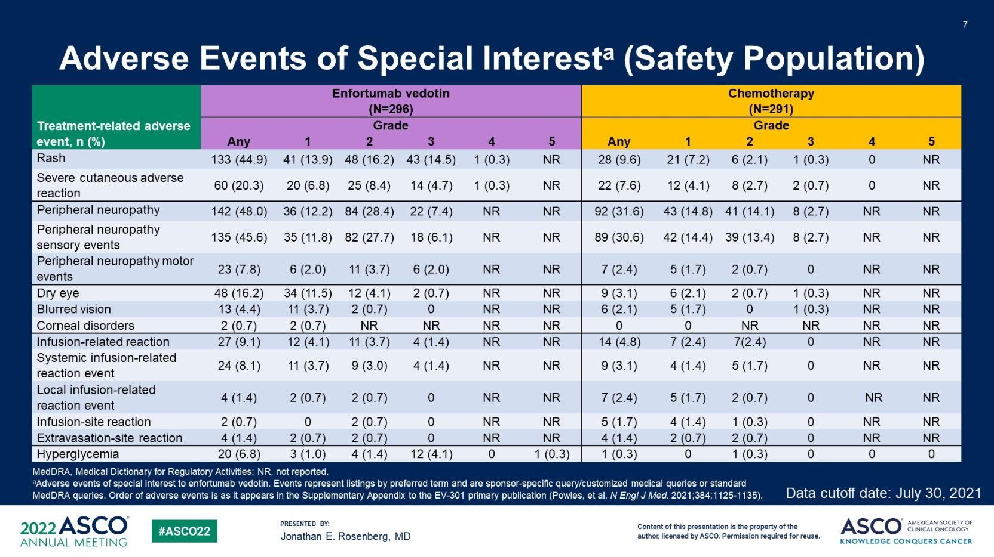

Slide 48
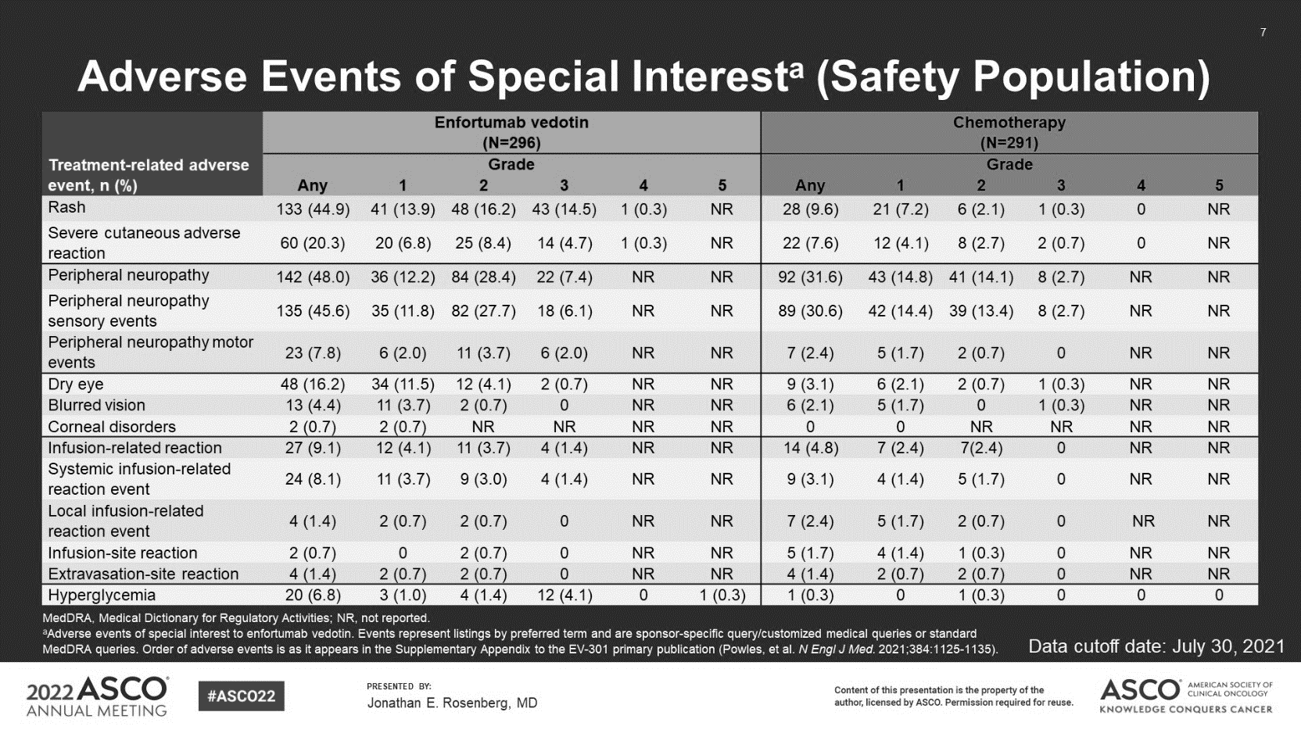
WARNING: SERIOUS SKIN REACTIONS
See full prescribing information for complete boxed warning.
Enfortumab vedotin can cause severe and fatal cutaneous adverse
reactions, including Stevens-Johnson syndrome (SJS) and Toxic
Epidermal Necrolysis (TEN).
Immediately withhold enfortumab vedotin and consider referral for
specialized care for suspected SJS or TEN or severe skin reactions.
Permanently discontinue enfortumab vedotin in patients with
confirmed SJS or TEN; or Grade 4 or recurrent Grade 3 skin
reactions. (2.2), (5.1) (6.1)

Slide 49
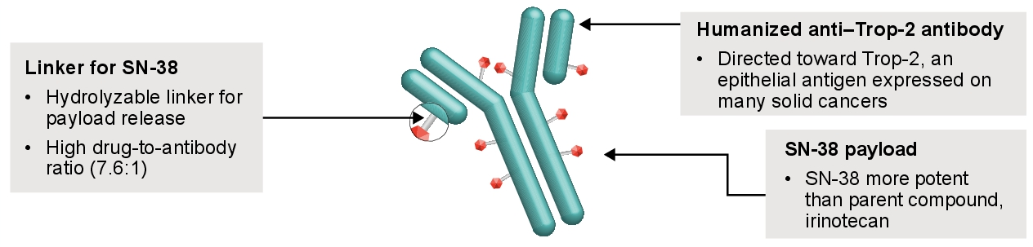
Sacituzumab Govitecan (SG)
Humanized monoclonal antibody targeting Trop-2 expression
Trop-2
  83% of mUC patient samples
  “Payload” is SN-38, the active metabolite of irinotecan, topoisomerase 1 inhibitor
Payload is conjugated by a hydrolyzable linker
(NCI, 2020)

Slide 50
TROPHY-U-01 Cohort 1: Phase II Study of Sacituzumab Govitecan for mUC That Progressed After Platinum Chemotherapy and a Checkpoint Inhibitor
(Tagawa et al., JCO 2021)

Slide 51
Sacituzumab Govitecan in Combination With Pembrolizumab for Patients With Metastatic Urothelial Cancer That Progressed After Platinum-Based Chemotherapy: TROPHY-U-01 Cohort 3
(Grivas et al., 2023)

Slide 52
SG + Pembro Side Effects
(Grivas et al., 2023)

Slide 53
Phase 3 THOR Study: Erdafitinib Versus Chemotherapy of Choice in Patients With Advanced Urothelial Cancer and Select FGFR Aberrations
Cohort 1
  FGFR alterations seen in ~20% of advanced or mUC as oncogenic drivers
Key eligibility criteria
Age ≥18 years
Metastatic or unresectable UC
Confirmed disease progression
Prior tx with anti–PD-(L)1
1-2 lines of systemic tx
Select FGFR3/2alt (mutation/fusion)ª
ECOG PS 0-2
Erdafitinib
(n=136)
Once-daily erdafitinib 8 mg with
pharmacodynamically guided uptitration to 9 mg
Primary end point:
OS
1:1
N=266^{b}
R
Chemotherapy of Choice
(n=130)
docetaxel or vinflunine once every 3 weeks
Key secondary end points:
PFS
ORR
Safety
Stratification factors: region (North America vs European Union vs rest of world), ECOG PS (0 or 1 vs 2), and disease distribution (presence vs absence of visceral [lung, liver, or bone] metastases)
NCT03390504
Loriot Y et al. ASCO 2023; Abstract LBA4619.

Slide 54
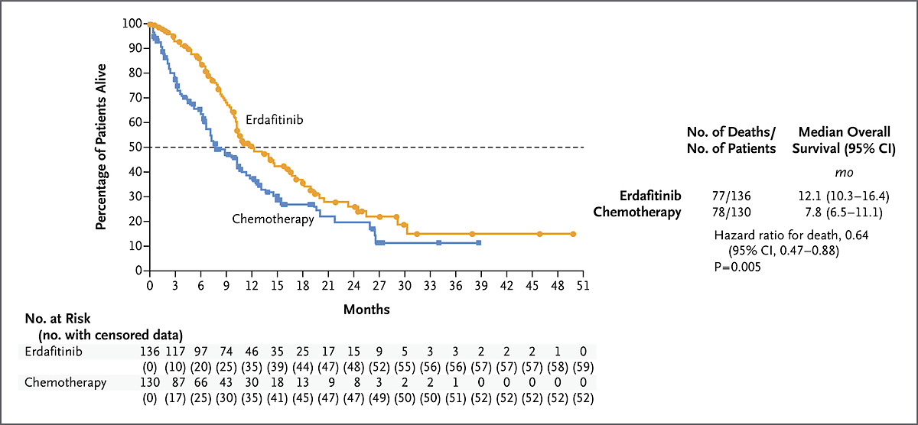

Overall Survival
Y Loriot et al. N Engl J Med 2023. DOI: 10.1056/NEJMoa2308849
Notes:
Figure 2. Overall Survival. Shown are Kaplan–Meier estimates of overall survival. Circles and squares indicate censored data in the erdafitinib group and chemotherapy group, respectively. Results for overall survival in key subgroups are provided in Figure S3.

Slide 55
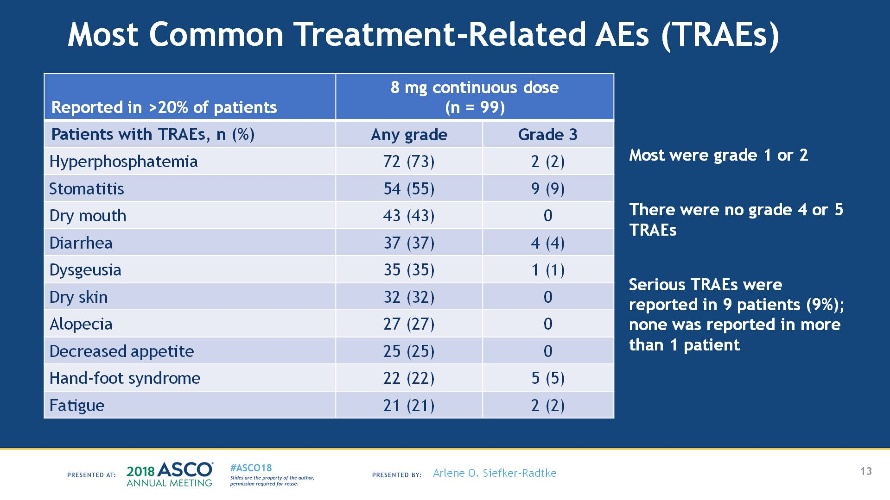
Erdafitinib - Toxicities
Courtesy of Peter H O’Donnell, MD
Siefker-Radtke AO et al. ASCO 2018;Abstract 4503.

Slide 56
Phase 3 THOR Study: Erdafitinib Versus Pembrolizumab in Patients With Metastatic Urothelial Carcinoma and Select FGFR Alterations
Cohort 2
Key eligibility criteria
Age ≥18 years
Metastatic or unresectable UC
Confirmed disease progression on 1 prior tx
Naive to anti–PD-(L)1 tx
Select FGFR3/2alt (mutation/fusion)ª
ECOG PS 0-2
Erdafitinib
(n=175)
Once-daily erdafitinib 8 mg with
pharmacodynamically guided uptitration to 9 mg
Primary end point
OS
1:1
N=351^{b}
R
Secondary end points
PFS
ORR
Safety
Pembrolizumab
(n=176)
200 mg once every 3 weeks
Stratification factors: region (North America vs European Union vs rest of world), ECOG PS (0 or 1 vs 2), and disease distribution (presence vs absence of visceral [lung, liver, or bone] metastases)
NCT03390504
Siefker-Radtke AO et al. Ann Oncol 2024;35(1):107-117.

Slide 57
No Difference in Overall Survival Between Erdafitinib and Pembrolizumab
100
Erdafitinib
Median OS:
10.9 months (95% CI, 9.2-12.6)
11.1 months (95% CI, 9.7-13.6)
80
ORR 40.0%
  Relative risk, 1.85 (95% CI, 1.32-2.59;
  P < 0.001ª)^{b}
Patients, %
CR 6.3%
(n=11)
60
OS, %
Pembrolizumab
40
ORR 21.6%
PR 33.7%
(n=59)
CR 4.5% (n=8)
20
0
PR 17.0%
(n=30)
0
3
6
9
12
15
18
21
24
27
30
33
36
39
42
45
48
51
54
57
Months Since Randomization
No. at risk
Erdafitinib
(n=175)
Pembrolizumab (n=176)
Erdafitinib
175
160
131
100
78
60
52
41
30
28
23
21
13
9
7
2
1
1
1
0
Pembrolizumab
176
148
119
103
84
72
60
52
43
34
29
23
19
11
8
8
1
1
0
0
Siefker-Radtke AO et al. Ann Oncol 2024;35(1):107-117.

Slide 58
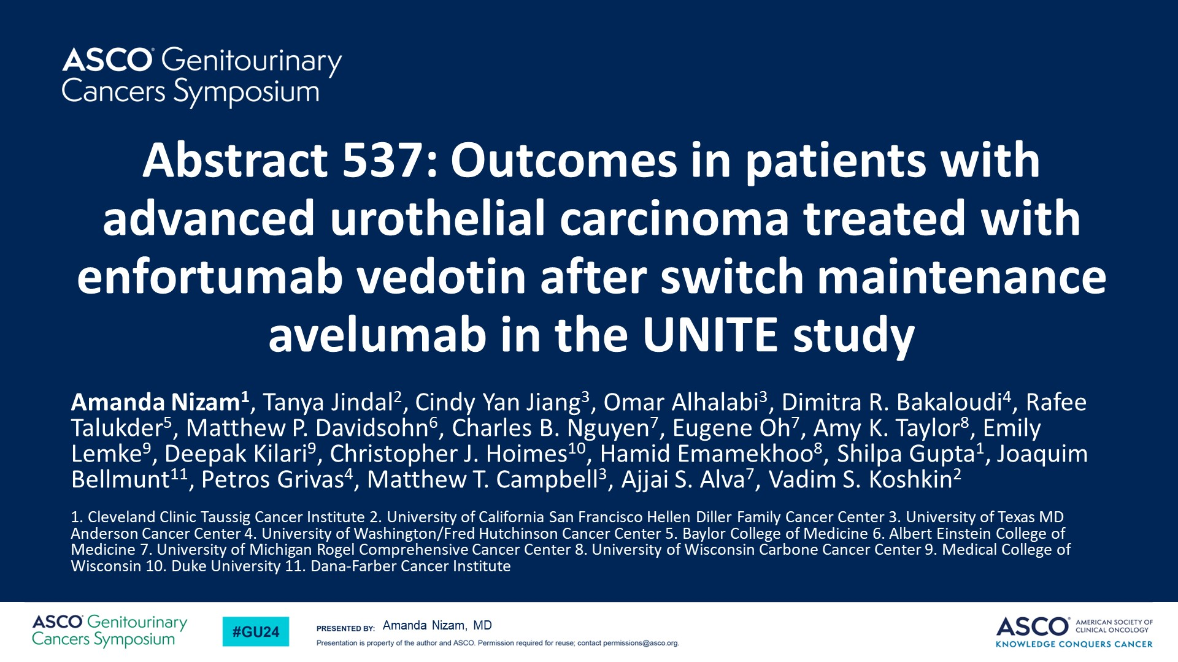
Abstract 537: Outcomes in patients with advanced urothelial carcinoma treated with enfortumab vedotin after switch maintenance avelumab in the UNITE study
Content of this presentation is the property of the author, licensed by ASCO. Permission required for reuse.

Slide 59
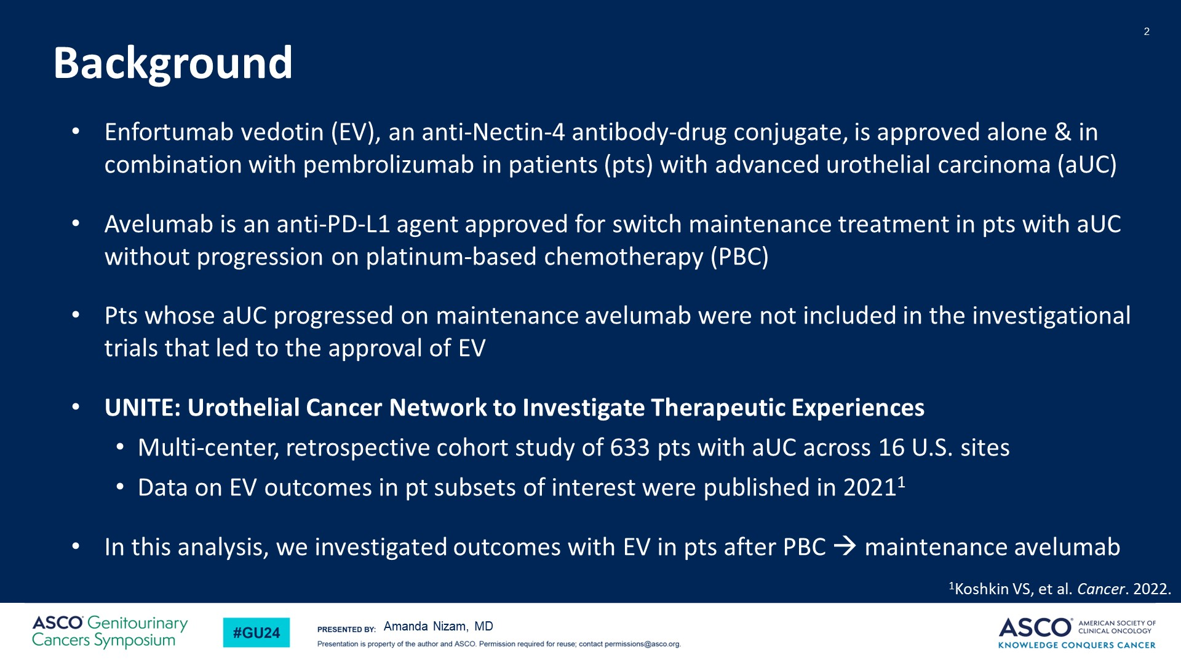
Background
Content of this presentation is the property of the author, licensed by ASCO. Permission required for reuse.

Slide 60
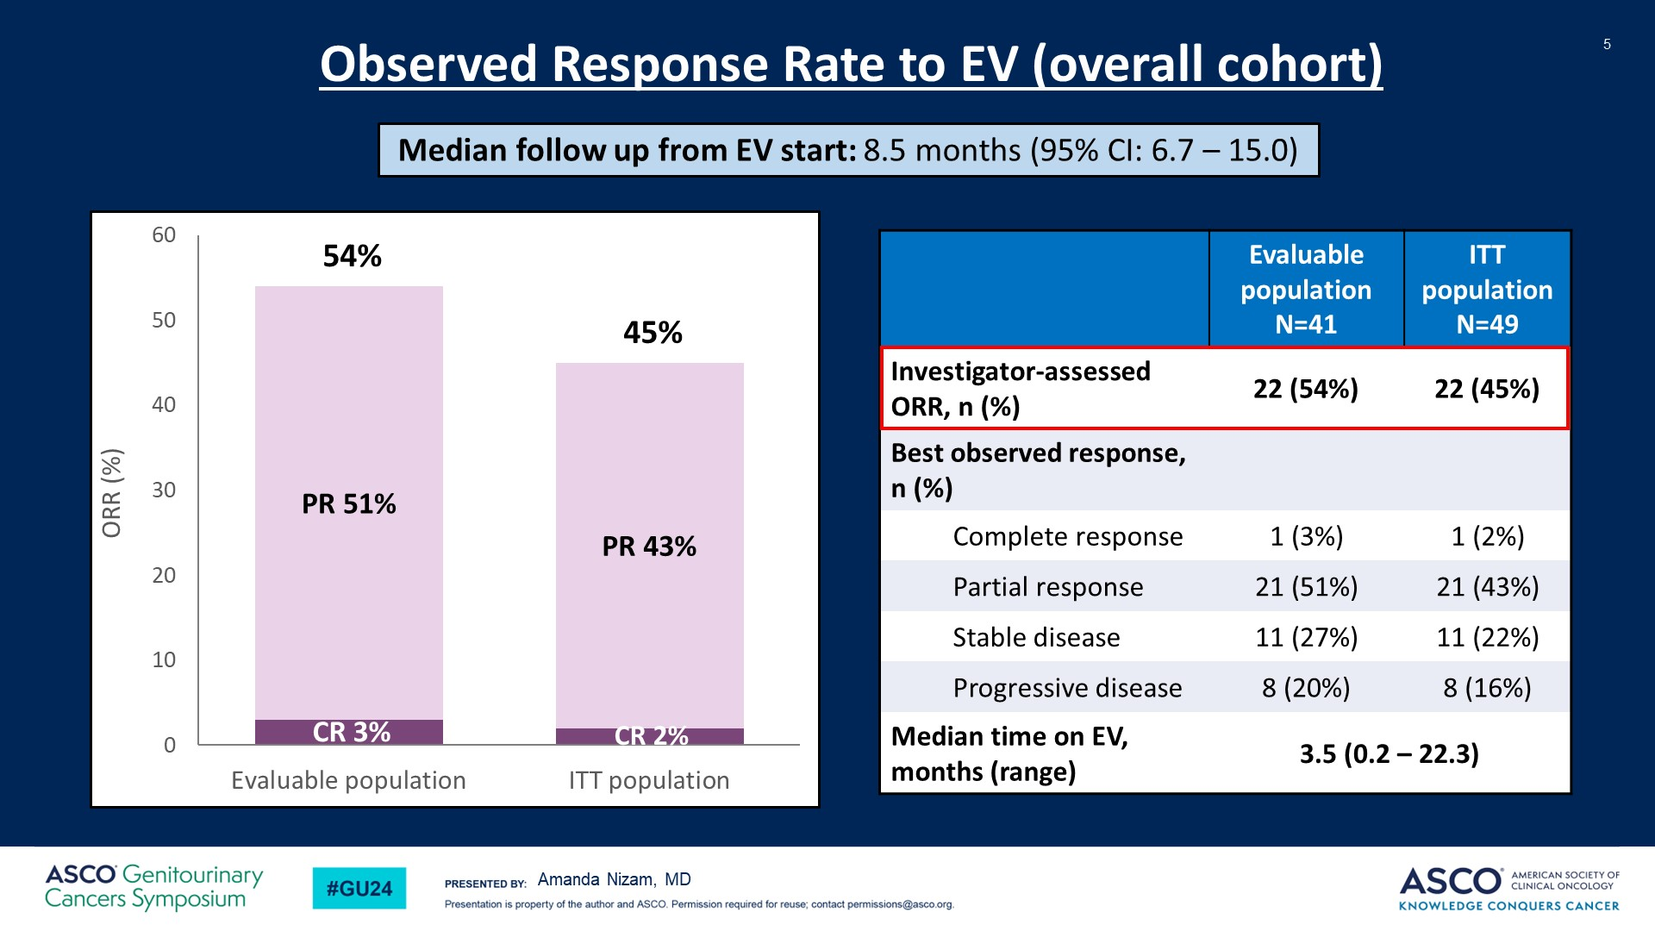
Slide 5
Content of this presentation is the property of the author, licensed by ASCO. Permission required for reuse.

Slide 61
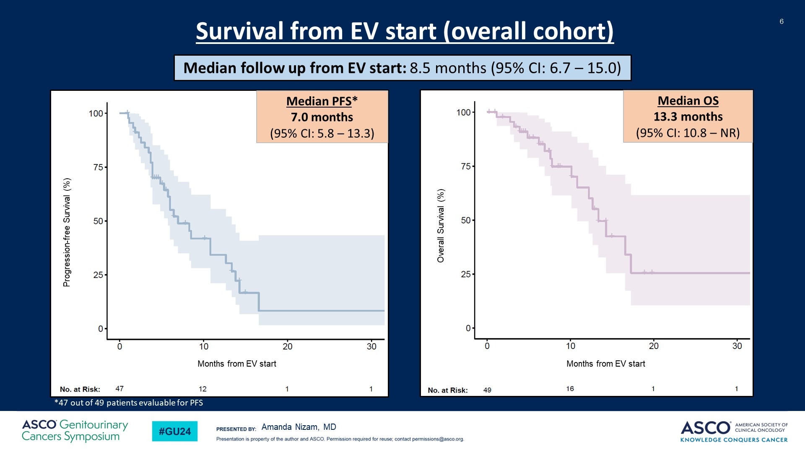
Slide 6
Content of this presentation is the property of the author, licensed by ASCO. Permission required for reuse.

Slide 62
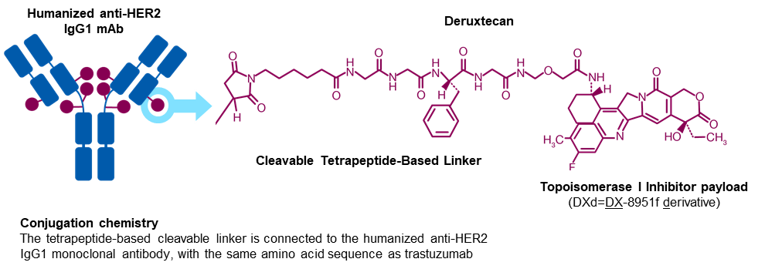
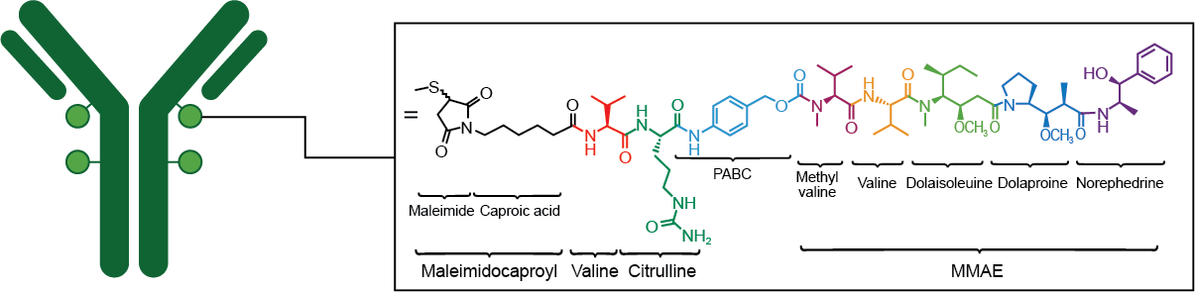
Her2 targeting therapy on the horizon
Trastuzumab Deruxtecan
Humanized anti-HER2 IgG1 mAb
Protease-cleavable vc maleimidocaproyl linker
Microtubule-disrupting agent, (MMAE/vedotin)
Disitamab
Disitamab vedotin

Slide 63
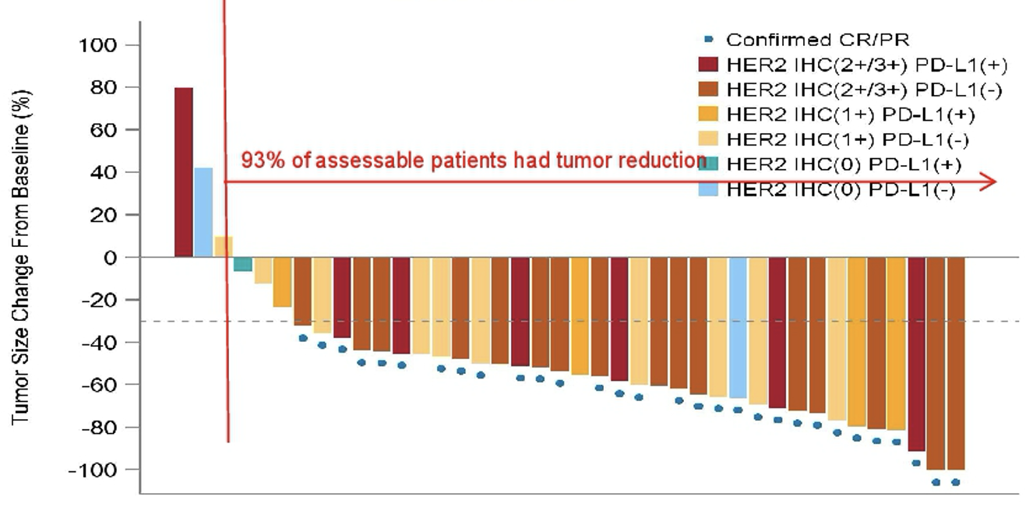
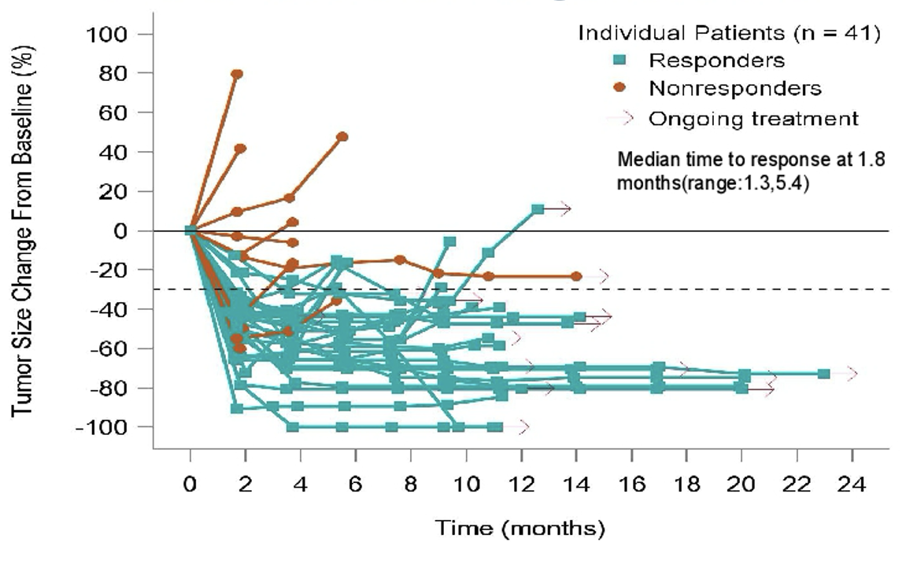
Disitamab Vedotin and Toripalimab
Confirmed ORR: 73.2%
4 CRs, 26 PRs
Sheng X et al. ASCO 2023;Abstract 4566.

Slide 64
BLADDER & RCC MALIGNANCIES
Tuesday, February 20, 2023

Slide 65
Case Discussions 2.20.24
Brad Somer
Katy Beckermann
Dan Vaena
Nikhil Gopal
Holger Gieschen

Slide 66
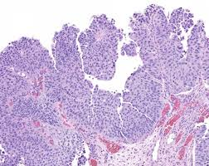
64 yo female smoker:
7/21- underwent TURBT 8 lesions­ - HG urothelial papillary carcinoma, T1. She received BCG x6 in July 2021
11/22- TURBT had 3 tumors with similar histology. She had adjuvant Gem/Docetaxel induction followed by maintenance.
6/22- ­ cysto showed bladder with multiple sites of disease.
7/6/22 TURBT – complete resection of ~6 tumors, largest 3 cm. Pathology- early invasive high grade urothelial papillary carcinoma. Some focal areas of Cis. No muscularis involvement. CT scan shows no metastases. GFR is 65.

Slide 67
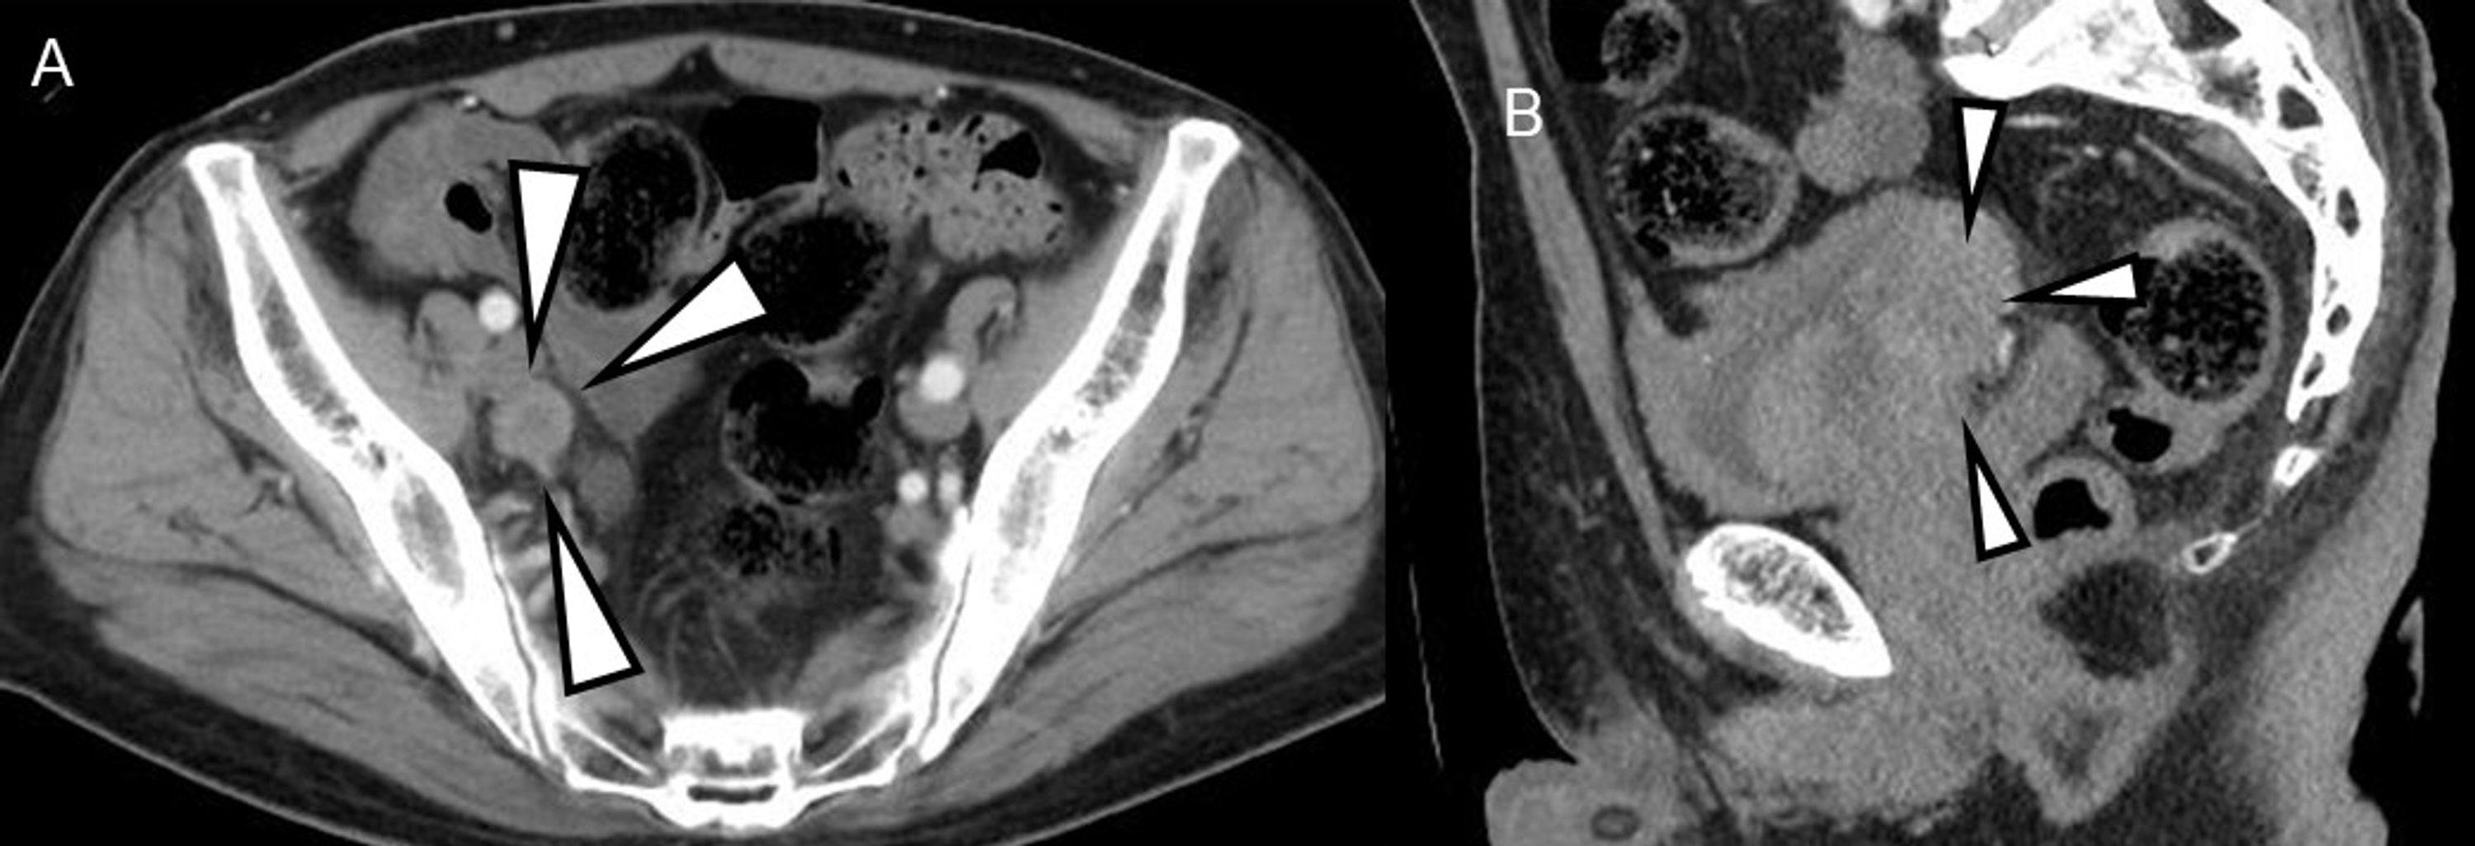
She refused a cystectomy. She received Pembrolizumab and got surveillance cystoscopies. She had continued disease at 3 months was ok, but at 6 months she had and had TURBT which showed high grade urothelial carcinoma with papillary differentiation with invasion of muscularis.
GFR remains ~65.
Imaging suggests 2 external iliac left lymph node metastases 1.3 cm, and 1.8 cm, transmural disease, no hydronephrosis.
CT guided biopsy of an external iliac LN confirmed high grade urothelial carcinoma.
PET/CT confirmed that these were isolated LNs.

Slide 68
She got neoadjuvant ddMVAC 2/23 and then had a radical cystectomy- results showed 20-40% tumor regression, T3 disease, and 1 LN with minimal disease out of 6 resected LNs, margins negative.

Slide 69
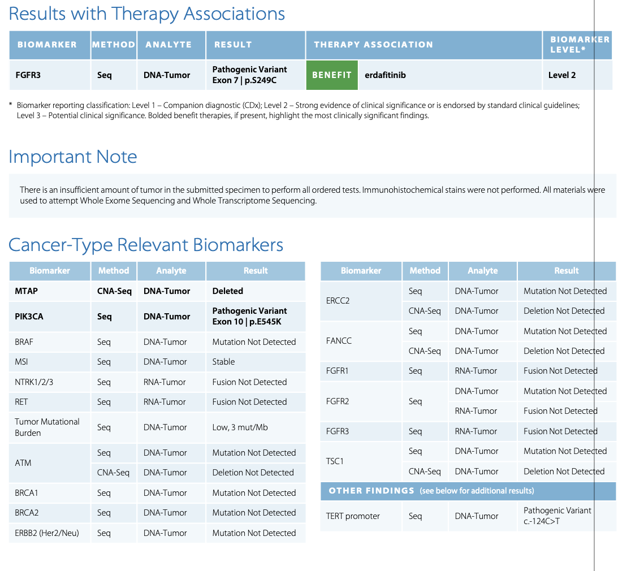
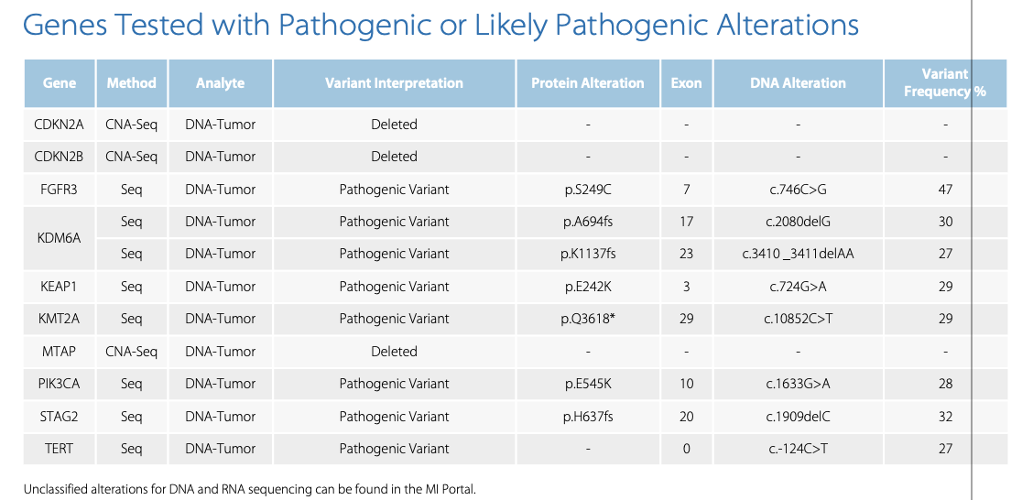
She had a 3 months recovery with some hospitalizations for sepsis, dehydration and renal insufficiency. She recovered with a stay in rehab and her GFR got back to ~55. About 4 months after surgery, prior to initiation of adjuvant nivolumab, she had repeat imaging and had recurrence in the retroperitoneal LNs, and multiple bone lesions. Biopsy shows recurrent urothelial cancer. Renal function is reasonable. She has an FGFR3 Exon 7 mutation on molecular profiling.

Slide 70
KIDNEY CANCER CASE DISCUSSION

Slide 71
67 year old morbidly obese male who had a left radical nephrectomy for a 4.5 cm G2 clear cell RCC, with negative margins. T1b.
Was surveilled for 3 years when on surveillance imaging, there was a 2.5 cm right lower lobe lung metastases and biopsy shows this to be recurrent disease.
Imaging suggests this to be the only site of disease. Labs are WNL. He is not the ideal operative candidate with BMI 44.

Slide 72
He had SBRT and no additional therapy
3 years later he developed multifocal lung metastases, 4 bone metastases and a liver lesion.
His GFR is 49. His Hb is 11.4. Good PFS. Platelet count is 556k.
He has DM, some minimal neuropathy. Labs otherwise WNL.

Slide 73
Treatment Options in refractory RCC
Katy Beckermann, MD, PhD
Vanderbilt University Medical Center
02.20.24
@Katy_Beckermann
@brian_rini and @Uromigos

Slide 74
The Majority of Front-line RCC Patients receive IO….
Ipilimumab is not a good salvage agent in RCC
 | HCRN¹ | OMNIVORE² | TITAN RCC³ |  | FRACTION⁴ | Salvage Ipi/Nivo⁵
N | 35* | 57 | 49 |  | 46 | 45
Prior TKI allowed | No | Yes | No |  | Yes | Yes
Timing | Nivo→Ipi (SD at 48 weeks or PD) | Nivo→Ipi (SD or PD at < 6 months) | Nivo→Ipi (SD/PD at week 8 or 16) |  | Nivo+Ipi in IO-refractory | Nivo+Ipi in IO-refractory
Ipi doses | 4 | 2 | 2-4 |  | 4 | 4
ORR | 11% | 4% | 14% |  | 17% | 20%
PD | 63% | 40% | 67% |  | 30% | 62%
CR | 3% | 0% | 2% |  | 0% | 0%
Nivo+ipi combo untreated ccRCC ORR 39%, PD 19%, CR 12% (Checkmate 214)
* 87% PD-L1 negative
@brian_rini
1. Atkins M et al. JCO 2022 2. McKay et al. JCO 2020 3. Grimm et al. ESMO 2022 4. Choueiri et al. JITC 2022 5. Gul et al. JCO 2020

Slide 75

Phase III CONTACT-03 study
Key eligibility criteria
  Advanced/metastatic clear cell or non–clear cellª RCC with or without a sarcomatoid component
  Radiographic progression on or after prior ICI treatment
    ICI as adjuvant, 1L or 2L (single agent or in combination with another permitted agent)
    ICI in the immediately preceding line of therapy
Atezolizumab 1200 mg IV q3w
+ Cabozantinib 60 mg daily PO
R
1:1
Cabozantinib 60 mg daily PO
N=522
  Stratification factors
  IMDC risk group
  0 vs 1-2 vs ≥3
  Histology
  Dominant clear cell without sarcomatoid vs dominant non-clear cell without sarcomatoid vs any sarcomatoid^{b}
  Most recent line of ICI
  Adjuvant vs 1L vs 2L
  Primary endpoints
  Independent centrally-assessed PFS^{c}
  OS
  Key secondary endpoints
  Investigator-assessed PFS^{c}
  ORR (per central review and per investigator)^{c}
  Duration of response (per central review and per investigator)^{c}
  Safety
ClinicalTrials.gov ID, NCT04338269. IMDC, International Metastatic RCC Database Consortium. Patients were enrolled between July 28, 2020 and December 27, 2021.
ª Papillary, chromophobe or unclassified (chromophobe requires sarcomatoid differentiation). ^{b} Clear cell or non-clear cell. ^{c} Assessed according to RECIST 1.1.
Choueiri, et al. CONTACT-03 (LBA4500)
Toni K. Choueiri, MD
@DrChoueiri

Slide 76

Primary analysis of centrally reviewed PFS
 | Atezo + Cabo (n=263) | Cabo (n=259)
PFS events, n (%) | 171 (65) | 166 (64)
Median PFS (95% CI), mo | 10.6 (9.8, 12.3) | 10.8 (10.0, 12.5)
12-month PFS (95% CI), % | 44 (38, 50) | 48 (42, 54)
Stratified HR (95% CI)ª | 1.03 (0.83, 1.28); P=0.784^{b}
PFS per central review (%)
Number at risk
Time (months)
Atezo + Cabo
Cabo
ª Stratified for IMDC risk group. ^{b} Not significant at α=0.02.
Choueiri, et al. CONTACT-03 (LBA4500)
Toni K. Choueiri, MD
@DrChoueiri

Slide 77
Will a PD-1 agent and different TKI with nivolumab and tivozanib perform differently?
RANDOMIZE 1:1
Tivozanib 0.89 mg
D1-21 of a 28-day cycle
+
Nivolumab 480 mg q28D
Advanced RCC s/p 1 or 2 prior lines of therapy, one of which was an immune checkpoint inhibitor (ICI)
  Previous nivolumab is allowed
Stratified by IMDC risk category and ICI as most recent prior therapy or not
N = 326
Tivozanib 1.34 mg
D1-21 of a 28-day cycle

Slide 78
2nd-Line Agents: Post VEGF-TKI
 | Axitinib ^{[1,2]} | Nivolumab ^{[3]} | Cabozantinib ^{[4]} | Lenvatinib/Eve (RP2) ^{[5,6]}
Patient Population | 2nd Line | TKI-refractory (72% 1 prior) | TKI-refractory (71% 1 prior) | TKI-refractory (100% 1 prior)
MSKCC risk: good/int/poor | 28/37/33 | 35/49/16 | 45/42/12 | 24/37/39
Comparator | Sorafenib | Everolimus | Everolimus | Everolimus
ORR, % PD, % | 19% 22% | 22% 35% | 17% 12% | 35% 4%
PFS, months | 4.8 | 4.6 | 7.4 | 12.8
OS, months | 20.1 | 25.0 | 21.4 | 25.5
Dose reductions | 31% (37% Increase) | n/a | 62% | 71%
D/C due to AE | 4% | 8% | 12% | 24%
Toxicity | Grade 3: 50% Grade 4: 6% | Grade 3 or 4: 19% | Grade 3: 63%* Grade 4: 8% | Grade 3: 57% Grade 4: 14%
* All AEs regardless of attribution to the drugs
@Brian_Rini
^{[1]} Motzer, et al. Lancet Oncol. 2013;14:552. ^{[2]} Rini, et al. Lancet 2011;378:19312. ^{[3]} Motzer, et al. N Engl J Med. 2015;373:1803. ^{[4]} Choueiri, et al. Lancet Oncol. 2016.
^{[5]} Motzer, et al. Lancet 2015;16:1473. ^{[6]} Motzer, et al. Lancet 2016;17:E4-45.
Notes:
AE, adverse event; D/C discontinuation; MSKCC, Memorial Sloan Kettering Cancer Center; ORR, objective response rate; OS, overall survival; PD, progressive disease; TKI, tyrosine kinase inhibitor
Let’s look at some other aspects of these trials. Poor risk category patients were most well represented in the trials of axitinib, and of lenvatinib plus everolimus, which might suggest better applicability of the results of these trials to these patients. The objective response rates were highest with the lenvatinib everolimus combination, but so were the grade 3-4 toxicities and the discontinuation rates due to toxicities. Although there was no PFS benefit with nivolumab, the toxicity profile suggests that nivolumab is a better tolerated agent.

Slide 79
Tivo3: Randomized Phase 3 Trial in Refractory RCC
RANDOMIZE 1:1
Tivozanib
1.34 mg once daily for 21 days on and 7 days off,
28-day cycle†
N=175
N=350
ECOG PS 0 or 1
Recurrent/metastatic RCC
Failed at least two prior regimens including
VEGFR-TKI
Stratification:
IMDC Risk Category
Prior therapy (TKI-TKI, TKI-CPI, TKI-Other)
†
Sorafenib
400 mg twice daily†
N=175
Primary Endpoint: PFS
Secondary Endpoint: OS, ORR, DoR, Safety and Tolerability for ITT
†Patients were treated until disease progression or unacceptable toxicity
ECOG, Eastern Cooperative Oncology Group;
TKI, Tyrosine Kinase Inhibitor; CPI, Checkpoint Inhibitor
IMDC, International Metastatic Renal Cell Carcinoma Database Consortium
Rini BI et al Lancet Oncol 2020;21(1):95-104

Slide 80

Primary Endpoint: PFS
ORR: 18%
Rini BI et al Lancet Oncol 2020;21(1):95-104

Slide 81
Long-term Tivo-3 Follow-up
(Beckermann et al., 2024)

Slide 82
Belzutifan Versus Everolimus in Participants with Previously Treated Advanced Clear Cell Renal Cell Carcinoma: Randomized Open-Label Phase 3 LITESPARK-005 Study
Laurence Albiges¹, Brian Rini², Katriina Peltola³, Guillermo de Velasco⁴, Mauricio Burotto⁵,
Cristina Suarez Rodriguez⁶, Pooja Ghatalia⁷, Roberto Iacovelli⁸, Elaine T. Lam⁹, Elena Verzoni¹⁰, Mahmut Gumus¹¹, Walter M. Stadler¹²; Christian Kollmannsberger¹³, Bohuslav Melichar¹⁴,
Balaji Venugopal¹⁵, Aobo Wang¹⁶, Rodolfo F. Perini¹⁶, Donna Vickery¹⁶, Thomas Powles¹⁷,
Toni K. Choueiri¹⁸
¹Département de Médecine Oncologique, Gustave Roussy, Université Paris Saclay, Villejuif, France; ²Vanderbilt Ingram Cancer Center, Nashville, TN, USA; ³HUS Helsinki University Hospital, Comprehensive Cancer Center, Helsinki, Finland; ⁴University Hospital 12 de Octubre, Madrid, Spain; ⁵Bradford Hill Clinical Research Center, Santiago, Chile; ⁶Medical Oncology, Vall d´Hebron Institute of Oncology (VHIO), Hospital Universitari Vall d´Hebron, Vall d´Hebron Barcelona Hospital Campus, Barcelona, Spain; ⁷Fox Chase Cancer Center, Philadelphia, PA, USA; ⁸Fondazione Policlinico Universitario A. Gemelli IRCC, Rome, Italy; ⁹University of Colorado Cancer Center, Aurora, CO, USA; ¹⁰Istituto Nazionale dei Tumori, Milano, Italy; ¹¹Göztepe Prof. Dr. Süleyman Yalçın Şehir Hastanesi-oncology, Istanbul, Türkiye; ¹²The University of Chicago Medical Center, Chicago, IL, USA; ¹³BC Cancer–Vancouver Center, Vancouver, BC, Canada; ¹⁴ Department of Oncology, Palacký University Hospital, Olomouc, Czech Republic; ¹⁵The Beatson West of Scotland Cancer Centre, University of Glasgow, Glasgow, UK; ¹⁶Merck & Co., Inc., Rahway, NJ, USA; ¹⁷St Bartholomew's Hospital–Barts Health NHS Trust, London, UK; ¹⁸Dana-Farber Cancer Institute, Boston, MA, USA

Slide 83

HIF-2α Inhibition in Renal Cell Carcinoma
The HIF pathway is central to the pathophysiology of clear cell renal cell carcinoma (ccRCC) and
von Hippel-Lindau (VHL) disease
Belzutifan is a first-in-class oral HIF-2α inhibitor that blocks heterodimerization with HIF-2β and downstream oncogenic pathways^{1,2}
  Approved in the US for certain VHL disease-associated RCC, pNET and
  CNS-HB
  Demonstrated clinical activity in pretreated advanced ccRCC²⁻⁵
There is no Level 1 evidence for therapies in
the post-immunotherapy, post–VEGFR-TKI ccRCC setting^{6,7}
CNS-HB, central nervous system hemangioblastoma; pNET, pancreatic neuroendocrine tumor; VEGFR-TKI, vascular endothelial growth factor receptor tyrosine kinase inhibitor.
1. Jonasch et al. New Eng J Med 2021;385:2036-2046; 2. Choueiri et al. Nat Med 2021;27:802-805; 3. Agarwal et al. ESMO 2023; Presentation 1881O; 4. Choueiri et al. Lancet Oncol 2023;24:553-562; 5. Choueiri et al. ESMO 2023; Presentation LBA87; 6. Powles et al. Ann Oncol 2021;32:1511-1519; 7. NCCN: Kidney cancer (v1.2024).

Slide 84
LITESPARK-005 Study (NCT04195750)
Key Eligibility Criteria
Unresectable, locally advanced or metastatic clear cell RCC
Disease progression after 1-3 prior systemic regimens, including ≥1 anti−PD-(L)1 mAb and ≥1 VEGFR-TKI
Karnofsky Performance Status score ≥70%
N = 374
Belzutifan 120 mg orally daily
R
1:1
Everolimus 10 mg orally daily
N = 372
Stratification Factors
IMDC prognostic scoreª: 0 vs 1-2 vs 3-6
Prior VEGF/VEGFR-targeted therapies: 1 vs 2-3
Dual Primary Endpoints:
PFS per RECIST 1.1 by BICR
OS
Key Secondary Endpoint:
ORR per RECIST 1.1 by BICR
Other Secondary Endpoints Include:
DOR per RECIST 1.1 by BICR
Safety
Time to deterioration in FKSI-DRS and EORTC QLQ-C30 GHS/QoL
ª Based on the number of present risk factors according to the International Metastatic Renal Cell Carcinoma Database Consortium (IMDC).
BICR, blinded independent central review; DOR, duration of response; EORTC QLQ-C30, European Organization for Research and Treatment of Cancer Quality-of-Life Questionnaire; FKSI-DRS, Functional Assessment of Cancer Therapy Kidney Symptom Index – Disease-Related Symptoms; GHS, global health status; mAb, monoclonal antibody; QoL, quality of life.

Slide 85
Primary Endpoint: PFS per RECIST 1.1 by BICR
Kaplan-Meier Estimate of PFS at IA2
 | IA1
 | Belzutifan | Everolimus
Events | 257 (68.7%) | 262 (70.4%)
Median, mo (95% CI) | 5.6 (3.9–7.0) | 5.6 (4.8–5.8)
HR (95% CI) | 0.75 (0.63–0.90); P <.001*
IA2
Belzutifan | Everolimus
289 (77.3%) | 276 (74.2%)
5.6 (3.8–6.5) | 5.6 (4.8–5.8)
0.74 (0.63–0.88)
ORR at IA2
22.7%
CR=3.5%
3.5%
PR=19.3%
PR=3.5%
* denotes statistical significance. Primary PFS endpoint was met at IA1 and was not formally statistically tested at IA2. Data cutoff date for IA1: November 1, 2022. Data cutoff date for IA2: June 13, 2023.

Slide 86
PFS by BICR per RECIST 1.1 by Subgroups
Data cutoff date for IA2: June 13, 2023.

Slide 87
Primary Endpoint: OS
 | IA1
 | Belzutifan | Everolimus
Events | 169 (45.2%) | 186 (50.0%)
Median, mo (95% CI) | 21.0 (17.2–24.3) | 17.2 (15.3–19.0)
HR (95% CI) | 0.87 (0.71–1.07); P =.096
IA2
Belzutifan | Everolimus
213 (57.0%) | 228 (61.3%)
21.4 (18.2–24.3) | 18.1 (15.8–21.8)
0.88 (0.73–1.07); P =.099
Kaplan-Meier Estimate of OS at IA2
67.9%
55.2%
65.8%
50.6%
Data cutoff date for IA1: November 1, 2022. Data cutoff date for IA2: June 13, 2023.

Slide 88
All-Cause AEs in ≥10% of Each Arm
Belzutifan
Everolimus
Data cutoff date for IA2: June 13, 2023.

Slide 89
Time to Confirmed Deterioration in FKSI-DRS and QLQ-C30 GHS/QoL Scores¹
FKSI-DRS
QLQ-C30 GHS/QoL
 | TTD, median,ª mo (95% CI) | HR (95% CI)^{b}
Belzutifan | NR (21.26-NR) | 0.53 (0.41-0.69); 2-sided nominal P<0.0001
Everolimus | 11.99 (5.55-15.38)
 | TTD, median,ª mo (95% CI) | HR (95% CI)^{b}
Belzutifan | 19.35 (11.89-NR) | 0.75 (0.58-0.96); 2-sided nominal P=0.0185
Everolimus | 10.19 (6.47-12.98)
100
100
90
90
80
80
70
70
60
60
No Deterioration, %
50
No Deterioration, %
50
40
40
30
30
20
20
10
10
0
0
0
3
6
9
12
15
18
21
24
27
30
33
36
0
3
6
9
12
15
18
21
24
27
30
33
36
No. at risk
Months
No. at risk
Months
352 | 192 | 143 | 123 | 100 | 84 | 62 | 46 | 25 | 14 | 8 | 4 | 0
334 | 137 | 83 | 62 | 41 | 30 | 15 | 6 | 3 | 2 | 1 | 0 | 0
351 | 184 | 131 | 105 | 86 | 75 | 55 | 41 | 28 | 17 | 10 | 4 | 0
333 | 130 | 80 | 53 | 32 | 25 | 17 | 5 | 3 | 1 | 0 | 0 | 0

Slide 90
Safety and Efficacy of Two Doses of Belzutifan in Patients With Advanced RCC: Results of the Randomized Phase 2 LITESPARK-013 Study
Neeraj Agarwal¹; James Brugarolas²; Pooja Ghatalia³; Saby George⁴; John Haanen⁵;
Howard Gurney⁶; Rahul Ravilla⁷; Astrid Van der Veldt⁸; Benoit Beuselinck⁹; Ilya Pokataev¹⁰; Britt Suelmann¹¹; Mark Tuthill¹²; Daniel Vaena¹³; Flora Zagouri¹⁴; Jimin Wu¹⁵; Yanfang Liu¹⁵; Rodolfo F. Perini¹⁵; Jaime Merchan¹⁶; Michael B. Atkins¹⁷
¹Clinical Translation, Cancer Research, Genitourinary Oncology Program, Huntsman Cancer Institute, Salt Lake City, UT, USA; ²Internal Medicine – Hematology/Oncology, University of Texas Southwestern Medical Center, Dallas, TX, USA; ³Hematology/Oncology, Fox Chase Cancer Center, Philadelphia, PA, USA; ⁴Oncology, Roswell Park Cancer Institute, Buffalo, NY, USA; ⁵Oncology, Netherlands Cancer Institute, Amsterdam, Netherlands; ⁶Oncology, Macquarie University, Sydney, Australia; ⁷New York Oncology Hematology, Albany, NY, USA; ⁸Oncology, Erasmus MC, Rotterdam, Netherlands; ⁹Oncology, UZ Leuven, Leuven, Belgium; ¹⁰Oncology, City Clinical Oncology Hospital No. 1, Moscow, Russia; ¹¹Oncology, Universitair Medisch Centrum Utrecht, Utrecht, Netherlands; ¹²Oncology and Haematology, Oxford University Hospitals NHS Foundation Trust, United Kingdom; ¹³Oncology, West Cancer Center and Research Institute, Germantown, TN, USA; ¹⁴Oncology, Alexandra Regional General Hospital Athens, Greece; ¹⁵Oncology, Merck & Co., Inc., Rahway, NJ, USA; ¹⁶Oncology, University of Miami Hospital and Clinics, Sylvester Cancer Center-Cancer Research Services, Miami, FL, USA; ¹⁷Oncology, Georgetown University Medical Center, Washington D.C., USA

Slide 91
Comparable Best Percentage Change From Baseline in Target Lesions by BICR Between the 2 Dose Groups
Belzutifan 200 mg
Belzutifan 120 mg
51/78 patients (65%) had a reduction in target lesions
52/76 patients (68%) had a reduction in target lesions
20% increase
20% increase
30% decrease
30% decrease

Slide 92
Phase 2 LITESPARK-003 Study of Belzutifan in Combination With Cabozantinib for Advanced Clear Cell Renal Cell Carcinoma
Toni K. Choueiri¹; Todd Bauer²; Jaime Merchan³; David McDermott⁴; Robert Figlin⁵; Edward Arrowsmith⁶; Marc Dror Michaelson⁷; Elisabeth I. Heath⁸; Anishka D’Souza⁹; Song Zhao¹⁰; Leila Mhamdi¹¹; Rodolfo Perini¹¹; Donna Vickery¹¹; Scott S. Tykodi¹²
¹Dana-Farber Cancer Institute, Boston, MA, USA; ²Sarah Cannon Research Institute and Tennessee Oncology, Nashville, TN, USA; ³University of Miami Health System, Miami, FL, USA; ⁴Beth Israel Deaconess Medical Center, Boston, MA, US; ⁵Cedars-Sinai Medical Center, Los Angeles, CA, USA; ⁶Tennessee Oncology, Chattanooga, TN, USA; ⁷Massachusetts General Hospital, Boston, MA, USA; ⁸Karmanos Cancer Institute, Detroit, MI, USA; ⁹University of Southern California, Los Angeles, CA, USA; ¹⁰Swedish Medical Center, Seattle, WA, USA; ¹¹Merck & Co., Inc., Rahway, NJ, USA; ¹²University of Washington and Fred Hutchinson Cancer Center, Seattle, WA, USA
Notes:
On behalf of my coauthors, I’m pleased to present results from the phase 2 LITESPARK-003 study of belzutifan in combination with cabozantinib for advanced clear cell renal cell carcinoma
Resources/Choueri_LITESPARK-003 Cohort 1 and Cohort 2_ESMO_2023_Full abstract_D6

Slide 93
Study Design of LITESPARK-003 (NCT03634540)
Cohort 1:
Treatment-naive
Belzutifan 120 mg/day PO
+
Cabozantinib 60 mg/day PO
N ≈ 50ª
Key Eligibility Criteria
Locally advanced or metastatic ccRCC
Either treatment naive or has received prior immunotherapy and ≤2 regimens for metastatic RCC
ECOG PS 0 or 1
Tumor Assessments
Week 9, then Q8W through month 12 and Q12W thereafter
End Points
Primary: ORR per RECIST v1.1 by investigator
Secondary: PFS, DOR, and TTR per RECIST v1.1 by investigator, OS, safety/tolerability
Cohort 2:
Prior immunotherapy treatment
± prior targeted treatment^{b}
Belzutifan 120 mg/day PO
+
Cabozantinib 60 mg/day PO
N ≈ 50ª
Notes:
Patients with treatment-naive (cohort 1) or immunotherapy-treated (cohort 2) locally advanced or metastatic ccRCC and ECOG PS 0 or 1 were eligible for enrollment
Patients received oral belzutifan 120 mg/day plus oral cabozantinib 60 mg/day
Tumor assessments occurred every 8 weeks after week 9 for 12 months, then every 12 weeks thereafter
The primary end point was ORR per RECIST v1.1 by investigator review
Secondary end points included PFS, DOR, TTR, OS, and safety/tolerability
Resources/150202366-02_ESMO2022_LITESPARK-003 Cohort 2_L3a_PRINT.pdf
Protocol/6482-003-05.pdf>p51, p53

Slide 94
ORR by Investigator in All Patients and by IMDC Risk
 | Cohort 1 |  |  | Cohort 2
n (%) | Overall N = 50 | IMDC risk category |  | Overall N = 52 | IMDC risk category
 |  | Favorable n = 28 | Intermediate/ poor n = 22 |  | Favorable n = 11 | Intermediate/ poor n = 41
ORR (CR + PR) , n (%) | 35 (70) | 22 (79) | 13 (59) | 16 (31) | 3 (27) | 13 (32)
DCR (CR + PR + SD), n (%) | 49 (98) | 28 (100) | 21 (96) | 48 (92) | 11 (100) | 37 (90)
Best response, n (%)
CR | 4 (8) | 3 (11) | 1 (5) | 2 (4) | 0 | 2 (5)
PR | 31 (62) | 19 (68) | 12 (55) | 14 (27) | 3 (27) | 11 (27)
SD | 14 (28) | 6 (21) | 8 (36) | 32 (62) | 8 (73) | 24 (59)
PD | 1 (2) | 0 (0) | 1 (5) | 3 (6) | 0 (0) | 3 (7)
Not availableª | 0 (0) | 0 (0) | 0 (0) | 1 (2) | 0 (0) | 1 (2)
Notes:
In cohort 1, ORR was 70% with complete response in 4 patients (8%) and partial response in 31 patients (62%)
The ORR was 79% in patients with favorable IMDC risk and 59% in patients with intermediate or poor IMDC risk
In cohort 2, ORR was 31% with complete response in 2 patients (4%) and partial response in 14 patients (27%)
The ORR was 27% in patients with favorable IMDC risk and 32% in patients with intermediate or poor IMDC risk
Data/Table/
t14_02_01_02_res.pdf>p1
t14_02_01_04_02_01_bestimdc2
t14_02_01_04_02_02_bestimdc2

Slide 95
Percentage Change From Baseline in Target Lesions by Investigator Over Time
Cohort 1
100
Cohort 2
100
90
90
80
CR
80
CR
70
PR
70
PR
60
SD
60
SD
50
PD
50
PD
40
40
30
30
20
20
10
10
Change From Baseline, %
Change From Baseline, %
0
0
−10
−10
−20
−20
−30
−30
−40
−40
−50
−50
−60
−60
−70
−70
−80
−80
−90
−90
−100
−100
0
4
8
12
16
20
24
28
32
36
40
44
48
0
4
8
12
16
20
24
28
32
36
40
44
48
Months
Months
Notes:
Reductions in target lesion size were durable in both cohorts 1 and 2
Data/Graph/
f14_02_06_01_spider1
f14_02_06_02_spider2

Slide 96

Chen, Rini, and Beckermann; 2022

Slide 97
BLADDER & RCC MALIGNANCIES
Tuesday, February 20, 2023

Slide 98
Case Discussions 2.20.24
Brad Somer
Katy Beckermann
Dan Vaena
Nikhil Gopal
Holger Gieschen

Slide 99
KIDNEY CANCER CASE DISCUSSION

Slide 100
67 year old morbidly obese male who had a left radical nephrectomy for a 4.5 cm G2 clear cell RCC, with negative margins. T1b.
Was surveilled for 3 years when on surveillance imaging, there was a 2.5 cm right lower lobe lung metastases and biopsy shows this to be recurrent disease.
Imaging suggests this to be the only site of disease. Labs are WNL. He is not the ideal operative candidate with BMI 44.

Slide 101
He had SBRT and no additional therapy
3 years later he developed multifocal lung metastases, 4 bone metastases and a liver lesion.
His GFR is 49. His Hb is 11.4. Good PFS. Platelet count is 556k.
He has DM, some minimal neuropathy. Labs otherwise WNL.

