Slide 1










GYNECOLOGIC CANCERS
Tuesday, October 17, 2023

Slide 2
Welcome
Noelle Stango
Manager, Strategic Alliance Partnerships
MJH Life Sciences™

Slide 3


Thank You to Our Supporter:

Slide 4


Slide 5


Slide 6


Slide 7


Slide 8
2023 Events
Precision Medicine: November 16,
Washington, DC
Breast: December 4, San Antonio, TX
2024 Events
Genitourinary: January 24, San Francisco, CA
Lung: March, Atlanta, GA
Gyn-Onc: May, Austin, TX
Lung: June, Chicago, IL
Gastrointestinal: November, Washington, DC
Breast: December, San Antonio, TX

Slide 9
Program Chair
Robert DeBernardo, MD
Section Head Gynecologic Oncology
Laura Fogarty Endowed Chair in Uterine Cancer Research
Director of the Peritoneal Surface Malignancy Program
Cleveland Clinic
Cleveland, OH

Slide 10
GYNECOLOGIC CANCERS
Tuesday, October 17, 2023

Slide 11
Frontline Maintenance Therapies for Ovarian Cancer: Spotlight on PARP Inhibitors
Johanna Kelley, MD
Gynecologic Oncology Fellow
Cleveland Clinic
Cleveland, Ohio
Notes:
Hello, I’m Johanna Kelley. I want to thank OncLive and Dr. DeBernardo for giving the opportunity to talk with you all tonight.
I wll be revieweing Frontline Maintenance Therapies for Ovarian Cancer: specifically with a spotlight on PARP inhibitors.

Slide 12
Objectives
Compare trial design between SOLO-1, PAOLA-1, and PRIMA
Highlight differences between Olaparib and Niraparib
Discuss Cost-Effectiveness
Notes:
Objectives for my talk are to review the trial design between SOLO-1, PAOLA-1 and PRIMA, highlight differences between Olaparib and niraparib, and discuss cost-effectiveness

Slide 13
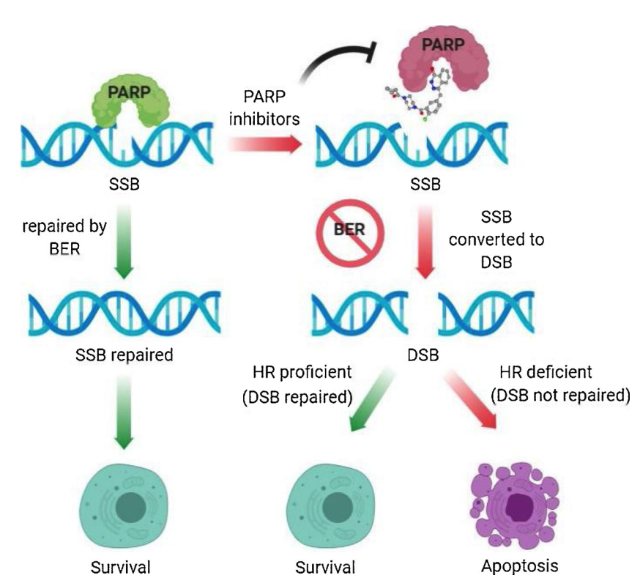
SOLO-1
Background:
Zhang. Biomedicine and Pharmacotherapy. 2020

Slide 14
SOLO-1
Methods:
Stage III or IV HGS or endometrioid ovarian cancer
  PDS or IDS or biopsy
Myriad “BRACAnalysis” (or BGI in China) or somatic tumor testing
CR or PR to platinum-based chemotherapy (no Bevacizumab)
Olaparib 300 mg BID or placebo for 2 years (longer if active disease) in 2:1 ratio

Slide 15
SOLO-1
Methods:
Randomized, phase 3 trial, stratified by response to platinum-based chemotherapy
Primary End Point: PFS
Secondary End Points:
  Second PFS, OS, Time to first subsequent therapy (TFST), TSST
  Quality of life

Slide 16
SOLO-1
Results:
391 patients randomized
82% CR to platinum-based chemotherapy
85% Stage III
62% primary debulking surgery, 35% interval debulking
  76% R0 resection
95% with normal CA-125 level

Slide 17
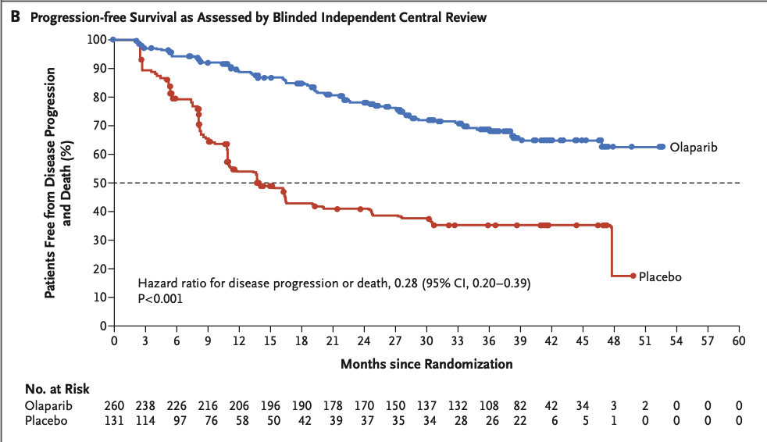
SOLO-1
Results – Initial Efficacy:
Data maturity 51%, Median follow-up 41 months
3 year PFS 69% Olaparib vs 35% placebo
Median PFS NR Olaparib vs 13.8 mo placebo

Slide 18
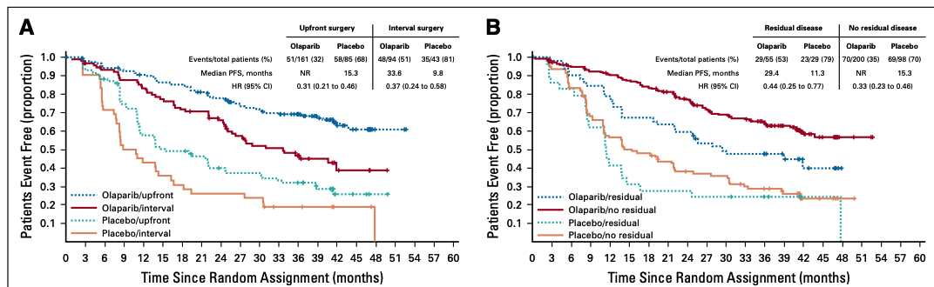
SOLO-1
Results – Initial Efficacy:

Slide 19
SOLO-1
Results - Safety:
Most common serious AE: Anemia in 7% Olaparib group vs 0% placebo
AML 1% Olaparib group vs 0% placebo group
New primary cancer in 2% Olaparib group vs 2% placebo group
Pneumonitis in 2% vs. 0%

Slide 20
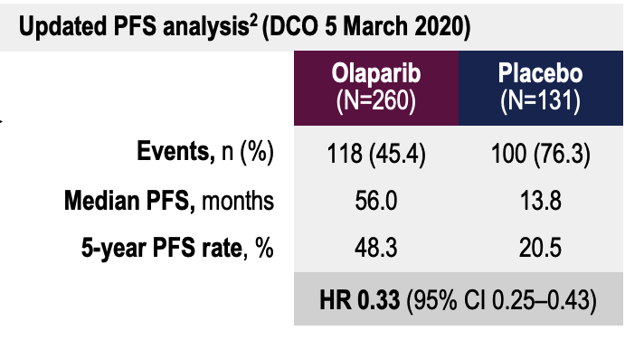
SOLO-1
Updated 2020 PFS Results:

Slide 21
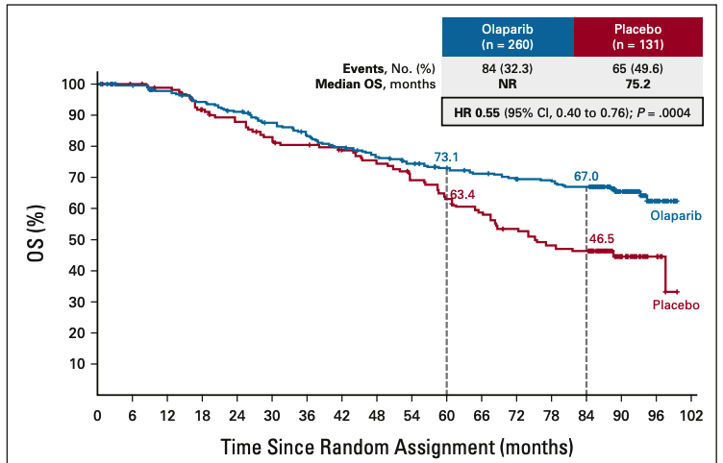
SOLO-1
Updated 7 year OS Results:
Median follow up 88 mo
2-sided p of 0.0001 required to declare statistical significance
Unadjusted for subsequent therapy
  (44% placebo group received PARP in subsequent therapy)
DiSilvestro. JCO. 2022
Notes:
Highlight that patients only took for 2 years – sustained benefit
This prespecified descriptive OS analysis was conducted 7 years after the last patient was randomly assigned (DCO: March 7, 2022). A final OS analysis is currently planned to be conducted at approximately 60% data maturity as prespecified in the study Protocol
A two-sided P value of , .0001 was required to declare statistical significance (Haybittle-Peto a 5 .0001).
Prespecified final OS analysis currently planned to be conducted at approximately 60% data maturity

Slide 22
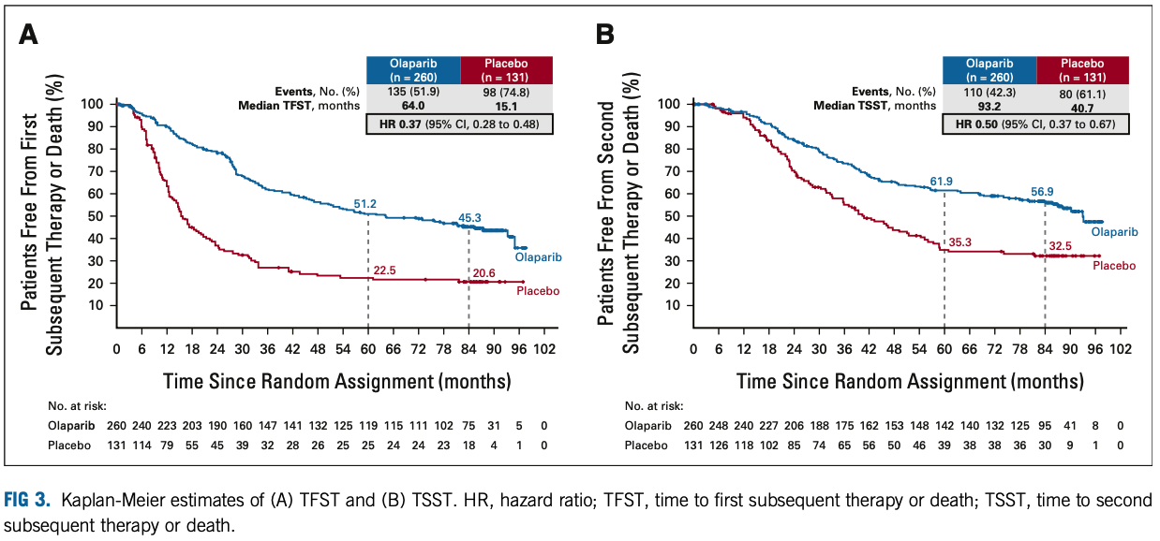
SOLO-1
Updated 7 year Results:

Slide 23
SOLO-1
Updated Results - Safety:
No new safety concerns
Serious AE: 21% Olaparib vs 13.8% placebo,
Most common: Anemia 7.3% Olaparib vs 0.0% placebo
Neutropenia 1.5% Olaparib vs 0.0% placebo
MDS/AML 1.5% Olaparib vs 0.8% placebo
New primary malignancies 5.4% Olaparib vs 6.2% placebo

Slide 24
SOLO-1
Conclusions:
Clinically meaningful improvement in OS with Olaparib in the first-line setting
No new safety signals
  Low rate of MDS / AML
  No difference in rate of new primary malignancies

Slide 25
PAOLA-1
Background:
SOLO1: Improvement in PFS
50% HGSOC are HRD
Phase II: Improved PFS 11.9 mo niraparib and bevacizumab vs 5.5 months niraparib in treatment for PS recurrent HGSOC (HR 0.35, p < 0.0001)
Raza Mirza. Lancet Oncol 2019.

Slide 26
PAOLA-1
Methods:
Stage III-IV high grade serous or endometrioid ovarian cancer
  Non-mucinous BRCA-mut epithelial ovarian cancers
  Optimal or suboptimal debulking – primary or interval
NED, CR or PR after platinum-taxane chemotherapy and bevacizumab
Bevacizumab 15 mg/kg q3weeks up to 15 mo with Olaparib 300 mg BID or placebo for 24 months

Slide 27
PAOLA-1
Methods:
Randomized phase III trial
myChoice HRD testing: score 42
Primary endpoint: PFS
Secondary endpoints:
  Second PFS, OS, Time to first subsequent therapy (TFST), TSST
  Quality of life

Slide 28
PAOLA-1
Results:
Notes:
7-8% never underwent surgery.
26-28% had PR after surgery/ platinum-based chemotherapy

Slide 29
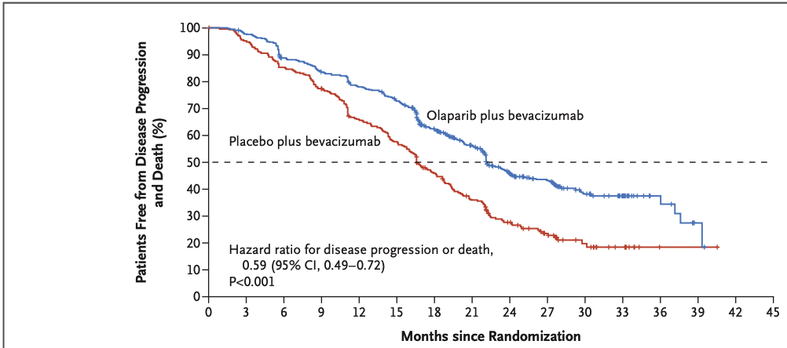
PAOLA-1
Results:
ITT population: 22.1 mo vs 16.6 mo

Slide 30
PAOLA-1
Results - Efficacy:
sBRCAmut: 37.2 mo vs 21.7 mo, HR 0.31 (0.20-0.47)
nonBRCAmut: 18.9 mo vs 16.0 mo, HR 0.71(0.58-0.88)
HRDpos: 37.2 mo vs 17.7 mo, HR 0.33 (0.25-0.45)
HRDneg: 16.6 mo vs 16.2 mo HR 0.92 (0.72-1.17)

Slide 31
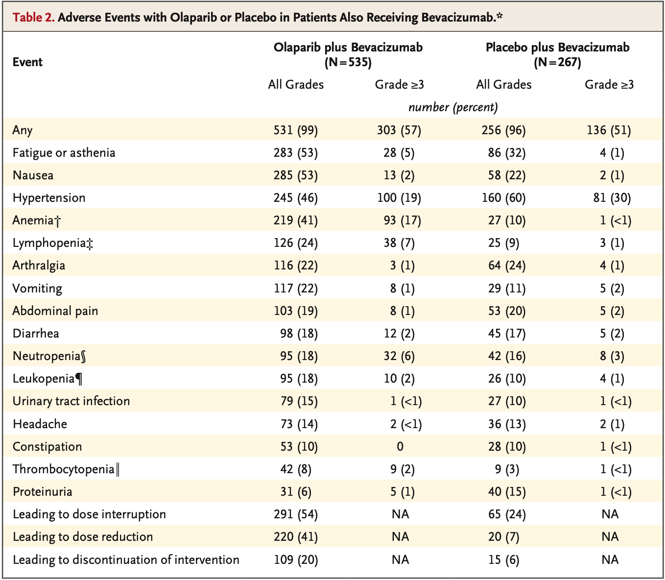
PAOLA-1
Results- Safety:

Slide 32
PAOLA-1
Results- Safety:
MDS/AML 1% Olaparib and bev vs. <1% bev
New primary cancers: 1% vs 1%
Pneumonitis: 1% vs 0%
No difference in QOL scores

Slide 33
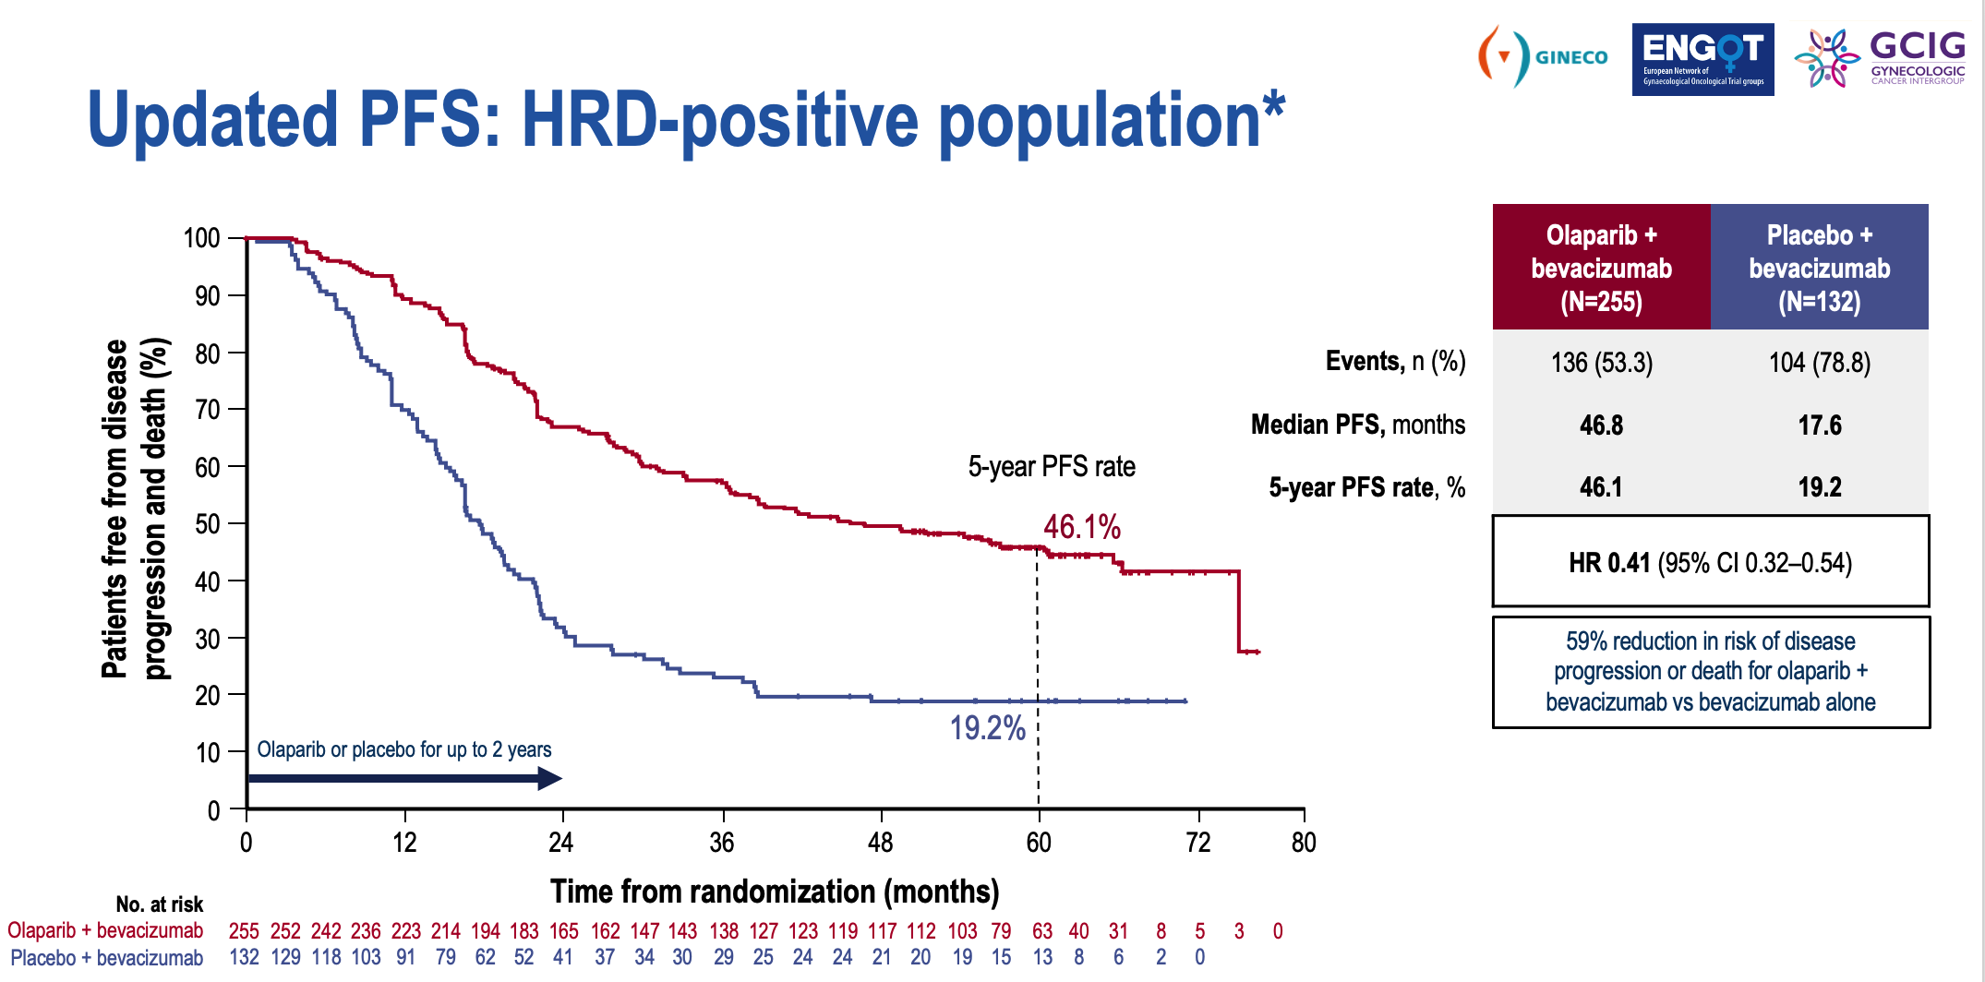
PAOLA-1
Results – Updated PFS:
Notes:
Median follow up 61 months

Slide 34
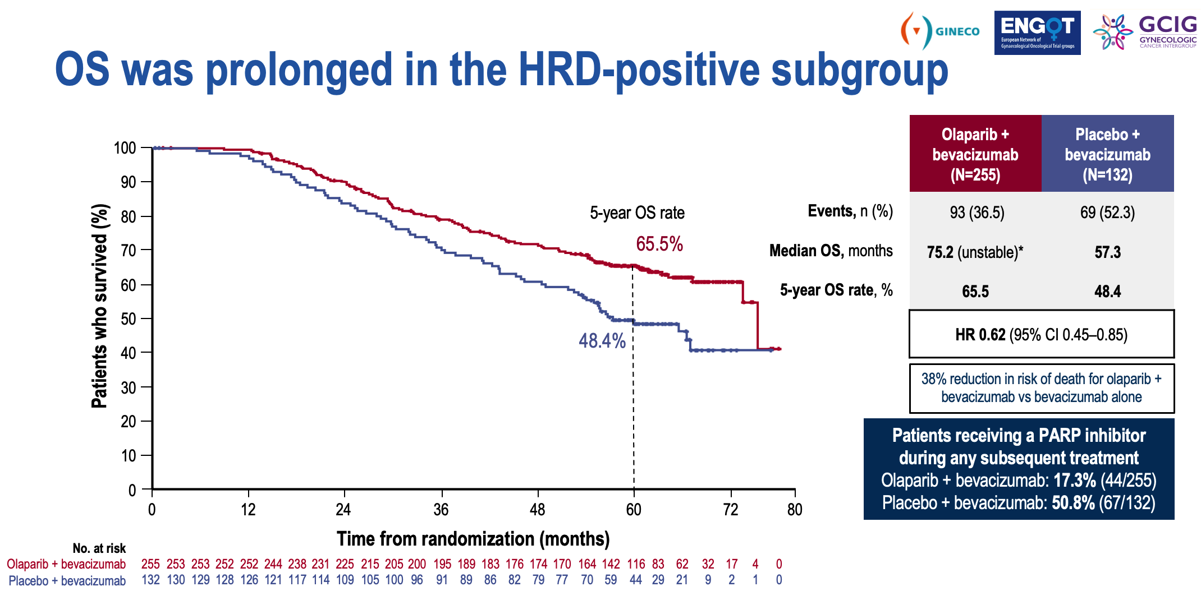
PAOLA-1
Results – Updated OS:
Notes:
Median follow up 61 months

Slide 35
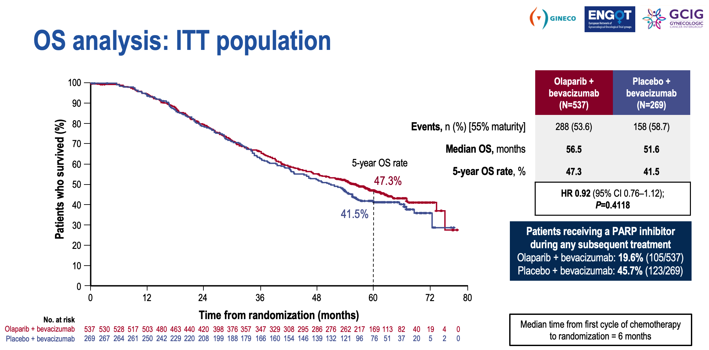
PAOLA-1
Results – Updated 5 year OS:
Notes:
Median follow up 61 months

Slide 36
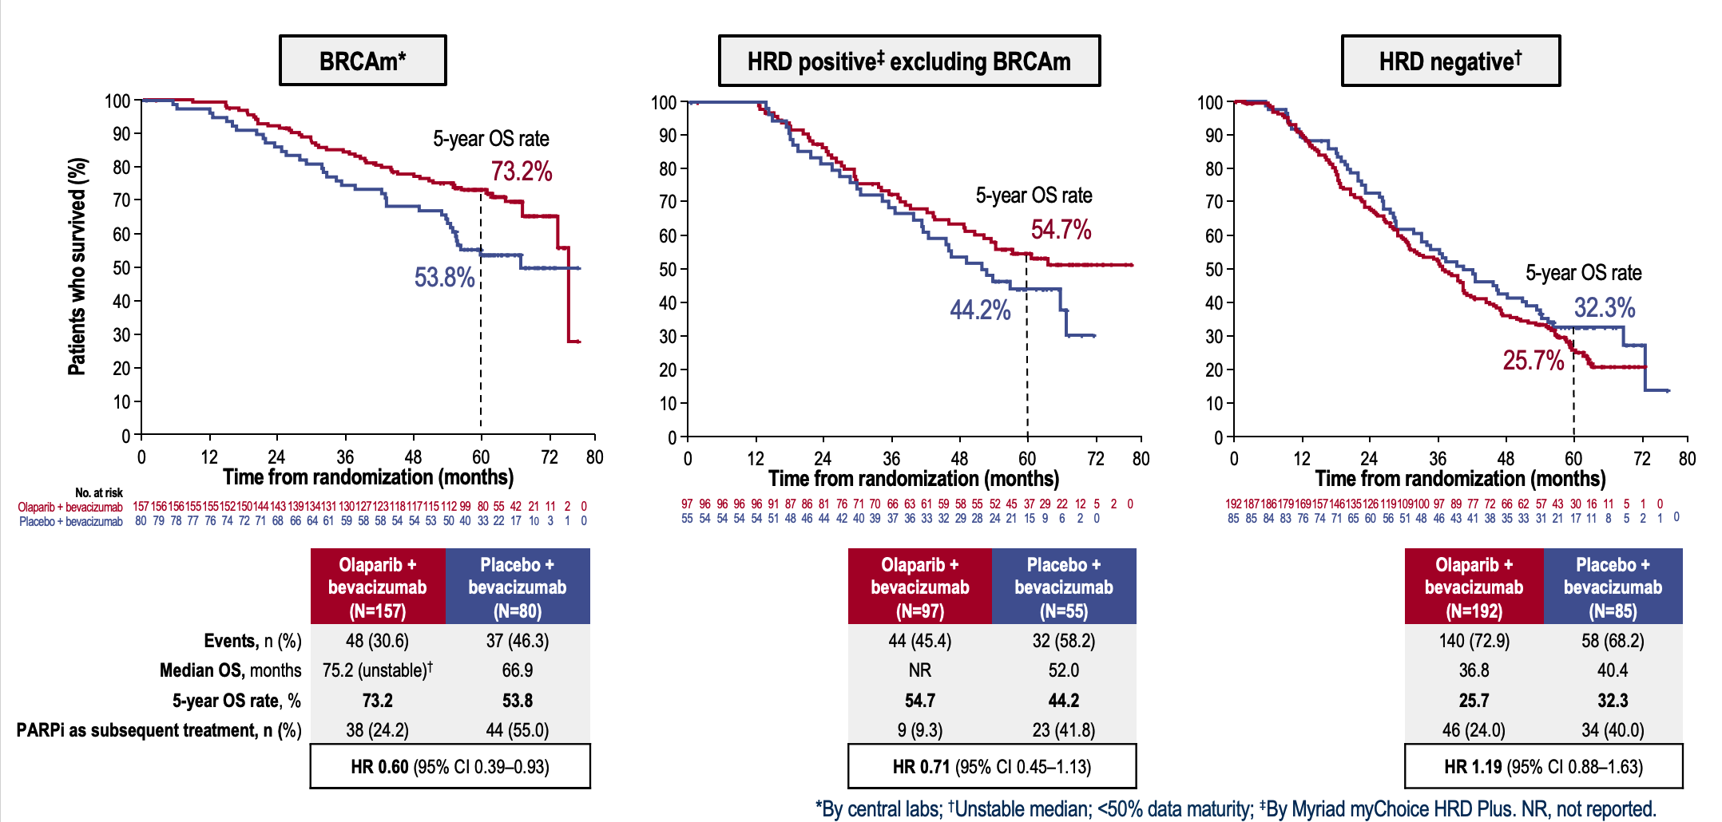
PAOLA-1
Results – Updated 5 year OS:
Notes:
Median follow up 61 months

Slide 37
PAOLA-1
Conclusions:
Improvement in PFS and OS for HRD positive population with addition of Olaparib to Bevacizumab
No new safety signals

Slide 38
SOLO1 vs PAOLA-1
BRCA
Stage III: 83%
PDS: 63%
Macroscopic residual disease 22%
Overall population
Stage III: 70%
PDS: 51%
Macroscopic residual disease 35%
Notes:
Higher disease burden in PAOLA1

Slide 39
PRIMA
Background
Niraparib – PARP1 and PARP2 inhibitor
PARP-regulated gene transcription, ribosome biogenesis, immune activation
Notes:
Niraparib’s primary action is to inhibit PARP1 and PARP2 to inhibit DNA damage repair. Compleementary mechanisms of action include: ***

Slide 40
PRIMA
Methods:
Randomized, phase 3 trial in Stage III-IV ovarian cancer
2:1 ratio 300 mg niraparib or placebo daily for 36 mo after response to platinum-based chemotherapy
  Includes residual disease after PDS, inoperable stage III, any stage IV, treatment with NACT
CR or PR to 6-9 cycles of platinum-based chemotherapy
HRD: BRCA mutation or Myriad myChoice score 42+
Notes:
Myriad mychoice Loss of heterozygosity, telomeric allelic imbalance, large-scale state transitions

Slide 41
PRIMA
Methods:
Primary endpoint: PFS in HRD and overall population
Secondary endpoints:
  OS, TFST, PFS2
  Pharmacokinetic analysis
  Patient reported outcomes
Amendment 11/27/2017: Starting dose of 200 mg daily for patients < 77 kg or platelets < 150,000 per cubic mm

Slide 42
PRIMA
Results:
733 patients enrolled, 487 Niraparib vs 246 Placebo
  23% Stage III with residual disease after PDS
  66.7% received NACT
  35% Stage IV
  30.5% PR to first-line platinum-based chemotherapy
  50.9% with HRD: 223/373 had BRCA mutations

Slide 43
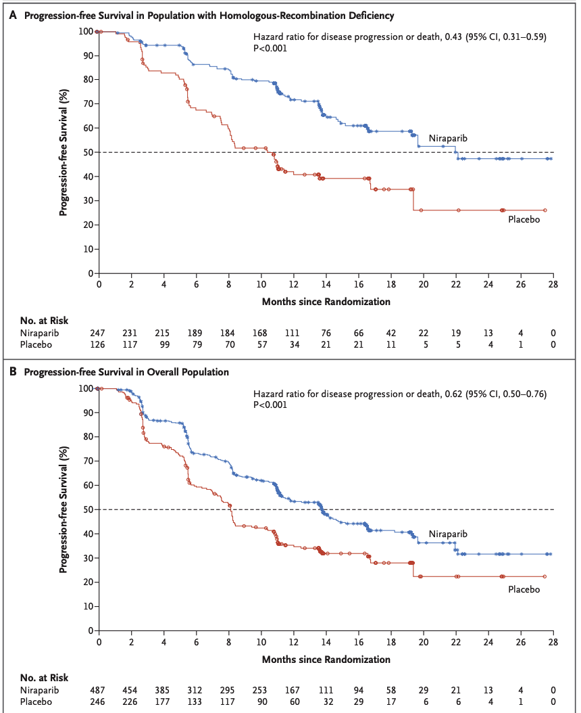
PRIMA
Results – Initial Efficacy Median PFS:
Median follow-up 13.8 mo
HRD: 21.9 mo niraparib vs 10.4 mo placebo, HR 0.43, p < 0.001
Overall population: 13.8 mo vs 8.2 mo, HR 0.62, p < 0.001
HRP: 8.1 mo vs 5.4 mo, HR 0.68 (0.49-0.94)

Slide 44
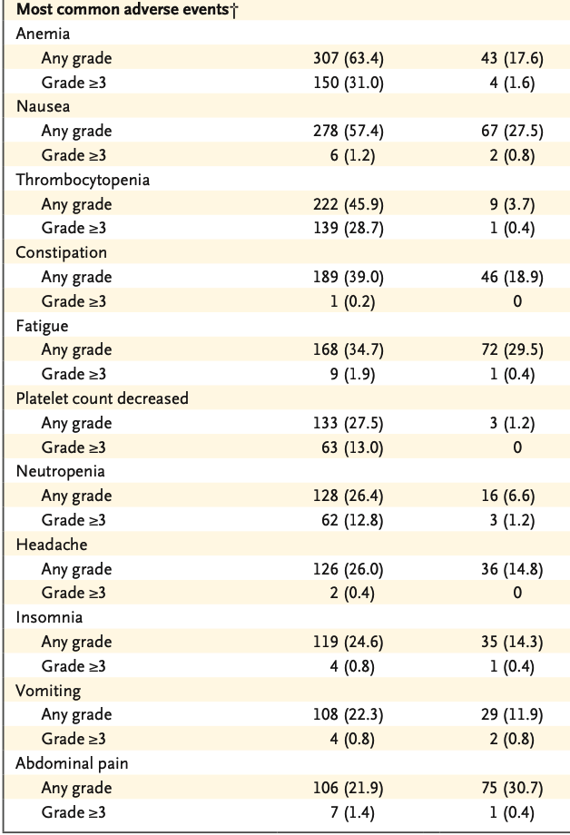
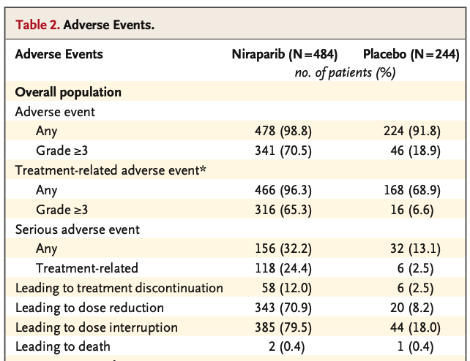
PRIMA
Results – Safety:

Slide 45
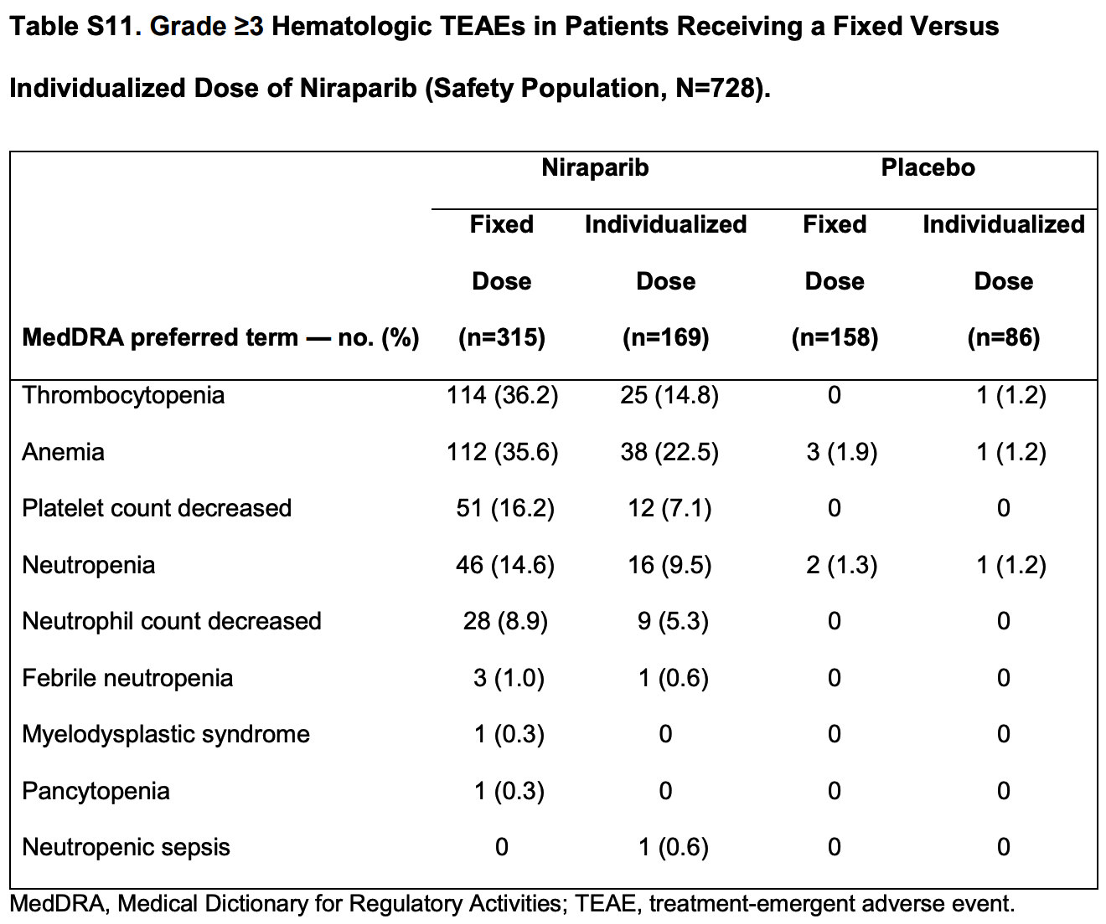
PRIMA
Results – Safety:

Slide 46
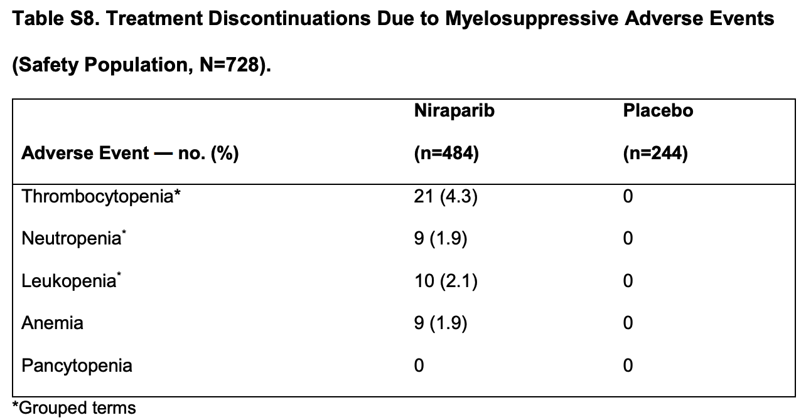
PRIMA
Results – Safety:

Slide 47
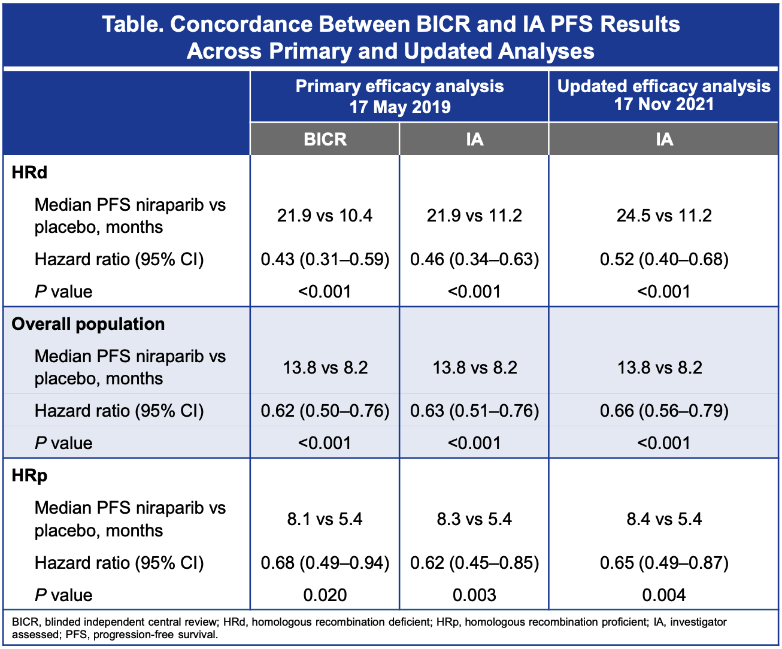
PRIMA – Updated ESMO Results
Median follow up 3.5 years
OS immature at 41.2% for overall population
Notes:
Myriad mychoice Loss of heterozygosity, telomeric allelic imbalance, large-scale state transitions

Slide 48
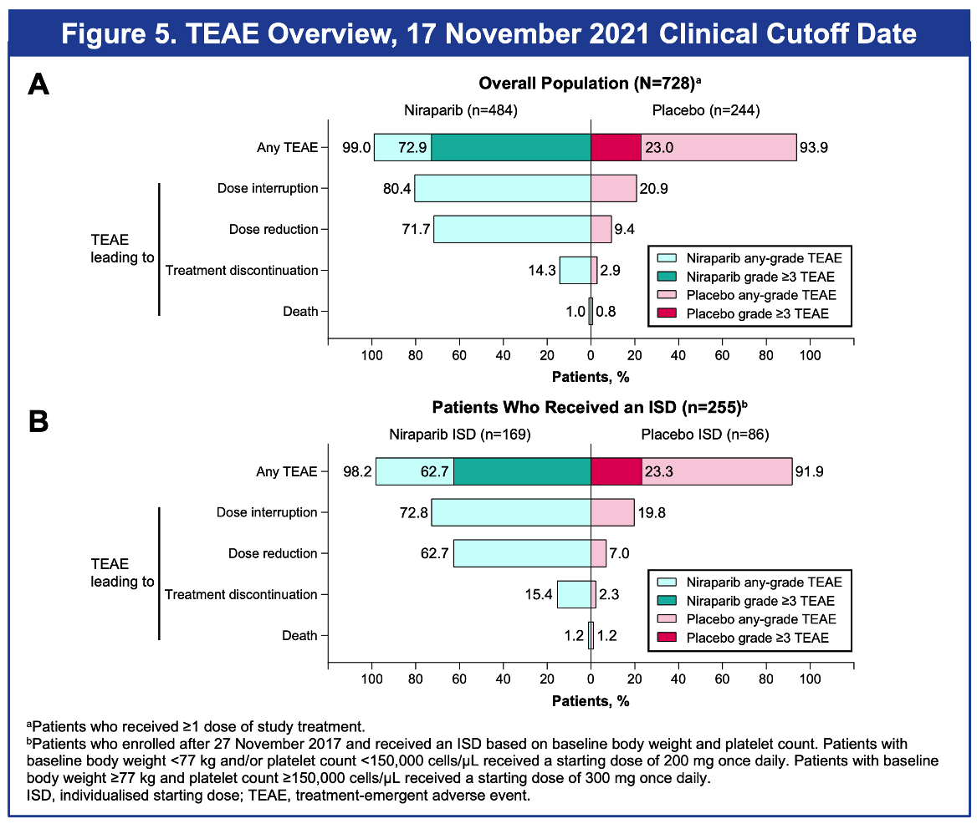
PRIMA - Updated ESMO Results
Results – Updated Safety:
No new safety signals
No difference in MDS or AML (1.2% in each arm)

Slide 49
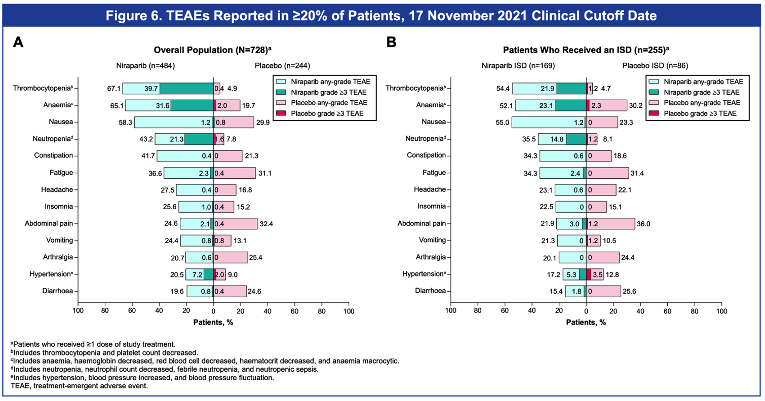
PRIMA - Updated ESMO Results

Slide 50
PRIMA
Conclusions:
Most benefit in BRCA-mut: HR 0.40 (0.27-0.62)
HRD, non-BRCA-mut: HR 0.50 (0.31-0.83)
HRP: HR 0.68 (0.49-0.94)
Most common TRAE: Thrombocytopenia, anemia, neutropenia, GI side effects, headache, fatigue
Most patients did experience a Grade 3 or higher TRAE, improved in ISD group
Notes:
Myriad mychoice Loss of heterozygosity, telomeric allelic imbalance, large-scale state transitions

Slide 51
SOLO1 vs PRIMA
BRCA
Stage III: 83%
NACT: 35%
44% Stage III PDS R0
Overall population
Stage III: 65%
NACT: 67%
0.4% Stage III PDS R0

Slide 52
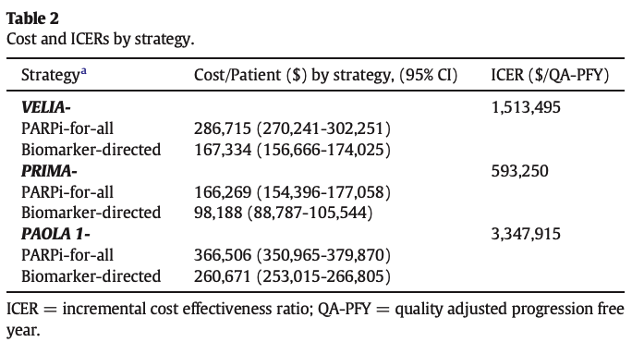
Cost Effectiveness Analysis
Gonzalez, Gyn Onc. 2020.
Notes:
The cost of two frontline PARPi maintenance strategies, PARPi-for-all and biomarker-directed maintenance, was compared using modified Markov decision models simulating the study designs of the PRIMA, VELIA, and, PAOLA-1 trials. Outcomes of interest included overall costs and incremental cost-effectiveness ratios (ICERs) reported in US dollars per quality adjusted progression-free life-year (QA-PFY) gained
BRCA or HRD positive

Slide 53
PRIME
Background:
Phase 3 PRIMA study improved PFS in first-line maintenance
  Most patients at high risk of progression
  PRIMA excluded R0 Stage III PDS
  Trial amendment for individualized starting dose
Li. JAMA Oncology 2023.

Slide 54
PRIME
Methods:
Stage III-IV high grade serous or endometrioid ovarian cancer
Primary or interval cytoreduction
6-9 cycles of platinum-based chemotherapy with CR or PR
2:1 randomization Niraparib or placebo for 36 months
If weight < 77 kg or platelets < 150,000 → Niraparib 200 mg daily, otherwise 300 mg daily
Notes:
stratified by germline BRCA variant status (yes or no), tumor HRD status (positive or nega- tive including unknown) on the HRD assay (BGI Genomics), receipt of neoadjuvant chemotherapy (yes or no), and clinical response to treatment with first-line platinum-based chemo- therapy (complete or partial).

Slide 55
PRIME
Methods:
BGI HRD assay
Primary endpoint: PFS in overall population
Secondary endpoints:
  OS, TFST
  PFS and OS in HRD subgroup

Slide 56
PRIME
Results:
384 patients: 200 mg in 97.7%, 300 mg in 2.3%
28% Stage IV disease
46% received neoadjuvant chemotherapy
13% suboptimal debulking
18% PR to platinum-based chemotherapy
32% BRCA germline mutation
66.9% HRD

Slide 57
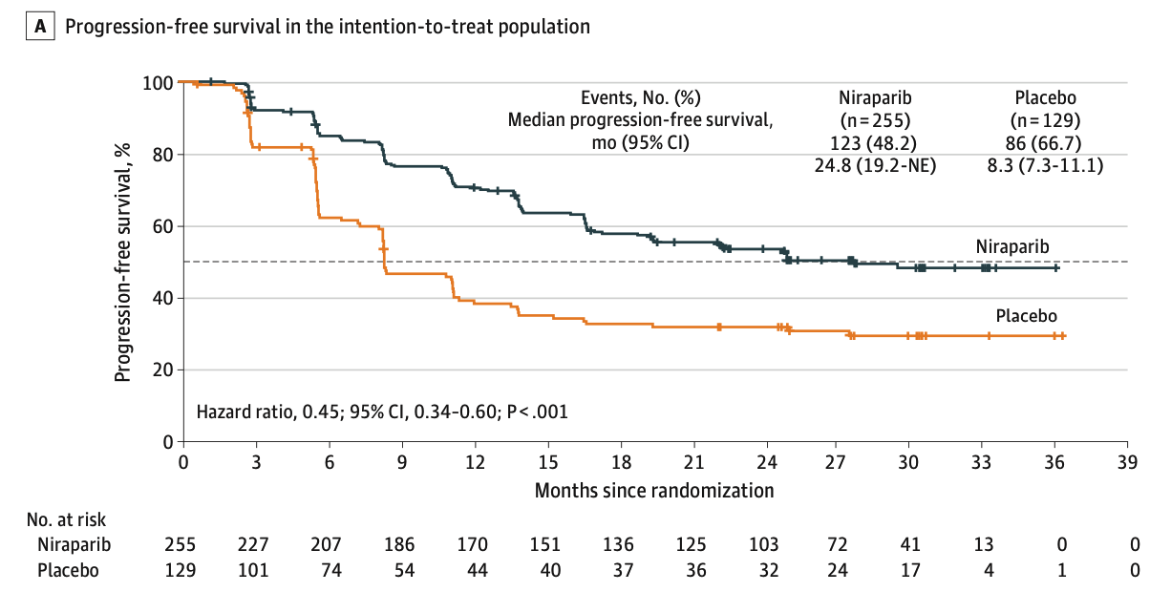
PRIME
Results:
Notes:
Median follow up 27.5 months

Slide 58
PRIME
Results:
HRD: Median PFS NR Niraparib vs 11.0 mo placebo (HR 0.48, 0.34-0.68)
ITT TFST: 29 months Niraparib vs 11.9 mo placebo (HR 0.45, p < 0.001)
HRP: Median PFS 16.6 months vs 5.5 months (HR 0.41, 0.22-0.75)
Optimal debulking: Median PFS 24.8 vs 8.3 mo (HR 0.44, 0.32-0.61)
Suboptimal debulking: median PFS 16.5 mo vs 8.3 mo (HR 0.27, 0.10-0.72)
Notes:
Median follow up 27.5 months

Slide 59
PRIME
Results - Safety:
Grade 3+ TRAE: 54.5% Niraparib vs 17.8% placebo
Most common Grade 3+ TRAE: Anemia 18.0%
Serious TRAE 18.8% Niraparib vs 8.5% placebo
1 case of AML in Niraparib group
40.4% rate of dose reductions for Niraparib vs 6.2% placebo
Notes:
Median follow up 27.5 months

Slide 60
PRIME
Conclusions:
Broader patient population than PRIMA
35% patients in PRIMA used individualized dose
Lower rate of Grade 3+ TRAE
  (54% PRIME vs 70.5% PRIMA)
Lower rate discontinuation (6.7% PRIME vs 12.0% PRIMA)
Improved PFS in HRP: HR 0.41 vs 0.68 in PRIMA
Notes:
Median follow up 27.5 months

Slide 61
Thank You

Slide 62
References
Zheng F, Zhang Y, Chen S, Weng X, Rao Y, Fang H. Mechanism and current progress of Poly ADP-ribose polymerase (PARP) inhibitors in the treatment of ovarian cancer. Biomed Pharmacother. 2020 Mar;123:109661. doi: 10.1016/j.biopha.2019.109661. Epub 2020 Jan 10. PMID: 31931287.
Moore K, Colombo N, Scambia G, Kim BG, Oaknin A, Friedlander M, Lisyanskaya A, Floquet A, Leary A, Sonke GS, Gourley C, Banerjee S, Oza A, González-Martín A, Aghajanian C, Bradley W, Mathews C, Liu J, Lowe ES, Bloomfield R, DiSilvestro P. Maintenance Olaparib in Patients with Newly Diagnosed Advanced Ovarian Cancer. N Engl J Med. 2018 Dec 27;379(26):2495-2505. doi: 10.1056/NEJMoa1810858. Epub 2018 Oct 21. PMID: 30345884.
DiSilvestro P, Banerjee S, Colombo N, Scambia G, Kim BG, Oaknin A, Friedlander M, Lisyanskaya A, Floquet A, Leary A, Sonke GS, Gourley C, Oza A, González-Martín A, Aghajanian C, Bradley W, Mathews C, Liu J, McNamara J, Lowe ES, Ah-See ML, Moore KN; SOLO1 Investigators. Overall Survival With Maintenance Olaparib at a 7-Year Follow-Up in Patients With Newly Diagnosed Advanced Ovarian Cancer and a BRCA Mutation: The SOLO1/GOG 3004 Trial. J Clin Oncol. 2023 Jan 20;41(3):609-617. doi: 10.1200/JCO.22.01549. Epub 2022 Sep 9. PMID: 36082969; PMCID: PMC9870219.
DiSilvestro P, Colombo N, Scambia G, Kim BG, Oaknin A, Friedlander M, Lisyanskaya A, Floquet A, Leary A, Sonke GS, Gourley C, Banerjee S, Oza A, González-Martín A, Aghajanian CA, Bradley WH, Mathews CA, Liu J, Lowe ES, Bloomfield R, Moore KN. Efficacy of Maintenance Olaparib for Patients With Newly Diagnosed Advanced Ovarian Cancer With a BRCA Mutation: Subgroup Analysis Findings From the SOLO1 Trial. J Clin Oncol. 2020 Oct 20;38(30):3528-3537. doi: 10.1200/JCO.20.00799. Epub 2020 Aug 4. Erratum in: J Clin Oncol. 2021 Apr 20;39(12):1414. PMID: 32749942; PMCID: PMC8190876.

Slide 63
References
Mirza MR, Åvall Lundqvist E, Birrer MJ, dePont Christensen R, Nyvang GB, Malander S, Anttila M, Werner TL, Lund B, Lindahl G, Hietanen S, Peen U, Dimoula M, Roed H, Ør Knudsen A, Staff S, Krog Vistisen A, Bjørge L, Mäenpää JU; AVANOVA investigators. Niraparib plus bevacizumab versus niraparib alone for platinum-sensitive recurrent ovarian cancer (NSGO-AVANOVA2/ENGOT-ov24): a randomised, phase 2, superiority trial. Lancet Oncol. 2019 Oct;20(10):1409-1419. doi: 10.1016/S1470-2045(19)30515-7. Epub 2019 Aug 29. PMID: 31474354.
Isabelle Ray-Coquard,¹. Final overall survival results from the Phase III PAOLA-1/ENGOT-ov25 trial evaluating maintenance olaparib plus bevacizumab in patients with newly diagnosed advanced ovarian cancer. ESMO 2022.
González-Martín A, Pothuri B, Vergote I, DePont Christensen R, Graybill W, Mirza MR, McCormick C, Lorusso D, Hoskins P, Freyer G, Baumann K, Jardon K, Redondo A, Moore RG, Vulsteke C, O'Cearbhaill RE, Lund B, Backes F, Barretina-Ginesta P, Haggerty AF, Rubio-Pérez MJ, Shahin MS, Mangili G, Bradley WH, Bruchim I, Sun K, Malinowska IA, Li Y, Gupta D, Monk BJ; PRIMA/ENGOT-OV26/GOG-3012 Investigators. Niraparib in Patients with Newly Diagnosed Advanced Ovarian Cancer. N Engl J Med. 2019 Dec 19;381(25):2391-2402. doi: 10.1056/NEJMoa1910962. Epub 2019 Sep 28. PMID: 31562799.
Gonzalez Martin. PRIMA/ENGOT-OV26/GOG-3012 Study: Updated Long-term PFS and Safety. ESMO 2022.
Gonzalez R, Havrilesky LJ, Myers ER, Secord AA, Dottino JA, Berchuck A, Moss HA. Cost-effectiveness analysis comparing "PARP inhibitors-for-all" to the biomarker-directed use of PARP inhibitor maintenance therapy for newly diagnosed advanced stage ovarian cancer. Gynecol Oncol. 2020 Nov;159(2):483-490. doi: 10.1016/j.ygyno.2020.08.003. Epub 2020 Aug 27. PMID: 32863036; PMCID: PMC8086124.

Slide 64
GYNECOLOGIC CANCERS
Tuesday, October 17, 2023

Slide 65
Ovarian Cancer: Second Line Maintenance Therapy And Beyond
Lisa Rauh-Benoit, MD, MPH
Associate Staff, Cleveland Clinic
Gynecologic Oncologist
Cleveland, Ohio
Notes:
Good evening.
I am one of the gynecologic oncologists at the Cleveland Clinic and have been asked to review second line maintenance therapy for recurrent ovarian/fallopian tube/primary peritonea cancer patients.
For brevity, I will refer to these diagnoses collectively as ovarian cancer throughout the talk.

Slide 66
 | OS Treatment | OS Placebo | Significant?
STUDY 19 # | 34.9 months | 30.2 months | NS
SOLO2 ** # | 51.7 months | 38.8 months | NS
NOVA # (gBRCA) | 40.1 months | 38.1 months | NS
NOVA # (non-gBRCA) | 31.8 months | 34.8 months | NS
ARIEL3 # | 36.0 months | 43.2 months | NS
OCEANS* ⁺ | 33.9 months | 32.9 months | NS
GOG 213^{* +} | 42.2 months | 37.3 months | NS
Platinum Sensitive Recurrent Ovarian Cancer Maintenance Therapy Trials
* First recurrence only
** BRCA mutations required
+ Bevacizumab
# PARP
Notes:
Here is a quick table summary of the major trials in platinum sensitive recurrent ovarian cancer that investigated recurrent ovarian cancer.
There is a lot of information to wade through. Some trials included only patients at first recurrence, some only patients with BRCA mutations, and some with bevacizumab versus a parp inhibitor as the investigational therapy.
I have been asked today to (hopefully) make sense of some of this for you.

Slide 67
Platinum sensitive or resistant?
Prior maintenance therapy?
Homologous recombination proficient/deficient and/or BRCA status?
Notes:
When considering maintenance therapy options in this setting, there are three questions you need to consider.
First, does this patient have platinum sensitive or resistant disease; we consider anyone with a platinum free interval of six months or greater platinum sensitive?
Secondly, has this patient had any prior maintenance therapy. This is especially important with the emerging data on PARP inhibitor maintenance therapy in the front line setting that Dr. Kelley has just reviewed?
Finally, knowing if that patient’s tumor homologous recombination proficient or deficient and the BRCA status is critical in helping guide these discussions.

Slide 68
Second Line Maintenance Therapy
Study 19
SOLO2
NOVA
ARIEL3
OCEANS
GOG 213
AURELIA
Notes:
There are multiple trials that investigated the use of maintenance therapy.
Study 19, SOLO2, NOVA, ARIEL3 looking at PARP maintenance therapy, whereas OCEANS, GOG 213 and AURELIA studied the use of concurrent and then maintenance bevacizumab in recurrent platinum sensitive and resistant setting.
However, given time limitations, I will focus primarily on SOLO2 and NOVA for today’s discussion.

Slide 69
Study 19
Recurrent platinum sensitive, serous ovarian cancer with CR or PR to most recent platinum
BRCA status not required at enrollment but retrospective germline and somatic BRCA testing for prespecified exploratory analysis^{1,2,3}
  BRCA status (germline and/or somatic) know for ~ 95 % of study population
Notes:
It is important to understand the context, out of which SOLO2 and NOVA were developed.
Study 19 was the first large study aimed to understand if PARP maintenance is valuable in the recurrent setting.
In this phase 2, randomized, double-blind trial, patients with recurrent platinum sensitive ovarian cancer with a complete or partial response to most recent platinum received either placebo or Olaparib (400 mg capsules BID).
BRCA testing was not required for enrollment although a preplanned exploratory analysis was performed. Somatic and/or germline BRCA status was available for 95 % of the patients, of which 51 % had either mutation.
Randomized monotherapy 400 mg capsules n = 265 patients

Slide 70
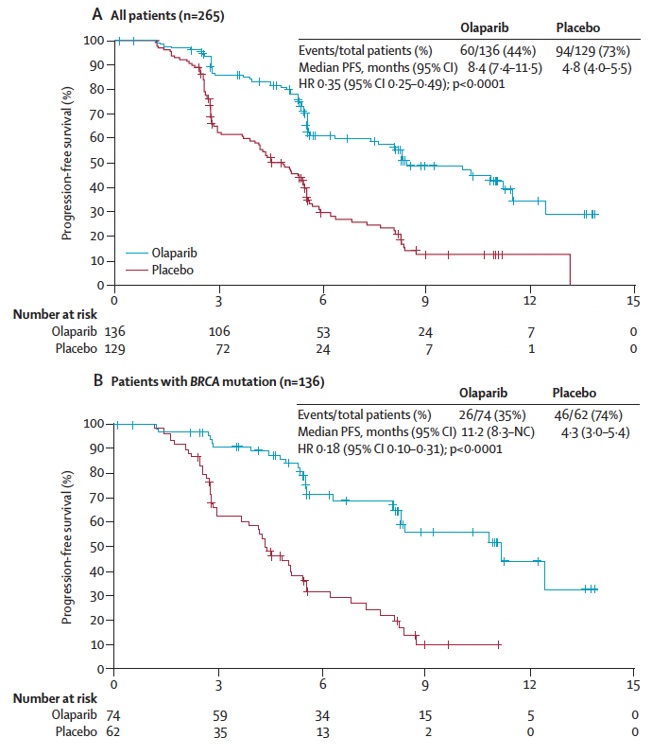
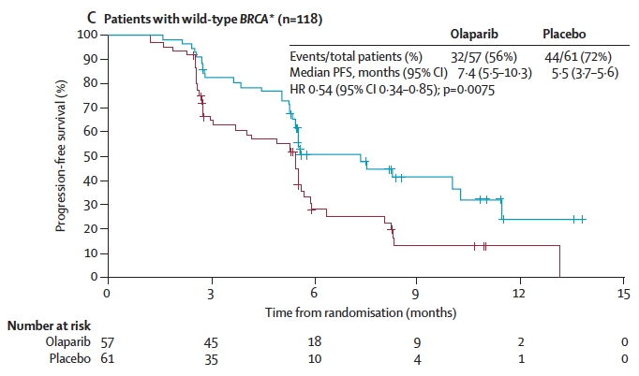
Study 19 PFS
HR 0.35
HR 0.54
HR 0.18
Notes:
As you can see from these survival curves from the prespecified exploratory analysis, PFS was significantly improved in all groups, including all patients, those with BRCA mutation, and those without a BRCA mutation.
As you will continue to see, the hazard ratios are particularly impressive in the BRCA mutated patients.

Slide 71
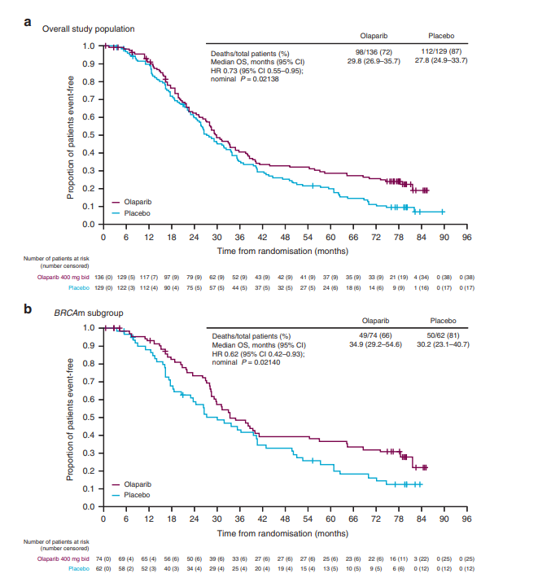
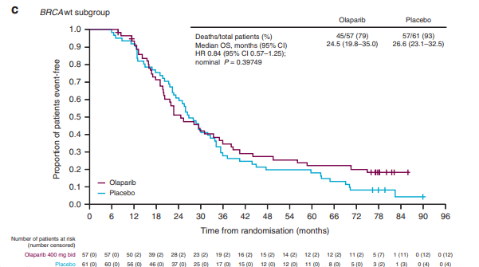
Study 19 OS
HR 0.73 .
(95 % CI 0.55 – 0.95), p = 0.02138
Notes:
Despite impressive and significant hazard ratios for progression free survival, there was no difference in overall survival seen in any group.
While when glancing at these survival curves there may appear to be an apparent advantage in OS for patients randomized to olaparib maintenance monotherapy vs placebo in the total study population the threshold did not meet the defined threshold for statistical significance (p <0.0095) (HR 0.73, 95% CI 0.55‒0.95; nominal P = 0.02138; Fig. 2a).

Slide 72
SOLO2
Randomized, double-blind phase III trial of BRCA mutated (germline or somatic)** recurrent platinum sensitive serous or endometrioid ovarian cancers with CR or PR to most recent line^{4,5.}
At least 2 prior lines but more allowed (median 2)
Randomized 2:1 olaparib vs placebo, no maximum duration
Primary endpoint PFS
** All patients had germline mutations
Notes:
SOLO2 was a subsequent trial investigating Olaparib maintenance but with the objective to confirm the findings of Study 19 in a more defined patient population.
Patients with platinum sensitive recurrence of a high grade serous or endometroid ovarian cancer and CR or PR to most recent line were allowed to enroll if they had a germline or somatic BRCA mutation although all the patients enrolled ultimately had germline mutations.
Patients were required to have had at least 2 prior lines although more lines were allowed.
Like all of these maintenance studies, the study was powered to a primary endpoint of progression free survival.
Finally, there was no defined time endpoint.
60 % PFI > 12 months
No defined endpoint other than intolerance or progression. No prescribed time

Slide 73
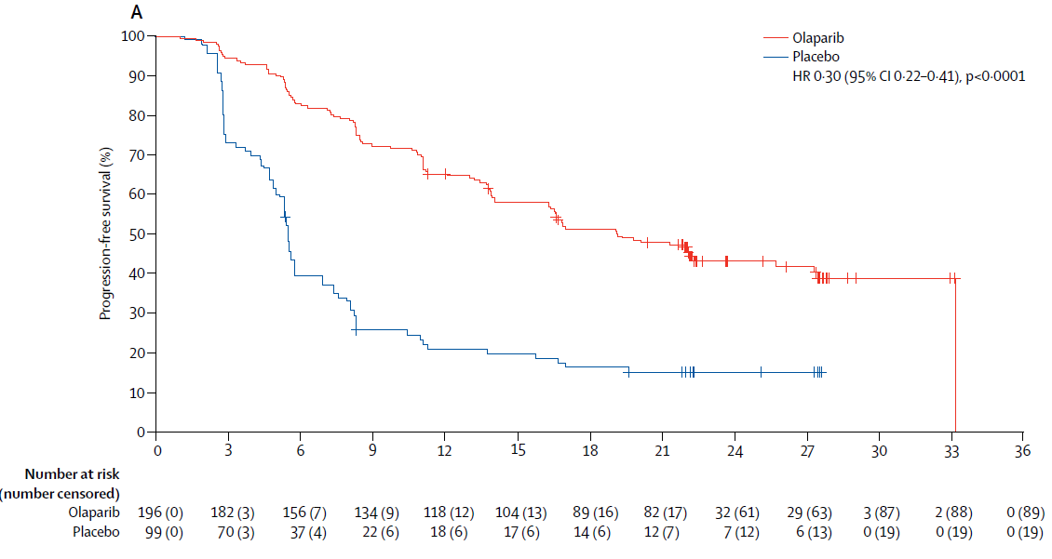
SOLO2
PFS 19.1 vs 5.5 months
Notes:
This is the Kaplan-Meier curve for progression free survival with Olaparib group in red and placebo in blue. With an absolute difference in PFS of 14 months and HR this is certainly statistically significant and outside of overall survival data, clinically significant.

Slide 74
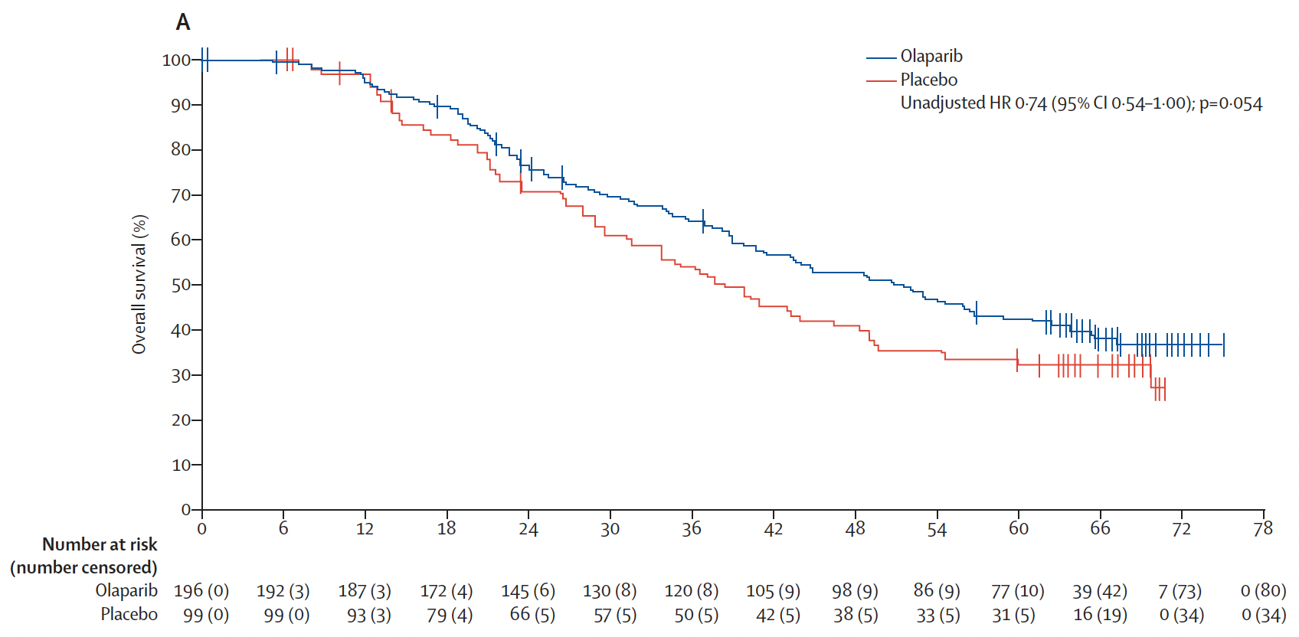
SOLO2
OS 51.7 vs 38.8 months
(12.9 months difference)
Notes:
Yet, when overall survival data was analyzed, while there is a trend towards improved OS in the Olaparib arm with an absolute difference of 12.9 months, this was not statistically significant.
Of course, the investigators did anticipate significant subsequent use of PARP and planned a prespecified exploratory analysis.

Slide 75
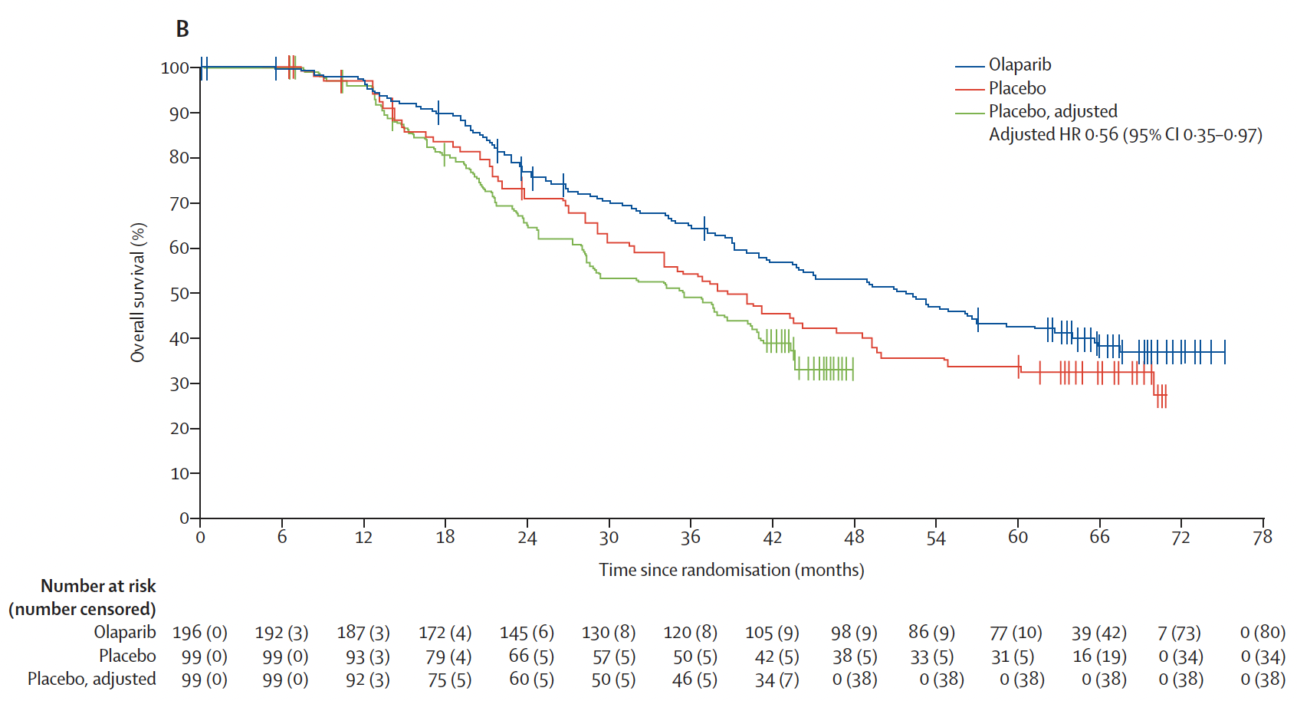
SOLO2
OS 51.7 vs 35.4 months
(16.3 months difference)
Notes:
38 % of patients in the placebo group and 10 % in the Olaparib received subsequent parp therapy.
A recensoring algorithm was applied to the placebo group to account for this.
Here, the OS survival curves are significant different with an absolute difference of 16.3 months and a HR 0.56.
However, it is important to remember the study was not powered to OS as a primary endpoint and that this data is from an exploratory analysis.

Slide 76
SOLO2
 | Olaparib (n = 195) | Placebo (n= 99)
MDS/AML (total) | 16 (8%) | 4 (4%)
MDS/AML (after safety period) | 9 (5%) | 4 (4%)
Median time to onset (y) | 3.0 | 1.4
Notes:
Beyond confirming the findings of Study19, another important finding from SOLO2 was the increased risk of MDS/AML.
You can see that twice as many patients in the Olaparib arm developed MDS or AML as compared to the placebo arm.
Interestingly however, time from randomization to onset was twice as long in the Olaparib versus placebo arm.
In patients who developed MDS/AML on olaparib, median number of prior lines was 2.
In patients who developed MDS/AML on placebo, median number of lines was 2.5.
Safety follow-up period was defined as 30 days from last dose of study treatment.
22 % patient of patients were on Olaparib for at least 5 years.

Slide 77
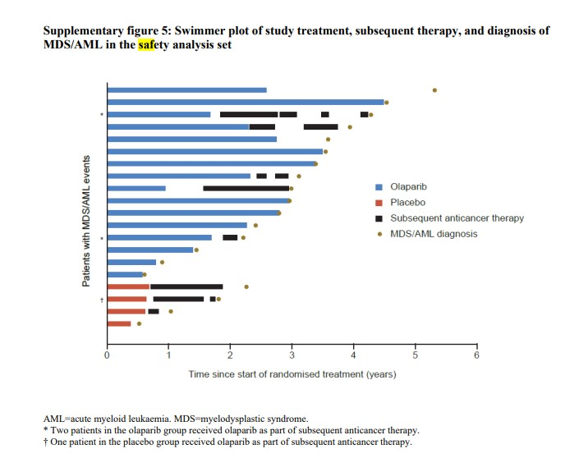
Notes:
Here is another representation of the information on the previous slide in the form of a swimmer plot.
You can see that those who developed MDS/AML in the Olaparib arm did so after significantly longer time since randomization whereas all in the placebo arm were after safety follow-up period. The investigators did not provide any hypothesis for this trend upon reviewing this data.

Slide 78
NOVA
Randomized phase III, placebo-controlled trial in recurrent platinum sensitive high grade serous ovarian cancer ^{6,7,8}
At least two prior platinum regimens
Randomized 2:1 niraparib (300 mg qd) vs placebo
Primary endpoint PFS
Notes:
Moving on to NOVA.
This study has a similar design to SOLO2 except it enrolled all platinum sensitive patients with CR or PR to most recent line agonstic to germline or somatic testing to understand application of parp in the broadest group of recurrent ovarian cancer patients.
Similarly, it was powered to a primary endpoint of PFS.

Slide 79
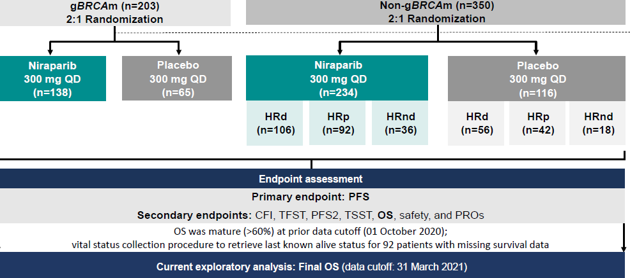
NOVA
3+ prior lines:
  gBRCA ~ 50 %
  Non-gBRCA ~ 30 %
PFI 6-12 months ~ 40 %
PFI > 12 months ~ 60 %
Slides presented by Dr. Matulonis SGO Annual Meeting 2023.
Notes:
Investigators enrolled independent cohorts on basis of presence of absence of germline BRCA mutation, and both cohorts were then randomized 2:1 niraparib vs placebo.
There stratified based on platinum free interval, CR or PR to most recent line, and prior bevacizumab.
I think it is important to mention this was a heavily pretreated population with greater than 50 % of germline BRCA patients having had 3+ prior lines and 30 % of non germline BRCA patients having at least 3+ lines as well.
In addition, 60 % of patients had a platinum free interval > 12 months prior to most recent recurrence.
~ 40 % of patients had PFI 6-12 months vs ~ 60 % of patients PFI > 12 months
Fairly heavily pretreated but more than half “very” platinum sensitive

Slide 80
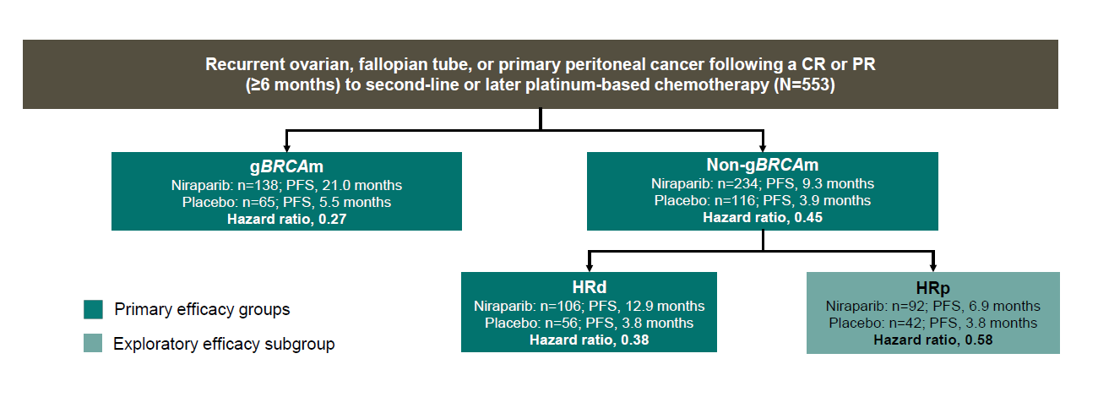
NOVA
Slides presented by Dr. Matulonis SGO Annual Meeting 2023.
Notes:
You can see from this schema presented at the recent SGO meeting that there were 3 primary efficacy groups, germlineBRCA, nongermline BRCA, and nongermline BRCA HRD as well as an exploratory group composed of non-germline HR proficient patients.
Echoing the findings from the preceding studies, all groups showed a significant improvement in progression free survival, with the most dramatic hazard ratios seen with the germline BRCA group.
Unique to NOVA is the non germline patients also noted to be homologous recombination proficient. While included on Study 19, it was not a defined population. While HR was technically statistically significant, the absolute difference in PFS was 3 months.
Germline BRCA group with PFS 21 vs 5.5 months and HR 0.27 (95 % CI 0.17-0.41, p < 0.001)
Non germline BRCA group with PFS 9.3 c 3.9 months HR 0.45 (95 % CI 0.24 – 0.59, p < 0.001)
Non germline BRCA/HRD group with PFS 12.9 vs 3.6 months HR HR 0.38 95 % CI 0.23 – 0.63, p < 0.001
Non germline BRCA/HPR group PFS 6.9 vs 3.8 months HR 0.58 (95 % CI 0.36 – 0.95 months, p = 0.02). So this final exploratory group showed a PFS difference of roughly 3 months.
Here we see similarly impressive hazard ratios as compared to SOLO2 especially for the germline BRCA and HRD groups.

Slide 81
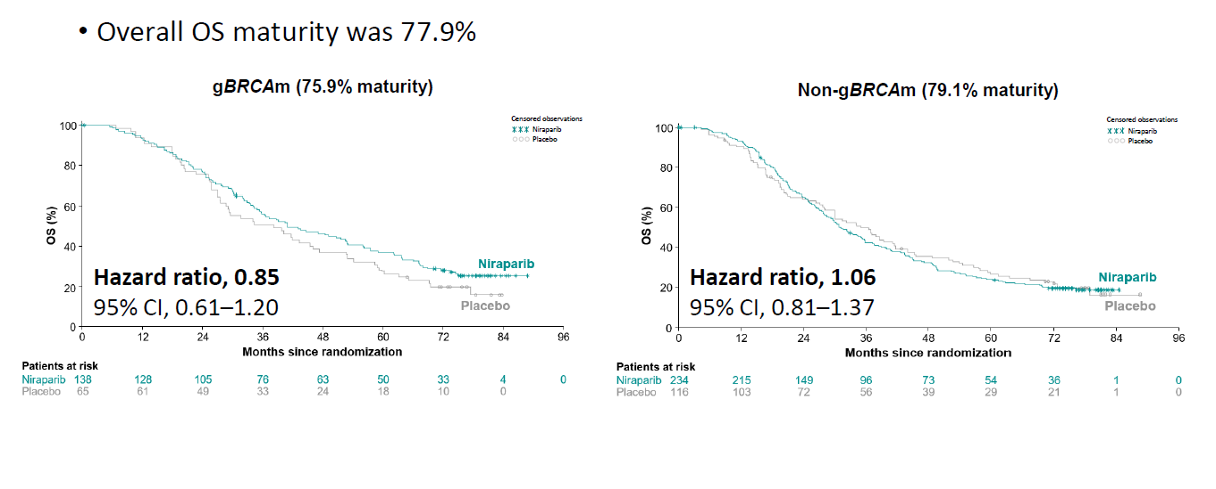
NOVA Overall Survival
Slides presented by Dr. Matulonis SGO Annual Meeting 2023.
Notes:
Overall survival was not significantly different between maintenance and placebo arm in either the germline or non germline cohorts in keeping with findings in other studies.

Slide 82
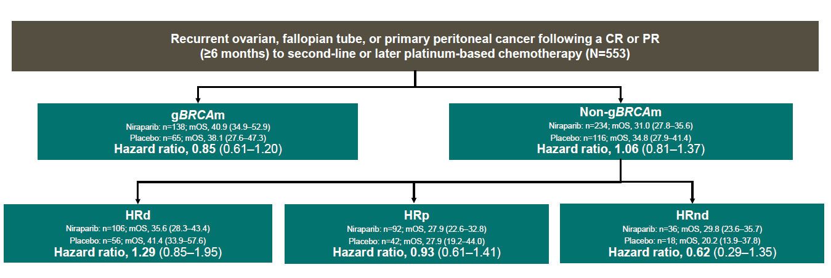
NOVA Overall Survival
Slides presented by Dr. Matulonis SGO Annual Meeting 2023.
Notes:
Here is another representation of overall survival from NOVA including primary and exploratory efficacy groups.
Again, while underpowered for OS, there was no difference in overall survival in any subgroup despite the often remarkable differences in PFS.

Slide 83
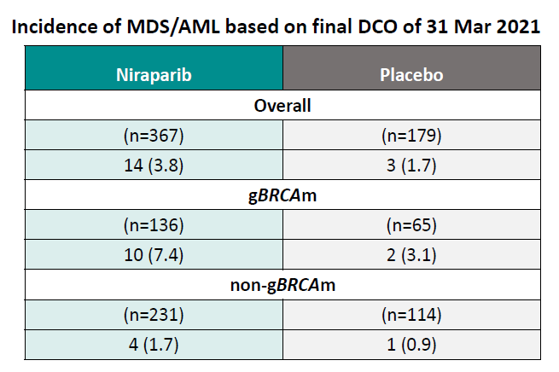
NOVA
Slides presented by Dr. Matulonis SGO Annual Meeting 2023.
Notes:
Here we see the risk of developing MDS or AML and it is in keeping with findings from SOLO2.
While numbers are too small to determine statistical significance, overall the risk of MDS/AML without PARP in the overall population seems to be about 2 %.
The germline BRCA cohort had > 7 % risk of developing compared to 3 % BRCA cohort who received placebo. Compared to 1.7 % and 0.9 % in the non germline BRCA group.

Slide 84
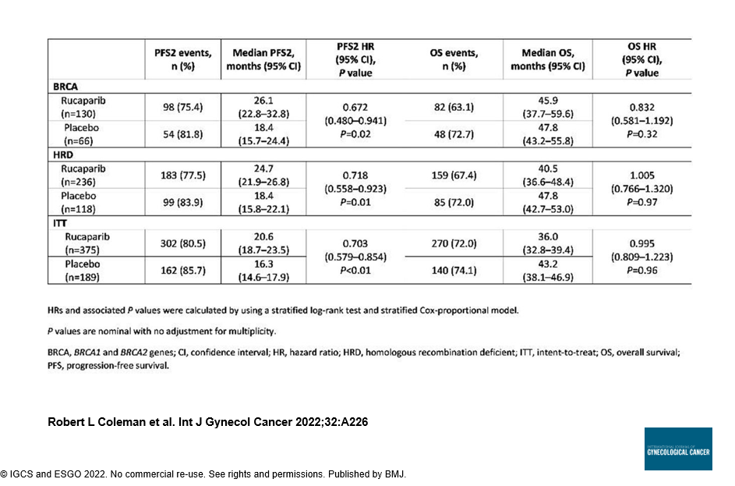
ARIEL3
Notes:
Just to briefly mention the other trial for parp maintenance therapy in the recurrent setting, this is overall survival data for ARIEL3 presented last year.
In keeping with prior studies, while PFS was significant, there was no difference in OS in the intention to treat, BRCA mutated, or HRD populations.
The boxed areas demonstrate OS in the BRCA, HRD, and intention to treat population.

Slide 85
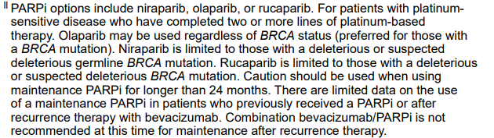
NCCN?
Notes:
How does NCCN distill this into guidelines for practice use.
Here you can see the statement from the most recent guidelines.
We can consider Olaparib in any patient and is the preferred therapy in BRCA mutated patients whereas niraparib and rucaparib are recommended only for those with suspected BRCA mutations.
I do think the note about limiting duration of therapy to 24 months is important. While none of the four reviewed trials defined an upper limit of duration, we see particularly with SOLO2 there may be a link between duration of drug exposure and risk of MDS and ML.

Slide 86
PARP Drug Approvals (Recurrent)
 | Olaparib | Niraparib | Rucaparib
Germline BRCA maintenance | Yes | Yes | Yes
Somatic BRCA maintenance | Yes | No ** | Yes
HRD maintenance | No | No ** | No **
HRP maintenance | No | No ** | No **
** Recent FDA approval withdrawals.
Notes:
I wanted to highlight that NCCN recommendations are not perfectly in line with recent FDA approvals., and I did want to put these approvals in the context of each study.
For Olaparib, Study 19 did not address the role in HRD and SOLO2 enrolled only BRCA germline or somatic patients (although all were germline). While NCCN recommends consideration of Olaparib agnostic to BRCA status, it does not have FDA approval for this indication based on the available data in the recurrent setting.
Neither NOVA nor ARIEL improvement in OS however PFS was statistically significant in all arms. Yet, when we consider NOVA with an absolutely difference of 16 months in the germline BRCA arm versus 3 in the nongermline/HRP arm, these recommendations do make sense.
I also want to highlight that the asterisk represent recent approval withdrawals all within the last year.

Slide 87
Summary
No overall survival benefit to maintenance PARP in the platinum sensitive recurrent setting regardless of BRCA mutation or homologous recombination deficiency.
Consider longterm risk of MDS/AML especially given trend for higher risk in gBRCA cohort.
  Consider limited duration of use.
Changes in FDA approval, specifically withdrawals, in last year.

Slide 88
Summary
Role for maintenance PARP inhibitors in recurrent setting will continue to shift with use of maintenance therapy after frontline chemotherapy especially for patients with germline and somatic mutations.

Slide 89
References
Ledermann J et al. Olaparib maintenance therapy in platinum-sensitive relapsed ovarian cancer. NEJM 2012; 366: 1382-1392.
Ledermann J et al. Olaparib maintenance therapy in patients with platinum-sensitive relapsed serous ovarian cancer: a preplanned retrospective analysis of outcome by BRCA status in a randomized phase 2 trial. Lancet Oncol 2014; 15: 852-861.
Friedlander M et al. Long-term efficacy, tolerability and overall survival in patients with platinum-sensitive, recurrent high-grade serous ovarian cancer treated with maintenance olaparib capsules following response to chemotherapy. Br J Cancer 2018; 119: 1075-1085.
Pujade-Lauraine E et al. Olaparib tablets as maintenance therapy in patients with platinum-sensitive, relapsed ovarian cancer and a BRCA ½ mutation (SOLO2/ENGOT-Ov21): a double-blind, randomized, placebo-controlled, phase 3 trial. Lancet Oncol 2017; 18: 1274-84.

Slide 90
References
Poveda A et al. Olaparib tablets as maintenance therapy in patients with platinum-sensitive relapsed ovarian cancer and a BRCA ½ mutation (SOLO2/ENGOT-Ov21): a final analysis of a double-blind, randomized, placebo-controlled, phase 3 trial. Lancet Oncol 2021; 22: 620-631.
Mirza MR et al. Niraparib maintenance therapy in platinum-sensitive, recurrent ovarian cancer. NEJM 2016; 375: 2151-2164.
Del Camp JM et al. Niraparib maintenance therapy in patients with recurrent ovarian cancer after a partial response to the last platinum-based chemotherapy in the ENGOT-OV16/NOVA trial. J Clin Oncol 2019; 37(32): 2968 – 2973.
Matulonis UA. Final overall survival and long-term safety in ENGOT-OV16/NOVA phase 3 trial of niraparib in patients with recurrent ovarian cancer. Society of Gynecologic Oncology Annual Meeting on Women’s Cancer, March 2023, Tampa, Florida.

Slide 91
References
9. Coleman R et al. Overall survival results from ariel3: a phase 3 randomised, double-blind study of rucaparib vs placebo following response to platinum-based chemotherapy for recurrent ovarian carcinoma. ESGO, October 2022, Berlin, Germany.

Slide 92
Thank You

Slide 93
GYNECOLOGIC CANCERS
Tuesday, October 17, 2023

Slide 94
Ovarian Cancer – State of the Science
Robert DeBernardo, MD
Section Head, Gyn Oncology
Director of Peritoneal Surface Malignancies
Laura J Fogarty Endowed Chair in Uterine Cancer Research
Cleveland Clinic
Cleveland, Ohio

Slide 95
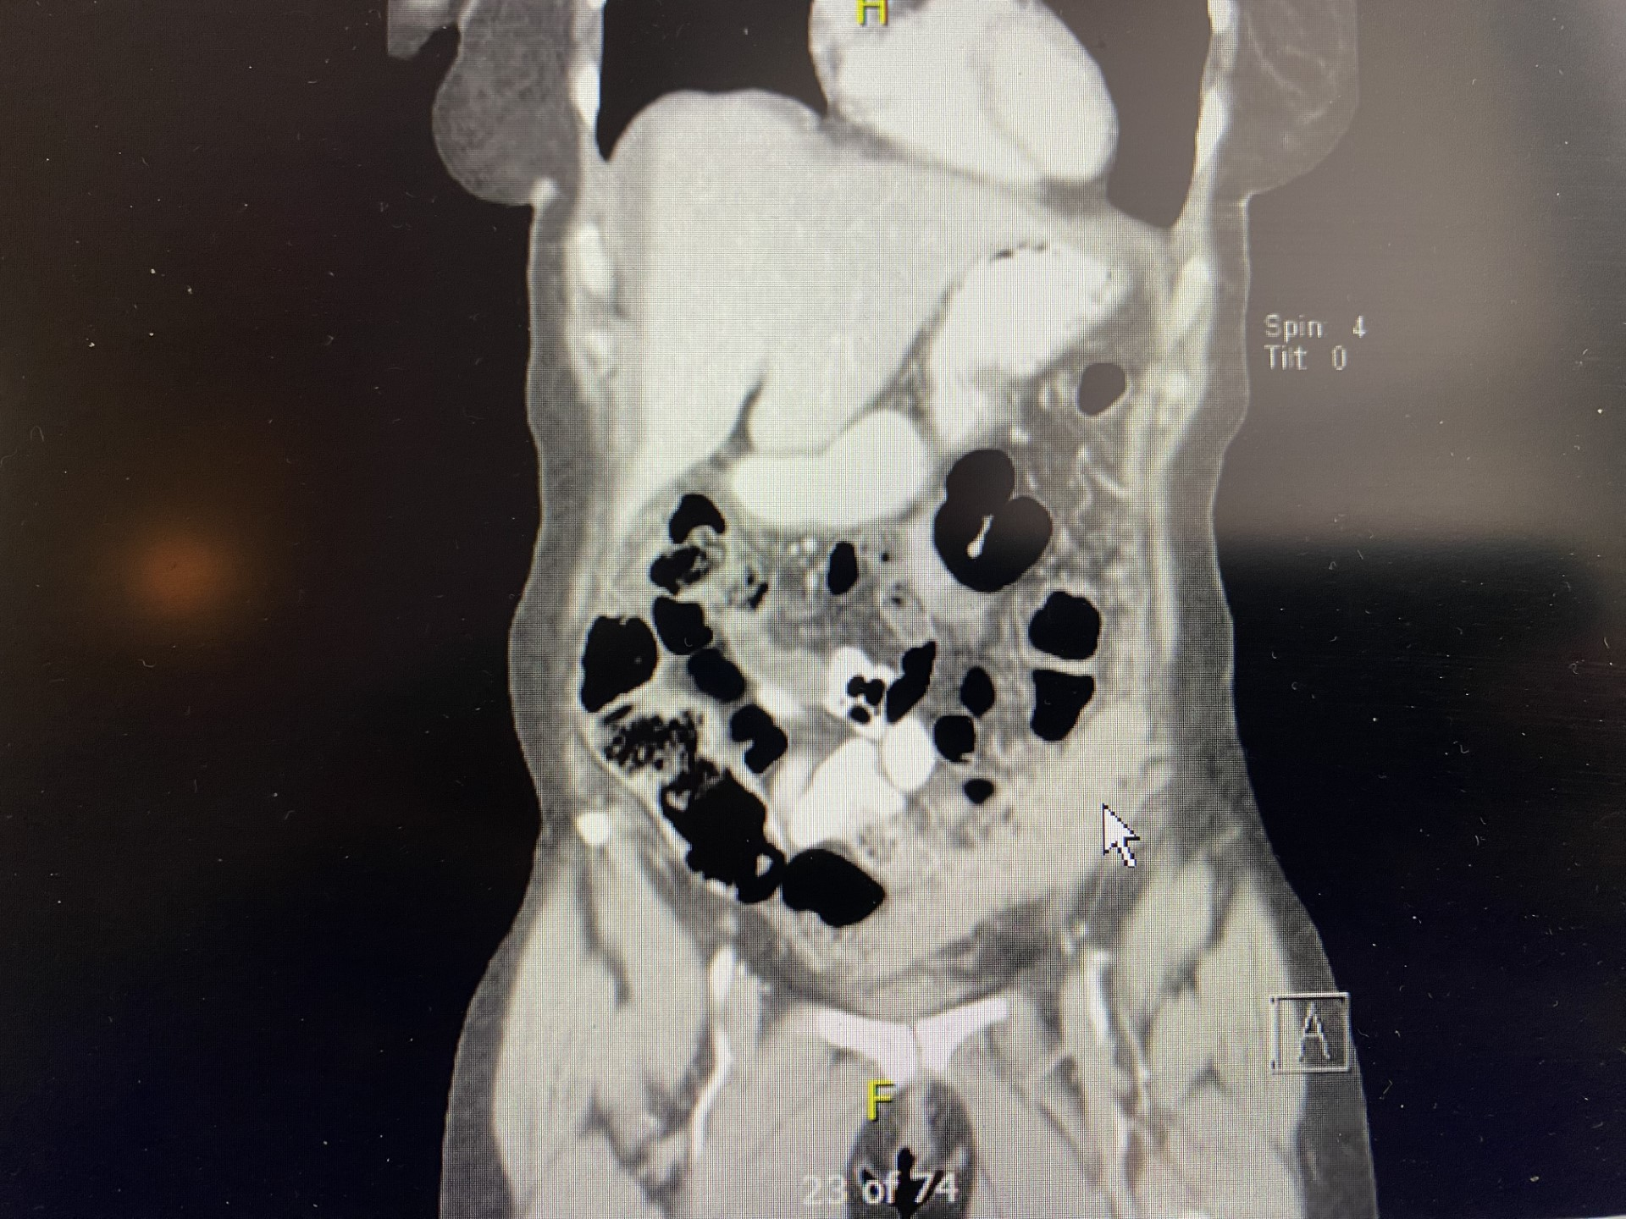
Case presentation: MLP
58y/o dx wT1 BN1M0 infiltrating ductal ca ER/PR positive, HER-2 negative. Primary being at least 8 mm in size with 3/7 (+) nodes
Received 1st cycle of Adria/Cytoxan - new sx
Diagnostic laparoscopy – carcinomatosis, path: high grade serous, PAX8, WT1 (+)
PMH/PSxH
CT Scan, CA 125 >1300
Options, how do we approach this patient?

Slide 96
Case Presentation MLP
Path CCF review:
Breast mass, axillary nodes – serous adenocarcinoma, c/w Mullerian origin
Does this change management?
FINAL DIAGNOSIS 1. Omentum, resection, Transverse colon, Falciform ligament, excision,. Right gutter mass, Spleen involving splenic capsule and perisplenic soft tissue, Rectosigmoid, bilateral ovaries and fallopian tubes and pericolonic soft tissue, Small bowel tumor, Abdominal wall port site, excision - Metastatic high-grade serous adenocarcinoma
Chemotherapy approaches?
Enters Remission
Genetic testing
Maintenance therapy options
Other considerations?

Slide 97
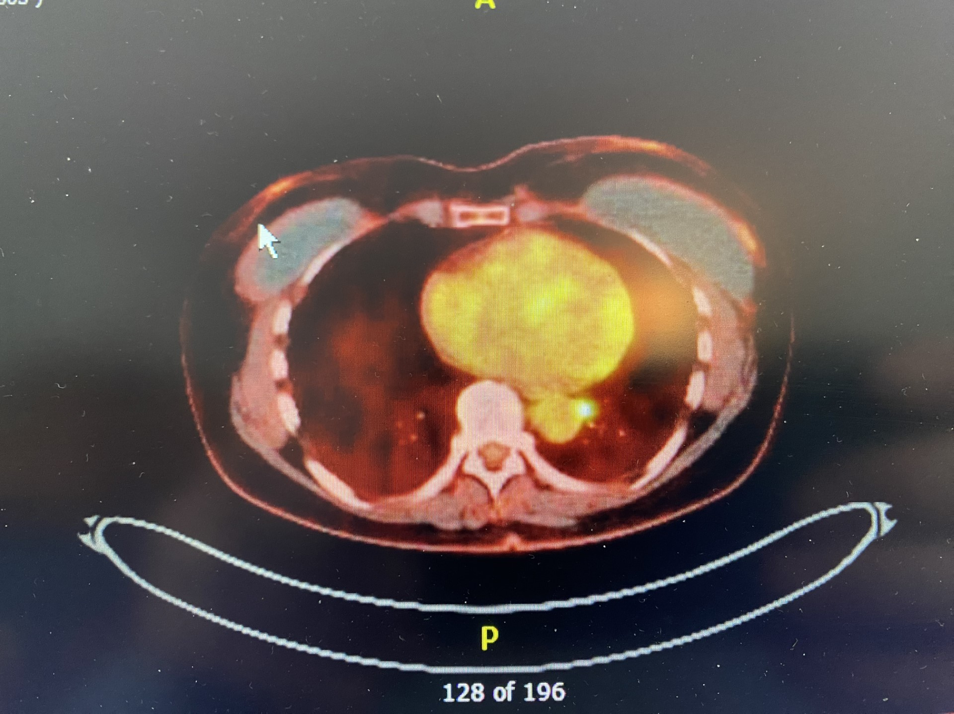
Case Presentation MLP
NED 2 yrs, increasing CA 125
CT C/A/P normal
Next moves?
PET imaging
FDG AVID LEFT POSTERIOR MEDIASTINAL NODE, CONCERNING FOR METASTASIS. NO ADDITIONAL ADENOPATHY OR METASTASIS ELSEWHERE IN THE ABDOMEN AND PELVIS
Treatment approaches?
Chemotherapy
Surgical
Radiation therapy

Slide 98
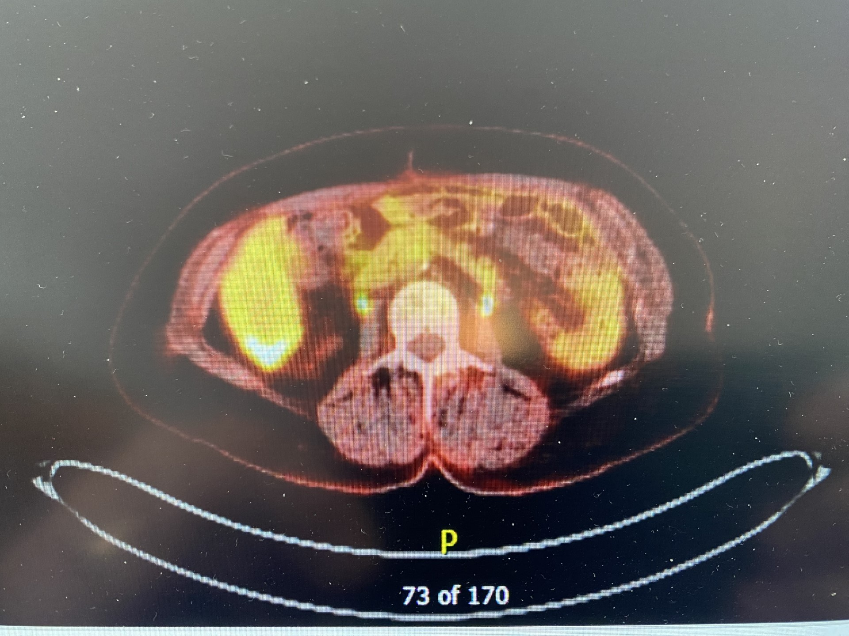
Case Presentation MLP
Treatment
SBRT & Gem/Carbo/Bev
Maintenance therapy?
Continue Bev
Start Parp
Observe
Progression in Liver
Now what?

Slide 99

Case Presentation MLP
Follow up and final thoughts

Slide 100
GYNECOLOGIC CANCERS
Tuesday, October 17, 2023

Slide 101
What’s The Latest in Endometrial Cancer?
Roberto Vargas, MD
Assistant Professor of Ob/Gyn and Reproductive Biology
The Cleveland Clinic
Cleveland, Ohio

Slide 102
Disclosures
None

Slide 103
Table of Contents
Updated FIGO Staging
Immunotherapy in the Front-Line Setting
Antibody-Drug Conjugates (ADC) Enter the Arena

Slide 104
Updated FIGO Staging
Endometrial cancer FIGO staging last updated in 2009
  Prior to publication of The Cancer Genome Atlas (TCGA)¹
  Staging changed in 2009 with multiple ongoing prospective clinical trials.
    Biomarker sub-analyses since published.

Slide 105
Updated FIGO Staging
The 2023 FIGO staging is aimed at recognizing and including:
  Non-aggressive versus aggressive subtypes
    Histologic evaluation
    Molecular characterization
  Other pathologic findings that confer increased recurrence risk (LVSI)

Slide 106
Prior FIGO (2009) Staging
Stage III
  Stage IIIA: Serosal involvement
  Stage IIIB: Parametrial/Vaginal Involvement
  Stage IIIC1/IIIC2: Nodal disease
Stage IV
  Stage IVA: Local invasion bladder/rectum
  Stage IVB: Distant Disease
Stage I
  Stage IA: <50% invasion
  Stage IB: >50% invasion
Stage II
  Cervical Stromal Invasion

Slide 107
New FIGO (2023) Staging
Stage I Disease (changed)
  Stage IA: Non-aggressive histology
    IA1: Confined to polyp or endometrium
    IA2: Less than 50% invasion and no LVSI or focal LVSI
    IA3: Meet IA2 criteria + ovarian involvement (must be unilateral, no capsule rupture)
  Stage IB: Non-aggressive histology with >50% invasion (no LVSI or focal LVSI)
  Stage IC: Aggressive histology without myo-invasion
Notes:
LVSI negative” (0 vessels); “LVSI focal” (<5 vessels); or “LVSI substantial/extensive” (≥5 vessels).

Slide 108
New FIGO (2023) Staging
Stage II Disease (changed)
  IIA: Non-aggressive histology with cervical stromal invasion
  IIB: Non-aggressive histology with multifocal LVSI
  IIC: Aggressive histology with any invasion
  Non-aggressive “subtypes” are generally grade 1-2 endometrioid histology.
  Aggressive “subtypes” are generally high-grade malignancies.

Slide 109
New FIGO (2023) Staging
Molecular subtyping
  When molecular classification available, denote “m” and subscript with subtype.
  When molecular classification reveals p53abn or POLEmut status in Stages I and II, this results in upstaging or downstaging of the disease.
    Surgical stage I/II tumor with POLE mutation confined to uterus (+/- cervical), regardless of LVSI or histologic classification, would be a IAm_{POLEmut}
    Surgical stage I/II tumor with p53abn classification would be a IICm_{p53abn} regardless of LVSI or invasion.
  MMRd or NSMP classification does not affect stage (would still defer to histologic classification).

Slide 110
New FIGO (2023) Staging
Stage III Disease (changed)
  IIIA1: Adnexal involvement
  IIIA2: Serosal involvement
  IIIB: Vaginal/parametrial involvement or pelvic peritoneal disease
  IIIC: Nodal involvement
    IIIC1: Pelvic nodes
    IIIC2: Para-aortic nodes
      i: Micrometastases
      Ii: Macrometastases
Notes:
>2mm macro

Slide 111
New FIGO (2023) Staging
Stage IV Disease (changed)
  IVA: Local invasion bladder/rectum
  IVB: Extra-pelvic peritoneal disease
  IVC: Distant disease

Slide 112
Immunotherapy in the Front-Line Setting
Two recent prospective, phase III trials incorporating PD-1 inhibition in combination with chemotherapy.
  NRG-GY018: Carboplatin + Paclitaxel +/- Pembrolizumab³
  ENGOT-EN6/RUBY: Carboplatin + Paclitaxel +/- Dostarlimab⁴
Notes:
>2mm macro

Slide 113
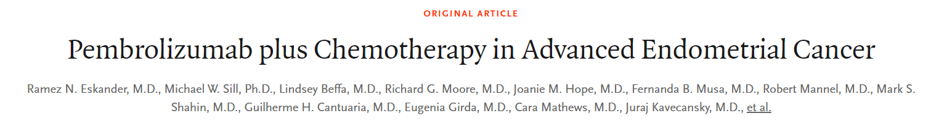
NRG-GY018
Double-blind, placebo-controlled, randomized trial comparing carboplatin/paclitaxel +/- pembrolizumab.
  Pembrolizumab (200mg) administered with each cycle and up to 14 cycles of maintenance therapy (400mg q6 weeks).
  Measurable stage III/IVA disease, any stage IVB disease or recurrent endometrial cancer
  All histologies except carcinosarcoma
  Stratified based on MMR status
Primary endpoint progression-free survival (PFS)
RN Eskander et al. N Engl J Med 2023;388:2159-2170.
Notes:
>2mm macro

Slide 114
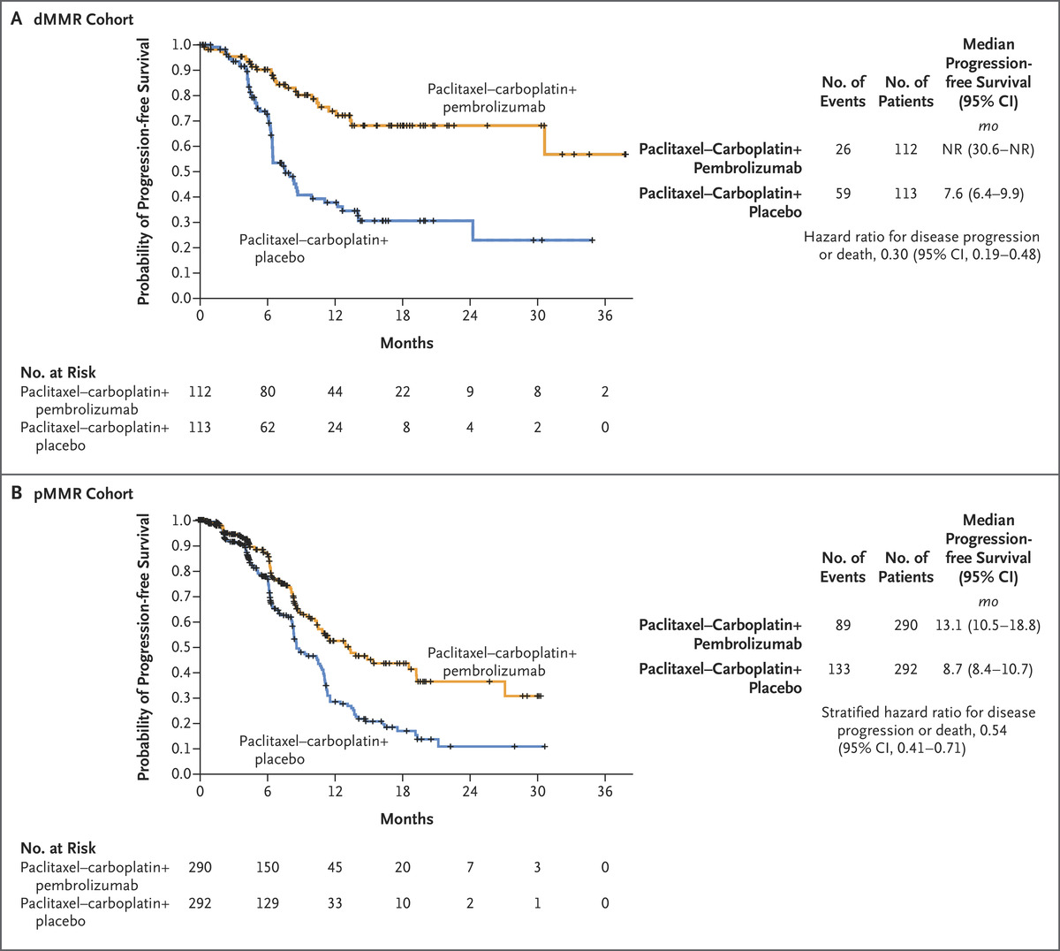
NRG-GY018
In the dMMR cohort, the 12-month PFS was 74% in the pembrolizumab group and 38% in the placebo group.
  Hazard ratio for progression or death, 0.30; 95% confidence interval [CI], 0.19 to 0.48; P<0.001), a 70% difference in relative risk.
In the pMMR cohort, median PFS was 13.1 months with pembrolizumab and 8.7 months with placebo (hazard ratio, 0.54; 95% CI, 0.41 to 0.71; P<0.001).
RN Eskander et al. N Engl J Med 2023;388:2159-2170.
Notes:
>2mm macro

Slide 115
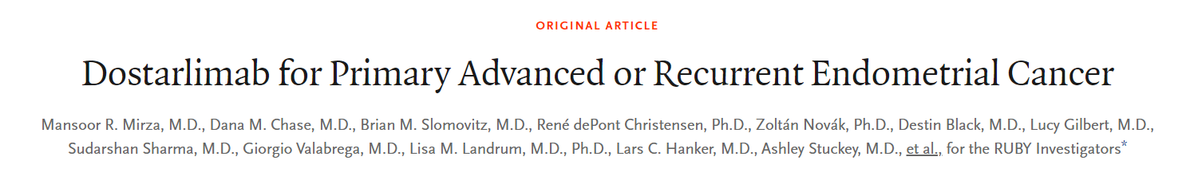
RUBY Trial
Global, double-blind, placebo-controlled, randomized trial comparing carboplatin/paclitaxel +/- dostarlimab.
  Dostarlimab (500mg) administered with each cycle and up to 3 years of maintenance therapy (1000mg q6 weeks).
Required measurable IIIA/B/IIIC1* for non-aggressive histologies. Ok non-measurable IIIC1* for aggressive.
  All histologies except carcinosarcoma
  24% of patients with dMMR disease.
Primary endpoint progression-free survival (PFS)
Notes:
>2mm macro

Slide 116
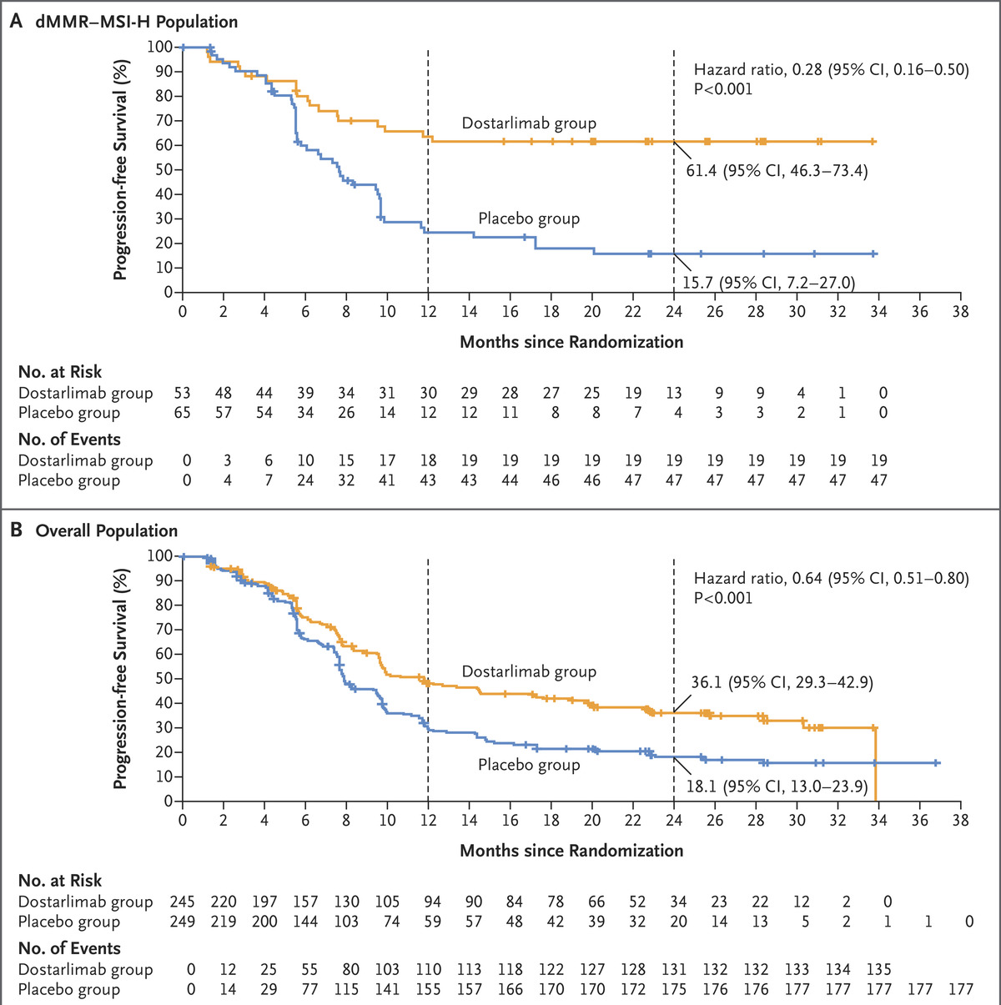
RUBY Trial
In the overall population, at 24 months was 36.1% (95% CI, 29.3 to 42.9) in the dostarlimab group were without progression, while 18.1% (95% CI, 13.0 to 23.9) in the placebo group. Hazard ratio, 0.64; (95% CI, 0.51 to 0.80; P<0.001).)
In the dMMR–MSI-H population, estimated progression-free survival at 2 years months was 61.4% (95% confidence interval [CI], 46.3 to 73.4) in the dostarlimab group and 15.7% (95% CI, 7.2 to 27.0) in the placebo group. Hazard ratio for progression or death, 0.28; (95% CI, 0.16 to 0.50; P<0.001)).
MR Mirza et al. N Engl J Med 2023;388:2145-2158.
Notes:
Overall survival at 24 months was 71.3% (95% CI, 64.5 to 77.1) with dostarlimab and 56.0% (95% CI, 48.9 to 62.5) with placebo (hazard ratio for death, 0.64; 95% CI, 0.46 to 0.87).
Among patients with pMMR–MSS tumors, a progression-free survival benefit was observed with the dostarlimab regimen as compared with the placebo regimen: progression-free survival at 24 months was 28.4% (95% CI, 21.2 to 36.0) in the dostarlimab group and 18.8% (95% CI, 12.8 to 25.7) in the placebo group (hazard ratio for disease progression or death, 0.76; 95% CI, 0.59 to 0.98) (Figure 2C). Overall survival at 24 months was 67.7% (95% CI, 59.8 to 74.4) in the dostarlimab group and 55.1% (95% CI, 46.8 to 62.5) in the placebo group (hazard ratio for death, 0.73; 95% CI, 0.52 to 1.02) (Figure 3C).

Slide 117
NRG-GY018 vs. ENGOT/EN6 (RUBY)
FDA approval currently only for dostarlimab in the dMMR population.
Neither trial reported grade III+ toxicities greater than placebo arm.
NRG-GY018 required measurable disease for IIIA/B/C + IVA* disease
RUBY required measurable IIIA/B/IIIC1* for non-aggressive histologies. Ok non-measurable IIIC1* for aggressive.
NRG-GY018 excluded carcinosarcoma, RUBY included this histology.
Maintenance phase for NRG-GY018 was 14 treatments (84 weeks) while RUBY was 3 years (156 weeks).
Notes:
Old/2009 staging

Slide 118
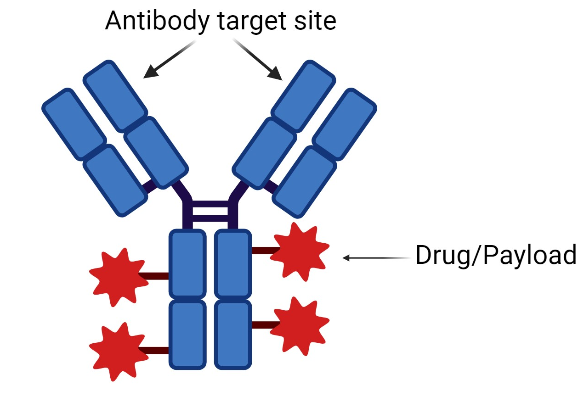
Antibody Drug Conjugates
Antibody with cytotoxic payload bound to Fc chain.
Fa chains (target binding) sites based on expressed surface proteins.
Example: HER2 expression and over-expression variable based on histology.
  Phase II trial supporting trastuzumab with chemotherapy in HER2 over-expressing uterine serous carcinoma.⁵
  Existing FDA approved HER2-targeting ADCs.
Fader, Amanda N., et al. "Randomized phase II trial of carboplatin-paclitaxel versus carboplatin-paclitaxel-trastuzumab in uterine serous carcinomas that overexpress human epidermal growth factor receptor 2/neu." (2018).
Notes:
>2mm macro

Slide 119
Antibody Drug Conjugates
NCCH1615/STATICE trial - Phase II, multicenter, single arm trial assessing safety and efficacy of trastuzumab deruxtecan in recurrent uterine carcinosarcoma.
  Topoisomerase I inhibitor payload
Recurrent uterine carcinosarcoma failing chemotherapy.
  HER2 IHC score ≥1+
  HER2 high (≥2) versus HER2 low (score = 1)
Administered IV every 3 weeks (5.4mg/kg based on adjusted breast CA data)
Primary endpoint based on HER2 high group (n = 22).
Nishikawa, Tadaaki, et al. "Trastuzumab Deruxtecan for Human Epidermal Growth Factor Receptor 2–Expressing Advanced or Recurrent Uterine Carcinosarcoma (NCCH1615): The STATICE Trial." Journal of Clinical Oncology 41.15 (2023): 2789-2799.
Notes:
>2mm macro

Slide 120
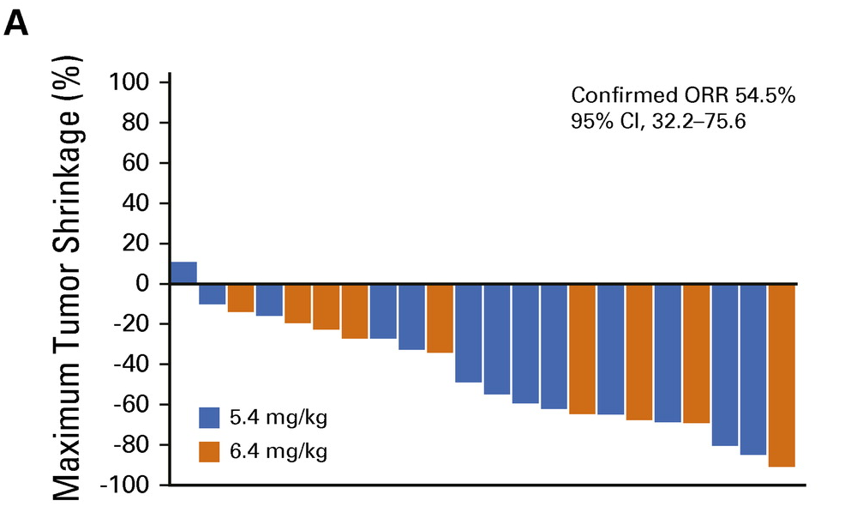
Antibody Drug Conjugates
The ORR was 68.2% (95% CI, 45.1 to 86.1) in the HER2-high group (n = 22) by investigator assessment.
The ORRs in the HER2-low group in an exploratory analysis was 60.0% (95% CI, 26.2 to 87.8) by investigator assessment (n = 10).
The median DoRs was 6.9 months (95% CI, 4.1 to 12.6) in the HER2-high group and 8.1 months (95% CI, 2.8 to not reached [NR]) in the HER2-low group.
Nishikawa, Tadaaki, et al. "Trastuzumab Deruxtecan for Human Epidermal Growth Factor Receptor 2–Expressing Advanced or Recurrent Uterine Carcinosarcoma (NCCH1615): The STATICE Trial." Journal of Clinical Oncology 41.15 (2023): 2789-2799.

Slide 121
Summary
2023 was a big year for endometrial cancer.
FIGO 2023 staging introduced molecular classification that influences final stage.
  Should consider original trial design/staging when prescribing adjuvant therapy until response data based on new staging available.
Promising data regarding PD-1 inhibition with chemotherapy in the front-line setting.
  Currently, FDA approval only for dostarlimab in dMMR group.
Antibody-drug conjugates enter the recurrent EC arena.
  Trastuzumab-deruxtecan FDA approved in breast, lung, and gastric cancer.
  Trastuzumab-emtansine FDA approved in breast cancer.
  Case reports of activity in trastuzumab-resistant uterine serous carcinoma.
Notes:
DM1 is microtubule drug

Slide 122
References
Levine, Douglas A., et al. "Integrated genomic characterization of endometrial carcinoma." Nature 497.7447 (2013): 67-73.
2) Berek JS, Matias‐Guiu X, Creutzberg C, Fotopoulou C, Gaffney D, Kehoe S, Lindemann K, Mutch D, Concin N, Endometrial Cancer Staging Subcommittee, FIGO Women's Cancer Committee, Berek JS. FIGO staging of endometrial cancer: 2023. International Journal of Gynecology & Obstetrics. 2023 Jun 20.
Eskander, Ramez N., et al. "Pembrolizumab plus chemotherapy in advanced endometrial cancer." New England Journal of Medicine (2023).
Mirza, Mansoor Raza, et al. "ENGOT-EN6/NSGO-RUBY: A phase III, randomized, double-blind, multicenter study of dostarlimab+ carboplatin-paclitaxel versus placebo+ carboplatin-paclitaxel in recurrent or primary advanced endometrial cancer (EC)." (2020): TPS6107-TPS6107.
Fader, Amanda N., et al. "Randomized phase II trial of carboplatin-paclitaxel versus carboplatin-paclitaxel-trastuzumab in uterine serous carcinomas that overexpress human epidermal growth factor receptor 2/neu." (2018).
Nishikawa, Tadaaki, et al. "Trastuzumab Deruxtecan for Human Epidermal Growth Factor Receptor 2–Expressing Advanced or Recurrent Uterine Carcinosarcoma (NCCH1615): The STATICE Trial." Journal of Clinical Oncology 41.15 (2023): 2789-2799.

Slide 123
Questions?

Slide 124
GYNECOLOGIC CANCERS
Tuesday, October 17, 2023

Slide 125
Endometrial Cancer Case Review
Panelists:
Michelle Kuznicki MD, Gynecologic Oncology
Sudha Amarnath MD, Radiation Oncology
Robert Soslow MD, Gynecologic Pathology
Cleveland Clinic

Slide 126
Early-Stage Endometrial Cancer
56 year old female with history of post menopausal bleeding. Ultrasound : 2cm endometrial lining
Endometrial biopsy: serous endometrioid adenocarcinoma
Surgery: TLH, BSO, sentinel lymph node and omental biopsies
Pathology: uterine serous ca, 80% myometrial invasion, negative nodes, washings and omental biopsy
Discuss Treatment Considerations
  POLE mutation positive

Slide 127
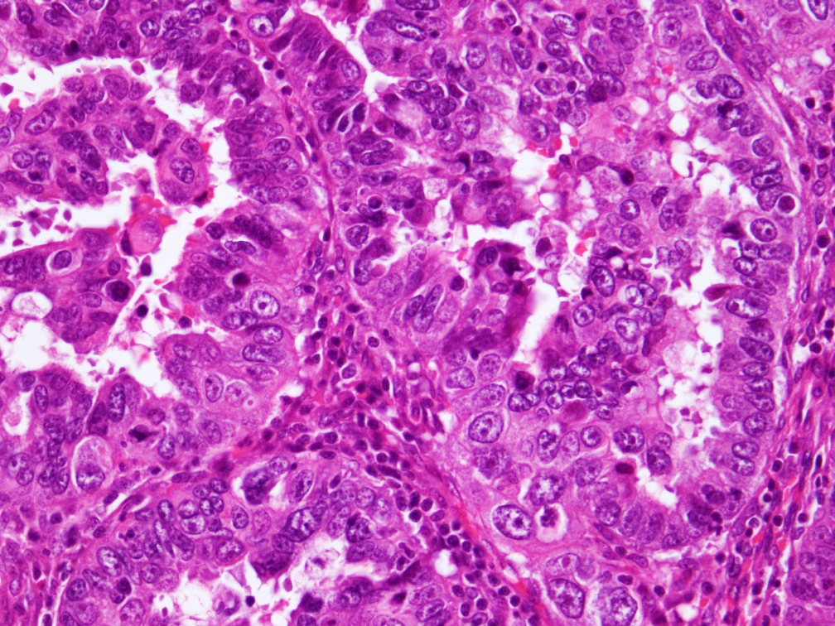
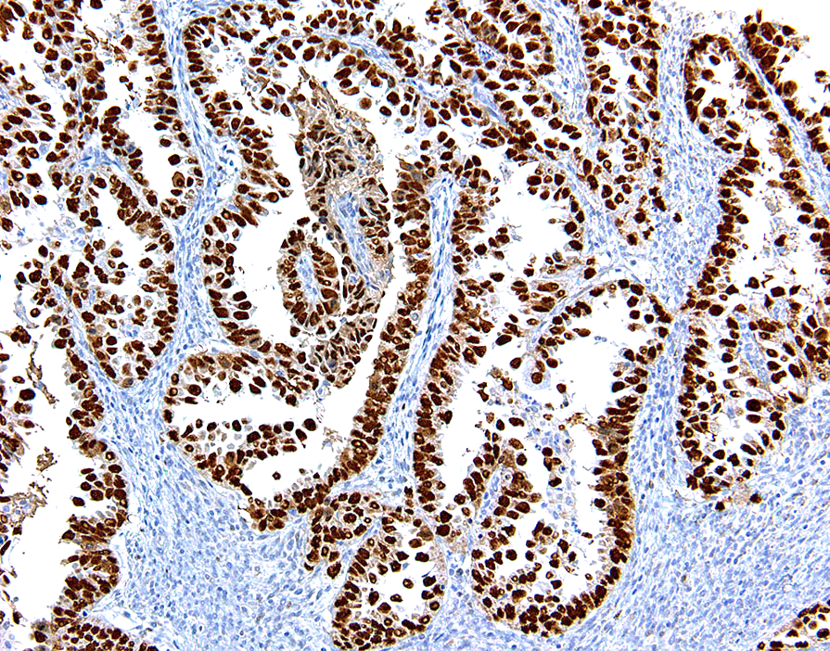
Mutation-type p53 staining
POLE mutated endometrioid carcinoma simulating serous carcinoma

Slide 128
Advanced Endometrial cancer
65 year old female presents with PMB.
Endometrial biopsy : serous endometrial cancer.
CT scan : Enlarged pelvic lymph nodes bilaterally
Surgery: TAH, BSO, omentectomy, pelvic lymph node debulking
Pathology: Uterine serous carcinoma, 70% myoinvasion, positive bilateral pelvic lymph nodes, negative omentum, negative washings
Discuss Treatment Considerations IIIC1 (2023 IC1ii) uterine serous cancer
  MMRd, MMRp
  Her2 positive 2+

Slide 129
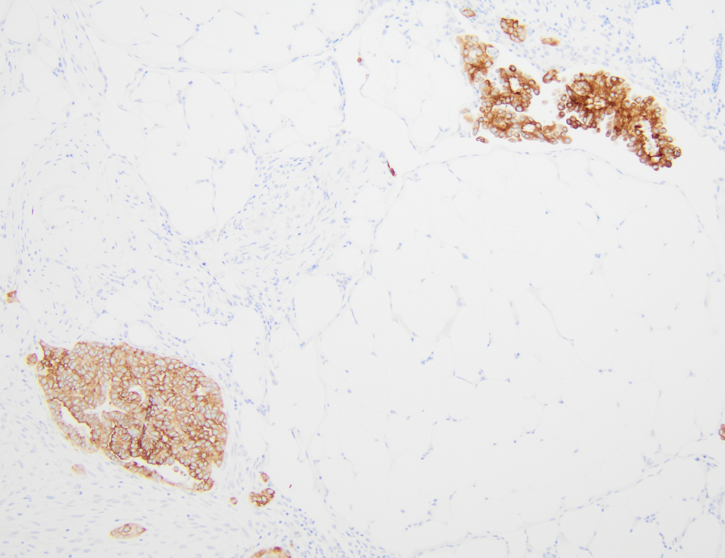
3+ (positive) Her2 expression in an endometrial serous carcinoma metastatic to omentum

