Slide 1










BREAST CANCER
Thursday, November 2, 2023

Slide 2
Updates in HER2+ and HER2 low Breast Cancer
Naji S. Mallat, MD
Assistant professor of Medicine
University Hospitals Seidman Cancer Center
Case Comprehensive Cancer Center
Case Western Reserve University

Slide 3
Disclosures: None

Slide 4
Outline
DESTINY-Breast03 Study (SABCS 2022).
PHERGain Study (ASCO 2023).
DESTINY-Breast04 Study: Subgroup analysis.

Slide 5
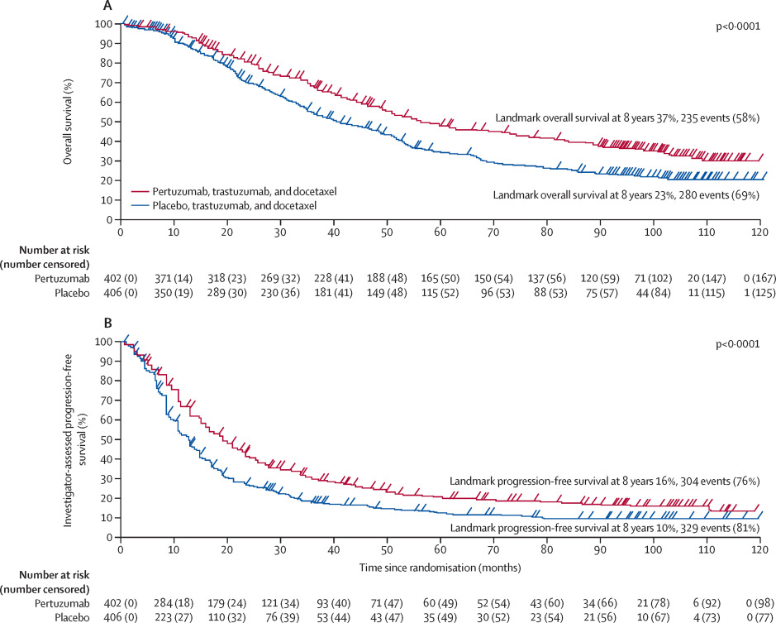
Cleopatra trial
mPFS: 12·4 months (95% CI 10–14) in the placebo group vs 18·7 months (17–22) in the pertuzumab group (HR 0·69, 95% CI 0·59–0·81).
mOS: 57·1 months (95% CI 50-72) in the pertuzumab group and 40·8 months (36-48) in the placebo group (hazard ratio 0·69, 95% CI 0·58-0·82).
Swain et al, Lancet Oncol 2020
Notes:
First line standard of care for Her2 positive metastatic breast cancer was established to be traztuzumab, pertuzumab and a taxane based on the Cleopatra trial, that was a double-blind, randomised, placebo-controlled, phase 3 trial for patients with Her2 positive metastatic disease where patients were randomly assigned to receive either pertuzumab or placebo plus trastuzumab and docetaxel
Median follow-up was 99·9 months in the pertuzumab group (IQR 92·9-106·4) and 98·7 months (90·9-105·7) in the placebo group.
Median progression-free survival was 12·4 months (95% CI 10–14) in the placebo group versus 18·7 months (17–22) in the pertuzumab group (HR 0·69, 95% CI 0·59–0·81).Median overall survival was 57·1 months (95% CI 50-72) in the pertuzumab group and 40·8 months (36-48) in the placebo group (hazard ratio 0·69, 95% CI 0·58-0·82); 8-year landmark overall survival rates were 37% (95% CI 31-42) in the pertuzumab group and 23% (19-28) in the placebo group

Slide 6
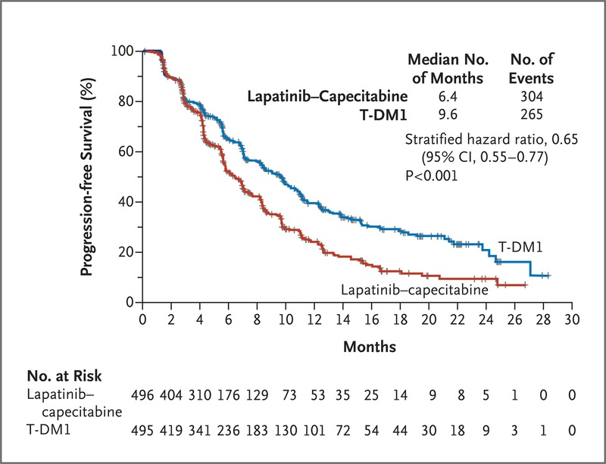
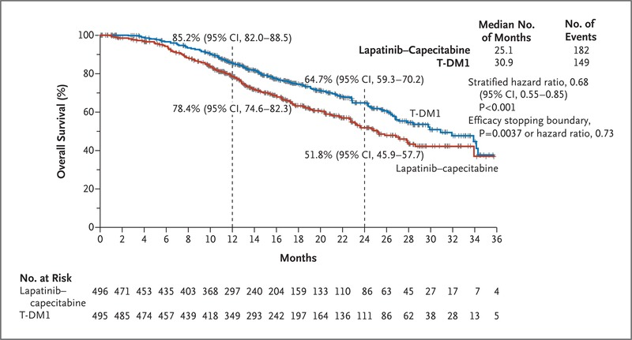
Emilia Trial
- mPFS: 9.6 months in the T-DM1 group vs 6.4 months in the lapatinib plus capecitabine group (HR: 0.65, 95% CI 0.55-0.71; P<0.001).
- mOS: 30.9 months in the T- DM1 group vs. 25.1 months in the lapatinib plus capecitabine group (HR: 0.68; 95% CI, 0.55 to 0.85; P<0.001).
Verma S et al. N Eng J Med. 2012
Notes:
The Emilia trial established traztuzumab emtansine as the standard of care therapy after THP in the 2nd line setting and beyond.
The Emilia Trial published in NEJM in 2012 was a randomized, open-label, international trial involving patients with HER2-positive, unresectable, locally advanced or metastatic breast cancer who were previously treated with trastuzumab and a taxane. Patients were randomly assigned in a 1:1 ratio to T-DM1 or lapatinib plus capecitabine
Treatment with T-DM1 significantly improved progression-free survival as assessed by independent review (median survival, 9.6 months, vs. 6.4 months with lapatinib plus capecitabine; stratified hazard ratio for progression or death from any cause, 0.65; 95% confidence interval [CI], 0.55 to 0.77; P<0.001)

Slide 7
DESTINY-Breast03: Study design
Pre-specified OS interim analysis was planned with 153 events. At the time of data cutoff (July 2022), 169 events were observed. The P value to achieve statistical significance was 0.013.
BICR, blinded independent central review; DOR, duration of response; ORR, objective response rate; OS, overall survival; PFS, progression-free survival; Ph3, phase 3;
Q3W, every 3 weeks.
ªHER2 IHC3+ or IHC2+/ISH+ based on central confirmation. ^{b}Progression during or <6 months after completing adjuvant therapy involving trastuzumab and taxane
Hurvitz SA et al. The Lancet. 2022;400 [in press]. Hurvitz SA et al. Presented at: San Antonio Breast Cancer Symposium 2022; December 6-10, 2022; San Antonio, TX, USA. Presentation GS2-02
Notes:
(Based on the strength of the destiny breast 03 efficacy and safety data, T-DXD is now considered the preferred 2nd line therapy in patients with advanced or metastatic breast cancer.
At the previously reported destiny breast 03 trial results in 2021, the PFS interim analysis showed in the TDXD arm, the risk of disease of progression or death was reduced by 72% with median PFS had not been reached at that time for TDXD and was 6.8mo for TDM1)
Then came destiny breast 03 that compared T-DXd vs TDM-1 in the second line setting This is the study design for destiny breast 03, It’s randomized open label phase 3 trial. Patient had to have metastatic or unresectable her2 positive breast cancer previously treated with traztuzumab and a taxane in the metastatic setting or within 6months of recurrence after early stage treatment
Patients were randomized 1 to 1 to TDXD or TDM1 every 3 weeks. The primary end point was PFS by Blinded independent central review with key secondary endpoint of OS.

Slide 8
T-DXd characteristics (1-4)
Anti HER2 ADC utilizing a Trastuzumab antibody backbone.
Payload: Exatecan, topoisomerase I inhibitor.
Drug to antibody ratio: ~8:1.
Tumor selective cleavable linker: Yes
Bystander effect: Yes
Trastuzumab deruxtecan
(T-DXd)¹
Nakada T et al. Chem Pharm Bull (Tokyo). 2019;67:173-85.
Ogitani Y et al. Clin Cancer Res. 2016;22:5097-108.
Trail PA et al. Pharmacol Ther. 2018;181:126-42.
Ogitani Y et al. Cancer Sci. 2016;107:1039-46.

Slide 9
Key secondary endpoint: Overall survival
Hurvitz SA et al. The Lancet. 2022;400 [in press]. Hurvitz SA et al. Presented at: San Antonio Breast Cancer Symposium 2022; December 6-10, 2022; San Antonio, TX, USA. Presentation GS2-02.
Notes:
At the overall survival, intermim analysis, the median OS was not yet reached for TDXD or TDM1 however the curves separate early in favor of TDXD with a HR 0.64 with p value of 0.0037
In the TDXT arm, 35.2 percent of pts who came off treatment were able to go and receive TDM1- in the TDM1, 17 percent of pts received standard of care TDXD

Slide 10
Primary end point: Progression free survival
Hurvitz SA et al. The Lancet. 2022;400 [in press]. Hurvitz SA et al. Presented at: San Antonio Breast Cancer Symposium 2022; December 6-10, 2022; San Antonio, TX, USA. Presentation GS2-02.
Notes:
The updated progression free survival results are shown here.
Now we have reached a median PFS for TDXD for 28.8 months which is 4 times better than that seen with TDM1 at 6.8months with HR of 0.33

Slide 11
Confirmed ORR
Hurvitz SA et al. The Lancet. 2022;400 [in press]. Hurvitz SA et al. Presented at: San Antonio Breast Cancer Symposium 2022; December 6-10, 2022; San Antonio, TX, USA. Presentation GS2-02
Notes:
The objective response rate is shown here, the majority of pts treated with TDXD experienced reduction in tumor size, the ORR was 78.5% with TDXT vs 35% with TDM1. 21% of patients had a CR vs 9.5% in the TDM1 and the duration of response was around 3 years with TDXD vs 2 years in the TDM1

Slide 12
Overall safety summary
Hurvitz SA et al. The Lancet. 2022;400 [in press]. 2. Hurvitz SA et al. Presented at: San Antonio Breast Cancer Symposium 2022; December 6-10, 2022; San Antonio, TX, USA. Presentation GS2-02
Notes:
Overall safety summary, it’s notable when you are comparing safety between 2 arms, the patients treated with TDXD were treated for a median of 18.2 months, so there treatment exposure was longer than TDM1 with a median treatment duration was 6.9mo
Grade 3,4 TEAE were equivalent comparing the 2 arms. 56.4% with TDXD vs 51.7% but similar to DB 02 presented by Dr Krop in San Antonio as well , there were more treatment emergent adverse events that led to drug discontinuation, reduction or interruption with TDXD vs TDM1

Slide 13
Overall safety summary
Notes:
Most common Adverse evernt , nausea, vomiting, alopecia in the TDXD group vs low platelet, liver enzyme elevation and nausea in the TDM1 group

Slide 14
Adverse events of special interest
Any grade ILD and pneumonitis rates for T-DXd: 15.2%
Previous reporting 1 year ago: 10.5%
No grade 4,5 events, no new grade 3 events
The additional accumulated events: grade 1 and 2
Hurvitz SA et al. The Lancet. 2022;400 [in press]. Hurvitz SA et al. Presented at: San Antonio Breast Cancer Symposium 2022; December 6-10, 2022; San Antonio, TX, USA. Presentation GS2-02

Slide 15
Summary 1- (DB-03)
T-DXd demonstrated clinically meaningful and statistically significant improvement in OS compared with T-DM1 as well as continued PFS benefit.
With a longer treatment duration, T-DXd continues to demonstrate a manageable safety profile.
The updated results of the DESTINY-Breast03 further support the use of T-DXd as the second line standard of care treatment for patient with HER2-positive metastatic breast cancer.

Slide 16
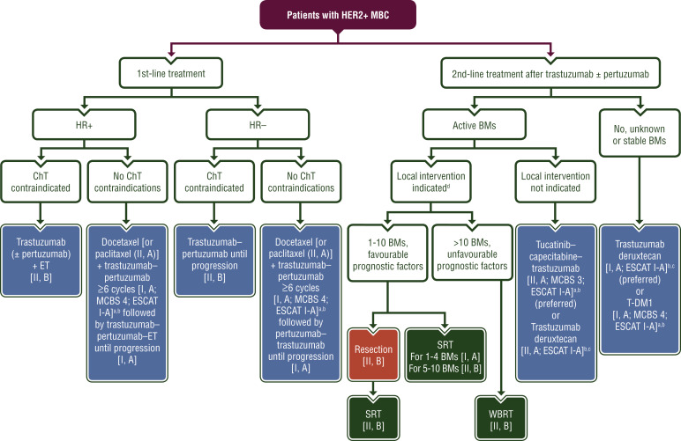
Treatment paradigm in 2022
ESMO Clinical Practice Guidelines for MBC. Gennari et al. AnnOncol 2021
Notes:
This is one example of international guidelines around the management of metastatic her2 positive BC. The first line treatment recommendation continues to be a taxane with pertuzumab and traztuzumab.
On the left of the slide, a chemotherapy free approach of traztuzumab and pertuzumab +/- endocrine or traztumab with endocrine therapy, is felt to be an option for patients but preferred in pts with chemo contraindicatins or if patients prefer the non chemo approach.
For second line therapy, traztuzumab deruxtican has been established as 2nd therapy based on the destiny 03 trial that we will discuss updated results presented in San Antonio

Slide 17
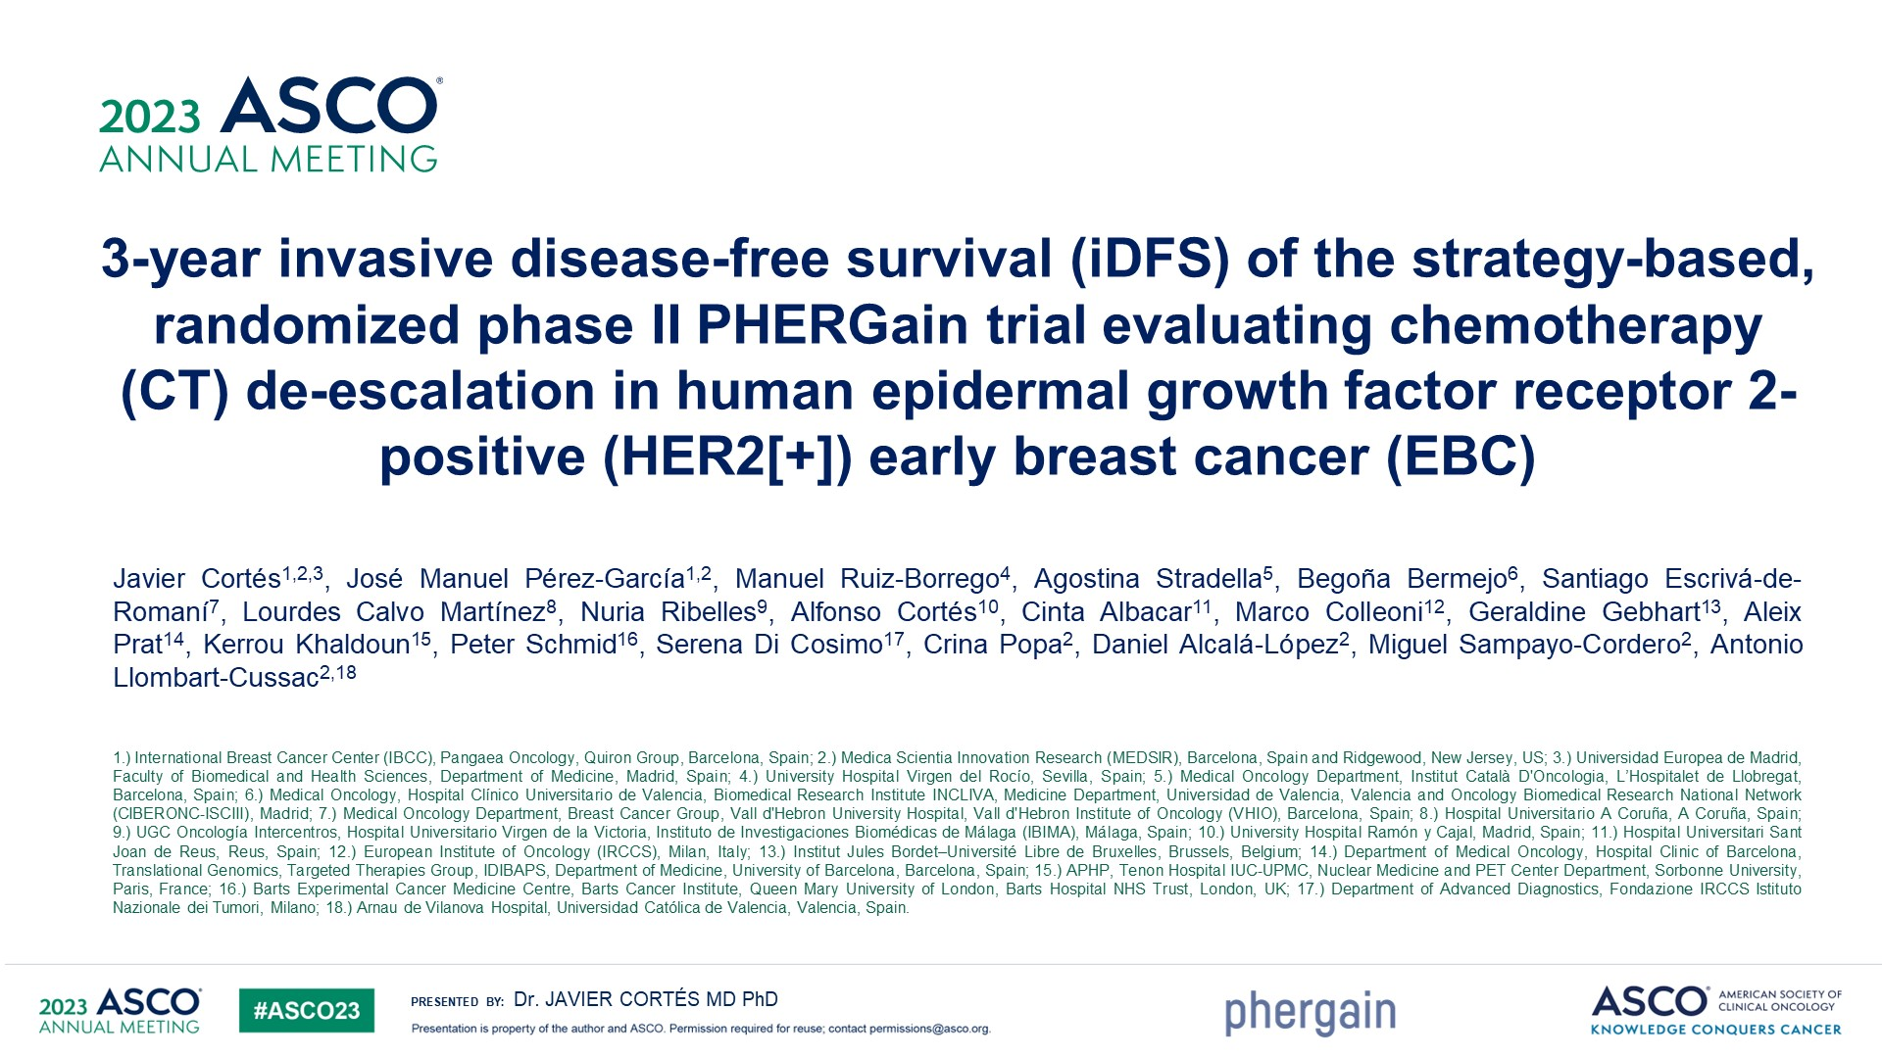

Slide 18
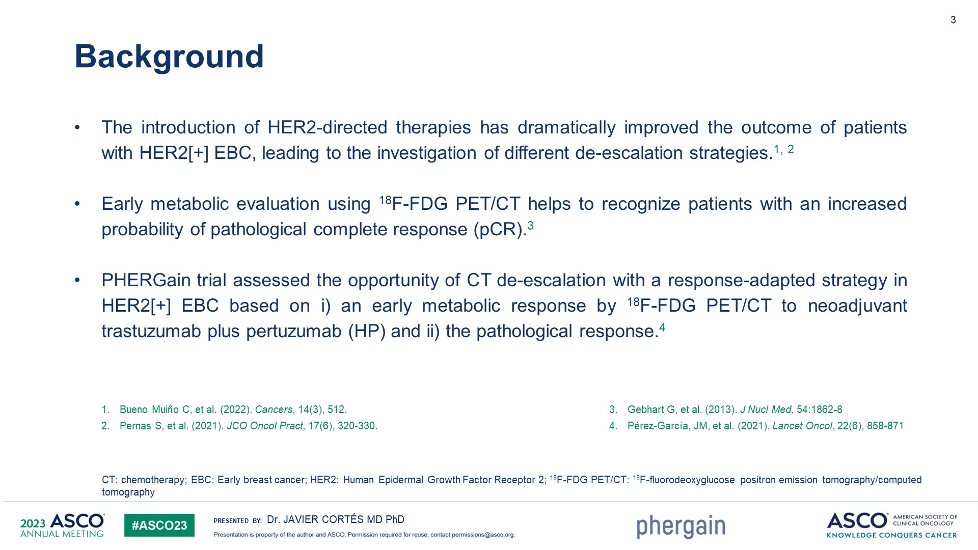

Slide 19
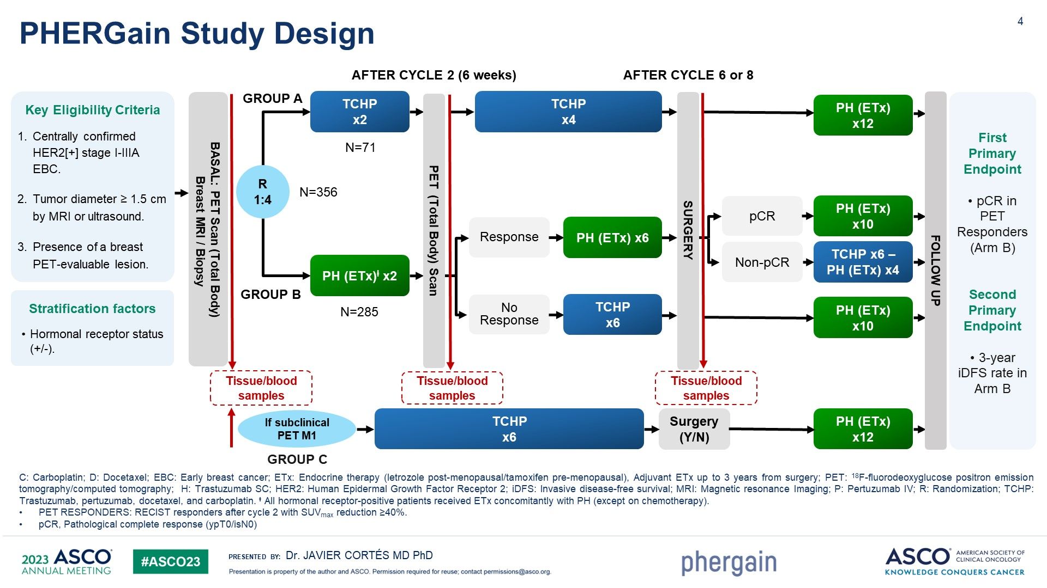

Slide 20
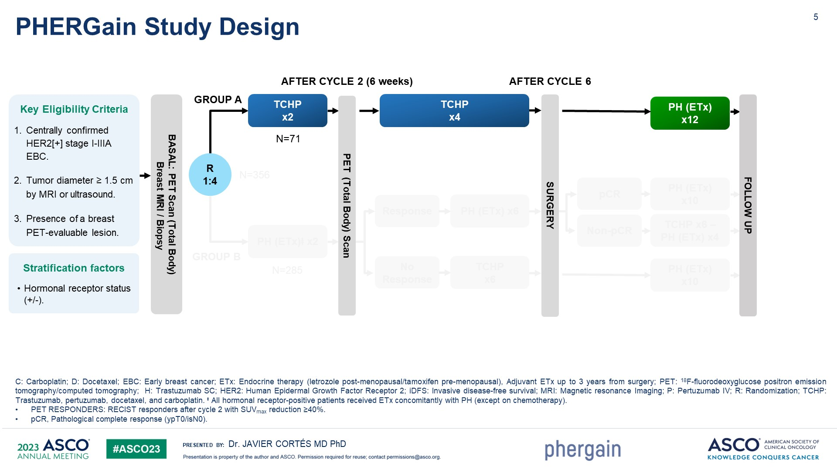

Slide 21
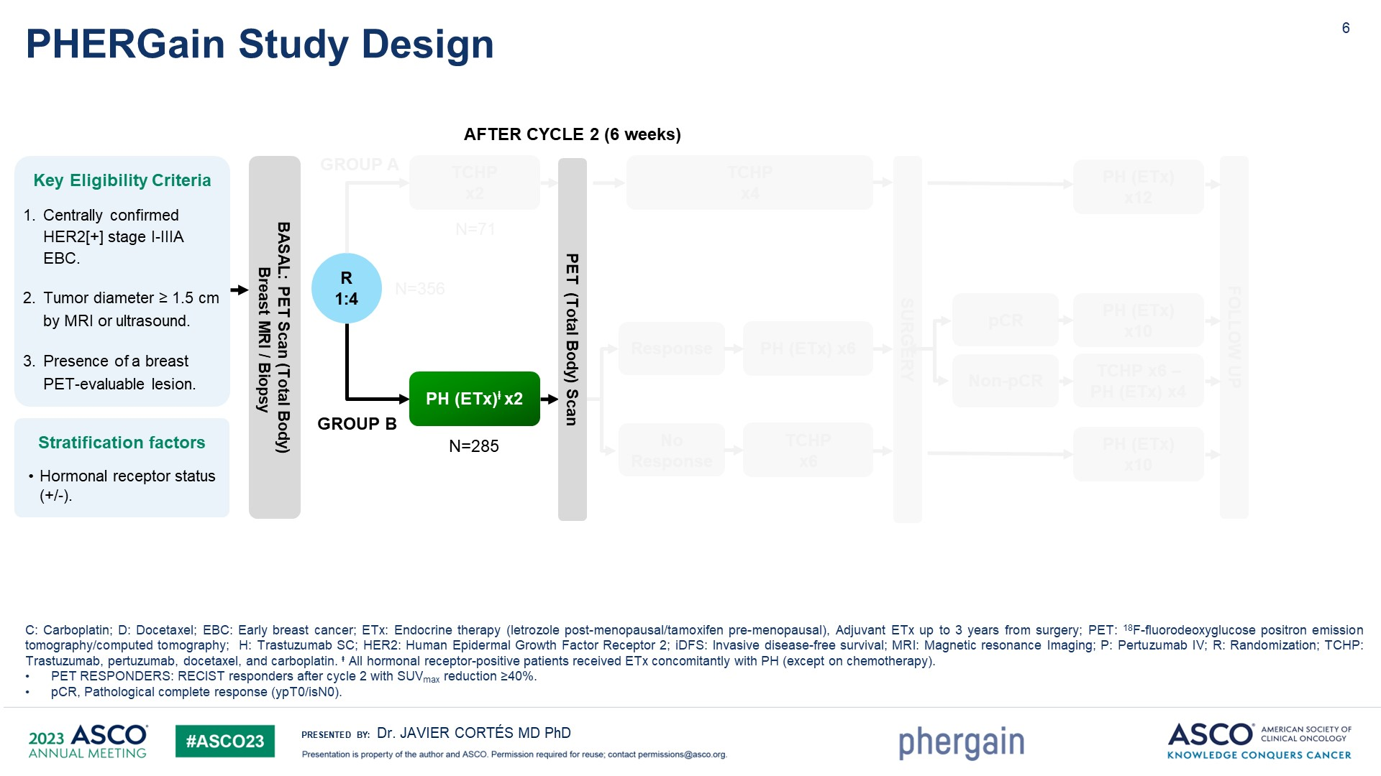
Slide 6
Content of this presentation is the property of the author, licensed by ASCO. Permission required for reuse.

Slide 22
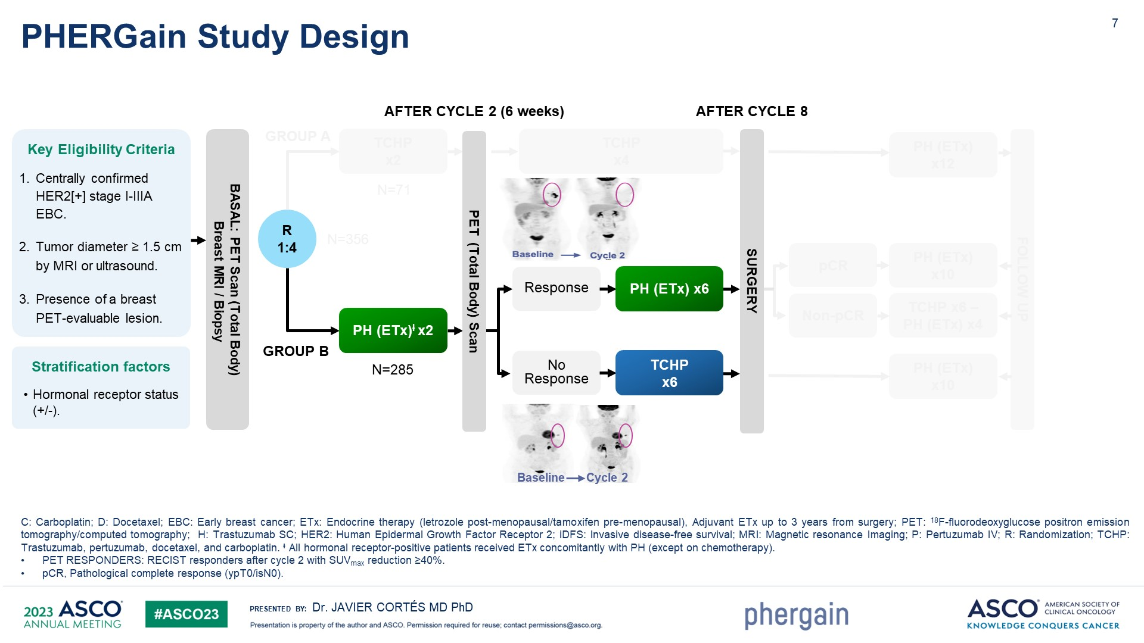
Slide 7

Slide 23
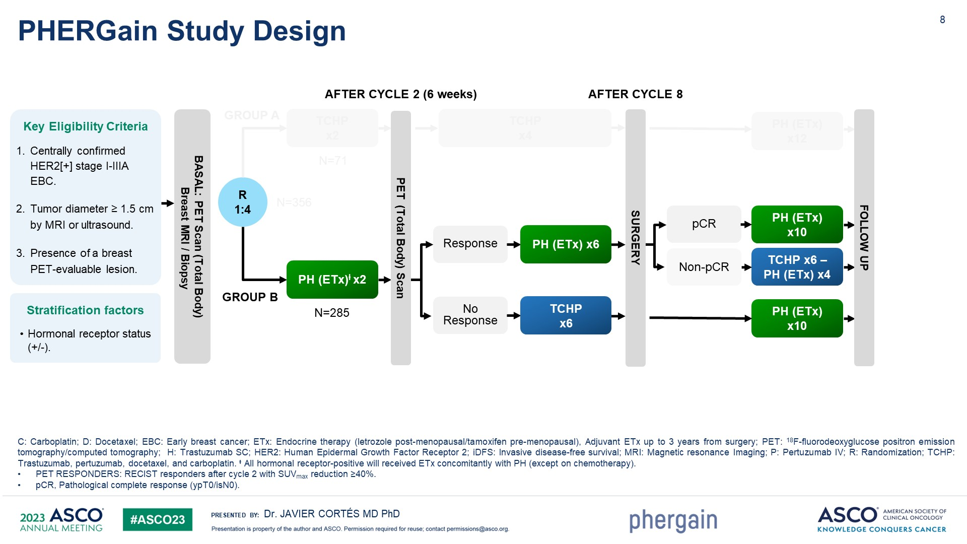
Slide 8

Slide 24
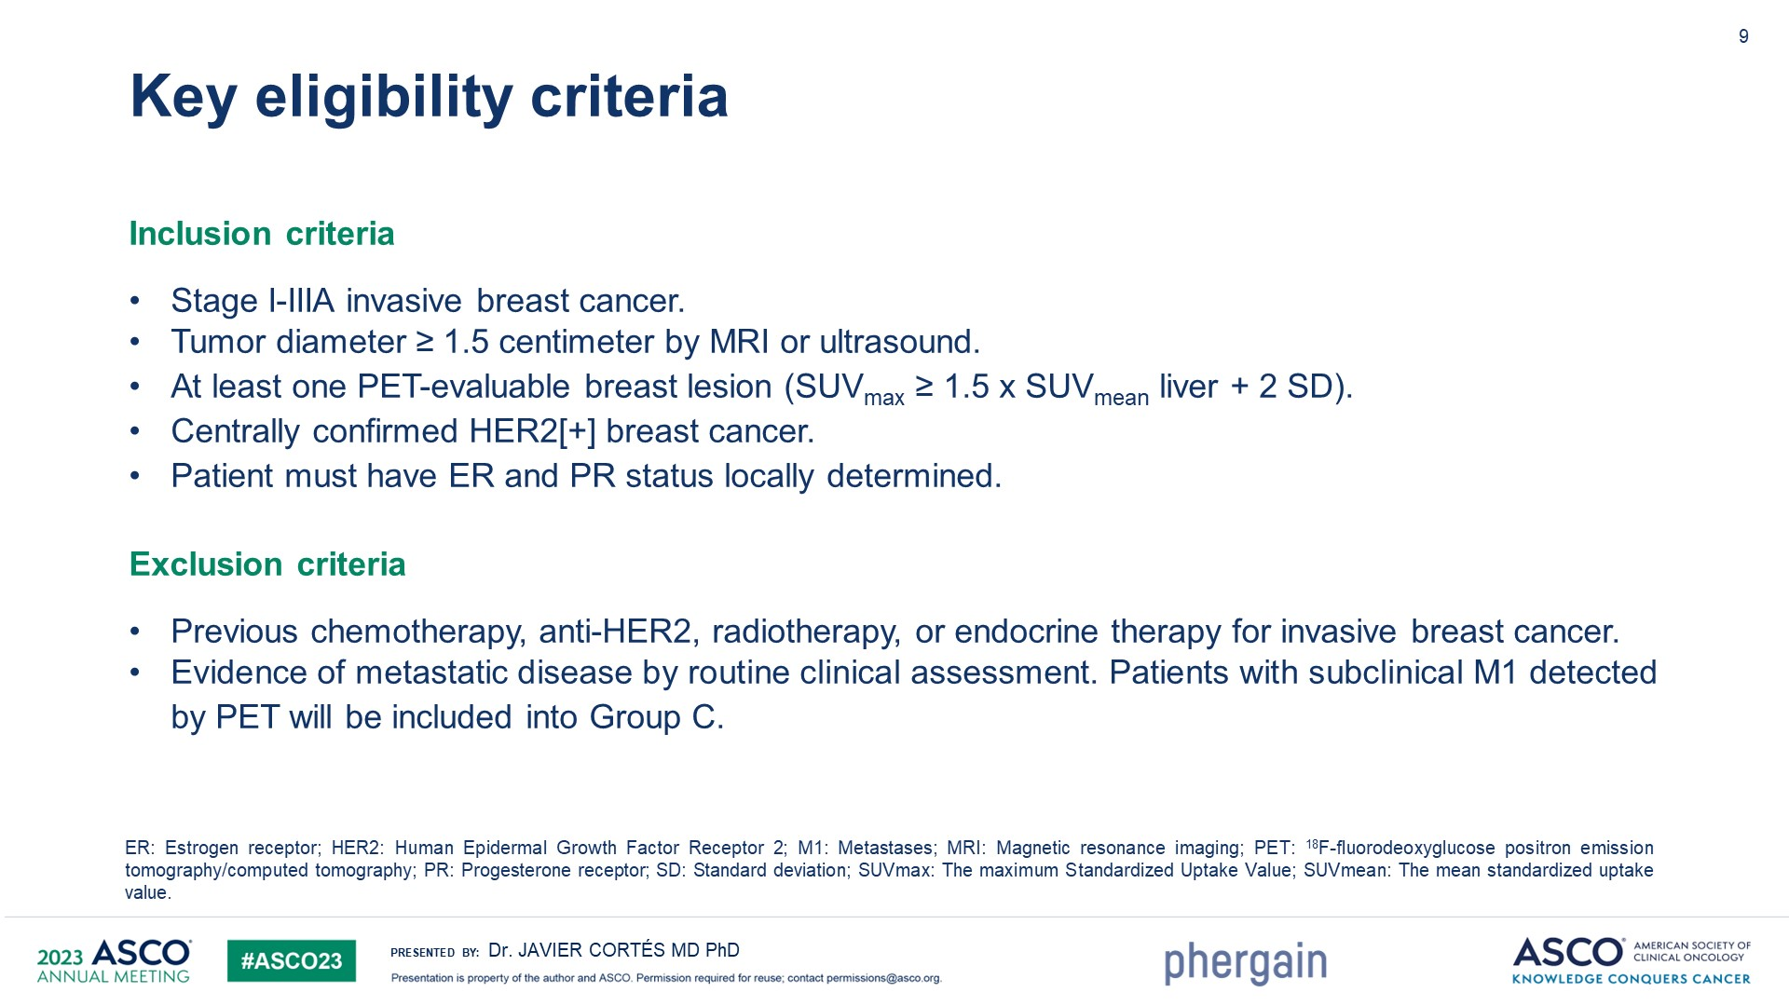
Slide 9

Slide 25
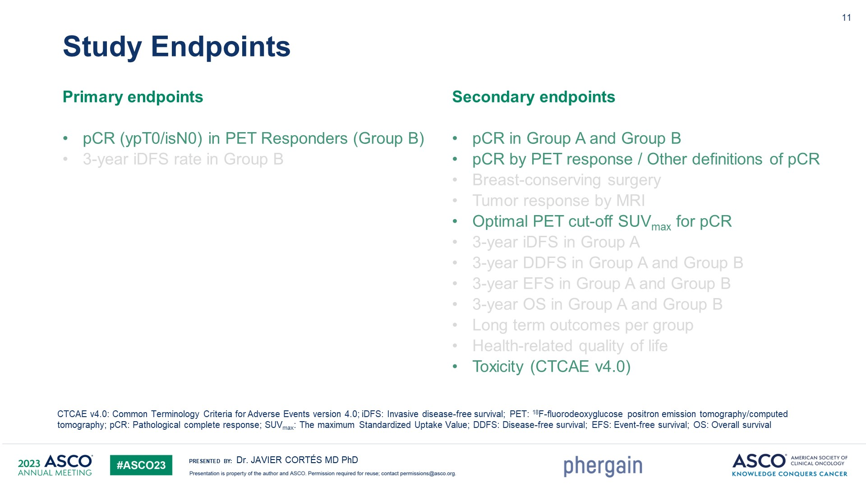
Slide 11

Slide 26
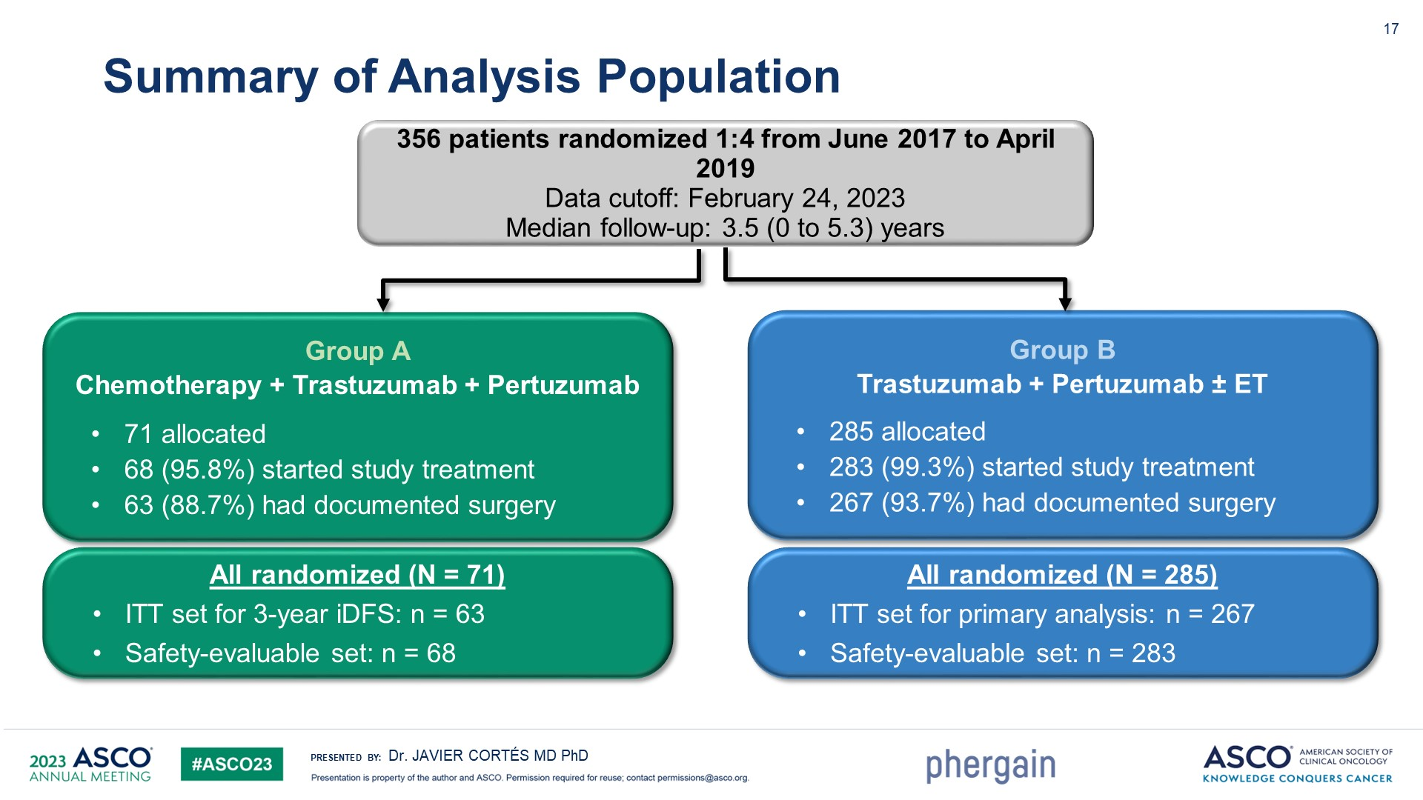
Slide 17

Slide 27
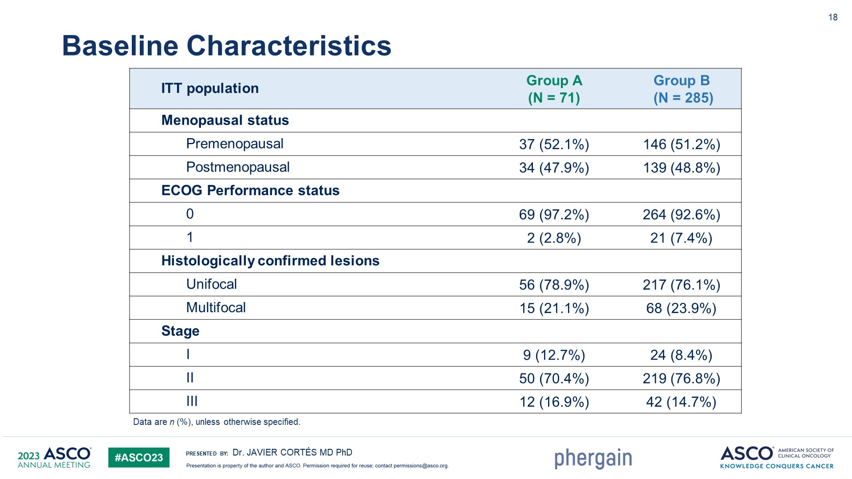
Slide 18

Slide 28
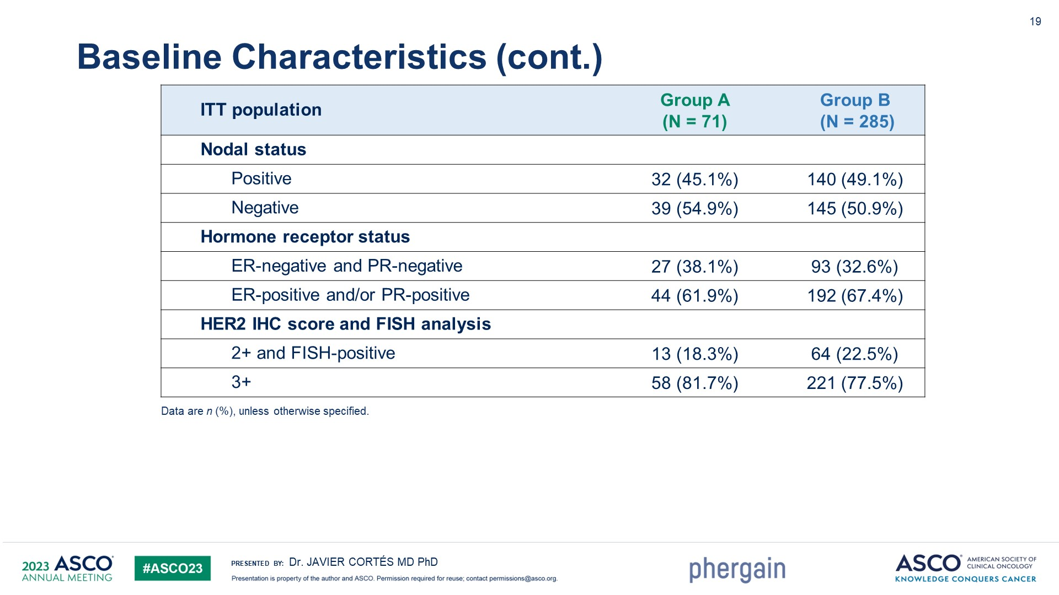
Slide 19

Slide 29
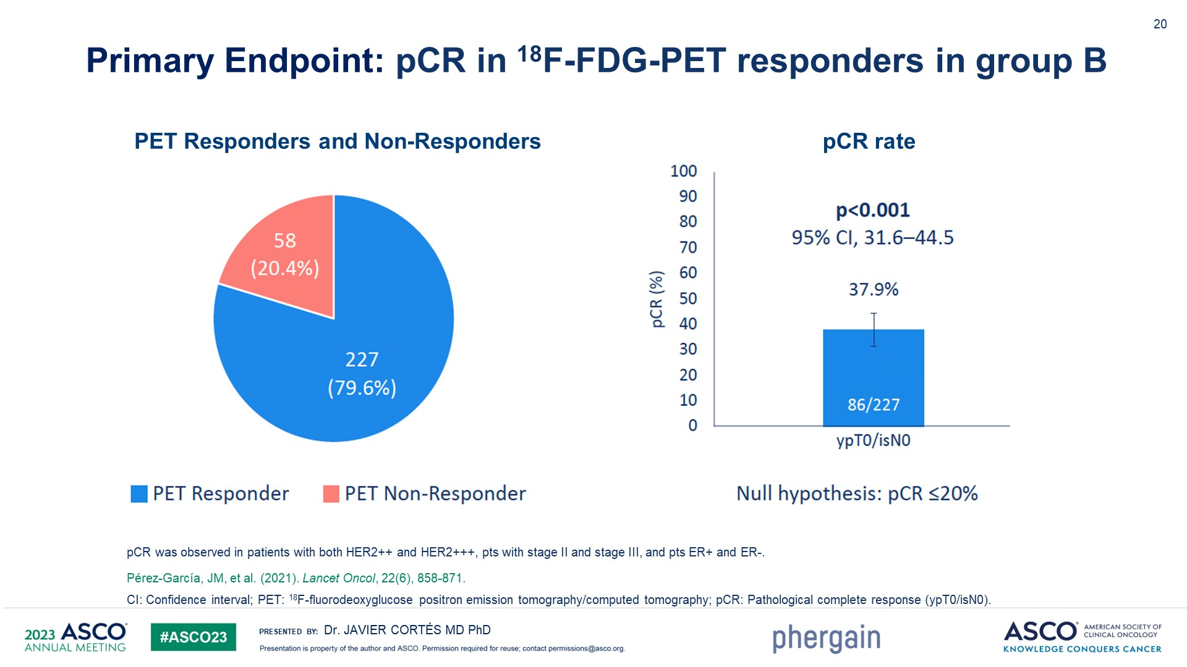
Slide 20

Slide 30
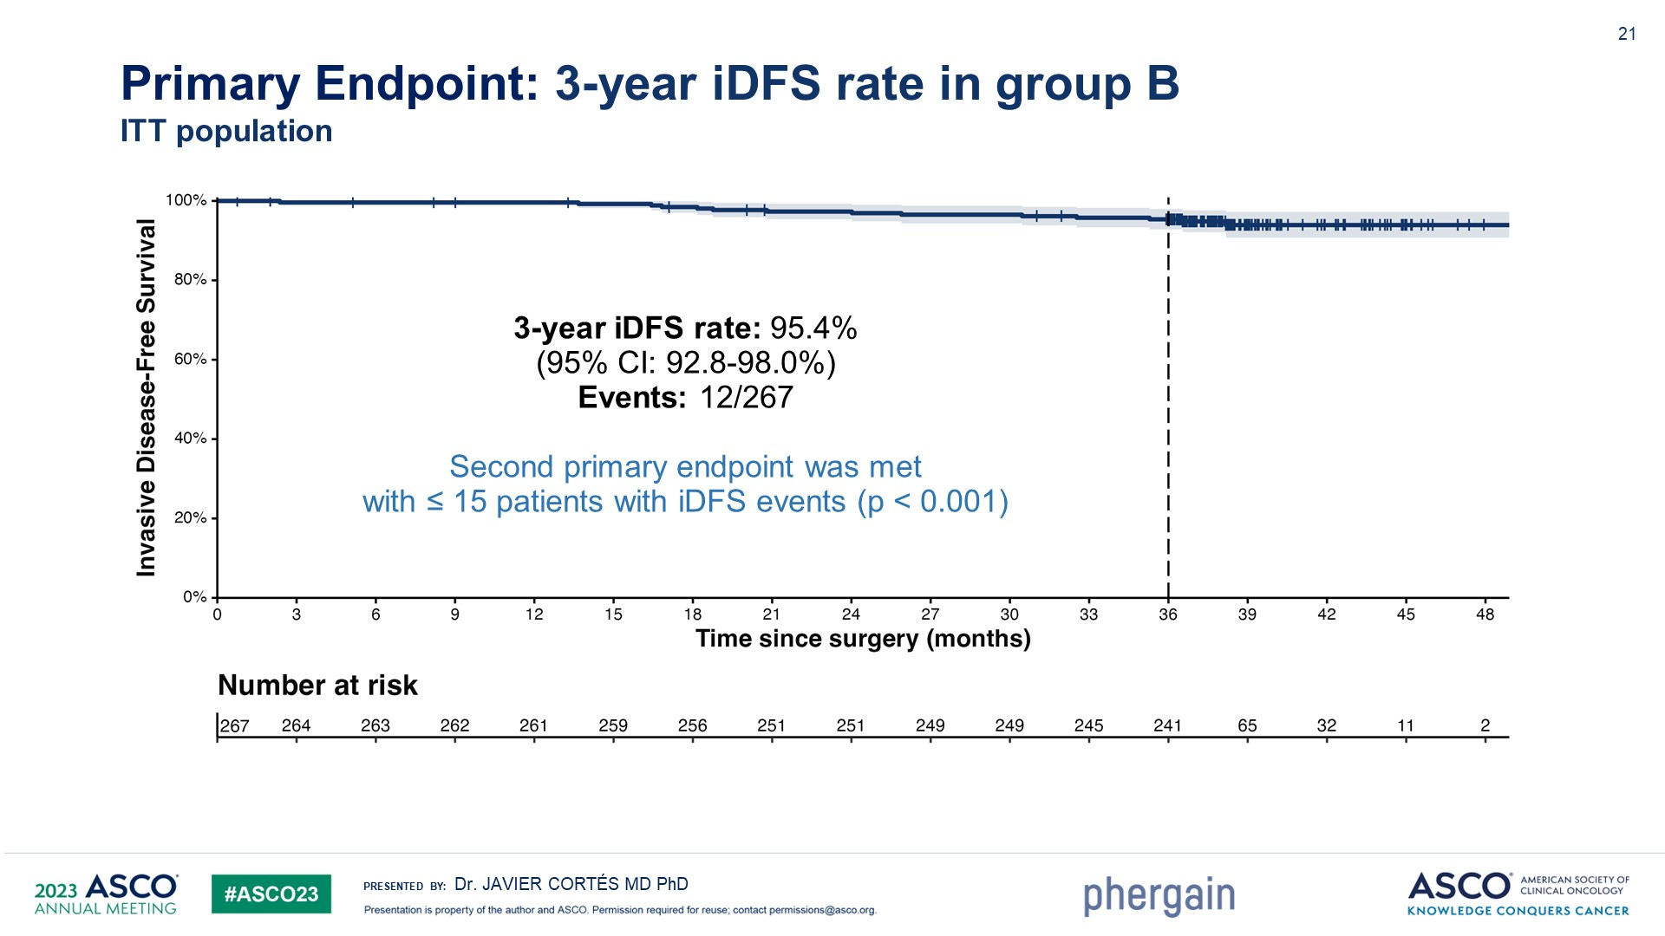
Slide 21

Slide 31
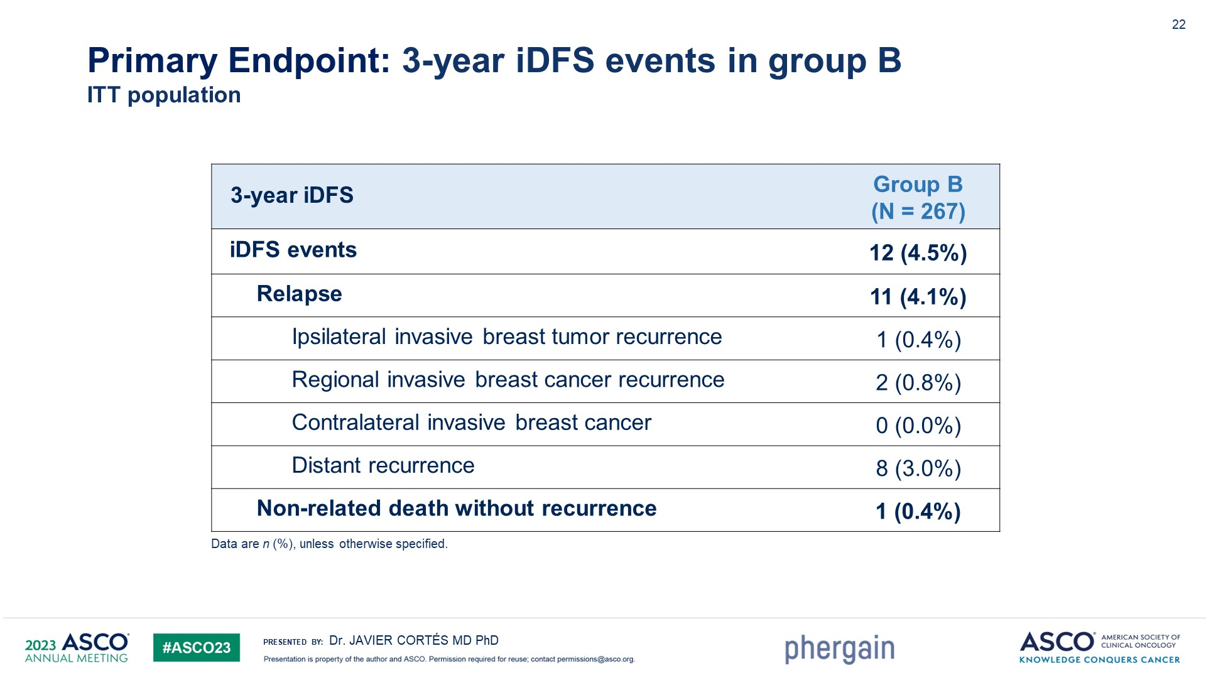
Slide 22

Slide 32
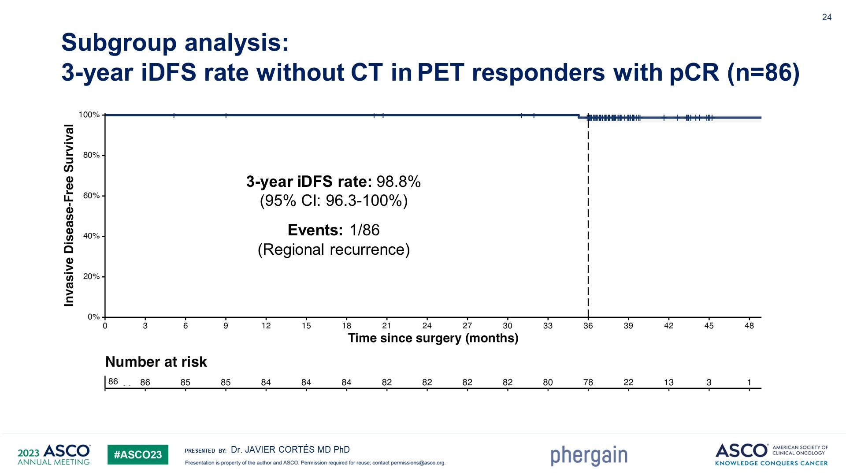
Slide 24

Slide 33
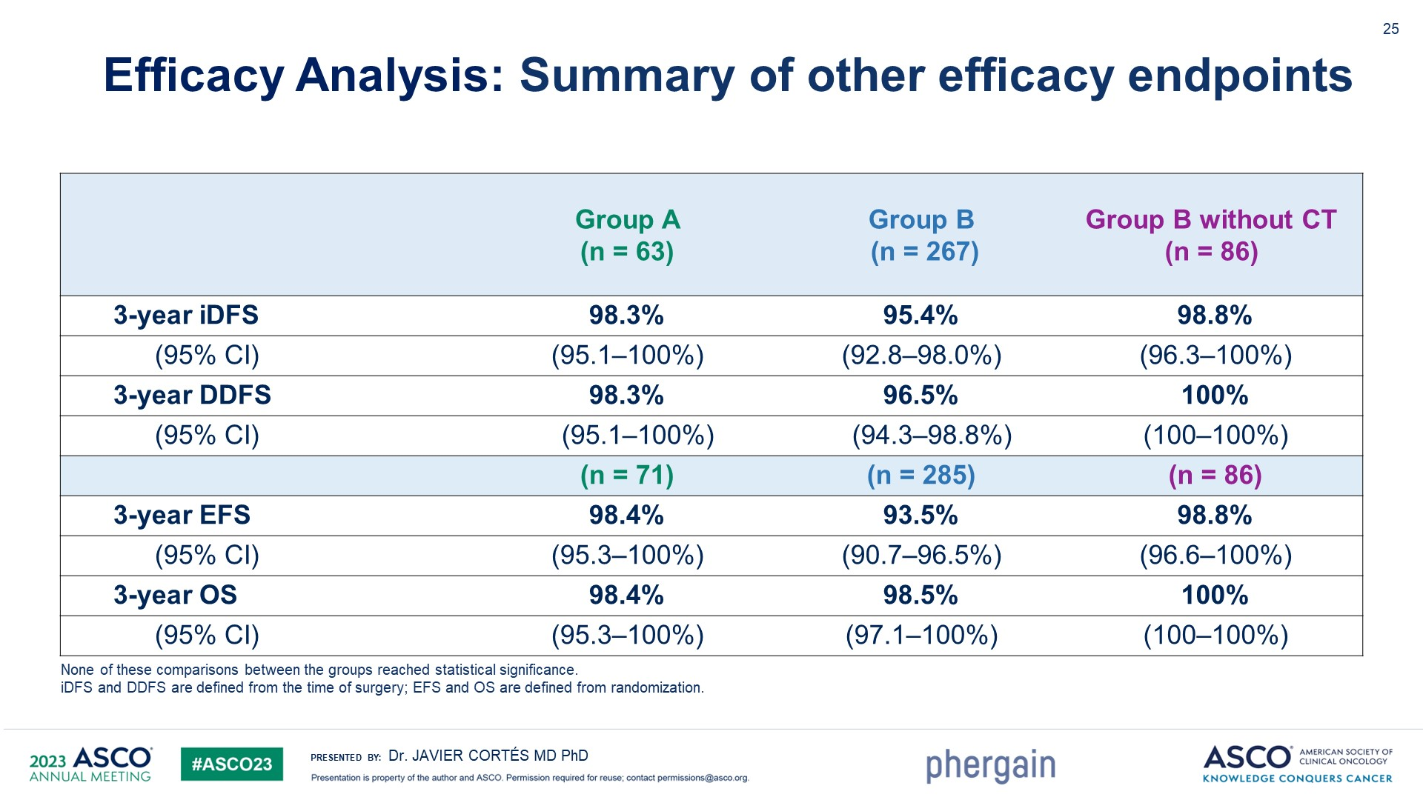
Slide 25

Slide 34
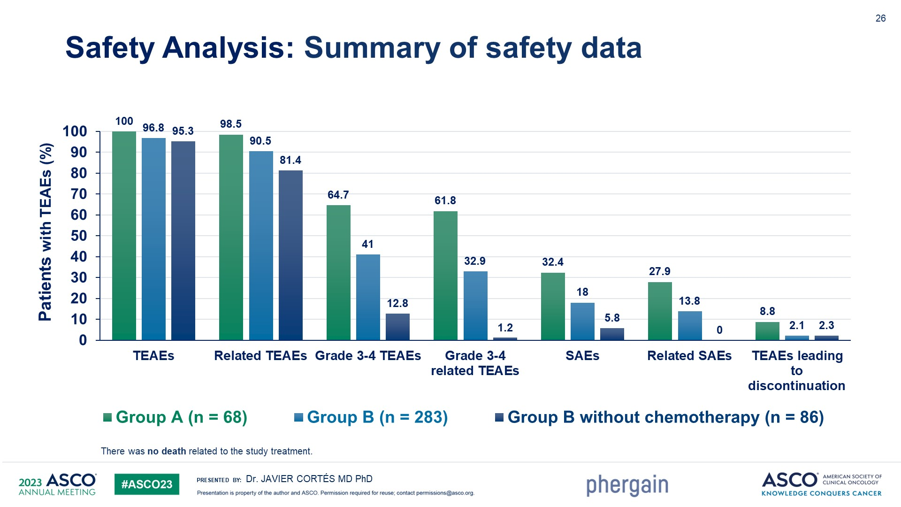
Slide 26

Slide 35
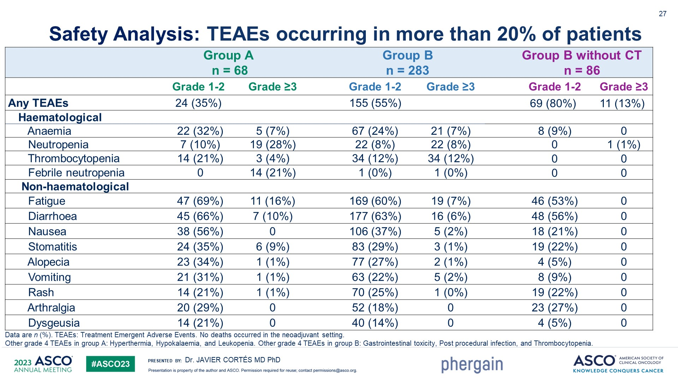
Slide 27

Slide 36
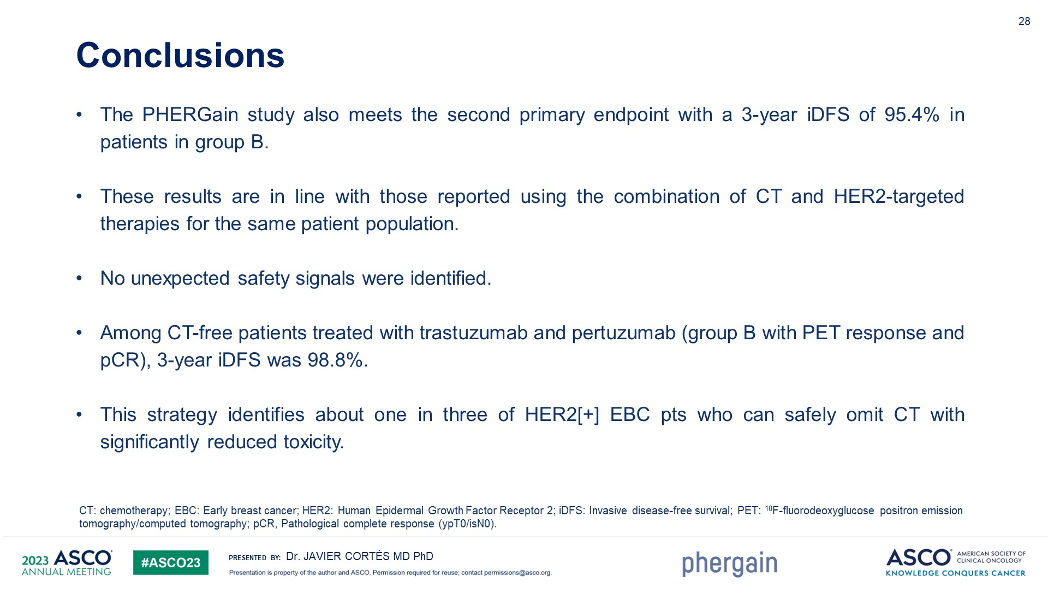
Slide 28

Slide 37
DESTINY-Breast 04
60% of human epidermal growth factor receptor 2 (HER2)–negative metastatic breast cancers express low levels of HER2, defined as a score of 1+ on immunohistochemical (IHC) analysis or as an IHC score of 2+ and negative results on in situ hybridization (ISH).
These “HER2-low” tumors constitute a heterogeneous population including both hormone receptor–positive and hormone receptor–negative breast cancers that vary in prognosis and sensitivity to systemic treatments.
Currently available HER2-directed therapies have not improved clinical outcomes in patients with this subtype. therefore, HER2-low breast cancer is currently treated as HER2-negative (HER2-low and HER2-zero [IHC score of 0]), with patients stratified according to hormone-receptor status.
Modi et al NEJM. 2022.doi:10.1056/NEJMoa2203690

Slide 38
DESTINY-Breast 04
Overall, these patients have limited targeted treatment options after progression during primary therapy and most commonly receive single-agent palliative chemotherapy.
Specifically, for patients with hormone receptor–positive, HER2-negative metastatic disease, combinations of endocrine therapy and cyclin-dependent kinase 4 and 6 (CDK4/6) inhibitors are effective for a median of approximately 2 years, after which resistance often occurs.
Real-world data suggest a progression-free survival as low as 4 months with systemic therapies given after CDK4/6 inhibitors and chemotherapy in the context of metastatic disease.
Modi et al NEJM. 2022.doi:10.1056/NEJMoa2203690

Slide 39
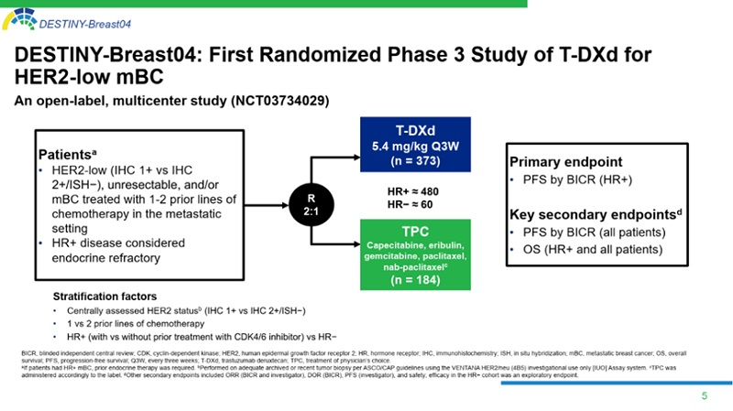
DESTINY-Breast 04

Slide 40
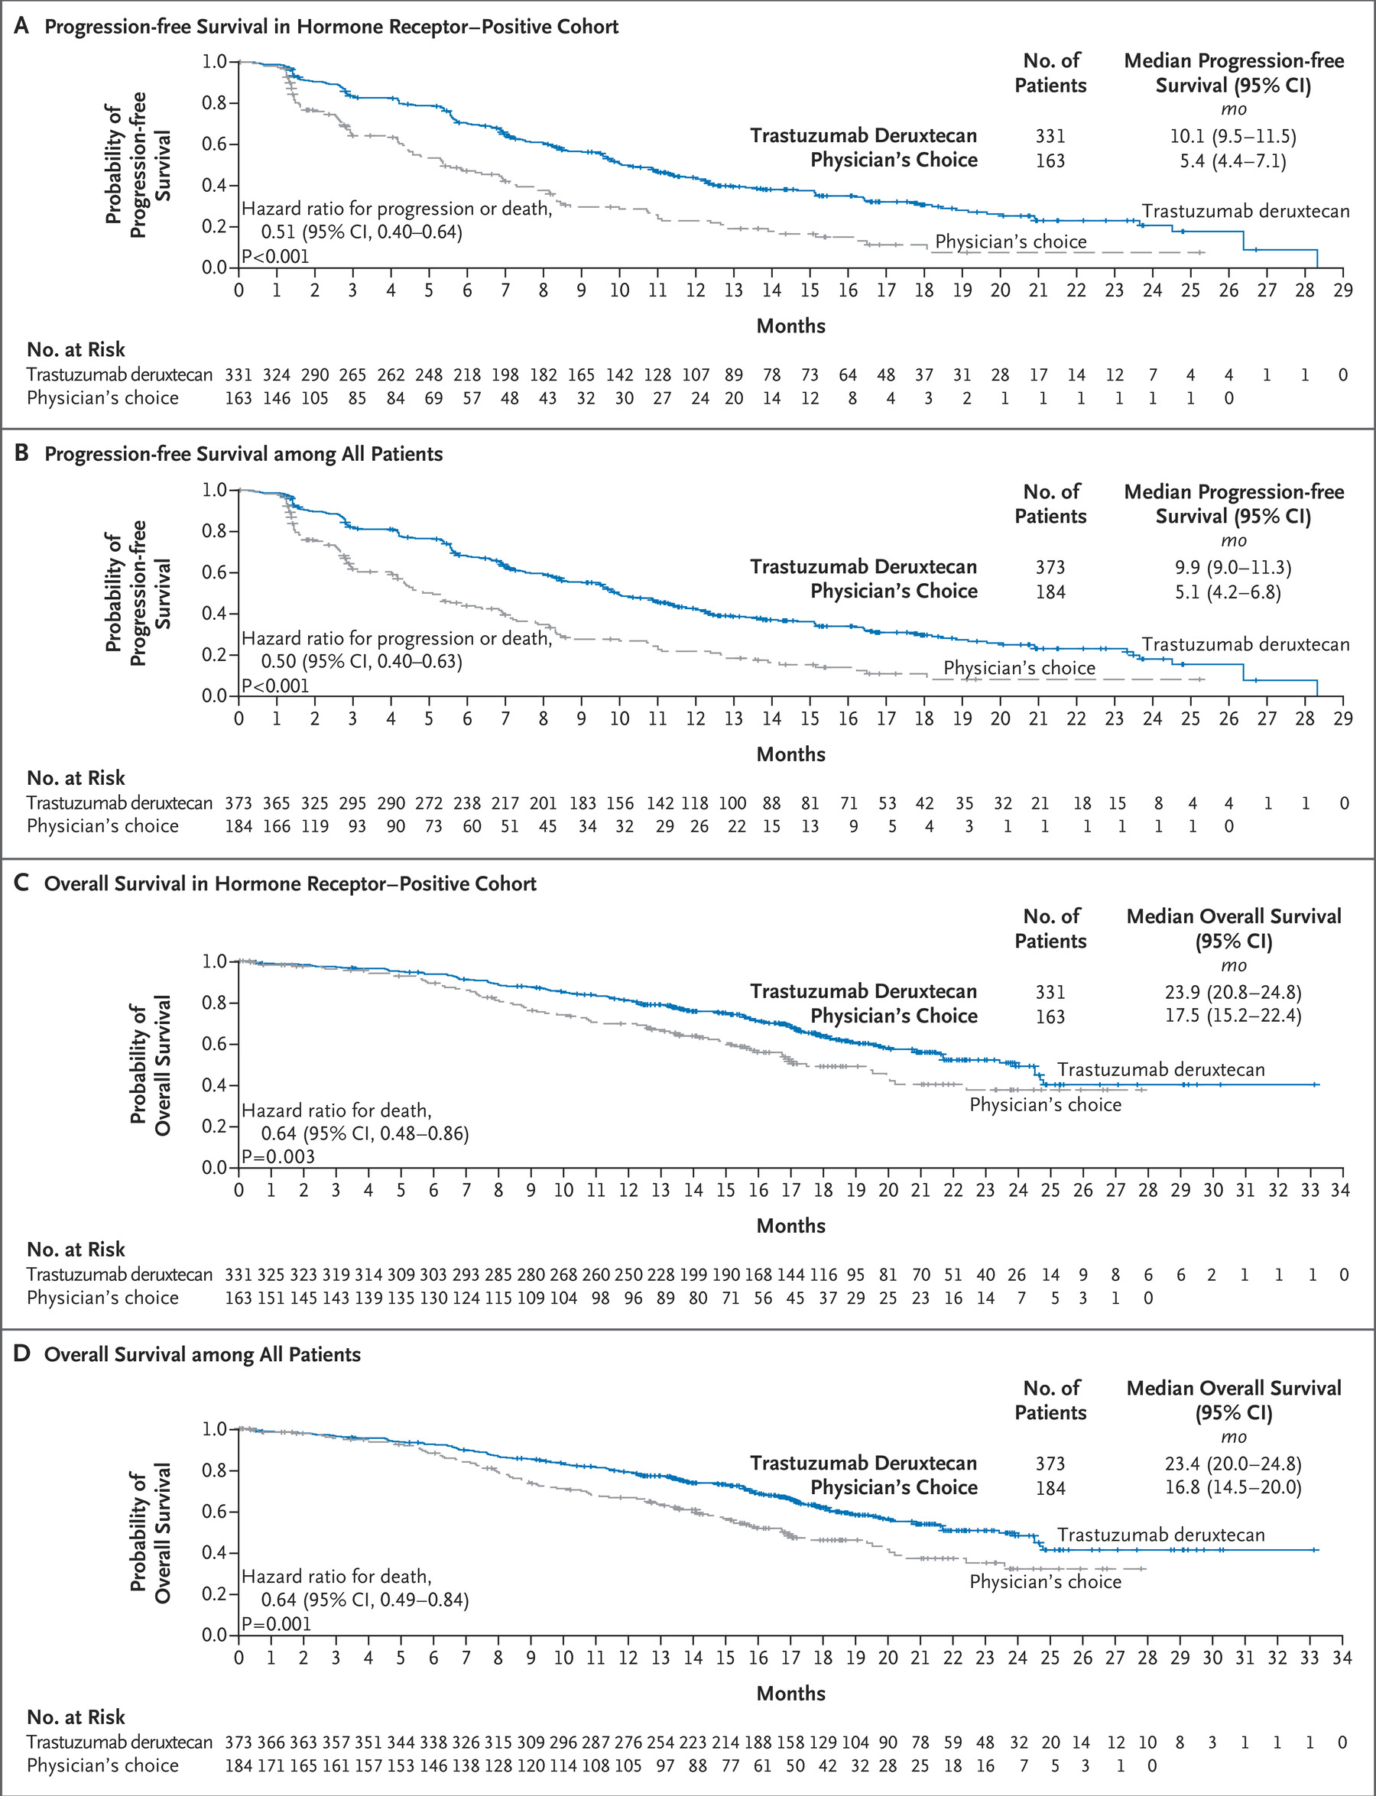
Destiny Breast 04

Slide 42
PFS in HR + and all patients
Modi et al NEJM. 2022.doi:10.1056/NEJMoa2203690

Slide 43
Subgroup analysis :PFS in HR +
Modi et al NEJM.2022.doi:10.1056/NEJMoa2203690

Slide 44
OS in HR+ and all patients
Modi et al NEJM. 2022.doi:10.1056/NEJMoa2203690

Slide 45
Exploratory endpoints: PFS and OS in HR-
Modi et al NEJM. 2022.doi:10.1056/NEJMoa2203690

Slide 49
DESTINY-Breast04 establishes-DXd as the new standard of care in
HER2-low,HR+/HR-mBC

Slide 50
THANK YOU

Slide 51
The Use of CDK4/6 Inhibitors in Breast Cancer
James Martin, MD
Hematology and Medical Oncology
University Hospitals/Seidman Cancer Center
Cleveland, OH

Slide 52
Outline
Background/Mechanism of CDK4/6 inhibitors
Use in metastatic breast cancer
Use in high-risk early-stage breast cancer (adjuvant)
MAINTAIN (continuing CDK4/6 inhibition)
SONIA (Is 1st or 2nd – line better?)

Slide 53
Background
Approximately 70-80% of breast cancer cases express estrogen receptor (ER) and/or progesterone receptor (PR) and targeting the estrogen signaling pathway has become SOC for both early and metastatic breast cancer.
Inhibitors of cyclin-dependent kinases 4/6 (CDK4/6i) were developed and have been shown to enhance the effect of antiestrogen therapy in vitro and in vivo.
Currently, there are 3 FDA-approved CDK4/6 inhibitors available for breast cancer: palbociclib, ribociclib and abemaciclib.

Slide 54
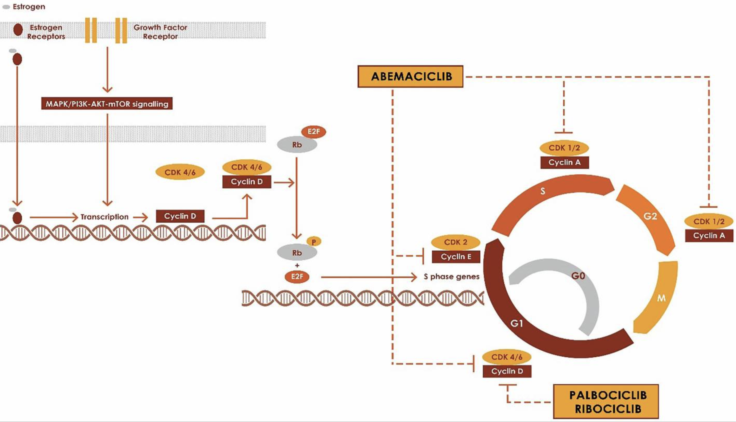
Front Oncol. 2021; 11: 693104.

Slide 55
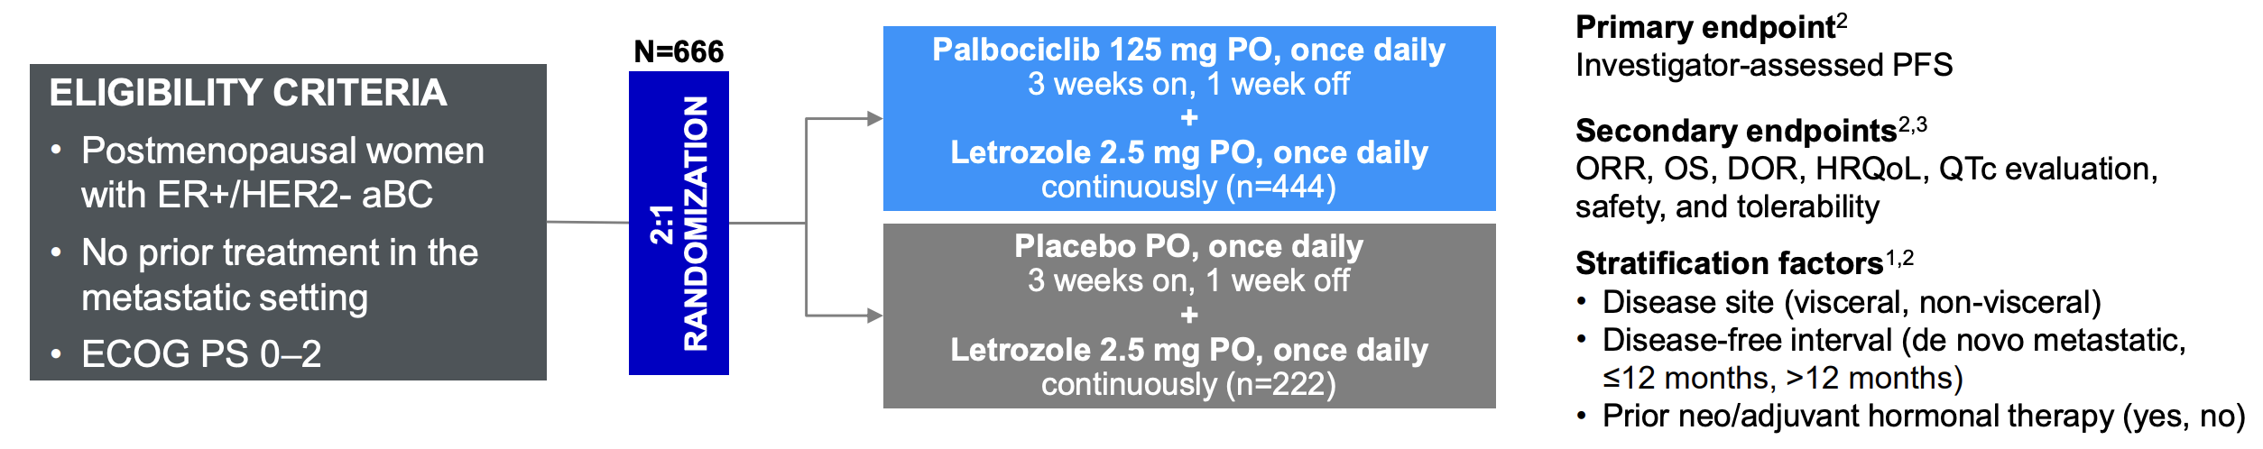
PALOMA-2 (front-line)
Randomized, double-blind, placebo-controlled trial.
1. Finn RS, et al. N Engl J Med. 2016;375:1925-1936.

Slide 56
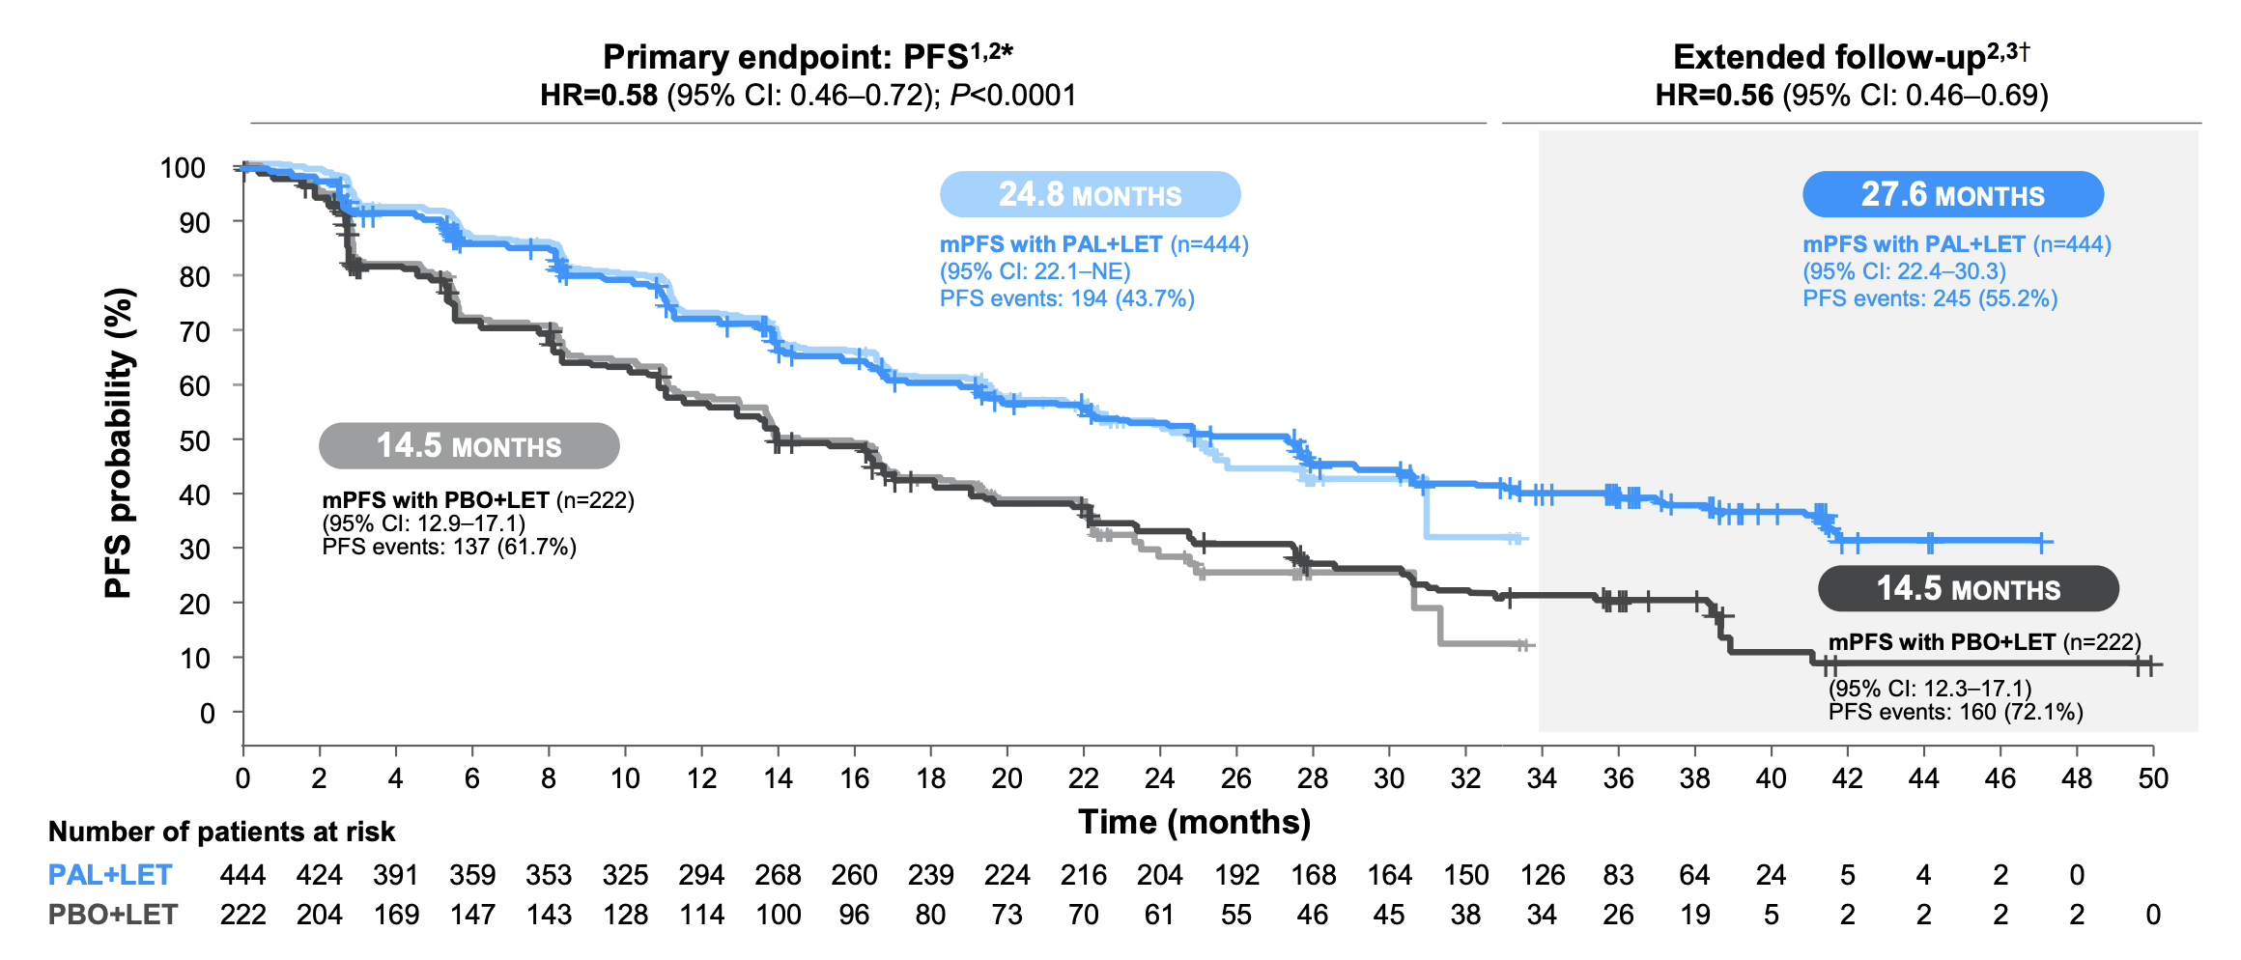
1. Finn RS, et al. N Engl J Med. 2016;375:1925-1936. 2. Rugo, HS, et al. Breast Cancer Res Treat. 2019;174:719-729. 3. Data on File (97). Pfizer.

Slide 57
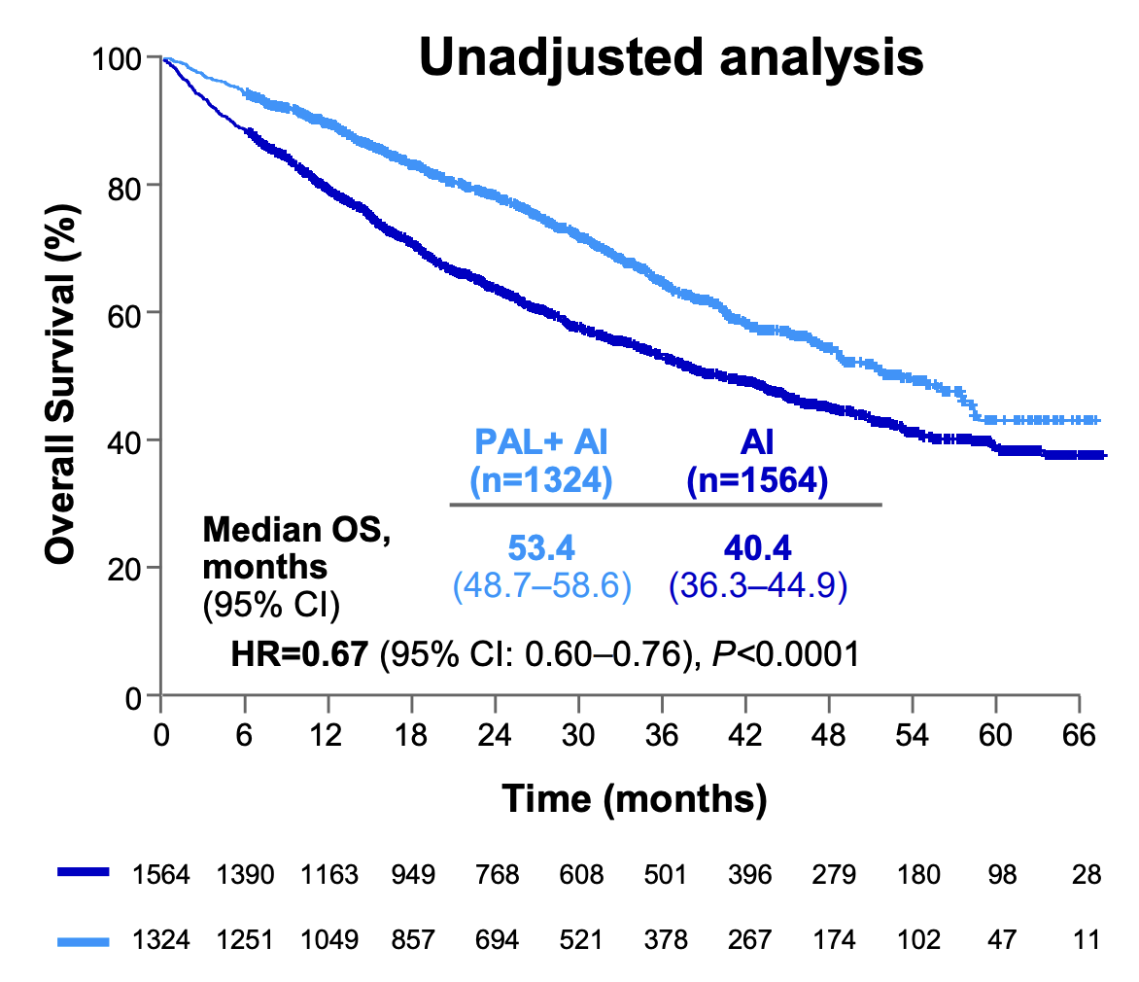
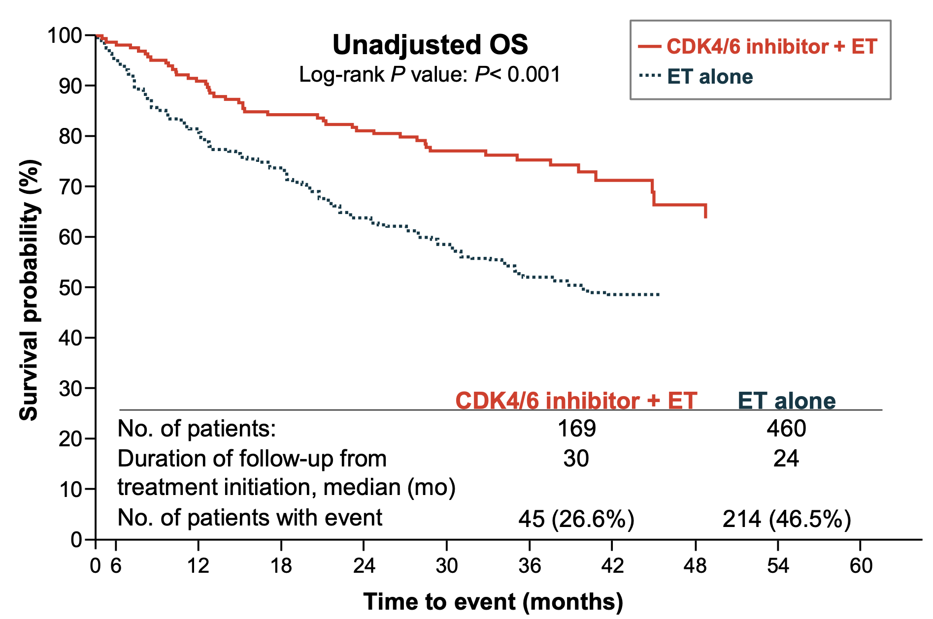
All subgroups appeared to benefit from addition of the CDK4/6i (age, bone-only disease, visceral disease, treatment-free interval, de novo metastatic disease).
Final OS evaluation did NOT show a statically-significant improvement with palbociclib: 53.9 months vs 51.2 months, p = 0.34¹.
Some real-world data that might suggest improvement in OS.
Finn RS, et al. Abstract LBA1003. ASCO 2022.
Rugo HS, et al. NPJ Breast Cancer. 2022;8:114.
Goyal RK, et al. Cancer. 2023;129:1051-1063.
Notes:
Flatiron
SEER: NE vs 34.8 months

Slide 58
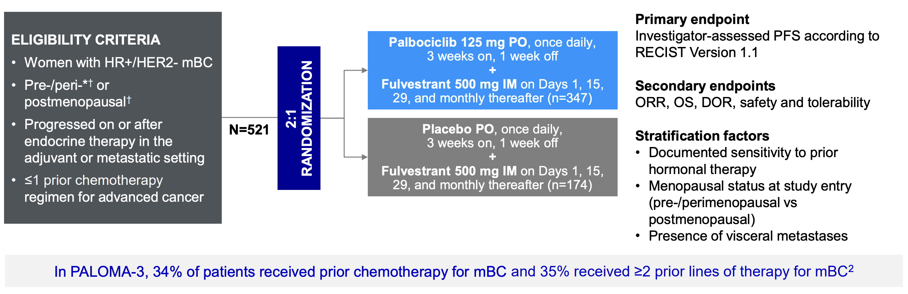
PALOMA-3 (second-line)
Turner NC, et al. N Engl J Med. 2015;373:209-219.
2. Turner NC, et al. N Engl J Med. 2018;379:1926-1936.

Slide 59
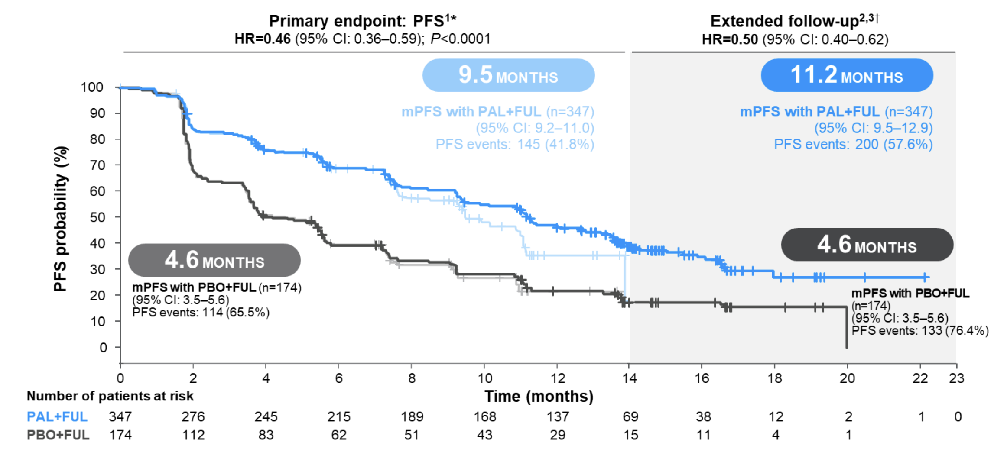

Slide 60
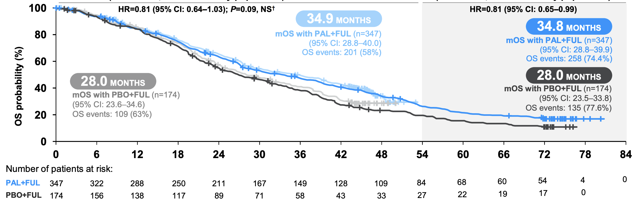
OS numerically improved, but not statistically significant.

Slide 61
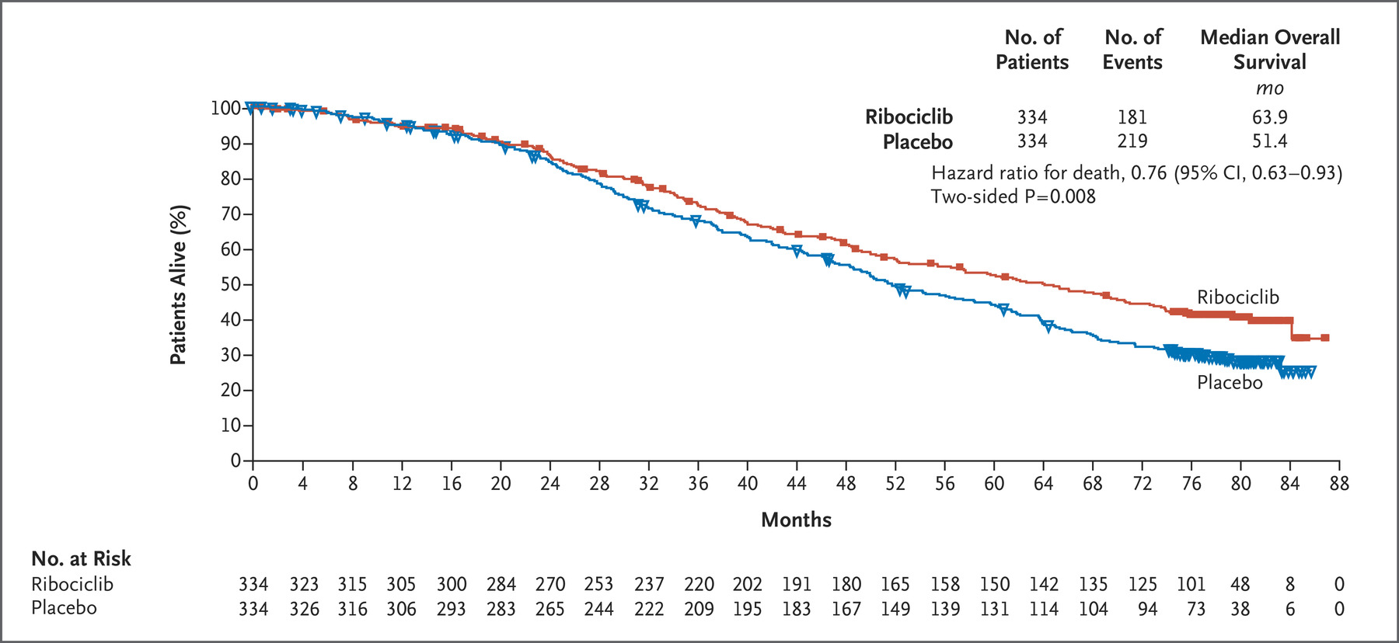
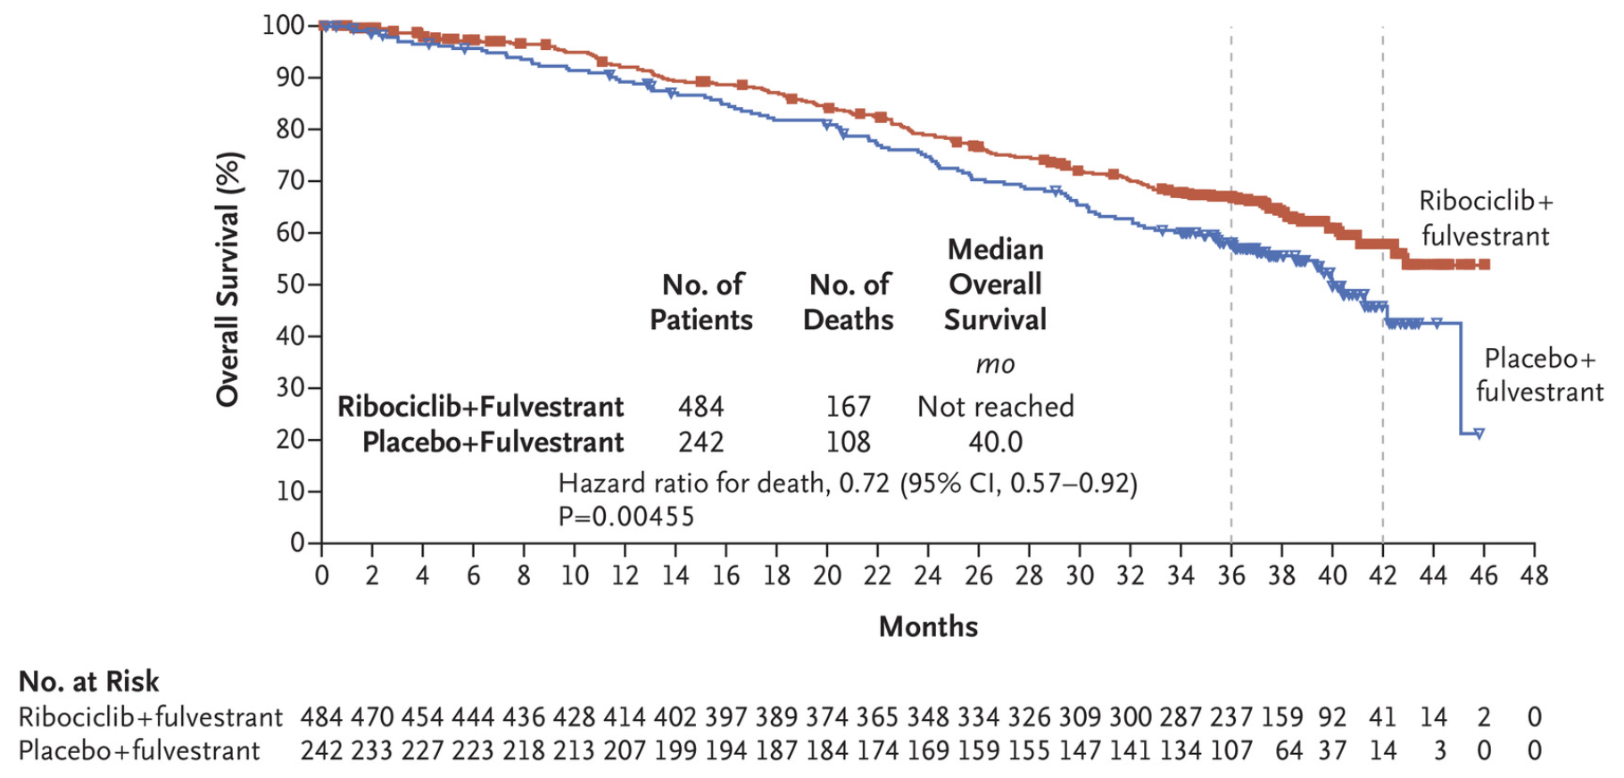
MONALEESA-2 and MONALEESA-3 (ribociclib)

Slide 62
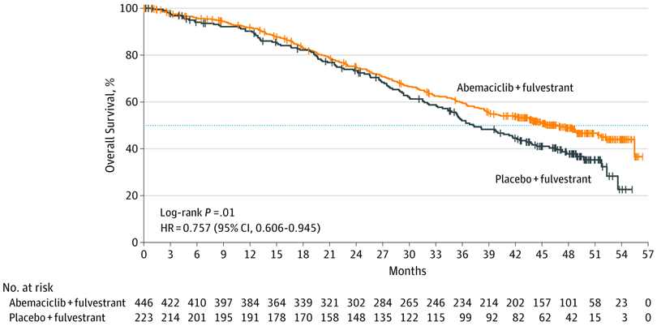
MONARCH 2 and MONARCH 3 (abemaciclib)
OS remains immature for MONARCH 3.
At last interim analysis: 67.1 vs 54.5 months, favoring abemaciclib.

Slide 63
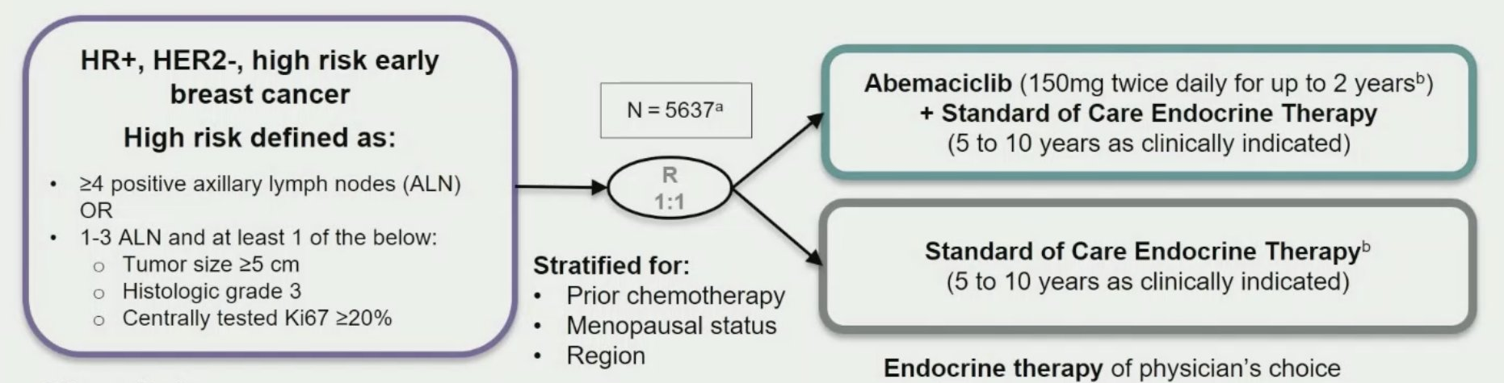
MonarchE
With success in advanced/metastatic setting, interest in moving CDK4/6i in adjuvant setting for high-risk early breast cancer.
>95% had chemotherapy in neoadjuvant or adjuvant setting.
AI or tamoxifen (+/- GnRH agonist).
LBA5_PR - Abemaciclib in high risk early breast cancer. Annals of Oncology (2020) 31 (suppl_4): S1142-S1215. 10.1016/annonc/annonc325

Slide 64
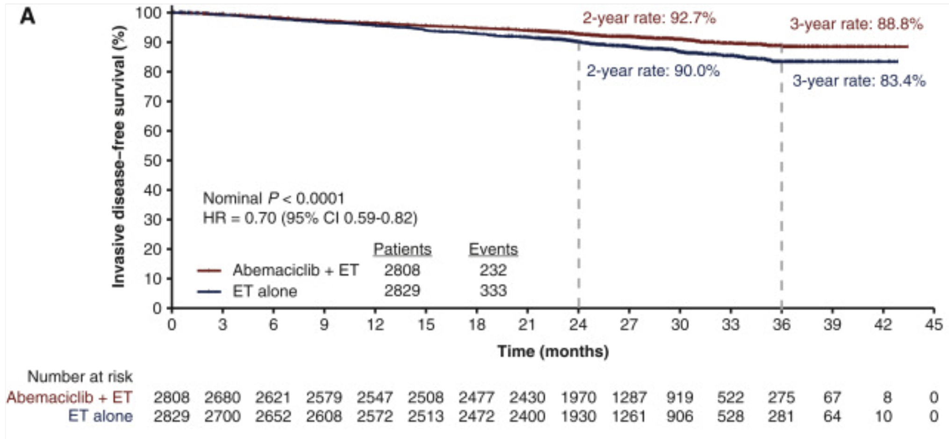
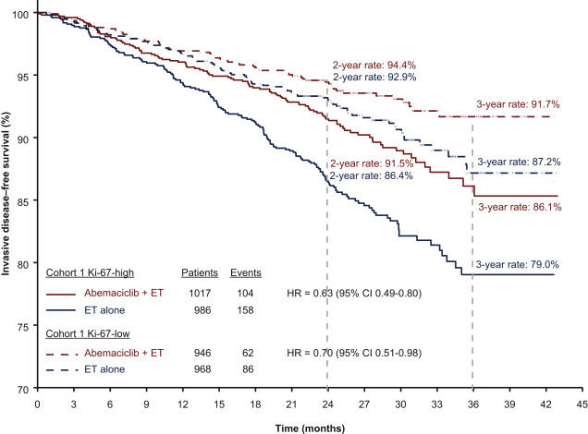
OS data still pending at this time.
Ann Oncol. 2021 Dec;32(12):1571-1581.

Slide 65
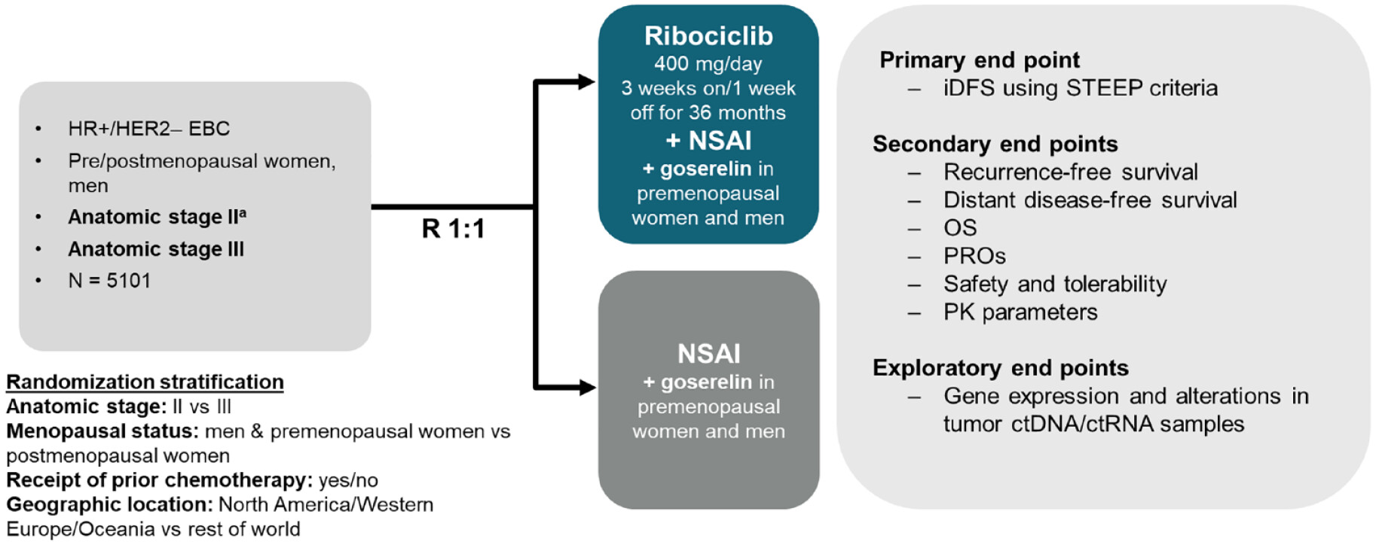
NATALEE
Ther Adv Med Oncol. 2023; 15: 17588359231178125.

Slide 66
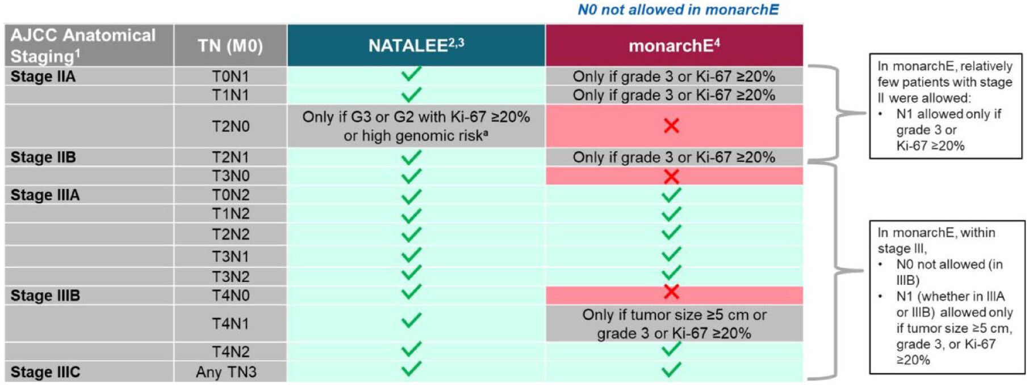
Ther Adv Med Oncol. 2023; 15: 17588359231178125.
~60% patients were postmenopausal. Men were allowed.
~30% had N0 disease.

Slide 67
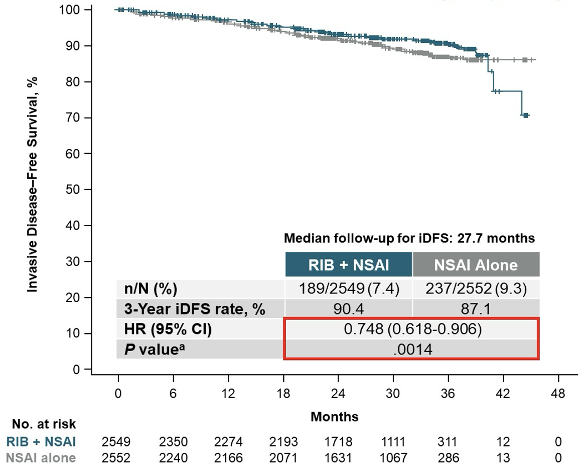
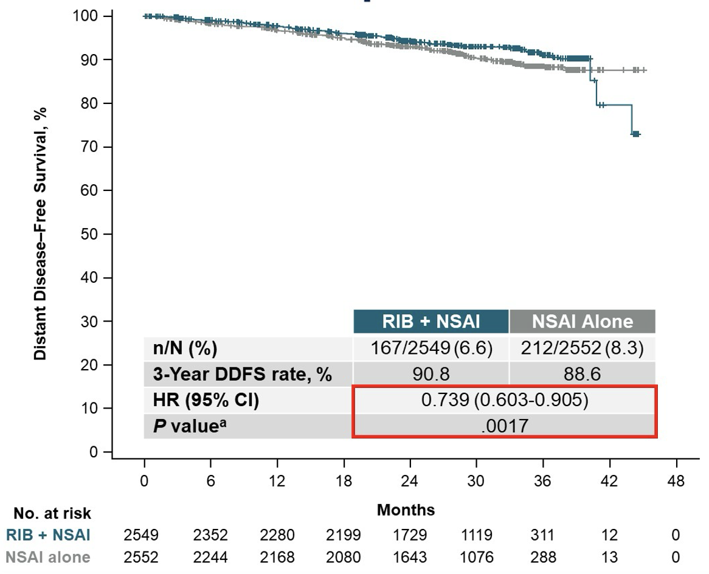
DDFS
iDFS
Slamon D. ASCO 2023. J Clin Oncol 41, 2023 (suppl 17; abstr LBA500)

Slide 68
NATALEE (conclusions)
NATALEE met primary endpoint at second interim analysis with IDFS improvement with ribociclib in addition to standard adjuvant endocrine therapy.
No OS benefit seen yet.
Ribociclib at 400 mg dosing was well tolerated- still had ~19% discontinuation rate for AE’s.
Benefit seen across prespecified subgroups- will this be maintained with longer follow-up? N0?
No FDA approval yet.

Slide 69
MAINTAIN
Should CDK4/6i continue in the second-line setting, if used in frontline setting?
MAINTAIN: 119 patients with documented progression on any CDK4/6i and any ET.
Randomized 1:1 to switching ET +/- ribociclib or placebo.
Fulvestrant was ET (if no prior FULV), but exemestane allowed (if FULV given previously).
~86% palbociclib, ~10-13% ribociclib in the preceding treatment.

Slide 70
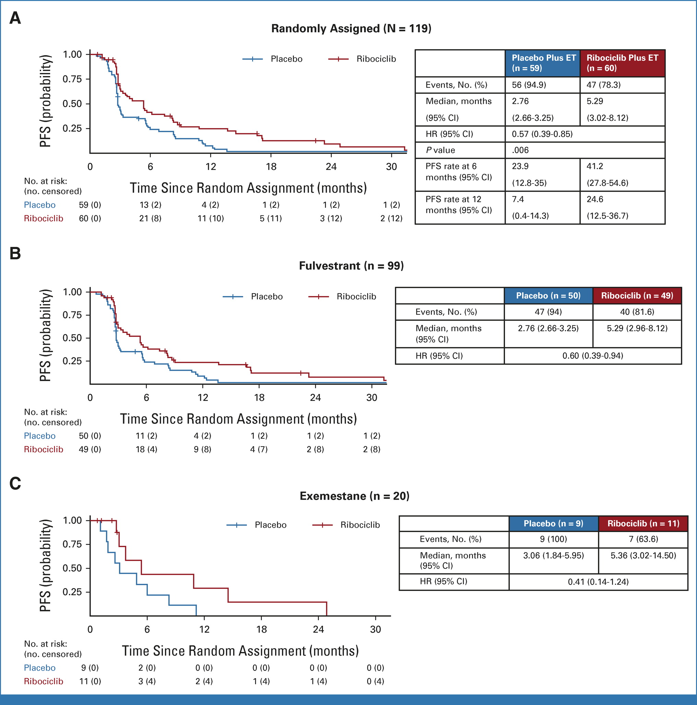

Slide 71
MAINTAIN (conclusions)
PFS improved with utilizing ribociclib in the second-line setting, after prior CDK4/6i in frontline setting.
Is this an effect of the CDK4/6i?
What about abemaciclib?
Is fulvestrant monotherapy a good comparison? Historically bad.
No OS data.
ESR1 mutations and PIK3CA mutations appeared to NOT benefit from ribociclib, compared to placebo (latter small numbers).
PACE: CDK4/6i + ET → FULV +/- palbociclib. No benefit.

Slide 72
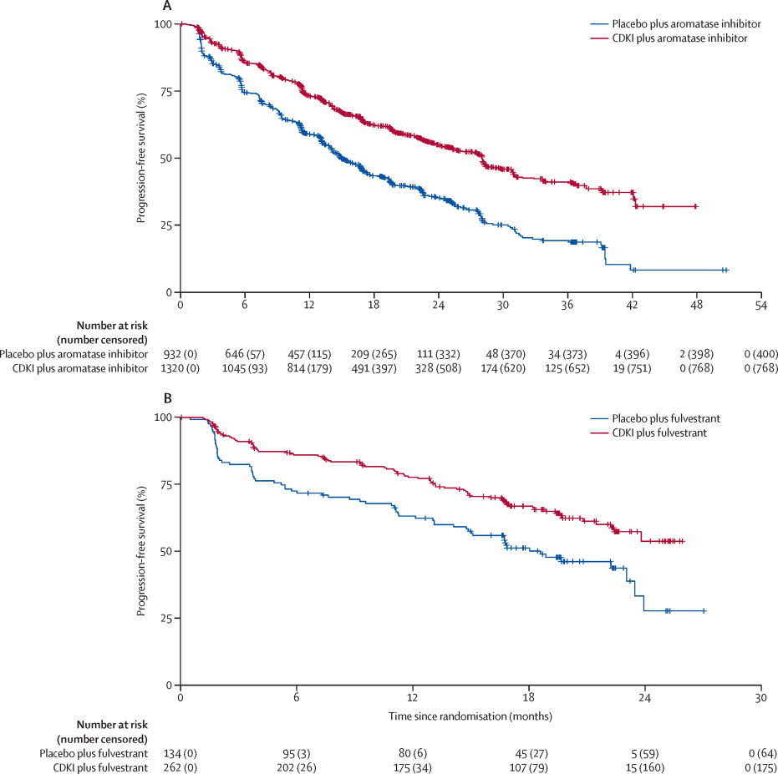
Does every patient require a CDK4/6i?
Several studies have suggested that nearly every patient may benefit from addition of a CDK4/6i¹.
Due to rising cost of healthcare and overall expense of these agents, prospective data were needed.
SONIA: an investigator-initiated, randomized phase 3 study conducted in the Netherlands.
1. Lancet Oncol. 2020 Feb;21(2):250-260.

Slide 73
SONIA
1050 pre-/postmenopausal women with untreated MBC were randomized to:
    Arm A: NSAI with CDK4/6i → Fulvestrant
    Arm B: NSAI → Fulvestrant with CDK4/6
(Neo)adjuvant therapy was allowed, presuming TFI >12 months for NSAI use. Any CDK4/6i allowed.
The primary endpoint was time from randomization to second objective disease progression, as assessed by local investigators, or death (PFS2).
Notes:
Majority of patients were postmenopausal.
~50% had visceral disease in each arm.
>90% palbociclib, ~8% ribociclib, ~1% abemaciclib.

Slide 74
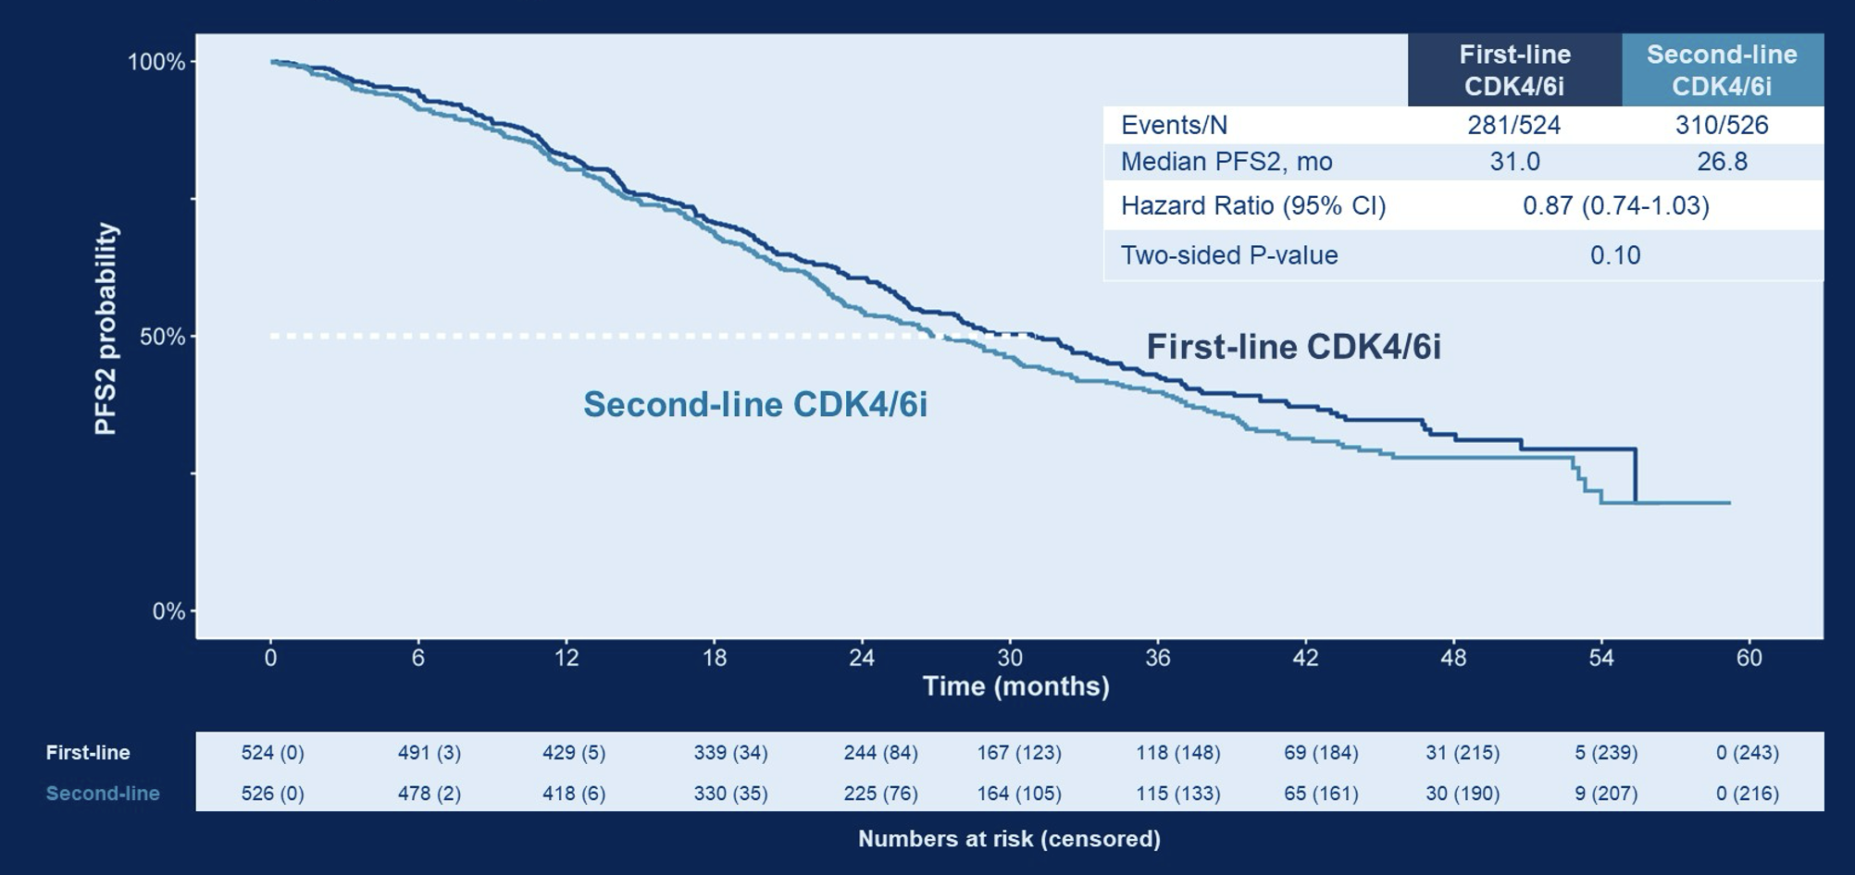
PFS2
Sonke G. ASCO 2023. J Clin Oncol 41, 2023 (suppl 17; abstr LBA1000)

Slide 75
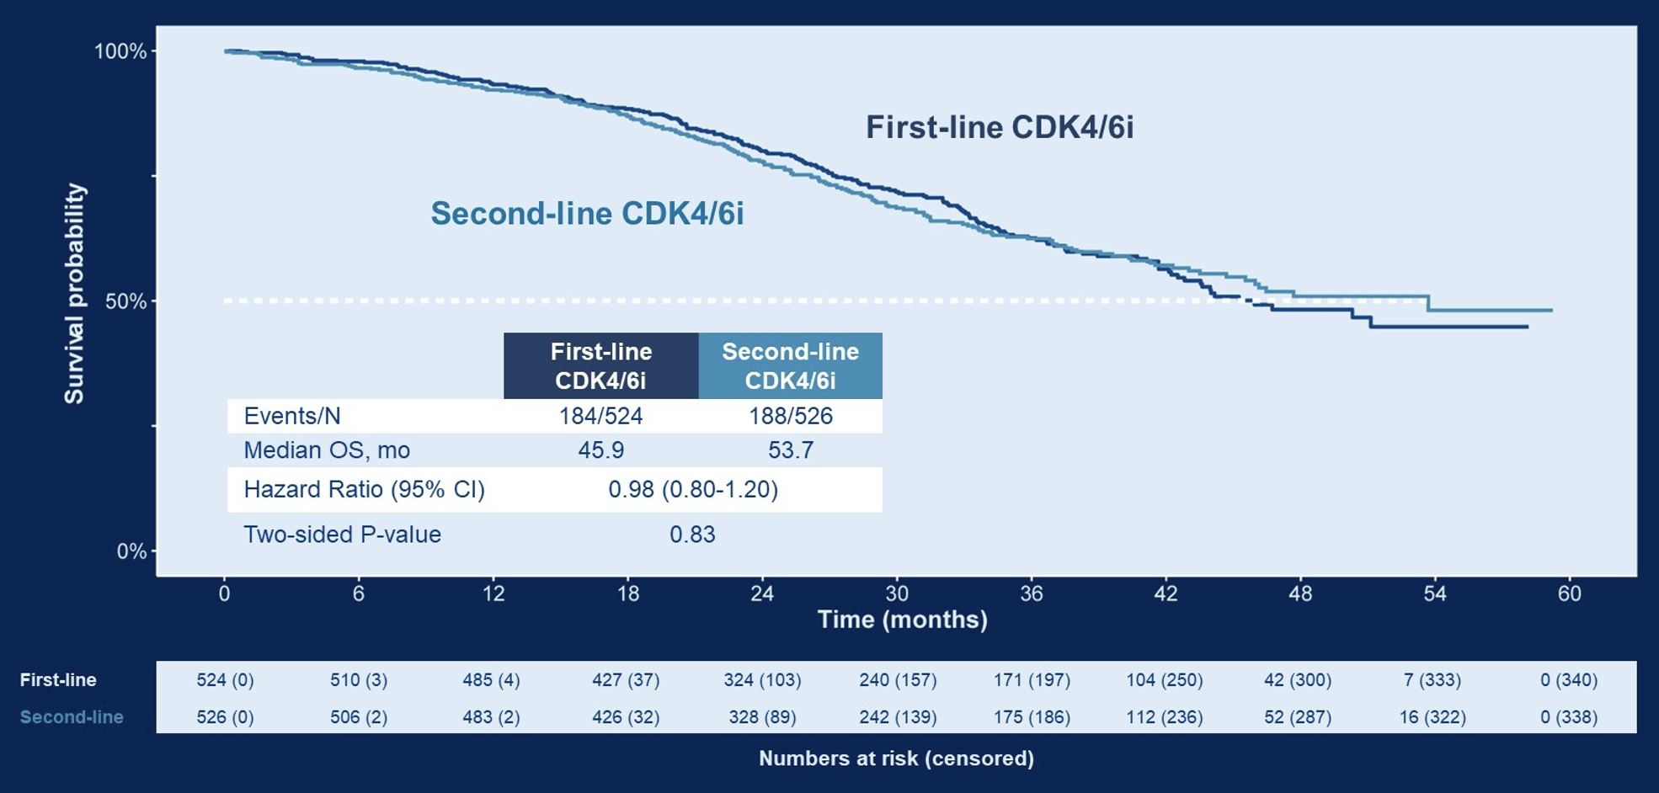
OS

Slide 76
SONIA (conclusions)
Potentially more AE’s when CDK4/6i used in frontline setting.
No difference in QOL assessments, per FACT-B.
Extends time on CDK4/6i by ~16 months.
Increases drug expenditure.
Potentially challenges need for frontline CDK4/6i, although concerns regarding single-agent fulvestrant, difference between CDK’s? Would certain populations benefit?

Slide 77
Overall CDK4/6i Conclusions
The addition of CDK4/6i to our treatment paradigms for MBC has improved PFS and OS in various settings.
Adjuvant abemaciclib improves IDFS for those with high-risk, LN+ early BC. OS data are immature.
Adjuvant ribociclib improves IDFS for those with high-risk, LN+/LN- early BC. Not yet FDA approved, no OS data.
Should we continue CDK4/6i in second-line setting? Maybe…
Can some patients wait to start CDK4/6i? Maybe…

Slide 78
Case Presentation
Bahar Moftakhar, MD
Assistant Professor, Breast Medical Oncology
University Hospitals
Cleveland, Ohio

Slide 79
Disclosures
None

Slide 80
Agenda
PALOMA2
MAINTAIN
EMERALD
DESTINY-Breast04

Slide 81
Case: S.B 65 year old F
2020 Presented with abnormal screening mammogram
Imaging & Bx: cT1N1 R IDC, G2, ER>95% PR>95% HER2-neg (1+).
R breast magseed lumpectomy and SLNBx: 3 cm, G2, Invasive carcinoma. All margins negative. 5 macrometastatic LNs with ENE.
Staging scans showed widely metastatic osseous disease and liver involvement
Liver biopsy consistent with poorly differentiated carcinoma, breast primary. ER/PR positive, HER2 negative (1+).

Slide 82
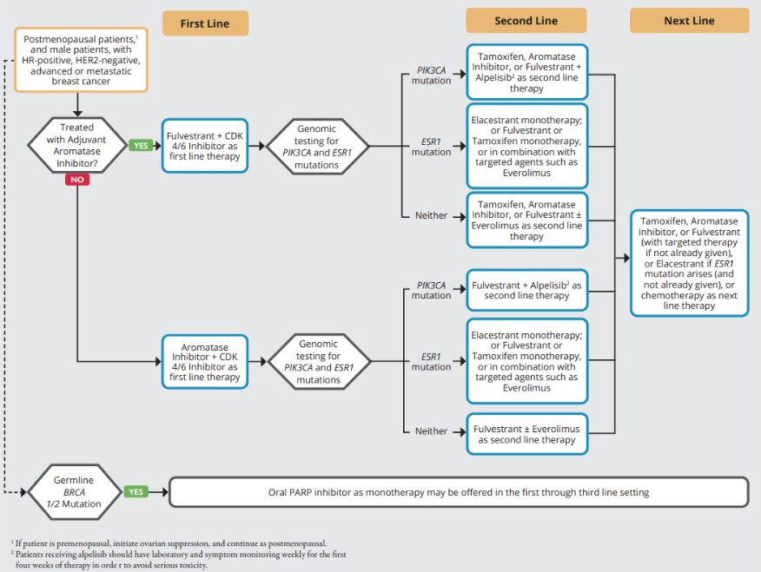
Burstein HJ et. Al. JCO 2023

Slide 83
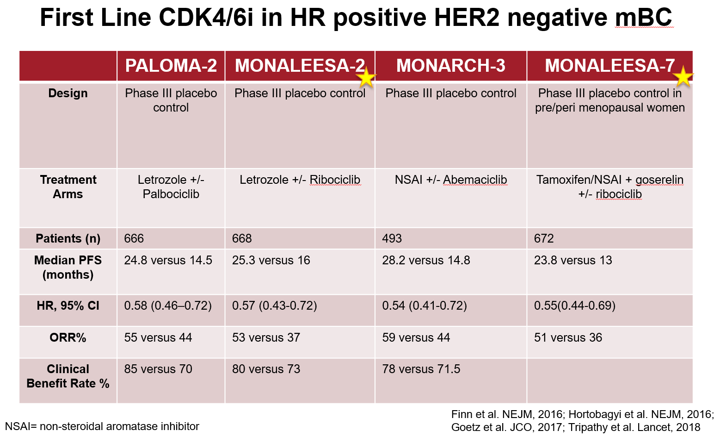

Slide 84

Finn et al. NEJM, 2016

Slide 85

PALOMA-2
Progression Free Survival
Notes:
Primary endpoint

Slide 86

PALOMA-2
Overall Survival
Notes:
7 years worth of follow-up, longest follow-up
2 month OS different

Slide 87


PALOMA-2
Survival disposition
Demographics and patient characteristics
Notes:
Significant number of patient’s lost fo follow-up in treatment arm (23% versus 13%)

Slide 88
PALOMA-2
Significant improvement in PFS seen with palbociclib+letrozole compared to placebo+letrozole.
No OS benefit in the ITT population.
Data should be interpreted with caution considering differences in patient population compared to other CDK4/6 inhibitor trials and large amount of missing data.
Is there difference in efficacy between the CDK4/6 inhibitors?
Notes:
Bottom line no OS

Slide 89
Case: S.B 65 year old F
Started on letrozole and ribociclib
Remained on this treatment for two years
Progressed in the liver
NGS on originally tumor did not show actionable mutation

Slide 90
Burstein HJ et. Al. JCO 2023

Slide 91
Continuing CDK 4/6 inhibitor
at time of progression?
Burstein HJ et. Al. JCO 2023

Slide 92

MAINTAIN
Kalinsky et. Al. JCO 2023

Slide 93

MAINTAIN
Demographics and characteristics
Kalinsky et. Al. JCO 2023

Slide 94


MAINTAIN
PFS
Kalinsky et. Al. JCO 2023

Slide 95

MAINTAIN
Kalinsky et. Al. JCO 2023

Slide 96
MAINTAIN
Important study assessing the question of continuation/switch ribociclib with ET switch after progression on a CDK4/6 inhibitor.
Small study and not practice changing.
Unclear if PFS benefit comes from ET switch, CDK4/6i switch or both.
Several trials underway to further assess this important clinical question.

Slide 97
Case: S.B 65 year old F
Started on fulvestrant with continuation of ribociclib
Progressed in liver after 6 months
Repeat biopsy showed ESR1 mutation

Slide 98
Burstein HJ et. Al. JCO 2023

Slide 99
Burstein HJ et. Al. JCO 2023

Slide 100

EMERALD
Bidard et. Al. JCO 2022
Notes:
Randomized open lable Phase III study
Post-menopausal women or men 18 years or older, with HR positive, HER2 negative metsttaic disease.
Must have progressed on 2 prior lines of endocrine theraoy ,prior CDK4/6i progression and no more than one line of chemotherapy for metastatic disease.
Elecastrant versus SOC endocrine therapy
Elacestrant is novel, nonsteroidal, oral SERD that degrades the ER alpha in a dose-dependent manner and inhibits estradiol-dependent ER-directed gene transcription and tumor growth
All received CDK4/6
PFS
PFS and ESR1 mutation
ESRI: result in estrogen-independent ER activation and, consequently, resistance to AIs but not ER inhibitors (eg, selective ER degraders [SERDs] and selective ER modulators).
477 randomized, 228 of which had ESR1 mutation

Slide 101

EMERALD
Bidard et. Al. JCO 2022
Notes:
statistically significantly prolonged in the elacestrant arm versus the SOC arm in all patients (HR = 0.70; 95% CI, 0.55 to 0.88; P = .002)
patients with ESR1 mutation HR = 0.55; 95% CI, 0.39 to 0.77 P = .0005
nitial drop in both arms, highlighting possible endocrine resistance in the second- /third-line setting, but then clear separation of the curves in the endocrine-sensitive setting.
6-month PFS rates were 34.3% (95% CI, 27.2 to 41.5) versus 20.4% (95% CI, 14.1 to 26.7) for the elacestrant versus SOC arms, respectively, in all patients and 40.8% (95% CI, 30.1 to 51.4) versus 19.1% (95% CI, 10.5 to 27.8), respectively, in patients with ESR1 mutation. Similarly, 12-month PFS rates were 22.3% (95% CI, 15.2 to 29.4) versus 9.4% (95% CI, 4.0 to 14.8), respectively, in all patients versus 26.8% (95% CI, 16.2 to 37.4) and 8.2% (95% CI, 1.3 to 15.1), respectively, in patients with ESR1 mutation.
An exploratory analysis of PFS in the 250 (52%) patients without ESR1 mutations showed a HR 0.86 (95% CI: 0.63, 1.19) indicating that the improvement in the ITT population was primarily attributed to the results seen in the ESR1 mutated population

Slide 102
EMERALD
Elacestrant was associated with a statistically significantly prolonged PFS compared with SOC endocrine therapy
Jan 2023 FDA approved elacestrant for postmenopausal women or adult men with ER-positive, HER2-negative, ESR1-mutated metastatic breast cancer with disease progression following at least one line of endocrine therapy.
Final OS results not yet mature
Notes:
Elecastrant versus SOC endocrine therapy
All received CDK4/6
PFS
PFS and ESR1 mutation

Slide 103
Case: S.B 65 year old F
Started on capecitabine
Progression after 6 months

Slide 104
Endocrine
resistance
Shorter duration
of benefit

Slide 105

DESTINY-Breast04
Modi et. Al. NEJM 2022

Slide 106

Modi et. Al. NEJM 2022

Slide 107

Modi et. Al. NEJM 2022

Slide 108

Modi et. Al. NEJM 2022

Slide 109
DESTINY-Breast04
TDxd demonstrated significant improvement in PFS and OS compared to physicians' choice of chemotherapy for pre-treated HER2 low mBC
HER2 low should be considered a targetable entity
Patients should be monitored for key toxicities seen with TDxd, specifically ILD
Practice changing results
Many questions remain regarding HER2 testing

Slide 110
Case: S.B 65 year old F
HER2 low status (1+)
Currently on trastuzumab-deruxtecan

Slide 111
Conclusions
PALOMA-2
No OS benefit with first line palbociclib in ITT population though this data must be interpreted with caution.
2. MAINTAIN
There may be benefit in continuing/switching to ribociclib with ET switch at progression, however, more information is needed before this becomes practice changing.
3. EMERALD
Elacestrant was associated with a statistically significantly prolonged PFS compared with SOC endocrine therapy, primarily in the ESR1 mutated population.
DESTINY-Breast04
HER2 low should be considered a targetable entity and trastuzumab deruxtecan showed significant improvement in PFS and OS compared to TPC in pretreated HER2 low mBC.

Slide 112
Actions Beyond CDK 4/6 Inhibitors in Metastatic Breast Cancer
Erin Roesch, MD
Assistant Professor of Medicine
Cleveland Clinic Lerner College of Medicine
Cleveland Clinic, Taussig Cancer Institute
Cleveland, OH
Notes:
Add references to all slides

Slide 113
Disclosures
I have no financial disclosures

Slide 114
Agenda
Oral SERDs
SERENA-2 (SABCS 2022, abstract GS3-02)
EMERALD (SABCS 2022, abstract GS3-01)
Targeting PI3K/AKT/mTOR pathway
CAPItello-291 (SABCS 2022, abstract GS3-04; ESMO Breast, abstract 1870; ASCO 2023, abstract 1067)
Antibody-drug conjugates
TROPiCS-02 (ASCO 2023, abstract 1003 and 1082)
TROPION-Breast01 (ESMO 2023, abstract LBA11)

Slide 115
Oral SERDs
First-line therapy for ER+/HER2- metastatic breast cancer includes endocrine therapy (ET) plus a CDK 4/6 inhibitor¹
Endocrine resistance can develop over time, often through development of ESR1 mutations²
2nd/3rd line therapies commonly include sequential endocrine monotherapy or ET combinations
Subsequent lines of ET are associated with low PFS rates in the post-CDK 4/6 inhibitor setting³
Fulvestrant is characterized by low bioavailability and IM administration
Combinations (exemestane + everolimus; alpelisib + fulvestrant) are fraught with toxicities and high discontinuation rates
A clinical need exists for potent oral SERDs, monotherapy and novel combination strategies⁴
1 Lin M, et al. J Cancer. 2020;11(24):7127-7136.
2. Brett JO, et al. Breast Cancer Res. 2021;23(1):85
3. Brufsky AM. Cancer Treat Rev. 2017;59:22-32.
4. Wang Y, Tang SC. Cancer Metastasis Rev. 2022;41(4):975-990.

Slide 116
Phase II SERENA-2 trial: Camizestrant vs fulvestrant in postmenopausal women with advanced ER+/HER2- breast cancer
Postmenopausal women with HR+/HER2-negative ABC, candidate for fulvestrant monotherapy
Recurrence or progression on at least 1 line of ET
≤1 line of prior endocrine therapy for ABC
≤1 line of chemotherapy for ABC
No prior fulvestrant or oral SERD in ABC setting
Camizestrant 300 mg (N=20))
Camizestrant 75 mg (N=74)
R 1:1:1:1
N=240
Camizestrant 150 mg (N=73)
Fulvestrant (N=73)
Stratification Factors:
Liver/lung metastases Prior CDK 4/6i
Primary endpoint: PFS (investigator assessment)
Secondary endpoints: CBR24, ORR, OS, safety
Translational endpoints
Oliveira M, et al. Presented at SABCS 2023. Abstract GS3-02.
Notes:
Camizestrant is a next-generation oral SERD and pure ER antagonist
SERENA 1 demonstrated the safety, tolerability and preliminary efficacy of a range of doses of camizestrant as monotherapy, with dose-dependent exposure
SERENA-2 was designed to explore the efficacy and safety of a range of camizestrant doses administered once daily as monotherapy compared with fulvestrant monotherapy
Median age was 60
Nearly 60% had visceral mets
Slightly more than 1/3 (37%) had ESR1 mutations
Approx 20% had received chemo in the metastatic setting
Approx 50% received prior CDK 4/6i
Majority (70%) had received 1 line prior ET in the ABC setting

Slide 117

Phase II SERENA-2 trial: Camizestrant vs fulvestrant in postmenopausal women with advanced ER+/HER2- breast cancer
Notes:
In the overall population, camizestrant produced a statistically significant and clinically meaningful PFS benefit for both 75mg and 150mg doses vs fulvestrant (HRs 0.58 and 0.67, respectively).

Slide 118

Phase II SERENA-2 trial: Camizestrant vs fulvestrant in postmenopausal women with advanced ER+/HER2- breast cancer
Notes:
In the subpopulation of pts previously treated with a CDK 4/6i + ET, camizestrant at both doses led to a clinically meaningful improvement in PFS vs fulvestrant

Slide 119

Phase II SERENA-2 trial: Camizestrant vs fulvestrant in postmenopausal women with advanced ER+/HER2- breast cancer
Notes:
Similarly, in the subpopulation of pts with detectable ESR1m at baseline, camizestrant at both doses produced a clinically meaningful improvement in PFS vs fulvestrant

Slide 120
SERENA-2
Conclusions
Camizestrant at both doses (75 mg and 150 mg) produced statistically significant PFS benefit vs fulvestrant in postmenopausal women with ABC
Clinically meaningful PFS benefit was observed across pre-specified subgroups including post-CDK 4/6i, visceral metastases and presence of ESR1 mutation
Camizestrant at both doses was well-tolerated with infrequent treatment-related AEs grade ≥3, dose reductions and discontinuations
Results from SERENA-2 support further studies of camizestrant in ER+ BC, two ongoing phase 3 trials include SERENA-4 and SERENA-6^{5,6}
5. Seock-Ah Im, et al. Journal of Clin Oncol. 2021;39:15_suppl, TPS1101.
6. Turner N, et al. Future Oncol. 2023 Mar;19(8):559-573.
Notes:
Serena 4: Phase 3 comparison of camizestrant + palbo vs anastrozole + palbo for pts with ER+/HER2- ABC who have not previously received systemic tx for advanced disease
Serena 6: Phase 3 study evaluating switching from AI to camizestrant while maintaining the same CDK 4/6i, upon detection of ESR1m in circulating tumor DNA before clinical disease progression on 1st line tx for HR2+/HER2- ABC
Grade 3 or higher AE 12% (75mg dose) and 22% (150 mg dose)
Photopsia all grade 12% (75 mg) and 24% (150 mg); no grade 3 or higher
Sinus bradycardia 5% (75 mg) and 26% (150 mg); no grade 3 or higher

Slide 121
Phase III EMERALD trial: Elacestrant vs SOC ET in patients with ER+/HER2- metastatic breast cancer
Men and postmenopausal women with ER+/HER2- MBC
Progressed or relapsed on/after 1-2 lines of ET in advanced setting, one of which was given with CDK 4/6i
≤1 line of chemotherapy for ABC
Elacestrant 400 mg po daily
R 1:1
N=478
Stratification Factors:
ESR1 mutation status
Prior fulvestrant
Presence of visceral metastases
Primary endpoints:
PFS in all patients
PFS in ESR1-mut
Investigator’s choice (SOC):
Fulvestrant, Anastrozole, Letrozole, Exemestane
Elacestrant improved PFS vs SOC ET in all patients and those with ESR1 mutations⁷
All patients: 6-mo PFS rates 34.3% vs 20.4%
ESR1-mut: 6-mo PFS rates 40.8 vs 19.1%
7. Bidard FC, et al. J Clin Oncol. 2022;40(28):3246-3256.
Bardia A, et al. Presented at SABCS 2022. Abstract GS3-01.
Notes:
Here is the schema for the phase 3 EMERALD trial.
Eligible patients had ER+/HER2-negative metastatic breast cancer. Patients were randomized 1:1 to elacestrant 400mg daily or investigators choice endocrine therapy which was fulvestrant or an AI based on prior ET use.
Results presented at SABCS 2021 showed the two primary endpoints, PFS in all pts and PFS in ESR1-mutated tumors, favored elacestrant vs SOC ET.
All patients had prior CDK 4/6 inhibitor use. Additionally, prior treatment with fulvestrant, chemotherapy, alpelisib and everolimus were allowed.
Over 2/3 had visceral metastases, almost half had two lines of ET in the metastatic setting, about ad prior fulvestrant and over ~20% had chemo in the metastatic setting.

Slide 122

Phase III EMERALD trial: Elacestrant vs SOC ET in patients with ER+/HER2- metastatic breast cancer
Notes:
Since the duration of CDK 4/6 inhibitor use is one parameter used to determine endocrine sensitivity, a post-hoc analysis of elacestrant vs SOC was conducted based on the duration of CDK 4/6 inhibitor use in the metastatic setting. Details of this were presented at SABCS 2022.
Patients were divided into groups as having at least 6 months CDK 4/6 inhibitor, at least 12 months, and at least 18 months.
The duration of prior CDK4/6i in the metastatic setting was positively associated with PFS. As shown here in these KM curves, the longer the duration of prior CDK4/6i in the metastatic setting, the longer the PFS on elacestrant versus SOC.

Slide 123

Phase III EMERALD trial: Elacestrant vs SOC ET in patients with ER+/HER2- metastatic breast cancer
Notes:
Similar to all patients, the longer the duration of CDK 4/6 inhibitor use, the longer the PFS on elacestrant vs SOC for ESR1-mutated tumors with a more pronounced effect.
Patients with ESR1-mutated tumors who had at least 18 months of prior CDK 4/6 inhibitor achieved median PFS of 8.61 months with elacestrant and 2.10 months with SOC ET.

Slide 124
EMERALD
Conclusions
EMERALD is the only phase 3 trial of an oral SERD with 100% prior CDK 4/6 inhibitor usage
Longer duration of CDK 4/6 inhibitor use was associated with longer PFS on elacestrant compared to SOC ET
Patients with ESR1-mutated tumors had an even more pronounced benefit with elacestrant vs SOC
No new safety signals were seen. No sinus bradycardia and low antiemetic use
These results support consideration of elacestrant for HR+/HER2-negative metastatic breast cancer in the 2nd/3rd line setting, with encouraging efficacy and favorable safety
  FDA approval was granted January 27, 2023 for postmenopausal women or adult men with ER+/HER2- ESR1-mutated ABC with disease progression following at least one line of ET
  Guardant360 CDx assay approved as companion diagnostic test
Notes:
In conclusion, EMERALD is the only phase 3 trial of an oral SERD with 100% prior CDK 4/6 inhibitor usage.
Longer duration of CDK 4/6 inhibitor use was associated with longer PFS on elacestrant compared to SOC ET.
Patients with ESR1-mutated tumors had an even more pronounced benefit with elacestrant versus SOC
No new safety signals were seen. No sinus bradycardia events and antiemetic use was low among all pts.
These results support consideration of elacestrant for HR+/HER2-negative metastatic breast cancer in the 2nd/3rd line setting, with encouraging efficacy and favorable safety.
Updated safety data were consistent with previously reported results.
Most adverse events including nausea were grade 1 and 2. There were no grade 4 treatment related events reported.
Only 3.4% of pts receiving elacestrant and 0.9% of pts receiving SOC discontinued therapy due to treatment related AE.
No treatment related deaths reported in either arm.
There were no hematologic safety signal concerns and no patients with sinus bradycardia.
Use of antiemetic was low in both arms (8% and 10% for elacestrant and AI respectively).

Slide 125

CAPItello-291
Background
AKT pathway activation occurs in many HR+/HER2-negative advanced breast cancers via genetic alterations in the PI3K/AKT/PTEN pathway, but may also occur in the absence of those genetic alterations^{8,9}
AKT signaling is also implicated in development of endocrine therapy resistance
Capivasertib is a potent selective inhibitor of all three AKT isoforms
In the phase 2 FACTION trial, addition of capivasertib to fulvestrant led to significant improvement in PFS and OS in endocrine resistant HR+/HER2-negative ABC, in overall population and more pronounced impact in tumors with pathway alterations¹⁰
8. Millis SZ, et al. JAMA Oncol. 2016;2(12):1565-1573.
9. Toss A, et al. Oncotarget. 2018;9(60):31606-31619.
10. Howell SJ, et al. Lancet Oncol. 2022;23(7):851-864.
Alves CL, Ditzel HJ. Int J Mol Sci. 2023;24(5):4522.

Slide 126
Phase III CAPItello trial: Capivasertib and fulvestrant with AI-resistant HR+/HER2- ABC
Dual Primary Endpoints:
PFS (overall population)
PFS (AKT pathway-altered tumors)
Capivasertib 400 mg po BID (4 days on, 3 days off)
Fulvestrant 500 mg IM (cycle 1: D1, 15; then Q4 wks)
Men and pre-/postmenopausal women with HR+/HER2-negative ABC
Recurrence during or <12 months from completion of adjuvant AI, or progression while receiving AI for ABC
≤2 lines of prior endocrine therapy for ABC
≤1 line of chemotherapy for ABC
R 1:1
N=708
Stratification Factors:
Liver metastases (yes/no)
Prior CDK 4/6i (yes/no)
Region
Key Secondary Endpoints:
Overall survival
Overall population
AKT pathway-altered tumors )
ORR
Overall population
AKT pathway-altered tumors
Placebo
Fulvestrant 500 mg IM (cycle 1: D1, 15; then Q4 wks)
Turner NC, et al. Presented at SABCS 2022. Abstract GS3-04.
Notes:
The phase 3 CAPItello-291 trial included patients with HR+/HER2-negative ABC, all of whom had progressed on prior aromatase inhibitor.
In the metastatic setting, up to 2 prior lines of ET and 1 prior line of chemotherapy were allowed.
Prior CDK 4/6 inhibitor were allowed and at least 51% were required.
708 patients were randomized 1:1 to fulvestrant plus capivasertib or fulvestrant plus placebo.
Capivasertib was given at a dose of 400mg po twice daily, 4 days on and 3 days off as previously studied, to maximize therapeutic window of AKT inhibition.
There were two co-primary endpoints, PFS by investigator assessment in overall population and AKT pathway altered tumors (with at least one mutation in PIK3CA, AKT1 or PTEN).
Key secondary endpoints were OS and objective response rates.

Slide 127

Phase III CAPItello trial: Capivasertib and fulvestrant with AI-resistant HR+/HER2- ABC
Notes:
Now for results for the two co-primary endpoints.
First, the investigator assessed PFS in the overall population.
Median PFS on placebo/fulvestrant was 3.6 months and this increased to 7.2 months with capivasertib/fulvestrant (adjusted HR 0.6, p<0.001)

Slide 128

Phase III CAPItello trial: Capivasertib and fulvestrant with AI-resistant HR+/HER2- ABC
Notes:
The second co-primary endpoint was investigator assessed PFS in the AKT pathway-altered population.
Median PFS was 3.1 months on placebo/fulvestrant, and increased to 7.3 months on capivasertib/fulvestrant (adjusted HR 0.50, p<0.001).

Slide 129
Capivasertib and fulvestrant with AI-resistant HR+/HER2- ABC:
Subgroup analyses from the Phase 3 CAPItello trial
 |  | N | Median PFS, months (95% CI) |  | HR (95% CI) (unadjusted)
 |  |  | Capivasertib + Fulvestrant | Placebo + Fulvestrant
Prior CDK 4/6i | Yes | 496 | 5.5 (3.9-6.8) | 2.6 (2.0-3.5) | 0.62 (0.51-0.75)
 | No | 212 | 10.9 (7.4-13.0) | 7.2 (4.8-7.9) | 0.65 (0.47-0.91)
Prior CT for ABC | Yes | 129 | 3.8 (3.0-7.3) | 2.1 (1.9-3.6) | 0.61 (0.41-0.91)
 | No | 579 | 7.3 (5.6-8.2) | 3.7 (3.4-5.1) | 0.65 (0.54-0.78)
Liver metastases | Yes | 306 | 3.8 (3.5-5.5) | 1.9 (1.8-1.9) | 0.61 (0.48-0.78)
 | No | 402 | 9.2 (7.4-11.1) | 5.5 (3.9-5.8) | 0.62 (0.49-0.79)
Buono G, et al. Presented at ESMO Breast 2023. Abstract 1870.
Notes:
At ESMO breast 2023, results were presented for PFS in key clinically relevant subgroups
If you recall from the study design, randomization was stratified by the presence of liver mets, prior CDK 4/6i use and region. Preplanned exploratory analyses included prior CDK 4/6i, prior chemotherapy for ABC and presence of liver mets.
A total of 496 pts had received prior CDK 4/6i (70%), 129 had received prior chemo for ABC (18%) and 306 pts (43%) had liver mets.
PFS benefit of capi/fulvestrant over placebo/fulvestrant was consistent across key clinical subgroups, including pts with prior CDK 4/6i exposure and those with liver mets, subgroups with poor prognosis on fulvestrant alone.

Slide 130

Phase III CAPItello trial: Capivasertib and fulvestrant with AI-resistant HR+/HER2- ABC
Characterization and management of common adverse events
Frequency of hyperglycemia was higher among those with history of diabetes and BMI ≥30
Rugo HS, et al. Presented at ASCO Annual Meeting 2023. Abstract 1067.
Notes:
Adverse events observed with AKT pathway inhibition include hyperglycemia, rash, stomatitis, diarrhea, nausea and fatigue
Poster presentation at ASCO 2023 reported a detailed analysis of AEs associated with capivasertib + fulvestrant to highlight this combination’s safety profile (reported for the overall population as similar findings were seen in AKT pathway-altered population)
In CAPItello, pts with HbA1c <8.0% and diabetes not requiring insulin were eligible.
The most frequently reported AEs with capivasertib + fulvestrant were diarrhea (any grade 72%, grade ≥3 9%) and rash (any grade 38%, grade ≥3 12%)
The maximum AE grade was mostly 1/2 and led to low rates of discontinuation.
In the capi arm, hyperglycemia was more frequent in pts with history of diabetes at baseline (10/34 or 29%) vs those with no h/o diabetes (48/321 or 15%).
In both arms, frequency of hyperglycemia AE was higher in pts with BMI ≥30 vs those with BMI <30; in capi arm, 21.2% (14/66) with BMI ≥30 vs 16.1% (46/285) of pts w/ BMI <30.

Slide 131

Phase III CAPItello trial: Capivasertib and fulvestrant with AI-resistant HR+/HER2- ABC
Characterization and management of common adverse events
Notes:
In the capi + fulvestrant arm, medications for the management of AEs were used in 151/257 pts (59%) with diarrhea (mostly loperamide; n=135), 109/135 pts (81%) with rash (mostly antihistamines; n=75/topical corticosteroids; n=64), and 28/60 pts (47%) with hyperglycemia (mostly metformin; n=18)

Slide 132
CAPItello-291
Conclusions
Capivasertib plus fulvestrant produced a statistically significant benefit in PFS in the overall and AKT pathway-altered populations vs placebo plus fulvestrant
Benefit was consistent across subgroups, including those previously treated with a CDK 4/6 inhibitor and those with liver metastases, subgroups with poor prognosis on fulvestrant alone
OS follow-up is ongoing
Most common AEs were diarrhea, rash and hyperglycemia; mostly grade 1/2 with relatively low treatment-related discontinuation rates
Emphasizes importance of developing strategies to effectively manage and reduce toxicities
These data demonstrate efficacy of capivasertib plus fulvestrant in HR+/HER2-negative ABC previously progressed on ET, and may be future therapeutic option for these patients

Slide 133

TROPiCS-02
Majority of HR+/HER2- metastatic breast cancers develop endocrine resistance over time
In ET-resistant setting, sequential single-agent chemotherapy is associated with low response rate and increased toxicities¹¹
Trop-2 is a transmembrane calcium signal transducer highly expressed in multiple breast cancer subtypes, associated with tumor progression and poor prognosis¹²
Sacituzumab govitecan (SG) is a Trop-2-directed ADC that selectively delivers SN-38, an active metabolite of irinotecan
In TROPiCS-02, SG vs TPC demonstrated improvement in PFS and OS in pretreated, endocrine-resistant, HR+/HER2- ABC¹³
11. Mestres JA, et al. Clin Transl Oncol. 2017;19(2):149-161.
12. Jeon Y, et al. BMC Cancer. 2022;22(1):1014.
13. Rugo HS, et al. Lancet. 2023;402(10411):1423-1433.
Rugo H, et al. Future Oncol. 2020;16:705-715.
Notes:
Sequential ET combined with targeted agents is the recommended option for HR+/HER2– mBC according to international guidelines, though the optimal sequencing of therapeutic agents following ET resistance remains unclear
Patients who develop ET-resistant disease are often limited to sequential single-agent chemotherapy, which is associated with low response rates, poor disease control, declining QoL, and increased toxicity
Few chemotherapy options are available in later lines, highlighting a high unmet clinical need for novel, effective therapy options for patients with late line pretreated, HR+/HER2– mBC
Trop-2 is a transmembrane calcium signal transducer highly expressed in multiple breast cancer subtypes, associated with tumor progression and poor prognosis
Sacituzumab govitecan (SG) is a Trop-2-directed ADC that selectively delivers SN-38, an active metabolite of irinotecan
In TROPiCS-02, SG vs TPC demonstrated improvement in PFS and OS in pretreated, endocrine-resistant, HR+/HER2- ABC

Slide 134
Phase III TROPiCS-02 trial: Sacituzumab govitecan vs TPC in HR+/HER2- metastatic breast cancer
Sacituzumab govitecan
10 mg/kg IV
D1 and D8 every 21 days
N=272
Metastatic or locally recurrent inoperable HR+/HER2- breast cancer that progressed after:
At least 1 line ET, taxane, and CDK 4/6i in any setting
At least 2, but not more than 4 lines of CT in ABC setting
Endpoints:
Primary
PFS by BICR
Secondary
OS
ORR, DOR, CBR
PRO
Safety
R 1:1
N=543
Stratification Factors:
Visceral metastases (yes/no)
ET in metastatic setting ≥6 months (yes/no)
Prior lines of CT (2 vs 3/4)
Disease progression or toxicity
Treatment of physician’s choice:
Capecitabine, vinorelbine, gemcitabine, eribulin
N=271
In the primary analysis, SG vs TPC significantly improved PFS (mPFS 5.5 vs 4.0 mos; HR 0.66, p=0.0003)
At the second interim analysis of OS (final OS analysis per protocol), SG continued to demonstrate efficacy improvement vs TPC (mOS 14.4 vs 11.2 mos; HR 0.79, p=0.020)¹⁴
14. Rugo HS, et al. J Clin Oncol. 2022;40:3365-3376.
Rugo HS, et al. Presented at ESMO Congress; 2022. Abstract LBA76.
Notes:
The phase 3 TRPOiCS 02 trial investigated SG vs TPC in metastatic HR+/HER2- breast cancer after experiencing disease progression on at least 1 line ET, taxane and CDK 4/6i, and at least 2 but not more than 4 lines of prior chemo in ABC setting.
543 pts randomized 1:1 to SG of TPC; stratification factors included presence of visceral mets, receipt of ET in metastatic setting for at least 6 mos and prior lines of chemo (2 vs 3/4)
Primary endpoint was PFS by BICR
Secondary endpoints included OS, ORR, DOR, CBR and safety
In the primary analysis, SG vs TPC significantly improved PFS (mPFS 5.5 vs 4.0 mos; HR 0.66, p=0.0003)
At the second interim analysis of OS (final OS analysis per protocol), SG continued to demonstrate efficacy improvement vs TPC (mOS 14.4 vs 11.2 mos; HR 0.79, p=0.020)
At ASCO annual meeting 2023, they reported results of an exploratory analysis of OS from TROPiCS-02 with a longer median follow-up (12.75 mo).

Slide 135

Phase III TROPiCS-02 trial: Sacituzumab govitecan vs TPC in HR+/HER2- metastatic breast cancer
SG continued to demonstrate improvement in PFS vs TPC with extended follow-up, with a 35% reduction in risk of disease progression or death
Tolaney SM, et al. Presented at ASCO Annual Meeting 2023. Abstract 1003.
Notes:
With longer follow-up, SG continued to demonstrate PFS benefit vs TPC, with a 35% reduction in risk of disease progression or death (mPFS 5.5 vs 4.0 mos)

Slide 136

Phase III TROPiCS-02 trial: Sacituzumab govitecan vs TPC in HR+/HER2- metastatic breast cancer
SG continued to demonstrate improvement in OS vs TPC with extended follow-up, with a 21% reduction in risk of death and more patients remaining alive at each landmark time point
Notes:
With this extended follow-up, SG continued to demonstrate improved OS versus TPC (median, 14.5 vs 11.2 mo; HR, 0.79)
The OS rates for SG versus TPC were 60.9% and 47.1% at 12 months, 39.2% and 31.7% at 18 months, and 25.6% and 21.1% at 24 months.

Slide 137
Phase III TROPiCS-02 trial: Sacituzumab govitecan vs TPC in HR+/HER2- metastatic breast cancer: Response data
BICR analysis | SG (N=272) | TPC (N=271) | Odds ratio (95% CI)
ORR, n (%) | 58 (21) | 38 (14) | 1.66 (1.06-2.61), p=0.027
CBR, n (%) | 92 (34) | 60 (20) | 1.80 (1.23-2.63), p=0.0025
Median DoR, mos (95% CI) | 8.1 (6.7-8.9) | 5.6 (3.8-7.9)
Notes:
SG improved ORR and CBR with prolonged DoR compared with TPC with longer follow-up

Slide 138

Phase III TROPiCS-02 trial: Sacituzumab govitecan vs TPC in HR+/HER2- metastatic breast cancer: Efficacy by Trop-2 expression
OS benefit was observed with SG vs TPC regardless of Trop-2 expression
Notes:
In a post hoc analysis presented by Hope Rugo at SABCS 2022, they compared clinical outcomes for SG vs TPC by Trop-2 expression in TROPiCS-02
Trop-2 expression was seen in ~95% of tumor samples
PFS and OS benefit favoring SG over TPC was demonstrated across Trop-2 subgroups (H-score <100 and ≥100)
Median PFS with SG vs TPC was 5.3 vs 4.0 mos (HR 0.77; 95% CI 0.54-1.09) in pts with H score <100 and 6.4 vs 4.1 mos (HR 0.60, 95% CI 0.44-0.81) in pts with H-score ≥100
Median OS with SG vs TPC was 14.6 vs 11.3 mos (HR 0.75, 95% CI 0.54-1.04) in pts with H-score <100 and 14.4 vs 11.2 mos (HR 0.83, 95% CI 0.62-1.11) in pts with H-score ≥100 Benefit from SG was also seen in tumors with very low Trop-2 expression (H-score ≤10), although results should be interpreted w/ caution due to small sample size in this subgroup (79 pts, 17%)
Overall, this post hoc analysis demonstrated that survival outcomes are better with SG vs TPC for pts w/ pretreated endocrine-resistant HR+/HER2- mBC regardless of Trop-2 expression
Results presented at ASCO 2023 (shown here) similarly showed OS benefit with SG vs TPC in both the H-score <100 and H-score ≥100 subgroups, consistent with prior analysis

Slide 139
Trop-2 mRNA expression and association with clinical outcomes with sacituzumab govitecan in HR+/HER2- metastatic breast cancer:
Biomarker results from TROPiCS-02
In TROPiCS-02 post hoc analyses, SG improved OS regardless of Trop-2 expression by IHC, but association using more sensitive assays are lacking
A post hoc analysis from TROPiCS2 was performed examining efficacy outcomes for SG vs TPC by Trop-2 gene (TACSTD2) mRNA expression and the correlation of TACSTD2 expression with other genes
Methods:
  RNA was isolated from archival tumor tissue samples using AllPrep DNA/RNA kits and libraries prepared with TruSeq RNA Exome Prep Kit
  Sequencing was via NovaSeq (2x150bp)
  Gene expression quantitation was performed using Salmon
  TACSTD2 expression was defined as high or low via median cut
  Membrane Trop-2 expression was determined using a validated IHC assay and H-score was calculated (cutoffs set at <100 and ≥100)
Bardia A, et al. Presented at ASCO Annual Meeting 2023. Abstract 1082.
Notes:
As mentioned, in TROPiCS-02 post hoc analyses, SG improved OS regardless of Trop-2 expression by immunohistochemistry (IHC; Rugo HS, et al. SABCS 2022), but association using more sensitive assays are lacking.
Subsequently, a posthoc analysis from TROPiCS2 was performed examining efficacy outcomes for SG versus TPC by Trop-2 gene (TACSTD2) mRNA expression and the correlation of TACSTD2 expression with other genes.
RNA was isolated from archival tumor tissue samples using AllPrep DNA/RNA kits and libraries prepared with TruSeq RNA Exome Prep Kit. Sequencing was via NovaSeq (2x150bp). RNAseq data were available for 197 tumor samples of the ITT population (36%). Gene expression quantitation was performed using Salmon. TACSTD2 expression was defined as high or low via median cut (which was 10.5 transcripts per million (TPM)). Membrane Trop-2 expression was determined using a validated IHC assay and H-score was calculated (cutoffs set at <100 and ≥100). HER2 low defined as IHC score 1+ or 2+/ISH neg; HER2 IHC0 defined as IHC score 0.

Slide 140


Trop-2 mRNA expression and association with clinical outcomes with sacituzumab govitecan in HR+/HER2- metastatic breast cancer:
Biomarker results from TROPiCS-02
Moderate positive concordance was observed between TACSTD2 mRNA expression (median 10.5 TPM) and Trop-2 IHC (median H-score 115)
Concordance by H-score was 71% (Cohen’s kappa = 0.41) – Table 2
TACSTD2 mRNA expression was not associated with ERBB2 mRNA (HER2 gene) expression – Fig. 5
TACSTD2 mRNA expression was similar across HER2 IHC subgroups and ERBB2 mRNA expression – Fig. 5
Notes:
In the mRNA analytical cohort (N=197), 49% had TACSTD2 high expression (SG, n=51; TPC, n=46), and 51% had TACSTD2 low expression (SG, n=47; TPC, n=53). Baseline characteristics were generally consistent between TACSTD2 expression subsets and the intention-to-treat population.
Table 2: A positive concordance between TACSTD2 expression and Trop-2 IHC (H-score) was observed (categorical concordance 71%; Cohen’s kappa = 0.41).
TACSTD2 expression was similar across HER2 IHC0 and HER2-Low (defined as IHC 1+ or 2+/neg ISH) subgroups (log2 transcripts per million [TPM] of 3.36 [IQR, 2.76-4.22] and log2TPM of 3.44 [IQR, 2.59-4.22], respectively). Figure 5

Slide 141

Trop-2 mRNA expression and association with clinical outcomes with sacituzumab govitecan in HR+/HER2- metastatic breast cancer:
Biomarker results from TROPiCS-02
Notes:
SG showed a numerically higher median PFS (TACSTD2 high, 7.3 vs 5.6 mo; TACSTD2 low, 5.6 vs 2.8 mo) versus TPC regardless of TACSTD2 expression. Figure 3
Similarly, for OS, outcomes favored SG over TPC regardless of TACSTD2 expression. Figure 4

Slide 142

Trop-2 mRNA expression and association with clinical outcomes with sacituzumab govitecan in HR+/HER2- metastatic breast cancer:
Biomarker results from TROPiCS-02
Notes:
SG showed a numerically higher median PFS (TACSTD2 high, 7.3 vs 5.6 mo; TACSTD2 low, 5.6 vs 2.8 mo) versus TPC regardless of TACSTD2 expression. Figure 3
Similarly, for OS, outcomes favored SG over TPC regardless of TACSTD2 expression. Figure 4

Slide 143
TROPiCS-02
Conclusions
In an updated exploratory analysis of TROPiCS-02, with extended follow-up of ~13 months, SG continued to demonstrated improved efficacy vs TPC
  Median PFS 5.5 vs 4.0 mos for SG vs TPC, respectively; HR 0.65
  Median OS 14.5 vs 11.2 mos for SG vs TPC, respectively, HR 0.79
SG improved ORR, CBR and extended DoR vs TPC
SG improved efficacy outcomes vs TPC regardless of Trop-2 expression level or Trop-2 mRNA expression
There was no correlation of Trop-2 mRNA expression and HER2 status
These results support the role of SG for patients with pretreated HR+/HER2- ABC in the endocrine refractory setting, irrespective of Trop2- expression

Slide 144

Datopotamab deruxtecan (Dato-DXd)
Datopotamab deruxtecan (Dato-DXd) is an ADC composed of a humanized anti-TROP2 IgG1 monoclonal antibody conjugated with a highly potent topoisomerase I inhibitor payload via a stable, tumor-selective, tetrapeptide-based cleavable linker
Dato-DXd demonstrated promising activity in heavily pre-treated patients with inoperable or metastatic HR+/HER2-BC in the Phase 1 TROPION-PanTumor01 trial¹⁵
  ORR 29% (12/41)
  DCR 85% (35/41)
  CBR 41% (17/41)
At ESMO meeting 2023, primary PFS results were reported from the Phase 3 TROPION-Breast01 trial
15. Meric-Bernstam F, et al. Cancer Res. 2023;83 (5_Supplement):PD13-08.
Okajima D, et al. Mol Cancer Ther. 2021;20(12):2329-2340.
Notes:
Datopotamab deruxtecan (Dato-DXd) is an antibody-drug conjugate consisting of a humanized anti-TROP2 IgG1 monoclonal antibody covalently linked to a highly potent topoisomerase I inhibitor payload via a stable, tumor-selective, tetrapeptide-based cleavable linker.
Dato-DXd demonstrated promising activity in heavily pre-treated patients (pts) with inoperable or metastatic HR+/HER2-BC in the Phase 1 TROPION-PanTumor01 trial (NCT03401385). At ESMO meeting 2023, primary PFS results were reported from the Phase 3 TROPION-Breast01 trial

Slide 145
Phase III TROPION-Breast01: Dato-DXd vs investigator’s choice chemotherapy for inoperable or metastatic HR+/HER2- breast cancer
Dato-DXd
6 mg/kg Q3 weeks
(N=365)
Adult patients with HR+/HER2-negative inoperable or mBC
Unsuitable for endocrine therapy
1-2 prior lines of chemotherapy for ABC
R 1:1
N=732
Stratification factors:
Number of prior lines of chemotherapy (1 vs 2)
Prior CDK 4/6i
Region
Disease progression or Toxicity
Investigator’s choice chemotherapy (ICC)
Eribulin, vinorelbine, capecitabine, gemcitabine
N=367
Dual Primary Endpoints:
PFS by BICR
OS
Bardia A, et al. Presented at ESMO Congress 2023. Abstract LBA11.
Notes:
Datopotamab deruxtecan (Dato-DXd) is an antibody-drug conjugate consisting of a humanized anti-TROP2 IgG1 monoclonal antibody covalently linked to a highly potent topoisomerase I inhibitor payload via a stable, tumor-selective, tetrapeptide-based cleavable linker.
Dato-DXd demonstrated promising activity in heavily pre-treated patients (pts) with inoperable or metastatic HR+/HER2-BC in the Phase 1 TROPION-PanTumor01 trial (NCT03401385). At ESMO meeting 2023, primary PFS results were reported from the Phase 3 TROPION-Breast01 trial
732 pts were randomised (Dato-DXd: 365; ICC: 367).
Adult pts with inoperable or metastatic HR+/HER2-BC, who had experienced progression on endocrine therapy (ET) and for whom ET was unsuitable, and who had received 1-2 prior lines of systemic chemotherapy (CT), were randomised 1:1 to Dato-DXd (6 mg/kg Q3W) or investigator’s choice of CT (ICC; eribulin, vinorelbine, capecitabine, or gemcitabine) until progression or unacceptable toxicity. Dual primary endpoints were progression-free survival (PFS) by blinded independent central review (BICR) per RECIST 1.1, and overall survival (OS).

Slide 146

Phase III TROPION-Breast01: Dato-DXd vs investigator’s choice chemotherapy for inoperable or metastatic HR+/HER2- breast cancer
PFS rate at 6 mos: 53.3% vs 37.5%, Dato-DXd vs ICC respectively
PFS rate at 9 mos: 38.5% vs 18.7%, Dato-DXd vs ICC respectively
OS data not yet mature; a trend favoring Dato-DXd was observed (HR 0.84)
Notes:
Primary PFS results are shown here.
Pts receiving Dato-DXd had significantly improved PFS vs ICC (HR 0.63 p<0.0001). OS data were not mature; a trend for improvement favoring Dato-DXd was observed. Pts receiving Dato-DXd had lower rates of grade ≥3 TRAEs and dose reductions vs ICC
Conclusions
TROPION-Breast01 met the primary endpoint of PFS; the study continues to final OS. Pts receiving Dato-DXd had statistically significant and clinically meaningful improvement in PFS compared with ICC, along with a favourable and manageable safety profile. Results support Dato-DXd as a novel treatment option for pts with inoperable or metastatic HR+/HER2-BC who have received 1–2 prior lines of CT.

Slide 147
Key Takeaways
Oral SERDs, approved and in development, represent a promising treatment option for HR+/HER2 ABC, particularly in combination with other targeted agents
Capivasertib plus fulvestrant demonstrated PFS benefit vs fulvestrant monotherapy in HR+/HER2-negative ABC previously progressed on ET, and may be future therapeutic option for these patients
ADCs, including sacituzumab govitecan and Dato-DXd, are potential options for patients with HR+/HER2 ABC, specifically in the endocrine refractory setting
Sequencing of these novel therapeutics continues to evolve
Genomic profiling is an integral component for treatment selection
Strategies to mitigate and manage toxicities are essential in the ABC setting
Clinical trial evaluation is valuable at each step along the treatment algorithm

Slide 148
Thank you
Questions

Slide 149
Liquid Biopsies in Breast Cancer
Julie E. Lang, MD, FACS
Chief of Breast Surgery, Hillcrest Hospital
Director, Eastern Region Cleveland Clinic Breast Program
Cleveland Clinic
Cleveland, OH

Slide 150

Circulating tumor DNA (ctDNA)
CTCs
ctDNA
exosomes
Marrugo-Ramírez, International Journal of Molecular Sciences, 2018

Slide 151
Nucleic acids shed into the bloodstream in patients with cancer are linked to apoptosis and necrosis of cancer cells in the tumor microenvironment. Vast amount wt DNA.
Cell free DNA (cfDNA) has been identified in the peripheral blood plasma fraction of healthy individuals but patients with cancerous tumors have higher quantities of ctDNA and detection is associated with poorer prognosis
Nucleic acids have a half-life in the circulation ranging from 15 minutes to several hours
Correlates with tumor burden/progression
Predictive biomarker
Screening biomarker

Slide 152
Is ctDNA the ideal circulating biomarker?
Technically easier to isolate than CTCs
DNA is more stable than cells or RNA
Proportion of ctDNA related to tumor burden and overall survival
High sensitivity and dynamic range
Pool of cancer cells/ disease sites – represents heterogeneity
  repertoire of genetic alterations
  level of genetic instability
  number and properties of subclones

Slide 153
Potential confounders for ctDNA
The majority of specific DNA markers is in the cell bound fraction
Cytotoxic chemotherapy leads to leukocyte and erythrocyte apoptosis, which may release cell bound DNA into plasma. An increase in these markers could be from the death of these cells rather than tumor cells.
Unclear if ctDNA is released from cancer cells because they are dying from therapy or if because they are resistant to therapy.
Not all DNA mutations are expressed

Slide 154
Clinical Uses of ctDNA
Screening
Select target therapy
Tumor burden
Monitor effectiveness of therapy
Snow, Lang Expert Review of Molecular Diagnostics 2019

Slide 155


ctDNA IN N of 1 STUDY DESIGN
Murtaza et al, Nature Communications 2015

Slide 156

ctDNA IN N of 1 STUDY DESIGN
Murtaza et al, Nature Communications 2015
Notes:
Whole exome sequencing of tumor biopsies and targeted amplicon sequencing of plasma

Slide 157
ctDNA can allow for profiling mutations in the plasma that reflect the clonal hierarchy inferred from sequencing tumor biopsies
Serial changes in circulating levels of sub-clonal private mutations correlate with different treatment responses at metastatic sites.
Murtaza et al, Nature Communications 2015

Slide 158
º There is no evidence of clinical utility and little evidence of clinical validity of ctDNA assays in early-stage cancer, treatment monitoring, or residual disease detection.
º There is no evidence of clinical validity and clinical utility to suggest that ctDNA assays are useful for cancer screening, outside of a clinical trial.
Body copy goes here
º There is insufficient evidence of clinical validity and utility for the majority of ctDNA assays in advanced cancer
º Evidence shows discordance between the results of ctDNA assays and genotyping tumor specimens and supports tumor tissue genotyping to confirm undetected results from ctDNA tests.
Merker et al, JCO 2018

Slide 159
Prevalence of ESR1 Mutations in Cell-Free DNA and Outcomes in Metastatic Breast Cancer: A Secondary Analysis of the BOLERO-2 Clinical Trial
According to Mutation Status A, Superior overall survival (OS) is shown for patients without mutation (MT) in ESR1 (wild-type [WT]) compared with those with D538G and/or Y537S mutation.
B, Overall survival results are shown for WT or D538G alone or Y537S alone or both D538G and Y537S (double MT).
Chandarlapaty et al, JAMA Oncology 2016

Slide 160
Prevalence of ESR1 Mutations in Cell-Free DNA and Outcomes in Metastatic Breast Cancer: A Secondary Analysis of the BOLERO-2 Clinical Trial
Kaplan-Meier Curves for Effect of Addition of Everolimus to Exemestane A, Progression-free survival (PFS) for patients without ESR1 mutation (wild-type [WT]) or with the D538G mutation (D538G).
B, Results for patients without ESR1 mutation (WT) or with the Y537S mutation (Y537S). Addition of everolimus (EVE) was associated with improved progression-free survival (PFS) for patients with WT or D538G mutation but not for those with Y537S mutation. PBO indicates placebo.
Chandarlapaty et al, JAMA Oncology 2016

Slide 161

ctDNA in clinical trials: use as a companion biomarker
BELLE2: study met primary endpoint in overall population of improved PFS in the buparlisib vs placebo in addition to fulvestrant
Baselga et al, Lancet Oncology 2017

Slide 162

Baselga et al, SABCS 2015

Slide 163

Buparlisib+ fulvestrant had improved PFS in patients with PIK3CA mutants in ctDNA
Baselga et al, Lancet Oncology 2017

Slide 164

Slide source =
Dr. Joanne Blum
Andre et al, NEJM 2019

Slide 165
Circulating tumour DNA analysis to direct therapy in advanced breast cancer (plasmaMATCH): a multicentre, multicohort, phase 2a, platform trial
A platform trial assessing the clinical validity of using ctDNA to select targeted therapies in patients with metastatic breast cancer without previous tissue sequencing
This study showed that ctDNA testing for PIK3CA, ESR1, HER2, AKT1, PTEN, and TP53 has sufficient accuracy for widespread use without concomitant tumor biopsy testing
Turner et al, Lancet Oncology 2020

Slide 166


plasmaMATCH
Turner et al, Lancet Oncology 2020

Slide 167

Slide source =
Dr. Joanne Blum
Bidard et al, Lancet Oncology 2022

Slide 168

Slide source =
Dr. Joanne Blum

Slide 169

Slide source =
Dr. Joanne Blum

Slide 170

I-SPY2: Treatment arms MK2206 (AKT inhibitor plus standard chemotherapy vs standard chemotherapy alone)
ctDNA to be present in 73% of patients’ plasma specimens prior to treatment
Lack of ctDNA clearance predicted for disease recurrence while ctDNA negativity was associated with improved outcomes even in the absence of a pCR
Tumor informed “bespoke assays”
Magbanua et al, Annals of Oncology 2021

Slide 171


EMERALD Trial: patients with detectable ESR1 mutation in ctDNA
Bidard et al, JCO 2023

Slide 172


Slide 173

Harvest of Circulating Tumor Cells (CTCs) from Patients with Metastatic Breast Cancer (MBC) Using the Parsortix® PC1 System
HOMING Trial
NCT03427450
Demonstrated that the Parsortix® PC1 System can capture and harvest CTCs from the peripheral blood of patients with MBC and that the CTCs harvested by the system can be used for subsequent downstream evaluation
Cohen et al, Cancers 2022
6.5-micron cassette
Minimum of 5 mL of blood
Notes:
Participants were enrolled, and samples were collected and processed at four
institutions:
The University of Texas MD Anderson Cancer Center, Houston, TX, USA; University of Southern California, Los Angeles, CA, USA; University of Rochester Medical Center,
Rochester, NY, USA; and Northwestern University, Chicago, IL, USA. The study was conducted with the approval of each institution’s institutional review board
Each participant provided between ~7 mL and 23 mL of whole blood collected specifically for this study into one 3 mL K2EDTA tube followed by two 10 mL K2EDTA tubes
at a single time point. For patients with MBC, blood was collected before the initiation of their new therapy and a minimum of 7 days after the last administration of any previous
cytotoxic treatment, either from venipuncture or through an existing port
For the capture of CTCs, all samples were processed using the Parsortix® PC1 System within 8 h of collection. First, the blood volume in each of the K2EDTA tubes was estimated
using an engineering ruler. The initial portion of blood collected into the 3 mL K2EDTA tube immediately following the venipuncture or the port flushing was used for a complete blood
count with leukocyte differential testing. For the two 10 mL K2EDTA tubes, a minimum combined volume of 5 mL of blood was required for processing using the Parsortix®
PC1 System equipped with a Parsortix GEN3D6.5 Cell Separation Cassette.

Slide 174
Conclusions
The field of liquid biopsy is evolving rapidly
Relatively few liquid biopsy assays are FDA approved for use in breast cancer at this time
ASCO guidelines incorporated testing for PIK3CA and ESR1 mutations
Current ctDNA and CTC assays cannot find circulating biomarkers in all breast cancer patients
Assay sensitivities and specificities vary
Pre-analytic variables are important
Liquid biopsy is being incorporated in clinical trials increasingly
NCCN guidelines do not include multi-marker molecular profiling with universal genomic testing in liquid biopsy to choose therapies at this time.
The concept of a minimally invasive blood draw to determine biomarker status is very appealing and with further research will likely continue to advance

Slide 175
Molecular Signatures for Personalization of Radiation Therapy: new approaches to biologically informed personalized treatment
Corey Speers MD, PhD
Vice Chair of Research, Dept. of Radiation Oncology
Co-Director of the Breast Oncology Program

Slide 176
Disclosures
Disclosures
Disclosures:
Paid consultant for Exact Sciences
Novartis - clinical trial support

Slide 177
Outline
Part 1-
Radiation response signatures for invasive breast cancer- radiation omission in favorable risk patients
Part 2-
Radiation response signatures for invasive breast cancer- radiation intensification in women with high-risk disease
Part 3-
Molecularly stratified clinical trials looking at personalization of radiation for BC and Summary

Slide 178

Multi-modal therapy is overtreatment for some women with BC and insufficient for others
70% need no additional radiation
Surgery, chemotherapy, and radiation are critical treatment modalities in the management of breast cancer, but the benefit to patients is heterogeneous:
2/3 relative risk reduction with the addition of radiation
10% recur despite standard therapy
Early Breast Cancer Trialists' Collaborative Group, 2005
Notes:
For certain patients, more effective surgical and systemic therapies have made adjuvant radiation therapy unnecessary
For other patients, current multi-modality therapy is ineffective in preventing disease recurrence and/or progression
Ineffective therapies
Inadequate risk stratification

Slide 179
Prognostic and Predictive Signatures
How do we harness tumor-specific information, coupled with clinicopathologic features, to guide treatment decisions?
Which individual (rather than which group) will benefit from adjuvant therapy?
Who benefits from chemotherapy?
Who can we safely spare?
Oncotype DX®, MammaPrint®, ProSignaTM, etc developed as prognostic and predictive biomarkers of chemotherapy response
Endopredict, SET 2,3, Breast Cancer Index (BCI) were developed as prognostic and predictive signatures of endocrine therapy response for women with ER+ BC

Slide 180
What about similar approaches to guide radiation decision making for women with breast cancer?

Slide 181

Attempts at Radiation Omission Based on Clinical and Pathological Variables
Still a 70-90% relative risk reduction with RT
Age
12 years
8 years
HR status
5 years
10 years
Size
<5 years
margins
5 years
9 years
grade
P. Franco et al., Clin and Trans Rad Onc 2020

Slide 182
PART 1
Can we use gene expression signatures to identify women with invasive breast cancer who do not benefit from radiation?

Slide 183
What about signatures to predict radiation response?
Several signatures are under development including ARTIC and POLAR and are nearing clinical application and are in clinical trials now, though none are yet clinically available
What about the previously derived signatures for chemotherapy benefit, like the Oncotype DX Breast Recurrence Score® or Mammaprint® test?

Slide 184

Locoregional Recurrence using Oncotype DX® Test in N- patients
B14 and B20 pts tam pts
B14 placebo pts
B20 chemo+tam pts
Importantly, there is no data regarding recurrence rates by recurrence score in women treated with lumpectomy WITHOUT RT, nor are there differences in LRR rates by RS score in RT treated pts.
EP Mamounas et al., JCO 2010, 28, 1677-1683.

Slide 185

Locoregional Recurrence using Oncotype DX® Test in N- patients
NSABP B-28 Cohort:
Mix of mastectomy (no radiation-604 pts) and lumpectomy (received RT-461 pts)
Important and useful data, but mixed treatment means it does not directly address the radiation question
EP Mamounas et al., J Natl Cancer Inst. 2017;109(4)

Slide 186
Locoregional Recurrence using Oncotype DX® test in N+ patients- association with RT
SWOG 8814 assessment of LRR by Recurrence Score® result
(led by Wendy Woodward at MD Anderson CC)
SWOG 8814: Tamoxifen With or Without Combination Chemotherapy in Postmenopausal Women Who Have Undergone Surgery for Breast Cancer
  Randomized phase III trial, N = 1477
  ER and/or PR+, Node+, post-menopausal randomized to Tamoxifen alone vs. Tamoxifen then CAF vs. Concurrent Tamoxifen + CAF
  RS determined using RT-PCR
Woodward WA et al., JAMA Oncol. 2020 Jan 9;6(4):505-11.

Slide 187


Locoregional Recurrence using Oncotype DX® test in N+ patients- association with RT
SWOG 8814: Post mastectomy patients without RT
1-3 nodes positive
>3 nodes positive
Woodward WA et al., JAMA Oncol. 2020 Jan 9;6(4):505-11.

Slide 188


Locoregional Recurrence using Mammaprint® test
1,053 pts treated in the Netherlands
BCT- all got RT
Prognostic for LRR in fully treated
Mastectomy- No RT
Not prognostic for LRR
Mastectomy- RT
* Adding the signature to the model based on clinicopathological factors did not significantly improve discrimination
Drukker et al., BCRT. 2014;148:599-613

Slide 189
What about signatures to predict radiation response?
Previously derived
Oncotype Dx®
Mammaprint®
IHC surrogates for subtype
Radiation specific signatures
Invasive disease
Danish Breast Cancer Group (DBCG-RT)
Radiation Sensitivity Index (RSI)
Radiosensitivity and Immune Gene Signature
Radiation Sensitivity Signature (Radiotype Dx®), Profile for the Omission of Local Adjuvant Radiation (POLAR), and Adjuvant RadioTherapy Intensification Classifier (ARTIC)

Slide 190



Development of POLAR
Performed by Chang and Speers
Performed by M. Sjöström
Training cohort: SweBCG-91 (N=243)
ER+/HER2-, no systemic adjuvant therapy
Training of Model
External validation of locked model in phase III randomized trial of +/- RT
Final Model
Profile for the Omission of Local Adjuvant Radiation (POLAR)
16 genes
Final locked model
Validation cohort
Scottish Omission Trial
Validation cohort
(SweBCG-91 N=354)
Validation cohort
Canadian Omission Trial
Notes:
A 27-gene expression signature was developed using three publicly available early stage BC gene expression datasets where patients were treated with RT and had detailed local recurrence information (van de Vijver et al., Servant et al., Sjöström et al.). The largest of the datasets was used to train the signature, and the other two datasets were used for signature refinement. As age was the strongest clinical factor for the endpoint in the training dataset, it was included in the model, resulting in a final clinical-genomic classifier of 27 genes and age. The classifier was locked before external validation in the SweBCG91-RT trial. This phase III trial randomized node-negative BC patients to +/- RT following BCS, with sparse use of adjuvant systemic treatment (9%). The median follow-up time was 14.0 years for LRR in patients free from event. Out of the original 1,178 patients, primary tumor tissue derived from formalin-fixed paraffin-embedded (FFPE) samples from 765 patients was successfully profiled on the GeneChip Human Exon 1.0 ST array (ThermoFisher). After remvoving overlapping patients with the Sjöström et al. study, 748 patients remained for the final analysis.

Slide 191
Gene discovery and algorithm development in SweBCG91RT
Marker Symbol | Marker Name
AGR2 | Anterior Gradient 2, Protein Disulphide Isomerase
B4GALT1 | Beta-1,4-Galactosyltransferase 1
CLDN7 | Claudin 7
EZR | Ezrin
GNG11 | G Protein Subunit Gamma 11
JUN | Jun Proto-Oncogene
MMP11 | Matrix Metallopeptidase 11
PKIB | CAMP-Dependent Protein Kinase Inhibitor Beta
PRPS1 | Phosphoribosyl Pyrophosphate Synthetase 1
PSMD10 | Proteasome 26S Subunit, Non-ATPase 10
SH3BP5 | SH3 Domain Binding Protein 5
SLC16A3 | Solute Carrier Family 16 Member 3
SLC7A11 | Solute Carrier Family 7 Member 11
SPP1 | Secreted Phosphoprotein 1
TNNT1 | Troponin T1, Slow Skeletal Type
UBE2E1 | Ubiquitin Conjugating Enzyme E2 E1
POLAR: a 16-gene mRNA-based signature
Gene Discovery
Identified gene sets associated with locoregional recurrence in cohort of stage I-II, N0 invasive breast cancer patients with ER+/HER2- tumors, not treated with radiotherapy
Gene set themes included immune response and proliferation
Sjostrom et al., JCO 2023

Slide 192


Results – POLAR and risk of LRR
Validation cohort
  RT untreated
  ER+/HER2-
  Not treated with systemic adjuvant therapy
  N = 178
  Cut-off at the 25th percentile
POLAR high
Locoregional recurrence (cum. inc.)
POLAR low
10-year LRR risk of 7% for POLAR low patients without RT and systemic adjuvant therapy
Sjostrom et al., JCO 2023

Slide 193


Results – POLAR and benefit of RT
No RT
Locoregional recurrence (cum. inc.)
Locoregional recurrence (cum. inc.)
No RT
RT
RT
Sjostrom et al., JCO 2023

Slide 194




Additional Validation: POLAR and benefit of RT- Canadian RT Omission
POLAR HIGH
POLAR LOW
Locoregional recurrence (cum. inc.)
Locoregional recurrence (cum. inc.)

Slide 195


Additional Validation: POLAR and benefit of RT- Scottish BCT
Scottish Conservation Trial (N=137)
POLAR HIGH
POLAR LOW
Locoregional recurrence (cum. inc.)
Locoregional recurrence (cum. inc.)

Slide 196
Clinical validation of POLAR signature: patient level meta-analysis
Plenary at AACR SABCS December 2022
Notes:
Cumulative incidence of LRR in POLAR Low vs High, stratified by treatment arm (N=623)

Slide 197

Clinical validation of POLAR signature
Clinical validation was performed in 3 clinical trials of patients randomized to +/- whole breast radiotherapy following breast conserving surgery
A patient-level meta-analysis was performed in the subset of node-negative patients who had ER-positive, HER2-negative tumors (N=623)
31% of patients
69% of patients
20%
7%
7%
5%
Plenary at AACR SABCS December 2022
Notes:
Cumulative incidence of LRR in POLAR Low vs High, stratified by treatment arm (N=623)

Slide 198

POLAR predicts RT benefit- interaction analysis
Cox PH model with POLAR x RT interaction term (N=623) and 10-year LRR risk
No interaction with RT (i.e not predictive)= parallel lines
Significant interaction with RT (i.e IS predictive)= lines diverge
20%
Variable | HR [95% CI] | p-value
POLAR | 1.54 [1.24-1.91] | 0.00008
POLAR : Radiotherapy | 0.64 [0.44-0.94] | 0.022
15%
10-year LRR risk
10%
5%
0%
25%
50%
75%
100%
POLAR score percentile
POLAR score was predictive of RT benefit. Patients with a low POLAR score show no apparent benefit from RT
Plenary at AACR SABCS December 2022

Slide 199
Multi-modal therapy is insufficient in patients with aggressive breast cancers
PART 2
Can we use gene expression signatures to identify women with invasive breast cancer who benefit from radiation?
Can these same signatures identify women likely to recur despite radiation therapy?
2/3 relative risk reduction with the addition of radiation
10% recur despite standard therapy
Early Breast Cancer Trialists' Collaborative Group, 2005

Slide 200
Radiation specific signatures for treatment decisions
Danish Breast Cancer Group (DBCG-RT)- radiation necessity signature based on benefit of post-mastectomy radiation on Danish 82b/c trials¹ – IDENTIFIES RADIATION BENEFIT GROUP
Radiation Sensitivity Index (RSI)- pan cancer radiation signature to predict benefit of radiation based on radiation sensitivity of NCI-60 cell lines² – IDENTIFIES RADIATION RESISTANT GROUP
Radiation Sensitivity Signature (RSS or Radiotype Dx®)- breast cancer cell line-specific signature to predict utility and efficacy of radiation in women treated with RT after lumpectomy³ ⁻ IDENTIFIES RADIATION BENEFIT AND RESISTANT GROUP
1. Tramm T, et al., Clin Cancer Res. 2014 Oct 15;20(20):5272-80
2. Torres-Roca JF et al., Cancer Res 2005: 65(16):7169-76
3. Speers C, et al., Clin Cancer Res 2015 Aug 15;21(16):3667-77

Slide 201

Radiation Sensitivity Index (RSI)
Radiosensitivity molecular signature (RSI) which was developed as a biomarker of cellular radiosensitivity (NCI-60 cell lines, mostly non-breast)
Signature is based on gene expression for 10 specific genes (AR, cJun, STAT1, PKC, RelA, cABL, SUMO1, CDK1, HDAC1, IRF1)
Initially evaluated in rectal, esophageal, and H&N SCC; extended into breast cancer evaluation in Swedish and Dutch cohorts
SA. Eschrich et al, Clin Can Res 2012 DOI: 10.1158/1078-0432.

Slide 202

Radiation Sensitivity Index (RSI)
Not prognostic in non-RT treated patients
Predicted RT resistance
Karolinska dataset: Post BCS; mostly predicted radiation resistant (RR)
Signature identifies radiation benefit, not prognostic or predictive in non-irradiated patients
SA. Eschrich et al, Clin Can Res 2012 DOI: 10.1158/1078-0432.

Slide 203

Radiation Sensitivity Index (RSI)
Predicted RT resistance
Not prognostic in non-RT treated patients
Erasmus dataset: Postmastectomy; mostly predicted radiation resistant (RR)
Signature identifies radiation benefit, not prognostic or predictive in non-irradiated patients
SA. Eschrich et al, Clin Can Res 2012 DOI: 10.1158/1078-0432.

Slide 204

Radiation Sensitivity Index (RSI)
Only in ER+
Not ER-
Predictive value seen in ER+ patients but not ER- in this cohort
SA. Eschrich et al, Clin Can Res 2012 DOI: 10.1158/1078-0432.

Slide 205

Radiation Sensitivity Index (RSI) validation
Unlike previous study, predictive value seen in ER- patients but not ER+ in this cohort (4 Dutch and 1 French non-randomized cohorts)
Went on to look at value of determining a genomic adjusted radiation dose (GARD) for breast and other types of cancers
J Torres-Rocha, Int J Radiat Oncol Biol Phys. 2015 Nov 1; 93(3): 631–638.

Slide 206


Development of Adjuvant RadioTherapy Intensification Classifier (ARTIC)
Developed using training and testing datasets (3 datasets). Final locked model was 27 genes and age
Validation performed in SweBCT-91 RT trial
ARTIC HIGH score
Predicted to have higher rates of LRR and be RT resistant
ARTIC profile of primary tumor
ARTIC LOW score
Predicted to have lower rates of LRR and be RT sensitive

Slide 207

Performance of ARTIC
Predicted to be sensitive
Predicted to be resistant
Performance of ARTIC for prognostication of locoregional recurrence and treatment prediction for adjuvant radiotherapy in the SweBCG91-RT validation cohort.
Cumulative incidence of locoregional recurrence for high and low classifier scores (as split by the 75th percentile score) and interaction with RT.
Sjöström et al, JCO Oct. 16, 2019; JCO.19.00761

Slide 208
Performance of ARTIC- Interaction Test
No interaction with RT (i.e not predictive)= parallel lines
Significant interaction with RT (i.e IS predictive)= lines diverge
ARTIC predictive of RT benefit
Sjöström et al, JCO Oct. 16, 2019; JCO.19.00761
Notes:
Continuous score
Difference in the effect of RT based on the continuous score

Slide 209





Ongoing efforts to validate ARTIC and POLAR
USA
NSABP B-06
PRIME1 (1985): 585 pts
Scottish (1985): 585 pts
PRIME2 (2004):
1326 pts
TREX trial (2023):
1350 pts
Uppsala (1981): 381 pts
SUPREMO (2020):
1600 pts
Canadian (Tony Fyles ≥50 yo 2004): 569 pts
EUROPA (2023):
926 pts

Slide 210
Previously derived signatures for pre-invasive BC
DCIS
Oncotype Dx® for DCIS
DCISionRT

Slide 211
Ongoing genomically stratified clinical trials for radiation treatment decisions

Slide 212
Trial ClinicalTrials.gov Identifier, Trial Status | Design, Target Accrual | Demographics | Pathologic | Hormone Receptors (all require HER2- tumors) | Additional RT omission criteria | Primary outcome | Other
IDEA NCT02400190, Closed to accrual | Prospective single-arm cohort 200 eligible patients enrolled | Female Age 50-69 Postmenopausal | Unifocal pT1 pN0-pN0(i+) Margins ≥2 mm No grade requirement | ER+ and PgR+ | Oncotype DX Recurrence Score ≤18 | 5-year LRR
LUMINA NCT01791829, Closed to accrual | Prospective single-arm cohort 500 patients in investigational cohort | Female Age ≥55 | Unifocal pT1 pN0 (i+ not specified) Margins ≥1 mm Grade 1-2 | ER ≥1% and PgR >20% | Exclude if central Ki-67 staining >13.25% (consistent with luminal B subtype) | 5-year IBR | Non-lobular histologies only No EIC or LVI
PRECISION NCT02653755, Closed to accrual | Prospective Phase II cohort 345 patients in investigational cohort | Female Age 50-75 | Unicentric pT1 pN0-pN0(i+) No tumor on ink Grade 1-2 (cN0 allowed if ≥70) | ER ≥10% or PgR+ | Prosigna PAM50 low Risk Of Recurrence score (i.e. luminal A subtype) | 5-year LRR | Optional survey component on decision comfort/regret
PRIMETIME ISRCTN: 41579286, Open to accrual | Prospective cohort 1,550 patients in RT omission cohort | Female Age ≥60 | Unifocal pT1 pN0-pN0(i+) Margins ≥1 mm Grade 1-2 | ER+ (PgR incorporated into IHC4+C score) | Central Ki-67 staining IHC4+C risk category very low (<5% distant recurrence rate at 10 years) | 5-year IBR | Postmenopausal women <60 with comorbidities placing at significant risk of RT toxicity allowed
EXPERT NCT02889874, Open to accrual | Randomized, non-inferiority, Phase III 1,170 patients randomized | Female Age ≥50 | Unifocal pT1 pN0-pN0(i+) No tumor on ink Grade 1-2 | ER ≥10% and PgR ≥10% | Prosigna PAM50 Risk Of Recurrence ≤60 and luminal A subtype | Non-inferiority of RT omission to adjuvant RT, followed up to 10 years | PRO, QALY, fear of recurrence assessment
DEBRA NCT04852887, Open to accrual | Randomized, non-inferiority, Phase III 1,670 patients randomized | Female or male Age 50-69 | Unicentric pT1 pN0 (i+ not allowed) No tumor on ink No grade requirement | ER ≥1% or PgR ≥1% | Oncotype DX Recurrence Score ≤18 | Non-inferiority of RT omission to adjuvant RT, followed up to 10 years | PRO, QoL, distress of recurrence assessment
2.3% at 5 yr ASCO 2022

Slide 213
Additional genomically stratified clinical trials for radiation omission in N+ patients
For whom is radiation omission appropriate?
MA.39 (TAILOR RT) –Oncotype DX® test (PI: Dr. Timothy Whelan on behalf of Canadian Cancer Trials Group) Randomized phase III, 2140 pts
  ≥40 yo women with Recurrence Score® result ≤25, N+ (1-3 nodes) randomized to +/- RT
    For BCS pts: Whole breast irradiation (WBI) +/- regional nodal RT (supraclavicular, non-dissected axillary, and internal mammary)
    For mastectomy pts: +/- chest wall and regional nodal RT
  1°endpoint: BCRFS between patients that received regional RT or not
Tailored Regional External Beam Radiotherapy in Clinically Node-negative Breast Cancer Patients With 1-2 Sentinel Node Macrometastases (TREX)– ARTIC and POLAR test (PI: Dr. Per Karlsson on behalf of Nordic Countries) Randomized phase III, 1350 pts
  ≥18 yo w/ T1-2 with 1-3 positive axillary nodes (macrometastases, > 2 mm)
  Breast or CW RT +/- regional nodal RT (supraclavicular, non-dissected axillary, and internal mammary)
  1°endpoint: RFS at 5 years

Slide 214
Summary
Genomic-based signatures now commonplace in guiding systemic therapy decisions

Slide 215
Summary
Genomic-based signatures now commonplace in guiding systemic therapy decisions
Genomic-based signatures not yet validated for clinical use to guide radiation decisions– though we are getting close

Slide 216
Summary
Genomic-based signatures now commonplace in guiding systemic therapy decisions
Genomic-based signatures not yet validated for clinical use to guide radiation decisions– though we are getting close
Validation awaited for:
  Invasive disease
    Oncotype Dx®
    Mammaprint®
    IHC based subtyping
    Radiation-specific signatures (POLAR, RSI, ARTIC, etc.)
  DCIS
    Oncotype Dx® for DCIS
    DCISionRT-

Slide 217


Summary
Treatment Intensification
ARTIC HIGH
RSI HIGH
RT resistant
+
RT sensitizer
(ala SWOG 1706)
+
Dose escalation
(ala IMPORT HIGH)
+
Added fields
(ala MA.20)
Molecular Profiling
(e.g. ARTIC, RSI, Oncotype, IHC4, Mammaprint, or POLAR)
Treatment De-escalation
ARTIC LOW
Oncotype/MP® IHC4 LOW
RT sensitive
+
No adjuvant ET
RT omission
+
RT omission
+
No adjuvant ET
POLAR LOW
RT no benefit
POLAR HIGH
RT sensitive
POLAR LOW
RT no benefit

Slide 218

Thank you!

