Slide 1
Multiple Myeloma
July 30th, 2024

Slide 2
Linvo, tec/tal, BiTEs: oh my! Updates with bispecific antibodies in MM
Rahul Banerjee, MD, FACP
Assistant Professor
Fred Hutchinson Cancer Center
Seattle, WA – July 30, 2024

Slide 3
Disclosures
Consulting: Adaptive Biotech, BMS/Celgene, Caribou Biosciences, Genentech/Roche, GSK, Karyopharm, Legend Biotech, Janssen Oncology, Pfizer, Sanofi Pasteur, SparkCures
Research funding: Novartis, Pack Health

Slide 4
Defining bsAbs (bispecific antibodies)
An artificially created antibody with 2 unique binding sites that target different antigens or epitopes, often CD3 on T cells
MM: Teclistamab, talquetamab, elranatamab, linvoseltamab, et al
NHL: Glofitamab, epcoritamab, mosunetuzumab (et al)
Blinatumomab (B-ALL), tebentafusp (uveal melanoma), and amivantamab (lung cancer) are not quite the same.
Physically a bispecific antibody
Mechanistically engage the immune system
MM and NHL bsAbs
Blinatumomab
Tebentafusp
Amivantamab

Slide 5
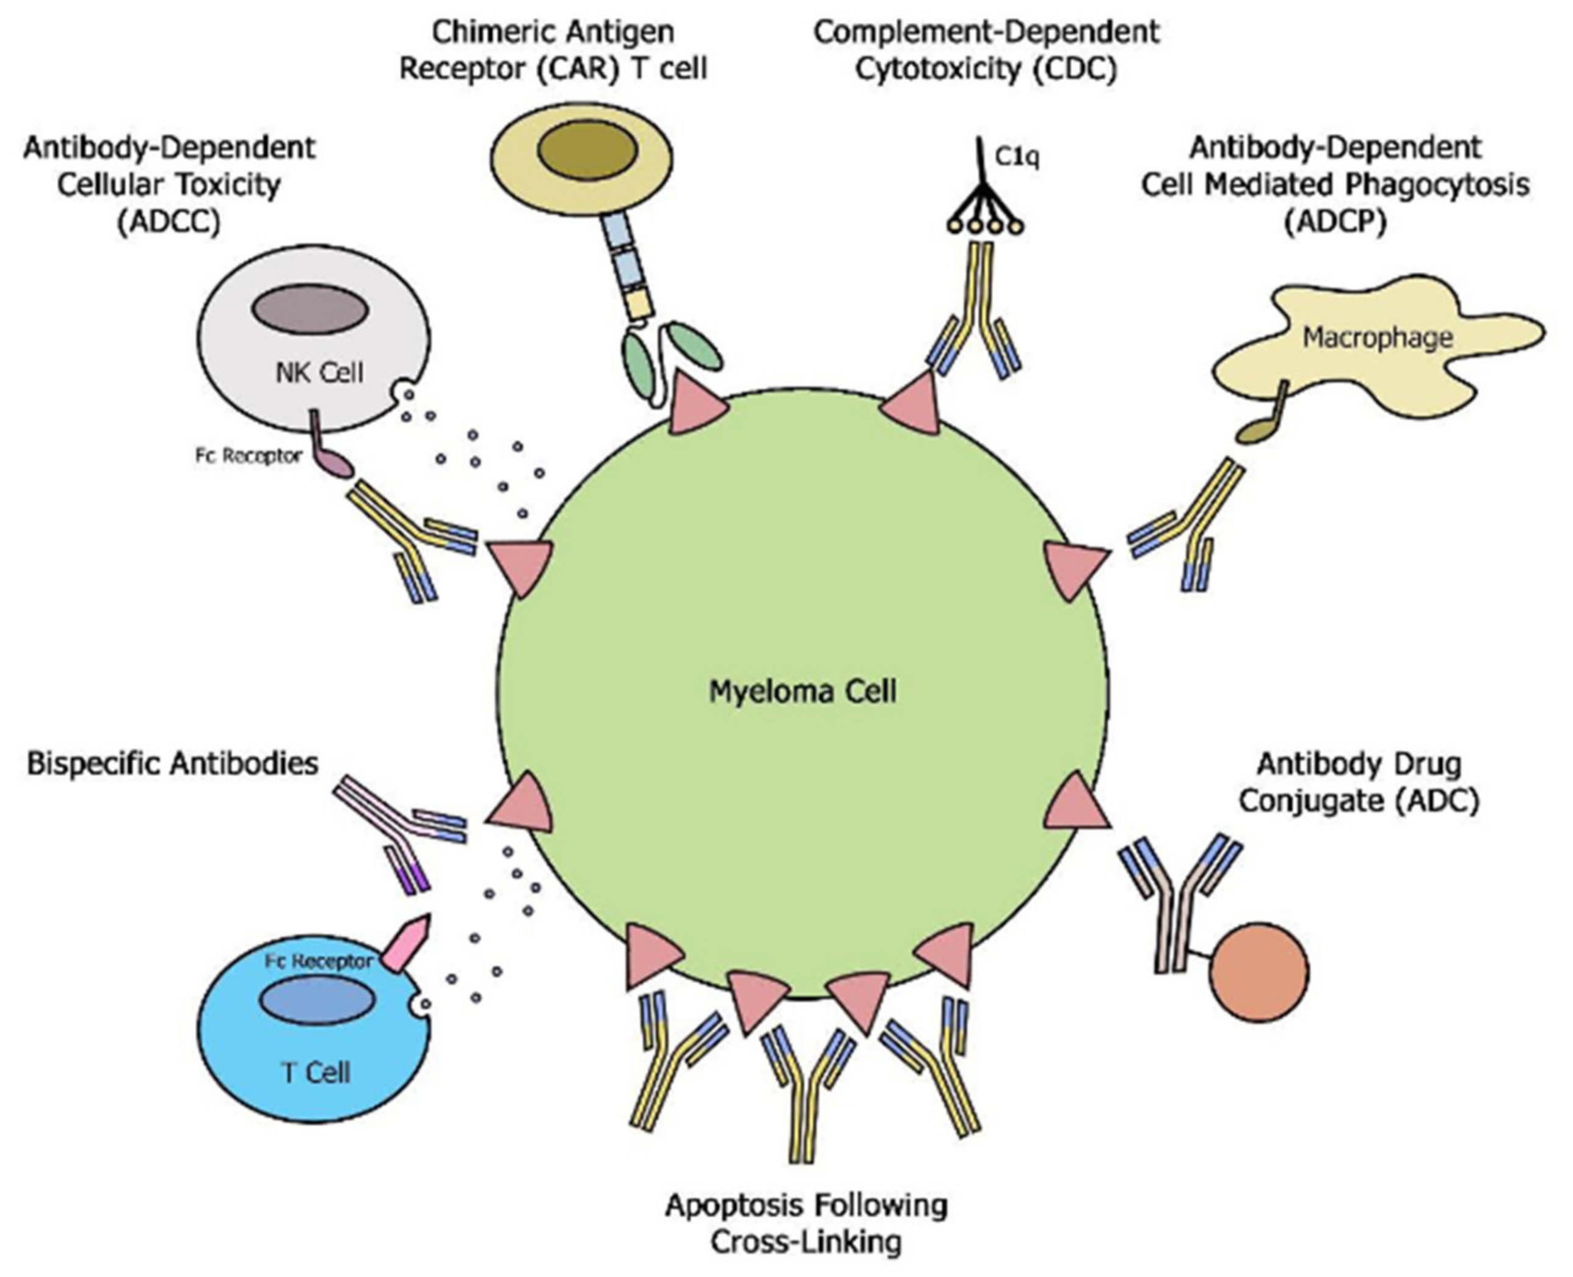
How do bsAbs compare to other classes?
Ide-cel, cilta-cel,
anito-cel, et al
Drug | Class | Target
Idecabtagene vicleucel | CAR-T | BCMA
Ciltacabtagene autoleucel | CAR-T | BCMA
Daratumumab, isatuximab | Antibodies with CDC and ADCC | CD38
Belantamab mafodotin | ADC | BCMA
Teclistamab | bsAb | BCMA
Elranatamab | bsAb | BCMA
Linvoseltamab | bsAb | BCMA
Talquetamab | bsAb | GPRC5D
Isa > dara
Dara > isa
Belantamab mafodotin
Tec, tal, elra, linvo, et al
Mohan M, Maatman TC, Schinke C. Cancers (Basel). 2021;13(19):4909. PMID: 34638393.

Slide 6
Teclistamab 101
Subcutaneous teclistamab:
BCMA-targeted bsAb. Approved for ≥4 prior lines, triple-class-exposed.
How it’s dosed commercially:
Two step-up doses (weight-based) ≥48 hours apart
48 hours of monitoring after each dose (more in Dr. Cowan’s section)
Weekly dosing thereafter per package insert
However, FDA has approved q2wk dosing for patients with CR ≥ 6 months

Slide 7
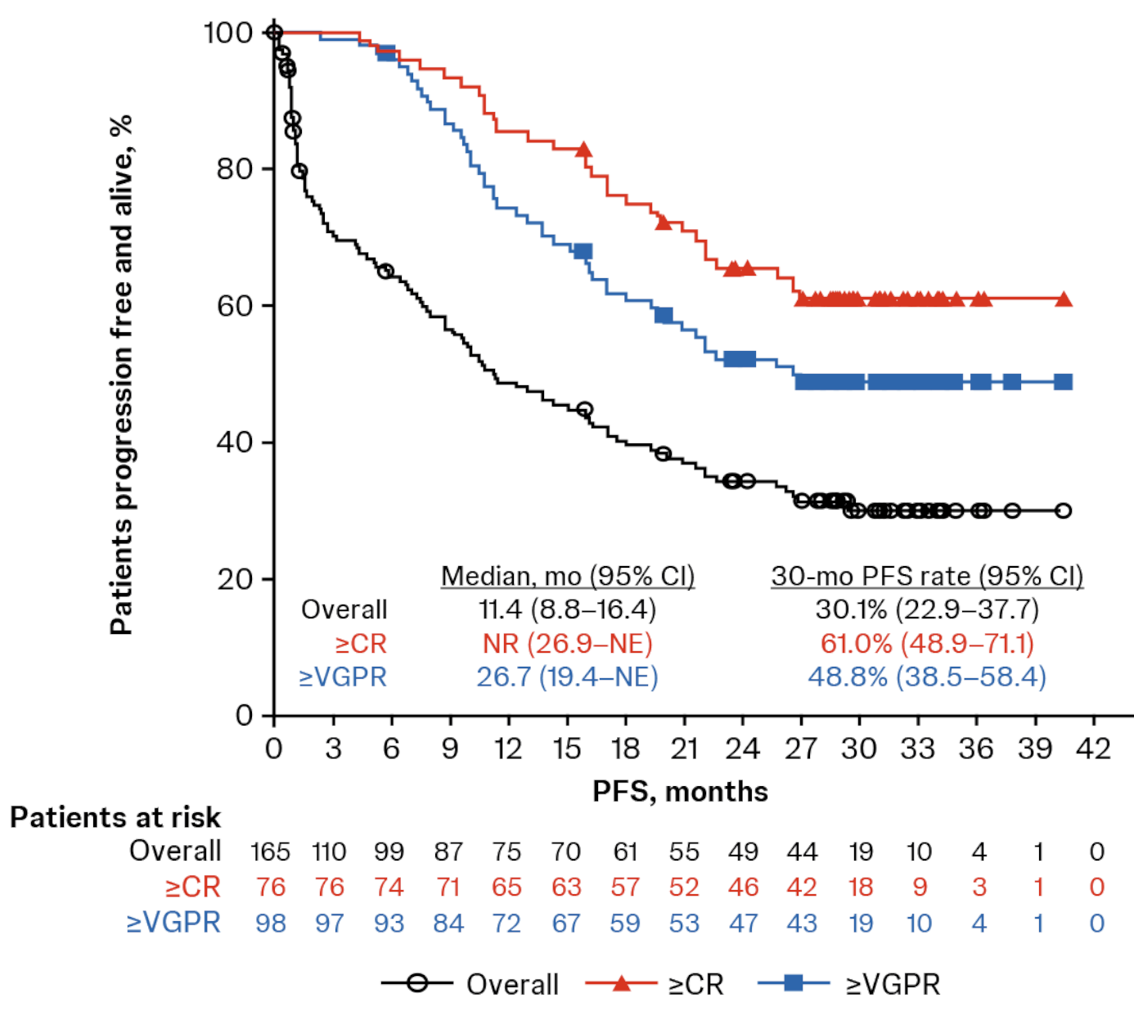
What’s new with teclistamab
MajesTEC-1 study of teclistamab
What we already knew:
63% ORR, mPFS 11.4 months
What’s new this year:
MRD-neg 29% (48/165 patients as intent to treat with 10⁻⁵ threshold)
mDOR 24 months in responders (n = 104)
mOS 22.2 months with 2.5 yrs follow-up
Prophylactic tocilizumab may help (more in Dr. Cowan’s section)
Oriol A, Popat R, Garfall AL, et al. EHA 2024.

Slide 8
Elranatamab 101
Subcutaneous elranatamab:
BCMA-targeted bsAb. Approved for ≥4 prior lines, triple-class-exposed.
How it’s dosed commercially:
Two step-up doses (fixed dose) ≥48 hours apart
48 hours of monitoring after first dose, then 24 hours of monitoring after second dose (more in Dr. Cowan’s section)
Weekly dosing through week #24, then q2wk assuming ≥PR for 2+ months
How is it different logistically from teclistamab?
24 hours of monitoring after second step-up dose, not 48 hours
Fixed vial size, so should be lower number of wasted vials
”Easier” to get to q2wk dosing assuming package insert followed verbatim

Slide 9
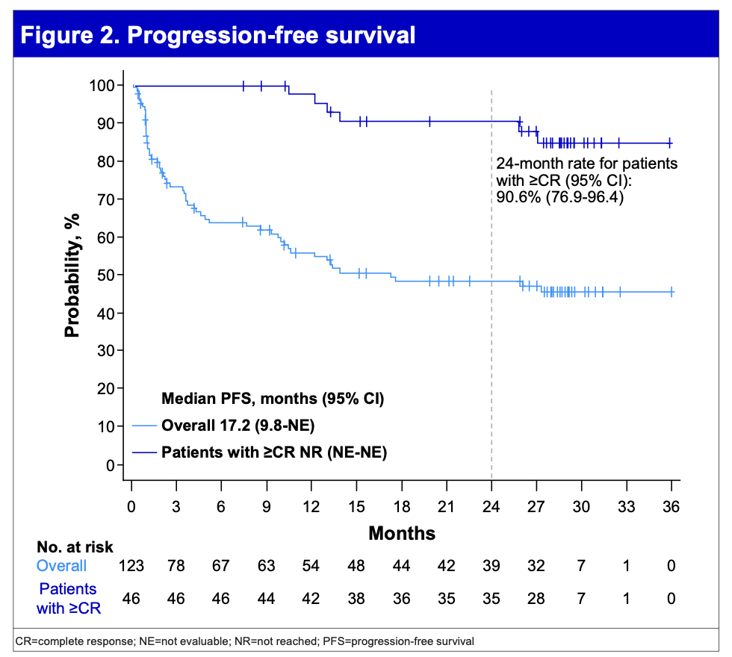
What’s new with elranatamab
MagnetisMM-3 study of elranatamab
BCMA-exposed patients not presented here
What we already knew:
61% ORR, mPFS ≥14.7 months
What’s new this year:
MRD-neg 25% (31/123 patients as intent to treat with 10⁻⁵ threshold)
mDOR ≥2 years (2-year PFS 66.9% of responders, n = 75)
mPFS 17.2 months
mOS 24.6 months
Mohty M, Iida S, Bahlis NJ, et al. EHA 2024.

Slide 10
Linvoseltamab 101
Intravenous elranatamab (BCMA-targeting):
NOT yet FDA-approved, but potentially later this year
How it might be dosed commercially:
Two step-up doses (fixed dose) one week apart
24 hours of monitoring after step-up dosing (more in Dr. Cowan’s section)
Weekly through month #3, q2wk through month #6, then q4wk assuming ≥VGPR
How is it different logistically from teclistamab?
Intravenous administration, shorter monitoring
“Easier” to get to q2wk & q4wk dosing assuming protocol followed verbatim

Slide 11
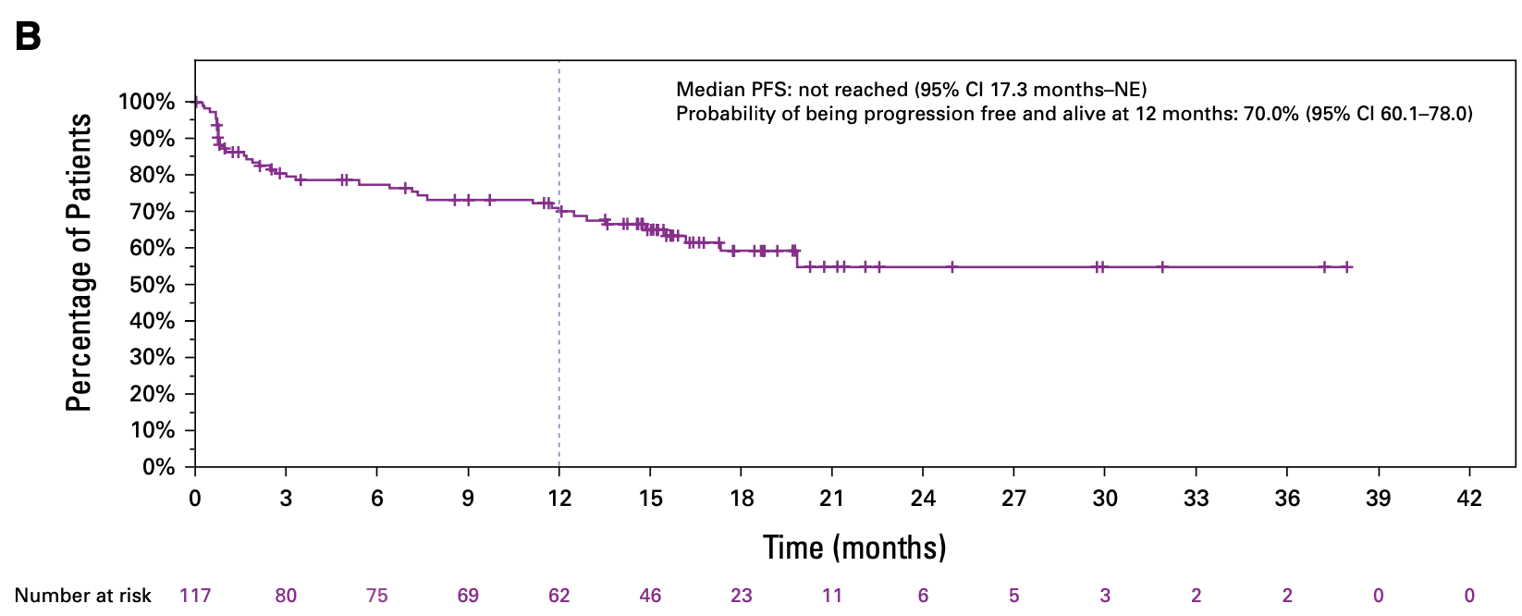
What’s new with linvoseltamab
LINKER-MM1 study of linvoseltamab
Published this year in JCO
N = 117 at RP2D
ORR 70.9%
MRD-neg 16% (19/117 patients as intent to treat with 10⁻⁵ threshold)
mDOR 29.4 months in responders (n = 83)
mPFS ≥14.3 months
mOS 31.4 months
Bumma N, Richter J, Jagannath S, et al. JCO 2024.

Slide 12
So, which BCMA bsAb should we choose?
????? Let me know if you figure it out!
 | SQ Tec | SQ Elra | IV Linvo
ORR | 63% | 61% | 71%
mPFS | 11.4 mo | ≥14.7 mo | ≥14.3 mo
mDOR | 24.0 mo | ≥24 mo | 29.4 mo
MRD-neg (IIT) | 29% | 25% | 16%
mOS | 22.2 mo | 24.6 mo | 29.4 mo
SUD obs | 48 hours | 24-48 hours | 24 hours
q2wk dosing? | CR ≥6mo | ≥PR @6mo | ≥4mo
ITT, intent o treat; SUD obs, post-step-up dose observation.

Slide 13
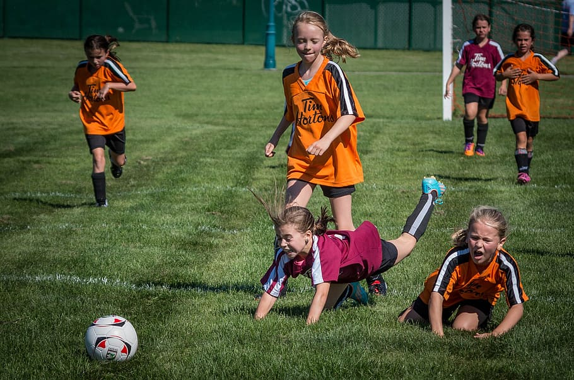
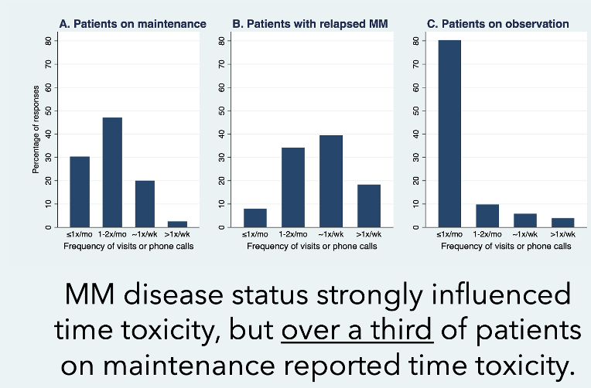
How will we actually choose BCMA bsAbs?
Alnuc?
Linvo
Cevo?
Elra
Tal
Tec
Lower financial & time toxicity
Banerjee R, Cowan AJ, Ortega M, et al. CLML. 2024.

Slide 14
Talquetamab 101
Subcutaneous talquetamab (GPRC5D-targeting):
Targets GPRC5D (found on plasma cells and skin/tongue epithelium)
The only approved non-BCMA immune effector cell therapy as of now
How it’s commercially:
Option #1: Two step-up doses, then weekly dosing
Option #2: Three step-up doses, then q2wk dosing
Option #1.5 (my choice): Two step-up doses → weekly → q2wk → q4wk
How is it different logistically from teclistamab?
Different target. Likely not as high of a risk of infections.
Much higher risk of skin, nail, and tongue toxicities

Slide 15
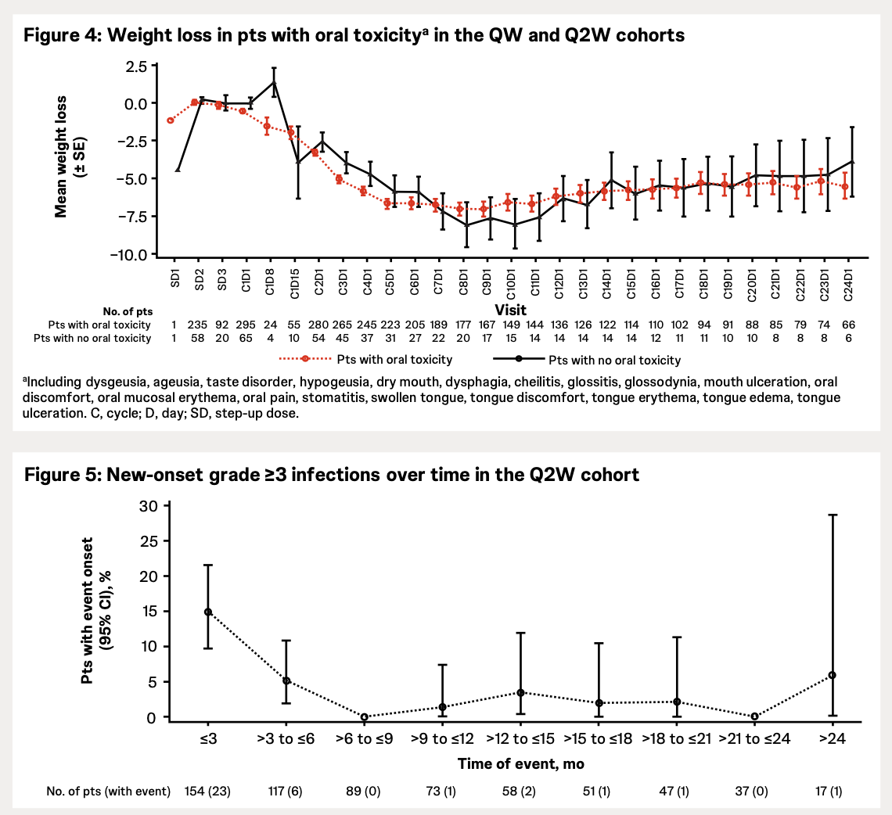
What’s new with talquetamab
MonumenTAL-1 study of talquetamab
Both weekly and q2wk dosing cohorts studied, including bsAb- or CAR-T exposed
What we already knew:
ORR 74% for weekly, 70% for q2wk
mPFS 11.2 mo for q2wk dosing
mPFS 7.5 mo for weekly dosing
What’s new this year:
mDOR 17.5 mo with q2wk dosing (n = 107)
mDOR 9.5 mo with weekly dosing (n = 106)
Weight loss real, infections milder
Rasche L, Schincke C, Touzeau C, et al. EHA 2024.

Slide 16
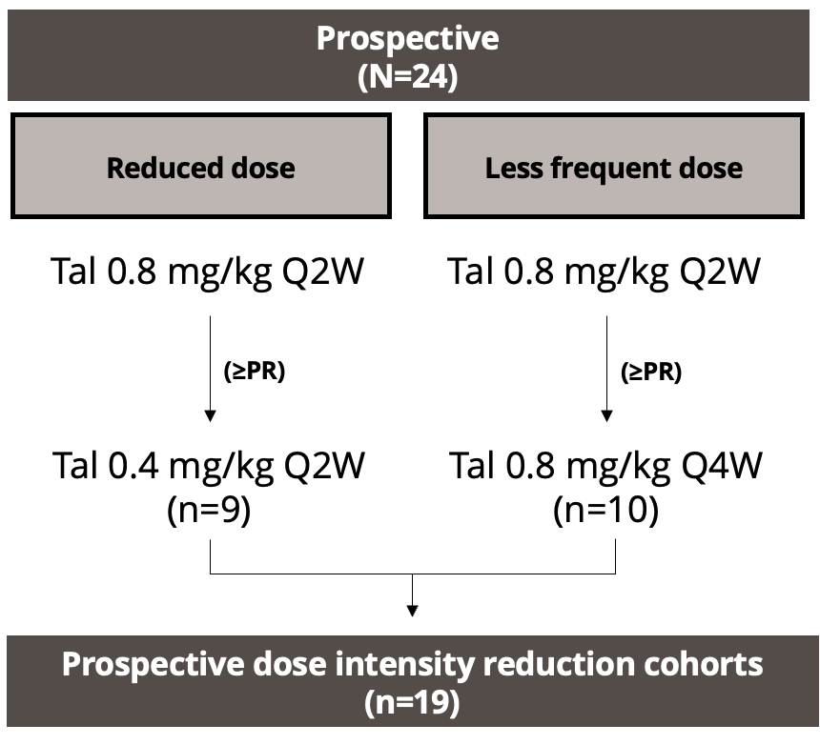
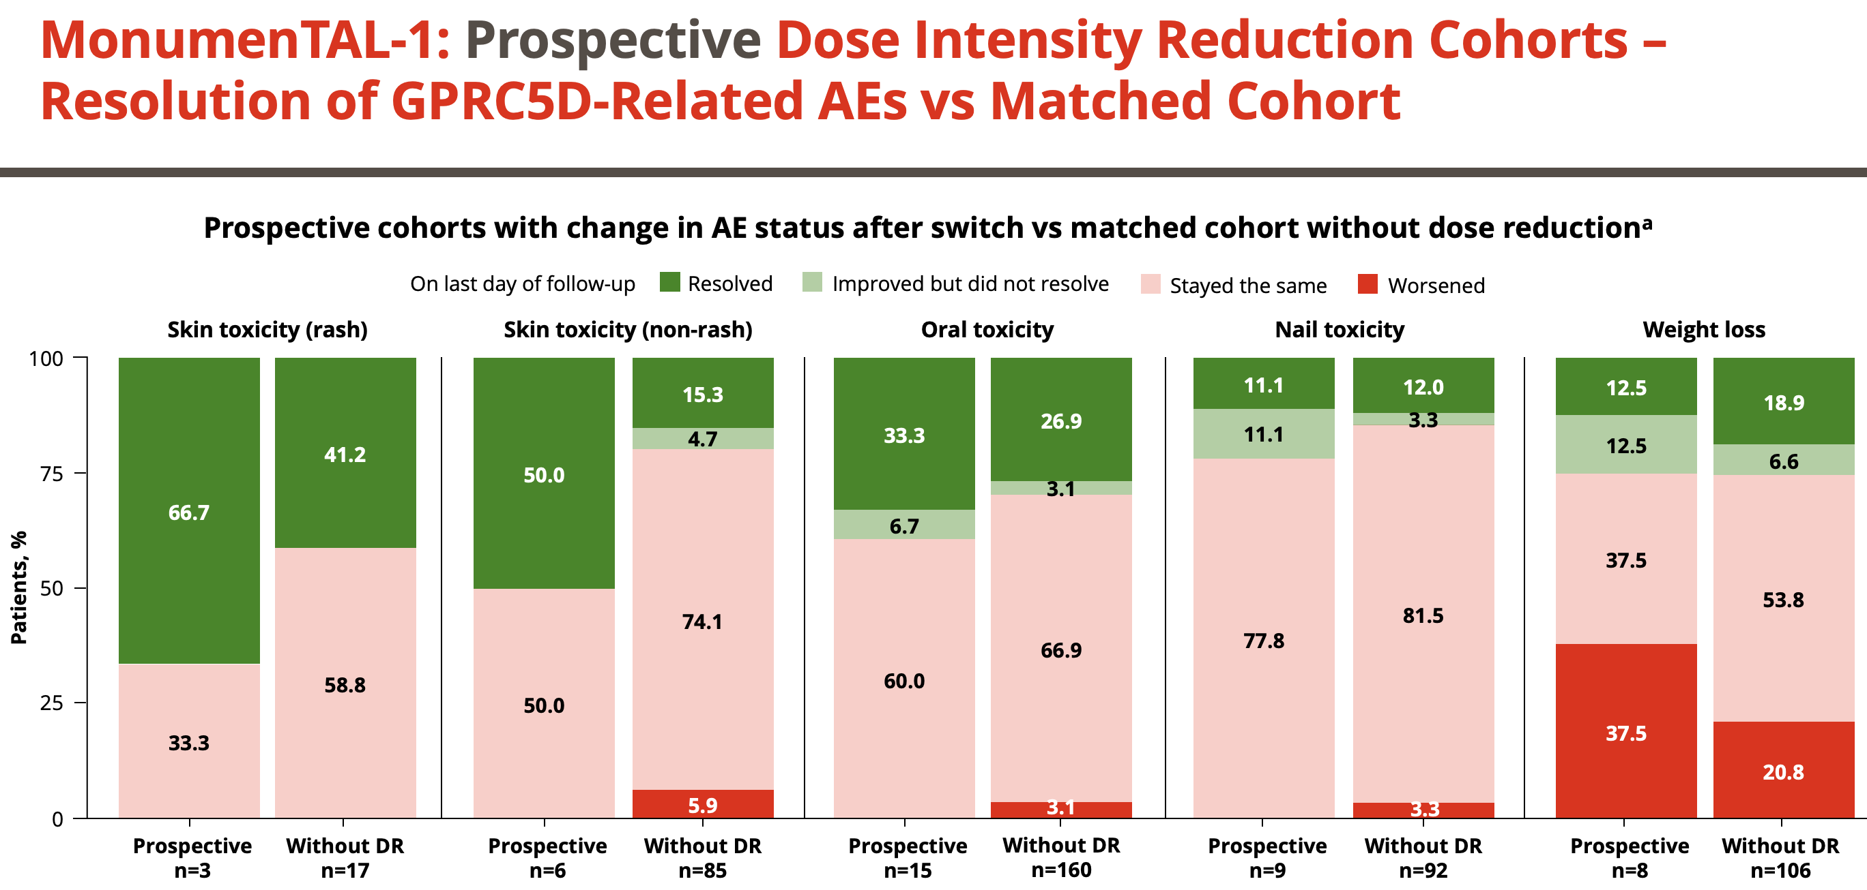
So how far can we lower the tal dose?
Cutting the frequency in half helps with most AEs, too!
Chari A, Oriol A, Krishnan A, et al. ASH 2023.

Slide 17
Reflections & Conclusions
Many advantages to bsAbs over CAR-T for certain patients
Rapid “brain-to-vein” times of only 2-3 weeks
More likely to be coming to your center (if not already) as opposed to CAR-T
Generally safer: Lower ICANS and no rare delayed neurotoxicity
Exception: Infections with BCMA bsAbs and weight loss with talquetamab
How will bsAbs evolve in the next 5 years?
Better outpatient models (more in Dr. Cowan’s section)
Available at community-based centers like many of yours!
Combinations, for example the RedirecTT-1 study of tec & tal together
Time-limited treatment (not treatment until PD or toxicities)

Slide 18
Thank you!

Slide 19
Multiple Myeloma
July 30th, 2024

Slide 20
The Bispecific Balancing Act in Multiple Myeloma: Inpatient, Outpatient, and Everything In Between
Andrew Cowan, MD
Associate Professor
Research Director, Myeloma
Fred Hutch Cancer Center
Seattle, WA

Slide 21
Disclosures
Research Funding:
Janssen, BMS, Juno/Celgene, Sanofi, Regeneron, IGM BIosciences, Nektar, Harpoon, Caelum
Advisory/Consulting:
Sebia, Janssen, BMS, Sanofi, HopeAI, Adaptive Biotechnologies, Abbvie

Slide 22
Agenda
Review approved bispecifics and hospitalization requirements
Hospitalization requirement
Step up dosing schedules – how, why, where, when?
The future state

Slide 23
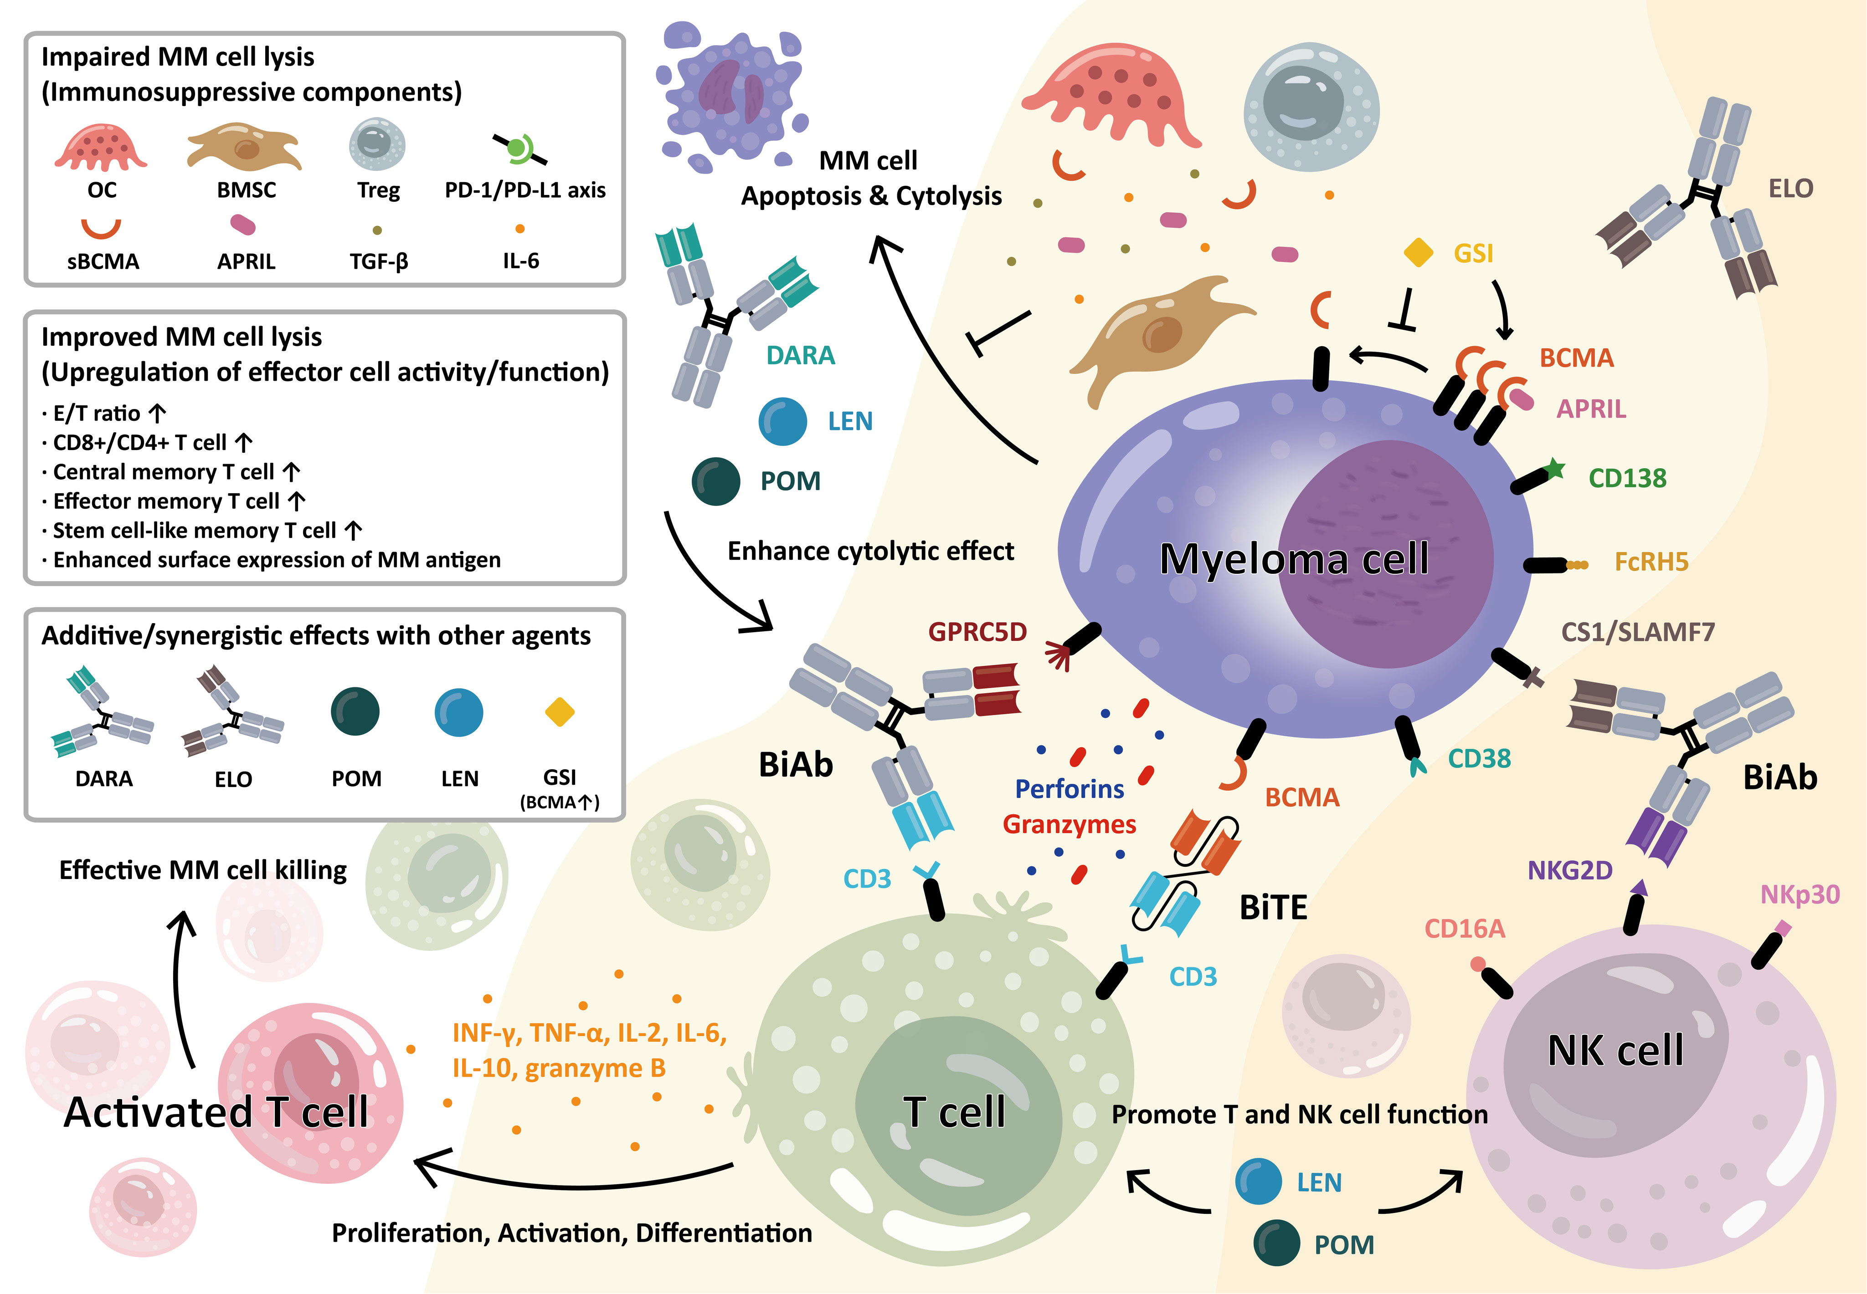
Cho SF et al Frontiers Oncology 2022.

Slide 24
BsAbs for MM: approved and in development
BCMAxCD3
Agent name | ORR | MRD (-)** | PFS | CRS | Infections | Hospitalization
Teclistamab¹* | 63% | 26.7% | mPFS 11.3 mos | 72% | G3-4, 44% | Y – 11 days
Elranatamab^{2*} | 61% | 90% | 12 mos PFS 58% | 57% | G3-4 35% | Y – 3 days
ABBV-383b³ | 57% | 73% | mPFS 10.4 mos | 57% | 41% all G | Y – 48 hrs D1
Linvoseltamab (REGN5458)⁴ | 51% | 4/10 pts | NA | 38% | Not reported | Y
Alnuctamab | 43% | Not reported | NA | 77% | Not reported | Y
GPRC5DxCD3
Talquetamab^{5*} | 68% | 69% | mDOR 10.2 mos | 80% at 800 ug | G3-4 7% | Y, 11 days
FcRH5xCD3
Cevostamab⁶ | 56.7% | 7/10 pts | mDOR 11.5 mos | 80% | ~20% | Y
*FDA Approvals 10/2022, 8/23.
** In Evaluable patients.
1. Moreau P et al, NEJM 2022; 2. Bahlis N et al ASH 2022; 3. D Souza A et al, JCO 2022; 4. Zonder JA ASH 2021; 5. Chari A et al NEJM 2022; 6. Trudel S et al ASH 2021.

Slide 25
Hospitalization – Why?
CRS
Elranatamab - G1 in 42%, G2 in 14.3%
Teclistamab: G1 in 50%, G2 in 21%, G3 in 1%
Talquetamab: G1 54%, G2 25%, G3 in 1%
ICANS: ~10%
In contrast to mosentuzumab for lymphoma – CRS rates are much higher across the board, making outpatient administration more challenging

Slide 26
Step up dosing – why?
Ball et al Mabs 2023
Notes:
Therefore as depicted inFigure 2, initial doses which are lower than the target dose maybe administered within the first treatment cycle in order toprovide a stepwise increase in peak drug concentrations whencompared to fixed dosing schedules, thus “priming” theimmune system more gradually in order to prevent an early,uncontrolled inflammatory response which could lead to CRSor other immune-related toxicities. Fractionated step-up dos-ing (Figure 2c) may also be implemented to provide a similaroverall first-cycle exposure of drug compared to the exposureat the target dose regimen, thus compensating for the lowerexposure of each individual step-up dose. (17) (PDF) Strategies for clinical dose optimization of T cell-engaging therapies in oncology. Available from: https://www.researchgate.net/publication/368779850_Strategies_for_clinical_dose_optimization_of_T_cell-engaging_therapies_in_oncology [accessed Jul 29 2024].

Slide 27
Step up dosing rationale
CRS mitigation
Improve Safety Profile
Allow for Outpatient Administration…
Maintain Efficacy
Notes:
The primary reason for step-up dosing is to reduce the risk and severity of CRS, which is a common and potentially serious side effect of these drugs. By starting with a lower dose and gradually increasing it, the immune system can be "primed" more gently, potentially reducing the sudden, intense cytokine release that can occur with full dosing.

Slide 28
Step up dosing for different BsABs
BCMA
Teclistamab: per MAJESTEC-1
C1: 0.06 mg/kg SC D1, 0.3 mg/kg SC D4, 1.5 mg/kg SC days 1, 8, 15
Per our practice: Days 1, 3, 5
Elranatamab: Per MM-3
Cycle 1: 12 mg SC once on day 1, then 32 mg SC once on day 4
GPRC5D
C1: 0.01 mg/kg SC D1, then 0.06 mg/kg SC on D4, then 0.4 mg/kg SC on D7

Slide 29
Comparison of hospital admission requirements
48 hr obs in hospital required for each dose
Teclistamab and talquetamab:
If given days 1, 4, 8 – 10 day hospitalization
If given days 1, 3, 5 – 7 day hospitalization
Elranatamab:
If dosed per package insert – 6 days in hospital!

Slide 30
Issues with hospitalization
Cost
Inconvenience to patient
Reimbursement
Limited staff/resources

Slide 31
Building an outpatient bispecific program
FHCC insights on challenges
Lack of coverage for outpatient toci (not on label)
Overnight, weekend coverage
No cancer center urgent care
Using the ER for CRS management overnight
Remote patient monitoring – a potential solution, but challenges
Notes:
Issues: toci not covered for IP admission; off label and cannot give prior to admit.

Slide 32
Whither toci prophylaxis?
53 patients with relapsed/ref MM at Emory
Toci administered 4 hrs prior to second SU dose
CRS in 10/33 patients who received PPX
Most 8/10 were grade 1
Compare to 72% CRS (all grade) in MAJESTEC 1
Marin E ASH 2023

Slide 33
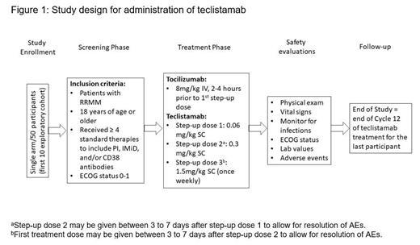
Optec:A Phase 2 Study to Evaluate Outpatient Administration of Teclistamab, a BCMA-Targeting Bispecific Antibody, in Patients with Multiple Myeloma
Rifkin et al ASH 2023
Notes:
Background:
Teclistamab is the only approved BCMA×CD3 bispecific antibody with a personalized, weight-based dosing schedule for the treatment of triple-class exposed relapsed/refractory multiple myeloma (RRMM). It is FDA approved for patients (pts) of therapy (LOTs), including a proteasome inhibitor, immunomodulatory drug, and anti-CD38 antibody. In the pivotal MajesTEC-1 study (Moreau et al NEJM 2022), teclistamab showed deep and durable responses and a manageable safety profile in heavily pretreated pts with RRMM who had limited treatment options. The incidence of all grade cytokine release syndrome (CRS) during the first 2 cycles was 70%. Most pts experienced CRS following step-up doses 1 (42%) or 2 (35%), or the initial treatment dose (24%); 33% of pts experienced recurrent CRS. Most CRS events were grade 1/2 and fully resolved without discontinuation or dose reduction of teclistamab. One (0.6%) case of grade 3 CRS occurred in a pt who pneumonia but resolved in 2 days. No grade 4 or 5 CRS occurred. Tocilizumab is a monoclonal antibody targeting the interleukin-6 receptor (IL-6R) which is used to manage CRS resulting from T-cell redirection therapy. Preclinical data indicate that inhibition of IL-6 signaling prior to teclistamab administration can prevent CRS development without impacting anti-tumor activity (Li et al Ann. Oncol. 2019). In MajesTEC-1, pts who received a single IV dose of tocilizumab before the first teclistamab step-up dose (n=23) showed a reduction in the incidence of all grades of CRS, compared with the overall study population (26% vs 72%). Currently, there are no data on the safety of administering the step-up doses of teclistamab in the outpatient (OP) setting, but OP step-up dosing may make teclistamab more accessible. Therefore, we seek to investigate whether the use of prophylactic tocilizumab can reduce the incidence and severity of CRS associated with teclistamab and allow safe OP administration of the step-up dosing.
Methods:
This single-arm, non-randomized, multicenter, prospective study (NCT05972135) will evaluate CRS incidence and severity after prophylactic tocilizumab in pts treated with teclistamab in the OP setting. A target of 50 participants will be enrolled with an initial PK/PD safety cohort (n=10). Objectives through end of study include recurrent CRS, grade ≥3 and any grade infections, neurotoxicity including ICANS, neutropenia, febrile neutropenia, and efficacy. Eligible pts are ≥18 years with a documented diagnosis of RRMM who have previously received ≥4 LOTs. Pts with rapidly progressing disease, central nervous system involvement, active infection, or contraindication to tocilizumab will be excluded from the trial. Prior to the treatment phase, pts will participate in a 28-day screening phase to determine study eligibility. During the treatment phase, a single dose of tocilizumab will be administered at 8 mg/kg IV, 2 to 4 hours prior to step-up dose 1 of teclistamab (Cycle 1 Day 1) in an outpatient setting (Figure 1). Teclistamab will then be administered at step-up doses of 0.06 mg/kg subcutaneously (SC) (Cycle 1 Day 1) and 0.3 mg/kg SC (Cycle 1 Days 3-5), followed by 1.5 mg/kg SC (Cycle 1 Day 8), with weekly administration for twelve 28-day cycles or until disease progression or unacceptable toxicity. Teclistamab may be reduced to 1.5 mg/kg SC every two weeks for participants who achieve partial response or better after 6 months of therapy. Safety evaluations will include physical examination, vital sign measurements, neurological examination, assessment of ECOG performance status, and clinical safety laboratory assessments. IVIG is recommended in pts with serum IgG <4 g/L. Follow-up of participants during the study will include monitoring for all adverse events, disease progression, and survival until end of study. By studying the feasibility and safety of administering the step-up dosing schedule in an outpatient setting, teclistamab may become more accessible to pts with RRMM and limited treatment options.

Slide 34
Mayo HBO: ASH 2023
Bansal R ASH 2023

Slide 35
Summary
Step up doses necessary to mitigate risk of CRS
Outpatient admin feasible, but resources to do this are lacking in many healthcare systems
Simple, efficient and easily scalable processes are desperately needed to improve availability of these advanced, effective therapies

Slide 36
Multiple Myeloma
July 30th, 2024

Slide 37
CAR T-cell therapy in early relapse of multiple myeloma
Mary Kwok, MD, FACP
Clinical Associate Professor
Clinical Director, Myeloma
Fred Hutch Cancer Center
Seattle, WA

Slide 38
Disclosures
Research Funding:
Beigene

Slide 39
Agenda
Review the differences in the trial design of KarMMa-3 and CARTITUDE-4
Review the differences in baseline characteristics and patient populations
Discuss the benefits of each ide-cel and ciltacel including differences in efficacy and safety outcomes

Slide 40
KarMMa-3: Study Design
Relapsed Refractory MM n= 386
Optional: bridging x 1 cycles per SoC
Idecabtagene Vicleucel
150-450 x 10⁶ CAR T-cells
(n = 225)
Investigator’s Choice SoC
(n=132)
PD or unacceptable AE’s
Crossover to ide-cel allowed after confirmed PD
Lymphodepletion with Flu/Cy
Phase 3 ​
International​
Triple class exposed RR MM​
2-4 prior lines of therapy ​
n = 254
n = 132
SoC options: DPd, DVd, IRd, Kd, EPd
Rodriguez-Otero. NEJM. 2023;388:1002.
Notes:
SOC arm:
43: DPd
30: Kd
30: Elo-Pd
22: IRd
7: DVd
Idecel: 213 underwent bridging
4 died between leuka and treatment
3 could not receive due to manufacturing failure

Slide 41
Patient characteristics
 | Ide-cel (n = 254) | Standard Regimen (n = 132)
Median Age (yr) | 63 (30-81) | 63 (42-83)
Age <65 | 150 (59) | 89 (59)
Age >= 65 | 104 (41) | 54 (41)
Age >= 75 | 12 (5) | 9 (7)
Male | 156 (61) | 79 (60)
Median time from initial dx | 4.1 (0.6-21.8 yrs) | 4 (0.7-17.7 yrs)
Extramedullary disease | 61 (24%) | 32 (24%)
High tumor burden | 71 (28%) | 34 (26%)
High risk cytogenetics | 107 (42%) | 61 (46%)
# of prior therapies | 3 (2-4) | 3(2-4)
Triple class refractory | 164 (65%) | 89 (67%)
Penta-refractory disease | 15 (6%) | 5 (4%)
Rodriguez-Otero. NEJM. 2023;388:1002.

Slide 42
KarMMa-3: Treatment response
 | Ide-cel (n = 254) | Standard regimen (n=132)
Best ORR | 181 (71%) | 55 (42%)
sCR | 90 (35%) | 6 (5%)
CR | 8 (3%) | 1 (1%)
VGPR | 55 (22%) | 13 (10%)
PR | 28 (11%) | 35 (27%)
MR | 4 (2%) | 9 (7%)
SD | 31 (12%) | 48 (36%)
PD | 24 (9%) | 10 (8%)
Median duration of response | 14.8 months (12-18.6) | 9.7 months (5.4-16.3)
Rodriguez-Otero. NEJM. 2023;388:1002.
Notes:
Secondary endpoints
ORR: 71% with idecel vs. 42% with standard

Slide 43
KarMMa-3 Progression free survival (ITT population)
Rodriguez-Otero. NEJM. 2023;388:1002.
Notes:
Median FU 18.6 months
PFS = 13.3 months
4.4 months with SOC

Slide 44
Safety Data
 | Ide-cel |  |  | Standard
 | Any Grade | Grade 3-4 | Grade 5 | Any Grade | Grade 3-4 | Grade 5
Hematologic | 224 (90) | 218 (87) | 0 | 90 (71) | 75 (60) | 0
GI | 182 (73) | 13 (5) | 0 | 65 (52) | 5(4) | 0
Infection | 146 (58) | 61 (24) | 11 (4) | 68 (54) | 23 (18) | 3 (2)
CRS | 197/225 | 9/225 (4) | 2/225 (1) | 0/126 | 0/126 | 0/126
Neurotoxic | 34/225 | 7/225 (3) | 0/225 | 0/126 | 0/126 | 0/126
Rodriguez-Otero. NEJM. 2023;388:1002.

Slide 46
CARTITUDE-4: Study Design
Relapsed Refractory MM n = 419
Bridging required for >= 1 cycle
Ciltacabtagene Vicleucel
0.75 x 10⁶ CAR T-cells
(n = 176)
Investigator’s Choice SoC
(n= 208)
PD or unacceptable AE’s
Lymphodepletion with Flu/Cy
RRMM
1-3 prior lines of therapy
Prior lenalidomide
n = 208
n = 211
SoC options: PVd or DPd
San-Miguel. NEJM. 2023;389:335

Slide 47
CARTITUDE-4: Patient characteristics
 | Cilta-cel (n = 208) | Standard Regimen (n = 211)
Median Age (yr) | 61.5 (27-78) | 61 (35-80)
Male | 116 (55.8) | 124 (58.8)
Median time from initial dx | 3 (0.3-18.1) years | 3.4 (0.4-22.1) years
Soft tissue plasmacytomas | 44 (21.2%) | 35 (16.6%)
High risk cytogenetics | 123/207 (59.4%) | 132/210 (62.9%)
Triple class refractory | 30 (14.4%) | 33 (15.6%)
Penta-refractory disease | 2 (1%) | 1 (0.5%)
San-Miguel. NEJM. 2023;389:335
Rodriguez-Otero. NEJM. 2023;388:1002.

Slide 48
CARTITUDE-4 Progression free survival
San-Miguel. NEJM. 2023;389:335
Notes:
Median follow-up of 15.9 months, median PFS not reached in ciltacel group, 11.8 mos in SOC group

Slide 49
CARTITUDE-4: Treatment response
 | Cilta-cel (n = 208) | Standard regimen (n=211)
Best ORR | 176 (84.6%) | 142 (67.3%)
sCR | 121 (58.2%) | 32 (15.2%)
CR | 31 (14.9%) | 14 (6.6%)
VGPR | 17 (8.2%) | 150 (23.7%)
PR | 7 (3.4%) | 46 (21.8%)
MR | 1 (0.5 %) | 5 (2.4%)
SD | 13 (6.2%) | 47 (22.3%)
PD | 17 (8.2%) | 6 (2.8%)
12 month duration of response | 84.7% | 63%
San-Miguel. NEJM. 2023;389:335
Notes:
Secondary endpoints
ORR: 71% with idecel vs. 42% with standard

Slide 50
Safety Data
 | Cilta-cel |  | Standard
 | Any Grade | Grade 3-4 | Any Grade | Grade 3-4
Hematologic | 197 (94.7) | 196 (94.2) | 90 (71) | 75 (60)
Infection | 129 (62) | 56 (26.9) | 148 (71.2) | 51 (24.5)
CRS | 134/176 | 2/176
Neurotoxic | 36/176 | 5/176
San-Miguel. NEJM. 2023;389:335

Slide 51
San-Miguel. NEJM. 2023;389:335

Slide 52
 | KarMMa-3 | CARTITUDE-4
Eligibility | RRMM, 2-4 prior lines of therapy | RRMM, 1-3 prior lines, refractory to len
# of patients | 381 | 419
Randomization | 2:1 | 1:1
Bridging therapy | Optional <=1 cycle of DPd, DVd, IRd | Required >= 1 cycle PVd or DPd
SoC comparison | DPd, DVd, IRd, Kd, EPd | PVd or DPd
Crossover allowed? | Yes | No
Primary Endpoint | PFS | PFS
Secondary Endpoint | OS, EFS, ORR, MRD, CR, TTR, DoR, safety, PK, PFS2 | CR, sCR, MRD, ORR, OS, safety, PFS2

Slide 53
 | KarMMa-3 | CARTITUDE-4
Eligibility | RRMM, 2-4 prior lines of therapy | RRMM, 1-3 prior lines, refractory to len
# of patients | 381 | 419
ORR | 176 (84.6%) | 181 (71%)
sCR | 121 (58.2%) | 90 (35%)
CR | 31 (14.9%) | 8 (3%)
VGPR | 17 (8.2%) | 55 (22%)
PD | 24 (9%) | 17 (8.2%)
Duration of response | Median DOR: 14.8 months (12-18.6) | 12 month DOR: 84.7%
CRS |  | 134/176
ICANS |  | 36/176

Slide 55
Applying Clinical Evidence to Practice:
R/R MM
Andrew J. Cowan, MD
Associate Professor, Clinical Research Division
Clinical Research Director, Myeloma Service
Fred Hutch Cancer Center
Seattle, WA

Slide 56
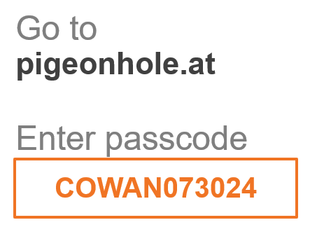
About Treatment Crossroads: Application of Data
This discussion will engage the audience to answer real-time polling questions on how to apply the clinical data presented by speakers today in your day-to-day practice.
We will capture practical implications of clinical data, trends in care, factors for decision-making, and the real-world impact of the information presented in clinical practice.
We appreciate your active engagement throughout the program as we apply these concepts! Your participation is essential as we navigate “treatment crossroads” and put clinical data into practice.

Slide 57
How many patients with R/R multiple myeloma are you seeing/treating each week in your practice?
POLLING QUESTION
1 to 4
5 to 9
10 to 14
15 to 19
20 or more

Slide 58
Exploring CAR T-Cell Therapy in Early Relapsed/Refractory Multiple Myeloma 20 minutes

Slide 59
Refresh of Highlights of Trials Presented Earlier Tonight
CAR T-Cell Therapy in R/R Multiple Myeloma
Presented by Mary Kwok, MD
KarMMa-3
Ide-cel significantly improved mPFS vs standard triplet regimens (13.3 vs 4.4 mo, p<0.0001) in previously treated R/R multiple myeloma patients and reduced the risk of disease progression or death by 51%.
CARTITUDE-4
Cilta-cel demonstrated a higher PFS compared to SOC in R/R MM patients with 1-3 prior lines of therapy (NR vs 11.8 mo, p=0.001).
Recent FDA Approvals
4/4/24: Ide-Cel was approved for the treatment of adult patients with R/R with ≥2 prior lines of therapy (incl. IMiD, PI, and anti-CD38 mAb).
4/5/24: Cilta-cel was approved for the treatment of adult patients with R/R MM with ≥1 prior lines of therapy (incl. IMiD, PI, and lenalidomide refractory).
Notes:
Moderator Notes: Please allow time to briefly discuss trial differences between KarMMa-3 and CARTITUDE-4.
Differences in trial design (including bridging therapies) in KarMMa-3 & CARTITUDE-4.
Differences in baseline characteristics/patient populations.
Benefits of each CAR T-cell therapy (ide-cel & cilta-cel), including differences in efficacy and safety outcomes.

Slide 60
Which of these factors do you consider as indicative of high-risk disease:
POLLING QUESTION
Chromosomal abnormalities
Early time to relapse (<18 months ± ASCT from induction)
Extramedullary disease
All of the above

Slide 61
Discussion: Referral for CAR T-Cell Therapy
How do you approach patient referrals for CAR T in your practice?
How are referrals processed between your academic site versus community practices?
When evaluating and counseling your patients:
What are those conversation like between you and the patient?
TxCrossroad Challenge: What roadblocks are present that may impact your referral process? How does a patient’s lifestyle impact your decision making?

Slide 62
Treatment Crossroad Scenario: Application of Data
You have a 60-year-old patient with lenalidomide refractory IgG-lambda multiple myeloma. They were previously treated Dara-VRd followed by lenalidomide maintenance and at first relapse met with their oncologist for second line options.
Given the availability of therapies, what treatment(s) might you consider for this patient?
At this point, what clinical/patient factors would make you consider initiating CAR T in the second line setting?
Notes:
Notes/Moderator Notes:

Slide 63
Discussion: Toxicity Management
What is your approach to toxicity management in patients treated post-CAR T?
Have you observed differences in safety profiles in the approved CAR Ts and if so, how?
For patients experiencing secondary primary malignancies (SPM):
How do the recent reports impact your current practice?
What strategies have you conducted before and during such event?

Slide 64
Discussion: Clinical Decision Making and Sequencing
Considering the KarMMa-3 and CARTITUDE-4 studies in Early R/R MM:
How do the trial differences, patient populations, and related data impact your decision to refer patients for CAR T treatment in early R/R MM?
Do specific patient or clinical factors make you favor CAR T over other standards of care?
How do you define functional high-risk status, and does it change your treatment approach?
For which patients would you elect to hold CAR T for the third line setting?
How would you approach treatment selection and sequencing in this setting?

Slide 65
Improving Utilization of Bispecifics for Later R/R Multiple Myeloma 20 minutes

Slide 66
Refresh of Highlights of Trials Presented Earlier Tonight
Bispecific Antibodies for R/R Multiple Myeloma Presented by Rahul Banerjee, MD, FACP
Elranatamab: MagnetisMM-3
Teclistamab: MajesTEC-1
With extended follow up, ORR per BICR remained at 61.9% (≥CR rate 37.4%) with MRD negativity observed at 90.3% in patients evaluable for MRD with ≥CR rate (n=31).
At a median follow up of 30.4 months, ORR was shown to be 63% (≥CR rate 46.1%) and of MRD-evaluable patients, 85.&7% were considered MRD-negative.
Talquetamab: MonumenTAL-1
Linvoseltamab: LINKER-MM1
Continued demonstration of elevated ORRs was shown Across QW (0.4 mg/kg) and Q2W (0.8 mg/kg) and prior TCR patient populations at rates of 74.1%, 69.5% and 66.7%, respectively.
At a median follow up of 14.3 months, early data shows an ORR of 71% and ≥CR rate in 50% of patients.

Slide 67
Treatment Crossroad Scenario: Application of Data
You have a patient with later R/R multiple myeloma after 4 prior lines of therapy and undergoes evaluation for a bispecific antibody.
In the later relapsed/refractory setting for myeloma, how do you choose between available options?

Slide 68
What is your preferred bispecifics antibody in later relapsed/refractory MM?
POLLING QUESTION
Elranatamab
Talquetamab
Teclistamab
Clinical Trial
Discussion:
What is your preferred regimen and why?

Slide 69
Patient received four prior lines of therapy, including ASCT and visits here oncologists for evaluation of a bispecific. What is the main challenge faced when implementing bispecifics in your practice?
POLLING QUESTION
Logistics of step-up dose delivery
Comfort level of management of bispecific-related toxicities (e.g., CRS, ICANS)
Financial considerations for your practice
Level of care when administering bispecifics (e.g., inpatient, outpatient)

Slide 70
Treatment Crossroad Scenario: Application of Data
You have a patient experiencing CRS following administration of the first step-up dosing. How would you manage this?
Based on the data discussed, how do the bispecific-related toxicities observed in your clinical practice compare to those reported in the trials?
What strategies (inpatient or outpatient) do you employ to effectively manage these toxicities and support patients throughout their treatment journey?

Slide 71
Discussion: Academic and Community Implementation of Bispecifics
How has your clinical practices evolved surrounding the administration of bispecifics?
What is your approach to transitioning patients to community settings?
What insights can you share on collaborating with community providers to effectively manage patients treated with bispecifics?

Slide 72
When considering the use of bispecifics, which factor has the greatest influence on your decision? Please rank in order from highest to lowest priority.
POLLING QUESTION
A. Efficacy
B. Toxicity profile
C. Convenience
D. Patient preferences
E. Comorbidities
F. Other

Slide 73
Final Questions
What learnings today changed perception of options that are available to treatment approach?
What will each of you take back to clinical practice tomorrow and share?
How might this data presented and discussed today change what your practice/choices will be tomorrow?

Slide 74
Thank You!

