Slide 1
Lung Cancer
Wednesday, June 26, 2024

Slide 2

Adjuvant and Neoadjuvant Therapy for NSCLC
Luis E. Raez MD FACP FCCP
Chief Scientific Officer & Medical Director
Memorial Cancer Institute/Memorial Health Care System
Research Professor at the I-Health Institute
Florida Atlantic University (FAU)
Past-President Florida Society of Clinical Oncology (FLASCO)
@LuisRaezMD

Slide 3
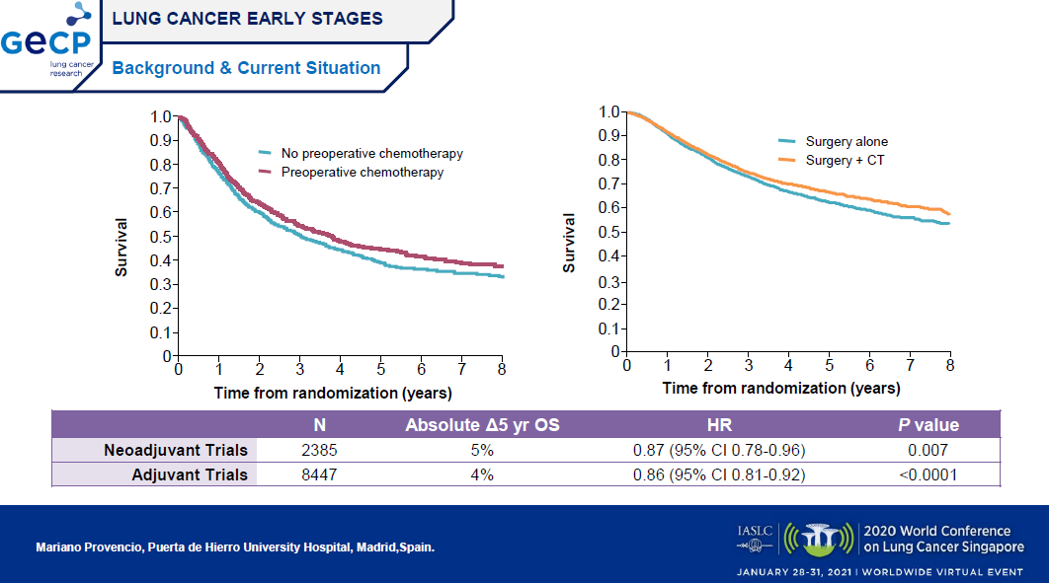

Slide 4
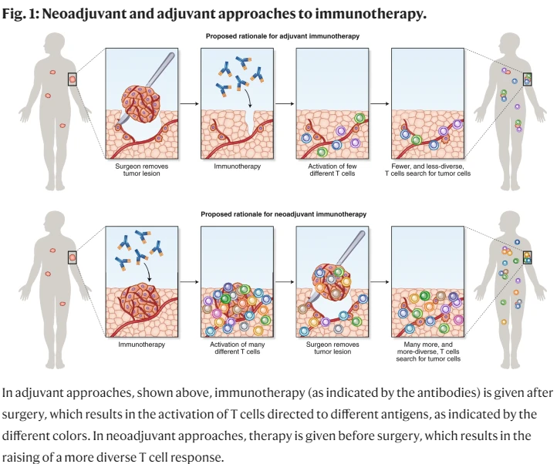

Slide 5
Neoadjuvant Immunotherapy in NSCLC
Checkmate 816
NADIM II

Slide 6
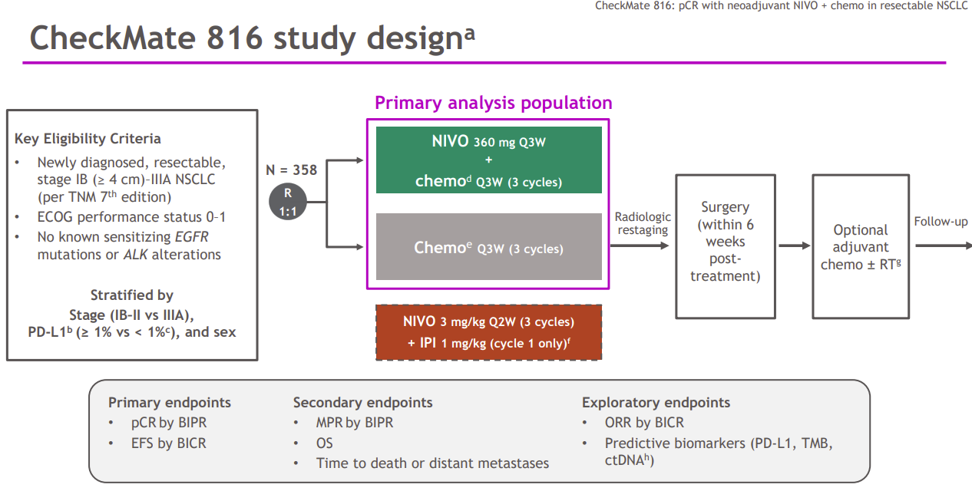
FDA approved 3/2022

Slide 7
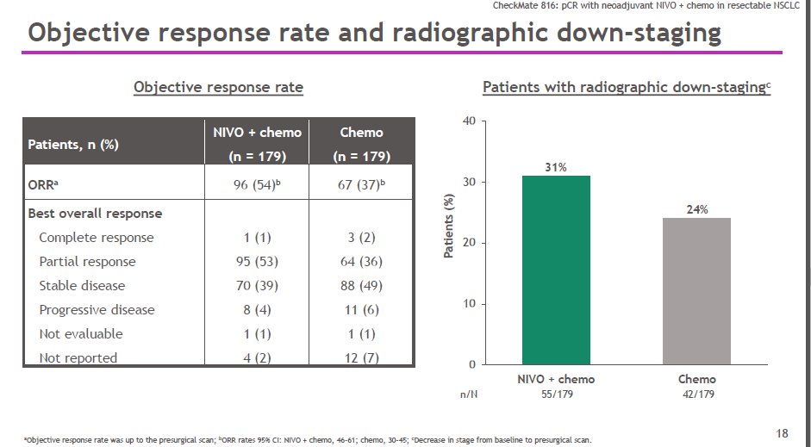

Slide 8
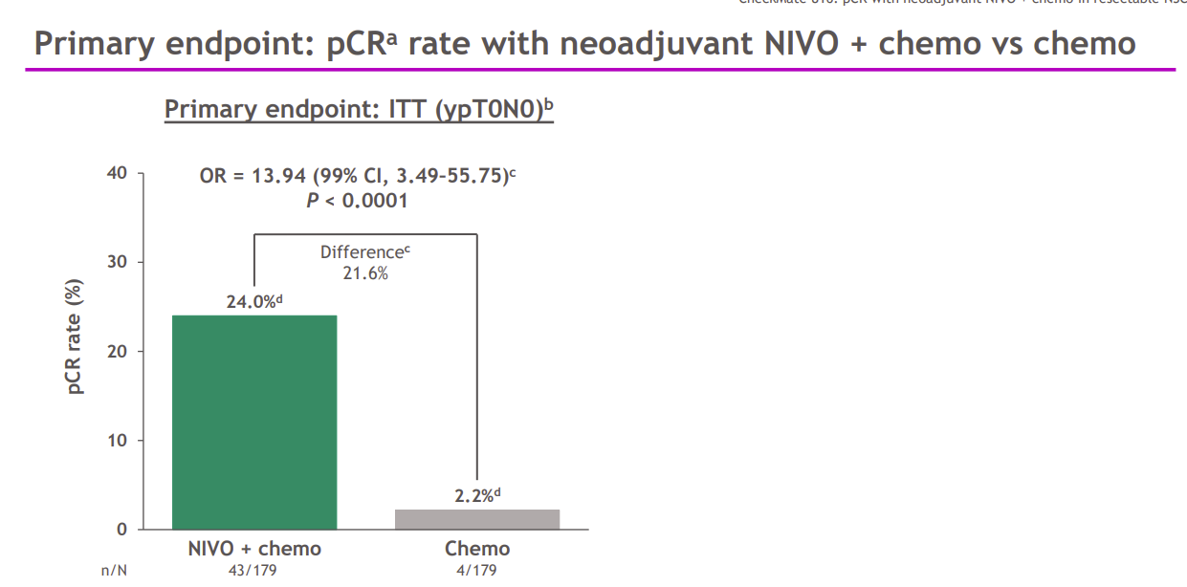
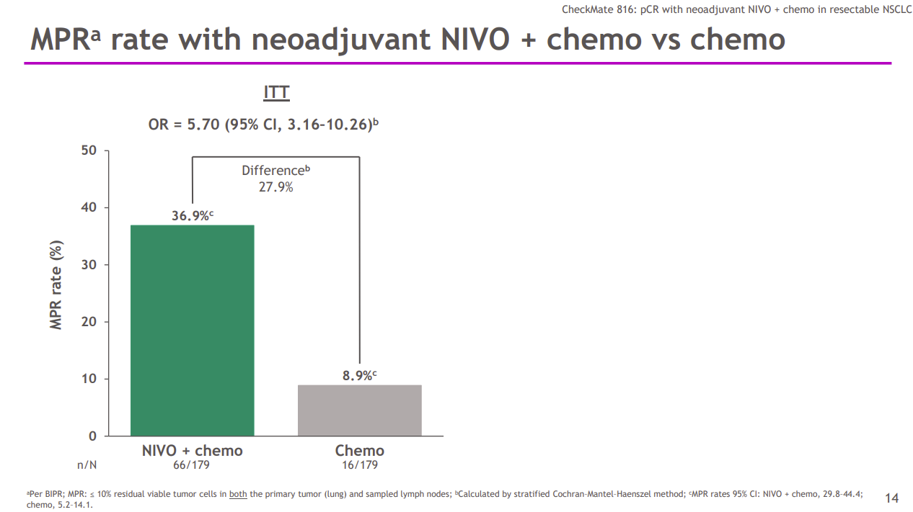

Slide 9
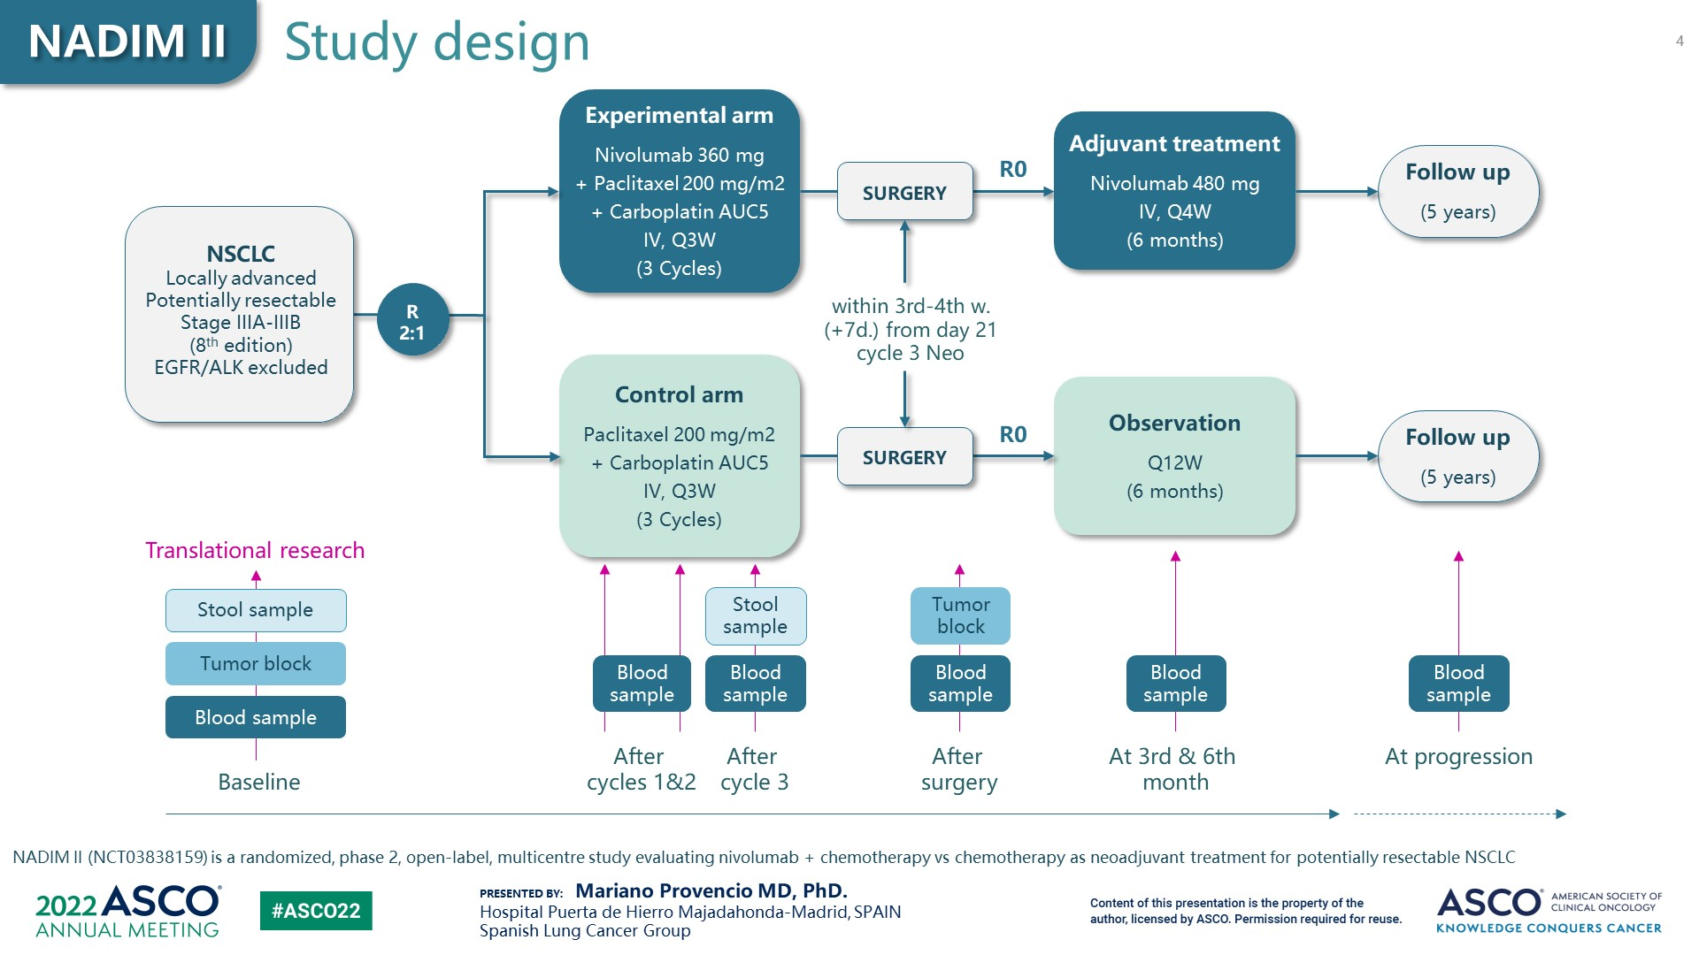
Slide 4

Slide 10
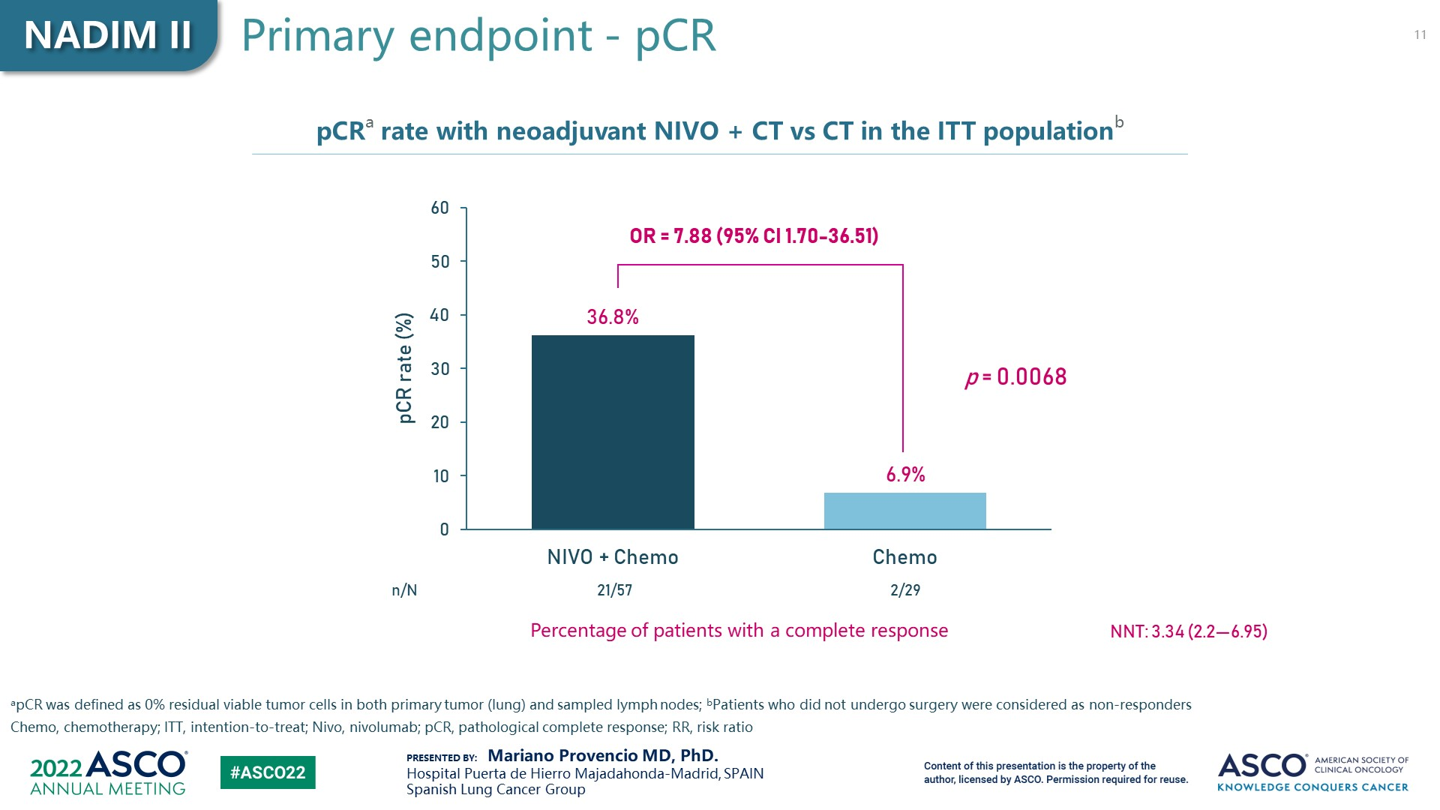
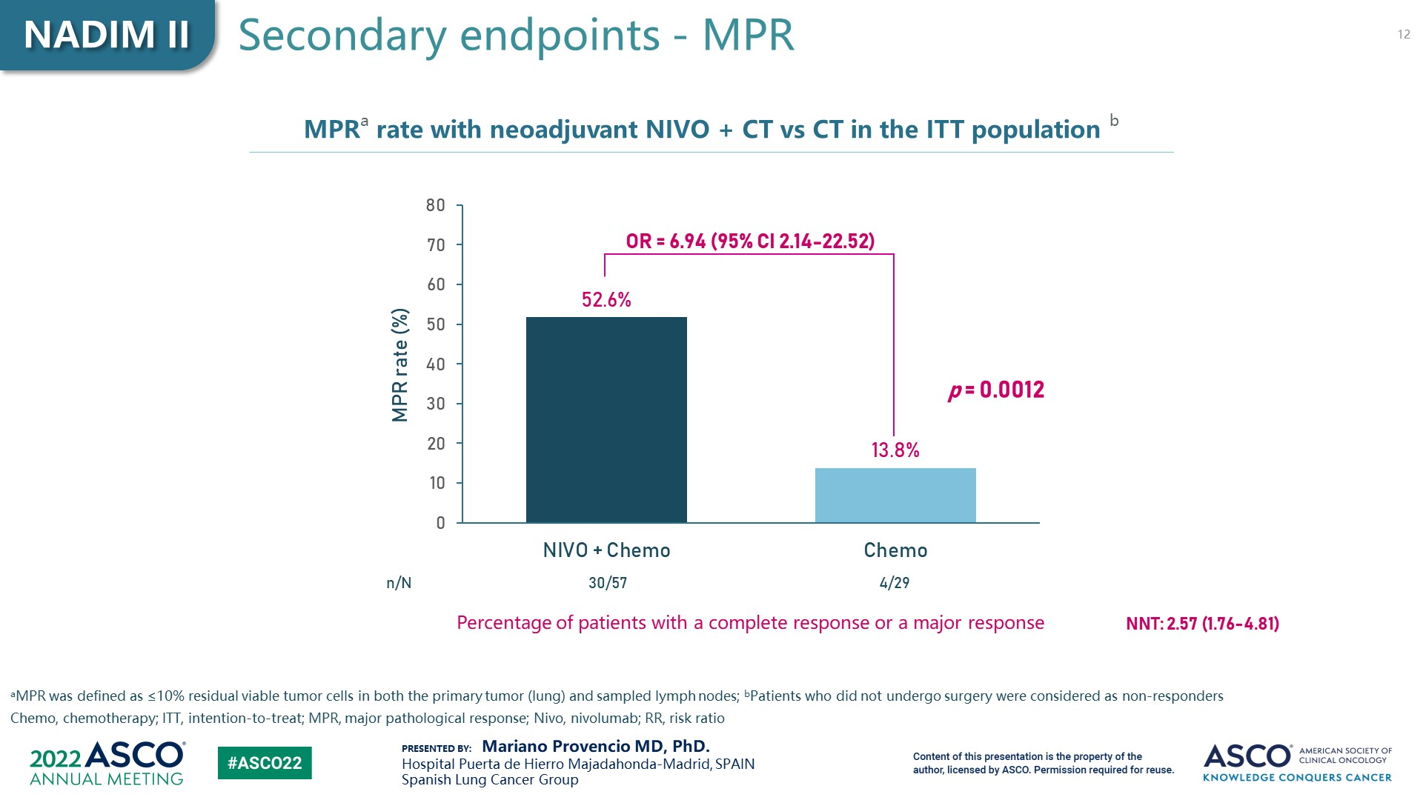

Slide 11
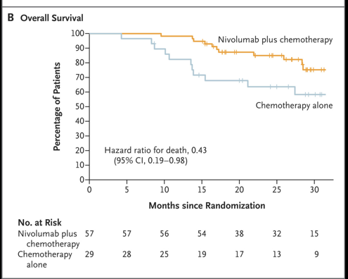
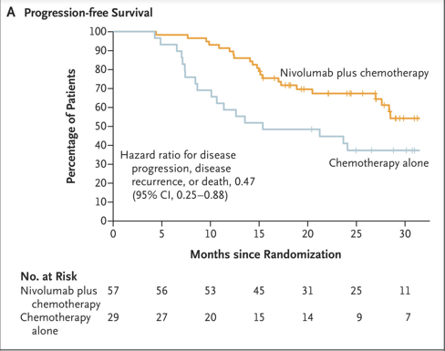
Neoadjuvant Nivolumab and Chemotherapy in Stage III Non–Small-Cell Lung Cancer
Provencio M, et al.N Engl J Med 2023; 389:504-513

Slide 12
ADJUVANT IMMUNOTHERAPY IN NSCLC
*IMPOWER 010
*Keynote 091
@LuisRaezMD

Slide 13
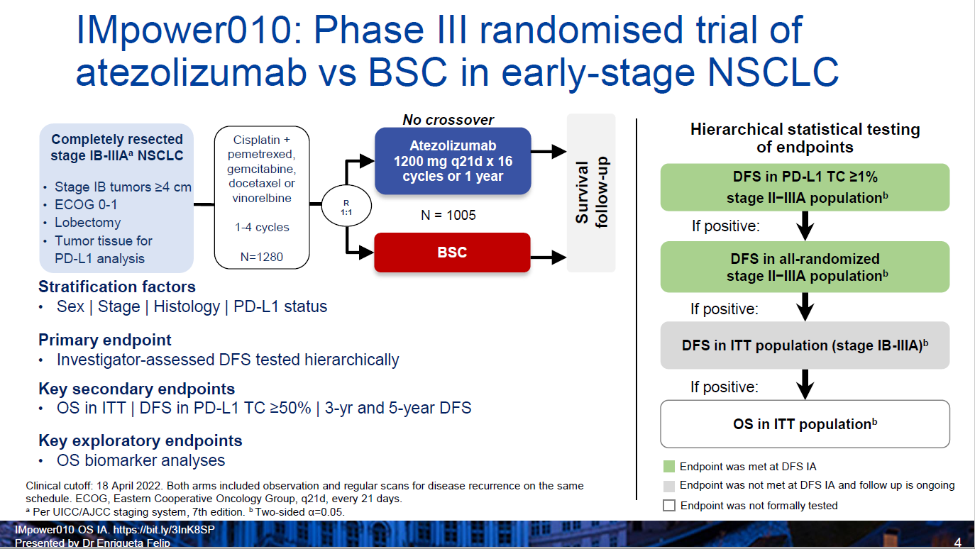

Slide 14
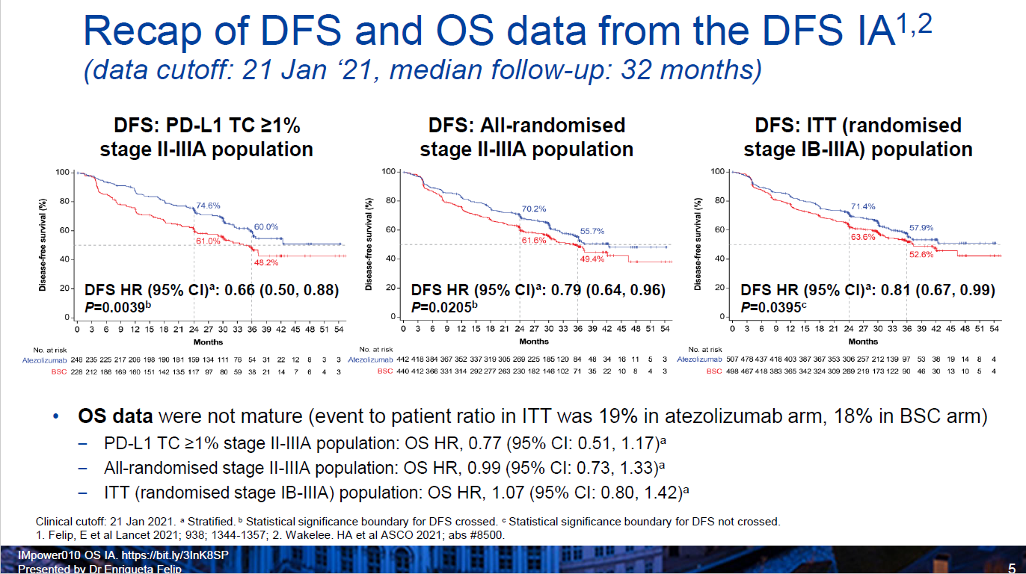

Slide 15
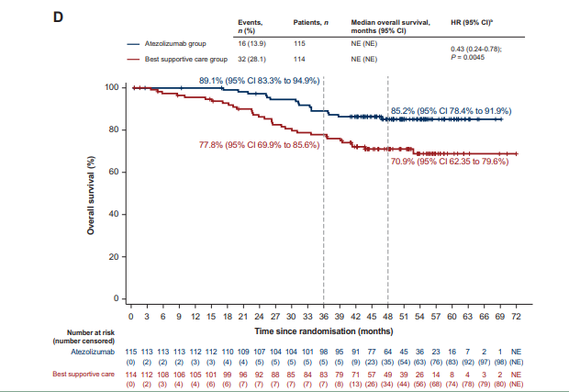
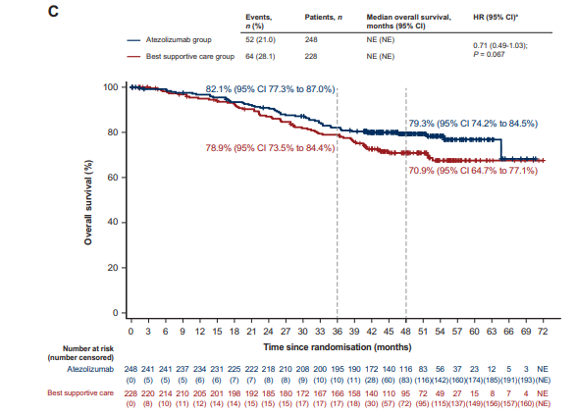
Overall Survival (data inmature)
Stage II-IIIA PD-L1 TC >1% Stage II-IIIA PD-L1 TC >50%
Felip E. https://doi.org/10.1016/j.annonc.2023.07.001

Slide 16
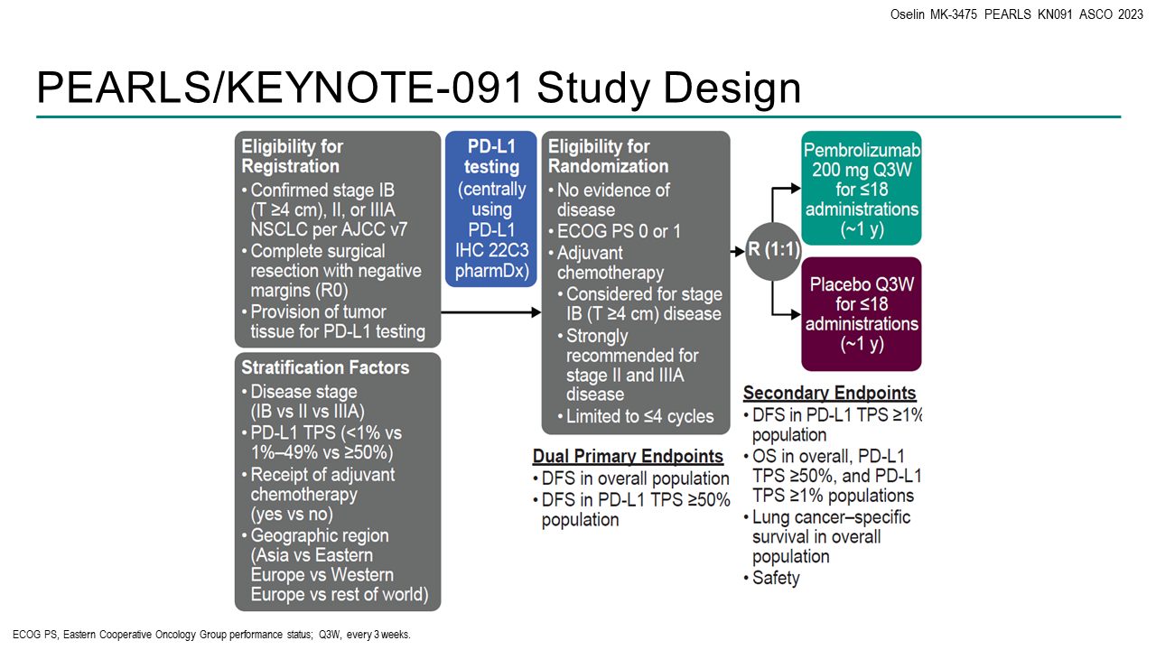

Slide 17
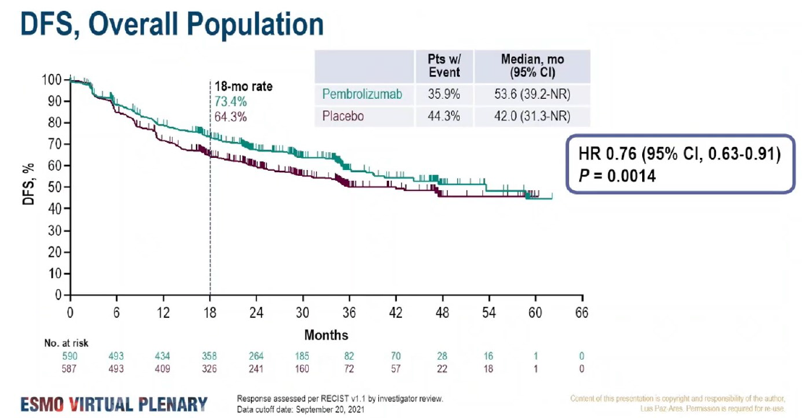

Slide 18
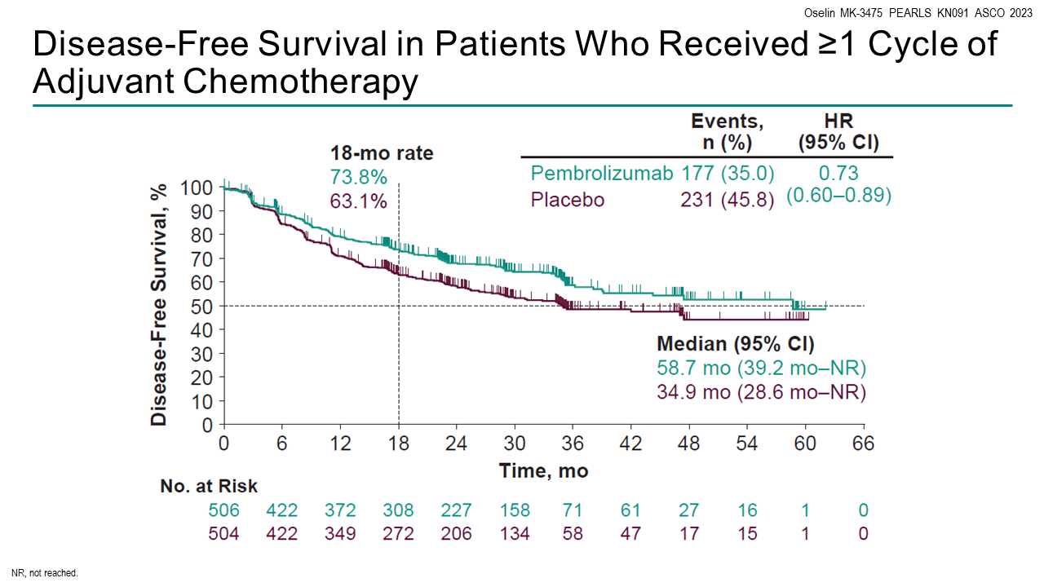

Slide 19
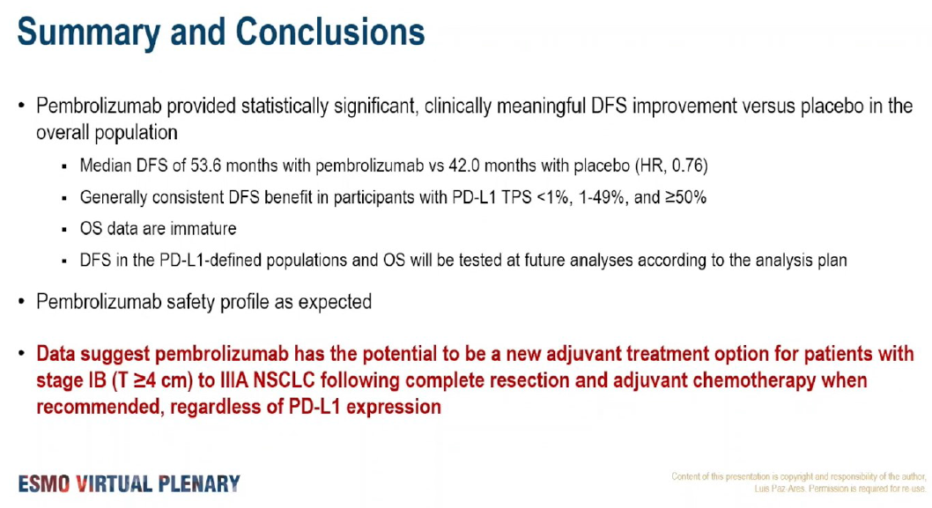
On January 26, 2023, the Food and Drug Administration (FDA) approved pembrolizumab (Keytruda, Merck) for adjuvant treatment following resection and platinum-based chemotherapy for stage IB (T2a ≥4 cm), II, or IIIA non-small cell lung cancer (NSCLC), regardless PDL1

Slide 20
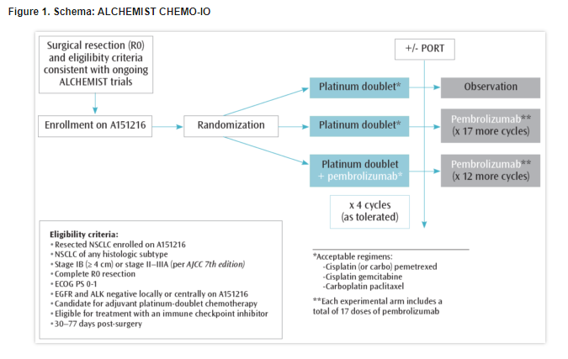

Slide 21
NEOADJUVANT PLUS ADJUVANT (PERIOPERATIVE)
IMMUNOTHERAPY IN NSCLC
*AEGEAN
*Keynote 671
*Neotorch
*Checkmate 77T
@LuisRaezMD

Slide 22
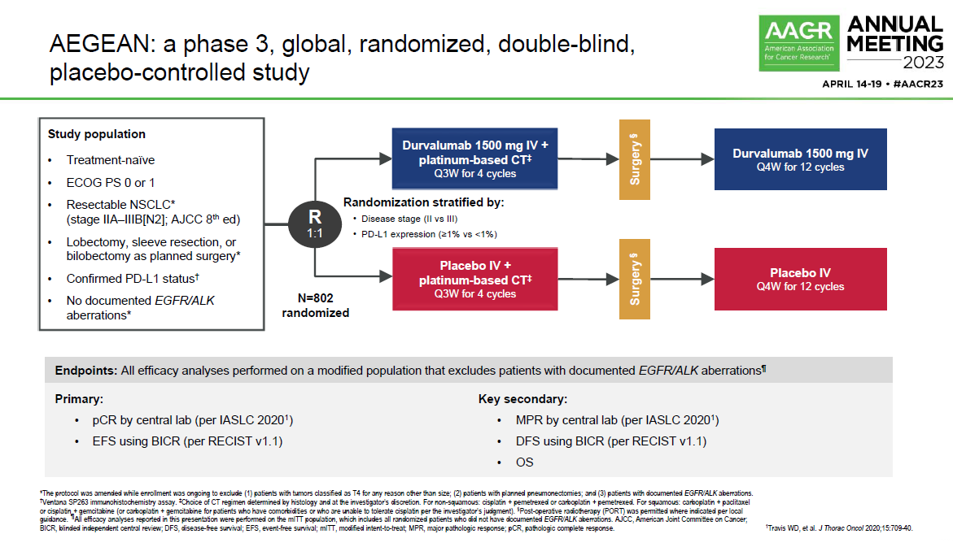

Slide 23
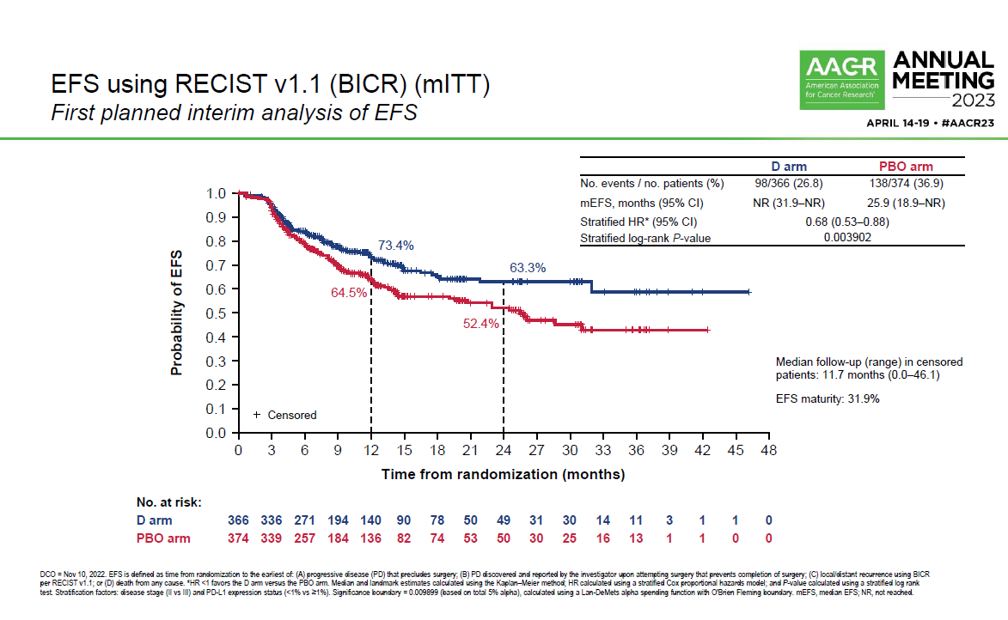

Slide 24
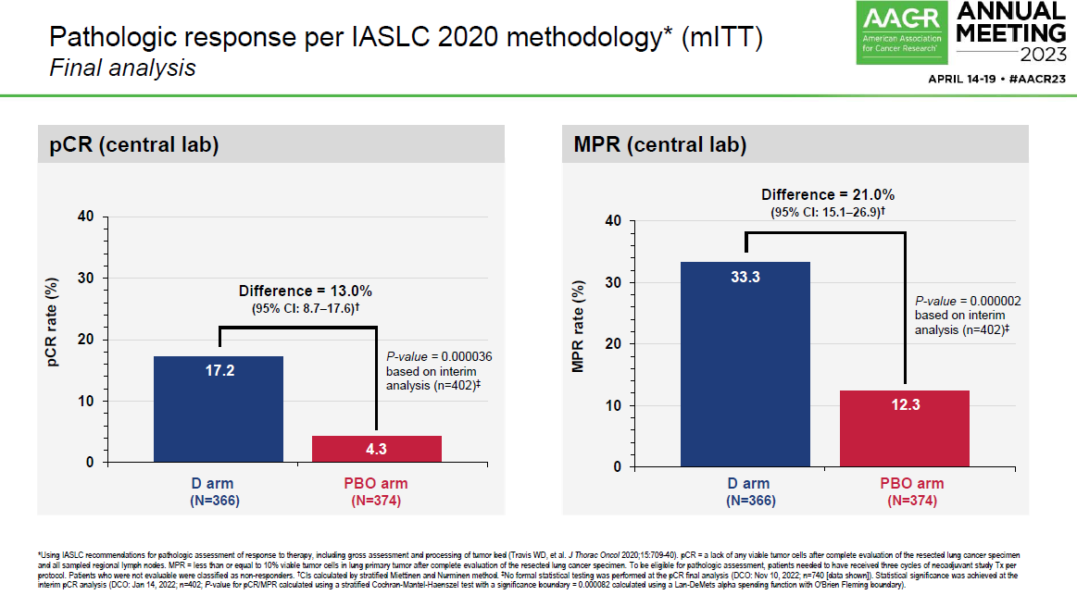

Slide 25
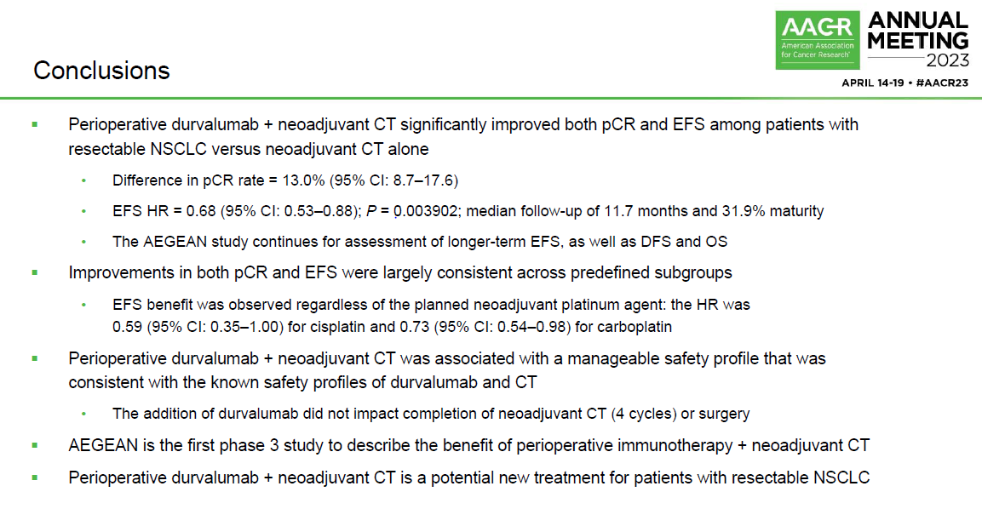

Slide 26
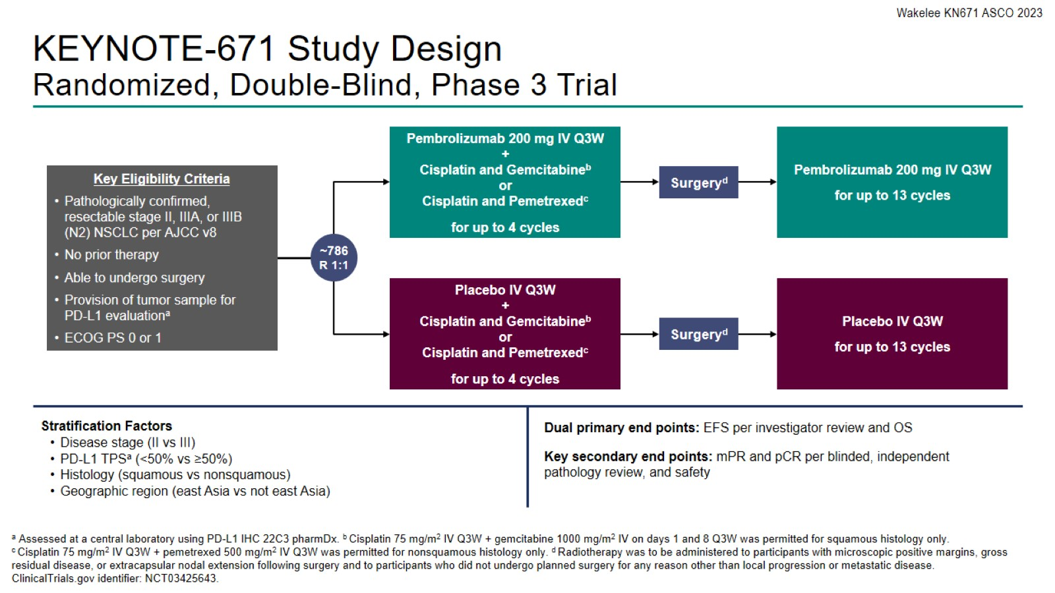
KEYNOTE-671 Study Design
Randomized, Double-Blind, Phase 3 Trial

Slide 27
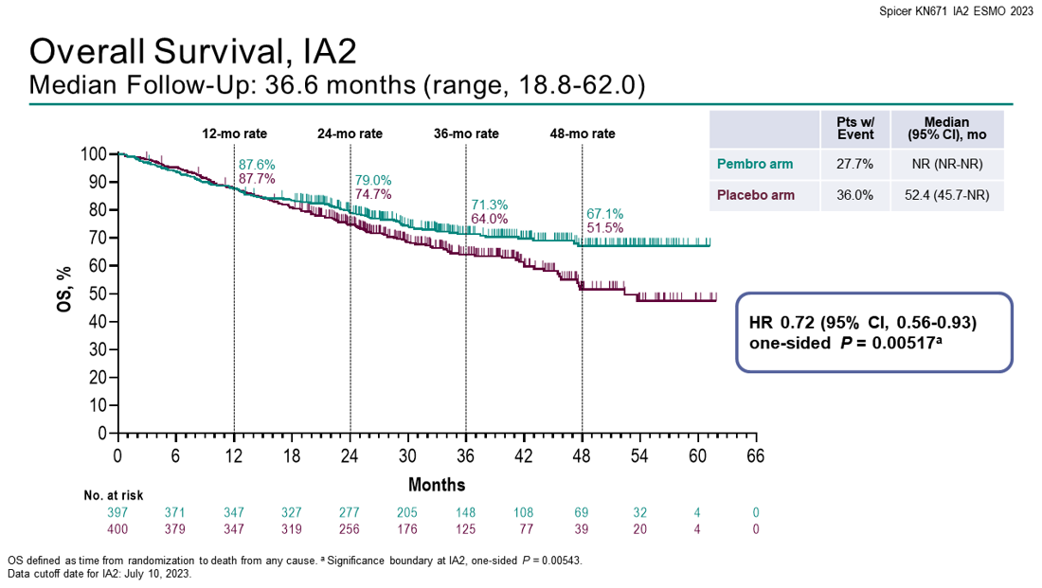

Slide 28
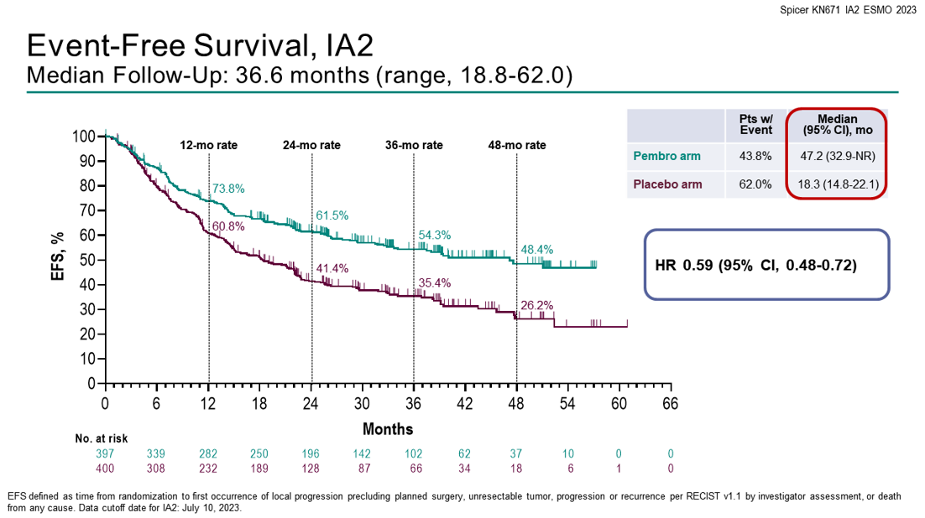

Slide 29
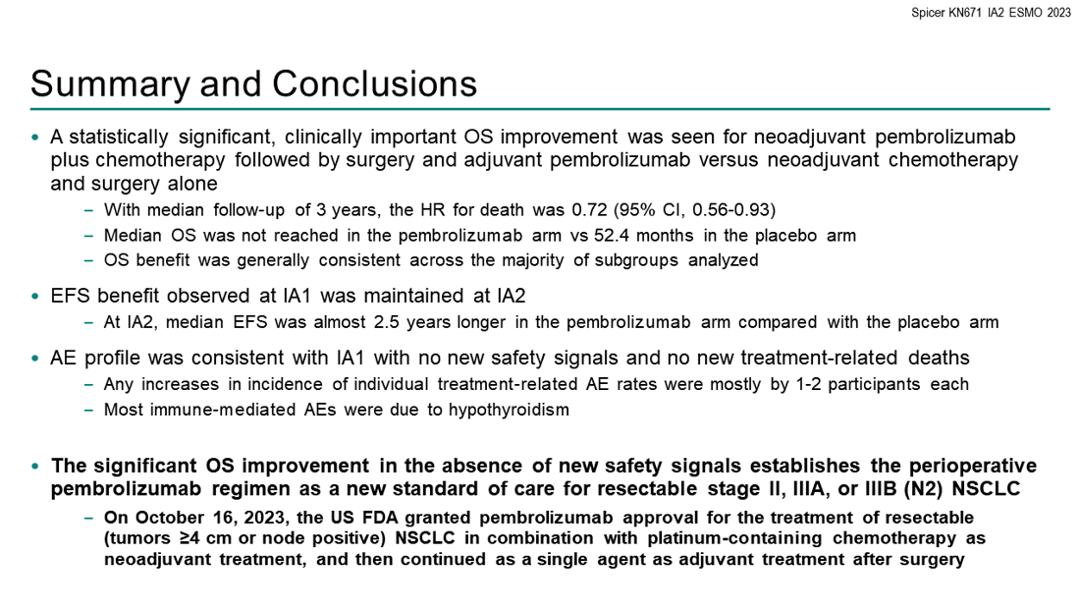

Slide 30
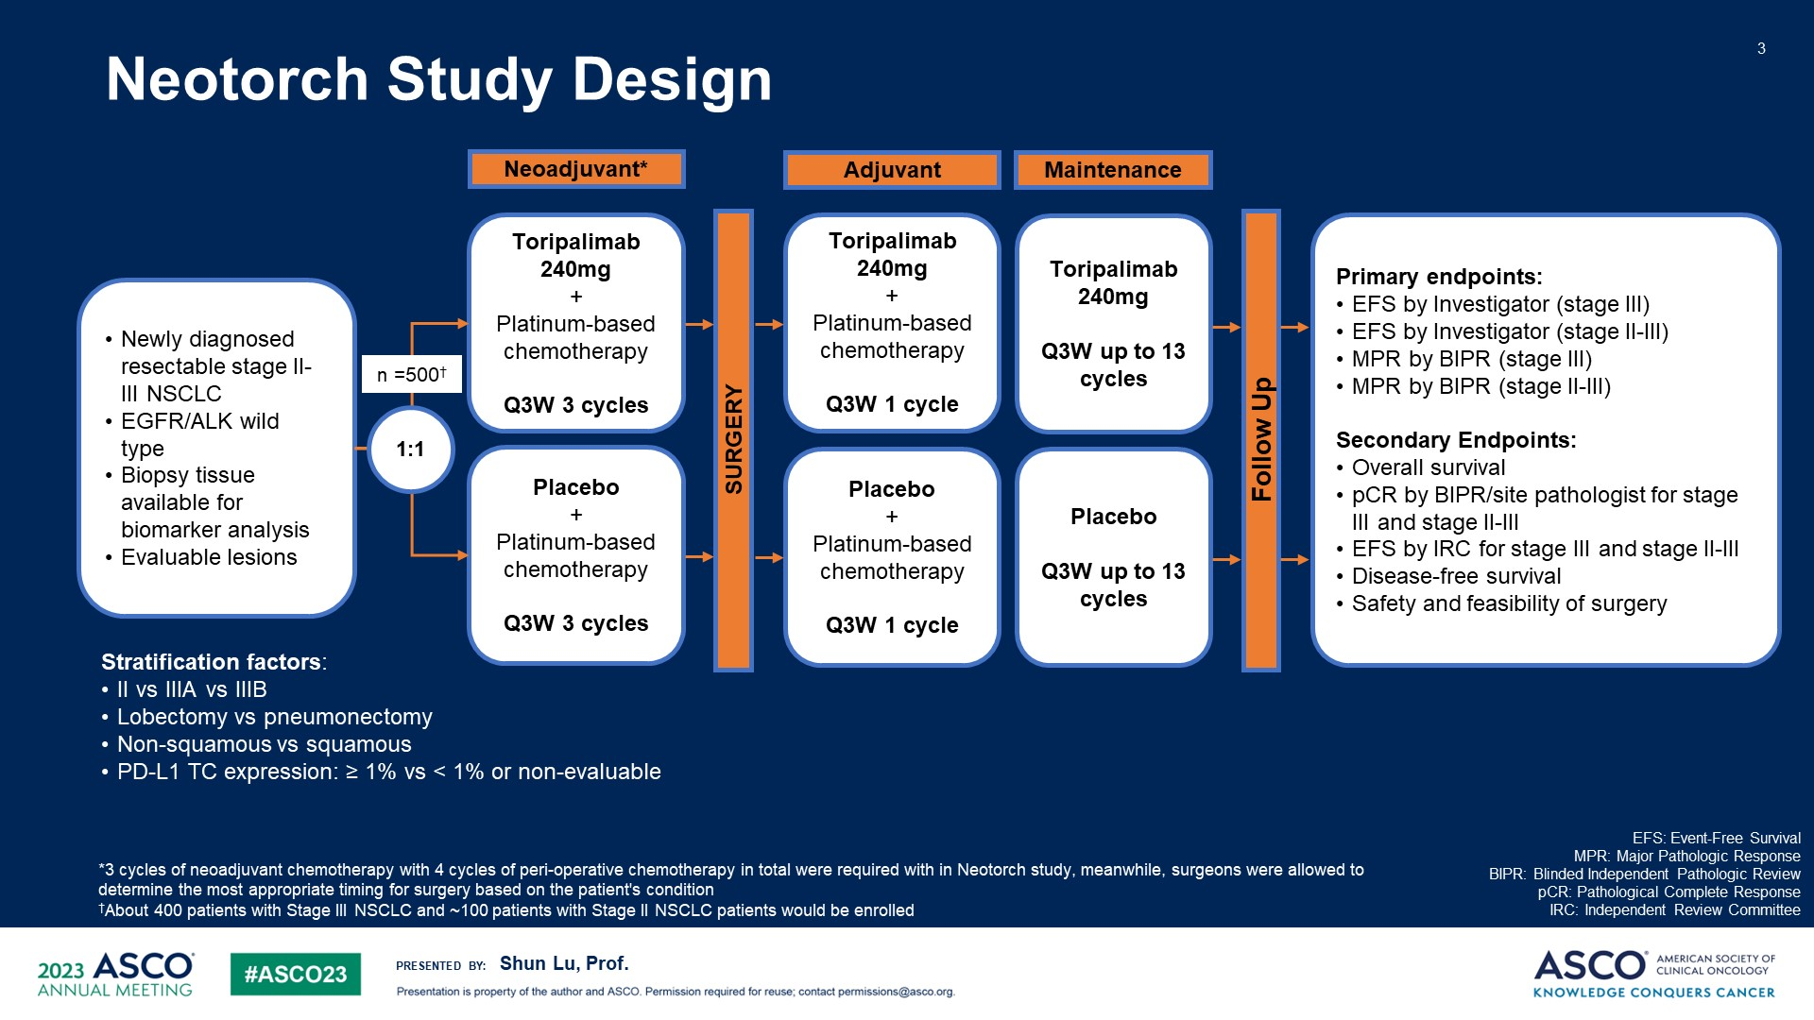
Neotorch Study Design
Content of this presentation is the property of the author, licensed by ASCO. Permission required for reuse.

Slide 31
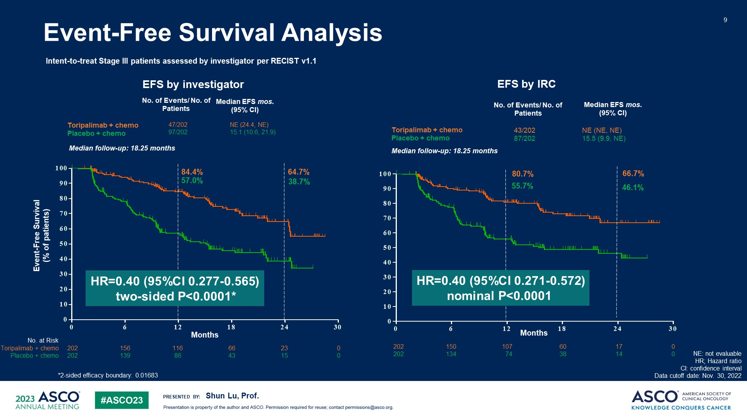
Event-Free Survival Analysis
Content of this presentation is the property of the author, licensed by ASCO. Permission required for reuse.

Slide 32
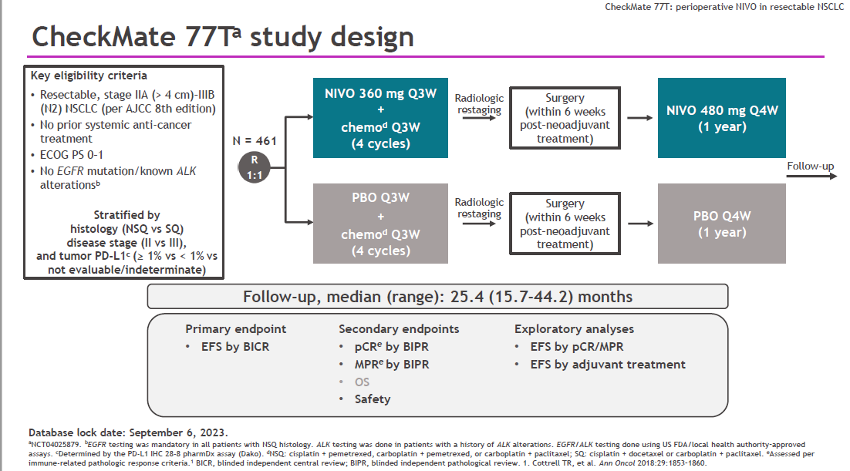

Slide 33
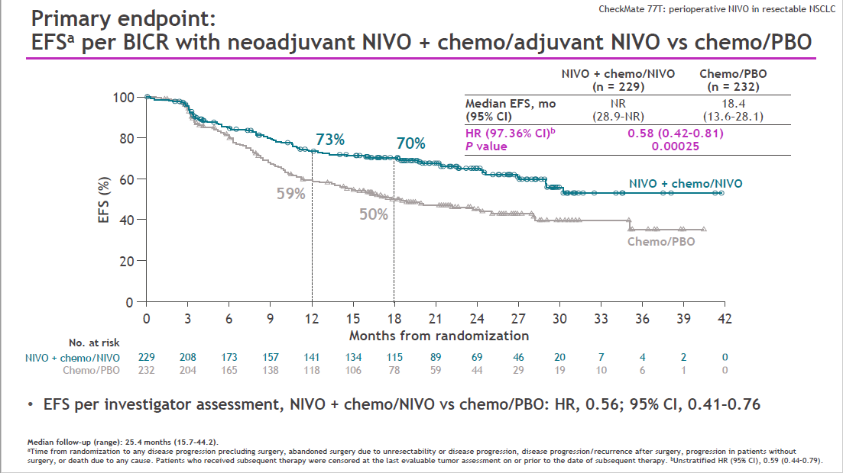

Slide 34
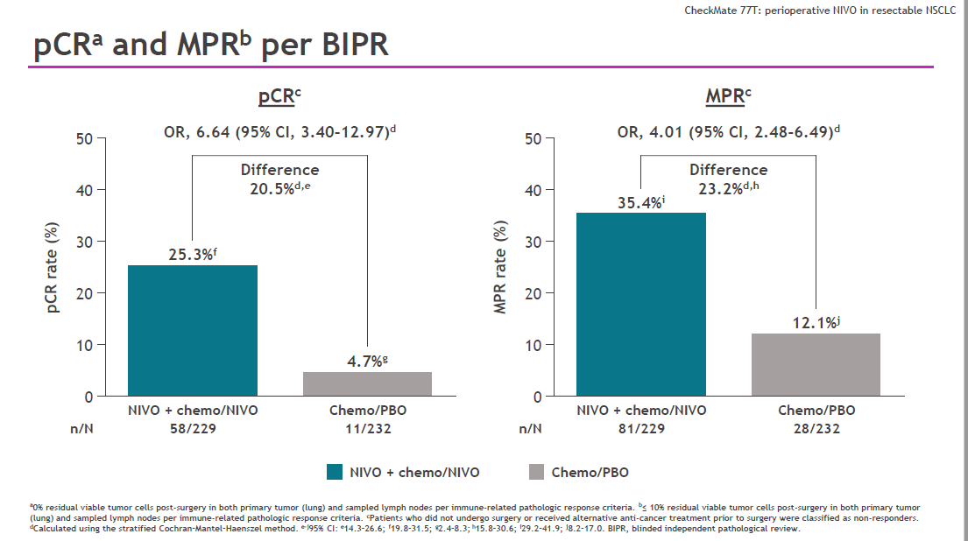

Slide 35
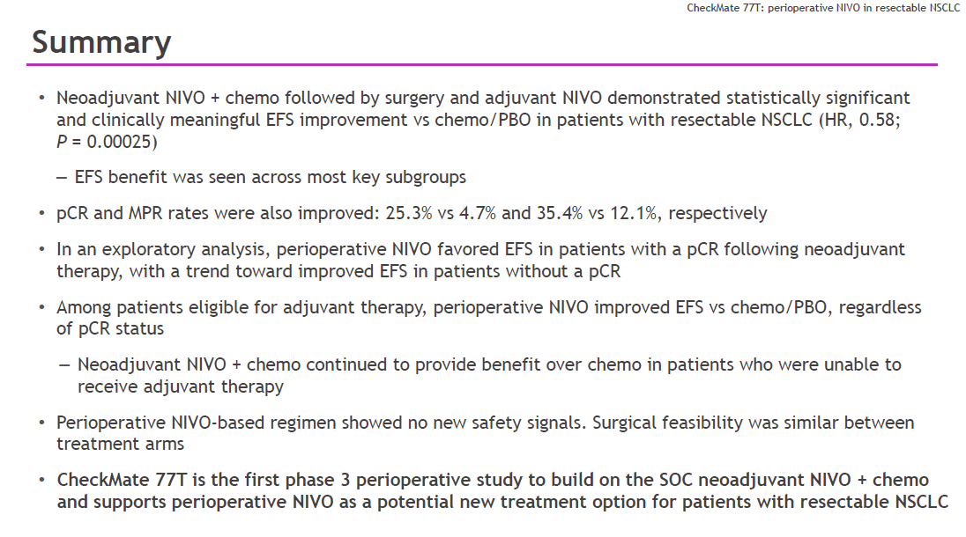

Slide 36
Thanks !!
@LuisRaezMD

Slide 37
Lung Cancer
Wednesday, June 26, 2024

Slide 38
Immunotherapy in advanced or metastatic NSCLC
Gelenis Domingo, MD
Memorial Cancer Institute/Memorial Health Care System

Slide 39
First Line Lung Cancer Therapy with no actionable genes
NSQCC:
Carboplatin/Pemetrexed/Pembrolizumab [Keynote 189]
Carboplatin/Paclitaxel/Bevacizumab/Atezolizumab [IMPOWER 150]
SQCC:
Carboplatin/Paclitaxel or nab-paclitaxel/Pembrolizumab [Keynote 407]
NSQCC and SQCC:
Cemiplimab/Chemotherapy [Empower Lung-3]
Durvalumab +Tremelimumab/Chemotherapy [Poseidon 3]
IO single Agent (NSQCC OR SQCC)
Pembrolizumab [Keynote 024 and 042]
Atezolizumab [IMPOWER 110]
Cemiplimab [Empower Lung-1]
Immunotherapy combinations:
Ipilimumab and Nivolumab [Checkmate 227]
Ipilimumab and Nivolumab plus 2 cycles of chemotherapy [Checkmate 9LA]

Slide 40
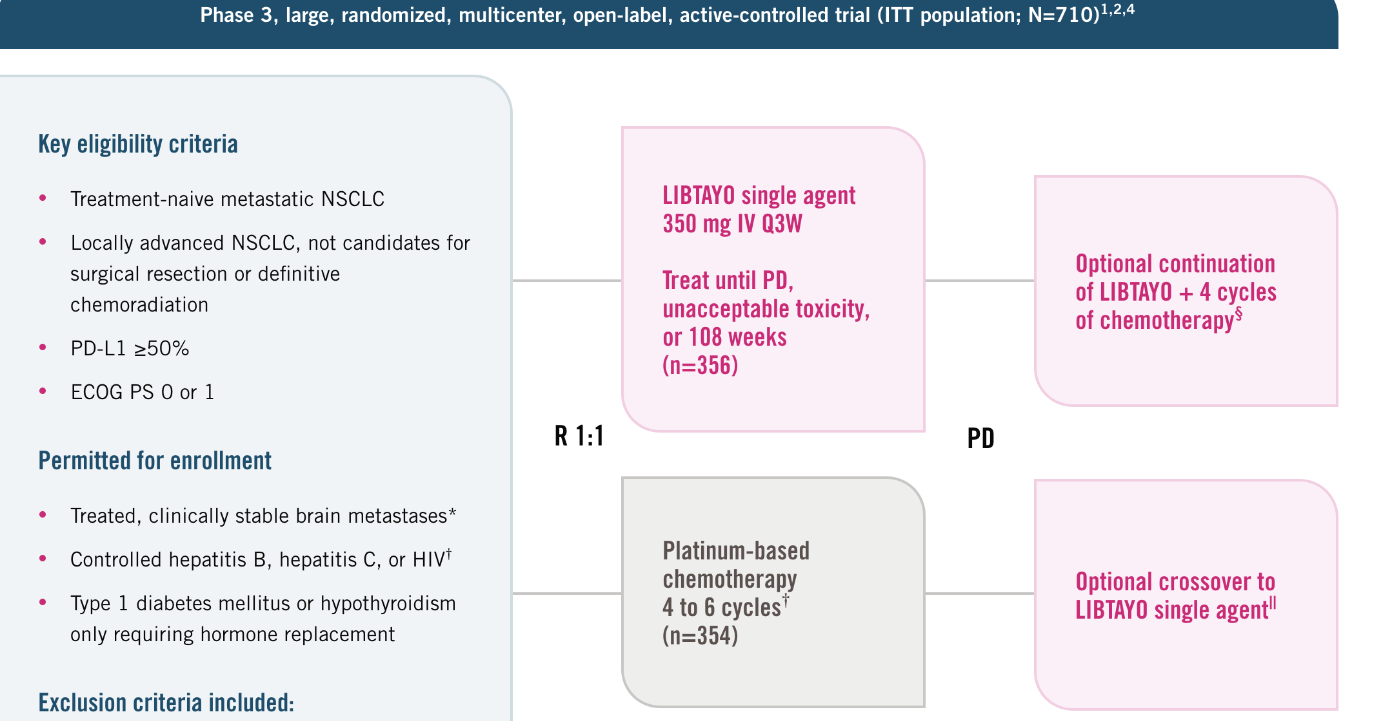
EMPOWER-Lung 1

Slide 41
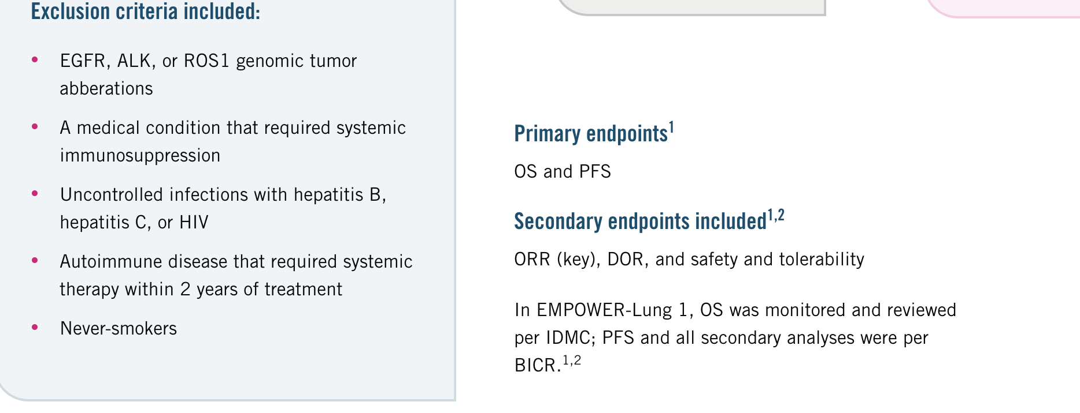
EMPOWER-Lung 1

Slide 42
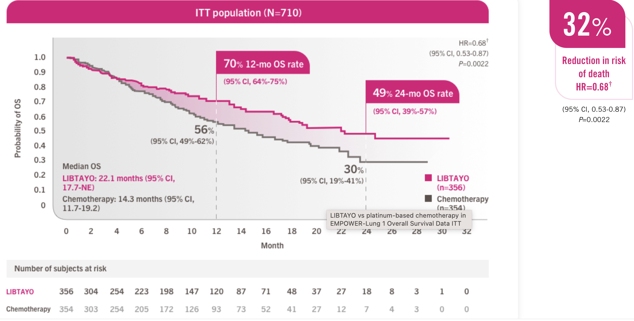
EMPOWER-Lung 1

Slide 43
EMPOWER-Lung 1
Cross over was allowed. Patients that progressed on chemotherapy were allowed to receive cemiplimab
Longer follow of 3 years and continues to have positive OS with HR 0.63
Patients were also stratified based on the percentage of PD-L1 and they found that the higher the expression the higher chance of response
45 percent of pts had SCC

Slide 44
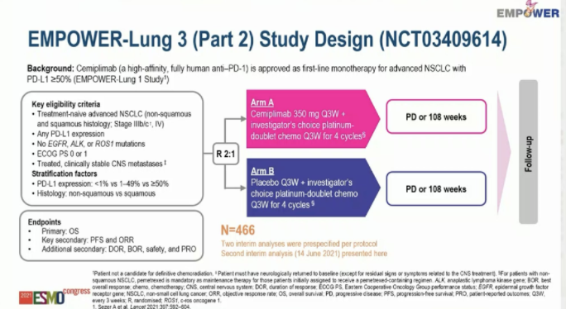

Slide 45
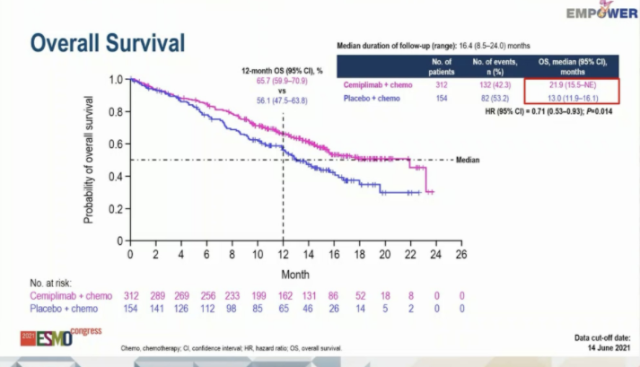

Slide 46
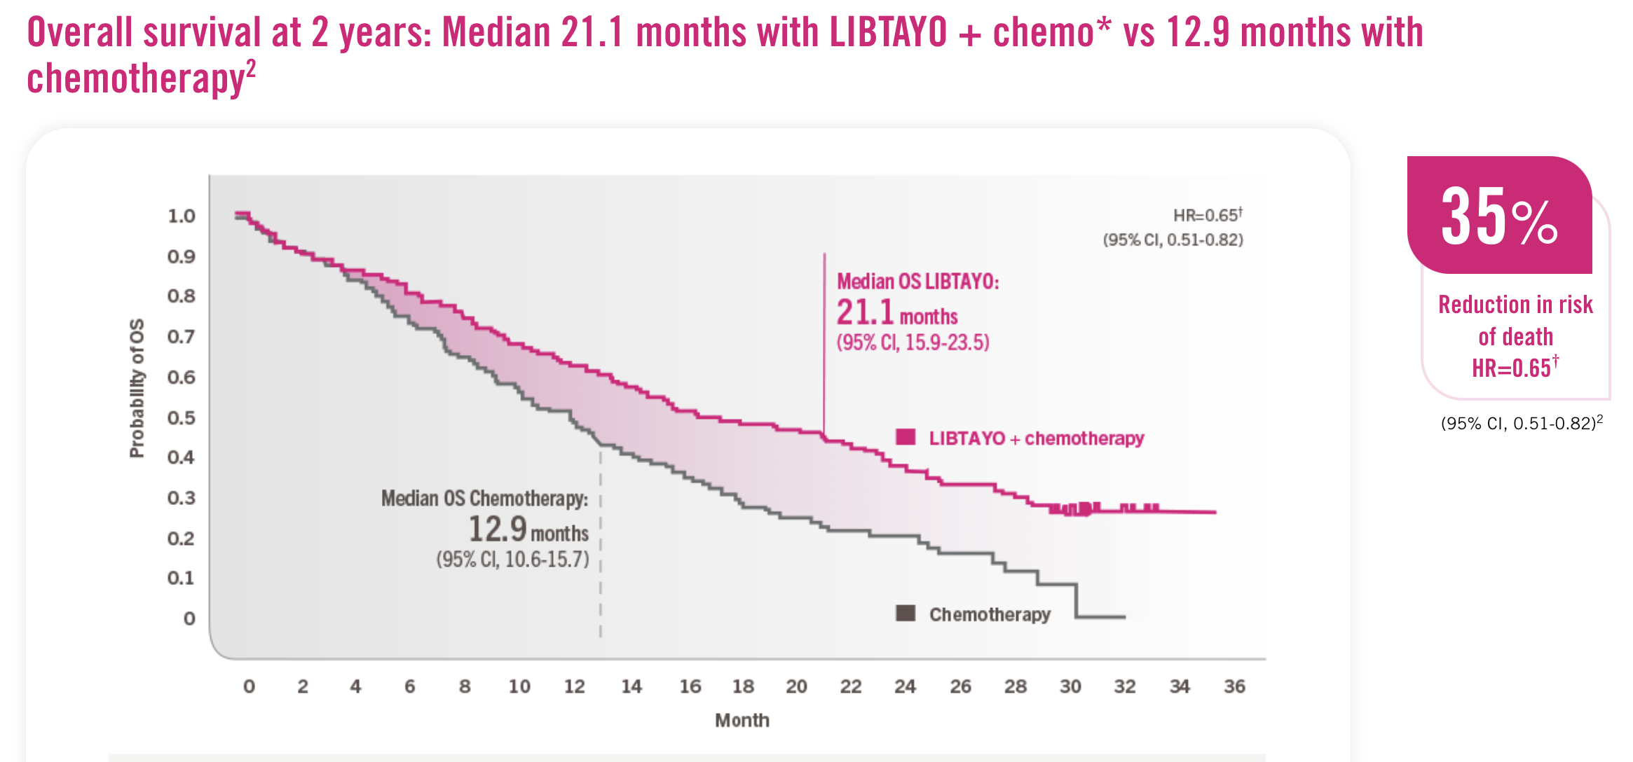

Slide 47




POSEIDON Study Design
Phase 3, global, randomized, open-label, multicenter study
Durvalumab 1500 mg q4w
+ pemetrexed†
until PD
Primary endpoints
PFS by BICR (D+CT vs CT)
OS (D+CT vs CT)
Key secondary endpoints
PFS by BICR (D+T+CT vs CT)
OS (D+T+CT vs CT)
OS in patients with bTMB
≥20 mut/Mb (D+T+CT vs CT)
Additional secondary endpoints
ORR, DoR, and BOR by BICR
PFS at 12 months
HRQoL
Safety and tolerability
Durvalumab 1500 mg + CT* q3w (4 cycles)
Stage IV NSCLC
No EGFR or
ALK alterations
ECOG PS 0 or 1
Treatment-naïve for metastatic disease
N=1013
(randomized)
Durvalumab 1500 mg q4w
+ tremelimumab 75 mg (week 16 only)‡
+ pemetrexed†
until PD
R
1:1:1
Durvalumab 1500 mg + tremelimumab 75 mg + CT* q3w (4 cycles)
Stratified by:
PD-L1
expression (TC ≥50% vs
<50%)
Disease stage (IVA vs IVB)
Histology
Pemetrexed†
until PD
Platinum-based CT* q3w (up to 6 cycles)
*CT options: gemcitabine + carboplatin/cisplatin (squamous), pemetrexed + carboplatin/cisplatin (non-squamous), or nab-paclitaxel + carboplatin (either histology);
†Patients with non-squamous histology who initially received pemetrexed during first-line treatment only (if eligible); ‡Patients received an additional dose of tremelimumab post CT (5th dose)
BICR, blinded independent central review; BOR, best objective response; bTMB, blood tumor mutational burden; D, durvalumab; DoR, duration of response; ECOG, Eastern Cooperative Oncology Group; HRQoL, health-related quality of life; Mb, megabase; mut, mutations; ORR, objective response rate; OS, overall survival; PD, progressive disease; PFS, progression-free survival; PS, performance status; q3w, every 3 weeks; q4w, every 4 weeks; T, tremelimumab; TC, tumor cell

Slide 48
Durvalumab + Tremelimumab + CT vs CT: PFS and OS
PFS OS
D+T+CT CT
Events, n/N (%) 238/338 (70.4) 258/337 (76.6) Events, n/N (%)
D+T+CT
CT
251/338 (74.3)
285/337 (84.6)
1.0
mPFS, months 6.2 4.8 mOS, months
14.0
11.7
1.0
(11.7–16.1) (10.5–13.1)
(95% CI) (5.0–6.5) (4.6–5.8) (95% CI)
HR (95% CI)
p-value
0.72 (0.60–0.86)
0.00031
HR (95% CI)
p-value
0.77 (0.65–0.92)
0.00304
0.8
0.8
0.6
0.6
Probability of PFS
Probability of OS
0.4
0.4
32.9%
26.6%
0.2
0.2
22.1%
13.1%
6 9 12 15 18
Time from randomization (months)
0.0
0.0
0
3
21
24
0 3 6 9 12 15 18 21 24 27 30 33 36 39 42 45 48
Time from randomization (months)
No. at risk
D+T+CT | 338 | 243 | 161 | 94 | 56 | 32 | 13 | 5 | 0
CT | 337 | 219 | 121 | 43 | 23 | 12 | 3 | 2 | 0
No. at risk
D+T+CT | 338 | 298 | 256 | 217 | 183 | 159 | 137 | 120 | 109 | 95 | 88 | 64 | 41 | 20 | 9 | 0 | 0
CT | 337 | 284 | 236 | 204 | 160 | 132 | 111 | 91 | 72 | 62 | 52 | 38 | 21 | 13 | 6 | 0 | 0
Median follow-up in censored patients at DCO: 10.3 months (range 0–23.1)
Median follow-up in censored patients at DCO: 34.9 months (range 0–44.5)
DCO PFS FA: Jul 24, 2019; DCO OS FA: Mar 12, 2021

Slide 49
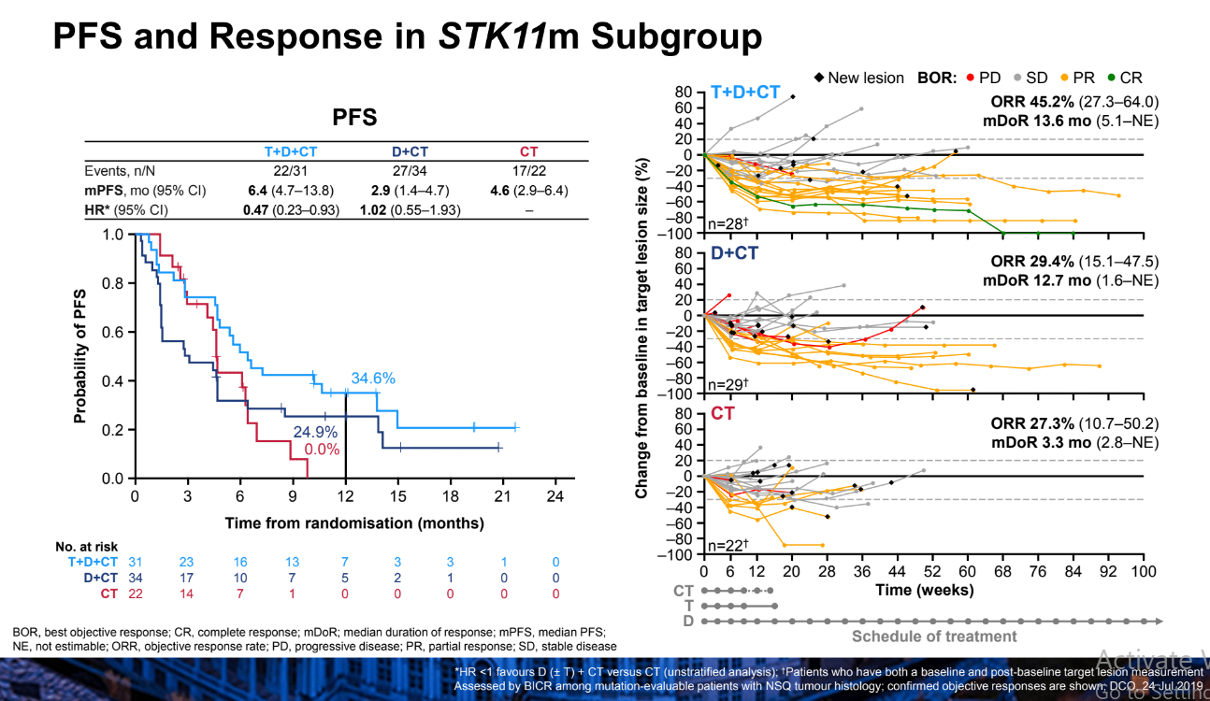

Slide 50
Conclusions
In POSEIDON, PFS was significantly improved with first-line durvalumab + CT vs CT in patients with mNSCLC, with a positive trend for OS that did not reach statistical significance
- PFS HR 0.74 (95% CI 0.62–0.89; p=0.00093)
- OS HR 0.86 (95% CI 0.72–1.02; p=0.07581)
First-line durvalumab + tremelimumab + CT demonstrated statistically significant and clinically meaningful improvements in both PFS and OS vs CT in patients with mNSCLC
- PFS HR 0.72 (95% CI 0.60–0.86; p=0.00031)
- OS HR 0.77 (95% CI 0.65–0.92; p=0.00304)
  OS and PFS benefit were more prominent among patients with non-squamous (than squamous) histology
Overall, the safety profile was similar across all three arms, with no new safety signals identified. Adding tremelimumab to durvalumab + CT did not lead to a meaningful increase in treatment discontinuation
  TRAE discontinuation rate 15.5% and 14.1% with D+T+CT and D+CT, respectively
Durvalumab + tremelimumab + CT represents a potential new first-line treatment option for mNSCLC
TRAE, treatment-related adverse event

Slide 51
First Line Lung Cancer Therapy with no actionable genes
Chemotherapy/IO Combinations
Carboplatin/Pemetrexed/Pembrolizumab [Keynote 189]
Carboplatin/Paclitaxel/Bevacizumab/Atezolizumab [IMPOWER 150]
Carboplatin/Paclitaxel or nab-paclitaxel/Pembrolizumab [Keynote 407]
Cemiplimab/Chemotherapy [Empower Lung-3]
Durvalumab + Tremelimumab/Chemotherapy [Poseidon 3]
IO single Agent (PDL1>50%)
Pembrolizumab [Keynote 024 and 042]
Atezolizumab [IMPOWER 110]
Cemiplimab [Empower Lung-1]
Immunotherapy combinations:
Ipilimumab and Nivolumab [Checkmate 227]
Ipilimumab and Nivolumab plus 2 cycles of chemotherapy [Checkmate 9LA]

Slide 52
ORR slightly in favor of combination chemo+IO
 | KN 24 (TPS > 50%) | KN 42 (TPS > 50%) | IMPW 10 TC3/IC3 (>50% and >10%) | KN 407 (TPS > 50%) | KN 189 (TPS > 50%)
ORR | 45% | 39.5% | 30.7% | 60.3% | 61.4%
DOR | Nr (1.8-20.6 m) | 20.2 m | Nr (1.8-29.3m) | 7.7 m (all patients) | 11.2 m (all patients)
Reck M, NEJM 2016, Mok T et al, Lancet 2019, Paz Ares, NEJM 2018, Ghandi, NEJM 2018

Slide 53
Adverse Events more prevalent with Chemo/IO
 | KN-42 |  | KN-24 |  | KN-189 |  | KN-407
 | Pembro | CT | Pembro | CT | Pembro + CT | CT | Pembro + CT | CT
All TRAE (%) | 62.7% | 89.9% | 76.6% | 90.0% | 99.8% | 99.0% | 98.2% | 97.9%
Grade 3-5 TRAE (%) | 17.8% | 41% | 31.2% | 53.3% | 67.2% | 65.0% | 69.8% | 68.2%
Discontinuation rate (any) (%) | 9% | 9.4% | 13.6% | 10.7% | 27.7% | 14.9% | 23.4% | 11.8%
Led to death | 0.2% | 0% | 1.3% | 2.0% | 6.7% | 5.9% | 8.3% | 6.4%

Slide 54
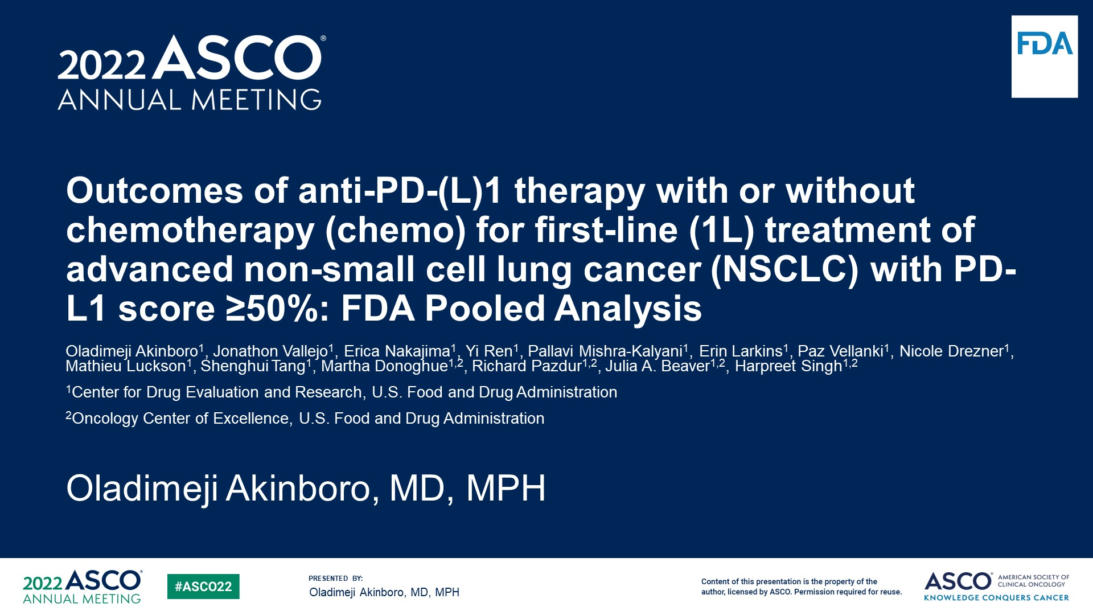
Outcomes of anti-PD-(L)1 therapy with or without chemotherapy (chemo) for first-line (1L) treatment of advanced non-small cell lung cancer (NSCLC) with PD-L1 score ≥50%: FDA Pooled Analysis
Content of this presentation is the property of the author, licensed by ASCO. Permission required for reuse.

Slide 55
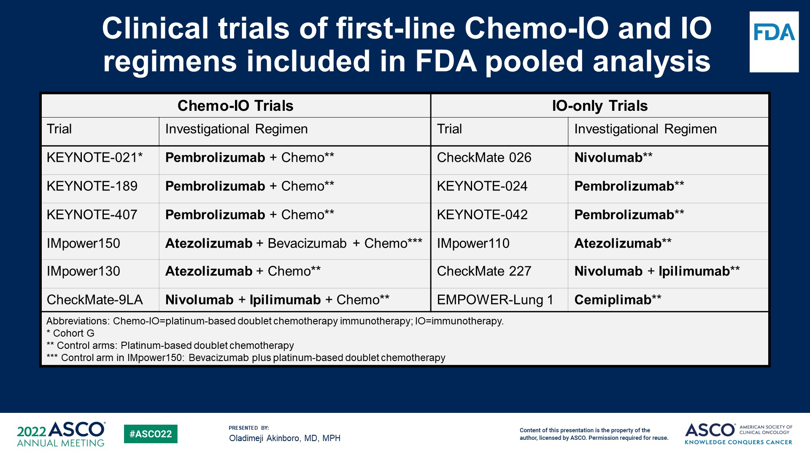
Clinical trials of first-line Chemo-IO and IO regimens included in FDA pooled analysis
Content of this presentation is the property of the author, licensed by ASCO. Permission required for reuse.

Slide 56
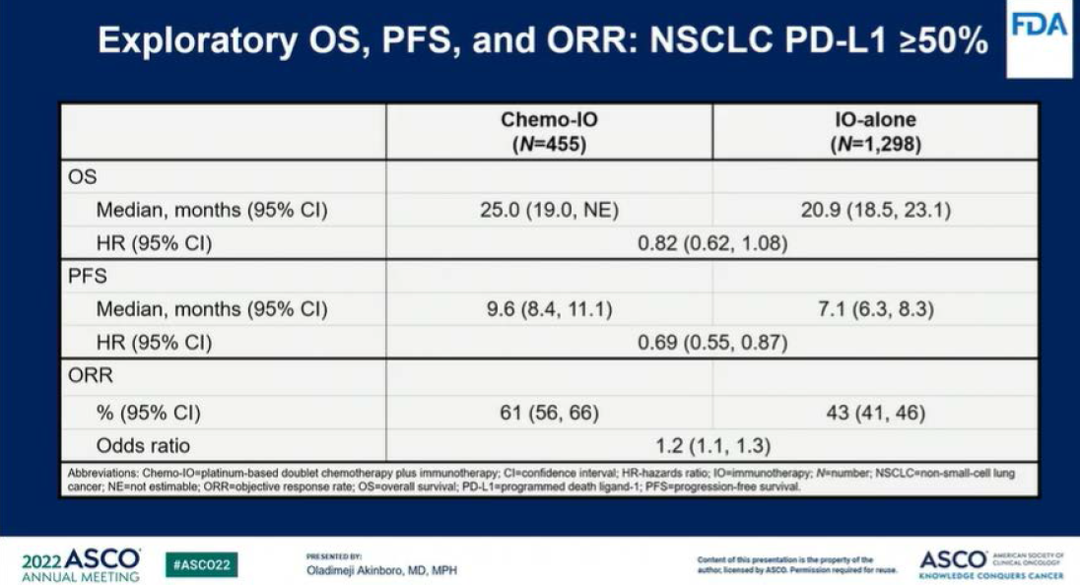

Slide 57
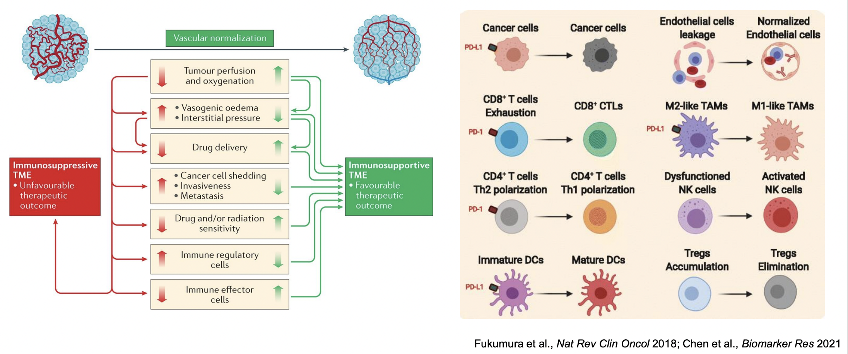
Targeting angiogenesis to overcome ICI resistance

Slide 58
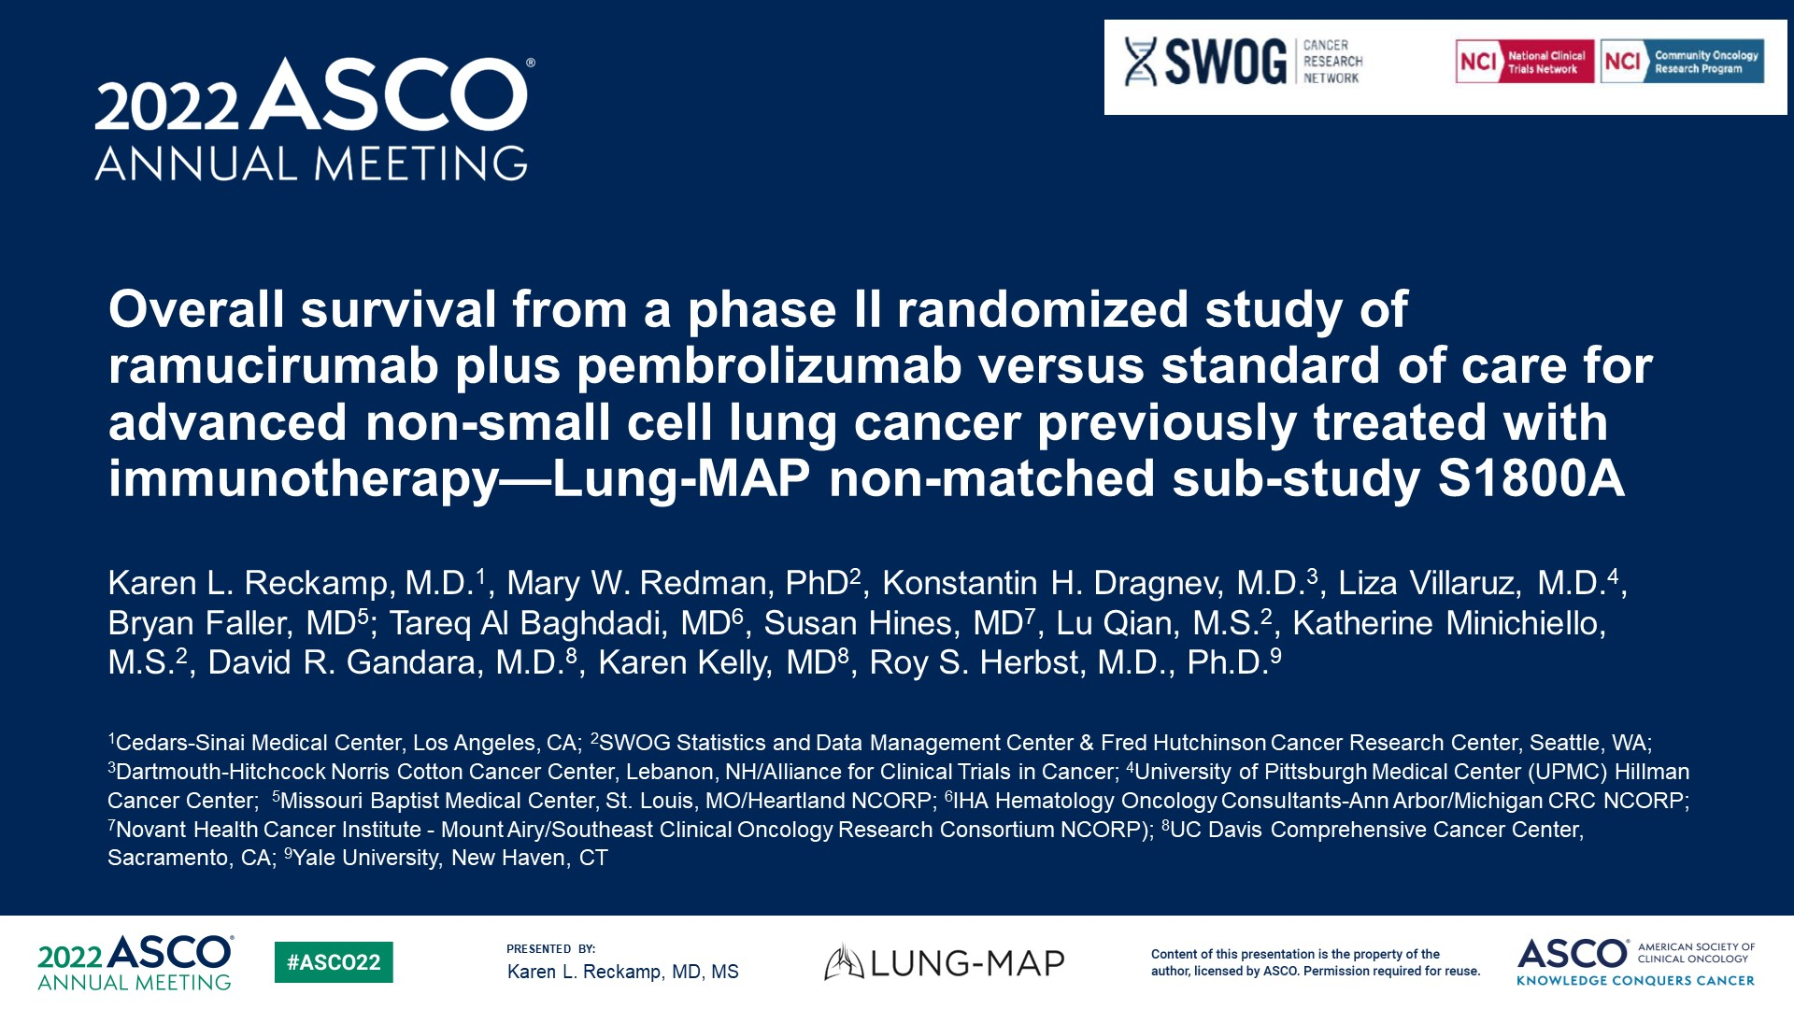
Overall survival from a phase II randomized study of ramucirumab plus pembrolizumab versus standard of care for advanced non-small cell lung cancer previously treated with immunotherapy—Lung-MAP non-matched sub-study S1800A

Slide 59
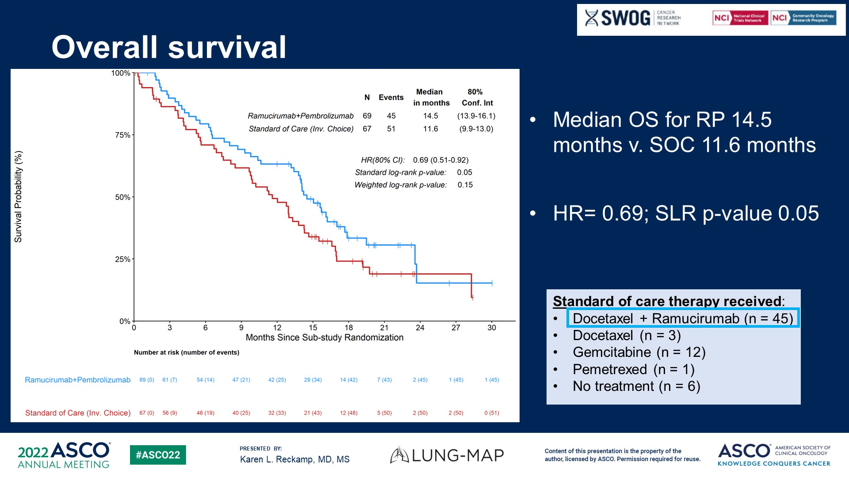
Overall survival

Slide 60
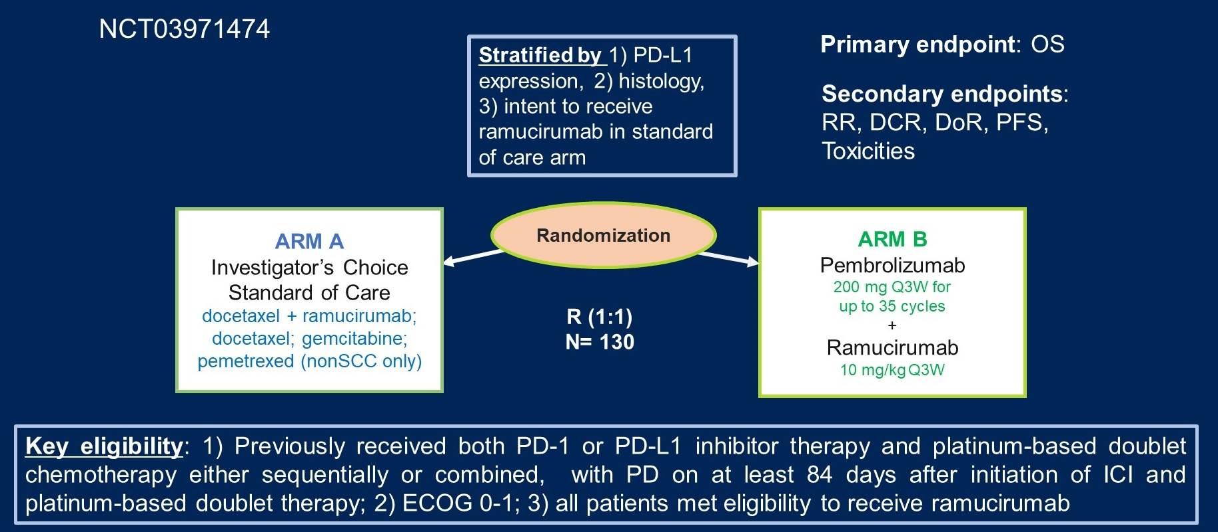
S1800A Schema—Randomized Phase II trial
PRAGMATICA LUNG, Phase 3 trial ongoing……..
Reckamp KL, et al. Presented at: ASCO;2022. Abstract 9004.

Slide 61
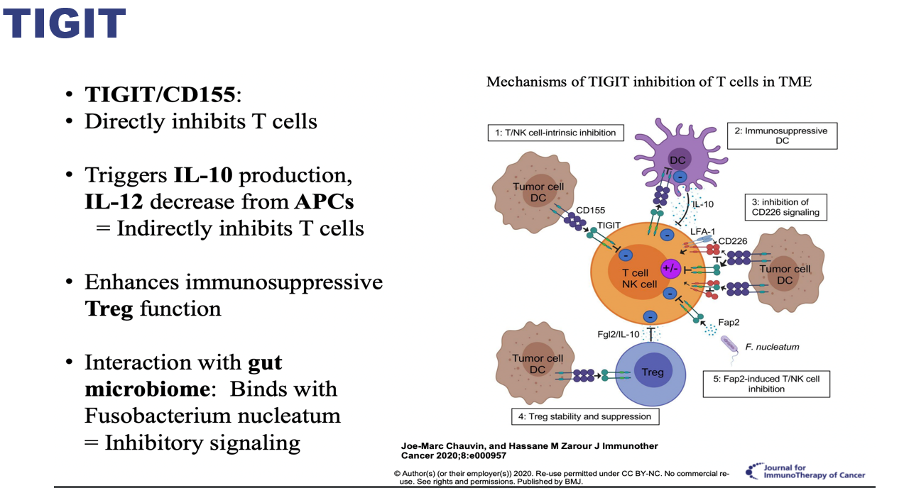
T cell immunoglobulin and ITIM domain
Reduce immunosuppression of T/NK cells and promoting anti tumor activity

Slide 62
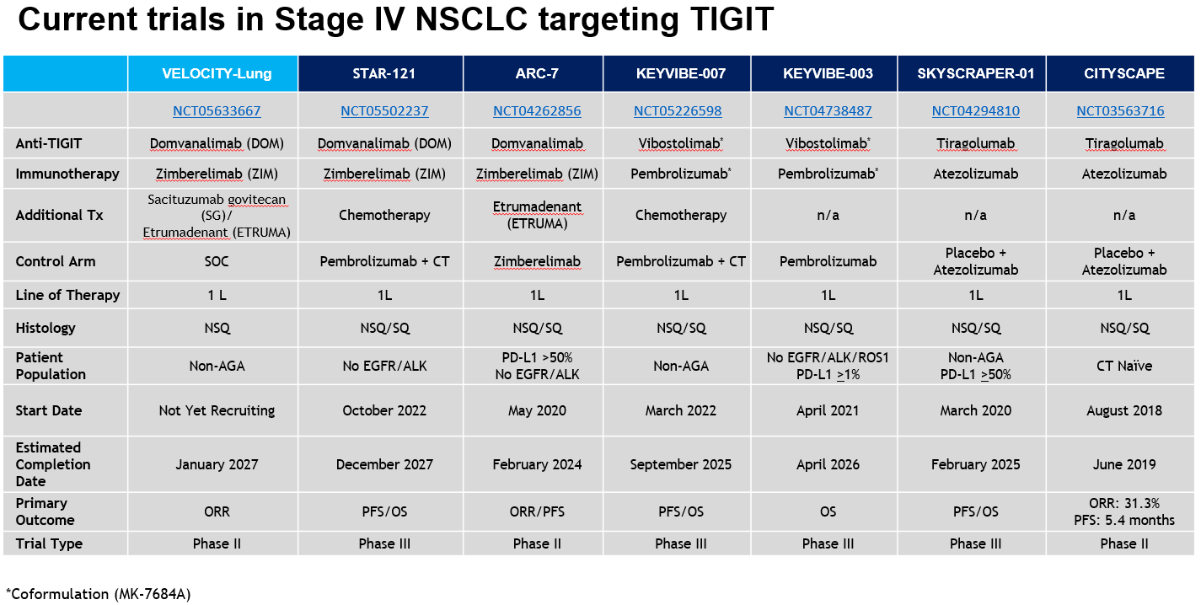

Slide 63

CITYSCAPE: Randomized Phase 2 Study of Tiragolumab + Atezolizumab in PD-L1+ Patients with NSCLC
IHC, immunohistochemistry; PROs, patient-reported outcomes; TPS, tumor proportion score.
Rodriguez-Abreu D, et al. Presented at: ASCO;2020.

Slide 64

Investigator-Assessed PFS: PD-L1 Subgroups
*Unstratified.
Updated analysis data cut-off: 16 August 2021 (median follow-up: 30.4 months)
PD-L1 status determined by 22c3 IHC assay.
Rodriguez-Abreu D, et al. Presented at: ASCO;2020.

Slide 65

ARC-7: Randomized, Open-label, Phase 2 Study in First-Line, Metastatic, PD-L1-High NSCLC
Content of this presentation is the property of the author, licensed by ASCO. Permission required for reuse.

Slide 66

Progression-Free Survival (mITT)<br />Zim Monotherapy vs. Dom + Zim Doublet
Content of this presentation is the property of the author, licensed by ASCO. Permission required for reuse.

Slide 67

Conclusions
Content of this presentation is the property of the author, licensed by ASCO. Permission required for reuse.

Slide 68
Thanks

Slide 69

Lung Cancer
Wednesday, June 26, 2024

Slide 70
Meri Muminovic, MD
Thoracic Oncology Program
Memorial Cancer Institute/Memorial Healthcare System
Miramar, FL

Slide 71
Case #1

Slide 72
Patient Profile and Initial Presentation
Name: SC
Age: 77
Gender: Female
Medical History:
Osteoporosis
Hyperlipidemia
Never smoker
Symptoms:
  Persistent cough
  Denies weight loss, shortness of breath, hemoptysis and dysphagia

Slide 73
Diagnostic Work-Up
CT screening CAD: September 5, 2023 which demonstrated a 4 x 4.4 cm mass in the left upper lobe of the lung with enlarged mediastinal lymph nodes.
PET scan: September 28, 2023 which demonstrated a hypermetabolic 4.2 x 3.8 x 5.0 cm left upper lobe perihilar mass abutting the major fissure with associated hypermetabolic enlarged mediastinal and left hilar lymph nodes.
Brain MRI: November 20, 2023 no evidence of disease
Evaluation:
EBUS with lymph node biopsy 4L LN
Pathology results: NSCLC, adenocarcinoma
Molecular Testing:
Guardant NGS EGFR L858R
CARIS NGS EGFR exon 21
PD-L1 1%

Slide 74
Treatment Plan
Initial Decision:
Stage IIIA disease (T2N2M0) she underwent chemoradiation due to not being surgical candidate.
Radiation 200 cGy x 30 fractions + chemotherapy (carboplatin and pemetrexed x 3 cycles)
Given the presence of an EGFR mutation, the patient was a candidate for targeted therapy and following chemoradiation the patient was started on adjuvant Osimertinib 01/2024.
Therapy:
Osimertinib (3rd generation) EGFR tyrosine kinase inhibitor (TKI)
  Dosage: 80 mg orally daily

Slide 75
Follow-up and Response
1 month follow-up:
  Subjective: Significant improvement in cough
  Imaging: Treatment response, decrease in size of the LUL mass and adenopathy
  Side effects: Mild diarrhea and fatigue
3 month follow-up: *Osimertinib held x 1 month*
  Subjective: Further improvement in respiratory symptoms
  Imaging: Since 09/2023 improved LUL and resolved adenopathy, radiation pneumonitis changes noted
  Side effects: Mild diarrhea and cough, managed with supportive care
6 month follow-up:
  Subjective: Stable, with no new complaints
  Imaging: Stable disease with some further reduction in tumor burden, radiation pneumonitis changes noted on CT (improved from previous)
  Side effects: Persistent mild diarrhea managed with supportive care.

Slide 76
Follow-up and Response
Efficacy: The patient demonstrated a significant partial response to osimertinib with manageable side effects. The presence of an EGFR exon 19 deletion mutation typically predicts a good response to EGFR TKIs.
Management of Side Effects: The patient's side effects were mild and managed conservatively with symptomatic treatment.
Prognosis: Continued surveillance and regular follow-up imaging are essential to monitor for progression or recurrence. The patient is expected to continue on osimertinib as long as the disease remains stable and side effects are tolerable.

Slide 77
Conclusion
This case highlights the potential of targeted therapy in managing unresectable stage III EGFR mutated NSCLC.

Slide 78

Phase 3, double-blind, placebo-controlled trial, randomly assigned patients with unresectable EGFR-mutated stage III NSCLC without progression during or after chemoradiotherapy to receive osimertinib or placebo until disease progression occurred or the regimen was discontinued. The primary end point was progression-free survival.

Slide 79
Background
Consolidation durvalumab is standard of care following definitive CRT without PD in patients with unresectable stage III NSCLC based on phase III PACIFIC trial^{1,2}
  PFS and OS outcomes were comparable with consolidation durvalumab vs placebo³
No targeted therapies are currently approved by FDA for unresectable stage III EGFR-mutated NSCLC
  Data from phase II trial and retrospective real-world analyses suggest EGFR TKIs
  may be of benefit in this setting, but phase III data are lacking
Phase III LAURA trial comparing efficacy and safety of osimertinib vs placebo in patients with unresectable stage III EGFR-mutated NSCLC and no PD during/after definitive CRT^{4,5}
1. Antonia. NEJM. 2017;377:1919. 2. NCCN. Clinical practice guidelines in oncology: non-small cell lung cancer. v.5.2024. nccn.org. 3. Naidoo. T Thorac Oncol. 2023;18:657. 4. Ramalingam. ASCO 2024. Abstr LBA4. 5. Lu. NEJM. 2024;[Epub].

Slide 80
Methods
216 patients who had undergone chemoradiotherapy were randomly assigned to receive osimertinib (143 patients) or placebo (73 patients).
Osimertinib resulted in a significant progression-free survival benefit as compared with placebo
The percentage of patients who were alive and progression free at 12 months was 74% (95% CI, 65 to 80) with osimertinib and 22% (95% CI, 13 to 32) with placebo.
OS (maturity, 20%) showed 36-month overall survival among 84% of patients with Osimertinib
The incidence of adverse events of grade 3 or higher was 35% in the osimertinib group and 12% in the placebo group

Slide 81


Results

Slide 82

Results

Slide 83
Results
Osimertinib significantly improved PFS
Interim OS data were immature but suggested benefit with Osimertinib
Safety profile of osimertinib after definitive CRT was manageable, with no new safety signals
Lu. NEJM. 2024;[Epub].

Slide 84
Case #2

Slide 85
Patient Profile and Initial Presentation
Symptoms
  Persistent cough
  Fatigue
  Unintentional weight loss 8 kg x 4 months
  Chest Pain
Name: SJ
Age: 42
Gender: female
Medical History:
DMT2
Hypertension
30 pack-year smoking history, quit 10 years ago

Slide 86
Diagnostic Work-Up
Chest X-ray: Mass in left upper lobe.
CT scan: Confirmed 5 cm mass in the left upper lobe with mediastinal lymphadenopathy and multiple liver lesions suggestive of metastasis
Biopsy: CT guided needle biopsy
  Pathology results – non-small cell lung cancer, adenocarcinoma subtype
Molecular testing
  EGFR: negative
  ALK: negative
  STK11: positive
  PD-L1: 40%
Staging
  PET-CT: extensive metastatic disease involving liver and bone.

Slide 87
Treatment Plan
Initial Decision: Given the presence of an STK11 mutation and the high PD-L1 expression, the patient was considered a candidate for the combination therapy as outlined in the Poseidon trial.
Therapy:
  Drug Regimen: Combination of durvalumab (Imfinzi), tremelimumab, and chemotherapy (platinum-based + pemetrexed)
    Durvalumab: 1500 mg IV every 3 weeks for 4 cycles, then every 4 weeks.
    Tremelimumab: 75 mg IV once
    Chemotherapy: Carboplatin (AUC 5 or 6) and pemetrexed 500 mg/m² IV every 3 weeks for up to 4 cycles.

Slide 88
Follow-Up and Response
1 month follow-up:
  Subjective: Mild improvement in cough and fatigue
  Imaging: Partial response with reduction in size of the primary tumor and some liver lesions.
3 month follow-up:
  Subjective: Significant improvement in respiratory symptoms and energy levels.
  Imaging: Continued partial response; stable disease with no new lesions.
  Side effects: Mild rash, fatigue, and nausea, managed with supportive care.
6 month follow-up:
  Subjective: Further improvement in symptoms, stable weight.
  Imaging: Stable disease with some further reduction in tumor burden.
  Side effects: Persistent mild rash and occasional fatigue, managed with supportive care.

Slide 89
Discussion
Efficacy: The patient demonstrated a partial response to the combination therapy regimen outlined in the Poseidon trial. The STK11 mutation, known to be associated with poor prognosis, did not prevent a favorable response in this case.
Management of Side Effects: The patient experienced mild side effects, including rash and fatigue, which were managed conservatively. Nausea was managed with antiemetic medications.
Prognosis: Continued surveillance and regular follow-up imaging are essential to monitor for progression or recurrence. The patient is expected to continue on maintenance therapy with durvalumab as long as the disease remains stable and side effects are tolerable.

Slide 90
Conclusion
This case highlights the potential of combination therapy involving durvalumab, tremelimumab, and chemotherapy in managing metastatic NSCLC with STK11 mutations.
The Poseidon trial regimen has provided significant clinical benefit in terms of symptom relief and disease control with a manageable side effect profile in this patient.
Continuous monitoring and supportive care are crucial in managing long-term treatment.

Slide 91

Open label phase III POSEIDON study evaluated tremelimumab + durvalumab + chemotherapy and durvalumab + chemotherapy vs. chemotherapy alone in first-line metastatic NSCLC

Slide 92
Methods
1013 patients with EGFR/ALK wild-type mNSCLC were randomly assigned (1:1:1) to tremelimumab 75 mg plus durvalumab 1,500 mg and platinum-based chemotherapy for up to four 21-day cycles, followed by durvalumab once every 4 weeks until progression and one additional tremelimumab dose
Durvalumab plus chemotherapy for up to four 21-day cycles, followed by durvalumab once every 4 weeks until progression; or chemotherapy for up to six 21-day cycles (with or without maintenance pemetrexed; all arms).
Primary end points were progression-free survival (PFS) and overall survival (OS).
  Secondary end points were PFS and OS
Johnson et al. JCO 2022

Slide 93
Results
PFS was significantly improved with D + CT versus CT (5.5 v 4.8 months)
Improved OS did not reach statistical significance
PFS 6.2 v 4.8 months and OS 14.0 v 11.7 months; 24-month OS, 32.9% v 22.1% were significantly improved with T + D + CT versus CT.
Treatment-related adverse events were maximum grade 3/4 in 51.8%, 44.6%, and 44.4% of patients receiving T + D + CT, D + CT, and CT, respectively
Johnson et al. JCO 2022

Slide 94


Results

Slide 95
Take Home Points
LAURA 2024
  Phase III LAURA trial comparing efficacy and safety of osimertinib vs placebo in patients with unresectable stage III EGFR-mutated NSCLC and no PD during/after definitive CRT^{4,5}
  New Standard of Care: The impressive PFS results suggest that osimertinib should become the new standard of care for patients with unresectable stage III EGFR-mutated NSCLC following chemoradiotherapy.
  Safety Profile: Osimertinib's safety profile was consistent with previous studies, showing manageable adverse effects.
    Common side effects included radiation pneumonitis, diarrhea, and skin rash.
  Disease Control: The study also highlighted a lower incidence of new lesions in the osimertinib group compared to placebo
  ​
  Overall Survival (OS): While overall survival data are still immature, initial trends favor osimertinib.

Slide 96
Take Home Points
2022 Poseidon Study
  Evaluated the safety and efficacy of ta triple therapy combination for 1L treatment of mNSCLC
  Triple therapy: durvalumab (PD-L1 antibody), tremelimumab (anti-CTLA-4 antibody) and chemotherapy.
  Improvement in PFS and OS compared to chemotherapy alone/Improved survival rates
  Response rates: Higher overall response rate --> more patients experienced reduction in tumor size
  Clinical implications: durvalumab, tremelimumab and chemotherapy are the new first line treatment option for mNSCLC

Slide 97


Slide 98
Lung Cancer
Wednesday, June 26, 2024

Slide 99


Slide 100


Slide 101


Slide 102


Slide 103


Slide 104


Slide 105


Slide 106


Slide 107


Slide 108


Slide 109


Slide 110


Slide 111


Slide 112


Slide 113


Slide 114


Slide 115


Slide 116


Slide 117


Slide 118


Slide 119


Slide 120


Slide 121


Slide 122


Slide 123


Slide 124


Slide 125


Slide 126


Slide 127


Slide 128


Slide 129


Slide 130


Slide 131


Slide 132










LUNG CANCER
Wednesday June 26, 2024

Slide 133
Antibody-Drug Conjugates in NSCLC: Winners and Losers
Estelamari Rodriguez, MD MPH
Clinical Research Lead, Thoracic SDG
Sylvester Comprehensive Cancer Center
Miami, FL

Slide 134



ADCs Combine the Best of Chemo and Targeted Therapy
Slide Courtesy: Dr. Ben Levy

Slide 135
FDA Approved ADCs
Agent | Antigen Target | Cytotoxic Payload | Approved Indications
Gemtuzumab ozogamicin (Mylotarg) | CD33 | Calicheamicin | AML
Inotuzumab ozogamicin (Besponsa) | CD22 | Calicheamicin | B-ALL
Polatuzumab vedotin (Polivy) | CD79b | MMAE | Lymphoma (DLBCL, HGBL)
Brentuximab vedotin (Adcetris) | CD30 | MMAE | Lymphoma (cHL, sALCL, PTCL)
Loncastuximab tesirine (Zylonta) | CD19 | SG3199 | Lymphoma (LBCL, DLBCL)
Trastuzumab emtansine (Kadcyla) | Her-2 | DM1 | Breast cancer
Trastuzumab deruxtecan (Enhertu) | HER2 | DXd | HER2 + or low BC, NSCLC, Gastric or GEJ adenocarcinoma
Sacituzumab govitecan (Trodelvy) | TROP-2 | SN-38 | BC (HR-positive or TN), Metastatic urothelial carcinoma
Tisotumab vedotin (Tivdak) | Tissue Factor | MMAE | Cervical cancer
Mirvetuximab soravtansine-gynx (Elahere) | FRα | DM4 | Ovarian, fallopian tube, or peritoneal cancer
Enfortumab vedotin (Padcev) | Nectin-4 | MMAE | Metastatic urothelial carcinoma

Slide 136
Overview of Antibody-Drug Conjugates (ADCs)
Important Properties of the ADC Components and Target Antigen
Antigen
High homogeneous expression on tumor
Low or no expression on healthy tissues
High affinity and avidity for antibody recognition
Linker
Stable in circulation
Efficient release of payload at target site
Prevents premature release of payload at nontarget tissue
Efficient linker technology
(cleavable vs noncleavable)
Site of conjugation
DAR affects drug distribution
and pharmacokinetics
Antibody
High affinity and avidity for tumor antigen
Chimeric or humanized to
decrease immunogenicity
Long half-life and high molecular weight
Fab
Fab
Cytotoxic Payload
Highly potent agents:
  Calicheamicin
  Maytansine derivative (DM1 or DM4)
  Auristatin (MMAE or MMAF)
  SN-38
  DXd topoisomerase I inhibitor
Optimal DAR (range: 2 to 8)
Fc
Cleavable Linkers
Depend on physiological conditions:
pH, proteolysis, or high intracellular glutathione
Noncleavable Linkers
Depend on lysosomal degradation
© Medscape, LLC
Slide by: Dr. Ben Levy; Chau CH, et al. Lancet. 2019;394:793-804.

Slide 137
ADC Mechanism of Action

Slide 138









The ADC is Internalized and Degraded
ADC
Payload
ADC binds to antigen receptor
Antigen
Apoptosis of target cell
Internalization via endocytosis
DNA Intercalation
Release of payload and drug action
Lysosome
Degradation of ADCs in lysosomes
© Medscape, LLC
Microtubule disruption
Slide Courtesy: Dr. Ben Levy; Chau CH, et al. Lancet. 2019

Slide 139




Bystander Effect
Control
T-DM1, 10 mg/kg
T-DXd, 3.0 mg/kg
Co-culture of HER2+ and HER2- tumors in vivo
HER2- cells still persist
Both HER2+ and HER2- are impacted
HER2+
cells
NCI-N87
HER2-
cells
MDA-MB-468
HER2-
cells
MDA-MB-468
Tumor regression
Slide Courtesy: Dr. Ben Levy; Ogitani Y et al. Cancer Sci. 2016

Slide 140



Antibody-Dependent Cellular Cytotoxicity
ADC
FcγRIIIa
Target
Natural killer (NK) cell
Tumor cell
Perforin &
granzymes
Tumor cell death
Slide Courtesy: Joseph Murray, MD, Phd

Slide 141

ADC
Targets in Lung Cancer
NSCLC
SCLC
SAR408701
(DM4)
Datopotamab Deruxtecan
(Dato-DXd)
Sacituzumab Govitecan
(SN-38)
Telisotuzumab Vedotin
(MMAE)
Patritumab
Deruxtecan
(HER3-DXd)
Rovalpituzumab Tesirine
(PYRROLO-BZD)
Trastuzumab Deruxtecan
(T-DXd)
Ado-Trastuzumab Emtansine
(T-DM1)
Lorvotuzumab Mertansine
(DM1)
Sacituzumab Govitecan
(SN-38)
1.
HER3
TROP2
CEACAM5
HER2
C-MET
DLL-3
CD-56
TROP2
HER2
2. Drug internalized
3. ADC in endosome
CYTOTOXIC EFFECT
4. Drug release from ADC in lysosome
Slide Courtesy: Dr. Ben Levy; Desai A et al. Lung Cancer. 2022

Slide 142

ADCs: Winners & Losers
Trastuzumab Deruxtecan
Patritutumab
Deruxtecan
Telisotuzumab vedotin
Sacituzumab Govitecan
Tusamitamab ravtansine

Slide 143

Destiny-01

Slide 144

mNSCLC: Trastuzumab Deruxtecan
Li BT et al. NEJM. 2022;386:241-51.

Slide 145


DESTINY-LUNG: Trastuzumab Deruxtecan
Progression Free Survival
Median: 8.2 (95% CI, 6.0 – 11.9)
Overall Survival
Median: 17.8 (95% CI, 13.8 – 22.1)
Confirmed ORR 50%
mDOR 9.3 mos
Li BT et al. NEJM. 2022;386:241-51.

Slide 146


Slide 147


Slide 148


Slide 149


Slide 150


Slide 151

Anti-TROp2 ADC: Sacituzumab Govitecan

Slide 152

ADCs in R/R mNSCLC: Sacituzumab Govitecan
https://www.gilead.com/news-and-press/press-room/press-releases/2024/1/gilead-provides-update-on-phase-3-evoke-01-studyhttps://www.gilead.com/news-and-press/press-room/press-releases/2024/1/gilead-provides-update-on-phase-3-evoke-01-study

Slide 153

ADCs in
CEACAM5 ADC 2L mNSCLC: Tusamitamab ravtansine
Ben Levy, TTLC 2022.

Slide 154

ADCs in
Tusamitamab ravtansine: CEACAM5-ADC
https://www.sanofi.com/en/media-room/press-releases/2023/2023-12-21-06-30-00-2799759

Slide 155


Slide 156


Slide 157
Why have some ADC drugs failed?
Drug Factors | Tumor & Patient Factors
Linker stability (premature or insufficient drug release) Payload drug resistance Poor penetration/fast clearance Off-target effects Immunogenicity Drug to Antibody Ratio | Tumor/Antigen Heterogeneity Tumor Evolution Tumor Microenvironment Tumor interference w delivery Inadequate biomarker selection Clinical Trial factors ( endpoint & patient selection)
Notes:
Answer: C

Slide 158
ADC’s –in the Horizon
HER3
Patritumab deruxtecan (FDA breakthrough designation for NSCLC)
TROP-2
Datopotamab deruxtecan
Sacituzumab deruxtecan
C-MET
Telisotuzumab vedotin (FDA breakthrough designation for NSCLC)
https://www.gilead.com/news-and-press/press-room/press-releases/2024/1/gilead-provides-update-on-phase-3-evoke-01-studyhttps://www.gilead.com/news-and-press/press-room/press-releases/2024/1/gilead-provides-update-on-phase-3-evoke-01-study

Slide 159
Take Home Points
While some ADCs have shown promising results, others have failed to show improvement compared to docetaxel.
Development of ADCs is complex due to interplay of biological, chemical, and clinical factors.
Advancements in understanding tumor biology, better biomarkers , improving ADC design, and refining clinical trial strategies are essential.

Slide 160

Thank you
@latinamd
estelarodriguez@miami.edu

Slide 161
LUNG CANCER
Wednesday June 26, 2024

Slide 162


New Developments in Small cell lung cancer and Locally Advanced NSCLC:
Adriatic & Laura Trials
OncLive State of The Summit: Lung Cancer
06/26/24
Rami Manochakian, MD
Associate Professor of Medicine. Thoracic Oncologist.
Vice-Chair Education. Hem/Onc fellowship Program Director
Division of Hematology/Oncology. Mayo Clinic Florida
Twitter: @RManochakian

Slide 163
Disclosures
Advisory Boards/Consulting:
AstraZeneca, BMS, DSI, Janssen, Novocure, Oncohost, Takeda

Slide 164
It is an era of hope for patients with lung cancer
Three out of five ASCO 2024 plenary session’s abstracts were on Lung Cancer
Along with many other presentations….

Slide 165
The LAURA Trial

Slide 166

LAURA Phase 3 double-blind study design
Ramalingam. ASCO 2024 Presentation. Lu et al, NEJM June 2024

Slide 167

Progression-free survival by BICR
Ramalingam. ASCO 2024 Presentation. Lu et al, NEJM June 2024

Slide 168

Progression-free survival by BICR across subgroups
Ramalingam. ASCO 2024 Presentation. Lu et al, NEJM June 2024
.

Slide 169

Tumor response by BICR
Ramalingam. ASCO 2024 Presentation. Lu et al, NEJM June 2024
.

Slide 170

Interim analysis of overall survival
Ramalingam. ASCO 2024 Presentation. Lu et al, NEJM June 2024
.

Slide 171

Exposure and safety summary
Ramalingam. ASCO 2024 Presentation. Lu et al, NEJM June 2024

Slide 172

All-causality adverse events (≥10%)*
Ramalingam. ASCO 2024 Presentation. Lu et al, NEJM June 2024

Slide 173

Factors to Consider with Indefinite Osimertinib
Sequist. ASCO 2024 Presentation.

Slide 174

The LAURA trial had high crossover<br />
Sequist. ASCO 2024 Presentation.

Slide 175
Conclusion/Take-Home Point from LAURA Trial
Osimertinib demonstrated statistically significant and clinically meaningful PFS improvement in patients with unresectable stage III EGFR mutant NSCLC following chemoradiotherapy
This is practice changing new standard of care

Slide 176
Conclusion/Take-Home Point from LAURA Trial
Osimertinib demonstrated statistically significant and clinically meaningful PFS improvement in patients with unresectable stage III EGFR mutant NSCLC following chemoradiotherapy
This is practice changing new standard of care
NGS Testing for ALL patients with NSCLC is A MUST
This is 2nd indication of Osimertinib in non-metastatic setting
(It’s approved as adjuvant Tx in pts with stage IB & above NSCLC post resection)

Slide 177
The ADRIATIC Trial

Slide 178

ADRIATIC study design
Spigel. ASCO 2024 presentation

Slide 179

Overall survival (dual primary endpoint)
Spigel. ASCO 2024 presentation

Slide 180

OS subgroup analysis
Spigel. ASCO 2024 presentation

Slide 181

Progression-free survival* (dual primary endpoint)
Spigel. ASCO 2024 presentation

Slide 182

PFS subgroup analysis
Spigel. ASCO 2024 presentation

Slide 183

Exposure and safety summary
Spigel. ASCO 2024 presentation

Slide 184

Most frequent AEs*
Spigel. ASCO 2024 presentation

Slide 185

Pneumonitis/radiation pneumonitis
Spigel. ASCO 2024 presentation

Slide 186
IO in Limited Stage Vs Extensive Stage SCLC
In Extensive Stage:
2 months improvement in OS (CASPIAN & Impower 133)
Vs
In Limited Stage:
22 months improvement in OS (ADRIATIC)
* Role of radiation in enhancing immune-mediates response
* ?? Biologic differences between limited and extensive stage

Slide 187
Conclusion/Take-home point from ADRIATIC Trial
Durvalumab demonstrated statistically significant and clinically meaningful improvement in overall survival & progression free survival as a consolidation treatment in patients with limited stage SCLC following chemoradiotherapy
This is practice changing new standard of care

Slide 188
Thank You
  Acknowledgment: Patients and their families
  “The human spirit is much stronger than anything that could happen to it”
  George Scott
  Twitter: @RManochakian

