Slide 1










BREAST CANCER
Wednesday, September 6, 2023

Slide 2
Welcome
Shane Marchesani
Senior National Accounts Manager
OncLive
MJH Life Sciences

Slide 3




Thank You to Our Supporters

Slide 4
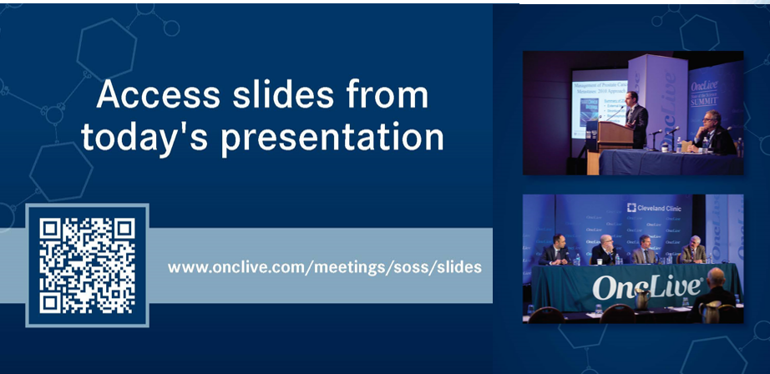
Thank You to Our Supporters
Shane Marchesani

Slide 5

Thank You to Our Supporters
Shane Marchesani

Slide 6

Thank You to Our Supporters
Shane Marchesani

Slide 7

Program Chair

Slide 8
Program Chair
Kari Wisinski, MD
Professor of Hematology and Oncology
Chief of Division of Hematology, Medical Oncology, Palliative Care
Associate Director of Clinical Research
Co-Lead of Breast Cancer Disease Oriented Team
Deputy Editor of Clinical Breast Cancer
UW Carbone Cancer Center

Slide 9
BREAST CANCER
Wednesday, September 6, 2023

Slide 10
Endocrine Based Therapy in HER2- Breast Cancer
Malinda West, MD, MS
Assistant Professor of Medicine
Division of Hematology, Medical Oncology and Palliative Care
University of Wisconsin Carbone Cancer Center
September 6, 2023
Notes:
Today I’ll be talking about endocrine based therapy in HER2- breast cancer
With a focus on the application of CDK 4/6 inhibitors

Slide 11
Objectives
Adjuvant CDK 4/6 inhibitors:
MonarchE
Natalee
MBC: 1L CDK 4/6 inhibitors:
3. Survival discussion
4. Right choice
CDK 4/6 inhibitor after CDK4/6 inhibitor:
Maintain
Pace
Palmira

Slide 12
Background

Slide 13
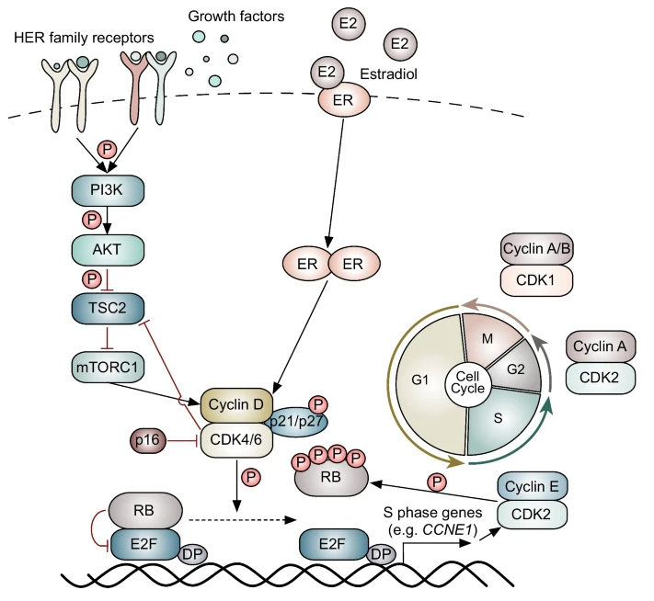
MOA
CDK 4/6 inhibitors prevent RB phosphorylation:
Block CDK 4/6 binding to D cyclins
Increase cytosolic p21 which binds and inhibits Cyclin E/CDK2
Synergism with estrogen blockade
Cytostatic
Induce senescence
Some apoptosis
Watt, et al. Breast Cancer Res 24, 17 (2022)
Notes:
This is a schema of the inside of an ER+ breast cancer cell.
Common aberrations include overamplified Cyclin D and CDK 4 and CDK6.
CDK 4 and 6 partner with D type cyclins (and a third protein p21 or p27)
This holoenzyme then phosphorylates RB, inactivating it, causing the E2F transcription factor to be released and trigger replication genes
CDK 4/6 inhibitors block CDK4 and CDK6 from binding to D cyclins.
Also leads to increased p21 protein which binds and inhbits CDK2/Cyclin E, which help with late push of G1 into S
Synergism with estrogen blockade as estradiol directly activates cyclin D.
Overall these agents are cytostatic, and induce senescence though evidence for long senescence and G1 delay may induce apoptosis.

Slide 14
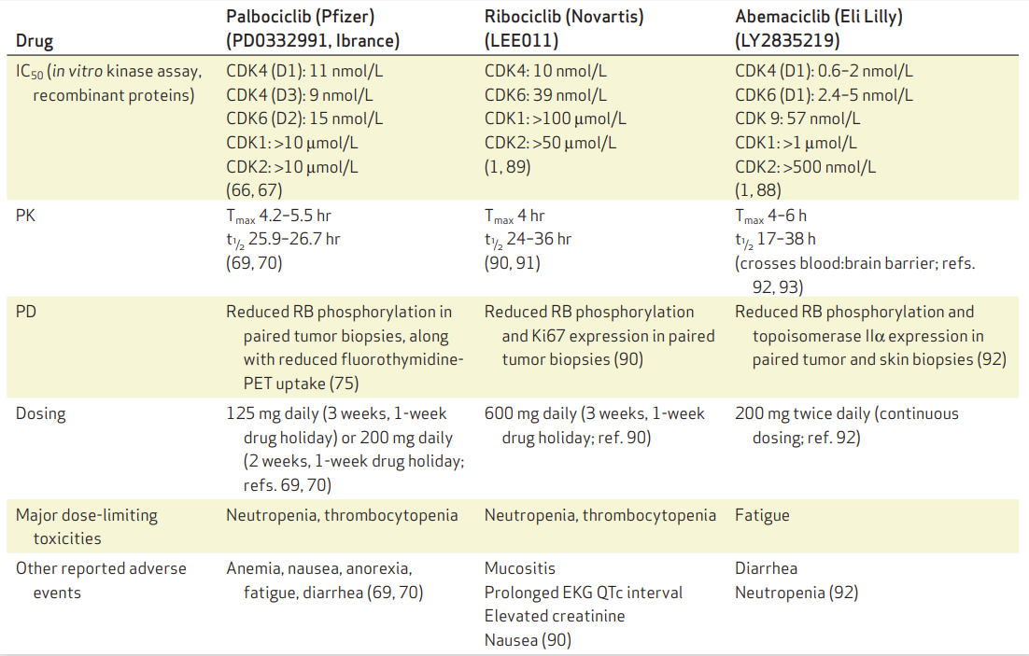
Drug Characteristics
IC50:
Abemaciclib (and ribociclib) more potent at CDK4 than CDK6
Dosing:
Only abemaciclib is continuous
Unbound free drug:
Ribociclib highest
LFT elev LFT elev
Fraction unbound Fu (%) | 14.7% | 27.2% | 7.8%
Sherr et al. Cancer Discov (2016) 6 (4): 353–367
Chen et al, Mol Cancer Ther (2016) 15 (10): 2273–2281
Notes:
3 FDA approved CDK 4/6 inhibitors in breast cancer
There appear to be some pharmacokinetic differences, and as we’ll discuss some possible clinical differences in these agents.
Looking at the IC50- concentration of drug required for 50% inhibition of cell growth. The lower the value, the more potent it is.
Abema and ribo more potent at CDK4 than CDK6:
- abema IC50 for CDK4 at 2
- Ribo IC50 for CDK4 10
IC50 for CDK6: most potent with abemaciclib ~10
Also, the amount of unbound free drug is highest with ribociclib and may speak to some of the clinical activity.
In terms of side effects and monitoring:
Palbociclib and ribociclib with very similar structures- and have similar neutropenia limiting side effects, resulting in the intermittent 3 weeks on 1 week off dosing.
Abemaciclib is dosed continuously, less neutropenia but more fatigue and diarrhea side effects.
Side effects highlighted in green here.

Slide 15
Adjuvant CDK 4/6 inhibitors

Slide 16
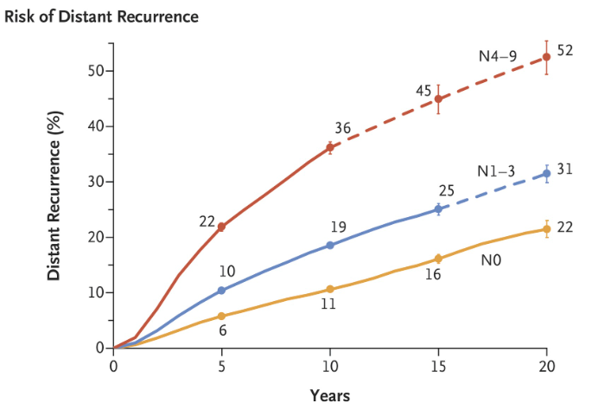
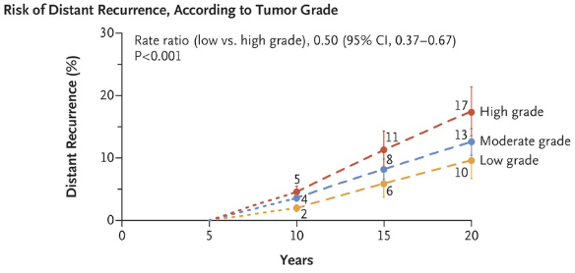
Gomis et al. (2017), Tumor cell dormancy. Mol Oncol, 11: 62-78.
Pan et al. N Engl J Med 2017; 377:1836-1846
Notes:
Goal of adjuvant therapy is to help reduce risk of late recurrence, characteristic of ER+ breast cancer.
We know there is risk for decades later recurrences, even with 5 years of endocrine therapy.
Predicted by TNM or tumor genomics when indicated, such as oncotype RS
So for example, even after 5 years of ET- risk of distant recurrence at 20 years for an N0 tumor is 22%, N1 31% and N2 52%
And may be influenced too by tumor grade and tumor size.

Slide 17
Adjuvant CDK 4/6 trials
Trial | Population | High- risk criteria | Duration of CDK 4/6 | Median F/U | iDFS / (∆) | HR/ p value
monarchE | N = 5,637 ET +/- abema | 4+ pathologic LN or 1-3+ LN and G3 or T3 | 2 years | 42.0 mo | 85.8%/ 6.4% | 0.664/ <0.0001
Natalee | N = 4,000 estimated ET +/- ribo | N1+ N0 with G2 or G3 and Ki67 >20% or Oncotype >26 | 3 years | 34.0 mo | 90.4%/ 3.3% | 0.748/ 0.0014
Penelope | N = 1,250 ET +/- palbo | After neoadjuv CT CPS score of 3+ or 2 and ypN+ | 1 year | 42.8 mo | 81.2%/ 3.5% | 0.93/ 0.525
Pallas | N = 5,761 ET +/- palbo | Anatomic stage II-III | 2 years | 31 mo | 84.2%/ 0% | 0.96/ 0.65
Notes:
Summary of trials
monarchE trial for abema, and FDA approved for highrisk
Natalee trial for ribo, compelling early significant findings that will be exciting to follow up
Natalee: still enrolling. adjuvant ribo for 3 years: high risk as N1+ or N0 with G2 or G3 AND ki67 >20% or Oncotype >26
monarchE: adjuvant abema for 2 years, Ki67 of 20%+ removed after 4 year interim f/u presented at SABCS last year finding that Ki67 was prognostic but not predictive of abemaciclib benefit, similar abema effects regardless of Ki67
Negative studies in this space include:
Pallas: adjuvant palbo for 2 years in stage II-III. 3 year IDF 88% in both ET and palbo ET arms
Penelope: adjuvant palbo for 1 year after neoadjuvant CT for for ER+ HER2- breast cancer with CPS score of 3+ or 2 and ypN+. 4 year iDFS 73 vs 72%, no difference in any subgroup.

Slide 18
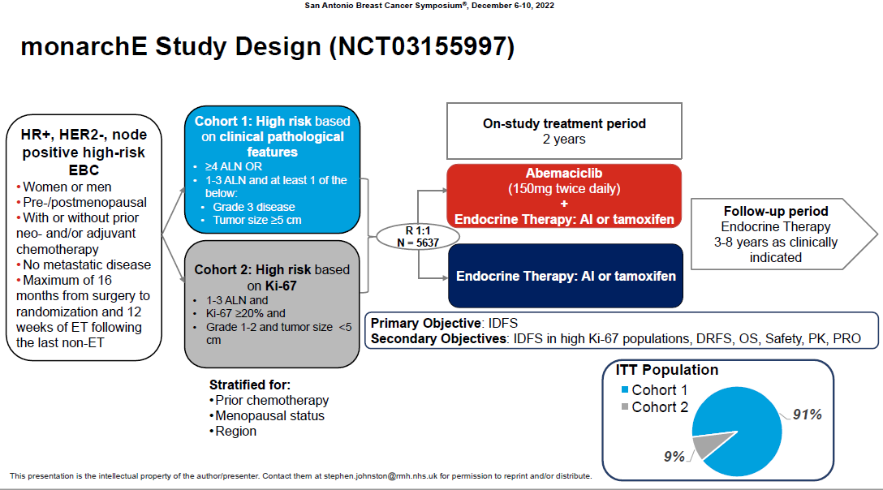
monarchE update
Balanced between control and study arms:
60% were post-meno
70% AI, 15% OFS, 30% tamoxifen
50% had T2
20% with T3
60% had 4+ axillary LN
40% had G3 histology
45% had Ki67 >20%
95% had received CT
80% with anthracycline and taxane
Johnston et al, Abstract GS1-09 SABCS 2022
Johnston et al, Lancet Onc, 2022
Notes:
Abemaciclib is the only CDK 4/6 inhibitor approved in the adjuvant setting currently.
It was approved in 2021 based on significant improvements in IDFS from the MonarchE trial
This was the trial schema
High risk node positive disease- stratified into cohorts above
- cohort 1 based on clinicopathological features: N2 disease or N1 + G3 or N1 + T>5cm
- cohort 2: N1 + Ki67 of more than 20% as a criteria
Randomized into abema + ET for 2 years or ET for 2 years, then followed by ET for an additional 3-8 years as indicated
Primary outcome of IDFS
Now updated data from SABCS last year with 4 year analysis- all off abema for 2 years.
Updated at SABCS last year for a pre-planned 4 year follow up- 2 years following primary outcome analysis.

Slide 19
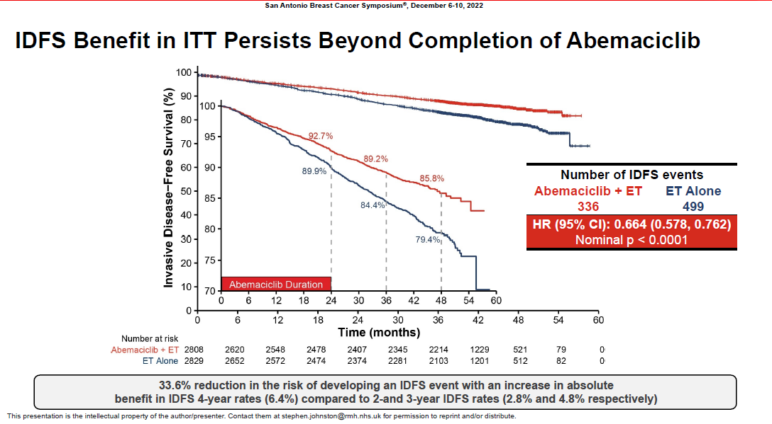
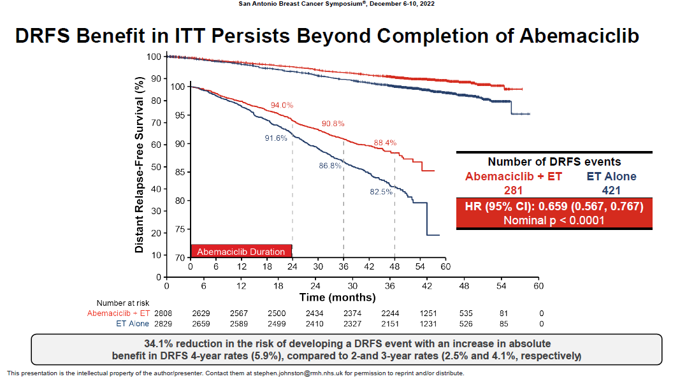
IDFS benefit: ∆ 6.4%
DRFS benefit: ∆ 5.9%
Johnston et al, Abstract GS1-09 SABCS 2022
Notes:
§ With additional follow-up, the benefit of adjuvant abemaciclib deepened in magnitude as compared to 2- and 3-year rates.
At 4 years:
- Increase in absolute IDFS of 6.4%
- Increase in absolute DRFS benefit of 5.9% at 4 years
Encouraging reductions in IDFS and DRFS that continued to widen after stopping abemaciclib at 2 years
Overall side effects well tolerated,
Most common with fatigue, diarrhea and

Slide 20
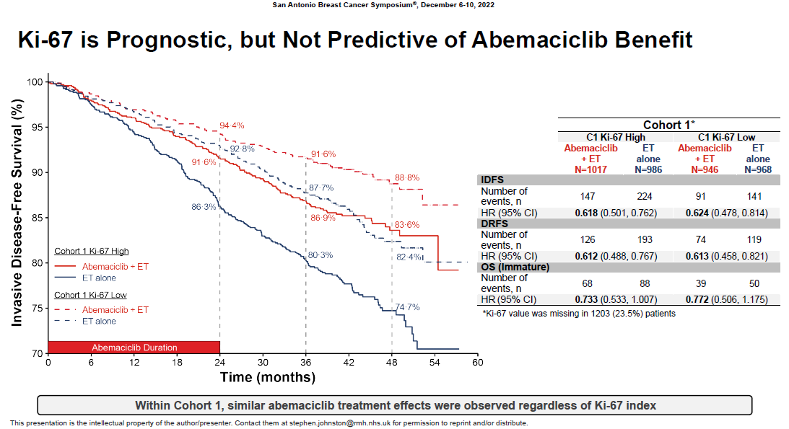
Johnston et al, Abstract GS1-09 SABCS 2022
Notes:
− Ki-67 remains prognostic- higher scores have more invasive recurrence however, not predictive of abemaciclib as benefit in both Ki67 high and low groups seen with abemaciclib addition.
Ther FDA has since REMOVED the Ki67 criteria from inclusion consideration after this data was presented.

Slide 21
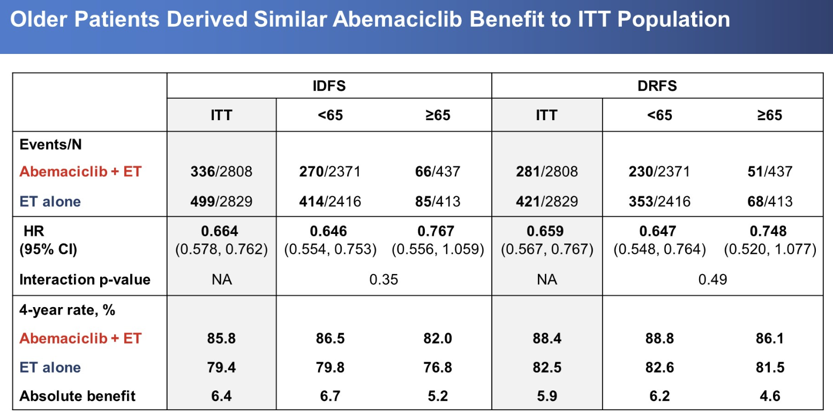
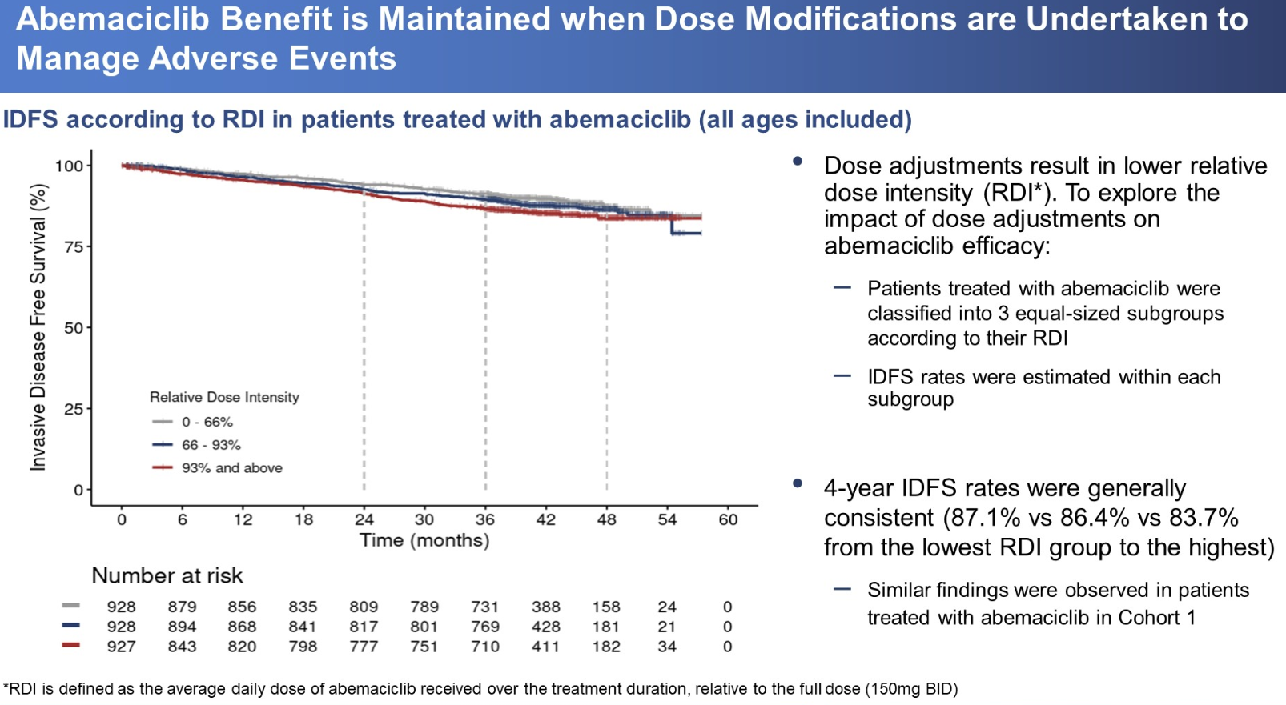
Adjuvant abema in older cohort
Hamilton et al, ASCO 2023 Abstract 501
Notes:
Additional analysis from MonarchE presented at ASCO 2023 described safety and efficacy in those aged >65 vs under 65 years.
There were more baseline comorbidities and less prior neo or adjuvant chemotherapy
There was more need for dose reductions- in the older population
However on Left, can still see there was similar IDFS and DRFS benefit in the older population compared with overall cohort.
And in graph on Right that there was no impact to IDFS when dose reductions were compared.
At 48 month follow up IDFS rates similar between
Low RDI group- 87.1%
Middle group- 86.4%
Highest RDI group- 83.7%

Slide 22
monarchE Takeaways
IDFS and DDFS continued to deepen after 2 years off active abema
OS data ultimately needed
Ki67 predictive but not prognostic of abema benefit, indication removed
Older derive similar benefit from abemaciclib
More G3 diarrhea and fatigue
Patient education and Closer monitoring
Dose reductions did not impact iDFS
Notes:
Benefit with abema may be more the continuous dose versus the lower dose

Slide 23
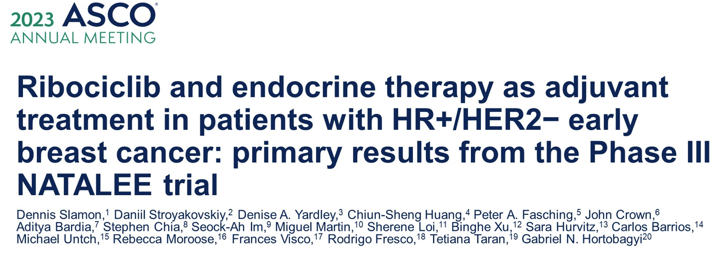
Slamon et al ASCO LBA 500, 2023

Slide 24
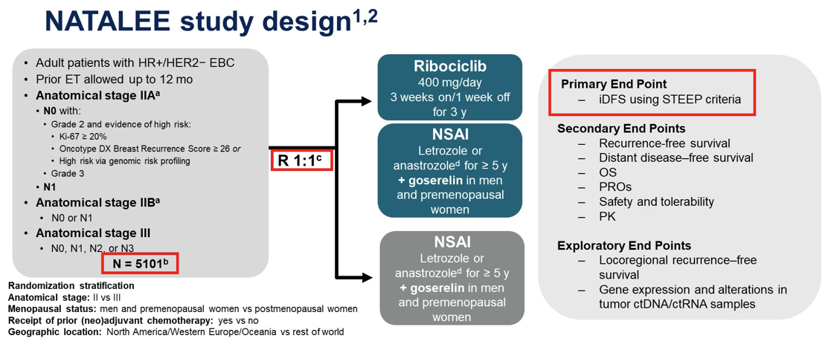
Slamon et al ASCO LBA 500, 2023
Notes:
Unique features of study design:
Anatomic stage IIA, IIB, III which included a NODE negative group
Use of ribociclib 400mg per day 3 weeks on/ 1 week off for 3 year
3 years→ to drive the cells into irreversible senescence

Slide 25
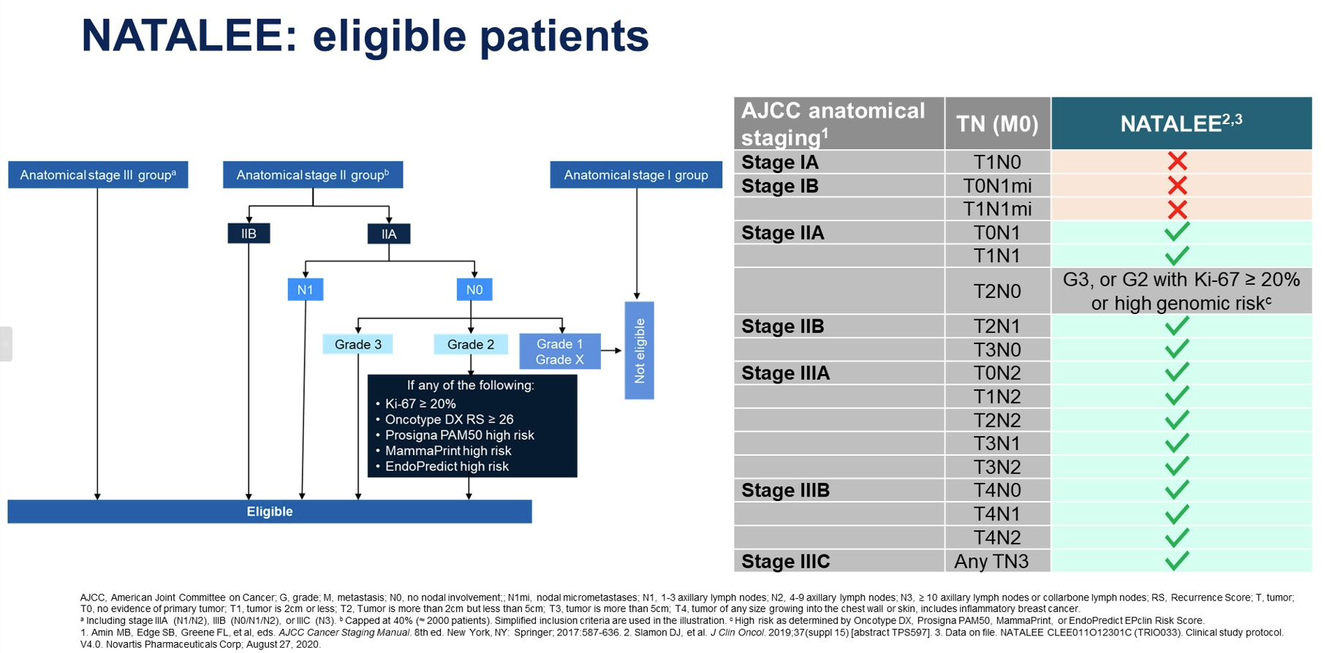
Slamon et al ASCO LBA 500, 2023
Notes:
Diagrms illustrating the eligible patients-
Overall N1+
Or N0 with at least T2 and another high risk feature

Slide 26
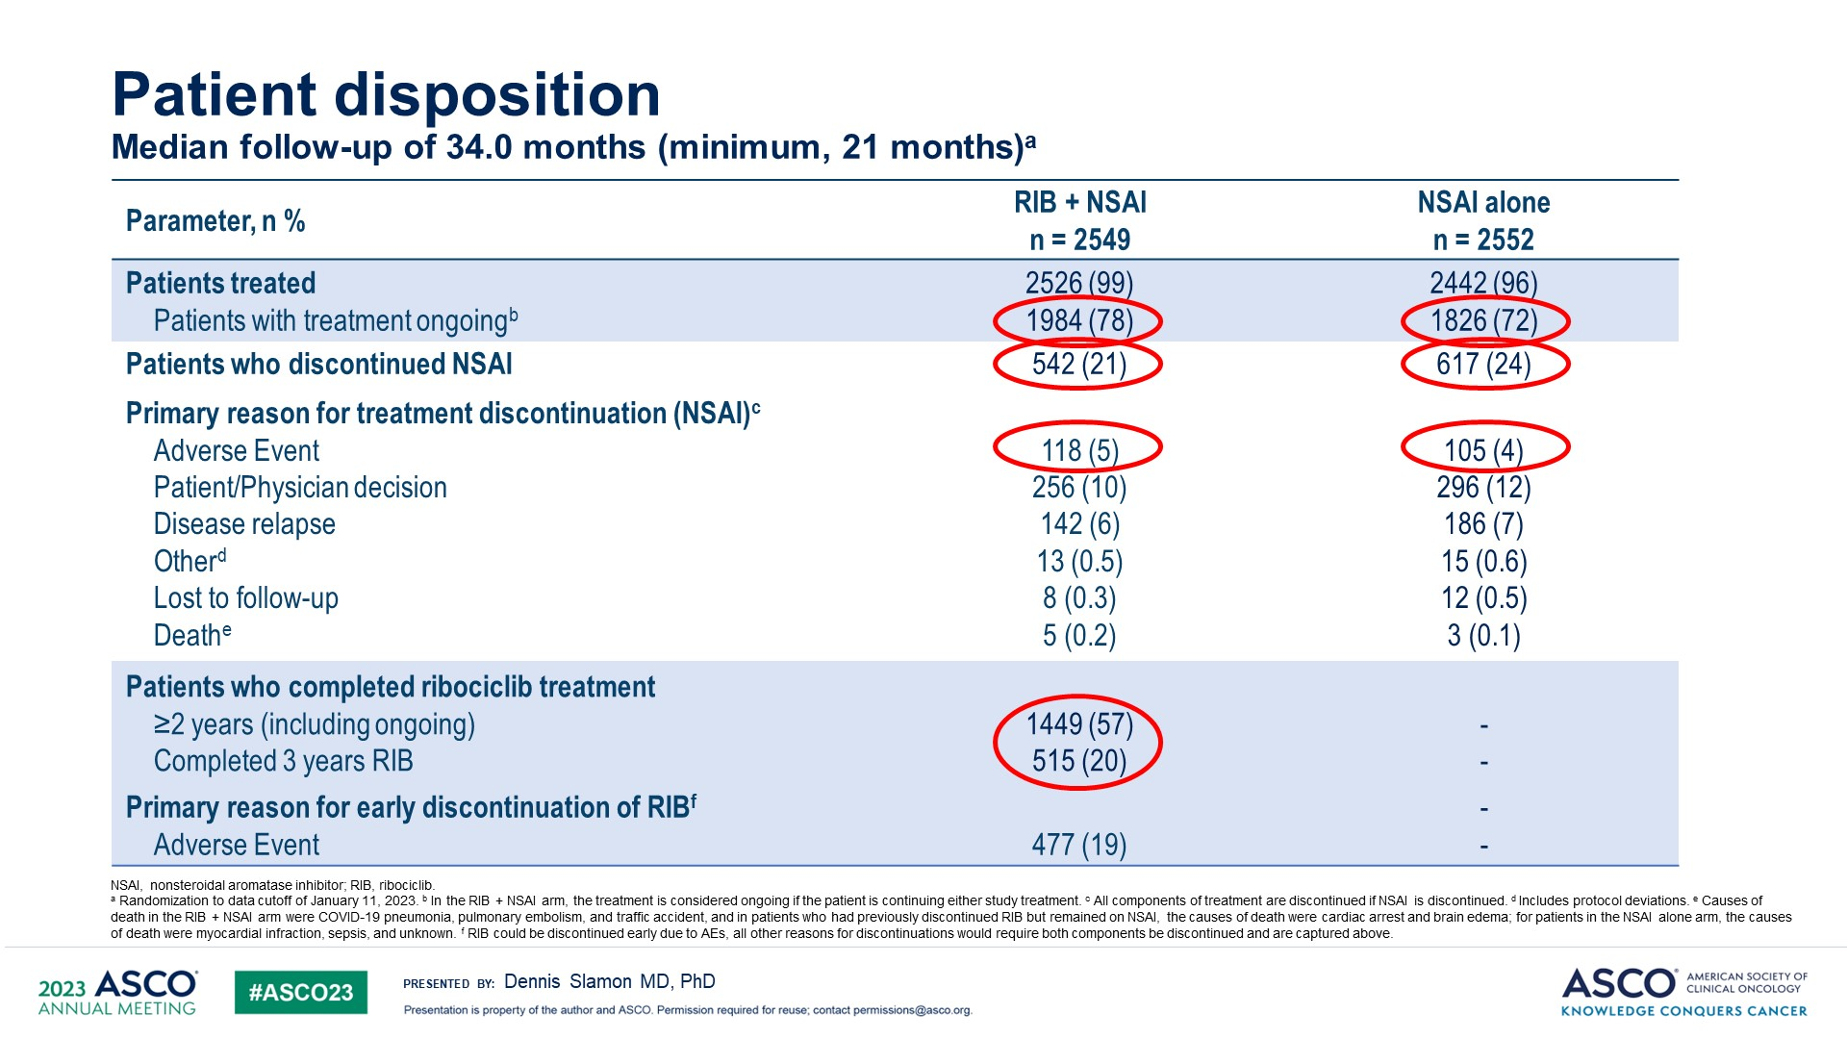
Baseline Patient Characteristics
 | Ribo + AI | AI alone
Postmenopausal Stage IIA Stage IIB Stage III Nx N0 N1 N2/N3 Prior ET Prior (neo)adj CT | 56% 19% 21% 60% 11% 27% 41% 19% 72% 88% | 56% 20% 20% 59% 10% 29% 41% 18% 71% 88%
Slamon et al ASCO LBA 500, 2023
Notes:
Natalee has completed accrual-baseline characteristics listed here:
Matched between study and control arms:
56% post-meno
20% Stage IIA
20% Stage IIB
60% Stage III
10% Nx
28% N0
41% N1
19% N2/N3
At median follow up of 34 months, 78% remain with treatment ongoing still in treatment arm, and 72% in the control arm.
20% have completed the 3 years of ribociclib
Rates of dc of NSAI equal between both arms

Slide 27
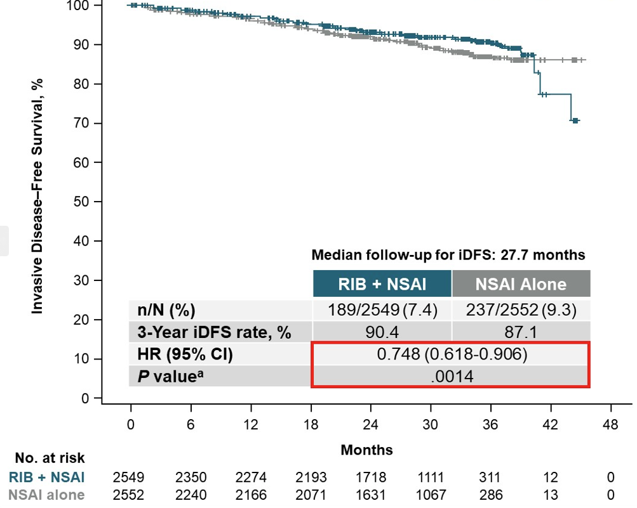
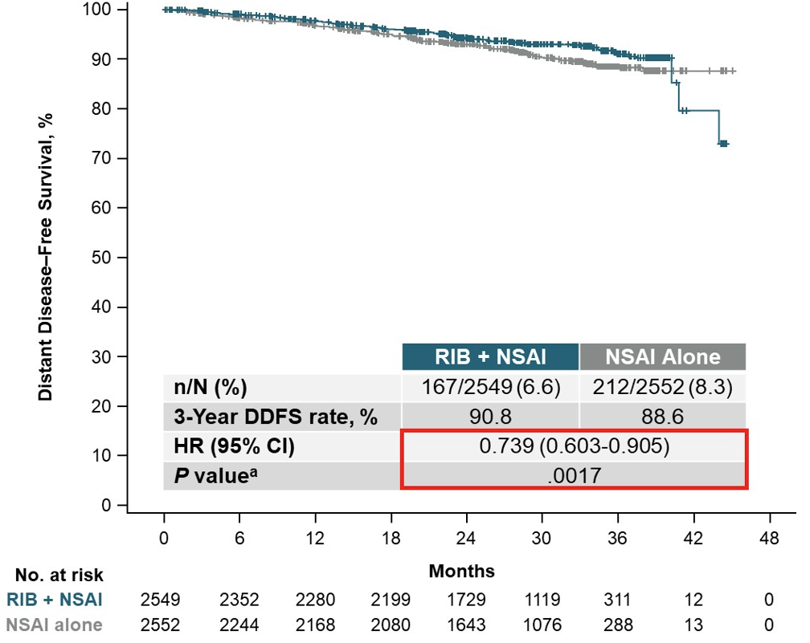
IDFS benefit: ∆ 3.3%
DDFS benefit: ∆ 2.2%
Slamon et al ASCO LBA 500, 2023
Notes:
Early significant findings that are encouraging to see:
Left: Primary endpoint of iDFS. delta absolute iDFS benefit at 3 years 3.3%
Right: DDFS- delta absolute DDFS benefit at 3 years 2.2%

Slide 28
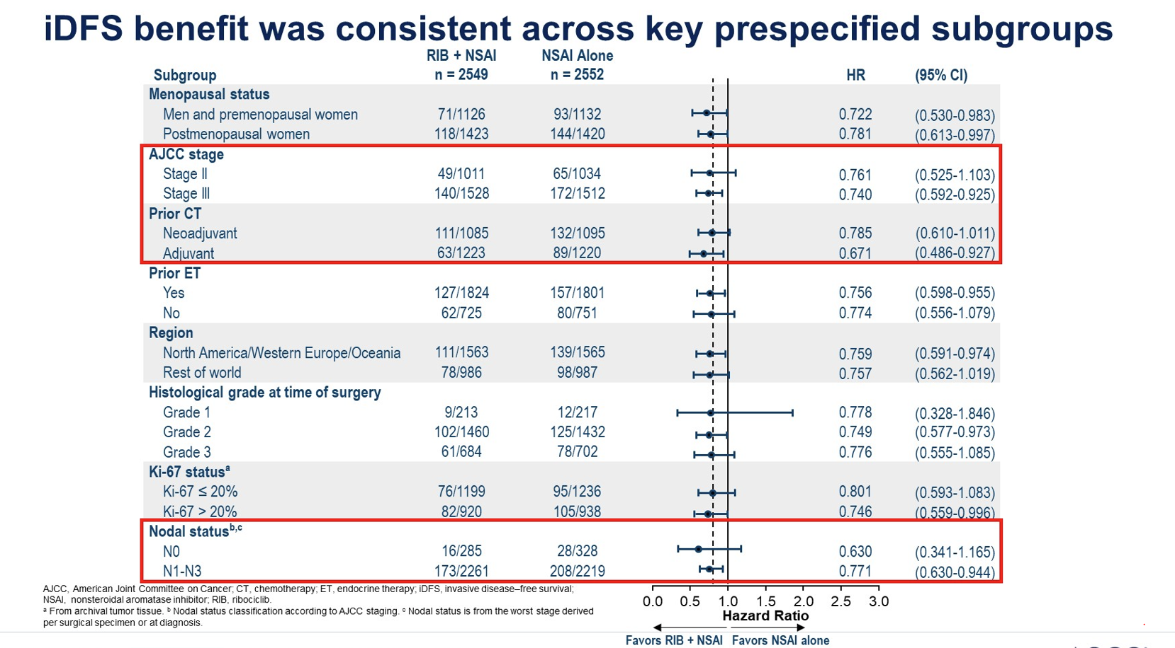
Slamon et al ASCO LBA 500, 2023
Notes:
Of interest will be the nodal status and N0 group specifically- currently wide CI but with only few results thus far

Slide 29
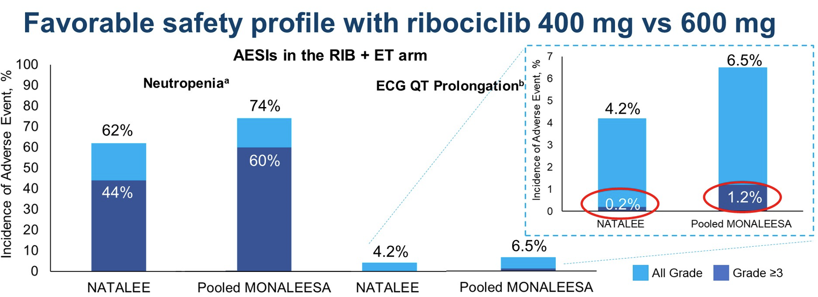
Slamon et al ASCO LBA 500, 2023
Notes:
Lower rates of dose dependent toxicities at 400mg dose compared to 600mg dose in advanced setting
Lower neutropenia, lower EKG QTc prolongation- new QTc of >500ms or increase from baseline of >60ms- overall rare, but lower

Slide 30
 | Natalee (N = 5,101) | monarchE (N = 5,601)
Key Inclusion | ≥N1 N0 + G3 or G2 and Ki67 ≥ 20% RS ≥ 26 (or other) | ≥ 4 LN 1-3 LN and G3 or T3
CDK 4/6 dose | Ribociclib 400mg 3 weeks on/ 1 week off | Abemaciclib 150mg BID Continuous dosing
CDK 4/6 duration | 3 years | 2 years
ET | NSAI +/- goserelin in pre-meno and men | AI or tamoxifen per physician choice +/- OFS
iDFS | 34 mo median f/u 3 year: 90.4% vs 87.1% (HR 0.748, p<0.0014) 3.3% difference | 42 mo median f/u 4 year: 85.8 vs 79.4% (HR 0.664, p<0.0001) 6.4% difference 3.0% at 19 mo
Completed CDK 4/6 | 20% | 100% past 2-year time 69% all of 2-year tx
Johnston S et al Lancet Oncology 2023
Slamon et al ASCO LBA 500, 2023
Notes:
Comparison of positive adjuvant phase 3 trials:
- of note, the time point at monarchE of at almost 2 years 3.9%
- compared to median fu of 34 mo (only 20% of whom have completed ribo) with 3.3% for natalee
Compared to 3.3% at 3 years for Natalee

Slide 31
Adjuvant CDK 4/6 inhibitor
Early positive findings encouraging, longer follow up needed
Most remain on ribociclib still
400mg less AE and early evidence of activity
Prior analysis from Monaleesa trials that dose reduction did not impact OS outcomes
Key questions that remain:
Will Overall Survival be improved?
What is the optimal dosing and duration?
Will node negative subgroup have iDFS benefit?
Need more follow up and data collected
Hart et al, JCO 2022;40 (suppl 16):11017.

Slide 32
CDK 4/6 inhibitors in 1L

Slide 33
Summary of 1L CDK 4/6 inhibitor trials
Trial | Population | mPFS/ (∆) | HR/p value | mOS/ (∆) | HR/p value
Paloma 1 | N = 165 Post-meno Letrozole +/- palbo | 20.2/ 10 mo | 0.488/ <0.0004 | 37.5 mo/ 3.2 mo | 0.897/ 0.281
Paloma 2 | N = 666 Post-meno Letrozole +/- palbo | 24.8 mo/ 10 mo | 0.58/ <0.001 | 53.9 mo/ 3 mo | 0.956/ 0.338
Monaleesa 2 | N = 668 Post-meno Letrozole +/- ribo | 25.3 mo/ 9 mo | 0.57/ <0.001 | 63.9 mo/ 12.5 mo | 0.76/ <0.001
Monaleesa 3 | N = 365 (1L) Post-meno Fulvestrant +/- ribo | 33.6 mo/ 15 mo | 0.55/ SS | NR at 52 mo | 0.70/ SS
Monaleesa 7 | N = 672 Pre/peri-meno OFS + tam or AI +/- ribo | 23.8mo/ 11 mo | 0.55/ <0.001 | 58.7 mo/ 11mo | 0.76/ 0.009
Monarch 3 | N = 493 Post-meno AI +/- abema | 28.2 mo/ 14mo | 0.54/ 0.00002 | 67.1mo/ 12 mo | 0.754/ 0.0301
Slamon et al Annals of Oncology 2021, Hortobagyi et al ESMO 2021, Im et al NEJM 2019, Johnston et al NPJ
Breast Cancer 2019, Finn et al BCRT 2020, Goetz ESMO 2022, Lu et al Clin Cancer Research 2022
Notes:
HR for PFS very similar across all the trials, all roughly ~0.5
However, differences in survival
Paloma 1- phase 2
Paloma 2- phase 3
Monaleesa trials with significant OS in both post meno Monaleesa 2 trial and pre/peri menopausal Monaleesa 7 trial
Monaleesa 3 OS data pends
Monarch 3 OS data was at 2nd interim analysis- despite HR of 0.754 and p 0.031, it did not meet the prespecified threshold for abema superiority- further follow up still ongoing currently

Slide 34
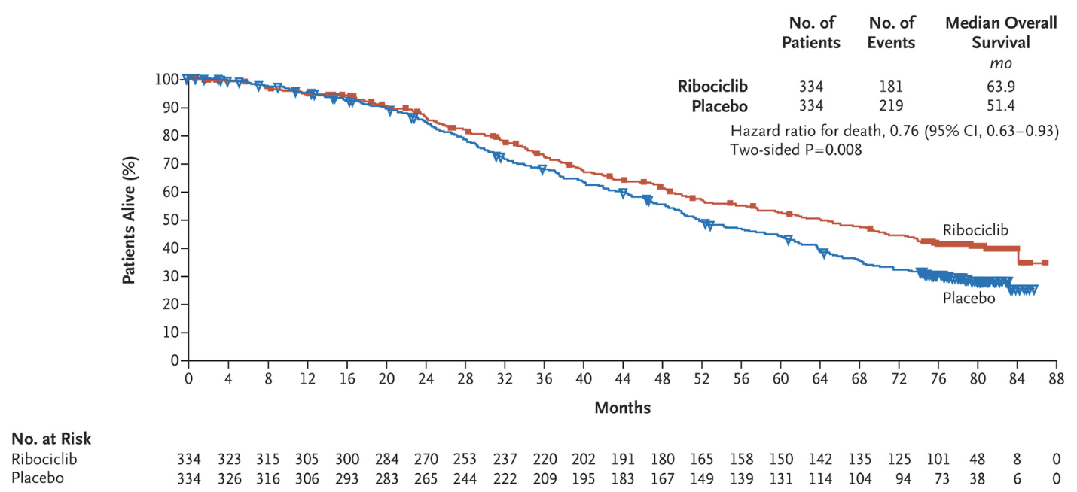
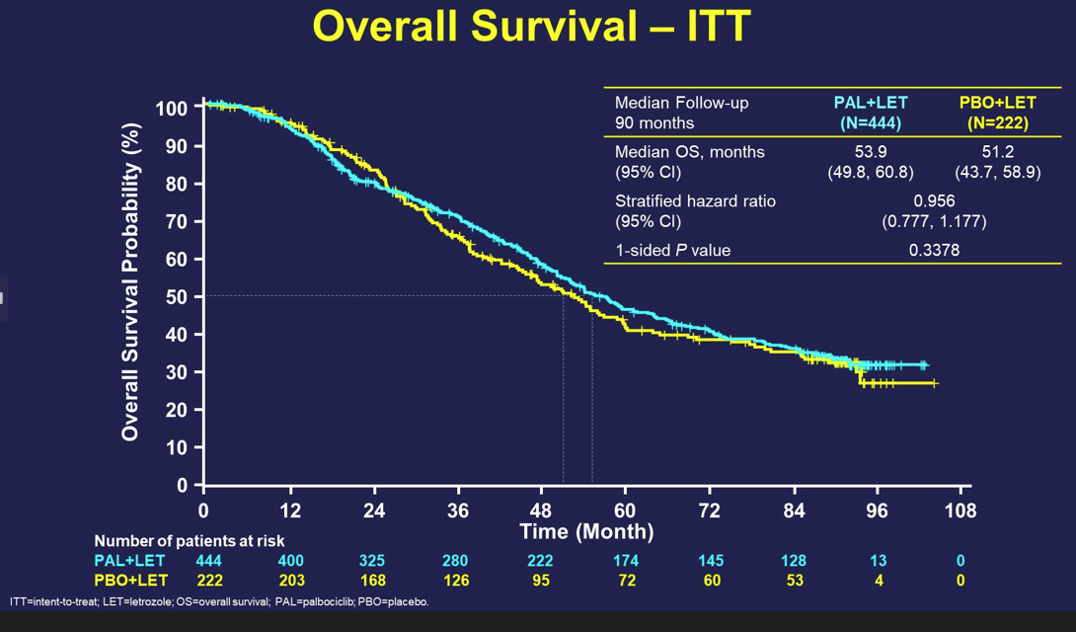
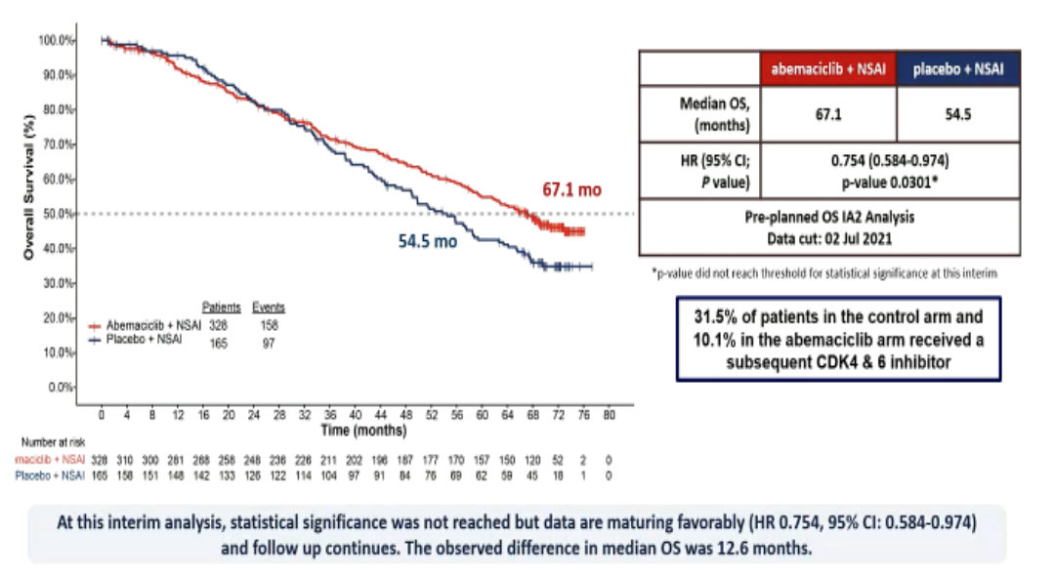
OS comparison in 1L
Trial | CDKi + ET | ET | P value
Monaleesa 2 | 64 months | 51 months | <0.001
Paloma 2 | 54 months | 51 months | 0.338
Monarch 3 | 67 months | 54 months | 0.03
Monaleesa 2 Paloma 2 Monarch 3
O’regan, ASCO 2023 discussion. Hortobagyi et al N Eng J Med 2022, Finn et al ASCO 2022, Goetz et al ESMO 2022
Notes:
Slide is borrowed from from Dr. O’regan discussion at ASCO this year, debating if all CDK 4/6 ihibitors are the same
With all the limitations in cross trial comparisons, it is interesting that in looking at overall survival, the initial PFS benefit with palbociclib narrowed and was not statistically significant.
Highlighted is the ET alone control arm, showing little variation here in outcomes- suggesting not the trial design but possibly the drug may behave differently.
Less CDK4 activity than abema or ribo and not as unbound in the circulation like ribo?
Trial design? Population? Drug?
Harmonia trial: prospective phase 3 looking at palbo vs ribo in 1L ER+ HER2- that on PAM 50 has a HER2 enriched subtype
Much discussion about Paloma 2 trial and why OS not seen.
Missing survival data: 13% in plabo arm and 21% in placebo arm- due to patients who were lost to fu or censored
However even when sensitivity analysis performed to adjust for this data still not statistical significance for OS
Real world analysis find PFS and OS benefits for palbo + letrozole over letrozole
At progression in Monaleesa 2, a higher percentage received subsequent CDK 4/6 inhibitor (22% in ribo arm, and 34% in AI arm).
In Paloma 2- only 12% from palbo arm and 27% from letrozole arm received subsequent CDK 4/6 inhibitor.
Majority in both received subsequent Palbociclib.
Learning that palbo after palbo per PACE unlikely to derive benefit
Though in Maintain going from palbo to ribo did result in some benefit, and so possibly switching CDK 4/6 inhib led to better outcomes for those in Monaleesa who received subsequent line CDK 4/6 inhib (palbo).
More Asian patients in Paloma 2 (14.3%) vs Monaleesa-2 (7.6%). Who may have increased toxicity with CDK 4/6 inhib due to slower drug clearance
Possibly less endocrine sensitive patients in Paloma-2- where 40%had a DFI of 1 year, though in Monaleesa2 60% had a DFI longer than 2 years
Unlikely due to different characteristics of trial populations given- same ET control arm outcomes and when use same definition of DFI <12 months for both, roughly equal numbers.

Slide 35
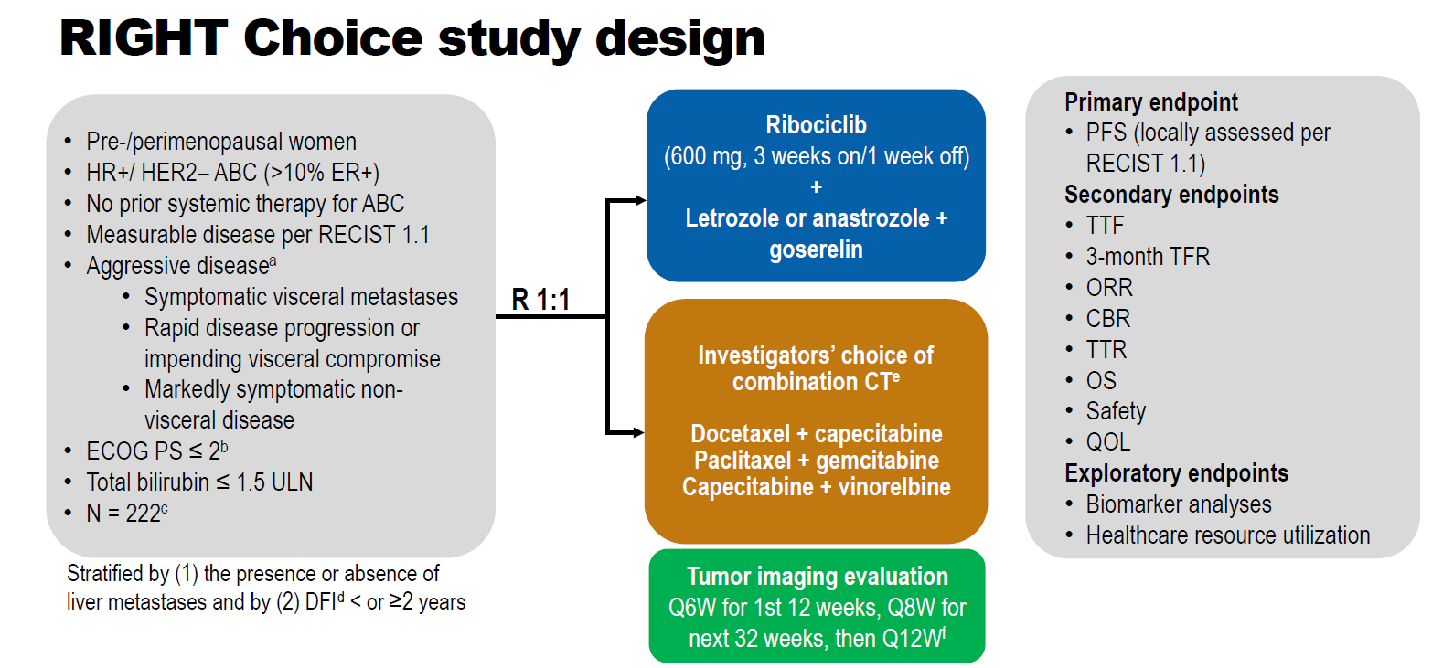
Lu, Y et al. SABCS 2022, GS1-10
Notes:
A compelling study looking at 1L with a CDK4/6 inhibitor + ET compared to chemotherapy in those with aggressive disease.
Inclusion criteria:
Pre menopausal
Advanced ER+ breast cancer, no prior tx in ABC setting
Aggressive disease
Primary endpoint….PFS
Key secondary endpoints listed here

Slide 36
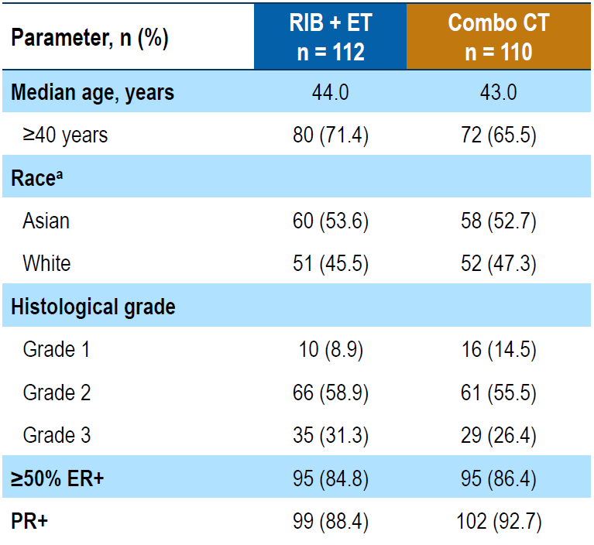
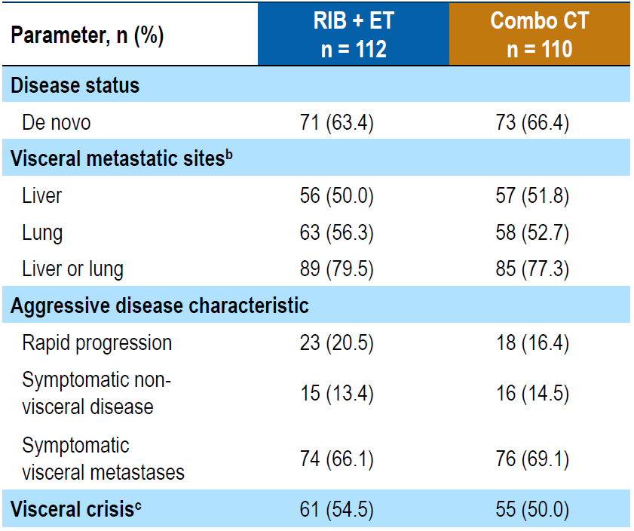
Baseline Patient Population
Lu, Y et al. SABCS 2022, GS1-10
Notes:
Majority are over 40 years old
With G2/3 histology
ER over 50% in the majority of cases
Denovo MBC in ~70% of cases
Aggressive disease characteristics:
Also that 66-69% had symptomatic visceral metastases and
54-55% had visceral crisis
Certainly h igh risk where traditionally consideration for CT had

Slide 37
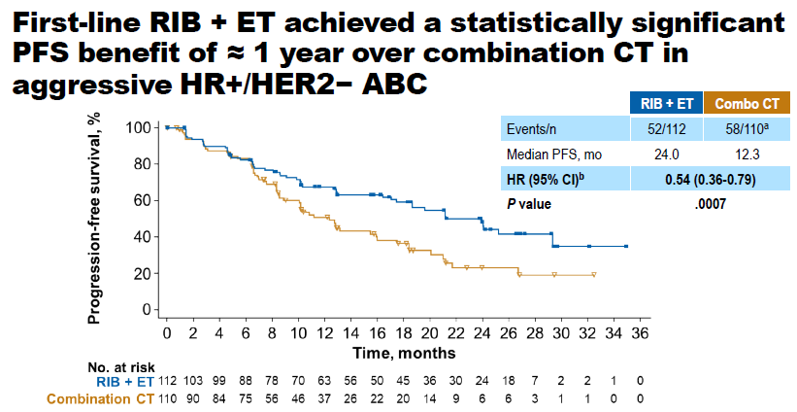
Primary Endpoint: PFS
Lu, Y et al. SABCS 2022, GS1-10
Notes:
Primary endpoint of PFS:
Ribociclib + AI + goserelin mPFS 24.0 months
Doublet CT: 12.3 months
HR of 0.54

Slide 38
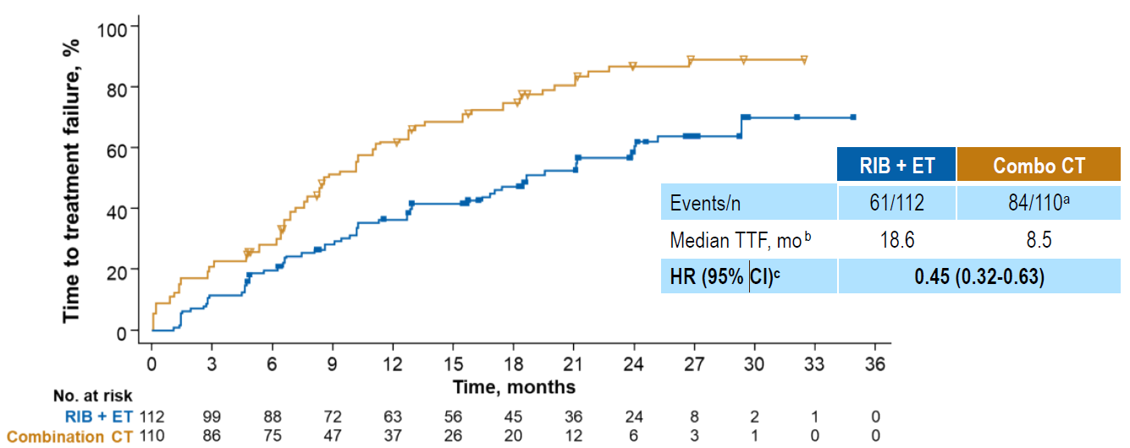
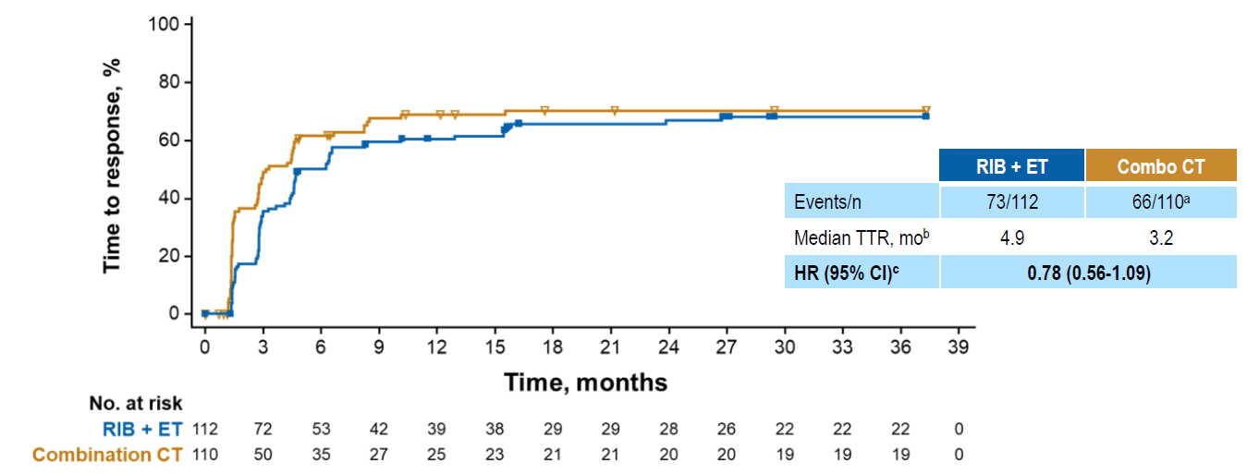
Secondary Endpoints
 | Ribo + ET ( n = 112) | Combo CT (n = 100)
ORR | 65.2% | 60.0%
CBR | 80.4% | 72.7%
Serious TRAE | 1.8% | 8.0%
TRAE leading to dc | 7.1% | 23.0%
Lu, Y et al. SABCS 2022, GS1-10
Notes:
Overall with promising responses on secondary endpoints:
LEFT: Longer time to treatment failure. 18.6 mo with ribo + ET vs 8.5 mo with combination CT for about a 10 month longer duration
RIGHT: Time to treatment response: Overall similar
Benefit with ribociclib and ET was also seen with ORR and clinical benefit rate:
Lastly, TRAE were overall lower in the ribo + ET over chemotherapy groups.

Slide 39
Right Choice Takeaways
Ribociblib + endocrine therapy can be a 1L option for ER+ MBC in those with visceral crisis or aggressive disease in younger pre-menopausal patients
Less toxic regimen, longer PFS, longer duration of treatment response, similar onset to treatment time
Questions:
Will this be seen with other CDK 4/6 inhibitors?
Notes:
Debate ongoing in terms of differences amongst CDK 4/6 inhibitors

Slide 40
CDK 4/6 inhibitor after CDK 4/6 inhibitor

Slide 41
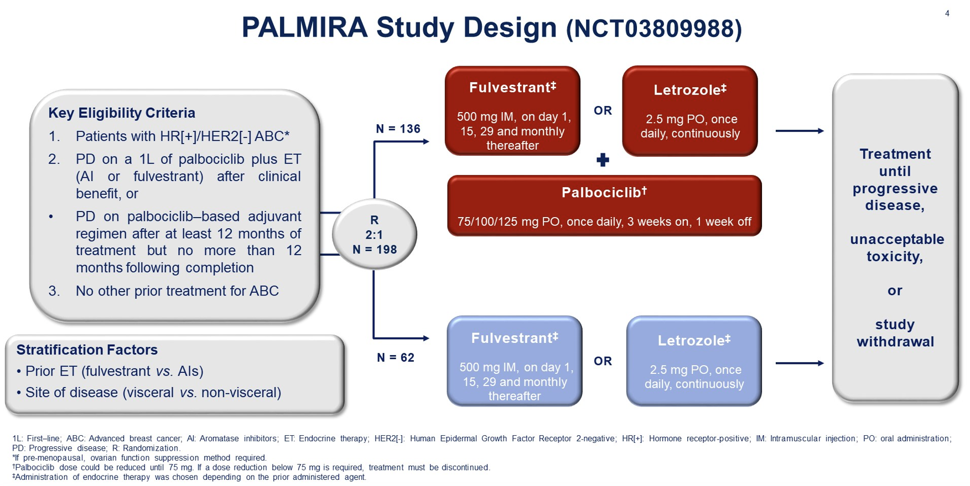
Notes:
Palmira trial aims to determine if maintaining Palbociclib with an alternative ET improves the antitumor activity of 2L ET in patietns with HR+ HER2- ABC progressing on a 1L palbo regimen

Slide 42
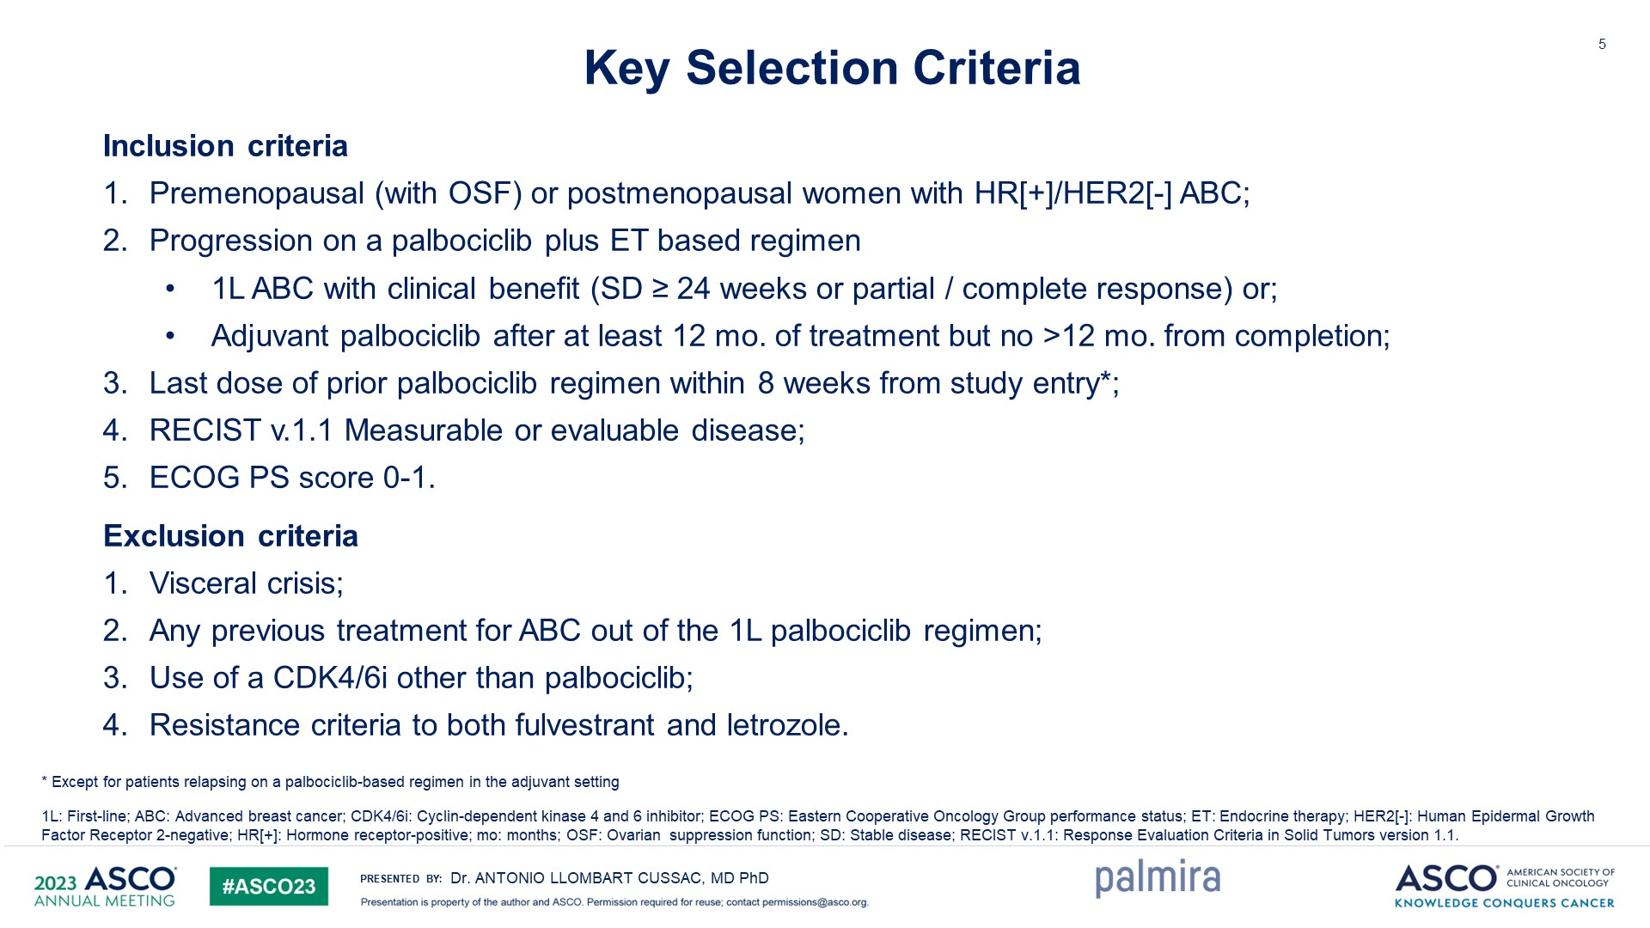

Slide 43
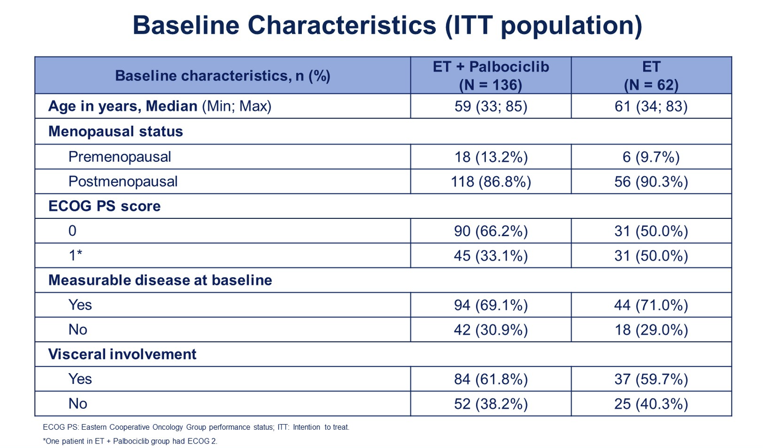
Notes:
Noting pre and post menopausal populations are balanced

Slide 44
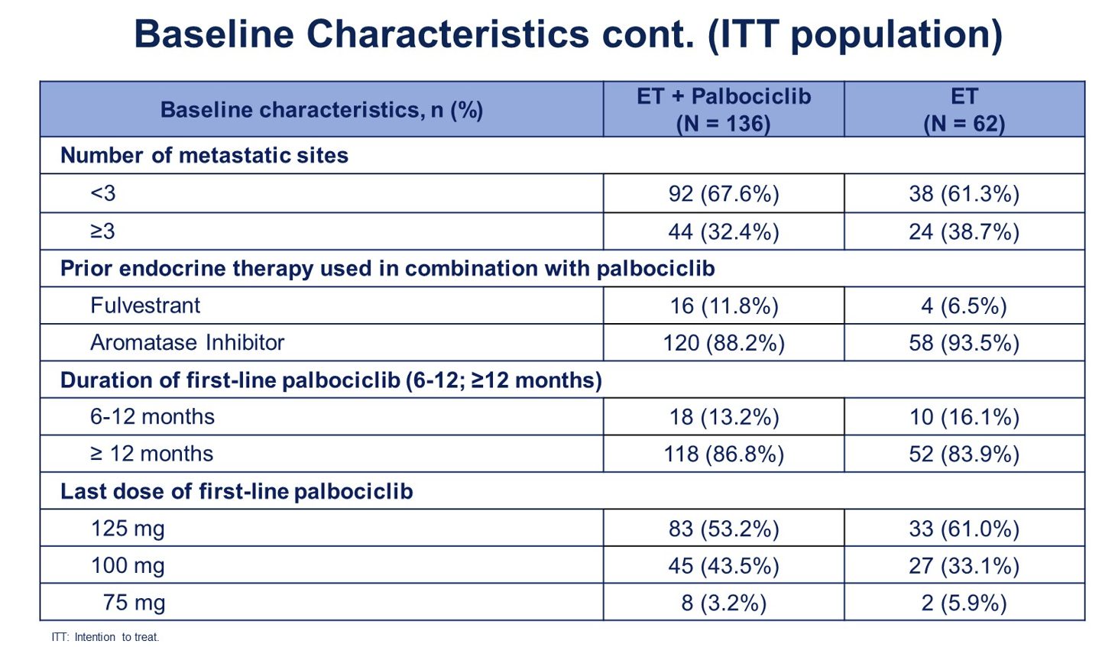
Notes:
Also well matched between prior ET combined with palbo: - those with AI as the prior ET in combination with palbo as the majority in both.
And with duration of 1L palbo 12+ months or more in around 85% in both groups

Slide 45
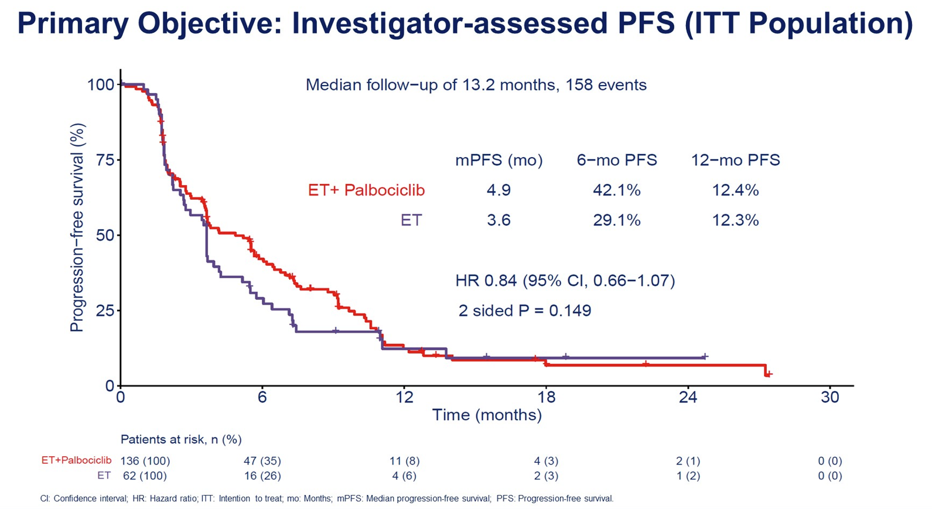
Notes:
Palbo maintenance with switched ET shown in the red line had 6 month widening initially though at 12 months had no difference compared to PFS with switched ET alone

Slide 46
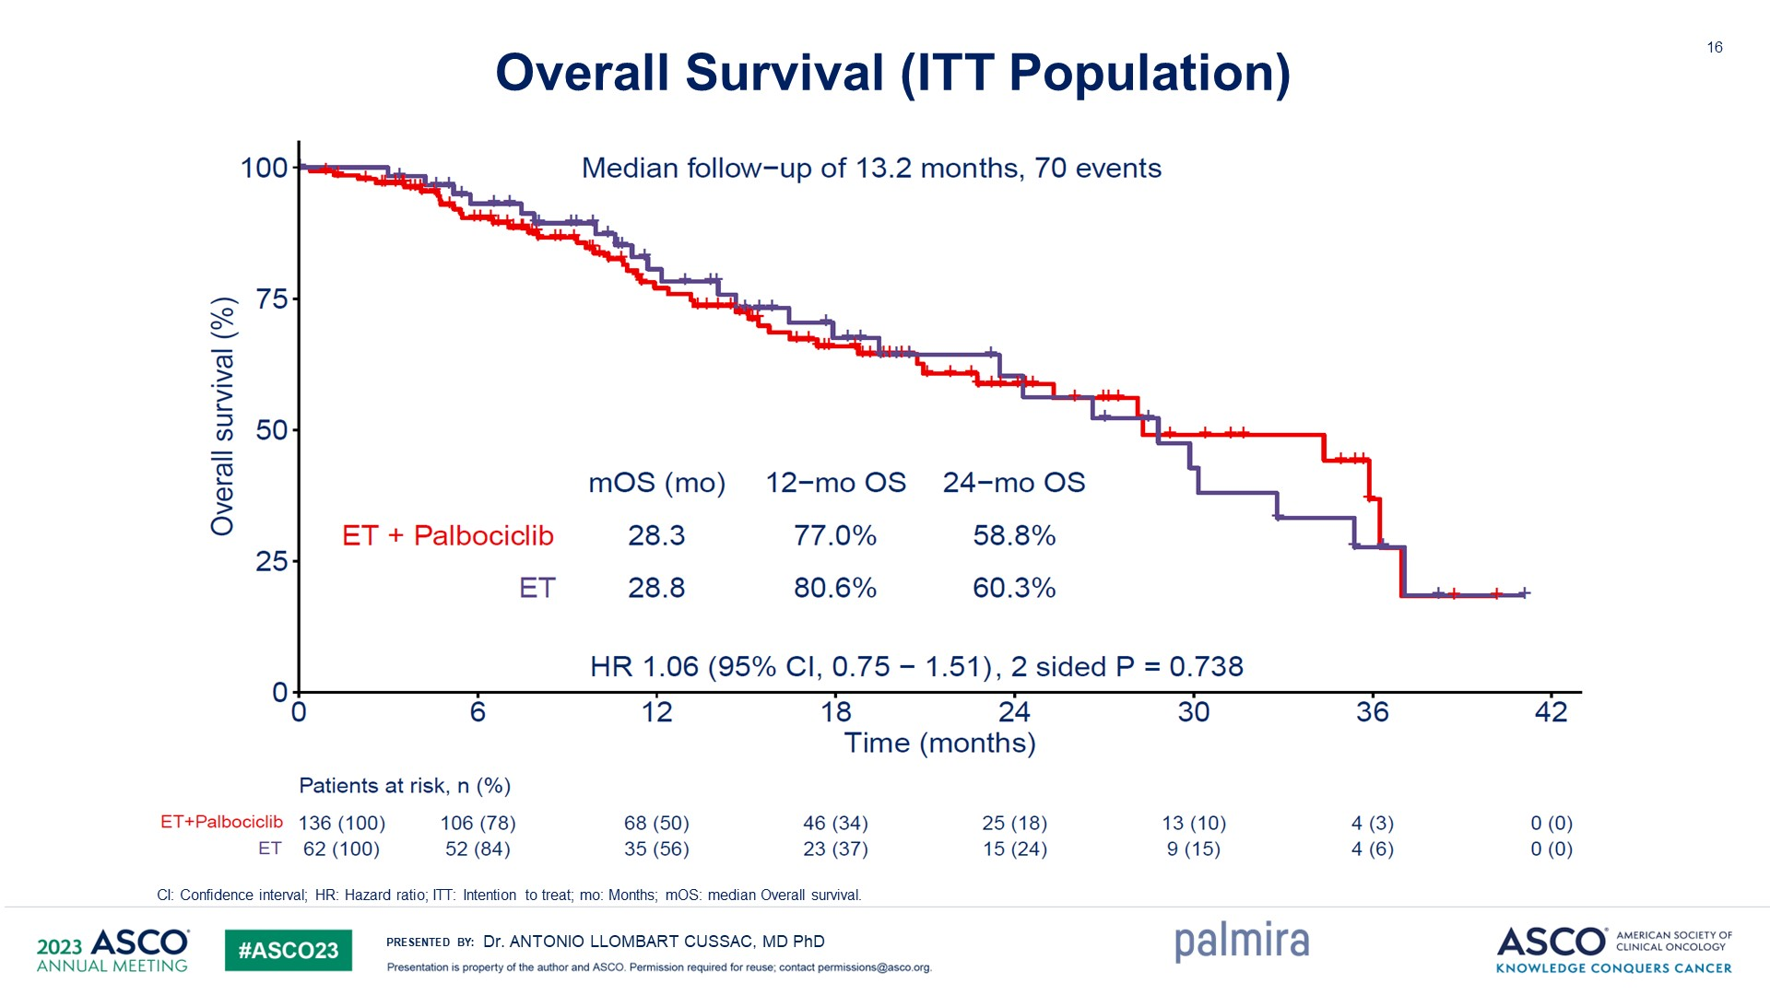
Notes:
Here with OS, the lines are completely superimposed showing no difference in between the two arms.
Continuing palbo at progression with little benefit.

Slide 47
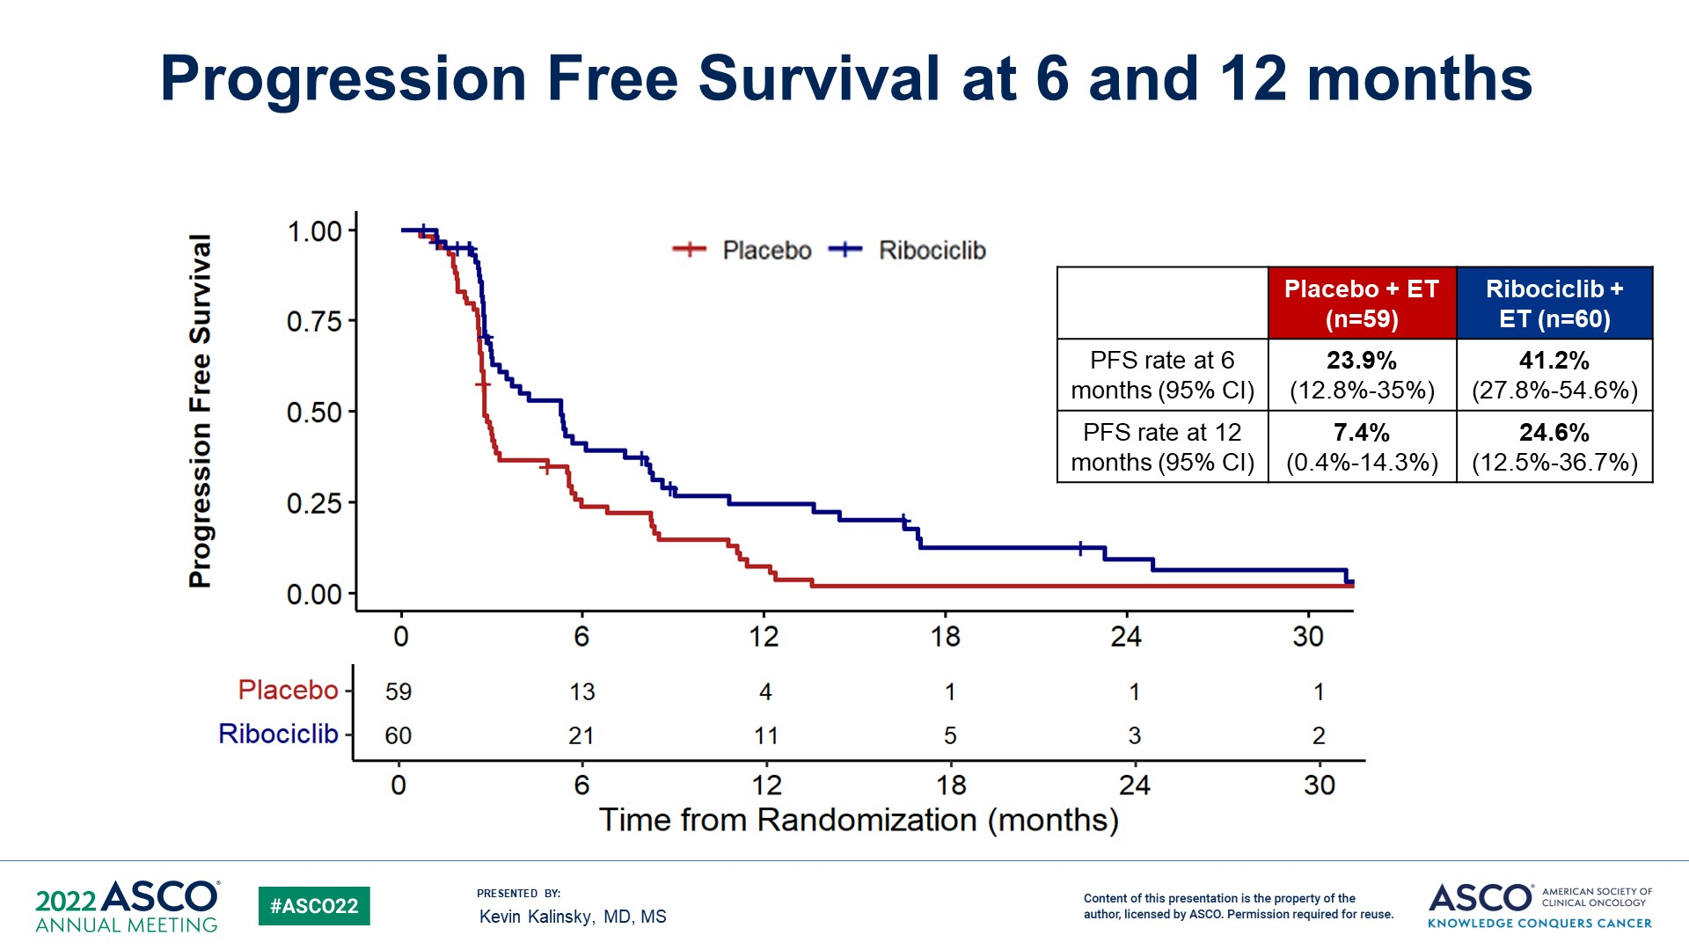
Discussion: continued CDK 4/6 inhibitor post-progression
PACE
MAINTAIN
 | Fulvestrant | Fulvestrant/ Palbociclib
Median PFS | 4.8m | 4.6m
6m PFS | 42.9% | 40.0%
12m PFS | 17.5% | 13.1%
 | ET | ET/ Ribociclib
Median PFS | 2.76m | 5.29m
6m PFS | 23.9% | 41.20%
12m PFS | 7.4% | 24.6%
*ET was fulvestrant in 83%
Mayer et al SABCS 2022
Kalinsky et al ASCO 2022
Notes:
Pace trial was phase II-again looked at continuing Palbociclib with fulvestrant after progression on prior CDK 4/6 inhib (majority palbo) and AI. And did not find a PFS benefit.
Maintain trial phase II- 119 patients on CDK 4/6 inhib + ET who progressed, then randomized to fulvestrant or exemestane with or without ribo. This majority of the cohort in the Maintain trial CDK 4/6 inhib was Palbociclib so was interesting to see what happens when switch the CDK 4/6 inhbi at progression. Median PFS was significantly longer in ribo + ET arm 5.20 vs 2.76 p = 0.006

Slide 48
Summary
No clear data to support continuing CDKi at progression
MAINTAIN was a phase II study with PFS benefit
PACE and PALMIRA without benefit (same CDK4/6i)
Ongoing studies include EMBER-3 and postMONARCH (abemaciclib)
Key questions that remain
Does the CDK4/6 inhibitor matter?
Who potentially benefits? Are there clinical characteristics or biomarkers that predict benefit to continued CDK4/6i
Is the impact similar after progression on adjuvant CDK 4/6 inhibitor?

Slide 49
Thank you
@MalindaTWestMD
mwest@medicine.wisc.edu

Slide 50
BREAST CANCER
Wednesday, September 6, 2023

Slide 51
Endocrine Therapy in Metastatic HR+/HER2- Breast Cancer: Beyond CDK4/6 Inhibitors
Kari B. Wisinski, MD
Professor of Medicine
Chief, Division of Hematology, Medical Oncology and Palliative Care
Associate Director for Clinical Research
University of Wisconsin Carbone Cancer Center
September 6, 2023

Slide 52
Changing landscape of ER-positive metastatic breast cancer
Ribociclib/
Abemaciclib
approved
Tamoxifen
approved
Fulvestrant
approved
Everolimus
approved
Elacestrant
approved
AIs
approved
Palbociclib
approved
Capivasertib anticipated
Neratinib published
Fulvestrant HD
approved
Alpelisib
approved
1970-80
1996
2002
2012
2012
2015
2017
2019
2023

Slide 53
Growth Factor Pathways in Endocrine Resistance
MoAb
IGF1R
TKI
EGFR/HER2
Increased upstream
signaling through
growth factor receptors
VEGFR
MoAb
P
P
AB
P
P
TKI
P
P
SOS
PI3-K
TKI
RAS
RAF
Akt
MEK
p90^{RSK}
MAPK
SERD
AI
T
ER
CCI
RAD
E2
Increased signaling
through PI3 Kinase pathway
P
P
P
P
Basal
Transcription
Machinery
Cytoplasm
ER
ER
p160
CBP
ERE
ER Target Gene Transcription
Cell
Growth
Nucleus
Plasma
Membrane
From Johnston CCR 2005

Slide 54
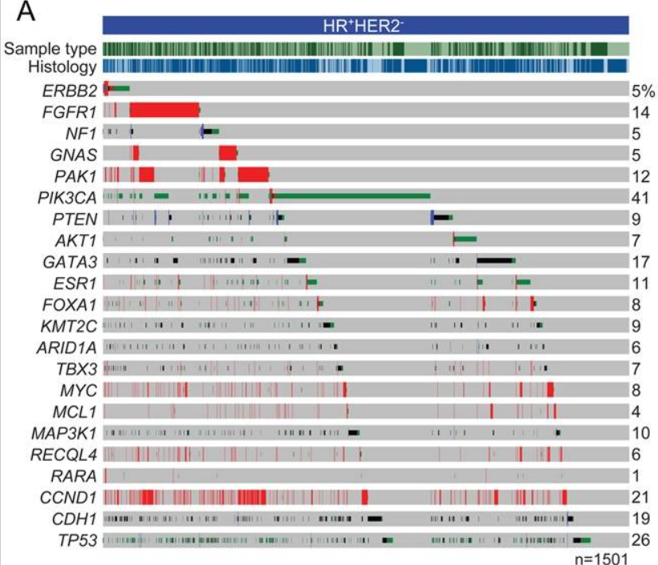
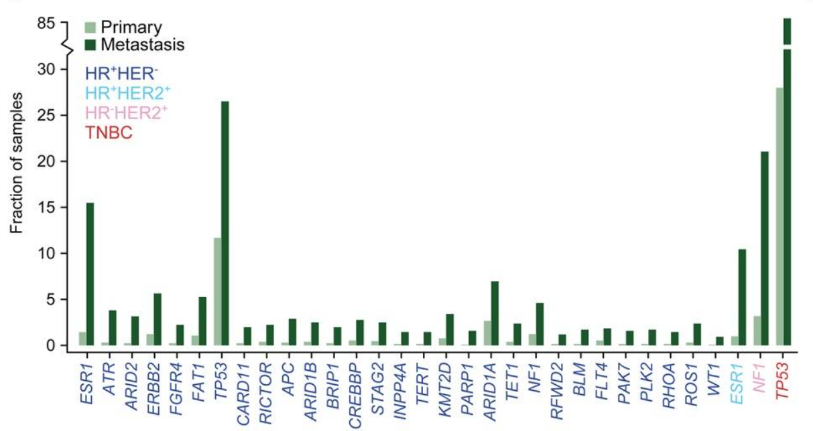
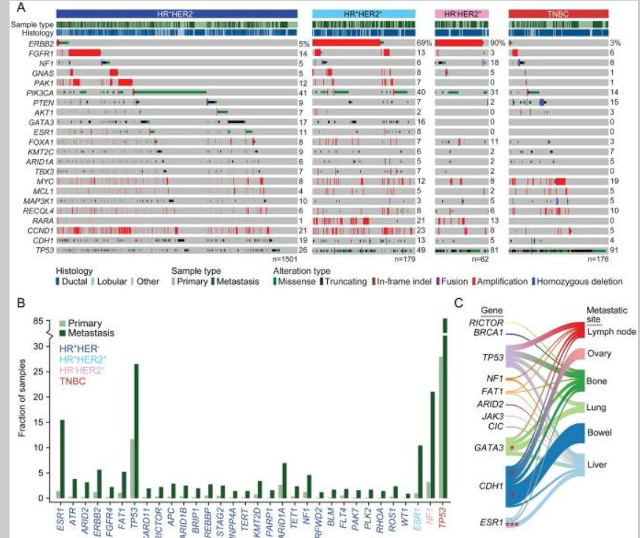
Genomic Landscape of Endocrine-Resistant Advanced Breast Cancers
Razavi et al Cancer Cell 2018

Slide 55
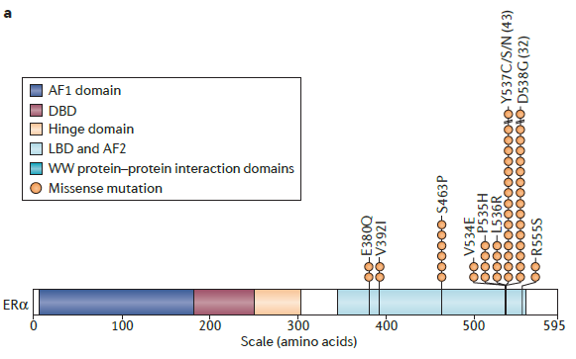
ESR1 Gain of Function Mutations
30-40% of metastatic ER+ breast cancer after prior endocrine therapy
Resistance to aromatase inhibitors and standard dose tamoxifen
High concordance between tumor & ctDNA; high detection in ctDNA
Fribbens C et al J Clin Oncol 2016
Ma C et al Nature Reviews 2015
Takeshita et al Transl Oncology 2017
Davis et al eBioMedicine 2020

Slide 56
Oral SERDs

Slide 57
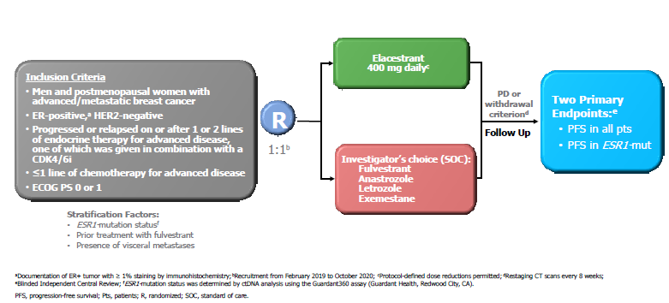
EMERALD Phase 3 with Elacestrant
Bidard et al JCO 2022
Kaklamani et al SABCS 2022

Slide 58
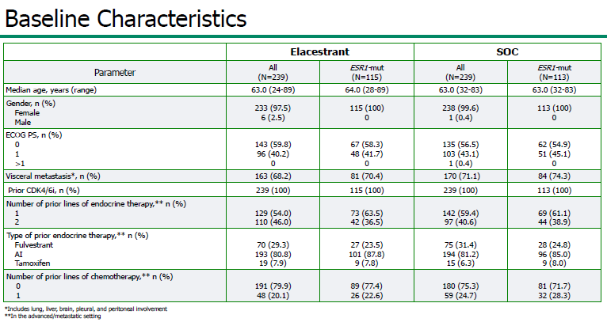
Baseline Characteristics

Slide 59
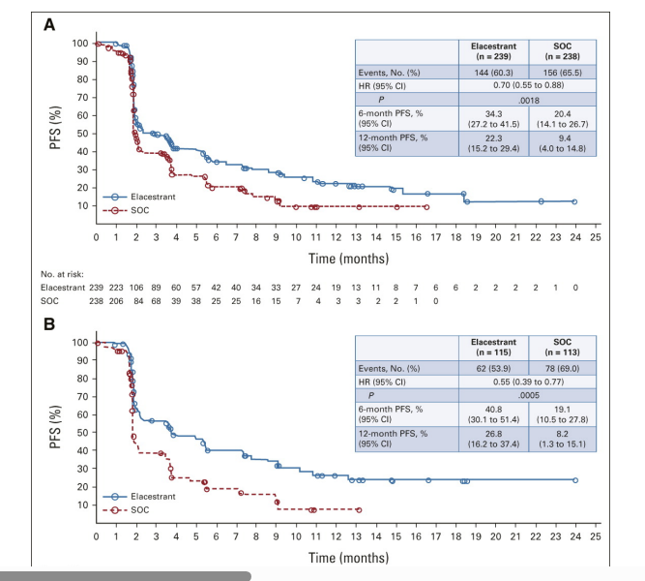
EMERALD: Primary Endpoint: PFS by IRC
All Patients (ITT)
 | Elacestrant | SOC
N | 239 | 238
Event (%) | 144 (60.3) | 156 (65.5)
Median PFS (months) | 2.79 | 1.91
P value | 0.0018
Hazard ratio (95% CI) | 0.697 (0.552 – 0.880)
Elacestrant
Standard of Care
0
1
2
3
4
5
6
7
8
9
10
11
12
13
14
15
16
17
18
19
20
21
22
23
24
25
Time (months)
Elcestrant
SOC
239
238
223
206
106
84
89
68
60
39
57
38
42
25
40
25
34
16
33
15
27
7
24
4
19
3
13
3
11
2
8
2
7
1
6
0
6
2
2
2
2
1
0
Notes:
Check where this slide came from – SABCS?

Slide 60
EMERALD: Primary Endpoint: PFS by IRC
Patients With Tumors Harboring mESR1

Slide 61
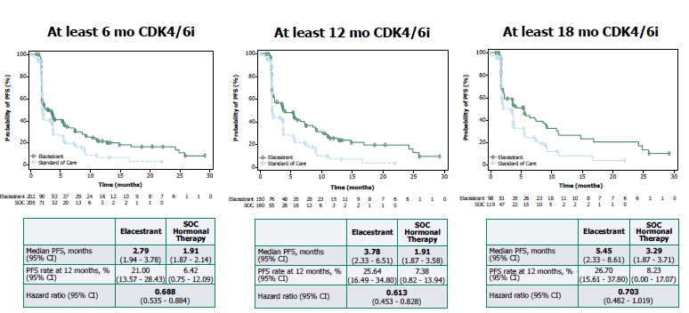
PFS by Duration of CDK4/6 Inhibitor (All Pts)

Slide 62
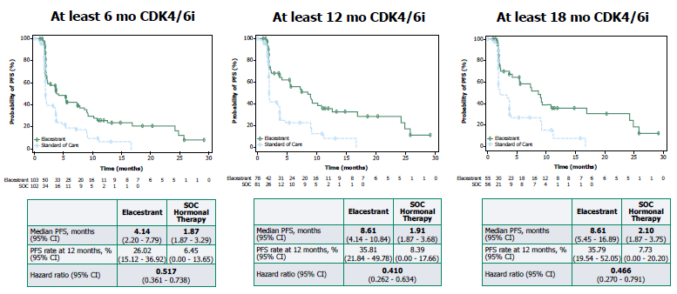
PFS by Duration of CDK4/6i (ESR1mut)

Slide 63
Oral SERDS: Mixed Results to Date
Trial | EMERALD |  | AcelERA |  | AMEERA-3
Treatment | ELAC | FULV | GIRE | SAET | AMCE | SAET
n ITT | 239 | 238 | 143 | 147 | 151 | 152
ESR1 mutation | 115 | 113 | 65 | 55 | 44 | 34
Prior CDKi | 100% | 100% | 80% | 78% | 43% | 41%
PFS (mos.) | 2.79 | 1.91 | 3.6 | 3.7 | 5.6 | 5.4
PFS in mESR1 (mos.) | 3.78 | 1.87 | 3.7 | 2.0 | 5.3 | 3.5
SERENA
CAM | FULV
74/73 | 73
30/36% | 48%
51/51 | 51
7.2/7.7 | 3.7
6.3/9.2 | 2.2
ELAC = Elacestrant; GIRE = Giredestant; AMCE = Amcenestrant; CAM: Camizestrant; FULV = fulvestrant; SAET= Standard anti-estrogen therapy
ELAINE 1: PFS not met: with oral SERM (lasofoxifene) vs fulv in mESR1+ prior AI/CDK4/6 inhibitors
- HR 0.699; 95% CI 0.445–1.125; p=0.138
Jimenez et al ESMO 2022; Goetz et al ESMO 2022
Oliveira et al SABCS 2022
Tolaney et al ESMO 2022; Bidard et al J Clin Oncol 2022

Slide 64
High dose Tamoxifen Study Schema
Higher tamoxifen doses inhibit mutant ERα transcriptional function in cells and is feasible/safe based on prior studies
Metastatic ER+
Breast Cancer Patients
Measurable or bone only disease
≥1 line of prior endocrine therapy
ESR1 Gene Mutation Positive
(any routine assay)
FES PET/CT
Complete vs Incomplete FES Blockade defined by ≥ 75% blockade at escalating tamoxifen doses
FES
Positive
(N=12)
FES PET/CT
3-4 weeks
PI: Wisinski/Fowler
Open at UWCCC & ProHealth
Tamoxifen 20-200mg
3 pts/cohort
(N=12)
Continue until progressive disease/
intolerance
Fanning SW et al (2016) eLife 5:e12792
Brandes JCO 1999; Cauldwell CCR 1996;
Berman Leukemia 1995

Slide 65
PI3K/Akt/mTOR Pathway

Slide 66
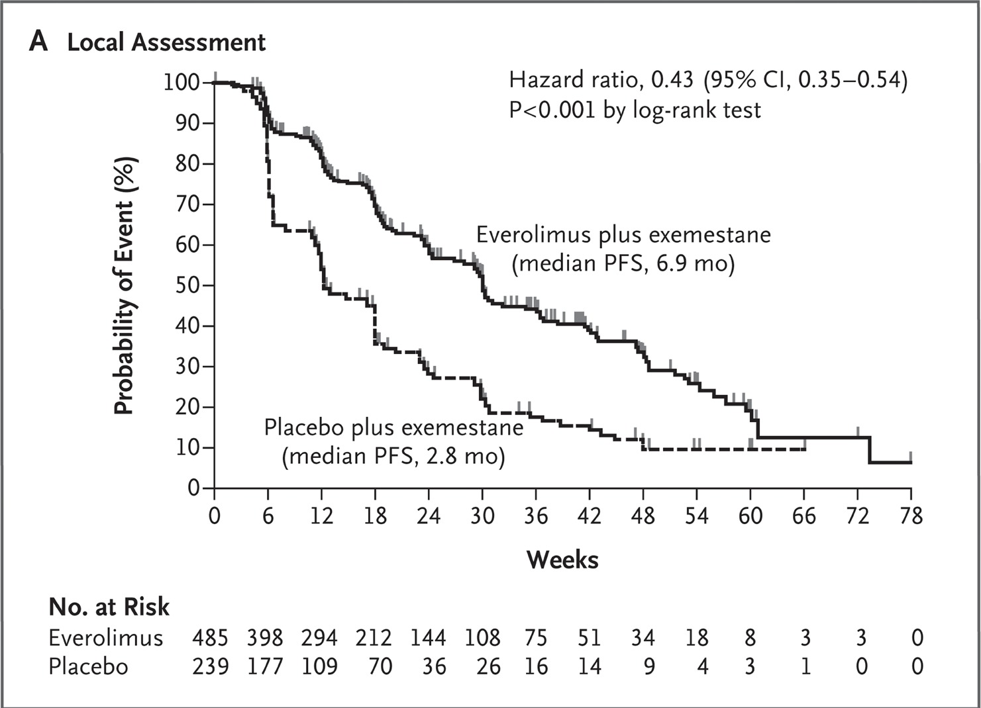
mTOR Inhibitors
BOLERO-2: phase 3
TamRad: phase 2
1.0
0.9
TAM 4.5 mo.
TAM + RAD 8.6 mo.
0.8
0.7
HR = 0.53 (95% CI: 0.35-0.81)
Exploratory log-rank: P = .0026
0.6
0.5
Probability of survival
0.4
0.3
0.2
0.1
0.0
0
2
4
6
8
10
12
14
16
18
20
22
24
26
28
Time (Months)
Median OS not met: 31 vs 26.6 mo (HR = 0.89; 95% CI 0.73–1.10; stratified log-rank P = 0.1426).
Bachelot et al JCO 2012
Baselga et al NEJM 2012
Piccart et al Ann Oncology 2014

Slide 67
SOLAR-1: PI3K Inhibition with Fulvestrant
Andre et al ESMO 2018; NEJM 2019

Slide 68
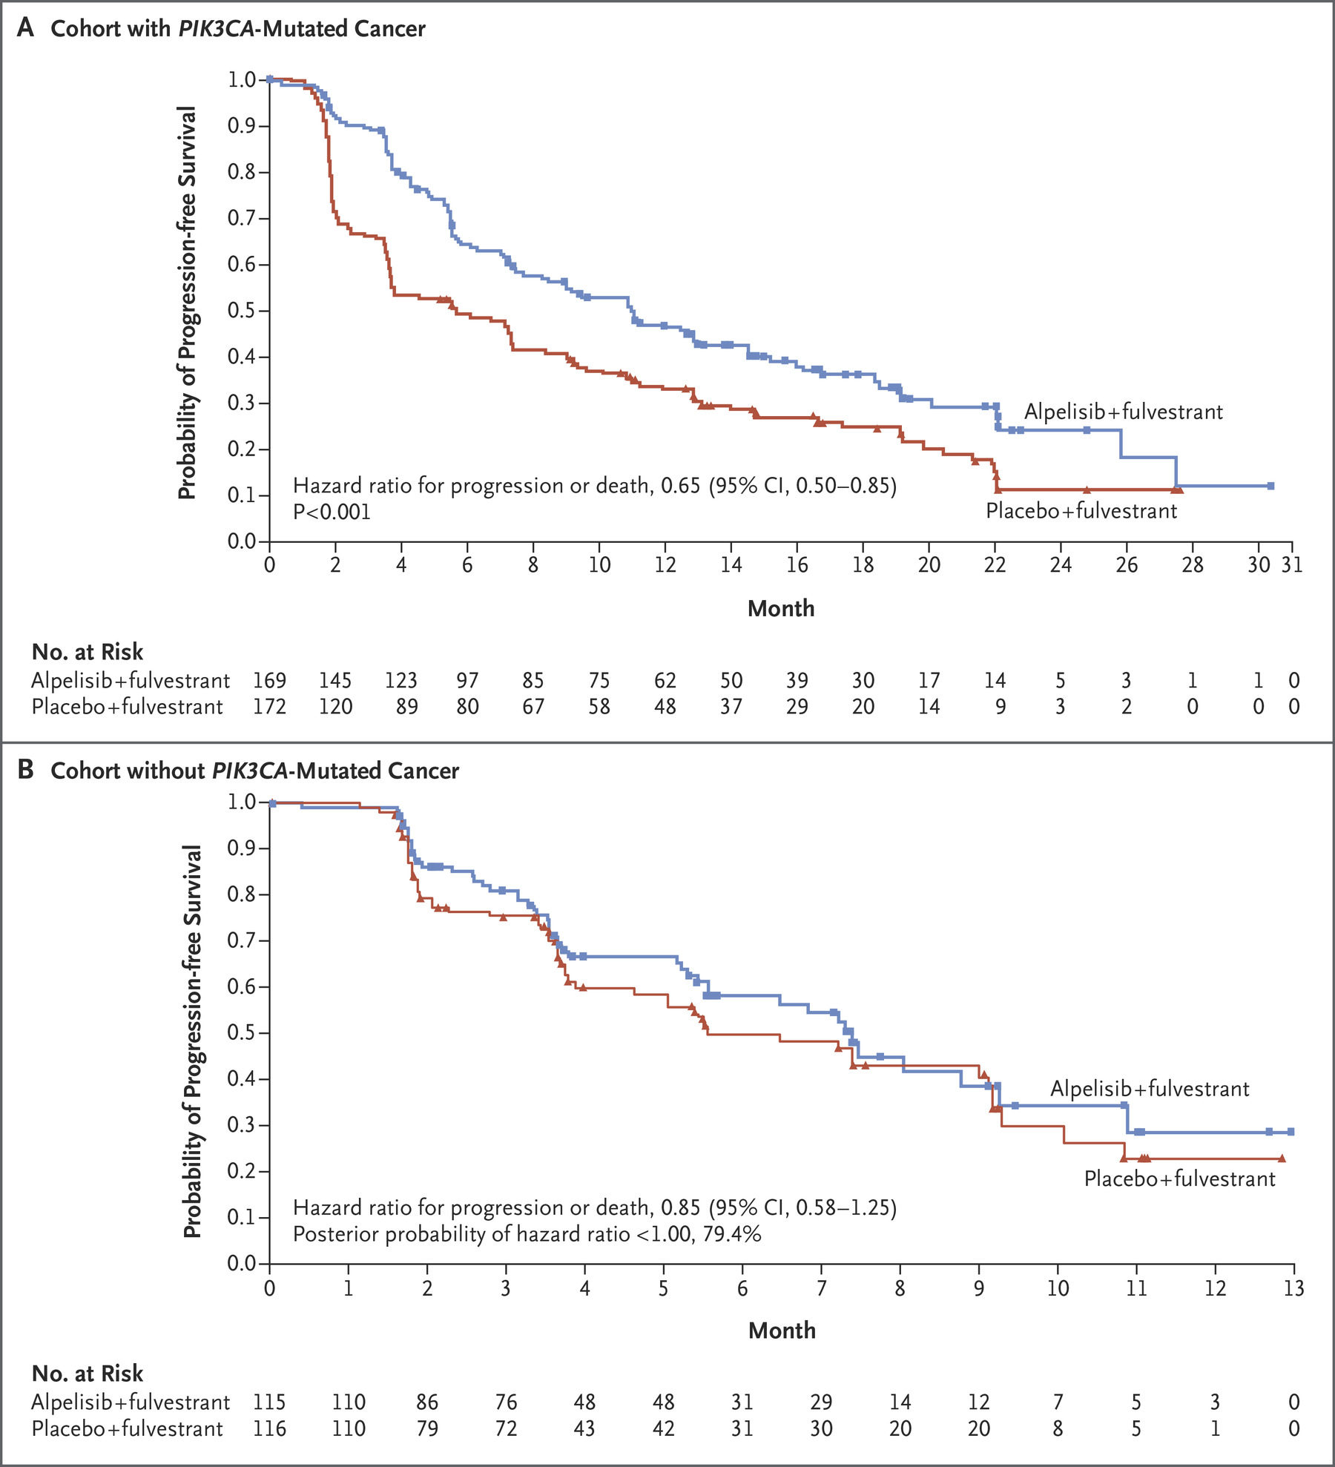
PFS improved in PI3K mutant cohort
Andre et al NEJM 2019

Slide 69
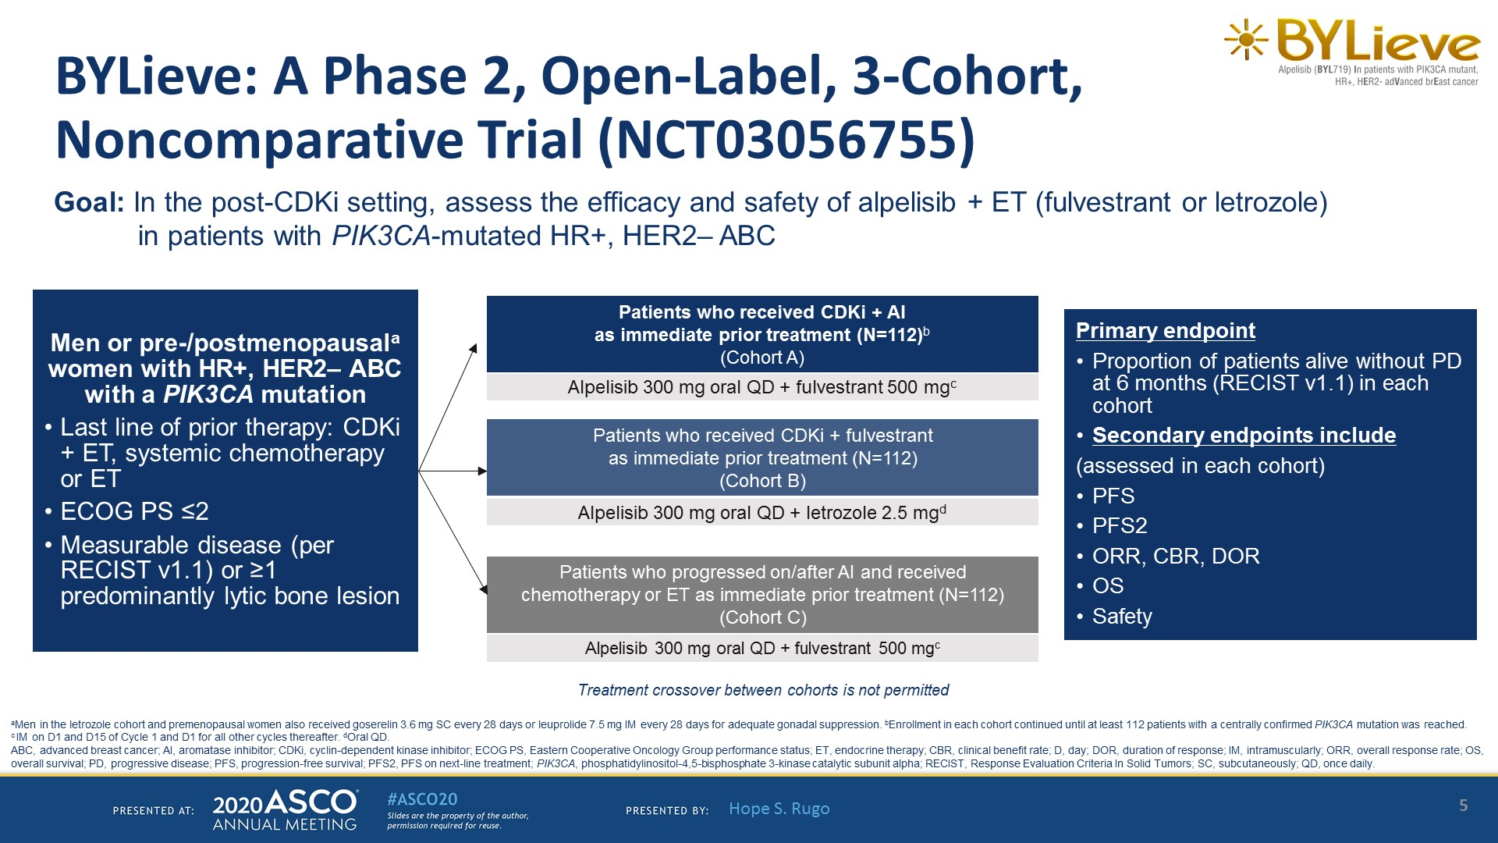
BYLieve: PI3K inhibition after CDK4/6i
Rugo et al ASCO 2020

Slide 70
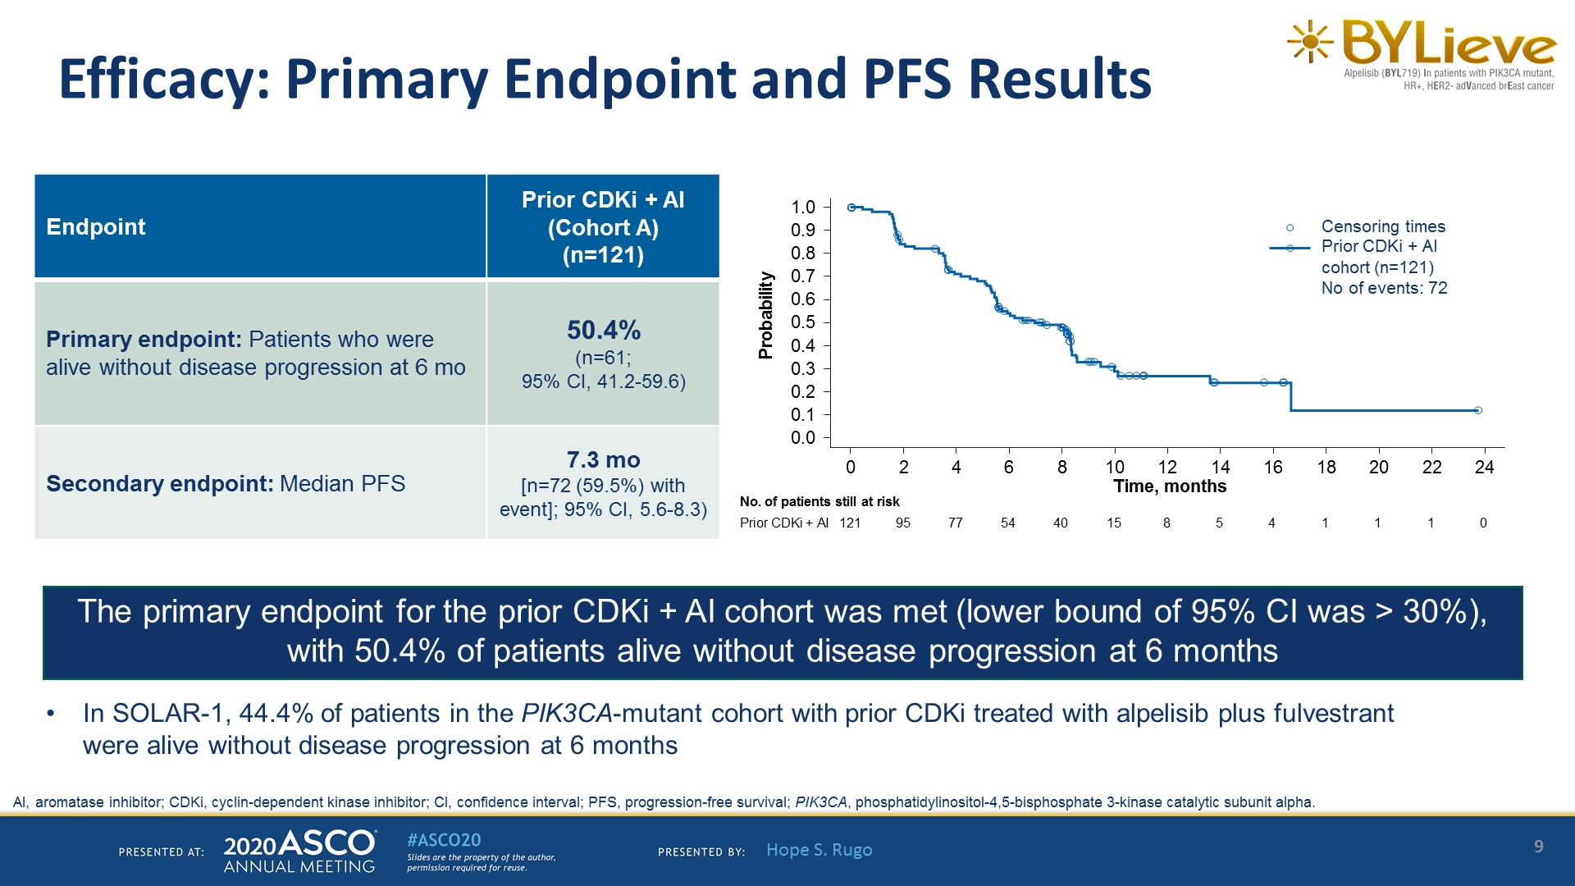
Primary Endpoint and PFS Results
Rugo et al ASCO 2020

Slide 71
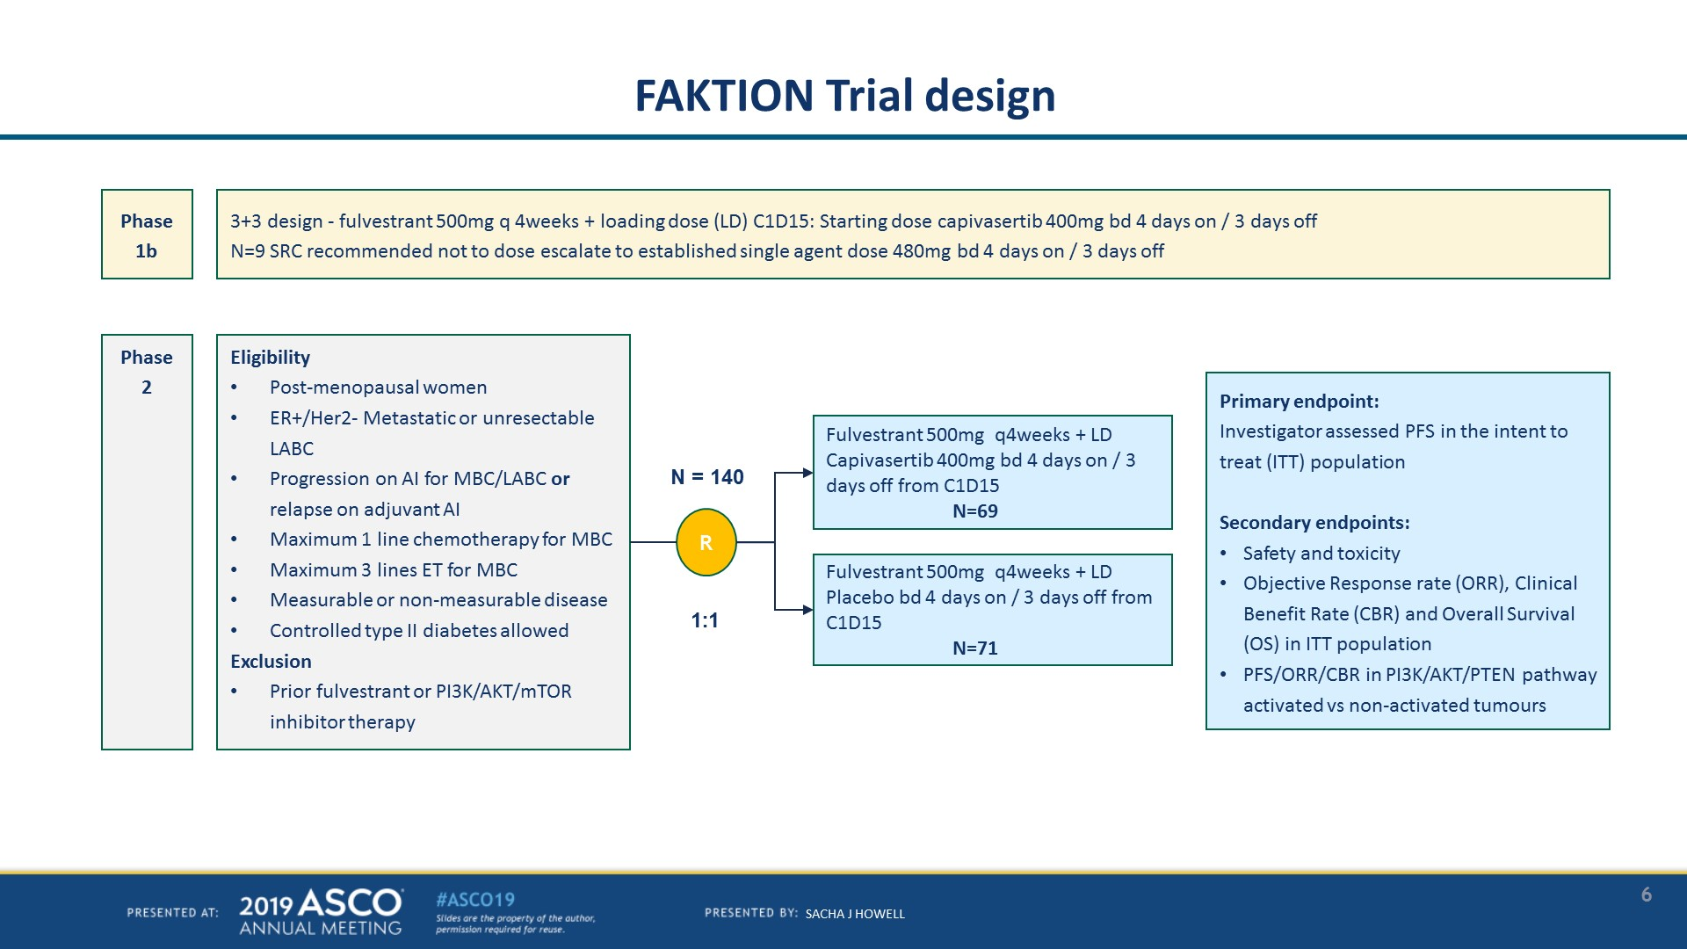
FAKTION: Phase 2 of AKT Inhibitor: Capivasertib
RH Jones et al Lancet Oncology 2020

Slide 72
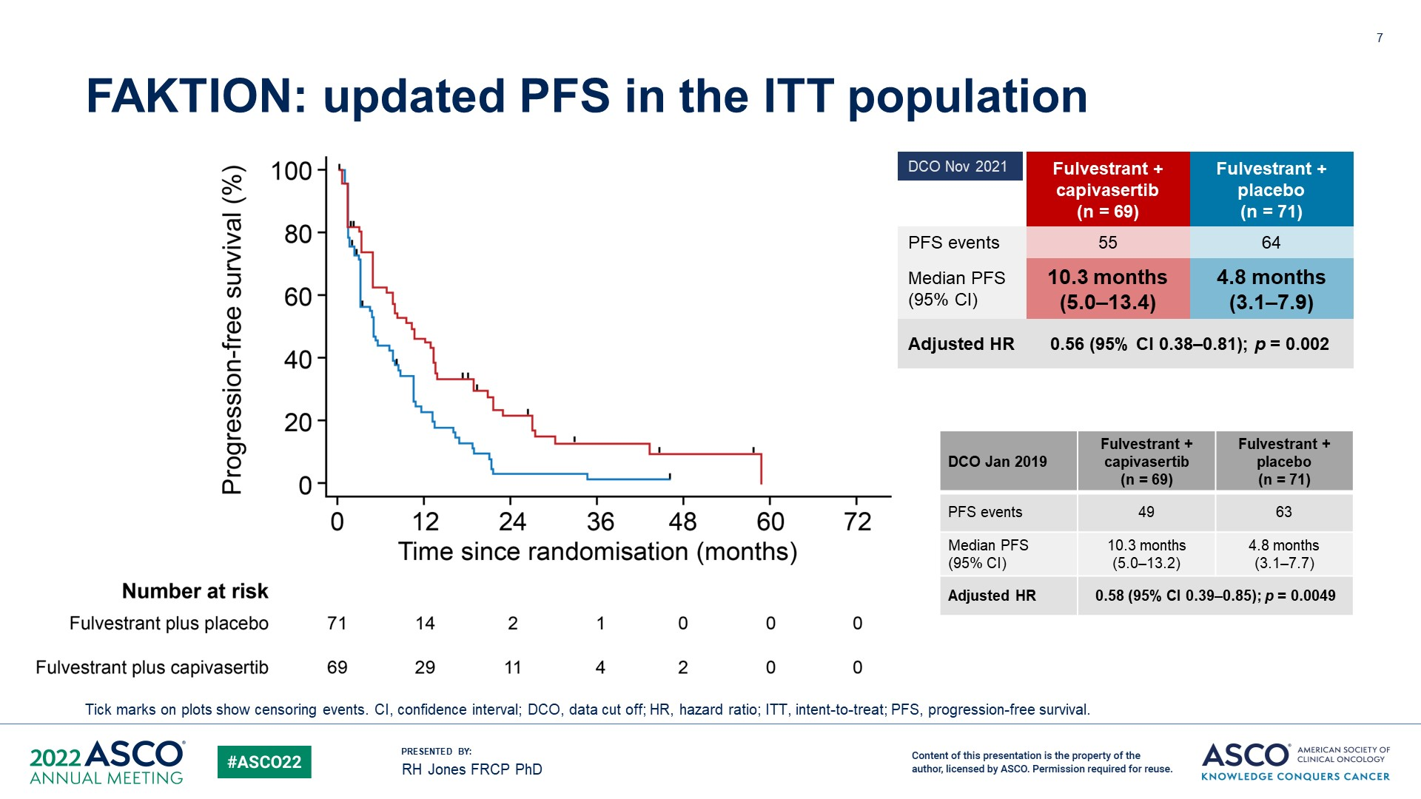

FAKTION: PFS/OS (ITT population)
RH Jones et al ASCO 2022

Slide 73

CAPItello-291: Randomized Phase 3 of Fulvestrant +/- Capivasertib
Turner et al SABCS 2022 and NEJM 2023

Slide 74


Patient and Tumor Characteristics

Slide 75


Slide 76


Slide 77


Slide 78
HER2 and other pathways

Slide 79

SUMMIT Basket Study: HER2 mutant HR+ MBC Neratinib + Fulvestrant + Trastuzumab
HER2 mutations
2-4% all MBC
8% HR+ MBC
Enriched in lobular
Neratinib: oral, irreversible, pan-HER tyrosine kinase inhibitor

Slide 80

Efficacy in Patients Treated with N+F+T

Slide 81

Best change in tumor from baseline corresponding histology and central biomarker analysis
Jhaveri et al Annals Oncology 2023

Slide 82

N2: Fulvestrant and Binimetinib in HR+/HER2neg MBC with NF1 alteration
Disrupting mutations: frame shift or nonsense or genomic deletion
Key Inclusion/Exclusion
Measurable disease by RECIST 1.1 and one additional lesion that can be biopsied
Prior therapy: Prior use of CDK4/6i is required, Up to one line of chemotherapy in a metastatic setting is permitted.
PI: Bora Lim, MD Dan L. Duncan Cancer Center

Slide 83


Rationale for combination
NF1 functions as ERα transcriptional co-repressor- loss leads to estradiol hypersensitivity
Initially retain sensitivity to SERDs, but RAS-Raf-MEK-ERK pathway leads to resistance->MEKi)
WHIM16: NF1-deficent ER+ PDX mouse model
Zheng et al 2020, Cancer Cell
Chang et al 2018 Ca Research
Data from protocol

Slide 84
Summary
Genomic testing for ESR1, PIK3CA, ERBB2 (HER2) and other mutations can aid in treatment recommendations.
Some mutations emerge during treatment and repeat testing may need to be considered
Multiple agents available after first line CDK4/6i in the metastatic setting
Alpeslisib for mutant PIK3CA
Elascestrant for mutant ESR1
Neratinib + trastuzumab for mutant HER2 (ERBB2)
Further CDK4/6i, capivasertib, everolimus also potential options
Still many opportunities for improvement->ongoing clinical trials

Slide 85
BREAST CANCER
Wednesday, September 6, 2023

Slide 86
Antibody-Drug Conjugates in HER2-negative Breast Cancer
Yee Chung Cheng, MD
Associate Professor
Division of Hematology and Oncology
Department of Medicine
Medical College of Wisconsin
Milwaukee, Wisconsin

Slide 87
Disclosure Information
I have no financial relationships to disclose

Slide 88
Antibody-Drug Conjugates in Breast Cancer
ADC | Target | Antibody | Payload | Approval
Trastuzumab emtansine | HER2 | Trastuzumab | DM1 | 2013
Trastuzumab deruxtecan | HER2 | Trastuzumab | DXd | 2019
Sacituzumab govitecan | TROP-2 | Sacituzumab | SN-38 | 2020

Slide 89

Sacituzumab govitecan
Future Medicine. 2020 Mar

Slide 90
ASCENT: Phase III Sacituzumab Govitecan vs Single-Agent CT in Metastatic TNBC After ≥ 2 Prior CT Regimens
Patients with mTNBC and ≥ 2 prior CT (no upper limit; could include PD within 12 mo of [neo]adjuvant tx); prior taxane; RECIST v1.1 measurable disease; permitted brain mets if stable ≥4 wk before tx; ECOG PS 0/1
(N = 529)
Sacituzumab govitecan 10 mg/kg IV on Days 1, 8 every 21 days
(n = 267)
Primary endpoint: PFS by BICR in patients without brain mets
Secondary endpoints: investigator-assessed PFS, OS, ORR, DoR, TTR, safety
Continue treatment until progression or unacceptable toxicity
Physician’s choice of single-agent CT*
(n = 262)
*Capecitabine, eribulin, gemcitabine, or vinorelbine.
Bardia. NEJM. 2021, 384:1529

Slide 91
ASCENT: Baseline Characteristics of Patients Without Brain Metastasis
Characteristic, n (%) | SG (n = 235) | CT (n = 233)
Female | 233 (99) | 233 (100)
Median age, yr (range) | 54 (29-82) | 53 (27-81)
ECOG PS 0 1 | 108 (46) 127 (54) | 98 (42) 135 (58)
Race/ethnicity White Black Asian Other | 188 (80) 28 (12) 9 (4) 10 (4) | 181 (78) 28 (12) 9 (4) 15 (6)
Characteristic, n (%) | SG (n = 235) | CT (n = 233)
No. prior CT 2-3 >3 | 166 (71) 69 (29) | 164 (70) 69 (30)
Median no. prior anticancer regimens (range) | 3 (1-16) | 3 (1-12)
Initial diagnosis of TNBC Yes No | 165 (70) 70 (30) | 157 (67) 76 (33)
Germline BRCA1/2 status Negative Positive | 133 (57) 16 (7) | 125 (54) 18 (8)
Bardia. NEJM. 2021, 384:1529

Slide 92
ASCENT: PFS in Patients Without Brain Metastasis (Primary Outcome)
PFS
100
BICR Analysis | SG (n = 235) | CT (n = 233)
No. of events | 166 | 150
Median PFS, mo (95% CI) | 5.6 (4.3-6.3) | 1.7 (1.5-2.6)
 | HR: 0.41 (95% CI: 0.32-0.52; P <.001)
80
60
PFS (%)
Sacituzumab govitecan Chemotherapy
40
20
0
0
3
6
9
12
15
18
21
24
Mo
Bardia. NEJM. 2021, 384:1529

Slide 93
ASCENT: OS in Patients Without Brain Metastasis (Secondary Outcome)
OS
100
BICR Analysis | SG (n = 235) | CT (n = 233)
No. of events | 155 | 185
Median OS, mo (95% CI) | 12.1 (10.7-14) | 6.7 (5.8-7.7)
 | HR: 0.48 (95% CI: 0.38-0.59; P <.001)
80
60
OS (%)
Sacituzumab govitecan Chemotherapy
40
20
0
0
3
6
9
12
15
18
21
24
27
Mo
Bardia. NEJM. 2021, 384:1529

Slide 94

ASCENT: Response in Patients Without Brain Metastasis
Outcome | Sacituzumab Govitecan (n = 235) | Physician’s Choice CT (n = 233)
ORR, n (%) | 82 (35) | 11 (5)
CR | 10 (4) | 2 (1)
PR | 72 (31) | 9 (4)
CBR, n (%) | 105 (45) | 20 (9)
Median DoR, mo | 6.3 | 3.6
*Indicates patients with no change from baseline.
Bardia. NEJM. 2021, 384:1529

Slide 95
ASCENT: Safety
TRAEs, % | SG (n = 258) |  |  | TPC (n = 224)
 | Any Gr | Gr 3 | Gr 4 | Any Gr | Gr 3 | Gr 4
Neutropenia | 63 | 34 | 17 | 43 | 20 | 13
Anemia | 34 | 8 | 0 | 24 | 5 | 0
Leukopenia | 16 | 9 | 1 | 11 | 4 | 1
Thrombocytopenia | 5 | 1 | 1 | 11 | 1 | 0
Febrile neutropenia | 6 | 5 | 1 | 2 | 2 | <1
Diarrhea | 59 | 10 | 0 | 12 | <1 | 0
Nausea | 57 | 2 | <1 | 26 | <1 | 0
Vomiting | 29 | 1 | <1 | 10 | <1 | 0
Constipation | 17 | 0 | 0 | 14 | 0 | 0
Abdominal pain | 11 | 1 | 0 | 4 | <1 | 0
Fatigue | 45 | 3 | 0 | 30 | 5 | 0
Asthenia | 12 | 1 | 0 | 10 | 1 | 0
Alopecia | 46 | 0 | 0 | 16 | 0 | 0
No treatment-related deaths, grade ≥3 neuropathy, or grade ≥4 ILD with SG
1 treatment-related death (neutropenic sepsis) with TPC
AEs leading to discontinuation:
SG, 5%
TPC, 5%
Bardia. NEJM. 2021, 384:1529

Slide 96

Rugo. SABCS GS1-11, Dec 2022

Slide 97


Slide 98


Slide 99


Slide 100


Slide 101


Slide 102


Slide 103


Slide 104


Slide 105


Slide 106
Exposure-Adjusted Incidence Rates (EAIRs)
Longer treatment exposure may lead to a higher incidence of AEs so when treatment duration differs significantly between treatment groups, absolute incidence rates may need adjustment to account for exposure
Tolaney. SABCS P3-07-08, Dec 2022

Slide 107

Exposure-Adjusted Incidence Rates (EAIRs)
Tolaney. SABCS P3-07-08, Dec 2022

Slide 108

Tolaney. SABCS P3-07-08, Dec 2022

Slide 109

Tolaney. SABCS P3-07-08, Dec 2022

Slide 110
Sacituzumab govitecan FDA indications
Advanced/metastatic triple-negative breast cancer after > 2 prior therapies (at least one in the metastatic setting)
Advanced/metastatic hormone receptor positive, HER2-negative breast cancer who have received endocrine-based therapy and at least two additional systemic therapies in the metastatic setting

Slide 111
Sacituzumab govitecan trials
Study | Phase | Population | Treatment
SASCIA NCT04595565 | 3 | HER2- post-neoadjuvant | SG vs TCP
ASCENT-03 NCT05382299 | 3 | Met TN PDL1 negative 1st line | SG vs TCP
ASCENT-04 NCT05382286 | 3 | Met TN PDL1 positive 1st line | SG + Pembrolizumab vs TCP + Pembrolizumab
ASCENT-05 NCT05633654 | 3 | TN post-neoadjuvant | SG + Pembrolizumab vs TCP
ASCENT-07 NCT05840211 | 3 | Met HR+HER2- after endocrine Tx | SG vs TCP

Slide 112
Study | Phase | Population | Treatment
S2007 NCT04647916 | 2 | Met HER2- brain metastasis | SG
NCT05675579 | 2 | neoadjuvant TN | SG + Pembrolizumab
ASPRIA NCT04434040 | 2 | TN | SG + Atezolizumab
NCT05113966 | 2 | TN | SG + Trilaciclib
ELEVATE TNBC NCT04958785 | 2 | TN | SG + Magrolimab
InCITe NCT03971409 | 2 | TN | SG + Avelimab
NCT04468061 | 2 | TN PDL1 negative | SG +/- Pembrolizumab
NCT04448886 | 2 | HR+ met BC | SG +/- Pembrolizumab
NCT04039230 | 1/2 | Met TN | SG + Talazoparib
NeoSTAR NCT04230109 | 1b/2 | Neoadjuvant TN | SG
SEASTAR NCT03992131 | 1b/2 | Met TN | SG + Rucaparib
Morpheus-TNBC NCT03424005 | 1b/2 | Met TN PDL1 positive | SG + Atezolizumab

Slide 113
New Anti-TROP2 ADCs in Breast Cancer
ADC | Target | Antibody | Payload
Datopotamab deruxtecan | TROP-2 | Datopotamab | DXd
SKB264 | TROP-2 | Anti-Trop2 | Topoisomerase I inhibitor
BAT8003 | TROP-2 | Anti-Trop2 | Maytansine
DAC-002 | TROP-2 | Anti-Trop2 | Tubulysin B analog

Slide 114

Krop. SABCS GS1-05, Dec 2021

Slide 115
New Target ADCs in Breast Cancer
ADC | Target | Antibody | Payload
Patritumab deruxtecan | HER3 | Patritumab | DXd
Ladiratuzumab vedotin | LIV-1 | Ladiratuzumab | MMAE
Enfortumab vedotin | Nectin-4 | Enfortumab | MMAE
NBE-002 | ROR1 | Anti-ROR1 | PNU-159682
Zilovertamab vedotin/MK-2140/VLS-101 | ROR1 | Anti-ROR1 | MMAE
Ozuriftamab vedotin/BA3021 | ROR2 | Anti-ROR2 | MMAE
Tusamitamab ravtansine/SAR408701 | CEA-CAM5 | Tusamitamab | Maytansinoid
SAR566658 | CA6 | DS6 | DM4
Cofetuzumab pelidolin | PTK7 | Cofetuzumab | Au0101
MCG018 | B7-H3 | Anti-B7-H3 | Duocarmycin
DS-7300 | B7-H3 | Anti-B7-H3 | DXd
AZD8205 | B7-H4 | Anti-B7-H4 | Topoisomerase 1 inhibitor
XMT-1660 | B7-H4 | Anti-B7-H4 | Microtubule inhibitor
CDX-011 | gpNMB | Glembatumumab | MMAE
MORAB-202 | FRα | Anti-FRα | Eribulin
CX2009 | CD166 | Anti-CD166 | DM4

Slide 116

Krop. ASCO June 2022

Slide 117


Slide 118
Nitrogen mustard
Chemotherapy
1935
Rituximab
Target therapy
1997
Gemtuzumab ozogamicin
Antibody-drug conjugate
2000
Pembrolizumab
Immune checkpoint inhibitor
2011

Slide 119

Jim Carrey, The Mask 1994

Slide 120
BREAST CANCER
Wednesday, September 6, 2023

Slide 121
Updates in HER2+ and HER2-low Breast Cancer
Lubna Naaz Chaudhary, MD, MS
Associate Professor of Medicine
Medical College of Wisconsin
Milwaukee, WI

Slide 122
Disclosures
Advisory Boards: Puma, Gilead Oncology, Astrazeneca, Novartis
Funding: Regeneron Pharmaceuticals drug funding

Slide 123
Objectives
DESTINY-Breast03
DESTINY-Breast02
DESTINY-Breast04
Real world perception of TDXd and ILD concerns

Slide 124

ADC, antibody-drug conjugate; HER2, human epidermal growth factor receptor 2; IgG1, immunoglobulin G1; mAb, monoclonal antibody; T-DXd, trastuzumab deruxtecan.
ªThe clinical relevance of these features is under investigation.
1. Nakada T et al. Chem Pharm Bull (Tokyo). 2019;67:173-185.
2. Ogitani Y et al. Clin Cancer Res. 2016;22:5097-5108.
3. Trail PA et al. Pharmacol Ther. 2018;181:126-142.
4. Ogitani Y et al. Cancer Sci. 2016;107:1039-1046.

Slide 125

DESTINY Breast-03: Trastuzumab Deruxtecan versus Trastuzumab Emtansine for Breast Cancer
N Engl J Med. 2022 Mar 24;386(12):1143-1154

Slide 126
Updated Primary Endpoint: PFS by BICR
mPFS was ~4X longer for T-DXd compared with T-DM1
 | T-DXd | T-DM1
Median (95% CI), months | 28.8 (22.4-37.9) | 6.8 (5.6-8.2)
HR | 0.33 (95% CI, 0.26-0.43)
P | < 0.000001^{a,b}
100
T-DXd: 75.2% (95% CI, 69.3-80.2)
T-DM1: 33.9% (95% CI, 27.7-40.2)
80
T-DXd: 53.7% (95% CI, 46.8-60.1)
T-DM1: 26.4% (95% CI, 20.5-32.6)
60
Progression-Free Survival Probability, %
40
20
Censor
T-DXd (n = 261)
0
T-DM1 (n = 263)
0
1
2
3
4
5
6
7
8
9
10
11
12
13
14
15
16
17
18
19
20
21
22
23
24
25
26
27
28
29
30
31
32
33
34
35
36
37
38
39
40
41
42
43
44
45
Patients still at Risk:
Time, months
T-DXd
261
256
250
244
240
225
216
207
205
191
176
173
167
154
146
140
134
131
130
125
123
117
113
107
99
96
90
82
73
64
55
41
32
28
23
20
18
13
7
5
4
2
1
0
T-DM1
263
253
201
164
156
134
111
99
96
81
69
67
63
58
54
51
49
49
47
47
42
41
39
37
36
32
28
27
22
19
15
14
8
7
6
4
2
2
2
1
1
1
1
1
1
0
BICR, blinded independent central review; HR, hazard ratio; mo, month; mPFS, median progression-free survival; PFS, progression-free survival; T-DM1, trastuzumab emtansine; T-DXd, trastuzumab deruxtecan.
ªTwo-sided, from stratified log rank test. ^{b}Nominal P value.

Slide 127
Prior Therapies
 | T-DXd n = 261 | T-DM1 n = 263
Any prior systemic cancer therapy,^{a,b} n (%) Trastuzumab Pertuzumab Other anti-HER2 therapy^{c} | 260 (99.6) 260 (99.6) 162 (62.1) 42 (16.1) | 262 (99.6) 262 (99.6) 158 (60.1) 38 (14.4)
Number of prior lines of therapy in the metastatic setting, median (range) | 2 (0-16) | 2 (0-15)
Prior lines of therapy in the metastatic setting,^{b} n (%) 0 1 2 3 4 ≥5 | 1 (0.4) 108 (41.4) 60 (23.0) 44 (16.9) 15 (5.7) 33 (12.6) | 1 (0.4) 102 (38.8) 64 (24.3) 45 (17.1) 23 (8.7) 28 (10.6)
ADC, antibody-drug conjugate; HER2, human epidermal growth factor receptor 2; T-DM1, trastuzumab emtansine; T-DXd, trastuzumab deruxtecan; TKI, tyrosine kinase inhibitor.
ª2 patients (1 in each treatment arm) were randomized in error and the prior cancer systemic therapy case report form was not completed. ^{b}Includes regimens indicated for advanced/metastatic or early progression within 6 months of regimen for (neo)adjuvant (12 months for pertuzumab). ^{c}Includes anti-HER2 TKI and other anti-HER2 antibody or ADC

Slide 128
Key Secondary Endpoint: Overall Survival
 | T-DXd | T-DM1
Median (95% CI), months | NR (40.5-NE) | NR (34.0-NE)
HR | 0.64 (95% CI, 0.47-0.87)
P | 0.0037^{a,b}
T-DXd: 94.1% (95% CI, 90.4-96.4)
T-DM1: 86.0% (95% CI, 81.1-89.8)
100
T-DXd: 77.4% (95% CI, 71.7-82.1)
T-DM1: 69.9% (95% CI, 63.7-75.2)
80
60
Overall Survival Probability ,%
40
Anti-cancer therapies in post-trial setting:
T-DXd arm: 64/182 (35.2%) received T-DM1
T-DM1 arm: 42/243 (17.3%) received T-DXd
20
Censor
T-DXd (n = 261)
0
T-DM1 (n = 263)
0
1
2
3
4
5
6
7
8
9
10
11
12
13
14
15
16
17
18
19
20
21
22
23
24
25
26
27
28
29
30
31
32
33
34
35
36
37
38
39
40
41
42
43
44
45
46
47
Patients still at risk:
Time, months
261
256
256
255
254
251
249
244
243
241
238
236
236
236
231
T-DXd
224
218
213
211
206
201
200
196
193
187
182
173
156
142
124
109
91
73
64
51
44
38
30
22
18
11
9
7
6
1
1
1
0
263
257
252
248
243
242
237
233
232
227
224
217
211
203
199
197
191
186
183
179
172
169
167
164
164
158
140
129
117
106
T-DM1
90
70
59
45
41
38
27
20
15
8
7
4
3
3
1
1
0

Slide 129
Overall Survival by Subgroups
 |  | Number of Events |  | Median OS time (months, 95% CI) |  | Hazard Ratio for Death (95% CI)
 |  | T-DXd | T-DM1 | T-DXd | T-DM1
All patients |  | 72/261 | 97/263 | NR (40.5-NE) | NR (34.0-NE) |  | 0.64 (0.47-0.87)
Hormone receptor status | Positive (n = 272) | 42/133 | 51/139 | NR (40.5-NE) | 37.7 (34.0-NE) |  | 0.76 (0.50-1.14)
 | Negative (n = 248) | 30/126 | 45/122 | NR (NE-NE) | NR (28.5-NE) |  | 0.55 (0.35-0.87)
Prior pertuzumab | Yes (n = 320) | 41/162 | 50/158 | NR (40.5-NE) | NR (37.7-NE) |  | 0.70 (0.46-1.06)
 | No (n = 204) | 31/99 | 47/105 | NR (NE-NE) | 31.5 (22.7-NE) |  | 0.59 (0.38-0.93)
Baseline visceral disease | Yes (n = 384) | 64/195 | 80/189 | NR (40.5-NE) | 35.4 (29.9-NE) |  | 0.68 (0.49-0.95)
 | No (n = 140) | 8/66 | 17/74 | NR (NE-NE) | NR (NE-NE) |  | 0.44 (0.19-1.02)
Prior lines of systemic therapyª | <3 (n = 379) | 44/188 | 57/191 | NR (40.5-NE) | NR (37.7-NE) |  | 0.70 (0.47-1.04)
 | ≥3 (n = 145) | 28/73 | 40/72 | NR (27.4-NE) | 22.8 (16.1-31.5) |  | 0.55 (0.34-0.89)
Baseline BM | Yes (n = 82) | 17/43 | 22/39 | NR (23.8-NE) | 25.1 (12.6-NE) |  | 0.54 (0.29-1.03)
 | No (n = 442) | 55/218 | 75/224 | NR (40.5-NE) | NR (37.7-NE) |  | 0.66 (0.47-0.94)
BM, brain metastases; NE, not estimable; NR, not reached; OS, overall survival; T-DM1, trastuzumab emtansine; T-DXd, trastuzumab deruxtecan.
ªPrior lines of systemic therapy not including hormone therapy.
2
(log₁₀)
T-DXd better T-DM1 better

Slide 130
Conclusions
T-DXd demonstrated clinically meaningful and statistically significant improvement in OS over T-DM1, as well as continued PFS benefit, in patients previously treated with trastuzumab and a taxane
T-DXd significantly reduced the risk of death by 36% (HR, 0.64)
mPFS with T-DXd was 4 times longer than with T-DM1 (28.8 months vs 6.8 months)
78.5% of patients experienced a confirmed objective response; 1 in 5 (21.1%) experienced a CR
Consistent OS benefit was observed across key prespecified subgroups
With a longer treatment duration, T-DXd continues to demonstrate a manageable and tolerable safety profile
There were similar rates of grade ≥3 TEAEs with T-DXd and T-DM1
There were no grade 4 or 5 adjudicated drug-related ILD/pneumonitis events
Updated results demonstrate remarkable OS and PFS benefit with T-DXd, further supporting the use of T-DXd as the second-line standard of care in patients with HER2-positive mBC
CR, complete response; HER2, human epidermal growth factor receptor 2; HR, hazard ratio; ILD, interstitial lung disease; mBC, metastatic breast cancer; mPFS, median progression-free survival; T-DM1, trastuzumab emtansine; T-DXd, trastuzumab deruxtecan.

Slide 131
Evolution of Treatments for HER2+ Metastatic Breast Cancer
T-DM1, EMILIA:
mPFS 9.6 months vs 6.4 months with lapatinib + capecitabine
HR, 0.65 (95% CI, 0.55-0.77; P < 0.001)¹
T-DXd, DESTINY-Breast03:
mPFS not reached vs 6.8 months with T-DM1;
HR, 0.28 (95% CI, 0.22-0.37; P < 0.001)²
Prior to DESTINY-Breast03, the EMILIA trial established T-DM1 as 2L+ standard of care¹
Based on the strength of the DESTINY-Breast03 trial efficacy and safety data, T-DXd is now the recommended option in the 2L setting²
2L+
T-DXd, DESTINY-Breast01:
mPFS = 19.4 months^{3,4}
T-DXd demonstrated robust activity in a post-TDM1 phase 2 single arm study, DESTINY-Breast01, leading to regulatory approvals globally³⁻⁵
3L+
DESTINY-Breast02 is a randomized, multicenter, open-label, phase 3 trial comparing the
efficacy and safety of T-DXd vs TPC in patients with HER2+ mBC previously treated with T-DM1 DESTINY-Breast02 is a confirmatory trial for DESTINY-Breast01.
2L, second-line; 3L, third-line; HER2, human epidermal growth factor receptor 2; HR, hazard ratio; mBC, metastatic breast cancer; mPFS, median progression-free survival; T-DM1, trastuzumab emtansine; T-DXd, trastuzumab deruxtecan; TPC, treatment of physician’s choice. 1. Verma S et al. N Engl J Med. 2012;367:1783-1791. 2. Cortés J et al. N Engl J Med. 2022;386:1143-1154. 3. Perez J et al. Expert Opin Biol Ther. 2021;21:811-824. 4. Saura C et al. Presented at ESMO 2021. 5. Modi S et al. N Engl J Med 2020;382:610-621.

Slide 132
DESTINY-Breast02
Randomized phase 3, open-label, multicenter study (NCT03523585)
T-DXd
5.4 mg/kg Q3W
(n = 406)
Primary endpoint
PFS (BICR)
Key secondary endpoint
OS
Secondary endpoints
ORR (BICR)
DoR (BICR)
PFS (investigator)
Safety
Exploratory endpoints
CBR (BICR)
PFS2 (investigator)
Key eligibility criteria
Centrally confirmed HER2-positive (IHC 3+ or IHC 2+/ISH+) unresectable or metastatic breast cancer
Documented radiographic progression after most recent treatment
Previously treated with T-DM1
R
2:1
TPC
Per label (n = 202)
Trastuzumab / Capecitabine or
Lapatinib / Capecitabine
Stratification factors
Hormone receptor status
Prior treatment with pertuzumab
History of visceral disease
Protocol-prespecified statistical analysis plan
At data cutoff (June 30, 2022), the median duration of follow-up was:
21.5 months (range, 0.1-45.6 months) in the T-DXd arm
18.6 months (range, 0-45.7 months) in the TPC arm
Primary analysis planned for ~372 BICR PFS events observed or 18 months from the last patient randomized, whichever came first
Group sequential testing was used to compare OS between treatment groups hierarchically, provided PFS was significant
BICR, blinded independent central review; CBR, clinical benefit rate; DoR, duration of response; HER2, human epidermal growth factor receptor 2; IHC, immunohistochemistry; ISH, in situ hybridization; mRECIST, modified Response Evaluation Criteria in Solid Tumors version 1.1; ORR, objective response rate; OS, overall survival; PFS, progression-free survival; PFS2; progression-free survival on the next line of therapy

Slide 133
Baseline Characteristics
Baseline Characteristics | T-DXd n = 406 | TPC n = 202
Age, median (range), years | 54.2 (22.4-88.5) | 54.7 (24.7-86.5)
Age, n (%)
<65 years | ≥65 years | 321 (79.1) | 85 (20.9) | 164 (81.2) | 38 (18.8)
Female, n (%) | 403 (99.3) | 200 (99.0)
Region, n (%)
Asia | 112 (27.6) | 52 (25.7)
Europe | 152 (37.4) | 78 (38.6)
North America | 41 (10.1) | 23 (11.4)
Rest of world | 101 (24.9) | 49 (24.3)
HER2 status (IHC),ª n (%)
3+ | 326 (80.3) | 159 (78.7)
2+ (ISH+) | 79 (19.5) | 41 (20.8)
2+ (ISH- or nonevaluable) | 1 (0.2) | 1 (0.5)
1+ (ISH+) | 0 | 1 (0.5)
ECOG PS, n (%)
0 | 1 | 2 | 228 (56.2) | 177 (43.6) | 1 (0.2) | 121 (59.9) | 81 (40.1) | 0
Hormone receptor, n (%)
Positive | 238 (58.6) | 118 (58.4)
Negative | 165 (40.6) | 83 (41.1)
Brain metastases at baseline, n (%)
Yes | No
Yes | No | 74 (18.2) | 332 (81.8) | 36 (17.8) | 166 (82.2)
Visceral disease, n (%)
Yes | No | 316 (77.8) | 90 (22.2) | 160 (79.2) | 42 (20.8)
Yes | No

Slide 134
Prior Therapies
Prior Treatment | T-DXd n = 406 | TPC n = 202
Prior treatment for BC, n (%) | 406 (100) | 202 (100)
Prior lines of therapy in the metastatic setting, n (%)
0 | 2 (0.5) | 0
1 | 18 (4.4) | 12 (5.9)
2 | 192 (47.3) | 92 (45.5)
3 | 123 (30.3) | 63 (31.2)
4 | 42 (10.3) | 13 (6.4)
≥5 | 29 (7.1) | 22 (10.9)
Median number of prior lines of systemic therapy in the metastatic setting, (range) | 2 (0-10) | 2 (1-8)
Prior systemic cancer therapy, n (%)
Trastuzumab | 404 (99.5) | 202 (100)
T-DM1 | 404 (99.5) | 202 (100)
Taxane | 386 (95.1) | 197 (97.5)
Pertuzumab | 318 (78.3) | 156 (77.2)
Other systemic therapy | 289 (71.2) | 157 (77.7)
Hormone therapy | 164 (40.4) | 87 (43.1)
Anti-HER2 TKI | 26 (6.4) | 17 (8.4)
Other anti-HER2 therapy (except HER2 TKI) | 11 (2.7) | 6 (3.0)

Slide 135
Primary Endpoint: PFS by BICR
100
Median (95% CI), months
100
T-DXd
T-DXd
TPC
17.8 (14.3-20.8)
6.9 (5.5-8.4)
80
80
HR (95% CI): 0.3589 (0.2840-0.4535)
T-DXd: 62.3% (95% CI, 57.0-67.1)
TPC: 27.2% (95% CI, 20.1-34.8)
P < 0.000001
60
60
Progression-Free Survival Probability, %
T-DXd: 42.2% (95% CI, 36.5-47.8)
TPC: 13.9% (95% CI, 7.9-21.6)
40
40
20
20
+
Censor
T-DXd (n = 406)
TPC (n = 202)
0
0
0
1
2
3
4
5
6
7
8
9
10
11
12
13
14
15
16
17
18
19
20
21
22
23
24
25
26
27
28
29
30
31
32
33
34
35
36
37
38
39
40
41
42
43
44
45
0
1
2
3
4
5
6
7
8
9
46
10
11
12
13
14
15
16
17
18
19
20
21
22
23
24
25
26
27
28
29
30
31
32
33
34
35
36
37
38
39
40
41
42
43
44
45
46
Patients still at risk
Time, months
T-DXd (406)
T-DXd (406)
406
88
83
76
65
60
55
47
38
35
31
27
23
19
15
14
12
10
6
4
4
3
1
1
1
1
0
400
374
359
355
330
296
278
260
239
213
203
194
179
170
161
149
141
132
119
109
6
4
4
3
1
1
1
1
0
406
88
83
76
65
60
55
47
38
35
31
27
23
19
15
14
12
10
400
374
359
355
330
296
278
260
239
213
203
194
179
170
161
149
141
132
119
109
TPC (202)
TPC (202)
202
95
78
72
64
48
39
37
32
28
24
20
17
13
11
9
9
8
8
6
3
3
3
2
2
2
2
2
1
1
1
1
1
0
180
148
126
118
9
9
8
8
6
3
3
3
2
2
2
2
2
1
1
1
1
1
0
202
95
78
72
64
48
39
37
32
28
24
20
17
13
11
180
148
126
118
BICR, blinded independent central review; HR, hazard ratio; mo, month; PFS, progression-free survival; T-DXd, trastuzumab deruxtecan; TPC, treatment of physician’s choice.

Slide 136


Slide 137
Key Secondary Endpoint: OS
In the TPC arm
69.3% (140/202) of patients received a new systemic anticancer treatment
25.7% (52/202) of patients received T-DXd in the post-trial setting
100
T-DXd: 89.4% (95% CI, 85.9-92.1)
TPC: 74.7% (95% CI, 67.4-80.4)
80
T-DXd: 65.9% (95% CI, 60.7-70.7)
TPC: 54.3% (95% CI, 46.3-61.6)
60
Overall Survival Probability, %
40
Median (95% CI), months
T-DXd
TPC
20
39.2 (32.7-NE)
26.5 (21.0-NE)
+
Censor
HR (95% CI): 0.6575 (0.5023-0.8605)
T-DXd (n = 406)
P =0.0021ª
0
TPC (n = 202)
0
1
2
3
4
5
6
7
8
9
10
11
12
13
14
15
16
17
18
19
20
21
22
23
24
25
26
27
28
29
30
31
32
33
34
35
36
37
38
39
40
41
42
43
44
45
46
Patients still at risk
Time, months
T-DXd (406)
93
8
6
3
1
1
1
0
82
72
63
51
40
34
29
25
19
406
10
404
400
390
385
382
374
366
357
352
350
346
339
331
317
306
295
282
277
257
234
215
196
183
160
144
139
122
104
TPC (202)
7
95
6
5
4
3
1
1
0
89
79
76
72
61
53
50
46
38
33
29
28
25
22
22
18
15
202
13
12
192
187
182
178
173
167
161
157
151
142
136
130
124
118
114
111
110
106

Slide 138
Overall Safety Summary
Type of Adverse Event, n (%) | T-DXd n = 404ª | TPC n = 195ª
Any-grade TEAE | 403 (99.8) | 185 (94.9)
Drug related | 394 (97.5) | 180 (92.3)
Grade ≥3 TEAEs | 213 (52.7) | 86 (44.1)
Drug related | 167 (41.3) | 60 (30.8)
Serious TEAEs | 103 (25.5) | 46 (23.6)
Drug related | 46 (11.4) | 15 (7.7)
TEAEs associated with drug discontinuations | 80 (19.8) | 19 (9.7)
Drug related | 58 (14.4) | 10 (5.1)
TEAEs associated with drug interruptions | 183 (45.3) | 90 (46.2)
Drug related | 132 (32.7) | 76 (39.0)
TEAEs associated with dose reductions | 102 (25.2) | 89 (45.6)
Drug related | 95 (23.5) | 89 (45.6)
TEAEs associated with an outcome of death | 11 (2.7)^{b} | 7 (3.6)^{c}
Drug related | 4 (1.0)^{d} | 0
Median treatment duration
T-DXd, 11.3 months
TPC, ~4.5 months
Most common drug-related TEAEs associated with drug discontinuation
T-DXd, pneumonitis (6.2%) and ILD (3.2%)
TPC, palmar-plantar erythrodysesthesia (1.5%)
ILD, interstitial lung disease; TEAE, treatment-emergent adverse event; T-DXd, trastuzumab deruxtecan; TPC, treatment of physician’s choice.
ªThe safety analysis set includes all randomized patients who received at least 1 dose of study treatment. ^{b}TEAEs associated with an outcome of death included pneumonitis (n = 2), acute myeloid leukemia (n = 1), brain edema (n = 1), COVID-19 (n = 1), disease progression (n = 1), hemorrhage (n = 1), hepatitis B (n = 1), malignant pleural effusion (n = 1), pneumonia (n = 1), and vasogenic cerebral edema (n = 1). ^{c}TEAEs associated with an outcome of death included disease progression (n = 4), cardiac arrest (n = 1), metastases to meninges (n = 1), and pericardial effusion (n = 1). ^{d}Drug-related TEAEs associated with an outcome of death included pneumonitis (n = 2), acute myeloid leukemia (n = 1), and pneumonia (n = 1).

Slide 139

Most Common TEAEs (≥15% of Patients in Either Treatment Arm)

Slide 140
Adverse Events of Special Interest: ILD and LV Dysfunction
Adjudicated as Drug-related ILD
n (%) | Grade 1 | Grade 2 | Grade 3 | Grade 4 | Grade 5 | Any Grade
T-DXd (n = 404) | 11 (2.7) | 26 (6.4) | 3 (0.7) | 0 | 2 (0.5) | 42 (10.4)
TPC (n = 195) | 0 | 0 | 1 (0.5) | 0 | 0 | 1 (0.5)
Median time to onset of adjudicated drug-related ILD was 209.5 days (range, 41-638 days) with T‑DXd
In the T-DXd arm, 18 (4.5%) patients experienced an LV dysfunction event^{c}
2 (0.5%) patients had a grade ≥3 event
In the TPC arm, 3 (1.5%) patients experienced an LV dysfunction^{d}
1 (0.5%) patient had a grade ≥3 event
LV dysfunction

Slide 141
Conclusions
In DESTINY-Breast02, T-DXd demonstrated statistically significant and clinically meaningful improvement in PFS and OS vs TPC for patients with HER2+ mBC previously treated with T-DM1
mPFS results showed T-DXd reduced the risk of progression or death compared with TPC (mPFS of 17.8 and 6.9 months, respectively; HR, 0.3589; 95% CI, 0.2840-0.4535; P < 0.000001)
mOS results showed T-DXd reduced the risk of death compared with TPC (mOS of 39.2 and 26.5 months, respectively; HR, 0.6575; 95% CI; 0.5023-0.8605; P = 0.0021)
The overall safety profile was consistent with the established safety of T-DXd, with no new safety signals observed
Overall incidence of ILD for T-DXd in DESTINY-Breast02 was 10.4% (grade 1/2 events, 9.2%)
Fewer grade 5 ILD events were observed in DESTINY-Breast02 (0.5%) compared with DESTINY-Breast01 (2.7%)¹⁻²
DESTINY-Breast02 confirms the favorable benefit/risk profile of T-DXd in patients with advanced HER2+ mBC, as previously demonstrated by DESTINY-Breast01

Slide 142
HER2- Low
HER2- low:
Score of 1+ on immunohistochemical [IHC] analysis
IHC score of 2+ and negative results on in situ hybridization (ISH).

Slide 143




HER2 expression in breast cancer
0
≤10% weak, incomplete staining
1+
>10% weak, incomplete staining
2+
>10% weak to moderate, circular staining
3+
>10% strong, circular staining
HER2 IHC
HER2 ISH
negative
positive
traditional classification
HER2-negative
HER2-positive
Denkert, Lebeau, Schildhaus, Jackisch, Rüschoff „Die Pathologie, 2022
HER2-positive
HER2-negative

Slide 144

Trastuzumab Deruxtecan in Previously Treated HER2-Low Advanced Breast Cancer
PHASE 3 trial: DESTINY-Breast04
N Engl J Med. 2022 Jul 7;387(1):9-20. doi: 10.1056/NEJMoa2203690

Slide 145

PFS in HR+ and in All Patients
88.7% had HR+ disease, 11.3% with HR-
TPC: eribulin (51.1%), capecitabine (20.1%), nab-paclitaxel (10.3%), gemcitabine (10.3%), or paclitaxel (8.2%)
Modi S. et al. NEJM 2022

Slide 146

OS in HR+ and in All Patients
Modi S. et al. NEJM 2022

Slide 147

PFS and OS in HR− (Exploratory Endpoints)
Modi S. et al. NEJM 2022

Slide 148



Subgroup Analysis
Benefit of T-DXd vs TPC was consistent in pts with or without prior CDK4/6i use (Table 1).
Pts with high disease burden (ie, ≥3 metastatic sites) also benefited from T-DXd vs TPC (Table 2).
Pts with rapid progression: T-DXd showed responses in 7/14 (50%) pts in this subgroup vs 0/8 with TPC; this subgroup also had prolonged median PFS with T-DXd vs TPC (Table 3)

Slide 149
P1-11-05: Provider perceptions of DESTINY-Breast04, HER2-low directed treatment, and interstitial lung disease
This survey-based study aimed to evaluate community oncologists’ perceptions of the DB04 data, HER2-low directed treatment, and management of ILD.
Methods: U.S.-based oncologists (n=83) convened at two live meetings in June 2022 to review clinical updates presented at ASCO 2022. Participant characteristics and demographic data were collected via an online survey prior to the respective meetings. Perceptions/reactions to clinical updates were captured in real-time. Data were summarized using descriptive statistics

Slide 150
P1-11-05: Provider perceptions of DESTINY-Breast04, HER2-low directed treatment, and interstitial lung disease
Demographics: 83.1% community providers (~20.7 years in practice, 88% direct patient care).
Awareness of HER2-low as a category: 49.4% prior to DB04 at ASCO 2022.
ILD concern: TDXd related ILD was cited as the greatest limitation of DB04 trial by 37.3% of respondents.
Majority of respondents (60.2%) indicated that they would not limit their use of TDXd based on ILD rates, with most (55.4%) opting for a risk-management approach involving increased monitoring for the development of ILD-related adverse events

Slide 151
Conclusions
T-DXd treatment for HER2-low mBC in the phase 3 study DESTINY-Breast04 showed consistent efficacy independent of disease burden, prior CDK4/6i treatment, or rapid progression status.
With T-DXd, rates of interstitial lung disease/pneumonitis were similar in pts with/without prior CDK4/6i use. ILD is an important identified risk and requires proactive monitoring and management.
These data continue to support the use of T-DXd as the new standard of care across subgroups of pts with HER2-low mBC
Despite the concern of ILD rates associated with T-DXd use, the majority of providers do not view this as a limiting factor due to the ability to closely monitor patients for the development of adverse events coupled with appropriate provider/patient education.

Slide 152
Thank you

Slide 153
BREAST CANCER
Wednesday, September 6, 2023

Slide 154
Novel Targets in Breast Cancer
Mark Burkard MD PhD
Mary and Rob Gooze Professor
Departments of Medicine and Oncology
University of Wisconsin Carbone Cancer Center
Madison, WI

Slide 155
Disclosures
Medical Advisory Board: Strata Oncology
Research Support: Abbvie, Arcus, Apollomics, Elevation Oncology, Endeavor, Genentech, Puma, Loxo Oncology, Seagen

Slide 156
Novel Drugs
Immunotherapy
pembrolizumab
ADCs
Trastuzumab dertuxtecan
Sacituzumab govitecan
Ad-trastuzumab emtansine
Synthetic lethal
CDK4/6i
PARPi
Targeted
AIs
faslodex
elacestrant
tamoxifen
trastuzumab
lapatinib
alpelisib
1970s
1980s
1990s
2000s
2010s
2020s
doxorubicin
paclitaxel
ixabepilone
eribulin
nab-paclitaxel
gemcitabine
Chemo
capecitabine

Slide 157
Druggable targets by NGS
efficacy
All BC types
NTRK fusion
HR+
ESR1 mut
MSI
BRCA1/2 mut
High TMB
PIK3CA mut
Approved
Actionability
HER2 mut
Akt mut
FGFR fusion
Off label/investigational
FGFR1 amp
PTEN
TP53
Mut=mutation
Amp=amplification
MSI = microsatellite instability
TMB = tumor mutational burden
Prevalence
M. Burkard, unpublished

Slide 158
Druggable targets by NGS
efficacy
All BC types
NTRK fusion
HR+
ESR1 mut
MSI
BRCA1/2 mut
High TMB
PIK3CA mut
Approved
Actionability
HER2 mut
Akt mut
FGFR fusion
Off label/investigational
FGFR1 amp
PTEN
TP53
Mut=mutation
Amp=amplification
MSI = microsatellite instability
TMB = tumor mutational burden
Prevalence
M. Burkard, unpublished

Slide 159
Targeting PIK3CA
Alpelisib
FDA approved 2022
Elevates BG
Rash/diarrhea
RLY-2608
Mutation specific
No effect on glucose

Slide 160

Targeting PIK3CA
RLY-2608
RLY-2608
Mutation specific
No effect on glucose
Varkaris et al. AACR 2023

Slide 161
Druggable targets by NGS
efficacy
All BC types
NTRK fusion
HR+
ESR1 mut
MSI
BRCA1/2 mut
High TMB
PIK3CA mut
Approved
Actionability
HER2 mut
Akt mut
FGFR fusion
Off label/investigational
FGFR1 amp
PTEN
TP53
Mut=mutation
Amp=amplification
MSI = microsatellite instability
TMB = tumor mutational burden
Prevalence
M. Burkard, unpublished

Slide 162

Targeting ESR1-mutant
elacestrant
Lasofoxifene
Single-agent activity limited
ELAINE2 trial found RR 33% in combination with abemaciclib
Bidard et al. JCO 2022
Damodaran et al. ASCO 2023

Slide 163
Druggable targets by NGS
efficacy
All BC types
NTRK fusion
HR+
ESR1 mut
MSI
BRCA1/2 mut
High TMB
PIK3CA mut
Approved
Actionability
HER2 mut
Akt mut
FGFR fusion
Off label/investigational
FGFR1 amp
PTEN
TP53
Mut=mutation
Amp=amplification
MSI = microsatellite instability
TMB = tumor mutational burden
Prevalence
M. Burkard, unpublished

Slide 164
Targeting HER2
amplification
Classic HER2+ subtype of breast cancer
Trastuzumzab (Herceptin) used for >20 years
“low”
mutation

Slide 165


New therapies for HER2 amplification
Zanadatimab
- bispecific for 2 HER2 epitopes
- activity in late-line
- 37% RR in multiple diseases
Standard Ab
Bispecific Ab
Meric-Bernstam et al. Lancet 2022

Slide 166
Targeting HER2
amplification
Classic HER2+ subtype of breast cancer
Trastuzumzab (Herceptin) used for >20 years
“low”
Low-level expression
No evidence of activation
TdxT (Enhertu) has activity as ADC
mutation

Slide 167
Targeting HER2
amplification
Classic HER2+ subtype of breast cancer
Trastuzumzab (Herceptin) used for >20 years
“low”
Low-level expression
No evidence of activation
TdxT (Enhertu) has activity as ADC
mutation
Point mutation that creates a constitutively active receptor form
Mechanism of hormone resistance in ER+ breast cancer
Emerging ‘triplet therapy’

Slide 168

Targeting HER2 mutations in ER+ BC
Fulvestrant+trastuzumab+neratinib
Jhaveri et al. Annal Oncol 2023

Slide 169
Novel Drugs
Immunotherapy
pembrolizumab
ADCs
Trastuzumab dertuxtecan
Sacituzumab govitecan
Ad-trastuzumab emtansine
Synthetic lethal
CDK4/6i
PARPi
Targeted
AIs
faslodex
elacestrant
tamoxifen
trastuzumab
lapatinib
alpelisib
1970s
1980s
1990s
2000s
2010s
2020s
doxorubicin
paclitaxel
ixabepilone
eribulin
nab-paclitaxel
gemcitabine
Chemo
capecitabine

Slide 170

Synthetic lethal therapeutics
AurkA: Alisertib in HR+HER2- BC
Haddad et al. JAMA Oncol 2023

Slide 171
Novel ADC targets
HER2 –
Trastuzumab deruxtecan
Ado-trastuzumab emtansine
Trop2 -
Sacituzumab govitecan
Datopotamab deruxtecan
LIV-1
Nectin 4

Slide 172
Novel ADC targets
HER2 –
Trastuzumab deruxtecan
Ado-trastuzumab emtansine
Trop2 -
Sacituzumab govitecan
Datopotamab deruxtecan
LIV-1
Nectin 4
New targets
Biomarkers?

Slide 173
Novel Drugs
Immunotherapy
pembrolizumab
ADCs
Trastuzumab dertuxtecan
Sacituzumab govitecan
Ad-trastuzumab emtansine
Synthetic lethal
CDK4/6i
PARPi
Targeted
AIs
faslodex
elacestrant
tamoxifen
trastuzumab
lapatinib
alpelisib
1970s
1980s
1990s
2000s
2010s
2020s
doxorubicin
paclitaxel
ixabepilone
eribulin
nab-paclitaxel
gemcitabine
Chemo
capecitabine

Slide 174
Immunotherapy
Other checkpoints:
TIGIT
TIM-3
LAG3
BiTEs
New Combinations of anti-PD1
Estrogen blockers
Anti-microtubule agents

Slide 175

Immunotherapy
High cGAS
expression
Hu et al. Mol Cancer Ther 2021

Slide 176
New Targets
Immunotherapy
pembrolizumab
TIGIT, T-cell engagers, combos
ADCs
Trastuzumab dertuxtecan
New cell-surface targets; HER2, CEA
Sacituzumab govitecan
Ad-trastuzumab emtansine
Synthetic lethal
CDK4/6i
PARPi
AurkA
Targeted
ESR1
AKT1
AIs
faslodex
elacestrant
HER2
tamoxifen
trastuzumab
lapatinib
alpelisib
PIK3CAm
1970s
1980s
1990s
2000s
2010s
2020s
doxorubicin
paclitaxel
ixabepilone
eribulin
nab-paclitaxel
gemcitabine
Chemo
capecitabine

Slide 177
BREAST CANCER
Wednesday, September 6, 2023

Slide 178
ctDNA for detection of Minimal Residual Disease
Marina Sharifi, MD, PhD
Assistant Professor
University of Wisconsin Carbone Cancer Center
Madison, WI
September 6, 2023

Slide 179
Outline
circulating tumor DNA: detection and clinical use cases
ctDNA dynamics and neoadjuvant therapy response
ctDNA for detection of disease relapse
ctDNA and adjuvant therapy

Slide 180

circulating tumor DNA
Advantages:
Minimally invasive – good for longitudinal/repeated sampling
Captures shedding from multiple metastatic sites
Challenges:
detection sensitivity: ctDNA present at extremely low concentrations compared to normal cfDNA

Slide 181

circulating tumor DNA in the clinic
ctDNA fraction
Adapted from Wan et al, Nature Reviews Cancer 2017 (PMID: 28233803)

Slide 182
circulating tumor DNA - detection
What can be detected:
gene mutations
gene translocations
gene amplifications/deletions
DNA fragmentation patterns
DNA methylation patterns
ctDNA detection techniques:
Single gene mutations (digital PCR)
Targeted next generation sequencing (NGS)
Whole exome/genome sequencing

Slide 183
circulating tumor DNA - detection
Targeted sequencing approaches:
Tumor informed = custom patient-specific mutation panel developed from tissue biopsy
Higher sensitivity
Typically used for MRD detection
Tumor agnostic = the same set of genes for every patient
Lower sensitivity but faster turnaround and less expensive
Best for detecting mutations in metastatic disease
Newer tumor agnostic MRD assays add cancer specific methylation analysis to increase sensitivity

Slide 184
Outline
circulating tumor DNA: detection and clinical use cases
ctDNA dynamics and neoadjuvant therapy response
ctDNA for detection of disease relapse
ctDNA and adjuvant therapy

Slide 185

ctDNA and neoadjuvant response
295 high risk early-stage breast cancer patients enrolled in the I-SPY2 neoadjuvant therapy trial platform
Tumor-informed NGS assay (Signatera)
Magbanua et al, Cancer Cell 2023 (PMID: 37146605)

Slide 186

ctDNA and neoadjuvant response
HR+HER2-
TNBC
Magbanua et al, Cancer Cell 2023 (PMID: 37146605)

Slide 187

ctDNA and neoadjuvant response
HR+HER2-
TNBC
Magbanua et al, Cancer Cell 2023 (PMID: 37146605)

Slide 188
ctDNA and neoadjuvant response
HR+HER2-
TNBC
Magbanua et al, Cancer Cell 2023 (PMID: 37146605)

Slide 189
ctDNA and neoadjuvant response
HR+HER2-
TNBC
Magbanua et al, Cancer Cell 2023 (PMID: 37146605)

Slide 190
Outline
circulating tumor DNA: detection and clinical use cases
ctDNA dynamics and neoadjuvant therapy response
ctDNA for detection of disease relapse
ctDNA and adjuvant therapy

Slide 191


ctDNA and breast cancer relapse
EBLIS cohort study:
49 patients with non-metastatic stage IIB/III breast cancer
Within 3 years of completing adjuvant therapy
ctDNA every 6 months for up to 4 years
Tumor-informed assay (Signatera)
16/18 patients with relapse were ctDNA positive prior (median lead time 10.7mo)
31/31 patients without relapse were ctDNA negative
Coombes et al, Clinical Cancer Research 2019 (PMID: 30992300)

Slide 192

ctDNA and breast cancer relapse
Garcia-Murillas et al cohort study:
101 patients with non-metastatic breast cancer
ctDNA every 3 months x 1 year then every 6 months
Tumor-informed assay (successful in 101/170 screened patients)
23/29 patients with relapse were ctDNA positive prior (median lead time 8.9mo)
Garcia-Murillas et al, JAMA Oncology 2019 (PMID: 31369045)

Slide 193
ctDNA and breast cancer relapse
HR+
HER2+
TNBC
Garcia-Murillas et al, JAMA Oncology 2019 (PMID: 31369045)

Slide 194

ctDNA and breast cancer relapse - late relapse
Lipsyc-Sharf et al prospective late relapse cohort study:
103 patients with high risk stage II-III HR+/HER2- breast cancer, > 5 years from diagnosis without recurrence (median 8.4 years)
ctDNA at enrollment and then every 6-12 months
Median follow up from diagnosis 10.4 years and from enrollment 2 years
Tumor-informed assay (RaDaR - successful in 83/103 patients)
Marla Lipsyc-Sharf et al, JCO 2022 (PMID: 35658506)

Slide 195

ctDNA and breast cancer relapse - late relapse
*Median ctDNA lead time: 12.4mo
Marla Lipsyc-Sharf et al, JCO 2022 (PMID: 35658506)

Slide 196
Outline
circulating tumor DNA: detection and clinical use cases
ctDNA dynamics and neoadjuvant therapy response
ctDNA for detection of disease relapse
ctDNA and adjuvant therapy

Slide 197


ctDNA and adjuvant therapy – HR+
78/1250 patients, median f/u 42.9 months
Tumor-informed assay (RaDaR)
Turner et al, ASCO 2023

Slide 198

ctDNA and adjuvant therapy – HR+
ctDNA detection at baseline:
Turner et al, ASCO 2023
Notes:
Higher sensitivity (49%) for relapses within 12 months
Low/Moderate sensitivity for early relapses within 24 months (36% of currently observed)
Very low sensitivity for relapses >48 months (relapses not yet observed, but will occur with longer follow-up)

Slide 199

ctDNA and adjuvant therapy – HR+
ctDNA detection at baseline by treatment allocation:
Turner et al, ASCO 2023

Slide 200

ctDNA and adjuvant therapy – HR+
ctDNA dynamics and relapse:
Turner et al, ASCO 2023

Slide 201

ctDNA and adjuvant therapy - TNBC
Turner et al, SABCS 2021

Slide 202

ctDNA and adjuvant therapy - TNBC
Turner et al, Annals of Oncology 2023 (PMID: 36423745)

Slide 203
ctDNA and adjuvant therapy - TNBC
7 patients relapsed without prior ctDNA+
45/161 patients ctDNA+ by 12 months
32 allocated to pembrolizumab
23 found to have overt metastatic disease on baseline staging
5 started treatment, none had ctDNA clearance
14 allocated to observation
4/14 recurrence free at 12 months – all had ctDNA clearance
2/15 had initial clearance and then became positive again
Turner et al, Annals of Oncology 2023 (PMID: 36423745)

Slide 204
ctDNA and adjuvant therapy - TNBC
What went wrong?
Population too high risk and/or didn’t start ctDNA screening early enough
Turner et al, SABCS 2021

Slide 205
ctDNA and adjuvant therapy
Population too high risk and/or didn’t start ctDNA screening early enough
Ineffective agent?
Gupta et al ESMO Breast 2023:
28 TNBC with residual disease receiving adjuvant capecitabine
Tumor informed ctDNA (Signatera) before, during and after treatment
3/20 ctDNA positive before capecitabine, 4/28 became positive during/after
None with a positive converted to ctDNA negative after capecitabine
6/7 ctDNA positive relapsed within 11 months.

Slide 206
Selected ongoing intervention trials
Name | Phase | Subtype | Clinical population | Intervention
PERSEVERE (NCT04849364) | Phase II | TNBC | Patients with residual disease after NAT+surgery | ctDNA-guided adjuvant therapy
APOLLO (NCT04501523) | Phase II | TNBC | Patients with ctDNA+ after NAT+surgery | RD/ctDNA+: randomized capecitabine +- anti-PD-1 pCR/ctDNA+: capecitabine
ARTEMIS (NCT04803539) | Phase II/III | TNBC | Patients with ctDNA+ after NAT+surgery | Randomized capecitabine +- anti-PD-1 + apatinib
TRAK-ER (NCT04985266) | Phase II | HR+ | Patients in adjuvant phase | ctDNA surveillance→if +, randomization to fulvestrant/palbociclib vs SOC ET
DARE (NCT04567420) | Phase II | HR+ | Patients in adjuvant phase | ctDNA surveillance→if +, randomization to fulvestrant/palbociclib vs SOC ET
LEADER (NCT03285412) | Phase II | HR+ | Patients with ctDNA+ in adjuvant phase | randomization to ET +- ribociclib

Slide 207
Conclusions
ctDNA dynamics during neoadjuvant therapy show promise in predicting response and stratifying risk for patients with residual disease
ctDNA detection after definitive therapy has high specificity for early and late distant relapse with lead time ranging from 3-4 to up to >12 months
Assay sensitivity improving, but even with current assays, a portion of ctDNA negative patients will relapse
Utilizing a highly sensitive assay designed for MRD detection is crucial
Interventions for ctDNA positive/radiographic negative patients remain under investigation → whether metastatic relapse can be prevented in these patients remains unknown

Slide 208

ctDNA and breast cancer relapse
Parsons et al retrospective cohort study:
142 patients with non-metastatic HR+/HER2- breast cancer
ctDNA 3 months, 1 year, and in some cases 4 years after surgery
13y follow up
Tumor-informed assay
3 months:
7/10 ctDNA+ relapsed
23/101 ctDNA- relapsed
1 year:
6/6 ctDNA+ relapsed
26/116 ctDNA- relapsed
Median lead time 18.9 mo
Parsons et al, JAMA Oncology 2020 (PMID: 32170028)

Slide 209

ctDNA and breast cancer relapse
Parsons et al retrospective cohort study:
142 patients with non-metastatic HR+/HER2- breast cancer
ctDNA 3 months, 1 year, and in some cases 4 years after surgery
13y follow up
Tumor-informed assay
3 months:
7/10 ctDNA+ relapsed
23/101 ctDNA- relapsed
1 year:
6/6 ctDNA+ relapsed
26/116 ctDNA- relapsed
Median lead time 18.9 mo
Parsons et al, JAMA Oncology 2020 (PMID: 32170028)

Slide 210
BREAST CANCER
Wednesday, September 6, 2023

Slide 211
Discussion / Q&A

Slide 212
Thank You to Our Supporters

Slide 213
Program Chair

Slide 214


