Slide 1
BREAST MALIGNANCIES
August 28th, 2024

Slide 2
Welcome
Jack Nirenberg
National Accounts Associate, OncLive
MJH Life Sciences™

Slide 3
Thank You to Our Supporters:

Slide 6
2024 Events
Pan Tumor: October, Miami, FL
Gastrointestinal: November, Washington, DC
Breast: December, San Antonio, TX

Slide 8
Program Chairs
Christos Vaklavas, M.D.
Associate Professor
Physician Leader in Breast Cancer
Huntsman Cancer Institute
Salt Lake City, Utah

Slide 9
BREAST MALIGNANCIES
August 28th, 2024

Slide 10
CDK4/6 inhibitors in first-line therapy for HR+/HER2- metastatic breast cancer
Margaret Van Meter, MD
Medical Director, Oncology Clinical Program
Medical Director, Breast Cancer
Intermountain Health
Salt Lake City, Utah

Slide 11
Questions to address
How do CDK4/6 inhibitors work?
What is the efficacy of CDK4/6i in first-line phase 3 RCTs for HR+/HER2- MBC?
What do studies show about CDK4/6i toxicities, quality of life, and dose reduction?
Does endocrine partner matter in first-line?
CDK4/6i vs chemotherapy in first-line?

Slide 12
How do CDK4/6 inhibitors work?

Slide 13
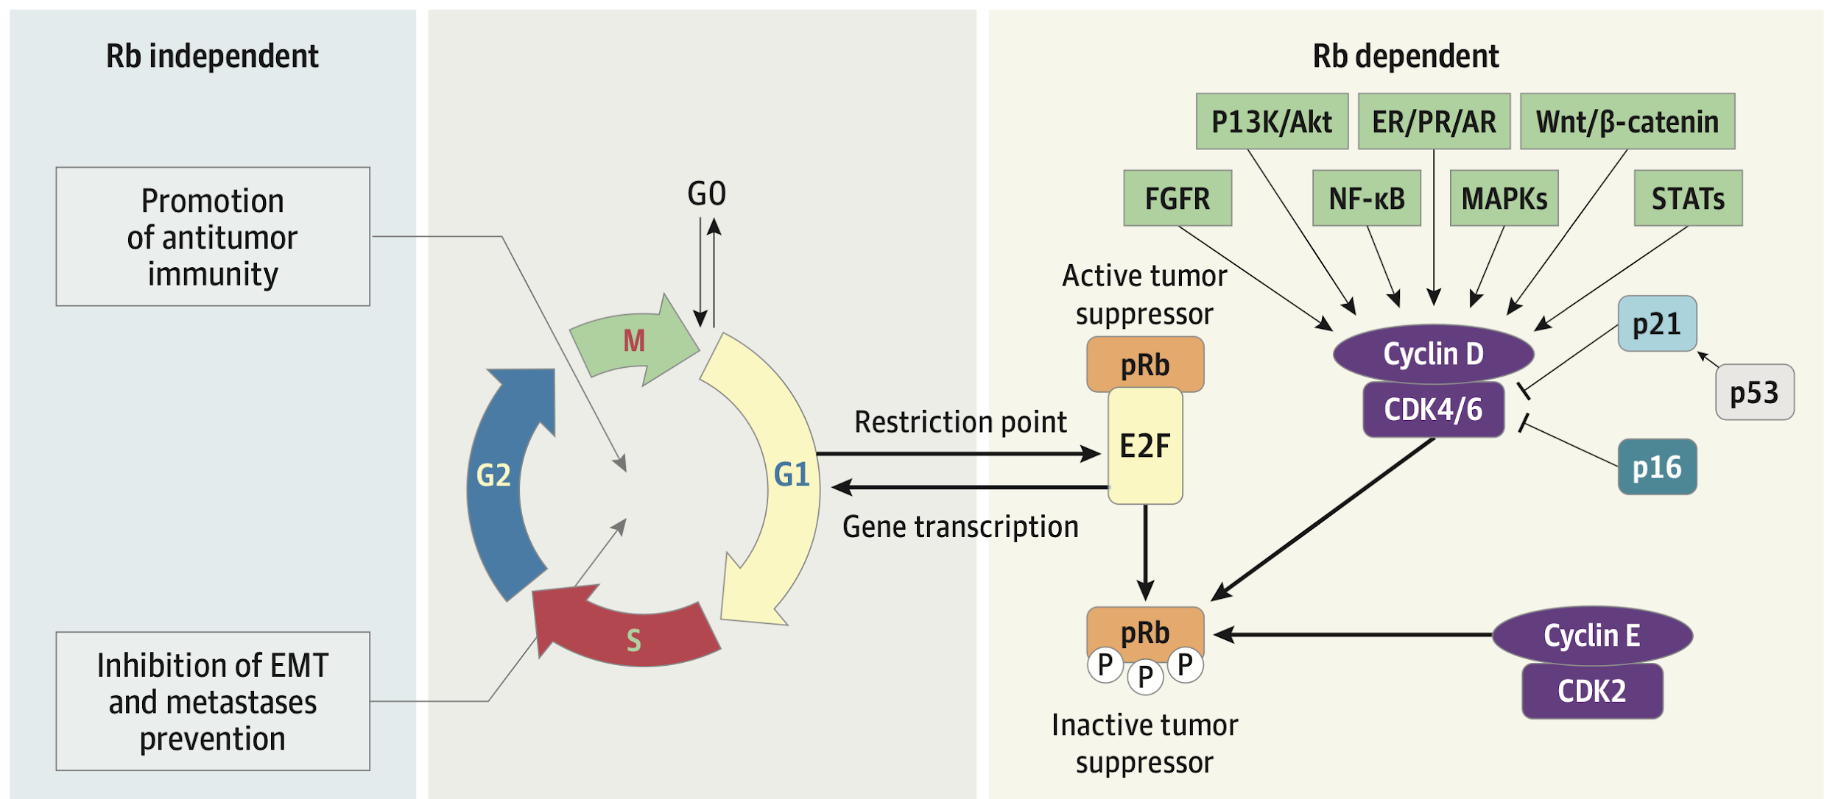
CDK4/6 inhibitor mechanism of action
O’Sullivan et al. 2023

Slide 14
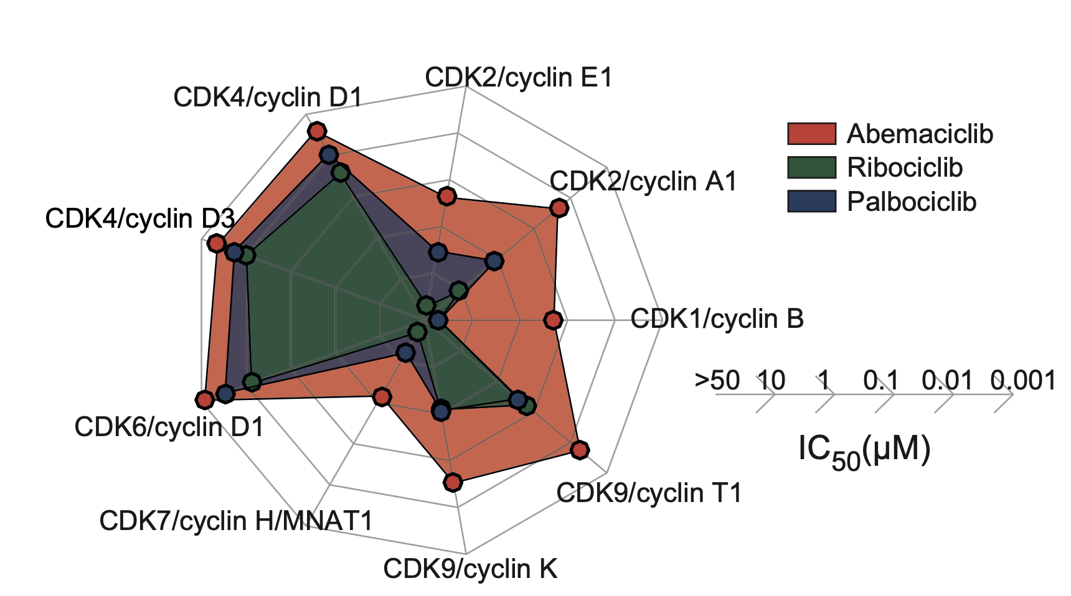
CDK4/6 inhibitors vary in target kinase inhibition
Strongest inhibitor of CDK4
Highest CDK4:CDK6
Additional kinase targets
More binding affinity to CDK4/cyclin D3
Similar binding affinity to CDK4/cyclin D3 and CDK6/cyclin D1
Johnston et al. 2023

Slide 15
What is the efficacy of CDK4/6i in first-line phase 3 RCTs?

Slide 16
 | PALOMA-2 (Slamon, 2024 Rugo, 2019) | MONALEESA-2 (Hortobagyi, 2022) | MONALEESA-3 (Neven, 2023 Slamon, 2020) | MONALEESA-7 (Lu, 2022 Tripathy, 2018) | MONARCH-3 (Goetz, 2024)
Design | Letrozole +/- palbociclib | Letrozole +/- ribociclib | Fulvestrant +/- ribociclib | Goserelin + tam/AI +/- ribo | NSAI +/- abemaciclib
Patients | 666, post-menopausal, 27% de novo | 668, post-menopausal, 34% de novo | 365 (1L), post-menopausal, 19% de novo | 672, pre/peri-menopausal, 40% de novo, 14% 1L chemo | 493, post-menopausal, 40% de novo
mFollow-up | 7.5 years | 6.7 years | 5.9 years | 4.5 years | 8.1 years
mPFS (months) | 27.6 vs 14.5 (△13.1) | 25.3 vs 16 (△9.3) | 33.6 vs 19.2 (△14.4) | 23.8 vs 13.0 (△10.8) | 29.0 vs 14.8 (△14.3)
mOS (months) | 53.9 vs 51.2 (△2.7) | 63.9 vs 51.4 (△12.5) | 67.6 vs 51.8 (△15.8) | 58.7 vs 48 (△10.7) | 66.8 vs 53.7 (△13.1)
Still on active Tx | 10% vs 2% | 9% vs 5% | 16.5% vs 8.6% | 21% vs 9% | 7% vs 3%

Slide 17
 | PALOMA-2 (Slamon, 2024 Rugo, 2019) | MONALEESA-2 (Hortobagyi, 2022) | MONALEESA-3 (Neven, 2023 Slamon, 2020) | MONALEESA-7 (Lu, 2022 Tripathy, 2018) | MONARCH-3 (Goetz, 2024)
Design | Letrozole +/- palbociclib | Letrozole +/- ribociclib | Fulvestrant +/- ribociclib | Goserelin + tam/AI +/- ribo | NSAI +/- abemaciclib
Patients | 666, post-menopausal, 27% de novo | 668, post-menopausal, 34% de novo | 365 (1L), post-menopausal, 19% de novo | 672, pre/peri-menopausal, 40% de novo, 14% 1L chemo | 493, post-menopausal, 40% de novo
mFollow-up | 7.5 years | 6.7 years | 5.9 years | 4.5 years | 8.1 years
mPFS (months) | 27.6 vs 14.5 (△13.1) | 25.3 vs 16 (△9.3) | 33.6 vs 19.2 (△14.4) | 23.8 vs 13.0 (△10.8) | 29.0 vs 14.8 (△14.3)
mOS (months) | 53.9 vs 51.2 (△2.7) | 63.9 vs 51.4 (△12.5) | 67.6 vs 51.8 (△15.8) | 58.7 vs 48 (△10.7) | 66.8 vs 53.7 (△13.1)
Still on active Tx | 10% vs 2% | 9% vs 5% | 16.5% vs 8.6% | 21% vs 9% | 7% vs 3%

Slide 18
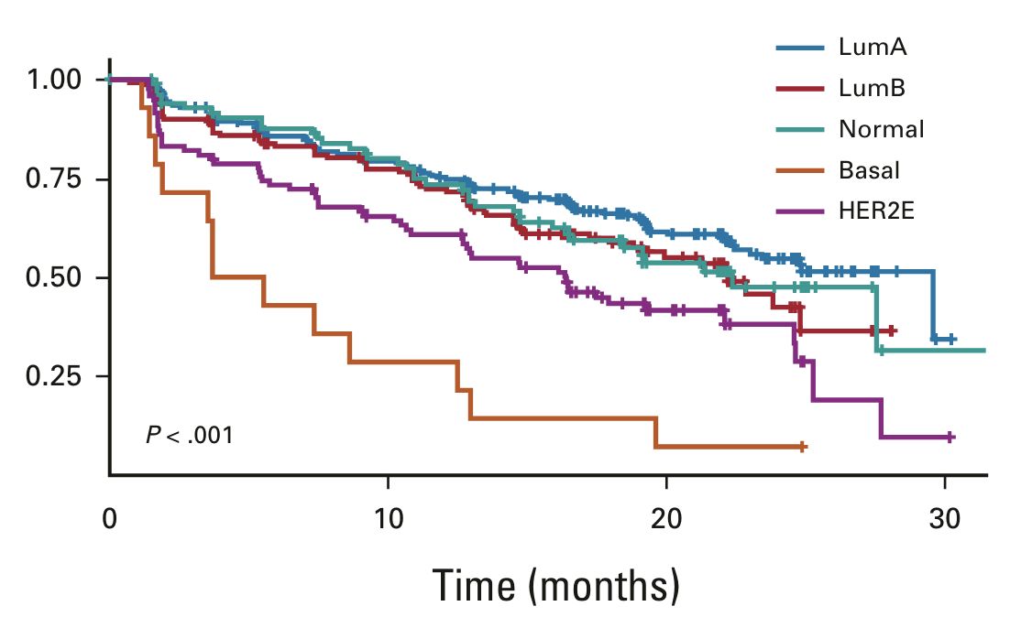
Predictors of response to CDK4/6i
Only known predictive biomarker is ER+
Emerging data on intrinsic subtypes
Both luminal A and B benefit
HER2-enriched had worst prognosis with ET alone, greatest relative benefit with addition of ribociclib
No benefit in basal-like
Finn et al. 2022, Prat et al 2021

Slide 19
What do studies show about CDK4/6i toxicities, quality of life, and dose reduction?

Slide 20
CDK4/6i comparative OS and safety
Network meta-analysis: 7 studies, 4415 patients
Median follow-up: 6.1 years
No statistically significant difference in OS
Non-significant association with shorter OS benefit with palbociclib
More treatment discontinuation due to AE with abemaciclib
More treatment-related death with abemaciclib
Statistically significant vs ribociclib
Not statistically significant vs palbociclib
Kappel et al. 2024

Slide 21
CDK4/6i comparative toxicities, statistically significant
Abema vs Ribo
More
Anemia
Diarrhea
Stomatitis
Fatigue
Less
Neutropenia
Prolonged QT
Transaminitis
Abema vs Palbo
More
Diarrhea
Nausea/Vomiting
Infection
Pneumonitis
Less
Neutropenia
Ribo vs Palbo
More
Prolonged QT
Transaminitis
Infection
Nausea/Vomiting
Less
Neutropenia
Fatigue
Kappel et al. 2024

Slide 22
CDK4/6 inhibitors & quality of life
Systematic review: 38 studies, clinical trials and real-world
CDK4/6 inhibitors do not worsen QoL
Better QoL if disease response, regardless of therapy received
Ribociclib
maintained QoL and work productivity in premenopausal women
Abemaciclib
QoL worsened by diarrhea, nausea, vomiting, and low appetite
Palbociclib
QoL not improved over ET alone, but QoL improved over capecitabine
Di Lauro et al. 2022

Slide 23
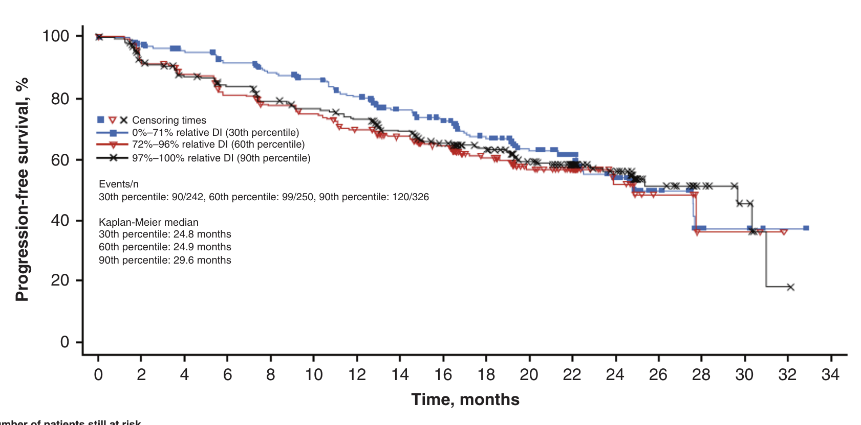
CDK4/6i dose reduction for toxicities & efficacy
No reduction in clinical benefit when dose modifications are required to manage toxicities
Burris et al. 2021

Slide 24
Does endocrine partner matter in the first line?

Slide 25
 | PALOMA-2 (Slamon, 2024 Rugo, 2019) | MONALEESA-2 (Hortobagyi, 2022) | MONALEESA-3 (Neven, 2023 Slamon, 2020) | MONALEESA-7 (Lu, 2022 Tripathy, 2018) | MONARCH-3 (Goetz, 2024)
Design | Letrozole +/- palbociclib | Letrozole +/- ribociclib | Fulvestrant +/- ribociclib | Goserelin + tam/AI +/- ribo | NSAI +/- abemaciclib
Patients | 666, post-menopausal, 27% de novo | 668, post-menopausal, 34% de novo | 365 (1L), post-menopausal, 19% de novo | 672, pre/peri-menopausal, 40% de novo, 14% 1L chemo | 493, post-menopausal, 40% de novo
mFollow-up | 7.5 years | 6.7 years | 5.9 years | 4.5 years | 8.1 years
mPFS (months) | 27.6 vs 14.5 (△13.1) | 25.3 vs 16 (△9.3) | 33.6 vs 19.2 (△14.4) | 23.8 vs 13.0 (△10.8) | 29.0 vs 14.8 (△14.3)
mOS (months) | 53.9 vs 51.2 (△2.7) | 63.9 vs 51.4 (△12.5) | 67.6 vs 51.8 (△15.8) | 58.7 vs 48 (△10.7) | 66.8 vs 53.7 (△13.1)
Still on active Tx | 10% vs 2% | 9% vs 5% | 16.5% vs 8.6% | 21% vs 9% | 7% vs 3%

Slide 26
PARSIFAL
Llombart-Cussac et al. ASCO 2020

Slide 27
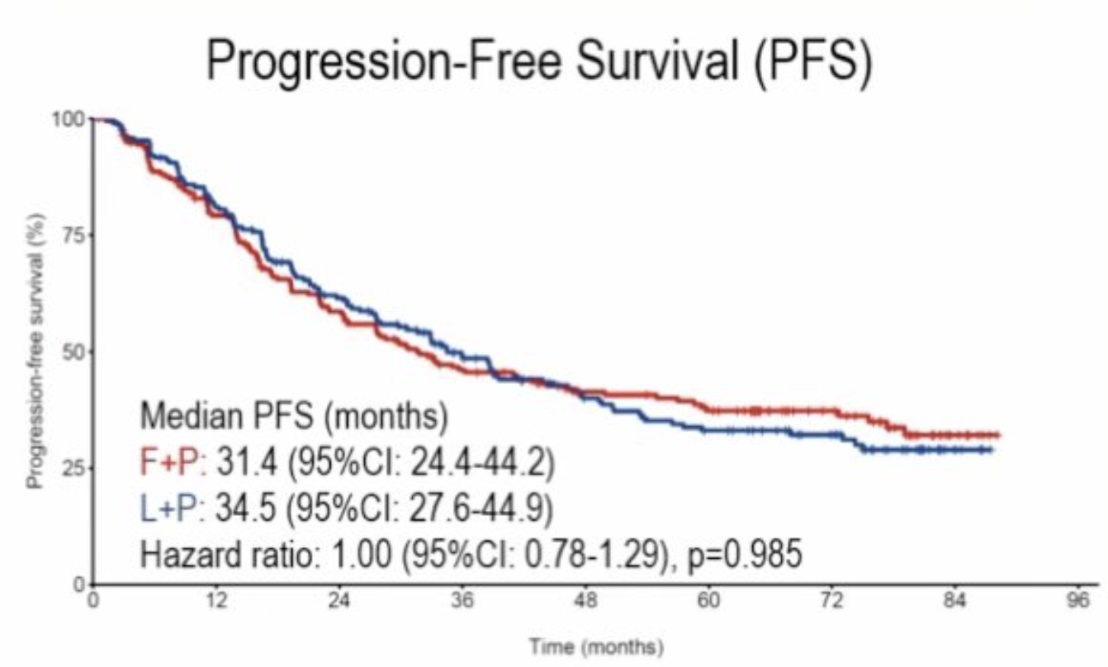
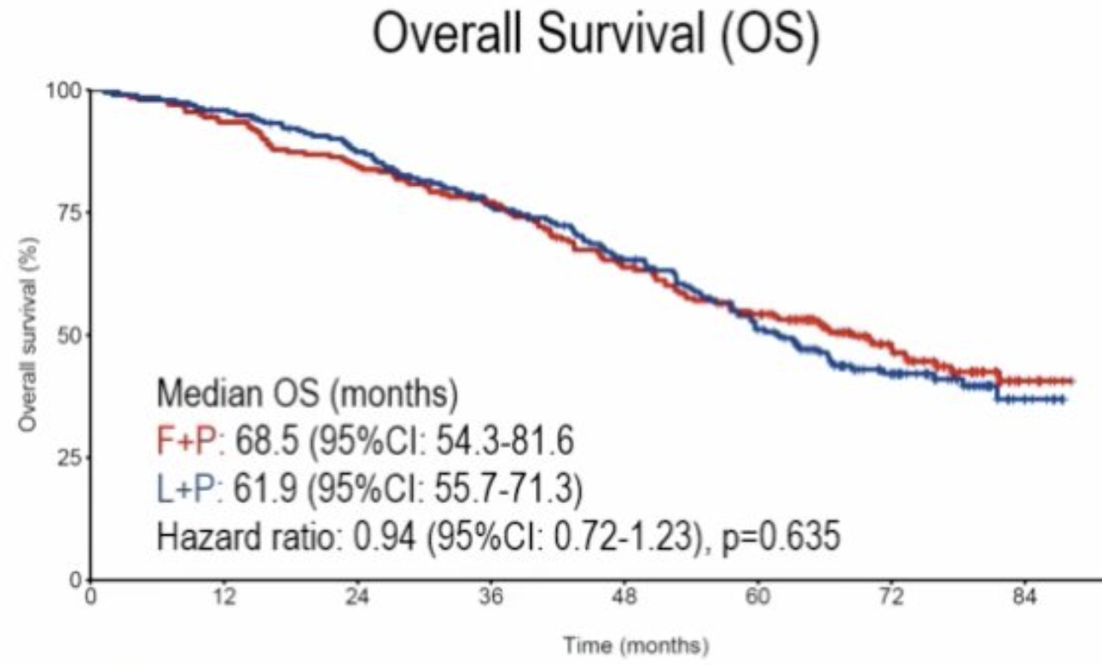
PARSIFAL-LONG: median follow-up 5 years
Combined cohorts: mPFS 33.2 months mOS 65.4 months
Llombart-Cussac et al. SABCS 2023

Slide 28
Is there a role for chemotherapy in the first line?

Slide 29
RIGHT Choice
Lu et al. SABCS 2022

Slide 30
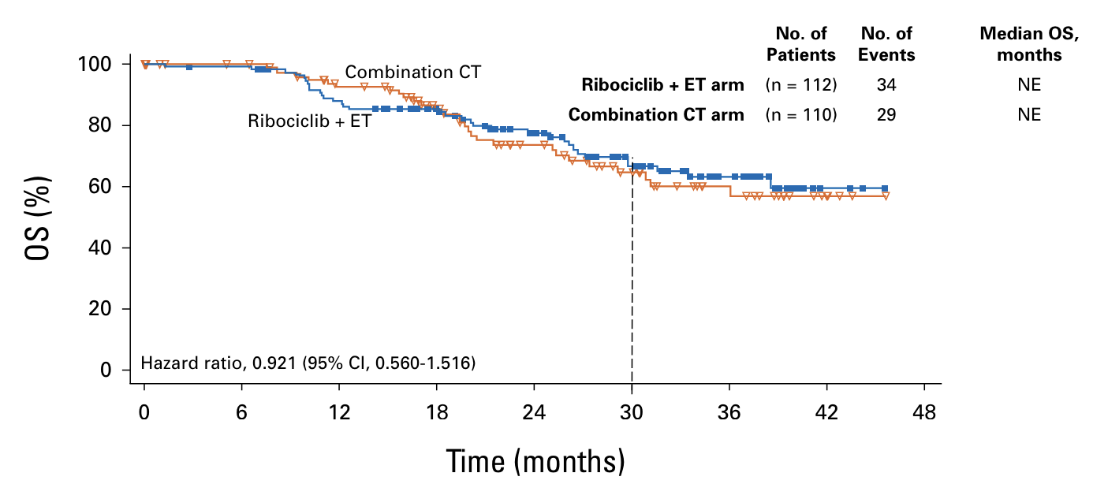
RIGHT Choice
Median follow-up 3.1 years
Ribociclib + endocrine therapy vs combination chemo
Median PFS 21.8 vs 12.8 mo (△9.0)
Median TTF 18.6 vs 9.1 mo (△9.5)
Survival data immature
Favors ribo+ET
Favors chemo
Lu et al. 2024

Slide 31
Young-PEARL
Park et al. ASCO 2024

Slide 32
Young-PEARL
Median follow-up 4.5 years
Palbociclib + endocrine therapy vs capecitabine
Median PFS 19.5 vs 14.0 mo (△5.5)
Median OS 54.8 vs 57.8 mo (△-3.0)
Multivariable analysis for OS
HR 0.057 for CDK4/6i use in any line of therapy after disease progression
Favors palbo+ET
Favors capecitabine
Park et al. ASCO 2024

Slide 33
Questions to address
How do CDK4/6 inhibitors work?
What is the efficacy of CDK4/6i in first-line phase 3 RCTs for HR+/HER2- MBC?
What do studies show about CDK4/6i toxicities, quality of life, and dose reduction?
Does endocrine partner matter in first-line?
CDK4/6i vs chemotherapy in first-line?

Slide 34
References
Burris HA et al. British J Cancer 2021;125:679.
Di Lauro V et al. ESMO Open 2022:7:1.
Finn RS et al. Clin Cancer Res 2020;26:110.
Goetz MP et al. Ann Oncol 2024;35:718.
Hortobagyi G et al. N Engl J Med 2022;386:942.
Hortobagyi G et al. Ann Oncol 2018;29:1541.
Johnston S et al. JNCI Cancer Spectrum. 2023;7:pkad045.
Kappel C et al. Scientific Reports 2024;14:3129.
Lu Y-S et al. J Clin Oncol 2024;42:2812.
Lu Y-S et al. Clin Cancer Res 2022;28:851.
Neven P et al. Breast Ca Res 2023;25:103.
O’Sullivan CC et al. JAMA Oncology 2023;9:1273.
Park YH et al. J Clin Oncol 2024;42 (17_suppl), ASCO Annual Meeting.
Prat A et al. J Clin Oncol 2021;39:1458.
Rugo H et al. Breast Ca Res Treat 2019;174:719.
Slamon D et al. N Engl J Med 2020:382:514.
Slamon D et al. J Clin Oncol 2024;42:994.
Tripathy D et al. Lancet Oncol 2018;19:904.

Slide 35
BREAST MALIGNANCIES
August 28th, 2024

Slide 36
Sequencing after frontline CDK 4/6i: Do you continue with a CDK 4/6i or switch therapy?
Shivani Shinde, MD MPH
Medical Oncology
Intermountain Health
Salt Lake City, UT

Slide 38
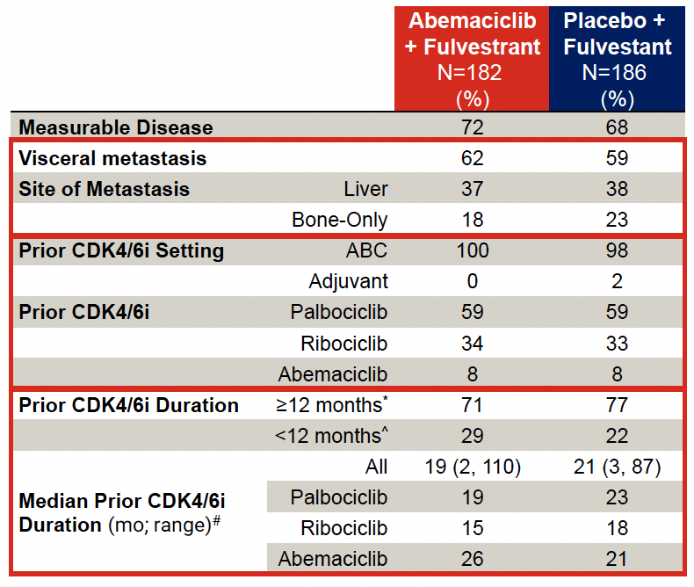
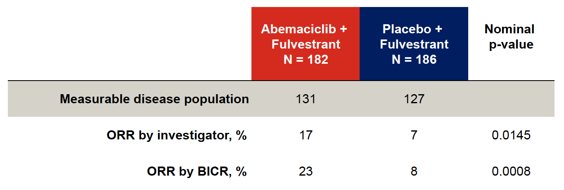
Kalinsky K et al. ASCO 2024;Abstract LBA1001.

Slide 39
The addition of abemaciclib to fulvestrant significantly prolongs PFS post CDKi and AI
Content of this presentation is the property of the author, licensed by ASCO. Permission required for reuse.

Slide 42
Post progression CDKi trials
 | postMONARCH | MAINTAIN | PALMIRA | PACE
Phase | 3 | 2 | 2 | 2
Patients | 368 | 132 | 198 | 220
Prior Chemo | 0% | 9% | 0% | 16%
Prior Palbo | 60% | 85% | 100% | 91%
Prior Ribo | 33% | 12% | 0% | 4.5%
Prior Abema | 8% | 2% | 0% | 4.1%
Second-line | 100% | 65% | 100% | 77%
> Second-line | 0% | 18.5% | 0% | 17%
CDKi on trial | Abema | Ribo | Palbo | Palbo
ET on trial | Fulv | Fulv or Exem | Fulv or Let | Fulv
Kalinsky et all ASCO 2024, Kalinsky et al J Clin Oncol 2023, Llombart-Cussac et al ASCO 2023, Mayer et al SABCS 2022

Slide 43
Post progression CDKi trials
 | postMONARCH |  | MAINTAIN |  | PALMIRA |  | PACE
ARM | Abema | Placebo | Ribo | Placebo | Palbo | Cont | Palbo | Cont
PFS | 6.0 mons. | 5.3 mons. | 5.3 mons. | 2.8 mons. | 4.9 mons. | 3.6 mons. | 4.6 mons. | 4.8 mons.
 | 0.7 mons. |  | 2.5 mons. |  | 1.3 mons. |  | -0.2 mons.
HR | 0.73 |  | 0.57 |  | 0.84 |  | 1.11
P value | 0.02 |  | 0.006 |  | 0.149 |  | 0.06
Kalinsky et all ASCO 2024, Kalinsky et al J Clin Oncol 2023, Llombart-Cussac et al ASCO 2023, Mayer et al SABCS 2022

Slide 45
Selection and Sequencing of Treatment for Patients with HR-Positive, HER2-Negative Disease Progressing on CDK4/6 Inhibition

Slide 46
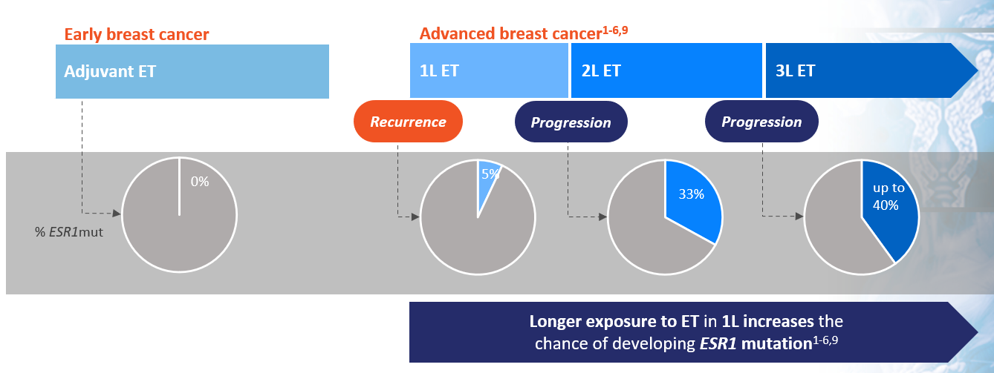
Most ESR1 mutations arise after progression on 1L mBC therapy
1. Jeselsohn R, et al. Clin Cancer Res. 2014;20:1757-1767. 2. Jeselsohn R, et al. Cancer Cell. 2018;33:173-186. 3. Allouchery V, et al. Breast Cancer Res. 2018;20:40; 4. Schiavon G, et al. Sci Transl Med. 2015;7;313ra182. 5. Brett JO, et al. Breast Cancer Res. 2021;23:85. 6. Callens C, et al. Anal Chem. 2022;94:6297-6303. 7. Robinson DR, et al. Nat Genet. 2013;45:1446-1451. 8. Reinert T, et al. Front Oncol. 2017;7:26. 9. Bidard FC, et al. J Clin Oncol. 2022;40:3246-3256.

Slide 47
Phase 3 EMERALD trial: Elacestrant vs SOC
PFS by duration of CDK 4/6i in mESR1 cohort
≥ 6 Months CDK4/6i
≥ 12 Months CDK4/6i
≥ 18 Months CDK4/6i
100
100
100
80
80
80
60
60
60
Probability of PFS (%)
Probability of PFS (%)
Probability of PFS (%)
40
40
40
20
20
20
Elacestrant
Standard of Care
Elacestrant
Standard of Care
0
Elacestrant
Standard of Care
0
0
0
5
10
15
20
25
30
0
5
10
15
20
25
30
0
5
10
15
20
25
30
Time (months)
Time (months)
Time (months)
Elacestrant
SOC
55
56
30
21
23
9
18
8
16
7
12
4
8
1
8
1
7
1
6
0
6
5
5
1
1
0
Elacestrant
SOC
103
102
50
34
33
16
25
11
20
9
16
5
11
2
9
1
8
1
7
0
6
5
5
1
1
0
Elacestrant
SOC
78
81
42
26
31
12
24
10
20
9
16
5
11
2
9
1
8
1
7
0
6
5
5
1
1
0
 | Elacestrant | SOC Hormonal Therapy
Median PFS, months (95% CI) | 4.14 (2.20 - 7.79) | 1.87 (1.87 - 3.29)
PFS rate at 12 months, % (95% CI) | 26.02 (15.12 - 36.92) | 6.45 (0.00 - 13.65)
Hazard ratio (95% CI) | 0.517 (0.361 - 0.738)
 | Elacestrant | SOC Hormonal Therapy
Median PFS, months (95% CI) | 8.61 (4.14 - 10.84) | 1.91 (1.87 - 3.68)
PFS rate at 12 months, % (95% CI) | 35.81 (21.84 - 49.78) | 8.39 (0.00 - 17.66)
Hazard ratio (95% CI) | 0.410 (0.262 - 0.634)
 | Elacestrant | SOC Hormonal Therapy
Median PFS, months (95% CI) | 8.61 (5.45 - 16.89) | 2.10 (1.87 - 3.75)
PFS rate at 12 months, % (95% CI) | 35.79 (19.54 - 52.05) | 7.73 (0.00 - 20.20)
Hazard ratio (95% CI) | 0.466 (0.270 - 0.791)
Bardia A et al. SABCS 2022. Abstract GS3-01; Bidard et al, JCO 2022

Slide 48
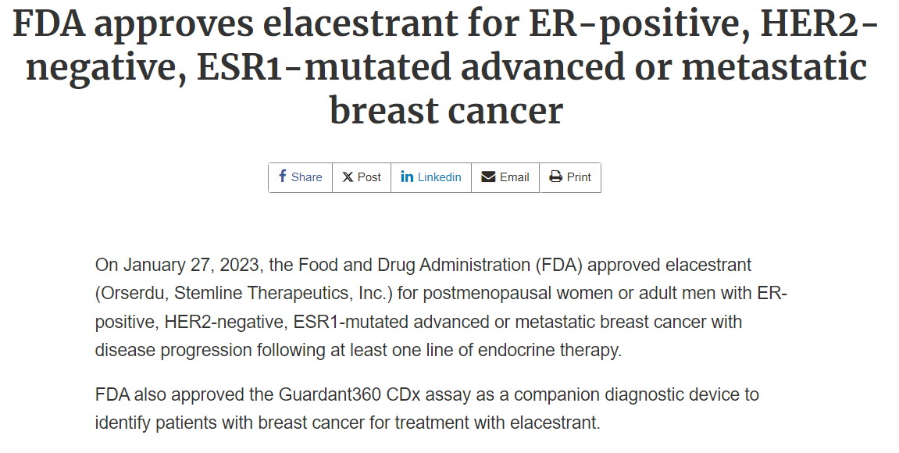

Slide 49
v
EMERALD (Phase 3, key subgroup analysis): Elacestrant for ESR1-mutated ER+/HER2− advanced/metastatic breast cancer
Benefit of elacestrant is confirmed in patients harboring ESR1 mutation
Similar benefit was observed in PIK3Ca mutant
Limited numbers may impact this analysis
Elacestrant being studied in combination with targeted agents; many new endocrine agents in ongoing trials in metastatic and early-stage disease; early phase combination studies
Bardia A, et al. SABCS 2023. Abstract PS17-02
Bardia A, et al. SABCS 2023. Abstract PS17-02

Slide 50
Inhibiting AKT pathway
Overactivation of AKT pathway occurs in ~ half of HR+ HER2- breast cancers
Activating mutations in PIK3CA and AKT1
Inactivating alterations in PTEN
AKT signaling may also be activated in absence of genetic alterations in patients with endocrine resistance
Alterations may be present at the time of initial diagnosis and can be acquired by means of previous treatments including CDK4/6i
Millis SZ, et al JAMA Oncol 2016, Wander SA, et al Cancer Discov 2020

Slide 51
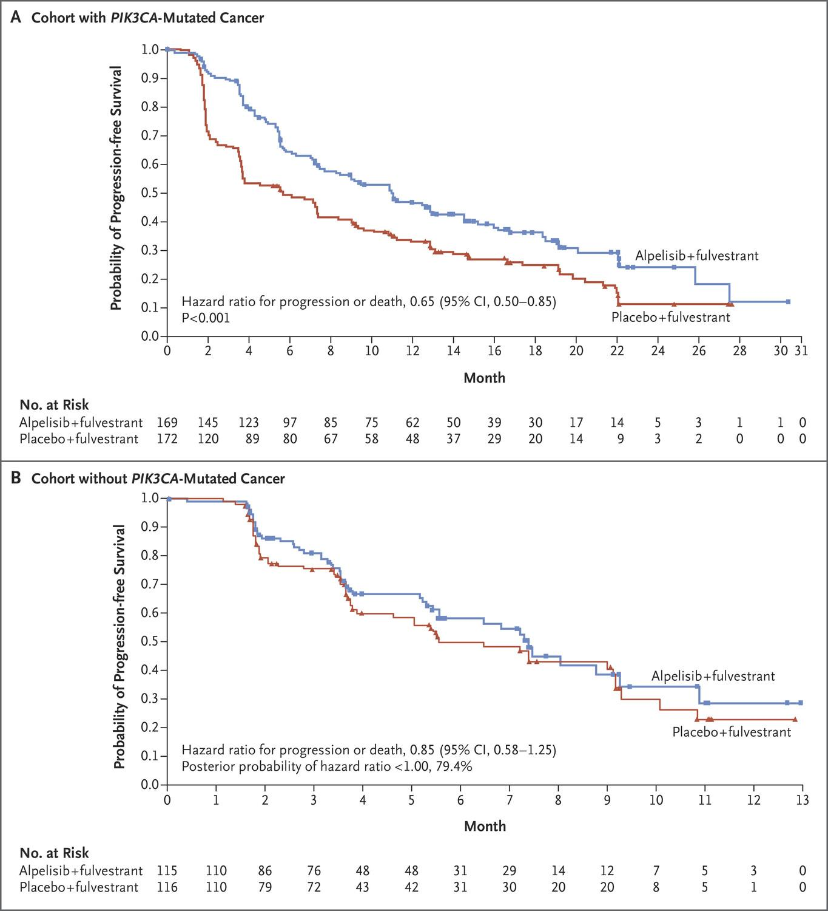
Phosphoinositide 3-Kinase (PI3K) inhibitors
PIK3CA mutation present in ~40% of patients with HR+ HER2- breast cancer
Alpelisib showed efficacy in the SOLAR-1 phase 3 trial
PFS was 11 months in the combination arm vs 5.7 months with fulvestrant alone
Discontinuation rate due to AEs 25.4%
Only 6% of patients had received prior CDK 4/6i
Andre F, et al. NEJM 2019

Slide 52
Prospective phase 2 BYLieve trial: Aplelisib with fulvestarnt or letrozole in patients with PIK3CA mutated ER+/HER2- mBC previously treated with CDK 4/6i
Cohort | A | B | C
N | 127 | 126 | 126
Details | Immediate prior AI + CDK4/6i | Immediate prior fulvestrant + CDK4/6i | Immediate prior CT or ET
Treatment | Fulvestrant + alpelisib | Letrozole + alpelisib | Fulvestrant + alpelisib
Prior CDK4/6i | 100% | 100% | 66.7
mPFS | 7.3 mons. | 5.7 mons. | 5.6 mons.
mOS | 17.3 mons. | Not reported | Not reported
ORR | 17% | 15.7% | 24.3%
Discontinuation rate due to AEs | 20% | 14.3% | 15.1%
Rugo H, et al. Lancet Onc 2021
Notes:
BYLieve is a phase II, open-label, three-cohort, non-comparative study of alpelisib plus either fulvestrant or letrozole in patients with HR + /HER2− PIK3CA mutant ABC progressing on or after prior treatments, including CDK4/6i (Table 2). All patients in cohorts A and B had received CDK4/6i with AI and fulvestrant, respectively, as the immediate past treatment, whilst 66.7% of those in cohort C received prior CDK4/6i^{65,66,67}. At 6 months, 50.4% of patients in cohort A, 46.1% in cohort B and 48.7% in cohort C were alive and without disease progression. mPFS was slightly lower than that in the predominantly CDK4/6i naive SOLAR-1 study population. The most frequent grade 3/4 adverse events (AEs) included hyperglycemia and rash which can affect dose delivery and efficacy. Frequency of AEs leading to discontinuation of alpelisib was lower compared to in SOLAR-1, possibly due to increasing familiarity and improved management of toxicities with measures such as prophylactic antihistamines for rash.

Slide 53
Analyzing alpelisib long term responders
ByLieve: Alpelisib + fulvestarnt after CDK 4/6i + ET (Cohort A)
Goal – to determine clinical features of long term responders
LT PFS (> 12 months) – 26% mPFS 25 mo
VLT PFS (>18 months) – 16% mPFS NR
Prognostic factors associated with LT/VLT responders:
Lower BMI and ECOG PS
Longer time from initial diagnosis to first recurrence
Bone only lesions
Fewer liver metastases
Incidence of ESR1 mutation on LT vs VLT v non-LT : 26% vs 25% vs 27%
Rugo H, et al. SABCS 2022 PD 13-06

Slide 54
Phase 3 trial CAPItello 291: Capivasertib + fulvestrant vs fulvestrant alone in HR+ HER2- mBC progressing after AI + CDK4/6i
Summary of demographics:
Median age ~59
Asian 26%, Black 1%
Primary ET resistance ~38%
Visceral mets ~68%
One line of prior ET for MBC ~75%
Prior CDK4/6i for MBC ~70%
Chemotherapy for ABC ~18%
Turner et al, NEJM 2023

Slide 55
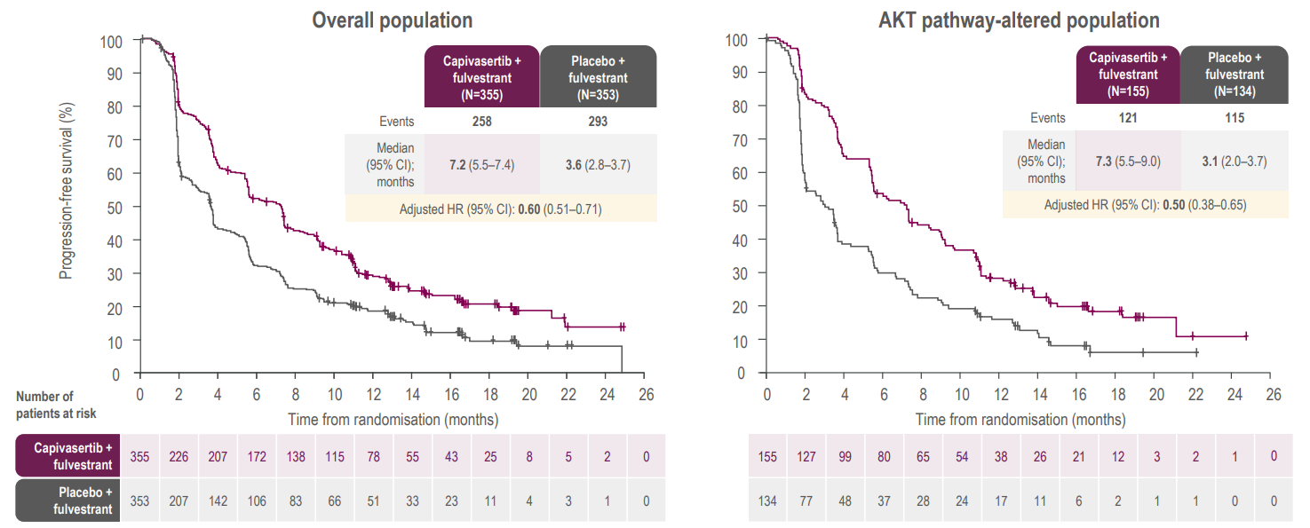
PFS in overall and AKT pathway-altered populations

Slide 56
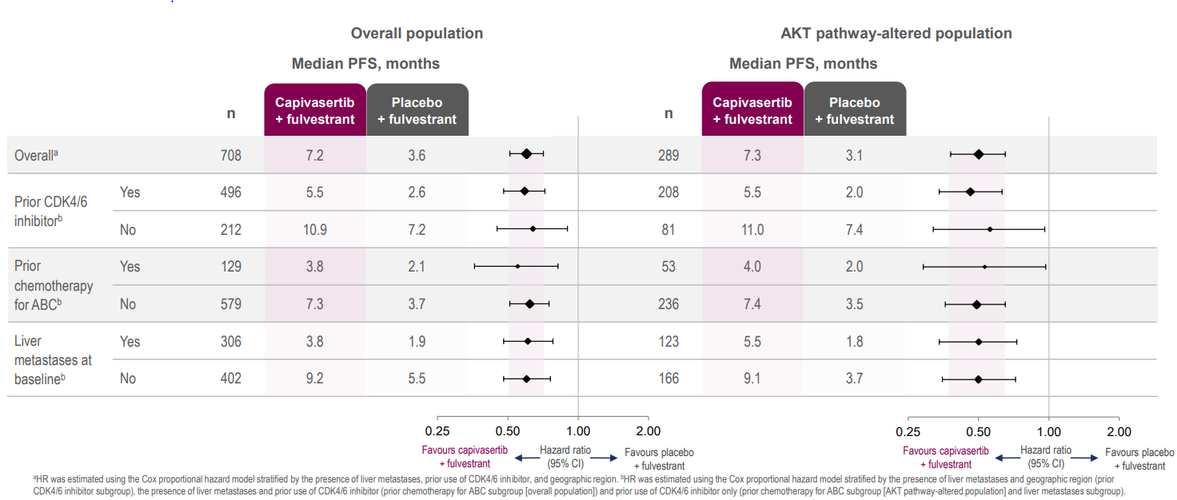
Summary of PFS by subgroup
Oliveira et al, ESMO BC 2023

Slide 57
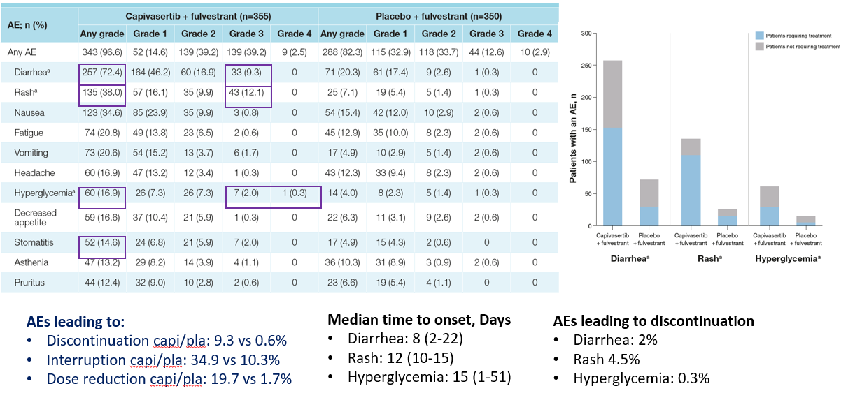
Rugo et al, ASCO 2023

Slide 58
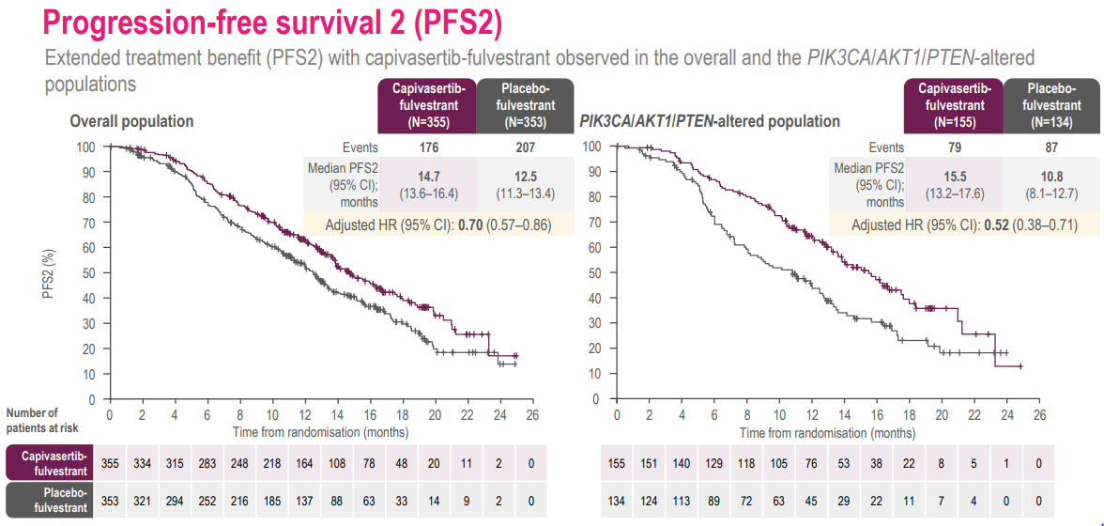
Rugo et al, ESMO 2024

Slide 59
Sequencing after frontline CDK 4/6i: Do you continue with a CDK 4/6i or switch therapy?
gBRCA 1/2 mutation
PARP inhibitor
Factors
Prior ET
Somatic mutations: ESR1, PIK3CA, AKT, PTEN
BRCA 1/2 status
Response to prior CDK 4/6i > or < 12 months
PIK3CA mutation
Alpelisib + FUL
Discontinuation rate 25%
AKT mutated pathway (PIK3CA/AKT/PTEN)
Capivasertib + FUL
Discontinuation rate 13%
AI + CDK4/6i
PIK3CA/AKT/PTEN wd
Benefit to 1st line CDK 4/6i < 12 mths
ESR1 mutated tumors prolonged benefit to 1st line CDK 4/6i (>12 mths)
Elacestrant
Fulvestrant mono less effective
Mild progression
No known mutation
Switching ET + Ribo/Abema
No mutation detected
Everolimus + ET
No data from randomized trials with CDK 4/6I pretreatment
Visceral crisis
Chemotherapy

Slide 60
Thank you!

Slide 61
BREAST MALIGNANCIES
August 28th, 2024

Slide 62
Case Presentation HR+ HER2- Metastatic Breast cancer
Xylina Gregg MD
Utah Cancer Specialists
Salt Lake City UT

Slide 63
70 yo presented with left breast mass and nipple inversion (screening mammo 6 mo earlier “normal”)
Biopsy of 2 breast masses: grade 3 invasive lobular carcinoma ER+ 99% PR+ 33% HER2 1+
Breast MRI: multifocal disease spanning 6 cm, mets to sternum & ribs
CT and bone scan: osseous mets
CA15-3: 1470
Germline genetic testing: negative

Slide 64
First Line Therapy
Started letrozole/palbociclib and denosumab
Palbociclib dose reduction due to neutropenia
NGS: PIK3CA, FGFR1, CDH1, MAP2K4, NSD3, ZNF703
CA15-3 increased from 1400 to 2900 1 month after starting therapy, but then slowly declined
Breast mass smaller, nipple inversion improved; imaging showed stable to “more sclerotic” bone mets
Paloma-2: 36% pts required dose reduction (Finn NEJM 2016)
Dose reductions did not affect PFS in trials or in real world studies (Wilkie Clinical Breast Cancer 2020)

Slide 65
First Line: letrozole/palbociclib
12-15 months
Tolerating Letrozole/palbociclib 100 mg
Denosumab stopped at 12 months due to ONJ (found on bone scan)
Breast MRI at 12 months showed response
Bone imaging stable
CA15-3 300
18 months
CA15-3 200
Enrolled on clinical trial monitoring ESR1: mESR1+
Screening imaging showed progression in breast and bones

Slide 66
What Next? mPIK3CA and mESR1
Elacestrant? (EMERALD)
Fulvestrant + capivasertib? (CAPItello-291)
Fulvestrant + ribociclib or abemaciclib? (MAINTAIN and post-MONARCH)

Slide 67
Second and Third Line
Second Line Treatment
Elacestrant
3 months: new right hip pain, CA15-3 increased from 700 to 1400 and imaging showed progression of bone mets
EMERALD: 40% progressed at 1st restaging
mPFS 3.6 mo with elacestrant vs 1.9 mo with SOC
mPFS 8.6 mo

Slide 68
Third Line Treatment
CAPItello-291
Capivasertib + fulvestrant
Improvement in hip pain at 1 month
Capivasertib held at 2.5 months due to g2 transaminitis
3 months: Recurrent hip pain, CA15-3 increased to 2400, imaging shows new bone lesions and new pulmonary nodules (all <7 mm)
Oliveira, abst 1870, ESMO 2024
No prior SERD

Slide 69
What Next?
Fam-trastuzumab deruxtecan-nxki (T-DXd)?
Capecitabine?
Paclitaxel/nab-paclitaxel?
Other chemo?
T-DXd is indicated for HER2-low (IHC 1+ or IHC 2+/ISH-) breast cancer who have received a prior chemotherapy in the metastatic setting
NCCN guidelines: T-DXd (category 1) after 1 line of chemotherapy for patients with HR+ HER2-low mBC who are in visceral crisis or are endocrine refractory
Sequencing and
future treatment options?

Slide 70
BREAST MALIGNANCIES
August 28th, 2024

Slide 71
Discussion / Q&A

Slide 72
Networking Reception We will return at 7:50 pm

Slide 73
BREAST MALIGNANCIES
August 28th, 2024

Slide 74
New Kids on the Block: Antibody-Drug Conjugates (ADC) for Breast Cancer
Christos Vaklavas, M.D.
Associate Professor
Physician Leader in Breast Cancer
Huntsman Cancer Institute
Salt Lake City, Utah

Slide 75
Disclosures
Research paid to my current institution: Pfizer, SeaGen, H3 Biomedicine/Eisai, AstraZeneca, CytomX.
Research paid to my previous institution: Genentech, Roche, Pfizer, Incyte, Pharmacyclics, Novartis, TRACON Pharmaceuticals, Innocrin Pharmaceuticals, Zymeworks, H3 Biomedicine.
Paid Consultation/Advisory Board: Guidepoint, Novartis, SeaGen, Daiichi Sankyo, AstraZeneca, CardinalHealth.
Unpaid Consultation: Genentech.
Participation in non-CME activity: Gilead, AstraZeneca.
Employment: Flatiron (wife)
Open payments: https://openpaymentsdata.cms.gov/physician/1306968

Slide 76
My Real Disclosures

Slide 77
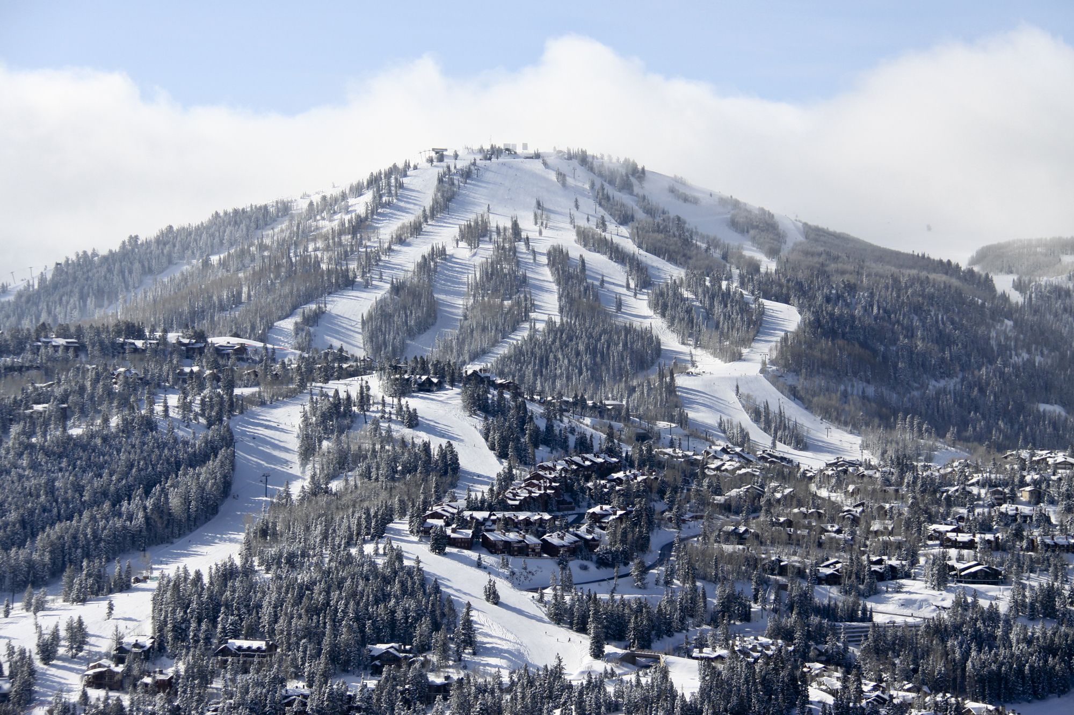
Where should I retire?
Deer Valley
Costa Rica
Bhutan
Greek Islands

Slide 78
I am going to build an ADC!
Fab
Payload
Monoclonal Antibody
Human IgG1 scaffold
Cys
Cys
Linker
PABA
MMAE
Cys
Cys
Maleimido caproyl spacer
Fc
Valine citrulline linker
Vaklavas C and Forero-Torres A. Safety and efficacy of brentuximab vedotin in patients with Hodgkin lymphoma or systemic anaplastic large cell lymphoma. Ther Adv Hem 2012 Aug;3(4):209-25.

Slide 79
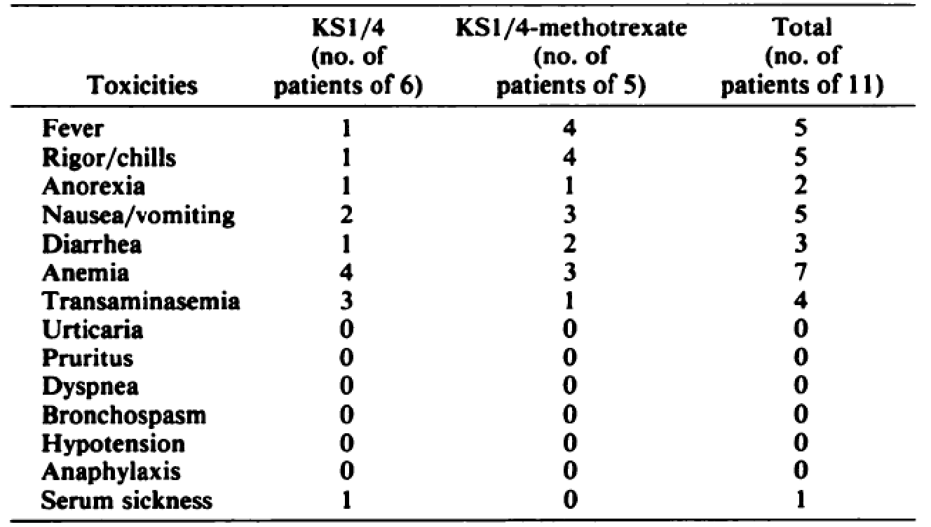
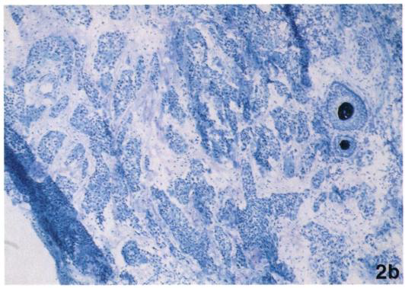
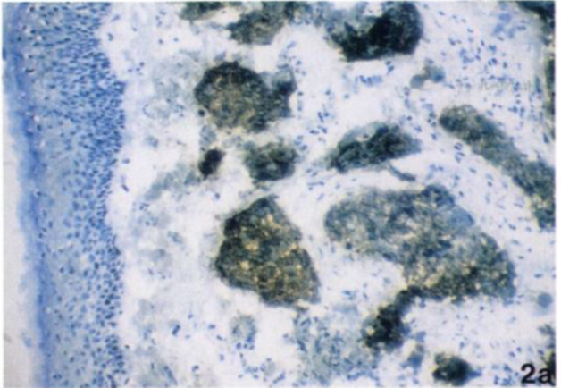
Historical Perspective
Proof of Principle but…
10/11 patients developed human antimurine response
1 acute immune complex-mediated reaction
1 possible clinical response
Elias DJ et al. Phase I Clinical Comparative Study of Monoclonal Antibody KS1/4 and KS1/4-Methotrexate Immunconjugate in Patients with Non-Small Cell Lung Carcinoma. Cancer Research 1990 Jul 1;50(13):4154-9.

Slide 80
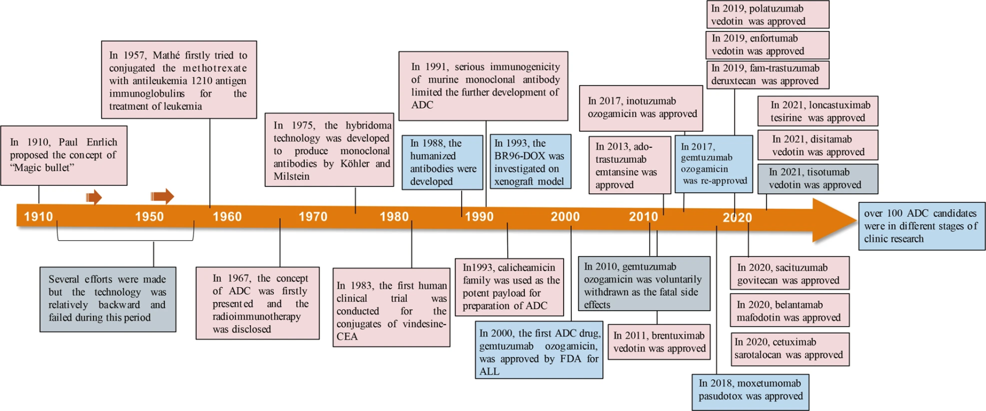
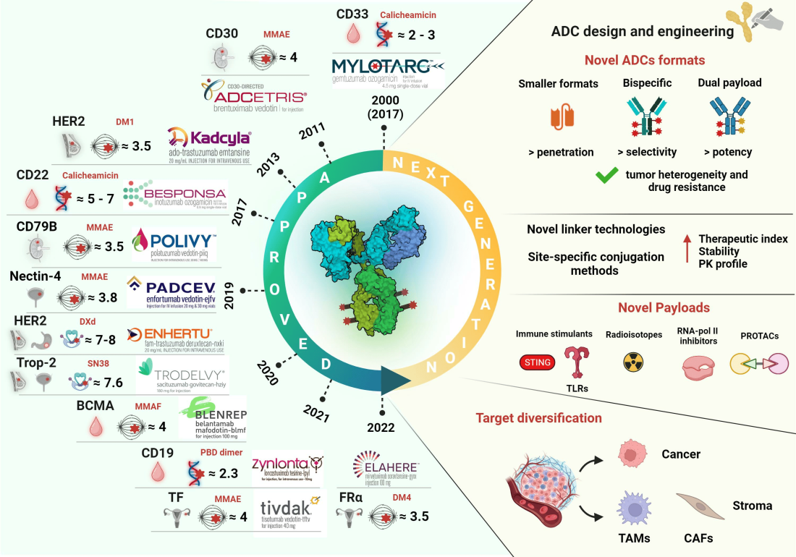
Historical Perspective
Fu Z, et al. Antibody drug conjugate: the “biological missile” for targeted cancer therapy. Signal Transduct Target Ther. 2022 Mar 22;7(1):93. doi: 10.1038/s41392-022-00947-7
Metrangolo V, et al. Antibody–Drug Conjugates: The Dynamic Evolution from Conventional to Next-Generation Constructs. Cancers 2024 Jan 20;16(2):447. doi: 10.3390/cancers16020447.
Doronina SO, et al. Development of potent monoclonal antibody auristatin conjugates for cancer therapy. Nat Biotechnol 2003 Jul;21(7):778-84. doi: 10.1038/nbt832.

Slide 81
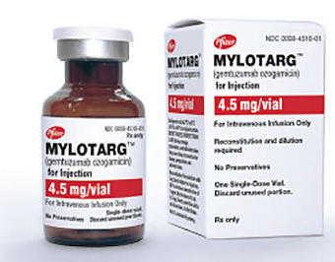
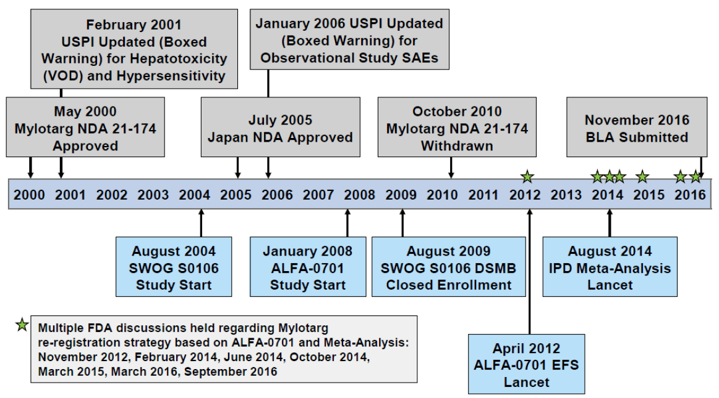
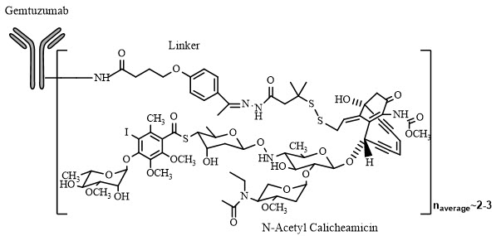
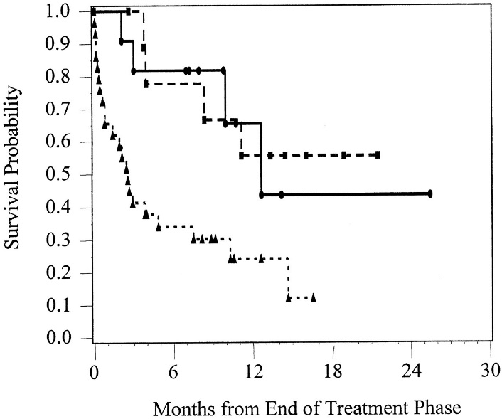
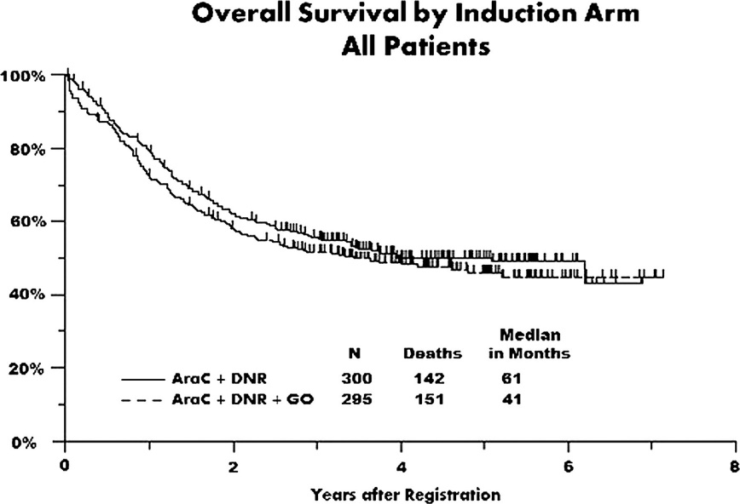
ADC Pioneer: Gemtuzumab Ozogamicin (Mylotarg®)
What went wrong?
Design: IgG4 scaffold has limited ability for Complement fixation & ADCC.
Manufacturing: variable DAR (0-6); too much naked Ab (ineffective), too much free conjugate (toxic); batch-to-batch variability.
Clinical development: patient selection, mechanisms of resistance.
www.pfizermedicalinformation.com
Sievers EL et al. Efficacy and safety of gemtuzumab ozogamicin in patients with CD33-positive acute myeloid leukemia in first relapse. JCO 2001 Jul 1;19(13):3244-54. doi: 10.1200/JCO.2001.19.13.3244
Petersdorf SH et al. A phase 3 study of gemtuzumab ozogamicin during induction and postconsolidation therapy in younger patients with acute myeloid leukemia. Blood 2013 Jun 13;121(24):4854-60.

Slide 82
The Ideal ADC
Linker
Conditionally cleavable: acid-labile, disulfide, protease-cleavable
Noncleavable: thioether
- stable in plasma with minimal decay
- Labile once internalized to release the payload in its active form
Target:
- Exclusively expressed in target cells.
- Target should allow for patient selection
- Understand the target:
Internalization, turnover, processing, & degradation.
Payload
- Extremely potent
- Sufficiently water soluble
- Stable in aqueous formulations and in plasma
- Sufficiently hydrophobic to permeate cells to induce bystander effect
- Suitable for conjugation
- Not susceptible to lysosomal degradation
Antibody:
- Chimeric or humanized to prevent immune neutralization.
- IgG1 scaffold preferred to retain CDC, ADCC, & target binding.
Cys
Cys
Conjugation sites & DAR
(manufacturing, manufacturing, manufacturing)
- Optimal and consistent conjugation sites that do not affect the affinity of the Ab and the ADCC and CDC properties of the naked Ab.
- Homogeneous species at the ideal antibody-drug stoichiometry (DAR)
Cys
Cys
Teicher BA and Chari RVJ. Antibody conjugate therapeutics: challenges and potential. CCR 2011 Oct 15;17(20):6389-97. doi: 10.1158/1078-0432.CCR-11-1417.

Slide 83
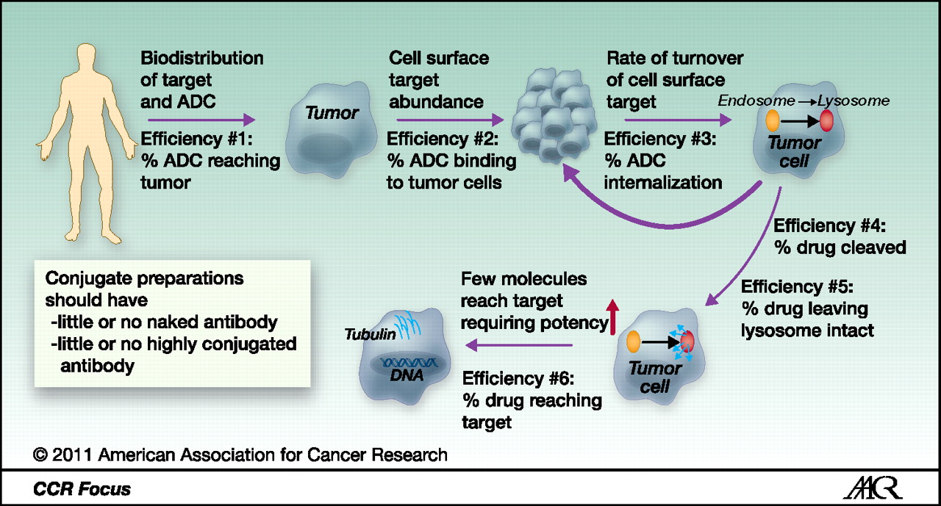
The Ideal ADC: The Importance of the Conjugate
Teicher BA and Chari RVJ. Antibody conjugate therapeutics: challenges and potential. CCR 2011 Oct 15;17(20):6389-97. doi: 10.1158/1078-0432.CCR-11-1417.

Slide 84
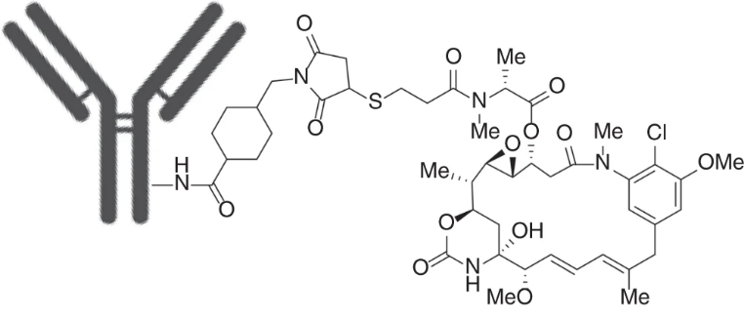
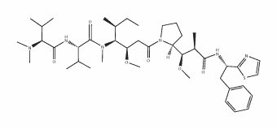
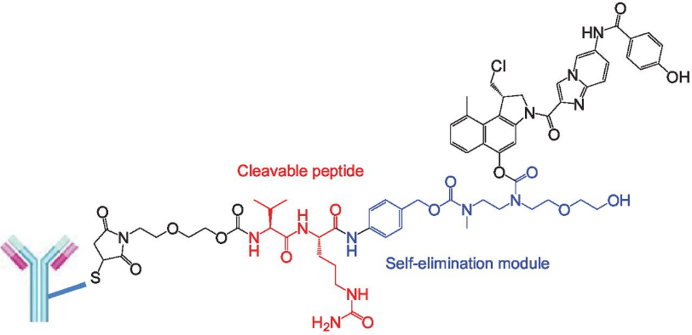
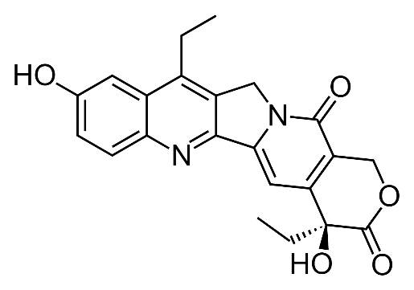
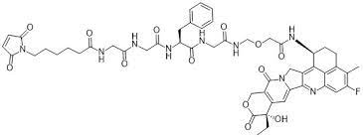
The Ideal ADC: Payloads
Maytansinoids & Dolastatin analogs
Tubulin inhibitors
T-DM1
Dolastatin 10
Duocarmycins & Calicheamicins
Target minor DNA groove & alkylate the DNA
(duocarmycins) or induce double strand breaks (calicheamicins).
SYD985
Mylotarg
SN-38 & exatecan derivatives
Topoisomerase I inhibitors &
inducer of double strand DNA breaks.
SN-38
Amatoxin analogs
RNA polymerase II & III inhibitors.
Deruxtecan
Van der Lee MMC et al. The Preclinical Profile of the Duocarmycin-Based HER2-Targeting ADC SYD985 Predicts for Clinical Benefit in Low HER2-Expressing Breast Cancers. MCT 2015 Mar;14(3):692-703. doi: 10.1158/1535-7163.
Hunter FW et al. Mechanisms of resistance to trastuzumab emtansine (T-DM1) in HER2-positive breast cancer. BJC 2020 Mar;122(5):603-612. doi: 10.1038/s41416-019-0635-y.

Slide 85
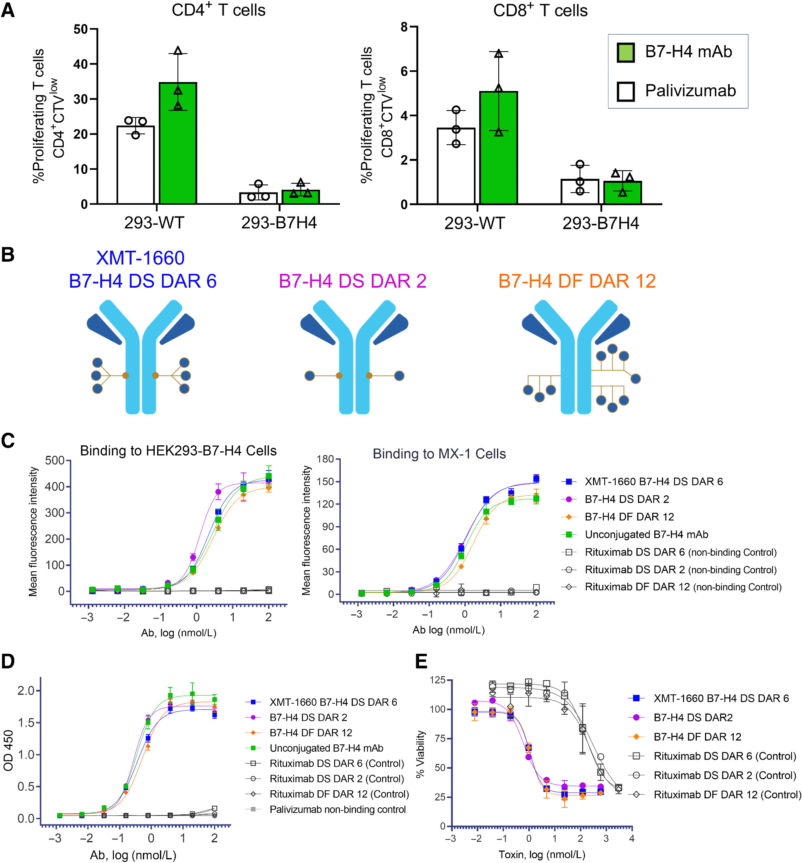
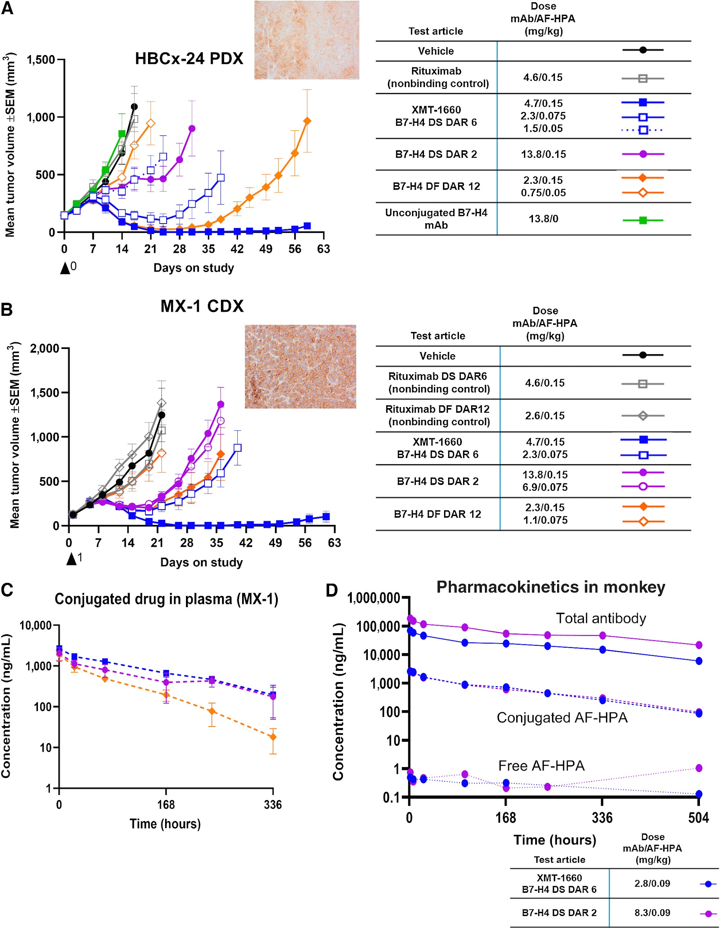
ADC Preclinical Development: the example of XMT-1660
Toader D et al. Discovery and Preclinical Characterization of XMT-1660, an Optimized B7-H4-Targeted Antibody-Drug Conjugate for the Treatment of Cancer. MCT 2023 Sep 5;22(9):999-1012.

Slide 86
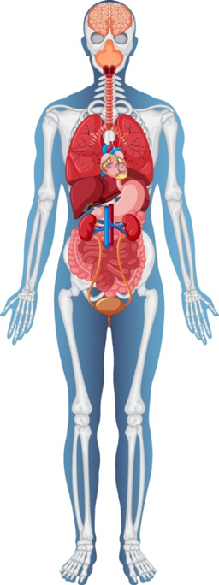
ADCs have unique profiles of toxicity
Sacituzumab Govitecan
Scaffold: sacituzumab
mAb isotype: IgG1
Linker: hydrolyzable
Payload: SN38, an irinotecan derivative
Payload MoA: Topoisomerase I inhibitor
DAR: 8
Datopotamab deruxtecan
Scaffold: datopotamab
mAb isotype: IgG1
Linker: tetrapeptide-based (Gly-Gly-Phe-Gly) linker
Payload: Dxd, an exatecan derivative
Payload MoA: topoisomerase I inhibitor
DAR: 4
myelosuppresion
stomatitis
Diarrhea, nausea
Nausea, fatigue
Hamilton EP. The ABCs of ADCs: What does the Future Hold? ASCO 2024.

Slide 87
ADCs: Pros & Cons
Advantages:
- Targeted therapeutic binding highly specific to the target antigen
- Highly potent, nonselective agents can be selectively delivered to tumor cells or cells of the tumor microenvironment
- Wide therapeutic index
- Prolonged circulation half-life and therapeutic exposure.
Disadvantages:
- Requirement for target antigen expression. Requirement for development of a companion diagnostic if no FDA-approved testing for the target antigen exists.
- Target antigen may have some normal tissue expression leading to toxicity.
- Toxic payload may have some premature release leading to cumulative toxicity
- ADC may not reach the target cells in sufficient concentrations to be lethal.
- Target antigen expression may be heterogeneous, especially in solid tumors.
- Optimally designed and engineered ADCs may just not work when brought to the clinic for reasons that need to be further explored.
Teicher BA and Chari RVJ. Antibody conjugate therapeutics: challenges and potential. CCR 2011 Oct 15;17(20):6389-97. doi: 10.1158/1078-0432.CCR-11-1417.

Slide 88
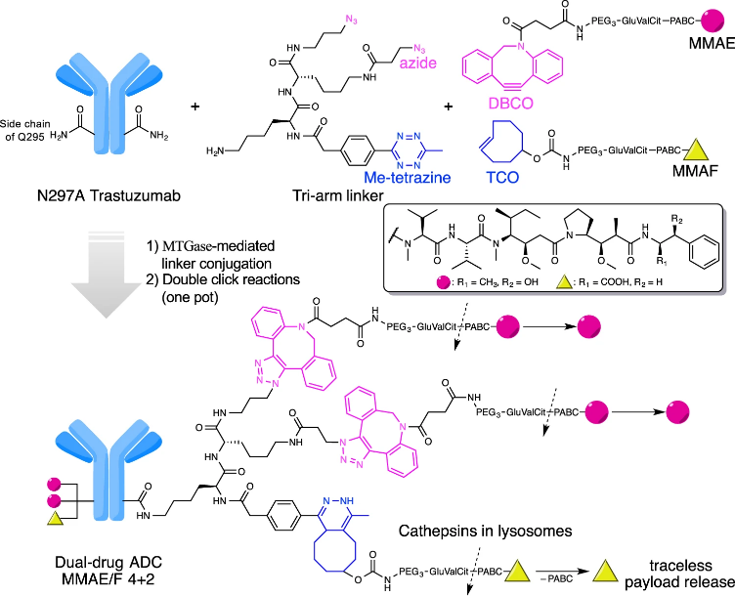
ADCs: What Lies in the Horizon?
Expansion of eligible patients & tumors
Dual Payloads
Novel targets & ADC platforms
Probody & bispecific antibody drug conjugates
Developments in the Linker Technology
Linkers with PEG spacers or polymer
Linkers with D- & L- alanine
Β-Glucuronide linkers and hydrophilic spacers
Site-specific conjugation

Slide 89
Thank you

Slide 90
HER2-Positive Breast Cancer Update
Mei Wei Huntsman Cancer Institute
August 2024

Slide 91
Disclosures:
Consultant/Advisory: Rely Therapeutics, Novartis, AstraZeneca, Arvinas, Segean, Merck

Slide 92
Early Stage HER2+ BC- Current SOC
Small tumor, cN0: adjuvant TH
Locally advanced: neoadjuvant TCHP: this might change (CompasspCR)
CompassPCR trial
pCR: complete 1 yr HP
RT and ET per guidelines
Stage II or IIIA
HER2+
Any ER, PR
THP x 4
surgery
Non-pCR: per physician’s choice or SOC
RT and ET per guidelines

Slide 93
Early stage HER2+ BC
Metastatic HER2+ BC
General
ER+/HER2+
CNS Metastases

Slide 94
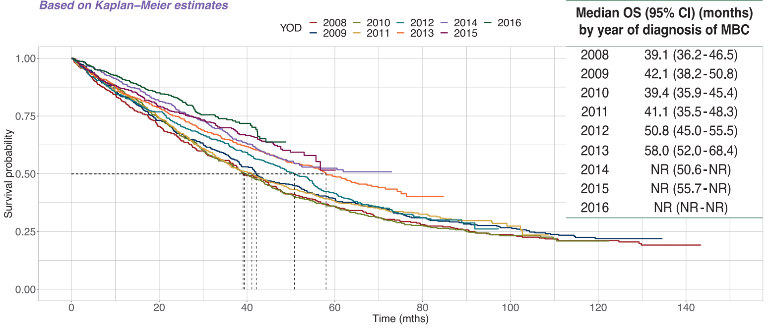
Overall Survival in HER2 + mBC by Year of Diagnosis
Grinda T, et al. ESMO Open. 2021

Slide 95
Metastatic HER2+BC – Current SOC
1L | 2L | 3L | 4L and beyond
THP | Tdxd | Tucatinib triplets | TDM1
 | Tucatinib triplets | Tdxd | Chemo+ trastuzumab
 |  | TDM1 | Lapatinib + Capecitabine
 |  |  | …
T-Dxd+ pertuzumab (n=378)
Destiny-Breast 09
Untreated HER2+ mBC
T-Dxd (n=378)
Primary Endpoint: PFS
Standard of Care (THP) (n=378)

Slide 96
Early stage HER2+ BC
Metastatic HER2+ BC
General
ER+/HER2+
CNS Metastases
Is triplets therapy an option?
PATRICIA study
MonarHER
PATINA

Slide 97
PATRICIA Cohort C:
HR+/HER2+ mBC
PAM50 Luminal A/B subtype (by Prosigna)
≥ 1L therapy for mBC
Stable CNS metastases allowed
No prior CDK 4/6i
Palbociclib+Trastuzumab+ ET(AI, fulvestrant, Tamoxifen)
N=38
1:1
TPC (TDM1, any ET, any chemo+trastuzmab)
N=35
Re-randomization
Primary Endpoints: PFS
Eva M Ciruelos MD, PhD. ASCO 2024. Oral Abstract

Slide 98
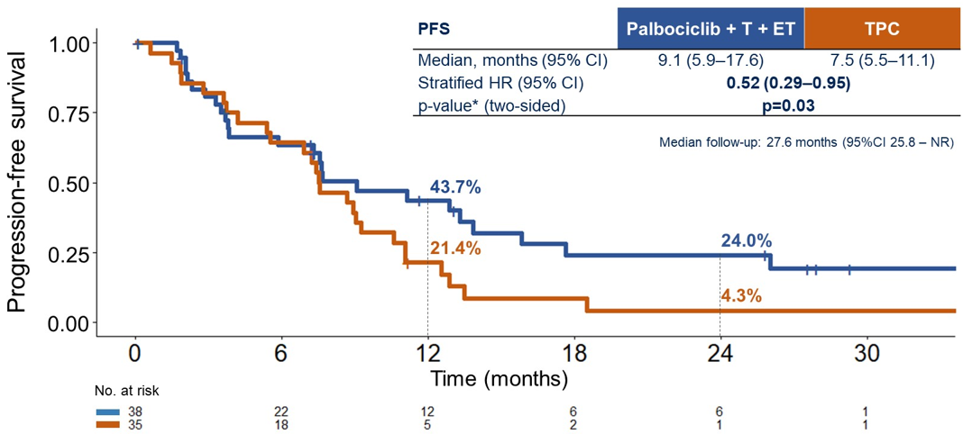
PATRICIA Cohort C Primary Endpoint: PFS
Eva M Ciruelos MD, PhD. ASCO 2024. Oral Abstract

Slide 99
Similar study: MonarHER
HR+/HER2+ mBC
Postmenopausal
Must have received:
Taxane
T-DM1
At least 2 anti-HER2 agents for mBC
A: Abemaciclib + trastuzumab + Fulvestrant
1:1
B: Abemaciclib + trastuzumab
C: Trastuzumab+ chemo agent
Primary Endpoints: PFS
S Tolaney, et al. Lancnt Oncol. 2020

Slide 100
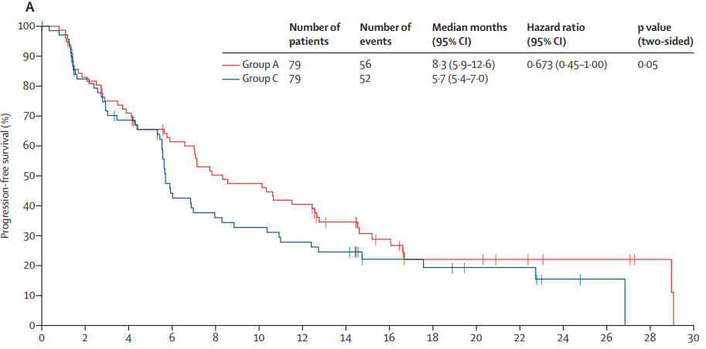
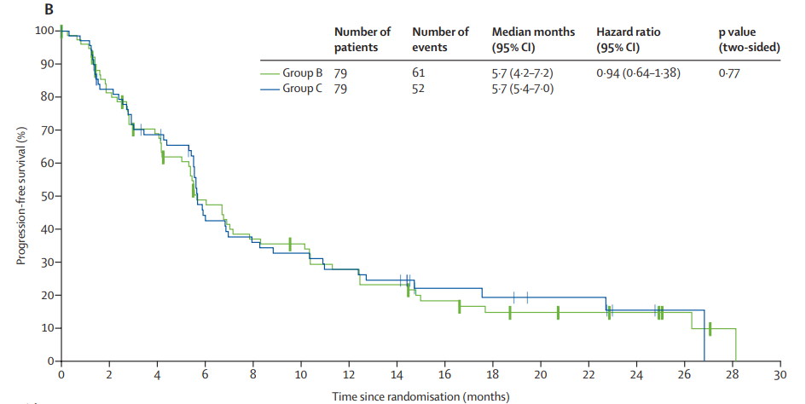
MonarHER
Abemaciclib + trastuzumab + Fulvestrant
vs
Abemaciclib + trastuzumab
PFS
PFS
Abemaciclib + trastuzumab
vs
Trastuzumab+ chemo agent
No significant difference by adding Abemaciclib
Not select Luminal type
S Tolaney, et al. Lancnt Oncol. 2020

Slide 101
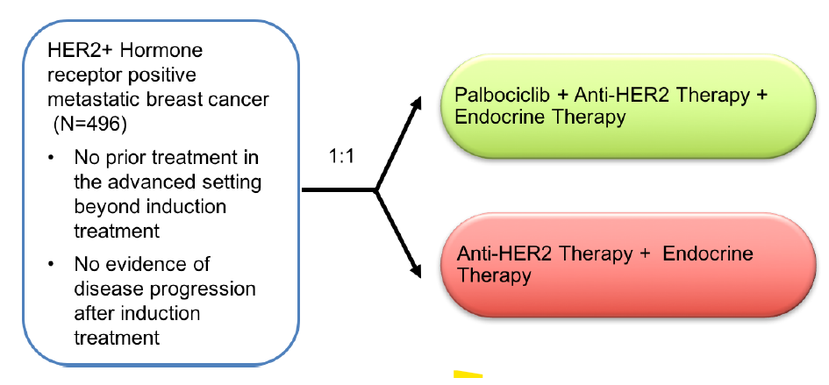
Similar study: PATINA
Triplets therapy maybe an option for selected ER+/HER2+ mBC
More high evidence data is needed
Waiting for results

Slide 102
Early stage HER2+ BC
Metastatic HER2+ BC
General
ER+/HER2+
CNS Metastases (tucatinib vs Tdxd)

Slide 103
HER2CLIMB Study Design

Slide 104
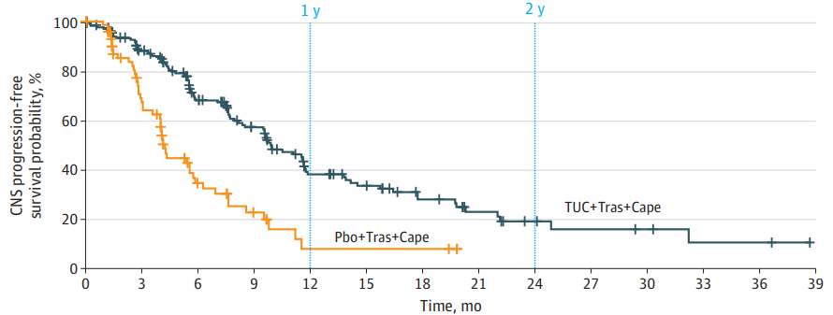
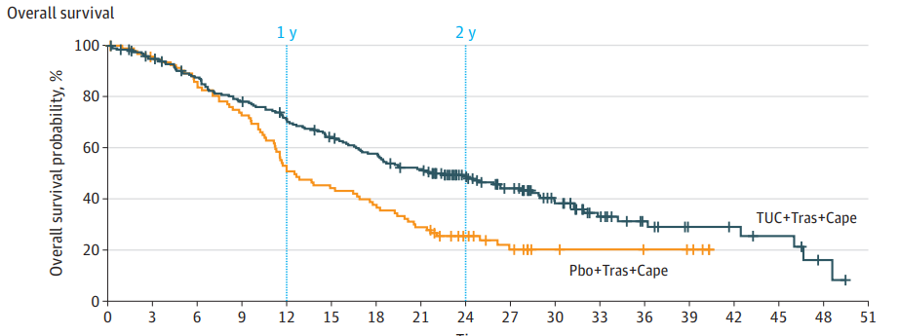
Median PFS
9.9 mo vs 4.2 mo
HER2CLIMB:
Patients with Brain Metastases
Median OS
21.6 mo vs 12.5 mo
Nancy Lin, et al. JAMA Oncol. 2022

Slide 105
DESTINY-Breast 01, 02, and 03 Pooled analysis of T-dxd in HER2+ mBC with Brain Metastases (BM)
DESTINY-Breast 01
BM=19
T-Dxd for previously treated HER2+ mBC.
Any line.
HER2+ mBC
Previously treated with TDM1
3L
T-Dxd
vs
Physician's choice
DESTINY-Breast 02 BM=124
HER2+ mBC
After Taxane and HP based therapy only
Not received TDM1
2L
T-Dxd
vs
TDM1
DESTINY-Breast 03
BM=88
Hurvitz SA, et al. ESMO 2023. Abstract 3770

Slide 106
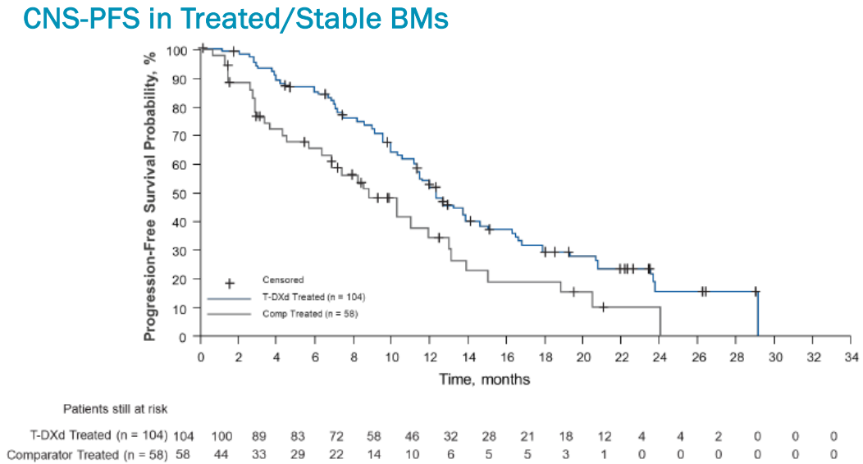
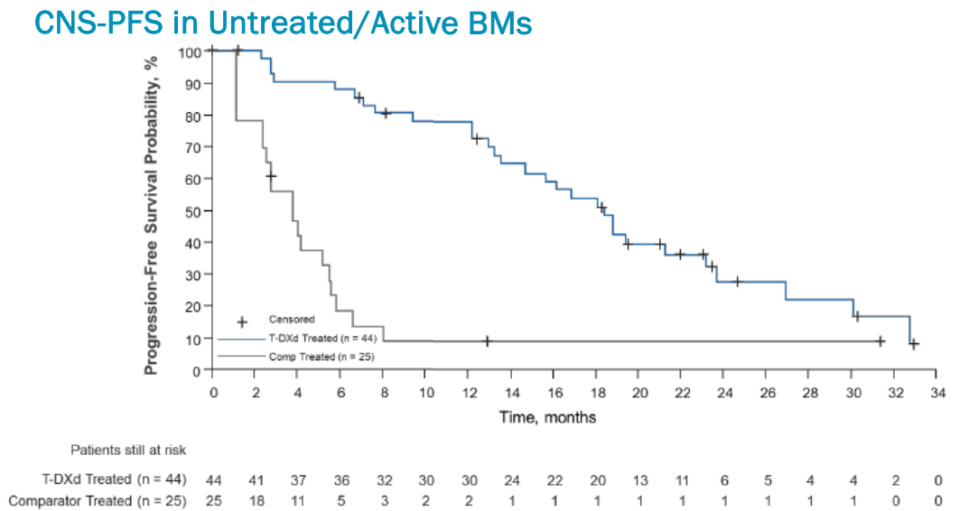
DESTINY-Breast 01, 02, and 03 Pooled analysis of T-dxd in HER2+ mBC with BM
T-Dxd
T-Dxd
Comparator
Comparator
Treated/Stable BM | T-Dxd n=104 | Comparator (n=58)
Median CNS-PFS, mo (95% CI) | 12.3 (11.1-13.8) | 8.7(6.3-11.8)
HR (95% CI) | 0.59 (0.39, 0.89)
untreated/active BM | T-Dxd n=44 | Comparator (n=25)
Median CNS-PFS, mo (95% CI) | 18.5(13.6,23.3) | 4.0(2.7, 5.7)
HR (95% CI) | 0.19 (0.11, 0.35)
Hurvitz SA, et al. ESMO 2023. Abstract 3770

Slide 107
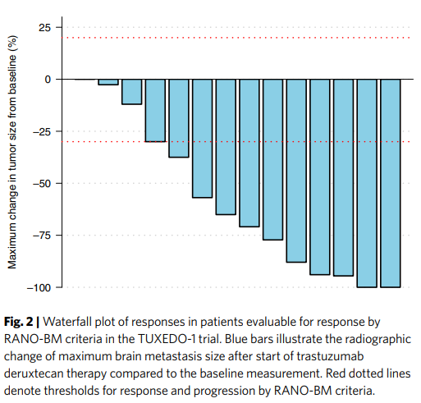
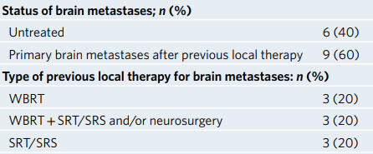
TUXEDO-1 trial: Tdxd in HER2+ mBC with brain metastases, N=15
Prospective
phase 2, single –arm
No LMD
Response | Patients (%)
CNS-CR | 2 (13%)
CNS-PR | 9 (60%)
CNS-SD | 3 (20%)
Intracranial response rate: 73.3%
Bartsch R et al. Naturamedicine. 2022

Slide 108
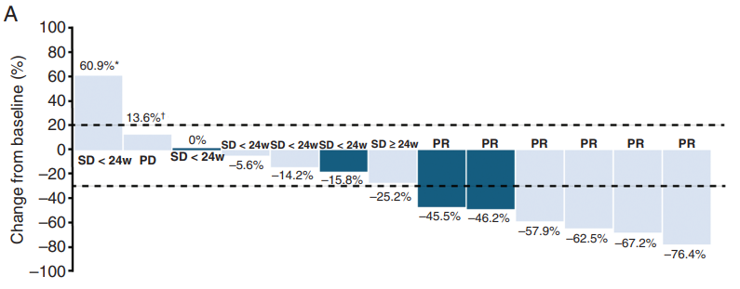
CNS response
DEBBRAH trial
Prospective
phase 2, single –arm
LMD cohort data is pending
Progressing brain mets. N=9
Asymptomatic, untreated brain mets. N=11
Pere-Garcia JM, et al. Neuro-Oncol. 2023

Slide 109
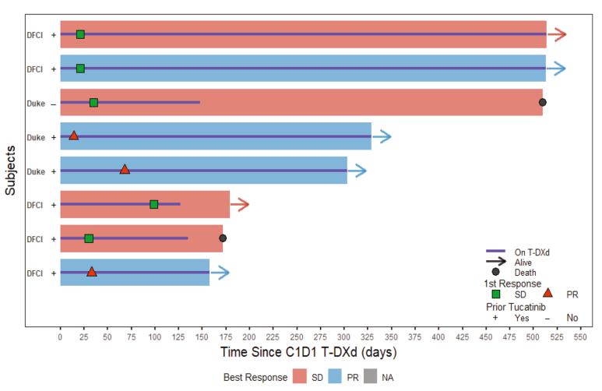
Does Tdxd have activities for LMD?
8 patients retrospective study
Had active LMD prior Tdxd
Median time on T-DXd: 7.6 mo
Median OS: 10.4 mo since the start of T-DXd
Tdxd shows encourage efficacy for HER2+ mBC with brain metastases, possible in LMD
Alder L, et al. NPJ Breast cancer. 2023

Slide 110
Thank you for your attention!
mei.wei@hci.utah.edu

Slide 111
BREAST MALIGNANCIES
August 28th, 2024

Slide 112
TNBC
Namita Chittoria, MD
Huntsman Cancer Institute
Salt Lake City, UT
•Acknowledge ASCO and the authors for reuse of slides

Slide 113
What is TNBC?
•ER 0% PR 0% Her2 neu negative ( +1 or negative by FISH)
•ER 1-10% – Low ER - heterogeneous group with biologic behavior like ER neg

Slide 114
•15%
•<40 year vs >50 year olds
•Positive BRCA mutation status – Up to 20 % of patients with TNBC harbor BRCA1/2 mutation. By contrast, <6% of all breast cancers are associated with a BRCA mutation.
•Referral to a genetic counselor to discuss BRCA germline testing

Slide 115
Early TNBC
T1a (1-5mm) Surgery Surveillance
T1b (>5 mm – 10 mm) Surgery ? TC
T1c (>10 mm – 20 mm) AC-->T Surgery
** TNBC > 1 cm are HIGH risk

Slide 117
KN522 5 yr EFS Update
81% vs 72%
With pCR - in the pembro and pbo groups - 92.2% vs 88.2%
Without pCR - in the pembro and pbo groups - 62.6% vs 52.3%
Follow-up for OS is ongoing.

Slide 118
44 year old women with cT2N1M0 (3 cm with 2 LNs) TNBC …
What's next?
Surgery
KN522
AC-->T

Slide 119
She received KN522 regimen and NOT in path CR...
What next?
Pembro + Capecitabine – safe
Pembrolizumab + Sacituzumab Govitecan – clinical trial enrolling NOW!

Slide 120
In pCR..
Continue Pembro..
results from SWOG1418 awaited...

Slide 121
44 year old women with cT1bN0M0 ( 9 mm) TNBC …
What's next?
Surgery
KN522
AC-->T

Slide 122
Surgery done!
Found to have a T1cN1M0 (1.2 cm) TNBC.
Now what?
AC 🡪 T
AC🡪 T and Carboplatin
AC🡪T and Carboplatin 🡪 Avelumab

Slide 124
AC🡪 T and Carboplatin​
AC🡪 T + Avelumab
A-BRAVE trial had only 18% of patients in the stratum A (who had not received neoadjuvant chemotherapy) and showed no benefit

Slide 125
SYSTEMIC THERAPY for Stage IV TNBC
PDL1 +
BRCA 1/2
Tumor burden
General health
Prior chemotherapy in NACT/Adj
Patient preference
Content of this presentation is the property of the author, licensed by ASCO. Permission required for reuse.

Slide 127
PD-L1-positive tumors CPS = 10 or more
First line – Pembro + chemotherapy
BRCA + PARPi
Second line
BRCA neg SG
Trastuzumab deruxtecan (Her 2 low)
Others

Slide 128
PD-L1-positive tumors

Slide 129
PD-L1-negative tumors
BRCA ½ positive -- PARPi
BRCA ½ negative – systemic therapy

Slide 131
Doxorubicin (60 to 75 mg/m² every three weeks, or 20 mg/m² weekly for three weeks followed by one week off) – Overall response rate (ORR) 30 to 47 percent.
Pegylated liposomal doxorubicin (40 mg/m² every four weeks) – ORR 10 to 33 percent
Lower risk of alopecia - such as gemcitabine (up to 15 percent), capecitabine (less than 10 percent), and pegylated liposomal doxorubicin (less than 20 percent).
Neuropathy and myalgia are greater with paclitaxel than with docetaxel
Mild-moderate hepatic dysfunction - Paclitaxel can be administered. In contrast, docetaxel should not be administered in this context. Anthracyclines with dose modification.
Nabpaclitaxel does not require premedication with steroids.
Capecitabine - oral, cross the BBB

Slide 135
50 y/o smoker from WY, comes in for second opinion. She was diagnosed with TNBC in 2019 with mets to bones and liver. PDL1 negative. She was treated with A+C x 2 and then A alone. She progressed and was treated with Taxol. Progressed and has mod neuropathy. Now presents with a single brain met and systemic progression. What's next?
Capecitabine
Trastuzumab deruxtecan (if Her 2 low)
SG
Others

Slide 136
Thank you

Slide 137
BREAST MALIGNANCIES
August 28th, 2024

Slide 138
Question-and-Answer

Slide 139
Thank You to Our Supporters:

Slide 140
Concluding Remarks
Thank you for coming!
Please scan the QR code here to complete a brief survey about tonight's event.

