Slide 1









Obtaining Tissue in the Era of Personalized Medicine
Jobelle Baldonado, MD
Thoracic Surgical Oncology
Wednesday, January 31st, 2024

Slide 3
Lung cancer remains the leading cause of cancer-related mortality
Pivotal role: pulmonologists, interventional radiologists, surgeons
Early adequate tissue, push for early differentiation of histological subtypes, staging, make treatment decisions
Lung Cancer Care
Notes:
Lung cancer remains the leading cause of cancer-related death in both men and women. Respiratory physicians have a pivotal role in the initial evaluation of patients with suspected lung cancer, with the key goals of obtaining an early tissue diagnosis, accurate staging, assessing the patient’s cardiorespiratory fitness, and make treatment decisions based on test results. Optimal treatment. for patients with advanced lung cancer increasingly involves biomarker-directed systemic therapy, which requires a multidisciplinary approach, aligning proceduralists (defined as a pulmonologist, surgeon, or interventional radiologist), pathologists, and oncologists.

Slide 4
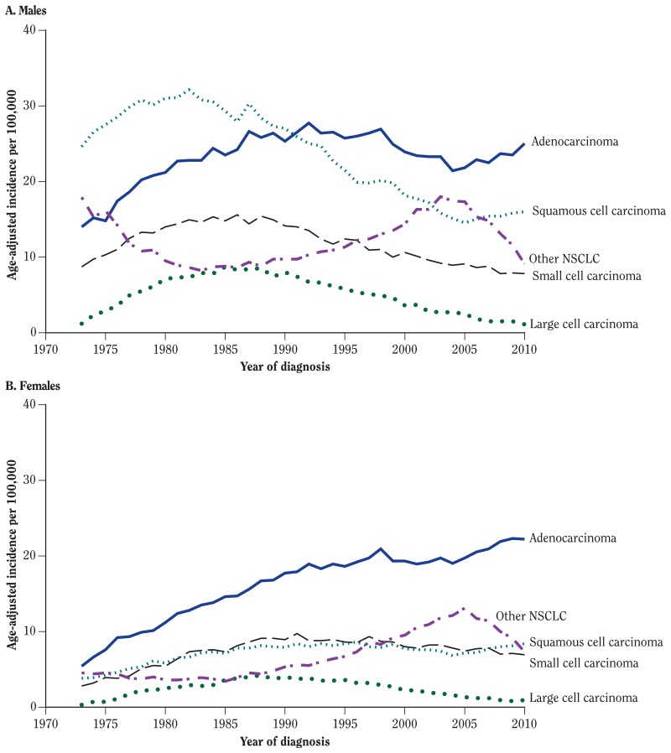
Notes:
Over the last 40 years, the prevalence of adenocarcinoma has been increasing relative to other lung cancer subtypes, impacting the need to obtain adequate tissue for histological subtyping and molecular testing. Along with this, there is an accompanying shift towards more peripherally located primary tumors which consequently has increased the difficulty in obtaining diagnostic material

Slide 5
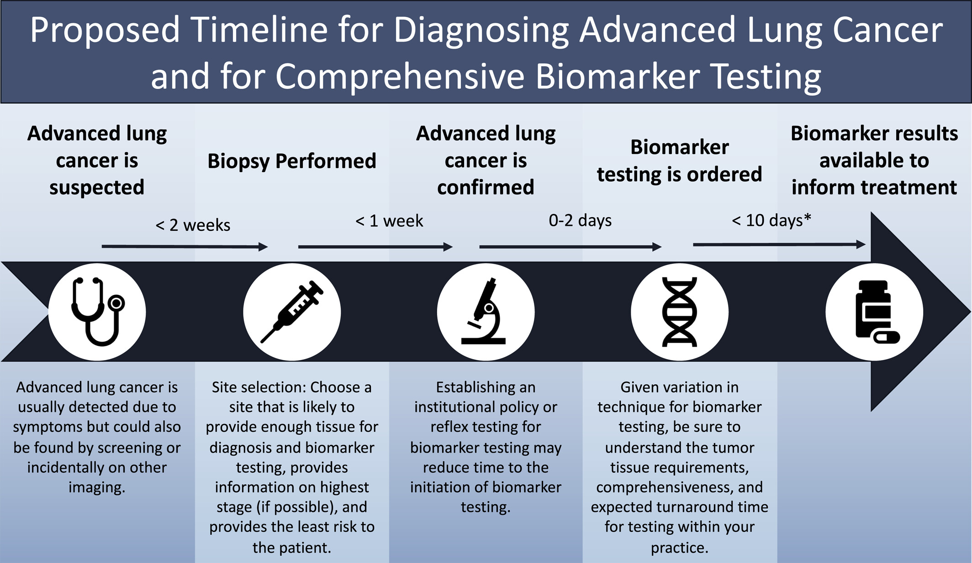
Acquiring tissue for advanced lung cancer diagnosis and comprehensive biomarker testing: A National Lung Cancer Roundtable best‐practice guide
CA A Cancer J Clinicians, Volume: 73, Issue: 4, Pages: 358-375, First published: 01 March 2023, DOI: (10.3322/caac.21774)
Notes:
Proposed timeline for diagnosing advanced nonsmall cell lung cancer. *2018 College of American Pathologists/International Association for the Study of Lung Cancer/Association of Molecular Pathology guidelines suggest that ideal turnaround time from receipt of specimens to reporting of all results should be <10 business days (see Lindeman et a
The goal of this guide is to aid multidisciplinary teams and health care providers involved in the initial diagnosis of lung cancer in achieving successful biomarker testing with a focus on timely decision making around the time of diagnosis. The initial site selected for biopsy is critical to the diagnostic process and should be chosen with care. Fundamental to this discussion is an understanding of methods to establish lung cancer diagnosis and appropriate staging tests. l., 201811).

Slide 6
Confirm the diagnosis and histologic subtype
Histologically confirm the most advanced stage
Secure sufficient quality and quantity of tissue for comprehensive biomarker testing
Minimize patient risk and cost exposure
Goals for biopsy site selection
Notes:
We summarize the key tenets for optimal biopsy site selection this table here.
1. Confirm the diagnosis and subtype of lung cancer (squamous, adenocarcinoma, small cell, etc.).
2. Histologically confirm the most advanced stage (within the limits of safety and yield).
3. Secure sufficient quality and quantity of tissue for comprehensive biomarker testing.
4. Minimize patient risk and cost exposure.

Slide 7
Bronchoscopy
Washings, brushings, forceps biopsy
Diagnostic yield of 88% in large, central lesions
Diagnostic yield is down to 14% in lesions <2cm and outer 1/3 of the lung
Shreiber G., Chest. 2003;123(Suppl. 1):S115–S128.
Baalini W.A.,et al. Chest. 2000;117:1049–1054
Notes:
While tissue sampling with bronchoscopy (through washings, brushings and forceps biopsy) has a diagnostic yield of 88% in large central lesions, the sensitivity declines significantly as lesions become smaller and more distal. In fact, the diagnostic yield of bronchoscopy for lesions <2 cm and in the outer 1/3 of the lung was shown in one study to be as low as 14%

Slide 8
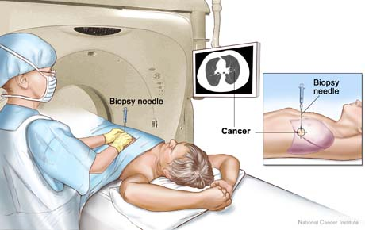
Percutaneous needle biopsy
Superior to bronchoscopy in peripheral lesions
Sensitivity of 90% but reduced to 70% in lesions under 1.5cm
NPV is only 70%
Higher risk of pneumothorax
Rivera P. Establishing the diagnosis of lung cancer: Diagnosis and management of lung cancer. Chest. 2013;143:e143S–e165S.
Li H. Am. J. Roentgenol. 1996;167:105–109.
Notes:
Radiologically guided percutaneous (or transthoracic) needle biopsy is increasingly being employed for the diagnosis of lung cancer, and is superior to bronchoscopy in peripheral lesions. A meta-analysis of published studies suggests the superiority of transthoracic needle biopsy to bronchoscopy in peripheral lesions with a pooled sensitivity of 90%. However, like bronchoscopy, the sensitivity of transthoracic needle biopsy is also affected by lesion size, reducing to 70% in lesions under 1.5 cm. Despite its high sensitivity, caution should be taken in using transthoracic needle biopsy as a “rule out” procedure, as the negative predictive value remains only 70%
There are associated complications with transthoracic needle biopsy. Reported rates of pneumothorax are as high as 60% (with a need for chest drain insertion in up to 15%) This compares to a pneumothorax rate of less than 2% associated with bronchoscopy. The risk of complication following percutaneous biopsy is increased with smaller, deeper lesions as well as in older, current smokers and those with emphysema. As a result, the decision to pursue percutaneous biopsies in a frequently high-risk cohort is often a difficult one.

Slide 9
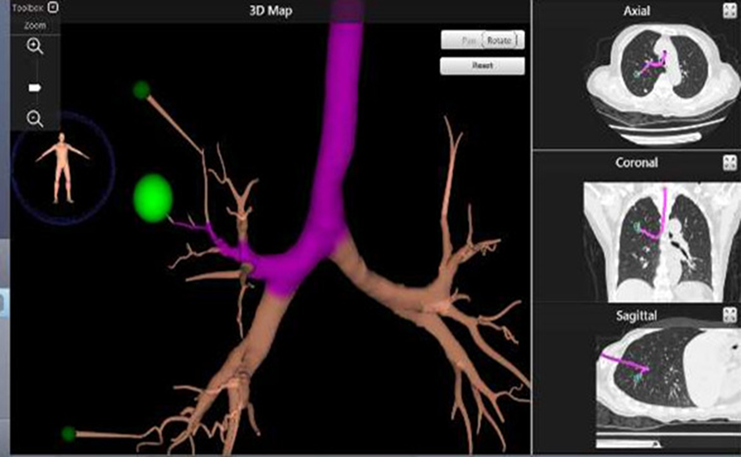
Complimentary navigation techniques
Notes:
These limitations and the changing topography of lung cancer have driven the recent development of complimentary navigation techniques to improve the ability to localize and therefore sample peripheral lung cancers bronchoscopically.

Slide 10
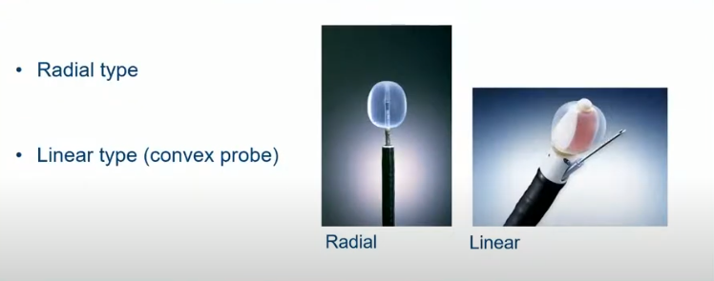
Endobronchial Ultrasound (EBUS)

Slide 11
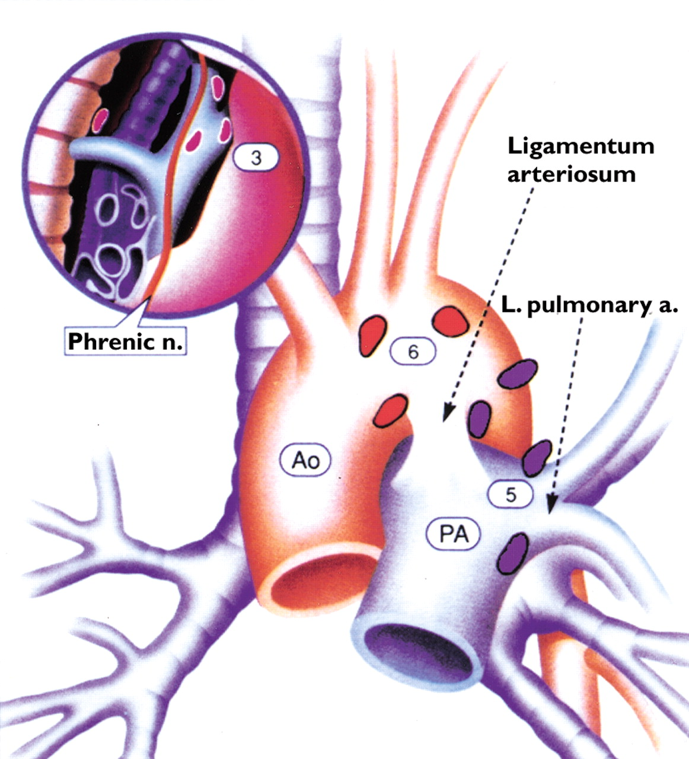
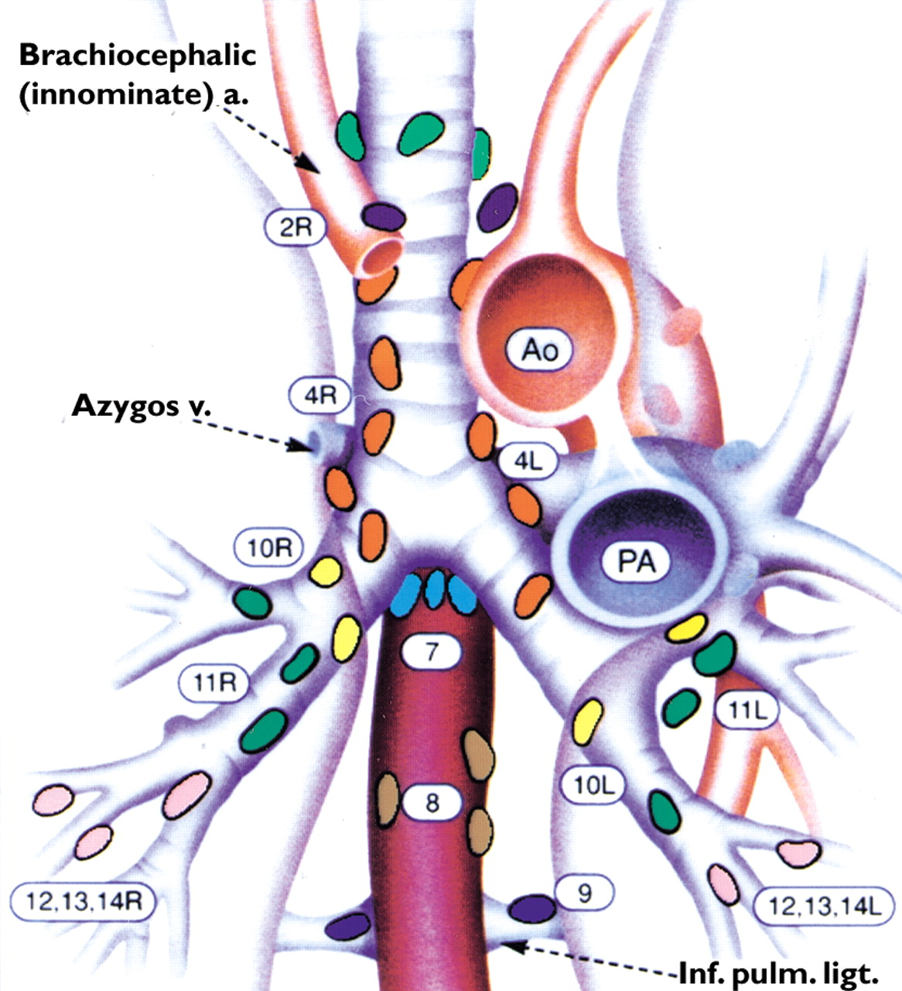


Staging (AJCC 8th Edition)

Slide 12
Radial Endobronchial Ultrasound (EBUS)
Probe contains an ultrasound
360° image of surrounding structures
Able to localize the target lesion in 96% of cases
Sn of 73%, 1% pneumothorax rate
No difference in diagnostic accuracy between radial probe EBUS (87.5%) and CT-guided biopsy (93.3%) but with a significantly reduced rate of complications (3% vs 27%).
Chen A., et al. Ann. Am. Thorac. Soc. 2014;11:578–582.
Steinfort D.P. Eur. Respir. J. 2011;37:902–910.
Steinfort D.P. Respir. Med. 2011;105:1704–1711.
Notes:
This technique utilises a probe that contains an ultrasound able to provide a 360-degree image of surrounding structures. The probe is inserted into the working channel of the bronchoscope and advanced to different segments of the target lobe until the location of the nodule for sampling is determined. Traditional bronchoscopy techniques are then used to perform a biopsy of the located lesion [13]. Impressively, in a large retrospective study, radial probe EBUS was able to localise the target lesion in 96% of cases [22]. A meta-analysis looking at mostly retrospective and small randomised controlled trials of radial probe EBUS reported a pooled diagnostic sensitivity of 73% with a pneumothorax rate of only 1% [23]. Finally, a randomised prospective study performed in an experienced Australian centre demonstrated no statistical difference in diagnostic accuracy between radial probe EBUS (87.5%) and CT guided biopsy (93.3%) but a significantly reduced rate of complications (3% vs. 27%) [24].

Slide 13
Linear Endobronchial Ultrasound (EBUS)
Convex-probe EBUS with transbronchial needle aspiration
Flexible bronchoscope with a convex transducer at its tip
50° ultrasound image of the structures by pointing the probe in contact with the central airway, then a TBNA needle is passed
Diagnosis and staging of lung cancer
First line in mediastinal staging in patients with
  Enlarged/FDG-avid mediastinal nodes on CT/PET
  Central tumor
  Enlarged hilar nodes
Notes:
There has been increasing emphasis on mediastinal staging to guide treatment decisions in NSCLC, with clear evidence that primary surgical resection is not beneficial for lung cancers with supraclavicular or contralateral lymph node involvement, or metastasis (Stage IIIb or IV disease) [31]. Linear (or convex probe) endobronchial ultrasound with transbronchial needle aspiration (EBUS-TBNA) is increasingly being chosen as the initial diagnostic procedure for those with central lesions and/or radiological evidence of node-positive disease. Linear EBUS is performed with a flexible bronchoscope which contains a convex transducer at its tip. A 50-degree ultrasound image of the structures underlying the transducer is produced by positioning the probe in direct contact with the wall of a central airway. Once the lymph node or mass is located a TBNA needle is passed through the working channel of the bronchoscope and under real-time ultrasound guidance introduced into the target to obtain a cytological specimen
This technique can diagnose and stage patients in a single, minimally invasive procedure, and is now recommended as first line for staging the mediastinum in all patients with enlarged and/or glucose-avid mediastinal lymph nodes on CT or PET imaging [33]. EBUS-TBNA is also recommended in patients without mediastinal node enlargement or PET avidity, who have a central tumour or enlarged hilar lymph nodes [33], due to false negative rates on PET-CT of up to 25% of these cases

Slide 14
Typical reported yield range 60-88%
Yield rates vary with lesion size and location
Best documented yields are with combined modality (Navigation + R-EBUS) increased to 88% similar to TTNA
Lower risk of pneumothorax
Electromagnetic Navigation (EMN)
Eberhardt R. Multimodality bronchoscopic diagnosis of peripheral lung lesions: A randomized controlled trial. Am. J. Respir. Crit. Care Med. 2007;176:36–41.
Notes:
More promising was the result of a randomised controlled trial which compared the use of either radial probe EBUS, EMN or the combination of the two, for the diagnosis of peripheral lung lesions. The study found that the diagnostic yield achieved by combining the two techniques increased to 88%, far greater than that for radial probe EBUS (69%) or EMN (59%) alone. The addition of complimentary navigation techniques to traditional bronchoscopy perhaps represents the way forward for the safe and accurate diagnosis of peripheral lung lesions. However, currently, the use of this approach is limited by the restriction of these diagnostic tools to only a few specialist centres.

Slide 15
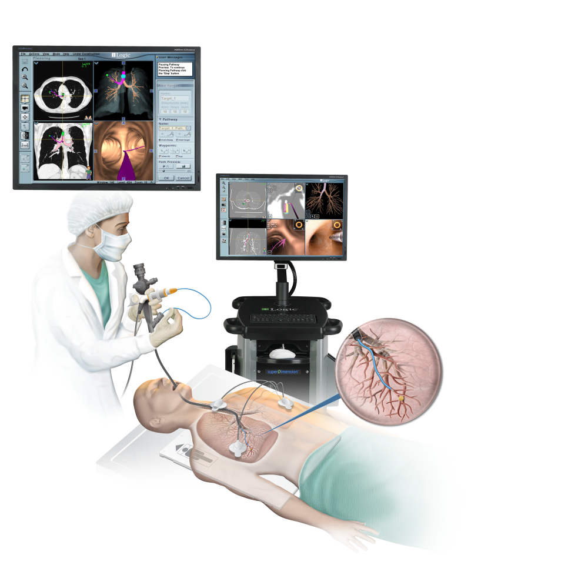
Electromagnetic Navigation (EMN)
Position sensor in the tip of a flexible probe through a bronchoscope
Diagnostic yield 68%
Pneumothorax rate 4%
Becker H.D Bronchoscopic biopsy of peripheral lung lesions under electromagnetic guidance: A pilot study. J. Bronchol. Interv. Pulmonol. 2005;12:9–13.
Rivera P. Chest. 2013;143:e143S–e165S.
Notes:
This involves an electromagnetic tracking system, which uses a position sensor in the tip of a flexible probe deployed through the working channel of the bronchoscope. The position of the sensor is mapped in 3-dimensions, on a real time reconstruction of a previously obtained CT. The position of the sensor can be monitored as it is maneuvred into the lung periphery and directed based on its position relative to the lesion depicted on the CT image [25]. Several small prospective studies have investigated the benefit of EMN in improving the diagnostic yield of bronchoscopy for small peripheral lesions. In these studies, the average diagnostic yield was 68% with a pneumothorax rate of 4%

Slide 16
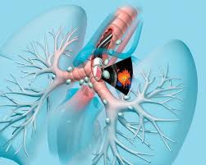
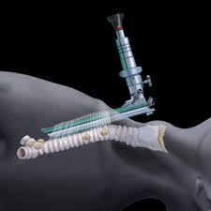
EBUS | Cervical mediastinoscopy
Outpatient | Outpatient
Deep sedation | General anesthesia
No incision | 2cm cervical incision
Lower accuracy (60-80%) | Higher accuracy (92-95%)
Lower risk of complications | Higher risk of complications (0.5%)
Stations 2R/2L, 3P, 4R/4L, 7, 10R/10L, 11-12 | 2R/2L, 4R/4L, 7
Notes:
An EBUS-negative for malignancy in a clinically (PET and/or CT) positive mediastinum should undergo cervical mediastinoscopy prior to surgical resection to confirm.

Slide 17
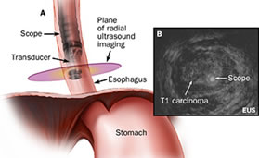
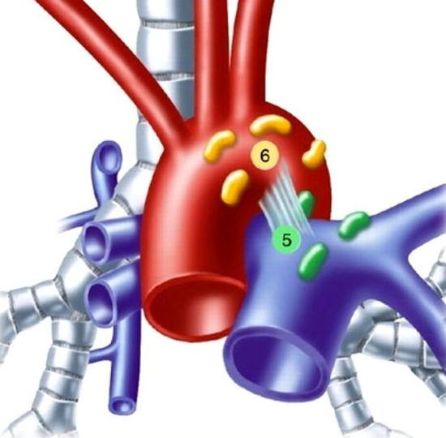
EUS | Chamberlain Procedure
Outpatient | Extended outpatient/inpatient
Deep sedation | General anesthesia
No incision | 2cm parasternal incision, 2nd interspace
Lower risk of complications | Stations 5 and 6
Can sample L adrenal gland
Stations 7, 8, 9, 5 (but tough)
Notes:
Whilst EBUS-TBNA can sample the majority of lymph node stations it cannot be used for nodes situated beyond the reach of the bronchoscope (stations 3, 5, 6, 8, 9). Most of these however, can be reached via an endoscopic ultrasound (EUS) approach and this has led to the development of a combined EUS and EBUS technique to “completely” stage the mediastinum. To date studies have demonstrated a small improvement in diagnostic sensitivity with the combined approach (91–96%) compared to EUS (89%) or EBUS (84–92%) alone

Slide 18
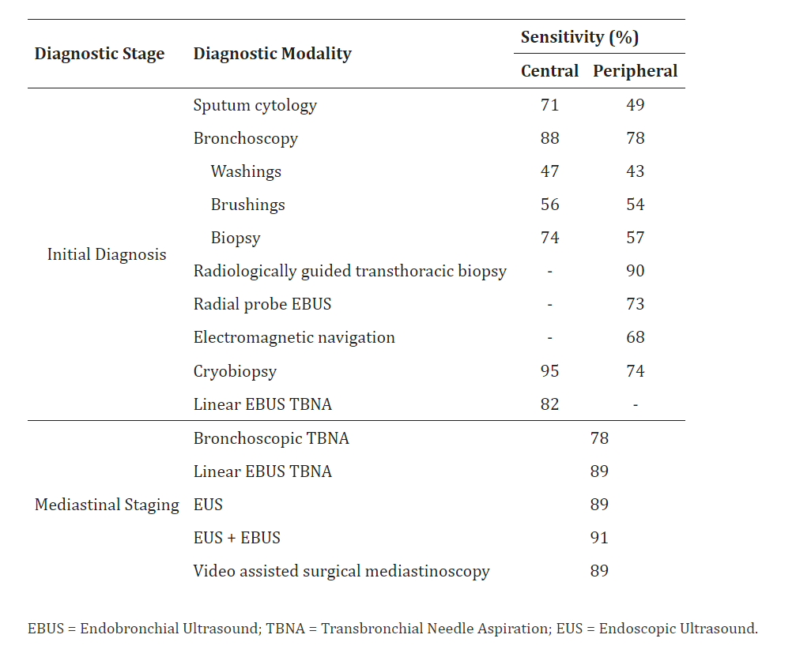
Notes:
This table here summarizes the sensitivities of various diagnostic techniques in lung cancer.
The high sensitivity and tolerability of EBUS-TBNA for mediastinal staging has left very little role for mediastinoscopy in the diagnosis of lung cancer today. Guidelines now suggest that mediastinoscopy should be reserved for situations where EBUS/EUS is not accessible or when very high clinical suspicion of mediastinal involvement remains despite negative EBUS/EUS

Slide 19
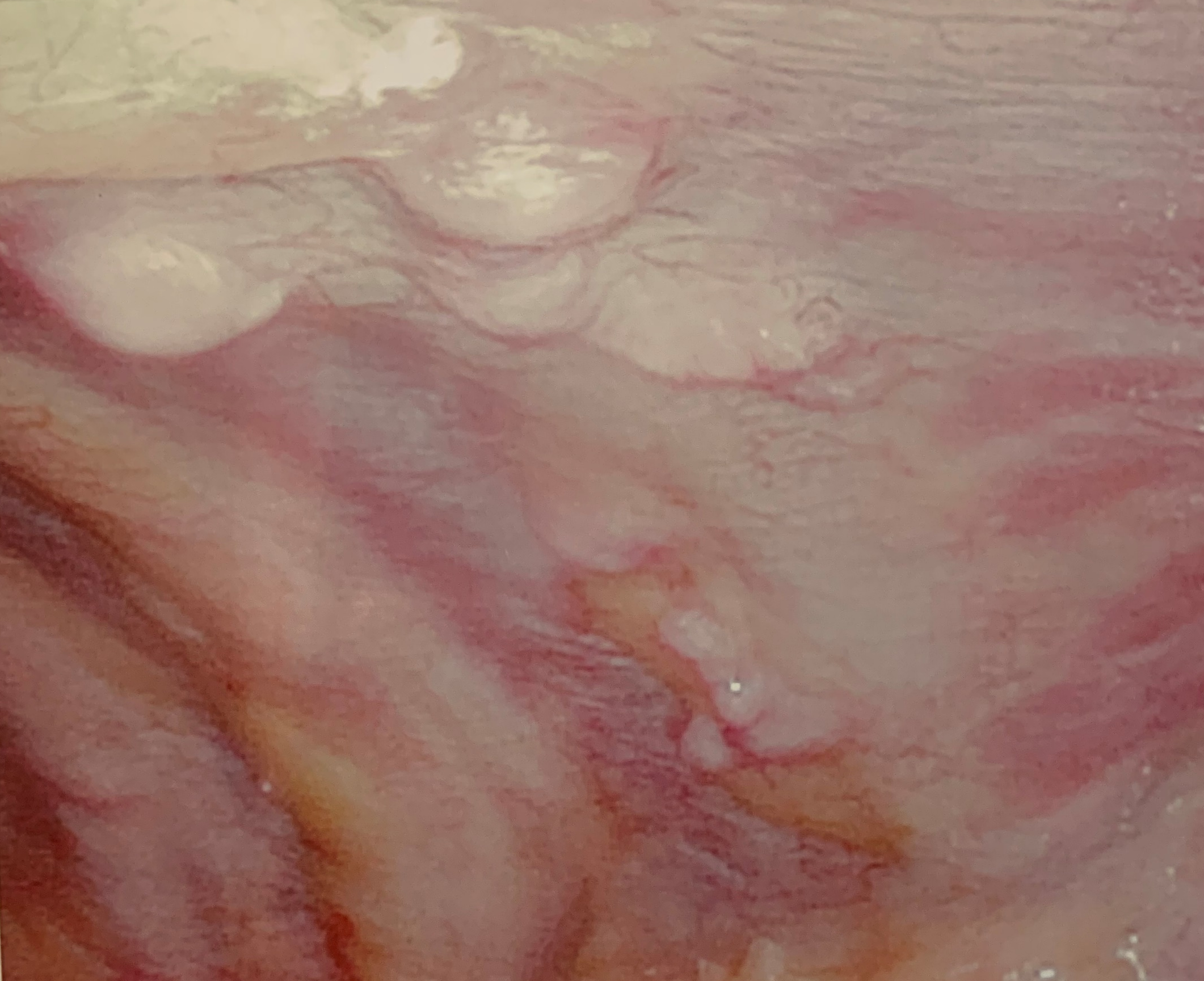
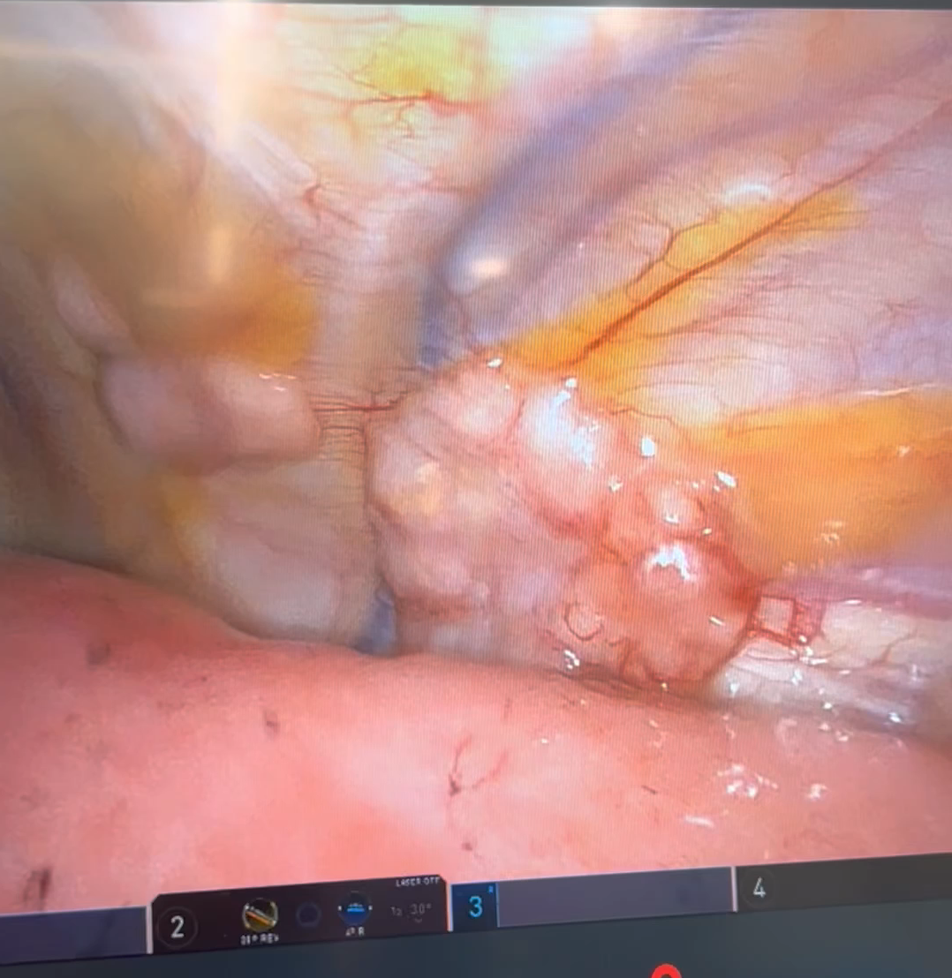
Surgical biopsy

Slide 20
Case Scenarios

Slide 21
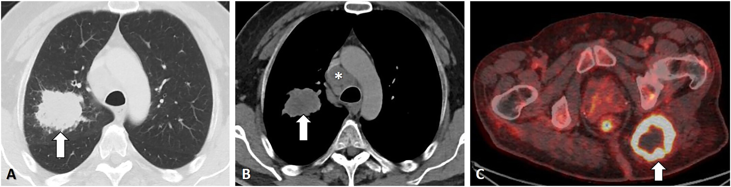
60/M, 90 py smoking history, cough and a vague L buttock pain
5cm RUL mass, paratracheal adenopathy, FDG-avid gluteal mass
Scant cells on EBUS-TBNA, negative mediastinoscopy
IR biopsy of gluteal mass: squamous cell carcinoma, PD-L1 positive
Notes:
So we have here a known smoker who has a suspicious metastatic lung cancer. Early on in his evaluation, the patient could have had a less invasive, safer, quicker, and less expensive outpatient procedure to obtain tissue from his left gluteal mass if attention had been paid to his presenting symptom of left gluteal pain. The patient could have been spared the bronchoscopy with EBUS-TBNA and cervical mediastinoscopy, which did not yield a diagnosis and delayed his care by several months. So this case illustrated the importance of site selection and a timely biopsy. As we know, a nondiagnostic biopsy sets back the entire diagnosis-to-treatment pathway.
Biopsies can be nondiagnostic for a variety of reasons, including noninvolvement with malignancy of the target site (as in this case), trouble sampling the target site during the procedure, low tumor cellularity in the lesion or in the sample collected, and extensive necrosis in the lesion.

Slide 22
Take-aways
Biopsy the most accessible site that confirms the stage
Initial site selection has implications with timeline for diagnosis, staging, biomarker testing
Squamous and non-squamous NSCLC are biologically different
PET/CT is not a perfect tool
Notes:
Biopsy the most accessible site that also confirms the stage. Suspicious, painful soft-tissue lesions and enlarged peripheral lymph nodes (especially neck lymph nodes), if present, can often be safely sampled and provide staging information. A biopsy of the suspected primary lung tumor provides the least amount of staging information.
As illustrated in this case, initial site selection for biopsy has implications for the entire timeline for diagnosis and completion of biomarker testing, both of which are critical to initiating a treatment plan. Not all sites are equally informative, and care should be taken when selecting the initial biopsy site.
Squamous cell and nonsquamous lung cancers are biologically different. Currently, PD-L1 testing is recommended for all metastatic NSCLC, regardless of histology, to direct the use of immunotherapy.¹⁰ For those with nonsquamous NSCLC, testing for oncogenic driver mutations is indicated. Guidelines do support targeted therapy assessment in squamous cell lung cancer, especially for young patients and persons with a history of light or no smoking.^{10, 11} Furthermore, poorly differentiated cancers may be difficult to classify, and small biopsies may miss an adenocarcinoma component.
PET/CT is imperfect for detecting cancer and sites of potential metastasis; false positive sites may be caused by infectious or inflammatory disorders. Confirming stage histologically, rather than solely relying on imaging, is warranted.

Slide 23
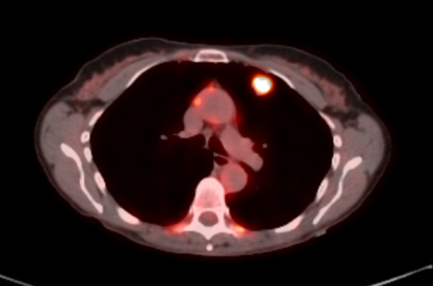
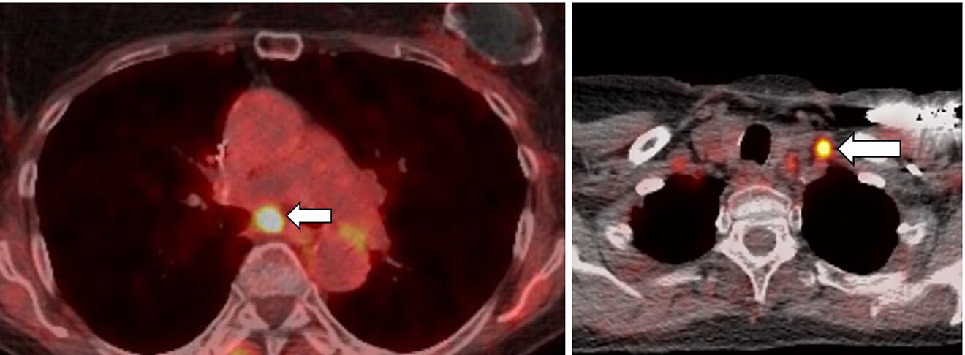
75/F with prior R upper lobectomy 10 yrs ago for pT1cN0M0 SCC new 1.9cm LUL nodule subcarinal and supraclavicular adenopathy
LN showed adenocarcinoma, PD-L1 positive
Chemoradiation then durvalumab
Notes:
You can see here that even if the LUL nodule is easily accessible for a percutaneous biopsy, you must take into account the possible spread to the regional lymph nodes, considering the lymphadenopathy evident on the PET scan. In this case, the supraclavicular node was excised outpatient under local anesthesia. So the patient was spared a bronchoscopy, CT-guided lung biopsy, or a cervical mediastinoscopy. The excision of the stage-defining supraclavicular lymph node confirmed adenocarcinoma and provided adequate tumor tissue for comprehensive biomarker testing. Given her otherwise good health, she was treated with pemetrexed, cisplatin, and radiotherapy with a good tumor response followed by durvalumab for her stage IIIB disease.

Slide 24
Take-aways
Target the most advanced, stage-defining lesion
Differentiate recurrence from a new primary NSCLC
Notes:
Target the most advanced stage-defining lesion for tissue sampling. Thoracic lymph nodes are commonly involved in advanced NSCLC when extrathoracic sites are not available, and sampling is indicated to confirm the stage of lung cancer histologically.
Differentiating recurrence from a new primary lung cancer as this has important treatment implications. The clinical characteristics (including stage and time interval), histology, and biomarker profile can aid in this determination.
Although biomarker-driven therapies do not have an established indication for first-line therapy in unresected stage III NSCLC, a recent retrospective analysis of the PACIFIC trial (ClinicalTrials.gov identifier NCT02125461) suggested that the benefit of consolidative immunotherapy with durvalumab was mostly in patients with PD-L1 expression >1%.⁴⁸ Furthermore, testing at the time of diagnosis can prepare for subsequent lines of therapy at the time of disease progression.

Slide 25
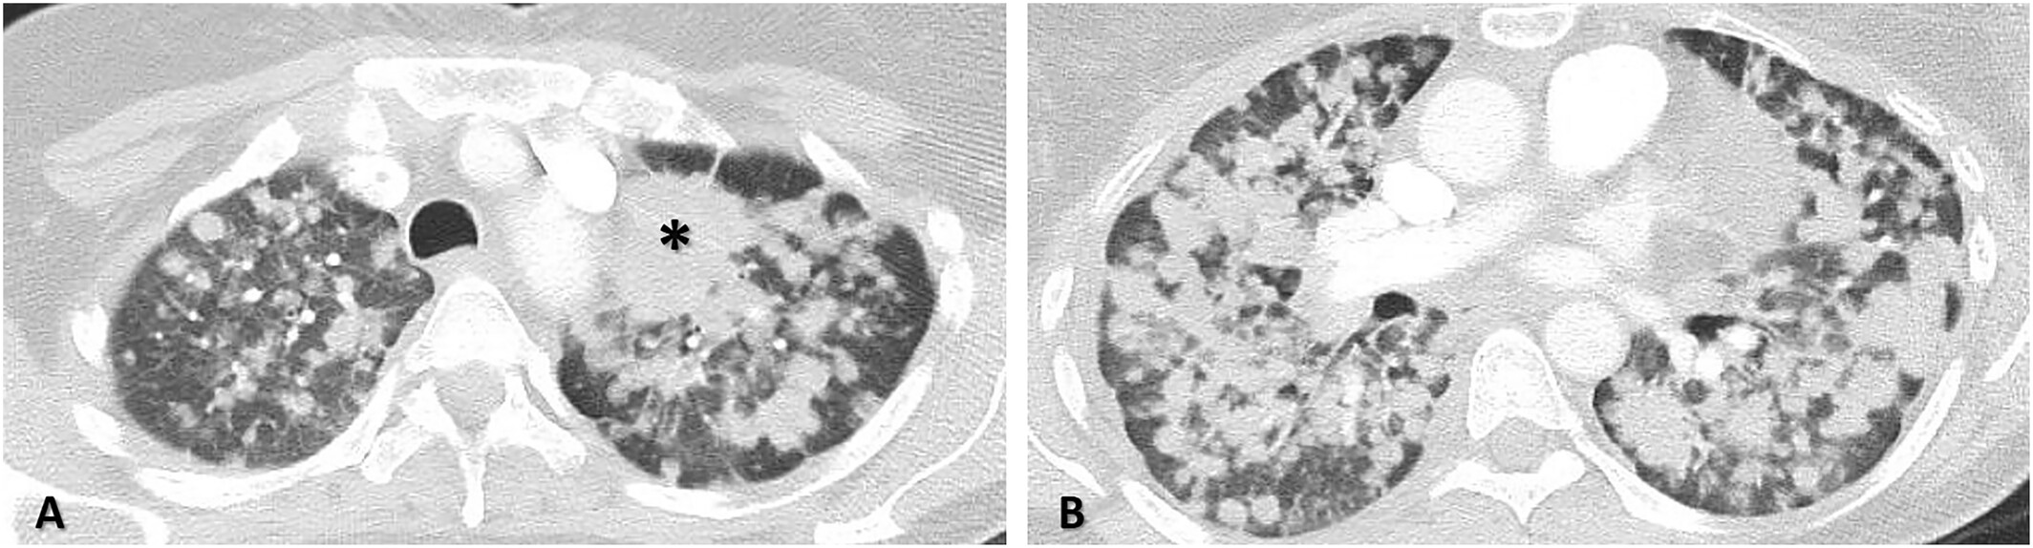
60/F, never smoker, presenting with SOB
Dominant 4cm LUL mass innumerable bilateral pulmonary nodules
bronchoscopy with TBNA nondiagnostic
IR biopsy of peripheral nodule: adenocarcinoma, PD-L1 positive, EGFR exon 20 insertion
Zhang JH. Kardiochir Torakochirurgia Pol. 2022; 19(2): 96-101
Notes:
In this patient many of the pulmonary nodules suspicious for a metastases present as better option for biopsy because they provide staging information that biopsy of the dominant LUL mass does not. Furthermore these sites are more easily accessed by a transthoracic needle biopsy because of the peripheral location. Again the meta-analysis of CT-guided biopsies demonstrates a pooled adequacy for molecular testing of 95%.
The patient is a never smoker and path was consistent with adenocarcinoma, increasing the likelihood of having a driver mutation. This patient was treated with empiric carboplatin and pemetrexed. An exon 20 EGFR insertion mutation found on biomarker testing of the IR biopsy specimen gives her the option to be treated with amivantamab after the platinum-based chemotherapy.

Slide 26
Take-aways
All patients with advanced nonsquamous NSCLC should be assessed for targetable mutations
All patients with advanced NSCLC should have PD-L1 testing
Delays in biopsy or repeat biopsy is an interdisciplinary issue
Biopsy of suspected primary lung cancer is not recommended when accessible metastatic lesions are available
Lindeman NI. Updated molecular testing guideline for the selection of lung cancer patients for treatment with targeted tyrosine kinase inhibitors: guideline from the College of American Pathologists, the International Association for the Study of Lung Cancer, and the Association for Molecular Pathology. Arch Pathol Lab Med. 2018; 142(3): 321-346.
Notes:
Current guidelines recommend that all patients with nonsquamous histology should be assessed for targetable mutations and to test certain patients with squamous histology: e.g., young persons, those with light or no smoking history, and those with poorly differentiated tumors. Although these same clinical factors may increase the likelihood of targetable mutations in patients with nonsquamous NSCLC, guidelines recommend a systematic approach to testing all eligible patients with advanced nonsquamous NSCLC. All patients with advanced NSCLC are recommended for PD-L1 testing, regardless of histology.
Delays in biopsy or re-biopsy and initiation of biomarker testing once tissue is collected is an interdisciplinary problem. Communication between providers is essential to prevent and minimize delays in the diagnostic process for patients.
Biopsy of the suspected primary lung cancer is not recommended in cases when accessible metastatic lesions are present. Compared with the primary cancer site, biopsy of intrapulmonary metastasis would provide histologic evidence of a higher clinical stage.

Slide 27
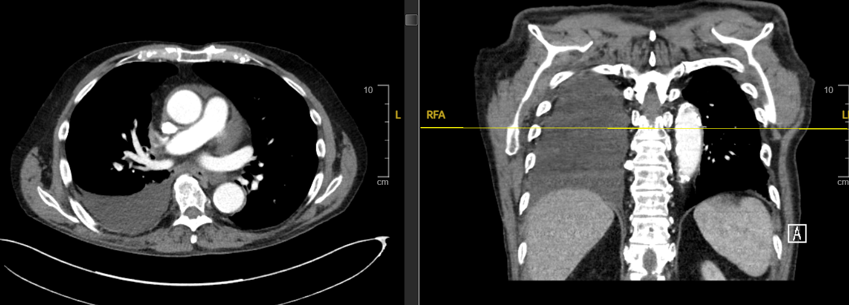
55/F, never smoker, presenting with SOB
Moderate right pleural effusion
Thoracentesis: 1L serosanguinous pleural fluid
Cytology showed adenocarcinoma, ALK rearrangement
Notes:
A 55-year-old woman with no history of smoking presented with 2 months of increasing shortness of breath. A chest radiograph showed a right-sided pleural effusion. A chest CT scan confirmed the effusion, but no other sites of metastatic disease. A thoracentesis yielded 1 liter of pleural fluid, and cytological examination showed an adenocarcinoma, consistent with metastatic spread from a primary lung cancer. Further immunohistochemical evaluation showed that the adenocarcinoma cells stained positive for ALK, which was confirmed by fluorescence in situ hybridization showing the ALK rearrangement. The findings from the formalin-fixed, paraffin-embedded cell block were confirmed by an NGS panel. She has remained on ALK inhibitor therapy for 5 years after initial diagnosis. So this case shows that thoracentesis can yield adequate numbers of tumor cells for cytological diagnosis and confirm clinical stage IVA. Diagnostic yield for malignancy from an initial thoracentesis is approximately 40%–60% and is influenced by clinical factors, such as level of suspicion for malignant etiology, degree of pleural involvement by tumor, and type of malignancy. Patients do not require sedation for thoracentesis and complications like pneumothorax and hemothorax are infrequent, occurring in fewer than approximately 5% of patients.⁵ In addition, many laboratories can perform comprehensive biomarker testing on cytology specimens obtained at thoracentesis.

Slide 28
Take-aways
Thoracentesis of suspected malignant pleural effusions is safe, inexpensive, stage-defining, obtains cytologic tissue for biomarker testing
Performed outpatient
Notes:
Thoracentesis of suspected malignant pleural effusions represents a safe, inexpensive, and convenient opportunity to confirm the diagnosis, establish stage IVA (M1a), and obtains cytologic tissue for biomarker testing. Thoracentesis can usually be performed in the outpatient setting.
Some laboratories may not be able to perform comprehensive biomarker testing on certain cytology samples. Cell block preparations of cytologic samples are widely accepted. Therefore, prior discussion with the biomarker testing laboratory is recommended.

Slide 29
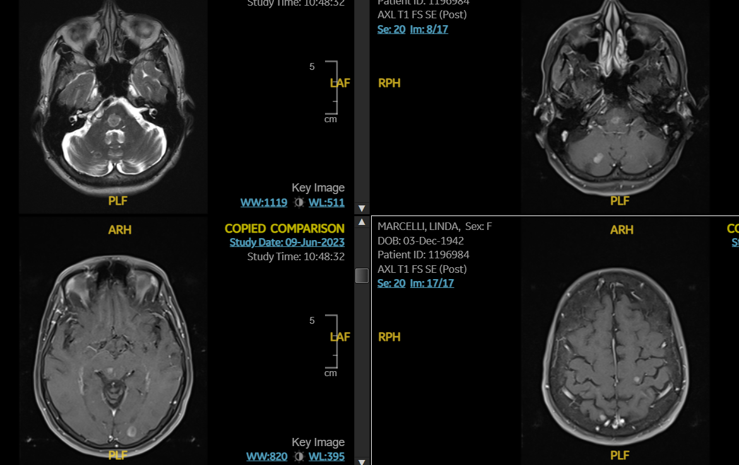
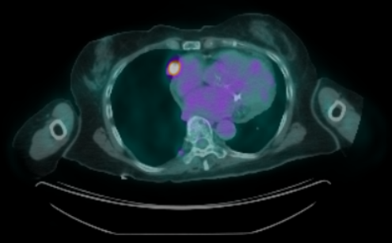
70/F with remote smoking hx, presenting with headaches brain MRI: multiple brain masses
FDG-avid RML nodule no nodes
RML wedge: adenocarcinoma, ALK rearranged
Notes:
The patient's presenting symptom of persistent headaches prompted an MRI of the brain, which showed multiple central nervous system lesions. This clinical scenario is worrisome for an extracranial malignancy with brain metastasis, the most common cause of which is lung cancer. And true enough, the patient underwent chest CT scanning showing a RML nodule which is FDG avid. Given the potential morbidity of a brain biopsy and the relative certainty that these radiographic findings represent brain metastasis, biopsy of the brain lesions is typically unnecessary. Rather, it is more advisable to search for the primary tumor and extracranial sites of metastasis, which are safer and more accessible sites for biopsy. When the known sites of metastasis are relatively inaccessible, biopsy of the presumed primary lung tumor may represent the best option, like in this case here. The right middle lobe mass is accessible only through a surgical biopsy, which, in this case, revealed a histologic diagnosis of adenocarcinoma and provided adequate amounts of tumor tissue for comprehensive biomarker testing.

Slide 30
Take-aways
When there’s overwhelming radiographic metastasis, a stage-confirmatory biopsy may not be necessary
When the evidence for brain metastasis is equivocal, a MDT should guide decision making
Notes:
When there is overwhelming radiographic evidence of metastasis, a stage-confirmatory biopsy may not be necessary. In this case, the risk from biopsy of intracranial metastasis is high and the likelihood of gaining valuable information not available from a safer, more accessible biopsy target is low.
If the evidence for brain metastasis is equivocal, a multidisciplinary discussion of the risks and benefits of diagnostic and management options, including biopsy or cerebrospinal fluid analysis for suspected leptomeningeal disease, should guide decision making.

Slide 31
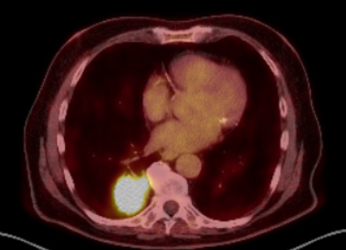
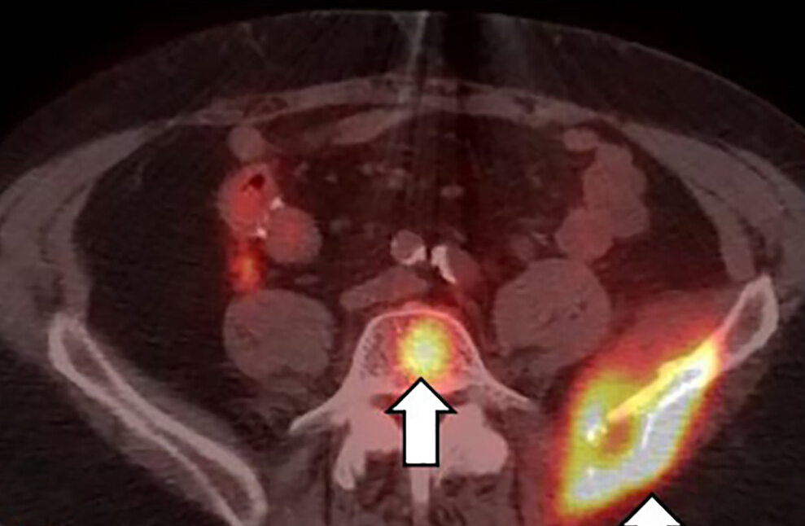
74/M with 30 py smoking history, presents with L hip pain
4.5cm RLL mass
Lytic lesions in L iliac bone and vertebral body
EBUS-TBNA: adenocarcinoma, no driver mutations, PD-L1 positive
Notes:
Patients with lung cancer commonly present with bone metastases. Multiple lytic bone lesions suggest metastatic disease, so histologic or cytologic evidence of bone metastases is not needed in this case. The patient had an accessible lesion so that a bronchoscopy with EBUS-TBNA provided a cytologic diagnosis. It is challenging to perform comprehensive biomarker testing on lung cancer tissue from bone biopsies because they typically require decalcification, a process that often renders the DNA unsuitable for genomic testing. Although some techniques, such as use of gentle chelating agents, may allow molecular testing after decalcification, it is critical to communicate with the laboratory performing the biomarker analysis to discuss whether any bone specimens are accepted. There is one important caveat: the presence of a significant soft tissue component to a metastatic bone lesion, by obviating the need for decalcification, may permit biomarker testing and thus make that lesion a preferable biopsy site. In this case, biopsy of the soft tissue component of the iliac lesion would have been less invasive and histologically would have documented a higher clinical stage.

Slide 32
Take-aways
Multiple lytic bony metastases do not require histologic confirmation
If metastasis is not overwhelming, it may require sampling or other imaging
Bone metastasis is a poor choice for biopsy, however those with soft tissue component may be appropriate
Notes:
Similar to lesions in the brain, imaging is highly suggestive of metastatic disease to the bone and does not typically require histologic confirmation.
If the evidence for metastatic disease is NOT overwhelming (e.g., a solitary suspicious boney site on PET scan), it may require sampling to confirm disease, especially if the patient would otherwise be excluded from a curative-intent treatment. For instance, false-positive PET signals can occur at sites of infection, arthritis, or osteonecrosis. An alternative approach to biopsy in such a case might be to perform a different radiologic evaluation of the suspicious site (e.g., MRI scan) to corroborate or refute the suspicion of metastasis.
Although boney sites of metastasis may be peripheral and easily biopsied, they are often a poor choice for biopsy because the decalcification process can render the sample unsuitable for biomarker testing, and some laboratories may not accept any bone biopsies for biomarker testing. However, sites of bone metastasis with a significant soft tissue component are unlikely to require decalcification.

Slide 33
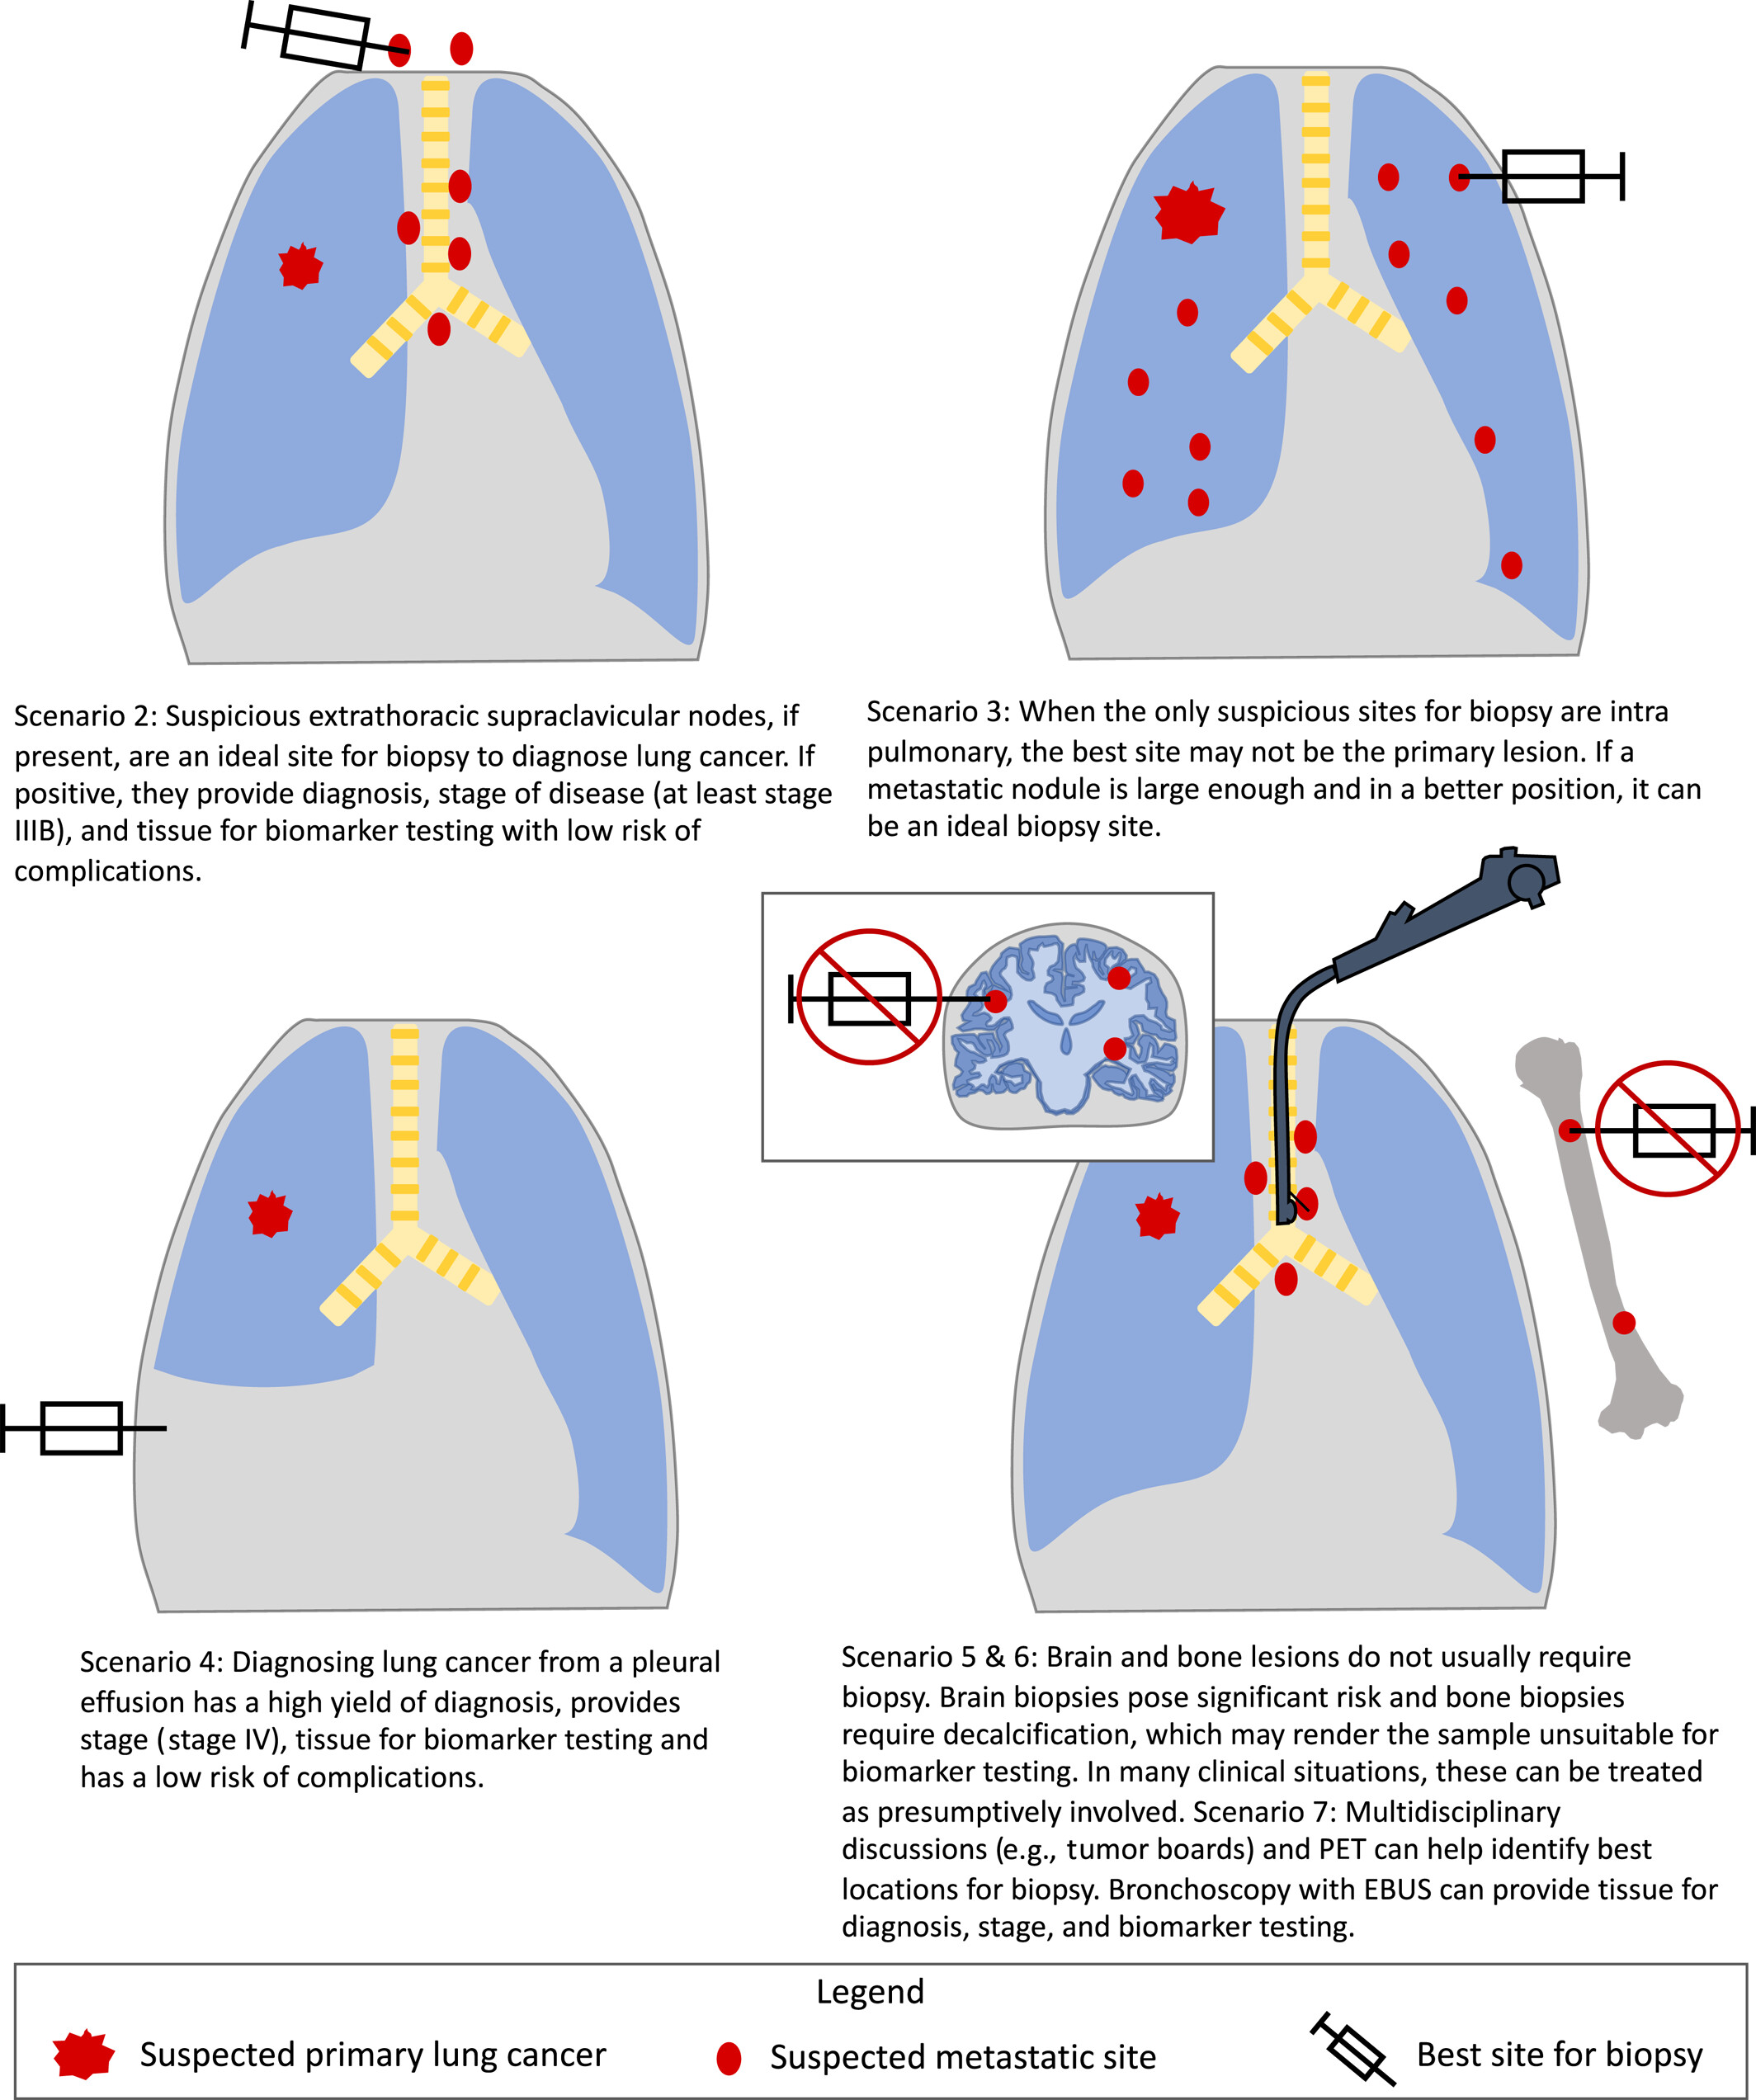

Slide 34
Simultaneously provide diagnosis, staging and molecular testing
Minimally invasive tools for lung cancer diagnosis and staging
Utility and safety of procedures vary
Individualized decision when planning the best approach
Robust multidisciplinary communication
Conclusion
Notes:
The task of diagnosing lung cancer has dramatically increased in difficulty and complexity over the last 20 years, driven by changing epidemiology and the rapid expansion and personalisation of treatment options in NSCLC. Whilst a small sample to distinguish between small cell and NSCLC was previously sufficient, the initial diagnostic procedure for lung cancer should now ideally simultaneously provide tissue for histopathological diagnosis, molecular testing and staging. Diagnostic techniques have adapted and developed in response to these changing conditions and there is now an arsenal of minimally invasive tools for lung cancer diagnosis. The utility and safety of these procedures vary greatly depending on the characteristics of both the patient and the tumour, and as a result the respiratory physician is faced with an increasingly difficult and individualised decision when planning the best diagnostic approach. A multidisciplinary approach to the diagnosis of lung cancer, including input from the respiratory proceduralist, has become increasingly important in ensuring the most efficient, low-risk and accurate diagnostic process for patients.

Slide 35

Liquid Biopsies and the platforms
Liquid Biopsies and the platforms
Bruna Pellini, MD
Assistant Member, Department of Thoracic Oncology
Moffitt Cancer Center and Research Institute
Assistant Professor, Department of Oncologic Sciences
Morsani College of Medicine, University of South Florida
@BrunaPellini

Slide 36
Disclosures:
Disclosures:
Research support: Bristol Myers Squibb Foundation/the Robert A. Winn Diversity in Clinical Trials Awards Program (institution),George Edgecomb Society (institution), NIH/NCI 1R21CA259215-01A1 (institution), Bristol Myers Squibb (institution).
Advisory Board/Consultant: AstraZeneca, BMS, Guardant Health, Regeneron, Illumina, Foundation Medicine, AH Merus.
Speaker Honoraria: AstraZeneca, Merck, Foundation Medicine, BioAscend, PlaytoKnow AG, Grupo Pardini, GBOT, MJH Life Science, Doctaforum, MLI, MEC.

Slide 37
Outline
Outline
ctDNA definition & sources of ctDNA
Tumor-informed vs. tumor-naïve assays
ctDNA applications in oncology:
  Treatment Monitoring
  Minimal residual disease (MRD) detection

Slide 38
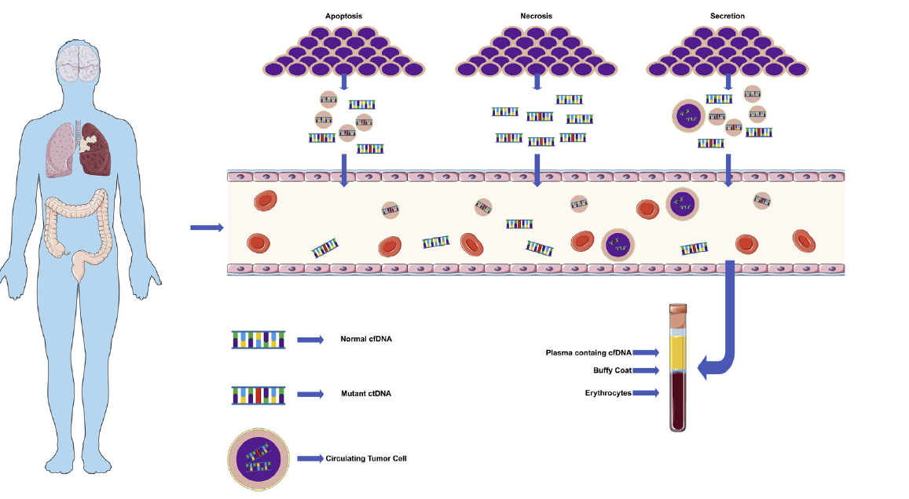
Tumor-derived fragments of nucleic acids identified in the blood are called circulating tumor DNA (ctDNA)
)
Pellini B et al. Thorac Surg Clin. 2020
Notes:
cfDNA explanation, explain that the remaining 90%+ comes from blood cells
Circulating tumor DNA (ctDNA) is under-represented in plasma
Typically <1% of total cfDNA in localized cancer & <10% in advanced cancer patients

Slide 39
Outline
Outline
ctDNA definition & sources of ctDNA
Tumor-informed vs. tumor-naïve assays
ctDNA applications in oncology:
  Treatment Monitoring
  Minimal residual disease (MRD) detection

Slide 40
Tumor-informed vs. tumor-naïve assays
Tumor-Informed | Tumor-naïve
Requires tissue biopsy | No need for biopsy
Personalized assay | Off the shelf assay
Longer turnaround time | Shorter turnaround time
Does not account for tumor heterogeneity | Can detect clonal variants that emerge during follow-up
Potential for better sensitivity and specificity | Variable sensitivity and specificity
        Pellini B and Chaudhuri A. J Clin Oncol. 2022

Slide 41
Outline
Outline
ctDNA definition & sources of ctDNA
Tumor-informed vs. tumor-naïve assays
ctDNA applications in oncology:
  Treatment Monitoring
  Minimal residual disease (MRD) detection

Slide 42
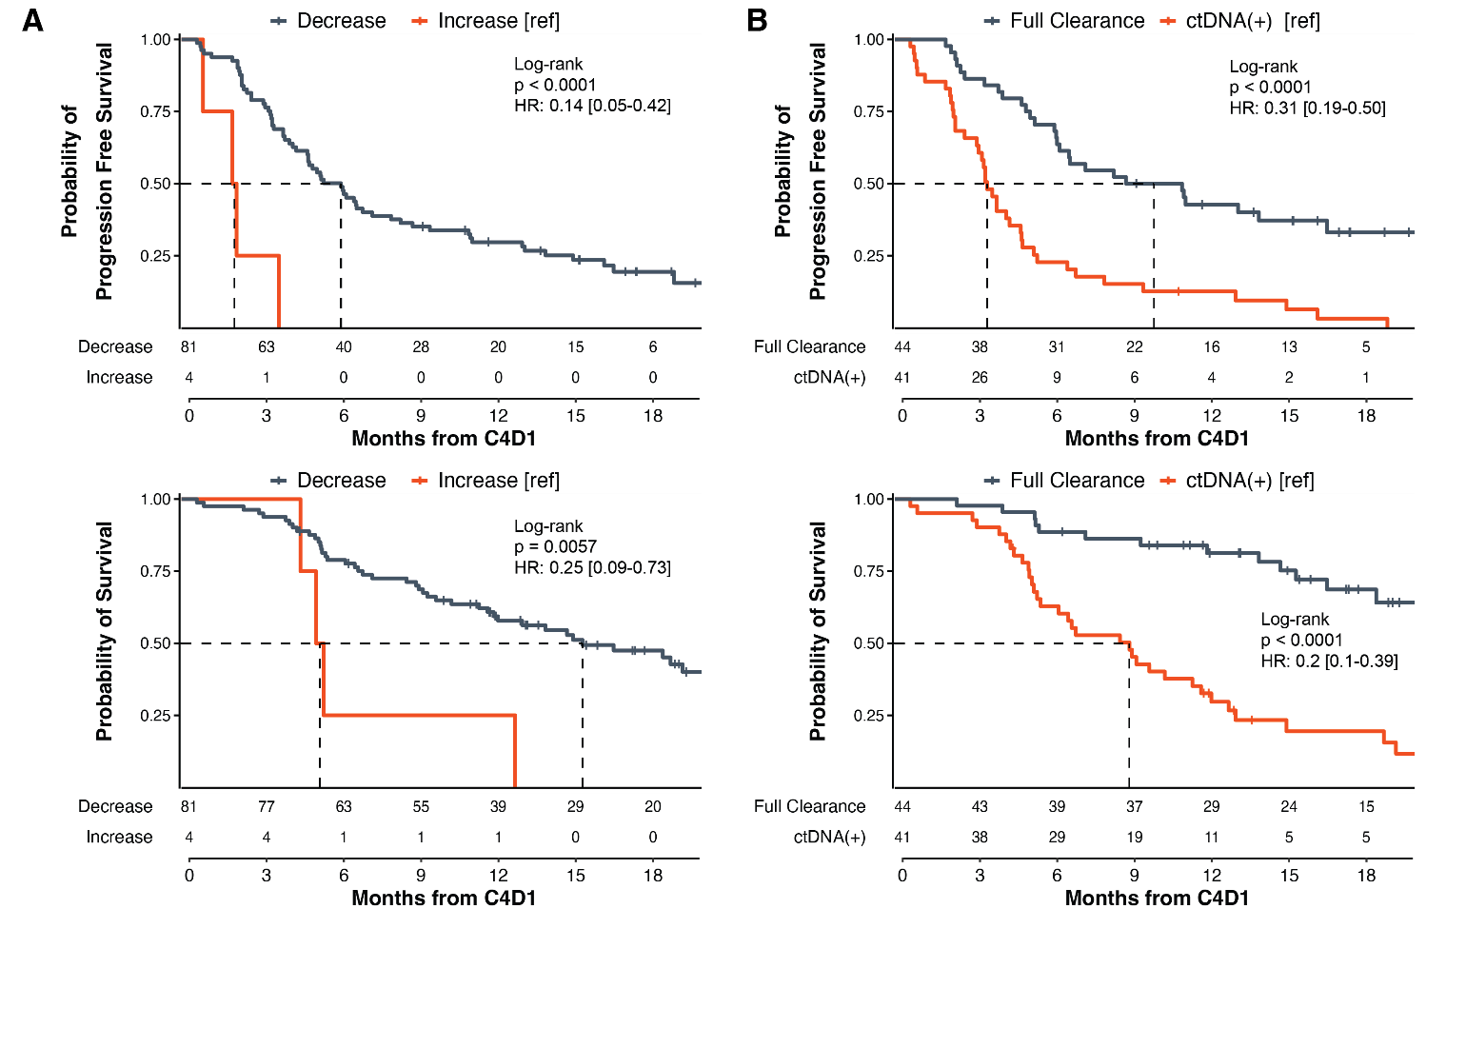
ctDNA Monitoring on Atezolizumab + Carboplatin +
Nab-Paclitaxel (A +CnP) identifies patients with SCC with higher risk for poorer outcomes
Analysis limited to the 85 patients with detectable ctDNA pre-treatment
mPFS=6.1 mo
mPFS=9.9 mo
mPFS=3.5 mo
PFS and OS are landmarked from C4D1
(i.e., 9 weeks into induction therapy)
mPFS=2.0 mo
Decrease is defined as any decrease
mOS=NR
mOS=15.3 mo
mOS=8.9 mo
mOS=5.3 mo
Pellini B, et al. Clin Cancer Res.2023
Notes:
50% decrease mPFS 6.1 vs 1.9; mOS=15.3 vs 5.1 mo
>/= 90% DECREASE mPFS comparable with full clearance
When adjusting for covariates, including PD-L1, any ctDNA decrease and full ctDNA clearance at C4D1 from baseline remained statistically significant as independent prognostic factors for clinical outcomes
of 38 chemoIO patients with ctDNA clearance at C4D1, only 21 (55%) had early clearance at C2D1; and of the 23 patients with early
clearance at C2D1, two developed detectable ctDNA by C4D1.

Slide 43
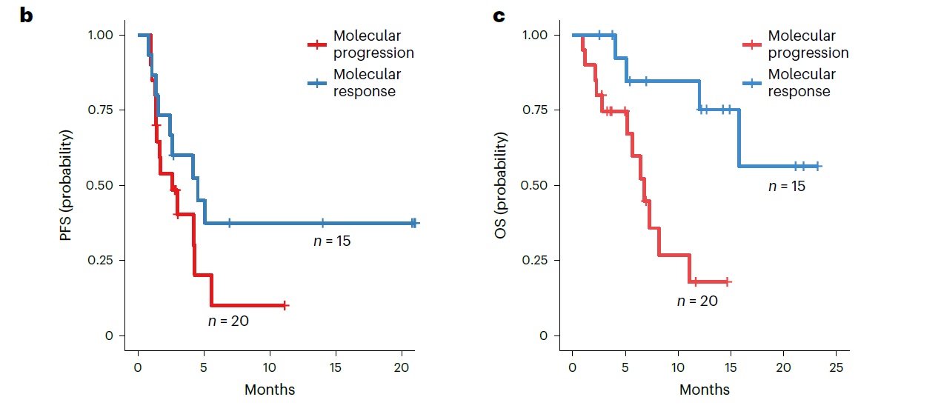
ctDNA molecular response risk stratifies patients with mNSCLC with
PD-L1≥ 1%
mOS= NR
mPFS=5.0 mo
mOS=7.2 mo
mPFS=2.6 mo
NCT04093167, Anagnostou et al., Nat Med, 2023
Median time to ctDNA response was 2.1 months

Slide 44
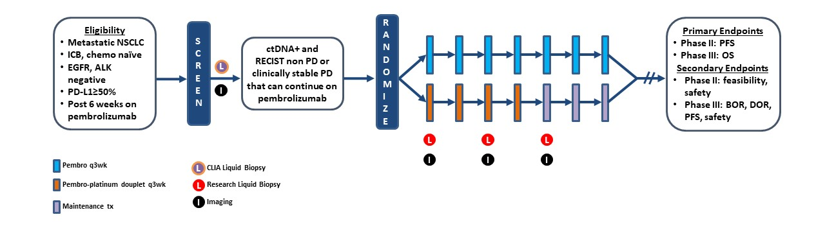
BR.36 stage 2-A Biomarker-Directed, Open Label, Multi-Center Phase II/III Study of Molecular Response Adaptive Immuno-Chemotherapy in Patients with NSCLC
NCT04093167, Anagnostou et al., Nat Med, 2023
Slide courtesy from Dr. Valsamo Anagnoustou

Slide 45
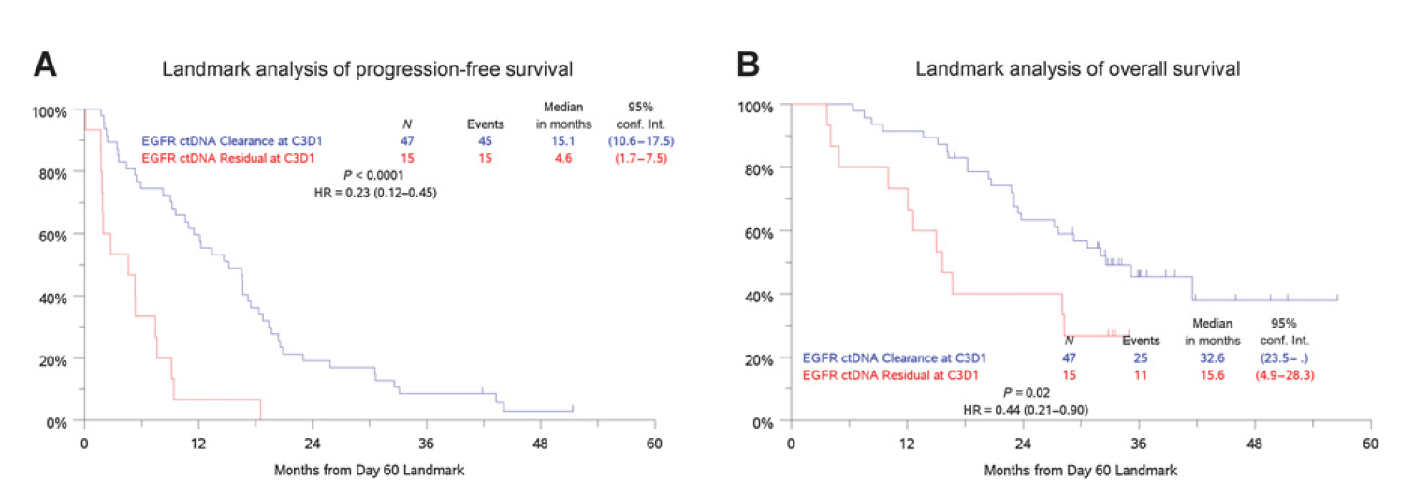
Patients with undetectable EGFR 8 weeks after treatment start had better PFS and OS
Patients with undetectable EGFR 8 weeks after treatment start had better PFS and OS
Stage IV NSCLC
Tumor-naïve assay (Guardant 360)
Mack PC et al. Clin Cancer Res. 2022

Slide 46
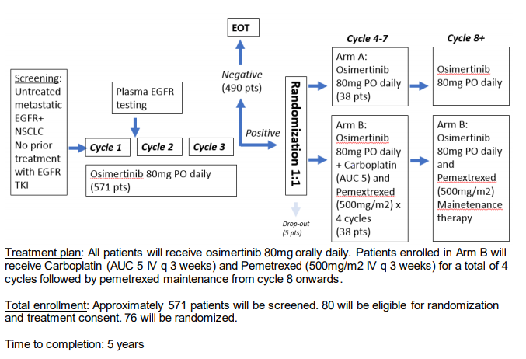
Treatment escalation based on ctDNA detection is under investigation for patients with EGFR mutations
3 weeks into therapy
NCT04410796
National Study PI: Helena Yu, MD (MSKCC); Moffitt PI: Bruna Pellini, MD

Slide 47
Outline
Outline
ctDNA definition & sources of ctDNA
Tumor-informed vs. tumor-naïve assays
ctDNA applications in oncology:
  Treatment Monitoring
  Minimal residual disease (MRD) detection

Slide 48
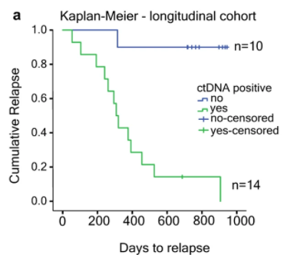
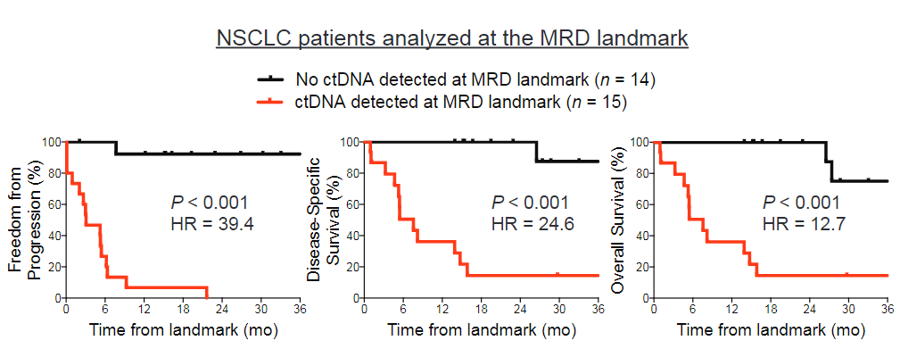
ctDNA can detect minimal residual disease (MRD) and it is a prognostic biomarker
Stages I-III NSCLC
Tumor-informed assay
(Signatera™)
Stages I-III NSCLC
Tumor-naïve assay (CAPP-Seq)
Abbosh C et al. Nature. 2017
Chaudhuri A et al. Cancer Discov. 2017

Slide 49

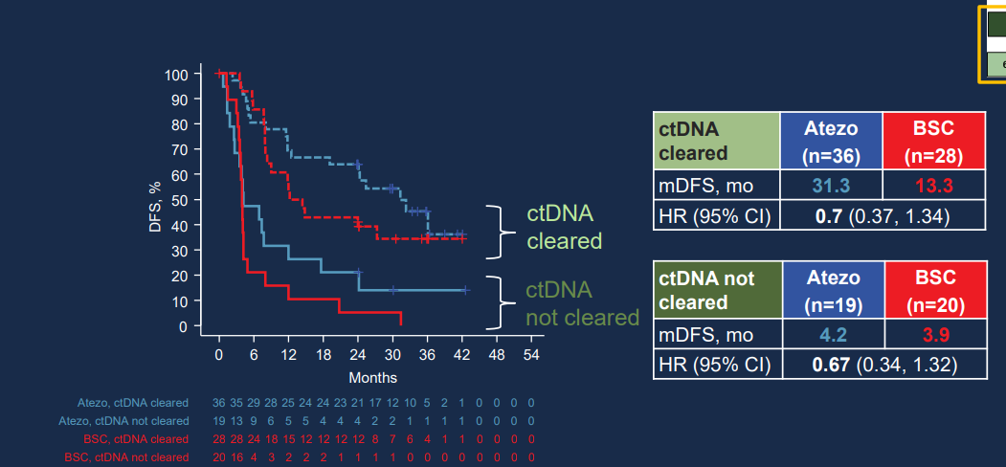

IMpower-010: data suggests adjuvant atezolizumab delays conversion to ctDNA +
Post-Chemo clearance status

Slide 50
The sensitivity to detect disease recurrence is heterogenous across different platforms and may be too low
Author & Year | No.ª | Clinical Stage | Treatment | ctDNA Assay | Sensitivity (%)^{b} | Specificity (%)^{b}
Chaudhuri et al (2017)^{c} | 32 | IB-IIIB | CRT or RT and/or surgery +/- chemo | CAPP-Seq | 94 | 100
Abbosh et al (2017)^{d} | 24 | IA-IIIB | Surgery +/- chemo +/- PORT | Signatera | 36 | 90
Chen et al (2019)^{e} | 25 | IIB-IIIB | Surgery +/- chemo | cSMART | 44 | 88
Zviran et al (2020)^{f} | 22 | IA-III | Surgery +/- chemo and RT | MRDetect | 100 | 71
Pellini B & Chaudhuri A. J Clin Oncol. 2022

Slide 51
Interrogating ctDNA in multiple timepoints after curative-intent treatment improves the sensitivity to detect disease recurrence
Author & Year | No.ª | Clinical Stage | Treatment | ctDNA Assay | Sensitivity (%)^{b} | Specificity (%)^{b}
Chaudhuri et al (2017)^{c} | 37 | IB-IIIB | CRT or RT and/or surgery +/- chemo | CAPP-Seq | 100 | 100
Abbosh et al (2017)^{d} | 24 | IA-IIIB | Surgery +/- chemo | Signatera | 93 | 70
Abbosh et al (2020)^{e} | 78 | I-III | Surgery +/- chemo | ArcherDx | 82 | 96
ctDNA post-treatment surveillance studies in NSCLC
Pellini B & Chaudhuri A. J Clin Oncol. 2022

Slide 52
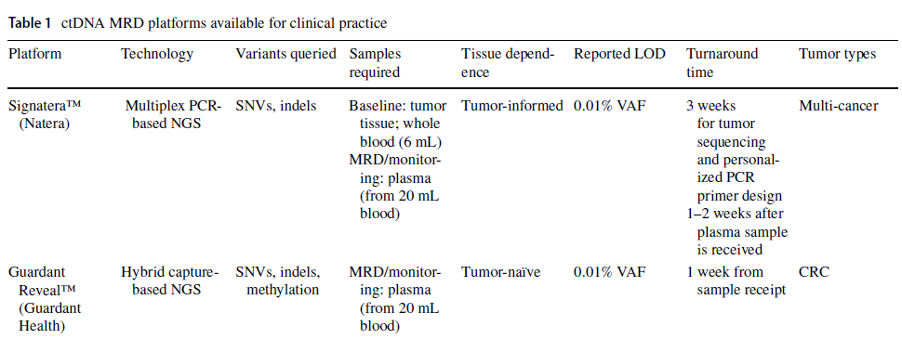
Commercial ctDNA assays
Commercial ctDNA assays
Chen K et al. Mol Diagn Ther. 2021

Slide 53
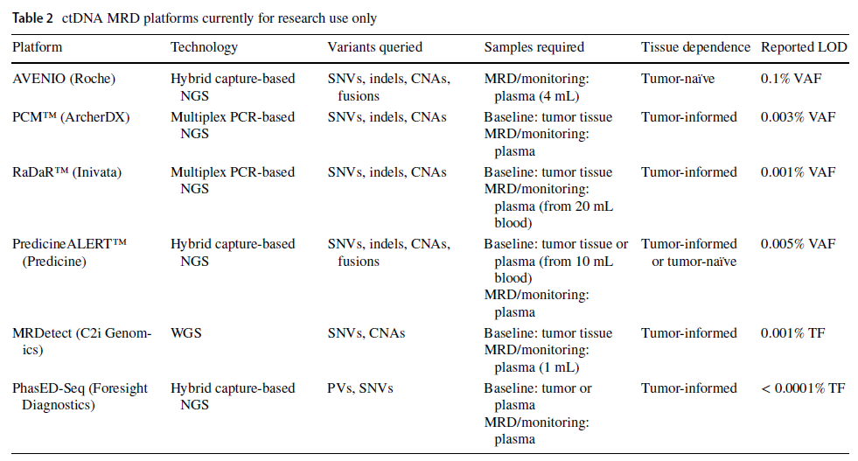
Commercial ctDNA assays
Commercial ctDNA assays
Chen K et al. Mol Diagn Ther. 2021
Notes:
Invitae PCM- 50 variants LOD 0.008% (80 ppm)

Slide 54
Current treatment landscape for resectable NSCLC
IMpower-010
KEYNOTE-091
Surgery
Adjuvant Chemotherapy
Adjuvant Immunotherapy
Neoadjuvant Chemoimmunotherapy
Surgery
NADIM
CheckMate-816
Neoadjuvant Chemoimmunotherapy
Surgery
Adjuvant Immunotherapy
AEGEAN
KEYNOTE-671
Neotorch
CM77T

Slide 55
Current treatment landscape for resectable NSCLC
IMpower-010
KEYNOTE-091
Surgery
Adjuvant Chemotherapy
Adjuvant Immunotherapy
pCR rates= 17.2-24.9%
MPR rates= 30.2-48.5%
Neoadjuvant Chemoimmunotherapy
Surgery
NADIM
CheckMate-816
Neoadjuvant Chemoimmunotherapy
Surgery
Adjuvant Immunotherapy
AEGEAN
KEYNOTE-671
Neotorch
CM77T

Slide 56
Take home points
56
Take home points
ctDNA can be used for molecular profiling in patients with advanced solid tumors to guide therapeutic decisions
ctDNA can identify patients with advanced NSCLC who are responding to therapy (molecular response) at an early timepoint (3-9 weeks).
ctDNA can detect MRD and it is a strong prognostic biomarker
One timepoint MRD status may not be enough to inform clinical-decision making
Tumor-informed MRD assays will not be feasible for patients with pCR and MPR
Ongoing trials will inform if clinical decision-making can be guided by ctDNA and if that improves patients’ outcomes

Slide 57


Thank you!
www.moffitt.org
Bruna.Pellini@moffitt.org
@BrunaPellini

Slide 58
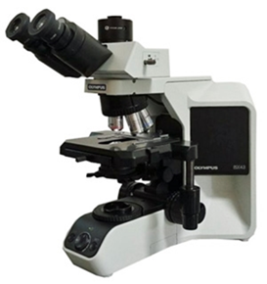
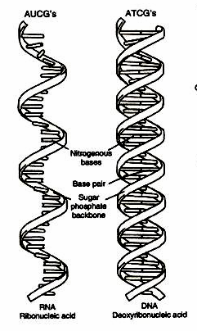
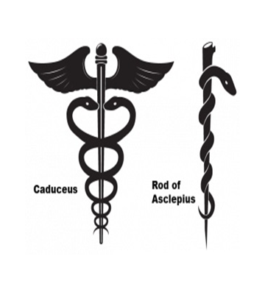
LUNG CANCER
Approaches to Molecular Testing
Theresa A. Boyle, MD, PhD, FCAP
Medical Director of Solid Tumor Genetics
Moffitt Cancer Center
January 31.2024

Slide 59

Ideal Molecular Profiling for Lung Cancer
Rapid
Reflexed
Comprehensive
3.1: Expert Consensus Opinion—EGFR and ALK results should be available within 2 weeks (10 working days) of receiving the specimen in the testing laboratory. Aim: < 5 working days.
3.2: “Patients with stage IV lung cancer have median untreated life expectancy of approximately 16 weeks; 20% of this time should not be spent waiting for test results.”
3.3: “Reflex testing and/or preparation of unstained recut sections at the time the sample is first processed in the histology laboratory may help.”

Slide 60
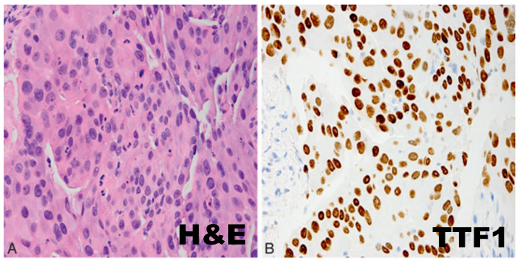
Example CaseStudy Highlighting Important Role of Genetic Testing for Best Patient Care
45 yo F with nonsmoking history presents complaining of cough, chest pain, and headache
Chest X-ray reveals a lung left lower lobe opacity
Chest CT confirms a 3.7 cm mass
Cranial MRI reveals a brain mass
Lung biopsy H&E and TTF1 IHC reveal lung adenocarcinoma
Should molecular
testing be performed?

Slide 61

Case Continued: Rapid and Comprehensive Testing
Rapid:
ALK IHC negative, PDL1 IHC 60%
Rapid EGFR Idylla platform assay revealed an EGFR mutation, p.L858R
Patient started on EGFR inhibitor
Comprehensive:
NGS confirmed EGFR mutation and identified low MET copy number gain (5 copies)
Post-therapy CT scan showed partial response

Slide 62
Case Continued: Resistance Testing
A year later, CT scan identifies new liver lesion
Blood NGS ordered to evaluate for resistance mutations
MET amplification (+++) reported by blood NGS (7 days)
Tissue NGS confirmed MET amplification (9 copies) and newly identified MET exon 14 skipping
RNA Salah Targeted Expression Panel (204 genes) confirmed MET exon 14 skipping and high wild-type MET expression
  Other genes with high expression (e.g. AXL, PDCD1 (PD-1) and LAG3) may inform later therapy lines and/or trial considerations

Slide 63
DNA-Based NGS Alone Can Miss Pathogenic Gene Fusions¹
DNA-based sequencing can lead to
false-negative and false-positive results
in a variety of cases, particularly in
detection of gene fusions^{1,2}
  Commercially available NGS for liquid biopsies relies on analysis of circulating cfDNA and lacks the sensitivity of RNA-based NGS³
RNA-based NGS is recommended to capture what DNA-based NGS can miss¹
True-positive
fusion eventsª
RNA-based NGS
DNA-based NGS
1. Benayed R et al. Clin Cancer Res. 2019;25(15):4712-4722. doi:10.1158/1078-0432.CCR-19-0225 2. Heydt C et al. BMC Med Genomics. 2021;14(1):62. doi:10.1186/s12920-021-00909-y 3. Choudhury Y et al. Poster presented at: 2022 ASCO Annual Meeting;
June 3-7, 2022; Chicago, IL.

Slide 64
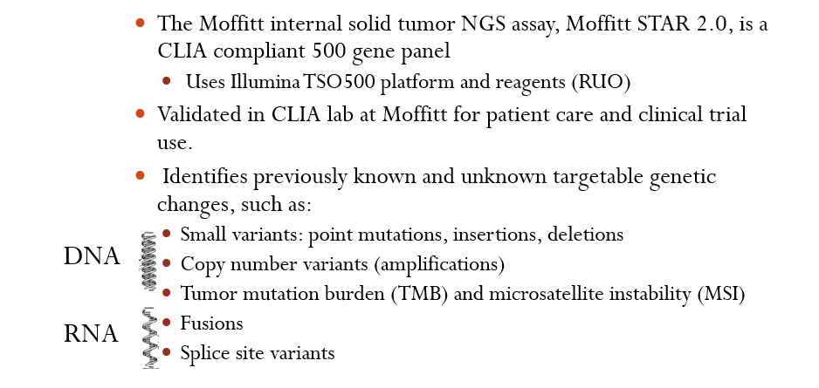
Moffitt Internal Solid Tumor NGS Assay

Slide 65
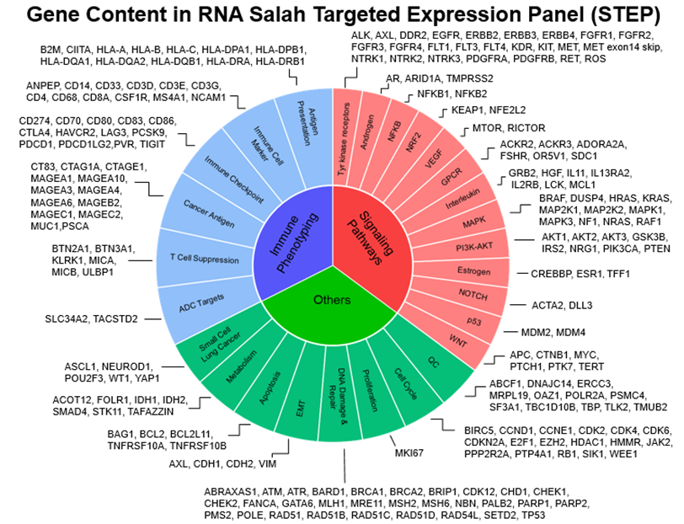
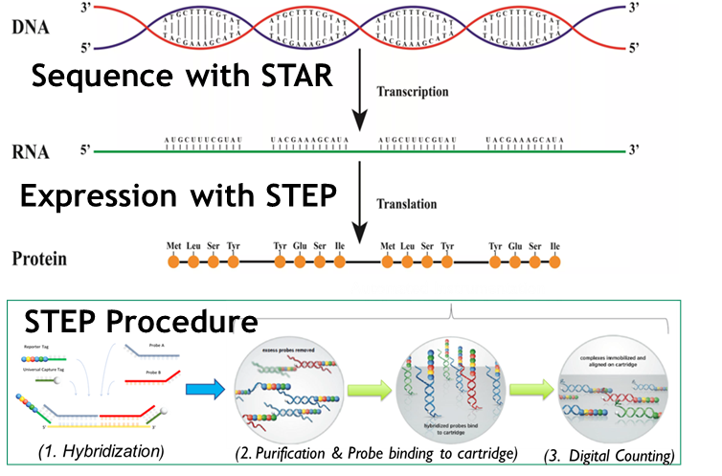

RNA STEP profiling provides orthogonal confirmation of NGS results, trial prescreening/screening, trial design, translation biomarker analyses

Slide 66
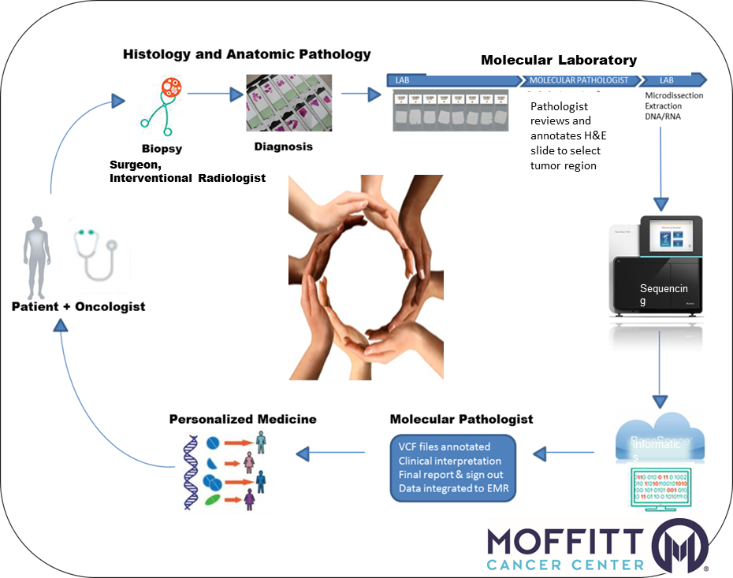
Best Patient Care Requires Teamwork
Recommendations for Genetic Testing
1. Order rapid and comprehensive testing.
Set up reflex testing pathways, eliminate disparities
Encourage efficient workflow
Perform rapid testing for ALK and EGFR
Perform comprehensive testing in parallel
2. Triage testing on limited tumor samples.
Encourage multiplex testing and multidisciplinary approach to tissue stewardship
Blood testing (ctDNA) is an alternative
3. Communicate as a team to translate results into appropriate therapy.
EMR integration for reporting
Interpretation may benefit from specialized expertise
Sequencing
Informatics

Slide 67

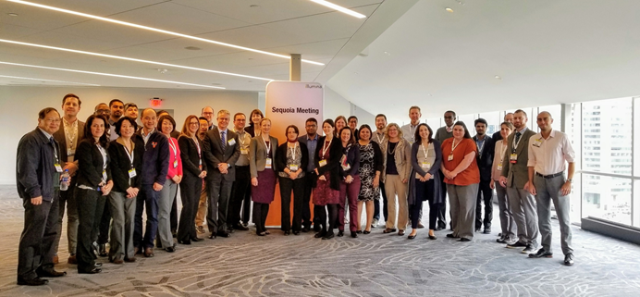
External Teamwork: SEQUOIA (SEQuencing Oncology Informatics Academic) Team
SEQUOIA initiated at 2017 Association for Molecular Pathology (AMP) meeting
  Monthly teleconference; annual AMP satellite meeting
  Collaboration to harmonize tumor mutation burden (TMB), microsatellite instability (MSI), and Homologous Recombination Deficiency (HRD) reporting

Slide 68
LUNG CANCER
Wednesday, January 31st, 2024

Slide 69
Antibody-Drug Conjugates (ADCs) in Lung Cancer
Andreas Saltos, MD

Slide 70
Disclosures
Research support (to institution): Genentech, Genmab, Turning Point Therapeutics, Novartis, Eli Lilly, Memgen, Mersana, BioAtla, AstraZeneca, Daiichi Sankyo
Advisory Board/Consulting: Daiichi Sankyo, Eli Lilly, Zymeworks
Honoraria: MJH Life Sciences, HMP Global

Slide 71
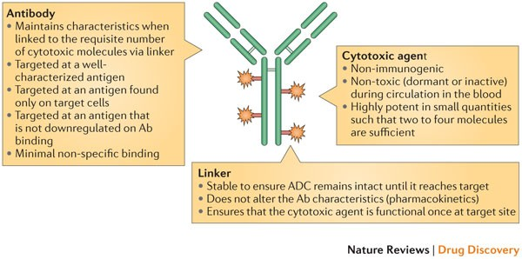
ABCs of ADCs
(Zolot, et al. Nature Reviews Drug Discovery 2013)

Slide 72
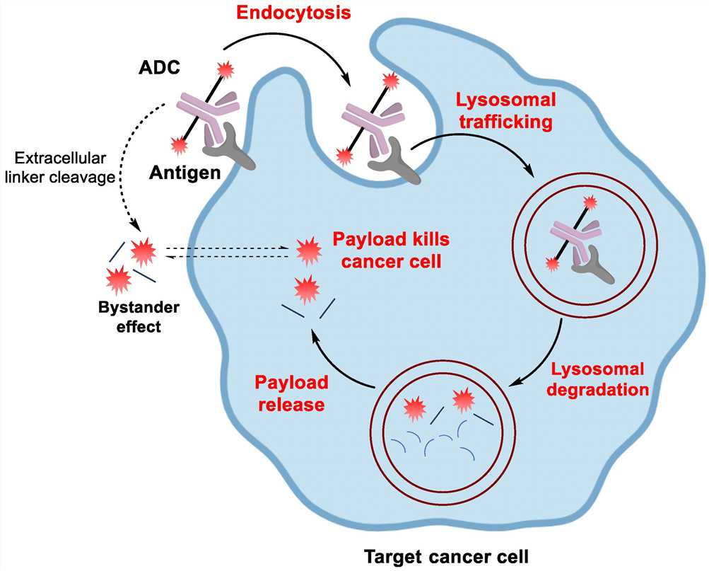
(Cheng-Sanchez, et al. Marine Drugs 2022)

Slide 73
Antibody / Target Selection
Target antigen expressed on tumor cells >>> normal tissues
Present on cell surface, not secreted
Efficient internalization of ADC-antigen complex upon binding
Biomarker (eg companion diagnostic) considerations

Slide 74
Linker
Impacts specificity, stability, potency, and toxicity
Cleavable vs. non-cleavable
  Cleavable linkers may be hydrolyzed in lysosome or endosome, either specifically by proteases and/or by low-pH environments
  Non-cleavable linkers are highly stable in circulation, with aim for lower off-target toxicity

Slide 75
Payload
Traditionally a potent cytotoxin, with sub-nanomolar IC₅₀
Examples:
  Tubulin inhibitors
    Auristatins (monomethyl auristatin E: MMAE; MMAF)
  DNA damaging agents
    Calicheamicins (ozogomycin), topoisomerase inhibitors (SN38, deruxtecan)
Drug-Antibody Ratio (DAR)

Slide 76
Novel Payloads
Immune Stimulating Antibody Conjugates (ISACs)
  STING, TLR agonists
  Glucocorticoid receptor modulators (autoimmune indications)
Protein toxins
  Diphtheria toxin, Pseudomonas exotoxin
Proteolysis Targeting Chimeras (PROTACs)
Dual-Payload ADCs
  MMAE + MMAF

Slide 77
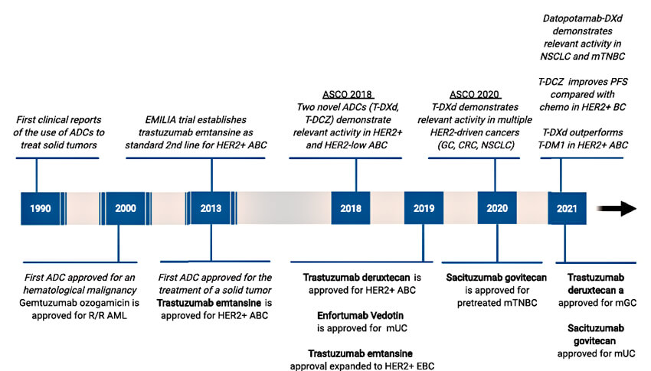
(Tarantino et al, CA: Cancer Journal 2022)

Slide 78
ADCs in the clinic for NSCLC

Slide 79
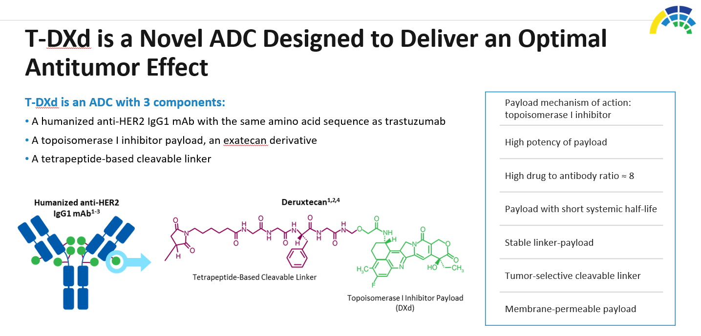
Trastuzumab Deruxtecan – HER2
(Smit et al, ASCO 2020)

Slide 80
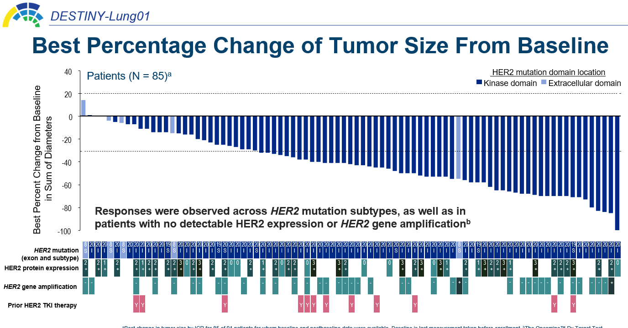
(Li et al, ESMO 2021)

Slide 81

TROP2
Sacituzumab govetecan
Yu et al. ASCO 2022

Slide 82

(Datopotamab deruxtecan)
Spira et al. WCLC 2020

Slide 83

Datopotamab deruxtecan
Garon et al. ESMO 2021

Slide 84

HER3
(Yu et al. JCO 2023)

Slide 85

cMET
Telisotuzumab vedotin
(Camidge et al. ASCO 2022)

Slide 86

Telisotuzumab vedotin – Interim efficacy
(Camidge et al. ASCO 2022)

Slide 87

Other Emerging Targets
B7-H3
(SCLC)
AXL, CEACAM5, other targets under investigation…
(Doi et al. ESMO 2022)

Slide 88
Treatment Crossroads: Which ALK inhibitor do you choose and why?
George R. Simon, MD
H Lee Moffitt Cancer Center
Tampa, FL
Wednesday, January 31st, 2024

Slide 89


ALK
Presented by: Bruce E. Johnson, MD

Slide 90

Slide 4
Presented By Leena Gandhi at 2014 ASCO Annual Meeting

Slide 91
Normal ALK activation
Oncogenic ALK activation
Activating
Mutations
Gene Fusions
In cancers that occur in tissues that normally express full length ALK?
Or re-express full-length ALK during malignant transformation?
Promoter of 5’ gene fusion partner drives expression of developmentally silenced ALK
5’ fusion partner dimerization domains mediate activation of ALK
Ligand
Ligand
Ligand
ALK
ALK
ALK
promoter
5’ partner
ALK
ALK
P
Ligand-induced
dimerization
P
P
P
P
P
P
P
P
P
P
P
5’ partner
P
P
P
P
P
ALK
P
P
P
5’ partner
ALK
P
P
Developmentally regulated
Adult human expression restricted to small intestine, nervous system and testes
P
P
‘ALKomas’
ALCL
NSCLC
IMT
Rhabdomyosarcoma
Colon
Bowden et al., #1117
Weickhardt et al., #3545
Breast
Renal cancer
Spitz tumors
Stephens et al., #9002
Neuroblastoma
Anaplastic thyroid
JAK/STAT
PI3K/AKT
MEK/ERK
Proliferation
Differentiation
Anti-apoptosis
Camidge and Doebele, Nat Rev Clin Oncol 2012

Slide 92
ALK Detection Methods
Method | % Detection rate | Comments
IHC | 95% | D5F3 Antibody (Ventana)
NGS | 93% | Highest concordance rates between IHC and FISH (87%)
Break Apart FISH | 82% | NGS can pick up ALK + patients missed by FISH

Slide 93
Timeline of FDA Approvals of ALK-Targeted Therapies
Crizotinib:
Accelerated approval
“PROFILE 1001/1005” Aug 26, 2011
Crizotinib:
Full approval “PROFILE 1007”
Nov 20, 2013
Ceritinib:
1L approval “ASCEND-4”
May 26, 2017
Alectinib:
1L approval
“ALEX”
Dec 11, 2017
Brigatinib:
1L approval “ALTA-1L”
May 22, 2020
Lorlatinib:
1L approval
“CROWN”
March 3, 2021
Ensartinib:
1L approval
“eXalt3”
?
2011 | 2012 | 2013 | 2014 | 2015 | 2016 | 2017 | 2018 | 2019 | 2020 | 2021 | 2022
Ceritinib:
Accelerated approval
“ASCEND-1”
Apr 29, 2014
Brigatinb:
Accelerated approval
“ALTA”
Apr 28, 2017
Alectinib:
Accelerated approval
“NP28673/NP28761”
Nov 26, 2015
Lorlatinib:
Accelerated approval
Nov 2, 2018
Slide courtesy of Ignatius Ou, MD PhD
Notes:
1L, first line.

Slide 94
PFS for ALEX, ALTA-1L, eXALT3 and CROWN Trials at Varying Levels of Data Maturity
Primary endpoints in bold
ALEX: Alectinib vs Crizotinib
Enrollment: Aug 2014 - Jan 2016
ALTA-1L: Brigatinib vs Crizotinib
Enrollment: Apr 2016 - Aug 2017
eXALT3: Ensartinib vs Crizotinib
Enrollment: ? - Nov 2018
CROWN: Lorlatinib vs Crizotinib
Enrollment: Apr 2017 - Feb 2019
Median duration of f/up in experimental arm:
Median duration of f/up in experimental arm:
Median duration of f/up in experimental arm:
Median duration of f/up in experimental arm:
18.6 mo
1st interim analysis¹ | Alectinib (n = 152) | Crizotinib (n = 151)
PFS (INV), mo | NR | 11.1
HR (95% CI) | 0.47 (0.34-0.65)
PFS (IRC), mo | 25.7 | 10.4
HR (95% CI) | 0.50 (0.36-0.70)
2nd interim analysis² | Alectinib (n = 152) | Crizotinib (n = 151)
PFS (INV), mo | 34.8 | 10.9
HR (95% CI) | 0.43 (0.32-0.58)
PFS (IRC), mo | -- | --
HR (95% CI) | --
Final analysis³ | Alectinib (n = 152) | Crizotinib (n = 151)
PFS (INV), mo | 34.8 | 10.9
HR (95% CI) | 0.43 (0.32-0.58)
PFS (IRC), mo | -- | --
HR (95% CI) | --
1st interim analysis⁴ | Brigatinib (n = 137) | Crizotinib (n = 138)
PFS (INV), mo | NR | 9.2
HR (95% CI) | 0.45 (0.30-0.68)
PFS (IRC), mo | NR | 9.8
HR (95% CI) | 0.49 (0.33-0.74)
2nd interim analysis⁵ | Brigatinib (n = 137) | Crizotinib (n = 138)
PFS (INV), mo | 29.4 | 9.2
HR (95% CI) | 0.43 (0.31-0.61)
PFS (IRC), mo | 24.0 | 11.0
HR (95% CI) | 0.49 (0.35-0.68)
Final Analysis⁶ | Brigatinib (n = 137) | Crizotinib (n = 138)
PFS (INV), mo | 30.8 | 9.2
HR (95% CI) | 0.43 (0.31-0.58)
PFS (IRC), mo | 24.0 | 11.1
HR (95% CI) | 0.48 (0.35-0.66)
23.8 mo
1st interim analysis⁷ | Ensartinib (n = 143) | Crizotinib (n = 147)
PFS (INV), mo | -- | --
HR (95% CI) | --
PFS (IRC), mo | 25.8 | 12.7
HR (95% CI) | 0.51 (0.35-0.72)
2nd interim analysis⁸ | Ensartinib (n = 143) | Crizotinib (n = 147)
PFS (INV), mo | 33.2 | 12.9
HR (95% CI) | 0.45 (0.32-0.64)
PFS (IRC), mo | 31.3 | 12.7
HR (95% CI) | 0.50 (0.36-0.71)
18.3 mo
11.0 mo
11.0 months
1st Interim analysis⁹ | Lorlatinib (n = 147) | Crizotinib (n = 149)
PFS (INV), mo | NR | 9.1
HR (95% CI) | 0.21 (0.14-0.31)
PFS (IRC), mo | NR | 9.3
HR (95% CI) | 0.28 (0.19-0.41)
27.8 mo
24.9 mo
27.6 mo
36 mo
2nd Interim analysis¹⁰ | Lorlatinib (n = 147) | Crizotinib (n = 149)
PFS (INV), mo | NR | 9.1
HR (95% CI) | 0.21 (0.14-0.31)
PFS (IRC), mo | NR | 9.3
HR (95% CI) | 0.27 (0.18-0.39)
37.8 mo
40.4 mo
Cross-trial comparisons have significant limitations
This information is presented to generate discussion, not to make comparisons between study results
36-mo PFS (INV)¹⁰ | 63.5% (95% CI: 54.6-71.1) | 18.9% (95% CI: 11.8-27.4)
36-mo PFS (Inv)³ | 46.4% (95% CI: --) | 13.5% (95% CI: --)
36-mo⁶ PFS (Inv) | 45% (95% CI: 36-54) | 18% (95% CI: 11-26)
1. Peters. NEJM. 2017;377:829. 2. Camidge. J Thorac Oncol. 2019;14:1233. 3. Mok. Ann Oncol. 2020;31:1056. 4. Camidge. NEJM. 2018;379:2027. 5. Camidge. JCO. 2020;38:3592. 6. Camidge. JTO. 2021;16:2091. 7. Horn. JAMA Oncol. 2021;7:1617. 8. Wu. WCLC 2020. Abstr FP14.12. 9. Shaw. NEJM. 2020;383:2018. 10. Solomon. AACR 2022. Abstr CT223.
Notes:
INV, investigator assessed; IRC, independent review committee; NR, not reached

Slide 95
Crizotinib Comparisons in Lung Cancer:
ORR and Intracranial Responses
KEY |  |  | Assessed by BICR |  |  | Assessed by Investigator
Population | CROWN¹ |  | ALTA-1L² |  | ALEX³
 | Lorlatinib | Crizotinib | Brigatinib | Crizotinib | Alectinib | Crizotinib
ITT population, n | 149 | 147 | 137 | 138 | 152 | 151
Confirmed ORR, % | 77.2 | 58.5 | 74 | 62 | 82.9 | 75.5
Complete response, % | 2.7 | 0.0 | 24 | 13 | 4 | 1
Median DoR, mo (95% CI) | NR (NR-NR) | 9.6 (9.0-12.9) | 33.2 (22.1-NR) | 13.8 (10.4-22.1) | NE | 11.1 (7.9-13.0)
Patients with any brain metastases at baseline, n | 37 | 39 | 47 | 49 | 64 | 58
Confirmed IC-ORR, % | 64.9 | 17.9 | 66 | 14 | 59 | 26
Complete IC response, % | 59.5 | 12.8 | 45 | 2 | 45 | 9
Median IC-DoR, mo (95% CI) | NR (NR-NR) | 9.4 (6.0-11.1) | 27.1 (16.9-42.8) | 9.2 (3.9-NR) | NE (17.3-NE) | 3.7 (3.2-6.8)
Patients w/≥1 measurable brain metastases at baseline, n | 18 | 13 | 18 | 23 | 21 | 22
Confirmed IC-ORR, % | 83.3 | 23.1 | 78 | 26 | 81 | 50
Complete IC response, % | 72.2 | 7.7 | 28 | 0 | 38 | 5
Median DoR, mo (95% CI) | NR (NR-NR) | 10.2 (9.4-11.1) | 27.9 (16.9-42.8) | 9.2 (3.9-NE) | 5.5 (2.1-17.3) | 17.3 (14.8-NE)
1. Solomon. AACR 2022. Abstr CT223. 2. Camidge. J Thorac Oncol. 2021;16:2091. 3. Peters. NEJM. 2017;377:829.
Cross-trial comparisons have significant limitations: This information is presented to generate discussion, not to make comparisons between study results.
Notes:
BICR, blinded independent central review; CI, confidence interval; DoR, duration of response; IC, intracranial; IC-DoR, intracranial duration of response; IC-ORR, intracranial objective response rate; ITT, intention-to-treat; NE, not estimable; NR, not reached; ORR, objective response rate.

Slide 96
Safety and Toxicity Profiles of ALK TKIs
Agent | Serious TRAEs, % | TRAE Leading to Dose Reduction, % | TRAE Leading to Drug D/c, % | TRAEs More Common in Study Drug vs Crizotinib
Lorlatinib¹ 100 mg/day PO | Lorlatinib: 34 Crizotinib: 27 | Lorlatinib: 21 Crizotinib: 15 | Lorlatinib: 7 Crizotinib: 9 | Hypercholesterolemia, hypertriglyceridemia, edema, weight increase, peripheral neuropathy, cognitive effects, anemia, hypertension, mood, hyperlipidemia
Alectinib^{2,3} 600 mg BID PO | Alectinib: 39 Crizotinib: 32 | Alectinib: 20 Crizotinib: 20 | Alectinib: 15 Crizotinib: 15 | Anemia, myalgia, increased bilirubin, increased weight, musculoskeletal pain, photosensitivity reaction
Brigatinib^{4,5} 90 mg/day PO x 7 days, then 180 mg/day PO | -- -- | Brigatinib: 44 Crizotinib: 25 | Brigatinib: 13 Crizotinib: 9 | Increased CK, cough, hypertension, increased lipase, early onset ILD/pneumonitis
Ensartinib⁶ 225 mg/day PO | Ensartinib: 7.7 Crizotinib: 6.1 | Ensartinib: 24 Crizotinib: 20 | Ensartinib: 9 Crizotinib: 7 | Rash (all grade 68%, grade 1/2 ~60%), pruritus, pyrexia
1. Shaw. NEJM. 2020;383:2018. 2. Peters. NEJM. 2017;377:829. 3. Mok. Ann Oncol. 2020;31:1056.
4. Camidge. NEJM. 2018;379:21 5. Camidge. J Thorac Oncol. 2021;16:2091. 6. Horn. JAMA Oncol. 2021;7:1617.
Updated from slide presented by Lovly, ESMO Virtual Congress 2020.
Notes:
ILD, interstitial lung disease; ; TKI, tyrosine kinase inhibitor; TRAE, treatment-related adverse event.

Slide 97
Mechanisms and potential strategies to overcome
acquired resistance to crizotinib
Small Cell or Squamous Cell Transformation
Amplification of
the ALK fusion
Mutation in the
ALK kinase domain
Bypass Signaling
EGFR
IGF-1R
c-KIT
EML4
ALK
Kinase
Domain
EML4
ALK
Kinase
Domain
EML4
ALK
Kinase
Domain
1151Tins
L1152R
C1156Y
I1171T
F1174L/C
L1196M
G1202R
F1245C
G1269A
Kinase
Domain
EGFR
inhibitors
IGF-1R
inhibitors
KIT
inhibitors
EML4
ALK
EML4
ALK
Kinase
Domain
KRASmut
EML4
ALK
Kinase
Domain
SRC
MEKmut
Src
inhibitors
Lovly ASCO Educ Book 2015
Next-generation
ALK inhibitors
MEK
inhibitors

Slide 98
ALK kinase domain mutations – drug efficacy
 | 1st gen | 2nd gen |  |  | 3rd gen
 | Crizotinib | Alectinib | Brigatinib | Ceritinib | Lorlatinib
G1123S | Res | Sens² | N/D | Res² | N/D
1151Tins | Res | Res³ | N/D | Res⁷ | Sens⁹
L1152P/R | Res | Sens | N/D | Res⁷ | Sens⁹
C1156Y/T | Res | Sens | N/D | Res⁷ | Sens⁹
I1171T/N | Res | Res^{4,5} | N/D | Sens^{4,5,7} | N/D
F1174C/L/V | Res | Sens | Sens⁶ | Res⁷ | Sens⁹
V1180L | Res | Res ⁴ | N/D | Sens⁴ | N/D
L1196M | Res | Sens³ | Sens⁶ | Sens⁷ | Sens⁹
L1198F | Sens ¹ | Res¹ | Res¹ | Res¹ | Res¹
G1202R | Res | Res³ | N/D | Res⁷ | Sens⁹
S1206C/Y | Res | Sens³ | Res⁶ | Sens⁷ | Sens⁹
F1245C | Res⁸ | N/D | N/D | Sens⁸ | N/D
G1269A/S | Res | Sens | N/D | Sens⁷ | Sens⁹
REFERENCES
Shaw NEJM 2016 4. Katayama CCR 2014 7. Friboulet Cancer Discov 2014 10. Bayliss Cel Mol Lif Sci 2015
Toyokawa JTO 2015 5. Ou Lung Cancer 2015 8. Kodityal Lung Cancer 2016
Katayama STM 2012 6. Ceccon MCR 2014 9. Zou Cancer Cell 2015

Slide 99

Lorlatinib Resistance
Shaw NEJM 2016
Crizotinib
Lorlatinib
ALK L1198 residue was targeted for lorlatinib’s design to increase selectivity against the majority of other kinases which do not have a leucine residue at this position within the ATP binding pocket.
[Ref: Johnson T Journal of Medicinal Chemistry 2014]

Slide 100



Lorlatinib Resistance
Shaw NEJM 2016

Slide 101

PEMETREXED BENEFIT MAY RELATE TO LOW THYMIDYLATE SYNTHASE LEVEL IN ALK-REARRANGED TUMORS
Presented By Leena Gandhi at 2014 ASCO Annual Meeting

Slide 102
ALINA: phase III, open-label superiority study
Resected Stage IB (≥4cm)–IIIA ALK+ NSCLC
Other key eligibility criteria:
ECOG PS 0–1
Eligible to receive platinum-based chemotherapy
Adequate end-organ function
No prior systemic cancer therapy or ALK TKIs
Stratification factors:
Disease stage per UICC/AJCC 7th edition: IB (≥ 4cm) vs II vs IIIA
Race: Asian vs non-Asian
Alectinib
600 mg BID
2 years
Recurrence
Further treatments at investigator’s choice
and survival follow-up
R
1:1
Platinum-based chemotherapy*
Q3W; 4 cycles
Recurrence
N=257
Disease assessments (including brain MRI)‡ were conducted: at baseline,
every 12 weeks for year 1–2, every 24 weeks for year 3–5, then annually
Primary endpoint
  DFS per investigator,§ tested hierarchically:
        Stage II–IIIA → ITT (Stage IB–IIIA)
Other endpoints
  CNS disease-free survival
  OS
  Safety
Here, we report data from the pre-specified interim analysis of DFS
Data cut-off: 26 June 2023; CNS, central nervous system; DFS, disease-free survival; ITT, intention to treat
*Cisplatin + pemetrexed, cisplatin + vinorelbine or cisplatin + gemcitabine; cisplatin could be switched to carboplatin in case of intolerability; ‡Assessment by CT scan where MRI not available; § DFS defined as the time from randomisation to the first documented recurrence of disease or new primary NSCLC as determined by the investigator, or death from any cause, whichever occurs first; NCT03456076

Slide 103

ALINA: phase III, open-label superiority study
C
Resected Stage IB (≥4cm)–IIIA ALK+ NSCLC
Other key eligibility criteria:
ECOG PS 0–1
Eligible to receive platinum-based chemotherapy
Adequate end-organ function
No prior systemic cancer therapy or ALK TKIs
Stratification factors:
Disease stage per UICC/AJCC 7th edition: IB (≥ 4cm) vs II vs IIIA
Race: Asian vs non-Asian
Alectinib
600 mg BID
2 years
Recurrence
Further treatments at investigator’s choice
and survival follow-up
R
1:1
Platinum-based chemotherapy*
Q3W; 4 cycles
Recurrence
N=257
Disease assessments (including brain MRI)‡ were conducted: at baseline,
every 12 weeks for year 1–2, every 24 weeks for year 3–5, then annually
Primary endpoint
  DFS per investigator,§ tested hierarchically:
        Stage II–IIIA → ITT (Stage IB–IIIA)
Other endpoints
  CNS disease-free survival
  OS
  Safety
Here, we report data from the pre-specified interim analysis of DFS
Data cut-off: 26 June 2023; CNS, central nervous system; DFS, disease-free survival; ITT, intention to treat
*Cisplatin + pemetrexed, cisplatin + vinorelbine or cisplatin + gemcitabine; cisplatin could be switched to carboplatin in case of intolerability; ‡Assessment by CT scan where MRI not available; § DFS defined as the time from randomisation to the first documented recurrence of disease or new primary NSCLC as determined by the investigator, or death from any cause, whichever occurs first; NCT03456076

Slide 104
ALINA: phase III, open-label superiority study
C
Resected Stage IB (≥4cm)–IIIA ALK+ NSCLC
Other key eligibility criteria:
ECOG PS 0–1
Eligible to receive platinum-based chemotherapy
Adequate end-organ function
No prior systemic cancer therapy or ALK TKIs
Stratification factors:
Disease stage per UICC/AJCC 7th edition: IB (≥ 4cm) vs II vs IIIA
Race: Asian vs non-Asian
CROSS OVER NOT CONTROLLED
Alectinib
600 mg BID
2 years
Recurrence
Further treatments at investigator’s choice
and survival follow-up
R
1:1
Platinum-based chemotherapy*
Q3W; 4 cycles
Recurrence
N=257
Disease assessments (including brain MRI)‡ were conducted: at baseline,
every 12 weeks for year 1–2, every 24 weeks for year 3–5, then annually
Primary endpoint
  DFS per investigator,§ tested hierarchically:
        Stage II–IIIA → ITT (Stage IB–IIIA)
Other endpoints
  CNS disease-free survival
  OS
  Safety
Here, we report data from the pre-specified interim analysis of DFS
Data cut-off: 26 June 2023; CNS, central nervous system; DFS, disease-free survival; ITT, intention to treat
*Cisplatin + pemetrexed, cisplatin + vinorelbine or cisplatin + gemcitabine; cisplatin could be switched to carboplatin in case of intolerability; ‡Assessment by CT scan where MRI not available; § DFS defined as the time from randomisation to the first documented recurrence of disease or new primary NSCLC as determined by the investigator, or death from any cause, whichever occurs first; NCT03456076

Slide 105
ALINA: Baseline Characteristics
Baseline Characteristic | Alectinib (n = 130) | CT (n = 127)
Median age, yr ≥65 yr, % | 54 21 | 57 27
Sex, % Female Male | 58 42 | 46 54
Smoking status, % Never Former Current | 65 32 4 | 55 43 2
Race, % Asian Non-Asian | 55 45 | 56 44
ECOG PS, % 0 1 | 55 45 | 51 49
Baseline Characteristic, % | Alectinib (n = 130) | CT (n = 127)
Stage at diagnosis IB II IIIA | 11 36 53 | 9 35 55
Nodal status N0 N1 N2 | 16 35 49 | 14 34 52
Histology Squamous Nonsquamous | 5 95 | 2 98
Surgical procedure Lobectomy Pneumonectomy Bilobectomy Sleeve lobectomy | 97 2 2 0 | 92 3 4 1
Solomon. ESMO 2023. Abstr LBA2.
Notes:
CT, chemotherapy; ECOG, Eastern Cooperative Oncology Group; PS, performance status.

Slide 106
Disease-free survival: ITT (stage IB–IIIA)*
100
93.6%
 | Alectinib (N=130) | Chemotherapy (N=127)
Patients with event Death Recurrence | 15 (12%) 0 15 | 50 (39%) 1 49
Median DFS, months (95% CI) | Not reached | 41.3 (28.5, NE)
DFS HR (95% CI) | 0.24 (0.13, 0.43) p‡<0.0001
88.7%
80
Alectinib
63.7%
60
54.0%
Disease-free survival (%)
Chemotherapy
40
20
0
0
6
12
18
24
30
36
42
48
54
Time (months)
No. at risk
Alectinib
130
123
123
118
74
55
39
22
10
3
Chemo
127
112
98
89
55
41
27
18
11
2
Median survival follow up: alectinib, 27.8 months; chemotherapy, 28.4 months
Marina Chiara Garassino @marinagarassino

Slide 107
ALINA: DFS (Primary Endpoint)
Efficacy Outcome | Alectinib (n = 130) | CT (n = 127) | HR (95% CI) | P Value
Median DFS for stage II-IIIA,* mo 2-yr DFS, % 3-yr DFS, % | NR 93.8 88.3 | 44.4 63.0 53.3 | 0.24 (0.13-0.45) | < .0001
Median DFS for stage IB-IIIA (ITT), mo 2-yr DFS, % 3-yr DFS, % | NR 93.6 88.7 | 41.3 63.7 54.0 | 0.24 (0.13-0.43) | < .0001
2-yr DFS, % Stage IB Stage II Stage IIIA | 92.3 95.6 92.7 | 71.6 66.3 60.7 | 0.21 (0.02-1.84) 0.24 (0.09-0.65) 0.25 (0.12-0.53)
*N = 116 (alectinib) vs 115 (CT).
DFS benefit with alectinib vs chemotherapy observed across all subgroups of the ITT population, including age, sex, race, baseline ECOG PS, tobacco use history, tumor stage, and regional LN status
Solomon. ESMO 2023. Abstr LBA2.
Notes:
CT, chemotherapy; DFS, disease-free survival; ECOG, Eastern Cooperative Oncology Group; ITT, intention-to-treat; LN, lymph node; NR, not reached; PS, performance status

Slide 108
ALINA: CNS DFS, OS, and Sites of Recurrence
Efficacy Outcome | Alectinib (n = 130) | CT (n = 127)
CNS DFS for stage IB-IIIA (ITT), % 2-yr rate 3-yr rate | 98.4 95.5 | 85.8 79.7
CNS DFS HR (95% CI) | 0.22 (0.08-0.58)
Efficacy Outcome, n | Alectinib (n = 130) | CT (n = 127)
No recurrence | 115 | 77
Extent of recurrence New primary (lung) Locoregional Distant Locoregional + distant | 1 9 3 2 | 0 22 22 5
Sites of recurrence Brain Bone Adrenal gland Lymph node Kidney Peritoneum Other | 4 1 0 0 0 0 1 | 14 8 3 2 1 1 0
At time of data cutoff, OS data were immature with 6 deaths (2.3%) reported
(2 in alectinib arm, 4 in CT arm)
Solomon. ESMO 2023. Abstr LBA2.
Notes:
CNS, central nervous system; CT, chemotherapy; DFS, disease-free survival; ITT, intention-to-treat; OS, overall survival.

Slide 109
Toxicity in adjuvant can be an issue
Adverse event
Alectinib
(N=128)
Chemotherapy (N=120)
Blood creatine phosphokinase increased
Constipation
Aspartate aminotransferase increase
Alanine aminotransferase increased
Blood bilirubin increased
COVID-19
Myalgia
Blood alkaline phosphatase increased
Anaemia
Asthenia
Nausea
Vomiting
Decreased appetite
Neurtophil count decreased
Neutropenia
White blood cell count increased
2 years
4 months
8 capsules
27%AEs leading to dose interruption
14%AEs leading to dose interruption
100%
80%
60%
40%
20%
0
20%
40%
60%
80%
100%
AE grade:
1/2
1/2
3/4
3/4
Data cut-off: 26 June 2023
Median treatment duration was 23.9 months in the alectinib arm and
2.1 months in the chemotherapy arm. No grade 5 events were observed

Slide 110
ALINA: Conclusions
ALINA represents the first phase III trial of an ALK inhibitor used in the adjuvant setting in stage IB-IIIA NSCLC
Adjuvant alectinib showed superior DFS vs chemotherapy in patients with resected stage IB-IIIA ALK+ NSCLC
  DFS: HR: 0.24 (95% CI: 0.13-0.43; P <.0001)
  CNS DFS: HR: 0.22 (95% CI: 0.08-0.58)
Adjuvant alectinib was tolerable, with no unexpected safety signals
Whether it will impact Overall Survival remains to be seen!?
Solomon. ESMO 2023. Abstr LBA2.
Notes:
CNS, central nervous system; DFS, disease-free survival; NSCLC, non-small-cell lung cancer.

Slide 111
Conclusions & Future Directions
Cure remains elusive
Emergent Resistance continues to be a problem
ALK Positive patients are generally non –responsive to Immunotherapy.
If you are using chemotherapy, use pemetrexed based chemotherapy
The first randomized, Adjuvant therapy with Alectinib reported a statistically significant improvement in DFS.

Slide 112

Thank You !!

Slide 113
LUNG CANCER
Wednesday, January 31st, 2024

Slide 114
Advances in HER2 and HER3 targeting in
Lung Cancer
Andreas Saltos, MD

Slide 115
Disclosures
Research support (to institution): Genentech, Genmab, Turning Point Therapeutics, Novartis, Eli Lilly, Memgen, Mersana, BioAtla, AstraZeneca, Daiichi Sankyo
Advisory Board/Consulting: Daiichi Sankyo, Eli Lilly, Zymeworks
Honoraria: MJH Life Sciences, HMP Global

Slide 116

Nami et al, Cancers 2018

Slide 117

EGFR_{mut} NSCLC
15-20%
Liu et al, ASCO 2023

Slide 118
Trastuzumab Deruxtecan
(Smit et al, ASCO 2020)

Slide 119

(Li et al, ESMO 2021)

Slide 120
(Li et al, ESMO 2021)

Slide 121


DESTINY-Lung02
(Goto et al, JCO 2023)

Slide 122

HER2 immunohistochemistry in LUAD
Ref | N | 0 | 1+ | 2+ | 3+ | (2+ or 3+)
Hirsch et al, BJC 2002 | 125 | 62% | 8% | 23% | 7% | 30%
Yoshizawa et al, Lung Cancer 2014 | 243 | 42% | 42% | 13% | 3% | 16%
Reis et al Lung Cancer 2015 *(stage 3/4) | 176 | 42% | 28% | 23% | 7% | 30%
Kim et al PLoS One 2017 (0-3+) | 321 | 77% | 31% | 7% | 1% | 8%
Kim et al PLoS One 2017 (H-Score) | 321 | 60% | 15% | 8% | 2% | 10%
(Tan et al, JCO Precision Oncol 2022)

Slide 123




T-DXd in HER2-Overexpressing NSCLC: DL-01
(Smit et al, Presented at ESMO 2022)

Slide 124

Most common Treatment-Emergent AEs in DESTINY-Lung02
(Goto et al, JCO 2023)

Slide 125



Pneumonitis/ ILD with
trastuzumab deruxtecan: Pooled analysis
(Powell et al, ESMO Open 2022)

Slide 126



HER2 Tyrosine Kinase Inhibitors
Afatinib
Poziotinib
ORR 28%, median DoR 5.1 mos
Dziadziuszko, et al. JTO 2019
Le, et al. JCO 2021

Slide 127





BI 1810631 (Zongertinib)
ELVN-002
(Heymach et al, Presented at ASCO 2023)
(Aujay et al, Presented at AACR 2023)

Slide 128



NRG1 fusion in NSCLC
1
2
Seribantumab
(Zenocutuzumab)
3
Zenocutuzumab
1. Russo et al Precision Cancer Medicine 2020
2. Carrizosa et al. ASCO 2022
3. Schram et al. ASCO 2021

Slide 129

HER3 in EGFR-mutant NSCLC
(Janne et al, Presented at ASCO 2021)

Slide 130

(Yu et al. Presented at WCLC 2023)

Slide 131
HERTHENA-Lung 01 Efficacy Results
(Yu et al. JCO 2023)

Slide 132

HERTHENA-Lung01 - toxicity
Adjuducated ILD occurred in 12/225 patients (5.3%)
One grade 5 ILD event (0.4%)
lower in patients with no previous immunotherapy (4%) than in patients with previous immunotherapy (8%)
(Yu et al. JCO 2023)

Slide 133
KRAS in NSCLC
George R. Simon, MD
H Lee Moffitt Cancer Center
Tampa, FL
Wednesday, January 31st, 2024

Slide 134
- KRAS Prevalence, Signaling & Targeting
- KRAS G12Ci single agent data & Intracranial activity
- KRAS G12Ci confirmatory studies
- Newer G12Ci
- Predictors of intrinsic resistance
- Acquired Mechanisms of resistance
- Combination Therapies

Slide 135

Overall Prevalence of KRAS G12C in NSCLC

Slide 136

Cancer Gene Therapy volume 29, pages875–878 (2022)

Slide 137

Cell. 2020 Nov 12; 183(4): 850–859.

Slide 138

Cell. 2020 Nov 12; 183(4): 850–859.

Slide 139

Slide 6

Slide 140
KRYSTAL-1 CNS Cohort: Depth and Duration of Response
Intracranial Best Tumor Change From Baseline
Among patients with intracranial response
  IC responses observed in 32%
  IC disease control response: 84%
  Median DoR: not reached
  Median PFS: 4.2 mo
  Median OS: not reached
Among patients with systemic response
  Median DOR: 9.6 mo
  Median PFS: 5.6 mo
20
0
PD
-20
SD
SD
Maximum Change From Baseline (%)
SD
-40
PR*
-60
SD
-80
PR
PR
-100
SD†
SD‡
PD§
CR
*Unconfirmed at data cutoff; confirmed CR after data cutoff. †SD due to nontarget lesion progression. ‡Unconfirmed CR due to no subsequent scan. §PD due to new lesions.
Sabari. ASCO 2022. Abstr LBA9009. Reproduced with permission.
Notes:
CR, complete response; IC, intracranial; DoR, duration of response; OS, overall survival; PD, progressive disease; PFS, progression-free survival; PR, partial response; SD, stable disease.

Slide 141
KRYSTAL-1 CNS Cohort: Duration of Treatment
SD
CR
CR
SD
SD
PR
SD
SD
CR
Evaluable Patients
PR
PD
PR
SD
PD
First response (PR or CR)
Disease progression
Death
Treatment ongoing
SD
SD
SD
Target lesion
Non-target lesions only
SD
NE
0
1
2
3
4
5
6
7
8
9
10
11
12
13
14
Mo
600 mg BID only
600 mg BID majority of time treated
400 mg BID majority of time treated
200 mg BID majority of time treated
Sabari. ASCO 2022. Abstr LBA9009. Reproduced with permission.
Notes:
CNS, central nervous system; CR, complete response; PR, partial response.

Slide 142

Confirmatory Phase III Studies vs Docetaxel<br />
Content of this presentation is the property of the author, licensed by ASCO. Permission required for reuse.

Slide 143

Confirmatory Phase III Sotorasib vs Docetaxel<br />
.

Slide 144
CodeBreaK 200: PFS by BICR (Primary Endpoint)
 | Sotorasib (n = 171) | Docetaxel (n = 174)
Median PFS, mo (95% CI) | 5.6 (4.3-7.8) | 4.5 (3.0-5.7)
HR (95% CI) P value (1-sided) | 0.66 (0.51-0.86) .002
1.0
0.8
0.6
PFS Proportion
12-mo PFS* = 24.8%
12-mo PFS* = 10.1%
0.4
0.2
Median study follow-up:
17.7 mo
0
0
2
4
6
8
10
12
14
16
18
20
22
24
Time From Randomization (Mo)
Patients at Risk, n
Mo From Randomization
Sotorasib
Docetaxel
171
174
139
93
93
62
63
36
56
20
38
10
30
7
24
5
14
3
6
1
2
1
15
7
0
Study met its primary endpoint of significantly improving PFS for sotorasib when compared with docetaxel (P = .002)
Johnson. ESMO 2022. Abstr LBA10. Reproduced with permission.
Notes:
BICR, blinded independent central review; PFS, progression-free survival.

Slide 145
CodeBreaK 200: OS
Parameter | Sotorasib (n = 171) |  | Docetaxel (n = 174)
Median OS, mo (95% CI) | 10.6 (8.9-14.0) | 11.3 (9.0-14.9)
HR (95% CI) P value (1-sided) | 1.01 (0.77-1.33) .53
Deaths, n (%) | 109 (63.7) | 94 (54.0)
1.0
0.8
0.6
OS Proportion
0.4
Subsequent Treatment, % | Sotorasib | Docetaxel
Any subsequent treatment, including crossover | 36 | 42
Subsequent KRAS^{G12C} inhibitor, including crossover | 4 | 34
Subsequent chemotherapy | 21 | 12
Subsequent IO | 9 | 6
0.2
0
0
2
4
6
8
10
12
14
16
18
20
22
24
26
Patients at Risk, n
Time From Randomization (Mo)
Sotorasib
Docetaxel
171
174
162135
137
115
119
103
98
90
81
81
73
65
66
61
56
44
25
20
15
7
3
4
0
1
0
*16.4% and 5.2% of patients in the sotorasib and docetaxel arms, respectively, were treated beyond progression.
.Johnson. ESMO 2022. Abstr LBA10. Reproduced with permission.
Notes:
IO, immunotherapy; OS, overall survival.

Slide 146

Room for more?

Slide 147


RAS(ON)i
Science. 2023 Aug 18; 381(6659): 794–799.

Slide 148

Objective Response Rates to KRAS G12C inhibitors by coalteration

Slide 149

Prognostic Value of KRAS Mutations in Patients Treated with Immunotherapy (PD1/PD-L1)

Slide 150

Acquired Mechanism of Resistance to KRAS-G12Ci
Cancer Gene Therapy volume 29, pages875–878 (2022)

Slide 151

Acquired Resistance to KRAS G12C inhibitors
.

Slide 152

Combination Therapy
ClinicalTrials.Gov
112 KRAS G12C studies in database
8 CodeBreak (Sotorasib) Studies
10 Krystal (Adagrasib) Studies
3 Divarasib Studies
Cell. 2020 Nov 12; 183(4): 850–859.

Slide 153
SCARLET: study schema
Key inclusion criteria
Advanced non-Sq, NSCLC
With KRAS G12C
Naïve for Cytotoxic chemotherapy and KRAS inhibitor
With measurable lesion
ECOG PS 0-1
Asymptomatic CNS mets allowed
Induction phase
Maintenance phase
Sotorasib 960mg
+ CBDCA (AUC5)/ PEM 500 mg/m ² [q3W, 4 cycles]
(n = 30)
Sotorasib + PEM [q3W, until PD]
Primary endpoint; ORR by blinded independent central review (BICR)
Secondary endpoints; DCR, PFS, DOR, OS and AEs
Translational research; NGS analysis (tissue and plasma [at baseline, 3 wks, and PD])
Trial identifier: jRCT2051210086
Hiroaki Akamatsu, MD, PhD.
Notes:
This is the schema of SCARLET study.
Key inclusion Criteria are as follows.
Patients diagnosed as advanced stage Non-squamous, NSCLC, harboring KRAS G12 mutation.
Naïve for Cytotoxic chemotherapy and KRAS inhibitor
Patients should have measurable lesion
And ECOG PS of 0-1
In this study, CNS metastases were allowed unless symptomatic
Study treatment consisted of 4 cycles of sotorasib 960mg plus CBDCA AUC of 5 and PEM 500mg per m2 followed by maintenance treatment with sotorasib and PEM until progression.
Primary endpoint of this study is ORR by blinded independent central review (BICR)
Secondary endpoints were DCR, PFS, DOR, OS and AEs
As a Translational research, we did NGS analyses using tissue and plasma.
We collected plasma samples at baseline, 3wks, and at the time of disease progression.

Slide 154
ORR 88.9% (80%CI 76.9-95.8%, 95%CI 70.8-97.6%)
Median PFS: 5.7 mo
6mo PFS: 49.6%
Median OS: not reached
6mo OS: 87.3%
Hiroaki Akamatsu, MD, PhD.

Slide 155
- Significant strides have been made in our effort to target KRAS
- Challenges remain and the hunt for optimal therapies continue
- Novel Combinations are under active investigation
- Newer KRAS G12C inhibitors are in early phase clinical development
- Our understanding of the mechanism of resistance is evolving and so are our efforts to mitigate these through combination studies

Slide 156
Thank You !

