Slide 1










RCC/PROSTATE
Wednesday, June 14, 2023

Slide 2
Welcome
Darryl Forest
Executive Director, Global Ambassador Strategies, Oncology
MJH Life Sciences

Slide 3




Thank You to Our Supporters:

Slide 4


Slide 5
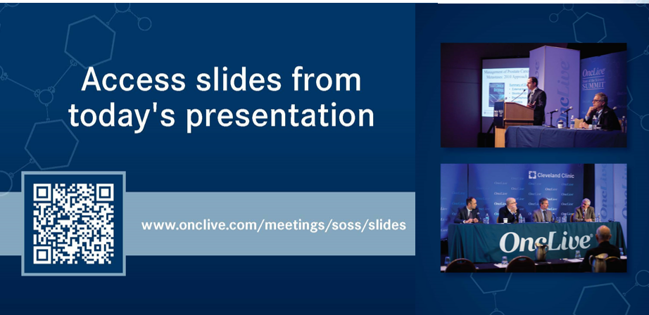

Slide 6
OncLive® is launching
a new app called
Meet MY MSL!
Visit https://cloud.email.onclive.com/referrals to be one of the first health care professionals to gain access to Meet My MSL
Meet My MSL has been created to provide oncologists the opportunity to initiate direct contact with the Medical Science Liaison (MSL) in their area of expertise. It has never been easier to meet, locate, and contact the MSL you need.
Find any MSL from any company for any tumor

Slide 7
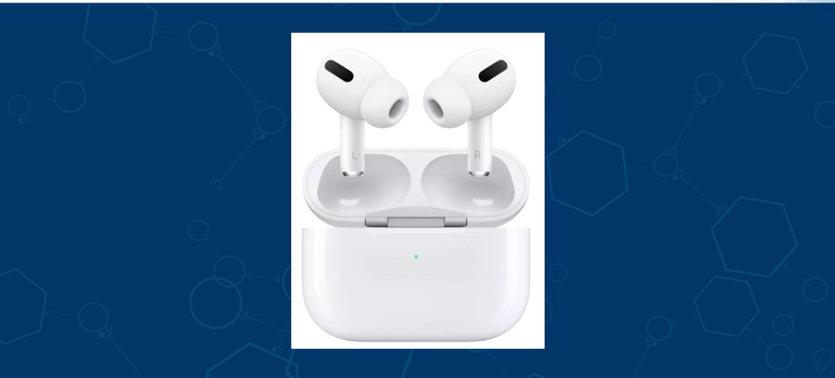

Slide 8
Program Chair
Pedro C. Barata, MD, MSc
Co-Leader GU Disease Team
Director of GU Medical Oncology Research Program
University Hospitals Seidman Cancer Center
Associate Professor of Medicine
Case Western Reserve University

Slide 9


PARP inhibitors or Advanced Prostate Cancer
Neeraj Agarwal, MD, FASCO
Professor of Medicine
Senior Director for Clinical Translation, Huntsman Cancer Institute (HCI)
HCI Presidential Endowed Chair of Cancer Research
Director, Center of Investigational Therapeutics
Director, Genitourinary Oncology Program
Huntsman Cancer Institute, University of Utah (NCI-CCC)
@neerajaiims

Slide 10
Conflict of Interest
(career wide/past or present)
Consultancy to Astellas, Astra Zeneca, Argos, Aveo, Bayer Oncology, Bristol Myers Squibb, Calithera, Clovis, Eisai, Eli Lilly, EMD Serono, Exelixis, Foundation Medicine, Genentech, Janssen, Merck, MEI Pharma, Nektar, Novartis, Pfizer, Pharmacyclics, Seattle Genetics
Research funding to my institution on my behalf: Active Biotech, Astra Zeneca, Bavarian Nordic, Bayer Oncology, BN Immunotherapeutics, Bristol Myers Squibb, Calithera, Celldex, Clovis, Eisai, Eli Lilly, EMD Serono, Exelixis, Genentech, Glaxo Smith Kline, Immunomedics, Janssen, Medivation, Merck, Nektar, New link Genetics, Novartis, Pfizer, Prometheus, Rexahn, Roche, Sanofi, Seattle Genetics, Takeda, Tracon
@neerajaiims

Slide 11
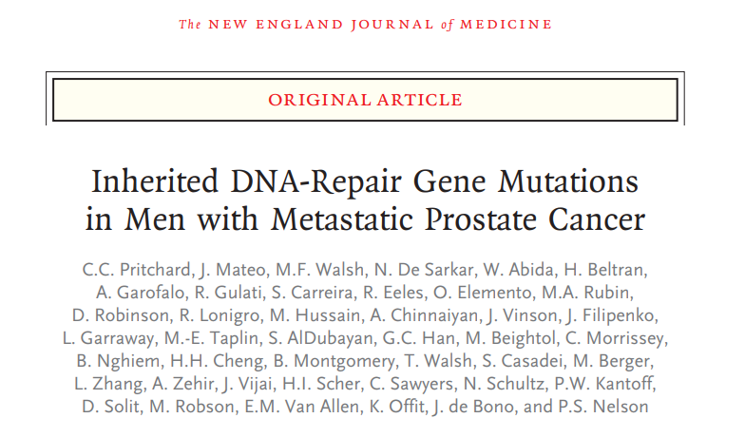
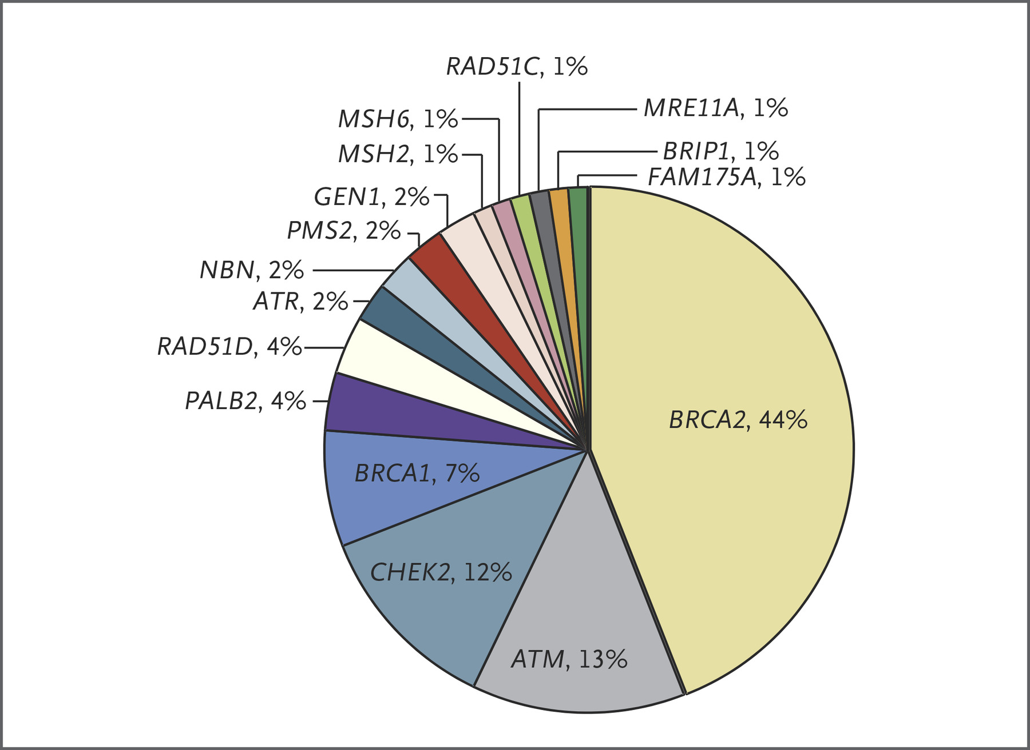
Germline HRR mutations in metastatic prostate cancer
Pritchard et al. NEJM 2016
@neerajaiims

Slide 12
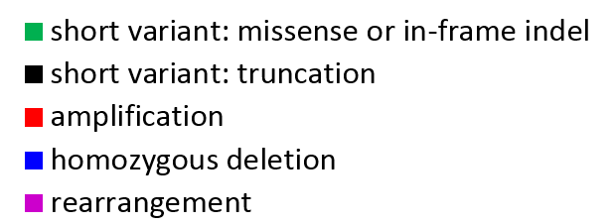

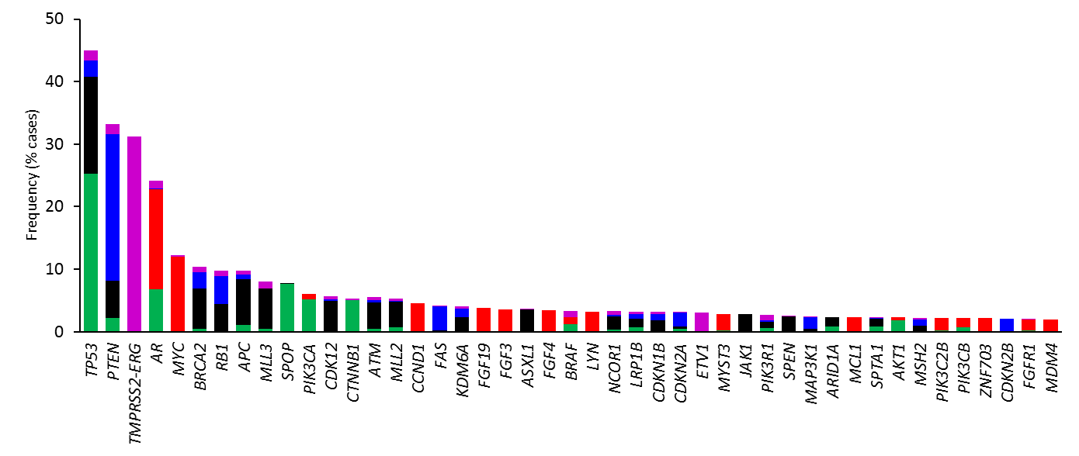
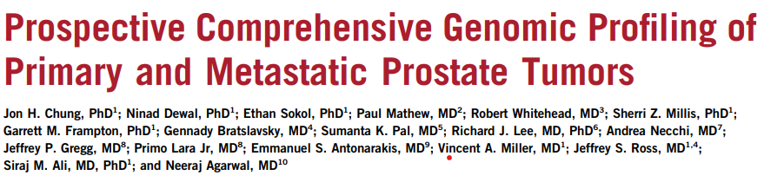
Genomic Landscape in Advanced Prostate Cancer (Tissue DNA)
n=3476 (Primary site: 1660; Metastatic site: 1816)
Chung JH, …, Agarwal N. JCO Precision Oncology 2019 (Online)
@neerajaiims
Notes:
The histogram above shows the frequency and type of GAs with the most frequent ones in <CLICK> TP53, PTEN, AR, MYC, and BRCA2. Many of the alterations detected are targetable with drugs already available in the clinic.

Slide 13
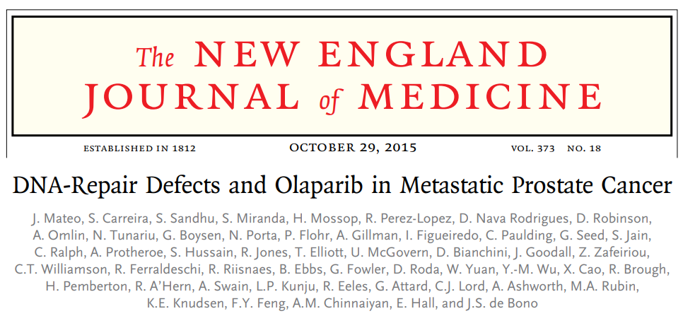
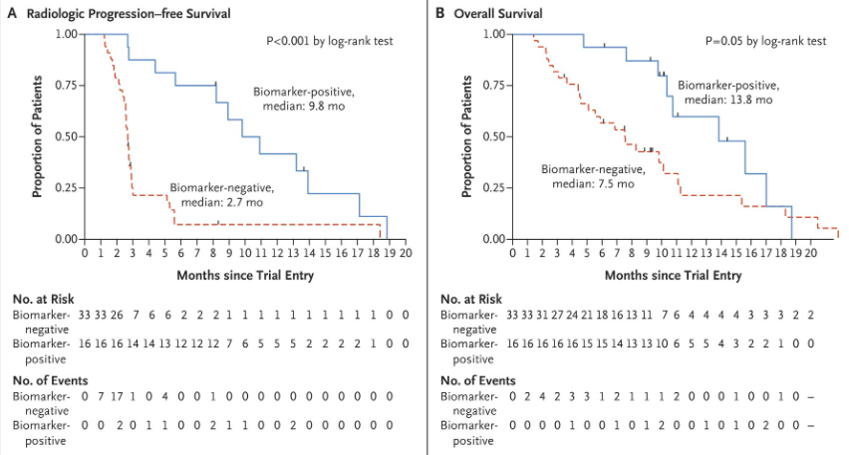
TOPARP-A (Olaparib): Phase 2 trial (mCRPC)
Mateo J. et al. NEJM 2015
@neerajaiims

Slide 14
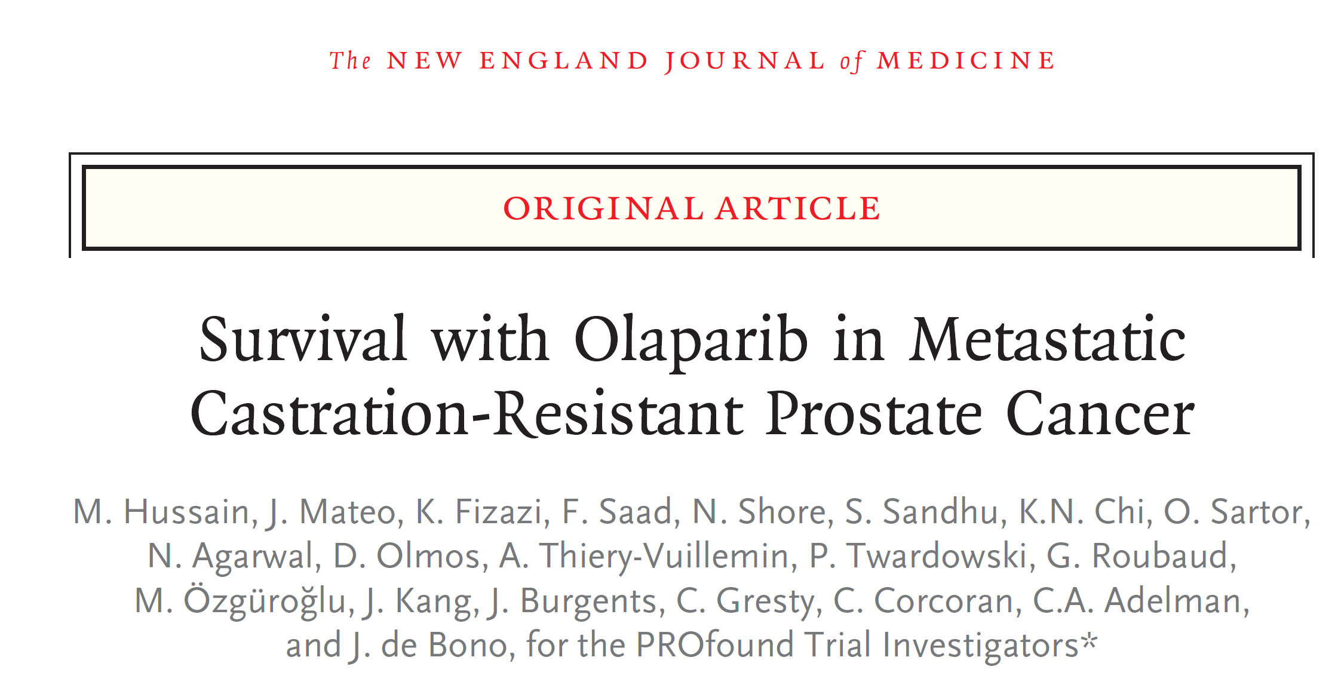
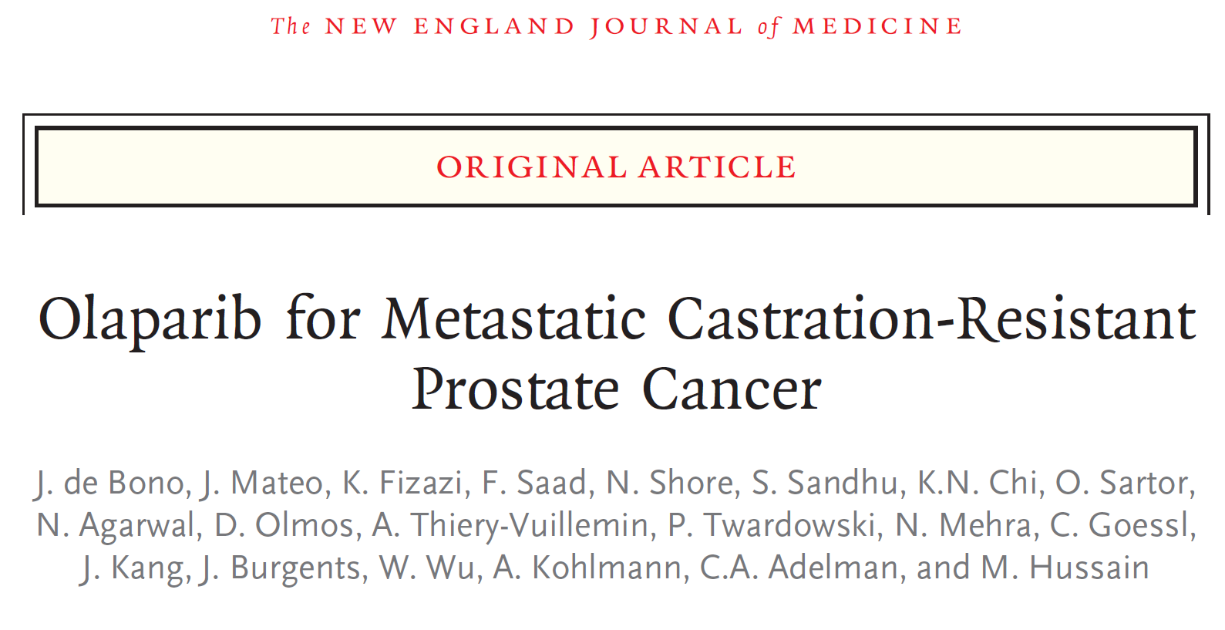
Profound (Olaparib): Phase 3 trial (mCRPC with HRR gene alteration)
2020 Apr 28. DOI: 10.1056/NEJMoa1911440
2020 Sep 20. doi: 10.1056/NEJMoa202248
@neerajaiims
Notes:
Profound was the first positive randomized phase 3 trial in metastatic prostate cancer where patients were selected based on a biomarker.

Slide 15
PROFOUND Trial: Phase 3 Trial Design
Olaparib 300 mg bid
n = 162
Primary endpoint:
rPFS by BICR in Cohort A
(alpha=0.05)
Key eligibility criteria
mCRPC
Disease progression on prior NHA, eg enzalutamide and/ or abiraterone treatment
Alterations in ≥1 of any qualifying gene with a direct or indirect role in HRR*
Cohort A:
BRCA1, BRCA2 or ATM
N=245
Physician's choice of enza or abi†
n = 83
Confirmed ORR by BICR in Cohort A
(alpha=0.05)
2:1 randomization
Open-label
Upon BICR progression, Physician's choice patients were eligible for crossover to olaparib
rPFS by BICR in Cohorts A+B
(alpha=0.05)
Olaparib 300 mg bid
n = 94
Time to pain progression
in Cohort A
(alpha=0.05)
Cohort B:
Other HRR alterations
N=142
Stratification Factors
Previous taxane
Measurable disease
Physician's choice of enza or abi†
n = 48
OS in Cohort A → Interim
(alpha=0.01)
OS in Cohort A → Final
(alpha=0.047)
*BRCA1, BRCA2, ATM, BARD1, BRIP1, CDK12, CHEK1, CHEK2, FANC, PALB2, PPP2R2A, RAD51B, RAD51C, RAD51D RAD54L; †Physician choice of either enzalutamide (160 mg qd) or abiraterone (1000 mg qd plus prednisone [5 mg bid]); BICR, blinded independent central review; bid, twice daily; ORR, objective response rate; OS, overall survival; rPFS, radiographic progression free survival.
1. de Bono J et al. N Engl J Med 2020;382:2091–102
@neerajaiims

Slide 16
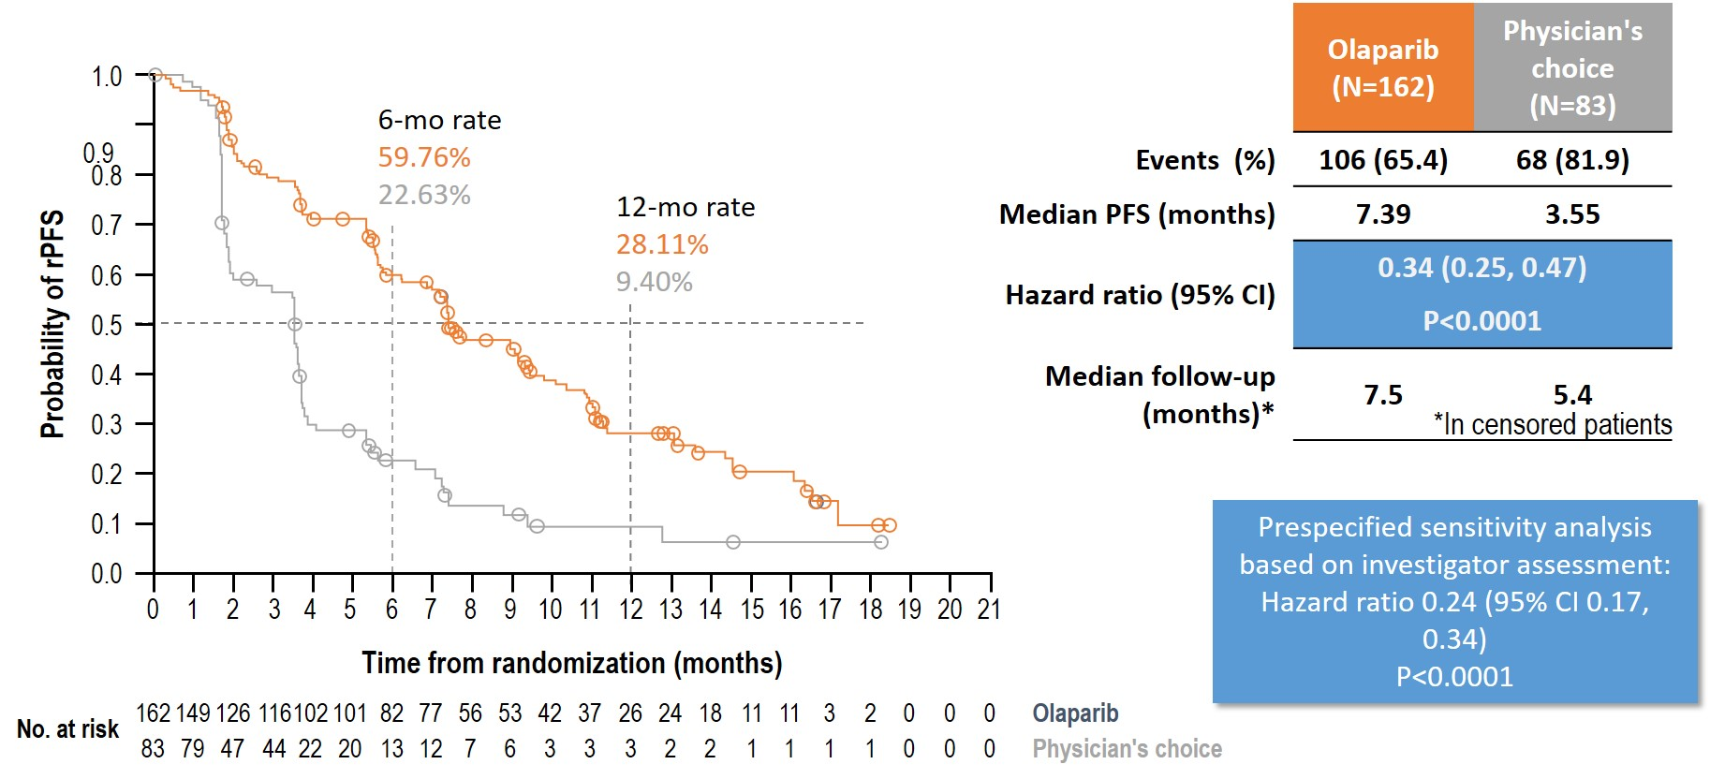
Primary endpoint: rPFS by BICR in patients with alterations in
BRCA1, BRCA2, or ATM (Cohort A)
1. de Bono J et al. N Engl J Med 2020;382:2091–102
@neerajaiims

Slide 17
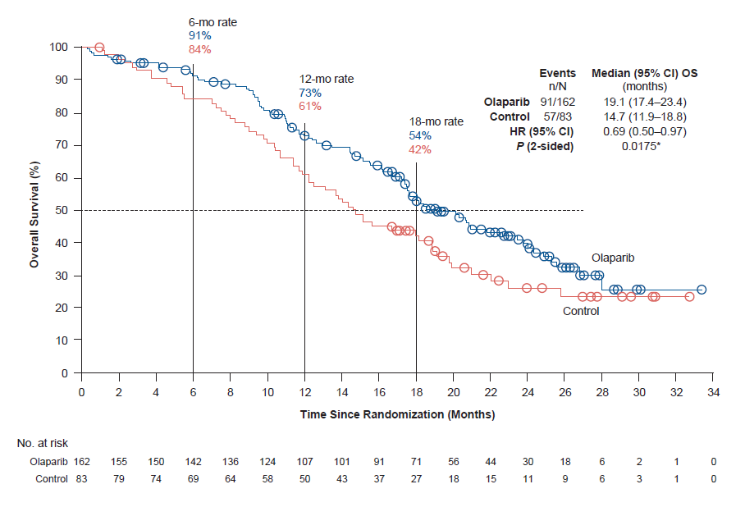
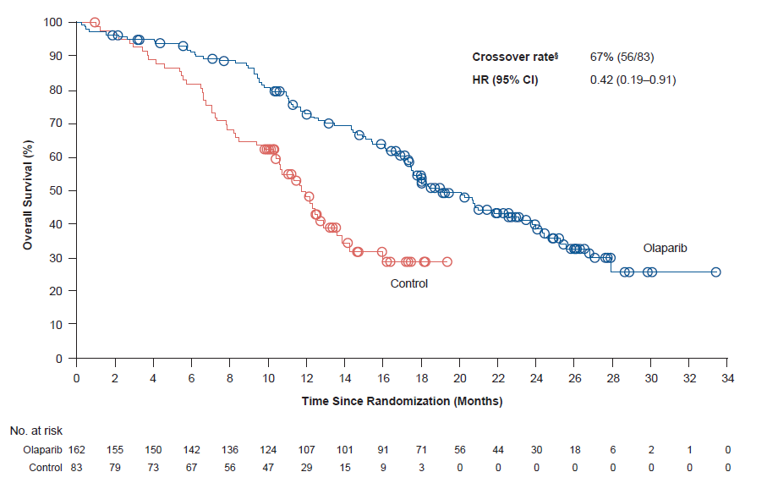
Final OS in Cohort A (BRCA1, BRCA2 and/or ATM mCRPC)
Cohort A
 | Olaparib (N=162) | Control (N=83)
Events (%) | 91 (56) | 57 (68)
Median OS | 19.1 months | 14.7 months
HR (95% CI) | 0.69
 | (0.50‒0.97); P=0.0175
Cohort A with adjustment for crossover*
Crossover rate | 67% (56/83)
HR (95% CI) | 0.42
 | (0.19‒0.91)
Median follow-up duration for censored patients was 21.9 months for the olaparib arm and 21.0 months for the control arm
*Re-censored; conducted using RPSFTM to demonstrate the impact on OS of crossover of patients from the control arm to receive olaparib as a first subsequent anticancer therapy
RPSFTM, rank-preserving structural failure time model
1. de Bono J et al. N Engl J Med 2020;382:2091–102
@neerajaiims

Slide 18
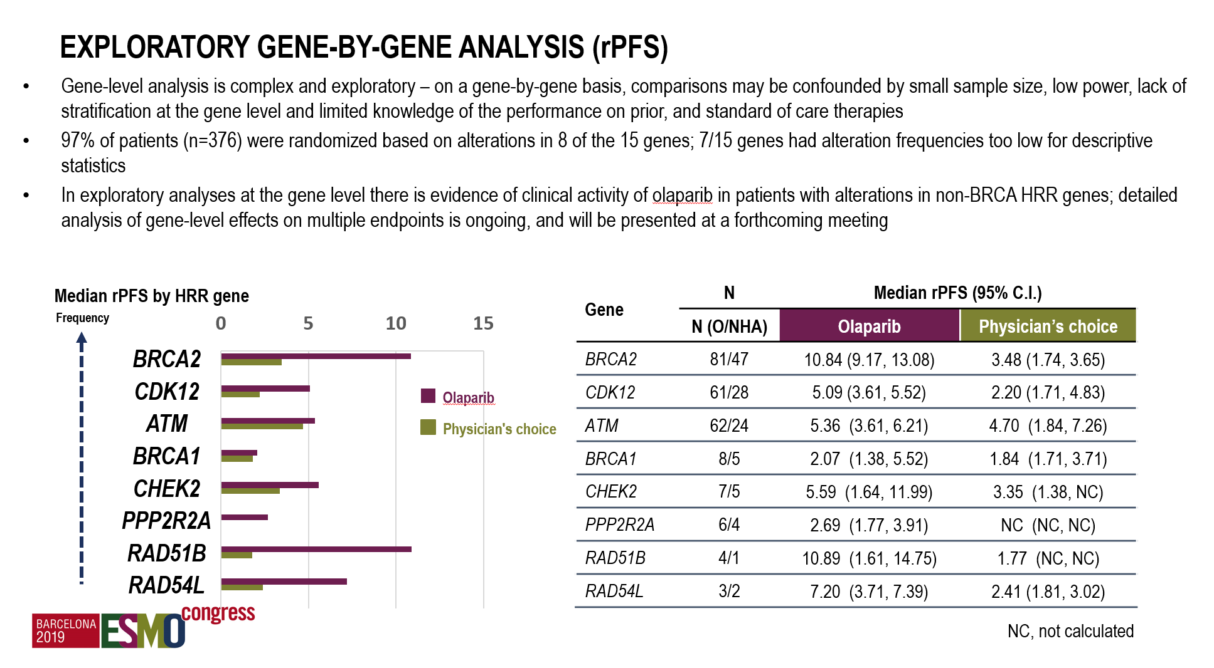
Exploratory Gene-by-Gene Analysis (rPFS)
1. de Bono J et al. N Engl J Med 2020;382:2091–102
@neerajaiims

Slide 19
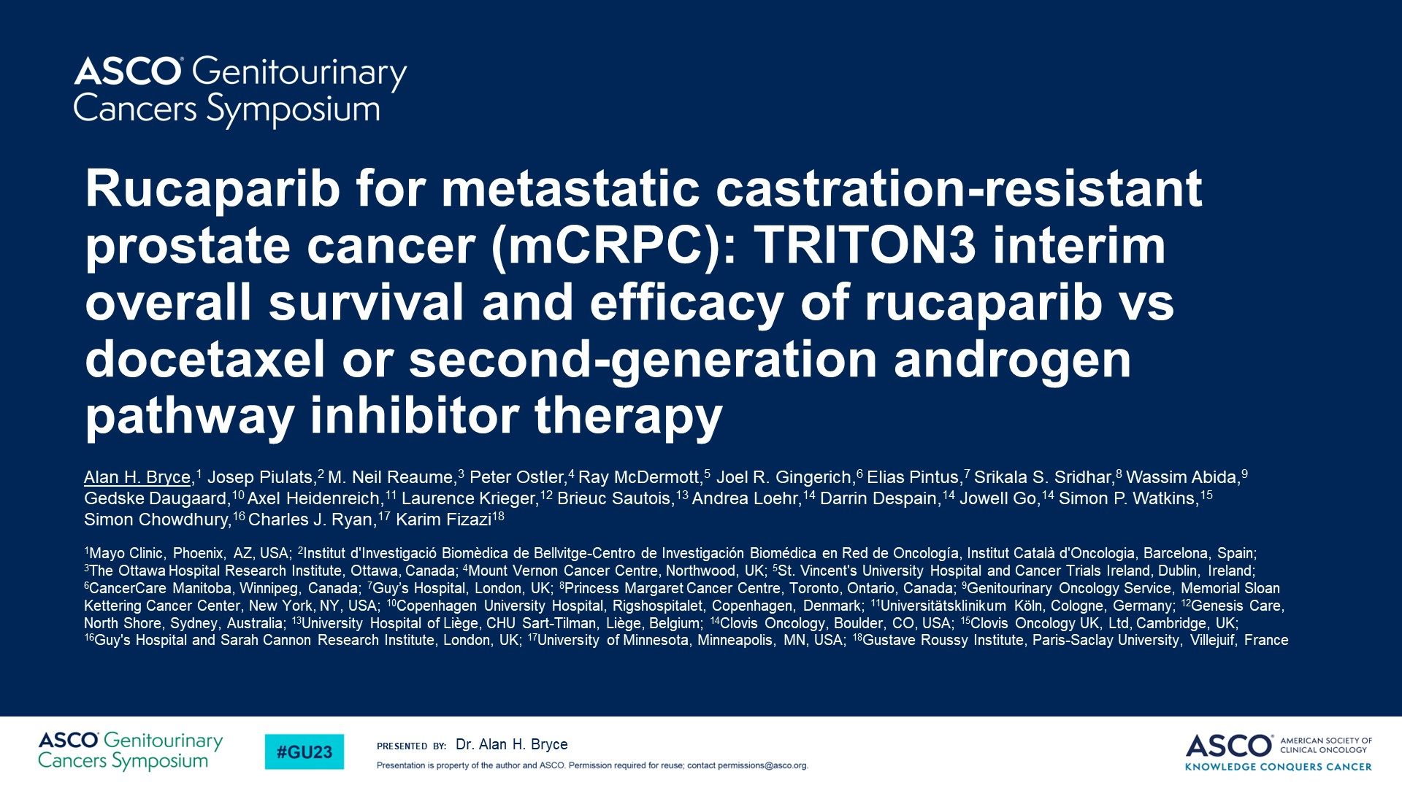
Rucaparib for metastatic castration-resistant prostate cancer (mCRPC): TRITON3 interim overall survival and efficacy of rucaparib vs docetaxel or second-generation androgen pathway inhibitor therapy
@neerajaiims

Slide 20
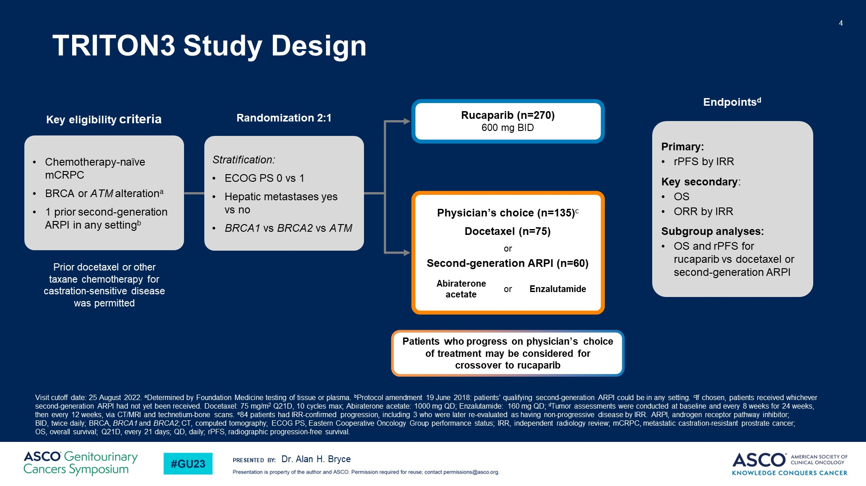
TRITON3 Study Design
@neerajaiims

Slide 21
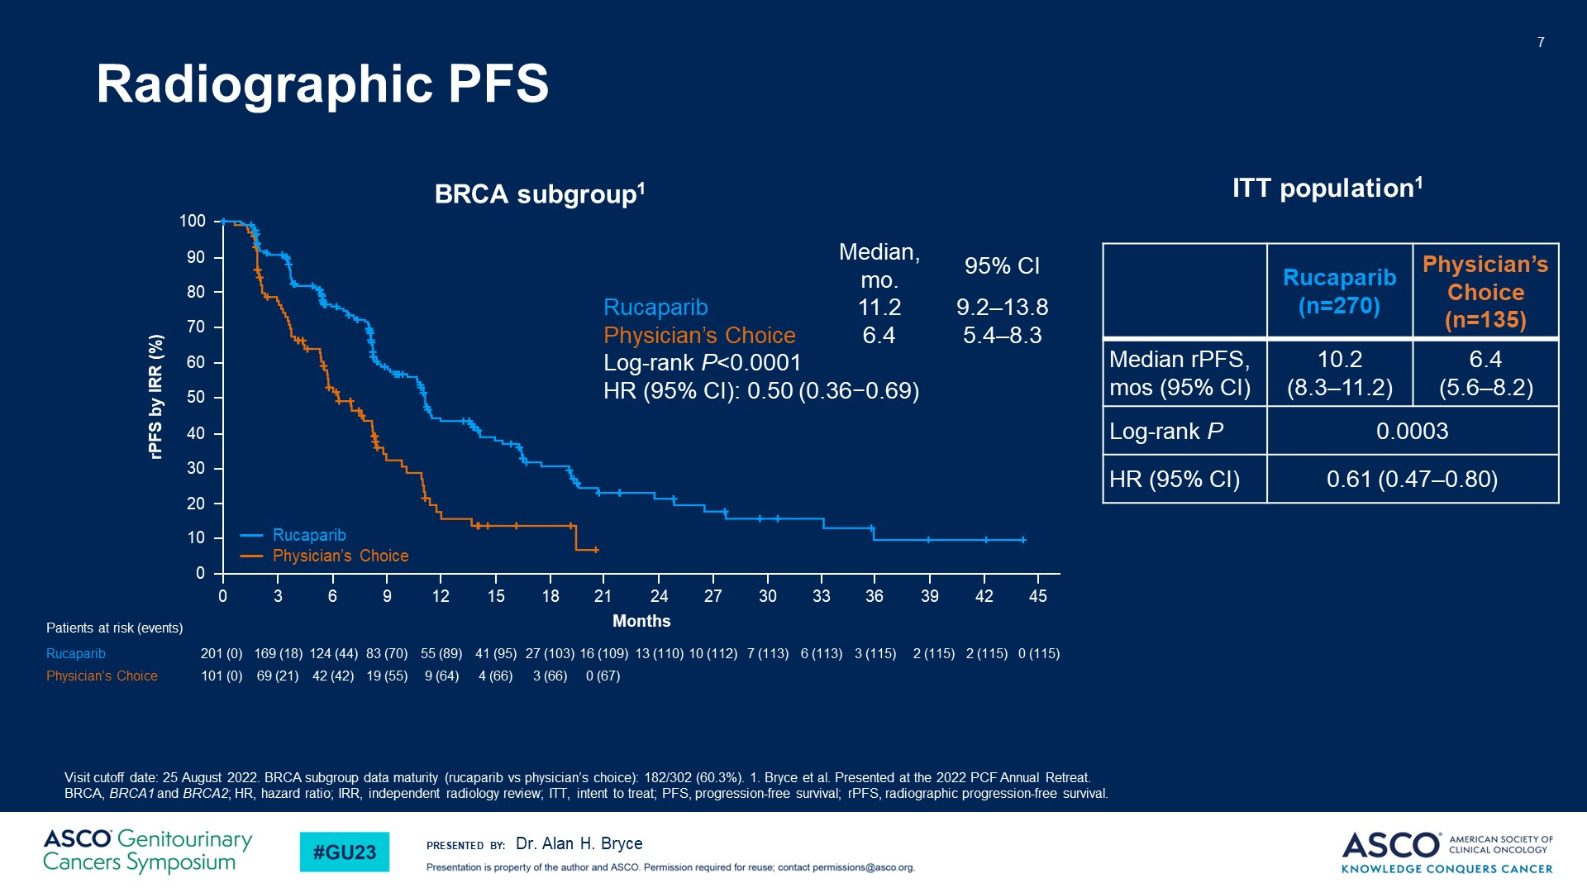
Radiographic PFS
@neerajaiims

Slide 22
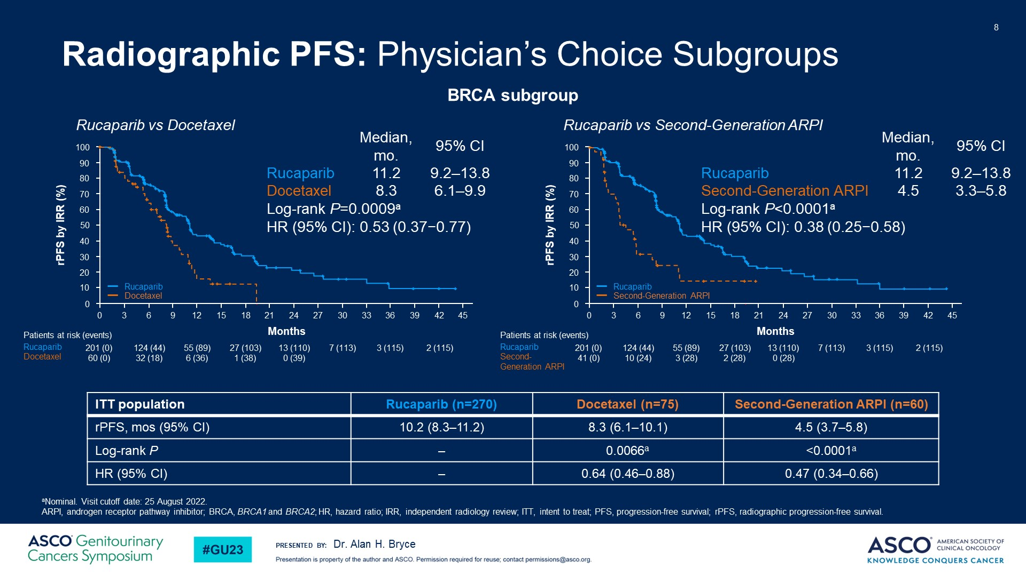
Radiographic PFS: Physician’s Choice Subgroups
@neerajaiims

Slide 23
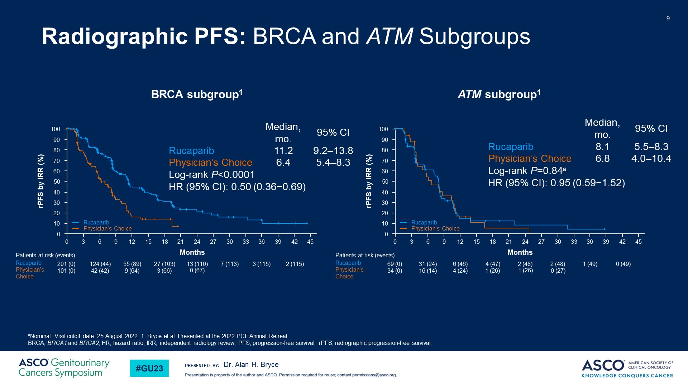
Radiographic PFS: BRCA and ATM Subgroups
@neerajaiims

Slide 24
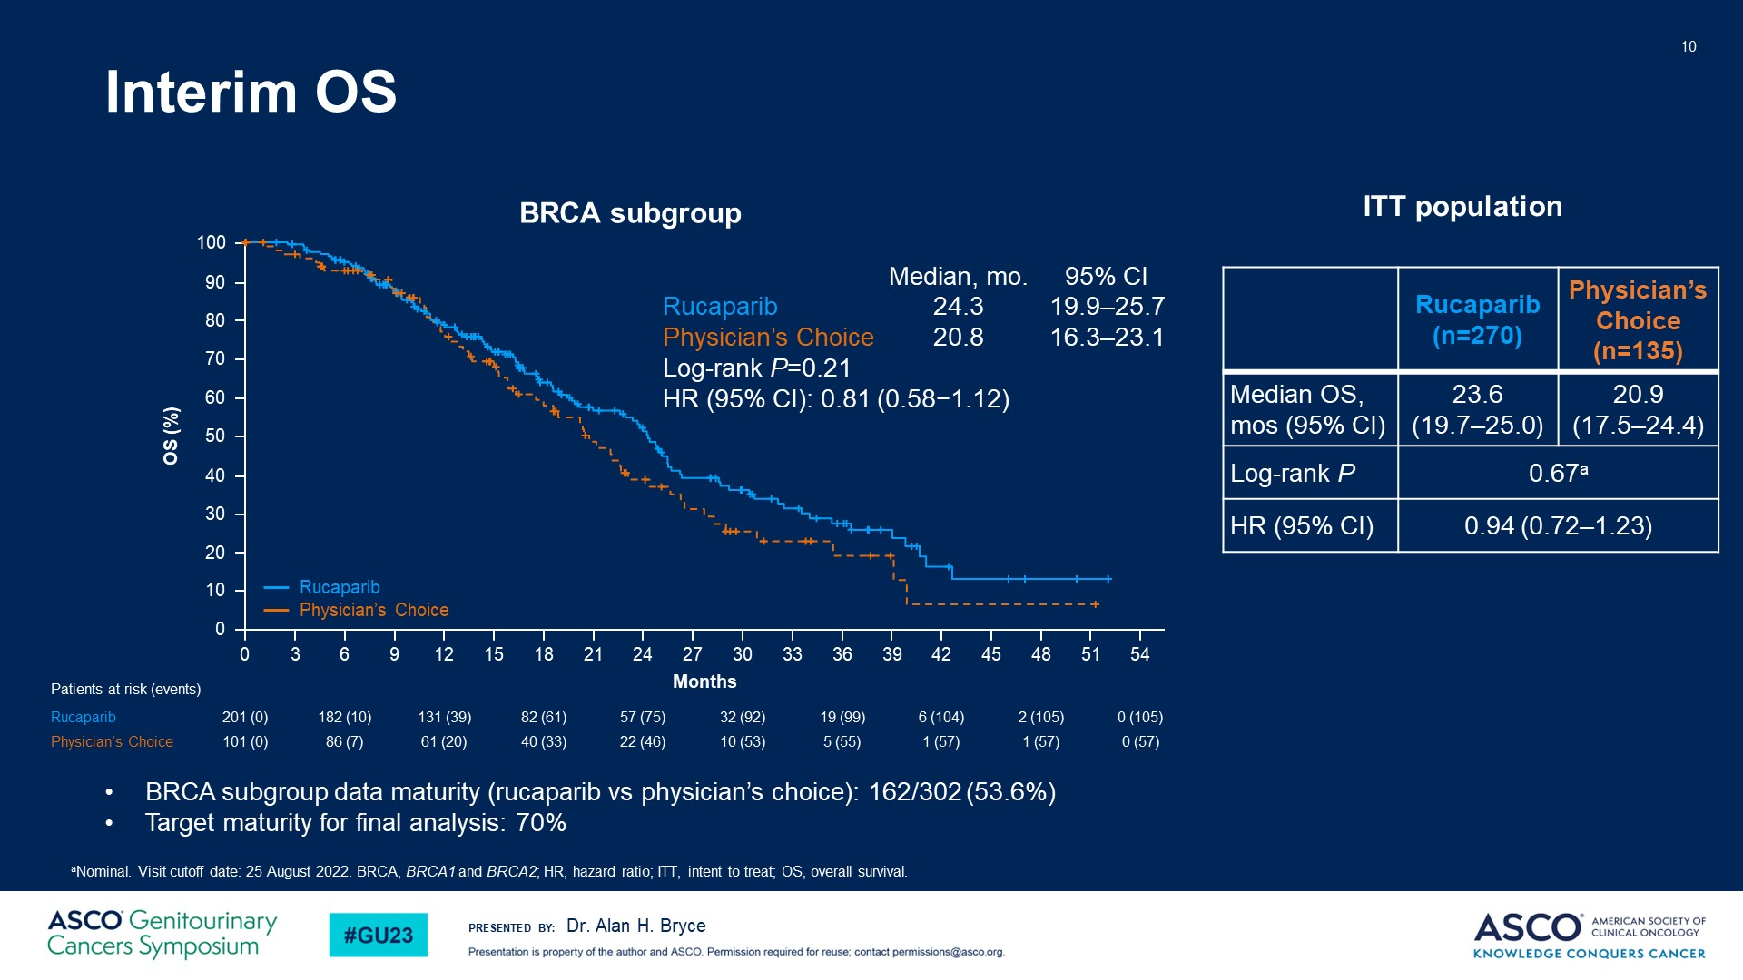
Interim OS
@neerajaiims

Slide 25
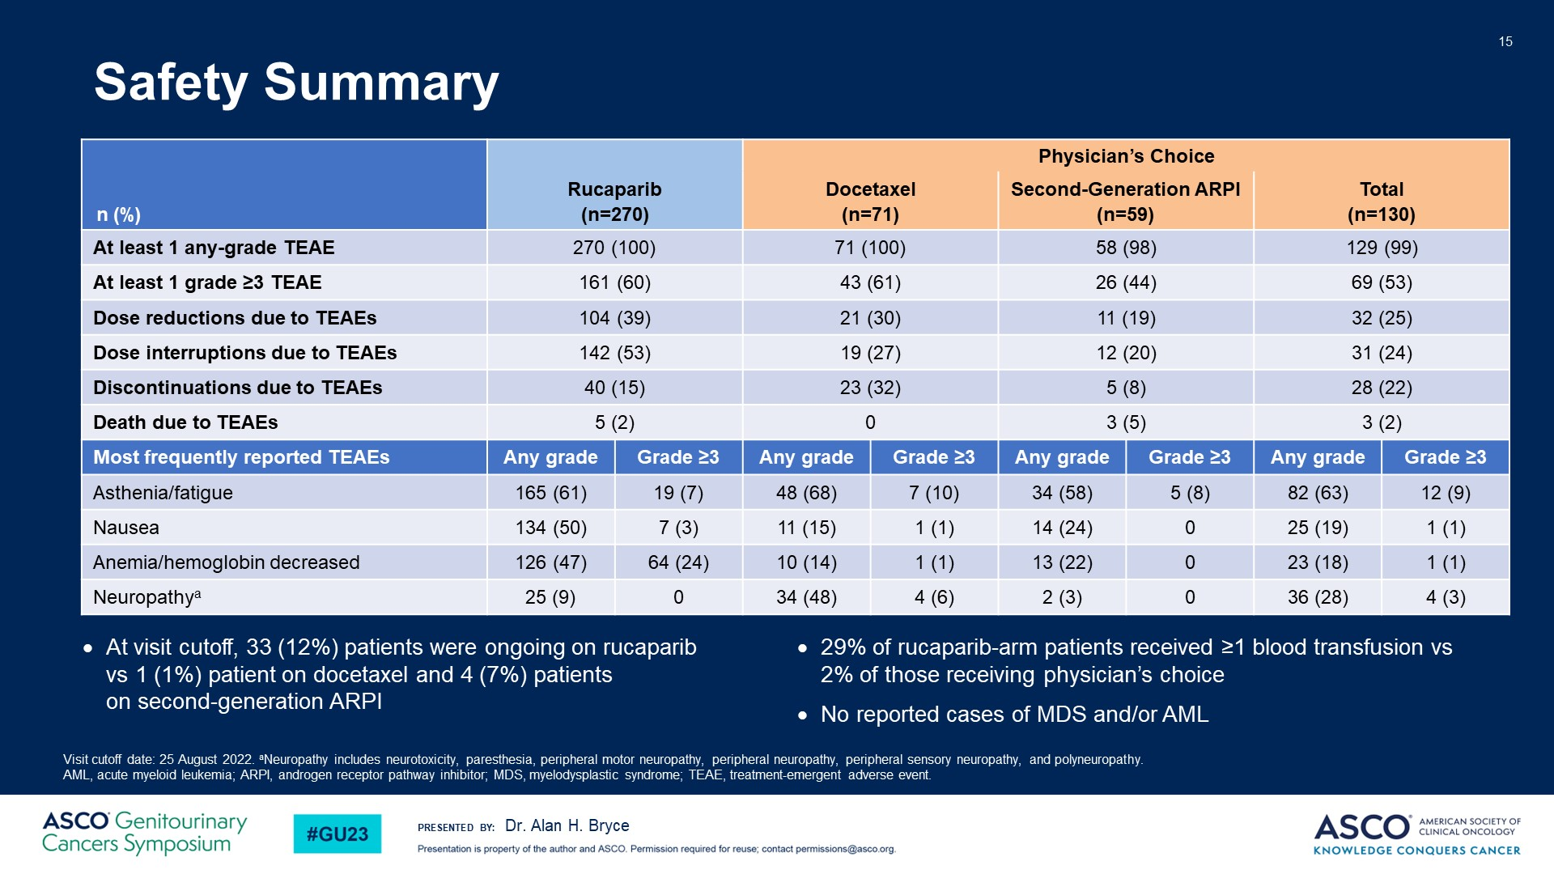
Safety Summary
@neerajaiims

Slide 26
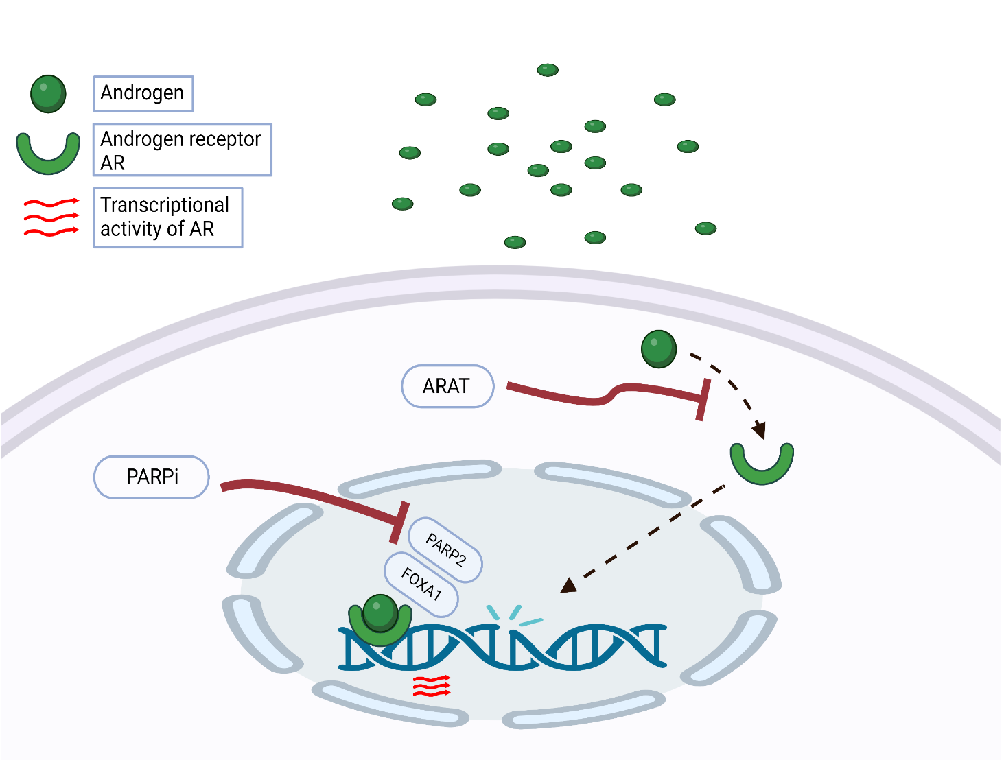
The rationale for combining PARPi with NHT
NHTs induce a phenotype resembling HRR deficiency
Suppressed AR function causes an upregulation of PARP
NHTs prime tumor cells
for PARP inhibition
PARP augments AR activity
PARP inhibitors may attenuate resistance to NHTs
PARP inhibitors extend the benefits of NHTs
Adapted from Bin Gui et al., PNAS 2019 June,
DOI https://doi.org/10.1073/pnas.1908547116
@neerajaiims
Notes:
AR inhibition upregulate PARP (as a matter of defence) and PARP augments AR activity (trying to negate the action of AR inhibitor).
beyond DNA damage repair function, PARP-2, but not PARP-1, is a critical component in AR transcriptional machinery through interacting with the pioneer factor FOXA1 and facilitating AR recruitment to genome-wide prostate-specific enhancer regions

Slide 27
Phase II Study: Abiraterone ± Olaparib in mCRPC
Randomized, double-blind, placebo-controlled phase II trial
Patients with mCRPC
  Pretreated with docetaxel
  ≤2 prior lines of chemotherapy
  No previous second-generation antihormonal agents
  Plasma (mandatory)/whole-blood (optional)/archival tissue (optional) tested for HRR mutations*
(N = 142)
Olaparib 300 mg BID +
Abiraterone 1000 mg QD + Prednisone 5 mg Q2D
(n = 71)
Until PD
Placebo +
Abiraterone 1000 mg QD + Prednisone 5 mg Q2D
(n = 71)
*Tumor/whole-blood tested first; if no data, then plasma.
Primary endpoint: radiologic PFS
Biomarker data obtained for 136 patients (96%), 21 (15%) of whom were
HRR mutation positive
  HRR mutations included BRCA2, ATM, CHEK1, CHEK2, PALB2, BRIP1, CDK12
Clarke. Lancet Oncol. 2018;19:975. NCT01972217.
@neerajaiims

Slide 28
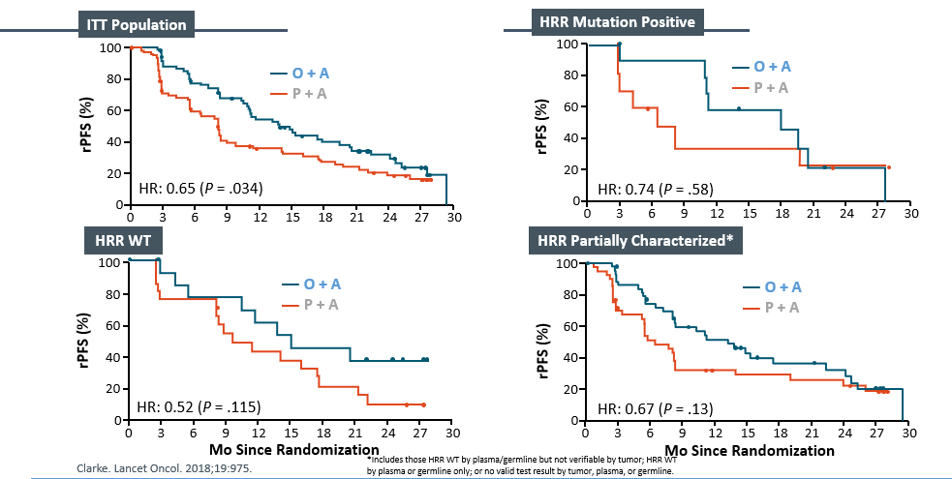
Abiraterone ± Olaparib in mCRPC: rPFS
@neerajaiims

Slide 29


Phase 3 trial of PARPi + AR pathway inhibitor in 1st line mCRPC setting
PROpel: Abiraterone + Olaparib ¹
Published
MAGNITUDE: Abiraterone + Niraparib ²
Presented
TALAPRO-2: Enzalutamide + Talazoparib
Published
CASPAR: Enzalutamide + Rucaparib Enrolling
1- Clarke NW et al., NEJM Evidence. 2022 Aug 23;1(9):EVIDoa2200043.
2- Chi KN et al., JCO. 2022 Feb 20;40(6_suppl):12–12. Kim Chi, (2022 Genitourinary cancers symposium (ASCO GU). Abstract #12)
@neerajaiims

Slide 30
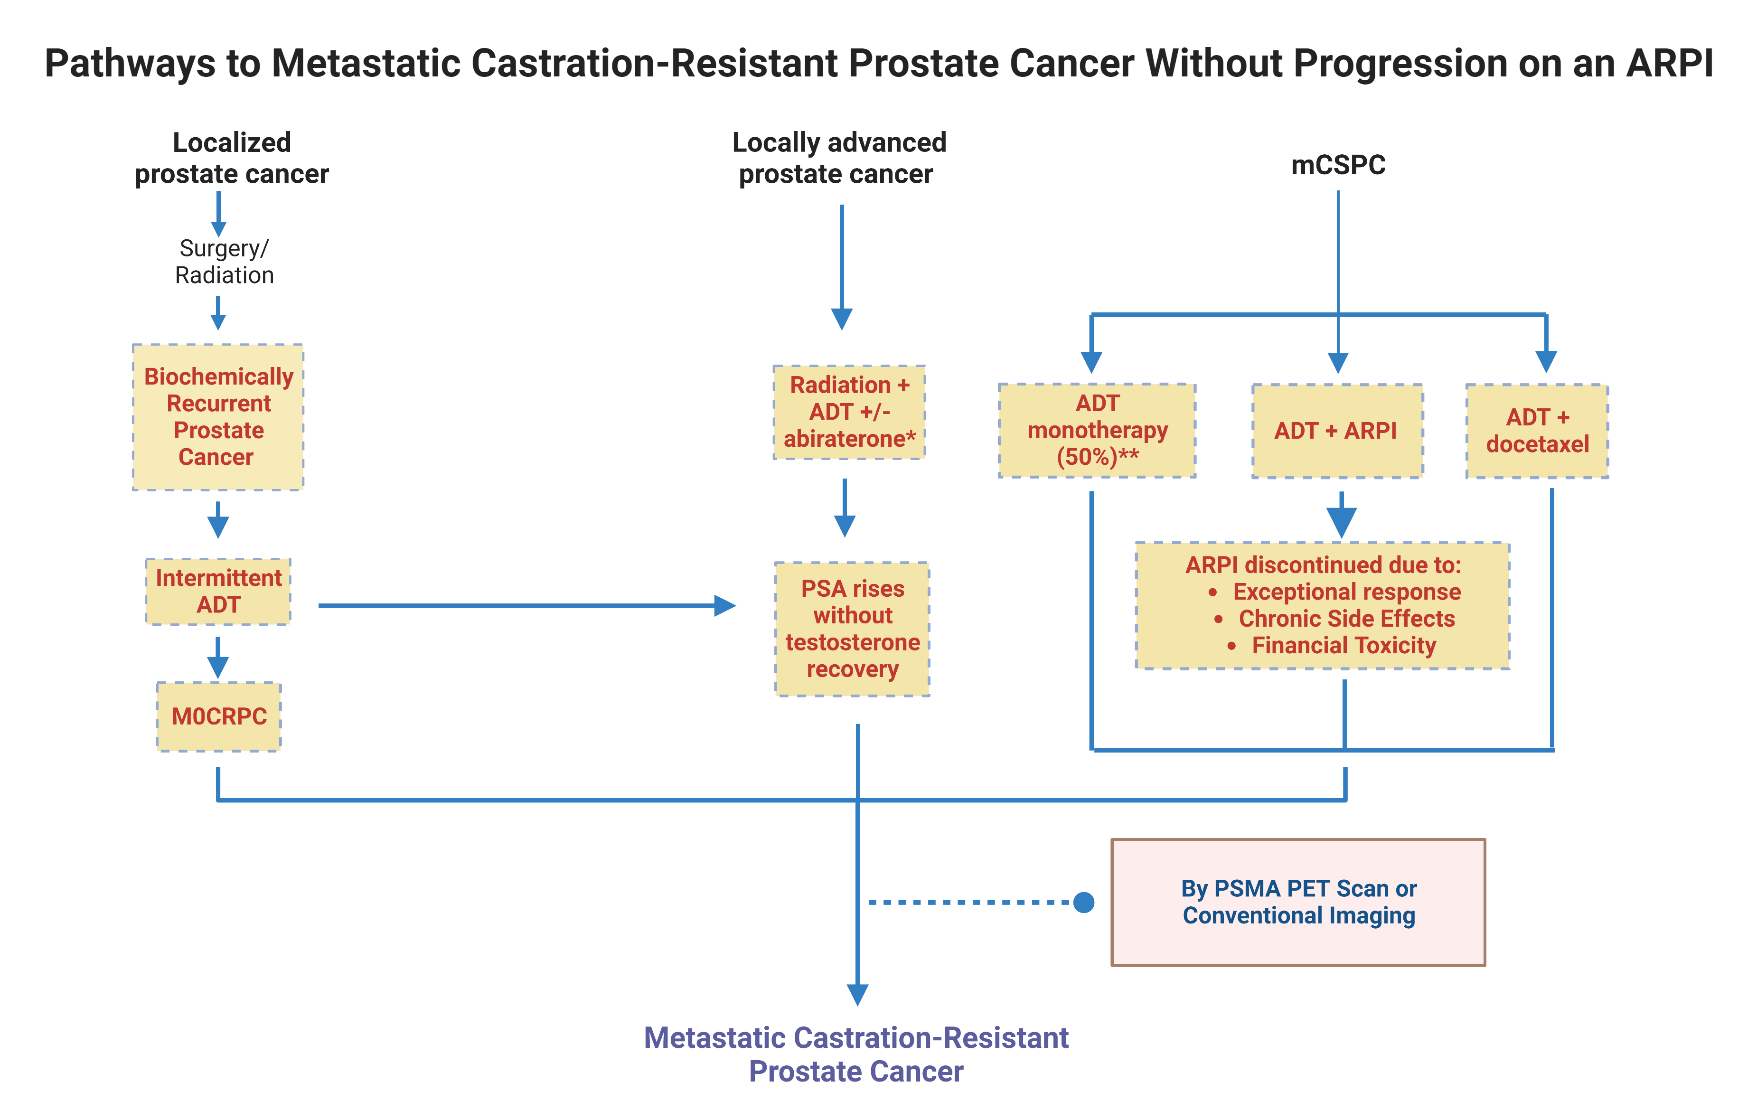
Pathways to Metastatic Castration-Resistant Prostate Cancer Without Progression on an NHT
*Limited Duration of 2 years **Swami U…Agarwal N., Cancers 2021
Abbreviations: ADT: androgen deprivation therapy; ARPI: androgen receptor pathway inhibitor; mCSPC: metastatic castration-sensitive prostate cancer; M0CRPC: non-metastatic castration-resistant prostate cancer; PSMA: prostate specific membrane antigen.
@neerajaiims

Slide 31
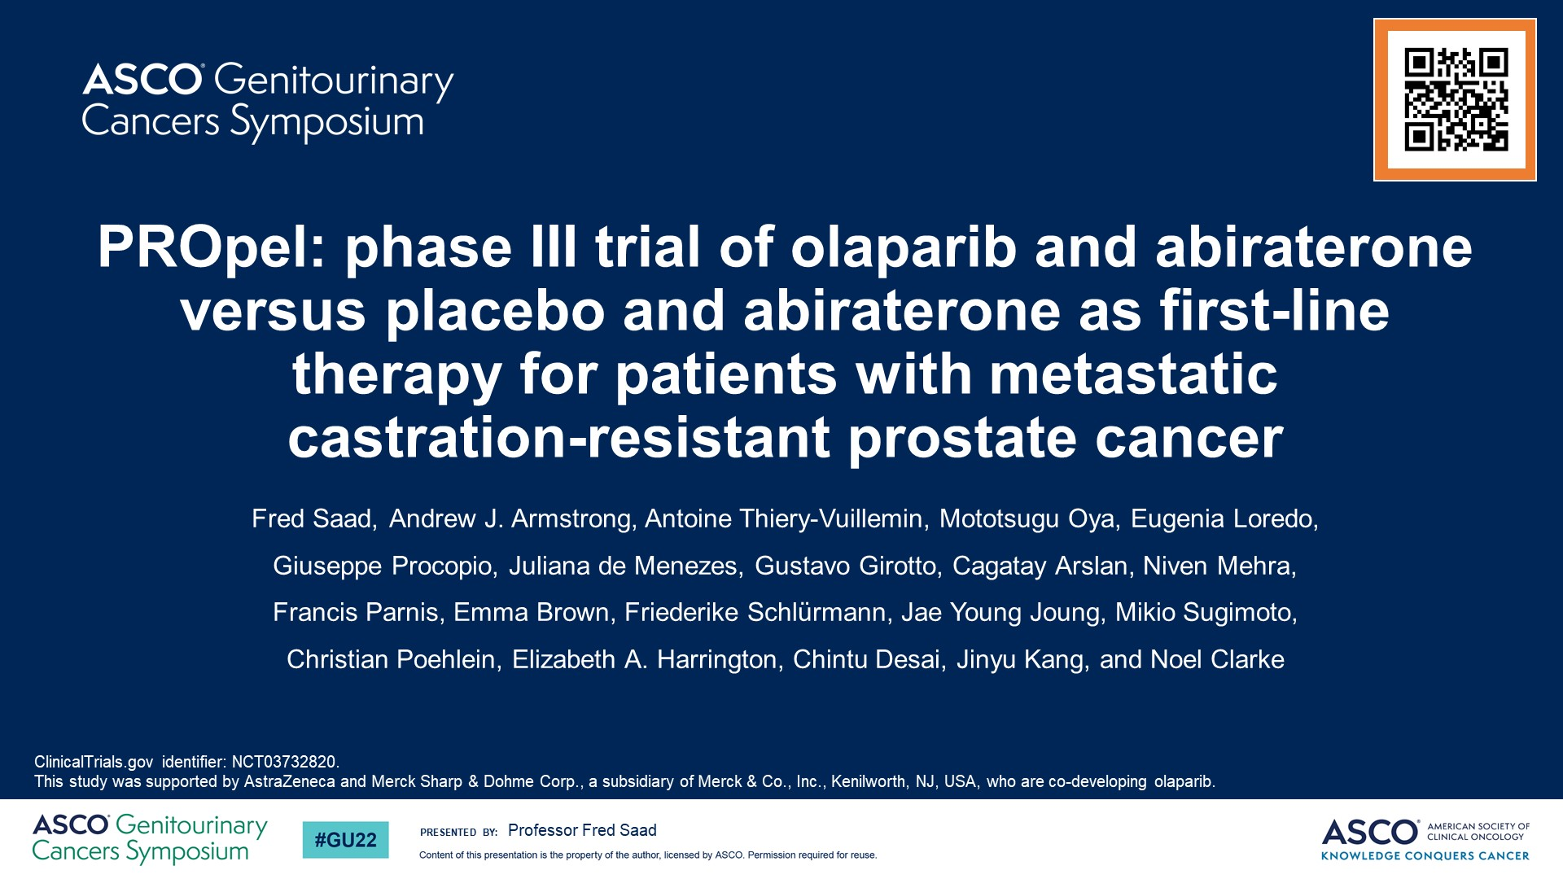
PROpel: phase III trial of olaparib and abiraterone versus placebo and abiraterone as first-line therapy for patients with metastatic <br />castration-resistant prostate cancer
@neerajaiims

Slide 32
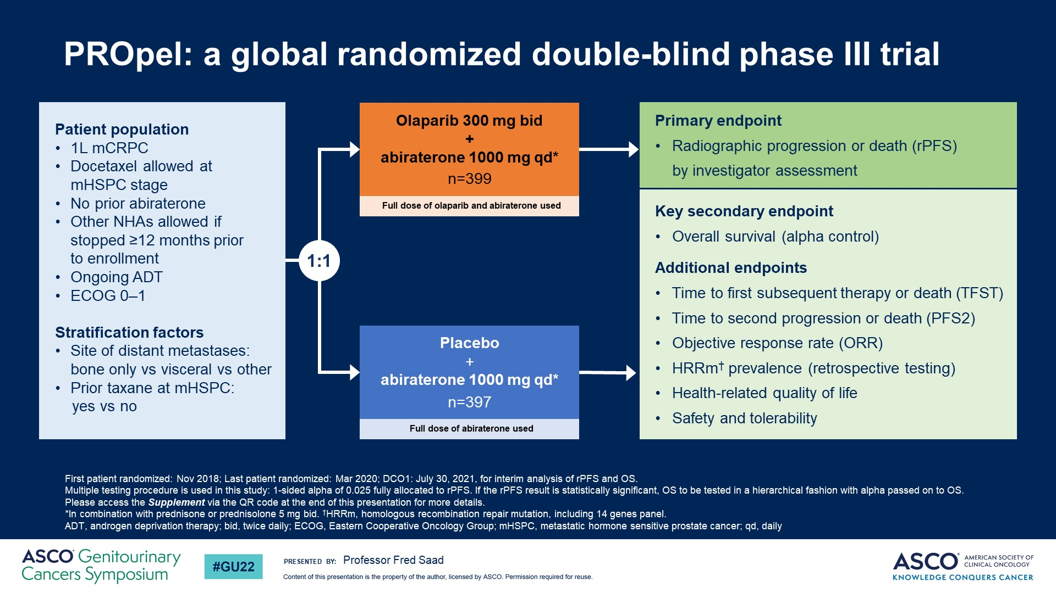
Slide 5
@neerajaiims
Notes:
PROpel is a randomized phase III trial evaluating the efficacy and safety of olaparib + abiraterone versus placebo + abiraterone in the first-line metastatic castration-resistant prostate cancer (mCRPC) setting. Docetaxel therapy was allowed if given in the metastatic castration-sensitive prostate cancer setting. Enrollment in this study was independent of defects in the homologous recombination repair pathway. The primary endpoint was investigator-assessed radiographic Progression-Free Survival (rPFS) with multiple secondary endpoints, including overall survival (OS) and safety. A total of 796 patients were randomized to olaparib + abiraterone (n=399) or placebo + abiraterone (n=397). Baseline characteristics were well-balanced between treatment arms including HRR mutation status.

Slide 33
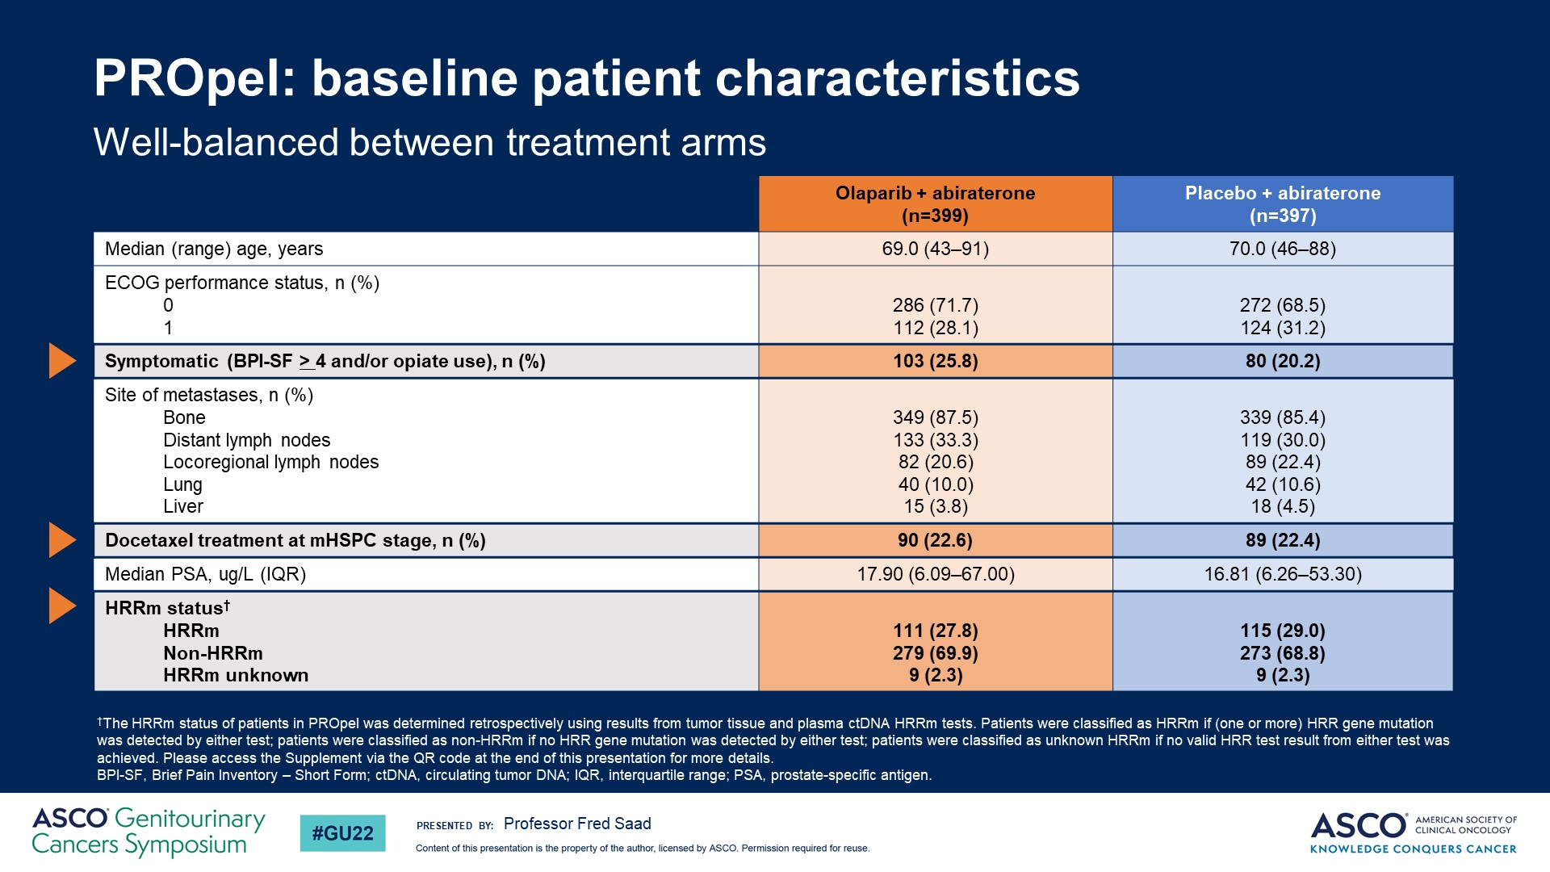
PROpel: baseline patient characteristics
@neerajaiims

Slide 34
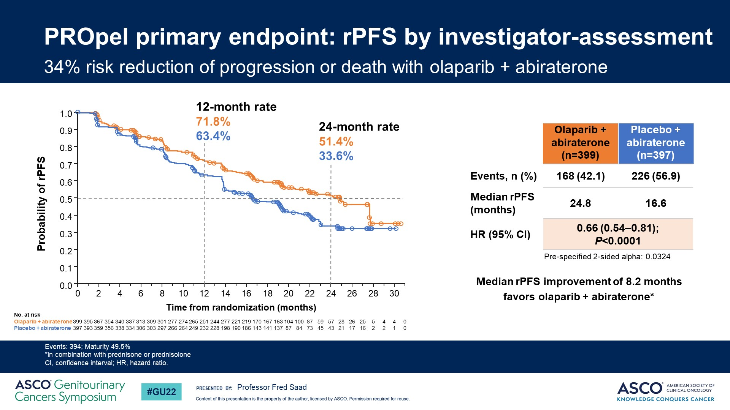
PROpel primary endpoint: rPFS by investigator-assessment
@neerajaiims
Notes:
At the pre-planned interim analysis, results show the trial met its primary endpoint with a significant improvement in rPFS for all patients receiving olaparib + abiraterone versus placebo + abiraterone regardless of the presence of homologous recombination repair gene mutations. Median rPFS was 24.8 vs 16.6 months for patients receiving olaparib + abiraterone versus placebo + abiraterone respectively, and a hazard ratio of 0.66, 95% confidence interval 0.54–0.81 and a P value <0.0001, which translates into a 34% reduction in the risk of progression or death.

Slide 35
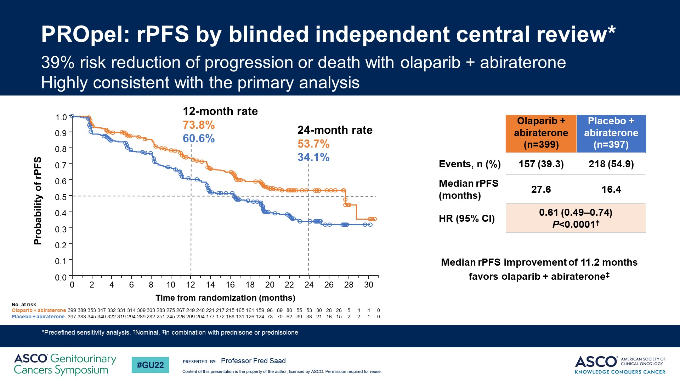
PROpel: rPFS by blinded independent central review*
@neerajaiims

Slide 36
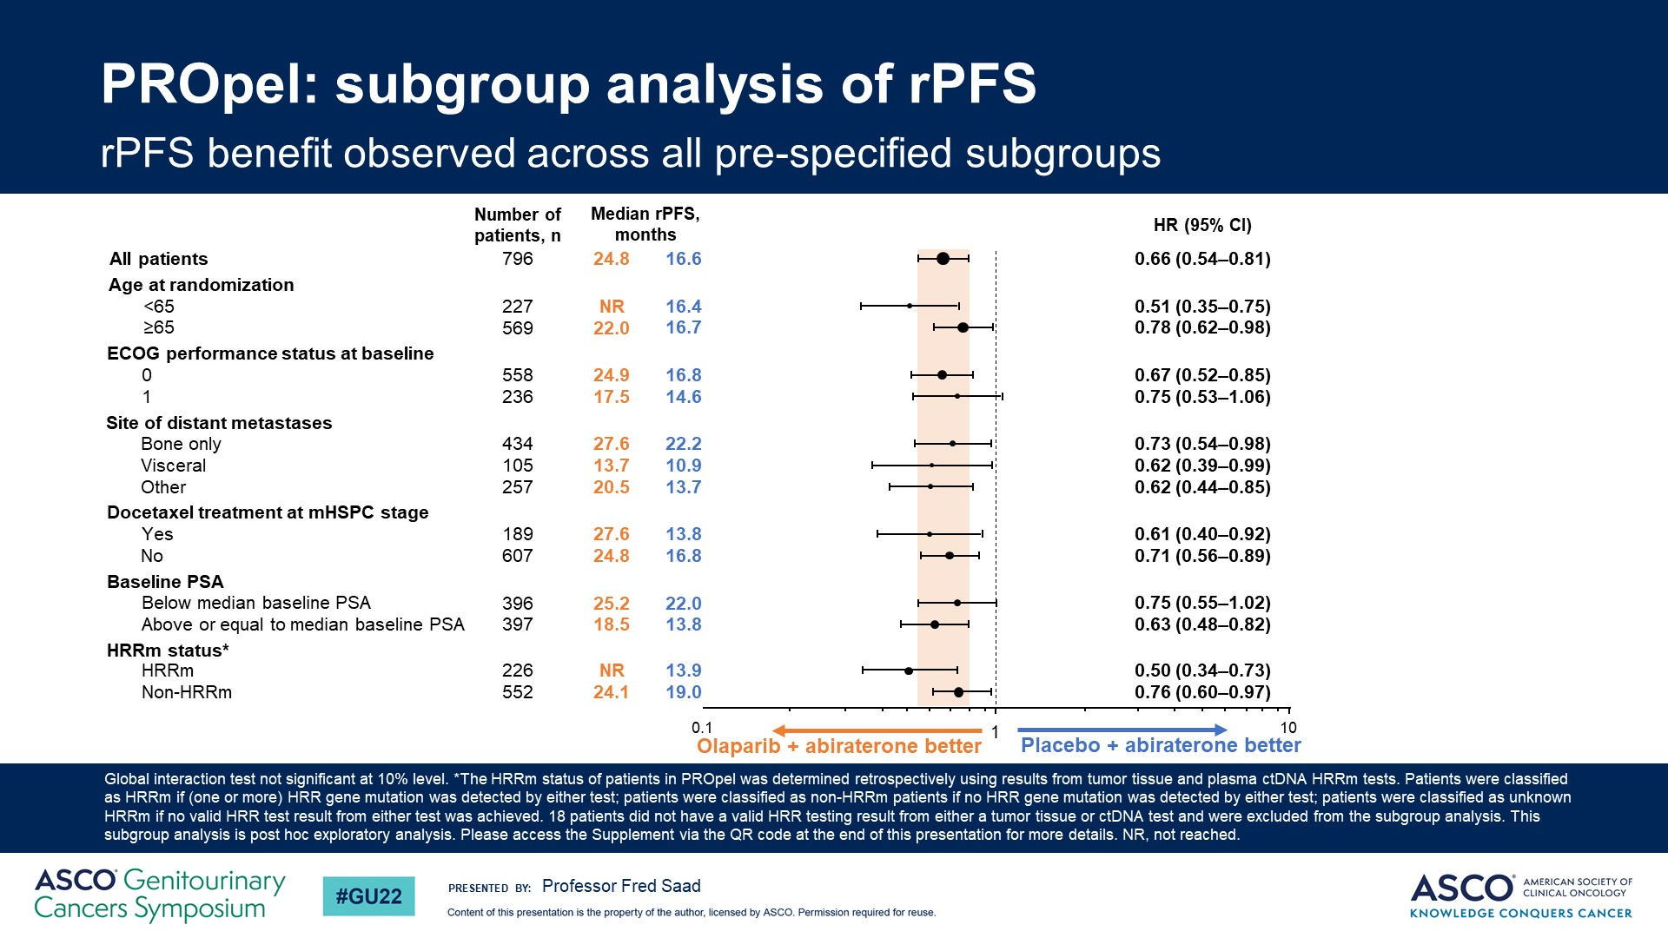
PROpel: subgroup analysis of rPFS
@neerajaiims

Slide 37
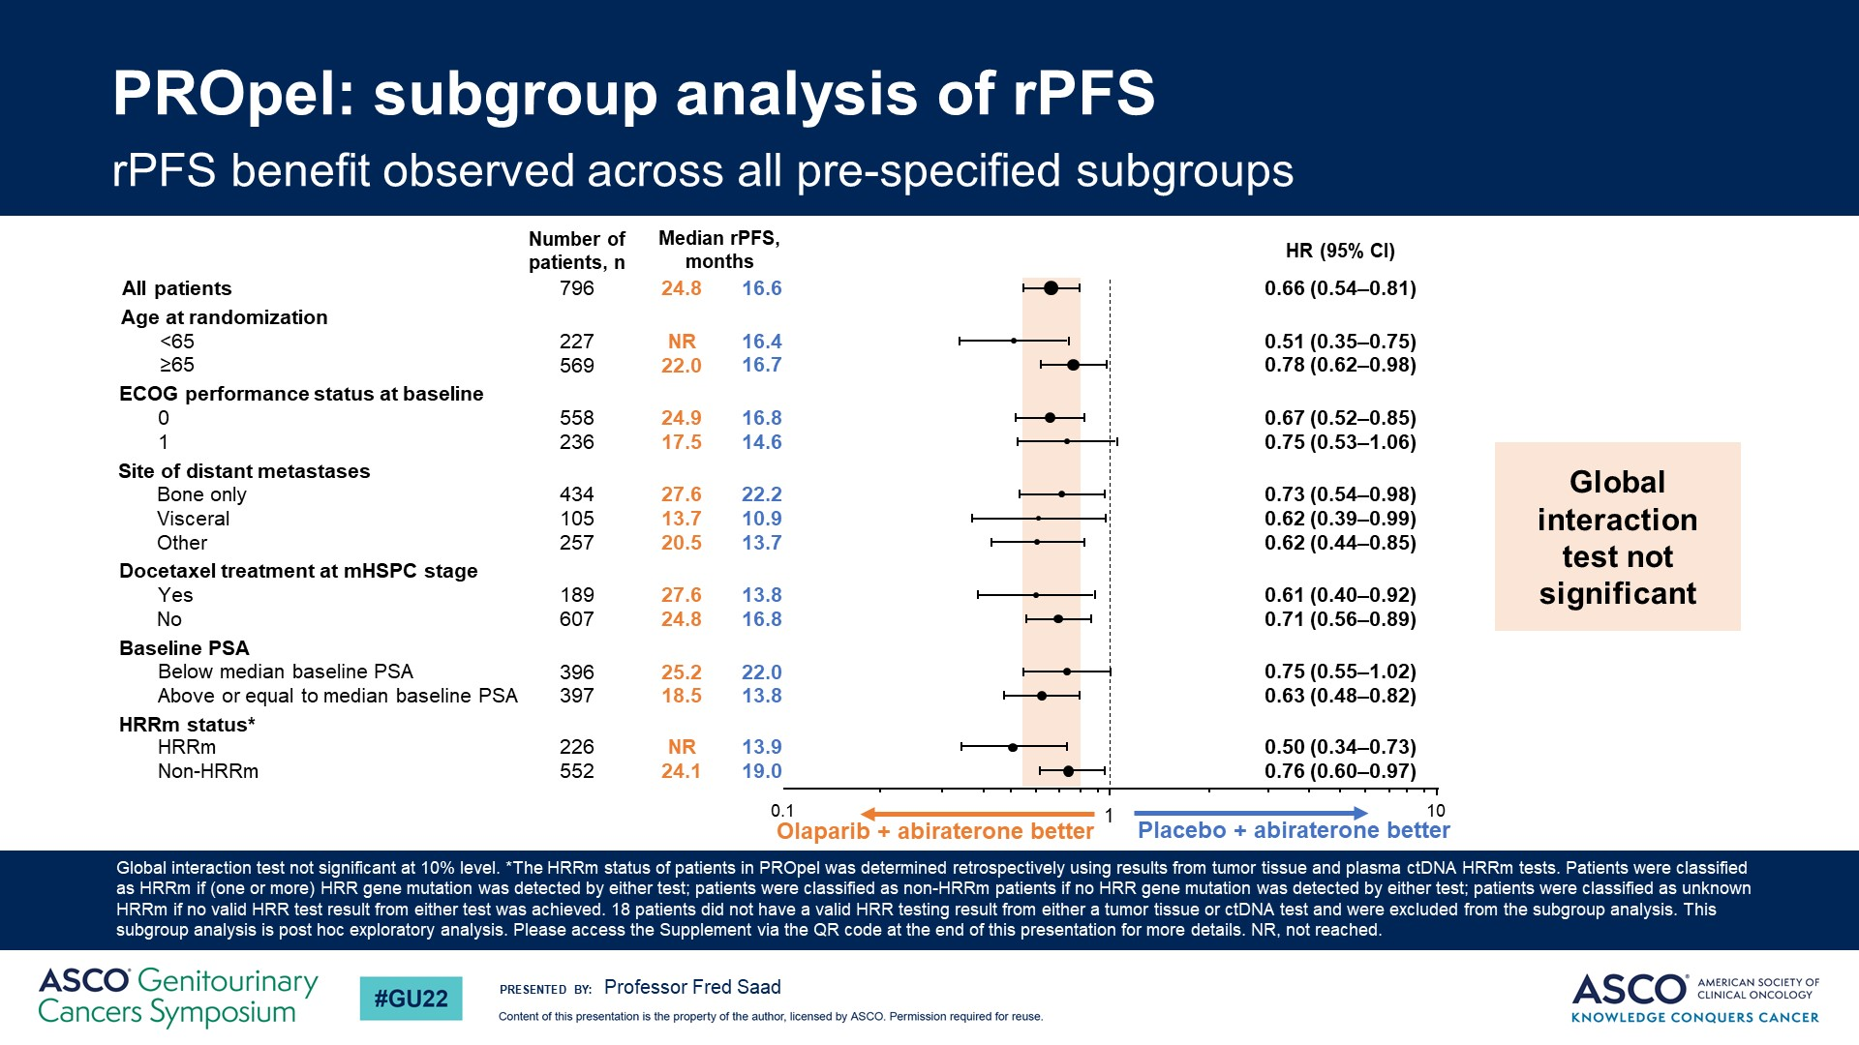
PROpel: subgroup analysis of rPFS
@neerajaiims
Notes:
It is interesting that even patients deemed negative for homologous recombination repair gene mutations showed significant improvement in rPFS when treated with olaparib + abiraterone versus placebo + abiraterone. It is important to note that, based on what was mentioned in the abstract, homologous recombination repair gene mutations were evaluated by cfDNA testing. This is notable for a reason. The levels of ctDNA present in the cfDNA can affect sensitivity for detection of homologous recombination repair gene mutations, especially in the case of copy number gene loss. In the first-line mCRPC setting this fraction may be especially low. If this is true, it is possible that some of the HRR positive patients were falsely determined to be HRR negative by the ctDNA testing, and included among the HRR negative patients. Based on the current results, there is no doubt that the combination of olaparib + abiraterone was effective in improving survival outcomes in the patient population studied in this trial. The survival benefit was more pronounced in the patients that were homologous recombination repair mutation positive versus not, but benefit was observed in both groups.

Slide 38
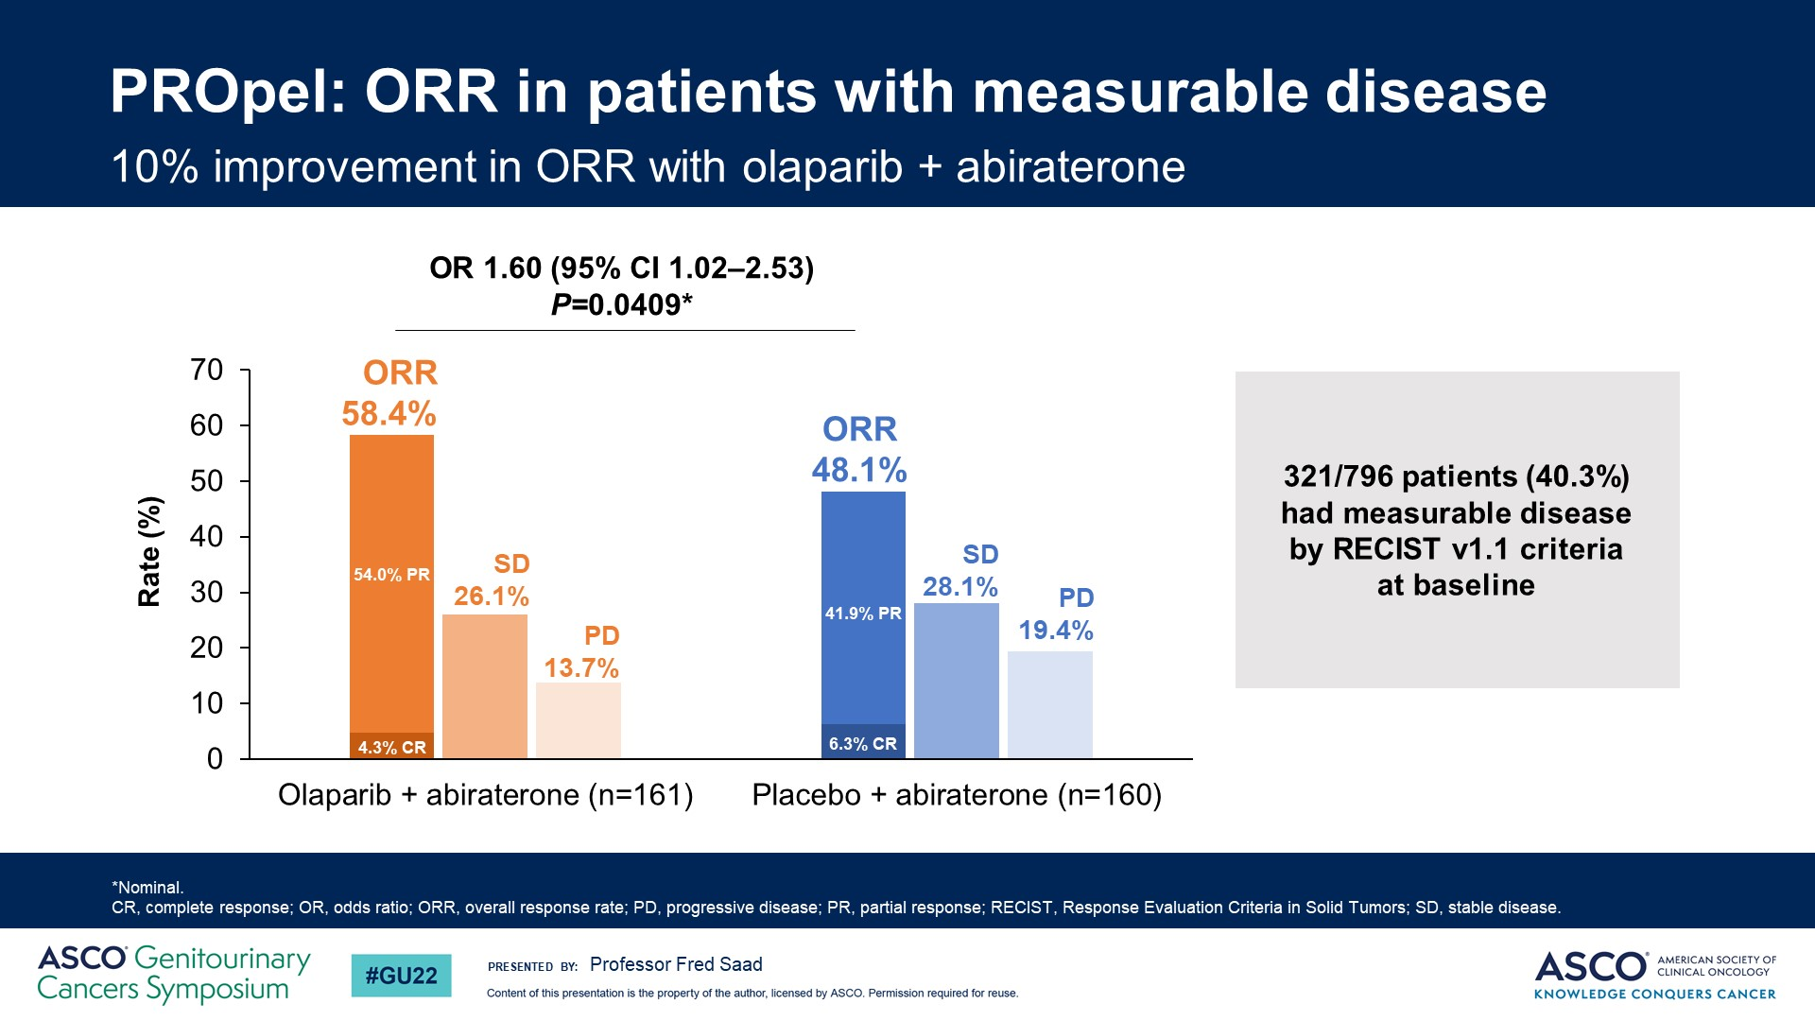
PROpel: ORR in patients with measurable disease
@neerajaiims

Slide 39
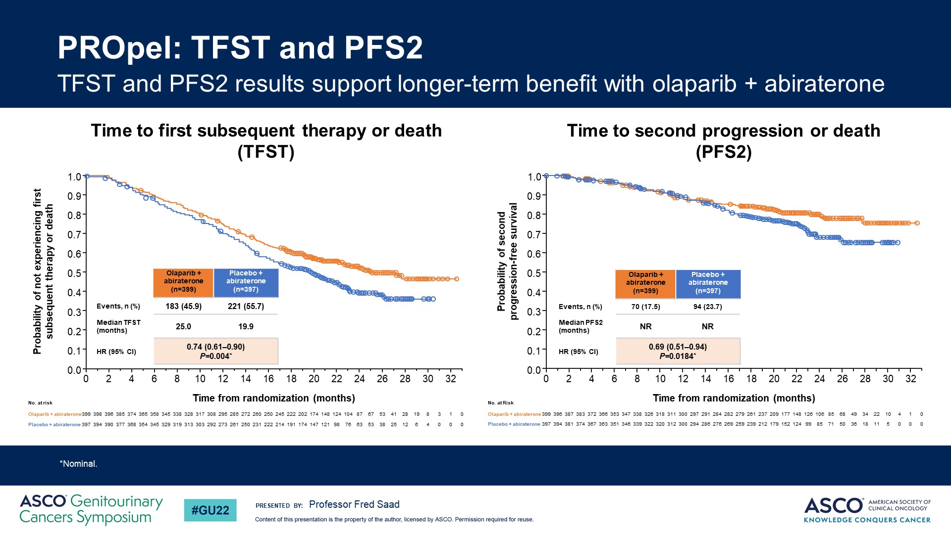
PROpel: TFST and PFS2
@neerajaiims

Slide 40
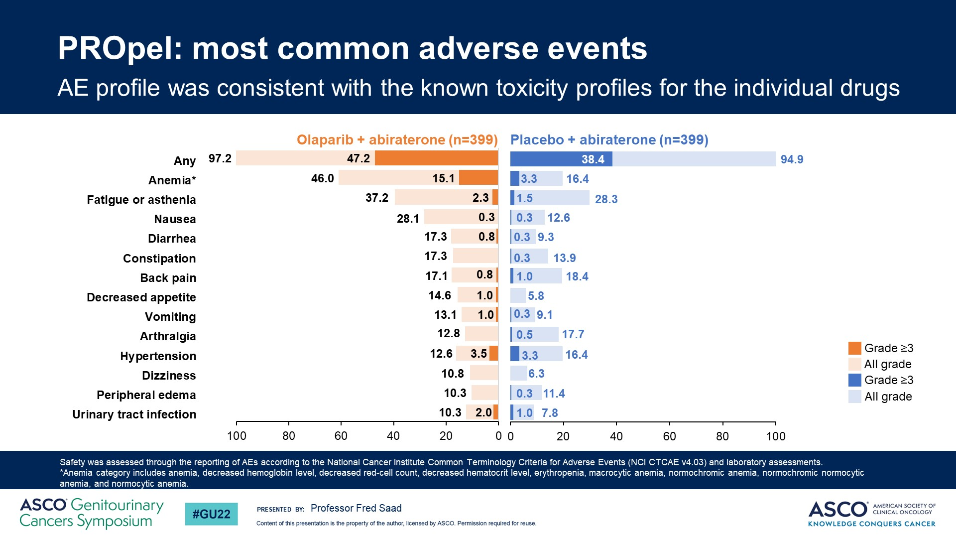
PROpel: most common adverse events
@neerajaiims
Notes:
Regarding the adverse events, they were what would be expected from the combination of a PARP inhibitor such as olaparib and abiraterone. We saw a higher frequency of all grade events of anemia, fatigue and nausea in the combination arm, while anemia was the only grade 3-4 adverse event observed at a significantly higher frequency in the combination arm.

Slide 41
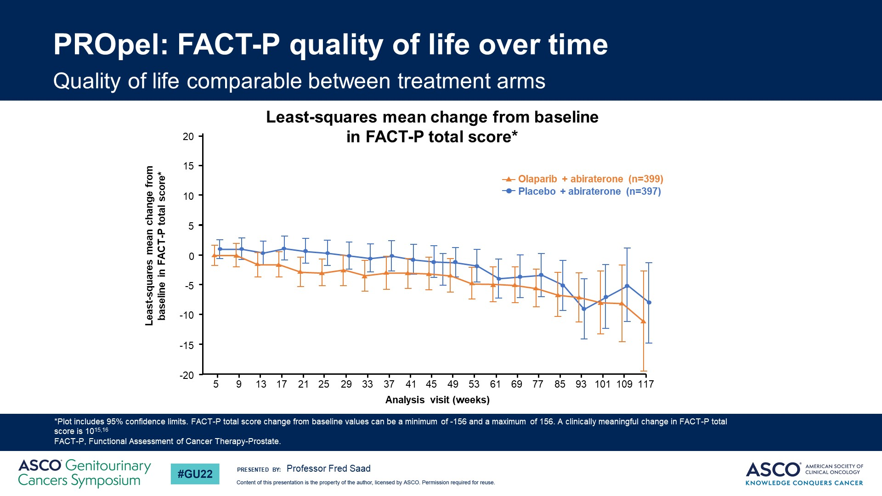
PROpel: FACT-P quality of life over time
@neerajaiims
Notes:
Health-related quality of life, as determined by the FACT-P assessment, was not affected by the combination therapy.

Slide 42
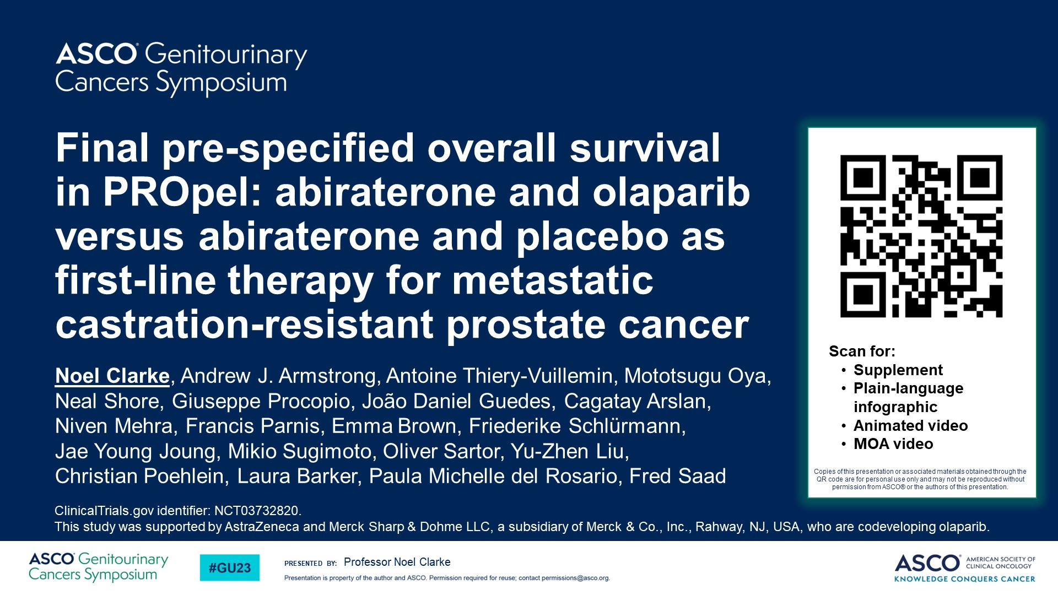
@neerajaiims

Slide 43
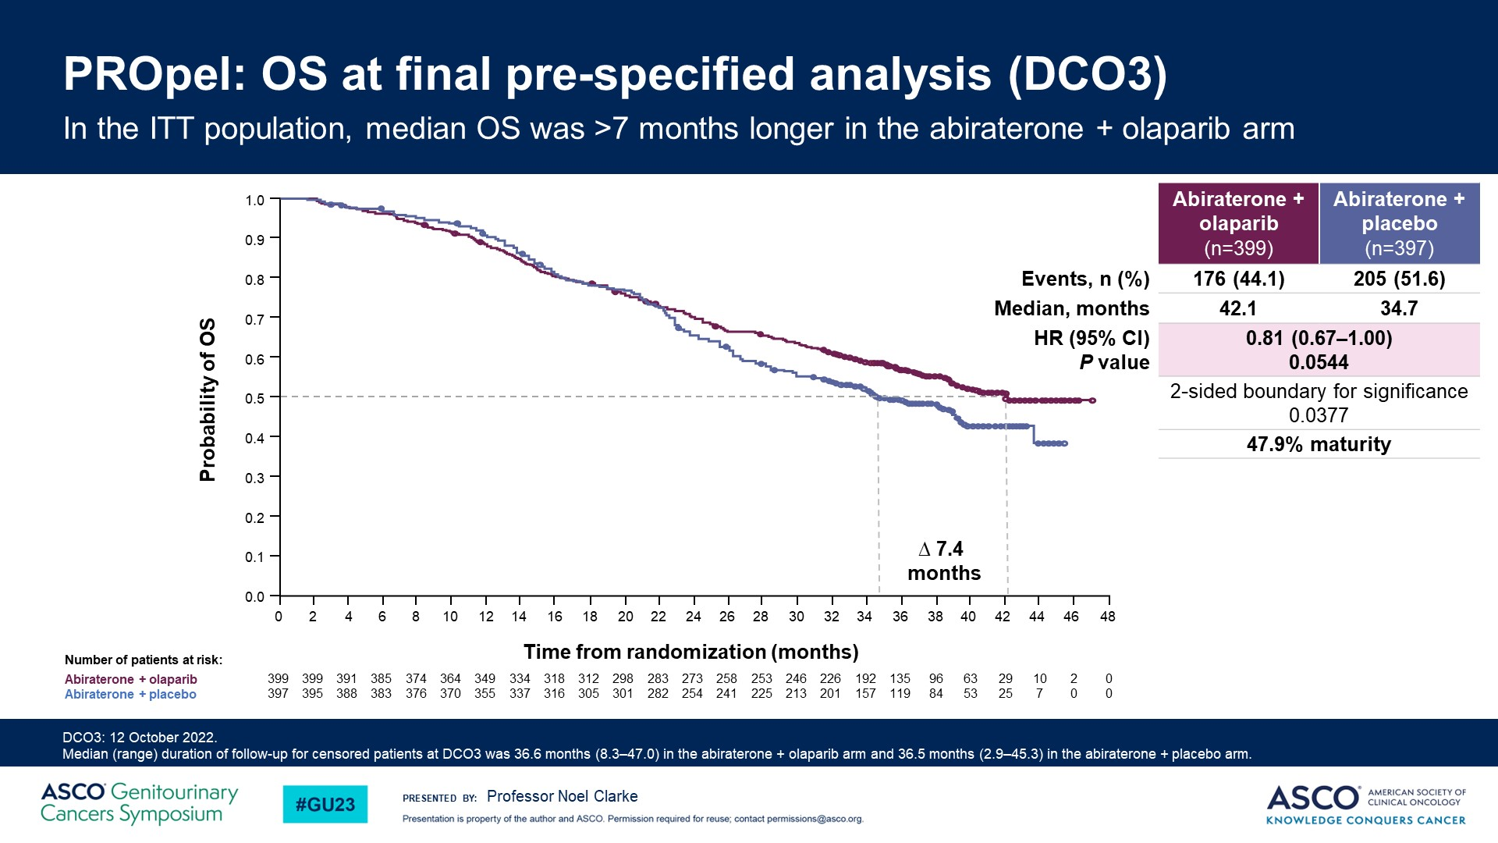
@neerajaiims

Slide 44
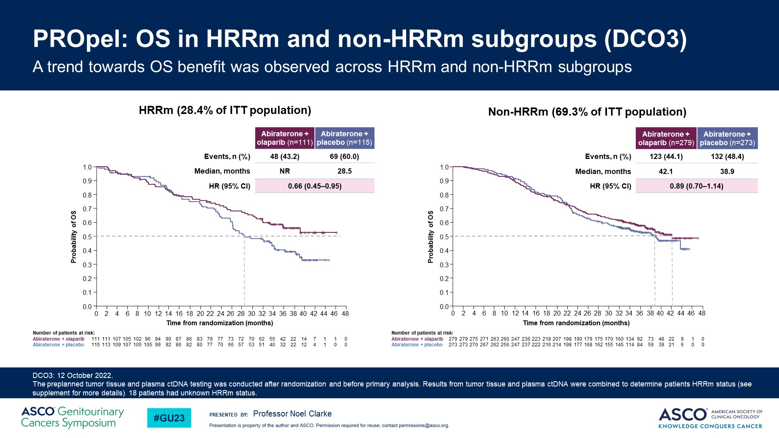
@neerajaiims

Slide 45
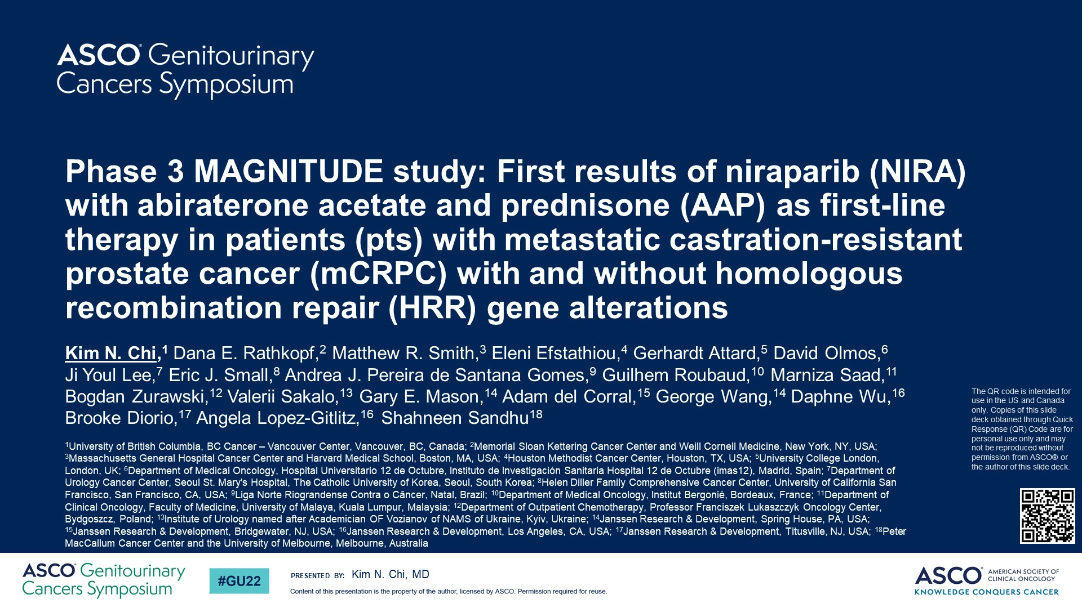
Phase 3 MAGNITUDE study: First results of niraparib (NIRA) with abiraterone acetate and prednisone (AAP) as first-line therapy in patients (pts) with metastatic castration-resistant prostate cancer (mCRPC) with and without homologous recombination repair (HRR) gene alterations
@neerajaiims

Slide 46
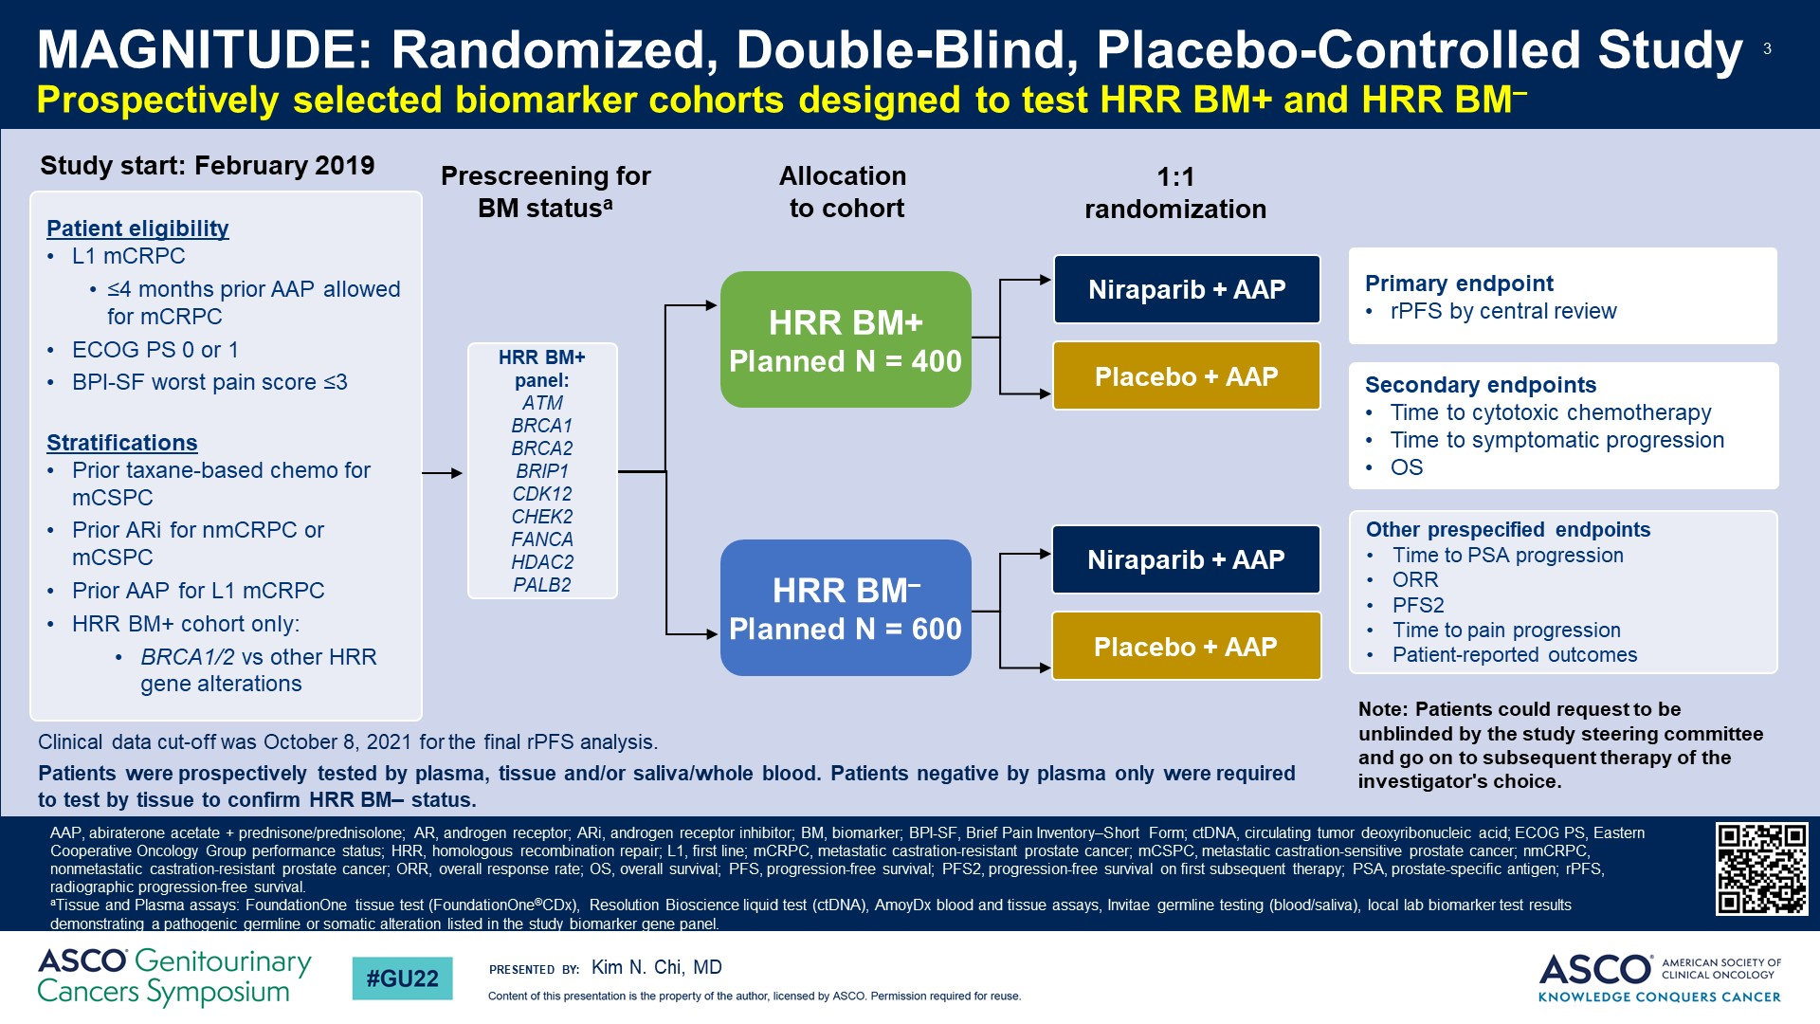
Slide 3
@neerajaiims
Notes:
MAGNITUDE is a randomized phase III trial evaluating the efficacy and safety of niraparib + abiraterone versus placebo + abiraterone in the first-line metastatic castration-resistant prostate cancer (mCRPC) setting. Prior taxane in mCSPC or NHT for (nmCRPC or mCSPC) or ≤ 4 months abiraterone in 1st line mCRPC were allowed. Prospective selection of patients with and without homologous recombination repair (HRR) pathway defects was required. The primary endpoint was radiographic Progression-Free Survival (rPFS) by central review with multiple secondary endpoints, including overall survival (OS) and safety.

Slide 47
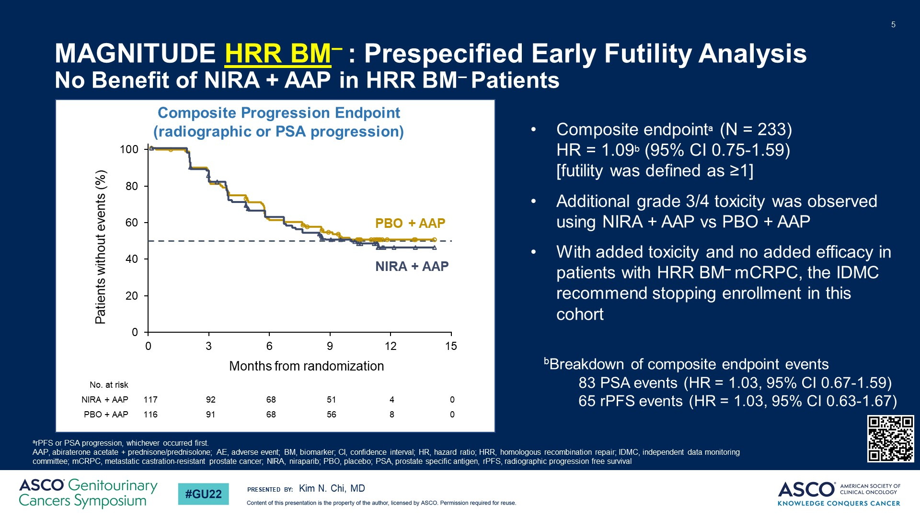
MAGNITUDE HRR BM– : Prespecified Early Futility Analysis <br />No Benefit of NIRA + AAP in HRR BM– Patients
@neerajaiims
Notes:
A pre-specified early futility analysis was planned after enrolling ~200 HRR negative (n=233) patients which were randomized to receive either niraparib + abiraterone (n=117) or placebo + abiraterone (n=116). Evaluation of futility was based on a composite PFS of PSA or radiographic progression, whichever occurred first, and a prespecified threshold of ~125 events. The pre-planned futility analysis showed no benefit in the biomarker negative cohort.

Slide 48
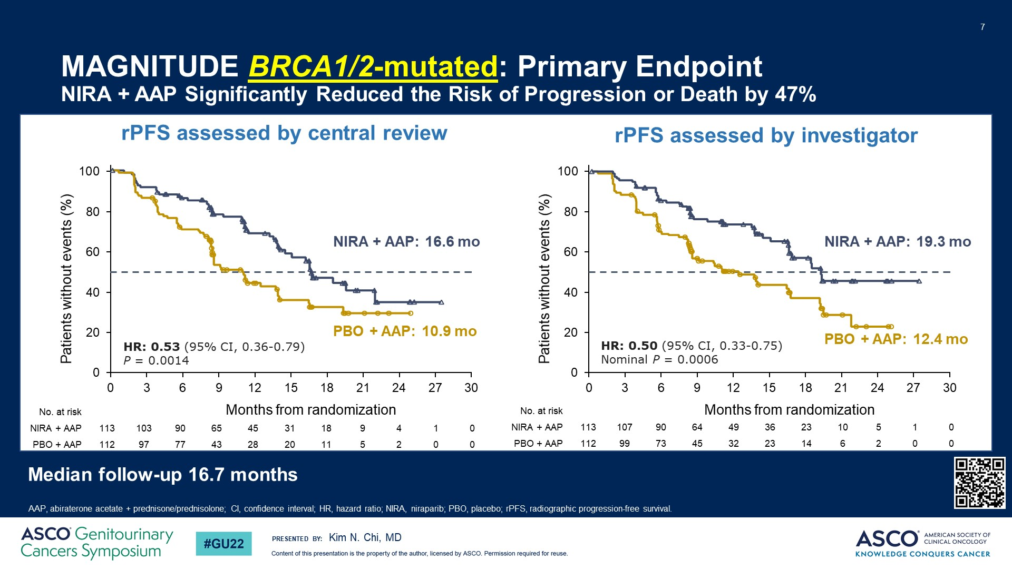
MAGNITUDE BRCA1/2-mutated: Primary Endpoint<br />NIRA + AAP Significantly Reduced the Risk of Progression or Death by 47%
@neerajaiims
Notes:
HRR Positive (n=423) patients were randomized to receive either niraparib + abiraterone (n=212) or placebo + abiraterone (n=211). At the pre-planned interim analysis, results show the trial met its primary endpoint with a significant improvement in rPFS for BRCA1/2 and all homologous recombination repair mutation positive patients receiving niraparib + abiraterone versus placebo + abiraterone. Overall survival results are still immature. It is important to note that in the HRR positive cohort of patients, approximately 50% were BRCA1/2 positive and that these patients clearly derived the most benefit from the combination with an approximate 47% reduction in the risk of progression or death. Median rPFS in the biomarker positive BRCA1/2 subgroup was 16.6 vs 10.9 months with a HR 0.53, 95% CI: 0.36 – 0.79; P=0.0014.

Slide 49
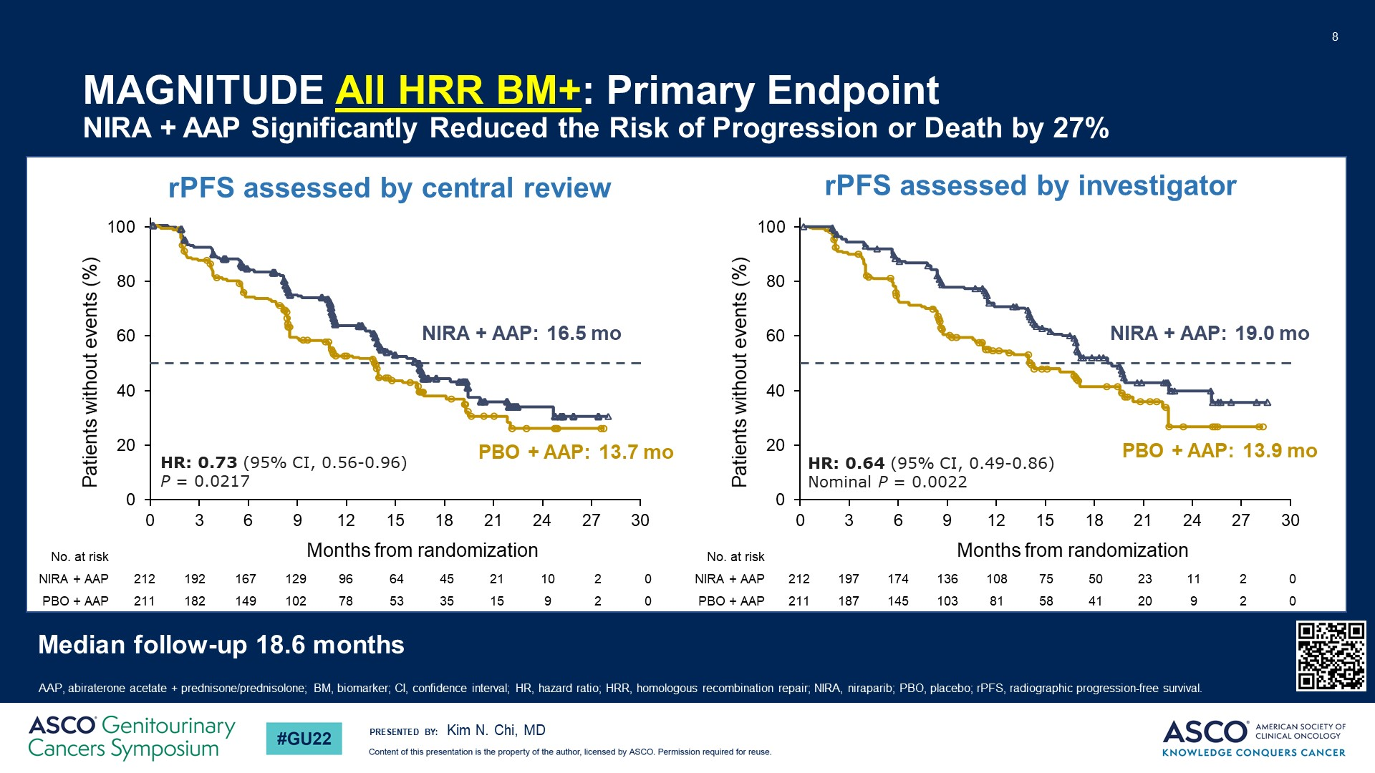
MAGNITUDE All HRR BM+: Primary Endpoint<br />NIRA + AAP Significantly Reduced the Risk of Progression or Death by 27%
@neerajaiims
Notes:
While benefit in all biomarker positive patients had a median rPFS of 16.5 versus 13.7 months with a HR of 0.73, 95% CI: 0.56 – 0.96 and P value = 0.217, which translates to a 27% reduction in the risk of progression or death.

Slide 50
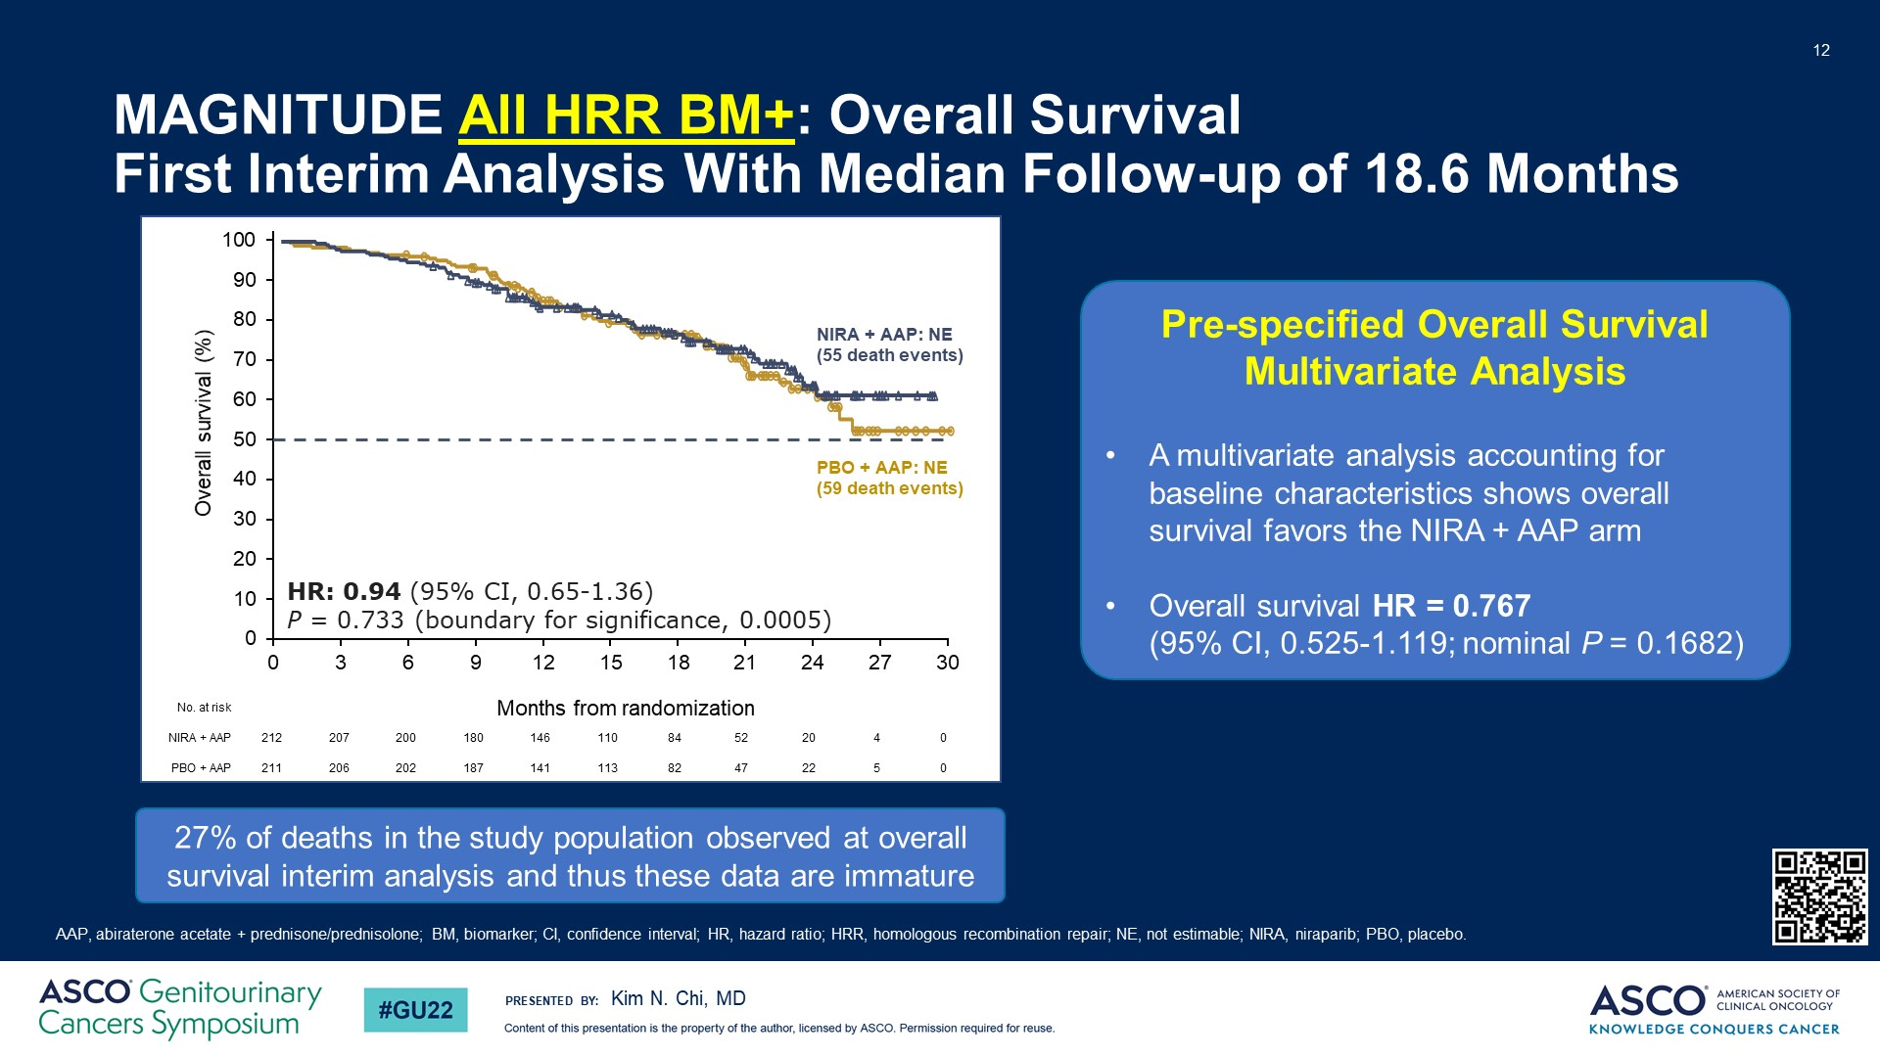
MAGNITUDE All HRR BM+: Overall Survival <br />First Interim Analysis With Median Follow-up of 18.6 Months
@neerajaiims
Notes:
Overall survival results are still immature with only 27% events in the study population reported to date.

Slide 51
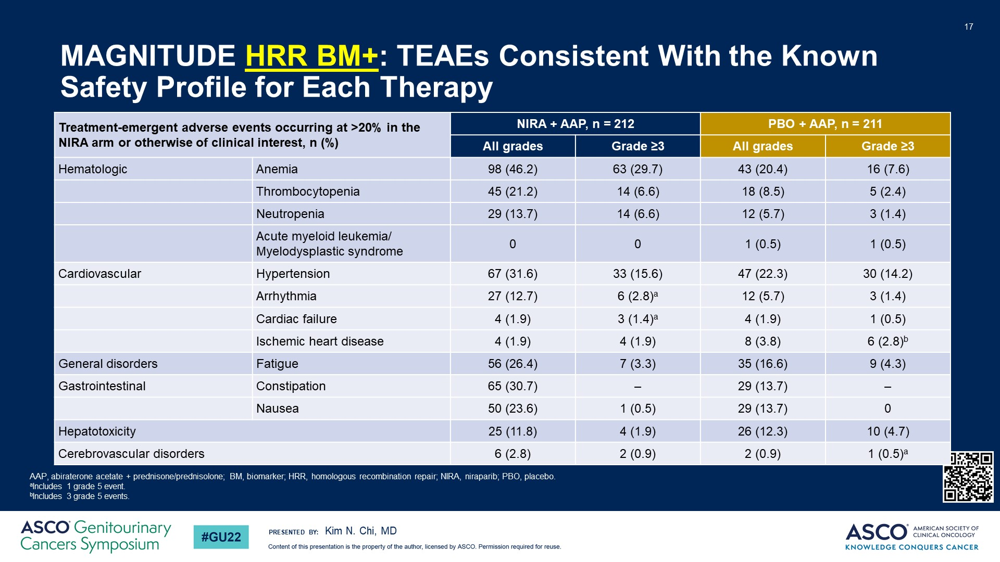
MAGNITUDE HRR BM+: TEAEs Consistent With the Known Safety Profile for Each Therapy
@neerajaiims
Notes:
Adverse event profile for the combination is consistent with previous reports for monotherapy for each therapy. More frequent all grade adverse events of anemia, thrombocytopenia, neutropenia and fatigue were observed in patients treated with the combination. Grade 3/4 adverse events of anemia, thrombocytopenia and neutropenia also were more frequently observed in the combination arm.

Slide 52
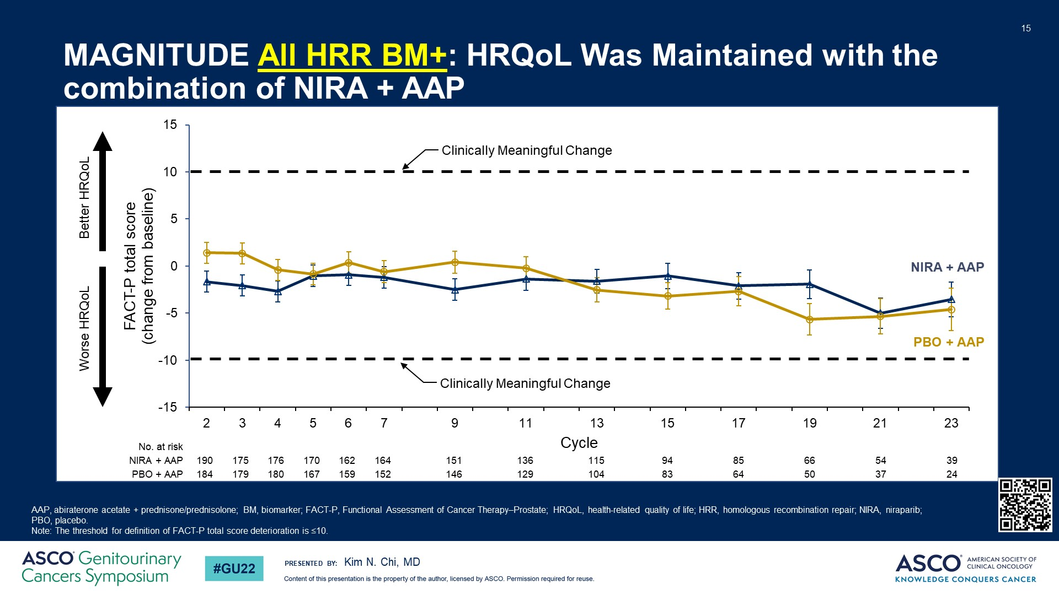
MAGNITUDE All HRR BM+: HRQoL Was Maintained with the combination of NIRA + AAP
@neerajaiims
Notes:
Health-related quality of life was not affected by the combination treatment.

Slide 53
PROpel and MAGNITUDE Revealed
Conflicting Results
PROpel (1)
MAGNITUDE (2)
olaparib + abiraterone
All-comers study
niraparib + abiraterone
2 seperate cohorts: HRR-pos. and HRR-neg.
HR 0.66
rPFS all-comers
rPFS HRR negative-NOT reported
rPFS HRR-positive
rPFS BRCA-positive
rPFS non-BRCA HRR-positive
N/A
HR 0.76
HR: Not assessed, given early termination
HR 0.5
HR 0.73
HR 0.24
HR 0.53
Not reported
HR 0.99
DATA SUPPORT ALL-COMERS APPROACH
DATA SUPPORT TARGETED APPROACH
TALAPRO-2: TIEBREAKER ?
1 Saad et al., 2022, ABSTRACT 11 ASCO-GU, NEJM Evidence, 2022.
2 Kim N. Chi et al., 2022. ABSTRACT 12 ASCO-GU, JCO, 2023
@neerajaiims

Slide 54
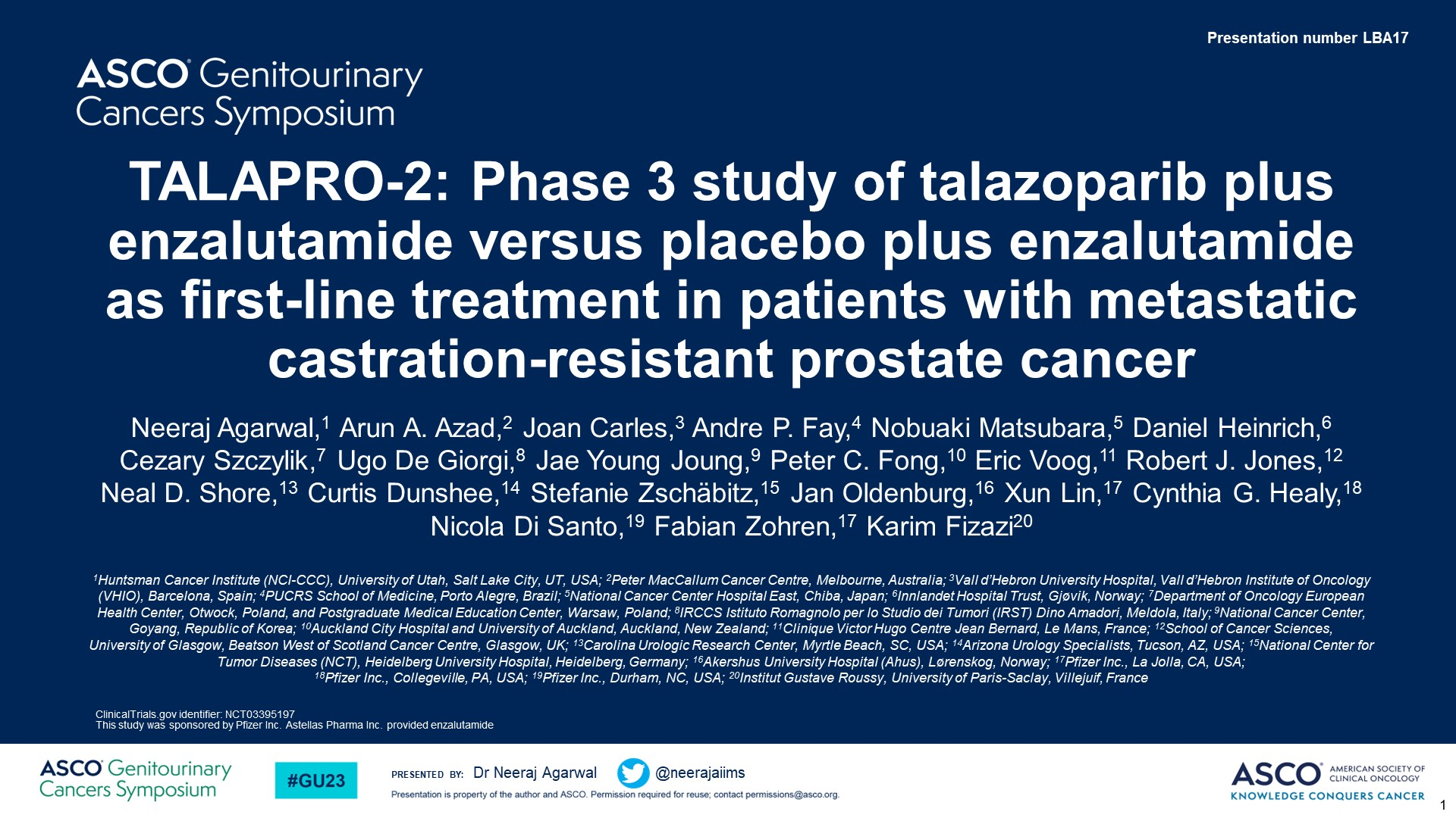
TALAPRO-2: Phase 3 study of talazoparib plus enzalutamide versus placebo plus enzalutamide as first-line treatment in patients with metastatic castration-resistant prostate cancer
@neerajaiims

Slide 55
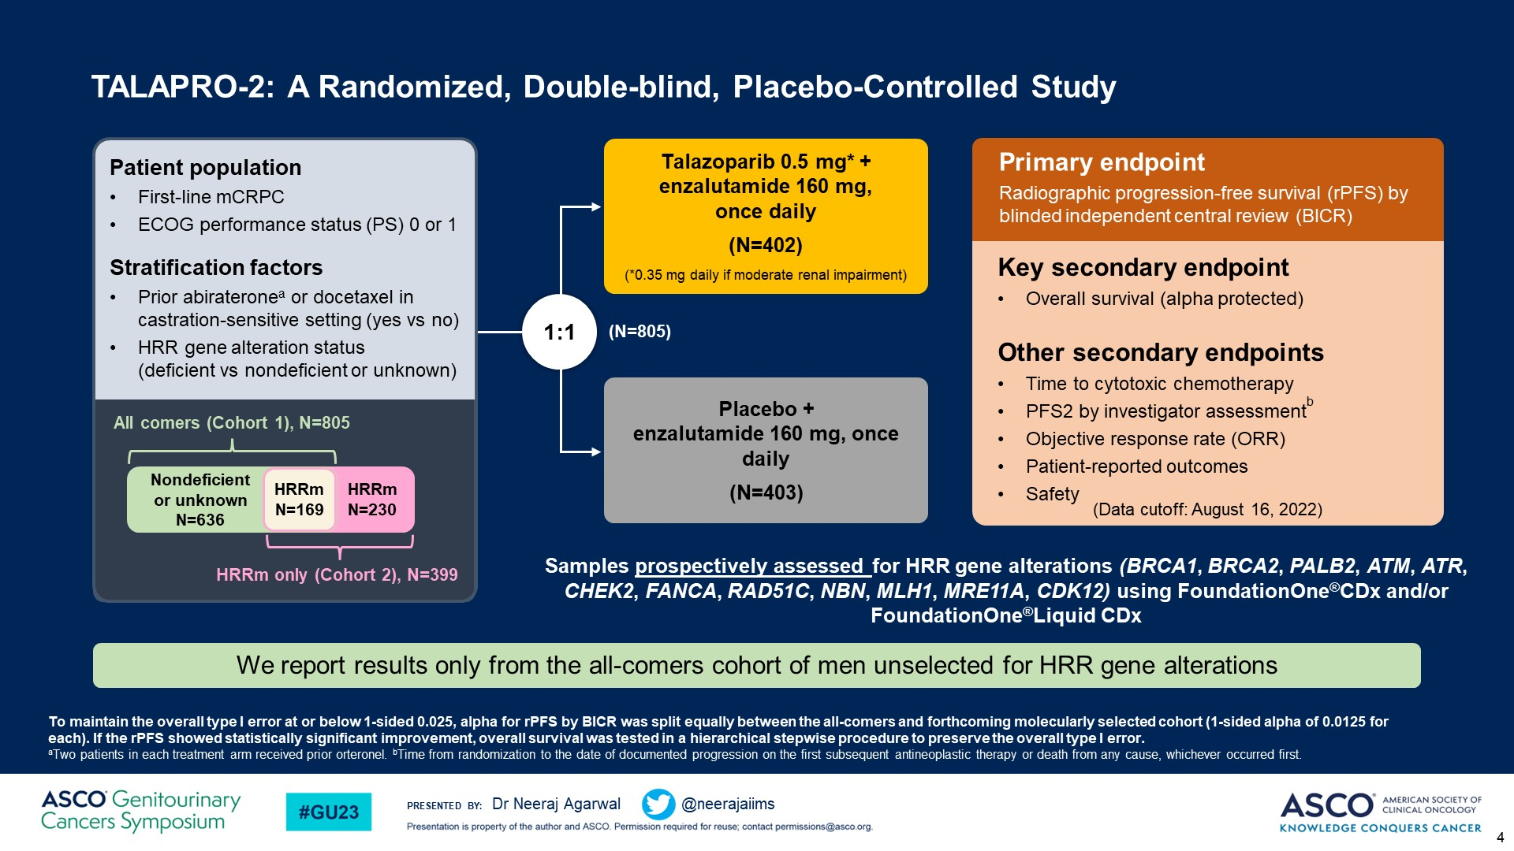
TALAPRO-2: A Randomized, Double-blind, Placebo-Controlled Study<br />
@neerajaiims

Slide 56
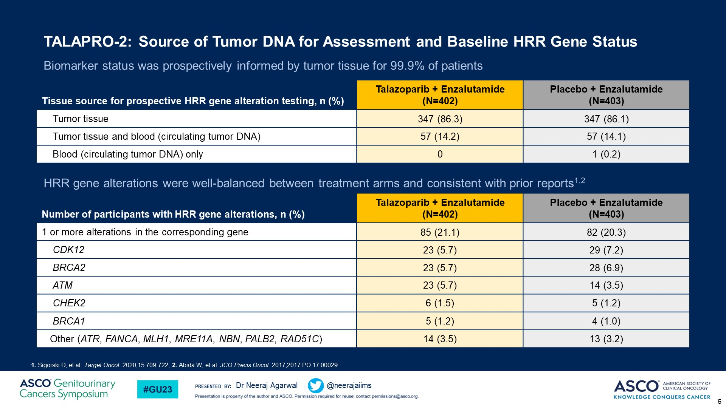
TALAPRO-2: Source of Tumor DNA for Assessment and Baseline HRR Gene Status<br />Biomarker status was prospectively informed by tumor tissue for 99.9% of patients
@neerajaiims

Slide 57

TALAPRO-2 Primary Endpoint: rPFS by BICR<br />Treatment with talazoparib plus enzalutamide resulted in a 37% reduced risk of progression or death
@neerajaiims

Slide 58

TALAPRO-2: Subgroup Analysis of rPFS by BICR <br />A consistent treatment effect with talazoparib plus enzalutamide was seen in prespecified subgroups
@neerajaiims

Slide 59

TALAPRO-2: rPFS by BICR in HRR-nondeficient by Prospective Tumor Tissue Testing<br />A 34% risk reduction was seen in patients without HRR gene alterations detected by prospective tumor tissue testing
@neerajaiims

Slide 60

TALAPRO-2: Overall Survival (Interim Analysis)<br />Overall survival data are immature: 31% maturity
@neerajaiims

Slide 61

TALAPRO-2: Time to PSA Progression<br />Treatment with talazoparib plus enzalutamide prolonged time to PSA progression
@neerajaiims

Slide 62

TALAPRO-2: Time to Cytotoxic Chemotherapy and PFS2<br />Benefits of talazoparib plus enzalutamide were consistently observed across other secondary endpoints
@neerajaiims

Slide 63

Slide 16
@neerajaiims

Slide 64

TALAPRO-2: Patient-Reported Global Health Status (GHS)/QoL per EORTC QLQ-C30<br />Talazoparib plus enzalutamide significantly prolonged time to definitive clinically meaningful deterioration in GHS/QoLa
@neerajaiims

Slide 65
 | PROpel* | MAGNITUDE* | TALAPRO-2**
Primary endpoint | rPFS (investigator view) | rPFS (central view) | rPFS
Prior NHA in mCSPC | Only after 12 mo of interruption (abiraterone not allowed) | Yes (except abiraterone) | Yes (abiraterone only)
Prior Docetaxel in mCSPC | Yes | Yes | Yes (if discontinued in the 28 days prior to randomization)
Stratification by HRR status | No | Yes | Yes
HRR analysis | Tissue or ctDNA /retrospective | 100% tissue/prospective | Primarily tissue (99.9%)/prospective
Patients who received NHA/Docetaxel in mHSPC in experimental arm (%) | 0.3/22.6 | 3.8/19.3**
rPFS
All commers | + (HR 0.66) | Not reported | + (HR 0.63)
HRR -ve | + (HR 0.76) | No benefit | + (HR 0.66)
HRR +ve | + (HR0.50) | + (HR 0.73 for BRCA+/0.53 for all HRR genes) | + (HR 0.46)
ORR | 58 vs 48% | 60% vs 28% (only HRR+ pts) | 61.7 vs 43.9%
HRQol | Maintained | Maintained | Prolonged time to clinically meaningful deterioration
OS | Immature | Immature | Immature
27(xx/xx)

Slide 66

TALAPRO-2: Study Cohorts and Enrollment
@neerajaiims

Slide 67

TALAPRO-2 HRR-Deficient: Baseline Demographics and Disease Characteristics
@neerajaiims

Slide 68

TALAPRO-2 HRR-Deficient Primary Endpoint: rPFS by BICR
@neerajaiims

Slide 69

TALAPRO-2 HRR-Deficient: rPFS by BICR by Selected Gene Subgroups
@neerajaiims

Slide 70

TALAPRO-2 HRR-Deficient: Overall Survival (Interim Analysis)
@neerajaiims

Slide 71

TALAPRO-2 HRR-Deficient: Time to PSA Progression
@neerajaiims

Slide 72

TALAPRO-2 HRR-Deficient: Time to Cytotoxic Chemotherapy and PFS2
@neerajaiims

Slide 73

TALAPRO-2 HRR-Deficient: Summary of TEAEs
@neerajaiims

Slide 74

TALAPRO-2 HRR-Deficient: Most Common All-Cause TEAEs
@neerajaiims

Slide 75

TALAPRO-2 HRR-Deficient: Patient-Reported Global Health Status
@neerajaiims

Slide 76
Phase 3 trial of PARPi + NHT in 1st line mCRPC and mCSPC
PROpel: Abiraterone + Olaparib
mCRPC
Published
MAGNITUDE: Abiraterone + Niraparib
Presented
TALAPRO-2: Enzalutamide + Talazoparib
Published
CASPAR: Enzalutamide + Rucaparib Enrolling
mCSPC
TALAPRO-3: Enzalutamde + Talazoparib Enrolling
Amplitutde: Abiraterone + Niraparib Enrolling
@neerajaiims

Slide 77
AMPLITUDE (Niraparib) : Phase 3 Trial Design (mCSPC)
Key Eligibility
Men aged ≥ 18 years with confirmed mCSPC (adenocarcinoma)
Metastatic disease documented by greater than or equal to (>=) 1 bone lesion(s)
Positive for deleterious germline or somatic homologous recombination repair (HRR) gene mutations
Radiation with curative intent or prior treatment with PARPi is not allowed
Patients with long-term use of systemically administered corticosteroids or history of MDS or AML were excluded
R
A
N
D
O
M
I
Z
E
D
n=788
Niraparib 200 mg qd
+
Abiraterone Acetate
1000 mg qd.
+
Prednisone 5 mg qd
Efficacy end points
Primary:
rPFS per PCWG 3
Secondary:
OS
Symptomatic PFS
Time to subsequent therapy
Duration of response (DOR)
Number of Participants with Adverse Events as a Measure of Safety and Tolerability
Placebo
+
Abiraterone Acetate
1000 mg qd.
+
Prednisone 5 mg qd
www.clinicaltrials.gov: (NCT04497844)
Rathkopf et al., 2021, ABSTRACT TPS 176 ASCO-GU
@neerajaiims
Notes:
The AMPLITUDE trial, is investigating a combination of niraparib plus abiraterone versus placebo plus abiraterone. This study plans to recruit a total of 788 patients with metastatic castration-sensitive prostate cancer with a known DNA repair gene defect status. The primary endpoint is radiographic PFS.

Slide 78
TALAPRO-3 (Talazoparib) : Phase 3 Trial Design (mCSPC)
Key Eligibility
Men aged ≥ 18 years with confirmed mCSPC (adenocarcinoma)
Metastatic disease documented by greater than or equal to (>=) 1 bone or soft tissue lesion(s)
Positive for deleterious germline or somatic homologous recombination repair (HRR) gene mutations
Radiation/surgery with curative intent or prior treatment with chemotherapy or PARPi is not allowed
Patients with brain metastases or a history of MDS or AML were excluded
R
A
N
D
O
M
I
Z
E
D
n=550
Talazoparib 0.5 mg/day
(0.35 mg/day [PO]
if moderate renal
impairment)
+
open-label enzalutamide
160 mg/day (PO)
Efficacy end points
Primary:
rPFS
Secondary:
OS
ORR
PSA response
Health-related quality of life
Placebo
+
open-label enzalutamide
160 mg/day (PO)
www.clinicaltrials.gov: (NCT04821622)
1 Agarwal et al., 2022, ABSTRACT TPS 221 ASCO-GU
@neerajaiims
Notes:
The TALAPRO-3 trial, is investigating a combination of talazoparib plus enzalutamide versus placebo plus enzalutamide. This study plans to recruit a total of 550 patients with metastatic castration-sensitive prostate cancer with a known DNA repair gene defect status. The primary endpoint is radiographic PFS.

Slide 79
Select Studies in mCRPC of PARP Inhibitors in Combination With Agents Targeting Potentially Synergistic Pathways
AR Therapy
Immunotherapy
Cotargeting Other Pathways
Olaparib
Ph III PROpel
Met primary endpoint
Ph III KEYLYNK-010
Negative results
Ph II
NCT03810105
Ph I/II COMRADE*
NCT03317392
Ph I LuPARP*
NCT03874884
Ph II NCT02893917
Abiraterone
Pembrolizumab
Durvalumab
Radium-223
¹⁷⁷Lu-PSMA-617
Cediranib (VEGFRi)
Talazoparib
Ph III TALAPRO-2
Met primary endpoint
Ph II†
NCT04824937
Ph I*
NCT04846478
Ph I*
NCT04703920
Enzalutamide
Telaglenastat (GLSi)
Tazemetostat (EZH2i)
Belinostat (HDACi)
Rucaparib
Ph III CASPAR*
NCT04455750
Ph II CheckMate 9KD
NCT03338790
Ph II PLATI-PARP
NCT03442556
Phase I/II
NCT04253262
Enzalutamide
Nivolumab
Chemotherapy
Copanlisib (PI3Ki)
Phase III
Niraparib
Ph III MAGNITUDE
Met primary endpoint
Ph I/II QUEST
NCT03431350
Ph I NiraRad
NCT03076203
Early phase
Trials active as of February 2023. *Recruiting. †Not yet recruiting.
Abiraterone
Cetrelimab
Radium-223
@neerajaiims

Slide 80
Conclusions
Phase 3 trials (Magnitude and Propel) in the 1st line mCRPC showed improved rPFS in HRRm positive patients with the combination of NHT+PARPi, but conflicting results in HRRm negative patients
All PARPi, and even combinations are not created equal.
Phase 3 TALAPRO-2 trial in the 1st line mCRPC: Talazoparib + enzalutamide (vs. enzalutamide) improves rPFS in patients with or without HRRm
@neerajaiims

Slide 81
Thank you!
Acknowledgements:
Nicolas Sayegh, MD
Umang Swami, MD
Beverly Chigarira, BS
Benjamin Louis Maughan, MD
Georges Gebrael, MD
Nishita Tripathi, MD
@neerajaiims
@neerajaiims
Notes:
Thank you very much for your kind attention.

Slide 82










RCC/PROSTATE
Wednesday, June 14, 2023

Slide 83
Clinical Cases (Prostate)

Slide 84

Mr. Gallo is a 66-year-old man with cT2cN1M1 prostate cancer
Gleason 5+4 (12/12+), initial PSA 144 ng/mL
Bulky > 2.5-cm left para-aortic and retroperitoneal (RP) nodes (Jan 2019) on CT scan
Bone scan negative
Started long-term androgen deprivation plus docetaxel (Jan 2019)
During follow-up, PSA nadir 0.7 ng/mL

Slide 85
Panel
Discussion
Germline Testing: BRCA2
Which options would you discuss with Mr. Gallo?
Abiraterone + olaparib
Enzalutamide + talazoparib (if available)
Abiraterone + niraparib (if available)
Abiraterone/Enzalutamide
Notes:
What if ATM

Slide 86
RCC/PROSTATE
Wednesday, June 14, 2023

Slide 87

Non-Metastatic CRPC
Treating the Visible or Invisible?
Jorge A. Garcia, MD, FACP.
Professor of Medicine ad Urology
George and Edith Richman Distinguished Scientist Chair
Chair, Division of Solid Tumor Oncology
University Hospitals Seidman Cancer Center
Case Comprehensive Cancer Center
Case Western Reserve University

Slide 88
Annual 2020-2023 Conflict of Interest Disclosure
Research Funding – Paid to Institution
  Merck, Tizona Therapeutics, Dragon Therapeutics, Merck
Paid Consultant – Paid to Individual
  Aptitude Health, PER, Targeted Oncology, ASCO (CME and Leadership)
US Food and Drug Administration (FDA) – Paid to Individual (Federal)
  Chairperson for ODAC

Slide 89
Considerations in Making Treatment Decisions for Patients with M0CRPC
PSA doubling time is an important factor to consider
  > 10 mos: observation or other secondary hormonal therapy appropriate
  ≤ 10 mos: Apalutamide, Enzalutamide, or Darolutamide indicated
Role of molecular imaging has evolved
  Various PET/CT or PET/MRI modalities are available that may play a role – Pts becoming M1
  Management of locally advanced disease with NHAs impacts sequence
  Serologic PD after management for LV or OligoMet CSPC is not equivalent to M0CRPC
Notes:
MRI, magnetic resonance imaging; PET, positron emission tomography; PSA, prostate-specific antigen

Slide 90
Utility of PSA Doubling Time in Men With M0CRPC
Faster PSADT is linked to shorter time to metastasis in patients with M0CRPC
Patients with PSADT < 10 mos vs those with PSADT ≥ 10 mos
  Risk of bone metastasis 12 x higher
  Risk of death 4 x higher
PSADT, Mos | Median Time to Metastasis, Mos
< 3.0 | 9
3.0-8.9 | 19
9.0-14.9 | 40
≥ 15.0 | 50
Moreira. Urology. 2016;96:171. Howard. BJU Int. 2017;120:E80. Metwalli. Urol Oncol. 2014;32:761
Notes:
CRPC, castration resistant prostate cancer; PSA, prostate-specific antigen; PSADT, prostate-specific antigen doubling time

Slide 91




Non-metastatic CRPC: A Very High–Risk Population
Age: 73 yrs
Gleason: 5+4
s/p ADT/RT
PSA rising on ADT
PSADT ≈ 8 mos
PSA: now 14 mg/nL
Ga-68 PSMA
Notes:
ADT/RT, androgen-deprivation therapy/radiotherapy; CRPC, castration-resistant prostate cancer; DT, doubling time; PSA, prostate-specific antigen; PSMA, prostate-specific membrane antigen.

Slide 92

Notes:
SPARTAN (A), PROSPER (B) and ARAMIS (C) clinical trial designs.10‐12,23,25,26 ADT, androgen deprivation therapy; ECOG, Eastern Cooperative Oncology Group; MFS, metastasis‐free survival; nmCRPC, nonmetastatic castration‐resistant prostate cancer; OS, overall survival; PFS, progression‐free survival; PSA(DT), prostate‐specific antigen (doubling time); SSE, symptomatic skeletal event
IF THIS IMAGE HAS BEEN PROVIDED BY OR IS OWNED BY A THIRD PARTY, AS INDICATED IN THE CAPTION LINE, THEN FURTHER PERMISSION MAY BE NEEDED BEFORE ANY FURTHER USE. PLEASE CONTACT WILEY'S PERMISSIONS DEPARTMENT ON PERMISSIONS@WILEY.COM OR USE THE RIGHTSLINK SERVICE BY CLICKING ON THE 'REQUEST PERMISSIONS' LINK ACCOMPANYING THIS ARTICLE. WILEY OR AUTHOR OWNED IMAGES MAY BE USED FOR NON-COMMERCIAL PURPOSES, SUBJECT TO PROPER CITATION OF THE ARTICLE, AUTHOR, AND PUBLISHER.

Slide 93
Apalutamide vs Placebo in Nonmetastatic CRPC (SPARTAN): Phase III Study Design
Stratified by PSA doubling time (≤ 6 vs > 6 mos), BL bone-sparing agent use (yes or no), N0 vs N1
Apalutamide 240 mg QD + ADT
(n = 806)
Patients with nonmetastatic CRPC (pelvic nodes < 2 cm below iliac bifurcation allowed) and PSADT ≤ 10 mos
(N = 1207)
Upon distant metastasis, treatment for metastatic CRPC at discretion of treating physician
2:1
Placebo + ADT
(n = 401)
Primary endpoint: metastasis-free survival
Secondary endpoints including: time to metastasis, PFS, time to symptomatic progression, OS, time to chemotherapy
Exploratory endpoints: time to PSA progression, PSA response rate, PFS2, PRO
Smith M, et al. NEJM. 2018;378:1408.
Notes:
ADT, androgen deprivation therapy; BL, baseline; CRPC, castration-resistant prostate cancer; PFS2, PFS after second treatment; PRO, patient-reported outcomes; PSA, prostate-specific antigen; PSADT, PSA doubling time.

Slide 94
Enzalutamide vs Placebo in Nonmetastatic CRPC (PROSPER): Phase III Study Design
Stratified by PSA doubling time (< 6 mos vs 6-10 mos), baseline bone-targeting agent use (yes vs no)
Enzalutamide 160 mg QD + ADT
(n = 933)
Patients with M0 nonmetastatic CRPC and PSA DT ≤ 10 mos
(N = 1401)
2:1
Placebo + ADT
(n = 468)
Primary endpoint: metastasis-free survival
Secondary endpoints including: safety, time to PSA progression, time to next therapy, OS, PSA response, QoL
Sternberg CN, et al. NEJM 2020;382:2197-2206
Notes:
ADT, androgen deprivation therapy; BL, baseline; CRPC, castration-resistant prostate cancer; DT, doubling time; PSA, prostate-specific antigen; QoL, quality of life

Slide 95

SPARTAN and PROSPER: Patient Characteristics*
Characteristic | SPARTAN^{[1]} |  | PROSPER^{[2]}
 | Apa + ADT (n = 806) | Pbo + ADT (n = 401) | Enza + ADT (n = 933) | Pbo + ADT (n = 468)
Median age, yrs | 74 | 74 | 74 | 73
Median PSADT, mos | 4.4 | 4.5 | 3.8 | 3.6
PSADT, %
< 6 mos/≥ 6 mos† | 71.5/28.5 | 70.8/29.2 | 77/23 | 77/23
Bone-targeted agent, %
Yes/No | 10.2/89.8 | 9.7/90.3 | 11/89 | 10/90
Nodal status, %
N0/N1 | 83.5/16.5 | 83.8/16.2 | NA | NA
ECOG PS, %
0/1 | 77.3/22.7 | 77.8/22.3 | 80/20 | 82/18
*Caveat: comparing across trials is problematic; not a head-to-head comparison. †In SPARTAN trial cutoffs were ≤ 6 mos/> 6 mos.
Smith. NEJM. 2018;378:1408
Sternberg CN, et al. NEJM 2020;382:2197-2206
Slide credit: clinicaloptions.com
Notes:
ADT, androgen-deprivation therapy; Apa, apalutamide; ECOG PS, Eastern Cooperative Oncology Group performance status; NA, not applicable; Pbo, placebo; PSADT, prostate-specific antigen doubling time.

Slide 96
SPARTAN and PROSPER: MFS (Primary Endpoint)*
SPARTAN^{[1]}
PROSPER^{[2]}
100
HR: 0.28 (95% CI: 0.23-0.35;P < .001)
100
HR: 0.29 (95% CI: 0.24-0.35;P < .001)
80
Apa: 40.5 mos (median)
80
Enza: 36.6 mos (median)
60
60
Metastases-Free Survival (%)
Metastases-Free Survival (%)
40
40
Pbo: 16.2 mos (median)
Pbo: 14.7 mos (median)
20
20
0
0
0
4
8
12
16
20
24
28
32
36
40
44
0
3
6
9
12
15
18
21
24
27
30
33
36
39
42
Patients at Risk, n
Mos
Patients at Risk, n
Mos
Apa + ADT
806
713
652
514
398
282
180
96
36
16
3
0
Enza + ADT
933
865
759
637
582
431
418
328
237
159
87
77
31
4
0
Pbo + ADT
401
291
220
153
91
58
34
13
5
1
0
0
Pbo + ADT
468
420
296
212
157
105
98
64
49
31
16
11
5
1
0
72% reduction of distant progression or death
Median MFS, mos: Apa 40.5 vs Pbo 16.2
24-mo additional MFS benefit
71% reduction of distant progression or death
Median MFS, mos: Enza 36.6 vs Pbo 14.7
22-mo additional MFS benefit
*Caveat: comparing across trials is problematic; not a head-to-head comparison
Smith. NEJM. 2018;378:1408
Sternberg CN, et al. NEJM 2020;382:2197-2206
Notes:
ADT, androgen deprivation therapy; Apa, apalutamide, Enza, enzalutamide; MFS, metastasis-free survival; Pbo, placebo.

Slide 97

SPARTAN and PROSPER: OS (Secondary Endpoint)*
Median follow-up of 2 yrs
SPARTAN^{[1]}
PROSPER^{[2]}
100
Apa: NR
100
Enza: NR
80
80
Pbo: 39.0 mos
(median)
Pbo: NR
60
60
OS (%)
OS (%)
40
40
20
20
HR : 0.70 (95% CI: 0.47-1.04; P = .07)
HR: 0.80 (95% CI: 0.58- 1.09; P = .15)
0
0
0
4
8
12
16
20
24
28
32
36
40
44
0
4
8
12
16
20
24
28
32
36
40
44
Mos
Mos
Patients at Risk, n
Patients at Risk, n
Apa + ADT
806
788
756
647
527
392
275
162
64
26
4
0
EN
Z
A + A
D
T
933
884
805
716
621
521
414
298
169
75
13
0
Pbo + ADT
401
387
374
319
248
183
126
64
29
9
0
0
Pbo + A
D
T
468
447
403
351
303
247
194
135
78
31
6
0
30% risk reduction of death (HR: 0.70; P = .07)
Median OS: Apa NR vs Pbo 39 mos
20% risk reduction of death (HR: 0.80; P = .15)
Median OS: Enza NR vs Pbo NR
*Caveat: comparing across trials is problematic; not a head-to-head comparison
Smith. NEJM. 2018;378:1408
Sternberg CN, et al. NEJM 2020;382:2197-2206
Notes:
ADT, androgen deprivation therapy; Apa, apalutamide, Enza, enzalutamide; NR, not reached; Pbo, placebo.

Slide 98
SPARTAN and PROSPER: Time to PSA Progression*
SPARTAN^{[1]}
PROSPER^{[2]}
100
HR: 0.06 (95% CI: 0.05-0.08)
100
HR: 0.07 (95% CI: 0.05-0.08;
P < .001)
80
80
Enza:
37.2 mos
Pbo: 3.7 mos
Apa: NR
Pbo: 3.9 mos
60
60
Patients Without PSA Progression (%)
Patients Without PSA Progression (%)
40
40
20
20
0
0
0
4
8
12
16
20
24
28
32
36
40
44
0
3
6
9
12
15
18
21
24
27
30
33
36
39
42
Mos
Mos
94% risk reduction in PSA progression
Median time to PSA progression: 3.7 mos vs NR
93% risk reduction in PSA progression
Time to median PSA progression: 3.9 vs 37.2 mos
*Caveat: comparing across trials is problematic; not a head-to-head comparison
Smith. NEJM. 2018;378:1408
Sternberg CN, et al. NEJM 2020;382:2197-2206
Notes:
Apa, apalutamide, Enza, enzalutamide; NR, not reached; Pbo, placebo. PSA, prostate-specific antigen

Slide 99
SPARTAN and PROSPER: Effect of Treatment on
QoL Assessed With FACT-P*
SPARTAN^{[1]}
PROSPER^{[2]}
156
144
140
132
120
108
120
96
84
Mean Score ± SD
Median FACT-P Total Score
72
60
100
48
36
Apa
Pbo
24
Enza
Pbo
12
0
0
Cycle
BL
2
3
4
5
6
7
9
11
13
17
21
25
29
BL
17
33
49
65
81
97
Patients at Risk, n
Wks
797
395
781
389
767
379
742
371
717
350
695
301
676
283
649
265
614
221
590
191
456
135
352
83
257
54
167
35
Apa + ADT
Pbo + ADT
*Caveat: comparing across trials is problematic; not a head-to-head comparison.
1. Saad. EAU 2018. Abstr 743.
2. Tombal. EAU 2018. Abstr 605.
Notes:
ADT, androgen deprivation therapy; Apa, apalutamide, BL, baseline; Enza, enzalutamide; Pbo, placebo; QoL, quality of life; SD, standard deviation.

Slide 100
SPARTAN and PROSPER: Safety and Adverse Events*
Adverse events, % | SPARTAN^{[1]} (Reporting Every 4 Wks) |  | PROSPER^{[2]} (Reporting Every 4 Mos)
 | Apa + ADT (n = 803) | Pbo + ADT (n = 398) | Enza + ADT (n = 933) | Pbo + ADT (n = 468)
Any grade | 96.5 | 93.2 | 87 | 77
Grade ≥ 3 | 45.1 | 34.2 | 31 | 23
Serious AE | 24.8 | 23.1 | 24 | 18
Leading to discontinuation | 10.6 | 7.0 | 9 | 6
Leading to death | 1.2 | 0.3 | 3 | 1
Major CV event | (n = 1) | (n = 1) | 5 | 3
Seizures | 0.2 | 0 | < 1 | 0
*Caveat: comparing across trials is problematic; not a head-to-head comparison.
Smith. NEJM. 2018;378:1408
Sternberg CN, et al. NEJM 2020;382:2197-2206
Notes:
ADT, androgen deprivation therapy; AE, adverse event; Apa, apalutamide; CV, cardiovascular; Enza, enzalutamide; Pbo, placebo.

Slide 101
Darolutamide vs Placebo in Nonmetastatic CRPC (ARAMIS): Phase III Study Design
Stratified by PSA doubling time (< 6 vs 6-10 mos), baseline bone-targeting agent use (yes vs no), Prior CNS allowed
Darolutamide 600 mg BID + ADT
(n = 955)
Patients with M0 nonmetastatic CRPC and PSA DT ≤ 10 mos,
PSA > 2 ng/mL, ECOG PS 0/1
(N = 1509)
2:1
Placebo + ADT
(n = 554)
Primary endpoint: metastasis-free survival
Secondary endpoints including: OS, time to first symptomatic skeletal event, time to first cytotoxic chemotherapy, time to pain progression
Fizazi K, et al. NEJM. 2019;380:1235.
Notes:
ADT, androgen deprivation therapy; BID, twice dailyi; CRPC, castration-resistant prostate cancer; ECOG PS, Eastern Cooperative Oncology Group performance status; PSA, prostate-specific antigen; PSA DT, PSA doubling time

Slide 102
ARAMIS: Patient Characteristics
Characteristic | Daro + ADT (n = 955) | Pbo + ADT (n = 554)
Median age, yrs | 74 | 74
Median PSADT, mos | 4.4 | 4.7
PSADT, %
< 6 mos/≥ 6 mos | 70/30 | 67/33
Bone-targeted agent, %
Yes/No | 3/97 | 6/94
Positive LN, %
Yes/No | 17/83 | 29/71
ECOG PS, %
0/1 | 68/32 | 71/29
Previous hormonal therapy, %
1/2 or more | 19/76 | 19/76
Fizazi K, et al. NEJM. 2019;380:1235.
Notes:
ADT, androgen deprivation therapy; Daro, darolutamide; ECOG PS, Eastern Cooperative Oncology Group performance status; LN, lymph node; Pbo, placebo; PSADT, PSA doubling time

Slide 103
ARAMIS: Metastasis-Free Survival (Primary Endpoint)
100
Median Metastasis-Free Survival, Mos (95% CI)
40.4 (34.3-NR)
18.4 (15.5-2.3)
80
Darolutamide
Placebo
Daro + ADT
60
Metastasis-Free Survival (%)
HR: 0.41 (95% CI: 0.34-0.50; P < .001)
22-mo additional MFS benefit
40
20
Pbo + ADT
0
0
4
8
12
16
20
24
28
32
36
40
44
48
Patients at Risk, n
Mos
Daro + ADT
Pbo + ADT
955
554
817
368
675
275
506
180
377
117
262
75
189
50
116
29
68
12
37
4
18
0
2
0
0
0
Fizazi K, et al. NEJM. 2019;380:1235.
Notes:
ADT, androgen deprivation therapy; Daro, darolutamide; MFS, metastasis-free survival; NR, not reached; Pbo, placebo.

Slide 104
ARAMIS: Other Prespecified Efficacy Endpoints
Time to Event (Median), Mos | Daro + ADT (n = 955) | Pbo + ADT (n = 554) | HR (95% CI) | P Value
OS | NR | NR | 0.71 (0.50-0.99) | .045
Pain progression | 40.3 | 25.4 | 0.65 (0.53-0.79) | < .001
First cytotoxic CT | NR | 38.2 | 0.43 (0.31-0.60) | < .001
First symptomatic SRE | NR | NR | 0.43 (0.22-0.84) | .01
PFS | 36.8 | 14.8 | 0.38 (0.32-0.45) | < .001
PSA progression | 33.2 | 7.3 | 0.13 (0.11-0.16) | < .001
First PCa-related invasive procedure | NR | NR | 0.39 (0.25-0.61) | < .001
Initiation of next antineoplastic therapy | NR | NR | 0.33 (0.23-0.47) | < .001
Fizazi K, et al. NEJM. 2019;380:1235.
Notes:
ADT, androgen deprivation therapy; CT, chemotherapy; Daro, darolutamide; NR, not reached; Pbo, placebo; PSA, prostate-specific antigen; PCa, prostate cancer; SRE, skeletal-related event.

Slide 105

ARAMIS: Adverse Events
Adverse Event, % | Daro + ADT (n = 954) |  | Pbo + ADT (n = 554)
 | Any Grade | Grade 3/4 | Any Grade | Grade 3/4
Any AE | 83.2 | 24.7 | 76.9 | 19.5
Serious AE | 24.8 | 15.8 | 20.0 | 12.6
Grade 5 AE | 3.9 | ─ | 3.2 | ─
AE leading to discontinuation | 8.9 | 3.4 | 8.7 | 4.3
Fatigue | 12.1 | 0.4 | 8.7 | 0.9
Back pain | 8.8 | 0.4 | 9.0 | 0.2
Arthralgia | 8.1 | 0.3 | 9.2 | 0.4
Diarrhea | 6.9 | 0 | 5.6 | 0.2
Hypertension | 6.6 | 3.1 | 5.2 | 2.2
Constipation | 6.3 | 0 | 6.1 | 0
Extremity pain | 5.8 | 0 | 3.2 | 0.2
Anemia | 5.6 | 0.8 | 4.5 | 0.4
Hot flush | 5.2 | 0 | 4.2 | 0
Nausea | 5.0 | 0.2 | 5.8 | 0
UTI | 4.9 | 0.6 | 5.1 | 0.5
Urinary retention | 3.5 | 1.6 | 6.5 | 2.0
Fizazi K, et al. NEJM. 2019;380:1235.
Notes:
ADT, androgen deprivation therapy; AE, adverse event; Daro, darolutamide; Pbo, placebo; UTI, urinary tract infection

Slide 106
Summary Statements
With the existing availability of PET Imaging, M0CRPC is an extremely rare disease
  When observed, ARI based therapy is indicated (PSADT needed)
Selection of ideal agent should be predicated on comorbidities and concomitant medications
Management of M0CRPC does not include patients sequencing from mCSPC with Oligo or low-volume disease
Sequential therapy after ARI should be clinical trial/NGS-based or Chemo-based on clinical/radiographic PD
No definitive biomarker for treatment selection or outcome

Slide 107
RCC/PROSTATE
Wednesday, June 14, 2023

Slide 108
Discussion / Q & A

Slide 109
Networking Reception
We will resume at 7:50 pm

Slide 110
RCC/PROSTATE
Wednesday, June 14, 2023

Slide 111
TKI Based Therapies in Advanced/Metastatic RCC
Ulka Vaishampayan MD
Professor of Oncology/Medicine
University of Michigan
Ann Arbor MI

Slide 112
Key TKI Studies in Metastatic RCC
3 frontline and 2 pretreated
Motzer et al. NEJM 2021 Lenvatinib + Pembro vs Sunitinib: (CLEAR)
Rini B et al. NEJM 2019 Axitinib/Pembrolizumab vs Sunitinib (KEYNOTE 426)
Rini B et al. NEJM 2019 Axitinib/Pembrolizumab vs Sunitinib (KEYNOTE 426)
Choueiri T, et al. J Clin Oncol 2017 CABOSUN trial: Cabozantinib vs Sunitinib
Pal S, et al. Lancet 2023 Cabo + Atezo vs Cabozantinib: (CONTACT-03)
Rini B, et al. Lancet Oncol 2020 TIVO-3 trial: Tivozanib vs Sorafenib

Slide 113

Final prespecified OS analysis of CLEAR: <br />4-year follow-up of lenvatinib plus pembrolizumab vs sunitinib in patients <br />with advanced renal cell carcinoma
Content of this presentation is the property of the author, licensed by ASCO. Permission required for reuse.

Slide 114

Prior results of the primary analysis
Content of this presentation is the property of the author, licensed by ASCO. Permission required for reuse.

Slide 115

Baseline characteristics
Content of this presentation is the property of the author, licensed by ASCO. Permission required for reuse.

Slide 116

Final OS analysis
Content of this presentation is the property of the author, licensed by ASCO. Permission required for reuse.

Slide 117

Final OS analysis adjusted for subsequent anticancer medications
Content of this presentation is the property of the author, licensed by ASCO. Permission required for reuse.

Slide 118

Final OS analyses in IMDC risk subgroups
Content of this presentation is the property of the author, licensed by ASCO. Permission required for reuse.

Slide 119

Continued PFS benefit of LEN+PEMBRO vs SUN with follow up extended by over 23 months
Content of this presentation is the property of the author, licensed by ASCO. Permission required for reuse.

Slide 120

PFS analyses in IMDC risk subgroups
Content of this presentation is the property of the author, licensed by ASCO. Permission required for reuse.

Slide 121

Objective response rate per independent reviewa
Content of this presentation is the property of the author, licensed by ASCO. Permission required for reuse.

Slide 122

Conclusions
Content of this presentation is the property of the author, licensed by ASCO. Permission required for reuse.

Slide 123

Pembrolizumab Plus Axitinib Versus Sunitinib as First-line Therapy for Advanced Clear Cell Renal Cell Carcinoma: 5-year Analysis of KEYNOTE-426
Content of this presentation is the property of the author, licensed by ASCO. Permission required for reuse.

Slide 124

KEYNOTE-426 Study Design (NCT02853331)
Content of this presentation is the property of the author, licensed by ASCO. Permission required for reuse.

Slide 125

Baseline Characteristics
Content of this presentation is the property of the author, licensed by ASCO. Permission required for reuse.

Slide 126

Progression-Free Survival in the ITT Population
Content of this presentation is the property of the author, licensed by ASCO. Permission required for reuse.

Slide 127

Best Overall Response in the ITT Population
Content of this presentation is the property of the author, licensed by ASCO. Permission required for reuse.

Slide 128

Duration of Response in the ITT Population
Content of this presentation is the property of the author, licensed by ASCO. Permission required for reuse.

Slide 129

Overall Survival in the ITT Population
Content of this presentation is the property of the author, licensed by ASCO. Permission required for reuse.

Slide 130

IMDC Favorable Risk: OS, PFS, ORR
Content of this presentation is the property of the author, licensed by ASCO. Permission required for reuse.

Slide 131

IMDC Intermediate/Poor Risk: OS, PFS, ORR
Content of this presentation is the property of the author, licensed by ASCO. Permission required for reuse.

Slide 132

Subsequent Anticancer Therapy
Content of this presentation is the property of the author, licensed by ASCO. Permission required for reuse.

Slide 133

Subsequent Anticancer Therapy
Content of this presentation is the property of the author, licensed by ASCO. Permission required for reuse.

Slide 134

Patients Who Completed 35 Cycles of Pembrolizumab: <br />OS and PFS
Content of this presentation is the property of the author, licensed by ASCO. Permission required for reuse.

Slide 135

Nuances of Managing Combination Therapy

Slide 136
SWOG 1931/PROBE Trial: Does Nephrectomy Impact OS?
Primary Endpoint: Overall Survival: Any of the 5 FDA approved regimens allowed
RCC with Primary Tumor and Mets
Start on I-O based regimen
Any of the 3 FDA approved regimens are permitted
12-16 week scan for response assessment
Randomize patient if PR or SD
Continue systemic therapy
Nephrectomy followed by continued systemic immune therapy
CR in primary or Rapid symptomatic progression:
Not eligible for randomization

Slide 137

CABOSUN: Phase II Randomized Cabo vs Sunitinib in Intermediate/Poor Risk RCC

Slide 138

Slide 16
Content of this presentation is the property of the author, licensed by ASCO. Permission required for reuse.

Slide 139

Phase III CONTACT-03 study
Content of this presentation is the property of the author, licensed by ASCO. Permission required for reuse.

Slide 140

Baseline demographics and characteristics
Content of this presentation is the property of the author, licensed by ASCO. Permission required for reuse.

Slide 141

Most common prior systemic cancer treatment
Content of this presentation is the property of the author, licensed by ASCO. Permission required for reuse.

Slide 142

Primary analysis of centrally reviewed PFS <br />(primary endpoint)
Content of this presentation is the property of the author, licensed by ASCO. Permission required for reuse.

Slide 143

Centrally reviewed PFS by subgroup
Content of this presentation is the property of the author, licensed by ASCO. Permission required for reuse.

Slide 144

Interim analysis of OS (primary endpoint)
Content of this presentation is the property of the author, licensed by ASCO. Permission required for reuse.

Slide 145

Safety summary
Content of this presentation is the property of the author, licensed by ASCO. Permission required for reuse.

Slide 146

Phase 3 TIVO-3: Study Design
1.5 mg
Primary endpoint: PFS (BICR)
Secondary endpoints: OS, ORR, DOR, and safety
Rini BI, et al. GU Ca Symp 2019. Abstract 541.
Rini BI, et al. Lancet Oncol. 2020;21:95-104.
Notes:
Moderator/Discussion Note:
Let’s take a look at some of the clinical trial data available to guide treatment selection in the post ICI-TKI space for adv/metastatic ccRCC.
Relevance to real-world practice – permitted prior VEGF TKI and IO. Lack of data specific to 3L space. Significance of TIVO-3 as only prospective phase 3 data set post ICI and VEGF TKI (all others phase 2 or retrospective). N = 350.
Slide/Content Notes:
TIVO-3 (NCT02627963) is a phase 3, open-label study that enrolled patients with mRCC whose disease progressed on 2 or 3 prior systemic regimens, 1 of which included a VEGFR TKI 1 (Figure 1)
— Patients were stratified by International Metastatic Renal Cell Carcinoma Database Consortium (IMDC) risk
category (favorable, intermediate, or poor) and type of prior therapy (2 prior VEGFR TKIs, VEGFR TKI plus
checkpoint inhibitor (CPI), or VEGFR TKI plus any other systemic agent) then randomized 1:1 to tivozanib or sorafenib
The primary endpoint was PFS, defined as the time from randomization to first documentation of objective tumor progression as assessed by blinded independent radiological review — Secondary endpoints included OS, ORR, duration of response (DOR), and safety
• Data cutoff for these analyses was January 15, 2021
Link to poster: https://investor.aveooncology.com/static-files/53ed6c60-22ed-4363-98a2-d44aa1dd33f2

Slide 147

Phase 3 TIVO-3: Baseline Characteristics
Age: 35% between age 65 and 75; 10% were over 75
Time from initial diagnosis: 50 months, both arms
Time from most recent relapse: 1 month, both arms
Data cutoff: Jan 15, 2021
Verzoni E, et al. ASCO 2021. Abstract 4546. Escudier B, et al. ASCO 2021. Abstract e16553.
Notes:
Moderator/Discussion Notes:
Reminder, these patients have seen I/O and TKI
Side/Content notes:
The median age was 63 years (range: 30 to 90 years),
73% were male,
95% were Caucasian,
ECOG performance status was 0 in 48% and 1 in 49% of patients (respectively), and
98% of patients had clear cell or clear cell component histology.
Prior therapy included two KIs (45%), a KI plus an immune checkpoint inhibitor (26%), and a KI plus another systemic agent (29%).
At the time of study entry, 20% of patients had favorable, 61% intermediate, and 19% poor IMDC prognoses.
Resource(s)
https://meetinglibrary.asco.org/record/197946/abstract
Link to poster: https://investor.aveooncology.com/static-files/53ed6c60-22ed-4363-98a2-d44aa1dd33f2
https://www.aveooncology.com/fotivdapi.pdf

Slide 148

TIVO-3: PFS (ITT) by Blinded Radiologic Review—Primary Analysis
Tivozanib active in patients who received prior axitinib (a similarly potent and selective VEGFR-TKI)
Prior axitinib does not influence tivozanib tolerability in 3rd and 4th line of therapy
1-year duration of response: 71% tivozanib vs 46% sorafenib
Median follow-up of 19 months; data cutoff: Oct 4, 2018.
Pal S, et al. Eur Urol. 2020;78(6):783-785. Rini BI, et al. GU Ca Symp 2021.
Notes:
Moderator/Discussion Note:
Reactions to tail of curve? Unique?
This was Blinded Radiologic Review
Content Notes:
As previously reported, at the October 2018 final analysis with a median follow-up of 19 months, 246 PFS events occurred – A significant reduction in the risk of PFS was observed for tivozanib compared with sorafenib with an HR of 0.73 (95% CI: 0.56, 0.94; P=0.016) and median PFS of 5.6 months vs. 3.9 months (Figure 2)
In the intention-to-treat population, 1-year duration of response (patients who did not progress on study) was 71% (95% CI 53–88) with tivozanib and 46% (19–73) with sorafenib (HR 0·60, 95% CI 0·22–1·61; p=0·33).

Slide 149


TIVO-3: Landmark Rates of Long-Term PFS (ITTª)—
INV Assessment
INV PFS (TIVO vs SOR):
HR, 0.624; 95% CI, 0.49-0.79^{b}
a. Results include the ITT population, with censoring for missing assessments and discontinuation without PD.
b. Data cut-off: May 24, 2021.
Atkins MB, et al. ASCO GU 2022. Abstract 362.
Notes:
Slide/Content Notes:
Methods: Exploratory analysis of LT-PFS was calculated using investigator-assessment [INV] with a data cut-off of May 24, 2021. PFS hazard ratio and landmark values of LT-PFS at 6, 12, 18, 24, 30, 36, 42 and 48 months are reported. Results include the ITT population, with censoring for missing assessments and discontinuation without PD. Cox proportional hazards and log-rank statistics were used to estimate the HR and 95% CI for INV-PFS; odds ratios (ORs) are reported for landmark timepoints up to 36-months. LT-PFS across prespecified subgroups were analyzed descriptively.
Results:
350 pts randomized to TIVO (n=175) or SOR (n=175)
INV PFS superior w/TIVO vs SOR (HR: 0.624, 95% CI: 0.49-0.79)
Landmark LT-PFS rates up to 48-mo consistently higher w/ TIVO vs SOR: @3-y: 12% vs 2%; @4-y: 7.6% vs 0%
Despite low # of pts at risk with extended follow-up, subgroups with >15% LT-PFS at 3-years include IMDC favorable risk, female gender, ECOG PS0, age >65 years, and region NA – all confined to the TIVO arm.
INV PFS in extended fu consistent w/ IRC PFS in primary analysis
Rates of INV LT-PFS higher w/ TIVO at every time point evaluated
https://meetinglibrary.asco.org/record/205679/abstract

Slide 150



TIVO-3: PFS by Prior Therapy
1
INV PFS by Prior Therapy²
1. Rini BI, et al. GU Ca Symp 2019. Abstract 541.
2. Atkins MB, et al. ASCO GU 2022. Abstract 362.
Notes:
Most patients who had previously been treated with
checkpoint inhibitors received treatment immediately
before study entry.tinglibrary.asco.org/record/170191/abstract

Slide 151

TIVO-3: Secondary Endpoint—Response (Prolonged Follow Up)¹
 | Tivozanib (n = 175) | Sorafenib (n = 175)
ORR, n (%) | 41 (23) | 20 (11)
DCR, n (%) | 144 (82) | 121 (69)
PR, n (%) | 41 (23) | 20 (11)
SD, n (%) | 103 (59) | 101 (58)
Duration of Response
20.3 months
9.0 months
DCR, disease control rate (CR + PR + SD).
Verzoni E, et al. ASCO 2021. Abstract 4546. Data cutoff: Jan 15, 2021.
Atkins MB, et al. ASCO GU 2022. Abstract 362. Data cut-off: May 24, 2021.
Notes:
Moderator/Discussion Note:
Point out ORR, how does that compare to frontline ORRs of ~20%?
Significant improvement in DOR - Median DOR was 20.3 months with tivozanib, twice that observed with sorafenib
3 patients in the sorafenib arm (2% of total arm; 15% of patients with responses) and 13 patients in the tivozanib arm (7%; 32%) had continued ongoing responses at time of data cutoff
ORR and DCR are higher at this data cut than in PI.
HR for OS 0.91 (NS), but getting better over time
Slide/Content Notes
Per investigator assessment, 41 patients (23%) had responses with tivozanib, and 20 patients (11%) had responses with sorafenib (Table 2 )
Median DOR (INV): 20.3 months (95% CI, 9.8-29.9 months) and 9.0 months (95% CI, 3.7-16.6 months) with tivozanib and sorafenib, respectively (Figure 2 ) — 3 patients in the sorafenib arm (2% of total arm; 15% of patients with responses) and 13 patients in the tivozanib arm (7%; 32%) had continued ongoing responses at time of data cutoff
Reference:
Link to poster: https://investor.aveooncology.com/static-files/53ed6c60-22ed-4363-98a2-d44aa1dd33f2

Slide 152

TIVO-3: Secondary Endpoint—Overall Survival
Serial OS
OS
continuing
to mature
Rini BI, et al. ASCO 2022. Abstract 4557.
Notes:
Moderator/Discussion Note
OS Data was updated and presented at ASCO 2022; HR for OS continuing to trend toward benefit.
_______
Slide/Content Notes:
Details on Conditional OS: A conditional survival analysis was also performed which looked at OS for pts whose disease was progression free at the 12-mo landmark, showing a statistically significant 55% relative reduction in risk of death with tivozanib over sorafenib in this population (HR 0.45; 95% Cl 0.22-0.91). The median OS for those patients achieving 12 mo PFS was 48.3 mo (tivozanib) as compared to 32.8 mo (sorafenib), once again demonstrating the long-term benefit of tivozanib (from ASCO poster).
Abstract
Background: Maturity of survival data is a consideration in the value assessment and confident clinical application of oncology drugs based on trial evidence. TIVO-3 supported FDA-approval of tivozanib (TIVO) in relapsed/refractory (R/R) advanced RCC, meeting the primary endpoint of significantly improved PFS over sorafenib (SOR) (HR: 0.73, 95% CI, 0.56-0.95). Long-term follow-up analyses demonstrate that the PFS rate at 3-years with TIVO is >5x higher than with SOR (12% vs 2%, respectively), yet a significant OS benefit for TIVO has not been observed to date. Here we report the contribution of event accumulation and data maturation on the stability of KM survival estimates.
Methods: Intent-to-treat analyses of Cox proportional hazards and log-rank statistics were used to estimate the HR and 95% CI for OS in the TIVO-3 trial at prespecified (2-years after last-patient-in [LPI]; ≥251 events) and exploratory extended follow-up timepoints (≥270 events; database closure). Patients were followed for survival until death, consent withdrawal, or loss to follow-up.
Results:350 patients were randomized 1:1 to TIVO (n=175) or SOR (n=175). 2-years post LPI and a mean follow-up of 17.9 months (data cut-off August 2019), 65% of patients experienced an event (HR: 0.99, 95% CI, 0.76-1.29). Subsequent analyses are reported at 20.3 (May 2020), 21.9 (January 2021), and 22.8 (May 2021) months follow-up. Accumulation of events and HR over time is shown in the Table. After almost 23 months of follow-up and realization of 80% of events, OS HR has decreased to below 0.90, in favor of TIVO.
Conclusions: Serial OS analyses using KM estimates are subject to increased curve reliability with decreased censoring and limited residual patients at risk for death. Long-term follow-up of TIVO-3 suggests early and consistent PFS benefit with TIVO over SOR is associated with an OS HR decline over-time with more events. Clinical trial information: N
https://meetings.asco.org/abstracts-presentations/209570CT02627963.

Slide 153
TKI Toxicities
Anticipate and Educate!
Most likely AEs
*Hypertension *Fatigue *Diarrhea *Hand foot syndrome
Usually occur in first few weeks of therapy
Other toxicities
#Mucositis #Thromboembolism #Cardiac events
#Delayed Wound Healing
Rare: ---RPLS

Slide 154
Monitoring on Therapy
Baseline labs: CBC, liver, renal function, TSH
BP monitoring : ideally daily but at least weekly for first 4 weeks
Treat hypertension aggressively (VEGF-TKI)
Labs every 3-4 weeks: CBC, liver, renal function.
TSH: Every 6-8 weeks unless symptomatic

Slide 155
Vigilance and Step Wise Management
Any symptom is suspect!
VEGF inhibitor therapy will improve quickly after medication is held
I-O toxicity takes longer to improve and will likely need steroids
Consider drug-drug interactions for VEGF inhibitors, especially with statins

Slide 156
Multidisciplinary Input is Critical!
Risk profiling
Treatment sequence
Individualizing the therapeutic plan
Changing treatment course based on toxicities, responses, residual disease
Optimizing the therapy for every case!

Slide 157

How do you decide on Therapy Choice?
Toxicity/efficacy balance
Histology
Sites of mets
IMDC risk
Oligometastatic disease
QOL
Cost/access

Slide 158
Conclusions
Improvement in front line therapy will impact therapy decisions in second line and subsequent lines of therapy
TKI backbone remains a critical therapy option throughout the duration of therapy for advanced RCC and post frontline single agent TKI remains standard!
Sequencing is important!
Managing the efficacy/toxicity of TKI is the secret to maintaining success.

Slide 159

Kidney Cancer Therapy is a MARATHON!

Slide 160
RCC/PROSTATE
Wednesday, June 14, 2023

Slide 161


Slide 162


Role of Immunotherapy in Renal Cell Carcinoma and Microbiome
Pedro C. Barata, MD, MSc
Co-Leader GU Disease Team
Director of GU Medical Oncology Research Program
University Hospitals Seidman Cancer Center
Associate Professor of Medicine
Case Western Reserve University
@PBarataMD

Slide 163
Treatment Landscape of Metastatic RCC
Nivolumab +
Cabozantinib
Sorafenib
Temsirolimus
Axitinib
Nivolumab +
Ipilimumab
Tivozanib
2005 2006 2007 2008 2009 2010 2011 2012 2013 2014 2015 2016 2017 2018 2019 2020 2021
Pembrolizumab + Axitinib
Avelumab + Axitinib
Sunitinib
Bevacizumab + IFN-α
Everolimus
Pazopanib
Nivolumab
Cabozantinib
Everolimus + Lenvatinib
Pembrolizumab + Lenvatinib
@PBarataMD
Notes:
In blue, immune checkpoint inhibitors

Slide 164
Summary of Select Immunotherapy Combination Trials
 | Nivolumab + Ipilimumab CheckMate-214 n=1096 | Pembrolizumab + Axitinib Keynote 426 n=861 | Nivolumab + Cabozantinib CheckMate-9ER n=651 | Pembrolizumab + Lenvatinib Clear n=1096
Follow-up, mo | 67.7 (median) | 42.8 (median) | 32.9 (median) | 33.7 (median)
Median PFS, mo | 12.3 | 15.7 | 16.6 | 23.9
PFS HR | 0.86 | 0.68 | 0.56 | 0.39
Median OS, mo | 55.7 | 45.7 | 37.7 | NR
12-month OS, % | 83 | 90 | 86 | 90
24-month OS, % | 71 | 74 | 70 | 79
OS HR | 0.72 | 0.73 | 0.70 | 0.72
ORR, % | 39 | 60 | 56 | 71
CR, % | 12 | 10 | 12 | 16
PD, % | 18 | 11 | 6 | 3
Motzer RJ, et al. N Engl J Med. 2018;378(14):1277-1290.
Rini BI, et al. N Engl J Med. 2019;380(12):1116-1127.
Motzer RJ, et al. N Engl J Med. 2019;380(12):1103-1115.
MotzerRJ, et al. N Engl J Med. 2021;384(14):1289-1300.

Slide 165

@PBarataMD

Slide 166


CONTACT-3: Negative Study
@PBarataMD

Slide 167
How do we improve on contemporary Immune therapy outcomes in advanced RCC?
Microbiome!
@PBarataMD

Slide 168



Microbiome in Renal Cell Carcinoma
Antibiotic use associated with inferior outcomes
Summary:
121 pts with RCC
239 pts with NSCLC
Antibiotic use associated with inferior outcome in pts receiving checkpoint inhibitors
Similar trends in NSCLC and RCC pts
Derosa L et al Ann Oncol 2018 (RCC Investigators: DeRosa, Albiges, Escudier)
@PBarataMD

Slide 169


Microbiome in Renal Cell Carcinoma
Specific bacterial species associated with response
Summary:
60 pts with NSCLC
40 pts with RCC
Baseline and serial stool collections after checkpoint inhibitor initiated
Specific bacterial species associated with response
Routy B et al Science 2017 (RCC Investigators: DeRosa, Albiges, Escudier)
@PBarataMD

Slide 170


Fecal Short chain fatty acids and Clinical Outcomes with correlates with
PD-1/PD-L1 therapy
N = 4 RCC
ORR = 28.8%.
↑ SCFAs associated with longer PFS
Short-Chain Fatty Acid Concentrations in the Programmed Cell Death 1 Inhibitor Responder and Nonresponder Groups
Nomura et al, JAMA 2020
@PBarataMD

Slide 171

CBM588 Properties
CBM588 is a strain of the bacterium Clostridium butyricum, an anaerobic butyric acid-producing bacterium
Used clinically in Japan to treat and prevent infectious and non-infectious diarrhea and other GI disorders caused by dysbiosis of the gut microbiome
Butyric acid producer: Restores gut microbiota and mucosal function
    Inhibit enteric pathogens
    Promotes Bifidobacteria growth
    Primary energy source for the colonic epithelium (water and salt absorption)
    Regulates mucosal immunity
@PBarataMD

Slide 172

CBM588: MOA
Similar to it’s proposed mechanism against pathogenic bacteria, CBM588 may augment the activity of ICIs in NSCLC and RCC by facilitating by a complex interplay with the gut immune milieu mediated by butyric acid along with direct cellular interactions and indirect effects on the gut microbiota.
Hagihara et al. iScience 2020
@PBarataMD
Notes:
172

Slide 173



CBM588 can augment the activity of CPIs in non-small cell lung cancer (NSCLC)
Resp.
Non-Resp.
N = 118 NSCLC treated with IO
Probiotic CBM588 ≤ 6 mo IO until stopping IO
@PBarataMD

Slide 174

Clinical Data
Phase 1B Study: Nivolumab/Ipilimumab ± CBM588 in RCC
@PBarataMD

Slide 175
Phase 1B Study Design (COH IRB 18,523, PI: Sumanta Pal, MD)
Nivolumab 3 mg/kg IV every 3 weeks x 4
+ Ipilimumab 1 mg/kg IV every 3 weeks x 4
Nivolumab 480 mg IV monthly
+
CBM588 80 mg oral twice daily
Metastatic renal cell carcinoma and:
Measurable metastatic disease
Clear cell and/or sarcomatoid component
ECOG performance status 0-1
No prior systemic therapy for metastatic disease
Intermediate- or poor-risk disease by IMDC classification
No active autoimmune disease or receiving high dose steroids
2:1 Randomization
Nivolumab 3 mg/kg IV every 3 weeks x 4
+ Ipilimumab 1 mg/kg IV every 3 weeks x 4
Nivolumab 480 mg IV monthly
Primary Endpoint: Change in Bifidobacterium spp from baseline to week 12
Secondary Endpoints: Progression-free survival (PFS), response rate (RR) and toxicity
Statistical Analysis: With 30 patients (randomized 2:1), 80% power to detect a 1-standard deviation change in specific Bifidiobacterium spp between study arms using a two-group t-test with a 1-sided type I error of 0.05.
Dizman, Meza, Bergerot et al. Nature Medicine 2022
@PBarataMD

Slide 176

Phase 1B Data: Nivolumab/Ipilimumab ± CBM588
CBM588 + Nivo/Ipi improves PFS and OS
Dizman, Meza, Bergerot et al. Nature Medicine 2022
@PBarataMD

Slide 177

Phase 1B Data: Nivolumab/Ipilimumab + CBM588
CBM588 + Nivo/Ipi improves the objective response rate
Dizman, Meza, Bergerot et al. Nature Medicine 2022
@PBarataMD

Slide 178

Phase 1B Data: Nivolumab/Ipilimumab ± CBM588
CBM588 increases Bifidobacteria in responders
Dizman, Meza, Bergerot et al.
Nature Medicine 2022
@PBarataMD

Slide 179
Follow-Up Study (COH IRB 21133, PI: Sumanta Pal, MD): Cabozantinib ± Nivo +/-CBM588
Completed enrollment
Cabozantinib 40 mg oral daily +
Nivolumab 480 mg IV monthly
+
CBM588 80 mg oral twice daily
Metastatic renal cell carcinoma and:
Measurable metastatic disease
ECOG performance status 0-1
No prior systemic therapy for metastatic disease
Intermediate- or poor-risk disease by IMDC classification
No history of autoimmune disease
2:1 Randomization
Cabozantinib 40 mg oral daily +
Nivolumab 480 mg IV monthly
Primary Endpoint: Change in Bifidobacterium spp. from baseline to week 12
Secondary Endpoints: Change in Shannon index, progression-free survival (PFS), response rate (RR) and toxicity
Statistical Analysis: With 30 patients (randomized 2:1), 80% power to detect a 1-standard deviation change in specific Bifidiobacterium spp. between study arms using a two-group t-test with a 1-sided type I error of 0.05.
Ebrahimi et al, ASCO 2023
@PBarataMD

Slide 180




Cabo Nivo +- CBM588
@PBarataMD
Ebrahimi et al, ASCO 2023

Slide 181
Take Home Points
Emerging data supports the role of microbiome in impacting the activity of immunotherapy;
No antibiotic use, specific bacterial species and fecal short fatty acids are associated with improved outcomes with immune checkpoint inhibitors;
Significant efficacy results in mRCC patients in recently concluded City of Hope trial with IO-IO and IO-TKI;
Excellent safety profile supports its investigation as add-on therapy;
Far reaching application in future across multiple tumor types where immune checkpoint inhibitor is used
@PBarataMD

Slide 182
RCC/PROSTATE
Wednesday, June 14, 2023

Slide 183
Clinical Cases (RCC)

Slide 184


Maria, a 70-year-old patient,
presents with gross hematuria
Abdominal CT shows a 12-cm right renal mass
Undergoes a radical right nephrectomy
12.1-cm tumor at resection with distal renal vein involvement
  Invading perinephric fat, negative margins
  Grade 3 with clear cell histology
  Rhabdoid and focal sarcomatoid differentiation
  Multifocal tumor necrosis; margins negative pT3aNxMx
Recovers well, and post-surgical imaging is clear

Slide 185
Panel
Discussion
UISS/UCLA Moderate Risk 80.4% Five Year survival
Which options would you discuss with Maria?
Surveillance
Pembrolizumab
Sunitinib

