Slide 1
PROSTATE / BLADDER CANCER
November 30, 2023

Slide 2
Welcome
Bridget Waddell
Executive Director, Global Ambassador Strategies, Oncology
MJH Life Sciences

Slide 3




Thank You to Our Supporters

Slide 4

Thank You to Our Supporters:

Slide 5


Slide 6


Slide 7
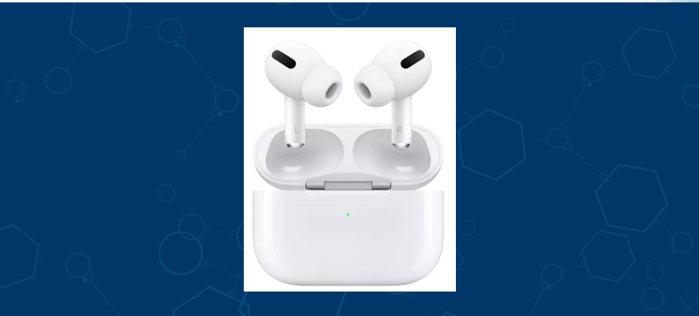

Slide 8
Program Chair
Edwin M Posadas, MD FACP KM
co-Director, Clinical Therapeutics Program
Medical Director, Urologic Oncology DRG/Center for Uro-oncology Research Excellence (CURE)
Cedars-Sinai Cancer

Slide 9
PROSTATE / BLADDER CANCER
November 30, 2023

Slide 10
Management of metastatic hormone-sensitive prostate cancer
Jun Gong, MD
Associate Professor, Medicine
Division of Medical Oncology
Cedars-Sinai Medical Center
Los Angeles, CA

Slide 11
Disclosures
Consulting/Advisory - Eisai, Exelixis, Janssen Biotech, Myovant/Pfizer, EMD Serono, Incyte, AVEO, Bayer, Seagen, Elsevier, Taiho Pharmaceutical

Slide 12
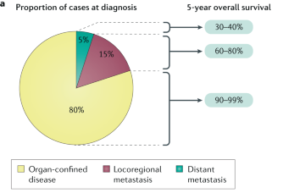
Epidemiology
- Majority of cases diagnosed with localized disease
- Survival decreases with locoregional and distant metastatic disease
Rebello RJ, et al. Nat Rev Dis Primers. 2021;7(1):9

Slide 13
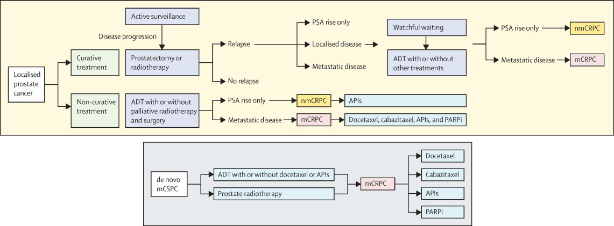
Defining disease states
- Localized disease can have a varied course from indolent, slow growing to higher risk where disease relapse is expected following definitive treatment
Whether localized disease or de novo metastatic disease → evolution to more aggressive disease states is characterized by castration-sensitive to castration-resistant prostate cancer
Sandhu S, et al. Lancet. 2021;398(10305):1075-1090

Slide 14
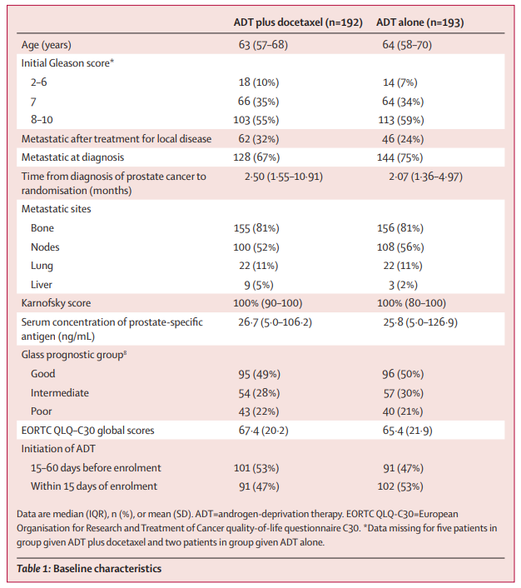
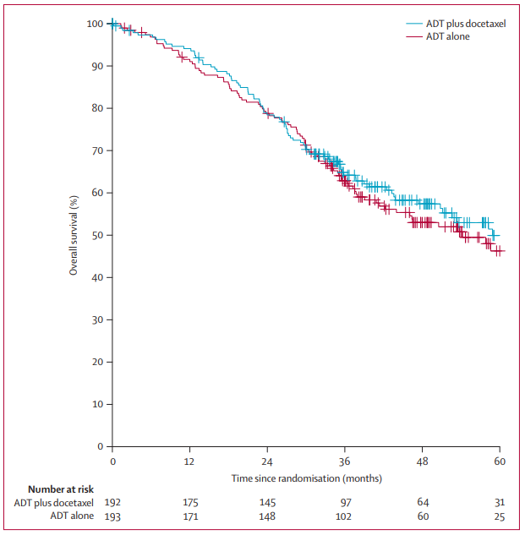
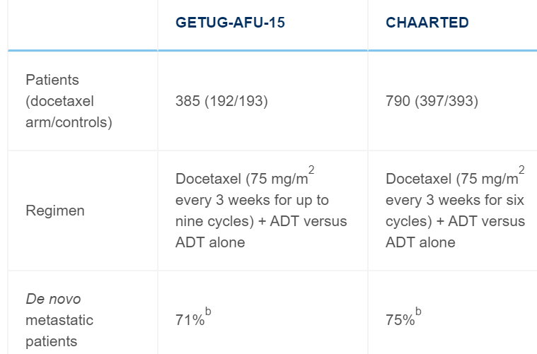
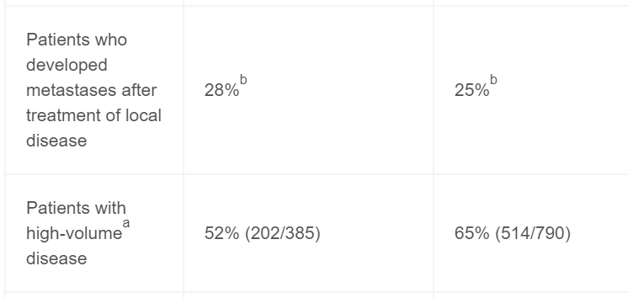
mHSPC – Intensification of ADT
GETUG-AFU 15: Randomized, open-label, phase 3 study (29 European centers)
  1:1 ADT + docetaxel (75 mg/m2 Q21 days) up to nine cycles vs. ADT
  ADT allowed up to 2 months prior to enrollment
Median PFS 23.5 vs. 15.4 mos
Median OS 58.9 ADT + docetaxel vs. 54.2 mos (HR 1.01, 95% CI 0.75-1.36, p=0.955)
Gravis G, et al. Lancet Oncol. 2013;14(2):149-58
Fizazi K, et al. Ann Oncol. 2015;26(8):1660-1667

Slide 15
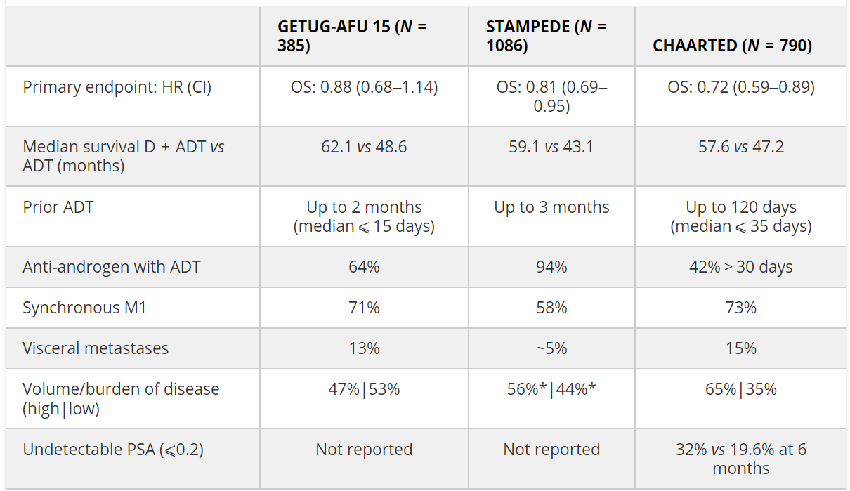
CHAARTED + STAMPEDE (Arm C)
High-volume: ≥4 bone metastases w/≥1 beyond the pelvis or vertebral column or visceral metastases
~39% M0
Davis ID. Ther Adv Med Oncol. 2022;14:17588359221086827
James ND, et al. Lancet. 2016;387:1163-1177
Sweeney CJ, et al. N Engl J Med. 2015;373:737-746

Slide 16
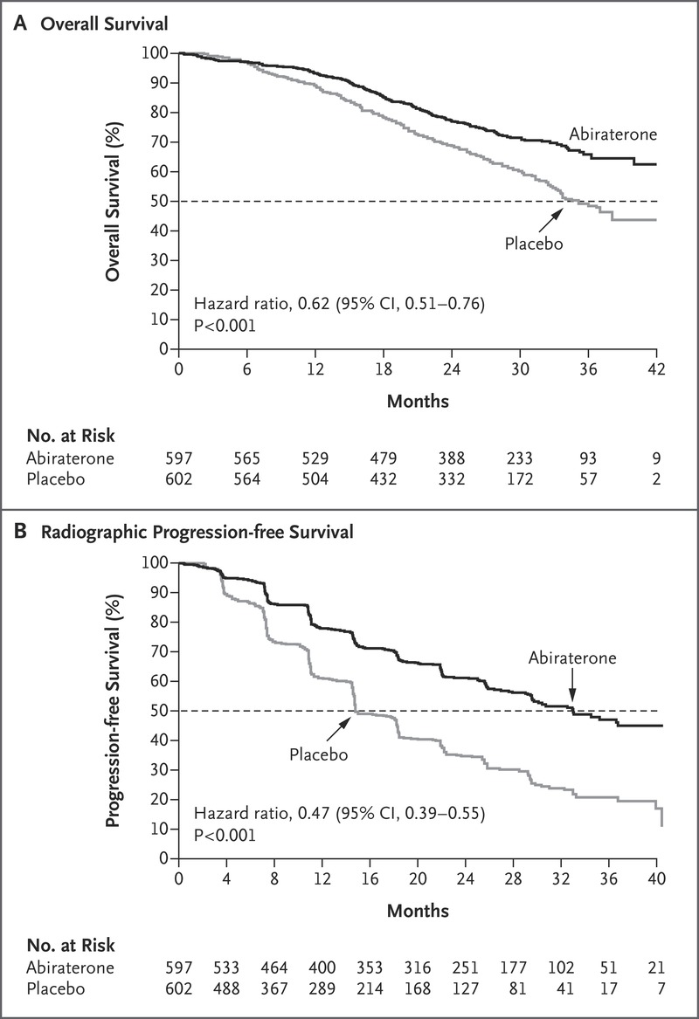
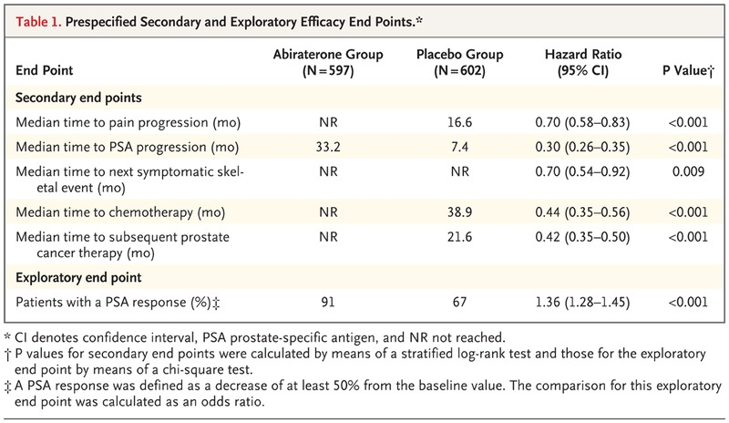
Intensification of ADT with ARSI
LATTITUDE: Randomized, double-blind, phase 3 trial
  1:1 ADT + abiraterone (1000 mg QD) + prednisone 5 mg QD vs. ADT
  ADT allowed up to 3 months prior to enrollment
  “High-risk” disease: ≥2 of the following: Gleason score ≥8, ≥3 bone mets, and visceral metastasis
Median OS 53.3 vs. 36.5 mos
Median PFS 33.0 vs. 14.8 mos
Fizazi K, et al. N Engl J Med. 2017;377:352-360
Fizazi K, et al. Lancet Oncol. 2019;20(5):686-700

Slide 17
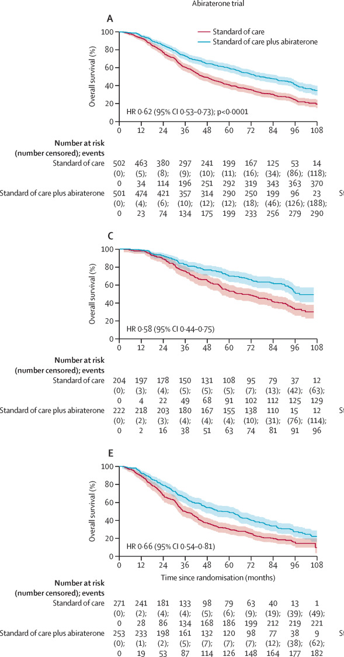
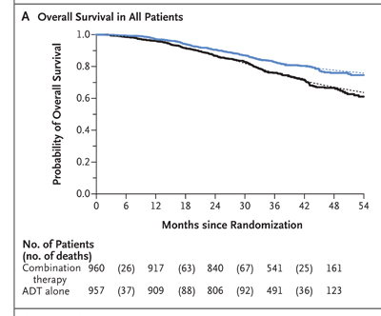
STAMPEDE (Arm G)
Randomized, double-blind, phase 3 trial of ADT intensification with abiraterone
  ~47% M0, smaller % w/ relapsed disease after RT or RT w/high-risk features (no longer receiving therapy, a PSA level >4 + PSADT <6 months, PSA level >20, nodal or metastatic relapse, or <12 months of total ADT with an interval of >12 months without treatment)
  ADT allowed up to 3 months prior to randomization
Median OS 76.6 vs. 45.7 mos
Benefit in both low volume and high-volume disease
Attard G, et al. Lancet Oncol. 2023;24(5):443-456
James N, et al. N Engl J Med. 2017;377:338-351

Slide 18
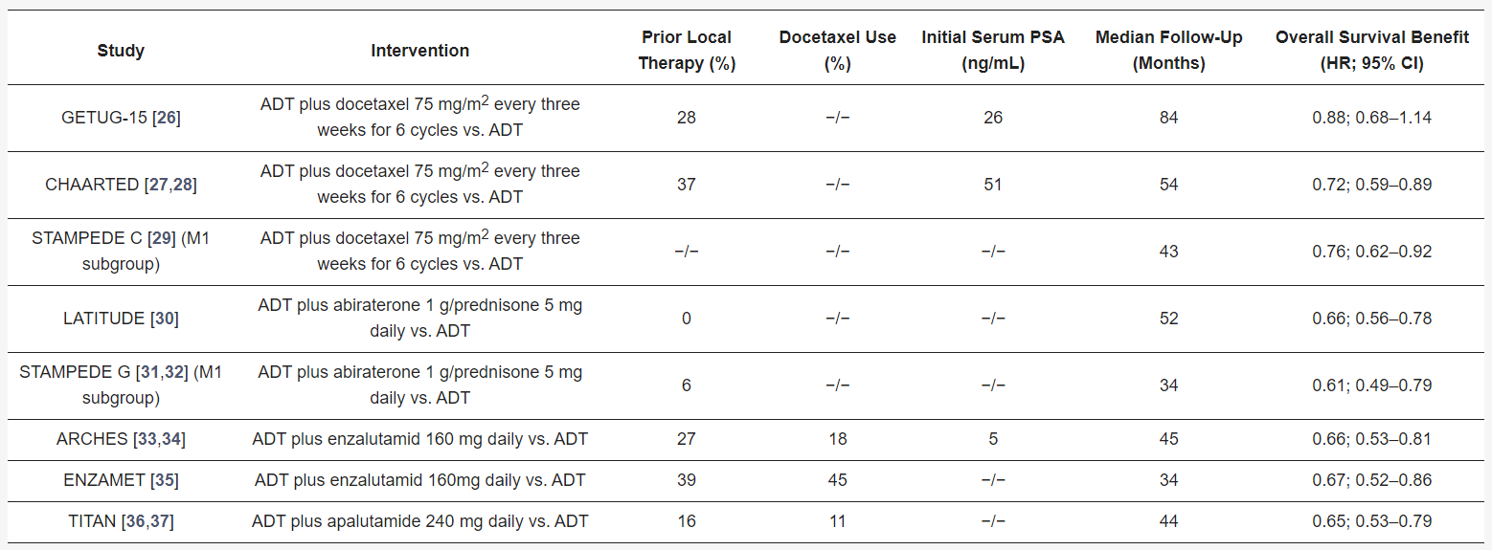
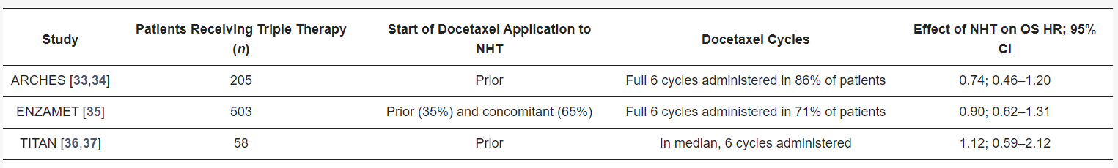
Newer ARSI + ADT combinations
~62% HV
52% HV
~62% HV
Adashek JJ, et al. Clin Genitourin Cancer. 2020;18:425-428
Armstrong AJ, et al. J Clin Oncol. 2019;10;37:2974-2986
Chi KN, et al. N Engl J Med. 2019;381:13-24
Davis ID, et al. N Engl J Med. 2019;381:121-131
Thomas C, et al. Cancers (Basel). 2021;14:8

Slide 19
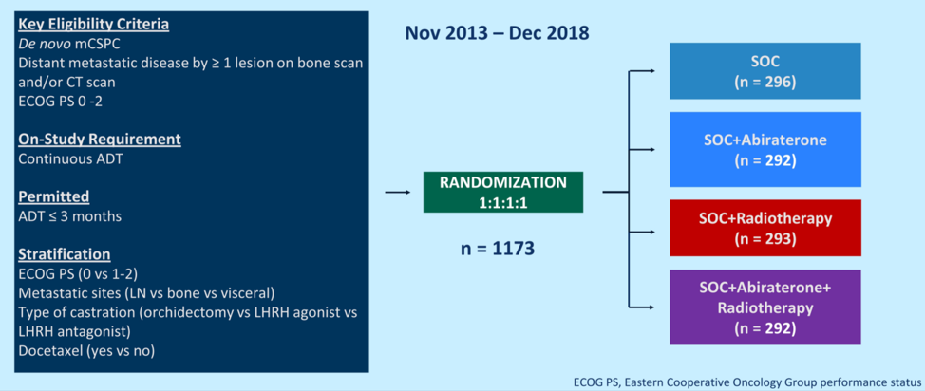
Triplet Therapy
PEACE-1: Phase III, open-label, 2 X 2 factorial design trial randomized 1:1:1:1
  Underwent several amendments: Initially ADT alone was SOC
  Approx 60% received a median of 6 cycles of docetaxel + ADT as amended SOC
  Given no interaction b/t abiraterone + RT for rPFS (p=0.64) or OS (p=0.86), RT arms collapsed into pooled analysis of abiraterone efficacy (n=583 w/abi vs. n=589 w/o abi)
Median OS 5.72 yrs vs. 4.72 yrs (HR 0.82, 95.1% CI 0.69–0.98, p= 0.030)
Grade ≥3 AEs greatest differences observed were hypertension (22% abi vs 13% no abi) and hepatotoxicity (6% vs 1%)
No differences were observed for grade ≥3 neutropenia (10% vs 9%), febrile neutropenia (5% vs 5%)
Fizazi K, et al. Lancet. 2022;399:1695-1707

Slide 20
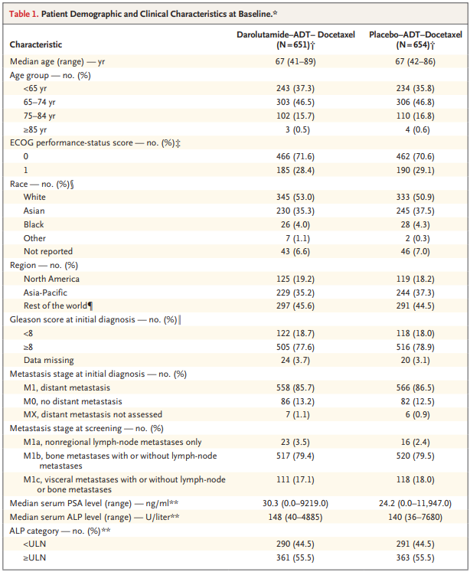
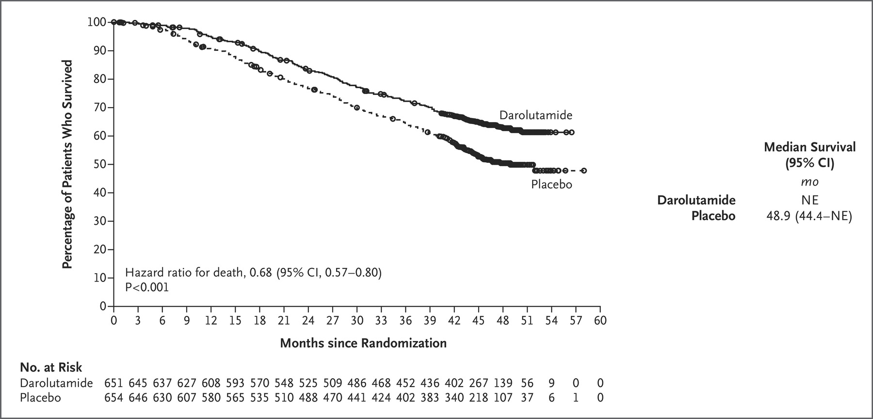
Triplet Therapy
ARASENS: Randomized, double-blind, phase III trial
  1:1 darolutamide (600 mg BID) + SOC (ADT + docetaxel X6) vs. placebo + SOC
  ADT allowed ≤12 weeks prior to randomization
Smith MR, et al. N Engl J Med. 2022;386:1132-1142

Slide 21
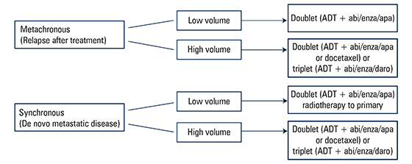
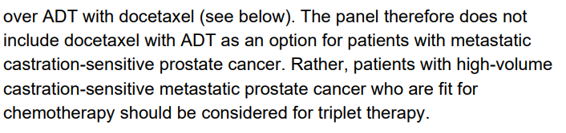
Triplet Therapy
PEACE-1, ARASENS, and subset analysis from ENZAMET → de novo high-volume mHSPC may benefit most from triplet therapy
Davis ID, et al. J Clin Oncol. 2022;40(17 suppl):LBA5004
Dorff T, et al. ASCO Daily News. 2023; https://dailynews.ascopubs.org/do/triplet-therapy-has-place-metastatic-hormone-sensitive-prostate-cancer-treatment-but
Fizazi K, et al. Lancet. 2022;399:1695-1707
NCCN Guidelines. Prostate Cancer Version 4.2023;Septemer 7, 2023
Smith MR, et al. N Engl J Med. 2022;386:1132-1142

Slide 22
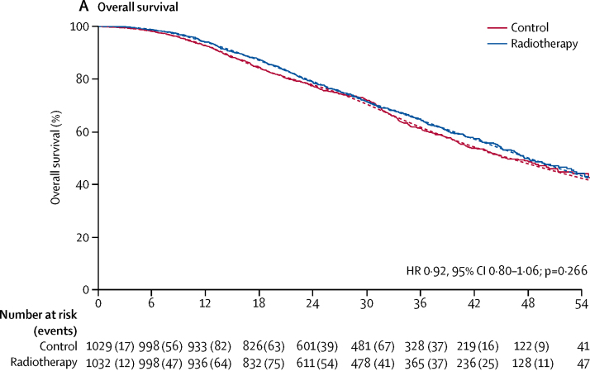
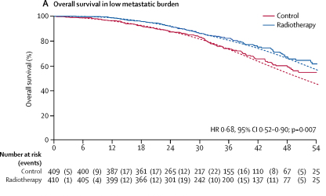
RT to primary: Low volume mHSPC
STAMPEDE (Arm H): Phase III, open-label, randomized trial:
  1:1 SOC (ADT ± docetaxel) + RT to prostate vs. SOC
  RT was to commence as soon as practicable after randomization and within 3-4 weeks after the last docetaxel dose
3-year OS 73% SOC vs 81% SOC + RT
Parker CC, et al. Lancet. 2018;392:2353-2366
NCCN Guidelines. Prostate Cancer Version 4.2023;Septemer 7, 2023

Slide 23
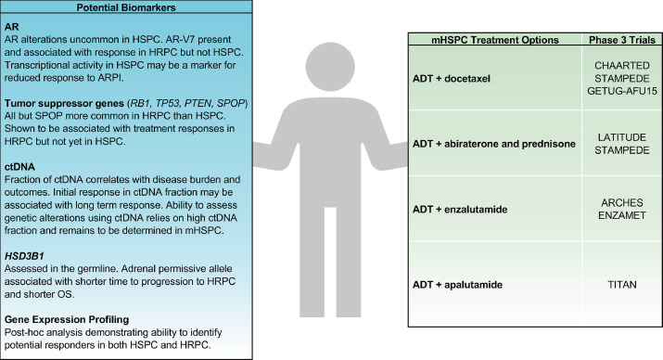
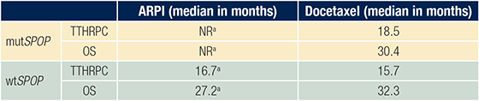
Future Directions
SPOP first predictive marker in de novo mHSPC?
ADT + abiraterone + docetaxel PEACE-1
ADT + darolutamide + docetaxel ARASENS
Hofmann MR, et al. Urology. 2021;155:165-171
Swami U, et al. Clin Cancer Res. 2022;28:4917-4925

Slide 24
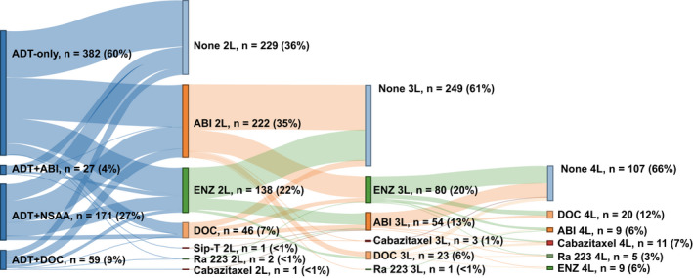
Future Directions
Freedland SJ, et al. Cancer Med. 2021;10:8570-8580

Slide 25
Conclusions
Intensification of ADT is standard for mHSPC
ADT + ARSI an option for low-volume mHSPC
  Benefit for RT to primary in low-volume mHSPC
Triplet therapy should be considered for fit individuals with high-volume mHSPC (especially de novo mHSPC)
Greater uptake of ADT intensification in the real world is vital for improving outcomes

Slide 26
Questions?

Slide 27

Bladder/Prostate
Thursday, November 30th, 2023

Slide 28
Radioligand treatment in prostate cancer
Helen H Moon MD
Medical Oncology Lead – GU oncology
Kaiser Permanente SCAL
Riverside, CA

Slide 29
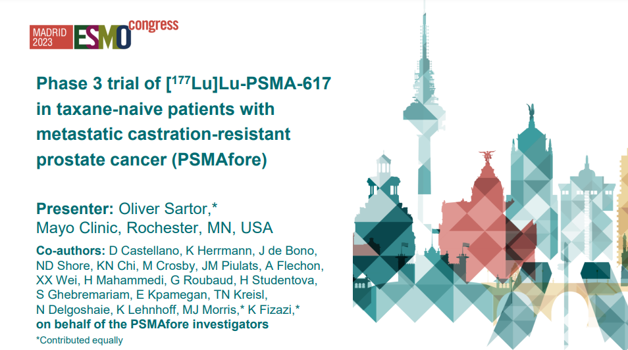

Slide 30
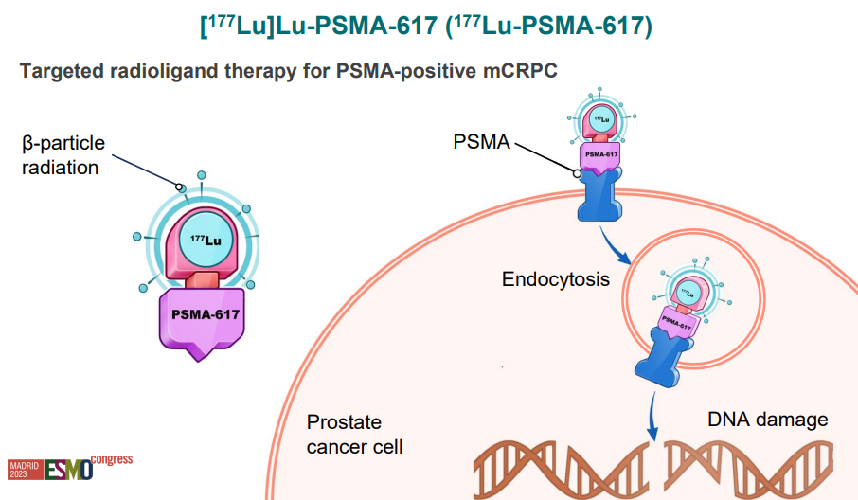

Slide 31
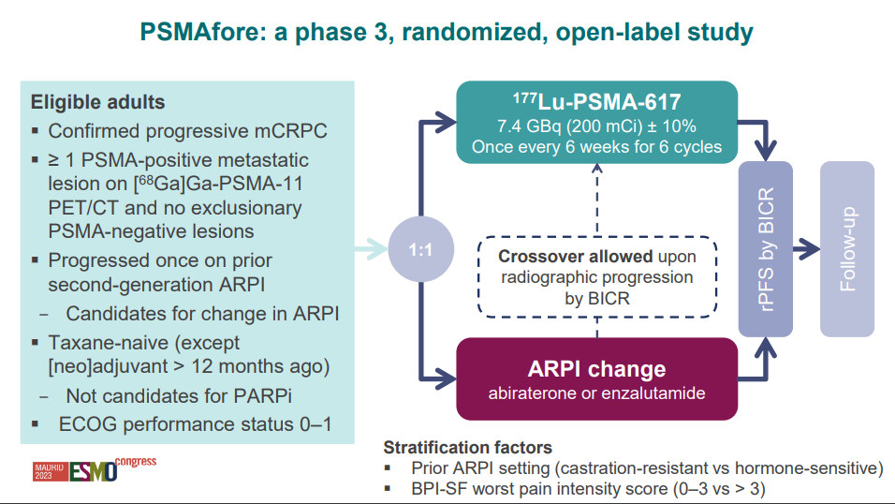

Slide 32
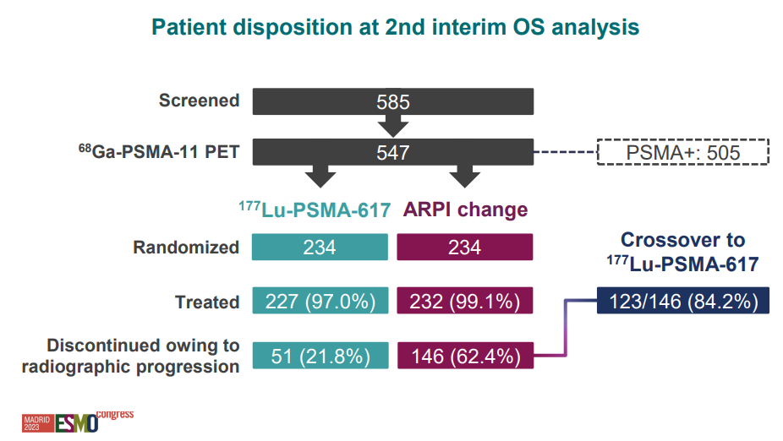

Slide 33
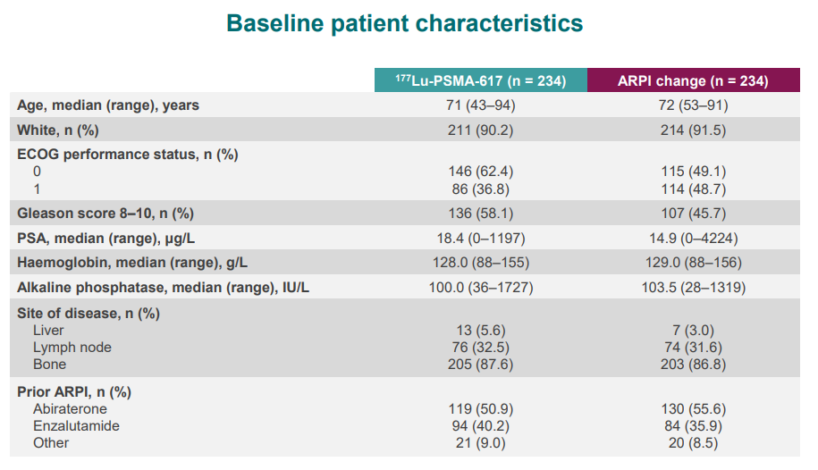

Slide 34
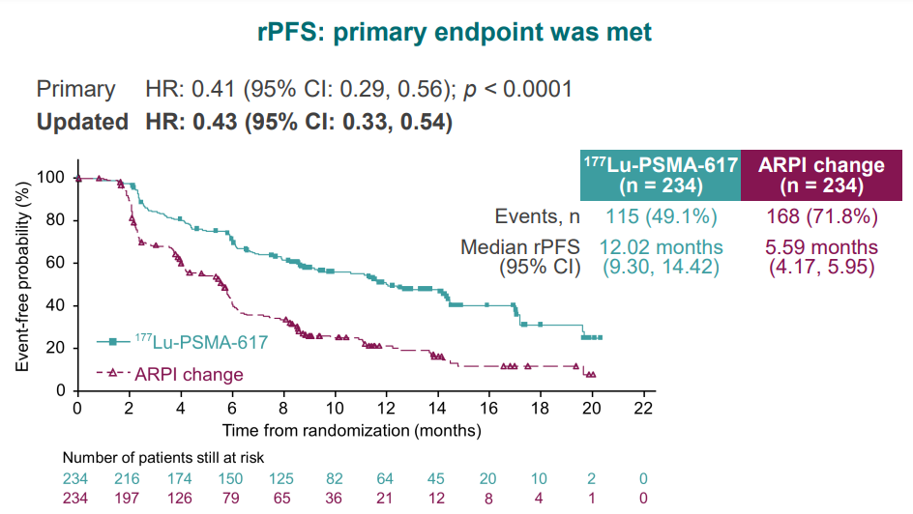

Slide 35
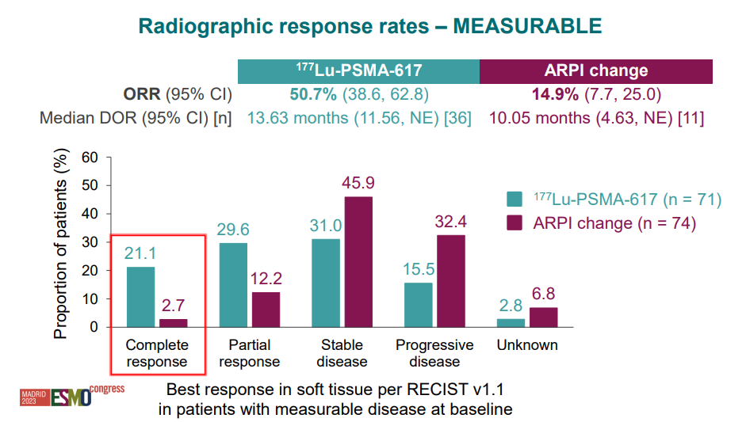

Slide 36
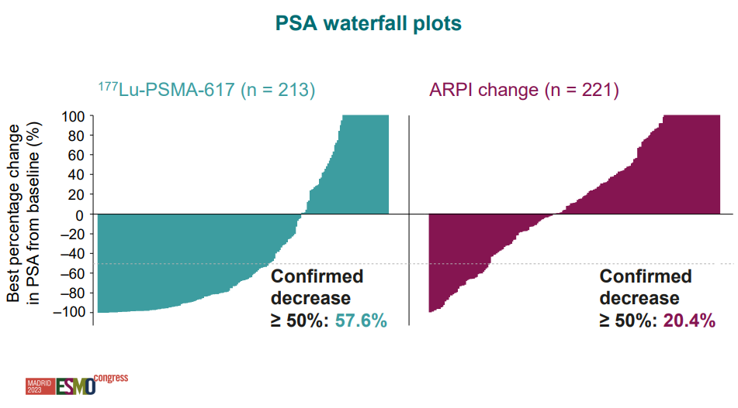

Slide 37
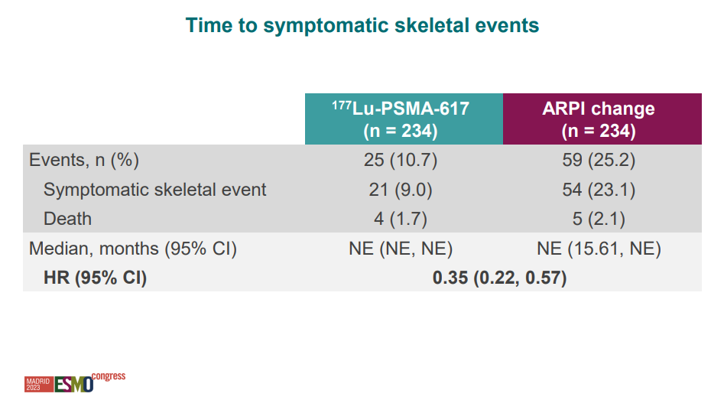

Slide 38
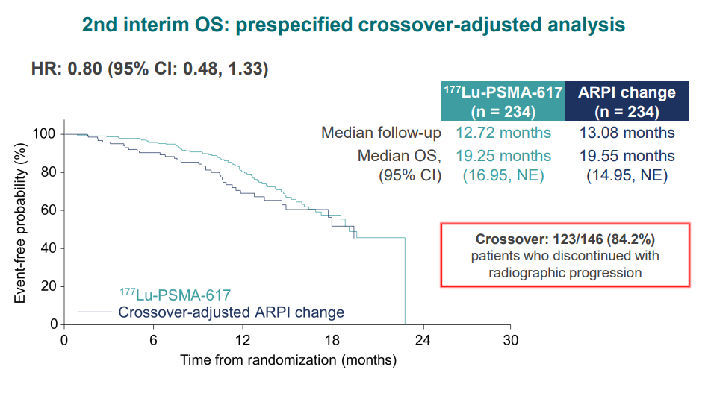

Slide 39
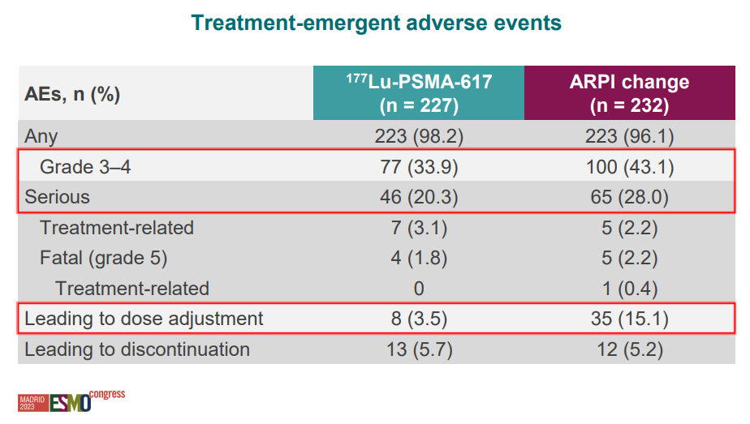

Slide 40
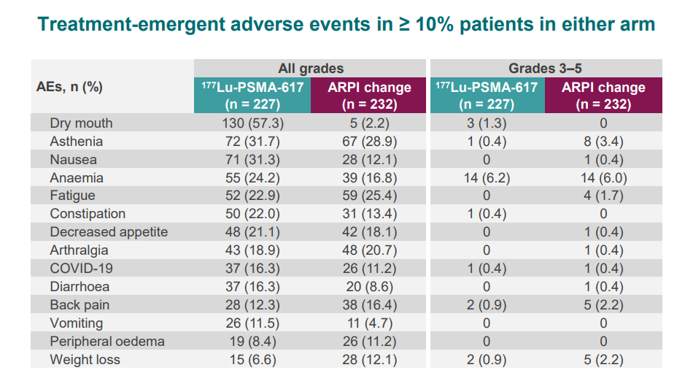

Slide 41
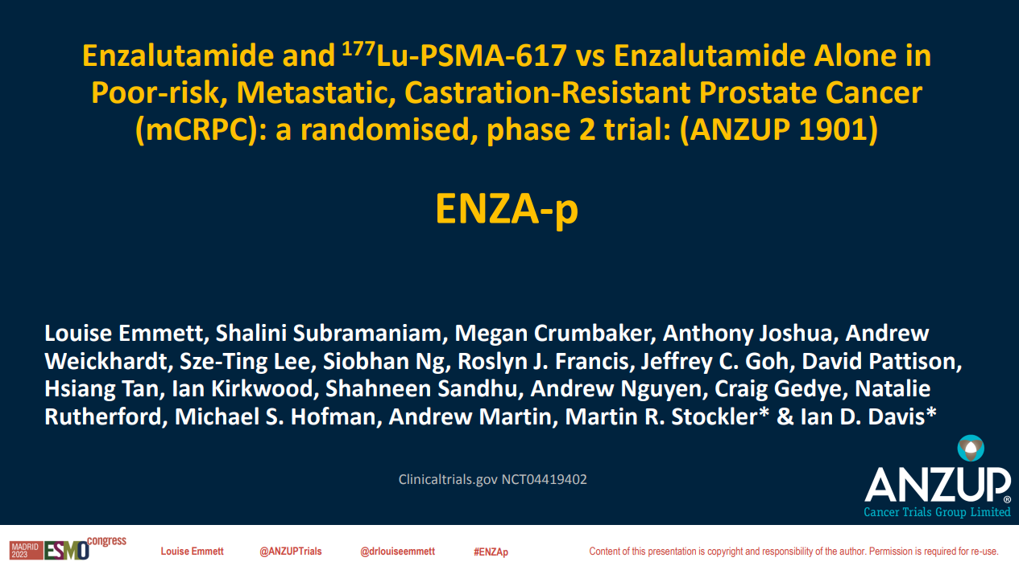

Slide 42
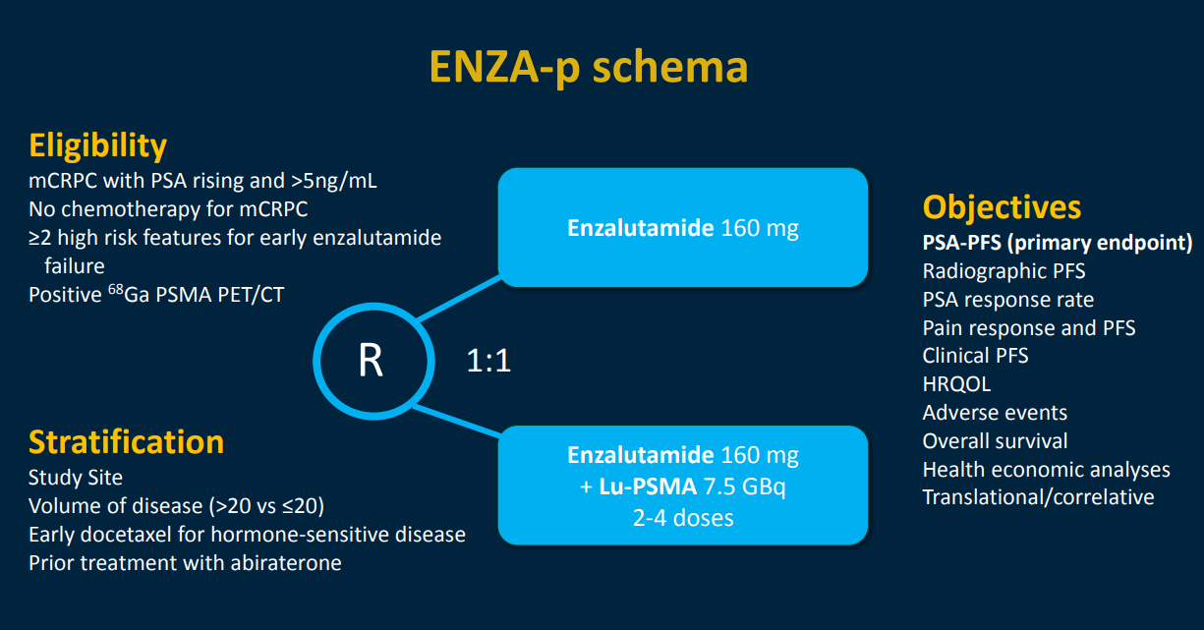

Slide 43
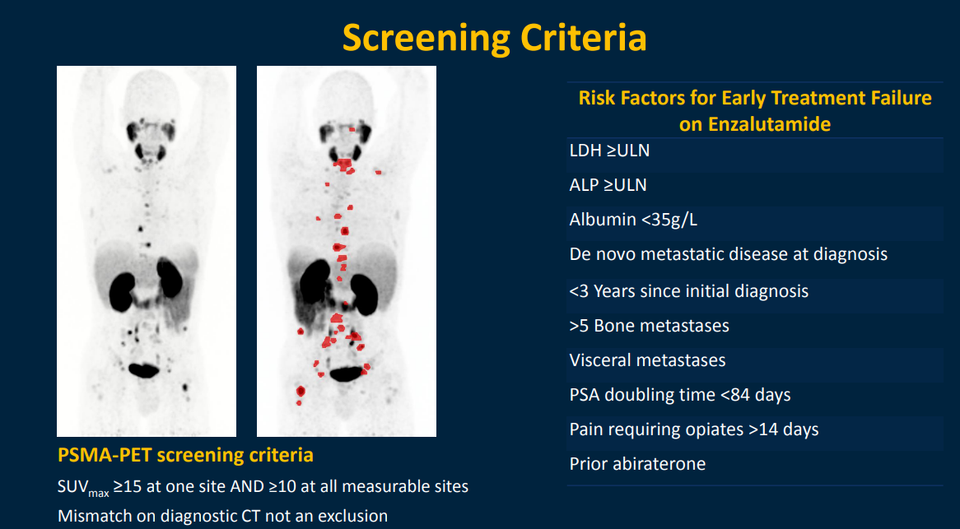

Slide 44
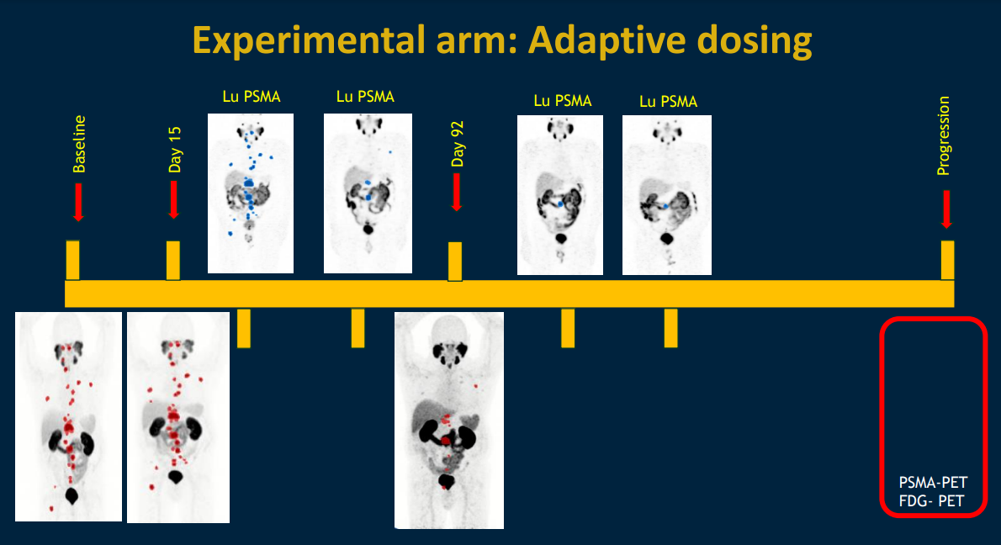

Slide 45
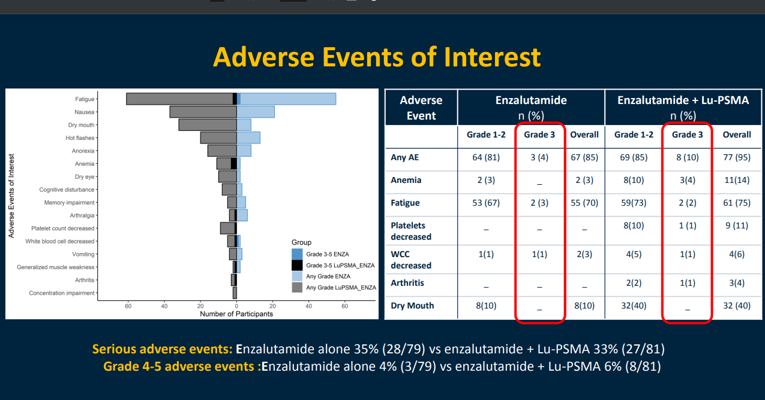

Slide 46
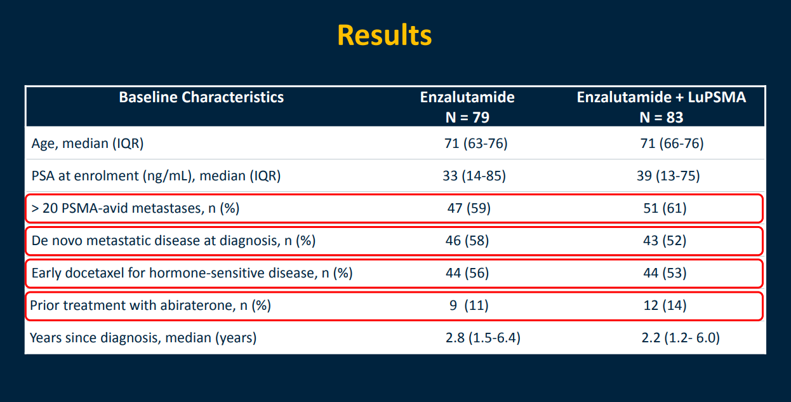

Slide 47
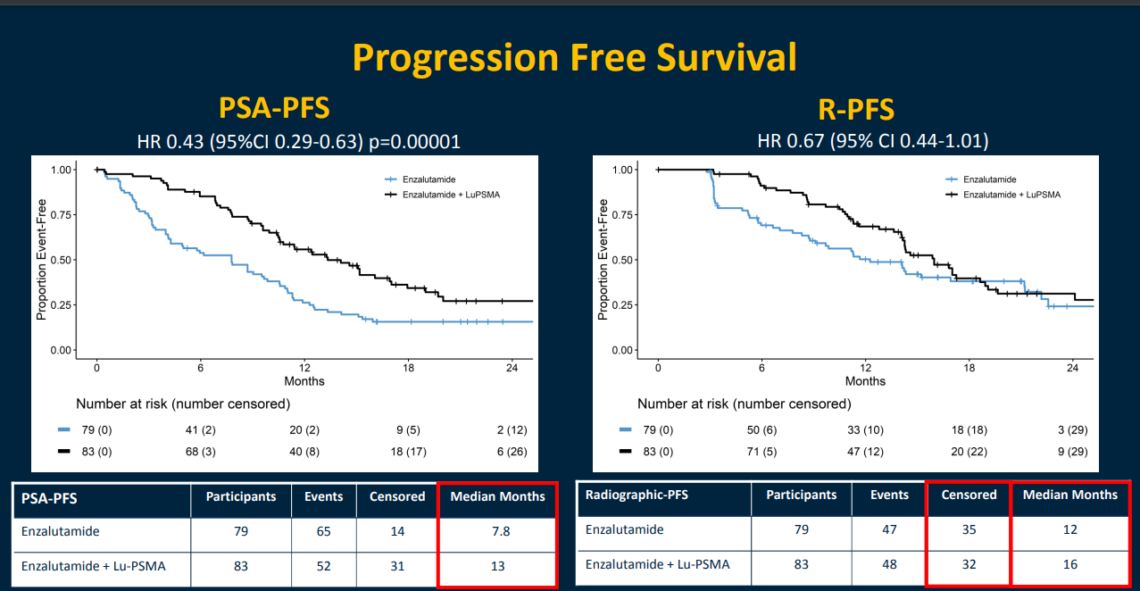

Slide 48
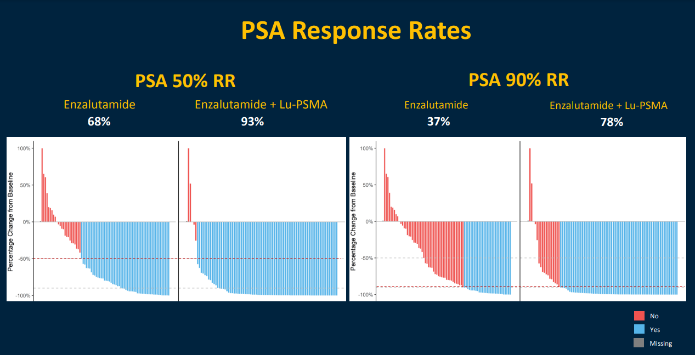

Slide 49
Conclusion
Prechemotherapy Lu 617 effective
  SAE’s of note
Patient selection can be crucial
Combination data starting to emerge
  Anzup
  PRINCE
Access remains an issue

Slide 50
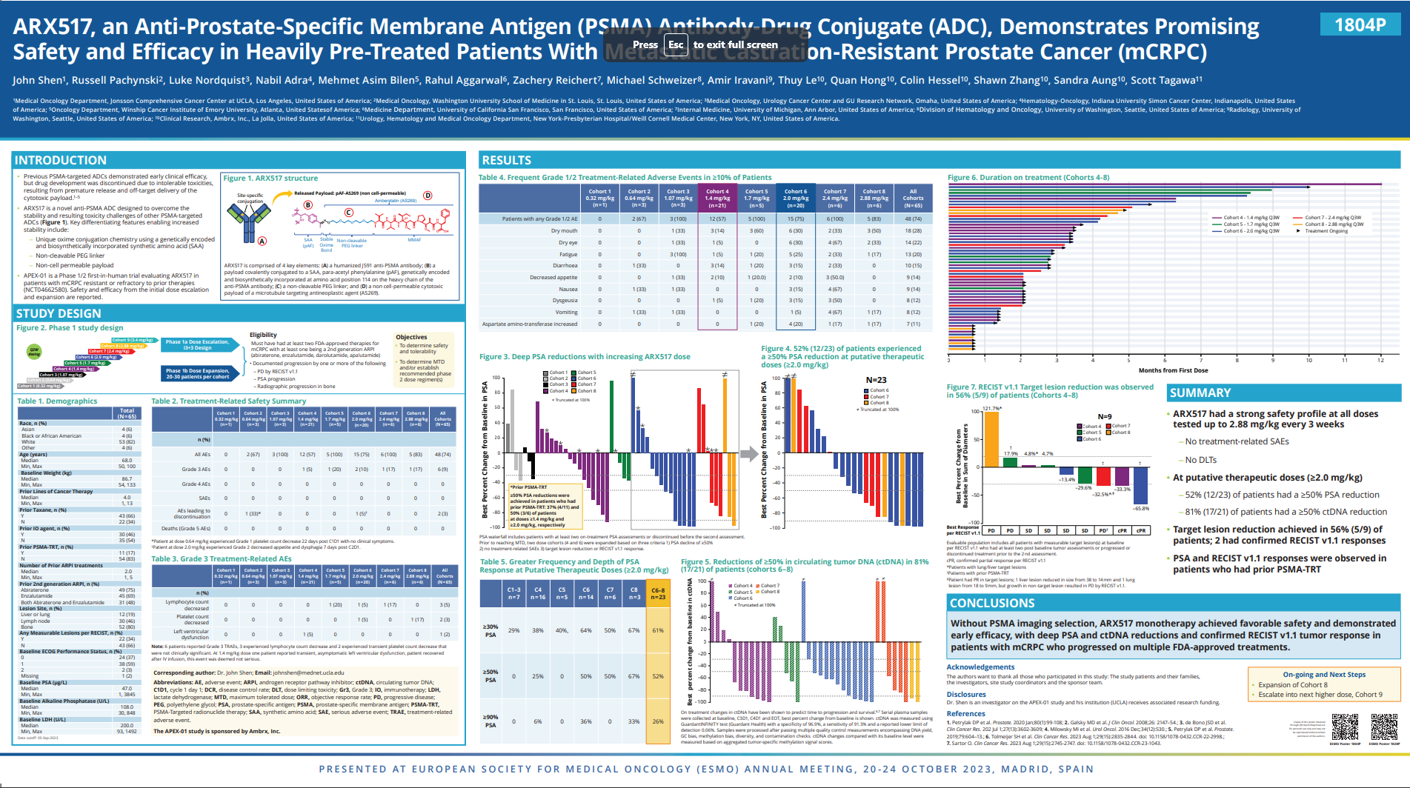

Slide 51
PROSTATE / BLADDER CANCER
November 30, 2023

Slide 52
PARP inhibitors and emerging targets in prostate cancer
Edwin M Posadas, MD FACP KM
Co-Director, Cancer Therapeutics Program
Medical Director, Centre for Uro-Oncology Research Excellence (CURE)
Cedars-Sinai Cancer
Professor of Medicine & Urology
Cedars-Sinai Medical Center
Los Angeles, CA

Slide 53
Disclosures
Speakers bureaus:
Bayer, Myovant
Consultant:
Janssen, Bayer

Slide 54
Case TM
Diagnosed with prostate CA at age 47- PSA 3.8; Gleason 3+4 T2N0 at time of RP
Pt experienced biochemical relapse 4 years after RP (age 51) undergoes salvage RT + ADT x 12 months with good biochemical response
3 years later (age 54), pt is found to have PSA concentration of 64 ng/mL with no symptoms and has a brief trial of ADT which he did not tolerate.
2 years later, pt develops an inguinal hernia with no other symptoms
During attempted repair, he is notified of peritoneal carcinomatosis: CgA+, SYN+, PSA/PSMA-, NKX3.1+
- NGS: FOXA1 p.R261fs (GOF), TP53 p.E58* (LOF); PALB2 c.1001A>G p.Y334C (VUS)- VAF 41%

Slide 55
Case TM
Rapid onset of symptoms (pain, weight loss) within 2 months that does not improve with castration
Started on docetaxel + carboplatin x 6 → Rapid regression of symptoms with moderate to severe toxicity but was poorly tolerated

Slide 56
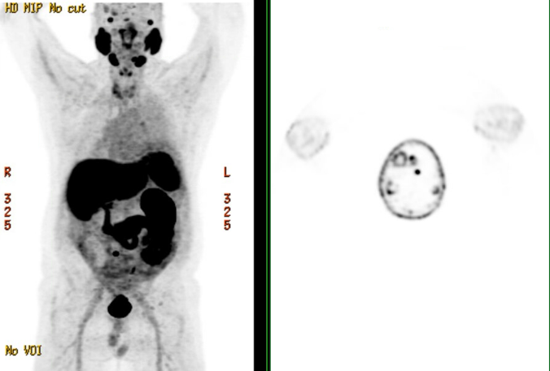
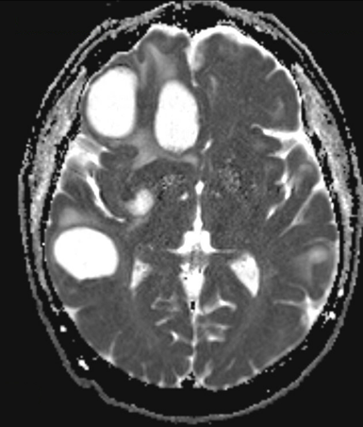
Case TM
Disease relapses within 1 year by symptoms (PSA 0.2 ng/mL CEA 8.6 ng/mL). Pt declines further chemotherapy. PSMA PET/CT obtained

Slide 57
Case TM
Referred to radiation oncology
Pt severely deconditioned and malnourished despite adjunctive steroid therapy
Started on olaparib 300 mg bid
Experienced severe fatigue, anemia, weakness complicated by diagnosis of a pulmonary embolism
Pt inquired about hospice care. Pt returned after 6 weeks and agreed to dose-reduced olaparib. PSA continued to decline off therapy.
Pt has now been on therapy for more than 1 year and has gained weight and function.

Slide 58
Case TM

Slide 59
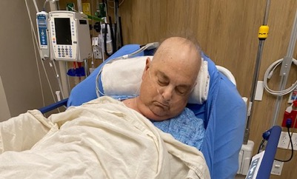

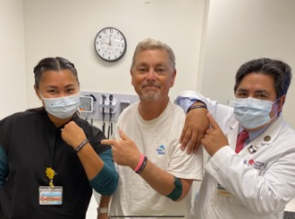
Case TM
August 2023 - Hawaii
Oct 2023

Slide 60
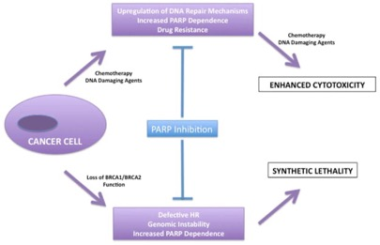



Poly (ADP-ribose) Polymerase (PARP)

Slide 61
PARPi + ARAT in 1st line mCRPC
 | PROpel | MAGNITUDE | TALAPRO-2
Key eligibility | No prior mCRPC therapy | No prior therapy for mCRPC (≤4 months of AA allowed), taxane and 2nd gen ARi allowed in mCSPC | No prior therapy for mCRPC, may have received taxane or abiraterone in mCSPC
Targeted enrollment | 720 | 1000 | 1018
Treatment Regimen (Randomization) | Olaparib 300 mg bid + Abiraterone 1000 mg qd vs. placebo + Abiraterone 1000 mg qd (1:1) | Niraparib 200 mg qd + Abiraterone 1000 mg qd vs. placebo + Abiraterone 1000 mg qd (1:1) | Talazoparib 0.5 mg qd + Enzalutamide 160 mg qd vs. placebo + Enzalutamide 160 mg qd (1:1)
Stratification | Metastasis: bone only vs. visceral vs. other Docetaxel treatment in mCSPC: yes vs. no | Prior taxane in mCSPC prior ARi in nmCRPC prior AAP in mCRPC BRCA1/2 versus other HRR gene mutation | Prior treatment NHT/taxanes: yes vs. no DDR mutation status: deficient vs non-deficient/unknown
Primary endpoint | rPFS | rPFS | rPFS

Slide 62
PROpel: Front line mCRPC
Olaparib 300mg Po BID + abiraterone 1000 mg QD † n = 399
Primary endpoint
Radiographic progression or death (rPFS) by investigator assessment
Key secondary endpoints
Overall survival (alpha control)
Additional endpoints
Time to first subsequent therapy or death
Time to second progression or death
Objective response rate
Prostate-specific antigen (PSA) response
Time to PSA progression
HRRm prevalence (retrospective testing)§
Health-related quality of life
Safety and tolerability
Patient population
1 L treatment at mCRPC stage
Docetaxel allowed mHSPC stage*
No prior abiraterone
Other NHAs allowed if stopped ≥12 months prior to enrolment
Ongoing ADT
ECOG performance status 0-1
Full dose of olaparib
and abiraterone used
1:1
R
N=796
Placebo + abiraterone 1000 mg QD †
n=397
Full dose of abiraterone used

Slide 63

PROpel: rPFS
Clarke NW. NEJM Evidence 2022

Slide 64

PROpel: Overall Survival (ITT)
months
Saad F, Lancet Oncol 2023

Slide 65

PROpel: Overall Survival (BRCAm)
months
Saad F, Lancet Oncol 2023

Slide 66

PROpel: Subsequent Therapy
Saad F, Lancet Oncol 2023

Slide 67
PROpel: overall safety profile (DCO3)
No new safety signals with longer treatment duration and follow-up
N (%) | Abiraterone + olaparib (n=398) | Abiraterone + placebo (n=396)
Any AE | 389 (97.7) | 380 (96.0)
Any AE CTCAE Grade ≥3 | 222 (55.8) | 171 (43.2)
Death due to an AE | 26 (6.5) | 20 (5.1)
Any AE leading to:
Dose interruption of Olaparib or placebo | 195 (49.0) | 112 (28.3)
Dose reduction of Olaparib or placebo | 90 (22.6) | 24 (6.1)
Discontinuation of Olaparib or placebo | 69 (17.3) | 34 (8.6)
Discontinuation of abiraterone | 45 (11.3) | 37 (9.3)
Two cases of MDS/AML in the Olaparib and abiraterone arm
Clarke NW. NEJM Evidence 2022

Slide 68
PROpel: Adverse Events
Abiraterone + Olaparib (n=398)
Abiraterone + placebo (n=396)
Any
Anemia*
Fatigue or asthenia
Nausea
Back pain
Diarrhoea
Constipation
Decreased appetite
Vomiting
Hypertension
Arthralgia
Covid-19
Peripheral odema
Dizziness
Urinary tract infection
Cough
Hot flush
Grade ≥ 3
All grade
Grade ≥ 3
All grade
Proportion of patients (%)
Pulmonary embolism (7.3% vs 2.3%) and cardiac failure events (1.8% vs 1.8%)
Clarke NW. NEJM Evidence 2022

Slide 69
TALAPRO-2: Talazoparib + Enzalutamide in first line mCRPC
Talazoparib 0.5 mg* +
enzalutamide 160 mg,
once daily
(N=402)
(*0.35 mg daily if moderate renal impairment)
Primary endpoint
Radiographic progression-free survival (rPFS) by blinded independent central review (BICR)
Patient population
First-line mCRPC
ECOG performance status (PS) 0 or 1
Stratification factors
Prior abirateroneª or docetaxel in castration-sensitive setting (yes vs no)
HRR gene alteration status (deficient vs nondeficient or unknown)
Key secondary endpoint
Overall survival (alpha protected)
Other secondary endpoints
Time to cytotoxic chemotherapy
PFS2 by investigator assessment^{b}
Objective response rate (ORR)
Patient-reported outcomes
Safety
(Data cutoff: August 16, 2022)
1:1
(N=805)
Placebo +
enzalutamide 160 mg, once daily
(N=403)
All comers (Cohort 1), N=805
Nondeficient or unknown
N=636
HRRm
N=169
HRRm
N=230
Samples prospectively assessed for HRR gene alterations (BRCA1, BRCA2, PALB2, ATM, ATR, CHEK2, FANCA, RAD51C, NBN, MLH1, MRE11A, CDK12) using FoundationOne®CDx and/or FoundationOne®Liquid CDx
HRRm only (Cohort 2), N=399
Aggarwal. ASCO GU 2023; LBA17.

Slide 70
TALAPRO-2: Baseline demographics
TALAPRO-2 : Source of Tumor DNA for Assessment and Baseline HRR Gene Status
Biomarker status was prospectively informed by tumor tissue for 99.9% of patients
Tissue source for prospective HRR gene alteration testing, n(%) | Talazoparib + Enzalutamide (N=402) | Placebo + Enzalutamide (N=403)
Tumor tissue | 347 (86.3) | 347 (86.1)
Tumor tissue and blood (circulating tumor DNA) | 57 (14.2) | 57 (14.1)
Blood (circulating tumor DNA) only | 0 | 1 (0.2)
Number of participants with HRR gene alterations, n(%) | Talazoparib + Enzalutamide (N=402) | Placebo + Enzalutamide (N=403)
1 or more alterations in the corresponding gene | 85 (21.1) | 82 (20.3)
CDK12 | 23 (5.7) | 29 (7.2)
BRCA2 | 23 (5.7) | 28 (6.9)
ATM | 23 (5.7) | 14 (3.5)
CHEK2 | 6 (1.5) | 5 (1.2)
BRCA1 | 5 (1.2) | 4 (1.0)
Other (ATR, FANCA, MLH1, MRE11A, NBN, PALB2, RAD51C) | 14 (3.5) | 13 (3.2)
1. Sigorski D, et al. Target Oncol. 2020;15:709-722; 2. Abida W, et al. JCO Precis Oncol. 2017;2017:PO.17.00029.

Slide 71

TALAPRO-2: rPFS (Primary Endpoint)
Months
Aggarwal. ASCO GU 2023; LBA17.

Slide 72


TALAPRO-2: rPFS (Primary Endpoint)
Aggarwal N, Lancet 2023
Months

Slide 73


TALAPRO-2: Overall Survival - immature
HRR-deficient
All-comers
HR 9,69 (95% CI, 0.46-1.03)
P = 0.068
Deaths:
123/402 (31%)- talazoparib
129/403 (32%)- placebo
Months
Months
18 Patients in the control arm and 3 patients in the talazoparib arm subsequently received olaparib
Aggarwal N, Lancet 2023; Fizazi ASCO 2023

Slide 74
TALAPRO-2 –Summary of TEAEs
ITT population
HRR-Deficient
TEAEs, n (%) | Talazoparib + Enzalutamide (N=398) | Placebo + Enzalutamide (N=401)
Any TEAE | 392 (98.5) | 379 (94.5)
Treatment-related | 357 (89.7) | 279 (69.6)
SAEs | 157 (39.4) | 107 (26.7)
Treatment-related | 78 (19.6) | 12 (3.0)
Grade 3-4 TEAEs | 286 (71.9) | 163 (40.6)
Grade 5 TEAEs | 13 (3.3) | 18 (4.5)
Treatment-related | 0 | 2 (0.5)
Dose interruption of talazoparib or placebo due to AE | 300 (75.4) | 94 (23.4)
Dose reduction of talazoparib or placebo due to AE* | 223 (56.0) | 29 (7.2)
Discontinuation of talazoparib or placebo due to AE | 76 (19.1) | 49 (12.2)
TEAEs, n (%) | Talazoparib + Enzalutamide (N=198) | Placebo + Enzalutamide (N=199)
Any TEAE | 196 (99.0) | 191 (96.0)
Treatment-related | 180 (90.9) | 144 (72.4)
SAEs | 60 (30.3) | 40 (20.1)
Treatment-related | 27 (13.6) | 0
Grade 3-4 TEAEs | 131 (66.2) | 74 (37.2)
Grade 5 TEAEs | 3 (1.5) | 5 (2.5)
Treatment-related | 0 | 0
Dose interruption of talazoparib or placebo due to AE | 133 (67.2) | 39 (19.6)
Dose reduction of talazoparib or placebo due to AEª | 110 (55.6) | 12 (6.0)
Discontinuation of talazoparib or placebo due to AE | 20 (10.1) | 14 (7.0)
Aggarwal N, Lancet 2023; Fizazi ASCO 2023

Slide 75
TALAPRO-2 – Most common All-cause TEAEs
ITT population
HRR-Deficient
Talazoparib + Enzalutamide (N=398)
Placebo + Enzalutamide (N=401)
Talazoparib + Enzalutamide (N=198)
Placebo + Enzalutamide (N=199)
65.8
17.5
64.6
15.6
35.7
7.0
26.6
33.3
33.7
29.4
32.3
6.5
24.6
3.5
24.7
2.5
22.1
4.5
20.7
17.1
22.1
18.0
20.2
14.1
All grades
Grade 1-2
Grade 3
Grade 4
All grades
Grade 1-2
Grade 3
Grade 4
21.6
15.7
19.7
22.1
20.6
12.5
12.6
22.1
Patients, %
Patients, %
Aggarwal N, Lancet 2023; Fizazi ASCO 2023

Slide 76
MAGNITUDE– Study Design
Patient eligibility
L1 mCRPC
≤4 months prior AAP allowed for mCRPC
ECOG PS 0 or 1
BPI-SF worst pain score ≤3
Stratifications
Prior taxane-based chemotherapy for mCSPC
Prior ARi for nmCRPC or mCSPC
Prior AAP for L1 mCRPC
HRR+ cohort only;
BRCA1/2 vs other HRR gene alterations
Prescreening for BM status
IA2 assessments
HRR+ panel:
ATM
BRCA1
BRCA2
BRIP1
CDK12
CHEK2
FANCA
HDAC2
PALB2
NIRA + AAP
N=212
BRCA1/2
n=113
Primary endpointª
rPFS by central review
Other HRR
n=99
Secondary endpoints^{b}
TCC
TSP
OS
1:1 randomization
PBO + AAP
N=211
BRCA1/2
n=112
Other endpoints
TTPP
TTPI
Other HRR
n=99
Efstathiou E. ASCO GU 2023.

Slide 77

MAGNITUDE: rPFS BRCA v HRR BM-
Prespecified early futility analysis
Progression in HRR BM- subgroup
Composite Progression Endpoint (radiographic or PSA progression)
PBO + AAP
NIRA + AAP
No benefit of NIRA + AAP in HRR BM- patients. HR 1.09. Addition grade ¾ toxicity was observed with NIRA + AAP. IDMC recommended early stopping in this cohort.
Chi K, Ann Onc 2023

Slide 78

MAGNITUDE: OS
Secondary endpoint: OS
OS with inverse probability censoring weighting
Chi K, Ann Onc 2023

Slide 79

MAGNITUDE: Subsequent Therapy
Chi K, Ann Onc 2023

Slide 80

MAGNITUDE: HRR+ (non-BRCA1/2)
Not all HRRm are equal! (but hard to interpret with this dataset)
Chi K, Ann Onc 2023

Slide 81
MAGNITUDE Final Analysis
 | NIRA + AAP (N = 212) | PBO + AAP (N = 211)
Median treatment exposure, months | 20.2 | 15.2
Any TEAE, n (%) | 212 (100) | 205 (97.2)
Grade 3-4 TEAE, n (%) | 157 (74.1) | 108 (51.2)
SAEs, n (%) | 100 (47.2) | 65 (30.8)
AESI, n (%) | 179 (84.4) | 136 (64.5)
TEAEs leading to discontinuation, n (%) | 39 (18.4) | 17 (8.1)
TEAEs leading to death, n (%) | 22 (10.4) | 10 (4.7)
Related to study drug | 1 (0.5) | 1 (0.5)
COVID-19 related or suspected | 10 (4.7) | 2 (0.9)
AEs leading to NIRA/PBO interruption, n (%) | 109 (51.4) | 60 (28.4)
AEs leading to NIRA/PBO reduction, n (%) | 43 (20.3) | 8 (3.8)
AEs leading to NIRA/PBO discontinuation, n (%) | 39 (18.4) | 14 (6.6)
Safety summary in the all HRR cohort
Safety profile remained consistent with prior analyses
AEs manageable with dose modifications
Safety profile in the BRCA+ population was consistent with
that of HRR cohort
Chi K, Ann Onc 2023

Slide 82
PARPi: 2nd Line mCRPC
 | PROfound | TRITON3
Key eligibility | HRRm by FoundationOneCDX Previous abiraterone or enzalutamide Prior taxane allowed | Known BRCA or ATM mutation Previous ARPI No prior taxane for CRPC
Sample size | 387 | 1000
Treatment Regimen (Randomization) | Olaparib 300 mg bid vs. Enzalutamide or apalutamide | Rucaparib 600 mg bid vs. Docetaxel or ARPI
Stratification | BRCA1/2 or ATM vs other HRRm | ECOG PS 0 vs 1 Hepatic metastases yes vs no BRCA1 vs BRCA2 vs ATM
Primary endpoint | rPFS | rPFS

Slide 83
PROfound: OLAPARIB after progression on NHA and with gene alterations
Patients with mCRPC and progression on prior NHA; harboring gene alterations with a role in HRR
(N=387)
Cohort A: BRCA1, BRCA2, or ATM alterations
(n=245)
Olaparib 300 mg BID
n=162
PD by
BICR
Crossover allowed upon progression on physician’s choice therapy
Control (enzalutamide or apalutamide)*
n=83
Cohort B: Other alterations
(n=142)
Olaparib 300 mg BID
n=94
PD by
BICR
Control (enzalutamide or apalutamide) *
n=48
* Enzalutamide 160 mg QD or abiraterone acetate 100 mg QD plus prednisone 5 mg BID
Primary endpoint: radiographic PFS in Cohort A using RECIST 1.1 and PCWG3 by BICR
† BRCA1/2, ATM, BRIP1, BARD1. CDK12, CHEK1, CHEK2, FANCL, PALB2, PPP2R2A, RAD51B, RAD51C, RA51D, OR RAD54L.
Secondary endpoints: radiographic PFS in both cohorts, confirmed radiographic ORR in Cohort A, time to pain progression in Cohort A, OS in Cohort A

Slide 84


PROfound: OS (Cohort A – BRCA1/2, ATM)
Adjusted for crossover
81% crossover from placebo to olaparib
Hussain M, N Eng J Med 2020
Saad AUA 2021.

Slide 85
TRITON3 – Rucaparib vs TPC in 2L BRCA mutated mCRPC
Endpoints^{d}
Key eligibility criteria
Randomization 2:1
Rucaparib (n=270)
600 mg BID
Primary:
rPFS by IRR
Key secondary
OS
ORR by IRR
Subgroup analyses:
OS and rPFS for rucaparib vs docetaxel or second-generation ARPI
Chemotherapy-naïve mCRPC
BRCA or ATM alterationª
1 prior second-generation ARPI in any setting^{b}
Stratification:
ECOG PS 0 vs 1
Hepatic metastases yes vs no
BRCA1 vs BRCA2 vs ATM
Physician’s choice (n=135)^{c}
Docetaxel (n=75)
Or
Second-generation ARPI (n=60)
Prior docetaxel or other
taxane chemotherapy for castration-sensitive disease was permitted
Abiraterone acetate
or
Enzalutamide
Patients who progress on physician’s choice of treatment may be considered for crossover to rucaparib
Fizazi K, N Eng J Med 2023

Slide 86

TRITON3: rPFS (BRCAm)
months
Fizazi K, N Eng J Med 2023

Slide 87

TRITON3: rPFS (BRCAm)
months
Fizazi K, N Eng J Med 2023

Slide 88

TRITON3: rPFS (ATMm)
months
Fizazi K, N Eng J Med 2023

Slide 89

TRITON3: OS (BRCAm)
months
Fizazi K, N Eng J Med 2023

Slide 90

TRITON3: OS (ITT)
months
Fizazi K, N Eng J Med 2023

Slide 91

TRITON3: OS (ATMm)
months
Fizazi K, N Eng J Med 2023

Slide 92




STEAP1: Six-Transmembrane Epithelial Antigen of the Prostate 1
metalloproteinases involved in iron and copper homeostasis and other cellular processes
STEAP1
PSMA
Xu M, Cancers 2022; Kelly WK, ESMO 2023

Slide 93






Xaluritamig (AMG 509): STEAP1 T-cell engager
Kelly WK, ESMO 2023

Slide 94


Endoglin (CD105)

Slide 95






APA-105: Apalutamide + Carotuximab (anti-CD105)
Neil Bhowmick, PhD
Tanya Dorff, MD
City of Hope
Umang Swami, MD
Huntsman/
U Utah

Slide 96
Conclusions
Prostate cancer therapy is under rapid evolution
Identifying known drivers of progression (and resistance) is now a part of the standard of care in advanced prostate cancer
    Consider NGS before the mCRPC state to identify truncal alterations
For patients with HRRm, PARP inhibitors represent a high active and important treatment in our armamentarium
    while there are toxicities associated with PARPi, they are manageable in the hands of a skilled oncologist
More data will be needed to optimize timing of PARPi therapy
Newer targets are emerging that address important drivers and molecular features of prostate cancer.
    There will be an increased need of knowing which patients are suitable for these treatments
    Participation in clinical trials will help to advance these new and active therapies

Slide 97
PROSTATE / BLADDER CANCER
November 30, 2023

Slide 98
Presentation Title
Michael Ahdoot, MD
Assistant Professor Urology
Cedar Sinai
Los Angeles, CA

Slide 99
First safety and efficacy results of the TAR-210 erdafitinib (erda) intravesical delivery system in patients (pts) with non muscle-invasive bladder cancer (NMIBC) with select FGFR alterations

Slide 100

TAR-210
Temporary intravesical implant
Gradual continuous release of Erdafitinib
Erdafitinib - selective pan-FGFR tyrosine kinase inhibitor
Notes:
Background: Treatment (tx) options are limited in NMIBC that recurs after intravesical
chemotherapy or bacillus Calmette-Guérin (BCG). TAR-210 is a novel intravesical drug
delivery system designed to provide local, continuous release of erda (selective pan-
FGFR tyrosine kinase inhibitor) within the bladder while limiting systemic toxicities.
This open-label, multicenter phase 1 study (NCT05316155) evaluates the safety, PK,
and efficacy of TAR-210 in pts with NMIBC whose tumors harbor select FGFRalt.
Methods: FGFRalt were identified in tumor tissue or urine cell-free DNA. Cohort 1
(C1) pts had recurrent, BCG-experienced high-risk NMIBC (high-grade Ta/T1; papillary
only) and refused or were ineligible for radical cystectomy. Cohort 3 (C3) pts had
recurrent, intermediate-risk NMIBC (Ta/T1) with history of only low-grade papillary
disease. Before tx, C1 pts must have all visible disease resected; C3 requires the
presence of visible tumors. TAR-210 systems with 2 different erda release rates were
evaluated. Response is assessed every 3 mo with continued tx for up to 1 year if
recurrence-free (RF) (C1) or in complete response (CR) (C3).
Results: As of Aug 29, 2023, 16 pts in C1 and 27 pts in C3 have been treated; 11 and
15 pts, respectively, had 1 response assessment. 82% in C1 were RF; 87% in C3
achieved CR (Table). Most common tx-related AEs were grade 1/2 lower urinary tract
AEs. There were no dose-limiting toxicities, no deaths, 2 pts discontinued due to AEs
of low-grade urinary symptoms, and 1 pt had serious AEs of pyelonephritis and sepsis.
PK showed sustained erda concentrations in urine, with very low plasma exposures.

Slide 101
Phase 1 Study
Safety and Tolerability
Efficacy

Slide 102
Patient Population
All patients with FGFR alterations detected in tumor tissue or cell free DNA
3 Cohorts
  Cohort 1 - recurrent, BCG-experienced high-risk NMIBC (high-grade Ta/T1; papillary only). Tumor resected (n=16)
  Cohort 3 - (C3) recurrent, intermediate-risk NMIBC (Ta/T1) with history of only low-grade papillarydisease. Tumors unresected. (n=21)
Notes:
Methods: FGFRalt were identified in tumor tissue or urine cell-free DNA. Cohort 1
(C1) pts had recurrent, BCG-experienced high-risk NMIBC (high-grade Ta/T1; papillary
only) and refused or were ineligible for radical cystectomy. Cohort 3 (C3) pts had
recurrent, intermediate-risk NMIBC (Ta/T1) with history of only low-grade papillary
disease. Before tx, C1 pts must have all visible disease resected; C3 requires the
presence of visible tumors. TAR-210 systems with 2 different erda release rates were
evaluated. Response is assessed every 3 mo with continued tx for up to 1 year if
recurrence-free (RF) (C1) or in complete response (CR) (C3).
Results: As of Aug 29, 2023, 16 pts in C1 and 27 pts in C3 have been treated; 11 and
15 pts, respectively, had 1 response assessment. 82% in C1 were RF; 87% in C3
achieved CR (Table). Most common tx-related AEs were grade 1/2 lower urinary tract
AEs. There were no dose-limiting toxicities, no deaths, 2 pts discontinued due to AEs
of low-grade urinary symptoms, and 1 pt had serious AEs of pyelonephritis and sepsis.
PK showed sustained erda concentrations in urine, with very low plasma exposures.

Slide 103

Notes:
Results: As of Aug 29, 2023, 16 pts in C1 and 27 pts in C3 have been treated; 11 and
15 pts, respectively, had 1 response assessment. 82% in C1 were RF; 87% in C3
achieved CR (Table). Most common tx-related AEs were grade 1/2 lower urinary tract
AEs. There were no dose-limiting toxicities, no deaths, 2 pts discontinued due to AEs
of low-grade urinary symptoms, and 1 pt had serious AEs of pyelonephritis and sepsis.
PK showed sustained erda concentrations in urine, with very low plasma exposures.

Slide 104
Adverse Effect
Most common tx-related AEs were grade 1-2 lower urinary tract AEs.
There were no dose- limiting toxicities
No deaths
2 pts discontinued due to ASs of low-grade urinary symptoms, and 1 pt had serious AEs of pyelonephritis and sepsis
Notes:
TAR-210 appears safe and well tolerated with predominantly low-grade
urinary system AEs and high CR rate and RF survival in pts with NMIBC with FGFRalt.
Results justify further study of targeted tx of erda using a novel intravesical delivery
system in early-stage bladder cancer.

Slide 105
Results from SunRISe-1 in patients (Pts) with bacillus CalmetteeGuérin (BCG) unresponsive high-risk non muscle-invasive bladder cancer (HR NMIBC) receiving TAR-200 monotherapy
Notes:
Background: Pts with BCG-unresponsive HR NMIBC are at high risk of disease progression
with limited treatment (tx) options. TAR-200, an intravesical drug delivery
system, provides sustained release of gemcitabine in the bladder over many days.
SunRISe-1 (NCT04640623) is an ongoing, randomized, ph 2b study assessing efficacy
and safety of TAR-200 + cetrelimab (anti-PD1) (Cohort 1 [C1]), TAR-200 alone (C2), or
cetrelimab alone (C3) in pts with BCG-unresponsive HR NMIBC ineligible for or
refusing radical cystectomy. We report results from C2.

Slide 106

TAR-200
Temporary intravesical implant
Gradual continuous release of gemcitabine
Notes:
Background: Treatment (tx) options are limited in NMIBC that recurs after intravesical
chemotherapy or bacillus Calmette-Guérin (BCG). TAR-210 is a novel intravesical drug
delivery system designed to provide local, continuous release of erda (selective pan-
FGFR tyrosine kinase inhibitor) within the bladder while limiting systemic toxicities.
This open-label, multicenter phase 1 study (NCT05316155) evaluates the safety, PK,
and efficacy of TAR-210 in pts with NMIBC whose tumors harbor select FGFRalt.
Methods: FGFRalt were identified in tumor tissue or urine cell-free DNA. Cohort 1
(C1) pts had recurrent, BCG-experienced high-risk NMIBC (high-grade Ta/T1; papillary
only) and refused or were ineligible for radical cystectomy. Cohort 3 (C3) pts had
recurrent, intermediate-risk NMIBC (Ta/T1) with history of only low-grade papillary
disease. Before tx, C1 pts must have all visible disease resected; C3 requires the
presence of visible tumors. TAR-210 systems with 2 different erda release rates were
evaluated. Response is assessed every 3 mo with continued tx for up to 1 year if
recurrence-free (RF) (C1) or in complete response (CR) (C3).
Results: As of Aug 29, 2023, 16 pts in C1 and 27 pts in C3 have been treated; 11 and
15 pts, respectively, had 1 response assessment. 82% in C1 were RF; 87% in C3
achieved CR (Table). Most common tx-related AEs were grade 1/2 lower urinary tract
AEs. There were no dose-limiting toxicities, no deaths, 2 pts discontinued due to AEs
of low-grade urinary symptoms, and 1 pt had serious AEs of pyelonephritis and sepsis.
PK showed sustained erda concentrations in urine, with very low plasma exposures.

Slide 107
Phase 2b Study
Safety
Efficacy
  Complete response Rates (CR)
  Durations of CR
Notes:
Background: Pts with BCG-unresponsive HR NMIBC are at high risk of disease progression
with limited treatment (tx) options. TAR-200, an intravesical drug delivery
system, provides sustained release of gemcitabine in the bladder over many days.
SunRISe-1 (NCT04640623) is an ongoing, randomized, ph 2b study assessing efficacy
and safety of TAR-200 + cetrelimab (anti-PD1) (Cohort 1 [C1]), TAR-200 alone (C2), or
cetrelimab alone (C3) in pts with BCG-unresponsive HR NMIBC ineligible for or
refusing radical cystectomy. We report results from C2.

Slide 108
Patient Population
CIS with or without any papillary disease (high grade Ta or T1)
ECOG performance status 0-2
Persistent or recurrent HR NMIBC with last dose of BCG 12 mo prior to CIS diagnosis
Notes:
Methods: Eligible pts aged 18 y had histologically confirmed carcinoma in situ (CIS)
papillary disease (high-grade Ta, any T1), ECOG performance status 0-2, and
persistent or recurrent HR NMIBC with last dose of BCG 12 mo prior to CIS diagnosis.
TAR-200 was dosed Q3W through Wk 24, then Q12W until Wk 96. Response
assessments: cystoscopy and centrally assessed urine cytology, CT/MRI, and bladder
biopsy (at Wk 24, 48, and as clinically indicated). Primary end point: overall complete
response (CR) rate. Secondary end points: duration of response (DOR), overall survival,
safety, and tolerability

Slide 109
Results
N= 54 (33% with concurrent papillary disease)
  30 patients were efficacy evaluable
77% CR – median follow up 48 weeks
  Of 21 responders all demonstrate no recurrence
    @ 6 months – 11 months
    @ 12 months – 6 patients
Notes:
Results: At 24 Aug 2023 data cutoff, 54 pts (median age, 71 y; range, 40-85; 33% with
concurrent papillary disease) received TAR-200 monotherapy. 30 pts were efficacy
evaluable. Centrally confirmed CR by urine cytology and/or biopsy was achieved in
23/30 pts (77%; 95% CI, 58-90).
Median DOR was not reached (median follow-up in
responders, 48 wks; range, 12-121); 21/23 responders remain in CR with 11/11 and 6/
6 having response 6 mo and 12 mo from CR, respectively. CR rate by investigator
assessment was comparable with central results. 29 pts (54%) had tx-related adverse
events (TRAEs); most common ( 10%) were pollakiuria, dysuria, and micturition
urgency. 4 pts (7%) had Gr 3 TRAEs; 1 (2%) had serious TRAE; 2 (4%) had TRAEs
leading to discontinuation. No deaths were reported.
Conclusions: In SunRISe-1, TAR-200 monotherapy is associated with an unprecedented
CR rate, durable responses, and a favorable tolerability profile in pts with
BCG-unresponsive CIS, supporting its continued investigation in HR NMIBC.

Slide 110
Adverse Effect
29 pts (54%) had tx-related adverse events (TRAEs)
  10% pollakiuria, dysuria, and micturition urgency.
  4 pts (7%) had grade 3 TRAEs
  1 (2%) had serious TRAE
  2 (4%) had TRAEs leading to discontinuation.
  No deaths were reported.
Notes:
29 pts (54%) had tx-related adverse
events (TRAEs); most common ( 10%) were pollakiuria, dysuria, and micturition
urgency. 4 pts (7%) had Gr 3 TRAEs; 1 (2%) had serious TRAE; 2 (4%) had TRAEs
leading to discontinuation. No deaths were reported.

Slide 111
PROSTATE / BLADDER CANCER
November 30, 2023

Slide 112
Trimodal Therapy for
Urothelial Bladder Cancer
Anthony T. Nguyen, MD, PhD
Assistant Professor, Radiation Oncology & Biomedical Sciences
Cedars-Sinai Medical Center
Los Angeles, CA

Slide 113

Bladder cancer is the 4th most common cancer in men
>82,000 estimated new cases in 2023 with ~7,250 cases in California
3:1 male to female predominance
>16,000 estimated new deaths in 2023
4th most common cancer among men
8th most common cause of cancer death in men
Median age of diagnosis is 73
Siegel et al CA Cancer J Clin 2023
Notes:
Most common malignancy of the urinary system
Urothelial is predominant histology in United States and Europe, 90% of all bladder cancers
~1/3 are muscle invasive
Smoking is a modifiable risk factor, >30 pack years is considered a high-risk factor

Slide 114


TMT is a SOC option for MIBC
Trimodal therapy (TMT) = maximal TURBT followed by radiotherapy (RT) with concurrent chemotherapy
AJCC 8th Edition (2017); NCCN v3.2023
Notes:
The remaining 30 percent of patients have muscle-invasive bladder cancer, including cancer involving the muscularis propria (T2), perivesical tissue (T3), or adjacent pelvic organs/structures (T4).
Radical cystectomy remains the cornerstone of curative treatment for muscle-invasive urothelial bladder cancer. Radical cystectomy involves removal of the bladder (in combination with removal of the uterus/ovaries/fallopian tubes and possibly a portion of the vagina in women and the prostate and seminal vesicles in men), pelvic lymph node dissection, and reconstruction of the urinary tract.

Slide 115







Why organ preservation? Why not?
Larynx cancer
Breast cancer
Esophageal cancer
Anal and
rectal cancer
Prostate cancer
Bladder cancer
Soft tissue sarcoma
Biorender
Notes:
What are the treatment goals for MIBC? Optimize survival, prevent pelvic failures and distant metastases, maintain QOL
Multidisciplinary involvement in organ preservation for cancer treatment in multiple cancers

Slide 116
Multiple RTOG trials have demonstrated the efficacy of TMT
Study | N | Treatment | CR | 5-year LC | 5-year OS
8512 | 42 | TURBT→ RT + cisplatin | 66% | 39% | 52%
8802 | 91 | TURBT → MCV x 2c → RT + cisplatin | 75% | 57% | 51%
8903 | 123 | TURBT → MCV x 2c → RT + cisplatin TURBT → RT + cisplatin | 61% 55% | 39% 45% | 48% 49%
9506 | 34 | TURBT → RT + 5FU/cisplatin | 67% | 55% | 83% (3yr)
9706 | 52 | TURBT → RT + cisplatin → MCV x 3c | 74% | 73% (3yr) | 61% (3yr)
9906 | 81 | TURBT → RT + cisplatin/taxol → cis/gem x 4c | 87% | 71% | 56%
Tester et al JCO 1996; Shipley et al JCO 1998
Notes:
There have been six NRG/RTOG studies demonstrated the efficacy of chemoradiation as part of a bladder-preserving trimodality therapy (TMT) approach

Slide 117


Comparable oncologic outcomes between TMT and RC
468 patients with cT2-T4a MIBC
Median follow-up of 4 years
Complete response (CR) rate of 69%
5- and 10-year OS was 57% and 36%
Of patients alive at 5 years, 80% retained their bladder
Mak et al JCO 2014
Notes:
Median follow up of 7.8 years for survivors
5 year and 10 year OS rates are 57% and 37% respectively
However, most deaths were not attributable to bladder cancer, which was the cause of death in only 24 percent of patients who had died by year 5.
80% of patients retained an intact bladder at 5 years
All of this with a late grade ≥3 GU and GI toxicity of 5.7% and 1.9%, respectively
Patients >75 had excellent compliance with RT

Slide 118

Large single-institution experiences
475 patients with cT2-T4a MIBC treated between 1986-2013
Median follow-up of 7.21 yr
5- and 10-yr OS 57% and 39%
CR rate improved from 66% to 88%
5-year DSS improved from 60% to 84%
5-year cystectomy rate decreased from 42% to 16%
Giacolone et al Eur Urol 2017
Notes:
In an observational study of 475 patients with cT2-T4a muscle-invasive bladder cancer (of whom 90 percent had cT2 to T3a disease) were treated at the Massachusetts General Hospital between 1986 and 2013 on various institutional and RTOG protocols
median follow-up of approximately seven years for surviving patients
complete response rate following chemoradiation was 75 percent for all patients and 83 percent for patients with cT2 disease
Decreased rates of RC from increased CR…evolving criteria for patient selection (hydronephrosis started as an exclusion criteria with RTOG 9506, completeness in turbt technique, advances in RT (CT planning, 3D conformal RT, IMRT, IGRT)

Slide 119
Is there randomized data comparing TMT with RC?
UK SPARE (Selective bladder Preservation Against Radical Excision) trial
Randomized patients to bladder preservation vs surgery after neoadjuvant chemotherapy
~45 patients recruited in 30 months
January 2010 trial was recommended to be closed due to poor recruitment
Huddart et al BJU Int 2010

Slide 120


Multi-institutional propensity score matched analysis
722 patients with cT2-4N0M0 MIBC at 3 university centers
No differences in metastasis-free survival, disease-free survival, or cancer-specific survival between TMT and RC
Overall survival favored TMT
TMT
Radical cystectomy
Zlotta, Ballas et al Lancet Oncol 2023
Notes:
<7 cm, no bilateral hydronephrosis, no extensive or multifocal CIS
Salvage cystectomy performed in 38 pts (13%) treated with TMT
NMIBC recurrence occurred in 21% treated with TMT
Final pT stage in whole cohort of 421 pts with RC:
-pT0 14%, pT1 7%, pT2 29%, pT3-4 42%, N+ 24%
Peri-RC mortality in whole cohort of 421 pts with RC: 2.1%
Median lymph nodes removed in whole cohort of 421 pts with RC: 40

Slide 121

MIBC is a multidisciplinary team effort!
Toronto multidisciplinary bladder cancer clinic
112 patients between 2018-2013
Median follow up 4.51 years
No difference in overall or disease-specific survival
Treatment changes in 23% of patients!
Kulkarani et al JCO 2017
Notes:
30% patients underwent cystectomy
32% chemoradiation
Remaining patients receiving palliation, surveillance or intravesical therapy
Of the 80 patients wo underwent RT:
24 (30%) were deemed unfit for RC based on co-morbidities
56 (70%) were candidates for RC but chose bladder preservation
No difference in OS or DSS on MVA with median FU of 6.61 years

Slide 122

Concurrent chemotherapy is critical to TMT
BC2001: phase III RCT of RT +/- chemo (5FU/MMC)
10-year follow-up, chemoRT had improved LRC and invasive LRC
5-year cystectomy rate decreased from 22% to 14% with chemo
No differences in late Grade 3+ toxicity
James et al NEJM 2012; Hall et al Eur Urol 2022
Notes:
BC2001 UK multicenter RCT (James NEJM 2012)
Ph III, N=360, cT2-T4aN0, adenocarcinoma, TCC, SCC included
Mostly elderly patients NOT cisplatin eligible (median age 72)
Median FU 70months
→ RT alone 55Gy/20fx or 64Gy/32fx (physician choice)
→ RT + chemo (5FU/MMC, not cis-based)
Part of a 2x2 random design reduced high-dose vs std-dose
No mid treatment cystoscopy (all definitive therapy)
No elective nodal irradiation (can salvage with cystectomy + PLND)
CRT improved locoregional control (HR 0.61, p=0.004)
CRT improved invasive locoregional control (HR 0.55, p=0.006)
BCSS was improved at 2+ years with CRT vs RT alone (p=0.019)
CRT decreased salvage cystectomy rate (14% CRT vs 22% RT, p=0.034)
No SS difference in DFS, MFS or OS

Slide 123

What if my patient is cisplatin ineligible?
NCCN v3.2023; Hoskin et al JCO 2010
Notes:
Cisplatin-based chemotherapy is generally favored in North America, since these are the regimens that have been evaluated by the NRG/RTOG
For patients with poor performance status or impaired kidney function where cisplatin is contraindicated, we offer the combination of 5-FU plus mitomycin.
Single-agent paclitaxel is another option as used in RTOG 0524
Another potential alternative to cisplatin is single-agent gemcitabine, which was evaluated in several prospective studies
In the phase II RTOG 07-12 trial, 70 patients (66 evaluable) with muscle-invasive bladder cancer were randomly assigned to concurrent chemoradiation with either cisplatin plus FU with twice-daily RT or low-dose gemcitabine (27 mg/m² twice per week) with once-daily RT
Another approach being studied uses an inhaled mixture of carbon dioxide and oxygen (CON) immediately before and during RT to minimize radioresistance due to tumor hypoxia.
In the Bladder Carbogen Nicotinamide (BCON) trial, 333 patients with locally advanced bladder cancer were randomly assigned to CON plus RT or RT alone

Slide 124
Is there a role for adjuvant immunotherapy?
Phase III Randomized Trial of Concurrent Chemoradiotherapy With or Without Atezolizumab in Localized Muscle Invasive Bladder Cancer
Activate April 2019; 96% accrual
Kulkarani et al JCO 2017
Notes:
16+ trials looking at immunotherapy + RT in bladder cancer

Slide 125



“Classical” radiation therapy techniques
Anterior/posterior
Laterals
Boost fields

Slide 126


Modern radiation therapy – intensity modulated radiotherapy

Slide 127


Shorter course RT may improve outcomes
Individual patient data meta-analysis of BC0021 and BCON
Patients were treated 64 Gy in 32 fractions or 55 Gy in 20 fractions
Patient treated with 55 Gy in 20 fractions had lower risk of invasive locoregional recurrence
Similar toxicity profile
Choudhury et al Lancet Oncol 2021

Slide 128

Prognostic and predictive biomarkers in TMT
New biomarkers may help select patients for TMT bladder sparing
High MRE11 is associated with improved CSS in RT patients
High immune infiltration was associated with increased CSS in TMT patients
Laurberg et al BJU Int 2012 ; Efstathiou et al Eur Urol 2019
Notes:
30% patients underwent cystectomy
32% chemoradiation
Remaining patients receiving palliation, surveillance or intravesical therapy
Of the 80 patients wo underwent RT:
24 (30%) were deemed unfit for RC based on co-morbidities
56 (70%) were candidates for RC but chose bladder preservation
No difference in OS or DSS on MVA with median FU of 6.61 years

Slide 129
Ideal candidates for TMT for bladder preservation
Solitary T2 or T3a tumors <6 cm
  Increasing T stage is associated with decreased complete response rates
Absence of tumor-associated hydronephrosis
  Decreased CR with hydronephrosis but this may be indicative of more advanced disease, not a hard contraindication
Visibly complete maximal TURBT
  1/3 of patients on BC2001 had biopsy only! DFS was >80%
Urothelial histology
  Prospective studies primarily with urothelial histology
Absence of extensive CIS
  Extensive CIS was associated with higher bladder tumor recurrence rates
Good bladder function and capacity – a bladder worth saving!

Slide 130
Conclusions
Bladder cancer is the 4th most common cancer in men
Trimodal therapy (TMT) is an NCCN category 1 recommendation for MIBC
Bladder cancer is a multidisciplinary effort involving urology, medical oncology, and radiation oncology!
Oncologic outcomes with TMT are comparable to cystectomy in well-controlled studies (in the absence of randomized data)
Modern radiotherapy and systemic therapy has improved outcomes in MIBC with opportunities for novel combinations and biomarker development

Slide 131
PROSTATE / BLADDER CANCER
November 30, 2023

Slide 132


Emerging Agents and systemic approaches in Metastatic Urothelial Carcinoma
Abhishek Tripathi, MD
Associate Professor
Department of Medical Oncology and Therapeutics Research
City of Hope Comprehensive Cancer Center, Duarte, CA

Slide 133
Disclosures
Advisory role: Deka Biosciences, EMD Serono, Exelixis, Seattle Genetics; Aadi Biosciences
Honorarium: Cardinal Health, Urology Times
Research funding to institution: Aravive Inc., EMD Serono, WindMil therapeutics

Slide 134


Advanced UC is heterogenous
Heterogeneity in initial stage of diagnosis: ?? biology
Majority of cases diagnosed 65-85
Heterogeneity in initial treatment of localized disease
Significant variation in comorbidities
Bladder Cancer Advocacy Network. Siegel RL, et al. CA Cancer J Clin. 2022;72(1):7-33. SEER 17.

Slide 135
Platinum-based chemotherapy in advanced UC
Cisplatin-eligible patients: GC vs. MVAC
Cisplatin in-eligible: EORTC 30986
von der Masse JCO 2005; De Santis et al. JCO 2012

Slide 136


Patient considerations in advanced UC
  Hearing loss
  Renal dysfunction
  Congestive heart failure
  Peripheral neuropathy
  Poor performance status
Cisplatin-ineligible (40-50%)
ECOG PS ≥ 3
Cr Cl < 30 ml/min
Peripheral neuropathy ≥ Grade 2
NYHA Heart Failure Class ≥ 3
ECOG PS 2 AND Cr Cl < 30 ml/min
Platinum-ineligible (10-15%)
Galsky et al. Lancet Oncol 2011; Gupta et al. ASCO 2022

Slide 137

Switch maintenance: JAVELIN 100 Bladder
Powles et al. NEJM 2020

Slide 138
Switch maintenance: JAVELIN 100 Bladder
OS in ITT patients
OS in PD-L1 high patients
Powles et al. NEJM 2020

Slide 139


Chemo-IO trials in bladder cancer
PFS = progression-free survival; OS = overall survival. ClinicalTrials.gov [www.clinicaltrials.gov].

Slide 140
CheckMate-901
von der Masse JCO 2005; De Santis et al. JCO 2012
van der Heijden et al. ESMO 2023; NEJM 2023

Slide 141
CheckMate-901
van der Heijden et al. ESMO 2023; NEJM 2023

Slide 142

Enfortumab vedotin
Target: Nectin-4
Linker: Cleavable protease
Target: MMAE (microtubule inhibitor)
MMAE = monomethyl auristatin E. Powles T, et al. J Clin Oncol. 2021;39(15):4520.

Slide 143
Powles et al ESMO 2023

Slide 144
Powles et al. ESMO 2023

Slide 145
Powles et al ESMO 2023

Slide 146
Powles et al. 2023

Slide 147
Powles et al. ESMO 2023

Slide 148
Powles et al. ESMO 2023

Slide 149
Siefker-Radke et al. ESMO 2023

Slide 150
Siefker-Radke et al. ESMO 2023

Slide 151
THOR trial: cohort 2
Siefker-Radke et al. ESMO 2023

Slide 152
Thor trial: Cohort 2
Siefker-Radke et al. ESMO 2023

Slide 153

EV in muscle invasive bladder cancer
Sridhar et al. ESMO 2023; Flaig et al. ASCO 2023

Slide 154

EV in muscle invasive bladder cancer
Cohort L
Cohort H
Sridhar et al. ESMO 2023; Flaig et al. ASCO 2023

Slide 155
Neoadjuvant EV in muscle invasive bladder cancer
 | Cohort L |  | Cohort H
 | N | % | N | %
pCR | 17/50 | 34 | 8/22 | 36.4
≤pT1 | 21/50 | 42 | 11/22 | 50
CR: Complete response
Sridhar et al. ESMO 2023; Flaig et al. ASCO 2023

Slide 156
NEMIO trial
Thibault et al. ESMO 2023

Slide 157
Thibault et al. ESMO 2023

Slide 158
NEMIO trial
Thibault et al. ESMO 2023

Slide 159
ABACUS-2 trial
Szabados et al. ESMO 2023

Slide 160
ABACUS-2 trial
Szabados et al. ESMO 2023

Slide 161
Szabados et al. ESMO 2023

Slide 162
Vogl et al. ESMO 2023

Slide 163
Conclusions
ADC/IO combination set to replace platinum-based chemotherapy in untreated metastatic UC
Erdafitinib failed to improve outcomes compared to PD-1 inhibition in refractory setting
  Unclear clinical impact considering most patients likely to get PD-1 inhibition in first line therapy
Enfortumab, atezolizumab and chemo+durva/treme demonstrated encouraging efficacy in neoadjuvant setting
Larger randomized data awaited!

