Slide 1
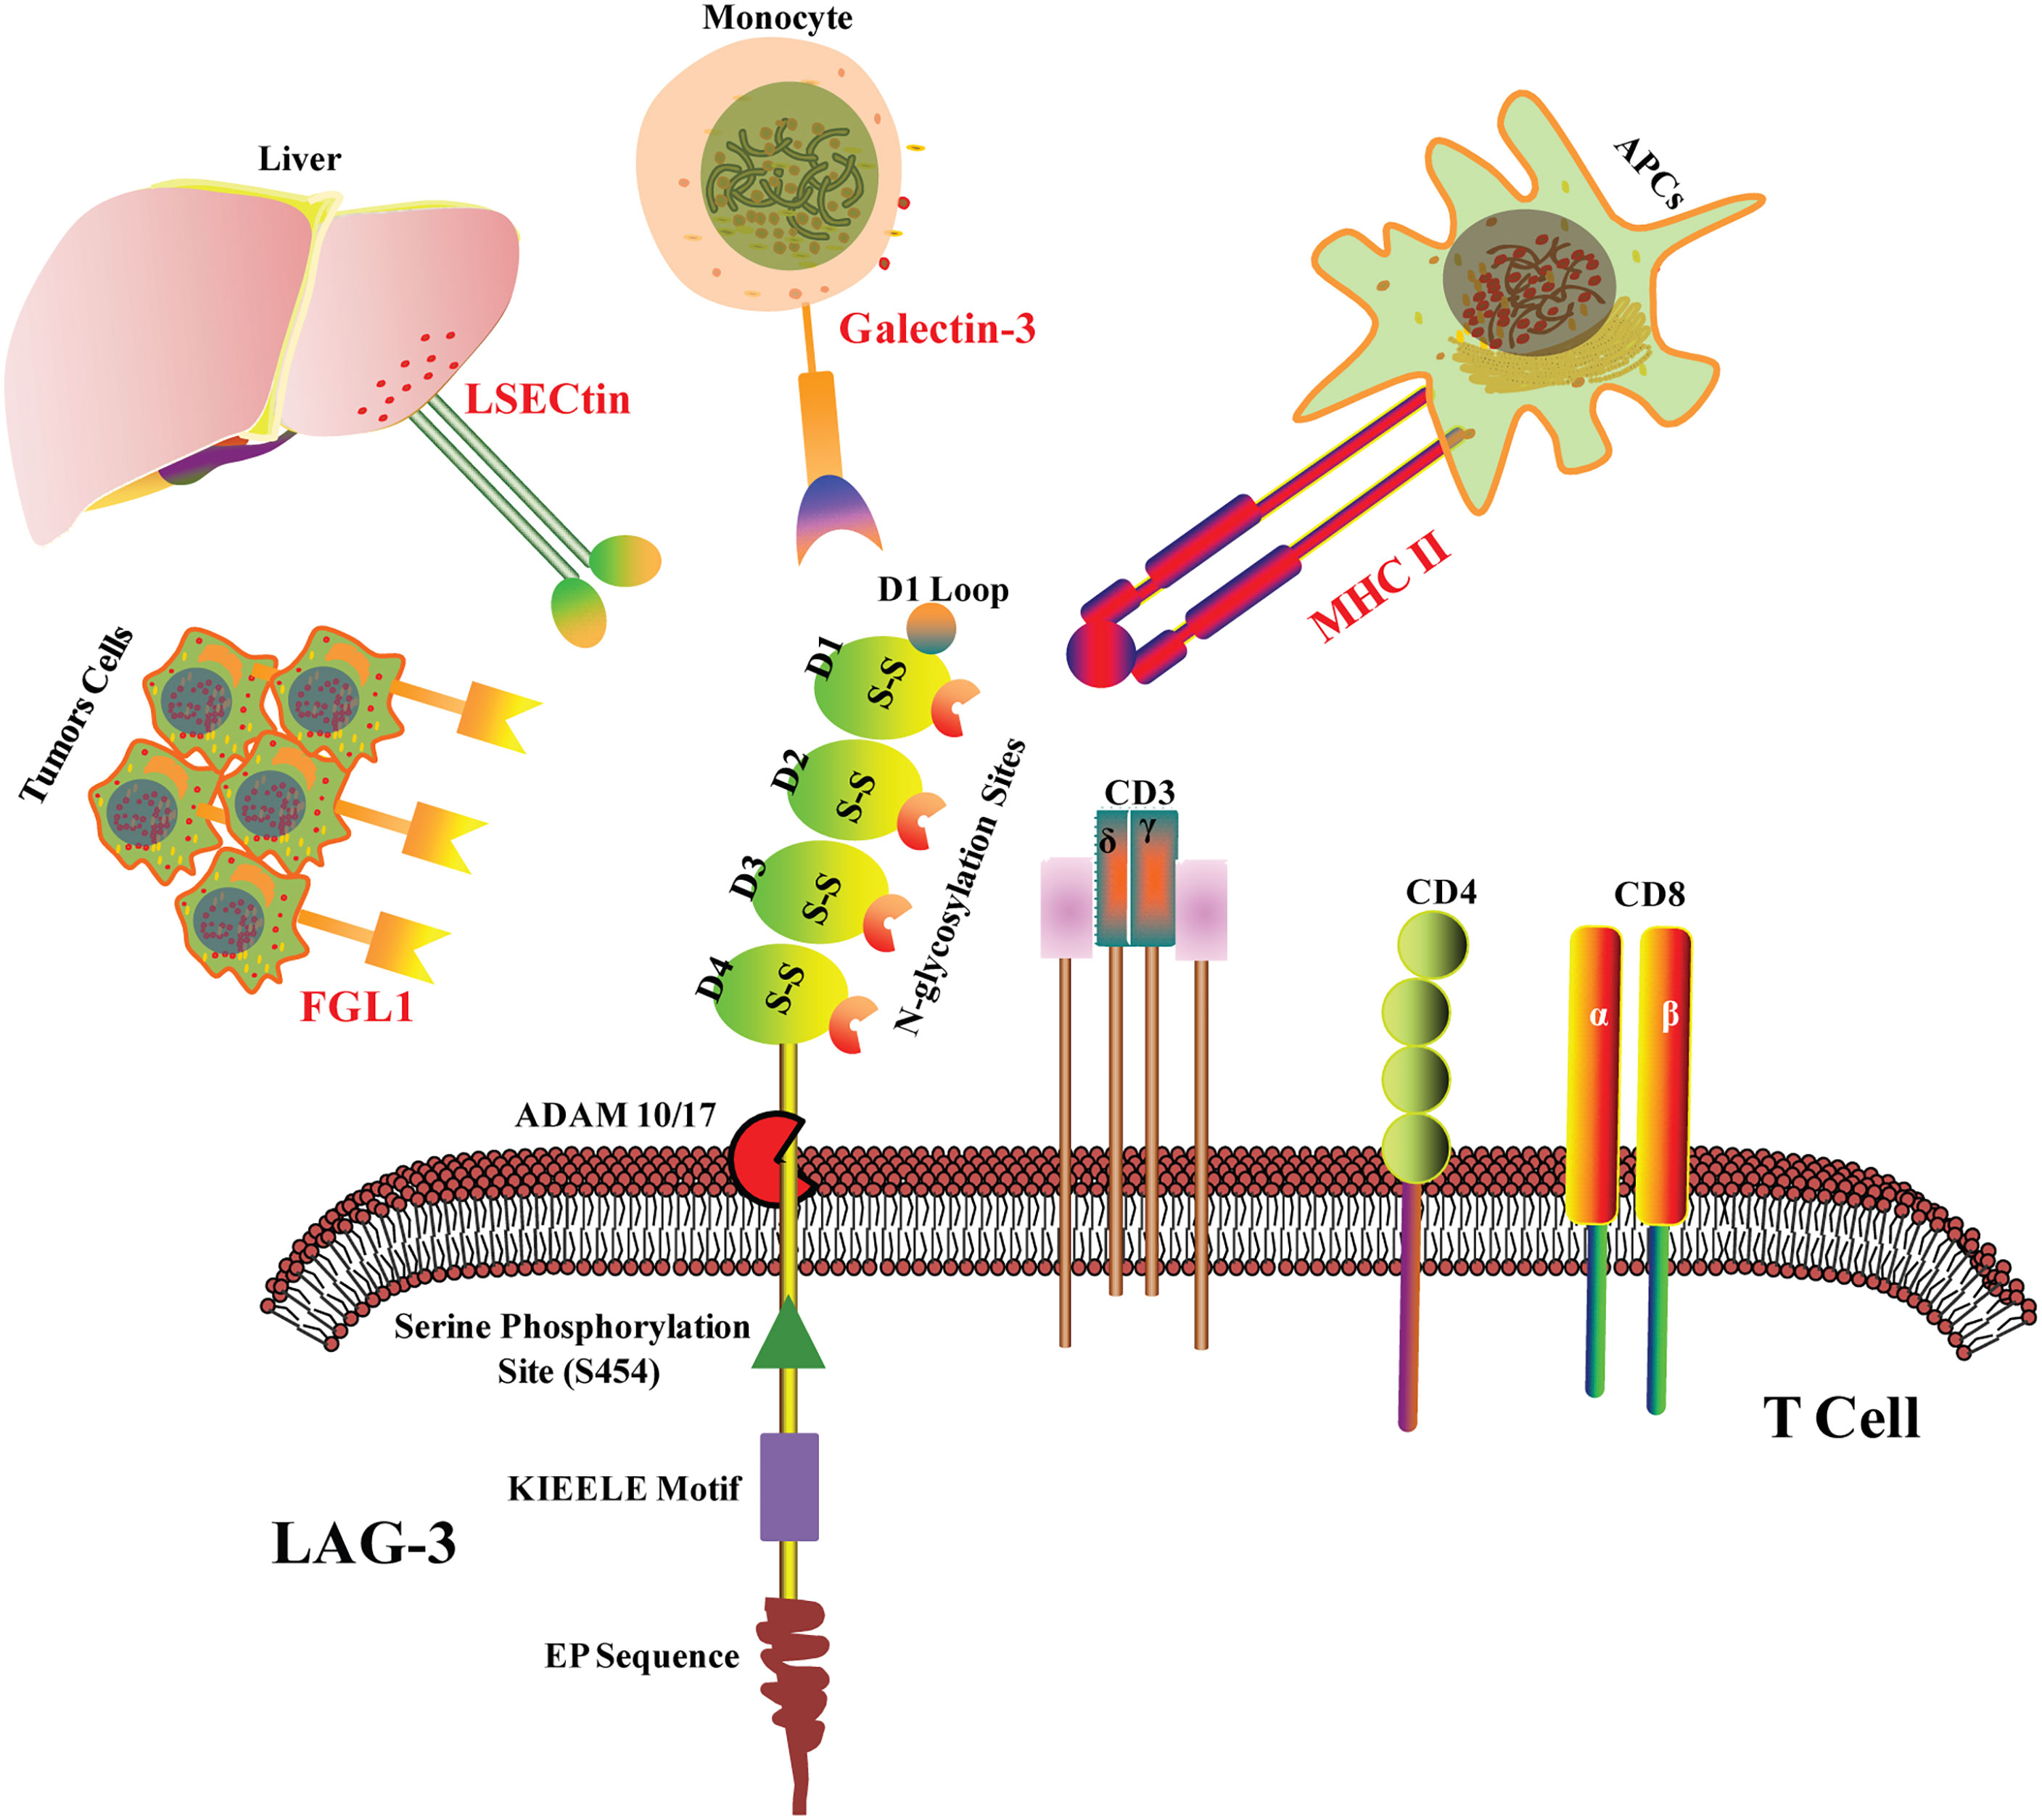
Biology behind LAG3

Slide 2
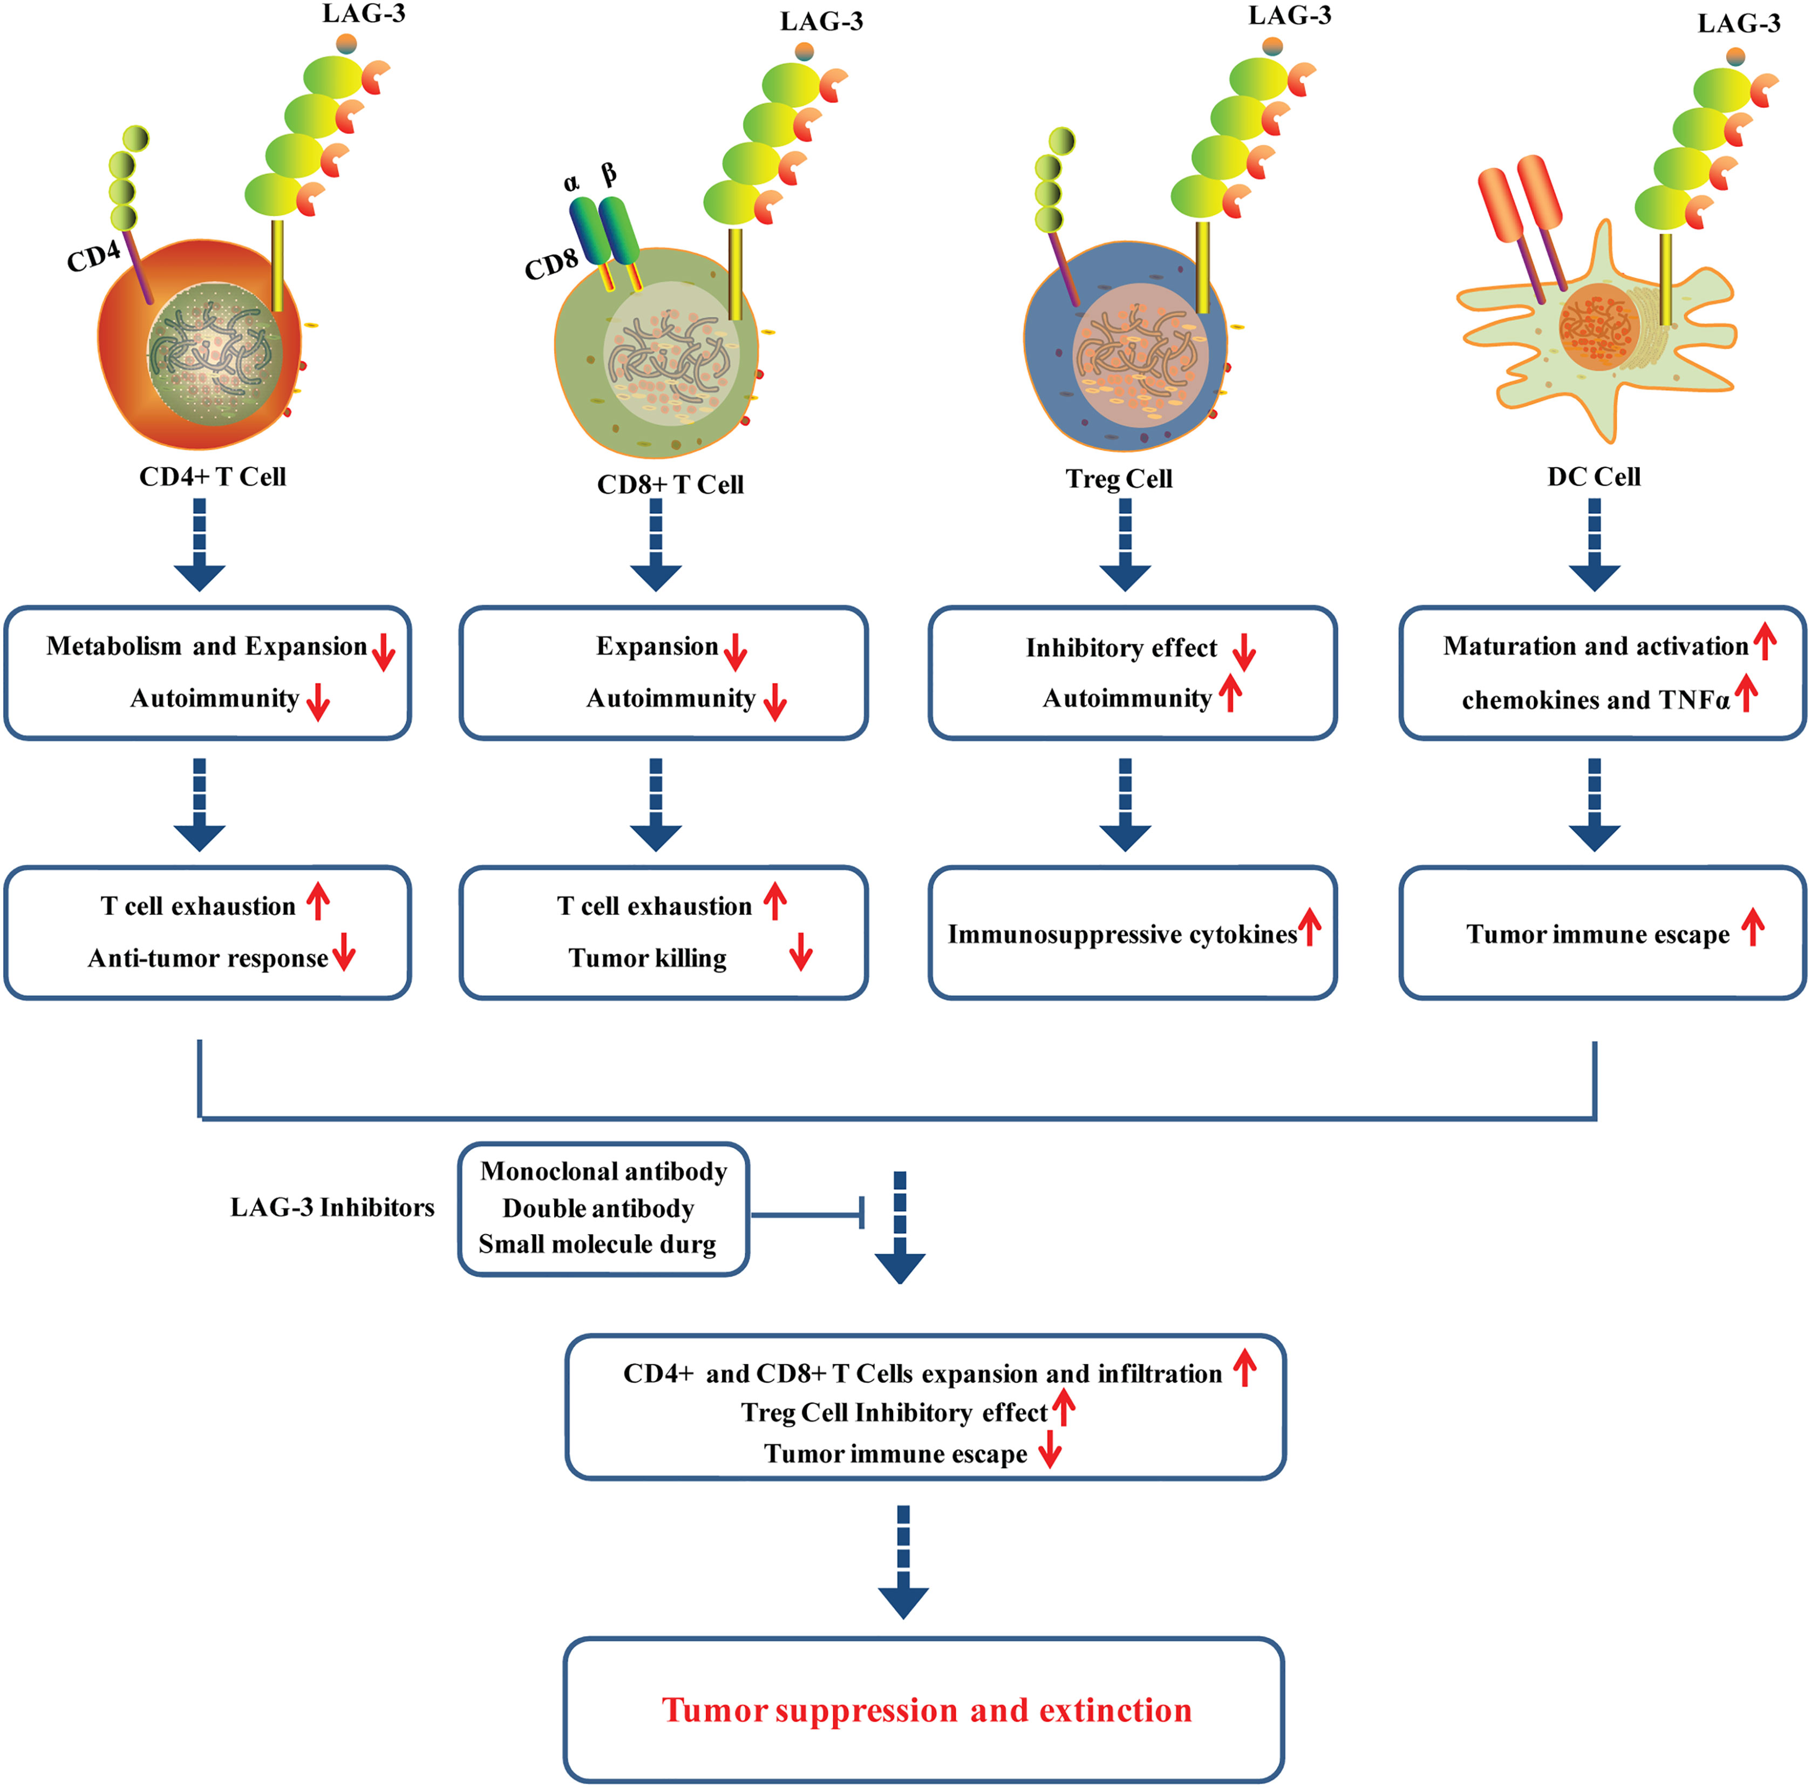
Interaction of LAG3 with Ligands

