Slide 1
Genitourinary Cancers
Tuesday, September 24, 2024

Slide 2

Navigating Combination Regimens for Advanced Clear Cell RCC
Alan Tan, MD
Associate Professor, Genitourinary Lead
Vanderbilt Ingram Cancer Center
Nashville, Tennessee

Slide 3
Honoraria
- Astellas, Seagen, Pfizer, Exelixis, Gilead, Merck, EMD Serono, Aveo
Equity
- Adaptimmune, Nektar, Bluebird, Aprea, Editas, Fate, Iovance, Rapt

Slide 4
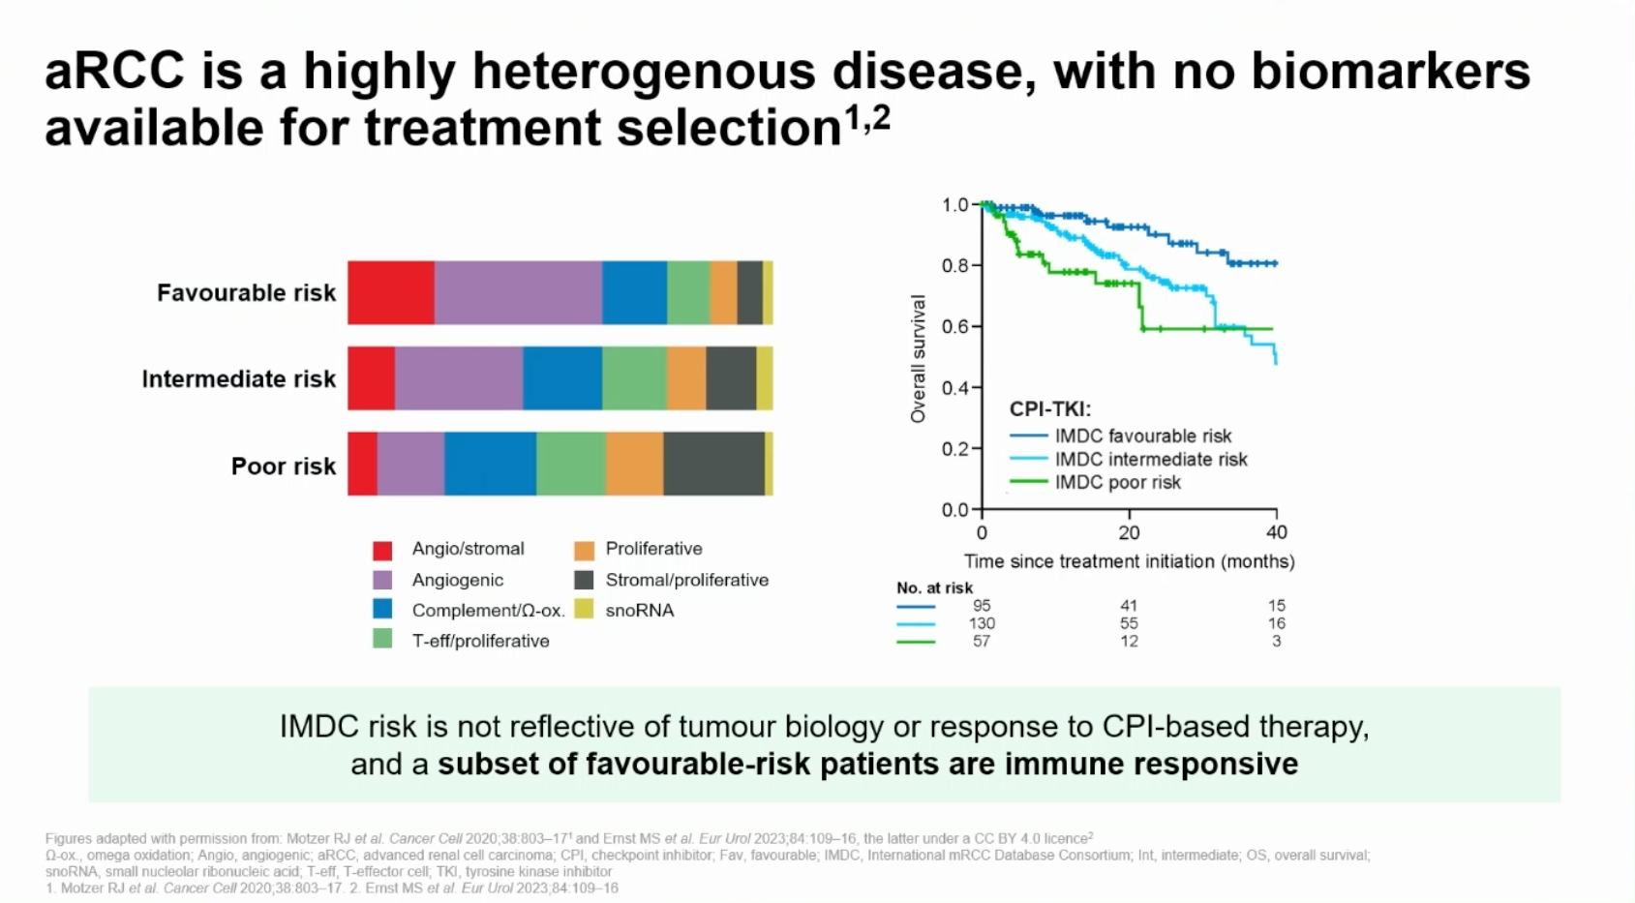
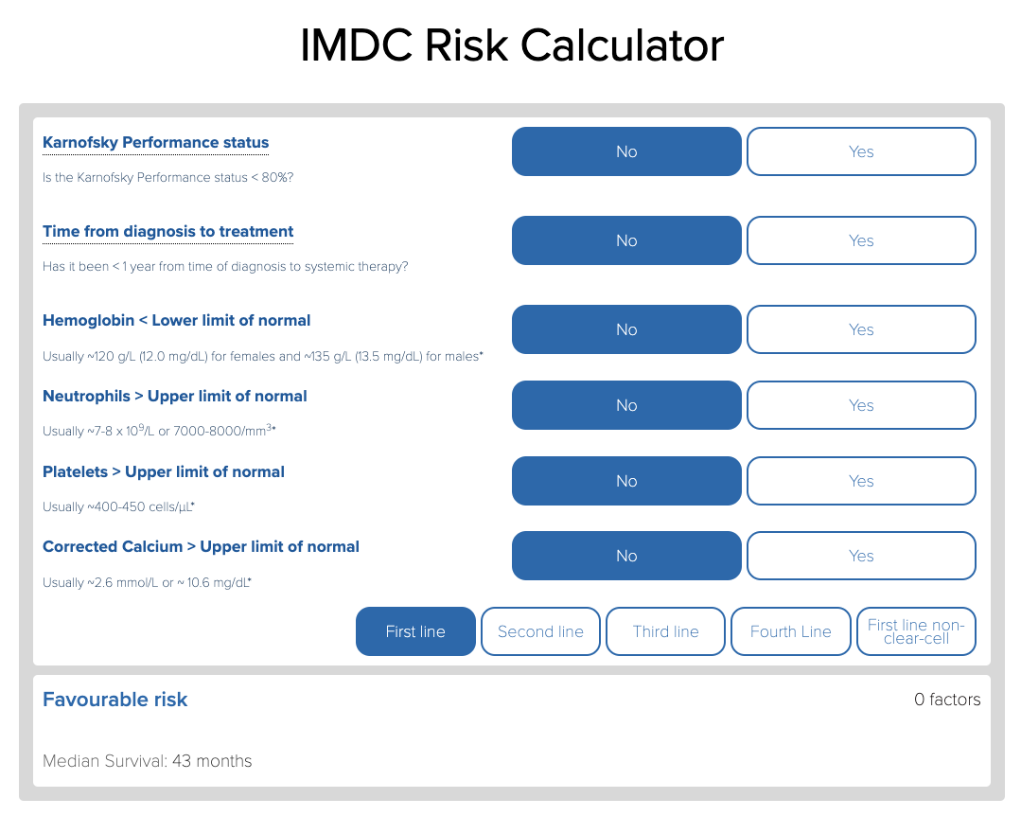

Slide 5
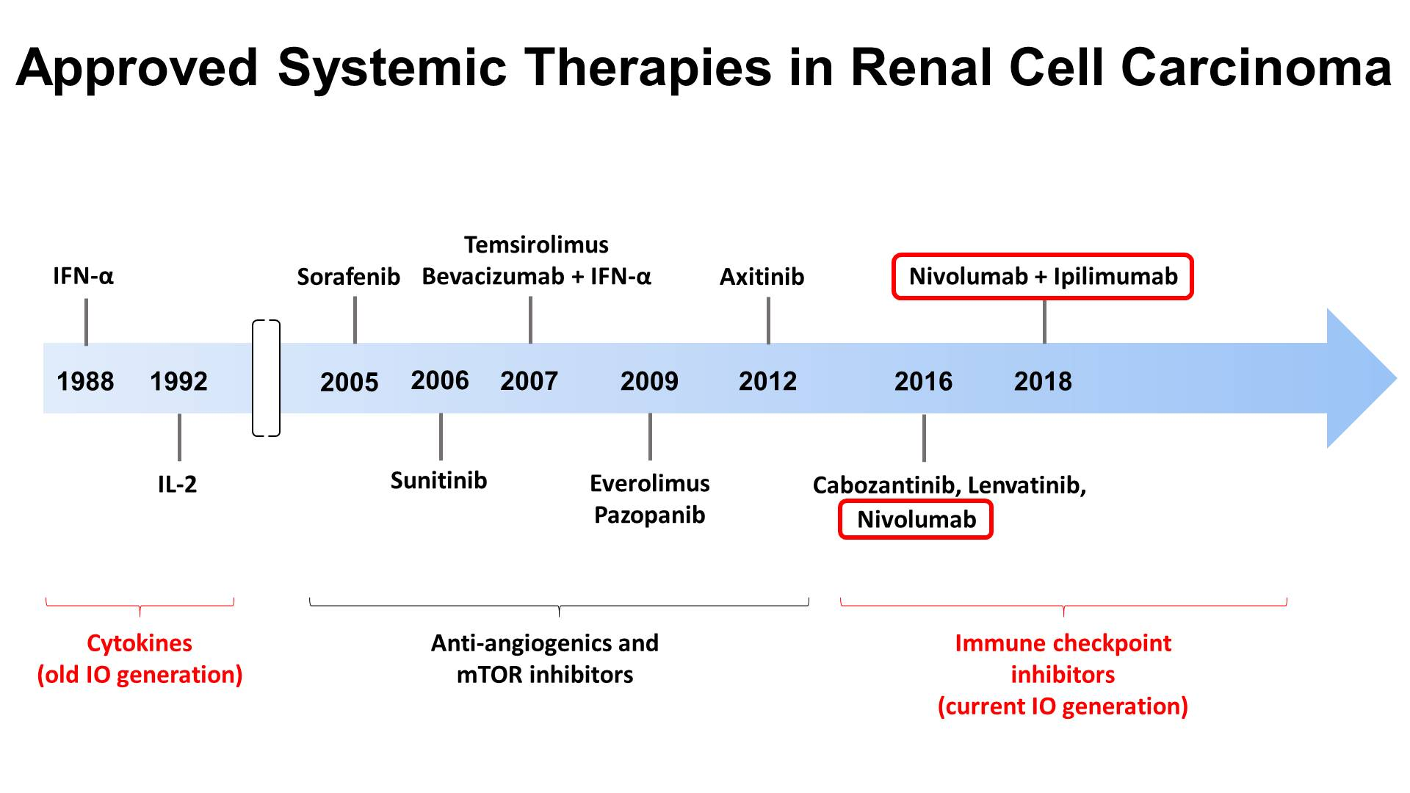
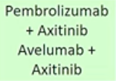
Slide 5
Nivolumab +
cabozantinib
2019
2021
Pembrolizumab
+ Lenvatinib
Tivozanib
belzutifan
Presented By Toni Choueiri at 2019 ASCO-SITC Clinical Immuno-Oncology Symposium

Slide 6
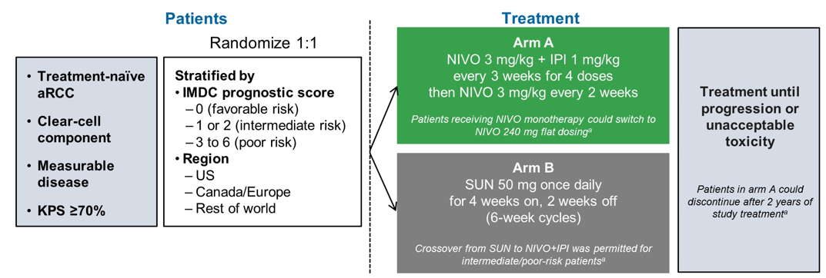
CheckMate 214: Study Design
Primary endpoint: ORR (INV) in Intermediate/Poor Risk; OS (Intermediate/Poor Risk); PFS (Intermediate/Poor Risk)
Secondary endpoints: ORR (INV) in any risk; OS (any risk), PFS (any risk)
Tannir N, et al. GU Ca Symp 2020. Abstract 609.
Notes:
Moderator/Discussion Note:
Point out that primary endpoint of this study were specific to Int/Poor Risk subgroup.
________________________
ASCO GU 2022 Updates
Health-related quality of life (HRQoL) in previously untreated patients with advanced renal cell carcinoma (aRCC) in CheckMate 214: Five-year follow-up results.
Cella D, et al.
ABSTRACT 307 Poster
Efficacy and safety of nivolumab plus ipilimumab (N+I) versus sunitinib (S) for first-line treatment of patients with advanced sarcomatoid renal cell carcinoma (sRCC) in the phase 3 CheckMate 214 trial with extended 5-year minimum follow-up.
Abstract 352. Poster
Tannir NM, et al.

Slide 7
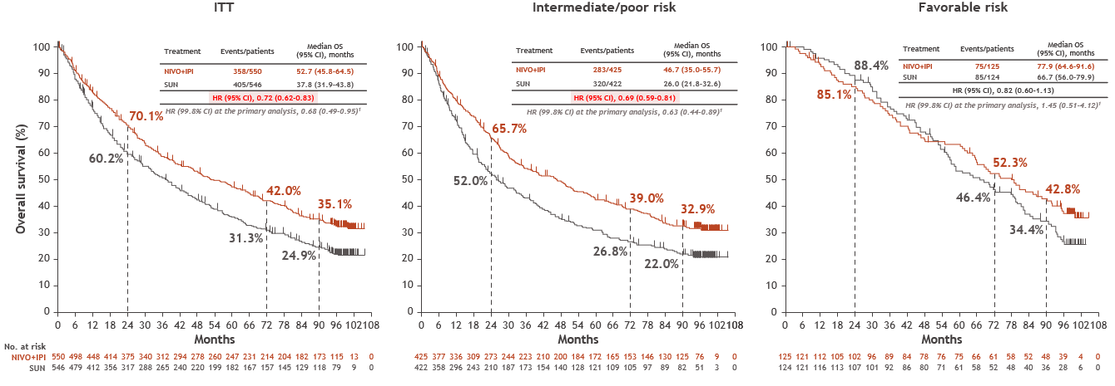
Checkmate 214: OS 8-Year Follow-Up
Checkmate 214: OS 8-Year Follow-Up
Tannir NM, et al. J Clin Oncol. 2024;42(4_suppl):abstr363.

Slide 8
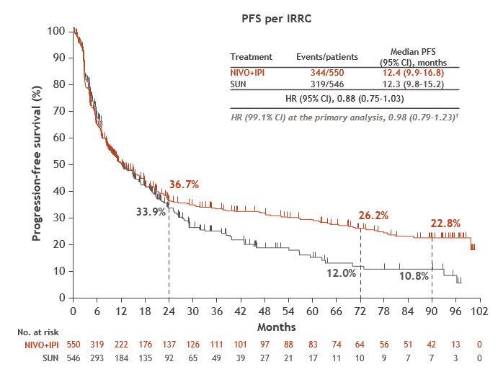
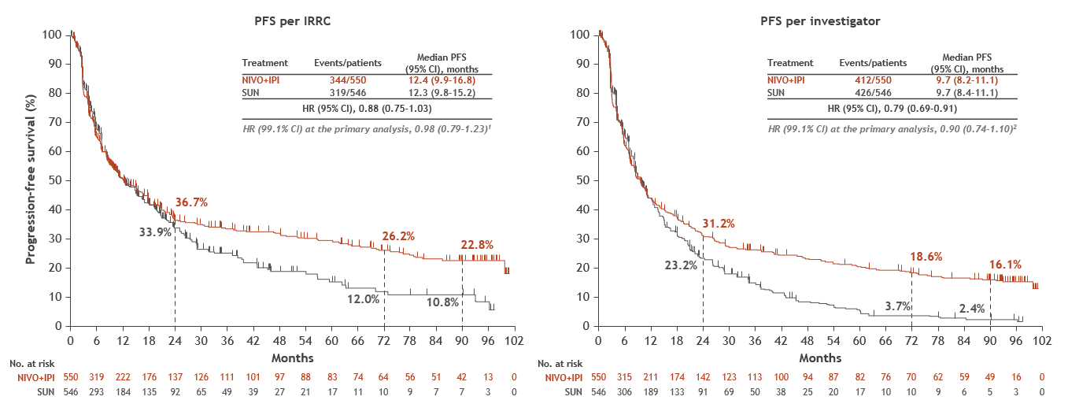
Checkmate 214: PFS 8-Year Follow-Up
Tannir NM, et al. J Clin Oncol. 2024;42(4_suppl):abstr363.

Slide 9
CheckMate214:
Response by Risk Subgroup
Nivolumab + Ipilimumab
Sunitinib
52%
42%
39%
32%
30%
27%
Motzer R, et al. Ann Oncol. 2021;32 (suppl_5): S678-S724. 10.1016/annonc/annonc675
Notes:
ORR (95% confidence interval [CI]) was 39% (35–44) with NIVO+IPI versus 32% (29–37) with SUN in ITT patients
Among FAV patients, ORR (95% CI) was 30% (22–38) with NIVO+IPI versus 52% (43–61) with SUN
42% (37–47) versus 27% (23–31) in I/P patients, respectively.
— A higher proportion of patients achieved CR with NIVO+IPI versus SUN regardless of risk (ITT, 12% vs 3%; FAV, 13% vs 6%); I/P, 11% vs 2%;
— More patients achieved CR and did not subsequently progress with NIVO+IPI (53/550, 9.6%) versus SUN (13/546, 2.4%)
Median duration of response was notably longer with NIVO+IPI in all 3 populations (ITT, not reached [NR] vs 24.8 months; I/P, NR vs 19.7 months; FAV, 61.5 vs 33.2 months), and more patients had ongoing responses with NIVO+IPI across all risk groups (ITT, 63% vs 50%; I/P, 64% vs 50%; FAV, 59% vs 52%)
Data Source:
Motzer. ESMO 2021.

Slide 10
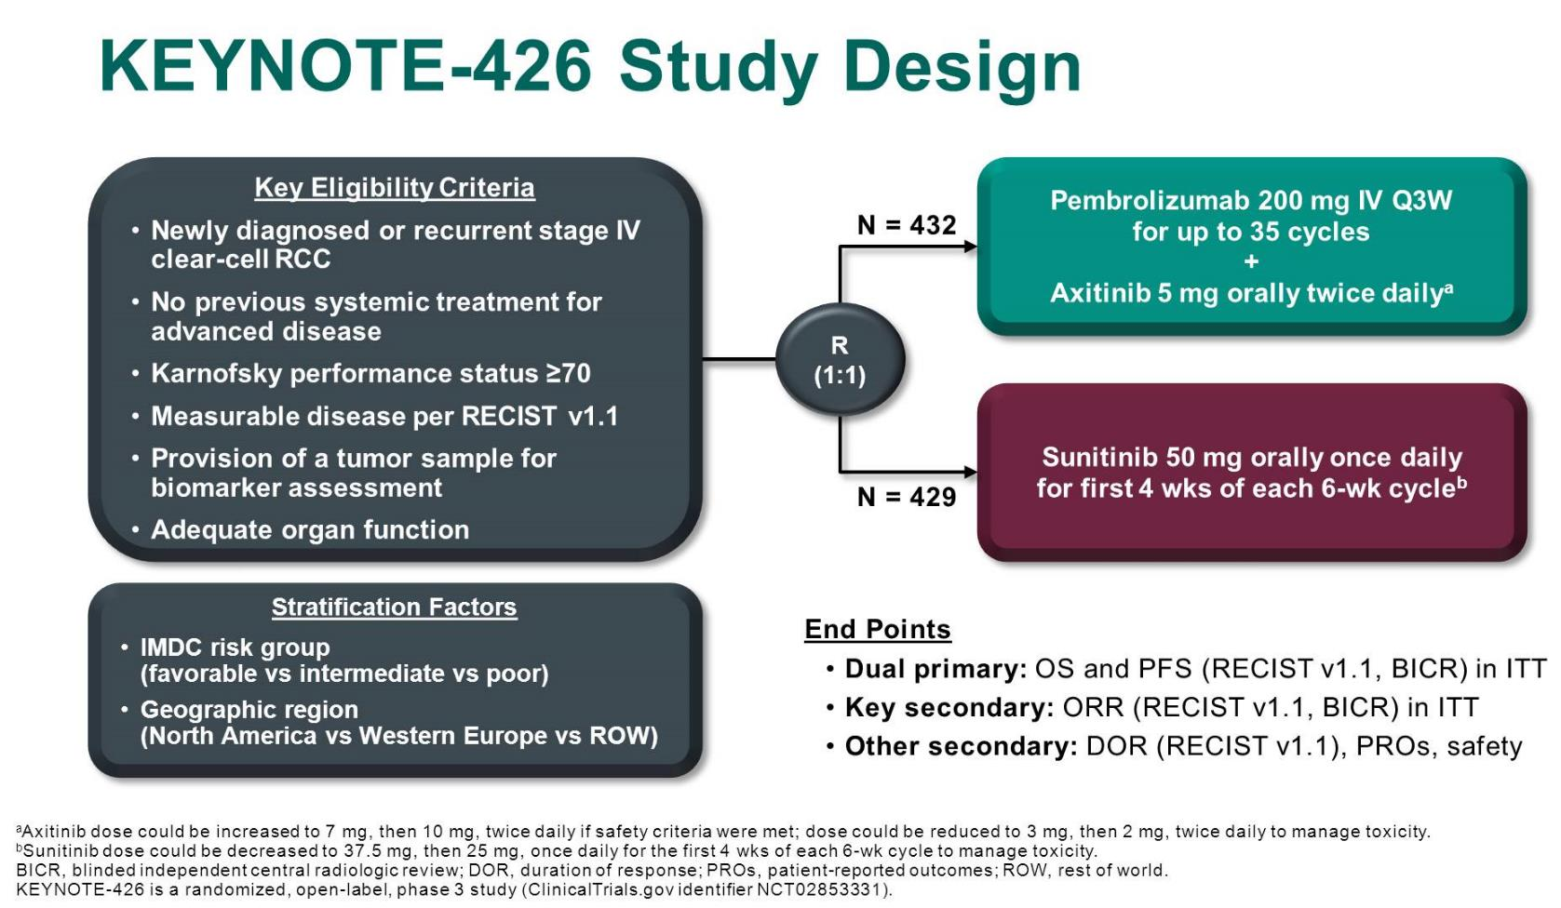
Powles T, et al. J Clin Oncol. 2022;40(6_suppl):Abstract 350-350.

Slide 11
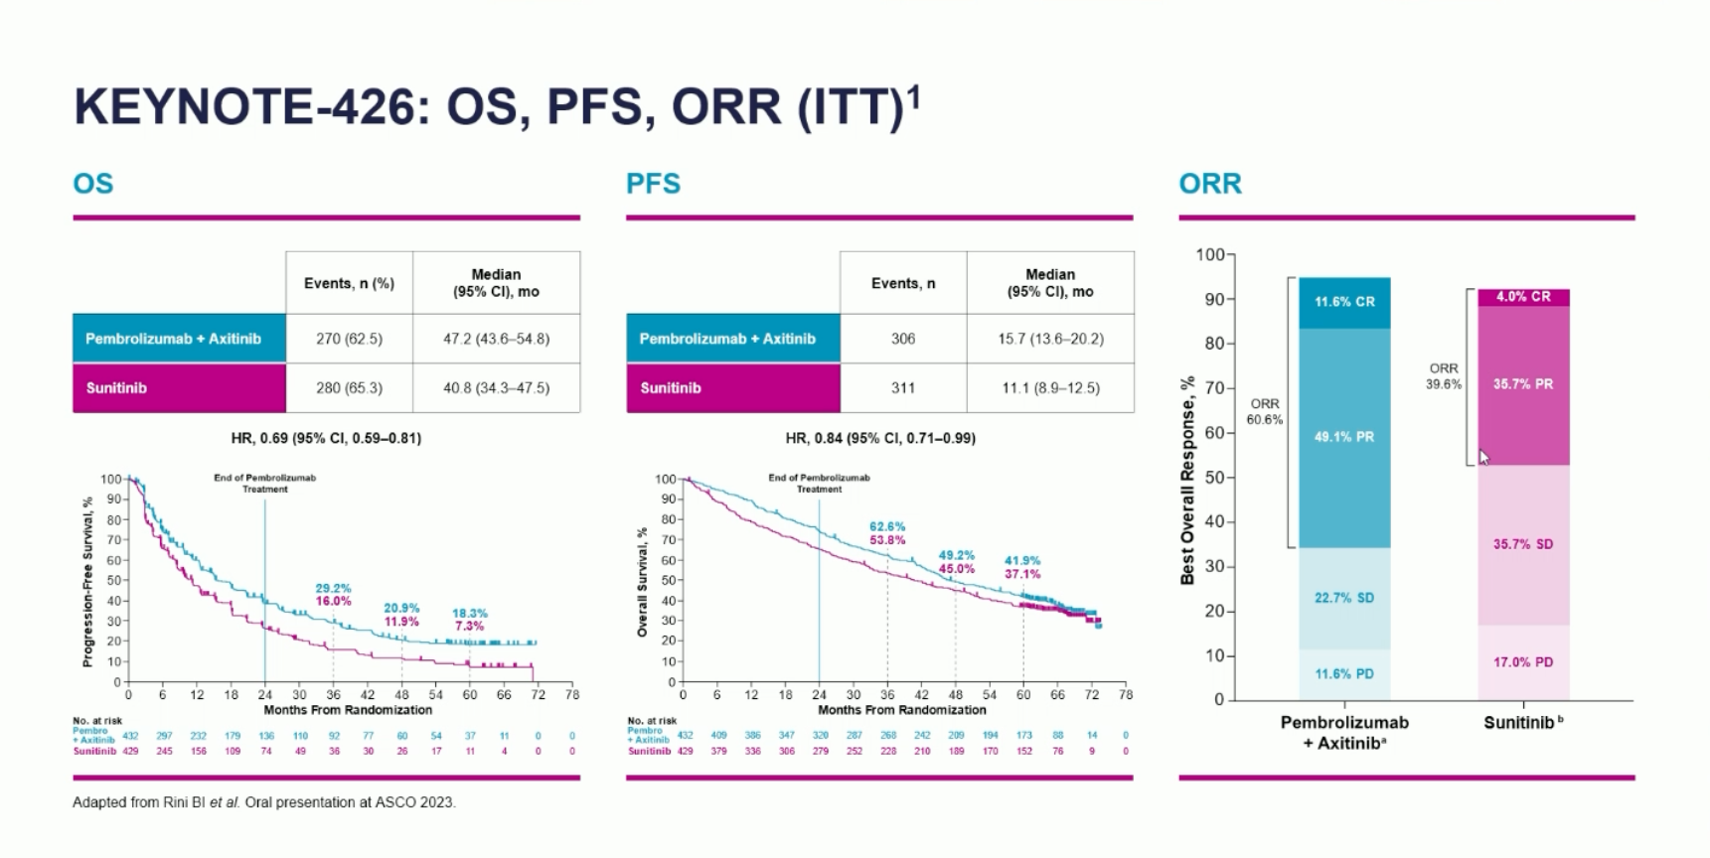

Slide 12
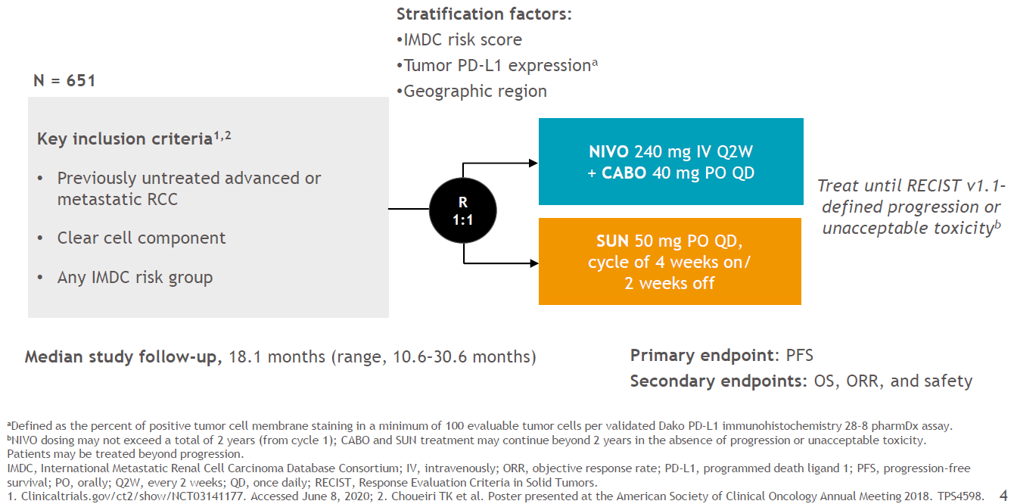
CheckMate 9ER
Burotto M, et al. J Clin Oncol. 2023;41(6_suppl.603):Abstract 603.
Choueiri T, et al. N Engl J Med. 2021;384:829-841.

Slide 13
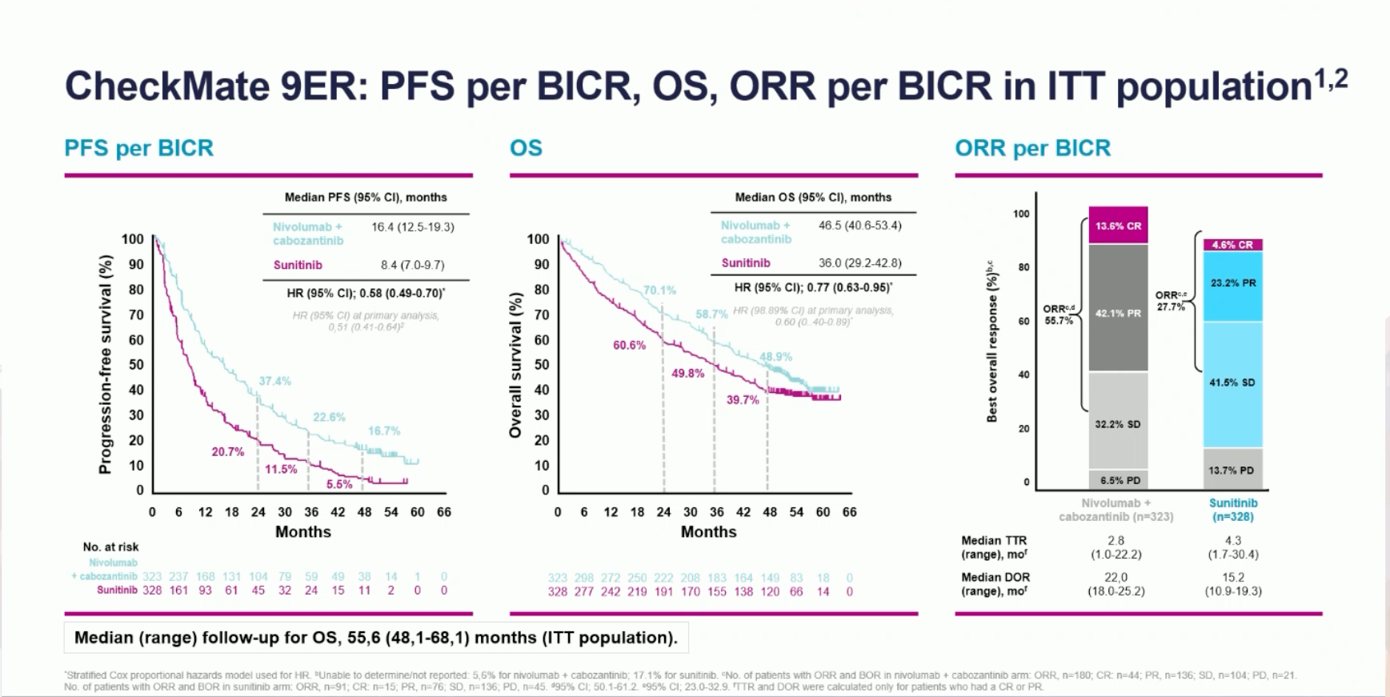
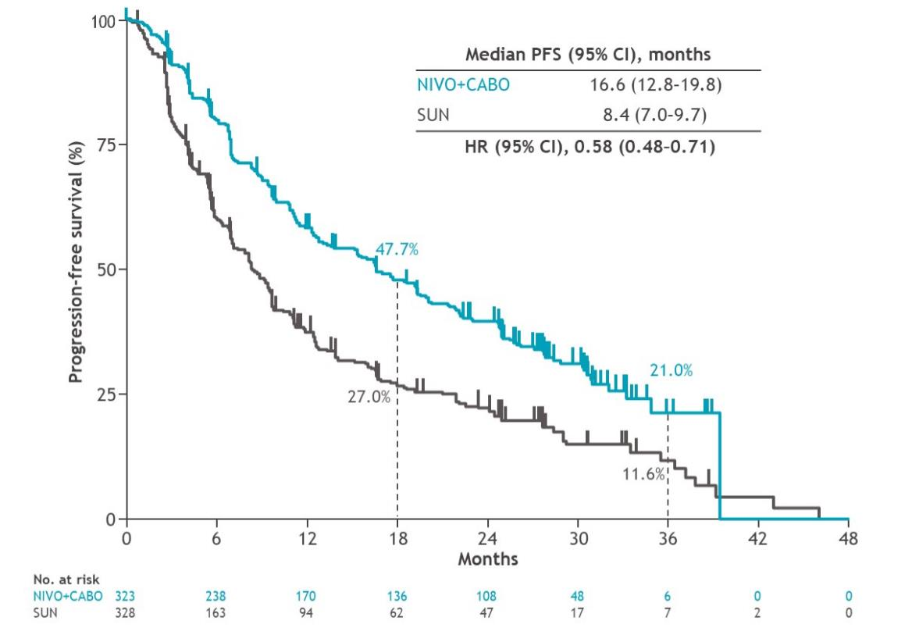
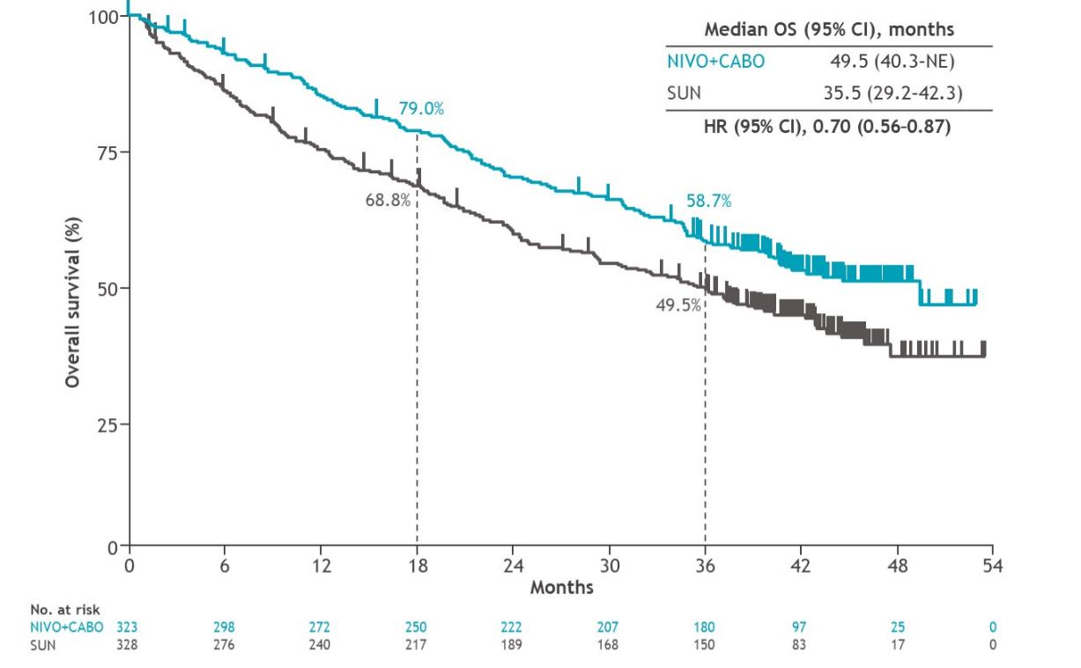
CheckMate 9ER: PFS, OS (ITT) median f/u 44 months
Burotto M, et al. J Clin Oncol. 2023;41(6_suppl.603):Abstract 603.

Slide 14
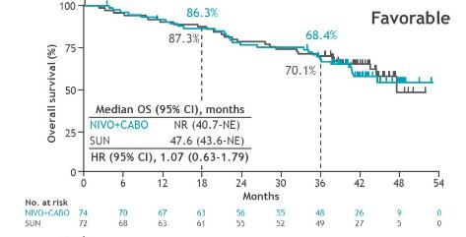
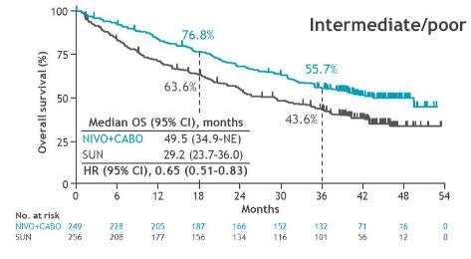
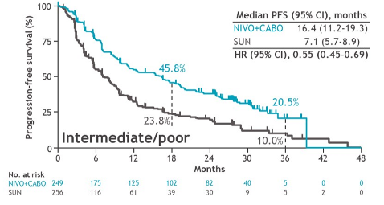
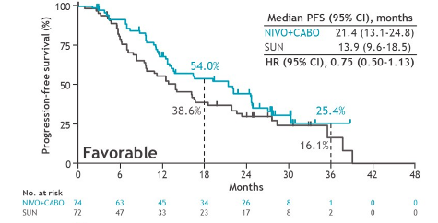
CheckMate 9ER: PFS and OS by IMDC
Burotto M, et al. J Clin Oncol. 2023;41(6_suppl.603):Abstract 603.

Slide 15
Phase 3 CLEAR Clinical Trial:
Study Design
Key Eligibility Criteria
Advanced clear-cell RCC
Treatment-naïve
Karnofsky PS ≥70
Measurable disease
Adequate organ function
Lenvatinib
20 mg oral QD
+
Pembrolizumab*
200 mg IV Q3W
Primary Endpoint
PFS by IRC per RECIST v1.1
OS
ORR by IRC per RECIST v1.1
Safety
HRQoL
DOR
Biomarkers
Secondary Endpoints
Lenvatinib
18 mg oral QD
+
Everolimus
5 mg oral QD
R
Stratification Factors
Geographic Region: Western Europe and North America vs Rest of the World
MSKCC Risk Category:
Favorable, Intermediate, or Poor
(1:1:1)
Key Exploratory Endpoints
Sunitinib
50 mg oral QD
4 weeks on /
2 weeks off
Motzer R, et al. N Engl J Med. 2021;384(14):1289-1300.

Slide 16
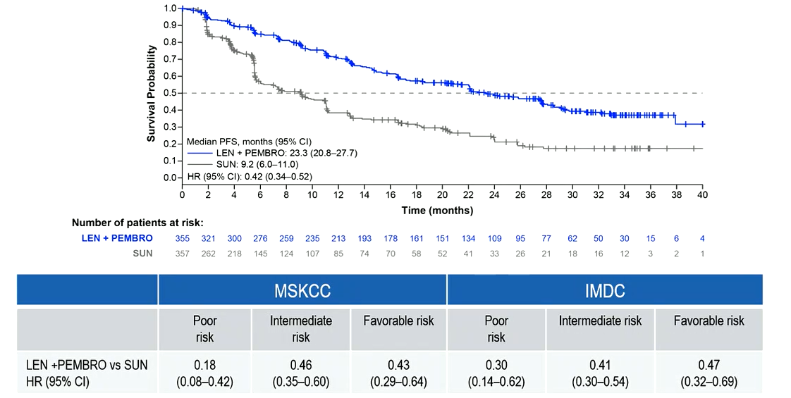
CLEAR: PFS
Median Follow-Up, 33.7 Months
Choueiri TK, et al. Lancet Oncol. 2023;24:228-238.
Porta CG, et al. Ann Oncol. 2022;33 (suppl_7): S660-S680. 10.1016/annonc/annonc1072.

Slide 17
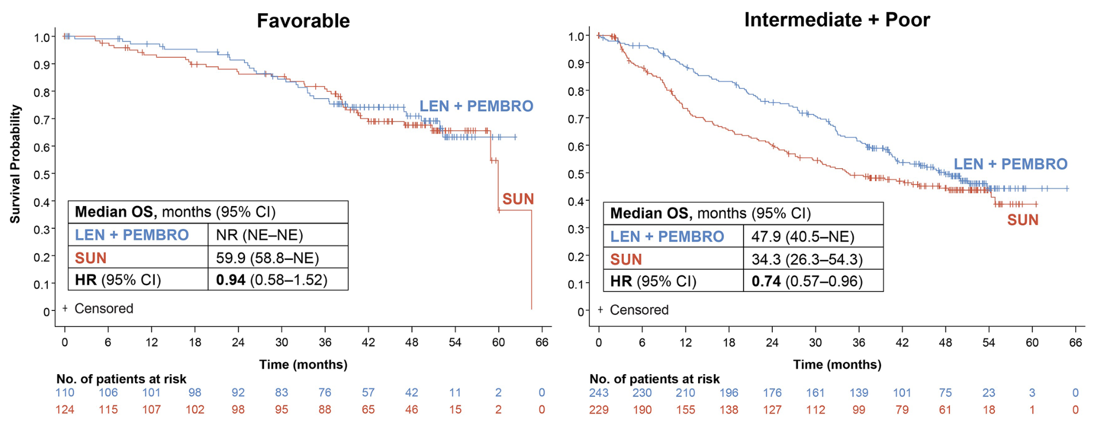
CLEAR: OS
4-year Follow-up
Abbreviations: CI, confidence interval; HR, hazard ratio; IMDC, International mRCC Database Consortium; LEN, lenvatinib; NE, not estimable; No., number; NR, not reached; OS, overall survival; PEMBRO, pembrolizumab; SUN, sunitinib
Motzer RJ, et al. J Clin Oncol. 2023;41(suppl 16):Abstract 4502.
DOI: 10.1200/JCO.2023.41.16_suppl.4502

Slide 18
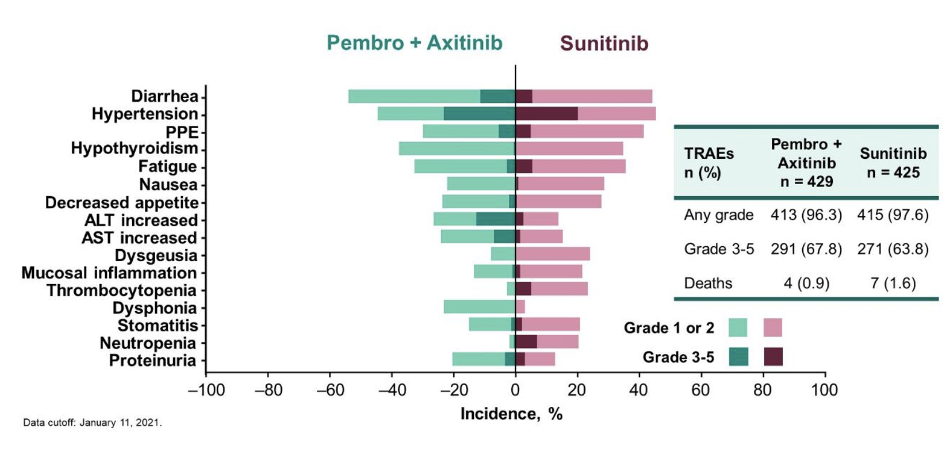
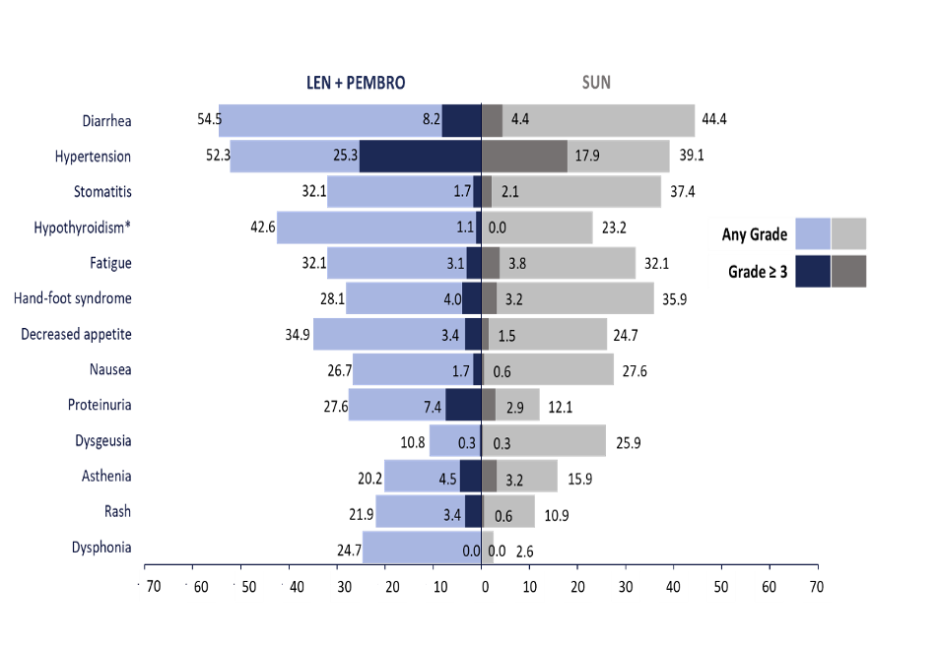
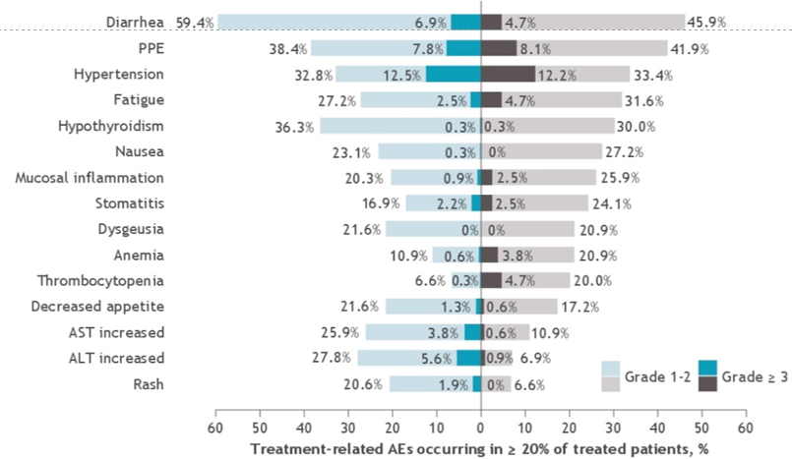
Safety Profile of IO/TKI
KN-426
CM-9ER
CLEAR

Slide 19
IO Combination Trials mRCC – Safety OverviewTrials in mRCC:
Safety Overview Summary
 | CM 214 (Ipi/Nivo)¹ (n=550 vs n=546) | KN-426 (Axi/Pembro)² (n=432 vs n=429) | CM 9ER (Cabo/Nivo)³ (n=323 vs n=328) | CLEAR (Len/Pembro)⁴ (N=355 vs n=357)
Median Follow-Up, mo | 99.1 | 42.8 | 55.6 | 49.8
TRAE, any gr, % | 94 vs 98 | 96 vs 98 | 98 vs 93 | 97 vs 92
TRAE, gr ≥3, % | 48 vs 64 (gr ≥3) | 68 vs 64 (gr ≥3) | 68 vs 55 (gr 3-4) | 74 vs 60 (gr ≥3)
Discontinuations due to AEª, % | 23 (N+I) 13 (S) | 21 (P) 20 (A) 7 (P+A) 12 (S) | 10 (N) 8 (C) 7 (N+C) 11 (S) | 24 (L) 26 (P) 10 (L+P) 11 (S)
High-dose corticosteroid use, % | 29 | 27 | 21.9 | 15
1. Tannir NM, et al. ASCO GU 2024. Abstract 363. Albiges et al. ESMO Open 2020. 2. Rini B, et al. ASCO 2021. Abstract 4500. Powles T, et al. Lancet Oncol. 2020;21:1563-1573. Axitinib. Full Prescribing Information. 3. Bourlon MT, et al. ASCO GU. Abstract 362. Choueiri TK, et al. N Engl J Med. 2021;384:829-41. 4. Motzer RJ, et al. J Clin Oncol. 2024;42:1222-1228. Pembrolizumab. Prescribing Information.
Notes:
Moderator/Discussion Note:
**How do you find balance between efficacy and toxicity (eg, response/depth of response vs QOL)?
_____________________________________________________________
Data Sources: Values May Differ From Data Updates on Prior Slides
CM214: Data updated from Tannir 8-y update; Corticosteroid use from Albiges ESMO Open 2020.
KN426: Most data from Powles Lancet Oncol 2020; steroid use from PI
CM9ER: Most data from Bourlon ASCO GU; corticosteroid use from Choueiri T, et al NEJM 2021.
CLEAR: Most data from Motzer JCO 2023 (supplement); steroid use from PI.

Slide 20
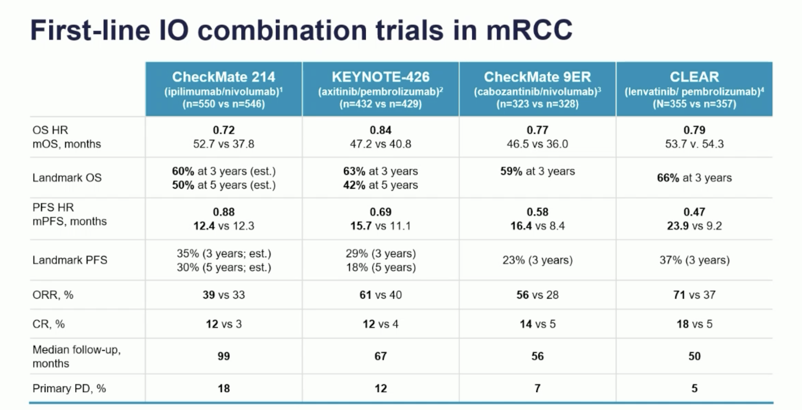
1. Motzer et al. ESMO 2021. Abstract 661P; Albiges et al. ESMO Open 2020. 2. Rini et al. ASCO 2021. 4500. Powles et al. Lancet Oncol. 2020;21:P1563-1573. 3. Powles T, et al. GU Ca Symp 2022. Abstract 350. Motzer RJ, et al. Lancet Oncol. 2022;23:888-898. Choueiri et al. N Engl J Med. 2021;384:829-41. Apolo et al. ASCO 2021. 4553. 4. Choueiri TK, et al. Lancet Oncol. 2023;24:228-238. Burotto M, et al. ASCO GU 2023. Abstract 603. Porta CG, et al. ESMO 2022. Abstract 1449MO.Motzer et al. N Engl J Med. 2021;384:1289-1300. Grunwald et al. ASCO 2021. Abstract 4560. Choueiri TK, et al. KCRS21. Oral Abstract.

Slide 21
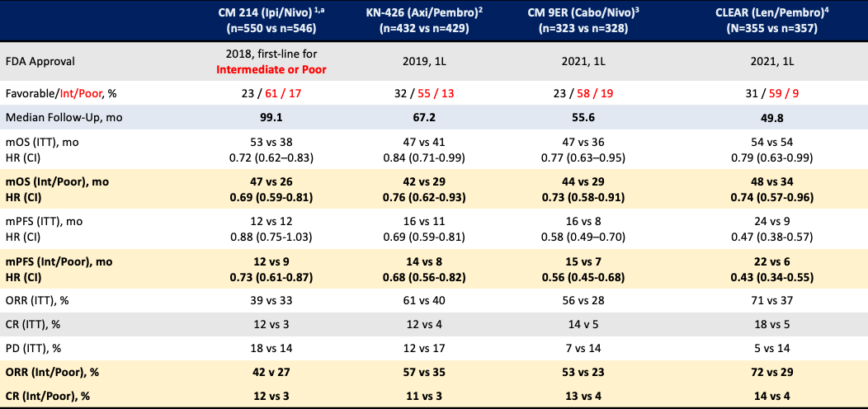
Intermediate/Poor Metastatic ccRCC
1. Tannir NM, et al. ASCO GU 2024. Abstract 363. 2. Rini BI, et al. ASCO 2023. Abstract LBA4501. Rini BI, et al. N Engl J Med. 2019;380:1115-1127. 3. Bourlon MT, et al. ASCO GU 2024. Abstract 362. 4. Motzer RJ, et al. J Clin Oncol. 2024;42:1222-1228. Grunwald V, et al. Eur J Urol. 2023;6:437-446.

Slide 22
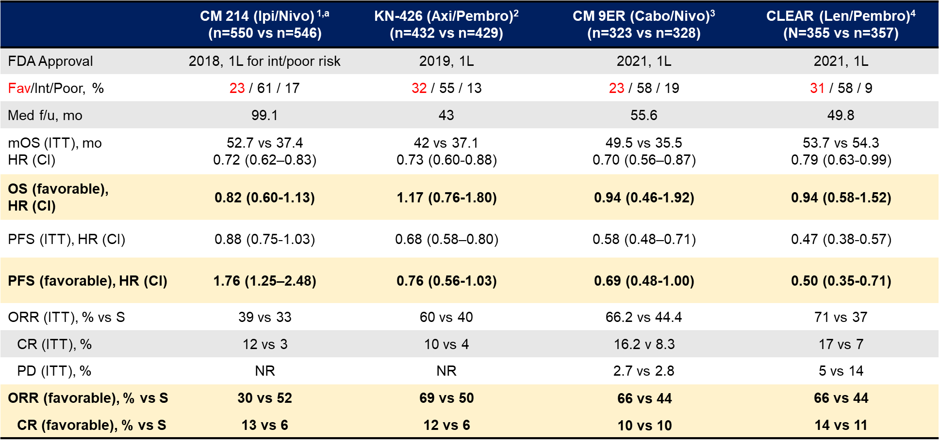
Favorable Risk Metastatic ccRCC
1. Tannir, N et al. J Clin Oncol 42, 2024 (suppl 4; abstr 363) 2.Plimack,E et al. Eur Urol 2023 (5):449-454 3.Bourlon, M et al. J Clin Oncol 42, 2024(suppl 4; abstr 362) 4. Motzer, R et al. J Clin Oncol 2023. 01569.

Slide 23

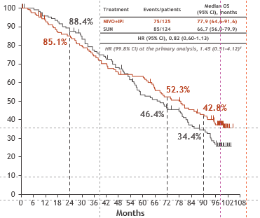
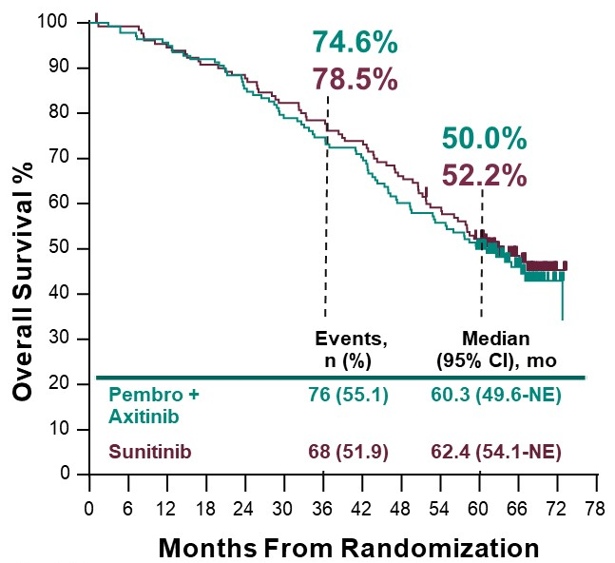
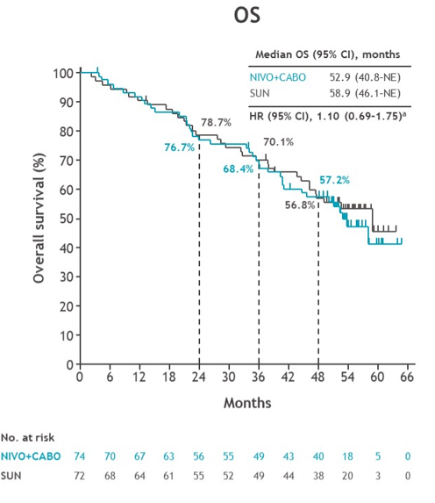
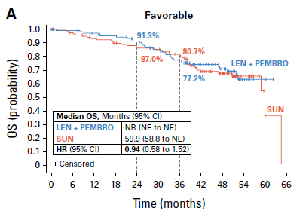
Favorable-Risk mRCC: OS
KEYNOTE426
CheckMate 214
CheckMate 9ER
CLEAR
Tannir NM, et al. ASCO GU 2024. Abstract 363. Rini BI, et al. ASCO 2023. Abstract LBA4501. Bourlon MT, et al. ASCO GU 2024. Abstract 362. Motzer RJ, et al. J Clin Oncol. 2024;42:1222-1228.

Slide 24
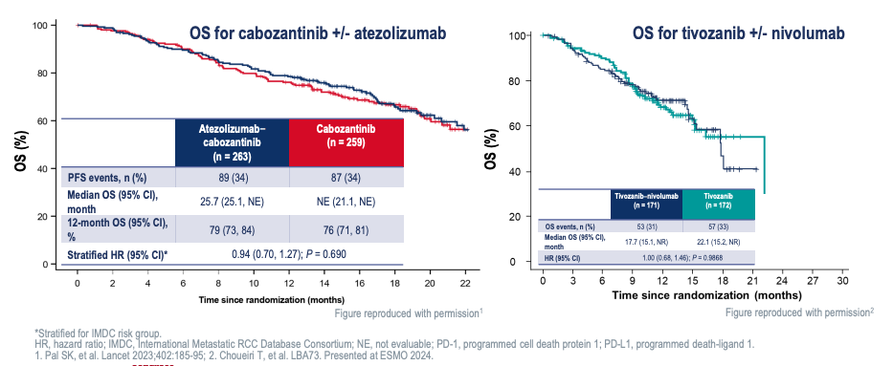
IO Rechallenge Conundrum

Slide 25
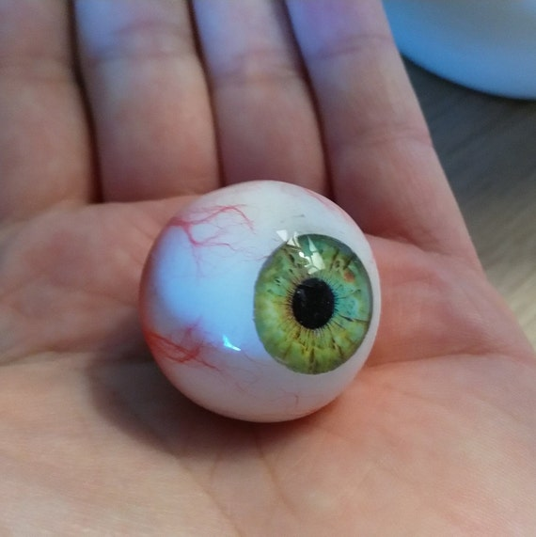
My Approach to Front-line ccRCC
IO/IO
IO/TKI
TKI
IO/TKI
Failed ”eyeball”
Rapid response needed
- Pleural effusions, ascites, hypercalcermia, large bone dominant, bulky liver metastases
YES
IMDC for prognostication
“Eyeball Test”
Good Risk
Asymptomatic
NO
NO
IO/IO
Oligometastatic?
Sarcomatoid
Local Therapy (SBRT, resection)

Slide 26
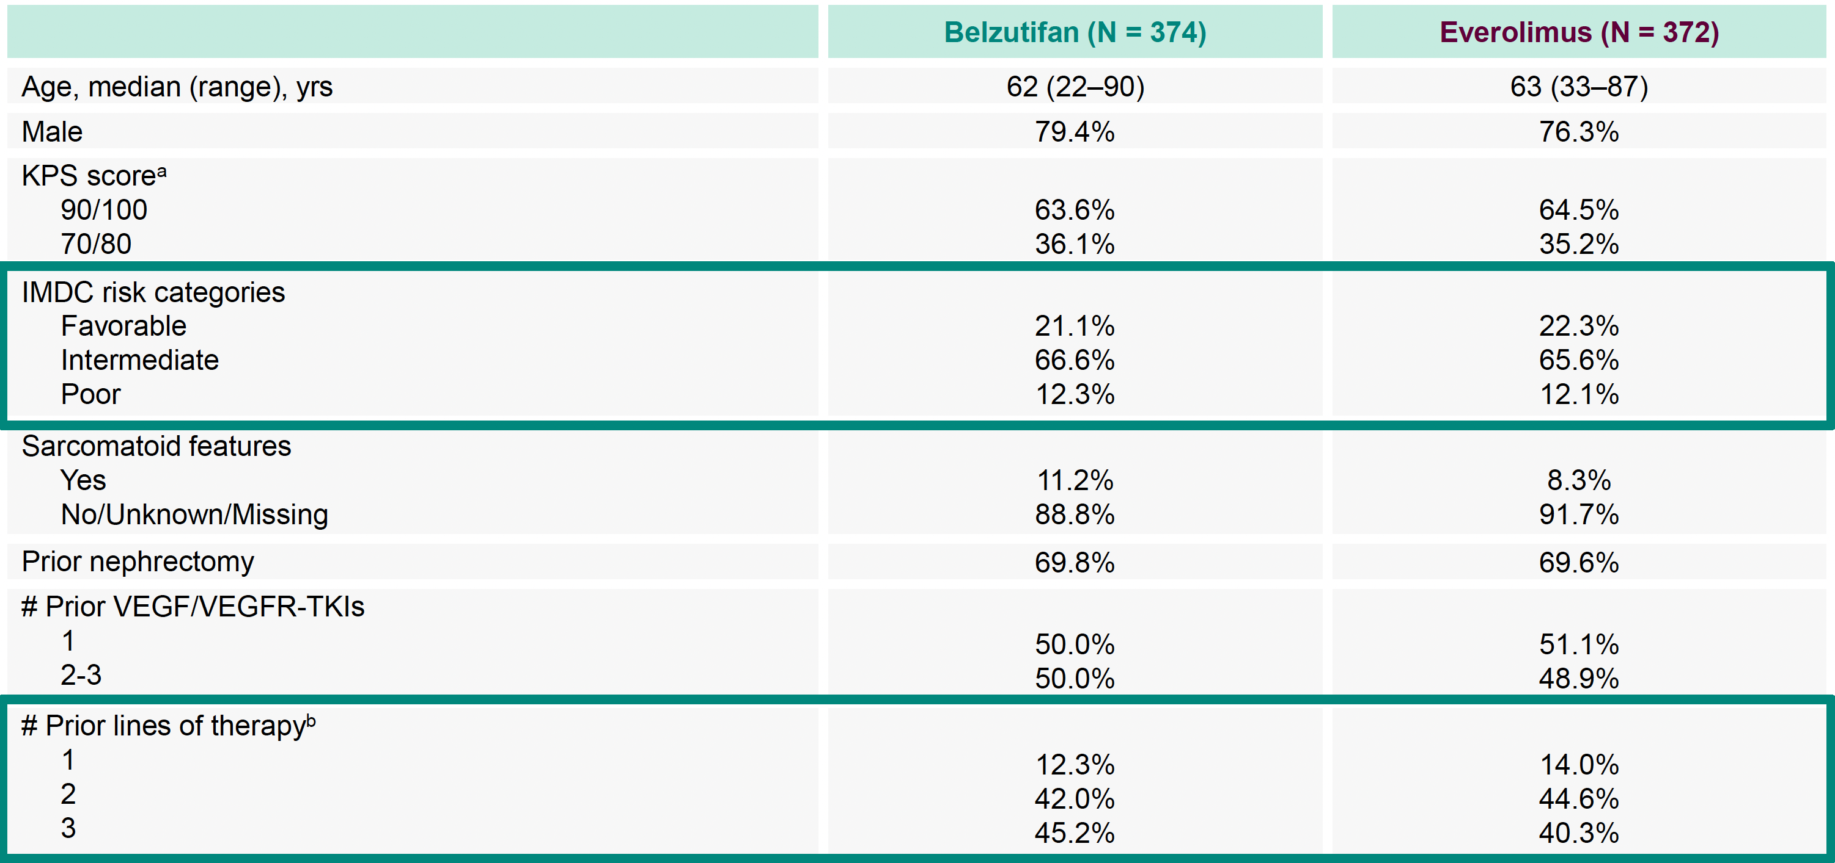
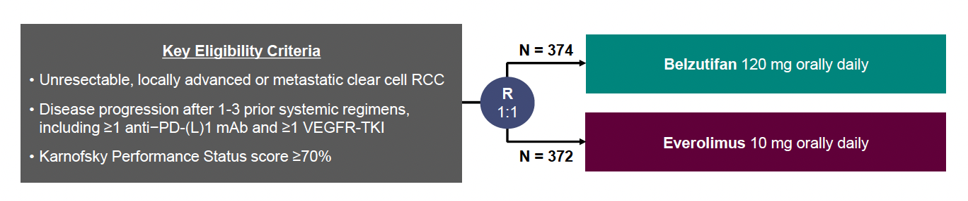
Belzutifan versus Everolimus for Previously Treated Advanced ccRCC: Randomized Open-Label Phase III LITESPARK-005 Study
Albiges L et al. ESMO 2023;Abstract LBA88.

Slide 27
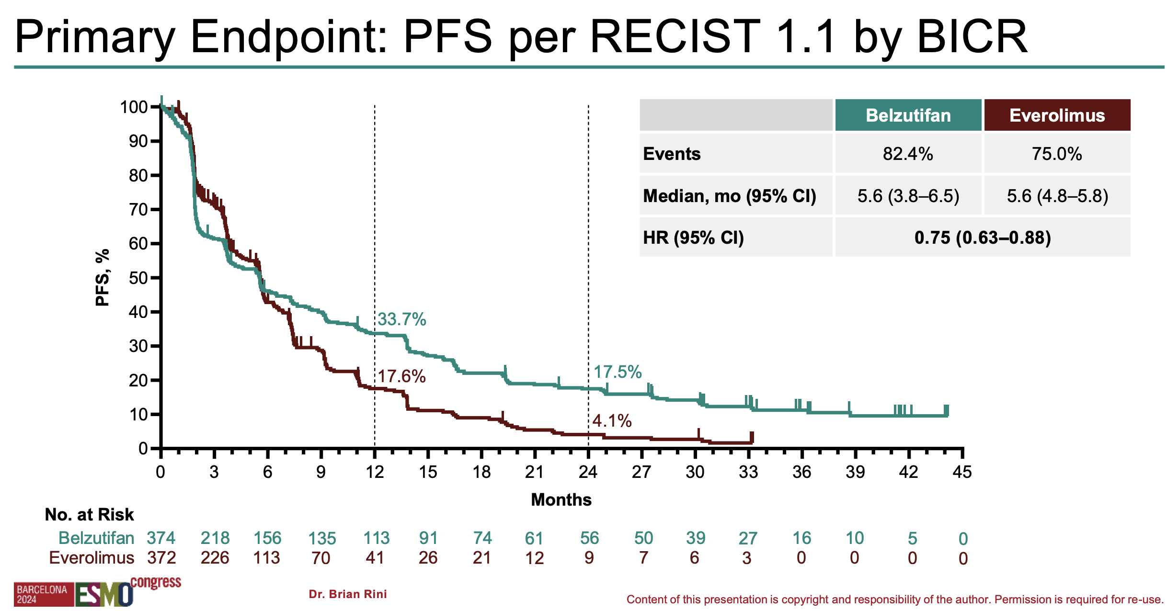
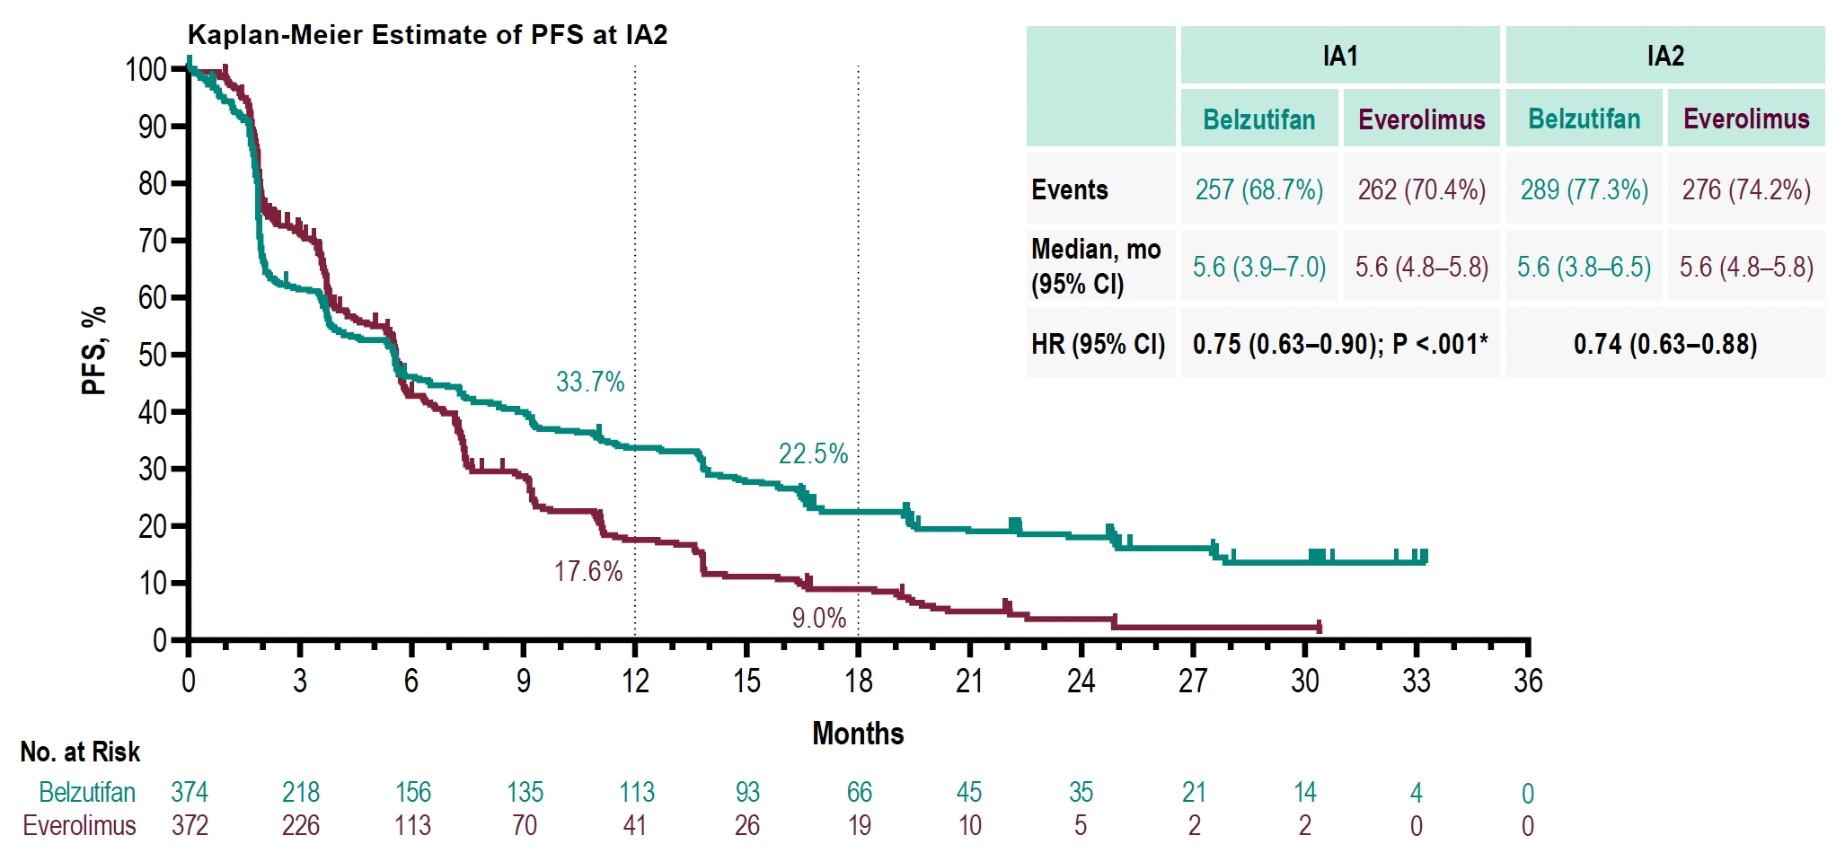
LITESPARK-005: Primary Endpoint of PFS by BICR
Rini, et al ESMO 2024

Slide 28
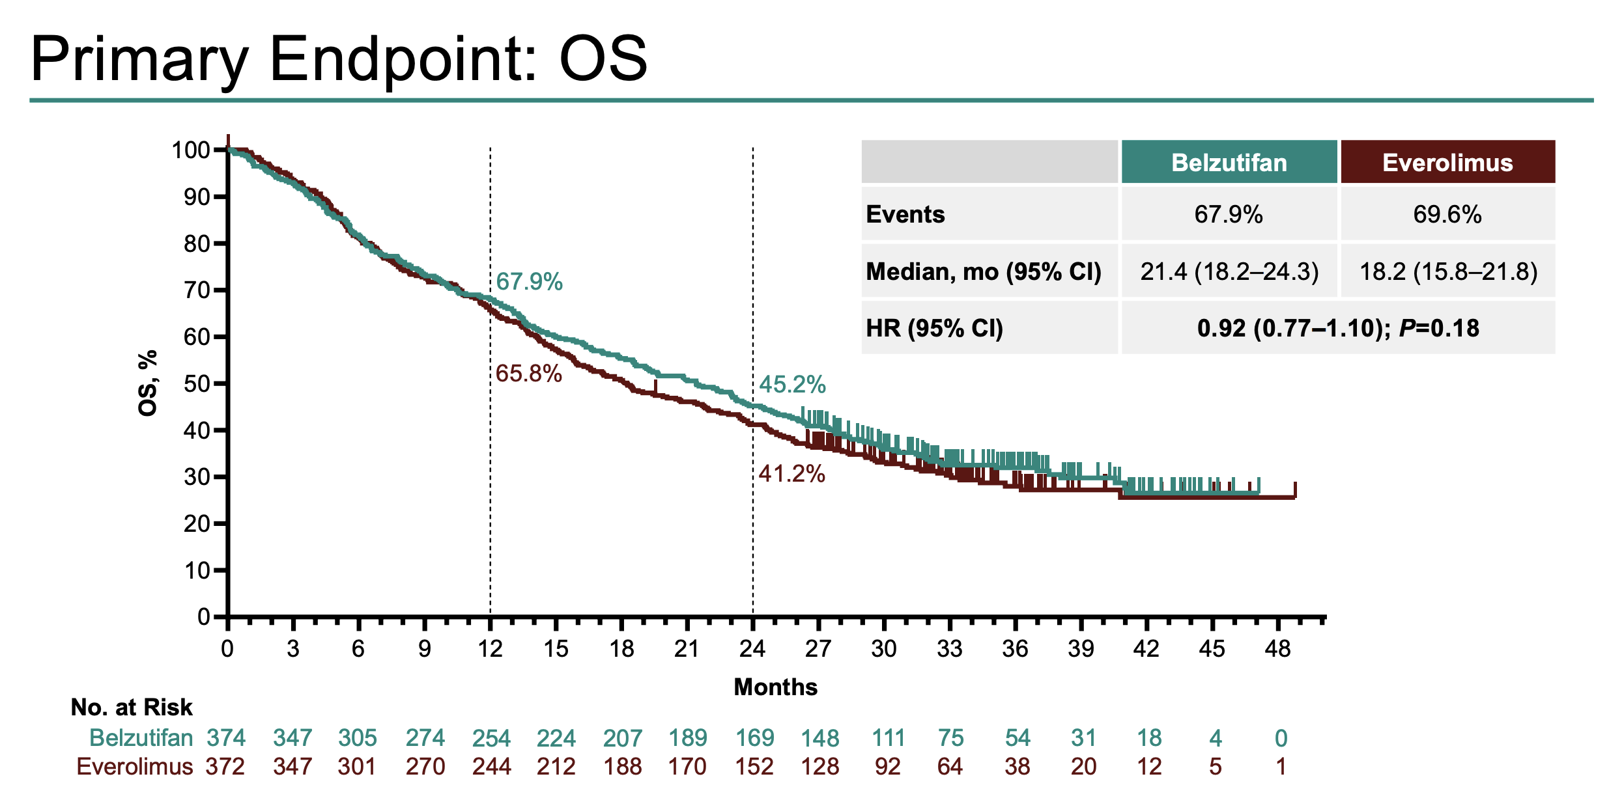
LITESPARK-005: Primary Endpoint of Overall Survival (OS)
Rini, et al ESMO 2024

Slide 29
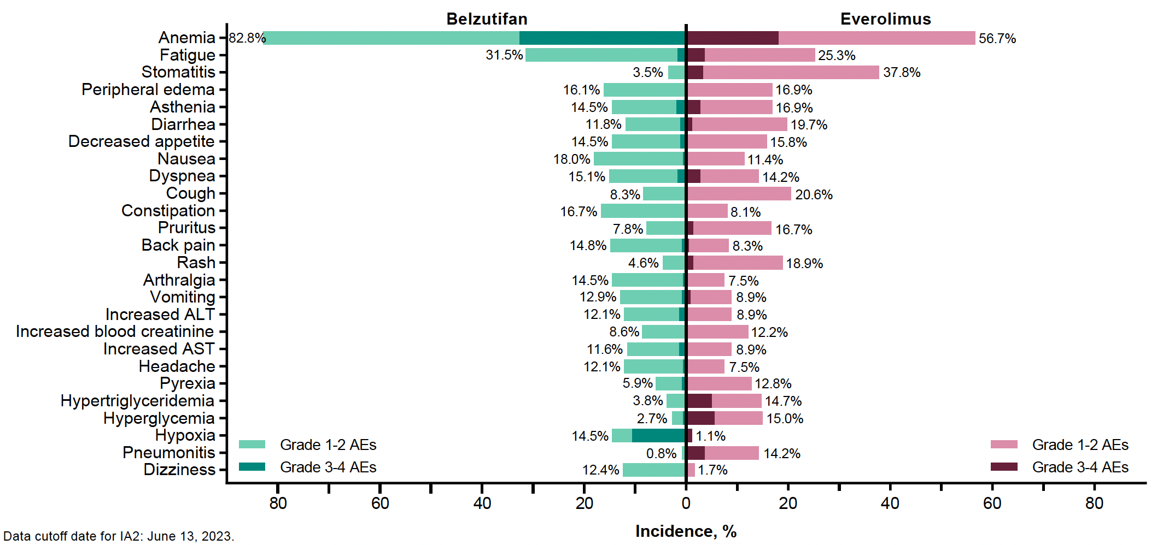
LITESPARK-005: Safety Profile
Albiges L et al. ESMO 2023;Abstract LBA88.

Slide 30
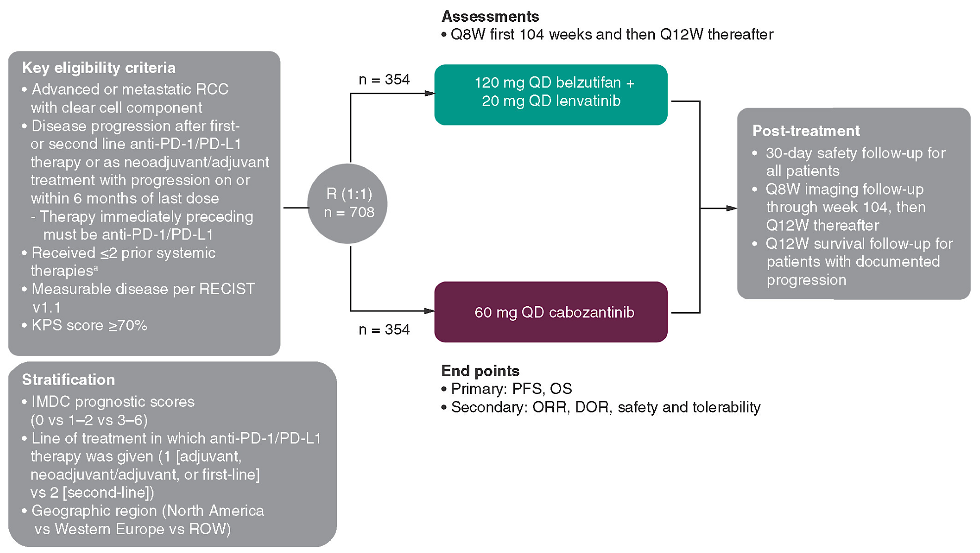
LITESPARK-011: Belzutifan and Lenvatinib versus Cabozantinib for
Advanced Renal Cell Carcinoma After Anti-PD-1/PD-L1 Therapy
Motzer RJ et al. Future Oncol 2023;19(2):113-21.

Slide 31
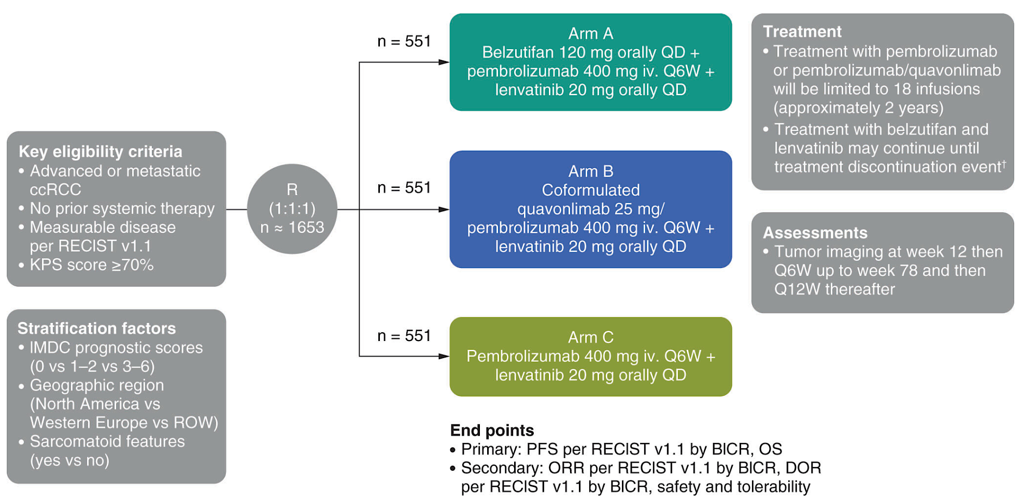
LITESPARK-012: Pembrolizumab and Lenvatinib with or without Belzutifan or Quavonlimab for Advanced Renal Cell Carcinoma
Choueiri TK et al. Future Oncol 2023;19(40):2631-40.

Slide 32
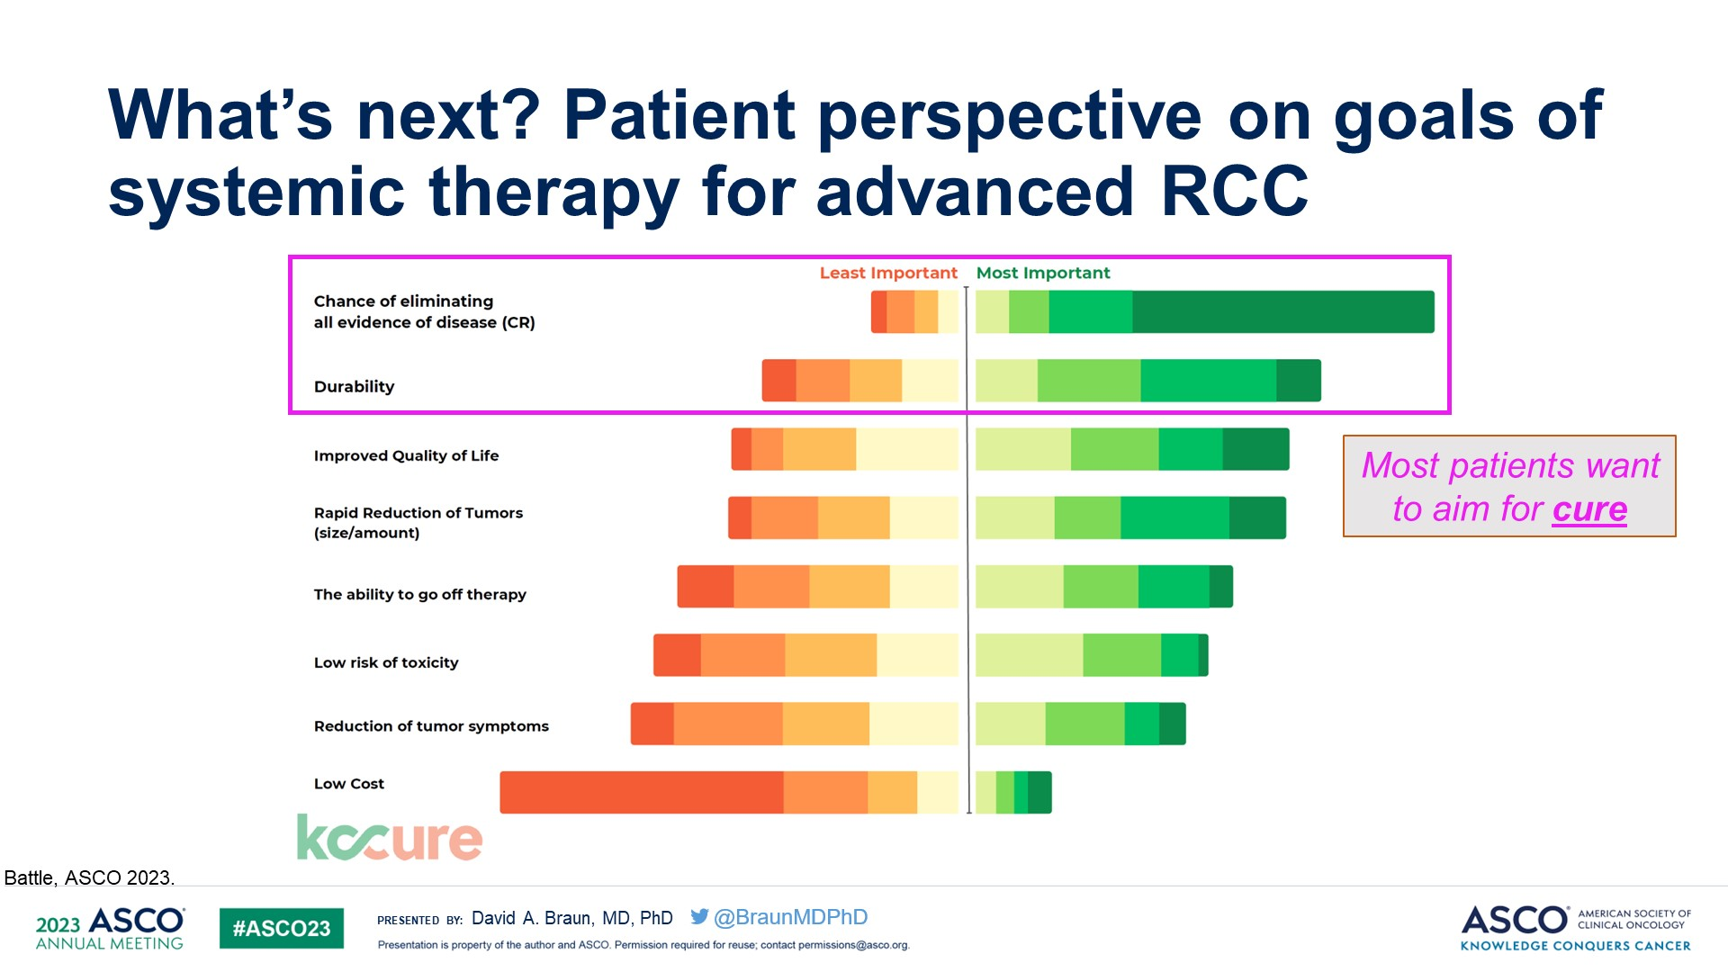

Slide 33
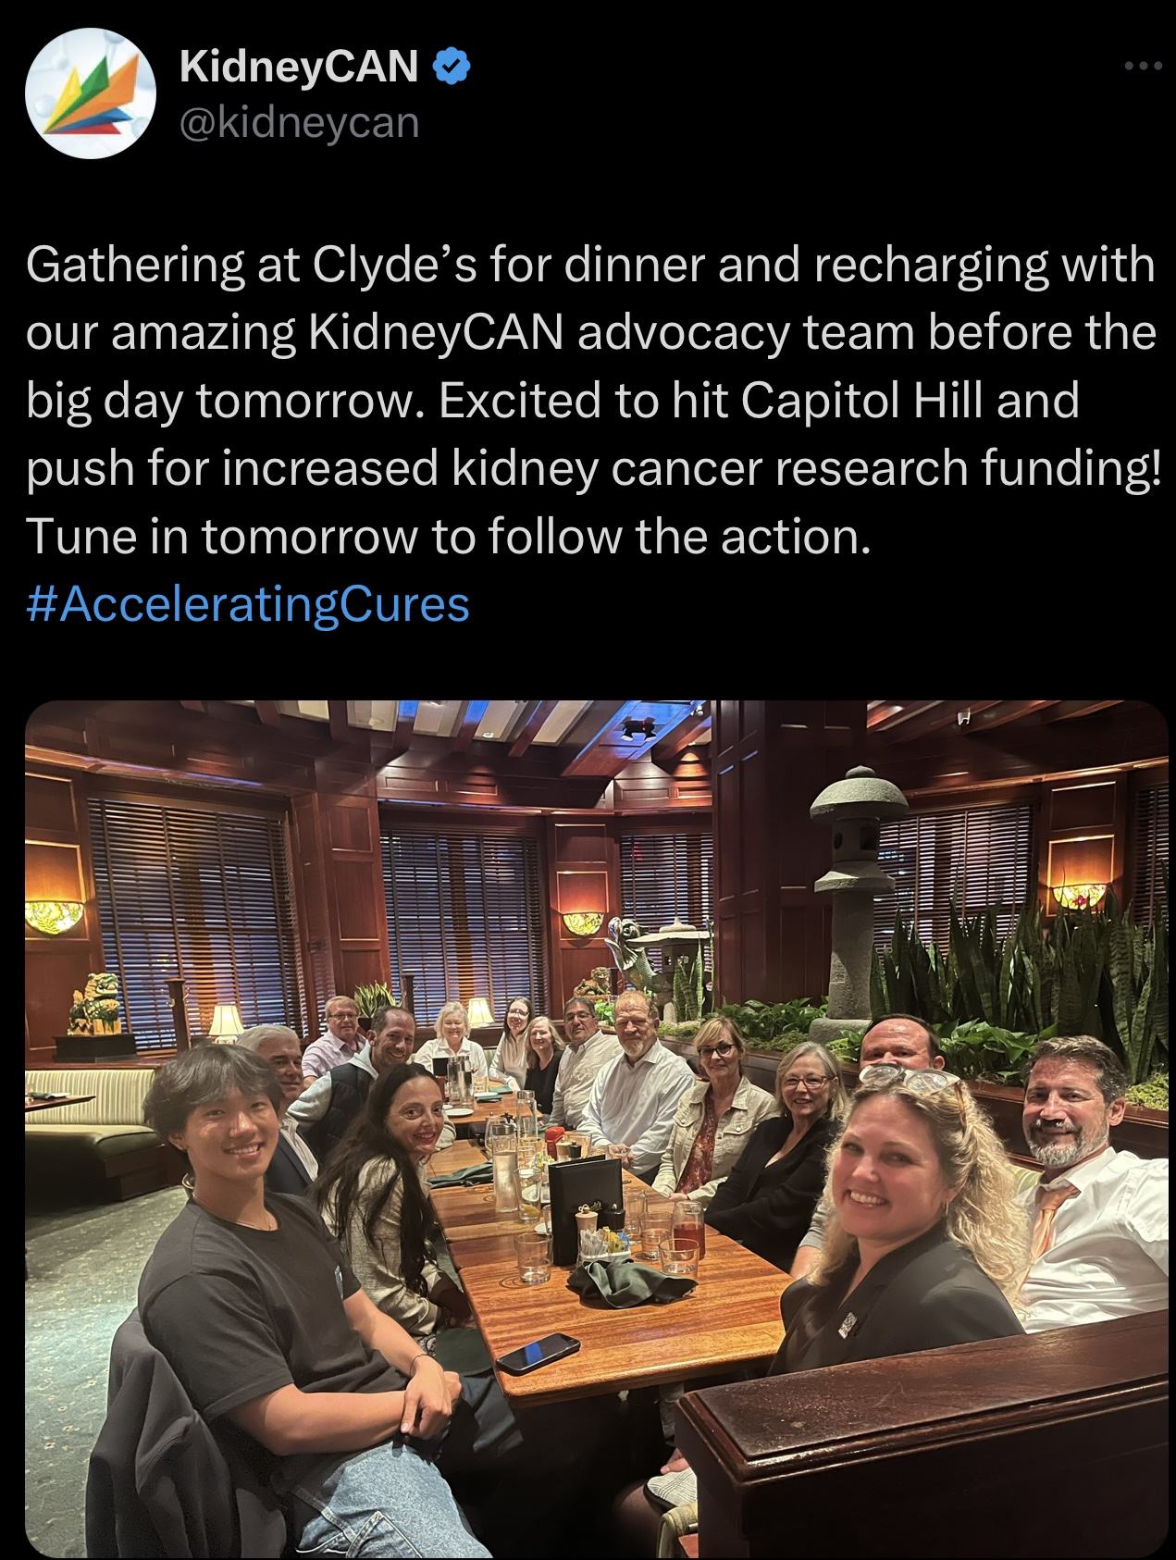

Slide 34
Genitourinary Cancers
Tuesday, September 24, 2024

Slide 35
Renal Cell Carcinoma
Case Discussions
Ami Badami, MD
Endeavor Health, NorthShore University HealthSystem
Evanston, IL

Slide 36
Case One:
Clear Cell Carcinoma

Slide 37
Case Discussion
70 year-old female presents with incidentally discovered left renal mass following an MVA and undergoes a left nephrectomy.
Pathology: clear cell carcinoma, WHO/ISUP grade 3
7.5 cm with extension into segmental branch of renal vein
Margins negative, seven lymph nodes negative (0/7)
pT3aN0
Patient declines adjuvant pembrolizumab – concerned about toxicity

Slide 38
Case Discussion (continued)
PMH:
HTN, Type 2 DM
Surgical History:
Appendectomy in his 30s
Family History:
Father with lung cancer (smoker)
Social Hx:
Retired
Never smoked
Rare alcohol use
Exam: Unremarkable
ECOG PS: 0

Slide 39
Case Discussion (continued)
Four years later: Noted to have a 1.8 cm RUL lung nodule and two sub-centimeter (6mm & 8mm) LLL lung nodules
RUL nodule was biopsied:
Pathology: clear cell RCC
Review of previous imaging revealed that nodules have been present over the last two years
Exam unremarkable, ECOG PS: 0
Notes:
Exam is stable, slight increase in size

Slide 40
Audience Question
What would you recommend next?
Observation
Ipilimumab/nivolumab
TKI + Immunotherapy combination (e.g., Nivo + cabo, lenvatinib + pembro, etc.)

Slide 41
Audience Question
What factor do you consider most when making your decision?
Toxicity
Disease burden
Risk category (i.e. favorable, intermediate/poor)
Duration of treatment
Patient preference

Slide 42
Case Discussion (continued)
Elected to proceed with observation based on indolent behavior, low volume disease, and patient preference
18 months later:
Patient presents for routine follow up
Notes increased shortness of breath

Slide 43
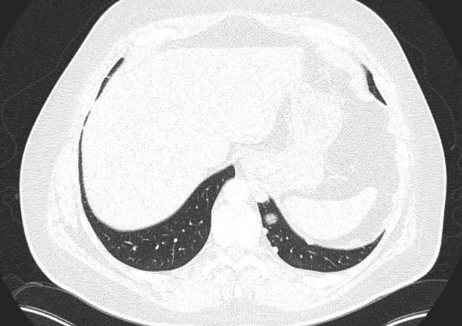
Case Discussion (continued)
Imaging shows:
Continued indolent growth of known lesions
Multiple new pulmonary nodules
Overall increased disease burden

Slide 44
Audience Question
What would you recommend next?
Continue Observation
Axitinib + Pembrolizumab
Cabozantinib + Nivolumab
Ipilimumab + Nivolumab
Lenvatinib + Pembrolizumab

Slide 45
Audience Question
What factor most informs your decision when selecting between regimens?
Disease burden
Response rate
Duration of response
Performance status
Toxicity profile
Overall survival

Slide 46
Case Discussion (continued)
Decided to initiate systemic therapy with pembrolizumab + axitinib
Disease stable after 6 cycles
Mild fatigue and moderate diarrhea (controlled with anti-diarrheal medication) were reported
14 months after initiation of therapy: increasing back pain, new rib pain, mild nausea, and weight loss

Slide 47
Case Discussion (continued)
Imaging confirms disease progression:
  New mediastinal and hilar nodal involvement
  New retroperitoneal nodes
  New lytic osseous lesions
ECOG PS 1
Summary: 70 metastatic ccRCC s/p nephrectomy with recurrence 4 years later and continued observation (low volume, indolent disease, patient preference).
- Developed progression with increased total tumor burden 18 months later.
- Started Axi/pembro with symptomatic progression 14 months later.

Slide 48
Audience Question
Which second-line therapy are you most likely to recommend for this patient?
Single-agent VEGF-TKI (e.g., axitinib, cabozantinib)
VEGF TKI combination (i.e., lenvatinib + everolimus)
Immune checkpoint inhibitor regimen (e.g., nivolumab ± ipilimumab)
HIF2-α inhibitor (i.e., belzutifan)

Slide 49
Case Discussion (continued)
Cabozantinib 60 mg QD was initiated
4 months later, disease progression is documented
The patient would like to continue active therapy

Slide 50
Audience Question
What factors MOST influence your third-line regimen selection?
For Example:
Disease characteristics (Sites/burden of disease)
Clinical factors (e.g., performance status, tolerance to previous therapy) Indication/NCCN guideline
Mechanism of action
Efficacy (which outcomes are most important)

Slide 51
Audience Question
What are you most likely to recommend for this patient upon disease progression outside of a clinical trial?
Tivozanib
Belzutifan
Lenvatinib + everolimus
Ipilimumab + nivolumab
Nivolumab
Single-agent TKI (e.g., sunitinib, pazopanib)

Slide 52
Case Discussion (continued)
A shared decision was made to start tivozanib

Slide 53
Case Two:
Non-Clear Cell Carcinoma

Slide 54
Case Discussion
A 50 year-old male presents with persistent fatigue, nausea, and hematuria after a “recent cold.”
PMH/PSH/FH:
Obesity, OSA, HTN
Tonsillectomy
No family history of malignancy
Social Hx:
Works in IT
10 pack-yr smoking history, quit 5 yrs ago
Rare alcohol use

Slide 55
Case Discussion (continued)
Exam:
VSS
ECOG PS 1
General: NAD
LYMPH: no palpable LAD
Lungs: CTAB
CV: RRR
Abdomen: soft, mild right flank tenderness
Labs:
135
105
18
118
3.8
23
1.1
Calcium: 7.4
11.1
4.8
250
32.6

Slide 56
Case Discussion (continued)
Imaging:
CT A/P:
  large right- sided renal mass (6.3 cm)
  extension into the renal vein
CT chest: negative

Slide 57
Case Discussion (continued)
He underwent a right nephrectomy and limited lymph node dissection
Pathology: non-clear cell carcinoma, favor papillary subtype
6.5 cm with extension into the vena cava (below the diaphragm)
pT3bN0

Slide 58
Audience Question
What would you do next?
Observe
Adjuvant pembrolizumab
Adjuvant sunitinib

Slide 59
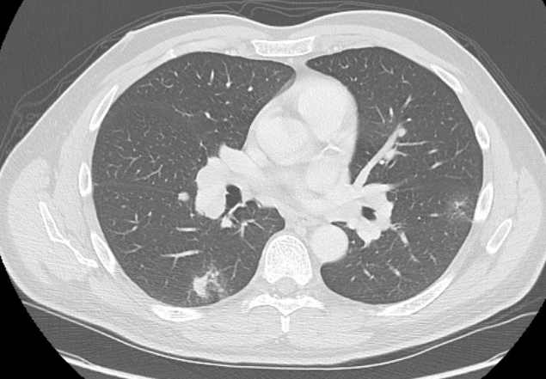
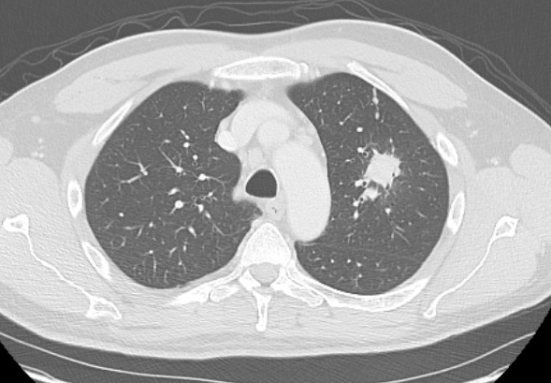
Case Discussion (continued)
12 months later: New pulmonary nodules, subcarinal and hilar LN’s

Slide 60
Audience Question
What are you most likely to recommend for this patient (outside of a clinical trial)?
Cabozantinib
Cabozantinib + Nivolumab
Lenvatinib + Pembrolizumab
Nivolumab + Ipilimumab
Pembrolizumab

Slide 61
Audience Question
What factor do you consider most when making your decision?
Toxicity
Response rate
Overall survival
NCCN guidelines
Insurance approval

Slide 62
Genitourinary Cancers
Tuesday, September 24, 2024

Slide 63
Emerging Treatments in Non-Clear Cell RCC
Thomas Westbrook, MD
Assistant Professor
Rush University
Chicago, IL

Slide 64
Background: Kidney Cancer Epidemiology
81,610 new cases, 14,390 deaths
  Localized disease 65%, regional 17%, metastatic 16%
  ~2:1 men to women incidence, median age 64
Incidence by RCC subtype
  Clear cell 75%
  Papillary 15%
  Chromophobe 5%
  Oncocytic 3%
  Collecting duct/Medullary
  Molecularly defined subtypes
Increasing incidence, decreasing mortality due to early detection
Siegal, et al. CA Cancer J Clin
Moch, et al. Eur Urol 2022

Slide 65
Background: 2022 WHO Classifications
Clear cell renal tumors
  Clear cell renal cell carcinoma
  Multilocular cystic renal neoplasm of low malignant potential
Papillary renal tumors
  Papillary adenoma
  Papillary renal cell carcinoma
Oncocytic and chromophobe renal tumors
  Oncocytoma
  Chromophobe cell renal carcinoma
  Other oncocytic tumors of the kidney
Collecting duct tumors
  Collecting duct carcinoma
Other renal tumors
  Clear cell papillary renal cell tumor
  Mucinous tubular and spindle cell carcinoma
  Tubulocystic renal cell carcinoma
  Acquired cystic disease–associated renal cell carcinoma
  Eosinophilic solid and cystic renal cell carcinoma
  Renal cell carcinoma, NOS
Molecularly defined renal carcinomas
  TFE3-rearranged renal cell carcinomas
  TFEB-altered renal cell carcinomas
  ELOC (formerly TCEB1)-mutated renal cell carcinoma
  Fumarate hydratase–deficient renal cell carcinoma
  Hereditary leiomyomatosis and renal cell carcinoma syndrome–associated renal cell carcinoma
  Succinate dehydrogenase–deficient renal cell carcinoma
  ALK-rearranged renal cell carcinomas
  Medullary carcinoma, NOS
  SMARCB1-deficient medullary-like renal cell carcinoma
  SMARCB1-deficient undifferentiated renal cell carcinoma, NOS
  SMARCB1-deficient dedifferentiated renal cell carcinomas of other specific subtypes
Metanephric tumors
Mixed epithelial and stromal renal tumors
Renal mesenchymal tumors
Moch, et al. Eur Urol 2022

Slide 66
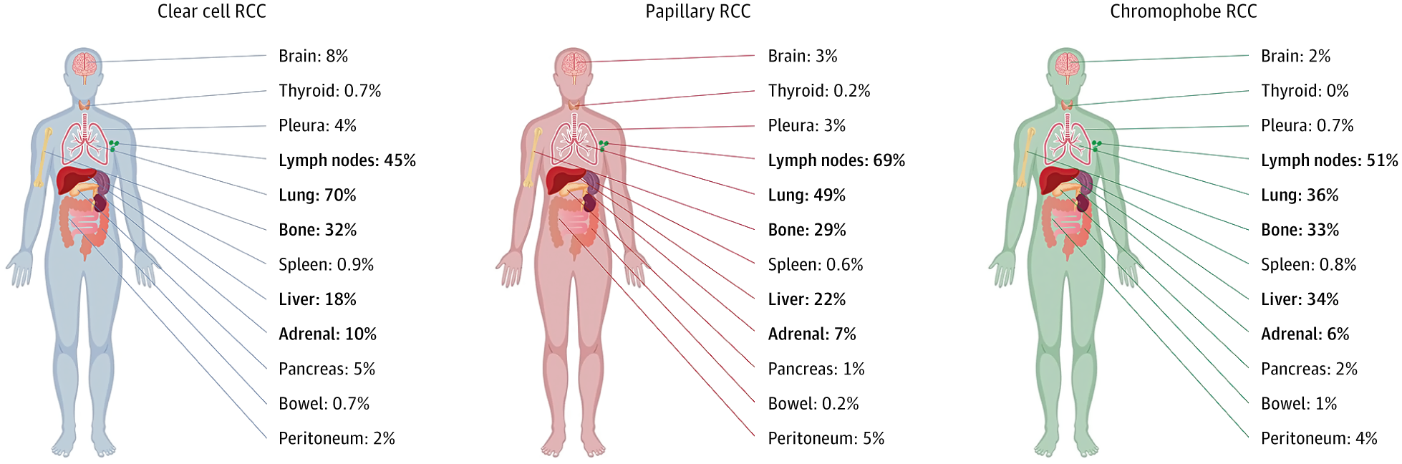
Background: Metastatic Patterns
Potential for metastasis
  Clear cell 11%
  Papillary 6%
  Chromophobe 2-6%
  Oncocytoma/oncocytic tumors (very uncommon)
Typical location of metastasis vary
Dudani, et al. JAMA Netw Open 2021
Monda, et al. Eur Urol Open Sci 2023

Slide 67
Background: Sarcomatoid Features
Sarcomatoid features more common in metastatic disease
  15% mRCC
  5-6% localized disease
Sarcomatoid features can occur in non-clear cell RCC
  Papillary 2-7%
  Chromophobe 9-30%
  Unclassified 11-26%
  Collecting duct 29%
Bakouny, et al. Nat Commun 2021

Slide 68
Management of Early Stage Disease
Management of localized disease is similar to clear cell
  Radical or partial nephrectomy
  Ablative techniques
  Embolization
  SBRT
Currently no role for adjuvant therapy
  KEYNOTE 564 did not include non-clear cell histologies
  RAMPART trial ongoing, includes nccRCC

Slide 69
mTOR/TKI Trials In Advanced Disease
Trial | Phase | N | ORR | PFS (months) | OS (months)
SUPAP (sunitinib) | II | 62 | 12% | 5.5-6.6 | 12.4-17.8
ESPN (everolimus vs. sunitinib) | II | 68 27 Papillary 12 Chromophobe 12 Clear cell with sarcomatoid features 10 Unclassified 7 Translocation associated | 3% vs. 9% | 4.1 vs 6.1 | 14.9 vs16.2
AXIPAP (axitinib) | II | 165 | 29% | 6.6 | 18.9
Hutson, et al. (lenvantinib + everolimus) | II | 31 20 Papillary 9 Chromophobe 2 Unclassified | 26% | 9.2 | 15.6
PAPMET (cabozantinib vs. sunitinib vs. crizotinib vs. savolitinib) | II | 152 | 23% vs. 4% vs. 0% vs. 3% | 9.0 vs 5.6 vs 2.8 vs 3.0 | 20 vs 16.4 vs 19.9 vs 11.7
Ravaud, et al. Ann Oncol 2015
Tannir, et al. Eur Urol 2016
Negrier, et al. Eur J Cancer 2020
Hudson, et al. Eur Urol 2021
Pal, et al. Lancet 2021

Slide 70
Checkpoint Inhibitor Trials
Trial | Phase | N | PDL1≥1% | ORR | PFS (months) | OS (months)
Checkmate 374 (nivolumab) | IIIB/IV | 44 24 Papillary 8 Unclassified 7 Chromophobe 1 Translocation associated 1 Collecting Duct 1 Medullary | 34% | 34% | 2.2 | 16.3
Keynote 427 (pembrolizumab) | II | 165 118 Papillary 26 Unclassified 21 Chromophobe | 61% | 27% | 4.2 | 28.9
Checkmate 920 (ipilimumab + nivolumab) | IIIB/IV | 52 22 Unclassified 18 Papillary 7 Chromophobe 2 Translocation associated 2 Collecting duct 1 Medullary | 39% | 20% | 3.7 | 21.2
McDermott, et al. JCO 2021
Vogelzang, et al. Clin Genitourin Cancer 2020
Tykodi, et al. J Immunother Cancer 2022

Slide 71
CA209-9KU
Single center non-comparative phase II trial
Cabozantinib 40mg + nivolumab
Metastatic nccRCC, first or second line of therapy
47 patients enrolled
  Subtypes
    68% Papillary
    15% Chromophobe
    13% Unclassified
    4% Translocation-associated
  66% previously untreated, 34% second line

Slide 72
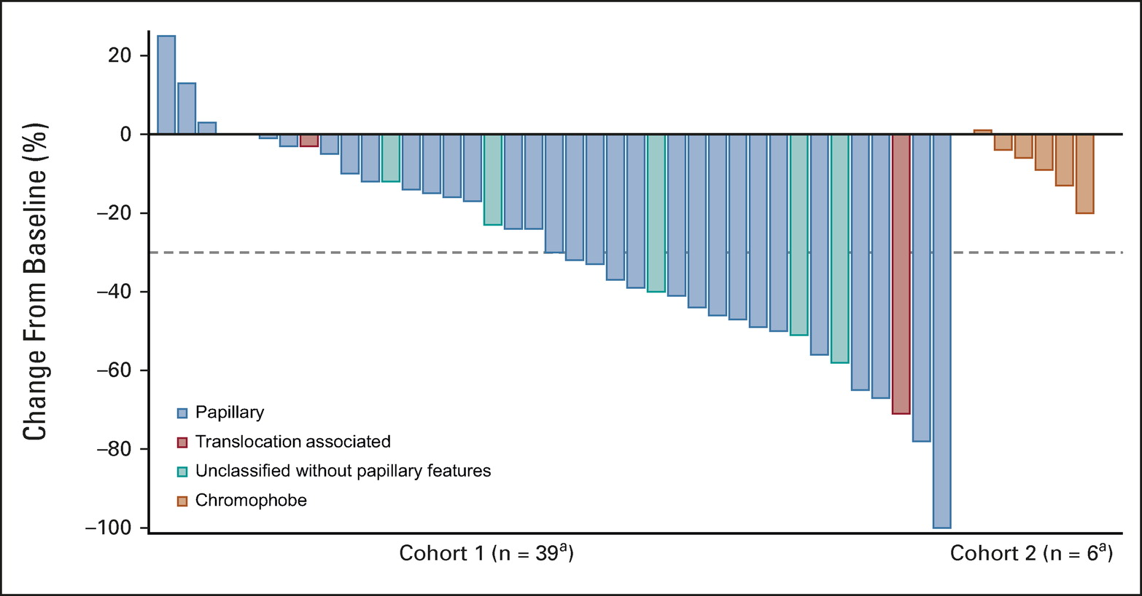
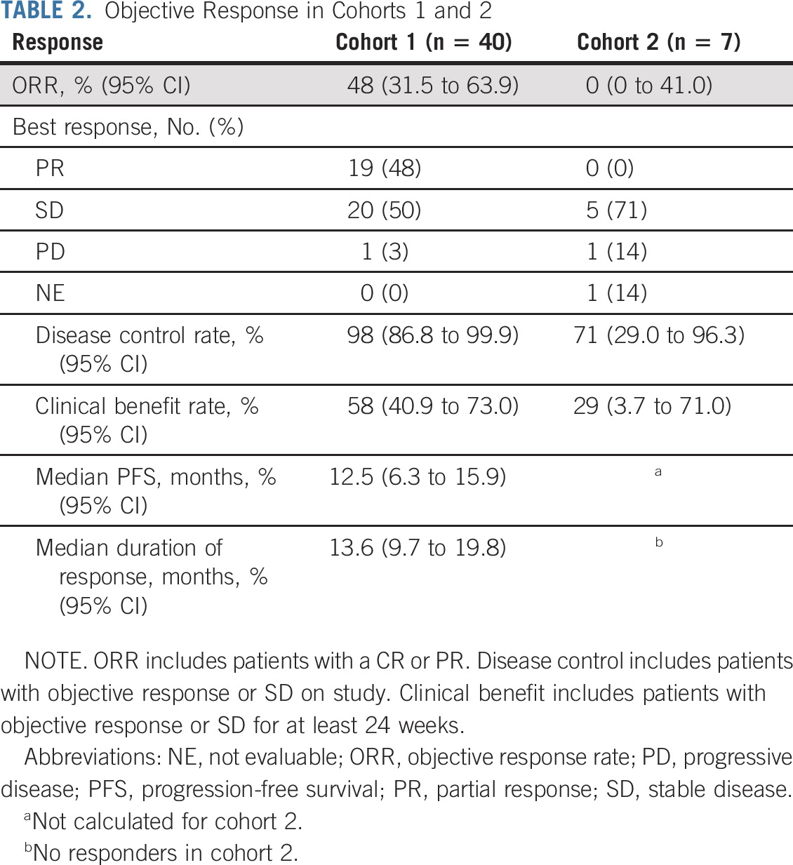
CA209-9KU
Fig 1. Maximum change from baseline in target lesions in combined cohort
mPFS 13mo
mOS 28mo
Lee, et al. JCO 2022

Slide 73
Cabozantinib/Nivolumab
Relatively high ORR (48%) among non-chromophobe cohort
  ~1/3 pretreated
0% ORR in chromophobe, outcomes not subsequently reported
Side effect profile as established by CheckMate 9ER
As a common ccRCC regimen, many have familiarity with it

Slide 74
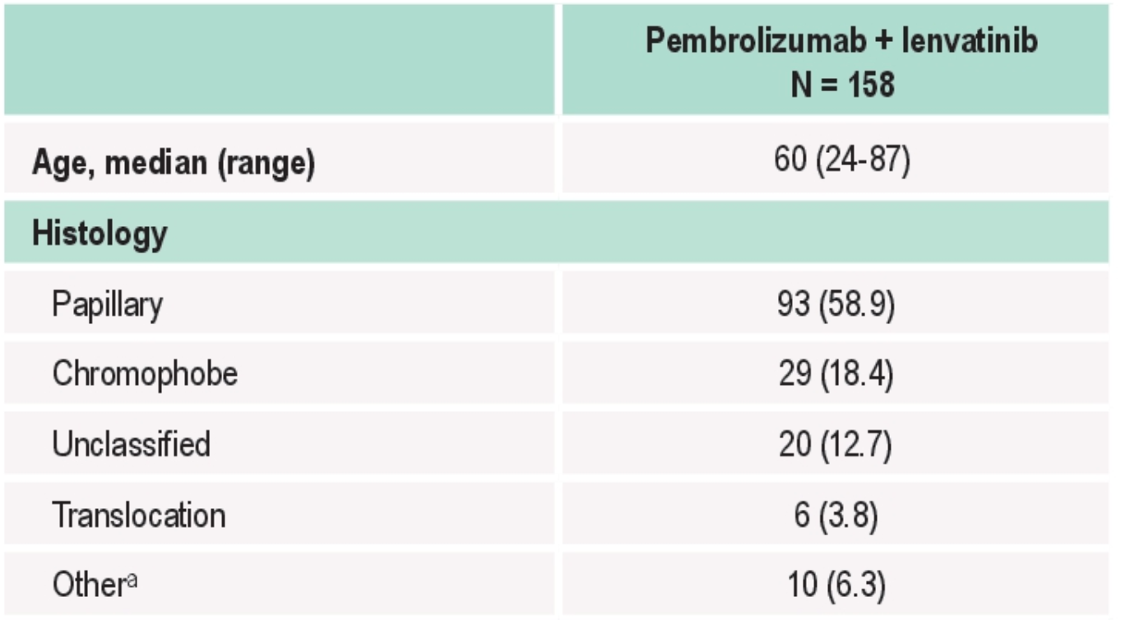
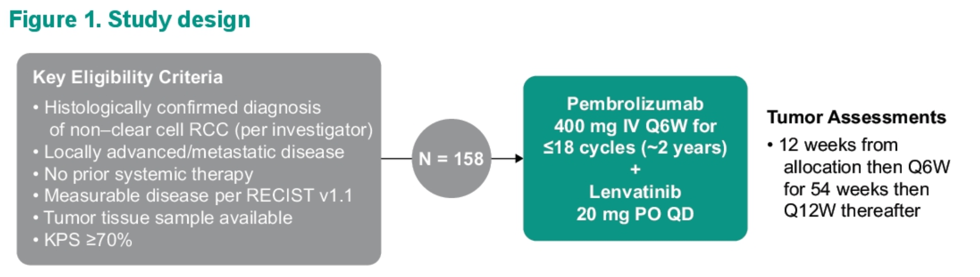

KENYOTE-B61 Study Design And Patients
Voss, et al. Presented ASCO GU 2024

Slide 75


KENYOTE-B61 Results
Voss, et al. Presented ASCO GU 2024

Slide 76


KENYOTE-B61 Survival
Voss, et al. Presented ASCO GU 2024

Slide 77
Lenvantinib/pembrolizumab
High ORR (51%) with responses across histologies
mOS not yet reached
Manageable side effect profile as established by CLEAR

Slide 78
SUNNIFORECAST
Randomized phase II multicenter study
First line metastatic nccRCC
Ipilimumab/nivolumab vs. SOC
309 patients enrolled
  178 Papillary
  60 Chromophobe
  50 Other
  12 Translocation
  9 Collecting duct

Slide 79


SUNNIFORECAST Efficacy
Bergman, et al. Presented ESMO 2024

Slide 80
Ipilimumab/Nivolumab
Reasonable response rates across histologies (33%)
Not clear if there are durable remissions
mOS 42.4m ipi/nivo vs 33.9m SOC
Strongest level of evidence yet
Establishes another good option, especially in CPS ≥1

Slide 81
First-Line Choice
Papillary, translocation, unclassified
  Lenvantinib/pembrolizumab
  Ipilimumab/nivolumab
Chromophobe
  Lenvantinib/pembrolizumab
  Lenvantinib/everolimus
  Ipilimumab/nivolumab
Collecting duct/medullary carcinoma
  Cisplatin or carboplatin + gemcitabine or paclitaxel
Sarcomatoid differentiation
  IO regimen
  Strongly consider ipilimumab/nivolumab

Slide 82
Ongoing Trials
ICONIC (NCT03866382)
CAN-I (NCT04413123)
NCI palbociclib + sasanlimab (NCT04413123)
SAMETA (NCT05043090)
PAXIPEM (NCT05096390)
PAPMET2 (NCT05411081)
STELLAR-002, STELLAR-304 (NCT05176483, NCT05678673)

Slide 83
Thank you for your attention
Questions?

Slide 84
mCRPC: Challenging Cases
Russell Szmulewitz, MD
University of Chicago

Slide 85
Clinical States of Prostate Cancer
Clinical
Metastases:
Noncastrate
Clinically
Localized
Disease
Non-
Castrate
Rising
PSA
Castration-
Resistant
Metastatic
(mCRPC):
1st Line
mCRPC:
2nd Line
mCRPC:
3rd Line
mCRPC:
4th Line
Non-
metastatic
CRPC
(nmCRPC)
Noncastrate
Castration-resistant
Framework for intervention
Regulatory framework
Becoming obsolete/challenging to interprest with intensification

Slide 86
Disclosures
I have served on advisory boards for: Novartis, Bayer, Janssen, Eisai, Merck, Astellas/Pfizer
I will discuss off label indications for FDA approved therapies

Slide 87
Case 1
56yo otherwise well with hx of prostate cancer:
2016 (age 48) “back pain”→CTA to r/o dissection→bone metastases, RP nodes
LN biopsy + prostate cancer
Germline BRCA2+
Bicalutamide-ADT, spine RT→docetaxel (CHAARTED style)
7/2018 PSA rising from undetectable to 0.5→AAWD, sip-T→undetectable PSA
7/2021 PSA 0.1→PET shows + in prostate only

Slide 88
Case 1
What is the most appropriate next line therapy choice?
ADT alone- continue surveillance as no met progression
Add ARSI (apa, enz, daro) for nmCRPC
PARPi+ARSI (e.g. talazoparib-enz)
Radiate prostate
Docetaxel retreat
Lu-177-PSMA-617

Slide 89
Case 1
Continued surveillance appropriate given lack of radiographic progression and patient has history of metastatic disease (not M0CRPC).
→RT to prostate→ PSA undetectable 9/2021-4/2024→ PSA 0.08 9/9/24

Slide 90


Case 1-Cont
Imaging:
Bonescan- previous uptake
“More prominent”
PSMA-PET

Slide 91
Case 1-cont
What is the most appropriate next line therapy choice?
ADT alone- continue surveillance as no met progression
Add ARSI (apa, enz, daro)
PARPi+ARSI (e.g. talazoparib-enz)
Radiate prostate oligometastatic disease
Docetaxel retreat
Lu-177-PSMA-617

Slide 92

Case 1-Cont
Continued surveillance (still) appropriate given lack of radiographic progression (1 ”new” met)
ARTO (Francolini, JCO 2023) Abi+/- met directed

Slide 93

Case 2
77yo PS0 with following history:
11/2021- PSA 5, Bx with GG2→EBRT (no ADT)
11/2022- PSA 75→met PC on bone scan→ADT, Abi/pred
Germline pathologic variant in CHEK2
5/2023-PSA nadir 24
4/2024-Radiographic progression with new bone metastases, rising PSA, pain→palliative RT to sacrum

Slide 94


Case 2-Cont
Imaging:
Bonescan PSMA-PET

Slide 95
Case 2
What is the most appropriate next line therapy choice?
Sipuleucel-T
Radium-223
Docetaxel
Lu-177-PSMA-617
PARPi (Talazoparib-Enzalutamide, Olaparib…)
Carbo-cabazitazel

Slide 96

Case 2
Standard of care=docetaxel
Lu177-PSMA-617 off label (PSMAfore)
PARPi miminal active in CHEK2 but on label
→Lu177-PSMA-617 as on PSMAddition and cross-over
C1D1 PSA 612
C2D1 PSA 60
…42→68 (C3D1)→141→repeat CT
New multifocal hepatic metastases: biopsy shows poorly differentiated with NE features

Slide 97
Case 2
Now what?
Sipuleucel-T
Radium-223
Docetaxel
Atezolizumab-cabozantinib
PARPi (Talazoparib-Enzalutamide, Olaparib…)
Carbo-cabazitazel

Slide 98
Case 2
As had not received chemotherapy, PS deteriorating, gave docetaxel→ rapid deterioration, hospice
-hindsight: cabo-cabazi (Corn Lanc Onc 2019)?

Slide 99

Case 3 (time permitting)
70 yo with de novo metastatic prostate cancer with following hx:
12/2015 back pain→PSA 600, Bx+, diffuse bone metastases
ADT-Docetaxel
10/2017- PSA progression→sip-T
7/2019-Progression→abiraterone/pred
Imaging progression→Ga68 PSMA positive mets
Note: molecular with FOXA1 mutation

Slide 100


Case 3 (time permitting)
Lu177-PSMA-617: PSA 6→8.5→12→17
Pre-Lu177-PSMA
Post C3-Lu177-PSMA

Slide 101
Case 3
Now what?
Radium-223
Docetaxel retreat (no neuropathy)
Enzalutamide
Cabazitaxel
Carbo-cabazitazel
Fly to Europe for Actinium PSMA

Slide 102
Case 3
Large data gaps for post ARSI, taxane, Lu177-PSMA
CARD (de Bono, NEJM, 2019)- cabazi>ARSI switch
On the horizon (investigational)
Ac225-PSMA
PSMA, STEAP-1 BiTE (e.g. AMG509)
Other

Slide 103
Target-Based Therapies for Prostate Cancer
Mohammad Atiq, MD, FACP
Assistant Professor of Medicine
University of Chicago Medicine

Slide 104
Disclosures
Honoraria: New England Journal of Medicine; Healthcare Monitoring Network, LLC

Slide 105
Outline
Background
PROpel
TALAPRO-2
MAGNITUDE
BRCAaway
Take Aways
Targets in Development

Slide 106

Clinical States of Prostate Cancer
Ref: Scher HI, J Clin Oncol. 2016 Apr 20;34(12):1402-18

Slide 107
DDR Mutations in mCRPC: 20-25%

Slide 108

PARP Inhibition for DDR Mutations: Olaparib
POD on NHA
BRCA1/2
De Bono et al, NEJM, 2020; Hussain, NEJM, 2020

Slide 109

PARP Inhibition for DDR Mutations: Rucaparib
TRITON-3: Phase 3 of Rucaparib vs. Physician’s Choice
  ARSI switch
  Chemotherapy
Improvement in rPFS with PARPi

Slide 110
PROpel: Abiraterone + Olaparib vs Abiraterone

Slide 111

ARPI + PARPi: Abiraterone + Olaparib

Slide 112

ARPI + PARPi: Abiraterone + Olaparib
Less than 1% of patients had received a prior NHA

Slide 113

ARPI + PARPi: Abiraterone + Olaparib

Slide 114

ARPI + PARPi: Abiraterone + Olaparib
Key Question
How would the HRRm curve look if there were crossover?

Slide 115
TALAPRO-2 : Enzalutamide + Talazoparib vs Enzalutamide

Slide 116

ARPI + PARPi: Enzalutamide + Talazoparib

Slide 117

ARPI + PARPi: Enzalutamide + Talazoparib
Approximately 6% had received prior NHA

Slide 118

ARPI + PARPi: Enzalutamide + Talazoparib
Overall survival data still immature

Slide 119

ARPI + PARPi: Enzalutamide + Talazoparib

Slide 120
MAGNITUDE: Abiraterone + Niraparib vs Abiraterone

Slide 121

ARPI + PARPi: Abiraterone + Niraparib

Slide 122

MAGNITUDE Patient Baseline Characteristics
Approximately 3% had received prior NHA
Ref: Efstathiou E, JCO. 2023 Feb;21(41): 6-6

Slide 123

ARPI + PARPi: Abiraterone + Niraparib

Slide 124

ARPI + PARPi: Abiraterone + Niraparib

Slide 125
Adverse Event Overview (Most Common)
PROpel
TALAPRO-2
MAGNITUDE
All Grades
Anemia
Fatigue
Nausea
≥ Grade 3: Anemia
All Grades
Anemia
Neutropenia
Fatigue
≥ Grade 3: Anemia
All Grades
Anemia
HTN, constipation
Fatigue
≥ Grade 3: Anemia
Ref: Clarke N, JCO. 2023 Feb;21(41): 6-6
Agarwal N, JCO. 2023 Feb;21(41): 6-6
Chi KN, Annals Of Onc. 2023 Sep; (34): 772-782

Slide 126
FDA Approval
2023: 3 FDA Approvals for PARPi + ARPI in BRCA or HRR mutated mCRPC
  PROpel: Olaparib + Abi (BRCAm)
    All comers
    Biomarker assessed retrospectively
  TALAPRO-2: Talazoparib + Abi (HRRm)
    All comers
    Biomarker assessed prospectively
  MAGNITUDE: Niraparib + Abi (BRCAm)
    Biomarker stratified
Ref: Saad F, Lancet Oncol. 2023 Oct;24(10):1094-1108
Agarwal N, Lancet. 2023 Jul 22;402(10398):291-303
Chi K, JCO. 2023 Jun 20;41(18):3339-3351

Slide 127
Key Question
Is ARPI + PARPi combination better than sequencing these?
Ref: Saad F, Lancet Oncol. 2023 Oct;24(10):1094-1108
Agarwal N, Lancet. 2023 Jul 22;402(10398):291-303
Chi K, JCO. 2023 Jun 20;41(18):3339-3351

Slide 128
BRCAaway: Abiraterone, Olaparib, Abiraterone + Olaparib

Slide 129

BRCAaway: Study Design
mCRPC
  ARi, PARPi naïve
  No chemo in mCRPC
NGS & Germline: BRCA1/2 and/or ATM
Randomized 1:1:1
  A1: Abi + Pred
  A2: Olaparib
  A3: Olaparib + Abi + Pred
Arms 1 & 2 could cross over at progression
Endpoints:
  1°: rPFS (per RECIST)
  2°: measurable RR, PSA RR, toxicity
Ref: Hussain M, JCO. 2024 Jan;29(42):19-19

Slide 130

BRCAaway

Slide 131

BRCAaway
131

Slide 132

BRCAaway: Crossover
8/21 pts crossed over to Olaparib from Abi + Pred
8/19 pts crossed over to Abi + Pred from Olaparib
PFS from randomization is identical
Ref: Hussain M, JCO. 2024 Jan;29(42):19-19
132

Slide 133
BRCAaway Implications
Suggests treating ARPI naïve, BRCA1/2 or ATM mutated front-line mCRPC with combination of Olaparib + Abiraterone rather than monotherapy
What do you do when a patient progresses on ARPI in the mCSPC setting?

Slide 134
My Take Aways for ARPI + PARPi
Patients with HRR-mutated mCRPC should be considered for treatment with combination ARPI + PARPi
Can still use PARPi monotherapy post-taxane in mCRPC with DDR (i.e., after triplet in mCSPC)

Slide 135
Targets in Development
PSMA (transmembrane glutamine carboxypeptidase)
  Modalities: BiTE, CAR-T
STEAP (Six Transmembrane Epithelial Antigen of Prostate)
  Modalities: BiTE, CAR-T
PSMA/STEAP: Bispecific ADC
B7-H3: immune checkpoint protein
  Modalities: Monoclonal antibody
KLK2: Kallikrein-2
  Modalities: Actinium-225
*Text in Red Denotes Trials Open/Opening at UChicago

Slide 136
Genitourinary Cancers
Tuesday, September 24, 2024

Slide 137
Radioligands in Prostate Cancer:
Past, Present, and Future
Natalie Reizine MD
Assistant Professor of Medicine
University of Illinois at Chicago
Chicago, IL

Slide 138
Disclosures
Speakers’ bureaus: Merck, Astrazeneca, Janssen, Tempus
I will be discussing off-label indications for FDA approved therapies

Slide 139
Intensification of Systemic Therapy is Moving Earlier
High Risk Localized Disease
Low Volume Metastatic Disease
High Volume Metastatic Disease
CRPC
Radiation to primary
Oligometastatic tx
  Visceral metastases AND at least one bone lesion
  OR
  at least 4 bone lesions with at least one outside the axial skeleton​
HRRm?
PSMA?
STAMPEDE: ADT + AAP
EMBARK: Enzalutamide +/- ADT
CHAARTED: docetaxel
STAMPEDE M1: abiraterone, docetaxel
LATTITUDE: abiraterone
ARCHES, ENZAMET: enzalutamide
TITAN: apalutamide
PEACE-1: Abiraterone + docetaxel
ARASENS: Darolutamide + docetaxel
Ra-223
Sip-T
VISION: LuPSMA
PROfound: Olaparib
TRITON2: rucaparib
PROPel: olaparib + AAP
TALAPRO-2: talazoparib + enza
MAGNITUDE: niraparib + AAP
Freedland NEJM 2023, Armstrong JCO 2022, Davis NEJM 2019, James Lancet 2016, Sweeney NEJM 2015, Chi NEJM 2019, Fizazi NEJM 2017, James NEJM 2017, Smith NEJM 2022, Fizazi Lancet 2022
Notes:
Embark: phase 3, high risk BCR (PSA DT <9 months)
1:1:1 enza + ADT; enza alone, ADT alone
Primary endpoint: MFS in combo vs. ADT alone
Secondary endpoint: MFS in mono vs. ADT alone
Enza alone: better sexual function but gynecomastia
PSMA pet era?

Slide 140

Novel Therapies in PCa
Immunotherapy-Based
Monoclonal antibodies
Antibody-Drug Conjugate
Radioimmunoconjugate
mAb linked to radionuclide binding to specific antigen on tumor cells
Radioconjugate
Radiolabeled peptides targeting tumor-specific membrane structures
Bispecific Antibodies
Tri-Specific T-cell Activating Construct
Gopanath Gnanasegaran IUCS 2023
Notes:
Monoclonal antibodies: antibodies targeting prostate or prostate cancer restricted antigens or cell surface molecules, stimulating Fc-receptor bearing immune effector cells
Bispecific antibodies: antibodies inducing Tcell stimulation through dual binding to TAA and activation of the TCR/CD3 complex
Trispecific Tcell activating construct: Tcell engaging protein constructs with 3 domains binding to a tumor antigen, human serum albumin, and TCR subunit CD3
Antibody drug conjugate: cytotoxic agents linked to antibodies that recognize and bind to antigens on PC cell surfaces to induce cell death
Radioconjugate: maB linked to radinuclide
Radioconjugate: radiolabeled peptides targeting tumor-specific membrane structures of cancer cells

Slide 141

PSMA PET/CT
PSMA: cell membrane protein highly expressed on surface of PCa
Diagnostic radiotracers:
Ga-68 PSMA-11
F-18 piflufolast
Obtain scans in:
high, very high risk PCa,
biochemical recurrence,
mCRPC prior to PSMA-radioligand
replacing conventional imaging?
~15% of PCa lesions are PSMA-negative
https://cancerecology.com/psma-imaging
Notes:
PSMA is a cell membrane protein highly expressed on the surface of PCa cells, making it an ideal imaging and therapeutic target for treating PCa. Two diagnostic radiotracers are currently approved: gallium Ga-68 PSMA-11 and F-18 piflufolast. Guidelines support obtaining these sensitive scans in high or very high-risk PCa, biochemical recurrence, and in the mCRPC setting as a requirement and criterion for receiving PSMA-targeted therapies. However, questions remain as to the natural history of PSMA-PET positive disease and whether aggressive early therapy will improve outcomes in patients with positive PSMA imaging yet negative conventional studies. In addition, prior long-term androgen deprivation therapy (ADT) therapy may lower the sensitivity of scans https://www.uptodate.com/contents/rising-serum-psa-following-local-therapy-for-prostate-cancer-diagnostic-evaluation?search=pet%20psma&source=search_result&selectedTitle=1~150&usage_type=default&display_rank=1#H3144300827

Slide 142

177LuPSMA Radioligand
6 injections (~20 minutes) q4-6 weeks
Hydration is important
AEs: salivary gland xerostomia, low blood counts, long-term renal toxicities
Beta particle radiation taken up by PSMA-positive cells and surrounding tissues
Internalization of radioligand results in accumulation of radioactivity in tumor tissue and irradiation

Slide 143

VISION: 177-Lu-PSMA-617 for Late Stage mCRPC
But no chemo

Slide 144

VISION: 177-Lu-PSMA-617 for Late Stage mCRPC
15.3 vs. 11.3m
Notes:
Multiple ligands of PSMA linked to radioisotopes are in development.
The first PSMA-targeted therapy, Lutetium-177-labeled-PSMA-617 (LuPSMA), was approved in 2022 for patients with PSMA-positive (defined as having at least one tumor on PSMA PET) mCRPC. LuPSMA is a beta-emitting isotope. In the VISION trial, patients were eligible following treatment with a prior androgen receptor signaling inhibitors (ARSI) and taxane chemotherapy, with therapy administered for 4-6 cycles. Results were impressive, demonstrating improved PSA response rates, radiographic progression-free survival (PFS), overall survival (OS), time to symptomatic skeletal event, as well as improved quality of life (QoL) compared to standard of care (SOC). In an updated analysis, the clinical efficacy of LuPSMA was observed regardless of prior treatment, including radium-223 and a second prior taxane, thus demonstrating response in heavily pretreated populations. The TheraP phase II trial also demonstrated a higher PSMA response for patients who received LuPSMA compared to cabazitaxel chemotherapy.
Although the results are impressive, not everyone responds to this therapy. Factors predictive of response to LuPSMA include: 1. No FDG+ disease on conventional PET; 2. A high whole-body SUV mean 3. Homogeneous target expression; 4. Low whole-body tumor volume (low number of lesions); 5. Nodal disease only (osseous disease associated with worse response). Although devoid of common chemotherapy-related adverse events (AEs), 98.1% of patients have toxicities with LuPSMA, the most common being fatigue, dry mouth, nausea, anemia, decreased appetite, and constipation. In the VISION trial, 11.9% of patients had an AE, leading to discontinuation of LuPSMA.
Sartor, O., De Bono, J., Chi, K. N., Fizazi, K., Herrmann, K., Rahbar, K., ... & Krause, B. J. (2021). Lutetium-177–PSMA-617 for metastatic castration-resistant prostate cancer. New England Journal of Medicine, 385(12), 1091-1103.
Vaishampayan, N., Morris, M. J., Krause, B. J., Vogelzang, N. J., Kendi, A. T., Nordquist, L. T., ... & Fizazi, K. (2022). [177Lu] Lu-PSMA-617 in PSMA-positive metastatic castration-resistant prostate cancer: Prior and concomitant treatment subgroup analyses of the VISION trial.
Hofman, M. S., Emmett, L., Sandhu, S., Iravani, A., Joshua, A. M., Goh, J. C., ... & Yip, S. (2021). [177Lu] Lu-PSMA-617 versus cabazitaxel in patients with metastatic castration-resistant prostate cancer (TheraP): a randomised, open-label, phase 2 trial. The Lancet, 397(10276), 797-804.
Vienna, Zisser Le et al Nucle Med Commun 2022

Slide 145

TheraP: randomized Ph2 in mCRPC
Hofman et al Lancet 2024
Secondary Outcome of OS
Median follow up 35.7 m
Higher ORR
mOS similar between groups
Lower Aes
Better QoL/PROs
LuPSMA resulted in higher response rates (BCR, imaging), longer PFS, and reduced G3/4 toxicities compared to cabazitaxel
BJU International, Volume: 124, Issue: S1, Pages: 5-13, First published: 22 October 2019, DOI: (10.1111/bju.14876)

Slide 146

PSMA radioligand pre-chemo: PSMAfore

Slide 147

PSMA radioligand pre-chemo: PSMAfore
Control arm = ARPI change
84% crossover
OS data immature
2024 ASCO update: improved QoL
Sartor et al, 2023
Notes:
recently presented at ESMO 2023, showing efficacy in a population of mCRPC patients prior to taxane chemotherapy, with improved rPFS compared to a comparator arm of a second ARSI
However, overall survival data is still immature and will need to be interpreted with caution given the high crossover rate (>80%)

Slide 148
Outstanding questions re: LuPSMA
How to monitor response on therapy?
What is the optimal dose?
Adaptive strategies?
What is the role of imaging in treatment selection?
  Re-treatment?
Are there biomarkers for prediction?
PSMA SUV; ctDNA?
How to sequence with other therapies?
How to manage toxicities?
How to prevent and overcome resistance?
What is the role of other radioligands?
Equitable Access to Theranostics*: Availability, NM access, cost
Notes:
Alpha particles: strong linear energy transfer increases number of cells killed, higher fraction of ds breaks
I&T: Curium

Slide 149
PSMA radioligand in earlier settings
Drug Therapy | Study Name | Study Design | Trial Population
LuPSMA before prostatectomy | Lutectomy | Phase I/II | High-risk localized or locoregional PCa
LuPSMA before SBRT vs. SBRT alone | LUNAR | Phase II | Oligorecurrent PCa
LuPSMA + EBRT | ProstACT TARGET | Phase II | Oligorecurrent PCa
LuPSMA + SABR vs. SABR alone | POPSTAR II | Phase II | Oligomestastatic PCa
LuPSMA + SOC vs. SOC alone | PSMAddition | Phase III | mHSPC
LuPSMA + Docetaxel vs Docetaxel alone | UpfrontPSMA | Phase II | mHSPC
LuPSMA vs. SOC | Bullseye | Phase II | Oligometastatic mHSPC
ESMO 2024
Tawagi and Reizine 2023
Improve efficacy in more homogenous population?

Slide 150


Slide 151

Presented by Arun Azad ESMO 2024

Slide 152

Presented by Arun Azad ESMO 2024

Slide 153

Presented by Arun Azad ESMO 2024

Slide 154
PSMA radioligand in combination regimens
Drug Therapy | Study Name | Study Design | Trial Population
Enzalutamide + LuPSMA vs Enzalutamide alone | ENZA-p | Phase II | mCRPC
LuPSMA I&T after ARSI progression | SPLASH | Phase III | mCRPC
LuPSMA vs ARSI | ECLIPSE | Phase III | mCRPC
Abemaciclib before LuPSMA | UPLIFT | Phase I/II | mCRPC
LuPSMA vs LuPSMA with Ipilimumab + Nivolumab | EVOLUTION/ANZUP2001 | Phase II | mCRPC
LuPSMA + Pembrolizumab | PRINCE | Phase I/II | mCRPC
LuPSMA + Cabazitaxel | LuCAB | Phase I/II | mCRPC
LuPSMA + Cabozantinib | CaboLu | Phase Ib | mCRPC
LuPSMA + Olaparib | LuPARP | Phase I | mCRPC
Improved PSA PFS
Lancet Oncology 2024
ESMO 2024
Tawagi and Reizine 2023
ICI, PARPi?
PSMA upregulation?
Timing/significance of sequencing with other therapies?

Slide 155


Slide 156

Presented by Irene Burger ESMO 2024

Slide 157

Presented by Oliver Sartor ESMO 2024

Slide 158

Presented by Oliver Sartor ESMO 2024

Slide 159

77/91 (84.6%) crossover to LuPNT
Presented by Oliver Sartor ESMO 2024

Slide 160

Presented by Oliver Sartor ESMO 2024

Slide 161


Role of Re-treatment of LuPSMA / More than 6 cycles?
Continued therapy vs. Re-challenge?
TheraP trial: 1 participant received 20 cycles over 5 distinct periods, with no dose limiting toxicities and observed PSA with each treatment re-challenge.

Slide 162

Role of other radioligands?
Alpha emitters (225-Ac-PSMA)
Shorter tissue ranges with 100-fold higher linear energy transfer
DNA damage is proportional to absorbed dose
https://www.urotoday.com/conference-highlights/aua-2024/aua-2024-prostate-cancer/151785-aua-2024-mcrpc-key-updates-in-radioligand-therapy-psma-sensitive-disease.html

Slide 163

Notes:
Alpha: higher energy transfer/more potent

Slide 164


Slide 165


Slide 166


Slide 167


Slide 168
Thank you!
nreizi2@uic.edu

