Slide 1
Hematologic Malignancies
May 9th, 2024

Slide 2
Welcome
Steven Frommeyer
Executive Director, Global Ambassador Strategies, Oncology
MJH Life Sciences™

Slide 3


Thank You to Our Supporters:

Slide 4
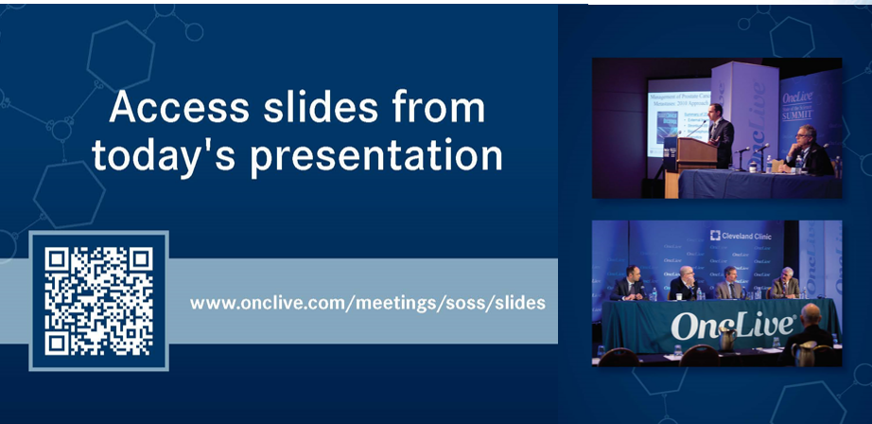

Slide 5


Slide 6
2024 Events
Lung: June, Chicago, IL
Pan Tumor: October, Miami, FL
Gastrointestinal: November, Washington, DC
Breast: December, San Antonio, TX

Slide 7
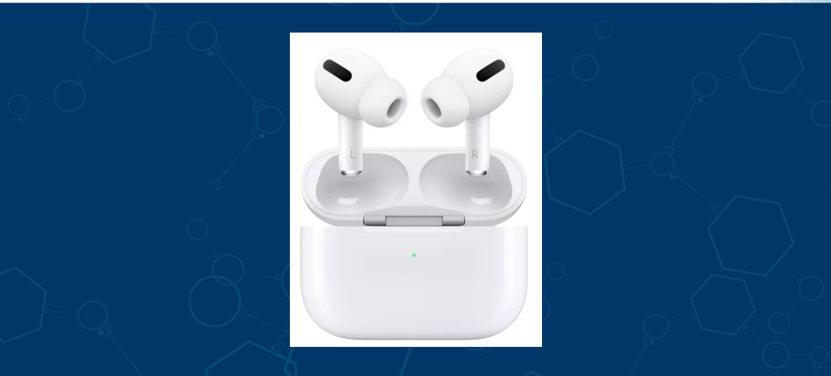
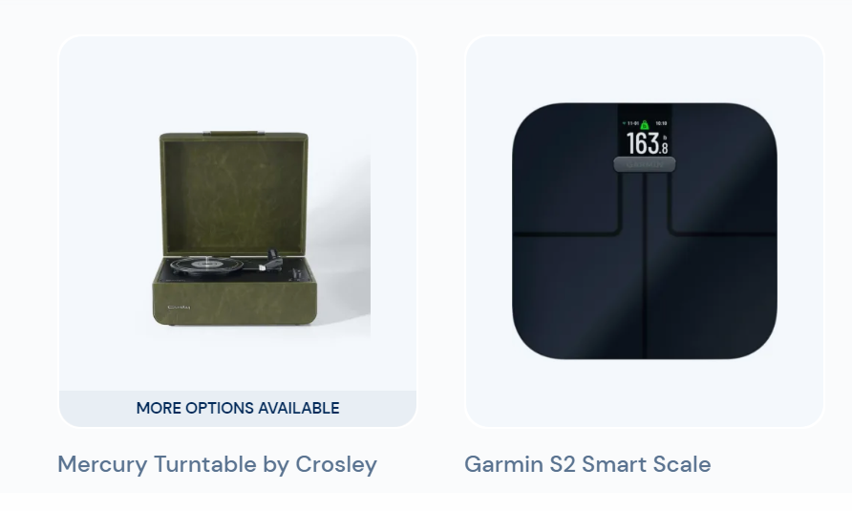
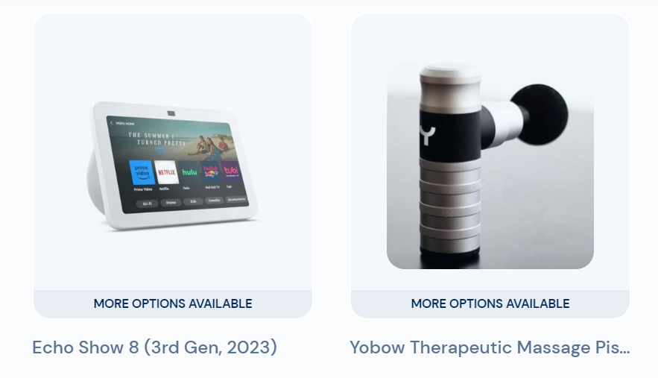

Slide 8
Program Chair
Annie Im, MD, FASCO
Associate Professor of Medicine
University of Pittsburgh, UPMC Hillman Cancer Center
Pittsburgh, PA

Slide 9
Hematologic Malignancies
May 9th, 2024

Slide 10
Evolving Standards in MF, PV, and…
(tales of subtypes, targets, dose intensity, and allele frequencies)
James M. Rossetti, DO
Assistant Professor of Clinical Medicine, UPSOM
UPMC Hillman Cancer Center
Pittsburgh, Pennsylvania

Slide 11
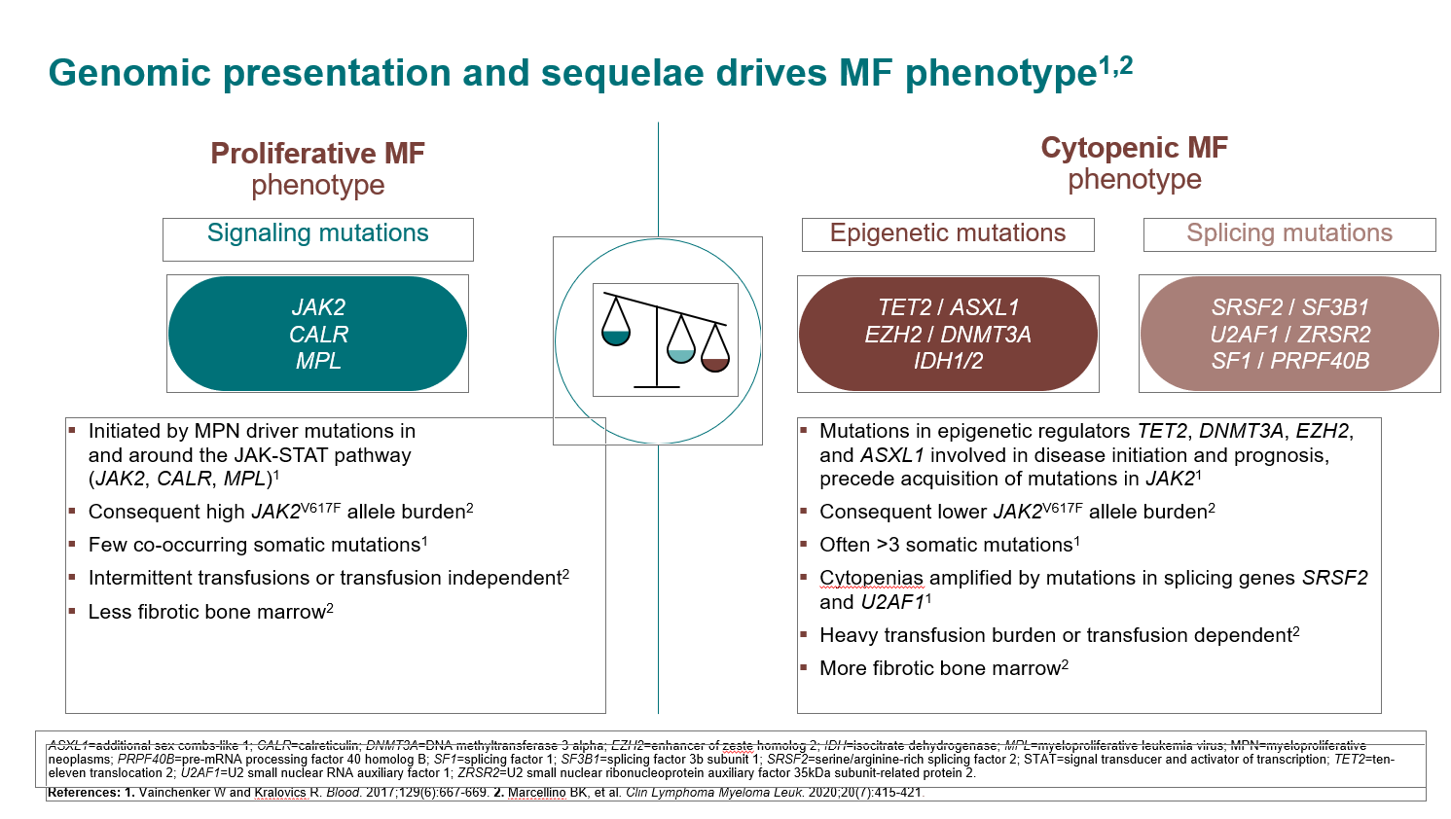

Slide 12
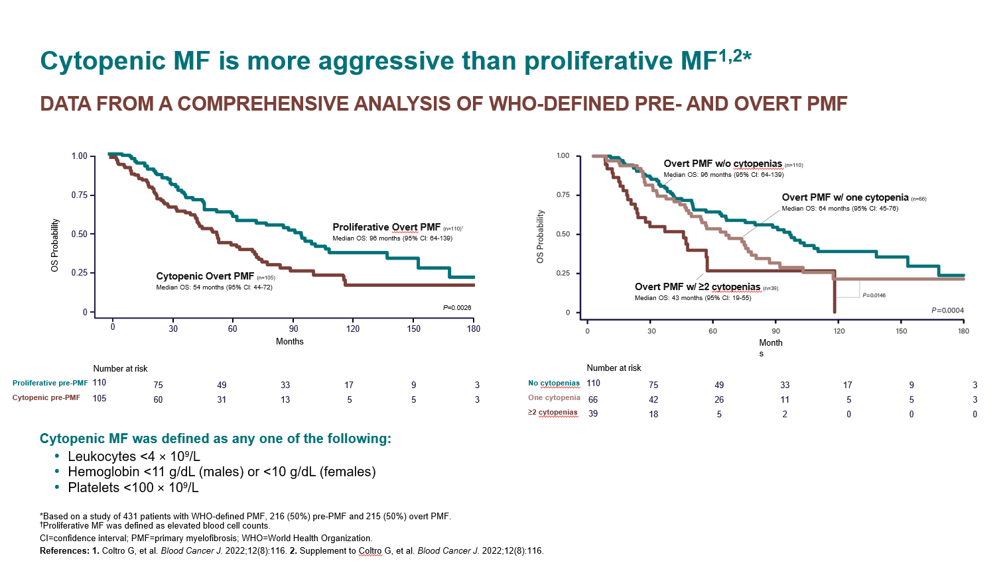

Slide 13
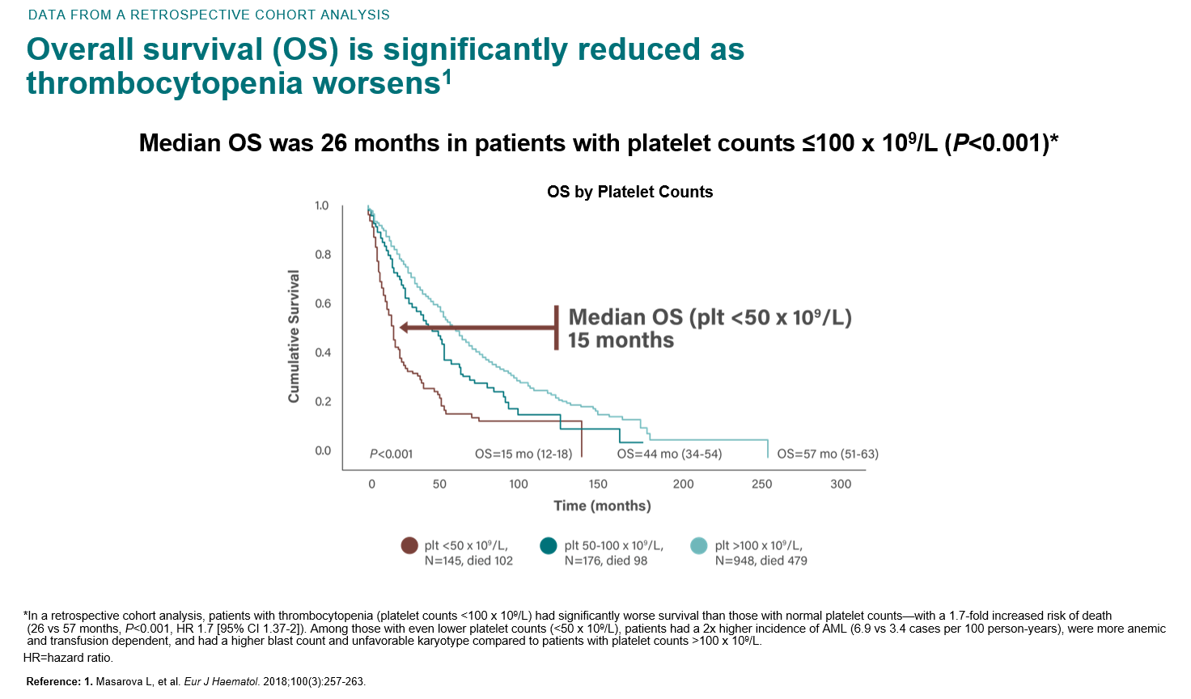

Slide 14
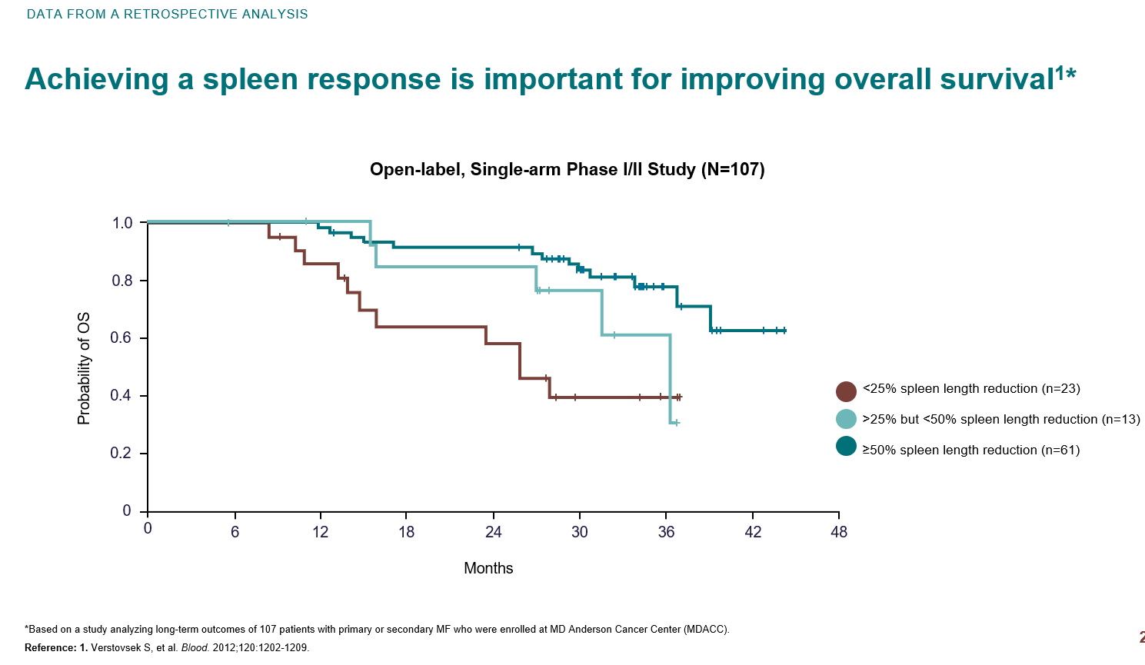

Slide 15
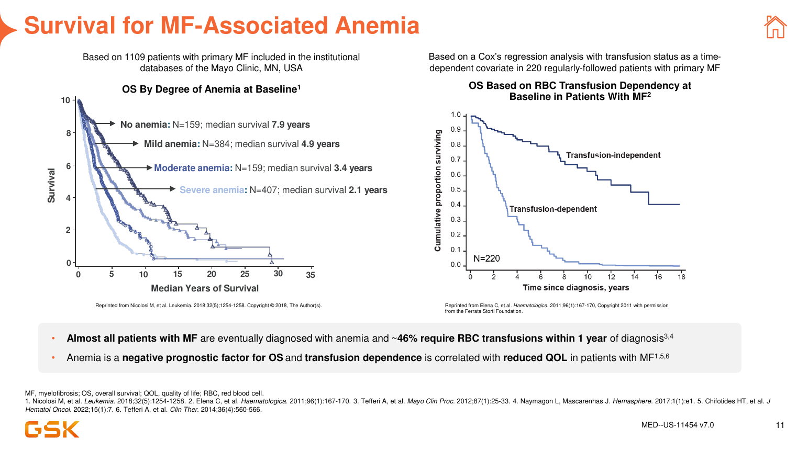

Slide 16
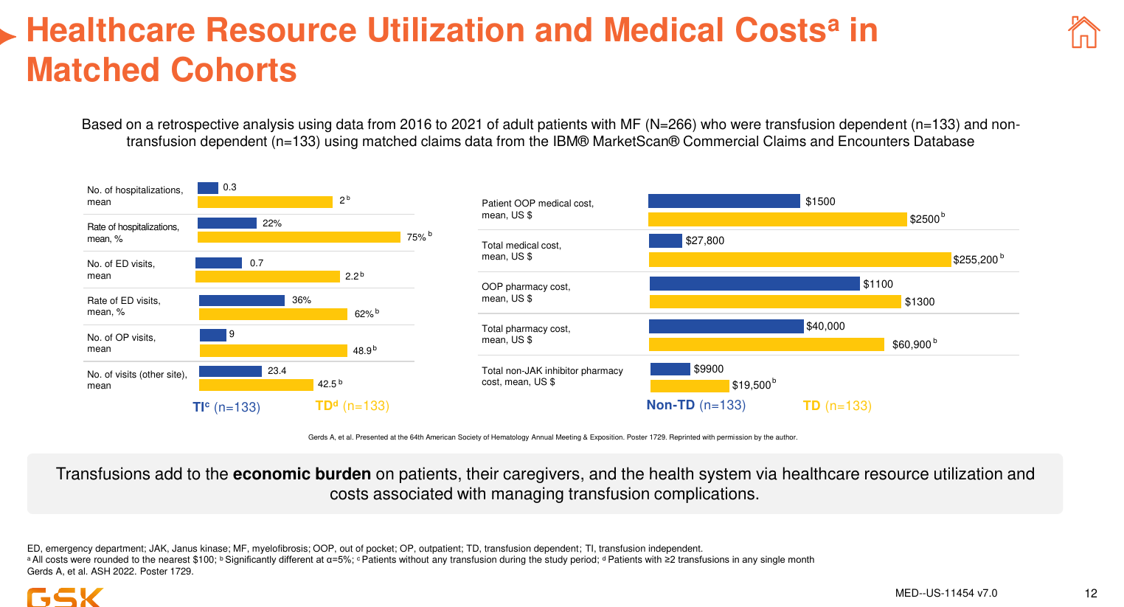

Slide 17
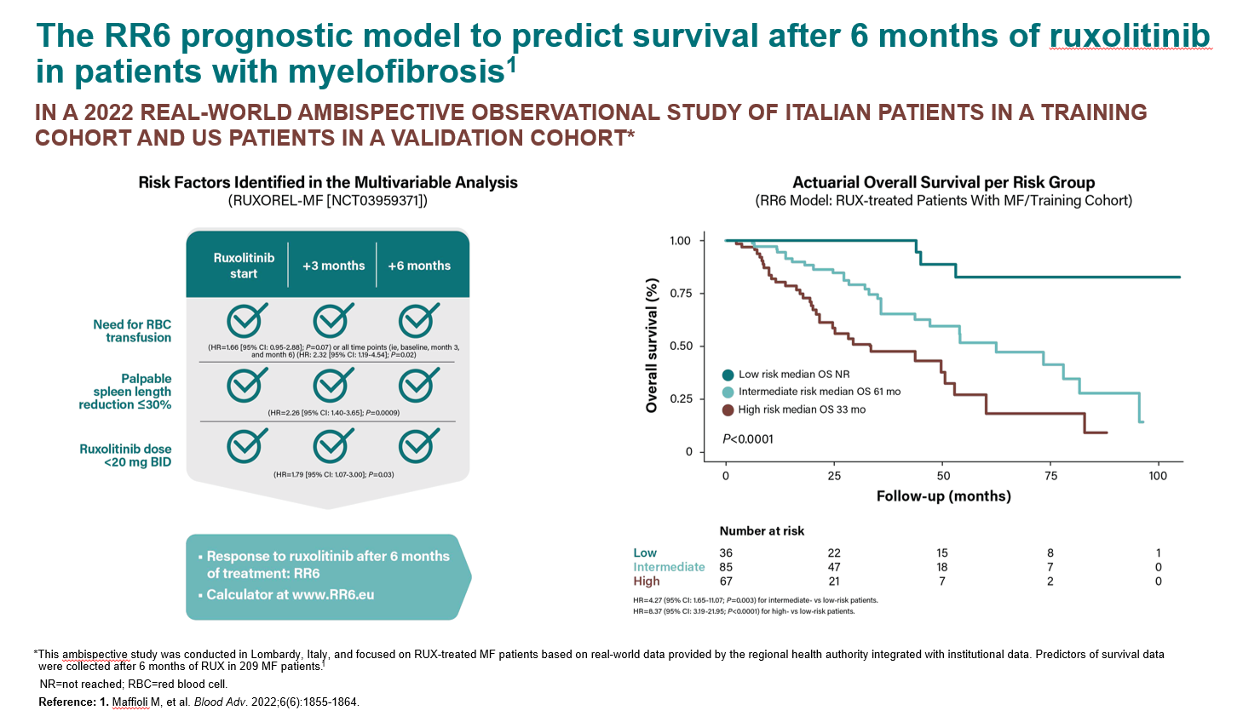

Slide 18
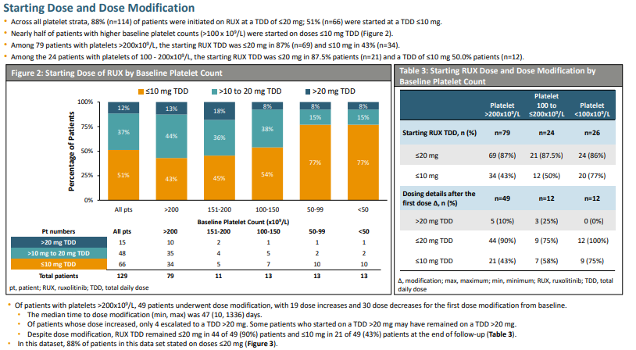
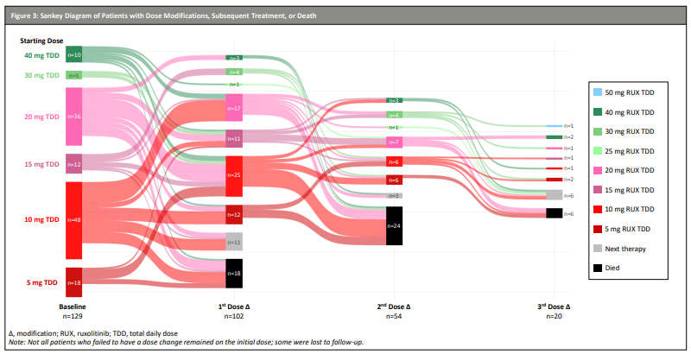

Slide 19
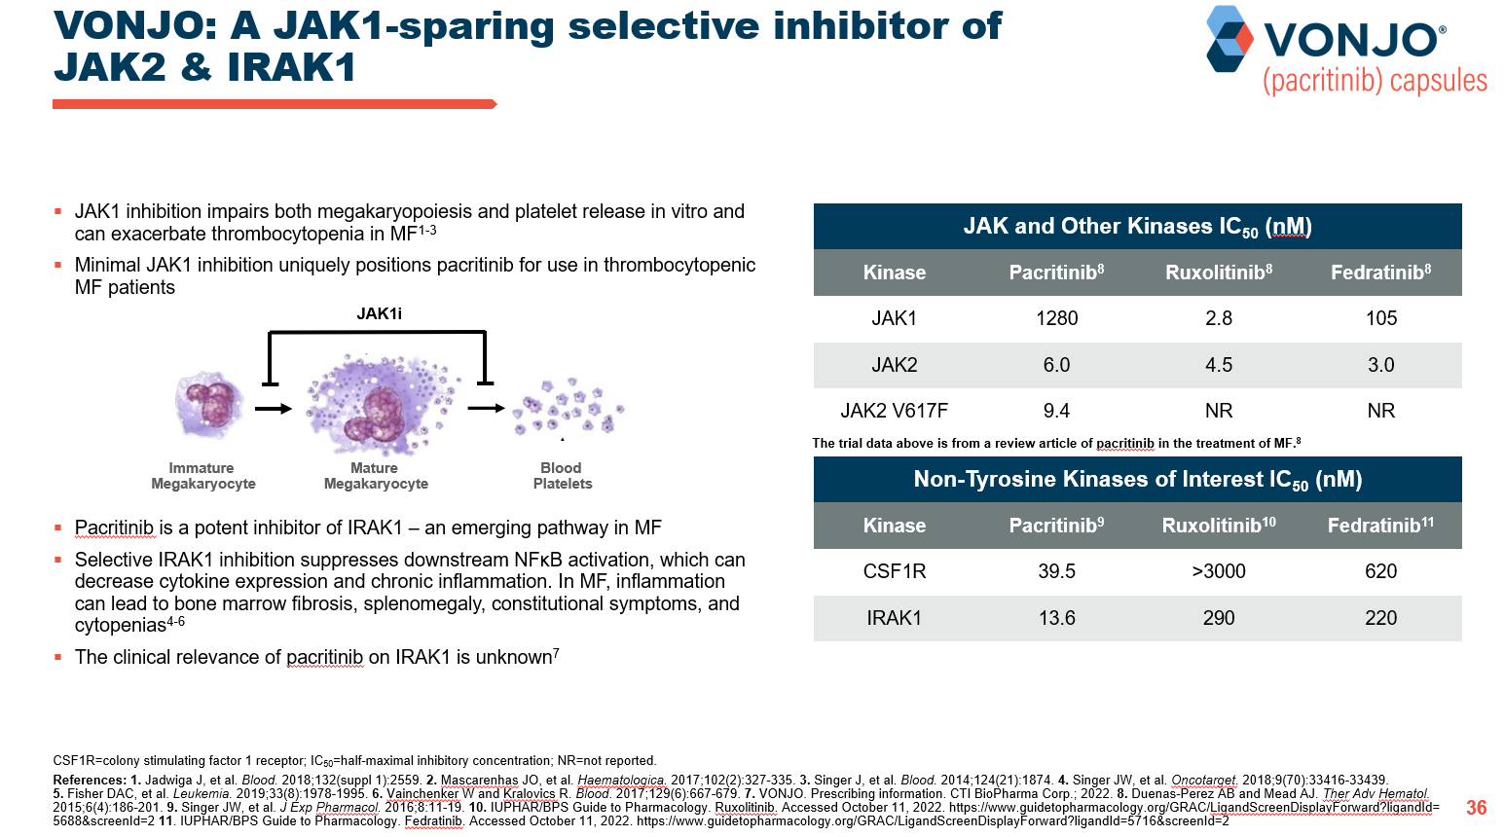

Slide 20
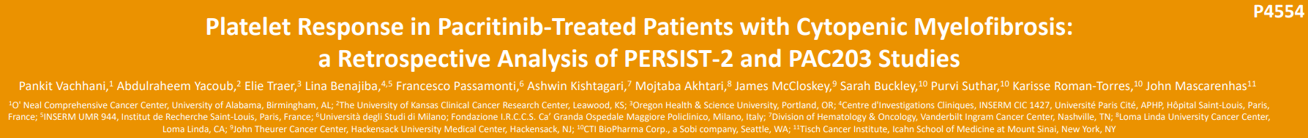
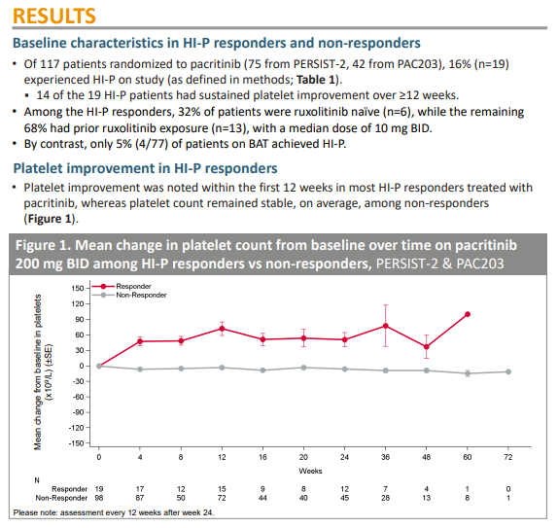
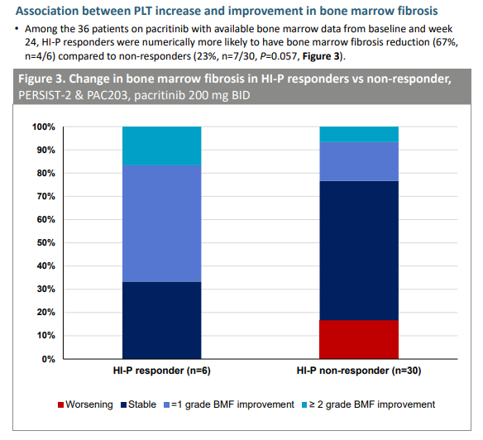

Slide 21
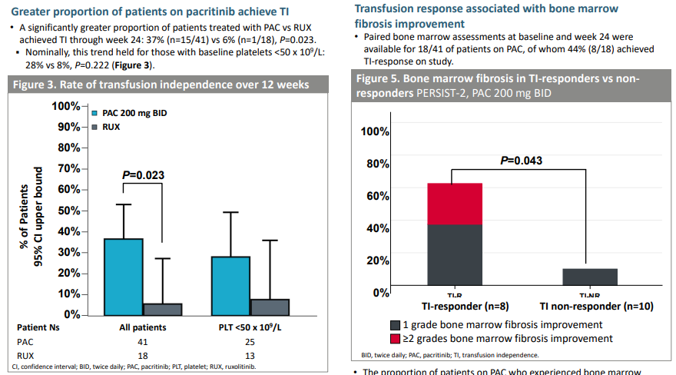

Slide 22
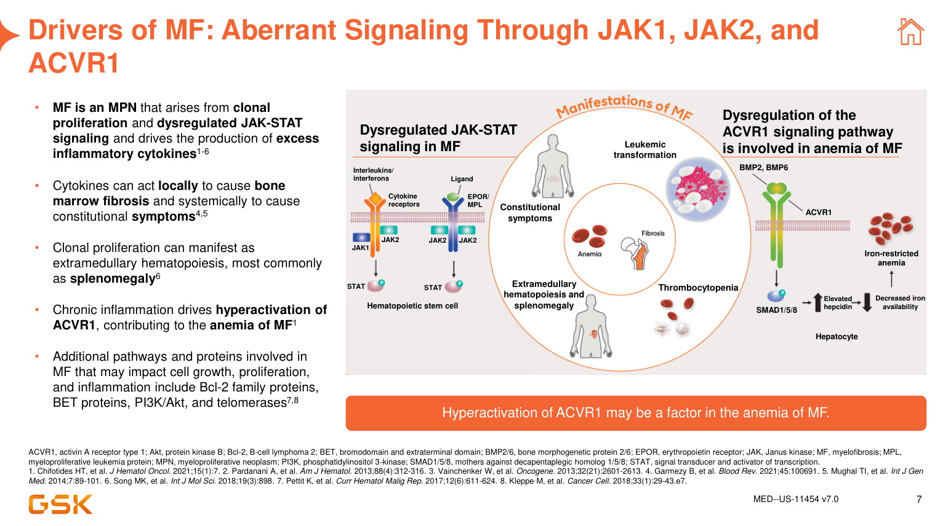

Slide 23
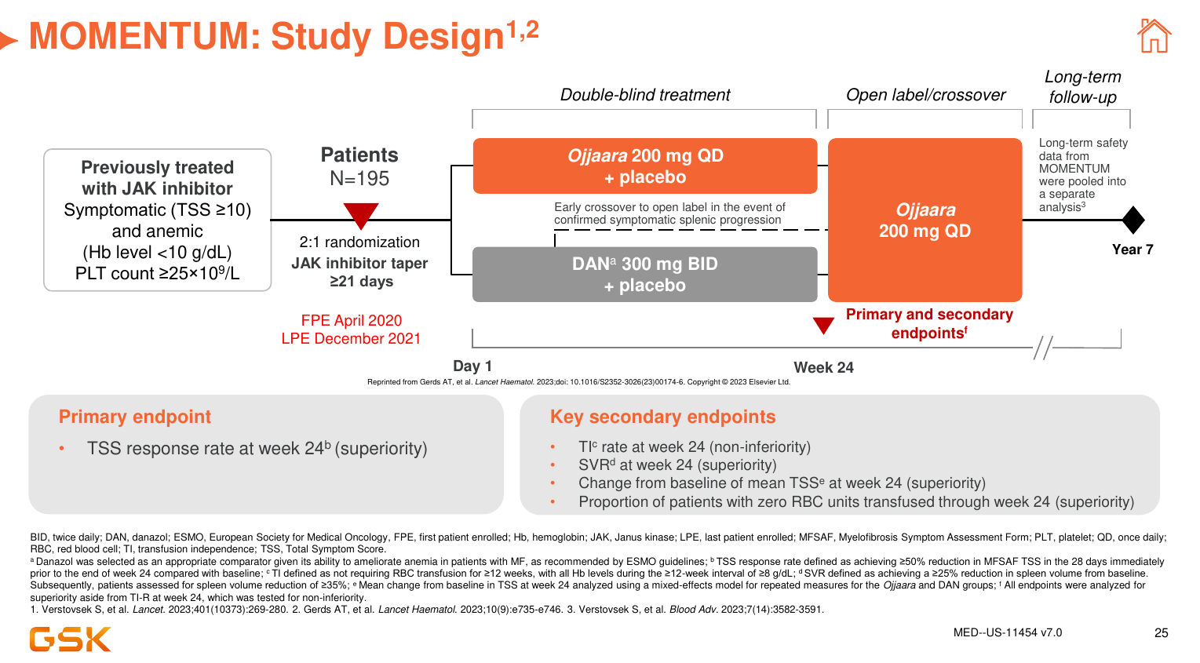

Slide 24
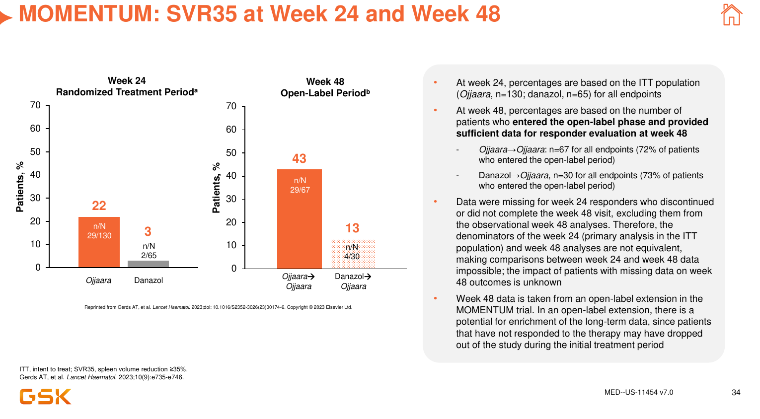

Slide 25
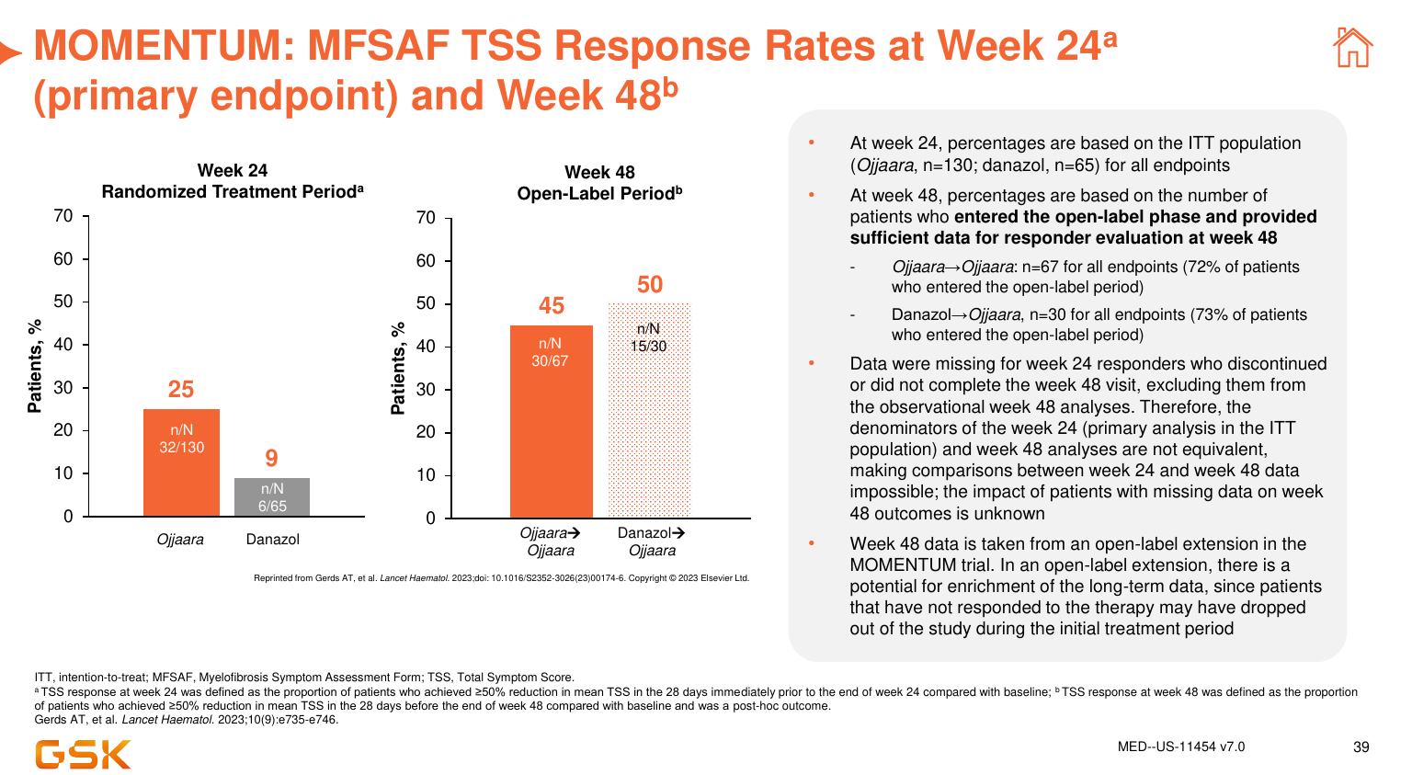

Slide 26
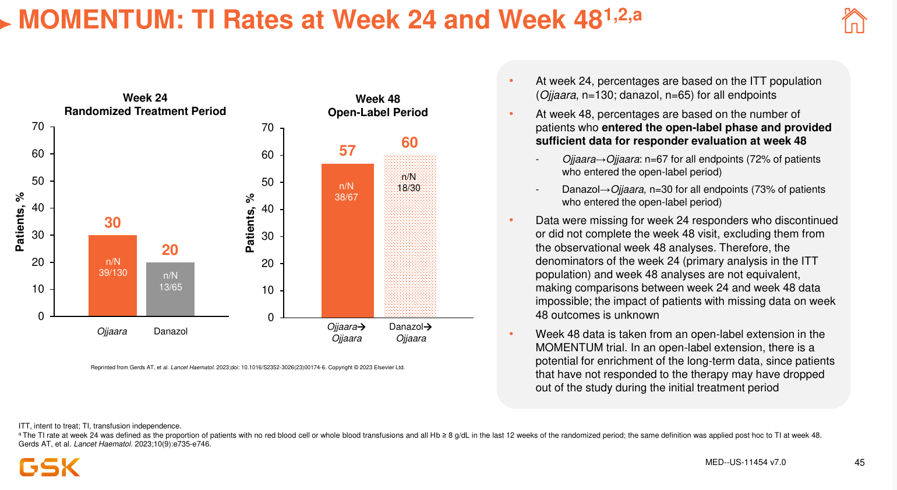

Slide 27
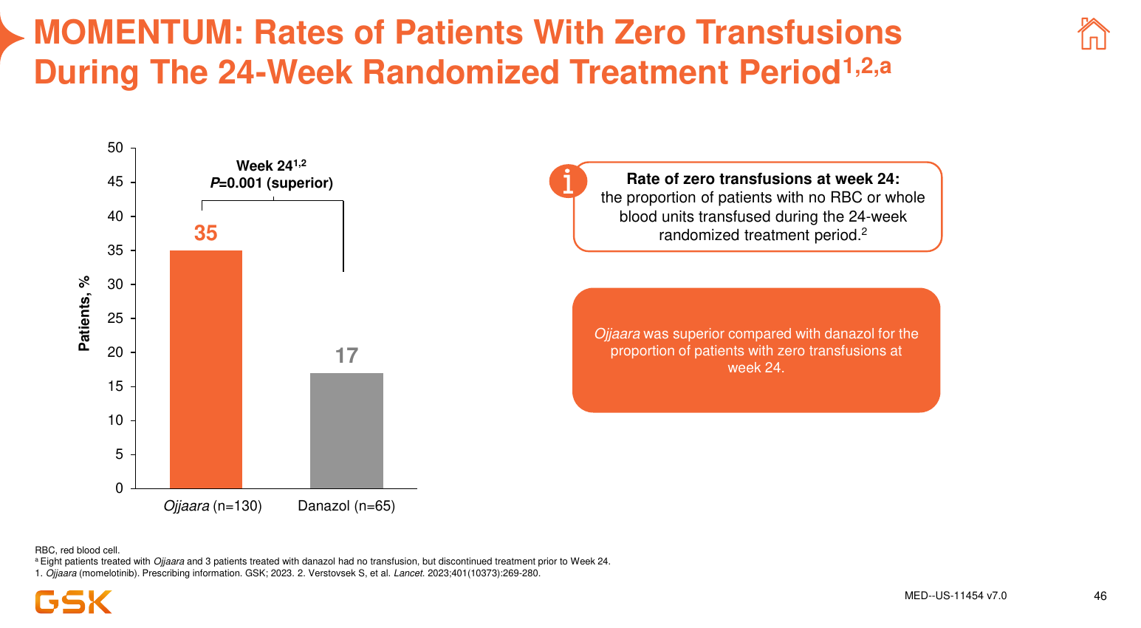

Slide 28
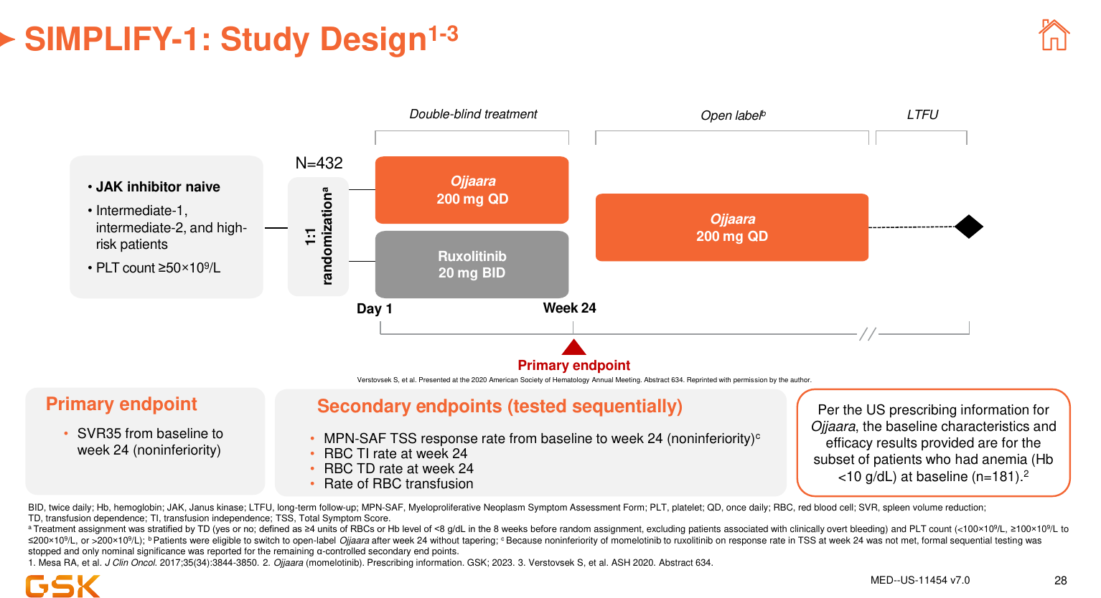

Slide 29
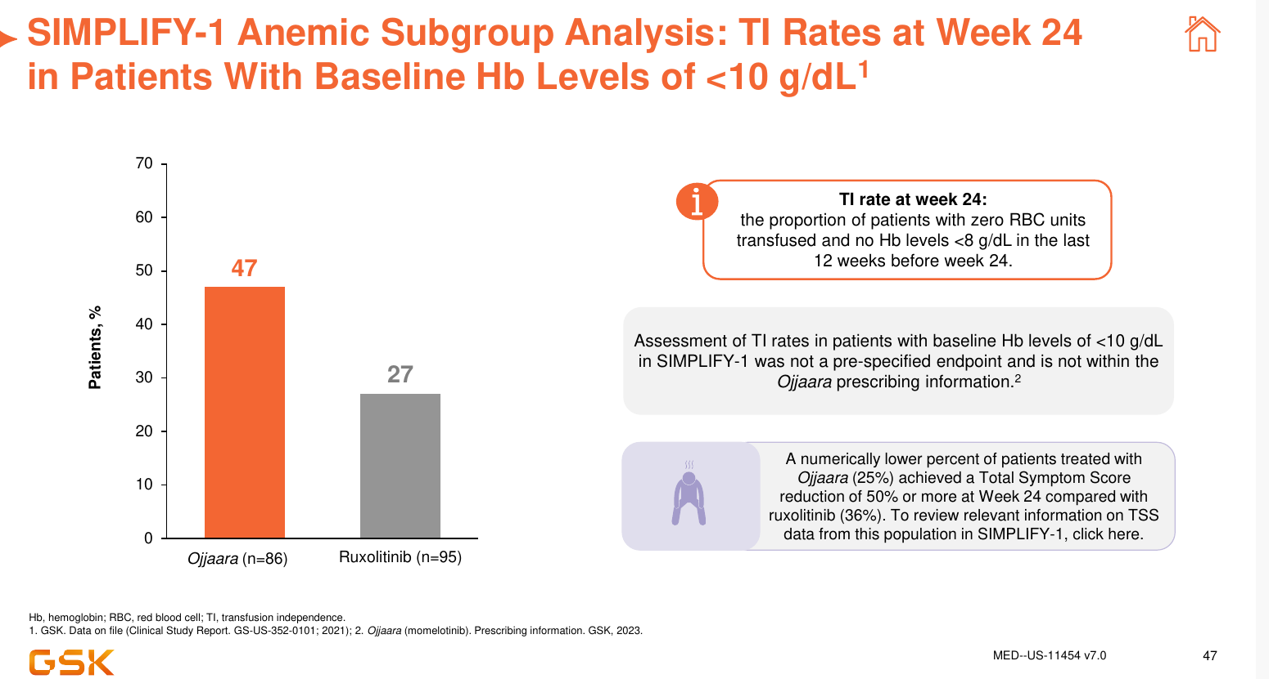

Slide 30
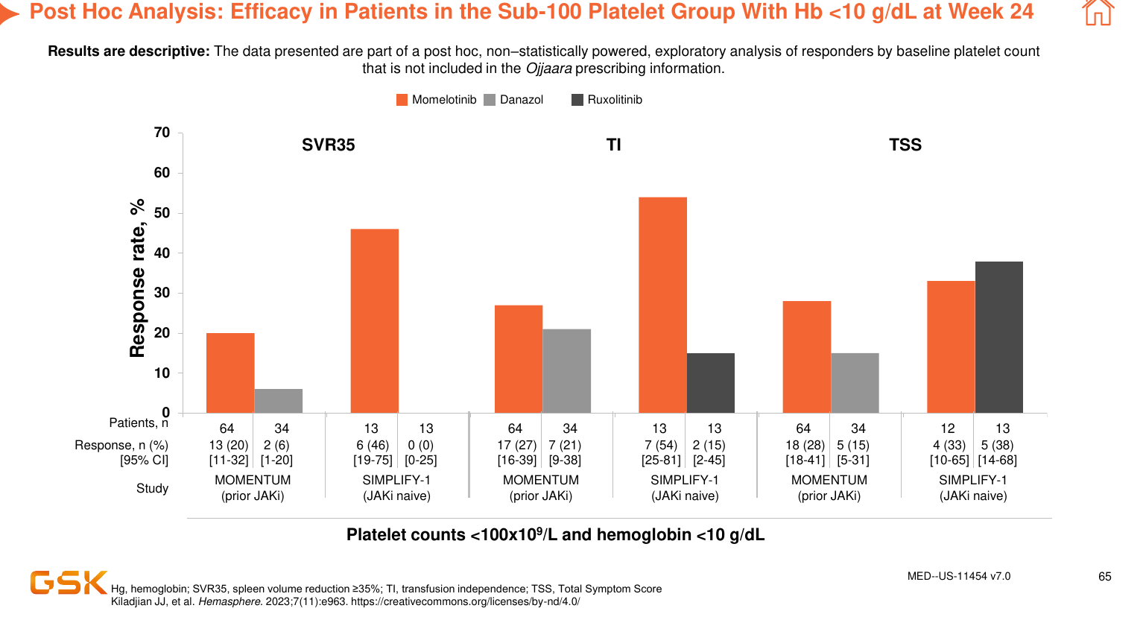

Slide 31
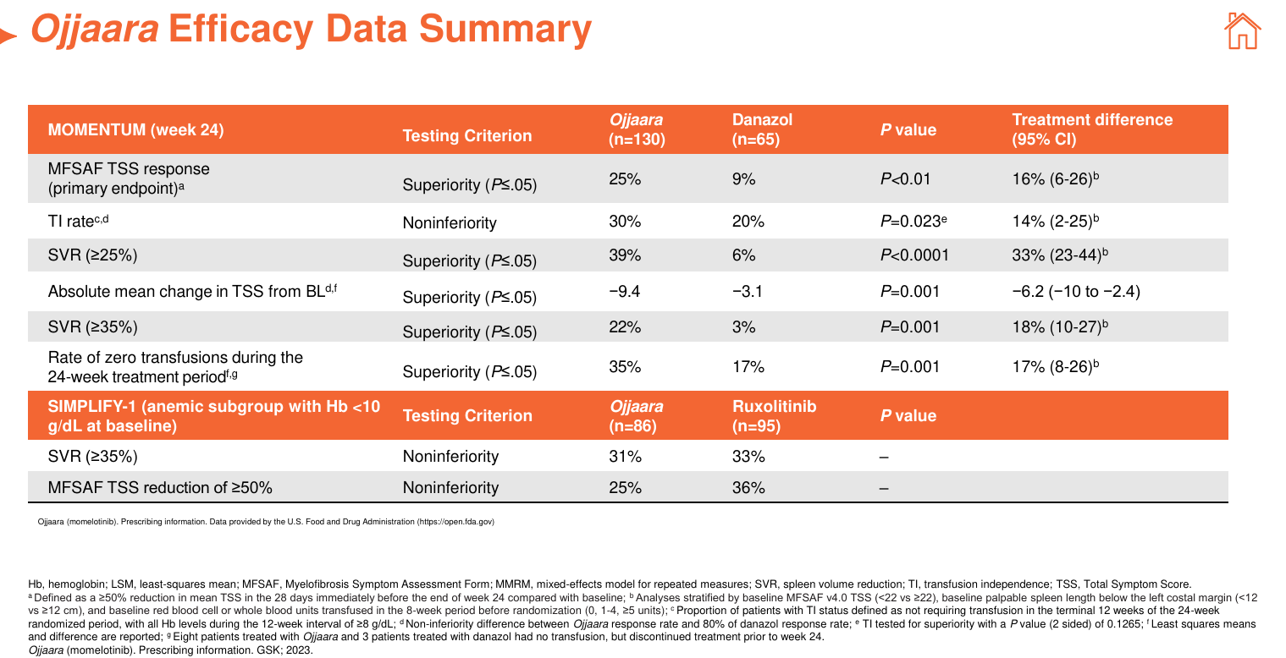

Slide 32
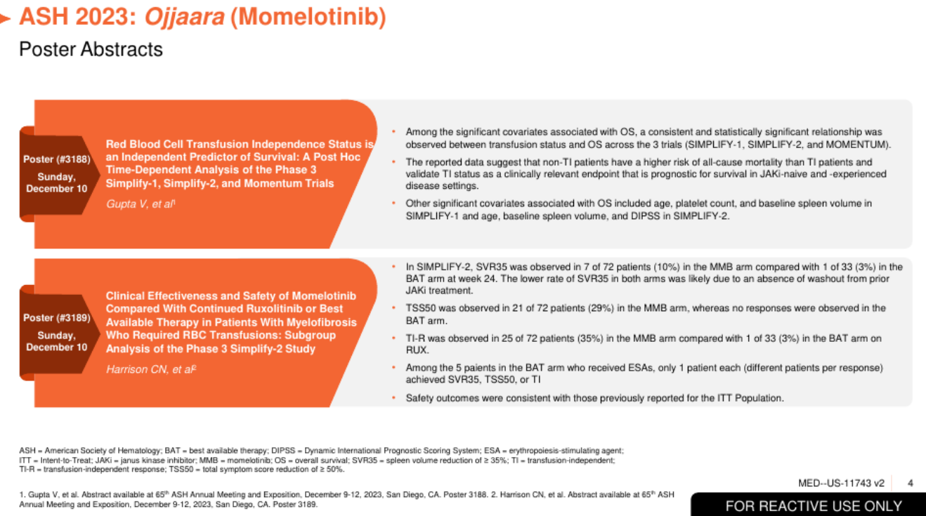
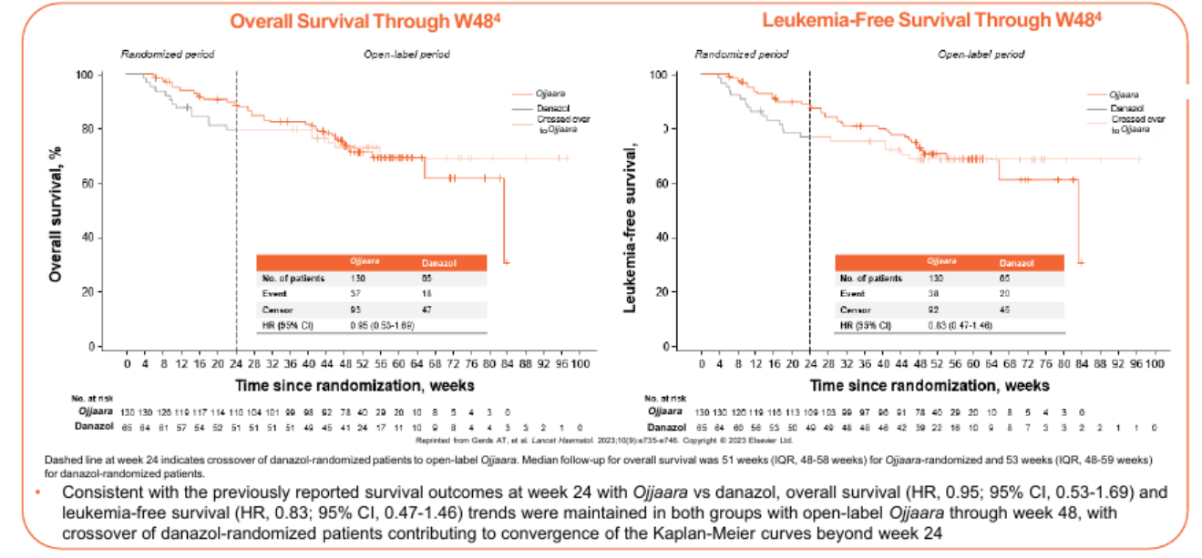

Slide 33
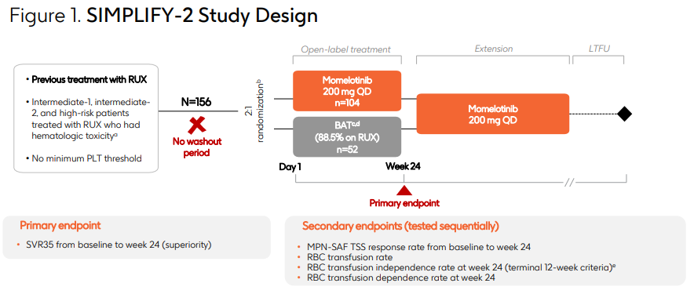
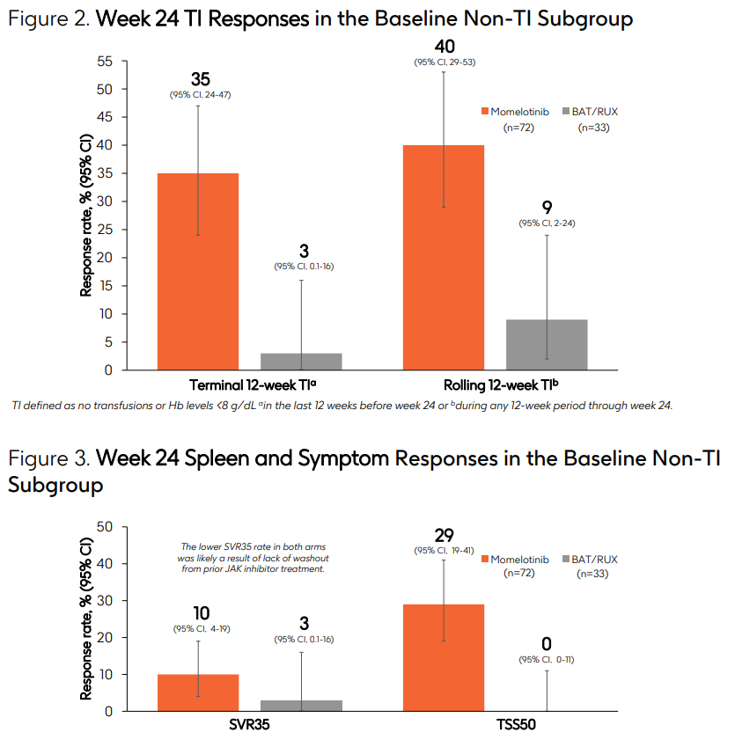
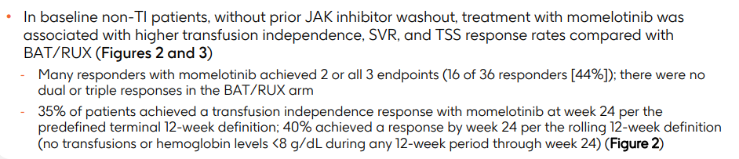

Slide 34
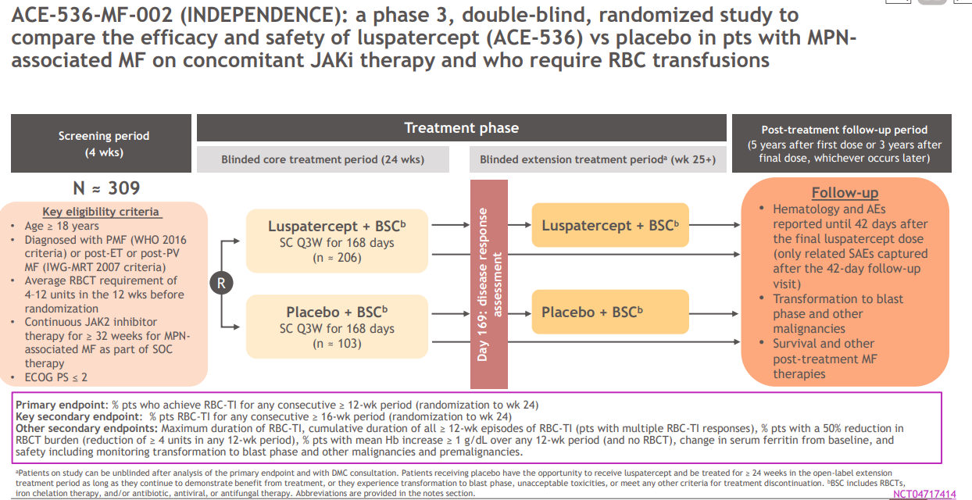

Slide 35
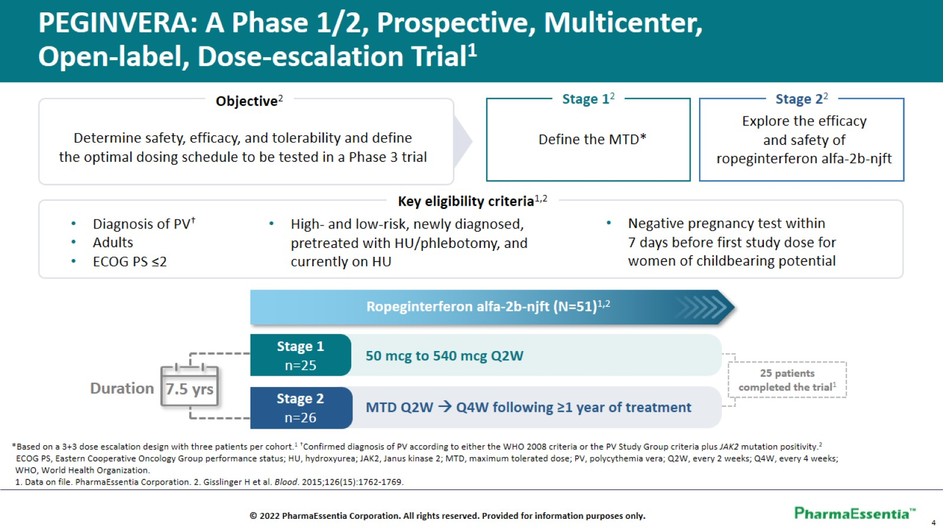

Slide 36
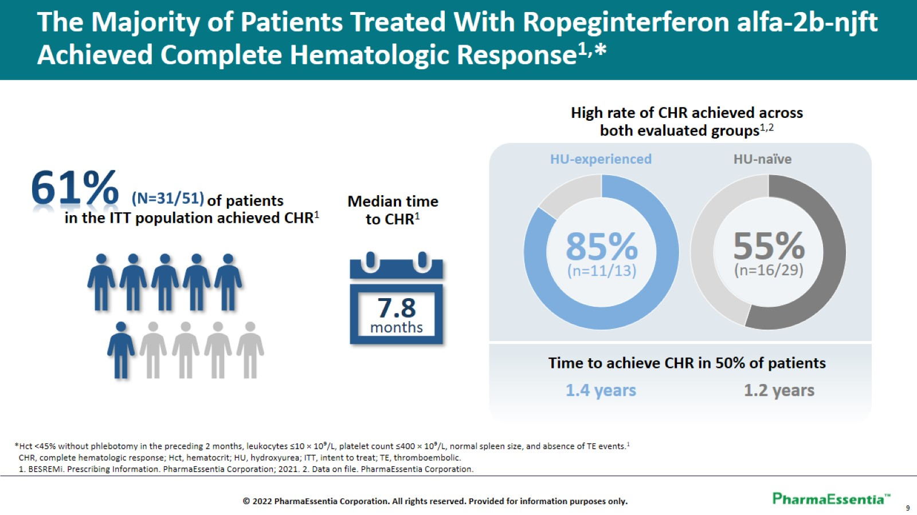

Slide 37
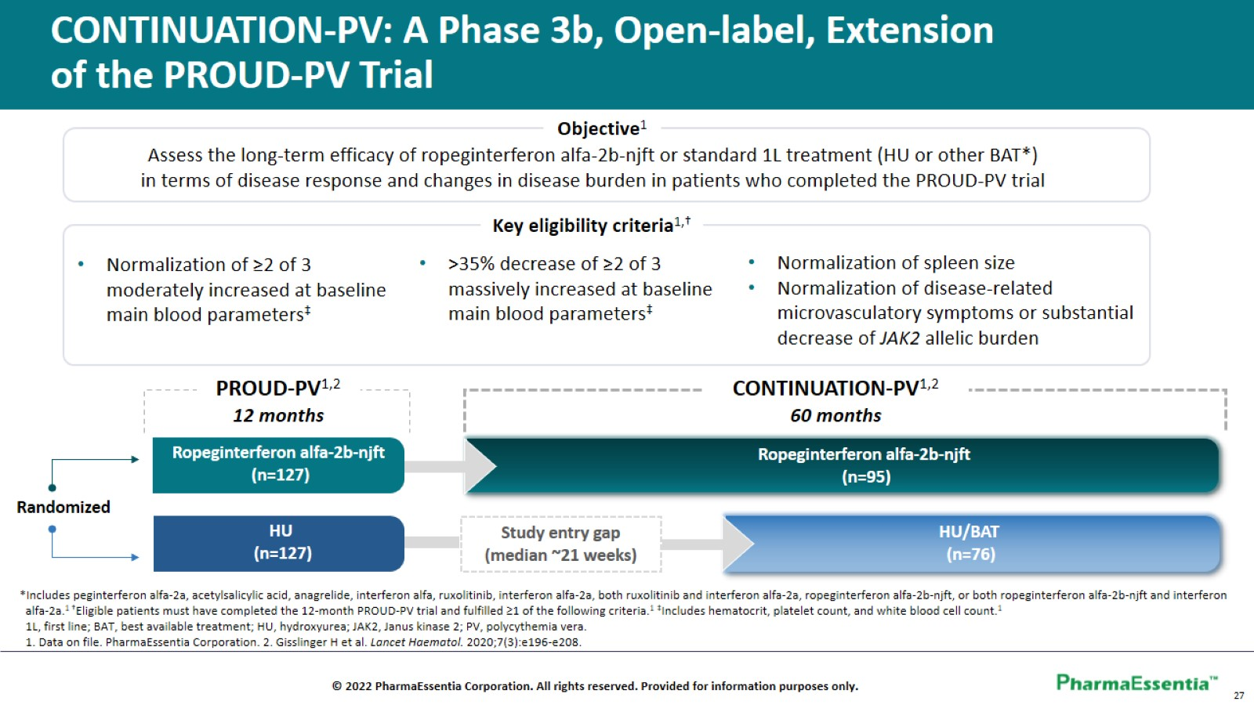

Slide 38
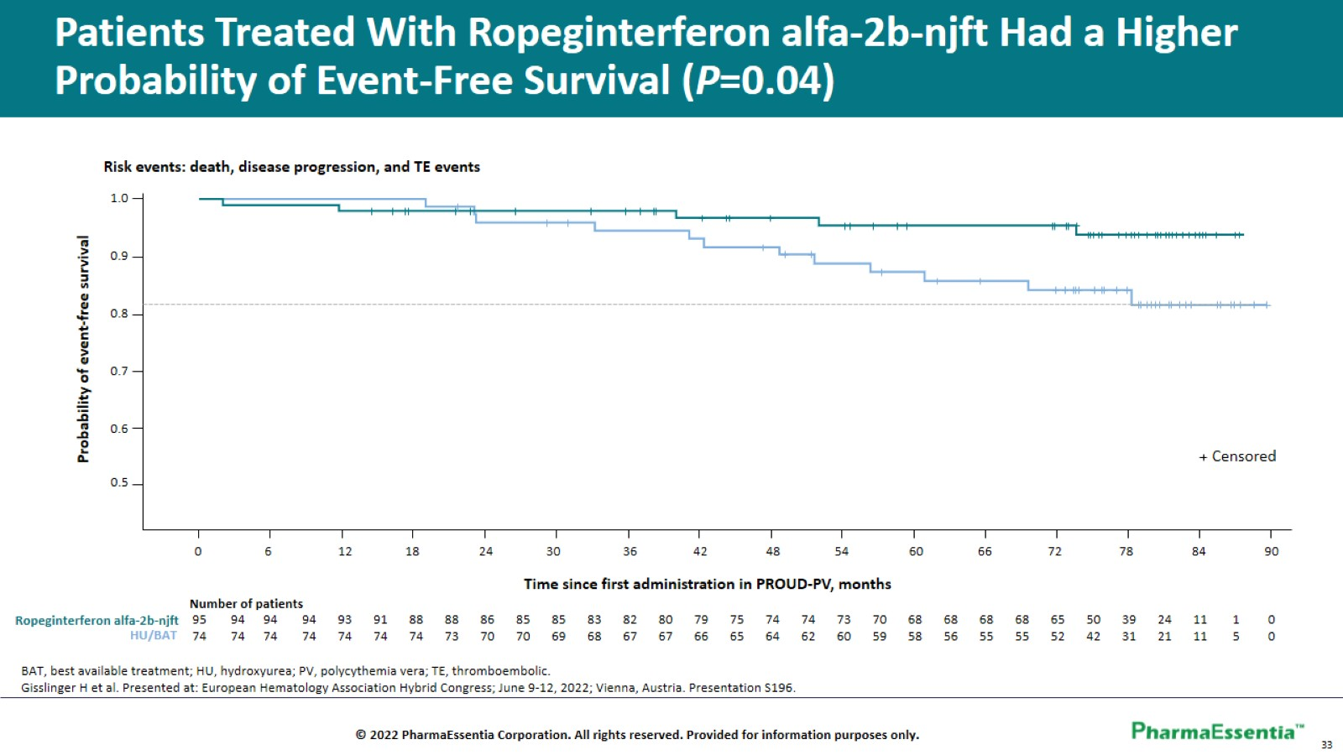

Slide 39
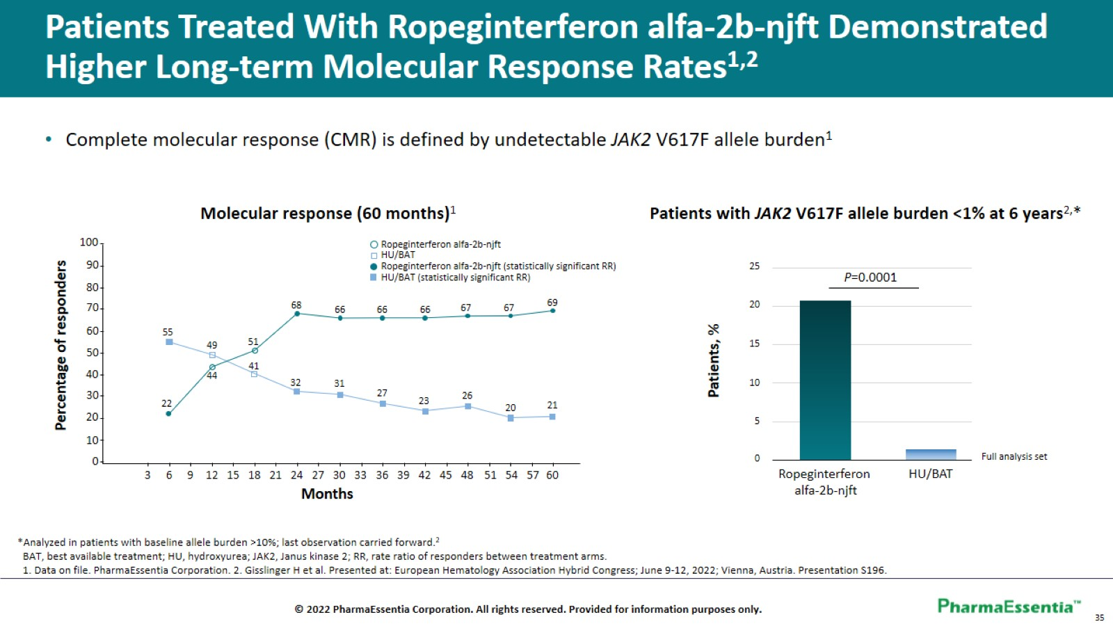

Slide 40
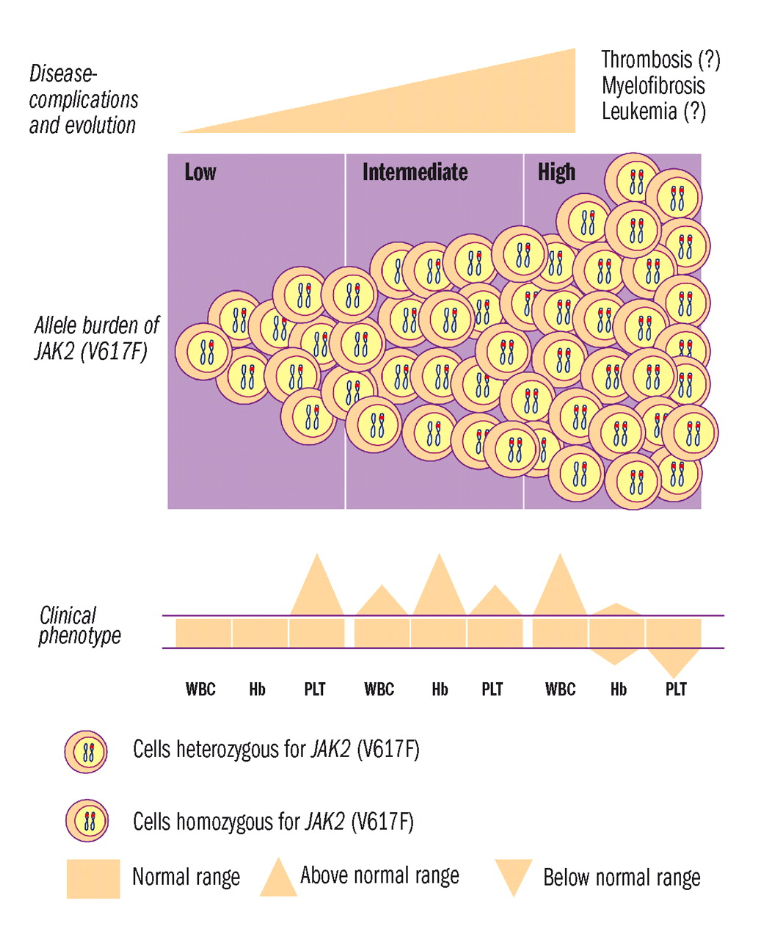

Slide 41
Hematologic Malignancies
May 9th, 2024

Slide 42
Management of Myelodysplastic Syndrome
Alison Sehgal, MD
Clinical Assistant Professor of Medicine
Hillman Cancer Center, UPMC
Pittsburgh, PA

Slide 43
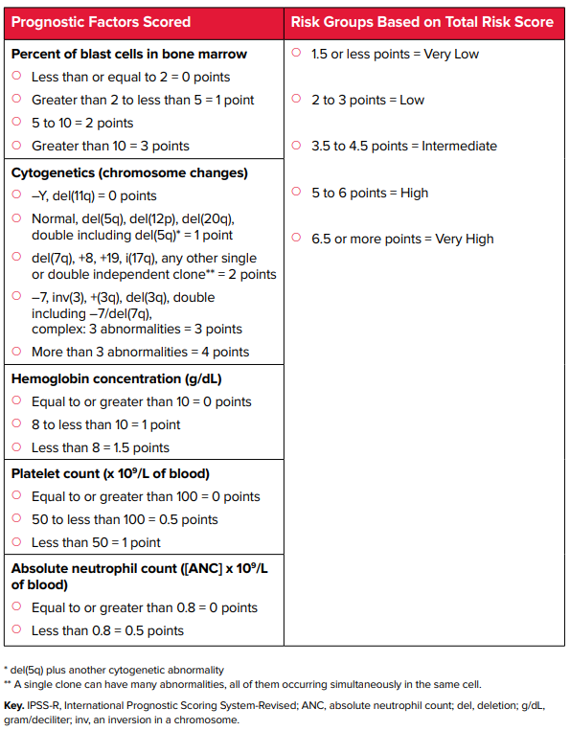
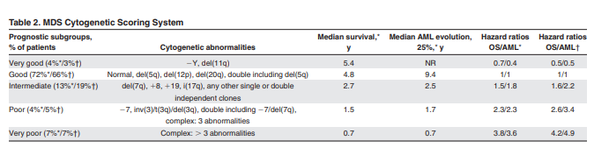
Prognostic category guides management of MDS
  R-IPSS¹
1. Greenberg, Tuechler, Schanz et al, Revised International Prognostic Scoring System (IPSS-R) for Myelodysplastic Syndrome, Blood 120: 2454, 2012.

Slide 44
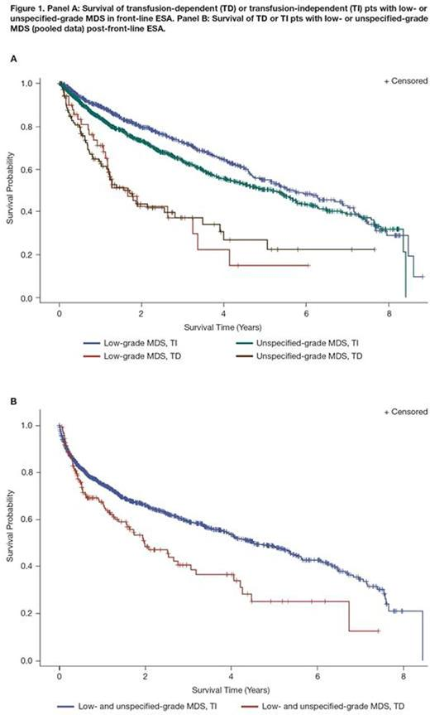
Transfusion Dependence Affects Survival in MDS patients using ESAs
Mehra M, et al December 2016 Blood 128(22):5974-5974

Slide 45
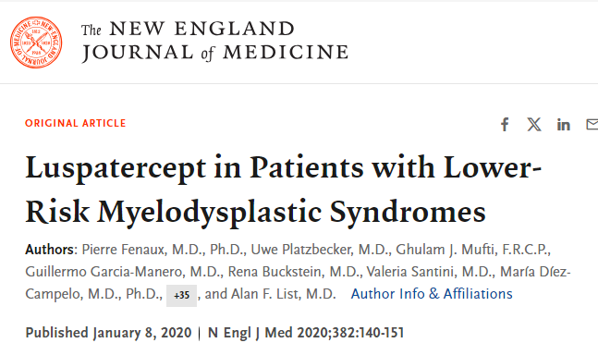
Lower-Risk Myelodysplastic Syndrome
A recombinant fusion protein that binds transforming growth factor β superfamily ligands to reduce SMAD2 and SMAD3 signaling
FDA approved for anemia failing an ESA & transfusion dependent with very low- to intermediate-risk MDS with ring sideroblasts (MDS-RS).
8 weeks of transfusion independence: 37.9% vs 13.2%, (p<0.0001.)

Slide 46
COMMANDS trial
Eligibility:
>18 years
MDS very low risk, low risk, or intermediate risk
ESA-naïve
RBC dependent (2–6 packed red blood cell units per 8 weeks for ≥8 weeks immediately before randomization
Trial Design
Randomized phase 3 to luspatercept or epoetin alfa (1.0–1.75 mg/kg) SQ Q3W, or epoetin alfa (450–1050 IU/kg) SC Q1W for >24 weeks
Stratified baseline RBC transfusion burden, Ring Sideroblast status. and sEPO (≤ 200 vs > 200 U/L).
Primary endpoint: RBC-TI ≥ 12 wk with a concurrent mean hemoglobin (Hb) increase ≥ 1.5 g/dL (wk 1–24)

Slide 47
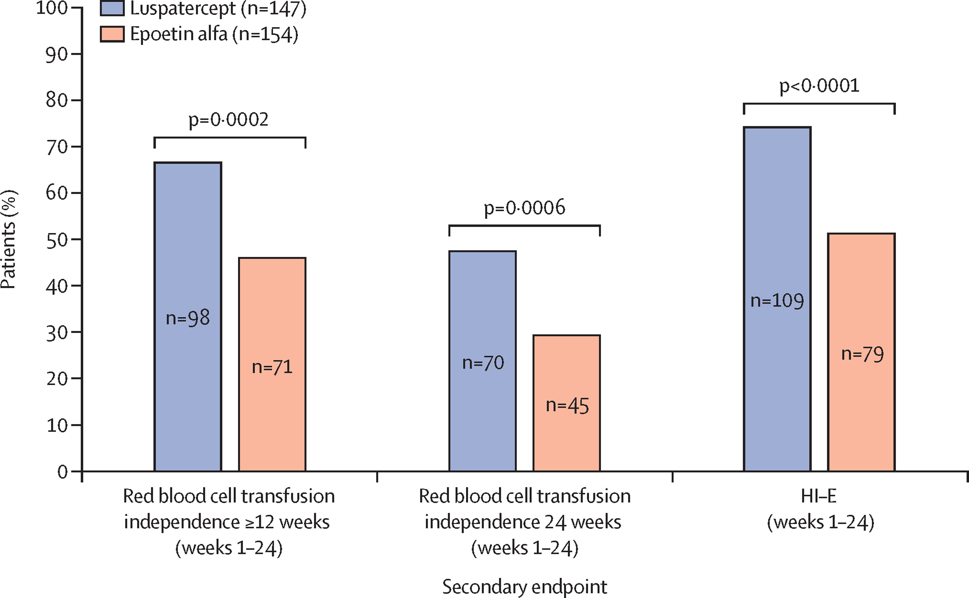
COMMANDS trial
Luspatercept versus epoetin alfa in lower-risk MDS in transfusion dependent ESA-naive patients: Interim Analysis (after 301 treated patients)
Platzbecker, et al . Lancet. 2023 Jul 29;402(10399):373-385. .

Slide 48
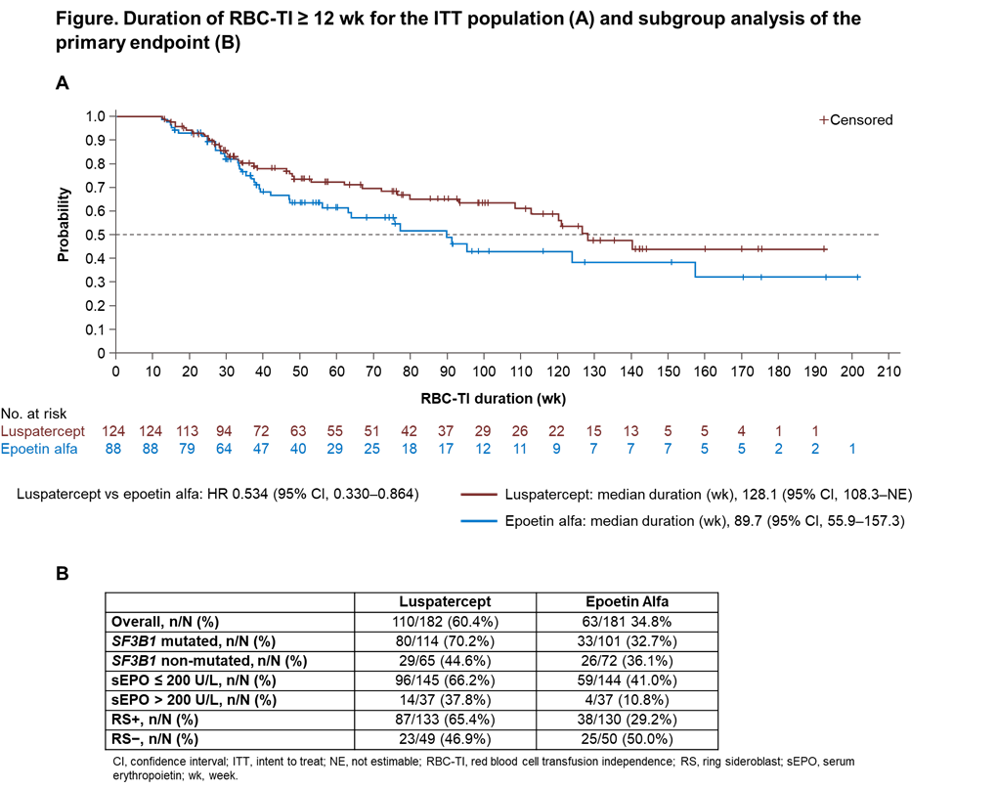
Garcia-Manero, et al, ASH 2023 Abstract 193

Slide 49
Garcia-Manero, et al, ASH 2023 Abstract 193

Slide 50
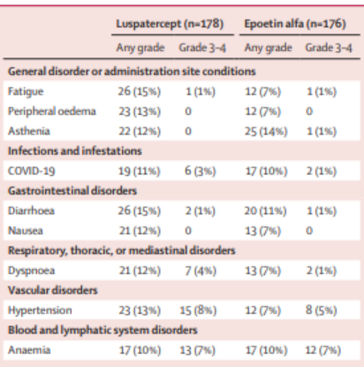
Platzbecker, et al . Lancet. 2023 Jul 29;402(10399):373-385. .

Slide 51
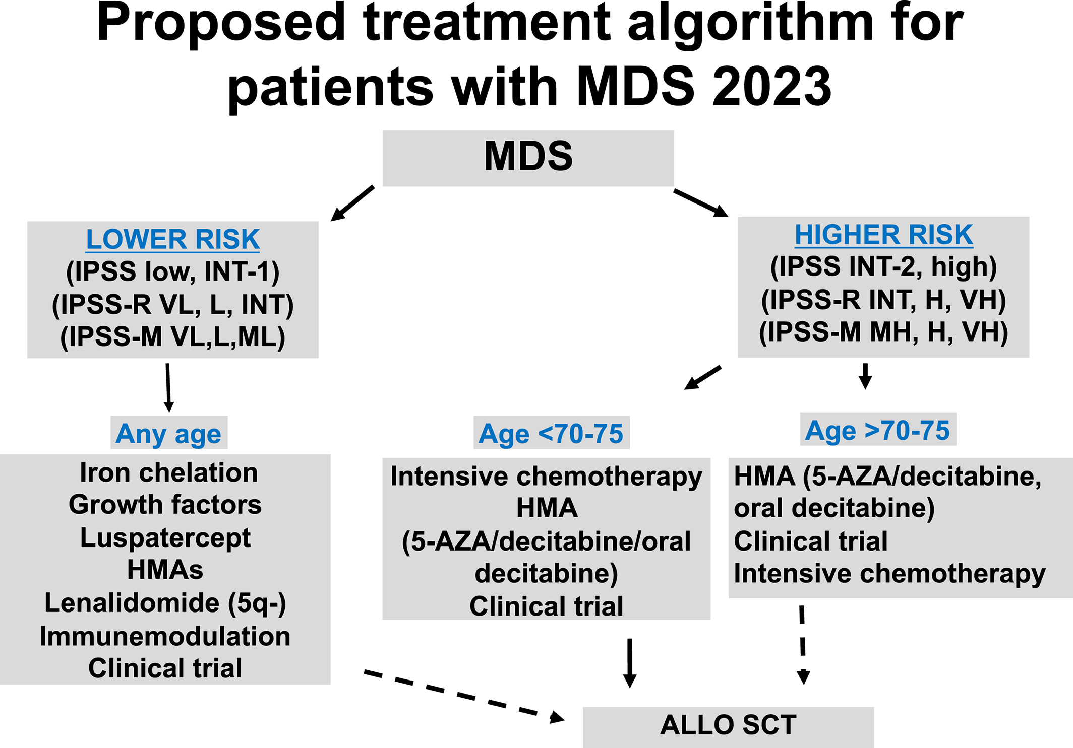
Garcia-Manero, G. J Hematol, Volume: 98, Issue: 8, Pages: 1307-1325

Slide 52
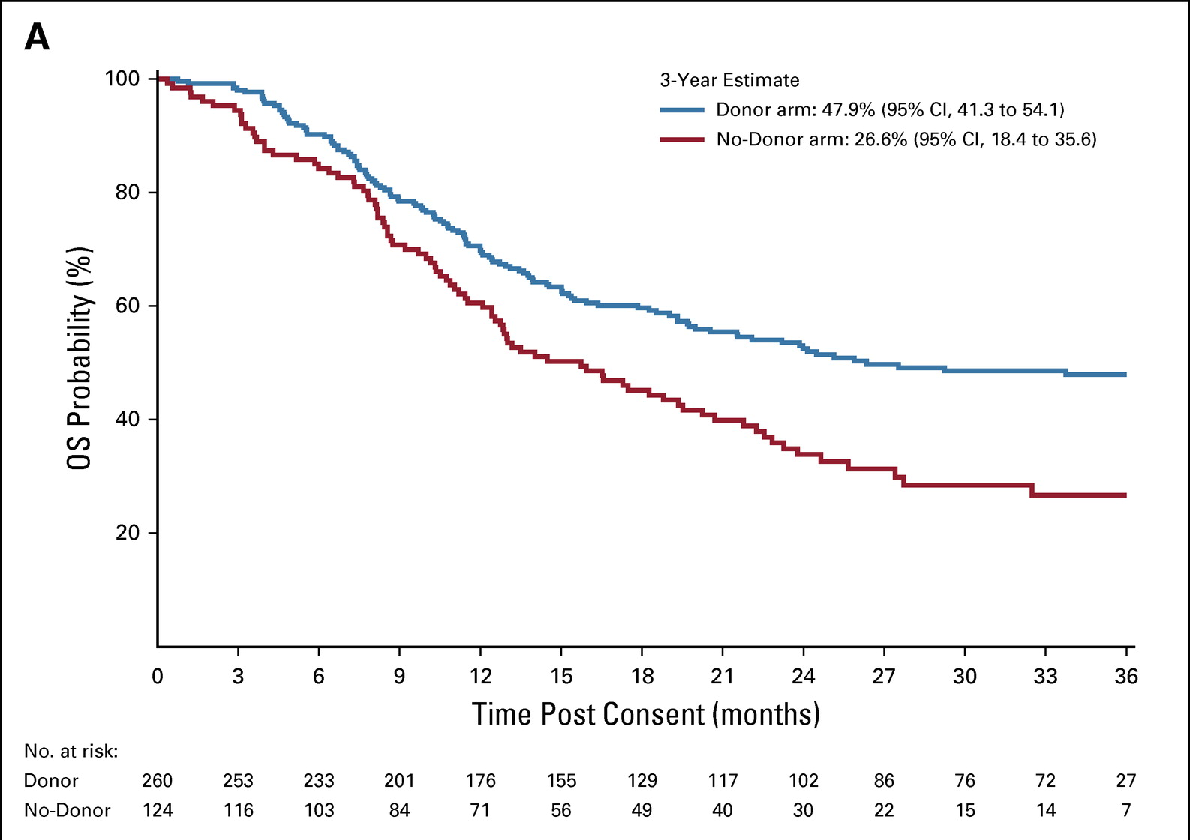
Allogeneic transplant
Multicenter, biologic assignment trial
Suitable donor vs. no suitable donor.
Occurred in 2014-2018
50-75 years of age
Intermediate-2 or high-risk MDS (IPSS)
Eligible for RIC allogeneic HCT

Slide 53
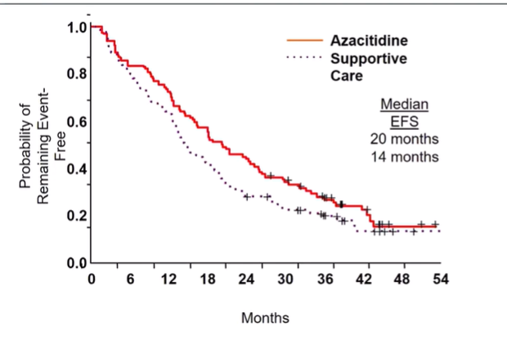
Hypomethylating agents in high risk MDS
Silverman, LR. et al, J Clin Oncol. 2002; 20: 2429-2440

Slide 54

Phase 3 VERONA: Aza+ Ven

Slide 55
Targeted therapy with the mutant IDH1 inhibitor ivosidenib IDH1-mutant myelodysplastic syndrome
Ivosidenib single agent- Continuous 28-day cycles of IVO - 500 mg orally QD.
  Cohort A: Higher risk MDS having failed azacytidine (n = 13)
  Cohort B: Untreated higher risk MDS without severe cytopenias (n = 13)
  Cohort C: Low-risk MDS after EPO failure (n= 2)
ORR: 69% including 12 CR (46%), 1 PR and 5 HI. Most patients achieved response after 3 cycles (17/18).
Response was achieved in 7 (54%), 10 (91%) and 1 (50%) in cohort A, B and C
Response duration: Median 7.4 mo
Sebert, et al., Blood (2021) 138 (Supplement 1): 62.
FDA Approval 10/2023

Slide 56

Targeted therapy with the mutant IDH2 inhibitor enasidenib for high-risk IDH2-mutant myelodysplastic syndrome
Goal: Assess the safety, tolerability, and efficacy of:
A) enasidenib in combination with azacitidine for higher-risk HMA-naïve mIDH2 MDS or
B) single-agent therapy for patients with R/R mIDH2 MDS following previous HMA therapy
DiNardo, et al., Blood Adv, 2023, Figure 4.

Slide 57
Olutasidenib Alone or in Combination with Azacitidine Induces Durable Complete Remissions in Patients with mIDH1 Myelodysplastic Syndromes/Neoplasms (MDS)
Study Design: Olutasidenib was administered at monotherapy (n=6) or in combination with azacitidine (n=16) for high risk MDS
Primary endpoint CR rate.
Note: 3 pts in monotherapy were treated at lower dose than approved. No response.
Cortes, J., ASH 2023, Abstract 1872

Slide 58
Conclusions
Low risk MDS
  Luspatercept in treatment naïve low-risk MDS
High risk MDS
  Allo-transplant referral
  Hypomethylating agent
    Combo or single agent IDH inhibitors
    Venetoclax

Slide 59
Hematologic Malignancies
May 9th, 2024

Slide 60
Case Presentation:
Low Risk MDS
Emily Geramita, MD PhD
Clinical Instructor
UPMC Hillman Cancer Center
Pittsburgh, PA
Notes:
Selected this case because it emphasizes some of the nuances of diagnosing and classifying MDS, and it also takes us through some of the decisions around the optimal treatment for low risk disease.

Slide 61
Initial presentation
October 2022
61-year-old woman presents with fatigue, dyspnea, hypotension
B12 281
Folate 7.5
Zn 0.98
Cu 121
Lead <1.0
B1 61
B6 <2.0
TSH 3.2
Peripheral smear:
Anisopoikilocytosis with microcytosis
Teardrop cells
Basophilic stippling in reticulocytes
7.4
EGD/colo: unremarkable
CTAP: known fatty liver
5.1
360
MCV 89
Retic count 40K
LDH 187
Haptoglobin 208
Notes:
61yo woman with previously normal blood counts comes in with…
normocytic anemia with hgb 7.4
Which are indicators of bone marrow dysfunction.

Slide 62
Past Medical History
Covid 9/2022
HTN
NAFLD
Hypothryoidism
Past Surgical History
None
Family History
Skin cancer, sarcoma, colon cancer, breast cancer – all in 2nd degree relatives
Social History
Alcohol: 3-4 shots per week, multiple hospitalizations for complications related to intoxication (e.g., falls, syncope)
No tobacco or illicits
Medications
Amlodipine
Atorvastatin
Metoprolol tartrate
Levothyroxine
Notes:
I would add, just as a brief aside, that her alcohol use from this point on has waxed and waned, driven largely by stress about her diagnosis of MDS, as she was a nurse and was familiar with the wide range of outcomes this diagnosis comes with.

Slide 63

Working diagnosis:
Anemia 2/2 bone marrow suppression due to recent Covid +/- nutritional deficiencies +/- alcohol
Hemoglobin since presentation
May 2023
Repleting B vitamins
Symptomatic when hgb <9 g/dL
Transfusions every 1-6 weeks
hgb (g/dL)
7 8 9 10 11 12
SEPT OCT NOV DEC JAN FEB MAR APR MAY
Notes:
Fast forward 7 months later.
Hgb recovered spontaneously shortly after presentation, then dropped to 7 and remained in the 7-9 range despite correcting B vitamin deficiency.
She was sx when <9 and required transfusions where you see red triangles, every 1-6 weeks.

Slide 64
Bone marrow biopsy
hypercellular (50-75%), 1.7% blasts, 43% ring sideroblasts, dysmegakaryopoiesis and dyserythropoiesis
normal cytogenetics
negative myeloid NGS panel

Slide 65
Diagnosis
WHO 2022:
MDS with low blasts and ring sideroblasts (MDS-LB and RS)
MDS with low blasts and SF3B1 mutation (MDS-SF3B1)
≥15% ring sideroblasts may substitute for SF3B1 mutation
  >90% of RS+ patients have SF3B1 mutation
Notes:
-Based on bmbx, she has a dx of MDS.
-Our most recent classification system is WHO 2022, which incorporates both morphologic and molecular features.
-In this system, she actually has two dx: morphologic …. and molecular …
-If you’re wondering how she got a molecular diagnosis with a negative NGS panel, you would be right to be confused.
-It turns out that >90% of pts with RS also have an SF3B1 mutation.
-So what the WHO has done is to allow the morphologic criteria of >15% RS to substitute for the molecular criteria in order to acknowledge their shared biology between these two features.

Slide 66

Comparing WHO 2016 vs. WHO 2022
MDS-5q
MDS-SLD
MDS-MLD
MDS-EB1
MDS-EB2
MDS-5q
MDS-biTP53
MDS-LB
MDS-hypoplastic
MDS-IB1
MDS-IB2
MDS-fibrosis
MDS-SF3B1
MDS-RS-SLD
MDS-RS-MLD
Zhang et al, Leukemia 2022;36:2875
Notes:
-To look a little more closely at these two classification systems, here you can see how WHO 2016 on the left translates to WHO 2022 on the right.
-What has happened is that some of our familiar classifications like MDS-EB1, MDS-EB2, MDS-MLD… have all been parsed out into either molecular categories or more simplified morphologic categories.
-Molecular groups: SF3B1 and TP53
-Morphologic groups: stratified based on degree of blasts, hypoplasia and fibrosis

Slide 67

Molecular subtypes are associated with disease severity
Red = enriched in high risk-MDS
Green = no difference between low risk and high risk MDS
SF3B1 = only mutation enriched in low risk MDS
Makishima et al, Nat Genetics 2017;49:204
Notes:
-The reason for this new classification system is to put more emphasis on the prognostic implication of certain molecular subtypes.
-Forest plot that looks at the assoc between common mutations and disease severity.
-Red: bad players - RUNX1, ASXL2, SRSF2, TP53
-Blue: only SF3B1 – and only mutation to be assoc with low risk disease.
strong correlation between molecular subtype and prognosis for some mutations

Slide 68
Risk stratification
IPSS-R
Cytogenetics
BM blast %
Hemoglobin
Platelets
ANC
Score 2.5 = low risk
mOS 5.3 years
IPSS-M
Cytogenetics
BM blast %
Hemoglobin
Platelets
(ANC)
Molecular
Score -0.96 = low risk
mOS 6 years
Notes:
-Once we have a diagnosis, the next step is to risk stratify.
-Two systems to do this: IPSS-R and the newer IPSS-M.
-Won’t belabor the point here after Dr. Sehgal’s discussion, other than to say that the IPSS-M takes into account most of the same characteristics as IPSS-R and adds molecular features to its model.
-Our patient is low risk by both stratification systems, with comparable mOS.

Slide 69
Treating anemia in low risk MDS
IPSS-R ≤ 3.5
Indications for treatment:
Hgb <10 g/dL, symptomatic +/- transfusion dependent
1L
ESA
or
Luspatercept
2L
Lenalidomide
or
Clinical trial
No response
Loss of response
del(5q)
Notes:
-So, now that we have a diagnosis and a risk stratification, we can start to think about treatment.
-Treatment is indicated for anemia in low risk MDS in pts who have hgb <10 who are symptomatic and may or may not be transfusion dependent.
-In the frontline setting, our options are ESA or luspatercept.

Slide 70

Back to our case…
August 2023
No improvement in hgb
Still transfusion dependent
New HTN
New lower extremity edema
Low risk MDS-SF3B1 / MDS-LB with RS
May 2023
Epoetin alfa 250 units/kg weekly
Luspatercept 1 mg/kg q3 weeks
hgb (g/dL)
8 9 10 11
MAY JUL
Notes:
We can use our case as an illustration of a typical response to ESAs and luspatercept.
Where we left off back in May 2023, 1 year ago, she was started on epo.
She was on this for 3 months, and there was no improvement in hgb…

Slide 71
Hemoglobin since starting treatment
April 2024
Hgb >12.5 g/dL
Transfusion independent
Alcohol cessation
luspatercept
ESA
Final diagnosis:
Low risk MDS-SF3B1
in setting of bone marrow suppression due to alcohol +/- nutritional deficiency +/- ?post-Covid syndrome
hgb (g/dL)
8 9 10 11 12 13
MAY JUL SEPT NOV JAN MAR MAY
Notes:
Hgb trend since starting treatment 1 year ago.
No improvement on ESA, then since starting luspatercept, hgb has improved to 12-13 range.

Slide 72
Treating anemia in low risk MDS
IPSS-R ≤ 3.5
Indications for treatment:
Hgb <10 g/dL, symptomatic +/- transfusion dependent
1L
ESA
or
Luspatercept
2L
Lenalidomide
or
Clinical trial
No response
Loss of response
del(5q)
Notes:
For last few minutes, I want to talk about how we decide between frontline ESA or luspatercept.

Slide 73
Who is unlikely to respond to ESAs?
Transfusion dependent
Serum EPO ≥ 200 U/L
Ring sideroblasts (short response duration)
Fenaux et al, NEJM 2020;382:140
Notes:
Until recently, ESAs were our SOC for first line treatment of anemia in low risk MDS.
But, as we saw with our patient, not all patients respond…

Slide 74

Luspatercept
COMMANDS Trial: phase 3 RCT of frontline luspatercept vs. ESA in transfusion dependent low risk MDS (with or without RS)
Transfusion independence + mean hgb increase ≥1.5 g/dL: 60% luspatercept vs. 35% ESA
Luspatercept: 128 weeks
Epoetin alfa: 90 weeks
Garcia-Manero et al, ASH 2023, abstract 193
Notes:
Recent COMMANDS Trial was pivotal in establishing a role for frontline luspatercept.
primary was a composite outcome
TI defined as 12 weeks

Slide 75

Who is likely to respond to luspatercept?
All subgroups except RS-
Highest response rates in SF3B1 mutated, sEPO ≤200 U/L, RS+
Rates of transfusion independence ≥12 weeks
Garcia-Manero et al, ASH 2023, abstract 193
Notes:
Transfusion independence rates upwards of 65%

Slide 76
Key points
Frontline luspatercept leads to higher and more durable transfusion independence rates in most low risk MDS patients compared to ESA
  Highest rates in SF3B1 mutated and RS+
SF3B1 mutation associated with low risk disease
Broad ddx for sideroblastic anemias
  If multiple etiologies, fix modifiable causes and treat MDS
Notes:
...so our patient was a prime example of someone likely to do very well with luspatercept given her high % of ring sideroblasts.
-important point to counsel our patients on, particularly if they’re struggling with coping with a difficult diagnosis like MDS, as our patient was.
-Lastly, I would encourage you to consider a broad differential for diagnoses like sideroblastic anemias. And if you find multiple etiologies as we did in our case, fix the modifiable causes as well as treat the MDS to give your patients the best chance overall at responding to treatment.

Slide 77
Luspatercept
MEDALIST Trial: phase 3 RCT in transfusion dependent low risk MDS-RS
  2nd line or 1st line if unlikely to respond to ESA
Transfusion independence: 38% luspatercept vs. 13% placebo
FDA approved in 2020 as 2nd line for transfusion dependent very low to intermediate risk MDS-RS and MDS/MPN-RS-T
Fenaux et al, NEJM 2020;382:140
Notes:
Most common AEs: fatigue, diarrhea, asthenia, nausea, dizziness. Incidence decreases over time
TI defined as 8 weeks during weeks 1-24

Slide 78
Hematologic Malignancies
May 9th, 2024

Slide 79
Treatment of Older AML in 2024
Annie Im, MD, FASCO
Associate Professor of Medicine
University of Pittsburgh, UPMC Hillman Cancer Center
Pittsburgh, PA

Slide 80
Learning Objectives
Describe the new standard of care in treatment of older AML
Recognize newly approved agents in older AML and indications for use

Slide 81
Current outcomes for older AML

Slide 82

AML incidence and survival by age
Oran B and Weisdorf DJ, Haematologica 2012

Slide 83

Older patients with AML may not benefit from intensive chemotherapy
Patients age ≥70 years treated with 7+3:
CR 45%
8-week mortality 36%
Overall survival 4.6 months
Kantarjian H, et al. Blood 2010

Slide 84


Outcomes with hypomethylating agents alone
CR 20%
Overall survival 10.4 months
CR 18%
Overall survival 7.8 months
Dombret H, et al. Blood 2015
Kantarjian H, et al. J Clin Oncol

Slide 85
AML: Prognostic factors
Patient related:
Advanced age
Poor performance status/High comorbidity index score
Disease related:
Poor risk cytogenetics
Molecular mutations
Extramedullary disease (ie CNS)
Treatment-related AML: previous chemotherapy/radiation
Secondary AML: underlying hematologic disorder
WBC >50,000 at diagnosis

Slide 86
Novel therapies for older AML

Slide 87
A Historical Perspective of Acute Myeloid Leukemia
BM Disease, BM Biopsy
(Neumann 1872, Mosler1876)
AML Genomic
Sequencing
Leukamie
(Virchow)
Leucocythemia
(Bennett)
Morphology Cytogenetic Molecular Genomic/NGS
1847 1900 1950 2000 2010 2021
Acute monoblastic leukemia (1913)
Acute Erythroleukemia (1917)
Acute Megakaryocytic leukemia (1931)
Acute Promyelocytic leukemia (1957)
FAB Classification
(1976)
--
No cytogenetics
No prognostic value
WHO Classification
(2001, 2008, 2016)
--
Cytogenetics
Prognostic group + Molecular
Genomic
Classification
Therapeutic
Agents
Cytarabine (1968)
Anthracycline (1973)
Mitoxantrone
Etoposide
Fludarabine
BMT (1977)
Mylotarg
(2000)
Azacitidine
Decitabine
Midostaurin
Enasidenib
CPX-351
Mylotarg
(2017)
Venetoclax
Ivosidenib
Glasdegib
Gilteritinib
(2018)
Onureg
(2020)
Adapted slide from Jing-Zhou Hou, MD, PhD
Notes:
NGS and novel agents

Slide 88
Recent FDA approvals in AML
BCL2 inhibitors:
Venetoclax (Venclexta)
  In combination with hypomethylating agent or cytarabine in age ≥75 or comorbidities precluding induction chemo
FLT3 inhibitors:
Midostaurin (Rydapt)
  Newly diagnosed AML with FLT3 mutation, in combination with 7+3
Gilteritinib (Xospata)
  Relapsed/refractory AML with FLT3 mutation
Quizartinib (Vanflyta)
  Newly diagnosed AML with FLT3 mutation, in combination with 7+3
IDH inhibitors:
Enasidenib (Idhifa)
  Relapsed/refractory AML with IDH2 mutation
Ivosidenib (Tibsovo)
  Relapsed/refractory AML with IDH1 mutation
  In combination with hypomethylating agent in age ≥75 years or comorbidities precluding induction chemo
Olutasidenib (Rizlidhia)
  Relapsed/refractory AML with IDH2 mutation

Slide 89
Recent FDA approvals in AML
Hedgehog inhibitors:
Glasdegib (Daurismo)
  In combination with low dose cytarabine in age ≥75 or comorbidities precluding induction chemo
Hypomethylating agent
Onureg (oral azacitidine)
  Maintenance for patients with CR/CRi and who are not able to complete intensive curative therapy
Chemotherapy:
CPX-351 (Vyxeos)
  Newly diagnosed therapy-related AML or AML with MDS-related change
Immunotherapy:
Gemtuzumab ozogamicin (Mylotarg)
  Newly diagnosed or relapsed/refractory CD33+ AML

Slide 90
Treatment algorithm
Newly diagnosed older AML
Induction candidate,
age >55, secondary AML
IDH1+
Age≥75 or not induction candidate
Vyxeos
Azacitidine/ivosidenib
HMA/venetoclax
Relapsed/refractory
FLT3+
IDH1/2+
Gilteritinib
Clinical trials
Mylotarg
Ivosidenib, Enasidenib, Olutasidenib

Slide 91
New standard of care:
Hypomethylating agent (HMA)/venetoclax
Oral bcl-2 inhibitor, approved for CLL
FDA approval: with HMA or low-dose cytarabine for newly diagnosed AML in patients age ≥75 or comorbidities precluding induction chemo
Schedule:
  Vidaza 75mg/m² SC/IV days 1-7 or Dacogen 20mg/m² IV days 1-5
  Venetoclax 400mg PO daily

Slide 92

Azacitidine + venetoclax improves overall survival
VIALE-A trial
CR/CRi 66%
Overall survival 15 months
Duration of response 17.5 months
Time to response 1.3 months
DiNardo CD, et al. N Engl J Med 2020

Slide 93
Azacitidine + venetoclax improves overall survival
VIALE-A trial
Survival benefit across subtypes (IDH, NPM1, FLT3, TP53)
DiNardo CD, et al. N Engl J Med 2020

Slide 94
HMA/venetoclax: Toxicities
Cytopenias and febrile neutropenia
Gastrointestinal side effects (mild)
Tumor lysis syndrome (TLS) is rare (1%), but dose ramp up recommended
Well tolerated!

Slide 95
HMA/venetoclax: Administration logistics
Can use azacitidine or decitabine
Venetoclax ramp up can be done outpatient
TLS prophylaxis includes allopurinol, daily labs, hydration
Considerations to admit patients for venetoclax ramp-up:
  WBC >25 (will need cytoreduction)
  Renal dysfunction
  Baseline lab abnormalities suggesting high risk for TLS
Notes:
ALSO – INSURANCE APPROVALS
High LDG, abnl Phos, Mg,

Slide 96
HMA/venetoclax: Dosing logistics
Drug-drug interactions are common (e.g. azoles)
Infectious prophylaxis for all patients (acyclovir, azole, levaquin)
Recommend antifungal prophylaxis with posaconazole and dose reduction to venetoclax 100mg daily
If fluconazole is used, dose reduction to venetoclax 200mg daily
Management of cytopenias based on response

Slide 97
Venetoclax dose adjustments for cytopenias
Bone marrow biopsy after cycle 1:
In CR?
Yes
No
If ANC <500 or platelets <25:
Hold venetoclax until improvement
Resume daily dosing
If recurs:
Hold venetoclax until improvement
Resume and reduce venetoclax duration by 7 days
Continue HMA/venetoclax as scheduled
Notes:
Almost half of people have a response after cycle 1
75% responders delayed subsequent cycle after blast clearance, median 9 days (range 1-39)
Prior MDS patients for example – may need 14 day duration of ven

Slide 98

Low-dose cytarabine (LDAC) and venetoclax
Survival benefit on post-hoc analysis
CR/CRi 48%
Overall survival 8.4 months
Consider in patients who previously received HMA
Wei A, et al. Blood 2020
Notes:
LDAC SC D1-10 – can be given at home
* HMA is synergistic – better results

Slide 99
Treatment algorithm
Newly diagnosed older AML
Induction candidate,
age >55, secondary AML
IDH1+
Age≥75 or not induction candidate
Vyxeos
Azacitidine/ivosidenib
HMA/venetoclax
Relapsed/refractory
FLT3+
IDH1/2+
Gilteritinib
Clinical trials
Mylotarg
Ivosidenib, Enasidenib, Olutasidenib

Slide 100
FLT3 inhibitor: Gilteritinib
Oral, FLT3 inhibitor – high potency
FDA approval: relapsed/refractory AML with FLT3 mutation
Dosing: 120mg PO daily
Notes:
Did not discuss midostaurin – only role is in induction candidates
incidence

Slide 101

Gilteritinib improves overall survival in relapsed/refractory AML
ADMIRAL trial
FLT3-ITD and TKD
CR 30% (vs 15%)
Overall survival 9.3 months
Unique toxicities: hepatic, drug-drug interactions
Compared to salvage (chemo or LDAC, azacitidine)
Perl A, et al., N Engl J Med 2019
Notes:
Up to age 85
Cytopenias, drug drug interactions

Slide 102
Treatment algorithm
Newly diagnosed older AML
Induction candidate,
age >55, secondary AML
IDH1+
Age≥75 or not induction candidate
Vyxeos
Azacitidine/ivosidenib
HMA/venetoclax
Relapsed/refractory
FLT3+
IDH1/2+
Gilteritinib
Clinical trials
Mylotarg
Ivosidenib, Enasidenib, Olutasidenib

Slide 103
IDH inhibitors:
Ivosidenib, Enasidenib, Olutasidenib
Oral, selective for IDH1 (Ivosidenib, Olutasidenib) and IDH2 (Enasidenib)
FDA approval:
  Relapsed/refractory AML with IDH1 or IDH2 mutations
  Newly diagnosed AML in patients age ≥75 or comorbidities precluding induction chemo (with azacitidine)
Dosing:
  Ivosidenib 500mg PO daily
  Enasidenib 100mg PO daily
  Olutasidenib 150mg twice daily
Notes:
incidence

Slide 104
IDH inhibitors in relapsed/refractory AML
 | Enasidenib (IDH2) | Ivosidenib (IDH1) | Olutasidenib (IDH1)
CR/CRi | 19% | 30% | 35%
ORR | 40% | 42%
Time to response | 3.7 months | 2.7 months | 1.9 months
Duration of response | 6 months | 8.2 months | 25.9 months
Received transplant | 11% | 12% | 11%
Overall survival | 9.3 months (20 months for CR) | 8.8 months
Stein E, et al., Blood 2017
DiNardo C, et al. N Engl J Med 2018
Watts J, et al. Lancet Haematol 2023
Notes:
Oral
Being evaluated upfront

Slide 105
IDH inhibitor-specific toxicities
IDH differentiation syndrome: 10-12%
  Median time to onset 29-48 days
  Managed with systemic steroids, diuretics, hydroxyurea
  Drug discontinuation not required
Leukocytosis (myeloid proliferation): overall 17-36%
Drug-drug interactions, QT-prolongation (ivosidenib), indirect hyperbilirubinemia (enasidenib)
Stein E, et al. Blood 2017
DiNardo CD, et al. N Engl J Med 2018
Notes:
Rare deaths due to DS
Increase in oral agents, patients want to be treated closer to home

Slide 106
Stay tuned…
Triplet regimens (HMA/ven + X)
Oral decitabine-cedazuridine
Menin inhibitors (NPM1 and MLL mutated AML)
LSD-1 inhibitors
Notes:
And other “TP53” targeted therapies

Slide 107
Take home points
HMA/venetoclax is a new standard of care for the treatment of older AML
Treatment is primarily outpatient – understand the toxicities, drug-drug interactions, and administration logistics
Novel therapies continue to be developed and approved for older AML
Notes:
Curative and well tolerated
Refer for clinical trials
Bone marrow biopsies

Slide 108
Diffuse Large B Cell Lymphoma
Update 2024
Jing-Zhou Hou, MD PhD
UPMC Hillman Cancer Center
May 9, 2023

Slide 109
Frontline Therapy for Advanced DLBCL
R-CHOP x6 cycles remains the current standard
  R-CHOP vs CHOP (GELA LNH 98-5: Coiffier et al. NEJM 2002)
No established role for maintenance Rituximab
  (ECOG 4494 trial, JCO 2006; NHL13 trial, Haematologica 2015)
No benefit of 8 cycles of CHOP-R
No benefit with an additional agent
  Bleomycin: R-ACVBP vs R-CHOP
  Etoposide: R-CHOEP vs R-CHOP (MInT Trial, Lancet Onc, 2006)
Dose Dense:
  RECOVER: R-CHOP-21 vs R-CHOP-14
  Mega dose Rituxan: R-mega-CHOP
Upfront Autologous SCT

Slide 110
Strategies to Improve Treatment Outcome
Second generation anti-CD20 Ab (Gazava/Obinutuzumab)
  G-CHOP vs R-CHOP (GAYO trial, JCO 2017)
Dosed Adjusted EPOCH-R vs R-CHOP (Alliance/CALGB 50303, JCO 2019)
Immunomodulator
  Lenalidomide + R-CHOP vs R-CHOP for ABC type DLBCL
  (ROBUST trial, Celgene.com 2019)
Ibrutinib + R-CHOP vs R-CHOP for ABC type DLBCL
  The study did not meet its primary end point in the ITT (Younes A et al, JCO, 2019).

Slide 111


Efficacy and safety of lenalidomide in DLBCL: a meta-analysis of randomized controlled trials
CR
OS
Secondary outcomes | No. of studies | No. of patients | I² (%) | P value for heterogeneity | HR (95%CI) | P value for effects model
PFS
ALL | 5 | 1899 | 3.6 | 0.386 | 0.77 (0.66, 0.90) | 0.001
Disease status
Untreated | 4 | 1790 | 10.1 | 0.343 | 0.79 (0.67, 0.94) | 0.006
Regimen
R-CHOP based | 3 | 1549 | 0 | 0.550 | 0.75 (0.62, 0.90) | 0.002
Median age
≥ 65 | 5 | 1899 | 3.6 | 0.386 | 0.77 (0.66, 0.90) | 0.001
Subtype
Non-GCB | 3 | 834 | 47.6 | 0.148 | 0.83(0.66, 1.05) | 0.125
GCB | 3 | 350 | 0 | 0.484 | 0.70 (0.48, 1.03) | 0.070
OS
ALL | 5 | 1601 | 0 | 0.592 | 0.99 (0.83, 1.20) | 0.950
EFS
ALL | 3 | 847 | 0 | 0.818 | 0.99 (0.81, 1.21) | 0.927
PFS
Liu J. et al, Clinical Exp Med, 2022

Slide 112


Pola-R-CHP vs R-CHOP
“Among patients with previously untreated intermediate-risk or high-risk DLBCL, the risk of disease progression, relapse, or death was lower among those who received pola-R-CHP than among those who received R-CHOP.”
Tilly H. et al, NEJM, 2022

Slide 113

Treatment Options of rrDLBCL

Slide 114



Is CAR T Therapy Potentially Curative for rrNHL?
Five-year follow-up of ZUMA-1 supports the curative potential of axicabtagene ciloleucel in refractory large B-cell lymphoma
Three-Year Follow-Up Analysis of Axicabtagene Ciloleucel in Relapsed/Refractory Indolent NHL (ZUMA-5)
PFS
Median OS in patients who received treatment was 25.8 months and the 5-year OS rate was 42.6%.
Among those who achieved a CR, median OS was not reached (95% CI, 63.4 months-NE), and the 5-year OS rate was 64.4% (95% CI, 50.8-75.1).
Median DOR in patients with FL was 38.6 months
Median DOR was not reached in patients with a CRand was 4.9 months in those with a PR.
At data cutoff, 51% (65/127) were in ongoing CR.
Among those who achieved a CR (n=100), 65% were in ongoing response at data cutoff
Neelepa SS et al, Blood, 2023
Neelepa SS et al, Blood, 2023

Slide 115

Number of Autologous HCTs in the U.S. by Selected Disease
Notes:
Slide 58: The number of autologous transplants for MM and Lymphoma.

Slide 116

Number of Autologous HCTs for Diffuse Large B-Cell Lymphoma (DLBCL) in the U.S.
Notes:
Slide 59: This slide shows a decrease in autologous HCT for Diffuse Large B-Cell Lymphoma.

Slide 117

FDA-approved CAR T cell therapies

Slide 118
Pivotal Phase 2 and 3: CD19‐CAR T vs Auto SCT in Refractory DLBCL
Study Treatment (n) CR EFS/PFS OS OS (4yr). CRS (>3) ICANS (>3)
ZUMA-7 Axi-cel (180) 65% 8.3 (mo) 61% (2yr) 56% (6%) 21%
AutoSCT (179) 32% 2.0 (mo) 52% 46%
ZUMA-1 Axi-cel (101) 54% 5.9 (mo) 50% 92%(10%) 67% (32%)
TRANSFORM Liso-cel (92) 74% NR 73% (18mo) 1% 4%
AutoSCT (92) 43% 2.4 (mo) 54%
TRANSCEND Liso-cel (256) 53% 42% 45% 42% (2%) 30% (10%)
BELINDA Tisa-cel (162) 28% 3 (mo) 16.9 (mo) 5% 2%
AutoSCT (160) 28% 3 (mo) 15.3 (mo)
JULIET Tisa-cel (115) 40% NA 40% 58% (22%) 21% (11%)
Locke FL et al, NEJM, 2022; Westin JR et al, NEJM 2023; Abrasom JS et al, Blood, 2023; Bishop M et al, NEJM, 2023;

Slide 119
CD19‐CAR T for in relapsed/refractory Follicular Lymphoma
Pivotal phase 2 Studies
Study (n) Treatment CR DOR EFS/PFS CRS (>3) ICANS (>3)
ZUMA-5 (84) Axi-cel 62% na 84% (8%) 77% (21%)
TRANSCEND Liso-cel 94% 81.9% 80.7% (12mo) 58% (1%) 15% (2%)
-FL (101)
ELARA (97) Tisa-cel 69.1% na 48.5% (0%) 37.1% (3%)
Jacobson CA et al, Lancet Onc, 2022
Morschhauser F et al, Hematol Oncol. 2023
Fowler NH et al, Nat Med, 2022

Slide 120


Is CAR T Therapy Potentially Curative for rrDLBCL?
ZUMA-7 (a median f/u 47.2 mo) for Relapse <12mo
Five-year follow-up of ZUMA-1 supports the curative potential of axicabtagene ciloleucel in refractory large B-cell lymphoma
OS
PFS
Median OS in patients who received treatment was 25.8 months and the 5-year OS rate was 42.6%.
Among those who achieved a CR, median OS was not reached (95% CI, 63.4 months-NE), and the 5-year OS rate was 64.4% (95% CI, 50.8-75.1).
EFS
Westin JR et al. NEJM 2023
YES
Neelepa SS et al, Blood, 2023

Slide 121

Formats of Bispecific Ab
(a). The building blocks of BsAbs.
(b). The examples of fragment-based BsAbs. These types of BsAbs are developed by linking the building blocks in a.
(c). The example of IgG-based BsAbs. These BsAbs are developed by pairing two different heavy chains and light chains (heterodimeric BsAb) or linking the building blocks to IgG (homodimeric BsAb). Various strategies are used for proper pairing; knob-into-hole, CRIB, and BEAT for heterodimerization of heavy chains, κλ body, Biclonics, DuoBody, CrossMAb, and WuXiBody for heterodimerization of light chains.
Abbreviations: BiTE; bispecific T-cell engager; TriKE, trispecific killer cell engager; DART, dual-affinity retargeting; TandAb, tandem diabody; TriTAC, trispecific T cell-activating construct; ImmTAC, immune mobilizing monoclonal TCR against cancer; scMATCH, single-chain multispecific antibody-based therapeutics by cognate heterodimerization; CRIB, charge repulsion induced bispecific; BEAT, bispecific engagement by antibodies based on the TCR; κλ body, kappa lambda body; DVD-Ig, dual-variable-domain immunoglobulin; Fcab, Fc region with an antigen-binding site.

Slide 122


Bispecific and Trispecific T Cell Engagers
Trispecific TCE

Slide 123
FDA Approved Bispecific T Cell Engagers (BsTCE)
BsTCE Antigen Target Disease ORR CR PFS (1yr) CRS (>3) ICANS (>3) Pharma
Mosunetuzumab CD20 rrFL 80% 60% 57.7% 39% (2%) 39% Roche
Glofitamab CD20 rrDLBCL 56% 43% 37% 70% 4.8% Roche
Epcoritamab CD20 rrFL/DLBCL 61% 38% na 51% (0%) 6% (4%) Genmab
Teclistamab BCMA rrMM 61.8% 72% 57% / 6% J&J
Elranatamab BCMA rrMM 57.7% 58% 59% / 7% Pfizer
Talquetamab GPCR5D rrMM 73% 33% 76% 23% J&J
TNB-486 CD19 rrFL 91% 91% 64.7% (0%)23% (1%) AZ
2 step doses 30% 5%
Not FDA
Approved

Slide 124
Interim Results of a Phase 1 Study of
TNB-486, a Novel CD19xCD3 T-Cell Engager, in Patients with Relapsed / Refractory (R/R) B-cell Non-Hodgkin lymphoma (B-NHL)
Jing-Zhou Hou, MD, PhD¹, Ryan Jacobs^{2*}, Dok Hyun Yoon, MD, PhD³, Seok-Goo Cho, MD, PhD⁴, Sumana Devata, MD⁵, Sameh Gaballa, MD⁶ , Don A. Stevens, MD⁷, Jin Seok Kim, MD, PhD^{8*}, Ben Buelow, MD, PhD⁹ and Ranjit Nair, MD¹⁰
¹Hematology and BMT, Lemieux Center for Blood Cancers, UPMC Hillman Cancer Center, Pittsburgh, PA; ²Hematology, Atrium Health Levine Cancer Institute, Charlotte, NC; ³Department of Oncology, Asan Medical Center, University of Ulsan College of Medicine, Seoul, Korea, Republic of (South); ⁴Department of Hematology, Seoul St. Mary's Hematology Hospital, College of Medicine, The Catholic University of Korea, Seoul, Korea, Republic of (South); ⁵Internal Medicine/Hematology/Oncology, University of Michigan, Milwaukee, WI; ⁶Department of Malignant Hematology, H. Lee Moffitt Cancer Center and Research Institute, Tampa, FL; ⁷Norton Cancer Institute, Norton Health Care, Louisville, KY; ⁸Department of Internal Medicine, Severance Hospital, Yonsei University College of Medicine, Seoul, Korea, Republic of (South); ⁹Ancora Biotech, Inc., San Francisco, CA; ¹⁰Department of Lymphoma/Myeloma, MD Anderson Cancer Center, Houston, TX

Slide 125
AZD0486/TNB486 (CD19xCD3) has unique structural key features
Fully human antibody
Unique αCD3 moiety to target lysis with reduced cytokine release
High affinity αCD19 domain, leading to preferential tumor cell over T-cell binding
Silenced IgG4 backbone to prevent nonspecific T-cell activation
Long half-life (9-11 days) for intermittent dosing
Off-the-shelf, outpatient administration from Cycle 2
Fixed duration treatment
Safer, accessible choice over CD19 CAR-T, potential superior profile with CD20 combo in 1L
TNB486
CD19xCD3 bispecific antibody¹
Activating αCD3 Ab
αCD19 UniAb
Fc Tail
1. Malik-Chaudry et al. Mabs 2021; 13(1), e1890411 (15 pages)
2. NCT04594642. Available at: https://clinicaltrials.gov/ct2/show/NCT04594642
B-cell NHL, B-cell non-Hodgkin lymphoma; CD20, cluster of differentiation 20;
CD19, cluster of differentiation 19

Slide 126

TNB486.001 (NCT04594642¹): an ongoing Phase 1, Global, Dose-escalation and Optimization Trial in R/R B-NHL
Key Eligibility
Study Design
Age ≥18 years
CD19+ R/R B-NHL
≥ 2 prior lines of therapy (anti-CD19 directed regimens and prior TCEs allowed)
ECOG PS ≤ 2
≥ 1 measurable lesion
No active CNS disease
TD
TD
TD
1.0 mg
0.27 mg
Each dose may be expanded up to N=15 for dose optimization and RP2D selection
C1: D1,8,15
C 2-24: D1,15
Study Endpoints
Treatment Schedule
Primary: safety, tolerability, PK
Secondary: anti-tumor activity (RECIL 2017²)
TNB-486 administered by IV infusion every 2 wks (28-day cycles), up to 2 yrs
In patients with CR after cycle 6, treatment may be given every 4 wks
B-NHL, B-cell non-Hodgkin lymphoma; CD19, cluster of differentiation 19; CNS, central nervous system; CR, complete response; ECOG PS, Eastern Cooperative Oncology Group Performance status; IV, intravenous; OS, overall survival; PK, pharmacokinetics; RECIL, Response evaluation criteria in lymphoma; RP2D, recommended Phase 2 dose; R/R, relapsed/refractory; SUD, step-up dosing. TD, target dose; 1. NCT04594642. Available at: https://clinicaltrials.gov/ct2/show/NCT04594642 . 2. Younes, et al. Ann Onc 2017.

Slide 127


High complete response rate reported by IRC
  ORR / CR rate 91% (10/11) at target doses of >2.4 mg
  Out of 5 CR patients with available samples, all were MRD negative by NGS
n=11 | ORR | CR
CD20 negative status, n (%) | 2/2 (100%) | 2/2 (100%)
Prior CD20 TCE | 2/2 (100%) | 2/2 (100%)
POD24, n (%) | 5/5 (100%) | 5/5 (100%)
≥ 4 prior lines | 3/4 (75%) | 3/4 (75%)
Data refers to efficacy evaluable subset. CD20; cluster of differentiation 20; CR, complete response; IRC, independent radiological review committee; MRD, minimal residual disease; ORR, overall response rate; POD24, progression of disease in 24 months, TCE, T-cell engagers

Slide 128
Low incidence of ICANS with fixed or single-step up dosing
Only 1 patient experienced Grade 3 ICANS (confusion and somnolence), prior to implementation of double step-up dosing schedule
All cases completely resolved
5.9%
5.9%
5.9%
15
5.9%
 | All patients (n=17)
Patients that experienced ICANS | 4 (23.5%)
Grade 1 | 1 (5.9%)
Grade 2 | 2 (11.8%)
Grade 3 | 1 (5.9%)
Onset*, median days (range) | 2.5 (2-3)
Duration, median days (range) | 2 (1-5)
Resolved | 4 (100%)
11.8%
10
NT Grade
Grade 3
Grade 2
94.1%
Grade 1
Number of Patients
88.2%
No NT
82.4%
5
0
*Calculated from dosing day
C1D1
C1D15
C2D1
Cycle
ICANS defined as TNB-486-related neurological AEs potentially consistent with ICANS, ICANS, Immune effector cell-associated neurotoxicity syndrome
Notes:
Overall incidence
All rapidly resolved with no sequelae. Primarily confusion
Sankey illustrates that almost all happened in C1, at C2D1 at latest (1 patient)
2xSUD implemented to further mitigate ICANS

Slide 129


BsTCE in Frontline Therapy
Mosunetuzumab + CHOP in previously untreated DLBCL: safety and efficacy results from a phase 2 study
Obinutuzumab or Rituximab Plus CHOP in Patients with Previously Untreated Diffuse Large B-Cell Lymphoma: Final Results from an Open-Label, Randomized Phase 3 Study (GOYA)
Sehn LH et al, JHO, 2020
Olszewski AJ, et al, Blood Adv, 2023

Slide 130
Study Schema
OLYMPIA 3

Slide 131
Current Open Trials of Bispecific Ab for rrNHL at Lemieux Center for Blood Cancer, UPMC HCC
HCC# 21-076: A Multicenter, Phase 1, Open-label, Dose-escalation and Expansion Study of TNB-486, a Bispecific Antibody Targeting CD19 in Subjects with Relapsed or Refractory B-Cell Non-Hodgkin Lymphoma.
HCC# 22-180 : A Phase 2, Open-Label Trial to Evaluate Safety of Epcoritamab Monotherapy in Subjects with Relapsed or Refractory Diffuse Large B-Cell Lymphoma and Classic Follicular Lymphoma (Previously Grade 1-3a) when Administered in the Outpatient Setting.
HCC# 22-056A: Phase 1/2, First in Human, Single-arm, Open-label Study to Evaluate the Safety and Efficacy of Triple-specific T-cell Engager 1A46 in Adult Patients with Advanced CD20 and/or CD19 Positive B-cell Hematologic Malignancies.

Slide 132
Upcoming Clinical Trials of Bispecific TCE for NHL at UPMC HCC, 2024
Diffuse Large B Cell Lymphoma
  Frontline therapy
    Odronextamab + CHOP vs R-CHOP
    Epcoritamab + R-CHOP vs R-CHOP
    Glofitamab + Polatuzumab + R-CHP vs Polatuzumab + R-CHP
    AZ486 + R-CHOP vs R-CHOP
  Second Therapy
Follicular Lymphoma and Indolent Lymphoma
  Frontline therapy
    AZ486 + Rituxan
    Odronextamab
    Odronextamab + R-Chemo
  Second line therapy
    AZ486
    Odronextmab + Lenalidomide

Slide 133

Verma G. et al, Hem Maligancy, 2023

Slide 134

Novel Agents for rrDLBCL
Verma G. et al, Hem Maligancy, 2023

Slide 135
Hematologic Malignancies
May 9th, 2024

Slide 136
Updates in Treatment Naïve CLL
Kathleen Dorritie, MD
Assistant Professor, Division of Hematology/Oncology
UPMC Hillman Cancer Center/University of Pittsburgh
Pittsburgh, PA

Slide 137
Disclosures
Research Funding: Janssen, BMS, Hoffman La-Roche, KiTE, Genmab
Advisory Board: BMS
Honoraria for Speaking: Janssen, BMS

Slide 138
Outline
Phase 3 ELEVATE-TN: 6 year follow-up
Phase 2 CAPTIVATE-2: 5 year follow-up
Phase 3 NCRI-FLAIR
Notes:
Since this presentation is focused on frontline, won't be discussing ALPINE (zanu vs ibrutinib for R/R) or BRUIN (pirtobrutinib in R/R)

Slide 139


Slide 140

Notes:
Obin was fixed duration, 6 cycles
Chlorambucil fixed, 6 cycles

Slide 141


Slide 142


Slide 143


Slide 144


Slide 145


Slide 146


Slide 147


Slide 148


Slide 149


Slide 150


Slide 151


Slide 152


Slide 153


Slide 154


Slide 155


Slide 156


Slide 157


Slide 158
Conclusions
At ~6 years of follow up, there was a favorable efficacy and safety profile of A+O and A vs O+Clb in patients with TN CLL
Safety of A+O and A remained consistent with previously reported findings, with low incidences of grade ≥3 AEs typically associated with BTKis
These data demonstrate the flexibility to administer acalabrutinib alone or in combination therapy for patients with TN CLL

Slide 159


Slide 160


Slide 161


Slide 162


Slide 163


Slide 164


Slide 165


Slide 166


Slide 167


Slide 168


Slide 169


Slide 170

Hillmen P, et al. ASH 2023. Abstract 631
Notes:
Younger, fit patients. All oral.
Still remains how I+V compares to I+V vs V+O

Slide 171



Slide 172

Hillmen P, et al. ASH 2023. Abstract 631
Notes:
At 9 months (3 mo post-FCR) 48.3% FCR pts became MRD neg in BM compared to 41.5% for I+V. However, with continued I+V more pts became MRD neg: the odds of MRD negativity at any time for I+V vs FCR were 2.03 (95% CI: [1.43, 2.89]; P<0.001) in BM and 3.91 (95% CI: [2.55, 6.00]; P<0.001) in PB. 90.6% pts achieved PB MRD negativity at up to 5 yrs I+V and 88% of these were BM MRD negative 6 mo after their first PB MRD neg result.

Slide 173

Hillmen P, et al. ASH 2023. Abstract 631

Slide 174

*MRD negativity deepened over time in I+V
Odds of MRD- I+V vs FCR at any time:
2.03 (95% CI: [1.43, 2.89]; P<0.001) in BM and 3.91 (95% CI: [2.55, 6.00]; P<0.001) in PB
90.6% of pts achieved PB MRD- at up to 5 yrs I+V, 88% were BM MRD- 6 months after first PB MRD-
Hillmen P, et al. ASH 2023. Abstract 631
Notes:
At 9 months (3 mo post-FCR) 48.3% FCR pts became MRD neg in BM compared to 41.5% for I+V. However, with continued I+V more pts became MRD neg: the odds of MRD negativity at any time for I+V vs FCR were 2.03 (95% CI: [1.43, 2.89]; P<0.001) in BM and 3.91 (95% CI: [2.55, 6.00]; P<0.001) in PB. 90.6% pts achieved PB MRD negativity at up to 5 yrs I+V and 88% of these were BM MRD negative 6 mo after their first PB MRD neg result.

Slide 175

Hillmen P, et al. ASH 2023. Abstract 631

Slide 176
Conclusions – NCRI FLAIR Study
I+V significantly improved CR/CRi, ORR, PFS, and OS when compared to FCR in TN CLL
--> PFS 97.2% in I+V at 3 years
Higher rates of MRD negativity were seen with I+V and MRD negativity rates deepened over time
I+V was well tolerated with no unexpected AEs

Slide 177
Remaining Questions
Should we be using V+O upfront or BTKi?
Which BTKi is the best choice upfront?
When should we consider I+V?
How should we incorporate MRD testing into clinical practice?
Notes:
Some think continuous BTKi better for TP53 mutated, some cross trial comparisons have shown decreased efficacy in FD V-O

Slide 178
Other TN CLL Abstracts:
Phase II Study of I+V in older, high risk patients (Jain, et al.)
Phase I/II Sonrotoclax (BGB-11417), a 2nd generation Bcl2i + Zanubrutinib (Tam, et al.)
Relapsed/Refractory Updates:
Extended Follow-Up of ALPINE Phase 3 Study of Zanubrutinib vs Ibrutinib for Patients With R/R CLL/SLL (Brown JR, et al. ASH 2023. Abstract 202)
Extended Follow-Up and Subgroup Analysis by BCL2i Experience From the BRUIN Phase 1/2 Study of Pirtobrutinib in Patients With R/R CLL/SLL (Woyach JA, et al. ASH 2023. Abstract 325)
BRUIN Phase 1b Study of Fixed-Duration Pirtobrutinib + Ven ± R in Patients With R/R CLL
(Roeker LE, et al. ASH 2023. Abstract 3269)
Several abstracts looking at BTK degraders in R/R B cell malignancies (623, 626, 641)

