Slide 1
BREAST MALIGNANCIES
April 29th, 2024

Slide 2
Welcome
John Marshall
National Accounts Associate
MJH Life Sciences™

Slide 3


Thank You to Our Supporters:

Slide 4


Slide 5


Slide 6
2024 Events
Lung: June, Chicago, IL
Pan Tumor: October, Miami, FL
Gastrointestinal: November, Washington, DC
Breast: December, San Antonio, TX

Slide 7




Slide 8
Program Chair
Lisa A. Newman, MD, MPH, FACS, FASCO, FSSO
Professor of Chief of Breast Surgery, Weill Cornell Medicine
Director, Interdisciplinary Breast Oncology Program, New York Presbyterian Hospital Network
Executive Director and Founder, International Center for the Study of Breast Cancer Subtypes
Adjunct Professor, M.D. Anderson Cancer Center
Komen Scholar Alumnus

Slide 9
BREAST MALIGNANCIES
April 29th, 2024

Slide 10
Frontline CDK4/6 + ET in Patients with HR+/HER2- Breast Cancer
Lauren Elreda, MD
Assistant Professor of Clinical Medicine
Director Breast Medical Oncology NYP Queens
Clinical Site Trials Leader Medical Oncology NYP Queens
Weill Cornell Medicine/New York Presbyterian

Slide 11
Cyclin Dependent Kinase 4/6 Inhibitors
Since the initial development and approval of palbociclib, first-in-class cyclin-dependent kinase 4/6 (CDK4/6) inhibitor, for estrogen receptor-positive/human epidermal growth factor receptor 2–negative (ER1/HER2–) advanced breast cancer (ABC) based on PALOMA-1 in 2015, the CDK4/6 inhibitor class has transformed the treatment landscape and, in combination with endocrine therapy (ET), has become the standard of care for the disease.
PALOMA-2 confirmed the results of PALOMA-1 with statistically and clinically significant improvement in progression-free survival (PFS) for palbociclib plus letrozole versus placebo plus letrozole in ER1/HER2– ABC.

Slide 12
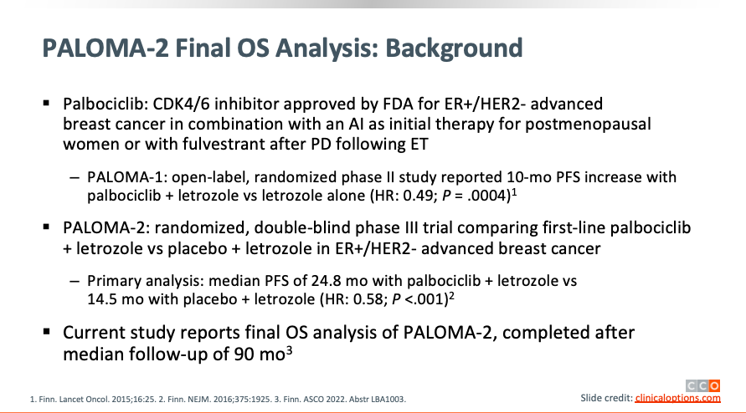

Slide 13
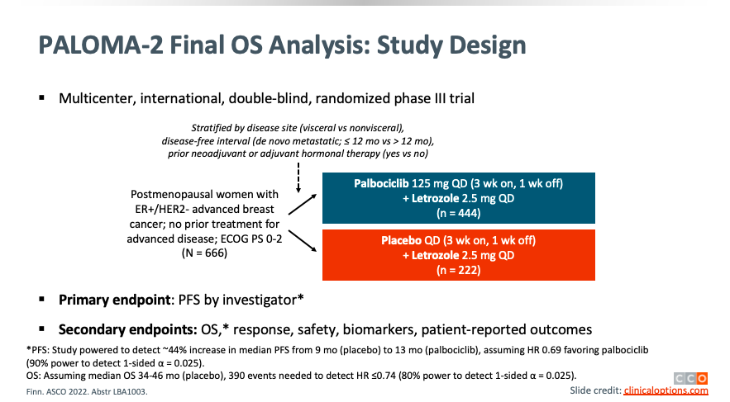

Slide 14
PALOMA-2 Final OS Analysis: Baseline Characteristics
Characteristic | Palbociclib + Letrozole (n = 444) | Placebo + Letrozole (n = 222)
Median age, yr (range) | 62 (30-89) | 61 (28-88)
ECOG PS, % 0/1/2 | 257 (58)/178 (40)/9 (2) | 102 (46)/117 (53)/3 (1)
Disease site, % Visceral Nonvisceral | 214 (48) 230 (52) | 110 (50) 112 (50)
Disease-free interval, % >12 mo from end of adjuvant to recurrence ≤12 mo from end of adjuvant to recurrence De novo metastatic | 179 (40) 98 (22) 167 (38) | 93 (42) 48 (22) 81 (37)
Prior endocrine therapy, % Yes No | 250 (56) 194 (44) | 126 (57) 96 (43)
Prior systemic treatment, % None Chemotherapy Endocrine therapy | 167 (38) 213 (48) 250 (56) | 81 (37) 109 (49) 126 (57)
Finn. ASCO 2022. Abstr LBA1003.
Notes:
ECOG, Eastern Cooperative Oncology Group; OS, overall survival; PS, performance status.

Slide 15
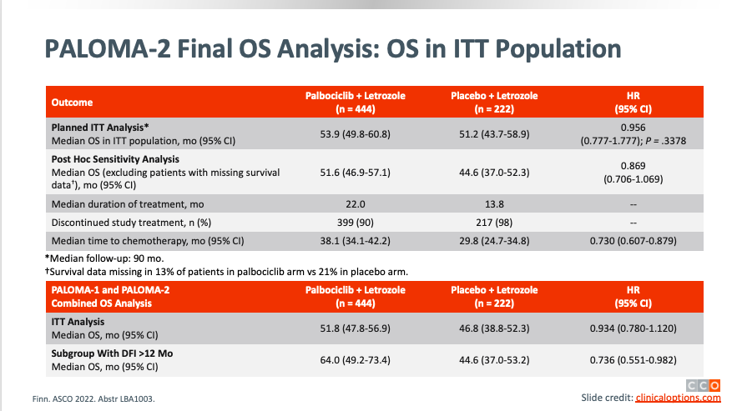

Slide 16
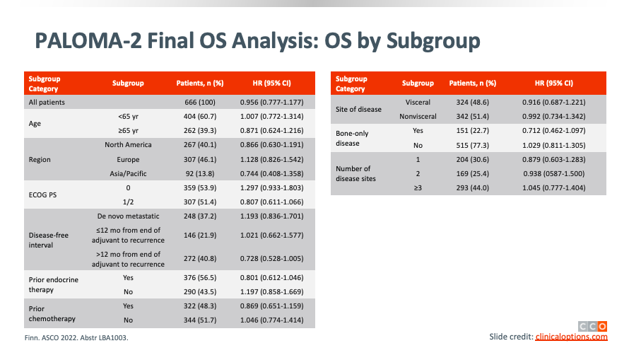

Slide 17
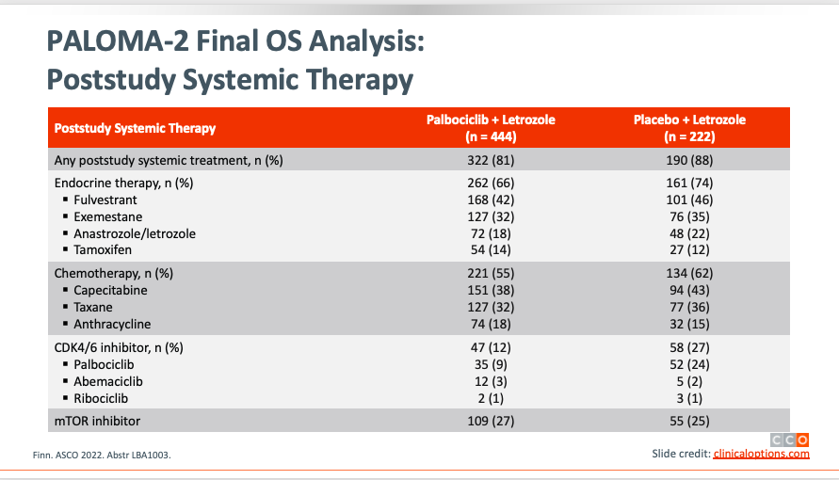

Slide 18
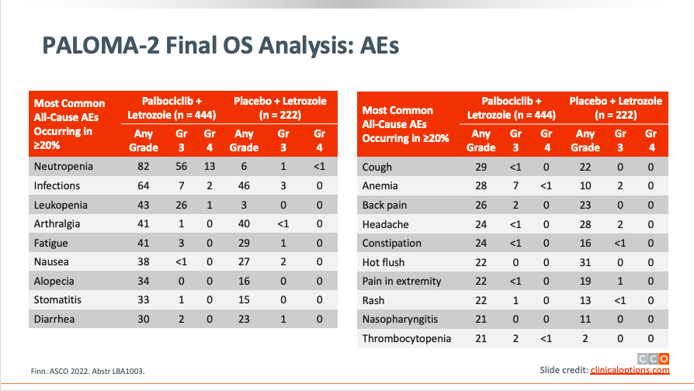

Slide 19
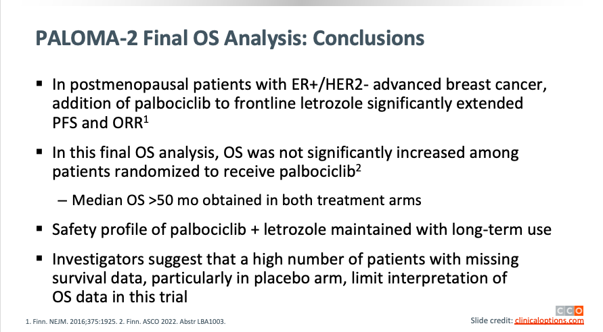
Notes:
PALOMA-2 demonstrated statistically and clinically significant improvement in progression-free survival with palbociclib plus letrozole versus placebo plus letrozole in estrogen receptor–positive/ human epidermal growth factor receptor 2–negative (ER1/HER2–) advanced breast cancer (ABC). Here, we report results for the secondary end point overall survival (OS). Postmenopausal women (N 5 666) with ER1/HER2– ABC without previous systemic therapy for ABC were randomly assigned 2:1 to palbociclib plus letrozole or placebo plus letrozole. After a median follow-up of 90.1 months, 405 deaths were observed and 155 patients were known to be alive. The median OS was 53.9 months (95% CI, 49.8 to 60.8) with palbociclib plus letrozole versus 51.2 months (95% CI, 43.7 to 58.9) with placebo plus letrozole (hazard ratio [HR], 0.96 [95% CI, 0.78 to 1.18]; stratified one-sided P 5 .34). An imbalance in the number of patients with unknown survival outcome between the treatment arms (13.3% v 21.2%, respectively) limited interpretation of OS results. With recovered survival data, the median OS was 53.8 (95% CI, 49.8 to 59.2) versus 49.8 months (95% CI, 42.3 to 56.4), respectively (HR, 0.92 [95% CI, 0.76 to 1.12]; one-sided P 5 .21). OS was not significantly improved with palbociclib plus letrozole compared with placebo plus letrozole

Slide 20
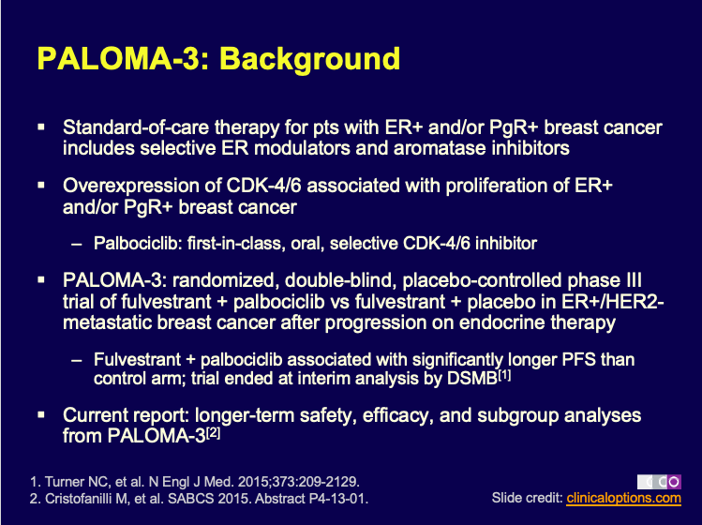

Slide 21
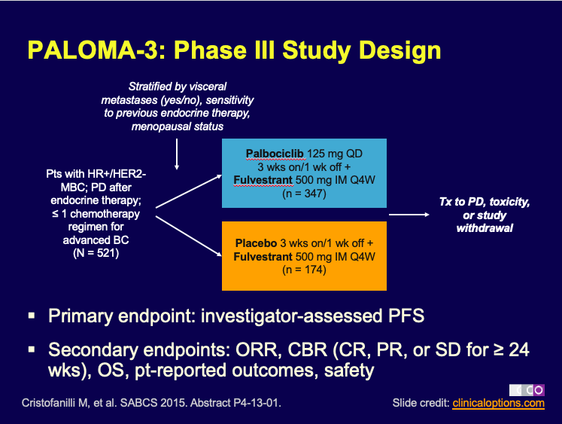

Slide 22
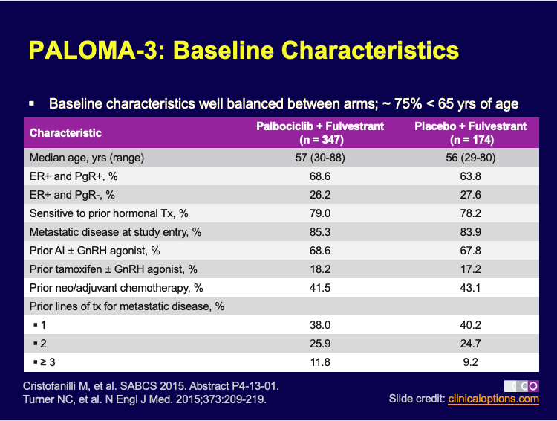

Slide 23
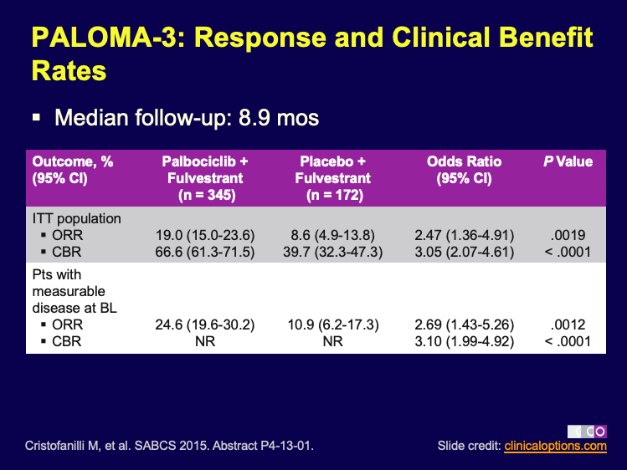

Slide 24
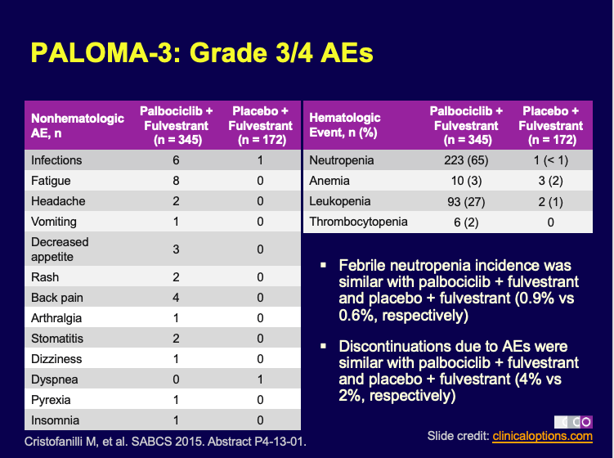

Slide 25

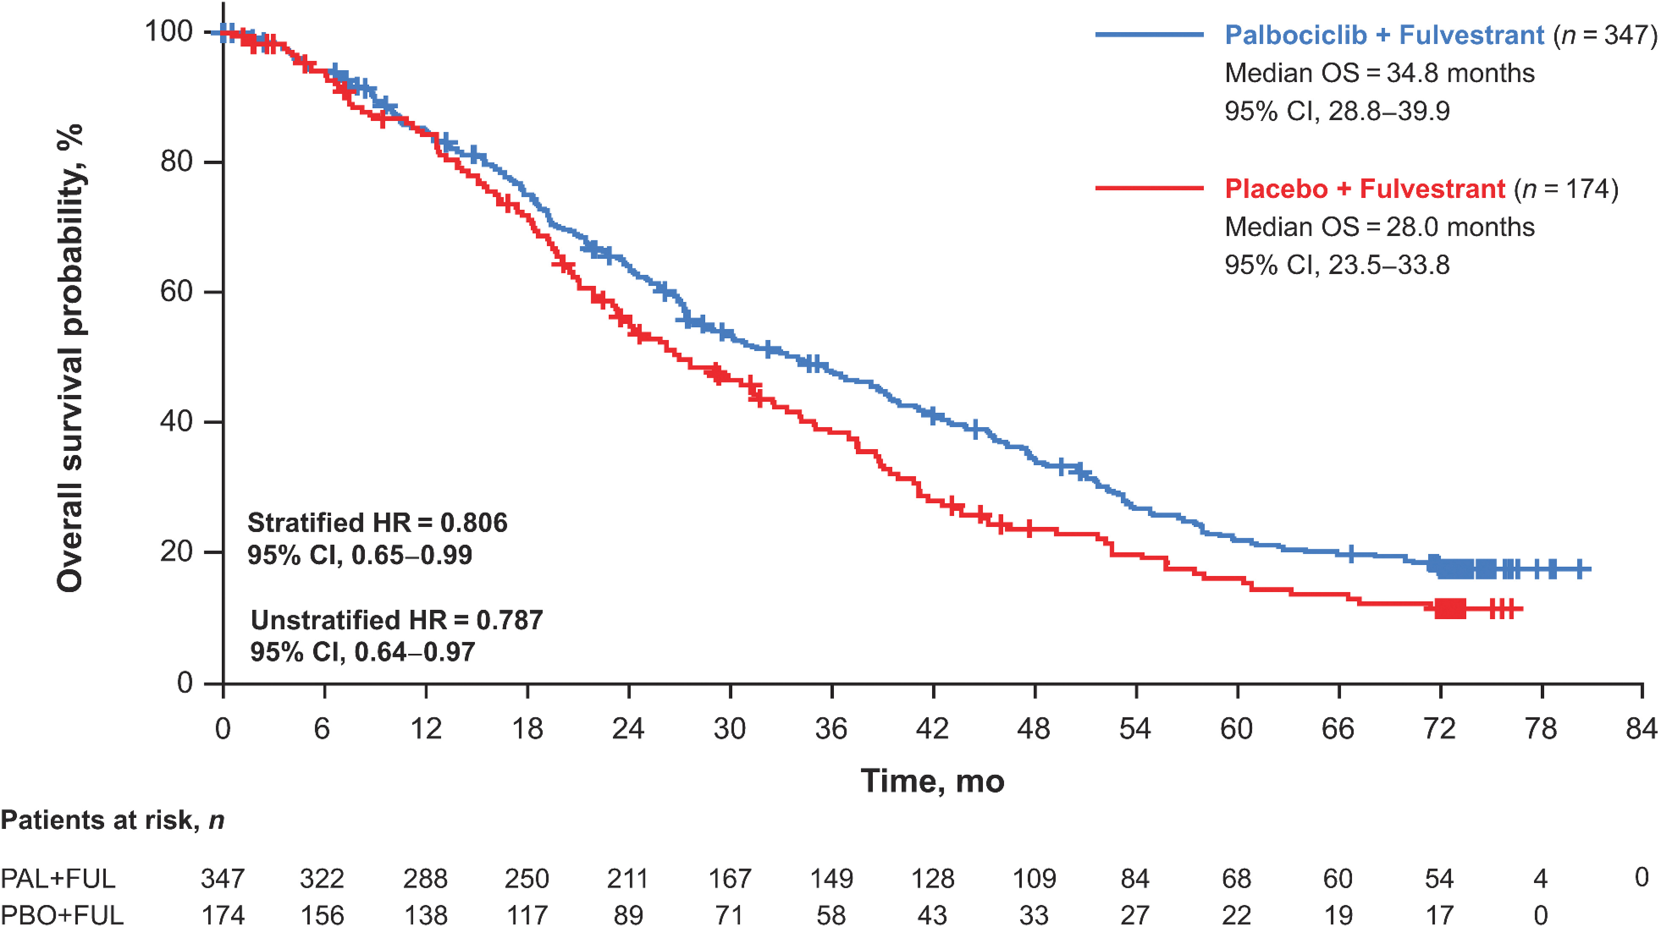
From: Overall Survival with Palbociclib and Fulvestrant in Women with HR⁺/HER2⁻ ABC: Updated Exploratory Analyses of PALOMA-3, a Double-blind, Phase III Randomized Study
Clin Cancer Res. 2022;28(16):3433-3442. doi:10.1158/1078-0432.CCR-22-0305
Date of Download: 4/22/2024
Copyright © 2024 American Association for Cancer Research. All rights reserved.
Notes:
Figure Legend:
Kaplan–Meier curves of OS in all patients in the intent-to-treat population. FUL, fulvestrant; HR, hazard ratio; OS, overall survival; PAL, palbociclib; PBO, placebo.
The median OS was 34.8 months (95% CI, 28.8–39.9) in the palbociclib plus fulvestrant group and 28.0 months (95% CI, 23.5–33.8) in the placebo plus fulvestrant group [stratified HR, 0.81 (95% CI, 0.65–0.99); Fig. 1]. The 5-year OS rate (95% CI) was 23.3% (18.7–28.2) in the palbociclib group versus 16.7% (11.2–23.3) in the placebo group;

Slide 26
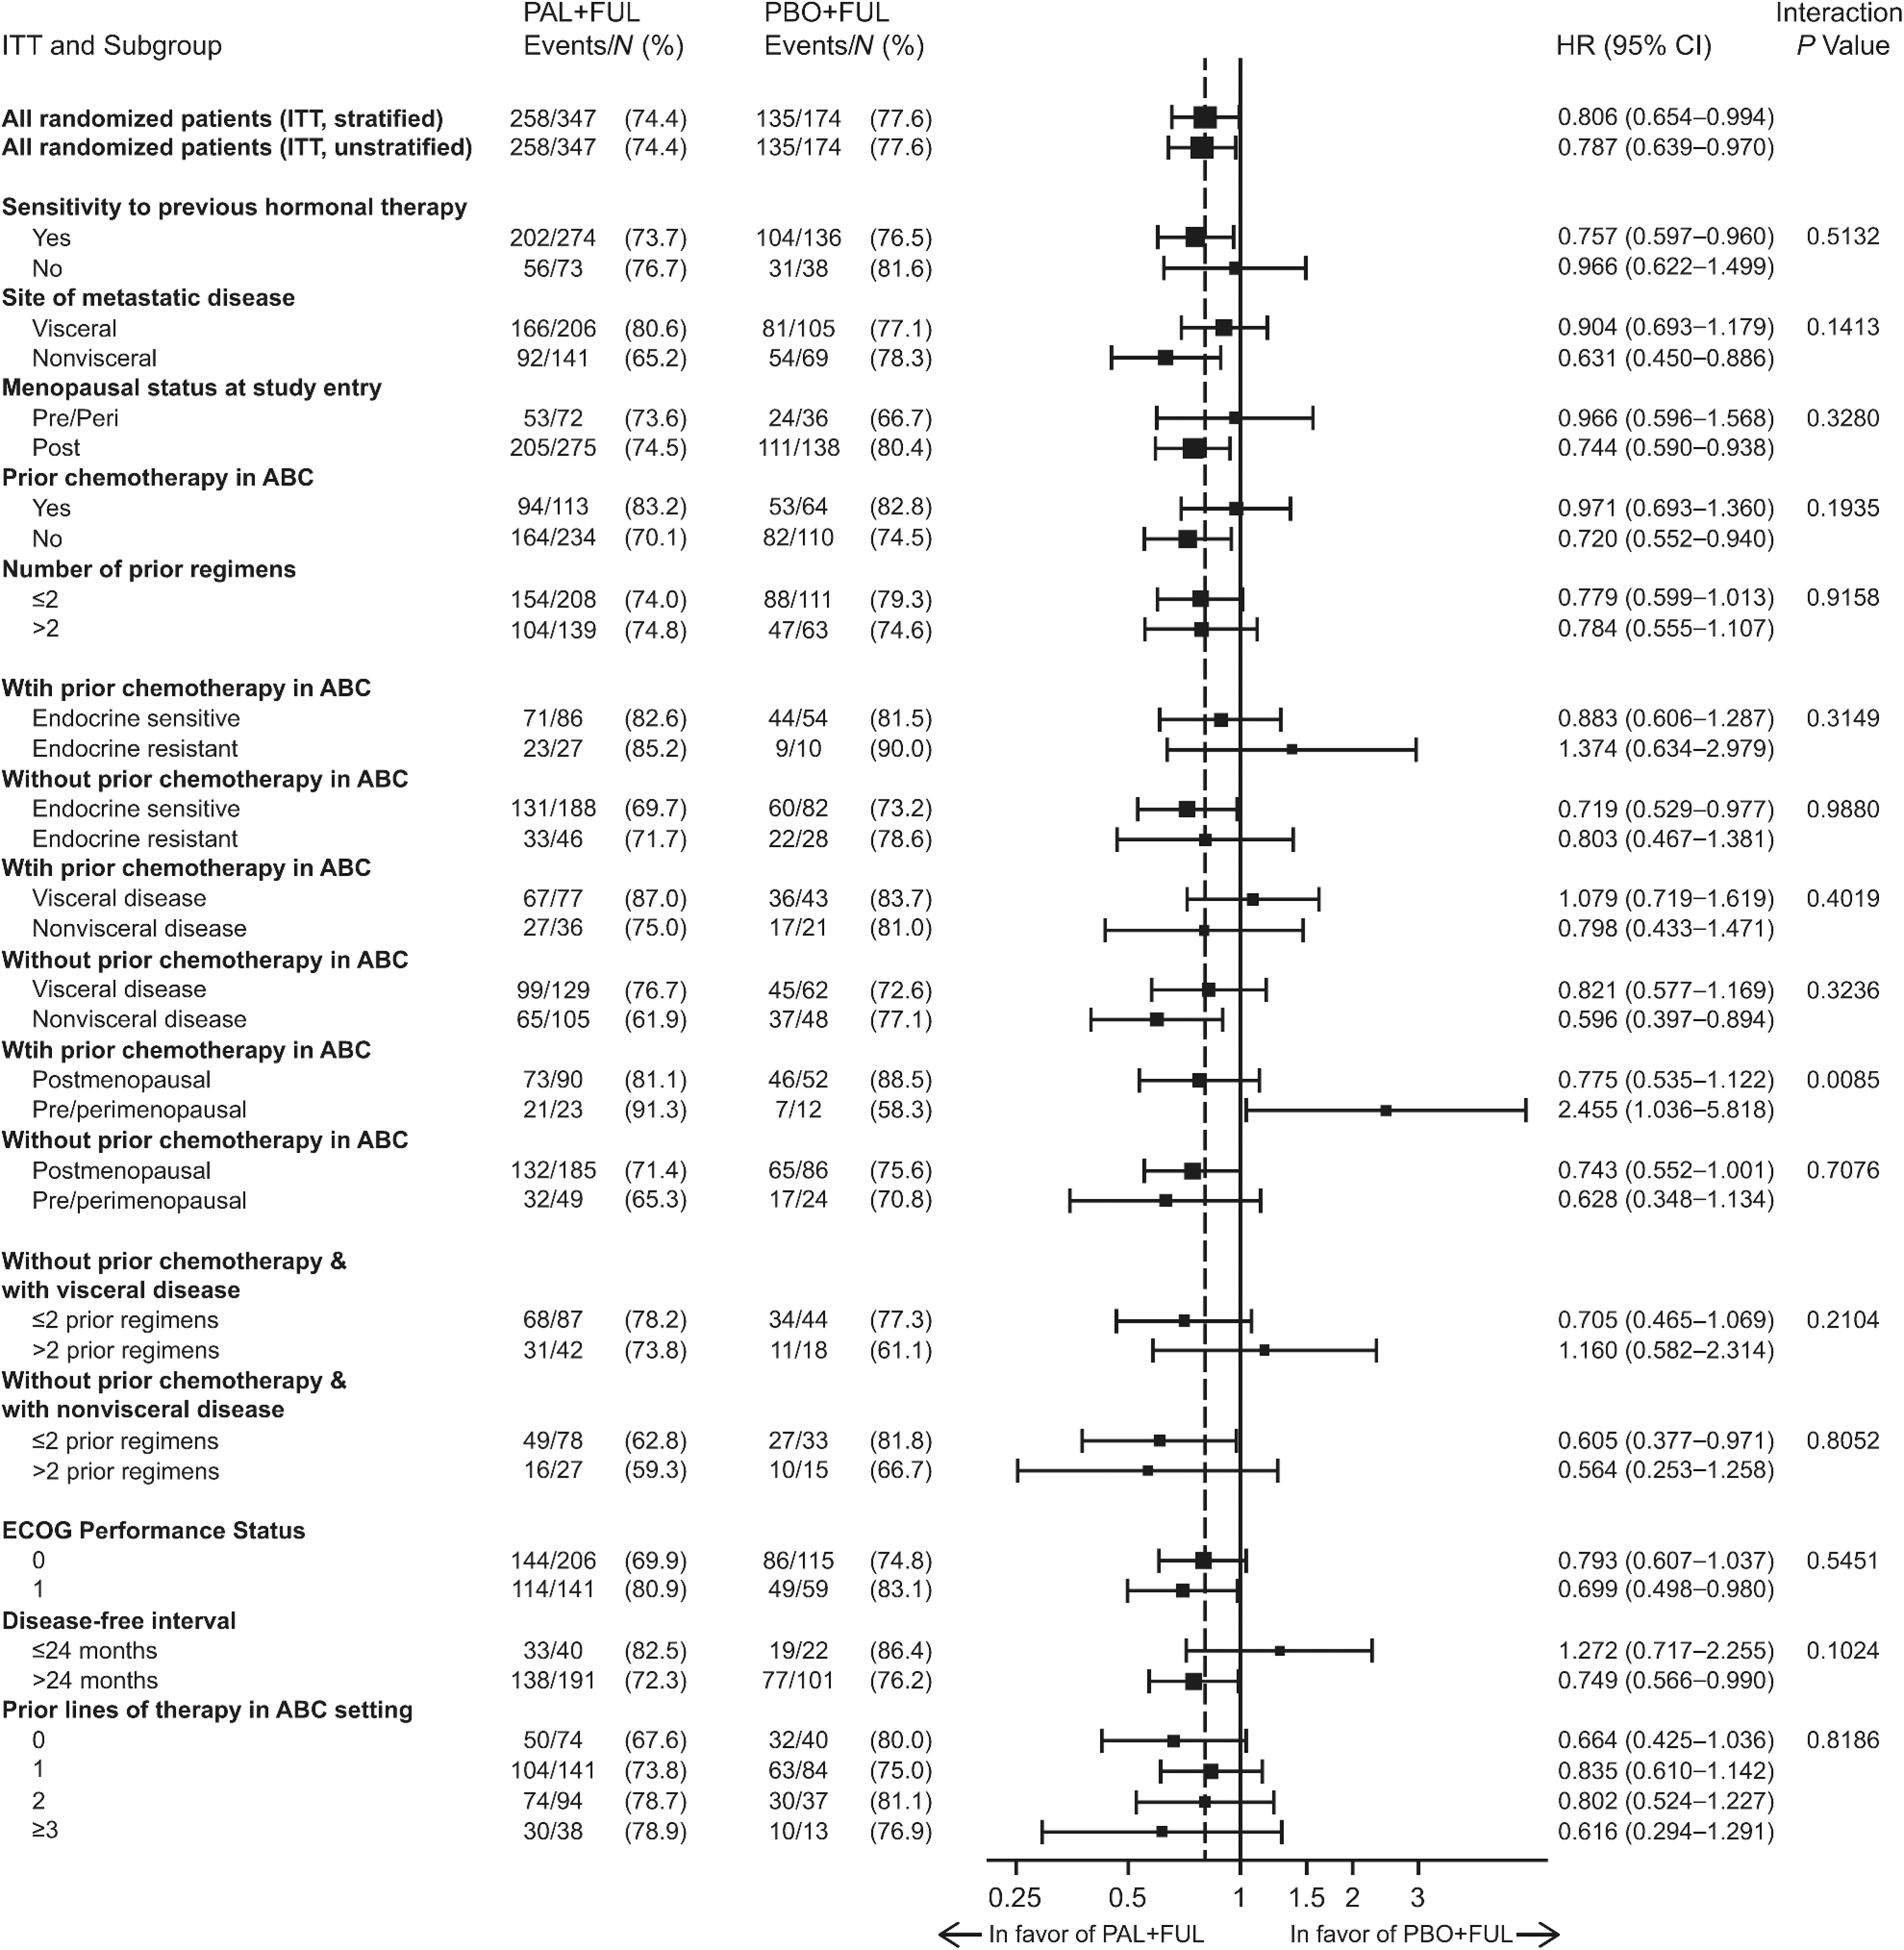
From: Overall Survival with Palbociclib and Fulvestrant in Women with HR⁺/HER2⁻ ABC: Updated Exploratory Analyses of PALOMA-3, a Double-blind, Phase III Randomized Study
Clin Cancer Res. 2022;28(16):3433-3442. doi:10.1158/1078-0432.CCR-22-0305
Copyright © 2024 American Association for Cancer Research. All rights reserved.
Notes:
Figure Legend:
OS by subgroup. P value determined from a one-sided unstratified log-rank test; one-sided P value from log-rank test reflects the sign of the test statistic (z-Score). ABC, advanced breast cancer; ECOG, Eastern Cooperative Oncology Group; EOT, end of treatment; FUL, fulvestrant; ITT, intent-to-treat; PAL, palbociclib; PBO, placebo.
n the subgroup of patients who had not received prior chemotherapy for ABC (n = 344), the median OS was 39.3 months (95% CI, 34.5–44.4) in the palbociclib plus fulvestrant group and 29.7 months (95% CI, 23.8–35.5) in the placebo plus fulvestrant group [hazard ratio, 0.72 (95% CI, 0.55–0.94); Supplementary Fig. S2A]. In the subgroup of patients who had received prior chemotherapy for ABC (n = 177), the median OS was 24.6 months (95% CI, 21.3–30.0) in the palbociclib plus fulvestrant group and 24.3 months (95% CI, 18.9–36.3) in the placebo plus fulvestrant group [hazard ratio, 0.97 (95% CI, 0.69–1.36); Supplementary Fig. S2B]. Favorable OS with palbociclib plus fulvestrant compared with placebo plus fulvestrant was observed in most of the subgroups evaluated

Slide 27
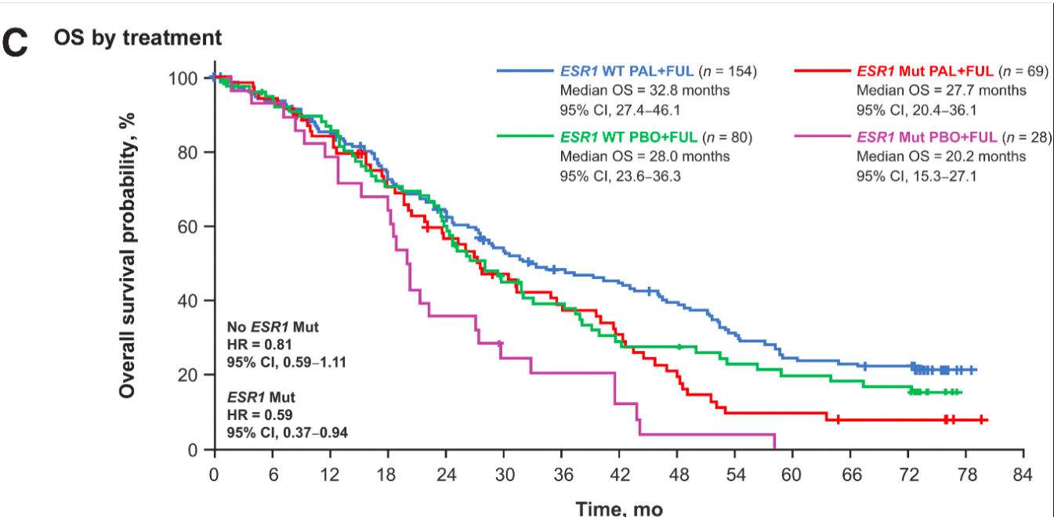
From: Overall Survival with Palbociclib and Fulvestrant in Women with HR⁺/HER2⁻ ABC: Updated Exploratory Analyses of PALOMA-3, a Double-blind, Phase III Randomized Study: ESR 1
Clin Cancer Res. 2022;28(16):3433-3442. doi:10.1158/1078-0432.CCR-22-0305
Copyright © 2024 American Association for Cancer Research. All rights reserved.
Notes:
Figure Legend:
Outcomes by ESR1 mutation status in ctDNA at day 1 or end of treatment. PFS by treatment (A), OS regardless of treatment (B), and OS by treatment (C). ctDNA, circulating tumor DNA; ESR1, estrogen receptor 1; FUL, fulvestrant; HR, hazard ratio; mut, mutation; OS, overall survival; PAL, palbociclib; PBO, placebo; PFS, progression-free survival; WT, wild type.
ESR1 mutations were prognostic for OS [hazard ratio, 1.58 (95% CI, 1.22–2.06); Fig. 3B] and were highly associated with shorter OS [<4 vs. ≥4 years; OR, 0.36 (95% CI, 0.19–0.68); Supplementary Table S1]. Regardless of ESR1 mutation status at day 1 or end of treatment, palbociclib plus fulvestrant provided OS benefit versus placebo plus fulvestrant (Fig. 3C). In patients without ESR1 mutations, the median OS was 32.8 months (95% CI, 27.4–46.1) with palbociclib plus fulvestrant and 28.0 months (95% CI, 23.6–36.3) with placebo plus fulvestrant [hazard ratio, 0.81 (95% CI, 0.59–1.11)]. In patients with ESR1 mutations, the median OS was 27.7 months (95% CI, 20.4–36.1) with palbociclib plus fulvestrant and 20.2 months (95% CI, 15.3–27.1) with placebo plus fulvestrant [hazard ratio, 0.59 (95% CI, 0.37–0.94)].

Slide 28
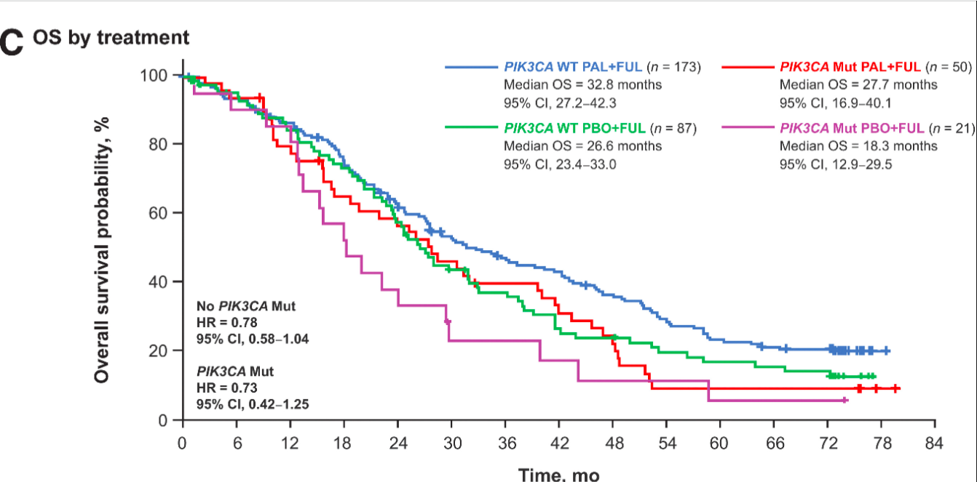
From: Overall Survival with Palbociclib and Fulvestrant in Women with HR⁺/HER2⁻ ABC: Updated Exploratory Analyses of PALOMA-3, a Double-blind, Phase III Randomized Study: PIK3CA
Clin Cancer Res. 2022;28(16):3433-3442. doi:10.1158/1078-0432.CCR-22-0305
Copyright © 2024 American Association for Cancer Research. All rights reserved.
Notes:
Figure Legend:
Outcomes by PIK3CA mutation status in ctDNA at day 1 or end of treatment. PFS by treatment (A), OS regardless of treatment (B), and OS by treatment (C). ctDNA, circulating tumor DNA; FUL, fulvestrant; HR, hazard ratio; mut, mutation; OS, overall survival; PAL, palbociclib; PBO, placebo; PFS, progression-free survival; PIK3CA, phosphatidylinositol 3-kinase catalytic alpha polypeptide; WT, wild type.
Palbociclib plus fulvestrant provided a PFS benefit compared with placebo plus fulvestrant regardless of PIK3CA status (Fig. 4A). In patients without PIK3CA mutations, the median PFS was 11.3 months (95% CI, 9.2–14.1) in patients receiving palbociclib plus fulvestrant and 3.8 months (95% CI, 3.4–7.2) in patients receiving placebo plus fulvestrant [HR, 0.48 (95% CI, 0.35–0.66)]. Palbociclib plus fulvestrant also improved median PFS compared with placebo plus fulvestrant in patients with PIK3CA mutations [10.9 months (95% CI, 5.6–12.7) vs. 3.5 months (95% CI, 1.9–11.2), respectively; hazard ratio, 0.55 (95% CI, 0.31–0.99)].
In addition, PIK3CA mutations were prognostic for OS [hazard ratio, 1.44 (95% CI, 1.08–1.92); Fig. 4B] and were numerically associated with shorter OS [<4 vs. ≥4 years; OR, 0.55 (95% CI, 0.29–1.08); Supplementary Table S1]. Palbociclib plus fulvestrant provided an OS benefit compared with placebo plus fulvestrant regardless of PIK3CA mutation status (Fig. 4C). Among patients without PIK3CA mutations, the median OS was 32.8 months (95% CI, 27.2–42.3) in patients receiving palbociclib plus fulvestrant and 26.6 months (95% CI, 23.4–33.0) in patients receiving placebo plus fulvestrant [hazard ratio, 0.78 (95% CI, 0.58–1.04)]. In patients with PIK3CA mutations, the median OS was 27.7 months (95% CI, 16.9–40.1) with palbociclib plus fulvestrant and 18.3 months (95% CI, 12.9–29.5) with placebo plus fulvestrant [hazard ratio, 0.73 (95% CI, 0.42–1.25)].

Slide 29
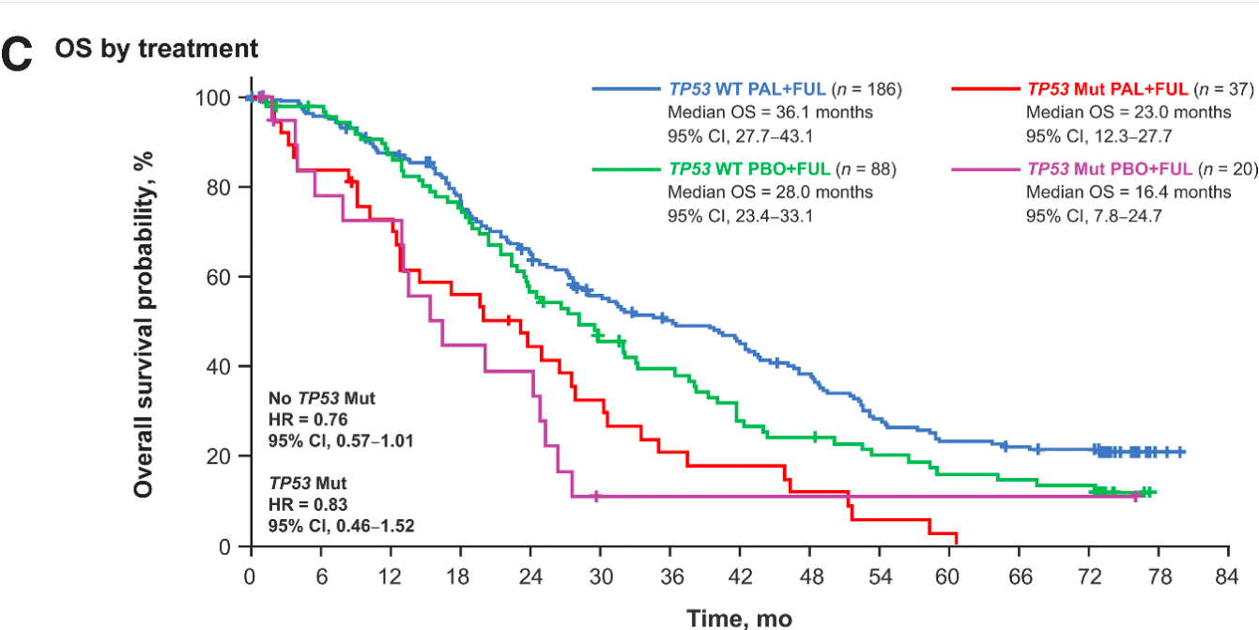
From: Overall Survival with Palbociclib and Fulvestrant in Women with HR⁺/HER2⁻ ABC: Updated Exploratory Analyses of PALOMA-3, a Double-blind, Phase III Randomized Study: TP53
Clin Cancer Res. 2022;28(16):3433-3442. doi:10.1158/1078-0432.CCR-22-0305
Copyright © 2024 American Association for Cancer Research. All rights reserved.
Notes:
Figure Legend:
Outcomes by TP53 mutation status in ctDNA at day 1 or end of treatment. PFS by treatment (A), OS regardless of treatment (B), and OS by treatment (C). ctDNA, circulating tumor DNA; FUL, fulvestrant; HR, hazard ratio; mut, mutation; OS, overall survival; PAL, palbociclib; PBO, placebo; PFS, progression-free survival; TP53, tumor protein 53; WT, wild type.
Regardless of TP53 mutation status, palbociclib plus fulvestrant was associated with improvement in PFS compared with placebo plus fulvestrant (Fig. 5A). In patients without TP53 mutations, the median PFS was 12.1 months (95% CI, 9.5–14.3) in the palbociclib plus fulvestrant group versus 5.4 months (95% CI, 3.6–7.3) in the placebo plus fulvestrant group (hazard ratio, 0.49; 95% CI, 0.36–0.67). In patients with TP53 mutations, the median PFS was 5.7 months (95% CI, 1.9–11.4) with palbociclib plus fulvestrant compared with 1.8 months (95% CI, 1.7–3.5) with placebo plus fulvestrant [hazard ratio, 0.50 (95% CI, 0.27–0.91)].
TP53 mutations were prognostic for OS [hazard ratio, 2.19 (95% CI, 1.61–2.99); Fig. 5B] and were highly associated with shorter OS [<4 vs. ≥4 years; OR, 0.23 (95% CI, 0.09–0.60)] and prior chemotherapy in the metastatic setting [OR, 1.95 (95% CI, 1.09–3.49); Supplementary Table S1]. Palbociclib plus fulvestrant also provided an OS benefit versus placebo plus fulvestrant regardless of TP53 mutation status (Fig. 5C). In patients without TP53 mutation, the median OS was 36.1 months (95% CI, 27.7–43.1) with palbociclib plus fulvestrant and 28.0 months (95% CI, 23.4–33.1) with placebo plus fulvestrant [hazard ratio, 0.76 (95% CI, 0.57–1.00)]. In patients with TP53 mutation, the median OS was 23.0 months (95% CI, 12.3–27.7) with palbociclib plus fulvestrant and 16.4 months (95% CI, 7.8–24.7) with placebo plus fulvestrant [hazard ratio, 0.83 (95% CI, 0.46–1.52)]. TP53 mutations were more frequent among patients who received prior chemotherapy for ABC in both the palbociclib and placebo groups (24.3% and 23.3%, respectively) compared with patients who did not receive prior chemotherapy (13.1% and 15.4%, respectively). No difference in the frequency of PIK3CA and ESR1 mutations was observed in patients with or without prior chemotherapy in ABC.

Slide 30
Conclusions: Paloma-3
In patients with HR⁺/HER2⁻ ABC who had progressed on prior endocrine therapy, the clinically meaningful improvement in OS with palbociclib plus fulvestrant was maintained with >6 years of follow-up, regardless of genomic alterations, and no new safety signals were identified.
These findings support palbociclib plus fulvestrant as a standard of care in patients with HR⁺/HER2⁻ ABC.
Moreover, ESR1, PIK3CA, and TP53 mutational status can provide prognostic value in this clinical setting.
Copyright © 2024 American Association for Cancer Research. All rights reserved
Notes:
Palbociclib is not my first choice for 1L treatment in HR+ metastatic disease. ▪ MONALEESA-2 did show an OS advantage with ribociclib. ‒ Ribociclib + letrozole showed a significant OS benefit as compared with placebo + letrozole. Median OS was 63.9 months (95% confidence interval [CI], 52.4 to 71.0) with ribociclib + letrozole and 51.4 months (95% CI, 47.2 to 59.7) with placebo + letrozole (HR for death, 0.76; 95% CI, 0.63 to 0.93; two-sided P=0.008). ‒ Awaiting for MONARCH-3 OS data ‒ Still appropriate to look at toxicity profile and individual patient characteristics

Slide 31
BREAST MALIGNANCIES
April 29th, 2024

Slide 32
CDK 4/6 Inhibitors, Side Effects and Management
Alan B. Astrow, M.D.
Chief Hem-Onc NYP Brooklyn Methodist Hospital
Professor of Clinical Medicine, Weill Cornell Medicine

Slide 33
What are the agents
Drug name | Brand name | Used to treat early or metastatic breast cancer?
Abemaciclib | Verzenio | Early and metastatic breast cancer
Palbociclib | Ibrance | Metastatic breast cancer
Ribociclib | Kisqali | Metastatic breast cancer

Slide 34
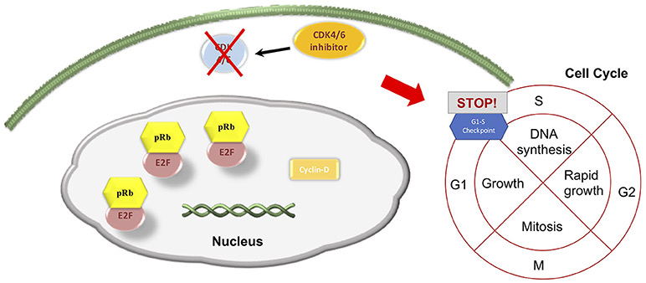
Mechanism of Action

Slide 35
CDK 4/6 forms a complex with cyclin D (CCND)
This complex phosphorylates the cell cycle repressor protein retinoblastoma 1 (RB1)
RB 1 phosphorylation disinhibits cell cycle proliferation, i.e. phosphorylated RB 1 drives growth
Unphosphorylated RB 1 represses genes involved in cell cycle progression, i.e inhibits growth
CDK 4/6 inhibitors block RB 1 phosphorylation by blocking formation of CDK/CCND complex and so inhibit growth

Slide 36
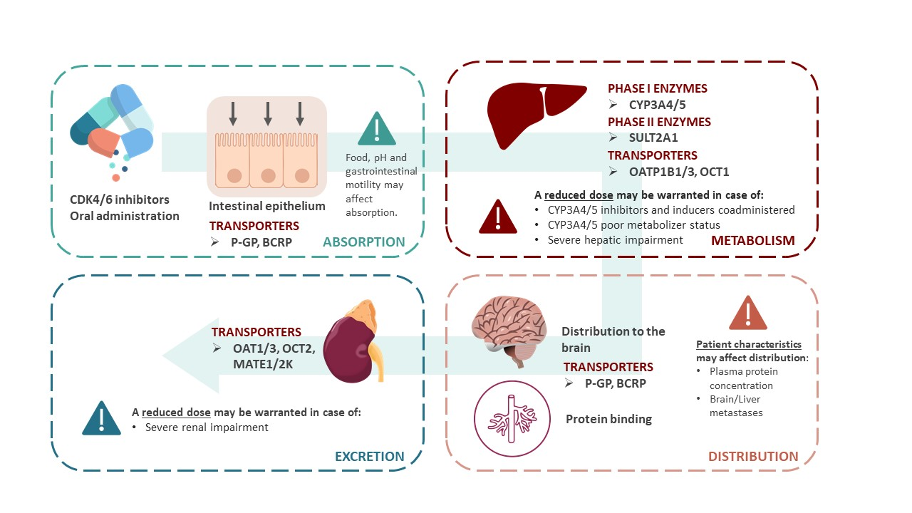
Absorption and Metabolism

Slide 37
Absorption and Metabolism
Palbociclib with slight increased absorption with food. Take capsules with food. Acid reducing agents may impair absorption.
Abemiciclib and ribociclib not influenced by food intake
All metabolized in liver via cytochrome p 450 3A4. Cyp 3A4 inhibitors (clarithromycin, itraconazole, grapefruit)/inducers (rifampin, phenytoin) may increase/decrease plasma concentrations
No dose adjustments needed for mild to moderate liver impairment but required for severe liver impairment
No dose adjustments needed for renal dysfunction

Slide 38
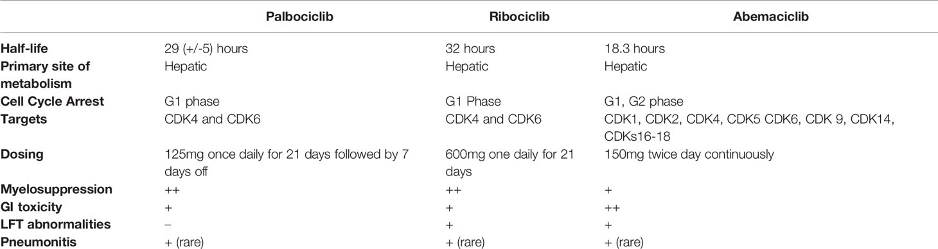
Summary of differences among agents

Slide 39
Side effects & Management
Abemaciclib
Diarrhea (usually improves with dose reduction). Take Imodium for symptom relief, I often prescribe with first cycle, hydration, electrolyte repletion (Pedialyte, ensure, sugar free liquid IV)
Stomach cramping
Cytopenias (although not as common as palbociclib)
Elevated LFTs; artifactual elevation of serum Cr
Red flags: pulmonary, g.i., vascular
Intractable diarrhea not resolving on Imodium
Signs of infection
DVT

Slide 40
Side effects & Management
Palbociclib
Cytopenias, specifically neutropenia
Otherwise, well tolerated
Red Flags: pulmonary, infectious toxicity
new prolonged cough --> rule out pneumonitis/ILD (but don’t see this often)
Signs of infection (due to neutropenia risk). Infection unusual despite leukopenia.

Slide 41
Side effects & Management
Ribociclib
QT prolongation: Monitor with EKG at baseline, QTc < 450 Ms, repeat 2 and 4 weeks after starting. Dose reduce for QTc > 480 Ms
EKG as needed based on cardiac symptoms
Red Flags: palpitations, dizziness, suggesting cardiac rhythm disturbance
Cytopenias
Nausea
Headache
Severe cutaneous adverse reactions (SJS, TEN, DRESS)

Slide 42
Side effects & Management
For all three agents, when used with aromatase inhibitors (ai’s) typically see ai related side effects:
Joint pain
Fatigue
Hair thinning

Slide 43
References
Onesti CE and Jerusalem G. CDK 4/6 inhibitors in breast cancer. Expert review of anti-cancer therapy. 21:3; 283-298, published online Dec 2020
Morrison L, Loibl S, and Turner NC. The CDK 4/6 inhibitor revolution. Nature Reviews of Clinical Oncology. 21:89-205, Feb 2024
Cazzaniga ME, Ciaccio A, Danesi R, et al. Late onset toxicities associated with the use of CDk 4/6 inhibitors. Frontiers in Oncology. 13: 1-18, published online October 2023.
George MA, Qureshi S, Omene C, et al. Clinical and pharmacologic differences of CDK 4/6 inhibitors in breast cancer. Frontiers in Oncology 11, July 2021

Slide 44
Thanks to . . .
Marina Barsoum, PharmD
Kelly Eng, N.P.
Samantha Holder, P.A.
Jennifer Schiff, N.P.
for their assistance in putting this presentation together.

Slide 45
BREAST MALIGNANCIES
April 29th, 2024

Slide 46
Treatment Crossroads: Second Line Therapies for ER+/HER2- Advanced or Metastatic Breast Cancer (mBC)
Pooja Murthy, MD
Assistant Professor of Clinical Medicine
Weill Cornell Medicine
New York Presbyterian-Queens
Flushing, NY

Slide 47
Background
Endocrine therapy (ET) plus CDK 4/6i is the mainstay 1st line therapy for ER+/HER2- mBC
However, tumors eventually develop resistance to endocrine therapy
Overcoming endocrine resistance
  EMERALD: phase 3 data guiding elacestrant use
  CAPItello-291: phase 3 data guiding capivasertib use
Bidard et al. JCO 2022.
Turner et al. NEJM 2023.

Slide 48
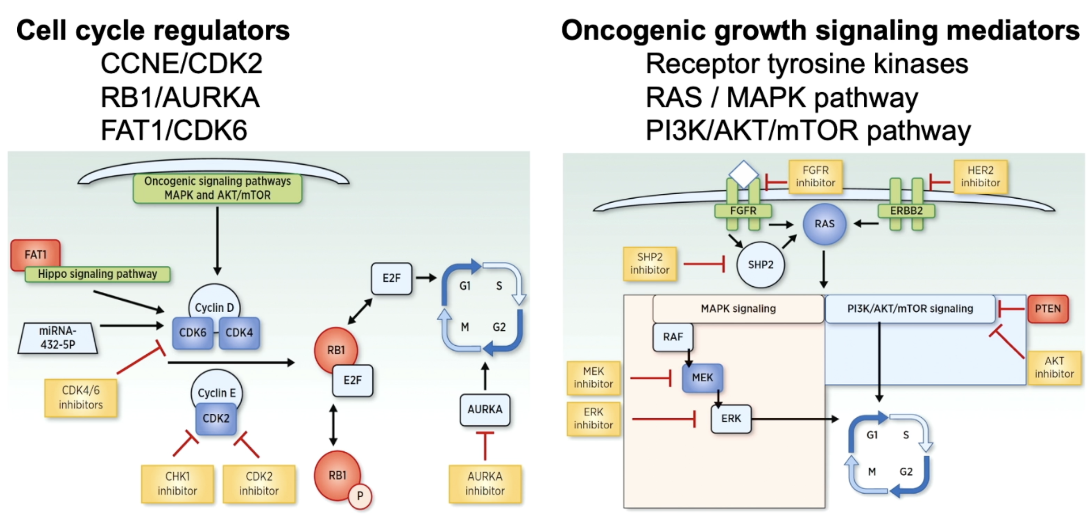
Resistance Mechanisms Lead to New Therapeutic Targets
Lloyd et al. CCR 2022.
Notes:
Endocrine therapy, with either aromatase inhibitors (AI) or fulvestrant, plus a cyclin-dependent kinase 4/6 (CDK4/6) inhibitor is the recommended first-line standard of care (SOC) for locally advanced or metastatic estrogen receptor (ER)–positive/human epidermal growth factor receptor 2 (HER2)–negative breast cancer.¹⁻³ Subsequent progression is associated with endocrine resistance, which includes development of acquired mutations in a variety of genes

Slide 49
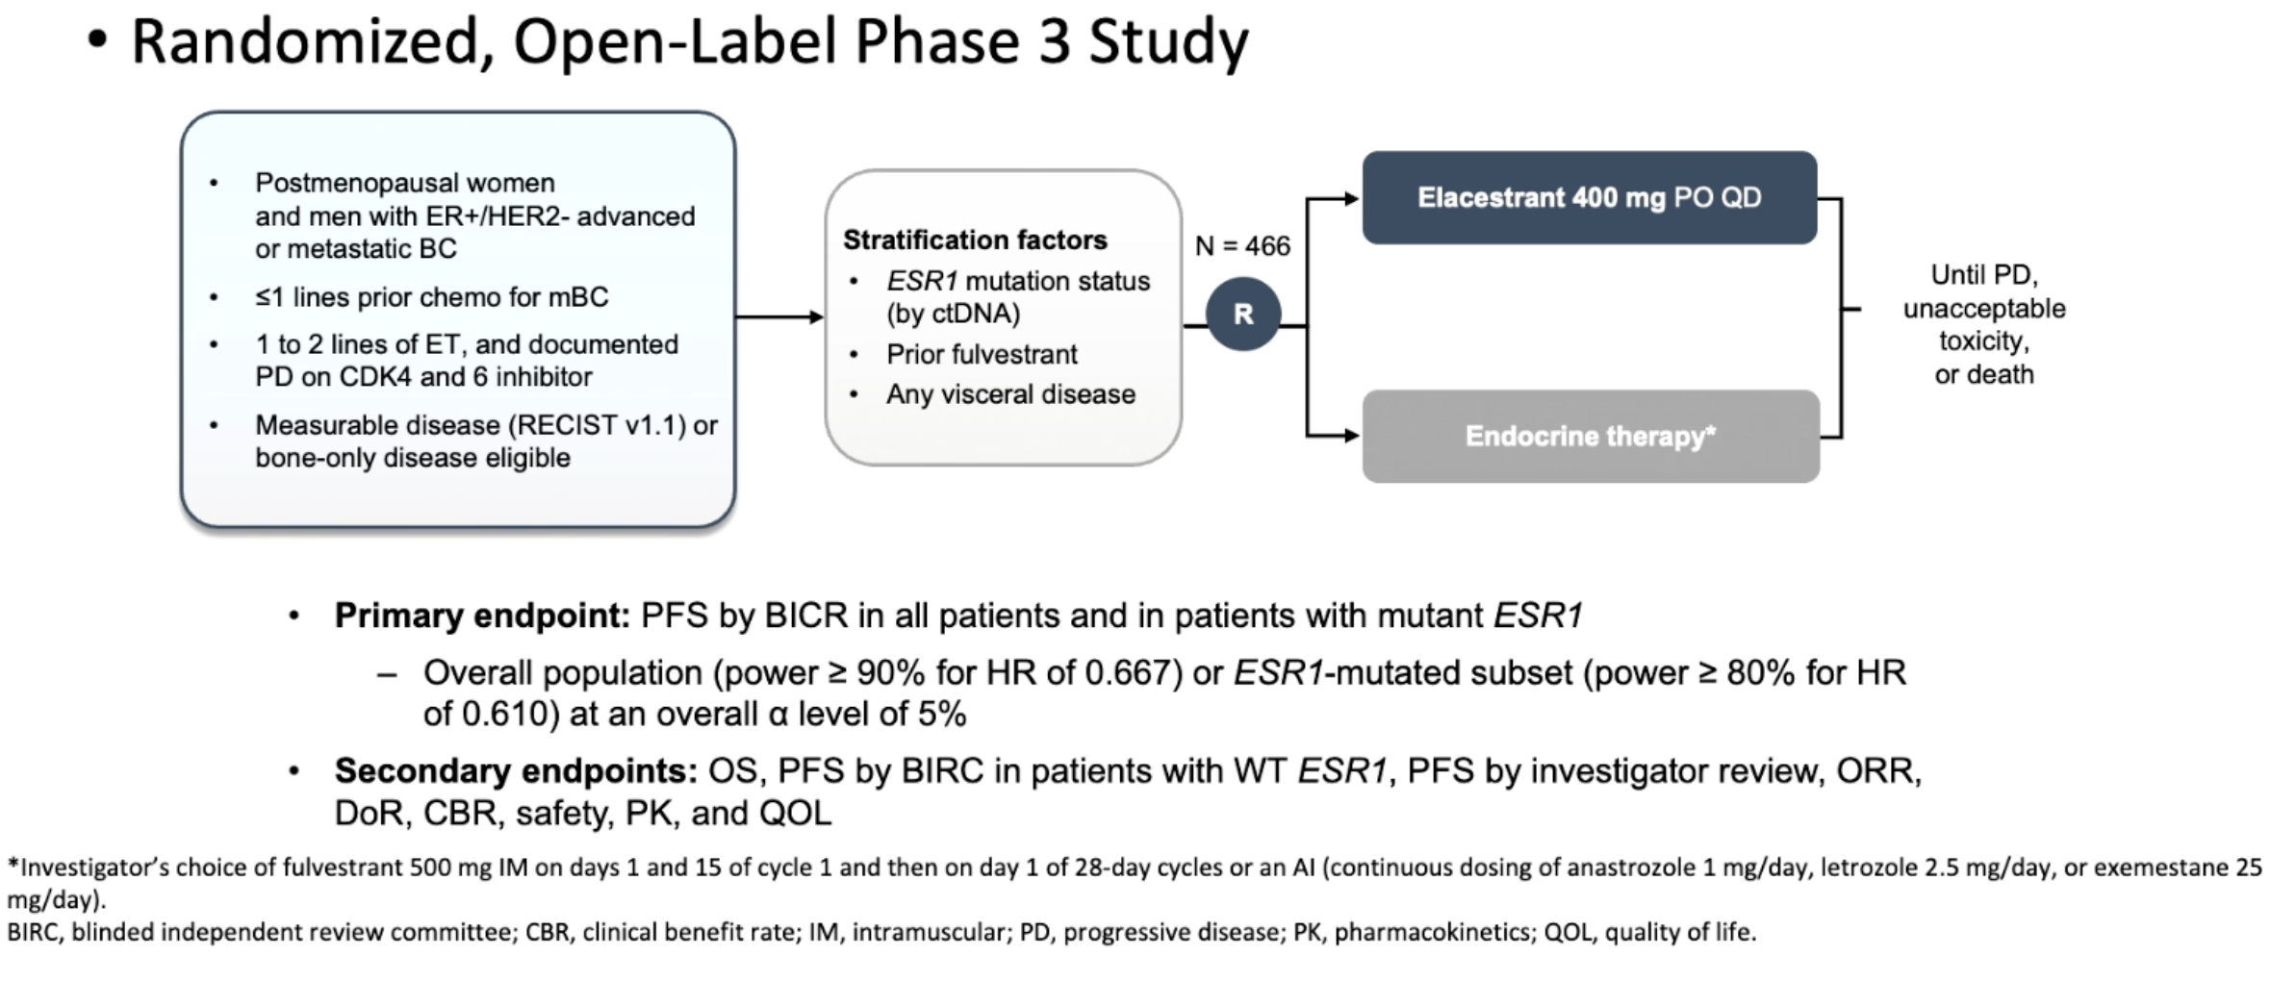
EMERALD Trial
Elacestrant vs Standard Endocrine Monotherapy for Advanced Breast Cancer After CDK4/6 Inhibition
Bardia et al. J Clin Oncol 2020.

Slide 50
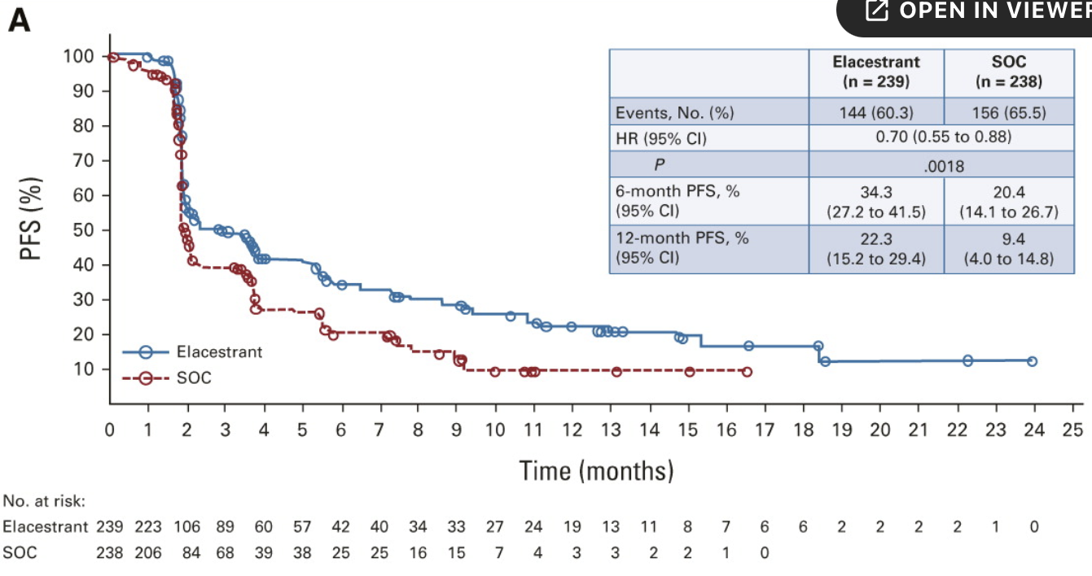
EMERALD Results
Primary Endpoint: PFS by BICR in all patients
Bidard et al. JCO 2022.
Notes:
elacestrant versus SOC in all patients
PFS assessed by BICR was statistically significantly prolonged in the elacestrant arm versus the SOC arm in all patients (HR = 0.70; 95% CI, 0.55 to 0.88; P = .002) and in patients with ESR1 mutation (HR = 0.55; 95% CI, 0.39 to 0.77 P = .0005; Figs 1A and 1B). A closer look at the Kaplan-Meier curves revealed an initial drop in both arms, highlighting possible endocrine resistance in the second- /third-line setting, but then clear separation of the curves in the endocrine-sensitive setting.

Slide 51
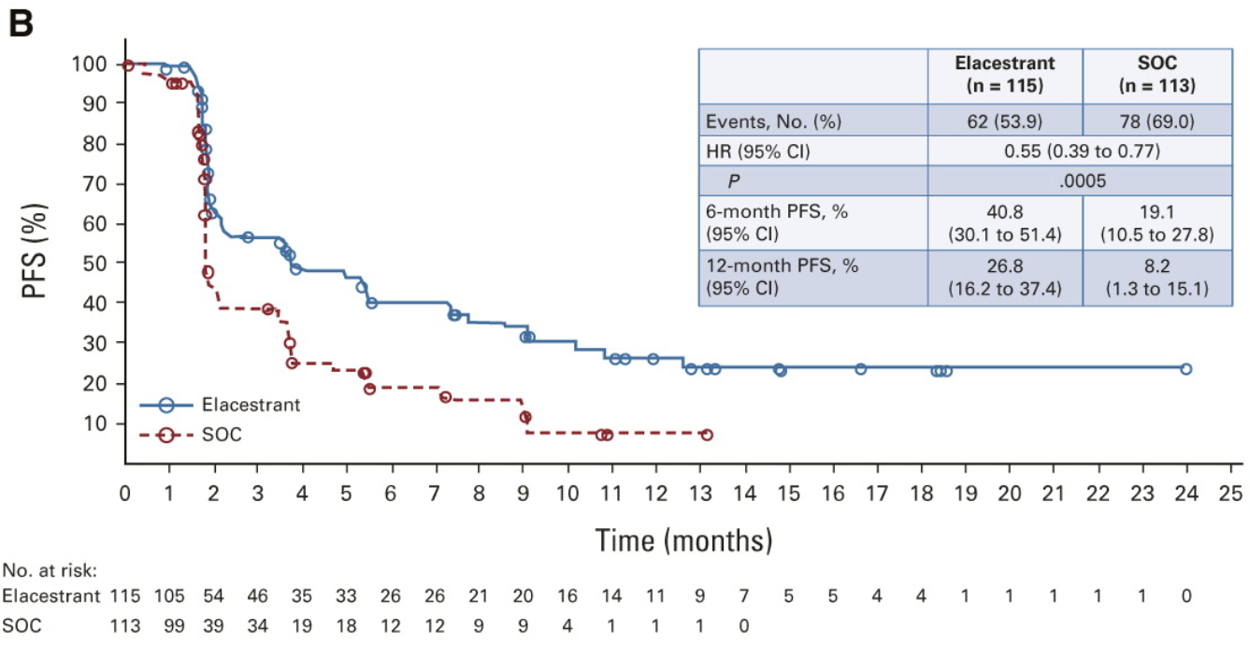
EMERALD Results
Primary Endpoint: PFS in patients with ESR1m
Bidard et al. JCO 2022.
Notes:
elacestrant versus SOC in patients with detectable ESR1 mutation
6-month PFS rates were 34.3% (95% CI, 27.2 to 41.5) versus 20.4% (95% CI, 14.1 to 26.7) for the elacestrant versus SOC arms, respectively, in all patients and 40.8% (95% CI, 30.1 to 51.4) versus 19.1% (95% CI, 10.5 to 27.8), respectively, in patients with ESR1 mutation. Similarly, 12-month PFS rates were 22.3% (95% CI, 15.2 to 29.4) versus 9.4% (95% CI, 4.0 to 14.8), respectively, in all patients versus 26.8% (95% CI, 16.2 to 37.4) and 8.2% (95% CI, 1.3 to 15.1), respectively, in patients with ESR1 mutation.

Slide 52
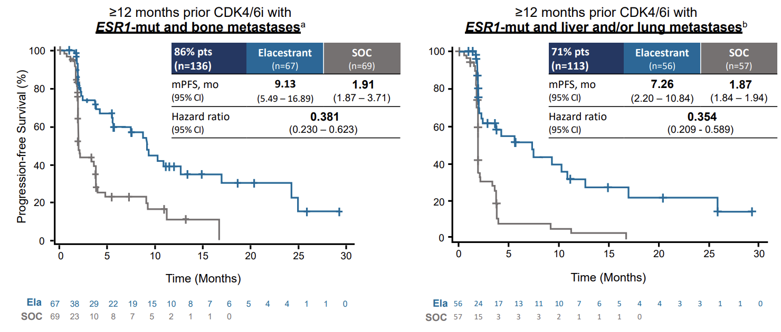
EMERALD Results
Clinically meaningful improvement in PFS favoring elacestrant for ESR1m tumors with prior CDK 4/6i for ≥ 12 months, across all subgroups
Lu et al. SABCS 2023.

Slide 53
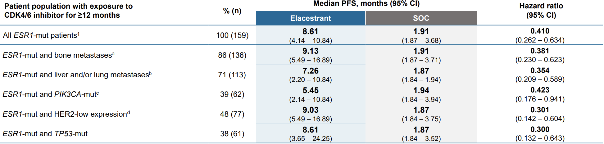
EMERALD Results
Clinically meaningful improvement in PFS favoring elacestrant for ESR1m tumors with prior CDK 4/6i for ≥ 12 months, across all subgroups
Lu et al. SABCS 2023.

Slide 54
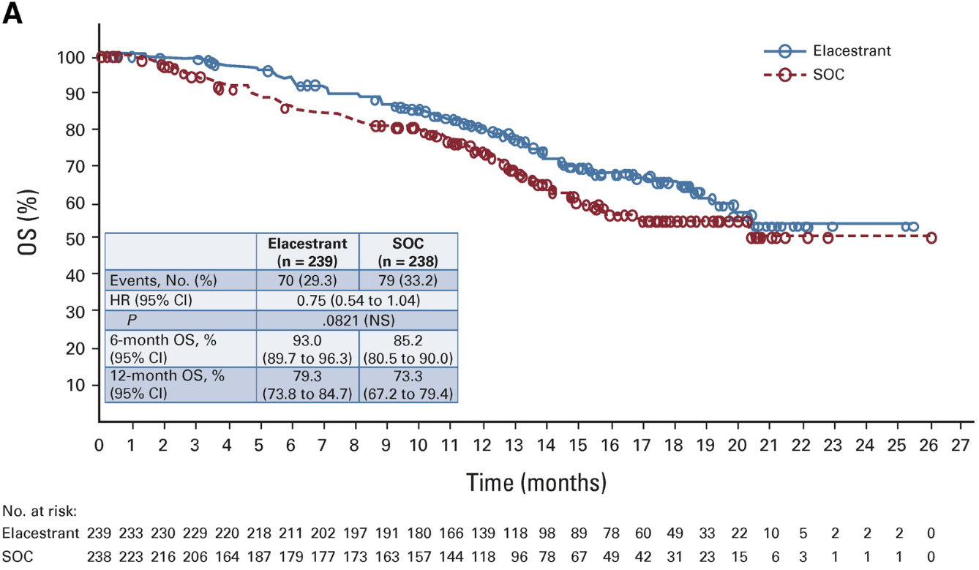
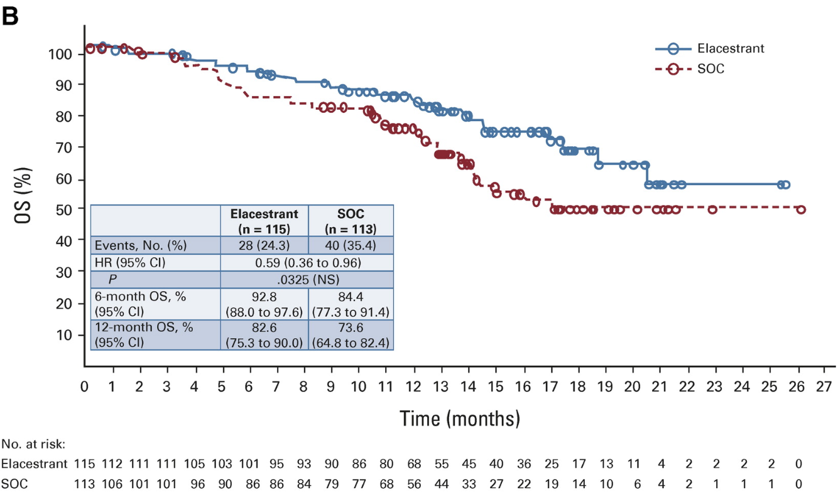
EMERALD Results
Secondary Endpoint: Interim OS Analysis
All Patients
ESR1m
Bidard et al. JCO 2022.

Slide 55
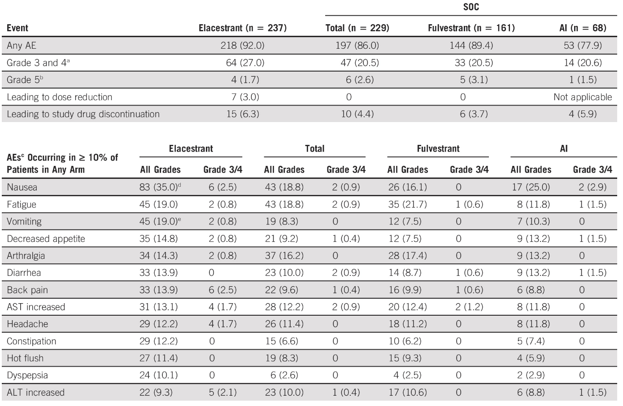
Elacestrant Safety
Bidard et al. JCO 2022.
Notes:
Mostly mild GI toxicities. No cardiac or ocular toxicity, reported with other SERDs

Slide 56
EMERALD Conclusions
Elacestrant is first oral SERD to demonstrate improved efficacy compared to SOC in advanced HR+ breast cancer
There is a subset of patients who derive most benefit: ESR1m, long duration of response to initial ET + CDK 4/6i
  Finding tumors with continued dependency on the ER pathway
Manageable safety profile
Establishes the use of cell free DNA in identifying an actionable target

Slide 57
EMERALD Limitations
Combination endocrine therapies with alpelisib, everolimus, and capivasertib are increasingly considered, therefore the control arm in this trial with single agent fulvestrant or AI may not reflect current practice
Combination therapies with elacestrant and other oral SERDs actively being investigated

Slide 58
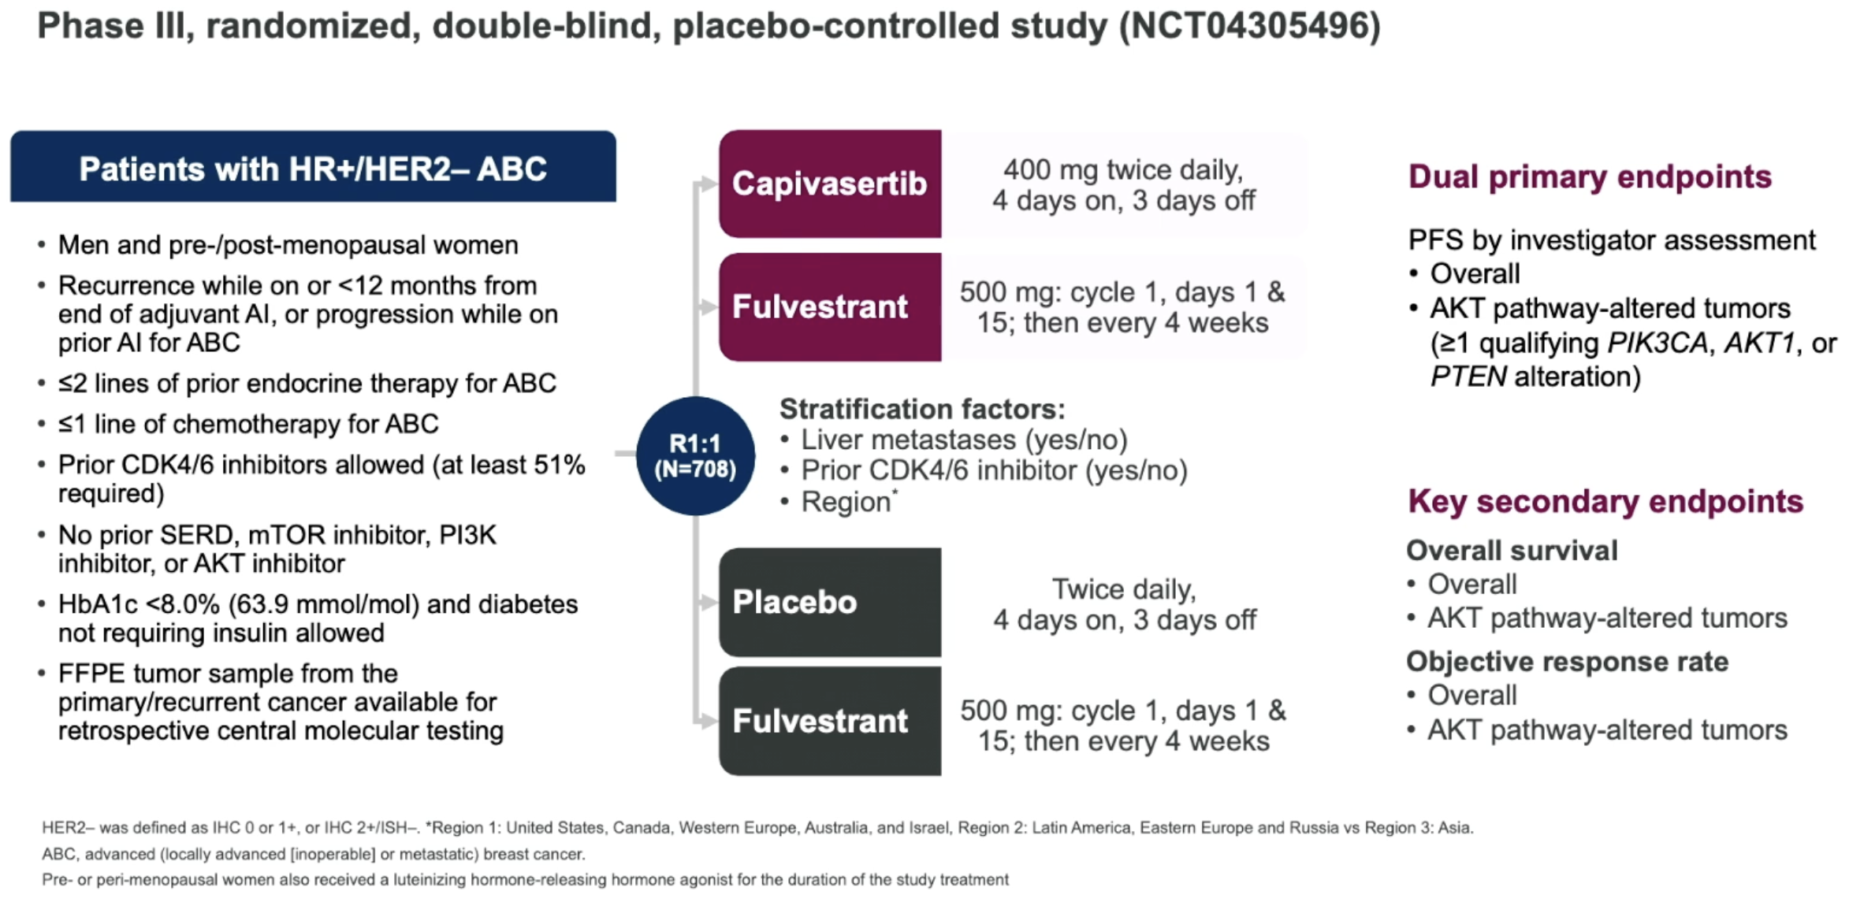
CAPItello-291 Trial
Turner NC et al SABCS 2022 and NEJM 2023.
.

Slide 59
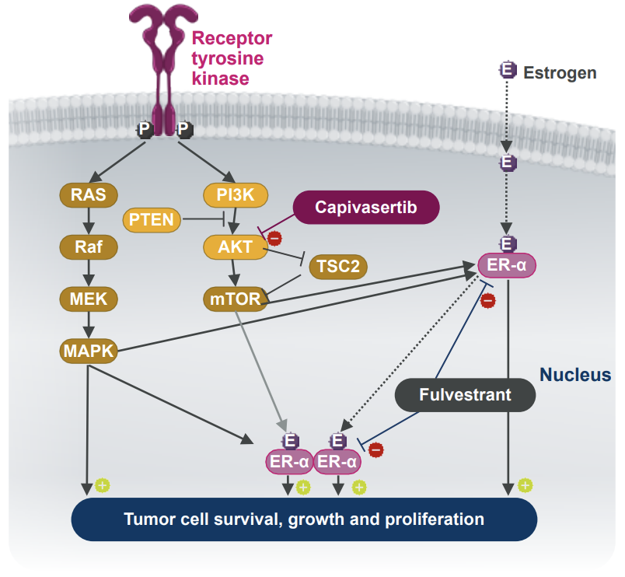
Capivasertib Mechanism of Action
Howell et al. SABCS 2023.

Slide 60
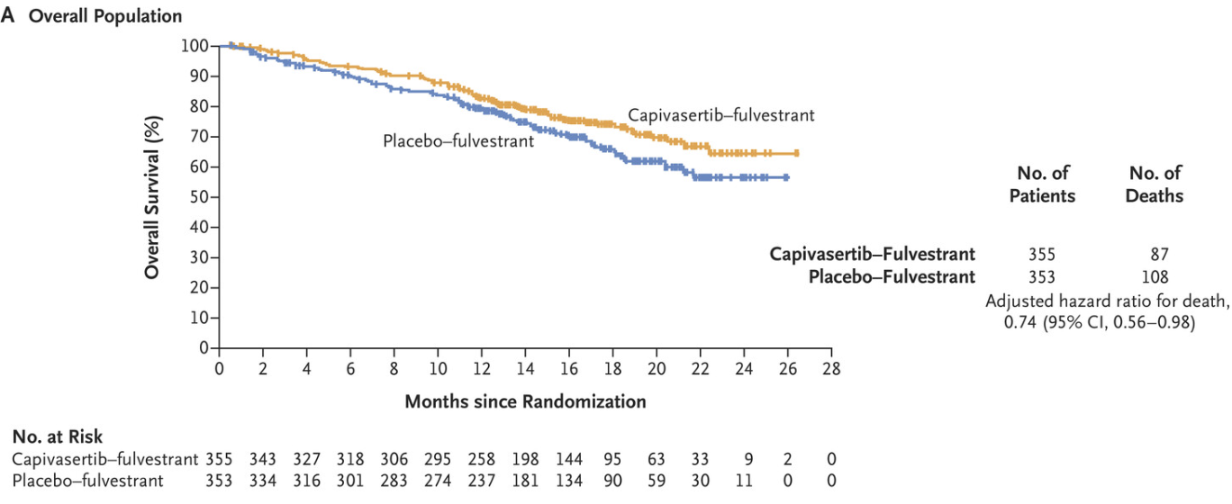
CAPItello-291: Results
PFS in the Overall Population
Turner et al. NEJM 2023.

Slide 61
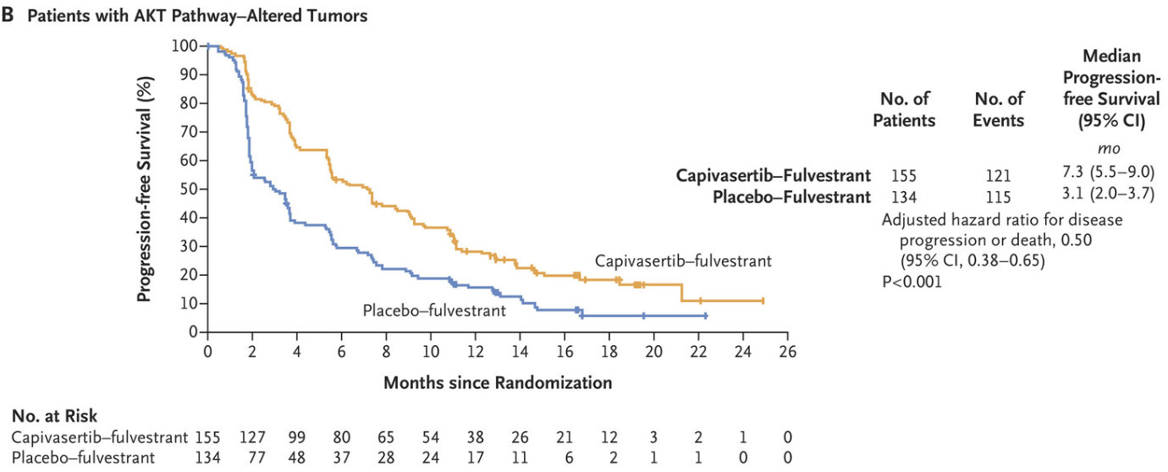
CAPItello-291: Results
PFS in Patients with AKT Pathway-Altered Tumors
Turner et al. NEJM 2023.

Slide 62
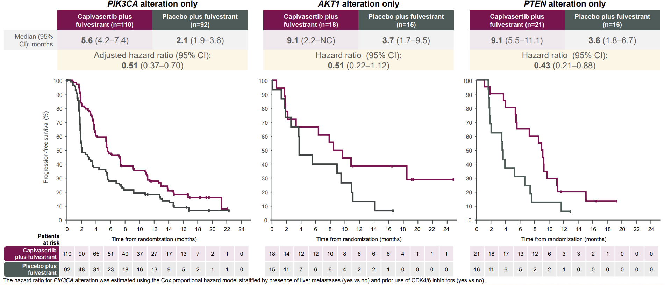
CAPItello-291 Results: PFS by Alteration Type
Howell et al. SABCS 2023.
Notes:
Consistent clinically meaningful benefit with capivasertib plus fulvestrant compared to placebo plus fulvestrant was observed in patients regardless of alteration detected

Slide 63
CAPItello-291 Safety
Common adverse events in capivasertib/fulvestrant versus placebo/fulvestrant
  Diarrhea: 72% versus 20%
    Grade 3: 9.3 % versus 0.3%
  Rash: 38% versus 7.1%
  Hyperglycemia: 16.3% versus 3.7%
    Grade 3: 2.3% versus 0.3%
Most adverse events grade 1-2
Oliviera et al. SABCS 2023.
Turner et al. NEJM 2023.

Slide 64
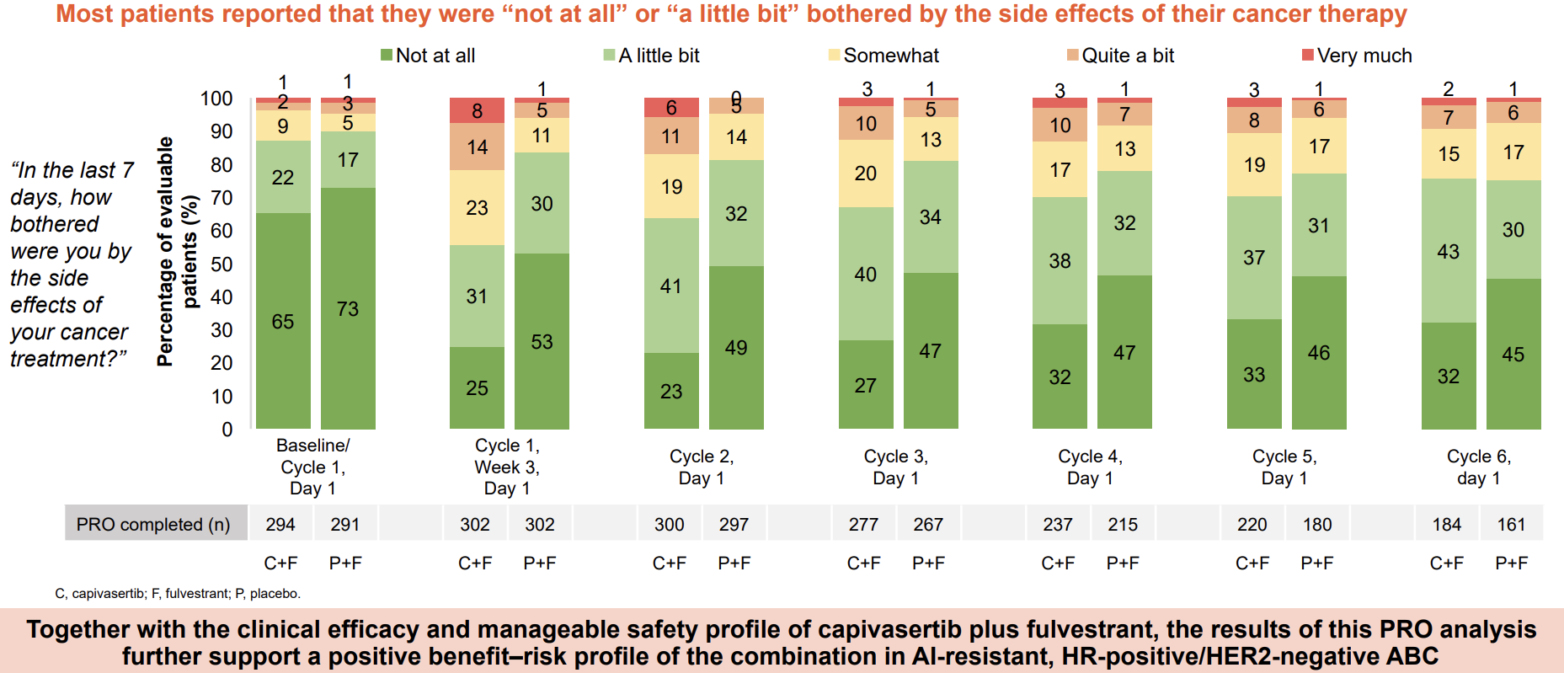
CAPItello-291: Treatment Tolerability by Patient Reported Outcomes
Oliviera et al. SABCS 2023.

Slide 65
CAPItello-291 Conclusions
Compared with fulvestrant alone, the addition of capivasertib to fulvestrant provided a consistent PFS benefit across alterations in all three key genes within the AKT pathway in patients with HR-positive/HER2-negative mBC
Capivasertib also has activity beyond AKT pathway-altered tumors
Diarrhea and rash were the most common adverse events
Rates of treatment discontinuation were low
Turner et al. NEJM 2023.
Howell et al. SABCS 2023.

Slide 66
Takeaways
Next generation sequencing is essential for ER+/HER2- mBC as there are now several actionable mutations (ESR1, PIK3CA/AKT/PTEN, BRCA)
Identifying endocrine sensitivity versus resistance is a key decision point in the second line setting
Single agent endocrine therapy has poor outcomes after prior CDK 4/6i

Slide 67
BREAST MALIGNANCIES
April 29th, 2024

Slide 68
ctDNA and MRD Detection in Breast Cancer Screening and Treatment
Massimo Cristofanilli, MD, FACP
Professor of Medicine
Chief of Breast Medical Oncology
Scientific Director of the Englander Institute of Precision Medicine (EPIM)
Associate Director of Precision Medicine
Sandra and Edward Meyer Cancer Center

Slide 69
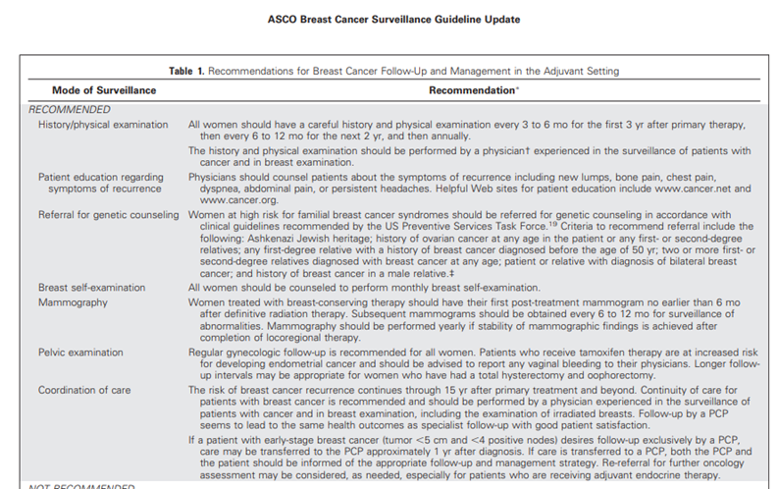
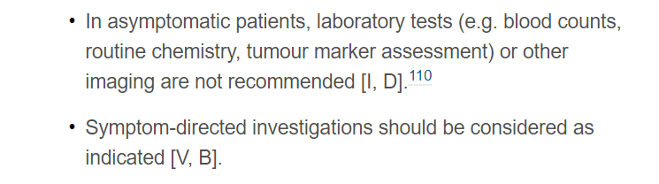
Early Breast Cancer Monitoring:
ASCO and ESMO Guidelines

Slide 70
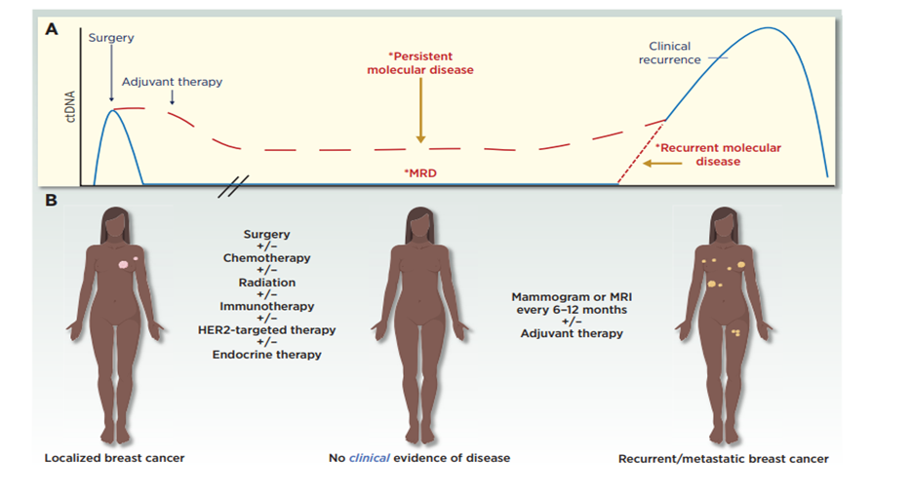
Molecular Residual Disease (MRD) detection opportunity
Medford AJ et al. Clinical Breast Cancer, 2023

Slide 71
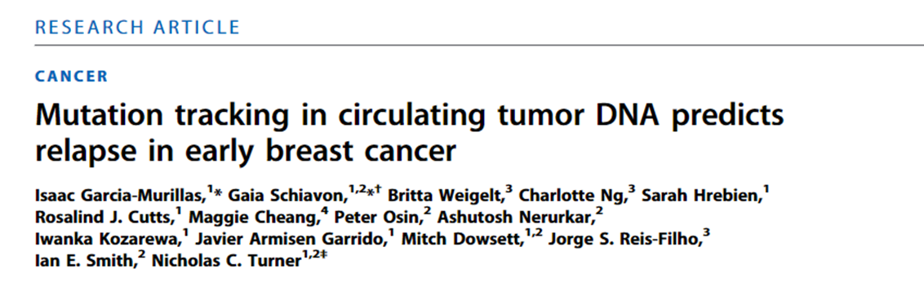
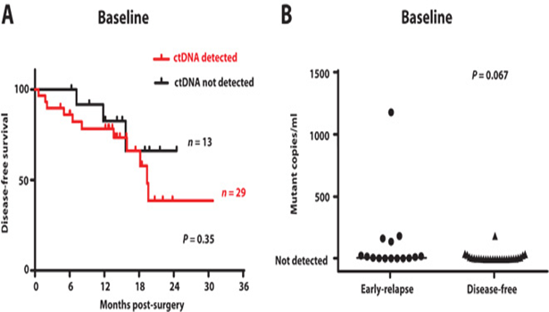
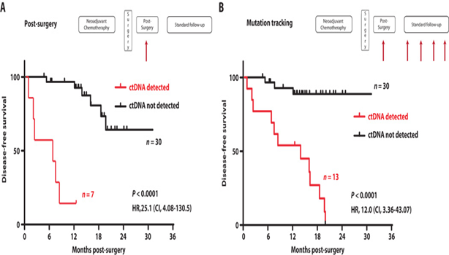

Slide 72
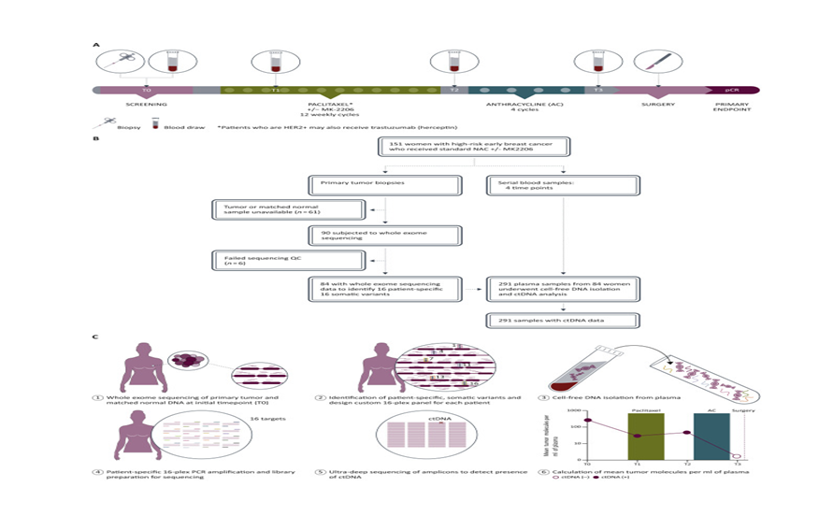
Circulating tumor DNA in neoadjuvant-treated breast cancer reflects response and survival

Slide 73
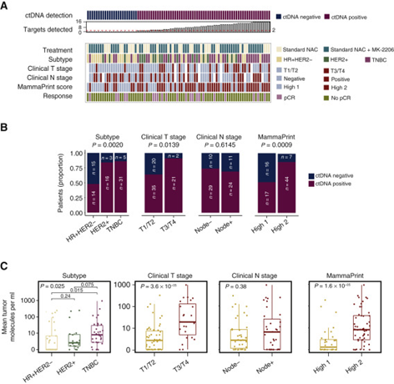
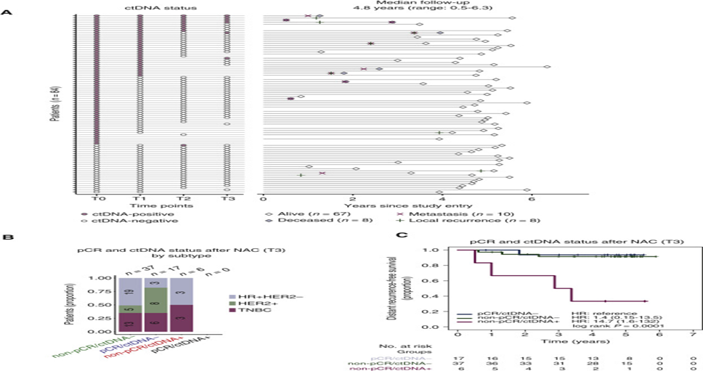
Circulating tumor DNA in neoadjuvant-treated breast cancer reflects response and survival

Slide 74
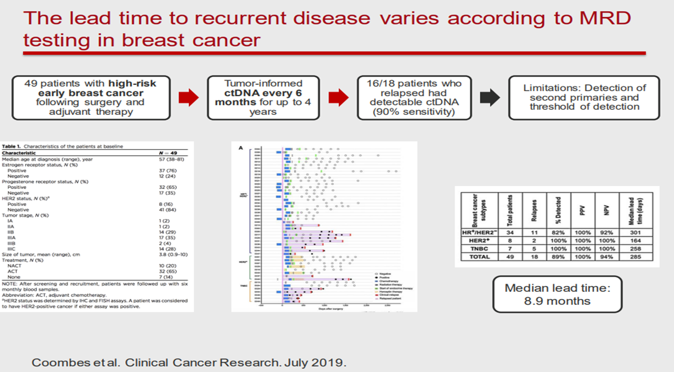
The lead time to recurrent (symptomatic) disease

Slide 75
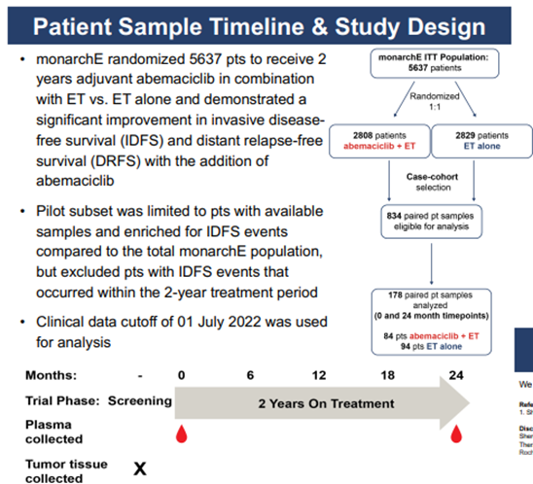
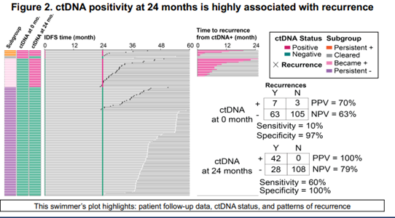
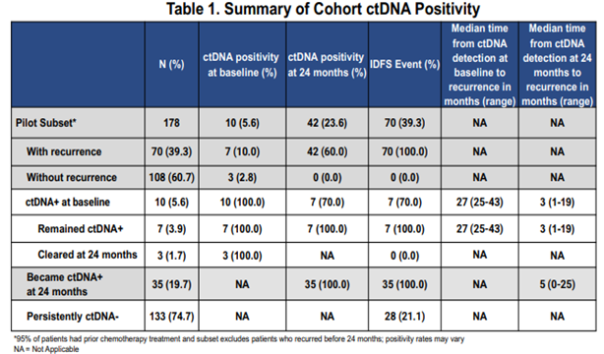

Slide 76
Real-world use of tumor-informed MRD assay

Slide 77
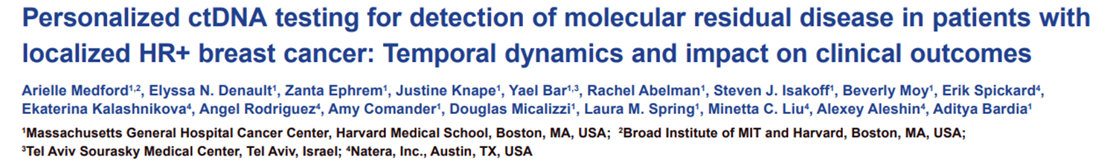
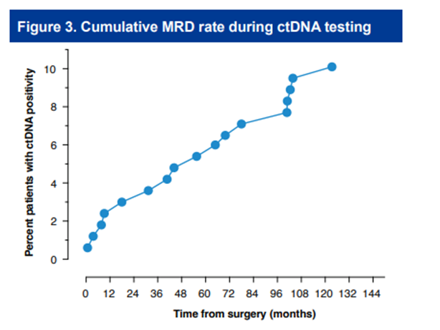


Slide 78

Case Presentation

Slide 79

Asymptomatic MBC

Slide 80

Case Presentation

Slide 81





Slide 82
Real-world use of non-tumor-informed MRD assay

Slide 83


Slide 84

Case Presentation

Slide 85




Slide 86

MRD in primary breast cancer

Slide 87

MRD testing approach

Slide 88





Slide 89
Conclusions
Use of liquid biopsy (NGS-ctDNA) is standard of care in advanced solid tumors. In metastatic breast cancer allows for molecular targets detection, monitoring and longitudinal evolution
In primary disease MRD monitoring in neoadjuvant and adjuvant settings can detect molecular recurrence with/without anatomical “asymptomatic” progression
Early interventions could impact long term outcome.

Slide 90


Slide 91
BREAST MALIGNANCIES
April 29th, 2024

Slide 92
Immunotherapy for Triple Negative Breast Cancer
Ashley Schreier, DO
Assistant Professor of Medicine
Weill Cornell Medicine
New York, N.Y.

Slide 93


Immune Checkpoint Blockade

Slide 94



Cancer’s great Escape
In order to progress, tumors must escape immune-mediated control.

Slide 95

T cell inhibitory receptors
Attack!

Slide 96
Immune Checkpoint Blockade
However, less success has been seen in breast cancer
Traditionally thought to not be a highly immunogenic tumor
Immunosuppressive tumor microenvironment
Benefit from ICIs is most appreciated in tumors with an immunogenic microenvironment infiltrated by anti-tumor T cells

Slide 97
TNBC: an immunogenic subtype
Within breast cancer, immune checkpoint blockade has been most studied in the triple negative setting, which is thought to be the most immunogenic breast cancer subtype-- highest mutational burden and increased TILs compared to hormone receptor positive tumors; higher prevalence of PD-L1 expression
HER2+ tumors have also been shown to have high levels of immune infiltrate in the tumor microenvironment

Slide 98

Advanced TNBC

Slide 99


Atezolizumab Monotherapy in metastatic triple negative breast cancer
-Heavily pre-treated
-ORR = 10%
-2 yr OS in responders = 100%
-Higher ORR in PDL1+ patients and first line setting; higher OS a/w higher TILs (OS 6 vs. 12 months in low vs high TILS)

Slide 100

PD-L1 expression and the Role of TILs
High numbers of tumor infiltrating lymphocytes has been correlated with improved response to immune checkpoint blockade in some studies
PD-L1 positive tumors also have shown favorable response compared to PD-L1 negative or unselected patient groups
High amount of TIL indicate a favorable prognosis in TNBC in the neoadjuvant setting and in HER2+ disease – suggesting a role for immune directed treatments in some types of breast cancer
Denkert C et al

Slide 101
Importance of TILs
Stromal TILS (sTILs) have been shown to have prognostic and predictive value in TNBC
De-escalation trial (Miguel Martín MD, PhD, Madrid): neoadjuvant anthracycline free regimen of docetaxel + carbo showed a 64% pCR rate in those with sTILs >30% and this was correlated with a favorable EFS with downstaging of patients in this category

Slide 102

First FDA approval in Breast Cancer
March 2019
atezolizumab for PD-L1 positive unresectable locally advanced or metastatic triple-negative breast cancer.

Slide 103


IMpassion130
November 29, 2018
N Engl J Med 2018; 379:2108-2121
DOI: 10.1056/NEJMoa1809615

Slide 104

IMpassion130
PFS: 7.2 months vs. 5.0 months
HR= 0.62; 95% confidence interval [CI], 0.49 to 0.78; P<0.001)

Slide 105



Slide 106

IMpassion131
No significant PFS or OS difference between atezolizumab plus paclitaxel vs paclitaxel alone in either the PD-L1–positive or IIT population.

Slide 107

Keynote 355

Slide 108


Keynote 355

Slide 109
Keynote 355
November 2020
pembrolizumab (KEYTRUDA, Merck & Co.) in combination with chemotherapy for the treatment of patients with locally recurrent unresectable or metastatic triple-negative breast cancer (TNBC) whose tumors express PD-L1 (CPS ≥10) as determined by an FDA approved test.

Slide 110
ICIs in Advanced TNBC: Summary
Responses to ICI monotherapy in metastatic TNBC are modest
  Factors: Line of therapy, PD-L1 expression level, tumor-infiltrating lymphocytes, TMB
Atezolizumab + nab-paclitaxel approved for first-line therapy in PD-L1+ advanced TNBC, per IMpassion130; no added efficacy with paclitaxel backbone, per IMpassion131
Pembrolizumab + nab-paclitaxel, paclitaxel, or gemcitabine/carboplatin approved for for 1st line therapy in PD-L1+ advanced TNBC

Slide 111

ATRACTIB
First line Atezolizumab + Taxol + Bevacizumab in advanced TNBC (first line)
Phase II study
Median PFS of 11 months; ORR 63%
Most patients were PD-L1 negative
? Combinations to enhance response in PD-L1 negative population
Maria Gion et al.

Slide 112

Neoadjuvant TNBC

Slide 113
Keynote 173
-pCR rate of 60% across all cohorts
-1 yr event-free and overall survival rates: 80% to 100%
-significant association between higher pre-treatment PD-L1 CPS and pre- and on-treatment sTILs with higher pCR rates
60 patients
between February 2016 - February 2017
Tumors were positive for PD-L1 expression by CPS 1 in 78% of patients
Immune related AE in 30% of patients

Slide 114

Impassion 031
PCR: 58% vs 41%, p=0·0044

Slide 115

Keynote 522

Slide 116

Keynote 522
Published February 9, 2022
N Engl J Med 2022;386:556-567
DOI: 10.1056/NEJMoa2112651
VOL. 386 NO. 6

Slide 117
neoMono
Neoadjuvant phase II trial
Atezolizumab + Chemo with or without a preceding Atezolizumab monotherapy window period (2 weeks)
No pCR difference but high (70%) pCR rates and pCR >90% in PD-L1 pos group who received Atezolizumab monotherapy window
Importance of sequencing? Chemo de-escalation in certain populations?
Hans-Christian Kolberg et al.

Slide 118
Unanswered questions
Use of pembrolizumab in the adjuvant setting – ideal management
Metastatic TNBC (PD-L1 negative) – how to make these tumors more immunogenic

Slide 119
Areas of Research Focus
Combination strategies
Novel agents
Understanding mechanisms of resistance
New directions – other immune targets

Slide 120

Future Directions
Adoptive cell therapy
Bispecific antibodies
Peptide and protein based vaccines
Autologous tumor cells
Tumor associated macrophages

Slide 121
Thank you!

Slide 122
BREAST MALIGNANCIES
April 29th, 2024

Slide 123

Oncologic Anthropology:
Understanding the Link between African Ancestry and Triple Negative Breast Cancer
State of the Science Summit: Breast Cancer
Weill Cornell Medicine
April 29, 2024
Lisa A. Newman, MD, MPH, FACS, FASCO, FSSO
Professor of Chief of Breast Surgery, Weill Cornell Medicine
Director, Interdisciplinary Breast Oncology Program, New York Presbyterian Hospital Network
Executive Director and Founder, International Center for the Study of Breast Cancer Subtypes
Adjunct Professor, M.D. Anderson Cancer Center
Komen Scholar Alumnus
I have no relevant disclosures

Slide 124

Oncologic Anthropology: Genetic Ancestry, Population Migration Patterns, Residential Racial Segregation, and Cancer Risk

Slide 125
Social Determinants of Health
World Health Organization
The conditions in which people are born, grow, live, work, age, and
a broader set of forces that shape daily life conditions

Slide 126


Slide 127
Selected U.S. Health Data, by Race/Ethnicity
 | Non-Hispanic Whites (White/Caucasian American) | Non-Hispanic Blacks (Black/African American) | Hispanic (Hispanic/LatinX)
Covid Mortality, Age-Adjusted Risk | 1.0 | 1.7 | 1.9
Obesity (BMI ≥30) | 34.6% | 48.0% | 42.6%
Uncontrolled Hypertension | 48.4% | 58.7% | 57.5%

Slide 128


Residential Racial Segregation: Systemic Racism in the 21st Century
Mortgage/Financing Discrimination
Digital Divide
Food Deserts/Nutritional Insecurity
Population Density
Poorer public school system
Reduced Employment Prospects
Health care access barriers
Annals of Surgery 2021

Slide 129
Breast Cancer Burden of
African Americans
Socioeconomic Disparities
Tumor biology
Genetics
Lifestyle & Reproductive Experiences
Environmental exposures
Diet/Nutrition
Higher mortality
Advanced stage distribution
Younger age distribution
Increased risk of adverse tumor features
Higher incidence of male breast cancer

Slide 130
Frequently-Asked Question in United States:
Is race a sociopolitical construct or a genetic/biologic entity?

Slide 131
Answer:
Both- Racial identity is a sociopolitical construct but it is also associated with ancestral genetic factors that contribute to cancer burden

Slide 132
SES-Adjusted Meta-Analysis, 2006
>13K AA & 75K WA Breast CA Pts; 19 Studies
AA Mortality Risk: 1.28 (95% CI 1.18-1.38)
Newman et al, JCO 2006

Slide 133
Breast Cancer Burden of
African Americans Compared to White Americans
Higher mortality
Advanced stage distribution
Younger age distribution
  30-40% AA <50; 20% WA<50
Higher risk of adverse tumor features
  Two-fold higher rates Triple Negative Breast Cancer (TNBC) in AA vs WA
Higher incidence Inflammatory Breast Cancer
Higher incidence male breast cancer
Socioeconomic Disparities
Delivery of Care
Tumor biology
Genetics
Lifestyle & Reproductive Experiences
Environmental exposures
Diet/Nutrition

Slide 134

“Parsing the Etiology of Breast Cancer Disparities” Newman, JCO 2016
SEER: Breast Cancer Incidence and Mortality
1973-2007
Tamoxifen
Surveillance, Epidemiology and End Results Program; Cancer.gov

Slide 135


Increased Prevalence of TNBC Among AA Patients Regardless of Age or Stage at Diagnosis
TNBC more common in young women, and in AA women in all age categories
TNBC more common with more advanced stages, and in AA women at all stages of disease
Breast Cancer Res Treat (2009) 113 : 357

Slide 136


“Breast cancer statistics, 2015: Convergence of incidence rates between black and white women”
Δ=42%
TNBC in AA
CA: A Cancer Journal for Clinicians
29 OCT 2015
Notes:
Trends in Female Breast Cancer Incidence and Mortality Rates by Race/Ethnicity, United States, 1975 to 2012.
Rates are per 100,000 females, age adjusted to the 2000 US standard population, and incidence rates are adjusted for reporting delay.
†Rates are 3‐year moving averages. NH indicates non‐Hispanic; API, Asian/Pacific Islander; AI/AN, American Indian/Alaska Native. Sources: Incidence: Surveillance, Epidemiology, and End Results program, National Cancer Institute, 2015. Mortality: National Center for Health Statistics, Centers for Disease Control and Prevention, as provided by the Surveillance, Epidemiology, and End Results program, National Cancer Institute, 2015. For Hispanics, incidence data do not include cases from the Alaska Native Registry and mortality data exclude New Hampshire and Oklahoma. Data for American Indians/Alaska Natives are based on Contract Health Service Delivery Area (CHSDA) counties.
© IF THIS IMAGE HAS BEEN PROVIDED BY OR IS OWNED BY A THIRD PARTY, AS INDICATED IN THE CAPTION LINE, THEN FURTHER PERMISSION MAY BE NEEDED BEFORE ANY FURTHER USE. PLEASE CONTACT WILEY'S PERMISSIONS DEPARTMENT ON PERMISSIONS@WILEY.COM OR USE THE RIGHTSLINK SERVICE BY CLICKING ON THE 'REQUEST PERMISSION' LINK ACCOMPANYING THIS ARTICLE. WILEY OR AUTHOR OWNED IMAGES MAY BE USED FOR NON-COMMERCIAL PURPOSES, SUBJECT TO PROPER CITATION OF THE ARTICLE, AUTHOR, AND PUBLISHER.

Slide 137

Henry Ford Health System, Metro Detroit MI
Benign Breast Disease Cohort
Benign Breast Disease Cohort, 1994-2005
  2,588 African Americans
  3,566 White Americans
  Follow-up (>10 years) and overall subsequent breast cancer detection rates (4%) as well as stage distribution similar for AA and WA pts, indicating equitable monitoring and screening
                Newman et al, JAMA Onc 2016

Slide 138



Screening Mammography Mitigates Disparities Related to TNBC: WCM (NYC) + HFHS (Detroit)
N=189

Slide 139
Five-Year Relative Survival Rates by
Race and Tumor Phenotype

Slide 140
TAILORx: 21-Gene Recurrence Score
Albain et al, SABCS 2018 and JNCI 2021
N= 9,719 HR-positive, HER2-negative, node-negative patients
  84% WA; 7% AA
RS distribution similar for AA and WA pts
RS had comparable prognostic/predictive value in AA and WA pts
BUT…
  AA with worse outcomes compared to WA, even within RS category
  RS 11-25 (intermediate risk range):
  AA with 80% higher relative risk of recurrence
  AA with 67% higher relative risk of death

Slide 141
ER-Negative and Triple Negative Breast Cancer and
African Ancestry Population Subsets: England, Switzerland and Brazil
Bowen et al, British J of Cancer 2008: London
    22% among Blacks vs 15% among Whites (overall)
    25% among Blacks vs 12% among Whites (<60yrs)
Copson et al, British J of Cancer 2014: UK POSH Study
    26% among Blacks vs 18% among Whites, all ≤40 yo
Carvalho et al, BMC Women’s Health 2014: Brazil
    Highest TNBC frequency in regions with increased African ancestry
Rapiti et al, Cancer Medicine 2016:
Switzerland
Swiss | 1 (ref)
European | 1.22
African | 2.52
North American | 2.18
Central/South American | 2.15

Slide 142

High-Risk Breast Cancer and
African Ancestry
Parallels between hereditary breast cancer and breast cancer in women with African ancestry
  younger age distribution
  increased prevalence of ER-neg, aneuploid tumors
  higher risk of male breast cancer
Is African ancestry associated with a heritable marker for high-risk breast cancer subtypes?
Unique opportunity to gain insights regarding etiology of breast cancer disparities and the pathogenesis of triple-negative breast cancer

Slide 143

TNBC in WA, AA, Ghanaians and Ethiopians
Plenary Presentation, Society of Surgical Oncology
Ann Surg Onc 2016
P<0.0001

Slide 144
Breast Cancer Phenotypes and
East/West African Ancestry in USA
Jemal A and Fedewa S,
  Breast Cancer Res Treat, 2012
SEER Registry, 1996-2008
Frequency of ER-negative breast cancer
  183,777 White American patients: 21%
  24,639 African American patients: 39%
  143 West African-born patients: 40%
  186 East African-born patients: 22%

Slide 145

Biologic Plausibility: “Oncologic Anthropology”
African Diaspora/ Patterns of Forced Population Migration
GHANA
ETHIOPIA

Slide 146



Melissa Davis, PhD
Scientific Director,
International Center for the Study of Breast Cancer Subtypes
Notes:
Snapshots of most impactful publications.

Slide 147



“Genetic ancestry and population differences in levels of inflammatory cytokines in women: Role for evolutionary selection and environmental factors”, Yao et al 2018
Duffy antigen receptor for chemokines/
Atypical chemokine receptor 1;
1q23 rs2814778: Duffy-null allele
SNV linked to African ancestry
Responsible for chemokine balance
Etiology of benign ethnic neutropenia
Implicated in transplant rejection
Association with breast/prostate cancer disparities?

Slide 148

“The Missing Diversity in Human Genetic Studies” Sirugo et al CELL, 2019
2% of individuals contributing to Genome Wide Association Studies with African Ancestry

Slide 149
Genetic Variants Associated with
Breast Cancer Risk + Duffy Null Allele
Variant | Region | Associated/Neighboring Gene(s)
rs2814778 | 1q23 | Duffy Antigen Receptor for Chemokines/ Atypical Chemokine Receptor 1
rs13000023 | 2q35 | TNP1, DIRC3
rs2363956 | 19p13.11 | ANKLE1
rs2981578 | 10q26 | FGFR2
rs2981579 | 10q26.13 | FGFR2
rs3112572 | 16q12 | LOC643714
rs3745185 | 19p13 | BABAM1
rs4245739 | 1q32.1 | MDM4
rs4849887 | 2q14.2 | LOC84931, GLI2
rs609275 | 11q13 | MYEOV, CCND1

Slide 150

TNBC-Specific Risk Assessment (Case Series)
ASA 2019 Podium Presentation;
Newman et al, Ann Surg 2019
 |  | By SNP Genotypes (Dominant Model) |  |  |  |  |  | By SNP Alleles (Dosage model)
SNP ID | Minor Allele | OR | SE | lower 95% CI | upper 95% CI | P-value | adjusted P-value | OR2 | SE2 | lower 95% CI4 | upper 95% CI5 | P-value | adjusted P-value2
rs2814778 Duffy-null | C | 7.175 | 0.3022 | 3.968 | 12.97 | <0.0001 | 0.0473 | 3.189 | 0.1602 | 2.33 | 4.364 | <0.0001 | 0.000345
rs13000023 | A | 0.259 | 0.78 | 0.0562 | 1.196 | 0.08353 | 0.03085 | 0.603 | 0.474 | 0.2382 | 1.528 | 0.2864 | 0.04996
rs2363956 | G | 0.274 | 1.127 | 0.0301 | 2.492 | 0.2503 | 0.07728 | 0.474 | 0.6857 | 0.1237 | 1.819 | 0.2768 | 0.03369
rs2981578 | C | 0.444 | 1.126 | 0.0489 | 4.037 | 0.4713 | 0.8362 | 0.444 | 1.126 | 0.04893 | 4.037 | 0.4713 | 0.8362
rs2981579 | G | 0.729 | 1.149 | 0.0767 | 6.932 | 0.7834 | 0.9271 | 0.964 | 0.6055 | 0.2943 | 3.158 | 0.9517 | 0.8631
rs3112572 | A | 0.84 | 0.8047 | 0.1735 | 4.067 | 0.8285 | 0.7438 | 1.193 | 0.6292 | 0.3477 | 4.096 | 0.7787 | 0.936
rs3745185 | A | 0.964 | 0.9019 | 0.1646 | 5.649 | 0.9678 | 0.8378 | 0.964 | 0.9019 | 0.1646 | 5.649 | 0.9678 | 0.8378
rs4245739 | C | 0.759 | 0.7908 | 0.161 | 3.574 | 0.7268 | 0.7032 | 0.528 | 0.5591 | 0.1765 | 1.579 | 0.2533 | 0.2315
rs4849887 | T | 1.667 | 0.8028 | 0.3456 | 8.038 | 0.5246 | 0.1145 | 1.4 | 0.6246 | 0.4114 | 4.761 | 0.5905 | 0.1949
rs609275 | C | 0.365 | 0.8613 | 0.0675 | 1.975 | 0.2421 | 0.5357 | 0.365 | 0.8613 | 0.06749 | 1.975 | 0.2421 | 0.5357

Slide 151

Global Distribution of Locally Adaptive Traits
Tishkoff, Science 2015; 349:1282

Slide 152

Duffy Antigen Receptor for Chemokines (DARC, Duffy)
Duffy-null phenotype carriers lack critical immunological regulation
A.
B.
chemokine bound DARC/ACKR1
unbound chemokine DARC/ACKR1
DARC/ACKR1
Endothelial Cells
Circulating Red blood Cells
Buffer Effect
Transcytosis of chemokines
Chemokine Sink/Buffering
DARC
PRESENT
DARC
ABSENT
2
Release into circulation
Sequestration of chemokines
High Serum Chemokine Levels
ABSENT in Africans and African-Americans
Recruitment of leukocytes
Blocks angiogenesis; slows tumor growth
Chemokine Capture – return to homeostatic levels
Expression in Cancer Context??
Expression in Normal circulation context
Courtesy, Melissa Davis PhD

Slide 153




Abstract
Women of sub-Saharan African descent have disproportionately higher incidence of Triple Negative Breast Cancer (TNBC), and TNBC-specific mortality. Population comparative studies show racial differences in TNBC biology, including higher prevalence of basal-like and Quadruple-Negative subtypes in African Americans (AA). However, previous investigations relied on self-reported race (SRR) of primarily United States (US) populations. Due to heterogenous genetic admixture, and biological consequences of social determinants, the true association of African ancestry with TNBC biology is unclear. To address this, we conducted RNAseq on an international cohort of AAs, west and east Africans with TNBC. Using comprehensive genetic ancestry estimation in this African-enriched cohort, we found expression of 613 genes associated with African ancestry and 2000+ associated with regional African ancestry. A subset of African-associated genes also showed differences in normal breast tissue. Pathway enrichment and deconvolution of tumor cellular composition revealed tumor-associated immunological profiles are distinct in patients of African descent.

Slide 154
Distinct Tumor Microenvironment Signature in AA Women
Yao et al, JNCI 2021

Slide 155

Tumor-Associated Lymphocytes and
Breast Cancer Survival: TCGA (JAMA Surg, 2024)

Slide 156


International Collaborations:
Opportunities to study variations in high-risk patterns of disease
Opportunities to improve the standard of health care in medically-underserved populations
Opportunities to cultural and academic exchange
Opportunities to forge powerful friendships
ICS BCS Mission: To reduce the global breast cancer burden through advances in research and delivery of care to diverse populations worldwide

Slide 157





ICS BCS Collaborations:
Capacity-Building Through Teaching/Training
New Clinical Programs:
Immunohistochemistry in Kumasi and Addis Ababa
Plastic Surgery/Breast Reconstruction
Core Needle Biopsy Training Program
Weekly Telemedicine Tumor Board Mtgs
Annual ICS BCS “Breast Cancer in Africa” Symposia

Slide 158









Slide 159
SURVIVAL RATES
60%
43%
20%

Slide 160
R.M.S. TITANIC
Passenger Status
Survival Rate
1st Class
60%
2nd Class
43%
3rd Class
20%
Outcome depends on access to care:
DEI Principles are foundational to
optimizing healthcare access for all

Slide 161

“Of all the forms of inequality, injustice in health is the most shocking and inhumane”
Rev. Dr. Martin Luther King, Jr.
Medical Committee for Human Rights, Chicago 1966

Slide 162









Acknowledgements
Colleagues in Ghana:
Dr. Baffour Awuah
Dr. Joseph Oppong
Dr. Frances Aitpillah
Dr. Ishmael Kyei
Dr. Francis Abantaga
Dr. Ernest Adjei
Dr. Ernest Osei-Bonsu
Dr. Michael Ohene-Yeboah
Dr. Emmanuel Amankwaa-Frempong
Patients of the Komfo Anokye Teaching Hospital
Colleagues in Ethiopia:
Dr. Aisha Suleiman-Jibril
Dr. Abebe Engida
Dr. Bekele Mahteme
Dr. Abebe Zerihun
Patients of the St. Paul’s Millenium Teaching Hospital

Slide 163

Thank You!!!

