Slide 1










LUNG CANCER
Thursday, April 27, 2023

Slide 2

Welcome
Bobby Goldsmith
Vice President of Sales

Slide 3



Thank You to Our Supporters:

Slide 4


Slide 5
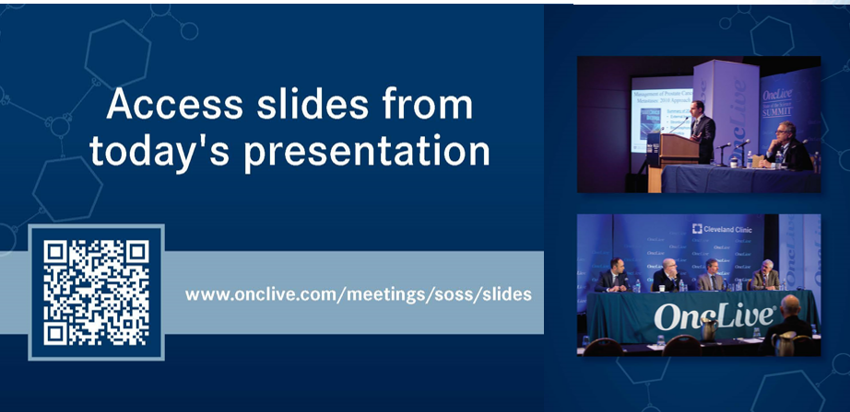

Slide 6


OncLive® is launching
a new app called
Meet MY MSL!
Visit https://cloud.email.onclive.com/referrals to be one of the first health care professionals to gain access to Meet My MSL
Meet My MSL has been created to provide oncologists the opportunity to initiate direct contact with the Medical Science Liaison (MSL) in their area of expertise. It has never been easier to meet, locate, and contact the MSL you need.
Find any MSL from any company for any tumor

Slide 7


Slide 8


Slide 9
Program Co-Chair
Benjamin Philip Levy, MD
Clinical Director of Medical Oncology, Johns Hopkins Sidney Kimmel Cancer Center at Sibley Memorial Hospital
Associate Professor of Oncology
Washington, D.C.

Slide 10
Program Co-Chair
Stephen Liu, MD
Associate Professor of Medicine at Georgetown University
Director of Thoracic Oncology
Head of Developmental Therapeutics at the Georgetown Lombardi Comprehensive Cancer Center
Washington D.C.

Slide 11
LUNG CANCER
Thursday, April 27, 2023

Slide 12
Emerging Treatments in ES-SCLC
Noura Choudhury, MD
Assistant Attending
Memorial Sloan Kettering Cancer Center
New York, NY

Slide 13
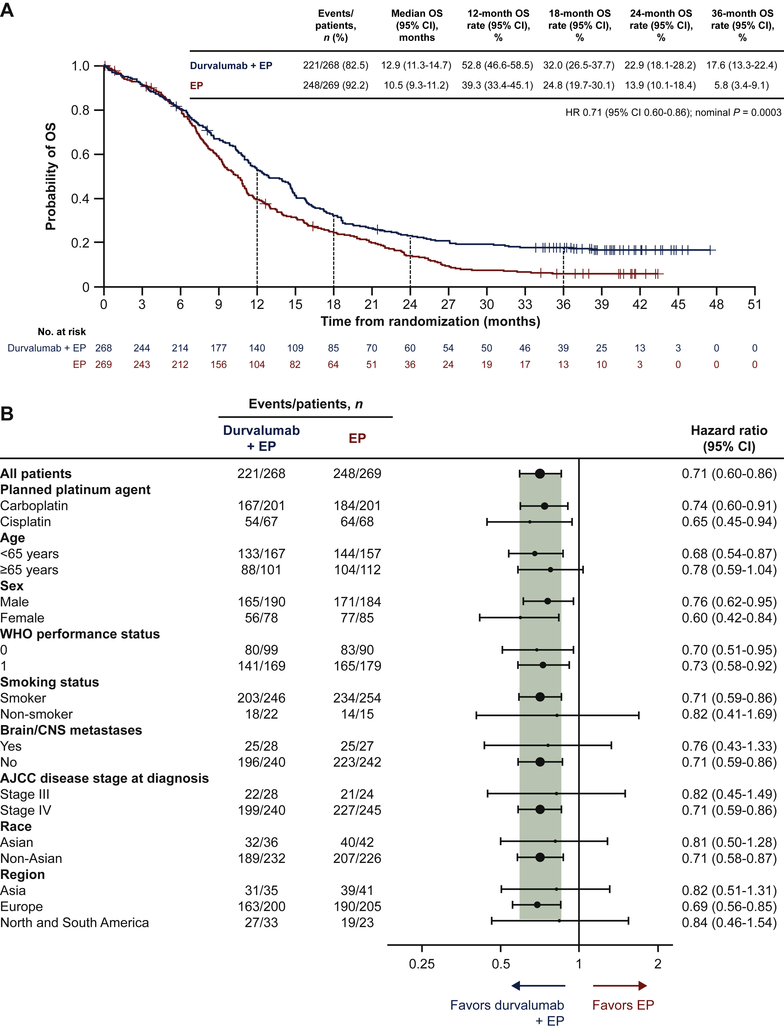
Prognosis of SCLC is extremely poor
Limited-stage
  Median OS: 15-20 months
  20-40% survival at 2 years
  10% survival at 5 years
Extensive-stage
  Median OS: 8-13 months
  5% survival at 3 years
  1% survival at 5 years
Paz-Ares et al, ESMO Open 2022

Slide 14
Overview of SCLC
Etiology
  Tobacco (~95% of cases associated with smoking)
  Adenocarcinomas can transform to SCLC
Epidemiology of SCLC
  10-15% of lung cancers
  Male:female ratio 1:1
  Majority with metastatic, extensive-stage disease (60%)
  Initially sensitive to chemoradiation, then rapidly develop resistance
  Limited benefit of subsequent line therapies

Slide 15
First-line therapies
Combination chemotherapy (EP) with immunotherapy is the standard
No identified biomarkers to predict benefit

Slide 16
IMPower133: EP +/- atezolizumab
Adapted from Liu et al, WCLC 2018
Notes:
Caspian study outcomes

Slide 17
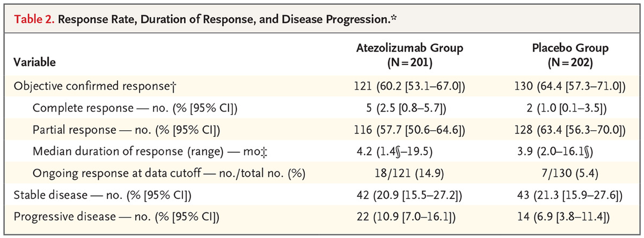
IMPower133 response rate
Horn et al, NEJM 2018

Slide 18
IMPower133 PFS
Horn et al, NEJM 2018

Slide 19
Updated IMPower133 results
Median follow-up:
22.9 months
Liu et al, JCO 2021

Slide 20
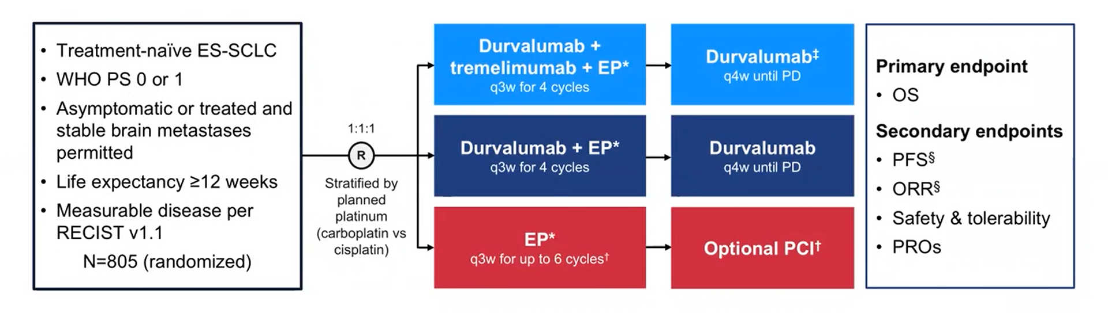
CASPIAN: Chemo +/- durvalumab
Paz-Ares et al, Lancet 2019.
Paz-Ares et al, ASCO 2020.
Goldman et al, Lancet Oncol 2020.
Notes:
Caspian study trial design

Slide 21
CASPIAN: updated OS data
Median follow-up:
39.4 months
Paz-Ares et al, ESMO Open 2022
Notes:
Caspian study trial design

Slide 22
First-line therapies
Negative results

Slide 23
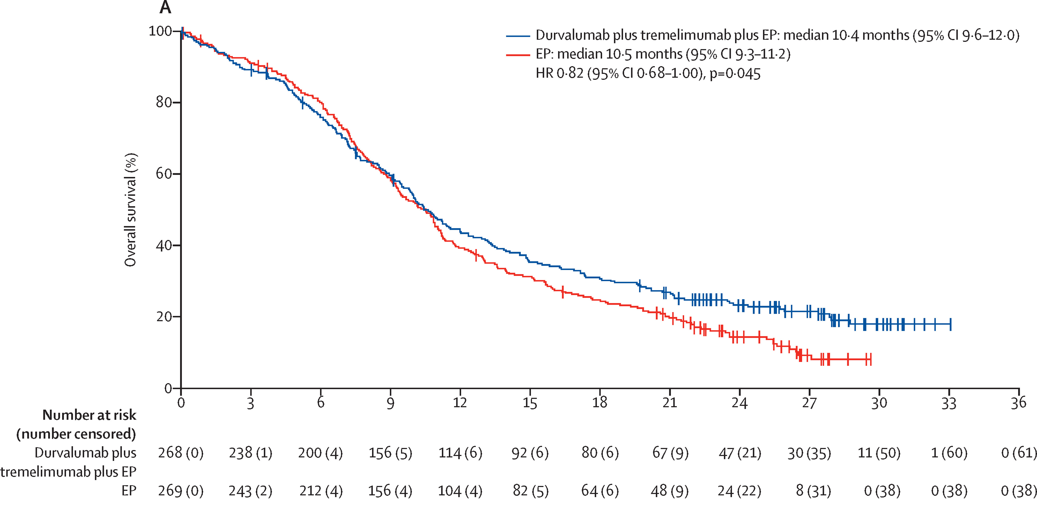
CASPIAN: addition of CTLA4i to chemo/durva showed no improvement in OS
Median follow-up:
25.1 months
Goldman et al, Lancet Oncol 2021
Paz-Ares et al, ASCO 2020.
Goldman et al, Lancet Oncol 2020.
Notes:
Caspian study trial design

Slide 24
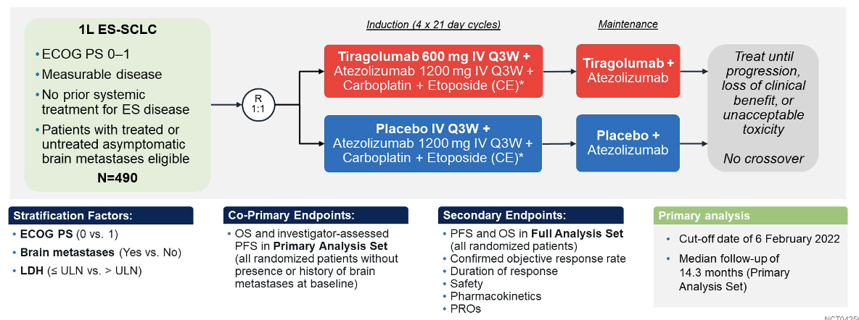
SKYSCRAPER-02: Tiragolumab
Rudin ASCO 2022
Rudin, ASCO 2022

Slide 25
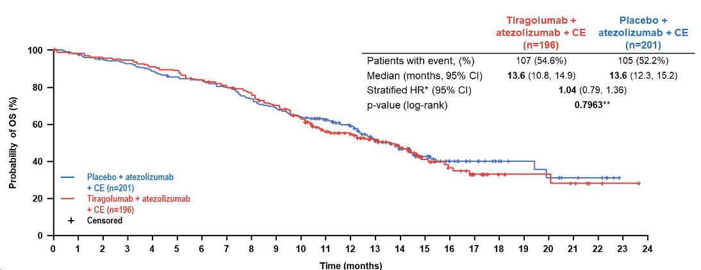
SKYSCRAPER-02: Tiragolumab
Rudin ASCO 2022
Rudin, ASCO 2022

Slide 26
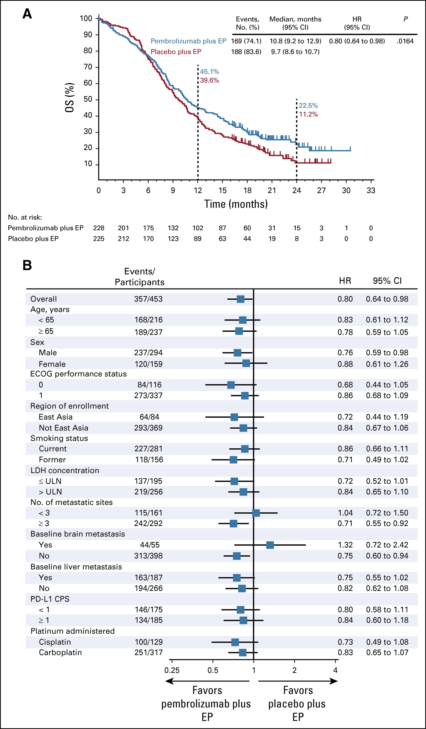
KEYNOTE-604: no improvement in OS
Rudin et al, JCO 2020

Slide 27
Second-line therapies
Two FDA approved therapies
  Lurbinectedin
  Topotecan
Emerging therapies

Slide 28
Second-line therapies
Two FDA approved therapies
  Lurbinectedin
  Topotecan
Emerging therapies

Slide 29
Lurbinectedin as second-line treatment for recurrent SCLC
lurbinectedin: synthetic alkaloid analogue that covalently binds to residues in the minor groove of DNA, though to lead to delayed progression through the cell cycle and ultimately leading to cell death
single-arm, open-label phase 2 basket study
only 1 prior chemotherapy-containing regimen allowed
all patients received lurbinectedin 3.2 mg/m² IV every 3 weeks
primary outcome: proportion of patients with an overall response (complete or partial)

Slide 30
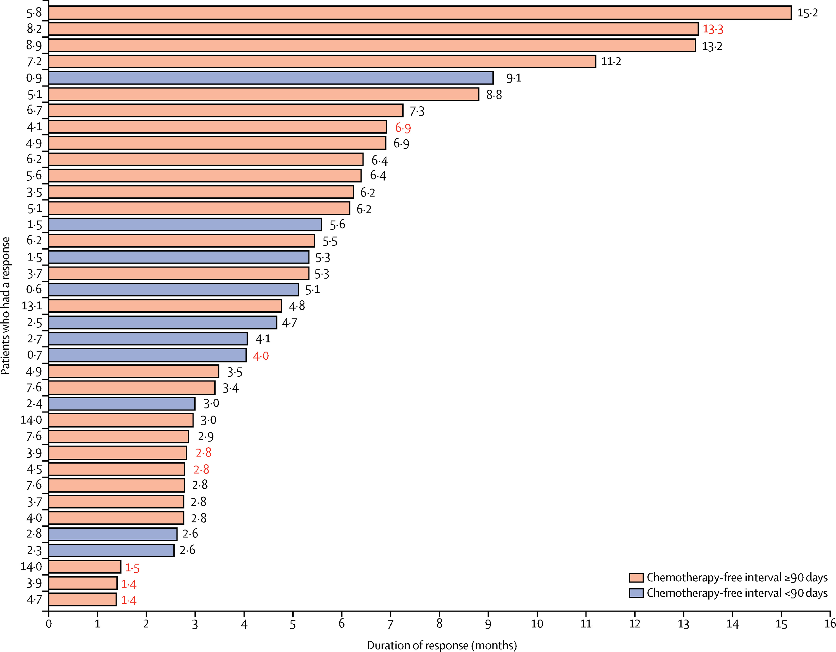
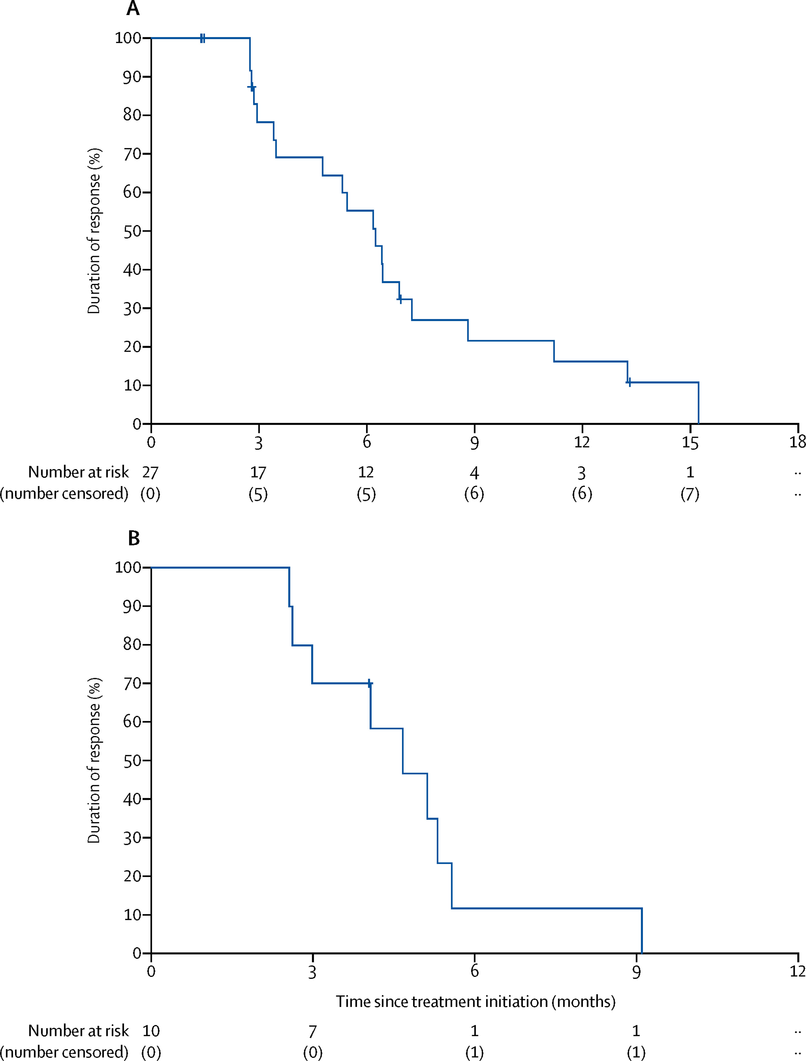
Lurbinectedin monotherapy
Median PFS 3.5 mo
Median OS 9.3 mo
ORR 35.2%
Trigo et al, Lancet Oncology 2020.

Slide 31
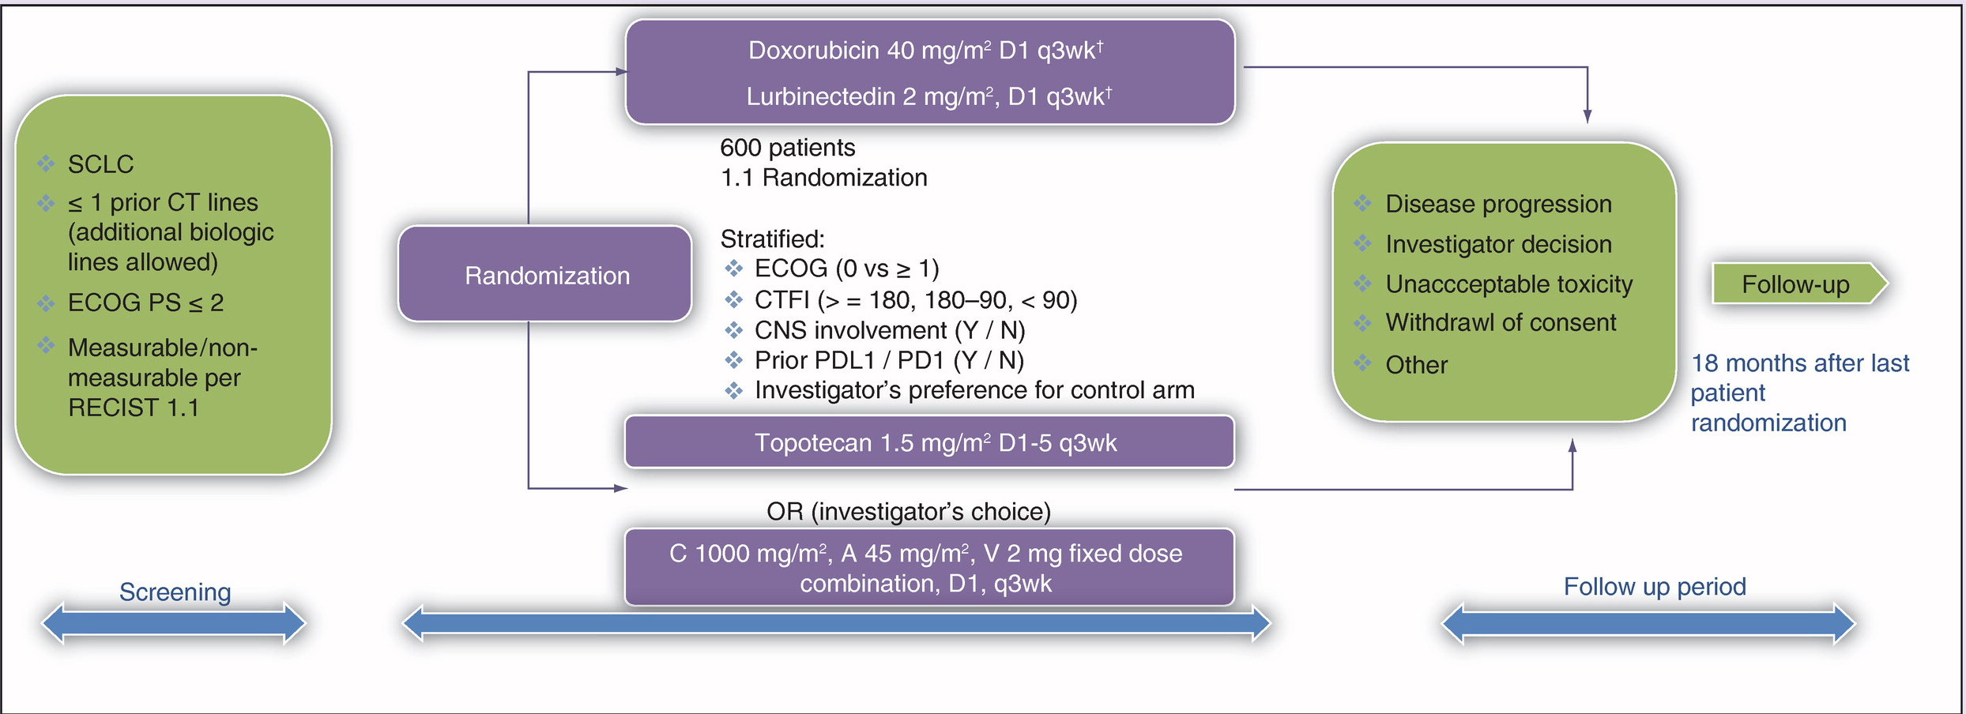
ATLANTIS: phase III trial of lurbi + doxo vs. topo or CAV
Farago et al, Future Med 2018

Slide 32
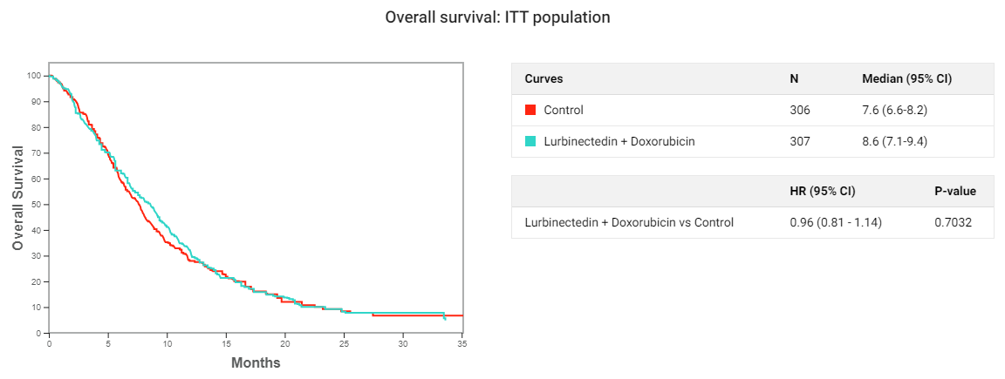
No improvement in OS with lurbi + dox
Paz-Ares et al, WCLC 2021

Slide 33
Second-line therapies
Two FDA approved therapies
  Lurbinectedin
  Topotecan
Emerging therapies

Slide 34
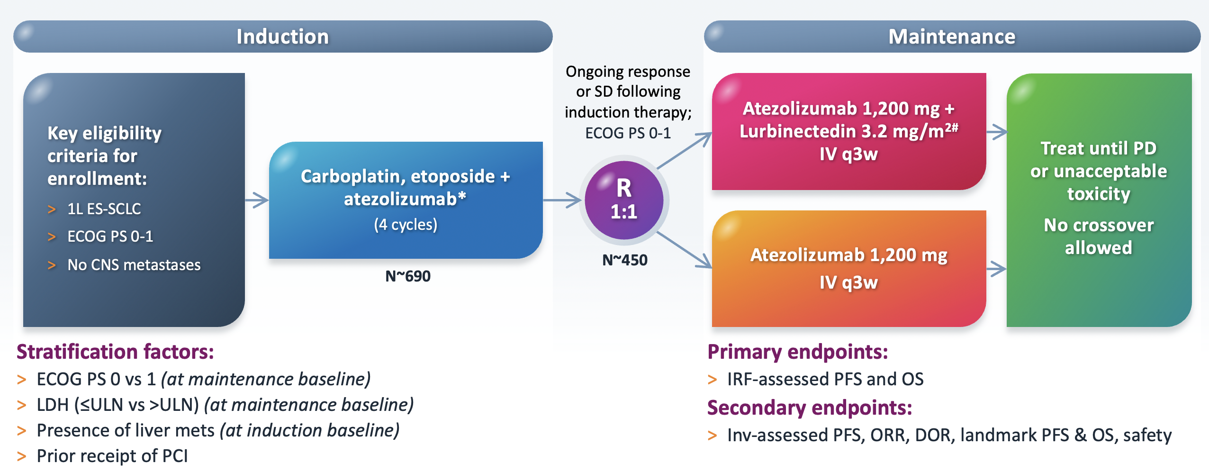
IMforte

Slide 35
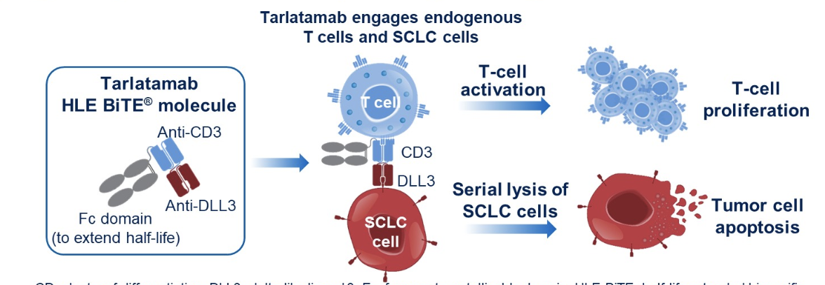
Tarlatamab
Owonikoko ASCO 2021

Slide 36
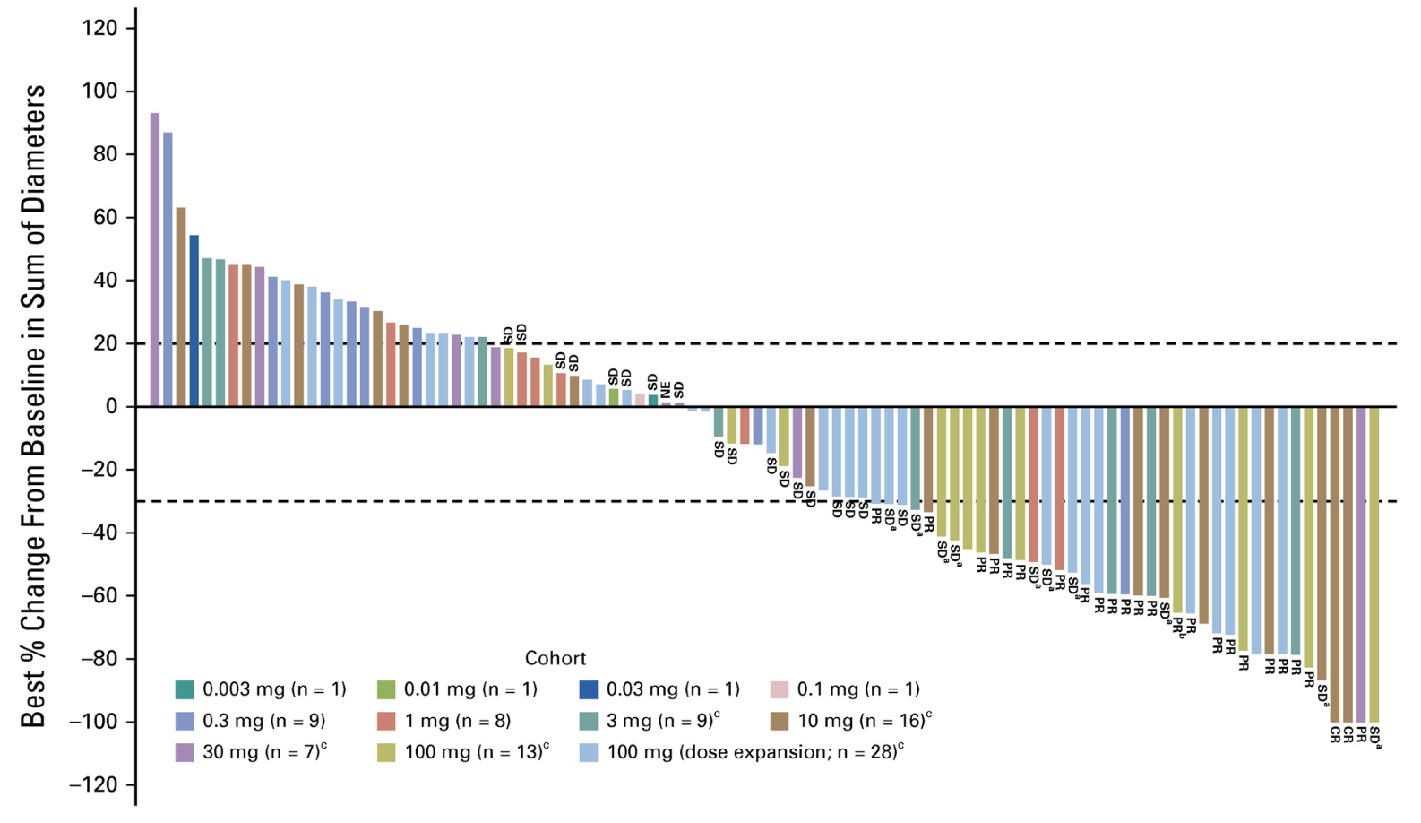
Preliminary tarlatamab activity
107 treated patients
Grade 3 AE 30.8%
  Any CRS 52%
  Gr 3 CRS 1%
ORR 23.4%
Median duration of response 12.3 mo
PFS 3.7 mo
OS 13.2 mo
Paz-Ares JCO 2023

Slide 37
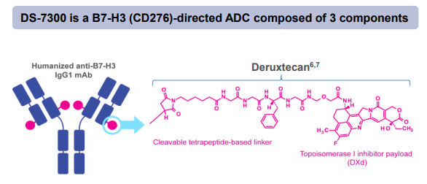
I-DXd
Ifinatamab deruxtecan (DS-7300) is a B7H3 ADC with promising activity in SCLC
Doi ESMO 2022

Slide 38
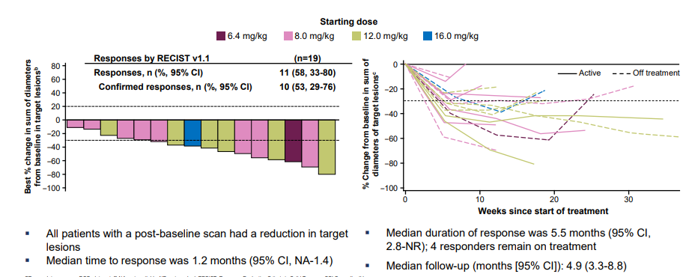
I-DXd activity in SCLC subset
Doi ESMO 2022

Slide 39
RESILIENT: liposomal irinotecan
N = 461 Key inclusion criteria Histologically or cytologically confirmed SCLC Radiologically confirmed progression after 1L platinum- based chemotherapy^{b} ECOG PS 0 or 1
 | R 1:1
 | Stratification factors Region Platinum sensitivity
 | ECOG PS 0 or 1 Prior immunotherapy
Liposomal irinotecan^{c}
70 mg/m² IV Q2W (6-week cycle)
Tumour assessment every 6 weeks per RECIST v1.1 or RANO BM^{d}
Treatment until disease progression or unacceptable toxicity^{e}
Topotecan^{c}
1.5 mg/m²/day IV for 5 days Q3W
(6-week cycle)
Follow-up every 4 weeks until death, loss to follow-up, withdrawal of consent, or study end^{f}
Adapted from Rudin ELCC 2023
•

Slide 40
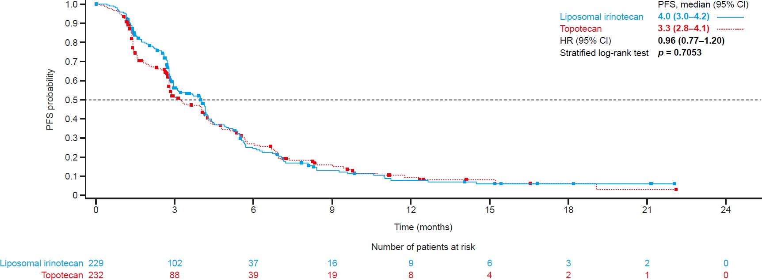
RESILIENT: PFS per BICR (ITT population)
Rudin ELCC 2023
•

Slide 41
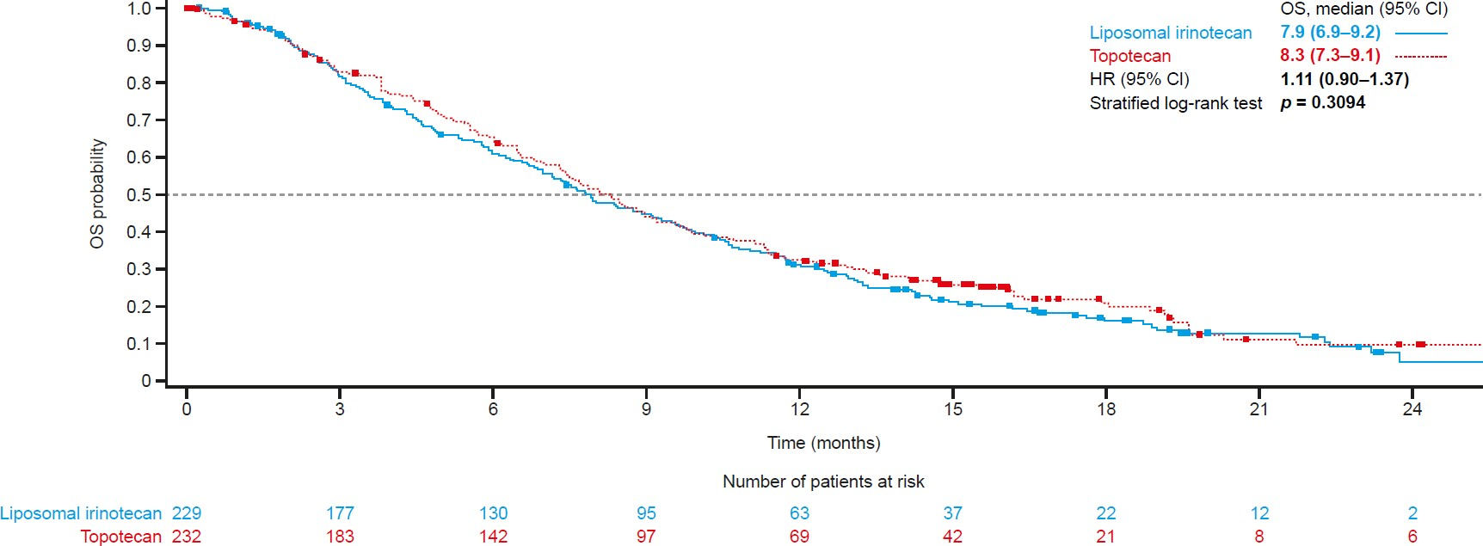
RESILIENT: OS (ITT population)
Median follow up 18.4 mo
Rudin ELCC 2023
•

Slide 42
Conclusions
There is an urgent need for improved therapies for ES-SCLC, with few approved options for relapsed disease
Several promising strategies are under investigation (ADCs, combination therapies, immunomodulatory strategies)
More mature data likely to become available in the upcoming year

Slide 43

Immunotherapeutic approaches for resectable NSCLC
Joshua E. Reuss, MD
Assistant Professor of Medicine
Georgetown Lombardi Comprehensive Cancer Center
April 27th, 2023
@Joshua_Reuss

Slide 44
Disclosures
Advisory Board / Consultant:
  Genentech/Roche, Sanofi/Genzyme, Personalis, Guardant, Astrazeneca, BMS, Arcus, Abbvie
Research Funding (to institution):
  Genentech/Roche, Verastem, Nuvalent, Mesothelioma Applied Research Foundation, LUNGevity Foundation, MedStar Health Institute
Honoraria/Speaking Fees:
  Astrazeneca, Merck
@Joshua_Reuss

Slide 45
Adjuvant Immunotherapy
@Joshua_Reuss

Slide 46
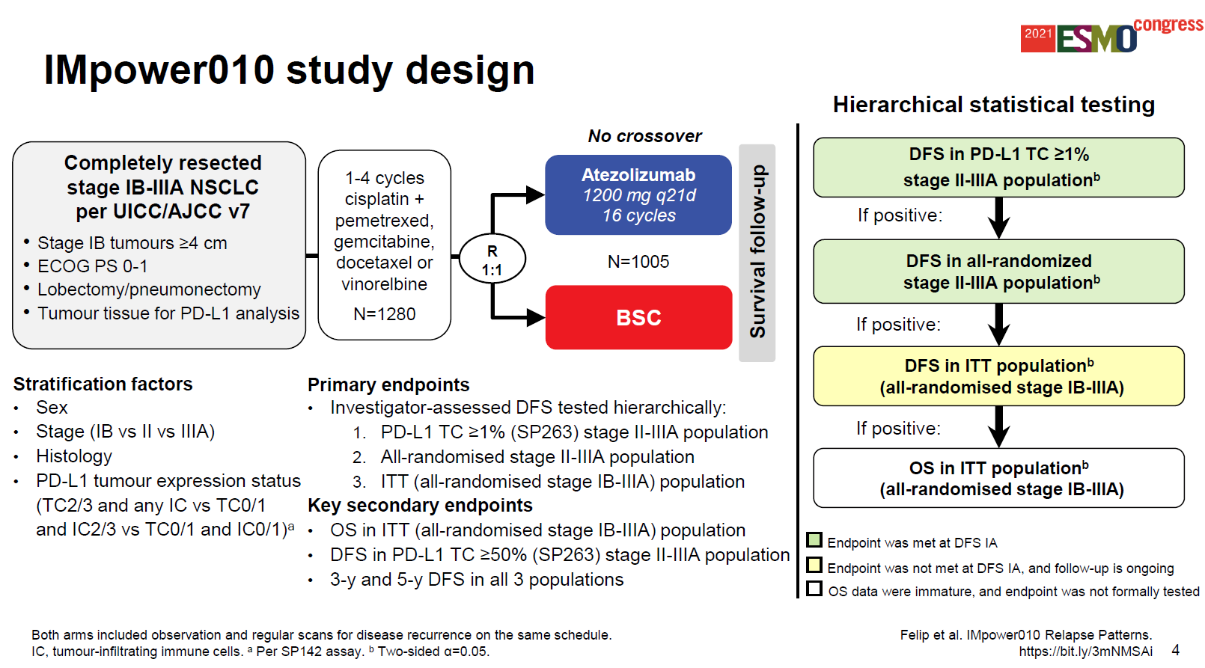
Phase III IMpower010
Notes:
Enrolled 1280 pts though 1005 ultimately randomized to atezo vs BSC

Slide 47
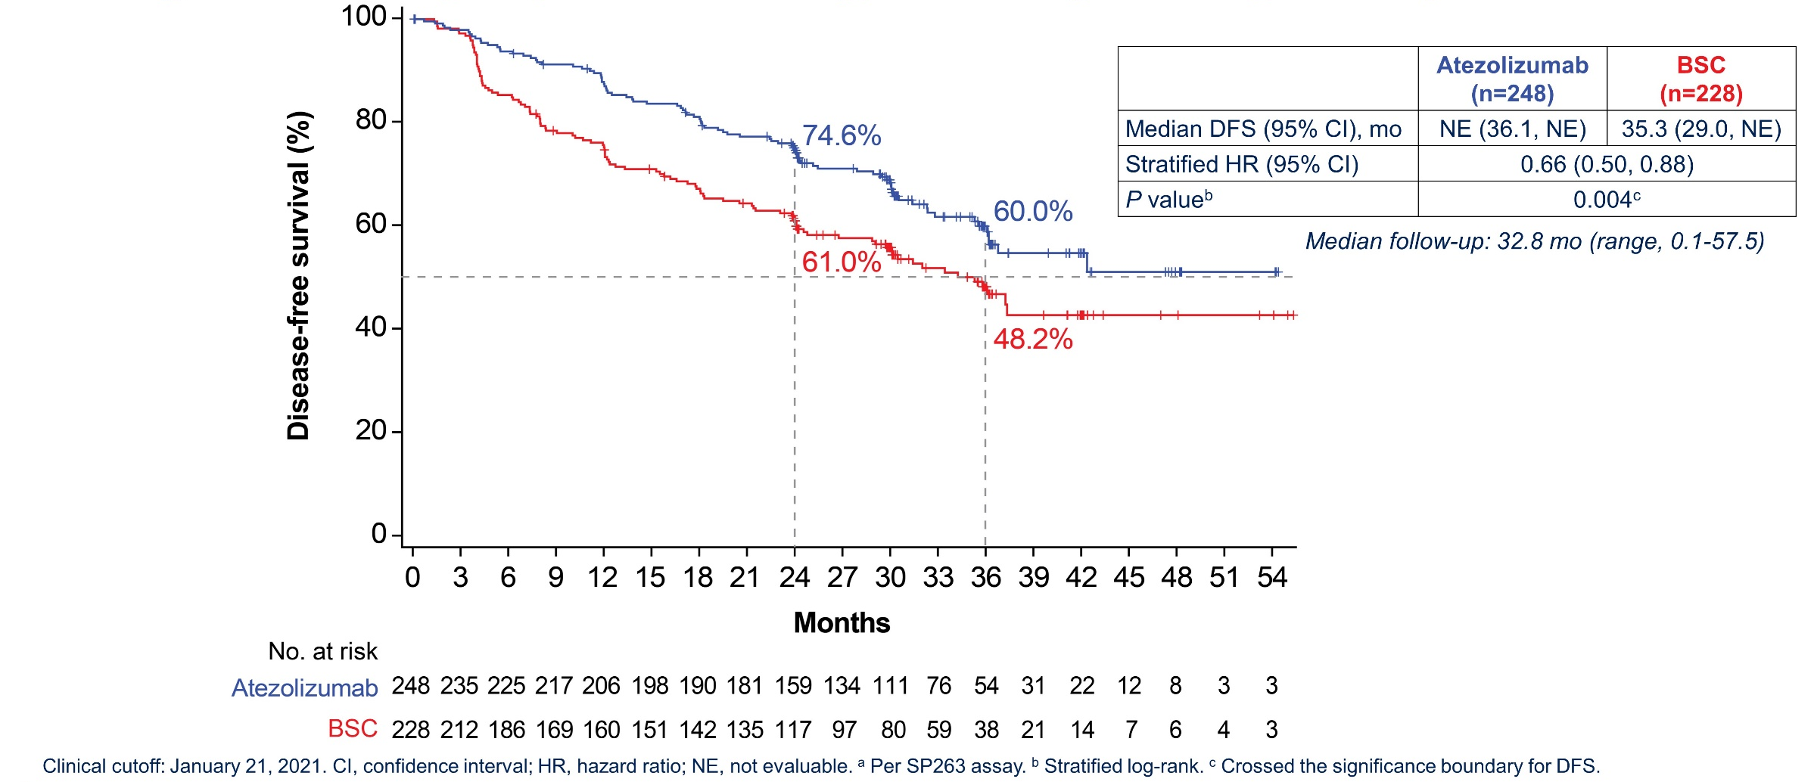
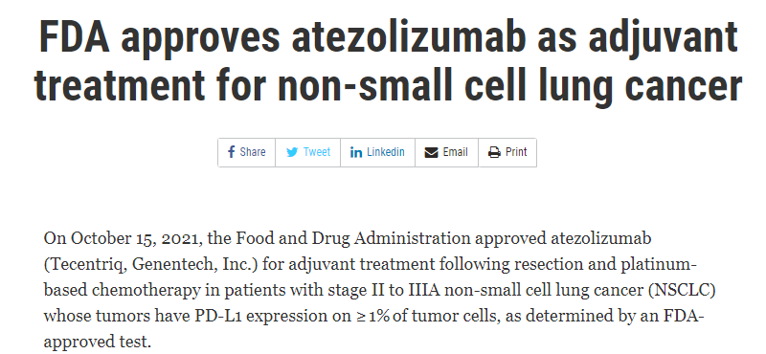
Atezolizumab improves DFS in patients with resected PD-L1 positive (TC≥1%ª) stage II-IIIA NSCLC
Wakelee et al. ASCO 2021; Felip et al. Lancet 2021
@Joshua_Reuss
Notes:
Adjuvant phase III studies take median of 11 years to publication of study results

Slide 48
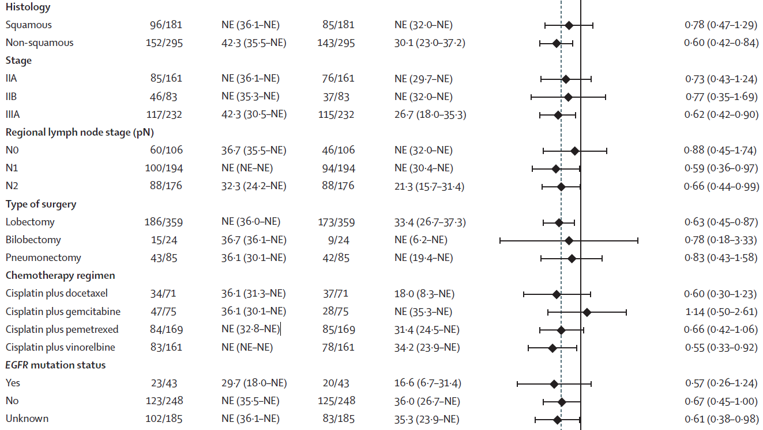
Atezolizumab improves DFS in patients with resected PD-L1 positive (TC≥1%) stage II-IIIA NSCLC
Felip et al. Lancet 2021
Notes:
Adjuvant phase III studies take median of 11 years to publication of study results

Slide 49
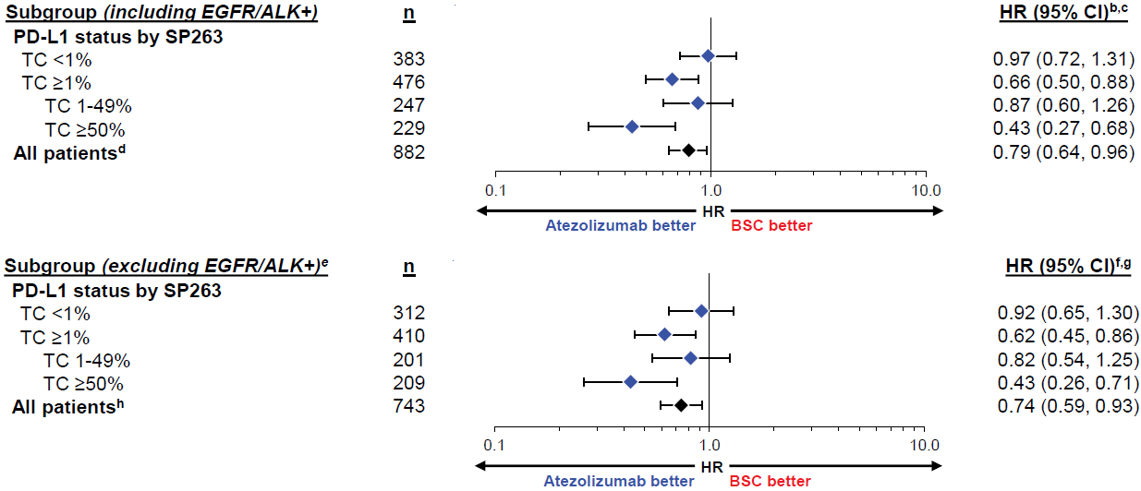
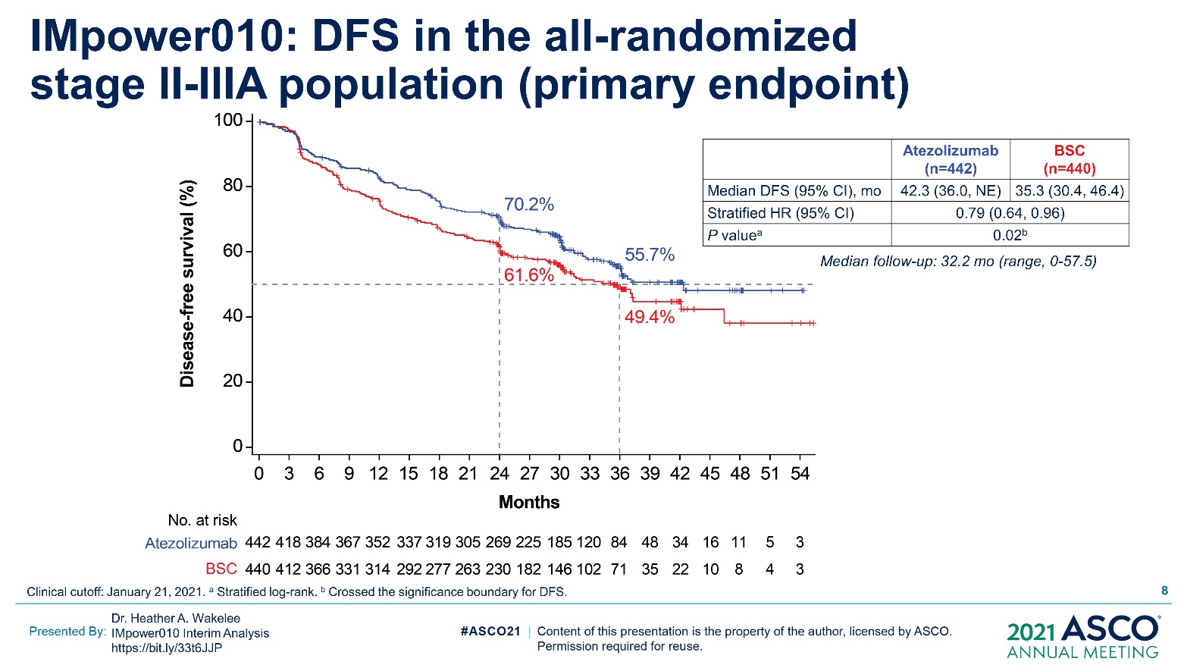
DFS benefit driven by PD-L1 high subgroup?
DFS by PD-L1 status
Wakelee et al. ASCO 2021; Felip et al. Lancet 2021
Notes:
Adjuvant phase III studies take median of 11 years to publication of study results

Slide 50
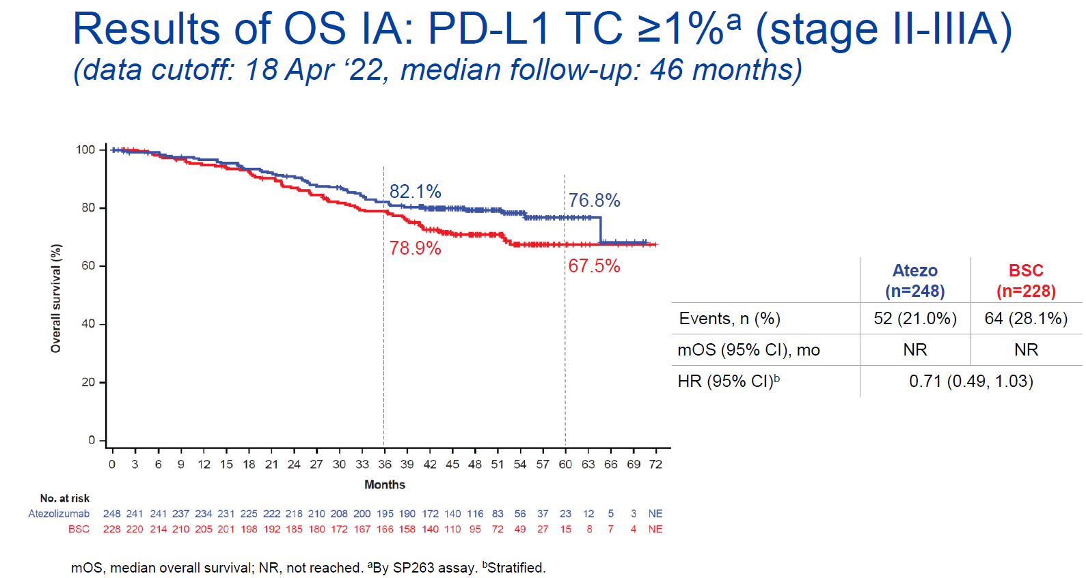
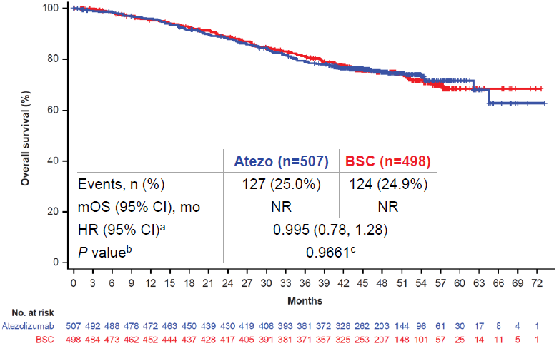
Interim OS data IMpower010
PD-L1 TC ≥1%ª Stage II-IIIA
All Randomized Stage IB-IIIA
Felip et al. WCLC 2022
Median f/u: 46mo
@Joshua_Reuss

Slide 51
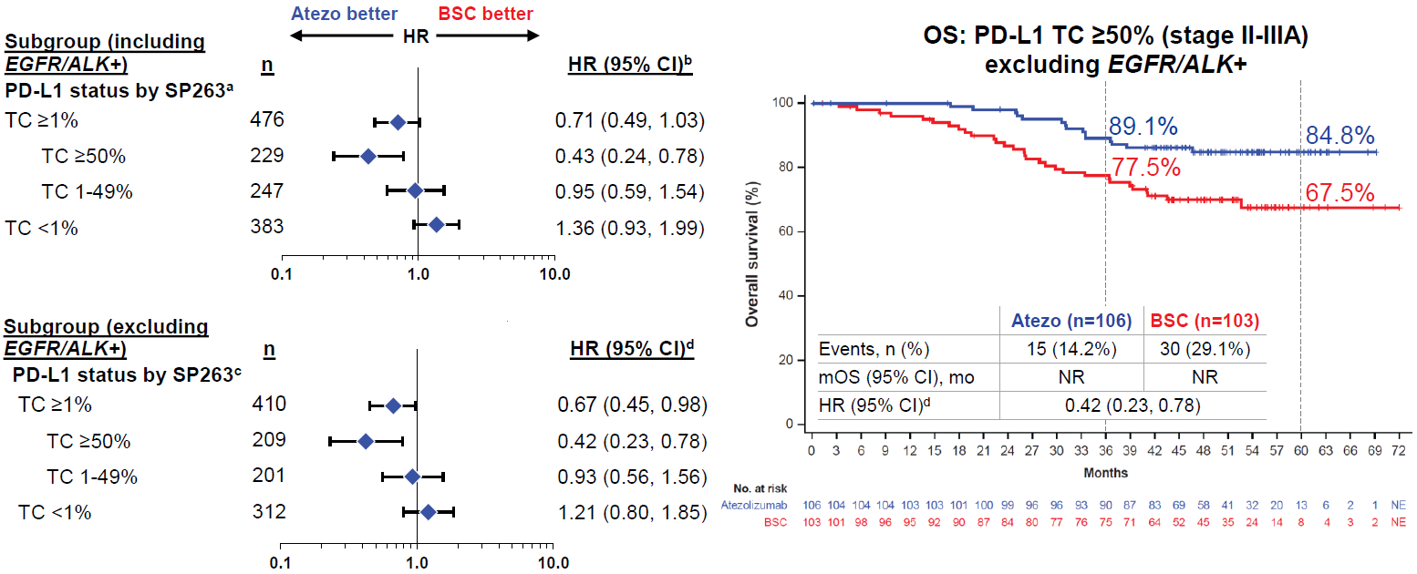
Early signal of OS benefit in PD-L1 high (TC≥50%) subgroup
Felip et al. WCLC 2022
@Joshua_Reuss

Slide 52
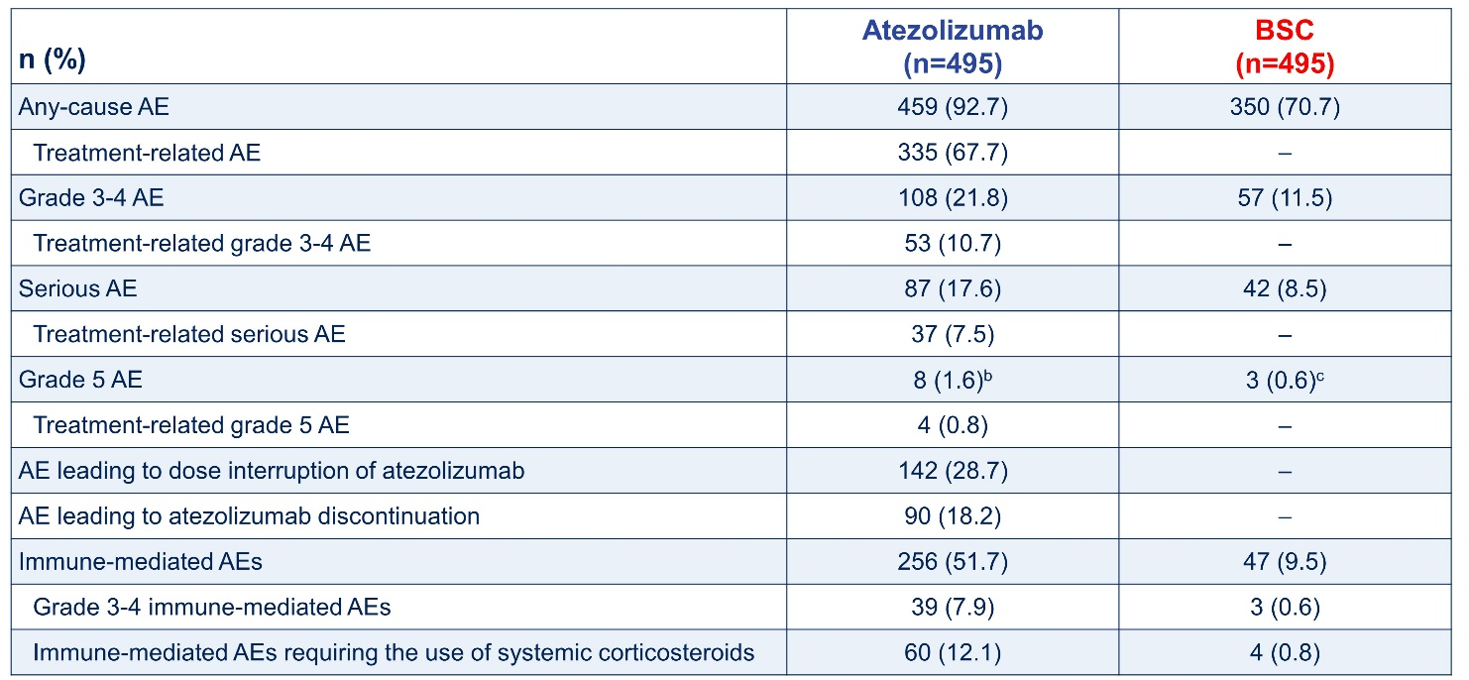
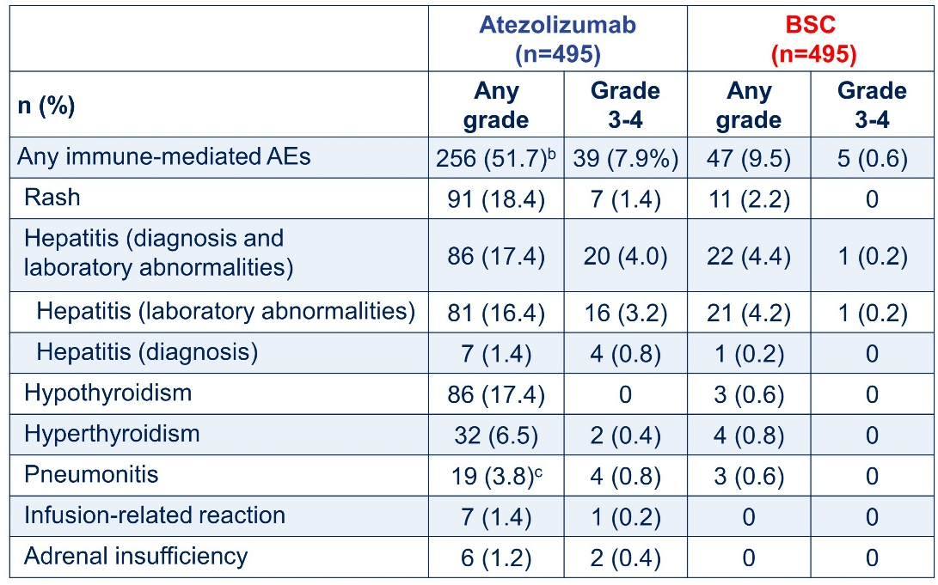
Adjuvant atezolizumab has acceptable safety profile
Safety Summary
Immune-mediated Adverse Events
Wakelee et al. ASCO 2021
@Joshua_Reuss
Notes:
Adjuvant phase III studies take median of 11 years to publication of study results

Slide 53
Phase III PEARLS/KEYNOTE-091
PEARLS/KEYNOTE-091 Study Design
Randomized, Triple-Blind, Phase 3 Trial
Eligibility for Registration
Confirmed stage IB (T ≥4 cm), II, or IIIA NSCLC per AJCC v7
Complete surgical resection with negative margins (R0)
Provision of tumor tissue for
PD-L1 testing
Eligibility for Randomization
No evidence of disease
ECOG PS 0 or 1
Adjuvant chemotherapy
  Considered for stage IB
  (T ≥4 cm) disease
  Strongly recommended for stage II and IIIA disease
  Limited to ≤4 cycles
Pembrolizumab 200 mg Q3W
for ≤18 administrations (~1 yr)
PD-L1 testing
done centrally using
PD-L1 IHC
22C3 pharmDx
R
1:1
Placebo Q3W
for ≤18 administrations (~1 yr)
Stratification Factors
Disease stage (IB vs II vs IIIA)
PD-L1 TPS (<1% vs 1-49% vs ≥50%)
Receipt of adjuvant chemotherapy (yes vs no)
Geographic region (Asia vs Eastern Europe vs
Western Europe vs rest of world)
Dual Primary End Points
DFS in the overall population
DFS in the PD-L1 TPS ≥50%
population
Secondary End Points
DFS in the PD-L1 TPS ≥1% population
OS in the overall, PD-L1 TPS ≥50%, and
PD-L1 TPS ≥1% populations
Lung cancer-specific survival in the
overall population
Safety
Paz-Ares et al. ESMO Plenary 2022
@Joshua_Reuss
Notes:
1177 patients randomized

Slide 54
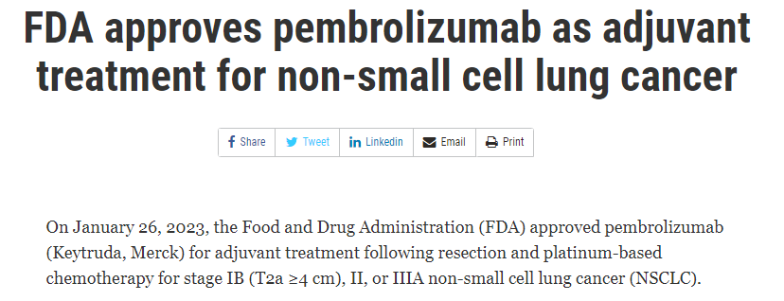
Adjuvant pembrolizumab improves DFS in overall population
DFS, Overall Population
 | Pts w/ Event | Median, mo (95% CI)
Pembrolizumab | 35.9% | 53.6 (39.2-NR)
Placebo | 44.3% | 42.0 (31.3-NR)
18-mo rate
73.4%
64.3%
HR 0.76 (95% CI, 0.63-0.91)
P = 0.0014
Paz-Ares et al. ESMO Plenary 2022
@Joshua_Reuss
Notes:
Median f/u of 35.6mo

Slide 55
Adjuvant pembrolizumab DFS benefit not driven by PD-L1 expression?
DFS, PD-L1 TPS ≥50% Population
 | Pts w/ Event | Median, mo (95% CI)
Pembrolizumab | 32.1% | NR (44.3-NR)
Placebo | 38.2% | NR (35.8-NR)
18-mo rate
71.7%
70.2%
HR 0.82 (95% CI, 0.57-1.18)
P = 0.14
Paz-Ares et al. ESMO Plenary 2022
@Joshua_Reuss

Slide 56
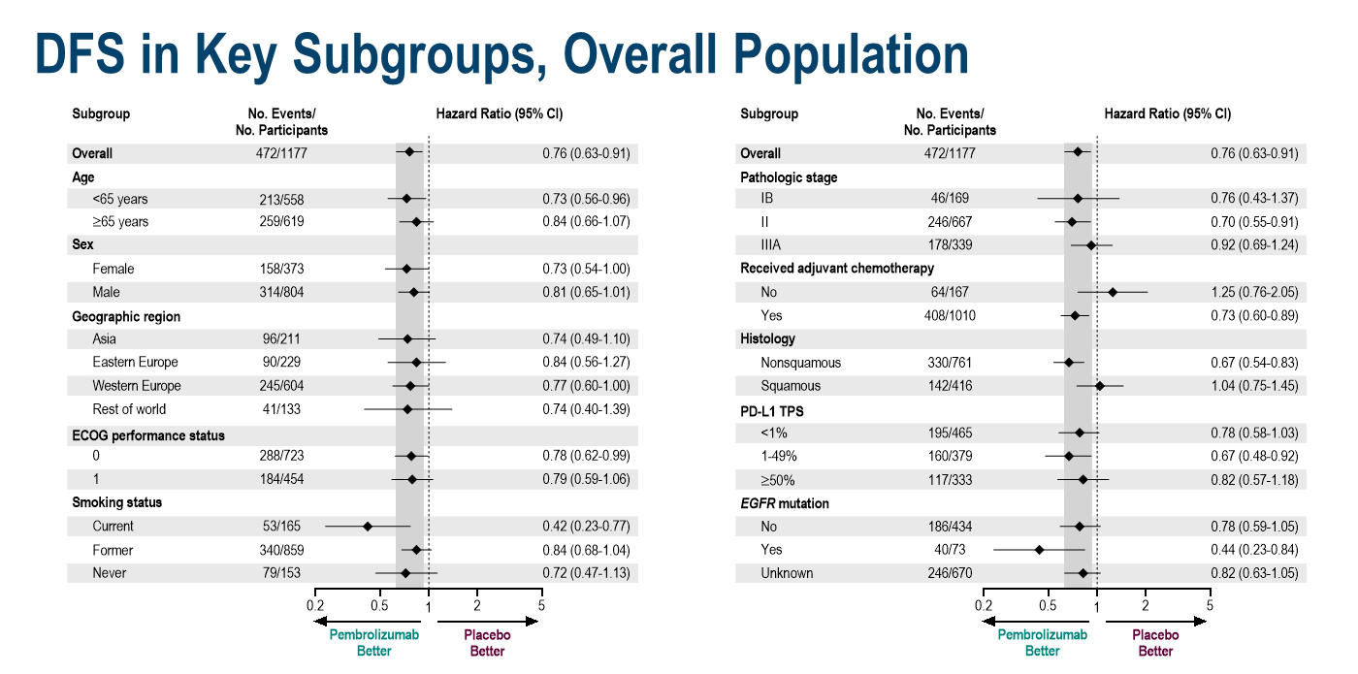
Adjuvant pembrolizumab DFS benefit not driven by PD-L1 expression?
Paz-Ares et al. ESMO Plenary 2022
@Joshua_Reuss

Slide 57
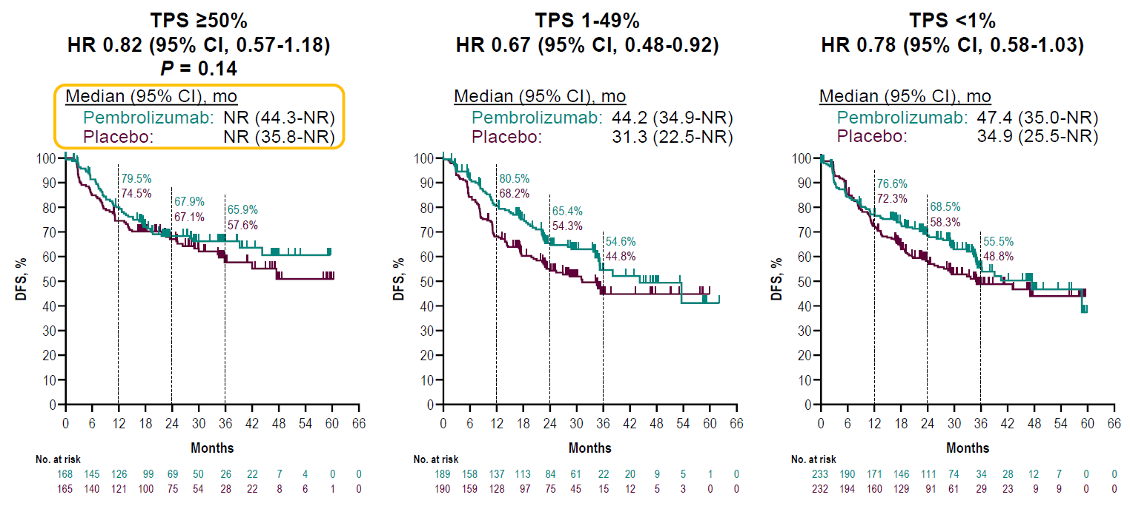
Did chemotherapy arm over-perform in the PD-L1 high subgroup?
Paz-Ares et al. ESMO Plenary 2022
@Joshua_Reuss
Peters et al. ESMO 2022

Slide 58
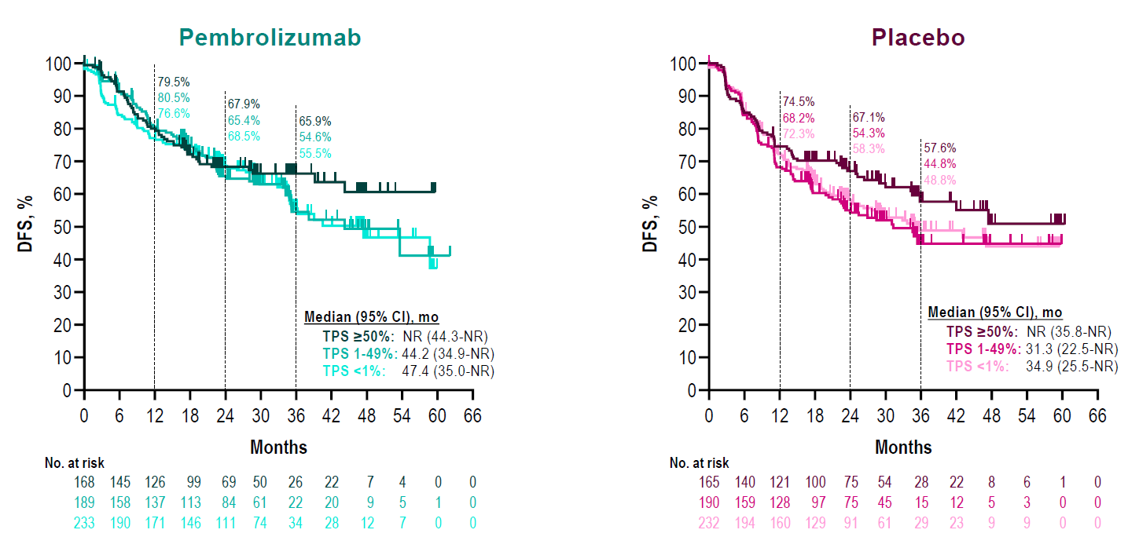
Did chemotherapy arm over-perform in the PD-L1 high subgroup?
@Joshua_Reuss
Peters et al. ESMO 2022

Slide 59
Phase III Adjuvant immunotherapy - summary
 | IMpower010¹ | PEARLS²
Design Stage Chemotherapy? | Atezolizumab vs BSC IB-IIIA (AJCC 7th) Yes | Pembrolizumab vs Placebo IB-IIIA (AJCC 7th) Advised for II/IIIA
Primary Endpoint | Hierarchical DFS: PD-L1 TC ≥1% stage II/IIIA → all-randomized stage II/IIIA → ITT population | Split α allocation: DFS in overall population DFS in PD-L1 TS ≥50%
% Stage IIIA | 41.1% | 28.8%
DFS HR (95% CI) PD-L1* <1% PD-L1* ≥1% PD-L1* 1-49% PD-L1* ≥50% | 0.79 (0.64-0.96) - Stage II/IIIA 0.97 (0.72-1.31) 0.66 (0.49-0.87) 0.87 (0.60-1.26) 0.43 (0.27-0.68) | 0.76 (0.63-0.91) - Overall Pop 0.78 (0.58-1.03) N/A 0.67 (0.48-0.92) 0.82 (0.57-1.18)
% ≥G3 AEs (G5) | 23% (2%) | 34% (2%)
FDA approved | PD-L1+ (TC ≥1%) Stage II/IIIA | Stage IB-IIIA NSCLC (irrespective of PD-L1 status)
*IHC per SP263 in IMpower010 and 22C3 in PEARLS
AE: adverse event; BSC: best supportive care; DFS: disease free survival; G: grade; HR: hazard ratio
1 - Felip et al. Lancet 2021; 2 – O’Brien et al. Lancet Oncol 2022
@Joshua_Reuss

Slide 60
Neoadjuvant Chemo-immunotherapy
@Joshua_Reuss

Slide 61
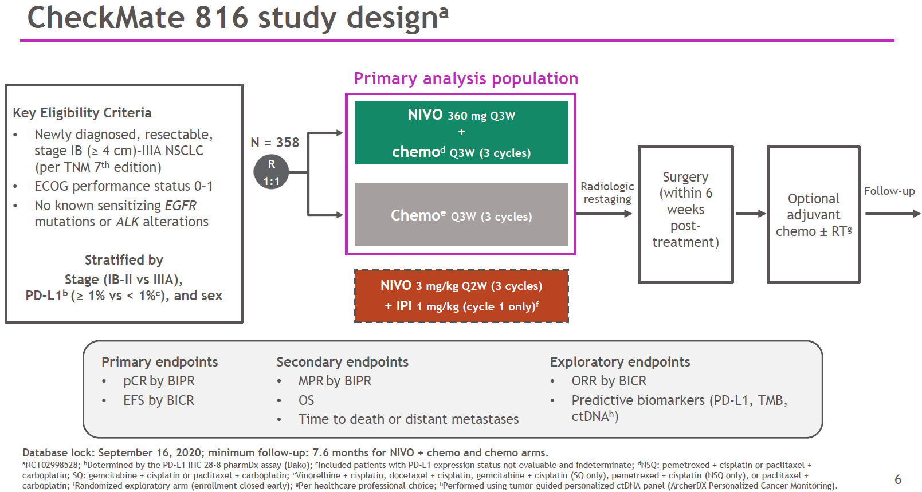
Phase III CheckMate 816 Trial
Forde et al. N Engl J Med 2022

Slide 62
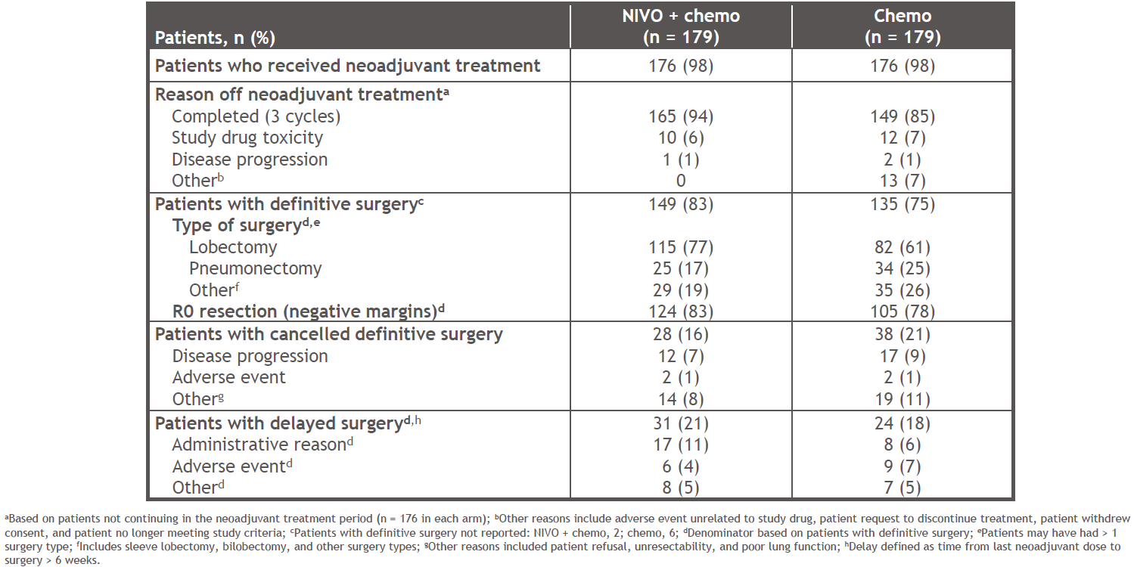
Noeadjuvant nivo-chemo is feasible with 83% of patients undergoing surgery, majority R0 resection
Forde et al. NEJM 2022
Notes:
~2/3 stage IIIA

Slide 63
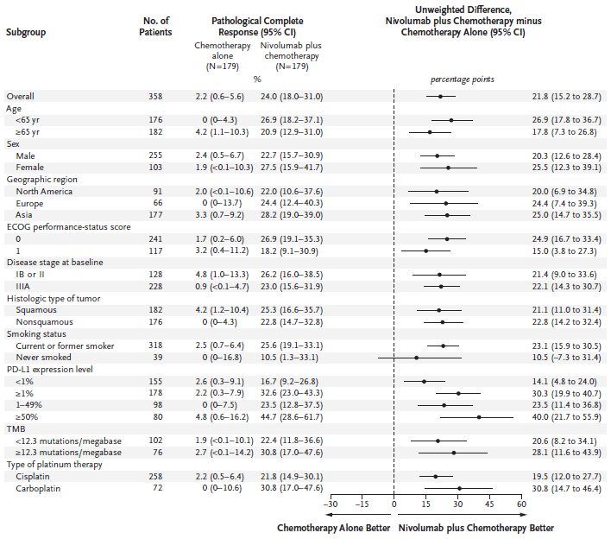
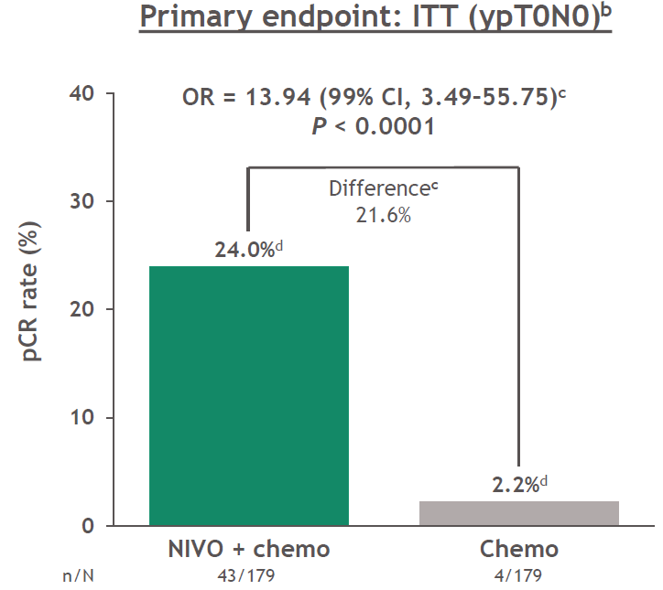
Neoadjuvant nivo-chemo improves pCR rates compared to chemotherapy
Forde et al. N Engl J Med 2022
Spicer et al. ASCO 2021

Slide 64
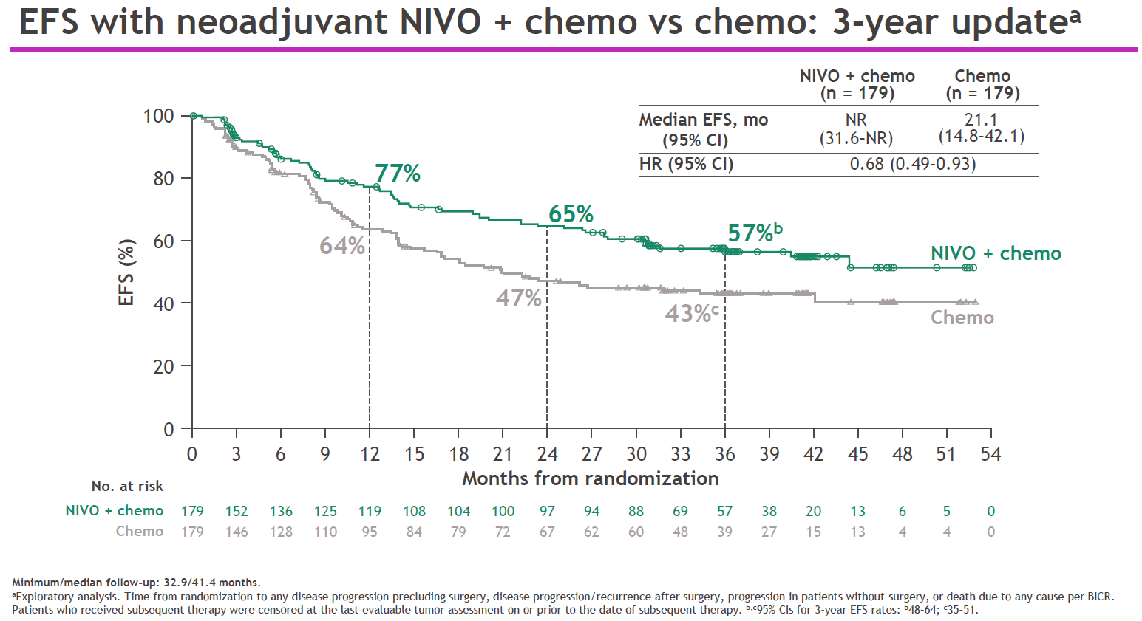
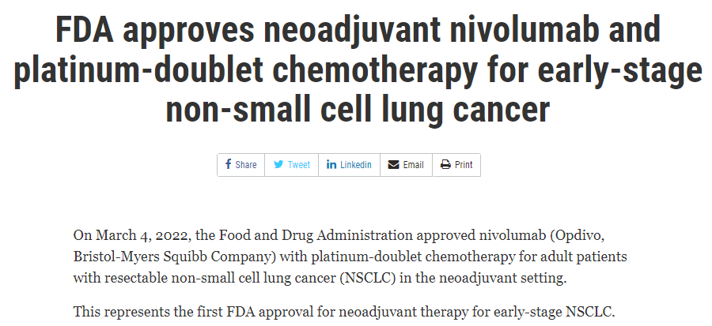
Neoadjuvant nivo-chemo improves EFS compared to chemotherapy
Forde et al. ELCC 2022

Slide 65
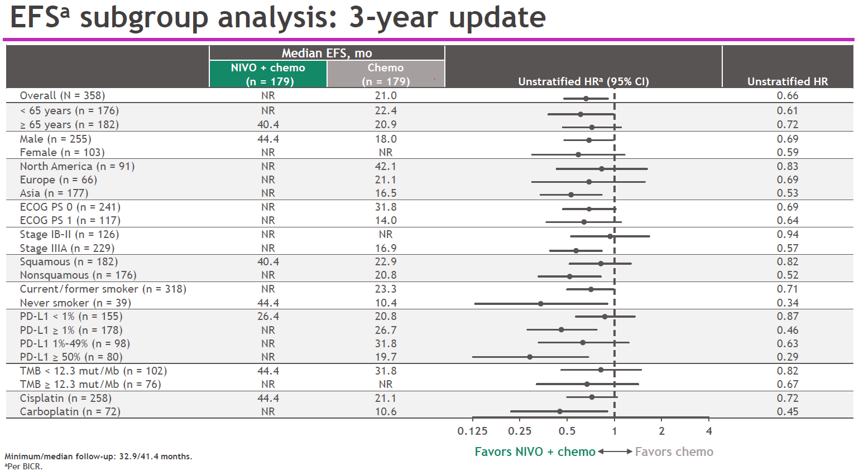
Neoadjuvant nivo-chemo improves EFS compared to chemotherapy
Forde et al ELCC 2023

Slide 66
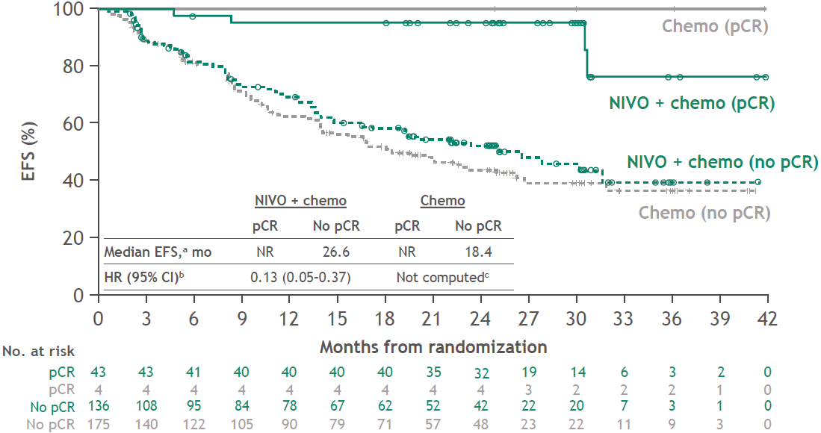
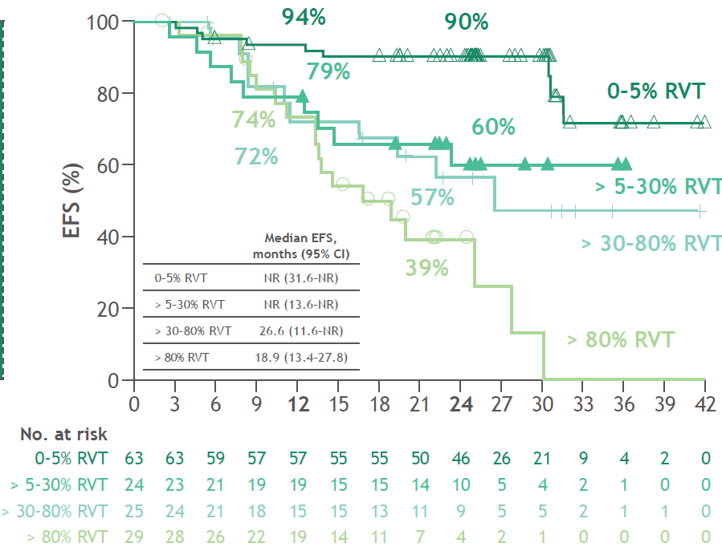
Pathologic response as surrogate for improved clinical outcomes?
EFS according to % residual viable tumor (RVT) in patients treated with nivo-chemo
EFS by PCR Status
Girard et al. AACR 2022; Forde et al. N Engl J Med 2022
Provencio et al. ASCO 2022
@Joshua_Reuss

Slide 67
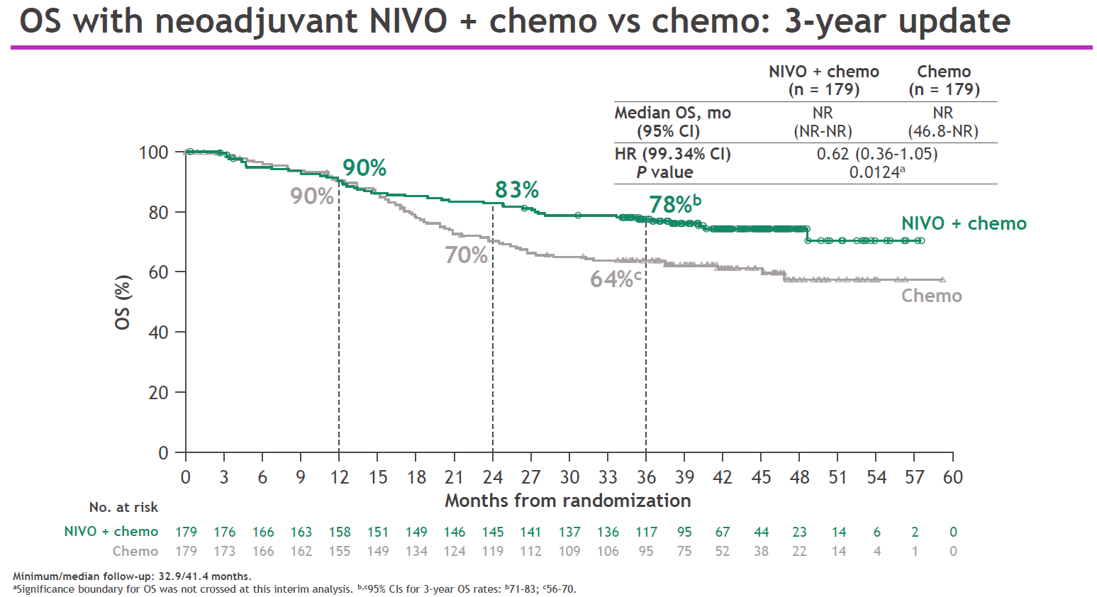
Overall survival immature but trending toward benefit
Forde et al. ELCC 2023

Slide 68
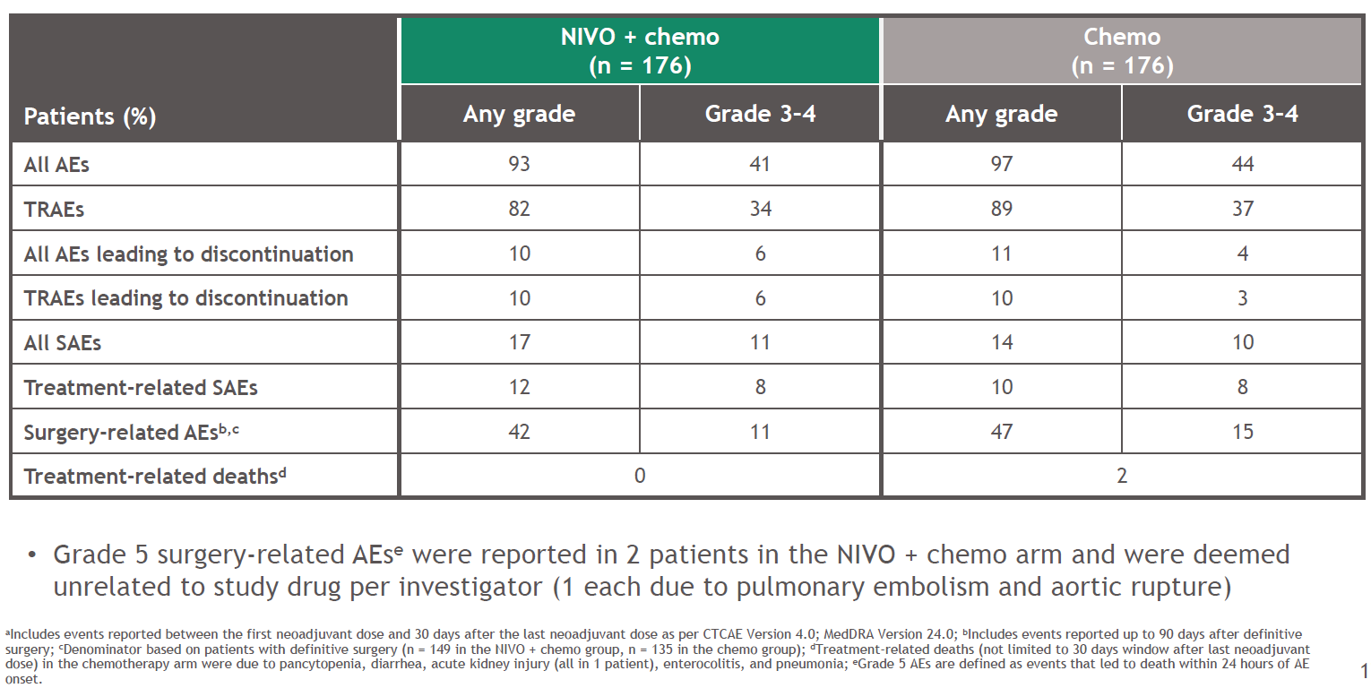
Neoadjuvant nivo-chemo is safe without increased adverse-events compared to chemotherapy
Girard et al. AACR 2022; Forde et al. N Engl J Med 2022

Slide 69
Peri-operative
Chemo-immunotherapy
@Joshua_Reuss

Slide 70
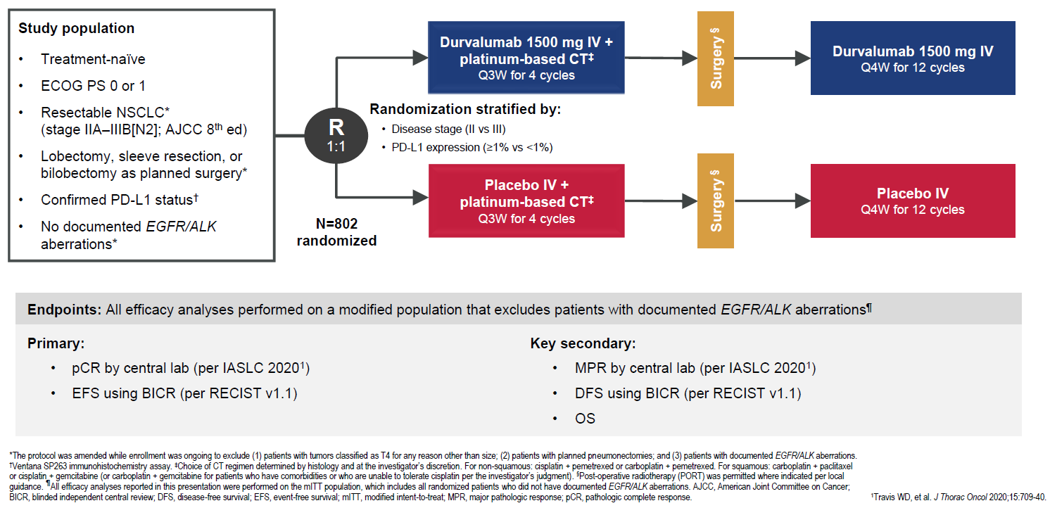
Phase III AEGEAN Trial
Heymach et al. AACR 2023

Slide 71
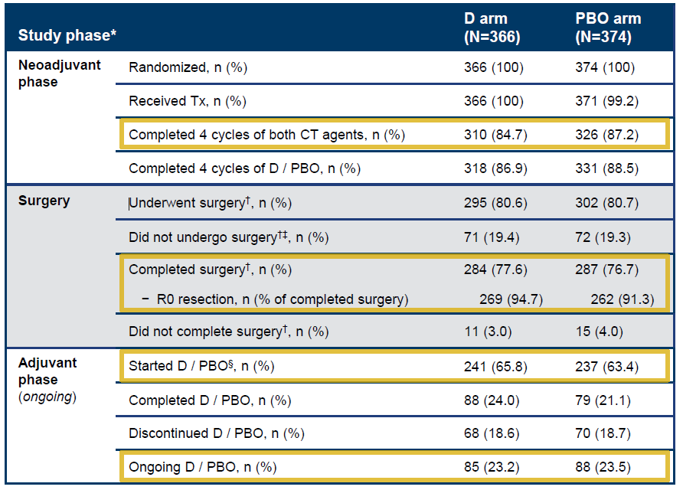
Peri-operative durva-chemo is feasible with 80% of patients undergoing surgery, nearly all R0
Heymach et al. AACR 2023

Slide 72
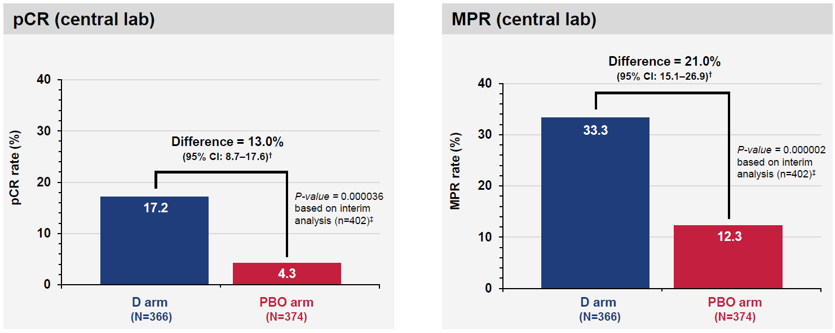
Peri-operative durva-chemo improves pCR rate compared to chemotherapy
Heymach et al. AACR 2023
@Joshua_Reuss

Slide 73
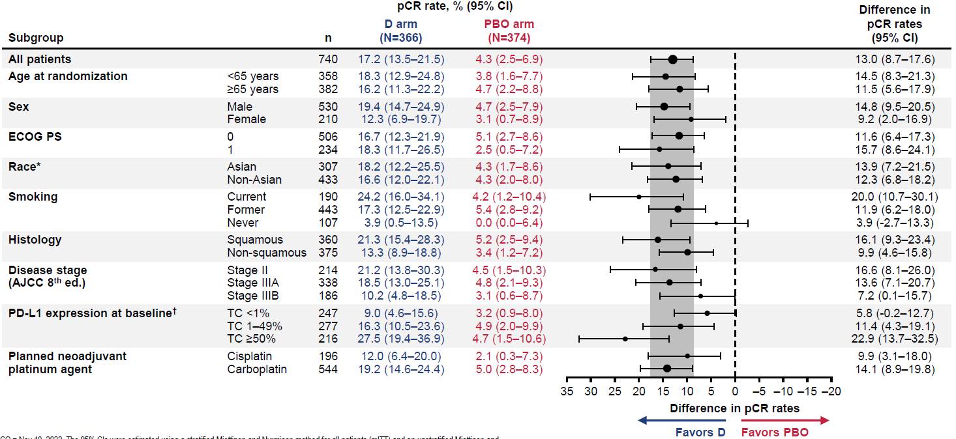
Peri-operative durva-chemo improves pCR rate compared to chemotherapy
Heymach et al. AACR 2023

Slide 74
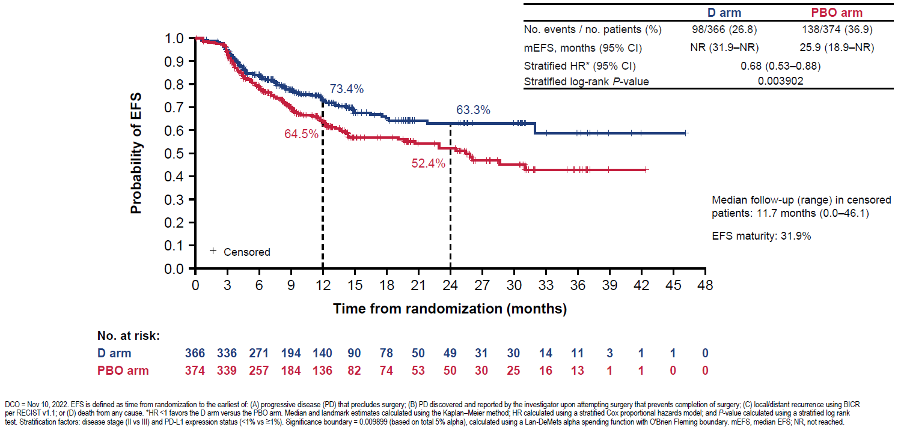
Peri-operative durva-chemo improves EFS compared to chemotherapy
Heymach et al. AACR 2023

Slide 75

Peri-operative durva-chemo improves EFS compared to chemotherapy
Median EFS follow-up in censored patients: 11.7mo
EFS maturity: 31.9%
Heymach et al. AACR 2023

Slide 76

Peri-operative durva-chemo is safe, without increased treatment-related adverse events
Heymach et al. AACR 2023

Slide 77
Phase III Neodjuvant/Perioperative chemo-immunotherapy studies - summary
 | CheckMate 816¹ | AEGEAN²
Design Stage Placebo? Adj IO? | Neoadj Nivo-chemo vs chemo IB-IIIA (AJCC 7th) No No | Peri-op Durva-chemo vs placebo-chemo II-IIIB (AJCC 8th) Yes Yes
% Stage III# IIIA IIIB | 64% 64% 0% | 71% 46% 25%
pCR rate (95% CI) | 24% (18.0 - 31.0) | 17% (13.5 – 21.5)
Median f/u | 41.4mo | 11.7mo
EFS HR (95% CI) PD-L1* <1% PD-L1* ≥1% PD-L1* 1-49% PD-L1* ≥50% | 0.68 (0.49-0.93) – ITT 0.87 (?) 0.46 (?) 0.63 (?) 0.29 (?) | 0.68 (0.53-0.88) – ITT 0.76 (0.49-1.17) Unknown 0.70 (0.46-1.05) 0.60 (0.35-1.01)
% ≥G3 AEs (G5) | 41% (0%) | 32% (1.8%)
FDA approved | Resectable NSCLC tumor ≥4cm or node positive | TBA
#CheckMate 816 – AJCC 7th, AEGEAN – AJCC 8th; *IHC per 28-8 in CheckMate 816, per SP263 in AEGEAN
AE: adverse event; BSC: best supportive care; DFS: disease-free survival; EFS: event-free survival; G: grade; HR: hazard ratio; ITT: intention-to treat
@Joshua_Reuss
1 - Forde et al. N Engl J Med 2022, Forde et al. ELCC 2023; 2 – Heymach et al. AACR 2023.

Slide 78




Additional Phase 3 Peri-operative chemo-immunotherapy studies in resectable NSCLC
KEYNOTE-671¹
CheckMate 77T³
EFS
Primary Endpoint: EFS, OS
IMpower030²
Primary Endpoint: EFS, OS
@Joshua_Reuss
Primary Endpoint: EFS
1 - Tsuboi et al. ESMO 2020; 2 - Peters et al. ELCC 2019; 3 – Cascone et al. ASCO 2020.

Slide 79
Critical questions that remain…
Which approach (neoadjuvant/adjuvant/peri-operative) will “win out”?
  Pre-operative N2, high tumor burden, PD-L1 low/neg, post-surgical upstaging, patient/provider preference
Will the observed EFS/DFS benefits translate into an OS benefit?
For those who receive neoadjuvant, who need additional adjuvant IO post-surgery?
  No pCR?
  Detectable MRD?
  Aggressive molecular markers (STK11, KEAP1, SMARCA4)
~20% of patients who receive neoadjuvant DO NOT get surgery, who are these patients and how were they subsequently treated?
How will we optimally integrate rapid/efficient NGS testing in the neoadjuvant setting?
If patients experience recurrence, what next?
@Joshua_Reuss

Slide 80



Role for ctDNA in assessing “MRD”?
ctDNA assessment in IMpower010
ctDNA clearance in CheckMate 816
Zhou et al. ESMO IO 2021
Forde et al. N Engl J Med 2022

Slide 81

Will there be a benefit of adjuvant immunotherapy in those who receive neoadjuvant?
Long-term follow-up from perioperative LCMC3 Study
Carbone et al. ELCC 2023
@Joshua_Reuss

Slide 82



If patients experience recurrence, then what?
CheckMate 816
IMpower010: PD-L1 ≥ 50%
Forde et al. ELCC 2023
Felip et al. ELCC 2022
@Joshua_Reuss

Slide 83
Conclusions
The approvals of neoadjuvant nivo-chemo, adjuvant atezolizumab, and adjuvant pembrolizumab are monumental breakthroughs in the treatment of resectable NSCLC that will hopefully enhance cure rates.
Efficient, rapid NGS testing at diagnosis will be critical to tailoring the right treatment for our patients.
Many questions remain – optimal treatment duration? which approach for which patients? what to do for those who recur?
@Joshua_Reuss

Slide 84


THANK YOU!
@Joshua_Reuss

Slide 85
LUNG CANCER
Thursday, April 27, 2023

Slide 86
Rising Immunotherapies in Advanced NSCLC
Julie R. Brahmer, MD, MSc, FASCO
Marilyn Meyerhoff Professor of Thoracic Oncology
Johns Hopkins Kimmel Cancer Center
Baltimore, Maryland

Slide 87

Standard of Care for Advanced NSCLC
Multiple Options for ICI + chemotherapy
  Pembrolizumab/carboplatin or cisplatin/pemetrexed (NSQ)
  Cemiplimab/carboplatin or cisplatin/pemetrexed (NSQ)
  Atezolizumab/carboplatin/paclitaxel/bevacizumab (NSQ)
  Atezolizumab/carboplatin/nab-paclitaxel (NSQ)
  Cemiplimab/carboplatin or cisplatin/paclitaxel (SQ/NSQ)
  Pembrolizumab/carboplatin/taxane (SQ)
  Nivolumab/ipilimumab + 2 cycles of CT (SQ/NSQ)
  Durvalumab/tremilimumab + 4 cycles CT (SQ/NSQ)
*Single-agent pembrolizumab also approved for 1-49% PD-L1 if poor PS or contraindications to combining w/CT. †Not an FDA-approved indication but included in guideline recommendations.
NCCN Guidelines 2023

Slide 88

Ozguroglu. ESMO 2022. Abstr LBA54. Sezer. Lancet. 2021;397:592.

Slide 89

Reck JCO. 2021;39:2339. Jassem. J Thorac Oncol. 2021;16:1872. Ozguroglu. ESMO 2022. Abstr LBA54.
Brahmer. JCO. 2022. Reck. ESMO Open. 2021;6:100273. Paz-Ares. ASCO 2022. Abstr LBA9026.

Slide 90

Ozguroglu. ESMO 2022. Abstr LBA54. Bersanelli. Lung Cancer. 2020;150:123.

Slide 91


Slide 92



EMPOWER-Lung 3
Gogishvili, ESMO 2021, Nature Medicine; 25, August 2022

Slide 93

Gogishvili Nat Med. 2022

Slide 94
How does another PD-1 Pathway and CTLA-4 Pathway Blockade Combination Fit in?
The Poseidon Story

Slide 95
POSEIDON Study Design – Key Differences from other IO combo studies
    Durvalumab 1500 mg + CT* q3w (4 cycles)
Durvalumab 1500 mg q4w + pemetrexed†
until PD
Primary endpoints
PFS by BICR (D+CT vs CT)
OS (D+CT vs CT)
Key secondary endpoints
PFS by BICR (D+T+CT vs CT)
OS (D+T+CT vs CT)
OS in patients with bTMB
≥20 mut/Mb (D+T+CT vs CT)
Additional secondary endpoints
ORR, DoR, and BOR by BICR
PFS at 12 months
HRQoL
Safety and tolerability
Stage IV NSCLC
No EGFR or ALK alterations
ECOG PS 0 or 1
Treatment-naïve for metastatic disease
N=1013 (randomized)
    Durvalumab 1500 mg + tremelimumab 75 mg + CT* q3w (4 cycles)
Durvalumab 1500 mg q4w + tremelimumab 75 mg
(week 16 only)‡
+ pemetrexed†
until PD
R
1:1:1
Stratified by:
PD-L1 expression (TC ≥50% vs <50%)
Disease stage (IVA vs IVB)
Histology
    Platinum-based CT*
    q3w (up to 6 cycles)
Pemetrexed†
until PD
*CT options: gemcitabine + carboplatin/cisplatin (squamous), pemetrexed + carboplatin/cisplatin (non-squamous), or nab-paclitaxel + carboplatin (either histology);
†Patients with non-squamous histology who initially received pemetrexed during first-line treatment only (if eligible); ‡Patients received an additional dose of tremelimumab post CT (5th dose)
Notes:
Tremi dose, 1000 pt Primary pfs and OS durva and chemo, secondary endpoint d,t,ct,

Slide 96

Key Results from Poseidon
Primary Endpoint - Durvalumab + Chemo – Improves PFS but not OS compared to Chemo
Secondary Endpoint – Durvalumab + Tremilimumab + Chemo – Improves PFS and OS compared to Chemo
Johnson M et al, ESMO 2022
Johnson M et al WCLC 2021
Notes:
Adjust font size and placement as needed to fit your content.

Slide 97

Key Subgroup Analyses
POSEIDON
Johnson M et al, ESMO 2022
Notes:
NO info on PD-L1 1-49%, Minimal improvement in PD-L1 Negative, Squamous histology which may be due to the paclitaxel Versus Gem debate, more IVB in chemo arm without improvement
Add Squire info???

Slide 98



Key Subgroup Analyses
POSEIDON
CheckMate 9LA
Did only 5 doses of Tremi impact the PD-L1 negative or squamous group?
Johnson M et al WCLC 2021, Reck M et al ASCO 2021
Notes:
Did only 5 doses of Tremi impact the PD-L1 negative or squamous group?
Is the Poseidon advantage only in the 50% or
Never smoking groups – probably not benefiting and would be great to have a drill down across studies to see which mutation landscape other than low TMB would provide the answer.

Slide 99


Key Subgroup Analyses
POSEIDON
CM 227
Johnson M et al WCLC 2021, Paz-Ares L et al ASCO 2021
Notes:
Compared to CM 227 do we need Chemo in the pd-l1 neg group??

Slide 100




Key Results – Results by Histology
POSEIDON - NSQ
POSEIDON-SQ
CheckMate 9LA
CheckMate 9LA
Johnson M et al ESMO 2022, Reck M et al ASCO 2021
Johnson M et al WCLC 2021, Reck M et al ASCO 2021
Notes:
Adjust font size and placement as needed to fit your content.

Slide 101


Key Results – Results by Mutation Status

Slide 102

Key Results – Results by Mutation Status
KN189
Johnson M et al, ESMO 2022,
Gadgeel SM et al, AACR 2020

Slide 103
Conclusions
For PD-L1–high disease, single-agent PD-1 or PD-L1 antibodies remain mainstay of treatment
  Chemo/IO combinations increase response, but survival is similar to single-agent PD-1 blockade
For PD-L1–negative disease, either IO/IO, chemo/IO, or IO/IO/chemo are options
For PD-L1 1%-49%, either chemo/IO, IO/IO, or IO/IO/chemo are options
Although long-term survival is possible, it is only realized in a subset of patients
Sequencing of IO therapy and chemo remains an open question

Slide 104
LUNG CANCER
Thursday, April 27, 2023

Slide 105
Question-and-Answer

Slide 106
Networking Reception
We will begin at 7:05pm

Slide 107
LUNG CANCER
Thursday, April 27, 2023

Slide 108
Targeting KRAS in NSCLC
Susan Scott, MD
Assistant Professor of Oncology
Johns Hopkins University School of Medicine
Washington, DC

Slide 109


KRAS-mutated NSCLC
KRAS G12C mutation is the most common mutation adenocarcinoma of the lung, present in 1 in 8 pts (about 13%).
Smoking-associated mutation.
Skoulidis F, Heymach JV. Nat Rev Cancer. 2019;19: 495–509.
Karachaliou N. Clin Lung Cancer. 2013;14: 205–214.

Slide 110

Targeting KRAS^{G12C}
Sotorasib
Adagrasib
Soto
KRAS^{G12C} prevents normal GTP breakdown, rendering the protein permanently active.
Sotorasib and adagrasib covalently bind GDP-bound KRAS^{G12C} in the switch II pocket and rely on the mutant C12 residue.
Binding locks KRAS in its inactive GDP-bound state.
Elez E, Tabernero J. Cancer Cell. 2020. 785–787.
Notes:
The KRAS gene encodes an oncoprotein involved in central signaling pathways for growth and differentiation.
The pathogenic mutations impair GTP hydrolysis to GDP resulting in constitutively active GTP-bound protein. The protein had long been felt to be undruggable, so most efforts had been focused on downstream effector proteins in the MAPK pathway like BRAF and MEK. Now, SMIs are available that inhibit mutatnt KRAS. The two most developed drugs in this space, sotorasib and adagrasib both take advantage of the trapping mechanism, locking KRAS in the inactive GDP bound state.
They both depend on the mutant cysteine residue, so this decreases effects on WT kras, but also restricts their use to the G12C genotype. Inhibitors for other genotypes like G12D are in development.
//
Switch 2 pocket allosteric binding site for small molecule near the effector region of mutant protein > allosteric inhibitor of mutant KRAS

Slide 111




Two FDA-Approved KRAS^{G12C} Inhibitors
Sotorasib: FDA approved May 2021
ORR: 37.1%; mOS: 12.5 mo
Adagrasib: FDA approved December 2022
ORR: 42.9%; mOS: 12.6 mo
Skoulidis F, et al. N Engl J Med. 2021 Jun 24;384(25):2371-2381. Jänne PA, et al. N Engl J Med. 2022 Jul 14;387(2):120-131.

Slide 112


Sotorasib: CodeBreak 100
Median DOR: 11.1 mo
ORR: 37%
Median PFS: 6.8 mo
Median OS: 12.5 mo
Skoulidis F, et al. N Engl J Med. 2021 Jun 24;384(25):2371-2381.
Notes:
Phase 2 results in 2L
ORR 37%
DCR 81%

Slide 113

Sotorasib: CodeBreak 100
Skoulidis F, et al. N Engl J Med. 2021 Jun 24;384(25):2371-2381.

Slide 114

Sotorasib: CodeBreak 200
Is sotorasib a new second-line SOC?

Slide 115


Sotorasib: CodeBreak 200
 | Sotorasib (N = 171) | Docetaxel (N = 174)
mPFS | 5.6 mo | 4.5 mo
ORR | 28% | 13%
DCR | 83% | 60%
Median DOR | 8.6 mo | 6.8 mo
Johnson ML, et al. Ann Oncol. 2022;33(suppl_7): Abstract LBA10.
Notes:
CB200 is RPh3 vs docetaxel in 2L
Increased ORR for soto 28 vs 13
Updated ph3 vs Not compared to taxol ram. More than doubled PFS at 12 mos.

Slide 116


Sotorasib: CodeBreak 200
Johnson ML, et al. Ann Oncol. 2022;33(suppl_7): Abstract LBA10.
Notes:
No OS benefit, but not powered, high crossover to soto.
Treatment beyond progression – 16% soto, 5% doce
Sotorasib showed sig improvement in primary endpoint of PFS. Median 5.6 vs 4.5 mo in prev tx. 12 mo PFS was 24.8% for sotorasib vs 10.1% for doce; PFS benefit across subgroups.
ORR, DCR, TTR, DoR were improved for soto > docetaxel. No diff in OS, though not powered for statistical difference.
Soto well tolerated with fewer gr 3+ TRAEs than docetaxel.
There findings support sotorasib as important, standard option for 2L treatment and reinforces importance of NGS testing for KRAS G12C (Ie/smokers).
-------------

Slide 117
Two FDA-Approved KRAS^{G12C} Inhibitors
Sotorasib: FDA approved May 2021
ORR: 37.1%; mOS: 12.5 mo
Adagrasib: FDA approved December 2022
ORR: 42.9%; mOS: 12.6 mo
Skoulidis F, et al. N Engl J Med. 2021 Jun 24;384(25):2371-2381. Jänne PA, et al. N Engl J Med. 2022 Jul 14;387(2):120-131.

Slide 118


Adagrasib: KRYSTAL-1
Median DOR: 8.5 mo
ORR: 43%
Median PFS: 6.5 mo
Median OS: 12.6 mo
Jänne PA, et al. N Engl J Med. 2022 Jul 14;387(2):120-131.
Notes:
ORR 43% (BICR)
DCR 80%
Median DOR 8.5m
N=112

Slide 119

Adagrasib: KRYSTAL-1
Jänne PA, et al. N Engl J Med. 2022 Jul 14;387(2):120-131.

Slide 120


CNS Activity
 | Sotorasib | Adagrasib
Evaluable | n=16 | n=33
IC-ORR | 13% | 33%
IC-DCR | 88% | 88%
mIC-DOR |  | 11.2m
mIC-PFS |  | 5.4m
Ramalingam SS et al. WCLC 2021. Jänne PA, et al. N Engl J Med. 2022 Jul 14;387(2):120-131.
Notes:
Ada: 42 pts with CNS mets at baseline. 33 evaluable. ORR 33.3%, duration intracranial response 11.2m. mIC PFS 5.4m. 27/33 of these pts had received RT previously. 13 with target lesions % change shown here.
In a retrospective analysis of data from 33 patients who could be evaluated radiographically by the modified Response Assessment in Neuro-Oncology Brain Metastases (RANO-BM) for the maximum percent change from baseline in an intracranial tumor, the cutoff date was December 31, 2021 (median follow-up, 15.4 months). One patient who had progressive disease had no change in tumor size. Data from 19 of these 33 patients are not shown here because these patients had only non-target lesions at baseline (4 of these patients had a complete response, 13 had stable disease, and 2 had progressive disease). One additional patient with tumor shrinkage of 8% was deemed to be not evaluable because the postbaseline scan was obtained too early for ev
Codebreak100: 40 stable BM, 65% prior RT, 20% surgery. RANO-BM 16 evaluable, 3 target/13 non-target… overall 2 cr, 12 sd, 2 pd.
Ramalingam SS et al. WCLC 2021. Jänne PA, et al. N Engl J Med. 2022 Jul 14;387(2):120-131

Slide 121


Response by co-mutation
Sotorasib
Adagrasib
STK11 KEAP1 TP53
Skoulidis F, et al. N Engl J Med. 2021 Jun 24;384(25):2371-2381. Jänne PA, et al. N Engl J Med. 2022 Jul 14;387(2):120-131.
Notes:
Prevalence TP35 &STK11 30-50%, KEAP1 less

Slide 122

Codebreak 100: Sotorasib + IO
ORR 29%
DCR 83%
Pretreated patients
Li BT, et al. Ann Oncol. 2022;33(suppl_7): Abstract OA03.06.
Notes:
Atezo or pembro, lead in

Slide 123

Codebreak 100: Sotorasib + IO
Li BT, et al. Ann Oncol. 2022;33(suppl_7): Abstract OA03.06.

Slide 124


KRYSTAL-7: Adagrasib + IO
ORR 49%
DCR 89%
Treatment naive patients
Jänne PA, et al. Ann Oncol. 2022;16(suppl_1): Abstract LBA4.

Slide 125

KRYSTAL-7: Adagrasib + IO
Jänne PA, et al. Ann Oncol. 2022;16(suppl_1): Abstract LBA4.

Slide 126
Targeting KRAS in NSCLC
Current therapy in metastatic disease
Sotorasib and adagrasib approved 2L+
Future directions
Sequencing and/or combination with immunotherapy
Patient selection: PD-L1, comutations (TP53, STK11, KEAP1)
Targeting KRAS in stage I-III NSCLC
Non-G12C targeted therapies

Slide 127
Navigating New Horizons: Advances in the Treatment Landscape for EGFR-mutant NSCLC
Chul Kim, MD, MPH
Assistant Professor of Medicine
Georgetown University

Slide 128
Disclosures
Research funding (to institution): AstraZeneca, Bristol-Myers Squibb, Novartis, Genentech, Janssen, Regeneron, Debiopharm, Karyopharm, Daiichi-Sankyo
Consultant or advisory board member: Novartis, Janssen, Astrazeneca, Sanofi, PierianDx, Diffuse pharmaceuticals, Mirati, Jazz Pharmaceuticals, Arcus Biosciences, Daiichi Sankyo, Eisai Inc

Slide 129

EGFR mutations are one of the most common genomic alterations in NSCLC
Early-stage lung adenocarcinoma
Metastatic lung adenocarcinoma
Skoulidis and Heymach Nat Rev Cancer 2019
Notes:
EGFR mutant NSCLC single largest lung cancer genotype treated with molecularly targeted therapies

Slide 130

Frequencies of EGFR mutations in NSCLC
COSMIC database
Harrison et al. Semin Cancer Biol 2020

Slide 131

Structure-based classification of EGFR mutations
Robichaux et al. Nature 2021

Slide 132

Timeline of genomic discoveries and drug development in EGFR-mutant NSCLC
Cooper et al. Nat Rev Clin Oncol 2022

Slide 133

FLAURA has established osimertinib as the preferred 1st-line treatment
A randomized, double-blind, phase 3 trial in untreated advanced EGFR-mutant NSCLC
Primary endpoint: Investigator-assessed PFS
Secondary endpoints: OS, ORR, DOR, disease-control rate, depth of response, safety
Araujo et al. WCLC 2017

Slide 134

Osimertinib improves PFS and OS
Median PFS: 18.9 vs. 10.2 months
HR: 0.46 (95% CI: 0.37-0.57; p<0.001)
Median OS: 38.6 vs. 31.8 months
HR: 0.80 (95% CI: 0.64-1.00; p=0.046)
Soria et al. N Engl J Med 2018; Ramalingam et al. N Engl J Med 2020

Slide 135



Osimertinib has CNS activity
CNS ORR: 91% in patients with ≥ 1 measurable CNS lesion (n=22)
64-year-old female treated with 1st line osimertinib
October 2020
February 2023
Reungwetwattana et al. J Clin Oncol 2018

Slide 136

Resistance to EGFR-TKI
On-target
Off-target: Activation of bypass signaling pathways
Off-target: Tumor cell lineage change
Passaro et al. Nat Rev Cancer 2021

Slide 137

Diverse mechanisms of resistance to first-line osimertinib in FLAURA detected via ctDNA analysis
No T790M-mediated acquired resistance observed in the osimertinib arm
vs.
44% in the comparator arm
Chmielecki et al. Nat Commun 2023

Slide 138

Diverse mechanisms of resistance to first-line osimertinib detected via tissue-based NGS
N=95 patients with post-progression biopsy
Treatment of patients with histologic transformation
Choudhury et al. J Thorac Oncol 2023

Slide 139


Chemotherapy plus gefitinib in EGFR-mutant NSCLC
NEJ009
TMC trial
Hosomi et al. J Clin Oncol 2022; Noronha et al. J Clin Oncol 2019

Slide 140


Trials of chemotherapy plus 3rd-generation EGFR-TKIs in the first-line setting
FLAURA2
(Osimertinib plus chemo)
ACROSS1
ACROSS2
(Aumolertinib plus chemo)
TP53, RB1, PTEN
Janne et al. WCLC 2019; Wang WCLC 2022

Slide 141
Amivantamab in combination with lazertinib in treatment naïve advanced EGFR-mutant NSCLC
Cho et al. ESMO 2020

Slide 142

MARIPOSA: Lazertinib plus amivantamab vs. osimertinib vs. lazertinib
Cho et al. Future Oncol 2021

Slide 143


Antibody drug conjugates (ADCs) in EGFR-mutant NSCLC
Patritumab deruxtecan (HER3 ADC)
N=57 (89% treated with osimertinib)
ORR=39%, mPFS=8.2 months (4.4-8.3 months)
Datopotamab deruxtecan (Trop-2 ADC)
N=34 (85% EGFR-mutant NSCLC)
ORR=35%
Patritumab deruxtecan +/- osimertinib as 1st and 2nd line treatment (NCT04676477)
Janne et al. Cancer Discov 2022; Garon et al. ESMO 2021

Slide 144
Select EGFR inhibitors designed to target EGFR C797S in clinical development
Drug | Phase | NCT
BLU-945 | I/II | NCT04862780
BLU-701 | I/II | NCT05153408 (Development deprioritized)
BBT-176 | I/II | NCT04820023
BDTX-1535 | I | NCT05256290
H002 | I/II | NCT05552781
BAY2927088 | I | NCT05099172
TQB3804 | I | NCT04128085
JIN-A02 | I/II | NCT05394831
TAS3351 | I/II | NCT05765734
HS-10375 | I/II | NCT05435248
Clinicaltrials.gov; Du et al. The Innovation 2021

Slide 145


ADAURA Phase III Double Blind Study Design
Herbst et al. J Clin Oncol 2023

Slide 146


Osimertinib improves DFS in patients with resected stage IB-IIIA EGFR-mutated NSCLC
DFS in pts with stage II/IIIA NSCLC
DFS in pts with stage IB/II/IIIA NSCLC
HR=0.23
HR=0.27
Remaining questions
Waning effect of osimertinib upon discontinuation?
Biomarker to select patients and duration of treatment?
Herbst et al. J Clin Oncol 2023
Notes:
Median f/u of 22.1mo

Slide 147


Osimertinib reduces risk of CNS recurrence in patients with EGFR-mutated NSCLC
CNS DFS in pts with stage II/IIIA NSCLC
CNS Disease Recurrence
HR=0.24
Herbst et al. J Clin Oncol 2023
Notes:
, there are differences in location and cellular effects of CTLA-4 and PD-1/PD-L1 checkpoint blockade. CTLA-4 affects the T cells at a proximal step in the immune response, whereas PD-1/PD-L1 impacts T cells in the later stages of the immune response within peripheral tissues
Additionally, PD-1 blockade allows dormant T cells to reestablish antitumor T cell activity, whereas CTLA-4 blockade leads to activation and proliferation of additional T cell clones, and reduces immunosuppressive T reg cells. Most importantly, PD-1 and PD-L1 directed therapy works by restoring the immune function of peripheral T cells that have become quiescent as a result of prolonged and elevated antigen exposure. PD-1 and PD-L1 blockade to increased therapeutic activity and decreased toxicity compared to CTLA-4 blockade.
Currently there are 6 FDA approved PD/PDL1 inhibitor and 1 CTLA -4
80 sec

Slide 148

Interim OS data
OS in patients with stage II/IIIA NSCLC
HR=0.40
(95% CI: 0.09-1.83)
Wu et al. N Engl J Med. 2020
Notes:
, there are differences in location and cellular effects of CTLA-4 and PD-1/PD-L1 checkpoint blockade. CTLA-4 affects the T cells at a proximal step in the immune response, whereas PD-1/PD-L1 impacts T cells in the later stages of the immune response within peripheral tissues
Additionally, PD-1 blockade allows dormant T cells to reestablish antitumor T cell activity, whereas CTLA-4 blockade leads to activation and proliferation of additional T cell clones, and reduces immunosuppressive T reg cells. Most importantly, PD-1 and PD-L1 directed therapy works by restoring the immune function of peripheral T cells that have become quiescent as a result of prolonged and elevated antigen exposure. PD-1 and PD-L1 blockade to increased therapeutic activity and decreased toxicity compared to CTLA-4 blockade.
Currently there are 6 FDA approved PD/PDL1 inhibitor and 1 CTLA -4
80 sec

Slide 149

Osimertinib improves OS
Press release on March 9, 2023
Plenary session presentation at ASCO 2023

Slide 150

Osimertinib maintenance after definitive chemoradiation in unresectable EGFR-mutant stage III NSCLC
LAURA is a phase III, double-blind, randomized, placebo-controlled trial
Primary endpoint: PFS by blinded independent central review
Lu et al. Clin Lung Cancer 2021

Slide 151

EGFR exon 20 insertion positive NSCLC
Standard EGFR-TKIs are not effective (A763_Y764insFQEA exception)
Vyse and Huang. Sig Transduct Target Ther 2019

Slide 152

Amivantamab in EGFR exon 20 insertion positive NSCLC
FDA approved for advanced EGFR exon 20 insertion positive NSCLC after platinum-based chemotherapy
Efficacy population (n=81)
ORR: 40%
mDOR: 11.1 months
mPFS: 8.3 months
Park et al. J Clin Oncol 2021

Slide 153

Mobocertinib in EGFR exon 20 insertion positive NSCLC
FDA approved for advanced EGFR exon 20 insertion positive NSCLC after platinum-based chemotherapy
Platinum-pretreated patients (n=114)
ORR: 28%
mDOR: 17.5 months (8.3-NE)
mPFS: 7.3 months (5.5-10.2)
Zhou et al. JAMA Oncol 2021

Slide 154


First-line trials of amivantamab and mobocertinib in EGFR exon 20 insertion mutations positive NSCLC
PAPILLON: Amivantamab plus chemo vs. chemo
EXCLAIM-2: Mobocertinib vs. chemo
Agarwal et al. WCLC 2020; Zhang and Zhu. Lung Cancer: Targets and Ther 2021

Slide 155
Conclusions
Osimertinib demonstrates superior efficacy with favorable tolerability in EGFR-mutant advanced NSCLC.
  Several combination strategies are currently under development to further improve outcomes in both treatment-naïve and previously treated EGFR-mutant NSCLC.
Osimertinib is also approved for adjuvant therapy in patients with resected EGFR-mutant NSCLC.
  Questions remaining include the optimal duration of treatment and the utilization of biomarkers for patient selection.
Amivantamab and mobocertinib are approved options for EGFR exon 20 insertion mutation positive NSCLC.
  Other promising drugs such as CLN-081 and sunvozertinib are also being actively evaluated.

Slide 156

Thank you for your attention!
chul.kim@gunet.georgetown.edu
@chulkimMD

Slide 157
LUNG CANCER
Thursday, April 27, 2023

Slide 158
Emerging targeted therapy in NSCLC:
EGFR exon 20 & NRG1 fusion
Amin Benyounes, MD
Thoracic medical oncologist
Inova Schar Cancer Institute
Fairfax, VA
Notes:
I would like to thank the organizers and Doctors Liu and Doctor Levy for this kind invitation.
I will be talking about targeted therapies in EGFR exon 20 inseration mutated and NRG1 fusion NSCLC’s.

Slide 159
Conflict of interest
Employment: Inova healthcare system
Notes:
These are my conflicts of interest

Slide 160



EGFR exon 20 insertions
~12% of NSCLC
heterogenous
Riess JW, et al. J Thorac Oncol. 2018 Oct; 13(10): 1560–1568.
Kosaka T, et al. Cancer Res . 2017 May 15;77(10):2712-2721.
Notes:
As you heard from Dr. Kim, EGFR mutations active the EGFR signaling pathway in the absence of a ligand and promote downstream pro-survival and anti-apoptotic signals such as PI3K/AKT and ERK/MAPK pathway.
The majority of EGFR mutations are exon 19 deletions and 28 L858R point substations.
Dr. Jonathan Riess and his group performed comprehensive genomic sequencing of around 15000 NSCLC cases and identified EGFR exon 20 insertions in 12% of EGFR mutated cases (263 out of 2251).
Exon 20 insertions including in-frame insertions and duplications near the C-helix of the EGFR kinase domains that cause a steric hindrance to EGFR TKI.
Exon 20 insertions are molecularly heterogeneous with greater than 100 variants; the type of variant usually does not have a prognostic value.

Slide 161

EGFR TKI in EGFR exon 20ins
Low response rate to EGFR TKI
Wu JY, et al. Clin Lung Cancer . 2019 Nov;20(6):e620-e630.
Notes:
Dr. Wu and colleagues from Taiwan retrospectively analyzed their cohort of 3805 treated NSCLC patients, 55% of which how EGFR mutations, and 4% exon 20 insertion mutations.
They observed a statistically significant difference in progression free survival, 1.8 months for EGFI, 95% CI 1.2–2.3 and 4.2 months with chemotherapy

Slide 162

ICI in EGFR Exon 20ins
Low response rate to ICI + chemotherapy
Yang G, et al. Cancer Med . 2023 Jan;12(1):335-344.
Notes:
Dr. Yang and colleagues from China retrospectively looked at 122 patients with exon 20 insertion lung cancer and divided them into those who received chemotherapy, chemotherapy and immunotherapy and chemotherapy and angiogenesis inhibitors.
They found that chemotherapy with angiogenesis inhibitor achieved a higher disease control rate and a numerically longer median progression free survival than chemotherapy plus immuno therapy regardless of PDL one and two mutational burden

Slide 163



Amivantamab
https://www.rybrevanthcp.com/mechanism-of-action
Notes:
This leads us to amivantamab, which is a fully human EGFR – MET bispecific antibody designed to engage two distinct driver pathways in NSCLC (namely EGFR and MET) through a three-pronged approach:
inhibiting ligand binding then
promoting receptor degradation and
inducing trogocytosis (process whereby lymphocytes conjugated to antigen-presenting cells extract surface molecules from these cells and express them on their own surface) and through antibody dependent cellular cytotoxicity

Slide 164

CHRYSALIS
Park K, et al. J Clin Oncol . 2021 Oct 20;39(30):3391-3402
Notes:
Which leads us to the Chrysalis study which is a phase 1 dose escalation those expansion study which included a cohort of EGFR exon 20 insertion who have received prior platinum therapy at the recommended phase 2 dose weekly for four weeks then biweekly

Slide 165
CHRYSALIS
Characteristic | Efficacy population (n=81)
Median previous lines of treatment | 2 (1-7)
Previous systemic therapy, No (%)
Platinum based | 81 (100)
IO | 37 (46%)
1st gen. EGFR TKI | 7 (9)
2nd gen. EGFR TKI | 6 (7)
3rd gen. EGFR TKI | 6 (7)
Exon20ins targeted | 1 (1)
No previous treatment, No (%) | 0
Park K, et al. J Clin Oncol . 2021 Oct 20;39(30):3391-3402
Notes:
Efficacy population included 81 patients with a median of the two prior lines of treatment; all received a platinum-based regimen, 46% received I/O therapy and 23% to received an EGFR TKI

Slide 166


CHRYSALIS
Robust and durable response
Park K, et al. J Clin Oncol . 2021 Oct 20;39(30):3391-3402
Notes:
Here you see you are on the left a spider plot of change from baseline in sum of diameter of target lesions and on the right a waterfall plot showing this change from baseline in sum of the diameter of target lesions.
The median duration of response was 11 months with 70% of responses occurring within the first assessment and a medium progression for survival of 8.3 months and overall survival of 22.8 months

Slide 167
CHRYSALIS
Event | Patients treated at the RP2D (n=258), %
Any AE | 257 (100)
Grade ≥ 3 | 101 (39)
AE leading to death | 13 (5)
AE leading to discontinuation | 17 (7)
AE leading to dose reduction | 26 (10)
AE leading to dose interruption | 88 (34)
Park K, et al. J Clin Oncol . 2021 Oct 20;39(30):3391-3402
Notes:
Safetywise 39% experienced a grade 3 or more adverse event, 5% leading to death, 7% leading to discontinuation, 10% leading to dose reduction and 34% leading to dose interruption

Slide 168
CHRYSALIS
Most common AE ≥ 10% | Total | Grade 1 | Grade 2 | Grade ≥ 3
Rash | 202 (78) | 101 (39) | 94 (36) | 7 (3)
Infusion-related reaction | 167 (65) | 21 (8) | 140 (54) | 6 (2)
Paronychia | 104 (40) | 50 (19) | 51 (20) | 3 (1)
Hypoalbuminemia | 63 (24) | 21 (8) | 38 (15) | 4 (2)
Dyspnea | 52 (20) | 28 (11) | 13 (5) | 11 (4)
Fatigue | 47 (18) | 29 (11) | 16 (6) | 2 (1)
Park K, et al. J Clin Oncol . 2021 Oct 20;39(30):3391-3402
Notes:
These are select common adverse events sorted by frequency, the most common being rash followed by Infusion-related reactions which were mitigated by splitting the dose in half during the first cycle paronychia hypoalbuminemia dyspnea and fatigue as the most common adverse events

Slide 169

Mobocertinib
https://www.exkivityhcp.com/about
Notes:
Moving on to mobocertinib which is the first in class oral irreversible TK design to target in frame EGFR exon 20 insertion mutations and to overcome the steric hindrance at the active site

Slide 170

Phase ½ open label mobocertinib
Zhou C, et al. JAMA Oncol . 2021 Dec 1;7(12):e214761
Notes:
This is a three part open label phase 1-2 non randomized trial that included
Dose escalation cohort
Dose expansion cohort in 7 molecularly/histologically distinct subgroups
And an extension cohort (EXCLAIM) for patients with advanced EGFR exon 20 insertion non-small cell lung cancer number who haven’t received a prior platinum treatment

Slide 171
Phase ½ open label mobocertinib
Characteristic | PPP (n=114)
Number of prior systemic regimens | 3 (0-10)
1 | 47 (41)
2 | 36 (32)
≥3 | 31 (27%)
Prior systemic therapy | 114 (100)
Platinum based chemotherapy | 114 (100)
EGFR TKI | 29 (25)
Immunotherapy | 49 (43)
Baseline brain metastases | 40 (35)
Zhou C, et al. JAMA Oncol . 2021 Dec 1;7(12):e214761
Notes:
Average of prior systemic lines of treatment three. 25% received an EGFR TKI, 43% received immuno therapy and 35% had treated/inactive brain metastasis

Slide 172

Phase ½ open label mobocertinib
Zhou C, et al. JAMA Oncol . 2021 Dec 1;7(12):e214761
Notes:
This is a waterfall plot for best change from baseline and target lesion size. The overall response rate was 28%. Median time to response was 1.9 months and medium progression free survival at data cut off was 7.3 months.

Slide 173

Phase ½ open label mobocertinib
Zhou C, et al. JAMA Oncol . 2021 Dec 1;7(12):e214761
Notes:
Medias overall survival was 24 months

Slide 174
Phase ½ open label mobocertinib
Adverse event | PPP cohort (n=114), No (%)
 | Any grade | Grade ≥3
Any treatment-related | 113 (99) | 54 (47)
Leading to dose reduction | 29 (25) | NA
Leading to treatment discontinuation | 19 (17) | NA
Zhou C, et al. JAMA Oncol . 2021 Dec 1;7(12):e214761
Notes:
25% of adverse events lactose reduction and 17% lead to a treatment discontinuation

Slide 175
Phase ½ open label mobocertinib
Adverse event | PPP cohort (n=114), No (%)
 | Any grade | Grade ≥3
Diarrhea | 104 (91) | 24 (21)
Rash | 51 (45) | 0
Paronychia | 43 (38) | 1 (<1)
Nausea | 39 (34) | 5 (4)
Fatigue | 16 (14) | 3 (3)
Zhou C, et al. JAMA Oncol . 2021 Dec 1;7(12):e214761
Notes:
these are select adverse events according to frequency, the most common being diarrhea followed by Rush followed by paronychia nausea and fatigue

Slide 176


NRG1 fusion
Schram AM, et al. ASCO 2021 Annual Meeting
Liu S V, et al. Ann Oncol. 2020 Dec;31(12):1693-1703.
Notes:
Moving on to NRG1 fusions; these are less common fusions that occur across different cancer types enriched in KRASwt PDAC and lung IMA . In lung cancer, they account for less than 1% of all NSCLC.
Clinically they present with a lymphangitic picture that is often misdiagnosed as pneumonitis.
NRG1 also known as Neuregulin 1 is a ligand that binds to HER3, promoting HER2/HER3 heterodimerization and activation of PI3K/AKT/mTOR signaling
Numerous NRG1 fusion partners identified (e.g., CD74, ATP1B1, SDC4)

Slide 177

Seribantumab
https://www.biochempeg.com/article/275.html
Notes:
Seribantumab is a fully human IgG2 monoclonal antibody that binds to human epidermal growth factor receptor 3 (HER3).
HER3 is traditionally activated through binding of its primary ligand,(NRG1). Thereby by blocking its ligand it blocks activation and phosphorylation of HER3 and as well dimerization and downstream signaling.

Slide 178

CRESTONE: seribantumab
Phase 2, seribantumab
All solid tumors
RP2D 3g once weekly
One prior line of therapy (no ERBB-targeted therapies
12 patients (goal: 55)
Carrizosa DR, et al. Journal of Clinical Oncology 40, no. 16_suppl (June 01, 2022) 3006-3006.
Notes:
The CRESTONE trial was phase 2 Study with Jen included a different solid tumor types, the recommended phase 2 dose was 3 g once weekly and included 12 patients with one prior line of therapytherapy

Slide 179
CRESTONE: seribantumab
ORR 30%
1CR, 2 PR, 6 SD, 1 PD
No drug discontinuation or dose reductions
All grade 1,2: Diarrhea (38%), fatigue (34%), rash (24%)
Development on hold 2/2023
Carrizosa DR, et al. Journal of Clinical Oncology 40, no. 16_suppl (June 01, 2022) 3006-3006.
Notes:
ORR was 30%, 1CR, 2 PR, 6 SD, 1 PD
The drug was safely tolerated without any drug discontinuation or reductions due to AE. ALL AE were grade 1 and 2 including diarrhea fatigue and Rush.
In February 2023 elevation oncology decided to put development to realign their resources towards advancing other pipeline programs

Slide 180

Zenocutuzumab
https://www.biochempeg.com/article/275.html
Notes:
Zenocutuzumab is a bispecific humanized Immunoglobulin containing 2 different arms targeting the extracellular domains of HER2 and HER3.
The HER2 targeting arm binds to the more abundant HER2 protein on the cell surface and the HER3 targeting arm blocks NRG1 binding to HER3.
This prevents phosphorylation of the cytoplasmatic domain of HER3 and downstream oncologenic signaling.

Slide 181
Zenocutuzumab
Phase 2
750 mg IV q2W
99 patients, 41 NSCLC
Median 2 prior systemic treatments (0-9)
ORR 34%, NSCLC 35%.
Grade ≥ 3 AE: <5%
Carrizosa DR, et al. Journal of Clinical Oncology 40, no. 16_suppl (June 01, 2022) 3006-3006.

Slide 182

Thank you!

Slide 183
LUNG CANCER
Thursday, April 27, 2023

Slide 184
Question-and-Answer

Slide 185
Concluding Remarks
Thank you for attending!

Slide 186



Thank You to Our Supporters:

