Slide 1

@OncLiveSOSS • #OncLiveIPC
Hematologic Malignancies • Wednesday, November 29, 2023

Slide 2
Welcome
Bonnie Labdi, PharmD, BCOP
Executive Director of Global Ambassador Strategies, Oncology
MJH Life Sciences™

Slide 3


Thank You to Our Supporters:

Slide 4


Slide 5
2023 Events
Precision Medicine: November 16,
Washington, DC
Breast: December 4, San Antonio, TX
2024 Events
Genitourinary: January 24, San Francisco, CA
Lung: March, Atlanta, GA
Gyn-Onc: May, Austin, TX
Lung: June, Chicago, IL
Gastrointestinal: November, Washington, DC
Breast: December, San Antonio, TX

Slide 6
Housekeeping Items
There is a Q&A box on the bottom of your screen. Please type your first and last name, including your institution so we know who is in attendance.
Please also use the Q&A box to ask a question. Questions will be addressed at the end of the program.
On the bottom of your screen, you will see “save a slide” and “take a slide note”. These slides will be sent directly to you one week following the event.
There will be a drawing for two $150 gift cards at the end of the program to those who pre-registered and attended.
There will be an opportunity to win $50 GrubHub Gift Card to those pre-registered US healthcare providers who attend until the end of the program and fill out our post event survey. The survey will be emailed the day after the program. To qualify for the Grubhub Gift Card, please answer each question and be thorough in your responses. Your feedback will help improve our virtual events and provide valuable insights to our faculty.

Slide 7
Program Chair
Sikander Ailawadhi, M.D.
Professor of Medicine
Mayo Clinic Cancer Center
Enterprise Deputy Director, Cancer International
Jacksonville, FL

Slide 8
Newly Approved Drugs in Myelofibrosis
Naseema Gangat, MBBS
Professor of Medicine
Division of Hematology
Mayo Clinic
Rochester, MN, USA
gangat.naseema@mayo.edu

Slide 9
Presenter disclosures
Consultancy: none
Research Funding: PI on Gilead, Sierra Oncology, Janssen, Takeda, Celgene, Actuate Therapeutics, Disc Medicine -sponsored studies
Honoraria: none
Patents and Royalties: none
Membership on an entity’s Board of Directors or advisory committees: none

Slide 10
Learning Objectives
Understand contemporary prognostic models for myelofibrosis
● Genetics based risk models (MIPSS70+ version 2.0)
2. Review current and recently approved therapies for myelofibrosis
  Newest JAK inhibitor (Momelotinib) approved September 15, 2023

Slide 11
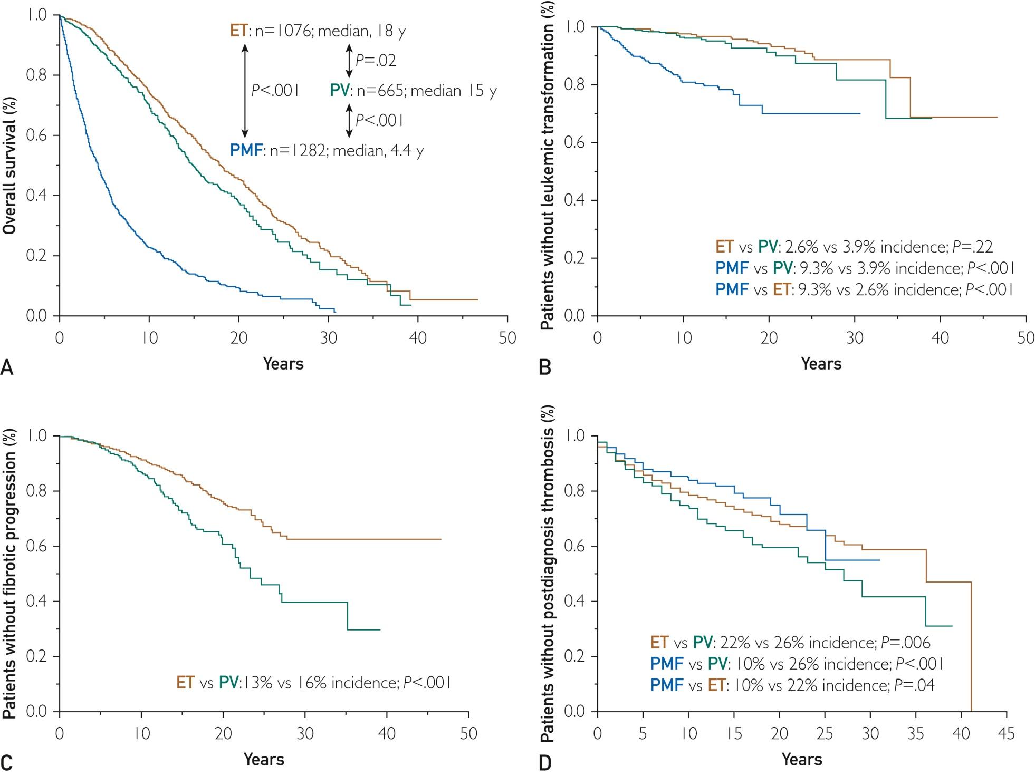
Disease complications in myelofibrosis
Anemia
Splenomegaly
Constitutional symptoms
Accelerated phase/blast transformation
Szuber et al. Mayo Clin Proceedings 2019

Slide 12
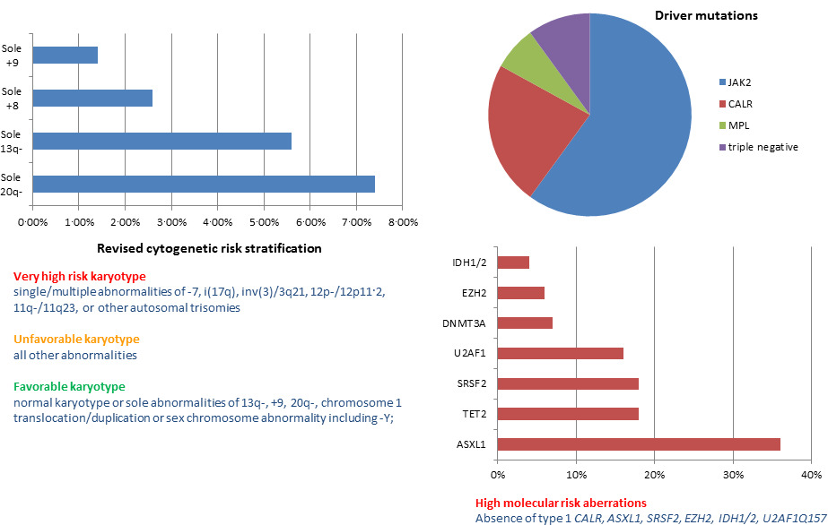
Recurrent genetic abnormalities in primary myelofibrosis
Abnormal karyotype at time of diagnosis ⁓ 30%
Driver mutations
frequency ⁓ 90%
JAK2 ⁓ 60%
CALR ⁓ 23%
MPL ⁓ 7%
TN ⁓ 10%
Other mutations
frequency ⁓ 80%
Gangat and Tefferi. BJH 2020

Slide 13
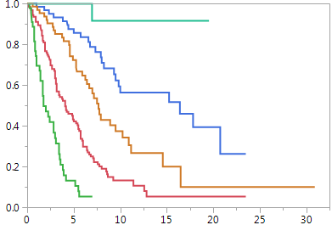
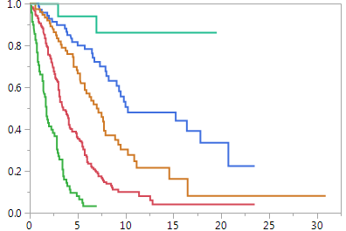

Survival in Mayo Clinic patients with primary myelofibrosis stratified by MIPSS70+ version 2.0
Risk categories: very high risk ≥9 points; high risk 5-8 points; intermediate risk 3-4 points; low risk 1-2 points; and very low risk zero points
Age 70 years or younger
311 patients
All ages
406 patients
Surviving
Very high risk; n=44; median 1.8 years; 10-year survival <5%
High risk; n=124; median 4.1 years; 10-year survival 13%
Intermediate risk; n=64; median 7.7 years; 10-year survival 37%
Low risk; n=61; median 16.4 years; 10-year survival 56%
Very low risk; n=18; median not reached; 10-year survival 92%
Years
Very high risk; n=69; median 1.8 years; 10-year survival <3%
High risk; n=172; median 3.5 years; 10-year survival 10%
Intermediate risk; n=76; median 7 years; 10-year survival 30%
Low risk; n=70; median 10.3 years; 10-year survival 50%
Very low risk; n=19; median not reached; 10-year survival 86%
Risk categories: very high risk ≥9 points; high risk 5-8 points; intermediate risk 3-4 points; low risk 1-2 points; and very low risk zero points
Very high-risk karyotype 4 points
Unfavorable karyotype 3 points
≥2 HMR mutations 3 points
One HMR mutation 2 points
Type 1/like CALR mutation absent 2 points
Constitutional symptoms 2 points
Severe anemia 2 points
Moderate anemia 1 point
≥2% circulating blasts 1 point
Online calculator
http://www.mipss70score.it/
Tefferi et al. J Clin Oncol. 2018

Slide 14
Mutation/karyotype-enhanced international prognostic scoring system for primary myelofibrosis (MIPSSv2)
≥5 points
High/very high risk
Median survival 1.8-3.5 years
10-year survival 0-10%
3-4 points
Intermediate risk
Median survival 7 years
10-year survival 30%
≤2 points
Low/very low risk
Median survival 10 years-not reached
10-year survival 50-86%
CALR type 1/like mutation
Absent
2 points
Present
0 points
Karyotype
Very high risk
-7,i(17q),inv(3), 12p, 11q23, other autosomal trisomies
4 points
Unfavorable
Not favorable or very high risk
3 points
Favorable
Normal, sole 13q-, +9, 20q-, 1q+, -Y
0 points
High molecular risk mutations
ASXL1, SRSF2, U2AF1Q157
Two
3 points
One
2 points
None
0 points
Clinical risk factors
Constitutional
symptoms
2 points
Severe
Anemia
Hgb <9 g/dL male
<8 g/dL female
2 points
Moderate
Anemia
Hgb 9-10.9 g/dL male
8-9.9 g/dL female
1 point
Circulating
blasts ≥2%
1 point
None of
the above
0 points
Tefferi, A. BMT (in press)

Slide 15
Therapeutic options in myelofibrosis
Curative or with potential to improve survival
  Allogeneic hematopoietic cell transplant (allo-HCT)
Palliative
  Observation alone (watch-and-wait)
  Treatment for anemia
    Thalidomide ± prednisone
    Androgens
    Danazol
    ESAs
    Lenalidomide/pomalidomide
  Treatment for symptomatic splenomegaly
    Hydroxyurea
    JAK2 inhibitors
    Splenectomy
  Treatment for constitutional symptoms
    JAK2 inhibitors
  Involved field radiotherapy for extra-medullary hematopoiesis
  Experimental therapy

Slide 16
Myelofibrosis: 2023 treatment algorithm
Very high risk
≥9 points
10-yr survival <3%
High Risk
5-8 points
10-yr survival 10%
Intermediate risk
3-4 points
10-yr survival 30%
Low risk
1-2 points
10-yr survival 50%
Very low risk
0 points
10-yr survival 86%
Transplant ineligible
Transplant eligible
Individualized
approach
Symptomatic
Asymptomatic
Investigational
treatment
Allogeneic transplant
Investigational
treatment
Observation
only
Symptoms-directed therapy*
Tefferi, A. AJH; First published: 21 January 2023
https://doi.org/10.1002/ajh.26857

Slide 17
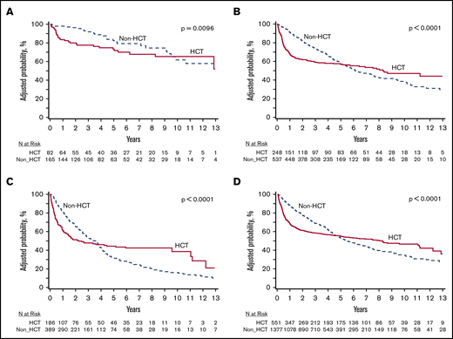
Survival following allogeneic transplant in patients with myelofibrosis
(CIBMTR and MPN Research Consortium study)
DIPSS low-risk
DIPSS Int-1
551 patients transplanted vs
1377 not transplanted
DIPSS ≥Int-2
DIPSS all grades
Gowin K et al. Blood Adv 2020;4: 1965.
Gowin K et al. Blood Adv 2020;4: 1965.

Slide 18
JAK2 inhibitors in myelofibrosis: activity in JAKi-naïve patients
 | Ruxolitinib (FDA 2011) | Fedratinib (FDA 2019) | Pacritinib (FDA 2022) | Momelotinib (FDA 2023)
Dose & Schedule | 20 mg BID (Plts >200 x10⁹/l) 15 mg BID (Plts 150-200 x10⁹/l) | 400 mg BID (Plts ≥50 x10⁹/l) | 200 mg BID (Plts <50 x10⁹/l) | 200 mg QD newly diagnosed and previously treated patients with myelofibrosis and anemia
SVR ≥35% | 29% (SIMPLIFY-1) Ruxo vs mom | 36% (JAKARTA-1) Pardanani et al. JAMA Oncology 2015 fed vs placebo | 19% (PERSIST-1) Mesa et al. Lancet Hematology 2017 Pac vs BAT | 27% (SIMPLIFY-1) Mesa et al. JCO 2017
Transfusion resolution | More likely to cause anemia | More likely to cause anemia | 25% (PERSIST-1) | 46% (Mayo study) Gangat et al. AJH 2022
Symptom response | 42% (SIMPLIFY-1) | 36% (JAKARTA-1) | 19% (PERSIST-1) | 28% (SIMPLIFY-1)
Adverse effects | Anemia Thrombocytopenia Withdrawal Opportunistic COVID vaccines | Anemia Thrombocytopenia GI symptoms ↑LFTs/amylase/lipase Wernicke’s (Rare event) | GI symptoms Edema Pneumonia Cardiac failure | Thrombocytopenia ↑LFTs/amylase/lipase Peripheral neuropathy First-dose effect (Dizziness, Hypotension, Flushing, Nausea)
Tefferi et al. Haematologica Early view Mar 2, 2023 https://doi.org/10.3324/haematol.2022.282612

Slide 19
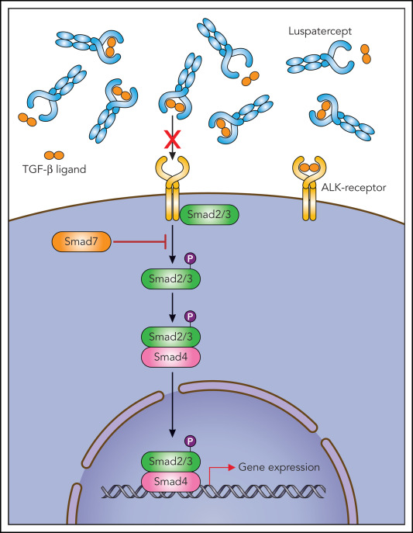
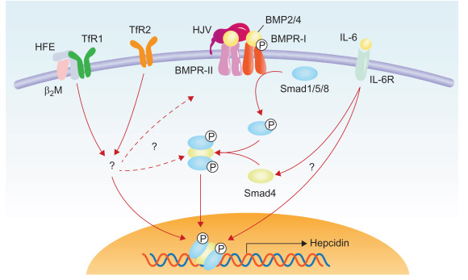
Momelotinib mechanism of action
Luspatercept
TGF-β Ligand trap
Momelotinib
Pacritinib
Activins
Bone morphogenic
protein (BMP)
ligands
ACVR1
Type 2 Receptor
(BMPR2/ACVR2A, ACVR2B)
Cytokine
receptors
Growth factor
receptors
Gain-of-function
mutations
BMP
signals
P
Activin
signals
JAK2
P
P
P
STAT3
SMAD1/5/8
SMAD2/3
STAT3
Anti-HJV
antibody
DISC-0974 clinical trial
P
SMAD4
Activation of genes linked to:
Proliferation
Survival
Inflammation
Activation of genes linked to:
Inflammation
Endochondral ossification
Hepcidin production
  Ineffective erythropoiesis
Myeloproliferation
Extramedullary hematopoiesis (hepatosplenomegaly)
Aberrant cytokine expression (constitutional symptoms; ineffective erythropoiesis)
ACVR1: Activin A receptor type 1 (aka. ALK2)
Tefferi et al. Haematologica Mar 2, 2023

Slide 20
MOMENTUM: Phase 3 randomized study of momelotinib (MMB) versus danazol (DAN) in symptomatic and anemic myelofibrosis (MF) patients previously treated with a JAK inhibitor
Wk 24 Endpoint | Test | MMB | DAN | p-value
TSS response rate (primary), % | Superiority | 24.6 | 9.2 | 0.0095
TI rate, % | Non-inferiority | 30.8 | 20.0 | 0.0064 (one-sided)
SRR ≥25%, % | Superiority | 40.0 | 6.2 | <0.0001
TSS change from BL | Superiority | -9.36 | -3.13 | 0.0014
SRR ≥35%, % | Superiority | 23.1 | 3.1 | 0.0006
Zero transfusion rate, % | Superiority | 35.4 | 16.9 | 0.0012
Gr ≥3 thrombocytopenia (MMB, 22%; DAN, 12%) and anemia (MMB, 8%; DAN, 11%)
Gr ≥3 infections (MMB, 15%; DAN, 17%)
Peripheral neuropathy (MMB, 4%; DAN, 2%, all Gr ≤2)
Verstovsek et al. Lancet, 2023

Slide 21
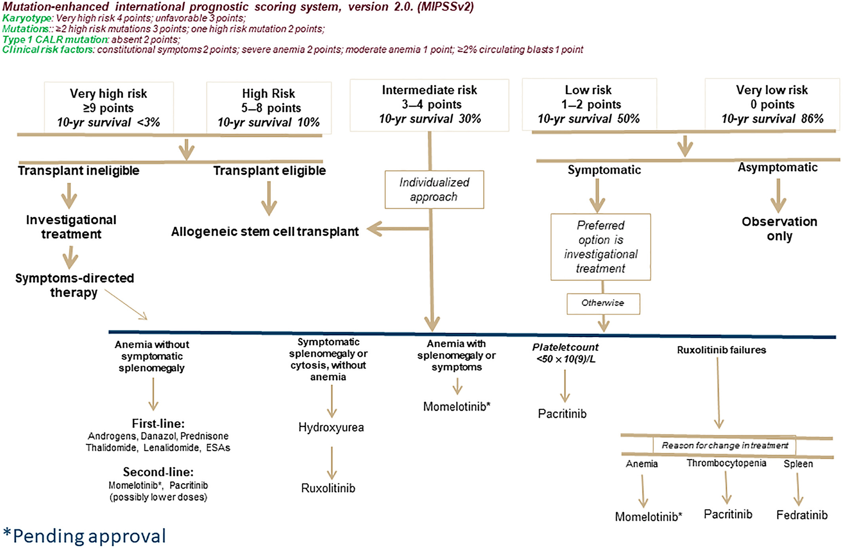
Management of myelofibrosis
Tefferi et al. Am J Hematol 2023

Slide 22
Momelotinib drug survival among 79 JAK inhibitor-naïve
Mayo clinic patients with myelofibrosis
Phase-1/2 study of momelotinib (NCT00935987)
Drug survival
1-year 68%
3-year 30%
5-year 16%
10-year 7%

Slide 23
Momelotinib drug survival among 79 JAK inhibitor-naïve Mayo Clinic patients
with myelofibrosis stratified by CALR type1/like (CALR-1) mutation
CALR-1 mutated
3-year 64%
5-year 40%
10-year 18%
P=0.01
CALR-1 wild-type
3-year 25%
5-year 11%
10-year 4%

Slide 24
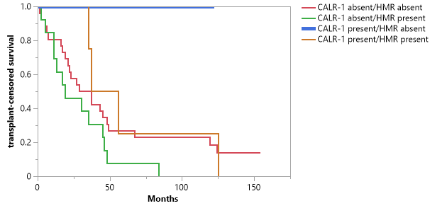
Transplant-censored survival among 79 JAK inhibitor-naïve patients with myelofibrosis treated with momelotinib and
stratified by CALR type1/like (CALR-1) and high molecular risk (HMR; ASXL1/SRSF2) mutations
Phase-1/2 study of momelotinib (NCT00935987)
CALR-1 present/HMR absent (N=2)
Median survival not reached
Deaths = 0
CALR-1 present/HMR present (N=4)
Median survival 47 months
Deaths = 4 (100%)
P=0.058
CALR-1 absent/HMR absent (N=26)
Median survival 33 months
Deaths = 22 (85%)
CALR-1 absent/HMR present (N=13)
Median survival 19 months
Deaths = 13 (100%)

Slide 25
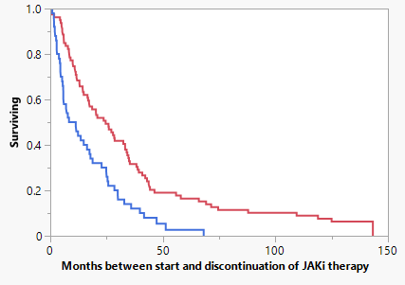
On-treatment survival among 129 Mayo Clinic patients with high/intermediate risk
myelofibrosis treated with either momelotinib or ruxolitinib
Momelotinib
N=79
Median 25 months
3-year treatment discontinuation rate 68%
5-year treatment discontinuation rate 84%
Ruxolitinib
N=50
Median 10 months
3-year treatment discontinuation rate 88%
5-year treatment discontinuation rate 97%
P<0.001
Tefferi et al. AJH. First published: 03 September 2022
https://doi.org/10.1002/ajh.26714

Slide 26
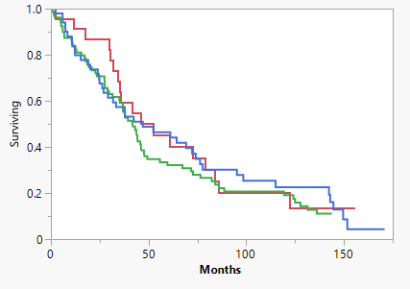
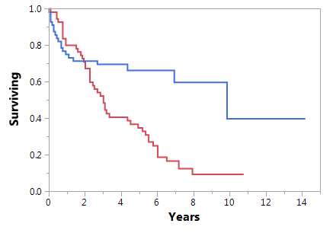

Survival impact of JAK inhibitors in myelofibrosis: Mayo Clinic studies
(retrospective comparisons with risk-adjusted controls)
Momelotinib; N=100
Median survival 3.2 years
Ruxolitinib, n=51
Survival
P=0.43
P=0.44
No ruxolitinib, n=410
No momelotinib; N=442
Median survival 3 years
Tefferi et al. NEJM 2011:365;15
Months
Tefferi et al. Blood Cancer J. 2018;8:29
N=23
N=79
Transplanted; N=56
Median 9.8 years
N=50
Total N=152
All JAKi naïve
Treated 2007-2011
Median survival 3.6 years
5-year survival 38%
10-year survival 20%
P=0.59
No transplant ; N=56
matched for age, risk and karyotype
Median 3 years
Gangat et al. Blood Cancer Journal volume 13, Article number: 3 (2023)

Slide 27
Concluding remarks
Allogeneic transplant is the only treatment modality that can secure long-term survival in both chronic and blast phase myelofibrosis
Newer JAK2 inhibitors target the triad of QoL offenders in myelofibrosis: anemia, splenomegaly and constitutional symptoms but, have not yet shown disease-modifying activity

Slide 28
The Era of Bispecifics in DLBCL
Muhamad Alhaj Moustafa, MD, MS
Mayo Clinic
Jacksonville, Florida

Slide 29
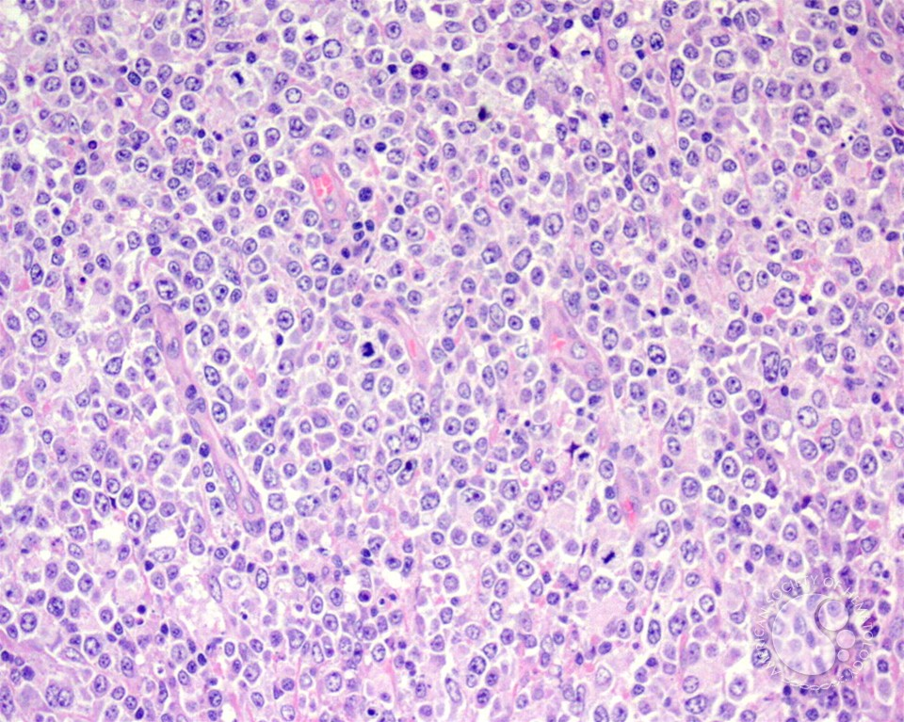
Diffuse Large B Cell Lymphoma
DLBCL accounts for 30% of adult NHL in The USA
Median age at diagnosis is 66 years
Male>female
SEER Cancer Stat Facts: DLBCL. National Cancer Institute. Bethesda, MD, https://seer.cancer.gov/statfacts/html/dlbcl.html
Epperla, N, Vaughn, JL, Othus, M, Hallack, A, Costa, LJ. Recent survival trends in diffuse large B-cell Lymphoma––Have we made any progress beyond rituximab? Cancer Med. 2020; 9: 5519– 5525. https://doi.org/10.1002/cam4.3237

Slide 30
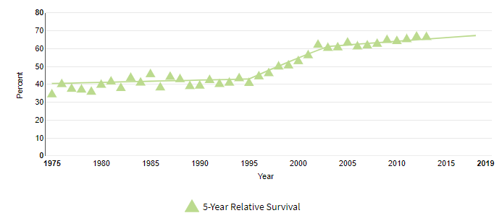
Diffuse Large B-cell lymphoma
Diffuse Large B Cell Lymphoma
Rituximab
SEER Cancer Stat Facts: Follicular Lymphoma. National Cancer Institute. Bethesda, MD, https://seer.cancer.gov/statfacts/html/follicular.html
Notes:
The overall survival of DLBCL has improved significantly over years from 40% 5 yrs OS in 1970s-80s to around 70% or more now. Click.
We can see the upward flick in the improvement of OS at the end of 1990s to around 2005. Click.
Which is related to the introduction of rituximab. Click.

Slide 31
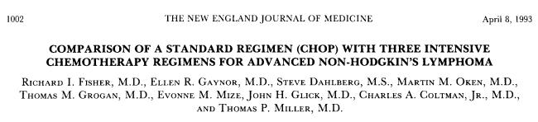
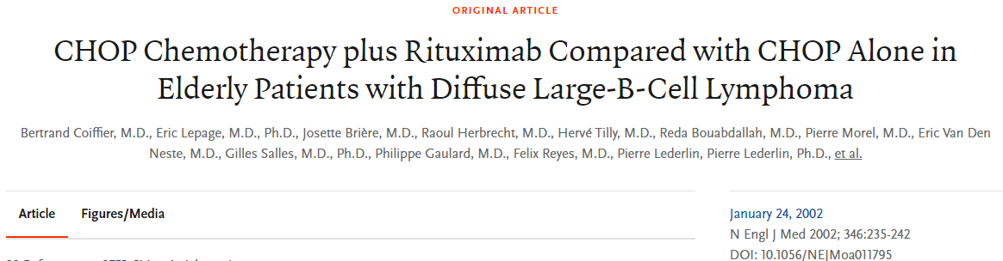
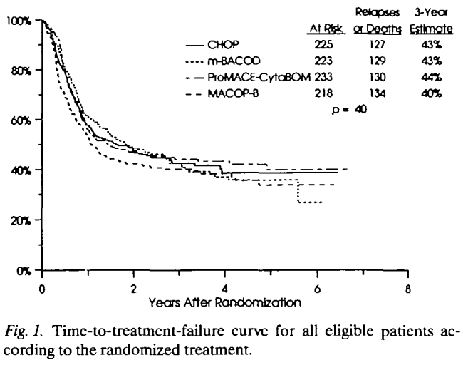
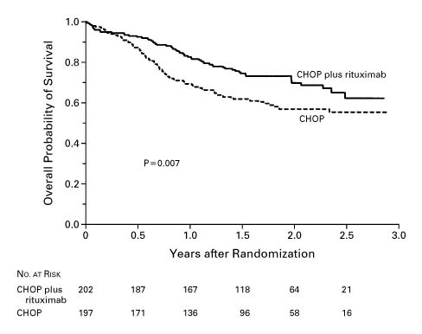
The story of R-CHOP
Newly Diagnosed DLCBL
1988
2002
CHOP became standard*
R-CHOP became standard
*Coltman CA, et al. Southwest Oncology Group studies in diffuse large cell lymphoma: a subset analysis. Cancer chemotherapy: challenges for the future. Tokyo, Japan: Excerpta Medica. 1988:194-202

Slide 32
DA-EPOCH-R
Alliance 50303
HR 1.09
p=0.65
O-CHOP
GOYA
HR 0.99
p=0.99
RCHOP + enzastaurin
ENGINE (DGM1+ genotype)
pending
(1) GELA
HR 0.96
p=0.749
RCHOP-14
RCHOP + acalabrutinib
(non-GCB and <65)
pending
(2) BNLI
HR 0.90
p=0.376
PHOENIX
(non-GCB by IHC)
HR = 0.99, p=0.96
*exploratory analysis suggests OS benefit in <60 subset
RCHOP+ ibrutinib
R-CHOP
Graveyard
LNH03-2B
(age <60/IPI 1)
HR 0.44
p=0.0071
R2CHOP (lenalidomide)
ROBUST
(ABC by Lymph2Cx)
2-year OS 79% vs. 80%
R-ABCVP
REMoDL-B
(COO by DASL)
HR 0.85, p=0.397
RCHOP+ bortezomib
RCHOP + ASCT
SWOG-9704
HR 1.24, p=0.32
*exploratory analysis suggests OS benefit in high-risk IPI
RCHOP + everolimus maintenance
RCHOP + enzastaurin maintenance
RCHOP+ lenalidomide maintenance
REMARC
HR 1.22
p=0.264
RCHOP+ R maintenance
(1) NHL13
HR 0.81, p=0.415
(2) ECOG4494
HR 1.28, P=0.48
(3) Hovon-Nordic
5-year OS 85% vs. 83%
PILLAR-2 (IPI 3-5)
HR 0.75, p=NS
PRELUDE (IPI 3-5)
HR 1.04, p=0.807
Adapted from Matt Cheung @MattCheungMD

Slide 33
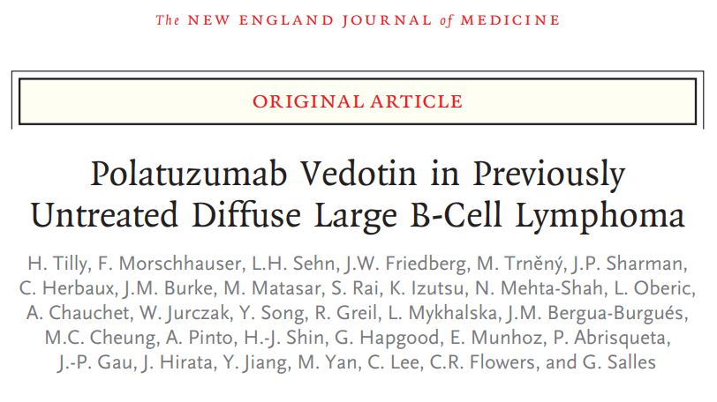
Polatuzumab R-CHP vs. R-CHOP (POLARIX study)
Phase III, randomized, double blinded, placebo-controlled, stratified (IPI, Bulky disease, and geographic region) trial
Tilly H, et al. Polatuzumab Vedotin in Previously Untreated Diffuse Large B-Cell Lymphoma. N Engl J Med. 2022 Jan 27;386(4):351-363. doi: 10.1056/NEJMoa2115304. Epub 2021 Dec 14. PMID: 34904799.

Slide 34
Pola R-CHP vs. R-CHOP (POLARIX study)
Polatuzumab R-CHP vs. R-CHOP (POLARIX study)
Median follow up time = 28.2 months
6.5% 2 years-PFS benefit in Pola-R-CHP (76.7% vs. 70.2%)
No OS benefit
Not included in the study: Transformed lymphoma, PMLBCL, >80 y.o
Tilly H, et al. Polatuzumab Vedotin in Previously Untreated Diffuse Large B-Cell Lymphoma. N Engl J Med. 2022 Jan 27;386(4):351-363. doi: 10.1056/NEJMoa2115304. Epub 2021 Dec 14. PMID: 34904799.

Slide 35
Therapeutic choices for DLBCL
First line
  R-CHOP / Pola-R-CHP
  DA-R-EPOCH (in certain situations)
Second line and beyond
  Transplant eligible (relapse >12 months):
    Chemoimmunotherapy → ASCT
  Transplant ineligible:
    Polatuzumab vedotin-piiq + bendamustine +rituximab
    Tafasitamab-cxix +lenalidomide
    Ibrutinib (non-GCB DLBCL)
  Relapsed within 12 months:
    Axicabtagene ciloleucel (CAR-T)
    Lisocabtagene maraleucel (CAR-T)
Third line and beyond
  Axicabtagene ciloleucel (CAR-T)
  Lisocabtagene maraleucel (CAR-T)
  Tisagenlecleucel (CAR-T)
  Loncastuximab tesirine-Ipyl
  Selinexor
  Epcoritamab-bysp
  glofitamab-gxbm

Slide 36
Treatment algorithm for DLBCL
Newly diagnosed DLBCL
Chemo-immunotherapy (CIT)
Within 1 year
CAR-T
Relapse
> 1 year
Salvage + ASCT
Relapse
CAR-T
Relapse
?????
CAR-T

Slide 37
Novel treatments in R/R DLBCL
Drug | Type | Combination | Line of therapy | CR/ORR (%) | Trial | Approval date
Tafasitamab-cxix | CD19-directed cytolytic antibody (Naked antibody) | Lenalidomide | 2nd (ASCT ineligible) or Beyond | 40/57 | Phase II (L-MIND) | July 2020
Polatuzumab vedotin-piiq | CD79b-directed antibody (drug conjugate) | Bendamustine + Rituximab | 3nd (ASCT ineligible) or beyond | 40/45 | Phase Ib/II trial, randomized | June 2019
Loncastuximab tesirine-Ipyl | CD19-directed antibody (alkylating agent conjugate) | N/A | 3rd or beyond | 35/48 | Phase II trial, single arm (LOTIS-2) | April 2021
Selinexor | Nuclear export inhibitor | N/A | 3rd or beyond | 12/28 | phase 2b study (SADAL) | June 2020
Epcoritamab-bysp | CD20-CD3 bispecific antibody | N/A | 3rd or beyond | 39.6/61 | Phase II (EPCOR-NHL1) | May 2023
glofitamab-gxbm | CD20-CD3 bispecific antibody | N/A | 3rd or beyond | 39/52 | Phase II | June 2023
Duell J. et al. Long-term outcomes from the Phase II L-MIND study of tafasitamab (MOR208) plus lenalidomide in patients with relapsed or refractory diffuse large B-cell lymphoma. Haematologica 2021;106(9):2417-2426;
Sehn LH, et al. Polatuzumab Vedotin in Relapsed or Refractory Diffuse Large B-Cell Lymphoma. J Clin Oncol. 2020 Jan 10;38(2):155-165. doi: 10.1200/JCO.19.00172. Epub 2019 Nov 6. PMID: 31693429; PMCID: PMC7032881.
Goparaju K, et al. Loncastuximab tesirine for treatment of relapsed or refractory diffuse large B cell lymphoma. Expert Opin Biol Ther. 2021 Nov;21(11):1373-1381. doi: 10.1080/14712598.2021.1973998. Epub 2021 Sep 10. PMID: 34505550.
Kalakonda N, et al. Selinexor in patients with relapsed or refractory diffuse large B-cell lymphoma (SADAL): a single-arm, multinational, multicentre, open-label, phase 2 trial. Lancet Haematol. 2020 Jul;7(7):e511-e522. doi: 10.1016/S2352-3026(20)30120-4. PMID: 32589977.
Thieblemont C, et al. Epcoritamab, a Novel, Subcutaneous CD3xCD20 Bispecific T-Cell–Engaging Antibody, in Relapsed or Refractory Large B-Cell Lymphoma: Dose Expansion in a Phase I/II Trial. Journal of Clinical Oncology 2023 41:12, 2238-2247
Dickinson M, et al. Glofitamab for Relapsed or Refractory Diffuse Large B-Cell Lymphoma. N Engl J Med 2022; 387:2220-2231. DOI: 10.1056/NEJMoa2206913

Slide 38
Relapse after CAR-T
Salvage treatment with novel agents is preferable to standard chemotherapy in patients with large B-cell lymphoma progressing after CAR-T therapy
Iacoboni et al
Iacoboni et al. Salvage Treatment with Novel Agents Is Preferable to Standard Chemotherapy in Patients with Large B-Cell Lymphoma Progressing after Chimeric Antigen Receptor T-Cell Therapy. Blood 2022; 140 (Supplement 1): 378–380.

Slide 39
Why is this important?
CD19 CAR-T → Relapse → Unclear treatment strategy
Poor outcomes

Slide 40
Methodology
Retrospective
Aggressive B-cell lymphoma relapsed after CD19 CAR-T
10 Spanish centers
Iacoboni et al. Salvage Treatment with Novel Agents Is Preferable to Standard Chemotherapy in Patients with Large B-Cell Lymphoma Progressing after Chimeric Antigen Receptor T-Cell Therapy. Blood 2022; 140 (Supplement 1): 378–380.

Slide 41
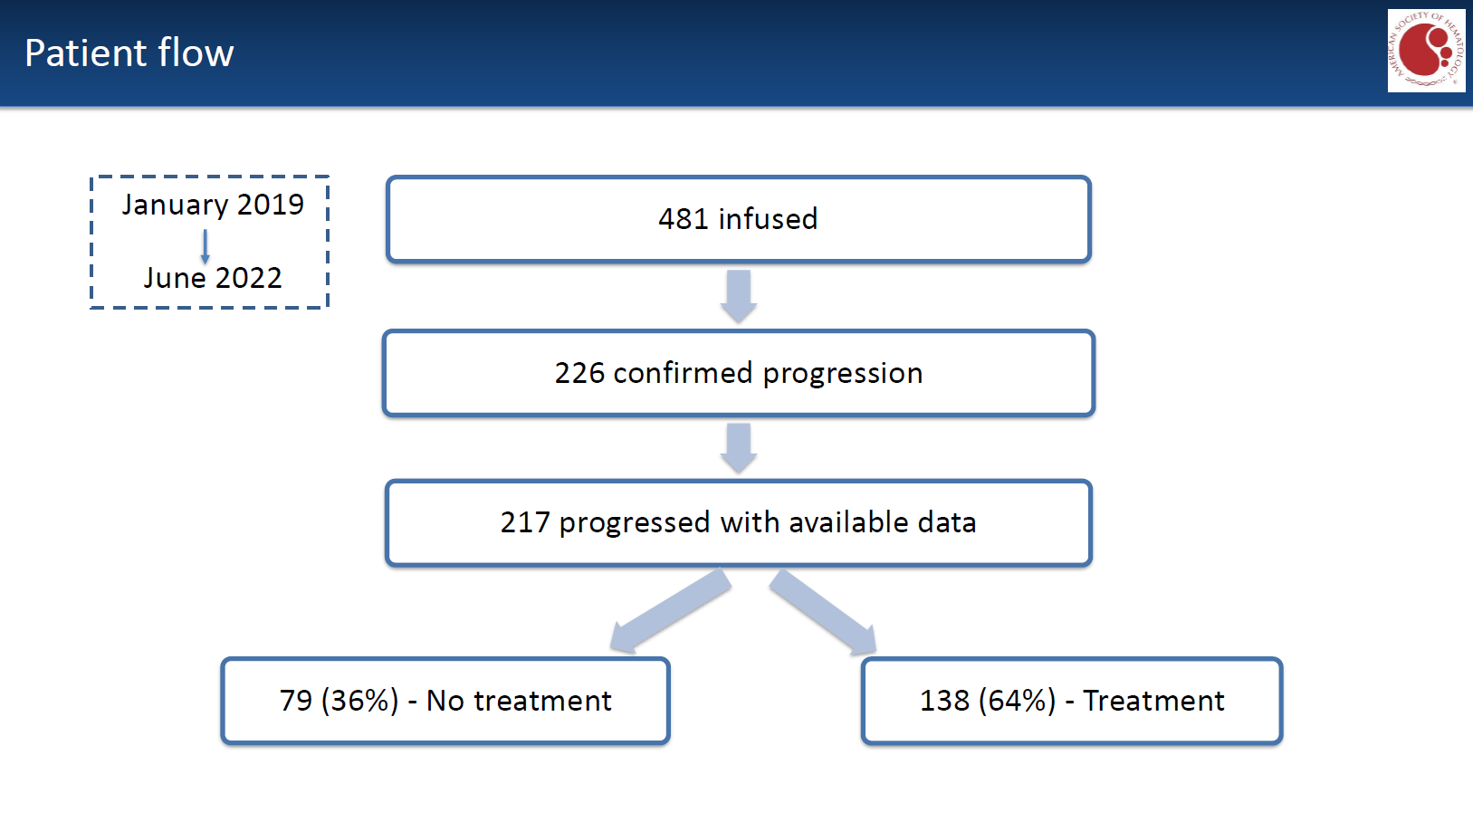
Iacoboni et al. Salvage Treatment with Novel Agents Is Preferable to Standard Chemotherapy in Patients with Large B-Cell Lymphoma Progressing after Chimeric Antigen Receptor T-Cell Therapy. Blood 2022; 140 (Supplement 1): 378–380.

Slide 42
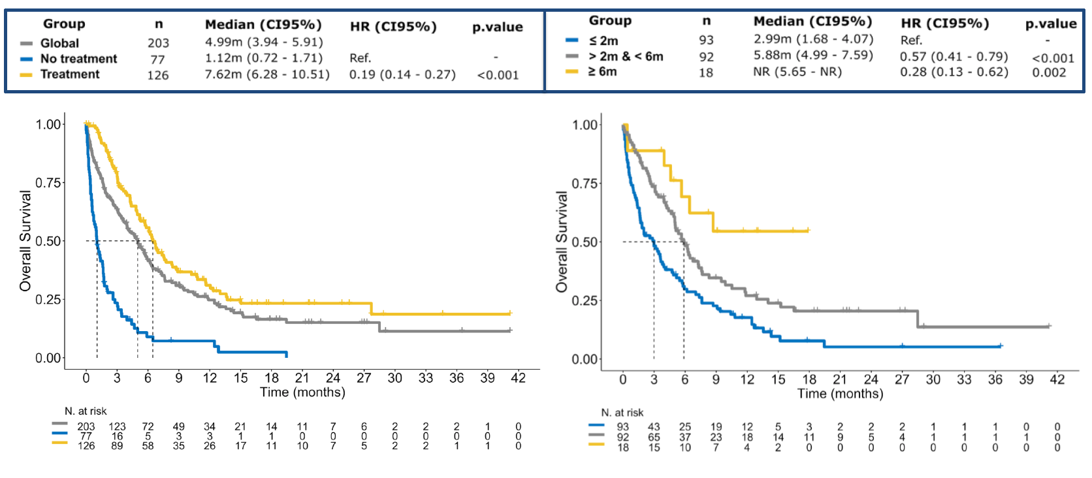
Overall survival after CAR-T relapse
Relapse >=6 month
Treatment
No Treatment
Relapse =<2 months
Iacoboni et al. Salvage Treatment with Novel Agents Is Preferable to Standard Chemotherapy in Patients with Large B-Cell Lymphoma Progressing after Chimeric Antigen Receptor T-Cell Therapy. Blood 2022; 140 (Supplement 1): 378–380.

Slide 43
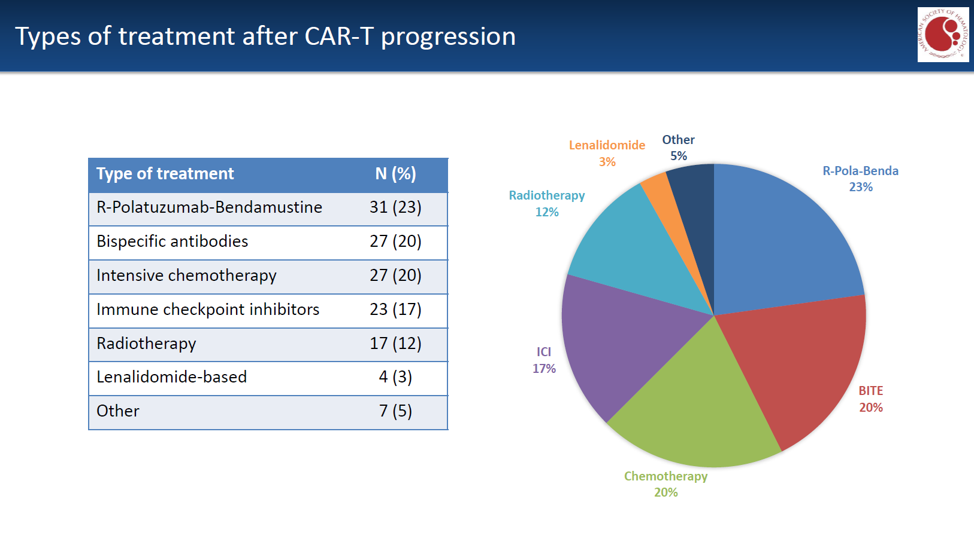
Iacoboni et al. Salvage Treatment with Novel Agents Is Preferable to Standard Chemotherapy in Patients with Large B-Cell Lymphoma Progressing after Chimeric Antigen Receptor T-Cell Therapy. Blood 2022; 140 (Supplement 1): 378–380.

Slide 44
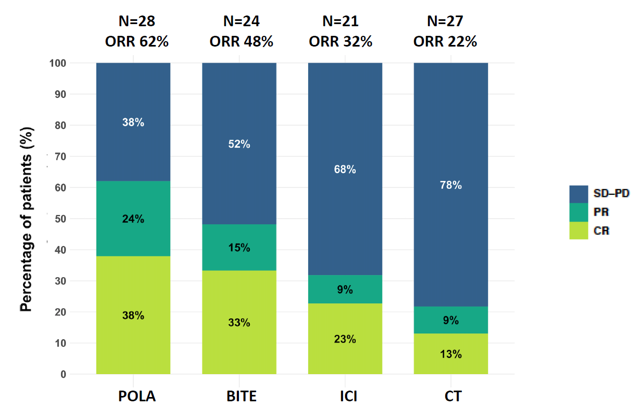
Response rates by type of salvage treatment
Iacoboni et al. Salvage Treatment with Novel Agents Is Preferable to Standard Chemotherapy in Patients with Large B-Cell Lymphoma Progressing after Chimeric Antigen Receptor T-Cell Therapy. Blood 2022; 140 (Supplement 1): 378–380.

Slide 45
Study Conclusions
POLA + BR and BITEs seemed to work better than traditional salvage chemotherapy
Consolidation with allogeneic transplant after salvage was a viable strategy

Slide 46
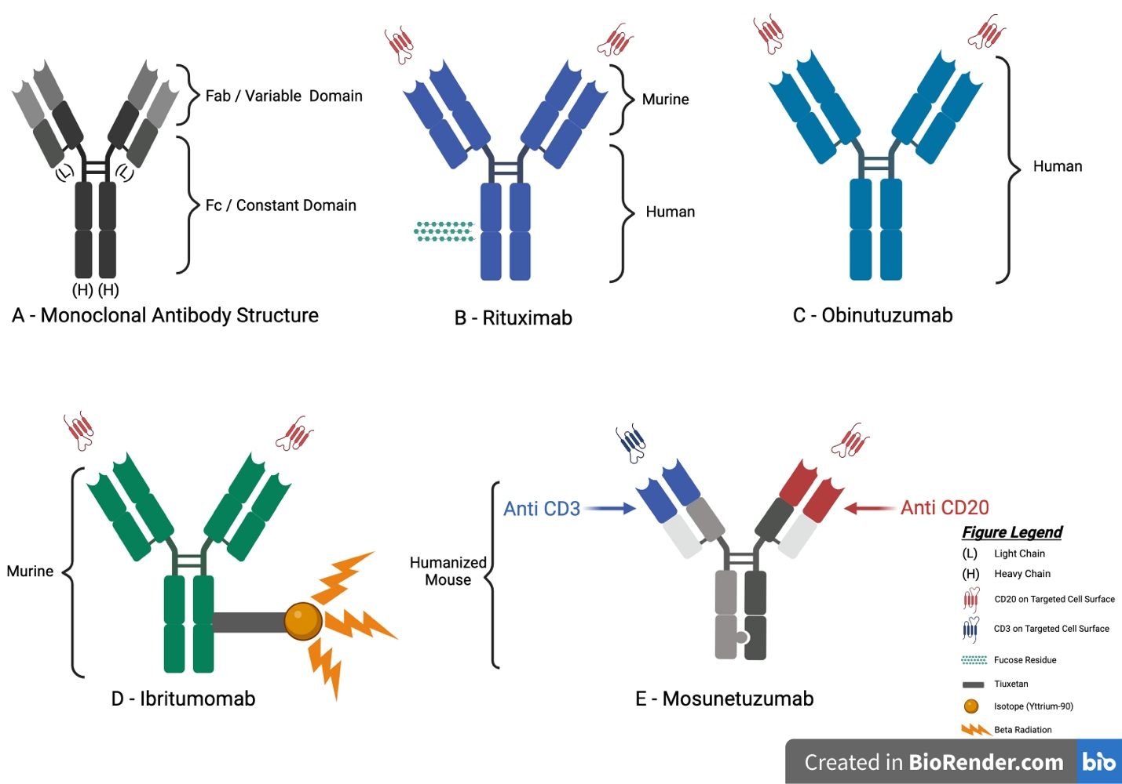
A Comprehensive Review of Monoclonal Antibodies for the Treatment of Follicular Lymphoma Including Both Approved and Investigational Options
Mario El Hayek, MD, Muhamad Alhaj Moustafa, MD, MS – 11/2023

Slide 47
Bispecific T-cell engagers
Epocoritamab

Slide 48
Approved Bispecific Antibodies
Epcoritamab-bysp
R/R DLBCL
After >2 lines
FDA approval: 5/19/2023
EPCORE NHL-1 (NCT03625037): Open-label, multicenter, multi-cohort study, single arm
148 pts for efficacy outcome
ORR: 61%, CR: 38%
F/U was 9.8 months
SC injections

Slide 49
Epcoritamab-bysp
ICANS any grade: 6%
CRS any grade: 51%
 | DLBCL
Grade ≥ 3
CRS | 2.5%
ICANS | o.6%
Infections | 15%

Slide 50
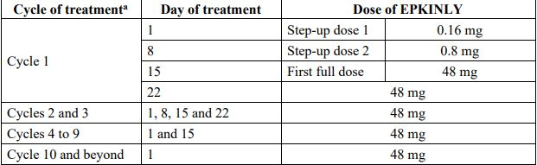
Cycles: 28 days
Epcoritamab-bysp
Continuos treatment until progression
FDA package insert: https://www.accessdata.fda.gov/drugsatfda_docs/label/2023/761324s000lbl.pdf

Slide 51
Timing of CRS/Neurotoxicity
Epcoritamab-bysp
The median time to onset of CRS from the most recent administered Epcoritamab-bysp dose across all doses was 24 hours (range: 0 to 10 days).
The median time to onset after the first full 48 mg dose was 21 hours (range: 0 to 7 days).
CRS resolved in 98% of pts and the median duration was 2 days (range: 1 to 27 days).

Slide 52
Bispecific T-cell engagers
Glofitamab
Hutchings et al, ASH 2022
Dickenson et al, NEJM 2022

Slide 53
Approved Bispecific Antibodies
Glofitamab-gxbm
R/R DLBCL
After >2 lines
FDA approval: 6/16/2023
NP30179 (NCT03075696): Open-label, multicenter, multi-cohort study, single arm
132 pts for efficacy outcome
ORR: 56%, CR: 43%
F/U was 11.4 months
IV infusion
Hutchings et al, ASH 2022
Dickenson et al, NEJM 2022

Slide 54
Glofitamab-gxbm
ICANS any grade: 4.8%
CRS any grade: 70%
 | DLBCL
Grade ≥ 3
CRS | 4.2%
Neurotoxicity | 2.1%
Infections | 10%
Hutchings et al, ASH 2022
Dickenson et al, NEJM 2022

Slide 55
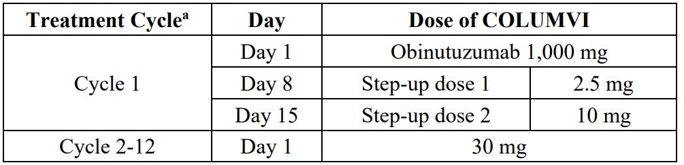
Cycles: 21 days
Glofitamab-gxbm
Continue Glofitamab-gxbm for a maximum of 12 cycles or until disease progression or unacceptable toxicity, whichever occurs first. (Limited therapy)

Slide 56
Glofitamab-gxbm vs. Epcoritamab-bysp
Glofitamab
Fixed duration (12 months)
IV infusion (4hrs)
Continuous treatment
Epcoritamab
SC
Cycle: 28 days
Cycle: 21 days
Pre-treatment Obintuzumab
*Both had low incidence of >= 3 grade CRS or ICANS
Also presented:
Efficacy in MCL (Phillips et al)
Efficacy/safety with R-CHOP in untreated DLBCL (Topp et al)

Slide 57
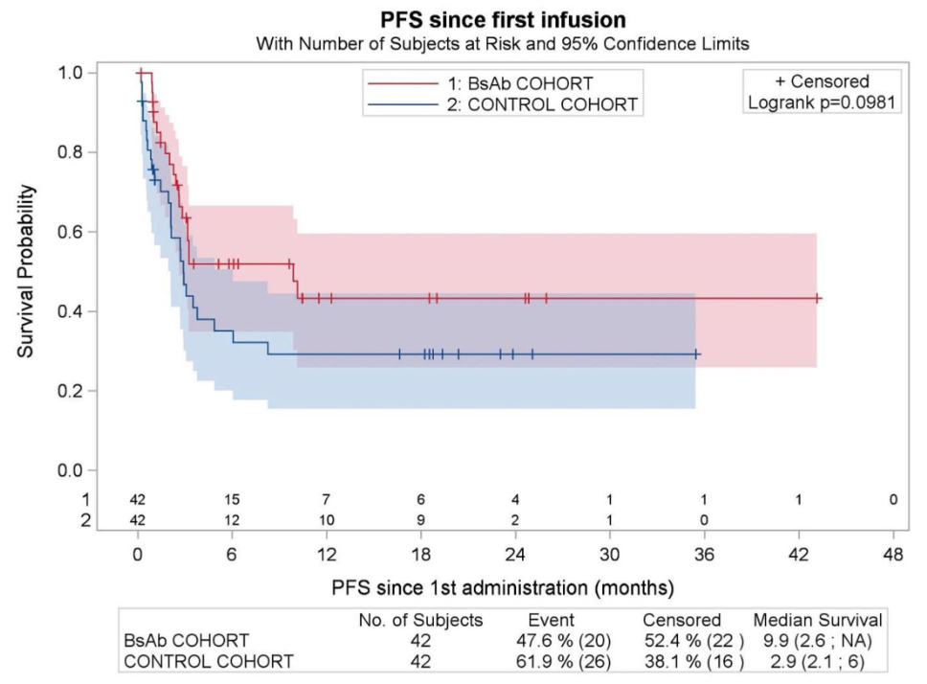
Efficacy of Chimeric Antigen Receptor T-Cell Therapy Is Not Impaired By Previous Bispecific Antibody Treatment in Patients with Large B-Cell Lymphoma
Retrospective
R/R LBCL pts treated with CD19-targeted CAR-T
47 pt exposed to BsAbs prior to apheresis
Control cohort from pts included in the DESCAR-T Registry (n=764)
1:1 propensity score matching to achieve balance between cohorts
Previous exposure to bispecific antibody treatment targeting different antigens does not have a negative impact on survival outcomes after CAR T-cell therapy
Lack of response to a previous BsAb does not predict for lower response rates after CAR T-cell infusion
Not significant
ASH-2023: Saturday, December 9, 2023: 3:15 PM
Gloria Iacoboni, MD^{1*}, Gilles Crochet, MD^{2*}, Audrey Couturier, MD^{3*}, Emmanuel Bachy, MD, PhD^{4*}, Josu Iraola^{1*}, Thomas Gastinne, MD^{5*}, Charles Herbaux, MD, PhD^{6*}, Tom Fradon^{7*}, Mi Kwon⁸, Romain Gounot^{9*}, Nuria Martinez-Cibrian, MD^{10*}, Cristina Castilla-Llorente, MD^{11*}, Manuel Guerreiro, MD^{12*}, Clementine Sarkozy^{13*}, Jose Aspa-Cilleruelo^{1*}, Vincent Camus, MD^{14*}, Stephanie Guidez^{15*}, Adrien Chauchet^{16*}, Eric Deconinck¹⁶, Krimo Bouabdallah, MD^{17*}, Pere Barba, MD¹, Roch Houot, MD, PhD^{3*} and Franck Morschhauser¹⁸

Slide 58
Conclusions and Future Directions
More single agent bispecific antibodies are likely to be approved in near future
Bispecific antibodies combinations with Chemo and Non-chemo agents are being studied
Early studies on Tri-specific studies are undergoing
Manipulation of the immune system is a hallmark for the future therapies along with drug conjugates and mutation-targeted therapies
More-effective less-toxic treatments are the ultimate goal (chemotherapy-free?)

Slide 59
Thank you
AlhajMoustafa.Muhamad@Mayo.edu
Twitter: @AlhajMoustafa
Notes:
Thank you and Happy to take any questions

Slide 60
Treatment Crossroads:
How to Choose Among the Bispecifics in Multiple Myeloma
Sikander Ailawadhi, M.D.
Professor of Medicine
Mayo Clinic Cancer Center
Enterprise Deputy Director, Cancer International
Image copyright Shutterstock
©2023 Mayo Foundation for Medical Education and Research | WF2491421-60

Slide 61
DISCLOSURE OF RELEVANT FINANCIAL RELATIONSHIP(S) WITH ineligible companies
Institutional Research Grants: GSK, Sanofi, BMS, Pharmacyclics, Janssen, Cellectar, Abbvie, Ascentage, Astra Zeneca
Consulting: GSK, BMS, Sanofi, Beigene, Janssen, Regeneron, Pfizer, Cellectar
REFERENCES TO OFF-LABEL USAGE(S)
OF PHARMACEUTICALS OR INSTRUMENTS
Nothing to disclose
All relevant financial relationships have been mitigated.

Slide 62


Current myeloma treatment paradigm
Triplet/Quad Induction
(4-6 cycles)
AutoSCT ± Consolidation
(1→2-4 cycles)
Len Maintenance
(1, 2, 3 yr+)
SCT
eligible
Relapsed/
Refractory
CAR-T or Bi-specifics
(<25% of patients)
CD38-Rd/RVd ± CD38 → Len ± CD38
Induction followed by continuous maintenance therapy
(8-12 cycles induction f/b maintenance)
SCT
ineligible
PD
PD
Autologous transplant
~50% MRD negative
Tumor
Burden
VGPR
PD
CR
MRD negative
NCCN. Clinical practice guidelines in oncology: multiple myeloma. V.3.2023. Rajkumar. Am J Hematol. 2022;97:1086.

Slide 63
Currently approved T-cell directed therapies in united states
Agent | Category | Target | Indication in R/R MM | Approval Date
Idecabtagene vicleucel | CAR T-cell therapy | BCMA | After ≥4 prior lines of therapy, including a PI, an immunomodulatory agent, and an anti-CD38 mAb | March 2021
Ciltacabtagene autoleucel | CAR T-cell therapy | BCMA | After ≥4 prior lines of therapy, including a PI, an immunomodulatory agent, and an anti-CD38 mAb | February 2022
Teclistamab | Bispecific antibody | BCMA | After ≥4 prior lines of therapy, including a PI, an immunomodulatory agent, and an anti-CD38 mAb | October 2022
Elranatamab | Bispecific antibody | BCMA | After ≥4 prior lines of therapy, including a PI, an immunomodulatory agent, and an anti-CD38 mAb | August 2023
Talquetamab | Bispecific antibody | GPRC5D | After ≥4 prior lines of therapy, including a PI, an immunomodulatory agent, and an anti-CD38 mAb | August 2023

Slide 64
Majestec-1: phase i/ii study of teclistamab
Patients with R/R MM after ≥3 lines of therapy, including exposure to IMiD, PI, and anti-CD38 mAb
  26% high-risk cytogenetics
  Median 5 prior lines of therapy (range: 2-14)
  77.6% triple-class refractory; 30.3% penta-drug refractory
  89.7% refractory to last therapy line
Teclistamab: 1.5 mg/kg SC weekly, after step-up
104 of 165 patients
ORR: 63.0% (95% CI: 55.2-70.4)
≥ CR
45.5%
Patients (%)
≥ VGPR
59.4%
Patient Subgroup | ORR, % (n/N)
≤3 prior lines of treatment | 74.4 (32/43)
>3 prior lines of treatment | 59.0 (72/122)
High-risk cytogenetics and/or EMD | 53.3 (32/60)
  All Patients (N = 165)
Median follow-up: 23 mo
Moreau. NEJM. 2022;387:495. van de Donk. ASCO 2023. Abstr 8011.

Slide 65
Majestec-1: efficacy
Progression-Free Survival
Overall Survival
100
100
80
80
60
60
Patients (%)
Patients (%)
40
40
20
20
Median OS: 22 mo (95% CI: 15-NE)
Median PFS: 11 mo (95% CI: 9-16)
0
0
0
3
6
9
12
15
18
21
24
27
0
3
6
9
12
15
18
21
24
27
Patients at Risk, n
Mo
Patients at Risk, n
Mo
165
110
98
81
59
22
10
2
0
0
165
135
124
114
91
37
14
2
1
0
Moreau. NEJM. 2022;387:495. van de Donk. ASCO 2023. Abstr 8011.

Slide 66
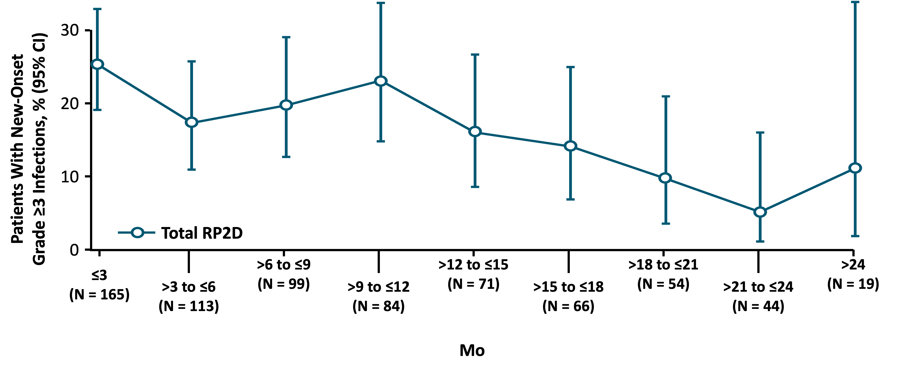
Majestec-1: safety
Rate of New Onset Grade ≥3 Infections
Median treatment duration: 8.5 mo (range: 0.2-24.4)
Median relative dose intensity: 93.7%
1 AE led to dose reduction
8 AEs led to discontinuation (infection: 5)
7 treatment-related deaths (COVID-19: 4)
All cases of ICANS resolved
CRS grade 1 (50.3%) or grade 2 (21.2%), (1 patient with transient grade 3 CRS)
All CRS events resolved without need for treatment reduction/discontinuation
Neurotoxic and ICANS events grade 1 or 2 (1 patient with seizure and bacterial meningitis)
CRS Parameter | All Patients (N = 165)
CRS, n (%) | 119 (72.1)
≥2 CRS events, n (%) | 55 (33.3)
Median time to onset, days (range) | 2 (1-6)
Median duration, days (range) | 2 (1-9)
Supportive measures, n (%)* Tocilizumab Low-flow oxygen by nasal cannula† Corticosteroids Single vasopressor | 110 (66.7) 60 (36.4) 21 (12.7) 14 (8.5) 1 (0.6)
van de Donk. ASCO 2023. Abstr 8011.

Slide 67
MagnetisMM-3 COHORT A: phase ii study of ELRANAtamab (BCMA-naïve RRMM)
75 of 123 patients
ORR: 61% (95% CI: 51.8 -69.6)
Patients with MM refractory to ≥1 IMiD, PI, anti-CD38 mAb
  96.7% triple-class refractory
  25.2% with high-risk cytogenetics
Elranatamab: 76 mg SC weekly with priming and/or premedication to reduce CRS
  If weekly dosing received for ≥6 cycles with achievement of ≥PR for ≥2 mo, then dosing interval changed to every 2 weeks
≥ CR
35%
Patients (%)
≥ VGPR
56.1%
Outcome | All Patients (N = 123)
Median DoR, mo (95% CI) | NR (NE)
Median PFS, mo (95% CI) | NR (9.9-NE)
Median OS, mo (95% CI) | NR (13.9-NE)
  All Patients (N = 123)
Median follow-up: 14.7 mo (range: 0.2-25.1)
Lesokhin. Nat Med. 2023;[epub].

Slide 68
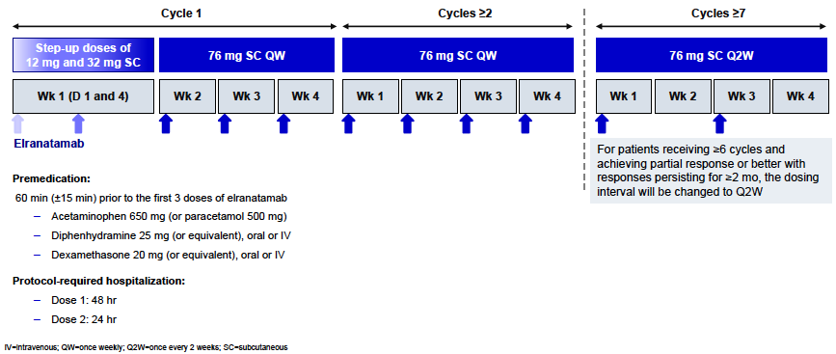
MagnetisMM-3 COHORT A: longer follow up and biweekly dosing schedule
Mohty M, et al. EHA 2023.

Slide 69
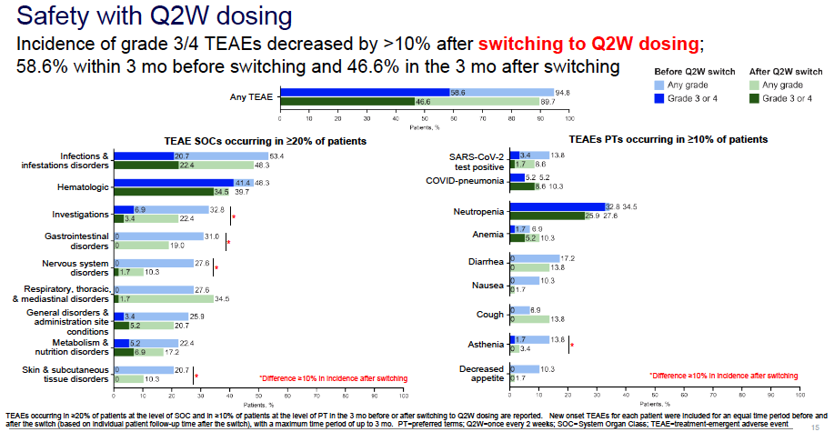
MagnetisMM-3 COHORT A: longer follow up and biweekly dosing schedule
Mohty M, et al. EHA 2023.

Slide 70
Summary efficacy of BCMA-targeted agents
 | Idecabtagene Vicleucel |  | Ciltacabtagene Autoleucel |  | Teclistamab | Elranatamab
Parameter | KarMMa (N = 128) | KarMMa-3 (N = 254) | CARTITUDE-1 (N = 97) | CARTITUDE-4 (N = 208) | MajesTEC-1 (N = 165) | MagnetisMM-3 (N = 123)
Trial phase | II | III | Ib/II | III | I/II | II
ORR, % | 73 | 71 | 98 | 85 | 63 | 61
Median PFS, mo | 8.8 | 13.3 | 35 | NR | 11 | NR
Median OS, mo | 24.8 | NR | NR | NR | 22 | NR
CRS, any (grade ≥3), % | 84 (5) | 88 (4) | 95 (5) | 76 (1) | 72 (<1) | 57.7 (0)
NT, any (grade ≥3), % | 18 (3) | 15 (3) | 22 (9) | 21 (3) | 15 (<1) | 3.4 (0)
Infection, any (grade ≥3), % | -- | 58 (28) | -- | 62 (27) | 80 (55) | 69.9 (39.8)
Mailankody. NEJM. 2022;387:558. Rodriguez-Otero. NEJM. 2023;388:1002. Martin. JCO. 2023;41:1265. Lin. ASCO 2023. Abstr 8009.
Dhakal. ASCO 2023. Abstr LBA106. San-Miguel. NEJM. 2023;[Epub]. Moreau. NEJM. 2022;387:495. van de Donk. ASCO 2023. Abstr 8011. Lesokhin. Nat Med. 2023 [Epub]

Slide 71
Monumental-1: phase i/ii talquetamab study
Targeting GPRC5D
Multicenter, open-label phase I/II trial
Primary endpoint (phase II): ORR
Secondary endpoints (phase II): DoR, ≥ VGPR rate, ≥ CR, sCR rate, TTR, PFS, OS, MRD, safety
Talquetamab 0.4 mg/kg SC QW*
(n = 143)
Adults with measurable MM
Phase I: progression on or intolerance to all established therapies; ECOG PS 0-1
Phase II: ≥3 prior lines of therapy that included a PI, an IMiD, and an anti-CD38 antibody; ECOG PS 0–2
Talquetamab 0.8 mg/kg SC Q2W*
(n = 145)
Prior T-Cell Redirection Group: Talquetamab
Either 0.4 mg/kg SC QW or 0.8 mg/kg SC Q2W
(n = 51)
*Previous anti-BCMA therapy allowed; T-cell redirection therapy naive.
Chari. ASH 2022. Abstr 157. NCT03399799. NCT04634552.

Slide 72
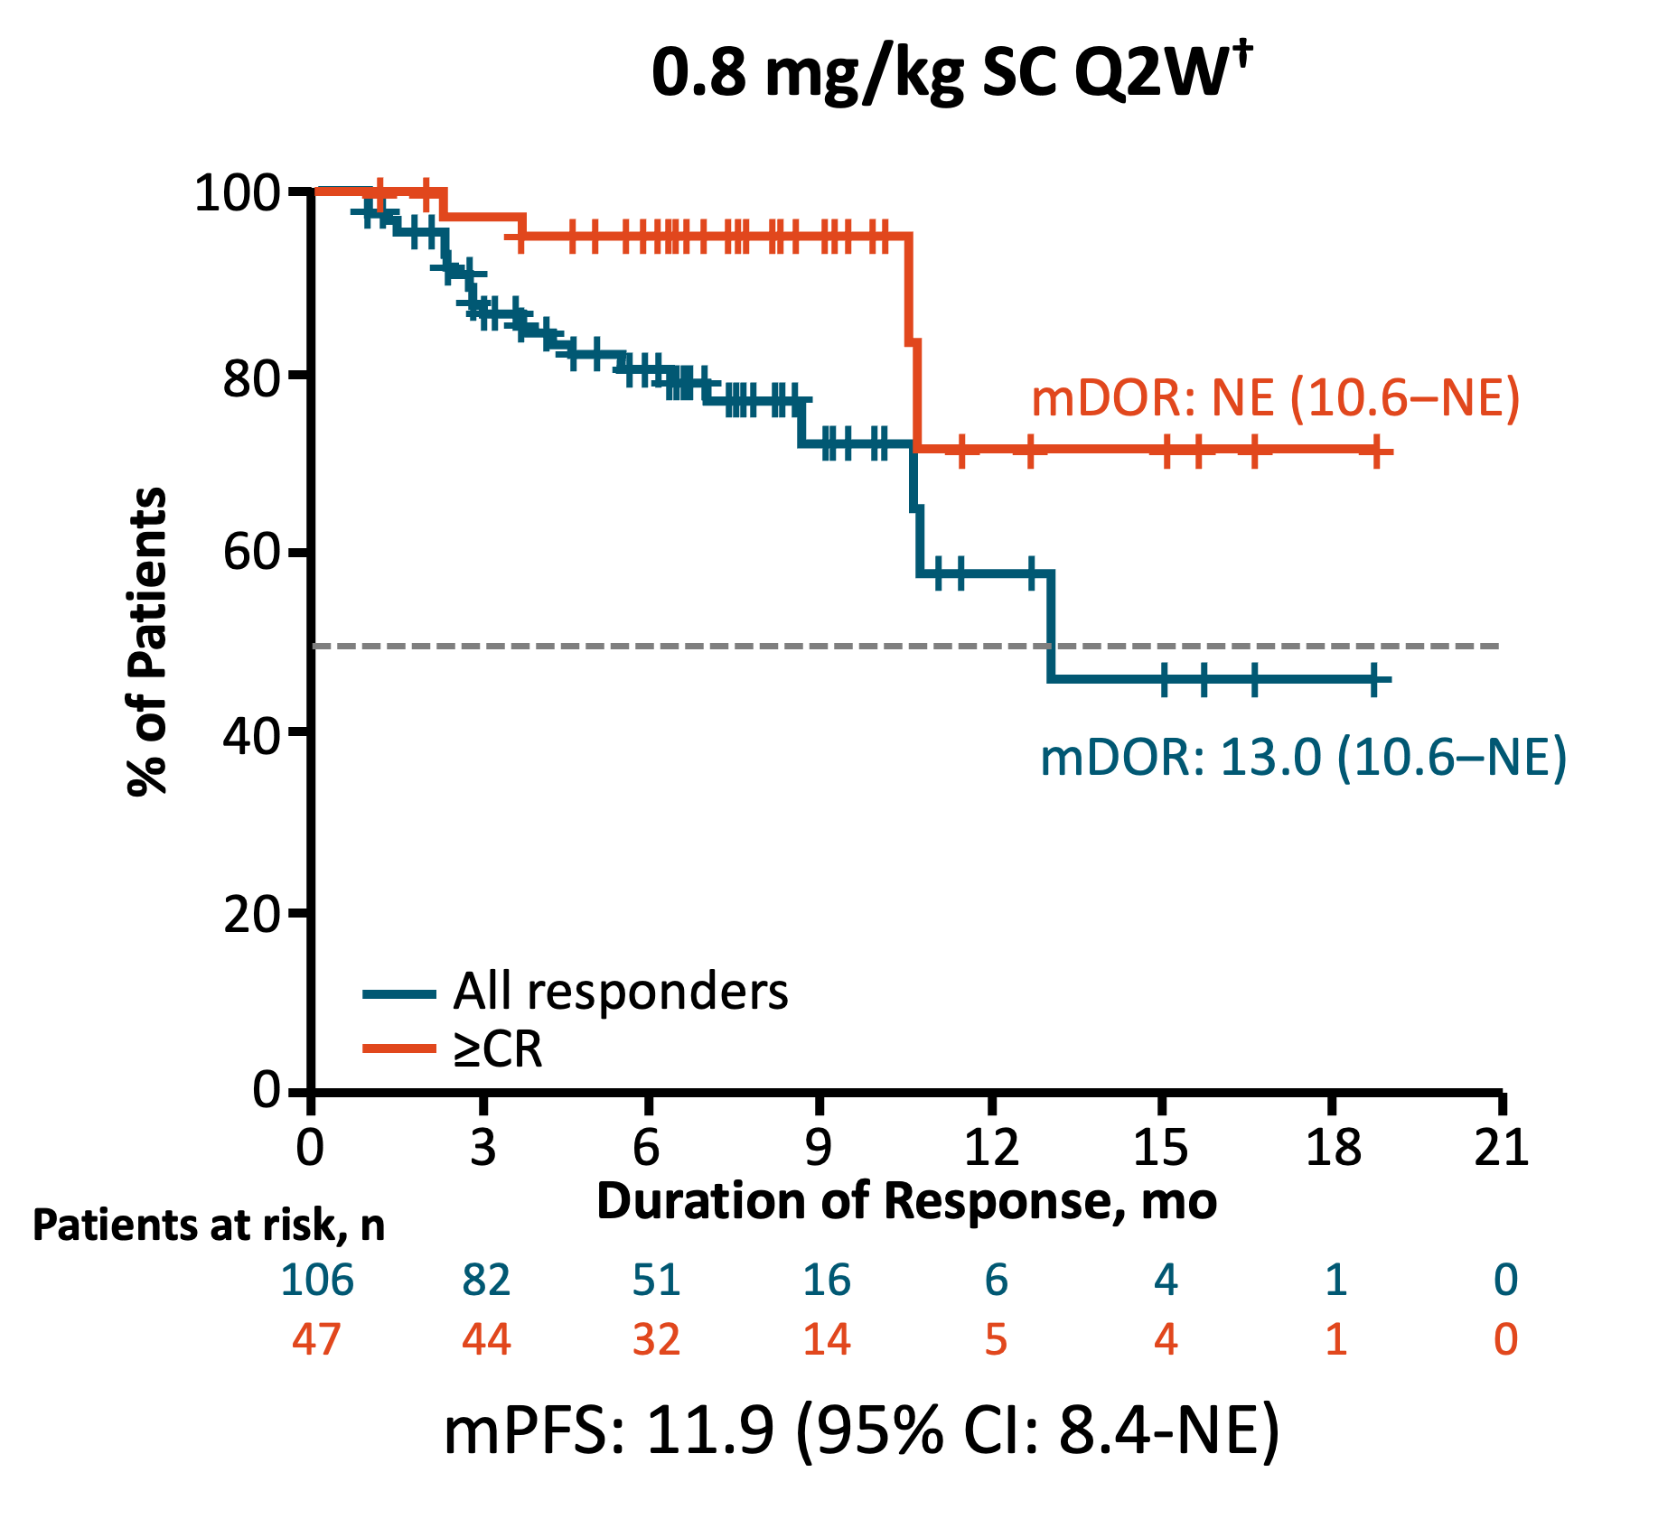
Monumental-1: efficacy
Timing | 0.4 mg/kg SC QW (n = 143) | 0.8 mg/kg SC Q2W (n = 145)
Median follow-up for efficacy, mo (range) | 14.9 (0.5-29.0) | 8.6 (0.2-22.5)
Median time to first response, mo (range) (n = 106 in each group) | 1.2 (0.2-10.9) | 1.3 (0.2-9.2)
Median time to best response, mo (range) (n = 106 in each group) | 2.2 (0.8-12.7) | 2.7 (0.3-12.5)
ORR
PR
VGPR
CR
sCR
100
80
60
40
20
0
Chari A, et al. N Engl J Med 2022;387:232-2244.

Slide 73
Monumental-1: ORR in patients with prior t-cell redirection
ORR
100
PR
VGPR
CR
sCR
Characteristic | Patients (n = 51)
Median prior lines of therapy, n (range) | 6 (3-15)
Exposure status, n (%) CAR T-cell Bispecific antibody | 36 (70.6)* 18 (35.3)*
Refractory status, n (%) Belantamab | 4 (7.8)
Talquetamab dosing schedule, n QW Q2W | 43 8
Median DoR, mo (range) | 12.7 (3.7-NE)
ORR by prior therapy, % (95% CI) CAR T-cell Bispecific antibody | 72.2 (54.8-85.8) 44.4 (21.5-69.2)
80
62.7% (32/51)
60
Patients (%)
17.6%
40
5.9%
≥VGPR:
52.9%
29.4%
20
9.8%
0
Prior T-cell Redirection
*3 patients received both CAR T-cell and bispecific antibody therapy.
Median follow-up (range): 11.8 mo (1.0-25.4).
Patients in cohort with prior T-cell redirection therapy were younger and had increased prevalence of high-risk cytogenetics
Safety profile comparable to overall population
Chari A, et al. N Engl J Med 2022;387:232-2244.

Slide 74

Can we do Double Take on the same target?
Notes:
Can we use the same CAR-T, or a different CAR-T at the same Target? Or a different target and a different CAR-T ….sequencing.

Slide 75
Can we sequence bcma-directed therapies?
CARTITUDE-2 cohort C: Cilta-cel after PI, IMiD, CD38 mAb, BCMA-targeted tx
Ide-cel retrospective study: 75% of patients
met KarMMa exclusion criteria
100
ORR: 87%
ORR: 73%
ORR
61.5%
75
ORR
60%
CR or sCR: 44%
CR or sCR, MRD-
CR or sCR, MRD+
CR or sCR, MRD unknown
VGPR
PR
ORR
57.1%
CR or sCR: 33%
Percent
50
25
0
Any Prior
BCMA-Targeted Therapy
No
Yes
mDoR, mo: 11.5
11.5
8.2
(n = 126)
(n = 33)
Best ORR (n=159)
Cohen. Blood. 2023;141:219. Hansen. JCO. 2023;41:2087.

Slide 76
Can we sequence bcma-directed therapies?
Ide-Cel in Pts with RRMM who have had prior anti-BCMA directed therapy:
    Kaplan-Meier Curves of PFS by Type of Prior BCMA-TT
Median PFS
No prior BCMA-TT 9.03 months
Prior Bispecific 2.83 months
Prior ADC 3.19 months
Prior CAR-T NR
Log-rank p=0.0004
Analysis time
PFS, progression-free survival; BCMA-TT, B-cell maturation antigen targeted therapy; ADC, antibody-drug conjugate; CAR T, chimeric antigen receptor T-cell therapy; NR, not reached
Ferreri CJ, et al. Blood 2022; 140 (Suppl 1): 1856-1858.

Slide 77
Bispecific Antibody Elranatamab After Previous BCMA Therapy
Pooled analysis of 4 MagnetisMM trials; median time to response 1.7 mo (range: 0.3-9.3)
Response | Any Prior BCMA Tx (n = 87) | Prior ADC (n = 59) | Prior CAR T-Cell (n = 36)
ORR, % | 46.0 | 42.4 | 52.8
Median DoR, mo (95% CI)* | 17.1 (9.8-NE) | 13.6 (6.8-NE) | NE (9.8-NE)
Median PFS, mo (95% CI) | 5.5 (2.2-10.0) | 3.9 (1.9-6.6) | 10.0 (1.9-NE)
Median OS, mo (95%CI) | 12.1 (7.5-NE) | 12.1 (6.4-NE) | 12.1 (6.5-NE)
TEAE in ≥20%, n (%)
 | Any grade | Grade 3/4
Hematologic Anemia Neutropenia Thrombocytopenia | 51 (58.6) 39 (44.8) 35 (40.2) | 40 (46.0) 36 (41.4) 25 (28.7)
Nonhematologic CRS | 57 (65.5) | 2 (2.3)
Infections, n (%) | N = 87
 | Any grade | Grade 3/4 | Grade 5
Infection TEAEs in ≥5% COVID-19 related Pneumonia URI Sinusitis UTI Rhinovirus infection Bronchitis | 22 (25.3) 15 (17.2) 12 (13.8) 9 (10.3) 8 (9.2) 7 (8.0) 6 (6.9) | 8 (9.2) 5 (5.7) 0 1 (1.1) 1 (1.1) 1 (1.1) 2 (2.3) | 5 (5.7) 0 0 0 0 0 0
Nooka. ASCO 2023. Abstr 8008.
Notes:
ADC, antibody-drug conjugate; mDoR, median duration of response; mOS, median overall survival; mPFS, median progression-free survival; NE, not evaluable; ORR, objective response rate.

Slide 78
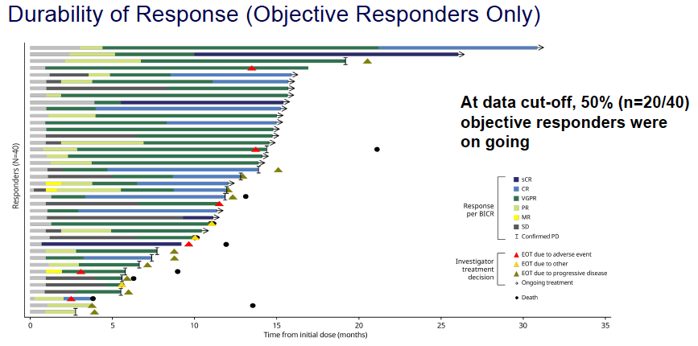
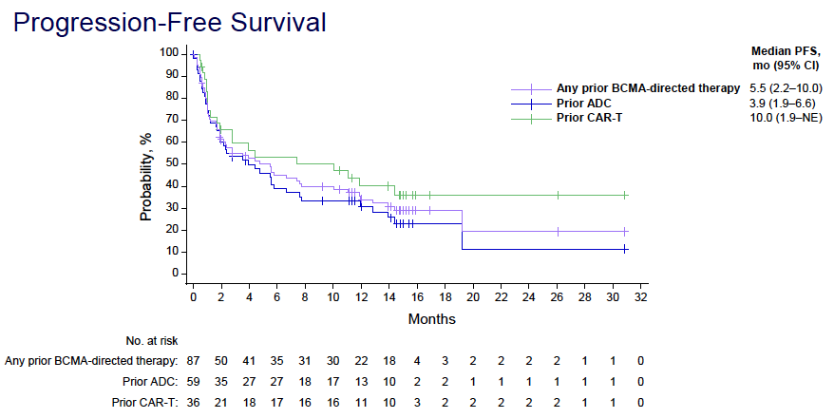
Bispecific Antibody Elranatamab After Previous BCMA Therapy
Pooled analysis of 4 MagnetisMM trials; median time to response 1.7 mo (range: 0.3-9.3)
Nooka. ASCO 2023. Abstr 8008.
Notes:
ADC, antibody-drug conjugate; mDoR, median duration of response; mOS, median overall survival; mPFS, median progression-free survival; NE, not evaluable; ORR, objective response rate.

Slide 79
Some practical differences
 | CAR T-Cell Therapies | Bispecific mAbs
Convenience factors | Specialized center Caregiver needed Prolonged manufacturing time | “Off the shelf”
Hospitalization | At most centers | For step-up doses
Length of treatment | 1-time administration | Ongoing weekly
Toxicities | CRS, neurotoxicity, cytopenias, infection | CRS, cytopenias, infection
REMS | Yes | Yes
Cost | >$400K | ~400K per yr Must consider length of treatment
Comorbidities/Renal Dysfunction | Lymphodepletion; challenging | Possible

Slide 80
Toxicities with bi-specifics
Acute Toxicities | Delayed Toxicities
Cytokine-release syndrome Immune effector cell–associated neurotoxicity syndrome Neurologic toxicity Infections Neutropenia Hypersensitivity or injection-site reactions | Hepatotoxicity Cytopenias Infections ? Neurologic toxicity
Generally managed by
treating center
Generally managed by
primary oncologists
(can be treating center or community)
Chakraborty. Transplant Cell Ther. 2021;27:222. Elranatamab PI. Martin. Cancer. 2023; 129: 2035. Teclistamab PI.

Slide 81
Risk Factors for Specific AEs Associated
With BCMA-Targeted Therapies
AEs | Patient Related | Disease Related | Treatment Related | Comments
CRS | Comorbidities, infections | Tumor burden | Higher dose of BCMA-targeted therapy | CRS occurs early after BsAb administration and usually within a few days after CAR T-cell infusion
ICANS | CRS, younger age, preexisting neurologic conditions | Tumor burden | Intensity of lymphodepletion therapy, CAR T-cell therapy | ICANS often preceded by CRS
Cytopenias + hypogamma-globulinemia | Reduced bone marrow function, older age, high baseline BMPC | Refractory, poorly controlled disease | Multiple previous therapy lines, intensity of lymphodepletion | Multifactorial: poor patient condition, tumor burden, pe-treatment lymphodepletion
Infections | Age, comorbidities, CRS, lymphopenia, neutropenia, previous frequent infections, hypogammaglobulinemia | Refractory, poorly controlled disease | High-dose and long-duration steroids, other immunosuppressive treatments | History of previous infections, biological age vs chronological age
Complete outstanding vaccinations at least 2 weeks prior to starting CAR T-cell or bispecific antibody therapy (e.g., influenza, pneumococcal, COVID-19)
Delay post-infusion vaccinations for at least 3-6 months (1 year for live)
Consider checking antibody titers
Ludwig. Lancet Oncol. 2023;24:e255.
Notes:
AE, adverse event; BsAb, bispecific antibody, CRS, cytokine-release syndrome; ICANS, immune effector cell–associated neurotoxicity syndrome.

Slide 82

Leap of Faith
Is there A cure in the wings?
Notes:
Is cure coming to us through CART?
So many new targets, technology improving significantly, and a wide variety of genetically modified immune cells getting added to the armamentarium.
ASCO talk highlighting that Axi-cel is a superior long-term benefit “curative” therapy to ASCT (~4 year follow up). Initial Zuma1 trial now has >5 year follow up as well showing long-term “curative” benefit.

Slide 83
Thank you

Slide 84
Future Directions in Multiple Myeloma
Ricardo D. Parrondo, MD
Assistant Professor of Medicine
Mayo Clinic Florida
Jacksonville, Florida

Slide 85
Objectives
Discuss Future Direction in Myeloma Treatment:
CAR-T for Earlier Lines of Therapy
Non-BCMA CAR-T Targets
Bispecific Antibody Combinations
Cereblon Modulators

Slide 86
CAR-T Updates
CD138
(syndecan-1)
CAR-T
NY-ESO-1
CD 38
CD19
CARTITUDE-4
KarMMA-3
MCARH109
Kappa light chain
BCMA
Myeloma cell
CD44 variant 6
Lewis Y
CD56
TACI
SLAMF7/CS1
CD229
GPRC5D
NKG2D ligands
CD70
Integrin B7
Redrawn from Somayeh Vandghanooni, Morteza Eskandani, Zohreh Sanaat, Yadollah Omidi, Recent advances in the production, reprogramming, and application of CAR-T cells for treating hematological malignancies, Life Sciences, 10.1016/j.lfs.2022.121016, 309, (121016), (2022). CC BY 4.0.

Slide 87
CARTITUDE 4 Trial: Cilta-cel or Standard Care in Lenalidomide-Refractory Multiple Myeloma
Randomized phase III trial of Cilta-Cel vs SOC (Dara-Pom-Dex [DPd]or Bort-Pom-Dex [PVd]) in 1:1 randomization, in patients who had received 1-3 prior lines of therapy and were refractory to lenalidomide, cross-over not permitted
Primary outcome was PFS
Both groups were balanced for ISS stage, cytogenetic features, race, ECOG and drug refractoriness
The median duration of progression-free survival was not reached in the cilta-cel group and was 11.8 months in the standard-care group (HR 0.26)
At 12 months in the intention-to-treat population, PFS was 75.9% in the cilta-cel group and 48.6% in the standard-care group
MRD negativity at any time during the trial occurred in 60.6% of the patients in the cilta-cel group and in 15.6% of those in the standard-care group (clonoSEQ 1.0 x 10⁻⁵)
Cranial nerve palsies, which most commonly affected cranial nerve VII, were reported in 16 patients (9.1%) (grade 1 or 2 in 14 and grade 3 in 2), and median onset was 21 days (range, 17 to 60) after infusion
San-Miguel J,et al. Cilta-cel or Standard Care in Lenalidomide-Refractory Multiple Myeloma. N Engl J Med. 2023 Jun 5

Slide 88
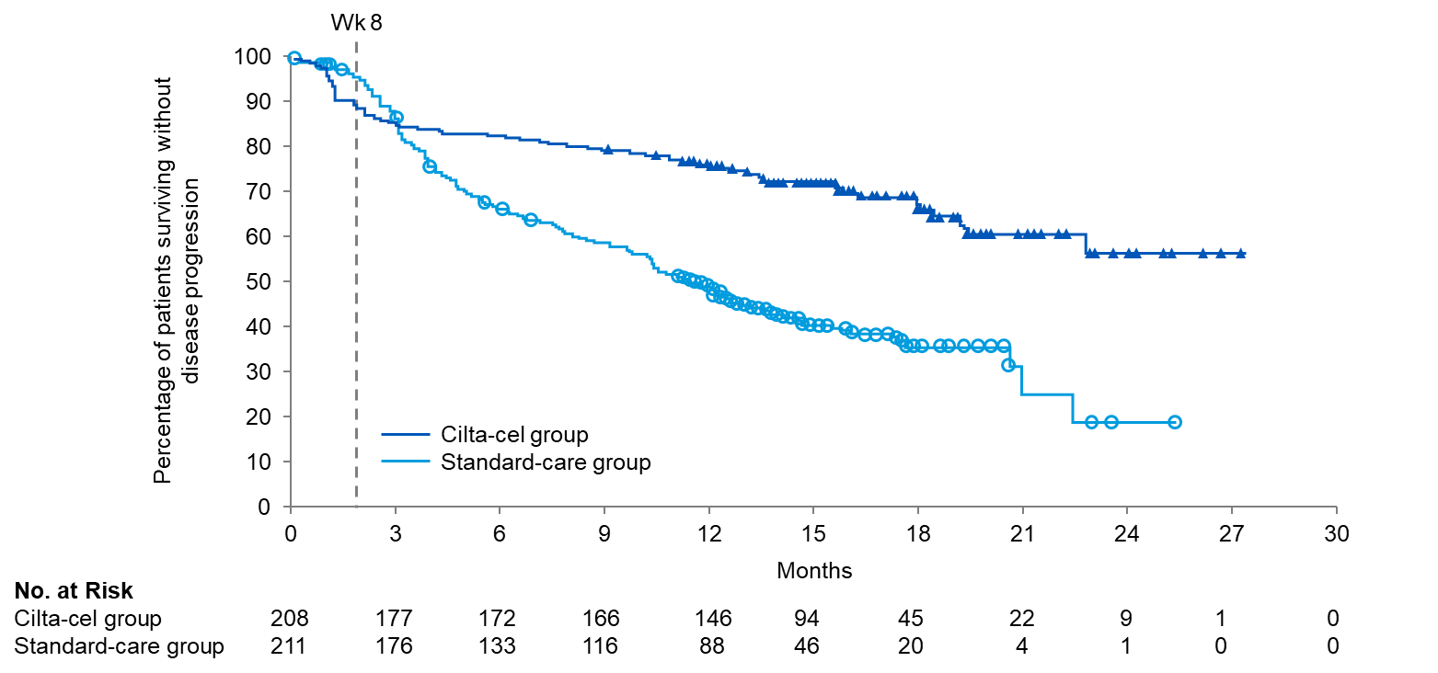
CARTITUDE 4 Trial: Cilta-cel or Standard Care in Lenalidomide-Refractory Multiple Myeloma
During the first 8 weeks after randomization, disease progression or death occurred in 22 patients in the cilta-cel group and in 8 patients in the standard-care group. All these events occurred before the infusion of cilta-cel while both groups received the same therapy.
During the bridging period, patients in the ciltacel group received doses of pomalidomide and bortezomib that were approximately 14% lower than those in the standard-care group, which could have affected the primary outcome
Redrawn from San-Miguel J,et al. Cilta-cel or Standard Care in Lenalidomide-Refractory Multiple Myeloma. N Engl J Med. 2023 Jun 5

Slide 89
KarMMa-3 Trial: Ide-cel or Standard Regimens in Relapsed and Refractory Multiple Myeloma
KarMMA-3 is a randomized phase III trial involving patients with relapsed and refractory MM who had received 2-4 prior regimens (including IMiDs, PI, and antiCD38 mAb) and who had disease refractory to the last regimen
Patients were randomly assigned patients in a 2:1 ratio to receive either ide-cel (dose range, 150×10⁶ to 450×10⁶ CAR-positive T cells) or one of five standard regimens (DPd, Kd, EPd, IRd, DVd)
The primary endpoint was PFS
Baseline characteristics were generally balanced in the two groups, median number of prior regimens was 3, 65% had triple-class refractory disease
In the intention-to-treat population, PFS was significantly longer in the ide-cel group than in the standard-regimen group (median, 13.3 months vs 4.4 months]; HR 0.49; the PFS benefit with ide-cel therapy was consistently observed across prespecified subgroups, including high-risk cytogenetic abnormalities, extramedullary disease, high tumor burden, or triple-class–refractory status
Ide-cel therapy resulted in a significantly higher percentage of patients with a response than standard regimens: 71% in the ide-cel group and 42% in the standard-regimen group had a partial response or better (odds ratio, 3.47)
Rodriguez-Otero P,et al. Ide-cel or Standard Regimens in Relapsed and Refractory Multiple Myeloma. N Engl J Med. 2023;388(11):1002-1014

Slide 90
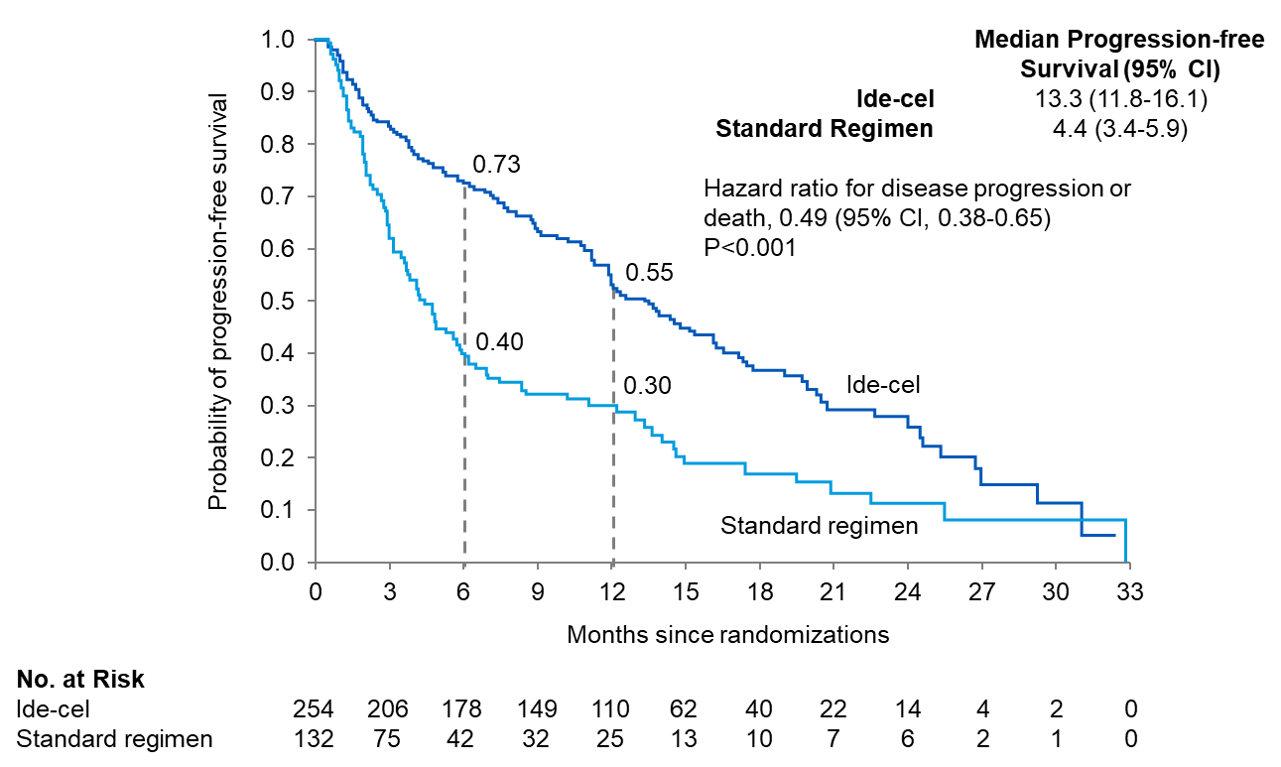
KarMMa-3 Trial: Ide-cel or Standard Regimens in Relapsed and Refractory Multiple Myeloma
Redrawn from Rodriguez-Otero P,et al. Ide-cel or Standard Regimens in Relapsed and Refractory Multiple Myeloma. N Engl J Med. 2023;388(11):1002-1014

Slide 91
MCARH109: GPRC5D-Targeted CAR T Cells for Myeloma
In this Phase I dose-escalation study, patients with relapsed MM (including patients with relapse after BCMA CAR T-cell therapy) received a GPRC5D-targeted CAR T-cell therapy (MCARH109) at four dose levels
The median age of the patients was 60 years (range, 38 to 76), and the median number of previous lines of therapy was 6 (range, 4 to 14). All the patients were penta-exposed. 13 patients (76%) had one or more high-risk cytogenetic features. 10 patients (59%) had received previous treatment with BCMA-targeted therapies, including 8 (47%) who received previous BCMA CAR T-cell therapy
Cytokine release syndrome was seen in 15 patients (88%) and was of grade 1 or 2 in all patients except for 1 patient who had received the highest dose level (450×106 CAR T cells) and had a grade 4 event. This same patient had grade 4 ICANS and grade 4 macrophage activation syndrome constituting a dose-limiting toxic effect and 2 patients had a grade 3 cerebellar disorder of unclear cause. No cerebellar disorder, ICANS of any grade, or cytokine release syndrome of grade 3 or higher occurred in the 12 patients who received doses of 25×10⁶ to 150×10⁶ cells
Mailankody S,et al. GPRC5D-Targeted CAR T Cells for Myeloma. N Engl J Med. 2022;387(13):1196-1206.

Slide 92
MCARH109: GPRC5D-Targeted CAR T Cells for Myeloma
Clinical Response in All Patients and in Patients with or without Previous BCMA-Directed Therapies
Response | All patients |  | Previous BCMA therapies |  | No previous BCMA therapies
 | All dose levels (N=17) | 25x10⁶-150x10⁶ CAR T cells (N=12) | All dose levels (N=10) | 25x10⁶-150x10⁶ CAR T cells (N=6) | All dose levels (N=7) | 25x10⁶-150x10⁶ CAR T cells (N=6)
 |  |  | Number (percent)
Partial response or better | 12 (71) | 7 (58) | 7 (70) | 3 (50) | 5 (71) | 4 (67)
Very good partial response or better | 10 (59) | 5 (42) | 6 (60) | 2 (33) | 4 (57) | 3 (50)
Complete response or better | 6 (35) | 3 (25) | 4 (40) | 2 (33) | 2 (29) | 1 (17)
Negativity for MRD in bone marrow* | 8 (47) | 6 (50) | 3 (30) | 2 (33) | 5 (71) | 4 (67)
*Negativity for minimal residual disease (MRD) in bone marrow was assessed by means of 10-color flow cytometry with a sensitivity of 1 in 10⁵ at 4 weeks after CAR T-cell therapy, at the occurrence of a complete response, and as clinically indicated.
Redrawn from Mailankody S,et al. GPRC5D-Targeted CAR T Cells for Myeloma. N Engl J Med. 2022;387(13):1196-1206.

Slide 93
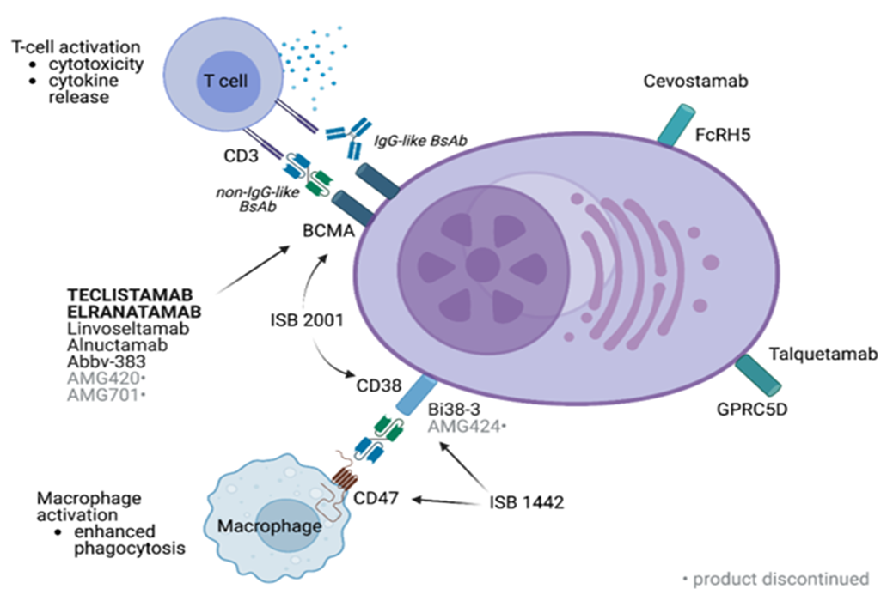
Bispecific Antibody Combinations
Talquetamab + Daratumumab (TRIMM-2 Study)
Teclistamab + Talquetamab (RedirecTT-1 Study)
Bispecific Antibodies with Other Anti-MM Agents
Image from Swan D, Murphy P, Glavey S, Quinn J. Bispecific Antibodies in Multiple Myeloma: Opportunities to Enhance Efficacy and Improve Safety. Cancers. 2023; 15(6):1819. https://doi.org/10.3390/cancers15061819. CC BY 4.0.

Slide 94
TRIMM-2: Talquetamab + Daratumumab
Pts received tal RP2Ds (400 or 800 ug/kg biweekly) with step-up dosing + dara 1800 mg per approved schedule
65 patients, median follow-up was 11.5 mo (range 1.0–27.3). Median age was 63 y (range 37–81); 18% of pts had high-risk cytogenetics; 25% had extramedullary plasmacytomas. Median prior LOT was 5 (range 2–16): 63% penta-drug exposed; 58% triple-class refractory
Prior treatments included anti-CD38 (88% [77% refractory]), anti-BCMA (54% [38%]), BsAb (25% [25%]), and anti-BCMA CAR-T (17% [2%]) therapy
Most common AEs were CRS (78%; all Gr 1/2), dysgeusia (75%), dry mouth (55%), anemia (52%), fatigue (45%), and skin exfoliation (45%). 63% of pts had infections (Gr 3/4 22%; Gr 5 3%). 38% of pts had neutropenia (Gr 3/4 26%). 85% had postbaseline IgG < 500 mg/dL. ICANS occurred in 3 pts (5%; all Gr 1/2 and resolved in 1–2 d)
ORR was 78% (66% ≥VGPR; 45% ≥CR) across RP2Ds (100% in anti-CD38 naïve pts), and responses deepened over time. In pts exposed/refractory to prior therapy, ORRs were 75%/76% for anti-CD38, 74%/64% for anti-BCMA, and 75%/75% for BsAb
mPFS was 19.4 mo; 12-mo PFS and OS rates were 76% and 93%, respectively

Slide 95
RedirecTT-1: Teclistamab (Tec) + Talquetamab (Tal)
63 pts received Tec + Tal. Median (range) age was 67 y (39–81); median (range) prior LOT was 5 (1–11); 33% (15/45) had high-risk cytogenetics; 78% (49/63) were triple-class refractory; 63% (40/63) were penta-drug exposed; and 43% (27/63) had extramedullary disease (EMD)
Median (range) duration of follow-up was 14.4 mos (0.5–21.9). The most common treatment-emergent AEs were CRS (81%; grade [gr] 3, 3%, no gr 4), neutropenia (76%; gr 3/4, 75%), and anemia (60%; gr 3/4, 43%). Dose-limiting toxicities (DLTs) were reported at dose level 1 (gr 3 herpetic stomatitis) and dose level 3 (gr 3 AST/ALT elevation). One ICANS event was reported at dose level 3. No DLTs were reported at the RP2R
Across all dose levels, overall response rate (ORR) was 84% (52/62) among all evaluable pts and 73% (19/26) among evaluable pts with EMD; rate of CR or better (≥CR) was 34% (21/62) and 31% (8/26), respectively. At the RP2R, ORR was 92% (12/13) among all evaluable pts and 83% (5/6) among evaluable pts with EMD; rate of ≥CR was 31% (4/13) and 33% (2/6), respectively

Slide 96
Bispecific Antibodies + IMiDs
Study | Bispecific Antibody | Target | IMiD-Based Combination Therapy
MajesTEC-2 NCT04722146 | Teclistamab | BCMA | Teclistamab/Daratumumab/Pomalidomide Teclistamab/Daratumumab/Bortezomib/Lenalidomide, Teclistamab/Daratumumab/Lenalidomide
MajesTEC-7 NCT05552222 | Teclistamab | BCMA | Teclistamab/Daratumumab/Lenalidomide vs. Daratumumab/Lenalidomide/Dexamethasone
MagnetisMM-4 NCT05090566 | Elranatamab | BCMA | Elranatamab/Lenalidomide/Dex
LINKER-MM2 NCT05137054 | Linvoseltamab | BCMA | Linvoseltamab + Lenalidomide Linvoseltamab + Pomalidomide
NCT04910568 | Cevostamab | FcRH5 | Cevostamab + Pomalidomide + Dexamethasone
NCT05050097 | Talquetamab | GPRC5D | Talquetamab+ Lenalidomide Talquetamab + Daratumumab + Lenalidomide Talquetamab + Pomalidomide
Swan D, Murphy P, Glavey S, Quinn J. Bispecific Antibodies in Multiple Myeloma: Opportunities to Enhance Efficacy and Improve Safety. Cancers. 2023; 15(6):1819. https://doi.org/10.3390/cancers15061819. CC BY 4.0.

Slide 97
BCMA Bispecific Antibody Combinations in NDMM
Study | Design | Treatment | Eligibility
MajesTEC-2 NCT04722146 | Multi-arm phase 1b study | Teclistamab with other MM therapies (daratumumab, pomalidomide, lenalidomide, bortezomib, nirogacestat, in various combinations, arms A-F) | Eligibility differs according to treatment arm
MajesTEC-4 NCT05243797 | Randomized, open-label, multicenter phase 3 study | Teclistamab + Lenalidomide vs. Lenalidomide maintenance post ASCT | NDMM patients who have undergone induction and ASCT
MajesTEC-7 NCT05552222 | Phase 3 randomized study | Teclistamab + Daratumumab + Lenalidomide vs. Daratumumab + Lenalidomide + Dexamethasone | NDMM patients either ineligible or not suitable for ASCT
MagnetisMM-6 NCT05623020 | Open-label, 2 arm, multicenter, randomized study | Elranatamab + Daratumumab + Lenalidomide vs. Daratumumab + Lenalidomide + Dexamethasone | NDMM ineligible for ASCT
MagnetisMM-7 NCT05317416 | Randomized, 2-arm, phase 3 study | Elranatamab vs. lenalidomide monotherapy | NDMM patients who are MRD positive post ASCT
Swan D, Murphy P, Glavey S, Quinn J. Bispecific Antibodies in Multiple Myeloma: Opportunities to Enhance Efficacy and Improve Safety. Cancers. 2023; 15(6):1819. https://doi.org/10.3390/cancers15061819. CC BY 4.0.

Slide 98
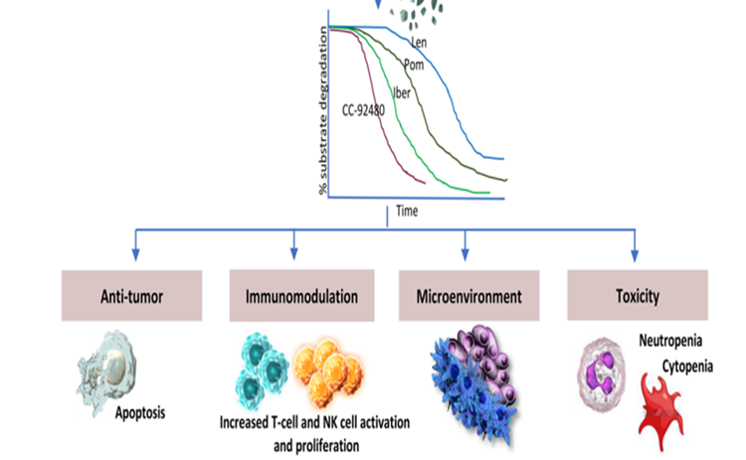
Cereblon E3 ligase Modulators
Iberdomide (20x more potent than pomalidomide)
Mezigdomide (more potent than iberdomide)
Have activity in patients resistant to lenalidomide and pomalidomide

Slide 99
Iberdomide and Mezigdomide
Iberdomide¹
Phase I/II: oral iberdomide in combination with dexamethasone for RRMM (phase 1; n=90, Phase 2; n=107)
In the dose-escalation cohort, the median number of previous lines of therapy was 5 and in the dose-expansion the median number of previous lines of therapy was 6, 97% triple-class refractory
Two dose-limiting toxicities (both infections, at 1.2 mg and 1.3 mg) were observed in the dose-escalation cohort, and 1.6 mg was selected as the RP2D (21d on, 7d off with weekly Dex)
In the dose-escalation cohort, the overall response rate was 32%
In the dose-expansion cohort, the overall response rate was 26%; median progression-free survival was 3.0 months, median overall survival was 10.7 months
The most common grade 3 or worse adverse events were neutropenia (48 [45%] of 107 patients), anemia (30 [28%]), infection (29 [27%]), and thrombocytopenia (23 [22%])
Mezigdomide²
Phase I/II: oral mezigdomide in combination with dexamethasone for RRMM (Phase 1; n=77, Phase 2; n-101)
DLTs were neutropenia and febrile neutropenia
RP2D was 1.0mg of mezigdomide (21d on, 7d off with weekly Dex)
All patients had triple-class–refractory multiple myeloma, 30 patients (30%) had received previous anti–B-cell maturation antigen (anti-BCMA) therapy
The most common adverse events: included neutropenia (in 77% of the patients) and infection (in 65%; grade 3, 29%; grade 4, 6%)
ORR= 41%, the median duration of response was 7.6 months, and the median progression-free survival was 4.4 months with a median follow-up of 7.5 months

Slide 100
Thank you!
Questions?

Slide 101
Recent Advances in MDS
Talha Badar, MD
Hematologist/Oncologist
Mayo Clinic
Florida, USA

Slide 102
Presentation Outline
Background
Updates on risk stratification
Updates on classification
Novel drugs for MDS with anemia
Targeted therapy for MDS
Treatment combinations for HR-MDS

Slide 103
Background
MDS are a heterogeneous group of stem cell disorders that are characterized by:
- Ineffective hematopoiesis leading to lowering of blood counts.
- Presence of dysplastic changes in one or more cell lines.
- Risk of progression to AML.
Commonly seen in elderly patient population.

Slide 104
Risk Stratification in MDS
IPSS-R has been widely used and feasible.
Used in all the pivotal clinical trials.
Validated and GOLD standard for prognostication.
It does not incorporate somatic mutation, understage significant # of pts with diploid CG.
Greenberg et al. Blood 2012
Malcovati et al. Haematologica 2011
Ramos et al. Oncotarget 2016

Slide 105
Risk Stratification in MDS
More precise prognostication tool.
Precise prognostication of intermediate risk gp (>50% re-stratified).
Better use for sec. & t-MDS.
Validated and works for treated pts.
Expensive, not feasible in resource restricted setups.
Does not account for allelic burden, different somatic mutation variants that may have differential outcome.
Sauta et al. JCO 2022
Bernard et al. Nature 2022
Badar et al. BCJ 2023
Bernard et al. NEJM evidence 2022

Slide 106
Risk Stratification in MDS
While IPSS-M should be used for risk stratification which certainly helps in prognostication; there is room for improvement.
We must prove its feasibility, to improve its use globally.

Slide 107
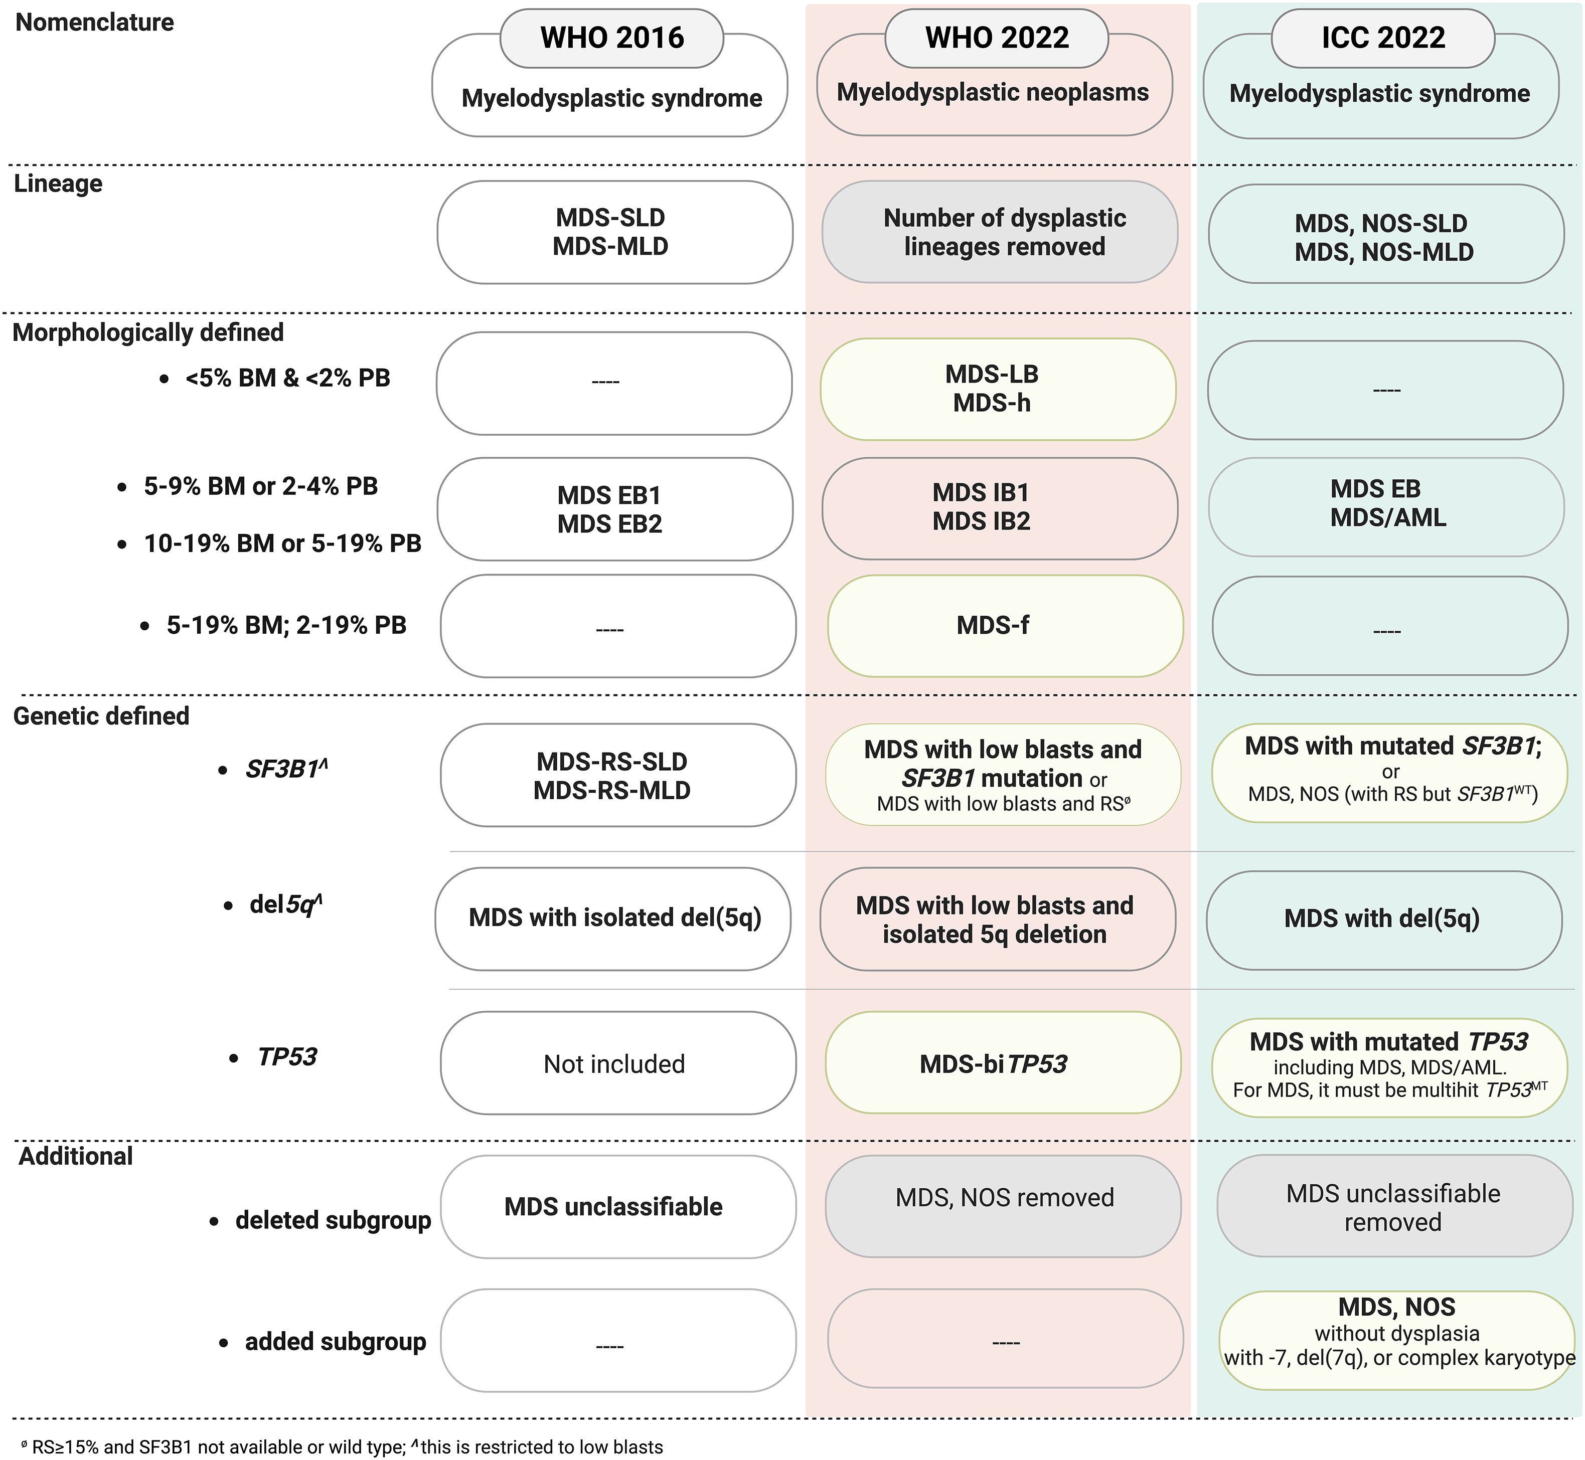
Revised classification of MDS
MDS/AML category will help in enrolling pts in AML clinical trials.
MDS-f sub-category tends to have poor outcome.
MDS-TP53m; distinct disease with poorer outcome
Stahl et al. Blood Reviews 2023

Slide 108
Novel drugs for MDS with anemia
Anemia is most common presenting symptoms in MDS.
Historically treated with ESA +/- G-CSF with modest responses.
After ESA; options are immunomodulatory agents, HMA or investigational agents.

Slide 109
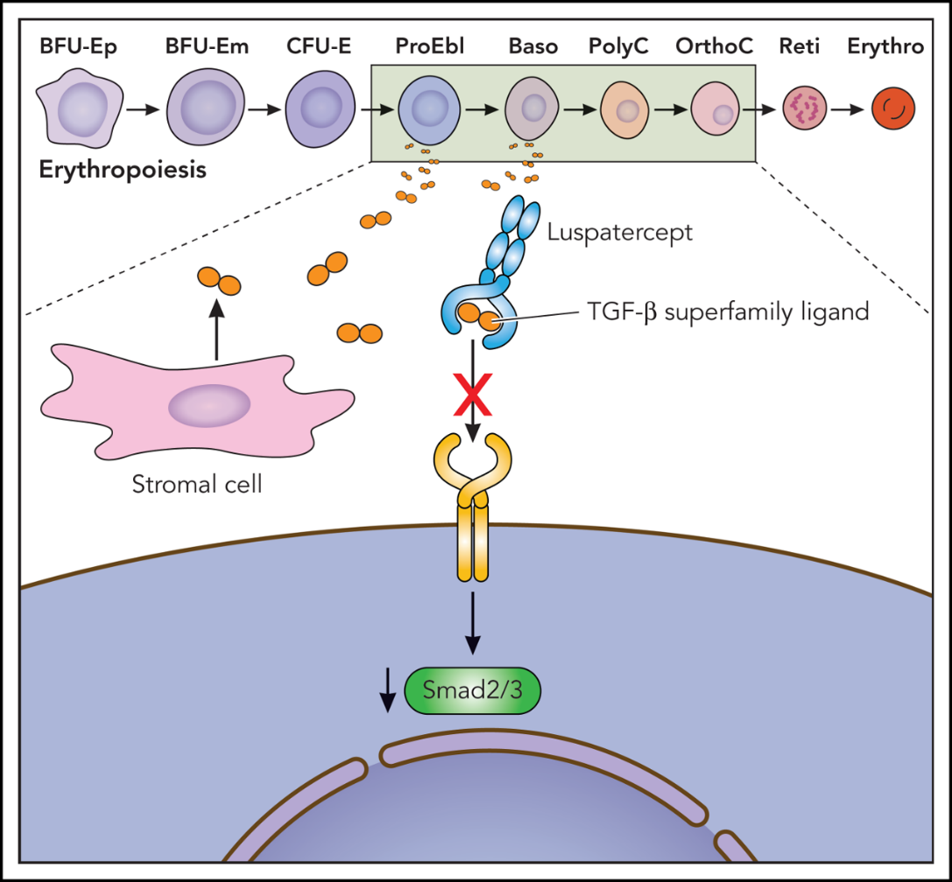
MEDALIST trial; luspatercept for LR-MDS
Luspatercept, TGF-B fusion trap protein, neutralizes TGF-B and restore effective erythropoiesis.
MEDALIST, PIII trial in pts with MDS-RS (IPSS-R; v. low → Int. risk), TD or ref. to ESA, randomized 2:1.
229 pts: luspatercept (153), placebo (76).
PE: TI for ≥ 8 wks (b/w wk 1-24)
Fenaux et al. NEJM 2020
Kubasch et al. Blood Adv 2021

Slide 110
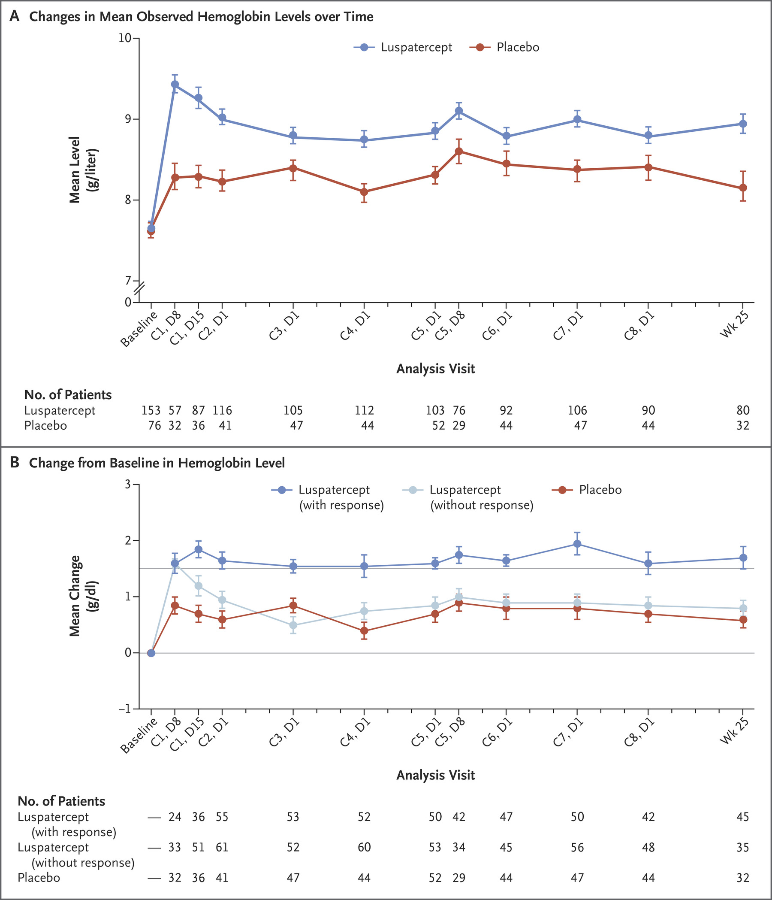
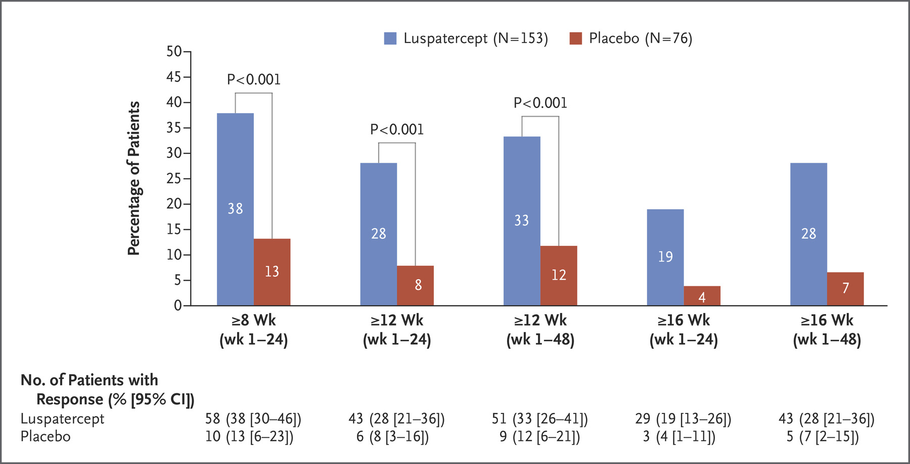
MEDALIST trial; luspatercept for LR-MDS
Initial FDA label: MDS-RS or MDS/MPN-RS-T (IPSS-R; v.low → Int risk), failing ESA, TD (at least 2; within 8 wks)

Slide 111
COMMANDS trial: luspatercept vs ESA in LR-MDS
Unlike MEDALIST trial, these pts are TN, (IPSS-R; v. low → Int. risk), TD. Not restricted to MDS-RS only.
PE: TI for at least 12 wks with a concurrent mean Hb ↑ of at least 1·5 g/dL (wks 1–24).
356 pts randomized: 178 (luspatercept), 178 (ESA).
Platzbecker et al. Lancet 2023

Slide 112
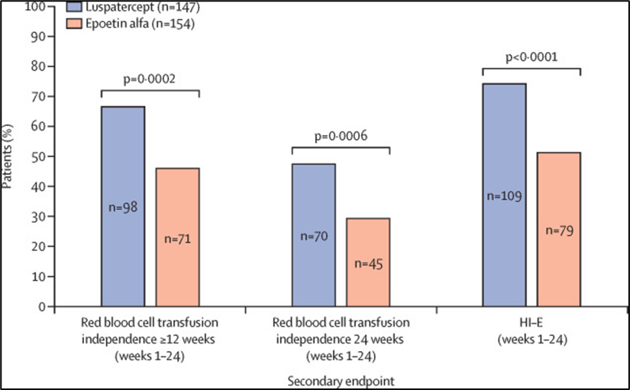
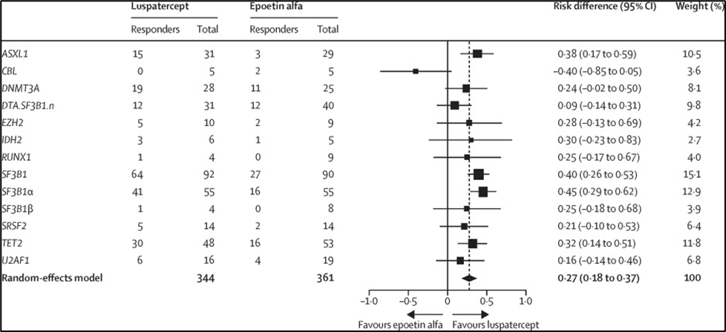
COMMANDS trial: luspatercept vs ESA in LR-MDS
SF3B1 with DNMT3A/AXSL1/TET2 ++
SF3B1 with BCOR/NRAS/SRSF2/STAG2 --
Rx was well tolerated, common AE’s were fatigue, asthenia, diarrhea and nausea. G3-4 AE 1%.
Platzbecker et al. Lancet 2023

Slide 113
IMerge trial
IMerge is a phase 3 trial of imetelstat vs placebo in TD, non-del 5q in LR-MDS with relapse/refractory/ineligible for ESA (Len/HMA naïve).
Randomized 2:1
PE; 8 weeks TI.
SE; 24-wk TI rate, TI duration and HI-E rate.
Platzbecker et al. Hemashpere 2023, 7 (Suppl): e0568592

Slide 114
PE was met:
- 47 (39.8%) vs 9 (15.0%) pts achieved 8-wk TI, P < 0.001, favoring imetelstat.
SE were also met:
-TI duration (95% CI) was 51.6 (26.9–83.9) vs 13.3 (8.0–24.9), P < 0.001, favoring imetelstat.
-24 wk TI was achieved in 33 pts (28.0%) vs 2 pts (3.3%).
- HI-E rates were 42.4% with imetelstat vs 13.3% with placebo, P < 0.001.
VAF ↓in 3 genes: SF3B1 (P < 0.001), TET2 (P = 0.032), DNMT3A (P = 0.019) and ASXL1 (P = NS); favoring imetelstat.
Platzbecker et al. Hemashpere 2023, 7 (Suppl): e0568592

Slide 115
MDS with IDH1 mutation
IDH1m present in 3% of pts with MDS.
Retrospective analysis suggests, MDS pts with neutropenia, regardless of IPSS-R, more enriched with IDH1/2m.
Komrokji et al. Haematologica 2023

Slide 116
Ivosidenib for MDS with IDH1 mutation
First in human, phase I dose escalation study, 16 pts were treated at 500 mg OD: CR 44%, 60% maintained response at 1 yr.
Idiome phase II study, evaluated IDHi in MDS failing HMA or HR-MDS; 32 pts treated, ORR was 69%, CR 46%. DOR 7.4 mo, OS 14 mo (91% response rate in treatment naive HR-MDS).
Sallman et al. ASCO Abstract 2022
Sebert et al. ASH Abstract 2021

Slide 117
Olutasidenib for MDS with IDH1 mutation
20 pts with MDS treated with Olutasidenib, 6 alone and 14 with AZA.
Clinical responses were seen in 33% with alone and 73% with combo.
Cortes et al. ASH Abstract 2019

Slide 118
Ivosidenib approval: MDS with IDH1 mutation
After FDA breakthrough designation, enrollment was expanded: 19 pts were Rx (78.9% with HMA failure).
15/18 had ORR,CR 39%.
mDOR not reached at data cut off. Median time to response 1.9 mo.
mOS 35.7 mo.
Dinardo et al. SOHO Abstract 2023

Slide 119
Ivosidenib approval: MDS with IDH1 mutation
Albeit study with small sample size and IDH1m occurrence in only 3-4% of MDS.
Seems to be effective target, highly encouraging responses post HMA failure.
ORR up-to 90% in treatment naive MDS.

Slide 120
HMA plus venetoclax
VEN combinations, has been a paradigm shift in management of AML.
Phase Ib study in HR-MDS (107 pts): ORR 86% (CR 30%, mCR 50.5%), DOR 16.6 mo, mOS 26 mo.
Phase III VERONA trial has completed accrual; results awaited.
Garcia et al. ASH abstract 2023

Slide 121
Magrolimab for HR-MDS
Magro is a mAb, that blocks cluster of differentiation CD47, a don't-eat-me signal overexpressed on cancer cells.
Magro has shown synergistic activity in AZA.
In TN Int/High/ v.High, risk MDS, magro +AZA was evaluated.
95 pts (26% TP53m): ORR 75%, CR 33% (CR 40% TP53m)
Sallman et al. JCO 2023

Slide 122
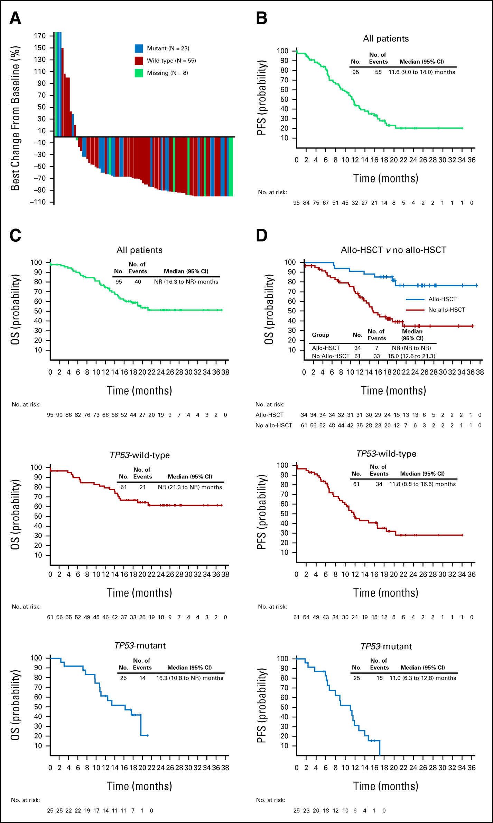
Magrolimab for HR-MDS
Duration of CR: 11.1 mo.
Duration of ORR: 9.8 mo (TP53m 9.2 mo)
OS: NR with 17.1 mo fu (TP53m 16.3 mo)

Slide 123
Magrolimab for HR-MDS
ENHANCE phase III study, initiated to evaluate magro + AZA vs AZA alone in HR-MDS (PE: CR and OS)
Unfortunately, it was discontinued due to futility based on a planned analysis.
Gilead press release 7/21/23

Slide 124
Summary
We have seen improvement in risk stratification with incorporation of molecular data.
Newer classification of MDS/AML will help in enrolling pts in clinical trial with high-risk disease.
Finally, we have seen 2 positive PIII clinical trials in MDS.
Approval of molecular targeted therapy for MDS, will open door for evaluation of other targeted therapies.

Slide 125
Thank you!
Email: badar.talha@mayo.edu
X (twitter) @TalhaBadarMD

Slide 126
Question-and-Answer

Slide 127
Concluding Remarks
Thank you for attending!

Slide 128
Thank You to Our Supporters:

