Slide 1









MYELOFIBROSIS/HEMATOLOGY
Wednesday, September 20, 2023

Slide 2
Welcome
Morgan Burum
Director of Sales, OncLive
MJH Life Sciences™

Slide 3



Thank You to Our Supporters:

Slide 4
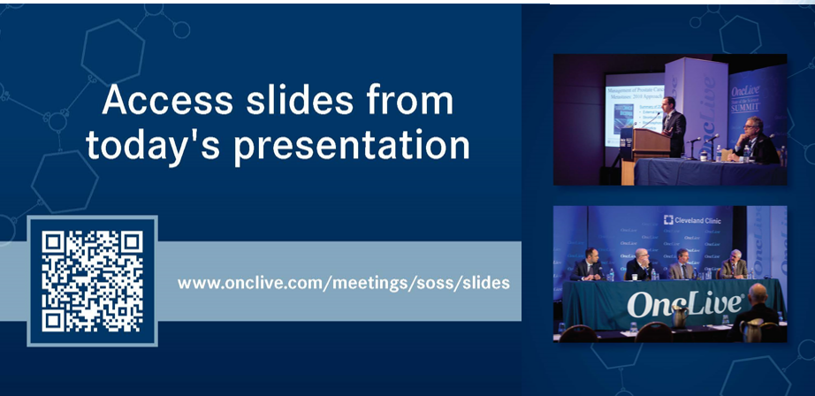

Slide 5


Slide 6


Slide 7
2023 Events
Precision Medicine: November 16,
Washington, DC
Breast: December 4, San Antonio, TX
2024 Events
Genitourinary: January 24, San Francisco, CA
Lung: March, Atlanta, GA
Gyn-Onc: May, Austin, TX
Lung: June, Chicago, IL
Gastrointestinal: November, Washington, DC
Breast: December, San Antonio, TX

Slide 8


Slide 9
Program Chair
Ehab Atallah, MD
Professor of Medicine
Section Head of Hematological Malignancies
Froedtert Hospital and The Medical College of Wisconsin Cancer Network
Milwaukee, WI

Slide 10
2023 Update:
Primary Myelofibrosis

Slide 11
Topics To Cover
Background of Disease; Unmet Needs
JAK-STAT pathway inhibitors
  Update on Momelotinib approval
  Role of JAKinhibitors in Anemia
Additional Options to Treat Anemia
  Luspatercept
  BET-inhibitors
Future directions

Slide 12

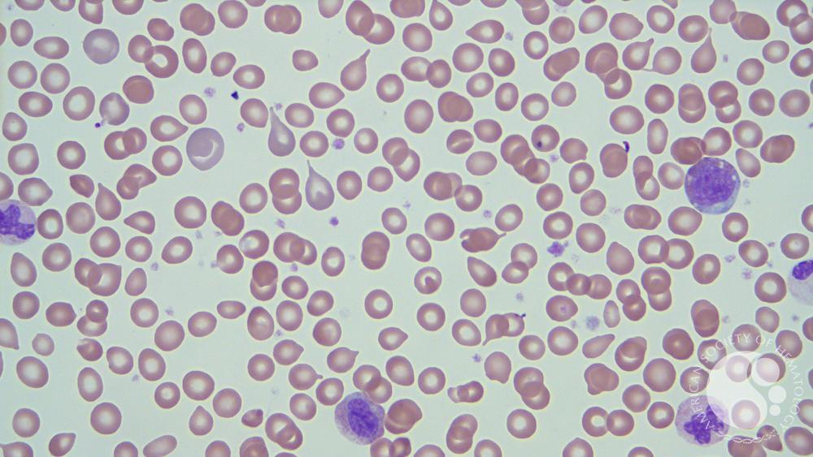
Myelofibrosis
Copyright © 2023 American Society of Hematology. Copyright restrictions may apply.
Notes:
teardrop poikilocytes, myelocytes and thrombocytosis.
Poikilocytosis refers to an increase in abnormal red blood cells of any shape that makes up 10% or more of the total population. Poikilocytes can be flat, elongated, teardrop-shaped, crescent-shaped, sickle-shaped, or can have pointy or thorn-like projections, or may have other abnormal features

Slide 13
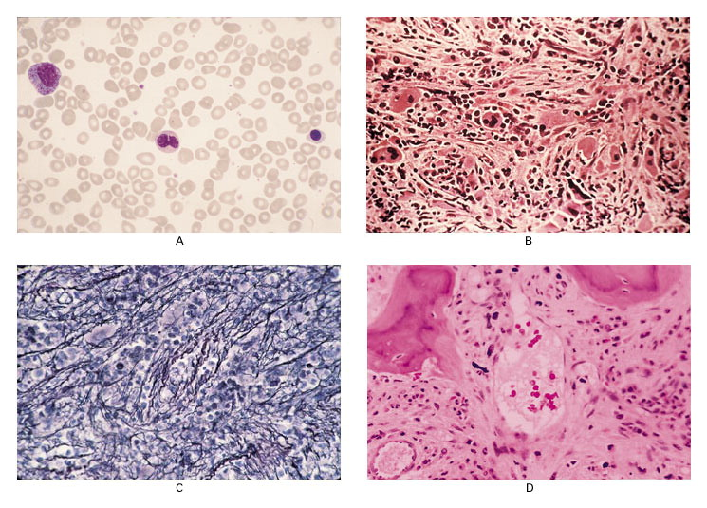
Epidemiology
Rare Disease
Annual Incidence: 0.46/100,000
Prevalence: 1.76-4.05/100,000 for PMF
Prevalence:
93/100,000 for all MPNs combined
State of Wisconsin: 5.7 million people -- approximately 171 currently with primary myelofibrosis
Tefferi A. N Engl J Med 2000;342:1255-1265; Am J Hematol. 2014; 89(6): 581-7
Notes:
Pathological Features of Peripheral Blood and Bone Marrow in Patients with Myelofibrosis with Myeloid Metaplasia. Panel A shows myelophthisis of the blood. Immature granulocyte precursors, a nucleated red cell, and teardrop-shaped red cells are visible (Wright–Giemsa, ×200). Biopsy specimens of the bone marrow core show stromal stranding and atypical megakaryocytes (Panel B; hematoxylin and eosin, ×128), collagen fibrosis on silver-impregnation staining of reticulin (Panel C, ×128), and thickening of the bone trabeculae (osteosclerosis) and intramedullary sinusoidal hematopoiesis (Panel D; hematoxylin and eosin, ×128).

Slide 14
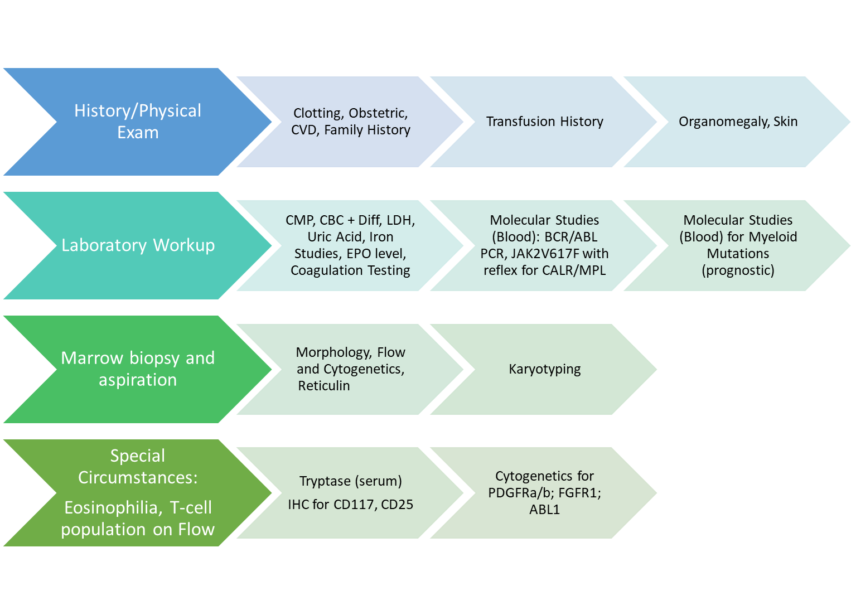
Initial approach

Slide 15
Clinical Heterogeneity
Myeloid dysplasia → blast accumulation
Extramedullary hematopoiesis
Progressive anemia secondary to ineffective hematopoiesis
Constitutional symptoms
Stem Cell Mutation(s)
Early Clonal Myeloproliferation
Dysplastic Megakaryocytes
Additional stem cell mutation(s)
Myeloproliferation
Reactive myelofibrosis
20% will transform to AML within 10 yrs

Slide 16
Myelofibrosis 2022
Risk Stratification/Goals of Care
Curative Therapy
Symptom Management/Palliative Therapy
Risk Stratification: DIPSS+; MIPSS70+ Ver 2.0
Risk Stratification for Prognostication: DIPSS+; MIPSS70+ Ver 2.0
Very High, High
Intermediate, Low, Very Low
Transplantation in Short Term
Transplantation Consultation, Discussion of Triggers for Transplant
Use Risk Stratification and Patient History, Symptoms to Determine Need for Treatment
Observation vs. Symptom Management/Disease Control
Splenomegaly/Symptoms
Clotting without Symptoms
Accelerated/Blast Phase Disease
Anemia or Evidence of Marrow Failure
Ruxolitinib or Hydrea or Fedratinib or Pacritinib
Hydrea or Interferon
(Ruxolitinib + HMA) or Clinical Trial (Check IDHmut)
Clinical Trial or Prednisone or EPO or Danazol

Slide 17
Currently Approved
Fedratinib (JAKARTA)
  JAK2, FLT3 inhibitor
  Approved by FDA in 2019
  Intermediate II or High-risk MF by IWG-MRT
  Approved for Plt>50K
  Benefits: Spleen reduction; Symptom Improvement
Ruxolitinib (COMFORT)
  Dual JAK1/JAK2 inhibitor
  Approved by FDA in 2011
  Intermediate II or High-risk MF by IPSS Score
  Minimal therapeutic dose generally accepted as 10mg BID
  Benefits: Spleen reduction; Symptom Improvement
  Survival Benefit in some patients
Pacritinib (PERSIST)
  JAK2, FLT-3, IRAK1 inhibitor
  Approved by FDA in 2022
  Intermediate I, II or High-risk MF by DIPSS
  Approved for Plt<50K
  Benefits: Spleen reduction
  Potentially beneficial in Anemia
Notes:
n the phase III COMFORT-I and COMFORT-II trials, pooled ruxolitinib discontinuation rates at 3 and 5 years were ~50% and ~70%, respectively [30, 31]. Suboptimal ruxolitinib dosing to avoid treatment-related adverse events (AEs), at least initially [33], appears to be relatively common

Slide 18
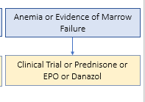
Anemia in Myelofibrosis
Occurs in 35-38% of patients
Less common in patients with PPV-MF or PET-MF
Pathophysiology: Fibrosis of the marrow, ineffective erythropoiesis; splenomegaly; increased production of hepcidin.

Slide 19
Anemia and JAK inhibitors
JAK-STAT pathway critical in erythropoietin-mediated signaling
Ruxolitinib & Fedratinib
  → Acquired anemia
  → Dosing limitation
Pacritinib
  PERSIST-2 vs. BAT
  More likely to achieve CI in hemoglobin levels
  Possibly related to IRAK1 inhibition, possibly due to ACVR1
  Subgroup analysis of PERSIST-2 study → Data presented at ASH 2022 by Dr. Stephen Oh’s lab
Stephen T Oh et al., Blood 2022; 140 (Supplement 1): 1518–1521.

Slide 20
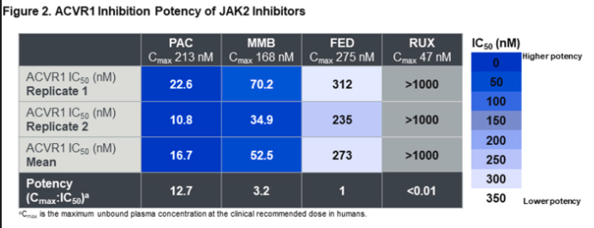
Stephen T Oh et al., Blood 2022; 140 (Supplement 1): 1518–1521.

Slide 21

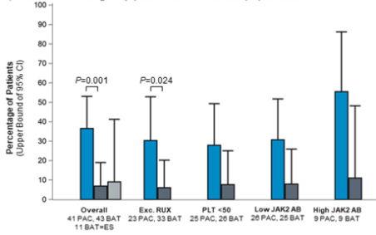

Slide 22
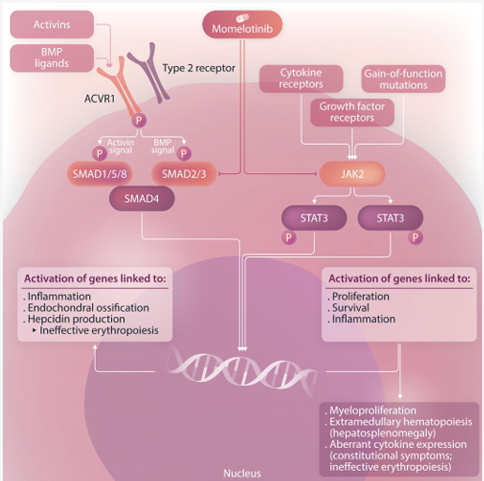
Newest Approval: September 15, 2023
Momelotinib (Ojjaara)
  Oral inhibitor of activin A receptor type 1 (ACVR1), JAK1 & JAK2; ALK2
  ACVR1 member of the TGFB receptor superfamily
Approval based on two studies
  Head to Head Study in MF – endpoint spleen response
  Randomized study in MF – endpoint transfusion dependence
Figure: Tefferi et al, Haematologica 2023
Notes:
Management of Myelofibrosis · SIMPLIFY-1 (ASH 22 abstr 337), MOMENTUM (ASH 22 abstr 627) · TRANSFORM, REFINE · ASCO 2023 Updates
Mutations of the ACVR1 receptor are linked to a rare condition called fibrodysplasia ossificans progressiva (FOP), a rare genetic disorder characterised by progressive heterotopic ossification.

Slide 23
Newest Approval: September 15, 2023
MOMENTUM Study
  Verstovsek et al., LANCET Jan 2023
WHO: Intermediate or High-risk MF with Anemia; Previously on JAKi ; symptomatic, cytopenic
Based on (1) Phase III Momentum Study (NCT04173494) and (2) Phase III Simplify Study (NCT01969838)
Design
  Randomization (2:1)
  Momelotinib (200 mg orally once per day) plus danazol placebo
  Vs.
  Danazol (300 mg orally twice per day) plus momelotinib placebo
Primary Endpoints
  Myelofibrosis Symptom Assessment Form (MFSAF) TSS response rate at week 24
Notes:
Management of Myelofibrosis · SIMPLIFY-1 (ASH 22 abstr 337), MOMENTUM (ASH 22 abstr 627) · TRANSFORM, REFINE · ASCO 2023 Updates

Slide 24
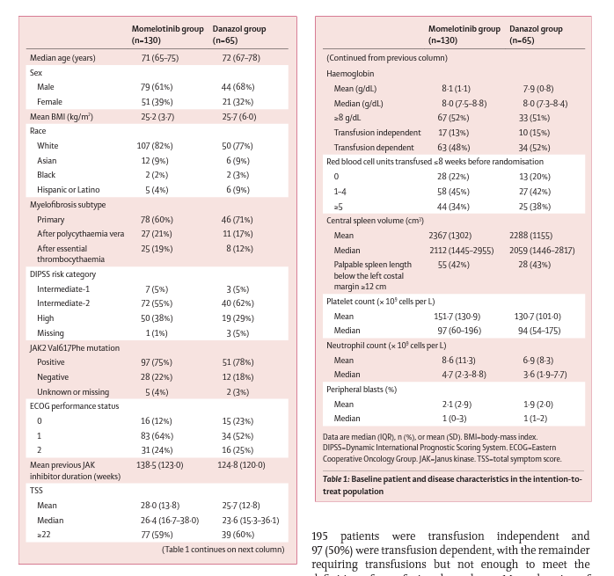
Verstovsek et al., LANCET Jan 2023

Slide 25
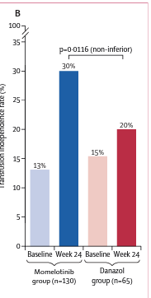
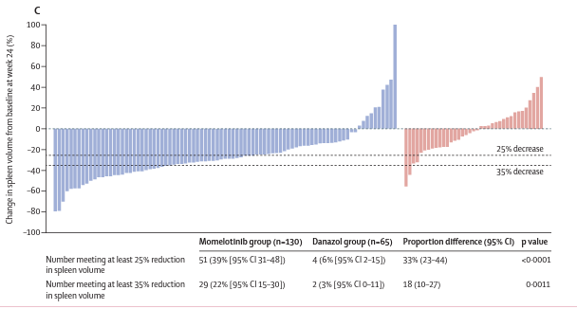
Verstovsek et al., LANCET Jan 2023

Slide 26
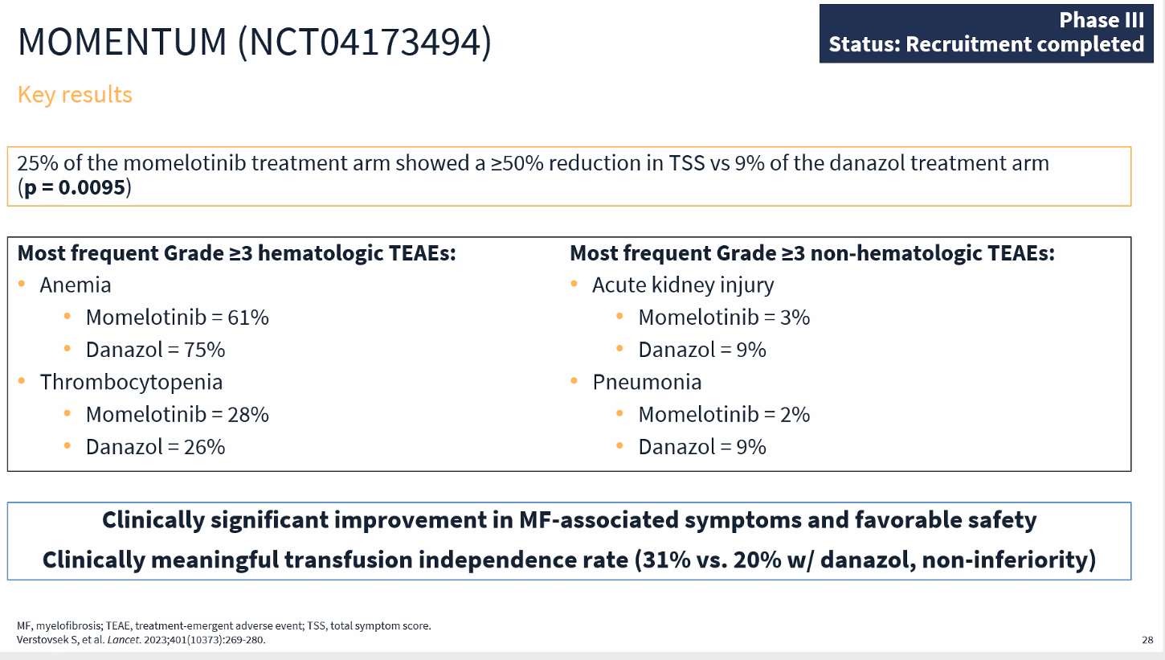
Slide Courtesy: MPN HUB https://mpn-hub.com
Notes:
The data shown are for events of the worst grade during the 24-week randomised treatment phase of the study, regardless of whether this grade was a change from baseline.

Slide 27
Phase III SIMPLIFY trials
SIMPLIFY 1 (Mesa, JCO 2017)
  N=432
  Head-to-head comparison
  Momelotinib vs. ruxolitinib
  JAK-I naïve; 24% were transfusion dependent
  Primary endpoint: non-inferiority in reducing spleen volume by 35% at week 24
Primary endpoint met
  Secondary endpoints: Symptom response, transfusion rates
Transfusion rates improved in Momelotinib arm
  Higher week 24 transfusion independence rate
  Increased hgn concentration
  Half the transfusion burden vs. ruxolitinib arm
Transfusion Independence is associated with improved OS
Mesa et al., JCO 2017c
Notes:
Baseline transfusion independence (TI) was associated with improved survival in both studies (SIMPLIFY-1 HR = 0.474, p = 0.0001; SIMPLIFY-2 HR = 0.226, p = 0.0005). Week 24 TI response in JAKi-naïve, momelotinib-randomized patients was associated with improved OS in univariate (HR = 0.323; p < 0.0001) and multivariate (HR = 0.311; p < 0.0001) analyses.

Slide 28
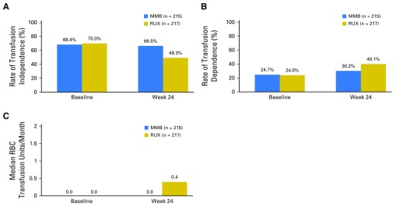
Mesa et al., JCO 2017c
Notes:
Comparison of momelotinib (MMB) and ruxolitinib (RUX) effects on transfusion requirements at week 24. (A) RBC transfusion independence rate (no RBC transfusion and no hemoglobin [Hb] < 8 g/dL in the prior 12 weeks; nominal P < .001). (B) RBC transfusion dependence rate (≥ 4 units of RBC transfusion or Hb < 8 g/dL in the prior 8 weeks; nominal P = .019). (C) Rate of RBC transfusions through week 24 (nominal P < .001).

Slide 29
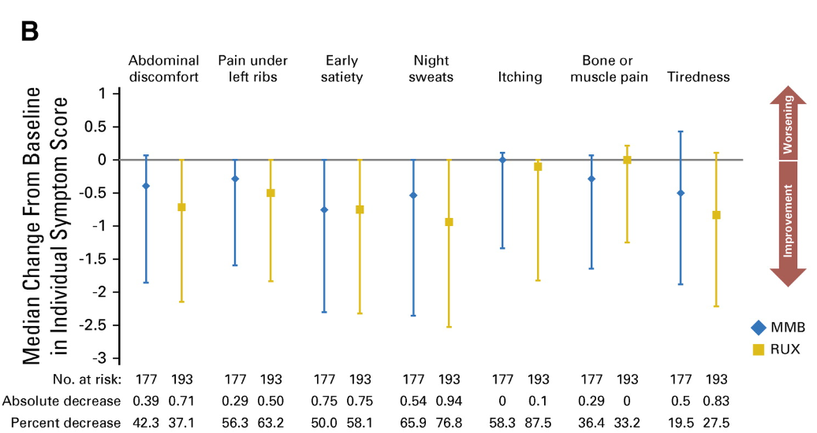
Mesa et al., JCO 2017c

Slide 30
How to deploy this new agent??
First line in patients with significant anemia
  SIMPLIFY 1 showed 24-weeks of momelotinib non-inferior to RUX for spleen response, not symptom response
  Reduced transfusion burden
Second line in patients with anemia

Slide 31
What about Luspatercept
Recombinant fusion protein
Decreases SMAD2 and SMAD3 signaling
Approved in MDS
ASCO update on data in Myelofibrosis: Aaron Gerds presented data from Phase II ACE-536-MF-001
Four Cohorts of patients: With and without Rux; Transfusion Dependent or Not
N=95 patients
Notes:
1.0 mg/kg (1.33 mg/kg for pts in cohort 3B expansion) with titration up to 1.75 mg/kg in 21-d cycles.

Slide 32
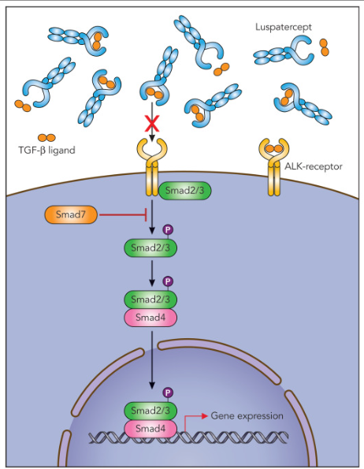
Kubasch et al, Blood Advances 2021
Notes:
In MDS, SMAD2/3 downstream mediators are constitutively activated and overexpressed in MDS CD34⁺ cells, which leads to impaired terminal erythroid differentiation and subsequent anemia as a result of an inhibitory effect on red-cell maturation.36, 37, 39 TGF-β, activins, GDF11, and GDF8 are SMAD2/3 pathway ligands that mediate inhibitory regulatory effects on multiple phases of erythropoiesis.37, 40 Interestingly, pharmacologic inhibition of TGF-β receptors as well as SMAD2/3 inhibition by short hairpin RNA was able to enhance hematopoiesis in a variety of MDS subtypes in vitro.

Slide 33
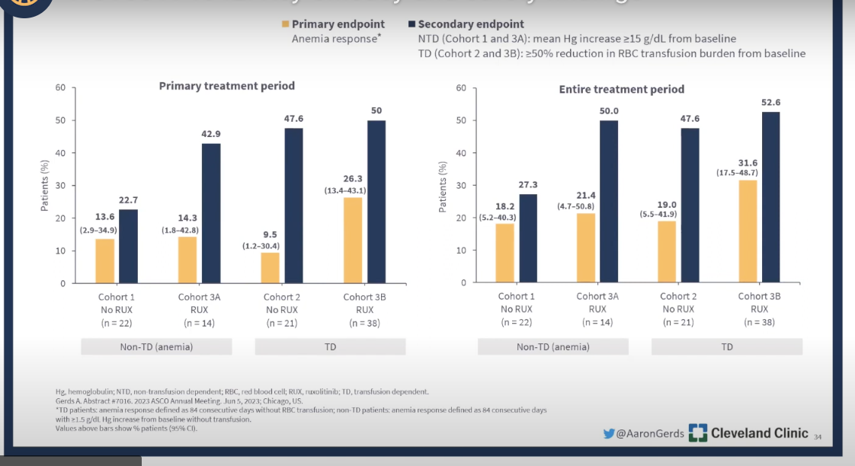
Slide Courtesy: MPN HUB https://mpn-hub.com

Slide 34
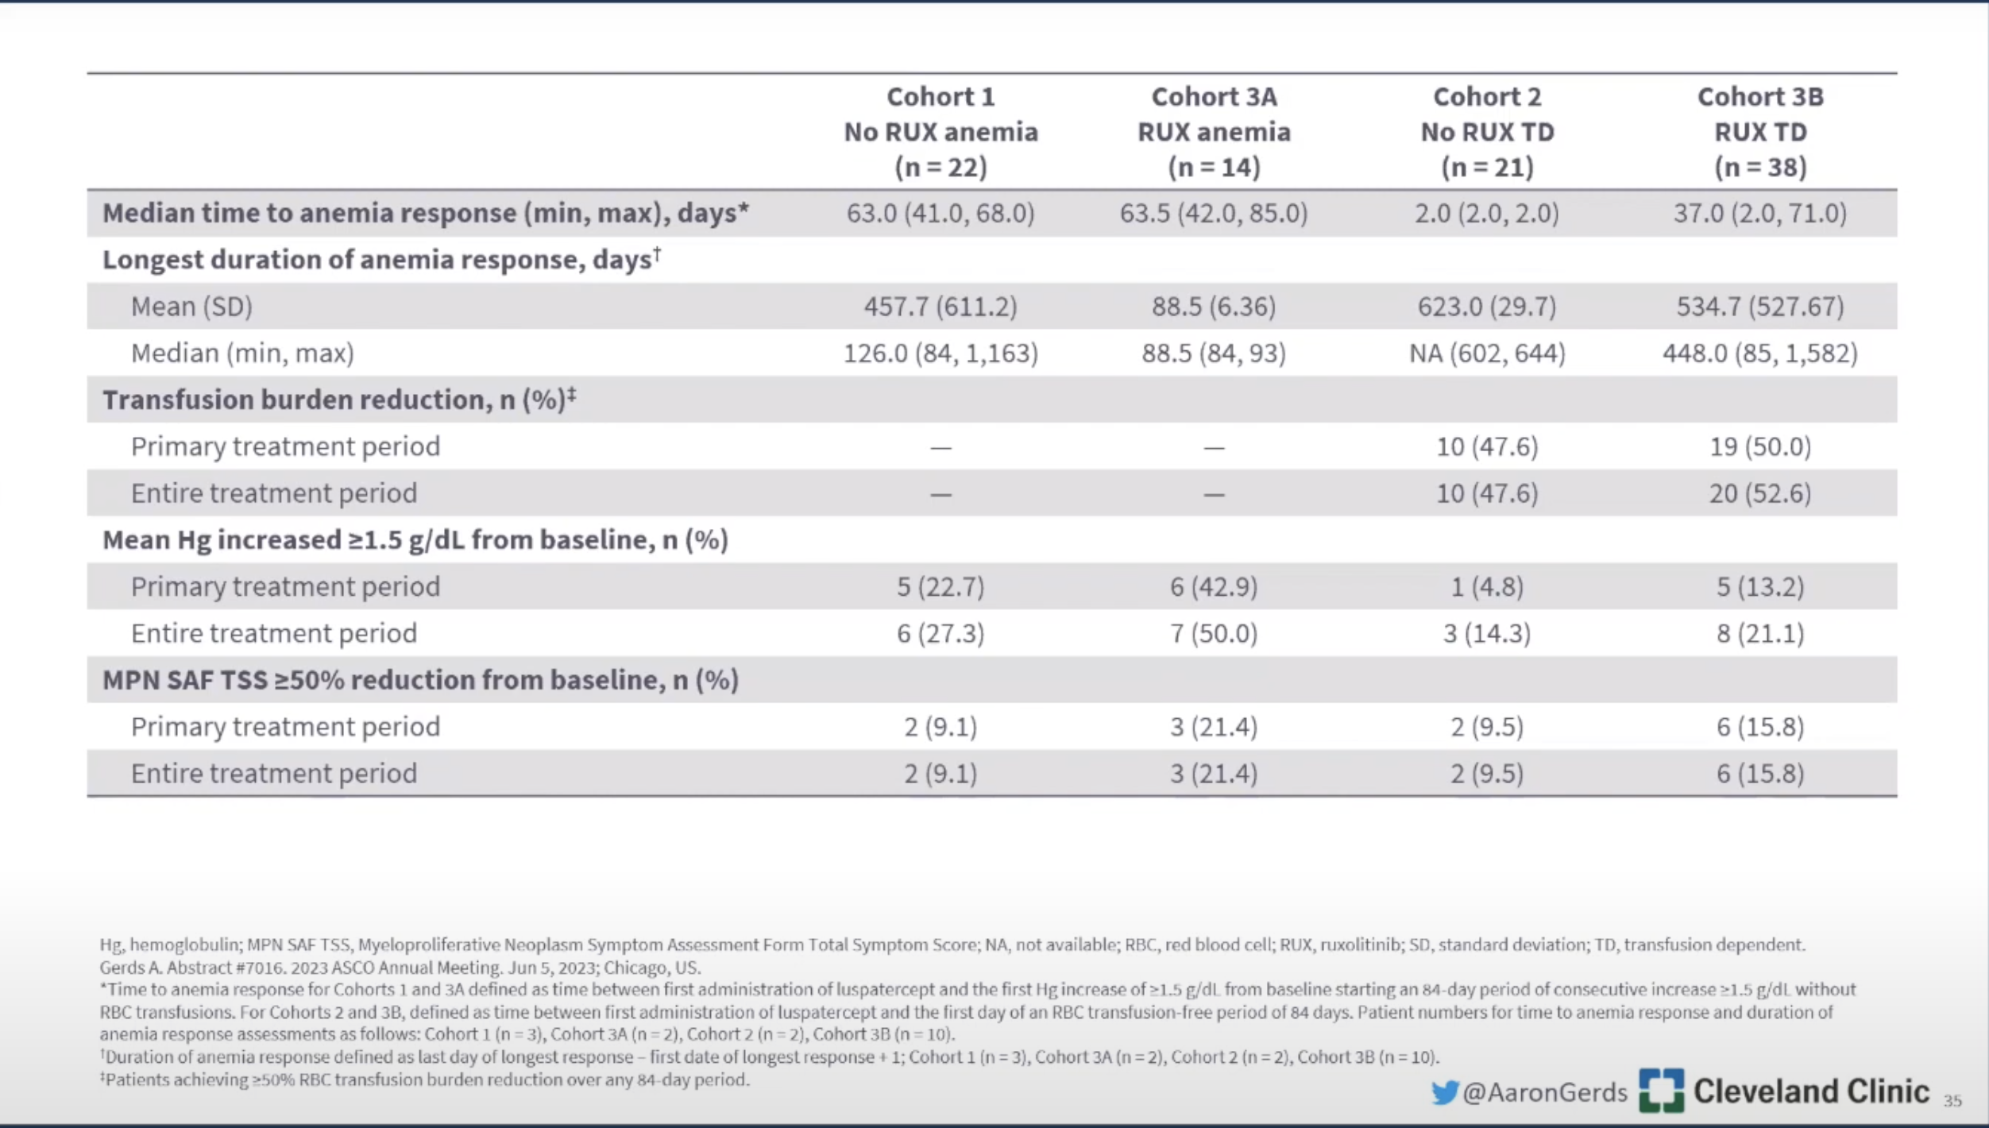
Slide Courtesy: MPN HUB https://mpn-hub.com

Slide 35
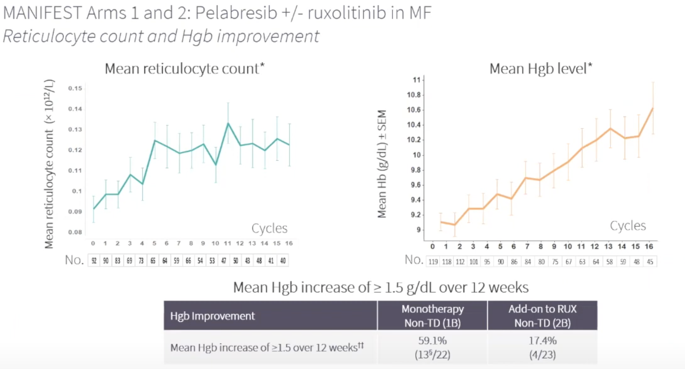
Other anti-anemia agents?
BET-inhibitors
  MANIFEST study
  Pelabresib (CPI-1610); BET inhibitor +/- Ruxolitinib

Slide 36
Anemia in Myelofibrosis
Rule out other causes
  Nutritional deficiency, Bleeding, Hemolysis
Measure serum erythropoietin
  Less than 500 mU/mL
    ESAs; Clinical Trial
  Greater than 500 mU/mL
    Clinical Trial
    Imids
    Luspatercept
    Momelotinib, Pacritinib

Slide 37
Future Studies to Watch
Placebo-controlled, Phase III Study of Navitoclax in combination with Ruxolitinib vs Ruxolitinib + Placebo – TRANSFORM 1
N=230
No prior JAKinhibitor treatment
Primary Endpoint: SVR 35%
Drug Targets: BCL2; BCL-XL
Phase II study, called REFINE – had cohort that matched enrollment criteria
  Results: spleen volume reduction of at least 35% at week 24
  Reduction in Bone Marrow Fibrosis; reduction in VAF also observed
Notes:
Also TRANSFORM-2 in JAKinhibitor exposed patients

Slide 38
Myelofibrosis: 2023
Risk Stratification/Goals of Care
Curative Therapy
Symptom Management/Palliative Therapy
Risk Stratification: DIPSS+; MIPSS70+ Ver 2.0
Risk Stratification for Prognostication: DIPSS+; MIPSS70+ Ver 2.0
Very High, High
Intermediate, Low, Very Low
Transplantation in Short Term
Transplantation Consultation, Discussion of Triggers for Transplant
Use Risk Stratification and Patient History, Symptoms to Determine Need for Treatment
Observation vs. Symptom Management/Disease Control
Splenomegaly/Symptoms
Clotting without Symptoms
Accelerated/Blast Phase Disease
Anemia or Evidence of Marrow Failure
Ruxolitinib or Hydrea or Fedratinib, Pacritinib or Momelotinib
Hydrea or Interferon
(Ruxolitinib + HMA) or Clinical Trial (Check IDHmut)
Clinical Trial, Momelotinib, Pacritinib, Luspatercept, EPO , Androgens, IMIDS

Slide 39
Conclusions
Selection of JAK inhibition is becoming more nuanced
  Consider symptoms, cytopenias and treatment goals
“Off-target” effects may play a role in anemia management
Outside of transplant, no definitive effect on survival yet, but may be coming

Slide 40
Thank you for your attention

Slide 41
MYELOFIBROSIS/HEMATOLOGY
Wednesday, September 20, 2023

Slide 42
Updates in Chronic GVHD
Sameem Abedin, MD
Associate Professor of Medicine
BMT and Cell Therapy Program
Medical College of Wisconsin
Milwaukee, WI

Slide 43
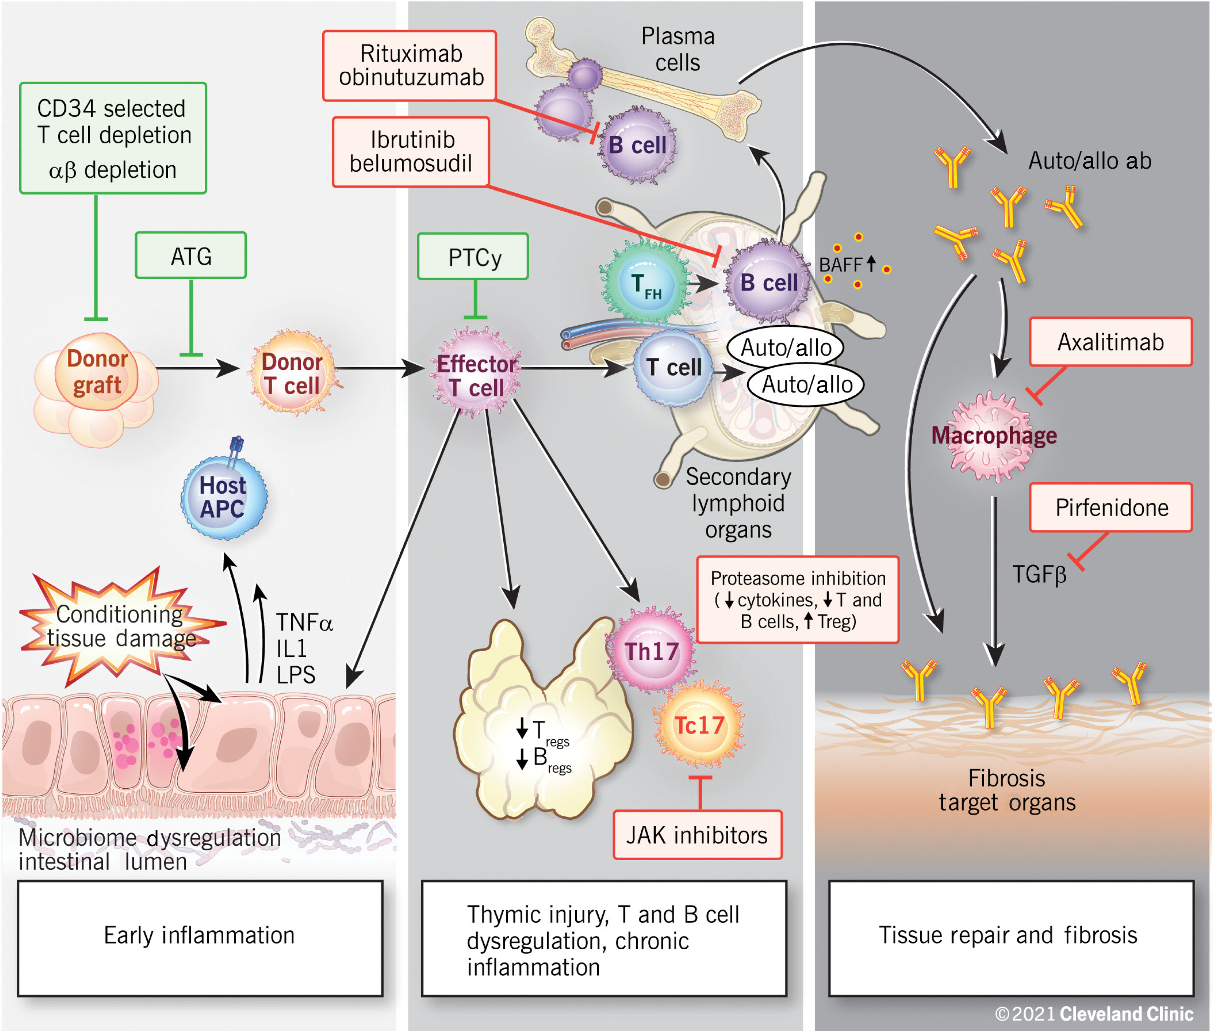
Chronic GVHD
Expansion auto-immune T cells and B cells due to early and persistent inflammation post transplant.
Impaired thymic function impairs elimination of autoimmune cells.
Auto-immune T-cells/B-cells attack self, resulting in organ injury followed by pathologic healing (fibrosis)
Hamilton BK. Hematology Am Soc Hematol Educ Program 2021 (1): 648-654

Slide 44
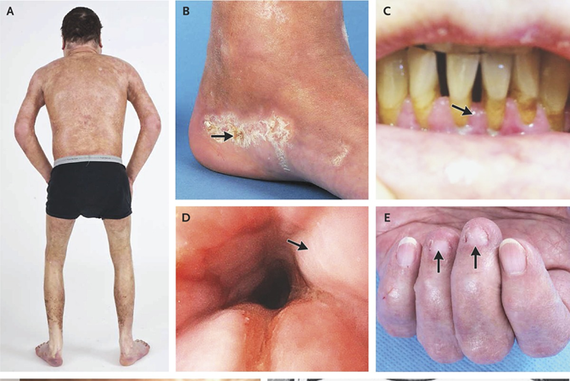
Clinical Features of Chronic GVHD
SKIN:
Hyperpigmented/hypopigmented skin, erythematous skin, pruritis,
Hidebound/shiny skin, sclerotic skin
Soft nails
MOUTH:
Dusky, erythematous mucosa. Lichenoid changes, reduced gingiva
UPPER GI:
Sclerotic changes in esophagus – anorexia, weight loss

Slide 45
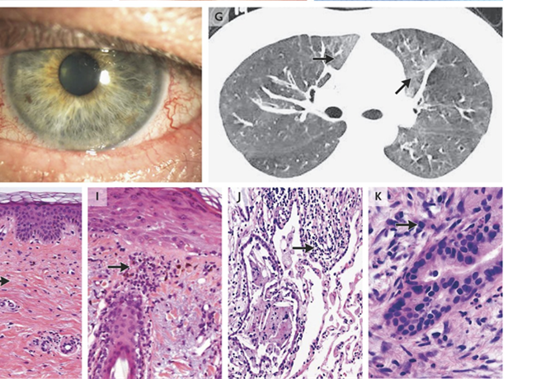
Clinical Features of Chronic GVHD
Eyes: Dry eyes. Light and wind sensitivity.
Eyes appear hyper vascular
Lungs: dyspnea on exertion.
Air trapping, bronchial wall thickening.

Slide 46
Chronic GVHD Treatment
Consideration of systemic therapy:
1 - Extensive or persistent Mild chronic GVHD
2 – Moderate or severe chronic GVHD
Standard therapy is corticosteroids:
0.5-1.0mg/kg/day Prednisone equivalent with taper
Could consider restarting immunosuppression (sirolimus or tacrolimus)

Slide 47
Steroid-refractory Chronic GVHD
STEROID REFRACTORY
Progressive disease while on Prednisone 1mg/kg/day for 1-2 weeks
Persistent disease while on Prednisone 0.5mg/kg/day for 1-2 months
STEROID DEPENDENCE
Inability to taper Prednisone below 0.25mg/kg/day, two unsuccessful attempts
STEROID INTOLERANCE
Unacceptable toxicity due to steroid therapy

Slide 48
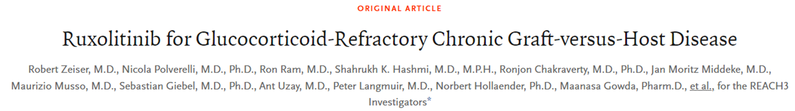
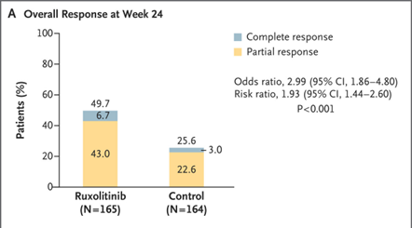
REACH3
Open-label, Randomized Phase 3 Trial
Ruxolitinib (JAK inhibitor) at 10mg twice daily
OR Investigators choice – ECP, MMF, Ibrutinib
Primary endpoint: ORR at week 24

Slide 49
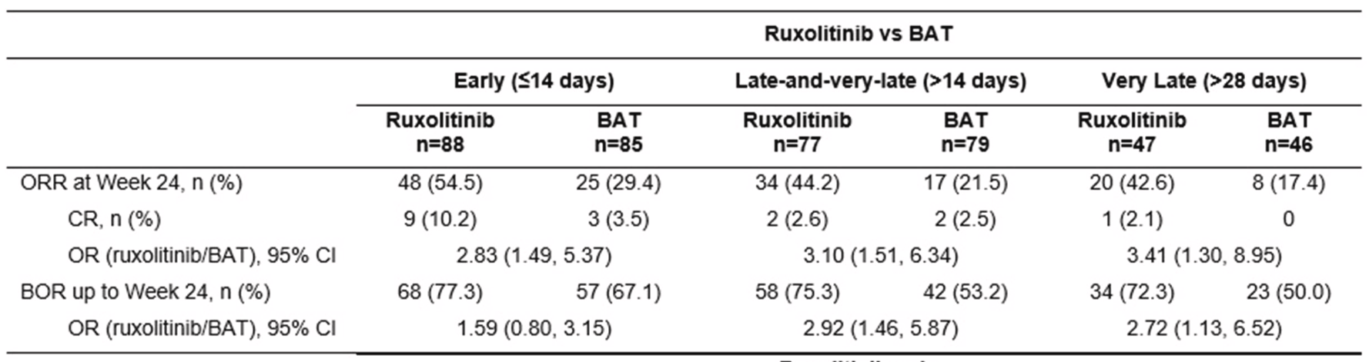
Early Versus Late Treatment with Ruxolitinib in Patients with Steroid-Refractory Chronic Graft-Versus-Host Disease: A Post Hoc Analysis from the Randomized, Phase 3 REACH3 Study
Post-Hoc Analysis: ORR at week 24
Early: <14 days from SR-cGVHD
Late: 14-28 days
Very late: 28 or more days

Slide 50
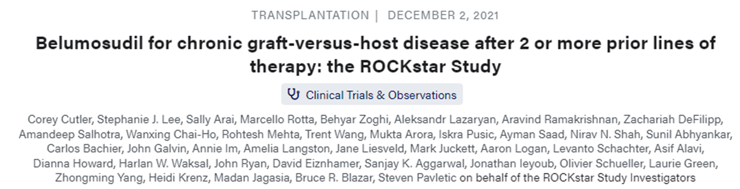
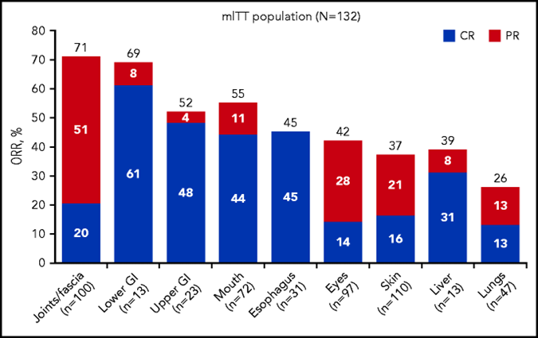
ROCKstar Study
Belumosudil is a RHO kinase-2 (ROCK2) inhibitor
Downregulates inflammatory cytokines, increases T regs, and downregulates pro-fibrotic pathway
Belumosudil at 200mg Daily Or Belumosudil at 200mg BID

Slide 51
Promising options on the horizon: Axatilimab
Fibrosis with chronic GVHD is a primary reason for treatment resistance
Colony-stimulating factor 1 receptor (CSF1R) dependent macrophages promote fibrosis
Axatilimab is a humanized monoclonal antibody that binds to CSF1R,
inhibiting profibrotic macrophages

Slide 52
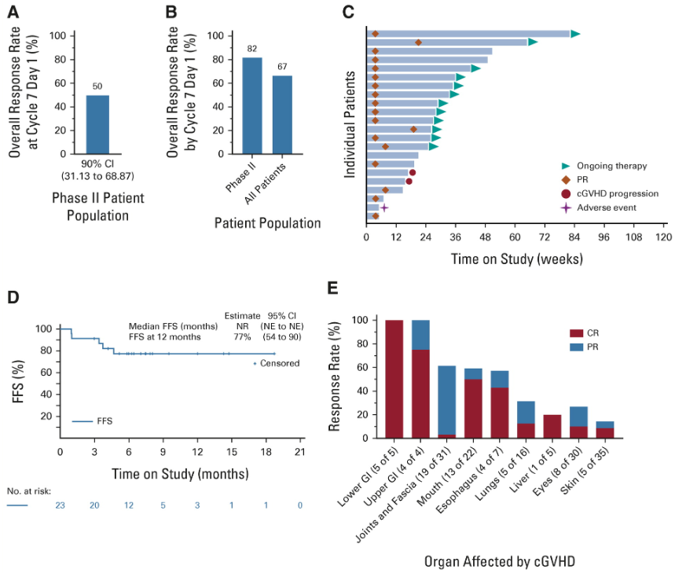
Phase I/II Study of Axatilimab
Kitko CL. JCO 41(10) 1864-1875

Slide 53
Conclusion
Chronic GVHD is an immune mediated complication after allogeneic HCT that can result in significant impairments to quality of life
After corticosteroid therapy, identification of non-responders and early initiation of ruxolitinib may allow for more meaningful responses
Among patients with ongoing issues related to GVHD, Belumosudil is now available
In the future, agents that more directly target fibrosis may be available and useful options for patients with chronic GVHD

Slide 54
MYELOFIBROSIS/HEMATOLOGY
Wednesday, September 20, 2023

Slide 55
Updates in AML
Lyndsey Runaas, MD
Assistant Professor
Medical College of Wisconsin
Milwaukee, WI

Slide 56
Quizartinib
-oral, daily, 2nd generation type 2 FLT3 inhibitor
 | Type I | Type II
FIRST | sunitinib | sorafenib
 | midostaurin | ponatinib
 | lestaurtinib | tandutinib
SECOND | crenolanib | quizartinib
 | gilteritinib
Notes:
1st and 2nd generation refers to PHASE of FLT3 inhibitor drug discovery
Type I vs II refers to interaction with FLT3 – type I targeting ITD and TKD whereas type II only in ITD

Slide 57
QuANTUM-First
Randomized, double-blind, placebo-controlled phase 3 trial
26 countries
Enrolled
  Newly diagnosed, FLT3 ITD + patients (VAF >3%)
  Aged 18-75
  between 9/27/2016-8/14/2019
Notes:
EXCLUDED: APL, BCR-ABL+ acute leukemia, AML secondary to chemotherapy or radiotherapy
Randomization was stratified by region, Age (< or > 60) and WBC <40 or >40)

Slide 58
QuANTUM-First
Tx:
  3+7 + placebo OR quizartinib 40 mg orally on D8 X 14 days
IF CR→consolidation
  HIDAC + placebo/quizartinib
  Allo SCT
  HIDAC + placebo/quizartinib→Allo SCT
After consolidation
  placebo/quizartinib continuation therapy – up to 3 years
Notes:
Dauno 60 or ida 12, cytarabine 100 or 200
Pt with persistent disease could get 2nd induction
Ara-C (3 gm vs 1.5 gm depending on > or <60)

Slide 59
QuANTUM-First
Primary efficacy outcome:
  Overall survival
Secondary efficacy outcomes:
  EFS – time from randomization to lack of complete remission/relapse/death
  Rates of CR
Exploratory outcomes:
  RFS
  Duration of CR
Notes:
Dauno 60 or ida 12, cytarabine 100 or 200
Pt with persistent disease could get 2nd induction
Ara-C (3 gm vs 1.5 gm depending on > or <60)

Slide 60
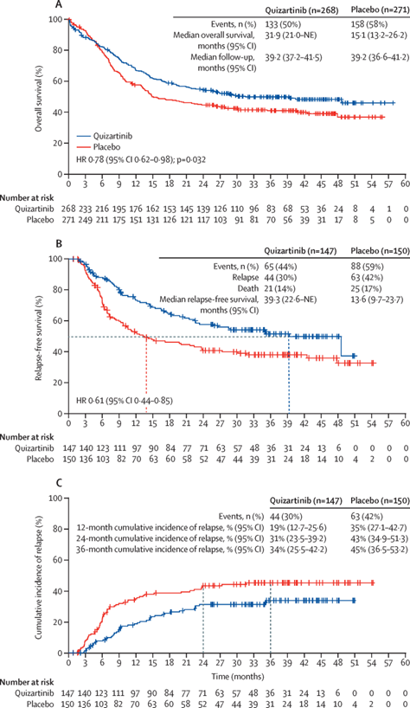
QuANTUM-First

Slide 61
QuANTUM-First
EFS: lack of CR within 42 days from the start of last induction cycle – NO difference
  Favored quizartinib with original protocol definition of lack of induction tx success if no composite complete remission up to 56 days

Slide 62
QuANTUM-First
Rates of
  CR
  composite CR (CR + CRi)
  CRi
  CR with MRD negativity
  composite CR with MRD negativity
  were similar
Notes:
CR: ANC >1, Plt >100K, Blasts <5%
Cri – not meeting plt or ANC cgoal

Slide 63
QuANTUM-First

Slide 64


Slide 65
QuANTUM-First
AEs:
  G3 or G4 AEs in >10% of patients – febrile neutropenia, hypokalemia, pneumonia, neutropenia (in quizartinib only)
  G5 infection (8% vs 6%)
  Induction deaths (6% vs 3%)
  Time to hematologic recovery in patients with CR
    Neutrophils – 36 (29-44) vs 29 (27-38)
    Plt – 31 (28-40) vs 29 (26-34)
  QT prolongation
    QTcF of >500 was uncommon (2% in quizartinib group)
    No cases of torsades de pointes
    2 patients in quizaritinib group had cardiac arrest with recorded VF on ECG

Slide 66
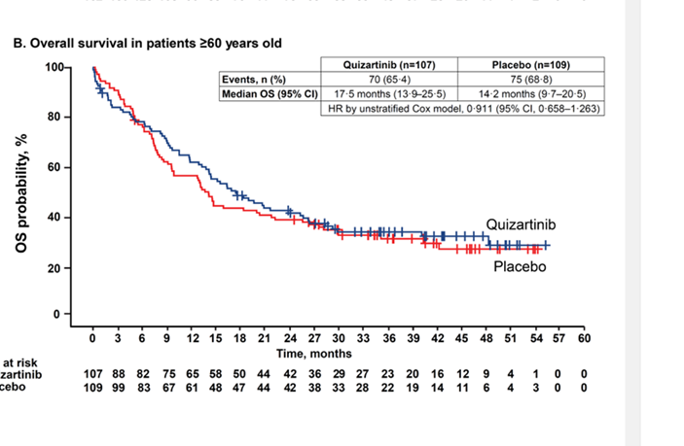
QuANTUM-First
Concerns:
  Placebo comparator (midostaurin approved in 2017)
    Low rates of N. American recruitment
  Daunorubicin dose is 60 (same as RATIFY)
Pros:
    Included older patients (RATIFY < 59) – but did it help these patients?
    Encouraged allo SCT
    Strong primary endpoint
    Included antifungal ppx – with dose adjustments

Slide 67
Olutasidenib
-oral, small-molecule inhibitor of IDH1
-IDH1 mutations seen in 7-14% of patients with AML; 3-4% of patients with MDS
-block normal differentiation of stem/progenitor cells and promote neoplastic transformation
Notes:
IDH1 mutations occurs in 7-14% of patients with AML; 3-4% of patients with MDS
Approved 12/2022 for R/R AML as monotherapy

Slide 68
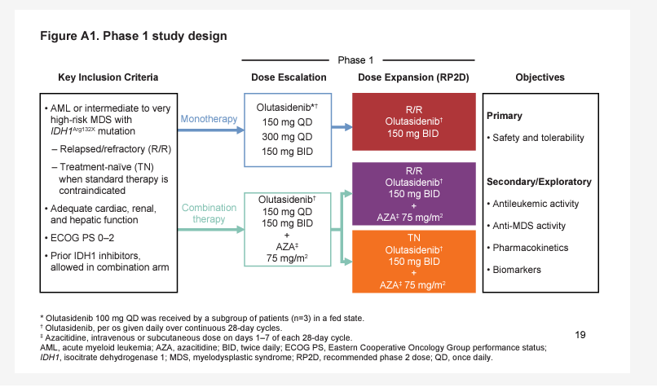
Notes:
8/16/2016-11/14/2018
Phase 1/2 trial – this is report of phase 1 activity.
Dose escalation in 3+3 study design

Slide 69
Olutasidenib
Safety + Tolerability
  Differentiation syndrome: 13%; maximum G3; mostly C1. All resolved with treatment interruption, dose reduction, dexamethasone or supportive treatments.
  G3 or higher LFT abnormalities – 11-16%; 2 patients discontinued because of
  QT prolongation – only in combination arm, 7%; all transient

Slide 70
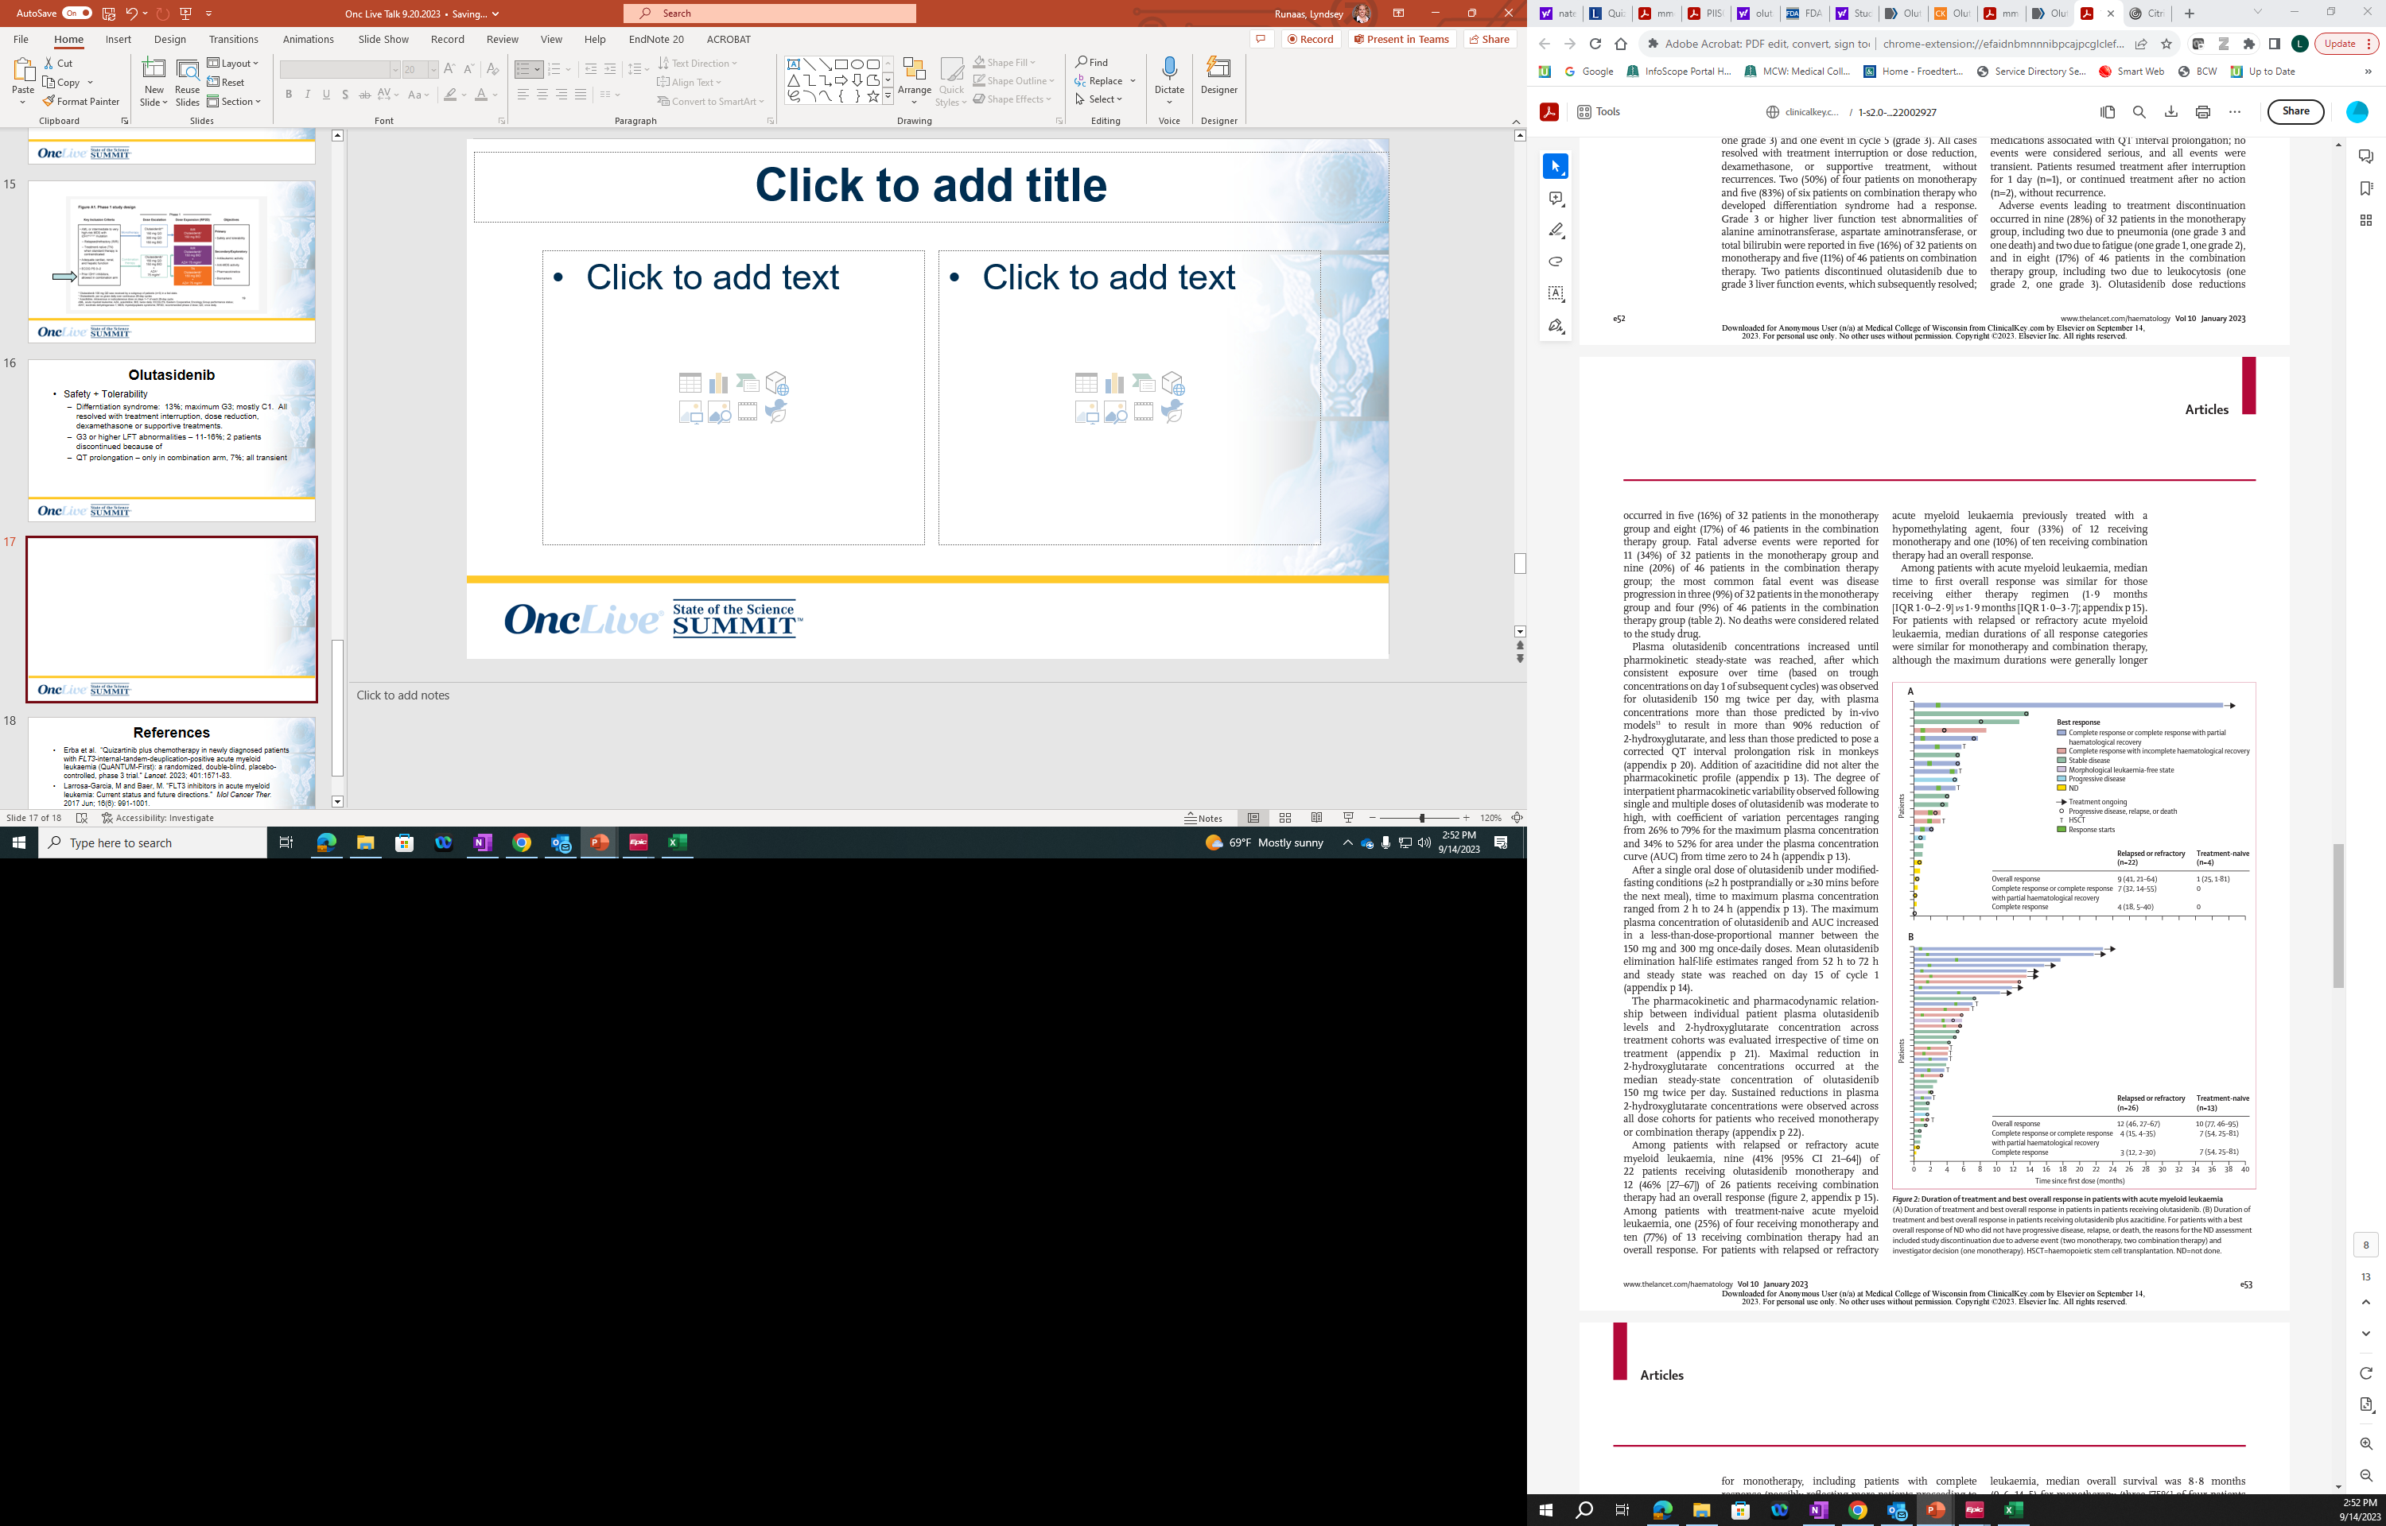
Monotherapy
OR: 41%, 25%
CR: 7%, 0%
Combination Therapy
OR: 46%, 77%
CR: 15%, 54%

Slide 71
Pros:
1st evaluation of IDH1 inhibitor with aza in MDS
1st eval showing clinically significant activity of IDHi monotherapy in MDS

Slide 72
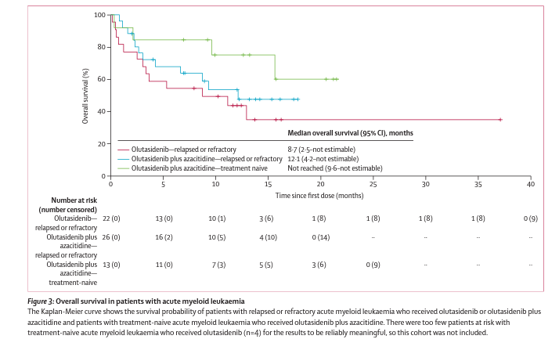

Slide 73
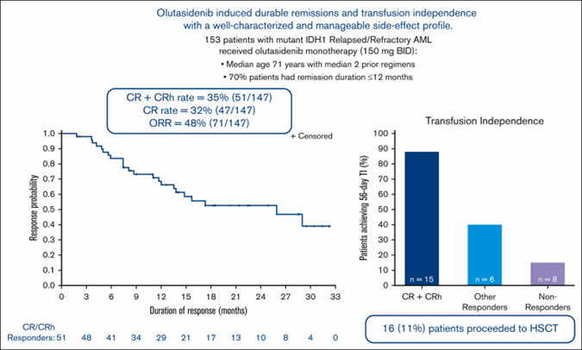
Notes:
-twice daily versus once daily (with ivosednib)
-has to be on empty stomach
-no increase in QTc prolongation

Slide 74
References
Erba et al. “Quizartinib plus chemotherapy in newly diagnosed patients with FLT3-internal-tandem-deuplication-positive acute myeloid leukaemia (QuANTUM-First): a randomized, double-blind, placebo-controlled, phase 3 trial.” Lancet. 2023; 401:1571-83.
Larrosa-Garcia, M and Baer, M. “FLT3 inhibitors in acute myeloid leukemia: Current status and future directions.” Mol Cancer Ther. 2017 Jun; 16(6): 991-1001.
Watts et al. “Olutasidenib alone or with azacytidine in IDH1-mutated acute myeloid leukaemia and myelodysplastic syndrome: phase 1 results of a phase 1/2 trial.” Lancet Haematol. 2023; 10:e46-58
Botton et al. “Olutasidenib (FT-2102) induces durable complete remissions in patients with relapsed or refractory IDH1-mutated AML.” Blood Adv. (2023)7(13):3117-3127.

Slide 75
MYELOFIBROSIS/HEMATOLOGY
Wednesday, September 20, 2023

Slide 76
BTK Inhibitors for Managing MCL
Timothy S. Fenske, MD
Professor of Medicine
Medical College of Wisconsin
Milwaukee, WI

Slide 77
Outline
TRIANGLE (ibrutinib in first line MCL)
Newer BTK combinations (1L and R/R)
Updated results for acalabrutinib for R/R MCL (ACE-LY-004 trial)
Zanubrutinib for R/R MCL
Pirtobrutinib for R/R MCL (BRUIN-MCL-321 trial)

Slide 78
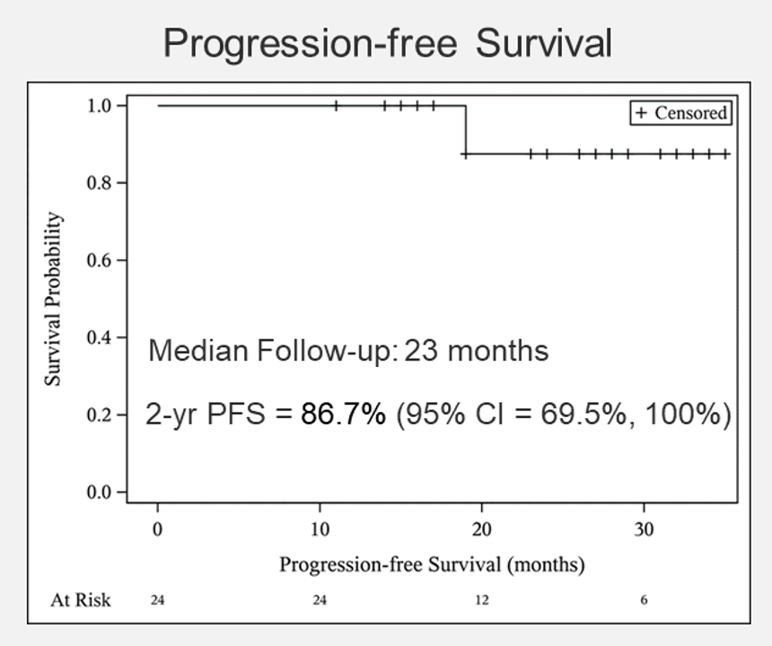
BTKi/ Lenalidomide combo
Acalabrutinib + Lenalidomide + Rituximab
  Ritux weekly x4, then Q8 weeks
  Acala 100mg po bid continuous
  Len 15-20 mg po D1-21 on 28d cycle for first year; then 15 mg
N=24; 63% int/high MIPI; 29% Ki-67> 30%
29% (N=7) with TP53 mutations
By 1 year, 100% ORR and 91% CR.
7/7 TP53 mutated patients responded. 2 have relapsed
Of those with MRD testing, 100% neg by C20
67% developed covid-19; all recovered
Ruan et al, ASH 2022; and Jia Ruan, personal communication

Slide 79
BTK/ Venetoclax combos
BOVen
  Kumar A, Soumerai JD, Abramson JS, et al. Preliminary safety and efficacy from a multicenter, investigator initiated phase II study in untreated TP53 mutant mantle cell lymphoma with zanutbrutinib, Obinutuzumab, and venetoclax (BOVen). ASH 2021, Poster 3540.
    Obin x 8 cycles; Zanu + Ven x 2 yrs unless remains MRD pos
    ORR 96%; CR 76%. (N=25; median f/u 12 mo)
OASIS
  LeGouill S, Morschhauser F, Chiron D, et al. Ibrutinib, Obinutuzumab, and venetoclax in relapsed and untreated patients with mantle cell lymphoma: a phase 1/2 trial. Blood. 2021;137(7):877-887. doi: 10.1182/blood.2020008727
SYMPATICO
  Wang M, Ramchandren R, Chen R, et al. Concurrent ibrutinib plus venetoclax in relapsed/refractory mantle cell lymphoma: the safety run-in of the phase 3 SYMPATICO study. J Hematol Oncol. 2021;14(1):179. doi:10.1186/s13045-021-01188-x

Slide 80
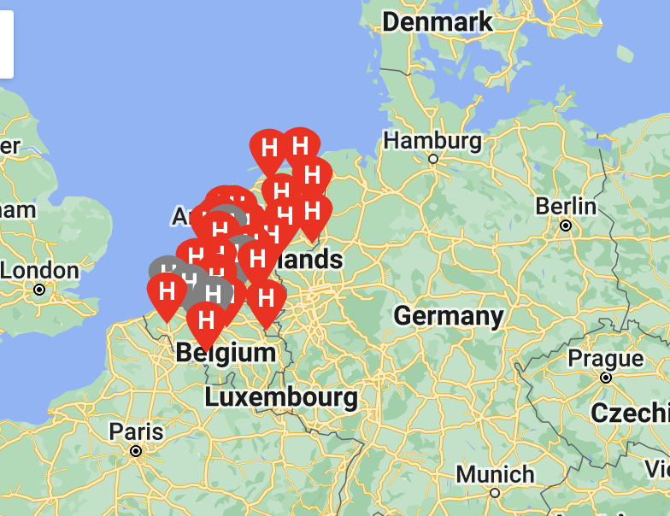
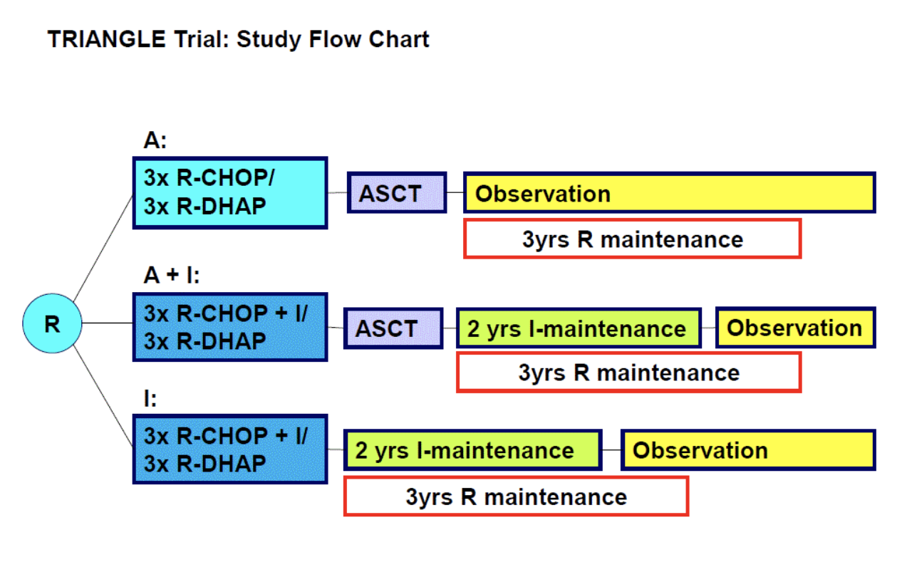
TRIANGLE Trial (Europe)
870 pts (290 per arm)
Activated Oct 2017
Completed accrual Dec 2020
Abstract #1 at ASH 2022
Between 2016-2020, 870 randomized 1:1:1
R maint added later (54-58% of pts received R maint)
Dreyling et al, ASH 2022, Abstract 1

Slide 81
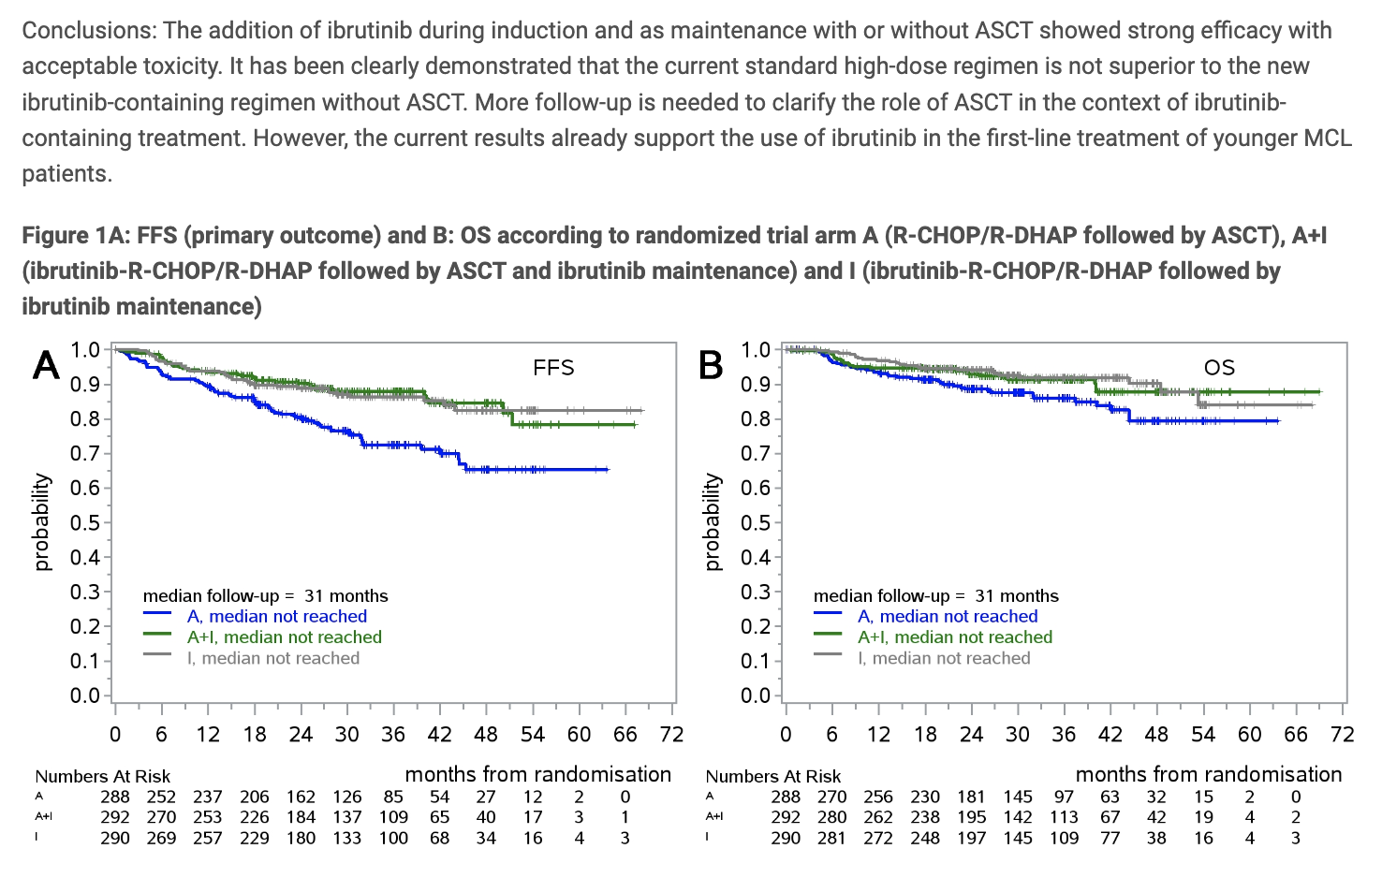
Triangle study
M
With median follow up of 31 mo
A+I was superior to A
  3 yr FFS 88% vs 72% (p=0.0008)
A failed to show superiority to I
- 3 yr FFS 72% vs 86%
3 yr OS: 86%, 91%, 92% for the 3 arms (not stat signif yet)
LyMA: 3 yr PFS approx. 90% and 3 yr OS approx. 95%. Triangle ”A” arm doing significantly worse than expected
Dreyling et al, ASH 2022, Abstract 1

Slide 82
Do the prelim results from Triangle change practice?
Unclear
Follow up is short (median 31 mo) – curves could change as we get out past maint. Need longer f/u
Control arm of Triangle performing no better than “no maintenance” arm of LyMA trial
We know auto-HCT med PFS following Nordic or RCHOP/RDHAP is about 8-9 yrs. For those who complete auto, 10-11 yrs (maybe even longer with maint R)
Ibrutinib being withdrawn from market for MCL
Unclear whether 2nd gen BTK-i will be covered 1L for this indication
Unclear how to pair BTK-i with some induction regimens (RCHOP/RHDAP not commonly used in U.S.)
Unclear if BTKi will be effective in relapse setting if given as part of 1L therapy
EA4151 is asking a different question (whether auto-HCT benefits MRD-neg patients) and that is approaching accrual goal now (nearly 600 pts enrolled to date; 86% of target)
Many centers still offering 1L auto-HCT and still enrolling on EA4151 but a few are not

Slide 83


EA4151/BMT-CTN 1601- Schema
Step 1
RANDOMIZATION
Arm A
Auto-HCT
+ Rituximab
x 3 years
Step 0
Any induction regimen
Enroll before, during, or
after induction
Stratify:
MIPI-c
Intensive vs non-
intensive induction
PREREGISTRATION
Post-induction restaging
+
Submission of blood for MRD assessment
MRD-neg CR
Arm B
Rituximab x 3 years
Submit
diagnostic tissue for molecular testing
Clonal
Marker
Present?
Yes
PR (MRD + or -)
or MRD-pos CR
REGISTRATION
Arm C
Auto-HCT
+ Rituximab
x 3 years
No
No informative
marker: MRD
indeterminate
Arm D
Auto-HCT
+ Rituximab
x 3 years
MRD indeterminate

Slide 84
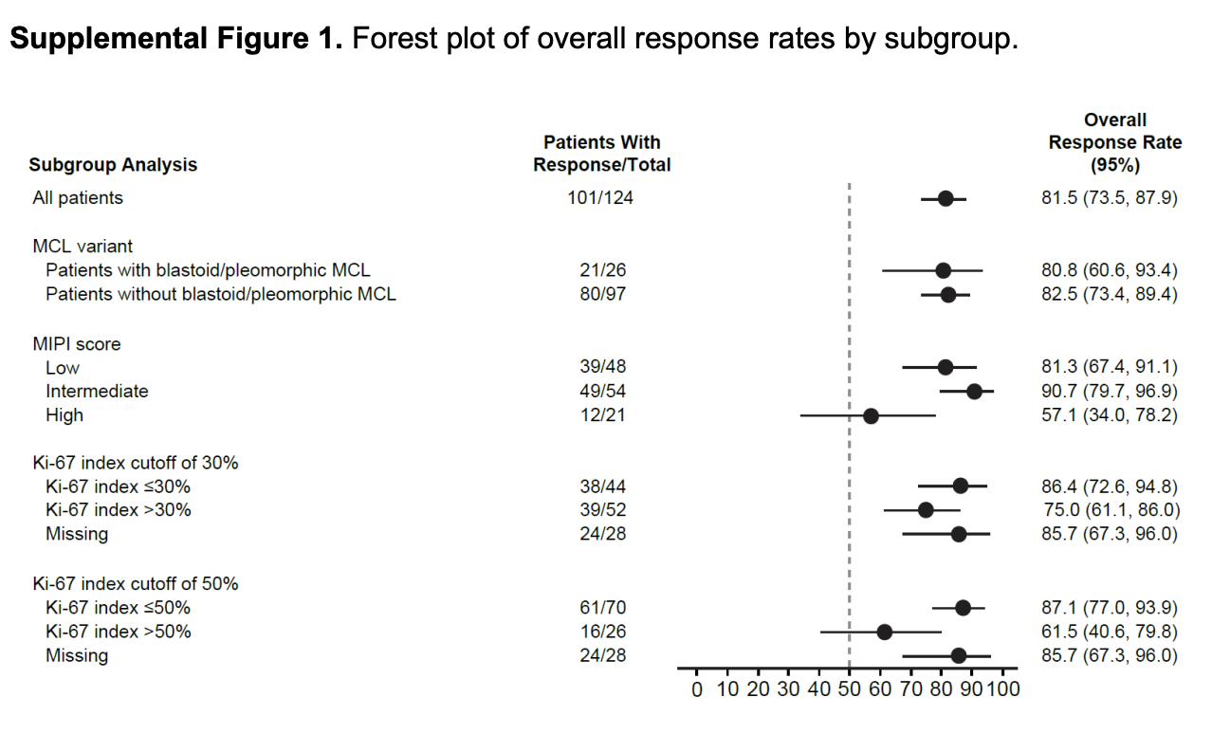
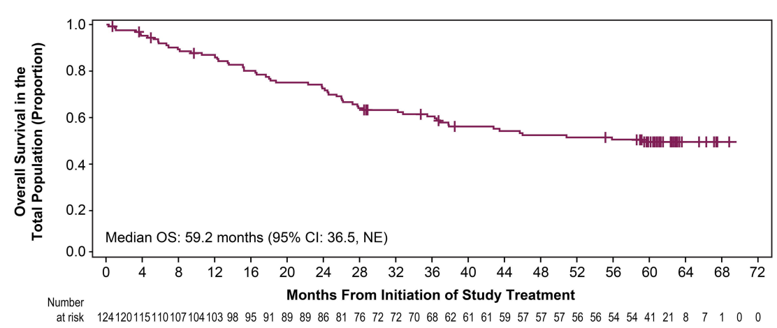
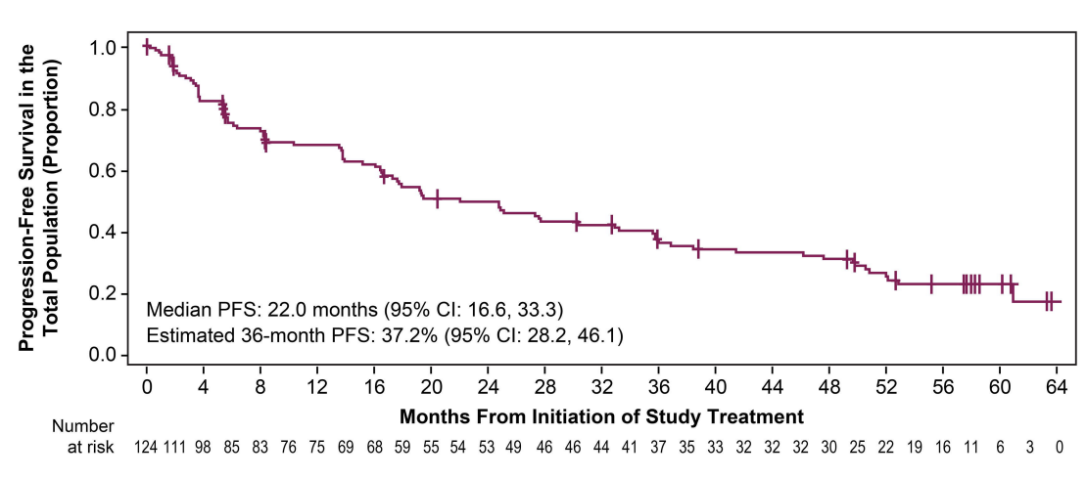
Acalabrutinib in R/R MCL
ACE-LY-004 trial
N=124 patients
ORR 81.5%; CR 47.6%
Median DOR 28.6 mo
Median PFS 22.0 mo
Estimated median OS (mOS) was 59.2 months
Estimated 5-year OS rate was 49.5% (95% CI: 40.1%, 58.2%)
43% on therapy for > 2 yrs
11% on therapy > 5 yrs
Le Gouill et al, Haematologica (2022)

Slide 85
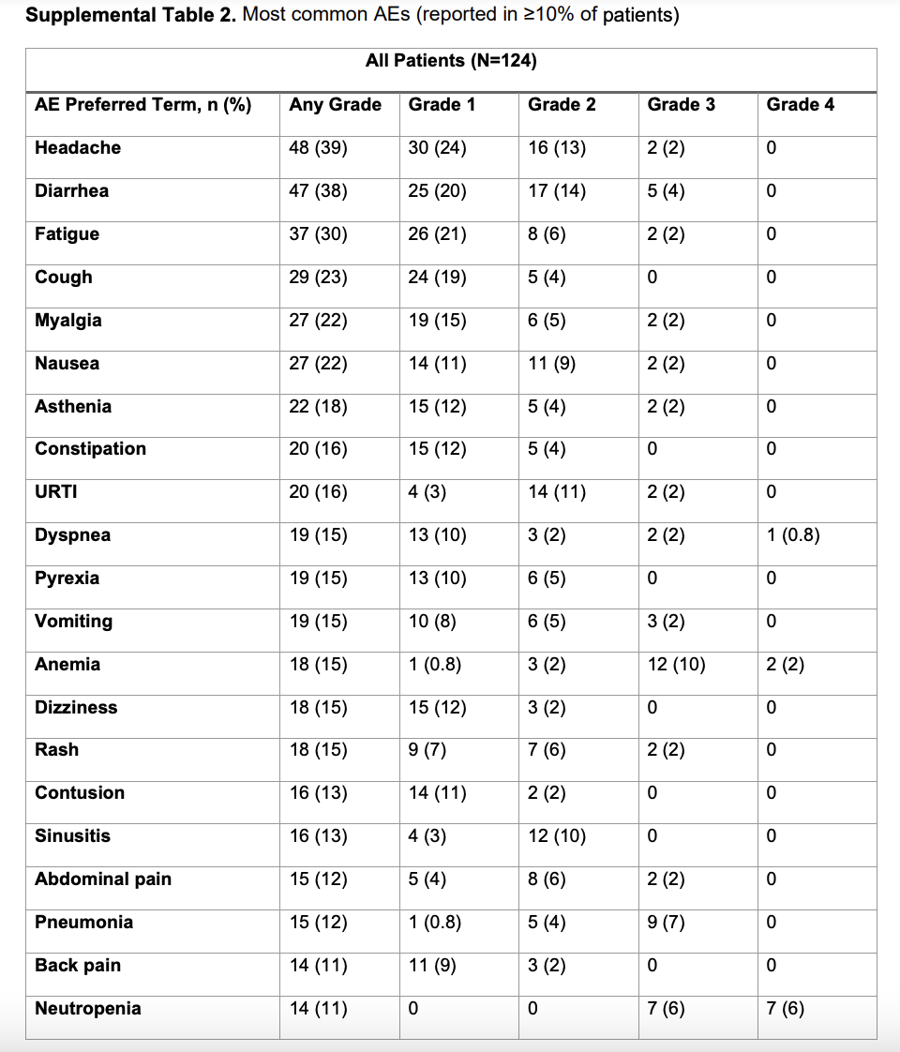
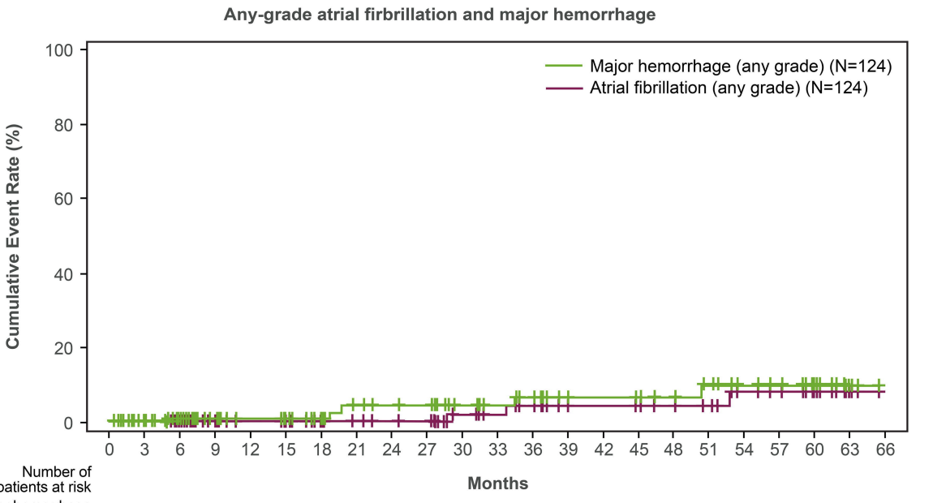
Acalabrutinib in R/R MCL
Acala was stopped due to toxicity in 12.1%
Head to head study vs ibrutinib in R/R CLL/SLL shows improved tolerability of acala
Le Gouill et al, Haematologica (2022)

Slide 86
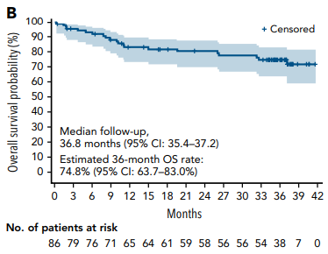
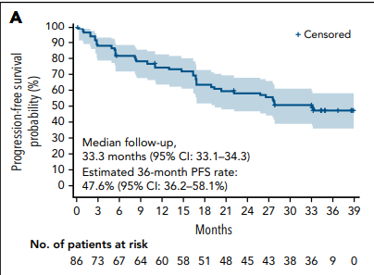
Zanubrutinib in R/R MCL
Phase 2 trial
N=86 patients; zanu 160mg po bid
ORR 83.7%; CR 77.9%
Median DOR not reached
Median PFS 33.0 mo
3 year PFS 47.6% and 3 year OS 74.8%
Song et al, Blood (2022)

Slide 87
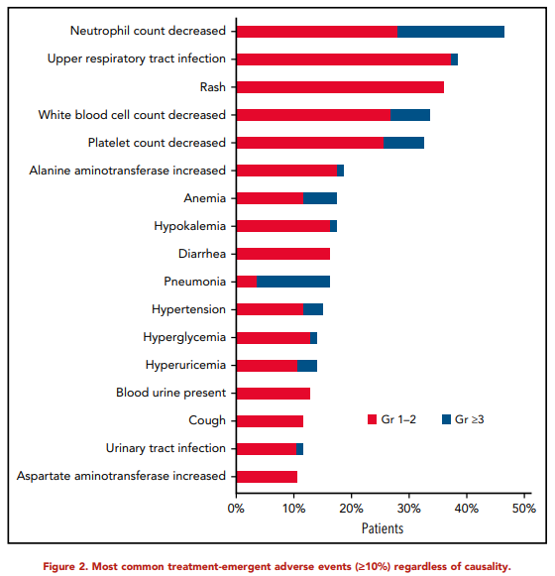
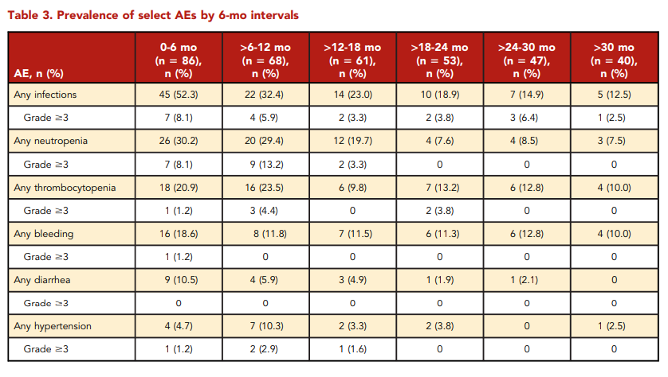
Zanubrutinib in R/R MCL
Neutropenia most common AE at 46% overall and 19% Gr 3-4
No Gr 3 neutropenia after 18 mo
No new Gr 3-4 HTN or major hemorrhage, no cases of Afib/ flutter
No gr 3-4 cardiac Aes
Head to head studies vs ibrutinib in R/R CLL/SLL and WM show improved safety and tolerability of zanubrutinib
Song et al, Blood (2022)

Slide 88
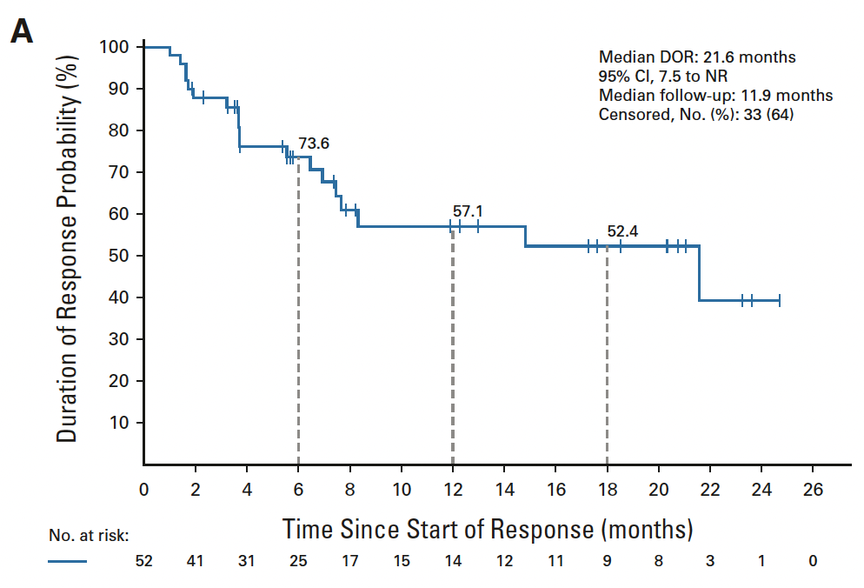
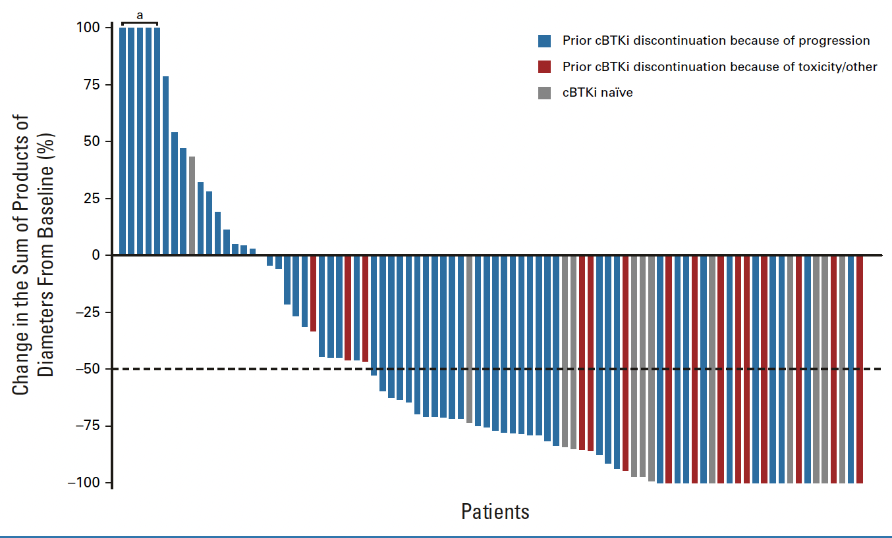
Pirtobrutinib in R/R MCL
A non-covalent BTK-I
Retains activity against the cBTKi-resistant C481S mutation (seen in CLL)
Study enrolled 104 pts, 90 of whom had prior cBTKi
70% int/high MIPI; 21% prior HCT; 4% prior CAR
Among the prior cBTKi treated pts, ORR 58%
Very favorable toxicity profile
FDA approved 1/27/23 after prior covalent BTK-I therapy
Ongoing randomized trial (vs other BTKi) as first BTKi
Wang et al, J Clin Onc (2023)

Slide 89
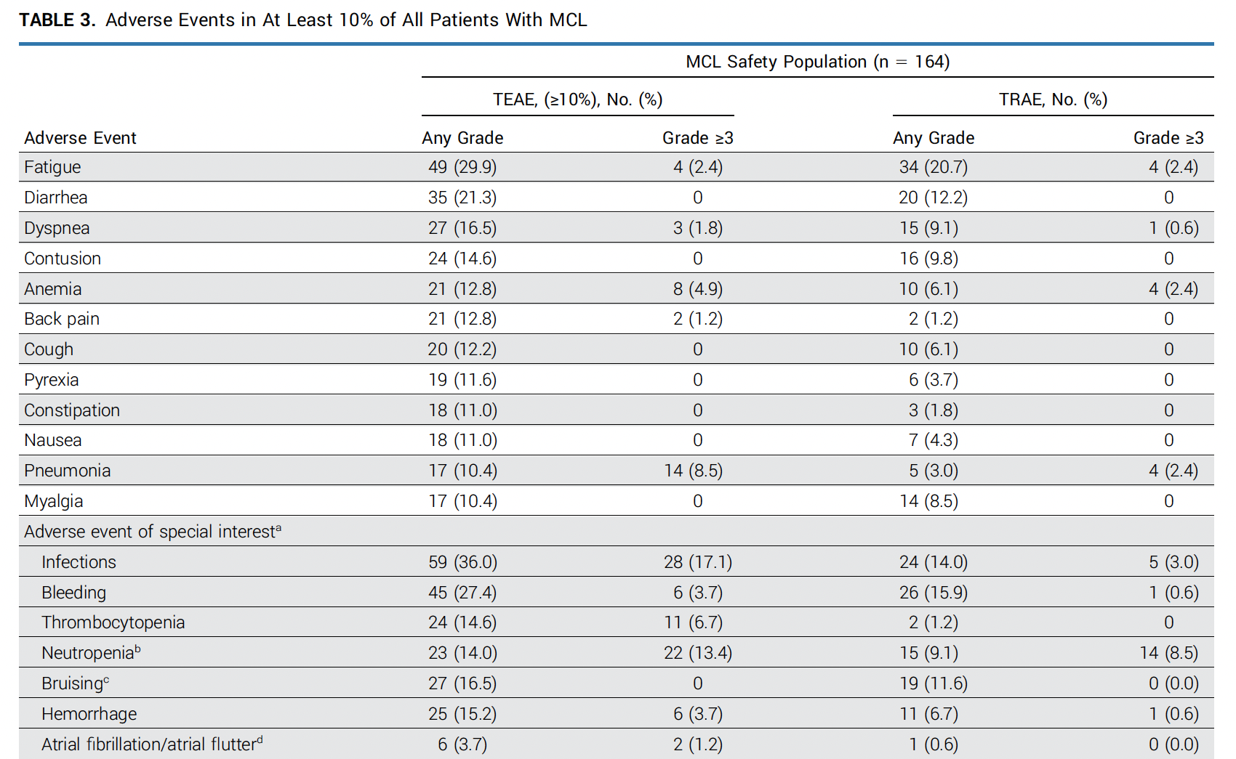
Wang et al, J Clin Onc (2023)

Slide 90
FDA approved options for rel-refr MCL (excluding CAR-T)
Regimen | Pts | ORR | CR | mPFS | mDOR | mOS | Ref | Comments
Bortezomib* | 141 | 32% | 8 % | 7 mo | 9 mo | 23 mo | 1 | Approved in 2006
Lenalidomide* (prior bortez) | 134 | 28% | 8 % | 4 mo | 17 mo | 19 mo | 2 | Approved 6/5/13
Len*+Ritux (R²) | 44 | 57% | 36% | 11 mo | 19 mo | 24 mo | 3
Ibrutinib* (3 pooled trials) | 370 | 70% | 28% | 12.5 mo | 22 mo | 26.7 mo | 4 | Approved 11/13/13 MCL indication withdrawn 4/6/23
Acalabrutinib* | 124 | 81% | 48% | 22 mo | 29 mo | 59 mo | 5 | Approved 10/31/17
Zanubrutinib* | 86 | 86% | 78% | 33 mo | >30 mo | 75% (3y) | 6 | Approved 11/14/19
Pirtobrutinib* (prior BTK-i) | 90 | 58% | 20% | 7.4 mo | 22 mo | Not reached | 7 | Approved 1/27/23
*FDA approved agent
¹Goy et al, Ann Oncol (2009); ²Goy et al, JCO (2013); ³Wang et al, Lancet Oncol (2012); ⁴Dreyling et al, Hemasphere (2022). ⁵Le Gouille et al, Haematologica (2003); ⁶Song et al, Blood (2022); ⁷Wang et al, JCO (2023)

Slide 91
Real-world treatment patterns of Bruton tyrosine kinase inhibitors (BTKi) in patients with mantle cell lymphoma (MCL) in community oncology practices in the United States (US).
Retrospective study used EMR data from Integra Connect database in 18 US community-based oncology practices.
Adults with MCL diagnosis on ≥2 separate dates who started BTKi therapy between 1/1/2019 and 11/30/2021 were included.
Baseline comorbidities were collected ≤90 days prior to index date based on diagnosis records.
Treatment duration was calculated based on EMR and claims until end of follow up. Discontinuation data was based on unstructured physician notes. Kaplan-Meier analysis was used to compare treatment duration between the 3 BTKi groups.
Bijal Shah et al, ASCO 2023

Slide 92
Real-world treatment patterns of Bruton tyrosine kinase inhibitors (BTKi) in patients with mantle cell lymphoma (MCL) in community oncology practices in the United States (US).
402 MCL patients identified to start BTKi therapy (44 zanubrutinib; 161 acalabrutinib; 197 ibrutinib)
median age (range) at BTKi therapy start was 75 (56-89) years in zanubrutinib, 76 (36-89) in acalabrutinib, and 72 (36-89) in ibrutinib group (P<0.01; Table).
no significant difference between the 3 BTKi groups in other baseline characteristics. Half of zanubrutinib patients used other BTKi in prior therapy, with 31.8% switched from other BTKis to zanubrutinib ≤60 days of treatment start. In acalabrutinib group, 29% had prior BTKi use. Given a later approval date, zanubrutinib group had a relative shorter mean follow-up period (493 days [d]) vs acalabrutinib (701 d) and ibrutinib (746 d). Nevertheless, zanubrutinib patients had significantly longer median treatment duration (292 d) vs acalabrutinib (259 d) and ibrutinib (149 d) (P<.01).
Bijal Shah et al, ASCO 2023

Slide 93
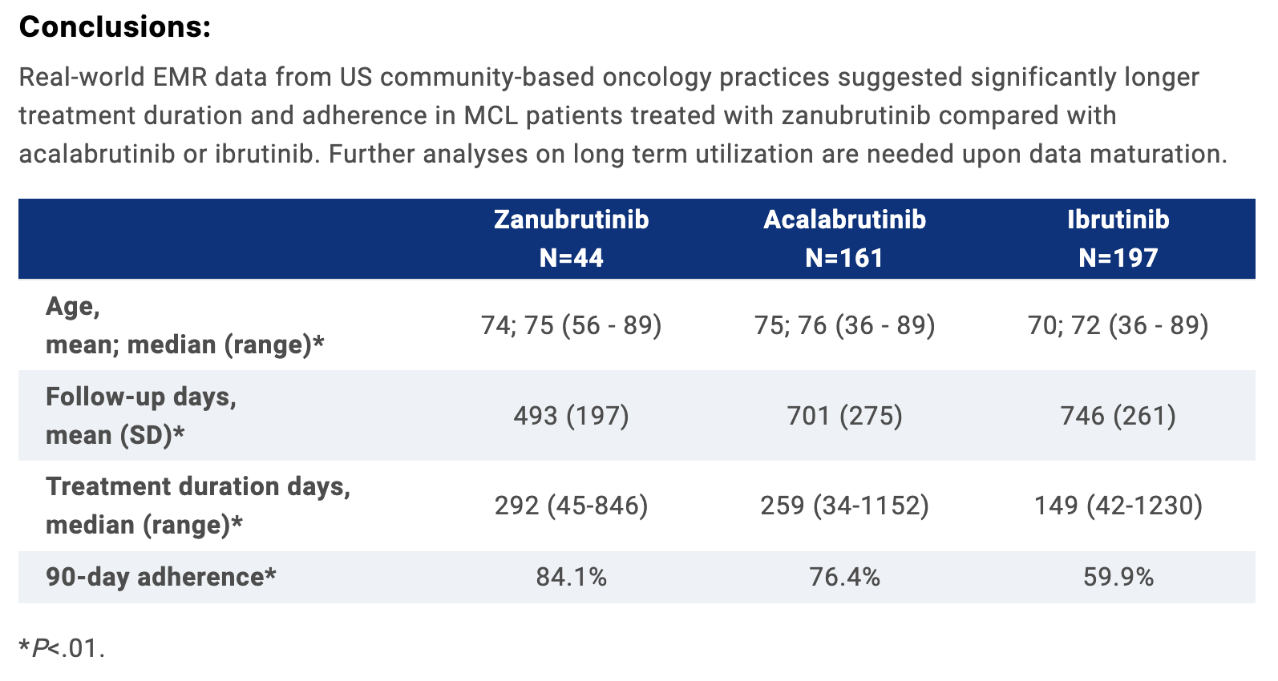
Bijal Shah et al, ASCO 2023

Slide 94

Thank you !
tfenske@mcw.edu
@timfenske

Slide 95
MYELOFIBROSIS/HEMATOLOGY
Wednesday, September 20, 2023

Slide 96
CAR-T cell therapy for lymphoid leukemia
Guru Subramanian Guru Murthy MD, MS
Assistant professor, Hematology/Oncology
Medical College of Wisconsin
Milwaukee, Wisconsin

Slide 97

CD19 CAR-T cells – B-ALL and CLL
CAR-T product | Costimulatory domain | Disease
Tisagenlecleucel | 4-1BB | Approved for B-ALL
Brexucabtagene autoleucel | CD28 | Approved for B-ALL
Obe-cel | 4-1BB | Clinical trials in B-ALL
Lisocabtagene maraleucel | 4-1BB | Clinical trials in CLL/SLL

Slide 98
CD-19 CAR-T cell therapy for B-ALL

Slide 99
Published studies
CAR-T type | N | Median age (range) | CR/CRi | Survival
19-28z (MSKCC) | 53 | 44 (23-74) | 83% | Median OS: 12.9 mon Median EFS 6.1 mon
19-41BBz (FHRC) | 53 | 39 (20-76) | 85% | Median OS 20 mon Median EFS 7.6 mon
19-41BBz (CTL019) | 75 | 12 (3-23) | 81% | EFS: 50% (12-mon) OS 76% (12-mon)
19-28z (NCI) | 20 | 14 (5-27) | 70% | OS: 51.6% (10 mon)
19-41BBz (SCRI) | 45 | 12 (1-25) | 89% | EFS: 51% (12 mon) OS: 70% (12 mon)
KTE-X19 (Zuma-3) | 71 | 40 (19-84) | 71% | Median OS 18.2 mon Median RFS 11.6 mon
Park J et al. NEJM. 2018
Hay KA et al. Blood. 2019;
Shah B et al. ASCO 2021
Maude S et al. NEJM 2018
Lee D et al. Lancet. 2015
Gardner R et al. Blood. 2017
Notes:
The published reports with CD19 CAR-T therapy have shown really high rates of CR of 70-90% in patients have not responded to any of the standard therapies for ALL and had relapsed/refractory disease prior to CAR-T therapy. This therapy has changed the outlook of these hard to treat population significantly and future studies are looking to incorporate CAR-T therapy much early in the disease course. The current commercial CAR-T therapy is approved for patients upto age 25, but we will soon have another approval for all adults with a newer CAR

Slide 100
ELIANA study - Tisagenlecleucel
Phase 2 multicenter global study
Children and young adults
Relapsed/refractory B-ALL with atleast 5% blasts at screening
No prior CD-19 directed therapy
Enrolled 92 patients with 79 patients receiving CAR-T infusion
Median age 11 years (range 3-23)
Median 3 prior lines of therapy (range 1-8)
Maude S et al. NEJM 2018
Laetsch TW et al. JCO 2023

Slide 101
Results
CR/CRi – 81%
MRD negative- 95%
OS at 3 years – 62%
Maude S et al. NEJM 2018
Laetsch TW et al. JCO 2023

Slide 102

ZUMA-3 - Brexucabtagene

Slide 103
Baseline characteristics
Shah BD et al. Lancet 2021
Shah BD et al. J Hematol Oncol 2022

Slide 104

Results
Grade 3-4 CRS 24%
Grade 3-4 neurotoxicity 25%
Shah BD et al. Lancet 2021
Shah BD et al. J Hematol Oncol 2022

Slide 105


Obe-cel- AUTO1
Fast-off CD19 CAR-T cell therapy
CR/CRi – 76%
Median follow-up 9.5 months - 61% of responders in remission
3.2% of patients experienced grade 3 or higher CRS
7.4% had grade 3 or higher ICANS
Roddie C et al. JCO 2021
Roddie C et al. ASCO 2023

Slide 106
CD-19 CAR-T cell therapy for CLL

Slide 107
Lisocabtagene – Transcend CLL 004 study
Phase 2 single arm open label study
Relapsed/refractory CLL/SLL
137 patients enrolled; 117 patients received CAR-T
100% prior BTKi exposed (88% refractory)
70% prior BTKi exposed (76% refractory)
86% prior chemoimmunotherapy
Siddiqui T et al. Lancet 2023

Slide 108

Results
Results
CR – 18%
PR – 30%
ORR – 48%
Median duration of response – 35.2 months
Median PFS – 17.8 months
Grade ≥3 CRS 9%
Grade ≥3 neuroevents 19%
Siddiqui T et al. Lancet 2023

Slide 109
Conclusions
CD-19 directed CAR-T cell therapy is safe and effective in patients with relapsed/refractory B-ALL and CLL/SLL
Currently 2 FDA approved CD-19 CAR-T therapy for relapsed/refractory B-ALL
Impact of prior CD19 directed therapy remains unclear
Ongoing studies with different tumor antigen targets and larger confirmatory studies needed.

Slide 110
Updates in Chronic Lymphocytic Leukemia
September 2023

Slide 111
Outline
NCCN guidelines for frontline therapy
Discuss data for different regimens

Slide 112


Slide 113



So many options…

Slide 114

Choosing Frontline CLL Therapy in 2023
Random choice
O: Obinatuzumab, Zanu: Zanubrutinib, Ven: Venetoclax, Acala: Acalabrutinib,
Ibr: Ibrutinib

Slide 115
Results of a Phase 3 Study of IVO vs IO for Previously Untreated Older Patients with CLL and impact of COVID-19 (Alliance).
RANDOMIZE
MRD –ve:
Observe
Obinutuzumab 1000 mg D1, 8, 15 then monthly x 5
Ibrutinib : Cycles 1-19 :d1-d28 420mg PO daily
Venetoclax C3-C14
Age >70 years
PS 0, 1, 2
MRD +ve:
Ibrutinib
Obinutuzumab 1000 mg D1, 8, 15 then monthly x 5
Ibrutinib1 : Cycles 1-15+:d1-d28 420mg PO daily

Slide 116
Results of a phase 3 study of IVO vs IO for previously untreated older patients (pts) with chronic lymphocytic leukemia (CLL) and impact of COVID-19 (Alliance).
N=465 pts were registered (IO:232, IVO:233).
Median age was 74; 67% of pts were men.
Rai stage 3-4 was seen in 55% and del17p in 13%.
Median follow-up of 14 months
PFS: of IO was 87.5% compared to 85% on IVO.
COVID-19 was the leading cause of death in both arms, (11 COVID-19 deaths on IO, 19 on IVO), with 13 and 11 additional deaths from other causes, respectively.
Conclusions: This study demonstrates that PFS for IVO is not superior to IO for treatment-naive older CLL pts in the setting of the COVID-19 pandemic.
Woyach J et al. J Clin Oncol 2023

Slide 117
Choosing Frontline CLL Therapy in 2023
Random choice
O: Obinatuzumab, Zanu: Zanubrutinib, Ven: Venetoclax, Acala: Acalabrutinib,
Ibr: Ibrutinib

Slide 118

Final analysis of the CLL2-GIVe trial: obinutuzumab, ibrutinib, and venetoclax for untreated CLL with del(17p)/TP53mut
Huber H et al. Blood 2023

Slide 119

Final analysis of the CLL2-GIVe trial: obinutuzumab, ibrutinib, and venetoclax for untreated CLL with del(17p)/TP53mut
Huber H et al. Blood 2023

Slide 120
Choosing Frontline CLL Therapy in 2023
Random choice
O: Obinatuzumab, Zanu: Zanubrutinib, Ven: Venetoclax, Acala: Acalabrutinib,
Ibr: Ibrutinib

Slide 121
SEQUOIA: Results of a Phase 3 Randomized Study of Zanubrutinib versus Bendamustine + Rituximab in Patients with Treatment-NaIve Chronic Lymphocytic Leukemia/Small Lymphocytic Lymphoma
Constantine S. Tam, MBBS, MD^{1,2,3,4}; Krzysztof Giannopoulos, MD, PhD^{5,6}; Wojciech Jurczak, MD, PhD⁷; Martin Šimkovič, MD, PhD^{8,9}; Mazyar Shadman, MD, MPH^{10,11};
Anders Österborg, MD, PhD^{12,13}; Luca Laurenti, MD¹⁴; Patricia Walker, MBBS, BMedSci, FRACP, FRCPA¹⁵; Stephen Opat, MBBS (Hons), FRACP, FRCPA^{16,17};
Henry Chan, MBChB, FRACP, FRCPA¹⁸; Hanna Ciepluch, MD, PhD¹⁹; Richard Greil, MD^{20,21,22}; Monica Tani, MD²³; Marek Trněný, MD²⁴; Danielle M. Brander, MD²⁵;
Ian W. Flinn, MD, PhD²⁶; Sebastian Grosicki, MD, PhD²⁷; Emma Verner, MBBS, BMedSci, FRCPA, FRACP^{28,29}; Jennifer R. Brown MD, PhD³⁰; Brad S. Kahl, MD³¹; Paolo Ghia, MD, PhD³²; Jianyong Li, MD, PhD³³; Tian Tian, PhD³⁴; Lei Zhou, MD³⁴; Carol Marimpietri³⁴; Jason C. Paik, MD, PhD³⁴; Aileen Cohen, MD, PhD³⁴; Jane Huang, MD³⁴; Tadeusz Robak, MD, PhD³⁵; and Peter Hillmen, MBChB, PhD³⁶
¹Peter MacCallum Cancer Centre, Melbourne, Victoria, Australia; ²University of Melbourne, Parkville, Victoria, Australia; ³St Vincent’s Hospital Melbourne, Fitzroy, Victoria, Australia; ⁴Royal Melbourne Hospital, Parkville, Victoria, Australia; ⁵Experimental Hematooncology Department, Medical University of Lublin, Lublin, Poland; ⁶Hematology Department, St. John's Cancer Centre, Lublin, Poland; ⁷Maria Sklodowska-Curie National Research Institute of Oncology, Krakow, Poland; ⁸Fourth Department of Internal Medicine - Haematology, University Hospital, Hradec Kralove, Czech Republic; ⁹Faculty of Medicine, Charles University, Prague, Czech Republic; ¹⁰Fred Hutchinson Cancer Research Center, Seattle, WA, USA; ¹¹Department of Medicine, University of Washington, Seattle, WA, USA; ¹²Department of Oncology-Pathology, Karolinska Institutet, Stockholm, Sweden; ¹³Department of Hematology, Karolinska University Hospital, Stockholm, Sweden; ¹⁴Fondazione Policlinico Universitario A Gemelli UCSC, Rome, Italy; ¹⁵Peninsula Private Hospital, Frankston, Victoria, Australia; ¹⁶Monash Health, Clayton, Victoria, Australia; ¹⁷Monash University, Clayton, Victoria, Australia; ¹⁸North Shore Hospital, Auckland, New Zealand; ¹⁹Copernicus Regional Oncology Center, Gdansk, Poland; ²⁰Third Medical Department with Hematology, Medical Oncology, Rheumatology and Infectiology, Paracelsus Medical University, Salzburg, Austria; ²¹Salzburg Cancer Research Institute (SCRI) Center for Clinical Cancer and Immunology Trials (CCCIT), Salzburg, Austria; ²²Cancer Cluster Salzburg (CCS), Salzburg, Austria; ²³Hematology Unit, Santa Maria delle Croci Hospital, Ravenna, Italy; ²⁴First Department of Medicine, First Faculty of Medicine, Charles University, General Hospital, Prague, Czech Republic; ²⁵Hematologic Malignancies and Cellular Therapy, Duke University School of Medicine, Durham, NC, USA; ²⁶Sarah Cannon Research Institute/Tennessee Oncology, Nashville, TN, USA; ²⁷Department of Hematology and Cancer Prevention, Health Sciences Faculty, Medical University of Silesia, Katowice, Poland; ²⁸Concord Repatriation General Hospital, Concord, New South Wales, Australia; ²⁹University of Sydney, Sydney, New South Wales, Australia; ³⁰Dana-Farber Cancer Institute, Boston, MA, USA; ³¹Washington University School of Medicine, St Louis, MO, USA; ³²Università Vita-Salute San Raffaele and IRCCS Ospedale San Raffaele, Milano, Italy; ³³Department of Hematology, The First Affiliated Hospital of Nanjing Medical University, Jiansu Province Hospital, Nanjing, China; ³⁴BeiGene (Beijing) Co., Ltd., Beijing, China and BeiGene USA, Inc., San Mateo, CA, USA; ³⁵Medical University of Lodz, Lodz, Poland; and ³⁶St James’s University Hospital, Leeds, United Kingdom
Sunday, December 12, 2021
642. Chronic Lymphocytic Leukemia: Clinical and Epidemiological I
63rd ASH Annual Meeting and Exposition, December 11-14, 2021
Abstract 396

Slide 122
SEQUOIA (BGB-3111-304)
Study Design
Arm A: Zanubrutinib
160 mg bid until PD, intolerable
toxicity, or end of study
Cohort 1
without del(17p) by central FISH
planned n ~450
open-label
Key Eligibility Criteria
Untreated CLL/SLL
Met iwCLL criteria for treatment
≥65 y of age OR unsuitable for treatment with FCRª
Anticoagulation and CYP3A inhibitors allowed
R 1:1
Arm B:
Bendamustine (90 mg/m² D1 & D2)
+ Rituximab (375 mg/m² C1, then 500 mg/m² C2-C6)
x 6 cycles
Stratification Factors
Age, Binet stage,
IGHV status, geographic region
Cohort 2
with del(17p)
planned n ~100
Arm C: Zanubrutinib
ClinicalTrials.gov: NCT03336333
Cohort 3¹
with del(17p)
planned n ~80
Arm D: Zanubrutinib + Venetoclax
ªDefined as Cumulative Illness Rating Scale >6, creatinine clearance <70 mL/min, or a history of previous severe infection or multiple infections within the last 2 years.
C, cycle; CLL/SLL, chronic lymphocytic leukemia/small lymphocytic lymphoma; CYP3A, cytochrome P450, family 3, subfamily A; D, day; del(17p), chromosome 17p deletion; FCR, fludarabine, cyclophosphamide, and rituximab; FISH, fluorescence in-situ hybridization; IRC, independent review committee; IGHV, gene encoding the immunoglobulin heavy chain variable region; iwCLL, International Workshop on CLL; ORR, overall response rate; PD, progressive disease; R, randomized.
1. Tedeschi A, et al. ASH 2021. Abstract 67.

Slide 123
Select Baseline Patient and Disease Characteristics
 | Arm A Zanubrutinib (n=241) | Arm B Bendamustine + Rituximab (n=238)
Median age, years (IQR) | 70 (66–75) | 70 (66–74)
Age ≥65, n (%) | 196 (81.3) | 192 (80.7)
Male, n (%) | 154 (63.9) | 144 (60.5)
ECOG PS 2, n (%) | 15 (6.2) | 20 (8.4)
Geographic region, n (%)
North America | 34 (14.1) | 28 (11.8)
Europe | 174 (72.2) | 172 (72.3)
Asia/Pacific | 33 (13.7) | 38 (16.0)
Binet stage C,ª n (%) | 70 (29.0) | 70 (29.4)
Bulky disease ≥5 cm, n (%) | 69 (28.6) | 73 (30.7)
Cytopenia at baseline,^{b} n (%) | 102 (42.3) | 109 (45.8)
Unmutated IGHV gene, n/N (%) | 125/234 (53.4) | 121/231 (52.4)
Del(11q), n (%) | 43 (17.8) | 46 (19.3)
TP53 mutation, n/N (%) | 15/232 (6.5) | 13/223 (5.8)
ªPatients with SLL had Binet stage calculated as if they had CLL.
^{b}Defined as having anemia (hemoglobin ≤110 g/L) or thrombocytopenia (platelets ≤100×10⁹/L) or neutropenia (absolute neutrophil count ≤1.5×10⁹/L).
CLL, chronic lymphocytic leukemia; del(11q), chromosome 11q deletion; ECOG PS, Eastern Cooperative Oncology Group performance status; IQR, interquartile range; IGHV, gene encoding the immunoglobulin heavy chain variable region; SLL, small lymphocytic lymphoma; TP53, gene encoding tumor protein p53.
Notes:
You may be questioned regarding the following:
Why does it appear that the unmutated IGHV rate is lower than reported in Alliance (61%)
Complex karyotype? [Data analyses is incomplete / not yet available]

Slide 124

Progression-Free Survival Per IRC Assessment
BR, bendamustine + rituximab; IRC, independent review committee; PFS, progression-free survival.

Slide 125


Progression-Free Survival Per IRC Assessment by IGHV Status
BR, bendamustine + rituximab; IGHV, gene encoding the immunoglobulin heavy chain variable region;
IRC, independent review committee.

Slide 126

Overall Survival
Median Follow-Up: 26.2mo. BR, bendamustine + rituximab.
Notes:
We would emphasize that at this early timepoint, no OS difference was observed.

Slide 127
Adverse Events of Interest
AE, n (%) | Arm A Zanubrutinib (n=240ª) |  | Arm B Bendamustine + Rituximab (n=227ª)
 | Any Grade | Grade ≥3 | Any Grade | Grade ≥3
Anemia | 11 (4.6) | 1 (0.4) | 44 (19.4) | 4 (1.8)
Neutropenia^{b} | 38 (15.8) | 28 (11.7) | 129 (56.8) | 116 (51.1)
Thrombocytopenia^{c} | 11 (4.6) | 5 (2.1) | 40 (17.6) | 18 (7.9)
Arthralgia | 32 (13.3) | 2 (0.8) | 20 (8.8) | 1 (0.4)
Atrial fibrillation | 8 (3.3) | 1 (0.4) | 6 (2.6) | 3 (1.3)
Bleeding^{d} | 108 (45.0) | 9 (3.8) | 25 (11.0) | 4 (1.8)
Major bleeding^{e} | 12 (5.0) | 9 (3.8) | 4 (1.8) | 4 (1.8)
Diarrhea | 33 (13.8) | 2 (0.8) | 31 (13.7) | 5 (2.2)
Hypertension^{f} | 34 (14.2) | 15 (6.3) | 24 (10.6) | 11 (4.8)
Infections^{g} | 149 (62.1) | 39 (16.3) | 127 (55.9) | 43 (18.9)
Myalgia | 9 (3.8) | 0 (0.0) | 3 (1.3) | 0 (0.0)
Other cancers | 31 (12.9) | 17 (7.1) | 20 (8.8) | 7 (3.1)
Dermatologic other cancers | 16 (6.7) | 2 (0.8) | 10 (4.4) | 2 (0.9)
ªSafety was assessed in patients who received ≥1 dose of treatment; 1 patient in Arm A and 11 patients in Arm B did not receive treatment. ^{b}Neutropenia, neutrophil count decreased, or febrile neutropenia. ^{c}Thrombocytopenia or platelet count decreased. ^{d}Pooled term of all-cause bleeding including bruising, petechiae, purpura, and contusion. ^{e}Major bleeding included all grade ≥3, serious, and any-grade central nervous system hemorrhage. ^{f}Hypertension, blood pressure increased, or hypertensive crisis. ^{g}All infection terms pooled.
AE, adverse event.
Notes:
We would emphasize higher rates of cytopenias in B+R arm, higher rates of all cause bleeding in zanu arm, as expected. The rates of atrial fibrillation was not different, including numerically lower rate of G3+ afib in zanu arm.
We will supply a list of the major bleeding events.

Slide 128

Cohort 2: PFS Per IRC Assessment in Patients With Del(17p)
Median follow-up: 30.5 mo
24-mo PFS: 88.9% (95% CI, 81.3–93.6)
Del(17p), chromosome 17p deletion; IRC, independent review committee; PFS, progression-free survival.

Slide 129
CONCLUSIONS
Zanubrutinib demonstrated superiority in progression-free survival over bendamustine + rituximab (hazard ratio 0.42, 2-sided P<0.0001) as assessed by independent review
Superiority was also observed across high-risk subgroups, such as patients with unmutated IGHV and del(11q)
Consistent with other zanubrutinib studies, zanubrutinib appeared well tolerated with no new safety signals identified; the rate of atrial fibrillation was low
These data demonstrate that a chemotherapy-free treatment using a potent and selective BTK inhibitor is safe and effective for patients with treatment-naive CLL/SLL
BTK, Bruton tyrosine kinase; CLL/SLL, chronic lymphocytic leukemia/small lymphocytic lymphoma; IGHV, gene encoding the immunoglobulin heavy chain variable region.

Slide 130
Choosing Frontline CLL Therapy in 2023
O: Obinatuzumab, Zanu: Zanubrutinib, Ven: Venetoclax, Acala: Acalabrutinib,
Ibr: Ibrutinib

Slide 131

CAPTIVATE: Study Design
Multicenter, randomized phase II study

Slide 132
Ibrutinib Plus Venetoclax for First-Line Treatment of Chronic Lymphocytic Leukemia: Primary Analysis Results From the Minimal Residual Disease Cohort of the Randomized Phase II CAPTIVATE Study
N=164 pts were enrolled. Median age was 58 years (range, 28-69).
High-risk features:
  Unmutated IGHV (60% of pts),
  del(17p)/TP53 mutation (20%),
  complex karyotype (19%), and del(11q) without del(17p) (17%).
After 12 cycles of Ibr + Ven, 149 pts were randomized: Confirmed uMRD to placebo (n=43) or Ibr (n=43); without Confirmed uMRD to Ibr (n=31) or Ibr + Ven (n=32). Median overall follow-up was 38.2 mo (range, 15.0-47.9); median post-randomization follow-up was 24.0 mo (range, 5.8-33.1).
Confirmed uMRD randomized to placebo versus Ibr:
  Estimated 36-mo PFS rates were 95% with placebo and 100% with Ibr.
In pts without Confirmed uMRD randomized to Ibr vs Ibr + Ven:
  Estimated 36-mo PFS rates were 97% with both Ibr and Ibr + Ven.
Weirda et al. J Clin Oncol 2021

Slide 133
Fixed-duration ibrutinib plus venetoclax for first-line treatment of CLL: primary analysis of the CAPTIVATE FD cohort
N=159 patients
High risk features:
  del(17p) and/or mutated TP53 (n = 27; 17%)
  Complex karyotype (n = 31; 19%),
  Unmutated IGHV (n = 89; 56%)
Tam CS. Blood 2022

Slide 134

Fixed-duration ibrutinib plus venetoclax for first-line treatment of CLL: primary analysis of the CAPTIVATE FD cohort
Tam CS. Blood 2022

Slide 135
Fixed-Duration Ibrutinib-Venetoclax in Patients with Chronic Lymphocytic Leukemia and Comorbidities-GLOW Trial
RANDOMIZE
Three cycles of ibrutinib lead-in at 420 mg once daily,
Followed by 12 cycles of ibrutinib-venetoclax with ramp up
N = 211
17p del/TP53 mutation excluded
Primary Endpoint: PFS
Obinutuzumab 1000 mg D1, 8, 15 then monthly x 6
Chlorambucil 0.5 mg/kg orally D 1, 15 x 6 months
Kater et al. NEJM evidence 2022

Slide 136

Fixed-Duration Ibrutinib-Venetoclax in Patients with Chronic Lymphocytic Leukemia and Comorbidities-Results
30-month PFS:
80.5% for ibrutinib-venetoclax and 35.8% chlorambucil-obinutuzumab
Kater et al. NEJM evidence 2022

Slide 137


Slide 138
Choosing Frontline CLL Therapy in 2023
O: Obinatuzumab, Zanu: Zanubrutinib, Ven: Venetoclax, Acala: Acalabrutinib,
Ibr: Ibrutinib

Slide 139
Acalabrutinib, Venetoclax, and Obinutuzumab as Frontline Treatment
A starts at 100 mg BID for 28 days,
Followed by 2 cycles of AO (O at standard dosing)
V starts on C4D1 with 4 week ramp up
AVO continues C5-7 (6 total cycles of O)
AV continues C8-15. If the primary endpoint of undetectable bone marrow MRD (BM-uMRD) CR is reached at C16D1, pts can discontinue therapy (tx); all others continue AV through C24, with the option to discontinue if BM-uMRD at C25D1.
Davids MS. Lancet Oncol. 2021 Oct;22(10):1391-1402
Ryan C et al. Blood 2022

Slide 140
Acalabrutinib, Venetoclax, and Obinutuzumab as Frontline Treatment
56 Evaluable patents patients
Median follow-up was 35 months (2-45)
At cycle 16 day 1, 24 (43%) of 37 participants had a complete remission with undetectable MRD in the bone marrow.
Davids MS. Lancet Oncol. 2021 Oct;22(10):1391-1402
Ryan C et al. Blood 2022

Slide 141

Figure 3
Acalabrutinib, Venetoclax, and Obinutuzumab as Frontline Treatment: Rates of undetectable MRD
TP53-aberrant disease
All patients
The Lancet Oncology 2021 221391-1402DOI: (10.1016/S1470-2045(21)00455-1)
Notes:
Rates of undetectable MRD in the peripheral blood of all patients (A) and in bone marrow for all patients (B), patients with IGHV-mutated disease (C), patients with IGHV-unmutated disease (D), and patients with TP53-aberrant disease (E) at the start of indicated cycles
Data on bars are n/N (%) of eligible patients in each subgroup. MRD=minimal residual disease.

Slide 142
Choosing Frontline CLL Therapy in 2023
O: Obinatuzumab, Zanu: Zanubrutinib, Ven: Venetoclax, Acala: Acalabrutinib,
Ibr: Ibrutinib

Slide 143
Zanubrutinib, Obinutuzumab, and Venetoclax with MRD Disease-Driven Discontinuation in previously untreated patients with CLL/SLL
Zanubrutinib at 160 mg twice per day starting in cycle 1 on day 1 + Obinutuzumab at 1000 mg on day 1, 2, 8 and 15 of cycle 1, and day 1 of cycles 2-8
Venetoclax ramp up to 400 mg per day starting in cycle 3 on day
Discontinued after 8-24 cycles when prespecified undetectable MRD criteria were met in the peripheral blood and bone marrow.
Soumerai JD et al. Lancet Haematol. 2021

Slide 144
Zanubrutinib, Obinutuzumab, and Venetoclax with MRD Disease-Driven Discontinuation in previously untreated patients with CLL/SLL
39 patients were enrolled and treated.
High risk features:
  72% IGVH
  13% 17p deletion or TP53 mutation.
Median follow-up of 25·8 months
33 (89%) of 37 patients had undetectable MRD in both blood and bone marrow
Soumerai JD et al. Lancet Haematol. 2021 Dec;8(12):e879-e890.

Slide 145
Choosing Frontline CLL Therapy in 2023
O: Obinatuzumab, Zanu: Zanubrutinib, Ven: Venetoclax, Acala: Acalabrutinib,
Ibr: Ibrutinib

Slide 146


Study design
Arm A – Ibrutinib + Rituximab
Cycles 1:
Ibrutinib 420 mg PO daily, days 1-28
Cycle 2:
Ibrutinib 420 mg PO daily, days 1-28
Rituximab 50 mg/m² IV, day 1
Rituximab 325 mg/m² IV, day 2
Cycles 3-7:
Ibrutinib 420 mg PO daily, days 1-28
Rituximab 500 mg/m² IV, day 1
Cycle 8 until progression:
Ibrutinib 420 mg PO daily, days 1-28
E1912
Eligibility:
-Previously untreated CLL
-Requires treatment (IWCLL 2008)
-Age < 70
-ECOG 0-2
-CrCL>40
-Able to tolerate FCR
-No deletion 17p by FISH
Randomization
Disease Progression
Arm B - FCR
Cycles 1-6:
Fludarabine 25 mg/m² IV, days 1-3
Cyclophosphamide 250 mg/m² IV, days 1-3
Cycle 1:
Rituximab 50 mg/m² IV, day 1, cycle 1
Rituximab 325 mg/m² IV, day 2, cycle 1
Cycle 2-6:
Rituximab 500 mg/m² IV, day 1, cycles 2-6
Planned Accrual: 519

Slide 147
Patient Characteristics Were Well Balanced
Baseline characteristics | IR n=354 | FCR n=175 | Total
Median age (y) | 58 | 57 | 58
Age > 60 | 41.0% | 40.0% | 40.6%
Female | 33.3% | 31.4% | 32.7%
ECOG = 0 | 63.8% | 62.3% | 63.3%
Rai stage 0 | 3.1% | 5.1% | 3.8%
Rai stage I-II | 52.8% | 53.7% | 53.1%
Rai stage III-IV | 44.1% | 41.1% | 43.1%
FISH 11q deletion | 22.0% | 22.3% | 22.2%
Trisomy 12 | 19.8% | 15.4% | 18.3%
13q deletion | 34.2% | 33.1% | 33.8
B2M >3.5 mg/L | 51.9% | 48.0% | 50.6%
IGHV Unmutated* | 75.0% | 61.7% | 71.1%
* Tested in 437 (82%) patients

Slide 148
Progression Free Survival
Intent to Treat
Eligible
HR = 0.35 (95% CI 0.22-0.5)
One sided p<0.00001
HR = 0.32 (95% CI 0.20-0.51)
One sided p<0.00001

Slide 149
PFS Sub-Group Analysis

Slide 150
Progression Free Survival: IGHV Status
IGHV Unmutated
IGHV Mutated
HR=0.26 (95% CI 0.14-0.50)One sided p<0.00001
HR = 0.44 (95% CI 0.14 – 1.36) One sided p=0.07

Slide 151
Overall Survival
Intent to Treat
Eligible
HR = 0.17 (95% CI 0.05-0.54)
One sided p<0.0003
HR = 0.13 (95% CI 0.03-0.46)
One sided p<0.0001

Slide 152
Choosing Frontline CLL Therapy in 2023
O: Obinatuzumab, Zanu: Zanubrutinib, Ven: Venetoclax, Acala: Acalabrutinib,
Ibr: Ibrutinib

Slide 153
CLL 14 trial
RANDOMIZE
Obinutuzumab 1000 mg D1, 8, 15 then monthly x 6
Venetoclax start on D22 x 12 months
N = 432
CIRS ≥6
Primary Endpoint: PFS
Obinutuzumab 1000 mg D1, 8, 15 then monthly x 6
Chloranbucil 0.5 mg/kg orally D 1, 15 x 12 months
https://www.venclextahcp.com

Slide 154
Results
Endpoint | VENCLEXTA + Obinutuzumab (N = 216) | Obinutuzumab + Chlorambucil (N = 216) | p
PFS
Number of events, n (%) | 29 (13) | 79 (37) | <0.0001
Disease progression | 14 (6) | 71 (33)
Death | 15 (7) | 8 (4)
Response ratec, n (%)
ORR | 183 (85) | 154 (71)
CR | 100 (46) | 47 (22)
CR+CRi | 107 (50) | 50 (23)
PR | 76 (35) | 104 (48)
CI = confidence interval; HR = hazard ratio; CR = complete remission; CRi = complete remission with incomplete marrow recovery; PR = partial remission; ORR = overall response rate (CR + CRi + PR). aFrom randomization until earliest event of disease progression or death due to any cause. IRC-

Slide 155
MRD negativity rate-PCR
 | VENCLEXTA + Obinutuzumab | Obinutuzumab + Chlorambucil
N | 216 | 216
Bone marrow, n (%) | 123 (57) | 37 (17)
95% CI | (50, 64) | (12, 23)
p-valuea | <0.0001
Peripheral blood, n (%) | 163 (76) | 76 (35)
95% CI | (69, 81) | (29, 42)
p-value | <0.0001

Slide 156

MRD outcome
Al-Sawaf et al. Lancet Oncology 2020

Slide 157

CLL 14 Outcomes
EFS
Time to next treatment
OS

Slide 158
Choosing Frontline CLL Therapy in 2023
O: Obinatuzumab, Zanu: Zanubrutinib, Ven: Venetoclax, Acala: Acalabrutinib,
Ibr: Ibrutinib

Slide 159
Acalabrutinib With or Without Obinutuzumab vs. Chlorambucil and Obinutuzmab for Treatment-Naive CLL (ELEVATE TN): a Randomised, Controlled, Phase III trial
RANDOMIZE
Oral acalabrutinib 100 mg twice
Obinutuzumab 1000 mg D1, 2, 8 and 15 of cycle 2 then day 1 cycles 3-7
Obinutuzumab 1000 mg D1, 8, 15 then monthly x 6
Chlorambucil 0.5 mg/kg orally D 1, 15 x 12 months
Sharman et al. Lancet 2020

Slide 160


Acalabrutinib with or without obinutuzumab versus chlorambucil and obinutuzmab for treatment-naive chronic lymphocytic leukaemia (ELEVATE TN): a randomised, controlled, phase 3 trial
PFS at 24 months:
93% with acalabrutinib-obinutuzumab
87% with acalabrutinib monotherapy
47% with obinutuzumab-chlorambucil
Sharman et al. Lancet 2020

Slide 161

Acalabrutinib with or without obinutuzumab versus chlorambucil and obinutuzmab for treatment-naive chronic lymphocytic leukaemia (ELEVATE TN): a randomised, controlled, phase 3 trial
Sharman et al. Lancet 2020

Slide 162
Clinical effects of a single dose of cannabinoids to patients with chronic lymphocytic leukemia.
Our results show that a single dose of THC/CBD affects a wide variety of leukocytes and only transiently reduce malignant cells in blood. Based on this study, THC/CBD shows no therapeutic potential for indolent B cell lymphomas
Melen CM et al. Leuk Lymphoma. 2022 Jan 17:1-11.

Slide 163
MYELOFIBROSIS/HEMATOLOGY
Wednesday, September 20, 2023

Slide 164
Question-and-Answer

Slide 165
Concluding Remarks
Thank you for attending!

Slide 166
Thank You to Our Supporters:

Slide 167

Concluding Remarks
Thank you for coming!
Please scan the QR code here to complete a brief survey about tonight's event.

