Slide 1









MULTIPLE MYELOMA
Tuesday January 17, 2023

Slide 2
Welcome
Sharyn Foster, RPh, MBA
Executive Director, Global Ambassador Strategies - Oncology
MJH Life Sciences™

Slide 3


Thank You to Our Supporters:

Slide 4
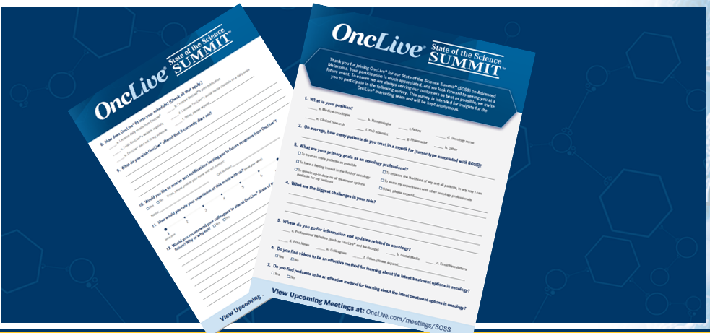

Slide 5
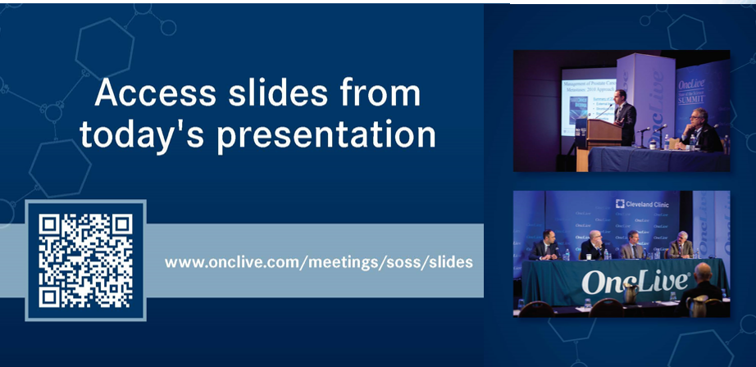

Slide 6
OncLive® is launching
a new app called
Meet MY MSL!
Visit https://cloud.email.onclive.com/referrals to be one of the first health care professionals to gain access to Meet My MSL
Meet My MSL has been created to provide oncologists the opportunity to initiate direct contact with the Medical Science Liaison (MSL) in their area of expertise. It has never been easier to meet, locate, and contact the MSL you need.
Find any MSL from any company for any tumor

Slide 7


Slide 8
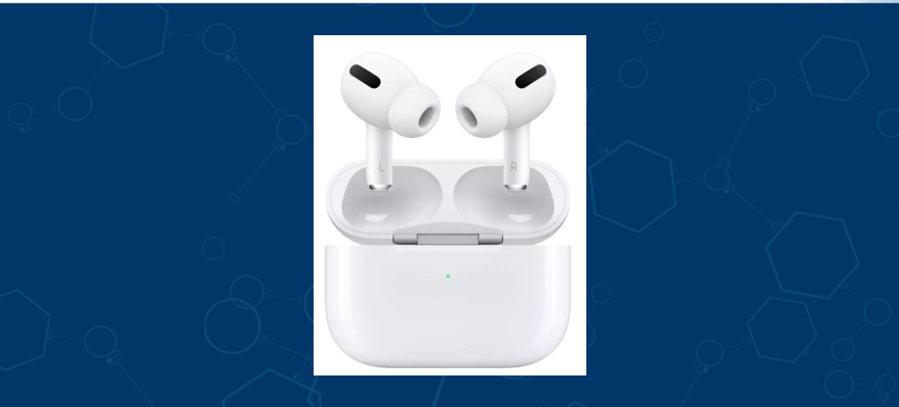

Slide 9
Program Chair
Ehsan Malek, MD
Assistant Professor, Medicine
Case Western Comprehensive Cancer Center
University Hospitals Seidman Cancer Center
Cleveland, OH

Slide 10
MULTIPLE MYELOMA
Tuesday January 17, 2023

Slide 11

Proteosome Inhibitors in Myeloma
Ok-Kyong Chaekal, MD
Associate Professor
UH Seidman Cancer
Case Western Comprehensive Cancer Center
Cleveland, OH

Slide 12
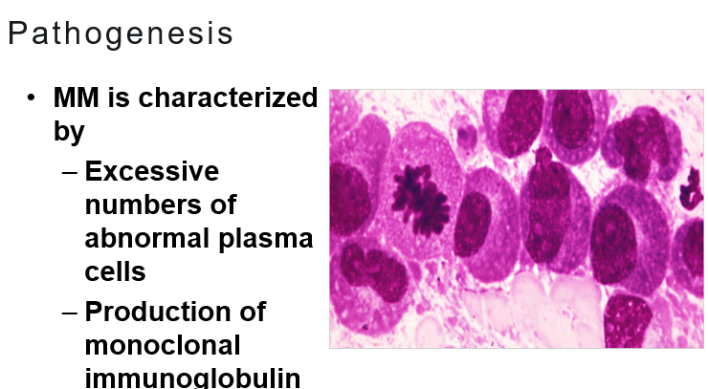

Slide 13
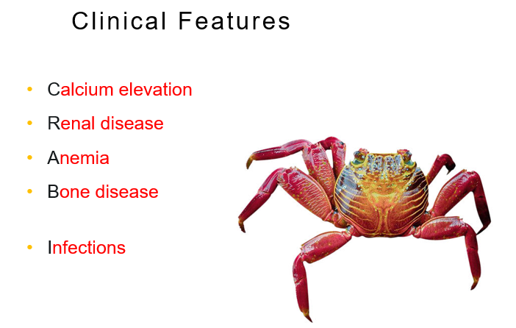

Slide 14
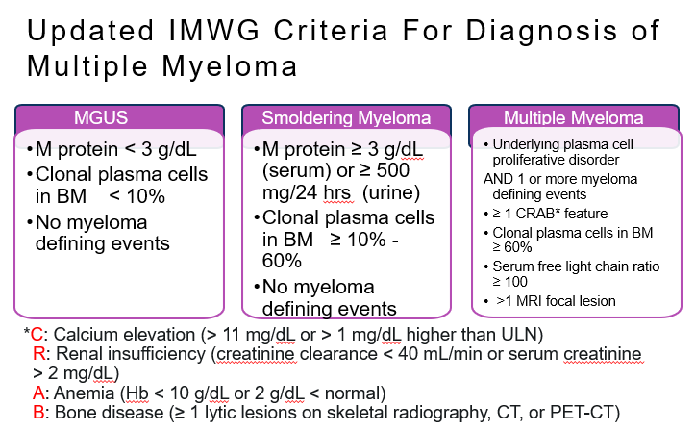

Slide 15
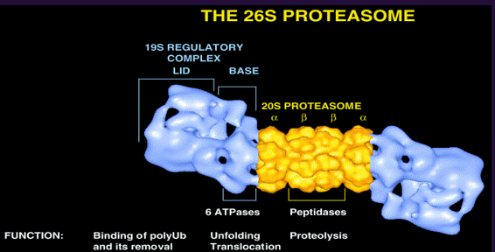
Notes:
Proteasomes are large, multicatalytic protein complexes that cleave cellular proteins into peptides. There are many distinct forms of proteasomes that differ in catalytically active subunits, regulatory subunits, and associated proteins. Proteasome inhibitors are an important class of drugs for the treatment of multiple myeloma and mantle cell lymphoma, and they are being investigated for other diseases. Bortezomib (Velcade) was the first proteasome inhibitor to be approved by the US Food and Drug Administration. Carfilzomib (Kyprolis) and ixazomib (Ninlaro) have recently been approved, and more drugs are in development. While the primary mechanism of action is inhibition of the proteasome, the downstream events that lead to selective cell death are not entirely clear.

Slide 16
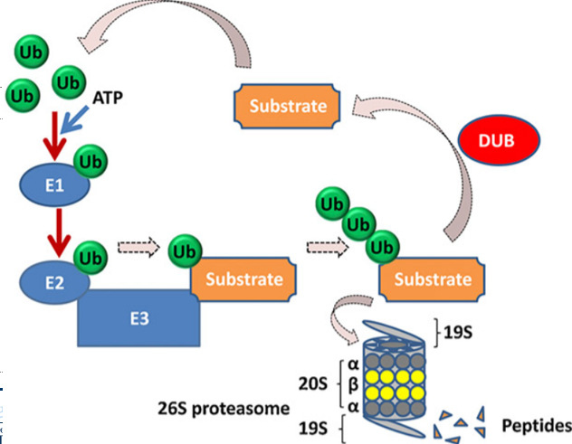

Slide 17

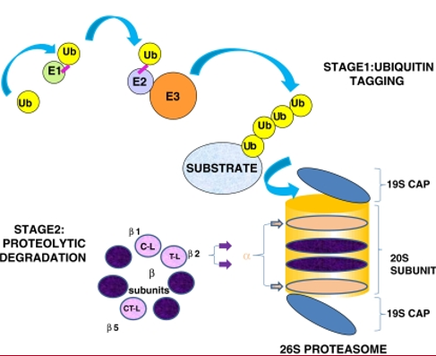
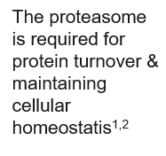

Slide 18
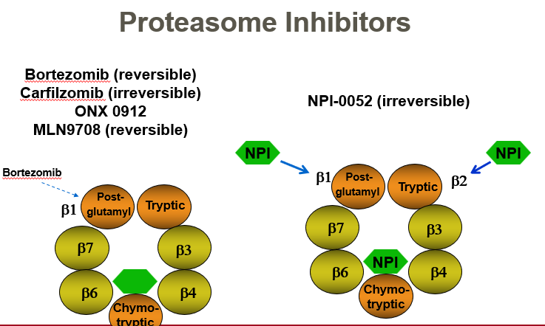

Slide 19
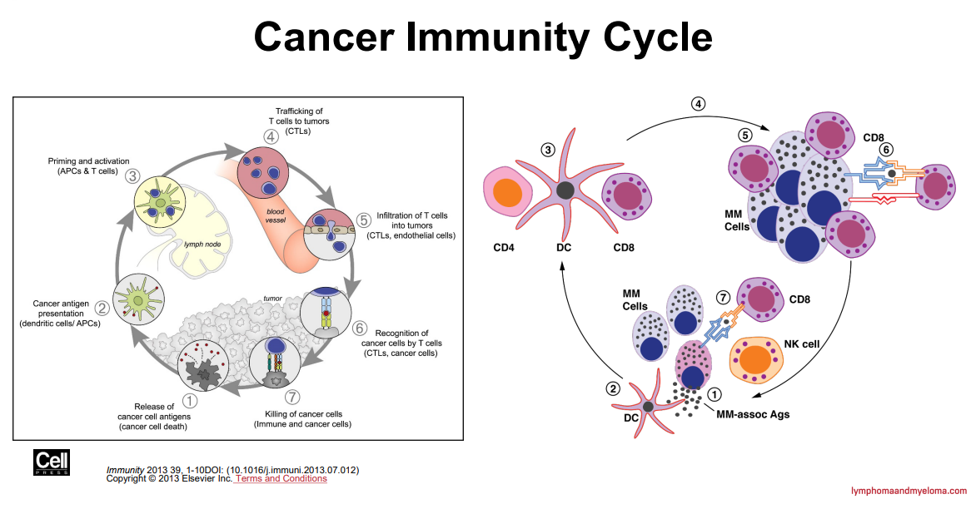

Slide 20
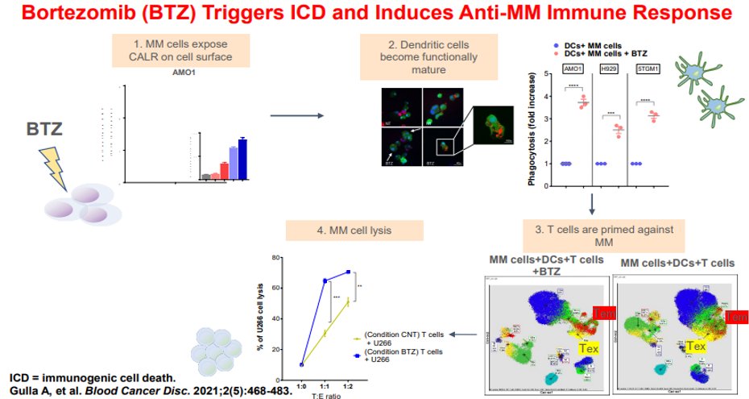

Slide 21
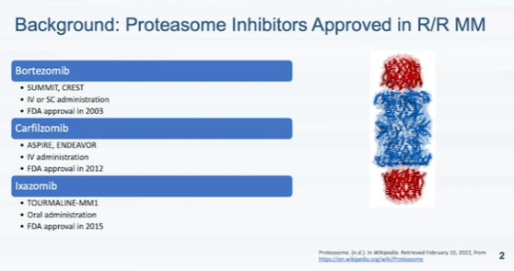

Slide 22
Mechanism of Action
Role of Proteosome Inhibitors in First Line Therapy
Side-Effects
Mechanism of Resistance
Role in Second Line –Relapse
New Developments

Slide 23
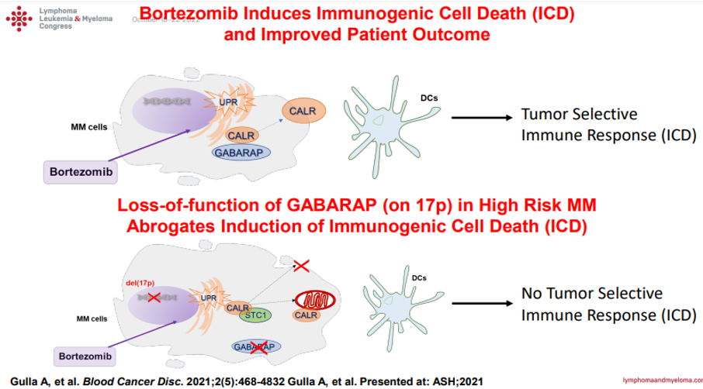

Slide 24
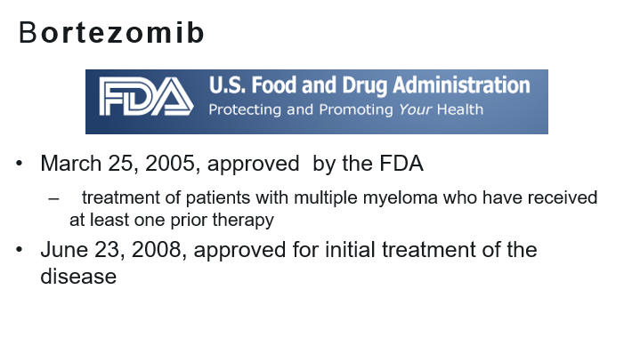

Slide 25
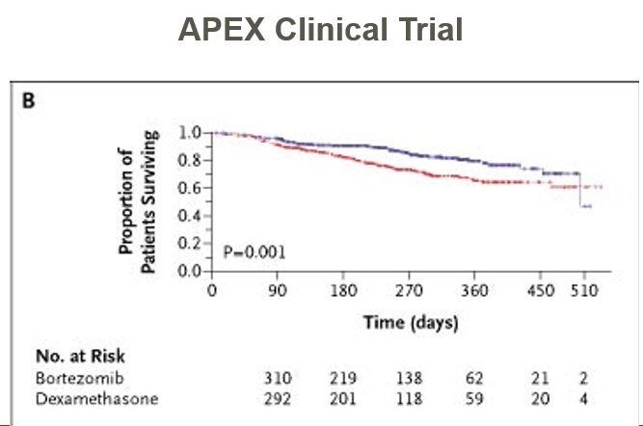

Slide 26
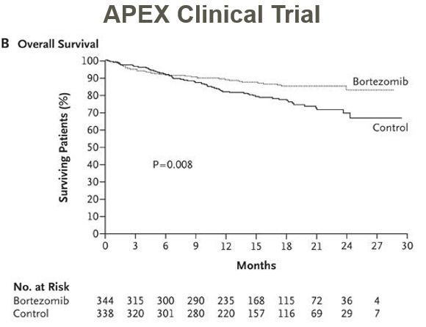

Slide 27
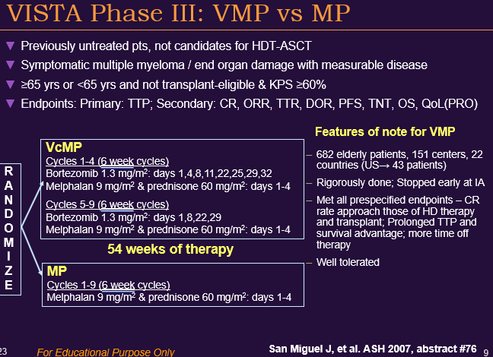

Slide 28
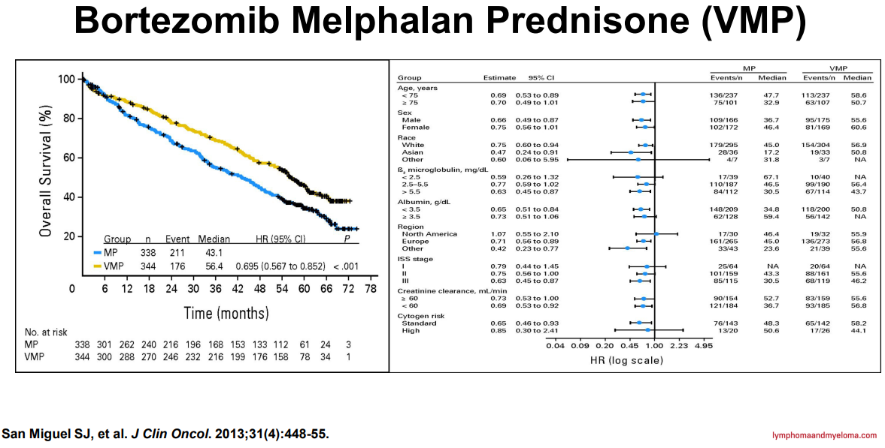

Slide 29
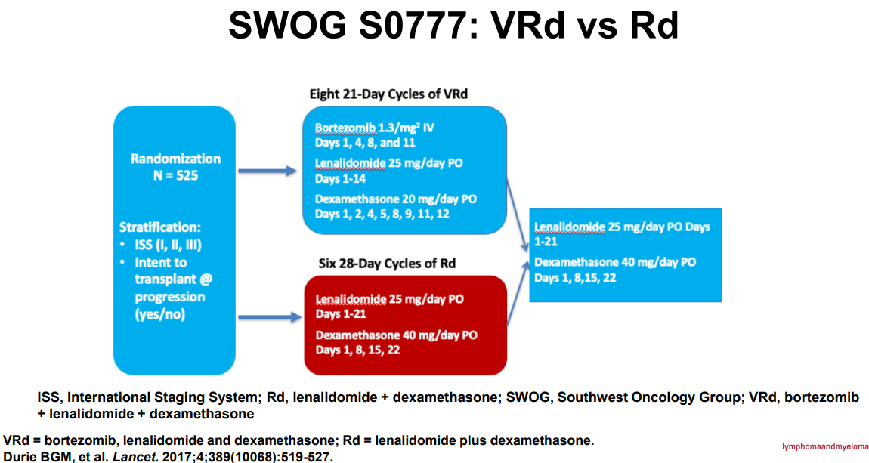

Slide 30
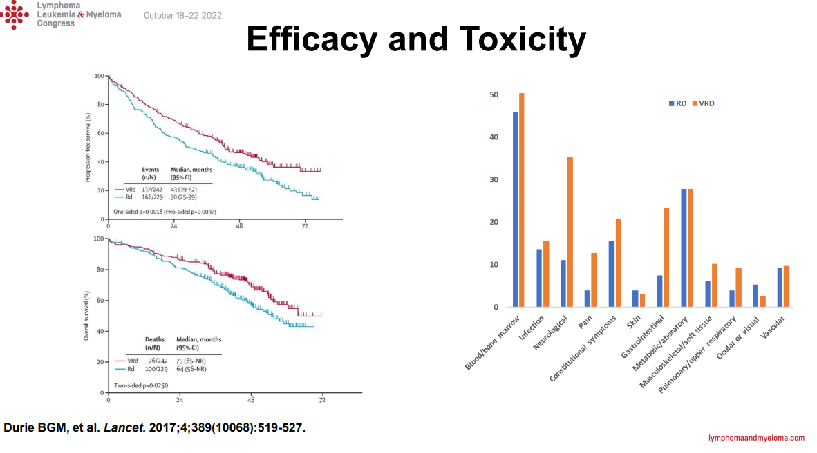

Slide 31


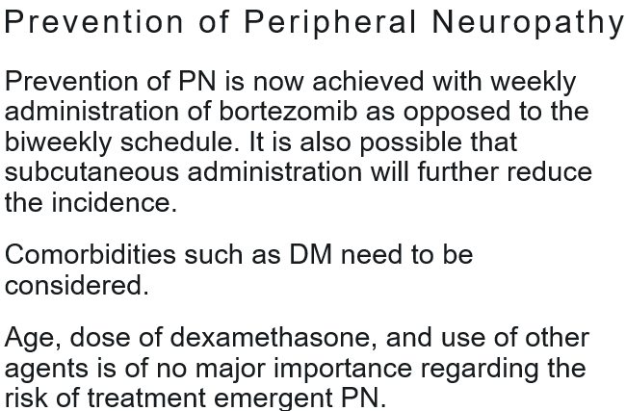
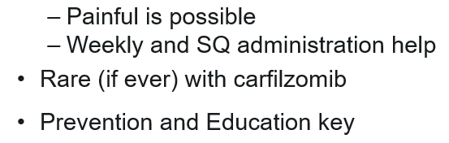

Slide 32
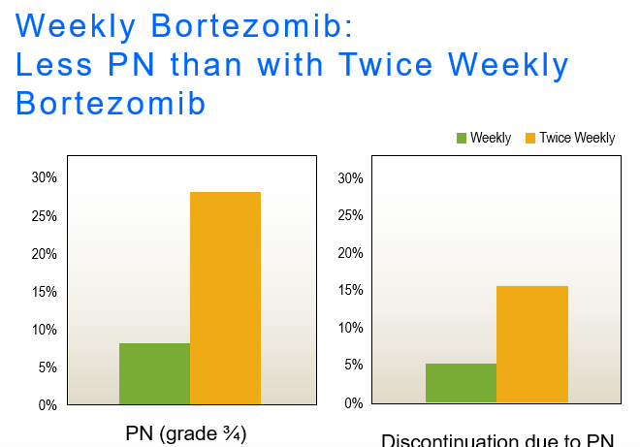

Slide 33
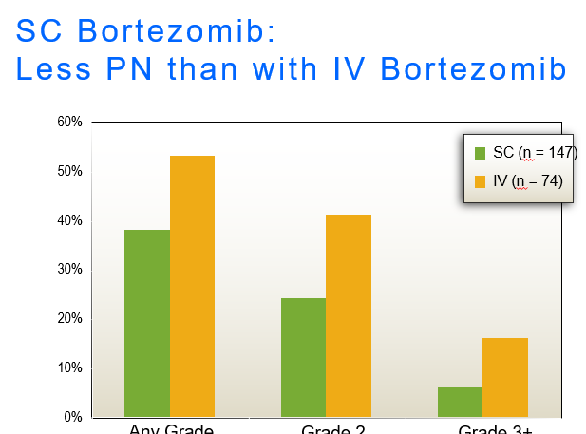

Slide 34
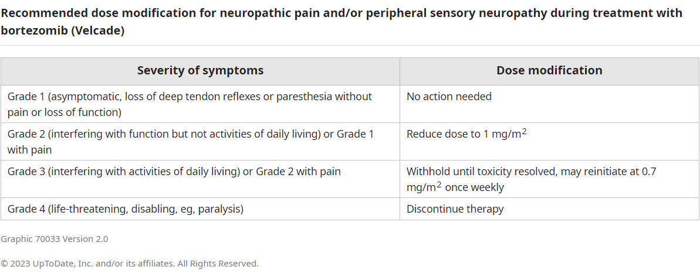

Slide 35
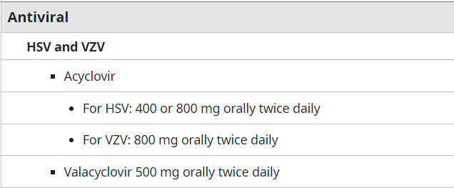

Slide 36
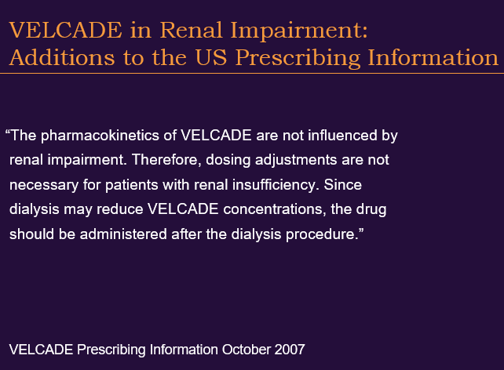

Slide 37
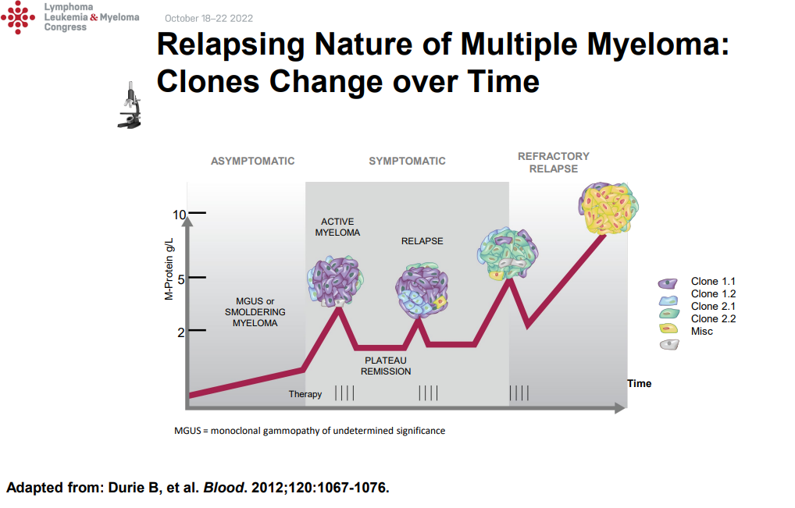

Slide 38
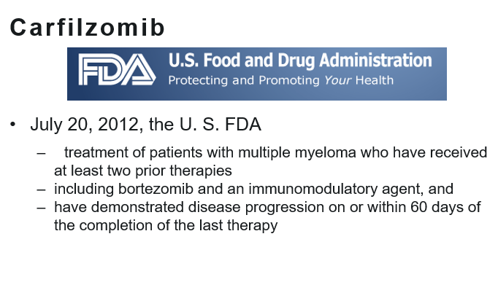

Slide 39
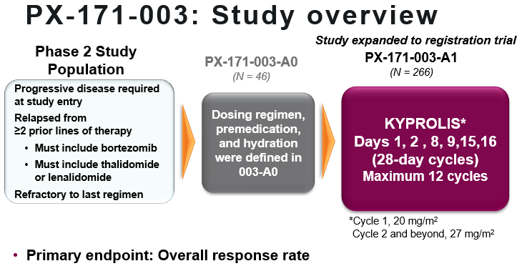

Slide 40
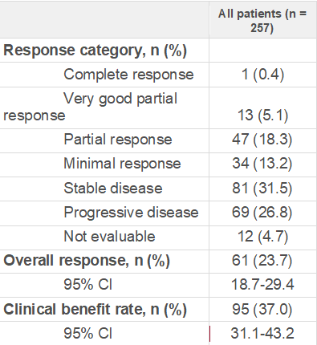
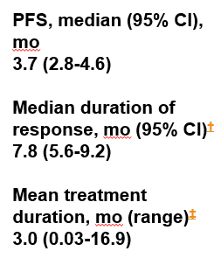

Slide 41
Mechanism of Action
Role of Proteosome Inhibitors in First Line Therapy
Side-Effects
Mechanism of Resistance
Role in Second Line –Relapse
New Developments

Slide 42
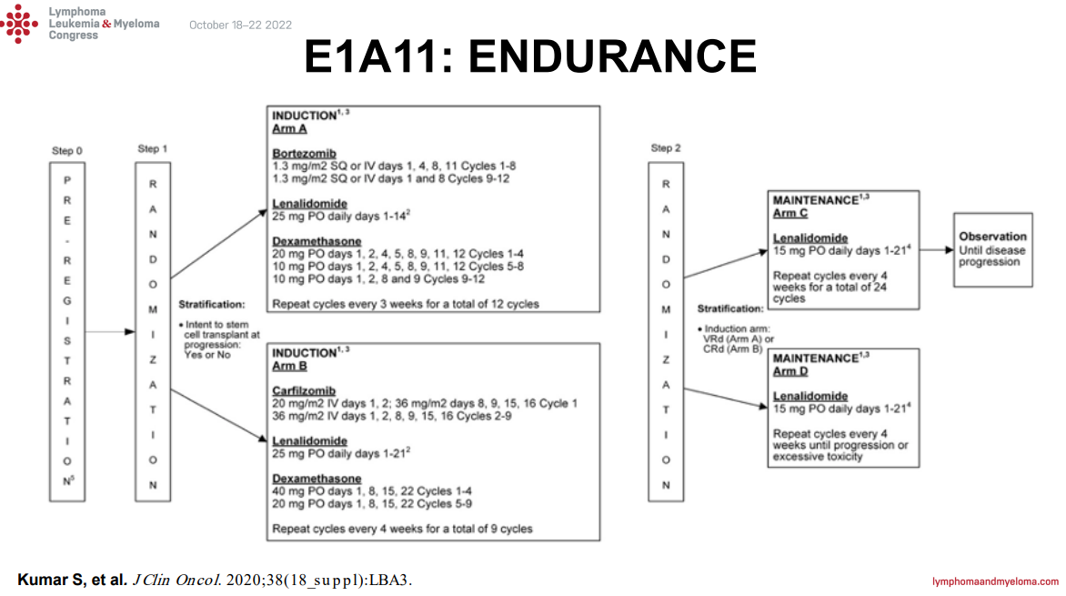

Slide 43
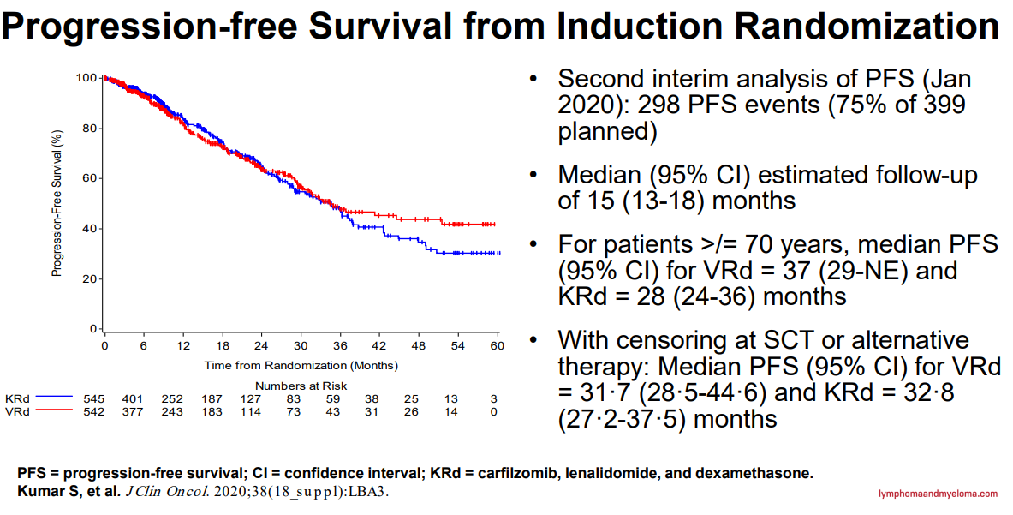

Slide 44
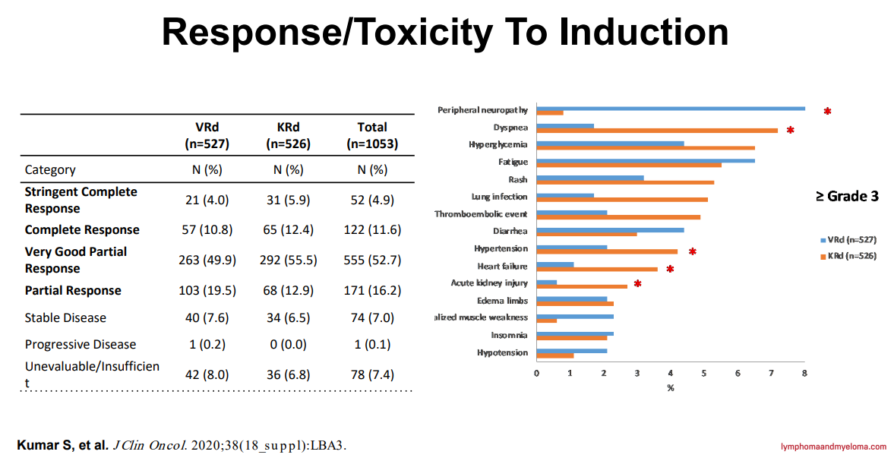

Slide 45
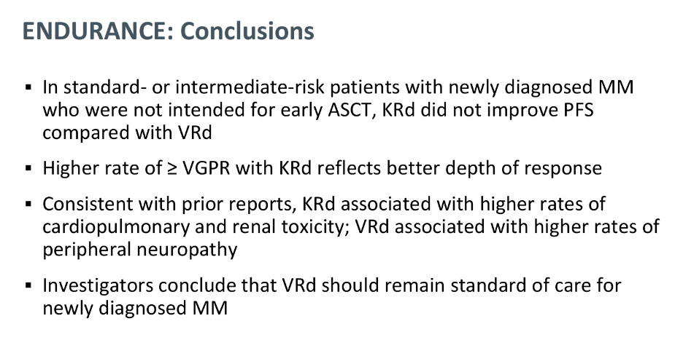

Slide 46
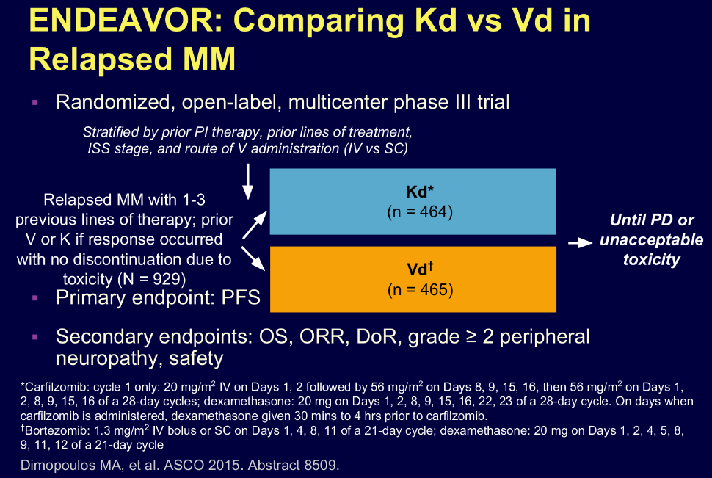

Slide 47
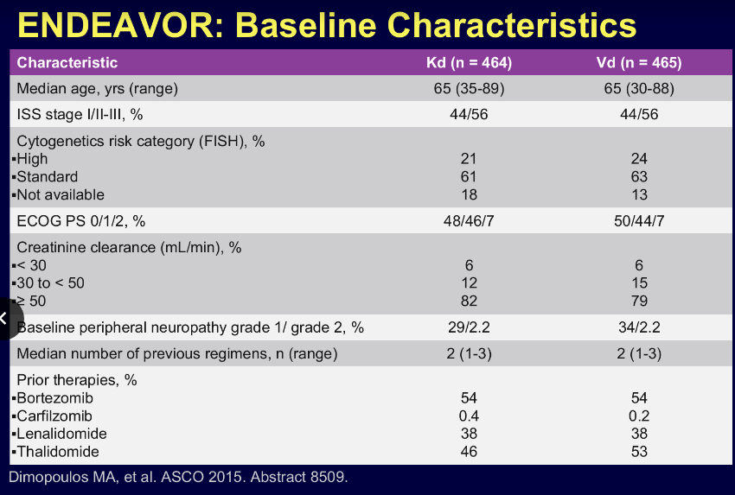

Slide 48
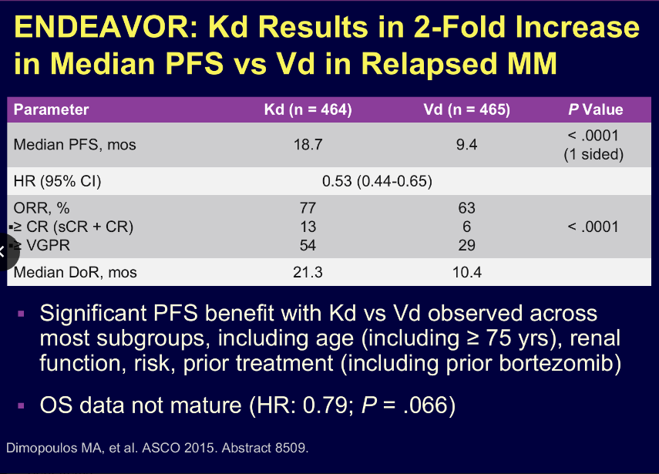

Slide 49
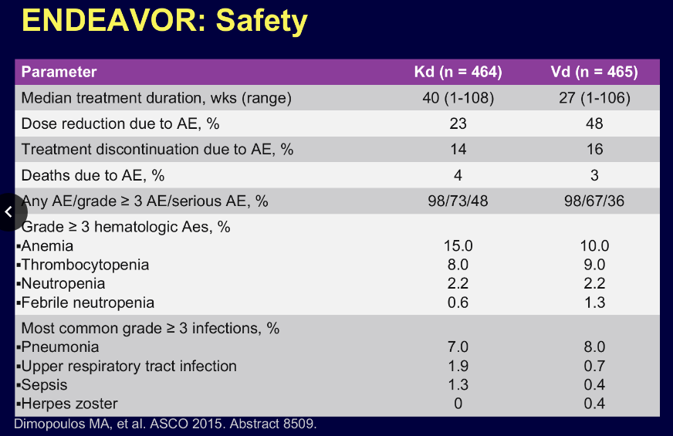

Slide 50
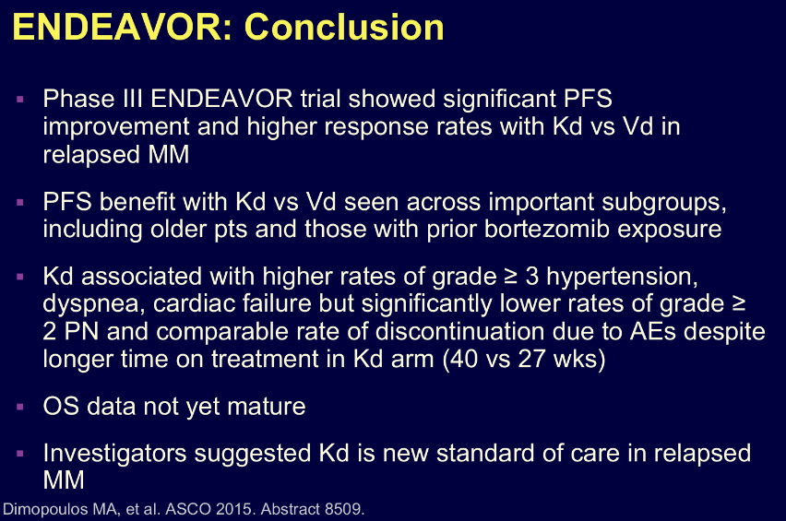

Slide 51
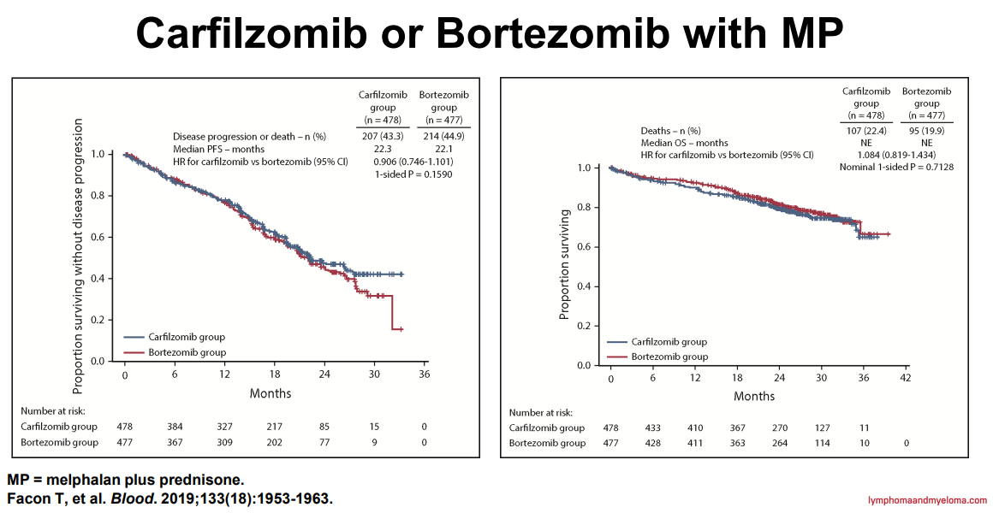

Slide 52
Mechanism of Action
Role of Proteosome Inhibitors in First Line Therapy
Side-Effects
Mechanism of Resistance
Role in Second Line –Relapse
New Developments

Slide 53

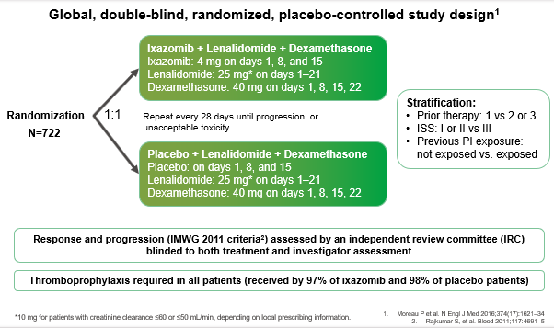

Slide 54
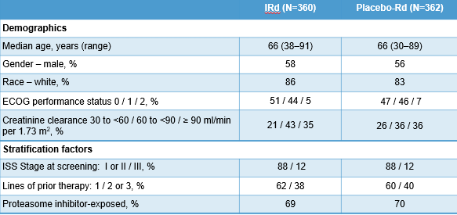

Slide 55
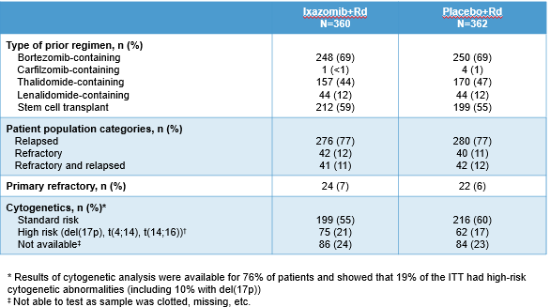

Slide 56

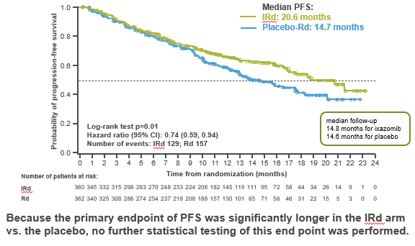

Slide 57

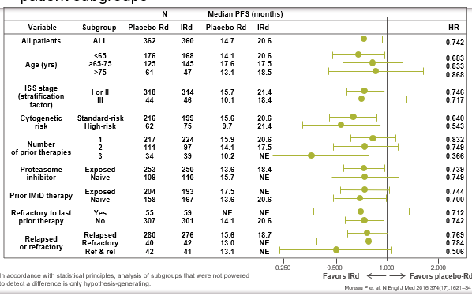

Slide 58

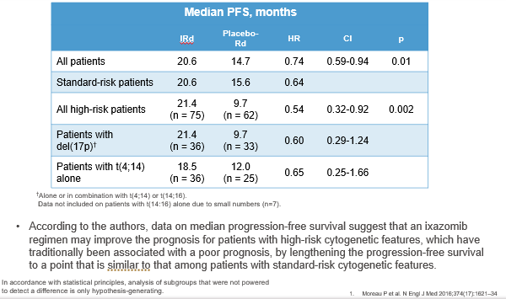

Slide 59


Slide 60


Slide 61



Slide 62



Slide 63


Slide 64


Slide 65


Slide 66


Slide 67


Slide 68

INSURE STUDY

Slide 69


Slide 70
INSURE Conclusion
IRd is effective in RRMM regardless of prior LEN or PI exposure
PFS similar to those reported in TOURMALINE
Prior exposure to LEN or PI should not preclude use of these agents in subsequent LOT

Slide 71


Slide 72


Slide 73


Slide 74


Slide 75


Slide 76


Slide 77


Slide 78




Slide 79


Slide 80
Mechanism of Action
Role of Proteosome Inhibitors in First Line Therapy
Side-Effects
Mechanism of Resistance
Role in Second Line –Relapse
New Developments

Slide 81


Slide 82


Slide 83
Mechanism of Action
Role of Proteosome Inhibitors in First Line Therapy
Side-Effects
Mechanism of Resistance
Role in Second Line –Relapse
New Developments

Slide 84
Mechanism of Action
Role of Proteosome Inhibitors in First Line Therapy
Side-Effects
Mechanism of Resistance
Role in Second Line –Relapse
New Developments

Slide 85


Slide 86


Slide 87


Slide 88


Slide 89


Slide 90

Oral XPO1 inhibitor Selinexor has shown promise in Triple-Class Refractory Multiple Myeloma
Despite advances in treatments
    Multiple myeloma (MM) remains incurable and becomes refractory to immunomodulatory drugs (IMiDs), proteasome inhibitors (PIs) and anti-CD38 monoclonal antibodies (anti-CD38 mAbs).
Patients with triple-class refractory MM (TCR MM) have a poor prognosis.
Oral XPO1 inhibitor selinexor blocks nuclear export and is indicated for treatment of relapsed/refractory MM (RRMM)
    in combination with either dexamethasone (twice-weekly Xd) or bortezomib and dexamethasone (once weekly [QW] XVd) based on the BOSTON study (NCT03110562).¹
Previously, the STOMP phase 1/2 Study (NCT02343042) and a phase 1 Study (NCT02199665)
    Found an overall response rate of 67%² and a median progression free survival extending over a year in patients with TCR MM treated with QW Xd plus the second-generation PI carfilzomib (XKd).³
Based on those results, we further investigated XKd in a subset of STOMP patients with TCR MM.
Selinexor mechanism of action
¹S. Grosicki et al., Lancet. 396, 1563–1573 (2020); ²C. Gasparetto et al., Br J Cancer. 126, 718–725 (2022); ³ A. J. Jakubowiak et al., Br J Haematol. 186, 549–560 (2019).

Slide 91
XPOVIO Evolving Into a Standard of Care with Dose and Schedule
Refined Over Time to Improve Efficacy and Patient Experience
From the STORM trial to the BOSTON trial to the STOMP trial, XPOVIO dosing
has been continually refined to help optimize the patient experience
Approval Date: July 2019
Approval Date: Dec 2020
Ongoing/Completed
1st approval in MM
Dose: 160 mg (80 mg twice weekly)
2nd approval in MM
Dose: 100 mg once weekly
Phase 1/2 study in MM
Dose range: 60-100 mg once weekly
Xd
STORM
XVd
BOSTON
SPd, SKd, SDd
STOMP
Phase 2b, single-arm,
open-label, multicenter study
Patients with penta-refractory MM
Phase 3, 2-arm, active comparator-controlled, open-label, multicenter study
After at least 1 prior therapy in MM
Phase 1/2, open-label, multicenter study
Patients with RRMM
(dose escalation/expansion)
Once Weekly (previously twice weekly)
Lower Dose
(previously a higher dose)
XPOVIO-based Triplets
(previously a doublet)
Earlier Lines
(previously only in later lines)
Supportive Care
(active symptom management)
*STOMP was designed to study selinexor in combination with other MOAs across multiple triplet and quadruplet regimens, including XVd.
MM=multiple myeloma; MOA=mechanism of action; RRMM=relapsed or refractory multiple myeloma.
Combinations other than XVd and Xd are not promoted by Karyopharm, but may be considered for future indication updates

Slide 92

BOSTON: A Phase 3, Global, Randomized, Open Label, Controlled Study in Patients with Multiple Myeloma who Had Received 1-3 Prior Therapies
Primary endpoint: PFS
Key secondary endpoints
ORR
≥VGPR
Grade ≥2 PN
Secondary endpoints:
OS†
DOR
TTNT
Safety
1:1
Randomization
XVd
N = 195
35-day
cycles
SEL: 100 mg PO on days 1, 8, 15, 22, 29
BOR: 1.3 mg/m² SC on days 1, 8, 15, 22
DEX: 20 mg PO on days 1, 2, 8, 9, 15, 16, 22, 23, 29, 30
N=402
5HT-3 prophylactic recommended
Vd
N = 207
21-day
cycles
BOR: 1.3 mg/m² SC on days 1, 4, 8, 11
DEX*: 20 mg PO on days 1, 2, 4, 5, 8, 9, 11, 12
XVd
Pts with prior Vd allowed on trial
Patients with IRC confirmed PD on Vd could crossover to XVd
BOR, bortezomib; DEX, dexamethasone; DOR, duration of response; IRC, independent review committee; OS, overall survival; PD, progressive disease; PFS, progression free survival; PN, peripheral neurophathy; PO, taken orally; SC, subcutaneous; SEL, selinexor; TTNT, time to next treatment; VGPR, very good partial response; Vd, bortezomib + dexamethasone; XVd, selinexor + bortezomib + dexamethasone.
*DEX dosing presented is for cycles 1-8; for cycles ≥9 DEX was given as 20 mg on days 1, 2, 8, 9, 15, 16, 22, 23, 29, and 30 of each 35-day cycle; †OS is not yet reached.
Grosicki S, et al. Lancet. 2020;396(10262):1563-1573.

Slide 93
Baseline Patient Characteristics
Characteristic | XVd arm (n = 195) | Vd arm (n = 207)
Median Age, years (range)¹ ≥75 years, n (%) | 66 (40, 87) 34 (17) | 67 (38, 90) 47 (23)
Male, n (%)¹ | 115 (59) | 115 (56)
Creatinine Clearance, mL/min, n (%)¹ <30 30-60 | 3 (2) 53 (27) | 10 (5) 60 (29)
Time since initial diagnosis, years, (range)¹ | 3.8 (0.4, 23.0) | 3.6 (0.4, 22.0)
High Risk Cytogenetics, [del (17p) or t (14;16) or t (4;14) or amp 1q21] n (%)^{1*} | 97 (50) | 95 (46)
R-ISS disease stage at screening, n (%)¹ I or II III Unknown | 173 (89) 12 (6) 10 (5) | 177 (86) 16 (8) 14 (7)
Number of prior lines of therapy, n (%)¹ 1 2 3 | 99 (51) 65 (33) 31 (16) | 99 (48) 64 (31) 44 (21)
Prior Therapies, n (%) Bortezomib¹ Carfilzomib¹ Daratumumab¹ Lenalidomide¹ Thalidomide² IMiD and PI³ Stem cell transplant¹ | 134 (68.7) 20 (10.3) 11 (5.6) 77 (39.5) 78 (40.0) 60 (30.8) 76 (39.0) | 145 (70.0) 21 (10.1) 6 (2.9) 77 (37.2) 87 (42.0) 64 (30.9) 63 (30.4)
IMiD, immunomodulatory drug; PI, proteasome inhibitor; R-ISS, revised international staging system; Vd, bortezomib + dexamethasone; XVd, selinexor + bortezomib + dexamethasone
*3 or more copies of 1q21
1. Grosicki S, et al. Lancet. 2020;396(10262):1563-1573; 2. Data on file (KPTSC1007); Karyopharm Therapeutics, 2021; 3. Data on file (KPTSC1005); Karyopharm Therapeutics, 2021.

Slide 94

Median PFS With XVd vs Vd
 | XVd arm (n = 195) | Vd arm (n = 207)
Median PFS, months (95% CI) | 13.93 (11.73, NE) | 9.46 (8.11, 10.78)
HR=0.70 (95% CI: 0.53, 0.93); one-sided P = .0075
This data represents:
An increase of 4.47 months in median PFS
A 30% reduction in the risk of disease progression
CI, confidence interval; HR, hazard ratio; NE, not evaluable; PFS, progression free survival; Vd, bortezomib + dexamethasone; XVd, selinexor + bortezomib + dexamethasone
Grosicki S, et al. Lancet. 2020;396(10262):1563-1573.

Slide 95
MM TREATMENT LANDSCAPE: PFS
 | SVd (BOSTON)¹ | PVd (OPTIMISMM)² | DVd (CASTOR)³
HR PFS | Median PFS: [SVd] 13.93 vs [Vd] 9.46 | Median PFS: [PVd] 11.2 vs [Vd] 7.10 | Median PFS: [DVd] 16.7 vs [Vd] 7.10
Dimopoulos MA, et al. ASCO 2020 Oral presentation. BOSTON.
Richardson P, et al, Lancet Oncol. 2019. OPTIMISMM.
Mateos MV, et al, Clin Lymph, MM & Leukemia. 2019. CASTOR.
KYPROLIS (carfilzomib) prescribing information.
Usmani. ASH 2019. Abstract LBA6. CANDOR.
Notes:
Background & Notes:
Note, due to differences in patient characteristics and trial design, cross trial comparison is difficult and cannot be made. The purpose these “MM Treatment Landscape” slides throughout todays meetings is for the purpose of contextualizing the data for SVd from the BOSTON trial with respect to currently utilized 2L-plus regimens in the treatment of patients with rrMM.
BOSTON SVd mPFS: 13.93 months:
In the context of other trials of combination regimen in patients with 2L+ rrMM:
OPTIMSMM PVd – mPFS [PVd, 11.2 mos], [Vd, 7.10 mos]
CASTOR DVd - mPFS [DVd, 16.7 mos], [Vd, 7.10 mos]
ENDEAVOR Kd – mPFS [Kd, 18.7 mos], [Vd, 9.4 mos]
CANDOR DKd – mPFS [DKd NR as current follow-up], [Kd, 15.8]
Above mPFS is particularly interesting in the context of severl key differences amongst study design and patient demographics as noted in previous slides:
mPFS for BOSTON SVd of 13.93 months for a study that is comparing the replacement of one of the BIW velcade doses seen in the control arm with one weekly dose of selinexor. This is the only study in rrMM that investigates a QW dosing of velcade to classical BIW velcade control arm.
All trials above are comparing BIW velcade dosing between the experimental arm AND the control arm.
In the BOSTON trial, 50% of patients on the study had rrMM with HR-cytogenetics and 27% of patients with CrCL between 30 – 60 mL/min.

Slide 96

Efficacy Outcomes with XVd Were not Impacted in Patients Receiving a Selinexor Dose Reduction
m
Overall Response Rates by Dose Reduction of Selinexor in the XVd arm*
81.7%†
66.7%†
≥VGPR 51.6%
≥VGPR 31.9%
Proportion of patients (%)
m
XVd (n =126)
XVd (n =69)
These subgroup analyses were exploratory in nature, not included in the study objectives and do not control for type 1 error. The analyses were not powered or adjusted for multiplicity to assess efficacy outcomes across these subgroups.
CR, complete response; HR, hazard ratio; IRC, independent review committee; mPFS, median progression free survival; PD, progressive disease PR, partial response; sCR, stringent complete response; VGPR, very good partial response; XVd, selinexor + bortezomib + dexamethasone.
†Overall response rate is the proportion of patients who achieve a partial response or better, before IRC-confirmed PD or initiating a new MM treatment or crossover.
Jagannath S, et al. Presented at: American Society of Hematology; Dec 10-14, 2021. Abstract 3793.

Slide 97

In the BOSTON Trial, XVd Treatment-Related Nausea was Transient With
Decreasing Incidence After the First Month of Therapy
Patients Experiencing Nausea in the First 6 months of XVd Treatment in the BOSTON Trial
In Month 1
92.4%
Patients with nausea resolved/resolving
Patients With At Least 1 Nausea Event by Grade, %
In Month 2
In Months 3, 4, 5 & 6
33.8
100%
Patients with nausea resolved/resolving
80.0%
Patients with nausea resolved/resolving
13.1
8.6
7.5
5.2
5.0
XVd, selinexor + bortezomib + dexamethasone.
Data on file (KPTSC1019); Karyopharm Therapeutics Inc., 2021.
Notes:
The graph depicts the percentage of patients with at least one event of nausea and onset during the period depicted. Only patients who were still under safety follow-up before the start of the period were considered in all analysis for the corresponding month
Incidence of nausea was highest in the first month of XVd treatment in the BOSTON trial (33.8%) and reduced in subsequent months¹
All patients in the BOSTON trial received a 5-HT3 antagonist and additional anti-emetics prior to and during treatment with XVd as needed to minimize and treat nausea²
It is important to note that anti-emetic prophylaxis and treatment was effective in the management of XVd treatment-related nausea evident by the high percentage of patients whose nausea was resolved/was resolving in each period with anti-emetic treatment¹:
94.2% in Month 1
80% in Month 2
100% in Months 3 to 6
References:
1. Data on file (KPTSC1019); Karyopharm Therapeutics Inc., 2021.
2. Grosicki S, et al. Lancet. 2020;396(10262):1563-1573.

Slide 98
Treatment Responses With XVd
Overall Response Rate
Key evidence of deep responses:
  ≥VGPR P = .0082*
  6% absolute difference in ≥CR
Clinical benefit was evident in the XVd arm vs the Vd arm:
  Proportion of patients with progressive disease: 0.5% in the XVd arm vs 5% in the Vd arm
ORR 76.4%
≥CR
16.9%
ORR 62.3%
≥VGPR 44.6%
≥CR
10.6%
 | XVd arm (n = 195) | Vd arm (n = 207)
Median Time to Response, months | 1.1 | 1.4
Median Duration of Response, months | 20.3 | 12.9
Median Time to Next Treatment, months | 16.1 | 10.8
≥VGPR
32.4%
CR, complete response; ORR, overall response rate; PR, partial response; sCR, stringent complete response; VGPR, very good partial response; ; Vd, bortezomib + selinexor; XVd, selinexor + bortezomib + dexamethasone.
*Statistical analyses using one-sided P value.
Grosicki S, et al. Lancet. 2020;396(10262):1563-1573.

Slide 99
MM TREATMENT LANDSCAPE: Response Rates
SVd (BOSTON)¹ | PVd (OPTIMISMM)² | DVd (CASTOR)³
[SVd] 76.4% ORR [Vd] 62.3% ORR [SVd]16.9% CR [Vd] 10.6% CR [SVd] 44.6% ≥VGPR [Vd] 32.4% ≥VGPR | [PVd] 82% ORR [Vd] 50% ORR [PVd] 12.5% CR [Vd] 3.2% CR [PVd] 37% VGPR [Vd] 14% VGPR | [DVd] 83% ORR [Vd] 63% ORR [DVd] 19% CR [Vd] 9% CR [DVd] 59% VGPR [Vd] 29% VGPR
Dimopoulos MA, et al. ASCO 2020 Oral presentation. BOSTON.
Richardson P, et al, Lancet Oncol. 2019. OPTIMISMM.
Palumbo A, et al, N Engl J Med. 2016. CASTOR.
KYPROLIS (carfilzomib) prescribing information.
Usmani. ASH 2019. Abstract LBA6. CANDOR.
Notes:
Background & Notes:
Note, due to differences in patient characteristics and trial design, cross trial comparison is difficult and cannot be made. The purpose these “MM Treatment Landscape” slides throughout todays meetings is for the purpose of contextualizing the data for SVd from the BOSTON trial with respect to currently utilized 2L-plus regimens in the treatment of patients with rrMM.
In the context of other Vd containing regimens and 2L+ rrMM combinations, BOSTON SVd ORR 76.4%, CR 16.9% and VGPR or greater 44.6% is comparable:
Key note is that SVd ORR, CR and VGPR rates of particular interest given the regimen is replacing one dose of bortezomib with a once weekly dose of selinexor when other studies above are investigating the experimental agent with a BIW dosing schedule for bortezomib.
Key note is that SVd ORR, CR and VGPR rates of particular interest given the patient population of the BOSTON SVd study (50% HR-cytogenetics, 27% CrCL of 30-60mL/min, 17% patients ≥75 years old.

Slide 100
Interim Overall Survival (OS)
Survival data is immature [148 deaths (36.8%)] (As of Data cutoff: Feb 15, 2021)
 | XVd arm (n = 195) | Vd arm (n = 207)
Death events, n (%) | 68 (34.9) | 80 (38.6)
Median OS, mo (95% CI) | 36.67 (30.19, NE) | 32.76 (27.83, NE)
HR=0.87 (95% CI: 0.63, 1.21); one-sided P = .2152
CI, confidence interval; HR, hazard ratio; NE, non-evaluable; Vd, bortezomib + dexamethasone; XVd, selinexor + bortezomib + dexamethasone.​
Data on file (KPTSC1045); Karyopharm Therapeutics Inc, 2021.

Slide 101
Peripheral Neuropathy
In the BOSTON trial, statistically significant* lower rates of bortezomib-induced
peripheral neuropathy were observed with once-weekly XVd compared to twice-weekly Vd
Vd, bortezomib + dexamethasone; XVd, selinexor + bortezomib + dexamethasone
*Statistical analyses using one-sided P value.​
Grosicki S, et al. Lancet. 2020;396(10262):1563-1573.

Slide 102
Safety Profile
Most Common TEAEs (In ≥10% in either group), n % | XVd arm (n = 195) |  | Vd arm (n = 204)*
 | Any Grade† | Grade 3/4 | Any Grade‡ | Grade 3/4
Hematological adverse events
Thrombocytopenia | 117 (60) | 77 (39) | 55 (27) | 35 (17)
Anemia | 71 (36) | 31 (16) | 47 (23) | 20 (10)
Neutropenia | 29 (15) | 18 (9) | 12 (6) | 7 (3)
Most Common TEAEs (In ≥10% in either group), n % | XVd arm (n = 195) |  | Vd arm (n = 204)*
 | Any Grade† | Grade 3/4 | Any Grade‡ | Grade 3/4
Non-hematological adverse events
Fatigue | 82 (42) | 26 (13) | 37 (18) | 2 (1)
Nausea | 98 (50) | 15 (8) | 20 (10) | 0
Diarrhea | 63 (32) | 12 (6) | 51 (25) | 1 (<1)
Peripheral neuropathy§ | 63 (32) | 9 (5) | 96 (47) | 18 (9)
Decreased appetite | 69 (35) | 7 (4) | 11 (5) | 0
Weight loss | 51 (26) | 4 (2) | 25 (12) | 2 (1)
Asthenia | 48 (25) | 16 (8) | 27 (13) | 9 (4)
Constipation | 33 (17) | 0 | 35 (17) | 3 (1)
Cough | 35 (18) | 1 (1) | 30 (15) | 0
Insomnia | 31 (16) | 2 (1) | 32 (16) | 4 (2)
Back pain | 30 (15) | 1 (1) | 29 (14) | 2 (1)
Pneumonia¶ | 35 (18) | 24 (12) | 34 (17) | 21 (10)
Pyrexia | 30 (15) | 3 (2) | 22 (11) | 2 (1)
Cataract | 42 (22) | 17 (9) | 13 (6) | 3 (1)
Vomiting | 40 (21) | 8 (4) | 9 (4) | 0
Peripheral edema | 23 (12) | 1 (1) | 26 (13) | 0
Dyspnea | 18 (9) | 1 (1) | 27 (13) | 5 (2)
Bronchitis | 24 (12) | 3 (2) | 20 (10) | 1 (<1)
URTI | 35 (18) | 5 (3) | 30 (15) | 1 (<1)
TEAE, treatment-emergent adverse events; URTI, upper respiratory tract infection; Vd, bortezomib and dexamethasone; XVd, selinexor, bortezomib, and dexamethasone.
*Three patients from this group who did not receive any doses of study drug were excluded from the safety population.
†Includes four grade 5 events: three (2%) cases of pneumonia and one (1%) case of bronchitis. ‡Includes four grade 5 events: three (1%) cases of pneumonia and one (<1%) case of anemia. §Includes high-level MedDRA term “peripheral neuropathies NEC”.
¶Includes pneumonia, lung infection, hemophilus infection, pulmonary sepsis, and pneumonia respiratory syncytial viral, pneumonia pneumococcal, pneumonia influenza viral, pneumonia parainfluenza viral, pneumonia bacterial, and pneumonia fungal infections.
Grosicki S, et al. Lancet. 2020;396(10262):1563-1573.

Slide 103
Treatment-Emergent Adverse Events in Clinical Trials
Selected Hematologic TEAEs of Any Grade in Patients With Multiple Myeloma Treated With Twice-Weekly Versus Once-Weekly Selinexor Containing Regimens
TEAE, n (%) | BIW Xd (N=123)¹ | QW XVd (N=195)²
Neutropenia | 49 (40) | 29 (15)
Thrombocytopenia | 90 (73) | 117 (60)
Anemia | 83 (67) | 71 (36)
Leukopenia | 41 (33) | -
Selected Hematologic TEAEs of Grade 3/4 in Patients With Multiple Myeloma Treated With Twice-Weekly Versus Once-Weekly Selinexor Containing Regimens
TEAE, n (%) | BIW Xd (N=123)¹ | QW XVd (N=195)²
Neutropenia | 26 (21) | 17 (9)
Thrombocytopenia | 72 (59) | 77 (39)
Anemia | 54 (44) | 31 (16)
Leukopenia | 17 (14) | -
BIW, twice weekly; QW, once weekly; TEAE, treatment-emergent adverse event; Xd, selinexor and dexamethasone; XVd, selinexor, bortezomib, and dexamethasone.
1. Chari A, et al. N Engl J Med. 2019;381:727-738. 2. Grosicki S, et al. Lancet. 2020;396:1563-1573.

Slide 104
Treatment-Emergent Adverse Events in Clinical Trials
Selected Gastrointestinal TEAEs of Any Grade in Patients With Multiple Myeloma Treated With Twice-Weekly Versus Once-Weekly Selinexor Containing Regimens
TEAE, n (%) | BIW Xd (N=123)¹ | QW XVd (N=195)²
Nausea | 88 (72) | 98 (50)
Decreased appetite | 69 (56) | 69 (35)
Diarrhea | 56 (46) | 63 (32)
Vomiting | 47 (38) | 40 (21)
Selected Gastrointestinal TEAEs of Grade 3/4 in Patients With Multiple Myeloma Treated With Twice-Weekly Versus Once-Weekly Selinexor Containing Regimens
TEAE, n (%) | BIW Xd (N=123)¹ | QW XVd (N=195)²
Nausea | 12 (10) | 15 (8)
Decreased appetite | 6 (5) | 7 (4)
Diarrhea | 9 (7) | 12 (6)
Vomiting | 4 (3) | 8 (4)
BIW, twice weekly; QW, once weekly; TEAE, treatment-emergent adverse event; Xd, selinexor and dexamethasone; XVd, selinexor, bortezomib, and dexamethasone.
1. Chari A, et al. N Engl J Med. 2019;381:727-738. 2. Grosicki S, et al. Lancet. 2020;396:1563-1573.

Slide 105
Treatment-Emergent Adverse Events in Clinical Trials
Selected Constitutional TEAEs of Any Grade in Patients With Multiple Myeloma Treated With Twice-Weekly Versus Once-Weekly Selinexor Containing Regimens
TEAE, n (%) | BIW Xd (N=123)¹ | QW XVd (N=195)²
Fatigue | 90 (73) | 82 (42)
Decreased weight | 62 (50) | 51 (26)
Insomnia | 21 (17) | 31 (16)
Selected Constitutional TEAEs of Grade 3/4 in Patients With Multiple Myeloma Treated With Twice-Weekly Versus Once-Weekly Selinexor Containing Regimens
TEAE, n (%) | BIW Xd (N=123)¹ | QW XVd (N=195)²
Fatigue | 31 (25) | 26 (13)
Decreased weight | 1 (1) | 4 (2)
Insomnia | 2 (2) | 2 (1)
BIW, twice weekly; QW, once weekly; TEAE, treatment-emergent adverse event; Xd, selinexor and dexamethasone; XVd, selinexor, bortezomib, and dexamethasone.
1. Chari A, et al. N Engl J Med. 2019;381:727-738. 2. Grosicki S, et al. Lancet. 2020;396:1563-1573.

Slide 106
Once Weekly Selinexor, Carfilzomib and Dexamethasone (XKd) in Triple-class Refractory Multiple Myeloma

Slide 107
STOMP Trial Design and XKd Arm
Phase 1/2 trial with 11 arms studying different combinations with selinexor
    Primary endpoints: maximum tolerated dose, recommended phase 2 dose, ORR.
    Secondary endpoints: PFS, duration of response (DOR), safety and tolerability per CTCAE, clinical benefit rate, overall survival (OS).
Key inclusion criteria for the XKd arm:
    Patients ≥18 years of age with RRMM and measurable disease in serum or urine per IMWG criteria.
    Prior therapy with carfilzomib but not refractoriness was allowed.
Patients were administered the QW combination of oral selinexor (60-100 mg), dexamethasone 40 mg, and IV carfilzomib 56-70 mg/m².
For this analysis
    Treatment-emergent adverse events (TEAEs) were used to assess safety and tolerability.
    Efficacy endpoints included ORR, DOR, PFS, OS, and time to response (TTR).

Slide 108
Patient Characteristics in XKd Arm
 | TCR (N = 12)ª | TCT (N=23) | All XKd patients (N = 33)
Age (Years)^{b}, median (range) | 67.0 (50-76) | 70.0 (50-77) | 70.0 (35-77)
Sex, N (%) Male Female | 5 (41.7) 7 (58.3) | 14 (60.9) 9 (39.1) | 21 (63.6) 12 (36.4)
Duration from initial diagnosis to first dose of study treatment (Years), median (range) | 4.91 (2.9-10.3) | 5.01 (2.6-11.3) | 5.01 (0.5-11.3)
Baseline ECOG performance status, N (%) 0 1 2 | 4 (33.3) 7 (58.3) 1 (8.3) | 6 (26.1) 15 (65.2) 2 (8.7) | 8 (24.2) 23 (69.7) 2 (6.1)
Number of prior lines of therapy, median (range) | 4.0 (2-8) | 4.0 (2-8) | 4.0 (1-8)
Supportive care continuing or starting on C1D1, N (%) 5-HT3 antagonist Olanzapine 5-HT3 antagonist and olanzapine | 7 (58.3) 3 (25.0) 3 (25.0) | 15 (65.2) 6 (26.1) 6 (26.1) | 23 (69.7) 8 (24.2) 7 (21.2)
Abbreviations: ECOG=Eastern Cooperative Oncology Group; TCR=triple class refractory; TCT=triple class treated; XKd=selinexor+carfilzomib+dexamethasone.
ªTreatment was administered in 28-day cycles; doses of selinexor and carfilzomib: 6/12 patients (selinexor 80 mg QW + carfilzomib 56 mg/m² QW on weeks 1-3), 3/12 patients (selinexor 100 mg QW + carfilzomib 56 mg/m² QW on weeks 1-3), 1/12 patients (selinexor 100 mg QW on weeks 1-3 + carfilzomib 56 mg/m² on weeks 1-3), 1/12 patients (selinexor 80 mg QW on weeks 1-3 + carfilzomib 70 mg/m² QW on weeks 1-3), 1/12 patients (selinexor 60 mg QW + carfilzomib 70 mg/m² QW on weeks 1-3). Carfilzomib was dosed at 20 mg/m² on the first day of therapy.
^{b}Age is at first dose of study treatment.
 | TCR (N = 12)ª | TCT (N=23) | All XKd patients (N = 33)
Age (Years)^{b}, median (range) | 67.0 (50-76) | 70.0 (50-77) | 70.0 (35-77)
Sex, N (%) Male Female | 5 (41.7) 7 (58.3) | 14 (60.9) 9 (39.1) | 21 (63.6) 12 (36.4)
Duration from initial diagnosis to first dose of study treatment (Years), median (range) | 4.91 (2.9-10.3) | 5.01 (2.6-11.3) | 5.01 (0.5-11.3)
Baseline ECOG performance status, N (%) 0 1 2 | 4 (33.3) 7 (58.3) 1 (8.3) | 6 (26.1) 15 (65.2) 2 (8.7) | 8 (24.2) 23 (69.7) 2 (6.1)
Number of prior lines of therapy, median (range) | 4.0 (2-8) | 4.0 (2-8) | 4.0 (1-8)
Supportive care continuing or starting on C1D1, N (%) 5-HT3 antagonist Olanzapine 5-HT3 antagonist and olanzapine | 7 (58.3) 3 (25.0) 3 (25.0) | 15 (65.2) 6 (26.1) 6 (26.1) | 23 (69.7) 8 (24.2) 7 (21.2)

Slide 109
Treatment-Emergent Adverse Events
 | TCR N = 12 n (%) | TCT N = 23 n (%) | All XKd patients N = 33 n (%)
TEAEs | 12 (100) | 23 (100) | 33 (100)
Grade 3/4 TEAEª | 9 (75.0) | 20 (87.0) | 27 (81.8)
Grade 4 TEAEª | 3 (25.0) | 7 (30.4) | 10 (30.3)
Serious TEAE | 5 (41.7) | 12 (52.2) | 16 (48.5)
TEAE Leading to Dose Modification^{b} | 10 (83.3) | 20 (87.0) | 29 (87.9)
TEAE Leading to Dose Reduction | 9 (75.0) | 17 (73.9) | 25 (75.8)
TEAE Leading to Drug Interruption | 9 (75.0) | 17 (73.9) | 24 (72.7)
TEAE Leading to Study Treatment Discontinuation | 2 (16.7) | 2 (8.7) | 5 (15.2)
TEAE Leading to Death | 0 | 0 | 1 (3.0)^{c}
Thrombocytopenia, all grades Grade 3/4 | 10 (83.3) 6 (50.0) | 21 (91.3) 13 (56.5) | 27 (81.8) 19 (57.6)
Nausea, all grades Grade 3/4 | 12 (100.0) 1 (8.3) | 19 (82.6) 2 (8.7) | 25 (75.8) 3 (9.1)
Fatigue, all grades Grade 3/4 | 7 (58.3) 0 | 14 (60.9) 2 (8.7) | 21 (63.6) 5 (15.2)
Decreased appetite, all grades Grade 3/4 | 7 (58.3) 1 (8.3) | 14 (60.9) 1 (4.3) | 20 (60.6) 1 (3.0)
Anaemia, all grades Grade 3/4 | 7 (58.3) 3 (25.0) | 15 (65.2) 7 (30.4) | 19 (57.6) 8 (24.2)
Weight decreased, all grades Grade 3/4 | 6 (50.0) 0 | 11 (47.8) 0 | 14 (42.4) 0
Neutropenia, all grades Grade 3/4 | 6 (50.0) 1 (8.3) | 8 (34.8) 1 (4.3) | 10 (30.3) 2 (6.1)
Cough, all grades Grade 3/4 | 6 (50.0) 0 | 12 (52.2) 0 | 18 (54.5) 0
Constipation, all grades Grade 3/4 | 7 (58.3) 0 | 10 (43.5) 0 | 14 (42.4) 0
Diarrhea, all grades Grade 3/4 | 6 (50.0) 0 | 9 (39.1) 0 | 14 (42.4) 0
Dyspnea, all grades Grade 3/4 | 5 (41.7) 0 | 10 (43.5) 0 | 12 (36.4) 0
Leukopenia, all grades Grade 3/4 | 5 (41.7) 2 (16.7) | 9 (39.1) 2 (8.7) | 11 (33.3) 3 (9.1)
Dysgeusia, all grades Grade 3/4 | 4 (33.3) 0 | 8 (34.8) 0 | 10 (30.3) 0
Hyponatremia, all grades Grade 3/4 | 4 (33.3) 1 (8.3) | 7 (30.4) 2 (8.7) | 9 (27.3) 3 (9.1)
Abbreviations: TCR=triple class refractory; TCT=triple class treated; TEAE=treatment-emergent adverse event; XKd=selinexor+
carfilzomib+dexamethasone.
*Hematologic and non-hematologic AEs that occurred in 25% or more of the full cohort.
ªBased on maximum severity grade observed for each patient.
^{b}The number of patients with dose modification(s) is not necessarily equal to the sum of the number of patients who had a modified dose or a drug interruption since the same patient could fall into more than one of these categories.
^{c}The fatal AE was respiratory failure in a patient treated at the maximum tolerated dose. It was judged by the investigator as not related to any study drug.

Slide 110
XKd Tolerability and Dose Intensity
Tolerability evidenced by:
    Duration of study treatment of more than 6 months in 58.3% of patients.
    Median time to discontinuation of 7.1 months (95% CI, 4.6-NE).
Starting dose of selinexor was:
    100 mg in 4/12 patients (33.3%)
    80 mg in 7/12 patients (58.3%)
    60 mg in 1/12 patients (8.3%).
Ten of 12 patients (83.3%) had selinexor dose reductions.
Median time to the first dose reduction was 46.5 days.
Median number of dose reductions was 1.
Median weekly selinexor dose was 60.8 mg.

Slide 111
Efficacy
Parameter | Study population
Overall response rate*, N (%) (95% CI) | 8 (66.7) (34.9, 90.1)
Clinical benefit rate*, N (%) (95% CI) | 9 (75.0) (42.8, 94.5)
Very good partial response or better, N (%) (95% CI) | 6 (50.0) (21.1, 78.9)
Time to response, median (months) (95% CI) [N] | 1.0 (0.9, NE) [8]
Progression free survival, median (months) (95% CI) [N] | 13.8 (5.3, NE) [12]
Duration of response, median (months) (95% CI) [N] | 12.0 (12.0, NE) [8]
Overall survival, median (months) (95% CI) [N] | 33.0 (20.4, NE) [12]
*Including 5 (41.7%) very good partial responses and 1 (8.3%) complete response.

Slide 112
Clarity of Sequencing with XPOVIO-based Regimens Post Anti-CD38mAb
in the 2L and 3L Settings of RRMM
XPOVIO provides a mechanistic switch and maintains full optionality to future regimens.
1L- 2L
2L-3L Post Anti-CD38 mAb
4L+
PI + IMiD Triplet and Rev Maintenance (SoC)
Other PI or IMiD based regimens
(Vd, Rd, Kd, Pd, etc.)
SLAMF7*, Alkylating agents
BCMAs (CAR-T)
BCMAs
Retreatment with PIs, IMiDs, CD38
Class Switch
Anti-CD38
monoclonal
antibodies
(mAbs)*
Proteasome
inhibitors (PIs)*
(IMiDs)*
USPI XVd
NCCN*** (SPd, SKd, SDd)
Class Switch
Selective Inhibitors of
Nuclear Export (SINE) - XPO1
inhibitors*
Anti-CD 38 mAb
based therapy
>42 months
*Combinations other than XVd and Xd will not be promoted by Karyopharm, but may be considered for future indication updates
9-13 months
* +dexamethasone
*** NCCN Guideline inclusion for SPd and SDd
Notes:
Ferrari 11/18 – Change the color of white to the middle and flanked by blue. Steve F. to fix the colors.

Slide 113
Conclusions
XKd was generally well tolerated in this patient population with a generally manageable AE profile and a median DOR of 12 months.
  This highlights the potential utility of the treatment regimen for patients with TCR MM.
The majority of patients were treated with a selinexor starting dose of 80 mg QW.
  With dose reductions, the median weekly dose was 60.8 mg.
These results compare favorably to the MAMMOTH¹ study and the prospective LocoMMotion study² of real world clinical practice, which found an ORR of 25.1% and a mPFS of 3.9 months in patients with TCR MM treated with standard treatment regimens.
¹U. H Gandhi et al., Leukemia. 33, 2266-2275 (2019); ²M.-V. Mateos et al., Leukemia. 36, 1371–1376 (2022).

Slide 114
Question-and-Answer

Slide 115
Networking Reception
We will begin at 7:30pm

Slide 116
MULTIPLE MYELOMA
Tuesday January 17, 2023

Slide 117
BCMA-Targeted Therapy in MM
ADCs, BiTEs, and more
Molly Gallogly, MD, PhD
Assistant Professor of Medicine
University Hospitals Seidman Cancer Center
Cleveland, OH

Slide 118

B Cell Maturation Antigen (BCMA)
Tumor necrosis factor (TNF) receptor (TNFR) superfamily: BCMA, BAFF, TACI
Regulate B cell proliferation, maturation, survival
BMCA is almost exclusively expressed on plasmablasts and plasma cells
Signals through NFκB, RAS, PI3K pathways
Yu et al. (2020), J Hematol & Oncol, 13:125.

Slide 119
Soluble BCMA (sBCMA)
sBCMA levels are higher in patients with MM
sBCMA levels correlate to higher disease burden, lower response rates, poorer prognosis
sBCMA may interfere with BMCA-targeted therapies by decreasing membrane-bound BCMA and sequestering therapeutic ligands or antibodies
Yu et al. (2020), J Hematol & Oncol, 13:125.

Slide 120

Pharmacological Targeting of BCMA
Belantamab mafadotin
Teclistamab Elranatamab
Idecabtagene vicleucel
Ciltacabtagene autoleucel
Yu et al. (2020), J Hematol & Oncol, 13:125.

Slide 121

Belantamab Mafadotin
Humanized anti-BCMA IgG1 mAb conjugated to monomethyl auristatin F (MMAF)
MMAF (microtubule inhibitor) released from lysosomes after ADC degradation
FDA package insert
Notes:
Let’s start with ADCs
Although it was recently withdrawn from the market, we can still learn from balantamab mafadotin, or Blenrep

Slide 122
Belantamab Mafadotin
 | DREAMM-1 | DREAMM-2
Phase, n | 1 (n = 35) | 2 (n = 196)
Patients | Refractory to ASCT, alkylators, PI, imid | Refractory to ASCT, alkylators, PI, imid, and CD38 mAb
Dose | 3.4 mg/kg IV q3w | 2.5 or 3.4 IV mg/kg q3w
Response | ORR 60%, VGPR 40%, CR 9%, sCR 6% | (2.5 mg/kg, 3.4 mg/kg): ORR 31%, 34%; VGPR 15%, 17%; sCR/CR 3%, 3%; PD 58%, PD 56%
AEs | G3+ thrombocytopenia (35%) anemia (17%), G1, 2 corneal events: blurry vision (52%), dry eyes (37%) | (2.5 mg/kg, 3.4 mg/kg): G3+ keratopathy (27%, 21%), thrombocytopenia (20%, 33%), anemia (20%, 25%)
Yu et al. (2020), J Hematol & Oncol, 13:125.
Notes:
The initial approval of belantamab mafadotin was based on results of the DREAMM studies
Lower ORR could be due to more refractory nature of the population
Ocular toxicity: no BCMA on corneal cells but attributed to MMAF; could be secondary to extracellular degradation of linker and circulation of free MMAF

Slide 123
Belantamab Mafadotin
Based on DREAMM-2 results, BM was approved by the FDA in August, 2020 for adults with R/R MM who have received at least 4 prior therapies including an anti-CD38 mAb, proteasome inhibitor, and an imid
Approval withdrawn in November, 2022, after the confirmatory randomized DREAMM-3 phase 3 trial of belantamab mafodotin monotherapy versus pomalidomide and dexamethasone did not meet its primary end point of superior PFS
Expanded access trials available through the manufacturer for responding patients
Ongoing trials: combination therapy, earlier line therapy, post-transplant maintenance
Notes:
And the potential role of belantamab mafadotin in combination with other myeloma therapies continues
DREAMM-4 – blenrep + pembro
DREAMM-6 – blenrep + len/dex or velcade/dex
DREAMM-7 – blenrep/velcade/dex vs. dara/velcade/dex
DREAMM-9 – frontline with SOC
MonumenTAL-5 – blenrep vs. talquetamab

Slide 124
Belantamab Mafadotin: ASH Updates
EAE120 – newly diagnosed, transplant ineligible
  Phase 1/2 study of BM +DRd in transplant-ineligible, untreated myeloma patients
  2 cohorts: 1.4 and 1.9 mg/kg BM + standard doses of DRd
  Of the 11 of 36 planned patients enrolled: median follow up 1.3m, safety profile similar to individual agents alone
GEM-BELA-Vrd – newly diagnosed, transplant eligible
  Phase 2, single arm study of induction with VRd q4w, BM 2.5 mg/kg IV q8w followed by high dose melphalan (200 mg/m²) and aSCT, followed by 2 consolidation cycles of VRd (q4w) and BM (q8w), then maintenance with R and BM q8w for 2 years
  Of the 40 of 50 planned patients who completed induction: 95% had an ocular AE. At C2, 50% had keratopathy (mild 50%, mod 46%, severe 4%). At C4, 80% had keratopathy (mild 38%, mod 53%, severe 9.4%)
  At median follow up 6m: ORR 82%, VGPR 69%, CR 13%
Terpos et al. (2022), Blood 140 (Supplement 1):12616.
Golzalez-Calle et al. (2022), Blood 140(Supplement 1):7286.
Notes:
In addition to the ongoing combination DREAMM trials, 2 from ASH studying BM in the frontline setting
EAE120 – will still need a confirmatory trial with a comparator arm to confirm the added benefit of BM
GEM-BELA-Vrd – encouraging but ocular toxicity may be prohibitive

Slide 125
Emerging Anti-BCMA ADCs
 | HDP-101 | MEDI2228
Sponsor | Heidelberg Pharma | MedImmune LLC
Toxin | Amanitin (RNA pol I inhibitor) | Pyrrolobenzodiazepine (DNA cross-linker)
Phase | A Phase 1/2a, First-in-human Study to Evaluate the Safety, Tolerability, Pharmacokinetics, and Efficacy of HDP-101 in Patients With Plasma Cell Disorders Including Multiple Myeloma (NCT04879043) | A Phase 1, Open-label Study to Evaluate the Safety, Pharmacokinetics, Immunogenicity, and Preliminary Efficacy of MEDI2228 in Subjects With Relapsed/Refractory Multiple Myeloma (NCT NCT03489525)
Notes | Does not require cell proliferation | High affinity to membrane-bound BCMA
Yu et al. (2020), J Hematol & Oncol, 13:125.
Notes:
Given the that BM’s ocular toxicity is hypothesized to involve the MMAF toxin, ADCs conjugated to other toxins are in clinical development
HDP-101
MEDI 2228

Slide 126
Summary: Anti-BCMA ADCs
The only anti-BCMA ADC approved by the FDA was belantamab mafadotin; it was voluntarily withdrawn due to lack of PFS superiority over pom/dex in DREAMM-3 trial.
Belantamab mafadotin continues to be studied in combination with other agents and in the peritransplant setting.
Belantamab mafadotin’s ocular toxicity, so far attributed to MMAF, may preclude its routine adoption.
ADCs with non-MMAF toxins are in early clinical development.

Slide 127
Pharmacological Targeting of BCMA
Belantamab mafadotin
Teclistamab Elranatamab
Idecabtagene vicleucel
Ciltacabtagene autoleucel
Yu et al. (2020), J Hematol & Oncol, 13:125.

Slide 128

Bispecific T Cell Engagers (BiTEs)
BiTE: 2 linked Fab fragments, one targeting a tumor-associated antigen (TAA) and one targeting cytotoxic T cell antigen (CD3)
FDA-approved BiTEs: blinatumomab (CD19-targeted for R/R B-ALL), mosunetuzumab (CD20-targeted for R/R FL), teclistamab (BCMA-targeted for R/R MM)
Zhao et al. (2021), Biomarker Res, 9:38.
Notes:
12/22/22 - mosunetuzumab

Slide 129

Teclistamab: MAJESTEC-1
Initial phase 1 schedule: 0.3 μg/kg IV q2w
MAJESTEC-1 Trial (phase 1/2)
Inpatient administration, standard premedications
Usmani et al. (2021), Lancet 398:665.
MultipleMyelomaHub.com
Notes:
A vs. C: prior BMCA-targeted treatment. Published data to date primarily related to cohort A
Treatment: hospitalization and premeds with dex 16 mg, acetaminophen, diphenhydramine for first full dose
Cycle duration 21 days (phase 1), 28 days (phase 2)

Slide 130
Teclistamab: MAJESTEC-1, Cohort A
Variable | Result
Patient characteristics | n = 165 (40 phase 1, 125 phase 2), 35 sites, 9 countries median age 64 (33-84), median lines of therapy 5 (2-14) 26% high risk cytogenetics, 17% extramedullary disease
Duration of treatment | median 8.5m; 59% received 6m, 48% received 9m
Response | ORR 63%, VGPR 59%, CR 39% median t to response 1.2m, median t to best response 3.8m [ND in responses according to cytogenetics] median DOR 18.4m, median PFS 11.3m, median OS 18.3m*
Safety | Grade 3-4 AEs in 95%, skipped doses for AEs in 63% AEs: hematologic (71%), hypogammaglobulinemia (75%), CRS (72%), neurotoxicity (15%) 2 discontinued due to AEs (grade 3 PNA, grade 4 PML)
Moreau et al. (2022), NEJM 387(6):495.
*Data not yet mature
Notes:
A vs. C: prior BMCA-targeted treatment. Results of Cohort A reported in Lancet and NEJM; results of Cohort C reported orally at EHA and not yet available in print.
Treatment: hospitalization and premeds with dex 16 mg, acetaminophen, diphenhydramine for first full dose
Cycle duration 21 days (phase 1), 28 days (phase 2)

Slide 131
Teclistamab: Safety
Cytokine release syndrome (CRS) – 72% of patients; most grade 1-2 (1 grade 3); most during step-up or C1 doses; median time to CRS 2 days (1-6), median duration 2 days (1-9); no discontinuation due to CRS
Neurotoxicity – 15% of patients; most grade 1-2 (1 grade 4); no discontinuation due to neurotoxicity
FDA package insert recommends CRS and neurotoxicity management per current practice guidelines
REMS Program
Notes:
I want to expand on CRS and neurotoxicity, which are complications of immune activation similar to what we see with CART therapy
UH experience: # treated, toxicities

Slide 132
Teclistamab: Conference Updates
Correlative analyses from MAJESTEC-1
  Blood and bone marrow aspirate samples analyzed by flow for BCMA expression, immunophenotyping
  sBCMA levels correlated inversely with response rates
  Non-responders had higher levels of CD38+ T cells (CD4, CD8, peripheral, and bone marrow)
TRIMM-2: Teclistamab + daratumumab for R/R MM (phase 1/2)
  Rational design based on daratumumab’s effects on suppressive CD38+ T cells
  Patients: ≥ 3 lines of therapy including PI and imid or double-refractory to PI and imid; no anti-CD38 therapy within ≤ 90 days
  Daratumumab SC 1800 mg per approved schedule + teclistamab 1.5-3 mg/kg q1-2w
  Median follow up 7.2m, median time to response 1 month, ORR 78%, VGPR 73%
  CRS in 61% (grade 1-2); median time to onset 2d, median duration 2d
Cortes-Silva et al. (2022), Blood 140 (Supplement 1):241.
Rodriguez-Otero et al. (2022), JCO 40(16, Supplement):8032.
Notes:
I’d like to share 2 updates since the publication of the initial MajesTEC trial, one from ASH and one from ASCO.
First is a correlative analysis…
sBCMA: supports the hypothesis that circulating BCMA may sequester targeted antibody or provide fewer therapeutic targets for activity on MM cells
[c/w exhausted T cell phenotype, may explain poorer response]
Prompts the question of whether addition of dara would deepen response
TRIMM-2
Shows that the combination is feasible; will need a comparator arm to confirm the contribution of teclistamab to response

Slide 133
Ongoing MajesTEC Trials
MajesTEC-2
  Phase 1b: Teclistamab + SC daratumumab and lenalidomide in patients with R/R MM
  Eligibility: 1-3 lines of therapy including PI and imid
  Schedule: weekly teclistamab + approved schedules of daratumumab, lenalidomide 25 mg
  Good tolerance and encouraging responses prompted phase 3 MajesTEC-7: tec-dara-len vs. dara-len-dex in newly diagnosed MM patients ineligible for aSCT
MajesTEC-4
  Phase 3: teclistamab + lenalidomide vs. lenalidomide alone as maintenance therapy after aSCT in patients with newly diagnosed multiple myeloma
Serle et al. (2022), Blood 140 (Supplement 1):394.
Zamagni et al. (2022), Blood 140(Supplement 1):7289.

Slide 134

Elranatamab
Anti-BCMA, anti-CD3 BiTE which received breakthrough designation in November, 2022
Phase 1
MagnetisMM-1 Trial
Patients
n = 58 (54 received monotherapy)
Median age: 64
Median prior regimens: 5
22% prior BCMA-targeted therapy
91% triple class-refractory
69% prior aSCT
29% high cytogenetic risk
Treatment
Dose escalation (weekly dosing)
Priming (weight-based)
Expansion (fixed dose)
Premeds: dexamethasone, acetaminophen, diphenhydramine
Sebag et al. (2021), Blood 138 (Supplement 1):895.
Raje et al. (2022), Blood 140 (Supplement 1):388.
MyelomaHub.com
Notes:
I’d like to acknowledge the new kid on the block, elranatamab
Being studied in the phase 1 MagnetisMM trial
Preliminary results from last ASH granted it fast track designation; updated results presented in 2022
Patients
Treatment studied in 3 cohorts…dose escalation, priming, expansion

Slide 135
Elranatamab
Anti-BCMA, anti-CD3 BiTE which received breakthrough designation in November, 2022
MagnetisMM-1 Trial
Results
Median follow up 12m
ORR 64% (54% prior BMCA therapy)
VGPR 56%
CR 38%
Median DoR 17m
100% patients with CR achieved MRD negativity to 1 x 10⁻⁵
Safety & Correlatives
Most common TEAEs: CRS (67%, all grade 1-2), neutropenia, anemia, injection site reaction, lymphopenia
Premedications decreased CRS duration (2-7d to 1-4d)
sBCMA levels inversely correlated with response
Sebag et al. (2021), Blood 138 (Supplement 1):895.
Raje et al. (2022), Blood 140 (Supplement 1):388.

Slide 136

Elranatamab
MagnetisMM-3 Trial
Preliminary Results (A)
n = 123
Median follow up 7m
ORR 61%
Median time to response 1.2m
Grade 3-4 TEAE 75%
Infections 62%
CRS 56%
ICANS 3%
Bahlis et al. (2022) Blood, 140 (Supplement 1):391.
OncLive.com
Notes:
MagnetisMM-3 Trial is now in progress
Phase 2 study of elranatamab. Like MajesTEC, has cohorts with and without prior BCMA-directed therapy
Preliminary results presented at ASH reported…

Slide 137
Summary Anti-BCMA BiTEs
Teclistamab and elranatamab are both BiTEs targeted to BCMA and CD3.
Teclistamab is FDA-approved; elranatamab was granted breakthrough designation.
Teclistamab must be administered inpatient with standard premedications and requires REMS training.
Teclistamab and elranatamab appear to have similar dosing, efficacy, and AE profiles, but have not been compared head to head.
Non-BCMA-directed BiTEs in clinical development include talquetamab (anti-GPRCD5), cevostamab (FcRH5). If approved, treatment sequencing will become an important question.
Notes:
…and it is unclear how to choose one over the other

Slide 138
Pharmacological Targeting of BCMA
Belantamab mafadotin
Teclistamab Elranatamab
Idecabtagene vicleucel
Ciltacabtagene autoleucel
Yu et al. (2020), J Hematol & Oncol, 13:125.
Notes:
Turn over to Ehsan for discussion of BCMA targeting with CART cells

Slide 139
CAR T-Cell Therapy for Multiple Myeloma
Ehsan Malek, MD
1/17/2023

Slide 140
Myeloma Drugs Approved Since 2000
Daratumumab
Ixazomib
Elotuzumab
Bortezomib
Liposomal doxorubicin
Pomalidomide
Selinexor
Daratumumab SC
Zoledronic acid
Thalidomide
Lenalidomide
Carfilzomib
Panobinostat
Denosumab
Isatuximab
2000
2005
2010
2015
2020
2021
Belantamab
mafodotin
Idecabtagene vicleucel

Slide 141
Newer Induction Regimens Have Led to Continued Improvement in Survival
100
ORR
1.0
VGPR
CR/nCR
0.8
80
60
0.6
Response (%)
Proportion Surviving
40
0.4
Median OS
2006-2010 6.1 yr
2001-2005 4.6 yr
20
0.2
0
0
VAD
RD
RVD
KRD
0
1
2
3
4
5
6
Follow-up From Diagnosis (Yr)
... but we need to do BETTER!
Stewart. Blood. 2009;114:5436. Jakubowiak. Blood. 2012;120:1801. Kumar. Leukemia. 2014;28:1122.
Notes:
KRD, carfilzomib/lenalidomide/dexamethasone; RD, lenalidomide/dexamethasone; RVD, lenalidomide/bortezomib/dexamethasone; VAD, vincristine/Adriamycin/dexamethasone.

Slide 142
MAMMOTH: Suboptimal Outcomes in Patients With MM Refractory to CD38 Antibody
Retrospective analysis of 275 patients from 14 academic centers
Characteristic | Median OS, Mo | Description
Not triple refractory | 11.2 | Refractory to 1 CD38 mAb, but not to both PI and IMiD
Triple and quad refractory | 9.2 | Refractory to 1 CD38 mAb + 1 PI + 1 or 2 IMiDs
Penta refractory | 5.6 | Refractory to 1 CD38 mAb + 2 PIs + 2 IMiDs
Overall cohort | 8.6
100
OS
80
60
Proportion Surviving (%)
Not triple refractory (n = 57)
40
Triple and quad
refractory (n = 148)
20
P = .002
Penta refractory (n = 70)
0
0
10
20
30
40
50
Mo
Gandhi. Leukemia. 2019;33:2266.
Notes:
IMiD, immunomodulatory imide drug; mAb, monoclonal antibody; MM, multiple myeloma; mOS, median OS; mPFS, median PFS; PI, proteasome inhibitor.

Slide 143
BCMA-Targeted Therapies for Multiple Myeloma
Antibody–Drug Conjugates
Belantamab mafodotin
MEDI2228
CC-99712
Bispecific Antibody Therapies
AMG 701
CC-93269
REGN5458
JNJ-64007957 (Teclistamab)
PF-06863135 (Elranatamab)
TNB-383B
BCMA
CAR T-Cell Therapies
Idecabtagene vicleucel*
Ciltacabtagene autoleucel*
P-BCMA-101
bb21217
ALLO-715
*Now approved for adults with R/R multiple myeloma after ≥4 prior lines of therapy, including an immunomodulatory agent, a proteasome inhibitor, and an anti-CD38 monoclonal Ab
Myeloma
cell
Notes:
BCMA, B-cell maturation antigen; CAR, chimeric antigen receptor.

Slide 144
KarMMa: Idecabtagene Vicleucel for R/R MM
Multicenter, single-arm phase II trial
Tumor Cell
Patients with R/R MM and ≥3 prior regimens each with ≥2 consecutive cycles, prior IMiD, PI, and anti-CD38 mAb, and refractory to last therapy by IMWG criteria
(N = 158)
Lentiviral vector
Tumor binding domain
Signaling domains
T-cell
Leukapheresed
n = 140
Idecabtagene vicleucel (n = 128, median f/u 24.8 mo)
150 x 10⁶ CAR T-cells (n = 4)
300 x 10⁶ CAR T-cells (n = 70)
450 x 10⁶ CAR T-cells (n = 54)
Idecabtagene CAR design
MND
SP
Anti-BCMA scFv
4-1BB
CD3 ζ
CD8
Promoter
Linker
Primary endpoint: ORR(null hypothesis ≤50%); secondary endpoints: CR (key), safety, DoR, PFS, OS, PK, MRD, QoL, HEOR
Tumor-binding domain
Signaling domains
Munshi. NEJM. 2021;384:705. Munshi. ASCO 2020. Abstr 8503. Anderson. ASCO 2021. Abstr 8016.
Notes:
BM, bone marrow; DoR, duration of response; GEP, gene expression profile; HEOR, health economics and outcomes research; IMiD, immunomodulatory drug; IMWG, International Myeloma Working Group; MM, multiple myeloma; mAb, monoclonal antibody; MRD, measurable residual disease; PI, proteasome inhibitor; PK, pharmacokinetics; QoL, quality of life; R/R, relapsed or refractory.

Slide 145
KarMMa: Baseline Characteristics
Characteristic | Ide-cel Treated (n = 128)
Median age, yr (range) | 61 (33-78)
Male, % | 59
High-risk cytogenetics (del[17p], t[4;14], t[14;16]), % | 35
High tumor burden (≥50% BMPCs), % | 51
Extramedullary disease, % | 39
Median no. of prior anti-MM regimens (range) | 6 (3-16)
Prior autologous SCT, % | 94
Any bridging therapies for MM, %* | 88
Refractory status, % Anti-CD38 mAb refractory Triple refractory Penta refractory | 94 84 26
*Only 4% of patients responded (4 PR, 1 VGPR) to bridging therapy.
Munshi. NEJM. 2021;384:705.
Notes:
BMPCs, bone marrow plasma cells; ECOG, Eastern Cooperative Oncology Group; Ide-cel, idecabtagene vicleucel; mAb, monoclonal antibody; MM, multiple myeloma; PS, performance status; R-ISS, revised International Staging System; SCT, stem cell transplant.

Slide 146
KarMMa: Response
ASH Presentation
KarMMa CR Correlates
Shah, Abstr 1739
Saturday, 12/11, 5:30 PM
100
CR/sCR and MRD negative
CR/sCR and MRD not evaluable
VGPR
PR
80
ORR: 82%
ORR: 69%
28
ORR: 73%
CRR:
39%
26
60
24
CRR:
29%
CRR:
33%
ORR: 50%
Response (%)
25
11
7
40
CRR:
25%
4
14
26
20
20
25
26
21
17
0
CAR T-cells:
150 x 10⁶
300 x 10⁶
450 x 10⁶
Ide-cel Treated (N = 128)
Median f/u: 13.3 mo; median TTFR: 1.0 mo (range: 0.5-8.8); median time to CR: 2.8 mo
(range: 1.0-11.8)
MRD-negative in all patients in ≥CR was 26% (79% in evaluable patients for MRD and in ≥CR)
Munshi. NEJM. 2021;384:705.
Notes:
f/u, follow-up; Ide-cel, idecabtagene vicleucel; MRD, measurable residual disease; sCR, stringent CR; TTFR, time to first response.

Slide 147
KarMMa: PFS and OS
PFS
OS
1.0
1.0
0.8
0.8
0.6
0.6
Probability of PFS
Probability of OS
0.4
0.4
0.2
0.2
Median: 8.8 mo (95% CI: 5.6-11.6)
Median : 19.4 mo (95% CI: 18.2-NE)
0
0
0
2
4
6
8
10
12
14
16
18
20
22
0
2
4
6
8
10
12
14
16
18
20
22
Mo
Mo
Update at ASCO 2021 with median f/u of 24.8 mo
  mPFS: 8.6 mo; mOS: 24.8 mo
Munshi. NEJM. 2021;384:705. Anderson. ASCO 2021. Abstr 8016.

Slide 148
KarMMa: PFS by Dose and Best Response
PFS by Target Dose
DoR by Best Response
Median, Mo (95% CI)
150 x 10⁶ 2.8 (1.0-NE)
300 x 10⁶ 5.8 (4.2-8.9)
450 x 10⁶ 12.1 (8.8-12.3)
Median, Mo (95% CI)
CR/sCR 20.2 (12.3-NE)
VGPR 11.3 (6.1-12.2)
PR 5.4 (3.8-8.2)
Nonresponders 1.8 (1.2-1.9)
1.0
1.0
0.8
0.8
0.6
0.6
PFS Probability
Probability of DoR
0.4
0.4
0.2
0.2
0
0
0
2
4
6
8
10
12
14
16
18
20
22
0
2
4
6
8
10
12
14
16
18
20
22
Mo
Mo
Patients at Risk, N
150 x 10⁶ 4 2 1 1 1 1 1 1 1 1 1 0
300 x 10⁶ 70 56 42 33 29 24 17 14 11 7 2 0
450 x 10⁶ 54 44 40 36 34 31 17 4 1 0 0
CR/sCR 42 42 42 40 39 37 26 16 11 8 1 0
VGPR 25 25 22 20 16 14 8 3 2 0 0 0
PR 27 16 10 9 5 1 0 0 0 0 Nonresponders 34 8 83 70 64 56 35 19 13 8 4 0
PFS may be dose dependent:
median PFS 12 mo at 450 x 10⁶ CAR+ T-cells
DOR improves with depth of response:
median DOR 20.2 mo in patients with CR/sCR
Munshi. ASCO 2020. Abstr 8503.
Notes:
DoR, duration of response; NE, not estimable; sCR, stringent CR.

Slide 149
KarMMa Update: AEs of Interest
AEs of Interest, n (%) | Ide-cel Treated (n = 128)
 | Any Grade | Grade 3/4
Hematologic (>25%) Neutropenia Anemia Thrombocytopenia Leukopenia Lymphopenia | 117 (91) 90 (70) 82 (64) 54 (42) 36 (28) | 114 (89) 78 (61) 67 (52) 50 (39) 35 (27)
Gastrointestinal Diarrhea Nausea | 45 (35) 37 (29) | 2 (2) 0
CRS | Ide-cel Treated (n = 128)
Any grade, n (%) | 107 (84)
Grade ≥3, n (%) | 7 (5)
Median onset, days | 1
Tocilizumab use, % | 52
Steroid use, % | 15
Neurotoxicity | Ide-cel Treated (n = 128)
Any grade, n (%) | 23 (18)
Grade ≥3, n (%) | 4 (3)
Median onset, days | 2
Median duration, days | 3
Munshi. NEJM. 2021;384:705. Anderson. ASCO 2021. Abstr 8016.
Notes:
AE, adverse event; BCC, basal cell carcinoma; HLH, hemophagocytic lymphohistiocytosis; MAS, macrophage activation syndrome; SPM, second primary malignancy.

Slide 150
CARTITUDE-1: Ciltacabtagene Autoleucel for R/R MM
Binding Domains
Single-arm, open-label phase Ib/II trial
Patients with R/R MM and ≥3 prior regimens or double refractory to IMiD and PI and had received IMiD, PI, and anti-CD38 mAb
(N = 113)
VHH
VHH
Leukapheresed
n = 113
4-1BB
Ciltacabtagene autoleucel (n = 97)
Target 0.75 x 10⁶ CAR T-cells (range 0.5-1 x 10⁶)
CD3z
Contains 2 BCMA-targeting single-chain antibody designed to confer avidity
Identical to the CAR construct used in the
LEGEND-2 study
Primary endpoints: phase Ib: AEs;
phase II: ORR
Berdeja. Lancet. 2021;398:314.
Notes:
BM, bone marrow; DoR, duration of response; GEP, gene expression profile; HEOR, health economics and outcomes research; IMiD, immunomodulatory drug; IMWG, International Myeloma Working Group; MM, multiple myeloma; mAb, monoclonal antibody; MRD, measurable residual disease; PI, proteasome inhibitor; PK, pharmacokinetics; QoL, quality of life; R/R, relapsed or refractory.

Slide 151
CARTITUDE-1: Baseline Characteristics
Characteristic | All Patients (N = 97)
Median age, yr (range) | 61 (56-68)
Male, % | 59
High-risk cytogenetics (del[17p], t[4;14], t[14;16]), % | 24
High tumor burden (≥60% bone marrow plasma cells), % | 22
Plasmacytomas (≥1 extramedullary), % | 13
Median no. prior lines of therapy, n (range) | 6 (4-8)
Previous autologous/allogeneic SCT, % | 90/8
Bridging therapy, % | 75
Triple-class refractory, % | 88
Penta refractory, % | 42
Refractory to anti-CD38 Ab, % | 99
Berdeja. Lancet. 2021;398:314.
Notes:
BCMA, B-cell maturation antigen; IMiD, immunomodulatory drug; PI, proteasome inhibitor; SCT, stem cell transplant.

Slide 152
CARTITUDE-1: Response and PFS
ASH Presentation
CARTITUDE-1 2-yr Update
Martin. Oral presentation. Abstr 549.
Sunday, 12/12/21, 5:00 PM
ORR: 97.9%
100
All patients (N = 97)
sCR (n = 78)
100
80
90
+
+
+
+
+
+
+
80
+
+
+
+
+
+
+
+
+
+
+
+
+
+
+
+
+
+
+
+
+
+
+
+
+
+
+
+
+
+
+
+
+
80.4%
sCR
+
+
+
60
70
+
+
+
+
+
+
+
+
+
+
+
+
+
+
+
+
+
+
+
80.4%
+
Patients %
94.8%
≥VGPR
60
18-month PFS
All patients: 66.0% (95% CI, 54.9-75.0)
sCR: 75.9% (95% CI, 63.6-84.5)
18-month OS
All patients: 80.9% (95% CI, 71.4-87.6)
Median:
not reached
Progression-Free Survival (%)
+
+
40
50
+
+
40
Median:
22.8 months
(95% CI, 22.8-NE)
20
30
14.4%
20
10
Median duration of follow-up:
18 months (range, 1.5-30.5)
0
3.1%
0
0
3
6
9
2
15
18
21
24
27
30
Best response:
PR
VGPR
sCR
Mo
Berdeja. Lancet. 2021;398:314. Usmani. ASCO 2021. Abstr 8005.
Notes:
DoR, duration of response; f/u, follow-up; sCR, stringent CR; SD, stable disease.

Slide 153
CARTITUDE-1: Safety
AE, n (%) | N = 97
 | Any grade | Grade 3/4
Hematologic AEs in ≥25% Neutropenia Anemia Thrombocytopenia Leukopenia Lymphopenia | 93 (95.9) 79 (81.4) 77 (79.4) 60 (61.9) 51 (52.6) | 92 (94.8) 66 (68.0) 58 (59.8) 59 (60.8) 48 (49.5)
Gastrointestinal Diarrhea Nausea | 29 (29.9) 27 (27.8) | 1 (1.0) 1 (1.0)
Other AST increased ALT increased | 28 (28.9) 24 (24.7) | 5 (5.2) 3 (3.1)
CRS | N = 97
Pts with CRS events,* n (%) Any grade Grade ≥3 | 92 (94.6) 5 (5.2)
Median time to onset (range), days | 7 (1-12)
Neurotoxicity | N = 97
Total CAR T-cell neurotoxicities, n (%) Any grade Grade ≥3 | 20 (20.6) 10 (10.3)
ICANS, n (%) Any grade Grade ≥3 | 16 (16.5) 2 (2.1)
Median time to onset, days | 8
Other neurotoxicities, n (%) Any grade Grade ≥3 | 12 (12.4) 9 (9.3)
Median time to onset, days | 27
*In phase Ib portion of the study CRS measured by Lee criteria; in phase II,
criteria measured by ASTCT criteria.
Usmani. ASCO 2021. Abstr 8005. Berdeja. Lancet. 2021;398:314.
Notes:
ALT, alanine aminotransferase ; AST, aspartate aminotransferase; ASTCT, American society for transplantation and cellular therapy; CAR, chimeric antigen receptor; CRS, cytokine release syndrome; ICANS, immune effector cell-associated neurotoxicity syndrome.

Slide 154
Future Directions of Most Advanced CAR T-Cell Products
Use beyond the refractory setting
  KarMMa-2 (NCT03601078) and CARTITUDE-2 (NCT04133636): multiple cohorts, including early relapse
  KarMMa-3 (NCT03651128): randomized phase III of ide-cel vs SoC in patients with 2-4 prior therapies
  CARTITUDE-4 (NCT04181827): randomized phase III of cilta-cel vs SoC in patients with 1-3 prior therapies
Frontline studies
  KarMMa-4 (NCT04196491): high-risk, newly diagnosed MM
  CARTITUDE-5 (NCT04923893): randomized VRd → cilta-cel vs VRd → Rd in newly diagnosed, transplant-ineligible MM

Slide 155

BAFF CAR T cell

Slide 156

Receptor expression in B cell malignancies
MCL – mantle cell lymphoma
ALL – acute lymphoblastic leukemia
MM – multiple myeloma

Slide 157
CAR-T cytokine release
Target: Jeko-1 (MCL)
1:1 E:T ratio
Target: rs4;11 (ALL)
5:1 E:T ratio
Target: RPMI-8226 (MM)
1:5 E:T ratio
BAFF CAR-T cells release much higher levels of pro-inflammatory cytokines and lytic enzymes
Notes:
Pro-inflammatory cytokines correlates with enhanced activation, antigen recognition.
Lytic enzymes correlate with cytotoxicity
Jeko-1, Luminary CAR-T, 1:1 ratio, ~22% transduction efficiency

Slide 158

In vivo cytotoxicity – MM (MM.1s)

Slide 159



In vivo cytotoxicity – MM (s.c., RPMI-8226)
Tumor Volume
Survival Curve

Slide 160

Study Design

Slide 161
Other Select Autologous CAR T-Cell Products of Interest
 | CT053 (LUMMICAR-2)¹ | bb21217² | P-BCMA-101³
Key characteristics | BCMA (hu) (Decrease anti-CAR ab) | Bb2121 cultured w/ PI3Ki to enrich memory-like phenotype | Centyrin (hu) PiggyBac transposon (nonviral) Safety switch New nanoplasmid manufacturing
N | 20 | 69 | 55
Median no. prior tx | 5 | 6 | 8
CAR T-cell dose | 1.5-3.0 x 10⁸ | 150-450 x 10⁶ | 50-1200 x 10⁶
ORR, % | 94 | 68 (84 at 450 x 10⁶* *(with manufacturing change) | 57
CR, % | 28 | 29 | NR
CRS, any gr/gr 3-5, % | 75/0 | 70/4 | 17/0
NT, any gr/gr 3/4, % | 15/0.05 | 16/4 | 4/4
Median time to onset of CRS, days | 1-2 | 2 | NR
1. Kumar. ASH 2020. Abstr 133. 2. Alsina. ASH 2020. Abstr 130. 3. Costello. ASH 2020. Abstr 134.
Notes:
CAR, chimeric antigen receptor; CR, complete response; CRS, cytokine release syndrome; hu, human; ICANS, immune effector cell-associated neurotoxicity syndrome; NR, not reported; NT, neurotoxicity; ORR, overall response rate; tx, treatment

Slide 162
UNIVERSAL: Allogeneic CAR T-Cell Therapy With
Anti-BCMA ALLO-715 in Patients With R/R MM
Multicenter, open-label, dose-escalation phase I study
Human
anti-BCMA
scFv
Rituximab
recognition
domains
Day 0*
Day 56
Adults with R/R MM;
≥ 3 previous therapies (including IMiD, PI, anti-CD38); refractory to last therapy; ECOG PS 0/1;
no donor specific Abs; no bridging therapy permitted
(N = 35)
Treatment
Single ALLO-715 Infusion
on Day 0
40, 160, 320, 480 x 10⁶
CAR+ T-cells
4-1BB
4-1BB
Signaling
domains
Knockout of CD52 KO for selective lymphodepletion with ALLO-647
CD 3ζ
CD 3ζ
x
x
CD52
*Following lymphodepletion with FCA, CA regimen (fludarabine 30 mg/m²/day x 3 days, cyclophosphamide 300 mg/m²/day x 3 days ALLO-647 13-30 mg x 3 days).
TCR
Primary endpoint: safety and tolerability
Secondary endpoints: lymphodepletion regimen and recommended ALLO-715 phase II dose, ORR, DoR, PFS, MRD, ALLO-715 cellular kinetics, ALLO-647 PK data
Knockout of TRAC to minimize risk of GvHD
Mailankody. ASH 2020. Abstr 129.
Notes:
Abs, antibodies; CA, cyclophosphamide/ALLO-647; DoR, duration of response; ECOG PS, Eastern Cooperative Oncology Group performance status; FCA, fludarabine/cyclophosphamide/ALLO-647; IMiD, immunomodulatory drug; MM, multiple myeloma; MRD, measurable residual disease; PI, proteosome inhibitor; PD, progressive disease; PK, pharmacokinetics; R/R, relapsed/refractory.

Slide 163
UNIVERSAL: Key Findings
Parameter | Finding
Treatment | First allogeneic BCMA CAR T-cell therapy trial presented ~90% of patients treated within 5 days of study enrollment No bridging therapy required prior to ALLO-715 dosing
Population (treated) | n = 31; median lines of prior therapies: 5
Safety | CRS 45% (no grade ≥3), no ICANS, no GVHD Infection rate similar to other studies in advanced multiple myeloma
Efficacy | 60% of patients in FCA plus 320 x 10⁶ dose of ALLO-715 cohort responded to treatment 5/6 patients assessed with ≥VGPR had negative MRD status
Mailankody. ASH 2020. Abstr 129.
Notes:
Abs, antibodies; CA, cyclophosphamide/ALLO-647; DoR, duration of response; ECOG PS, Eastern Cooperative Oncology Group performance status; FCA, fludarabine/cyclophosphamide/ALLO-647; IMiD, immunomodulatory drug; MM, multiple myeloma; MRD, measurable residual disease; PI, proteosome inhibitor; PD, progressive disease; PK, pharmacokinetics; R/R, relapsed/refractory.

Slide 164
Improving On Current Products: ASH 2022
Downregulation or loss of antigen expression (BCMA-negative relapses have been reported)
  Gamma-secretase inhibitor combination trials ongoing: NCT03502577, FHCRC
Loss/quality of CAR T-cells (persistence
may be important)
  Development of anti-CAR antibodies;
  fully human constructs
Alternate antigen targets beyond BCMA
  GPRC5D, APRIL, CS-1, NKG2D-ligands, CD38

Slide 165
Conclusion
CAR T-cell therapy is now FDA approved for R/R MM
The results are impressive, but relapses still occur
Much work needed to understand how best to use this therapy
  Single agent vs combination
  Maintenance vs no maintenance
Understanding rational sequencing of available BCMA-directed therapy will be important
  ADCs, bispecific antibodies, CAR T-cell therapy
The future looks bright!

Slide 166
MULTIPLE MYELOMA
Tuesday January 17, 2023

Slide 167
Presentation Title
Louis S. Williams, MD, MBA
Associate Staff, Hematology Oncology
Cleveland Clinic Taussig Cancer Center
Cleveland, OH

Slide 168
COI: Consulting with Janssen Pharmaceuticals, BMS

Slide 169
Anti-CD38 monoclonal antibody combinations
Updates from ASH 2022:

Slide 170

CD38 as a Target

Slide 171
Effector functions of anti-CD38 mAb
Daratumumab & Isatuximab
Fully human vs chimeric
Distinct epitopes on CD38
Secondary crosslinking required for direct effects in dara, not isa
Isa can induce direct effects as a single agent
Dara is approved for subcutaneous administration
Similar AE profiles and efficacy
No meaningful “salvage” effect
Van de Donk & Usmani. Frontiers in Immunology, 2018

Slide 172
Indications and NCCN Recommendations
Safety
Depends on indication/combination
Infusion reactions, upper respiratory infections, hematologic toxicity

Slide 173
Contextualizing anti-CD38 mAbs in myeloma treatment
Smoldering MM?
Newly diagnosed transplant eligible
Newly diagnosed transplant ineligible/Elderly, frail MM
Relapsed/refractory disease
High-risk MM
Maintenance
Combinations with BITEs and cellular therapies

Slide 174
Interim analysis of the ASCENT Trial
Smoldering MM:

Slide 175
Update from the ASCENT trial (Abstract 757)
Open-label phase 2 design
Pts with a diagnosis of SMM enrolled if they met high-risk criteria by the Mayo Clinic 2/20/20 staging system or a total score ≥ 9 on the IMWG scoring system
Excluded pts with renal dysfunction and amyloidosis excluded
Fixed duration Dara-KRd (dosing scheme to be shown on next slide)
Primary endpoint: sCr rate at the end of maintenance
Secondary endpoints: MRD negativity at 10⁻⁵ (flow cytometry), PFS
N = 87, median f/u = 25.8 months, median age = 64, 50.6% male
Kumar, et al. Abstract 757

Slide 176

Update from the ASCENT trial (Abstract 757)
Slide credit: Clinicaloptions.com
Kumar, et al. Abstract 757

Slide 177

Update from the ASCENT trial (Abstract 757)
Slide credit: Clinicaloptions.com
Kumar, et al. Abstract 757

Slide 178

Update from the ASCENT trial (Abstract 757)
Slide credit: Clinicaloptions.com
Kumar, et al. Abstract 757

Slide 179

Update from the ASCENT trial (Abstract 757)
Slide credit: Clinicaloptions.com
Kumar, et al. Abstract 757

Slide 180
Updates from GRIFFIN, MASTER, and others
Newly Diagnosed Transplant Eligible MM:

Slide 181

GRIFFIN: Dara-RVD in NDMM

Slide 182

MASTER: MRD-Adapated Dara-KRD in NDMM

Slide 183

Analysis of TE NDMM pts who received Dara-based quadruplets with HRCA on the GRIFFIN & MASTER Studies
MASTER: 43% (n=53) pts with no HRCA, 37% (n=24) 1 HRCA, 20% (n=24) with ≥2 HRCA
GRIFFIN: 56% (n=67) pts with no HRCA, 28% (n=34) 1 HRCA, 11% (n=13) with ≥2 HRCA

Slide 184

MAIA: DRd in NDMM (Abstract 3245)

Slide 185
MAIA: Assessment of key subgroups
At a median of 56 mo f/u (n = 737), Dara-Rd improved PFS and OS vs Rd (Facon et al, Lancet Oncol. 2021
Subgroup analysis at a median of 64.5 mo f/u presented at ASH 2022:
  Age ≥ 75 (n = 160/161)
  ISS Stage III (n = 107/110)
  Renal insufficiency (n = 162/142)
  EMD (n = 15/9)
  High-risk cytogenetics incl t(4;14), t(14;16), del17p (n=48/44)
PFS and ORR generally favored DRd across subgroups with the exception of EMD (next slide)
Sustained 12-month MRD negativity rates: Age ≥ 75 (13.8% v 3.1%), ISS Stage III (15.9% vs 2.7%), Renal insufficiency (18.5% vs 1.4%), EMD (13.3% vs 0%), HR cytogenetics (12.5% vs 0%)
Safety profiles did not vary greatly within subgroups
Moreau, et al. Abstract 3245

Slide 186

MAIA: Assessment of key subgroups
Moreau, et al. Abstract 3245

Slide 187
What about a glucocorticoid free approach? (IFM2017-03)
The use of long-term dexamethasone in elderly and especially frail elderly pts is associated with multiple adverse outcomes, including infection and increased rates of pathologic fracture
IFM 2017-03 evaluates the efficacy and safety of a steroid-sparing approach (DR) as opposed to lenalidomide and dexamethasone (RD) in frail, elderly patients
The trial enrolled a total of 295 pts, ECOG proxy frailty score ≥ 2, median age = 81, 84% of patients over the age of 65
Stratified by ISS and age
MRD by NGS performed at 12 months for all patients Interim analysis endpoints: MRD rates by NGS 10⁻⁵, ORR, VGPR or better, SE > grade III
Manier, et al. Abstract 569

Slide 188

What about a glucocorticoid free approach? (IFM2017-03)
Slide credit: Clinicaloptions.com
Manier, et al. Abstract 569

Slide 189

What about a glucocorticoid free approach? (IFM2017-03)
Slide credit: Clinicaloptions.com
Manier, et al. Abstract 569

Slide 190
What about a glucocorticoid free approach? (IFM2017-03)
12 month efficacy analysis
ORR 77% in RD vs 88% DR (p < 0.03)
12 month VGPR: 42% vs 58% ( p = 0.013)
Treatment benefit for DR was “detectable” across subgroups defined by ECOG, Charlson, ISS, cytogenetics and renal function but not provided in the data update
Among pts achieving at least a VGPR (n = 63), there was no difference in MRD negativity at 12 months (18% vs 33%, p = 0.36)
Manier, et al. Abstract 569

Slide 191
Interim analysis of the GMMG-Concept Trial
High-Risk MM:

Slide 192
Interim analysis from GMMG-CONCEPT(Abstract 759)
153 pts with HR cytogenetics incl del17p (44.0%), t(4;14) (38.4%), t(14;16) (15.2%), gain/amp 1q (36.0%) enrolled in either at TE or TNE arm
For the interim analysis, TE-ITT = 99 (median age 58), TNE-TT = 26 (median age 74)
TE-ITT: Isa-KRd 6 cycles → HDM → Isa-KRd 4 cycles → Isa-KR maintenance
TNE-ITT: Isa-KRd 12 cycles → Isa-KR maintenance
Primary endpoint: MRD negativity at 10⁻⁵ following consolidation
Secondary endpoint: PFS
H₀: MRD neg rate ≤ 50% (TE), ≤ 30% (TNE)
Weisel, et al. Abstract 759

Slide 193
Interim analysis from GMMG-CONCEPT(Abstract 759)
MRD results:
  TE-ITT 67.7% MRD negative (p= 0.0004)
  TNE-ITT 57.7% MRD negative (p=0.012)
Response rates:
  TE-ITT 94.9% ORR, with 72.7% CR or better, 18.2% VGPR
  TNE-ITT: ORR not reported, with 57.7% CR or better, 3.8% VGPR
Safety:
  85.2% of pts with grade ≥ 3 AE
  Serious AE in 64.8% of pts, leading to discontinuation in 5 patients.
Weisel, et al. Abstract 759

Slide 194
Update from APOLLO
Relapsed and Refractory MM:

Slide 195

Apollo: DPd vs Pd in RRMM (Abstract 3236)
Dimopolous, et al. Abstract 3236

Slide 196

Apollo: DPd vs Pd in RRMM
Dimopolous, et al. Abstract 3236

Slide 197

Apollo: DPd vs Pd in RRMM
Dimopolous, et al. Abstract 3236

Slide 198
APOLLO: DPd vs Pd in RRMM (Abstract 3236)
Final OS and safety results with a median follow up of 39.6 mo (n=304)
Almost all patients received subQ daratumumab (7 received IV prior to protocol amendment)
Median age = 67, median 2 prior lines of therapy, 79.6% lenalidomide refractory, 42.5 % double refractory
PFS longer with DPd (12.4 mo vs 6.9 months, p< 0.05); No OS benefit (34.4 mo vs 23.7 mo, p = 0.19)
70% of the Pd arm went on to receive post-protocol therapy with an anti-CD48 ab at relapse.
Grade ¾ pneumonia (14.1% v 7.3%) and serious AE (53.7% vs 40%) higher in the DPd arm
Dimopolous, et al. Abstract 3236

Slide 199
Conclusions & Parting Thoughts

Slide 200
Question-and-Answer

Slide 201
Concluding Remarks
Thank you for attending!

Slide 202
Thank You to Our Supporters:

