Slide 1
PROSTATE/RCC
Tuesday, October 10, 2023

Slide 2
Welcome
Bonnie Labdi, PharmD, BCOP
Executive Director, Global Ambassador Strategies, Oncology
MJH Life Sciences™

Slide 3
Thank You to Our Supporter:

Slide 7
2023 Events
Precision Medicine: November 16, Washington, DC
Breast: December 4, San Antonio, TX
2024 Events
Genitourinary: January 24, San Francisco, CA
Lung: March, Atlanta, GA
Gyn-Onc: May, Austin, TX
Lung: June, Chicago, IL
Gastrointestinal: November, Washington, DC
Breast: December, San Antonio, TX

Slide 9
Program Chair
Marijo Bilusic, MD, PhD
Professor of Clinical Medicine
University of Miami
Miami, FL

Slide 10
PROSTATE/RCC
Tuesday, October 10, 2023

Slide 11
Clinical Practice in Hormone Sensitive Prostate Cancer (HSPC): The evolution to triplet therapy
Janaki Sharma, MD
Assistant Professor
Hematology/Oncology Fellowship Director
University of Miami
Miami, FL

Slide 12
Disclosures
None

Slide 13
Treatment Intensification in mCSPC
STAMPEDE C
Docetaxel + ADT
ARCHES
Enzalutamide + ADT
ENZAMET
Docetaxel +
Enzalutamide+ ADT
ARASENS
Docetaxel +
Darolutamide + ADT
CHAARTED
Docetaxel + ADT
TITAN
Apalutamide + ADT
2014
2015
2017
2018
2019
2021
2022
LATITUDE
Abiraterone + ADT
PEACE-1
Docetaxel +
Abiraterone + ADT
STAMPEDE G
Abiraterone + ADT

Slide 14
CHAARTED: ADT + Docetaxel
Docetaxel in addition to ADT improves OS in mHSPC
Sweeney et al. NEJM 2015
Notes:
A total of 790 patients (median age, 63 years) underwent randomization. After a median follow-up of 28.9 months, the median overall survival was 13.6 months longer with ADT plus docetaxel (combination therapy) than with ADT alone (57.6 months vs. 44.0 months; hazard ratio for death in the combination group, 0.61; 95% confidence interval [CI], 0.47 to 0.80; P<0.001). The median time to biochemical, symptomatic, or radiographic progression was 20.2 months in the combination group, as compared with 11.7 months in the ADT-alone group (hazard ratio, 0.61; 95% CI, 0.51 to 0.72; P<0.001). The rate of a prostate-specific antigen level of less than 0.2 ng per milliliter at 12 months was 27.7% in the combination group versus 16.8% in the ADT-alone group (P<0.001). In the combination group, the rate of grade 3 or 4 febrile neutropenia was 6.2%, the rate of grade 3 or 4 infection with neutropenia was 2.3%, and the rate of grade 3 sensory neuropathy and of grade 3 motor neuropathy was 0.5%.

Slide 15
CHAARTED: ADT + Docetaxel
Benefit of docetaxel is only significant in high volume disease
Sweeney et al. NEJM 2015

Slide 16
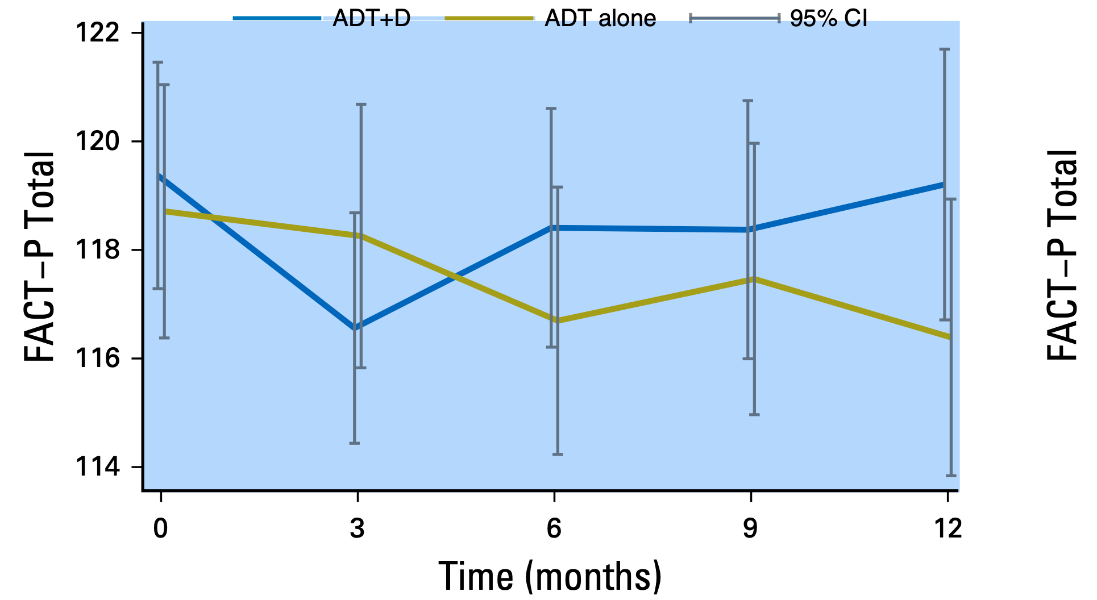
CHAARTED: ADT + Docetaxel
Early Decline in QoL significantly improves by 12 months
Morgans, et al. JCO 2018

Slide 17
STAMPEDE Arm C: ADT + Docetaxel
Extended OS analysis (median f/u 78.2 mos)
Median OS
59.1 vs 43.1 months
HR 0.81
Clarke et al. ESMO 2019

Slide 18
STAMPEDE Arm C: ADT + Docetaxel
Extended OS analysis confirms no difference by volume of disease
Median OS 39.9 vs 35.2 mos, HR 0.81
Median OS 93.2 vs 76.7 mos, HR 0.76
Clarke et al. ESMO 2019
Notes:
Between 05 October 2005 and 31 March 2013, 1086 M1 patients were randomised to receive SOC (n = 724) or SOC + docetaxel (n = 362). Metastatic burden was assessable for 830/1086 (76%) patients; 362 (44%) had low and 468 (56%) high metastatic burden. Median follow-up was 78.2 months. There were 494 deaths on SOC (41% more than the previous report). There was good evidence of benefit of docetaxel over SOC on OS (HR = 0.81, 95% CI 0.69–0.95, P = 0.009) with no evidence of heterogeneity of docetaxel effect between metastatic burden sub-groups (interaction P = 0.827). Analysis of other outcomes found evidence of benefit for docetaxel over SOC in failure-free survival (HR = 0.66, 95% CI 0.57–0.76, P < 0.001) and progression-free survival (HR = 0.69, 95% CI 0.59–0.81, P < 0.001) with no evidence of heterogeneity of docetaxel effect between metastatic burden sub-groups (interaction P > 0.5 in each case). There was no evidence that docetaxel resulted in late toxicity compared with SOC: after 1 year, G3-5 toxicity was reported for 28% SOC and 27% docetaxel (in patients still on follow-up at 1 year without prior progression).

Slide 19
STOPCAP M1 Metanalysis: ADT + Docetaxel
OS Analysis from GETUG15, STAMPEDE & CHAARTED shows greatest benefit for high volume disease and possibly bulky primary and de novo disease
Vale et al. Lancet 2023
Notes:
Findings
We obtained individual participant data from 2261 patients (98% of those randomised) from three eligible trials (GETUG-AFU15, CHAARTED, and STAMPEDE trials), with a median follow-up of 72 months (IQR 55–85). Individual participant data were not obtained from two additional small trials. Based on all included trials and patients, there were clear benefits of docetaxel on overall survival (hazard ratio [HR] 0·79, 95% CI 0·70 to 0·88; p<0·0001), progression-free survival (0·70, 0·63 to 0·77; p<0·0001), and failure-free survival (0·64, 0·58 to 0·71; p<0·0001), representing 5-year absolute improvements of around 9–11%. The overall risk of bias was assessed to be low, and there was no strong evidence of differences in effect between trials for all three main outcomes. The relative effect of docetaxel on progression-free survival appeared to be greater with increasing clinical T stage (p_{interaction}=0·0019), higher volume of metastases (p_{interaction}=0·020), and, to a lesser extent, synchronous diagnosis of metastatic disease (p_{interaction}=0·077). Taking into account the other interactions, the effect of docetaxel was independently modified by volume and clinical T stage, but not timing. There was no strong evidence that docetaxel improved absolute effects at 5 years for patients with low-volume, metachronous disease (–1%, 95% CI –15 to 12, for progression-free survival; 0%, –10 to 12, for overall survival). The largest absolute improvement at 5 years was observed for those with high-volume, clinical T stage 4 disease (27%, 95% CI 17 to 37, for progression-free survival; 35%, 24 to 47, for overall survival).
Interpretation
The addition of docetaxel to hormone therapy is best suited to patients with poorer prognosis for metastatic, hormone-sensitive prostate cancer based on a high volume of disease and potentially the bulkiness of the primary tumour. There is no evidence of meaningful benefit for patients with metachronous, low-volume disease who should therefore be managed differently. These results will better characterise patients most and, importantly, least likely to gain benefit from docetaxel, potentially changing international practice, guiding clinical decision making, better informing treatment policy, and improving patient outcomes.

Slide 20
ADT + ARPI
 | LATITUDE | STAMPEDE | TITAN | ARCHES
N | 1199 | 1917 | 1052 | 1150
Treatment Arms | ADT+ abiraterone ADT + placebo | ADT + abiraterone ADT alone | ADT + apalutamide ADT + placebo | ADT + enzalutamide ADT + placebo
Disease Risk | 100% high risk | 52% high risk | 63% high volume | 63% high volume
De Novo | 100% | 49% | 81% | 67%
Primary Endpoint | OS: HR 0.66 (0.51–0.76) | OS: HR 0.61 p = 0.005 | OS: HR 0.65 (0.51–0.89) | OS: HR 0.66 (0.53–0.81)
High Vol/ High Risk Disease | OS HR: 0.58 (0.41–0.83) | OS: HR 0.54 (0.41–0.70) | OS: HR 0.68 (0.50–0.92) | OS: HR 0.66 (0.52–0.83)
Low Vol/ Low Risk Disease | OS: HR 0.69 (0.58–0.82) | OS: HR 0.66 (0.44–0.98) | OS: HR 0.67 (0.34–1.32) | OS: HR 0.66 (0.43–1.02)
Mittal et al. Curr Onc 2023

Slide 21
ADT + ARPI
 | LATITUDE | STAMPEDE | TITAN | ARCHES
N | 1199 | 1917 | 1052 | 1150
Treatment Arms | ADT+ abiraterone ADT + placebo | ADT + abiraterone ADT alone | ADT + apalutamide ADT + placebo | ADT + enzalutamide ADT + placebo
Disease Risk | 100% high risk | 52% high risk | 63% high volume | 63% high volume
De Novo | 100% | 49% | 81% | 67%
Quality of Life | Improved for ADT + abiraterone + prednisone |  | No difference/ Maintained | No difference/ Maintained
AEs (>G2) | Grade 3/4: 68% Most common: hypertension, hypokalemia | Grade 3–5: 47% Most common: endocrine, cardiovascular disorders | Grade 3–4: 42.2% Most common: hypertension, rash | Grade ≥ 3: 24.3% Most common: hypertension, fatigue
Mittal et al. Curr Onc 2023

Slide 22
How well have we done with escalating therapy?
The National Comprehensive Cancer Network (NCCN) guidelines have assigned a level 1 recommendation for combination treatment options in patients with mCSPC, including ADT along with an NHT or docetaxel.
The Commission on Cancer (CoC) and the Quality Oncology Practice Initiative (QOPI) describe standards for cancer care, including utilizing data for continuous quality improvement and tracking adherence to nationally recognized guidelines to drive treatment selection.
In Florida, the utilization of NHT-based treatment has been up trending in the past several years; however, LHRH monotherapy remains the dominant modality as first-line treatment in newly diagnosed mCSPC patients.

Slide 23
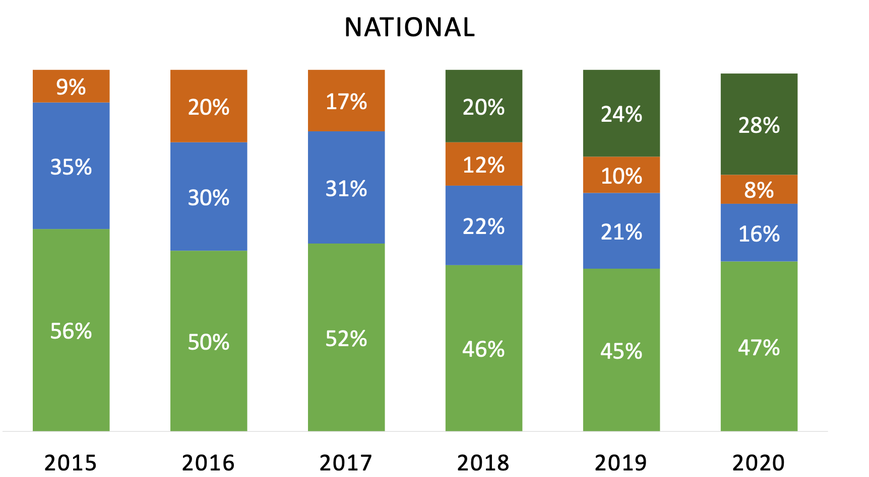
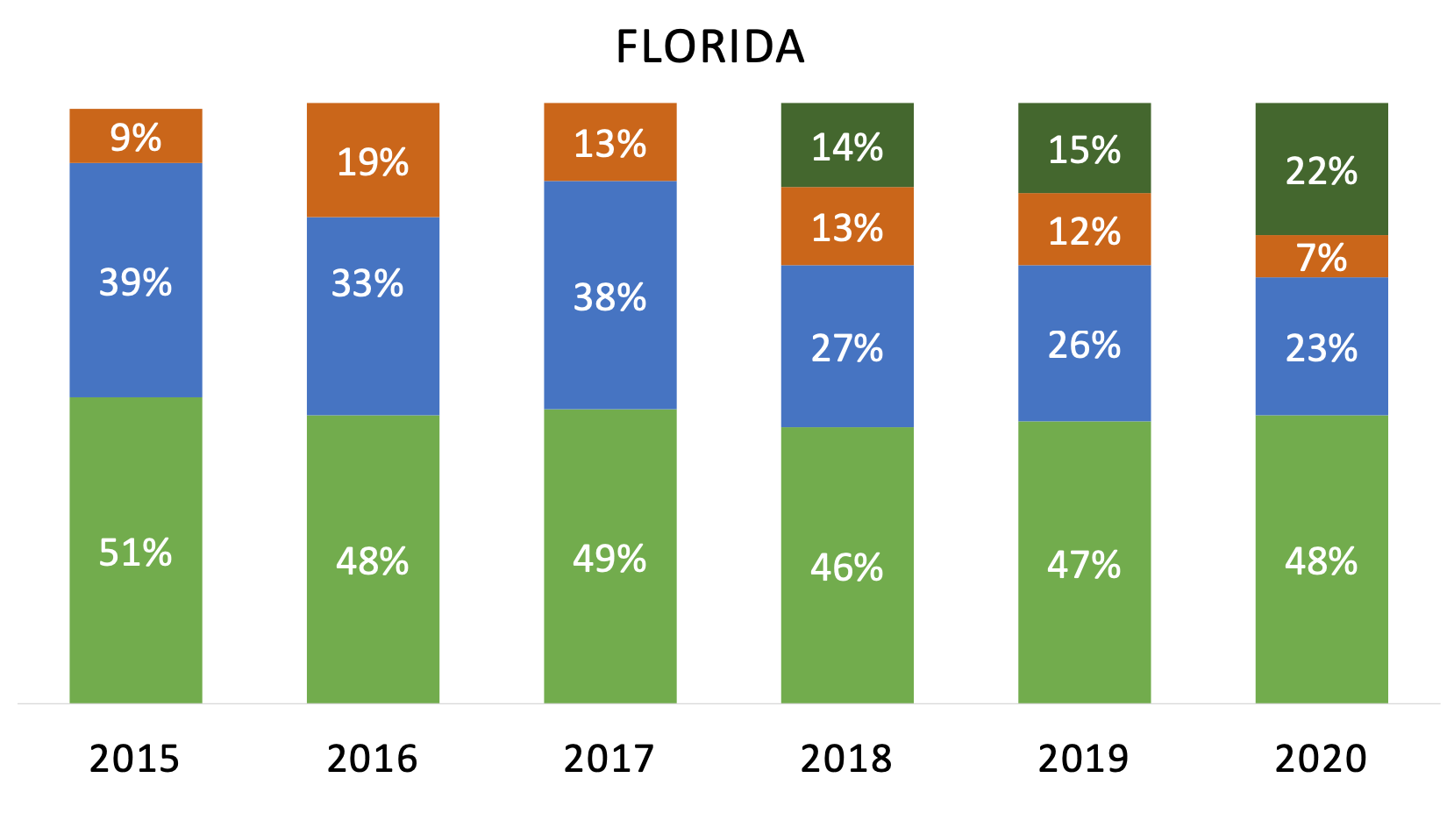
How well have we done with escalating therapy?
FLASCO 2022

Slide 24
Triplet Therapy: PEACE-1
Fiazzi, et al. Lancet 2022

Slide 25
Triplet Therapy: PEACE-1
Fiazzi, et al. Lancet 2022

Slide 26
Triplet Therapy: PEACE-1
Abiraterone prolongs overall survival with and without docetaxel
Fiazzi, et al. Lancet 2022

Slide 27
Triplet Therapy: PEACE-1
Survival benefit most pronounced in high volume disease
Fiazzi, et al. Lancet 2022

Slide 28
Triplet Therapy: ENZAMET

Slide 29
Triplet Therapy: ENZAMET

Slide 30
Triplet Therapy: ENZAMET

Slide 31
Triplet Therapy: ENZAMET

Slide 32
Triplet Therapy: ARASENS

Slide 33
Triplet Therapy: ARASENS

Slide 34
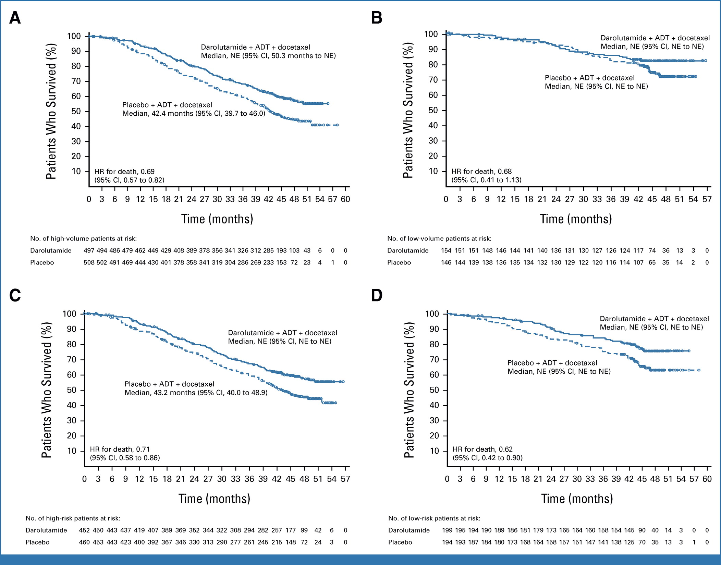
Triplet Therapy: ARASENS
Hussein JCO 2023
Notes:
FIG 2. OS in subgroups of patients by (A) high-volume disease, (B) low-volume disease, (C) high-risk disease, and (D) low-risk disease in ARASENS. High-volume disease was defined as the presence of visceral metastases or ≥ 4 bone lesions with ≥ 1 beyond the vertebral bodies and pelvis.1 High-risk disease was defined by two of the following three risk factors: Gleason score ≥ 8, ≥ 3 bone lesions, and measurable visceral metastases.2 ADT, androgen-deprivation therapy; HR, hazard ratio; NE, not estimable; OS, overall survival.

Slide 35
Triplet Therapy: ARASENS

Slide 36
Role of Prognostic Factors
High Volume
Liver Metastases
BRCA 2
pTEN/RB1/TP53 loss
Young Age (<55)
Low PSA to disease burden
De Novo disease
Low Volume
SPOP Mutations
Lung Only Metastases
Bone Only Metastases
Metachronous disease

Slide 37
Conclusions
Most patients with mHSPC should be offered atleast ADT + ARPI
Patients with high volume disease and select patients with low volume disease and risk factors, should be considered for triplet therapy (ADT + docetaxel + abiraterone or prednisone)
ADT + docetaxel alone without ARPI is not recommended any more
Benefit of docetaxel + ARPI over ARPI remains to be defined

Slide 38
PROSTATE/RCC
Tuesday, October 10, 2023

Slide 39
Updates in mCRPC
Marijo Bilusic, MD, PhD
Professor of Clinical Medicine
University of Miami
Miami, FL

Slide 40
Topics
PARP Inhibitor Based Combination in mCRPC
TALAPRO-2 (enzalutamide + talazoparib)
PROPEL (abiraterone + olaparib)
MAGNITUDE (abiraterone + niraparib)
Navigating PARP inhibitors in prostate cancer

Slide 41
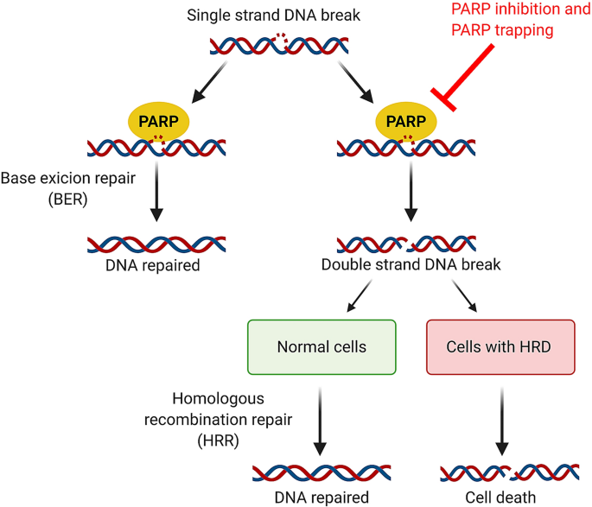
Bruin, M.A.C., Sonke, G.S., Beijnen, J.H. et al. Pharmacokinetics and Pharmacodynamics of PARP Inhibitors in Oncology. Clin Pharmacokinet 61, 1649–1675 (2022).

Slide 42
Mutational Landscape by Disease State
Locoregional
mCSPC
mCRPC
Genomic progression from localized disease to mCRPC
BRCA1: 1% to 2%
BRCA2: 6% to 10%
ATM: 2% to 11%
FANCA: 1% to 7%
Abida. JCO Precision Oncol. 2017;PO.17.00029.

Slide 47
PROpel Trial: Abiraterone +/- Olaparib
Primary endpoint: rPFS by investigator
Key secondary endpoints: OS, time to subsequent therapy or death, PFS2, ORR, HRRm prevalence (retrospectively assessed), HRQoL, safety

Slide 48
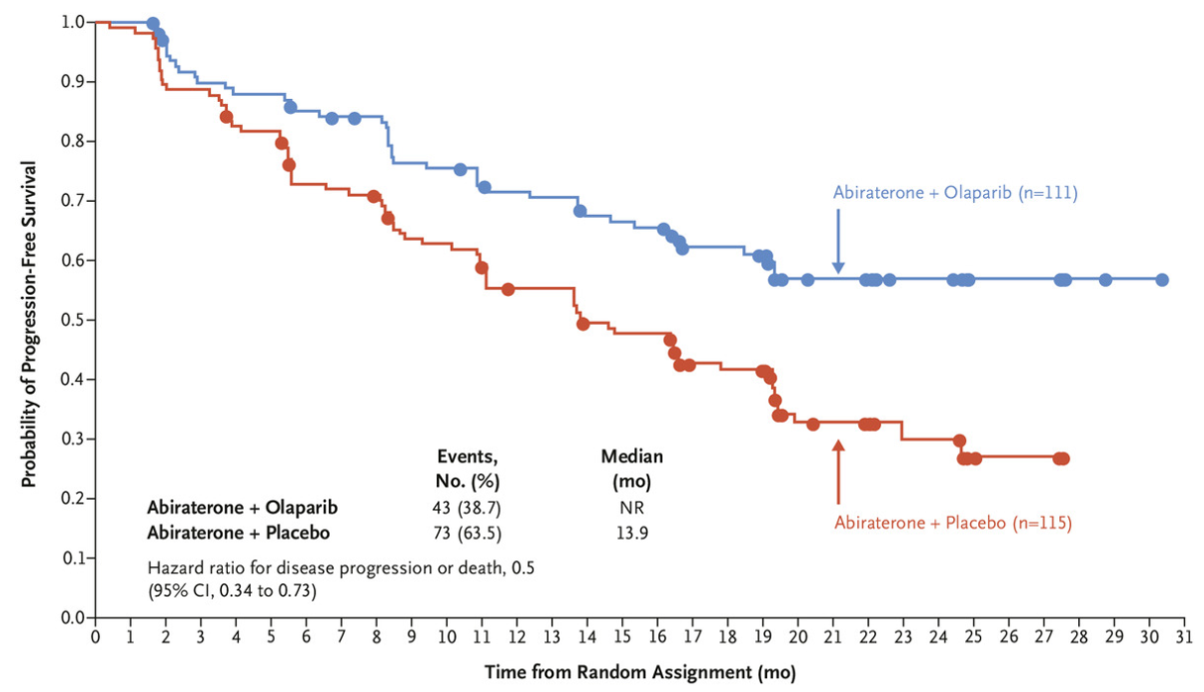
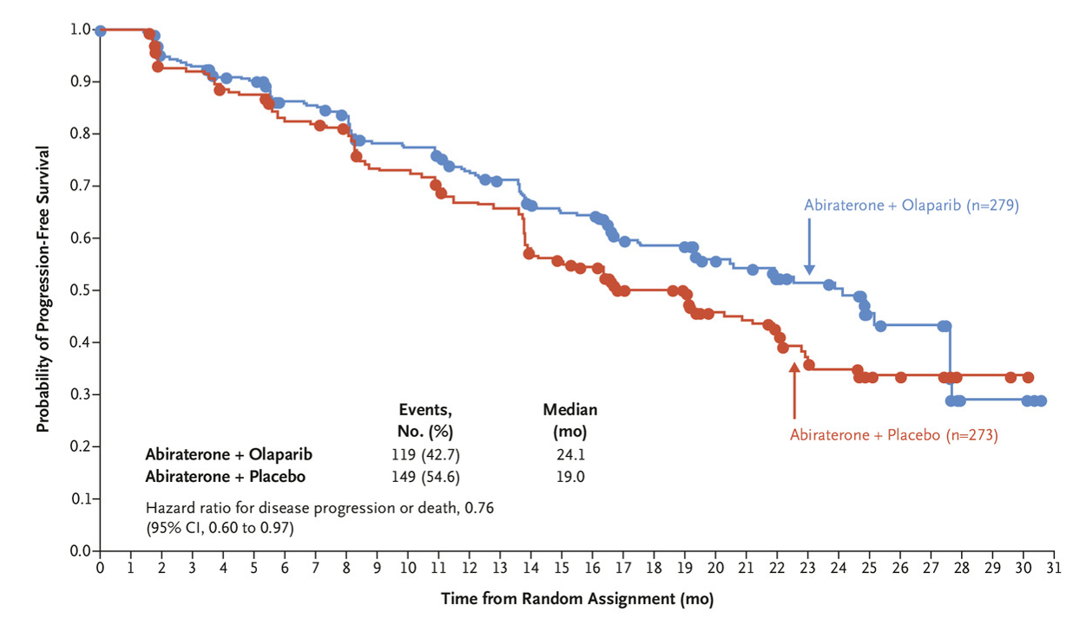
PROpel: Radiographic PFS by HRR Status
HRR Mutated (28.4% of ITT population)
Not HRR Mutated (69.3% of ITT population)
 | Abi + Ola (n = 111) | Abi + Placebo (n = 115)
Events, n (%) | 43 (38.7) | 73 (63.5)
Median rPFS, mo | NR | 13.9
 | HR: 0.5 (95% CI: 0.34-0.73)
 | Abi + Ola (n = 279) | Abi + Placebo (n = 273)
Events, n (%) | 119 (42.7) | 149 (54.6)
Median rPFS, mo | 24.1 | 19.0
HR: 0.76 (95% CI: 0.60-0.97)
1.0
1.0
0.8
Abiraterone + Olaparib
0.8
Abiraterone + Olaparib
0.6
0.6
Probability
Probability
0.4
0.4
0.2
0.2
Abiraterone + Placebo
Abiraterone + Placebo
0
0
0
4
8
12
16
20
24
28
32
36
40
44
48
0
4
8
12
16
20
24
28
32
36
40
44
Mo
Mo
Clarke. NEJM Evid. 2022;1.
Notes:
Abi, abiraterone; HRR, homologous recombination repair; ITT, intention-to-treat; Ola, olaparib; OS, overall survival.

Slide 49
PROpel: OS by HRR Status
HRR Mutated (28.4% of ITT population)
Not HRR Mutated (69.3% of ITT population)
 | Abi + Ola (n = 111) | Abi + Placebo (n = 115)
Median OS, mo | NR | 28.5
 | HR: 0.66 (95% CI: 0.45-0.95)
 | Abi + Ola (n = 279) | Abi + Placebo (n = 273)
Median OS, mo | 42.1 | 38.9
HR: 0.89 (95% CI: 0.70-1.14)
1.0
1.0
0.8
0.8
0.6
0.6
Probability
Probability
0.4
0.4
0.2
0.2
0
0
0
4
8
12
16
20
24
28
32
36
40
44
48
0
4
8
12
16
20
24
28
32
36
40
44
Mo
Mo
Clarke. ASCO GU 2023. Abstr LBA16.
Notes:
Abi, abiraterone; HRR, homologous recombination repair; ITT, intention-to-treat; Ola, olaparib; OS, overall survival.

Slide 50
Most Common AEs
Olaparib + Abiraterone (n = 399)
Placebo + Abiraterone (n = 399)
Any
Anemia
Fatigue or asthenia
Nausea
Diarrhea
Constipation
Back pain
Decreased appetite
Vomiting
Arthralgia
Hypertension
Dizziness
Peripheral edema
Urinary tract infection
97.2
47.2
38.4
94.9
46.0
15.1
3.3
16.4
37.2
2.3
1.5
28.3
28.1
0.3
0.3
12.6
17.3
0.8
0.3
9.3
17.3
0.3
13.9
17.1
0.8
1.0
18.4
14.6
1.0
5.8
13.1
1.0
0.3
9.1
Grade ≥3
All grade
Grade ≥3
All grade
12.8
0.5
17.7
12.6
3.5
3.3
16.4
10.8
6.3
10.3
0.3
11.4
10.3
2.0
1.0
7.8
100
80
60
40
20
0
0
20
40
60
80
100
Outcome, n (%) | Olaparib + Abiraterone (n = 399) | Placebo + Abiraterone (n = 397)
Cardiac failure SMQ Death Due to AE | 6 (1.5) 16 (4.0) | 5 (1.3) 17 (4.3)
Embolic and thromboembolic events, arterial SMQ | 8 (2.0) | 10 (2.5)
Embolic and thromboembolic events, venous SMQ Pulmonary embolism | 29 (7.3) 26 (6.5) | 13 (3.3) 7 (1.8)
Notes:
AEs, adverse events; SMQ, standardized MedRA Query.

Slide 51
MAGNITUDE: Abiraterone ± Niraparib

Slide 53
MAGNITUDE: TEAEs in HRRmut+ Cohort
Safety Outcome, n (%) | Niraparib + AAP (n = 212) | Placebo + AAP (n = 211)
All TEAEs Drug related | 210 (99.1) 162 (76.4) | 199 (94.3) 116 (55.0)
Grade 3/4 TEAEs | 142 (67.0) | 98 (46.4)
Serious AEs Drug related | 76 (35.8) 24 (11.3) | 52 (24.6) 6 (2.8)
Dose reduction due to AE | 42 (19.8) | 7 (3.3)
Discontinuation of niraparib/placebo due to AE | 23 (10.8) | 10 (4.7)
All deaths within 30 days of last dose Death due to prostate cancer AE | 19 (9.0) 8 (3.8) 11 (5.2) | 19 (9.0) 12 (5.7) 7 (3.3)
AEs most frequently leading to dose reduction in niraparib arm:
Anemia, 13.2%
Thrombocytopenia, 2.8%
Median relative dose intensity in niraparib arm: 99%
Chi. J Clin Oncol. 2023; JCO2201649. Chi. ASCO GU 2022. Abstr 12.
Notes:
AAP, abiraterone acetate + prednisone; AE, adverse event; HRRmut, homologous recombinant repair gene mutation; TEAE, treatment-emergent adverse event.

Slide 54
PARP Inhibitor Based Combination - SUMMARY
THREE Phase III trials of AR-targeting + PARP inhibitors for mCRPC:
TALAPRO2:
rPFS benefit for talozaparib + enza in patients with HRR alterations (27.9 v 16.4 months, HR 0.46, p<0.001).
BRCA – HR=0.2; non-BRCA – HR=0.72
MAGNITUDE:
rPFS benefit for niraparib + Abi/Pred in patients with BRCA alterations (16.6 vs 10.9 mo; HR: 0.53; P = .0014)
OS 30.4 m vs 28.6 m (HR 0.79; 95% CI: 0.55, 1.12)
non-BRCA HRR mutations, the rPFS hazard ratio was 0.99 (95% CI: 0.67, 1.44) and the OS hazard ratio was 1.13 (95% CI: 0.77, 1.64),
PROpel :
rPFS benefit for olaparib + Abi/Pred; NR vs 8 months (HR=0.24 (BRCA mutated)
FDA approvals – frontline therapy for mCRPC
05/23/2023: Olaparib + Abiraterone (BRCA mutated)
06/20/2023: Talazoparib + Enzalutamide (HHR gene mutated mCRPC)
08/11/2023; Niraparib + Abiraterone-(combined pill 200 mg niraparib + 1000 mg Abiraterone) (BRCA mutated)

Slide 55
PARP Inhibitors Currently FDA Approved in mCRPC
OLAPARIB
Approved by FDA in May 2020 for mCRPC with deleterious/suspected deleterious HRR gene mutations (germline or somatic) SECOND LINE: prior treatment with ENZA or ABI Approved by FDA in May 2023 for mCRPC in combination with abiraterone for mCRPC with deleterious/suspected deleterious BRCA mutations (germline or somatic)1,3 FRONT LINE
RUCAPARIB
Received accelerated approval from FDA in May 2020 for deleterious BRCA-mutated (germline and/or somatic) mCRPC^{4,5} THIRD LINE post AR-directed therapy and taxane-based chemotherapy
TALAZOPARIB
Approved by FDA in June 2023 for mCRPC in combination with ENZALUTAMIDE for mCRPC with HHR gene mutated mCRPC FRONT LINE
NIRAPARIB
Approved by FDA in August 2023 for mCRPC in combination with abiraterone for mCRPC with deleterious/suspected deleterious BRCA mutations (germline or somatic) FRONT LINE
1. Olaparib PI. 2. Hussain. NEJM. 2020;383:2345. 3. Clarke. NEJM Evid. 2022;1. 4. Rucaparib PI. 5. Abida. JCO. 2020;38:3763.
6. Fizazi. NEJM. 2023;388:719.
Notes:
AR, androgen receptor; CRPC, castration-resistant prostate cancer; HRR, homologous recombination repair; OS, overall survival; rPFS, radiographic progression-free survival.

Slide 56
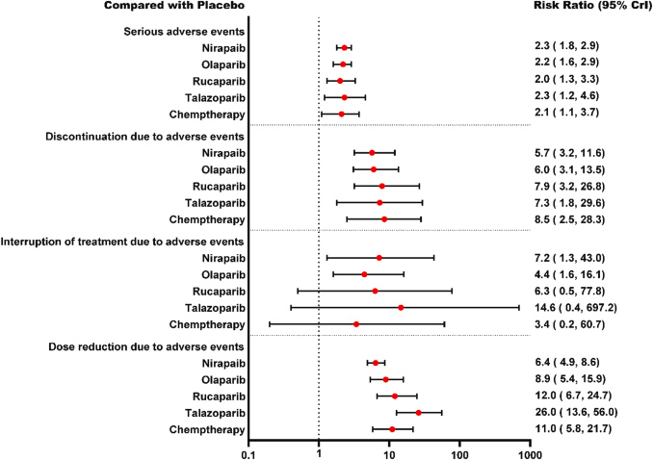
Are all PARP inibitors the same?
- SAE and discontinuation of treatment did not differ significantly
- Talazoparib is associated with a higher risk of interruption of treatment and dose reduction (excluding rucaparib) due to AE
- Niraparib showed a trend of lower risk of AE related dose reduction
Pharmacological Research
Volume 172, October 2021

Slide 57
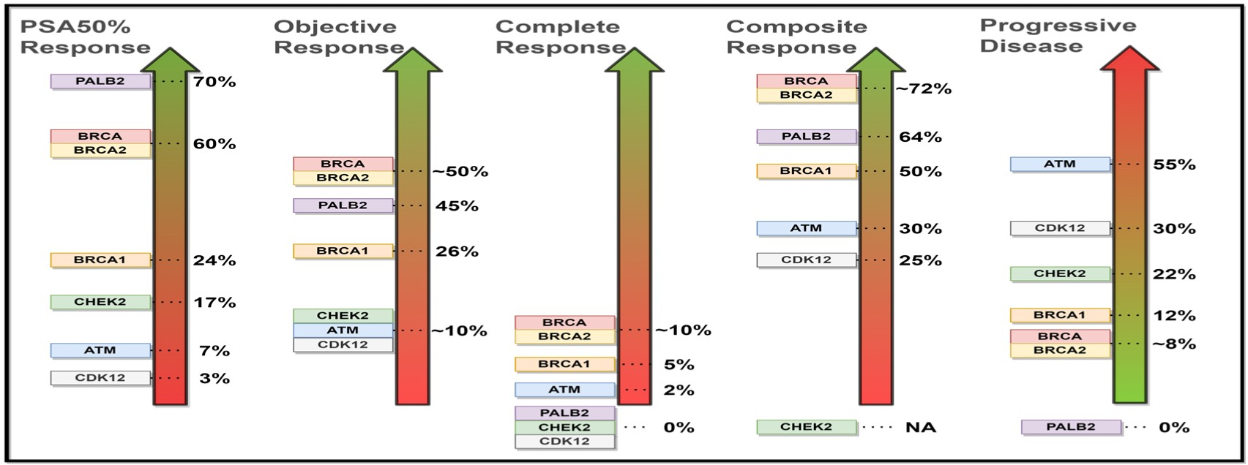
PARP Inhibitors in mCRPC With DNA Repair Defects
Naqvi. ASCO GU 2022. Abstr 134.

Slide 58
When to use?
Front line mCRPC
Olaparib/Abi (BRCA mutated)
Talazoparib/Enza (HRR mutated)
higher risk of dose reduction/treatment interruption
Niraparib/Abi (BRCA mutated)
less risk of dose reduction
One pill (cost)
Second line mCRPC (post abi/enza)
Olaparib (HRR mutated)
Third line mCRPC (post abi/enza and docetaxel)
Rucparib

Slide 59
PROSTATE/RCC
Tuesday, October 10, 2023

Slide 60
PSMA PET Imaging in Clinical Practice
Janaki Sharma, MD
Assistant Professor
Hematology/Oncology Fellowship Director
University of Miami/Sylvester Cancer Center
Miami, FL

Slide 61
Disclosures
None

Slide 62
Prostate Surface Membrane Antigen (PSMA)
A protein expressed on virtually all prostate cancer cells
Increases with higher grade, stage and CRPC
Low level expression on prostate epithelial cells, small intestine, renal tubules, salivary gland and nervous system
Also on neovasculature of other solid tumors
Very low expression in neuro-endocrine prostate cancer

Slide 63
PSMA PET Scans
3 Different FDA Approved radiotracers
¹⁸F-DCFPyl (Pylarify)
⁶⁸Ga-PSMA-11
¹⁸F-rhPSMA-7.3 (Posluma)
Notes:
The molecular structure of POSLUMA uses radiohybrid™ technology, with a DOTAGA complex with nonradioactive gallium and radioactive F 18 covalently bound to silicon^{1,5}
The DOTAGA complex in radiohybrid™ technology can be labeled with alpha- or beta-emitting radiometals^{5,6}
My general sense about the 2 PSMA-PET imaging agents—and I think we’re probably going to wind up with about half a dozen PSMA-PET imaging agents approved at some point—is that they’re both great and better than anything that we've had before. And I think that to power a study that would head-to-head compare them in a prospective way to some oncological outcome is something that's going to take hundreds and hundreds of patients and be so expensive that it’s probably prohibitive. So, I don't know that we're ever going to have sort of this definitive answer that piflufolastat F 18 is better than Ga 68 PSMA-11, or vice versa.
“That said, F 18 as a radionuclide has a certain image quality and practical images relative to Ga 68; it has a longer half-life and can be made in generally much larger quantities. So, centrally producing it and sending it out to sites is a little more practical than it is with Ga 68. However, we do have a distribution model for Ga-68 dotatate PET/CT scan for neuroendocrine tumors that’s been very successful in the US and Europe and other places. So, I think that, where there’s a will there’s a way and I definitely expect Ga 68 PSMA-11 to be available nationwide in the not too distant future.
“So, there are some image quality advantages with F 18—looking at the scans side-by-side, it’s a little clearer; it’s a little less noisy. But the vast, vast majority of findings are going to be visible on both and I don’t think that on the whole, any of the top-level data really ever differentiates the 2 scans.”

Slide 64
Why use PSMA Imaging?
Study | Tracer | Context (N) | Sensitivity | Specificity | PPV
Osprey | ¹⁸F-DCFPyL | Localized (252) | 40.3% | 97% | 87%
Hope | ⁶⁸GA-PSMA-11 | Localized (277) | 40% | 95% | 75%
Condor | ¹⁸F-DCFPyL | Biochemical Relapse w/Neg CI (208) |  |  | 86% (64% change in mngmnt)
Fendler | ⁶⁸GA-PSMA-11 | Biochemical Relapse |  |  | 92%
Osprey J Urol 2021, Hope JAMA Oncol 2021, Condor CCR 2021, Fendler JAMA 2019

Slide 65
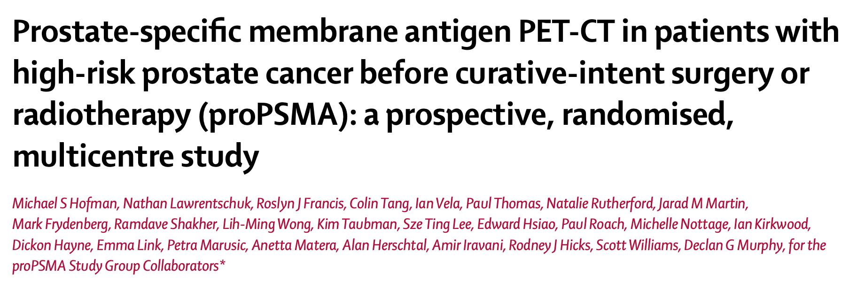
Why use PSMA Imaging?
High Risk Patients (PSA >20, GG 3-5 or >cT3)
Randomized to CT + Bone scan (n=152) or ⁶⁸Ga-PSMA-11 PET/CT (n=150)
Hofman Lancet 2021

Slide 66
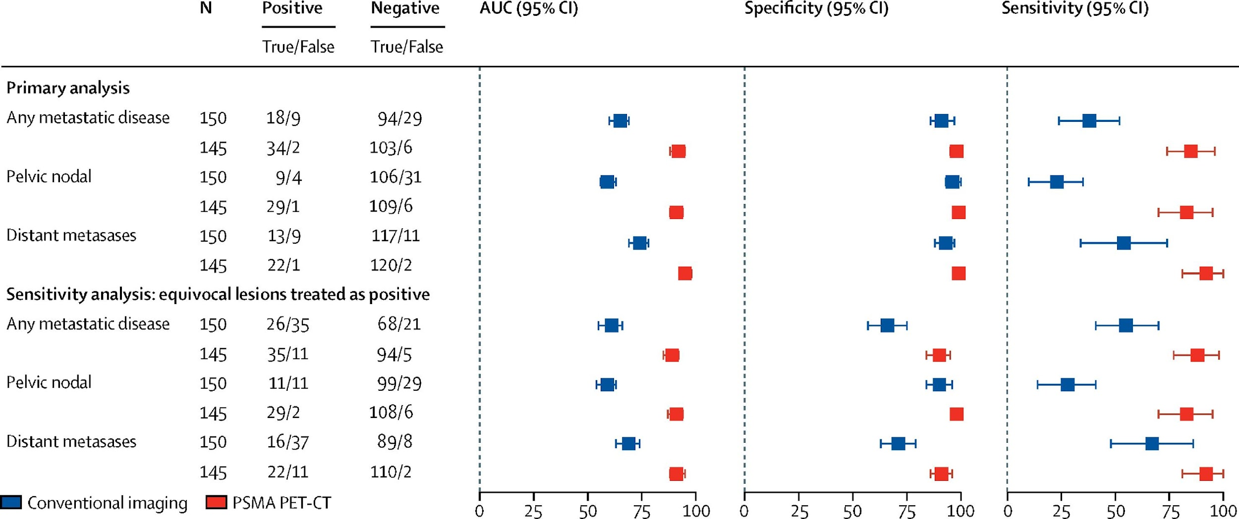
Why use PSMA Imaging?
PSMA PET has 27% greater accuracy (92% vs 65%)

Slide 67
Why use PSMA Imaging?
IAEA Study
- Patients with clinically established biochemical recurrence
- PSA <4, Negative conventional imaging
- N=1004 (77% post RP, 22% post radiation therapy)
65.1% of patients had positive PSMA-PET/CT
(56.8% of patients had treatment modified)
PSMA PET Positivity correlated with Gleason Score, PSA, PSADT and radiotherapy
Cerci et al ASC0 2023

Slide 68
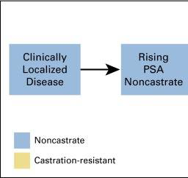
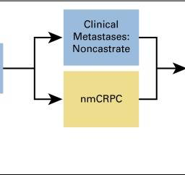
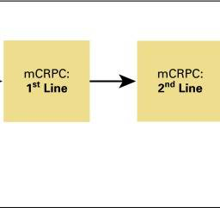
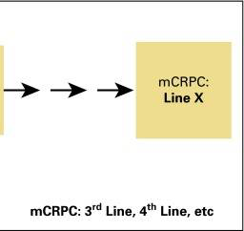
When to use PSMA Imaging?
Initial Staging
Biochemical Progression (Oligo-progression)
and
Metastatic Assessment (incl Response)
Biochemical Recurrence/Persistence
Biochemical Progression

Slide 69
ASCO Prostate Cancer Imaging Guidelines
 | Conventional Imaging | PSMA PET Scan
High Risk New Dx | Negative/Equivocal | Yes
 | Positive | No
Rising PSA post prostatectomy | Negative | Yes, if planning local salvage
Rising PSA after radiotherapy | Negative | Yes if considering loco-regional therapy
Metastatic, HSPC | Positive | Yes, to clarify if oligometastatic
Non-metastatic CRPC (M0) | Negative | Yes – if contemplating change in clinical care
Metastatic CRPC | Stable | No recommendation
 | Progression | No

Slide 70
NCCN Prostate Cancer Imaging Guidelines Initial Risk Stratification and Staging
Risk Group | Very Low/Low | Favorable Intermediate | Unfavorable Intermediate | High/Very High
Imaging | Not recommended | Not recommended | Bone & Soft Tissue Imaging | Bone and Soft Tissue Imaging
^{k} Because of the increased sensitivity and specificity of PSMA-PET tracers for detecting micrometastatic disease compared to conventional imaging (CT, MRI) at both initial staging and biochemical recurrence, the panel does not feel that conventional imaging is a necessary prerequisite to PSMA-PET and that PSMA-PET/CT or PSMA-PET/MRI can serve as an equally effective, if not more effective front-line imaging tool for these patients.

Slide 71
ESMO/EUA Guidelines
 | Intermediate Risk | High Risk | Biochemical Relapse
NCCN | PSMA PET | PSMA PET | PSMA PET
ESMO | CT/MRI + Bone Scan Or PSMA PET | CT/MRI + Bone Scan Or PSMA PET | PSMA PET
EUA | CT/MRI + Bone Scan | PSMA PET or Body MRI | PSMA PET

Slide 72
When do we deviate from guidelines?
Oligometastatic disease
Rising PSA without evidence of metastatic disease

Slide 73
Practical Considerations for PSMA Imaging
Sensitivity and PPV increase with PSA value
Starting at PSA 0.2, sensitivity for disease is ~40%
Imaging should happen prior to starting ADT
SUV intensity on PSMA Scan does not always mean disease
Important to correlate to CT finding
Histologic confirmation suggested to rule out false positives (ribs, ganglia, ureter)
Other cancers can show PSMA uptake in neo-vasculature

Slide 74
PROSTATE/RCC
Tuesday, October 10, 2023

Slide 75
FRONTLINE IO-TKIs FOR ADVANCED/METASTATIC RCC
Jaime R. Merchan, MD, MMSc
Professor of Medicine
University of Miami Miller School of Medicine
Sylvester Comprehensive Cancer Center
Miami, FL

Slide 76
RENAL CELL CARCINOMA
Cancer Facts and Figures, 2023
Notes:
‹#›
UPDATE FOR 2023 STATS!!!

Slide 77
FIRST LINE THERAPY FOR ADVANCED ccRCC: NCCN GUIDELINES (2023)

Slide 78
LBA 4501: Pembrolizumab plus axitinib versus sunitinib as first-line therapy for advanced clear cell renal cell carcinoma: 5-year analysis of KEYNOTE-426.
Rini B, Et Al. 2023 Asco Annual Meeting.

Slide 79
Keynote 426 Summary (before ASCO 2023)
Median follow-up (months) | 12.8¹ | 30.6² | 42.8³ | 67.2
OS, months | NR | NR | 45.7 | 47.2
HR (95% CI) | 0.53 (0.38-0.74) | 0.68 (0.55-0.85) | 0.73 (0.6-0.88) | 0.84 (0.71-0.99)
PFS, months | 15.1 | 15.4 | 15.7 | 15.7
HR (95% CI) | 0.69 (0.57-0.84) | 0.71 (0.6-0.84) | 0.68 (0.58-0.8) | 0.69 (.59-0.81)
ORR(%)/CR(%) | 59/6 | 60/9 | 60/10 | 60.6/11.6
1. Rini et al. NEJM, 2019. PMID: 30779529. 2. Powles et al, Lancet Oncol., 2020. PMID: 33284113. 3. Rini et al, ASCO 2021. 4.Rini et al, ASCO 2023

Slide 80
KEYNOTE-426: FINAL PFS AND OS
PFS
OS
NO NEW SAFETY SIGNALS
Median PFS (months)
Axi-Pembro: 15.7 (13.6-20.2)
Sunitinib: 11.1 (8.9-12.5)
Median OS (months)
Axi-Pembro: 47.2 (43.6-54.8)
Sunitinib: 40.8 (34.3-47.5)
Rini B, Et Al. 2023 Asco Annual Meeting.

Slide 81
KEYNOTE-426 OUTCOMES: FAVORABLE RISK PTS
Rini B, Et Al. 2023 Asco Annual Meeting
Rini B, Et Al. 2023 Asco Annual Meeting.

Slide 82
KEYNOTE 426 OUTCOMES BY RISK: IINTERMEDIATE/POOR
Rini B, Et Al. 2023 Asco Annual Meeting.
Rini B, Et Al. 2023 Asco Annual Meeting.

Slide 83
OS ADJUSTED BY SUBSEQUENT THERAPY
Rini B, Et Al. 2023 Asco Annual Meeting.

Slide 84
ABST 4502: Final prespecified OS analysis of CLEAR: 4-year f/u of lenvatinib + pembrolizumab vs sunitinib in patients with advanced RCC
Motzer R., et al. Abstract 4502. ASCO 2023

Slide 85
CLEAR: 4 YEAR FOLOW UP: PFS
PFS
PFS by Risk
Favorable
Intermediate/ poor
Motzer R., et al. Abstract 4502. ASCO 2023

Slide 86
CLEAR: 4 YEAR FOLOW UP: OS
PFS
OS by Risk
Favorable
OS
Intermediate/ poor
Motzer R., et al. Abstract 4502. ASCO 2023

Slide 87
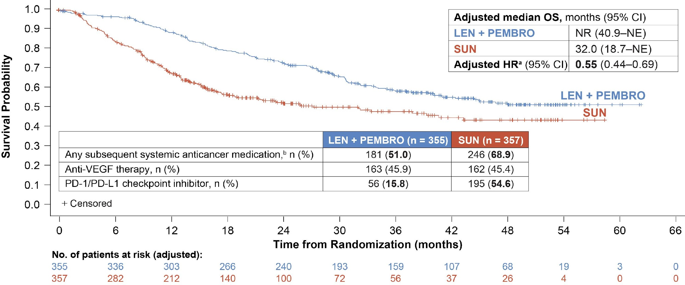
CLEAR: OS adjusted for subsequent anticancer medications
Motzer R., et al. Abstract 4502. ASCO 2023

Slide 88
Motzer R., et al. Abstract 4502. ASCO 2023

Slide 89
CONCLUSIONS
Keynote 426 (5 year follow up): Pembrolizumab plus axitinib continue to demonstrate improved PFS, OS and ORR compared to sunitinib
CLEAR (4 year follow up): Pembrolizumab plus lenvatinib continued to demonstrate clinically meaningful and durable benefit vs sunitinib in the 1L treatment of patients with advanced RCC at the final analysis.
No new safety signals were identified.
The above data support Pembrolizumab plus axitinib and Pebrolizumab plus Lenvatinib as standard of care for patients with previously untreated advanced ccRCC

Slide 90
THANK YOU!

Slide 91
PROSTATE/RCC
Tuesday, October 10, 2023

Slide 92
Advanced/Metastatic RCC: Second Line and Beyond
Pasquale Benedetto, MD
Leonard M Miller Professor of Medicine
Robert J and Marion G Fewell Endowed Chair in Medical Oncology
University of Miami Sylvester Cancer Center
Miami, Florida

Slide 93
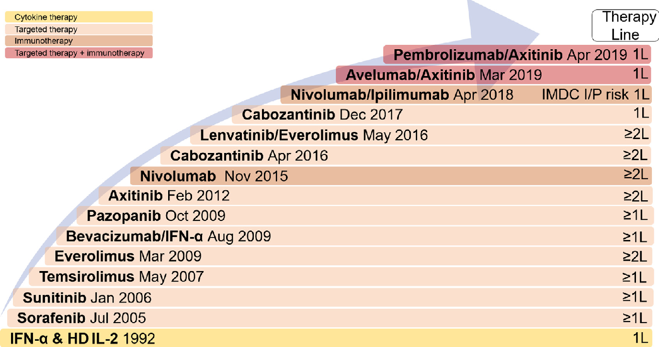

Slide 94
Clear Cell RCC: Second Line Therapy
Choice depends on
Choice of 1L therapy
Comorbidities
autoimmune disorders
solid organ transplant
Location of metastatic disease
e.g., bone

Slide 95
RCC First Line Therapy
Ipilimumab/nivolumab
Checkmate - 214
TKI/IO
Keynote 426, CLEAR, Checkmate-9ER, Javelin-Renal
Single agent VEGF-TKI
CABOSUN, COMPARZ

Slide 96
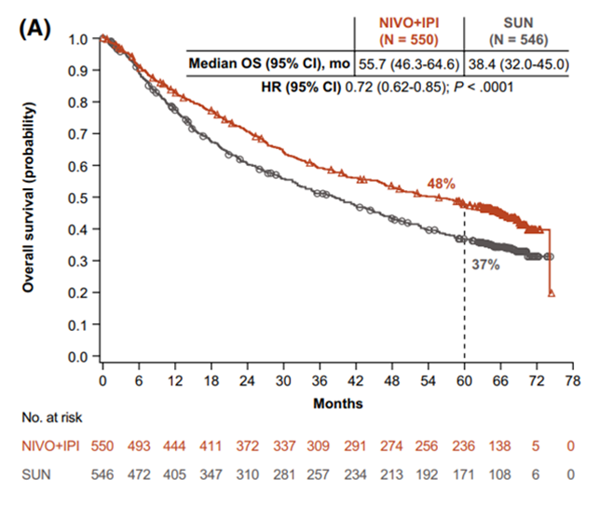
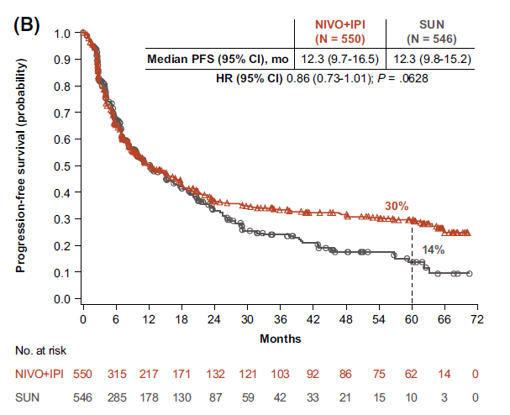
Checkmate 214 RCC: 1L IO/IO Therapy
Phase III trial Ipilimumab/Nivolumab v Sunitinib
N =1096 treatment naive
Favorable 23%
Intermediate/poor 77%
ORR (%) Ipi/Nivo v Sun
ITT 39.3 v 32.4
CR 11.6 v 3.1
Favorable 30 v 52
However, 5 yr OS, PFS, CR, DOR favored Ipi/Nivo
mDOR NR v 24.8
PFS similar in both groups; time on Rx 7.9 m/7.8 (Fig B)
mOS (mos) 55.7 m v 38.4 m (HR 0.72)
5 y OS 48 v 37 (Fig A)
Initially approved for intermediate/poor risk IMDC
Subsequent Rx IO 55% (CR 22%, PR 39%), TKI 68%
Motzer, Cancer 2022, Median F/U 67 months

Slide 97
RCC First LineTKI/IO
 | KEYNOTE-426¹ ^{5 y F/U} |  |  | CLEAR² ^{33 mF/U} |  | CHECKMATE 9ER³ ^{44m mF/U} |  | JAVELIN⁴ ^{34 mF/U}
TKI IO | Axitinib Pembro |  | S | Lenvatinb Pembro | S | Cabozantinib Nivolumab | S | Axitinib Avelumab |  |  | S
# pts | 861 |  |  | 1069 |  | 651 |  | 886
IMDC (%) favorable intermediate poor | 31.9 55.1 13 | 30.5 57.3 12.1 |  | 31 59 9.3 | 34.7 53.8 10.4 | 23 58 19 | 22 57 21 | 21.7 64 11.5 |  | 22.5 66 10.1
mPFS | 15.7 | 11.1 |  | 23.3 | 9.2 | 16.6 | 8.3 | 13.8 | 8.4
ORR (%) CR | 60.4 10 | 39.6 3.5 |  | 71 16. | 36.1 4.2 | 55.7 12 | 27.1 5 | 51.4 3.4 |  | 25.7 1.8
DOR (mos) | 23.6 | 15.3 |  | 25.8 | 14.6 | 23.1 | 15.1 | 19.4 |  | 14.5
mOS | 45.7 40.1 HR 0.73 |  |  | >41.5 >38.4 HR 0.72 |  | 49.5 35.5 HR 0.7 |  | >42.2 HR 0.79 |  | 37.8
AE ≥ Gr 3 | 75.8 | 70.6 |  | 82.4 | 71.8 | 65 | 54 | 71.2 |  | 71.5
d/c | 30.5 | 13.9 |  | 37.2 | 14.4 | 27 | 10 | 7.6 |  | 13.4
2L Rx (%) | 58 | 73 |  | 54.9 | 71 | NS | NS | 20.8 |  | 39.2
¹Rini ASCO 2023 ²Choueiri, Lancet Oncology 2023, ³ Burroto, ASCO GU 2023. ⁴ Haanen ESMO OPEN, 8 (3), 2023.

Slide 98
 | KEYNOTE-426¹ | CLEAR² | CHECKMATE 9ER³ | JAVELIN⁴ |  | Checkmate 214
TKI IO | Axitinib Pembro | Lenvatinib Pembro | Cabozantinib Nivolumab | Axitinib Avelumab |  | Ipi/NIVO
# pts | 861 | 1069 | 323 | 886 |  | 1096
IMDC (%) favorable intermediate poor | 31.9 55.1 13 | 31 59 9.3 | 23 58 19 | 21.3 61.3 16.3 |  | 23 72
mPFS | 15 | 23.9 | 16.6 | 13.8 |  | 7.9
ORR (%) CR | 59.3 5.8 | 71 16. | 55.7 12 | 51.4 3.4 |  | 39.3 11.6
DOR (mos) | 23.6 | 25.8 | 23.1 | NE |  | >24.8
OS (HR) | 0.73 | 0.66 | 0.7 | 0.79 |  | 0.72
AE ≥ Gr 3 | 75.8 | 82.4 | 65 | 71.2
d/c | 30.5 | 37.2 | 27 | 7.6
2L Rx (%) | 58* | 54.9 | 25.4* | 46.2* |  | 55
¹Rini N Engl J Med 2019;380:1116-27 ²Motzer N Engl J Med 2021;384:1289-300, ³Motzer Lancet Oncology Vol 23 July 2022. ⁴Motzer N Engl J Med 2019;380:1103-15.

Slide 99
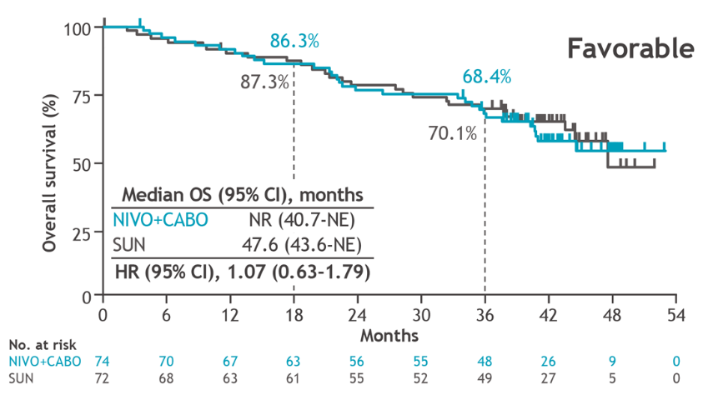
First line therapy:
Ipilimumab/nivolumab
Approved for intermediate/poor risk
TKI + IO
Axitinib/pembro v Lenvatinib/pembro
All risk strata
OS: HR 0.73 v 0.66
Cabo/Nivo
Favorable risk no survival advantage c/w sunitinib

Slide 100
NCCN Guidelines 2023

Slide 101
 | KEYNOTE-426 |  | CLEAR² | CHECKMATE 9ER³ | JAVELIN⁴ | Checkmate 214
TKI IO | Axitinib Pembro | S | Lenvatinib Pembro | Cabozantinib Nivolumab | Axitinib Avelumab | Ipi/Nivo
# pts | 861 |  | 1069 | 323 | 886 | 1096
2L Rx (%) | 58 | 73 | 54.9 | 25.4 | 46.2 | 55
¹Rini N Engl J Med 2019;380:1116-27 ²Motzer N Engl J Med 2021;384:1289-300, ³Motzer Lancet Oncology Vol 23 July 2022. ⁴Motzer N Engl J Med 2019;380:1103-15.

Slide 102
RCC: Second Line Rx options
Most options were studied in second line after failure to first line TKI
Phase III RCT
Nivolumab * (CHECKMATE -025)
Cabozantinib * (METEOR)
Axitinib v sorafenib (AXIS)
Everolimus v placebo (RECORD-1)
Phase II
Lenvatinib + everolimus*
Other
Sunitinib
Pazopanib
Temsirolimus

Slide 103
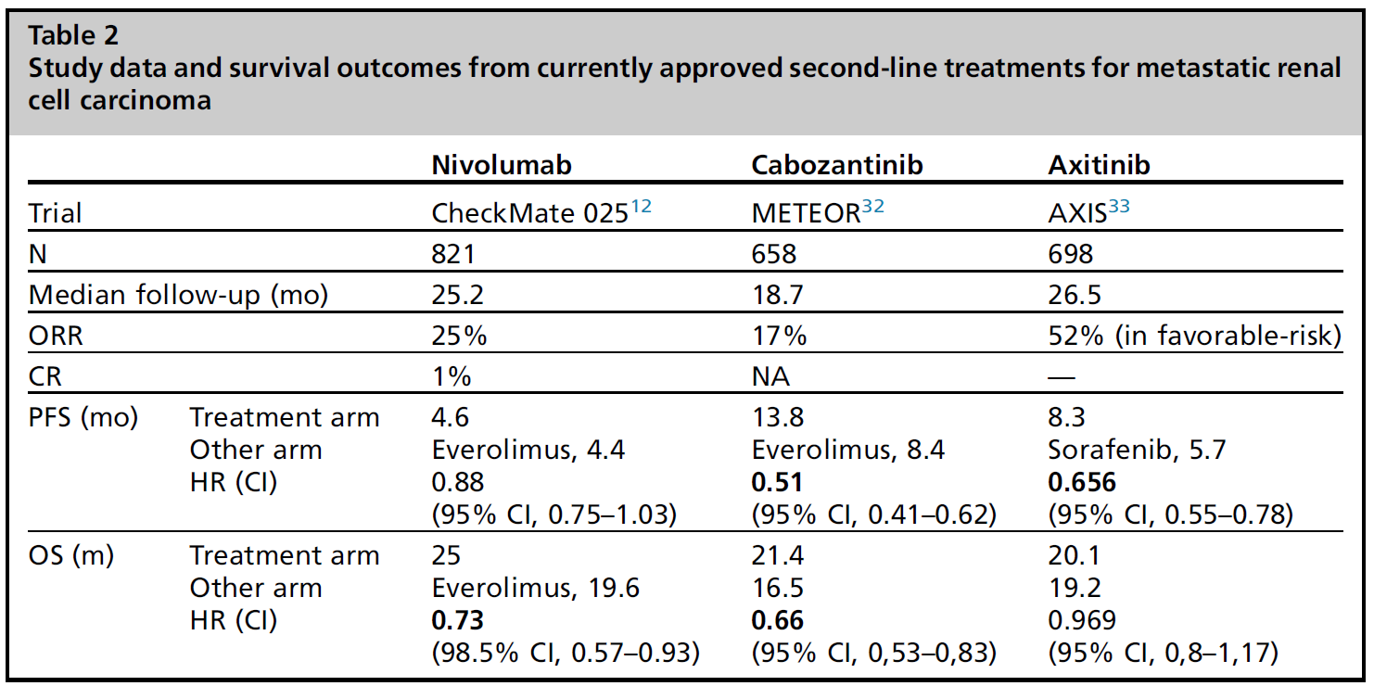
¹² Motzer, NEJM 2015, ³² Choueri, Lancet Oncol 2016
³³ Bracarda, Clin Genitourin Cancer 2019

Slide 104
METEOR Trial
Cabozantinib conferred benefit in subgroup with bone metastases (PFS 7.4 v 2.4 m)

Slide 105
Phase II
Lenvatinib v Everolimus (L+E) v Lenvatinib (L) + Everolimus
153 pts
mPFS (mos)
CBR 84%; ORR 43% for L+E
mOS (mos): L+ E 25.5 v. E 15.4 (HR = 0.5)
Lenvatinib | Everolimus | L + E
7.4 | 5.5 | 14.6
HR = 0.4
HR = 0.61
NS

Slide 106
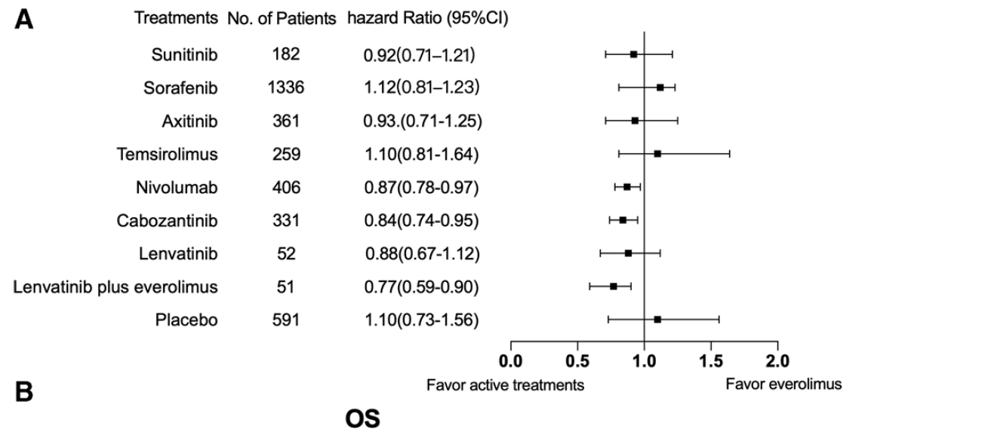
Heo et al, J Clin Pharm Ther 2021, 46 (Metanalysis)

Slide 107
Rechallenge with immunotherapy
Retrospective analysis
9 US centers
69 patients
ICI-1: IO/IO 39%, IO/TKI 42%
ICI-2: IO monotherapy 38%, IO/IO 32%
ORR 23%
Response greater IF response to prior IO - 29%
Response in pts who had progression to prior IO 21%
mTTP: ICI-1 8.2 m v ICI-2 5.7 m
(p = 0.045)
45 patients
ICI-2: IO/IO (Ipi/Nivo)
ORR 20%
No CR, SD 16%
IO/TKI 🡪 IO/IO 🡪 PD
48pts
Monotherapy > 6 months 🡪 IO/TKI
ORR 63.6%, mPFS 18 mos
Iacovelli, Cancer Treatment Reviews 105 (2022)

Slide 108
Keynote 426
ESMO 2021 update
Median F/U 42.8 mos
Ipi/nivo arm
58% received 2L therapy
🡪88% TKI
Cabozantinib 48.5%
Sunitinib
73% received 2L therapy
🡪 IO 74%

Slide 109
Response to subsequent-line targeted therapies (VEGF TKI) is higher in patients who received first-line Ipilimumab/nivolumab than IO/TKI (45% versus 15%, respectively; P = .040)¹
Times to treatment failure were 5.4 months and 3.7 months, not statistically significant ¹
A retrospective analysis showed disease control rates of 82% in patients exposed to prior-line immunotherapy and 75% in patients with previous treatment of immunotherapy and targeted therapy combination who received cabozantinib after IO therapy.²
After a combination therapy involving either 2 immunotherapies or an immunotherapy and targeted therapy, cabozantinib is a better option due to its mechanistic rationale (targets VEGF, AXL, MET) and clinical evidence
¹ Dudani Eur Urol 2019 ²McGregor Ann Oncol 2018

Slide 110
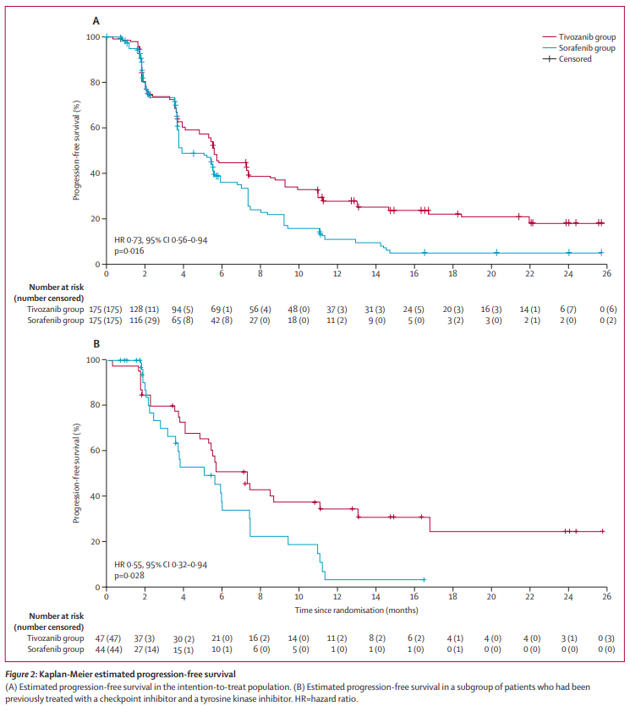
Tivozanib: Third line RCC therapy
Phase III trial:
Tivozanib 1.5 mg po QD v Sorafenib 400 mg BID
350 pts: 20% favorable risk
>2L
PR 18%
ITT mPFS 5.6 m v 3.9; HR 0.73
No OS advantage
Post IO therapy (Figure B):
1 yr PFS: 37% (tivozanib), 5% (sorafenib)
HR 0.55

Slide 111
Second Line Therapy Algorithm
Ipi/nivo 🡪 VEGF TKI (cabozantinib, esp with bone metastases) 🡪
PDIGREE trial design may help answer sequence issue
Ipi/Nivo 🡪 Nivo +/- CABO for stable disease and PR
3L lenvatinib + everolimus, tivozanib, immunotherapy rechallenge
TKI/IO 🡪 VEGF TKI (cabozantinib)
Reduced response to cabo after prior TKI
immunotherapy rechallenge
VEGF TKI 🡪 immunotherapy (nivolumab)
if contraindicated then lenvatinib+everolimus or cabozantinib (if not first line choice) or axitinib

Slide 113
Thank YOU !!!

Slide 114
PROSTATE/RCC
Tuesday, October 10, 2023

Slide 115
MANAGEMENT OF NON-CLEAR CELL RCC CASE PRESENTATION(S) JAIME R. MERCHAN, MD

Slide 116
Case Presentation
60 y.o. Hispanic male with history of left flank pain and proteinuria.
Workup revealed a 6 cm left renal mass, c/w RCC
Underwent robotic left nephrectomy
Pathology: Papillary type 1 RCC. ISUP Gr 3. pT3a.
Invades renal vein. Negative Margins. No Sarcomatoid/rhabdoid/necrosis features.
Followed every three months for 2 years, then every 6 months.
At the end of the second year of f/u, scan shows multiple 1 to 2 cm lung nodules and mediastinal and retroperitoneal LAD
Biopsy of Med. LAD: Metastatic Papillary type 1 RCC

Slide 117
Case Presentation
Symptoms: Moderate non-productive cough; decreased appetite
Comorbidities: Well controlled DM. No cardiac issues. Psoriatic arthritis
HB: 11 g/dl
ANC: 4.0K/uL
Platelets: 200K/uL
Corr. Calcium: 9.0
KPS: 80%
Creatinine: 1.5 mg.dl (GFR: 50 ml/min)
LFTs: WNL

Slide 118
Management Strategies for Advanced RCC

Slide 119
NCCN Guidelines For Advanced non clear cell RCC
Preferred Regimens
Other Recc’d Regimens
Useful In Certain Circumstances
Clinical Trial
Cabozantinib
Lenvatinib/Everolimus
Nivolumab
Nivolumab/Cabozantinib
Pembrolizumab
Sunitinib
Axitinib*
Bevacizumab
Bev/Erlotinib (HLRCC)
Bev-Everolimus
Erlotinib\Everolimus
Nivo-Ipilimumab*
Pazopanib
Temsirolimus
NCCN.org 2023. All recommendations are category 2 A, unless otherwise specified. * Cat 2B; **

Slide 120
Selected Trials in non-clear cell RCC
Treatment | Study Phase/Pt population | N | ORR | mPFS | mOS
Sunitinib Everolimus | Randomized phase 2 (ASPEN): P, C, U | 108 | 4% 5% | 8.3 5.6 | 31.5 13.2 (NS)
Axitinib | Phase 2 (Pap. 60% type 2) | 40 | 37.5% | 7.4 | 12.1
Lenvatinib + everolimus | Phase 2 (P, C, U) | 31 | 26% | 9.2 | 15.6
Atezo +Bev | Phase 2 (P, C, U, CD, T) | 42 | 25% | NR | 21.2
Cabo, Sun, 2 others) | PAPMET (RP2)-Papillary | 152 | C;23%; S: 4% | 9 5.6 | 20 16.4
Nivo/Cabo | Phase 2 (P, C, U, T, M, CD | 40 | 47.5% | 12.5 | 28
Pembro-Lenva | Phase 2 (P, C, U, T) | 158 | 49% | 18 | NR
P: Papillary
C:Chromophobe U: Unclassified
T: Translocation CD: Collecting duct;
M: Medullary
PMIDs: 26794930, 28546525, 29903415, 31721643, 35298296, 33592176, 37451291

Slide 121
Papillary Renal Cell Carcinoma: SWOG S1500
RANDOMIZE
RP2
ADVANCED PAPILLARY RCC
0-1 PRIOR THERAPIES (NO VEGF OR MET TKIS)
SUNITINIB
CABOZANTINIB
CRIZOTINIB
SAVOLITINIB
Primary Endpoint: PFS
mPFS: Cabo: 9 (5.6-12.4); Sun: 5.6 (2.9-6.7)
ORR: Cabozantinib: 23%; Sun: 4%
Pal Sk Et Al. Lancet. 397. 10275:20-26 2021
The Lancet 2021 397695-703DOI: (10.1016/S0140-6736(21)00152-5)
Copyright © 2021 Elsevier Ltd Terms and Conditions

Slide 122
Lenvatinib +Pembro in non-ccRCC: Keynote B61
Phase 2 Trial
Pembro + Lenvatinib
N: 158 pts:
P:93; Chr: 29; Uncl: 21; Tr: 6; O: 9
ORR: 49% (CR: 6%)
P: 54%; Chr: 28%; Trl: 67%;
U: 52%; Other: 56%
Median PFS: 18 mos (95% CI: 16-NR)
Median OS: NR
12 month survival rate: 82%

Slide 123
Case Presentation
Patient decided to be treated
Given h/o autoimmune disease, pt was treated with cabozantinib
First follow up CT scan showed response in lung nodules and lymph nodes
AEs from treatment: HTN (on 1 anti-HTN med), gr 1 hand-foot syndrome, treated with urea and clobetasol.
Patient continues on cabozantinib for 9 months with dose reduction (40 mg per day).

Slide 124
Case Presentation 2
40 y.o. caucasian female with history of left flank pain and proteinuria.
Workup revealed 8 cm right renal mass, c/w RCC and uterine leiomyoma (benign)
Underwent robotic left nephrectomy
Pathology: Papillary non-type 1 (type 2 in older classification) RCC. ISUP Gr 4. pT3a. Genomic profiling: FH deficient RCC.
At 14 months follow up, pt presented with back pain and weight loss.
Imaging studies show multiple liver mets and sacral bone metastasis. Biopsy of Med. LAD: Metastatic Papillary non-type 1 RCC, c/w renal primary

Slide 125
Hereditary Leiomyomatosis and Renal Cell Carcinoma (HLRCC
HLRCC: Hereditary (autosomal dominant) cancer syndrome associated with a type 2 (non-type 1) papillary RCC (pRCC) variant.
HLRCC is caused by germline mutations in the gene for the Krebs cycle enzyme fumarate hydratase (FH).
FH inactivation results in VHL-independent upregulation of hypoxia inducible factor, a reliance on aerobic glycolysis, and activation of the NRF2 pathway.
Some of these features are also shared by some sporadic pRCC tumors.
Aggressive tumor behavior and poor prognosis

Slide 126
Erlotinib-Bevacitumab in pRCC/HLRCC
Phase 2 Study: 83 pts (43=HLRCC, 40=sporadic pRCC).
Bevacizumab 10mg/kg q 2 weeks + Erlotinib 150 mg PO daily
ORR (Primary endpoint): HLRCC: 72% (95% CI: 57-83). Sporadic pRCC: 35% (95% CI: 22-51)
mPFS (mos): HLRCC: 21.1 (95% CI: 15.6-26.6). Sporadic pRCC: 8.9 (95%CI: 5.5-18.3)
mOS: HLRCC: 44.6 (95% CI: 32.7-NA). Sporadic pRCC: 18.2 (95%CI: 12.6-29.3)
Most Common AEs: Rash, diarrhea proteinuria, dry skin.

Slide 127
Case Presentation 2
Patient wished to be treated and was started on bevacizumab and erlotinib
Patient had an excellent response at the 2 month scan, with more than 30% reduction in her disease bulk.
AEs: Rash, mild diarrhea, HTN (controlled with anti HTN meds)
Pt continued on treatment past one year, with dose reductions on erlotinib, due to intolerable skin rash.

Slide 128
CONCLUSIONS
The treatment landscape for non ccRCC is evolving
More NCCN treatment options
CLINICAL TRIALS PREFERRED
Cabo, IO/TKI combinations (Nivo-Cabo; Lenvatinib-Pembro
Papillary RCC is a heterogeneous disease
Many subtypes, type 1 and non-type 1
Remember it can be part of a hereditary cancer syndrome (HLRCC), where good treatment options are available

Slide 129
Thank you!

Slide 130
PROSTATE/RCC
Tuesday, October 10, 2023

Slide 131
Question-and-Answer

Slide 132
Thank You to Our Supporter:

Slide 133
Concluding Remarks
Thank you for coming!
Please scan the QR code here to complete a brief survey about tonight's event.

