Slide 1









GI CANCERS
Wednesday, November 8, 2023

Slide 2
Welcome
Bridget Waddell
Executive Director, Global Ambassador Strategies, Oncology
MJH Life Sciences™

Slide 3


Thank You to Our Supporters:

Slide 4


Slide 5


Slide 6


Slide 7
2023 Events
Precision Medicine: November 16,
Washington, DC
Breast: December 4, San Antonio, TX
2024 Events
Genitourinary: January 24, San Francisco, CA
Lung: March, Atlanta, GA
Gyn-Onc: May, Austin, TX
Lung: June, Chicago, IL
Gastrointestinal: November, Washington, DC
Breast: December, San Antonio, TX

Slide 8


Slide 9
Program Chair
Syma Iqbal, MD
Assistant Professor of Medicine
Assistant Program Director, Oncology Fellowship Program
USC/Keck School of Medicine, Norris Comprehensive Cancer Center
Los Angeles, CA

Slide 10
Program Chair
Anthony El-Khoueiry, MD
Associate Professor of Clinical Medicine
Director of Phase I Drug Development Clinical Program
Director of Clinical Investigations Support Office
USC/Keck School of Medicine, Norris Comprehensive Cancer Center
Los Angeles, CA

Slide 11
Her2 Overexpressing Metastatic Colorectal Cancer: State of the Art
Heinz-Josef Lenz
Professor of Medicine and Preventive Medicine
Deputy Cancer Center Director
J Terrence Lanni Chair in Cancer Research
Director, USC Center for Cancer Drug Development
USC/Norris Comprehensive Cancer Center
Los Angeles, California

Slide 12
Genomic Markers in CRC
RAS mutation ±
PIK3CA/PTEN mutation
PIK3CA/PTEN mutation
Kinase inhibitor
Gene fusion
MET amp
MET inhibitor
HER2 amp
Anti-HER2 Tx
POLE amp
MSI + other
Wild type
MSI
Anti-PD-1/PD-L1
BRAF non-V600
Anti-EGFR therapies
BRAF V600E
BRAF inhibitor + anti-EGFR ± MEK inhibitor
CRC = colorectal cancer.
Dienstmann R, et al. Am Soc Clin Oncol Educ Book. 2018;38:231-238.
Notes:
CRC, colorectal cancer.

Slide 13
Clinical characteristics of HER2+ tumors in mCRC
Tumor sidedness
Tumors originating in the right or left side of the colon differ in epidemiology, pathology, mutation profile,
and presentation:¹
Right-sided
(RCC)
Transverse colon
Left-sided
(LCC)
Features of HER2+ tumors:⁴
(vs. HER2-negative controls)
more likely to originate in the left
colon (including rectum)
more likely to show more metastatic sites
are more likely to metastasize to
the lungs and the brain
Right colon
(ascending)
MSI-H
Left colon
(descending)
distinct embryologic origins of proximal and distal colon
BRAFmut
HER2+
HER2-targeting agents
↑KRASmut
↑KRASwt
Rectum
Sigmoid colon
RCC are associcated with a worse prognosis and unfavourable outcomes using anti-EGFR treatment (irrespective of RAS mutation status).^{2,3}
LCC benefit from anti-EGFR treatment in mCRC patients with KRASwt.³ Patients with HER2+ are candidates for HER2-targeted agents.

Slide 14
Key questions answered by recent data
What is the activity of tucatinib + trastuzumab in patients with HER2+ mCRC?
What role does trastuzumab deruxtecan play in the management of HER2+ mCRC?
  What dose optimizes safety and efficacy?
  Is there activity in patients with HER2+ disease with KRAS co-mutations?
  What is the activity in patients with intermediate HER2 expression (HER2 IHC=2+/ FISH+)?
Which HER2 testing strategies are relevant and useful to identify HER2+ mCRC patients that may benefit from HER2-targeted therapies?
  How does the above impact current international guideline recommendations in mCRC?
  What is the role for anti-EGFR therapies in patients with RAS wt HER2+ mCRC?
Tucatinib and trastuzumab deruxtecan are not approved by EMA in mCRC.
Tucatinib y trastuzumab no están aprobados por la EMA en el tratamiento del cáncer de colon metastásico.
HER2, human epidermal growth factor receptor 2; HER2+, HER2 gene amplification; IHC, immunohistochemistry; FISH, fluorescence in situ hybridization; KRAS, Kirsten rat sarcoma virus gene; mCRC, metastatic colorectal cancer; NGS, next-generation sequencing; RAS, rat sarcoma virus gene; wt, wildtype.

Slide 15
Currently no established criteria for HER2 testing
HER2 test criteria vary across major trials in mCRC
Trial | Criteria for HER2 overexpresion
HERACLES¹ | Intense membranous IHC HER2 protein expression in ≥50% of cells Intense membranous IHC HER2 protein expression in >10% of cells and positive FISH (ERBB2:CEP17 ratio ≥2) Equivoval membranous IHC HER2 protein expression in ≥50% of cells and positive FISH (ERBB2:CEP17 ration ≥2)
MyPathway²⁻⁴ | Complete, intense IHC 3+ score (observed in >10% of tumor cells) HER2/CEP17 ratio >2.0 or HER2 copy number >6.0 (NGS) HER2 amplification based on copy number gain
MOUNTAINEER⁵ | Strong complete staining, score of IHC 3+ (in >10% of tumor cells) Weak to moderate staining, score of IHC 2+ (in >10% of tumor cells) with an amplified FISH or CISH assay HER2 amplification tested by CLIA-certified NGS assay
DESTINY-CRC-01⁶ (02) | Strong complete membrane staining in ≥10% of tumor cells (IHC3+ or IHC2+/ISH+, cohort A) Weak-moderate membrane staining in ≥10% of tumor cells (IHC2+/ISH-, cohort B) Barely perceptible membrane staining in ≥10% of tumor cells (IHC1+, cohort C)

Slide 16
Meta-analysis of anti-EGFR treatment in RAS wt mCRC: PFS for HER2+ vs. HER2-¹
Study |  | HR (95% Cl) | N
Yagisawa 2021 ² |  | 2.35 (0.81-6.80) | 54
Jeong 2016/2017 ^{3.4} |  | 2.73 (1.18-6.31) | 142
Sartore-Bianchi 2019 ⁵ |  | 1.35 (0.96-1.89) | 184
Raghav 2016/2019 ^{6,7} |  | 10.66 (4.51-25.18) | 70
Khelwatty 2021⁸ |  | 2.56 (1.30-5.06) | 144
Overall |  | 2.84 (1.44-5.60)
Heterogeneity: T²=0.45, I²=78.85%, H²=4.73
1
2
4
8
16
HR (95% Cl)
Better PFS in HER2+
Worse PFS in HER2+

Slide 17
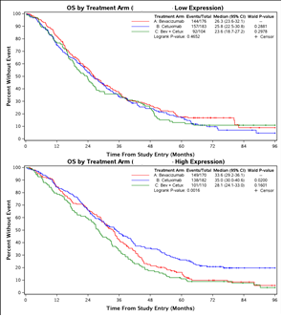
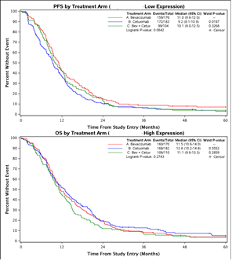

Slide 18
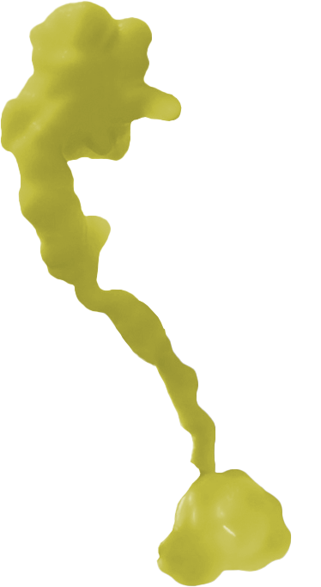
Overview of drug classes targeting HER2 in mCRC¹
mAb
e.g. pertuzumab
Monoclonal antibodies (mAb)
trastuzumab, pertuzumab
bind HER2 at a single extracellular domain
thereby preventing ligand binding and/or receptor dimerization
Small molecule inhibitors (TKI)
lapatinib, tucatinib*
bind to intracellular tyrosine-kinase domain thereby preventing ATP binding and phosphorylation
Antibody drug conjugates (ADC)
trastuzumab emtansine, trastuzumab deruxtecan
bind HER2 at a single extracellular domain via mAb part and release cytotoxic component into cancer cell
binding
subdomain II
extracellular
binding
subdomain IV
mAb, ADC
e.g. trastuzumab
Vertical
HER2-Inhibition²
(mAb + TKI)
intracellular
tyrosine
kinase-domain
small molecule TKI
e.g. tucatinib*

Slide 19
Evolution of HER2-targeted therapies in mCRC
Milestones from early clinical trials to now
HER2
2011
2015
2016-2019
2020-2022
2023
Identification of HER2 as a target for combination therapies in mCRC based on PDX models
Approval of tucatinib in combination with trastuzumab by FDA*
Phase II studies in mCRC patients with HER2+ tumors
Randomized studies ongoing
Validation of a HER2 scoring system for CRC
Inclusion of treatment & testing in clinical practice guidelines
* FDA has granted accelerated approval to tucatinib plus trastuzumab for RASwt HER2-positive unresectable or metastatic CRC that has progressed following chemotherapy. (Jan 2023).

Slide 20
Therapeutic landscape for HER2+ metastatic CRC (2023)
Size of data point adjusted for sample size
MOUNTAINEER²
Tucatinib + traz
Lapatinib + traz
DESTINY-CRC-02⁹
6.4 mg/kg
Pertuzumab + traz
T-DXd
SWOG 1613¹⁰
TDM-1 + pertuzumab
HERACLES-A¹
DESTINY-CRC-01⁷
6.4 mg/kg
Progression Free Survival, months
HERACLES-B⁸
DESTINY-CRC-02⁹
5.4 mg/kg
TAPUR⁴
TRIUMPH⁵
MyPathway³
Objective response rate, %
This chart is not intended as a cross-trial comparison.
Trastuzumab, pertuzumab, lapatinib, trastuzumab deruxtecan, trastuzumab emtansine are not approved by EMA in mCRC. Trastuzumab, pertuzumab, lapatinib, trastuzumab deruxtecan y trastuzumab emtansina no están aprobados por la EMA en el tratamiento del cáncer de colon metastásico.
CRC, colorectal cancer; HER2, human epidermal growth factor receptor 2; HER2+, HER2 gene amplification; T-DXd, trastuzumab-deruxtecan; TDM-1, trastuzumab emtansine; traz, trastuzumab.
1. Tosi F et al., Clin Colorectal Cancer 2020; 2. Strickler JH et al., Lancet Oncol. 2023; 3. Meric-Bernstam F et al., Lancet Oncol 2019; 4. Gupta et al., J Clinical Oncol. 2020; 5. Nakamura Y et al., Nature Medicine 2021; 6. Meric-Bernstam F et al., Ann Oncol. 2019; 7. Yoshino T et al., Nat. Commun. 2023. 8. Sartore-Bianchi A et al., ESMO Open 2020; 9. Raghav K et al., presented at ASCO Annual Meeting 2023, Chicago (USA), June 2-6, Oral Abstract 3501; 10. Raghav K et al., J Clin Oncol. 2023.

Slide 21
Trials targeting HER2+ in mCRC
An Overview
Study | Intervention | Patients | ORR | Median PFS, mo (95% CI) | Median OS, mo (95% CI)
HERACLES-A¹ | Trastuzumab + lapatinib | 32 | 28% | 4.7 (3.7, 6.1) | 10.0 (7.9, 15,8)
MOUNTAINEER² | Trastuzumab + tucatinib | 84 | 38.1% | 8.2 (4.2, 10.3) | 24.1 (20.3, 36.7)
MyPathway³ | Trastuzumab + pertuzumab | 57 | 32% | 2.9 (1.4, 5.3) | 11.5 (7.7, NE)
TAPUR⁴ | Trastuzumab + pertuzumab | 28 | 25% | 17.2 weeks (11.1, 27.4) | 60 weeks (32.1, 102.3)
TRIUMPH⁵ | Trastuzumab + pertuzumab | 27 | 30% | 4 (1.3, 5.6) | 10.1 (4.5, 16.5)
NCT02892123 ⁶ | Zanidatamab (ZW25) | 13 | 37% | NR | NR
DESTINY-CRC-01^{7,8} | Trastuzumab-deruxtecan | 53 | 45.3% | 6.9 (4.1, 8.7) | 15.5 (8.8, 20.8)
DESTINY-CRC-02⁹ | Trastuzumab-deruxtecan 5.4mg- / 6.4mg – kg Q3B | 82 /40 | 37.8% / 27.5% | 5.8 / 5.5 (4.6-7.0 / 4.2-7.0) | 13.4 / NE (12.5-16.8 / 9.9-NE)
Notes:
.

Slide 22
T-DXd in Patients with HER2-Overexpressing/Amplified (HER2+) Metastatic Colorectal Cancer (mCRC): Primary Results from the Multicenter, Randomized, Phase 2 DESTINY-CRC02 Study
Kanwal Raghav
The University of Texas MD Anderson Cancer Center, Houston, TX, USA
June 4, 2023
Additional authors: Salvatore Siena, Atsuo Takashima, Takeshi Kato, Marc Van Den Eynde, Maria Di Bartolomeo, Yoshito Komatsu, Hisato Kawakami, Marc Peeters, Thierry Andre, Sara Lonardi, Kensei Yamaguchi, Jeanne Tie, Christina Gravalos Castro, John Strickler, Daniel Barrios, Qi Yan, Takahiro Kamio, Kojiro Kobayashi, Takayuki Yoshino
Raghav K, et al. Presented at: ASCO;2023.
Notes:
Raghav K, et al. Presented at: ASCO;2023.

Slide 23
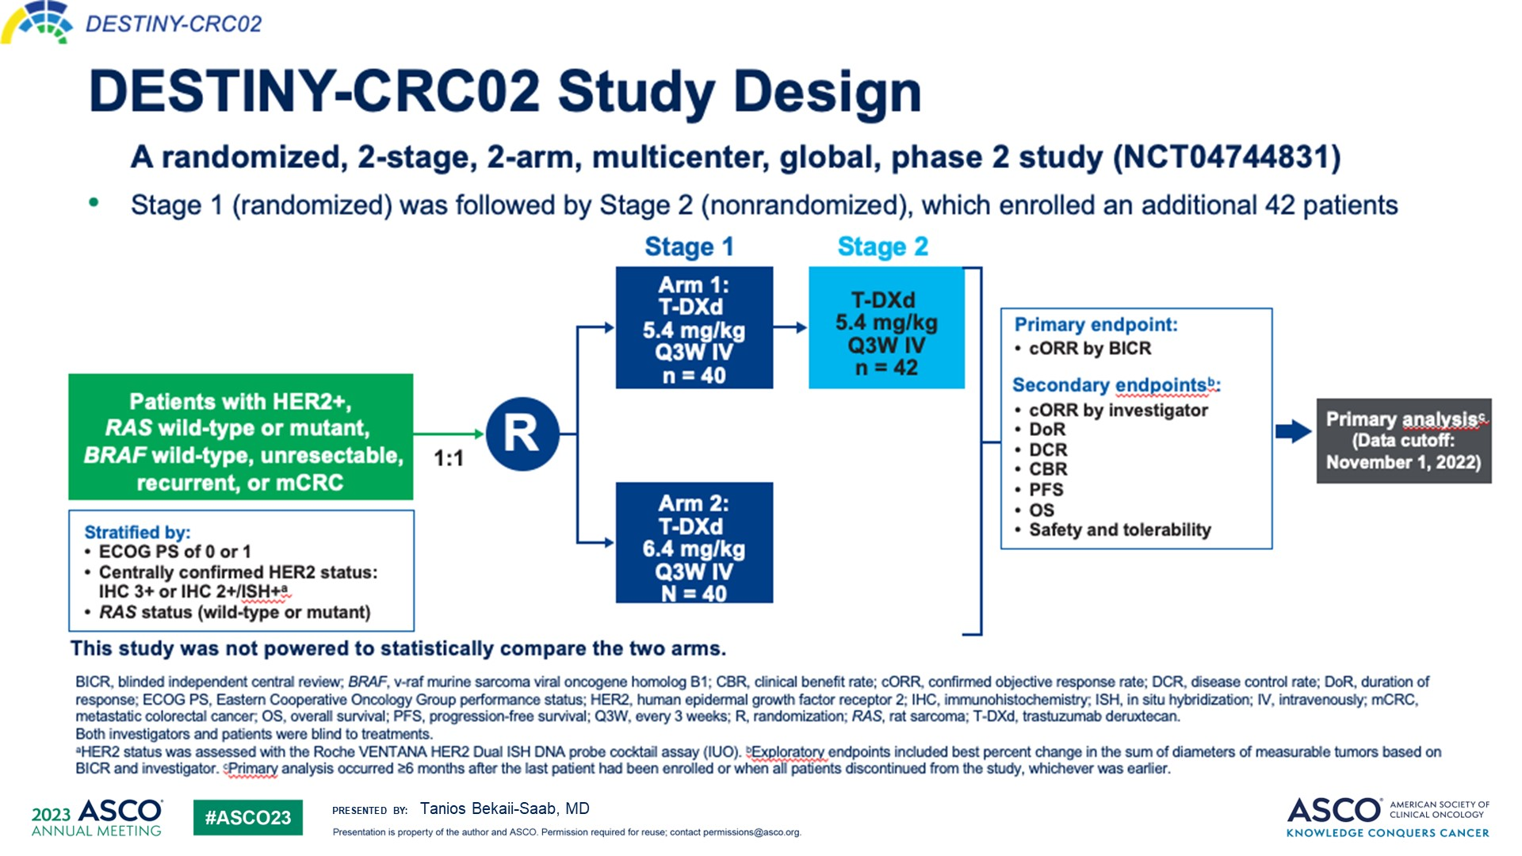
Slide 7
Content of this presentation is the property of the author, licensed by ASCO. Permission required for reuse.

Slide 24
Best Percentage Change in Sum of Diameters by BICR for T-DXd 5.4 mg/kg
T-DXd 5.4 mg/kg Q3W Total (N = 82)
100
RAS mutant
80
60
40
20
0
Best % Change in Sum of
Diameters from Baseline
−20
−40
−60
−80
Patients
−100
Best minimum change, %
n
Mean
Standard deviation
Median
Minimum
Maximum
80
−25.8
29.15
−23.0
−100
43
HER2 statusª
IHC 3+ (n = 63)
IHC 2+/ISH+ (n = 17)
BICR, blinded independent central review; HER2, human epidermal growth factor receptor 2; IHC, immunohistochemistry; ISH, in situ hybridization; Q3W, every 3 weeks; RAS, rat sarcoma; T-DXd, trastuzumab deruxtecan.
Only patients with measurable disease at baseline and at least one postbaseline tumor assessment were included in the waterfall graphs.
ªHER2 status was assessed by central laboratory.
Raghav K, et al. Presented at: ASCO;2023.

Slide 25
DESTINY-CRC-02: Trastuzumab deruxtecan for HER2+ mCRC - Baseline Characteristics
 | T-DXd 5.4 mg/kg Q3W | T-DXd 6.4 mg/kg Q3W
 | Total N = 82 | Stage 1 N = 40
Median age, years (range) | 59.1 (26-84) | 62.3 (35-81)
Sex, n (%) Male | 45 (54.9) | 19 (47.5)
Region, n (%) Asia-Pacific US Europe | 47 (57.3) 6 (7.3) 29 (35.4) | 24 (60.0) 2 (5.0) 14 (35.0)
HER2 status, n (%) IHC 3+ IHC 2+/ISH+ | 64 (78.0) 18 (22.0) | 34 (85.0) 6 (15.0)
ECOG PS, n (%) 0 1 | 46 (56.1) 36 (43.9) | 22 (55.0) 18 (45.0)
RAS status, n (%) Wild-type Mutant | 68 (82.9) 14 (17.1) | 34 (85.0) 6 (15.0)
HER2/RAS status, n (%) IHC 2+ ISH+/wild-type IHC 2+ ISH+/mutant IHC 3+/wild-type IHC 3+/mutant | 12 (14.6) 6 (7.3) 56 (68.3) 8 (9.8) | 6 (15.0) 0 28 (70.0) 6 (15.0)
Primary tumor site, n (%) Left colonª Rectum Right colon^{b} | 61 (74.4) 27 (32.9) 21 (25.6) | 34 (85.0) 19 (47.5) 6 (15.0)
ªIncludes rectum, sigmoid, and descending. ^{b}Includes cecum, ascending, and transverse.
Trastuzumab deruxtecan is not approved by EMA in mCRC. Trastuzumab deruxtecan no está aprobado por la EMA en el tratamiento del cáncer de colon metastásico.
ECOG PS, Eastern Cooperative Oncology Group performance status; HER2, human epidermal growth factor receptor 2; IHC, immunohistochemistry; ISH, in situ hybridization; Q3W, every 3 weeks; RAS, rat sarcoma virus gene; T-DXd, trastuzumab deruxtecan; US, United States.
Raghav K et al., presented at ASCO Annual Meeting 2023, Chicago (USA), June 2-6, Oral Abstract 3501.

Slide 26
DESTINY-CRC-02: Trastuzumab deruxtecan for HER2+ mCRC - Best ORR (BICR) by T-DXd 5.4 mg/kg subgroup
ORR, % (n/N)
95% CIª
All patients (5.4 mg/kg)
N = 82
37.8 (31/82)
27.3-49.2
IHC 3+
46.9 (30/64)
34.3-59.8
HER2 status
IHC 2+/ISH+
5.6 (1/18)
0.1-27.3
RAS status
Wild-type
39.7 (27/68)
28.0-52.3
Mutant^{b}
28.6 (4/14)
8.4-58.1
ECOG PS
0
39.1 (18/46)
25.1-54.6
1
36.1 (13/36)
20.8-53.8
Left colon^{c}
39.3 (24/61)
27.1-52.7
Primary tumor site
Right colon^{d}
33.3 (7/21)
14.6-57.0
No
36.9 (24/65)
25.3-49.8
Prior anti-HER2 treatment
Yes
41.2 (7/17)
18.4-67.1
0
10
20
30
40
50
60
70
80
Objective Response Rate, %
ªBased on the exact Clopper-Pearson method for binomial distribution. ^{b}All RASm responders were IHC 3+. ^{c}Includes rectum, sigmoid, and descending. ^{d}Includes cecum, ascending, and transverse.
Trastuzumab deruxtecan is not approved by EMA in mCRC.
Trastuzumab deruxtecan no está aprobado por la EMA en el tratamiento del c´áncer de colon metastásico.
BICR, blinded independent central review; CI, confidence interval; ECOG PS, Eastern Cooperative Oncology Group Performance Status; HER2, human epidermal growth factor receptor 2; HER2+, HER2 gene amplification; IHC, immunohistochemistry; ISH, in situ hybridization; mCRC, metastatic colorectal cancer; ORR, objective response rate; RAS, rat sarcoma virus gene; T-DXd, trastuzumab deruxtecan.
Raghav K et al., presented at ASCO Annual Meeting 2023, Chicago (USA), June 2-6, Oral Abstract 3501.

Slide 27
Median Progression-Free Survival by BICR
T-DXd 5.4 mg/kg Q3W Total (N = 82)
T-DXd 6.4 mg/kg Q3W Stage 1 (N = 40)
1.0
Median PFS
1.0
Median PFS
5.8 months (95% CI, 4.6-7.0)
5.5 months (95% CI, 4.2-7.0)
0.8
0.8
0.6
0.6
Progression-free Survival
Progression-free Survival
0.4
0.4
0.2
0.2
Censor
Censor
95% CI
95% CI
0.0
0.0
0
1
2
3
4
5
6
7
8
9
10
11
12
13
14
0
1
2
3
4
5
6
7
8
9
10
11
12
13
14
Time, months
Time, months
82
79
69
60
58
43
27
21
16
7
3
3
0
40
38
28
25
22
15
11
8
8
5
4
4
2
0
Number of patients at risk
Number of patients at risk
BICR, blinded independent central review; PFS, progression-free survival; Q3W, every 3 weeks; T-DXd, trastuzumab deruxtecan.
Raghav K, et al. Presented at: ASCO;2023.

Slide 28
Median Overall Survival
T-DXd 5.4 mg/kg Q3W Total (N = 82)
T-DXd 6.4 mg/kg Q3W Stage 1 (N = 40)
1.0
Median OS
1.0
Median OS
13.4 months (95% CI, 12.5-16.8)
NE (95% CI, 9.9 months-NE)
0.8
0.8
0.6
0.6
Overall Survival
Overall Survival
0.4
0.4
0.2
0.2
Censor
Censor
95% CI
95% CI
0.0
0.0
0
1
2
3
4
5
6
7
8
9
10
11
12
13
14
15
16
17
18
0
1
2
3
4
5
6
7
8
9
10
11
12
13
14
15
16
17
18
Time, months
Time, months
82
80
78
76
73
68
64
61
52
41
30
18
13
6
5
3
2
1
0
40
38
37
36
35
33
29
28
26
24
21
16
11
9
5
5
1
0
Number of patients at risk
Number of patients at risk
NE, not evaluable; Q3W, every 3 weeks; T-DXd, trastuzumab deruxtecan.
Raghav K, et al. Presented at: ASCO;2023.

Slide 29
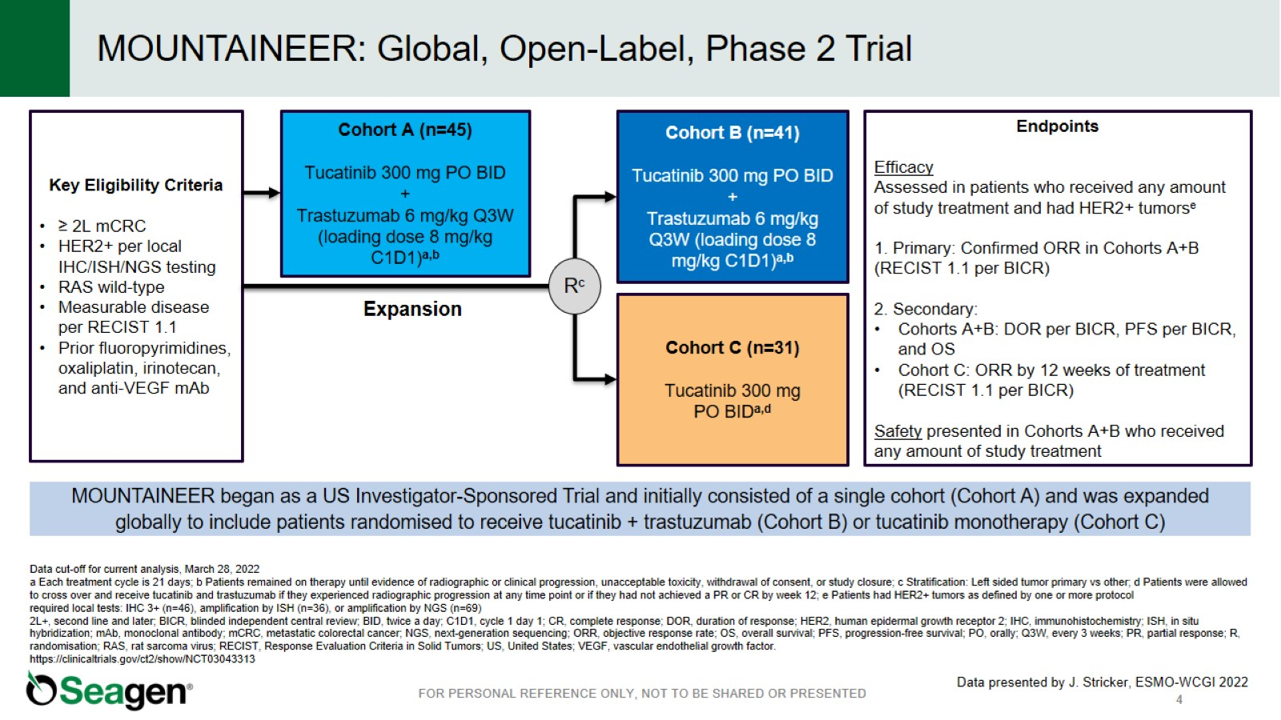
MOUNTAINEER: Global, Open-Label, Phase 2 Trial
Stricker J, et al. Presented at: ESMO-WCGI;202.

Slide 30
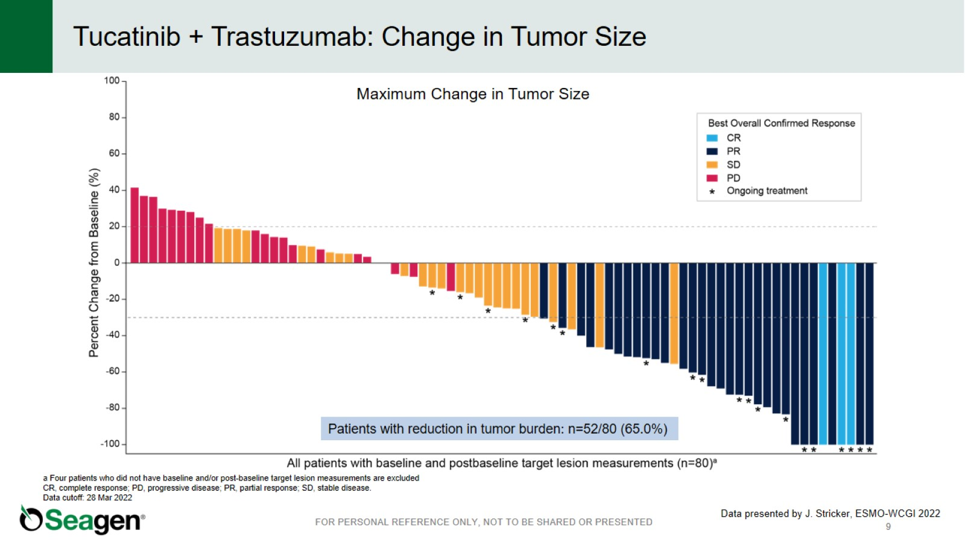
Tucatinib + Trastuzumab: Change in Tumor Size
Raghav K, et al. Presented at: ASCO;2023.

Slide 31
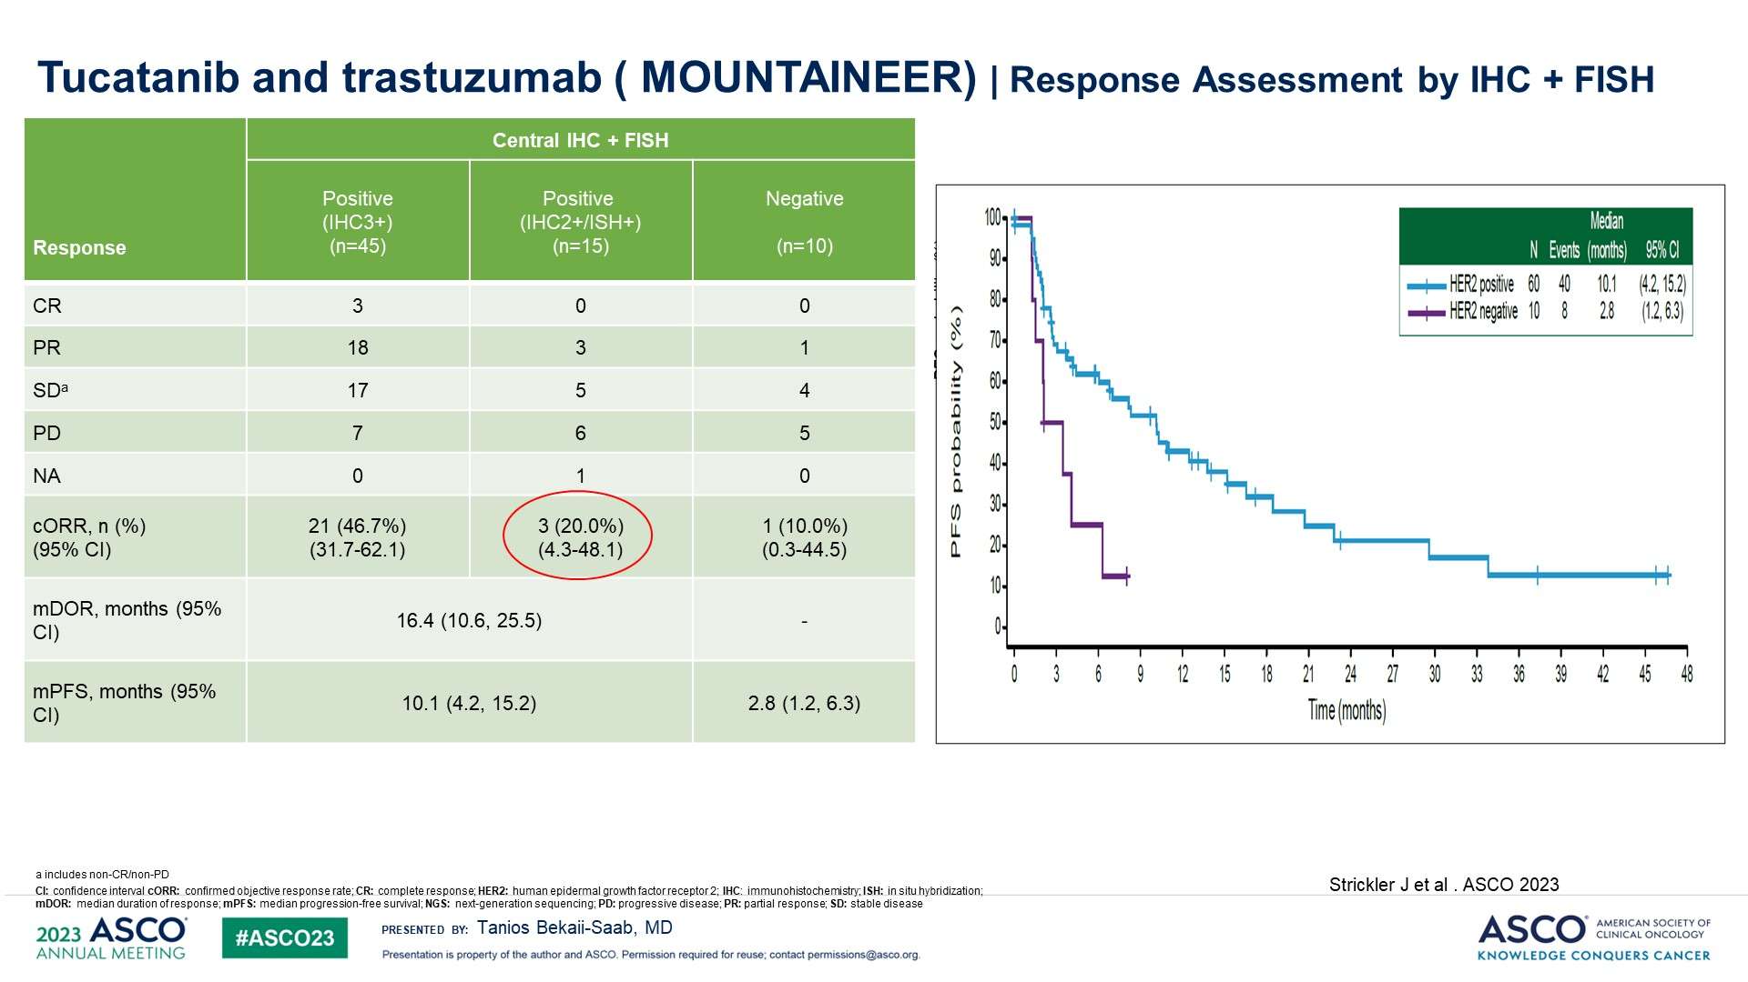
<br />Tucatanib and trastuzumab ( MOUNTAINEER) | Response Assessment by IHC + FISH
Content of this presentation is the property of the author, licensed by ASCO. Permission required for reuse.

Slide 32
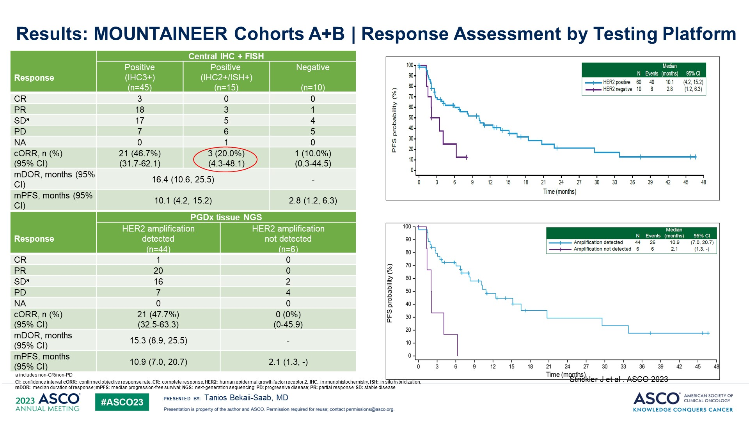
<br />Results: MOUNTAINEER Cohorts A+B | Response Assessment by Testing Platform
Content of this presentation is the property of the author, licensed by ASCO. Permission required for reuse.

Slide 33
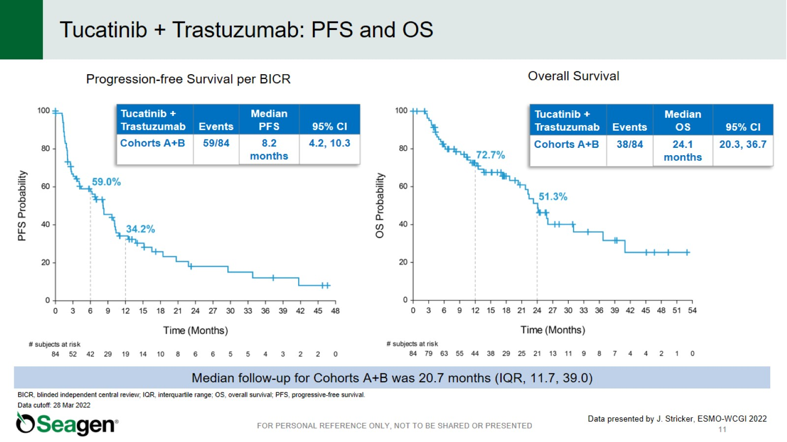
Tucatinib + Trastuzumab: PFS and OS
Raghav K, et al. Presented at: ASCO;2023.

Slide 34
MOUNTAINEER: Tucatinib + Trastuzumab:
Summary – efficacy and safety
Overview efficacy Tucatinib + Trastuzumab Cohorts A+B (n=84)¹
Overview safety Tucatinib + Trastuzumab Cohorts A+B (n=86)²
Confirmed ORR, % (95% CI) | 38.1% (27.7-49.3)
mDOR, months (95% CI) | 12.4 months (8.5-25.5)
DCR, n (%) | 60 (71%)
PFS, months (95% CI) | 8.2 months (4.2-10.3)
OS, months (95% CI) | 24.1 months (20.3-36.7)
TEAEs, n (%) | Tucatinib + Trastuzumab
Any grade AEs | 82 (95.3)
Tucatinib-related | 63 (73.3)
Trastuzumab-related | 58 (67.4)
Grade ≥3 AEs | 33 (38.4)
Tucatinib-related | 8 (9.3)
Trastuzumab-related | 6 (7.0)
SAEs | 19 (22.1)
Tucatinib-related | 3 (3.5)
Trastuzumab-related | 2 (2.3)
AEs leading to study treatment discontinuation^{a,b} | 5 (5.8)
AEs leading to tucatinib dose modification | 22 (25.6)
Deaths due to AEs | 0
ªTEAEs leading to discontinuation of tucatinib included alanine aminotransferase increase (2.3%), COVID-19 pneumonia (1.2%), cholangitis (1.2%), and fatigue (1.2%);
^{b}TEAEs leading to discontinuation of trastuzumab included alanine aminotransferase increase (2.3%) and COVID-19 pneumonia (1.2%).
Tucatinib and trastuzumab are not approved by EMA in mCRC. Tucatinib y trastuzumab no están aprobados por la EMA en el tratamiento del cáncer de colon metastásico.
AE, adverse event; CI, confidence interval; DCR, disease control rate; mDOR, median duration of response; ORR, objective response rate; OS, overall survival; PFS, progression-free survival; SAE, serious adverse event; TEAE, treatment-emergent adverse event.
1. Strickler JH et al., Lancet Oncol. 2023; 2. Stricker JH et al., presented at ESMO GI 2022, abstract LBA-2.

Slide 35
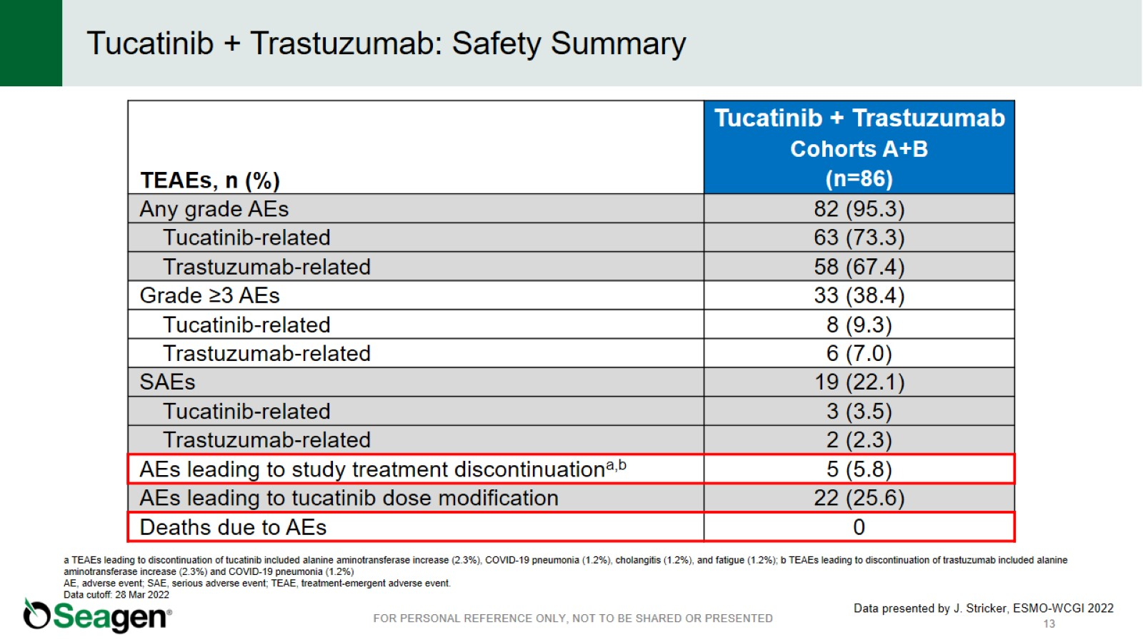
Tucatinib + Trastuzumab: Safety Summary

Slide 36
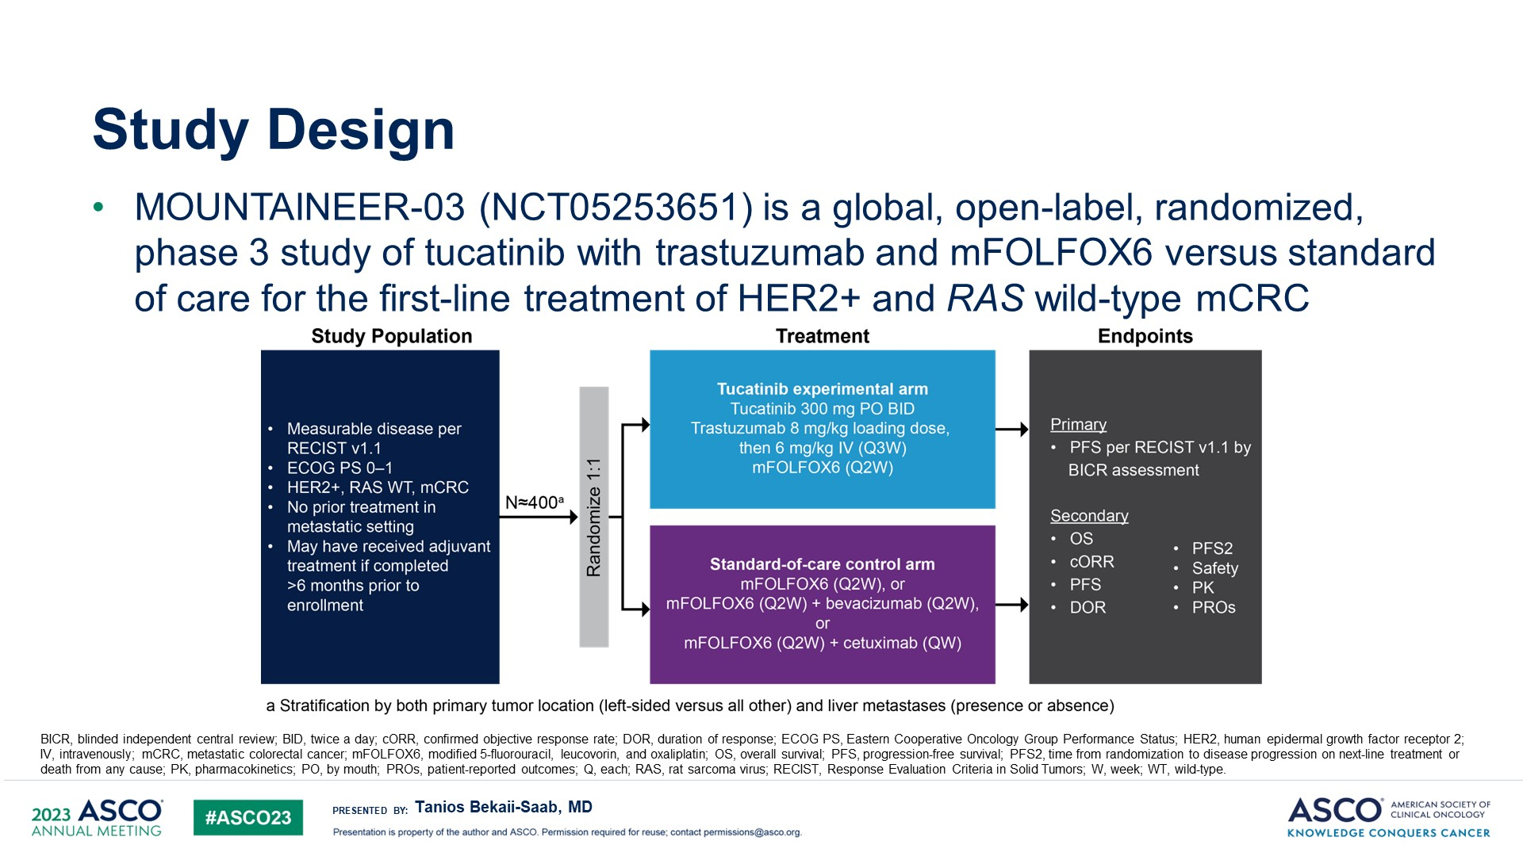
Study Design
Content of this presentation is the property of the author, licensed by ASCO. Permission required for reuse.

Slide 37
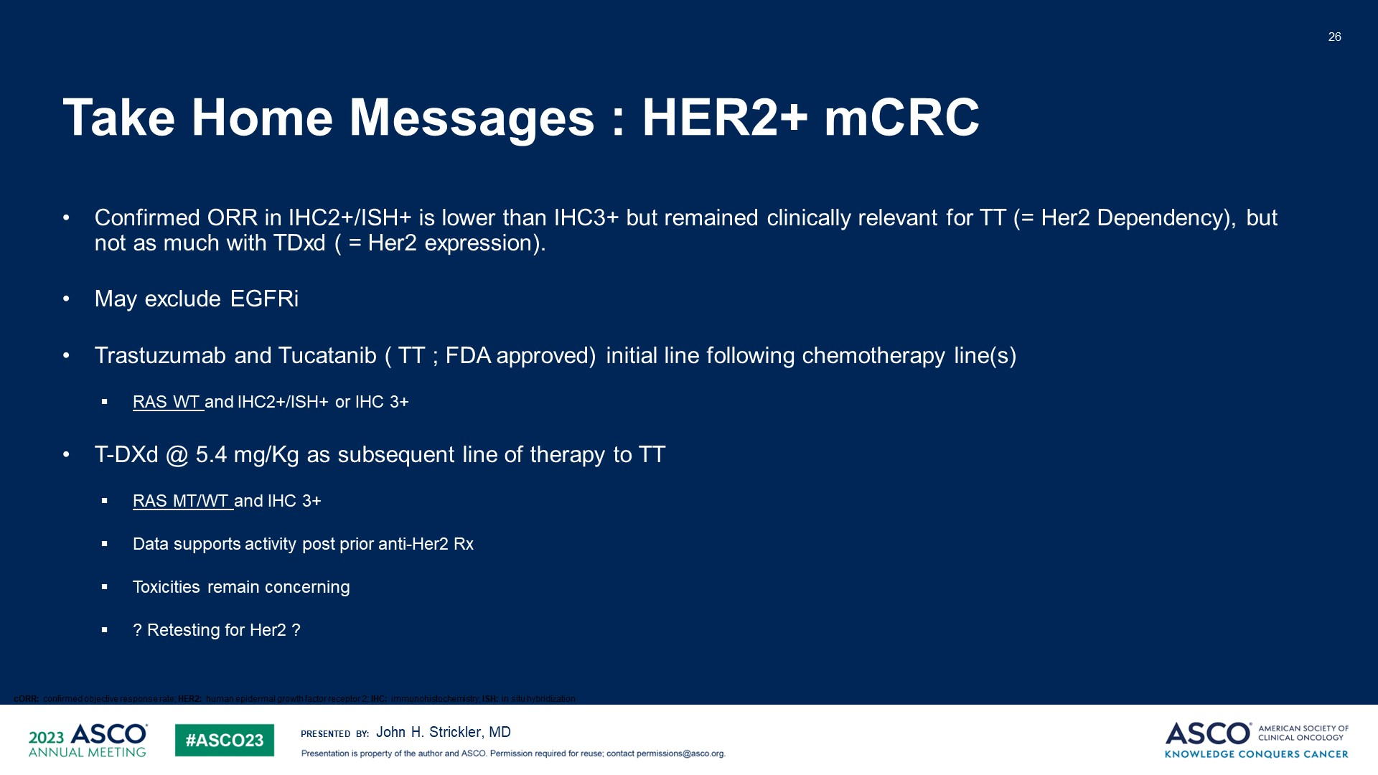
Take Home Messages : HER2+ mCRC
Raghav K, et al. Presented at: ASCO;2023.
Content of this presentation is the property of the author, licensed by ASCO. Permission required for reuse.

Slide 38
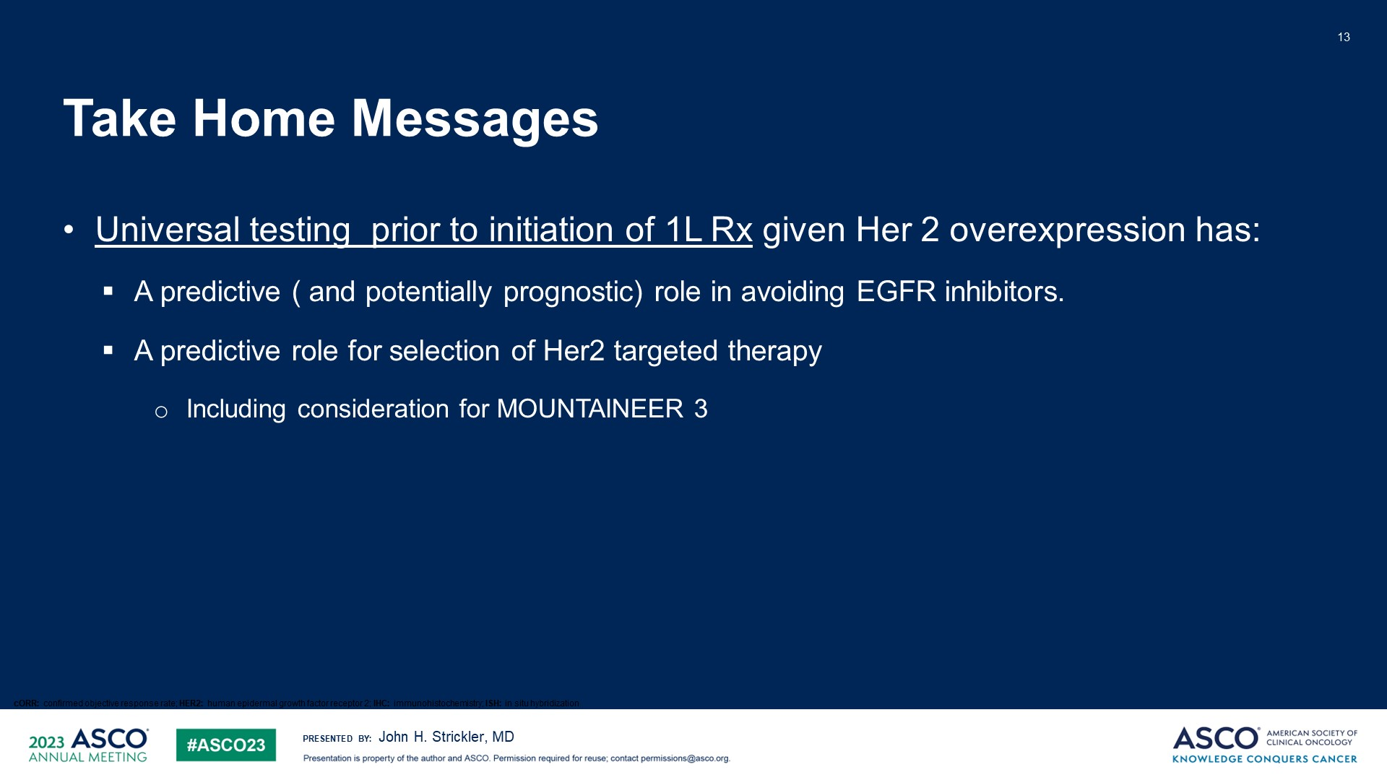
Take Home Messages
Content of this presentation is the property of the author, licensed by ASCO. Permission required for reuse.

Slide 39
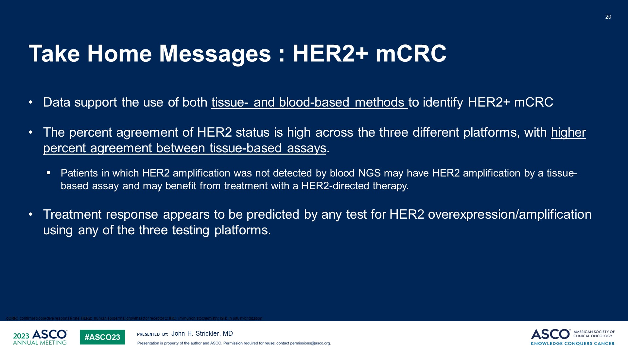
Take Home Messages : HER2+ mCRC
Content of this presentation is the property of the author, licensed by ASCO. Permission required for reuse.

Slide 40
How I treat HER2+ metastatic CRC*
Test HER2, RAS, and BRAF prior to start of 1st line treatment
Trastuzumab deruxtecan
5.4 mg/kg
Options after progresion
Clinical trial
Chemotherapy + bevacizumab
Chemotherapy + anti-EGFR if HER2
is low/ lost on re-biopsy
Consider in select circumstances: trastuzumab + pertuzumab or lapatinib
RAS or BRAF mutation?
YES
HER2+
NGS (preferred)
or IHC3+
or IHC2+/ISH+
Chemotherapy + bevacizumab
Consider repeat biopsy or ctDNA
for HER2 biomarker testing
NO
Tucatinib + Trastuzumab
Trastuzumab deruxtecan
5.4 mg/kg
Trastuzumab, trastuzumab deruxtecan, tucatinib are not approved by EMA in mCRC.
Trastuzumab, trastuzumab deruxtecan, tucatinib no están aprobados por la EMA en el tratamiento del cáncer de colon metastásico.
* FDA has granted accelerated approval to tucatinib plus trastuzumab for RAS wt HER2-positive unresectable or metastatic CRC that has progressed following chemotherapy. (Jan 2023). No HER2-targeted treatment is currenty approved in the EU by EMA (July 2023).
BRAF, v-raf murine sarcoma viral oncogene homolog B1; CRC, colorectal cancer; ctDNA, circulating tumor DNA; EGFR, epidermal growth factor receptor; HER2, human epidermal growth factor receptor 2; IHC, immunohistochemistry; ISH, in situ hybridization; NGS, next-generation sequencing; RAS, rat sarcoma virus gene.
Strickler JH, Duke Cancer Institute (Durham, USA), personal communication.

Slide 41
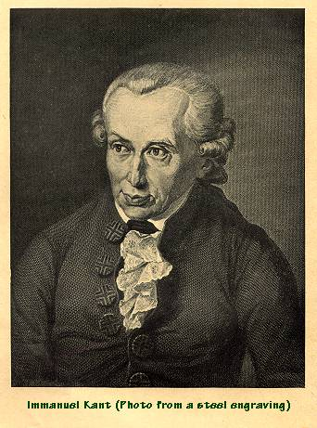

The one who knows more, may decide better

Slide 42
GI CANCERS
Wednesday, November 8, 2023

Slide 43
Novel Approaches to the Treatment of Rectal Cancer
Sandy Algaze, MD
Assistant Professor of Medicine
University of Southern California
Los Angeles, CA

Slide 44
Objectives
Historical Trials
Contemporary Trials
Future Directions

Slide 45
Disclosures
Advisory Board: Elevar Pharmaceuticals

Slide 46
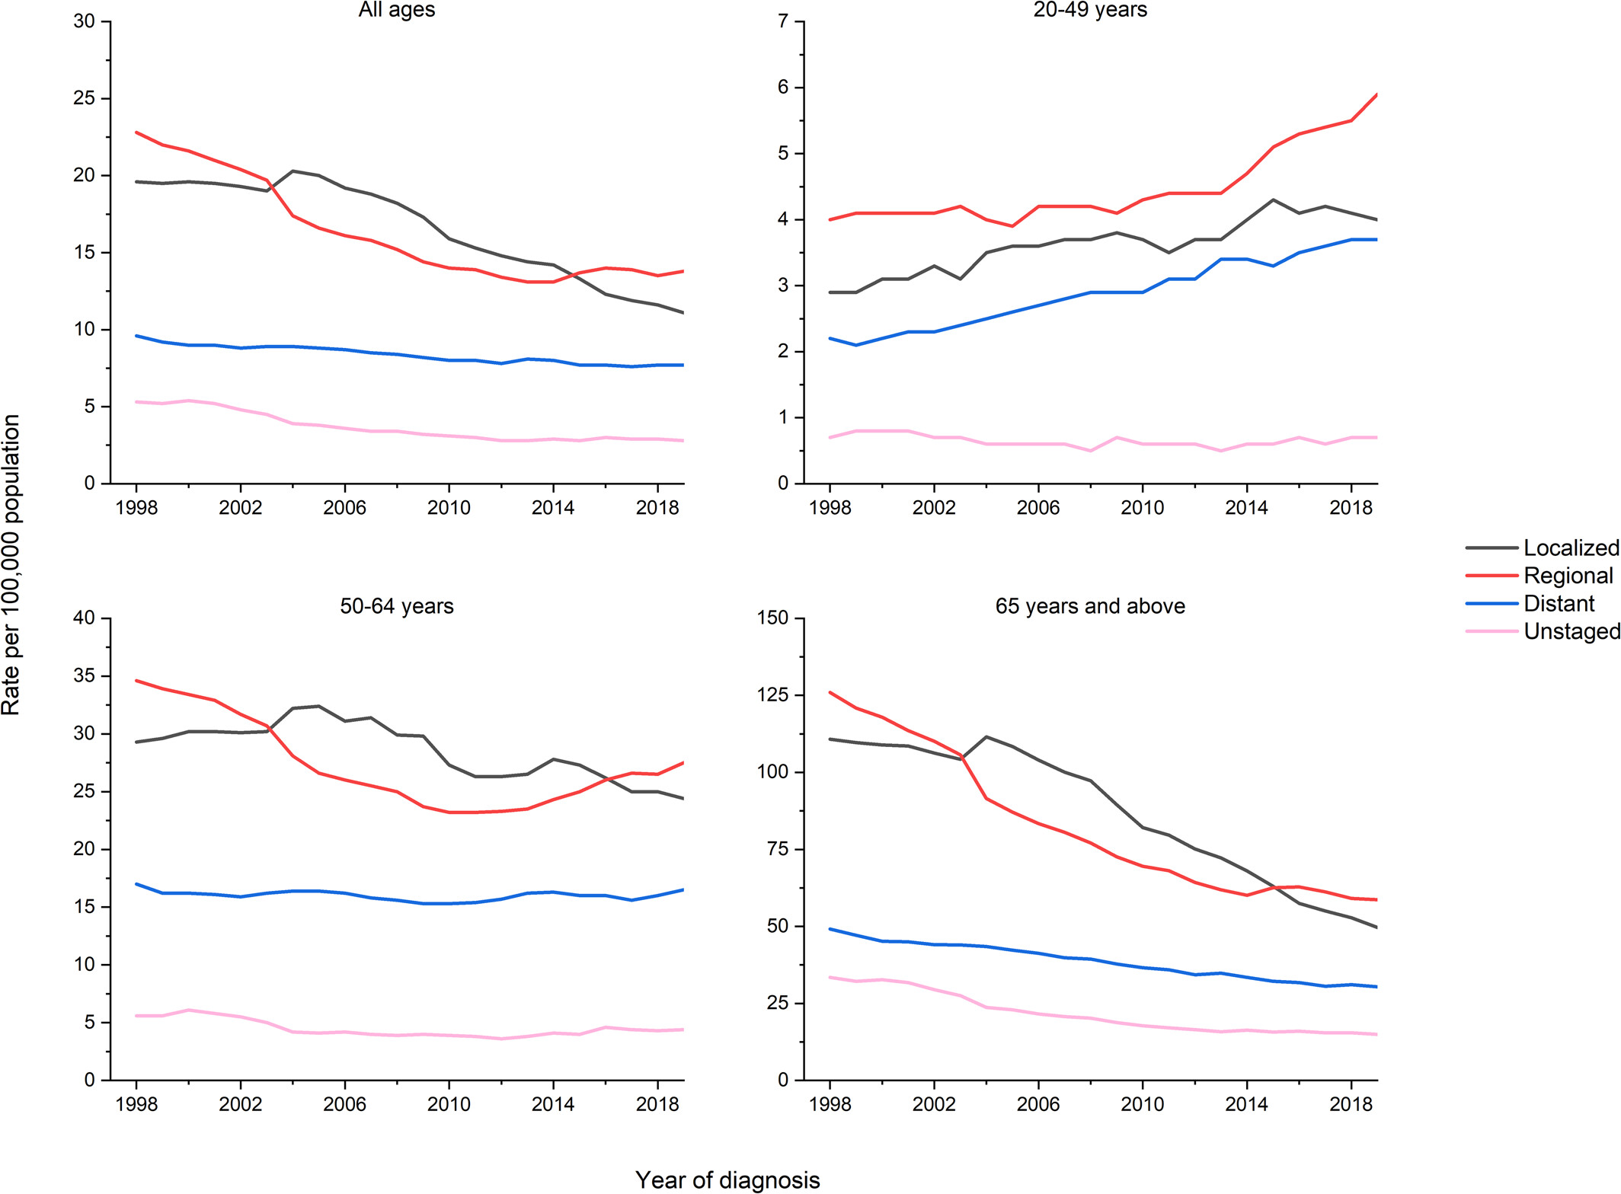
Rectal Cancer increasing in Younger Patients
Colorectal cancer statistics, 2023
CA A Cancer J Clinicians, Volume: 73, Issue: 3, Pages: 233-254, First published: 01 March 2023, DOI: (10.3322/caac.21772)
Notes:
In 2021, USPTF screening changed screening recommendations to age 45
Presenting without known hereditary syndromes
Southwest, Kentucky/west virgina area – environmental, diet, microbiome

Slide 47
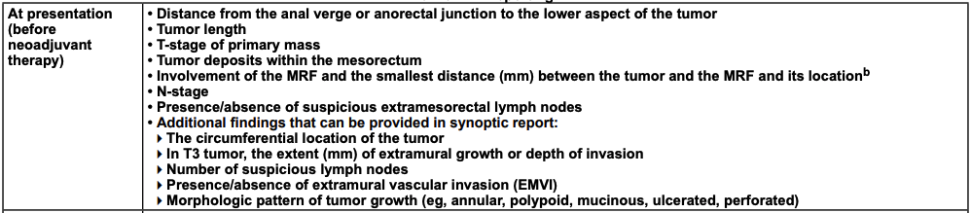
MRI Staging is Critical
Significant heterogeneity exists within Stage II/III rectal cancer
Collaboration with Radiology is Essential
Critical for personalized decision making

Slide 48
Historical Rectal Cancer Trials
Trial | Population | Arm | Arm | Findings
Swedish Rectal Cancer Trial (1997)¹ | Below promontory by barium enema <80 yrs | 25 Gy In 5 fx 1 week prior to surgery | Surgery alone (not TME) | 5 yr LRR: 11% vs 27% 5 yr DM: 22.6% vs 24.6% 5 yr OS: 58% vs 48%
Dutch CRC Group (2001)² | < 15 AV No DM 1/3 Stage III | 5 Gy in 5 fx → TME | TME | 2 yr LR: 2.4% vs 8.2% 2 yr DM: 14.8% vs 16.8% 2 yr OS 82% vs 81.5%
German Rectal Cancer Study Group (2004)³ | T3/T4 or N+ by ERUS/ CT < 75 yrs < 16cm AV | TME→ CRT (50.4 +5.4 boost with 5-FU) after 4w | CRT (50.4Gy with 5-FU) → TME after 6w | 5 yr: LR 13% vs. 6% 5 yr: DM: 24.4% vs 25.1%

Slide 49
Historical Rectal Cancer Trials
TME has improved clinical outcomes
Preoperative chemoradiation improves Locoregional recurrence, but not rate of Distant Metastases or Overall Survival
Notes:
Historical benchmarks ~ 6% local recurrence rate and ~ 30% distant metastatic recurrent rate

Slide 50



What’s New in Rectal Cancer
MSI-H
Immunotherapy
Alone?
Non-Operative Management
Omission of Radiation
Total Neoadjuvant Therapy
Notes:
TNT – chemo compliance
Decreased DM
Improved pCR
Earlier reversal of diverting ileostomy

Slide 51
Total Neoadjuvant Therapy
Chemoradiation and Chemotherapy all neoadjuvantly
Potential Advantages
  Chemotherapy adherence
  Decreased Distant Recurrence
  Improved Rates of Pathologic Response
  Earlier Reversal of Diverting Ilesotomy

Slide 52
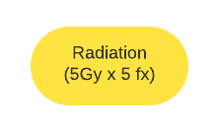


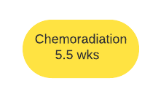
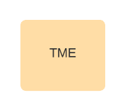
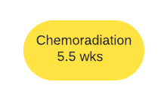
Total Neoadjuvant Therapy Options
Rapido
PRODIGE-23
German Trial
OPRA Trial
German Trial
OPRA Trial

Slide 53
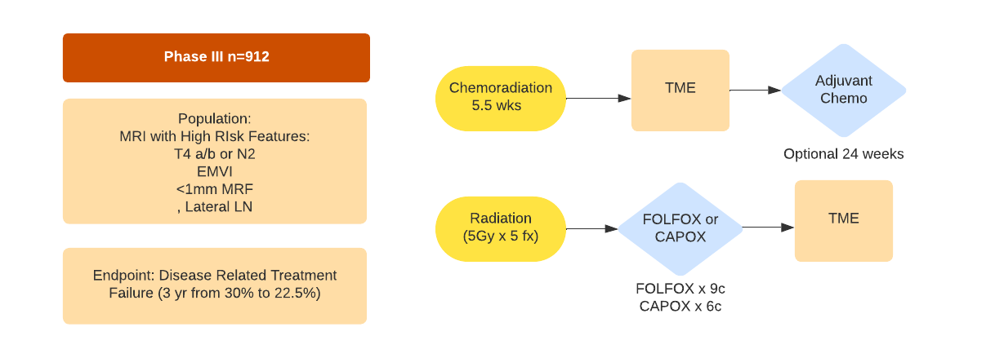
Rapido Trial
Dijkstra et al. Annals of surgery 2023
Bahadoer et al. The Lancet Oncology 2021
Notes:
High Risk Patients – T4 disease, EMVI, abutting MRF, lateral LN

Slide 54
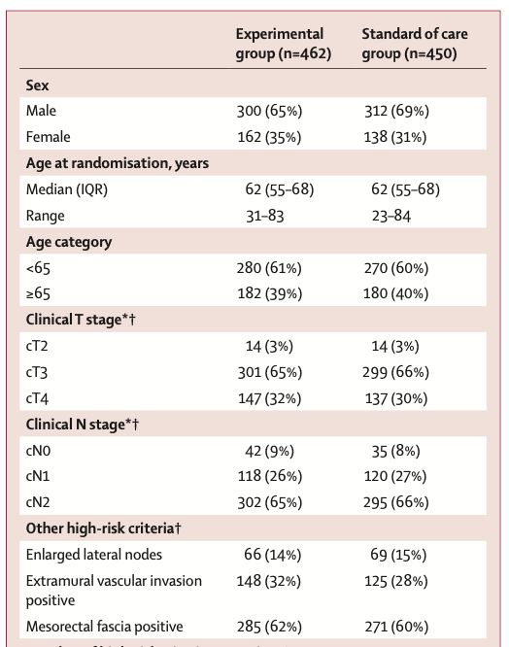
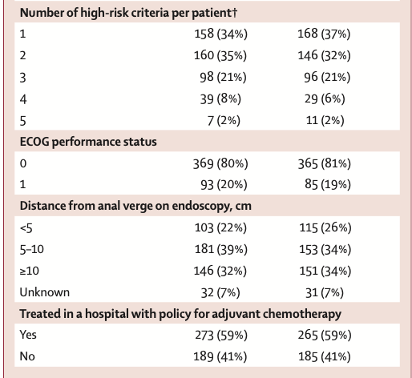
Rapido Trial
Dijkstra et al. Annals of surgery 2023
Bahadoer et al. The Lancet Oncology 2021
Notes:
High Risk Patients – T4 disease, EMVI, abutting MRF, lateral LN

Slide 55
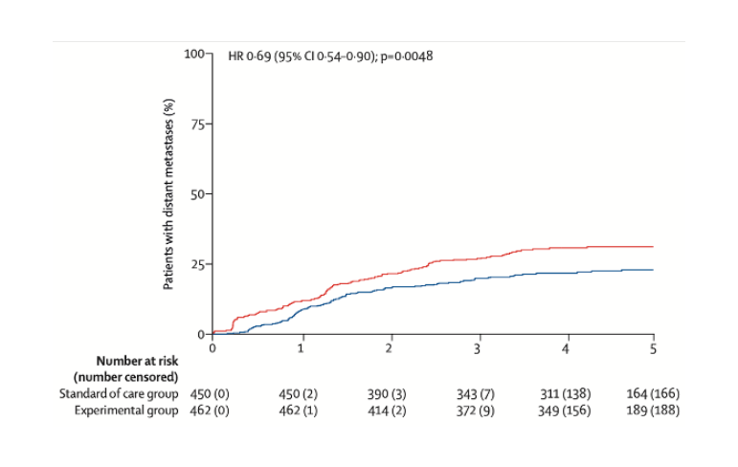
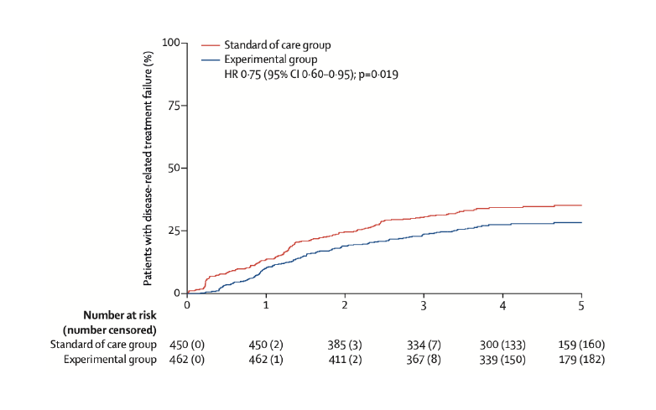
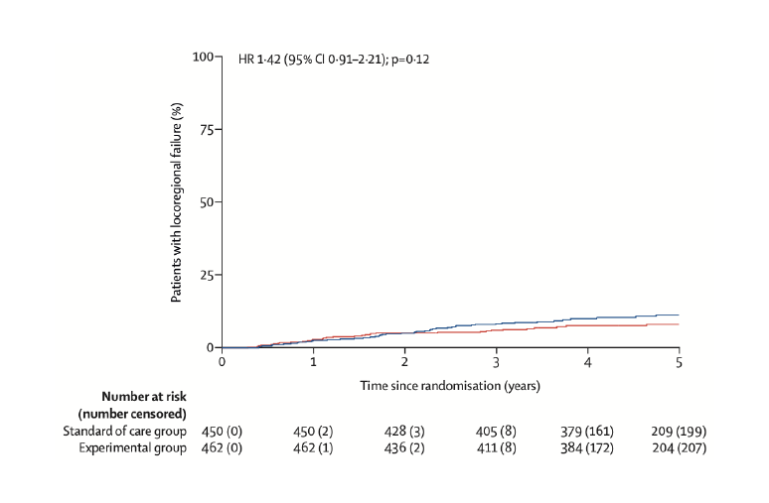
Rapido Trial
Dijkstra et al. Annals of surgery 2023
Bahadoer et al. The Lancet Oncology 2021
Disease Related
Treatment Failure
Distant Metastases
Local Failure
Breached mesorectum on TME specimen in ScRT group (11 vs 6%, p=0.022)
 | RT→ FOLFOX | Standard
3 Year | 23.7% | 30.4%
5 Year | 27.8% | 34.0%
 | RT→ FOLFOX | Standard
3 Year | 20.0% | 26.8%
5 Year | 23.0% | 30.4%
 | RT→ FOLFOX | Standard
3 Year | 8.7% | 6.0%
5 Year | 27.8% | 12%

Slide 56
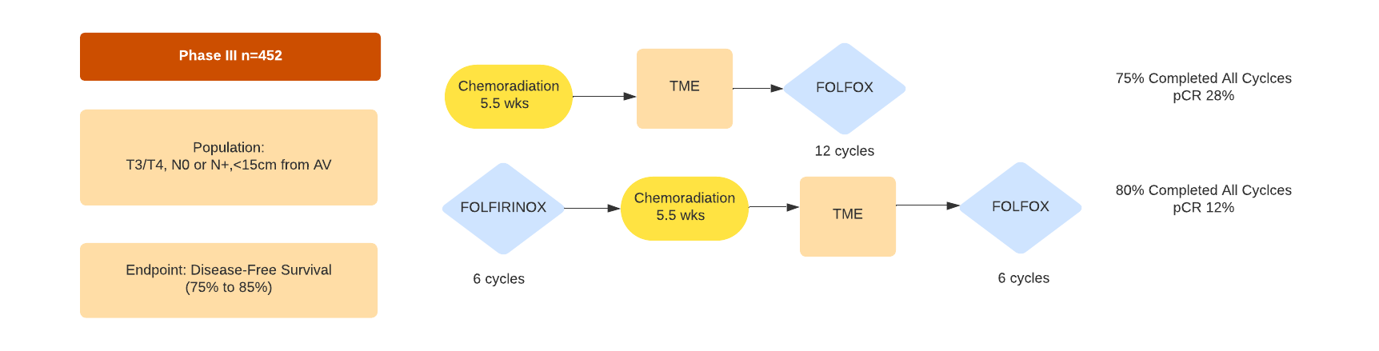
PRODIGE 23 Trial
Conroy et al. Journal of Clinical Oncology 2023
Conroy et al. The Lancet Oncology 2021

Slide 57
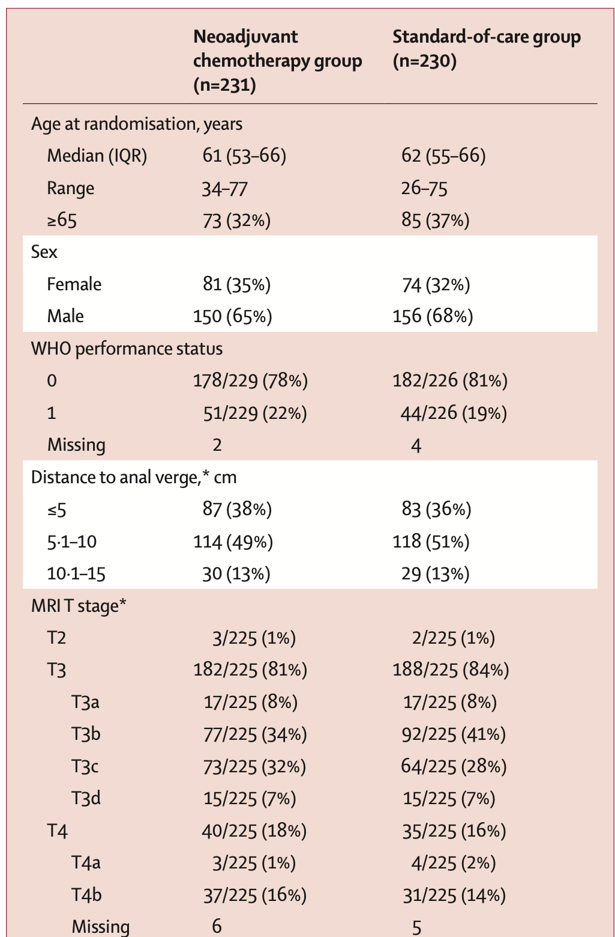
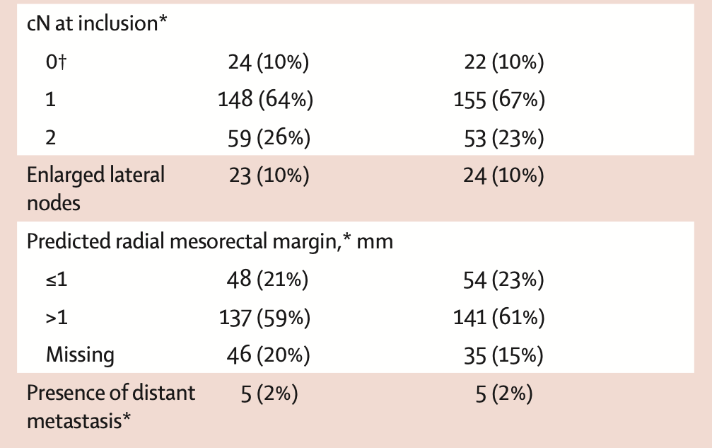
PRODIGE 23
Conroy et al. Journal of Clinical Oncology 2023
Conroy et al. The Lancet Oncology 2021

Slide 58
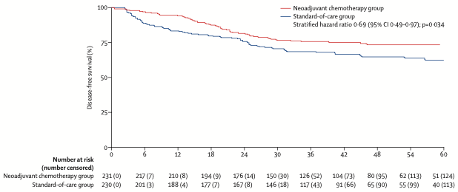
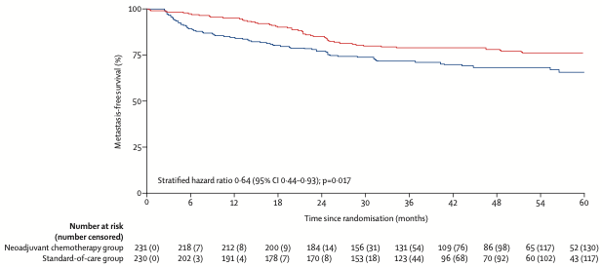
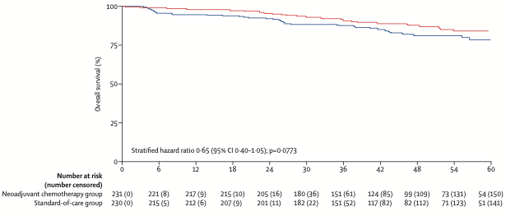
PRODIGE 23 Trial
Conroy et al. Journal of Clinical Oncology 2023
Conroy et al. The Lancet Oncology 2021
Disease Free Survival
Distant Metastatic Free Survival
Overall Survival
Local Recurrence 4.3 vs 5.7%, p=0.51
 | NAC Chemo | Standard | P-Value
3 Year | 76% | 69% | 0.034
7 Year | 67.6% | 62.5%
 | NAC Chemo | Standard | P-Value
3 Year | 79% | 72% | 0.017
7 Year | 73.6% | 65.4%
 | NAC Chemo | Standard | P-Value
3 Year | 91% | 88% | 0.0773
7 Year | 81.9% | 76.1%

Slide 59
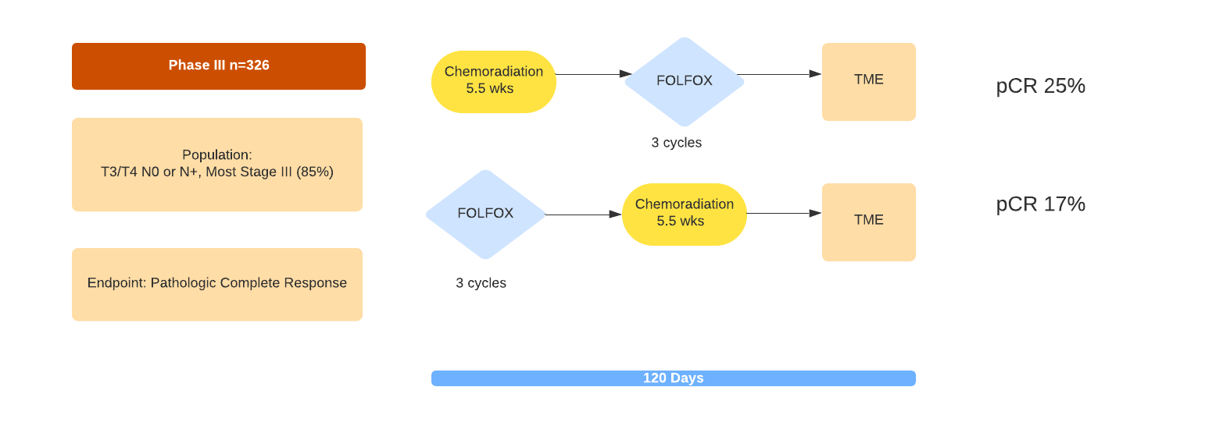
German CAO/ARO/AIO-12 Trial
Fokas et al. Journal of Clinical Oncology 2019

Slide 60
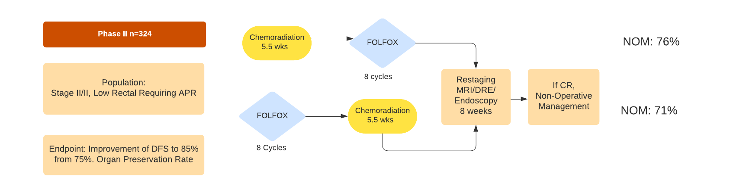
OPRA Trial
Garcia-Aguilar et al. Journal of Clinical Oncology 2022
Notes:
TNT and NOM Trial

Slide 61
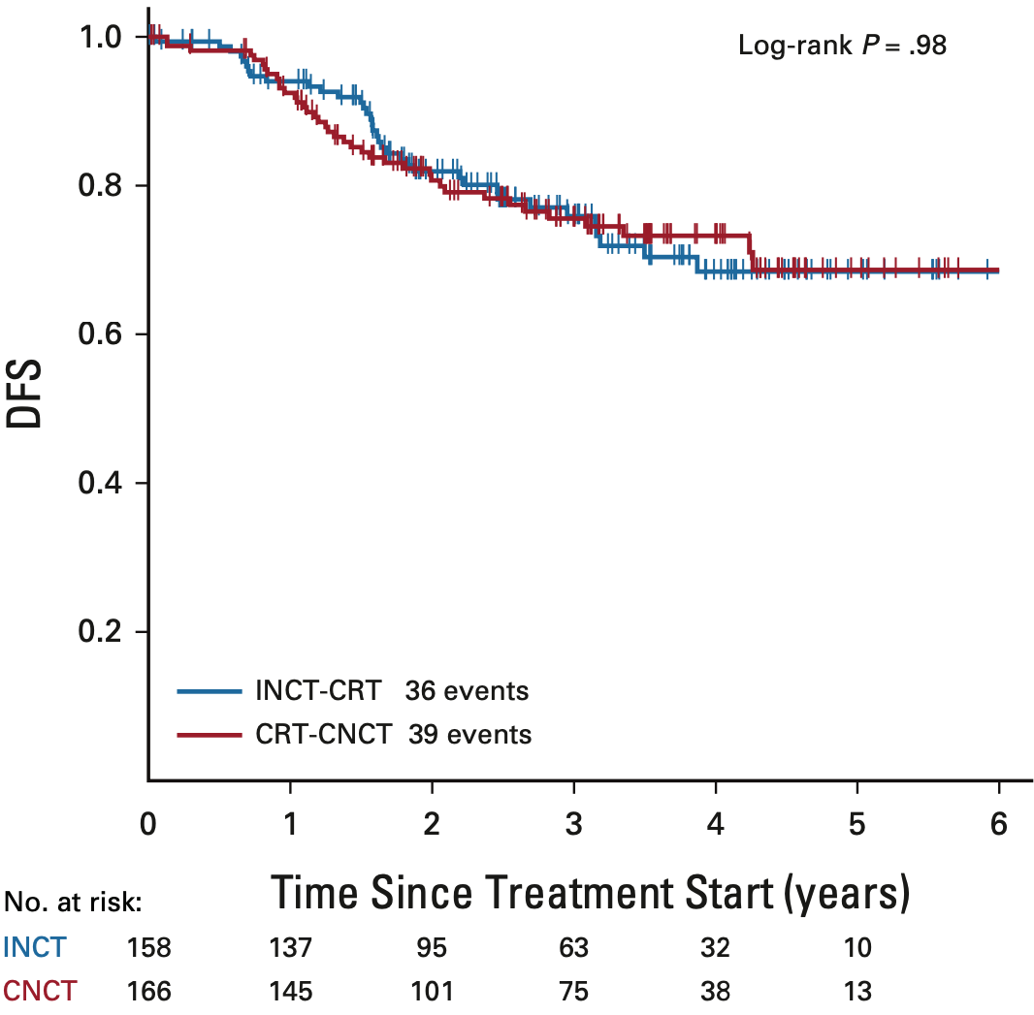
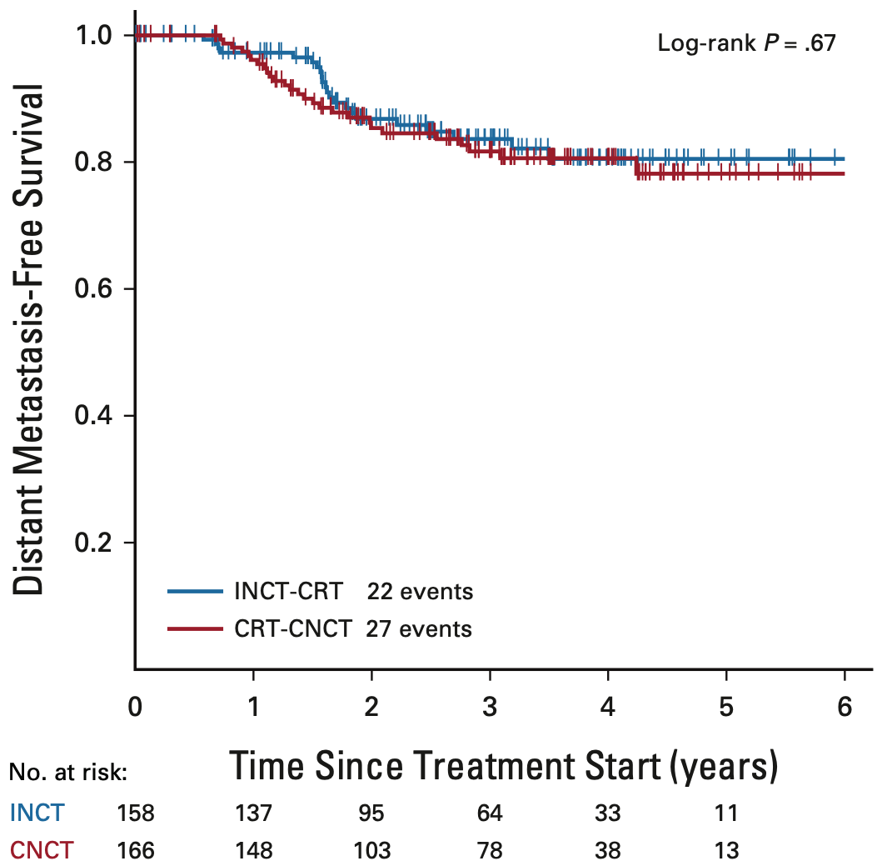
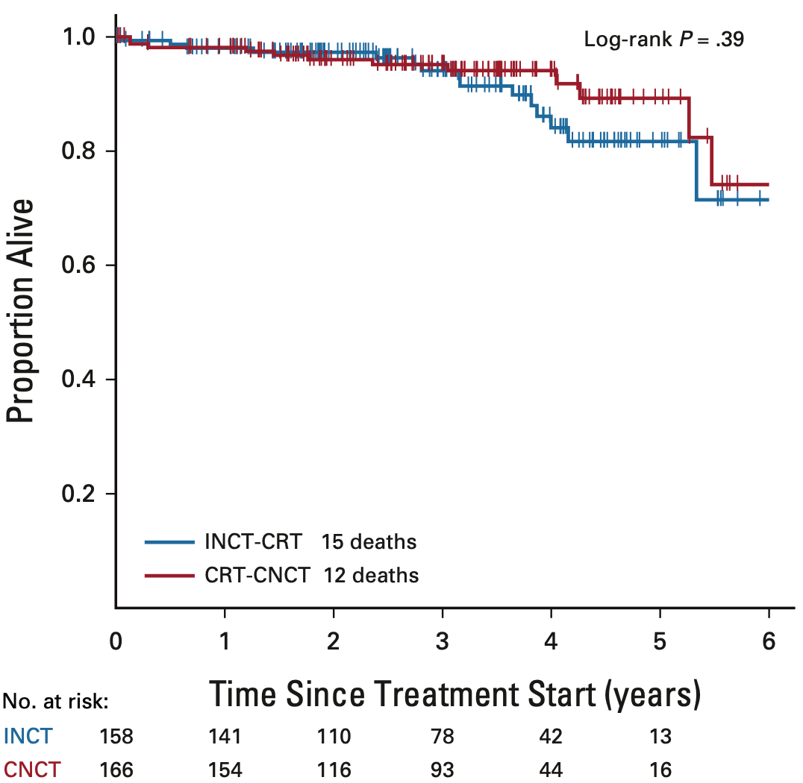
OPRA Trial
Garcia-Aguilar, Julio, et al. Journal of Clinical Oncology 2022
Disease Free Survival
Distant Metastatic Free Survival
Overall Survival
 | NAC Chemo | Standard
3 Year RR | 76% (24%) | 76% (24%)
 | NAC Chemo | Standard | P-Value
3 Year DMR | 84% (16%) | 82% (18%) | 0.017
 | NAC Chemo | Standard | P-Value
3 Year | 91% | 88% | 0.0773

Slide 62
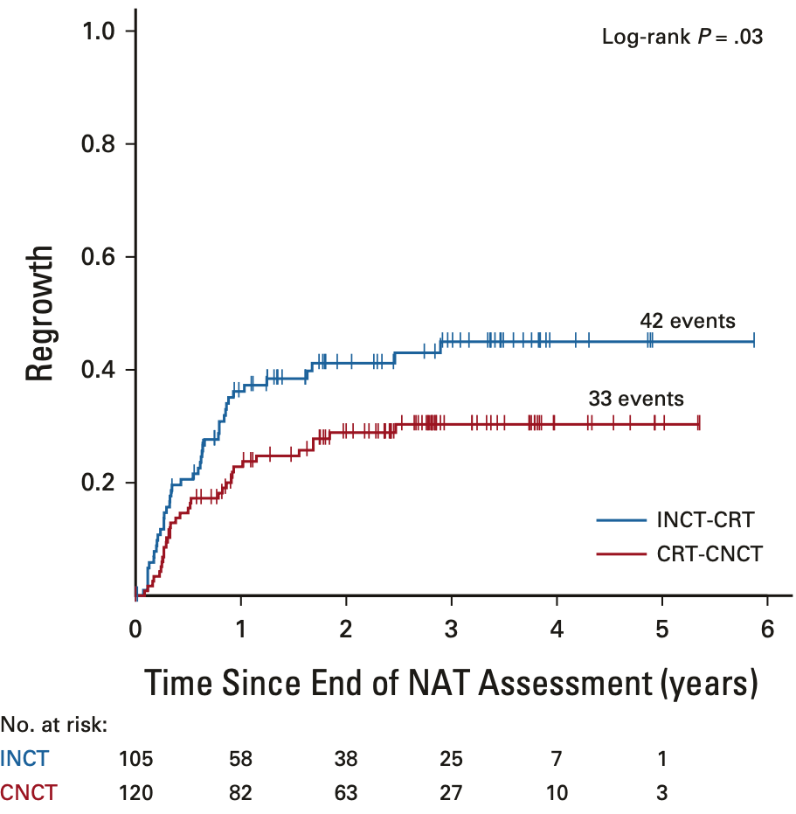
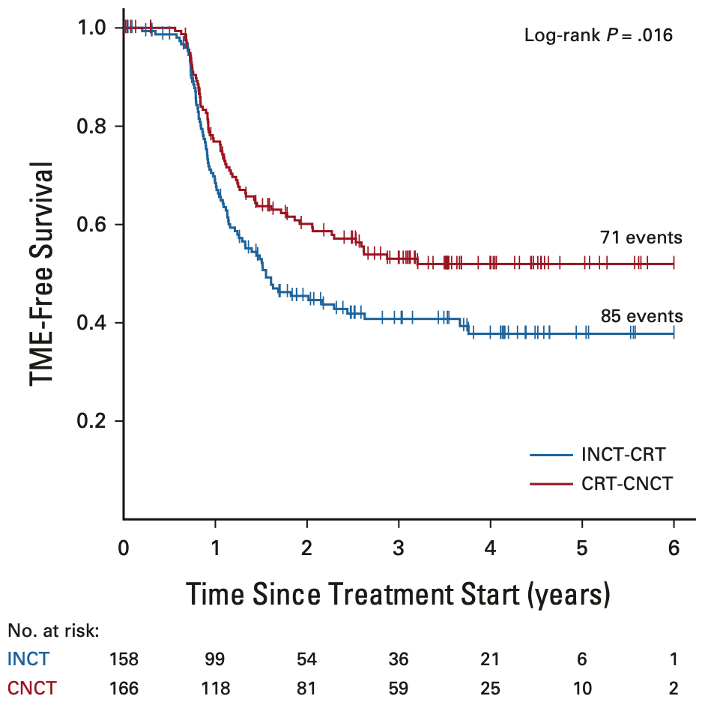
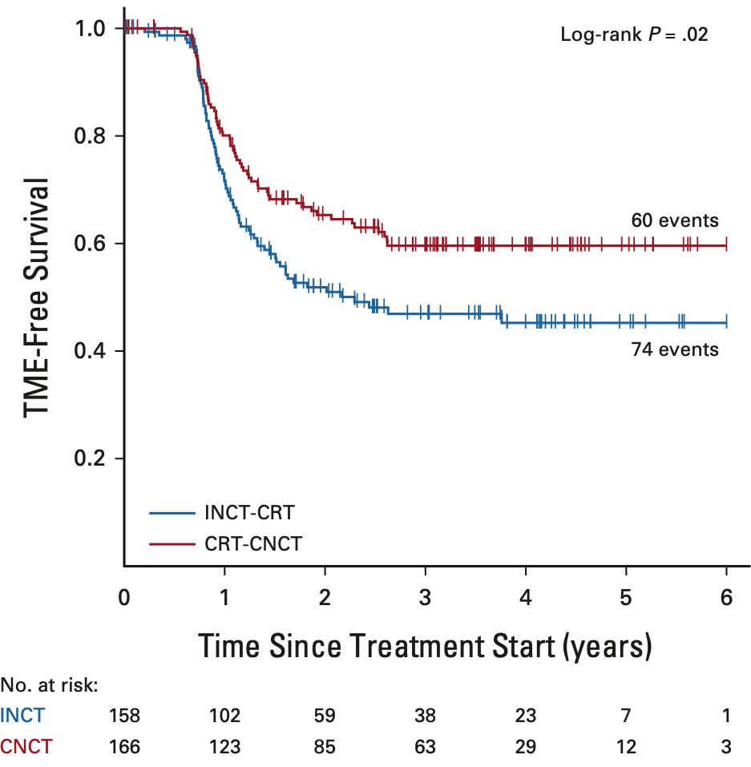
OPRA Trial
Garcia-Aguilar, Julio, et al. Journal of Clinical Oncology 2022
Regrowth
TME- Free Survival (ITT)
TME- Free Survival (TME)
 | FOLFOX/CRT | CRT/FOLFOX
3 Year | 40% | 27%
 | FOLFOX/CRT | CRT/FOLFOX
3 Year | 41% | 53%
 | FOLFOX/CRT | CRT/FOLFOX
3 Year | 47% | 60%
Notes:
Less regrowth with CRT first

Slide 63
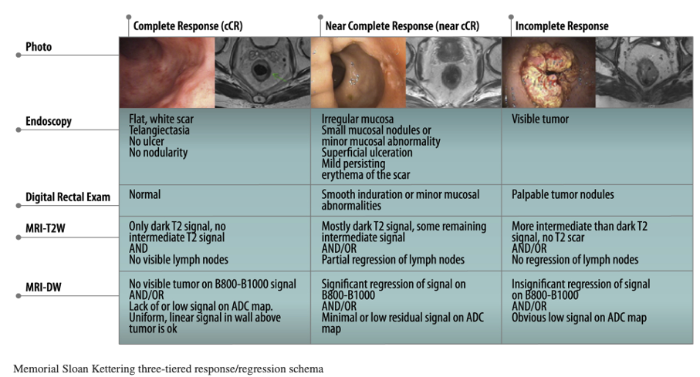
Non-Operative Management
Quezada-Diaz et al. Oncol Clin 2022
Surveillance
History and Physical and CEA every 3-6 months for 2 years, then every 6 months for 5 years
DRE and proctoscopy or flex sigmoidoscopy every 3-4 months for 2 years every 6 months for 5 years
MRI rectum every 6 months for 3 years
CT CAP every 6-12 months for 5 years
Colonoscopy at 1 year

Slide 64
Ongoing TNT Trials
GERMAN TNT Trial CAO/ARO/AIO-18.1
  Evaluating organ preservation of Short Course RT followed by FOLFOX (9 cycles) compared to Chemoradiation with FOLFOX followed by FOLFOX (6 cycles)
Alliance JANUS Trial
  Mid/Low T4 or N+ or Low T3 – LCRT followed by FOLFOX/CAPOX or FOLIRINOX

Slide 65
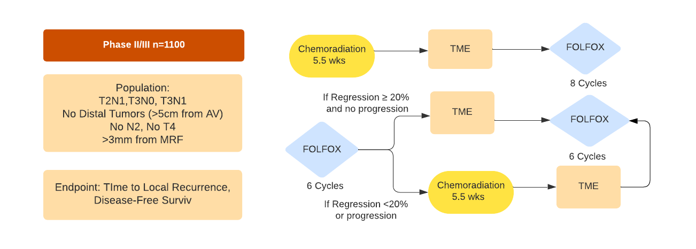
PROSPECT Trial
Schrag et al. NEJM 2023
Can we omit radiation?

Slide 66
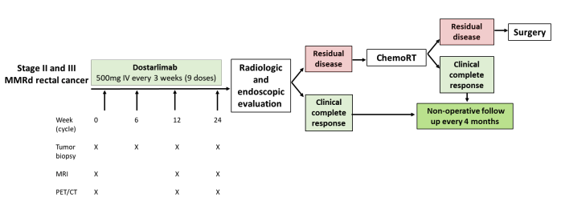
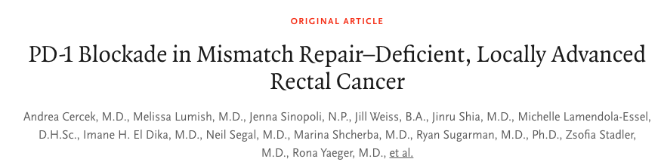
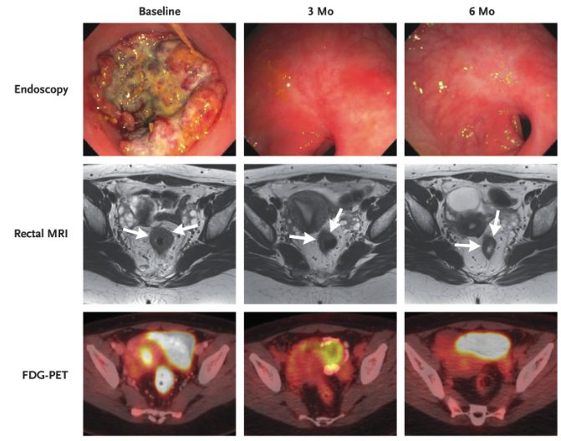
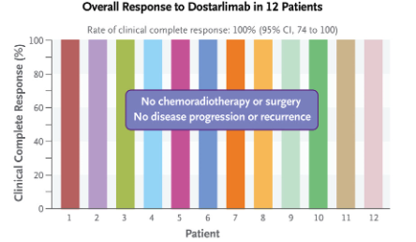
Microsatellite High (MSI-H) /Deficiency in Mismatch Repair (dMMR) Rectal Cancer
Cercek et al. NEJM 2022

Slide 67
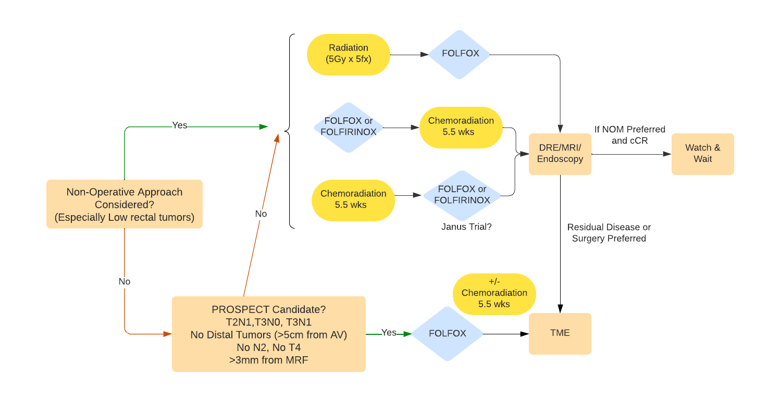
Approach for MSS Locally Advanced Rectal Cancer

Slide 68

Thank you!
Any questions?

Slide 69
GI CANCERS
Wednesday, November 8, 2023

Slide 70
Updates in the Treatment of Esophagogastric Cancer
Syma Iqbal, MD
USC/Keck School of Medicine, Norris Comprehensive Cancer Center

Slide 71
Update of Esophagogastric Cancers
First line immunotherapy with chemotherapy – Updates
CLDN 18.2 – New target
HER2 + Cancer
Perioperative therapy

Slide 72
Advanced Esophagogastric Cancer

Slide 73
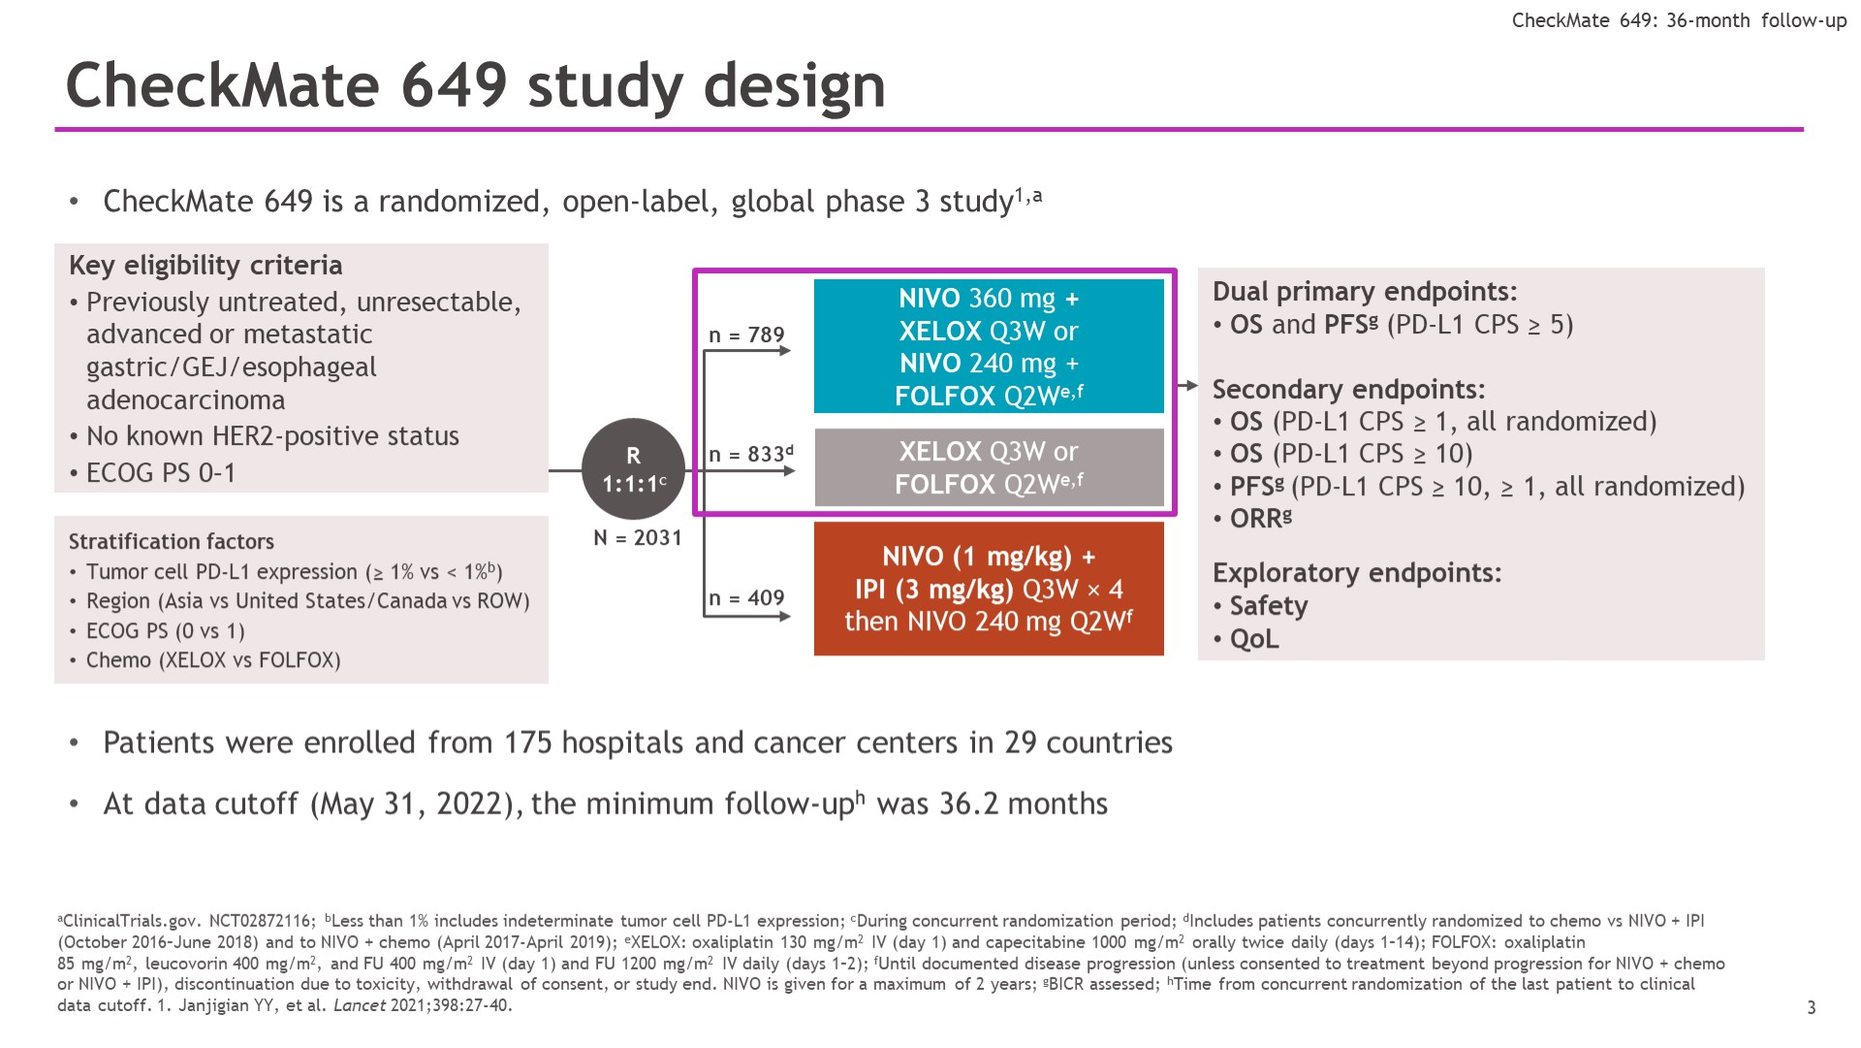
CheckMate 649 study design
Janjigian, Y et al, ASCO Gastrointestinal Symposium 2023, Abstract 291

Slide 74
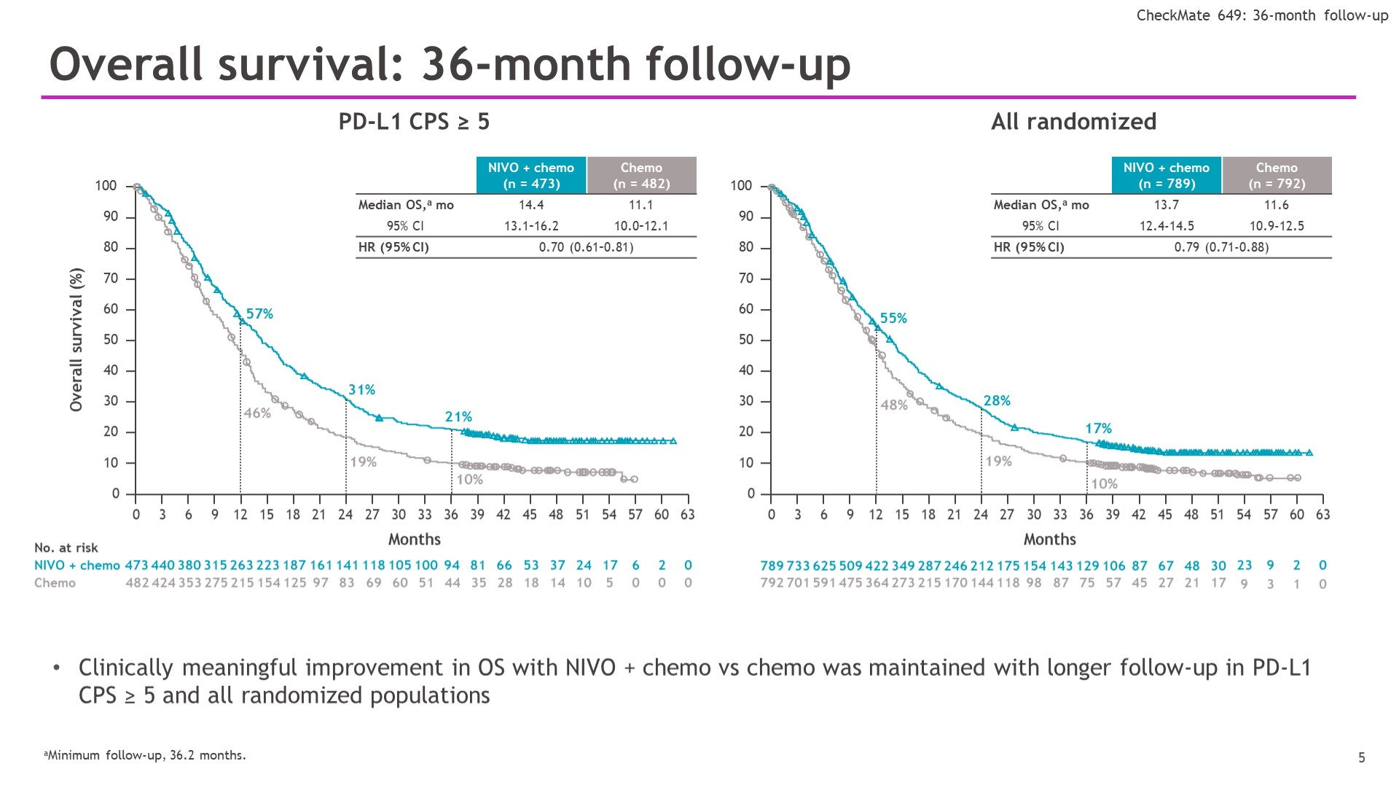
Overall survival: 36-month follow-up
Janjigian, Y et al, ASCO 2023, Abstract 291

Slide 75

Overall survival by MSI status: 36-month follow-up
Janjigian, Y et al, ASCO 2023, Abstract 291

Slide 76

Rha SY et al. ESMO Virtual Plenary 2023;Abstract VP1-2023.

Slide 77

OS = overall survival; ITT = intent to treat
Rha SY et al. ESMO Virtual Plenary 2023;Abstract VP1-2023.

Slide 78
IO Summary
First line immunotherapy in combination with chemotherapy superior to chemotherapy alone with longer follow up.
  Pembrolizumab – KEYNOTE 590, KEYNOTE 859
    Similar QofL
  Nivolumab – CheckMate 659
  *Cross trial comparison similar
Benefit across subgroups, enriched in higher PDL1
MSI-H patients benefit
No new safety signals

Slide 79
New Targets - CLDN 18.2

Slide 80


Claudin18.2 – A novel target
Mechanism of Action
of Zolbetuximab
Claudin18.2
zolbetuximab
FcγR+ Effector Cell
CLDN18.2
Complement
ADCC
CDC
CLDN18.2
Tumor Cell
CLDN18.2
Member of the claudin family
Major structural component of tight junctions
Seals intercellular space in epithelial sheets
Not expressed in any healthy tissues, except: stomach mucosa
Cell Death
Sahin U et al. Ann Oncol. 2021 May;32(5):609-619

Slide 81

SPOTLIGHT: Phase III Study Design
Shitara K et al. Gastrointestinal Cancers Symposium 2023;Abstract LBA292.

Slide 82

Primary End Point: PFS by Independent Review Committeea
Shitara K et al. Gastrointestinal Cancers Symposium 2023;Abstract LBA292.

Slide 83

SPOTLIGHT: Overall Survival (Key Secondary Endpoint)
Shitara K et al. Gastrointestinal Cancers Symposium 2023;Abstract LBA292.

Slide 84

SPOTLIGHT: Response Rates (Key Secondary Endpoint)
Shitara K et al. Gastrointestinal Cancers Symposium 2023;Abstract LBA292.

Slide 85

TEAEsa Occurring in ≥15% of All Treated Patients
Shitara K et al. Gastrointestinal Cancers Symposium 2023;Abstract LBA292.

Slide 86

GLOW: A Phase III Study of First-Line Zolbetuximab and CAPOX for Claudin 18.2-Positive, HER2-Negative Advanced Gastric or Gastroesophageal Junction Adenocarcinoma
Shah M et al. ASCO Plenary Series, March 22, 2023;Abstract 405736.

Slide 87


PFS by Independent Review Committee (Primary Endpoint)
OS (Secondary Endpoint)
Shah M et al. ASCO Plenary Series, March 22, 2023;Abstract 405736.

Slide 88
SPOTLIGHT and GLOW
 | SPOTLIGHT | GLOW
Control | FOLFOX | CapeOX
Countries | Global | Global (~50% from China)
CPS≥5 | 13% | 22%
mPFS | 10.6 vs 8.7 +1.9 HR 0.75 | 8.2 vs 6.8 +1.4 HR 0.69
mOS | 18.2 vs 15.5 +2.7 HR 0.75 | 14.4 vs 12.2 +2.2 HR 0.77
ORR | 61 vs 62% -1% | 54 vs 49% +5%
Nausea Vomiting | 81 vs 61% 65 vs 35% | 69 vs 50% 66 vs 31%
Discontinuation of zolbe/pbo by AE | 14 vs 2% | 7 vs 4%
Shitara K, et al. ASCO-GI 2023; Lancet 2023; Xu RH, et al. ASCO Plenary series 2023

Slide 89
CLDN 18.2 Summary
CLDN 18.2 new target
Zolbetuximab with mFOLFOX6 and CAPOX with improvement in PFS and OS
Toxicity profile includes GI toxicity – nausea/vomiting
Awaiting FDA approval
Target for cell therapy and other trials, antibody-drug conjugate

Slide 90
HER2-Positive

Slide 91

Slide 2
KEYNOTE-811: Pembrolizumab Plus Trastuzumab and Chemotherapy for HER2+ Metastatic Gastric or GEJ Cancer
Janjigian YY et al. ESMO World Congress on Gastrointestinal Cancer 2021;Abstract LBA4.

Slide 92

KEYNOTE-811: Confirmed Response at First Interim Analysis
ORR: 74.4%
ORR: 51.9%
ORR = objective response rate
Janjigian YY et al. ESMO World Congress on Gastrointestinal Cancer 2021;Abstract LBA4.

Slide 93
KEYNOTE 811 Press Release, June 2023
PD-1 therapy, in combination with trastuzumab and chemotherapy met one of its dual primary endpoints of progression-free survival (PFS) … At a pre-specified interim analysis conducted by an independent Data Monitoring Committee, pembrolizumab in … the intention-to-treat (ITT) study population.
Based on a pre-specified subgroup analysis by PD-L1 expression, the improvement in PFS observed in the ITT population was limited to patients whose tumors were PD-L1 positive (Combined Positive Score [CPS] ≥1).

Slide 94

Shitara K, et al. Lancet Oncol. 2018;19:1437-48.
Yamaguchi K et al. J Clin Oncol 2023 February 1;41(4):816-25.

Slide 95

DESTINY-Gastric01: Best Percent Change from Baseline Tumor Size in Patients with Treatment-Naïve HER2-Low Advanced Gastric or GEJ Adenocarcinoma
Yamaguchi K et al. J Clin Oncol 2023 February 1;41(4):816-25.

Slide 96

DESTINY-Gastric02 Phase II Study Design
Ku G et al. ESMO 2022;Abstract 1205MO.

Slide 97


DESTINY-Gastric02: PFS and OS
Response Rate
Ku G et al. ESMO 2022;Abstract 1205MO.

Slide 98
Summary - HER2 Positive Cancer
Chemotherapy with Trastuzumab and Pembrolizumab improved RR and PFS in PDL1>5 patient
Refractory options – Trastuzumab-deruxtecan
HER2 low being investigated with Ab-drug conjugates
Multiple investigational Agents – TKI, Ab-drug, cell therapy

Slide 99
Perioperative Therapy Esophagogastric Cancers

Slide 100


Slide 101


Slide 102

Neoadjuvant nivolumab plus ipilimumab and adjuvant nivolumab in MSI/dMMR gastric or GEJ adenocarcinoma: NEONIPIGA phase II GERCOR Study
Andre, Thierry et al, ASCO GI 2022; Abstract 244

Slide 103

Surgery and TNM and Tumor Regression Grading (TRG)
Andre, Thierry et al, ASCO GI 2022; Abstract 244

Slide 104

ATTRACTION-5: a Phase 3 study of nivolumab plus chemotherapy as postoperative adjuvant treatment for stage III gastric or gej cancer
Terashima, Masanori, ASCO 2023

Slide 105


Primary endpoint: RFS per BICR
Secondary endpoint: OS
Terashima, Masanori, ASCO 2023

Slide 106
KEYNOTE-585: Pembrolizumab plus chemotherapy vs chemotherapy as neoadjuvant and adjuvant therapy in locally-advanced gastric and gastroesophageal junction cancer
804 pts were randomized to the main (402 pembro; 402 pbo)
Efficacy | Pembro + chemoN = 502 | Pbo + chemoN = 505 | Treatment difference (95% CI)
Path CRª, % | 13.0 (10.2-16.3) | 2.4 (1.3-4.2) | 10.6% (7.4-14.0) P<0.0001
Median EFS, mo (95% CI) | 45.8 (35.9-NR) | 25.7 (21.9-33.9) | HR 0.81 (0.68-0.97) P=0.011
Median OS, mo (95% CI) | 60.7 (51.5-NR) | NR (45.7-NR) | HR 0.93 (0.76-1.12)
Safety | Pembro + chemoN = 498 | Pbo + chemoN = 503 | NA
Grade ≥ 3 drug-related AEs | 67% | 63% | NA
In first 987 pts randomized; HR, hazard ratio; NA, not applicable; NR, not reached
Shitara, et al. ; Annals of Oncology (2023) 34 (suppl_2): S1254-S1335; ESMO Congress 2023, LBA74.

Slide 107

KEYNOTE-585: Pembrolizumab plus chemotherapy vs chemotherapy as neoadjuvant and adjuvant therapy in locally-advanced gastric and GEJ
Neoadjuvant/adjuvant pembro + chemo followed by adjuvant pembro, significantly improved pathCR rate with no significant improvement in EFS vs placebo + chemo in pts with untreated, locally-advanced resectable G/GEJ cancer.
Shitara, et al. ; Annals of Oncology (2023) 34 (suppl_2): S1254-S1335; ESMO Congress 2023, LBA74.

Slide 108

Janjigian YY, et al. ESMO Congress 2023, LBA73

Slide 109

Janjigian YY, et al. ESMO Congress 2023, LBA73

Slide 110
Perioperative Therapy - Summary
Adjuvant immunotherapy in Esophageal Adenocarcinoma/SCC, CheckMate 577
  Await OS
Addition of IO did not improve OS/EFS
  ATTRACTION 5
  KEYNOTE 585
Improvement in TRG/path CR
  Matterhorn
MSI High perioperative therapy – IO only
Awaiting final results of perioperative trials

Slide 111

Coexpression of Targets
Pellino, A J. Pers. Med. 2021,11, 1095.

Slide 112
Molecular Testing in Esophagogastric Cancer
MMR testing in all Esophagogastric Cancers
CPS testing in Esophagogastric CA
  Nivolumab + chemo in CPS > 5 HER2 negative GEA (CM649)
  Pembrolizumab + chemo in CPS > 10 HER2 negative esophageal CA (KN590)
HER2 testing in all Esophagogastric CA
  Trastuzumab + chemo + pembrolizumab in 1L HER2+ GEA (Keynote-811)
  Trastuzumab deruxtecan (DS-8201) in 2L+ HER2+ GEA (Destiny-Gastric-01/02)
CLDN18.2 – new treatment option
  Zolbetuximab 1L (GLOW, SPOTLIGHT)

Slide 113
GI CANCERS
Wednesday, November 8, 2023

Slide 114
TKI-Based Therapies in Hepatocellular Carcinoma
Diana L Hanna, MD

Slide 115
Patient Presentation
52 yo man with Hep C, Child-Pugh B cirrhosis
presents with hepatocellular cancer that has progressed
after locoregional therapies.
ECOG 1, AFP > 500, Multinodular Disease w/Extrahepatic Spread
What is the most appropriate treatment for this patient?

Slide 116
Progress of Systemic Therapy in HCC
TREMELIMUMAB + DURVALUMAB:
HIMALAYA
LENVANTINIB:
REFLECT
CABOZANTINIB:
CELESTIAL
SORAFENIB:
SHARP/ASIA-PACIFIC
RAMUCIRUMAB:
REACH-2
REGORAFENIB: RESORCE
2007 2008 2009 2010 2011 2012 2013 2014 2015 2016 2017 2018 2019 2020 2021 2022
SUNITINIB
SORAFENIB + ERLOTINIB
LINIFANIB
ATEZOLIZUMAB + BEVACIZUMAB:
IMBRAVE 150
SORAFENIB + DOXORUBIN:
CALBG-80802
BRIVANIB
NIVOLUMAB + IPILIMUMAB:
CHECKMATE-040
FIRST-LINE
PEMBROLIZUMAB:
KEYNOTE-224
SECOND-LINE
NEGATIVE TRIALS
NIVOLUMAB:
CHECKMATE-040

Slide 117
BCLC Approach to HCC
Reig et al, Journal of Hepatology, 2022

Slide 118

Tremelimumab
AXL
Llovet et al, Nat Rev Dis Primers, 2021

Slide 119
TKIs + Anti-Angiogenics Modulate the Tumor Microenvironment
Increase effector T-cell activation
Decrease Treg immune suppression
Improvement recruitment of T-cells
Downregulate PD-L1 expression
Bejjani et al, JCO, 2022; Fang et al, Cell Death & Disease, 2023

Slide 120
First-Line Therapies in HCC

Slide 121


Sorafenib as 1st-Line Therapy in Advanced HCC
SHARP
ASIA-PACIFIC
OS: 10.7 v 7.9 mo
HR 0.69 (P < 0.001)
TTP 5.5 vs 2.8 mo
OS: 6.5 v 4.2 mo
HR 0.69 (P = 0.014)
TTP 2.8 vs 1.4 mo
N = 602 – 1:1 randomization
N = 226 – 2:1 randomization
Llovet et al, NEJM, 2008
Cheng et al, Lancet Oncol, 2009

Slide 122


REFLECT: Ph 3 Non-Inferiority Study of Lenvatinib vs Sorafenib in 1L Advanced HCC
Treatment-Related Adverse Event – Gr 3-4 | Lenvatinib (N=476) | Sorafenib (N=475)
Hypertension | 24% | 15%
Decreased weight | 8% | 3%
Fatigue | 7% | 6%
Proteinuria | 6% | 2%
Decreased appetite | 5% | 1%
Palmar-plantar erythrodysaesthesia | 3% | 11%
Kudo et al, Lancet, 2018

Slide 123
IMbrave150: Atezolizumab + Bevacizumab vs Sorafenib in 1L Advanced HCC
Atezolizumab + Bevacizumab
(N = 336)
KEY ELIGIBILITY
HCC not amenable to curative therapy No prior systemic therapy ECOG 0-1 Child-Pugh A EGD within 6 months of randomization Portal vein thrombus/invasion allowed
2:1
R
Sorafenib
(N = 165)
- Stratification Factors: Asia vs ROW; Extrahepatic Disease/Macrovascular Invasion; AFP < or ≥ 400: ECOG 0 vs 1
- Primary Endpoints: Overall Survival, Progression-Free Survival
- Secondary Endpoints: Objective Response Rate, Duration of Response, Time to Deterioration of QOL
Finn et al, NEJM, 2020
Cheng et al, Journal of Hepatology, 2022

Slide 124



IMbrave150: Atezolizumab + Bevacizumab vs Sorafenib in 1L Advanced HCC
6-Month OS: 84.8% 72.2%
Median Time To Deterioration QOL
11.2 vs 3.6 months
Finn et al, NEJM, 2020
Cheng et al, Journal of Hepatology, 2022

Slide 125

IMbrave150: Atezolizumab + Bevacizumab vs Sorafenib in 1L Advanced HCC
OS: 19.2 vs 13.4 mo, HR 0.66
PFS: 6.9 vs 4.3 mo, HR 0.65
Finn et al, NEJM, 2020
Cheng et al, Journal of Hepatology, 2022

Slide 126
HIMALAYA: Tremelimumab + Durvalumab (STRIDE) vs Sorafenib in 1L Advanced HCC
STRIDE: Tremelimumab x 300 mg x 1
+ Durvalumab (N = 393)
KEY ELIGIBILITY
BCLC B or C HCC No prior systemic therapy ECOG 0-1 Child-Pugh A Portal vein thrombus not allowed
2:1:1
T75+D: Tremelimumab 75 mg x 4
+ Durvalumab
R
Durvalumab
(N = 389)
Sorafenib
(N = 389)
- Stratification Factors: HCC etiology (HBV, HCV, Other), Asia vs other; extrahepatic disease, macrovascular invasion
- Primary Endpoints: Overall survival
- Secondary Endpoints: TTP, PFS, ORR, DCR, DOR, QOL
Abou-Alfa et al, NEJM Evidence, 2022

Slide 127



HIMALAYA: Tremelimumab + Durvalumab (STRIDE) vs Sorafenib in 1L Advanced HCC
STRIDE vs Sorafenib OS: 16.4 vs 13.8 mo
OS at 36-months: 30.7% , 24.7%, 20.2%
Median PFS not significantly different between the groups.
Abou-Alfa et al, NEJM Evidence, 2022

Slide 128
LEAP-002: Ph 3 Study of Lenvatinib + Pembrolizumab vs Lenvatinib + Placebo in 1L HCC: NO Difference in PFS, OS
Lenvatinib + Pembrolizumab
(N = 395)
KEY ELIGIBILITY
HCC not amenable to curative therapy No prior systemic therapy ECOG 0-1 Child-Pugh A EGD within 3 months of randomization No main portal vein invasion
1:1
R
Although the OS endpoint was not met, LEAP-002 confirmed the efficacy of Lenvatinib in the 1L setting and had the longest OS reported to date…
Lenvatinib + Placebo
(N = 399)
Post-study systemic therapies were received in 44.1% vs 52.1%.
About 15-20% received IO,
~35-40% TKI/VEGF.
- Stratification Factors: Asia vs Japan vs ROW; Extrahepatic Disease/Macrovascular Invasion; AFP < or ≥ 400: ECOG 0 vs 1
- Primary Endpoints: Progression-Free Survival, Overall Survival per RECIST by BICR
- Secondary Endpoints: Objective Response Rate, Duration of Response, Safety/Tolerability
Finn et al, ESMO, 2022

Slide 129
CARES-310: Ph 3 Study of Camrelizumab + Rivoceranib vs Sorafenib in 1L Advanced HCC
Camrelizumab + Rivoceranib
(N = 272)
KEY ELIGIBILITY
BCLC B or C HCC No prior systemic therapy ECOG 0-1 Child-Pugh A No variceal bleeding w/in last 6 mo
1:1
R
Sorafenib
(N = 271)
- Stratification Factors: Asia vs Non-Asia; Extrahepatic Disease +/- Macrovascular Invasion; AFP < or ≥ 400
- Primary Endpoints: Overall Survival, Progression-Free Survival
- Secondary Endpoints: Objective Response Rate
Qin et al, Lancet, 2023

Slide 130

CARES-310: Camrelizumab + Rivoceranib Improved PFS vs Sorafenib in 1L HCC
Qin et al, Lancet, 2023

Slide 131
CARES-310: Camrelizumab + Rivoceranib Improved OS vs Sorafenib in 1L HCC
Qin et al, Lancet, 2023

Slide 132

CARES-310: PFS & OS Benefit Across Subgroups
Qin et al, Lancet, 2023

Slide 133
CARES-310: Treatment-Related Adverse Events
Among patients with BCLC B/C hepatocellular carcinoma, camrelizumab + rivoceranib resulted in longer PFS, OS than sorafenib.
This is the longest OS (22.1 months) reported for un-resectable HCC in an international randomized Phase 3 trial.
This is the first positive study combining a checkpoint inhibitor with a TKI in the first-line setting for un-resectable HCC.
Overall Gr 3/4 Events 80.5% vs 52%
Qin et al, Lancet, 2023

Slide 134
COSMIC-312: Ph 3 Study of Cabozantinib + Atezolizumab vs Sorafenib in 1L Advanced HCC
Cabozantinib 40 mg + Atezolizumab
(N = 432)
KEY ELIGIBILITY
BCLC B or C HCC No prior systemic therapy ECOG 0-1 Child-Pugh A No variceal bleeding w/in last 6 mo
2:1:1
Sorafenib
(N = 217)
R
Cabozantinib 60 mg
(N = 188)
- Stratification Factors: HCC etiology (HBV, HCV, Other), Asia vs other; extrahepatic disease, macrovascular invasion
- Primary Endpoints: Overall survival, Progression-free survival (Cabo/Atezo vs Sorafenib)
- Secondary Endpoints: Progression-free survival (Cabo vs Sorafenib), Objective response rate
Kelley et al, Lancet Oncology, 2022

Slide 135

COSMIC-312: Cabozantinib/Atezolizumab
Improved PFS vs Sorafenib in 1L HCC
Kelley et al, Lancet Oncology, 2022

Slide 136
COSMIC-312: No OS Benefit
Cabozantinib/Atezolizumab vs Sorafenib in 1L HCC
Kelley et al, Lancet Oncology, 2022

Slide 137

COSMIC-312:
Cabozantinib Improved PFS vs Sorafenib in 1L HCC
Cabozantinib plus atezolizumab significantly improved the primary endpoint of progression-free survival versus sorafenib in 1L HCC, but there was no significant difference in overall survival.
Cabozantinib significantly improved PFS versus sorafenib in 1L HCC.
Kelley et al, Lancet Oncology, 2022

Slide 138
Summary of Pivotal Trials in 1st-Line HCC
 | SHARP Sorafenib vs Placebo (N = 602) | REFLECT Lenvatinib vs Sorafenib (N = 954) | IMbrave150 Atezo/Bev vs Sorafenib (N = 501) | HIMALAYA Treme/Durva vs Sorafenib (N = 782) | CARES-310 Camrelizumab + Rivoceranib vs Sorafenib (N = 543)
Targets | VEGFR1-3, PDGFR, RAF, KIT | VEGFR1-3, PDGFR, FGFR1-4, RET | PD-L1, VEGF | CTLA-4, PD-L1 | PD-1, VEGFR2
Median OS, mo, HR (95% CI) | 10.7 vs 7.9 HR 0.69 (0.55-0.87) p<0.001 | 13.6 vs 12.3 HR 0.92 (0.79-1.06) p=NS | 19.2 vs 13.4 HR 0.66 (0.52-0.85) p<0.001 | 16.43 vs 13.77 HR 0.78 (0.65-0.93) p=0.0035 | 22.1 vs 15.2 HR 0.62 (0.49-0.80) P<0.0001
Median PFS, mo, HR (95% CI) | 5.5 vs 2.8 HR 0.58 (0.45-0.74) p<0.001 | 7.4 vs 3.7 HR 0.66 (0.56-0.77) p<0.0001 | 6.9 vs 4.3 HR 0.65 (0.53-0.81) p<0.001 | 3.78 vs 4.07 HR 0.90 (0.77-1.05) p=NS | 5.6 vs 3.7 HR 0.52 (0.41-0.65) p<0.0001
ORR, % | 2.3% vs 0.7% | 18.8% vs 6.5% | 30% vs 11% | 20.1% vs 5.1% | 25% vs 6%
Llovet et al, NEJM, 2008 Abou-Alfa et al, NEJM Evidence, 2022
Kudo et al, Lancet, 2018 Qin et al, Lancet, 2023
Finn et al, NEJM, 2020

Slide 139
PD-1/PD-L1 Monotherapy vs Sorafenib in 1L HCC
 | Checkmate-459 Nivolumab vs Sorafenib (N = 743) | HIMALAYA Durvalumab vs Sorafenib (N = 778) | RATIONALE-301 Tislelizumab vs Sorafenib (N = 674)
 | Superiority | Non-Inferiority | Non-Inferiority
Median OS, mo, HR (95% CI) | 16.4 vs 14.7 HR 0.85 (0.72-1.02) p=0.075 | 16.56 vs 13.77 HR 0.86 (0.73-1.03) p=0.0674 | 15.9 vs 14.1 HR 0.85 (0.712-1.019) p=0.0398
Median PFS, mo, HR (95% CI) | 3.7 vs 3.8 HR 0.93 (0.79-1.10) | 3.65 vs 4.07 HR 1.02 (0.88-1.19) | 2.2 vs 3.6 HR 1.1 (0.92-1.33)
ORR, % | 15% vs 7% | 17.0% vs 5.1% | 14.3% vs 5.4%
Yau et al, Lancet Oncology, 2021
Abou-Alfa et al, NEJM Evidence, 2022
Qin et al, JAMA Oncology, 2023

Slide 140
Selecting 1st-Line Therapy in Advanced HCC
Patient with Advanced HCC
Contraindications to Immunotherapy
NO
Not Suitable for IO Combination
NO
YES
Atezolizumab
+ Bevacizumab
(EGD with treatment of varices within 6 months)
Tremelimumab
+ Durvalumab
Lenvatinib
Sorafenib
PD-1 or PD-L1 Monotherapy

Slide 141
Second-Line Therapies in HCC

Slide 142


RESORCE: Ph 3 Study of Regorafenib vs Placebo
After Sorafenib in Advanced HCC
KEY ELIGIBILITY
Advanced HCC Prior tolerance of sorafenib (≥400 mg/day for ≥20 of last 28 days of treatment) ECOG 0-1 Child’s Pugh A
OVERALL SURVIVAL
10.6 vs 7.8 months
Bruix et al, Lancet, 2017

Slide 143
CELESTIAL: Ph 3 Study of Cabozantinib vs Placebo in Advanced HCC after Sorafenib
Cabozantinib 60 mg PO daily
(N = 470)
KEY ELIGIBILITY
Advanced HCC Prior treatment with sorafenib May have received 1 other therapy ECOG 0-1 Child-Pugh A
2:1
R
Placebo
(N = 237)
- Stratification Factors: HCC etiology (HBV, HCV, Other), Asia vs other; extrahepatic disease +/- macrovascular invasion
- Primary Endpoints: Overall survival
- Secondary Endpoints: Progression-free survival, Objective response rate
Abou-Alfa et al, NEJM, 2018

Slide 144

CELESTIAL: Cabozantinib Improved OS, PFS
Compared to Placebo in Advanced HCC
OVERALL SURVIVAL
PROGRESSION-FREE SURVIVAL
10.2 v 8.0 mo
5.2 v 1.9 mo
Abou-Alfa et al, NEJM, 2018

Slide 145

CELESTIAL: Cabozantinib Improved Outcomes Across Subgroups
Abou-Alfa et al, NEJM, 2018

Slide 146

CELESTIAL: Treatment-Related Adverse Events
Among patients with previously treated advanced hepatocellular carcinoma, cabozantinib resulted in longer OS, PFS than placebo.
Abou-Alfa et al, NEJM, 2018

Slide 147

Checkmate-040: Nivolumab + Ipilimumab
After Sorafenib in Advanced HCC

Slide 148

Checkmate-040: Nivolumab + Ipilimumab
After Sorafenib in Advanced HCC

Slide 149

Sequencing Systemic Therapies – TKI after IO
Gile et al, ASCO GI, 2023
Palmer et al, ASCO GI, 2023
Cheon et al, ASCO GI, 2023

Slide 150

Sequencing Systemic Therapies – IO after IO
Retrospective, Multi-Center, Observational Study
Ipilimumab + Nivolumab after Prior Immunotherapy
Cheon et al, ASCO GI, 2023

Slide 151
HCC Systemic Therapies – Does Sequence Matter?
Retrospective, Real-World Study
Patients diagnosed with HCC, Jan 2008-Dec 2021, treated at Prince of Wales Hospital.
Over 75% had Hepatitis B. Over 90% started first-line therapy after 2017.
Primary Endpoint: OS and OS at 24 months
Four Treatment Sequences Evaluated
  TKI → TKI, TKI → IO, IO → TKI, IO → IO
Among the first-line TKI group, 37 (31.9%) received second-line TKI and 79 (68.1%) received IO.
Among the first-line IO group, 41 (73.2%) received second-line TKI and 15 (26.8%) received IO.
Across the four sequences, there was no significant difference in median OS (P = .475).
  TKI → TKI (15.9 mo), TKI → IO (14.8 mo), IO → TKI (24.4 mo), IO → IO (22.5 mo)
Median OS favored patients treated with first-line IO (n = 56) vs first-line TKI (n = 116) at 24.1 vs 15.3 mos.
  However, this difference was not statistically significant (HR, 0.766; 95% CI, 0.527-1.114; P = .162).
  Similar trends were seen for OS at 24 months.
IO was an independent prognostic factor for survival (HR, 0.645; 95% CI, 0.496-0.830; P = 0.001).
No significant difference in OS was observed between first-line IO (18.2 months) and IO administered in the second line or beyond within the overall cohort (15.9 months; P = 0.515).
Ongoing Trials Evaluating Second-Line Therapy after Atezolizumab + Bevacizumab
IMbrave251
Atezolizumab + Lenvatinib or Sorafenib
vs Lenvatinib or Sorafenib
ACCRU-GI-2008
Atezolizumab + Cabozantinib or Lenvatinib
vs Cabozantinib or Lenvatinib
“Given the lower proportion of patients treated with first-line TKIs receiving subsequent treatment, and lower OS24 in first-line TKI sequences, the findings suggest first-line IO to be the preferred approach,”
“For patients treated with first-line MKI, IO should be used subsequently.”
Mok K et al, International Liver Cancer Association Conference, 2023. Abstract P-98

Slide 152
Summary of Pivotal Trials in 2nd-Line HCC
 | RESORCE Regorafenib vs Placebo (N = 573) | CELESTIAL Cabozantinib vs Placebo (N = 707) | REACH-2 Ramucirumab vs Placebo (N = 292) | CHECKMATE-040 Ipilimumab + Nivolumab (N = 50) | KEYNOTE-240 Pembrolizumab vs Placebo (N = 413)
Targets | VEGFR1-3, PDGFR, RAF, FGFR1-2 | VEGFR1-3, MET, RET, AXL | VEGFR2 | CTLA-4, PD-L1 | PD-1
Median OS, mo, HR (95% CI) | 10.6 vs 7.8 HR 0.63 (0.50-0.79) p<0.0001 | 10.2 vs 8.0 HR 0.76 (0.63-0.92) p=0.005 | 8.5 vs 7.3 HR 0.71 (0.53-0.95) p=0.020 | 22.8 | 13.9 vs 10.6 HR 0.78 (0.61-1.00) p=0.0238
Median PFS, mo, HR (95% CI) | 3.4 vs 1.5 HR 0.43 (0.35-0.52) p<0.0001 | 5.2 vs 1.9 HR 0.44 (0.36-0.52) p<0.001 | 2.8 vs 1.6 HR 0.45 (0.34-0.60) p<0.0001 |  | 3.0 vs 2.8 HR 0.78 (0.61-0.99) p=0.0186
ORR, % | 7% vs 3% | 4% vs <1% | 4.6% vs 1.1% | 32% | 18.3% vs 4.4%
Bruix et al, Lancet, 2017 Yau et al, JAMA Oncol, 2020
Abou-Alfa et al, NEJM, 2018 Finne et al, JCO, 2020
Zhu et al, Lancet Oncol, 2019

Slide 153
Selecting 2nd-Line Therapy in Advanced HCC
First-Line Therapy | Second-Line Options | Relevant Studies
Atezolizumab/Bevacizumab Tremelimumab/Durvalumab Single-Agent IO | TKI Combination IO | No definitive evidence.
Sorafenib or Lenvatinib | Cabozantinib Regorafenib Ramucirumab (AFP ≥ 400) Combination IO Single-Agent IO | CELESTIAL RESORCE REACH-2 CheckMate-040 KEYNOTE-224, KEYNOTE-394

Slide 154

Overview of Current Systemic Therapy in HCC
Reig et al, Journal of Hepatology, 2022

Slide 155
Benefit of Adding Local Therapies in Advanced HCC

Slide 156
LAUNCH: Ph 3 Study of Lenvatinib +/- TACE in Advanced 1L HCC
TACE + Lenvatinib
(N = 170)
KEY ELIGIBILITY
Advanced HCC, no prior therapy Single tumor ≤ 10 cm OR Multiple tumors with burden ≤ 50% OR Portal vein tumor thrombus OR Extrahepatic disease ECOG 0-1 Child-Pugh A
2:1
R
Lenvatinib
(N = 168)
- Stratification Factors: ECOG (0 vs 1), Tumor Thrombus, Body Weight (< or ≥ 60 kg), Trial Site
- Primary Endpoints: Overall survival
- Secondary Endpoints: Time to Progression
Over 85% patients had Hepatitis B.
Approximately 70% patients had portal vein invasion.
More than 50% patients had extrahepatic disease.
Peng et al, JCO, 2022

Slide 157


LAUNCH: Adding TACE to Lenvatinib Improves PFS, OS in Advanced HCC
OVERALL SURVIVAL
17.8 v 11.5 mo, HR 0.45, P < 0.001
PROGRESSION-FREE SURVIVAL
10.6 v 6.4 mo, HR 0.43, P < 0.001
Peng et al, JCO, 2022

Slide 158
Benefit of Systemic Therapies in Intermediate-Stage HCC

Slide 159
Systemic Therapy vs TACE in Intermediate-Stage HCC
Proof of Concept Study of Lenvatinib (N=30) vs TACE (N=60)
ORR 73.3% vs 33.3%
Ongoing Phase 3 Trials
RENO-TACE: Regorafenib + Nivolumab
vs TACE in Intermediate-Stage HCC
Primary Endpoint: PFS
Secondary Endpoints: OS, ORR
ABC-HCC: Atezolizumab + Bevacizumab
vs TACE in Intermediate-Stage HCC
Primary Endpoint: TTF
Secondary Endpoints: OS, ORR
ECOG 0-1
Child-Pugh A
N=496
(NCT04777851)
ECOG 0
Child-Pugh A
N=432
(NCT04803994)
Kudo et al, Cancers, 2019

Slide 160
TACTICS: Ph 2 Randomized Study of TACE +/- Sorafenib in Intermediate-Stage HCC
TACE + Sorafenib
(N = 80)
KEY ELIGIBILITY
Unresectable HCC No vascular invasion No extrahepatic spread No prior systemic therapy Prior TACE OK if > 6 months ago ECOG 0-1 Child-Pugh ≤ 7 Max 10 tumors (none > 10 cm)
1:1
R
TACE Alone
(N = 76)
- Primary Endpoints: TACE-Specific PFS, Overall Survival per RECICL
- Secondary Endpoints: Objective Response Rate after first TACE; Safety
TACE-Specific PFS - time from randomization to PD or death from any cause
PD was defined as unTACEable progression due to intrahepatic progression
(25% increase vs. baseline), extrahepatic spread, vascular invasion,
or transient deterioration of liver function to Child-Pugh C after TACE.
Kudo et al, Liver Cancer, 2022

Slide 161


TACTICS: Ph 2 Randomized Study of TACE +/- Sorafenib in Intermediate-Stage HCC
Post-trial anti-cancer treatments were administered to
76.3% in the TACE group vs
58.8% in the TACE + sorafenib group (p = 0.014).
“The realization that more than 60% of patients progressing after TACE receive effective next-line therapies may compel the adoption of PFS as an acceptable primary endpoint for major trials”
- AASLD Consensus Conference, 2021
Kudo et al, Liver Cancer, 2022
Llovet et al, Hepatology, 2021

Slide 162
EMERALD-3: Ph 3 Study of STRIDE +/- Lenvatinib + TACE vs TACE Alone in Intermediate-Stage HCC
Arm A
STRIDE + Lenvatinib + TACE
KEY ELIGIBILITY
HCC not amenable to curative therapy ECOG 0-1 Child-Pugh A Measurable disease per mRECIST No main portal vein invasion or uncontrolled hypertension
1:1:1
Arm B
STRIDE + TACE
R
N=525
Arm C
TACE Alone
- Primary Endpoints: Progression-Free Survival for Arm A vs Arm C per RECIST by BICR
- Secondary Endpoints: PFS for Arm B vs Arm C, OS, Health-Related Quality of Life; Safety
Abou-Alfa et al, ESMO, 2022 - NCT05301842

Slide 163

LEAP-012: Ongoing Ph 3 Study of
TACE +/- Lenvatinib + Pembrolizumab in Intermediate-Stage HCC
- Primary Endpoints: Overall Survival, Progression-Free Survival per RECIST by BICR
- Secondary Endpoints: ORR, DCR, DOR, TTP per RECIST by BICR; PFS, ORR, DCR, DOR, TTP per mRECIST by BICR
El-Khoueiry et al, ASCO GI, 2022; Llovet et al, Cardiovasc Intervent Radiol, 2022 - NCT04246177

Slide 164
Patient Presentation – Cont.
52 yo man with Hep C, Child-Pugh B cirrhosis
presents with hepatocellular cancer that has progressed
after locoregional therapies.
ECOG 1, AFP > 500, Multinodular Disease w/Extrahepatic Spread
What is the most appropriate treatment for this patient?
2016: Sorafenib x 6 months → Nivolumab x 2 years → No Active Disease

Slide 165

Molecular Landscape & Testing in Advanced HCC
Gong et al, Int J Mol Sci. ,2020

Slide 166


Beyond TKIs & CPIs - Promising Targets & Select Ongoing Trials in HCC
SAR444200
GPC3 T-Cell Engager

Slide 167
Summary
Checkpoint inhibitors have revolutionized the management of HCC.
TKIs remain relevant in advanced HCC as front-line therapy in patients with contraindications to immunotherapy and after progression on checkpoint inhibitors.
TKIs modulate the tumor immune microenvironment and can synergize with IO.
Optimal sequence of systemic therapy remains unclear, incl. treatment after first-line IO and the role of HCC etiology, tumor genetic alterations, etc..
Discovering biomarkers and evaluating therapies in patients with Child-Pugh B cirrhosis remain unmet needs.
Molecular testing can identify clinical trial opportunities and novel drug targets.
Future studies will define the role of systemic therapy in early/intermediate stage disease and locoregional therapy for advanced disease.

Slide 168

Thank you

Slide 169
GI CANCERS
Wednesday, November 8, 2023

Slide 170
Updates in Metastatic
Pancreatic Cancer
Steven R. Grossman, MD, PhD
Professor of Medicine/Cancer Physician in Chief
USC Norris Comprehensive Cancer Center
Los Angeles, CA

Slide 171
Outline
Review genomic landscape for PDAC
Review SOC systemic therapy options 1L, 2L, 3L+
Review current challenges and unmet needs in stage 4 PDAC
Precision therapy strategies- DNA Repair Defective (DRD)
Precision therapy strategies- MSI-H
Review novel approaches (IO, CAR-T/TCR-T, K-Ras inhibitors)
Norris clinical trials open to accrual
Conclusions

Slide 172

Common mutations in PDAC
PDAC is characterized by tumor suppressor loss and KRAS mutation
Ryan DP et al. N Engl J Med 2014;371:1039-1049.
Notes:
Update

Slide 173

Genetic Landscape of PDAC- NGS era
Rare!
NTRK
RET
Pancreatology 22 (2022) 925e936

Slide 174

Standard of care- stage 4
Trials Defining Current SOC- the long wait for anything new…
Ryan DP et al. N Engl J Med 2014;371:1039-1049

Slide 175


Current SOC

Slide 176
1st-2nd line- stage 4

Slide 177
Nal-Iri based regimens
1st line:
From NCCN V2.2023:
“While NCCN recognizes that there is high-level evidence supporting the use of NALIRIFOX over gemcitabine and albumin-bound paclitaxel, it should be recognized
that this regimen does not appear to have an advantage over FOLFIRINOX and adds considerably more expense compared to FOLFIRINOX”
2nd line:
5FU+LV+Nal-Iri Category 1 if prior gem-based 1L therapy

Slide 178

NAPOLI-1: 2L long term outcomes
European Journal of Cancer 108 (2019) 78e87

Slide 179

2nd Line 5FU regimens- retrospective analysis
Clinics and Research in Hepatology and Gastroenterology (2020) 44, 295—301

Slide 182
Unmet needs and opportunities in advanced PDAC
Overcome intrinsic and acquired chemoresistance
How to overcome intrinsic immunosuppressive TME
How to best leverage the few known actionable genetic alterations- esp. DRD, non-RAS driver mutations
Identify novel cross-mechanism combinations

Slide 183

TMB- ICI
Ret- Selpercatinib
K-RasG12C- Sotorasib
NRG1- afatinib

Slide 184

Actionable mutations are uncommon
Cancers 2022, 14, 3239.

Slide 185

ICI for MSI-H PDAC/KEYNOTE 158
J Clin Oncol 38:1-10.
Notes:
2020

Slide 186

MSI-H +ICI: Mayo “real world” experience
JCO Precis Oncol 7:e2200706
Notes:
2023

Slide 187

Gem/cis +/- PARPi in DRD
G4 thrombocytopenia
Arm A= 22%
Arm B= 0%
J Clin Oncol. 2020 May 1; 38(13): 1378–1388.

Slide 188


From: Response Rate Following Albumin-Bound Paclitaxel Plus Gemcitabine Plus Cisplatin Treatment Among Patients With Advanced Pancreatic Cancer: A Phase 1b/2 Pilot Clinical Trial
JAMA Oncol. 2020;6(1):125-132. doi:10.1001/jamaoncol.2019.3394

Slide 189

ICI + DRD? (U Miami experience)
JAMA Oncology June 2022 Volume 8, Number 6 (Reprinted

Slide 190

Sotorasib- KRAS G12C
N Engl J Med. 2023 January 05; 388(1): 33–43.
Notes:
Duke- multi-I
Median 2 prior lines (1-8)
960 mg daily

Slide 191

K-RAS Targeted TCR-T
N Engl J Med. 2022 June 02; 386(22): 2112–2119

Slide 192
Norris Advanced PDAC Clinical Trials
A Phase 1/2 Trial to Evaluate the Safety, Tolerability, Pharmacokinetics, and Preliminary Efficacy of GP-2250 in Combination with Gemcitabine in Subjects with Advanced Unresectable or Metastatic Pancreatic Adenocarcinoma Who Have Progressed on Prior Treatment with FOLFIRINOX Chemotherapy | Progressed while receiving or within 3 months of completing tx w/ FOLFIRINOX Exclusion: No prior gem except radiosensitizer
A Randomized, Open-Label, Phase II Trial of Nab-paclitaxel + Gemcitabine with or without Botensilimab (AGEN1811) in Patients with Metastatic Pancreatic Cancer Who Have Progressed on Prior 5FU + Leucovorin + Irinotecan + Oxaliplatin (FOLFIRINOX) | Disease progression on FOLFIRINOX for stage 4 PDAC < Grade 2 pre-existing peripheral neuropathy Exclusion: >1 prior regimen (i.e.,FOLFIRINOX) -Prior ICI
A Phase 1b Study to evaluate the safety, tolerability and preliminary efficacy of ATP150/ATP152, VSV-GP154 and Ezabenlimab (BI 754091) in Patients with KRAS G12D/G12V Mutated Pancreatic Ductal Adenocarcinoma (Maintenance) (vaccine/anti-PD1/oncolytic virus) | -Metastatic PDAC -KRAS G12D or KRAS G12V who completed at least 16 weeks of 1L therapy with evidence (clinical/radiological) of response or stable disease at study entry
A Phase 1/2 Study Investigating the Safety and Efficacy of Autologous TAC T Cells in Subjects with Unresectable, Locally Advanced or Metastatic Claudin 18.2+ Solid Tumors | -Tumor tissue positive for CLDN18.2 + HER2 negative -at least 2 and no more than 5 prior lines of therapy.
AFM24 + Atezolizumab in EGFR-Expressing Cancers. (AFM24 is a tetravalent, bi-specific NK-cell engager directed against EGFR on tumor cells and CD16A on NK/Macrophages) | Advanced pancreatic adenocarcinoma: following ≥1 prior line of an approved standard of care therapy or ineligible for standard of care therapy
Notes:
GP-2250 GAPDHi

Slide 193

On the Horizon
1. Enhanced CAR-T strategies to address immune suppressive TME
2. pan-RAS inhibitors
3. DRD/IO strategies- maintenance
4. Bi-specifics- NK, Macrophage, T cell
5. Metabolic strategies- NADi/PARPi; Mitochondrial targeting
6. Next gen anti-CTLA4 agents

Slide 194
Conclusions
1st line SOC for stage 4 PDAC remains FFX for PS 0-1 age<“70”; GA for PS>1 or age >”70”
2nd line SOC is GA after FFX OR FOLFIRI/ FFX after GA- the role and advantage of nal-IRI relative to 30X cost remains unclear
Clinical trial is preferred at all lines of therapy
For DRD deficient tumors consider prioritizing platinum containing regimen- role of PARPi yet to be defined
Tumor and germline genetics for ALL patients-
Actionable: NTRK, KRAS-G12C NRG1, ERBB2, RET, ALK, B-RAF
ICI’s are indicated in small number of MSI-H patients- role of next-gen CTLA4 antagonists to be defined with intriguing early data in setting of DRD

Slide 195
Thank You!
?

Slide 196
GI CANCERS
Wednesday, November 8, 2023

Slide 197
The Evolving Treatment Landscape of Biliary Tract Cancer
Anthony El-Khoueiry, MD
Associate Director for Clinical Research
Phase I Program Director
USC Norris Comprehensive Cancer Center
Los Angeles, CA

Slide 198

Biliary Tract Cancers
Valle, et al, Cancer Discov. 2017

Slide 199


Advanced Biliary Tract Cancer First Line therapy
It started with Gemcitabine and Cisplatin
Valle J et al. N Engl J Med. 2010;362:1273-1281.

Slide 200
Benefit from addition of CPI to Chemotherapy: TOPAZ
Key eligibility
Locally advanced or metastatic BTC (ICC, ECC, GBC)
Previously untreated if unresectable or metastatic at initial diagnosis
Recurrent disease >6 months after curative surgery or adjuvant therapy
ECOG PS 0 or 1
Durvalumab 1500 mg Q3W + GemCis (up to 8 cycles)
Durvalumab 1500 mg Q4W until PD
→
R (1:1)
(N=685)
Placebo Q3W
+ GemCis (up to 8 cycles)
Placebo
Q4W until PD
→
Primary objective
Overall survival
Secondary objectives
Progression-free survival
Objective response rate
Duration of response
Efficacy by PD-L1 status
Safety
Stratification factors
Disease status
- (initially unresectable versus recurrent)
Primary tumor location
- (ICC versus ECC versus GBC)
Oh DY et al, NEJM 2022

Slide 201

TOPAZ: Baseline Characteristics

Slide 202


Slide 203
Updated Survival: ESMO 2022
Oh DY et al, ESMO Annual Meeting 2022

Slide 204



Slide 205


Slide 206


Slide 207


Slide 208


Slide 209



Slide 210
Summary 1
  Gemcitabine and Cisplatin continues to be the standard chemotherapy backbone
  In patients who do not have contraindications, addition of durvalumab or pembrolizumab has been shown to have a modest benefit on survival
  The addition of CPIs did not worsen the toxicity profile

Slide 211

El-Khoueiry A et al, GI Cancers Symposium 2023

Slide 212


Stay tuned for ASCO GI 2024: updated survival data and biomarker analysis
El-Khoueiry A et al, GI Cancers Symposium 2023

Slide 213



SWOG 1815: A Phase III Randomized Trial of Gemcitabine, Cisplatin, and Nab-Paclitaxel versus Gemcitabine and Cisplatin in Newly Diagnosed, Advanced Biliary Tract Cancers
Rachna T. Shroff, MD, Katherine A. Guthrie, PhD, Aaron J. Scott, MD, Mitesh J. Borad, MD, Laura W. Goff, MD, Khalid Matin, MD, Amit Mahipal, MD, Aparna Kalyan, MD, Milind Javle, MD, Carol Aghajanian, MD, Benjamin Tan, MD, Puneet Cheema, MD, Anuj K. Patel, MD, Renuka V. Iyer, MD, Robin K. Kelley, MD, Jaykumar Thumar, MBBS, MD, Anthony B. El-Khoueiry, MD, E. Gabriela Chiorean, MD, Howard S. Hochster, Philip A. Philip, MD, PhD
Arm | Median (CI)
GCN | 14.0 mths (12.6-16.3)
GC | 12.7 mths (9.5-16.6)
OS by stage of disease
Data in locally advanced disease is hypothesis generating: possible role in peri-operative setting?
Response by stage of disease
Shroff R et al, GI Cancers Symposium 2023

Slide 214
Advanced BTC: Second Line Treatment
ABC 06: 5FU and Oxaliplatin
Emerging data with liposomal irinotecan
Targeted therapies for patients with actionable mutations

Slide 215

ABC 06: mFOLFOX in second line
Lamarca A, et al, ASCO 2019

Slide 216
NIFTY Trial: Liposomal Irinotecan
Yoo C et al, ESMO 2022

Slide 217

However: NALIRICC
Vogel A et al, ESMO 2022

Slide 218
We do need to do better: Second line trial with CTX-009

Slide 219




Cardinale et al, Adv Hepatol 2014
Jain A, Javle M J Gastrointest Oncol. 2016;7(5):797-803

Slide 220


Slide 221

Targeting IDH1: ClarIDHy phase3 trial

Slide 222
Primary endpoint of PFS by IRC was met
+
Censored
Ivosidenib
Placebo
 | Ivosidenib | Placebo
PFSª
Median, months | 2.7 | 1.4
6-month rate | 32% | NE
12-month rate | 22% | NE
Disease control rate (PR+SD) | 53% (2% PR, 51% SD) | 28% (0% PR, 28% SD)
HR = 0.37 (95% CI 0.25, 0.54)
1-sided p < 0.0001
PFS probability
Number of patients at risk:
124
105
54
40
36
28
22
16
14
10
9
6
5
4
3
3
2
1
1
Ivosidenib
61
46
11
6
4
1
Placebo
Survival (months)
Abou Alfa G et al, Lancet Oncol 2020

Slide 223
Overall survival (final analysis)
+
Censoredª
Ivosidenib
Placebo
 | Ivosidenib n = 126 | Placebo n = 61
Number of events (%) | 100 (79.4%) | 50 (82.0%)
Median OS^{b}, months | 10.3 | 7.5
6-month rate | 69% | 57%
12-month rate | 43% | 36%
Placebo (RPSFT adjusted)
HR = 0.79 (95% CI 0.56, 1.12); 1-sided p = 0.093
HR = 0.49 (95% CI 0.34, 0.70); 1-sided p < 0.0001 (RPSFT adjusted)
Overall survival probability
The rank-preserving structural failure time (RPSFT)^{1,2} model was implemented as a prespecified analysis to adjust for the effect of crossover from placebo to ivosidenib
The median OS for placebo after adjustment for crossover was 5.1 months
Survival (months)
Number of patients at risk:
126
113
97
85
72
62
53
48
42
32
25
18
14
10
7
6
5
2
ªPatients without documentation of death at the data cutoff date were censored at the date the patient was last known to be alive or the data cutoff date, whichever was earlier
^{b}All randomized patients as of 31May2020
61
50
43
35
29
27
21
18
17
12
8
4
4
2
1
1
1
1. Watkins C et al. Pharm Stat. 2013;12:348-57. 2. Robins JM, Tsiatis AA. Commun Stat Theory Methods.1991;20:2609-31.
61
49
37
29
21
14
6
4
2
1
1
Abou Alfa G et al, Lancet Oncol 2020

Slide 224

FIGHT-302: Pemigatinib
OVERALL SURVIVAL = 21.1 mth
PFS = 6.9 mth
RESPONSE RATE = 35.5%
TIME TO RESPONSE = 2.7 mth
DURATION OF RESPONSE = 7.5 mth
TOXICITIES = Alopecia, hyperphosphatemia,
dysgeusia, diarrhea, stomatitis, dry eye,
nail changes
N = 107 Patients
13.5 mg oral daily 2 weeks on/one week off dosing
ABOU-ALFA ET AL, LANCET ONC 2020

Slide 225

Foenix-CCA2: Futibatinib
OVERALL SURVIVAL = 21.7 mth
PFS = 9 mth
RESPONSE RATE = 42%
TIME TO RESPONSE = 2.5 mth
DURATION OF RESPONSE = 9.7 mth
TOXICITIES = Alopecia, hyperphosphatemia,
dysgeusia, diarrhea, stomatitis, dry eye,
nail changes
N = 103
Patients 20 mg oral daily dosing
GOYAL ET AL, NEJM 2023; LANCET ONC 2020

Slide 226

Hollebeque A et al, ESMO 2022

Slide 227

Hollebeque A et al, ESMO 2022

Slide 228


Slide 229

Zanidatamab in BTC
HER2+ (IHC3+ or IHC2+) = HER2 high
RESPONSE RATE = 41% (IHC3+/IHC2+)
TIME TO RESPONSE = 1.8 mth
DURATION OF RESPONSE = 12.9 mth
PFS = 5.5 mth
DISEASE CONTROL RATE = 67.5%
TOXICITIES = Grade ≥3 : Diarrhea (4.6%), decreased ejection fraction (3.4%)
N = 87 Patients (80 IHC3+/IHC2+)
20 mg/kg IV every 2 weeks
HARDING ET AL, LANCET ONC 2023, WEISSER ET AL NATURE COMM 2023

Slide 230

Tucatinib/Trastuzumab
in BTC
HER2 NGS amplified, HER2 IHC3+, HER2 ISH+
RESPONSE RATE = 46.7% (IHC3+/IHC2+)
TIME TO RESPONSE = 2.1 mth
PFS = 5.5 mth
DURATION OF RESPONSE = 6 mth
1 YEAR SURVIVAL = 53.6%, MEDIAN OS = 15.5 mth
DISEASE CONTROL RATE = 76.7%
TOXICITIES = Pyrexia, diarrhea
N = 30 Patients (80 IHC3+/IHC2+)
Nakamura et al, JCO 2023

Slide 231


ROAR: Dabrafenib/Trametenib for BRAF V600E BTC
Subbiah et al. Lancet Oncol 2020

Slide 232
Final Summary and Conclusions
First line therapy evolving
  TOPAZ: gemcitabine, cisplatin and durvalumab
  Triplet chemotherapy: SWOG 1815 negative
  IMBRAVE 151: gemcitabine, cisplatin, atezolizumab and bevacizumab: awaiting longer follow up
Second line: poor outcomes with chemo
  FOLFOX
  NalIRI?; need more data?
  Prioritize trials
Heterogeneous disease with molecular subsets and actionable mutations
  Biliary cancers should be offered tumor profiling early
  Targeted therapies moving into first line (ongoing trials with FGFR2 agents and IDH1 in first line)
  Therapies to target FGFR2, IDH1, Her2 and RAF are now available!

