Slide 1
Hematologic Malignancies
April 17th, 2024

Slide 2
Welcome
Jack Nirenberg
National Accounts Associate, OncLive
MJH Life Sciences™

Slide 3


Thank You to Our Supporters:

Slide 4
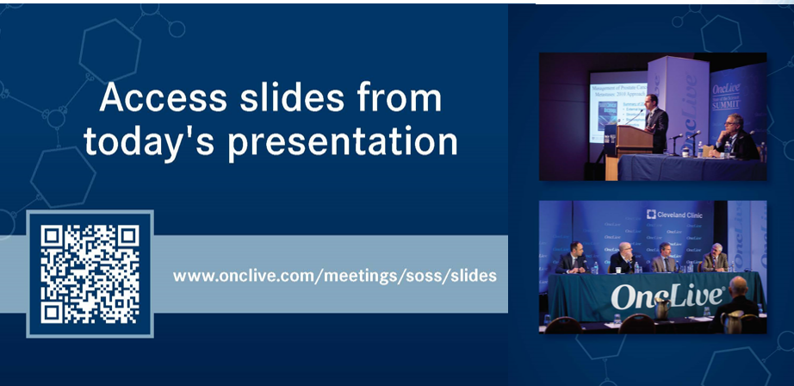

Slide 5


Slide 6
2024 Events
Gyn-Onc: May, Austin, TX
Lung: June, Chicago, IL
Gastrointestinal: November, Washington, DC
Breast: December, San Antonio, TX

Slide 7


Slide 8
Program Chair
Rebecca Klisovic, MD
Chief Medical Information Officer
University Hospitals Seidman Cancer Center Center
Columbus, OH

Slide 9
Hematologic Malignancies
April 17th, 2024

Slide 10
Which JAK Inhibitor for MF?
Rebecca Klisovic, MD
Associate CMIO – Academic & Specialty Service Lines
Clinical Professor of Internal Medicine
UH Hospitals Seidman Cancer Center
Cleveland OH

Slide 11
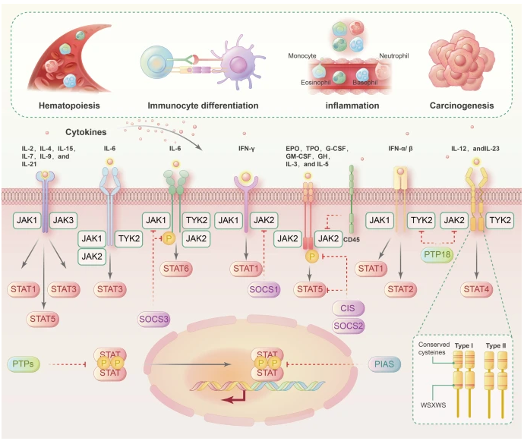
MYELOFIBROSIS
Classical Ph- myeloproliferative neoplasm
Driver mutations in JAK2, CALR, MPL
Characterized by marrow fibrosis, cytokine-mediated systemic symptoms, hepatosplenomegaly, anemia
Risk for progression to acute myeloid leukemia
Xue C, et al. Signal Transduction and Targeted Therapy; (2023) 8:204.

Slide 12
JAK INHIBITOR APPROVALS IN MF
2011
FEDRATINIB
MOMELOTINIB
2022
Jak1, Jak2, ACVR1
INT/HIGH RISK MF
SIMPLIFY-1/2
MOMENTUM
Jak1, Jak2, Jak3, TYK3
INT-2/HIGH RISK MF
- JAKARTA-1/2
2011
RUXOLITINIB
PACRITNIB
Jak1, Jak2
INT/HIGH RISK MF
COMFORT-1/2
Jak2, FLT3, IRAK1, CSF1R, ACVR1
INT/HIGH RISK MF
- PERSIST-1/2
2023
2019

Slide 13
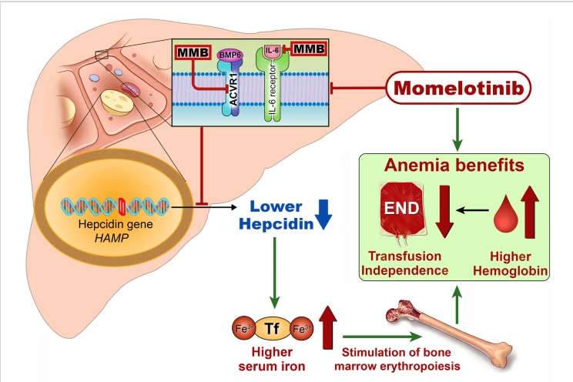
MOMELOTINIB
Oral, small-molecule, inhibits Jak1, Jak2, ACVR1
Inhibition of ACVR1 leads to decreased hepcidin expression in liver thereby increasing iron availability for erythropoiesis
Chifotides HT, Bose P, Verstovsek S. J Hem & Oncol. 2022; 12(1):1.

Slide 14
SIMPLIFY-1 Momelotinib
Phase 3 comparing momelotinib to ruxolitinib, randomized 1:1
INT-1 (symptomatic), INT-2, High risk MF
JAK inhibitor (JAKi) naïve
Platelets >50K
Double blind, double dummy 24 week treatment phase then open label momelotinib
Non-inferiority trial
Primary endpoint: SVR35 (35% splenic volume reduction) @ 24wks
Secondary endpoints:
  TSS response (>50% reduction in MPNSAF total symptom score)
  RBC transfusion independence rate
  RBC transfusion dependence rate
  Rate of RBC transfusion (avg no. units per subject-month)
Mesa R, et al. J Clin Oncol. 2017; 35: 3844-50.

Slide 15
SIMPLIFY-2 Momelotinib
Phase 3 comparing momelotinib to BAT, randomized 2:1
Prior RUX requiring RBC transfusion, RUX dose reductions <20 mg BID for cytopenias and palpable spleen
No minimum platelet criteria
Open label
Primary endpoint: SVR35 (35% splenic volume reduction) @ 24wks
Secondary endpoints:
  TSS response (>50% reduction in MPNSAF total symptom score)
  RBC transfusion independence rate
  Rate of RBC transfusion (avg no. units per subject-month)
  CR/PR/anemia response/spleen response/TSS response
Harrison C, et al. Lancet Haematol. 2018; 5: e73-813.

Slide 16
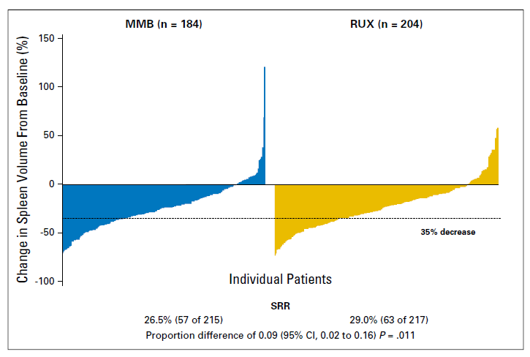
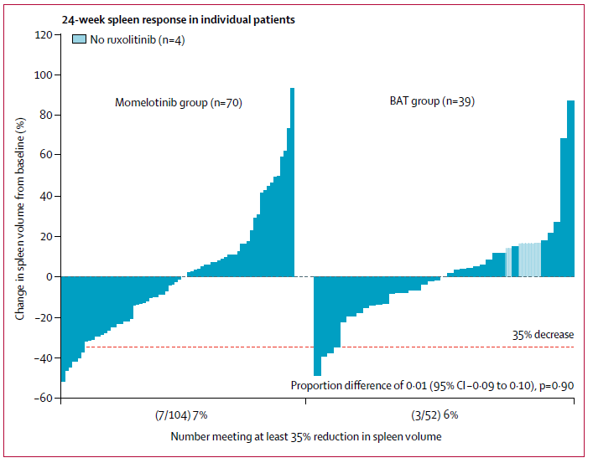
SIMPLIFY-1/2 Momelotinib SVR35
MMB non-inferior to RUX
No difference between MMB and BAT
Mesa R, et al. J Clin Oncol. 2017; 35: 3844-50.
Harrison C, et al. Lancet Haematol. 2018; 5: e73-813.

Slide 17
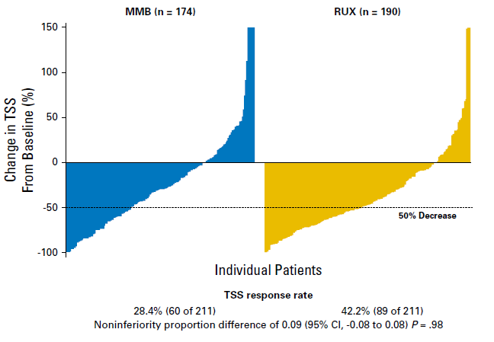
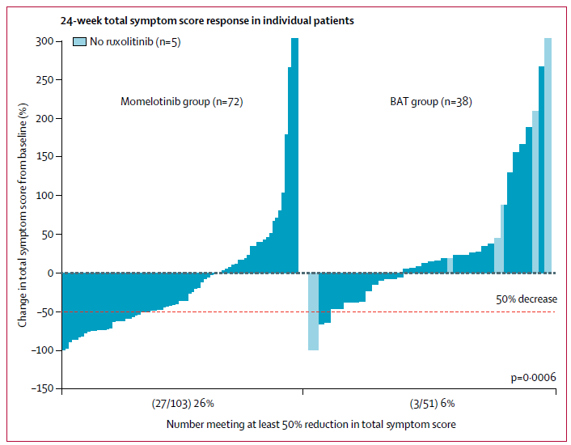
SIMPLIFY-1/2 Momelotinib Symptoms
MMB did not show non-inferiority to RUX
MMB superior to BAT
89% RUX
Mesa R, et al. J Clin Oncol. 2017; 35: 3844-50.
Harrison C, et al. Lancet Haematol. 2018; 5: e73-813.

Slide 18
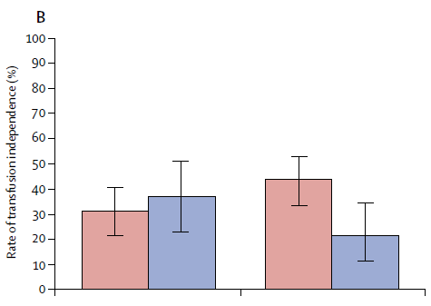
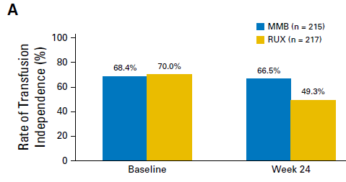

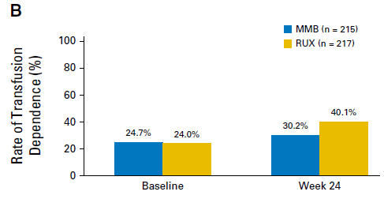
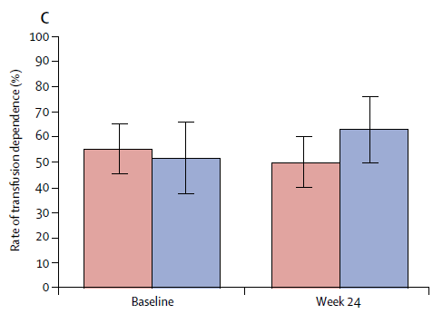
SIMPLIFY-1/2 Momelotinib Anemia
Transfusion Independence: no RBC transfusion, no Hgb<8 in prior 12 weeks
p=0・0012
P< .001
Transfusion Dependence: >= 4 units PRBCs or Hgb <8 in prior 8 weeks
P = .019
p=0・10
Mesa R, et al. J Clin Oncol. 2017; 35: 3844-50.
Harrison C, et al. Lancet Haematol. 2018; 5: e73-813.

Slide 19
MOMENTUM Momelotinib
Phase 3 comparing momelotinib to danazol, randomized 2:1
Prior JAKi >90 days or >28 days with cytopenias, symptomatic, anemic (Hgb<10)
Platelets >25K
Double blind, double dummy for 24 weeks
Open label cross-over after 24 weeks
Primary endpoint: TSS response rate at 24 wks (>50% reduction in MPNSAF TSS)
Secondary endpoints:
  TSS response (>50% reduction in MPNSAF total symptom score)
  RBC transfusion independence rate
  RBC transfusion dependence rate
  Rate of RBC transfusion (avg no. units per subject-month)
Verstovsek S, et al. Lancet. 2023; 401: 269-80.
Gerds AT, et al. Lancet Haematol. 2023: e73-46.

Slide 20
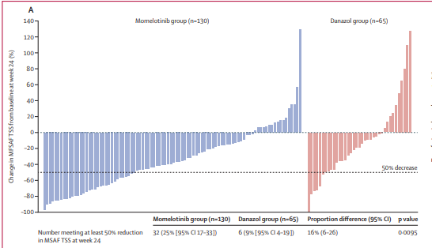
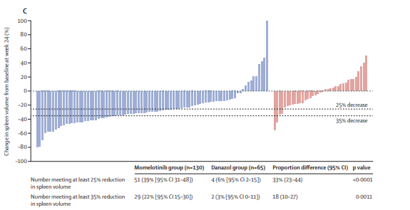
MOMENTUM Momelotinib vs. Danazol
MMB superior in symptom reduction
MMB superior in SVR reduction
Verstovsek S, et al. Lancet. 2023; 401: 269-80.
Gerds AT, et al. Lancet Haematol. 2023: e73-46.

Slide 21
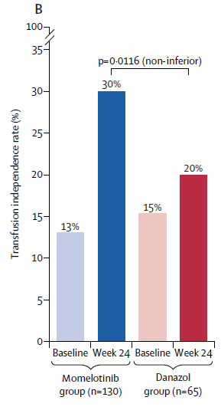
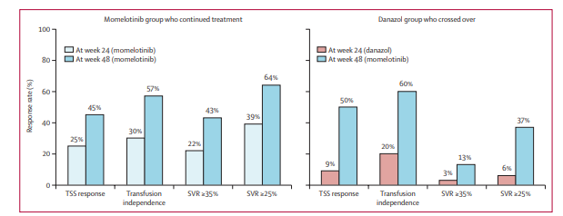
MOMENTUM Momelotinib vs. Danazol
MMB improved responses after cross-over
Verstovsek S, et al. Lancet. 2023; 401: 269-80.
Gerds AT, et al. Lancet Haematol. 2023: e73-46.

Slide 22
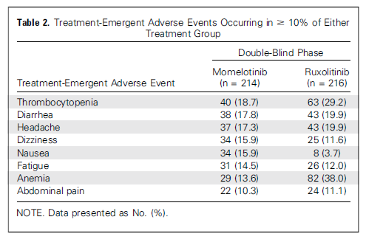
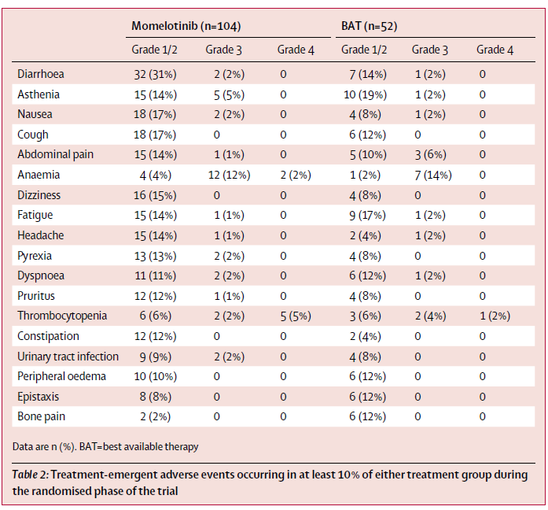
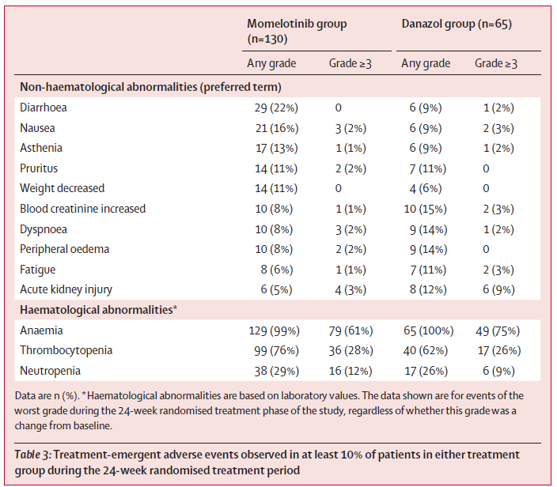
Momelotinib Safety
SIMPLIFY-1
SIMPLIFY-2
MOMENTUM
Peripheral Neuropathy: 10.3% MMB, 4.6% RUX
Peripheral Neuropathy: 4% MMB, 2% Danazol
Mesa R, et al. J Clin Oncol. 2017; 35: 3844-50.
Harrison C, et al. Lancet Haematol. 2018; 5: e73-813.
Verstovsek S, et al. Lancet. 2023; 401: 269-80.
Gerds AT, et al. Lancet Haematol. 2023: e73-46.
Peripheral Neuropathy:
11% MMB, 0% BAT

Slide 23
Momelotinib in MF
Setting (Comparator) | Spleen | Symptoms | Transfusion Independence | Transfusion Dependence
JAKi Naïve (RUX) | Non-inferior | Non-inferiority not shown | More independence | Less dependence
Prior JAKi (BAT) | No difference | Better symptom control | More independence | No difference
Prior JAKi (Danazol) | MMB superior | MMB superior | Non-inferior | (not reported)

Slide 24
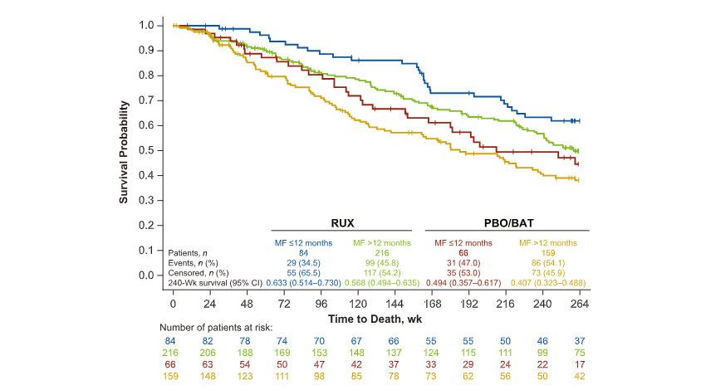
Impact of early intervention: COMFORT-I/II
Verstovsek S, et al. Cancer. 2023; 129(11): 1619-1780

Slide 25
Which JAK Inhibitor for MF?
PANEL
Molly Gallogly, MD, PhD
Leland Metheny, MD
Benjamin Tomlinson, MD
UH Hospitals Seidman Cancer Center
Cleveland OH

Slide 26
71y M newly diagnosed PMF
Spleen 8 cm below LCM
WBC 6, Hgb 8.2, plts 462
MPNSAF TSS 45
DIPSS Plus INT-2
Ruxolitinib
Fedratinib
Pacritinib
Momelotinib
Notes:
- Good treatment candidate, probably favor rux given OS data and needs symptom control, can tolerate thrombocytopenia

Slide 27
62y W PMF on ruxolitinib
Spleen 12 cm below LCM and growing
WBC 6, Hgb 7.2, plts 98
MPNSAF TSS 25
DIPSS Plus INT-2
Ruxolitinib
Fedratinib
Pacritinib
Momelotinib
Notes:
Needs anemia spleen and symptom control, probably favor pacritinib (anemia data and improved spleen compared to BAT in PERSIST-2), fedratinib non-randomized study in prior JAKi, MMB not has good at spleen

Slide 28
54y W newly diagnosed PMF
Spleen 4 cm below LCM
WBC 11, Hgb 6, plts 34
MPNSAF TSS 22
DIPSS Plus High
Ruxolitinib
Fedratinib
Pacritinib
Momelotinib
Notes:
PAC vs. MMB -> both allowed lower plt cts

Slide 29
40y M newly diagnosed PMF
Spleen 2 cm below LCM
WBC 11, Hgb 11, plts 252
MPNSAF TSS 2
DIPSS Plus Low
Ruxolitinib
Fedratinib
Pacritinib
Momelotinib
Notes:
No clear criteria for treatment…but COMFORT studies show improved OS that persists even despite cross over (treating earlier is better?) although this pt was not included in COMFORT trials (low risk).

Slide 30
Any cases from the audience?
Ruxolitinib
Fedratinib
Pacritinib
Momelotinib
Notes:
No clear criteria for treatment…but COMFORT studies show improved OS that persists even despite cross over (treating earlier is better?) although this pt was not included in COMFORT trials (low risk).

Slide 31
Hematologic Malignancies
April 17th, 2024

Slide 32
Updates in MDS and AML
Benjamin Tomlinson, MD
Assistant Professor of Medicine
University Hospitals Seidman Cancer Center
Cleveland, OH

Slide 33
Objectives
Background – the rapidly changing landscape of myeloid malignancies
Low Risk MDS – New Approvals and Trials
High Risk MDS – New Approvals
Acute Myeloid Leukemia – New Approvals
Up and coming medications

Slide 34
Disclosures
BMS – advisory Board
I will be discussing some non-FDA approved uses of FDA-approved medications
I will be highlighting clinical trials of some unapproved medications

Slide 35
Background
Midostaurin
Enasidenib
Gemtuzumab-Ozogamicin
Liposomal Dauno-cytarabine
Venetoclax
Gilteritinib
Ivosidenib
2017
2018
2019
2020

Slide 36
Background
Luspatercept
Decitabine-Cedazuricine
Venetoclax receives breakthrough designation for MDS
Ivosidenib approved for 1st-line in IDH1 AML (with AZA)
Olutasidenib
2020
2021
2022
2023

Slide 37
Background
Significantly increased our armamentarium
Set new standards of care for several types of
May be translating to overall survival benefits

Slide 38
Updates in low risk MDS
Luspatercept approved for 1st line therapy for MDS patients with MDS
COMMANDS Trial
Platzbecker et al. Lancet. 2023 Jul 29;402(10399):373-385.

Slide 39
COMMANDS
Phase 3 randomized trial of Luspatercept vs Epoietin Alfa
Key Inclusion:
  IPSS-R very low, low, and intermediate risk
  Marrow blasts < 5%
  Transfusion dependent (2-6 PRBCs/8 weeks)
  Serum EPO < 500 units/L
Primary Endpoint: 12-week transfusion independence
Platzbecker et al. Lancet. 2023 Jul 29;402(10399):373-385.

Slide 40
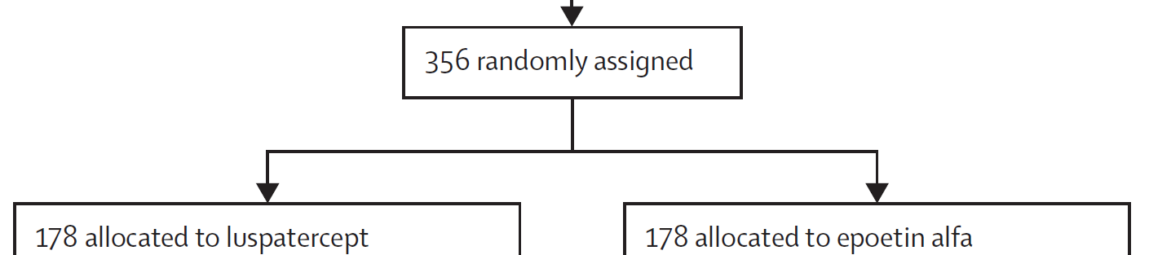
COMMANDS
Phase 3 randomized trial of Luspatercept vs Epoietin Alfa
Platzbecker et al. Lancet. 2023 Jul 29;402(10399):373-385.

Slide 41
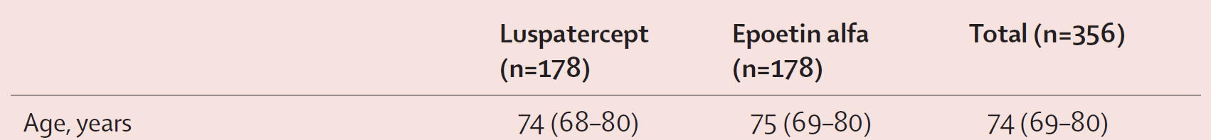
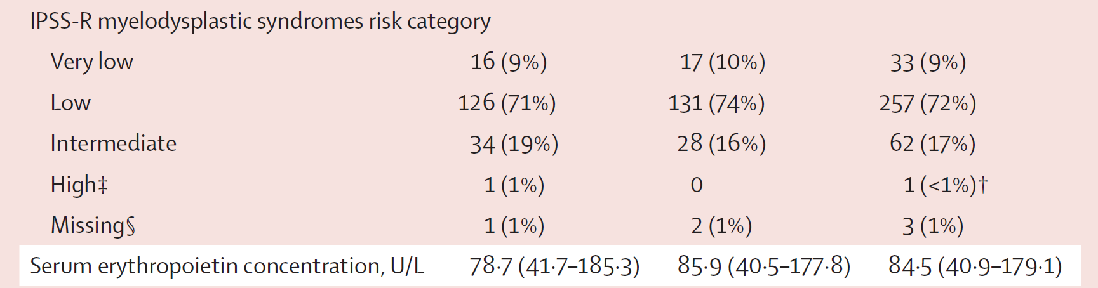
COMMANDS
Platzbecker et al. Lancet. 2023 Jul 29;402(10399):373-385.

Slide 42
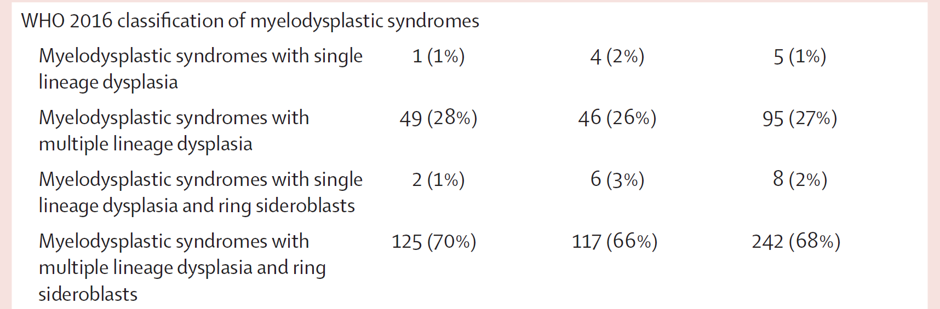
COMMANDS
Platzbecker et al. Lancet. 2023 Jul 29;402(10399):373-385.

Slide 43
COMMANDS
Platzbecker et al. Lancet. 2023 Jul 29;402(10399):373-385.

Slide 44
COMMANDS
Platzbecker et al. Lancet. 2023 Jul 29;402(10399):373-385.

Slide 45
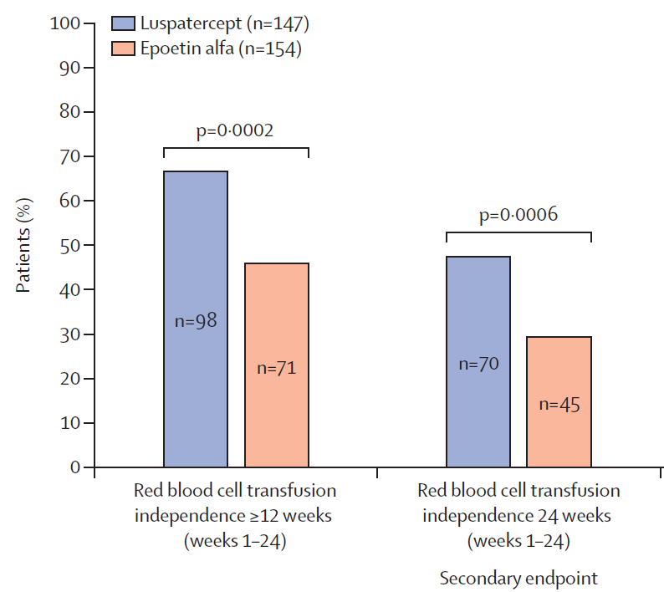
Platzbecker et al. Lancet. 2023 Jul 29;402(10399):373-385.
COMMANDS

Slide 46
Platzbecker et al. Lancet. 2023 Jul 29;402(10399):373-385.
COMMANDS
Notes:
Statistically significant improvement in % of patients with red cell transfusion dependence at 12 and 24 weeks

Slide 47
Low Risk MDS
Full results of EQOL-MDS
Phase 3 study of 2:1 randomized eltrombopag vs placebo in lower-risk MDS with severe thrombocytopenia
Key Inclusion criteria:
  IPSS low or int-1 MDS
  Plts < 30
  Refractory to alternative therapy
Olivia, et al. JCO 41, 4486-4496(2023)

Slide 48
EQOL-MDS
Key Exclusion criteria:
  Fibrotic marrow with inability to aspirate marrow
  5% or more marrow blasts
Intervention:
  Eltrombopag at 50mg/day, titrated up by 50mg to maximum dose of 300mg/day
Olivia, et al. JCO 41, 4486-4496(2023)
Notes:
The 5% blasts did not apply to the whole cohort

Slide 49
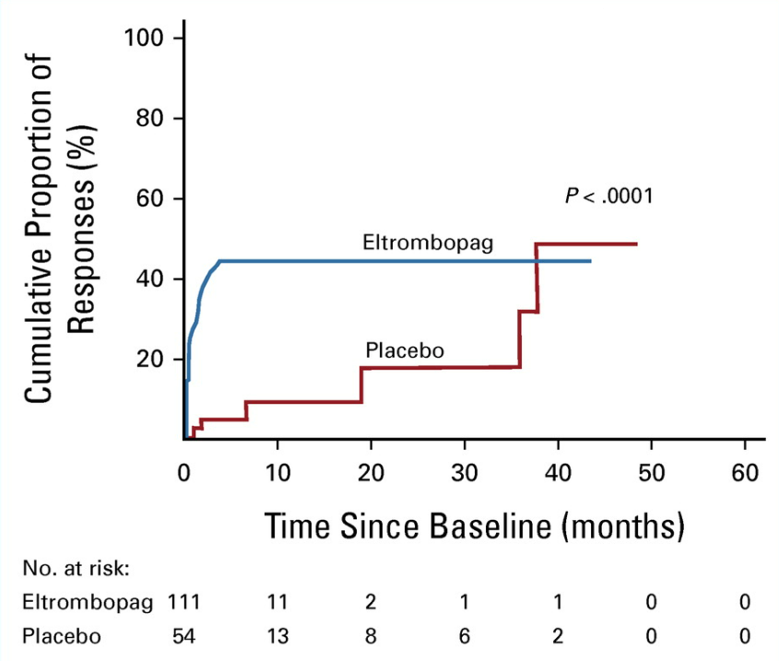
EQOL-MDS
Olivia, et al. JCO 41, 4486-4496(2023)
Notes:
This improvement was also associated with a statiscally significant improvement in clinically relevant bleeding events: 17 (31.5%) cases in the placebo group (exposure-adjusted event rate [EAER], 7.3 events per 100 patients/week) versus 22 eltrombopag cases (19.8%; EAER, 3.9 events per 100 patients/week; incidence rate ratio, 0.54; 95% CI, 0.38 to 0.75; P = .0002

Slide 50
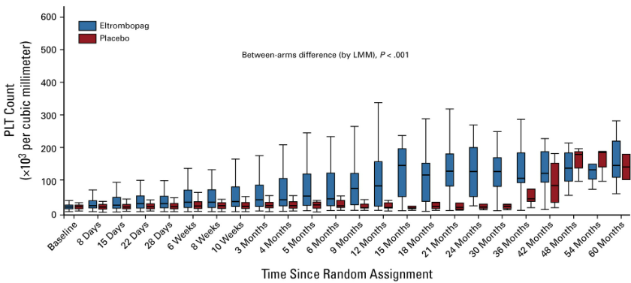
EQOL-MDS
Olivia, et al. JCO 41, 4486-4496(2023)

Slide 51
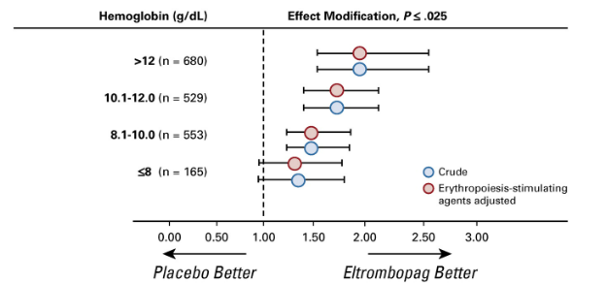
EQOL-MDS
Olivia, et al. JCO 41, 4486-4496(2023)
Notes:
Moreover, erythrocyte responses were also seen: 18 (27.3%) achieved a durable and significant erythroid improvement and 11 of 30 (36.7%) red blood cell transfusion-dependent patients became transfusion-independent.

Slide 52
EQOL-MDS – Key Safety Data
AML Evolution occurred in 9% vs 7% of eltrombopag vs placebo (p = 0.729)
18 patients with eltrombopag had to stop due to liver test abnormalities
Olivia, et al. JCO 41, 4486-4496(2023)
Notes:
The 5% blasts did not apply to the whole cohort

Slide 53
Updates in Higher Risk MDS
Ivosidenib was approved for r/r MDS

Slide 54
Ivosidenib
Ivosidenib was approved for r/r MDS
Approval based on – a single arm, open label study of ivosidenib in R/R MDS
16 patients enrolled with 7 patients achieving a CR with mediation duration of response of 12 months
  3 patients with CRs over 60 months
Sallman et al. JCO 40, 7053-7053(2022).

Slide 55
Updates in Acute Myeloid Leukemia
Quizartinib was approved with 7+3 for the upfront treatment of AML with mutated FLT3-ITD
Based on results of QuANTUM-First

Slide 56
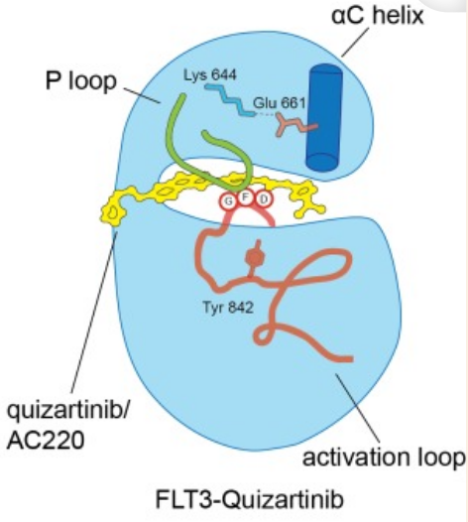
Quizartinib
Highly potent, and selective inhibitor of FLT-ITD
Zorn et al. PLoS One. 2015 Apr 2;10(4):e0121177.
Notes:
Importanly, not FLT3-TKD

Slide 57
Quizartinib
QuANTUM-First was a phase 3, 1:1 randomized trial of 7+3 with quizartinib 40mg vs placebo given days 8-21.
Patients must have FLT3-ITD adult AML, ages 18-75, and eligible for intensive induction
Primary Endpoint was OS
Erba et al. Lancet. 2023 May 13;401(10388):1571-1583.

Slide 58
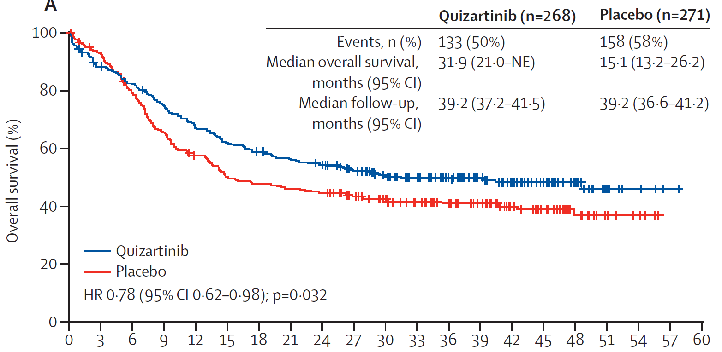
QuANTUM-First – Overall Survival
Erba et al. Lancet. 2023 May 13;401(10388):1571-1583.

Slide 59
Future medications?
Numerous promising medications, but some may be closer than others
Azacitidine and Cedazuridine
Menin Inhibitors
Notes:
Although, there are many medications in development, and some that we hope will have positive clinical trial results

Slide 60
Azacitidine-Cedazuridine
Cedazuridine is a CDA inhibitor that permits oral
Decitabine-Cedazuridine was FDA approved on the basis of PK equivalent to IV
Azacitidine-Cedazuridine (ASTX030) is actively being studied in a Phase-1-3 trial - ASTX030-01 with the primary endpoint of PK AUC₂₄ equivelance to subcutaneous azacitidine
Garcia-Manero et al. Blood (2023) 142 (Supplement 1): 3245.
Notes:
Although, there are many medications in development, and some that we hope will have positive clinical trial results

Slide 61
Azacitidine-Cedazuridine
As of 7/5/2023, 65 patients were reported enrolled and initial phase 1 data presented
Preliminary results suggest the AUC endpoint was met, though results are considered preliminary
Garcia-Manero et al. Blood (2023) 142 (Supplement 1): 3245.
Notes:
Although, there are many medications in development, and some that we hope will have positive clinical trial results

Slide 62
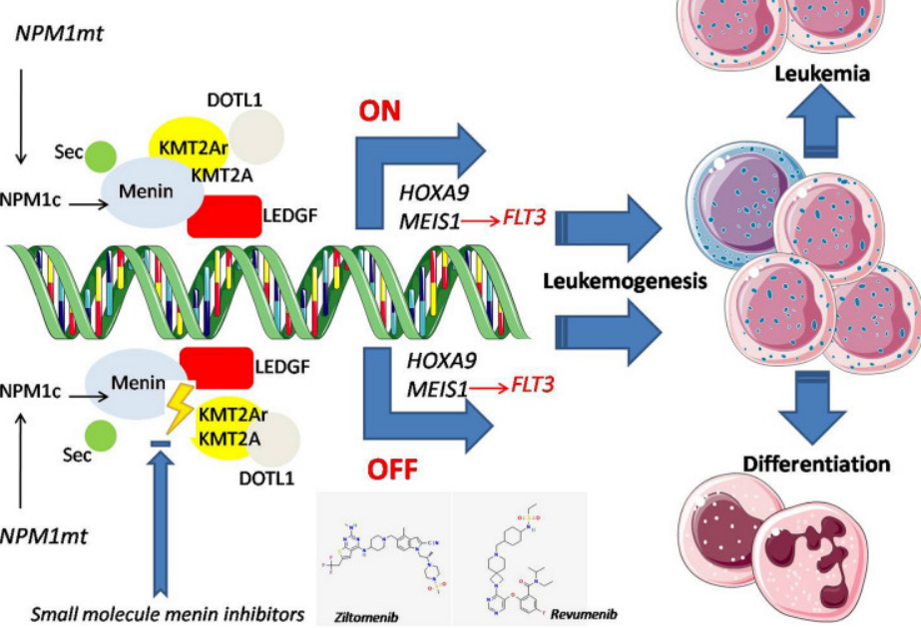
Menin Inhibitors
Thomas. Oncol Ther. 2024 Mar;12(1):57-72.
Notes:
Although, there are many medications in development, and some that we hope will have positive clinical trial results

Slide 63
Menin Inhibitors
Thomas. Oncol Ther. 2024 Mar;12(1):57-72.
Notes:
Although, there are many medications in development, and some that we hope will have positive clinical trial results

Slide 64
Menin Inhibitors
Early phase trial data of single agent inhibitors have shows CR+CRh rates of 30-43% in NPM1 and KMT2a translocated AML
Phase 1-3 trials of menin inhibitors combined with SOC upfront therapy are actively
These protocols are available or are opening locally!
Aldoss et al. Blood (2023) 142 (Supplement 2): LBA-5.
Erba et al. Blood (2022) 140 (Supplement 1): 153–156.
Notes:
Although, there are many medications in development, and some that we hope will have positive clinical trial results

Slide 65
Summary
Luspatercept for treatment of anemia in SF3B1 mutated MDS a new SOC option
Growing evidence supporting eltrombopag to manage severe thrombocytopenia
Ivosidenib available for r/r MDS
Quizarzitinib increases the options for FLT3-ITD AML
Many new therapies to monitor for the future!
Notes:
Although, there are many medications in development, and some that we hope will have positive clinical trial results

Slide 66
Thank you!

Slide 67
Hematologic Malignancies
April 17th, 2024

Slide 68
Treatment Crossroads: Sequencing BTK Inhibitors in CLL
BRUIN & Other supporting data/trials in BTKis in CLL
Changchun (George) Deng, M.D., Ph.D.
Director, Lymphoma and CLL, Associate Professor
UH Seidman Cancer Center and Case Western Reserve University
Cleveland, OH

Slide 69
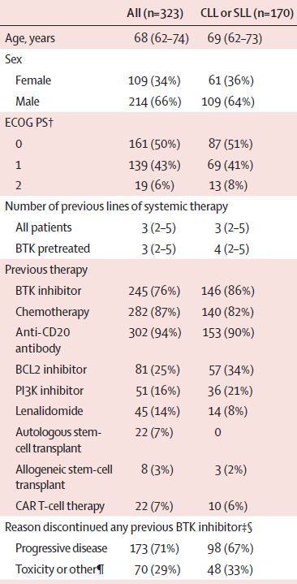
Pirtobrutinib in relapsed or refractory B-cell malignancies
(BRUIN): a phase 1/2 study (Mato, et al., Lancet 2021)
In CLL with pretreatment tissue:
17p deletion in 20 (25%) of 81 pts
TP53 mutation in 27 (30%) of 91 pts

Slide 70
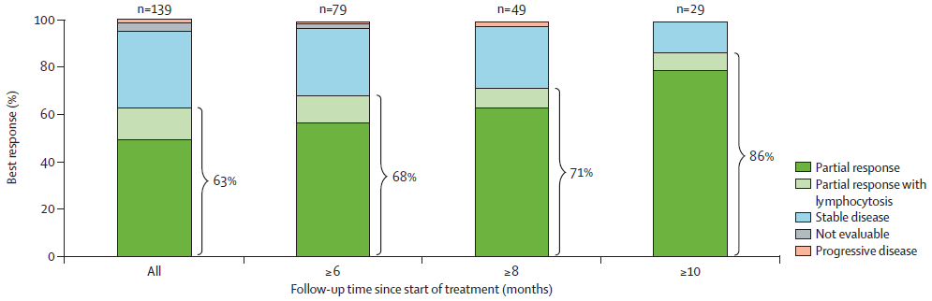
Pirtobrutinib: different (favorable) safety profile and promising efficacy in CLL/SLL
323 patients were treated with pirtobrutinib across seven dose levels.
No DLTs were observed and the MTD was not reached.
The most common adverse event of grade 3 or higher was neutropenia (32 [10%]).
Grade 3 atrial fibrillation or flutter was not observed.
No CR

Slide 71
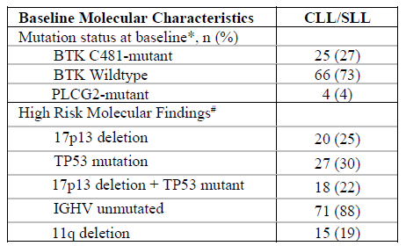
Pirtobrutinib: promising efficacy in CLL/SLL with high risk molecular features
Patients with 17p deletion and/or TP53 mutation demonstrated comparable ORR (77-84%) regardless of prior cBTKi exposure.

Slide 72
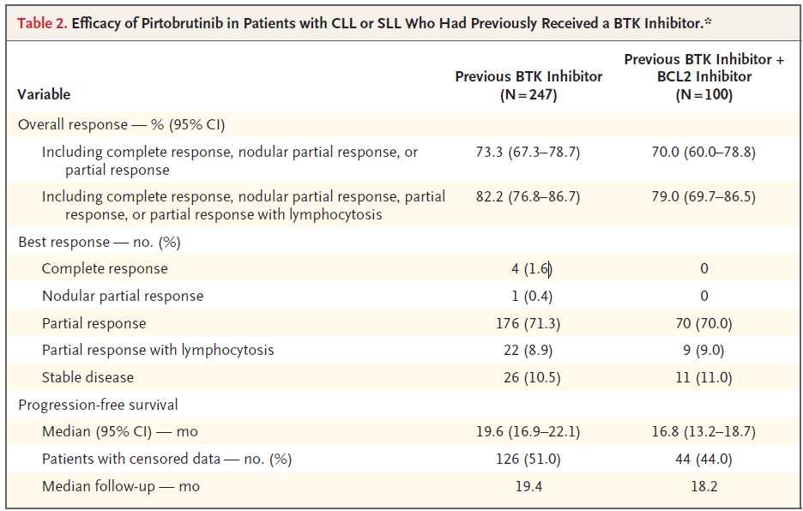
Pirtobrutinib: efficacy in CLL/SLL (Mato. NEJM 2023)

Slide 73
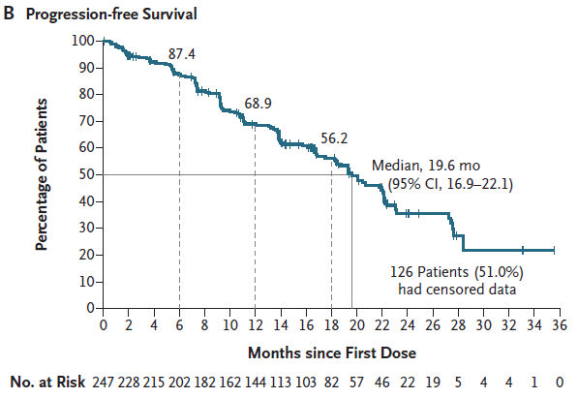
Pirtobrutinib: efficacy and safety
Treatment-Related Adverse Events Grade ≥3 in > 5% patieints: Neutropenia (14.8%)

Slide 74
How to sequence CLL treatments
There is no wide consensus regarding the choice of first line treatments, e.g. BTKi or BCL2i.

Slide 75
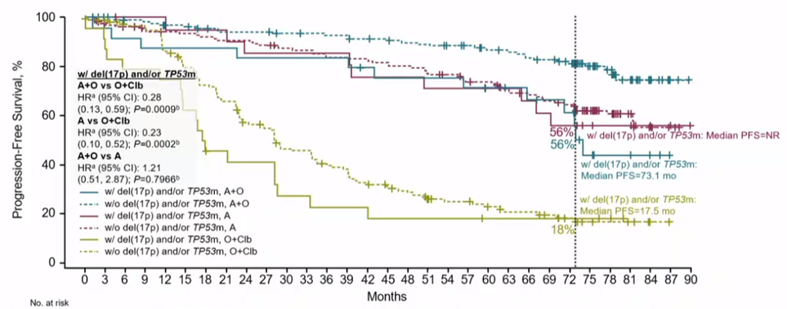
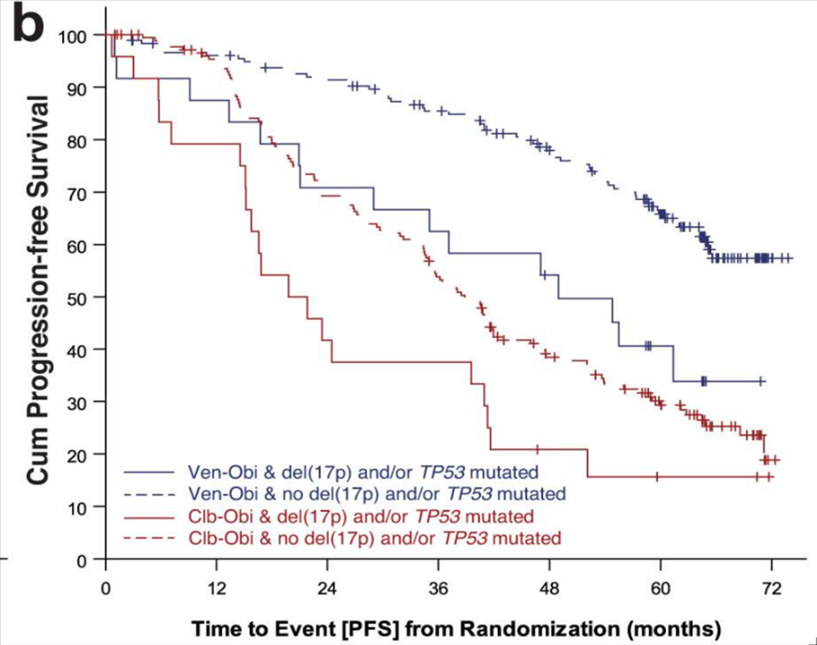
PFS of BTKi (AO) and BCL2i (VO) in TN CLL
ELEVATE-TN
CLL14
In SEQUOIA Arm C: Zanubrutinib in TN CLL with del(17): 18-mo PFS of 88.6%

Slide 76
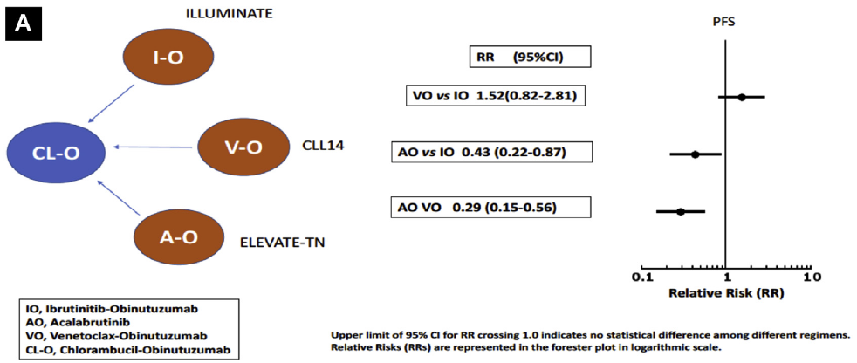
Meta-analysis suggest potential PFS advantage for BTKi (AO) vs BCL2i (VO)
Molica et al Clinical Lymphoma, Myeloma & Leukemia, 2020

Slide 77
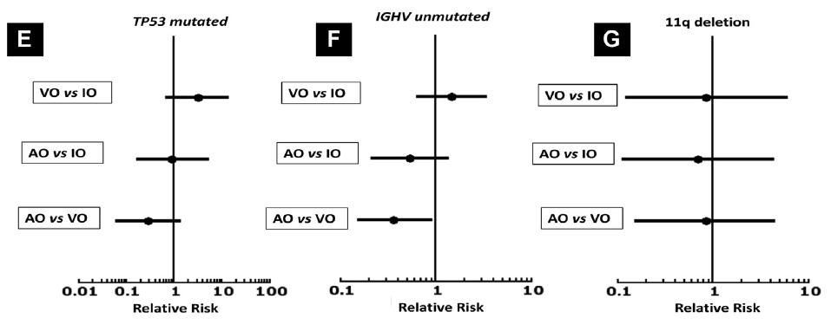
For TP53 mutated TN CLL BTKi (AO) shows a trend of PFS advantage vs BCL2i (VO)

Slide 78
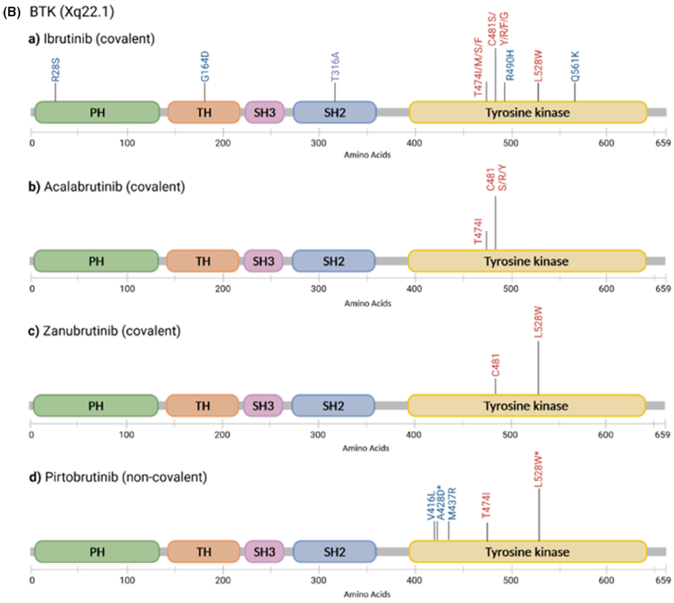
Clinically observed BTK mutations
Nakhoda BJH 2023

Slide 79
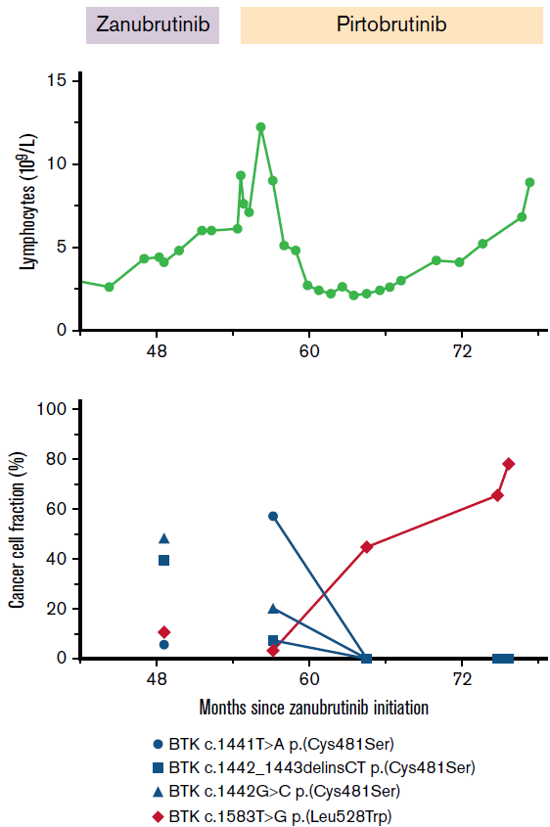
Enrichment of BTK Leu528Trp mutations in patients with CLL on zanubrutinib: potential for pirtobrutinib cross-resistance
Blombery. Blood Adv 2022
Two patients.
Both patients subsequently responded to venetoclax-based treatment.
Pirtobrutinib targets BTK C481S in ibrutinib-resistant CLL but second-site BTK mutations lead to resistance
Naeem. Blood Adv 2022

Slide 80
Sequencing CLL treatments – a personal perspective
Without 17p deletion or TP53 mutation
(CIT) cBTKi
Venetoclax
Pirtobrutinib
Venetoclax, other Tx
(CIT) Venetoclax
cBTKi
(→Other tx)
Pirtobrutinib
Venetoclax, other Tx
CIT: chemoimmunotherapy
cBTKi: acalabrutinib or zanubrutinib approved and preferred; ibrutinib approved.

Slide 81
Sequencing CLL treatments – a personal perspective
17p deletion and/or TP53 mutation present
cBTKi
Venetoclax
Pirtobrutinib
other Tx, Venetoclax
Venetoclax
cBTKi
(→Other tx)
Pirtobrutinib
Venetoclax, other Tx
CAR-T
alloSCT
Other Tx

Slide 82
Thank you!!

Slide 83
Hematologic Malignancies
April 17th, 2024

Slide 84
A New Era: Bispecifics for Hematological Malignancies
James Ignatz-Hoover, MD PhD
Clinical Instructor
Seidman Cancer Center
Cleveland, OH

Slide 85
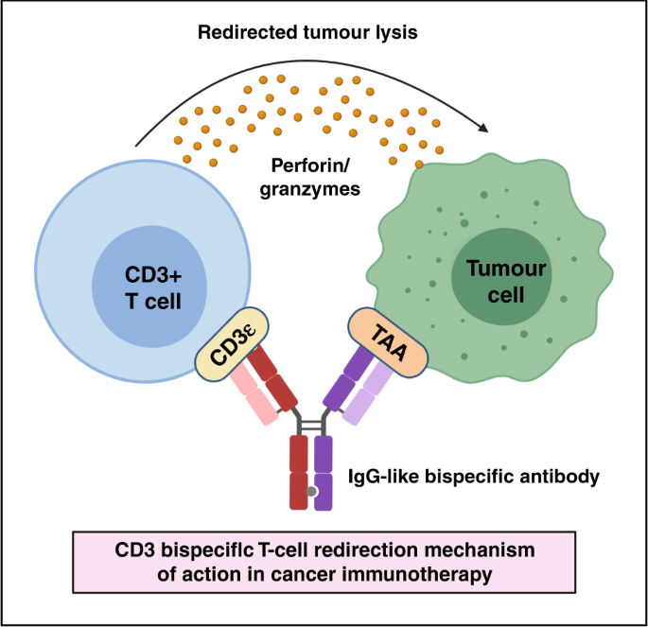
What’s a bispecific T cell engager?
Designer antibodies with two discrete specificities: one for CD3 (T cells), one for a tumor-associated antigen.
Off-the-shelf and well tolerated.
¹Singh A et al B J Cancer 2021.

Slide 86
BiTEs are relevant in multiple diseases
Acute lymphocytic leukemia: CD19xCD3-blinatumamab (Amgen)
Multiple myeloma: BCMA- teclistamab (Janssen)/elranatamab(Pfizer), GPCR5D- talquetamab (Janssen)
Diffuse large B cell lymphoma: CD20xCD3 epcoritamab (Abbvie)

Slide 87
Bispecifics REMS side-effects
Cytokine release syndrome (CRS)
  Inflammatory febrile illness that can be associated with vital instability and end organ damage
  Management with tocilizumab, steroids
Neurotoxicity
  Lower grades associated with nonspecific “brain fog” and confusion without focal neurological findings.
  Higher grades can exhibit focal weakness, seizures.
  Manage with steroids. Can give tocilizumab with co-morbid CRS.

Slide 88
Blinatumamab has changed ALL care
Ph+ and Ph- space
Post induction consolidation: MRD- or MRD+
Relapsed or treatment refractory
Long term side effects: B cell aplasia/hypogammaglobulinemia

Slide 89
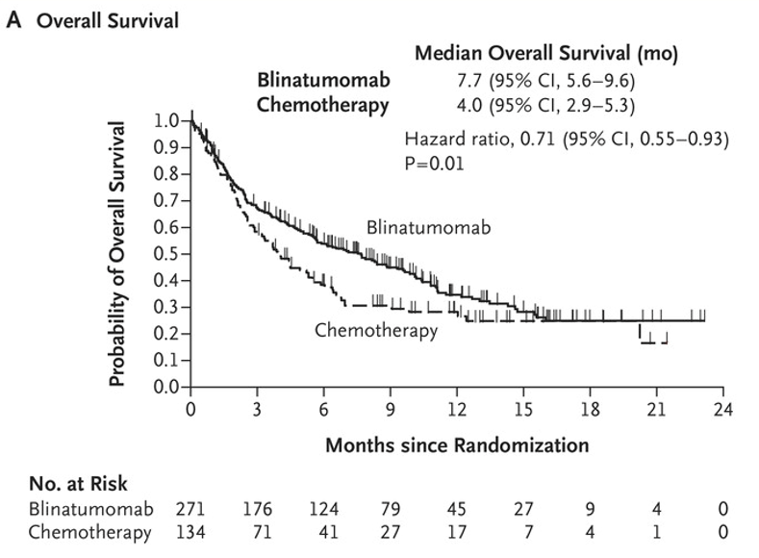
Blinatumamab in Relapsed/Refractory ALL
Phase 3 study
Blino v Chemo in R/R disease
²Kantarjian et al NEJM 2017

Slide 90
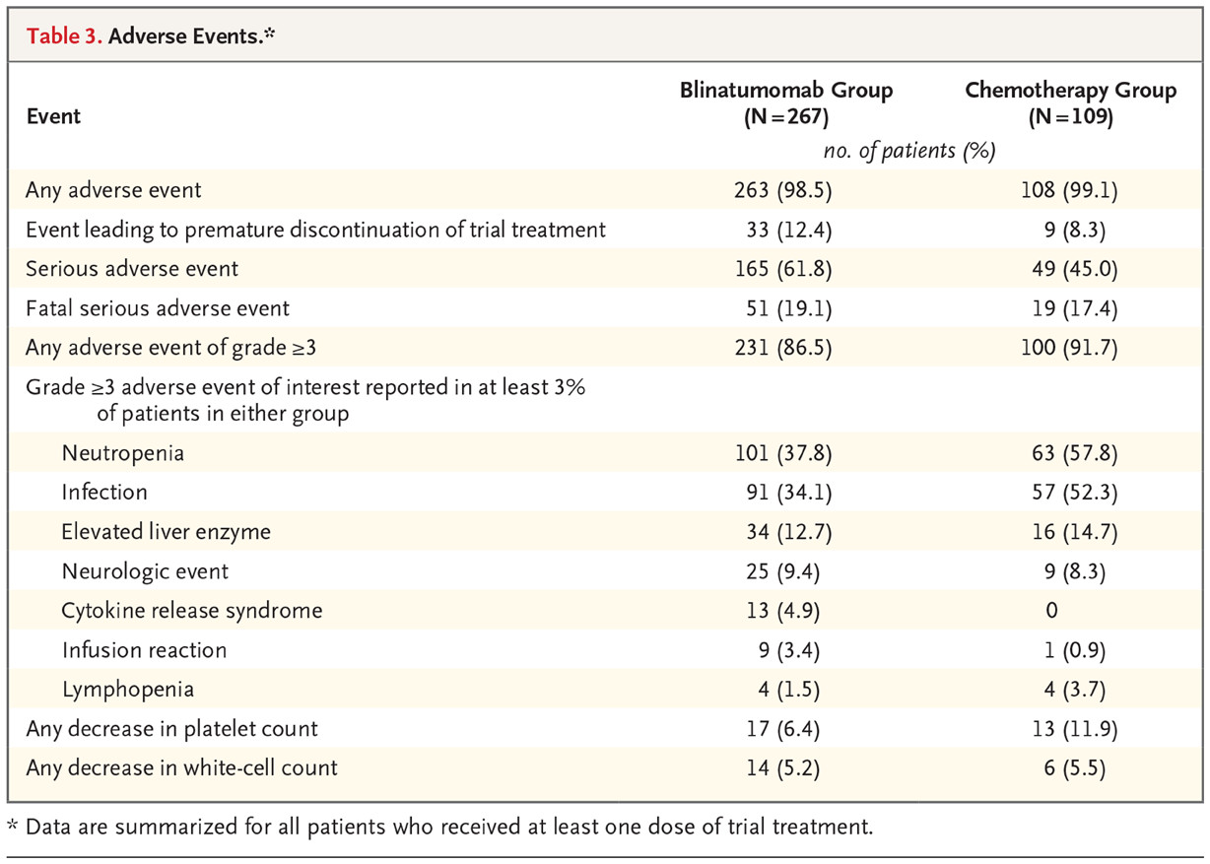
Blinatumamab side effects
²Kantarjian et al NEJM 2017

Slide 91
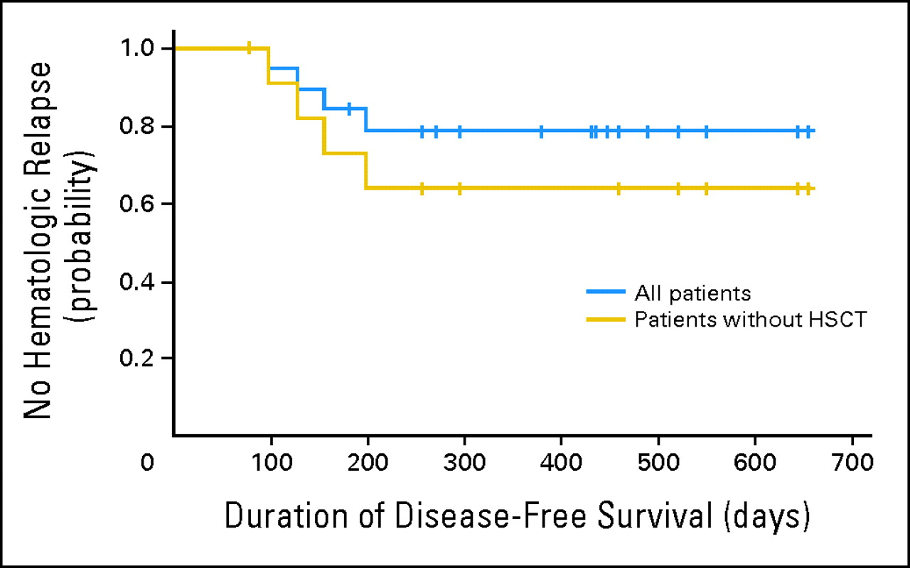
Blinatumamab consolidation in MRD+ ALL
High rate of relapse in ALL with MRD+ without alloSCT
Blinatumamab used as a bridge to transplant in a single armed 21 patient study.
High rate of MRD conversion and excellent PFS.
³Topp et al JCO 2011

Slide 92
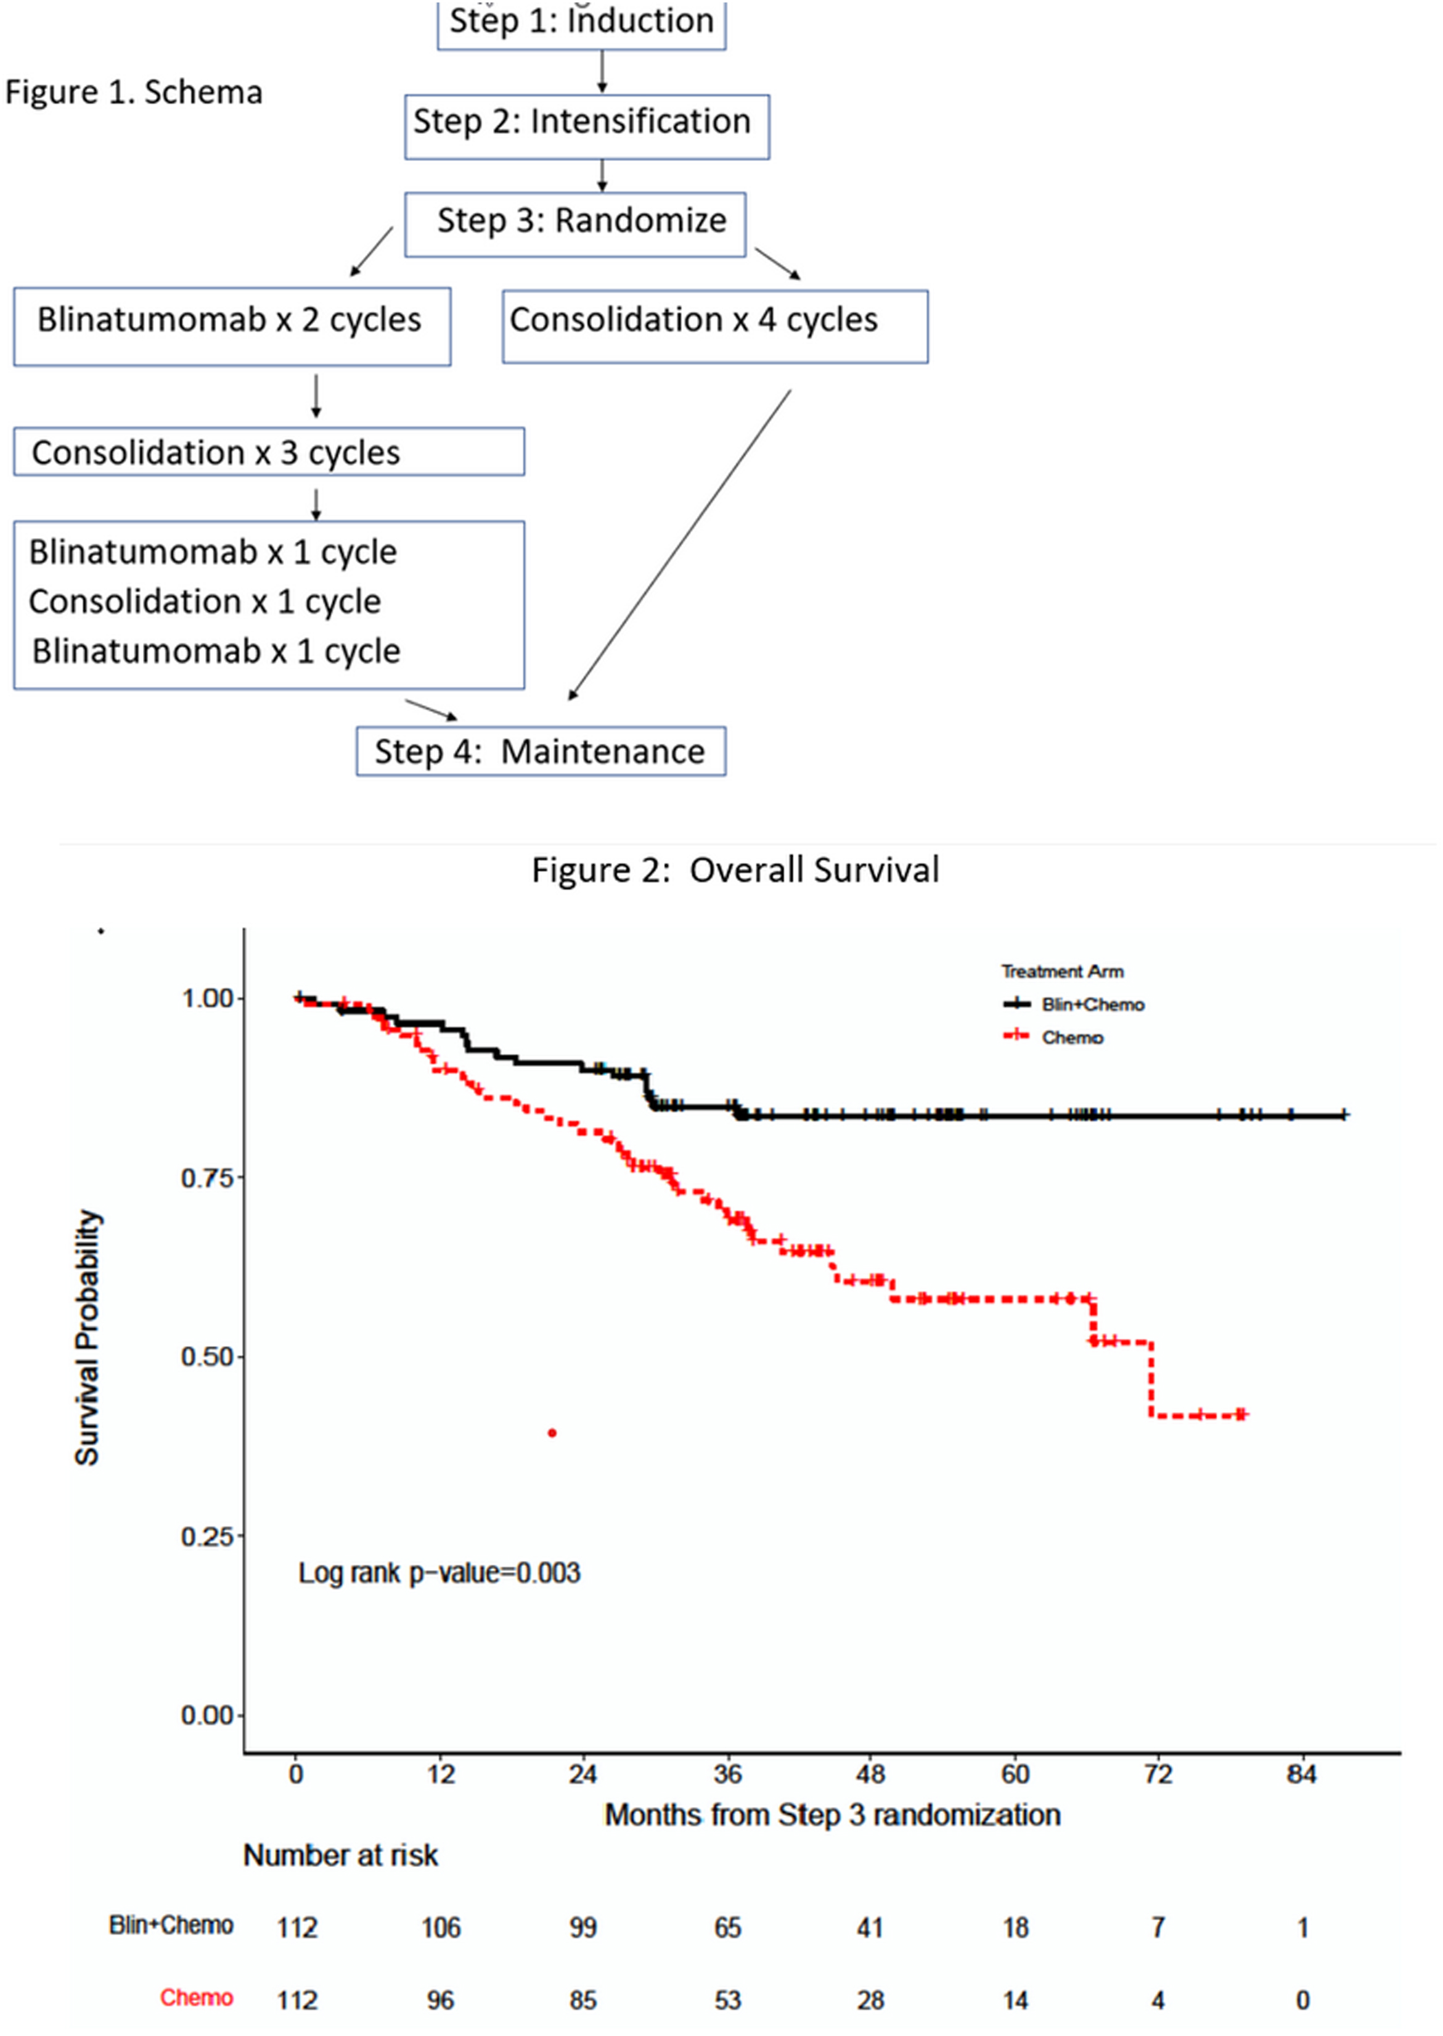
Blinatumamab Consolidation: MRD- Ph ALL
ECOG-ACRIN 1910 asked can blinatumamab improve OS in MRD- ALL patients
Randomized trial comparing 4 cycles of chemo consolidation v chemo+blinatumamab
Improved OS with blinatumamb.
⁴Litzgow et al ASH annual meeting 2022 LBA-1

Slide 93
Bispecifics in Multiple Myeloma (MM)
BCMA targeted
  Teclistamab, Elranatamab
  Specific toxicities: hypogammglobulinemia/infection
GPCR5D targeted
  Talquetamab
  Notable toxicities: Nail, hair, oral toxicities

Slide 94
Indications for Bispecifics in MM
For all agents, current FDA approvals are for patients who received at least four or more prior lines of therapy.
Patients must have received an anti-CD38 agent, proteasome inhibitor, and an immunomodulator.
Notably these are accelerated, not full approvals.

Slide 95
IMWG Uniform Response criteria
IMWG Uniform response criteria‖
Stringent complete response | Complete response as defined below plus normal FLC ratio** and absence of clonal cells in bone marrow biopsy by immunohistochemistry (κ/λ ratio ≤4:1 or ≥1:2 for κ and λ patients, respectively, after counting ≥100 plasma cells)††
Complete response | Negative immunofixation on the serum and urine and disappearance of any soft tissue plasmacytomas and <5% plasma cells in bone marrow aspirates
Very good partial response | Serum and urine M-protein detectable by immunofixation but not on electrophoresis or ≥90% reduction in serum M-protein plus urine M-protein level <100 mg per 24 h
Partial response | ≥50% reduction of serum M-protein plus reduction in 24 h urinary M-protein by ≥90% or to <200 mg per 24 h;
Minimal response | ≥25% but ≤49% reduction of serum M-protein and reduction in 24-h urine M-protein by 50–89%.

Slide 96
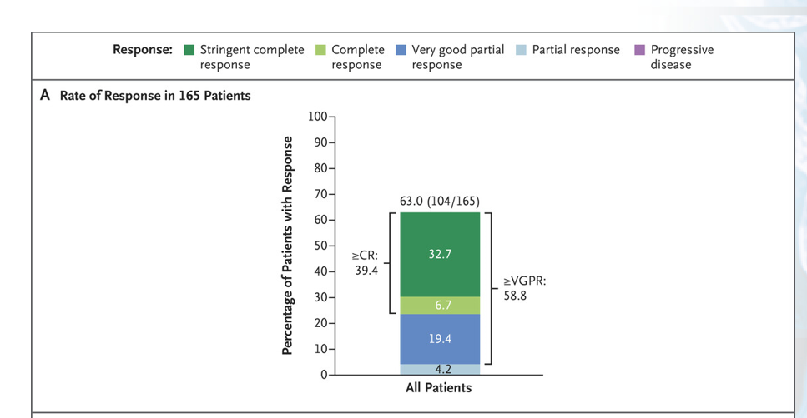
Teclistamab in MM
MajesTEC-1 enrolled patients post 3x lines of therapy and at least triple class exposed.
Median PFS of 11.3 months (95% CI 8.8 to 17.1).
⁵Moreau et al NEJM 2023

Slide 97
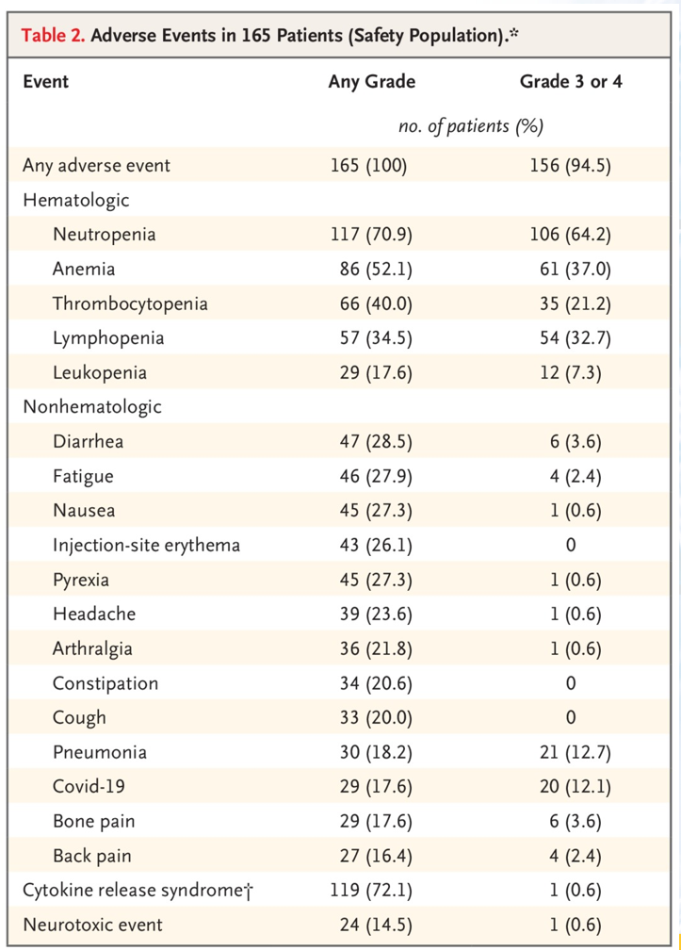
Side effect profile
CRS is common, but high-grade events are low.
Neurotoxicity relatively rare.
⁵Moreau et al NEJM 2023

Slide 98
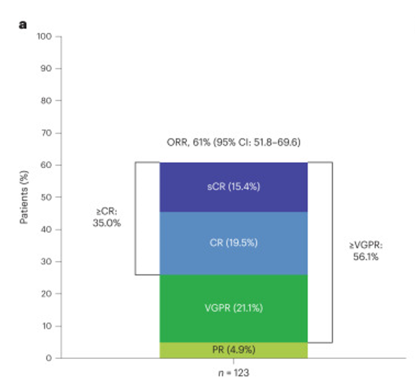
Elranatamab in MM
MagnetisMM-3 trial enrolled triple class exposed, 3 prior lines.
Median PFS of 11.8 months (6-19.1).
⁶Leshokin Nat Med 2023

Slide 99
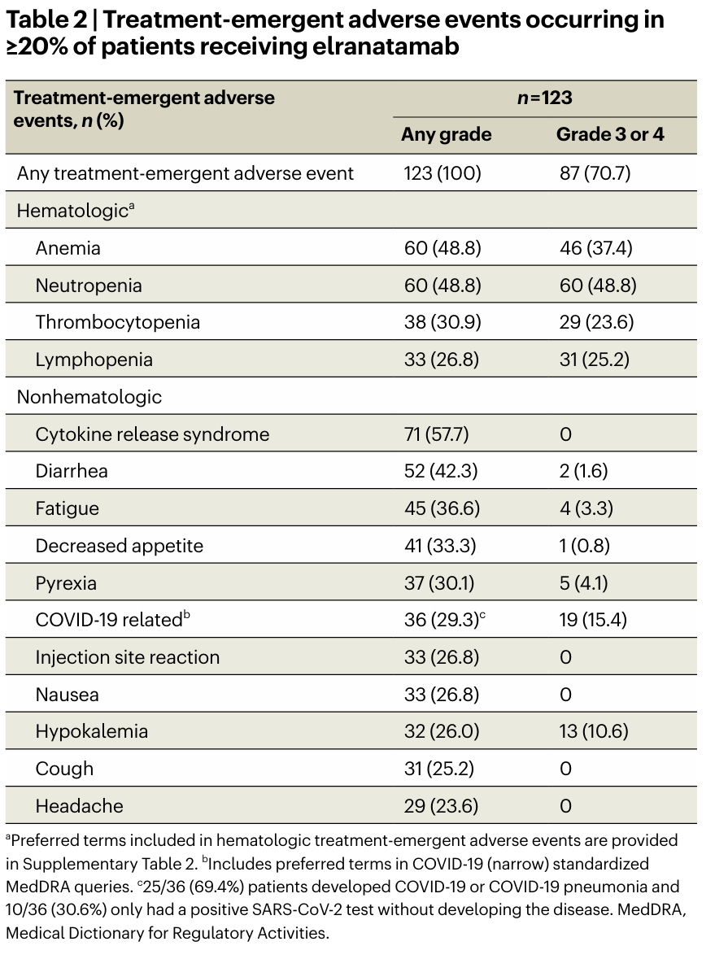
Side effect profile
CRS is common, but high-grade events are low.
⁶Leshokin A Nat Med 2023

Slide 100

Talquetamab in MM
MonumenTAL-1 accrued patients with no other options for therapy (Average 6 lines of prior therapy).
10.2 month DoR for 405 μg dose, 4.2 months for the 800 μg dose group.
⁷Chari NEJM 2022

Slide 101

Side effect profile
CRS is common, but high-grade events are low.
Nail, skin, and oral events are seen.
⁷Chari NEJM 2022

Slide 102
BiTE or CAR-T?
BiTEs
  Less deep responses.
  Off the shelf.
  Less CRS and neurotoxicity.
CAR-T
  Deeper responses
  Longer vein to vein time
  Higher CRS and neurotox rate.

Slide 103
Summary of BiTEs in MM
Multiple bispecific antibodies can provide deep responses in heavily pretreated patients using an off-the-shelf product.
Generally well tolerated agents.
Key research questions include how to sequence these agents with CAR-T.

Slide 104
Epcoritamab and DLBCL
CD20xCD3 agent
Currently approved for DLBCL NOS or transformed DLBCL after two or more lines of systemic therapy.

Slide 105
Epcoritamab is active even post CAR-T
Epicore NHL-1 enrolled patients with DLBCL, FL grade 3B, PMBL or high-grade B cell lymphoma treated with at least two prior lines of therapy.
Post CAR-T allowed (40% of cases).
Lugano response criteria
  CR Deauville 1,2,3
  PR Deauville 4,5 but lower intensity masses
  SD Deauville 4,5 no change in mass intensity
  PD:Deauville 4,5 increased intensity or new mass
⁸Thieblemont JCO 2022

Slide 106

Epcoritamab is active even post CAR-T
⁸Thieblemont JCO 2022

Slide 107

⁸Thieblemont JCO 2022

Slide 108

Epcoritamab side effect profile
⁸Thieblemont JCO 2022

Slide 109
Conclusions
Epcoritamab is active in DLBCL.
Can be considered as an off-the-shelf option for the CAR-T ineligible or for patients progressed post CAR-T.

Slide 110
Citations
¹ Singh A, Dees, S et al Br J Cancer 2021. 124 (6) 1037 -1048.
² Kantarjian H et al NEJM 2017 376 (9) 836-847.
³ Topp et al J Clin Onc 2011 29 (18) 2493-8.
⁴ Litzgow et al ASH Annual Meeting LBA 1.
⁵ Moreau P et al NEJM 2022 386 (6) 495-505.
⁶ Lesokhin AM et al Nat Med 2023 (29) 2259-2267.
⁷ Chari A et al NEJM 2022 387 (24) 2232-2244.
⁸ Thieblemont C et al J Clin Onc 2022 41 (12) 2238-2247.

Slide 111
Hematologic Malignancies
April 17th, 2024

Slide 112
Exciting Studies to Look for in 2024 in Hematologic Malignancies
Leland Metheny, MD
Associate Professor
University Hospitals, Seidman Cancer Center
Cleveland, Ohio
Notes:
Thank you for the opportunity to give this talk and your attention. I am Leland Metheny, of the Seidman Cancer Center at University Hospitals. I am here today to briefly touch on some exciting clinical trials in Hematology and Cell Therapy.

Slide 113
Overview
Non-Hodgkin’s Lymphoma Studies
  Rapid CAR-T
  Maintenance after CAR-T
Myeloma Studies
  BAFF CAR-T
  Maintenance after Autologous Transplant
Acute Myeloid Leukemia & Myelodysplasia Studies
  CASE 4919: Cycling Azacitidine and Decitabine for MDS
  SIERRA: Radio-isotope Conditioning for Allogeneic Transplant
Acute Lymphoblastic Leukemia Studies
  Post-Transplant Inotuzumab for All
Notes:
I will be focusing on 4 disease states, including NHL, Myeloma, AML/MDS, and ALL. I will be discuss both novel and local clinical trials and those that are multi-center which may have practice changing implications.

Slide 114
Non-Hodgkin’s Lymphoma Studies
CASE 2422: Rapid CAR-T for NHL
S2114: Maintenance or Consolidation following CAR-T for NHL

Slide 115
CASE 2422: Rapid CAR-T
Phase I study of an CD19 directed CAR-T
Apheresis starts at T-7
Manufactured in 17-20hrs with lentiviral vector
Stadel, ASH Abstract, 2023
Notes:
This is a phase I clinical trial involving for patients with CD19+ NHL who are have relapsed after 2 lines of chemotherapy or are refractory to chemotherapy.
This autologous CAR-T, UF-KURE19, can be manufactured in in 1-2 days or beginning on T-7, after collection of autologous T-cell. The patient then start lymphodepletion shortly thereafter. About 10-20 million CAR-T cells will be infused in the patient with expansion occurring in vivo. This clinical trial has been accruing at UH, CCF, and Iowa. Accrual will be met early this year.

Slide 116
Maintenance after CAR-T
Randomized Phase II study of immunotherapy maintenance after CD19 CAR-T
Mosunetuzumab: BITE against CD20
Polatuzumab: CD79b-directed antibody-drug conjugate
Notes:
In this phase II randomized trial, NHL patients with either stable disease or partial remission at day 30 following CAR-T are randomized the mosunetuzumab, polatuzumab, combination mosunetuzumab/polatuzumab, or observation. In the observation arm there is allowable cross over to combination mosunetuzumab/polatuzumab. The primary endpoint is PFS. This clinical trial is open at UH and CCF as well as nationwide. This clinical trial could have implication in how we can potentiate PFS following CAR-T for NHLs.

Slide 117
Myeloma Studies
BAFF CAR-T for R/R Myeloma
S1803: Maintenance after Autologous Transplant for Myeloma

Slide 118

BAFF CAR-T (LMY-920)
Phase I Study of BAFF CAR-T cell in R/R MM s/p 3 lines of therapy
Open and Enrolling at UH SCC
Point of Care Manufacturing at UH Wesley Center
Wong, Nature Communications, 2022
Notes:
LMY-920 is an autologous CAR-T cell therapy consisting of autologous CD4+ and CD8+ human T cells that are genetically engineered using the non-viral transposon system TcBuster/Electroporation to express the BAFF-ligand CAR that targets the BAFF signaling axis to eliminate myeloma. This ligand-CAR consists of truncated human BAFF ectodomain, which confers ability to bind the classical BAFF receptors, BAFF-R, BCMA, and TACI. The BAFF-R is required for B-cell maturation and is detected on B-cells of the mantle zones. BCMA is involved in plasma cell survival and is an established target for CAR-T cell therapy for multiple myeloma
. TACI is expressed on late-stage B cells, such as memory B cells, plasmablasts and plasma cells. ( The co-stimulatory domain is CD28). This clinical trial is open at UH and currently enrolling. There is a sister study at CCF enrolling patients with NHL as these targets are also expressed on lymphoma cells.

Slide 119
S1803: Maintenance after Auto
Phase I Study of BAFF CAR-T cell in R/R MM s/p 3 lines of therapy
Open and Enrolling at UH SCC
Point of Care Manufacturing at UH Wesley Center
Notes:
S1803 is Phase III Study of Daratumumab/rHuPH20 (NSC- 810307) + Lenalidomide or Lenalidomide as Post-Autologous Stem Cell Transplant Maintenance Therapy in Patients with Multiple Myeloma (MM) Using Minimal Residual Disease to Direct Therapy Duration (DRAMMATIC Study). Patient will be started on therapy within 180 days following autologous transplant and randomized into either Dara/Len or Len arms for 2 years. Then based on a MRD assessment, the patients may undergo a second randomization for either continuing the therapy or going off therapy if MRD negative. The endpoint is OS. This clinical trial is open to accrual and is enrolled patients at UH.

Slide 120
Acute Myeloid Leukemia & Myelodysplasia Studies
CASE 4919: Cycling Azacitidine and Decitabine for MDS
SIERRA trial: Radio-isotope conditioning for relapse or refractory AML

Slide 121
CASE 4919
Phase II Study of azacitidine and decitabine for the treatment of patients with MDS
Open at UH
Ebrahem, Blood, 2015
Notes:
CASE 4919 is a phase II study combining azacitidine and decitabine for the treatment of patients with MDS of MDS/overlap syndromes. The primary endpoint is ORR. Eligibility includes MDS patients with adequate organ function with an indication for treatment. Interesting this regimen differs significantly from the standard 5-7 day therapy with theses agents. The treatment involves giving a dose of azacitadine on day 1 weekly and a dose of decitabine on day 4 weekly. The hypothesis is that cycling these agents enhances their activity (DNMT1-depletion) by preventing the development of resistance to these agents because they have different mechanisms of metabolism. There is also the possible benefit of reduced toxicity in this combination.

Slide 122

SIERRA trial
Phase III Study radio-isotope conditioning for patients with R/R AML
Finished enrollment and reporting of primary outcome of durable CR soon.
Gyurkocza, Hemasphere, 2023
Notes:
The SIERRA trial is a randomized phase III study for patients with R/R AML. In this study patients with R/R AML who are transplant eligible are randomized to either SOC (more chemotherapy or direct transplant) or conditioning chemotherapy that includes Iomab-B (131I-apamistamab) is an anti-CD45 radioimmunoconjugate delivering targeted myeloablative radioactivity followed by an allogeneic MRD or MUD transplant. The primary endpoint is durable CR. This study should be reporting out soon, but abstracts seem to demonstrate the superiority of the Iomab-B conditioning and rapid allogeneic transplant compared to SOC. For example, in an abstract published last year, of evaluable pts (Iomab: 59; CC: 64), 44 (74.6%) pts on the Iomab-B arm achieved initial CR/CRp compared to 4 (6.3%) on CC. Durable CR rates were 22% vs 0% (95% CI; 12.29, 34.73; p<0.0001). In the graph above, for the patients in the Iomab group who achieved CR, there is a signficiant proportion of long term survivors.

Slide 123
Acute Lymphoblastic Leukemia Studies
1. CASE 1916: Inotuzumab Maintenance follow Allogeneic Transplant for ALL

Slide 124

CASE 1916
Phase II Study of Inotuzumab Maintenance following Allogeneic Transplant for ALL
Open and Enrolling at UH SCC, OSU, Nebraska, Kansas
Metheny, Blood Adv, 2024
Notes:
CASE 1916 is a phase I/II study of maintenance inotuzumab following allogeneic transplant for ALL. Inotuzumab is a CD22 antibody-drug conjugate that has single agent effectivity in ALL. The primary endpoint of the phase II is PFS at 1 year following transplant. Eligibility includes CD22+ ALL with a high risk of relapse following allogeneic transplant. The phase I portion of the study has been published which demonstrates that post-transplant inotuzumab is safe and feasible with a PFS of 89% at 1 year after transplant. The phase II study is open to enrollment and is currently enrolling at UH, OSU, Nebraska, and Kansas. Fred Hutch is also opening as a site.

Slide 125
Questions?
Notes:
Thank you again for your attention and are there any questions?

