Slide 1
Innovators 2010
Pharmacokinetic/Pharmacodynamic Model of Allosteric Calcium Sensing Receptor Antagonists
AAPS Graduate Student Symposium Awards in Pharmacokinetics, Pharmacodynamics, and Drug Metabolism
K. Abraham^{1 & 2}, T. S. Maurer², A. Kalgutkar², X. Gao², M. Li², D. R. Healy², D. N. Peterson², D. A. Griffith², D. E. Mager¹)
¹University at Buffalo, State University of New York, NY.
² Worldwide Research and Development, Pfizer Inc., Andover, MA & Groton, CT

Slide 2
Abstract
Purpose: To develop a model-based approach for interpreting the exposure-response relationships of a series of allosteric calcium sensing receptor (CaR) antagonists in early development for modulating in vivo parathyroid hormone (PTH) concentrations.
Methods: Six compounds were administered orally to male Sprague Dawley rats (n = 5 per dose group), and plasma concentration-time profiles for drug and PTH were measured at 0, 1, 3, 10, 30, and 100 mg/kg single dose levels. Individual drug pharmacokinetic (PK) profiles were described using standard two- or three-compartment linear models with first-order absorption. The pharmacodynamics (PD) of CaR antagonists, assessed as ionized calcium (Ca⁺²) mediated regulation of PTH, were jointly fitted using our previously developed allosteric-binding PK/PD model that incorporates CaR occupancy. A precursor-pool indirect response model was used to describe PTH turnover. Estimation of model parameters was conducted using the maximum likelihood algorithm (ADAPT II, BMSR, Los Angeles).

Slide 3
Abstract
Results: Time-course of the six compounds at five dose levels was well characterized by linear PK functions. The central volume of distribution (V_{c}/F) was relatively high (2.48-20.0 L/kg), which is consistent with compounds in this class. Administration of CaR compounds resulted in dose-dependent stimulation of PTH release from biological stores. Allosteric binding to the CaR decreases Ca⁺² occupancy in the model, resulting in the net stimulation of PTH concentrations. The model well characterized PTH profiles using a common set of PTH turnover parameters and distinct compound specific terms. The equilibrium dissociation constant for Ca⁺² was fixed to an in vitro estimate (K_{D} = 1.2 mmol/L). The estimated in vivo half-life for PTH was 1.54 minutes, which is in good agreement with literature reported values (0.5-5 min). The values of the allosteric co-operativity constant (α = 0.174 to 0.812), a drug-specific parameter, were estimated with good precision.
Conclusion: A mechanistic model, driven by CaR occupancy, well characterized PTH stimulation for a series of CaR antagonists. The final model provides a platform for the systematic evaluation of new allosteric CaR binding compounds under development based on PK/PD principles.

Slide 4
OBJECTIVES
To develop a pharmacokinetic/pharmacodynamic (PK/PD) model that describes parathyroid hormone (PTH) modulation in response to antagonism of the calcium sensing receptor (CaR) by a series of inhibitors.
To determine whether compound-specific binding parameters obtained in vitro can be incorporated into the model to predict the extent and duration of PTH stimulation by CaR antagonists.

Slide 5
Introduction
Alternatives to recombinant PTH anabolic treatment for osteoporosis that are currently in early development include the calcium sensing receptor (CaR) antagonists, Wnt signaling modulators, and activin inhibitors.
The CaR antagonists are orally active small molecule compounds that offer distinct advantages over recombinant PTH.¹ These agents bind to the transmembrane region of the receptor that is allosteric to the extracellular Ca⁺² binding site.

Slide 6
Introduction
Slight negative modulation of the CaR stimulates endogenous PTH production according to a steep inverse concentration-effect relationship.²
A PK/PD model for the underlying PTH-Ca⁺² pharmacology has been developed, which could be adapted to incorporate compound specific parameters and allosteric receptor occupancy.³

Slide 7
Materials and Methods
Six compounds (A-F) with different in vitro potencies (IC₅₀) were dosed orally at five dose levels (0, 1, 3, 10, 30, & 100 mg/kg) to fasted male Sprague-Dawley rats (N=5/dose; 11 – 13 weeks old) .
Serial plasma samples were collected via jugular vein catheter over 24 hours post dose and kept frozen at – 20ºC until analysis of drug and PTH concentrations.
Analyte concentrations in plasma were monitored on a Sciex API4000Qtrap mass spectrometer and PTH concentrations were measured using a validated commercial ELISA (Immunotopics, San Clemente, CA)

Slide 8
Materials and Methods
A mechanistic PK/PD model (Figure 1) was used to simultaneously fit resultant PTH concentration-time profiles (ADAPT II, BMSR, CA). The PTH response was primarily driven by an allosteric receptor occupancy function:⁴

Slide 9
Materials and Methods
The concentration-time profiles of compounds A, B, C, D, and E were modeled using a standard 2-compartment linear disposition model with first-order absorption from the gut compartment. An additional peripheral compartment was added to describe the PK profiles of compound F.
PTH profiles after multiple dosing of compound E were simulated and compared to observed data for a limited qualification of model predictive performance.

Slide 10
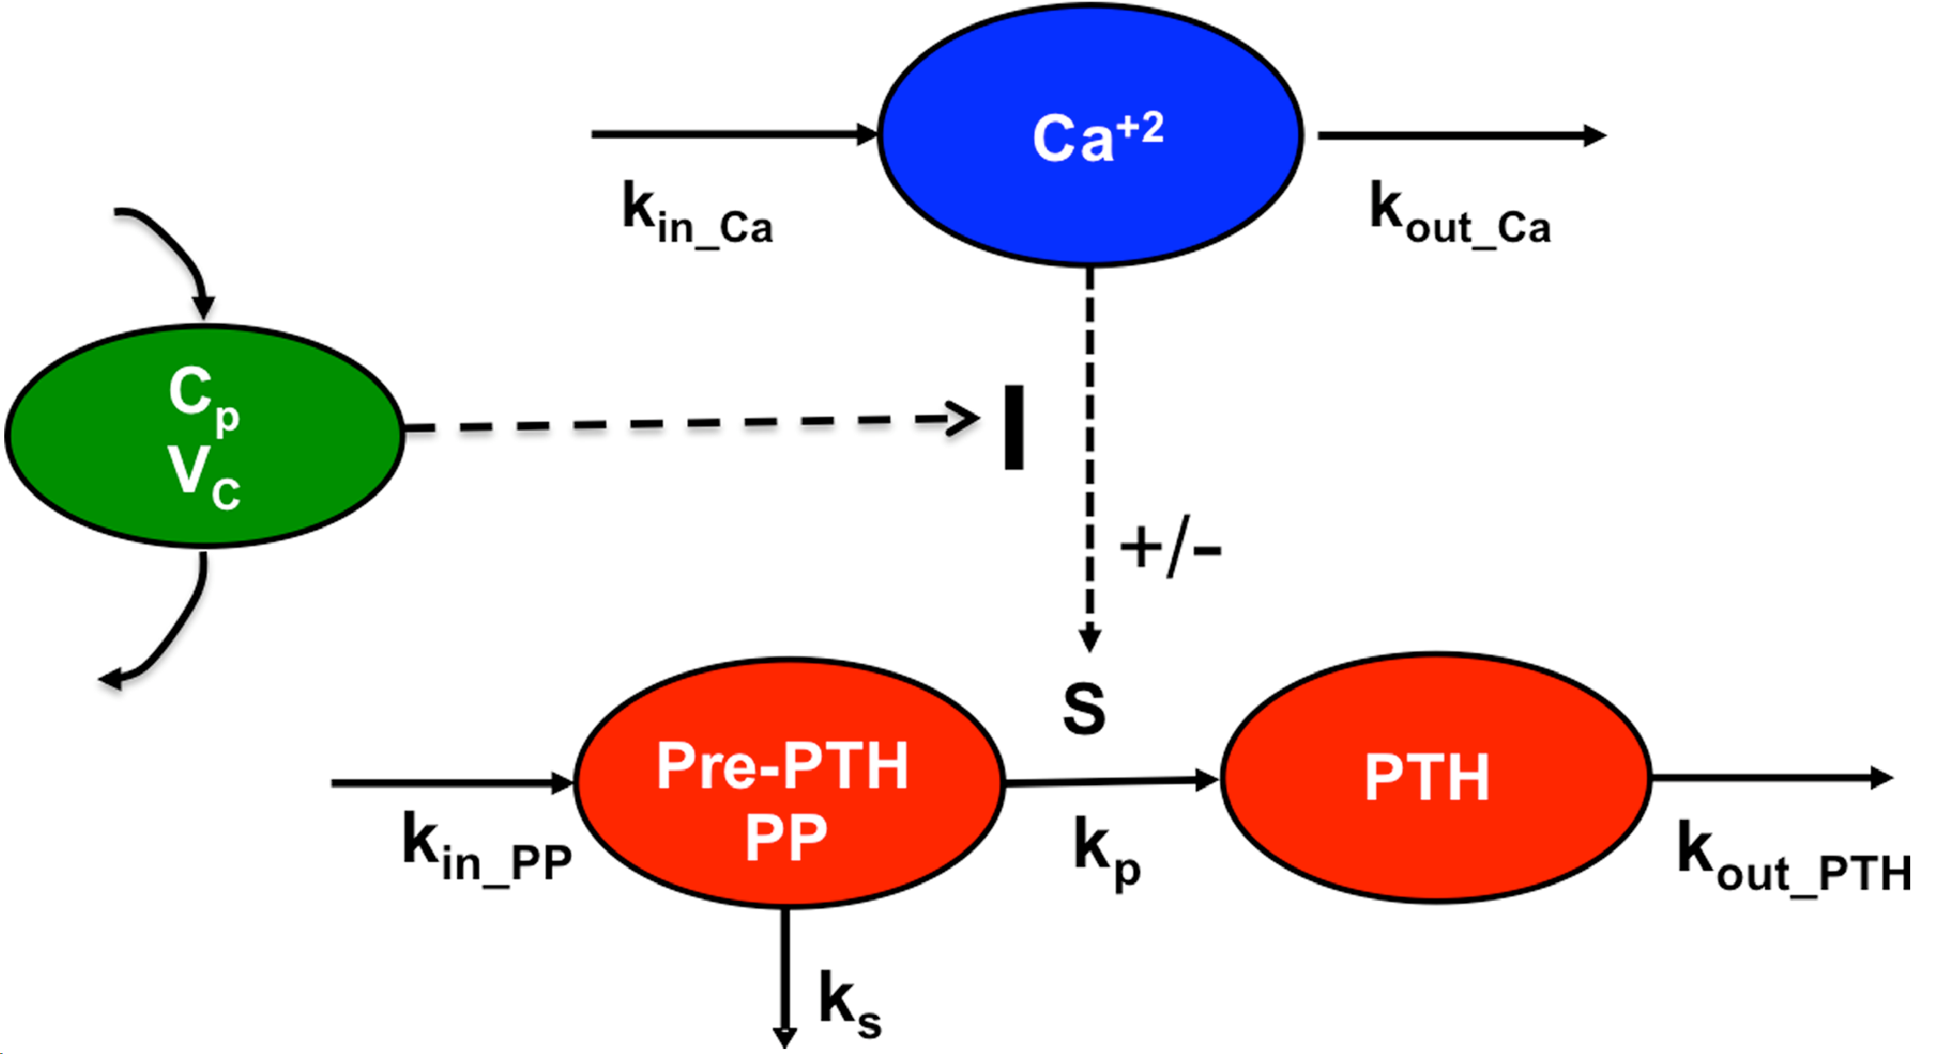
Results
Fig. 1. Schematic representation of the integrated PK/PD model for the effect of CaR antagonists on the parathyroid hormone-extracellular Ca⁺² in vivo regulatory system.

Slide 11
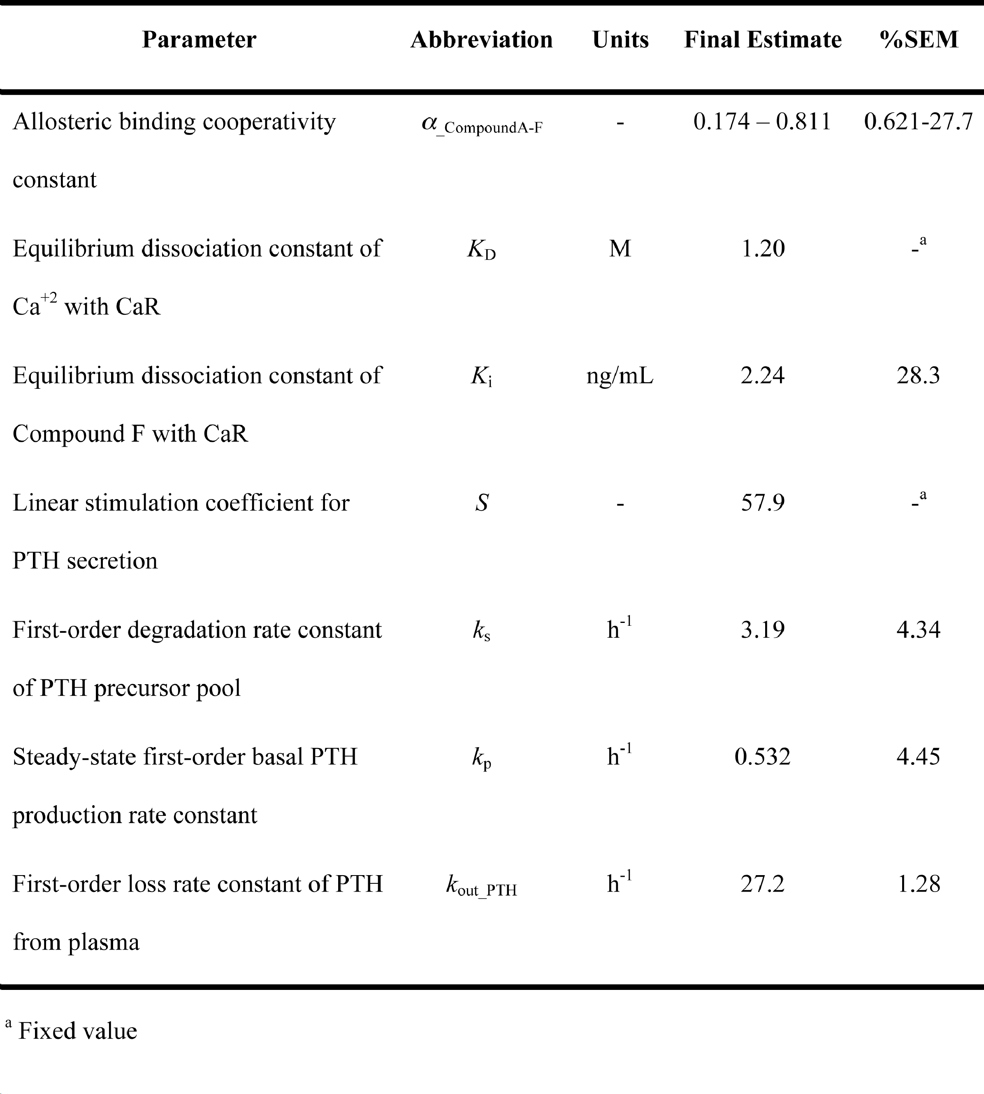
Results
Table I. Final pharmacodynamic model parameter estimates for calcium sensing receptor antagonists from simultaneous fitting of PTH data.

Slide 12
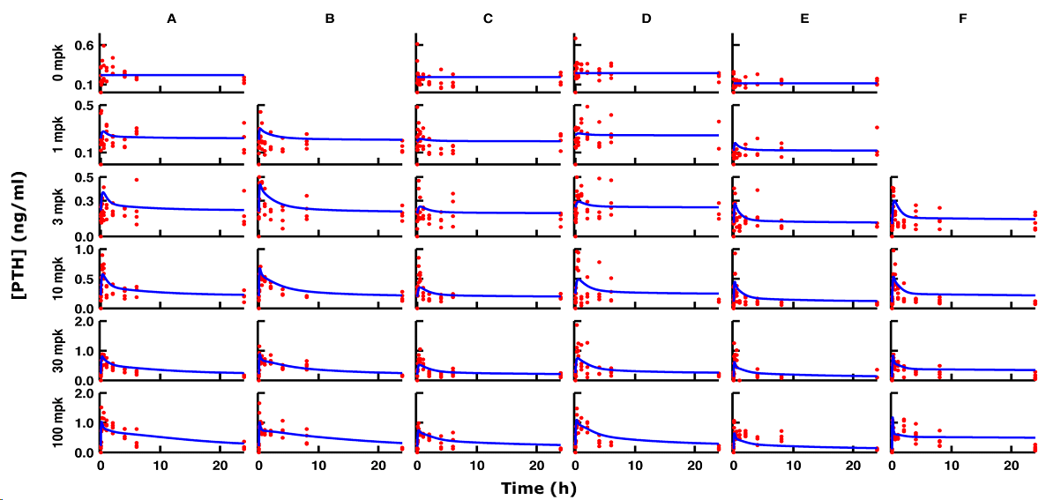
Results
Fig. 2. Concentration-time profiles of parathyroid hormone in normal adult rats after dosing of 0, 1, 3, 10, 30, and 100 mg/kg doses of compounds A-F. Solid lines represent model-fitted profiles. Columns represent each compound and rows represent the dose level for each compound after a single dose study.

Slide 13
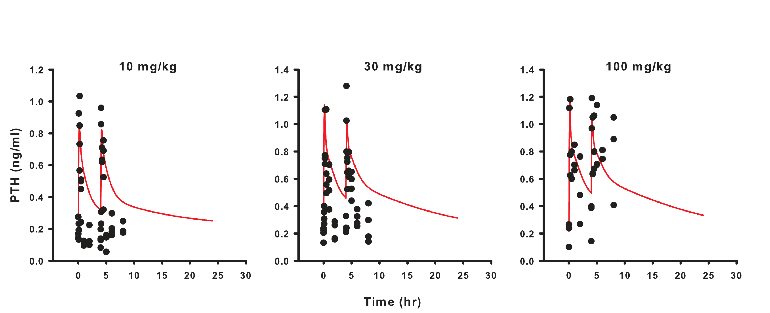
Results
Fig. 3. Predicted and observed parathyroid hormone concentrations in normal adult rats after a multiple dose (10, 30, and 100 mg/kg) study of compound E. Solid lines represent model-simulated profiles.

Slide 14
Discussion & Conclusion
The fitted PTH profiles adequately described data for a series of CaR antagonists at multiple dose levels and estimates for PTH turnover were consistent with previously reported values.³
The PK/PD model for CaR antagonists successfully incorporated parameters that are distinct for the pharmacological system (k_{s}, k_{p}, k_{out_PTH}, K_{D}, S), and the compound (k_{el}, k_{pt,n}, k_{tp,n}, V_{c}, f_{up}, K_{i} or IC₅₀, α).

Slide 15
Discussion & Conclusion
Simulations for multiple dosing of compound E suggest an acceptable qualification of the model for predicting the intensity and time-course of short-term PTH response in rats.
Designing relevant in vitro biological screens to generate an allosteric co-operativity constant value “α” could further enhance the utility of the PTH model.
The model has potential for incorporating human dose projections as well as clinical end-point measures such as bone mineral density.

Slide 16
Acknowledgments
This work was supported by the University at Buffalo-Pfizer Strategic Alliance.

Slide 17
References
Balan G, Bauman J, Bhattacharya S, Castrodad M, Healy DR, Herr M, et al., Bioorg Med Chem Lett. 19(12):3328-32, (2009)
Brown EM. Reviews in endocrine & metabolic disorders. 1(4):307-15, (2000)
Abraham AK, Mager DE, Gao X, Li M, Healy DR, Maurer TS. J Pharmacol Exp Ther. 330(1):169-78, (2009)
Ehlert FJ. Mol Pharmacol. 33(2):187-94.(1988)

Slide 18
BIOS/Contact info
Anson K. Abraham, Ph.D.
Senior Scientist (BioTherapeutics Research)
Pharmacokinetics, Dynamics, & Metabolism, Pfizer Inc.
1 Burtt Rd, Andover, MA 01810
Email: anson.k.abraham@pfizer.com

