Slide 1


Young Innovators 2011
Population Pharmacokinetic and Pharmacodynamic Model-based Comparability Assessment of a Recombinant Human Epoetin Alfa and the Biosimilar HX575
Xiaoyu Yan¹, Phil Lowe², Etienne Pigeolet², Martin Fink², Alexander Berghout³, Sigrid Balser³, Wojciech Krzyzanski¹
¹ Department of Pharmaceutical Sciences, State University of New York at Buffalo, Buffalo, New York, USA ² Novartis Pharma AG, Modeling & Simulation, Basel, Switzerland ³ Hexal AG, Sandoz Biopharmaceuticals, Holzkirchen, Germany

Slide 2
Abstract
The aim of this study was to develop an integrated pharmacokinetic and pharmacodynamic (PK/PD) model and to assess the comparability between HX575, the first biosimilar erythropoietin alfa approved in Europe and a comparator erythropoietin alfa by a model-based approach. PK/PD data including serum drug concentrations, reticulocyte counts, red blood cells, and hemoglobin levels were obtained from two clinical studies. 149 healthy male subjects received multiple intravenous or subcutaneous doses of 100 IU/kg HX575 and the comparator thrice-weekly (TIW) for four weeks. A population model based on pharmacodynamics-mediated drug disposition (PDMDD) and cell maturation processes was used to characterize the PK/PD data for the two drugs. Simulations showed that due to target amount changes, total clearance may increase up to 2.4-fold as compared with the baseline. Further simulations suggested that once-weekly (QW) and thrice-weekly subcutaneous dosing regimens would result in similar efficacy. The findings from the model-based analysis were consistent with previous results using the standard noncompartmental approach demonstrating PK/PD comparability between HX575 and comparator. However, due to complexity of the PK/PD model, control of random effects was not straightforward. Whereas population PK/PD model-based analyses are suited for studying complex biological systems, such models have their (statistical) limitations, and comparability results from such models should therefore be interpreted carefully.
Adapted from the publication Yan X, Lowe P, Fink M et al. J Clin Pharmacol. 2011

Slide 3
Introduction
Erythropoietin (EPO) is a 30.4 kDa, glycoprotein hormone endogenously produced by fetal liver and adult kidney. EPO stimulates red blood cell (RBC) production by binding to EPO receptors (EPOR) on the surface of erythroid precursor cells in the human bone marrow.1 Binding between EPO and EPOR leads to a receptor-mediated endocytosis and degradation of EPO. This clearance pathway has been suggested to result in nonlinear and nonstationary pharmacokinetics. The total clearance of recombinant human EPO (rHuEPO) tends to increase in multiple dosing regimens in both anemic patients and healthy subjects, due to the expansion of erythroid precursor cells.²
Adapted from the publication Yan X, Lowe P, Fink M et al. J Clin Pharmacol. 2011

Slide 4
Introduction
HX575 is the first biosimilar erythropoietin alfa approved in Europe in 2007. HX575 is not approved in the US. Although legislation was passed in 2010 providing a regulatory pathway, there has not yet been a biosimilar approved via the new pathway. Clinical studies confirmed PK/PD comparability between HX575 and the comparator epoetin alfa in TIW intravenous (IV) and subcutaneous (SC) regimens.^{3,4} In these studies, both PK and PD data were evaluated and the comparability was established based upon metrics such as AUC, Cmax and AUEC, etc., estimated from the standard noncompartmental analysis (NCA) approach. Another approach using the population pharmacokinetic modeling has also been suggested to evaluate the PK/PD comparability as a supplement to the standard approach, although it is not a standard regulatory practice.^{5,6} One of the advantages of using model-based approach is that it can take into account nonlinear/nonstationary pharmacokinetics. The interaction between pharmacokinetics and pharmacodynamics of rHuEPO can result in both nonlinear and nonstationary PK behavior. A population PK/PD model can mechanistically characterize this interaction and assess the nonlinear and nonstationary PK properties. More importantly, it may enable more meaningful estimates for parameters and metrics, assisting in comparability evaluation.
Adapted from the publication Yan X, Lowe P, Fink M et al. J Clin Pharmacol. 2011

Slide 5
Materials and Methods
Study Design: Open, randomized, parallel, TIW IV and SC 100 IU/kg Epoetin alfa, 4 weeks, 74 healthy males receiving HX575 and 75 receiving the comparator
PK/PD Data: Serum drug concentrations, reticulocytes counts (RET), red blood cells (RBC), and hemoglobin (HGB), 5962 observations for PK and 8388 observations for PD
Model and software: Pharmacodynamics-mediated drug disposition model, operational model of agonism, NONMEM6 FOCEI
Parameterization for 2 drugs:
Model Evaluation: Visual predictive check with n = 500
Monte Carlo simulation for PK/PD Comparability analysis with 500 simulated data sets
Adapted from the publication Yan X, Lowe P, Fink M et al. J Clin Pharmacol. 2011

Slide 6
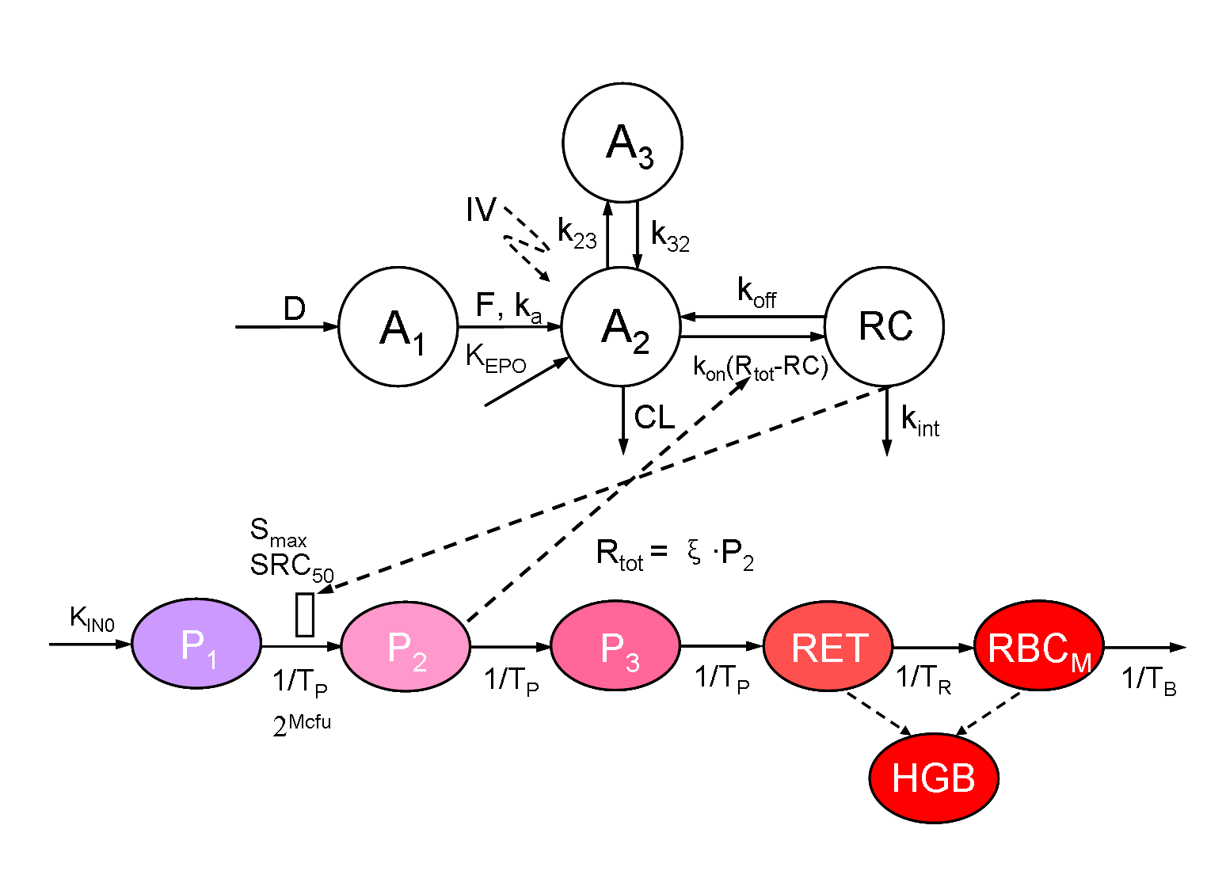
PDMDD model with incorporation of operational model of agonism
Fig. 1 PDMDD model for HX575 and the comparator epoetin alfa in healthy subjects
Adapted from the publication Yan X, Lowe P, Fink M et al. J Clin Pharmacol. 2011

Slide 7
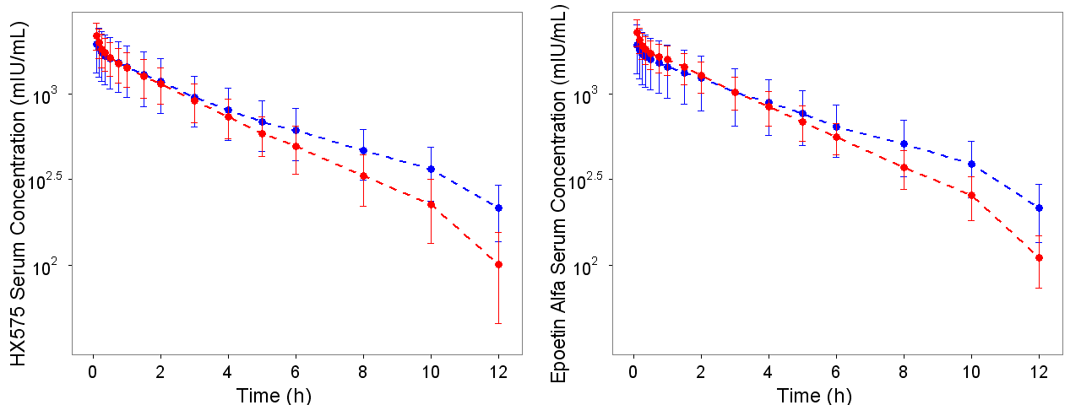
Nonstationary pharmacokinetics
Mean observed concentrations vs. time since last dose profiles after the 1st IV dose (blue) and 11th IV (red) dose with SD (standard deviation) bars for HX575 (left) and the comparator epoetin alfa (right). One tailed paired t-test was applied to compare the mean observed AUC0-12 after the 1st and 11th IV dose. P = 0.0059 for HX575 and P = 0.13 for the comparator.
Adapted from the publication Yan X, Lowe P, Fink M et al. J Clin Pharmacol. 2011

Slide 8
Parameter estimation
Table 1 Parameter Estimates Which Were Allowed to Vary BetweenHX575 and the Comparator Epoetin Alfa
Unpaired t-test was performed for parameters which are specific for two drugs based on parameter estimates and standard error from NONMEM. For all parameter estimates, HX575 vs Comparator, P >.05
Adapted from the publication Yan X, Lowe P, Fink M et al. J Clin Pharmacol. 2011

Slide 9
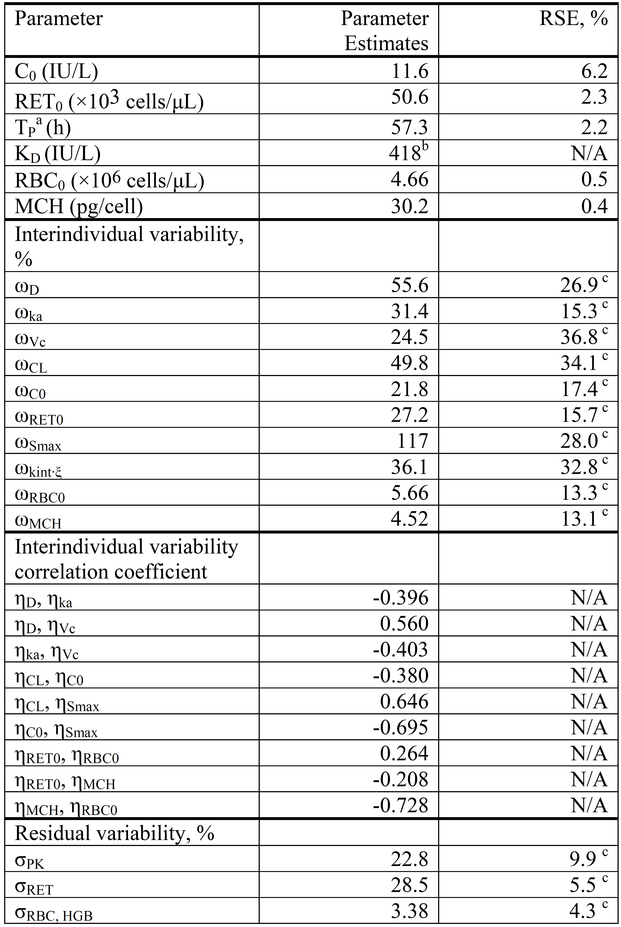
Parameter estimation
Table 2 Parameter estimates which are assumed same for HX575 and the comparator
RSE, relative standard error; N/A, not available
ª T_{P}=T_{R}; ^{b} Fixed; ^{c} The RSE is given for the variance of the parameter and not the standard deviation.
Adapted from the publication Yan X, Lowe P, Fink M et al. J Clin Pharmacol. 2011

Slide 10
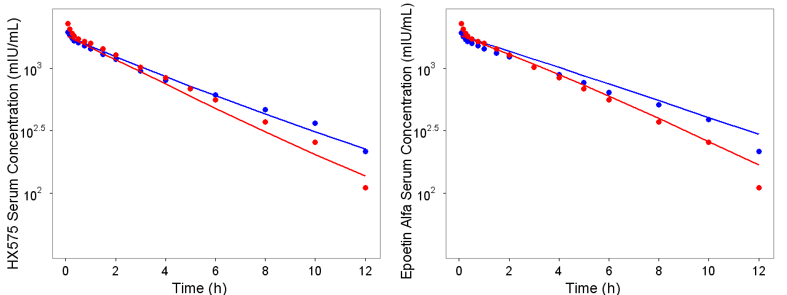
Model predictions for nonstationary PK
Mean concentrations vs. time since the last dose profiles after the 1st IV dose (blue line) and 11th IV dose (red line) generated from the visual predictive check for HX575 (left) and the comparator epoetin alfa (right). Blue and red circles represent the observed mean data.
Adapted from the publication Yan X, Lowe P, Fink M et al. J Clin Pharmacol. 2011
Young Innovators 2011

Slide 11
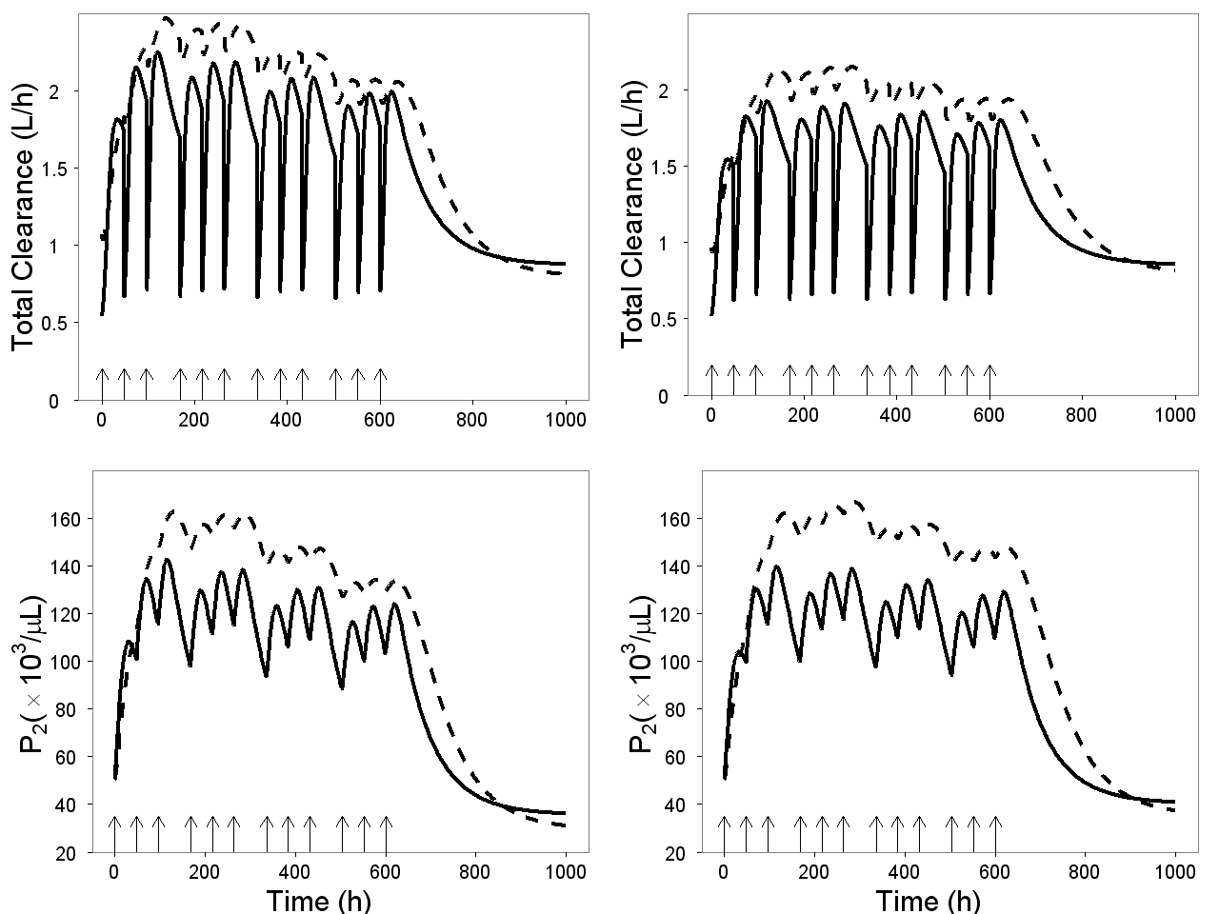
Nonstationary clearance
HX575 IV HX575 SC
Comparator IV Comparator SC
HX575 IV HX575 SC
Comparator IV Comparator SC
Top two panels: simulation of the total clearance vs. time profiles after multiple IV and SC administrations of HX575 (left) and the comparator (right). Bottom two panels: simulation of P2 vs. time profiles after multiple IV and SC administrations of HX575 (left) and the comparator (right). Arrows represent dosing events.
Adapted from the publication Yan X, Lowe P, Fink M et al. J Clin Pharmacol. 2011
Young Innovators 2011

Slide 12
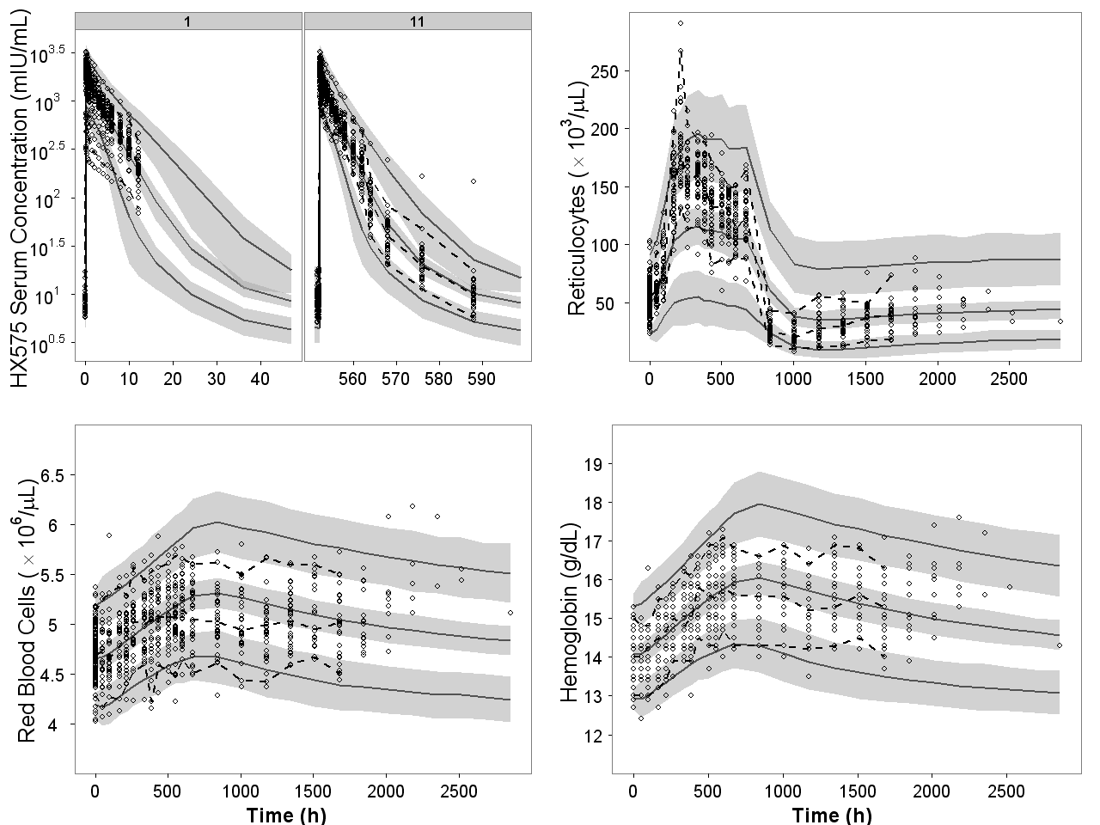
Visual predictive check for HX575 IV
Visual predictive checks for serum drug concentrations (after the 1st and 11th dose), reticulocytes, red blood cells, and hemoglobin after IV dosing of HX575. Open circles represent observed data. Dashed lines represent the 5th, 50th, and 95th percentiles of observed data. Solid lines represent the 5th, 50th, and 95th percentiles of simulated data. Shaded area represents the 95% confidence interval for each mean percentile of simulated data.
Adapted from the publication Yan X, Lowe P, Fink M et al. J Clin Pharmacol. 2011
Young Innovators 2011

Slide 13
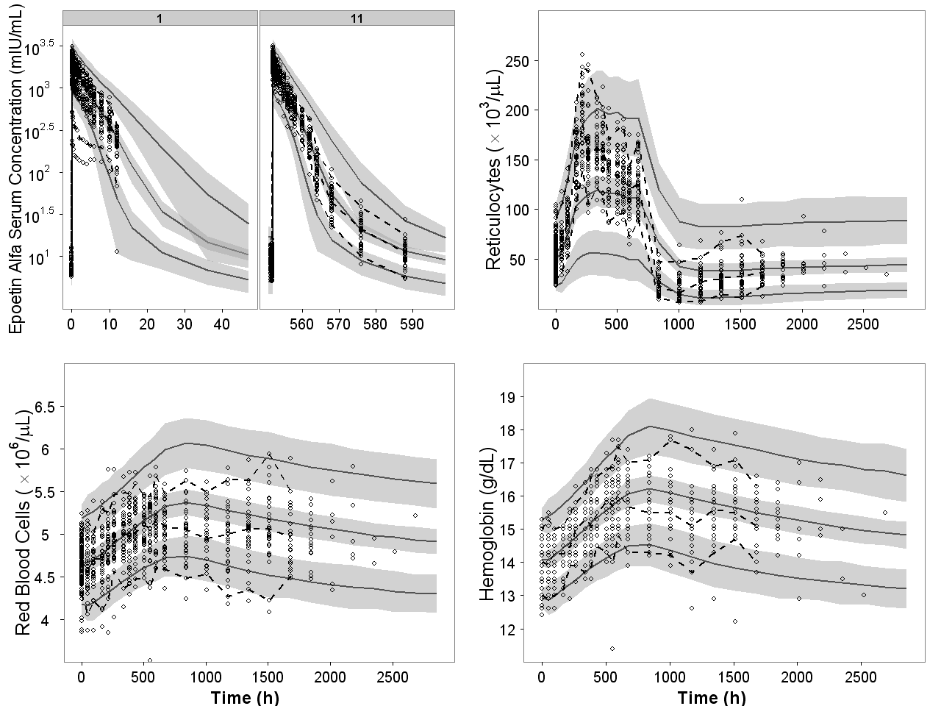
Visual predictive check for comparator IV
Visual predictive checks for serum drug concentrations (after the 1st and 11th dose), reticulocytes, red blood cells, and hemoglobin after IV dosing of the comparator. Open circles represent observed data. Dashed lines represent the 5th, 50th, and 95th percentiles of observed data. Solid lines represent the 5th, 50th, and 95th percentiles of simulated data. Shaded area represents the 95% confidence interval for each mean percentile of simulated data.
Adapted from the publication Yan X, Lowe P, Fink M et al. J Clin Pharmacol. 2011
Young Innovators 2011

Slide 14
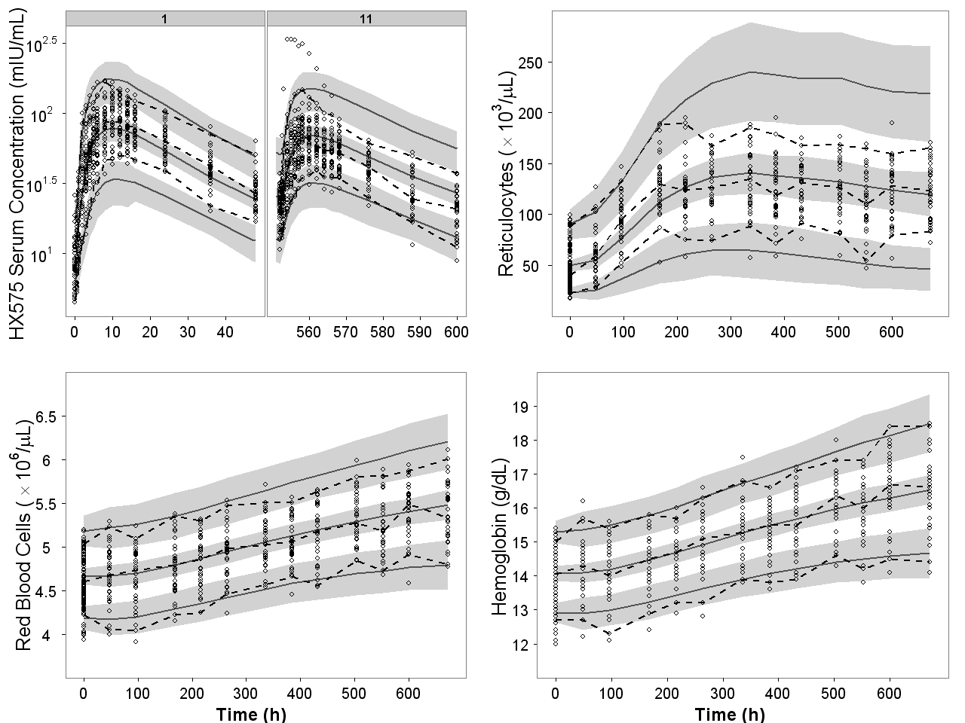
Visual predictive check for HX575 SC
Visual predictive checks for serum drug concentrations (after the 1st and 11th dose), reticulocytes, red blood cells, and hemoglobin after SC dosing of HX575. Open circles represent observed data. Dashed lines represent the 5th, 50th, and 95th percentiles of observed data. Solid lines represent the 5th, 50th, and 95th percentiles of simulated data. Shaded area represents the 95% confidence interval for each mean percentile of simulated data.
Adapted from the publication Yan X, Lowe P, Fink M et al. J Clin Pharmacol. 2011

Slide 15
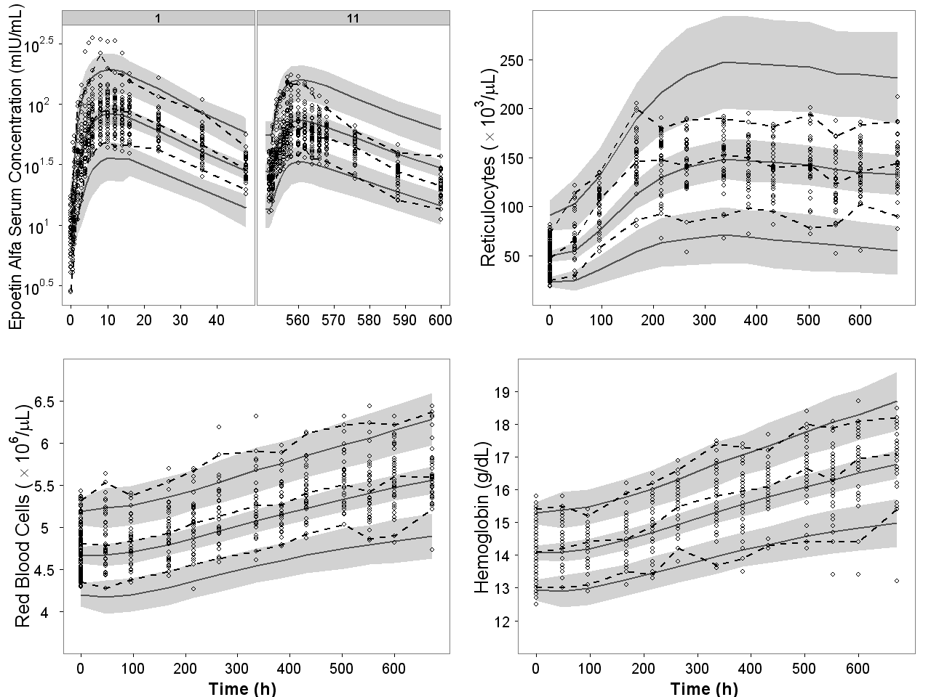
Visual predictive check for comparator SC
Visual predictive checks for serum drug concentrations (after the 1st and 11th dose), reticulocytes, red blood cells, and hemoglobin after SC dosing of the comparator. Open circles represent observed data. Dashed lines represent the 5th, 50th, and 95th percentiles of observed data. Solid lines represent the 5th, 50th, and 95th percentiles of simulated data. Shaded area represents the 95% confidence interval for each mean percentile of simulated data.
Adapted from the publication Yan X, Lowe P, Fink M et al. J Clin Pharmacol. 2011
Young Innovators 2011

Slide 16
PK/PD comparability analysis
Table 3 Metrics Estimates for PK/PD Comparability Analysis
R= reference; T = test; CI, confidence interval
ª Results were adapted from two publications by Sorgel et al.^{1,2}
1. Sorgel et al. Pharmacology. 2009;83:122-130
2. Sorgel et al. BMC Clin Pharmacol. 2009;9:10
Adapted from the publication Yan X, Lowe P, Fink M et al. J Clin Pharmacol. 2011
Young Innovators 2011

Slide 17
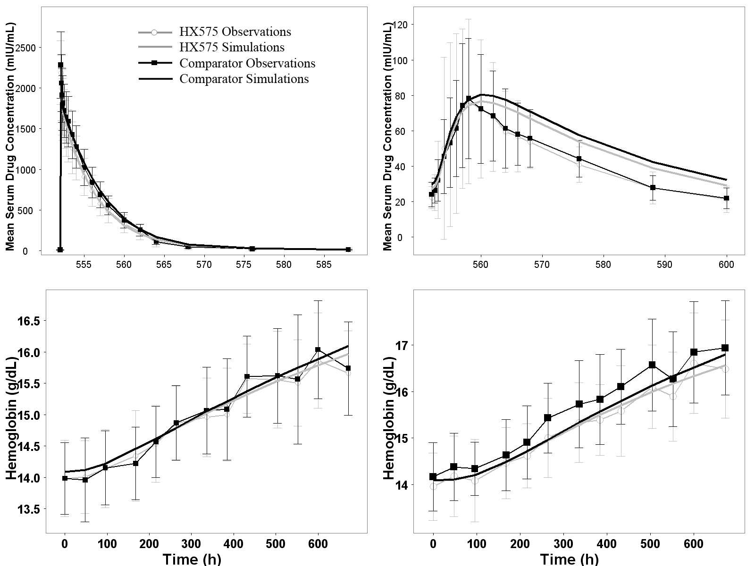
PK/PD comparability analysis
Mean profiles generated from Monte Carlo simulations for PK/PD comparability analysis, including drug concentration vs. time after the 11th IV dose (upper left) and 11th SC dose (upper right), and hemoglobin vs. time after multiple IV (lower left) and SC (lower right) administrations. Mean profiles were overlaid with mean observations with SD bars.
Adapted from the publication Yan X, Lowe P, Fink M et al. J Clin Pharmacol. 2011
Young Innovators 2011

Slide 18
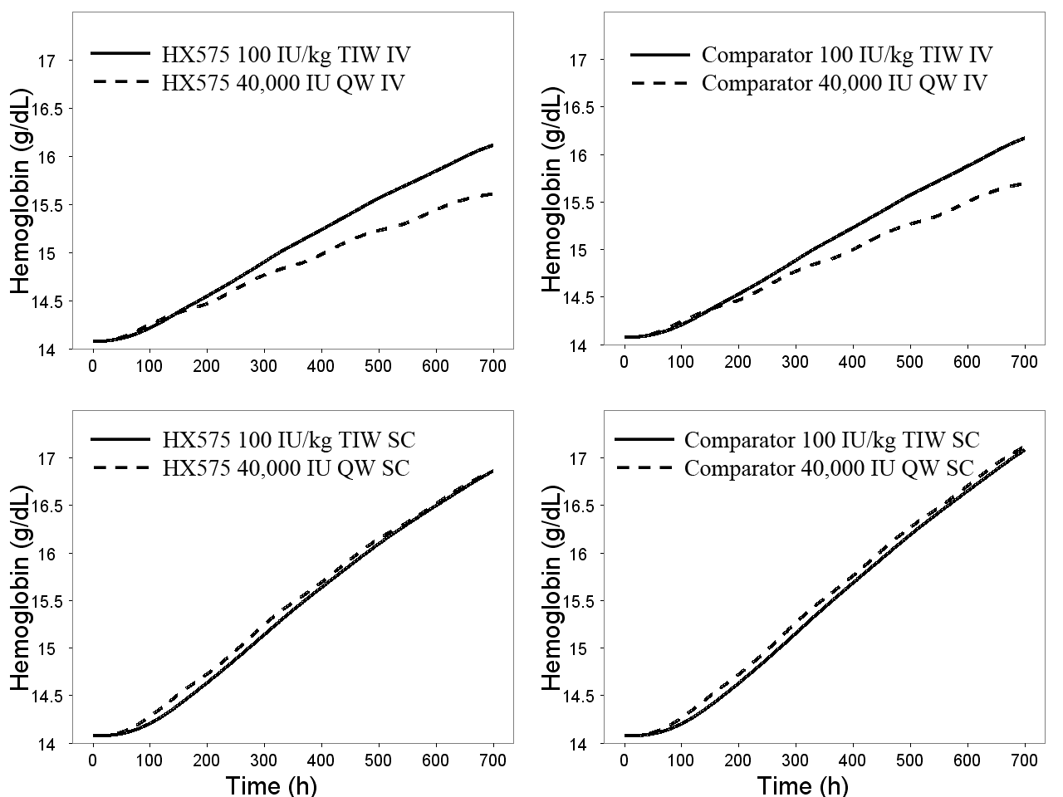
Simulation of weekly dosing regimen
Simulated hemoglobin vs. time profile for the TIW and QW, IV and SC dosing regimens for HX575 and the comparator. Fixed effect model parameters for HX575 and the comparator were used in the simulation.
Adapted from the publication Yan X, Lowe P, Fink M et al. J Clin Pharmacol. 2011
Young Innovators 2011

Slide 19
CONCLUSIONS
1. The PDMDD model adequately described the data and explained the nonstationary pharmacokinetics of rHuEPO in multiple dosing regimens. 2. The total clearance may increase up to 2.4-fold as compared with the baseline. 3. Comparability assessment using population model-based approach generally agrees with previous results using the standard NCA approach. 4. Simulations suggested the comparable efficacy of FDA approved QW SC regimen compared with TIW SC regimen for HX575. 5. The overall findings demonstrate the applicability but also the limitations of model-based methods to assess the comparability of drugs with nonstationary pharmacokinetics.
Adapted from the publication Yan X, Lowe P, Fink M et al. J Clin Pharmacol. 2011

Slide 20
Acknowledgments
This work was supported by the Novartis Pharma AG (Basel, Switzerland), Hexal AG (Holzkirchen, Germany), the Laboratory for Protein Therapeutics at the University at Buffalo, and Grant GM 57980 from the National Institute of Health.
Adapted from the publication Yan X, Lowe P, Fink M et al. J Clin Pharmacol. 2011

Slide 21
References
1. Elliott S, Pham E, Macdougall IC. Exp Hematol. 2008 1573-1584. 2. McMahon FG, Vargas R, Ryan M, et al. Blood. 1990;76:1718-1722. 3. Sorgel F, Thyroff-Friesinger U, Vetter A, et al. Pharmacology. 2009;83:122-130. 4. Sorgel F, Thyroff-Friesinger U, Vetter A, et al. BMC Clin Pharmacol. 2009;9:10. 5. Pentikis HS, Henderson JD, Tran NL. et al. 1996;13:1116-1121. 6. Dubois A, Gsteiger S, Pigeolet E, et al. Pharm Res. 2010;27:92-104.
Adapted from the publication Yan X, Lowe P, Fink M et al. J Clin Pharmacol. 2011

Slide 22
BIOS/Contact info
Ph.D Candidate, Department of Pharmaceutical Sciences, University at Buffalo, the State University of New York
Email: xyan4@buffalo.edu

