Slide 1


Young Innovators 2009
Selectivity Studies of PI3K Inhibitors
by Molecular Docking
Dima Sabbah
University of Nebraska Medical Center
College of Pharmacy

Slide 2
Abstract
The PI3Kα isoform mediates PDGF and EGF-induced mitogenic responses, and is an attractive target for anticancer drug therapy.
Limited compounds have been reported as potent and selective inhibitors.
The absence of any experimental PI3Kα/ ligand 3D structure hinders the rational development of new potent and selective drugs.

Slide 3
Abstract
The PI3Kγ isoform is important for immune system function.
Selective PI3K inhibitors would target PI3Kα to inhibit the tumor growth while spare the damage of the immune system.
Gain-of-function mutations have been observed in 32% of colon cancer, 27% brain cancer, 25% gastric cancer and 8% breast cancer.
Hot-spot mutants: H1047R, E545K, and R88Q.

Slide 4
Introduction
The phosphatidylinositol 3-Kinases (PI3K) are lipid kinases that phosphorylate phosphoinositide at the D-3 position of the inositol ring; the 3-hydroxyl position of phosphoinositides (PIs). PIP₂→ PIP₃
Vanhaesebroeck et al. Exp.Cell Res. 1999,253,239-254.

Slide 5
Introduction
Pan PI3K inhibitors; non selective inhibitors of PI3Kα and PI3Kγ.

Slide 6
Introduction
Hayakawa et al. Bioorg. Med. Chem. 2007,15, 5837-5844.
Alpha selective inhibitors
Young Innovators 2009

Slide 7
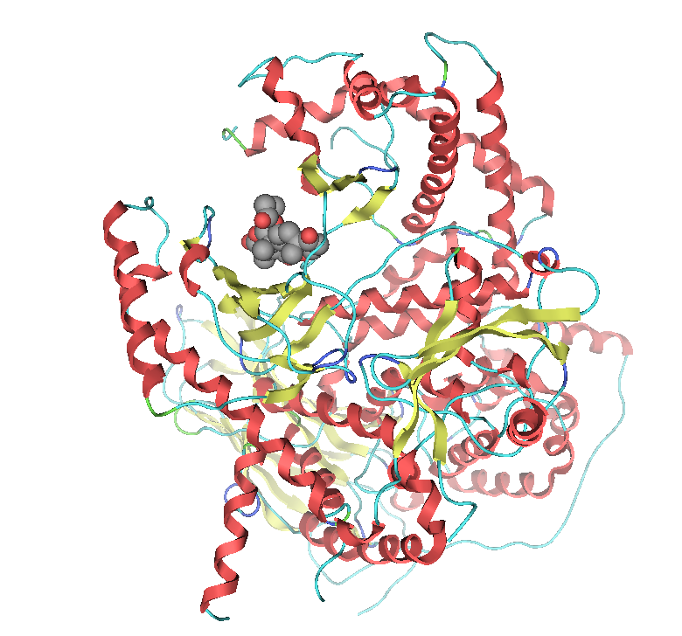
Introduction
Secondary structure of PI3Kγ(PDB code: 2E7U). Snapshot captured using PYMOL.
Young Innovators 2009

Slide 8
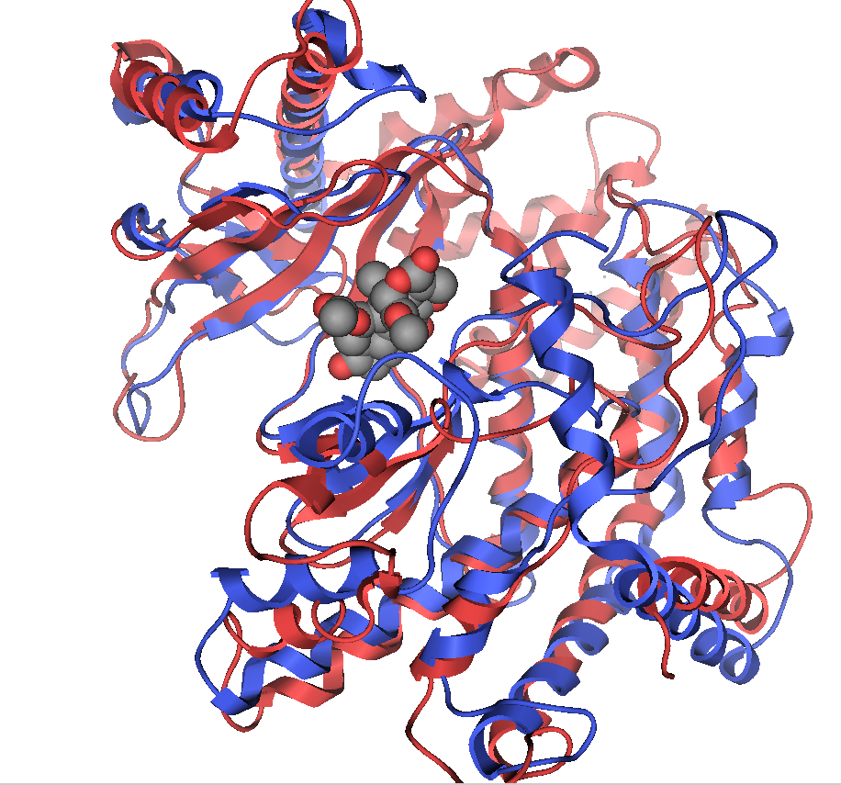
Introduction
We Hypothesized that :
The kinase domain of PI3Kα might be the ligand binding domain and could be a target for drug design.
Kinase domain of PI3Kα.Picture made by PYMOL.
Young Innovators 2009

Slide 9
Materials and Methods
Homology Modeling.
Mutation of hot spot residues in PI3Kα.
Docking Study against (PI3Kα native and mutated) in addition to PI3Kγ.

Slide 10
Materials and Methods
Young Innovators 2009
Homology Modeling of PI3Kα and PI3Kγ.
Fixing of the missing residues of PI3Kα and PI3Kγ using MOE.
Alignment of PI3Kγ (template) with its ligand to PI3Kα using Dalilite Pairwise comparison of protein structure.

Slide 11
Materials and Methods
Young Innovators 2009
Mutation of residues using Mutate module in Maestro.
Docking of prospective hits in the receptor using Maestro.
  Glide receptor generation.
  Ligand docking.

Slide 12
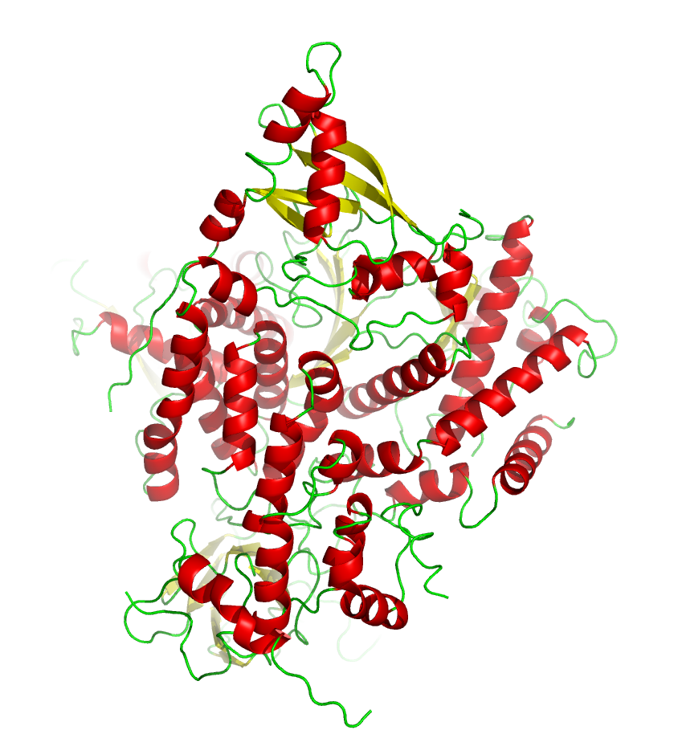
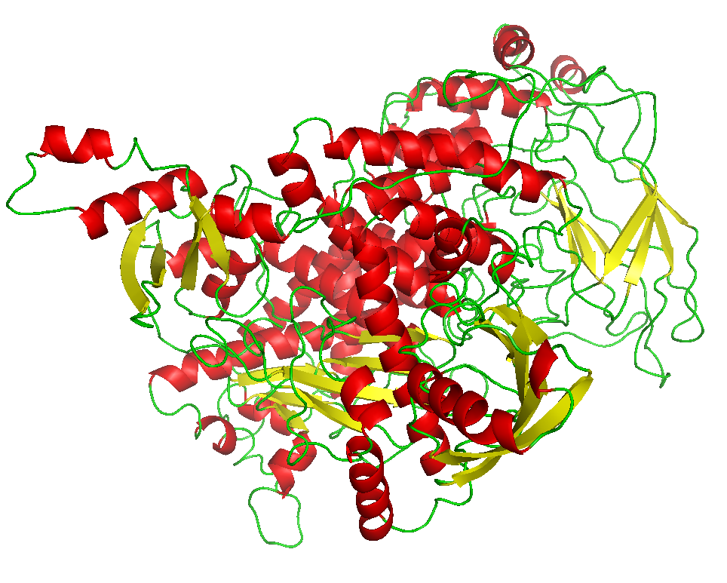
Results
Secondary structure of PI3Kα before and after treatment .Picture captured using PYMOL.

Slide 13
Results
Compound’s name | PI3Kα native | H1047R | R88Q | E545K | PI3Kγ
ORGLET06_ Cpd24 | -10.33 | -9.79 | -9.06 | -9.39 | -6.71
MOLCELL00_Cpd30 Staurosporine | -10.31 | -12.03 | -10.17 | -10.39 | NA
BMC07_Cpd6 | -9.74 | -9.11 | -9.72 | -7.08 | -6.25
BMC07_Cpd10 | -9.52 | -7.41 | -7.42 | -7.75 | -4.84
JAFC07_Cpd25 | -8.80 | -9.72 | -9.16 | -9.17 | NA
BMC07_Cpd16 | -8.33 | -8.89 | -9.32 | -7.67 | -5.50
BMC07_Cpd12 | -9.00 | -7.63 | -9.29 | -7.36 | -2.51
Docking scores of PI3Kα (native and mutated ) and PI3Kγ.

Slide 14
Results
Compound’s name | PI3Kα native | H1047R | R88Q | E545K | PI3Kγ
ABB08_Cpd23 | -7.85 | -8.99 | -9.11 | -7.73 | -9.56
MOLCELL00_Cpd28 Quecetin | -9.65 | -9.96 | -9.54 | -9.47 | -13.84
BMC07_Cpd18_LY294002 | -7.81 | -7.47 | -8.84 | -8.75 | -11.50
MOLCELL00_Cpd29 Myricetin | -9.21 | -8.90 | -8.78 | -10.23 | -14.38
ABB08_Cpd21 | -6.39 | -6.22 | -9.77 | -10.22 | -9.16
Docking scores of PI3Kα (native and mutated ) and PI3Kγ.
Young Innovators 2009

Slide 15
Results
Name | PI3Kα | R88Q | H1047R | E545K
BMC07_8c | ASP933 | No | LYS802 | VAL851,LYS802
BMC07_8d | ASP933 | VAL851,LYS802 | LYS802 | VAL851
BMC07_8i | VAL851,GLN859 LYS802 | VAL851 | VAL851, GLN859 | NO
BMC07_8H | VAL851,GLN859 | VAL851,GLN859 LYS802 | VAL851 | VAL851
BMC07_15 | VAL851,LYS802 | VAL851,LYS802 | VAL851 | GLN859, LYS802
Active binding residues of PI3Kα (native and mutated ) .
Young Innovators 2009

Slide 16
Results
Name | PI3Kγ
MOLCELL_00_Quercetin | LYS833,ASP841,TYR867,Val882
MOLCELL_00_Myrecetin | LYS833,ASP841,TYR867,Val882
ABB_08_Cpd22 | LYS833,Val882
ABB_08_Cpd23 | LYS833
Active binding residues of PI3Kγ.
Young Innovators 2009

Slide 17
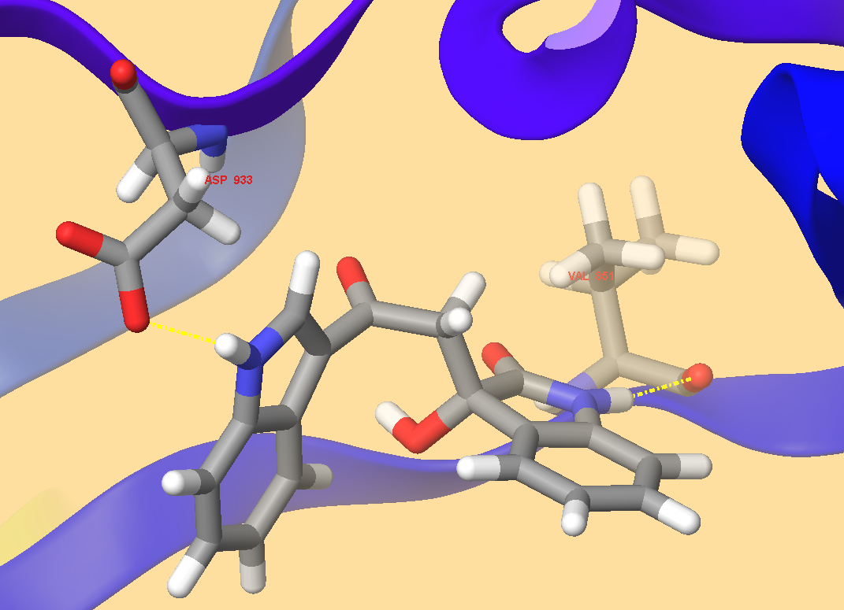
Results
Active binding site of native PI3Kα;showing H bond in yellow dotted line.
Young Innovators 2009

Slide 18
Discussion
Four sections were filled up: section one with 18 missing residues [Tyr 307-Thr 324]; section two with 9 missing residues [Ala 415-Ala 423]; section three with 22 missing residues [ Phe 506-Asp 527] and section four with 10 missing residues [Lys 941-Glu 950].
Docking studies exploited the active binding residues of PI3Kα and PI3Kγ.
Evaluation of docking results was based on the scores value ;the more the negative, the more favored binding, and also based on their tendency to form hydrogen bonds with the backbone of active residues.

Slide 19
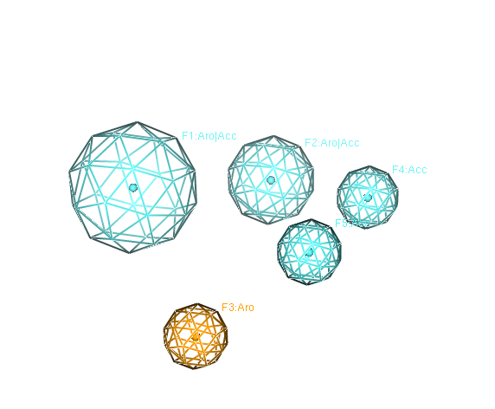
Discussion
Pharmacophore models were generated based on a series of active PI3Kα inhibitors using the MOE program.
Conformational search of these inhibitors was carried out with imidazo [1, 2-a] pyridine derivatives.
Alignment of global minima to the most active compound was accomplished using the superpose module for conserved functional group.
Pharmacophore query editor.
Young Innovators 2009

Slide 20
Discussion
Young Innovators 2009
The pharmacophore search was recruited using National Cancer Institute database containing 148276 number ligands.
The huge NCI database was filtered depending on Lipinski's rule of five:
  Not more than five hydrogen bond donor (N or O with one or more H atoms).
  Not more than 10 H bond acceptors (N or O atoms).
  A molecular weight under 500 gm/mole.
  Log P (Partition Coefficient) less than 5.

Slide 21
Discussion
Structures and docking scores of hit molecules and reported inhibitors.
Young Innovators 2009

Slide 22
Conclusion
The pharmacophore model suggests the aromatic rings and the hydrogen bond acceptors as the essential functional groups for active PIK3A inhibitors.
The docking model has quite successfully generated the experimental data.
Our results suggest residues Asp933,Val851, Lys802, Gln859 are critical for ligand binding to the native PI3Kα.
Residues Val851, Lys802, Gln859 play more important roles in ligand binding to the hot-spot mutants.
Interactions with Lys833, Val882, Asp841, Tyr867 may reduce the selectivity of ligands.

Slide 23
Acknowledgments
University of Nebraska Medical Center
College of Pharmacy / Pharmaceutical department
Dr. Jonathan Vennerstrom
University of Nebraska Omaha
Department of Chemistry
Dr. Haizhen Zhong

Slide 24
References
Fry, M.J., Waterfield, M.D. Structure and function of phosphatidylinositol 3-kinase: A potent second messenger system involved in growth control. Philos Trans R. Soc Lond J Biol Sci 340,337-344, 1993.
Vanhaesebroeck, B., Stein, R.C., Waterfield, M.D. The study of phosphoinositide 3-kinase function. Cancer Surv 27, 249-270, 1996.
Vanhaesebroeck, B., Waterfield,M. D .Signaling by distinct classes of phosphoinositide 3-kinases. Exp Cell Res 253, 239-254, 1999.

Slide 25
References
Young Innovators 2009
Leevers, S.J., Vanhaesebroeck, B.,Waterfield, M.D. Signaling through phosphoinositide 3-kinases:The lipids take centre stage. Curr Opin Cell Biol 11, 219-225, 1999.
Vanhaesebroeck, B., Leevers, S.J., Panayotou, G., Waterfield, M.D. Phosphoinositide 3-kinases: A conserved family of signal transducers. Trends Biochem Sci 22, 267-272, 1997.
Cantley, L.C. The phosphoinositide 3-kinase pathway. Science 296, 1655-1657, 2002.
Frederick, R., Denny, W.A. Phosphoinositide-3-kinases (PI3Ks): combined comparative modeling and 3D-QSAR to rationalize the inhibition of p110 α. J Chem Inf Model 48,629-638, 2008.

Slide 26
References
Young Innovators 2009
Walker,E.H., Perisic,O., Ried,C., Stephens,L., Williams,R.L. Structural insights into phosphoinositide 3-kinase catalysis and signaling. Nature 402, 313-320, 1999.
Walker,E.H.,Pacold,M.E.,Perisic,O.,Stephens,L.,Hawkins,P.T.,Wymann,M.P.,Williams,R.L.Structure determinants of phosphoinositide 3-kinase inhibition by wortmannin, LY294002,quercetin, myricetin and staurosporine. Mol Cell 6,909-919, 2000.
Knight,Z.A.,Gonzalez,B.,Feldman,M.E.,Zunder,E.R.,Goldenberg,D.D.,Williams,O.,Loewith,R.,Stokoe,D.,Balla,A.,Toth,B.,Balla,T.,Weiss,W.A.,Williams,R.L.,Shokat,K.M. A pharmacological map of the PI3K family defines a role of p110 alpha in insulin signaling. Cell 125, 733-747, 2006.
Campbell, I.G., Russell, S.E., Choong ,D.Y., Montgomery, K.G., Ciavarella, M.L., Hooi, C.S., Cristiano, B.E., Pearson, R.B., Phillips, W.A. Mutation of the PIK3CA gene in ovarian and breast cancer. Cancer Res 64, 7678-7681, 2004.

Slide 27
References
Gymnopoulos, M., Elsliger,M.,Vogt, P. Rare cancer specific mutations in PIK3CA show gain of function. PNAS 104, 13, 5569-5574, 2007.
Kang,S,Bader,A,Vogt,P.K. Phosphatidylinositol 3-kinase mutations identified in human cancer are oncogenic. Proc Natl Acad Sci USA 102, 3,802-807,2005.
Nolte,R.T., Eck,M.J., Schlessinger, J., Shoelson, S.E., Harrison, S,C. Crystal Structure of the PI3 kinase p85amino terminal SH2 domain and its phosphopeptide complex. Nat Struct Biol 3,364-374, 1996.
Broderick, D.K., Di, C., Parrett, T.J., Samuels, Y.R.,Cummins, J.M., McLendon, R.E., Fults, D.W., Valculescu, V.E., Binger, D.D.,Yan, H. Mutations of the PIK3CA in anaplastic oligodroglimos, high grade astrocytomas and medulloblastomas. Cancer Res 64, 5048-5050, 2004.

Slide 28
BIOS/Contact info
Young Innovators 2009
Dima Azzam Sabbah dsabbah@unmc.edu
Campus Address: 986025 Nebraska Medical Center, Omaha, Nebraska, 68198-6028. (Cell phone #: 313-717-2834)
Bachelor of Pharmacy (June, 1996), College of Pharmacy, the University of Jordan, Amman, Jordan
Master degree of pharmaceutical sciences (August, 2003) ,College of Pharmacy, the University of Jordan, Amman, Jordan
Ph.D. of pharmaceutical sciences (August 2007 to present) : College of Pharmacy, University of Nebraska Medical Center, Omaha, NE.

