Slide 1


Young Innovators 2011
Improving Patient Pharmacotherapy via Informative Study Design and Model-based, Decision Support
Jeffrey S. Barrett, PhD, FCP
The Children’s Hospital of Philadelphia
University of Pennsylvania School of Medicine

Slide 2
Abstract
Post approval clinical experience is often essential for evolving optimal pharmacotherapeutic strategies particularly for patient subpopulations including pediatrics and critically ill patients.
Clinical pharmacology studies in these "at risk" populations provide targeted investigation focused on evaluating the therapeutic window.
Much of my research has focused on designing such trials and the evaluation of PK and PK/PD in order to propose dosing recommendations from such studies.
These studies can improve our understanding of disease biology and many cases these efforts culminate in changes to the standard of care.

Slide 3
Abstract
An important element of this research is the dissemination of the knowledge that these investigations provide to the caregiver community that ultimately prescribe and manage these patients.
Decision support systems integrated to a hospital’s electronic medical records system can provide this knowledge real-time in an manner that evolves with the science and the data.
An emerging consortium of clinical pharmacology, IT and pharmacometric expertise has taken up the task to build such systems to pave the way for expert pharmacotherapy systems in the future.

Slide 4


Introduction
Our knowledge regarding the optimal management of drug therapy evolves with time
Drug Development
Post Marketing Evaluation
Clinical Practice / Utilization
Pre-IND
IND
Phase I
Phase II
Phase III
Disease biology
Mechanism of action
Basic ADME
PK/PD in healthy volunteers and patients
Therapeutic window
Safety and efficacy in target populations
Special populations
Patient “extremes”
ADR reporting
Long term safety and efficacy in target populations
Health economics
DDI potential
Safety “signals” in patient subpopulations
Compliance factors
Lifestyle factors
Patient factors
. . . Sometimes, we don’t know what we should know at a particular phase

Slide 5
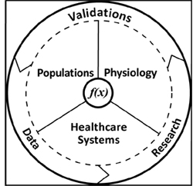
Introduction
Well-designed trials . . .
Fulfill study objectives
Are well-powered and designed
Collect meaningful data at the clinically-relevant occasions
Evaluate clinically-relevant dose(s) / regimen(s)
Minimize or eliminate sources of confounding
Study the appropriate populations / characteristics
Modeling and simulation techniques can facilitate well-designed trials . . .

Slide 6

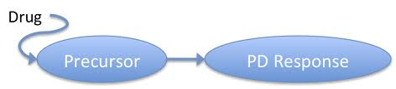
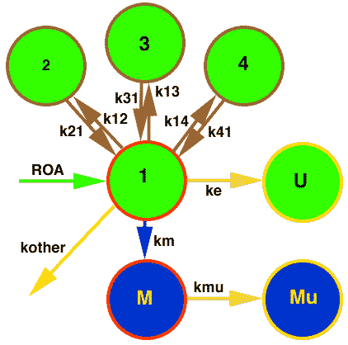
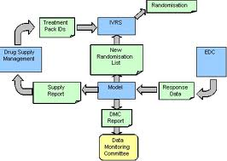
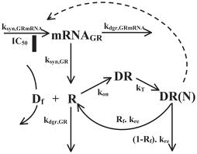
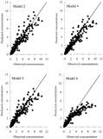
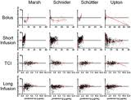
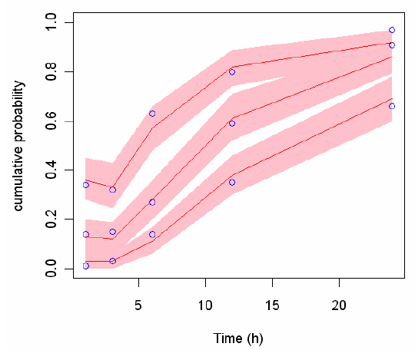
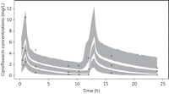
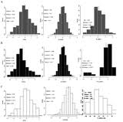
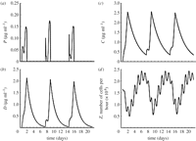
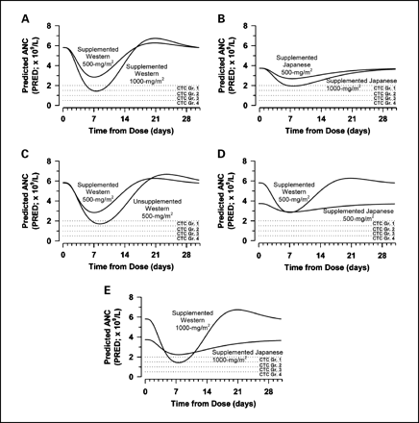

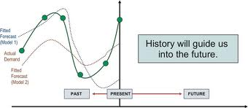
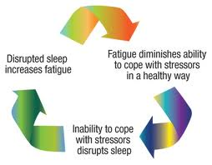
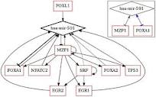
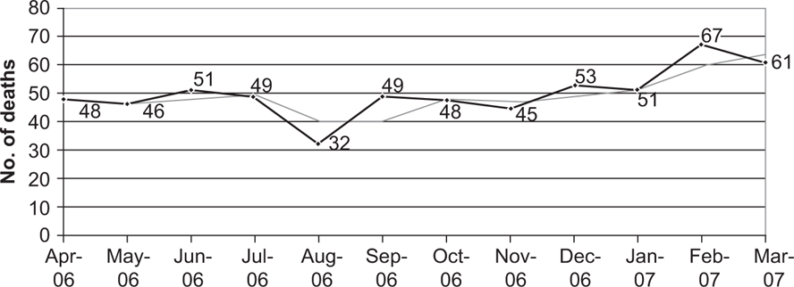
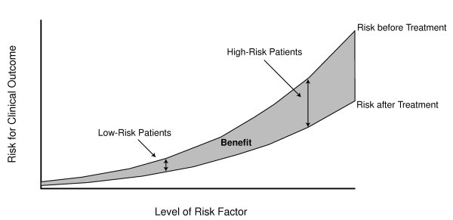
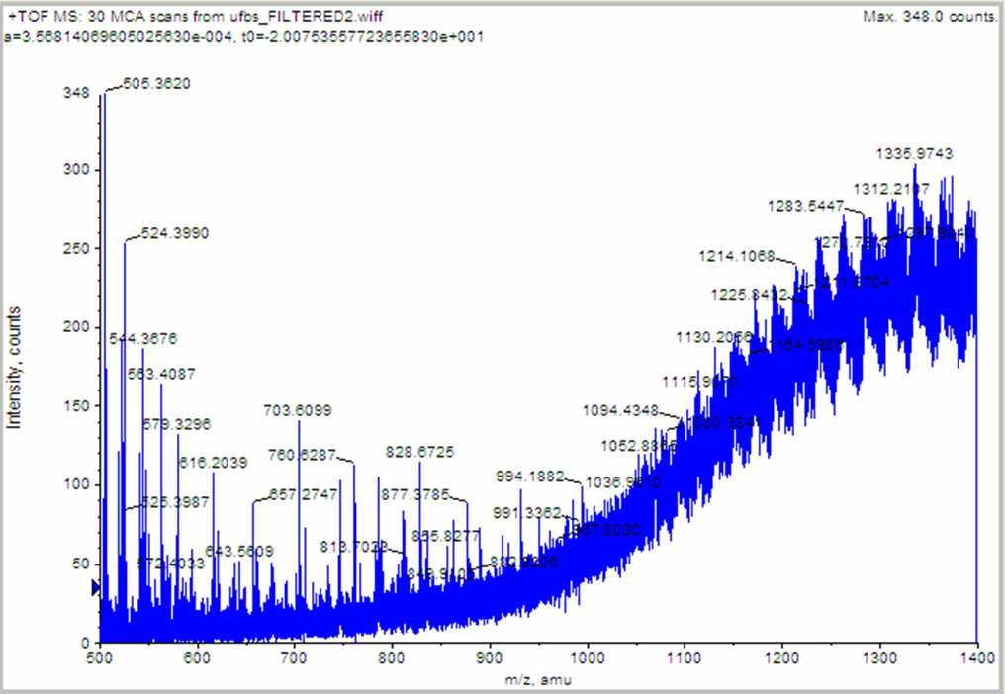
Introduction Outputs from Modeling & Simulation Research
Models to evaluate dose-exposure (PK), exposure-response (PD), clinical outcomes (CTS)
Model diagnostics and other means of evaluating model appropriateness and generalizability
Simulations that describe model precision and evaluate parameter sensitivity
Simulations that test scenarios under which a clinical trial can be conducted (design, dose, sampling scheme, population, etc)
Forecasting of future events based on progression of model inputs or alteration of experimental conditions
Feedback loops that update models based on predefined requirements (decision logic)
Graphical representations of model outputs or performance

Slide 7
Introduction
Application of M&S spans many settings that facilitate pharmacotherapy guidance
Systems biology modeling (target identification and mechanism of action)
Animal disease model to clinic bridge
Formulation development (IVIVC)
Special population modeling (bridging)
Disease progression modeling

Slide 8
3 Case Studies from Barrett Lab
Actinomycin / Vincristine in children with Cancer
Fluconazole dosing in Neonates
Pediatric Knowledgebase (PKB)

Slide 9
AMD /VCR in Children with Cancer
Old chemotherapeutic agents used in a variety of pediatric cancers without informative dosing guidance
Drugs often given in combination; difficult to do PK in children with cancer – additionally, venapuncture dissuades parents / children
BPCA Contract proposed by NIH/NCI
In August of 2002, the Children’s Oncology Group suspended 3 active protocols for paediatric rhabdomyosarcoma after 4 AMD-associated deaths from VOD

Slide 10
AMD /VCR in Children with Cancer
Project 1
Retrospective Study
Pooled historical data from Wilms tumour and RMS studies to define dose-toxicity relationships
Project 2
Catheter Study
Dosing and PK sampling procedure utilizing a single central venous catheter
Project 3
M & S Study
PK/PD models based on exposure-response relationships that incorporate physiologic-based and mechanistic expression; CTS
Project 4
Prospective Study
PK/PD/Out come trial in children with cancer

Slide 11
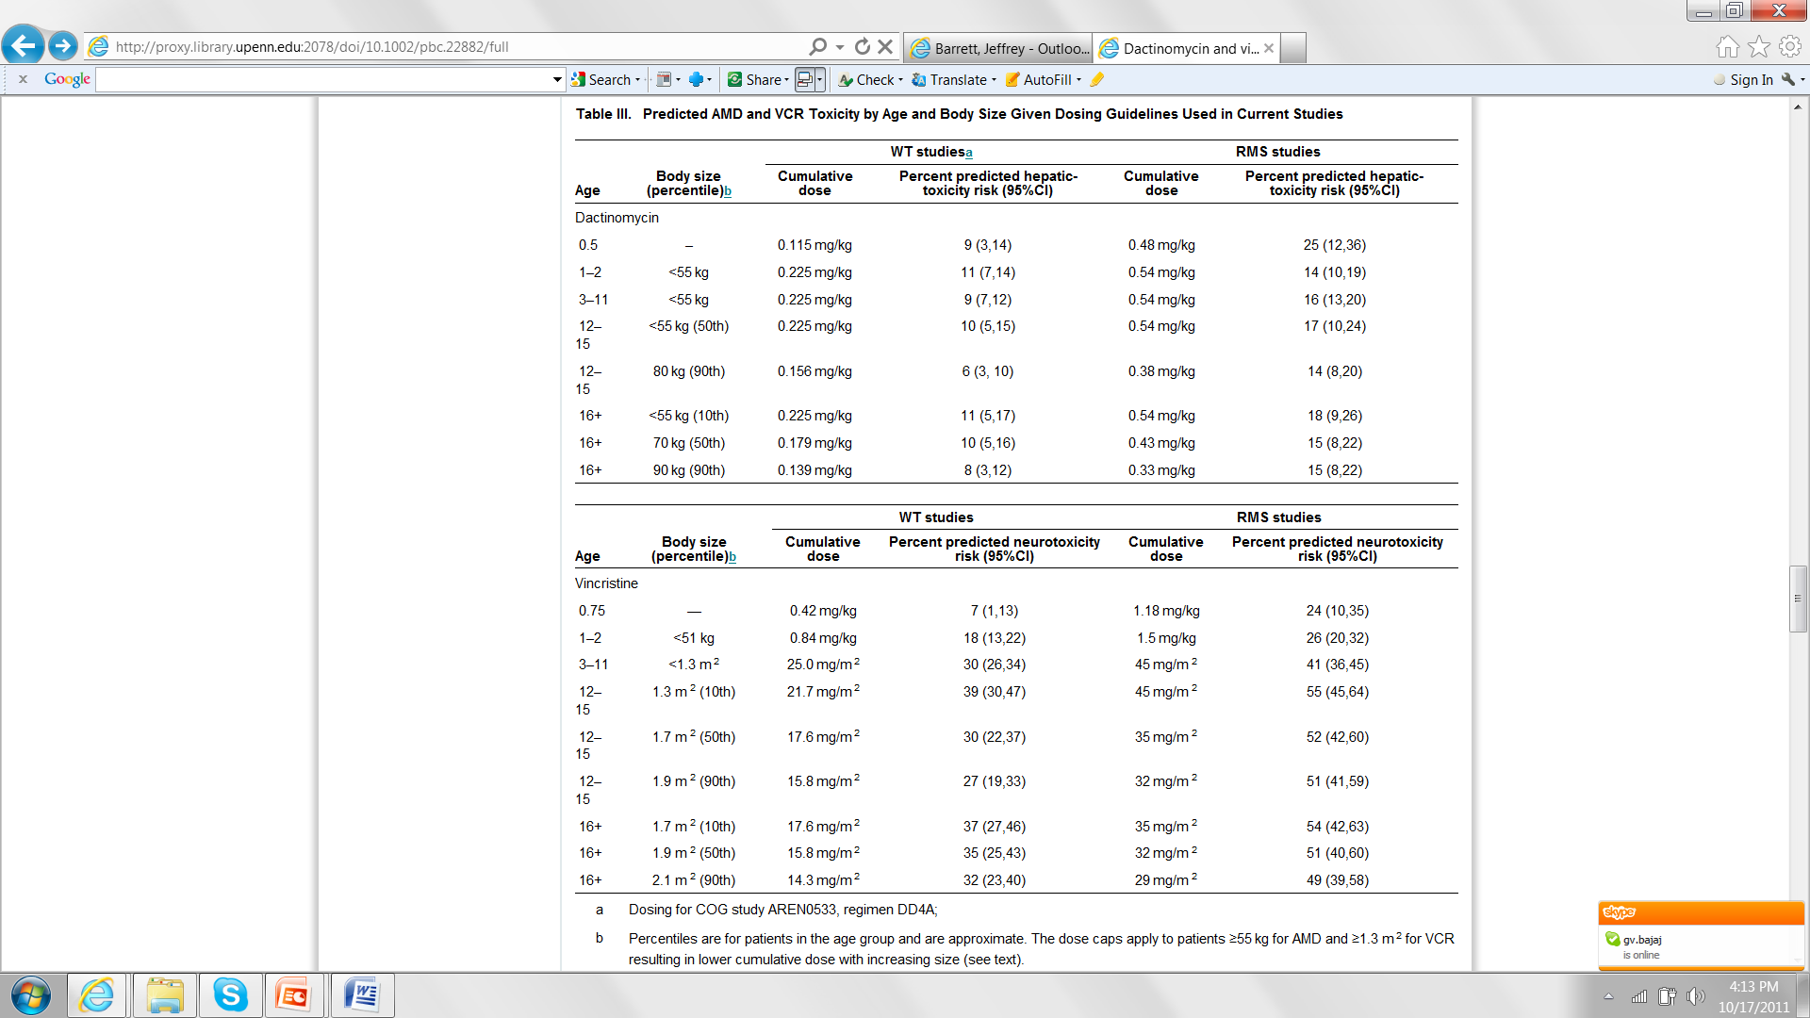
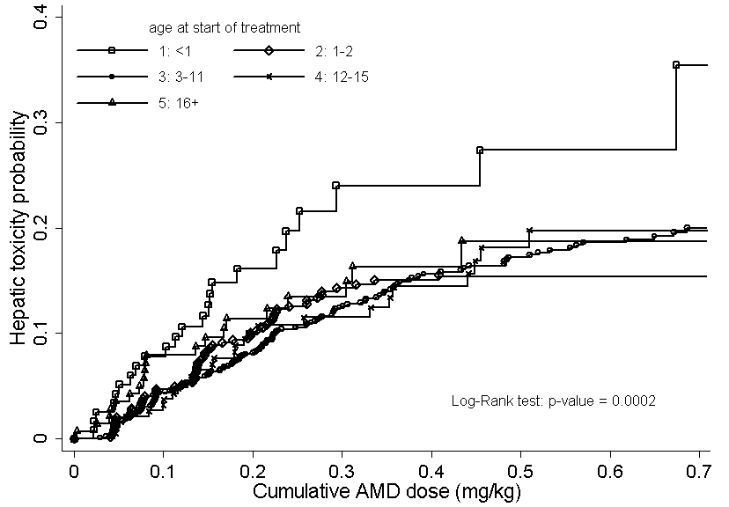
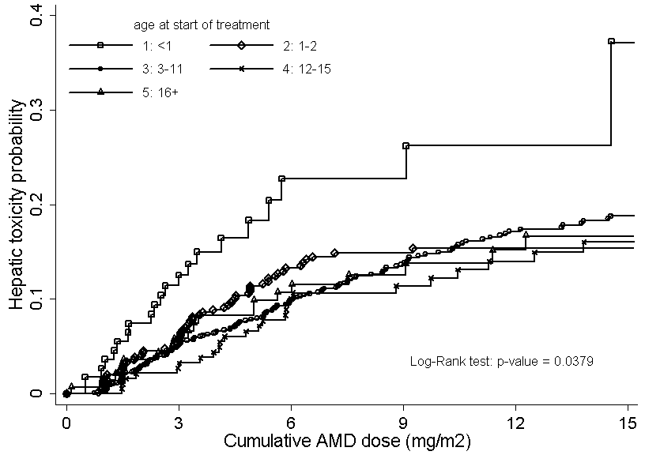
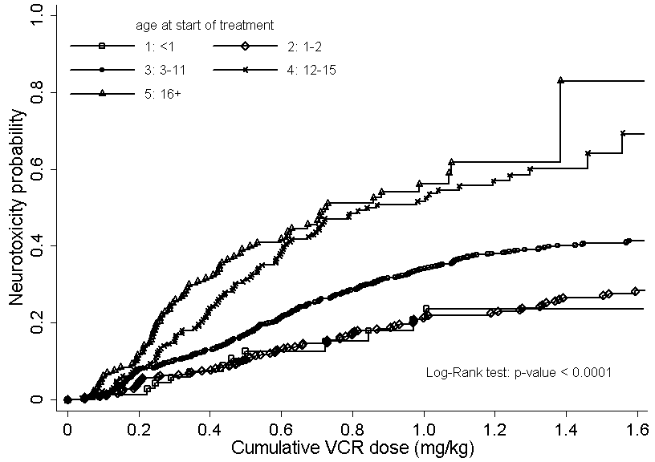
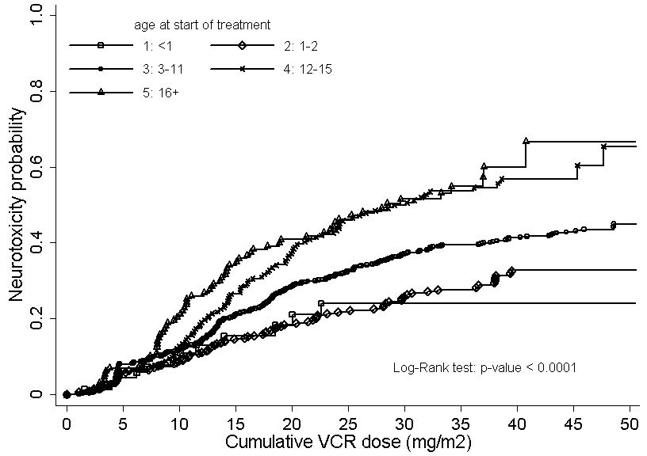
AMD /VCR in Children with Cancer Results – Project 1
< 1 y group at greater risk for hepatotoxicity with AMD
Older children at greater risk for neurotoxicity with VCR
Langholz B, Skolnik J, Barrett JS, Renbarger J, Seibel N, Zajicek A, Arndt C. Dactinomycin and vincristine toxicity in the treatment of childhood cancer: A retrospective study from the Children’s Oncology Group. Pediatric Blood & Cancer 57(2):252-7, 2011.

Slide 12
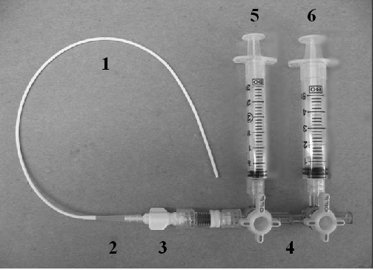
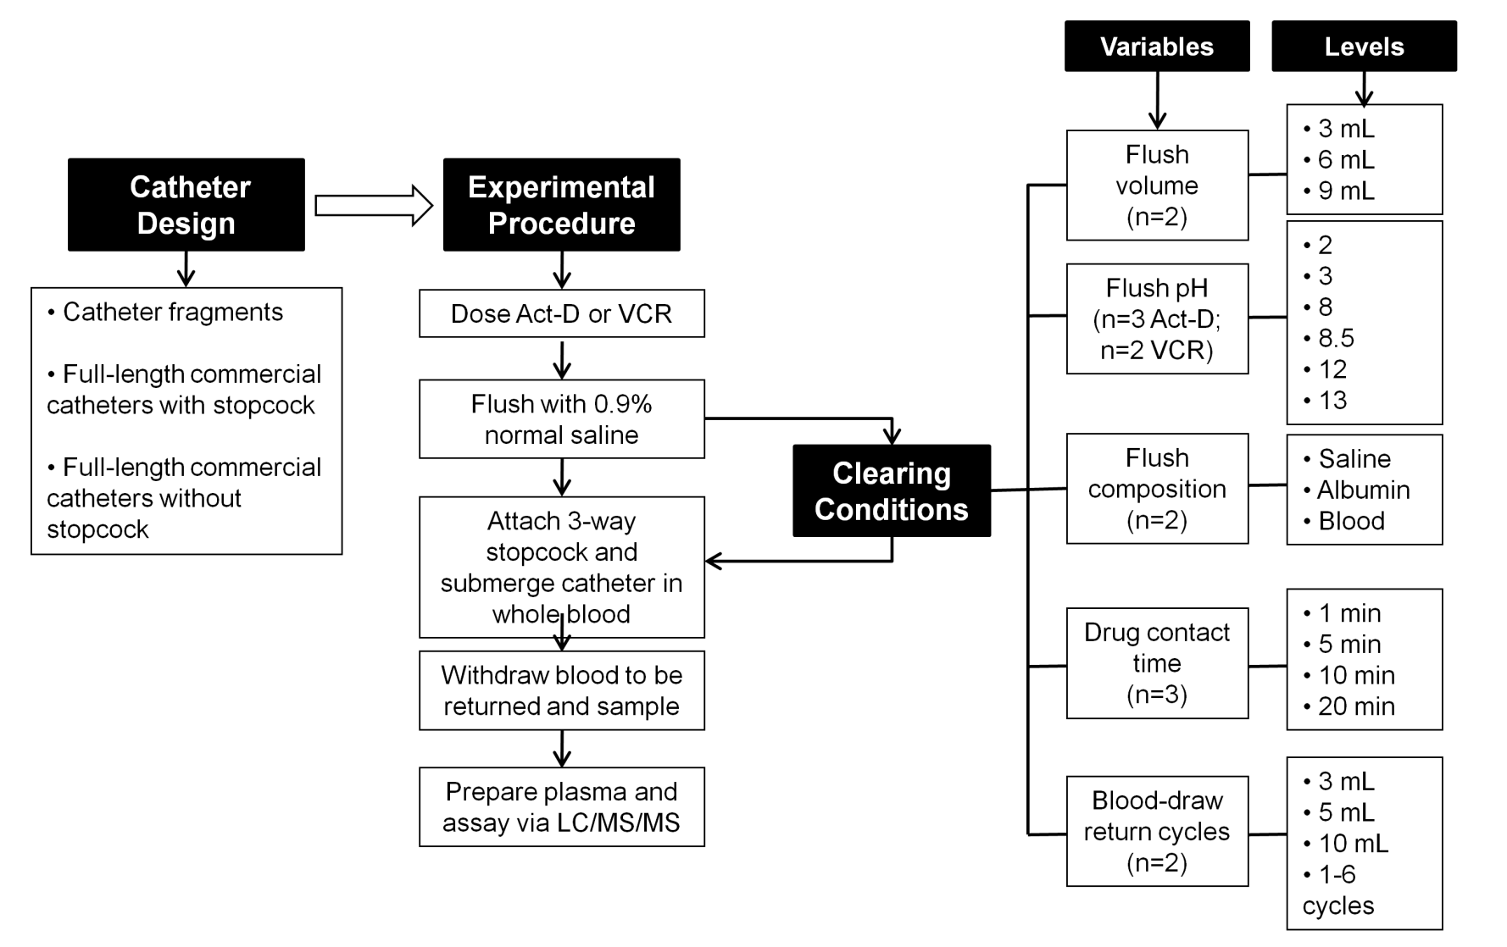
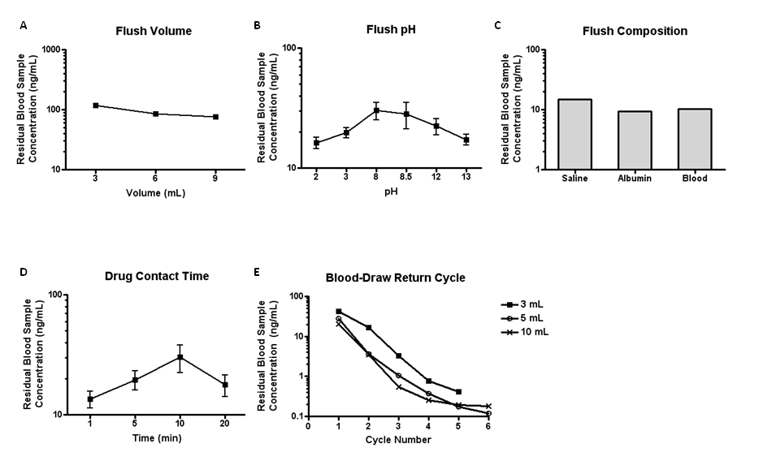
AMD /VCR in Children with Cancer Results – Project 2
Mimic of in vivo setting
Common catheter configurations
Procedures, agents and conditions for clearing
1. Cook® 5 french 27 cm catheter fragment
2. 200 µL pipette tip
3. Cook® catheter syringe connector
4. Medex 3-way stopcock
5. 5 mL syringe for waste collection
6. 3 mL syringe for sample collection
Skolnik JM, Zhang AY, Barrett JS, and Adamson PC. Approaches to clear residual chemotherapeutics from indwelling catheters in children with cancer J. Ther. Drug Monitoring 32(6): 741-8, 2010.

Slide 13
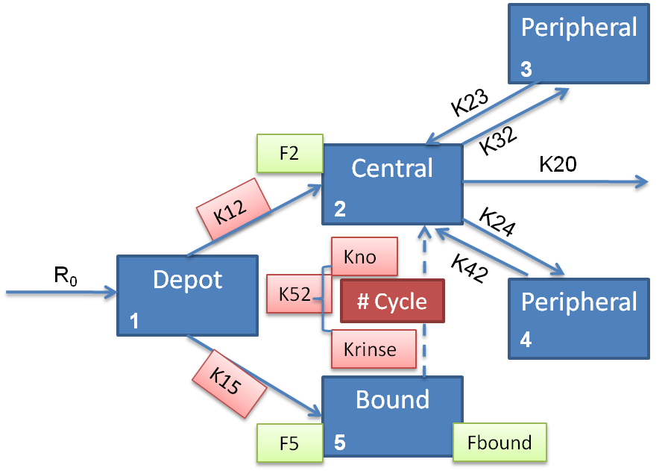
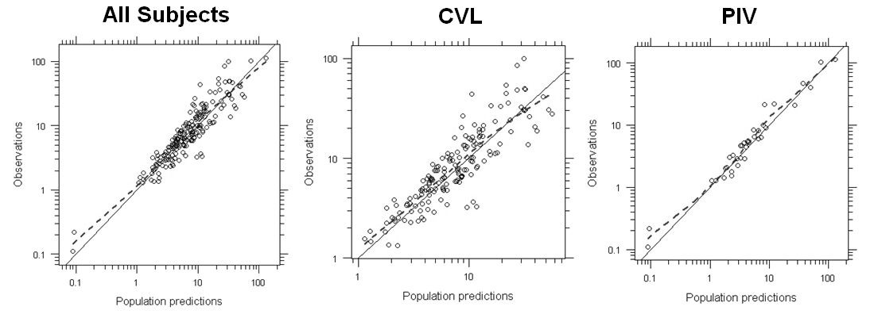
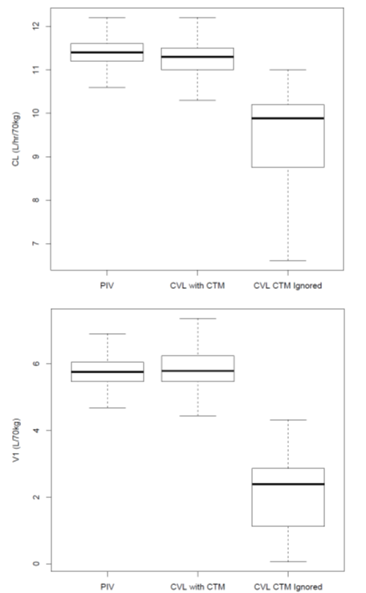
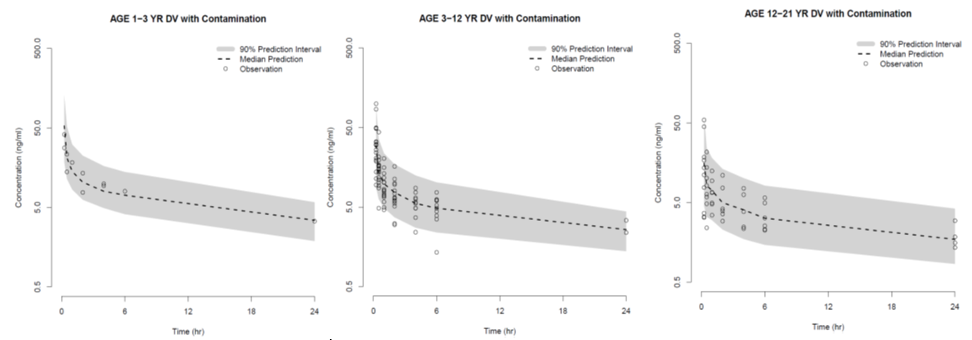
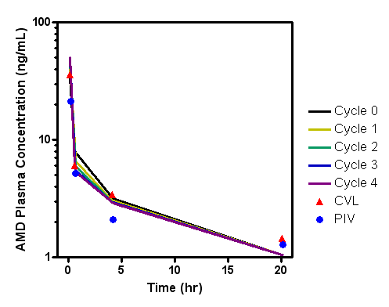
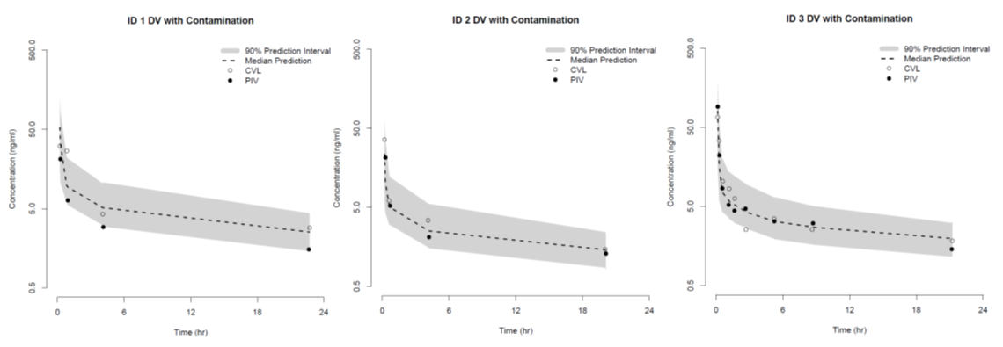
AMD /VCR in Children with Cancer Results – Project 2
Parameter Assumptions/Initial Esitmates
F2: F unbound to central 0.76
F5: F bound in catheter 0.24
Fbound: F dissociated from bound 1.00
Kno: dissociation rate from bound 0.781 hr⁻¹
Krinse: dissociation rate with “pull-push” 1.67 hr⁻¹
K52 = Kno + Krinse*CYCL
Zhang AY, Skolnik JM, Dombrowsky E, Patel D, Barrett JS. Modeling and Simulation Approaches to Evaluate Chemotherapeutics Contamination From Central Venous Catheters in Pediatric Pharmacokinetic Studies (Submitted, Cancer Chemother Pharmacol)

Slide 14
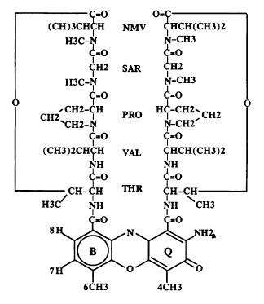
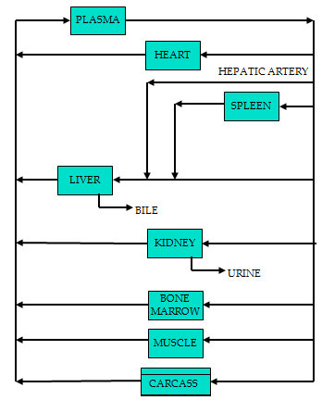
AMD /VCR in Children with Cancer Results – Project 3
Barrett JS, Gupta M, Mondick JT. Model-based Drug Development for Oncology Agents. Expert Opinion on Drug Discovery 2(2): 185-209, 2007.

Slide 15
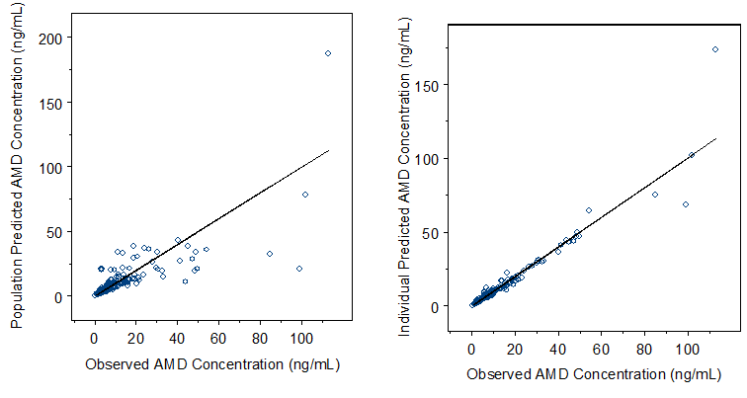
AMD /VCR in Children with Cancer Results – Project 3
Pop-PK model developed in 34 children with cancer
Model used to verify sample size, sampling scheme and dosing rules
Mondick JT, Gibiansky L, Gastonguay MR, Skolnik J, Veal GJ, Boddy A, Adamson PC, Barrett JS. Population Pharmacokinetics of Actinomycin-D in Children and Young Adults. J Clin Pharmacol: 48(1): 35-42, 2008

Slide 16
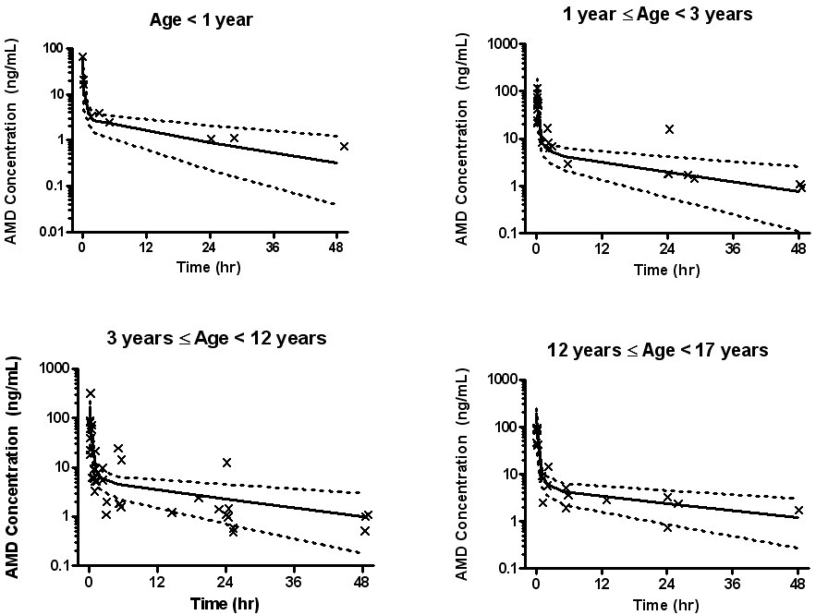
AMD /VCR in Children with Cancer Results – Project 4
ADVL06B1, A Pharmacokinetic-Pharmacodynamic-Pharmacogenetic Study of Actinomycin-D and Vincristine in Children with Cancer Study officially closed to enrollment on October 5, 2011
Follow-up ongoing
PGx complete
Data assembly ongoing
Preliminary data analysis ongoing

Slide 17
Fluconazole Dosing in Neonates
We know . . .
Triazole class, inhibitor of fungal P450
Excellent CSF, lung, kidney & tissue penetration
Active drug eliminated by kidney with minimal metabolism
Low incidence of adverse events in children/adults
Effective in adults and children
C. albicans & parapsilosis sensitive to Fluconazole
C. galbrata & krusei are uniformly resistant
We need to know . . .
Pharmacokinetics in infants
Optimal Doses for effective treatment and prevention of emergence of resistance
For systemic treatment: FL (AUC)/ Candida MIC>50
For prevention: no known target
Safety and efficacy

Slide 18
Fluconazole Dosing in Neonates Historical Data
PK 6mg/kg | Wiest 1991 | H Saxen, K Hoppu 1993 |  |  | Wenzl 1998
Infants | 28wk PNA 40d N=1 | 26-29 wk PNA d1 N=7 | 26-29 wk PNA d6 N=7 | 26-29 wk PNA d13 N=4 | 25-29 wk PNA >30d N=3
Cl (L/hr/kg) | 0.0198 | 0.0108 | 0.0198 | 0.03128 | 0.029
Vd (L/kg) | 1.2 | 1.18 | 1.84 | 2.25 | 1.43
T ½ (hr) | 37.4 | 88.6 | 67.5 | 55.2 | 35
Delayed CL improves with postnatal age
Long t½
Large variability in individual PK parameters
No Pharmacokinetic data < 750 g
Inadequate to support dosing

Slide 19
Fluconazole Dosing in Neonates Objectives
To conduct a prospective PK trial to establish a population PK model of fluconazole disposition in infants 23-40 weeks gestation and < 120 days old
To facilitate PK trial by leveraging clinical practice
Fluconazole exposure as routine clinical care
Sparse microvolume blood sampling timed with clinical care
Scavenge left over plasma from discarded hematology samples to increase samples in PK dataset
To determine dosage guidelines that provide adequate exposure for treatment and prevention of invasive candidiasis

Slide 20
Fluconazole Dosing in Neonates Results
Prospective, open label PK trial
Inclusion Criteria
Infants receiving Fluconazole as routine care
GA 23-40 weeks, PNA<120 days
Informed consent
Dose and length of therapy determined by clinician
Enrollment stratified by GA & PNA (8 groups)
Clinical information collected from medical record
Sparse sampling scheme
Up to 6 samples around single dose
Up to 3 samples at steady state (day 7, 14, 21)
Supplement with scavenged samples
New, highly sensitive LC/MSMS assay (10ng/ml)
Population PK model: Non-linear mixed effect modeling

Slide 21
Fluconazole Dosing in Neonates Results
Characteristics (N=55 infants) | Median (Range)
GA at birth (wk) | 26 (23-40)
Post-natal Age (days) | 16 (1-88)
Weight (g) | 1020 (451-7125)
Gender (% male) | 56% male
Indication | # Infants (%)
Prophylaxis from birth | 23 (42 %)
Prophylaxis for broad antibiotic exposure | 11 (20 %)
Prophylaxis for NEC | 8 (15 %)
Treatment Fungal Sepsis | 7 (13 %)
Empiric Treatment Fungal | 4 (7 %)
Treatment of + fungal urine | 2 (3 %)
PK dataset
55 infants
357 PK samples
217 (61%) timed samples
140 (39%) scavenged

Slide 22
Fluconazole Dosing in Neonates Results
V (L) = 1.024 (wt/1)
CL (L/hr) = 0.015 x (wt/1) ^{0.75} x (BGA/26)^{1.739} x (PNA/2)^{0.237} x SCRT^{(-4.896)(CR)}
Residual Standard Error around estimates: 3-24%
Wade KC, Wu D, Kaufman DA, Ward RM, Benjamin DK, Ramey N, Jayaraman B, Kalle H, Adamson PC, Gastonguay M, Barrett JS. Population Pharmacokinetics of Fluconazole in Young Infants. Antimicrob Agents Chemother 52(11):4043-9, 2008.

Slide 23
Fluconazole Dosing in Neonates Results
Strategies for Treatment
Dose to achieve AUC 800
Strategies for Prevention
3 mg/kg twice weekly (Kaufman)
Equivalent to 50 mg/kg/day adult
<10% infants maintain [Fluc] > MIC 4
23-29 wk GA 30-40 wk GA
6 mg/kg Saxen: Q72 h (pna<14d),
Q48 hr (pna 14-28d), Q24 (pna >28d)
Predicted AUC by Day of Therapy
Equivalent to 200 mg/kg/day adult
80% infants maintain [Fluc] > MIC 4
25 mg/kg load
12 mg/kg/day
*Q48 hr dosing if GA 23-25 wks
& <8 days old

Slide 24
Pediatric Knowledgebase
Global appreciation and demand for personalized medicine
More quantitative data on benefit:risk of drug therapy exists today with greater appreciation for complexities of dosing requirements
Medication errors and adverse drug reactions affect at least 1.5 million people every year at a cost to the healthcare system between $77 and $177 billion annually
75% of drugs on market have no information on how to manage drug therapy in children

Slide 25
Pediatric Knowledgebase
Data provided in compendial sources is often based on small studies – many pediatric subpopulations are left behind
Children are dosed (experimented on) every day with the caregiver using only their “best medical judgment” to guide them
The knowledge is static → not specific to the patient and does not evolve

Slide 26
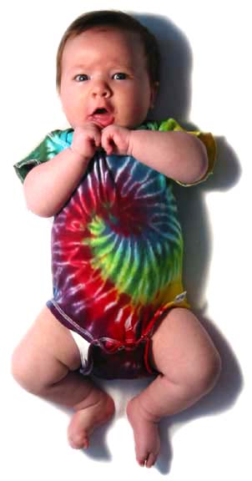
Pediatric Knowledgebase
E
LECTRONIC
Direct Indicators of Health Status (vital signs, BP, Temp, HR…)
Clinical Observations & Patient Response to Therapy
REC
ORDS
Disease/Condition specific assessments (Scans, Tests…)
Procedures or Interventions
TDM Data (Drug/Biomarker levels)
M E D I C A L

Slide 27
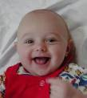

















Pediatric Knowledgebase
Opportunities for:
- Disease progression
- Population analysis
- Meta analyses . . . correlation
Longitudinal: within patient
Data Mining: across patients

Slide 28
Pediatric Knowledgebase
Compendial guidance and other relevant views of static data
Historical Views of “Like” Patients
Views to formulary guidance
Dashboard Concept
Forecasting Tools for
Guidance on:
Existing dosing practices
Caregiver requested guidance
Projection of outcomes associated with current or modified care
Views to past patient hospital visits
Views to clinically-relevant indicators of pharmacotherapy status and guidance

Slide 29
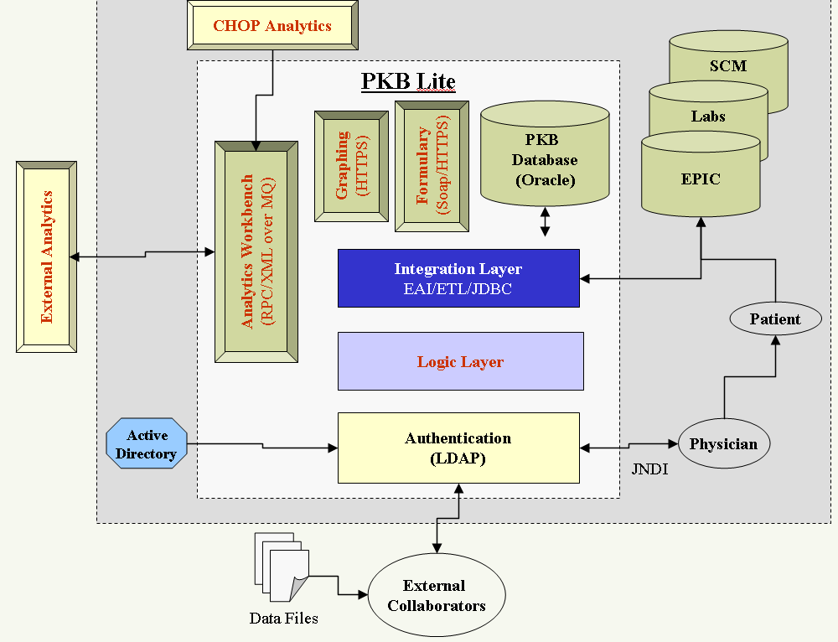
Pediatric Knowledgebase
Service-oriented architecture
Compliant with HL7 CDA

Slide 30
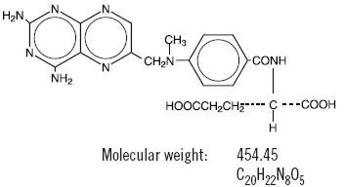
Pediatric Knowledgebase The Methotrexate Dashboard
Anti-folate chemotherapeutic agent
Renal excretion
Enterohepatic recirculation
Toxicity at high or prolonged low exposure

Slide 31
Pediatric Knowledgebase The Methotrexate Dashboard
Disease | Dose | Route | Leucovorin
ALL | 8-15 mg | IT | No
ALL | 20 mg/m² | PO | No
ALL | 100-300 mg/m² | IV | No
NHL | 1 g/m² | IV | Yes
OS | 12 g/m² | IV | Yes

Slide 32
Pediatric Knowledgebase The Methotrexate Dashboard
BLACK BOX WARNING
METHOTREXATE SHOULD BE USED ONLY BY PHYSICIANS WHOSE KNOWLEDGE AND EXPERIENCE INCLUDE THE USE OF ANTIMETABOLITE THERAPY.
BECAUSE OF THE POSSIBILITY OF SERIOUS TOXIC REACTIONS (WHICH CAN BE FATAL):
METHOTREXATE SHOULD BE USED ONLY IN LIFE THREATENING NEOPLASTIC DISEASES, OR IN PATIENTS WITH PSORIASIS OR RHEUMATOID ARTHRITIS WITH SEVERE, RECALCITRANT, DISABLING DISEASE WHICH IS NOT ADEQUATELY RESPONSIVE TO OTHER FORMS OF THERAPY.
DEATHS HAVE BEEN REPORTED WITH THE USE OF METHOTREXATE IN THE TREATMENT OF MALIGNANCY, PSORIASIS, AND RHEUMATOID ARTHRITIS.
PATIENTS SHOULD BE CLOSELY MONITORED FOR BONE MARROW, LIVER, LUNG AND KIDNEY TOXICITIES. (See PRECAUTIONS.)
PATIENTS SHOULD BE INFORMED BY THEIR PHYSICIAN OF THE RISKS INVOLVED AND BE UNDER A PHYSICIAN'S CARE THROUGHOUT THERAPY.

Slide 33
Pediatric Knowledgebase The Methotrexate Dashboard
Current procedure is to photocopy “master” nomogram for specific protocols and hand plot individual data

Slide 34
Pediatric Knowledgebase The Methotrexate Dashboard
MTX Administration
Urine pH must be ≥ 7
25 mg/ml solution in Dextrose 5% in water (D5W)
Maximum absolute dose: 20g
MTX TDM
Begins 24 hours after the start of MTX infusion
Results plotted on protocol-specific nomogram
Continues daily until MTX level ≤ 0.1 µM
MTX Cleared
MTX level ≤ 0.1 µM
Patient can be discharged
Before Administration
0 – 24 Hours
24 Hours - Discharge
Prehydration
750 ml/m² of D5 0.22% NaCl with 40 mEq/L NaHCO₃ is given over 1 hour
If urine pH < 7, 0.5 mEq/L NaHCO₃ is given over 30 minutes. Repeated if urine pH is < 7 after 1 hour
Continuing Hydration
D5 0.22% NaCl with 40 mEq/L NaHCO3 at 100 ml/m²/hr
Urine pH measured every 8h. If pH < 7, 10 ml/kg hydration fluid is given over 30 min and pH measured
Lasts until MTX level ≤ 0.1 µM
LVR Administration
LVR starts 24 - 42 h after start of MTX infusion as 15 mg/m² IVSS over 15 minutes, every 6 hours
Dose can be modified based on protocol-specific nomogram because of excretion delay
Lasts until MTX level ≤ 0.1 µM

Slide 35
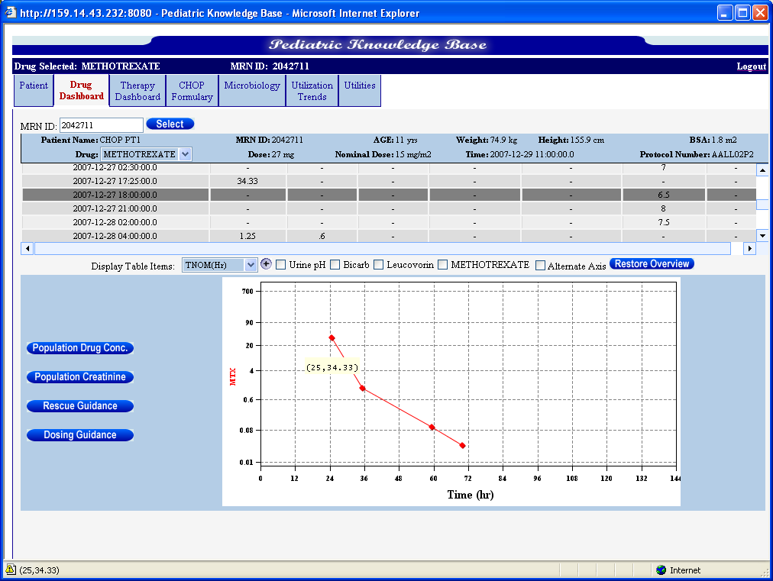
Pediatric Knowledgebase The Methotrexate Dashboard

Slide 36
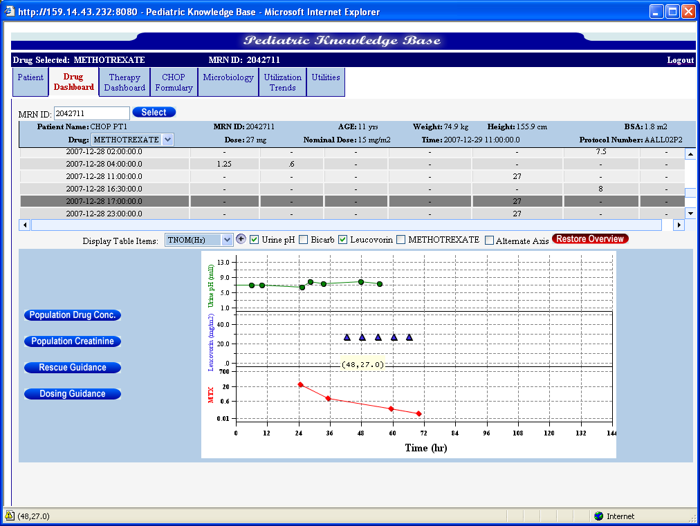
Pediatric Knowledgebase The Methotrexate Dashboard

Slide 37
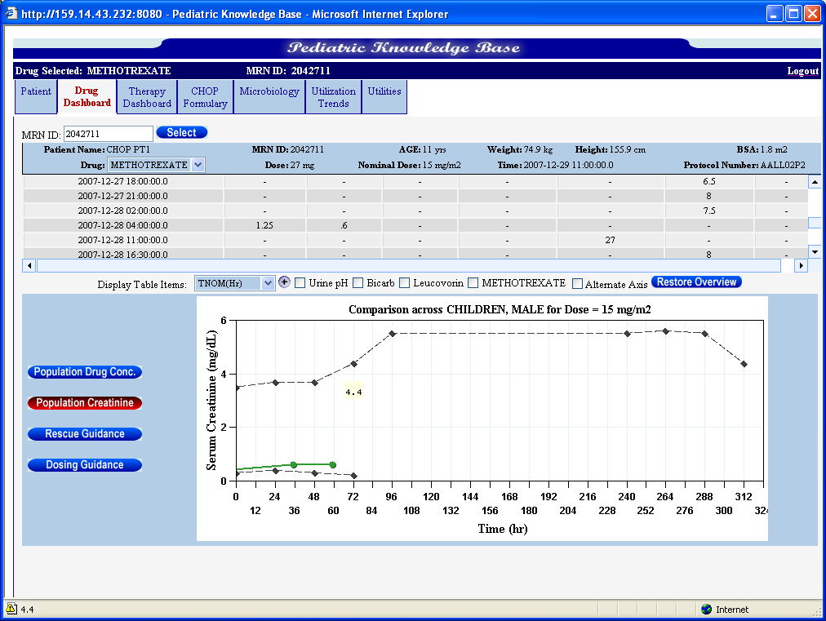
Pediatric Knowledgebase The Methotrexate Dashboard

Slide 38
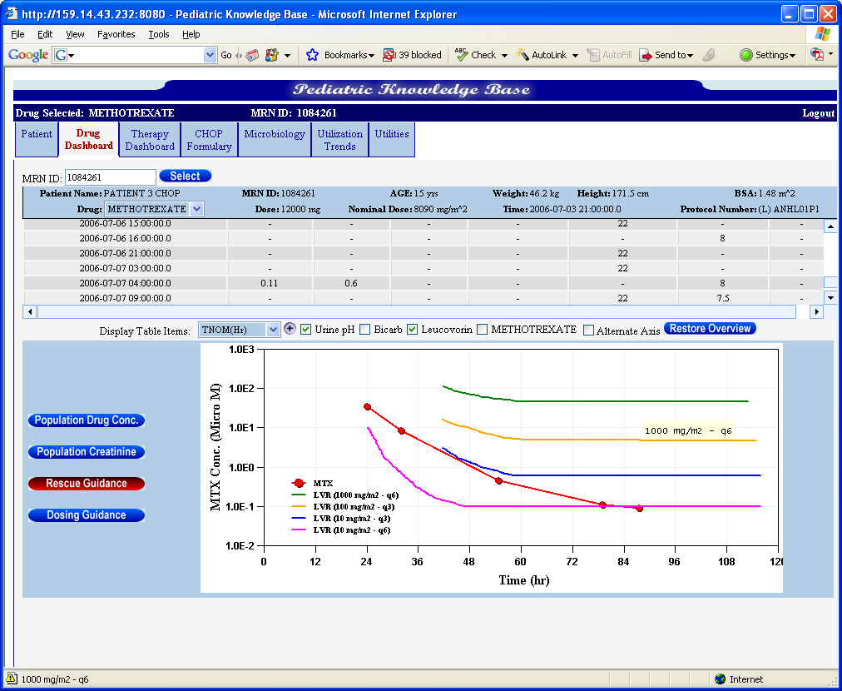
Pediatric Knowledgebase The Methotrexate Dashboard

Slide 39
Pediatric Knowledgebase Vision
An international consortium of pediatric centers of excellence that support and drive the development of the PKB
PKB-lite development for clinics, institutions without EMRs and small physician offices
Global connectivity that accommodates regional and global best practices with guidance options
Guidance for developing countries / institutions

Slide 40
Discussion
Modeling and simulation activities allow the investigator to:
Select the right dose or dose range
Use the minimal, but most informative, sampling scheme to produce meaningful results that satisfy regulatory requirements
Propose a design / population that has the greatest likelihood of fulfilling study objectives.

Slide 41
Discussion
The link between clinical pharmacology and medical informatics will provide an excellent form for “real” personalized medicine:
Decision support systems which integrate patient records with drug and disease-specific indices.
Disease progression with forecasting of individual patient disease trajectories based on treatment modality options.

Slide 42
Ongoing Research in Barrett Lab
Disease progression modeling in pancreatic cancer
Model-based approaches to study nanomedicine strategies in oncology
Disease progression modeling in Spinal Muscular Atrophy (SMA)
Translational research in Neuro AIDS
Clinical evaluation of NK1r antagonism in NeuroAIDS
PK/PD relationships for next generation COX-2 inhibitors
PK/PD for natural products (frankinsense, silymarin, etc)
Model-based strategies for Traditional Chinese Medicine (TCM)
Clinical trial design optimization for early phase drug development in oncology (NCI/CTEP)
PBPK strategies in children to guide hospital-based dosing in critically-ill children
PK/PD relationships in obese children
Correlation of DDI potential and observed toxicity in children with cancer

Slide 43
Acknowledgments
LAPK/PD Staff (past and present)
Di Wu, PhD
Dimple Patel, MS
Erin Dombrowsky, MS
Sarapee Hirankarn, PhD
Chee Ng, PhD
Yin Zhang, PharmD, PhD
Manish Gupta, PhD
Divya Menon, PhD
Doug Marsteller, PhD
Jason Williams, PhD
James Lee, PhD
Ganesh Moorthy, PhD
Gaurav Bajaj, PhD
Vu Nguyen, BS
Mahesh Narayan, MS
John Mondick, PhD
Craig Comisar, PhD
Sarah Kurliand, MBA
Linda Pederson, MBA
Heng Shi, PhD
Bhuvana Jayaraman, MS
Sundarajaran Vijakumar, PhD
Kalpana Vijakumar, MS
Collaborators
Stephen Douglas, MD
Peter C Adamson, MD
Carolyn Felix, MD
Athena Zuppa, MD
Jeffrey Skolnik, MD
Kelly Wade, MD
Walter Kraft, MD
John van den Anker, MD
Mike Fossler, PharmD, PhD
Marc Gastonguay, PhD
Sander Vinks, PhD
Andrea Edginton, PhD
Ram Agharkar, PhD
Shashank Rohatagi, PhD
Jun Shi, MD
Bernd Meibohm, PhD
Stephanie Laer, PhD
Hong Yuan, MD
Olivera Marsenic, MD
Hartmut Derendorf, PhD
Gunther Hochhaus, PhD
Toshimi Kimura, PhD
Jamie Renbarger, MD
Pat Thompson, MD
Carsten Skarke, MD
Nick Holford, MD
Brian Anderson, MD
Saskia DeWildt, MD
Leslie Mitchell, PhD
Guy Young, MD
Leslie Ruffino, MD
Garret Fitzgerald, MD
Dwight Evans, MD
Dave Flockhart, MD
Robert Gross, MD
Brian Strom, MD
Dave Cadieu, BS
Diva Deleon, MD
Richard Aplenc, MD
Scott Shulman, MD
Greg Hammer, MD
David Drover, MD
Anne Zajicek, PharmD, MD
Jane Bai, PhD
Sandeep Dutta, PhD

Slide 44
References
Zuppa AF, Adamson PC, Barrett JS. Letter to the Editor, Pediatric drug labeling: improving the safety and efficacy of pediatric therapies, J Pediatr. Pharmacol Ther 9(1): 70-71, 2004.
Barrett JS, Collison KR. Dosing LMWH in special populations: safety, PK/PD and monitoring considerations. International J of Cardiovascular Med and Science 4(2): 41-54, 2004.
Barrett JS, Labbe L, Pfister M. Application and impact of population pharmacokinetics in the assessment of antiretroviral pharmacotherapy. Clinical Pharmacokinetics 44(6): 591-625, 2005.
Zuppa AF, Mondick J, Davis LA, Maka D, Tsang B, Narayan M, Nicholson C, Patel D, Collison KR, Adamson PC, Barrett JS. Drug Utilization in the Pediatric Intensive Care Unit: Monitoring Prescribing Trends and Establishing Prioritization of Pharmacotherapeutic Evaluation of Critically-ill Children. J. Clin. Pharmacol. 45: 1305-1312, 2005.
Meibohm B, Panetta C, Barrett JS. Population pharmacokinetic studies in pediatrics: Issues in design and analysis. AAPS Journal. 7(2): Article 48: E475-E487, 2005.
Kenna LA, Labbe L, Barrett JS, Pfister M. Modeling and simulation of adherence: Approaches and applications in Therapeutics. AAPS Journal. 7(2): E390-E407, 2005.
Zuppa AF, Nicolson SC, Adamson PC, Wernovsky G, Mondick JT, Burnham N, Hoffman TM, Gaynor WJ, Davis LA, Greeley WJ, Spray TL, Barrett JS. Population Pharmacokinetics of Milrinone in Neonates with Hypoplastic Left Heart Syndrome Undergoing Stage 1 Reconstruction, Anesthesia & Analgesia 102(4):1062-9, 2006.
Barrett JS, Gupta M, Mondick JT. Model-based Drug Development for Oncology Agents. Expert Opinion on Drug Discovery 2(2): 185-209, 2007.
Barrett JS. Facilitating Compound Progression of Antiretroviral Agents via Modeling and Simulation. J Neuroimmune Pharmacol 2:58-71, 2007.
Zuppa AF, Vijayakumar S, Mondick JT, Pavlo P, Jayaraman B, Patel D, Narayan M, Boneva T, Vijayakumar K, Adamson PC, Barrett JS. Design and implementation of a web-based hospital drug utilization system. J Clin Pharmacol: 47(9): 1172-1180, 2007.
Barrett JS. Quantitative Pharmacology in a Translational Research Environment. Chinese J Clin Pharmacol Therapeut: 12(10): 1081-88, 2007.
Skolnik JT, Barrett JS, Jayaraman B, Patel D, Adamson PC. Shortening the Timeline of Pediatric Phase 1 Trials: The Rolling Six Design. J. Clin Oncol 26(2): 190-5, 2008
Barrett JS, Mondick JT, Narayan M, Vijayakumar K, Vijayakumar S. Integration of Modeling and Simulation into Hospital-based Decision Support Systems Guiding Pediatric Pharmacotherapy. BMC Medical Informatics and Decision Making 8:6, 2008.
Barrett JS. Applying Quantitative Pharmacology in an Academic Translational Research Environment. AAPS Journal 10(1):9-14, 2008.
Barrett JS, Jayaraman B, Patel D, Skolnik JM. A SAS-based solution to evaluate study design efficiency of phase I pediatric oncology trials via discrete event simulation. Computer Methods and Programs in Biomedicine 90: 240-250, 2008.
Barrett JS, Fossler MJ, Cadieu, KD and Gastonguay MR. Pharmacometrics, A Multidisciplinary Field to Facilitate Critical Thinking in Drug Development and Translational Research Settings. J Clin. Pharmacol 48(5): 632-49, 2008. Published in Chinese Journal as well Chinese J Clin Pharmacol Ther. 13(5): 481-493, 2008.
Zuppa AF, Barrett JS. Pharmacokinetics and pharmacodynamics in the critically ill child. Pediatr Clin North Am. 55(3):735-55, 2008.
Skolnik JM and Barrett JS. Refining the Phase 1 Pediatric Trial. Pediatric Health 2(2): 105-106, 2008. ponse. J Clin Oncology 29(23):3109-11, 2011.

Slide 45
References
Barrett JS, Shi J, Xie H, Huang X, Fossler MJ and Sun R. Globalization of Quantitative Pharmacology: First International Symposium of Quantitative Pharmacology in Drug Development and Regulation. J Clin Pharmacol 48(7): 787-792, 2008.
Barrett JS, Patel D, Jayaraman B, Narayan M, Zuppa A. Key Performance Indicators for the Assessment of Pediatric Pharmacotherapeutic Guidance. J Pediatr Pharmacol Ther 13: 141-155, 2008.
Wade KC, Wu D, Kaufman DA, Ward RM, Benjamin DK, Ramey N, Jayaraman B, Kalle H, Adamson PC, Gastonguay M, Barrett JS. Population Pharmacokinetics of Fluconazole in Young Infants. Antimicrob Agents Chemother 52(11):4043-9, 2008.
Barrett JS, Skolnik JM, Jayaraman B, Patel D, Adamson PC. Improving Study Design and Conduct Efficiency of Event-Driven Clinical Trials via Discrete Event Simulation: Application to Pediatric Oncology. Clinical Pharmacol Ther 84(6): 729-733, 2008.
Menon-Andersen D, Mondick JT, Jayaraman B, Thompson PA, Blaney SM, Adamson PC, Barrett JS. Population Pharmacokinetics of Imatinb Mesylate and its Metabolite in Children and Young Adults. Cancer Chemother and Pharmacol 63(2):229-38, 2009.
Wade KC, Benjamin Jr. DK, Kaufman DA, Ward RM, Smith PB, Jayaraman B, Adamson PC, Gastonguay M, Barrett JS. Fluconazole dosing for the prevention or treatment of invasive candidiasis in young infants. Ped Infectious Disease J 28(8): 717-23, 2009.
Läer S, Barrett JS, and Meibohm B. The In Silico Child: Using Simulation to Guide Pediatric Drug Development and Manage Pediatric Pharmacotherapy. J Clin Pharmacol 49(8): 889-904, 2009.
Su F, Nicolson SC, Gastonguay MR, Barrett JS, Adamson PC, Kang DS, Godinez RI, Zuppa AF. Population Pharmacokinetics of Dexmedetomidine in Infants Following Open Heart Surgery. Anesth Analg. 110(5):1383-92, 2010.
Marsenic O, Zhang L, Zuppa A, Barrett JS, Pfister M. Application of Individualized Bayesian Urea Kinetic Modeling to pediatric hemodialysis. ASAOI J 56(3):246-53, 2010.
Kimura T, Kashiwase S, Makimoto A, Kumagai M, Taga T, Ishida Y, Ida K, Nagatoshi Y, Mugishima H, Kaneko M, Barrett JS. Pharmacokinetic and pharmacodynaminc Investigation of Irinotecan hydrochloride in Pediatric Patients with Recurrent or Progressive Solid Tumors. Int J Clin Pharmacol Ther. 48(5):327-334, 2010.
Skolnik JM, Zhang AY, Barrett JS, and Adamson PC. Approaches to clear residual chemotherapeutics from indwelling catheters in children with cancer J. Ther. Drug Monitoring 32(6): 741-8, 2010.
Langholz B, Skolnik J, Barrett JS, Renbarger J, Seibel N, Zajicek A, Arndt C. Dactinomycin and vincristine toxicity in the treatment of childhood cancer: A retrospective study from the Children’s Oncology Group. Pediatric Blood & Cancer 57(2):252-7, 2011.
Dombrowsky E, Jayaraman B, Narayan M, Barrett JS. Evaluating Performance of a Decision Support System to Improve Methotrexate Pharmacotherapy in Children with Cancer. J. Ther. Drug Monitoring 33(1): 99-107, 2011.
Piper L, Smith B, Hornik CP, Cheifetz IM, Barrett JS, Moorthy G, Wade KC, Cohen-Wolkowiesz, Benjamin DK. Fluconazole Loading Dose Pharmacokinetics and Safety in Infants. Pediatric Infectious Disease J 30(5): 375-8, 2011.
Barrett JS, Zuppa AF, Adamson PC, Patel D and Narayan M. Prescribing Habits and Caregiver Satisfaction with Resources for Dosing Children: Rationale for More Informative Dosing Guidance. BMC Pediatrics 11: 25, 2011.
Maitland ML, Bies RR, Barrett JS. A Time to Keep and a Time to Cast Away Categories of Tumor Response. J Clin Oncology 29(23):3109-11, 2011.

Slide 46
BIOS/Contact info
Biography
Dr. Jeffrey S. Barrett, is Research Professor of Pediatrics, University of Pennsylvania School of Medicine, the Director of the Laboratory for Applied PK/PD in the Division of Clinical Pharmacology and Therapeutics at the Children's Hospital of Philadelphia (CHOP) and an Associate Scholar in the Center for Clinical Epidemiology and Biostatistics at The University of Pennsylvania. Dr. Barrett served as the Principal Investigator for CHOP's Pediatric Pharmacology Research Unit and heads the Kinetic Modeling and Simulation core of the Penn/CHOP CTSA. He also manages the pharmacology and biostatistics cores for several multidisciplinary projects both within CHOP, UPenn and various multi-center cooperative groups. He received his BS from Drexel University in Chemical Engineering and his Ph.D. in Pharmaceutics from the University of Michigan. Dr. Barrett spent 13 years in the pharmaceutical industry involved with PK/PD aspects of clinical drug development and was an early proponent of industrial pharmacometrics prior to joining CHOP. He is a Fellow of the American College of Clinical Pharmacology (ACCP) and the American Association of Pharmaceutical Scientists (AAPS) and received the Young Investigator and Clinical Pharmacology Mentorship Awards from ACCP in 2002 and 2007 respectively. He is a member of the FDA Clinical Pharmacology Advisory Committee, the Board of Directors of the Metrum Research Institute and the Scientific Advisory Board of Pharsight Corporation. Dr. Barrett has co-authored over 100 manuscripts, 135 abstracts and has given over 100 invited lectures on PK/PD, clinical pharmacology and pharmacometrics. He joined the Editorial Boards of the Journal of Clinical Pharmacology in 2007 and the Journal of Pharmacokinetics and Pharmacodynamics in 2009. Dr. Barrett has mentored numerous physician fellows and post doctoral candidates in clinical pharmacology and pharmacometrics and continues to evolve his training program to accommodate the demand for training in this area. Dr. Barrett’s research interest is focused on investigating sources of variation in pharmacokinetics and pharmacodynamics applying clinical pharmacologic investigation coupled with modeling and simulation strategies to pursue rational dosing guidance. He develops pharmacometric approaches to advance PK/PD, medical informatics and disease progression modeling. Dr. Barrett has also integrated model-based decision support systems with hospital electronic medical records and pioneered the pediatric knowledgebase development program for the past 6 years. He is actively involved with creating disease progression models for spinal muscular atrophy and pancreatic cancer. His team is developing model-based development approaches for Traditional Chinese Medicine, nanomedicine PK/PD-guided delivery and gene therapy.
Contact Details:
Jeffrey S. Barrett, PhD, FCP
Colket Translational Research Building, Rm 4012 Ph: 267-426-5479
3501 Civic Center Blvd Fax: 267-425-0114
Philadelphia, PA 19104 Email: barrettj@email.chop.edu

