Slide 1
Innovators 2010
Tuftsin-Modified Alginate Based Nanoparticles for Local and Systemic Anti-Inflammatory Gene Therapy
2010 AAPS Graduate Student Symposium
Awards in Biotechnology
Shardool Jain and Mansoor Amiji
Department of Pharmaceutical Sciences, School of Pharmacy
Northeastern University, Boston, MA 02115

Slide 2
ABSTRACT
Macrophage-targeted tuftsin-modified cross-linked alginate nanoparticles were developed for the local and systemic anti-inflammatory gene therapy. Plasmid DNA expressing both enhanced green fluorescent protein (GFP) and interleukin-10 (IL-10) were physically encapsulated in the non-condensing alginate matrix. Alginate based nanoparticles could efficiently encapsulate the plasmid and protect again DNAse degradation. Furthermore, the tuftsin-modified nanoparticles were efficiently internalized in J774A.1 macrophage cells with saturation within 1 hour of incubation. Both quantitative and qualitative analysis of transgene expression with GFP- and IL-10-expressing plasmid DNA showed that the tuftsin-modified nanoparticles had significantly greater efficiency than any of the other systems, including scrambled peptide-modified nanoparticles and Lipofectin®, a cationic lipid-based transfection reagent (p<0.0001).

Slide 3
INTRODUCTION
Chronic inflammatory diseases are mainly treated with systemic therapies that include the use of NSAIDs, cyclo-oxygenase inhibitors, steroids, and immunosuppressive agents [1]. Systemic administration of these anti-inflammatory drugs can lead to undesirable side effects.
Gene therapy using plasmid DNA has become an exciting prospect for the treatment of local and systemic inflammation, especially in cases of chronic diseases where therapeutic levels of the drug need to be maintained for an extensive period of time [1,2]. Local production of the therapeutic protein using transgene expression affords greater control over therapy with fewer side effects than repeated systemic administration of proteins, like antibodies.
Viral and non-viral gene delivery systems have been investigated for anti-inflammatory gene therapy but the main challenge has been to develop safe and effective system so that this experimental strategy can be translated into a clinical-viable therapeutic approach [3].
Unlike cationic lipids and polymers that form electrostatic complexes with negatively-charged DNA, we have intentionally selected alginate as a biocompatible non-condensing polymer for preparation of nanoparticles and the surface was modified with tuftsin for macrophage-selective uptake.
The anti-inflammatory gene therapy using plasmid encoding for the IL-10 cytokine protein has been utilized in this project. The main biological function of IL-10 is to terminate the inflammatory responses, block the pro-inflammatory secretion and regulate the differentiation and proliferation of natural killer cells, antigen presenting cells, mast cells and granulocytes [4-5].

Slide 4
OBJECTIVES AND SPECIFIC AIMS
The main objective of this study was to develop a safe and effective non-viral gene delivery system for IL-10-expressing plasmid DNA and transfection for local and systemic anti-inflammatory therapy.
The specific aims of the project are:
Preparation, characterization, and optimization of control and macrophage-targeted alginate-based gene delivery systems.
Evaluation of macrophage cytotoxicity and transgene expression efficiency using reporter plasmid DNA expressing green fluorescent protein (GFP).
In vitro evaluations of interleukin-10 (IL-10) expressing plasmid DNA transfection and suppression of pro-inflammatory cytokine levels in lipopolysaccharide-stimulated J774A.1 adherent macrophage cells.

Slide 5
EXPERIMENTAL METHODS
External gelation method was used for formulating control and peptide modified cross-linked calcium-alginate nanoparticles.
Zeta-Sizer 90 Instrument used for particle size and surface charge measurements.
Transmission electron microscopy was performed to determine morphology of the peptide-modified nanoparticle.
Pico-Green® analysis performed for measuring plasmid DNA loading.
Gel retardation assay to prove DNA stability in the nanoparticle system.

Slide 6
EXPERIMENTAL METHODS – Cont’d
Evaluation of nanoparticle toxicity towards these cells measured via MTS (formazan) assay.
Qualitative evaluation of transfection efficiency of macrophage targeted versus non-targeted nanoparticle encapsulation pEGFP-N1 plasmid DNA via fluorescence microscopy.
Quantitative evaluation of transfection efficiency of targeted vs. non-targeted nanoparticle encapsulation pEGFP-N1 plasmid DNA via ELISA.

Slide 7
EXPERIMENTAL METHODS – Cont’d
Quantitative evaluation of the IL-10 transgene expression via murine IL-10 specific ELISA (R&D Systems, Cat# M1000).
Qualitative evaluation of the therapeutic expression of the pro-inflammatory cytokine expression via PCR. The primers sequence for TNF-α and IL-1β used are as follows:
Murine TNF- α Forward: CATGAGCACAGAAAGCATGATC
Murine TNF- α Reverse: CCTTCTCCAGCTGGAAGACT
Murine IL-1β Forward: GGCTGCTTCCAAACCTTTGA
Murine IL-1β Reverse: GCTCATATGGGTCCGACAGC
PCR Product size of TNF- α and IL-1β are 620bp and 330 bp respectively.
Quantitative evaluation of the therapeutic expression of the pro-inflammatory cytokine expression via TNF-α specific ELISA (R&D Systems, Cat # MTA00).

Slide 8
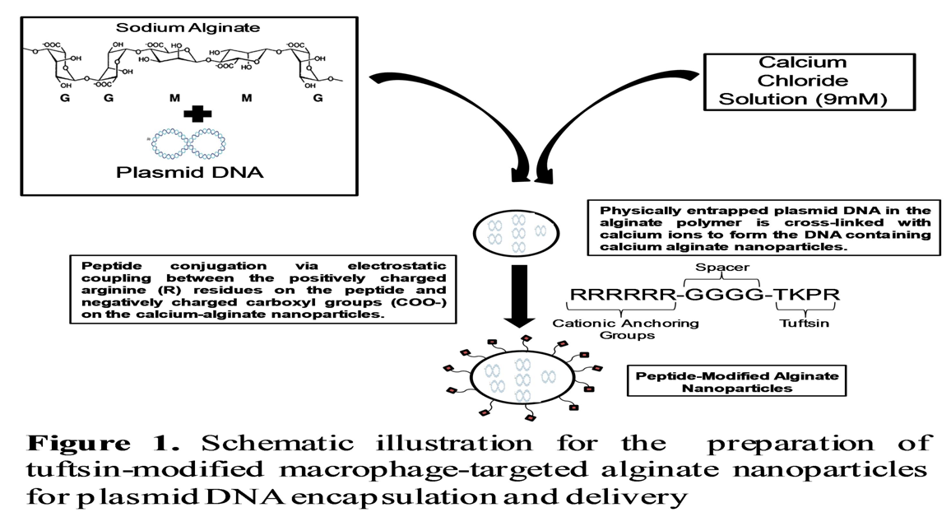
PREPARATION OF TUFTSIN-MODIFIED ALGINATE NANOPARTICLES

Slide 9
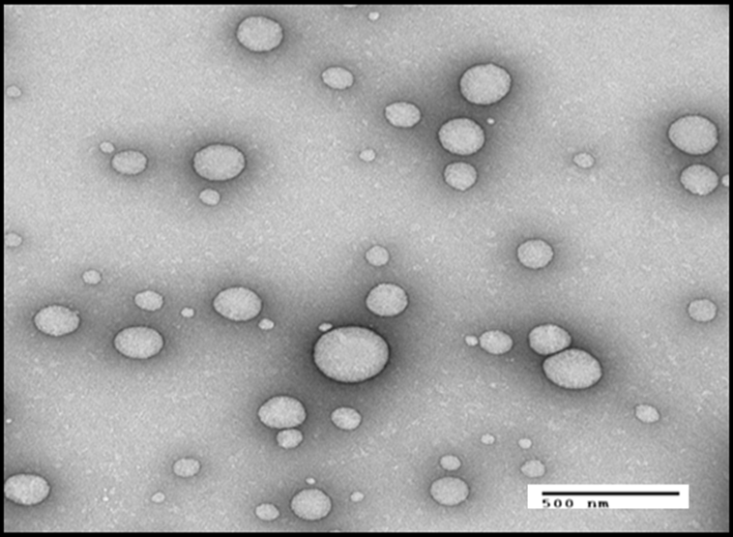
NANOPARTICLE CHARACTERIZATION
1 2 3 4 5 6
Stability of encapsulated DNA by agarose gel electrophoresis. The size of the plasmid EGFP-N1 is 4.7 KB. Lanes 1 and 6 are 2-10 kB DNA ladder. Lane 2 represents the tuftsin modified NPs treated with alginate lyase only. Lane 3. Scrambled NPs treated with alginate lyase only. Lane 4. Tuftsin NPs treated with DNAse I and alginate lyase in a sequential manner. Lane 5. Scrambled peptide NP treated with DNAse I and alginate lyase in a sequential manner.
Transmission electron microscopy image of the tuftsin-modified alginate NP.

Slide 10
CYTOTOXICITY ANALYSIS IN J774A-1 MACROPHAGE CELL LINE
Cytotoxicity of the different versions of the calcium alginate nanoparticles in J774A-1 macrophages evaluated with the MTS (formazan) assay. The toxicity of the plasmid DNA loaded formulation in macrophages was compared to untreated cells, poly(ethyleneimine) (PEI, used as a positive control), and blank NP (0.5 mg and 1 mg), Unmodified NP (0.2 mg, 0.5 mg, and 1 mg), Scrambled peptide NP (0.2 mg, 0.5 mg, and 1 mg), and tuftsin-modified NP (0.2 mg, 0.5 mg, and 1 mg).

Slide 11
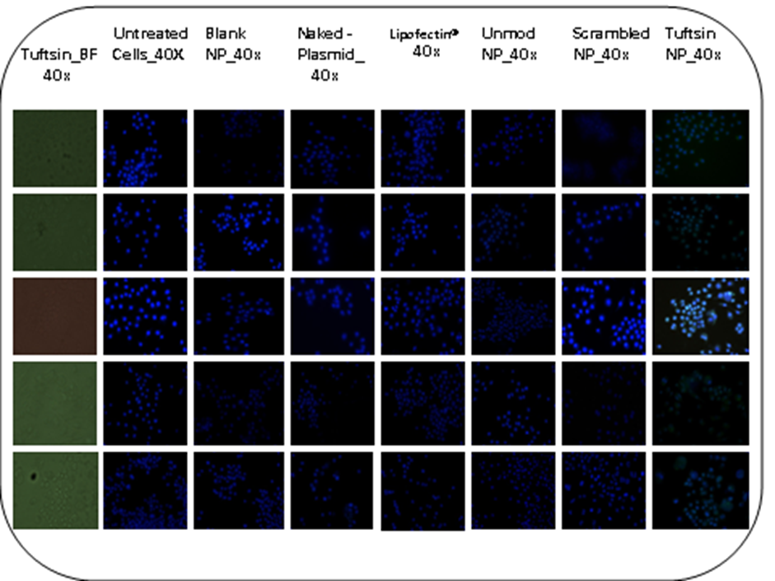
QUALITATIVE GFP TRANSFECTION STUDIES
T=12 Hr
T=24 Hr
T=48Hr
T=72 Hr
T=96 Hr
Qualitative evaluation of EGFP-N1 plasmid DNA transfection in J774A-1 macrophage cells at 12, 24, 48, 72, and 96 hours time points. Shown are the overlap images of the cells expressing the GFP plasmid (green) and stained with nuclei dye (Hoechst 33342-blue). (A). Bright Field image of the tuftsin modified NP, (B). Fluorescence images of untreated cells, (C). Cells treated with blank nanoparticles, (D). Cells treated naked EGFP-N1 plasmid DNA (E). Cells treated with EGFP-N1 plasmid DNA complexed with Lipofectin®, (F). Cells treated with EGFP-NI plasmid DNA encapsulated in the unmodified NP, (G). Cells treated with scrambled sequence modified alginate NP, (H). Cells treated with tuftsin peptide modified nanoparticles.

Slide 12
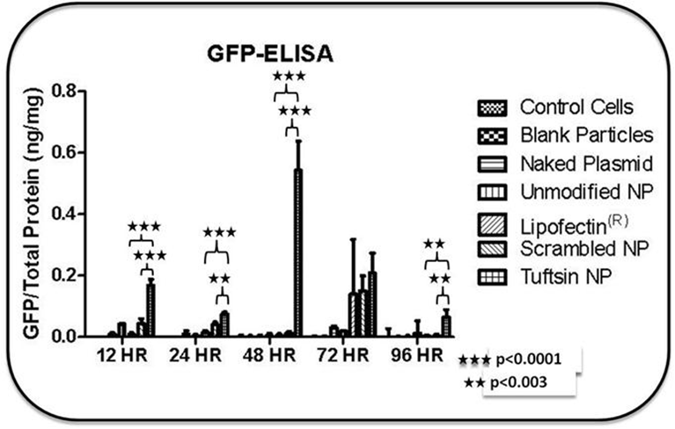
QUANTITATIVE GFP TRANSFECTION STUDIES
Time dependent quantitative analysis of GFP expression in J774A.1 macrophage cell line upon administration of EGFP-N1 plasmid DNA in control and tuftsin-modified alginate NPs. Statistical significance of ELISA results was determined using one-way ANOVA and Tukey's Multiple Comparison Test with a 95% confidence interval (p<0.05).

Slide 13
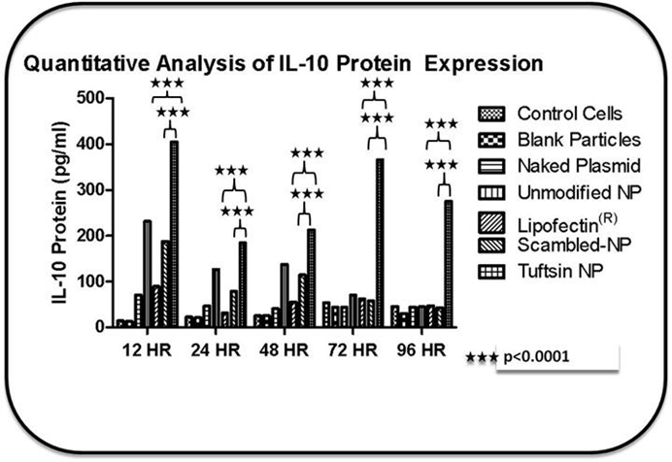
QUANTITATIVE IL-10 TRANSFECTION STUDIES
Time-dependent quantitative analysis of mIL-10 expression in J774A.1 macrophage cell line upon administration of murine IL-10 plasmid in control and tuftsin-modified alginates nanoparticles. Statistical significance of ELISA results was determined using one-way ANOVA and Tukey's Multiple Comparison Test with a 95% confidence interval (p<0.05).

Slide 14
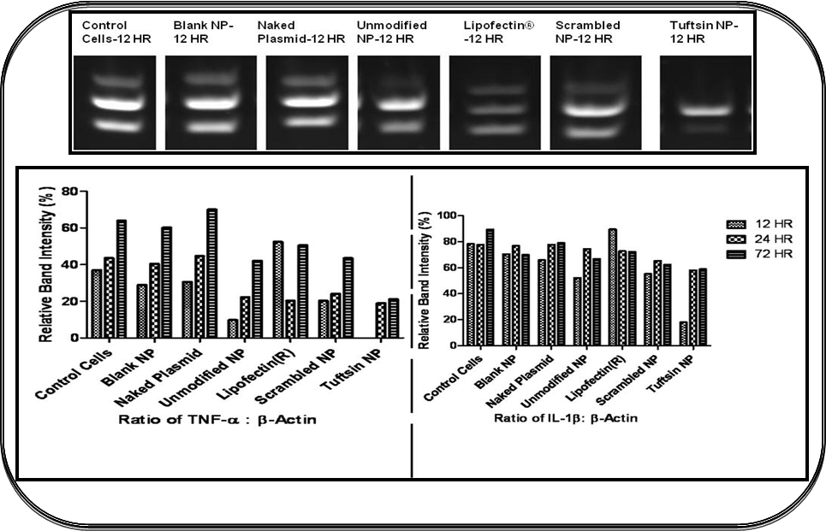
ANTI-INFLAMMATORY EFFECTS OF IL-10 IN LPS-STIMULATED MACROPHAGES
Top panel represents the PCR Products obtained at 12 hours post DNA-encapsulated nanoparticle administration for TNF-α, β-actin, and IL-1β (in a sequential manner from top to bottom). The PCR product of TNF-α, β-actin, and IL-1β are 620 bp, 459 bp, and 330 bp, respectively. Bottom Panel represents plot of the ratio of the TNF-α: β-actin & IL-1β: β-actin band intensities. β-Actin served as an internal control.

Slide 15
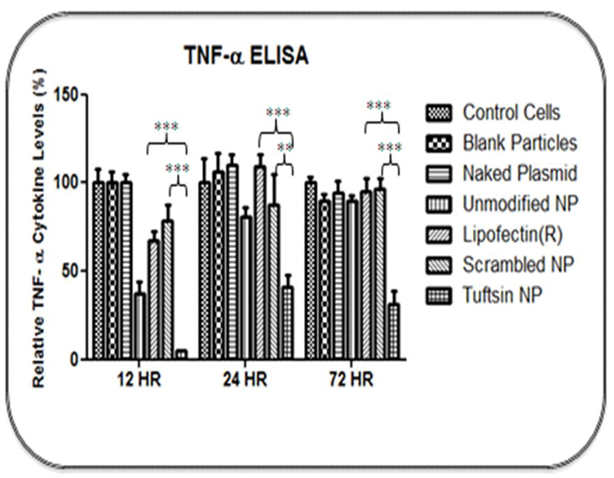
EFFECTS OF IL-10 ON TNFα LEVELS IN LPS-STIMULATED MACROPHAGES
Time-dependent quantitative analysis of mTNF-α expression in J774A.1 macrophage cell line upon administration of murine IL-10 plasmid in control and tuftsin-modified alginates nanoparticles. The graph represents the relative cytokine levels (%). The values in the control/untreated group were assumed to be 100% and values observed in the rest of the treatment groups were normalized to control values. Statistical significance of ELISA results was determined using one-way ANOVA and Tukey's Multiple Comparison Test with a 95% confidence interval (p<0.05).

Slide 16
DISCUSSION POINTS
GFP- and IL-10-expressing plasmid DNA was mixed with an aqueous solution of medium viscosity alginate polymer and cross-linked by drop-wise addition of calcium chloride to form nanoparticles. The particles were then surface modified with tuftsin to target specific receptors on macrophages.
Nanoparticles formed were spherical in shape with a mean diameter of approximately 300-400 nm. On average, the surface charge of the unmodified formulation and the peptide-modified formulation were -47.7 mV and +19.7 mV, respectively,
Both GFP- and IL-10 expressing plasmid DNA were optimally encapsulated with an efficiency of approximately 60% and the stability studies conducted with gel electrophoresis assay confirmed that plasmid DNA remained stable even upon treatment with DNAse.
The cytotoxicity profile of the blank, and DNA-loaded unmodified as well as tuftsin-modified nanoparticles showed that these systems were relatively non-toxic across the entire concentration range.
Fluorescence microscopy studies showed that GFP expression was higher and expression prolonged with tuftsin-modified nanoparticles than other controls including Lipofectin® and scrambled peptide-modified nanoparticles.
Quantitative GFP expression by ELISA graph also confirmed that the highest protein expression (0.54 ± 0.09 ng of GFP per mg of total protein) was observed at 48 hour time point in the tuftsin-modified nanoparticle group. Additionally, the GFP levels observed with tuftsin-modified nanoparticles was significantly higher than rest of the controls at all other time points up to 96 hours post particle administration.

Slide 17
DISCUSSION POINTS – Cont’d
The levels of IL-10, as measured by an ELISA, were significantly higher with tuftsin-modified nanoparticles than the other controls (p<0.0001).
The expressed IL-10 was effective in reducing the inflammatory effect of LPS stimulation in macrophages. First, the PCR results showed suppression of pro-inflammatory cytokines IL-1β and TNF-α mRNA with IL-10 expression using tuftsin-modified nanoparticles.
Additionally, the expressed IL-10 was also effective in lowering TNF-α levels when measured by ELISA. For the 24 h time point, the level found in the case of tuftsin-modified nanoparticles (40.9 ± 6.9%) were significantly lower than the Lipofectin® (109.5 ± 6.2 %; p<0.0001), and scrambled peptide-modified nanoparticles (87.4 ± 17.6%; p<0.001). Moreover, at this time point the TNF-α level in the case of unmodified nanoparticles also increased to 80.8 ± 5.5%.
Young Innovators 2010

Slide 18
CONLUSIONS
Tuftsin and scrambled sequence peptides were successfully conjugated to the surface of DNA-encapsulated alginate nanoparticles.
The nanoparticles were relatively non-toxic to the J774A.1 macrophages.
Cell uptake of the tuftsin-modified nanoparticles was evident at earlier time points indicating receptor mediated endocytosis.
Transfection studies conducted using reporter EGFP-N1plasmid DNA showed higher protein expression levels in the case of tuftsin-modified nanoparticles across all the time points.
The studies conducted with IL-10 expressing plasmid DNA revealed the same trend, where tuftsin-labeled nanoparticles were able to afford higher expression for up to 4 days.
Lastly, the expressed IL-10 cytokine observed with the tuftsin-modified nanoparticles was efficient in blocking the expression of pro-inflammatory cytokines such as TNF-α and IL-1β in LPS-stimulated macrophages.
Future studies will aim at evaluating the therapeutic efficacy and safety of this DNA delivery system in adjuvant-induced rheumatoid arthritis model established in male Lewis rats.

Slide 19
ACKNOWLEDGMENTS
Thesis Advisor: Dr. Mansoor Amiji (Distinguished Professor and Chair, Department of Pharmaceutical Sciences, School of Pharmacy, Northeastern University)
Dr. Amiji’s Lab Members (past and current)
Department of Pharmaceutical Sciences at Northeastern University: Faculty, Staff, and Students
Family and friends
AAPS

Slide 20
REFERENCES
M. M. Alexis, et al., DNA vaccination as anti-inflammatory strategy. In P. D. R. C.H. Evans (Ed), Gene Therapy in Inflammatory Diseases, Progress in Inflammation Research, Birhauser Verlag, Basel, Switzerland, 2000, pp. 205-230.
R. J. Mrsny. Tissue-and Cell-Specific Targeting for the Delivery of Genetic Information. In M.M. Amiji (Ed), Polymeric Gene Delivery: Principles and Applications, CRC Press, Boca Raton, FL. 2005, pp. 5-27.
Bhavsar MD, Amiji MM. Polymeric nano- and microparticle technologies for oral gene delivery. Expert Opin Drug Deliv 2007;4:197-213.
S.-H. H. Ming-Cai Li. IL-10 and its related cytokines for treatment of inflammatory bowel disease. World Journal of Gastroenterology,2004, 10: 620-625.
K. W. Moore, R. de Waal Malefyt, R. L. Coffman, and A. O'Garra. Interleukin-10 and the interleukin-10 receptor. Annu Rev Immunol, 2001, 19: 683-765.

Slide 21
BIOGRAPHICAL/CONTACT INFO
Shardool Jain (PhD. Candidate)
Department of Pharmaceutical Sciences
School of Pharmacy
Northeastern University
212 Mugar Life Sciences Building
360 Huntington Avenue
Boston, MA-02115
Tel: (617)-373-7383
Fax: (617)-373-8886
Email: jain.sha@husky.neu.edu

