Slide 1


Young Innovators 2009
Pharmaceutical Channel Hydrate:
Elucidation of its Thermodynamic Stability and
Solid-state Transformation during Dehydration.
Ji Yi Khoo, J. Y. Y. Heng & D. R. Williams
Department of Chemical Engineering,
Imperial College London, United Kingdom.

Slide 2
DRYING: NEMESIS OF HYDRATE
50% of hydrate-forming drug substances used in hydrate form.
Drying: Controls the processability, quality and marketability.
Problem: caking/agglomeration, lump formation, decrease in purity, irreversible damage - polymorphism.

Slide 3
RESEARCH OBJECTIVES
To elucidate the solid-state transformation of a model hydrate.
To establish the causal relationship between dehydration behaviors and key operating parameters.

Slide 4

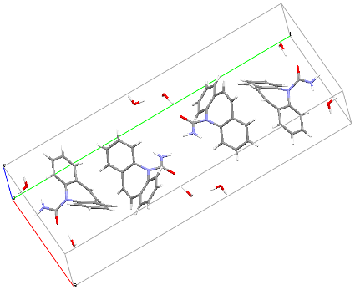



RESEARCH OUTCOME
Stability increases at ambient condition.
Young Innovators 2009

Slide 5
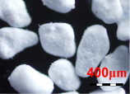
MATERIALS & METHODS
1
2
‘Forced’ hydration
Crystallisation
Agglomerated DH
Needle shaped DH
Plate shaped DH
Dehydration kinetics
Activation energy determination
Dehydration stability
Monitor phase transformation
Dynamic Vapour Sorption
X-ray powder diffraction
TGA, DSC;
SEM, HSM;
N₂ BET, Hg Porosimetry.
Young Innovators 2009

Slide 6
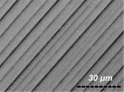
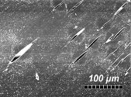
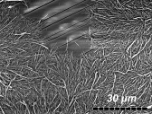
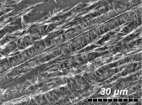
DEHYDRATION STABILITY
Dehydrating
Dehydration at MeOH %P/P₀, 20ºC.
Dehydration at 10⁻³ Torr, no air flow.
Organic solvent vapor induced
‘Smooth’ dehydration
Dehydration rate α solubility:
MeOH > EtOH > Acetone >> Water.
Rate limiting diffusion of water.
‘Catastrophic’ dehydration
Collapse to amorphous form.
Recrystallisation on different facets.
Rate limiting nucleation.
Water vapor induced
Vacuum pressure induced

Slide 7
CONCLUSIONS
Affinity & accessibility of solvent vapour pressure promotes dehydration rate and determines formation of the end products.
Potential to anticipate & tailor polymorphism in formulation design & development of drug product.
Inclusion of unbound water in agglomerated DH provides strategy for improving moisture stability of formulated products.
As an experimental screening method for mapping out stability envelope of other hydrating APIs.

Slide 8
Acknowledgments
Academic Supervisors:
  Dr. Daryl R. Williams
  Dr. Jerry Y. Y. Heng
All members of Surfaces and Particle Engineering Lab, Imperial College London.
Financial Supports:
  Overseas Research Studentships (ORS)
  Imperial College Student Opportunities Fund (SOF)

Slide 9
References
Khoo, J., Heng, J.Y.Y. & Williams, D.R. (2009) Agglomeration effects on the drying and dehydration stability of a pharmaceutical acicular hydrate: Carbamazepine dihydrate. Ind. & Eng. Chem. Res. (Accepted).
Khoo, J., Heng, J.Y.Y. & Williams, D.R. (2009) Dehydration kinetics of pharmaceutical hydrate: Effect of crystal properties. Proceedings of 4th Inter-American Drying Conference. In: 8th World Congress of Chemical Engineering, Montreal, Canada. II-21, p244-250.
AAPS Graduate Student Symposium in MSE
November 10th, 2009. From 0830 to 1100, Room 502A.
AAPS 2009 Poster No.: W5368
November 11th, 2009. From 1300 to 1700, West Exhibit Hall A.

Slide 10
CONTACT INFO
Ji Yi Khoo
Email: j.khoo06@imperial.ac.uk
Website: www.imperial.ac.uk/spel
Department of Chemical Engineering
Imperial College London
South Kensington Campus
London SW7 2AZ
United Kigndom.

