Slide 1


Innovators 2010
Particle Engineering: The Role of Interfacial Properties
2010 AAPS New Investigator Grant In Pharmaceutics And Drug Delivery And Pharmaceutical Technologies
Dr Jerry Y. Y. Heng
Department of Chemical Engineering, Imperial College London, South Kensington, London SW7 2AZ, United Kingdom

Slide 2
Outline
Definitions
Work in SPEL
Surface Properties
Milling
Granulation
Drying
Crystallisation
Current/Developing Work (Crystal Engineering)
Templated/Seeded Crystallisation
Flow Induced Protein Crystallisation
Conclusions
Acknowledgements
Inverse Gas Chromatography – Heterogeneity Homogeneity/Heterogeneity
Surface Energy Dependence on Crystal Habits
Spray Dried Lactose
Effect of Fines on Carrier Particles Lactose
Modelling and surface energy distribution

Slide 3
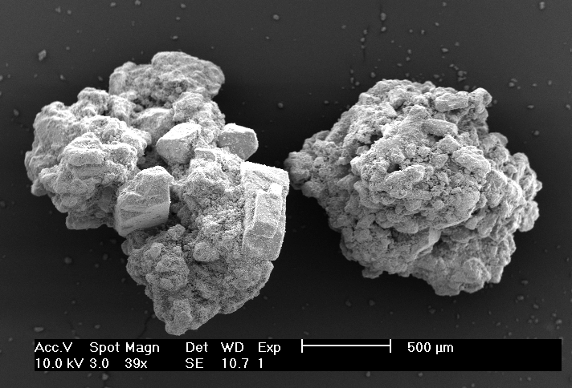
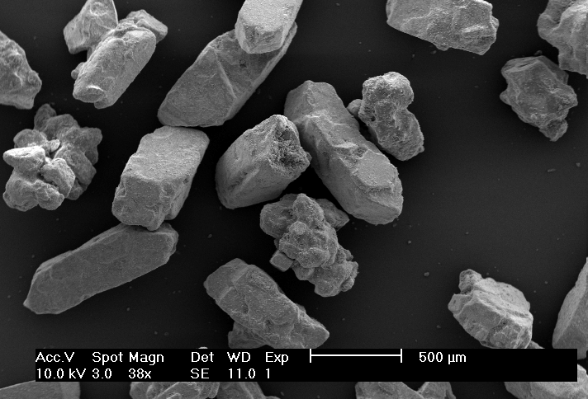
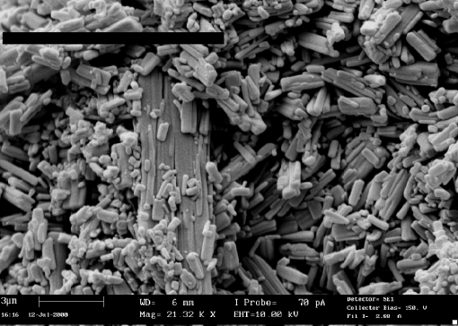
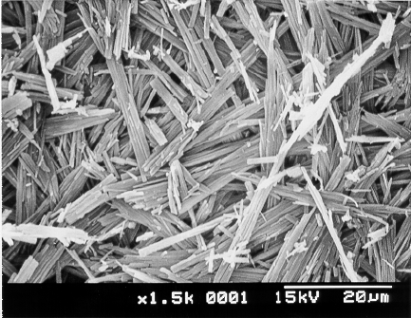
Introduction
What are PARTICLES?
What is ENGINEERING?
What is Particle Engineering?
How can we engineer particles?
What is the role of particle surface properties?

Slide 4
Pharmaceutical Solids Processing

Slide 5
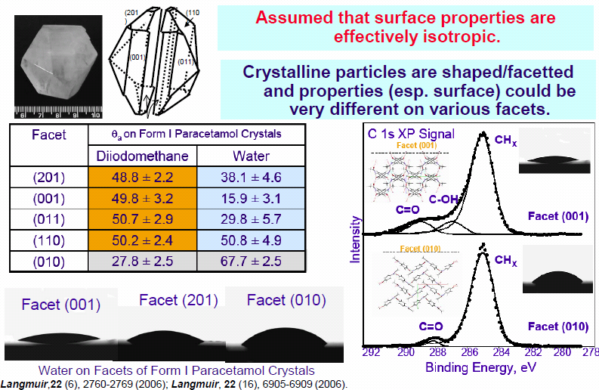
Current State of Knowledge on Surface Chemistry

Slide 6
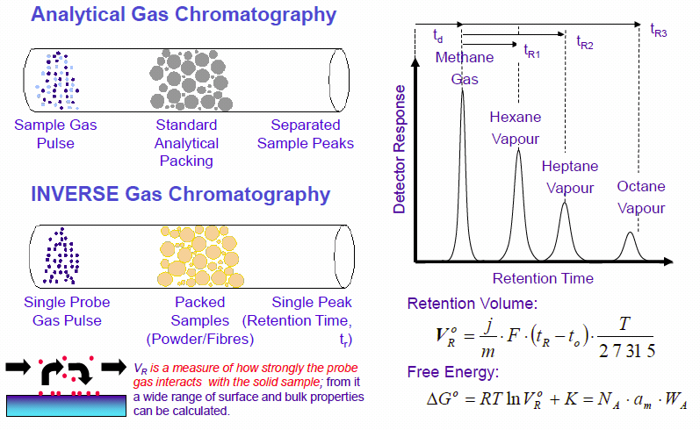
Inverse Gas Chromatography

Slide 7
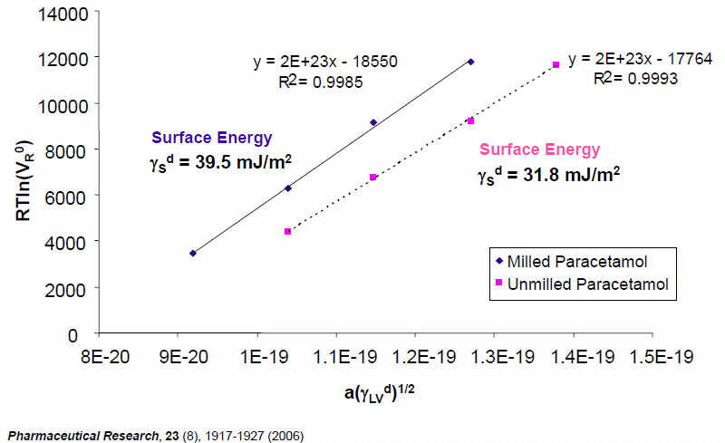
Case Study: Milling of Paracetamol

Slide 8
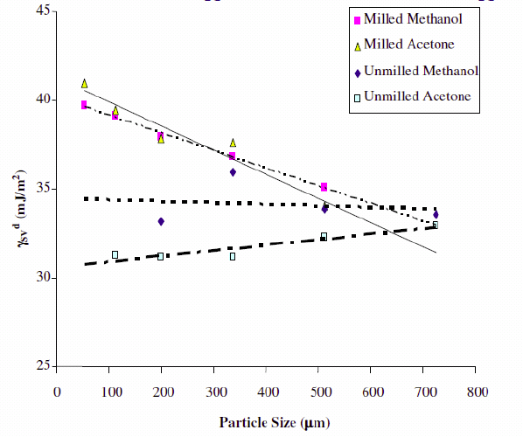
Effects of Milling on Paracetamol

Slide 9
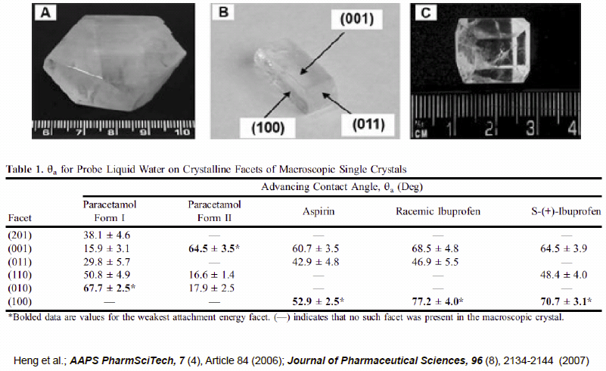
Milling – Increases Hydrophobicity of APIs

Slide 10
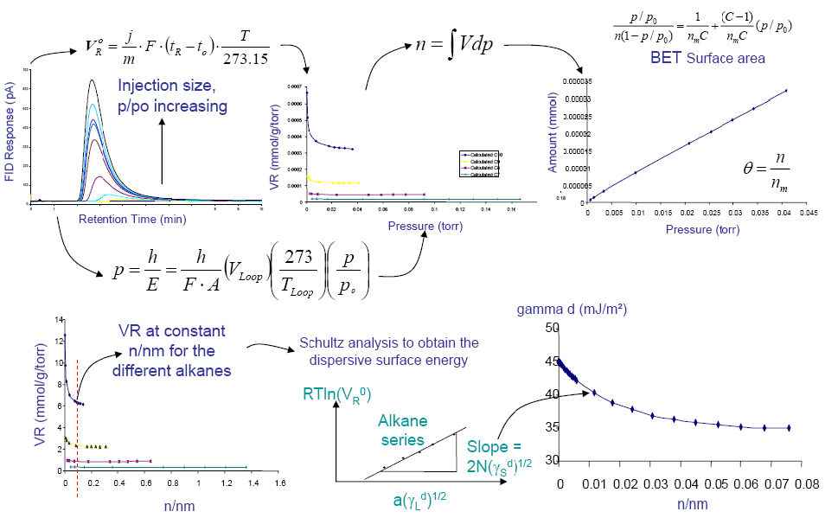

IGC - Heterogeneity (Mapping)
IGC – conventionally at infinite dilution – preferentially probe high energetic sites?
Heterogeneity – surface energy as a function of surface coverage.

Slide 11
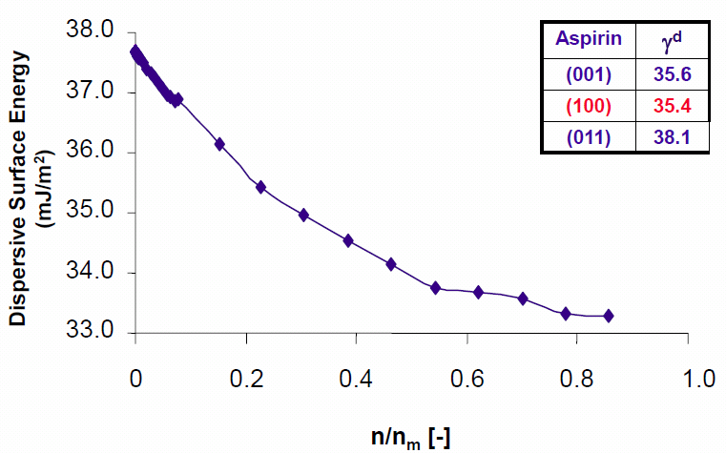
Case Study: Surface Energy of Aspirin

Slide 12
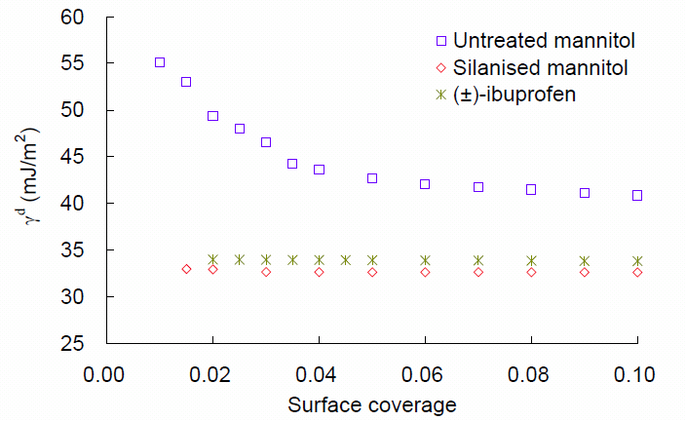
HomoHetero-geneity Mapping

Slide 13
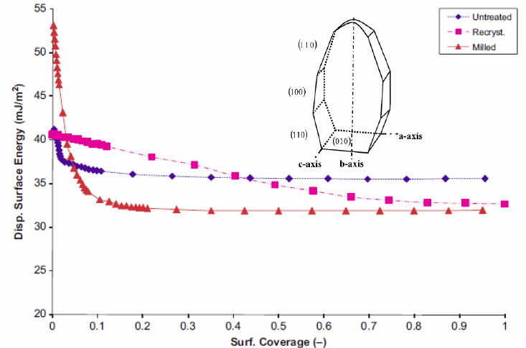
Effects of Processing on Lactose

Slide 14
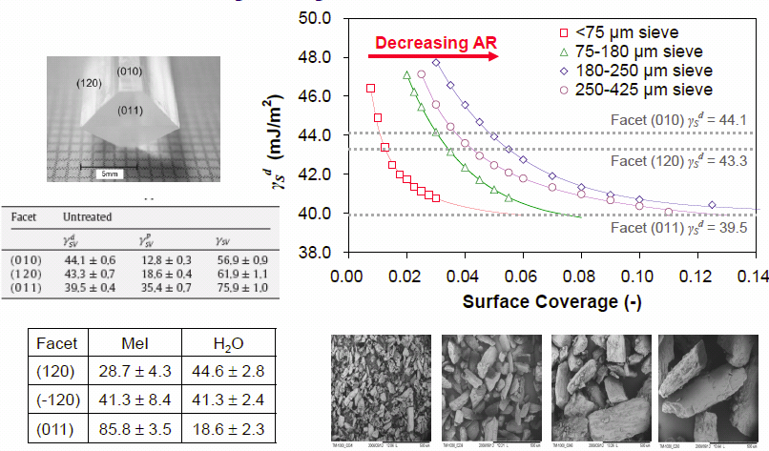
Effects of Crystallisation: Mannitol

Slide 15
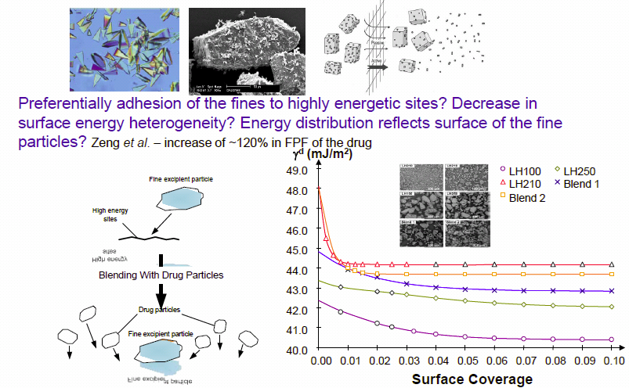
Modification of Lactose Surface Properties for Pulmonary Drug Delivery

Slide 16
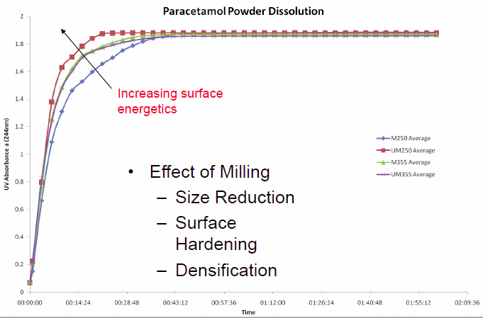
Case Study: Dissolution of Paracetamol

Slide 17
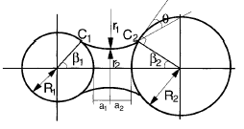
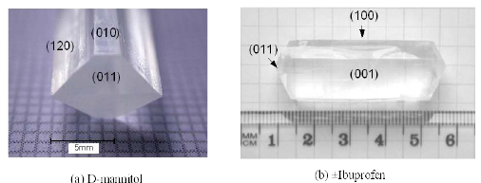
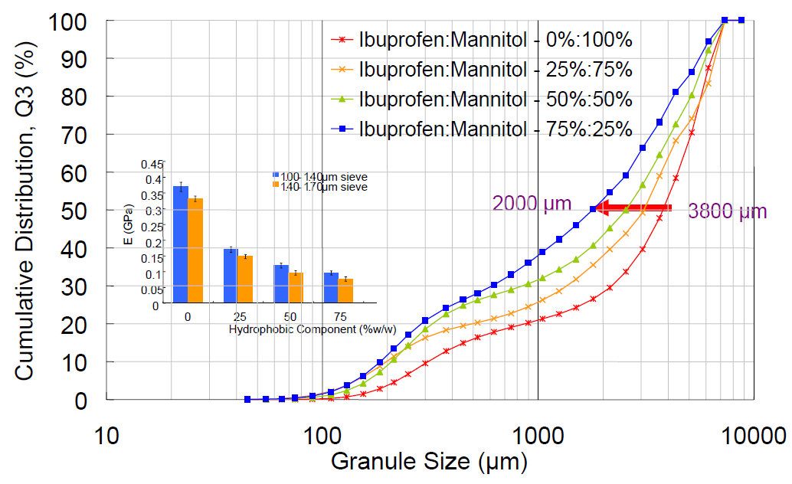
Case Study: Granulation of Mannitol/Ibuprofen
Improve the flow of powder mixtures & mechanical properties of tablets.
Four key parameters:
  Particle surface roughness amplitude,
  Particle correlation length,
  Equilibrium contact angle,
  Relative droplet sizes.

Slide 18
What is Surface Heterogeneity?
Different kinds of heterogeneity can be considered depending on:
Surface Properties
Topography – roughness, porosity
Chemistry – molecules, functional group
Thermodynamics – surface energy, hydrophobic/hydrophilic
Length Scales
Nano/Atomic – chemisorption/physisorption of molecules
Microscopic – adsorption, surface reaction of substrate
Macroscopic – wetting behaviour

Slide 19
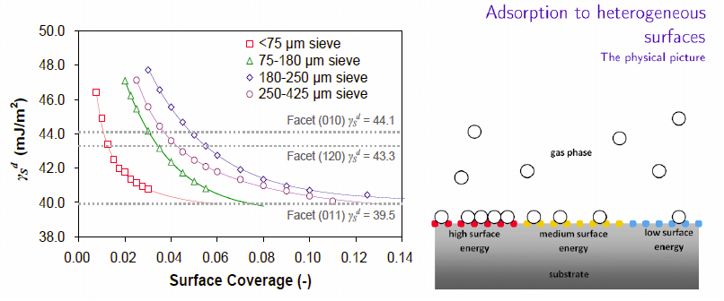
Modelling Surface Energy Distributions
Assumption: measured surface energy is the average of surface energy of all filled sites.
Experimentally, we can obtain the surface energy and the surface coverage – want to know surface energy “distribution”.

Slide 20
Modelling Surface Energy Distributions

Slide 21
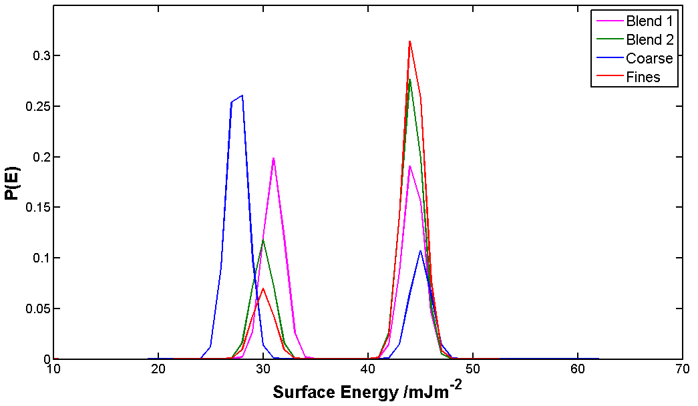
Modelling Surface Energy Distributions

Slide 22



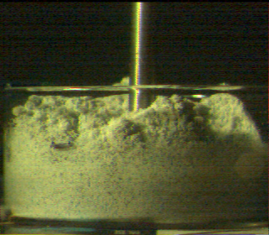
Drying of Pharmaceutical Solids
Majority of manufactured drug products are in powder form.
Needs for maintaining processability, quality and marketability of solids.
Numerous recurring industrial problems in drying process:
  Caking/agglomeration
  Lump formation
  Erratic flow
  Decrease in purity
  Irreversible damage etc.
Conventional wisdom: good or optimum drier - “solvent removal, time, cost”.

Slide 23
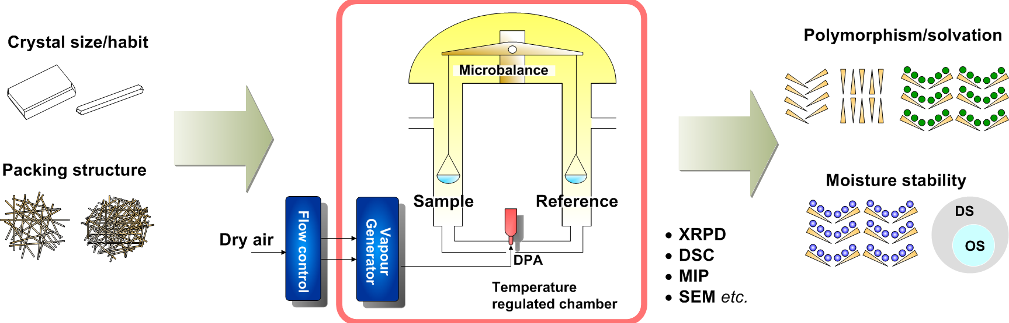
Drying of Pharmaceutical Solids
To establish the causal relationship between dehydration behaviours and key operating parameters.
To elucidate the solid-state transformation of a model hydrate (Carbamazepine dihydrate).
Dynamic Vapour Sorption

Slide 24
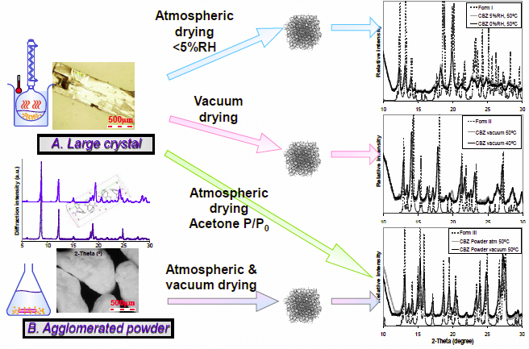
Case Study: Drying of Carbamazepine Dihydrate

Slide 25
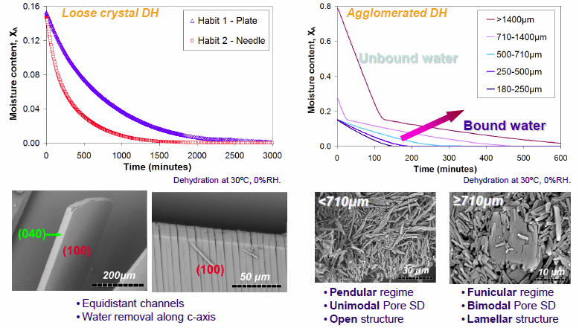
Effects of Particle Properties on Drying

Slide 26
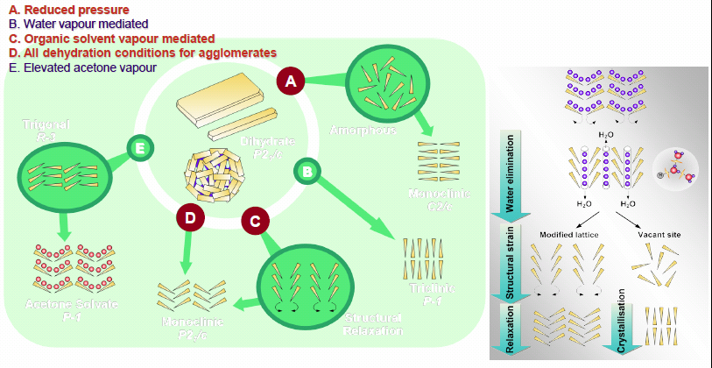
Drying of Carbamazepine Dihydrate

Slide 27
Crystal Engineering
In industrial crystallisation of organic molecules, there remains a need to address:
Crystallisation process
Crystal habit
Polymorphism
Benefits of crystallisation as
DOWNSTREAM BIOSEPARATIONS. :
Isolation and Purification
Dosage Levels – Bioavailability
Sustained Release (Stability)
Handling/Processing/Delivery
Engineering to Suit Purpose
Despite these advantages, only one product (insulin) is currently produced and administered as a crystalline form

Slide 28
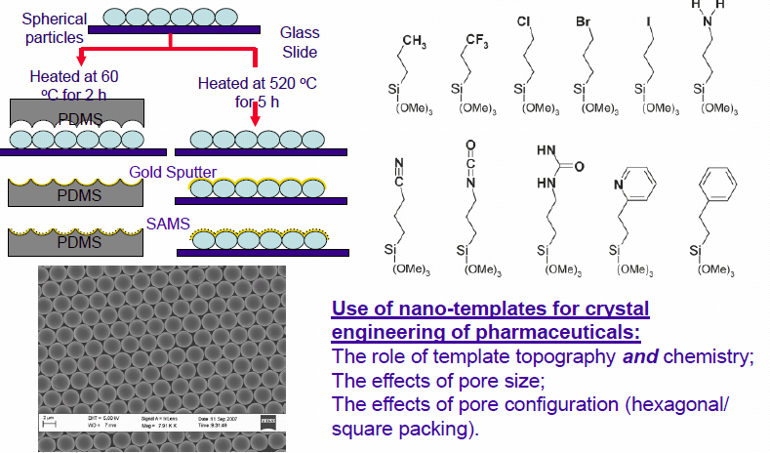
3D Nanotemplates for Crystallisation

Slide 29
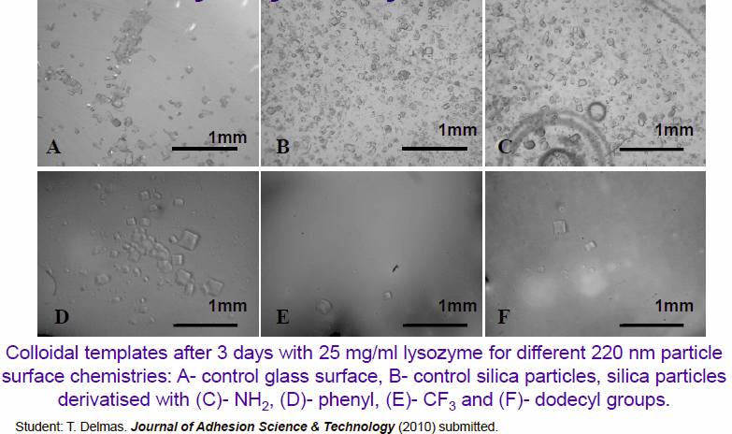
Effects of Surface Chemistry on Lysozyme Crystallisation

Slide 30
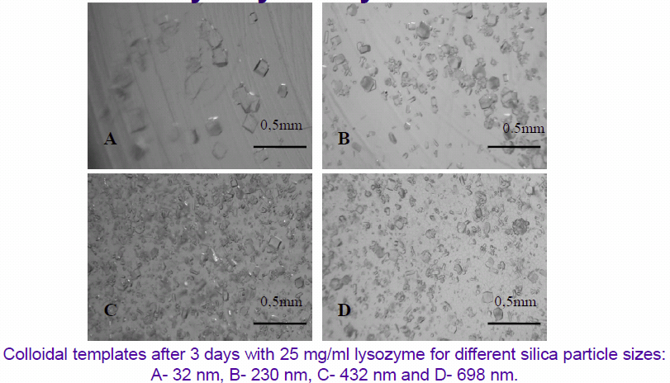
Effects of Surface Topography on Lysozyme Crystallisation

Slide 31
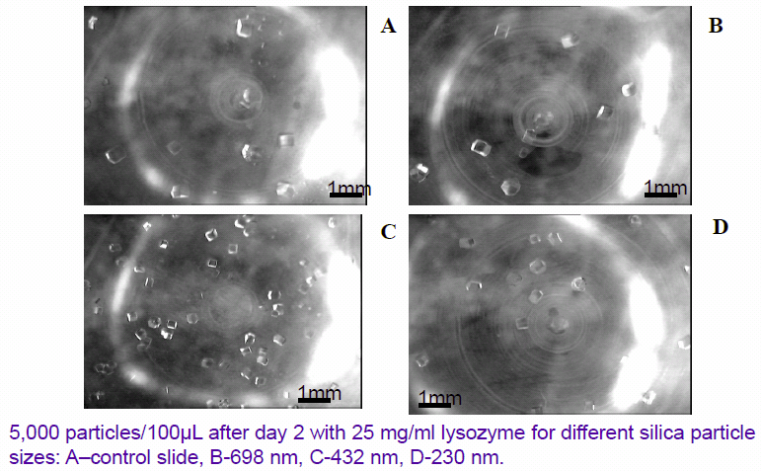
Effects of Intra-particle Porosity on Lysozyme Crystallisation

Slide 32
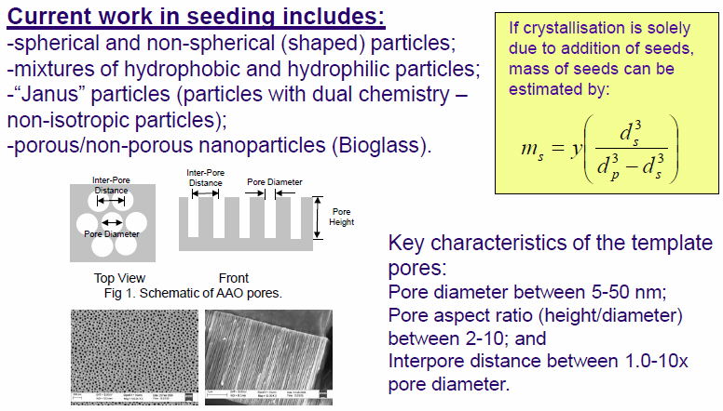
Effects of Porosity on Crystallisation

Slide 33
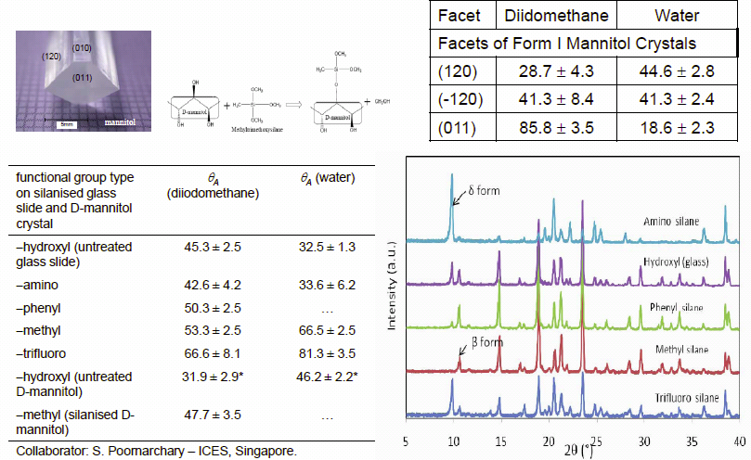
Effects of Surface Chemistry on Secondary Nucleation

Slide 34
Protein Crystallisation - AIMS
To increase the efficiency of protein crystal preparation.
To produce larger protein crystals in a shorter time.
To streamline protein crystal preparation into a
continuous process.
To regularise protein crystal size distribution.
To control the number and size of protein crystals by
chemical and physical modification of surfaces.

Slide 35
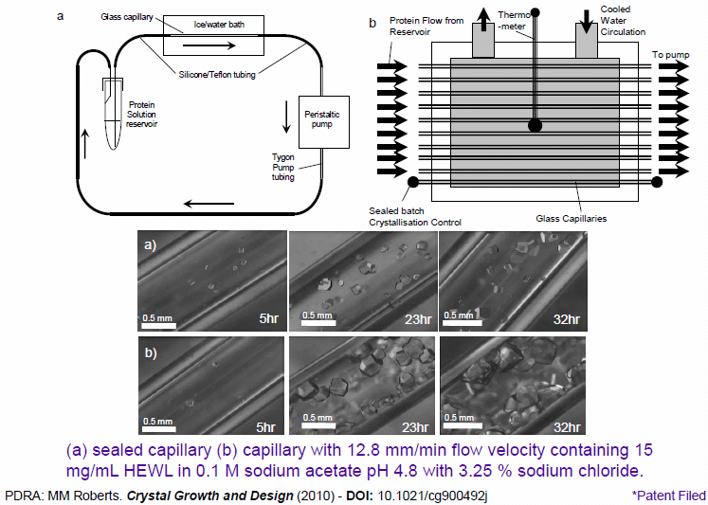
Flow Crystallisation*

Slide 36
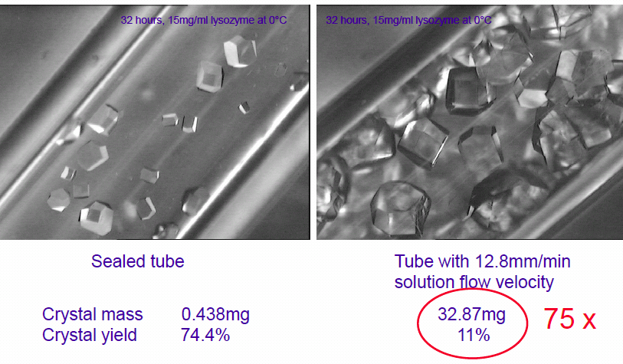
Flow Crystallisation

Slide 37
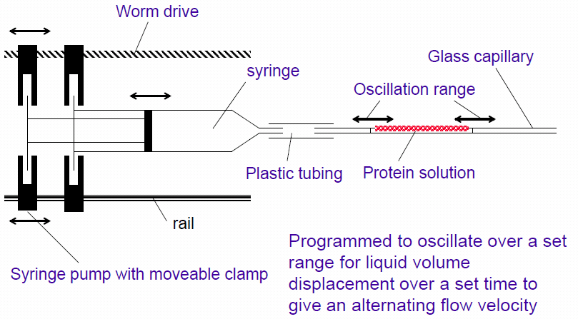
Effects of Flow Mode

Slide 38
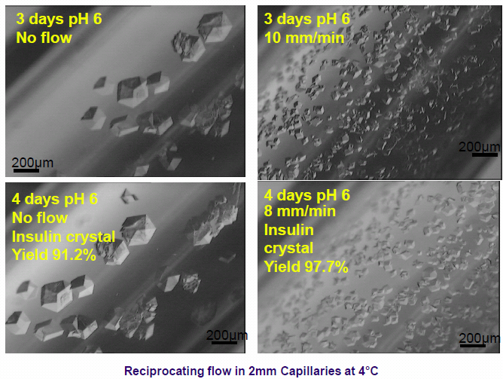
Oscillating Flow - Insulin

Slide 39
Conclusion
Surface properties can influence a range of processing operations and could have an impact on the formulation of pharmaceuticals (and vice versa). [Surface energy (wettability) of crystalline solids is anisotropic (heterogeneous).]
Knowledge of interfacial properties can be used to design/optimise (engineer) a range of particle attributes for solids processing.

Slide 40
Acknowledgments
SPEL Sponsors: AstraZeneca, BBSRC, EPSRC, FrieslandCampina DOMO, GlaxoSmithKline, SMS, Pfizer
Imperial College – DR Williams, PF Luckham, MR Roberts
University of Surrey - JF Watts and S Hinder
University of York - AF Lee and K Wilson
ICES, Singapore – RBH Tan, WK Ng, SK Poornachary
SMS Ltd., UK - F Thielmann (currently at Novartis) and DJ Burnett
C Hayles-Hahn, R Ho*, AE Jefferson, JY Khoo*, A Quigley, U Shah, RR Smith, GD Wang, Y Wang and A Zicari – PhD Students

Slide 41
References
T. Delmas, M. M. Roberts and J. Y. Y. Heng, “Nucleation and Crystallisation of Lysozyme: Role of Substrate Surface Chemistry and Topography”, accepted by Journal of Adhesion Science and Technology (2010).
A. E. Jefferson, D. R. Williams and J. Y. Y. Heng, “Computing the true surface energy heterogeneity of crystalline powders”, accepted by Journal of Adhesion Science and Technology (2010).
J. Y. Khoo, D. R. Williams, and J. Y. Y. Heng, “Dehydration Kinetics of Pharmaceutical Hydrate: Effects of Environmental Conditions and Crystal Forms”, Drying Technology (2010), 28, 1164 – 1169.
M. M. Roberts, J. Y. Y. Heng and D. R. Williams, “Protein Crystallisation by Continuous Flow of a Supersaturated Solution: Enhanced Crystal Growth of Lysozyme in Glass Capillaries”, Crystal Growth and Design (2010), 10 (3), 1074-1083.
R. Ho, A. S. Muresan, G. A. Hebbink and J. Y. Y. Heng, “Influence of Fines on the Surface Energy Heterogeneity of Lactose”, International Journal of Pharmaceutics (2010), 388(1-2), p88-94.
R. Ho, S. E. Dilworth, S. J. Hinder, J. F. Watts, D. R. Williams and J. Y. Y. Heng, “Determination of surface heterogeneity of D-mannitol by sessile drop contact angle and finite concentration inverse gas chromatography”, International Journal of Pharmaceutics (2010), 387(1-2), p79-86.
J. Y. Khoo, J. Y. Y. Heng and D. R. Williams, “Agglomeration effects on the drying and dehydration stability of a pharmaceutical acicular hydrate: Carbamazepine dehydrate”, Industrial & Engineering Chemistry Research (2010), 49(1), p422-427.
R. Ho, D. A. Wilson and J. Y. Y. Heng, “Crystal Habits and the Variation in Surface Energy Heterogeneity”, Crystal Growth & Design (2009), 9 (11), 4907-4911.
J.Y.Y. Heng, “The effects of crystal properties on formulation success”, Journal of Pharmacy and Pharmacology, 61, A152 (2009).
R. Ho, J. Y. Y. Heng, S. Dilworth and D. R. Williams, “Wetting Behaviour of Ibuprofen Racemates Surfaces”, The Journal of Adhesion, 84 (6), 483-501, 2008.
P. Yla-Maihaniemi, J. Y. Y. Heng, F. Thielmann and D. R. Williams, “A novel method for studying the surface energy heterogeneity of solid surfaces”, Langmuir, 24 (17), 9551-9557, 2008.
J. Y. Y. Heng, A. Bismarck, A. F. Lee, K. Wilson and D. R. Williams, “Anisotropic Surface Chemistry of Aspirin Single Crystals”, Journal of Pharmaceutical Sciences, 96 (8), 2134-2144 (2007).
F. Thielmann, D. J. Burnett and J. Y. Y. Heng, “Determination of the surface energy distributions of different processed lactose”, Drug Development and Industrial Pharmacy, 33 (11), 1240-1253 (2007).
J. Y. Y. Heng and D. R. Williams, “Wettability of Paracetamol Polymorphic Forms I and II”, Langmuir, 22 (16), 6905-6909 (2006).
J. Y. Y. Heng, A. Bismarck, A. F. Lee, K. Wilson and D. R. Williams, “Anisotropic Wettability of Macroscopic Form I Paracetamol Crystals”, Langmuir, 22 (6), 2760-2769 (2006).
J. Y. Y. Heng, F. Thielmann and D. R. Williams, “The Effects of Milling on the Surface Properties of Form I Paracetamol Crystals”, Pharmaceutical Research, 23 (8), 1917-1927 (2006).
J. Y. Y. Heng, A. Bismarck and D. R. Williams, “Anisotropic Surface Properties of Crystalline Pharmaceutical Solids”, AAPS PharmSciTech, 7 (4), Article 84 (2006)

Slide 42
BIOS/Contact info
Dr Jerry Heng (JH) currently heads the Surfaces and Particle Engineering Laboratory (www.imperial.ac.uk/spel) at the Department of Chemical Engineering in Imperial College London, UK. The Heng group studies the role of surface properties (and particle properties eg. shape, size, porosity) in powder processing, particle handling and particle performance related to pharmaceutics, drug delivery, and/or the pharmaceutical technologies, engineering particle properties for optimized product performance. The SPEL group currently consists of 1 postdoc, 8 PhD students and 4 MSc students working in the area of particle engineering. The SPEL group houses a range of experimental techniques; eg. DVS, IGC, QCM, XRD, AFM, SEM, Optical Profilometer, PCS
Contact:
Email: jerry.heng@imperial.ac.uk
Phone: +44-207-5940784

