Slide 1


AAPS Graduate Student Symposium in Drug Design and Discovery
Development of ^{99m}Tc-EC-Tyrosine for Early Detection of Response to the Anticancer Drug Melphalan in Breast Cancer
Fan-Lin Kong*, YinHan Zhang, DongFang Yu, David J. Yang
The University of Texas MD Anderson Cancer Center, Houston, Texas

Slide 2
Abstract
Purpose: Radiolabeled tyrosine analogues are used for cancer imaging and accumulate in tumor cells through the upregulated L-type amino acid transporters (LAT). The anticancer drug melphalan is also LAT substrate. This study was to develop a ^{99m}Tc–labeled tyrosine analogue ethylenedicysteine-Tyrosine (EC-Tyrosine), which could be used to noninvasively assess tumor response to melphalan.
Methods: The precursor EC-Tyrosine was synthesized and labeled with ^{99m}Tc. We assessed the cellular uptake kinetics by measuring the %uptake of ^{99m}Tc-EC-Tyrosine in the rat breast cancer cell line 13762 0-2 h. To investigate the transport mechanism of ^{99m}Tc-EC-Tyrosine, we performed a competitive inhibition study in the same cell line using L-Tyrosine. The tissue distribution of ^{99m}Tc-EC-Tyrosine was determined in normal rats up to 4 h after injection. Planar imaging of ^{99m}Tc-EC-Tyrosine in breast tumor–bearing rats was performed 0.5-4 h after injection. To assess the tumor response to melphalan, the breast tumor–bearing rats were equally divided into three groups and treated with/without melphalan at day 0: high dose (40mg/kg), low dose (20mg/kg), and untreated groups. Planar imaging of ^{99m}Tc-EC-Tyrosine was performed 0 and 3 days after treatment, and the tumor-to-muscle ratios (T/Ms) were calculated. The rats’ tumor sizes were measured with a caliper. H&E staining and immunohistochemical analyses were conducted to determine the expression of LAT and the cellular proliferation marker Ki-67.
Results: ^{99m}Tc-EC-Tyrosine was highly stable in vivo in normal rats. Its cellular uptake was significantly inhibited by L-Tyrosine, which indicated ^{99m}Tc-EC-Tyrosine as a LAT substrate. Melphalan reduced the rats’ tumor volumes in a dose-dependent manner and significantly reduced the ^{99m}Tc-EC-Tyrosine T/Ms in both treated groups. About 70% of the tumor cells in the treated groups underwent apoptosis, and the changes in the ^{99m}Tc-EC-Tyrosine T/Ms reflected the reduced percentage of viable cells in the treated tumors.
Conclusions: Our findings collectively suggest that ^{99m}Tc-EC-Tyrosine has great potential for evaluating the tumor response to melphalan in breast tumor-bearing rats.

Slide 3
Introduction
Positron Emission Tomography (PET) using ¹⁸F-fluoro-deoxy-glucose (¹⁸F-FDG) , is the most common tool for tumor imaging
Limitations of ¹⁸F-FDG:
Poor contrast to detect and grade brain tumors
Difficult to differentiate between inflammation and tumor tissues
Radiolabeled amino acid-based radiotracers as an alternative

Slide 4
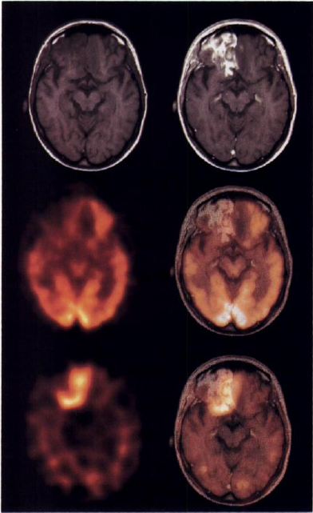
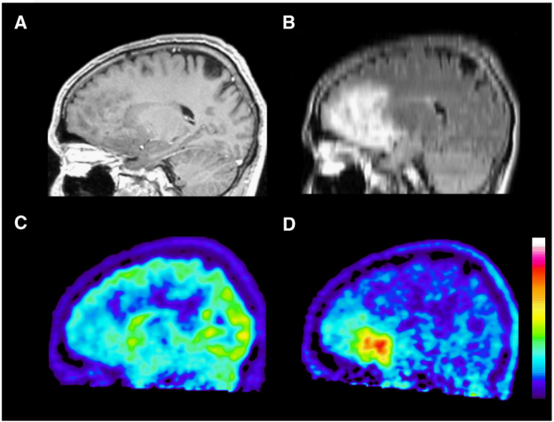
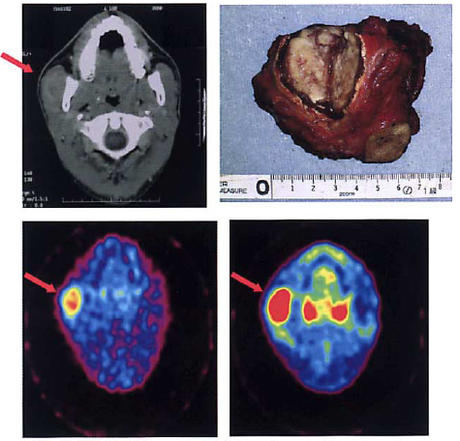
Promising Clinical Data of Tyrosine-based Radiotracers for Diagnosis and Staging of Cancer
¹²³I-AMT
Recurrent Glioblastoma
¹⁸F-FET
Oligoastrocytoma Grade III
¹⁸F-AMT
Maxillofacial Tumor
Pauleit et.al., NMB 2009; 36; 779-787
Adapted from Sato et. al., Neuroradiology; 2003; 45; 700-707
Weber et.al., JNM 1997; 38; 802-808

Slide 5
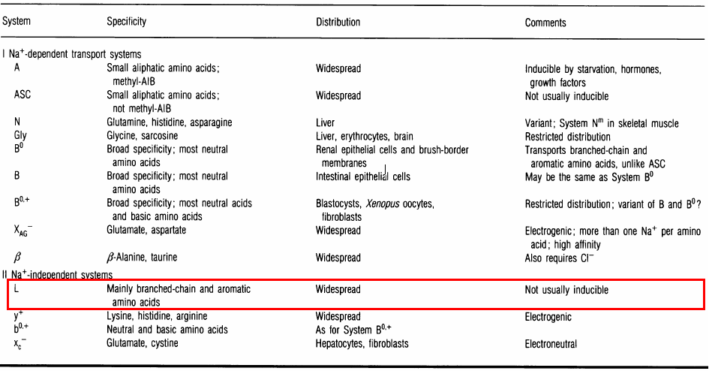
Major Amino Acid Transport Systems in Mammalian Cells
McGivan et al., Biochem J., 1994

Slide 6
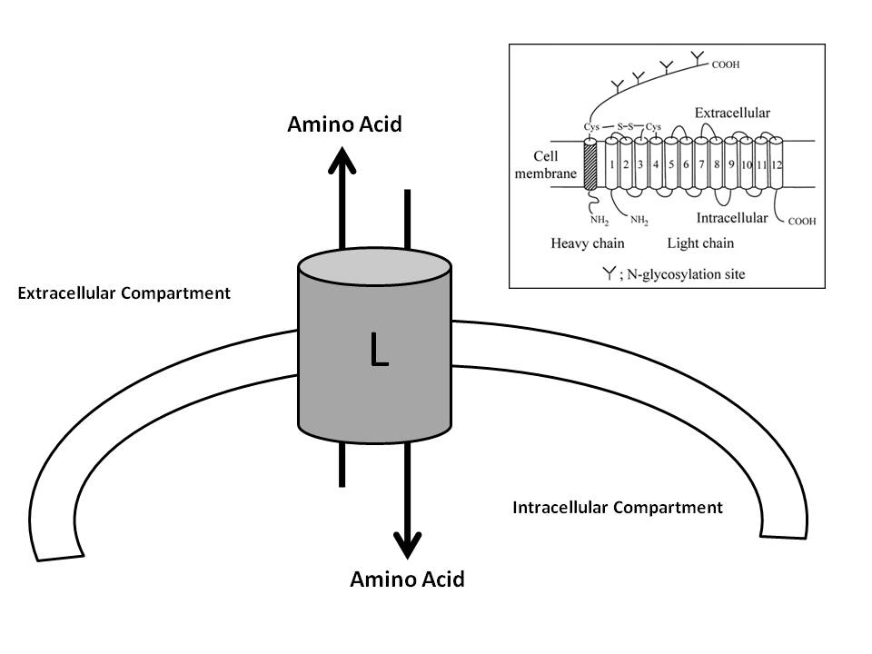
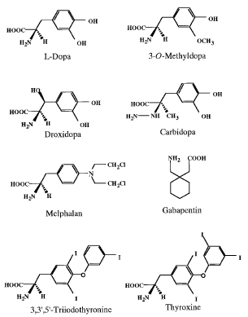
L-type Amino Acid Transporters (LAT family)
Uchino et.al., Mol Pharmacol., 2002. 61 ($): p.729
Na⁺-independent system
transports large neutral amino acids (i.e., branched-chain and aromatic amino acids)
a heterodimer consisting of a heavy chain and a light chain
Upregulated LAT-1 expression is considered as a diagnostic and prognostic biomarker for various cancer types
Broad substrate selectivity: hormones, L-DOPA, melphalan, etc.

Slide 7
Radioisotopes Have Been Labeled with Tyrosine Analogues
 | Isotope | Source | Decay Type | Half-life | Energy (MeV)
PET | ¹¹C | cyclotron | Β⁺ (100%) | 20 min | 0.511
 | ¹⁸F | cyclotron | Β⁺ (97%) K (3%) | 110 min | 0.511
 | ¹²⁴I | cyclotron | Β⁺ (28%), K | 4.2 d | 0.511
 | ¹²⁵I | reactor | K | 57.4 d | 0.035 (100%)
SPECT | ¹²³I | cyclotron | K | 13 h | 0.159 (100%)
 | ¹³¹I | reactor fission products | Β⁻ | 8.05 d | Β⁻ 0.61 (87%), γ 0.364 (82%)
Notes:
So far, ¹¹C, ¹⁸F, and different isotopes of Iodine have been labeled with tyrosine and its analogs.
However, most of these radioisotopes are cyclotron produced, which is inconvenient and expensive.
Besides, the half-life of those isotopes is either too long or too short, which is not suitable for tumor imaging.
Furthermore, the radiosynthetic yield of ¹⁸F-labeled tyrosine analogs appeared to be relatively low because of its electrophilic fluorination step (covalent chemistry vs. coordination chemistry).
Therefore, it is desirable to develop a radiotracer with a simpler chemistry and affordable isotope, which can be used in most major medical facilities.

Slide 8
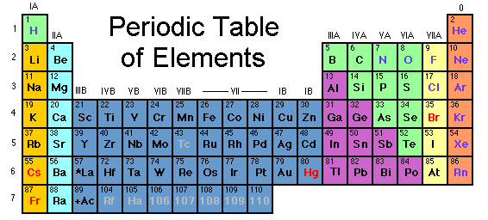
Technetium-99m (^{99m}Tc)
Decay: 140 kev γ –ray (89%)
Half-life: 6.02 h
In-house generator produced (⁹⁹Mo/^{99m}Tc generator)
Diagnostic/therapeutic matched pair with Rhenium-188 (¹⁸⁸Re)
used in more than 30 radiopharmaceuticals
About 50,000 ^{99m}Tc-based diagnostic procedures are performed in the US every day
Notes:
Here, I will choose ^{99m}Tc for tyrosine analogs labeling.
^{99m}Tc is an ideal radioisotope for diagnostic imaging studies, because of its physical characteristics.
It emits a 140 keV gamma ray in 89% abundance, which can be detected by NaI detectors with low energy high-resolution collimator in the standard gamma camera or SPECT (Single photon emission computed tomography ).
^{99m}Tc has a half-life of 6.02 hr, which is ideal for preparation of the radiolabeled small ligands.
Most important thing is that it is produced by in-house generator that contains the parent nuclide molybdenum-99 (Mo-99), and does not require the cyclotron.
In addition, technetium (Tc) is in the same group as rhenium (Re), which has the radioisotope rhenium-188 (¹⁸⁸Re) for cancer therapeutic applications. Tc chemistry is very similar to that of Re, which leads to the diagnostic/therapeutic matched pair.
Furthermore, due to their identical coordination parameters with the same ligands, Re complex is a good structural model for ^{99m}Tc complex, because of its non-radioactivity.

Slide 9

Why Use Chelators?
Label different kinds of radioisotopes to the same target ligand
For various imaging modalities
Provide dosimetry for internal radionuclidic therapy
Monitoring tumor response to treatment
Notes:
So the next question is how can we label tyrosine analogs with ^{99m}Tc. Here, we use “chelator”, which acts like a bridge to connect the radioisotope and our target ligand, in this case, tyrosine and its analogs.
The advantage of using chelator is that we can label different kinds of radioisotopes to the same target ligand. By doing this, we can use the radiotracer for various imaging modalities.
We can provide dosimetry for radiation therapy, and monitor tumor response to the treatment.

Slide 10
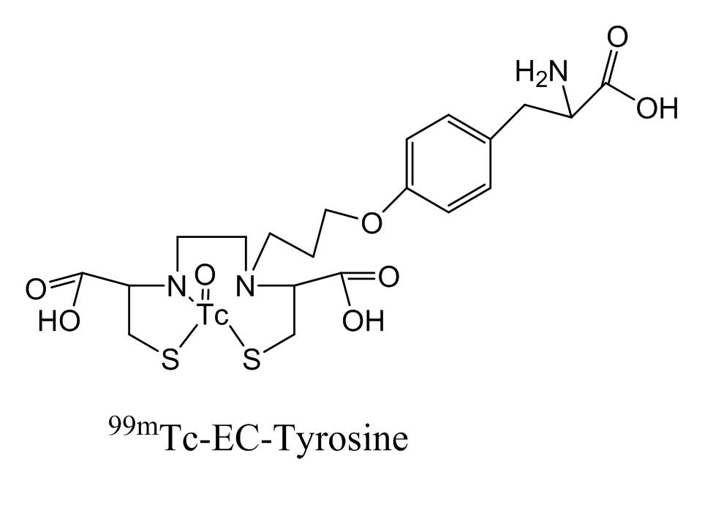
Purpose
Radiolabeled tyrosine analogues are used for cancer imaging successfully and accumulate in tumor cells through the upregulated L-type amino acid transporters (LAT).
The anticancer drug melphalan is also LAT substrate.
This study was to develop a ^{99m}Tc–labeled tyrosine analogue ethylenedicysteine-Tyrosine (EC-Tyrosine), which could be used to noninvasively assess breast tumor response to melphalan.

Slide 11
Materials and Methods
Chemistry and Radiochemistry
EC-Tyrosine synthesis
^{99m}Tc-EC-Tyrosine labeling
Partition coefficient measurement
In Vitro Evaluation
Cellular uptake kinetics in rat breast tumor cell line 13762
Competitive inhibition study using L-Tyrosine in the same cell line
In Vivo Evaluation
Blood clearance in normal Fischer 344 rats
Biodistribution in normal Fischer 344 rats
Planar scintigraphic imaging in breast tumor-bearing rats
In vivo uptake blocking study
Melphalan treatment response assessment

Slide 12
Results (Chemistry)

Slide 13
Results (Cell Uptake Kinetics)

Slide 14
Results (Competitive Inhibition Study)

Slide 15
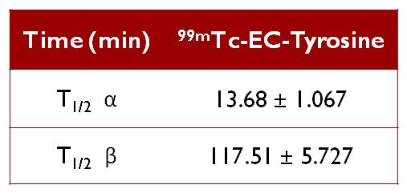
Results (Blood Clearance )

Slide 16
Results (Biodistribution)
%ID/g | 30 MIN | 120 MIN | 240 MIN
Blood | 0.96 ±0.076 | 0.41 ±0.039 | 0.23 ±0.006
Heart | 0.24 ±0.007 | 0.12 ±0.011 | 0.08 ±0.009
Lungs | 0.47 ±0.041 | 0.33 ±0.001 | 0.20 ±0.025
Thyroid | 0.43 ±0.036 | 0.24 ±0.001 | 0.11 ±0.002
Pancreas | 0.21 ±0.018 | 0.17 ±0.016 | 0.10 ±0.007
Liver | 1.47 ±0.045 | 2.42 ±0.075 | 0.97 ±0.007
Spleen | 0.47 ±0.054 | 1.41 ±0.117 | 0.62 ±0.036
Kidneys | 11.12 ±0.545 | 16.50 ±0.395 | 11.13 ±0.234
Stomach | 0.27 ±0.006 | 0.19 ±0.002 | 0.08 ±0.000
Intestine | 1.13 ±0.009 | 0.33 ±0.023 | 0.17 ±0.017
Muscles | 0.10 ±0.009 | 0.05 ±0.006 | 0.03 ±0.000
Bones and joints | 0.28 ±0.021 | 0.10 ±0.003 | 0.07 ±0.009
Brain | 0.04 ±0.003 | 0.01 ±0.001 | 0.01 ±0.001

Slide 17
Results (Planar Scintigraphic Imaging)

Slide 18
Results (In Vivo Uptake Blocking Study)

Slide 19
Results (Melphalan Treatment Response Assessment)

Slide 20
Results (Melphalan Treatment Response Assessment)

Slide 21
Conclusion
Precursor EC-tyrosine was synthesized and labeled with ^{99m}Tc readily and efficiently, with high radiochemical purity.
In vitro cellular uptake and in vivo uptake blocking studies collectively demonstrated that ^{99m}Tc-EC-tyrosine transport involved the amino acid transporter system LAT.
Melphalan reduced the rats’ tumor volumes in a dose-dependent manner and significantly reduced the ^{99m}Tc-EC-Tyrosine T/Ms in both treated groups. About 70% of the tumor cells in the treated groups underwent apoptosis, and the changes in the ^{99m}Tc-EC-Tyrosine T/Ms reflected the reduced percentage of viable cells in the treated tumors.
Because of its simple chemical synthesis procedure, high cost effectiveness of the radioisotope, comparatively high T/M %uptake ratios on planar imaging, and excellent ability to evaluate tumors’ response to melphalan, ^{99m}Tc-EC-tyrosine will be a great alternative to the clinical gold standard, ¹⁸F-FDG, for breast cancer imaging.
By taking advantage of the coordination ability of the chelator, EC-tyrosine can chelate various radioisotopes for diagnostic imaging, chemotherapy prediction, or internal radionuclide therapy in the future.

Slide 22
Acknowledgments
AAPS Drug Design and Discovery Section
Dr. David Yang’s lab members
Funding sources:
Sponsored research agreement made by Cell>Point L.L.C (MDA LS01-212)
John S. Dunn Foundation
M.D. Anderson Cancer Center CORE Grant NIH NCI CA-16672

Slide 23
References
1. Weber, W., P. Bartenstein, M.W. Gross, D. Kinzel, H. Daschner, H.J. Feldmann, G. Reidel, S.I. Ziegler, C. Lumenta, M. Molls, and M. Schwaiger, Fluorine-18-FDG PET and iodine-123-IMT SPECT in the evaluation of brain tumors. J Nucl Med, 1997. 38(5): p. 802-8.
2. Pauleit, D., G. Stoffels, A. Bachofner, F.W. Floeth, M. Sabel, H. Herzog, L. Tellmann, P. Jansen, G. Reifenberger, K. Hamacher, H.H. Coenen, and K.J. Langen, Comparison of (18)F-FET and (18)F-FDG PET in brain tumors. Nucl Med Biol, 2009. 36(7): p. 779-87.
3. Sato, N., T. Inoue, K. Tomiyoshi, J. Aoki, N. Oriuchi, A. Takahashi, T. Otani, H. Kurihara, T. Sasaki, and K. Endo, Gliomatosis cerebri evaluated by ¹⁸Falpha-methyl tyrosine positron-emission tomography. Neuroradiology, 2003. 45(10): p. 700-7.
McGivan, J.D. and M. Pastor-Anglada, Regulatory and molecular aspects of mammalian amino acid transport. Biochem J, 1994. 299 ( Pt 2): p. 321-34.
Uchino, H., Y. Kanai, D.K. Kim, M.F. Wempe, A. Chairoungdua, E. Morimoto, M.W. Anders, and H. Endou, Transport of amino acid-related compounds mediated by L-type amino acid transporter 1 (LAT1): insights into the mechanisms of substrate recognition. Mol Pharmacol, 2002. 61(4): p. 729-37.

Slide 24
BIOS/Contact info
Fan-Lin Kong, Ph.D.
Department of Experimental Diagnostic Imaging
The University of Texas M. D. Anderson Cancer Center
1515 Holcombe Blvd., Mailbox 059
Houston, Texas 77030
Phone: 713-745-7043
Email: fanlin.kong@mdanderson.org

