Slide 1


Young Innovators 2009
Novel drug and gene delivery systems for targeted cancer therapy
Sneha Sundaram
University of Nebraska Medical Center

Slide 2
Abstract
Purpose: By developing tumor targeted drug-peptide conjugates and functionalized nanoparticles, the purpose of this study was to advance innovative drug delivery systems for treating lung and prostate cancers.
Methods: Deslorelin was conjugated to docetaxel and conjugation was confirmed using NMR, FTIR and LC-MS analyses. Further, surface functionalized anti-VEGF plasmid (a gift from Dr. Bala Ambati) loaded poly(lactide-co-glycolide) nanoparticles (NP) were prepared and used in various studies. In vitro antiproliferative effects of the drug and conjugate in LNCaP, PC-3 and H1299 cells were determined using an MTT assay. Further, the efficacy of the drug conjugate following intravenous dosing was determined in mouse xenograft models. RGD peptide conjugated, plasmid containing NP were assessed for their ability to enhance the antitumor efficacy of deslorelin-docetaxel conjugate. Finally, deslorelin and transferrin functionalized NP were assessed for enhancing noninvasive delivery of plasmid across excised nasal tissue for effects in target prostate cancer cells.

Slide 3
Abstract
Results: Deslorelin-docetaxel enhanced antiproliferative efficacy of docetaxel in both prostate and lung cancer cells by about 10-fold. Intravenous deslorelin-docetaxel achieved 5.5- and 2.5-fold greater tumor inhibition compared to docetaxel in PC-3 prostate and H1299 lung cancer xenograft models, respectively. RGD functionalized plasmid loaded NP were more effective than non-functionalized NP in the lung cancer model. Further, co-administration of deslorelin-docetaxel with plasmid containing RGD functionalized NP resulted in the greatest reduction in tumor size. Nasal transport studies with functionalized plasmid loaded NP followed by exposure of the transported particles to prostate cancer cells indicated that the NP exhibited nasal transport, nasal uptake and target cell efficacy in the order: transferrin functionalized NP > deslorelin functionalized NP > non-functionalized NP >> plasmid alone suggesting the suitability of functionalized NP for non-invasive systemic gene delivery via the nose.
Conclusions: Deslorelin conjugation enhances anticancer activity of docetaxel both in vitro and in vivo in cancer models. Functionalization of NP enhances gene delivery via invasive as well as non-invasive routes.

Slide 4
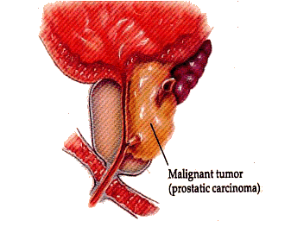
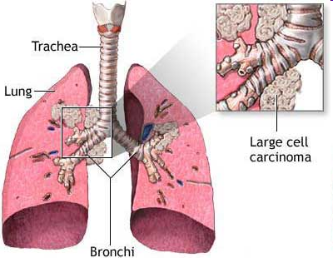
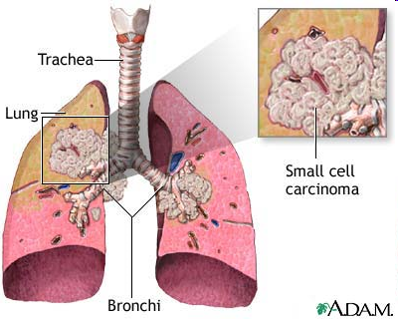
Introduction
New cases (2009): Prostate = 192,280; Lung = 219,440
Deaths (2009): Prostate = 27,360; Lung = 159,390

Slide 5
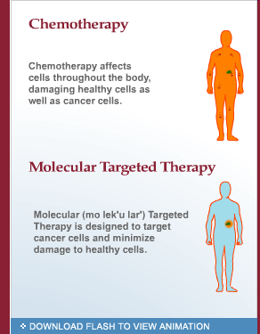
Introduction
Chemotherapy
Limitations
Non-specific toxicity
Intrinsic/ acquired drug resistance
Side effects
Targeted delivery
Specifically to the tumor site
Improved efficiency
Reduced dose = same efficacy
Dose escalation

Slide 6
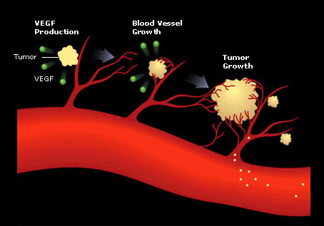
Introduction
VEGF and angiogenesis: Tumor growth and progression
Tumors cannot grow beyond 2 mm
Produce VEGF
VEGF ➔ new blood vessel growth ➔ tumor growth ➔ metastasis
VEGF inhibition ➔ tumor growth inhibition
Gene therapy with anti-VEGF intraceptor (Flt23k) plasmid

Slide 7
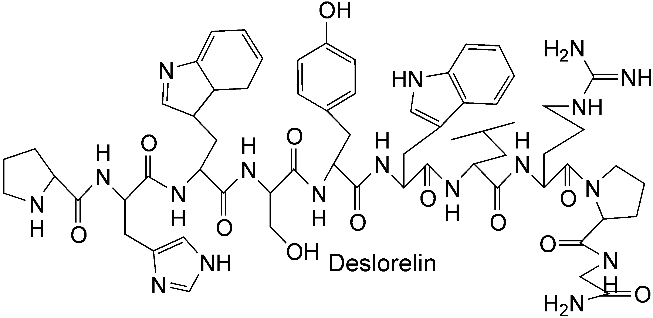
Introduction
pGlu-His-Trp-Ser-Tyr-D-Trp-Leu-Arg-Pro-NHEt
LHRH agonist, 1.3 kDa
144 time potent than native LHRH
Useful in treatment of diseases
  Uterine fibroids
  Endometriosis
  Breast and prostate cancer

Slide 8
Materials and Methods
Incubate 10000 cells (PC-3, LNCaP or H1299) per well for 24 h
Incubate with treatment over 24, 48 or 72 h
MTT assay for antiproliferative efficacy
Add treatment
Controls
Untreated
Ethanol Control
Treatments:
Deslorelin
Docetaxel
Deslorelin-docetaxel conjugate

Slide 9
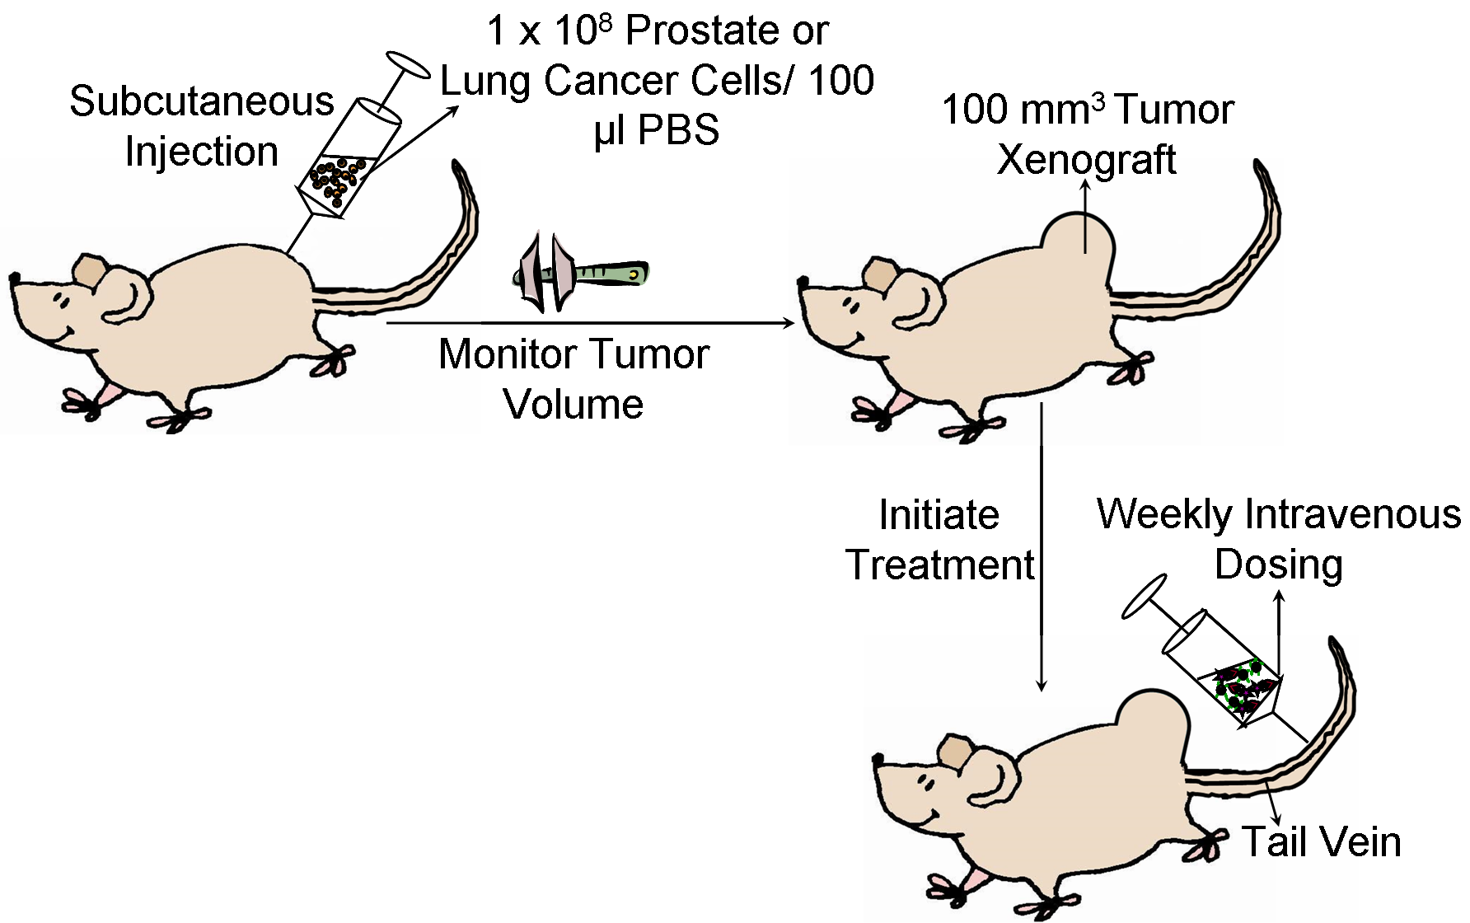
Materials and Methods

Slide 10
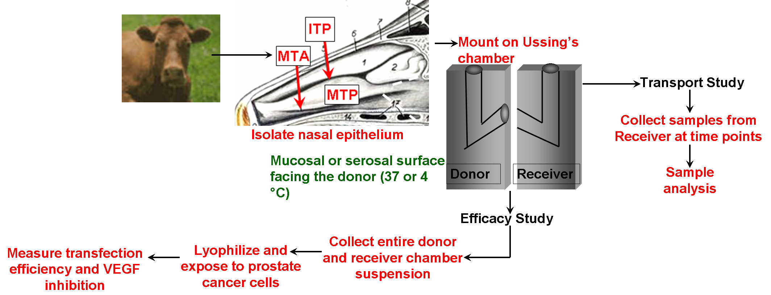
Materials and Methods

Slide 11
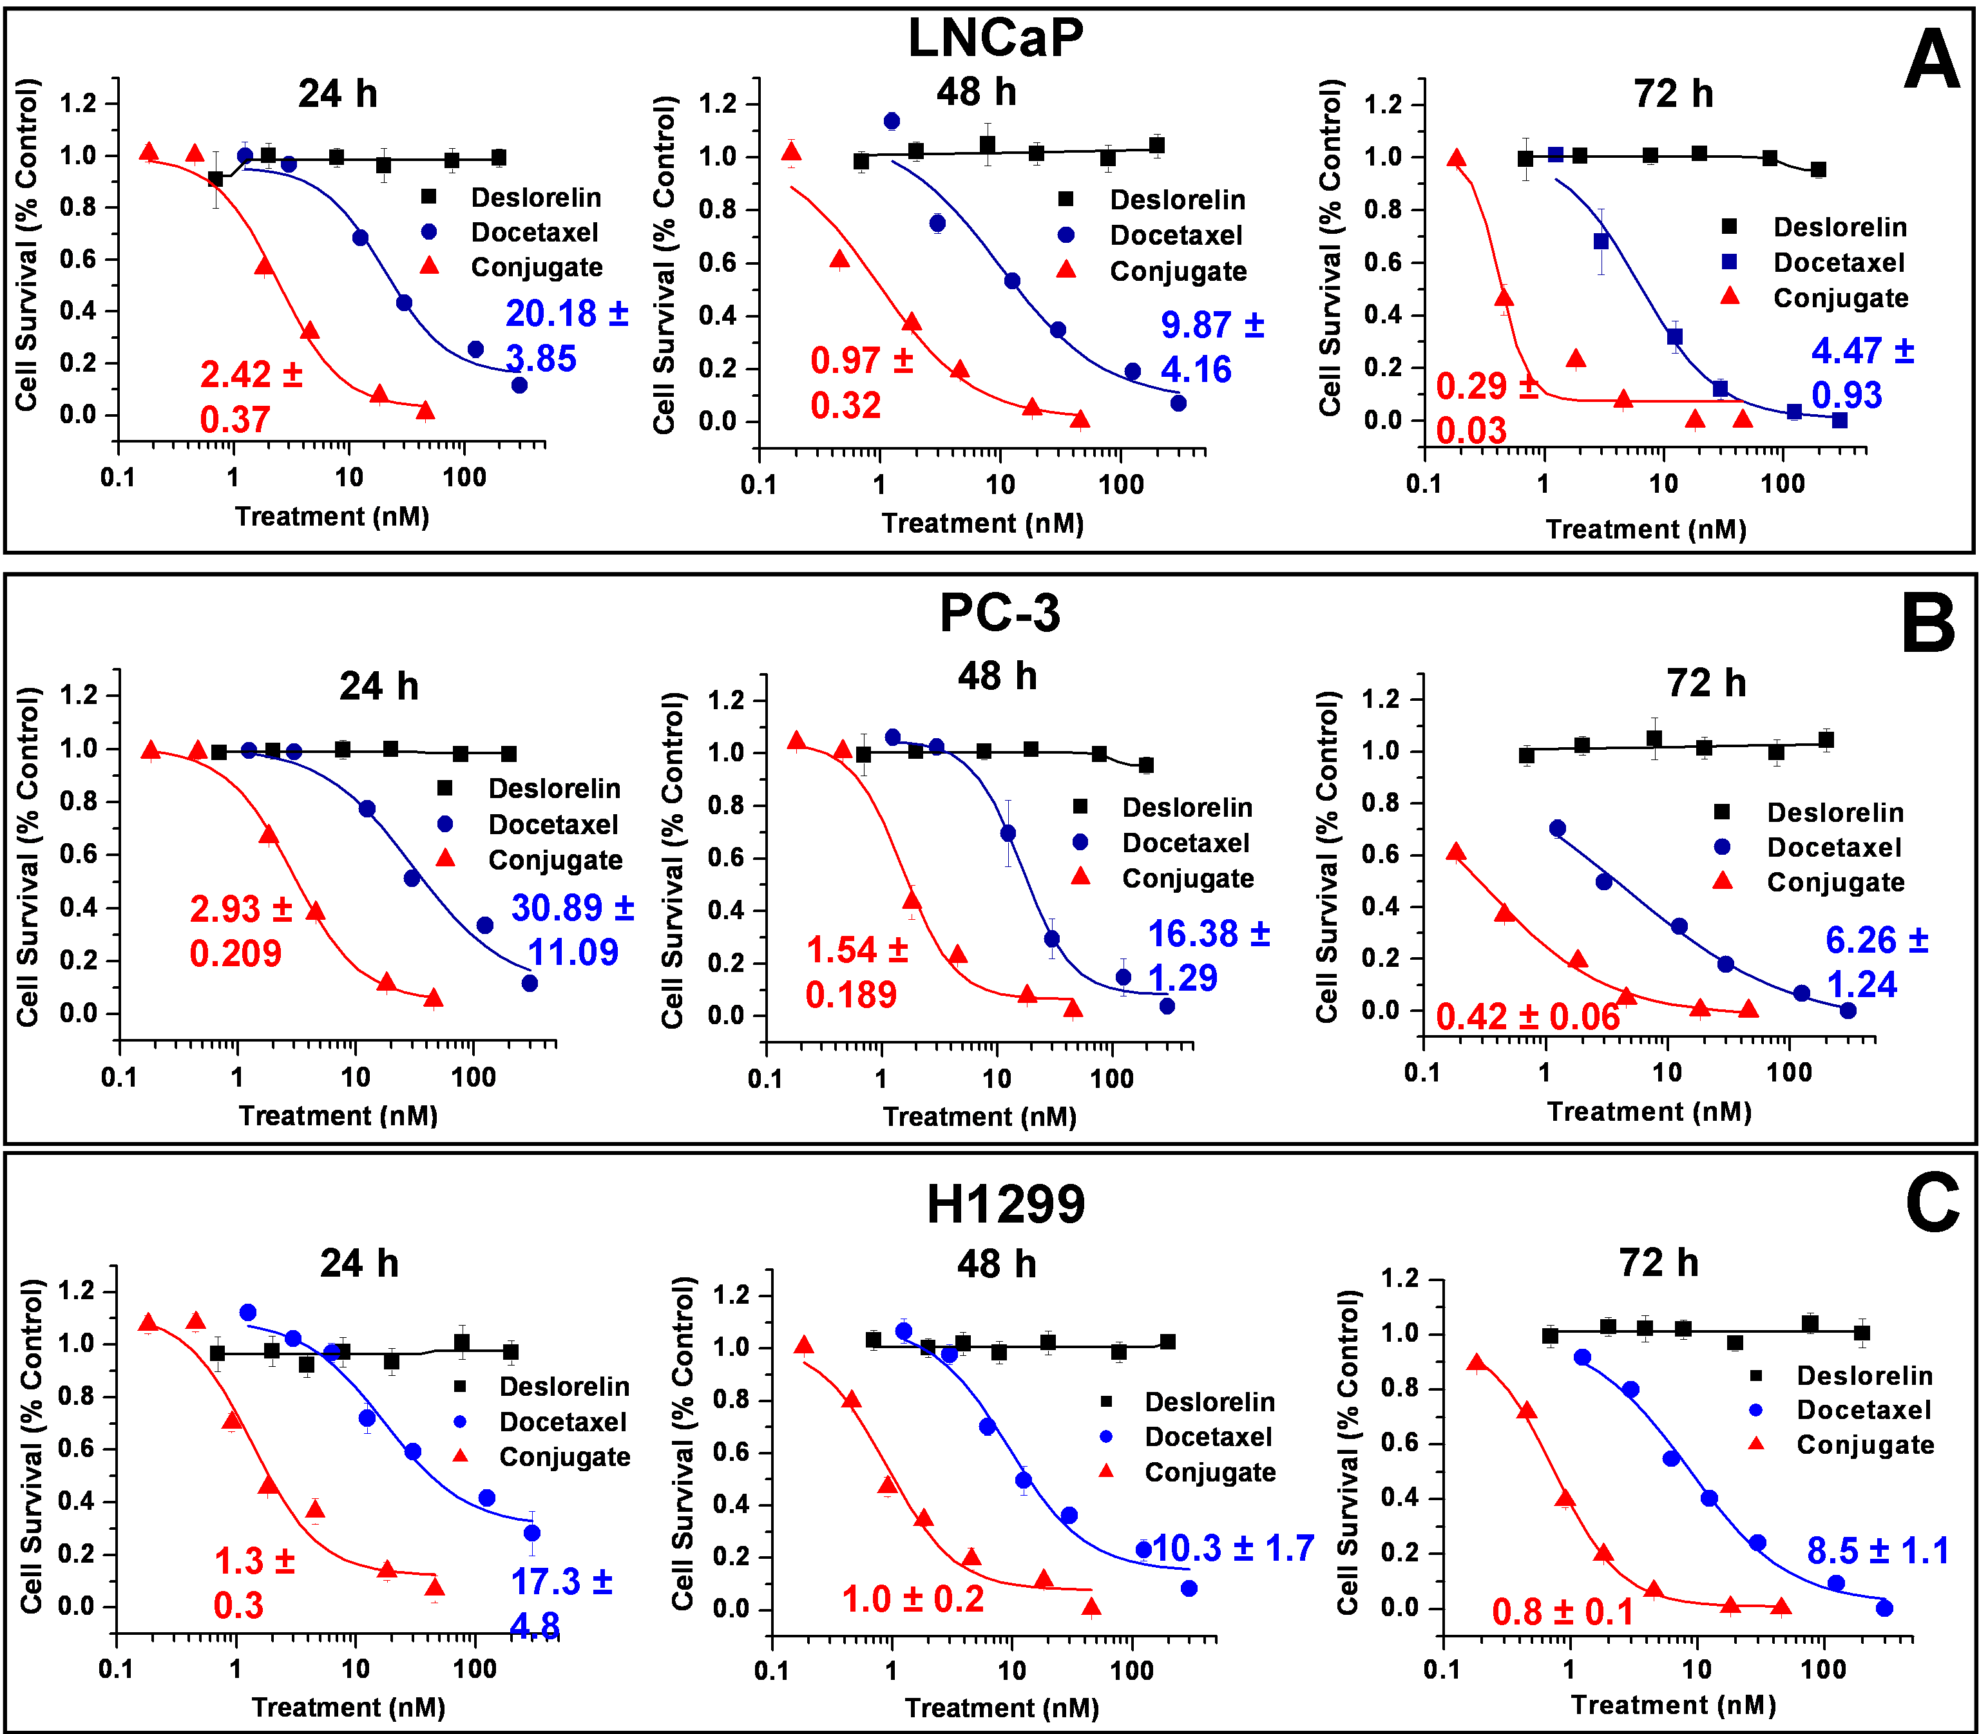
Results
Deslorelin-docetaxel conjugate exhibits greater efficacy via the LHRH-R in prostate and lung cancer cells in vitro

Slide 12
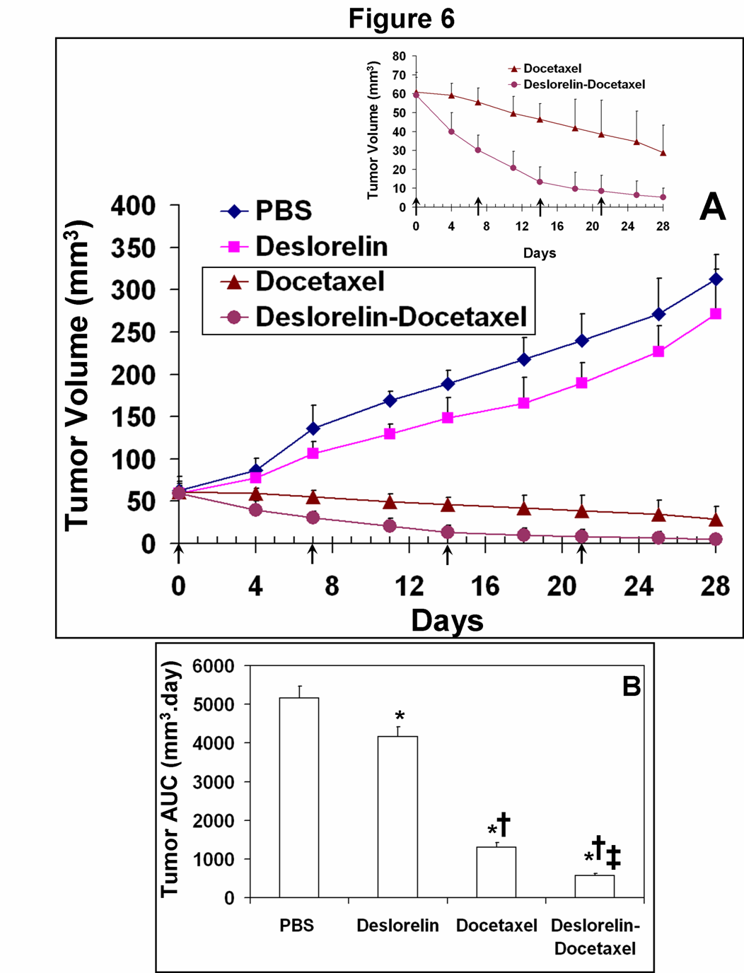
Results
Data is expressed as mean ± s.d. for n = 6
Tumor growth inhibition exhibits the order: deslorelin-docetaxel > docetaxel >> deslorelin > vehicle
Deslorelin-docetaxel exhibits 55-fold greater tumor inhibition compared with vehicle and 5-fold greater tumor inhibition compared with docetaxel

Slide 13
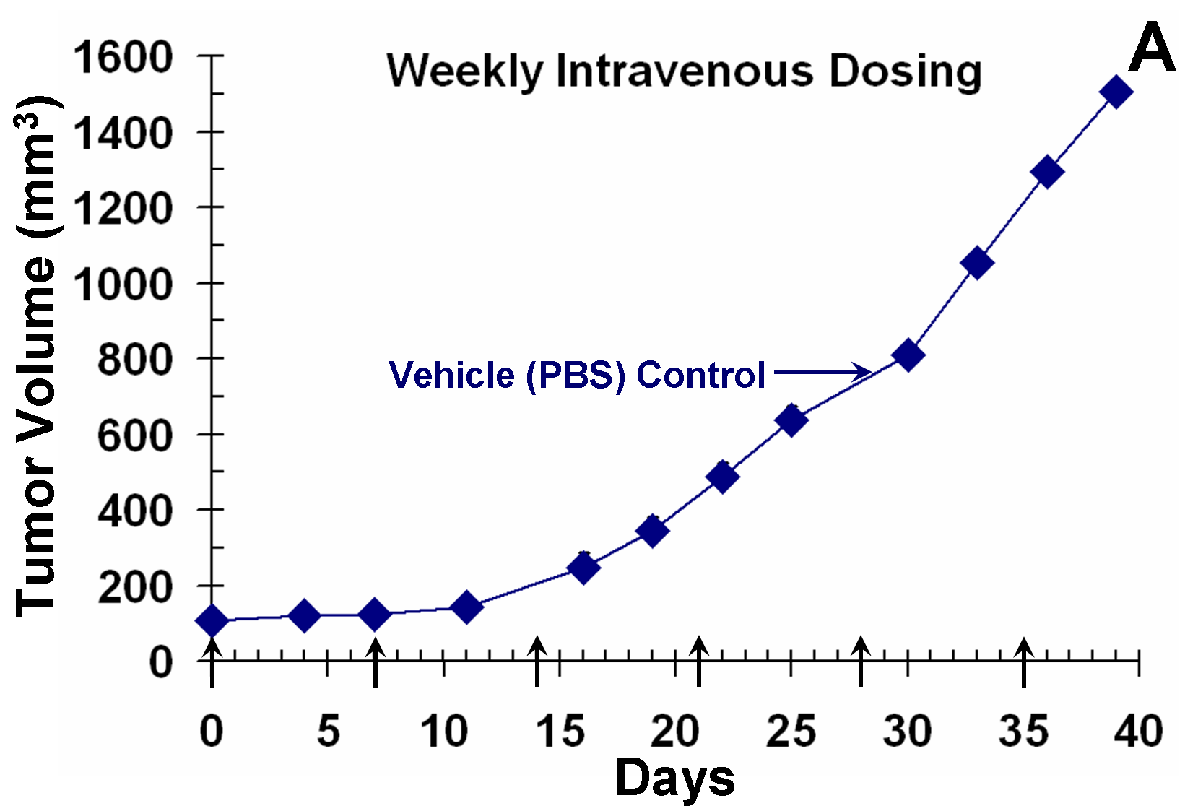
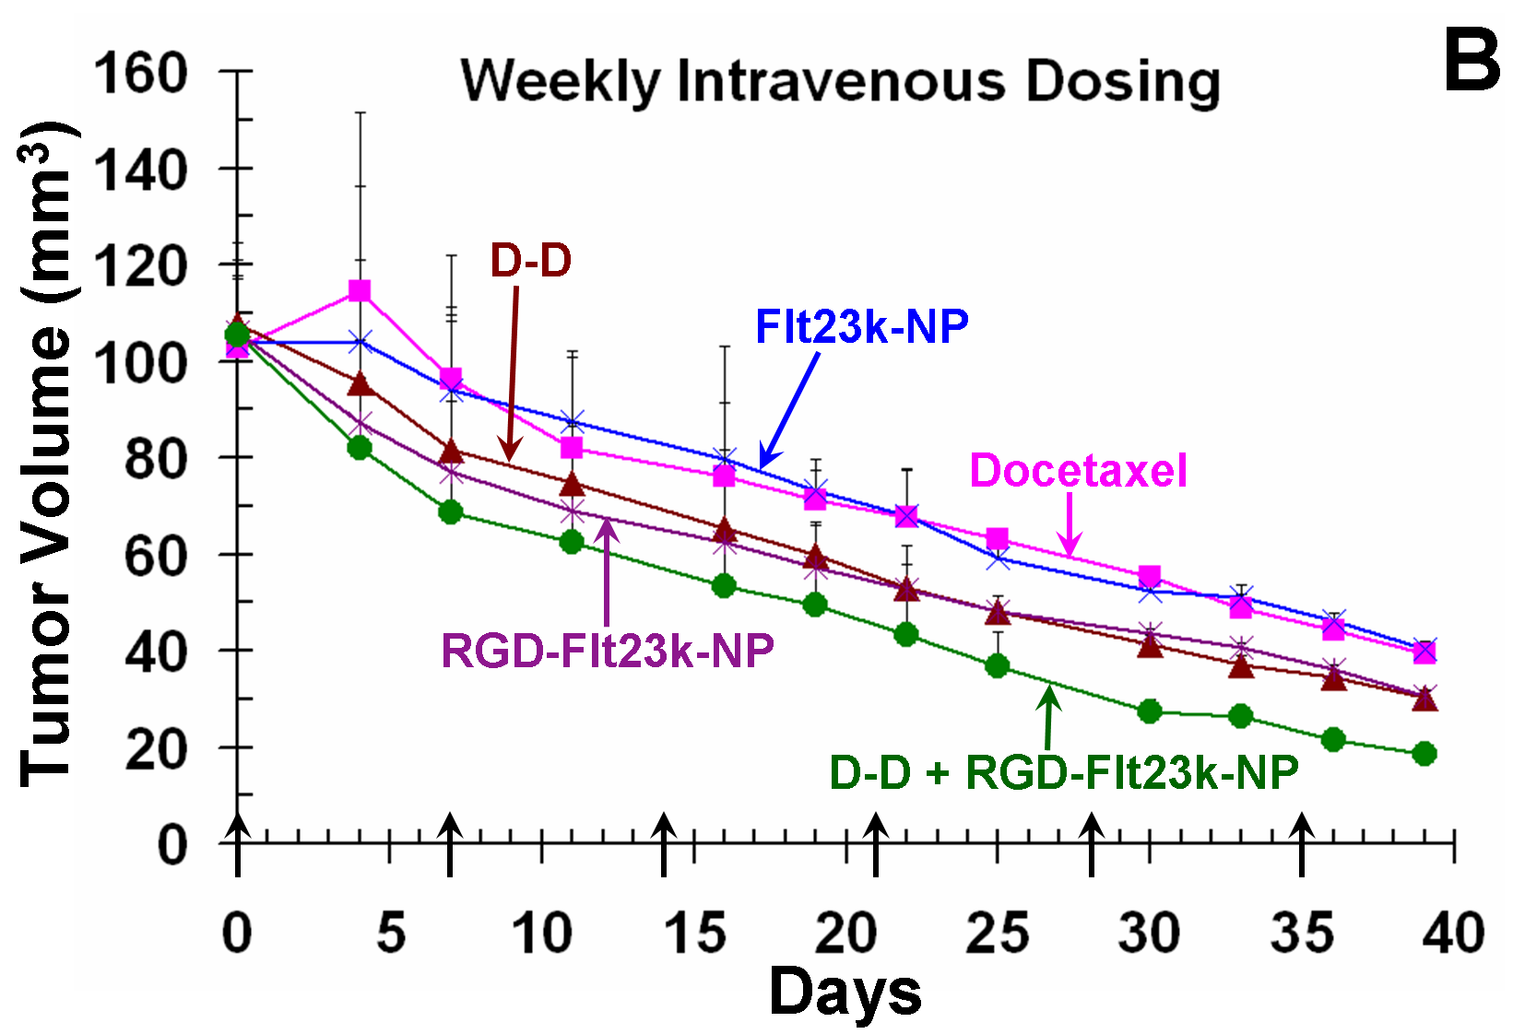
Results
= days when treatment was administered
Data are expressed as mean ± standard deviation for n = 6
Co-administration of two therapeutic agents enhances in vivo efficacy in lung cancer xenografts

Slide 14
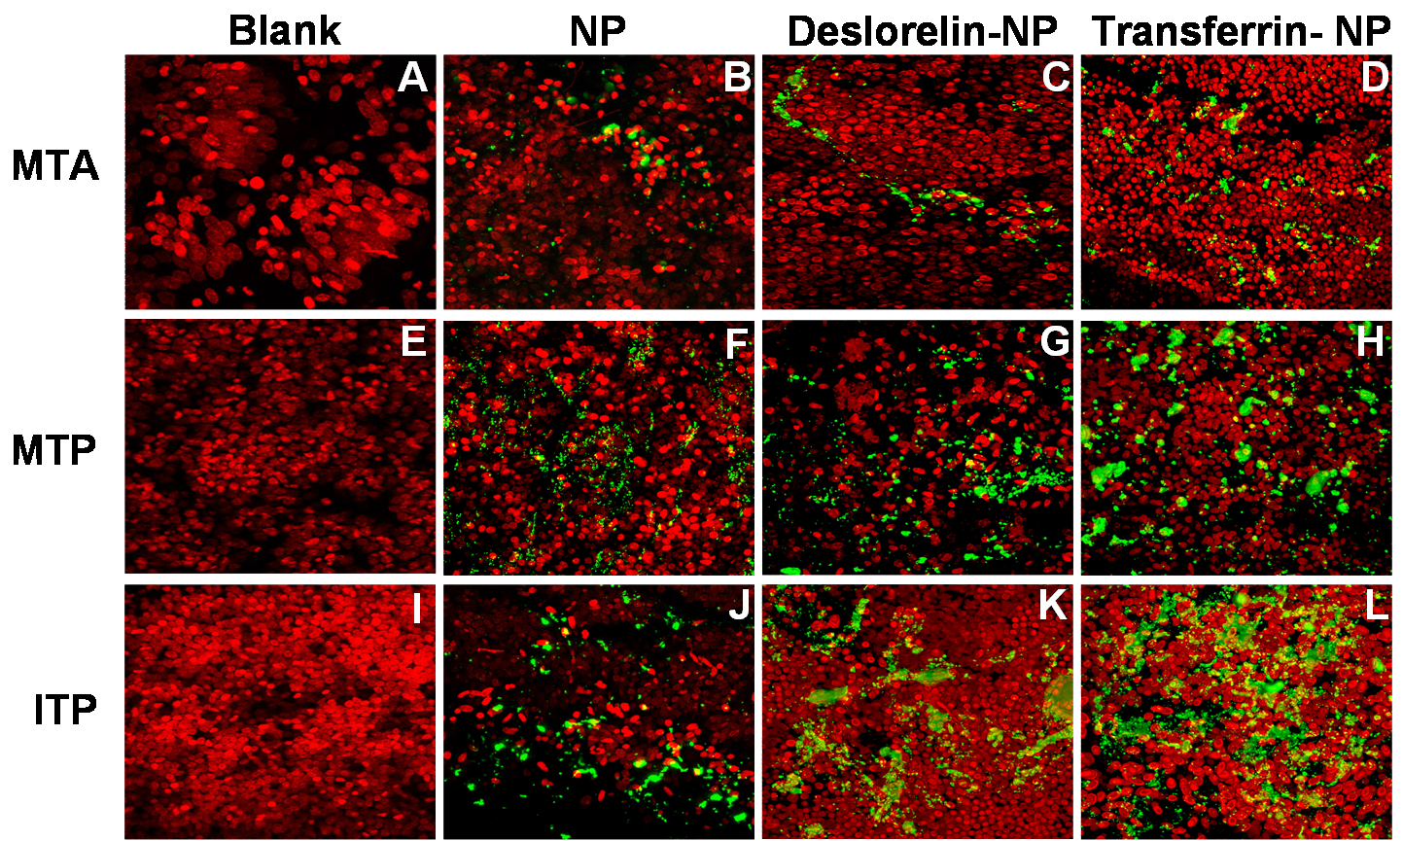
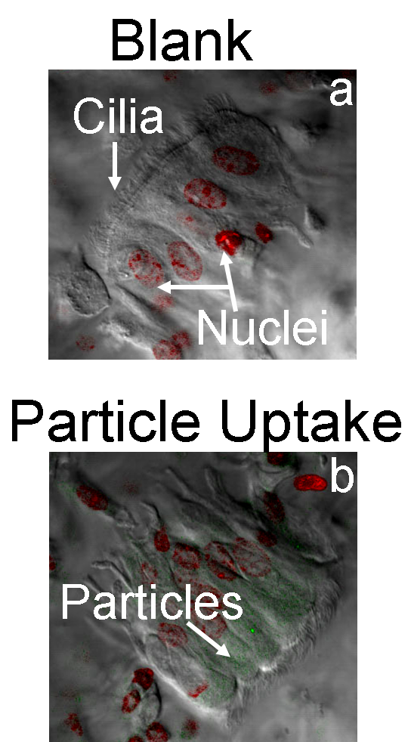
Results
Functionalization enhances uptake into nasal tissues: Transferrin-NP > Deslorelin-NP > NP
Respiratory cells take up nanoparticles

Slide 15
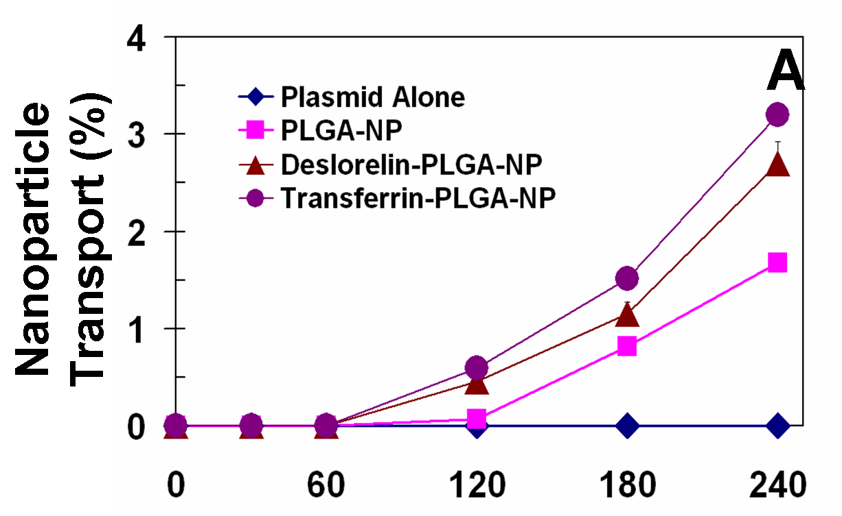
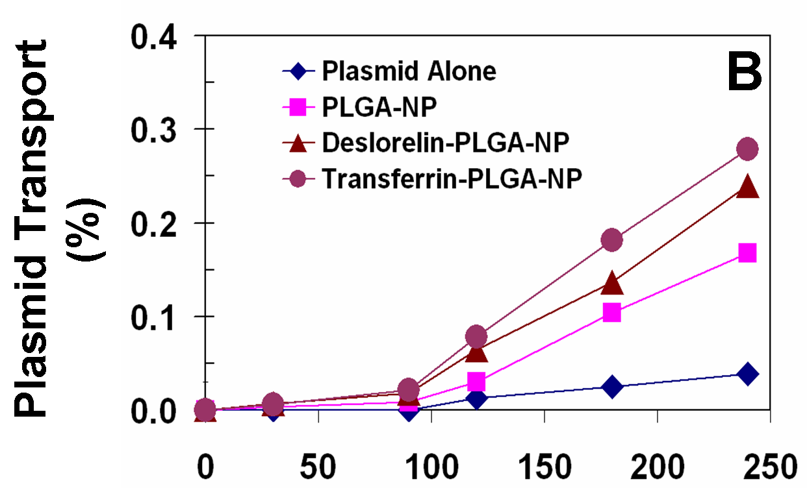
Results
Data is expressed as mean ± s.d. for n = 3
Functionalization of nanoparticles enhances transport of both particles and encapsulated payload

Slide 16
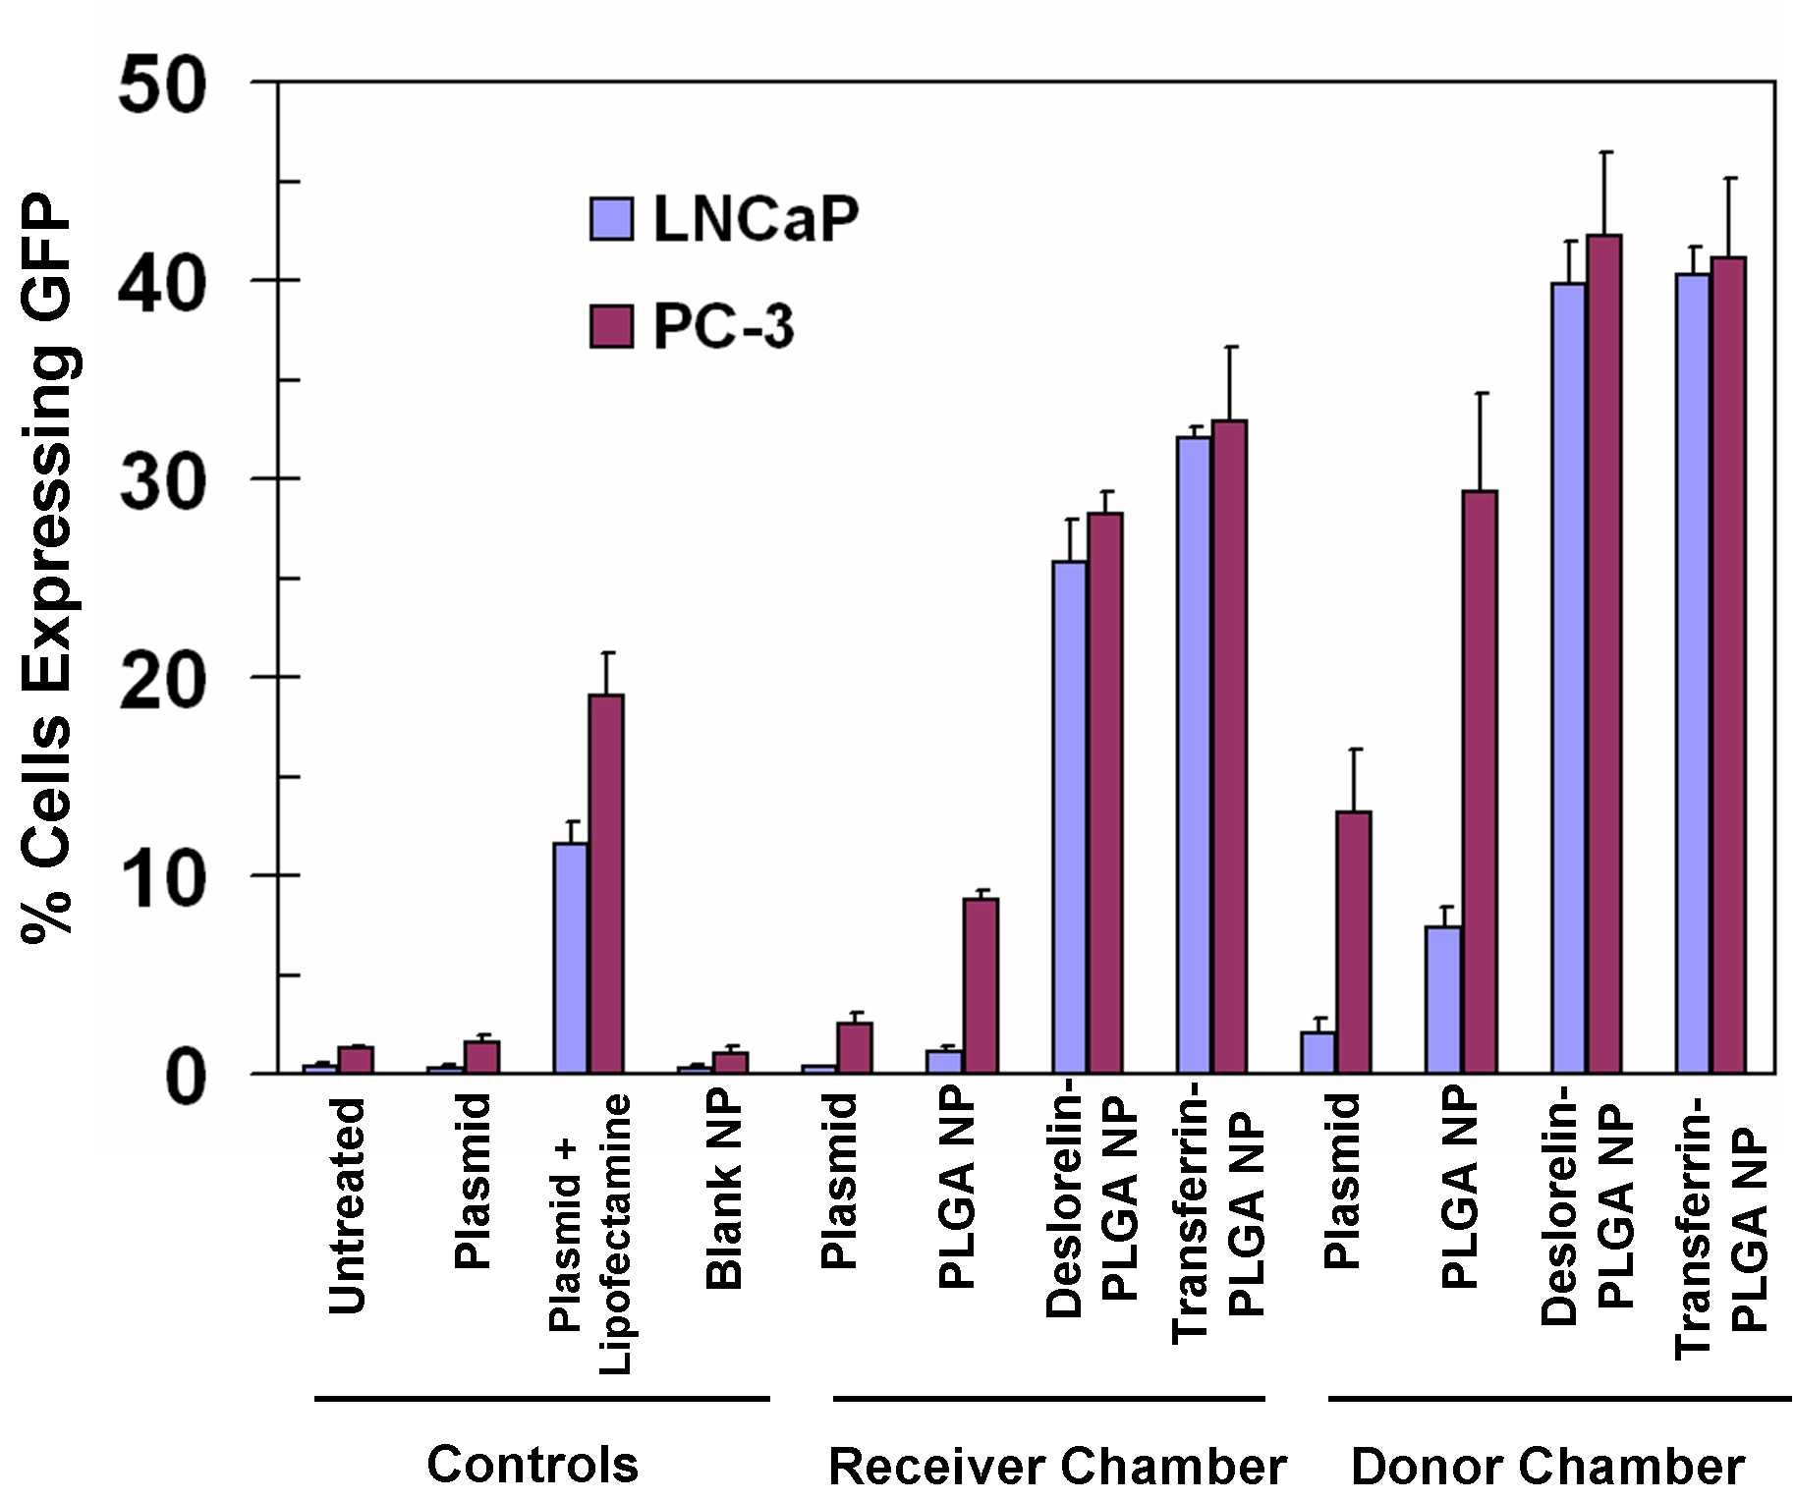
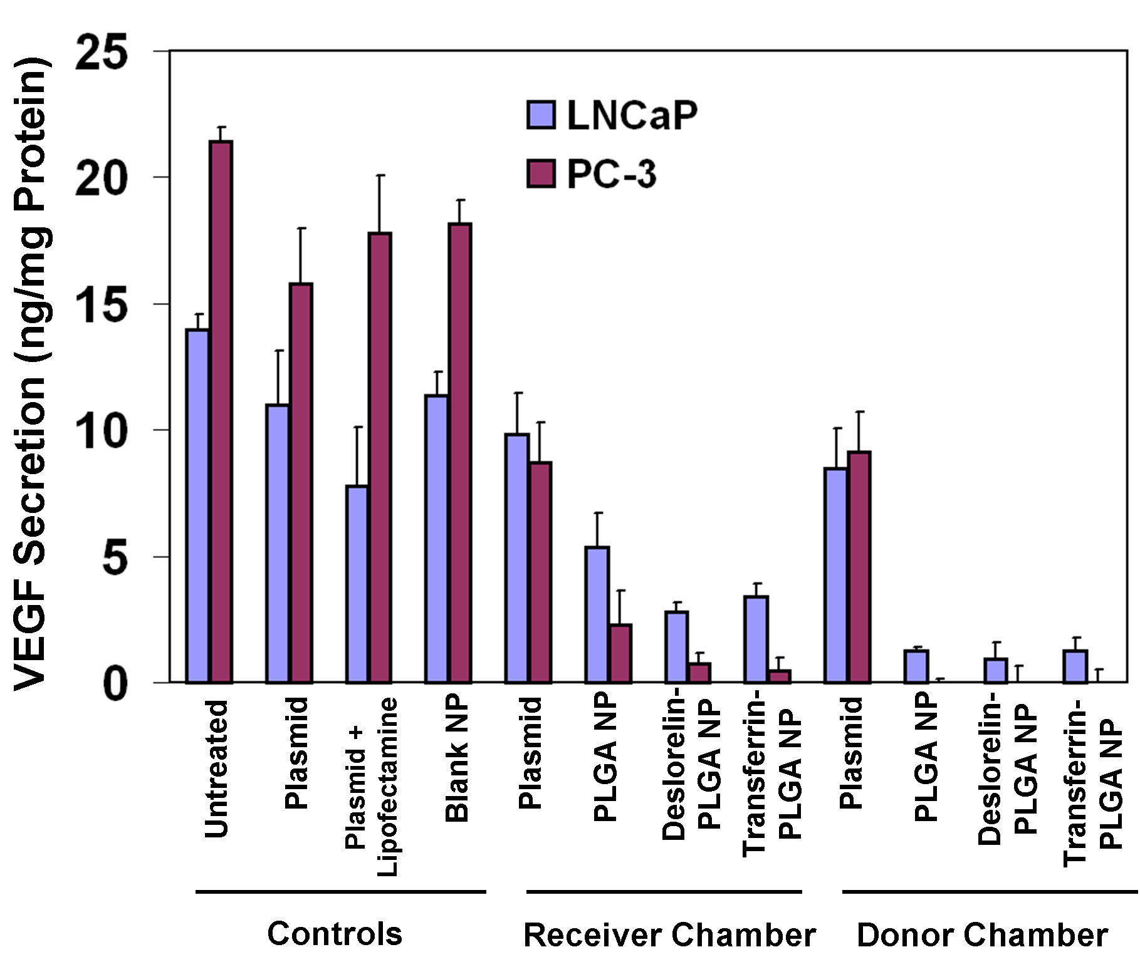
Results
a
b
Data is expressed as mean ± s.d. for n = 3
Functionalized nanoparticles exhibit greater transfection efficiency and VEGF inhibition even after transport

Slide 17
Discussion
Deslorelin-docetaxel exhibits ~10-fold lower IC₅₀ than docetaxel indicating its superior efficacies in both lung and prostate cancer
Deslorelin-docetaxel achieved a 2.5-fold and 5.2-fold greater tumor inhibition compared to docetaxel alone in lung and prostate cancer xenografts, respectively
Co-administration of deslorelin-docetaxel with RGD conjugated anti-VEGF plasmid loaded nanoparticles achieved 2-fold greater tumor inhibition in lung cancer xenografts
Surface functionalized nanoparticles achieved greater transport, uptake, transfection efficiency and VEGF inhibition compared to the non-functionalized nanoparticles

Slide 18
Conclusion
Conjugation with deslorelin enhances anticancer activity of docetaxel in vitro and in vivo in prostate and lung cancer models
Nanoparticles functionalized with ligands to cell surface receptors exhibit enhanced efficacy via systemic route and alternative non-invasive nasal route
Combination therapy with deslorelin-docetaxel conjugate and functionalized anti-VEGF plasmid loaded nanoparticles exhibits enhanced anti-tumor efficacy in vivo
This study advances novel targeted cytotoxic therapy and targeted anti-angiogenic gene delivery for cancer treatment based on nanomaterials

Slide 19
Acknowledgments
Advisor: Dr. Uday B. Kompella
Committee members
Dr. Shyamal Roy
Dr. Pi-Wan Cheng
Dr. Donald Leopold
Collaborators
Dr. Ambati
Dr. Ramesh
Lab members
For Support and Encouragement
Balance Pharmaceuticals Inc.,
University of Nebraska Medical Center
American Heart Association
University of Colorado, Denver

Slide 20
References
A. Jemal, R. Siegel, E. Ward, Y. Hao, J. Xu, T. Murray, and M. J. Thun. Cancer statistics, 2008. CA Cancer J Clin 58: 71-96 (2008)
S. Sundaram, C. Durairaj, R. Kadam, and U. B. Kompella. LHRH-receptor targeted deslorlein-docetaxel conjugates enhance efficacy of docetaxel in prostate cancer therapy. Molecular Cancer Therapeutics 8(6): 1655-65 (2009)
S. Sundaram, R. Trivedi, C. Durairaj, R. Ramesh, B. K. Ambati, and U. B. Kompella. Targeted drug and gene delivery systems for lung cancer therapy. Clin Cancer Res (2009)
S. Sundaram, S. K. Roy, B. K. Ambati, and U. B. Kompella. Surface functionalized nanoparticles for targeted gene delivery across nasal respiratory epithelium. FASEB J 23: 1-14 (2009)

Slide 21
BIOS/Contact info
Sneha Sundaram, Ph.D.
Post-Doctoral Fellow; University of Colorado Denver, 2009 – present
PhD; University of Nebraska Medical Center; 2003-2009
BS; University of Mumbai; 1998-2001
Email: sneha.sundaram@ucdenver.edu
Ph: 620-875-9165

