Slide 1


Young Innovators 2009
Lyoprotectant Crystallization in Frozen Systems and Phase Transformation During Drying
Prakash Sundaramurthi
Department of Pharmaceutics, University of Minnesota

Slide 2
Abstract
Protein drugs are often chemically and physically unstable in solution and freeze-drying is frequently used to obtain a robust formulation with acceptable shelf life.
Lyoprotectants are stabilizers used to prevent denaturation of proteins during freeze-drying and subsequent storage.
In order to be effective, the lyoprotectant MUST be retained amorphous not only during processing but also during the entire shelf-life.
Trehalose is one of the commonly used lyoprotectants.

Slide 3
Abstract
For the first time, crystallization of trehalose has been reported in frozen solutions.
The lyoprotectant crystallization can have serious implications on protein stability and warrants further investigation.
We have identified the processing parameter and formulation composition to inhibit trehalose crystallization in the frozen solution.
During drying, the crystalline trehalose dihydrate dehydrated to substantially amorphous anhydrate. Therefore, the final lyophile will be substantially amorphous

Slide 4

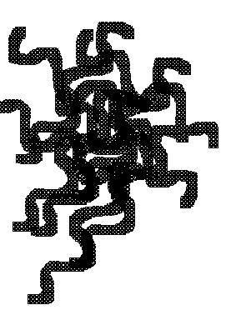

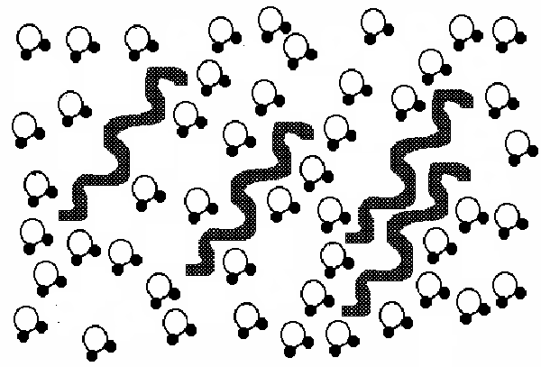
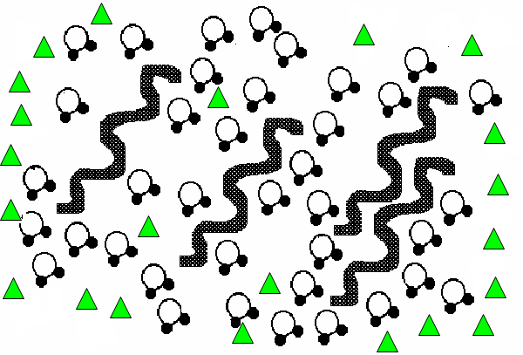
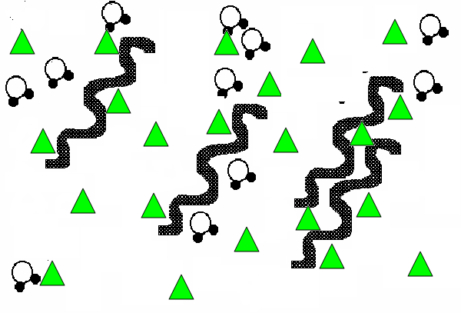
Introduction
Frozen solution
Lyophile
Freeze
-drying
Cooling
w/o lyoprotectant
Prelyo solution
Phase separated ice
Denatured protein
Cooling
with lyoprotectant
Freeze
-drying
Water
Native Protein
“Preferential exclusion /hydration”
“Water replacement”
Lyoprotectant
Lyoprotectant crystallization either in the frozen solution or in the lyophile can potentially DENATURE the protein

Slide 5
Introduction
Trehalose, disaccharide of α-glucose, is a commonly used lyoprotectant in freeze-drying of protein drugs.
It has excellent chemical and physical stability.
It stabilizes the protein both during freeze-drying and subsequent storage.
It is reported to exist in the amorphous state.

Slide 6
Objectives
To study the crystallization behavior of trehalose in frozen systems using X-ray diffractometry (XRD) and differential scanning calorimetry (DSC)
To monitor the physical state of crystallized trehalose during entire freeze-drying

Slide 7

Methodology
Prelyo solution
Trehalose & mannitol
Trehalose, mannitol & protein
Trehalose & Sucrose
Trehalose
Cooled to −40°C @ 0.5 °C/min
Frozen solution
seeding
Annealed at −18°C
Analyzed by DSC and XRD

Slide 8
Results
4% w/v trehalose and 2% w/v mannitol
Observations
Prelyo solution containing trehalose & mannitol was cooled to -40°C and annealed at -18°C
Upon cooling, hexagonal ice crystallized first, followed by mannitol hemihydrate and trehalose dihydrate

Slide 9
Results
4% w/v trehalose and 2% w/v mannitol
Observations
Mannitol HH and trehalose DH peak intensities increased as a function of annealing time
~ 50% of the trehalose had crystallized
Characteristic diffraction peaks used
Ice: 22.9, 24.4, 26 and 33.6° 2θ
Mannitol HH: 9.83 and 17.83° 2θ
Trehalose DH: 9.0 and 24.9° 2θ

Slide 10
Results
4% w/v trehalose solution
trehalose dihydrate
hexagonal ice
*
*
Seeded with α-Tre
*
*
*
*
*
*
c
*
12 hrs
Intensity, (arbitrary units)
b
Seeded with SA
12 hrs
Annealing
No seeding
a
3 days
10
15
20
25
2θ, (°)
When the aqueous trehalose solution was cooled and annealed, crystallization of trehalose DH was evident

Slide 11
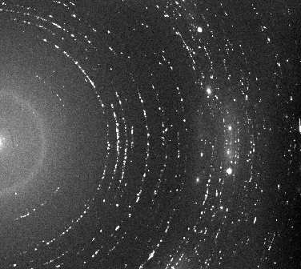
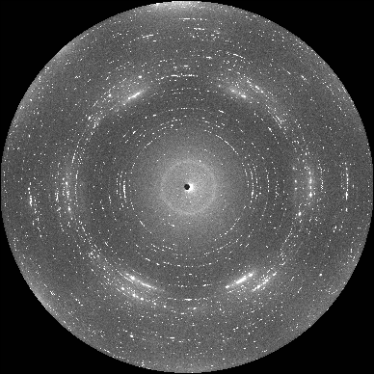
Results
Frozen trehalose solution, seeded with trehalose DH crystals
After 48 hours of annealed at -18°C
3.65
5.36
3.93
10.10
5.79
trehalose dihydrate
7.00
6.10
hexagonal ice
6.45
3.46
Characteristic Debye rings (in Å units) are indicated

Slide 12
Results
Lactic dehydrogenase (LDH)
*
*
Prelyo solution containing LDH (1 mg/ml ), trehalose (4% w/v), mannitol (2% w/v) was cooled and annealed.
In protein formulation, mannitol HH crystallized first, followed by trehalose DH
Similar effect was observed with other model proteins, such as glucose oxidase, lysozyme, and catalase.
*
#
*
*
#
#
80
70
Intensity, (arbitrary units)
Annealed at -18°C, (hrs)
52
44
21
8
3
0
2θ, (°)

Slide 13
Results
Prelyo solution containing trehalose (4% w/v) & sucrose (2% w/v)
Sucrose completely inhibited trehalose crystallization

Slide 14
Results
Why no reports of trehalose crystallization in lyophilized products?
Conventional practice is to characterize the final lyophile by X-ray diffractometry

Slide 15
Results
Trehalose dihydrate
*
#
Trehalose anhydrate
#
10°C – ½ hr
10°C – ¼ hr
Secondary drying
0°C – ½ hr
During drying, trehalose DH dehydrated to yield a substantially amorphous lyophile
0°C – ¼hr
-10°C – 1 hr
-10°C – ½ hr
-10°C – ¼ hr
Intensity (arbitrary units)
-25°C – 3 hrs
-25°C – 2 hrs
Primary drying
-25°C – 1½ hr
-25°C – 1 hr
-25°C – ¾ hr
-25°C – ½ hr
-25°C – ¼ hr
*
*
2θ (°)

Slide 16
Conclusion
Crystallization of trehalose dihydrate has been reported, for the first time, in frozen solutions
Mannitol accelerated trehalose dihydrate crystallization
Lyoprotectant crystallized even in model protein formulations; this can have serious implications on protein stability
During drying, trehalose dihydrate dehydrated to predominantly amorphous anhydrate

Slide 17
Acknowledgments
Dr Raj Suryanarayanan
  University of Minnesota
Dr Satyendra Kumar
  Kent State University
Dr Douglas Robinson
  Argonne National Laboratory
IT characterization facility
  University of Minnesota

Slide 18
References
P. Sundaramurthi and R. Suryanarayanan. Effective Inhibition of Buffer Salt Crystallization by Lyoprotectants, AAPS annual meeting, Vol. 10, AAPS Journal, Atlanta, GA., November 2008, p. S2.
D.B. Varshney, P. Sundaramurthi, E.Y. Shalaev, S. Kumar, S.-W. Kang, L.A. Gatlin, and R. Suryanarayanan. Phase transitions in frozen systems and during freeze-drying: quantification using synchrotron X-ray diffractometry. Pharm Res. 26:1064-1075 (2009).
D.P. Miller, J.J. de Pablo, and H. Corti. Thermophysical properties of trehalose and its concentrated aqueous solutions. Pharm Res. 14:578-590 (1997).
X.Y. Li, X.G. Chen, C.S. Liu, H.N. Peng, and D.S. Cha. Effect of trehalose and drying process on the survival of encapsulated lactobacillus casei ATCC 393. Drying Technol. 26:895-901 (2008).

Slide 19

BIOS/Contact info
Prakash Sundaramurthi
PhD Student, Department of Pharmaceutics
College of Pharmacy, University of Minnesota
308 Harvard St SE, 9-125 Weaver Densford Hall
Minneapolis, MN 55455
Phone: 612 245 5104; email: sunda023@umn.edu
Prakash Sundaramurthi received his Bachelors degree in Pharmacy from the Tamil Nadu Dr MGR Medical University and his Master of Science in Pharmaceutics from the National Institute of Pharmaceutical Education and Research (NIPER), Mohali, India. He served as a Junior Scientist in Formulation Research Department in Discovery Research division of Dr Reddy’s Laboratories (DRL), Hyderabad, India.
Currently, Prakash is pursuing his doctorate degree in Pharmaceutics at the University of Minnesota, Minneapolis. During his PhD tenure, he was involved in two industrial summer internships first at Genentech Inc., South San Francisco, CA and the second at Eli Lilly and Co, Indianapolis, IN. He publications have appeared in Pharmaceutical Research, Journal of Pharmaceutical Sciences and Pharmaceutical Development and Technology.

