Slide 1


Young Innovators 2011
Understanding Aromatase:
A Mechanistic Basis for Drug Interactions and
New Aromatase Inhibitors
Wenjie Jessie Lu
Indiana University School of Medicine

Slide 2
Abstract
Aromatase is the target of the aromatase inhibitor class of drugs widely used to treat estrogen-mediated conditions including breast cancer, but little is known about its role in drug metabolism or in drug interactions.
This lack of knowledge has become a great impediment to optimal therapy for breast cancer due to unpredictable side effects and reductions in efficacy that result.
In this work, a comprehensive series of studies was carried out to characterize the ability of aromatase to metabolize drugs, and its susceptibility to inhibition by xenobiotics.
The overall objective was to better understand the interactions of small molecules with aromatase and to use this new knowledge to predict aromatase-mediated drug interactions and anticipate novel molecular structures that have the potential to be developed as improved aromatase inhibitors.

Slide 3
Abstract
Results: Aromatase was shown to be a drug metabolizing enzyme able to metabolize methadone both in vitro and in vivo.
A number of novel aromatase inhibitors that employ diverse kinetic mechanisms were identified: a competitive inhibitor norendoxifen, two non-competitive inhibitors endoxifen and N-desmethyl-tamoxifen, a mechanism-based inhibitor methadone and a stereoselective inhibitor naringenin.
Through investigation of the structure-potency relationships so discovered, a series of new biochemical structures to be exploited as aromatase inhibitors were identified.
Conclusions: These studies have identified new roles of aromatase as a catalyst for methadone metabolism and as a mediator in tamoxifen effects. They also provide a new mechanistic framework for the design of novel aromatase inhibitors that can be used in breast cancer, and suggest ways to optimize therapeutic benefits in each person treated.

Slide 4
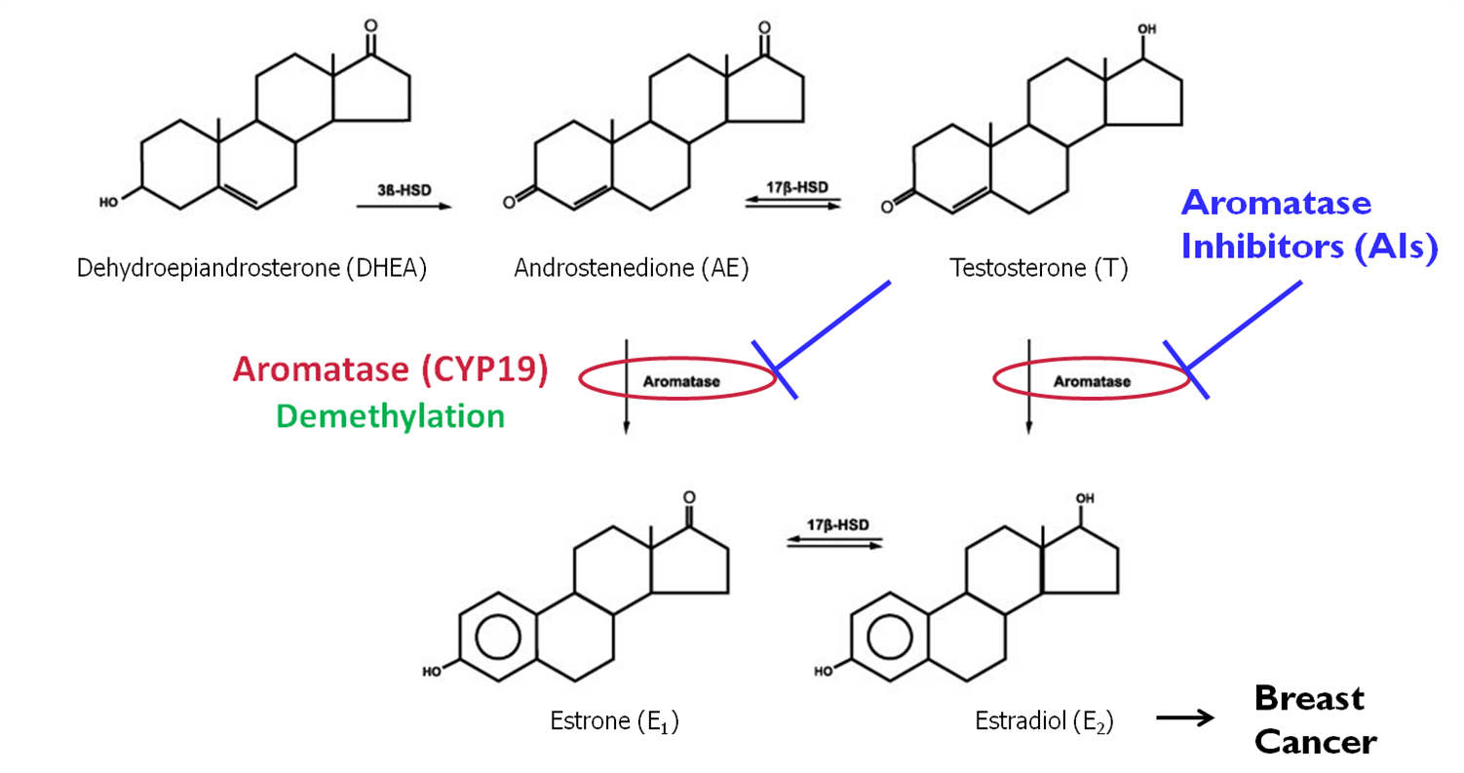
Introduction

Slide 5
Introduction
To Study Possible Drug Interactions with Aromatase
Selection Criteria:
Drugs that undergo demethylation
Drugs commonly prescribed to breast cancer patients
Is aromatase able to metabolize the selected drugs?
Can these selected drugs or their metabolites in turn affect aromatase activity?
Key Illustrative Example:
Tamoxifen metabolites

Slide 6
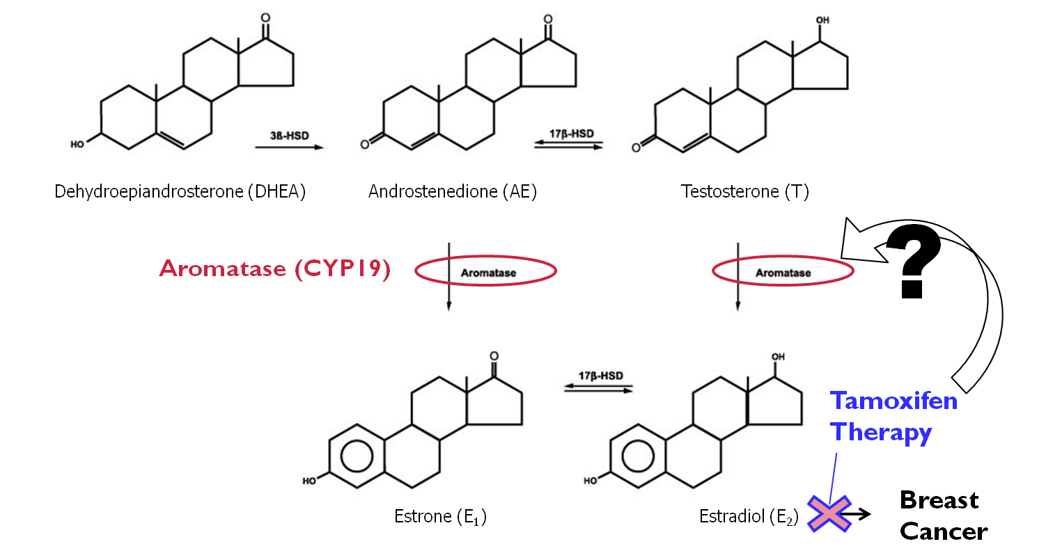
Introduction

Slide 7
Introduction
Anti-estrogenic effects of tamoxifen were thought to be exclusively mediated via its active metabolites by modulating estrogen receptor signaling, but the effects of tamoxifen on aromatase have not been studied until now.
HYPOTHESIS:
Structurally related tamoxifen metabolites are aromatase inhibitors.

Slide 8
Materials and Methods
In vitro microsomal incubation
Fluorescent assays for inhibition of aromatase and other Cytochrome P450 isoforms
Inhibition of testosterone metabolism by placental aromatase
Inhibition of other liver Cytochrome P450 isoforms
HPLC-MS/MS quantification of metabolite formation

Slide 9
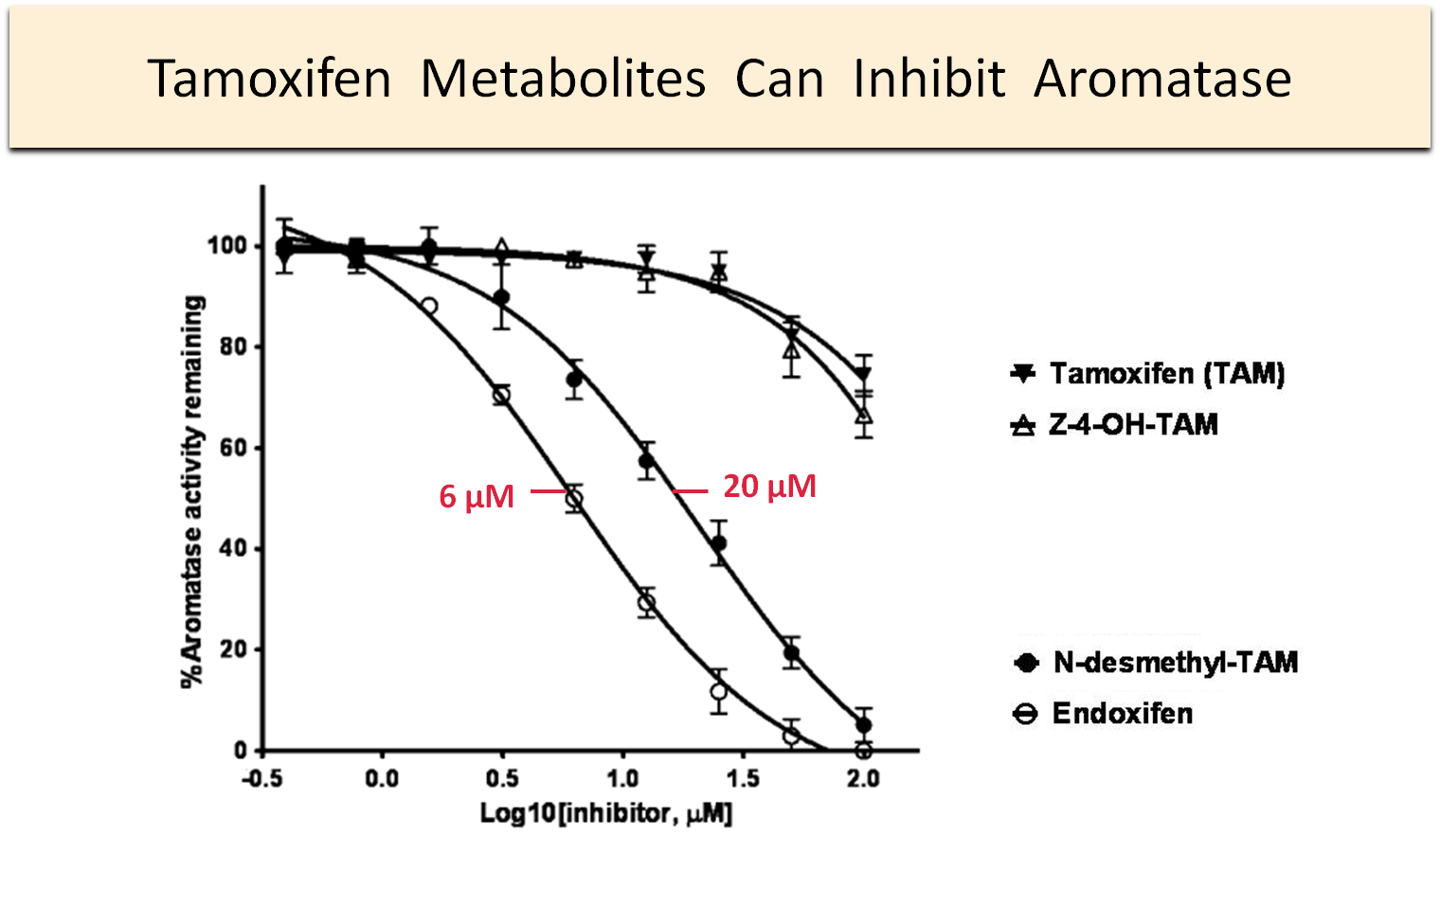
Results

Slide 10
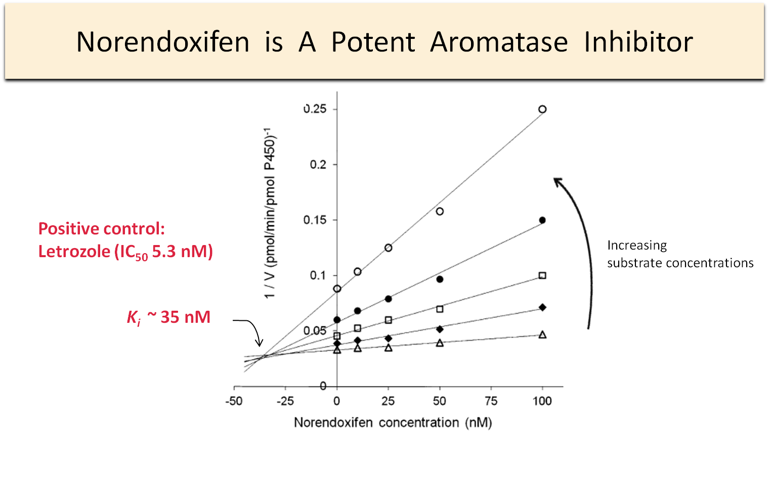
Results

Slide 11
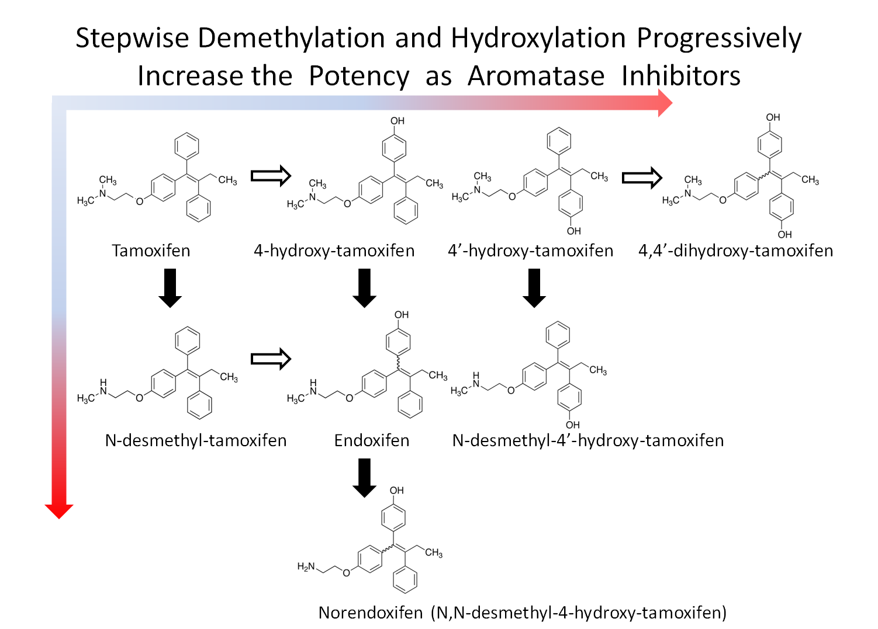
Results

Slide 12
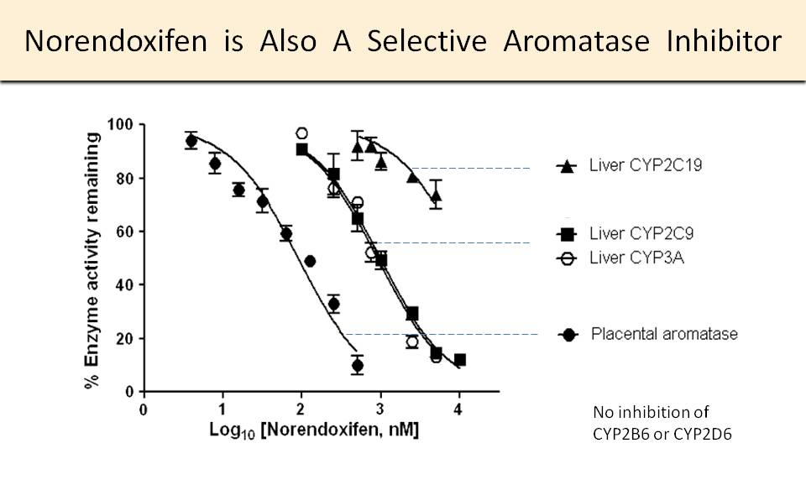
Results

Slide 13
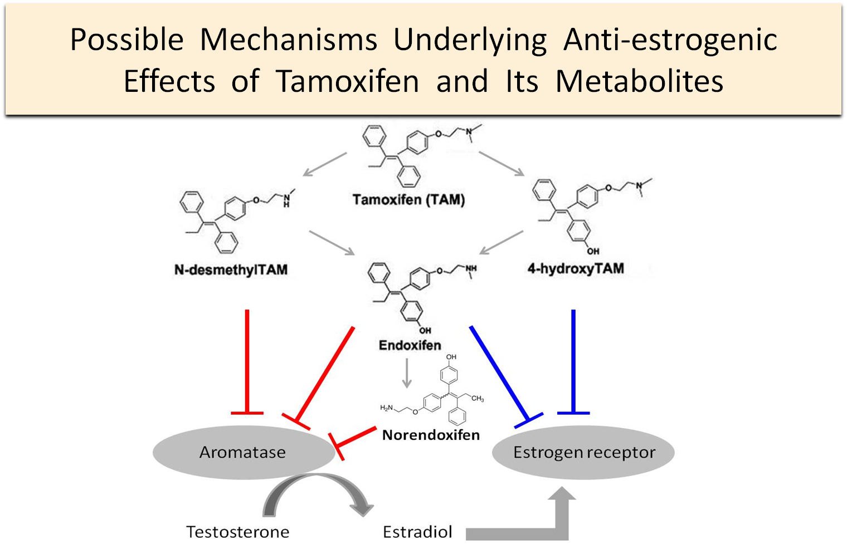
Discussion

Slide 14
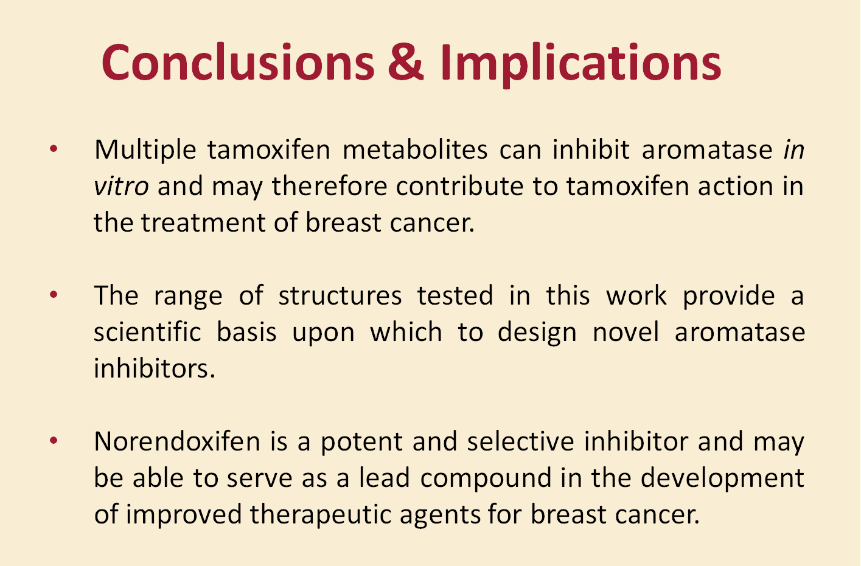
Conclusion
Place your conclusion here

Slide 15
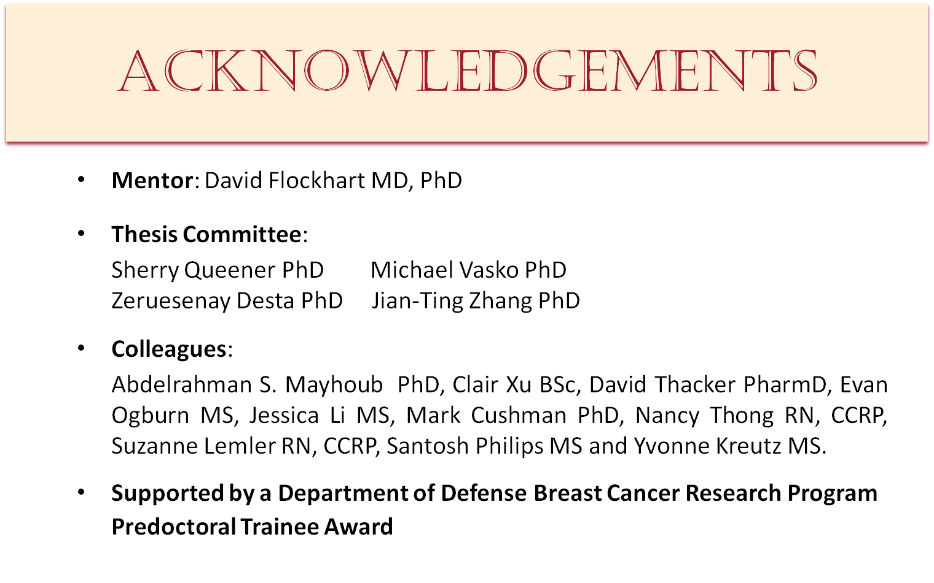

Acknowledgments

Slide 16
References
Original research articles:
Wenjie Jessie Lu, Cong Xu, Zifan Pei, Abdelrahman Salah Abbas Mayhoub, Mark Cushman, David A Flockhart. The tamoxifen metabolite norendoxifen is a potent and selective inhibitor of aromatase and a potential lead compound for novel therapeutic agents. Breast Cancer Research and Treatment, 2011. PMID: 21814747
Wenjie Jessie Lu, Valentina Ferlito, Cong Xu, David A Flockhart, Salvatore Caccamese. Enantiomers of naringenin as pleiotropic, stereoselective inhibitors of cytochrome P450 isoforms. Chirality, 2011. PMID: 21953762
Wenjie Jessie Lu, Zeruesenay Desta, David A Flockhart. Tamoxifen metabolites as active inhibitors of aromatase in the treatment of breast cancer. Breast Cancer Research and Treatment, 2011. PMID: 21390495
Wenjie Jessie Lu, Robert R Bies, Landry Kamden Kamden, Zeruesenay Desta, David A Flockhart. Methadone: a substrate and mechanism-based inhibitor of CYP19 (Aromatase). Drug Metabolism and Disposition, 2010 Aug; 38(8):1308-13. PMID: 20410453
Wenjie Jessie Lu, Yvonne Kreutz, David A Flockhart. Methadone adverse reaction presenting with large increase in plasma methadone binding: a case series. Journal of Medical Case Report, 2011 (in press)
Wenjie Jessie Lu, Suzanne M. Lemler, David A Flockhart. The effect of aromatase inhibition by letrozole on the pharmacokinetics of methadone in postmenopausal women. 2011 (submitted for publication)
Patent:
Wenjie Jessie Lu and David A Flockhart. Materials for inhibiting aromatase and method of using the same to diagnose, treat and monitor breast cancer. March 2011 (IURTC No. 11051, US patent)

Slide 17
BIOS/Contact info
Wenjie Jessie Lu
EDUCATION
2007 – 2011 Ph.D. Pharmacology (expected December 2011)
Indiana University, USA
2010 – 2011 Certificate in the Business of Life Science
Indiana University Kelly School of Business, USA
2003 – 2007 B.Sc. Biological Sciences
Peking University, China
CONTACT
Address 1001 West 10th Street, Room W7123
Wishard Memorial Hospital, Myers Building
Indianapolis, Indiana 46202
Phone (317) 630-8795
Fax (317) 630-8185
Email lu20@iupui.edu

