Slide 1


Innovators 2010
Sorafenib Brain Distribution is Restricted by BCRP-Mediated Efflux at the BBB
Sagar Agarwal
University of Minnesota

Slide 2
Abstract
Purpose:
It is well known that the ATP Binding Cassette (ABC) transporters p-glycoprotein (P-gp) and breast cancer resistance protein (BCRP) limit drug transport across the blood-brain barrier (BBB). This objective of this study was to investigate the role of these two efflux systems in limiting the delivery of sorafenib to the brain.
Methods:
In vitro studies - Directional flux and intracellular accumulation studies were conducted in MDCKII cells that overexpressed P-gp or BCRP. In vivo studies - FVBn (wild-type) mice were administered an I.V. dose of 10 mg/kg sorafenib followed by collection of blood and brain different time points post dose. Alzet osmotic minipumps were used to administer sorafenib via a continuous intraperitoneal infusion and steady-state brain and plasma concentrations were determined in FVBn wildtype, Mdr1a/b^{(-/-)}, Bcrp1^{(-/-)} and Mdr1a/b^{(-/-)}Bcrp1^{(-/-)} mice.
Results:
In vitro studies showed that sorafenib was an avid substrate for BCRP with an apparent Km of 5.6 nM. While sorafenib did not appear to be P-gp substrate, it inhibited P-gp with an IC₅₀ of 25 µM. In the study conducted in FVB wildtype mice, sorafenib concentrations in brain were significantly lower than the plasma concentrations at all time points. The ratio of the area under the curve (AUC) in brain to that in plasma was 0.06 demonstrating the restricted brain penetration of sorafenib. Steady-state brain-to-plasma ratio of sorafenib was approximately 0.1 in the wild-type mice. This ratio increased by ~ 4-fold in the Bcrp1^{(-/-)} mice and by ~10-fold in the Mdr1a/b^{(-/-)}Bcrp1^{(-/-)} mice, confirming BCRP mediated efflux at the BBB. Absence of P-gp in the Mdr1a/b^{(-/-)} mice did not result in any significant improvement in the brain partitioning of sorafenib, as expected from the in vitro transport experiments.
Conclusion:
These results show that delivery of sorafenib to the brain is significantly restricted due to active efflux at the BBB. BCRP appears to be the dominant transporter in limiting sorafenib transport across the BBB. This study highlights the importance of BCRP at the BBB and warrants further investigation into the mechanism by which P-gp and BCRP ‘cooperate’ at the blood-brain barrier to keep substrate drugs out of the brain.

Slide 3
Sorafenib : A Multi-targeted Kinase Inhibitor for Glioma
Glioma - a malignant brain tumor
Median Survival 12-18 months
No effective treatment !!
Sorafenib inhibits PDGFR and VEGFR
Currently being evaluated for therapy in glioma
Efficient drug delivery to brain (tumor) essential for therapeutic efficacy

Slide 4
Objective
Study the interaction of sorafenib with p-glycoprotein (P-gp) and breast cancer resistance protein (BCRP)
Examine the effect of this interaction on distribution of sorafenib to the brain

Slide 5
Materials and Methods – In Vitro
Invitro Studies
  Intracellular Accumulation
  Transcellular Flux
MDCKII Cells
  MDR1 Overexpressing
  Bcrp1 Overexpressing
Apical
Basolateral
MDCKII Cells

Slide 6
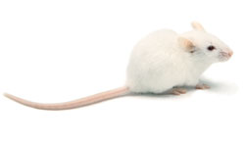
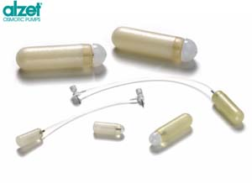
Materials and Methods – In Vivo
Intravenous Drug Administration
Blood and Brain Collection by Sparse Sampling
Concentration
Genetic knockouts
Mdr1a/b (-/-) [P-gp knockout]
Bcrp1 (-/-) [BCRP knockout]
Mdr1a/b (-/-) Bcrp (-/-)
Pharmacological Inhibitors
Elacridar (GF120918)
Dual P-gp/BCRP inhibitor
brain
time
Steady-State Pharmacokinetics
Constant Rate Infusion
Concentration
time

Slide 7
Interaction of Sorafenib with P-gp and BCRP
High affinity substrate for BCRP
  Apparent Km of ~ 5 nM
Not efficiently transported by P-gp
Inhibits P-gp mediated transport
  IC₅₀ ~ 25 µM
No inhibitory effect on BCRP mediated
transport of prazosin or mitoxantrone

Slide 8
Limited Sorafenib Transport to the Brain
FVB WT MICE
t ½ = 1.6 hrs
AUC_{brain}/AUC_{plasma} = 0.06
10 mg/kg i.v. dose
Sorafenib transport to brain is restricted by the BBB
Agarwal et al., October 2010, JPET

Slide 9
BCRP-Mediated Efflux Predominant at the BBB
0.91 (10X)
?
0.36 (4X)
0.09
0.11
Constant rate infusion of 2 mg/hr/kg into the peritoneal cavity
Blood and brain sampled at 48 hours
Agarwal et al., October 2010, JPET

Slide 10
Elacridar Increases B/P Ratio in the Knockouts
10 mg/kg i.v. dose, 1 hr timepoint
BCRP and P-gp together limit brain distribution
Agarwal et al., October 2010, JPET

Slide 11
P-gp – BCRP Cooperation at the BBB
Polli et al., DMD, 2008
Chen et al., JPET, 2009
P-gp
Dasatinib
Lapatinib
Agarwal et al., JPET, 2010
Agarwal et al., October 2010, JPET
Gefitinib
Sorafenib
BCRP

Slide 12
  Contribution of P-gp and BCRP to the total clearance out of brain

Slide 13
Efflux Clearance due to P-gp and BCRP
 | P-gp Knockout | BCRP Knockout | Triple Knockout
R | 1.22 | 4 | 10.1
Solving the three equations, by setting PS_{l,eff} = 1
PS_{l,eff} = 1
PS_{Pgp} = 1.5
PS_{BCRP} = 7.5
Kodaira H. et al., JPET 2010

Slide 14
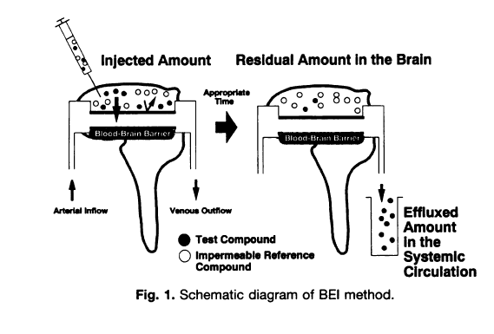
Brain Efflux Index Method
LOG (100 – BEI) %
Slope = k_{efflux}
Time after injection
Kakee et al., JPET 1996

Slide 15
Brain Efflux Index of Sorafenib
Triple Knockout
K_{out} = 0.049/min
BCRP Knockout
K_{out} = 0.104/min
Wild-type
P-gp Knockout
K_{out} = 0.145/min
K_{out} = 0.157/min

Slide 16
Brain Efflux Index of Sorafenib
Mice | K_{out} (min⁻¹) | t_{1/2} (min) | K_{out} (min⁻¹) | Fold Increase
Wild Type | 0.145 | 4.78
P-gp Knockout | 0.157 | 4.41 | BCRP = 0.108 | 2.2
BCRP Knockout | 0.104 | 6.66 | Pgp = 0.055 | 1.1
Triple Knockout | 0.049 | 14.1 | P_{l, eff} = 0.049 | 1
Efflux rate constant
correlates with
brain partitioning
BCRP is the dominant transporter compared to P-gp
in effluxing sorafenib out of brain

Slide 17
Summary
In vitro : Sorafenib is an avid BCRP substrate
Transport of sorafenib across the BBB is restricted by BCRP and P-gp mediated active efflux
The contribution of BCRP to the total efflux clearance is greater than that of P-gp
P-gp and BCRP work together at the BBB significantly limiting delivery of dual substrates to the brain
Delivery of Sorafenib to the brain can be an important determinant of its efficacy against brain tumors

Slide 18




Acknowledgements
Eli Lilly & Co., AAPS PPDM Section
Dr. William Elmquist
Dr. John Ohlfest (University of Minnesota)
Elmquist Lab – Dr. Li Li, Tianli Wang, Ramola Sane, Rajneet Oberoi
NIH-NCI Grant CA138437
Children’s Cancer Research Fund
Doctoral Dissertation Fellowship, University of Minnesota
Dr. Ronald Sawchuk Fellowship in Pharmacokinetics, UMN
Dr. Edward Rippie Scholarship in Pharmaceutics, UMN

Slide 19
Contact info
Sagar Agarwal
  Ph.D. Candidate
  Department of Pharmaceutics, University of Minnesota
  Major: Pharmacokinetics, Pharmacodynamics.
  Advisor: Dr. William F. Elmquist
  Email: agar0077@umn.edu
  Address: 9-177 Weaver Densford Hall, 308 Harvard Street SE, Minneapolis, MN 55455

